Slide 1
Intel’s chiplet-based
big.LITTLE processor lines
Dezső Sima
October 2020
Vers. 1.1
© Sima Dezső, 2020

Slide 2
Intel’s chiplet-based big.LITTLE processor lines
1. Introduction
2. The mobile oriented Lakefield line
3. The desktop oriented Alder Lake-S line
4. References
Notes:
2

Slide 3
1.Introduction
Notes:
3

Slide 4
1. Introduction (1)
1. Introduction
As their name suggests, chiplet-based big.LITTLE processors deploy two key
design paradigms:
the chiplet-based design paradigm (Section 1.1),
consequently, they use multichip packaging (Section 1.2) and
employ the big.LITTLE CPU core architecture (Section 1.3).
In this introductory Section next we give a brief overview of these issues.
Chiplet: Többlapkás
*

Slide 5
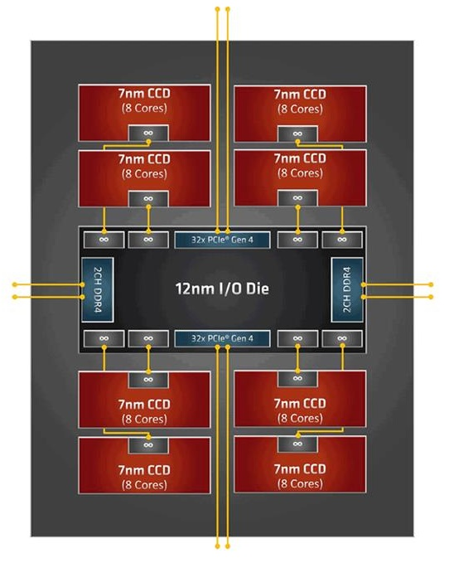
1. Introduction (2)
1.1 Chiplet-based design
Implementation alternatives of LSIs
Monolithic implementation
Chiplet-based implementation
The LSI is implemented
on a single die
The LSI is implemented on multiple dies,
these dies are properly interconnected and
mounted into the same package,
called usually as MCM package
Examples
Intel's Skylake-SP (2017) [5]
AMD’s Rome server proc. [6]
Up to 28 cores
LSI: Large-Scale Integration
MCM: Multi-Chip Module
*

Slide 6
1. Introduction (3)
Motivations for a chiplet-based design
To reduce manufacturing costs by implementing multiple lower cost dies.
To overcome die size limitations (arising from the IC-manufacturing process)
in case when a large die can not be implemented cost effectively.
To deploy different IC manufacturing technologies
e.g. 10 nm and 14 nm technologies or mix “mainstream IC technology”
and dedicated IC technology, like traditional MOSFET and eRAM technology,
for different parts of the LSI circuit.
Consequence of the chiplet design
Multiple dies need to be properly interconnected and mounted into a single
package, this necessitates the development of novel multi-chip packaging
technologies, like 2D or 3D packaging technologies, as discussed later.
In other words, chiplet design leads to Multi-Chip Modules (MCMs) called also
as System in Package (SiP) solutions.
Drawbacks of the chiplet based design
The interconnections between the dies
need dedicated interconnection technologies (e.g. Intel’s EMIB, to be
discussed subsequently),
cause longer signal delays and
have additional power consumption.
*

Slide 7
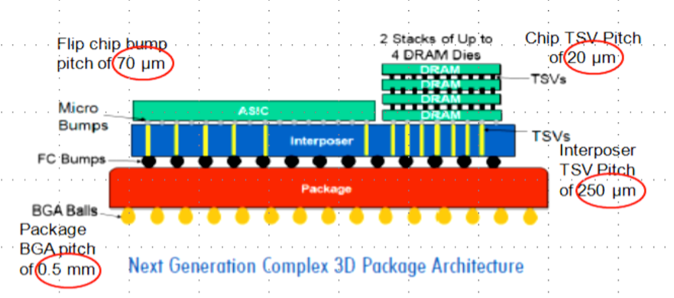
1. Introduction (4)
1.2 Multichip packaging
Alternatives for in-package integration
2D packaging
(Horizontal die placement)
3D packaging
(Vertical die placement)
Both 2D and 3D packaging
(Horizontal and vertical
die placement
Dies are tiled side-by-side,
interconnected and packaged
Dies are stacked,
interconnected and packaged
Tiled and stacked dies are
interconnected and packaged
Intel’s recent
technologies
EMIB
Foveros
Foveros + EMIB
(Section b1)
(Section b2)
(Section b3)
Sources of the Figures: [7], [8]
Stacked: Egymásra helyezett
Tiled: Egymás mellé helyezett
*

Slide 8
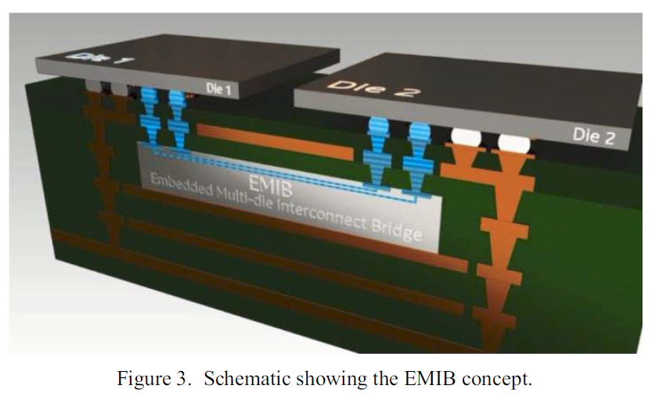
1. Introduction (5)
a) 2D in-package integration by Intel’s EMIB technology [10]
(EMIB: Embedded Multi-Die Interconnect Bridge)
EMIB uses short Cu wires, called silicon bridges that are embedded into the
package substrate to interconnect dies, as indicated below.
Silicon bridge
Figure: Schematic scheme of EMIB [10]
Intel revealed the EMIB technology in 2014 [9].
*

Slide 9
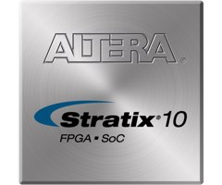
1. Introduction (6)
Example: Using EMIB to interconnect an FPGA die (Stratix-10) and two
HBM dies (2017) [11]
XCVR: Transceiver
~50x50 mm
FPGA: Field Programmable Gate Array HBM: High-BandWidth Memory

Slide 10
1. Introduction (7)
b) 3D in-package integration by Intel’s Foveros technology [12]
Key features of the Foveros technology:
The dies to be interconnected are placed face-to-face.
There are μbumps with solder (with a diameter of about 25 μm) on both dies
(the Compute die and the Base logic die in the Figure).
The interconnection is achieved by thermal compression binding.
c) TSVs (Through Silicon Vias) provide interconnection through the Base logic die
to the Package subtract.
TSVs have a diameter of about 10 μm.
d) Package balls on the Package substrate allow soldering to the Circuit board.
Bump: Forrasztási csúcs Via: Átvezetés
*

Slide 11
1. Introduction (8)
SEM image of the face-to-face stacked Logic and Compute die and the
interconnection to the Package substrate through TSVs [13]
μbumps
TSVs
Compute die
Logic die
Package substrate
Intel’s 3D packaging technology is quite new, it has been announced in 12/2018 [14].
SEM: Scanning Electron Microscope

Slide 12
1. Introduction (9)
Remarks to thermal issues in 3D packaging
Obviously, while stacking multiple dies on top of each other generated heat
becomes a big issue and limits the use of th3 3D packaging technology.
One possibility to encounter this problem to leave air gaps between the dies,
as seen in the Figure below.
Figure: Air gaps between dies of the Lakefield processor [15]
Thermal cooling can be improved e.g. by filling air gaps by thermally conductive
materials, called adhesives.
*

Slide 13
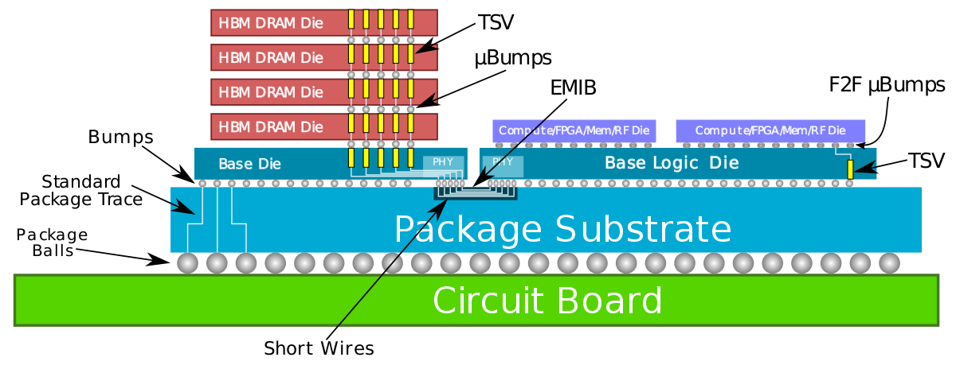
1. Introduction (10)
c) 2D+3D in-package integration by using both Intel’s EMIB and Foveros
technologies [12]
HBM: High Bandwidth Memory
*

Slide 14
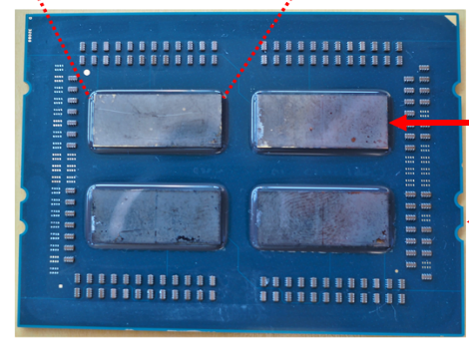
1. Introduction (11)
Remark on AMD’s use of the chiplet design paradigm
In 2017 AMD introduced their highly successful Zen processor family covering,
client, HEDT and server processors.
This family is built up of chiplets (as seen below).
Nevertheless, for packaging multiple dies into single units AMD choose the
2D packaging technology rather than the 3D technology presumable due to
failing a suitable 3D technology at development time.
AMD's EPYC server processor (2017)
Up to 4x8 cores
Single
package
Figure: Implementing AMD’s 1. gen EPYC server processor based on 4 chiplets [5], [16]
*

Slide 15
1. Introduction (12)
1.3 big.LITTLE processing [17]
big.LITTLE technology aims at power reduction,
this is the reason while this technology has been
proposed for mobile processors by ARM in 2011.
The rationale of this technology is that during
running workloads high-intensity and
low-intensity usage patterns alternate,
and when low-intensity processing will run on
lower performance but less power hungry
cores, the total power consumption may be
significantly reduced.
Due to its benefits, big.LITTLE technology
became widespread in the first halve of the 2010’s,
as the next Figure demonstrates.
*

Slide 16
1. Introduction (13)
Moving to big-LITTLE processing in mobile processors
Main types of CPU architectures in mobile processors
Single core CPUs
Multicore CPUs
Symmetrical
multicores
big.LITTLE
core clusters
DynamIQ
core clusters
Exclusive cluster allocation
Inclusive
core allocation
(GTS)
Apple
ARM1176 (2007)
until A4 (2010)
A5 (2011)
(2C)
A10 (2016)
(2+2)C
A11 (2017)
(2+4)C
A12? (2018)
(2+4)C
Samsung
Exynos
3110 (2010)
3250 2C (2011)
4412 4C (2012)
5410 (2013)
(4+4)C
5420 (2013)
(4+4)C
9810 (2018)
(4+4)C
Qualcomm
Snapdragon
MSM 7225 (2007)
8260 2C (2013)
400 4C (2013)
808 (2+4)C (2014)
810 (4+4)C (2015)
845 (2018)
(4+4)C
855 (2018)
(1+3+4)C
Huawei
Kirin
(K3V1) (2009)
(K3V2 4C (2012))
920 (4+4)C (2014)
980 (2018)
(2+2+4)C
MediaTek
MT6218B
(2003)
MT6582 4C (2013)
MT6592 8C (2013)
MT8135 (2+2)C (2013)
MT6595 (4+4)C (2014)
Helio P90 (2+6)C (2019)
*

Slide 17
1. Introduction (14)
Principle of operation of big.LITTLE processing -1
Let’s have two or more clusters of architecturally identical cores in a processor.
As an example let’s take two core clusters;
a cluster of low performance/low power cores, called the LITTLE cores and
a cluster of higher performance higher power cores, termed as the big cores,
as seen in the Figure below.
Cluster of
big cores
Cluster of
LITTLE cores
CPU0
CPU1
CPU0
CPU1
Figure: A big.LITTLE configuration
consisting of two core clusters
CPU2
CPU3
CPU2
CPU3
Cache coherent interconnect
To memory
Let’s interconnect these core clusters by a cache coherent interconnect to have
a multicore processor, as indicated in the Figure.
The cache coherent interconnect allows an easy migration of workloads between
the clusters.
*

Slide 18
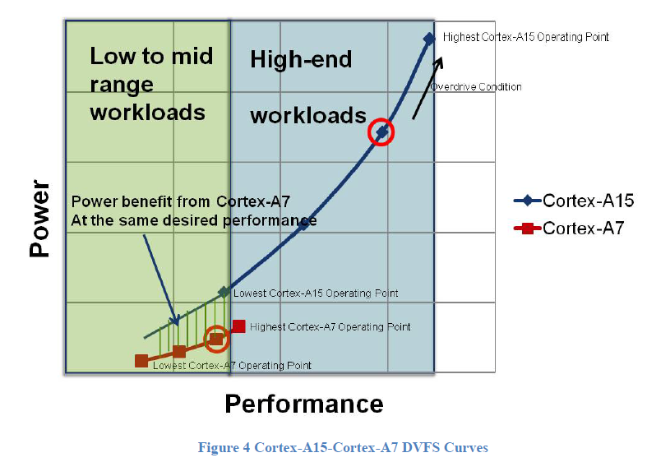
1. Introduction (15)
Principle of operation of big.LITTLE processing -2 [18]
Let’s further on assume that the big and LITTLE cores have certain operating
points (given by clock frequency/core voltage values), as indicated below for
ARM’s Cortex-A15 (big) and Cortex-A7 (LITTLE) cores.
*

Slide 19
1. Introduction (16)
Principle of operation of big.LITTLE processing -3
There are a number of different alternatives how big.LITTLE technology can be
implemented and operated (not detailed here).
Nevertheless, to give a conceivable description of the big.LITTLE technology,
we will assume a specific implementation, called exclusive cluster switching,
when all cores of the big- or the LITTLE core cluster run at the same but
variable operating point and the scheduler of the OS choses either the big
cluster or the LITTLE cluster to run the workload according to its actual
intensity.
*

Slide 20
1. Introduction (17)
Principle of operation of big.LITTLE processing -4
Let’s suppose that an appropriate OS routine tracks the intensity of the
workload (e.g. by counters) and sets the operating point of the cores accordingly.
The scheduler activates the low power, low performance „LITTLE” cluster
as long as it can tackle the actual workload.
If however the workload exceeds the performance capability of the LITTLE core
cluster, an appropriate switching routine activates the cluster of the
high performance high power “big” cores, performs a cluster switch by
migrating the actual workload to the cores of the big cluster and switches off
the cores of the LITTLE cluster.
When any time the actual workload becomes less then a given lower limit
of the big core cluster, the scheduler activates again the cluster of the LITTLE
cores etc.
In this way, at any given time only cores of one cluster may be active in case
of the assumed exclusive cluster scheduling mode.
Here we note that exclusive cluster switching is just a straightforward operation
mode and recent big.LITTLE architectures operate typically at a more efficient
scheduling policy, called inclusive core switching (not detailed here).
*

Slide 21
2. The mobile oriented Lakefield line
2.1 Introduction
2.2 The Sunny Cove core
2.3 The Tremont Atom core
2.4 The Foveros 3D packaging technology as used
in the Lakefield processor
2.5 Introduced Lakefield models and performance issues
Notes:
21

Slide 22
2.1 Introduction
Notes:
22

Slide 23
2.1 Introduction to the Lakefield mobile line (1)
2.1 Introduction to the Lakefield mobile line -1
It is the first member of Intel’s chiplet-based, “hybrid” processor families, consisting of
big and little CPU cores, as revealed at Intel’s 2020 Architecture Day (08/2020).
(big cores)
(little
cores)
Figure: Intel’s CPU core roadmap, revealed at their 2020 Architecture Day [19].
*

Slide 24
2.1 Introduction to the Lakefield mobile line (2)
Introduction to the Lakefield mobile line (2)
Announced in 05/2019 at Intel’s 2019 Investor Meeting.
It is Intel’s first big.LITTLE design with
one “big” Sunny Cove (as in the 10th gen. 10 nm Ice Lake) and
four “little” Tremont (Atom)
cores.
It is using chiplets and is built up of by the the Foveros 3D packaging technology.
It is intended primarily to be used in “always on always connected” notebooks.
Intel makes use of the 10 nm technology for the compute die and the 22 nm
technology for the base die.
First Lakefield processor models were introduced in 06/2020.
*

Slide 25
2.1 Introduction to the Lakefield mobile line (3)
Design goals
• Aiming at always on, always connected notebooks with very low standby
power.
• Excellent compute performance by lower TDP.
*

Slide 26
2.1 Introduction to the Lakefield mobile line (4)
Significant gen. over gen. improvements¹:
Using the 10 nm technology for the compute die (and 22 nm for the base die)
1/10th standby power
• ~50% GFX (graphics) improvement
• ~40% core area reduction
• ~40% Z (high) reduction.
¹ In the cited conference presentation (Hot Chips 2019) unfortunately, the authors
do not specify exactly what they mean under previous generation.
*

Slide 27
2.2 The Sunny Cove core
(Only the introductory slide will be discussed)
Notes:
27

Slide 28
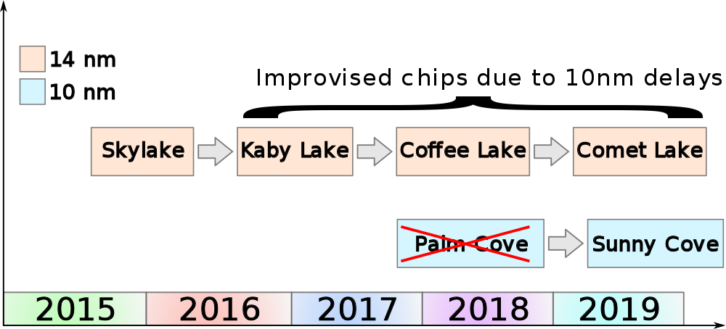
2.2 The Sunny Cove core (1)
2.2 The Sunny Cove core
Positioning the Sunny Cove core within Intel’s Core 2 cores (Based on [20])
14 nm processors
Cannon L.
Ice Lake
10 nm Processor
Cores
*

Slide 29
2.2 The Sunny Cove core (2)
Major enhancements of the Sunny Cove core
Dual objectives for increasing processor performance [21]
*

Slide 30
2.2 The Sunny Cove core (3)
a) Microarchitecture enhancements to improve general purpose performance
Main areas of microarchitecture enhancements vs. the Skylake core
a1) wider issue and execution
(for processing more instructions per clock),
a2) deeper key structures, including caches
(for providing more parallelism per clock cycle) and
a3) smarter units
(for processing more instructions or data per cycle)
In the lecture however, we do not go into further details.
*

Slide 31
2.2 The Sunny Cove core (4)
a1) Wider issue and execution -1
2 additional issue ports
7 additional execution units

Slide 32
2.2 The Sunny Cove core (5)
a1/1 More issue ports
Sunny Cove provides 10 issue ports up from 8 being in the Skylake core and
7 more Execution units (see below).
DCU: Data Cache Unit
Figure: Contrasting the back-ends of Skylake and Sunny Cove [22]

Slide 33
2.2 The Sunny Cove core (6)
a1/2) Deeper key structures, including caches
(for providing more parallelism per clock cycle) [22]
(now 48 KB vs 32 KB)

Slide 34
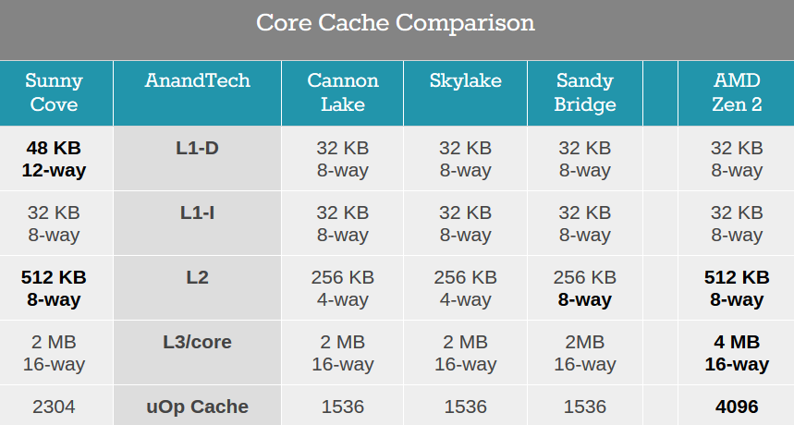
2.2 The Sunny Cove core (7)
Comparing cache sizes of major processor lines [23]

Slide 35
2.2 The Sunny Cove core (8)
Comparing cache latencies of major processor lines [23]

Slide 36
2.2 The Sunny Cove core (9)
a1/3) Smarter units (for processing more instructions or data) [22] -1

Slide 37
2.2 The Sunny Cove core (10)
a1/3) Smarter units (for processing more instructions or data) [22] -2
In this respect Intel improved branch prediction accuracy, with additional latency
improvements, like load latency and implemented a new, faster integer divider
unit.

Slide 38
2.2 The Sunny Cove core (11)
b) Enhancements to improve special purpose performance
These enhancements include ISA and microarchitecture extensions to improve
performance for specific application domains and algorithms [21], [22]
Figure: Special domains of interest in improving performance of Sunny Cove [22]

Slide 39
2.3 The Tremont Atom core
(Only the first four introductory slides will be discussed)
Notes:
39

Slide 40
2.3 The Tremont Atom core (1)
2.3 The Tremont Atom core
Evolution of Intel’s basic CPU microarchitectures (based on [27])
5-wide
out-of-order
2-wide
in-order
2-wide
out-of-order
2-wide
out-of-order
3-wide
out-of-order

Slide 41
2.3 The Tremont Atom core (2)
Intel’s smartphones/tablets oriented Atom family [3]
Intel's Atom History
AnandTech | Node | Year | Smartphone | Tablet | Netbook Notebook | Networking Server
Bonnell | 45nm | 2008 | Lincroft | Silcerthorne | Pineview
Saltwell | 32nm | 2012 | Medfield Clover Trail+ | Clover Trail | Cedar Trail
Silvermont | 22nm | 2013 | Merrifield Moorefield | Bay Trail-T | Bay Trail-M Bay Trail-D | Rangeley Avoton
Airmont | 14nm | 2015 | 'Riverton' | Cherry Trail-T | Braswell | Denverton
Goldmont | 14nm | 2016 | 'Broxton' | Willow Trail Apollo Lake | Apollo Lake
Goldmont+ | 14nm | 2017 |  |  | Gemini Lake
Tremont | 10+ | 2020 |  | Lakefield | Lakefield | Snow Ridge
Note that the Tremont core is Intel’s latest core of its low power Atom processor family.
*

Slide 42
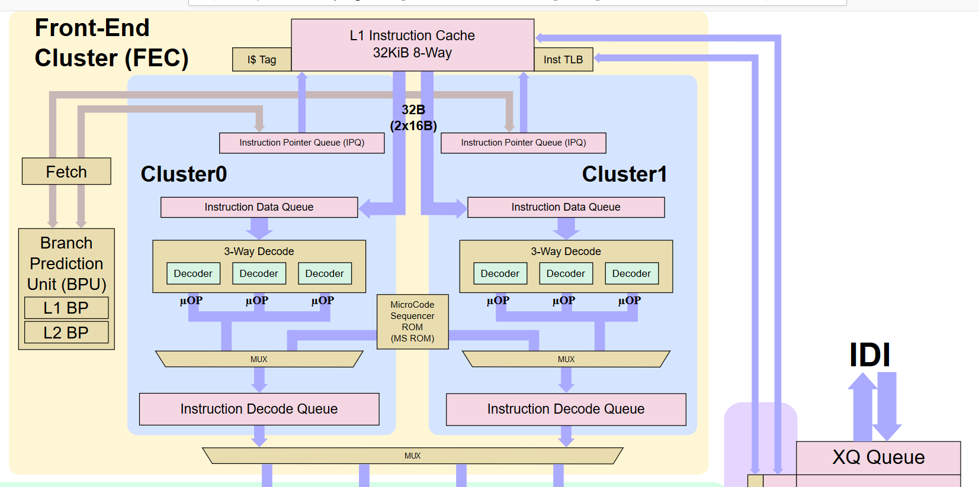
2.3 The Tremont Atom core (3)
The front-end part of the Tremont core of the Lakefield processor [4]
Note that the core has a 6-wide decoder split into dual 3-wide decode units.
*

Slide 43
2.3 The Tremont Atom core (3b)
Evolution of the width (in terms of the decode rate) of mobile cores
Width of mobile cores
(or of big cores of big.LITTLE or dynamIQ core clusters)
2-wide
3-wide
4-wide
6-wide
ARM
v7 HP Cortex-A15
(2010)
v7 M Cortex-A (2005-09)
v7 LP Cortex-A7 (2011)
(v7 LP Cortex-A5 1-wide (2009))
v8.0 HP Cortex-A-57/72
(2013-15)
v8.0 LP Cortex-A (2013/15)
v8.2 HP Cortex-
A76/77/78
(2018/20/20)
v8.2 HP Cortex-X1
(2020) (5-wide)
v8.0 HP Cortex-A73 (2016)
v8.2 HP Cortex-A75
(2017)
Intel
Atom family (2008-15)
Airmont core (2016)
Goldmont core (2016)
Tremont core (2x3) (2019)
AMD
Cat family (2011-2015)
v8 Cyclone (A7) (2013)
and A8-A10 (2014-16)
v8.2 A11 (2017) 7-wide
and subsequent cores
Apple
v7 Cortex-A8 (2009)
v7 Swift (A6) (2012)
Qualcomm
v7 Scorpion
(S1-S3) (2007-10)
v7 Krait
(S4/S400/S60x/S80x)
(2012-14)
v8 Kryo/Kryo 280
(S820/821/835) (2015/2016/2017)
v8.2 Kryo 385
(S845) (2018)
Samsung
v7 Exynos 5
(2013-14)
v8 Exynos 7
(2016)
v8 M1 (2016)
(Exynos 8 Octa)
v8 M2 (2017)
(Exynos 9 Octa)
v8.2 M3 (2018)
(Exynos 9810)
v8.2 M6 (8-wide) (planned/cancelled)
HP: High-Performance
M: Mainstream
LP: Low-Power
*

Slide 44
2.3 The Tremont Atom core (4)
Remarks to the front-end [3]
Prefetchers and branch predictors are derived from the Sunny Cove core rather
than from the preceding Goldmont+ Atom core.
There is a 6-wide decoder split into dual 3-wide decode units.
The allocation/dispatch unit is surprisingly only 4-wide rather than having the
same width as the decoders.
There is no known explanation for this.
Tremont does not have a micro-op cache.
The re-order buffer can keep 208 entries for instructions, vs. 78 in Goldmont and
95 in Goldmont Plus.

Slide 45
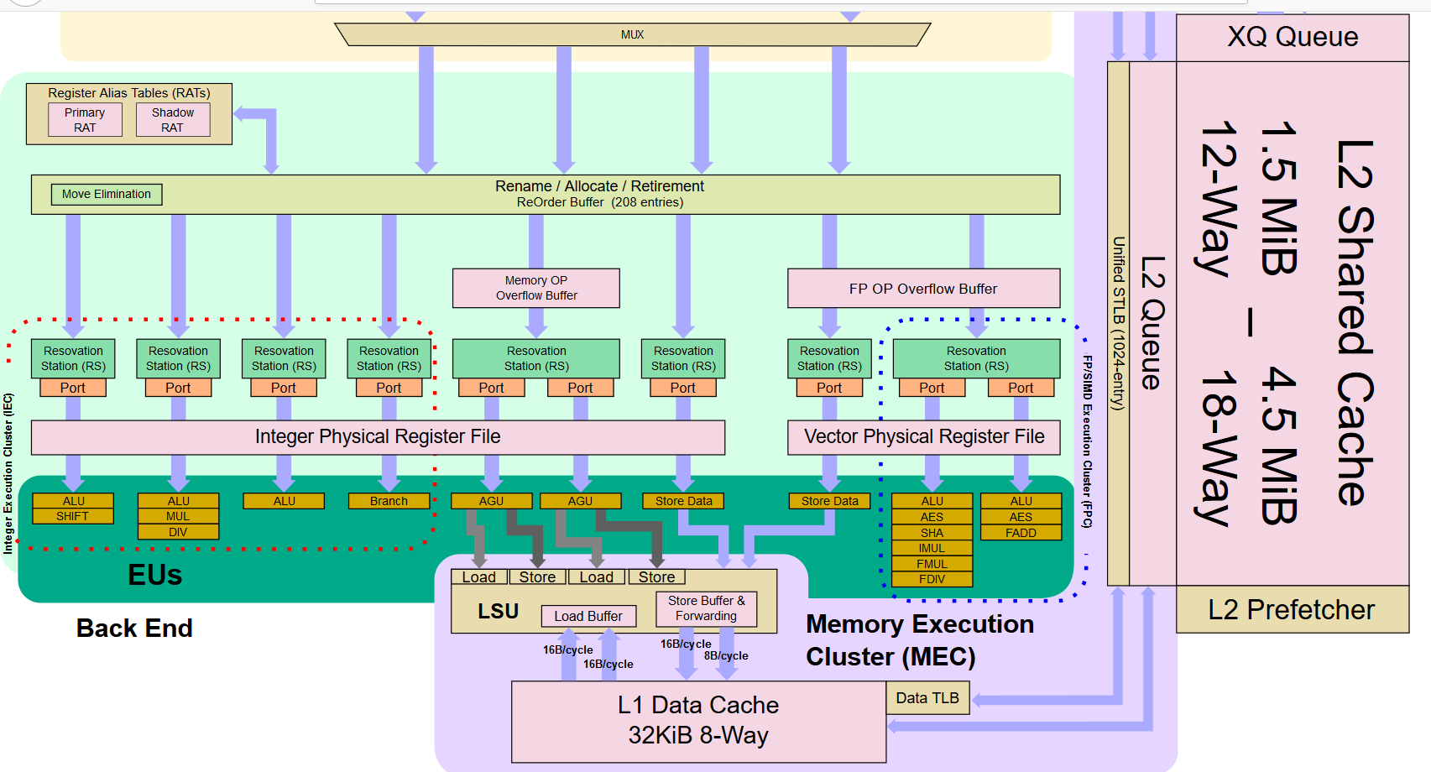
2.3 The Tremont Atom core (5)
The back-end part of the Tremont core of the Lakefield processor [4]

Slide 46
2.3 The Tremont Atom core (6)
Remarks to the back-end part of the Tremont core [3]
The FX execution units make use of individual reservation stations except of the
AGUs.
Both AGUs have a shared reservation station in order to supply both AGUs with
either 2x 16-byte stores, 2x 16-byte loads, or one of each.
The FP and SIMD part has three ports: two ALU ports with a shared
reservation station and a Store port with a private reservation station.
From the two ALU ports one is focused on fused addition (FADD) whereas the
other on fused multiplication and division (FMUL).
On the other hand, there is no 256-bit SIMD support.
In the lecture we are not going to discuss these details.

Slide 47
2.3 The Tremont Atom core (7)
Cache architectures of Intel’s Atom cores [3]
Intel Caches
 | Tremont | Goldmont+ | Goldmont |  | Sunny Cove | Skylake
Process | 10+ | 14 | 14 |  | 10+ | 14++
Decode | 2x3-wide | 3-wide | 3-wide |  | 4-6 wide | 4-5 wide
Allocate | 4-wide | 4-wide | 3-wide |  | 10-wide | 8-wide
L1 Instruction | 32 KiB/Core 8-way | 32 KiB/Core 8-way | 32 KiB/Core 8-way |  | 32 KiB/Core 8-way | 32 KiB/Core 8-way
L1 Data | 32 KiB/Core 8-way | 24 KiB/Core 6-way | 24 KiB/Core 6-way |  | 48 KiB/Core 12-way | 32 KiB/Core 8-way
L1 Latency | 3-cycle | 3-cycle | 3-cycle |  | 5-cycle | 4-cycle
L2 Cache | 1.5-4.5 MiB Per Module 12-18 way | 1.0 MiB Per Core 16-way | 0.5-1.0 MiB Per Core 16-way |  | 512 KiB Per Core 8-way | 256 KiB Per Core 4-way
L2 Latency | 17-cycle | 19-cycle | 17-cycle |  | 13-cycle | 12 cycle

Slide 48
2.3 The Tremont Atom core (8)
Remarks to the cache architecture of the Tremont core [3]
The L1 data cache has been enlarged to 32 KB from 24 KB of the Atom design
whereas the L1 data cache of the Sunny Cove core is 48 KB large.

Slide 49
2.3 The Tremont Atom core (9)
Efficiency improvement of the Tremont core vs. the Goldmont+ core [3]
*

Slide 50
2.4 The Foveros 3D packaging technology as used in the Lakefield processor
Notes:
50

Slide 51
2.4 The Foveros 3D packaging technology as used in the Lakefield processor (1)
2.4 The Foveros 3D packaging technology as used in the Lakefield processor
[2]
22 nm
PoP: Package on Package
*

Slide 52
2.4 The Foveros 3D packaging technology as used in the Lakefield processor (2)
Blown up structure of the Lakefield SoC [1]

Slide 53
2.4 The Foveros 3D packaging technology as used in the Lakefield processor (3)
Block diagrams of the Compute and Base dies [1]
(22 nm)
SNC: Sunny Cove TNT: Tremont

Slide 54
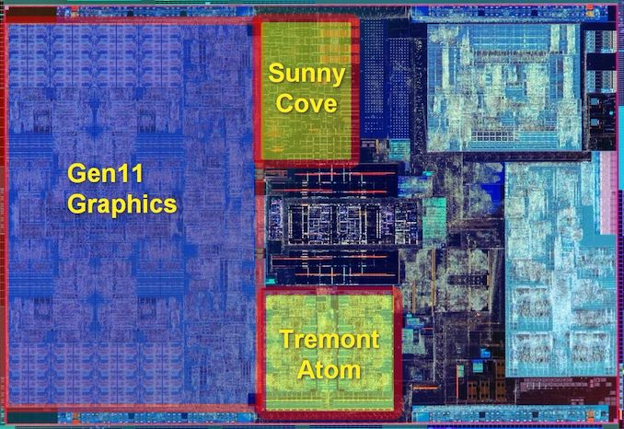
2.4 The Foveros 3D packaging technology as used in the Lakefield processor (4)
Micrograph of the compute die [15]
Die area: 84 mm²

Slide 55
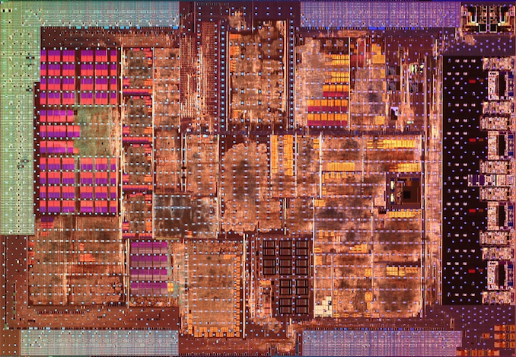
2.4 The Foveros 3D packaging technology as used in the Lakefield processor (5)
Micrograph of the base die (called also as the active interposer) [15]
Die area: 92 mm²

Slide 56
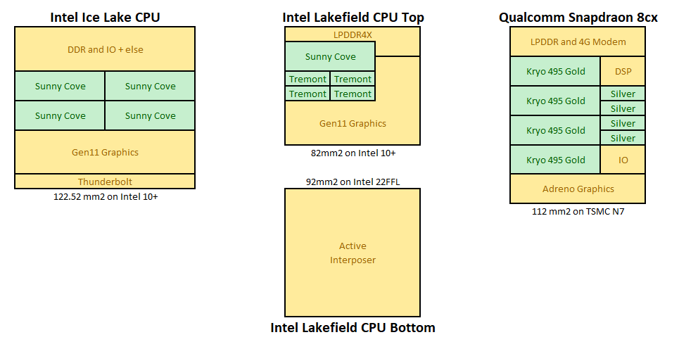
2.4 The Foveros 3D packaging technology as used in the Lakefield processor (6)
Contrasting the die size of Lakefied with those of comparable processors [15]
Base die
(
)
*

Slide 57
2.4 The Foveros 3D packaging technology as used in the Lakefield processor (7)
Remarks to the designation “active interposer” [15], [24]
An interposer is an intermediate layer made e.g. of plastic with metal wiring,
to reroute connections between a die and the package connections (pins or
solder balls), as indicated in the Figure below.
Figure: Sideview of a BGA package with an interposer [24]
Because the base die has active circuits on and has TSV (Through Silicon Vias)
connections e.g. for power to pass through, Intel technically calls this chiplet
also an “active interposer”.

Slide 58
2.4 The Foveros 3D packaging technology as used in the Lakefield processor (8)
Connecting the DRAM POP (Package on Package) to the compute die [15]
Actually the base die
*

Slide 59
2.4 The Foveros 3D packaging technology as used in the Lakefield processor (9)
Package and mainboard sizes related to the Lakefield processor [1]
(10 cents)
*

Slide 60
2.5 Introduced Lakefield models and performance issues
Notes:
60

Slide 61
2.5 Introduced Lakefield models and performance issues (1)
2.5 Introduced Lakefield models and performance issues
In 06/2020 Intel introduced only two Lakefied models with the main features as
given below:
Intel Lakefield Processors
 | Cores | Base Freq | 1C Turbo | nT Turbo | Gen11 IGP | IGP max Freq | DRAM LP4 | TDP
i5-L16G7 | 1+4 | 1400 | 3000 | 1800 | 64 EUs | 500 | 4267 | 7 W
i3-L13G4 | 1+4 | 800 | 2800 | 1300 | 48 EUs | 500 | 4267 | 7 W
Table: Introduced Lakefield models in 06/2020 [15]
Note that model names do not follow the regular model designation scheme.
*

Slide 62
2.5 Introduced Lakefield models and performance issues (2)
Contrasting main feature of Lakefiel i5-L16G7 with comparable models [15]
Comparison Table for Lakefield
Intel i5-L16G7 |  | Intel i3-1005G1 | Intel m3-8100Y | Intel Atom N5030 | Qualcomm Snapdragon 7c
Lakefield | SoC | Ice Lake-Y | Amber Lake-Y | Goldmont+ | Kryo
10 nm | Technology | 14 nm | 14 nm | 14 nm | 8 nm
1+4 | Core Config | 2+0 | 2+0 | 0+4 | 0+8
7 W | TDP | 9 W | 5 W | 6 W | ~7 W
1 x SNC 4 x TNT | CPU | 2 x SNC | 2 x SKL | 4 x GMN+ | 8 x Kryo
Gen 11 64 EUs 0.5 GHz | GPU | Gen 11 32 EUs 0.9 GHz | Gen 9 24 EUs 0.9 GHz | Gen 9 18 EUs 750 MHz | Adreno 618
4267 | LPDDR | 3733 | LPD3-1866 | 2400 | 4267
Wi-Fi 6* | Wi-Fi | Wi-Fi 5* | - | - | Wi-Fi 6
- | Modem | - | - | - | Cat15/13

Slide 63
2.5 Introduced Lakefield models and performance issues (3)
Single thread (ST) and multithread (MT) power/performance of Lakefield [1]
*

Slide 64
2.5 Introduced Lakefield models and performance issues (4)
Scheduling issues -1
Lakefield schedules cores to threads for execution while using the inclusive core
switching policy.
In this case the scheduler may allocate even all cores to threads according to a
chosen scheduling policy while preferring e.g. the least power consumption.
This is in contrast to the exclusive cluster switching policy when either the cores
of the little cluster or those of the big cluster may be active at the same time.
The next Figure is an example, how the scheduler allocates tasks during web
browsing.
*

Slide 65
2.5 Introduced Lakefield models and performance issues (5)
Use of Lakefield’s Sunny Cove and Tremont cores during web browsing [15]
The Sunny Cove (SNC) is used for responsiveness and user experience threads.
Tremont (TNT) cores run in foreground (FG) user related tasks that the user is
waiting on.
Tremont (TNT) cores run in background (BG) non-user related tasks in efficiency
mode.
Note that the big Sunny Cove core and the little Tretmont cores may run at the same
time.

Slide 66
2.5 Introduced Lakefield models and performance issues (6)
Scheduling shortcomings
big.LITTLE architectures assume both big and LITTLE cores having identical ISAs.
This is however, not the case for Lakefield, since the Sunny Cove core and the
Tremont cores support different ISA extensions, e.g. the Tremont cores do not
execute AVX512 instructions whereas the Sunny Cove core does.
In this case, only the common denominator of both ISAs can be activated while
both cores are used with traditional schedulers, e.g. AVX512 instructions not.
Nevertheless, Intel revealed that the next generation hybrid processor, the
Alder Lake will already provide an improvement since it will have a
hardware-guided OS scheduler that takes into account differences in the
ISA capabilities of the big and little cores. [25].

Slide 67
2.5 Introduced Lakefield models and performance issues (7)
Standby power of Lakefield vs. previous generations [1]
Skylake
Standby power is 0.08 x that of the 6. gen. (Skylake) line.
*

Slide 68
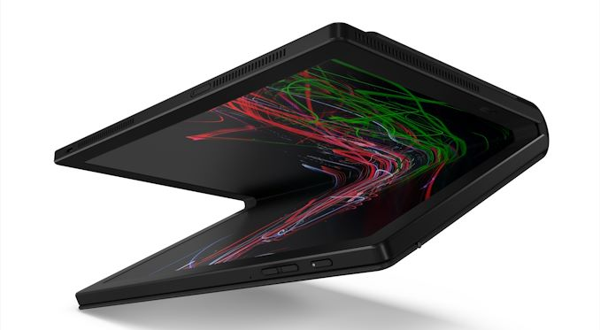
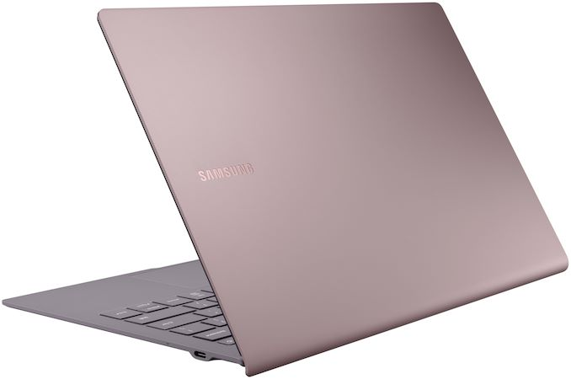
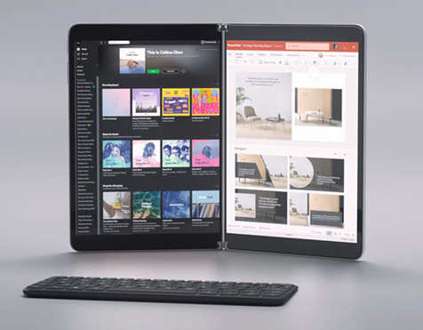
2.5 Introduced Lakefield models and performance issues (8)
First notebooks built up on Intel’s Lakefield models announced in 06/2020 [15]
Samsung Galaxy Book S
Lenovo ThinkPad X1 Fold
Microsoft
Surface Book Neo

Slide 69
2.5 Introduced Lakefield models and performance issues (9)
The importance of Lakefield [15]
Although performance-focused benchmark reviews point out performance
deficiencies of Lakefield, this hybrid (big.little) processor with its novel chiplet-based
design paradigm and fitting 3D packaging technology marks a big step in Intel’s
processor design history and can be considered as the first member of a new,
important class of Intel’s processors.
*

Slide 70
3.The desktop oriented Alder Lake-S line
Notes:
70

Slide 71
3.The desktop oriented Alder Lake-S line (1)
3.The desktop oriented Alder Lake-S line
It is the second member of Intel’s “hybrid” processor families, consisting of big and
little CPU cores, as revealed at Intel’s 2020 Architecture Day (08/2020).
(big cores)
(little
cores)
Figure: Intel’s CPU core roadmap, revealed at their 2020 Architecture Day [19].
*

Slide 72
3.The desktop oriented Alder Lake-S line (2)
Key features of the Alder Lake-S line [26]
It is desktop oriented rather than notebook oriented.
In may include up to 8 big Goldven Cove cores and up to 8 LITTLE Gracemont cores,
as indicated in non-Intel publications [26].
It will incorporate the new enhanced Xe GPU and
will have the newer LGA 1700 socket.
*

Slide 73
3.The desktop oriented Alder Lake-S line (3)
Expected core variants of the Alder Lake processor [25]
Processor | Big Cores | Small Cores | GPU Cores
Alder Lake-S | 8 | 8 | 1
Alder Lake-S | 8 | 6 | 1
Alder Lake-S | 8 | 4 | 1
Alder Lake-S | 8 | 2 | 1
Alder Lake-S | 8 | 0 | 1
Alder Lake-S | 6 | 8 | 1
Alder Lake-S | 6 | 6 | 1
Alder Lake-S | 6 | 4 | 1
Alder Lake-S | 6 | 2 | 1
Alder Lake-S | 6 | 0 | 1
Alder Lake-S | 4 | 0 | 1
Alder Lake-S | 2 | 0 | 1

Slide 74
4. References
Notes:
74

Slide 75
4. References (1)
[1]: Khushu S., Gomes W., Lakefield: Hybrid cores in 3D Package, Intel, 2019,
https://newsroom.intel.com/wp-content/uploads/sites/11/2019/08/Intel-Lakefield-
HotChips-presentation.pdf
[2]: Cutress I., Intel: Lakefield in 2020, Possible 5G on Foveros, AnandTech, Dec. 11 2019,
https://www.anandtech.com/show/15223/intel-lakefield-today-lakefield-refresh-by-
holiday-2020-possible-5g-on-foveros
[3]: Cutress I., Intel's new Atom Microarchitecture: The Tremont Core in Lakefield, AnandTech,
Oct. 24 2019, https://www.anandtech.com/show/15009/intels-new-atom-microarchitecture-
the-tremont-core
[4]: Tremont - Microarchitectures – Intel, Wikichip, 2019
https://en.wikichip.org/wiki/intel/microarchitectures/tremont
[5]: Chiappetta M., Intel Xeon Scalable Debuts: Dual Xeon Platinum 8176 With 112 Threads
Tested, Hot Hardware, July 11 2017,
https://hothardware.com/reviews/intel-xeon-scalable-processor-family-review
[6]: Chiappetta M., AMD Threadripper 3990X Review: A 64-Core Multithreaded Beast Unleashed,
Hot Hardware, Febr. 7 2020,
https://hothardware.com/reviews/amd-ryzen-threadripper-3990x-cpu-review
[7]: Intel Calls for 3D IC, EE Times, March 5 2015,
https://www.eetimes.com/author.asp?section_id=36&doc_id=1325921&image_number=1
[8]: Marcoux P., 2.5D, Silicon Interposers, Silicon Bridges, Glass Panels, Organic HDI,
http://www.meptec.org/Resources/1%20-%20ALLVIA%20-%20Marcoux.pdf

Slide 76
4. References (2)
[9]: Intel Announces New Packaging and Test Technologies for Foundry Customers, Aug. 27 2014,
https://newsroom.intel.com/news-releases/intel-announces-new-packaging-and-test-
technologies-for-foundry-customers/#gs.dwgt07
[10]: Mahajan R. et al., Embedded Multi-die Interconnect Bridge (EMIB) -- A High Density, High
Bandwidth Packaging Interconnect, 2016, IEEE 66th ECTC
[11]: Pirzada U., Intel and Altera Develop World’s First HBM2, 2.5D Stacked, SiPs With Integrated
Stratix 10 FPGA and SoC Solution, WCCF Tech, Nov. 17 2015,
https://wccftech.com/intel-altera-offering-hbm2-fpga-sip-stratix-10/
[12]: Foveros – Intel, Wikichip, https://en.wikichip.org/wiki/intel/foveros
[13]: Ingerly D.B. et al., Foveros: 3D Integration and the use of Face-to-Face Chip Stacking for
Logic Devices, 2019, IEEE IEDM
[14]: Fact Sheet: New Intel Architectures and Technologies Target Expanded Market Opportunities,
Intel Newsroom, Dec. 12 2018, https://newsroom.intel.com/articles/new-intel-architectures-
technologies-target-expanded-market-opportunities/#gs.dwlba8
[15]: Cutress I., The Intel Lakefield Deep Dive: Everything To Know About the First x86 Hybrid
CPU, AnandTech, July 2 2020,
https://www.anandtech.com/show/15877/intel-hybrid-cpu-lakefield-all-you-need-to-know
[16]: Teich P., The Heart Of AMD’s EPYC Comeback Is Infinity Fabric, The Next Platform, July 12 2017,
https://www.nextplatform.com/2017/07/12/heart-amds-epyc-comeback-infinity-fabric/
[17]: big.LITTLE MP, Linaro, https://wiki.linaro.org/projects/big.LITTLE.MP#Overview

Slide 77
4. References (3)
[18]: Greenhalgh P., Big.LITTLE Processing with ARM Cortex-A15 & Cortex-A7, White Paper,
Sept. 2011, http://www.arm.com/files/downloads/big.LITTLE_Final.pdf
[19]: Cutress I., Intel Alder Lake: Confirmed x86 Hybrid with Golden Cove and Gracemont for
2021, AnandTech, Aug. 14 2020, https://www.anandtech.com/show/15979/intel-alder-
lake-confirmed-x86-hybrid-with-golden-cove-and-gracemont-for-2021
[20]: Why hasn't Intel moved to 10nm yet?, Quora,
https://www.quora.com/Why-hasnt-Intel-moved-to-10nm-yet
[21]: Cutress I., Intel's Architecture Day 2018: The Future of Core, Intel GPUs, 10nm, and
Hybrid x86, AnandTech, Dec. 12, 2018, https://www.anandtech.com/show/13699/intel-
architecture-day-2018-core-future-hybrid-x86
[22]: Hruska J., Intel Details Its Upcoming Sunny Cove CPU Architecture, ExtremeTech, Dec. 12,
2018, https://www.extremetech.com/computing/282119-intel-details-its-upcoming-
sunny-cove-cpu-architecture
[23]: Coffee Lake - Microarchitectures – Intel, WikiChip (visited on 27 Aug., 2019),
https://en.wikichip.org/wiki/intel/microarchitectures/coffee_lake
[24]: Interposer, Wikipedia, https://en.wikipedia.org/wiki/Interposer
[25]: Alcorn P., Intel Dishes on Alder Lake-S: First x86 Hybrid CPU for Desktops, Tom’s Hardware,
2020, https://www.tomshardware.com/news/intel-alder-lake-x86-hybrid-cpu-for-desktops
[26]: Mujtaba H., Intel Alder Lake 10nm Desktop CPUs Reportedly Launching in 2021, Complete
7nm Product Portfolio in 2022, WCCF Tech, April 9 2020, https://wccftech.com/intel-10nm-
alder-lake-desktop-cpus-2021-launch-full-7nm-cpu-gpu-family-2022/

Slide 78
[27]: Smith S.L., Intel Strategy & Technology Update, Barclays Capital Global Technology Conf.,
Dec. 2011, http://files.shareholder.com/downloads/INTC/1576180143x0x526852/c9868a3a-
494e-4506-bcc6-a631aca1fd75/Steve%20Smith%20Barclays%20Dec%202011.pdf

Slide 79
https://newsroom.intel.com/news/2019-intel-investor-meeting/#gs.e9o9md

