Slide 1
The Tiger Lake line
Dezső Sima
(This is part of a series of Processor Notes describing the lines of Intel’s
Core 2 family, available on my homepage).
September 2020
Vers. 1.0
© Sima Dezső, 2020

Slide 2
The Tiger Lake mobile line
1. Introduction
2. Intel’s SuperFin process
3. Key enhancements of the Tiger Lake processor
4. Further enhancements, launched models and
performance assessment
Notes:
2

Slide 3
1. Introduction
Notes:
3

Slide 4
1. Introduction (1)
1. Introduction
Intel’s 10 nm processor lines and their key features -1
Key new features of the ISA
and the microarchitecture
8G
TICK Cannon Lake
05/2018
AVX 512
10G
New microarchitecture
Thunderbolt 3, WiFi 6
4 YEARS
TOCK Ice Lake
07/2019
10nm
New microarchitecture,
dual ring bus, Xe GPU
Thunderbolt 4, USB 4, PCIe 4
11G
TOCK Tiger Lake
09/2020
12G
TOCK Alder Lake
??/2022
Big-little core structure
*

Slide 5
1. Introduction (2)
Intel’s 10 nm processor lines and their key features -2
Key new features
of the power management
8G
TICK Cannon Lake
05/2018
10G
FIVR, Dynamic Tuning 2.0
(not discussed)
4 YEARS
TOCK Ice Lake
07/2019
10nm
11G
TOCK Tiger Lake
09/2020
12G
TOCK Alder Lake
??/2022

Slide 6
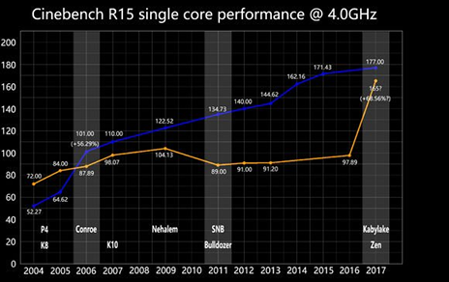
1. Introduction (3)
The Tiger Lake mobile line -1
Since introducing the Core 2 family Intel achieved dominance over AMD due to the higher performance of its CPUs vs. AMD’s as seen in the Figure below [89]
(Core 2)

Slide 7
1. Introduction (3b)
The Tiger Lake mobile line -2
Tiger Lake was debuted at a tough time for Intel, when AMD challenges it and takes
more and more market share, as the Table below indicates.
 | 2Q20 | 1Q20 | 4Q19 | 3Q19 | 2Q19 | 1Q19 | 4Q18 | 3Q18 | 2Q18 | 1Q18 | 4Q17 | 3Q17
DT | 19.2% | 18.6% | 18.3% | 18% | 17.1% | 17.1% | 15.8% | 13% | 12.3% | 12.2% | 12.0% | 10.9%
Mobile | 19.9% | 17.1% | 16.2% | 14.7% | 14.1% | 13.1% | 12.2% | 10.9% | 8.8%
Server | 5.8% | 5.1% | 4.5% | 4.3% | 3.4% | 2.9% | 3.2% | 1.6% | 1.4% | 0.8%
Table: AMD’s worldwide market unit share since introducing the Zen family [353]
*

Slide 8
1. Introduction (43)
The Tiger Lake mobile line -3
First details of Tiger Lake appeared in 08/2020 at Hot Chips 2020, first processors
launched in 09/2020.
Tiger Lake processors are designated as Intel’s 11. gen. Core 2 processors.
They are fabricated on Intel’s next iteration 10 nm SuperFin technology.
Intel claims the Tiger Lake line to be the most powerful client processor
on the planet, achieved partly due to the new manufacturing process and
partly due to improvements of the processor architecture, to be discussed next.
*

Slide 9
2. Intel’s SuperFin process
Notes:
9

Slide 10
1. Introduction (4)
2. Intel’s SuperFin process
Intranode performance improvements in Intel’s 14 nm process (%) [343]
Broadwell
(2014)
Kaby Lake
(2016)
Coffee Lake Refresh
(2018)
Skylake
(2015)
Coffee Lake
(2017)

Slide 11
1. Introduction (5)
Intranode performance improvement while transitioning from the 10 nm
base FinFET to the 10 nm SuperFin technology (%) [343]

Slide 12
1. Introduction (6)
Assessment of Intel’s new SuperFin technology [343]
This is roughly the same performance improvement as achieved by multiple
14 nm technology updates from Broadwell (2014) to Coffee Lake Refresh (2018),
as the preceding Figures indicate.
According to Intel the SuperFin technology provides the “largest intranode
performance enhancement in Intel’s history” enabling 17-18 % higher
performance than the base 10 nm technology.
*

Slide 13
3. Key enhancements of the Tiger Lake processor architecture
3.1 The Willow Cove core
3.2 The Iris Xe graphics
3.3 PCIe 4.0
3.4 Thunderbolt 4
3.5 USB 4.0
Notes:
13

Slide 14
1. Introduction (7)
3. Key enhancements of the Tiger Lake processor architecture -1 [344]

Slide 15
1. Introduction (8)
Key enhancements of the Tiger Lake processor architecture -2 [344]
From the enlisted improvements we point out and discuss subsequently the following
key enhancements:
The Willow Cove core (Section 3.1)
The Iris Xe graphics (Section 3.2)
PCIe 4.0 (Section 3.3)
Thunderbolt 4 capability (Section 3.3)
USB 4 capability (Section 3.4)

Slide 16
3.1 The Willow Cove core
Notes:
16

Slide 17
3.1 The Willow Cove core (1)
3.1 The Willow Cove core -1
It is based on the preceding Sunny Cove core.
Differences -1:
The core architecture remained the same but fundamental circuits were
redesigned to take advantage of the SuperFin technology.
L2 cache (ML$) size increased from 512 KB to 1.25 MB.
*

Slide 18
3.1 The Willow Cove core (2)
The preceding Sunny Cove core [297]
RS:
Reservation
Station
ML$:
1.25 MB
(up from
0.5 MB)
DCU: Data Cache Unit
AGU: Address Generation Unit
FMA: Fused Multiply Add

Slide 19
3.1 The Willow Cove core (3)
The Willow Cove core -2
Differences -2:
Doubling the bandwidth of the cache coherent data fabric (dual bi-directional
ring buses)
*

Slide 20
3.1 The Willow Cove core (4)
Cache coherent bi-directional ring bus in the Sunny cove core of the
Ice Lake processor (2019) [305]
TB3: Thunderbolt 3
IPU: Image Processing Unit
The Willow cove core has dual ring buses, doubling the bandwidth of the internal
data transfers.

Slide 21
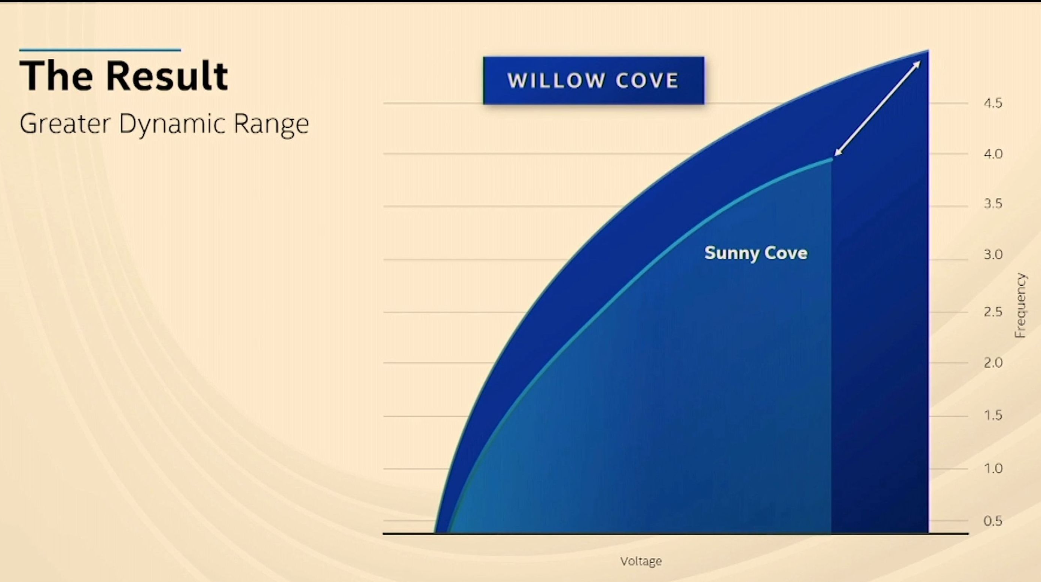
3.1 The Willow Cove core (5)
Frequency/Voltage characteristics of Sunny cove vs. Willow cove cores [343]

Slide 22
3.2 The Iris Xe graphics
Notes:
22

Slide 23
3.2 The Iris Xe graphics (1)
3.2 The Iris Xe graphics [344]
AMD’s head of graphics design (R. Koduri) left the firm in 2017
and became the chief architect and senior vice president
of Intel's discrete graphics division.
The Xe graphics family is the result of his work.
The Xe graphics family incorporates multiple product segments,
including
low power graphics for client processors,
graphics for ML (Machine Learning) or
graphics for HPC (High Performance Computing).
The Iris Xe graphics of Tiger Lake belongs to the Low power graphics segment,
as indicated in the next Figure.
*

Slide 24
3.2 The Iris Xe graphics (2)
The Low Power optimized product segment of the Xe graphics family [345]
(LP: Low Power optimized)

Slide 25
3.2 The Iris Xe graphics (3)
The road to Xe [345]
(Xe for exascale)
Ice
Lake
Sandy
Bridge
(Westmere)

Slide 26
3.2 The Iris Xe graphics (4)
Design goal of Tiger Lake’s GPU (called Xe) [345]

Slide 27
3.2 The Iris Xe graphics (5)
Design goal of Tiger Lake’s GPU (called Xe) [345]

Slide 28
3.2 The Iris Xe graphics (6)
The Xe GPU of Tiger Lake [345]
It has up to 6 subslices
(model dependent)
16 EUs/subslice
i.e. 96 EUs/slice
(up from 64)

Slide 29
3.2 The Iris Xe graphics (7)
Xe EUs: Contrasting the structures of gen. 11 and Xe EUs [345]
(EM)
An 11th gen. EU can execute 2 FP x SIMD4 x 2 (MAD) = 16 SP FP operations/cycle.
An Xe EU can execute 2 FP x SIMD8 = 16 FP operations/clock cycle.
*

Slide 30
3.2 The Iris Xe graphics (9)
Efficiency improvements of the Xe LP graphics vs. the gen. 11 graphics [345]

Slide 31
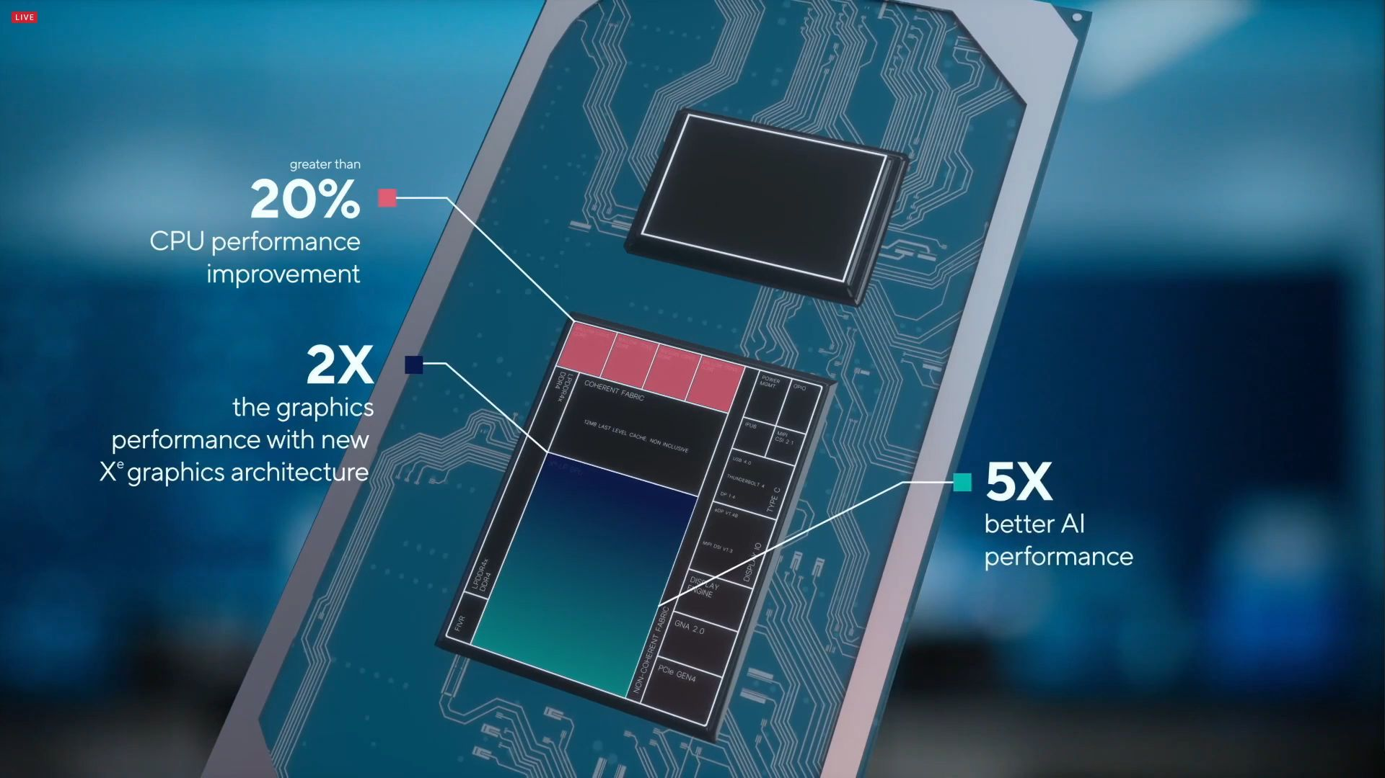
3.2 The Iris Xe graphics (10)
Achieved performance improvements of Tiger Lake vs. previous gen.
according to Intel’s own measurements (without providing details) [344]

Slide 32
3.3 PCIe 4.0
Notes:
32

Slide 33
3.3 PCIe 4.0 (1)
3.3 PCIe 4.0
One of the main improvement of Tiger Lake is replacing PCIe 3.0 by PCIe 4.0.
This doubles the data transfer speed with attached I/O devices, e.g. with SSDs.
*

Slide 34
3.3 PCIe 4.0 (2)
b) Evolution of subsequent PCIe generations [165]
PCI Express version | Intro- duced | Line code | Transfer rate in each direction | Throughput in each direction
 |  |  |  | ×1 | ×2 | ×4 | ×8 | ×16
1.0 | 2003 | 8b/10b | 2.5 GT/s | 250 MB/s | 0.50 GB/s | 1.0 GB/s | 2.0 GB/s | 4.0 GB/s
2.0 | 2007 | 8b/10b | 5.0 GT/s | 500 MB/s | 1.0 GB/s | 2.0 GB/s | 4.0 GB/s | 8.0 GB/s
3.0 | 2010 | 128b/130b | 8.0 GT/s | 984.6 MB/s | 1.97 GB/s | 3.94 GB/s | 7.88 GB/s | 15.8 GB/s
4.0 | 2017 | 128b/130b | 16.0 GT/s | 1969 MB/s | 3.94 GB/s | 7.88 GB/s | 15.75 GB/s | 31.5 GB/s
5.0 | 2019 | 128b/130b | 32.0 GT/s[ | 3938 MB/s | 7.88 GB/s | 15.75 GB/s | 31.51 GB/s | 63.0 GB/s

Slide 35
3.3 PCIe 4.0 (3)
Evolution of attaching PCIe lanes in Intel’s and AMD’s client processors
Intel’s processor lines
AMD’s processor lines
PCIe lanes
on the NB
PCIe lanes
on the processor
PCIe lanes
on the NB
PCIe lanes
on the processor
PCIe 1.0
lanes
Core 2 (2006)
Core 2 Quad (2006)
with 965/Series 3 NB
K8 with 6xx NB (2005)
Penryn (2007)
Penryn Quad (2008)
with Series 4 NB
Bobcat (2011)
Fam. 12h (Llano) (2012)
Piledriver (2012)
Jaguar (2013)
Puma (2014)
PCIe 2.0
lanes
2. G. Nehalem
(Lynnfield) (2009)
Sandy Bridge (2011)
K10 with 7xx NB (2008)
Fam. 11h (Griffin)
with 7xxM NB (2011)
G. Nehalem
(Bloomfield) (2008)
with X58 NB
Type of available PCIe lanes
Ivy Bridge (2012)
Haswell (2013)
Skylake (2015)
and further lines
Steamroller (2014)
Excavator 2015/2016)
Zen-based laines (2017)
Zen+-based (2018)
PCIe 3.0
lanes
PCIe 4.0
lanes
Tiger Lake (2020)
Zen 2-based lines (2019)

Slide 36
3.4 Thunderbolt 4
Notes:
36

Slide 37
3.4 Thunderbolt 4 (1)
3.4 Thunderbolt 4 (TB 4) [346] -1
Thunderbolt is a hardware interface standard developed by Intel in cooperation
with Apple.
In fact, the TB standard specifies a fast serial bus, that is competing against USB 4.
Intel owns the IP (Intellectual Property), but Apple may use TB without restrictions.
To encourage wide adoption Intel made the TB standard royalty free in 2017.
Nevertheless, using the logo needs previous certification by Intel.
*

Slide 38
3.4 Thunderbolt 4 (2)
Thunderbolt 4 (TB 4) [346] -2
TB appeared first in Apple’s MacBook Pro laptop in 2011.
TB 3 made its debut in Intel’s Ice Lake (in 2019) whereas TB 4 in the Tiger Lake
line in 09/2020.
Both TB 3 and TB 4 make use of USB-C connectors and sockets, unlike previous
TB versions (that used the Mini DisplayPort).
Nevertheless, there is a big difference in implementing TB 3 and TB 4.
TB 3 has the same physical interface as USB 3 but it needs a dedicated controller
since TB 3 does not operate via USB 3 circuitry.
In contrast, TB 4 is a superset of TB 3, USB 3x and USB 4, meaning that any TB 4
Type-C socket is able to accept also TB 3, USB 3x and USB 4 connectors.

Slide 39
3.4 Thunderbolt 4 (3)
Intel’s introduction of Thunderbolt 4 (07/2020) [352]

Slide 40
3.4 Thunderbolt 4 (4)
Replacing USB ports by TB 4 ports [346]

Slide 41
3.4 Thunderbolt 4 (5)
Replacing USB cables by TB 4 cables [346]

Slide 42
3.4 Thunderbolt 4 (6)
Data transfer rates supported by Thunderbolt and USB standards
(based on [311])
Thunderbolt 4
Thunderbolt 3
USB 4
Thunderbolt 2 &USB3.2
*

Slide 43
3.4 Thunderbolt 4 (7)
Main features of the Thunderbolt 3/4 and USB 3/4 standards [347]
 | Thunderbolt 4 | Thunderbolt 3 | USB4 | USB 3/DP
1 universal port | ✓ | ✓
40Gb/s cables up to 2 meters | ✓
Accessories with up to 4 TB ports | ✓
Min PC speed requirement | 40GB/s | 40GB/s | 20GB/s (40GB/s is optional) | 10GB/s
Min PC video requirement | 2 x 4K displays or 1 x 8K display | 1 x 4K display | 1 display (no min resolution) | 1 display (no min resolution)
Mini PC data requirements | PCIe 32GB/s USB 3.2 10GB/s | PCIe 16GB/s USB 3.2 10GB/s | USB 3.2 10GB/s | USB 3.2 5GB/s
PC charging port required | At least one
PC wake from sleep w/TB dock connected | Required
Min PC port power for accessories | 15W | 15W | 7.5W | 4.5W
Thunderbolt networking | ✓ | ✓
Mandatory certification for PCs and accessories | ✓ | ✓
Intel VT-d based DMA protection required | ✓
USB4 specification | Compliant | Compatible | Compliant | Compatible

Slide 44
3.4 Thunderbolt 4 (8)
TB 4 branding and logos [346]

Slide 45
3.4 Thunderbolt 4 (9)
Main requirements for certification of the TB 4 logo [346]
For using the TB logo on their devices vendors need certification by Intel.
A certification will be provided, if third parties approve the fulfillment of given
requirements, including
Support for TB 4 docks with four TB 4 ports
PC Charging on at least one port (for laptops up to 100 W)
Wake from sleep by peripherals connected to a TB 4 dock etc.
*

Slide 46
3.4 Thunderbolt 4 (10)
Processor accessories with possible Thunderbolt interfaces [346]

Slide 47
3.4 Thunderbolt 4 (11)
Spreading of the Thunderbolt technology [312]
Recently Thunderbolt 3 is common on high-end Windows laptops.
The number of PCs and peripherals shipped with Thunderbolt doubles annually,
in 05/2020 there were more than 400 PC models on the market with
Thunderbolt 3 as well as 450 compatible peripherals [348], with tens of millions
sold.
*

Slide 48
3.4 Thunderbolt 4 (12)
Implementing TB controllers -1
Before Ice Lake (2019) Intel implemented discrete TB controllers, as seen
in the next Figure.

Slide 49
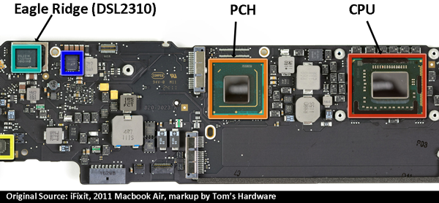
3.4 Thunderbolt 4 (13)
Example of a discrete Thunderbolt implementation
(actually in Apple’s Macbook Air (2011) [313]
(1. gen. Thunderbolt controller)

Slide 50
3.4 Thunderbolt 4 (14)
Example for using external TB controllers to connect SATA discs to an
Apple Mac platform [349]
RC: Light Ridge TB controller

Slide 51
3.4 Thunderbolt 4 (15)
Implementing TB controllers -2
Intel’s Ice Lake line (2019) was the first one that provided a fully integrated
Thunderbolt 3 implementation.
Intel’s subsequent Tiger Lake line supported already the TB 4 standard and
integrated the TB 4 controller onto the processor die as well.
In addition Intel provides TB4 host controllers for use in desktops, laptops etc.
for OEMs (called Maple Ridge JHL8540 and JHL 8340)
*

Slide 52
3.5 USB 4.0
Notes:
52

Slide 53
3.5 USB 4.0 (1)
3.5 USB 4 [350]
USB standards are developed by a non-profit organization (called USB-IF
(USB-Implementer Forum)) established by major IT vendors including Apple,
Hewlett-Packard, Intel and Microsoft.
USB standards are royalty free open standards.
Design goal of USB 4: using a single USB-C interface infrastructure (connector,
socket and cable type) instead of the previous USB generations while retaining
compatibility with existing USB and Thunderbolt products.
USB 4 is based on Intel’s Thunderbolt 3 protocol and supports data transfers
up to 40 Gb/s.
USB 4 was announced in 03/2019, ratified in 09/2019.
The first processor implementing USB 4 was Intel’s Tiger Lake (09/2020),
although TB4 support was not indicated on the Figure stating Tiger Lake’s
enhancements.
USB: Universal Serial Bus
*

Slide 54
3.5 USB 4.0 (2)
Principle of operation of USB 4 [351]
USB 4 by itself doesn’t provide any dedicated data transfer mechanism, instead
it supports tunneling data according to a number of protocols, like previous
USB 3, Thunderbolt 3 or DP (Display Port) 1.4a protocols.
As an illustration, the next Table shows the supported USB data transfer modes
and related features.

Slide 55
3.5 USB 4.0 (3)
USB 4 data transfer modes [351]
Marketing name |  | Logo | Specifications | Old specifications | Encoding | Nominal speed
 |  |  |  |  |  | Gbit/s | GB/s
SuperSpeed USB 5Gbps |  |  | USB 3.2 Gen 1×1 | USB 3.0, USB 3.1 Gen 1 | 8b/10b | 5 | 0.5
SuperSpeed USB 10Gbps |  |  | USB 3.2 Gen 2×1 | USB 3.1 Gen 2 | 128b/132b | 10 | 1.2
N/A |  |  | USB 3.2 Gen 1×2 |  | 8b/10b | 10 | 1.0
SuperSpeed USB 20Gbps |  |  | USB 3.2 Gen 2×2 |  | 128b/132b | 20 | 2.4
N/A |  |  | USB4 Gen 2×1 |  | 64b/66b^{[a]} | 10 | 1.2
N/A |  |  | USB4 Gen 3×1 |  | 128b/132b^{[a]} | 20 | 2.4
USB4 20Gbps |  |  | USB4 Gen 2×2 |  | 64b/66b^{[a]} | 20 | 2.4
USB4 40Gbps |  |  | USB4 Gen 3×2 |  | 128b/132b^{[a]} | 40 | 4.8

Slide 56
3.5 USB 4.0 (4)
Remark: Evolution of the USB standard [262]
USB 1.0 (1996) Transfer rates of up to 12 .5 Mb/s.
USB 2.0 (2000) Transfer rates of up to 480 Mb/s.
USB 3.0 (2008) SuperSpeed transfer rate of up to 5 Gb/s.
The USB 3.0 specification recommends that the Standard-A USB
receptacle have a blue insert.
USB 3.1 (2013) has two alternatives:
USB 3.1 Gen. 1 and
USB 3.1 Gen 2 with the SuperSpeed+ transfer rate of up to
10 GB/s.
USB 3.2 (2017) Two new SuperSpeed+ transfer modes with transfer rates of
10 Gb/s and 20 Gb/s over USB-C connectors.
USB 4.0 (2019) Based on the Thunderbolt 3 standards.
transfer speeds: up to 40 Gb/s.
*

Slide 57
3.5 USB 4.0 (5)
Contrasting USB 4 and TB 4
USB 4 and TB 4 are now two competing standards with almost similar features
but involved vendors have dissimilar aspects for choosing one or the another.
As their marketing materials reveal Intel intends to displace USB 4 in favor of TB 4.
Time will show which of both standards will succeed.
Contrasting USB 4 and TB 4
USB 4
TB 4
Developed
by
USB-IF (USB-Implementer Forum)
including major IT firms
Intel in cooperation with Apple
Trademark
USB-IF
Intel
Royalty
Royalty free
Royalty free (since 2017)
Max. data rate
40 Mb/s
40 Mb/s
Physical interface
USB-C
USB-C
Power delivery capability
Yes
Yes
External display
driving capability
Yes
Yes
Windows 10 support
Yes
Yes
*

Slide 58
4. Further enhancements of the processor architecture, launched models and performance assessment
Notes:
58

Slide 59
4. Further enhancements, launched models and performance assessment (1)
Further enhancements of the processor architecture -1
New memory controller
LPDDR4x-4266 4x32 bit
DDR43200 2x64 bit
(LPDDR4x-3767 memory was already introduced in the previous 10 nm
Ice Lake (2019))

Slide 60
4. Further enhancements, launched models and performance assessment (2)
The LPDDR4x (Low Voltage DDR4 memory)
Power reduction by LPDDR4x
Figure: Power reduction by using
LPDDR4x memory [323]
*

Slide 61
4. Further enhancements, launched models and performance assessment (3)
Further enhancements of the processor architecture -2
New Media encoders
up to 4Kx60 FPS 10 bit
up to 8Kx30 FPS 10 bit
4x Display pipes
New Image Processing Unit (UP6)
New GNA 2.0 (Gaussian Neural Accelerator)
(Dedicated low-power neural inferencing engine for offloading NN tasks from
the CPU)
Enhanced Power management

Slide 62
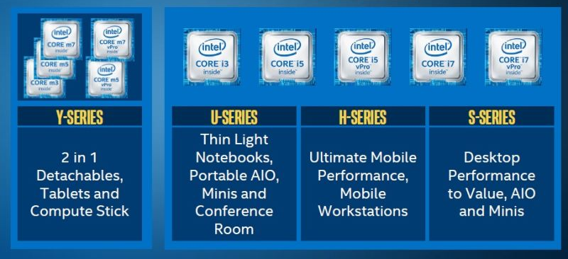
4. Further enhancements, launched models and performance assessment (4)
b) Launched Tiger Lake models -1
Intel’s typical client series: (actually Skylake-based mobile and client series
[206]
TDP
4.5 W
15/28 W
45 W
65/91 W
*

Slide 63
4. Further enhancements, launched models and performance assessment (5)
b) Launched Tiger Lake models -2
Target applications of UP3/UP4 performance classes of the models [344]
Note that UP4 class models with a cTDP value of 7-15 W are intended for fanless
12”-13” laptops whereas
UP3 class models with a cTDP value of 12-28 W for fanned 14”-15” models.
cTDP: Configurable TDP, meaning that OEMs can choose between the specified TDP
values depending on their cooling solution.
*

Slide 64
4. Further enhancements, launched models and performance assessment (6)
Main features of UP3 class Tiger Lake models [344]

Slide 65
4. Further enhancements, launched models and performance assessment (7)
Main features of UP4 class Tiger Lake models [344]

Slide 66
4. Further enhancements, launched models and performance assessment (8)
UP3 and UP4 packages [344]
UP3
UP4
BGA1449
46.5x25
26.5x18.5

Slide 67
4. Further enhancements, launched models and performance assessment (9)
c) Achieved performance improvements of Tiger Lake vs. previous gen.
according to Intel’s own measurements (without providing details) [344]
*

Slide 68
4. Further enhancements, launched models and performance assessment (10)
Introducing a new, premium class platform, called the Evo platform [344]
FHD: Full High Definition display (commonlyly 1920 x 1080 pixels).
*

