Slide 1
The mobile boom
Sima Dezső
Dec. 2020
(Ver. 2.7)
© Sima Dezső, 2020

Slide 2
Contents
1. Emergence and spread of smartphones
2. Emergence and spread of tablets
3. Key requirements of mobile devices
4. How leading IT vendors addressed the mobile boom?
5. Conclusions
6. References

Slide 3
1. Emergence and spread of smartphones
Notes:
3

Slide 4
1. Emergence and spread of smartphones ()
1. Emergence and spread of smartphones
The traditional computer market around 1995
Main computer market segments around 1995
Servers
Desktops
Embedded
computer devices
E.g.
Intel’s Xeon lines
Intel’s Pentium lines
AMD’s K5, K6 lines
ARM’s lines
Around 1995: spreading of multimedia, graphics and internet and
emergence of laptops (aka notebooks) (portable computers).
Desktops
Laptops
(notebooks)
Since about 1995
*

Slide 5
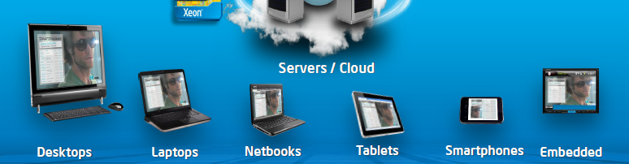
1. Emergence and spread of smartphones (1)
Emerging of mobile devices, first smartphones (≈2006) then tablets (≈2010)
[2]
The mobile boom
Netbooks: Small size laptops (e.g. with a display size of 10" or smaller.)
*

Slide 6
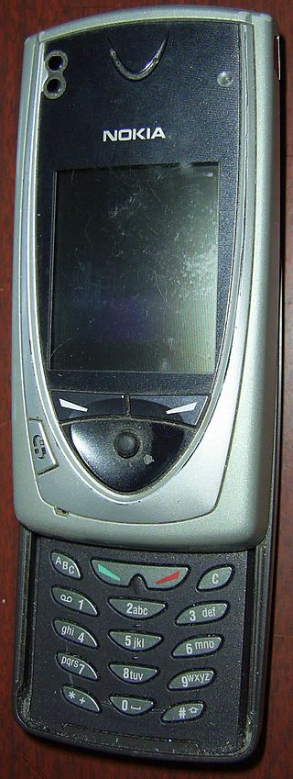
1. Emergence and spread of smartphones (2)
Emergence of smartphones-1
Forerunners of smartphones emerged already
at the beginning of the 2000’s, like Nokia’s 7650
(shipped in 2002).
The 7650 became the first widely available phone
with camera and color screen but supported
no video.
It was the first Nokia phone running under
the Symbian OS.
Figure: Nokia’s 7650 [39]

Slide 7
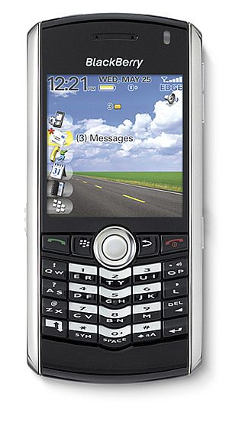
1. Emergence and spread of smartphones (3)
Emergence of smartphones-2
The emergence of smartphones is often
contributed to the BlackBerry Pearl 8100
line of the Canadian firm RIM
(Research in Motion)[5].
This phone – shipped in 2006 - supported
beyond a camera also video and became
very popular in the US.
It was run under the BlackBerry OS.
Figure: RIM’s BlackBarry Perl 8100
(2006) [38]
*

Slide 8
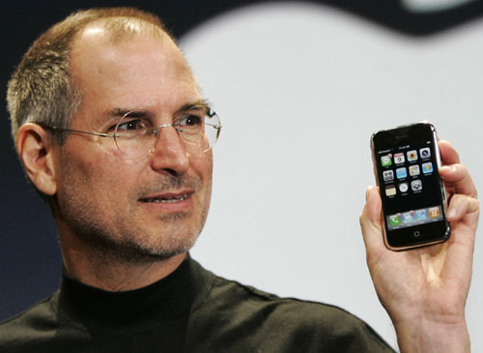
1. Emergence and spread of smartphones (4)
Early spread of smartphones-1
In 2007 Apple’s iPhone gave a strong momentum for rapid spreading of
smartphones.
It run under the iPhone OS (renamed later to iOS in 2010).
Figure: Steve Jobs introducing the iPhone at MacWorld Expo in 1/2007 [47]
*

Slide 9
1. Emergence and spread of smartphones (5)
Remark
After the introduction of iPhone (2007) Steve Ballmer (CEO of Microsoft) said in an
interview [20]:
“There's no chance that the iPhone is going to get any significant market share.
No chance…
But if you actually take a look at the 1.3 billion phones that get sold, I'd prefer
to have our software (Windows Phone) in 60% or 70% or 80% of them, than
I would to have 2% or 3%, which is what Apple might get”.
CEO: Chief Execution Officer

Slide 10
1. Emergence and spread of smartphones (6)
Early spread of smartphones-2
Google’s Android was unveiled also in 2007 with first Android-powered phones
sold in 10/2008 [6].
*

Slide 11
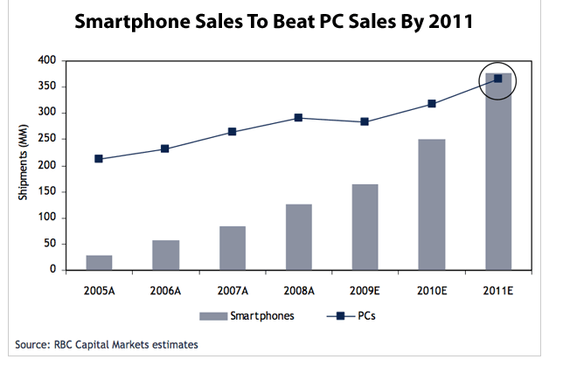
1. Emergence and spread of smartphones (7)
Emergence and rapid increase of smartphone sales 2005-2011 [4]
PC sales: Desktop + Notebook sales
A: Actual values
E: Estimated

Slide 12
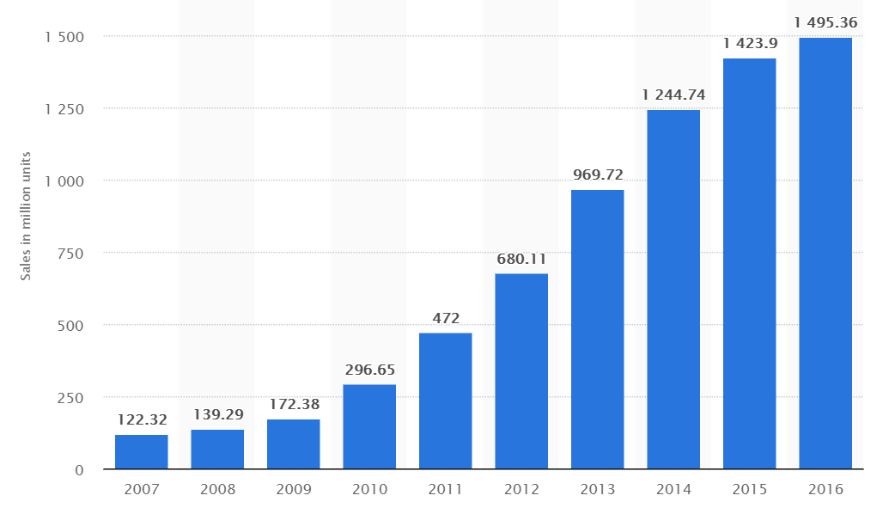
1. Emergence and spread of smartphones (8)
Worldwide unit shipments of smartphones 2007-2016 [28]

Slide 13
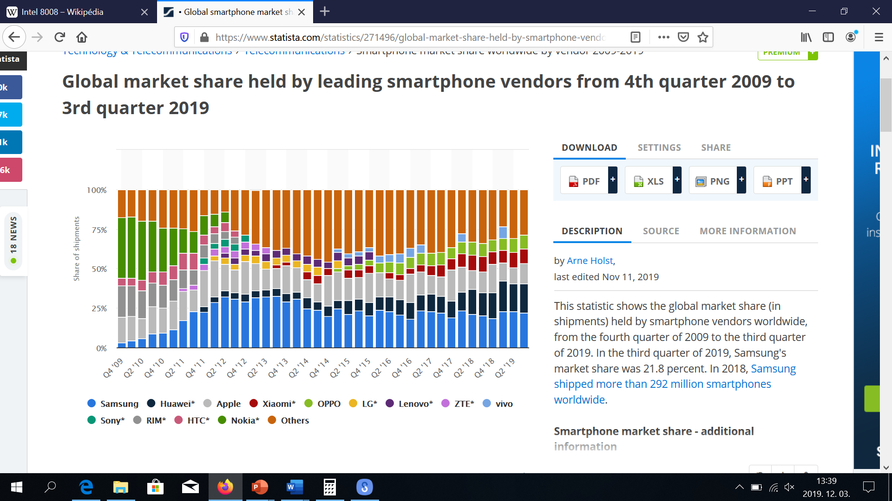
1. Emergence and spread of smartphones (10)
Worldwide smartphone market share 2009-2019 (in unit shipments) [108]
Nokia
OPPO
Xiomi
Apple
HTC
RIM
Huawei
Apple
Samsung
HTC: High Tech Computer Corp. (Taiwan)

Slide 14
1. Emergence and spread of smartphones (11)
Worldwide market share of smartphone OSs to end users in 2009-2015 [42]
(Black Berry OS)
*
*

Slide 15
1. Emergence and spread of smartphones (12)
Remember
After the introduction of iPhone (2007) Steve Ballmer (CEO of Microsoft) said in an
interview [20]:
“There's no chance that the iPhone is going to get any significant market share.
No chance…
But if you actually take a look at the 1.3 billion phones that get sold, I'd prefer
to have our software in 60% or 70% or 80% of them, than I would to have 2%
or 3%, which is what Apple might get”.

Slide 16
1. Emergence and spread of smartphones (13)
Worldwide market share of smartphone OSs to end users in 2009-2015 [42]
*

Slide 17
1. Emergence and spread of smartphones (14)
Worldwide market share of application processors in 1H 2017 used in
smartphones (based on revenue) [71]
Vendor | Market share | Processor lines (examples) | ISA
Qualcomm (USA) | 42 % | Snapdragon line 200-805 Snapdragoon 808-845 | ARMv7 ARMv8
Apple (USA) | 18 % | Apple A4-A6X Apple A7-A11 | ARMv7 ARMv8
MediaTek (Taiwan) | 18 % | Helio x10 Helio X20 | ARMv7 ARMv8
Samsung (S. Korea) |  | Exynos 5 line Exynos 7/8/9 | ARMv7 ARMv8
[Source: Strategy Analytics]
ARMv7: 32-bit
ARMv8: 64-bit
*

Slide 18
2. Emergence and spread of smartphones (15)
Main features of Qualcomm’s Snapdragon lines used about 2013 - 2017
Model | Released | Technology | CPU | Word length bit | Clock rate (up to) | Connectivity
835 | Q2/2017 | 10 nm | 4+4 Kryo 280 | 64 | 2.45 GHz | integrated LTE + RF
821 | Q3/2016 | 14 nm | 2+2 Kryo | 64 | 1.4 GHz | integrated LTE + RF
820 | Q4/2015 | 14 nm | 2+2 Kryo | 64 | 2.2 GHz | integrated LTE + RF
810 | H2/2014 | 20 nm | 4x ARM Cortex A57 + 4x ARM Cortex A53 | 64 | 2.0 GHz | integrated LTE + RF
808 | H1/2015 | 20 nm | 2x ARM Cortex A57 + 4x ARM Cortex A53 | 64 | 2.0 GHz | integrated LTE + RF
805 | Q1/2014 | 28 nm | 4x Krait 450 | 32 | 2.7 GHz | integrated LTE + RF
801 | Q4/2013 | 28 nm | 4x Krait 400 | 32 | 2.5 GHz | integrated LTE + RF
800 | Q2/2013 | 28 nm | 4x Krait 400 | 32 | 2.3 GHz | integrated LTE + RF
600 | Q1/2013 | 28 nm | 4x Krait 300 | 32 | 1.9 GHz | integrated WiFi
410 | 1H/2014 | 28 nm | 4x ARM Cortex A53 | 64 | 1.4 GHz | integrated LTE + RF
400 | Q4/2013 | 28 nm | 4x Krait 300 or 4x ARM Cortex A7 | 32 | 1.7 GHz 1.4 GHz | integrated LTE + RF
200 | 2013 | 28 nm | 4x ARM Cortex A5 or 4x ARM Cortex A7 | 32 | 1.4 GHz 1.2 GHz | integrated 3G + RF
RF: Radio Frequency Front End implemented on a separate chip

Slide 19
2. Emergence and spread of tablets
Notes:
19

Slide 20
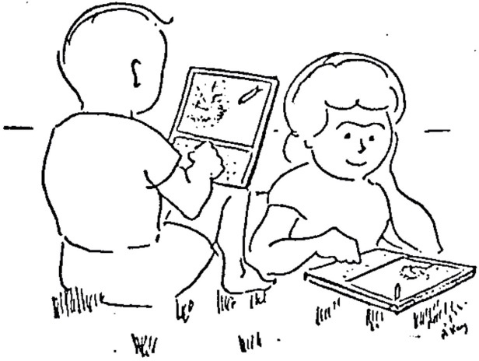
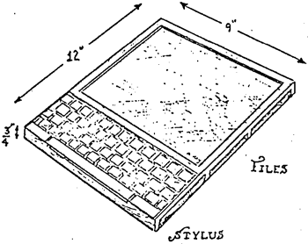
2. Emergence and spread of tablets (1)
2. Emergence and spread of tablets
An early vision of tablets targeting children - the Dynabook []
In 1972 at the ACM National Conference Alan Kay from the Xerox Palo Alto Research
Center (PARC) introduced a Personal Computer for Children, called the Dynabook.
(Intel 8008: 1972).
Picture of a DynaBook
Picture of two kids sitting in the grass with Dynabooks
“This note speculates about the emergence of personal, portable information manipulators and their effects when used by both children and adults. Although it should be read as science fiction, current trends in miniaturization and price reduction almost guarantee that many of the notions discussed will actually happen in the near future."
*

Slide 21
2. Emergence and spread of tablets (2)
Steve Jobs vision of tablets
In a talk given at the Center for Design Innovation Steve Jobs envisioned tablets
already in 1983 saying
”Apple’s strategy is really simple. What we want to do is we want to put an
incredibly great computer in a book that you can carry around with you and learn
how to use in 20 minutes.
... And we really want to do it with a radio link in it so you don’t have to hook up
to anything and you’re in communication with all of these larger databases and
other computers” [19].
*

Slide 22
2. Emergence and spread of tablets (3)
The relation of the Dynabook and iPad [73]
We note that Steve Jobs and Apple engineers visited PARC in 1979.
In an interview in 2010 while asking "whether he felt that Jobs had stolen
the idea for the iPad" Kay denied such a thought.
He said that "Jobs has known about the Dynabook idea and the interim-Dynabook
machine (called the PARC Alto) for several decades".
But there is a difference in the usage models of Dynabook and IPad.
Dynabook represented an idea of active computing e.g. with children
programming it by means of its keyboard in Smalltalk.
By contrast, iPad is built for passive computing while using applications
downloaded e.g. from the App Store.
*

Slide 23
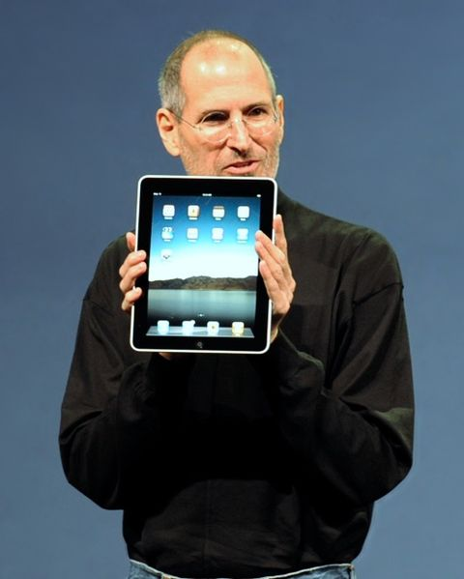
2. Emergence and spread of tablets (4)
Designs leading to the rapid spreading of tablets around 2010
From 2009 on Android-based tablets arrived the market from many vendors.
In 2010 Apple’s iPad was introduced with 9.7 “ touch screen and Wi-Fi or
additionally wireless 3G broadband internet connection (mobile internet connection),
operating under iOS [12].
Figure: Steve Jobs introducing the iPad in 2010 [12]
*

Slide 24
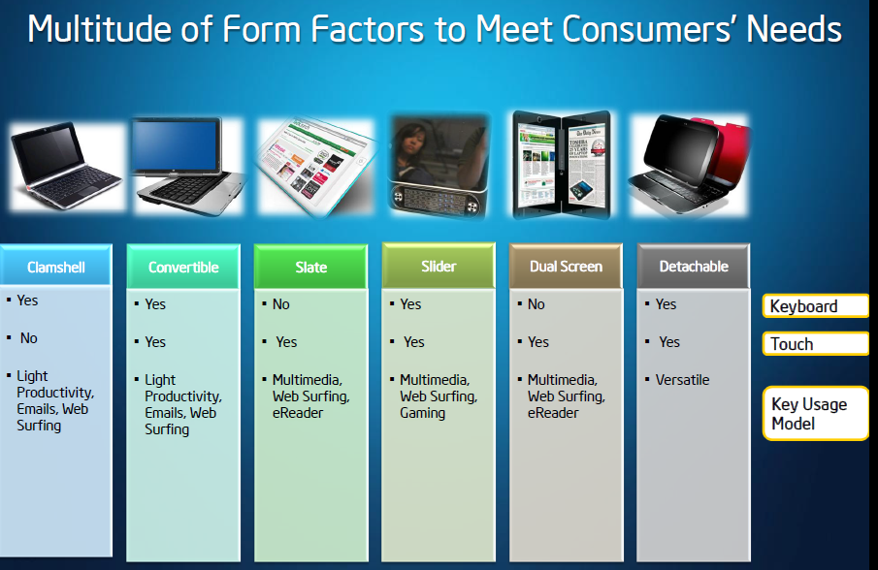
2. Emergence and spread of tablets (5)
Implementation alternatives of tablets -1 [8]

Slide 25
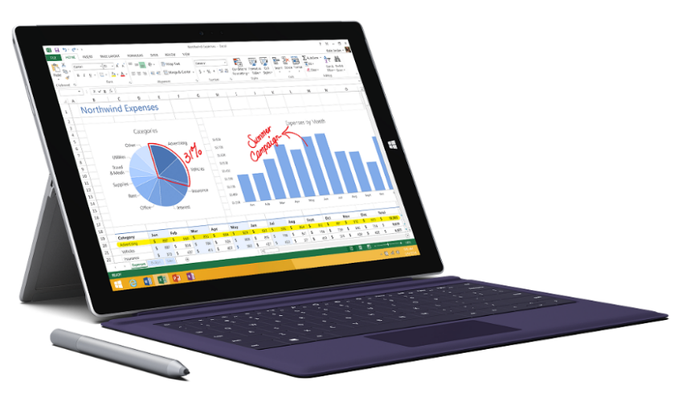
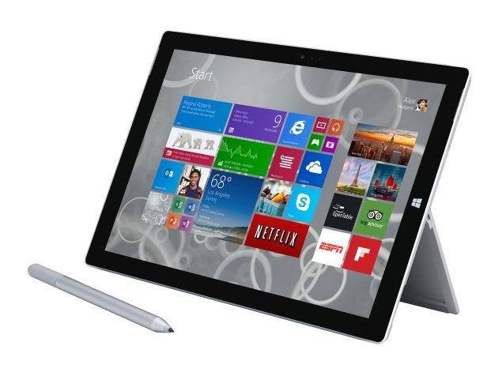
2. Emergence and spread of tablets (6)
Implementation alternatives of tablets -2 [8]
2 in 1 tablets (≈ attachable keyboard + touchscreen)
Example: Windows Surface Pro 3 (8/2014)
Aim: Replacing laptops
Intel’s Surface Pro 3
used as a laptop [22]
Intel’s Surface Pro 3
used as a tablet [23]
*

Slide 26
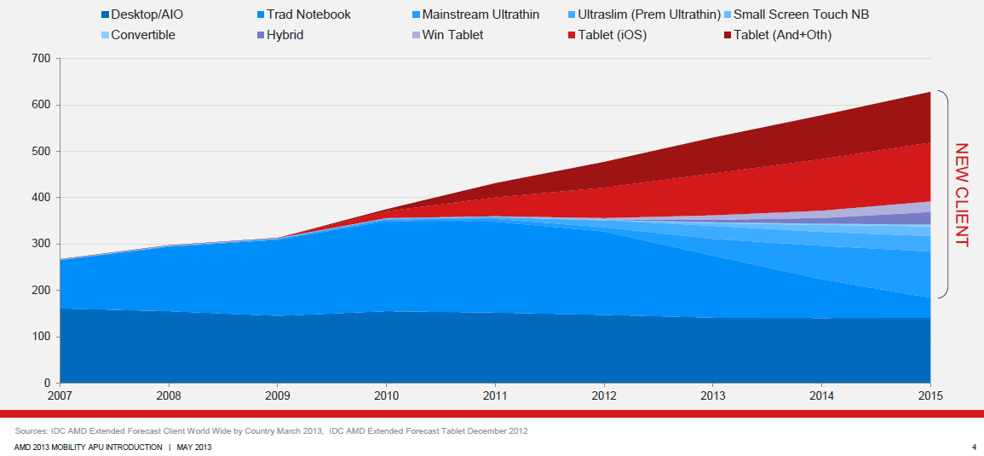
2. Emergence and spread of tablets (7)
Rapid increase of tablet sales in the first half of the 2010’s
Besides smartphones, tablets and all their alternative designs (that provide also keyboard/mouse input, such as convertibles or 2 in 1 designs) have recently the highest growth potential, as indicated in the Figure below (12/1012) [3].
Tablets
Notebooks
Desktops
Figure: Yearly worldwide sales figures of desktops, notebooks and tablets [3]

Slide 27
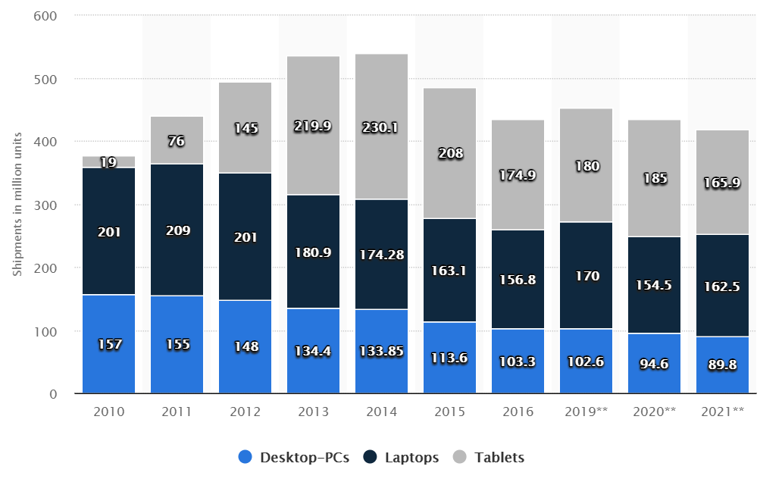
2. Emergence and spread of tablets (8)
Worldwide shipment of desktop PCs, laptops and tablets from 2010 to 2016
as well as sale forecasts until 2021 (in million units) [35]
Source: Gartner

Slide 28
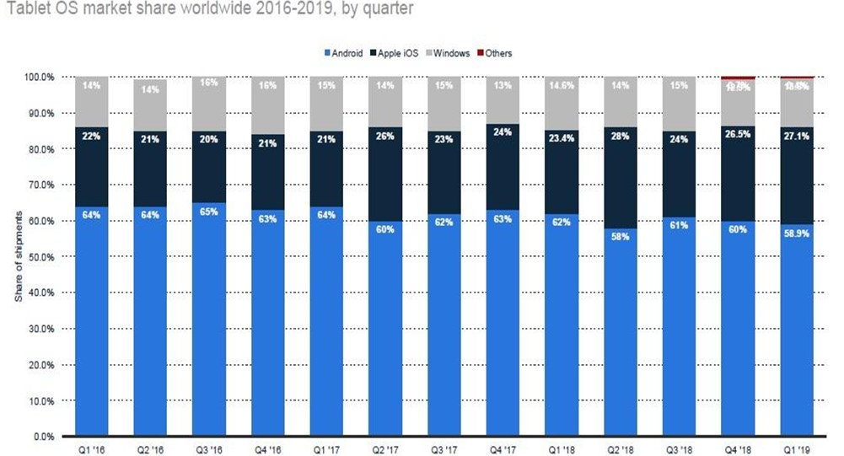
2. Emergence and spread of tablets (9)
Global market share of tablet OSs Q1/2016-Q1/2019 [109]

Slide 29
3. Key requirements of mobile devices (tablets, smartphones)
Notes:
29

Slide 30
3. Key requirement of mobile devices (tablets, smartphones)
3. Key requirements of mobile devices (tablets, smartphones)
Key requirements of mobile devices (tablets, smartphones)
Low power operation
Connectivity
(3G/4G/Wi-Fi)
(Section 3.1)
(Section 3.2)
*

Slide 31
3.1 Low power operation
Notes:
31

Slide 32
3.1 Low power operation (1)
3.1 Low power operation
It will be expressed
either by specifying the power consumption, e.g. the TDP value of
the processor in Watt,
or in in length of the operating hours of the device under given conditions.
Power consumption = Active power (C_{dyn}∗V_{CC}² ∗ f_{c}) + Leakage power (V_{CC} ∗ I_{leak})
*

Slide 33
3.1 Low power operation (2)
Contrasting the design paradigms of traditional and mobile processors
Traditional processors
Tablets and smartphones
High performance/power
(Power efficiency)
(e.g. GFLOPS/Watt)
Low power consumption
(Watt)
(Number of operating hours)
*

Slide 34
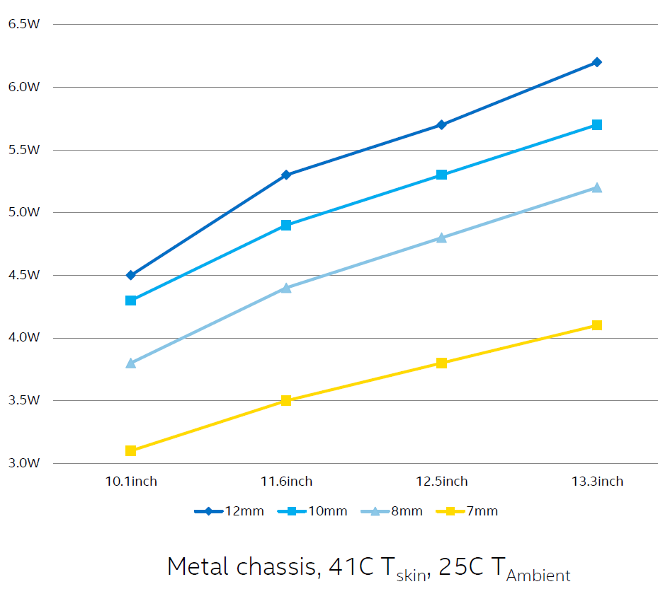
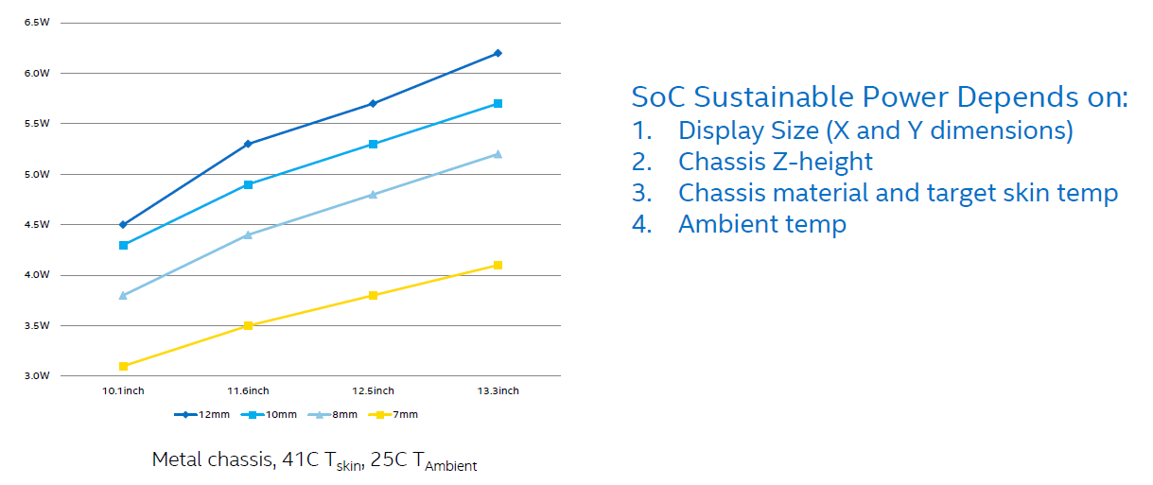
3.1 Low power operation (3)
Sustainable power for fanless tablets [78]
*

Slide 35
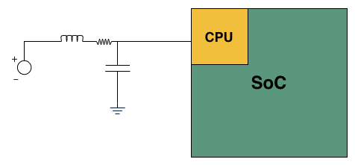
3.1 Low power operation (4)
Measuring the power consumption of a CPU [80]
e.g. 20 mΩ
Basic LC filter modified with an inline resistor

Slide 36
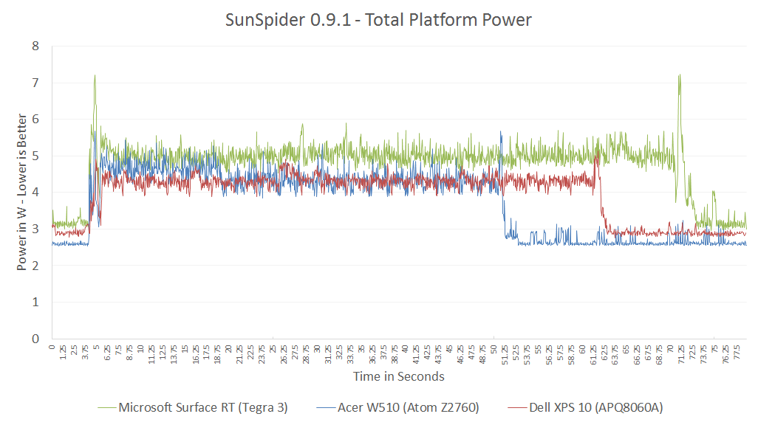
3.1 Low power operation (5)
Example: Total power consumption of tablets
(while running the SunSpider 0.9.1 benchmark) [80]
SunSpider, is a mid-length JavaScript benchmark.
Nvidia
T30
Intel
Atom
Qualcomm
S4
NVidia T30
(4+1C, 4x Cortex A9, 1.3 GHz+ 1C)
Intel Atom Z2760
(2C, 1.8 GHz)
Qualcomm S4 (APQ8060A)
(2C 1.5 GHz)

Slide 37
3.1 Low power operation (6)
Battery sizes of tablets - examples
Apple iPad: 32.4 Wh
Apple iPad Air: 32.4 Wh
Microsoft Surface RT: 31.5 Wh
Acer Iconia W510: 27 Wh
Dell XPS 10: 28 Wh
Battery: akku

Slide 38
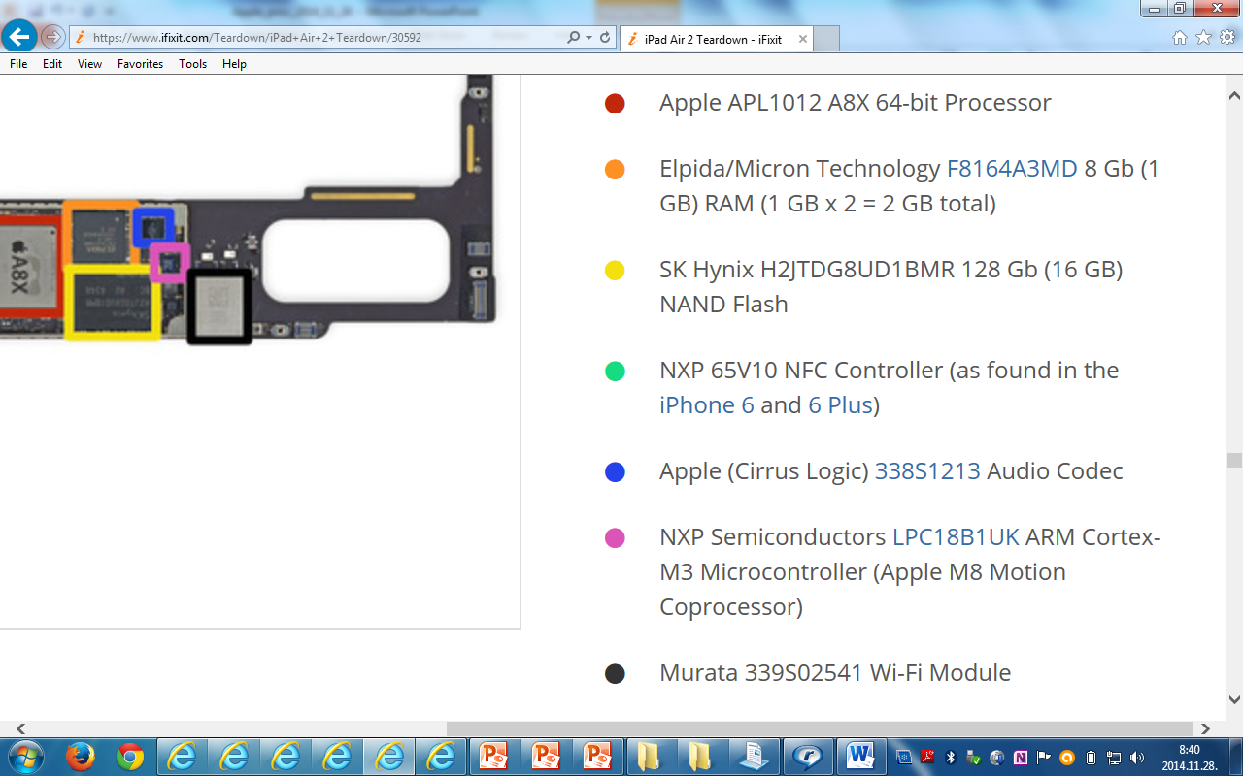
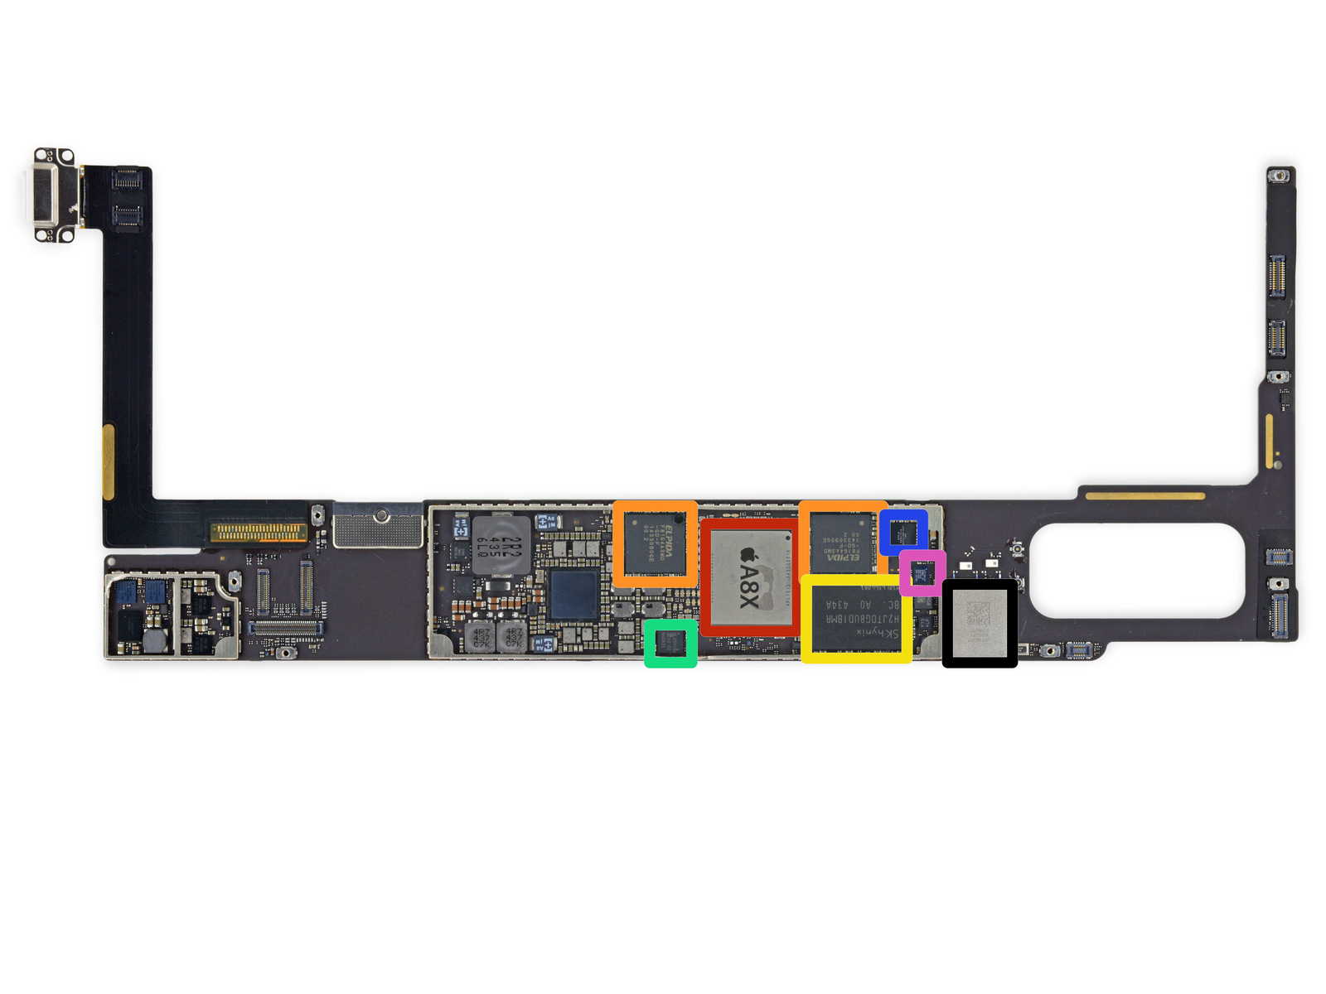
3.1 Low power operation (7)
Total platform power consumption
It results from the power consumption of the SOC, Flash memory, co-processors etc.
i.e. from any circuit that is mounted on the motherboard.
Figure: Example: one side of the iPad Air 2 motherboard [79]

Slide 39
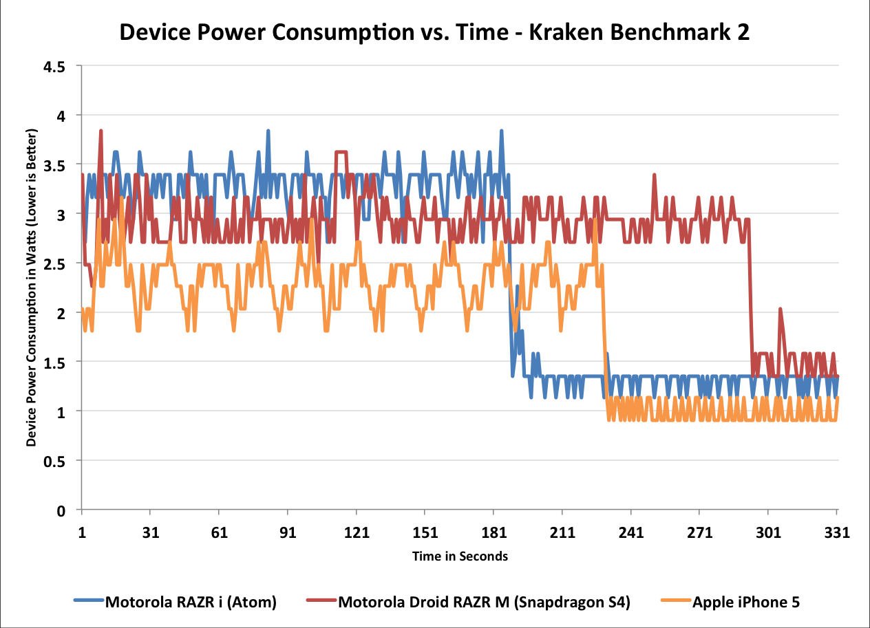
3.1 Low power operation (8)
Example: Power consumption of smartphones while running the
(Kraken Benchmark 2 [80]
Intel
Atom Z2460
Qualcomm
S4
Apple
A6
*
1.6 GHz Atom Z2460 (x86-32)
1.5 GHz 2C MSM8960 (Krait 200, ARMv7)
1.3 GHz 2C A6 (Swift, ARMv7)

Slide 40
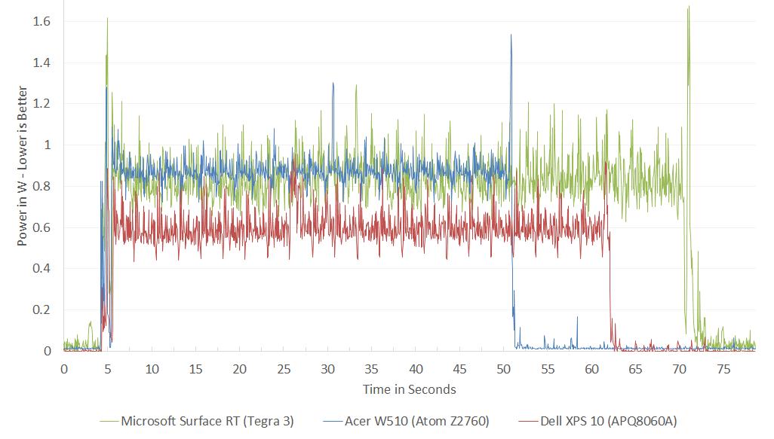
3.1 Low power operation (9)
Example: Power consumption of CPUs (while running the SunSpider 0.9.1
benchmark) [80]
Intel
Atom
Nvidia
T30
Qualcomm
S4
SunSpider, is a mid-length JavaScript benchmark.
In the power consumption of Qualcomm's S4
the L2 cache is not taken into account.
NVidia T30
4+1x Cortex A9, 1.3 GHz)
Intel Atom Z2760
(2C, 1.8 GHz)
Qualcomm S4 (APQ8060A)
(2C 1.5 GHz)
*

Slide 41
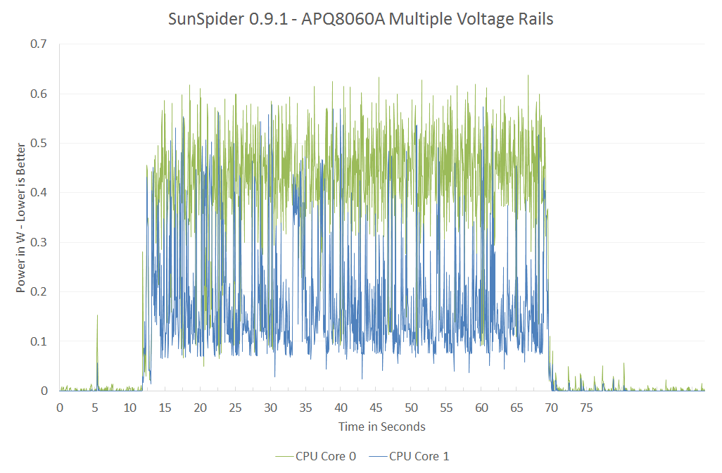
3.1 Low power operation (10)
Remark to the power management of the referenced processors [80]
The cores in both the dual core Atom and 4 ARM9 cores of NVIDIA's Tegra 3 share
the same voltage and frequency during power management.
By contrast, the dual core Qualcomm's S4 make use of per core voltage and
frequency scaling, as indicated below.
In addition L2 has a separate voltage rail and can be power managed separately.
Figure: Power consumption of the S4 while running the Sunspider 0.9.1 benchmark [80]

Slide 42
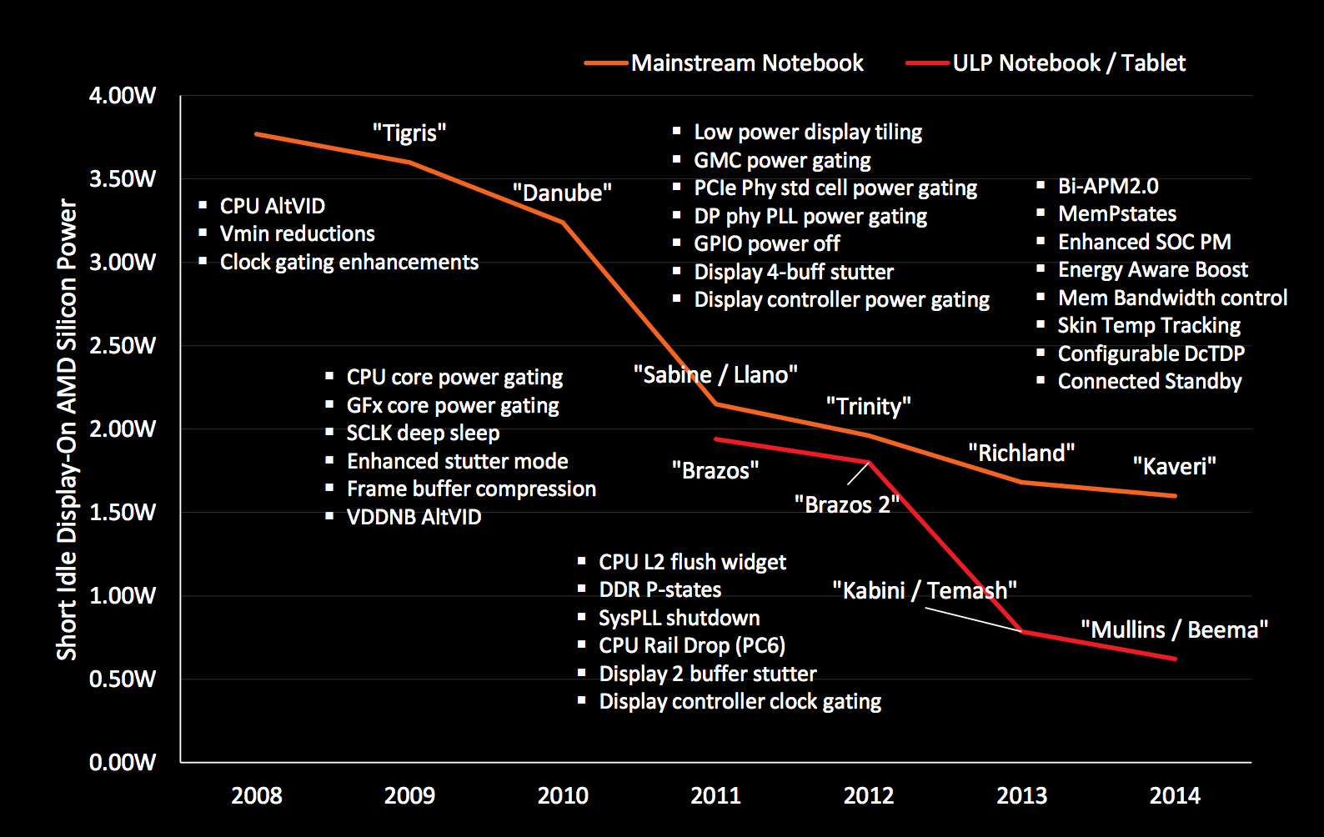
3.1 Low power operation (11)
Example: AMD’s technologies to reduce power consumption (2008-2014) [27]

Slide 43
3.1 Low power operation (12)
How to achieve low power consumption?
In this point let’s focus on the microarchitecture of CPUs (processor cores).

Slide 44
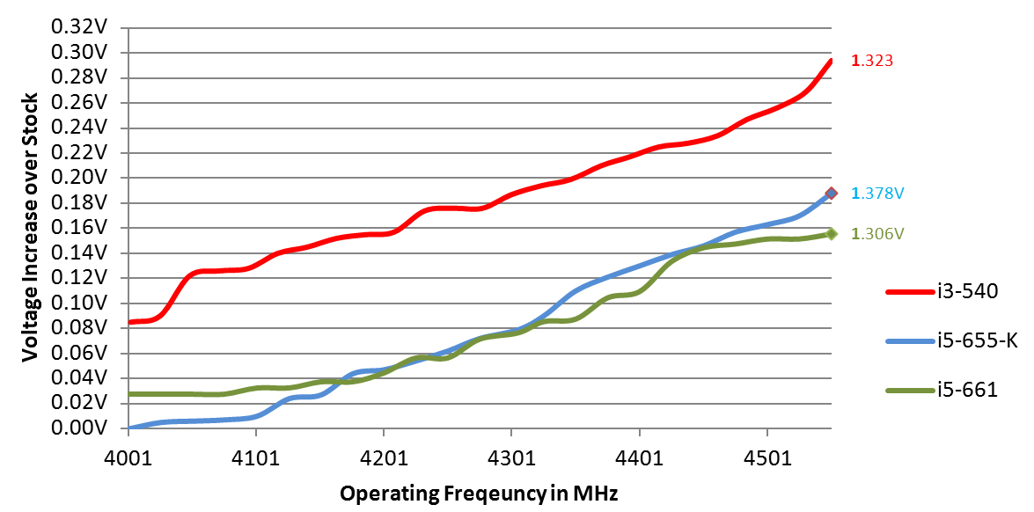
3.1 Low power operation (13)
Key enabler of low power microarchitectures – low clock frequency -1
Basics
Active power consumption = C_{dyn}∗V_{CC}² ∗ f_{c}
In addition: higher fc requires higher V_{CC} (V_{CC} ≈ const x f_{C}).
Figure: Core voltage (V_{CC}) vs. clock frequency (f_{C}) for Intel’s Westmere processors [26]
*

Slide 45
3.1 Low power operation (14)
Key enabler of low power microarchitectures – low clock frequency -1
It follows
Higher f_{C}
higher V_{CC}
higher D
D ≈ f_{C}³
Traditional CPUs
Mobile CPUs
Allow higher power budget
Allow lower power budget
Relative high base clock frequency
(typically 2-4 GHz)
Relative low base clock frequency
(typically 1-2 GHz)
*

Slide 46
3.1 Low power operation (15)
Example: Base frequency of Skylake models with different TDPs and
configurations (Based on data from [58])
TDP (W) | No. of cores | Graphics | No. of graphics EUs | eDRAM | Base frequency up to (GHz)
4.5 | 2 | HD 515 | 18 | -- | 1.2
15 | 2 | HD 540 | 48 | 64 MB | 2.2
15 | 2 | HD 520 | 24 | -- | 2.6
28 | 2 | HD 550 | 48 | 64 MB | 3.3
35 | 4 | HD 530 | 24 | -- | 2.8
45 | 4 | HD 530 | 24 | -- | 2.9
65 | 4 | HD 530 | 24 | -- | 3.4
91 | 4 | -- | -- | -- | 4.2
Note that low TDP can be achieved first of all by reducing the core frequency and
limiting the computer resources (cores, GPU EUs) provided.
*

Slide 47
3.2 Connectivity
Notes:
47

Slide 48
3.2 Connectivity (1)
3.2 Connectivity
Connectivity may include (depending on the model features)
LAN connectivity
Wi-Fi connectivity (coined after Hi-Fi)
mobile broadband connectivity (recently 3G/4G/5G).
Subsequently, we will focus only on the mobile broadband connectivity.
*

Slide 49
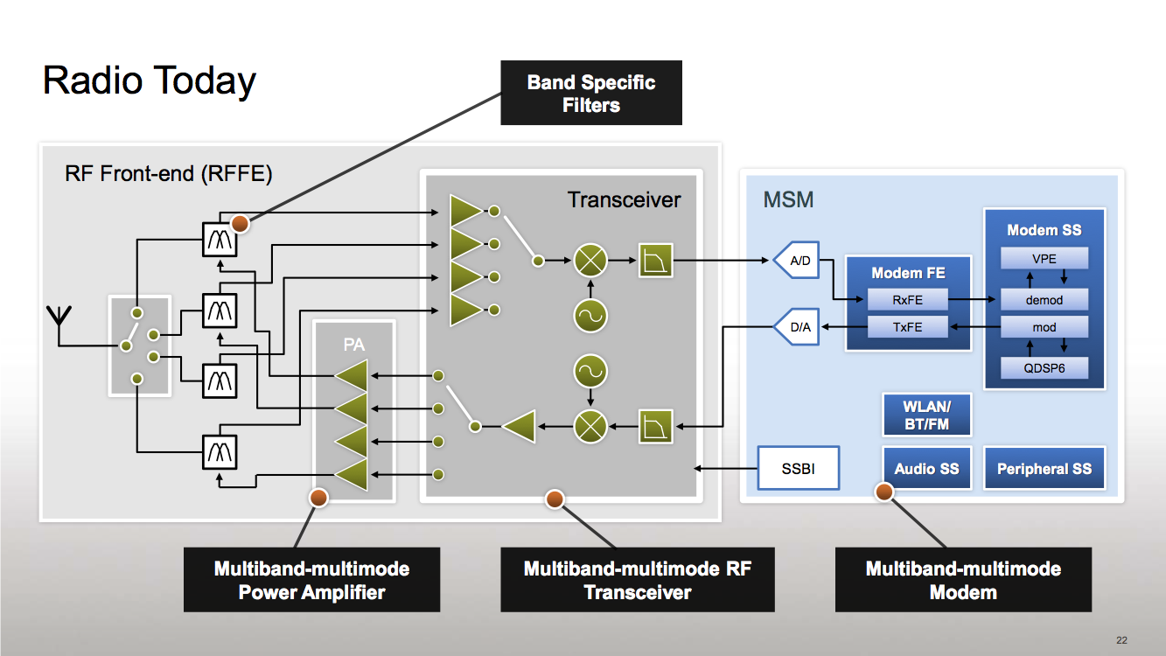
3.2 Connectivity (2)
Simplified view of a platform providing mobile broadband connectivity [59]
RF
Modem + Application Processor
(if integrated implementation)
Modem: Actually a baseband
processor that runs under a
proprietary real-time OS).
It has two functions:
LNA
Mixers
to performe modulation/
demodulation and
to manage the
communication
according to a protocol
(DSP)
PA: Power Amplifier LNA: Low Noise Amplifier Transceiver: Transmitter/Receiver
Multiband: multiple frequency bands, e.g. 900/1800 MHz
Multimode: 3G/ 4G (LTE)
*

Slide 50
3.2 Connectivity (3)
Integration of the application processor and the modem
Integrating the modem onto the application processor die results in less costs and
shorter time to market.
Qualcomm pioneered this move designing integrated parts already about 1996.
Integration of the application processor and the modem
Use of discrete
application processor and modem
Use of integrated
application processor and modem
Qualcomm’s MSM product offerings
since ~ 1996
including their Snapdragon families
MediaTek’s 81xx line (2013)
MediaTek’s 6xxx/8xxx families (since ~ 2009)
except the 81xx line
NVIDIA’s Tegra 2-4, K1 (since 2011)
NVIDIA’s Tegra 4i (2014)
Samsung’s Exynos 3/4/5/7 families
(since ~ 2010)
Samsung’s Exynos 8 Octa 8890
(2015)
E.g.
Intel’s Atom line (2008)
except recent Atom X3 (Sophia (2015)
Intel’s Atom X3 (Sophia) (2015)
Apple’s own processor designs
(Swift (2012), Cyclone (2013)
*

Slide 51
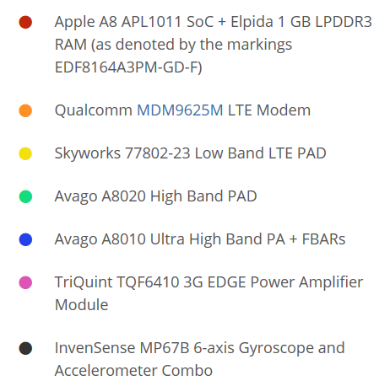
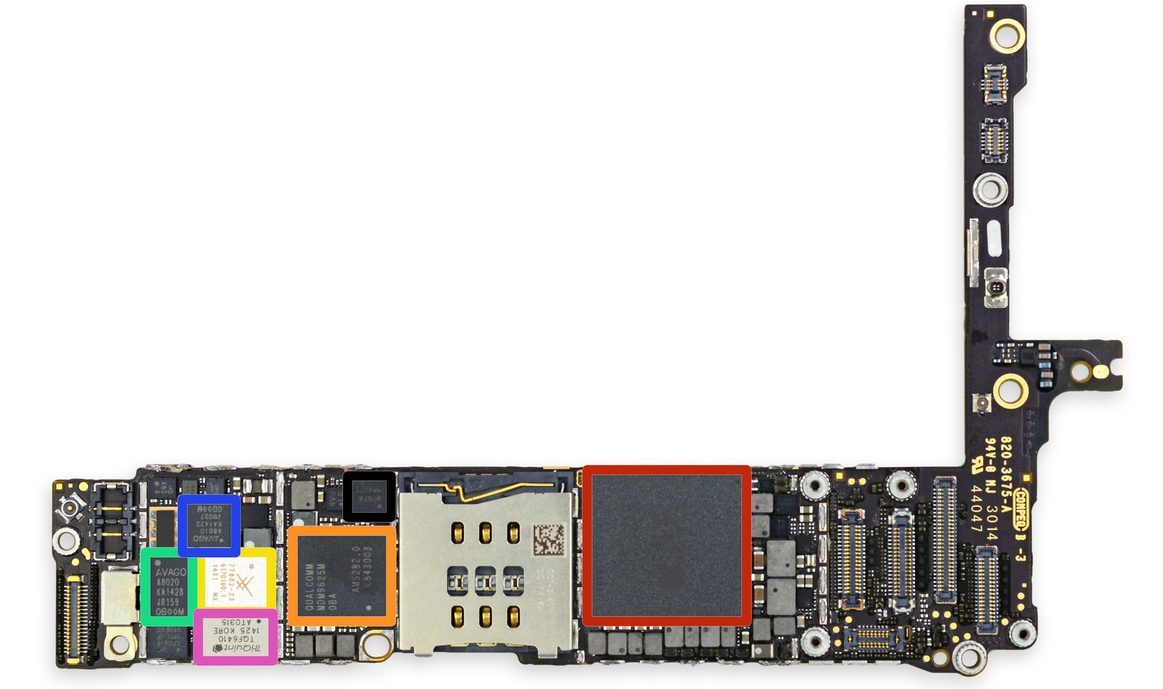
3.2 Connectivity (4)
Example of using discrete application processor and modem: The iPhone 6+
The front side of the
logic board [60]
PAD: Integrated Power Amplifier-Duplexer

Slide 52
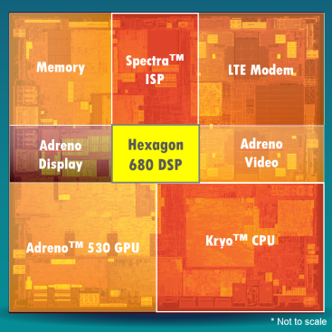
3.2 Connectivity (5)
Example of using an integrated application processor and a modem
(Qualcomm’s Snapdragon 820) [61]

Slide 53
4. How leading IT vendors addressed the mobile boom?
4.1 Intel’s response to the mobile boom
4.2 AMD’s response to the mobile boom
4.3 Microsoft’s response to the mobile boom
4.4 A new challenge for Intel and AMD: presented
by Apple
Notes:
53

Slide 54
4.1 Intel’s response to the mobile boom
Notes:
54

Slide 55
4.1 Intel’s response to the mobile boom (1)
4.1 Intel’s response to the mobile boom-1
Intel’s and AMD’s traditional CPUs are designed for high performance/power,
but mobile devices require low power consumption, consequently
Intel’s and AMD’s traditional microarchitectures are not suited for mobile devices.
*

Slide 56
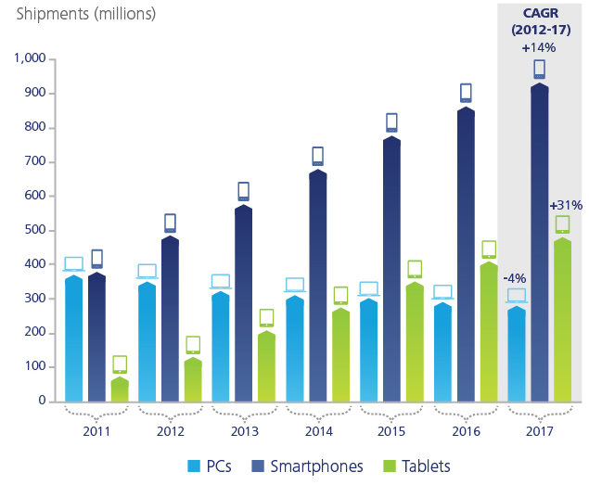
4.1 Intel’s response to the mobile boom (2)
(1)
Dynamic increase of smartphone and tablet shipments vs. PCs (2011-2017)
[28]
Smartphone and tablet shipments
will vastly exceed PC shipments
(desktops and notebooks)
in a few years
Source: Gartner (2013)

Slide 57
4.1 Intel’s response to the mobile boom (3)
Intel’s and AMD’s response to the mobile boom-2
To avoid shrinking market shares on the global processor market
and benefit from the rapidly increasing mobile market
Intel and AMD needed processors that are competitive with ARM based designs.
Thus Intel and AMD were forced
to introduce new, narrow (i.e. 2-wide), low-power microarchitectures
for their CPUs and
clock them at a relative low rate.
*

Slide 58
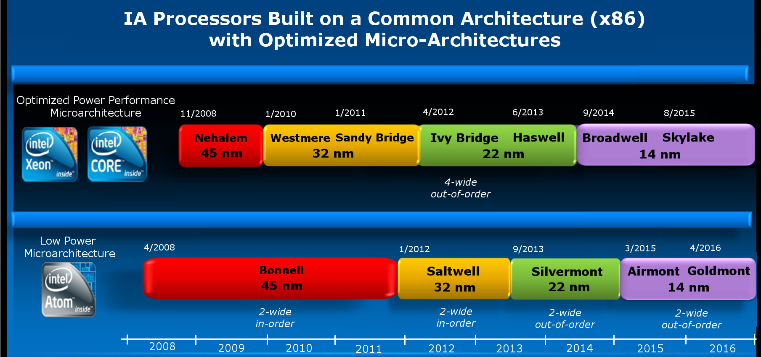
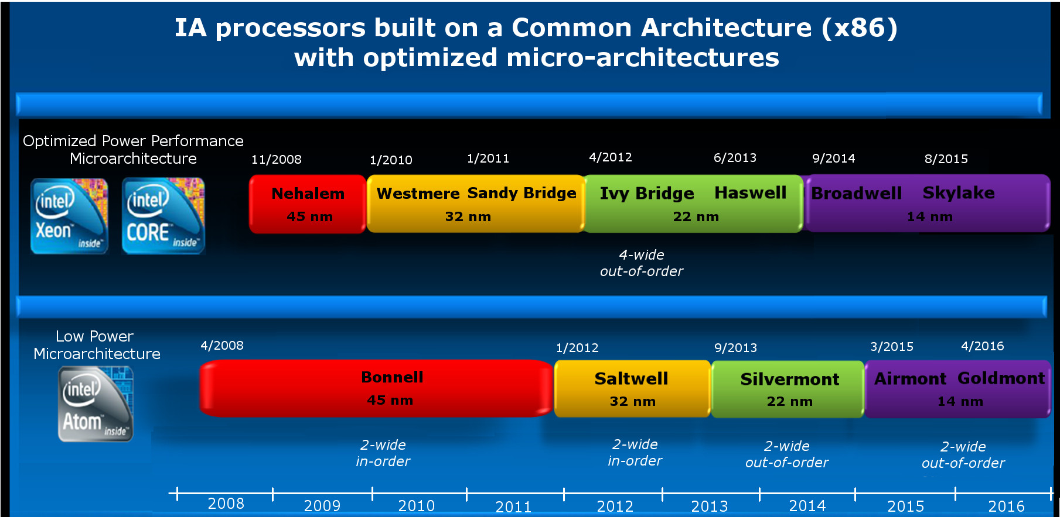
4.1 Intel’s response to the mobile boom (4)
Intel's effort to enter the mobile market [Based on 2]
Introduction of the Atom line targeting the mobile market
2-wide
in-order
2-wide
out-of-order
2-wide
out-of-order
3-wide
out-of-order
*

Slide 59
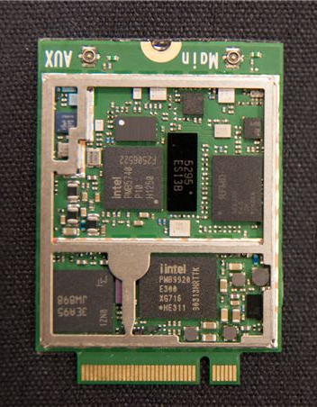
4.1 Intel’s response to the mobile boom (5)
Intel’s (off-die) XMM modem line
(including a 3G/4G modem and a transceiver (on two chips))
RF Transceiver
3G/4G modem
Figure: Implementation
example of the
XMM7160 [46]
*

Slide 60
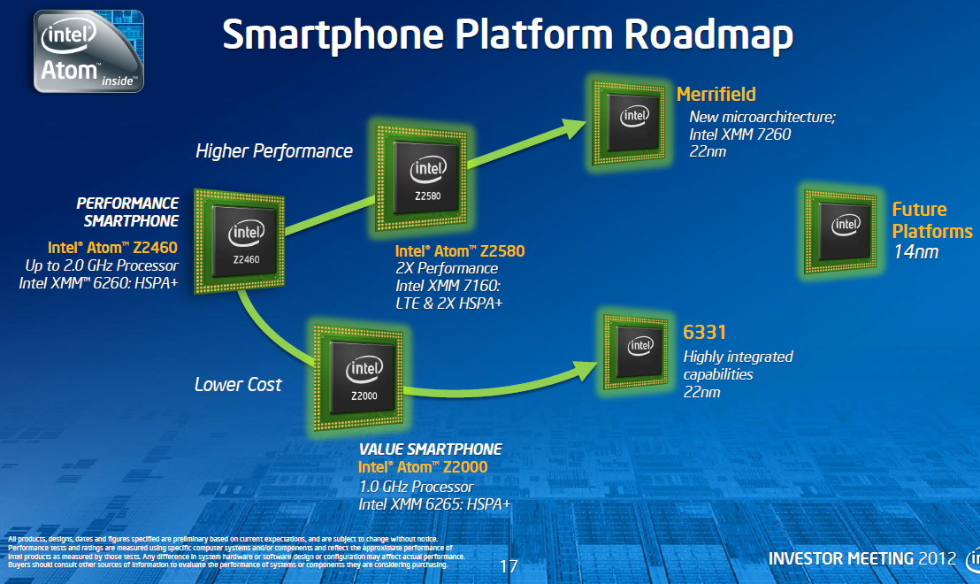
4.1 Intel’s response to the mobile boom (6)
Intel's platforms targeting tablets (based on [11])
Willow Trail
(2016)
Cherry Trail
(2015)
Bay Trail
(2013)
Performance (not to scale)
Clover Trail
(2012)
Z5xxx
4x Goldmont
14 nm
+XMM 7360
W/A
Oak Trail
(2011)
Z4xxx
4x Airmont
14 nm
+XMM 7160/7260
W/A
Menlow
(2008)
Z37x0
2x/4x Silvermont
22 nm
+XMM 6260/7160
W/A
Cancelled
in 04/2016
Z2760
2x Saltwell
32 nm
+XMM 6260
W
Z650/670
1x Bonnell
45 nm
+ no XMM
W/MeeGo/A
Z5xx
1x Bonnell
45 nm
+ no XMM
W/Moblin
W: Windows
A: Android
(Clover Trail+ (2013) not shown in the Figure!)
(It is used both for tablets and smartphones)
(Z2520-2580))
(A )

Slide 61
4.1 Intel’s response to the mobile boom (7)
Intel’s Atom platforms targeting smartphones (based on [11])
Morganfield
(2016)
Moorefield
(2014)
Merrifield
(2014)
Performance (not to scale)
Clover Trail+
(2013)
Z5xxx
4x Goldmont
14 nm
+XMM 7360
Z35xx
4x Silvermont
22 nm
+XMM 7260/2/35
Medfield
(2012)
Z34x0
2x Silvermont
22 nm
+XMM 7160/7260
Cancelled
in 04/2016
Morestown
(2010)
Z2520-2580
2x Saltwell
32 nm
+XMM 6268/6360/7160
SoFIA
(x3 3G/LTE)
(2015)
Riverton
(2015)
Z2460/2480
1x Saltwell
32 nm
+XMM 6260
Slayton
(2014)
Lexington
(2013)
Z6xx
1x Bonnell
45 nm
+Wireless
module
C31xx/32xx/34xx
2x/4x Silvermont
28 nm
Integrated LTE
3G/4G modem
Z3xxx
2x Airmont
14 nm
Integrated
LTE modem
Z3xxx
2x Silvermont
22 nm
+A-GOLD 620
Z2420
1x Saltwell
32 nm
+XMM 6265
Cancelled
in 04/2016
Planned, not mplemented
Planned, not implemented

Slide 62
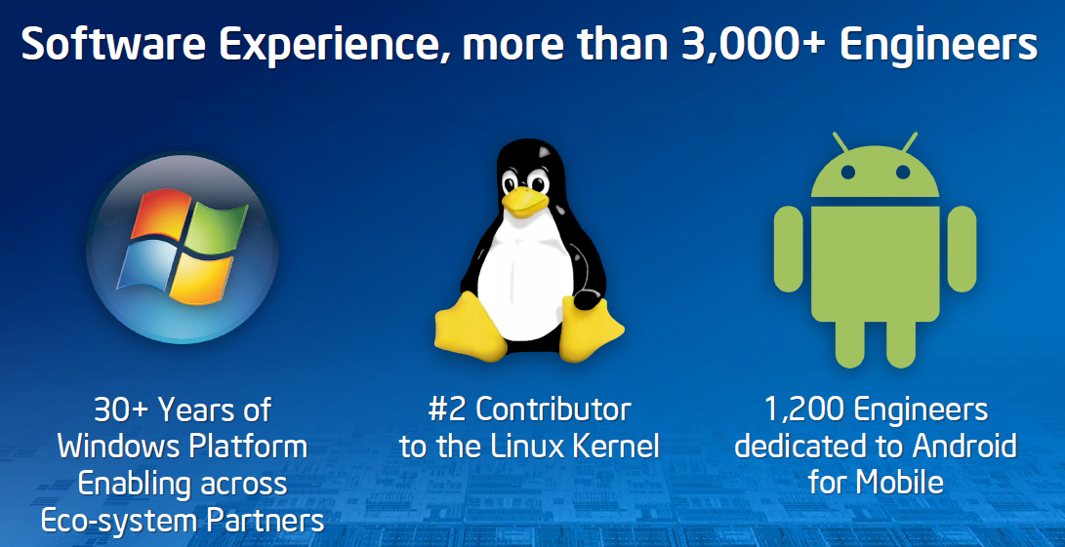
4.1 Intel’s response to the mobile boom (8)
Intel’s effort to optimize their devices from the software point of view
In their 2012 Investor meeting (5/2012) Intel revealed that more than 3000
engineers are working on OS support, among them about 1200 engineers
are dedicated to Android, as indicated below [11].
*

Slide 63
4.1 Intel’s response to the mobile boom (9)
Intel’s share in smartphone application processors in 2014 [54]
Despite great efforts Intel could not become one of the 5 largest suppliers
of smartphone application processors.
According to industry sources in 2014 Intel achieved less than 1 % share in revenue
in smartphone application processors.
As a consequence, in 04/2016 Intel cancelled their smartphone processor designs.
*

Slide 64
1. Emergence and spread of smartphones (10)
Intel's withdrawal from the mobile smartphone market in 04/2016
Morganfield
(2016)
Moorefield
(2014)
Merrifield
(2014)
Performance (not to scale)
Clover Trail+
(2013)
Z5xxx
4x Goldmont
14 nm
+XMM 7360
Z35xx
4x Silvermont
22 nm
+XMM 7260/2/35
Medfield
(2012)
Z34x0
2x Silvermont
22 nm
+XMM 7160/7260
Cancelled
in 04/2016
Morestown
(2010)
Z2520-2580
2x Saltwell
32 nm
+XMM 6268/6360/7160
SoFIA
(x3 3G/LTE)
(2015)
Riverton
(2015)
Z2460/2480
1x Saltwell
32 nm
+XMM 6260
Slayton
(2014)
Lexington
(2013)
Z6xx
1x Bonnell
45 nm
+Wireless
module
C31xx/32xx/34xx
2x/4x Silvermont
28 nm
Integrated LTE
3G/4G modem
Z3xxx
2x Airmont
14 nm
Integrated
LTE modem
Z3xxx
2x Silvermont
22 nm
+A-GOLD 620
Z2420
1x Saltwell
32 nm
+XMM 6265
Cancelled
in 04/2016
Planned, not mplemented
Planned, not implemented

Slide 65
2. Emergence and spread of tablets (11)
Intel’s effort to rise its share in tablet application processors [35], [36], [56]
Intel ’s action to pay subsidies to OEMs if they change to Atom processors
Since about 2013 Intel offered significant subsidies (~ 50 $/tablet) to netbook
and tablet manufacturers to let them switch from ARM based processors
to x86 Atom processors.
Achieved market share in 2015 due to paying subsidies
In 2015 Intel achieved the 3. place in the worldwide market share in
tablet application processor revenue, as the Table below shows.
Tablet application processors worldwide market share 2015 (revenue) [57]
Apple (USA) | 31 %
Qualcomm (USA) | 16 %
Intel (USA) | 14 %
MediaTek (Taiwan)
Samsung (S. Korea)
Table: Worldwide market share of application processors used in tablets in 2015
(based on revenue)
Subsidy: szubvenció
*

Slide 66
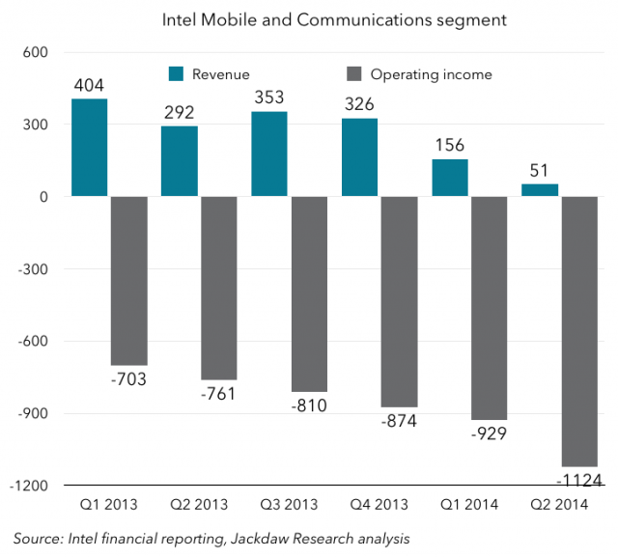
2. Emergence and spread of tablets (12)
Intel's losses on the mobile development in 2013 - 2014 [74]
Nevertheless, owing to subsidies Intel's mobile and communication division has lost
7 billion $ in the years 2013-2014 , as indicated in the next Figure [83].
*
Figure: Revenues/operating income of Intel's Mobile and Communications segment [83]

Slide 67
4.1 Intel’s response to the mobile boom (13)
Intel's withdrawal from the mobile tablet market in 04/2016
Willow Trail
(2016)
Cherry Trail
(2015)
Bay Trail
(2013)
Performance (not to scale)
Clover Trail
(2012)
Z5xxx
4x Goldmont
14 nm
+XMM 7360
W/A
Oak Trail
(2011)
Z4xxx
4x Airmont
14 nm
+XMM 7160/7260
W/A
Menlow
(2008)
Z37x0
2x/4x Silvermont
22 nm
+XMM 6260/7160
W/A
Cancelled
in 04/2016
Z2760
2x Saltwell
32 nm
+XMM 6260
W
Z650/670
1x Bonnell
45 nm
+ no XMM
W/MeeGo/A
Z5xx
1x Bonnell
45 nm
+ no XMM
W/Moblin
W: Windows
A: Android
(Clover Trail+ (2013) not shown in the Figure!)
(It is used both for tablets and smartphones)
(Z2520-2580))
(A )

Slide 68
4.2 AMD’s response to the mobile boom
Notes:
68

Slide 69
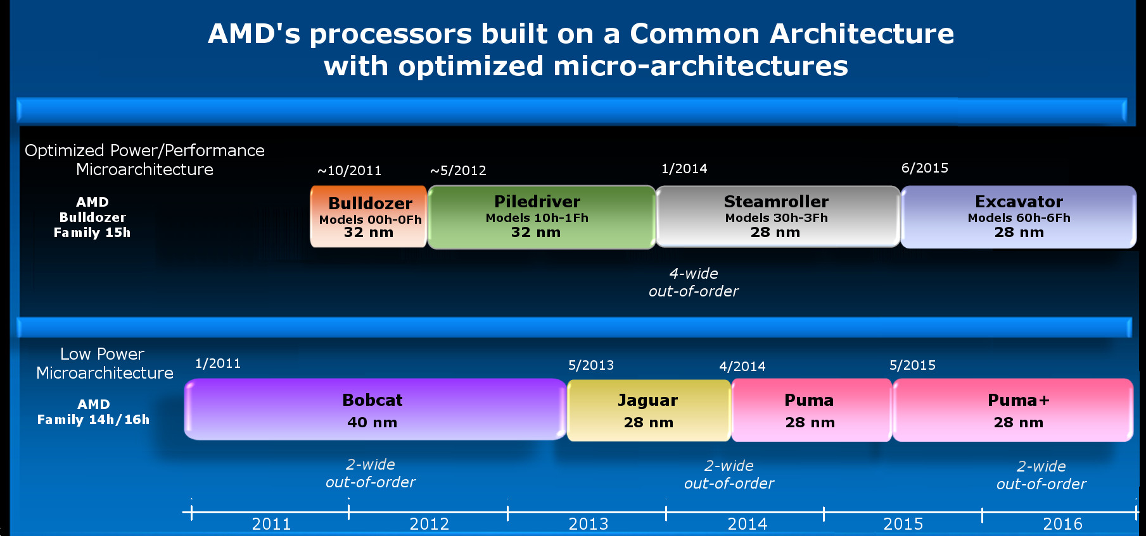
4.2 AMD’s response to the mobile boom (1)
4.2 AMD’s response to the mobile boom
Emergence and evolution of AMD’s low power “Cat”-line
4-wide
out-of-order
4/2014
2-wide
out-of-order
2-wide
out-of-order
2-wide
out-of-order
2014
*

Slide 70
4.2 AMD’s response to the mobile boom (2)
Cancellation of AMD's Cat line in 2015
As the previous market share tables show neither Intel nor AMD became
successful on the mobile market, so beyond Intel also AMD cancelled their
activities on this market.
The last core of AMD's Cat line was the Puma+ core (launched in 6/2015 in the
Carrizo-L APU).
Instead AMD placed emphasis on Zen core based products in the mobile sector.
*

Slide 71
4.2 AMD’s response to the mobile boom (4)
Use of AMD’s low power Jaguar and Puma architectures in game consoles
Many game consoles in the 2010’s were based on AMD’s low power Jaguar
architecture, including
Nintendo Wii U (2012)
Sony Playstation 4 (2013)
Microsoft Xbox One (2013)
Microsoft Xbox One S (2016)
Microsoft Xbox One X (2017)
Ataribox (2017).
These consoles have a noticeable global market share, as indicated in the next
Figure.
*

Slide 72
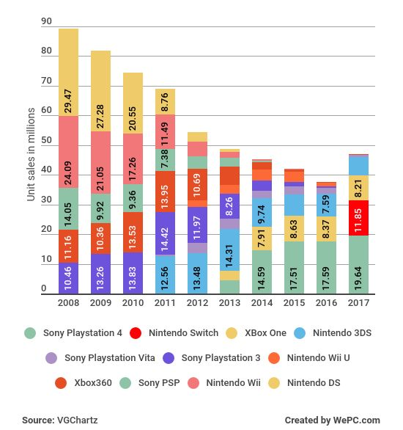
4.2 AMD’s response to the mobile boom (5)
Global unit sales of video game consoles between 2008-2017 [105]
(in million units)
With AMD’s processors
Nintendo Wii U (2012)
Sony Playtation 4 (2013)
Microsoft Xbox One (2013)
Microsoft Xbox One S (2016)
Microsoft Xbox One X (2017)
AtariBox (2017).

Slide 73
4.2 AMD’s response to the mobile boom (6)
Use of AMD Zen 2-based CPUs in recent game consoles
Game console | Release date | CPU
Nintendo Switch Lite | 09)2019 | Custom NVIDIA Tegra
Microsoft Xbox Series X | 11/2020 | AMD Zen 2 custom CPU, 8 cores, 16 threads
Sony PlayStation 5 | 11/2020 | AMD Zen 2 custom CPU, 8 cores, 16 threads

Slide 74
4.3 Microsoft’s response to address the mobile boom
Notes:
74

Slide 75
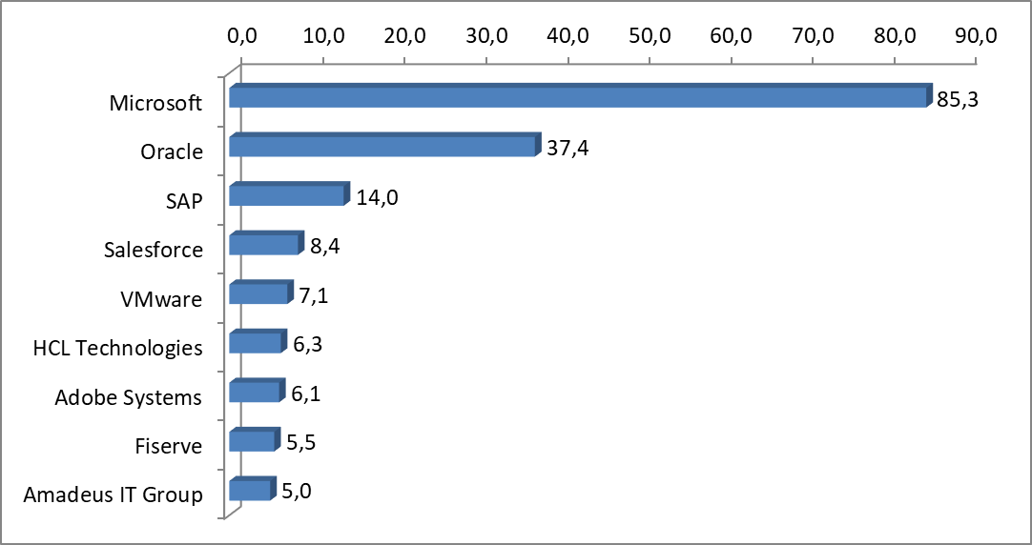
4.3 Microsoft’s response to the mobile boom (1)
4.3 Microsoft’s response to address the mobile boom -1
Worldwide software revenues in 2017 (billion US $) [103]
(GDP of Hungary in 2017: ~ 140 billion US $)
*

Slide 76
4.3 Microsoft’s response to the mobile boom (2)
Microsoft's response to address the mobile boom -2
Microsoft's response to address the mobile boom
Introducing
Windows for
smartphones
Widening the scope
of Windows to cover also touchscreen tablets
Widening the scope
of Windows to cover also ARM processors
Microsoft’s vision to become a
devices and services
company
(Subsection a)
(Subsection b)
(Subsection c)
(Subsection d)
*

Slide 77
4.3 Microsoft’s response to the mobile boom (3)
a) Introducing Windows for smartphones
2003: Windows Mobile 2003
It was based on the kernel of Microsoft's Windows CE.
(Windows CE was an OS for embedded devices, optimized for minimal
memory).
2004-2008 Subsequent releases up to Windows Mobile 6.5.
2010: Windows Phone 7
Nokia's Lumia smartphone series, starting with the Lumia 800 (2011),
were based on Qualcomm processors but run under the Windows Phone
(later renamed to Windows 10 Mobile) OS.
Windows Phone 7 earned moderate success.
Subsequent versions:
2010 Windows Phone 8
2014 Windows Phone 8.1
2015: Windows 10 Mobile
Despite Microsoft's efforts, Windows based phone OSs could not achieve
notable market share, as indicated in the next Figure.
Finally, in 10/2017 Microsoft cancelled Windows 10 Mobile.
Remark: Only Windows Mobile 2003 and Windows 10 Mobile are expected to know.
*

Slide 78
4.3 Microsoft’s response to the mobile boom (4)
Global market share of leading smartphone OSs in terms of sales figures
to end users from Q1 2009 to Q2 2018 [42]
*

Slide 79
4.3 Microsoft’s response to the mobile boom (5)
b) Widening the scope of Windows to cover also touchscreen tablets -1
Windows 8, released in 2012, was Microsoft’s first try to cover the whole spectrum
of computers from servers through desktops and notebooks till touchscreen tablets
by a single OS.
It introduced a new, tiles-based start menu, but the classic start menu can be
reinstalled, as seen in the next Figure.
*

Slide 80
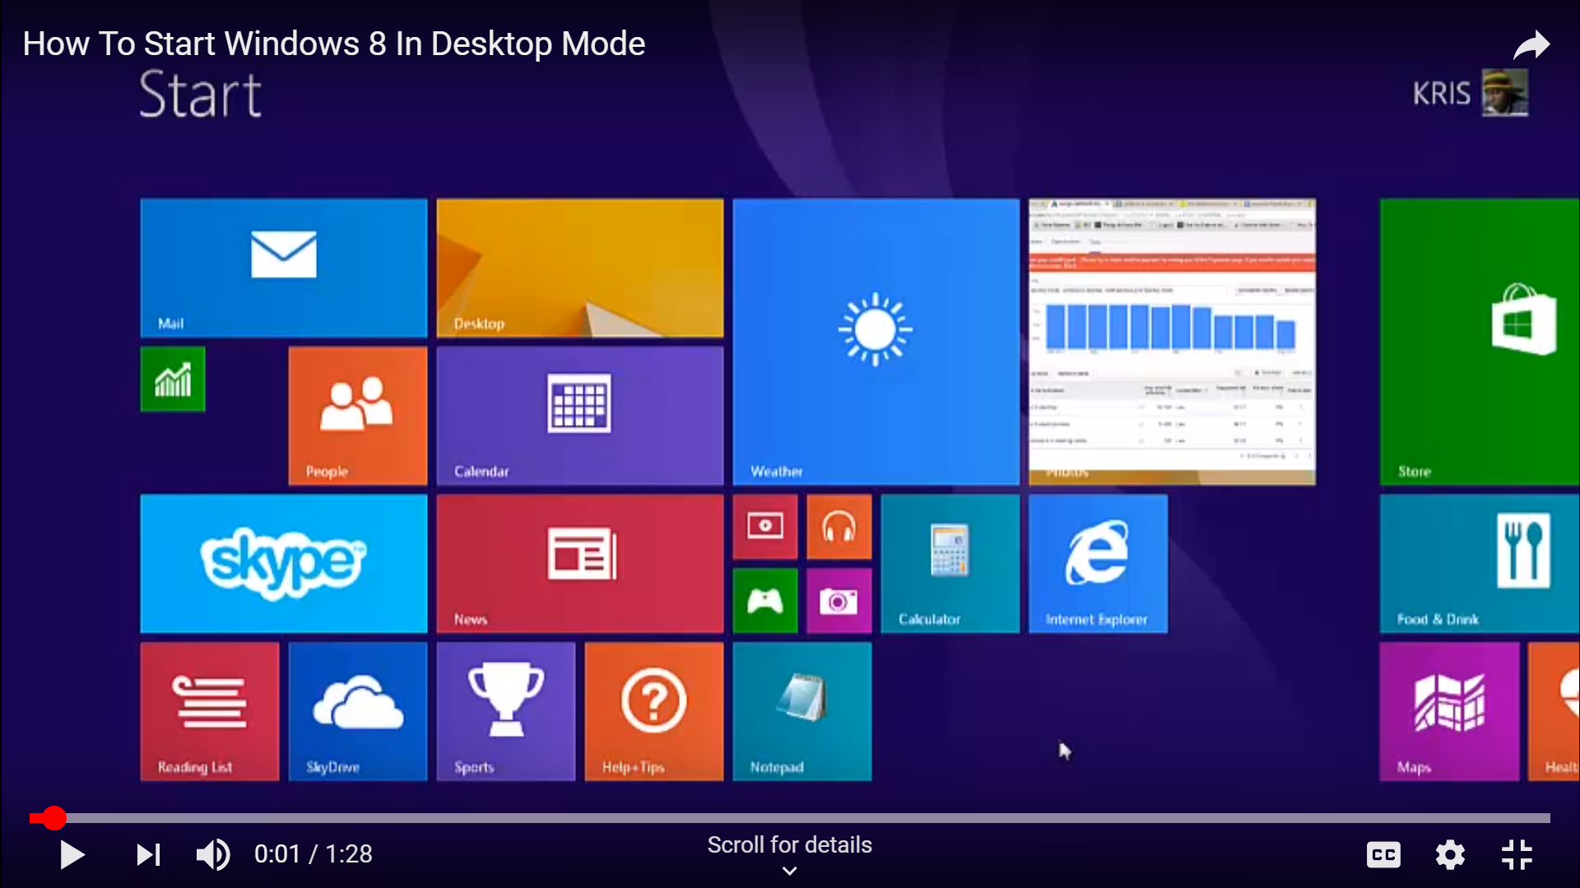
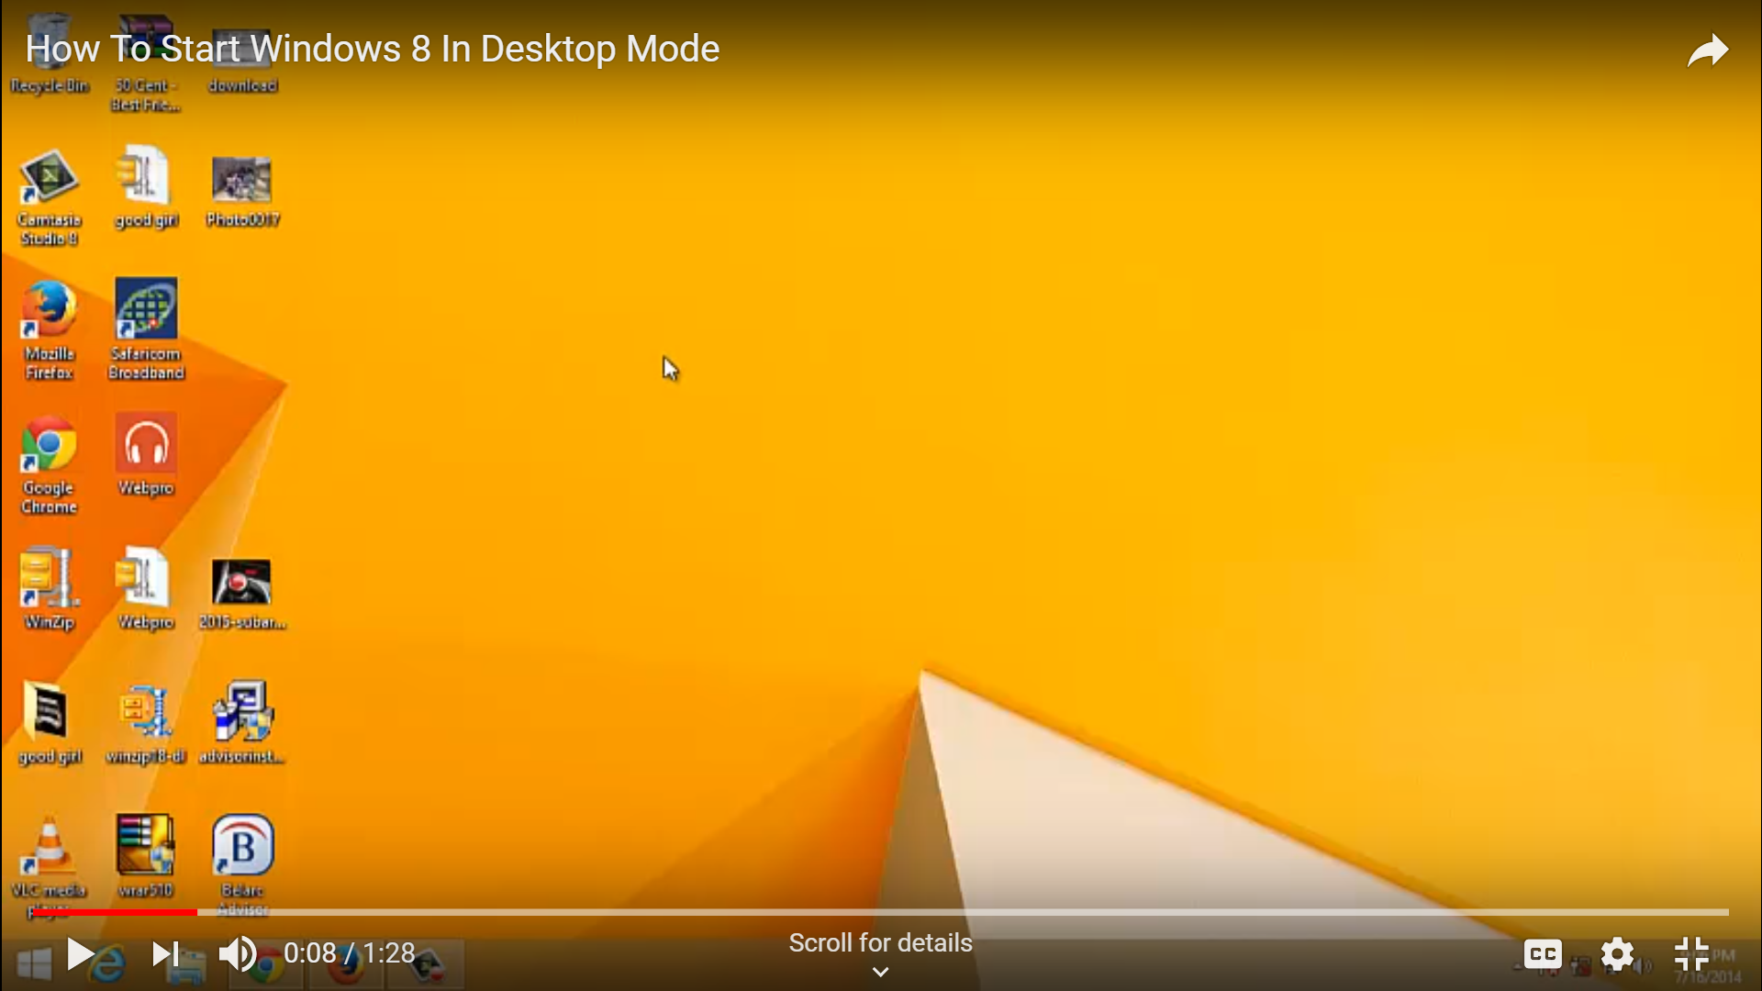
4.3 Microsoft’s response to the mobile boom (6)
Tiles-based touchscreen and reinstalled “classic menu” of Windows 8 [104]
Reinstallation is a rather
complicated procedure.

Slide 81
4.3 Microsoft’s response to the mobile boom (7)
Widening the scope of Windows to cover also touchscreen tablets -2
Market reflections: Windows 8 earned moderate success, Android and iOS
dominated further on the market for smartphones and tablets.
Subsequent OS releases that cover touch screen devices as well:
2013 Windows 8.1
It is an upgrade for Windows 8.
Again there is a possibility (through a number of steps) to switch
between the tile-based Start menu and the classic desktop menu.
2014 Windows 8.1 with Bing for low cost devices
It was delivered for hardware manufacturers for free.
2014 Windows 9 skipped
2014 Windows 10 Technical Preview
2015 Windows 10 general availability
It allows to choose between desktop or tablet modes in the updated
Start menu.
To encourage its adoption Microsoft made it available free of charge
during its first year of availability to users with genuine copies of
Windows 7/Windows 8.1.
Remark: Only the sequence of Windows OS releases is expected to know.
*

Slide 82
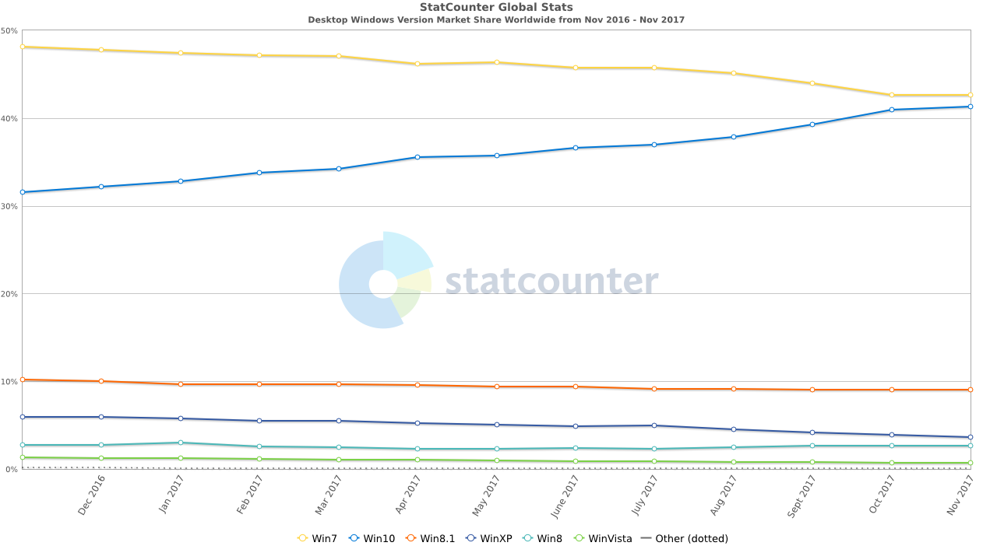
4.3 Microsoft’s response to the mobile boom (8)
Worldwide market share of desktop Windows versions [91]
Win7
Win10
Win8.1
WinXP
Win8
Vista
As seen neither Windows 8 nor Windows 8.1 could achieve a notable market share.
*

Slide 83
4.3 Microsoft’s response to the mobile boom (9)
c) Widening the scope of Windows to cover also ARM-based processors
In 08/2016 Microsoft and Qualcomm announced their aim to jointly develop
Windows laptops or 2-in-1 devices that are built on ARM ISA-based processors.
For this goal Qualcomm promised to develop the Snapdragon 835 processor
and Microsoft’s a new Windows 10 version, called Windows 10 on ARM.
Accordingly, .
in Q1/2017 Qualcomm began to sample the Qualcomm 835 that was
designed to support Windows 10 and
in 10/2017 Microsoft released a new update (the Fall Creators Update)
to Windows 10 desktop S- or Pro versions that enables Windows 10 to run
on ARM processors by using emulation.
First laptops and 2-in-1 devices arrived on the market in Q1/2018.
*

Slide 84
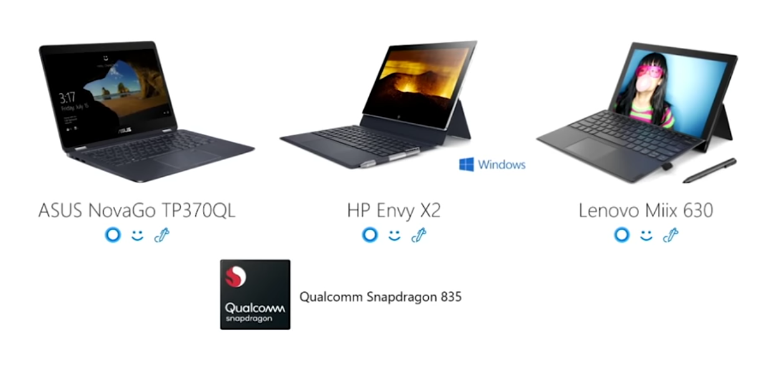
4.3 Microsoft’s response to the mobile boom (10)
First Windows 10 notebooks based on the Snapdragon 835
In Q1 2018 three vendors launched Windows 10 laptops or 2-in-1 devices
based on Qualcomm’s Snapdragon 835 processor, as shown below.
These devices have a very long battery life (e.g. 15 hours) but show a rather poor
performance, as indicated in the next Figure.
Figure: First Windows 10 devices based on Snapdragon 835, launched in Q1/2018 [97]

Slide 85
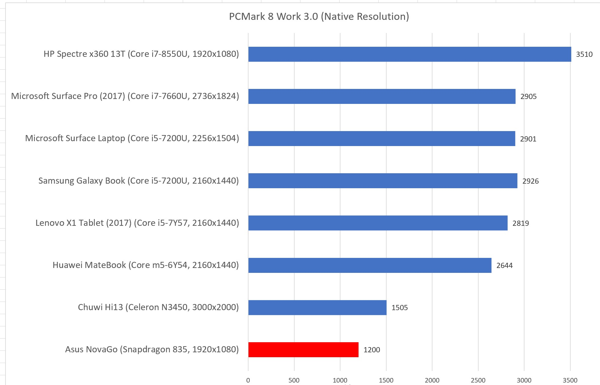
4.3 Microsoft’s response to the mobile boom (11)
Performance figures for PCMark8 of comparable tablets and laptops [95]

Slide 86
4.3 Microsoft’s response to the mobile boom (12)
Significance of developing Windows laptops on ARM processors -1
Windows 10 desktop (Pro and S editions) with the Fall Creators Update (released
in 10/2017) can run on ARM64 (AArch64) processors.
The low power nature of ARM CPUs allows PCs running under Windows 10 to
become always on, always connected PCs.
Always on, always connected devices are a new category of devices.
They provide the simplicity and mobility of a phone and capability of a PC.
E.g. they can receive notifications and synchronize data all the time, even in sleep
mode.
*

Slide 87
4.3 Microsoft’s response to the mobile boom (13)
Significance of developing Windows laptops on ARM processors -2
Benefit for Qualcomm
Breaking into the laptop market with their processors that support Windows 10.
Benefit for Microsoft
Gaining higher market share in laptop OSs.
Benefit of ARM-processors based laptop designs vs. x86 systems
extended battery life,
fan-less designs and
lighter devices
but recent implementations suffer sever limitations as shown before.
Note
Subsequent slides detailing ARM processors based Windows laptops (slides 14 to 23)
will not discussed in the Lecture.
*

Slide 88
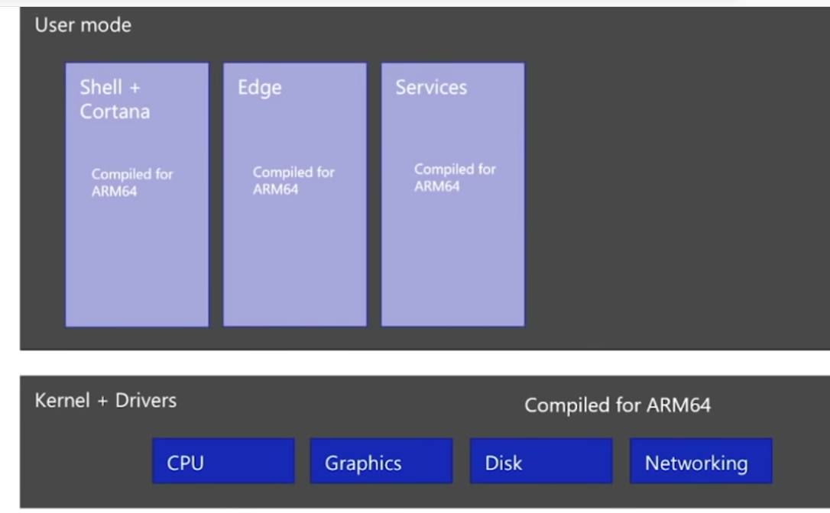
4.3 Microsoft’s response to the mobile boom (14)
Running built in Windows apps, the kernel and drivers on Windows 10 on ARM
Built in apps (like Edge, Explorer etc.), the kernel and device drivers are all recompiled and run as native ARM64 or ARM32 code on an ARM processor,
as indicated below.
Figure: Use of recompiled ARM64 (ARM32) code under Windows 10 on ARM [97]

Slide 89
4.3 Microsoft’s response to the mobile boom (15)
Running UWP and x86 Win32 apps under Windows 10 on ARM [102]
UWP (Universal Windows Platform) apps are available from the Microsoft Store.
All ARM32 UPW apps are run by Windows 10 on ARM natively without any
emulation.
By contrast, x86 UWP apps will run under emulation.
x86 Win32 apps (32-bit apps) (like Adobe reader) don’t have to be recompiled
for ARM, they will be emulated.
x64 Win32 apps (64-bit apps) are not supported, but the vast majority of apps
all have x86 (i.e. 32-bit) versions.
Remark: In Microsoft’s terminology
x86: indicates 32-bit x86
x64: indicates 64-bit x86

Slide 90
4.3 Microsoft’s response to the mobile boom (16)
x86 Win32 emulation (simplified) -1 [98]
x86 apps are emulated using a custom x86 to ARM CPU emulator from
Microsoft.
The emulation does not happen directly to ARM code but to an abstract machine
(virtual machine) called WOW (Windows on Windows) abstraction layer, as
indicated in the next Figure.

Slide 91
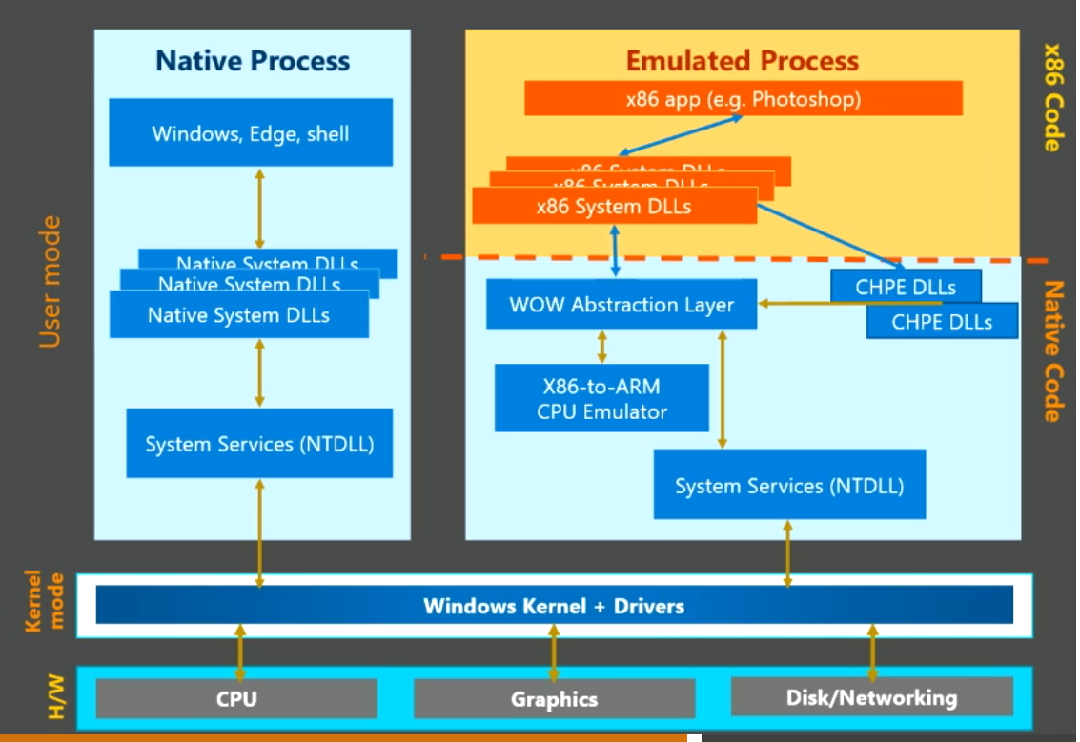
4.3 Microsoft’s response to the mobile boom (17)
Windows 10 emulation on an ARM processor vs. native processing [98]
NT Layer DLL"
(NT kernel functions)

Slide 92
4.3 Microsoft’s response to the mobile boom (18)
x86 Win32 emulation (simplified) -2 [98]
WOW is an existing abstraction layer to provide compatibility between different
Windows versions, used e.g. for 16-bit emulation on x86 (32-bit) hardware or
for x86 (32-bit) emulation on x64 hardware.
The emulator quickly translates blocks of machine code to the abstraction layer
at runtime.
In a second step the abstract code of the virtual machine will be executed on the
host processor (Just-In-Time or JIT compilation).
It is completely transparent to users and developers.
This process is similar as translating Java to Java byte-code and executing
the byte-code in a second step.
Remark: Microsoft’s terminology
x86: 32-bit x86
x64: 64-bit X86

Slide 93
4.3 Microsoft’s response to the mobile boom (19)
x86 Win32 emulation (simplified) -3 [98]
The emulation is speeded up
by caching and optimizing previously translated code and using
CHPE (Compiled Hybrid Portable Executives) DLLs (ARM64 code (binaries)),
as indicated in the next Figure.
DLL: Dynamic Link Library
(It provides the functionality of the OS in a modularized form).

Slide 94
4.3 Microsoft’s response to the mobile boom (20)
Windows 10 emulation on an ARM processor vs. native processing [98]
NT Layer DLL"
(NT kernel functions)

Slide 95
4.3 Microsoft’s response to the mobile boom (21)
Key limitations of Windows 10 on ARM (as of 11/2018) [101]
x64 apps aren't supported (as already mentioned).
The Windows Hypervisor Platform is not supported, consequently any virtual
machines using Hyper-V on an ARM device will not run.
OpenGL versions 1.1 or later that require hardware-accelerated OpenGL
don't work, accordingly, certain games do not run.

Slide 96
4.3 Microsoft’s response to the mobile boom (22)
Qualcomm’s efforts for enhancing the performance of their application
processors intended to be used in Windows 10 laptops [95]
The 10 nm Snapdragon 835 (2017) aims at always on, always connected
Windows 10 laptops and 2-in-1 devices.
It is based on ARM’s Cortex-A73 design (2016).
Qualcomm’s subsequent, still 10 nm Snapdragon 850, that targets only
Windows 10 devices provides about 30 % higher performance and needs about
20 % less power than its predecessor.
It is based on the Cortex-A75 design.
Subsequent designs will be based on the Cortex-A76 design.
Remark
Always on, always connected devices are a new category of devices.
They provide the simplicity and mobility of a phone and capability of a PC.
They can receive notifications and synchronize data all the time, even in sleep
mode.
(Always on, always connected: Folyamatosan bekapcsolt és folyamatos
internet-kapcsolattal rendelkező)

Slide 97
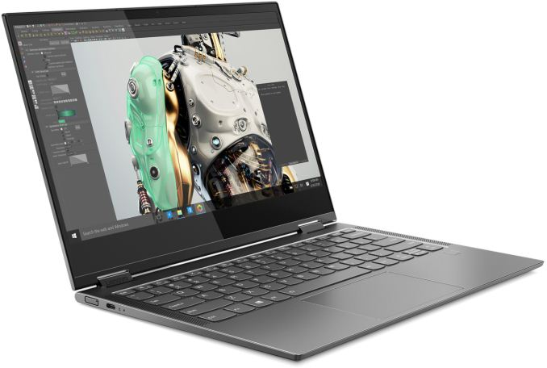
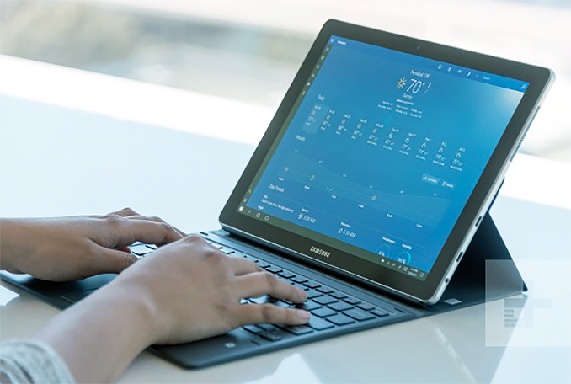


4.3 Microsoft’s response to the mobile boom (23)
Windows 10 notebooks based on the Snapdragon 850
Lenovo Yoga C630
(08/2018)
Galaxy Book 2
(10/2018)
Huawei Matebook E 2019
(04/2019)
Driver and
Compatibility
issues yet.
Weibu H116QA-MT
(10/2019)

Slide 98
4.3 Microsoft’s response to the mobile boom (24)
d) Microsoft's vision to become a devices and services company
Ballmer (CEO of Microsoft in 9/2012):
“I think that in a back-looking view, people would say we were a software company.
That's kind of how we were born.
I think when you look forward, our core capability will be software, (but)
you'll probably think of us more as a devices-and-services company.” [22]
Microsoft's vision to become a devices-and-services company
Microsoft's activities to become a devices and services company
Taking part in
the game console market
Introduction of the
Surface line of tablets
Entering the
phone business
(Subsection d1)
(Subsection d2)
(Subsection d3)
*

Slide 99

4.3 Microsoft’s response to the mobile boom (25)
d1) Microsoft's participation in the game console market
Microsoft created a family of video game consoles, dubbed as Xbox.
Main models of the Xbox family
2001: The original Xbox
2005: Xbox 360
2013: Xbox One
2016: Xbox One S
2017: Xbox One X
2020: Xbox One Series X
Xiomi
Xiomi
Picture: The original Xbox console with the Controller
Source of the picture: https://en.wikipedia.org/wiki/Xbox
*

Slide 100
4.3 Microsoft’s response to the mobile boom (26)
Global unit sales of video game consoles between 2008-2017 [105]
(in million units)
Xbox360
XboxOne

Slide 101
4.3 Microsoft’s response to the mobile boom (27)
d2) Introduction of the Surface family of tablets
Microsoft’s Surface family of tablets
Surface lines
Surface Pro lines
Since 2012
Since 2013
First Surface tablets are NVIDIA’s Tegra based
and run under Windows RT.
Subsequent Surface tablets are Intel’s Atom based
and are running under Windows 8.1
Surface Pro tablets are Core 2 based
and run under Windows 8.1
or subsequent Windows versions
Less expensive models
High end models
*

Slide 102
4.3 Microsoft’s response to the mobile boom (28)
Overview of Microsoft’s Surface tablets -1
Main features of Microsoft’s Surface tablet line
Model | Intro | Processor | Word length | Core nr. | OS
Surface | 10/2012 | Tegra 3 | 32-bit | 4 | Windows RT
Surface 2 | 10/2013 | Tegra 4 | 32-bit | 5 | Windows RT
Surface 3 | 05/2015 | Atom X7-Z8700 Airmont core | 64-bit | 4 | Windows 8.1
Table: Microsoft’s ARM/Intel Atom-based Surface tablets
Note that NVidia's Tegra processors are 32-bit ARMv7-A based.
Windows RT was a modified version of Windows 8 that targeted the ARMv7-A ISA.
The exclusivity of Windows RT drastically limits app availability, and is one of the main reasons why sales of Surface tablets remained lower than expected [21].
In 2015 Microsoft dropped production of devices based on Windows RT.
RT: Real Time

Slide 103
4.3 Microsoft’s response to the mobile boom (29)
Overview of Microsoft’s Surface tablets -2
Main features of Microsoft’s Surface Pro tablet line
Model | Intro | Processor | Word length | Core count | OS
Surface Pro | 02/2013 | Ivy Bridge i5 | 64-bit | 2 | Windows 8 Pro
Surface Pro 2 | 10/2013 | Haswell i5 | 64-bit | 2 | Windows 8.1 Pro
Surface Pro 3 | 06/2014 | Haswell i3/i5/i7 | 64-bit | 2 | Windows 8.1 Pro
Surface Pro 4 | 10/2015 | Skylake-U i5 | 64-bit | 2 | Windows 10 Pro
Surface Pro 2017 | 06/2017 | Kaby Lake m3 | 64-bit | 2 | Windows 10 Pro
Surface Pro 6 | 10/2018 | Kaby Lake Refr. | 64-bit | 4 | Windows 10 Home
Surface Pro 7 | 10/2019 | Ice Lake i3/i5/i7 | 64-bit | 2/4 | Windows 10 Home
Table: Microsoft’s Intel Core 2-based Surface Pro tablets

Slide 104
4.3 Microsoft’s response to the mobile boom (30)
Example: Windows Surface Pro 3 (8/2014)
2 in 1 tablet 12”
Aim: Replacing laptops
Intel’s Surface Pro 3
used as a laptop [22]
Intel’s Surface Pro 3
used as a tablet [23]

Slide 105
4.3 Microsoft’s response to the mobile boom (31)
Optional reading on Microsoft’s activities toward ARM-based processors (96]
“Windows on ARM isn't new: from Windows Phone to Windows RT to Windows IoT, Microsoft has had multiple systems that take Windows beyond the familiar Intel and AMD processors. Older versions of Windows ran on PowerPC, Alpha, Itanium, and MIPS, after all, and in 2009 an unofficial internal project had Windows 7 running on ARM. Development continued for ARMv7 32-bit processors with VFP floating point, NEON (ARM's version of Intel's SSE instructions for processing data in parallel) and the Thumb-2 instruction set.
But when that shipped as Windows RT, it only ran apps that had been specifically written and compiled for ARM using only the WinRT APIs.
But when that shipped as Windows RT, it only ran apps that had been specifically written and compiled for ARM using only the WinRT APIs. The idea was to turn Windows in a OS that was designed for mobile -- like iOS -- to get better security and battery life. But not running standard Windows programs -- either recompiled or in emulation -- was an artificial limitation (although designing Windows RT devices just for Store apps meant they used rather underpowered Tegra SOCs.
Although the first systems to go on sale will all come with Windows 10 S, which only runs apps that come from the Store, those Store apps can include standard desktop x86 apps that have been packaged up for distribution through the Store. There's also a free upgrade to Windows 10 Pro -- not a special or limited version of Windows, but the full Windows 10 Pro that Microsoft has compiled for ARM.
Install Windows 10 Pro and you can install standard Windows applications.”

Slide 106
4.3 Microsoft’s response to the mobile boom (32)
d3) Microsoft's move to enter the phone business -1
In the beginning of 2011 the sales figures of mobiles running Google's Android
surpassed those running under Nokia's Symbian.
Figure: Global market share (in terms of sales figures) of leading smartphone OSs
to end users from Q1 2009 to Q2 2018 [42]
*
*

Slide 107
4.3 Microsoft’s response to the mobile boom (33)
Microsoft's move to enter the phone business -2
In 2/2011 Nokia tried to improve its unfavorable market position by establishing
a business partnership with Microsoft and adopted Microsoft’s Windows Phone
as its primary platform for their new smartphone line, called Lumia.
9/2013: Microsoft announces their plan to acquire the phone business of Nokia,
including the Lumia brand.
4/2014: Microsoft finalyses the acqisition by paying about 7 billion USD to Nokia,
and taking over about 25000 Nokia employees.
11/2014: Microsoft rebranded the Nokia Lumia line to Microsoft Lumia line.
*

Slide 108

4.3 Microsoft’s response to the mobile boom (34)
The first Microsoft branded Lumia phone (the Lumia 535 from 11/2014) [85]

Slide 109

4.3 Microsoft’s response to the mobile boom (35)
The outcome of Microsoft's Nokia deal -1
Microsoft's acquisition of Nokia's phone business did not seriously boost the sale
figures of Windows phone based Lumia devices, as indicated in the Figure below.
Microsoft ackquires
Nokia's phone buiness
Rebranding the Nokia Lumia line
to Microsoft Lumia line
Million
1 % of worldwide
smartphone sales
Figure: Quarterly sale figures of Lumia devices (million units) [85]
(Nokia introduced the Lumia brand for a series of smartphones running Windows phone)
On the contrary, in about two years sale figures desreased below 1 % of the total
world sales of smartphones, as indicated in the Figure.

Slide 110
4.3 Microsoft’s response to the mobile boom (36)
The outcome of Microsoft's Nokia deal -2
Consequences of deminishing sales figures of Windows based Lumia phones
In 7/2015 Microsoft restructured Microsoft Mobile and laid off 7200 employees.
In 5/2016 Microsoft made the decision to sell their feature phone business
to Foxconn (Taiwan), for 350 million USD.
As a consequence, 4500 Microsoft employes were moved to Foxconn.
At the same time Microsoft confirmed that it will continue to develop
Windows 10 Mobile, and support existing Lumia phones and ones built
by third-party phone makers [86].
In 10/2017 Microsoft cancelled Windows 10 Mobile.
*

Slide 111
4.4 A new challenge for Intel and AMD presented by Apple
Notes:
111

Slide 112

4.4 A new challenge for Intel and AMD presented by Apple (1)
4.4 A new challenge for Intel and AMD presented by Apple
Apple’s new processors, introduced in 11/2020: Apple A14 and M1 [82]
(ARMv8.6)

Slide 113

4.4 A new challenge for Intel and AMD presented by Apple (2)
Apple vs. Intel top performance single thread benchmark figures [110]
i9-10900K Comet Lake TDP:125 W
i7-1185G7 U3 Tiger Lake TDP: 28 W

Slide 114

4.4 A new challenge for Intel and AMD presented by Apple (3)
Single core Geekbench 5 scores of recent ARM and x86 ISA-based
MacBooks [111]
Rosetta 2: Just-in-time compiler (futásidejű fordító) to allow running existing x86-based
Mac apps on Apple’s new ARM ISA-based M1 processors
Geekbench 5, a cross-platform benchmarking tool that works across processor types.
The same tool can be used to benchmark both desktop-class processors and mobile chips,

Slide 115

4.4 A new challenge for Intel and AMD presented by Apple (4)
Multicore Geekbench 5 scores of recent ARM and x86 ISA-based
MacBooks [111]

Slide 116
5. Conclusions
Notes:
116

Slide 117
5. Conclusions (1)
5. Conclusions -1
Informatics came into a transitional phase
new paradigms
new devices
new players
*

Slide 118
5. Conclusions (2)
Conclusions- 2
Established companies have to respond early, quick and in an appropriate way
to the new challenges, else…
8/2010 Intel acquires Infineon’s (former Siemens) Wireless Solutions business
8/2011 Google acquires Motorola Mobility
9/2013 Microsoft decides to purchase Nokia’s phone business
9/2013 BlackBerry lays off 4500 employees (~ 40% of their workforce)
6/2014 Broadcom decides to exit the baseband business
~ 2015 AMD leaves the mobile market
4/2016 Intel leaves the mobile market
5/2016 NVIDIA declares that they will moving out from the smartphone market

Slide 119
5. Conclusions (3)
Conclusions -3
Even the largest IT firms have a hard time to cope with as indicated by
resignation of AMD’s, Intel’s and Microsoft’s CEOs (Chief Execution Officers):
1/2011 AMD: Dirk Meyer
11/2012 Intel: Paul Otellini
8/2013 Microsoft: Steve Ballmer
But it is also an opportunity and challenge for individuals and institutions
to catch up with the progress and make benefit of it.
*

Slide 120
6. References
Notes:
120

Slide 121
6. References (1)
6. References
[1]: Bártfai D., Merre felé tartanak a hardverek?, Aug. 22-24 2007
[2]: Smith S.L., Intel Strategy & Technology Update, Barclays Capital Global Technology Conf.,
Dec. 2011, http://files.shareholder.com/downloads/INTC/1576180143x0x526852/c9868a3a-
494e-4506-bcc6-a631aca1fd75/Steve%20Smith%20Barclays%20Dec%202011.pdf
[3]: AMD 2013 Mobility APU Introduction, May 22 2013,
http://www.slideshare.net/AMD/amd-2013-mobility-apu-introduction-deck-final-for-lp
[4]: Frommer D., CHART OF THE DAY: Smartphone Sales To Beat PC Sales By 2011,
Business Insider, Aug. 21 2009, http://www.businessinsider.com/chart-of-the-day-
smartphone-sales-to-beat-pc-sales-by-2011-2009-8
[5]: Wikipedia, BlackBerry Pearl, http://en.wikipedia.org/wiki/BlackBerry_Pearl
[6]: Wikipedia, Android (operating system),
http://en.wikipedia.org/wiki/Android_%28operating_system%29
[7]: Ciufo C.A., Tizen OS for Smartphones – Intel’s Biggest Bet Yet, Jan. 4 2013,
http://eecatalog.com/caciufo/2013/01/04/samsung-hedges-apple-google-bets-with-intels-
html5-based-tizen/
[8]: Introduction of the Next Generation Intel Atom Processor, Oak Trail Z670, 4/2011,
http://newsroom.intel.com/docs/DOC-1976
[9]: Apple Maintains 48 Percent Share of Global Branded Tablet Shipments in Q1 2013,
Strategy Analytics, April 25 2013, Boston,
http://www.strategyanalytics.com/default.aspx?mod=pressreleaseviewer&a0=5351

Slide 122
6. References (2)
[10]: Goto H., ARM Cortex – A Family Architecture, 2010,
http://pc.watch.impress.co.jp/video/pcw/docs/423/409/p1.pdf
[11]: Eul H., Bell M., Mobile at Intel, Investor Meeting 2012,
http://www.cnx-software.com/pdf/Intel_2012/2012_Intel_Investor_Meeting_Eul_Bell.pdf
[12]: Wikipedia, iPad, http://en.wikipedia.org/wiki/IPad
[13]: Tablet Platforms with Next Generation Intel Atom Processor and Microsoft Windows 8,
IDF 2012
[14]: The $15.3 Billion Server Market – Surprisingly Buoyant In Q1 2012, IT Candor, July 3 2012,
http://www.itcandor.com/server-q112/
[15]: Shah A., Intel Loses Laptop Chip Market Share to AMD in Q3, PC World, Nov. 3 2011,
http://www.pcworld.com/article/243114/intel_loses_laptop_chip_market_share_to_amd_
in_q3.html
[16]: Perry D., AMD Steals Market Share From Intel, Tom’s Hardware, March 16 2012,
http://www.tomshardware.com/news/amd-intel-cpu-processor,15041.html
[17]: Shilov A., AMD Shows Off Opteron "Interlagos" Again: No Performance Benchmarks,
No Design Wins, No Launch Date Announced, Xbit Labs, Aug. 3 2011,
http://www.xbitlabs.com/news/cpu/display/20110803103016_AMD_Shows_Off_Opteron_
Interlagos_Again_No_Performance_Benchmarks_No_Design_Wins_No_Launch_Date_
Announced.html
[18]: Arthur C., PC business still waning as Microsoft's Windows 8 fails to lift it, 11 July 2013,
http://www.theguardian.com/technology/2013/jul/11/pc-business-microsoft-windows-8

Slide 123
6. References (3)
[19]: Golson J., Steve Jobs Envisioned the iPad in 1983, MacRumors, Oct. 2, 2012,
http://www.macrumors.com/2012/10/02/steve-jobs-envisioned-the-ipad-in-1983/
[20]: Yarow J., Steve Ballmer's Biggest Mistakes As CEO Of Microsoft, Business Insider, Aug. 27
2013,
http://www.businessinsider.com/steve-ballmers-most-epic-mistakes-as-ceo-of-microsoft-
2013-8?op=1
[21]: Arora, P., Microsoft Is Not Killing The Surface RT Lineup? Seeking Alpha, Aug. 25 2014,
http://www.macrumors.com/2012/10/02/steve-jobs-envisioned-the-ipad-in-1983/
[22]: Surface Pro 3 Fact sheet May 2014, Microsoft,
http://www.microsoft.com/global/eu/PublishingImages/Surfacepro3texhspecs.pdf
[23]: Microsoft Surface Pro, NDTV Gadget, May 2014,
http://gadgets.ndtv.com/microsoft-surface-pro-3-1611
[24]: Guenette S., Nearly $2 Billion In The Hole, Microsoft Continues To Dive Deeper Into Tablets,
Seeking Alpha, Aug. 8, 2014,
http://seekingalpha.com/article/2402725-nearly-2-billion-in-the-hole-microsoft-continues
-to-dive-deeper-into-tablets
[25]: Deskovich V., Microsoft: A Monopoly No More? Seeking Alpha, Jul. 11, 2014
http://seekingalpha.com/article/2309835-microsoft-a-monopoly-no-more
[26]: Gill R., Intel’s Core i5-655K & Core i7-875K: Overclocked and Analyzed, AnandTech,
May 28 2010, http://www.anandtech.com/show/3742/intels-core-i5655k-core-i7875k-
overclocked-and-analysed-/2
[27]: Shimpi A. L., AMD Beema/Mullins Architecture & Performance Preview, AnandTech,
April 29, 2014, http://www.anandtech.com/show/7974/amd-beema-mullins-architecture-
a10-micro-6700t-performance-preview

Slide 124
6. References (4)
[28]: Wilson S., & Wigginton C., Making open innovation work in mobile - Insights from the
semiconductor industry, Deloitte University Press, July 24v2013,
http://dupress.com/articles/making-open-innovation-work-in-mobile/
[30]: Arora P., Wait, Microsoft Is Not Killing The Surface RT Lineup? Seeking Alpha, Aug. 25, 2014,
http://seekingalpha.com/article/2447735-wait-microsoft-is-not-killing-the-surface-rt-lineup
[31]: Hodgins K., Apple Maintains Narrowing Lead in Tablet Market Share, MacRumors, May 1,
http://www.macrumors.com/2014/05/01/apple-tablet-market-share-1q14
[32]: Arora P., Wait, Microsoft Is Not Killing The Surface RT Lineup? Seeking Alpha, Aug. 25, 2014,
http://seekingalpha.com/article/2447735-wait-microsoft-is-not-killing-the-surface-rt-lineup
[33]: Eul H., & Bell M., Mobile at Intel, Investor Meeting 2012, Intel,
http://www.cnx-software.com/pdf/Intel_2012/2012_Intel_Investor_Meeting_Eul_Bell.pdf
[34]: Qualcomm dominates smartphone chip and baseband, tablet processor markets, Mobile
Europe, February 17 2014
http://www.mobileeurope.co.uk/Press-Wire/qualcomm-dominates-smartphone-chip-and
-baseband-tablet-processor-markets
[35]: Gartner Says Worldwide Tablet Sales Grew 68 Percent in 2013, With Android Capturing 62
Percent of the Market, Gartner, Newsroom, March 3, 2014,
http://www.gartner.com/newsroom/id/2674215
[36]: Trefis Team, Why Intel Can Gain Additional Share In The Mobile Market, Forbes, 5/09/2014
http://www.forbes.com/sites/greatspeculations/2014/05/09/why-intel-can-gain-additional-
share-in-the-mobile-market

Slide 125
6. References (5)
[37]: Meeker M., Devitt S., Vu L., Internet Trends, CM Summit, Morgan Stanley, New York,
June 7, 2010, http://demo.tizra.com/Morgan-Stanley-Internet-Trends-June-7-2010/3
[38]: Hardy E., BlackBerry Pearl 8100 Review, Brighthand, November 15 2006,
http://www.brighthand.com/phonereview/blackberry-pearl-8100-review/
[39]: Nokia 7650, Wikipedia, http://en.wikipedia.org/wiki/Nokia_7650
[40]: Bokil-Paranjape S., Worldwide smartphone sales hit 267 million in Q1 2014: Trend Force,
Phonearena, April 18 2014, http://www.fonearena.com/blog/101450/worldwide-
smartphone-sales-hit-267-million-in-q1-2014-trend-force.html
[41]: Grifiths H., How the ubiquity of today’s smartphones make an ideal platform for delivering
campus-based services, Ombiel, 2010,
http://www.rms-inc.com/files/datasheets/Ombiel_Whitepaper.pdf
[42]: Global mobile OS market share in sales to end users from 1st quarter 2009 to 2nd quarter
2018, statista, 2018,
https://www.statista.com/statistics/266136/global-market-share-held-by-smartphone-
operating-systems/
[43]: Smartphone Apps Processor Revenue Reached $4.7 Billion in Q1 2014 says Strategy
Analytics, Strategy Analytics, July 14 2014,
http://www.strategyanalytics.com/default.aspx?mod=pressreleaseviewer&a0=5543
[44]: Klug B. & Shimpi A. L., Qualcomm's New Snapdragon S4: MSM8960 & Krait Architecture
Explored, AnandTech, Oct. 7 2011, http://www.anandtech.com/show/4940/qualcomm-
new-snapdragon-s4-msm8960-krait-architecture
[45]: Lomas N., Report: Intel Gained Just 0.2% Of Smartphone Chip Market In 1H As Qualcomm
Milked LTE Lead, Tech Crunch, Oct. 5 2012, http://techcrunch.com/2012/10/05/report-
intel-gained-just-0-2-of-smartphone-chip-market-in-1h-as-qualcomm-milked-lte-lead

Slide 126
6. References (6)
[46]: Klug B., Intel XMM7160 LTE Modem Demonstrated on Live Network, AnandTech, Sept. 11
2013, http://www.anandtech.com/show/7321/intel-xmm7160-lte-modem-demonstrated-
on-live-network
[47]: Bocha, Apple iPhone megateszt, Mobilarena, 2007-07-23,
http://mobilarena.hu/teszt/apple_iphone_megateszt_a_bunbeeses_almaja/bevezeto.html
[48]: Shimpi A.L., Apple's Cyclone Microarchitecture Detailed, AnandTech, March 31 2014,
http://www.anandtech.com/show/7910/apples-cyclone-microarchitecture-detailed
[49]: Dilger D.E., Apple's new A8X powered iPad Air 2 smokes new Android tablets, including
Nvidia's Tegra K1 Shield Tablet [u], Apple Insider, Oct. 21 2014,
http://appleinsider.com/articles/14/10/21/apples-new-a8x-powered-ipad-air-2-smokes-
new-android-tablets-including-nvidias-tegra-k1
[50]: Dilger D.E., Apple Inc. A8X iPad chip causing big problems for Intel, Qualcomm, Samsung
and Nvidia, Apple Insider, Nov. 14 2014,
http://appleinsider.com/articles/14/11/15/apple-inc-a8x-ipad-chip-causing-big-problems-
for-intel-qualcomm-samsung-and-nvidia
[51]: De Gelas J., The Intel Xeon E7-8800 v3 Review: The POWER8 Killer?, AnandTech,
May 8, 2015, http://www.anandtech.com/show/9193/the-xeon-e78800-v3-review
[52]: Global PC shipments from 1st quarter 2009 to 2nd quarter 2015, by vendor (in million units),
Statista, http://www.statista.com/statistics/263393/global-pc-shipments-since-1st-
quarter-2009-by-vendor/

Slide 127
6. References (7)
[53]: Gartner Says Worldwide Smartphone Sales Recorded Slowest Growth Rate Since 2013,
Gartner, Newsroom, Aug. 20 2015, http://www.gartner.com/newsroom/id/3115517
[54]: Leswing K., Asus Zenfone 2 Preview: Intel's Best Chance In Years To Break Into
Smartphones, International Business Time, May 19 2015,
http://www.ibtimes.com/asus-zenfone-2-preview-intels-best-chance-years-break-
smartphones-1929726
[55]: Richter F., Tablets to Outsell PCs Worldwide by 2015, Statista, Febr. 28 2014,
http://www.statista.com/chart/1138/tablet-and-pc-shipment-forecast/
[56]: Dilger D. E., After losing Apple's iPad business, Intel has bled $7 billion while heavily
subsidizing cheap x86 Atom Android tablets, Appleinsider, November 16, 2014,
http://appleinsider.com/articles/14/11/16/after-losing-apples-ipad-business-intel-has-
bled-7-billion-while-heavily-subsidizing-cheap-x86-atom-android-tablets
[57]: Smartphone and tablet processor market share in 2014, May 7 2015
http://mobilesemi.blogspot.hu/2015/05/smartphone-and-tablet-processor-market.html
[58]: Cutress I., The Intel Skylake Mobile and Desktop Launch, with Architecture Analysis,
AnandTech, Sept. 1 2015, http://www.anandtech.com/show/9582/intel-skylake-mobile-
desktop-launch-architecture-analysis
[59]: Klug B., The State of Qualcomm's Modems - WTR1605 and MDM9x25, AnandTech,
Jan. 4 2013, http://www.anandtech.com/print/6541/the-state-of-qualcomms-modems-
wtr1605-and-mdm9x25
[60]: iPhone 6 Plus Teardown, iFixit,
https://www.ifixit.com/Teardown/iPhone+6+Plus+Teardown/29206

Slide 128
6. References (8)
[61]: Ho J., Qualcomm Details Hexagon 680 DSP in Snapdragon 820: Accelerated Imaging,
AnandTech, August 24, 2015, http://www.anandtech.com/print/9552/qualcomm-details-
hexagon-680-dsp-in-snapdragon-820-accelerated-imaging
[62]: QSC6055/QSC6065/QSC6075/QSC6085 Hardware Training, Introductions and Device
Overview, 80-VC881-21 Rev. A, April 2007,
http://www.droid-developers.org/images/3/3c/Qsc6085-overview.pdf
[63]: James D., Inside Today’s Systems & Chips: A Survey of the Past Year, Chipworks, 2013,
http://theconfab.com/wp-content/uploads/2014/dick_james_confab14.pdf
[64]: Global unit sales of current generation video game consoles from 2008 to 2014 (in million
units), Statista, http://www.statista.com/statistics/276768/global-unit-sales-of-video-
game-consoles/
[65]: CPU Benchmarks, Passmark Software, 10th june 2016,
http://www.cpubenchmark.net/market_share.html
[66]: Anchorite, AMD Is A Threat To Intel's X86 Market Share, Not Vice Versa, Seeking Alpha,
Jun. 10, 2016 ,
http://seekingalpha.com/article/3981352-amd-threat-intels-x86-market-share-vice-versa?
auth_param=djq9a:1blm8ut:579a4c85ebfd66607461f023a383c45c
[67]: Gartner Says Five of Top 10 Worldwide Mobile Phone Vendors Increased Sales in
Second Quarter of 2016, Gartner, Aug. 19, 2016,
http://www.gartner.com/newsroom/id/3415117
[68]: Jan C.-H., RF CMOS Technology Scaling in High-k/Metal Gate Era for RF SoC (System-on-
Chip) Applications, IEDM ’10, San Francisco 2010,
http://www.intel.com.br/content/dam/doc/technology-brief/32nm-soc-with-rf-cmos-
technology-presentation.pdf

Slide 129
6. References (9)
[69]: Smartphone Vendor Market Share, 2017 Q1, IDC ,
https://www.idc.com/promo/smartphone-market-share/vendor
[70]: Smartphone OS Market Share, 2017 Q1, IDC,
https://www.idc.com/promo/smartphone-market-share/os
[71]: Apple Tied with MediaTek for the #2 Spot in the Global Smartphone Applications Processor
Market, Patently Apple, 2107,
http://www.patentlyapple.com/patently-apple/2017/10/apple-tied-with-mediatek-for-the-
2-spot-in-the-global-smartphone-applications-processor-market.html
[72]: Kay A. C., (Xerox Palo Alto Research Center) A Personal Computer for Children of All Ages,
Proceedings of the ACM National Conference, Boston Aug. 1972 Vol. 1 Article No. 1.
[73]: Gruener W., Did Steve Jobs Steal The iPad? Genius Inventor Alan Kay Reveals All, Tom's
Hardware, April 17, 2010,
http://www.tomshardware.com/news/alan-kay-steve-jobs-ipad-iphone,10209.html
[74]: Triggs R., Intel is losing billions on mobile development, Android Authority, April 16, 2014,
https://www.androidauthority.com/intel-losing-billions-on-mobile-369148/
[75]: Shipment forecast of laptops, desktop PCs and tablets worldwide from 2010 to 2021
(in million units), Statista,
https://www.statista.com/statistics/272595/global-shipments-forecast-for-tablets-laptops
-and-desktop-pcs/
[76]: Worldwide Tablet Shipments Decline More Than 12% in Second Quarter as the Market
Shifts Its Focus Toward Productivity, IDC, 01 Aug 2016,
https://www.idc.com/getdoc.jsp?containerId=prUS41632416

Slide 130
6. References (10)
[77]: Dilger D. E.: IDC offers a rosy forecast for Microsoft Surface, reminiscent of its 2012
Windows Phone outlook, Appleinsider, Dec. 02, 2015,
http://appleinsider.com/articles/15/12/02/idc-offers-a-rosy-forecast-for-microsoft-surface-
reminiscent-of-its-2012-windows-phone-outlook
[78]: Jourdan S., Broadwell Microarchitecture Disclosures, Intel, Aug. 11, 2014,
http://download.intel.com/newsroom/kits/14nm/pdfs/Intel_14nm_New_uArch.pdf
[79]: iPad Air 2 Teardown, iFixit,
https://www.ifixit.com/Teardown/iPad+Air+2+Teardown/30592
[80]: Shimpi A. L., The ARM vs x86 Wars have Begun: In-Depth Power Analysis of Atom,
Krait C Cortex A15, AnandTech, Jan. 4, 2013,
https://www.anandtech.com/show/6536/arm-vs-x86-the-real-showdown
[81]: Nguyen H., NVIDIA Definitely “Not Interested” In Building Smartphones SoCs, Ubrergizmo,
06/04/2016,
http://www.ubergizmo.com/2016/06/nvidia-not-interested-smartphones-soc/
[82]: Smith R. and Cutress I., Intel's Changing Future: Smartphone SoCs Broxton & Sophia
Officially Cancelled, AnandTech, April 29, 2016,
https://www.anandtech.com/show/10288/intel-broxton-sofia-smartphone-socs-cancelled
[83]: Hruska J., How Intel lost the mobile market, part 2: the rise and neglect of Atom,
Extreme Tech, May 4, 2016,
https://www.extremetech.com/computing/227816-how-intel-lost-the-mobile-market-part-
2-the-rise-and-neglect-of-atom
[84]: Surface Pro (2017),
https://en.wikipedia.org/wiki/Surface_Pro_(2017)

Slide 131
6. References (11)
[85]: Microsoft Lumia,
https://en.wikipedia.org/wiki/Microsoft_Lumia
[86]: Warren T., Microsoft just hinted it's the end of Lumia phones, The Verge, Mai 18, 2016,
https://www.theverge.com/2016/5/18/11699766/microsoft-lumia-phone-brand
[87]: Tyson M., Leaked slides show AMD desktop and mobility roadmaps for 2016, Hexus,
April 30, 2015,
http://hexus.net/tech/news/cpu/82813-leaked-slides-show-amd-desktop-mobility-
roadmaps-2016/
[88]: Tablet operating systems' market share worldwide from 2013 to 2020, Statista, 2017,
https://www.statista.com/statistics/272446/global-market-share-held-by-tablet-operating-
systems/
[89]: Number of smartphones sold to end users worldwide from 2007 to 2016 (in million units),
Statista, 2017
https://www.statista.com/statistics/263437/global-smartphone-sales-to-end-users-since-
2007/
[90]: Kahn O., Valentine B.: Intel Next Generation Microarchitecture Codename Sandy Bridge:
New Processor Innovations, IDF 2010
[91]: Desktop Windows Version Market Share Worldwide, Statcounter, Nov. 2016 - Nov. 2017,
http://gs.statcounter.com/os-version-market-share/windows/desktop/worldwide
[92]: Qualcomm Announces Flagship Companies to Build Windows 10 PCs Powered by
Snapdragon, Qualcomm, Press Release, May 31 2017
https://www.qualcomm.com/news/releases/2017/05/31/qualcomm-announces-flagship-
companies-build-windows-10-pcs-powered

Slide 132
6. References (12)
[93]: Warren T., Microsoft is bringing Windows desktop apps to mobile ARM processors,
The Verge, Dec. 7, 2016,
https://www.theverge.com/2016/12/7/13866936/microsoft-windows-10-arm-desktop-
apps-support-qualcomm
[94]: Global tablet shipments from 2010 to 2018, by operating system, Statista, 2018,
https://www.statista.com/statistics/273268/worldwide-tablet-sales-by-operating-system-
since-2nd-quarter-2010
[95]: Hachman M., ARM challenges Intel in PCs with Deimos and Hercules chips, PCWorld,
Aug. 16, 2018,
https://www.pcworld.com/article/3297941/components-processors/arm-challenges-intel-
in-pcs-with-deimos-and-hercules-chips.html
[96]: Branscombe M., Windows 10 on ARM: S versus Pro, emulation and 64-bit app support,
ZDNet, February 5, 2018,
Windows 10 on ARM: S versus Pro, emulation and 64-bit app support
[97]: Pulapaka H. and Kishan A., Windows 10 on ARM, Presentation, Microsoft Build 2018, Seattle,
May 7-9, 2018,
https://channel9.msdn.com/Events/Build/2018/BRK2438
[98]: Kishan A. and Pulapaka H., Windows 10 on ARM, Presentation, Microsoft Build 2017, Seattle,
May 11, 2017,
https://channel9.msdn.com/Events/Build/2017/P4171
[99]: Accelerating mobile and laptop performance: Arm, ARM Newsroom, 2018,
https://www.arm.com/company/news/2018/08/accelerating-mobile-and-laptop-performance

Slide 133
6. References (13)
[100]: Frumusanu A., Arm Unveils Client CPU Performance Roadmap Through 2020, AnandTech,
Aug. 16, 2018,
https://www.anandtech.com/show/13226/arm-unveils-client-cpu-performance-roadmap
[101]: Limitations of apps and experiences on ARM, Microsoft, Windows Dev. Center, ‎02‎/‎15‎/‎2018,
https://docs.microsoft.com/en-us/windows/uwp/porting/apps-on-arm-limitations
[102]: Windows 10 on ARM, Windows Dev Center, ‎02‎/‎15‎/‎2018,
https://docs.microsoft.com/en-us/windows/uwp/porting/apps-on-arm
[103]: Menear H., Top 10 enterprise software companies, GigabitMagazine, Apr 19, 2018,
https://www.gigabitmagazine.com/top10/top-10-enterprise-software-companies-0
[104]: How To Start Windows 8 In Desktop Mode, WebPro Education, July 28, 2014,
https://www.youtube.com/watch?v=7QmNb6TnyuM
[105]: Johnson B., Photostream, https://www.flickr.com/photos/154918400@N05/42748177621
[106]: Frumusanu A., The iPhone XS & XS Max Review: Unveiling the Silicon Secrets, AnandTech,
Oct. 5, 2018,
https://www.anandtech.com/show/13392/the-iphone-xs-xs-max-review-unveiling-the-
silicon-secrets
[107]: Frumunanu A., The Apple iPhone 11, 11 Pro & 11 Pro Max Review: Performance, Battery,
& Camera Elevated, AnandTech, Oct. 16, 2019,
https://www.anandtech.com/show/14892/the-apple-iphone-11-pro-and-max-review/2

Slide 134
6. References (14)
[108]: Holst A., Global market share held by leading smartphone vendors from 4th quarter 2009
to 3rd quarter 2019, Statista, Nov 11, 2019,
https://www.statista.com/statistics/271496/global-market-share-held-by-smartphone-
vendors-since-4th-quarter-2009
[109]: 24 Tablet Market Share Statistics and Analysis, ejectejecteject, Dec. 2019,
https://www.ejectejecteject.com/statistics/24-tablet-market-share-statistics-and-analysis/
[110]: Frumusanu A., Apple Announces The Apple Silicon M1: Ditching x86 - What to Expect,
Based on A14, AnandTech, Nov. 10, 2020,
https://www.anandtech.com/show/16226/apple-silicon-m1-a14-deep-dive
[111]: Owen M., M1 benchmarks prove Apple Silicon outclasses nearly all current Intel Mac chips,
Appleinsider, Nov. 17, 2020,
https://appleinsider.com/articles/20/11/17/m1-benchmarks-proves-apple-silicon-
outclasses-nearly-all-current-intel-mac-chips

