Slide 1
AMD’s Zen family
Lecture
Dezső Sima
Sept. 2022
(Ver. 2.3)
© Sima Dezső, 2022

Slide 2
Preface
Preface
In this Chapter we focus on design concepts of AMD’s Zen core based processors
that enabled AMD to surpass Intel’s processors at least temporary.
To reduce the length of this Chapter we omit discussing the evolution of the
implemented ISA, the microarchitecture and power management of Zen processors.
These issues are discussed then in Chapters dealing with mobile, client and
server processors in general.
Remarks to the terminology
The term Zen-based is ambiguous.
It may refer either to Zen core based processors in general or to first generation
“Zen core”-based processors in particular.
To resolve this ambiguity, we use the term Zen-based if we refer to Zen core-based
(Family 17h-based) processors in general and make use of the term
1. gen. Zen core-based if we make reference to its first generation implementation
in particular.
In addition, AMD interprets the term mobile individually, (like Intel) by using
this term for laptops.
In this Chapter we follow AMD’s terminology.

Slide 3
AMD’s Zen processor family - Overview
1. Introduction
2. Cornerstones of AMD’s Zen processor family
3. Key building blocks of CPU dies
4. Case example: The Zen 3-based Ryzen 5000 gaming
DT line
5. Overview of AMD’s Zen lines
6. References
Notes:
3

Slide 4
1. Introduction
Notes:
4

Slide 5
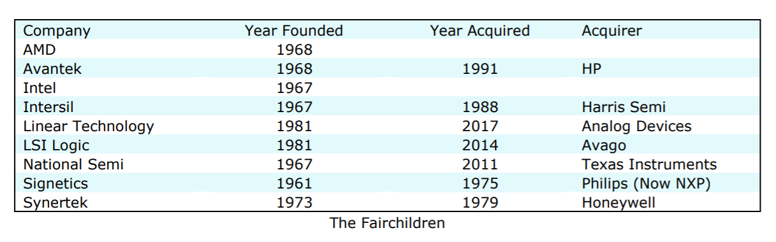
1. Introduction (1)
Emergence and concentration of semiconductor companies in the US [115]
Around 1960 Fairchild became a pioneer in inventing advanced transistor
technologies and integrated circuits (in 1960).
Nevertheless, as entrepreneurial technologists employed by Fairchild Semiconductor
became frustrated by the vendors management practices in the decade of
1965-1975 they set out on their own and founded a large number of semiconductor
companies, as the next Table indicates.
Table: Companies founded by former employees of Fairchild [115]
As the Table indicates, from all the firms grounded only AMD and Intel survived.

Slide 6
1. Introduction (2)
1. Introduction
Overview of AMD’s processor lines
AMD’s in-house designed x86 families
32-bit
x86 families
64-bit Hammer
family
Intermediate
families
The Bulldozer
family
The Cat
family
The Zen
family
K5/K6/K7
families
(32-bit
(clients)
1996-2003)
K8/K10/K10.5
families
(08h/10h/10.5h)
(Servers,
clients)
(2003-2009)
Families
11h/12h
(Clients
oriented)
(2008-2011)
Family
15h
(High-performance
oriented)
(2011-2016)
Families
14h/16h
(Low-power
oriented)
(2011-2015)
Family
17h
(Modular design)
(2017- )
K7: Athlon (1999-2003)
Clients: Laptops/DTs
Remarks
Before the in-house designed K5, AMD licensed and manufactured Intel designed processors.
The K8 processor is highlighted as it was AMD’s first 64-bit x86-64 implementation in 2003.

Slide 7
1. Introduction (3)
AMD’s outstanding innovations around 2000 -1
Historical background: Intel’s and hp’s vision on 64-bit computing in the 1990’s
In the 1990’s CISC processors were 32-bit wide whereas RISCs mostly 64-bit.
In order to enter the 64-bit market, Intel and hp (Hewlett Packard) started
a cooperation in 1994.
Result of this joint effort was the development of the VLIW-based IA-64 ISA
(Intel Architecture 64) in 1997 and based on it the 64-bit Itanium line announced
in 1999, targeting high-end DTs to servers.
VLIW: Very Large Instruction Word
(Actually, the IA64 makes use of 128-bit instruction bundles).

Slide 8
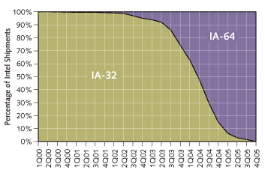
1. Introduction (4)
Industry analyst’s prediction from 2000 for how IA-64 will supplant IA-32 [211]
As the Figure shows, analysts expected IA64 to penetrate Intel’s processor shipments
already in 2004.

Slide 9
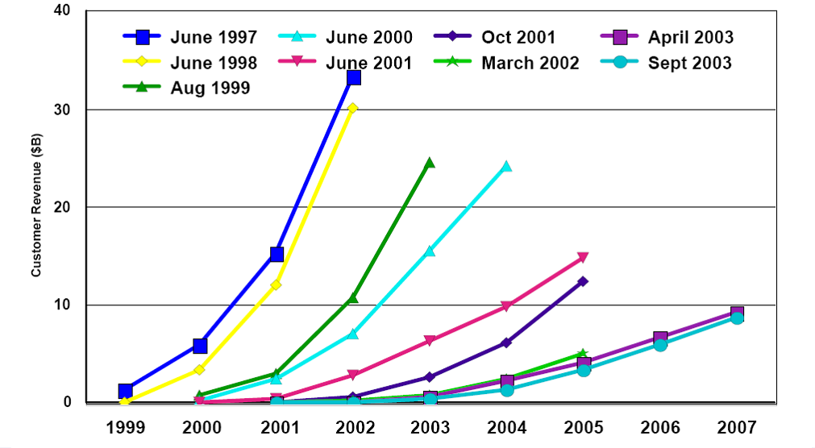
1. Introduction (5)
Market reception of the first IA-64 processors
By contrast, due to two years delay in shipping and worse than expected performance,
sales expectations of IA64 processors radically flattened in time, as the next Figure shows.
Figure: Sales expectations of the Itanium lines [10]

Slide 10
1. Introduction (6)
AMD’s outstanding innovations around 2000 -2
Intel’s and hp’s vision for transferring 32-bit CISC computing to 64-bit VLIW computing
were sharply confronted by two outstanding innovations of AMD, as follows.
Downwards compatible extension of the 32-bit x86 ISA to 64-bit, called the
x86-ISA in 1999.
AMD’s goal was clearly formulated in the x86-64 ISA specification from 2000
[210]:
"Ultimately this technology is designed to help preserve the enterprise
community's enormous financial investment in 32-bit operating systems,
applications, development tools and support infrastructure while
providing a seamless path to deploy future 64-bit technology."
As AMD pointed out, "Perhaps the most noteworthy feature of AMD's
approach to 64-bit computing is that it is an extension to the 32-bit
environment prevailing in the industry today rather than a radical
departure“, envisioned by Intel’s and HP’s joint IA64 VLIW architecture
concept, released in 1997.

Slide 11
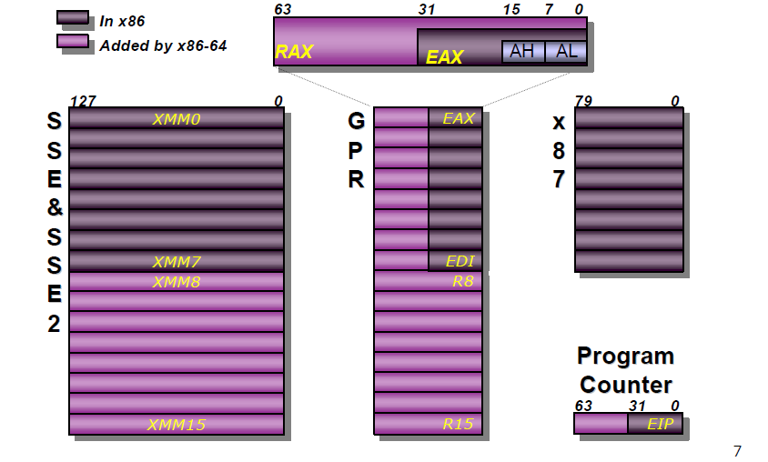
1. Introduction (7)
Extending the register set in the x86-64 ISA [167]
Based on the extended register set AMD necessarily defined new instructions to
manipulate 64-bit data in the extended register space.
Notes:
11

Slide 12
1. Introduction (8)
AMD’s outstanding innovations around 2000 -3
b) Developing the Direct Connect Architecture (DCA) multiprocessor concept.
The DCA concept has two ingredients:
b1) Integrating Memory Controllers onto the processor die. (It is not AMD’s invention).
See the next Figure.
Figure: AMD’s Direct Connect Architecture concept [168]
This reduces the access path and thus shortens the access time of the memory,
vs. the previous solution, when memory had been attached via the MCH, as indicated next.

Slide 13
1. Introduction (9)
Comparing options for connecting memory channels to a client platform
There are two main alternatives how memory channels can directly be connected
to a client platform, as shown below.
Connecting memory channels directly to a client platform
Connecting memory channels
via the MCH
Connecting memory channels
via the processor
MC is integrated
into the MCH.
Data is transferred
between the MCH and
the processor through
the FSB (Front Side Bus)
MC is integrated
onto the processor die.
The MC is usually linked
by an interconnect fabric
to other units (e.g. cores)
of the processor.
Processor
Processor r
MC
Memory
FSB
FSB
MCH
MCH
MC
Memory
ICH
MCH: Memory Control Hub
IOH: IO Control Hub
ICH

Slide 14
1. Introduction (10)
Remark
Integrating Memory Controllers onto the processor die is not AMD’s invention,
it had been long before introduced and widely used, as the next Table shows.
Options for attaching memory to platforms
Attaching memory to the MCH
Attaching memory to the processor die
Examples
HP PA-7100 (1992)
HP PA-7150 (1994)
and subsequent PA models
HP PA-7000 (1991)
UltraSPARC II (1C) (~1997)
UltraSPARC III (2001)
and all subsequent Sun models
AMD’s K7 lines (1C)
(1999-2003)
Opteron server lines (2C) (2003)
and all subsequent AMD lines
POWER4 (2C) (2001)
POWER5 (2C) (2005)
and subsequent POWER families
Core 2 Duo line (2C) (2006)
and all preceding Intel lines
Core 2 Quad line (2x2C) (2006/2007)
Penryn line (2x2C) (2008)
Nehalem lines (4) (2008)
and all subsequent Intel lines
Montecito (2C) (2006)
Tukwila (4C) (2010)

Slide 15
1. Introduction (11)
b) Developing the Direct Connect Architecture (DCA) multiprocessor concept cont.
b2) DCA provides up to 3 serial 2B–wide HyperTransport links to interconnect processors of servers as well as processors with the chipset. as shown below.
Figure: AMD’s Direct Connect Architecture concept [168]
The DCA concept allows to implement servers without the memory bandwidth limitations
of the previous solution.

Slide 16
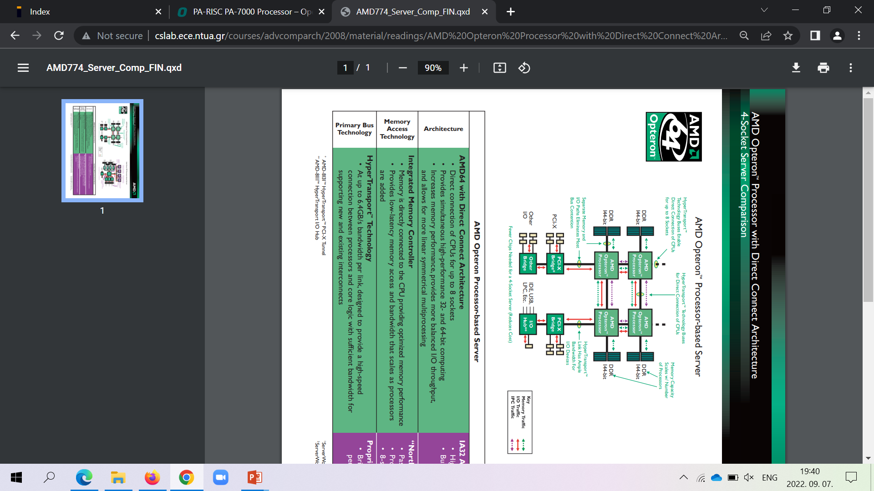
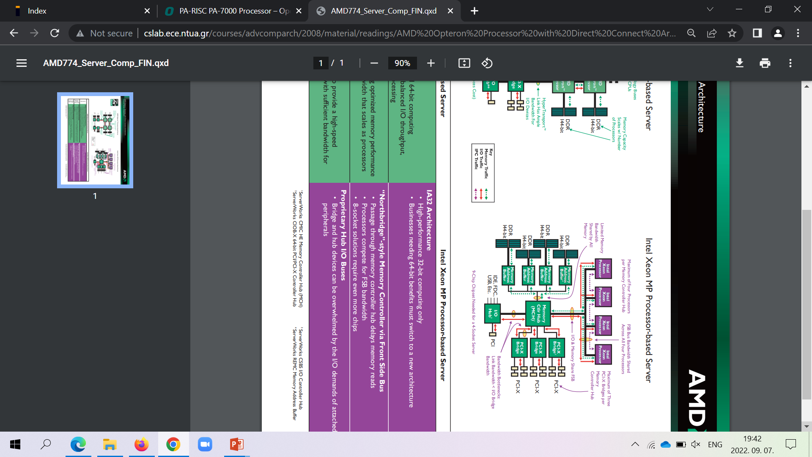
1. Introduction (12)
Contrasting memory bandwidth issues in a 4S server while attaching memory
via the MCH or directly, via the processors (based on [228])
PCI
As the Figure shows, the DCA architecture greatly relieves bandwidth limitations of
platforms where memory is attached via the MCH and the FSB (Front Side Bus).
FSB: Előoldali busz

Slide 17
1. Introduction (14)
AMD’s outstanding innovations around 2000 -4
AMD’s implementation of the x86-64 ISA extension and the DCA architecture -1
In 2002 AMD announced Microsoft support for their x86-64 ISA.
In 2003 AMD shipped the K8 server processor that is based on the x86-64 ISA and
implements DCA.
Subsequently, in 2004, Intel took over AMD’s x86-extension (presumable enforced
by Microsoft’s support of this ISA) and introduced it in their 3. core of the Pentium 4
line (called Prescott).
By contrast, Intel followed AMD by attaching memory channels immediately to the
processor die much later, only in their Nehalem line in 2008.
Both AMD’s introduced x86-64 server and subsequent DT processors were superior
to Intel’s existing lines [169], and AMD’s market share rose on the world market from
2003 on.

Slide 18
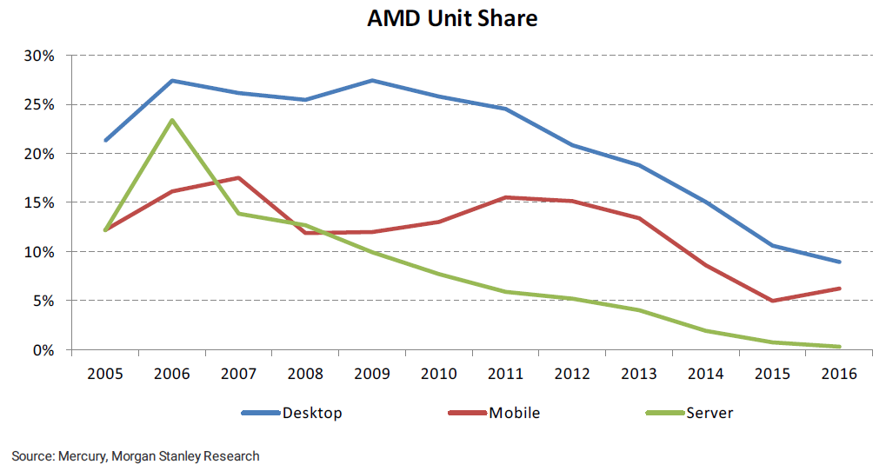
1. Introduction (15)
AMD's increasing unit shares on the world market 2006-2016 [51]

Slide 19
1. Introduction (16)
AMD's decreasing unit shares on the world market 2006-2016 [51] -1
Nevertheless, after taking over AMD’s x86-64 ISA extension, and launching the
newly developed Core 2 line in 2006, Intel regained superiority in processor
performance, so subsequently AMD’s share on the world market started to shrink,
as the next Figure indicates.

Slide 20
1. Introduction (17)
AMD's decreasing unit shares on the world market 2006-2016 [51] -2
AMD’s subsequent decrease in market shares was caused by the superior performance
of Intel’s Core 2-based processors vs. AMD’s next (K10-based) lines.

Slide 21
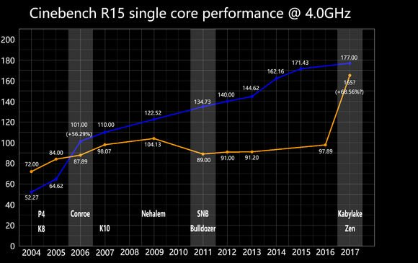
1. Introduction (18)
Contrasting the single core performance of Intel and AMD CPUs - 2004 to 2017,
based on the Cinebench 15 benchmark [89]
(Core 2)
This Figure makes clear why AMD loose their market share to Intel.

Slide 22
1. Introduction (19)
Remarks on the CineBench benchmark [27]
It is a real-world cross-platform test suite that evaluates CPU and graphics
performance for 3D content creation.
It is based on MAXON's award-winning animation software Cinema 4D.

Slide 23
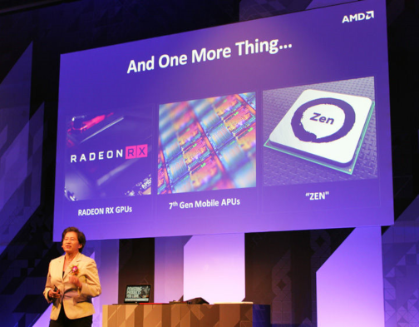
1. Introduction (20)
Announcing the Zen architecture at Computex 2016 as a turning point
in AMD’s market position [1]

Slide 24
1. Introduction (21)
AMD’s effort to design the Zen core [11]
M. Papermaster, CTO of AMD: Up to 300 engineers were working on the Zen core
spending over two million working hours.
Aim: optimizing the power/frequency curve.
CTO: Chief Technology Officer

Slide 25
1. Introduction (22)
AMD’s rising unit share on the world market after launching the Zen family
2017-2020 [116]
 | 2Q20 | 1Q20 | 4Q19 | 3Q19 | 2Q19 | 1Q19 | 4Q18 | 3Q18 | 2Q18 | 1Q18 | 4Q17 | 3Q17
DT | 19.2% | 18.6% | 18.3% | 18% | 17.1% | 17.1% | 15.8% | 13% | 12.3% | 12.2% | 12.0% | 10.9%
Mobile | 19.9% | 17.1% | 16.2% | 14.7% | 14.1% | 13.1% | 12.2% | 10.9% | 8.8 %
Server | 5.8% | 5.1% | 4.5% | 4.3% | 3.4% | 2.9% | 3.2% | 1.6% | 1.4% | 0.8%
As the Table indicates, AMD could continuously rise their unit share on the world market
in all three major market segments, e.g. approximately by doubling the market share
of their DTs and mobiles and increase the market share of their severs by more than fivefold.

Slide 26
1. Introduction (23)
Implementation of the x86-64 ISA extension and the DCA architecture -2
As a result of the continuous evolution of the Zen architecture, AMD’s 7 nm Zen 3-based
processors became after about 15 years anew the highest performing processors in 2020,
as for example the next two Figures show.

Slide 27
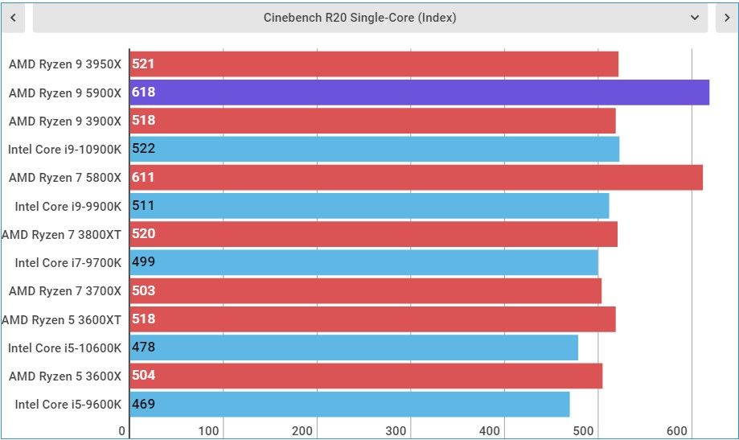
1. Introduction (24)
AMD’s performance leadership in single core (SC) Cinebench R20 benchmark
results along with their Zen 3-based Ryzen 9 5900 DT processor in 2021 [185]

Slide 28
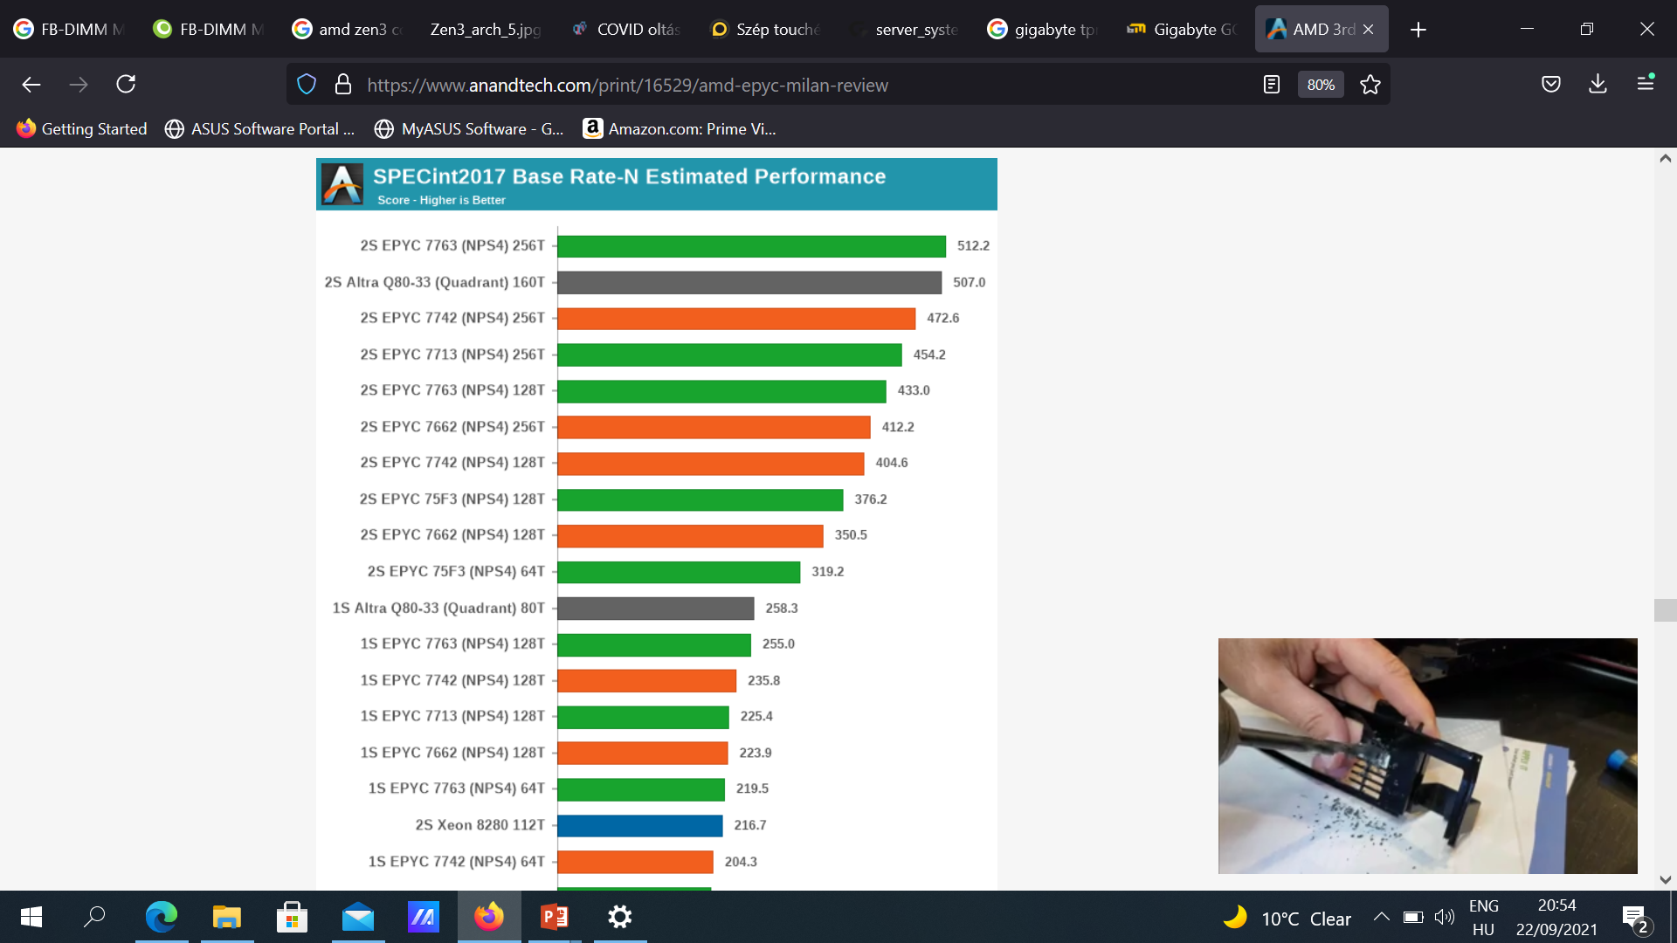
1. Introduction (25)
AMD’s performance leadership of in SPECint2017 Rate N benchmark along with their
Zen 3-based EPYC processors in 2021 ([208]
SPECint2017 Rate
integer benchmark
measure the throughput or work
per unit of time.
NPS4 (4 Nodes per Socket) means a given server setting
with 4 processors
(not discussed here).
Base means standard
setting for the
measurements (no tuning
allowed.)
T: Threads
Red columns: Zen 2-based
Green columns: Zen 3-based
Note that emerging ARM-based servers, like Ampere’s 80-core Altra Q80-33 2S servers achieve already competitive performance results, that indicates an upcoming sharpening competition
in this processor category.

Slide 29
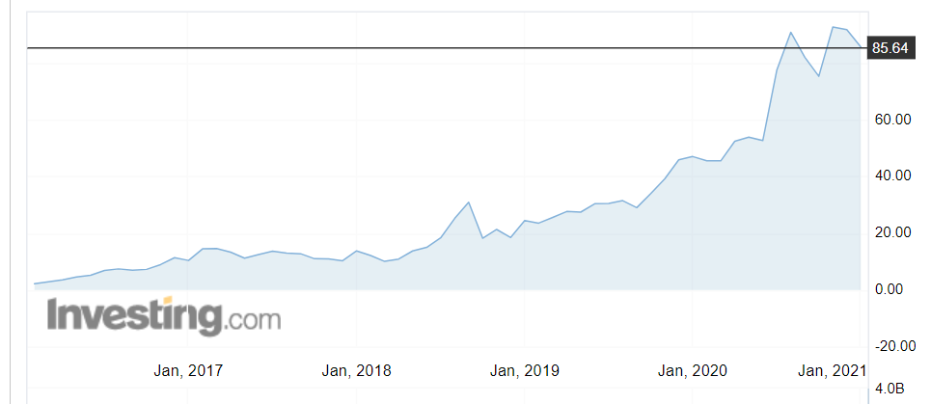
1. Introduction (26)
AMD’s stock price 2017 - 2021
Along with increasing market shares AMD’s stock price tremendously rose from about
2 $ in 2016 to more than 80 $ in 2020 when AMD’s processors gained the performance
crown.
Source: Investing.com

Slide 30
1. Introduction (27)
Subsequent developments pursued for achieving the performance crown
Since AMD’s success with their Zen 3-based processors there is a tough competition
for the performance crown with varying results.
Lastly Intel regained leadership with their 12th gen. 10 nm Alder Lake line (11/2021),
but AMD responded with the Zen 4-based 7 nm Ryzen 7000 processors, nevertheless,
Intel is expected soon to counter with their 13th gen.10 nm Raptor Lake line
and so on.
.
Remark to the fate of the IA64-based Itanium line
Due to its lower than expected performance and “exotic” ISA the Itanium line came
to a dead end and Intel cancelled it in 2019.

Slide 31
1. Introduction (28)
Summing up key issues preceding the introduction of the Zen family -1H
Historical background
In the 1990s CiSC processors were 32-bit wide whereas RISCs mostly 64-bit.
In order to enter the 64-bit market, Intel and hp (Hewlett Packard) started
a cooperation in 1994.
Results of this joint effort were the development of the VLIW-based IA-64 ISA
(Intel Architecture 64) in 1997 and based on it the 64-bit Itanium line announced
in 1999, targeting high-end DTs to servers.

Slide 32
1. Introduction (29)
Summing up key issues preceding the introduction of the Zen family -2
AMD’s outstanding innovations around 2000
Downwards compatible extension of the 32-bit x86 ISA to 64-bit, called the
x86-ISA in 1999.
AMD’s goal was clearly formulated in the x86-64 ISA specification from 2000
[210]:
"Ultimately this technology is designed to help preserve the enterprise
community's enormous financial investment in 32-bit operating systems,
applications, development tools and support infrastructure while providing
a seamless path to deploy future 64-bit technology."
b) Developing the Direct Connect Architecture (DCA) multiprocessor concept.
The DCA concept has two ingredients:
b1) Integrating Memory Controllers onto the processor die. (It is not AMD’s invention).
This reduces the access path and thus shortens the access time of the memory,
vs. the previous solution, when memory had been attached via the MCH.
b2) Providing up to 3 serial 2B–wide HyperTransport links to interconnect
processors of a server as well as processors with a chipset.
This greatly reduces memory bandwidth limitations of the previous solution when
memory channels had been attached via the MCH, and the FSB (Front Size Bus)
was shared by all processors.

Slide 33
1. Introduction (30)
Summing up key issues preceding the introduction of the Zen family -2
Implementation of the x86-64 ISA extension and the DCA architecture
In 2002 AMD announced Microsoft support for their x86-64 ISA.
In 2003 AMD shipped the K8 server processor that is based on the x86-64 ISA and
implements DCA.
Subsequently, in 2004, Intel took over AMD’s x86-extension (presumable enforced
by Microsoft’s support of this ISA) and introduced it in their 3. core of the Pentium 4
line (called Prescott).
By contrast, Intel followed AMD by attaching memory channels immediately to the
processor die much later, only in their Nehalem line in 2008.
Both AMD’s introduced x86-64 server and subsequent DT processors were superior
to Intel’s existing lines [169], and AMD’s market share rose on the world market from
2003 on.
Nevertheless, after taking over AMD’s x86-64 ISA extension, and launching the
newly developed Core 2 line in 2006, Intel regained superiority in processor
performance, so subsequently AMD’s share on the world market started to shrink,
as the next Figure indicates.

Slide 34
. Introduction (31)
Subsequent developments pursued for achieving the performance crown
Since AMD’s success with their Zen 3-based processors there is a tough competition
for the performance crown with varying results.
Lastly Intel regained leadership with their 12th gen. 10 nm Alder Lake line (11/2021),
but AMD responded with the Zen 4-based 7 nm Ryzen processors, nevertheless,
Intel is expected soon to counter with their 13th gen.10 nm Raptor Lake line
and so on.
.
Remark to the fate of the IA64-based Itanium line
Due to its lower than expected performance and “exotic” ISA the Itanium line came
to a dead end and Intel cancelled it in 2019.

Slide 35
2. Cornerstones of AMD’s Zen processor family
2.1 Overview
2.2 The multi-die approach
2.3 The Infinity Fabric (IF) cache coherent interconnect
2.4 MCM 2D and 3D V-cache packaging technologies
2.5 Modular, lego-like approach
Notes:
35

Slide 36
2.1 Overview
Notes:
36

Slide 37
2.1 Overview (1)
Cornerstones of AMD’s Zen family
The key design choice for the success of the Zen family can presumable be contributed
to the multi-die approach chosen for implementing processors rather than
holding on to the monolithic die implementation.
AMD’s design choice however has three major consequences as follows:
a) While using multiple dies for a processor, an appropriate cache coherent interconnect
is needed to link them together effectively.
For this reason AMD designed the Infinity Fabric (IF).
The developed IF is also capable to interconnect multiple processors of a server
as well.
b) While using multiple dies, obviously, an appropriate packaging technology is also needed.
For this reason AMD developed the MCM (Multi Chip Module) 2D and the V-cache
3D packaging technologies.
c) Finally, multiple-dies allow to use a modular, lego-like design for processors
targeting different market segments, such as mobiles, desktops, HEDTs or servers
to be built up out of the same set of dies.
AMD’s chose was to have three types of dies:
CPU dies (dies which do not include GPUs)
APU dies (dies including both CPUs, GPUs and IO)
IO dies (dies linked to CPU dies to perform IO functions).
APU: Accelerated Processing Unit

Slide 38
2.2 The multi-die approach
Notes:
38

Slide 39
2.2 Multi-die approach (1)
2.2 The multi-die approach
In 2017 the multi-die approach for implementing processors was by far not new.
Both Intel and even AMD introduced dual-die processor implementations already
in the middle of the 2000’s, as the subsequent examples show.

Slide 40
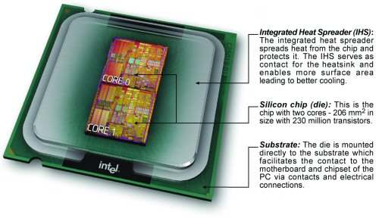
2.2 Multi-die approach (2)
Intel’s first dual die design (Dual-core DT Pentium D-820) (5/2005) [91], [92]
Intel made use of the dual-die approach to launch higher core processors before the
needed IC technology would have been available.

Slide 41
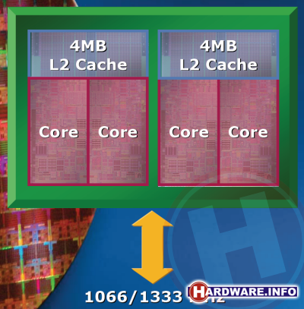
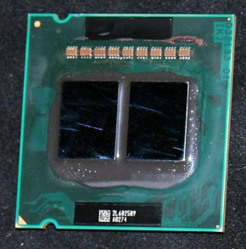
2.2 Multi-die approach (3)
Further examples of Intel’s dual-die processor designs, used to implement
dual-core and quad-core server processors
Examples
Xeon Paxville DP 2.8: (2x1C), 2xDP-enhanced Pentium 4 Prescott (10/2005)
Xeon 5000 (Dempsey): (2x1C) DP, ~ the 65 nm shrink of the 90 nm Paxville DP 2.8 (5/2006)
Xeon 5300 (Clowertown): (2x2C) 2xCore 2-based 65 nm 2C Xeon 5100 (Woodcrest), 11/2006
Xeon 5300
(Clowertown) [4], [5]
Xeon 5400 Harpertown: 2x2C, 2x Core 2-based 45 nm 2C Harpertown (11/2007)

Slide 42
2.2 Multi-die approach (4)
Examples of AMD’s 12-core and 16-core dual-die server processors
AMD was forced to use dual dies to compete with Intel’s high-core count server processors
due to the less advanced technology available in their own foundry.
Examples
Opteron 6100 (Magny-Course): 2x6C, 2xBulldozer-based 45 nm Istambul die, (3/2010)
Opteron 6200 (Interlagos): 2x8C, 2xBulldozer-based 32 nm Orochi die, (11/2011)
Opteron 6300 (Abu Dhabi): 2x8C, 2xPiledriver-based 32 nm Abu Dhabi die, (11/2012)
Opteron 6400 (Warsaw): 2x8C, 2xPiledriver-based, 32-nm Abu-Dhabi die, (2014)

Slide 43
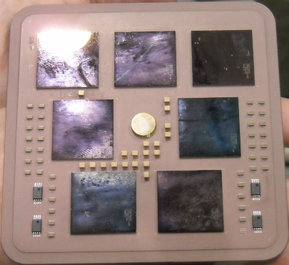
2.2 Multi-die approach (5)
Example of a server processor design built up of 7 dies: IBM’s 7-die z10 server
processor from 2008
Figure: IBM’s 17-core z10 server processor built on 5 proc. dies + 2 mem. control dies [6]

Slide 44
2.2 Multi-die approach (6)
Design paradigms for the physical implementation of multicore processors
Obviously, multicore processors may be implemented either on a single die, this is called
monolithic implementation or on multiple dies, termed multi-die approach, as indicated below.
Design paradigms for the physical implementation of processors
Monolithic implementation
Multi-die approach
All cores are implemented
on the same die
Cores are implemented on multiple dies,
these dies are properly interconnected and
mounted into the same package

Slide 45
2.2 Multi-die approach (7)
Pros and cons of the multi-die approach [3]
Pros
Large dies may more economically be manufactured if they are segmented
into a number of smaller dies, since smaller dies have lower failure rates and
thus higher yield and lower cost.
The multi die approach allows using a modular, lego-like design concept for
implementing processors in such a way that processors for different market
segments, like mobiles, desktops, HEDTs or servers may be built up basically
from the same set of dies reducing development and manufacturing costs.
While using a modular concept, in large core count server processors, memory
channels and I/O may easily be linearly scaled with the core count.
Cons
Multiple dies within a package or even multiple processors need to be linked
together by an efficient cache coherent interconnect and control fabric.
This causes additional transfer latencies that degrade performance and gives
rise to extra power consumption.
Multiple dies need to be packed together by 2D/2.5D or 3D packaging technologies
(to be discussed in Section 2.4), this increases fabrication cost.

Slide 46
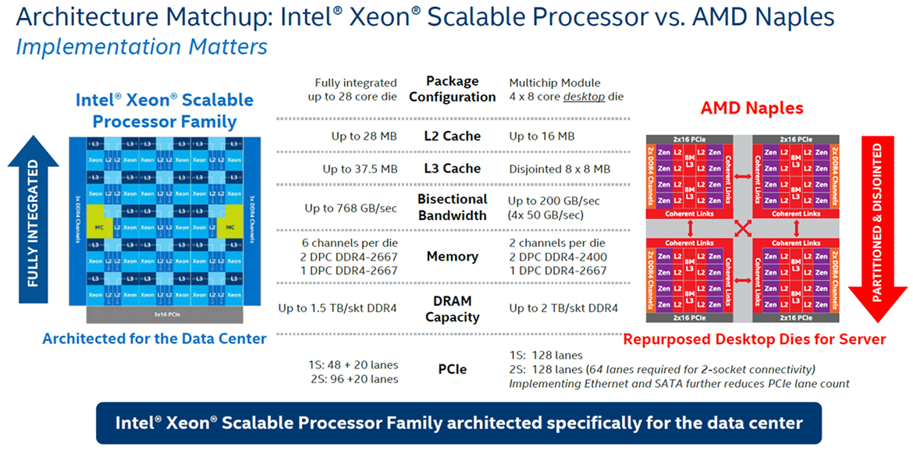
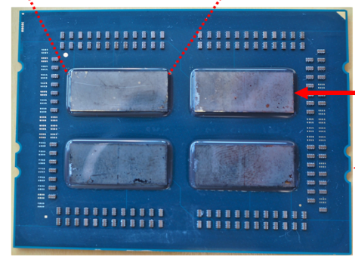
2.2 Multi-die approach (8)
Intel’s traditional and AMD’s choice for implementing their Zen processors
Design paradigms for the physical implementation of multicore processors
Monolithic implementation
Multi-die approach
All cores are implemented
on the same die
Cores are implemented on multiple dies,
these dies are properly interconnected and
mounted into the same package
Example
Intel's Skylake-SP (2017) [2]
AMD's EPYC (2017) processor [2], [3]
Up to 28 cores
Up to 4x8 cores
Single
package

Slide 47
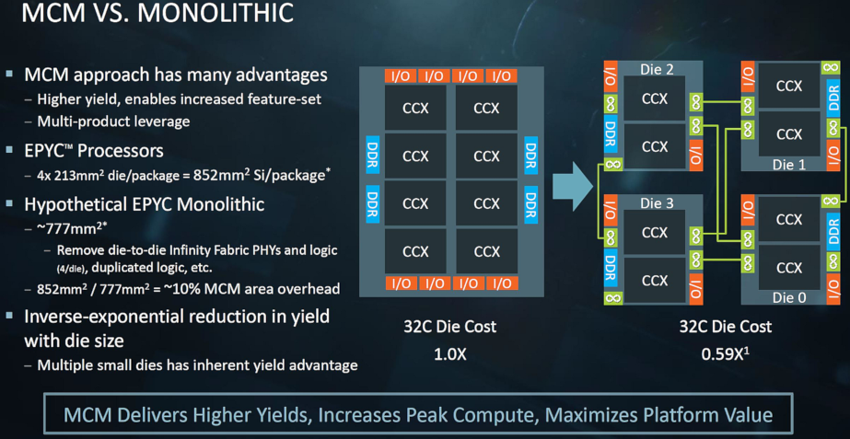
2.2 Multi-die approach (9)
AMD's cost argumentation for choosing the multi-die approach [7]
(Presented at the Hot Chips Conference in Aug. 2017)
(CCX: 4-core Core CompleX)
With the multi-die approach, AMD expects higher yields and lower cost vs. the monolithic implementation.

Slide 48
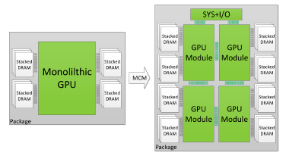
2.2 Multi-die approach (10)
NVIDIA's possible future use of multi die designs, revealed in a research
paper in 2017 [32]

Slide 49
2.2 Multi-die approach (11)
Remarks to Intel’s and AMD’s recent multi-die developments
1) In 06/2020 Intel introduced their multi-die (chiplet-based) big.little 10nm/22 nm
mobile processor line, called Lakefield (without any generation specification) and
discontinued its distribution after one year.
Nevertheless, thereafter, in 11/2021 Intel launched their monolithic, big.little 10 nm
12th gen. Alder Lake line with mobile and DT models.
2) Also AMD is reported to work on a flagship (RDNA 3) multi-chip GPU design that
features 160 CUs and a total of 10,240 stream processors to be launched in
2022 [186].

Slide 50
2.2 Multi-die approach (12)
Summing up key issues of the multi-die approach -1
Design paradigms for implementing processors
Monolithic implementation
Multi-die approach
The processor is implemented
on a single die
The processor is implemented on multiple dies,
these dies are properly interconnected and
mounted into the same package

Slide 51
2.2 Multi-die approach (13)
Summing up key issues of the multi-die approach -2
Pros and cons of the multi-die approach [3]
Pros
Large dies may more economically be manufactured if they are segmented
into a number of smaller dies, since smaller dies have lower failure rates and
thus higher yield and lower cost.
The multi-die approach allows using a modular, lego-like design concept for
implementing processors in such a way that processors for different market
segments, like mobiles, desktops, HEDTs or servers may be built up basically
from the same set of dies reducing development and manufacturing costs.
While using a modular concept, in large core count server processors, memory
channels and I/O may easily be linearly scaled with the core count.
Cons
Multiple dies within a package or even multiple processors need to be linked
together by an efficient cache coherent interconnect and control fabric.
This causes additional transfer latencies that degrade performance and gives
rise to extra power consumption.
Multiple dies need to be packed together by 2D/2.5D or 3D packaging technologies
(to be discussed in Section 2.4), this increases fabrication cost.

Slide 52
2.2 Multi-die approach (14)
Summing up key issues of the multi-die approach -3
AMD's cost argumentation for choosing the multi-die approach [7]
(CCX: 4-core Core CompleX)
With the multi-die approach, AMD expects higher yields and lower cost vs. the monolithic implementation.

Slide 53
2.3 The Infinity Fabric (IF) cache coherent interconnect
2.3.1 Overview of the Infinity Fabric
2.3.2 Implementation of the Infinity Fabric
Only Section 2.3.1 is discussed, Section 2.3.2 is not part of the exam.
Notes:
53

Slide 54
2.3.1 Overview of the Infinity Fabric
Notes:
54

Slide 55
2.3.1 Overview of the Infinity Fabric (1)
2.3.1 Overview of the The Infinity Fabric
The Infinity Fabric (IF) is AMD’s cache coherent interconnect and control network
designed along with the Zen core.
The task of the Infinity Fabric is:
to link together system units and
provide system wide control functions, such as power management
or system security.
IF roots in the HyperTransport bus, it is similar to Intel's QPI or UPI
interconnection technology or ARM's CCN (Cache Coherent Network).

Slide 56
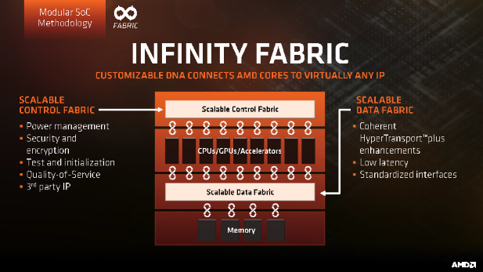
2.3.1 Overview of the Infinity Fabric (2)
Key parts of AMD’s Infinity Fabric (IF)
Consequently, the Infinity Fabric consists of two key parts:
a Scalable Data Fabric (SDF), and
a Scalable Control Fabric (SCF),
as seen in the next Figure.
Power management
Security and Encryption
Quality of Service
Coherent
advanced
HyperTransport
bus
Low latency
standardized
interfaces
Figure: Key parts of AMD's Infinity Fabric (IF)[19]
SDF: Adatkapcsolat SCF: Vezérlés

Slide 57
2.3.1 Overview of the Infinity Fabric (3)
The Scalable Data Fabric (SDF) -1
The Scalable Data Fabric (SDF) provides a high performance cache coherent data
interconnect for all system blocks.
It is a greatly enhanced version of the HyperTransport bus.
Power management
Security and Encryption
Quality of Service
Coherent
advanced
HyperTransport
bus
Low latency
standardized
interfaces
Figure: AMD's Infinity Fabric [19]

Slide 58
2.3.1 Overview of the Infinity Fabric (4)
The Scalable Data Fabric (SDF) -2
Its task is to interconnect
a) building blocks, like CCX core complexes, memory and IO-controllers within a die,
b) different dies within a package via IFOP (IF On-Package) links and
c) two sockets of a 2S server via IFIS (IF Inter-Socket) links,
as the next examples illustrates.

Slide 59
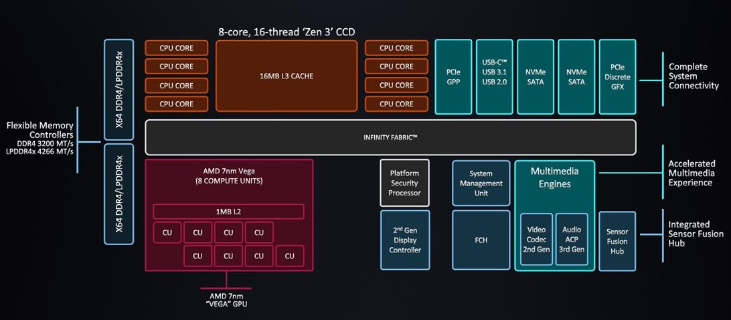
2.3.1 Overview of the Infinity Fabric (5)
a) Use of IF for interconnecting building blocks within a die
Example: Zen 3-based Ryzen 5000 (Cezanne) mobile APU SoC [213]
APU: Accelerated Processing Unit (in AMD’s terminology a processor with a GPU)
SoC: System on a Chip
CCD: CPU Compute Die

Slide 60
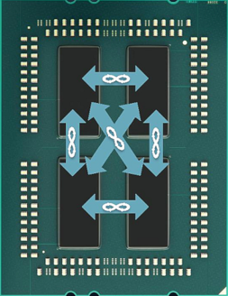
2.3.1 Overview of the Infinity Fabric (6)
b) Use of IF for interconnecting different dies within a package
Example: 1. gen. EPYC server processor [21]
The 4 dies are
8-core Zeppelin dies
Revealed in AMD's EPYC Launch event presentation, June 20 2017

Slide 61
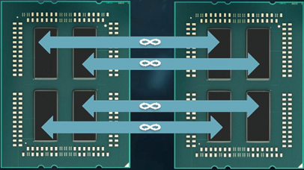
2.3.1 Overview of the Infinity Fabric (7)
c) Use of IF for interconnecting two sockets of a 2S server
Example:1. gen. EPYC server processor [21]
Socket 1
Socket 2
The 2x4 dies are
8-core Zeppelin dies
Revealed in AMD's EPYC Launch event presentation, June 20 2017

Slide 62
2.3.1 Overview of the Infinity Fabric (7b)
Signaling systems used in buses
Signals
Single ended
Voltage referenced
Differential
Typ.voltage
swings
S+
V_{REF}
S-
V_{CM}
t
t
t
3.3-5 V
600-800 mV
200-300 mV
Signaling
system
used in
TTL (5 V)
FPM/EDO
SSTL
SSTL2 (DDR)
SSTL1.8 (DDR2)
SSTL1.5 (DDR3)
RSL (RDRAM)
FSB
LVDS
PCie
QPI, DMI, ESI
FB-DIMMs
LVTTL (3.3 V)
FPM/EDO
SDRAM
HI 1.5
DRSL
XDR (data)
Smaller voltage swings
LVDS: Low Voltage Differential Signaling LVTTL: Low Voltage TTL
(D)RSL: (Differential) Rambus Signaling Level SSTL: Stub Series Terminated Logic V_{CM}: Common Mode Voltage V_{REF}: Reference Voltage

Slide 63
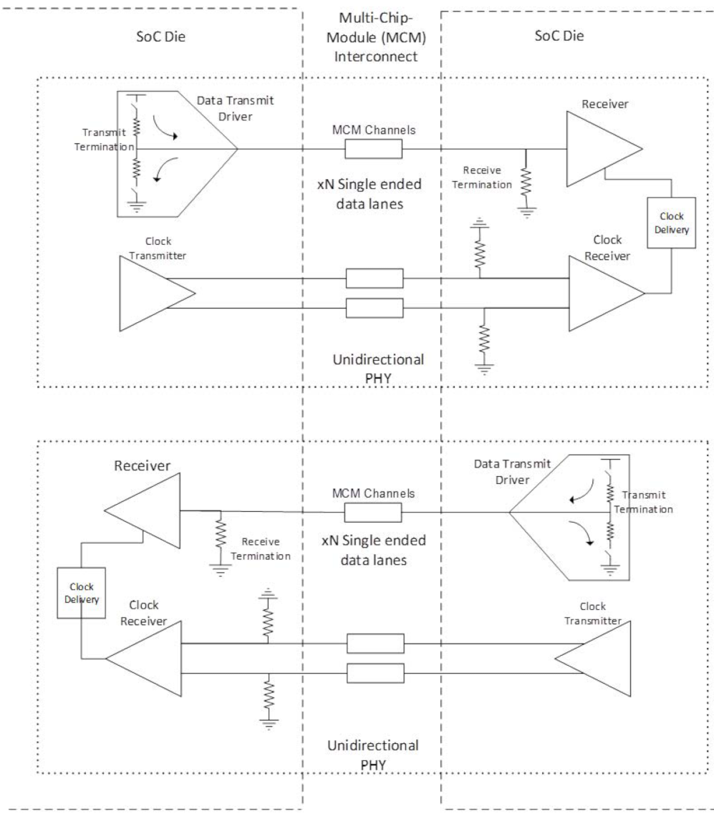
2.3.1 Overview of the Infinity Fabric (7c)
Example: Implementation of 1.gen. IFOP links with
single-ended data lanes and differential clock lanes [87]
Differential lanes

Slide 64
2.3.1 Overview of the Infinity Fabric (8)
The Scalable Control Fabric -1
The Scalable Control Fabric is responsible for the system wide
Power management
Security and Encryption
Quality of Service,
as indicated below.
Power management
Security and Encryption
Quality of Service
Coherent
advanced
HyperTransport
bus
Low latency
standardized
interfaces
Figure: AMD's Infinity Fabric [19]

Slide 65
2.3.1 Overview of the Infinity Fabric (9)
The Scalable Control Fabric -2
The Scalable Control Fabric incorporates central control elements, and
remote embedded elements dispersed in all blocks of the SoC.
The remote embedded elements are mainly sensors monitoring temperature,
speed and voltage.
The data acquired is fed into the central control element and allows to optimize
power management in a closed control loop, as seen in the next Figure.

Slide 66
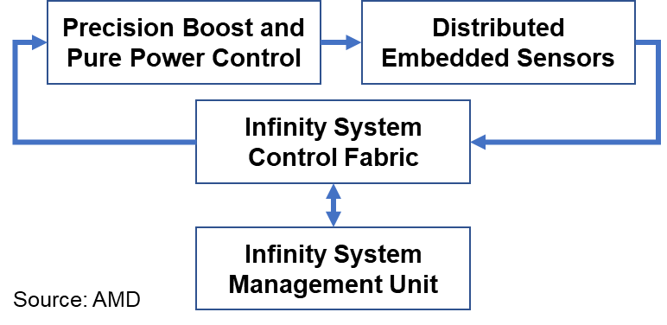
2.3.1 Overview of the Infinity Fabric (10)
Principle of the operation of Infinity System’s Control Fabric [3]
Control algorithms for AVFS
Over 1000 sensors per CCX
Central Control Element
The system may be customized
by choosing the proper balance between
performance and power consumption

Slide 67
2.3.2 Implementation of the Infinity Fabric
Optional reading, not part of the exam.
Notes:
67

Slide 68
2.3.2.1 Implementation of the Scalable Data Fabric (1)
2.3.2 Implementation of the Infinity Fabric
2.3.2.1 Implementation of the Scalable Data Fabric
As discussed before, the task of the Scalable Data Fabric is threefold, to interconnect
a) building blocks, like CCX core complexes, memory and IO-controllers within a die,
b) different dies within a package via IFOP (IF On-Package) links and
c) two sockets of a 2S server via IFIS (IF Inter-Socket) links,
Its implementation differs according to its specific task, as follows.

Slide 69
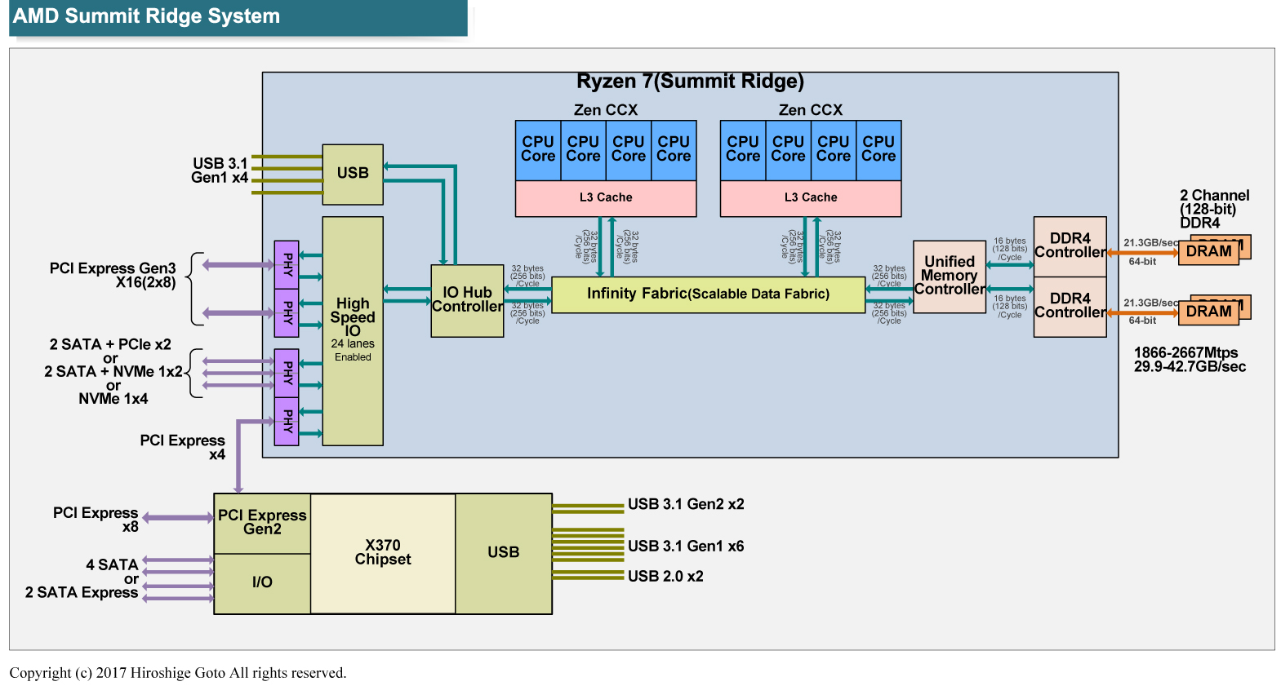
2.3.2.1 Implementation of the Scalable Data Fabric (2)
a) Implementation of interconnecting building blocks within a die
Example: In a Zen core-based GPU-less DT processor (Ryzen 1000) [10]
256-bit/cycle
UMC
As indicated above, the interconnect is 256 bit wide in its first generation.

Slide 70
2.3.2.1 Implementation of the Scalable Data Fabric (3)
b) Implementing the links that interconnect the dies within a package
(called IFOP links)
IFOP (IF On-Package)
links
The 4 dies are
8-core Zeppelin dies
Revealed in AMD's EPYC Launch event presentation, June 20 2017

Slide 71
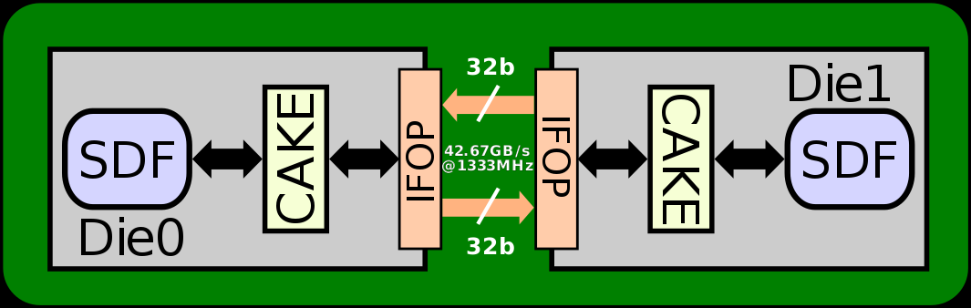
2.3.2.1 Implementation of the Scalable Data Fabric (4)
Details of IFOP (IF On-Package) links -1
They provide a die-to-die communication path within a package.
Their length is up to 10-20 mm.
IFOP links make use of single-ended signals with differential clocking
(detailed later).
Figure: Example implementation of 1. gen. IFOP links [206]
CAKE: Coherent AMD SocKet Extender (It takes SDF requests, encodes them into 128-bit
serialized packets per clock cycle and forwards them to the IFOP (or IFIP) interface.
Responses are also decoded by the CAKE and are forwarded back to the SDF) [207].

Slide 72
2.3.2.1 Implementation of the Scalable Data Fabric (5)
Signaling systems used in buses
Signals
Single ended
Voltage referenced
Differential
Typ.voltage
swings
S+
V_{REF}
S-
V_{CM}
t
t
t
3.3-5 V
600-800 mV
200-300 mV
Signaling
system
used in
TTL (5 V)
FPM/EDO
SSTL
SSTL2 (DDR)
SSTL1.8 (DDR2)
SSTL1.5 (DDR3)
RSL (RDRAM)
FSB
LVDS
PCie
QPI, DMI, ESI
FB-DIMMs
LVTTL (3.3 V)
FPM/EDO
SDRAM
HI 1.5
DRSL
XDR (data)
Smaller voltage swings
LVDS: Low Voltage Differential Signaling LVTTL: Low Voltage TTL
(D)RSL: (Differential) Rambus Signaling Level SSTL: Stub Series Terminated Logic V_{CM}: Common Mode Voltage V_{REF}: Reference Voltage

Slide 73
2.3.2.1 Implementation of the Scalable Data Fabric (6)
Example: Implementation of 1.gen. IFOP links with
single-ended data lanes and differential clock lanes [87]
Differential lanes

Slide 74
2.3.2.1 Implementation of the Scalable Data Fabric (7)
Details of IFOP (IF On-Package) links -2
Power consumption in the 1. gen.: IF: 2 pJ/bit.
4 transfers/mem. clock.
32 single-ended data lanes per direction.
Figure: Example implementation of 1. gen. IFOP links [206]
CAKE: Coherent AMD SocKet Extender (It takes SDF requests, encodes them into 128-bit
serialized packets per clock cycle and forwards them to the IFOP (or IFIP) interface.
Responses are also decoded by the CAKE and are forwarded back to the SDF) [207].

Slide 75
2.3.2.1 Implementation of the Scalable Data Fabric (8)
c) Implementing the links that interconnect two sockets of a 2S server
(called IFIS links)
Socket 1
Socket 2
IFIS (IF Inter-Socket)
links
The 2x4 dies are
8-core Zeppelin dies
Revealed in AMD's EPYC Launch event presentation, June 20 2017

Slide 76
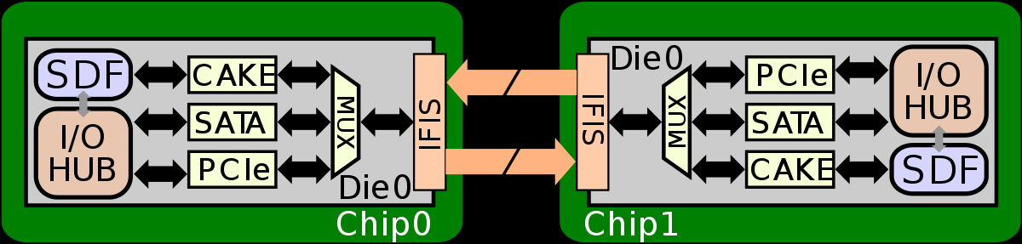
2.3.2.1 Implementation of the Scalable Data Fabric (9)
Details of IFIS (IF Inter-socket) links
They provide communication paths between sockets.
Their lengths is > 20 mm.
IFIS links make use of differential signaling.
Power consumption in the 1. gen. IF: 11pJ/bit.
8 transfers/memory clock.
4x16 lanes per direction.
4x16 lanes/dir.
Figure: Example implementation of 1. gen. IFIS links [206]
CAKE: Coherent AMD SocKet Extender (It takes SDF requests, encodes them into 128-bit
serialized packets per clock cycle and forwards them to the IFOP (or IFIP) interface.
Responses are also decoded by the CAKE and are forwarded back to the SDF) [207].

Slide 77
2.3.2.1 Implementation of the Scalable Data Fabric (10)
Contrasting main features of 1. gen. IFOP and IFIS links
IFOP (IF On-Package) links
IFIS (IF Inter-Socket) links
They provide a communication path
within a package between dies.
Their length is about 10-20 mm.
IFOP links make use of single-ended signals
with differential clocking (detailed later).
Power consumption (1. gen. (IF): 2 pJ/bit.
4 transfers/mem. clock.
32 data lanes per direction.
They provide a communication path
between sockets.
Their lengths is > 20 mm.
IFIS links make use of differential signaling.
Power consumption (1. gen. IF): 11pJ/bit.
8 transfers/memory clock.
4x16 lanes per direction.
In-band CRC, 8/9 efficient bandwidth
Examples
CAKE: Coherent AMD SocKet Extender
Figure: 1. gen. IFOP link [206]
Figure: 1. gen. IFIS link [206]
CAKE: Coherent AMD SocKet Extender (It takes SDF requests, encodes them into 128-bit
serialized packets per clock cycle and forwards them to the IFOP (or IFIP) interface.
Responses are also decoded by the CAKE and are forwarded back to the SDF) [207].

Slide 78
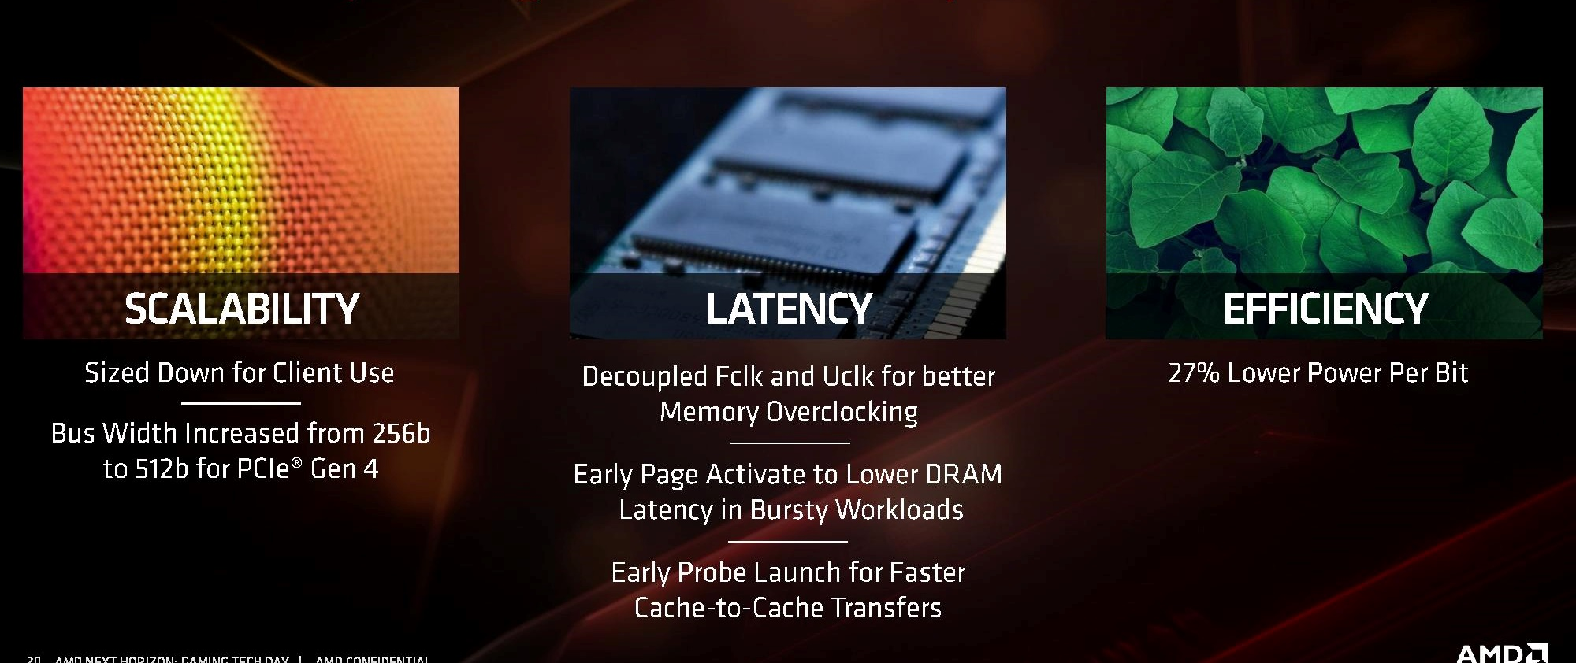
2.3.2.1 Implementation of the Scalable Data Fabric (11)
The 2. gen. Infinity Fabric (IF)
It has been introduced along with the Zen 2 core in 2019, with major enhancements,
as seen below.
Figure: Major improvements of the 2. gen. IF [103]

Slide 79
2.3.2.2 Implementation of the Scalable Control Fabric (12)
2.3.2.2 Implementation of the Scalable Control Fabric
Principle of the operation of the Scalable Control Fabric as part of the Infinity Fabric [3]
Control algorithms for Turbo Boost and AVFS
Over 1000 sensors per CCX
The system may be customized
by choosing the proper balance between
performance and power consumption
The data acquired is fed into the central control element and allows to optimize
power management in a closed control loop, as seen above.

Slide 80
2.4 MCM 2D and 3D V-cache packaging technologies
Notes:
80

Slide 81
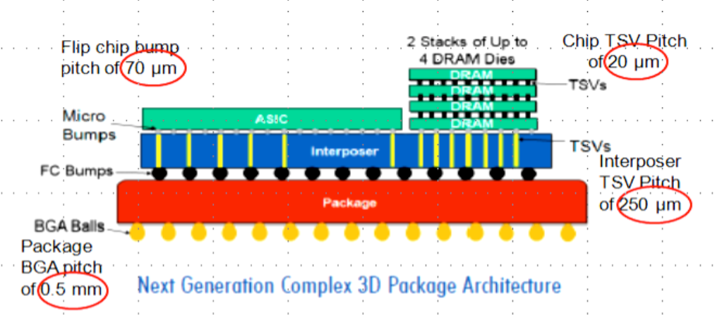
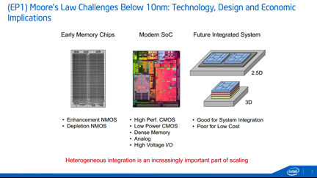
2.4 MCM 2D and 3D V-cache packaging technologies (1)
2.4 MCM 2D and 3D V-cache packaging technologies
Overview of packaging technologies used by Intel and AMD
Alternatives for in-package integration
2D packaging
(Horizontal die placement)
3D packaging
(Vertical die placement)
Both 2D and 3D packaging
(Horizontal and vertical
die placement
Dies are tiled side-by-side,
interconnected and packaged
Dies are stacked,
interconnected and packaged
Tiled and stacked dies are
interconnected and packaged
Intel’s recent technologies
EMIB
Foveros
Foveros + EMIB
AMD’s recent technologies
MCM
(Multi-chip Module)
3D V-Cache
(L3 stacked over proc. die)
Sources of the Figures: [187], [188]
Tiled: Egymás mellé helyezett
Stacked: Egymásra helyezett

Slide 82
2.4 MCM 2D and 3D V-cache packaging technologies (2)
MCM packaging to encase multiple dies-2
MCM (Multi-Chip Module) packaging is a kind of 2D packaging, as indicated
in the preceding Figure.
At the time being however, no details are available about the implementation
technique used by AMD for their MCM technology.
Thus only some illustrations can be presented of how the MCM technology is
used by AMD for implementing Zen processors.

Slide 83
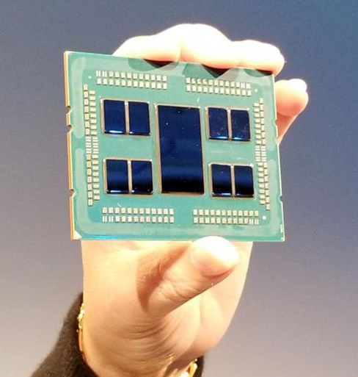
2.4 MCM 2D and 3D V-cache packaging technologies (3)
Use of MCM (Multi-Chip Module) packaging to encase multiple dies -3
The Figure below shows how MCM (Multi-Chip Module) technology is used to encase
multiple dies into a package in AMD’s 2. gen. 64-core EPYC server processor.
Figure: AMD 2. gen. 64-core EPYC server processor (Source: hothardware. com)

Slide 84
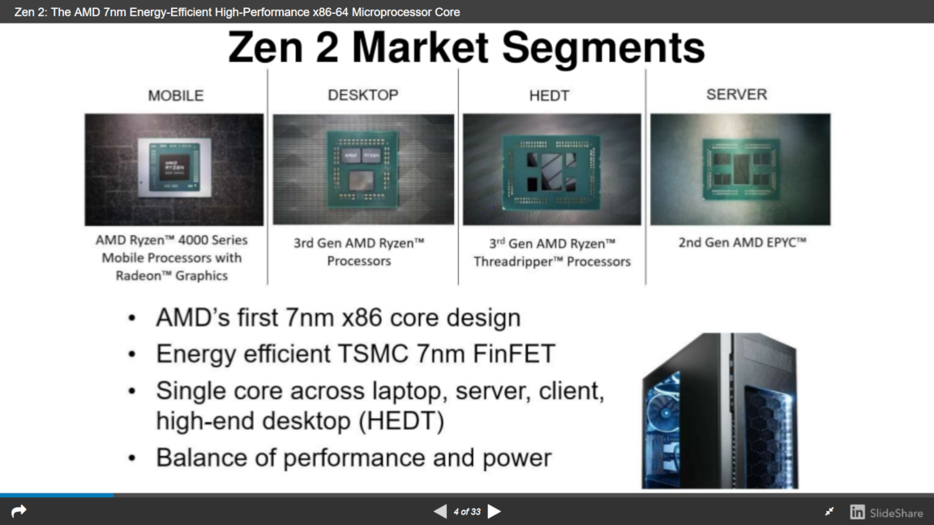
2.4 MCM 2D and 3D V-cache packaging technologies (4)
Examples of Zen 2-based processor packages [122]
(1/2)
(No need for MCM packaging)
(4/8)
(2/4/
6/8

Slide 85
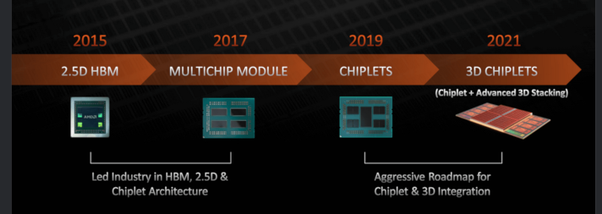
2.4 MCM 2D and 3D V-cache packaging technologies (5)
AMD’s multi die packaging roadmap presented in 08/2021 [212]
3D V-Cache
Zen-based
processors
Zen 2-based
processors
Zen 3-based
processors
Chiplet is AMD’s designation for multiple often identical dies used as components of
an MCM processor, introduced along with their Zen 2-based processors.
HBM: High Bandwidth Memory (3D-stacked, large (e.g. 32 GB), high-bandwidth (e.g. ≈500 GB/s) memory

Slide 86
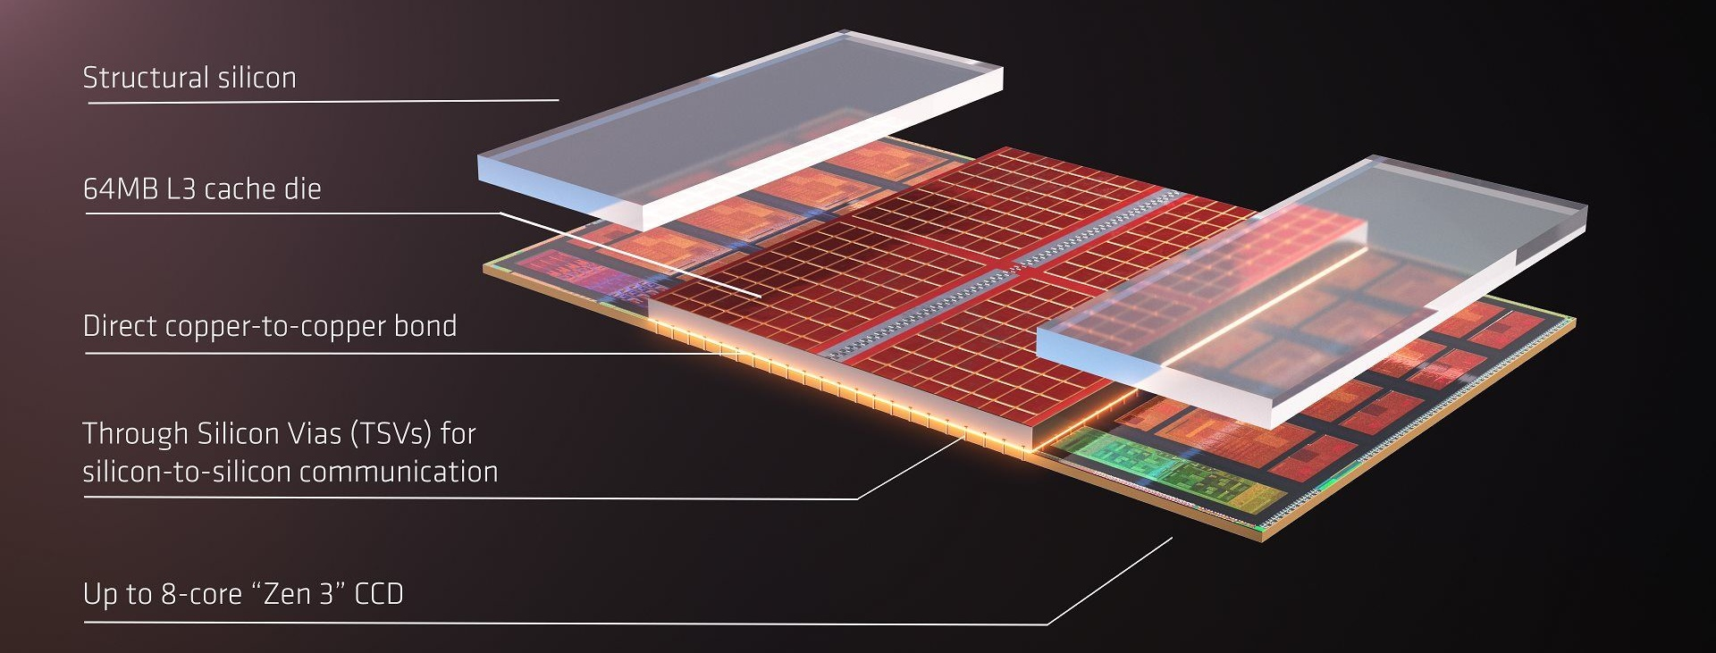
2.4 MCM 2D and 3D V-cache packaging technologies (6)
AMD’s 3D V-Cache technology, as announced in 2021 [213]
AMD’s 3D V-Cache technology is a kind of 3D technology used to stack L3 dies on top of
a base die to increase L3 size, as shown in the Figure below.
In the above Figure 2x 64 MB L3 cache dies are stacked vertically atop of an Zen 3 base die
(called CCD), providing altogether 192 MB L3 cache for 8 cores.

Slide 87
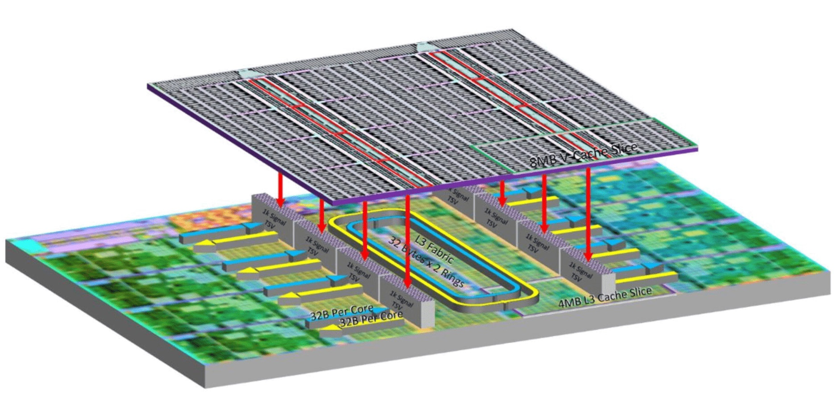
2.4 MCM 2D and 3D V-cache packaging technologies (7)
AMD’s first implementation of the 3D V-Cache technology in 2022 -1 [215]ű
(Zen 3-based Ryzen 7 5800X3D DT processor, 2022)
64 MB L3
32 MB on-die L3
The 64 MB 3D V-Cache is built up of eight 8 MB L3 "segments" with 1024 contact points per segment.
8 K contact points altogether provide a bandwidth of more than 2 TB/s.
The contact points will be cooper bonded to the base die.

Slide 88
2.4 MCM 2D and 3D V-cache packaging technologies (8)
AMD’s first implementation of the 3D V-Cache technology in 2022 -2 [215]
The first processor enhanced with the 3D V-cache technology is the Zen 3-based
Ryzen 7 5800X3D DT processor, launched in 05/2022.
The Ryzen 7 5800X3D has 8 cores, 32+64 MB L3 (achieved by the 3D V-Cache technology,
3.4 GHz base frequency and 105 W TDP.
By contrast, the “simple” 8-core Ryzen 7 5800 has 32 MB L3 cache, 3.8 GHz base
frequency and 105 W TDP.
Note that AMD chose an 8-core processor for their first 3D V-Cache implementation
since an 8-core processor has just a single CPU die and no additional complexity
arises to interconnect two CPU dies.
Further on, as the 3D V-Cache enhanced version has the same 105 W TDP value as
its predecessor, its base clock frequency obviously had to be reduced (actually
from 3.8 GHz to 3.4 GHz).
The 3D V-cache enhancement is beneficial first of all in gaming applications.

Slide 89
2.5 Modular, lego-like approach
Notes:
89

Slide 90
2.5 Modular, lego-like approach (1)
2.5 Modular, lego-like approach -1
Preceding Remark
Zen 2 or higher generation Zen processors differ in their implementation from their
Zen- or Zen+ based predecessors.
in order to simplify and shorten our discussion, in this Section we will consider
only Zen 2 or higher-based processor implementations.

Slide 91
2.5 Modular, lego-like approach (2)
Modular, lego like approach -2
The modular lego like approach allows AMD to implement processors for
different market segments, such as mobiles, DTs, HEDTs and servers out of the
same dies set (modules).
The chosen die set includes three die types:
APU dies
CPU dies, and
IO dies.
Next we briefly outline these die types.

Slide 92
2.5 Modular, lego-like approach (3)
Modular, lego like approach -3
APU dies (Accelerated Processing Units) are dies of full fledged processors,
including all building blocks needed for a general purpose laptop or DT processor,
especially an integrated GPU (iGPU).
CPU dies provide computing resources.
They include CPU cores, but CPU cores are organized into core blocks, called
CCXs (Core CompleXes), with 4 or 8 cores each.
CPU dies include one or two CCX core blocks, but do not include an iGPU.
Second and subsequent generation CPU dies are termed CCDs (CPU Compute Dies).
IO dies interconnect CCX core blocks and are responsible for IO and memory
connectivity.
They have two subtypes: IODs (IO Dies) used in HEDTs and servers, and
cIODs (client IO Dies) used in gaming DTs.

Slide 93
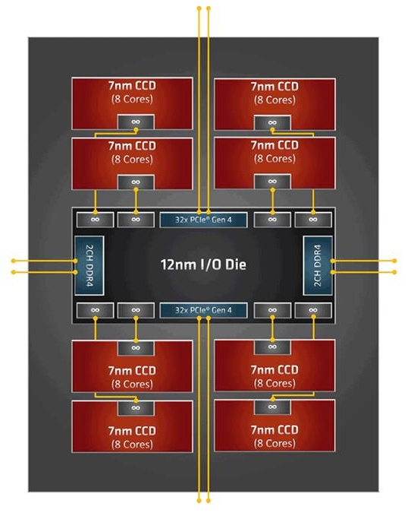
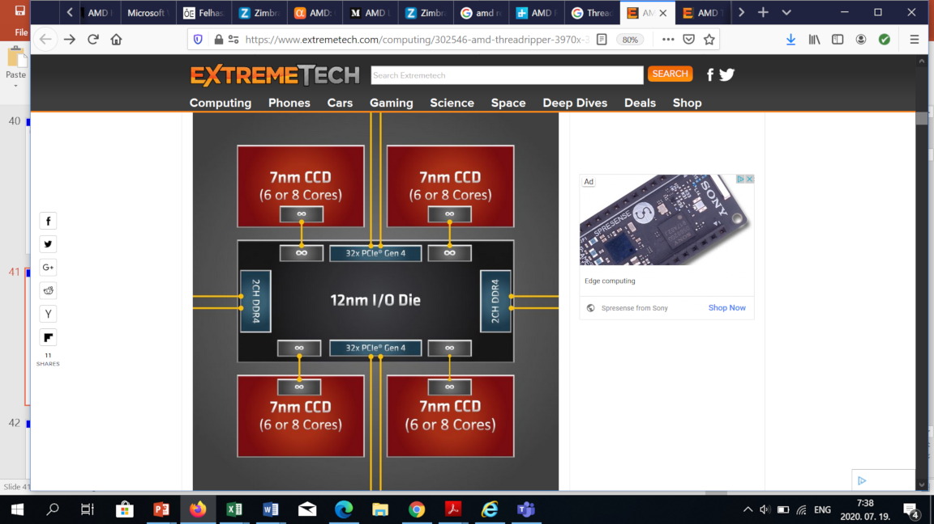
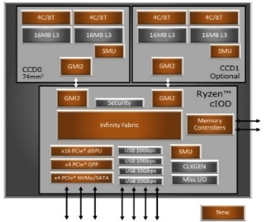
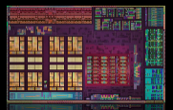
2.5 Modular, lego-like approach (4)
Example 1: The modular design of AMD’s Zen 2-based processor lines
AMD's Zen 2-based processor lines
Mobile APUs
(Ryzen 4xxxU/H/HS)
DT APUs
(Ryzen 4xxxG/GE)
Gaming DTs
(Ryzen 3xxx/X)
HEDTs
(Threadripper 39xxX)
1S/2S servers
(EPYC 7xx2/P)
1 APU die
(up to 8 cores)
1 or 2 CCD die(s)
+1 cIOD die
(up to 2x 8 cores)
2/4/8 CCD dies
+ 1 IOD die
(12/16/24/36/48/ cores)
2/4/6/8 CCD dies
+ 1 IOD die
(8/12/16/24/36/48/64 cores)
(Renoir) [126]
(Matisse) [107]
(Castle Peak) [127]
(Rome) [134]

Slide 94
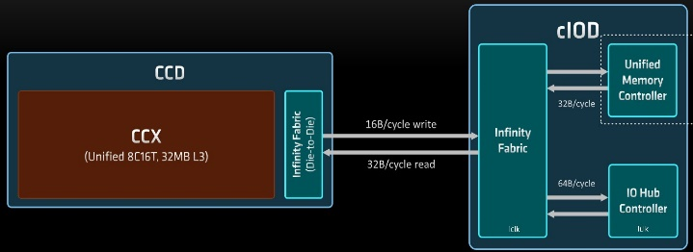
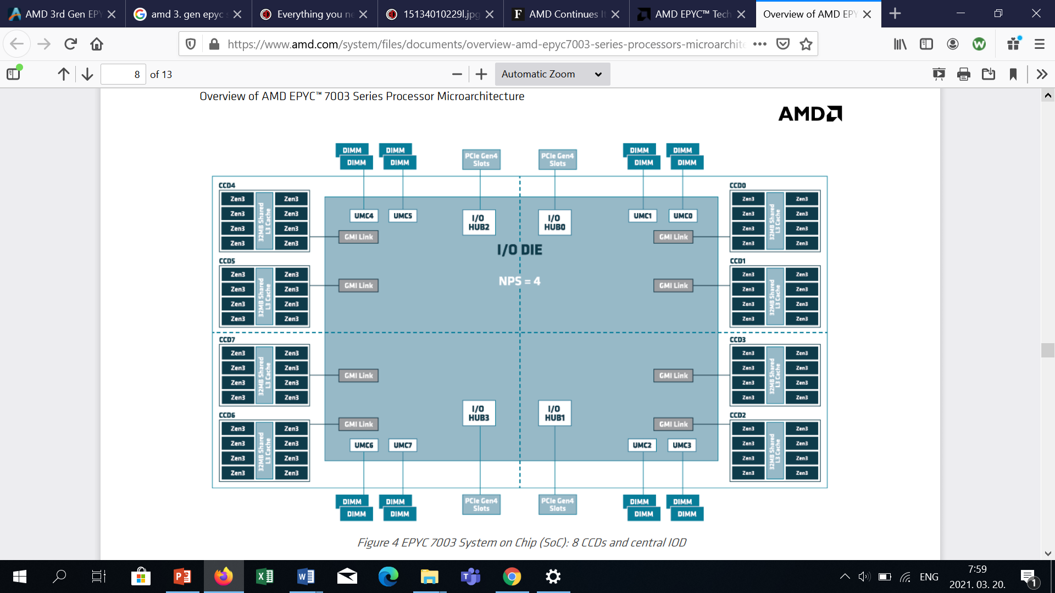
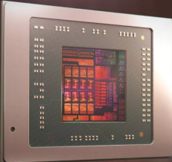
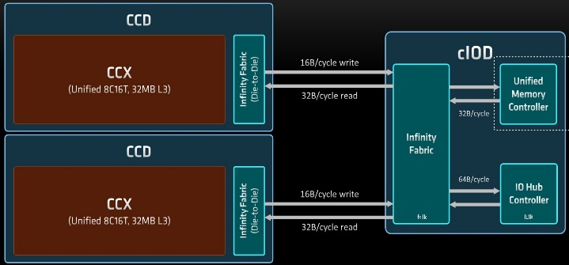
2.5 Modular, lego-like approach (5)
Example 2: The modular design of AMD’s Zen 3-based processors
AMD's Zen 3-based processor lines
Mobile APUs
(Ryzen 5xxxU/H/HS)
DT APUs
(Ryzen 5xxxG/GE)
Gaming DTs
(Ryzen 5xxx/X)
1S/2S servers
(EPYC 7xx3/P)
1 APU die
(up to 8 cores)
1 or 2 CCD die(s)
+1 cIOD die
(up to 2x 8 cores)
4/8 CCD dies
+ 1 IOD die
(8/12/16/24/28/36/48/56/64 cores)
[205]
[171]
[219]

Slide 95
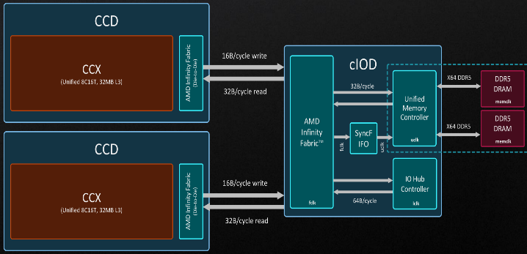
2.5 Modular, lego-like approach (6)
Example 3: The modular design of AMD’s Zen 4-based processors
AMD's Zen 4-based processor lines
Mobile APUs
DT APUs
Gaming DTs
(Ryzen 7xxx/X)
1S/2S servers
1 or 2 CCD die(s)
+1 cIOD die
(up to 2x 8 cores)
[230]

Slide 96
2.5 Modular, lego-like approach (7)
Note
Previous examples reveal that beginning from Zen 2-based implementations
mobile and DT APU processors include a single APU die,
gaming DT processors incorporate one or two CCDs and a cIOD die whereas
threadripper and server processors up to eight CCDs and an IOD die.
Remark
AMD differentiate between gaming DTs and DT APUs), by contrast Intel does not maintain
two different DT categories, instead just one, this one includes iGPUs, nevertheless
there are certain models without iGPUs. certain models without iGPUs.

Slide 97
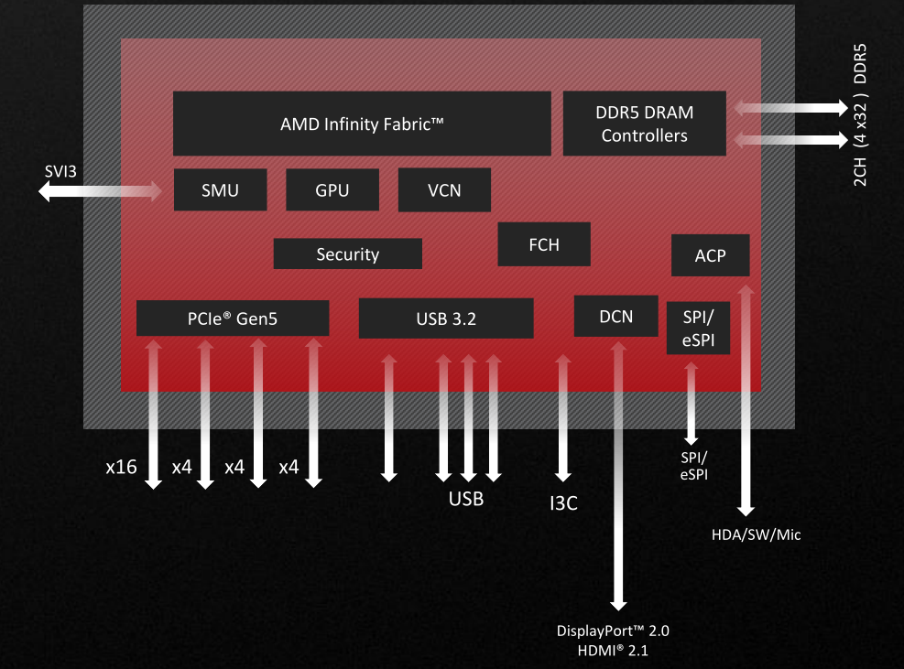
2.5 Modular, lego-like approach (8)
Remarks to the Zen 4-based cIOD die used in gaming DTs -1
Up to the Zen 4-based implementations, gaming DT processors did not include integrated
graphics (iGPU), but made use of discrete graphics cards.
Finally, in Zen 4-based cIODs AMD included an iGPU, which is RDNA 2-based,
as seen in the Figure below.
cIOD
For the abbreviations see the next slide.
Figure: Block diagram
of the cIOD die of
Ryzen 7000 gaming DT
processors [230]

Slide 98
2.5 Modular, lego-like approach (9)
Remarks to the Zen 4-based cIOD dies used in gaming DTs -2
Abbreviations occurring in the previous Figure:
SPI: Serial Peripheral Interface
eSPI: Enhanced SPI
SMU: System Management Unit
VCN: Video Core Next (Decoder)
DCN: Display Core Next
SVI3: Serial Voltage Regulator Interface
ACP: Audio Co-Processor
HDA: High Definition Audio
FCH: Fusion Control Hub (chipset)
SW: Switch
I3C: Improved I²C (2-wire serial data bus)

Slide 99
2.5 Modular, lego-like approach (10)
Remarks to the Zen 4-based cIOD die used in gaming DTs [230] -3
The implemented iGPU is not very powerful, it includes only 2 graphics EUs whereas
high-end Ryzen mobile APUs 12.
Thus it does not intend to compete with AMD’s DT APUs, it is used only to support
basic DT workloads, like video decoding, or even allows to run light-weight games.

Slide 100
3. Key building blocks of CPU dies
3.1 Zen cores
3.2 CCX core blocks
Notes:
100

Slide 101
3. Key building blocks of CPU dies (1)
3. Key building blocks of CPU dies
In this Section we will only be concerned with CPU dies, moreover only with their key
components, that are the Zen cores and CCX core blocks, due to volume limitations.
In our discussion we will show how impressive AMD evolved their designs from
generation to generation.

Slide 102
3.1 Zen cores
Notes:
102

Slide 103
3.1 Zen cores (1)
3.1 Zen cores [13], [170]
Emergence of the Zen core
AMD began planning the Zen microarchitecture after re-hiring Jim Keller,
the famous processor architect, in 2012.
After three years development, AMD announced the Zen family at their
Financial Analyst Day in 5/2015.
First details of the Zen architecture were published at the Computex Conference
in 6/2016.
According to M. Papermaster, AMD’s CTO, up to 300 engineers were working
on the core design.
Key design objective was raising IPC rather than power reduction.
Recall that IPC (Instructions Per Cycle) indicates the efficiency of a microarchitecture.
It is strongly workload dependent.
For specifying the IPC value of a microarchitecture the IPC scores will be measured
on a set of benchmark programs and the geometric mean of the results is given.
CTO: Chief Technology Officer

Slide 104
3.1 Zen cores (2)
Main architectural improvements of 1. gen. Zen cores vs. the previous Bulldozer
design
a) Departure from the previous module concept and returning to the usual
core structure
b) Introducing multithreading
c) Introducing the SenseMI technology package that includes a number of
innovations,
as discussed subsequently.

Slide 105
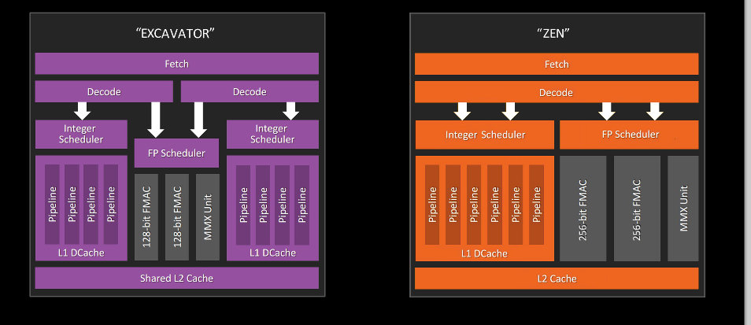
3.1 Zen cores (3)
a) Departure from the previous module concept and returning to the usual
core structure [14]
With the Zen core AMD left Bulldozer’s module concept that crammed two integer
blocks and an FP block into a unit and declared it to be dual cores, instead, AMD
followed the regular path of implementing full fledged cores, as indicated below.

Slide 106
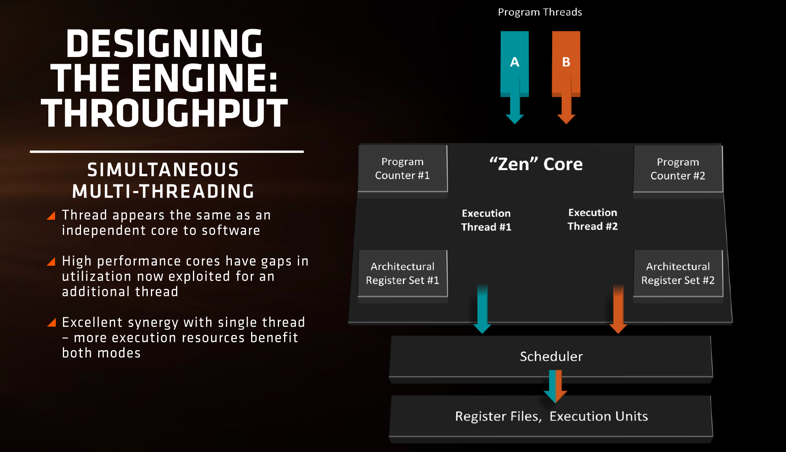
3.1 Zen cores (4)
b) Introducing multithreading [10]
As shown in the Figure below, in AMD’s implementation of multithreading, both threads
have private PCs and architectural states, whereas the execution resources are shared.

Slide 107
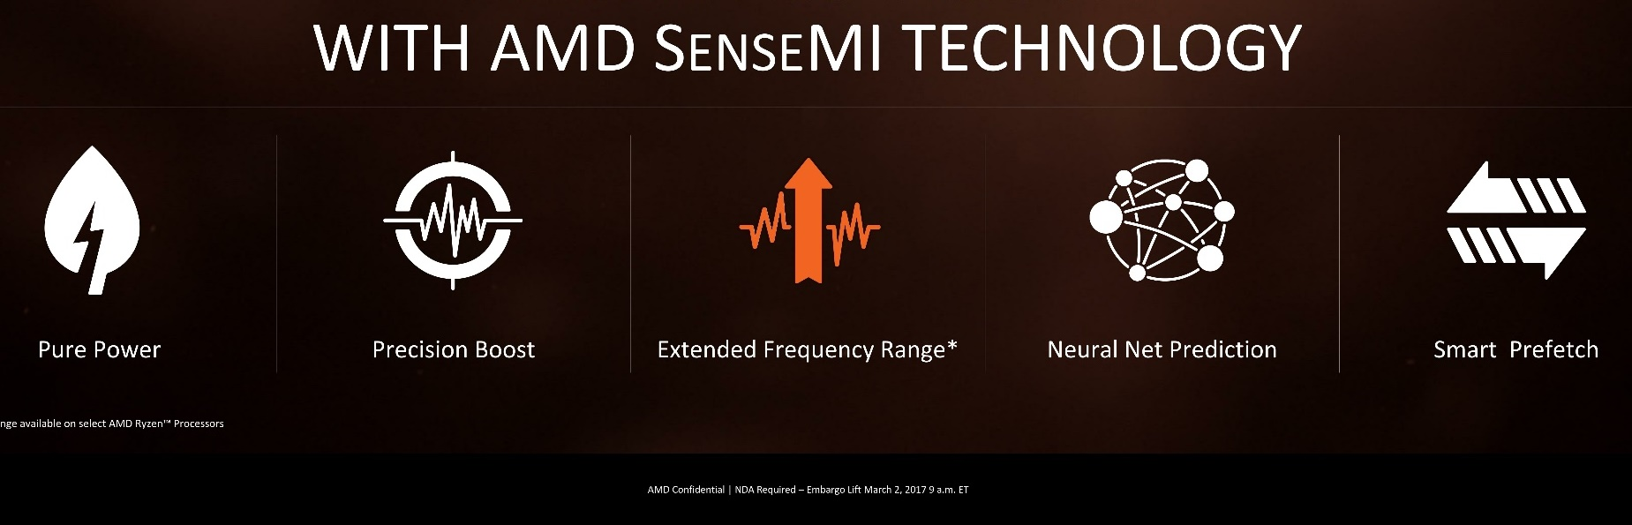
3.1 Zen cores (5)
c) Introducing the SenseMI technology package that includes a number of
innovations, as indicated below [10]
Pure power (AVS)
(Adaptive Voltage
Scaling)
Precision Boost
(Enhanced Turbo Boost
like Intel’s SpeedShift)
Extended Frequency Range
(XFR) (Higher fc for
premium cooling,
like Intel’s TVB)
Neural Net
Prediction
Smart
Prefetch
Extended Frequency Range
(XFR) (Higher fc for
premium cooling,
like Intel’s TVB)
To reduce
dissipation
To raise fc
To raise IPC
Here we do not go into details of the SenseMI technology package, only name the
corresponding Intel designations with the exception of AVS, since Intel does not
make use of this technique.
AVS: Adaptive Voltage Scaling TVB: Thermal Velocity Boost

Slide 108
3.1 Zen cores (6)
Resulting benefits of 14 nm 1st gen. Zen cores vs. the previous 28 nm
Excavator modules
52 % performance improvement (IPC) for single threaded workloads
Up to 3.7x improvement in performance/Watt

Slide 109

3.1 Zen cores (7)
Evolution of the IC technology of Zen cores (as of 09/2022) [226]

Slide 110



3.1 Zen cores (8)
Evolution of key features of Zen cores [230]
AVX-512
5nm
2017
2022
As the above Figure indicates, AMD generation over generation enhances key features of
their Zen family, like the max. turbo boost frequency, IPC, core count per CCD, L2 and
L3 cache sizes and introduces new features, like FP-256, AVX-512 or even integrated graphics.

Slide 111
3.1 Zen cores (9)
Key features of Zen 4 cores [227]
5 nm technology
1 MB/core L2 caches rather than 512 KB
AVX-512 and VNNI support
Up to 5.7 GHz max turbo boost
+13 % IPC increase
Remarks
Key innovations of the IOD
Integrated RDNA2 graphics
DDR5 memory (4x32-bit channels) but without DDR4 support
PCIe5.0 (24 lanes)
Key platform innovations
AM5 platform replacing the AM4 platform used since 2017
LGA 1718 socket (departure from PGA 1331 (Pin Grid Array) to LGA (Land Grid Array)
type sockets.
IOD: IO Die
Platform: Defines processor socket, memory and IO interfaces.

Slide 112

3.1 Zen cores (10)
Per generation IPC improvements of AMD’s Zen cores
Zen4
+13 %
160 %
+19 %
+13 %
+3 %
Figure: Per generation IPC improvements of AMD’s Zen cores [Based on [171]
The Figure indicates an ~ 16 % average performance uplift per Zen generation.

Slide 113


3.1 Zen cores (11)
State of the art: The Zen 3 core’s microarchitecture -1 [176]
2 threads/core (SMT)
State of the art branch predictor
Caches
I-cache 32k 8-way
Op-cache 4K instructions
D-cache 32k
L2-cache 512k
4 Instructions/Cycle
8 Macro Ops/Cycle
Decode
4 instr./cycle from decode
8 Macro op/cycle from
cached microcoded
instructions
6 Macro Ops/Cycle dispatched
Dispatch
6 Macro ops/cycle
dispatched to FX or FP units
Execution capabilities
4 FX units
dedicated branch unit
dedicated store data unit
3 address gen. units
3 mem. ops/cycle
max 2 can be stores
2 256-bit FP FMA oper./cycle

Slide 114
3.1 Zen cores (12)
State of the art: The Zen 3 core’s microarchitecture -2 [176]
Note that Zen 3 cores decode up to 4 instructions/cycle, they can deliver up to 8
Macro Ops/cycle from the Op cache that holds microcoded instructions and may
dispatch up to 6 Macro operations per cycle.
The decode rate of 4 seems to be too low when compared to Intel’s 6. gen. Skylake
processors having 5-wide decoders or Intel’s 12th gen. Alder Lake line of processors
with dual 3-wide decoders.

Slide 115
3.1 Zen cores (13)
Remarks to the cache architecture of the cores of AMD’s Zen-based core blocks
Zen cores (in all Zen generations until now (03/2022) have
private 32 KB L1 data and 64 KB L1 instruction caches,
private 512 kB L2 caches in Zen-Zen 3 cores, but private 1 MB L2 caches in Zen 4 cores.
a segmented, shared (by all cores of a CCX core block) L3 cache with 2 MB/core
cache segments in 1. gen. Zen cores and 4 MB/core cache segments
in subsequent generations.
L3 is mostly exclusive to the L2 cache, i.e. it is actually a slightly modified
victim cache to the L2 (keeping data removed from the L2 cache).

Slide 116
3.2 CCX core blocks
Notes:
116

Slide 117
3.2 CCX core blocks (1)
3.2 CCX core blocks
In their Zen generations AMD arranges Zen cores in groups of 4 or 8 cores and names
these core groups CCX or core blocks, where CCX stands for Core CompleX.
CCX core blocks are the main computing resources of Zen processors.
Core blocks represent one option how multicores may be implemented, as far as the
arrangement of the cores is concerned.
There are three fundamentally different multicore configurations, as discussed next.

Slide 118
3.2 CCX core blocks (2)
a) Symmetrical multicores
Alternative multicore configurations
Symmetrical multicores
Cores are implemented
as stand alone, single
building blocks

Slide 119
3.2 CCX core blocks (3)
Example for symmetrical multicores
Schematic layout of Intel’s traditional DT and server processors with a shared,
segmented L3 cache and a ring bus.
Ci
Ci
Ci
Ci
Ci
Ci
Ci
Ci
Shared, segmented L3
Interconnection Network (Ring bus)
Shared, segmented L3
Ci
Ci
Ci
Ci
Ci
Ci
Ci
Ci

Slide 120
3.2 CCX core blocks (4)
b) Homogeneous core blocks
Alternative multicore configurations
Homogeneous core blocks
Cores are organized into blocks,
all blocks are equal

Slide 121
3.2 CCX core blocks (5)
Example for homogeneous core blocks
Schematic layout of AMD’s Zen 2 processors with a shared, segmented L3 and
the Infinity Fabric as a cache coherent interconnect
Ci
Ci
Ci
Ci
Ci
Ci
Ci
Ci
Shared, segmented L3
Shared, segmented L3
Interconnection Network (Infinity Fabric)

Slide 122
3.2 CCX core blocks (6)
c) Heterogeneous core blocks
Alternative multicore configurations
Heterogeneous core blocks
Cores are organized into blocks,
core blocks have different
performance/power characteristics but the same ISA
(called big.little configurations)

Slide 123
3.2 CCX core blocks (7)
Example for heterogeneous core blocks
Schematic layout of Arm v7/v8-based mobile processors with dual core clusters
which are using different interconnection networks
Ci
Ci
Ci
Ci
Ci
Ci
Ci
Ci
Shared L2
Shared L2
Interconnection Network
Remark: A further example is Intel’s 12th gen. Alder Lake processor line (introduced in 2021)
that may include up to 8 P-cores (Performance cores) and up to 8 E-cores (Efficient cores)
with per core L1 and L2 caches, a shared, segmented L3 cache and a ring bus.

Slide 124
3.2 CCX core blocks (8)
Summing up: Alternative multicore configurations
There are three fundamentally different multicore configurations, as indicated below:
Alternative multicore configurations
Symmetrical multicores
Homogeneous core blocks
Heterogeneous core blocks
Cores are implemented
as stand alone, single
building blocks
Cores are organized into blocks,
all blocks are equal
Cores are organized into blocks,
core blocks have different
performance/power characteristics but the same ISA
(called big.little configurations)

Slide 125
3.2 CCX core blocks (9)
Why did AMD choose homogeneous core blocks for their Zen family?
AMD chose homogeneous core blocks and designated them CCX core blocks
(Core CompleXes).
AMD did not reveal the reasons for their choice, nevertheless, it can be assumed
that AMD avoided symmetrical multicores since they do not “behave” well
for higher core counts, as higher core counts induce either higher core to core latencies
if ring buses are used or rapidly rising hardware complexity if crossbar switches are used.
On the other hand, implementing heterogeneous core blocks, i.e. big.little configurations,
might have seemed to be a too complex and risky task for AMD without related deep
background.
Nevertheless, AMD is expected to introduce big.little core blocks in their forthcoming
Zen 5-based processors to be manufactured on 3 nm or 4 nm technology, around
2024 [224].

Slide 126

3.2 CCX core blocks (10)
How did AMD implemented their Zen-based CCX core blocks?
1. gen. Zen-based CCX core blocks
(1. gen.) Zen-based core blocks include 4 cores with private L1/L2 caches and 2 MB
L3 cache segments per core that are interconnected by a crossbar switch, as indicated
in the schematic layout and die plot of Zen-based CCXs.
C₃
C₂
L3
L3
2 MB 2 MB
Crossbar (4x4)
2 MB 2 MB
C₀
C₁
Figure: Schematic layout and die plot of a (1. gen.) Zen-based CCX [16]
Through the crossbar switch each core of the core block can access each
L3 cache segment with the same latency.

Slide 127

3.2 CCX core blocks (11)
AMD’s Zen 2-based CCX core blocks
Zen 2-based core blocks resemble to the previous CCX implementation.
There is only one difference, AMD increased the L3 cache segments size to 4 MB per core,
as indicated in the schematic layout and die plot of Zen-based CCXs.
C₃
C₂
L3
L3
4 MB 4 MB
Crossbar (4x4)
4 MB 4 MB
C₀
C₁
Figure: Schematic layout and die plot of a 2. gen. Zen-based CCX [16]

Slide 128


3.2 CCX core blocks (12)
Enhancing the Zen 2-based CCX design to Zen 3-based CCX designs [171]
In Zen 3-based core blocks there are 8 cores and a shared 32 MB L3 cache, as seen
in the Figure below.
Zen 2-based CCX
Zen 3-based CCX
Figure: Contrasting Zen 2- and Zen 3-based CCX designes [171]
The benefit of the new design is that now each core can access 32 MB L3 cache directly,
rather than only 16 MB, as in the previous design.
This reduces the memory access time in the 16-to-32 MB access window compared
to Zen 2-based CCXs.

Slide 129

3.2 CCX core blocks (13)
Additiional enhancement: Introducing bi-directional ring buses in Zen 3-based
CCX core blocks [216]

Slide 130

3.2 CCX core blocks (14)
AMD’s Zen 3-based CCX core blocks
Accordingly, Zen 3-based core blocks include 8 cores with private L1/L2 caches and
4 MB L3 cache segments per core, interconnected by a bi-directional ring bus,
as shown below, while the ring bus can transfer 32 bytes per cycle in both direction.
C₅
C₆
C₇
C₄
Shared, segmented L3 (4x4 MB)
Bi-directional ring bus
Shared, segmented L3 (4x4 MB)
C₀
C₁
C₂
C₃
Figure: Schematic layout and die plot of a 3. gen. Zen-based CCX [200]

Slide 131
3.2 CCX core blocks (15)
Summing up the evolution of core counts and interconnects in subsequent CCX generations
(1. gen.) Zen and Zen 2-based core blocks have 4 cores interconnected by a crossbar switch,
whereas in Zen 3-based CCX core blocks AMD doubled the core count from 4 to 8
and replaced the crossbar switch by a bi-directional ring bus.
Ci
Ci
Ci
Ci
2 MB 2 MB
4 MB 4 MB
1. gen. Zen CCX
Crossbar (4x4)
Zen 2 CCX
Crossbar (4x4)
2 MB 2 MB
4 MB 4 MB
Ci
Ci
Ci
Ci
L3
L3
L3
L3
C₅
C₆
C₇
C₄
Shared, segmented L3 (4x4 MB)
Bi-directional ring bus
Zen 3 CCX
Shared, segmented L3 (4x4 MB)
C₀
C₁
C₂
C₃
Figure: Schematic layout
of Zen core blocks

Slide 132
3.2 CCX core blocks (16)
Summing up the evolution of L3 cache segment sizes in subsequent CCX generations
(1. gen.) Zen-based core blocks have 2 MB L3 cache segments per core whereas
in subsequent Zen 2- and Zen 3 based core blocks AMD doubled the 2 MB/core L3 size
to 4 MB/core, as indicated below.
Ci
Ci
Ci
Ci
2 MB 2 MB
4 MB 4 MB
Zen CCX
Crossbar (4x4)
Zen 2 CCX
Crossbar (4x4)
2 MB 2 MB
4 MB 4 MB
Ci
Ci
Ci
Ci
L3
L3
L3
L3
C₅
C₆
C₇
C₄
Shared, segmented L3 (4x4 MB)
Bi-directional ring bus
Zen 3 CCX
Shared, segmented L3 (4x4 MB)
C₀
C₁
C₂
C₃
Figure: Schematic layout of
Zen core blocks

Slide 133
3.2 CCX core blocks (17)
Summing up the evolution of f L3 cache sizes per CCX in subsequent CCX generations
It follows that AMD doubled the L3 cache size of core blocks in every subsequent
generation, first from 8 MB to 16 MB in Zen 2-based and then to 32 MB
in Zen 3-based core blocks.

Slide 134

3.2 CCX core blocks (18)
How did AMD raise the core count of their CPUs by interconnecting core blocks?
Along with Zen 2-based CPUs AMD revised their design concept and introduced
dedicated IO dies for interconnecting CCX core blocks as well as to provide memory
and IO connectivity.
Thus afterwards, CCX core blocks do only computing and are linked to an IO die.
There are however, two different types of IO dies, as shown below.
Types of IO dies
IO dies for clients (cIOD)
IO dies for HEDTs and servers (IOD)
(i.e. for Threarippers and EPIC servers)
They interconnect up to 2 CCX core blocks and
provide memory and IO connectivity.
They interconnect up to 8 CCX core blocks and
provide memory and IO connectivity.
12/14 nm IOD
(see Remark
on the next slide))
12 nm, 2.09 billion 125 mm² [128]
12/14 nm, 8.34 billion, 416 mm^{2,}
[127]

Slide 135
3.2 CCX core blocks (19)
Example: Layout of interconnecting 2 core blocks by a cIOD die in a Zen 3-based
16-core gaming DT processor (Ryzen 5950X)
cIOD
Ci
Ci
Ci
Ci
Ci
Ci
Ci
Ci
Shared, segmented L3 (4x4 MB)
Shared, segmented L3 (4x4 MB)
Bi-directional ring bus
Bi-directional ring bus
Shared, segmented L3 (4x4 MB)
Shared, segmented L3 (4x4 MB)
Ci
Ci
Ci
Ci
Ci
Ci
Ci
Ci
Zen 3 CCX
Zen 3 CCX

Slide 136

3.2 CCX core blocks (20)
Core-to-core latencies in Zen 3-based 16-core gaming DT processors
(Ryzen 5950X) -1 [171]
(The 5950X has two CCX core blocks with 8 cores/16 threads each).

Slide 137
3.2 CCX core blocks (21)
Core-to-core latencies in Zen 3-based 16-core gaming DT processors
(Ryzen 5950X) -2 [171]
Clearly, core to core latencies within the same 8-core CCX are significantly
lower than core-to-core latencies between cores belonging to different core blocks,
(~18 ns vs. 81 ns).

Slide 138
3.2 CCX core blocks (22)
Summing up key issues of CCX core blocks -1
3.2 CCX core blocks
In their Zen generations AMD arranges Zen cores in groups of 4 or 8 cores and names
these core groups CCX or core blocks, where CCX stands for Core CompleX.
CCX core blocks are the main computing resources of Zen processors.
Core blocks represent one option how multicores may be implemented, as far as the
arrangement of the cores is concerned.
There are three fundamentally different multicore configurations, as discussed next.
Alternative core configurations of multicores
There are three fundamentally different multicore configurations, as indicated below:
Alternative multicore configurations
Symmetrical multicores
Homogeneous core blocks
Heterogeneous core blocks
Cores are implemented
as stand alone, single
building blocks
Cores are organized into blocks,
all blocks are equal
Cores are organized into blocks,
core blocks have different
performance/power characteristics but the same ISA
(called big.little configurations)

Slide 139
3.2 CCX core blocks (23)
Summing up key issues of CCX core blocks -2
Why did AMD choose homogeneous core blocks for their Zen family?
AMD chose homogeneous core blocks and designated them CCX core blocks
(Core CompleXes).
AMD did not reveal the reasons for their choice, nevertheless, it can be assumed
that AMD avoided symmetrical multicores since they do not “behave” well
for higher core counts, as higher core counts induce either higher core to core latencies
if ring buses are used or rapidly rising hardware complexity if crossbar switches are used.
On the other hand, implementing heterogeneous core blocks, i.e. big.little configurations,
might have seemed to be a too complex and risky task for AMD without related deep
background.
Nevertheless, AMD is expected to introduce big.little core blocks in their forthcoming
Zen 5-based processors to be manufactured on 3 nm or 4 nm technology, around
2024 [224].

Slide 140
3.2 CCX core blocks (24)
Summing up key issues of CCX core blocks -3
Summing up the evolution of core counts and interconnects in subsequent CCX generations
(1. gen.) Zen and Zen 2-based core blocks have 4 cores interconnected by a crossbar switch,
whereas in Zen 3-based CCX core blocks AMD doubled the core count from 4 to 8
and replaced the crossbar switch by a bi-directional ring bus.
Ci
Ci
Ci
Ci
2 MB 2 MB
4 MB 4 MB
1. gen. Zen CCX
Crossbar (4x4)
Zen 2 CCX
Crossbar (4x4)
2 MB 2 MB
4 MB 4 MB
Ci
Ci
Ci
Ci
L3
L3
L3
L3
C₅
C₆
C₇
C₄
Shared, segmented L3 (4x4 MB)
Bi-directional ring bus
Zen 3 CCX
Shared, segmented L3 (4x4 MB)
C₀
C₁
C₂
C₃
Figure: Schematic layout
of Zen core blocks

Slide 141
3.2 CCX core blocks (25)
Summing up key issues of CCX core blocks -4
Summing up the evolution of L3 cache segment sizes in subsequent CCX generations
(1. gen.) Zen-based core blocks have 2 MB L3 cache segments per core whereas
in subsequent Zen 2- and Zen 3 based core blocks AMD doubled the 2 MB/core L3 size
to 4 MB/core, as indicated below.
Ci
Ci
Ci
Ci
2 MB 2 MB
4 MB 4 MB
Zen CCX
Crossbar (4x4)
Zen 2 CCX
Crossbar (4x4)
2 MB 2 MB
4 MB 4 MB
Ci
Ci
Ci
Ci
L3
L3
L3
L3
C₅
C₆
C₇
C₄
Shared, segmented L3 (4x4 MB)
Bi-directional ring bus
Zen 3 CCX
Shared, segmented L3 (4x4 MB)
C₀
C₁
C₂
C₃
Figure: Schematic layout of
Zen core blocks

Slide 142
3.2 CCX core blocks (26)
Summing up key issues of CCX core blocks -5
Summing up the evolution of f L3 cache sizes per CCX in subsequent CCX generations
It follows that AMD doubled the L3 cache size of core blocks in every subsequent
generation, first from 8 MB to 16 MB in Zen 2-based and then to 32 MB
in Zen 3-based core blocks.

Slide 143
3.2 CCX core blocks (27)
Summing up key issues of CCX core blocks -8
How did AMD raise the core count of their CPUs by interconnecting core blocks?
Along with Zen 2-based CPUs AMD revised their design concept and introduced
dedicated IO dies for interconnecting CCX core blocks as well as to provide memory
and IO connectivity.
Thus afterwards, CCX core blocks do only computing and are linked to an IO die.
There are however, two different types of IO dies, as shown below.
Types of IO dies
IO dies for clients (cIOD)
IO dies for HEDTs and servers (IOD)
(i.e. for Threarippers and EPIC servers)
They interconnect up to 2 CCX core blocks and
provide memory and IO connectivity.
They interconnect up to 8 CCX core blocks and
provide memory and IO connectivity.

Slide 144
4. Case example: The Zen 3-based Ryzen 5000 Gaming DT line
Notes:
144

Slide 145
4. Case example: the Zen 3-based Ryzen 5000 gaming DT line (1)
4. Case example: the Zen 3-based Ryzen 5000 gaming DT line
It is built on the Vermeer architecture.
Announced in 10/2020, launched in 11/2020.
Aimed at gaming and is unlocked.
Implemented as an MCM package, consisting of up to three dies:
one or two eight-core 7 nm CPU chiplet(s) (CCDs), and
one 12 nm IO chiplet (cIiOD) with dual memory controllers and PCie 4.0 x24 lanes.
They have the AM4 socket further on.
The line makes use of 400/500-series chipsets and motherboards.
The Ryzen 9 5950X overtook the ST performance crone from Intel in the first
time for about 20 years.
Nevertheless, its reign did not last long, about 1 year later Intel introduced their
Alder Lake big.little (hybrid) line those highest performance model (Core i9-12900K)
retook the performance crone from AMD both for gaming and
application performance.
ST: Single Thread

Slide 146
4. Case example: the Zen 3-based Ryzen 5000 gaming DT line (2)
Main features of the Zen 3-based Ryzen 5000 Gaming DT line -1
 | 1. gen. Ryzen DT | 2. gen. Ryzen DT | 3. gen. Ryzen DT | 4. gen. Ryzen DT
Architecture | Summit Ridge | Pinnacle Ridge | Matisse | Vermeer
CPU core/technology | Zen/ 14 nm | Zen+/ 12 nm | Zen 2/ 7 nm | Zen 3/ 7 nm
Launched | 03/2017 - 07/2017 | 04/2018 | 07/2019 – 04/2020 | 11/2020
Launched models | Ryzen 7 1x00/X Ryzen 5 1x00/X Ryzen 3 1x00/X | Ryzen 7 2700/X/E Ryzen 5 2600/X/E Ryzen 5 2500/X/E Ryzen 3 2300X | Ryzen 9 39x0/X/XT Ryzen 7 3x00X/XT Ryzen 5 3x00X/XT Ryzen 3x00/X | Ryzen 9 5950X Ryzen 9 5900X Ryzen 7 5700X Ryzen 5 5600X
Layout | Zeppelin die (2x CCX) | Zeppelin die (2x CCX) | Up to 3 dies: 1xCCD +cIOD or 2xCCD + cIOD | Up to 3 dies: 1xCCD +cIOD or 2xCCD + cIOD
Integrated GPU | No | No | No | No
Core count | 4/6/8 | 4/6/8 | 4/6/8/12/16 | 6/8/12/16
SMT | SMT (except Ryzen 3) | SMT | SMT | SMT
Mem. channels/rate | 2xDDR4-2666 | 2xDDR4-2933 | 2xDDR4-3200 | 2xDDR4-3200
PCie lanes | 20x PCie 3.0 | 20x PCie 3.0 | 24x PCie 4.0 | 24x PCie 4.0
TDP | 65/95 W | 65/95/105 W | 65/95/105 W | 65/105 W
Socket | AM4 (PGA 1331) | AM4 (PGA 1331) | AM4 (PGA 1331) | AM4 (PGA 1331)
Chipset | 300/400-series | 300/400-series | 400/500-series | 400/500-series

Slide 147
4. Case example: the Zen 3-based Ryzen 5000 gaming DT line (3)
Main features of the Zen 3-based Ryzen 5000 Gaming DT line -2 [171]
AMD Ryzen 5000 Series Processors Zen 3 Microarchitecture
 | Cores Threads | Base freq. | Turbo freq | L3 Cache | TDP | MSRP
Ryzen 9 5950X | 16c/32t | 3400 | 4900 | 64 MB | 105 W | $799
Ryzen 9 5900X | 12c/24t | 3700 | 4800 | 64 MB | 105 W | $549
Ryzen 7 5800X | 8c/16t | 3800 | 4700 | 32 MB | 105 W | $449
Ryzen 5 5600X | 6c/12t | 3700 | 4600 | 32 MB | 65 W | $299
MSRP: Manufacturer's Suggested Retail Price

Slide 148

4. Case example: the Zen 3-based Ryzen 5000 gaming DT line (4)
Ryzen 5000 series 8-core Gaming DT topology with 1x CCD + cIOD [171]

Slide 149

4. Case example: the Zen 3-based Ryzen 5000 gaming DT line (5)
Ryzen 5000 series 16-core Gaming DT topology with 2x CCD + cIOD [171]

Slide 150

4. Case example: the Zen 3-based Ryzen 5000 gaming DT line (6)
New 8-core CCX topology that reduces the effective memory latency [176]
Remember: previous Zen 2-based CCX core blocks had only 4 cores supported by 16 MB L3.

Slide 151

4. Case example: the Zen 3-based Ryzen 5000 gaming DT line (7)
Core-to-core latency of the Zen 2-based Ryzen 9 3950X processor [171]
(16 cores on 2 CCDs with 2 CCX/CCD and 4 cores/CCX) -1

Slide 152
4. Case example: the Zen 3-based Ryzen 5000 gaming DT line (8)
Core-to-core latency of the Zen 2-based Ryzen 9 3950X processor [171]
(16 cores on 2 CCDs with 2 CCX/CCD and 4 cores/CCX) -2
As data in the above Table shows, core-to-core latencies within the same 4-core CCX
are significantly lower than those between different core blocks (≈30 vs. 80 ns).
This is quite obvious since to access a different CCX core block, altogether two
4x4 crossbar switches and the intermediate crossbar switch needs to be passed.
Note also that only 25 % of all core to core latencies are low but the remaining
75 % high.

Slide 153
4. Case example: the Zen 3-based Ryzen 5000 gaming DT line (9)
Core-to-core latency of the Zen 3-based Ryzen 9 5950X processor [171]
(16 cores on 2 CCDs with 1 CCX/CCD and 8 cores/CCX) -1

Slide 154
4. Case example: the Zen 3-based Ryzen 5000 gaming DT line (10)
Core-to-core latency of the Zen 3-based Ryzen 9 5950X processor [171]
(16 cores on 2 CCDs with 1 CCX/CCD and 8 cores/CCX) -2
Clearly, again core to core latencies within the same 8-core CCX are significantly
lower than core to core latencies between cores belonging to different core blocks,
(~18 ns vs. 81 ns).
Compared to the prior CCX implementation the most important improvement is that
now 50 % of all core to core latencies are low (green fields) whereas this ratio was
only 25 % previously.
Note further on that in Zen 3-based CCXs core to core latencies within the same
core block are significantly lower than previously in Zen 2-based CCXs, only 15-17 ns
vs. 30-32 ns due to the introduced bidirectional ring bus interconnecting L3 cache
segments.

Slide 155

4. Case example: the Zen 3-based Ryzen 5000 gaming DT line (11)
The CCD die of the Ryzen 5000 Gaming DT (Vermere-based) processor [200]

Slide 156

4. Case example: the Zen 3-based Ryzen 5000 gaming DT line (12)
Blown up 1-core part of the CCD die of the Ryzen 5000 Gaming DT processor [200]
The blown up die shot indicates cache sizes and further functional blocks like cache tags.
(32 KB L1 D$, 64 KB L1 I$, 512 KB L2, 4 MB L3)

Slide 157

4. Case example: the Zen 3-based Ryzen 5000 gaming DT line (13)
Contrasting max. turbo frequencies of (Zen 3-based) Ryzen 9 5950X and
(Zen 2-based) Ryzen 9 3950X Gaming DT processors [171]

Slide 158

4. Case example: the Zen 3-based Ryzen 5000 gaming DT line (14)
Frequency ramp-up of Ryzen 9 5950X [171]

Slide 159

4. Case example: the Zen 3-based Ryzen 5000 gaming DT line (15)
Per-core power consumption of the Ryzen 9 5950X in Turbo mode [171]
(TDP: 105 W)
Red color means: die temperature limits per core power consumption.

Slide 160

4. Case example: the Zen 3-based Ryzen 5000 gaming DT line (16)
Load dependent core and package power consumption of Ryzen 9 5950X [171]
(Turbo mode) -1

Slide 161
4. Case example: the Zen 3-based Ryzen 5000 gaming DT line (17)
Load dependent core and package power consumption of Ryzen 9 5950X [171]
(Turbo mode) -2
The load dependent power consumption graph of the considered processor clearly shows
that in Turbo mode the package consumption may exceed by about 30 % the TDP value.

Slide 162

4. Case example: the Zen 3-based Ryzen 5000 gaming DT line (18)
Peak power consumption of the Ryzen 5950X and competing processors
while running all the tests [171] -1

Slide 163
4. Case example: the Zen 3-based Ryzen 5000 gaming DT line (19)
Peak power consumption of the Ryzen 5950X and competing processors
while running the tests [171] -1
As the above Figure shows, some Intel processors consume up to twice as much
power than their TDP value (e.g. about up to 250 W vs. 125 W TDP) when running
in Turbo mode, whereas AMD’s processors draw only about 40 % more power than
their TDP specification.

Slide 164

4. Case example: the Zen 3-based Ryzen 5000 gaming DT line (20)
Generational performance per clock improvement (Ryzen 9 5950X vs. Ryzen 9
3950X) while running various SPEC CPU benchmark programs [171]
19 %
Remark
Performance per clock improvement indicates efficiency improvement (~IPC boost).
As the Figure indicates, its mean value is 19 %, actually a remarkable high value.

Slide 165
4. Case example: the Zen 3-based Ryzen 5000 gaming DT line (21)
Performance comparisons
There are a large number of performance tests published for various application
domains, like
Power (e.g. Peak Power),
Office,
Science (e.g. AI Benchmark 0.1.2. using TensorFlow),
Simulation,
Rendering (e.g. CineBench R20),
Encoding,
Rendering, MM content creation (e.g. CineBench 10, 15),
Web,
Synthetic (e.g. GeekBench 4,
SPEC (e.g. SPEC2006int/fp) etc.
From all of the results revealed for the Ryzen 5950X we show only four examples,
as follows:
Single thread (ST) SPEC2006int/fp that indicates the capability of the microarchitecture,
b/c) ST/MT multimedia content creation performance by CineBench R20 and
d) Gaming performance

Slide 166

4. Case example: the Zen 3-based Ryzen 5000 gaming DT line (22)
a) Single thread (ST) SPEC2006int/fp results - comparison [171] -1

Slide 167
4. Case example: the Zen 3-based Ryzen 5000 gaming DT line (23)
ST (Single Thread) SPEC2006int/fp results [171] -2
The indicated results show that AMD’s Ryzen 9 5950X overtook the ST performance
crone from Intel in the first time for about 20 years (in that time AMD’s Athlon
processors provided higher performance than Intel’s competing Pentium III,
Pentium 4 processors) [172].
Remark to AMD’s Athlon (K7) processor
The success of the Athlon processor family can be contributed to Dirk Meyer who
was the co-architect of DEC’s Alpha 2064 to 20264 RISC processors, that were
the highest performance processors of that time, but he left DEC to AMD along with
many of his team colleges in 1996.
Remark to stepping down Intel’s CEO in 02/2020
After Intel had lost its leading role in IC manufacturing and processor performance
its CEO, Bob Swan resigned in 02/2020, only after two years of leadership.

Slide 168

4. Case example: the Zen 3-based Ryzen 5000 gaming DT line (24)
AMD’s leadership claim for their Ryzen 5000 gaming DT line [174]

Slide 169

4. Case example: the Zen 3-based Ryzen 5000 gaming DT line (25)
b) CineBench R20 ST score of Ryzen 9 5950X and competing processors [171]

Slide 170

4. Case example: the Zen 3-based Ryzen 5000 gaming DT line (26)
c) CineBench R20 MT score of Ryzen 9 5950X and competing processors [171]

Slide 171

4. Case example: the Zen 3-based Ryzen 5000 gaming DT line (27)
d) Gaming performance of Ryzen 9 9550X and competing processors [171]
Remark: Far Cry 5 is a game developed by Ubisoft (Canada), released in 2018.
FPS: Frames Per Second (képkocka/sec)

Slide 172

4. Case example: the Zen 3-based Ryzen 5000 gaming DT line (28)
Example: Zen 3-based Ryzen 5000 DT platform with the X570 chipset [173]

Slide 173
4. Case example: the Zen 3-based Ryzen 5000 gaming DT line (29)
Remarks to the performance of Zen 3-based EPYC servers (called Milan)
At present AMD’s Zen 3-based EPYC servers also own the performance crown,
as indicated in the next two Figures.

Slide 174

4. Case example: the Zen 3-based Ryzen 5000 gaming DT line (30)
Performance of current Zen3-based 2S servers while running the SPEC2017 Rate
benchmark [208] (ST version)
SPEC2017 Rate benchmark
measure the throughput or work per unit of time.
(F: Performance optimized)
NPS1 implies that the CPU is a single NUMA domain, with all the cores in the socket and all the memory in this one NUMA domain. Memory is interleaved across the eight memory channels.
NPS4 partitions the CPU into four NUMA domains. Each quadrant is a NUMA domain here and memory is interleaved across the two memory channels in each quadrant [209].

Slide 175
4. Case example: the Zen 3-based Ryzen 5000 gaming DT line (31)
Performance of current 2S servers while running the SPECint2017 Rate N benchmark [208]
(MT version)
SPECint2017 Rate
integer benchmark
measure the throughput or work
per unit of time.
N means multithreading
is used.
Base means standard
setting for the
measurements (no tuning
allowed.)
Note here the outstanding high performance
Armv8.2 ISA-based Altra Q80-33 2S server.

Slide 176
5. Overview of AMD’s Zen lines
Notes:
176

Slide 177






5. Overview of AMD’s Zen lines (1)
5. Overview of AMD’s Zen lines -1
Brands of the Zen family, their logos, series and max. core counts [8]
Logo |  | Brand | General Description | Cores up to
Clients (mobile-, DT processors)
 |  | Ryzen 3 | Entry level | 4
 |  | Ryzen 5 | Mid-range | 6
 |  | Ryzen 7 | High-end | 8
 |  | Ryzen 9 | High-end | 16
HEDTs (Enthusiasts/Workstations)
 | Ryzen Threadripper |  | Enthusiasts | 64
2S server processors
 |  | EPYC | High-perf. | 64
Brand: Márkanév

Slide 178
5. Overview of AMD’s Zen lines (2)
Overview of AMD’s Zen lines -2
As already pointed out, there is a fundamental difference in implementing GPU-less
processors and processors which include a GPU, called APUs, as follows.
GPU-less processors (for gaming DTs, Threadrippers, EPYC servers) typically include
multiple dies (except single die 1. gen. Zen core-based gaming DTs), whereas
processor including an iGPU (APU processors) are implemented as single dies¹.
This is the reason why we discuss the implementation of Zen processors
separately for GPU-less processors and APUs.
¹ There is however an exception: Zen4-based gaming DT processors include a
less powerful iGPU implemented on the cIOD die.

Slide 179
5. Overview of AMD’s Zen lines (3)
Overview of AMD’s Zen lines -3
Zen-based processor lines
Zen-based
GPU-less processor lines
Zen-based
APU processor lines
1S/2S server
lines
HEDT
lines
Gaming DT
lines
DT APU
lines
Mobile APU
lines
Z
Z+
Z2
Z3
Z3+
Z4
EPYC 7xx1
EPYC 7xx2
EPYC 7xx3
Threadripper 19xxX
Threadripper 29xxX
Threadripper 39xxX
Threadripper 59x5WX
R. 3/5/7 1xxx/X
R. 3/5/7 2xxx/X/E
R. 3/5/7/9 3xxx/X/XT
R. 5/7/9 5xxx/X
R. 5/7/9 7xxx/X
R. 3/5 2xxxG/GE
R. 3/5 3xxxG/GE
R. 3/5/7 4xxxG/GE
R. 3/5 5xxxG/GE
R. 3/5/7 2xxx/H/U
R. 3/5/7 3xxx/H/U
R. 3/5/7/9 4xxx/H/U
R. 3/5/7/9 5xxx/H/U
R. 5/7/9 6xxx/H/U
Servers
HEDTs
Clients
R.: Ryzen

Slide 180
5. Overview of AMD’s Zen lines (4)
Packaging of AMD’s Zen-based client processor lines
Ryzen client processor lines
Desktop (DT) processor lines
PGA/LGA socket
Zen to Zen 3-based: AM4 (PGA-1331)
Zen 4-based: AM5 (LGA-1718)
Mobile (laptop) processor lines
BGA socket
Zen/Zen+ based: FP5 (BGA-1140)
Zen 2/Zen 3-based: FP6 (BGA-1140)
Zen 3+ based: FP7 (BGA-1140)
PGA: Pin Grid Array (érintkező tűs tok)
LGA: Land Grid Array (érintkező tüs foglalat)
BGA: Ball Grid Array (forrasztó csúcsos tok)
AM4/AM5: DT platforms
FP5/FP6/FP7: mobile platforms

Slide 181

5. Overview of AMD’s Zen lines (5)
Recent processor package types [169]
PGA
(Pin Grid Array)
LGA
(Land Grid Array)
BGA
(Ball Grid Array)
In the PGA package pins provide the contacts, arranged in a regular array.
LGA packages are essentially the direct opposite of PGAs, the contact pins are on the
socket, whereas contact pads on the package provide the connections.
BGA packages are soldered directly onto the motherboard, so practically they can not
be replaced without proper equipment.
PGA and LGA packages are inserted to their respective sockets.
*

Slide 182
5. Overview of AMD’s Zen lines (6)
Tagging and TDPs of AMD’s Zen-based client processor lines
Ryzen client processor lines
Desktop (DT) processor lines
PGA/LGA socket
Mobile (laptop) processor lines
BGA socket
Gaming DT lines
DT APU lines
Mobile APU lines
Untagged lines
X lines
G lines
GE lines
H lines
U lines
65 W
95/105
170 W
65 W
35 W
35/45 W
15 W

Slide 183
5. Overview of AMD’s Zen lines (7)
Architecture names of AMD’s Zen-based client processor lines
Ryzen client processor lines
Gaming DT lines
DT APU lines
Mobile APU lines
Untagged lines
X lines
G lines
GE lines
H lines
U lines
65 W
65/95/105 W
65 W
35 W
35/45 W
15 W
¹ 105/170 W
Gen. | Based on | Models (Architecture) | Models (Architecture)
1. gen. | Zen | R.1000/X | R. 2000G/GE | R. 2000H/U
 |  | (Summit Ridge) | (Raven Ridge)
2. gen. | Zen+ | R. 2000/X/E | R. 3000G/GE | R. 3000H/U
 |  | (Pinnacle Ridge) | (Picasso)
3. gen. | Zen 2 | R. 3000/X/XT | R. 4000G/GE | R. 4000H/U
 |  | (Matisse) | (Renoir)
4. gen. | Zen 3 | R. 5000X | R. 5000G/GE | R. 5000H/HS/HX/U
 |  | (Vermeer) | (Cezanne)
5. gen. | Zen 3+ |  | R. 6000G/GE | R. 6000H/HS/HX/U
 |  |  | (Rembrandt)
6. | Zen 4 | R. 7000X¹
gen. |  | (Raphael)

Slide 184
5. Overview of AMD’s Zen lines (8)
Main features of AMD's 1S/2S EPYC server lines
 | 1. gen. EPYC | 2. gen. EPYC | 3. gen. EPYC
Architectures | Naples | Rome | Milan
Core/Technology | Zen 14 nm | Zen 2/7 mm | Zen 3/7 nm
Launched | 06/2017-11/2018 | 08/2019 +09/2019 | 03/2020
Launched Models | EPYC 7xx1 (2S server) EPYC 7xx1P (1S server) | EPYC 7xx2 (2S server) EPYC 7xx2P (1S server) | EPYC 7xx3 (2S) EPYC 7xF3 (2S) (proc. perf. optimized) EPYC 7xx3P (1S)
Layout | MCM (4x Zeppelin die) | MCM (8 dies with 2x CCX + one IO die) | MCM (8 dies with 1x CCX + one IO die)
Integrated GPU | No | No | No
Core count | 32/24/16/8 | 64 to 8 | 64 to 8
SMT | SMT | SMT | SMT
Mem. channels/rate | 8xDDR4-2666 | 8xDDR4-3200 | 8xDDR4-3200
PCie lanes | 1S: 128x PCie 3.0 2S: 64x PCie 3.0 | 128x PCie 4.0 | 128x PCie 4.0
TDP | 120-180 W | 120-240 W | 155-280 W
Socket | SP3 (LGA 4094) | SP3 (LGA 4094) | SP3 (LGA 4094)
Chipset | No chipset, SOC | No chipset, SoC | No chipset, SoC

Slide 185
5. Overview of AMD’s Zen lines (9)
Main features of AMD’s Threadripper HEDT lines
 | 1. gen. Threadripper | 2. gen. Threadripper | 3. gen. Threadripper | 4. gen. Threadripper
Architecture | Whitehaven | Pinnacle Ridge | Castle Peak | Chagall
Core / Technology | Zen / 14 nm | Zen+ / 12 nm | Zen 2 / 7 nm | Zen 3 / 7 nm
Launched | 08/2017 | 08/2018 / 10/2018 | 11/2019 - 07/2020 | 03/2022
Launched models | 1950X/1920X/ 1900X | 2990WX/2970WX 2950X/2920X | 3990X/3970X/3960X 39x5WX Pro Series | 59x5WX Pro Series
Layout | MCM (2 Zeppelin dies) | MCM (up to 4 Zeppelin dies) | MCM (4/8 CCD with 6/8 cores and one I/O die) | MCM (4/8 CCD with one I/O die)
Integrated GPU | No | No | No | No
Core count | 16/12/8 | 32/24/16/12 | 64/32/24 | 64/32/24/16/12
SMT | SMT | SMT | SMT | SMT
Mem. channels/rate | 4xDDR4-2666 | 4xDDR4-2933 | 4xDDR4-3200 | 8xDDR4-3200
PCie 3.0 lanes | 64x PCie 3.0 | 64x PCie 3.0 | 64x PCie 4.0 | 128x PCie 4.0
TDP | 180 W | 180/250 W | 280 W | 280 W
Socket | TR4 (SP3r2) (LGA-4094) | TR4 (SP3r2) (LGA-4094) | sTRX4 (SP3r3) (LGA-4094) | sWRX8 (LGA-4094)
Chipset | X399 | X399 | TRX40 | TRX40

Slide 186
5. Overview of AMD’s Zen lines (10)
Main features of AMD’s Ryzen Gaming DT lines
 | 1. gen. Ryzen DT | 2. gen. Ryzen DT | 3. gen. Ryzen DT | 4. gen. Ryzen DT
Architecture | Summit Ridge | Pinnacle Ridge | Matisse | Vermeer
CPU core/technology | Zen/ 14 nm | Zen+/ 12 nm | Zen 2/ 7 nm | Zen 3/ 7 nm
Launched | 03/2017 - 07/2017 | 04/2018 | 07/2019 – 04/2020 | 11/2020
Launched models | Ryzen 7 1x00/X Ryzen 5 1x00/X Ryzen 3 1x00/X | Ryzen 7 2700/X/E Ryzen 5 2600/X/E Ryzen 5 2500/X/E Ryzen 3 2300X | Ryzen 9 39x0/X/XT Ryzen 7 3x00X/XT Ryzen 5 3x00X/XT Ryzen 3x00/X | Ryzen 9 5950X Ryzen 9 5900X Ryzen 7 5700X Ryzen 5 5600X
Layout | Zeppelin die (2x CCX) | Zeppelin die (2x CCX) | Up to 3 dies: 1xCCD +cIOD or 2xCCD + cIOD | Up to 3 dies: 1xCCD +cIOD or 2xCCD + cIOD
Integrated GPU | No | No | No | No
Core count | 8/6/4 | 8/6/4 | 16/12/8/6 | 16/12/8/6
SMT | SMT (except Ryzen 3) | SMT | SMT | SMT
Mem. channels/rate | 2xDDR4-2666 | 2xDDR4-2933 | 2xDDR4-3200 | 2xDDR4-3200
PCie lanes | 20x PCie 3.0 | 20x PCie 3.0 | 20x PCie 4.0 | 20x PCie 4.0
TDP | 65/95 W | 65/95/105 W | 65/95/105 W | 105/65 W
Socket | AM4 (PGA-1331) | AM4 (PGA-1331) | AM4 (PGA-1331) | AM4 (PGA-1331)
Chipset | 300/400-series | 300/400-series | 400/500-series | 400/500-series

Slide 187
5. Overview of AMD’s Zen lines (11)
Main features of AMD’s Ryzen gaming DT lines -2
 | 5. gen. Ryzen DT
Architecture | Raphael
CPU core/technology | Zen 4/ 5 nm
Launched | 09/2022
Launched models | Ryzen 9 7950X Ryzen 9 7900X Ryzen 7 7700X Ryzen 5 7600X
Layout | Up to 3 dies: 1xCCD +cIOD or 2xCCD + cIOD
Integrated GPU | RDNA2
Core count | 16/12/8/6
SMT | SMT
Mem. channels/rate | 4xDDR5-5200
PCie lanes | 20x PCie 5.0
TDP | 170/105 W
Socket | AM5 (LGA-1718)
Chipset | 600-series

Slide 188
5. Overview of AMD’s Zen lines (12)
Main features of AMD’s DT APU lines
 | 1. gen. Ryzen DT APU | 2. gen. Ryzen DT APU | 3. gen. Ryzen DT APU | 4. gen. Ryzen DT APU
Architecture | Raven Ridge | Picasso | Renoir | Cezanne
CPU core/technology | Zen / 14 nm | Zen+ / 12 nm | Zen 2 / 7 nm | Zen 3 /7 nm
Launched | : 02/2018 - 04/2018 | 07/2019 / 09/2019 | 07/2020 | 08/2021
Launched models | R. 5 2400G/GE R. 3 2200G/GE | R. 5 3400G/GE R. 3 3200G/GE | R. 7 4700G/GE R. 5 4600G/GE R. 3 4300G/GE | R. 7 5700G/GE R. 5 5600G/GE R. 5300G/GE
Layout | CCX + G | CCX + G | 2xCCX + G | CCX + G
Integrated GPU | Vega 11/8 | Vega 11/8 | Vega 8/7/6 | Vega 8/7/6
CPU core count | 4 | 4 | 8/6/4 | 8/6/4
SMT | SMT only for Ryzen 5 | SMT only for Ryzen 5 | SMT | SMT
Mem. channels/ Rate (up to) | 2xDDR4-2933 | 2xDDR4-2933 | 2xDDR4-3200 | 2xDDR4-3200
PCie lanes | 20x PCie 3.0 | 20x PCie 3.0 | 20x PCie 4.0 | 20xPCIe 4.0
TDP | 65/35 W | 65/35 W | 65/35 W | 65/35 W
Socket | AM4 (PGA-1331) | AM4 (PGA-1331) | AM4 (PGA- 1331) | AM4 (PGA1131)
Chipset | 300/400-series | 300/400-series | 400/500-series | 500-series

Slide 189
5. Overview of AMD’s Zen lines (13)
Main features of AMD’s Ryzen mobile APU lines -1
 | 1. gen. Ryzen mobile APU line | 2. gen. Ryzen mobile APU line | 3. gen. Ryzen mobile APU line | 4. gen. Ryzen mobile APU line
Architecture | Raven Ridge | Picasso | Renoir | Cezanne
CPU core/techn.. | Zen / 14 nm | Zen+ / 12 nm | Zen 2 / 7 nm | Zen 3¹/Zen 2² / 7 nm
Launched | 10/2017-09/2018 | 01/2019-09/2019) | 03/2020-05/2020 | 01/2021
Launched models | R. 7 2x00H/U R. 5 2x00H/U R. 3 2x00U | R. 7 3xx00/H/U R. 5 3xx0/H/U R. 3 3x00U | R. 9 4900H/HS R. 7 4xx0/H/HS/U R. 5 4xx0/H/HS/U R. 3 4x00U | R. 9 5900H/HS/HX¹ R. 7 5xx0/H/HS/U^{1,2} R. 5 5xx0/H/HS/U^{1,2} R. 3 5300U²
Layout | Monolithic (CCX + G) | Monolithic (CCX + G) | Monolithic up to 2x CCX + G | Monolithic
Integrated GPU | Vega 3 - 11 | Vega 6 – 11 | Vega 5 - 8 | Vega 6 -8
CPU core count | 4/2 | 4 | 8/6/4 | 8/6/4
SMT | Yes, except Ryzen 3 3x00U | Yes, except Ryzen 3 3300U | Yes, except Ryzen 3 4300U | Yes, all models
Mem. channels/rate | 2xDDR4-2400/ 3200 | 2xDDR4-2400 | 2xDDR4-3200/ 4x LPDDR4x-4266 | 2xDDR4-3200/ 4x LPDDR4x-4266
PCie lanes | 8+8 PCie 3.0 | 8+8 PCie 3.0 | 8+12 PCie 3.0 | 8+12 PCie 3.0
TDP | U:15W H:45 W | U:15W H:35W | U:15W HS: 35W H: 45W | U:15W HS:35W H: 35W HX: 45+W
Socket | FP5 (BGA-1140) | FP5 (BGA-1140) | FP6 (BGA-1140) | FP6 (BGA-1140)
Chipset | SoC | SoC | SoC | SoC

Slide 190
5. Overview of AMD’s Zen lines (14)
Main features of AMD’s Ryzen mobile APU lines -2
 | 5. gen. Ryzen mobile APU line
Architecture | Rembrandt
CPU core/techn. | Zen 3+/ 6 nm
Launched | 02/2022
Launched models | R. 9 6900/HS/HX¹ R. 7 6800/H/HS/U^{1,2} R. 5 6600/H/HS/U^{1,2}
Layout | Monolithic
Integrated GPU | RDNA 2 (Navi)
CPU core count | 8/6
SMT | Yes, all models
Mem. channels/rate | 4xDDR5-4800/ 4x LPDDR5-6400
PCie lanes | 16xPCie 4.0
TDP | U:15-28W HS:35W H: 35W HX: 45+W
Socket | FP7 (BGA-1140)
Chipset | SoC

Slide 191
5. Overview of AMD’s Zen lines (15)
Brand names and related processor names in AMD’s Zen lines
 | Core | Zen | Zen+ | Zen 2 | Zen 3
 | Technology | 14 nm | 12 nm | 7 nm | 7 nm+
 | Launched in | 2017-2018 | 2018-2019 | 2019-2020 | 2020-2021
 | 2P servers (~120-240 W) | EPYC 7xx1 (Naples arch.) |  | EPYC 7xx2 (Rome arch.) | EPYC 7xx3? (Milan arch.)
 | 1P servers (~120-240 W) | EPYC 7xx1P (Naples arch.) |  | EPYC 7xx2P (Rome arch.) | EPYC 7xx3? (Milan arch.)
HEDTs | HEDTs (~95-125 W) | Threadripper 19x0X (Whitehaven arch.) | Threadripper 29x0X/WX (Colfax arch.) | Threadripper 39x0X (Castle Peak arch.) | Threadripper 49x0X (Genesis Peak a.)
 | Gaming DTs (~65-105 W) | Ryzen 7/5/3 1xxx/X (Summit Ridge a.) | Ryzen 7/5 2xxx/X (Pinnacle Ridge arch.) | Ryzen 9/7/5/3 3xxx/X (Matisse arch.) | Ryzen 9/7/5 5xxxX (Vermeer arch.)
 | DT APUs (~35-65 W) | Ryzen 5/3 2x00G/GE (Raven Ridge arch.) | Ryzen 5/3 3xxx/G/GE (Picasso arch.) | Ryzen 7/5/3 4xx0G/GE (Renoir arch.) | Ryzen 6000 (Rembrandt arch.)
 | Mainstream (~35-55 W) | Ryzen 7/5/3 2x00H (Raven Ridge arch.) | Ryzen 7/5/3 3x00H (Picasso arch.) | Ryzen 9/7/5 4xx0H/HS (Renoir arch.) | Ryzen 9/7/5 5xx0H (Cezanne arch.)
 | Ultra portables (~10-25 W) | Ryzen 7/5/3 2xx0U (Raven Ridge arch.) | Ryzen 7/5/3 3xx0U (Picasso arch.) | Ryzen 7/5/3 4xx0U (Renoir arch.) | Ryzen 7/5/3 5xx0U (Cezanne arch.)
Servers
DTs
Notebooks

Slide 192
5. Overview of AMD’s Zen lines (16)
Brand names and related processor names in AMD’s Zen lines
 | Core | Zen 4
 | Technology | 5 nm
 | Launched in | 2022
 | 2P servers (~120-240 W)
 | 1P servers (~120-240 W)
HEDTs | HEDT (~95-125 W)
 | No GPU (~105-170 W) | Ryzen 9/7/5 7xxxX (Raphael arch.)
 | APU (~35-65 W)
 | Mainstream (~35-55 W)
 | Ultra portable (~10-25 W)
Servers
DTs
Notebooks

Slide 193

5. Overview of AMD’s Zen lines (17)
AMD’s Pro tagged models [120]
AMD’s Pro technologies feature set provides additional security, manageability, and business readiness.
Pro tagged models were introduced in parallel with the standard models in 2017.
To simplify our presentation Pro models are not indicated since their basic parameters are usually the same as those of the mainstream models.

Slide 194
6. References
Notes:
194

Slide 195
6. References (1)
[1]: Morris J., Computex 2016: AMD inches closer to Zen, announces Polaris graphics and new
APUs, ZD Net, June 1 2016, http://www.zdnet.com/article/computex-2016-amd-inches-
closer-to-zen-announces-polaris-graphics-and-new-apus/
[2]: Chiappetta M., Intel Xeon Scalable Debuts: Dual Xeon Platinum 8176 With 112 Threads
Tested, Hot Hardware, July 11 2017,
https://hothardware.com/reviews/intel-xeon-scalable-processor-family-review
[3]: Teich P., The Heart Of AMD’s EPYC Comeback Is Infinity Fabric, The Next Platform, July 12,
2017,
https://www.nextplatform.com/2017/07/12/heart-amds-epyc-comeback-infinity-fabric/
[4]: Intel quadcore Xeon 5300 review, Nov. 13 2006, Hardware.Info,
http://www.hardware.info/en-US/articles/amdnY2ppZGWa/Intel_quadcore_Xeon_5300_
review
[5]: Wasson S., Intel's Woodcrest processor previewed, The Bensley server platform debuts,
May 23, 2006, The Tech Report, http://techreport.com/articles.x/10021/1
[6]: Wikipedia, IBM z10, https://en.wikipedia.org/wiki/IBM_z10
[7]: Kennedy P., AMD EPYC Infinity Fabric Update and MCM Cost Savings, STH, Aug. 22 2017,
https://www.servethehome.com/amd-epyc-infinity-fabric-update-mcm-cost-savings/
[8]: - List of AMD Ryzen microprocessorsZen - Microarchitectures – AMD, Wikipedia,
https://en.wikipedia.org/wiki/List_of_AMD_Ryzen_microprocessors
[9]: Amjad T., AMD Zen CPU Core Implementation Details Shared At ISSCC, SegmentNext,
Febr. 9 2017, https://segmentnext.com/2017/02/09/amd-zen-CPU/

Slide 196
6. References (2)
[10]: Cutress I., The AMD Zen and Ryzen 7 Review: A Deep Dive on 1800X, 1700X and 1700
AnandTech, March 2 2017, http://www.anandtech.com/show/11170/the-amd-zen-and-
ryzen-7-review-a-deep-dive-on-1800x-1700x-and-1700
[11]: Alcorn P., Intel Plays Defense: Inside Its EPYC Slide Deck, Tom’s Hardware, July 17 2017,
http://www.tomshardware.com/reviews/intel-amd-die-fabric-slides,5125-2.html
[12]: Wan S., AMD Releases EPYC Enterprise Processors, eTeknix, 2017,
https://www.eteknix.com/amd-releases-epyc-enterprise-processors/
[13]: Cutress I., AMD Gives More Zen Details: Ryzen, 3.4 GHz+, NVMe, Neural Net Prediction,
& 25 MHz Boost Steps, AnandTech, Dec. 13 2016, http://www.anandtech.com/show/10907/
amd-gives-more-zen-details-ryzen-34-ghz-nvme-neural-net-prediction-25-mhz-boost-steps
[14]: Hruska J., New leak hints at AMD Zen’s architecture, organization, Extreme Tech, April 29
2015, https://www.extremetech.com/gaming/204523-new-leak-hints-at-amd-zens-
architecture-organization
[15]: Clark M., A New x86 Core Architecture for the Next Generation of Computing, Hot Chips 28,
Aug. 23 2016, http://www.hotchips.org/wp-content/uploads/hc_archives/hc28/HC28.23-
Tuesday-Epub/HC28.23.90-High-Perform-Epub/HC28.23.930-X86-core-MikeClark-AMD-
final_v2-28.pdf
[16]: Singh T., Zen: A Next-Generation High-Performance x86 Core, Proc. ISSCC 2017, Session 3,
Digital Processors,
https://ieeexplore.ieee.org/stamp/stamp.jsp?arnumber=7870256
[17]: Goto H., AMD Infinity Fabric, PC Watch, April 6 2017,
http://pc.watch.impress.co.jp/docs/column/kaigai/1053318.html

Slide 197
6. References (3)
[18]: Morgan T. P., AMD Winds Up One-Two Compute Punch For Servers, The Next Platform,
June 19 2017,
https://www.nextplatform.com/2017/06/19/amd-winds-one-two-compute-punch-servers/
[19]: Koduri R., AMD’s 2017 Financial Analyst Day, May 16 2017
[20]: Ung G. M., Ryzen Threadripper review: AMD's monster 1950X stomps on other CPUs,
PC World, Aug. 10 2017, https://www.pcworld.com/article/3214635/components-
processors/ryzen-threadripper-review-we-test-amds-monster-CPU.html
[21]: Cutress I., AMD's Future in Servers: New 7000-Series CPUs Launched and EPYC Analysis,
AnandTech, June 20 2017, http://www.anandtech.com/show/11551/amds-future-in-
servers-new-7000-series-CPUs-launched-and-epyc-analysis/2
[22]: Alcorn P., Intel Core i9-7900X Review: Meet Skylake-X, Tom’s Hardware, June 19 2017,
http://www.tomshardware.com/reviews/intel-core-i9-7900x-skylake-x,5092-2.html
[23]: Cutress I., The AMD Ryzen Threadripper 1950X and 1920X Review: CPUs on Steroids,
AnandTech, Aug. 10 2017, http://www.anandtech.com/show/11697/the-amd-ryzen-
threadripper-1950x-and-1920x-review
[24]: Alcorn P., AMD Ryzen Threadripper 1950X Review, Tom’s Hardware, Aug. 10 2017,
http://www.tomshardware.com/reviews/amd-ryzen-threadripper-1950x-CPU,5167-2.html
[25]: Gasior G., Your guide to the Ryzen AM4 platform and its X370, B350, and A320 chipsets,
March 2 2017, https://rog.asus.com/articles/technologies/your-guide-to-the-ryzen-am4-
platform-and-its-x370-b350-and-a320-chipsets/

Slide 198
6. References (4)
[26]: Ung G. M., Why Ryzen Threadripper has two extra chips, PC World, July 27 2017,
https://www.pcworld.com/article/3211409/computers/why-ryzen-threadripper-has-two-
mysterious-chips.html
[27]: Cinebench, Maxon, https://www.maxon.net/en/products/Cinebench/
[28]: AMD: Threadripper Owns Intel, Seeking Alpha, Aug. 11 2017,
https://seekingalpha.com/article/4097976-amd-threadripper-owns-intel?auth_param=
djq9a:1corga9:7e836bbeb489dc69af8486d4cc569a2e
[29]: A New Day for the Datacenter, Presentation at AMD Financial Analyst Day, May 16 2017,
http://ir.amd.com/phoenix.zhtml?c=74093&p=irol-analystday
[30]: Teich P., The New Server Economies Of Scale For AMD, The Next Platform, July 13 2017,
https://www.nextplatform.com/2017/07/13/new-server-economies-scale-amd/
[31]: Kingsley-Hughes A., AMD EPYC: What you need to know, ZD Net, June 21 2017,
http://www.zdnet.com/article/amd-epyc-what-you-need-to-know/
[32]: MCM-GPU: Multi-Chip-Module GPUs for Continued Performance Scalability, Nvidia,
http://research.nvidia.com/publication/2017-06_MCM-GPU%3A-Multi-Chip-Module-GPUs
[33]: H11DSI-NT Users’s Manual, Supermicro, 2017
[34]: Hruska J., Report: AMD Stealing Significant Market Share, Revenue from Intel, Extremetech
Sept. 6, 2017,
https://www.extremetech.com/computing/255122-european-retailer-shows-amd-stealing
-significant-market-share-revenue-intel

Slide 199
6. References (5)
[35]: Skylake (client) - Microarchitectures - Intel,
https://en.wikichip.org/wiki/intel/microarchitectures/skylake_(client)
[36]: Zen - Microarchitectures - AMD, WikiChip,
https://en.wikichip.org/wiki/amd/microarchitectures/zen
[37]: Kampman J., AMD's Ryzen 7 2700U and Ryzen 5 2500U APUs revealed, TechReport,
Oct. 26, 2017
http://techreport.com/review/32743/amd-ryzen-7-2700u-and-ryzen-5-2500u-apus-revealed
[38]: Cutress I., Ryzen Mobile is Launched: AMD APUs for Laptops, with Vega and Updated Zen,
AnandTech, Oct. 26, 2017,
https://www.anandtech.com/show/11964/ryzen-mobile-is-launched-amd-apus-for-laptops-
with-vega-and-updated-zen
[39]: Day M., Understanding Low Drop Out (LDO) Regulators, Texas Instruments, 2006
http://www.ti.com/lit/ml/slup239/slup239.pdf
[40]: Bright P., CPU competition at last: AMD Ryzen brings 8 cores from just $329, ArsTechnica,
2/22/2017, https://arstechnica.com/information-technology/2017/02/amd-ryzen-arrives-
march-2-8-cores-16-threads-from-just-329
[41]: Processor Programing Reference (PPR) for AMD Family 17h Model 01h, Revision B1 Processors,
54945 Rev. 1.14, April 15, 2017 ,
[42]: Kennedy P., Second AMD Naples Server Pictures and Platform Block Diagram 112 PCie Lanes
Exposed!, ServeTheHome, April 6, 2017,
https://www.servethehome.com/wp-content/uploads/2017/04/AMD-Naples-Server-Block-
Diagram.jpg

Slide 200
6. References (6)
[43]: Infinity Fabric (IF) - AMD, https://en.wikichip.org/wiki/amd/infinity_fabric
[44]: Frumusanu A., ARM Reveals Cotex-A72 Architecture Details, AnandTech, Apr. 23, 2015,
http://www.anandtech.com/show/9184/arm-reveals-cortex-a72-architecture-details
[45]: Lee H-J., Shin Y., Bae S., Kim M., Kim K., 20nm High-K Metal Gate Heterogeneous 64-bit
Quad-core CPUs and Hexa-core GPU for High performance and Energy-efficient Mobile
Application Processor, ISOCC, 2015
[46]: Multi-core and System Coherence Design Challenges, ARM,
http://www.ece.cmu.edu/~ece742/lib/exe/fetch.php?media=arm_multicore_and_system_
coherence_-_cmu.pdf
[47]: Cheng M., NXP QorIQ Product Family Roadmap, Freescale, APF-NET-T0795, April 2013,
http://www.freescale.com/files/training/doc/dwf/DWF13_APF_NET_T0795.pdf
[48]: Kennedy P., AMD Ryzen 5 1600X and 1500X (6-core and 4-core) Announced, STH,
March 2, 2017,
https://www.servethehome.com/amd-ryzen-5-1600x-and-1500x-6-core-and-4-core-
announced/
[49]: ARM Cortex-A57 — So Big is Relative but How Relative is Your Big?, ARM,
https://community.arm.com/soc/b/blog/posts/arm-cortex-a57-so-big-is-relative-but-
how-relative-is-your-big
[50]: Moammer K., AMD Ryzen Architectural Deep-Dive – Ending The Intel Monopoly, WCCFtech,
Feb 15, 2017,
https://wccftech.com/amd-ryzen-architecture-detailed

Slide 201
6. References (7)
[51]: Cho A., Examining AMD Bear Logic, Seeking Alpha, Nov. 6. 2017,
https://seekingalpha.com/article/4121329-examining-amd-bear-logic
[52]: Bright P., Intel to build discrete GPUs, hires AMD’s top graphics guy to do it, ArsTechnica,
11/9 2017,
https://arstechnica.com/gadgets/2017/11/intel-poaches-amds-top-gpu-architect-to-build-
its-own-discrete-graphics-chips
[53]: Alcorn P., Hot Chips 2017: Intel Deep Dives Into EMIB, Hot Chips 2017, August 25, 2017,
http://www.tomshardware.com/news/intel-emib-interconnect-fpga-chiplet,35316.html
[54]: Mardi S., AMD Announces New Ryzen Mobile Processors, TeckKnow, Oct. 26, 2017
https://www.teckknow.com/amd-announces-new-ryzen-mobile-processors/
[55]: Cortex-A73, ARM Developer,
https://developer.arm.com/products/processors/cortex-a/cortex-a73
[56]: ARM Unveils Cortex-A75, A55 Processors And Mali-G72 GPU, ARM Developer,
https://www.xda-developers.com/arm-unveils-cortex-a75-a55-processors-and-mali-
g72-gpu/
[57]: Embedded Multi-die Interconnect Bridge, Intel, 2017,
https://www.intel.com/content/www/us/en/foundry/emib.html
[58]: Mujtaba H., Intel Kaby Lake-G Processors To Pack Fast Discrete GPU and HBM2 Memory –
Will Utilize Multi-Die Package Design, WCCFTech, Apr. 3, 2017
https://wccftech.com/intel-kaby-lake-g-hbm2-gpu-multi-die/

Slide 202
6. References (8)
[59]: Clark M., The "Zen" Architecture, ARM Ryzen Tech Day presentation, 2. March, 2017
[60]: AMD Tech Day, March 2, 2017, AMD Marketing
https://www.reddit.com/r/Amd/comments/5x4hxu/we_are_amd_creators_of_athlon_
radeon_and_other
[61]: Intelligent Energy Management: An SoC design based on ARM926EJ-S, Hot Chips 2003,
https://www.hotchips.org/wp-content/uploads/hc_archives/hc15/2_Mon/5.arm.pdf
[62]: Deo M., Enabling Next-Generation Platforms Using Intel's 3D System, White Paper, Altera,
2017, https://www.altera.com/content/dam/altera-www/global/en_US/pdfs/literature/
wp/wp-01251-enabling-nextgen-with-3d-system-in-package.pdf
[63]: Cutress I., The AMD 2nd Gen Ryzen Deep Dive: The 2700X, 2700, 2600X, and 2600 Tested,
AnandTech, April 19 2018, https://www.anandtech.com/print/12625/amd-second-
generation-ryzen-7-2700x-2700-ryzen-5-2600x-2600
[64]: AMDs 2019er CPU-Generationen heißen "Matisse" (CPU) und "Picasso" (APU), 3D Center,
Sept. 26 2017, http://www.3dcenter.org/news/amds-2019er-CPU-generationen-heissen-
matisse-CPU-und-picasso-apu
[65]: Bassiri S., AMD Ryzen 7 2700X and Ryzen 5 2600X Review, Tweak Town, April 19 2018,
https://www.tweaktown.com/reviews/8602/amd-ryzen-7-2700x-5-2600x-review/index2.html
[66]: Kingsley-Hughes A., AMD's 2nd-generation Ryzen - The ultimate desktop processor, ZD Net,
April 19 2018, https://www.zdnet.com/article/amds-2nd-generation-ryzen-the-ultimate-
desktop-processor/

Slide 203
6. References (9)
[67]: Kennedy P., Intel Optane Memory – 3D XPoint for Client Workloads Launched, STH,
March 27 2017, https://www.servethehome.com/intel-optane-memory-3d-xpoint-client-
workloads-launched/
[68]: Cutress I., AMD Tech Day at CES: 2018 Roadmap Revealed, with Ryzen APUs, Zen+ on 12nm,
Vega on 7nm, AnandTech, Febr. 1 2018, https://www.anandtech.com/print/12233/amd-
tech-day-at-ces-2018-roadmap-revealed-with-ryzen-apus-zen-on-12nm-vega-on-7nm
[69]: Garrou P., IFTLE 329 3D Integration Leaders – Europe; Trolls; More on Intel EMIB, Solid State
Technology, April 6 2017, http://electroiq.com/insights-from-leading-edge/2017/04/iftle-
329-3d-integration-leaders-europe-trolls-more-on-intel-emib/
[70]: Alcorn P., Intel Presents Its AMD EPYC Server Test Results, Tom’s Hardware, Nov. 27 2017,
https://www.tomshardware.com/news/amd-intel-epyc-xeon-benchmarks,35993.html
[71]: R281-Z91, https://b2b.gigabyte.com/Rack-Server/R281-Z91-rev-100#ov
[72]: AMD Introduces New Ryzen Mobile Processors, TechPowerUp, Oct. 26 2017,
https://www.techpowerup.com/forums/threads/amd-introduces-new-ryzen-mobile-
processors.238193/
[73]: Cutress I., The AMD Threadripper 2990WX 32-Core and 2950X 16-Core Review, AnandTech,
August 13, 2018,
https://www.anandtech.com/show/13124/the-amd-threadripper-2990wx-and-2950x-review
[74]: Cutress I., The AMD 2nd Gen Ryzen Deep Dive: The 2700X, 2700, 2600X, and 2600 Tested,
AnandTech, Apr. 19, 2018,
https://www.anandtech.com/show/12625/amd-second-generation-ryzen-7-2700x-2700-
ryzen-5-2600x-2600

Slide 204
6. References (10)
[75]: AMD SenseMI Technology, AMD, 2018,
https://www.amd.com/en/technologies/sense-mi
[76]: Leather A., Frequency boosting could be the hot CPU topic of 2018, bit-tech, April 5, 2018,
https://www.bit-tech.net/blogs/CPU-frequency-boosting-could-be-the-hot-topic-of-2018/1
[77]: Beck N. C al., “Zeppelin”: an SOC for Multi-chip Architectures, Presentation at ISSCC 2018,
Febr. 12, 2018,
https://www.slideshare.net/AMD/isscc-2018-zeppelin-an-soc-for-multichip-architectures
[78]: Schor D., ISSCC 2018: AMD’s Zeppelin; Multi-chip routing and packaging, WikiChip Fuse,
March 24, 2018,
https://fuse.wikichip.org/news/1064/isscc-2018-amds-zeppelin-multi-chip-routing-and-
packaging/
[79]: AMD StoreMI Technology, AMD, 2018, https://www.amd.com/en/technologies/store-mi
[80]: Cutress I., Intel Expands 8th Gen Core: Core i9 on Mobile, Iris Plus, Desktop, Chipsets,
and vPro, AnandTech, April 3 2018, https://www.anandtech.com/show/12607/intel-
expands-8th-gen-core-core-i9-on-mobile-iris-plus-desktop-chipsets-and-vpro
[81]: Raettig N., AMDRyzen 2000/X/E - Spiele-Benchmarks, Taktraten und Preise aufgetaucht,
GameStar, 07-03-2018,
https://www.gamestar.de/artikel/amd-ryzen-2000-benchmarks-taktraten-und-preise,
3326979.html
[82]: Hallock R., Understanding Precision Boost Overdrive in Three Easy Steps,
AMD Communities, 13. Aug. 2018,
https://community.amd.com/community/gaming/blog/2018/08/13/understanding-
precision-boost-overdrive-in-three-easy-steps

Slide 205
6. References (11)
[83]: Gupsterg, Crosshair VII Hero Essential Info Thread, Republic of Gamers, 04-25_2018,
https://rog.asus.com/forum/showthread.php?101617-Crosshair-VII-Hero-Essential-Info-
Thread
[84]: AMD Redefines High-Performance Computing with New Processor and Graphics Products
Preview at CES 2018, AMD, 2018 CES 1/7/2018,
https://www.amd.com/en-us/press-releases/Pages/ces-2018-2018jan07.aspx
[85]: Bott E., Intel Optane: Memory acceleration kicks PCs into warp drive on April 24, ZD Net,
March 27 2017, http://www.zdnet.com/article/intel-optane-memory-acceleration-
modules-to-go-on-sale-april-24/
[86]: Johndms, AMD Extended Frequency Range (XFR) – Explained, Linustechtips, Oct.23, 2017,
https://linustechtips.com/main/topic/850358-amd-extended-frequency-range-xfr-explained/
[87]: Beck, N. & al., "Zeppelin": An SoC for Multichip Architectures, ISSCC 2018, Febr. 12, 2018,
Digest of Technical Papers, pp. 40-42
[88]: Beck, N. & al., "Zeppelin": An SoC for Multichip Architectures, ISSCC 2018, Febr. 12, 2018,
Presentation slides,
https://www.slideshare.net/AMD/isscc-2018-zeppelin-an-soc-for-multichip-architectures
[89]: O Donnell D., OC'd Threadripper 2990WX beat 5.0GHz and topped Cinebench scores...with
caveats, Notebookcheck, Aug. 10, 2018,
https://www.notebookcheck.net/OC-d-Threadripper-2990WX-beat-5-0GHz-and-topped-
Cinebench-scores-with-caveats.321206.0.html
[90]: Gwennap : L., Sandy Bridge Spans Generations, Microprocessor, 9/27/10,
http://www.cs.nyu.edu/courses/fall13/CSCI-GA.3033-008/Microprocessor-Report-
Sandy-Bridge-Spans-Generations-243901.pdf

Slide 206
6. References (12)
[91]: Intel Pentium D 820 Review Overclock Benchmark –Overclocking D820, Xtreview,
2006-05-26, http://xtreview.com/review88.htm
[92]: Douglas J., Intel 8xx series and Paxville Xeon-MP Microprocessors, Hot Chips 17, 2005,
https://www.hotchips.org/wp-content/uploads/hc_archives/hc17/3_Tue/HC17.S8/
HC17.S8T1.pdf
[93]: Mujtaba H., AMD Officially Talks Zen 2 CPU Architecture: Significant Performance Uplift With
2X Throughput, Doubled Core Density With Up To 64 Cores, PCie Gen 4.0 Support, Aiming
Server EPYC Rome 7nm CPUs First, WCCFTech, No. 6, 2018,
https://wccftech.com/amd-zen-2-7nm-CPU-architecture-epyc-rome-and-ryzen-official
[94]: Prickett T., AMD’s Long Road From Naples To Milan Centers On Rome, TheNextPlatform,
Nov. 6, 2018,
https://www.nextplatform.com/2018/11/06/amds-long-road-from-naples-to-milan-centers-
on-rome/
[95]: Prickett T., Intel To Challenge AMD With 48 Core “Cascade Lake” Xeon App, TheNextPlatform,
Nov. 5, 2018,
https://www.nextplatform.com/2018/11/05/intel-to-challenge-amd-with-48-core-cascade-
lake-xeon-ap/
[96]: Schiesser T., Our take on Intel's newly announced Skylake-X Refresh and Xeon W-3175X
28-core, TechSpot, Oct. 10, 2018,
https://www.techspot.com/news/76855-our-take-intel-newly-announced-skylake-x-refresh.
html
[97]: System Guidance for Infrastructure, ARM Developer,
https://developer.arm.com/products/system-design/system-guidance/system-guidance-
for-infrastructure

Slide 207
6. References (13)
[98]: Bouvier D., Delivering A New Level of Visual Performance in an SOC AMD “Raven Ridge” APU,
Hot Chips 30, 2018,
http://www.hotchips.org/archives/2010s/hc30/
[99]: 12LP 12nm FinFET Technology, Product Brief, PB12LP-1.1, GlobalFoundries,
https://www.globalfoundries.com/sites/default/files/product-briefs/pb-12lp-11-web.pdf
[100]: Alcorn P., AMD Launches 3000-series Picasso APUs, new H-Series and A-Series Processors,
TomsHardware, Jan. 6, 2019,
https://www.tomshardware.com/news/amd-3000-series-picasso-apu-ryzen,38290.html
[101]: Chromebook, 2019, https://en.wikipedia.org/wiki/Chromebook
[102]: Cutress I., AMD Ryzen 3rd Gen 'Matisse' Coming Mid 2019: Eight Core Zen 2 with PCie 4.0
on Desktop, AnandTech, Jan. 9, 2019,
https://www.anandtech.com/show/13829/amd-ryzen-3rd-generation-zen-2-PCie-4-eight-
core
[103]: Cutress I., AMD Zen 2 Microarchitecture Analysis: Ryzen 3000 and EPYC Rome, AnandTech,
June 10, 2019,
https://www.anandtech.com/show/14525/amd-zen-2-microarchitecture-analysis-ryzen-
3000-and-epyc-rome
[104]: Sandhu T., AMD Ryzen 9 3950X unveiled - 16 cores and 32 threads for gamers,
June 11, Hexus,
https://manikantareddyd.github.io/blog/dynamic-branch-predictors/
[105]: AMD Ryzen 3000 "Zen 2" BIOS Analysis Reveals New Options for Overclocking & Tweaking,
Techpowerup, March 22, 2019,
https://www.techpowerup.com/253954/amd-ryzen-3000-zen-2-bios-analysis-reveals-
new-options-for-overclocking-tweaking

Slide 208
6. References (14)
[106]: Cinebench, Maxon, https://www.maxon.net/en/products/Cinebench-r20-overview/
[107]: Alcorn P., AMD Ryzen 9 3900X and Ryzen 7 3700X Review: Zen 2 and 7nm Unleashed,
TomsHardware, July 7, 2019,
https://www.tomshardware.com/reviews/ryzen-9-3900x-7-3700x-review,6214.html
[108]: Tayal P., AMD EPYC Rome Cheaper, More Powerful than Intel CPU, Market Realist, Aug. 23,
2019,
https://marketrealist.com/2019/08/amd-epyc-rome-cheaper-more-powerful-than-intel/
[109]: Alcorn P., AMD Unveils 7nm EPYC Rome Processors, up to 64 Cores and 128 Threads
for $6,950, TomsHardware, Aug. 7, 2019,
https://www.tomshardware.com/news/amd-epyc-rome-7000-series-data-center-
processor-zen-2-7nm,40108.html
[110]: Mujtaba H., AMD EPYC Rome Officially Launched: 7nm High-Performance Server CPUs
With More Cores, Higher Frequencies – Best-In-Class Performance, Efficiency, and Value,
WCFTech, Aug. 7, 2019,
https://wccftech.com/amd-epyc-rome-7nm-server-CPU-official-launch-64-core-128-thread
-128-pCie-gen4/
[111]: Larabel M., POWER9 & ARM Performance Against Intel Xeon Cascadelake + AMD EPYC
Rome, Phoronix, Aug. 19, 2019,
https://www.phoronix.com/scan.php?page=article&item=rome-power9-arm&num=4
[112]: De Gelas J., AMD Rome Second Generation EPYC Review: 2x 64-core Benchmarked,
AnandTech, Aug. 7, 2019,
https://www.anandtech.com/show/14694/amd-rome-epyc-2nd-gen/8

Slide 209
6. References (15)
[113]: Larabel M., AMD EPYC 7002 Series Unveiled With Primed Linux Support & Strong Server
Performance, Phoronix, Aug. 9, 2019,
https://www.phoronix.com/scan.php?page=article&item=amd-linux-epyc-7002&num=1
[114]: Mujtaba H., AMD 2nd Gen EPYC Rome Processors Feature A Gargantuan 39.54 Billion
Transistors, IO Die Pictured in Detail, WCCFtech, Oct. 22, 2019,
https://wccftech.com/amd-2nd-gen-epyc-rome-iod-ccd-chipshots-39-billion-transistors/
[115]: EPYC: A Study in Energy Efficient CPU Design, Insight 64, 2018,
https://www.amd.com/system/files/documents/The-Energy-Efficient-AMD-EPYC-Design.pdf
[116]: Alcorn P., AMD Reaches Highest Overall x86 Chip Market Share Since 2013, Tom’s Hardware,
August 2020, https://www.tomshardware.com/news/amd-vs-intel-highest-overall-x86-
chip-market-share?utm_source=notification
[117]: Mujtaba H., AMD Ryzen 4000 CPUs With Zen 3 & Ryzen APUs ‘Renoir’ With Zen 2 Now
Supported By AIDA64, WCCF Tech, Nov. 28 2019,
https://wccftech.com/amd-ryzen-4000-CPU-zen-3-and-zen-2-support-aida64-v620/
[118]: AMD Releases PPR for Family 17h Model 60h, Revision A1 Processor, July 2020,
https://www.coelacanth-dream.com/posts/2020/07/09/amd-ppr-fam17h-model60h/
[119]: Socket TR4, Wikipedia, https://en.wikipedia.org/wiki/Socket_TR4
[120]: Cutress I., AMD Launches 12 Desktop Renoir Ryzen 4000G Series APUs: But You Can’t Buy
Them, AnandTech, July 21 2020, https://www.anandtech.com/show/15921/amd-launches-
12-desktop-renoir-ryzen-4000g-series-apus-but-you-cant-buy-them

Slide 210
6. References (16)
[121]: Annotated hi-res core die shots of Zen 1 and 2, AnandTech, Febr. 23 2020,
https://forums.anandtech.com/threads/annotated-hi-res-core-die-shots-of-zen-1-and-
2.2577382/
[122]: Singh T. & al., Zen 2: The AMD 7nm Energy-Efficient High-Performance x86-64 Microprocessor,
Presentation at Proc. IEEE ISSCC 2020, https://www.smalltechnews.com/archives/92710
[123]: File:raven ridge die (annotated).png, Wikichip,
https://en.wikichip.org/wiki/File:raven_ridge_die_(annotated).png
[124]: First information about the mainboard chipset for AMD's Zen processors, 3D Center,
May 8 2015, https://www.3dcenter.org/news/erste-informationen-zum-mainboard-chipsatz-
fuer-amds-zen-prozessoren
[125]: File:AMD Zen 2 CCD.jpg, Wikichip, https://en.wikichip.org/wiki/File:AMD_Zen_2_CCD.jpg
[126]: Mujtaba H., AMD Ryzen 4000 ‘Renoir’ Desktop APUs Launching on 21st July, Will Include
Ryzen 7 PRO 4750G, Ryzen 5 PRO 4650G & Ryzen 3 PRO 4350G, WCCF Tech, July 7 2020,
https://wccftech.com/amd-ryzen-4000-renoir-desktop-apu-21st-july-official-launch-lineup-
full-specs-detailed/
[127]: Hruska J., AMD Threadripper 3970X, 3960X, and Intel Core i9-10980XE CPUs Tested: Intel
Cuts Prices, AMD Redefines What’s Possible, Extreme Tech, Nov. 25 2019,
https://www.extremetech.com/computing/302546-amd-threadripper-3970x-3960x-intel-
10980xe-cascade-lake-CPU-review
[128]: Nafziger S. and al., AMD Chiplet Architecture for High-Performance Server and Desktop
Products, Proc. 2020 IEEE International Solid-State Circuits Conference (ISSCC) 2020,
pp. 43-44

Slide 211
6. References (17)
[129]: Zen 2 - Microarchitectures - AMD, Wikichip,
https://en.wikichip.org/wiki/amd/microarchitectures/zen_2
[130]: Chiappetta M., AMD Launches Ryzen 4000 Series For Laptops: Zen 2 Mobile Unleashed With
Big Performance Gains, Hot Hardware, March 16 2020,
https://hothardware.com/reviews/amd-ryzen-4000-series-mobile-processors
[131]: Schilling A., IOD of Ryzen and EPYC processors with detailed labeling, Hardware Luxx,
April 27 2020, https://www.hardwareluxx.de/index.php/news/hardware/prozessoren/
52995-iod-von-ryzen-und-epyc-prozessoren-mit-ausfuehrlicher-beschriftung.html
[132]: Schilling A., AMD Rome with 256 MB L3 cache: Two quad-core CCX with 16 MB per chiplet
each, Hardware Luxx, Nov. 26 2018,
https://www.hardwareluxx.de/index.php/news/hardware/prozessoren/47913-amd-rome-
mit-256-mb-l3-cache-zwei-quad-core-ccx-mit-jeweils-16-mb-pro-chiplet.html
[133]: Zen 2, Wikipedia, https://en.wikipedia.org/wiki/Zen_2
[134]: Chiappetta M., AMD Threadripper 3990X Review: A 64-Core Multithreaded Beast Unleashed,
Hot Hardware, Febr. 7 2020,
https://hothardware.com/reviews/amd-ryzen-threadripper-3990x-CPU-review
[135]: Mujtaba H., AMD Ryzen 4000 ‘Renoir’ Notebook CPU Family Officially Launched – Led By The
8 Core Ryzen 9 4900HS, Superior Performance & Value Than Intel Based Notebook Offerings,
WCCF Tech, March 30 2020, https://wccftech.com/amd-ryzen-4000h-notebook-CPU-family-
official-launch-ryzen-9-4900h-ryzen-7-4800h/

Slide 212
6. References (18)
[136]: Wallossek I., Gaming notebooks in a tight spot: Ryzen 4000 APUs in bandwidth limit, Tiger
Lake will probably come with only 4 cores in 2020 for the time being, and Ampere need
more speed, Igor’s Lab, July 23 2020,
https://www.igorslab.de/en/manufacturers-when-gaming-notebooks-in-the-clamp-ryzen-
4000-apus-in-the-bandwidth-limit-tiger-lake-comes-first-with-only-4-cores-2/
[137]: Risska V., Zen 2 architecture: Ryzen 3000 are AMD's most powerful desktop processors,
Computer Base, Nov. 6 2019,
https://www.computerbase.de/2019-06/amd-zen-2-ryzen-3000-architektur/
[138]: AMD Epyc 7002 servers from Lenovo from the end of August, Planet 3D Now, Nov. 8 2019,
https://www.planet3dnow.de/cms/49748-amd-epyc-7002-server-von-lenovo-ab-ende-august/
[139]: Broekhuijsen N., AMD's 64-Core EPYC and Ryzen CPUs Stripped: A Detailed Inside Look,
Tom’s Hardware, Oct. 23 2019, https://www.tomshardware.com/news/amd-64-core-epyc-
CPU-die-design-architecture-ryzen-3000
[140]: Shilov A., AMD Preps New Ryzen 2000-Series CPUs: 45W Ryzen 7 2700E & Ryzen 5 2600E
AnandTech, May 31 2018, https://www.anandtech.com/show/12841/amd-preps-new-
ryzen-2000series-CPUs-45w-ryzen-7-2700e-ryzen-5-2600e
[141]: Cutress I., AMD To Launch New Ryzen 3000 XT CPUs: Zen 2 with More MHz, AnandTech,
June 16 2020, https://www.anandtech.com/show/15854/amd-ryzen-3000-xt-CPUs-zen-2-
more-mhz
[142]: Taillac W., ASRock Rack X470D4U Review AMD Ryzen Meet Server, STH, May 18 2020,
https://www.servethehome.com/asrock-rack-x470d4u-review-amd-ryzen-meet-server/

Slide 213
6. References (19)
[143]: Asztalos O., Nem bonyolította túl az X570-es chipset tervezését az AMD, HWSW, May 24 2019,
https://www.hwsw.hu/hirek/60385/amd-x570-chipset-lapkakeszlet-alaplap-am4-ryzen-
3000-matisse.html
[144]: Hagedoorn H., Ryzen 3000 Ready Chipsets Overview, Guru 3D, June 5 2019,
https://www.guru3d.com/news-story/ryzen-3000-ready-chipsets-overview.html
[145]: Cutress I., AMD Ryzen 3000 APUs: Up to Vega 11, More MHz, Under $150, Coming July 7th
AnandTech, June 10 2019, https://www.anandtech.com/show/14523/amd-ryzen-3000-
apus-up-to-vega-11-more-mhz-under-150
[146]: Cutress I., AMD Details Renoir: The Ryzen Mobile 4000 Series 7nm APU Uncovered,
AnandTech, March 16 2020, https://www.anandtech.com/show/15624/amd-details-renoir-
the-ryzen-mobile-4000-series-7nm-apu-uncovered
[147]: Cutress I., AMD’s Mobile Revival: Redefining the Notebook Business with the Ryzen 9 4900HS
(A Review), AnandTech, April 9 2020, https://www.anandtech.com/print/15708/amds-
mobile-revival-redefining-the-notebook-business-with-the-ryzen-9-4900hs-a-review
[148]: Shilov A., AMD Launches Ryzen 7 2800H & Ryzen 5 2600H APUs for High-Performance Laptops
AnandTech, Sept. 18 2018, https://www.anandtech.com/show/13373/amd-launches-
ryzen-7-2800h-ryzen-5-2600h-apus
[149]: Campbell M., AMD's Ryzen 4000 G-Series desktop CPUs claim efficiency and gaming leadership,
Overclock 3D, July 21 2020, https://www.overclock3d.net/news/CPU_mainboard/amd_s_
ryzen_4000_g-series_desktop_CPUs_claim_efficiency_and_gaming_leadership/1

Slide 214
6. References (20)
[150]: DH5AV_JV_0V Schematics Document, Dec. 25 2017, https://www.innics.com/wp-content/
uploads/2019/06/Acer-Acer-Aspire-3-A315-Compal-LA-G021P-r1.B.pdf
[151]: Ung G.M., Ryzen 4000 CPUs explained: How AMD optimized Zen 2 for laptops, PC World,
March 16 2020, https://www.pcworld.com/article/3530289/ryzen-4000-CPUs-amd-zen-2-
laptops.html
[152]: Alcorn P., AMD Dishes on Ryzen Mobile 'Renoir' 4000 Series: New Ryzen 9 4900H, HS-Series
Chips, Tom’s Hardware, March 16 2020, https://www.tomshardware.com/news/amd-
ryzen-mobile-Renoir-4000-series-9-4900h-hs-series
[153]: Chiappetta M., AMD Beema and Mullins Low Power 2014 APUs Tested, Hot Hardware,
April 29 2014, https://hothardware.com/reviews/amd-beema-and-mullins-mainstream-
and-lowpower-2014-apus-tested?page=2
[154]: Jain A. et al., Power management to change power limits based on device skin temperature,
US Patent, US9958921B2, https://patents.google.com/patent/US9958921B2/en
[155]: Rotem E., Intel Architecture, Code Name Skylake, Deep Dive: A New Architecture to Manage
Power Performance and Energy Efficiency, IDF15, San Francisco, Aug. 2015
[156]: Risska V., Ryzen 4000U / H "Renoir": The technology behind AMD's first 7 nm APU explained,
Computer Base, March 16 2020,
https://www.computerbase.de/2020-03/amd-renoir-CPU-gpu-apu-technik/
[157]: Cutress I., Frumusanu A., Bonshor G., The AMD Ryzen Threadripper 3960X and 3970X
Review: 24 and 32 Cores on 7nm, AnandTech, Nov. 25 2019,
https://www.anandtech.com/print/15044/the-amd-ryzen-threadripper-3960x-and-3970x-
review-24-and-32-cores-on-7nm

Slide 215
6. References (21)
[158]: Cutress I., Bonshor G., The 64 Core Threadripper 3990X CPU Review: In The Midst Of Chaos,
AMD Seeks Opportunity, AnandTech, Febr. 7 2020,
https://www.anandtech.com/print/15483/amd-threadripper-3990x-review
[159]: Cutress I., AMD Announces Ryzen Threadripper Pro: Workstation Parts for OEMs Only,
AnandTech, July 14 2020, https://www.anandtech.com/show/15910/amd-announces-
ryzen-threadripper-pro-workstation-parts-for-oems-only
[160]: AMD Zen 3 Could Bid the CCX Farewell, Feature Updated SMT, TechPowerUp, Oct. 7 2019,
https://www.techpowerup.com/259869/amd-zen-3-could-bid-the-ccx-farewell-feature-
updated-smt
[161]: About the CCIX Consortium, https://www.ccixconsortium.com/about/
[162]: Esteve E., CCIX Protocol Push PCi Express 4.0 up to 25G, SemiWiki, June 8 2017,
https://semiwiki.com/eda/synopsys/6826-ccix-protocol-push-pci-express-4-0-up-to-25g/
[163]: Kennedy P., AMD EPYC 7002 Series Rome Delivers a Knockout, STH, Aug. 7 2019,
https://www.servethehome.com/amd-epyc-7002-series-rome-delivers-a-knockout/
[164]: AMD Releases x86-64™ Architectural Specification; Enables Market Driven Migration to
64-Bit Computing, Aug. 10 2000
hhttp://www.amd.com/us/press-releases/Pages/Press_Release_715.aspx
[165]: AMD Discloses New Technologies At Microporcessor Forum, Oct. 5 1999
http://www.amd.com/us/press-releases/Pages/Press_Release_751.aspx
[166]: AMD and Microsoft Collaborate to further 64-Bit Computing, April 24 2002
http://www.amd.com/us/press-releases/Pages/Press_Release_19906.aspx

Slide 216
6. References (22)
[167]: Weber F., AMD’s Next Generation Microprocessor Architecture, Oct. 2001,
http://www.datasheetcatalog.org/datasheet/AdvancedMicroDevices/mXsutyv.pdf
[168]: Builder’s Guide for AMD Opteron Processor-Based Servers and Workstations, Febr. 2004
http://support.amd.com/us/Processor_TechDocs/30925.pdf
[169]: AMD64 Technology Wins Best Of Show At 2004 Teched, June 1 2004,
http://www.amd.com/us/press-releases/Pages/Press_Release_85830.aspx
[170]: Moammer K., AMD Announces Zen, 40% IPC Improvement Over Excavator – Coming
In 2016, Will Be Arriving To Desktops First, WCCFTECH, Mai 7, 2015,
https://wccftech.com/amd-zen-architecture-release-schedule-revealed-rolled-server-
market/
[171]: Cutress I. & Frumusanu A., AMD Zen 3 Ryzen Deep Dive Review: 5950X, 5900X, 5800X
and 5600X Tested, AnandTech, Nov. 5, 2020,
https://www.anandtech.com/print/16214/amd-zen-3-ryzen-deep-dive-review-5950x-
5900x-5800x-and-5700x-tested
[172]: Shimpi A. L., AMD's Athlon XP: Great performance, poor marketing, AnandTech, Oct. 9,
2001,
https://www.anandtech.com/print/835/
[173]: - AMD Ryzen 9 5950X Review, Techpowerup, Nov 17. 2020,
https://www.techpowerup.com/review/amd-ryzen-9-5950x/
[174]: Cutress I., AMD Ryzen 5000 and Zen 3 on Nov 5th: +19% IPC, Claims Best Gaming CPU,
AnandTech, Oct. 8, 2020,
https://www.anandtech.com/print/16148/amd-ryzen-5000-and-zen-3-on-nov-5th-19-
ipc-claims-best-gaming-CPU

Slide 217
6. References (23)
[175]: Cutress I., AMD Launches Ryzen 5000 Mobile: Zen 3 and Cezanne for Notebooks,
AnandTech, Jan. 12, 2021, https://www.anandtech.com/show/16405/amd-launches- ryzen-5000-mobile-zen-3-and-cezanne-for-notebooks
[176]: Chiapetta M., AMD Ryzen 9 5950X And 5900X ci Review: Zen 3 Dominates,
Hot Hardware, Nov. 5, 2020,
https://hothardware.com/reviews/amd-ryzen-5000-zen-3-processor-review
[177]: Socket AM4 B550 Chipset Motherboards, AMD, https://www.amd.com/en/chipsets/b550
[178]: B550 AORUS MASTER (rev. 1.0), Gygabyte,
https://www.gigabyte.com/Motherboard/B550-AORUS-MASTER-rev-10#kf
[179]: Kiselev V., AMD AM4 Motherboards Selection Guide for Video Editors, Personal View,
Jan. 2019,
http://www.personal-view.com/talks/discussion/21405/amd-am4-motherboards-
selection-guide-for-video-editors/p1
[180]: Chia K., RYZEN 3000: Block diagram (redrawn), Thread 8, Mai 16. 2019,
https://twitter.com/chiakokhua/status/1132733771181113350
[181]: Chiapetta M., AMD Launches Ryzen 4000 Series For Laptops: Zen 2 Mobile Unleashed
With Big Performance Gains, Hot Hardware, March 16, 220,
https://hothardware.com/reviews/amd-ryzen-4000-series-mobile-processors
[182]: Cutress I., AMD Details Renoir: The Ryzen Mobile 4000 Series 7nm APU Uncovered,
AnandTech, March 16, 2020,
https://www.anandtech.com/show/15624/amd-details-renoir-the-ryzen-mobile-4000-
series-7nm-apu-uncovered/4

Slide 218
6. References (24)
[183]: Smith R., AMD's Graphics Core Next Preview: AMD's New GPU, Architected For Compute,
AnandTech, Dec. 21 2011, http://www.anandtech.com/show/4455/amds-graphics-core-
next-preview-amd-architects-for-compute/2
[184]: Introducing RDNA architecture, AMD, Aug. 2019,
https://www.amd.com/system/files/documents/rdna-whitepaper.pdf
[185]: Thomas B., AMD Ryzen 5000 release date, price, benchmarks and specs, TechRadar,
27 Jan.,2021,
https://www.techradar.com/news/amd-ryzen-5000
[186]: Campbell A., AMD's reportedly working on a multi-die RDNA 3 GPU - Navi 31 is MASSIVE!,
Overlock3D, 25 Jan., 2021,
https://overclock3d.net/news/gpu_displays/amd_s_reportedly_working_on_a_multi-die
_rdna_3_gpu_-_navi_31_is_massive/1
[187]: Intel Calls for 3D IC, EE Times, March 5 2015,
https://www.eetimes.com/author.asp?section_id=36&doc_id=1325921&image_number=1
[188]: Marcoux P., 2.5D, Silicon Interposers, Silicon Bridges, Glass Panels, Organic HDI,
http://www.meptec.org/Resources/1%20-%20ALLVIA%20-%20Marcoux.pdf
[189]: Burd T. & al., Zeppelin”: An SoC for Multichip Architectures, IEEE J. of SSC, Vol. 54, No. 1,
Jan. 2019, pp. 133-143
[190]: Tarunr B., AMD "Renoir" Die Annotation Raises Hopes of Desktop Chips Featuring x16
PEG, Techpowerup, June 19, 2020,
https://www.techpowerup.com/268747/amd-renoir-die-annotation-raises-hopes-of-
desktop-chips-featuring-x16-peg

Slide 219
6. References (25)
[191]: Cutress I., AMD Ryzen Mobile 4000: Measuring Renoir’s Die Size, AnandTech, Jan. 14,
2020,
https://www.anandtech.com/show/15381/amd-ryzen-mobile-4000-measuring-renoirs-
die-size
[192]: Cutress I., AMD Ryzen 4000 Mobile APUs: 7nm, 8-core on both 15W and 45W, Coming Q1,
AnandTech, Jan. 6, 2020,
https://www.anandtech.com/print/15324/amd-ryzen-4000-mobile-apus-7nm-8core-on-
both-15w-and-45w-coming-q1
[193]: Mujtaba H., AMD Ryzen 5000 Zen 3 ‘Vermeer’ Undressed, First Ever High-Res Die Shots
Close Ups Pictured & Detailed, WCCFTech, Nov. 9, 2020,
https://wccftech.com/amd-ryzen-5000-zen-3-vermeer-undressed-high-res-die-shots-
close-ups-pictured-detailed/
[194]: Vogel T., AMD Ryzen 5000: Die Zen-3-Architektur im Detail, PCGH, 05.11.2020,
https://www.pcgameshardware.de/Vermeer-Codename-276905/Specials/Zen-3-
analysiert-1361112/
[195]: Mujtaba H., AMD Ryzen 5000 ‘Cezanne’ APU Spotted, Zen 3 & 7 nm Vega Chips To Retain
AM4 Support Till 2021, WCCFTech, Jun. 23, 2020,
https://wccftech.com/amd-ryzen-5000-cezanne-apu-family-spotted-zen-3-CPU-veg-
gpu-cores/
[196]: Pirzada U., AMD Announces Zen 3 Based ‘Cezanne’ Ryzen 5000 Mobility Series Processors,
WCCFTech, Jan. 25, 2021,
https://wccftech.com/amd-announces-zen-3-based-cezanne-ryzen-5000-mobility-
series-processors/

Slide 220
6. References (26)
[197]: Sandhu T., deeper look at AMD 5000 Series Mobile processors, Hexus, Jan. 26, 2021,
https://hexus.net/tech/news/laptop/147336-a-deeper-look-amd-5000-series-mobile-
processors/
[198]: Ryzen 3000 delidded, https://www.youtube.com/watch?v=IPA-oQo3jzE,
Visited on 17. Febr. 2021
[199]: Cutress I., AMD Zen Microarchitecture: Dual Schedulers, Micro-Op Cache and Memory
Hierarchy Revealed, AnandTech, Aug. 18, 2016,
https://www.anandtech.com/print/10578/amd-zen-microarchitecture-dual-schedulers-
micro-op-cache-memory-hierarchy-revealed
[200]: Mujtaba H., AMD Ryzen 5000 Zen 3 ‘Vermeer’ Undressed, First Ever High-Res Die Shots Close Ups
Pictured & Detailed, WCCFTech, Nov. 9, 2020,
https://wccftech.com/amd-ryzen-5000-zen-3-vermeer-undressed-high-res-die-shots-
close-ups-pictured-detailed/
[201]: Alcorn P., Intel Teases Rocket Lake Core i9-11900K, Intends to Retake Gaming Crown
With 19% IPC Increase, Toms Hardware, 11 Jan. 2021,
https://www.tomshardware.com/news/intel-rocket-lake-s-gaming-crown-19-percent-
ipc-increase
[202]: Smith R., AMD's Graphics Core Next Preview: AMD's New GPU, Architected For Compute,
AnandTech, Dec. 21, 2011,
https://www.anandtech.com/show/4455/amds-graphics-core-next-preview-amd-
architects-for-compute
[203]: The Raven Ridge die, Wikichip, visited on 21 Febr. 2021,
https://en.wikichip.org/wiki/File:raven_ridge_die

Slide 221
6. References (27)
[204]: Fritchen F., Photostream, visited on 24. Febr., 2021,
https://www.flickr.com/photos/130561288@N04/48350029156
[205]: Sandhu T., AMD unleashes Zen 3 and reckons it's faster for gaming than Core i9, Hexus,
Oct. 8, 2020,
https://hexus.net/tech/news/CPU/146011-amd-unleashes-zen-3-reckons-faster-gaming-
core-i9/
[205]: Alcorn P., AMD Ryzen 5000 Mobile 'Cezanne' SoC Deep Dive: Zen 3 Powers Into Notebooks,
TomsHardware, Jan. 26, 2021,
AMD Ryzen 5000 Mobile 'Cezanne' SoC Deep Dive: Zen 3 Powers Into Notebooks | Tom's
Hardware (tomshardware.com)
[206]: Infinity Fabric (IF) – AMD, Infinity Fabric (IF) - AMD – WikiChip, visited on 25. Sept., 2021
[207]: Beck N. & al.: "Zeppelin": An SoC for Multichip Architectures, Proc. ISSCC 2018, IEEE,
pp. 40-42
[208]: Cutress I., Frumusanu A., MD 3rd Gen EPYC Milan Review: A Peak vs Per Core Performance
Balance, AnandTech, March 15, 2021,
AMD 3rd Gen EPYC Milan Review: A Peak vs Per Core Performance Balance (anandtech.com)
[209]: AMD Rome – is it for real? Architecture and initial HPC performance, Article Number:
000137696, Dell,
AMD Rome – is it for real? Architecture and initial HPC performance | Dell Hungary
[210]: ZDNet staff: AMD releases its "Hammer“, ZDNet, Aug. 17, 2000,
https://www.zdnet.com/article/amd-releases-its-hammer/
[211]: Gwennap L., Intel's Itanium and IA-64: Technology and Market Forecast, MDR, 2000

Slide 222
6. References (28)
[212]: AMD Investor-Presentation August 2021, AMD,
https://d1io3yog0oux5.cloudfront.net/_c89d59197e1048e82462d576c15bf11a/amd/db/
708/6446/pdf/AMD_Investor+Presentation+August+2021.pdf
[213]: Solca, B., AMD presents more details on Zen 3 3D V-Cache and the future of 3D stacking,
Notebookcheck, Aug. 24, 2021
https://www.notebookcheck.net/AMD-presents-more-details-on-Zen-3-3D-V-Cache-and-
the-future-of-3D-stacking.556527.0.html
[214]: The AMD K8 Processor Architecture, AMD Press material, Dec. 14, 2006,
PPT - The AMD K8 Processor Architecture PowerPoint Presentation, free download –
ID:462091 (slideserve.com)
[215]: Szewczyk C., AMD talks about its upcoming 3D V-Cache design at ISSCC, PC Gamer,
Febr. 2022,
https://www.pcgamer.com/amd-talks-about-its-upcoming-3d-v-cache-design-at-isscc/
[216]: Evers M., Barnes L., Clark M., Next Generation „ZEN 3” Core, AMD, https://hc33.hotchips.org/assets/program/conference/day1/HC2021.C1.2%20AMD%20Mark%20Evers.pdf
[217]: Pomianowski A., AMD RDNA 2 Gaming Architecture, Hot Chips 33, 27. Aug. 2021, IEEE Xplore Full-Text PDF, https://www.servethehome.com/amd-rdna-2-and-epyc-inspired-infinity-cache-at-hot-chips-33/
[218]: AMD claims its Radeon 6000 integrated Radeon 600M RDNA2 GPUs are faster with FSR than NVIDIA’s GTX 1650 Max-Q, 17th Feb 2022, https://videocardz.com/newz/amd-claims-its-radeon-6000-integrated-radeon-600m-rdna2-gpus-are-faster-with-fsr-than-nvidias-gtx-1650-max-q

Slide 223
6. References (29)
[219]: Dr. Wong A., AMD Infinity Cache Explained : L3 Cache Comes To The GPU!, 29. October 2020, https://www.techarp.com/, https://www.techarp.com/computer/amd-infinity-cache-explained/
[220]: Minoso, Comparing Zen 3 to Zen 2,Oct. 2020,
https://community.microcenter.com/discussion/5134/comparing-zen-3-to-zen-2
[221]: Suggs D., Subramony M., Bouvier, D., The AMD “Zen 2” Processor, Publisher: IEEE, 17. February 2020, https://ieeexplore.ieee.org/document/9000513
[222]: Naffziger S., AMD Chiplet Architecture for High-Performance Server and Desktop Products, ISSCC 2020, Presentation,
https://www.slideshare.net/AMD/amd-chiplet-architecture-for-highperformance-server-and-desktop-products
[223]: Btarunr., AMD Zen3+ Architecture and Ryzen 6000 "Rembrandt" Mobile Processors Detailed, https://www.techpowerup.com/, 18. Feb 2022,
https://www.techpowerup.com/292118/amd-zen3-architecture-and-ryzen-6000-rembrandt-mobile-processors-detailed
[224]: Lilly P., MD Patents big.Little Core Task Transition Tech For Ryzen 8000 Zen 5 Processors,
HotHardware, June 13, 2021,
https://hothardware.com/news/amd-patents-biglittle-core-task-transition-ryzen-8000-zen-5
[225]: Pomianowski A., RDNA 2 Gaming Architecture, Hot Chips 33, August 22, 2021,
https://hc33.hotchips.org/assets/program/conference/day2/2021%20Hot%20Chips%
20RDNA2%20Pomianowski%20Final%2020210820.pdf

Slide 224
6. References (30)
[226]: Smith R., AMD Details Ryzen 7000 Launch: Ryzen 7950X and More, Coming Sept. 27th,
AnandTech, Aug. 29, 2022,
https://www.anandtech.com/show/17552/amd-details-ryzen-7000-launch-up-ryzen-7950x-coming-sept-27
[227]: Alcorn P., AMD Zen 4 Ryzen 7000 Specs, Release Date, Benchmarks, Price Listings,
TomsHardware, 31 Aug. 2022,
https://www.tomshardware.com/news/amd-zen-4-ryzen-7000-release-date-specifications-
pricing-benchmarks-all-we-know-specs
[228]: AMD Opteron Processor with Direct Connect Architecture – 4-Socket Server Comparison,
AMD, 2003
[229]: Frumusanu A. & Smith R., ARM A53/A57/T760 investigated - Samsung Galaxy Note 4
Exynos Review, AnandTech, Febr. 10, 2015,
https://www.anandtech.com/show/8718/the-samsung-galaxy-note-4-exynos-review
[230]: Smith R. & Bonshor G., AMD Zen 4 Ryzen 9 7950X and Ryzen 5 7600X Review: Retaking
The High-End, AnandTech, Sept. 26, 2022,
https://www.anandtech.com/show/17585/amd-zen-4-ryzen-9-7950x-and-ryzen-5-7600x-
review-retaking-the-high-end
[231]: [29]: P. Gerasimov, Marissa du Bois, and D. Leigh; Game Dev Guide for Alder Lake
Performance Hybrid Architecture; https://intel.com/; 26 Oct. 2021;
https://www.intel.com/content/www/us/en/developer/articles/guide/alder-lake-developer-
guide.html

