Slide 1
ARM’s CPU core designs
Lecture
Dezső Sima
Sept. 2022
(v7.0)
© Dezső Sima 2022

Slide 2
Forword (1)
Remarks to the terminology
The use of the terms processor and CPU needs clarification.
ARM designs functional units of processors, like CPU cores, GPUs, NPUs (Neural
Processing Units), MCs (Memory Controllers), on-die interconnects etc. and
markets the IP (Intellectual Property) of their designs to other firms.
By contrast, other firms, like Intel, AMD, Apple, Samsung, Qualcomm etc. are
designing full fledged processors, partly based on ARM’s IP (Intellectual Property)
while fabricate their processors by themselves (e.g. Intel, Samsung) or let them
manufacture by external foundries (e.g. TSMC, Samsung).
This is the reason, why we use a particular terminology while discussing
ARM’s related designs, as follows (see next Figure).
IP: Intellectual Property (szellemi termék) On-die interconnect: lapkán megvalósított kapcsolóhálózat

Slide 3
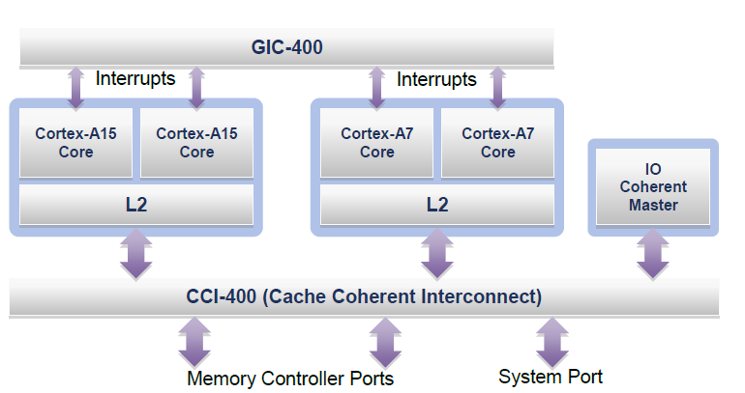
Forword (2)
Illustration of the terminology used
Processor
GIC: General
Interrupt Controller
CPU
Core cluster
CPU core
Figure: An example big.LITTLE processor [37]
CPU cores are the basic building blocks of processors, like ARM’s Cortex-A cores,
multiple CPU cores along with a shared cache may be set up to core clusters,
multiple core clusters may be included in a CPU and
a CPU augmented by further functional units, like GPUs, NPUs, a Cache Coherent
Interconnect makes up a processor, as demonstrated in the Figure above.

Slide 4
Forword (3)
Remark to the terminology -2
In their presentations and documentations ARM often designates cores as CPUs.
While relating to the Cortex-A family of CPUs neither ARM nor the Lecture Notes
are consequent in using the “A tag” (Application) in any case.
Nevertheless, the related Sections discuss only CPU cores based on the Armvx-A ISA,
regardless, whether the “A tag” is stated or not in a designation.

Slide 5
ARM’s CPU cores
1. Introduction to ARM
2. Evolution of the ARM ISA up to the Armv8 release
3. The Cortex family of CPU cores
4. Arnv8.2-A ISA extensions and related Cortex-A cores
5. Armv9-A ISA extensions and related Cortex-A cores
6. References
Notes:
5

Slide 6
1. Introduction to ARM

Slide 7
1. Introduction to ARM (1)
1. Introduction to ARM
ARM (ARM Holdings plc) was a British semiconductor design company with
its headquarter in Cambridge, that was acquired by Softbank (Japan) in 2016.
The company
designs low power processor components for the embedded, mobile and server
market, such as Cortex CPUs, Mali GPUs, Ethos NPUs, Memory Controllers
(DMC), on-chip interconnects etc. as well as
develops related software tools (e.g. development studios etc.),
and licences their IP (Intellectual Property) including their Arm ISA but
does not fabricate semiconductors.
Here we note that ARM announced in 2018 a new CPU family branding as well,
called Neoverse for processors and platforms, aiming at information
infrastructures (datacenters, routers, switches etc.), not discussed in this
Lecture.
plc: Public Limited Company (a.m. kft)
NPU: Neural Processing Unit
Intellectual Property: szellemi tulajdon

Slide 8
1. Introduction to ARM (2)
Example 1: ARM's IP offer related to the Cortex-A73 CPU [89]
Graphic IP | Other IP | Tools
ARM Mali™-G71 Mali-DP550 (Display processor) Mali-V550 (Video Processor) | ARM CoreLink™ CCI-550 (Cache Coherent Interconnect) CoreLink GIC-500 (Interrupt Controller) CoreLink MMU-500 (System Memory Management Unit) CoreLink TZC-400 (ARM TrustZone® Controller) CoreLink DMC-500/DMC-520 (Dynamic Memory Controller) ARM CoreSight™ SoC-400 (Debug and Trace) ARM POP™ (Physical IP) | ARM DS-5 Development Studio Fixed Virtual Platforms ARM Versatile™ Express ARM Compiler 6 ARM Fast Models

Slide 9
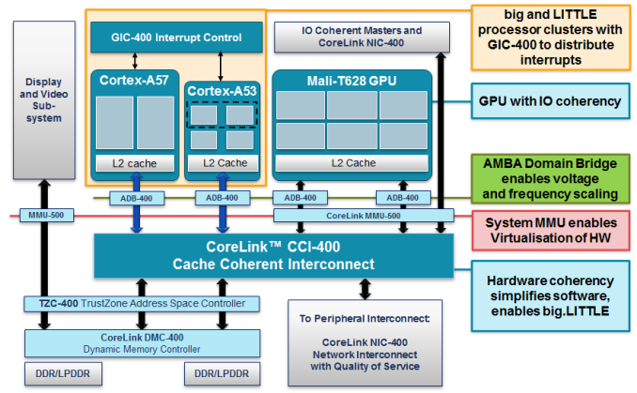
1. Introduction to ARM (3)
Example 2: Armv8.0-based SoC design with Cortex-A57/A53 CPUs and
CCI-400 interconnect (2012) [134]
ADB: AMBA Domain Bridge
(to implement DVFS)
Published by ARM and used in LG's Odin/Nuclun SoC.

Slide 10
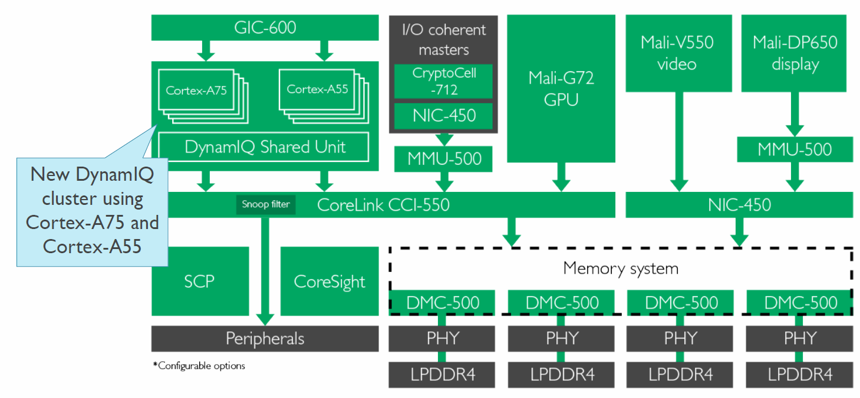
1. Introduction to ARM (4)
Example 3: Armv8.2-based SoC design with Cortex-A75/A55 CPUs and
CCI-550 interconnect (2017) [135]
CCI-550: Cache Coherent interconnect
MMU-500: Memory Management Unit (responsible for virtualization and caching)
NIC-450: Network Interconnect (interface converter)
GIC-600: General Interrupt Controller
SCP: System Control Processor

Slide 11
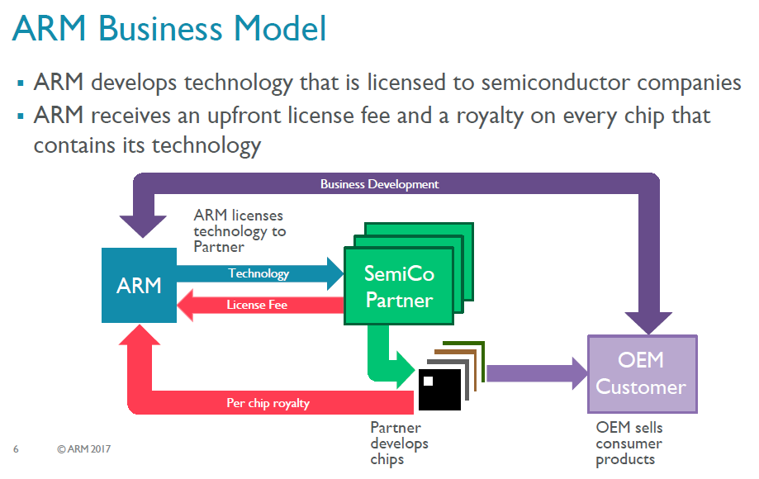
1. Introduction to ARM (5)
ARM's business model [117]
ARM possesses the Arm ISA as well as develops functional units and licenses them
to semiconductor companies.
ARM receives an upfront license fee and subsequently a royalty on every chip that contains
its technology.
Semiconductor partners fabricate and sell chips to OEMs (Original Equipment
Manufacturers) while OEMs provide feedback to Arm for new design needs.

Slide 12
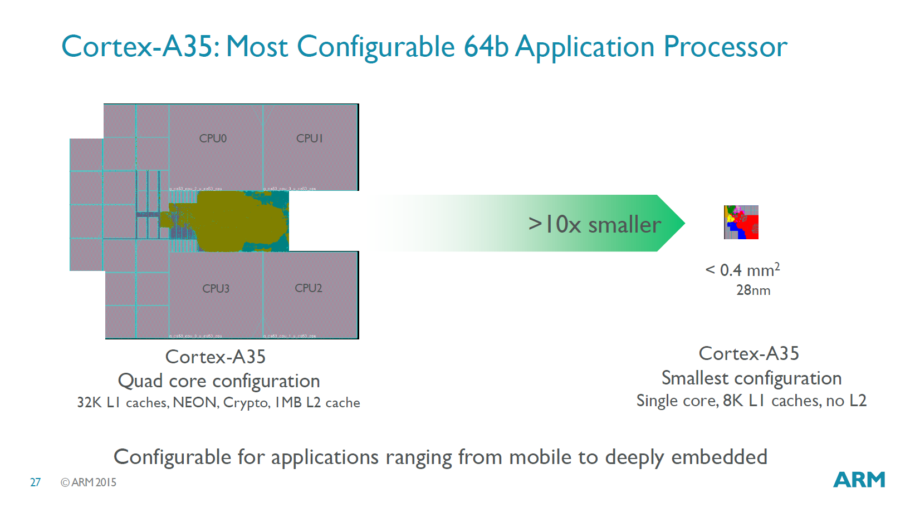
1. Introduction to ARM (6)
Configurability of ARM’s designs
ARM’s design are configurable, e.g. L1/L2/l3 cache sizes, core counts etc. may be
chosen by implementation.
The Figure below shows an example for configuration options of a Cortex-A35
CPU ranging from mobile to deeply embedded use.
Figure: Configuration options of a Cortex-A35 CPU [96]

Slide 13
1. Introduction to ARM (7)
Evolution of the approaches used for circuit design -1 [1]
Approaches to circuit design
Full custom design
Semi custom design
Full synthesizable design
Hand layout of the
entire circuit
The design will be subdivided into
functional units and further on into blocks
and the appropriate implementation technique
(hand layout, structured layout or automated layout)
is chosen for each.
Automated layout of the
entire circuit
Simple scaling, e.g.
from 28 nm to 16 nm
Power/performance
optimized
Implementation time
optimized
Trend

Slide 14
1. Introduction to ARM (8)
Evolution of the approaches used to circuit design -2 [1]
ARM's processor designs before the Cortex-A9 were partly hand layouts and
partly automated layouts.
ARM’s first fully synthesizable design was the Cortex-A9 processor (announced in 2007).
Recently, automated design tools are typically used for processor design.
Over time more and more advanced standard cell libraries were developed that
have a large variety of design options, e.g. cell types or drive strengths, which
lessens the need for custom design.

Slide 15
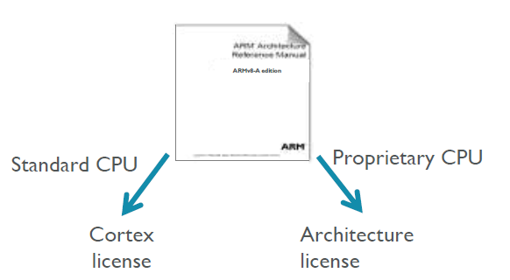
1. Introduction to ARM (9)
ARM’s licensing policy [131] -1
ARM provides either a Cortex license or an Architecture license.
In case of a Cortex license the licensee gets a complete standard microarchitecture
design (IP) with flexible configuration options, e.g. for the sizes of the L1 or L2
caches.
The Architecture license allows using the ARM ISA and the licensee has to design
their custom microarchitecture, which leads to a proprietary CPU.
E.g. Apple or Samsung bought an Architecture license, designed their CPUs
and named them as they liked.

Slide 16
1. Introduction to ARM (10)
ARM’s advanced “Built on ARM Cortex Technology” licensing model [131]
Introduced in 02/2016.
It is available only for lead partners.
The new license agreement allows licensees to request changes of the
microarchitecture and use this customized design in their products.
ARM provides its engineering and design services for implementing the requested
modifications for additional costs.
Under the license's terms, ARM still owns the IP, however the modified
microarchitecture is not shared or made available to other licensees.
Licensees have branding freedom.
An example is Qualcomm’s Kryo 280 CPU that is based on ARM’s Cortex-A73,
whereas earlier Qualcomm CPUs were custom designed based on an
Architecture license.

Slide 17
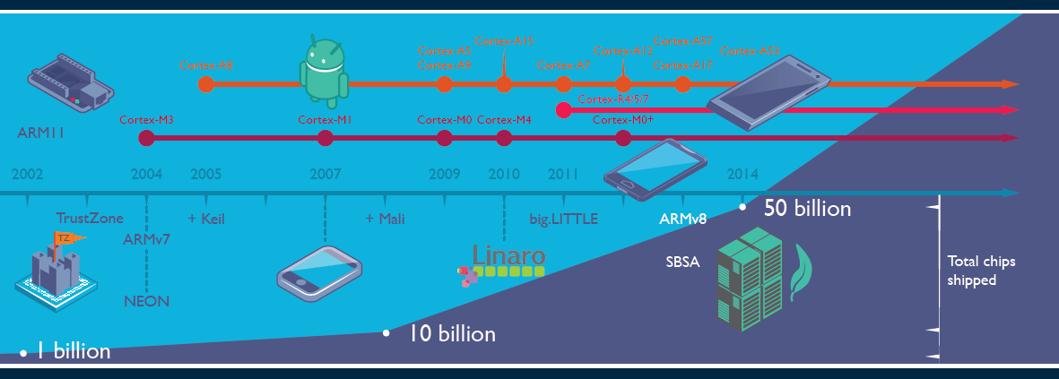
1. Introduction to ARM (11)
Evolution of ARM’s products and the total number of ARM based chips shipped [19]
Keil: Software development tool for embedded processors Cortex R: Real time M: Embedded
Linaro: Nonprofit company, established by ARM, Freescale, IBM, Samsung, ST-Ericsson and TI
to support open source software developers using Linux on SoCs.
SBSA: Server Base System Architecture, a standardized server platform for 64-bit ARM processors.

Slide 18
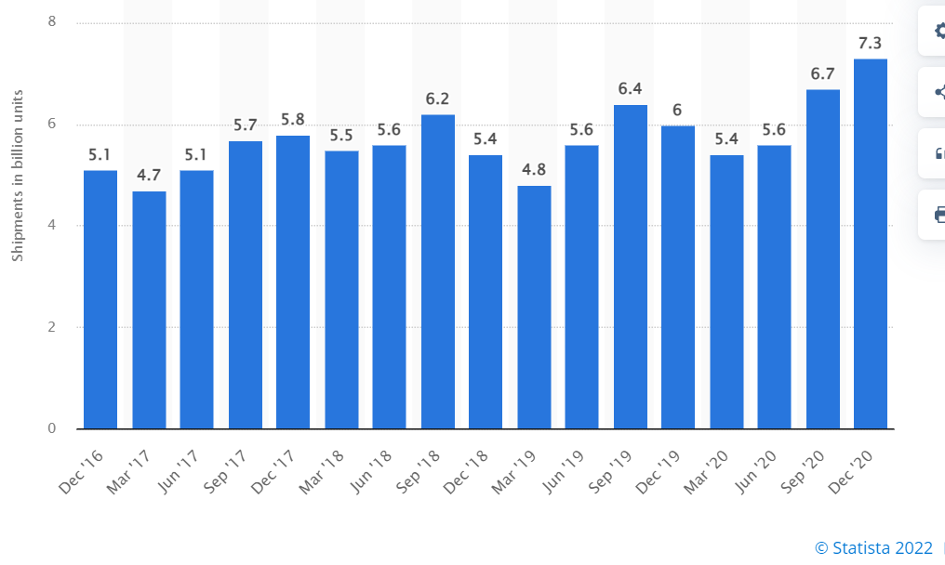
1. Introduction to ARM (12)
Number of ARM ISA-based chips shipped per quarter 2016-2020 [166]

Slide 19
1. Introduction to ARM (13)
Total number of ARM-based chips shipped until 10/2021
As ARM announced, until 10/2021 there were over 200 billion chips shipped with
their ISA [167].

Slide 20
1. Introduction to ARM (14)
Why AMD designs became dominant in the embedded and mobile market?
(including smartphones and tablets)
The ARM ISA is a RISC architecture in contrast to the x86 ISA which is a CISC
ISA.
RISC ISAs are Load/Store architectures which fetch their operands from
registers,
whereas CISC architectures allow operand fetches both from registers and the
memory.
This has two consequences;
CISC instructions are different long, they may be 1 to 15 byte long, partly why they may refer to memory operands, whereas RISC instructions are equal long (typically 4-byte), since they only refer to register operands (except LS instructions, which also my be encoded in 4-bytes).
b) CISC architectures consume inherently more power since memory fetches
and decoding need more power than register fetches and RISC decoding.
This is the reason why ARM designs dominate recently the embedded and the
mobile market (including smartphones and tablets) and why increasingly more
ARM ISA-based server processor designs appear (e.g. ARM’s Neoverse line).

Slide 21
1. Introduction to ARM (15)
Historical remarks -1 [60], [61]
ARM’s parent company is Acorn Computers (UK).
Acorn Computers started their Acorn RISC Machine project in October 1983
to develop a powerful processor for a line of business computers,
(two years after the introduction of the IBM PC).
The acronym ARM was coined originally at this time (1983) from the designation
Acorn RISC Machine.
In 1990 the company Advanced RISC Machines Ltd. (ARM Ltd.) was founded as a
joint venture of Acorn Computers, Apple Computers and VLSI Technology.
Accordingly, also the interpretation of ARM was changed to “Advanced RISC
Machines”.

Slide 22
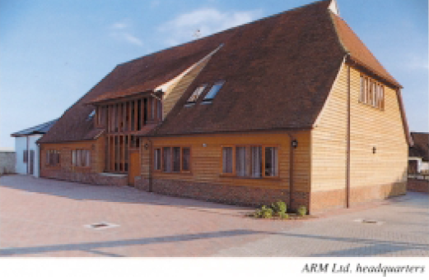
1. Introduction to ARM (16)
Historical remarks -2
Figure: The headquarters of ARM Ltd. about 1990 [62]

Slide 23
1. Introduction to ARM (17)
Optional reading: A brief account of the beginning of ARM [168]
“ARM’s First Chip¹ (from 1992)
Although the ARM processor were developed as a custom device for a highly specific purpose, the team designing it felt that the best way to produce a good custom solution was to produce a processor with good all-round performance. However, it’s interesting to note that the ARM’s architectural fate was sealed accidentally. While most of the RISC processor vendors were designing relatively huge chips (SPARC RISC, Intel i860, AMD 29000, etc.), ARM opted to develop a small-scale processor. One of the reasons the ARM processor was designed as a small-scale solution was that the resources to design it were not sufficient to allow the creation of a large and complex device. While this is now a technical plus for the ARM processor, it began as a necessity for a processor designed by a team of talented, but inexperienced designers (outside of university projects, most team members were programmers and board-level circuit designers) using new tools, some of which were far from state-of-the-art. Despite the unusal working quarters, the motivation and excitement of the small team was high and the company had an open, communicative style that helped maintain the “buzz”.
As with most start-up’s, ARM’s primary goal was to get the first product out; in this case, it was the ARM610, designed specifically for Apple. This product included full 32-bit addressing and endian-ness support, one of many changes requested by Apple in order to use the ARM processor in its planned products. An improved video controller, VIDC20, was also developed as well as a floating-point processor. Apple’s goal was to use the IP product within a hand-held personal organizer processor. The processor became known as ARM600, from which the 20 MHz ARM610 used in the Newton was later derived. At the same time, ARM Ltd.'s software team developed the ARM Cross Development Toolkit, a suite of software that allowed designers working on a range of platforms to use ARM development tools, assembler, compilers, and debugging and emulation programs.”
¹ Armv3 based

Slide 24
1. Introduction to ARM (18)
Historical remarks -3
Finally, in 1998 the company went to the stock exchange and its name was changed
to ARM Holdings plc, to its current designation.

Slide 25

1. Introduction to ARM (19)
Historical remarks -4
Figure: ARM's recent headquarter in Cambridge (UK) [78]

Slide 26
1. Introduction to ARM (20)
Acquisition of ARM by Softbank (Japan)
Announced in 07/2016
Completed in 09/2016
Price: 31 bUSD (ARM's revenues in 2015 ≈ 1.5 bUSD).

Slide 27
1. Introduction to ARM (21)
NVIDIA’s intention to acquire ARM from Softbank
Announced in 09/2020
Price: 40 bUSD
To be completed in 2022.
NVIDIA aims at “burying x86 PCs” as stated by their CEO (Huang) in 09/2020
[134]:
"The PC of the future will be made by new OEMs, sold through new distributors
and use a new instruction-set architecture.
ARM will be the most important CPU architecture of the future, and it already is
the fastest growing processor architecture.”

Slide 28
1. Introduction to ARM (22)
Cancellation of the acquisition of ARM by NVIDIA [169]
In 02/2022 NVIDIA and Softbank (ARM’s owner) announced the termination of
the previously planned transaction due to regulatory objections.
At this occasion Huang, CEO of NVIDIA stated that “I expect Arm to be the
most important CPU architecture of the next decade.”

Slide 29
2. Evolution of the ARM ISA up to the Armv8.0 release
2.1 Overview of the evolution of the Arm ISA
2.2 ISA extensions introduced to enhance compute capabilities
2.3 The SVE register set-based ISA extensions

Slide 30
2.1 Overview of the evolution of the Arm ISA

Slide 31
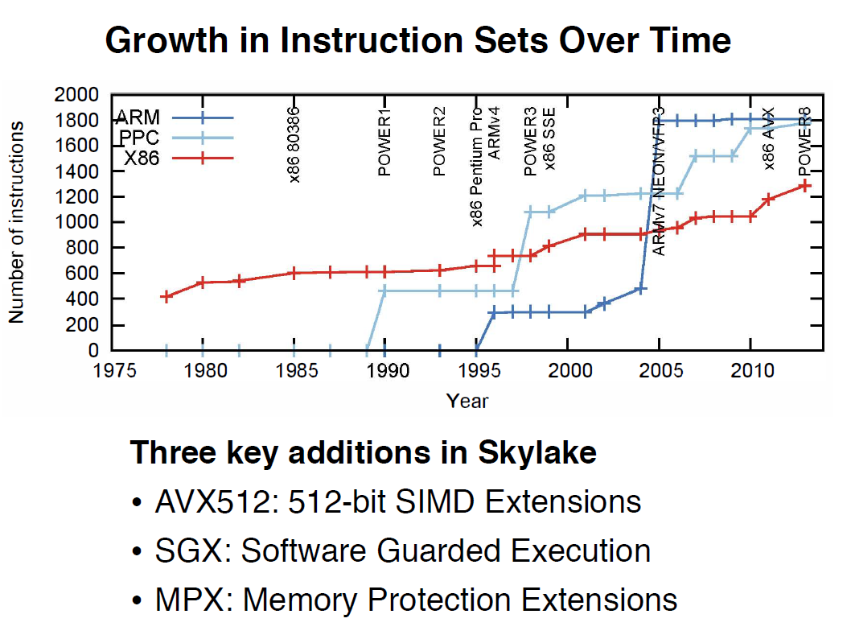
2.1 Overview of the evolution of the Arm ISA (1)
2.1 Overview of the evolution of the Arm ISA
Growth of instruction sets of processors over time [163]
Note in the above Figure that both RISC ISAs, (IBM’s PPC and the Arm ISA), as well as
the x86 CISC ISA evolve continuously, and the number of available instructions has been raised
tremendously in both RISC (Reduced Instruction Set Computer) and CISC (Complex
Instruction Set Computer) ISAs to far over 1000, thus recently the number of instructions
in RISC and CISC ISAs do not differ notably from each other any more.

Slide 32
2.1 Overview of the evolution of the Arm ISA (2)
Overview of ARM’s ISA versions
Also ARM’s ISA has been evolved enormously.
How huge work has been done is indicated by the fact that the recent (2022)
Architecture Reference Manual [171] covers more than 11000 pages.
A half page excerpt of the manual illustrates this on the next slide.

Slide 33
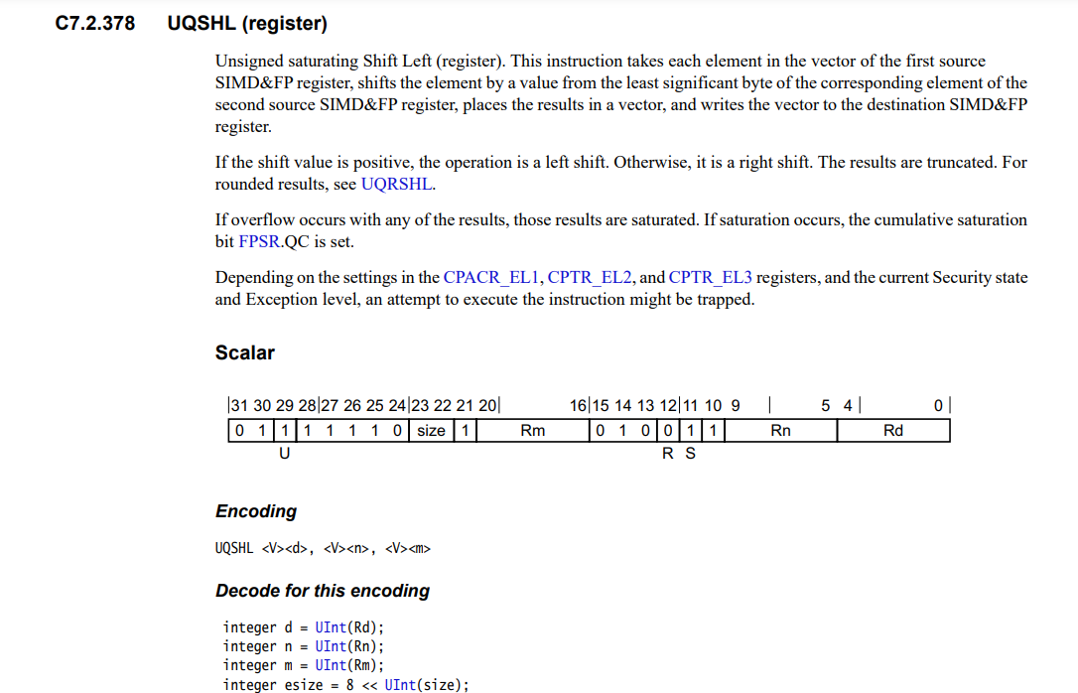
2.1 Overview of the evolution of the Arm ISA (3)
Example: 1/2 page excerpt of the Arm Architecture Reference Manual (2022) [171]
(1/2 from 11530)

Slide 34
2.1 Overview of the evolution of the Arm ISA (4)
ARM’s basic ISA
Until now there are nine ARM ISA versions, designated as Armv1 to Armv9,
described in related releases of the Architecture Reference Manual.
The earliest versions (Armv1 and Armv2) only provided an address range of
26 bits yet, the first ISA version with 32 bit address range became the Armv3,
first implemented (in the ARM60 processor) in 1992.
Arbitrarily, we consider the Armv3 ISA as ARM’s basic ISA and discuss its
evolution next.
Armv3
Armv4
Armv5
Armv6
Armv7-A
Armv8.0-A
Armv9-A
Example CPUs
ARM60
(1992)
ARM710T
(~1995)
ARM10200
(2000)
ARM1136
(2002)
Cortex-A5 - A15
(2005)
Cortex-A53/A57
(2012)
Neoverse N2/V1
Cortex-X2/A510/A710
cores (2021)

Slide 35
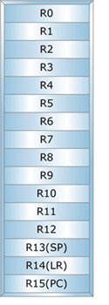
2.1 Overview of the evolution of the Arm ISA (5)
Key features of ARM’s basic ISA
It is a straightforward 32-bit RISC ISA, capable of processing only 32-bit scalar FX
and logical data, as it mainly aimed at embedded microcontrollers.
This ISA provides 16 32-bit registers, called the core registers.
13 out of them are used as general purpose registers (GPRs), the remaining three
are dedicated, as shown below.
GPR
Stack pointer
Link register
PC
Figure: Core registers in the Armv3-Armv7 ISA versions [63]

Slide 36
2.1 Overview of the evolution of the Arm ISA (6)
Main directions of extending ARM’s basic ISA (simplified)
Early focus of ARM ISA extensions (1)
As ARM’s early (26/32-bit) processors were mostly used in embedded applications,
the code size and the execution speed of bytecodes were of importance.
This motivated ARM to introduce enhancements first for reducing code size and
speeding up the execution of bytecodes, as pointed out in the next Figure.
Main directions of extending ARM’s basic ISA
ISA extensions
to reduce
code size
ISA extensions
to speed up
the execution of bytecodes
After focusing on mobiles
these extensions became obsolete
Later, more or less when ARM’s processors became 64-bit wide, these extensions
became obsolete.

Slide 37
2.1 Overview of the evolution of the Arm ISA (7)
Changing focus of using ARM processors in the early 2000’s (2)
Next, in the early 2000’s ARM processors found their way more and more
into mobiles where more general workloads were common, including graphics
processing.
This was the reason for introducing ISA extension for enhancing compute capabilities
by FP and SIMD processing and also for security improvements, as indicated below.
Main directions of extending ARM’s basic ISA
ISA extensions
to reduce
code size
ISA extensions
to speed up
the execution of bytecodes
ISA extensions
to enhance
compute capabilities
ISA extensions
to enhance
security
Discussed
subsequently
Not discussed

Slide 38
2.1 Overview of the evolution of the Arm ISA (8)
Overview of the main directions and actual extensions of ARM’s basic ISA
(For the explanation of the superscripts in the Figure see next slide)
The thumb instruction set aims at reducing code size.
AArch32
AArch64
AArch64
Crypto-graph. extension
To enhance
security
TrustZone
Confidential
Compute Arch.
MTE
A32
SVE⁴
(v8.2, opt.)
A64
Aarch32⁵
A64
SVE2
To enhance
compute
capabilities
SIMD
Adv. SIMD¹
(NEON)
VFPv1/2
VFPv3/v4²
To speed up
the execution
of bytecodes
Jazelle
(Jazelle DBX)
Jazelle
(ex. by SW)
Jazelle RCT³
(ThumbEE)
Thumb⁶
(Armv4T)
Thumb-2
(Armv6T2)
T32
(Thumb)
Armv4
Armv5
Armv6
Armv7-A
Armv8.0-A
Armv9-A
ARM710T
(~1995)
ARM10200
(2000)
ARM1136
(2002)
Cortex-A5 - A15
(2004)
Cortex-A53/A57
(2012)
Neoverse N2/V1
Cortex-X2/A510/A710
cores (2021)

Slide 39
2.1 Overview of the evolution of the Arm ISA (9)
Explanation of the superscripts in the previous Figure
¹Neon technology is ARM’s designation for Advanced SIMD extensions.
²The VFP subset became depricated in the Armv8 ISA.
³Jazelle-RTC (ThumbEE) became depricated in Armv7 Issue C in 10/2011.
⁴The SVE (Scalable Vector Extension) subset became introduced in the
Armv8.2 ISA as an optional feature, only in 2017.
⁵The AArch32 execution mode is only supported in certain implementations, e.g.
in the Cortex-A510 CPU.

Slide 40
2.1 Overview of the evolution of the Arm ISA (10)
The importance of the Armv7/v8 ISA releases
The Armv7 (2004) and especially the Armv8 (2012) ISA releases were major
contributors for enhancing the compute capabilities of ARM’s processors.
ARM announced the Armv7 ISA release in 2004 and along with it the Cortex Family
of CPU cores, these processors became the workhorse for mobile processors of the 2000’s.
Along with the Armv8 ISA revision in 2012 ARM opened the way for 64-bit processing
and provided largely enhanced register spaces for computing, as discussed later.
The new 64-bit Armv8 ISA introduced two execution modes (AArch32/Aarch64)
in order to provide backward compatibility with the 32-bit Armv7 ISA.
In the Aarch32 execution mode processors behave like Armv7 processors, so they
have the same execution capabilities as provided in the Armv7 ISA, whereas
in the Aarch64 execution mode the processor has a largely extended register space
for executing instructions, compared to the Armv7 ISA, as discussed later.
At the same time early aspects, like reducing code size and speeding up the
execution of bytecodes became pointless and their support was dropped,
as indicated in the next Figure.

Slide 41
2.1 Overview of the evolution of the Arm ISA (11)
The importance of the Armv9 release
The last phase of the ISA evolution revealed in 2021) is mainly connected to the
Armv9 release and provides enhanced support for AI.
AI support is manifested in further improving performance and security.
As performance is concerned, the Armv9 release made SVE mandatory
(optional from 2017 on) and introduced as mandatory feature SVE2
(see Section 2.3).
To improve security, Armv9 introduced the Confidential Compute Architecture
and also Memory Tagging (not discussed).

Slide 42
2.1 Overview of the evolution of the Arm ISA (12)
Summing up key issues of the overview of extending the Arm ISA (1)
Both RISC ISAs (IBM’s PPC and the Arm ISA), as well as the x86 CISC ISA evolve
continuously, and the number of available instructions has been raised tremendously
in both RISC (Reduced Instruction Set Computer) and CISC (Complex Instruction Set
Computer) ISAs to far over 1000, thus recently the number of instructions in RISC
and CISC ISAs do not differ notably from each other any more.
Overview of ARM’s ISA versions
Until now there are nine ARM ISA versions, designated as Armv1 to Armv9,
described in related releases of the Architecture Reference Manuals.
The earliest versions (Armv1 and Armv2) provided an address range of only
26 bits yet, the first ISA version with 32 bit address range became the Armv3,
first implemented in 1992.
Arbitrarily, we consider the Armv3 ISA as ARM’s basic ISA and discuss its
evolution.
Key features of ARM’s basic ISA
It is a straightforward 32-bit RISC ISA, capable of processing only 32-bit scalar FX
and logical data, as it mainly aimed at embedded microcontrollers.
The ISA provides 16 32-bit registers, called the core registers.
13 out of them are used as general purpose registers (GPRs), the remaining three
are dedicated.

Slide 43
2.1 Overview of the evolution of the Arm ISA (13)
Summing up key issues of the overview of extending the Arm ISA (2)
Changing focus of the ARM ISA extensions -1
As ARM’s early (26/32-bit) processors were mostly used in embedded applications,
the code size and the execution speed of bytecodes were of importance.
This motivated ARM to introduce early enhancements to reduce code size and
speed up the execution of bytecodes, not discussed in this Section.
Next, in the early 2000’s ARM processors found their way more and more
into mobiles where more general workloads were common, including graphics
processing.
This was the reason for enhancing compute capabilities by FP and SIMD processing,
and also by security improvements.
The Armv7 (2005) and especially the Armv8 (2011) ISA releases were major
contributions to this move.
ARM announced the Armv7 ISA release in 2004 and along with it the Cortex Family
of CPU cores, these processors became the workhorse for mobile processors of the 2000’s.

Slide 44
2.1 Overview of the evolution of the Arm ISA (14)
Summing up key issues of the overview of extending the Arm ISA (3)
Changing focus of the ARM ISA extensions -2
Along with the Armv8 ISA revision ARM opened the way for 64-bit processing
and provided largely enhanced register spaces.
The new 64-bit Armv8 ISA introduced two execution modes (AArch32/Aarch64)
in order to provide backward compatibility with the 32-bit Armv7 ISA.
In the Aarch32 execution mode the processor behaves like an Armv7 processor, so it
has the same execution capabilities as the Armv7 ISA, whereas in the Aarch64
execution mode the processor has a largely extended register set and a largely
enhanced register space for executing instructions, compared to the Armv7 ISA.
The last phase of the ISA evolution is mainly connected to the Armv9 release,
revealed in 2021.
In this phase of the evolution, performance and security remained the dominant
aspects and motivations to introduce further enhancements to compute capabilities,
like the SVE/SVE2 extension or extensions to security, such as the Confidential
Compute Architecture or the Memory Tagging Extension, to be discussed later.
At the same time early aspects, like reducing code size and speeding up the
execution of bytecodes became pointless and their support was dropped.

Slide 45
2.2 ISA extensions introduced to enhance compute capabilities

Slide 46
2.2 ISA extensions introduced to enhance compute capabilities (1)
2.2 ISA extensions introduced to enhance compute capabilities -1
Main directions of extending ARM’s basic ISA
ISA extensions
to reduce
code size
ISA extensions
to speed up
the execution of bytecodes
ISA extensions
to enhance
compute capabilities
ISA extensions
to enhance
security

Slide 47
2.2 ISA extensions introduced to enhance compute capabilities (2)
The starting point: ARM’s basic ISA (Armv3, 1992) [63], [66]
As already discussed and indicated in the Figure below, ARM’s basic ISA only provides
13 32-bit wide GPR registers and supports scalar computing with FX32 and Boolean data,
since it is mainly aimed at embedded microcontrollers.
32-bit wide
GPR register set
(Basic ISA)
R0
R1
R2
.
.
.
R12
R13(SP)
Stack pointer
Link register
PC
R14(LR)
R15(PC)
GPRs in the Armv3-Armv7 ISA
Basic ISA
Figure: ARM’s basic ISA
Scalar data (+Boolean)
FX32

Slide 48
2.2 ISA extensions introduced to enhance compute capabilities (3)
ISA extensions introduced to enhance compute capabilities -2
ARM’s ISA extensions for enhancing compute capabilities may best be described by
considering the register sets introduced for this reason and the declared ISA extensions
provided for manipulating data in the declared register spaces.

Slide 49
2.2 ISA extensions introduced to enhance compute capabilities (4)
Register sets introduced in the Arm ISA
In the long history of the Arm ISA, the firm introduced three different register sets,
as shown below.
Register sets introduced in the Arm ISA
(GPR register set
of the basic ISA)
Secondary register set
SVE register set
Introduced in
Armv3 (1992)
Armv5 (2000)
(yet in the FP coprocessor)
Armv8.2 (2016), optional
(in the AArch64 mode)
Armv9.0 (2021) mandatory
Extended in
Armv8 (2012)
Armv7 (2004)
(moved into the core)
Armv8 (2012)
(in the AArch64 mode)

Slide 50
2.2 ISA extensions introduced to enhance compute capabilities (5)
Extending the GPR and secondary register sets
As indicated in the previous Figure, in the course of the dynamic evolution of the
ARM ISA both the GPR and the secondary register space became extended,
as discussed next.

Slide 51
2.2 ISA extensions introduced to enhance compute capabilities (6)
a) Extending the GPR register set in the Armv8 ISA (2012) [63], [66]
The GPR register set was vastly enlarged in the Armv8 ISA release, as shown below.
32-bit wide
32-bit wide
64-bit wide
R0
X0
W0
R1
X1
W1
R2
X2
W2
W3
X3
.
.
.
.
.
.
.
.
.
R12
X12
W12
R13(SP)
Stack pointer
Link register
PC
X13
W13
R14(LR)
X14
W14
R15(PC)
.
.
.
.
.
.
X30
W30
X31
Dedicated use
W31
Dedicated use
32-bit access
64-bit access
GPRs in the Armv3-Armv7 ISA
and in the Armv8 ISA
in the AArch32 execution mode (2012)
GPRs in the Armv8 ISA
in the AArch64 execution mode (2012)

Slide 52
2.2 ISA extensions introduced to enhance compute capabilities (7)
b) Introducing a secondary register set into the Arm ISA and its extension
For efficient implementation of FP calculations needed e.g. in 3D applications, ARM
introduced a secondary register space of 32 32-bit wide registers in the Armv5 ISA
and implemented it in the FP coprocessor in 2000.
Subsequently, when the Arm ISA became widely used in mobiles, ARM extended this
register space to 32 64-bit registers and implemented it in the CPU core, to introduce
64/128-bit SIMD processing in 2004.
Finally, in the Armv8 Aarch64 execution mode ARM widened the secondary register set to
32 128-bit in 2012, to provide better support for 128-bit processing, as illustrated below.
(Implemented in
the coprocessor)
(Implemented in
the CPU core)
(Implemented in
the CPU core)
32
64
128
32
32
32
Armv5
Armv7 (or Armv8 AArch32 mode)
Armv8 AArch64 mode
(2000)
(2004)
(2012)
Figure: Introducing a secondary register set into the Arm ISA and its evolution

Slide 53
2.2 ISA extensions introduced to enhance compute capabilities (8)
ARM’s names of the introduced secondary register set
ARM’s names for the discussed additional register sets are confusing, as indicated below.
FP register set
Advanced SIMD and FP register set
(Extension register set)
SIMD and FP register set
32
64
128
32
32
32
Armv5
Armv7 (or Armv8 AArch32 mode)
Armv8 AArch64 mode
(2000)
(2004)
(2012)
Figure: Introduction and evolution of the secondary register set in the Arm ISA
This is the reason why we do not use ARM’s own register designations but refer to them
collectively as the secondary register set in this Section.

Slide 54
2.2 ISA extensions introduced to enhance compute capabilities (9)
c) Introducing the SVE register set into the Arm ISA [96]
The SVE (Scalable Vector Extension) was announced in 2016 (in the Hot Chips
conference) and introduced in the Armv8.2-based ISA in 2017 as an optional feature.
SVE is implemented only in the AArch64 mode of Armv8.2.
SVE aims at HPC scientific workloads rather than media or image processing.
It provides 32 registers (called Z0 – Z31), each up to 16 x 128 bit long
(implementation dependent) to hold data elements, as seen below.
SVE supports both FX- and FP SIMD processing.
SVE register set
128
---
32
(1...16)x 128 bit
Armv8.2 (AArch64 mode)
Figure: The SVE register set

Slide 55
2.2 ISA extensions introduced to enhance compute capabilities (10)
ISA extensions declared to the introduced register spaces
Next we are going to present ARM’s ISA extensions introduced up to the Armv8.0 ISA
for enhancing compute capabilities.
The extensions brought in along with the Armv8.2 and Armv9 ISAs are described separately
in the Sections 4.2 and 5.2, (except the SVE/SVE2 extensions that are described
in the following Section).

Slide 56
2.2 ISA extensions introduced to enhance compute capabilities (11)
Overview of ARM’s ISA extensions declared to enhance compute capabilities -1
The sequence of ARM’s ISA extensions introduced represents a clear-cut logic as follows:
Based on the existing GPR register set, first FX SIMD instructions were added to
the scalar FX instructions provided by the basic ISA.
ARM’s ISA extensions introduced to enhance compute capabilities
FX SIMD
extensions
Based on the
GPR reg. set

Slide 57
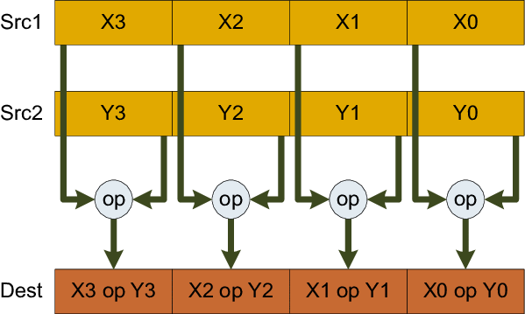
2.2 ISA extensions introduced to enhance compute capabilities (12)
Remarks to the introduction of SIMD instruction extensions
SIMD instructions execute the same operation on a number of data, as indicated
in the Figure below.
SIMD instructions may refer either to FX or FP data.
FX SIMD instructions support e.g. multimedia applications, by executing
(2/4/8 or more) FX-operations on pixels in-parallel, whereas
(FP SIMD instructions accelerate e.g. 3D graphics by executing multiple FP-operation
on graphics data).
Clearly, the introduction of SIMD instructions into a traditional ISA requires
an appropriate register space and ISA subset.
X:
Y:
Z = X op Y
Figure: Interpretation of the execution of SIMD instructions [179]

Slide 58
2.2 ISA extensions introduced to enhance compute capabilities (13)
Overview of ARM’s ISA extensions declared to enhance compute capabilities -2
Next the basic ISA was augmented by a secondary register set and based on it
scalar FP, vector FP (sequentially executed) and FX/FP SIMD instructions on
64/128-bit data vectors were introduced.
ARM’s ISA extensions introduced to enhance compute capabilities
Scalar FP
extensions
Vector FP
extension
FX/FP SIMD
extensions
(coproc. based)
(32-bit, coproc. based)
(Sequentially executed)
(64/128-bit, proc. based)
(Neon)
Based on the
secondary register set

Slide 59
2.2 ISA extensions introduced to enhance compute capabilities (14)
Remark to sequentially executed FP processing
ARM introduced in their ISA extension sequentially executed FP vector processing
by the FP coprocessor such that the coprocessor executed operations on up to 8
elements of two data vectors, held in coprocessor registers, one after another, in a loop.
This is in contrast to SIMD processing, when the operations are executed in parallel
on all elements of the vectors held in the register space.

Slide 60
2.2 ISA extensions introduced to enhance compute capabilities (15)
Overview of ARM’s ISA extensions declared to enhance compute capabilities -3
Finally, based on the SVE register set the very long FX/FP SIMD extensions were added,
that can operate on 128-2048 bit wide data vectors, as indicated below.
ARM’s ISA extensions introduced to enhance compute capabilities
Very long FX/FP SIMD
extensions
(128-2048-bit)
(SVE/SVE2)
Based on the
SVE register set

Slide 61
2.2 ISA extensions introduced to enhance compute capabilities (15b)
Summing up ARM’s ISA extensions declared to enhance compute capabilities -4
ARM’s ISA extensions introduced to enhance compute capabilities
FX SIMD
extensions
Scalar FP
extensions
Vector FP
extension
FX/FP SIMD
extensions
Very long FX/FP SIMD
extensions
(coproc. based)
(32-bit, coproc. based)
(Sequentially executed)
(64/128-bit)
(128-2048-bit)
(Neon)
(SVE/SVE2)
Based on the
GPR reg. set
Based on the
secondary register set
Based on the
SVE register set

Slide 62
2.2 ISA extensions introduced to enhance compute capabilities (16)
Remark: ARM’s names of their ISA extensions introduced to enhance compute capabilities
AMD refers to their ISA extensions aiming at enhancing compute capabilities by
confusing names, as shown below.
ARM’s ISA extensions introduced to enhance compute capabilities
FX SIMD
extensions
Scalar FP
extensions
Vector FP
extension
64/128-bit FX/FP SIMD extensions
128 - 2048-bit FX/FP SIMD
extensions
Designated at introduction
(SIMD)
(VFPv1/2)
(coproc. based)
(VFPv1/2)
(coproc. based)
(Sequentially
executed)
(Advanced SIMD)
(Neon) or (VFPv3/4)
(implementation
dependent)
(SVE/SVE2)
Introduced in
Armv6
(2002)
Armv5
(2000)
Armv5
(2000)
Armv7
(2005)
SVE: Armv8.2 (opt.) (2016)
SVE2: Armv9 (mandatory) (2021)
Based on the
GPR reg. set
Based on the
secondary register set
Based on the
SVE register set
(Section 2.3
Figure: AMD’s naming of their ISA extensions introduced to enhance compute capabiities
VFP: Vector FP
SVE: Scalable Vector Extension

Slide 63
2.2 ISA extensions introduced to enhance compute capabilities (17)
Recap: GPR and secondary register set based ISA extensions up to the Armv8.0
ARM ISA |  | Name of the extensions | Basic arch. |  | GPR-based FX-SIMD data type extension | Secondary register set based extensions
 |  |  | GPRs | Data type |  | Secondary reg. set | Scalar data types | SIMD (Vector) data types
Name
Armv1 | 1985 |  | n.a. | FX32
Armv2 | 1989 |  | n.a.
Armv3 | 1991 |  | 13x32
Armv4 | 1996
Armv5 | 2000 | VFP(v1)¹ |  |  |  | FP register set 32x32/16x64 | FP 32/64 | FP 32/64 Serially ex.
 |  | VFP2¹
Armv6 | 2002
 |  | SIMD |  |  | 32-bit wide FX8/16
Armv7 | 2005 | VFPv3² |  |  |  | Adv. SIMD and FP register set 32x64 or 16X128 | +FP 16⁵ | FP 16⁵/32/64
 |  | VFPv4^{2,3,4} |  |  |  |  | + FMA
 |  | Adv. SIMD (NEON)^{5,6} |  |  |  | 32x64 or16x128 | FP 32/64 | 64/128-bit wide FX 8/16/32/64 FP 16⁵/32/64 +FMA⁵
Armv8 | 2012 | SIMD/Neon (in AArch32) | 31x64 | FX32/64 | 32-bit wide FX8/16 | 32x64 or 16x128 | FP 16⁵/32/64 | As for Armv7 Adv. SIMD
 |  | SIMD/Neon (in AArch64) |  |  | 64-bit wide FX8/16/32 | SIMD and FP register set 32x128 | FX 8/…/64 FP 16⁵/32/64 | As for Armv7 Adv. SIMD

Slide 64
2.2 ISA extensions introduced to enhance compute capabilities (18)
Remarks
¹VFPv2 vs. VFP(v1): VFPv2 adds some enhancements and modifications to VFPv1
²VFPv3/v4 and advanced SIMD register space:
Certain processors implement only 16 64-bit wide registers with the option to use
this register space as 32 32-wide registers.
³VFP3/v4 is a subset of Neon
⁴VFP4 is implemented on certain ARMv7 processors.
It adds FMA (Fused Multiply Accumulate) instructons to the VFPv3 instructon set.
⁵FP16 supports only data conversion between FP16 and FP32/FP64.
⁶In the Advanced SIMD (NEON) extension FP16 is supported only if VFP3/VFP4
is implemented respectively, FMA if VFP4 is implemented.

Slide 65
2.2 ISA extensions introduced to enhance compute capabilities (19)
Arm ISA extensions used at present in numeric computations
From all extensions introduced for enhancing the compute capabilities of the Arm ISA,
recently only the 64/128-bit FX/FP SIMD extension (commonly called Neon) and
the 128-2028-bit long FX/FP SIMD extensions, called SVE/SVE2 are of importance,
since they absorb all previous extensions.
ARM’s ISA extensions introduced to enhance compute capabilities
FX SIMD
extensions
Scalar FP
extensions
Vector FP
extension
FX/FP SIMD
extensions
Very long FX/FP SIMD
extensions
(Coproc. based)
(Coproc. based)
(Sequentially executed)
(64/128-bit)
(128-2048-bit)
(Neon)
(SVE/SVE2)
Based on the
GPR reg. set
Based on the
secondary register set
Based on the
SVE register set

Slide 66
2.2 ISA extensions introduced to enhance compute capabilities (20)
Remarks on the evolution of Intel’s x86 ISA SIMD extensions [142] -1
It is worth comparing the evolution of SIMD extensions provided by the x86 ISA with
those introduced by the Arm ISA.
Intel introduced their first multimedia inspired MMX extension in the Pentium M
processor in 1997 while using the 64-bit mantissa part of the FP registers.
Subsequently, Intel defined a dedicated register space in the SSE extension in the
Pentium III (Katmai) core in 1999, as seen in the next Figure.

Slide 67
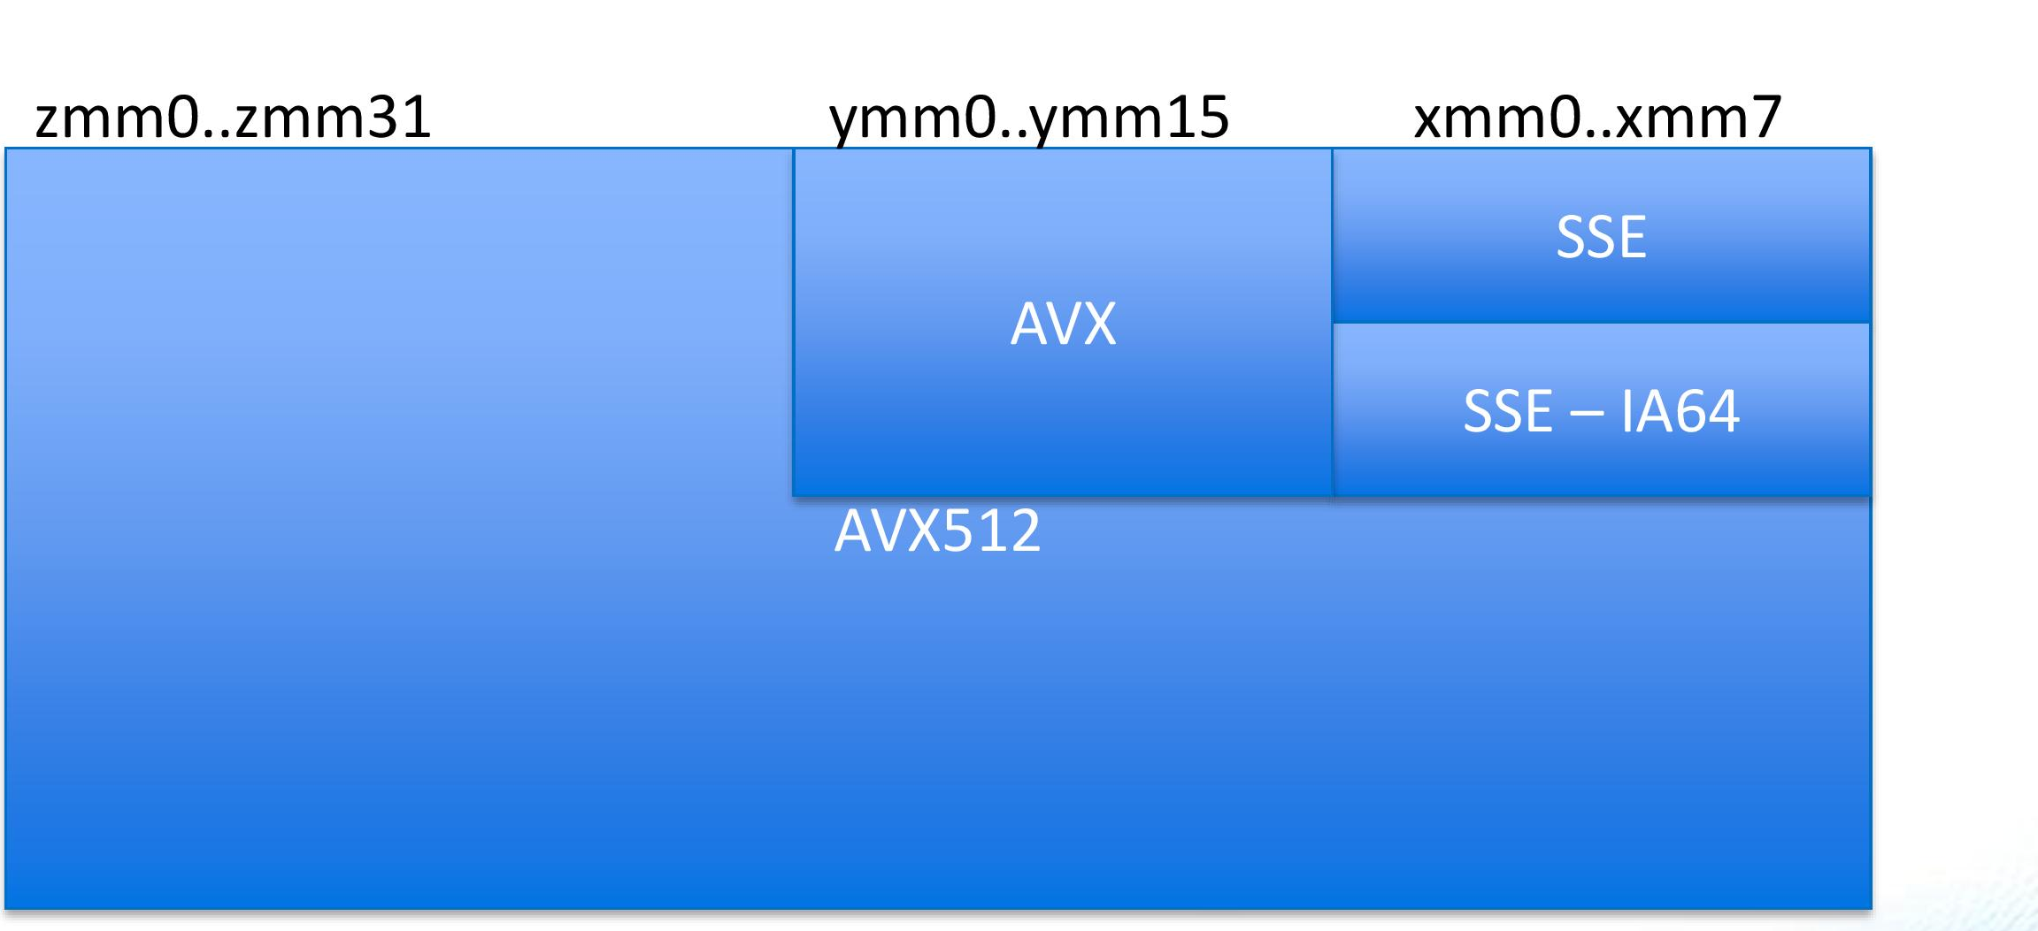
2.2 ISA extensions introduced to enhance compute capabilities (21)
Remarks on the evolution of Intel’s x86 ISA SIMD extensions [142] -2
The introduced dedicated register space was 8x128-bit in size.
It was extended in the following three steps:
first to 16x128-bit (in the SSE3 extension, in 2004),
then to 16x256-bit (in the AVX extension, in 2011) and
finally, to 32x512-bit (in the AVX512 extension, in 2017).
The extension was implemented in an aliased way, as discussed next.
zmm (511-0)
ymm (255-0)
xmm (128-0)
SSE (32-bit)
(xmm0-xmm7)
0
AVX/AVX2
ymm0-ymm15)
7
SSE3 (64-bit)
(xmm0-xmm15)
AVX-512
(zmm0-zmm31
15
AVX-512
(ymm0-ymm31
AVX-512
(xmm0-xmm31)
31
511
255
127
0
Figure: Dedicated register space of the x86 ISA for SIMD processing and its extension [180]

Slide 68
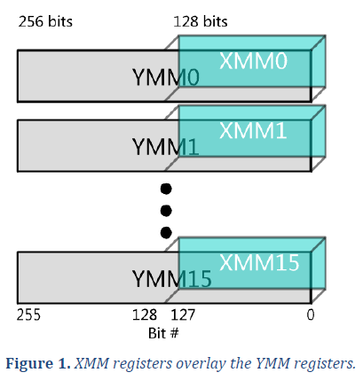
2.2 ISA extensions introduced to enhance compute capabilities (22)
Remark
In an aliased extension the lower parts of the extended registers (e.g. 256-bit registers)
are the initial (e.g. 128-bit) registers, as illustrated below.
Figure: Extending the existing 128-bit wide XMM [0, 15] SIMD register set
to the 256-bit YMM [0, 15] register set in an aliased way [181

Slide 69
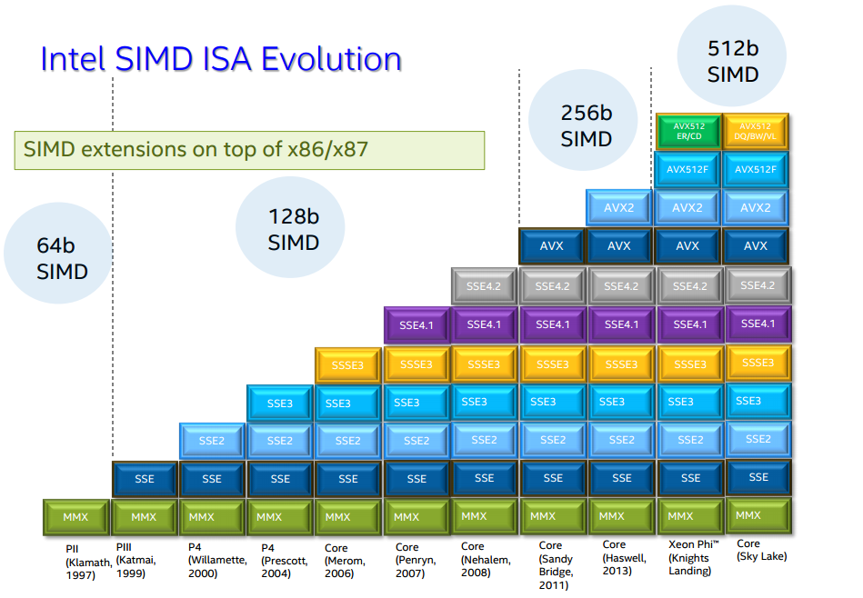
2.2 ISA extensions introduced to enhance compute capabilities (23)
Overview of Intel’s x86 ISA SIMD extensions [142]
Based on the register space extensions Intel
introduced the following SIMD extensions
of the x86 ISA:
Pentium_MMX
(1997)
PII
Klamath,
(1997)
Core
Cannon-Lake,
(2018)
Skylake-X/SP,
(2017)
(2016)

Slide 70
2.2 ISA extensions introduced to enhance compute capabilities (24)
Summing up Intel’s x86 ISA SIMD extensions [142]
SIMD extensions of Intel’s x86 ISA
MMX SIMD
extensions
SSE SIMD extensions
SSE2.SSE4.2 SIMD extensions
AVX SIMD extension
AVX2 SIMD extension
AVX-512
SIMD extension
64-bit
FX SIMD
128-bit
FP SIMD
128-bit
FX/FP SIMD
256-bit
FP SIMD
256-bit
FX/FP SIMD
512-bit
FX/FP SIMD
Introduced in
DTs/laptops
(Pentium-MMX)
(1997)
(Pentium III)
(1999)
(Pentium 4
Willamette)
(2000)
(Sandy Bridge)
(2011)
(Haswell
(2011)
(Cannon Lake)
(2018)

Slide 71
2.2 ISA extensions introduced to enhance compute capabilities (25)
Comparing Intel’s and AMD’s recent SIMD extensions
Beyond the general purpose 16x64-bit GPR and 8x80-bit FP architectural register
spaces, Intel’s x86-64 ISA declares three dedicated register spaces (of 16x128-,
16x256- and 32x512-bit) for SIMD operations, where the longer registers are aliased
with the smaller ones.
Intel introduced for each major ISA extension a different instructions set.
By contrast, AMD now makes use of two distinct register spaces for SIMD operations,
a 32x128-bit secondary register space for the Neon extension and a 32x128 to
2048-bit SVE register space for the SVE/SVE2 extensions.
The Neon and SVE ISA extensions make use of different ISA subsets, where the
SVE/SVE2 extensions are data length agnostic, i.e. the same instructions may be
used for different long data, e.g. for 128-, 256- or 512-bit data.
Here we note also that the Neon extension is expected to be replaced in the
future by the SVE2 extension, then all of ARM’s SIMD extensions may be used
in a unified way irrespective of their implementation width in the cores.

Slide 72
2.2 ISA extensions introduced to enhance compute capabilities (26)
Summing up key issues of ISA extensions introduced to enhance compute capabilities -1
The starting point: ARM’s basic ISA (Armv3, 1992) [63], [66]
As already discussed and indicated in the Figure below, ARM’s basic ISA only provides
13 32-bit wide GPR registers and supports scalar computing with FX32 and Boolean data,
since it is mainly aimed at embedded microcontrollers.
32-bit wide
GPR register set
(Basic ISA)
R0
R1
R2
.
.
.
R12
R13(SP)
Stack pointer
Link register
PC
R14(LR)
R15(PC)
GPRs in the Armv3-Armv7 ISA
Basic ISA
Figure: ARM’s basic ISA
Scalar data (+Boolean)
FX32

Slide 73
2.2 ISA extensions introduced to enhance compute capabilities (27)
Summing up key issues of ISA extensions introduced to enhance compute capabilities -2
ISA extensions introduced to enhance compute capabilities
ARM’s ISA extensions for enhancing compute capabilities may best be described by
considering the register sets introduced for this reason and the declared ISA extensions
provided for manipulating data in the declared register spaces.
Register sets introduced in the Arm ISA
In the long history of the Arm ISA, the firm introduced three different register sets,
as shown below.
Register sets introduced in the Arm ISA
(GPR register set
of the basic ISA)
Secondary register set
SVE register set
Extending the GPR and secondary register sets
As indicated in the previous Figure, in the course of the dynamic evolution of the
ARM ISA both the GPR and the secondary register space became extended,
as discussed next.

Slide 74
2.2 ISA extensions introduced to enhance compute capabilities (28)
Summing up key issues of ISA extensions introduced to enhance compute capabilities -3
a) Extending the GPR register set in the Armv8 ISA (2012) [63], [66]
The GPR register set was vastly enlarged in the Armv8 ISA release, as shown below.
32-bit wide
32-bit wide
64-bit wide
R0
X0
W0
R1
X1
W1
R2
X2
W2
W3
X3
.
.
.
.
.
.
.
.
.
R12
X12
W12
R13(SP)
Stack pointer
Link register
PC
X13
W13
R14(LR)
X14
W14
R15(PC)
.
.
.
.
.
.
X30
W30
X31
Dedicated use
W31
Dedicated use
32-bit access
64-bit access
GPRs in the Armv3-Armv7 ISA
and in the Armv8 ISA
in the AArch32 execution mode (2012)
GPRs in the Armv8 AArch64 execution mode (2012)

Slide 75
2.2 ISA extensions introduced to enhance compute capabilities (29)
Summing up key issues of ISA extensions introduced to enhance compute capabilities -4
b) Introducing a secondary register set into the Arm ISA and its extension
(Implemented in
the coprocessor)
(Implemented in
the CPU core)
(Implemented in
the CPU core)
32
64
128
32
32
32
Armv5
Armv7 (or Armv8 AArch32 mode)
Armv8 AArch64 mode
(2000)
(2004)
(2012)
Figure: Introducing a secondary register set into the Arm ISA and its evolution

Slide 76
2.2 ISA extensions introduced to enhance compute capabilities (30)
2.2 ISA extensions introduced to enhance compute capabilities (1)
Summing up key issues of ISA extensions introduced to enhance compute capabilities -5
Overview of ARM’s ISA extensions declared to enhance compute capabilities -1
The sequence of ARM’s ISA extensions introduced represents a clear-cut logic as follows:
Based on the existing GPR register set, first FX SIMD instructions were added to
the scalar FX instructions provided by the basic ISA.
Then the basic ISA was augmented by a secondary register set and based on it
scalar FP, vector FP (sequentially executed) and FX/FP SIMD instructions on
64/128-bit data vectors were introduced.
Finally, the very long SVE register set and FX/FP SIMD instructions on very long,
128-2048 bit wide data vectors were added, as indicated below.
ARM’s ISA extensions introduced to enhance compute capabilities
FX SIMD
extensions
Scalar FP
extensions
Vector FP
extension
FX/FP SIMD
extensions
Very long FX/FP SIMD
extensions
(coproc. based)
(32-bit, coproc. based)
(Sequentially executed)
(64/128-bit)
(128-2048-bit)
(Neon)
(SVE/SVE2)
Based on the
GPR reg. set
Based on the
secondary register set
Based on the
SVE register set

Slide 77
2.2 ISA extensions introduced to enhance compute capabilities (31)
Summing up key issues of ISA extensions introduced to enhance compute capabilities -6
Arm ISA extensions used at present in numeric computations
From all extensions introduced for enhancing the compute capabilities of the Arm ISA,
recently only the 64/128-bit FX/FP SIMD extension (commonly called Neon) and
the 128-2028-bit long FX/FP SIMD extensions, called SVE/SVE2 are of importance,
since they absorb all previous extensions.
ARM’s ISA extensions introduced to enhance compute capabilities
FX SIMD
extensions
Scalar FP
extensions
Vector FP
extension
FX/FP SIMD
extensions
Very long FX/FP SIMD
extensions
(Coproc. based)
(Coproc. based)
(Sequentially executed)
(64/128-bit)
(128-2048-bit)
(Neon)
(SVE/SVE2)
Based on the
GPR reg. set
Based on the
secondary register set
Based on the
SVE register set

Slide 78
2.2 ISA extensions introduced to enhance compute capabilities (32)
Summing up key issues of ISA extensions introduced to enhance compute capabilities -7
Comparing Intel’s and AMD’s SIMD extensions
Beyond the general purpose 16x64-bit GPR register space, Intel’s x86-64 ISA
declares three dedicated register spaces (of 16x128-, 16x256- and 32x512-bit)
for SIMD operations, where the longer registers are aliased with the smaller ones.
Intel introduced for each major ISA extension a different instructions set.
By contrast, AMD recently, makes use of two distinct register spaces, a 32x128-bit
secondary register space for the Neon extension and a 32x128 to 2048-bit SVE
register space for the SVE/SVE2 extensions.
The Neon and SVE ISA extensions make use of different ISA subsets, where the
SVE/SVE2 extensions are data length agnostic, i.e. the same instructions may be
used for different long data, e.g. for 128-, 256- or 512-bit data.
Here we note also that the Neon extension is expected to be replaced in the
future by the SVE2 extension, then all of ARM’s SIMD extensions may be used
in a unified way irrespective of their implementation width in the cores.

Slide 79
2.3 The SVE register set-based ISA extensions

Slide 80
2.3 The SVE register set-based ISA extensions (1)
2.3 The SVE register set-based ISA extensions
Although the SVE extension was introduced only in the Armv8.2-A ISA, as an optional
feature, the SVE2 even in the Armv9-A ISA, as a mandatory feature, we discuss both
within with this Section in order to give a comprehensive overview of the ISA
extensions based on the additional register spaces.
Both the SVE and SVE2 extensions are based on the SVE (Scalable Vector Extension)
register set, which is the third register set introduced into the Arm ISA, as indicated
below.
Register sets provided by the Arm ISA
The GPR register set
The secondary register set
The SVE register set
It supports
FX/ FX-SIMD operations
It supports
scalar FP/vector FP and
FX/FP SIMD operations
It supports
FX/FP SIMD operations
on long (up to 16x128-bit) data
Introduced in
Armv6
Armv5
Armv8.2
(2002)
(2000)
(2017)
Discussed in the previous Sections
Discussed in this Section

Slide 81
2.3 The SVE register set-based ISA extensions (2)
The SVE register set
It consists of 32 very long registers, their length is implementation defined,
though, their length should be multiples of 128 bit, up to 16x128 (2048) bit.
The actual length of the SVE registers is held in a field (called LEN) in a control
register, not discussed here.
LEN: 1 to 16
Designation of the SVE registers [96]
The 1. lanes (first 128 bits) of the SVE Z register set are shared with the 32 128-bit
wide SIMD registers (V0-31) of the Armv8.0 ISA.

Slide 82
2.3 The SVE register set-based ISA extensions (3)
The SVE register set based SIMD extensions
The SVE and SVE2 ISA extensions will be discussed subsequently.

Slide 83
2.3 The SVE register set-based ISA extensions (4)
a) The SVE register set based SIMD extension [96]
The SVE (Scalable Vector Extension) was announced in 2016 (in the Hot Chips
conference) and introduced in the Armv8.2-based ISA in 2017 as an optional feature.
SVE is implemented only in the AArch64 version of Armv8.2 and supports both
FX- and FP processing.
SVE aims at HPC scientific workloads rather than media or image processing.
It provides 32 registers (called Z0 – Z31), each including up to 16 x 128 bit lanes
(fields) to hold data elements, as seen below.
SVE register set
128
---
32
(1...16)x 128 bit
Armv8.2 (AArch64 mode)
Figure: The SVE register set
The data elements may be 8-bit FX, 16/32/64-bit FX/FP, 128-bit FX, as illustrated
in the next Figure.

Slide 84
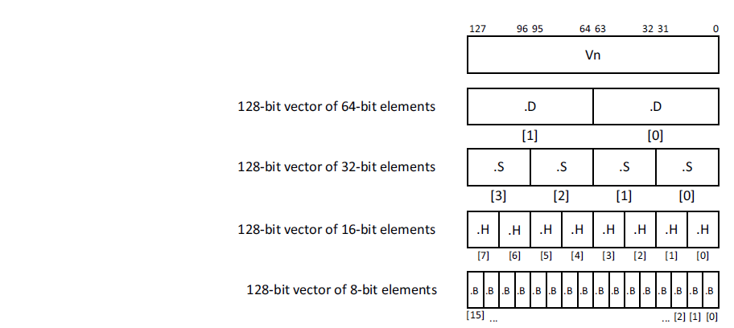
2.3 The SVE register set-based ISA extensions (5)
Possible data elements per 128-bit lane [116]
Possible data elements
in the lanes
8-bit FX
16-bit FX/FP
32-bit FX/FP
64-bit FX/FP
128-bit FX

Slide 85
2.3 The SVE register set-based ISA extensions (6)
Summing up the layout of the SVE register extension (2017)
Armv8.2 (AArch64 mode)
(optional)
SVE register set
15.lane
2. lane
1. lane
---
32
128
Up to 16 x 128-bit (Up to 2048-bit)
SVE (2017)/SVE2 (2021) extensions
Up to 16x 128-bit wide lanes
FX/FP SIMD (vector) data
Each 128-bit lane holds: FX8/16/32/64
FP16¹/32/64
data elements
The data width must be multiples of 128 bits, up to 16x128-bit.
The 1. lanes (first 128 bits) of the SVE Z register set are shared with the 32 128-bit
wide SIMD registers (V0-31) of the Armv8.0 ISA.
¹: Only data conversions are supported

Slide 86
2.3 The SVE register set-based ISA extensions (7)
Key feature of the SVE extension: Vector length agnostic programming
As discussed both for the x86 and Arm ISAs, the evolution of instruction sets
is marked by supporting continuously wider SIMD execution, e.g. in the x86 ISA
first 64-bit, then 128-, 256- and lastly 512-bit long SIMD execution.
This way of evolution has however, a drawback in the x86 ISA, as each SIMD
extension brought with it a new subset of instructions, like MMX, SSE, SSE2,
SSE3, AVX, AVX512, so in order to utilize the benefits of wider and wider SIMD
execution resources software had be rewritten and recompiled.
The SVE extension makes programming “vector length agnostic” i.e. the
programmer doesn’t not need to use different instruction subsets while using
different long ISA extensions.

Slide 87
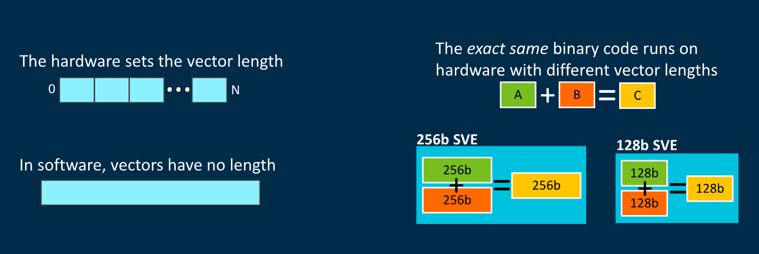
2.3 The SVE register set-based ISA extensions (8)
Interpretation of vector length agnostic programming [173]
(implemented by masking)
As the Figure above indicates, the same binary code runs on different wide hardware,
i.e. different wide SIMD execution units.

Slide 88
2.3 The SVE register set-based ISA extensions (9)
Benefits of vector length agnostic (VLA) programming
VLA simplifies programming and provides portability for binary code between
processors with different wide SIMD execution units, since instruction execution
will automatically be scaled to the width of the available execution resources.
A further benefit of vector length agnostic programming is that it allows
auto-vectorization by advanced compilers.

Slide 89
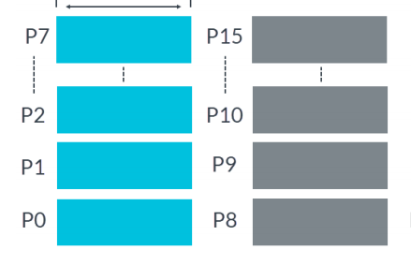
2.3 The SVE register set-based ISA extensions (10)
How ARM implements data vector length agnostic programming? [136]
The introduced SVE extension utilizes Predicate registers (P registers) as masks
to indicate which active elements of the Z-registers are involved in the operation.
Predicate registers hold one bit for each byte available in a Z register.
For example, an implementation providing 1024-bit Z registers has 128-bit wide
Predicate registers.
There exist 16 Predicate registers, as seen below.
P0-P7 include predicates for loads, stores, and arithmetic operations,
P8-P15 are extra predicates for loop management.
Up to 16x16 bit
Figure: Predicate registers

Slide 90
2.3 The SVE register set-based ISA extensions (11)
Specifying the length of the vectors (data words) in the instructions
Predicate registers are used as masks for particular data word formats
(e.g. 4x32-bit long data elements, or 8x16-bit data elements).
While writing programs, beyond the operation code, source and destination
registers also a Predicate register has to be specified (that had been previously set)
to identify which data elements should be used in the referenced SVE registers.
A „1” value of the Predicate register will activate the associated byte, a „0” value
will neglect it.
The next example demonstrates this.

Slide 91
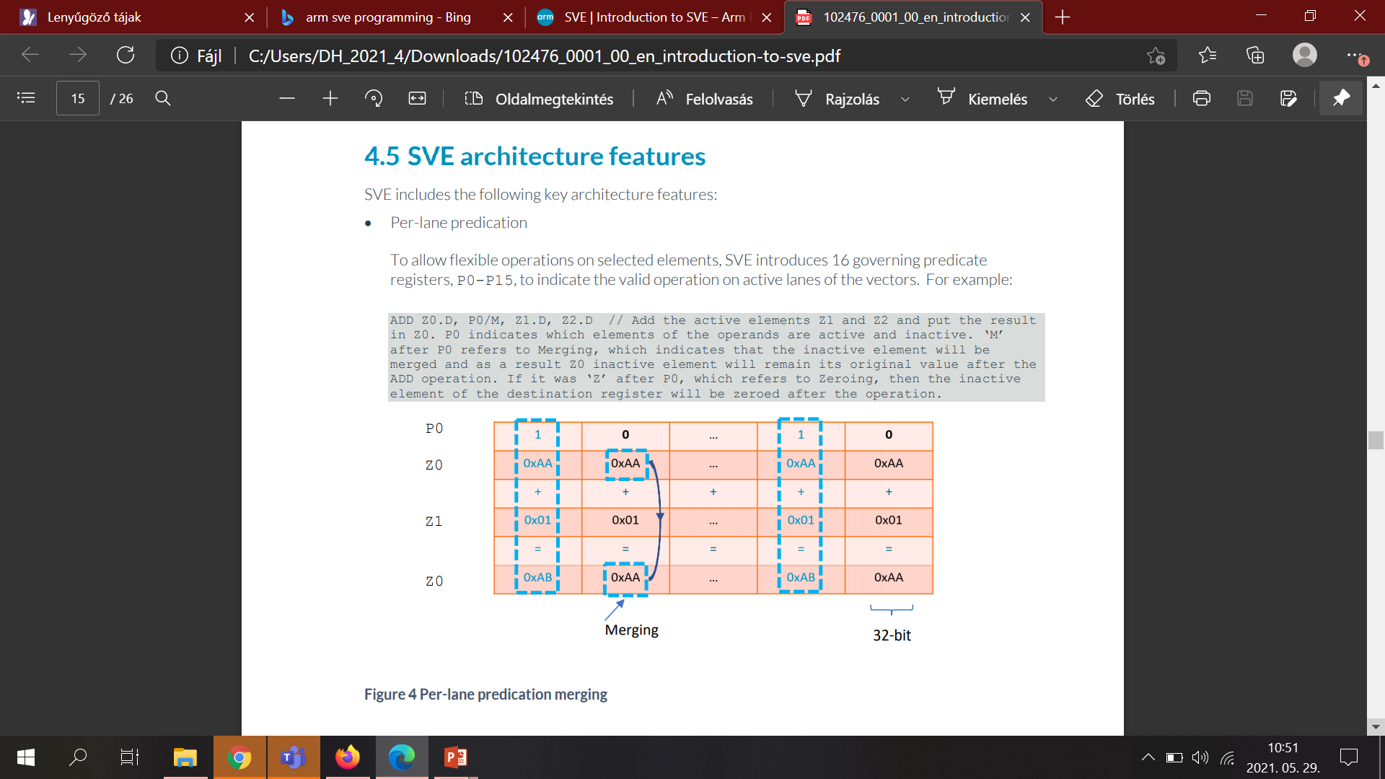
2.3 The SVE register set-based ISA extensions (12)
Example: Masking out active data elements from the SVE-registers by
using predicates while performing the zo < z1 + z0 operation [136]
1111
0000
1111
0000
The active data elements of the source registers Z0 and Z1 (indicated by the
„1” values per byte in the Predicate register P0) are added and the result is
written into the destination register Z0.
The masked out data elements of the SVE source register Z0 are copied into
the destination register Z0.

Slide 92
2.3 The SVE register set-based ISA extensions (13)
Remark
Our previous discussion of interpreting the use of Predicate registers is strongly
simplified, for a more detailed explanation we refer to [116] or [136].

Slide 93
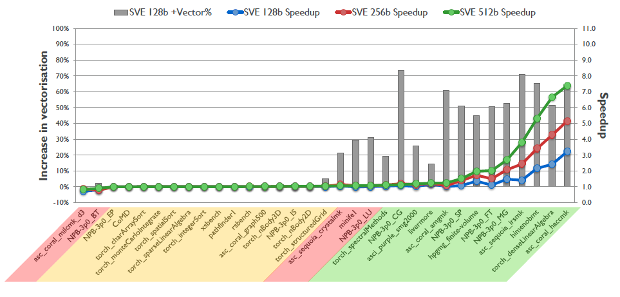
2.3 The SVE register set-based ISA extensions (14)
Speed-up potential of SVE [96]
As the above Figure indicates, SVE brings real speed-up only for appropriate workloads.

Slide 94
2.3 The SVE register set-based ISA extensions (15)
b) The 2. generation 128 – 2048-bit FX/FP SIMD extension, called the
SVE2 ISA extension
It was introduced in the Armv9-A ISA in 2021 as a mandatory feature.
As long as the SVE extension targeted mainly HPC (High Performance Computing)
workloads, the SVE2 extension has a much richer instruction subset and can be
considered as a future replacement of the recent SIMD extension (called Neon).

Slide 95
2.3 The SVE register set-based ISA extensions (16)
Contrasting the SVE and SVE2 SIMD extensions
ARM ISA |  | ISA extension | The SVE register set based SIMD extensions
 |  |  | Available register set | Scalar data types | Vector data types | Instruction subset
Name | Year
Armv8.2 (optional) | 2017 | SVE | SVE register set 32 registers each (1...16)x128-bit wide | --- | FX 8/16/32/64/128 FP 16/32/64 (1...16)x128-bit wide SIMD data (FMA available) | Small basic instruction subset aiming at HPC workloads
Armv9 (mandatory) | 2021 | SVE2
 |  |  |  |  |  | (Vastly enhanced instruction subset aiming at general-purpose workloads
SVE2 provides a large number of instruction set extensions that result in a faster,
more efficient execution on long SIMD data.
Execution resources provided for SVE/SVE2 instructions are 128-bit quantized,
that is they may be 128-bit, 256-bit etc. long up to 2048-bit.
HPC: High-Performance Computing (computing intensive)

Slide 96
2.3 The SVE register set-based ISA extensions (17)
Implementation of the SVE and SVE2 extensions
Until now SVE has been implemented only by Fujitsu in its A64FX processor.
It is an Armv8.2 ISA-based 48-core processor with 512-bit wide SIMD execution,
manufactured on 7 nm technology, used in the Fugaku supercomputer
(designed by Fujitsu, completed in 03/2021).
This is not surprising, since SVE targets HPC workloads whereas mobiles or
tablets do not run such workloads.
On the other hand, SVE2 is recently (2021) implemented in the Armv9 ISA-based
Neoverse and Cortex designs.

Slide 97
2.3 The SVE register set-based ISA extensions (18)
Major benefits of using the SVE and SVE2 extensions (recap) [144]
SVE and SVE2 have two major benefits:
a) They provide quantized very long vector sizes from 1x128-bit to 16x128-bit,
and
b) allow word length agnostic programming.
The resulting code can utilize the full width of recent and future execution units
without the need to rewrite or recompile the code.

Slide 98
2.3 The SVE register set-based ISA extensions (19)
The stunning dynamics of enhancing the Arm ISA
The thumb instruction set aims at reducing code size.
AArch32
AArch64
AArch64
Crypto-graph. extension
To enhance
security
TrustZone
Confidential
Compute Arch.
MTE
A32
SVE⁴
(v8.2, opt.)
A64
Aarch32⁵
A64
SVE2
To enhance
compute
capabilities
SIMD
Adv. SIMD¹
(NEON)
VFPv1/2
VFPv3/v4²
To speed up
the execution
of bytecodes
Jazelle
(Jazelle DBX)
Jazelle
(ex. by SW)
Jazelle RCT³
(ThumbEE)
Thumb⁶
(Armv4T)
Thumb-2
(Armv6T2)
T32
(Thumb)
Armv4
Armv5
Armv6
Armv7-A
Armv8.0-A
Armv9-A
ARM710T
(~1995)
ARM10200
(2000)
ARM1136
(2002)
Cortex-A5 - A15
(2005)
Cortex-A53/A57
(2012)
Neoverse N2/V1
Cortex-X2/A510/A710
cores (2021)
For the Remarks see the next slide.

Slide 99
2.3 The SVE register set-based ISA extensions (20)
Summing up key issues of SVE extensions enhancing computing capabilities -1
The SVE (Scalable Vector Extension) was announced in 2016 (in the Hot Chips
conference) and introduced in the Armv8.2-based ISA in 2017 as an optional feature.
SVE is implemented only in the AArch64 version of Armv8.2.
SVE aims at HPC scientific workloads rather than media or image processing.
It provides 32 registers (called Z0 – Z31), each including up to 16 x 128 bit lanes
to hold data elements for both FX- and FP SIMD processing, as seen below.
SVE register set
128
---
32
(1...16)x 128 bit
Armv8.2 (AArch64 mode)
Figure: The SVE register set
The data elements may be 8-bit FX, 16/32/64-bit FX/FP, 128-bit FX.
The 1. lanes (first 128 bits) of the SVE register set are shared with the 32 128-bit
wide SIMD registers of the Arm8.0 ISA.

Slide 100
2.3 The SVE register set-based ISA extensions (21)
Summing up key issues of SVE extensions enhancing computing capabilities -2
Key feature of the SVE extension: Vector length agnostic programming
The SVE extension makes programming “vector length agnostic” i.e. the programmer
doesn’t not need to use different instruction subsets while using different long
ISA extensions.
Benefits of vector length agnostic (VLA) programming
VLA simplifies programming and provides portability for binary code between
processors with different wide SIMD execution units since instruction execution
will automatically be scaled to the width of the available execution resources.
A further benefit of VLA programming is that it allows auto-vectorization by
advanced compilers.
How ARM implements data words agnostic programming? [136]
The introduced SVE extension utilizes Predicate registers (P registers) as masks
to indicate which active elements of the Z-registers are involved in the operation.
Predicate registers hold one bit for each byte available in a Z register.
For example, an implementation providing 1024-bit Z registers has 128-bit wide
Predicate registers.
There exist 16 Predicate registers.

Slide 101
2.3 The SVE register set-based ISA extensions (22)
Summing up key issues of SVE extensions enhancing computing capabilities -3
Specifying the length of the vectors (data words) in the instructions
Predicate registers are used as masks for particular data word formats
(e.g. 4x32-bit long data elements, or 8x16-bit data elements).
While writing programs, beyond the operation code, source and destination registers
also a Predicate register has to be specified (that had been previously set) to show
which data elements should be used in the referenced SVE registers.
A „1” value of the Predicate register will activate the associated byte, a „0” value
will neglect it.
Specifying theactual length of the SVE registers [136]
The actual length of the SVE registers is held in a field (called LEN) in a control
register.

Slide 102
2.3 The SVE register set-based ISA extensions (23)
Summing up key issues of SVE extensions enhancing computing capabilities -3
The SVE2 SIMD extension
It was introduced in the Armv9-A ISA in 2021 as a mandatory feature.
As long as the SVE extension targeted mainly HPC (High Performance Computing)
workloads, the SVE2 extension has a much richer instruction subset and can be
considered as a future replacement of the recent SIMD extension (called Neon).
Implementation of the SVE and SVE2 extensions
Until now SVE has been implemented only by Fujitsu in its A64FX processor.
It is an Armv8.2 ISA-based 48-core processor with 512-bit wide SIMD execution.
On the other hand, SVE2 is recently (2021) implemented in the Armv9 ISA-based
Neoverse N2 and V1 processor designs which target HPC and servers.

Slide 103
3. The Cortex family of CPU cores

Slide 104
3. The Cortex family of CPU cores (1)
3. The Cortex family of CPU cores
In 10/2004 ARM announced the Cortex Family of CPU cores and its first model the
Cortex-M3 CPU core.
The Cortex brand is used by ARM’s for their mobile application oriented CPU cores,
based on the Armv7 ISA or later releases.
It is worth noting that ARM announced a second CPU brand in 2018 as well,
called Neoverse for CPU cores to be used in processors focused on information
infrastructures (datacenters, routers, switches etc.), discussed in another Chapter.

Slide 105
3. The Cortex family of CPU cores (2)
Profiles of ARM’s Cortex family of CPU cores [6], [7], [113] -1
In the technical specification of the Armv7 ISA ARM introduced three family profiles
to optimize its Cortex family CPU cores for specific market segments:
Profiles of ARM’s Cortex family of CPU cores
Cortex-A profile
(Application profile)
Cortex-R profile
(Real-time profile)
Cortex-M profile
(Microcontroller profile)

Slide 106
3. The Cortex family of CPU cores (3)
Profiles of ARM’s Cortex family of CPU cores [6], [7], [113] -2
The Cortex-A (application) profile
It aims at application processors running mobile OSs and user applications, like
processors in smartphones, tablets, netbooks, eBook readers etc.
At introduction it supported two instruction sets:
the 32-bit A32 and
the 16-bit T32 (which is a subset of the A32)
instruction sets.
Subsequently,
the Armv8.0-A ISA supports 64-bit processing and introduced two execution modes:
the AArch32 execution mode to maintain compatibility with the A32
instruction set and
the AArch64 execution modes, to allow using the new, 64-bit A64
instruction set.
At the same time, in the AArch64 mode ARM terminated the support
of the Thumb instruction set, finally
in the Armv9.0-A ISA
ARM withdrew the general availability of the AArch32 execution mode,
as indicated in the next Figure.

Slide 107
3. The Cortex family of CPU cores (4)
Cortex CPUs
AArch32
AArch64
AArch64
Crypto-graph. extension
To enhance
security
TrustZone
Confidential
Compute Arch.
MTE
A32
SVE⁴
(v8.2, opt.)
A64
Aarch32⁵
A64
SVE2
To enhance
compute
capabilities
SIMD
Adv. SIMD¹
(NEON)
VFPv1/2
VFPv3/v4²
To speed up
the execution
of bytecodes
Jazelle
(Jazelle DBX)
Jazelle
(ex. by SW)
Jazelle RCT³
(ThumbEE)
Thumb⁶
(Armv4T)
Thumb-2
(Armv6T2)
T32
(Thumb)
Armv4
Armv5
Armv6
Armv7-A
Armv8.0-A
Armv9-A
ARM710T
(~1995)
ARM10200
(2000)
ARM1136
(2002)
Cortex-A5 - A15
(2005)
Cortex-A53/A57
(2012)
Neoverse N2/V1
Cortex-X2/A510/A710
(2021)
For the Remarks see the next slide.

Slide 108
3. The Cortex family of CPU cores (5)
Remarks to the introduced extensions
¹The Advanced SIMD architecture extension is commonly referred to as the
NEON technology.
The VFP subset became depricated in the Armv8 ISA.
³Jazelle-RTC (ThumbEE) became depricated in Armv7 Issue C in 10/2011.
⁴The SVE (Scalable Vector Extension) subset became introduced in the
Armv8 ISA as an optional feature, only in 2017.
⁵The AArch32 execution mode is only supported in certain implementations, e.g.
in the Cortex-A510 CPU.
⁶ The Thumb extension aims at reducing code size.

Slide 109
3. The Cortex family of CPU cores (6)
Profiles of ARM’s Cortex family of CPU cores [6], [7], [113] -3
The Cortex-R (Real-time) profile [113]
It aims at embedded CPUs for real time applications, like mass storage or
printer controllers.
It supports the A32 and T32 instruction sets.
The Cortex-M (Microcontroller) profile [113]
CPUs of the M profile are optimized for deeply embedded CPUs aimed at
microcontroller and cost-sensitive applications, like automotive body electronics
or smart sensors.
It supports writing interrupt handlers in high-level languages.
It maintains a variant of the T32 instruction set.

Slide 110
3. The Cortex family of CPU cores (7)
Extending the ARM Cortex family with the SecurCore profile in 10/2007
In 10/2007 ARM introduced the SecurCore profile.
It is optimized for smart card and secure applications.

Slide 111
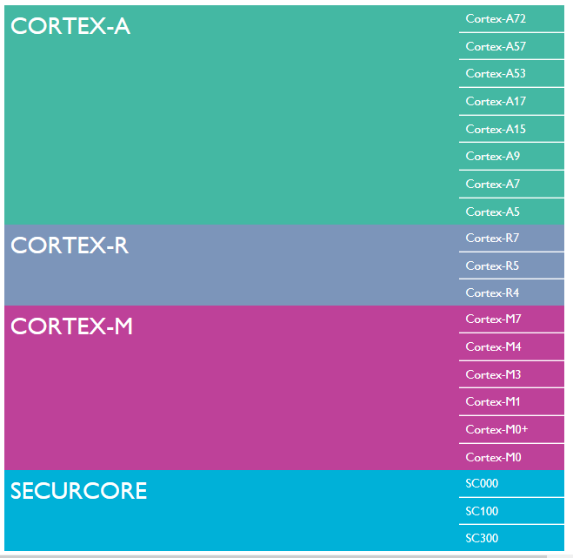
3. The Cortex family of CPU cores (8)
Overview of
Cortex profiles
and related CPU cores
(as of 2015) [6]

Slide 112
3. The Cortex family of CPU cores (9)
Remark
According to the general scope of this Lecture Notes, subsequently, we shall be
concerned only with the Cortex-A series of CPU cores.

Slide 113
3. The Cortex family of CPU cores (10)
Overview of the evolution of the Cortex-A series CPU cores
Cortex-A cores
Armv7A -based
Cortex-A cores
Armv8.0-A based
Cortex-A cores
Armv8.2-A based Cortex-A cores
Armv9-A based
Cortex-A cores
32-bit architectures
(announced in 2004)
Supporting big.LITTLE
core clusters
(since 2011,
in specific models)
64-bit architectures
(announced in 2012)
Supporting big.LITTLE
core clusters
64-bit architectures
(announced in 2017)
Supporting DynamIQ
core clusters
64-bit architectures
(announced in 2021)
Supporting Armv9-based
DynamIQ core clusters
First cores
Cortex-A8
Cortex-A57/A53
Cortex-A75/A55
Cortex-X2/A710/A510
Not discussed
Not discussed.
Section 4.3
Section 5.3
Remark
big.LITTLE core clusters are described in the Chapter Architecture of mobile processors,
whereas DinamIQ and Armv9-based DynamIQ core clusters will be discussed in
the Sections 4.2 and 5.2, respectively.

Slide 114
4. Armv8.2-A ISA extensions and related Cortex-A cores
4.1 Main extensions of the Armv8.2-A ISA
4.2 Main enhancement of the Armv8.2-A based Cortex-A cores:
The DynamIQ core cluster
4.3 Armv8.2-A based Cortex-A cores
Section 4.2 is not part of the test and the exam.

Slide 115
4.1 Main extensions of the Armv8.2-A ISA

Slide 116
4.1 Main extensions of the Armv8.2-A ISA (1)
4.1 Main extensions of the Armv8.2-A ISA -1 [97]
Preliminary remarks to Armv8.0-A extensions [174]
Each Armv8.x-A extension includes a set of features, some mandatory and some
optional.
A processor implements an .x extension if it implements all the mandatory
features of that extension, and all mandatory features of all previous extensions.
The Arm architecture includes a set of feature registers that report the
features supported by the processor.
For each new feature added by a .x extension, even an optional features,
a field in these feature registers reports whether it is supported or not.
There is no field that reports whether a processor is Armv8.x-A.
Instead, software reads the feature fields for the mandatory 8.x-A features, and
if they all present, the processor is considered to be compliant with Armv8.x-A.
Actually, there is no known CPU that is considered to be Armv8.1 compliant,
the Cortex A55/A75/76/77/78/X1 are Armv8.2-A compliant and consequently,
they provide also Armv8.1 support.
Armv8.3 or higher ISA versions are implemented in Armv9-A compliant CPUs,
and there are no Cortex CPUs that are compliant with Armv8.3 or higher ISA
versions.

Slide 117
4.1 Main extensions of the Armv8.2-A ISA (2)
Main extensions of the Armv8.0-A ISA -2 [97]
Revision | Released | Main enhancements | Cortex-A/ Neoverse CPUs
Armv8-A | 10/2011 |  | A32/A35/ A53/A57/ A72/A73
Armv8.1-A | 12/2014 | Incremental benefits over v8.0-A relating to the instruction set, exception model and memory translation
Armv8.2-A | 04/2017 | Optional increase of the address space from 48 to 52 bits RAS extensions Statistical profiling to be able to analyze large working sets SVE (Scalable Vector Extension) (optional) Half-precision FP (FP16) (optional) BFfloat16 (optional) Dot product of two 32-bit vectors with 4x FX8 data (optional) | A55/A75/76/77/ 78/X1 (provide also Armv8.1 support) Neoverse N1, E1

Slide 118
4.1 Main extensions of the Armv8.2-A ISA (3)
Main extensions of the Armv8.0 ISA -3 [97]
Revision | Released | Main enhancements | Cortex-A/ Neoverse CPUs
Armv8.3-A | 12/2017 | Pointer authentication Improvements to the exception model for nested virtualization | TBA
Armv8.4-A | 10/2018 | Activity Monitors Extension (AMU) (optional) Dot product of two 32-bit vectors with 4x FX8 data (mandatory) Cripto extensions Memory partitioning and monitoring capabilities New Secure EL2 state | Neoverse V1
Armv8.5-A | 07/2019 | Spectre and Meltdown Vulnerability Detection Memory Tagging Extension (optional) Random Number Generator Branch Target Identification | TBD
Armv8.6-A | 07/2020 | AMU Extension v1.1 (optional) Half-precision FP (FP16) (mandatory) BFloat16 (mandatory) | TBD
Armv8.7-A | 01/2021 | Alternate Floating Point Behaviour Support for 64-byte Load/Stores 52-bit Address Space for 4KB/16 KB Translation Granules (Smallest memory blocks) | TBD

Slide 119
4.1 Main extensions of the Armv8.2-A ISA (4)
Discussed enhancements of the Armv8.2-A ISA
As shown before, the Armv8.2-A ISA has introduced the following extensions:
Revision | Released | Main enhancements | Cortex-A/ Neoverse CPUs
Armv8.2-A | 04/2017 | Optional increase of the address space from 48 to 52 bits RAS extensions Statistical profiling to be able to analyze large working sets SVE (Scalable Vector Extension) (optional) Half-precision FP (FP16) (optional) BFfloat16 (optional) Dot product of two 32-bit vectors with 4x FX8 data (optional) | A55/A75/76/77/ 78/X1 (provide also Armv8.1 support) Neoverse N1, E1
From the indicated Armv8.2-A enhancements next we briefly describe the ones
extending the computing capabilities first of all in AI as follows:
a) Half-precision FP and FP16 (BFfloat16) (both optional)
b) Dot product of two 32-bit vectors with 4x FX8 data (optional)
Here we note that the optional SVE extension has already discussed in Section 2.3.

Slide 120
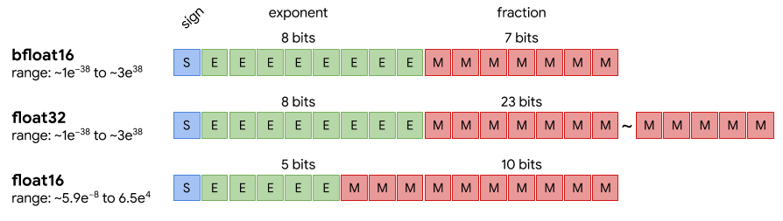
4.1 Main extensions of the Armv8.2-A ISA (5)
a) Half-precision FP (FP16) and BFfloat16 data formats (both optional)
In NN processing weights and activation data may be represented also by short,
even only 8 or 16-bit long data types, such as FP16 (dubbed also as float16),
Bfloat16 (named also as bfloat16) or Int8 (known also as int8) to keep twice or
four times more data in registers or memory and execute up to four times more
data per cycle than using FX32 data.
This was the reason why IEEE introduced the half-precision FP16 (float16) (in 2008)
and Google the Bfloat (bfloat) (brain FP) data format in 2018 (see the next Figure).
Figure: FP representation of data used in deep learning [151]
Due to its benefits the Bfloat16 (bfloat16) data type became in a short time
widespread, among others in Intel’s and AMD’s processors.

Slide 121
4.1 Main extensions of the Armv8.2-A ISA (6)
Remark
The FP16 (float16) and Bfloat16 data formats were introduced as optional features in
the Armv8.2 ISA version (in 2017) and became mandatory in the Armv8.6-A ISA
revision (in 2020).

Slide 122
4.1 Main extensions of the Armv8.2-A ISA (7)
b) Dot product of two 32-bit vectors with 4x FX8 data (optional) [152]
The int8MatMul instruction calculates the dot product of four 8-bit int8 data
elements included in the referenced first 32-bit SIMD data with the four
8-bit data elements of the referenced second SIMD data and accumulates
the result into the corresponding 32-bit destination register (see the Figure below).
There are two versions of the instruction, one with signed 8-bit integers and
another with unsigned integers.
int8_{i1}
int8_{i2}
int8_{i3}
int8_{i4}
int8_{j1}
int8_{j2}
int8_{j3}
int8_{j4}
32-bit SIMD data
int8MatMul = int8_{i1}*int8_{j1}+ int8_{i2}*int8_{j2}+ int8_{i3}*int8_{j3} + int8_{i4}*int8_{j4}
Figure: Interpretation of the int8MatMul instruction
The int8MatMul instruction is used to speed up matrix multiplications with 8-bit
integers, a common operation needed in NN calculations.
This feature is optional in Armv8.2-A implementations and mandatory in
Armv8.4 implementations.
Dot product: skalár szorzat

Slide 123
4.2 Main enhancement of Armv8.2-A based Cortex-A cores:
The DynamIQ core cluster
(ARM modified the DynamIQ core cluster in the Armv9 ISA,
so it is just for optional reading and is not part of the exam,
instead the modified DynamIQ core cluster is dealt with in Section 5.3).

Slide 124
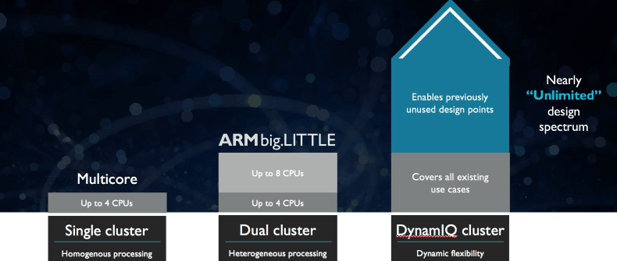
4.2 The DynamIQ core cluster (1)
4.2 Main enhancement of Armv8.2-A based Cortex-A cores:
The DynamIQ core cluster -1
It represents the next step in the evolution of the core cluster technology.
SMP
(
)
ARM11 MPCore (2004)
Cortex-A7/A15 (~2011)
Cortex-A55/A75 (~2017)
Figure: Evolution steps of the core cluster technology [114]

Slide 125
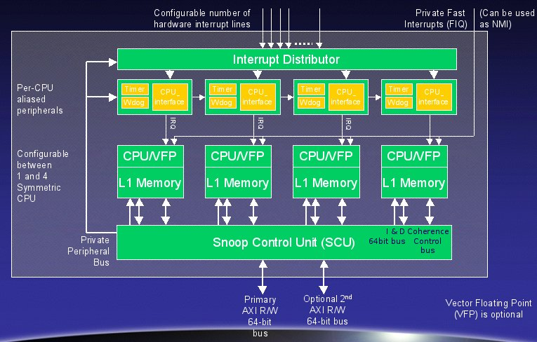
4.2 The DynamIQ core cluster (2)
From the ARM11 MPCore to the big.LITTLE technology
ARM11 MPCore [115]
big and LITTLE core clusters
Cluster of
big cores
Cluster of
LITTLE cores
CPU0
CPU1
CPU0
CPU1
CPU2
CPU3
CPU2
CPU3
Cache coherent interconnect
(2004)
(2011)
(Shared L1 cache)
Private L1 caches
(Shared L2 cache)

Slide 126
4.2 The DynamIQ core cluster (3)
Main enhancement of Armv8.2_A based cores:
The DynamIQ core cluster -2
ARM started working on the DynamIQ core cluster technology in 2013 [98].
DynamIQ was announced in 03/2017.
It is an enhancement of the big.LITTLE technology, as indicated in the next slides.

Slide 127
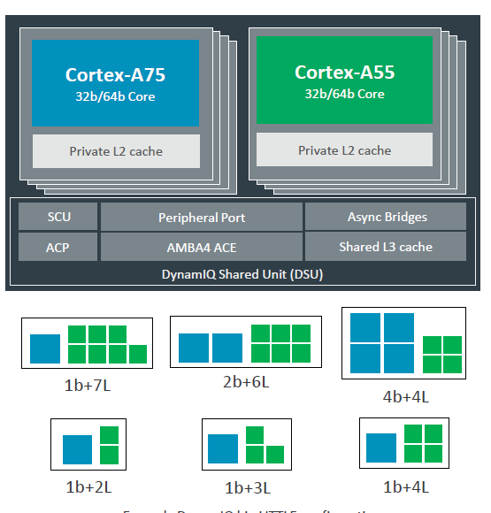
4.2 The DynamIQ core cluster (4)
Main enhancement of Armv9-A based Cortex-A cores:
The Armv9-A based DynamIQ core cluster
Predecessors: big.LITTLE and Armv8.2-A ISA-based DynamIQ core clusters
big and LITTLE core clusters
Arm 8.2-A ISA-based DynamIQ core cluster [118]
Cluster of
big cores
Cluster of
LITTLE cores
CPU0
CPU1
CPU0
CPU1
CPU2
CPU3
CPU2
CPU3
Shared L2
Shared L2
To the cache coherent interconnect through the AMBA4 ACE bus
To
Cache coherent interconnect
Two stand alone core clusters
with up to 4 cores (2011)

Slide 128
4.2 The DynamIQ core cluster (5)
Enhancements of the Dynamic core cluster vs. the foregoing big.LITTLE
core cluster
 | big.LITTLE core clusters | DynamIQ core clusters
Cluster topology | Two stand alone core clusters; the big and the LITTLE core clusters, with up to 4 homogeneous cores each | In a single core cluster up to 8 cores out of two types, big cores and LITTLE cores. 1 to 4 big cores.
Cache architecture | Per cluster shared L2 cache No L3 cache | Per core L2 caches Shared L3 cache
Additional features | -- | See subsequent Figure
ACP: Accelerator Coherency Port, port for not cache coherent sensors and accelerators

Slide 129
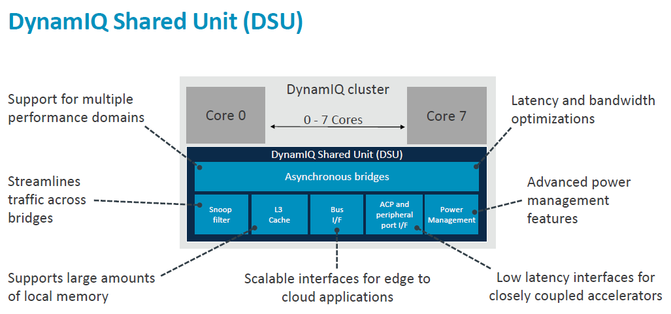
4.2 The DynamIQ core cluster (6)
Block diagram of the Armv8.2-A based DynamIQ core cluster [106]
(Partitions)
(up to 4 MB)
(Per-core DVFS control,
Partial L3 power down)
(Up to two 128-bit AMBA 5 ACE,
or a single 256-bit AMBA 5 CHI bus)
ACP: Accelerator Coherency Port, port for not cache coherent sensors and accelerators
Snoop filter: Used to speed up cache coherent memory accesses

Slide 130
4.2 The DynamIQ core cluster (7)
The DynamIQ core cluster as an evolution of the big.LITTLE technology -1
big and LITTLE core clusters
A single DynamIQ core cluster [118]
Cluster of
big cores
Cluster of
LITTLE cores
CPU0
CPU1
CPU0
CPU1
CPU2
CPU3
CPU2
CPU3
Cache coherent interconnect
To cache coherent interconnect through the AMBA4 ACE bus
To
Two separate core clusters
with up to 4 cores each (2011)
A single cluster of up to 8 cores of up to two core types
(but up to 4 big cores) (2017)

Slide 131
4.2 The DynamIQ core cluster (8)
The DynamIQ core cluster as an evolution of the big.LITTLE technology -2
It assumes Armv8.2-A compatible cores, such as the Cortex-A55 and Cortex-A75
or subsequent Cortex-A7x cores.

Slide 132
4.2 The DynamIQ core cluster (9)
Main enhancements introduced by DynamIQ core clusters
Up to 8 CPU cores of up to two core types (Armv8.2-A ISA based )
Private (per-core) L2 caches in the CPU cores
c) DynamIQ Shared Unit (DSU) with a shared L3 cache and snoop filter
d) Capability for partitioning the cores, the L3 cache and the ACP ports
e) Finer-grain frequency and voltage control
ACP: Accelerator Coherency Port, port for not cache coherent sensors and accelerators

Slide 133
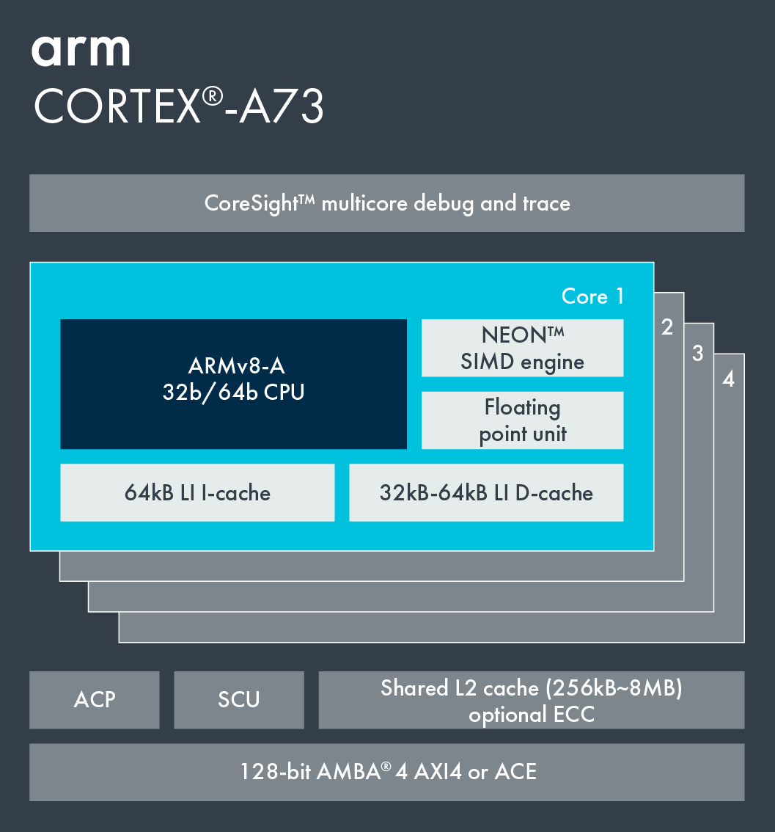
4.2 The DynamIQ core cluster (10)
a) Up to 8 CPU cores of up to two core types (Armv8.2-A ISA based)
big or LITTLE core cluster (2015) [102]
DynamIQ core cluster (2017) [118]
Cortex-A73 core
Armv8.0 CPU
Armv8.0-A support,
e.g. Cortex-A53/A57/A72/A73,
single core type, up to 4 cores/cluster
Armv8.2-A support,
Cortex-A55/75 and subsequent Cortex-A7x cores
2 core types, up to 8 cores but only up to 4b/cluster

Slide 134
4.2 The DynamIQ core cluster (11)
b) Private (per-core) L2 caches in the CPU cores
big or LITTLE core cluster (2015) [55]
DynamIQ core cluster (2017) [56]
Cortex-A73 core
Armv8.0 CPU
Armv8.0-A support, e.g. Cortex-A53/
A57/A72/A73, up to 4 cores/cluster
Shared L2 cache
Armv8.2-A support, (Cortex-A55/75)
2 CPU types, up to 8 cores but only 4b/cluster
Private L2 caches, shared L3 cache

Slide 135
4.2 The DynamIQ core cluster (12)
c) DynamIQ Shared Unit (DSU) with a shared L3 cache and snoop filter [106]
(Partitions)
(Per-core DVFS control,
Partial L3 power down)
(Up to two 128-bit AMBA 5 ACE,
or 256-bit AMBA 5 CHI)

Slide 136
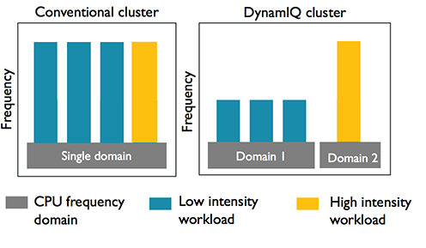
4.2 The DynamIQ core cluster (13)
e) Finer-grain frequency and voltage control [98]
In case of DynamIQ core clusters
groups of cores (i.e. partitions)
can run at different
frequencies and voltages.

Slide 137
4.2 The DynamIQ core cluster (14)
Example of an Armv8.2-A based premium mobile system (2018) [108]
CCI-550: Cache Coherent Interconnect
MMU-500: Memory Management Unit (responsible for virtualization and caching)
NIC-450: Network Interconnect (interface converter)
GIC-600: General Interrupt Controller
SCP: System Control Processor

Slide 138
4.3 Armv8.2-A based Cortex-A cores

Slide 139
4.3 Armv8.2-A based Cortex-A cores (1)
4.3 Armv8.2-A based Cortex-A cores
Positioning and key features of Armv8.2-A based Cortex-A cores
Cortex-A cores
Armv7-A based
Cortex-A cores
Armv8.0-A based
Cortex-A cores
Armv8.2-A based Cortex-A cores
Armv9-A based
Cortex-A cores
32-bit architectures
(announced in 2004)
Supporting big.LITTLE
core clusters
(since 2011,
in specific models)
64-bit architectures
(announced in 2012)
Supporting big.LITTLE
core clusters
64-bit architectures
(announced in 2017)
Supporting DynamIQ
core clusters
64-bit architectures
(announced in 2021)
Supporting Armv9-based
DynamIQ core clusters
First cores
Cortex-A8
Cortex-A57/A53
Cortex-A75/A55
Cortex-X2/A710/A510
Not discussed
Not discussed
Section 4.3
Section 5.3

Slide 140
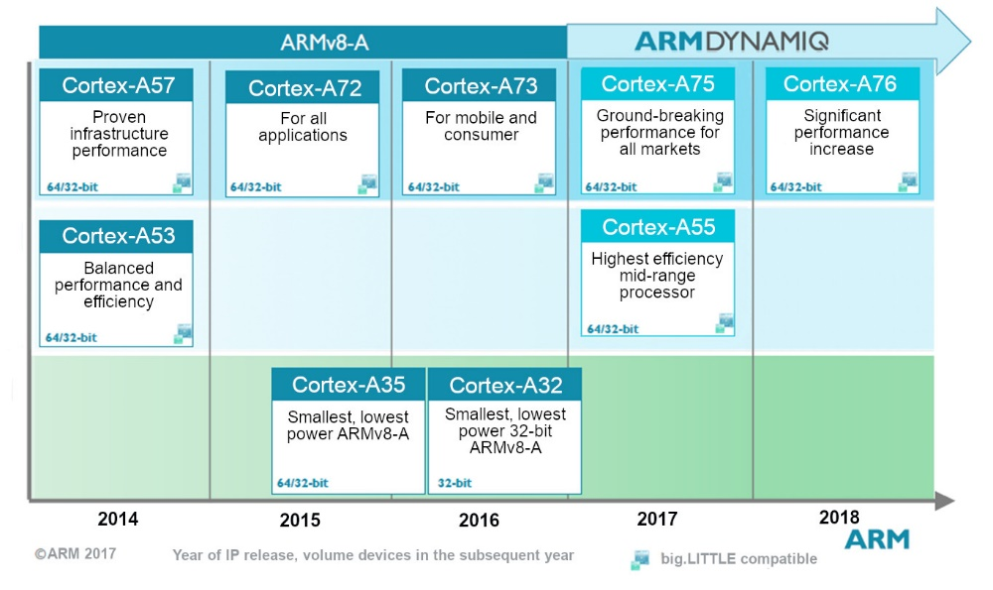
4.3 Armv8.2-A based Cortex-A cores (2)
Introduction of Armv8.2-A based Cortex-A cores [153]
A7x
Series
Source: ARM
As the above Figure shows, first Armv8.2-based cores were the Cortex-A75 and –A55,
they appeared in 2017 and were followed by higher numbered A7x series models.

Slide 141
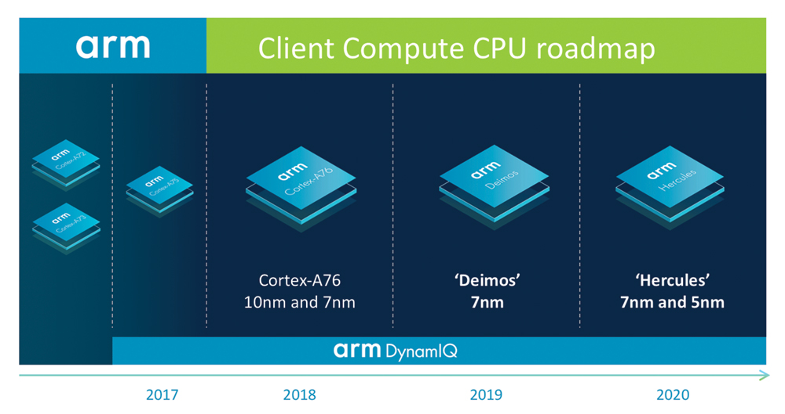
4.3 Armv8.2-A based Cortex-A cores (3)
Evolution of Armv8.2-A based cores according to ARM’s roadmap from 2018 [133]
(A-77)
(A-78)

Slide 142
4.3 Armv8.2-A based Cortex-A cores (4)
Key features of Armv8.2-A based Cortex-A cores
CPU core | Announced | Available in devices | Big.LITTLE support | Target category | Efficiency
Cortex-A55 | 2017 | 2018 | Yes (with A75 or higher) | Low-end | ~3 DMIPS/MHz
Cortex-A75 | 2017 | 2018 | Yes (with A55) | High-end | ~8.2-9.5 DMIPS/MHz
Cortex-A76 | 2018 | 2018 | Yes (with A55) | High-end | ~10.7-12.4 DMIPS/MHz
Cortex-A78 | 2020 | 2020 | Yes (with A55) | High-end | n.a.
Cortex-X1 | 2020 | 2021 | Yes (with A55) | Extra High-end | n.a.
According to the above Table, subsequent A7x models were high-end and extra
high-end models (X1).
In addition, all models support big.LITTLE core configurations within a DynamIQ
core cluster, where the big cores may be the A7x models whereas the LITTLE
cores are A55 CPUs.

Slide 143
4.3 Armv8.2-A based Cortex-A cores (5)
Widening the Cortex-A7x/X1 cores -1
Cortex model | ISA | Launched in | Target IC techn. | Decode rate | Dispatch rate | Issue rate | ROB size
A72 | ARM 8.0 | 02/2015 | 16 nm | 3 | 5 | 8 | n.a.
A73 | ARM 8.0 | 05/2016 | 10 nm | 2 | 4 | 7 | n.a.
A75 | ARM 8.2 | 05/2017 | 10 nm | 3 | 6 | 8 | 128
A76 | ARM 8.2 | 05/2018 | 12, 7, 5 nm | 4 | 8 | 9 | 128
A77 | ARM 8.2 | 05/2019 | 7, 5 nm | 4 | 6 | 12 | 160
A78 | ARM 8.2 | 05/2020 | 5 nm | 4 | 6 | 13 | n.a.
X1 | ARM 8.2 | 05/2020 | 5 nm | 5 | 8 | 15 | 224
Data in the above Table indicates that subsequent, Armv8.2-based cores almost
doubled the front end width of the microarchitectures (while raising the decode rate
from 3 (in the A75) to 5 (in the X1).
This could be motivated by Apple’s very dynamic move, as their A7 became
already 6-wide (in 2013) and subsequent models first 7-wide (A11/A12), then
even 8-wide (A13/A14/M1) between 2017 and 2020, as the next Figures show.

Slide 144
4.3 Armv8.2-A based Cortex-A cores (6)
Evolution of the decoding width of mobile cores -1
Width of mobile cores
(or of big cores of big.LITTLE or dynamIQ core clusters)
2-wide
3-wide
4-wide
5-wide
ARM
v7 HP Cortex-A15
(2010)
v7 Cortex-A (2005-09)
(except 1-wide LP A5 (2009)
and 3-wide HP A15))
v8.0 HP Cortex-A73
(2016)
v8.0 HP Cortex-A (2013-15) (except 2-wide HP Cortex-A73)
v8.0/8.2 LP Cortex-A
(2013/2017)
v8.2 HP Cortex-A75
(2017)
v8.2 HP Cortex-A76
(2018) to
HP Cortex-A78
(2020)
v8.2 HP Cortex-X1
(2020))
Intel
Atom family (2008-15)
Airmont-based Atom core (2016)
AMD
Cat family (2011-2015)
Apple
v7 Cortex-A8 (2009)
v7 Swift (A6) (2012)
Qualcomm
v7 Scorpion
(S1-S3) (2007-10)
v7 Krait
(S4/S400/S60x/S80x)
(2012-14)
v8 Kryo/Kryo 280
(S820/821/835) (2015/2016/2017)
v8.2 Kryo 385
(S845) (2018)
Samsung
v7 Exynos 5
(2013-14)
v8 Exynos 7
(2016)
v8.0 M1 (2016)
(Exynos 8 Octa)
v8 M2 (2017)
(Exynos 9 Octa)
HP: High-Performance/big core
LP: Low-Power

Slide 145
4.3 Armv8.2-A based Cortex-A cores (7)
Evolution of the decoding width of mobile cores -2
Width of mobile cores
(or of big cores of big.LITTLE or dynamIQ core clusters)
6-wide
7-wide
8-wide
ARM
Intel
AMD
Apple
v8.0 HP A7-A10X
(2013-2017)
v8.2 HP A11 (2017)
v8.3 HP A12/A12X
(2018)
v8.4 HP A13 (2019)
v8.6 HP A14/M1
(2020)
Qualcomm
Samsung
v8.2 M3 (2018) Exynos 9810)
v8.2 M4 (2019) Exynos 9820)
v8.2 M5 (2019) Exynos 990)
v8.2 M6
(2020)/cancelled
HP: High-Performance/big core
LP: Low-Power

Slide 146
4.3 Armv8.2-A based Cortex-A cores (8)
Widening the Cortex-A7x/X1 cores -2
Note further on, that the dispatch rate is roughly twice as wide as the decode rate
and the issue rate even almost 3-times wider, as data in the presented Table show.
Cortex model | ISA | Launched in | Target IC techn. | Decode rate | Dispatch rate | Issue rate | ROB size
A72 | ARM 8.0 | 02/2015 | 16 nm | 3 | 5 | 8 | n.a.
A73 | ARM 8.0 | 05/2016 | 10 nm | 2 | 4 | 7 | n.a.
A75 | ARM 8.2 | 05/2017 | 10 nm | 3 | 6 | 8 | 128
A76 | ARM 8.2 | 05/2018 | 12, 7, 5 nm | 4 | 8 | 9 | 128
A77 | ARM 8.2 | 05/2019 | 7, 5 nm | 4 | 6 | 12 | 160
A78 | ARM 8.2 | 05/2020 | 5 nm | 4 | 6 | 13 | n.a.
X1 | ARM 8.2 | 05/2020 | 5 nm | 5 | 8 | 15 | 224
Table: Main features of Cortex-A7x CPUs
In addition we note that ROB sizes were also increased more or less in line with the
widening of the cores.
(ROB: ReOrder Buffer (Out-of-order window) determines the max. number of in-flight
instructions)

Slide 147
4.3 Armv8.2-A based Cortex-A cores (9)
Remarks to further enhancements of the microarchitectures of Armv8.§/8.2-based cores
The A72 and A73 support big.LITTLE core clusters the others DynamIQ core clusters.
The A72 introduced instruction fusion.
The A75 introduced FP16 and Int8 datatypes to support AI
The A77 introduced a Macro-Op (MOP) cache
We note also that the A73 and A75 were designed in the Sophia Design Center,
in France, all others in Austin.

Slide 148
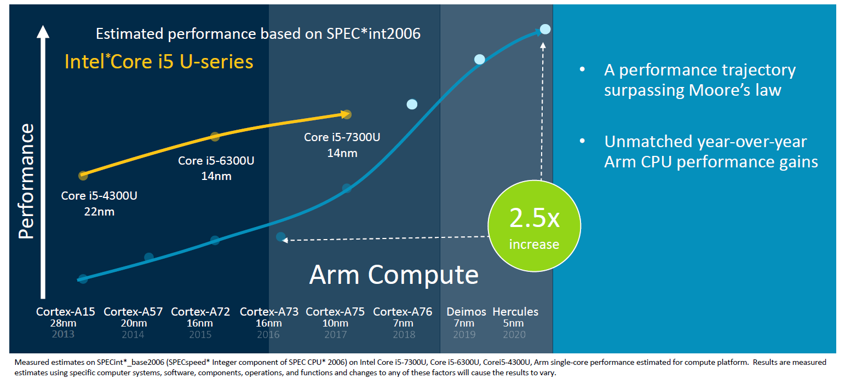
4.3 Armv8.2-A based Cortex-A cores (10)
ARM’s expectations related to their CPU performance leadership
As the Figure below clearly indicates, ARM expected higher performance gains from
their cores than from Intel’s comparable processors.
A-78
A-77
A-76
Figure: Expected year-over-year performance gain of ARM cores vs. Intel’s processors [125]
Nevertheless, ARM could not meet this expectation, since e.g. 12th gen. Core i5-1230U processors
provide Geekbench 5 single core scores of ≈1400 whereas ARM Cortex-X1 based
Qualcomm Snapdragon processors only ≈1100 (According to Geekbench 5 results).

Slide 149
5. Armv9-A ISA extensions and related Cortex-A cores
5.1 Main extensions of the Armv9-A ISA
5.2 Main enhancement of Armv9-A based Cortex-A cores:
The Armv9-based DynamIQ core cluster
5.3 Overview of Armv9-based Cortex-A cores

Slide 150
5.1 Main extensions of the Armv9-A ISA

Slide 151
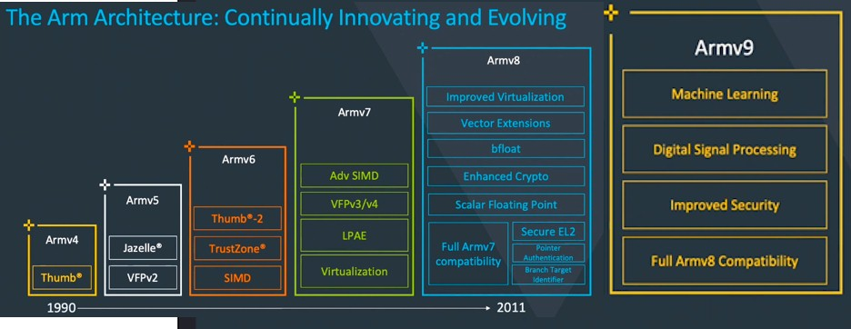
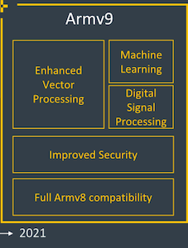
5.1 Main extensions of the Armv9-A ISA (1)
5.1 Main extensions of the Armv9-A ISA [154], [144] -1
Evolution of the Arm ISA
Adv. SIMD (NEON)
It was a long evolution path until the Armv9, as illustrated above.
As seen in the Figure, Armv9’s enhancements focus on vector processing, ML, DSP
and security.
ML: Machine Learning

Slide 152
5.1 Main extensions of the Armv9-A ISA (2)
Introduction of the Armv9-A ISA extension and Cortex-A cores based on it
ARM announced the Armv9 ISA in 03/2021.
The first core that implemented Armv9-A ISA is the server oriented Neoverse N2
core, introduced in 04/2021 followed by the mobile oriented Cortex-X2, -A710
and –A510 cores, announced in 05/2021.

Slide 153
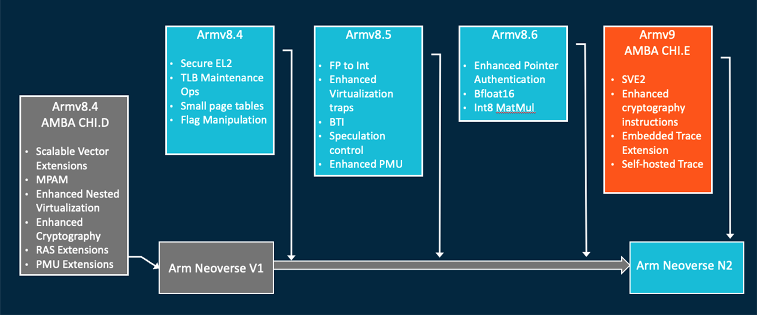
5.1 Main extensions of the Armv9-A ISA (3)
Main extensions of the Armv9-A ISA -2
The Armv9-A ISA includes all enhancements introduced in the new releases of the
Armv8 ISA (for compatibility), and introduces a number of few further extensions
as well, as the Figure below indicates on the example of the ARM Neoverse N2 CPU.
Figure: Architectural features supported by the Neoverse N2 CPU [158]

Slide 154
5.1 Main extensions of the Armv9-A ISA (4)
Main extensions of the Armv9-A ISA to enhance computing efficiency [144]
The Armv9-A ISA introduces two key additions to enhance computing efficiency:
a) SVE2 to improve vector and DSP capabilities
b) Transactionalal memory for improving the efficiency of multithreaded programming,
as discussed next.
DSP: Digital Signal Processing

Slide 155
5.1 Main extensions of the Armv9-A ISA (5)
Improving vector and DSP capabilities by introducing the SVE2 extension
Previously, in the Armv8.2-A ISA ARM introduced the SVE (Scalable Vector
Extension) as an optional feature in 2017.
It aimed primarily at HPC workloads and did not cover the wide spectrum of
instructions that were provided by the Neon extension.
SVE2, announced in 04/2019 and introduced in 2021 as mandatory part of the
Armv9 ISA, amends the above mentioned deficiency of SVE.
This qualifies SVE2 to become a replacement of the Neon extension.
SVE2 has already been discussed in Section 2.3.
HPC: High Performance Computing

Slide 156
5.1 Main extensions of the Armv9-A ISA (6)
b) Transaction memory for improving the efficiency of multithreaded
programming
In multithreaded programming race conditions occur if two or more threads
may modify shared data in a not controlled way.
In such cases cores access shared data in the order that is determined by the
thread scheduling algorithm and this may differ from the sequence of
program logic, which cause program errors.
Basically, there are two mechanisms to address race conditions in
multithreaded programming, as discussed subsequently:

Slide 157
5.1 Main extensions of the Armv9-A ISA (7)
Basic mechanisms to address race conditions in multithreaded programs
Basic mechanisms to address race conditions in multithreaded programs
Locks
Transactional memory (TM)
Pessimistic approach,
it intends to prevent possible conflicts
by enforcing serialization of transactions
through locks.
Optimistic approach,
it allows access conflicts to occur
but provides a checking and repair mechanism
for managing these conflicts, i.e.
it allows all threads to access shared data simultaneously.
After completing a transaction however,
it will be checked whether a conflict arose,
if yes, the transaction will be rolled back and
replayed in the right order
else the execution continues.
The next Figure contrasts these thread synchronization mechanisms.

Slide 158
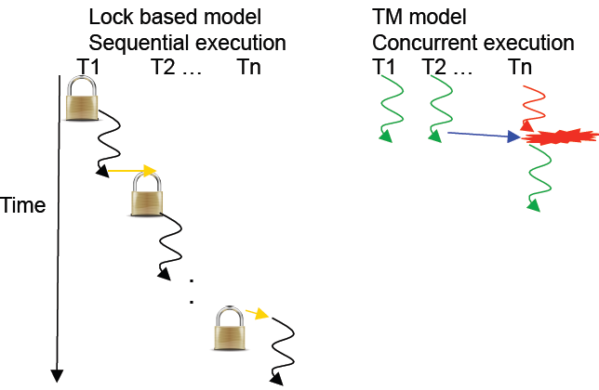
5.1 Main extensions of the Armv9-A ISA (8)
Contrasting lock based and transaction memory (TM) based thread
synchronization [155]
Conflict, to be
repaired

Slide 159
5.1 Main extensions of the Armv9-A ISA (9)
b1) Locks [156]
The most common way of addressing race conditions is to use locks, called also
monitors, critical sections, mutexes or binary semaphores.
Locks provide a mechanism for ensuring that at any time only one thread can
execute a particular section of code (called critical section) that includes shared
data.

Slide 160
5.1 Main extensions of the Armv9-A ISA (10)
b2) Transactional memory (TM)
The concept of the transactional memory (TM)
Note that the concept of transactional memory is a kind of speculative execution
of accessing shared data while providing a repair mechanism for occurring
conflicts.
The repair mechanism saves the execution state before the conditional execution
is performed and in case when a conflict occurs restores it and lets continue
execution.
This is basically the same mechanism as the speculative execution of predicted
branches or the speculative execution of loads, i.e. execution of loads before
checking for possible load-store conflicts (loading memory data from a given
address before storing to this address has been completed).

Slide 161
5.1 Main extensions of the Armv9-A ISA (11)
Implementation of Transactional Memory (TM) in commercial CPUs
From 2009 on a number of commercial CPUs introduced TM, as enlisted below.
Sun’s Rock (2009)
IBM Blue Gene/Q (2011)
IBM’s System/z EC12 (2012)
Intel’s Haswell (2013)
IBM’s POWER8 (2014)
ARM’s Armv9-A based Cortex-A and Neoverse models, such as the Cortex-X2
and Neoverse N2 (2021)

Slide 162
5.2 Main enhancement of Armv9-A based Cortex-A cores:
The Armv9-A based DynamIQ core cluster

Slide 163
5.2 The Armv9-A based DynamIQ core cluster (5)
Overview of the main enhancements of the Armv9-A based DynamIQ
core cluster
it allows to use three core types rather than only two, as before.
Sliced implementation of the L3 cache, snoop filter and the control logic of the
DynamIQ Shared Unit
c) Wider (scalable) bus interface
Subsequently, we discuss the above mentioned enhancements.

Slide 164
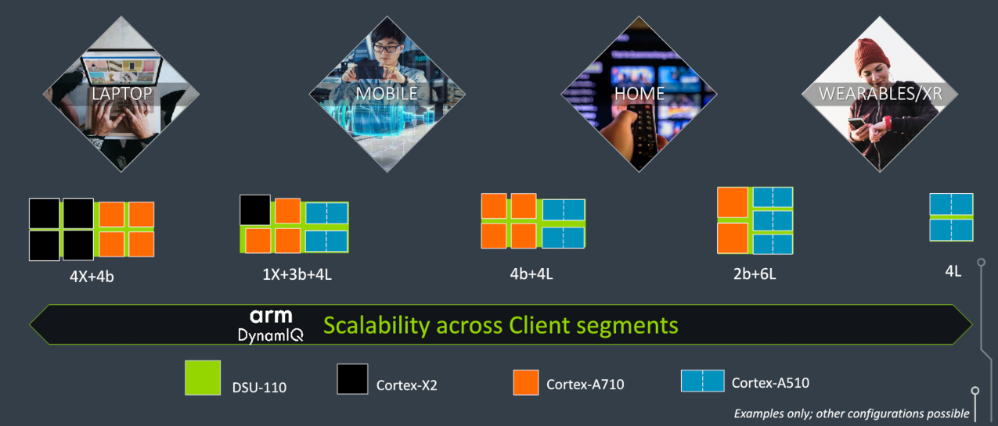
5.2 The Armv9-A based DynamIQ core cluster (6)
a) Use of three core types rather than two as in DynamIQ core clusters
The new Dynamic core cluster may have up to 8 cores out of 3 core types:
high-performance Cortex-X2 cores (even 8 Cortex-X cores),
the high-efficiency Cortex-A710 big and
the higher-efficiency Cortex-A510 LITTLE cores,
while the chosen mix of the cores depends on the target device type, as seen below.
Figure: Possible use of three core types depends on the target device type [157]

Slide 165
5.2 The Armv9-A based DynamIQ core cluster (3)
Key parts of the DynamIQ Shared Unit of CPUs based on the Armv8.2-A ISA [106]
(Partitions)
(Per-core DVFS control,
Partial L3 power down)
(up to 4 MB)
(Up to two 128-bit AMBA 5 ACE,
or a single 256-bit AMBA 5 CHI bus)
ACP: Accelerator Coherency Port, port for not cache coherent sensors and accelerators
Snoop filter: Used to speed up cache coherent memory accesses

Slide 166
5.2 The Armv9-A based DynamIQ core cluster (3)
Sliced implementation of the L3 cache, Snoop filter and the control logic of the
DynamIQ shared Unit [106]
(Partitions)
(Per-core DVFS control,
Partial L3 power down)
(up to 4 MB)
(Up to two 128-bit AMBA 5 ACE,
or a single 256-bit AMBA 5 CHI bus)
ACP: Accelerator Coherency Port, port for not cache coherent sensors and accelerators
Snoop filter: Used to speed up cache coherent memory accesses

Slide 167
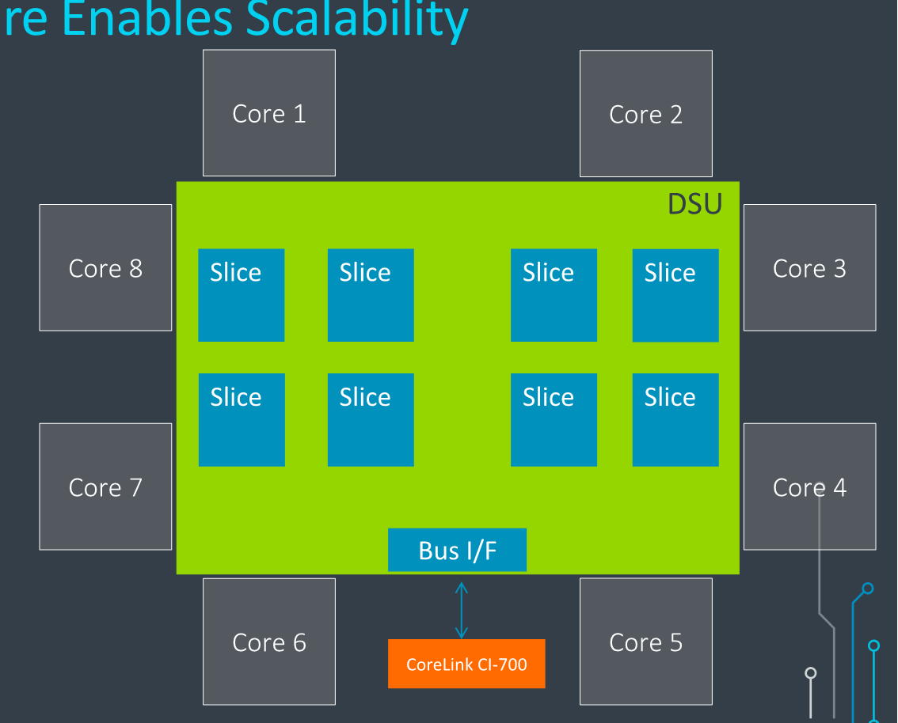
5.2 The Armv9-A based DynamIQ core cluster (7)
Sliced implementation of the L3 cache, snoop filter and the control logic [157]
L3 cache, snoop filter
and control logic is
sliced.
Slices are interconnected
by dual bi-directional
ring buses
(see next slide)

Slide 168
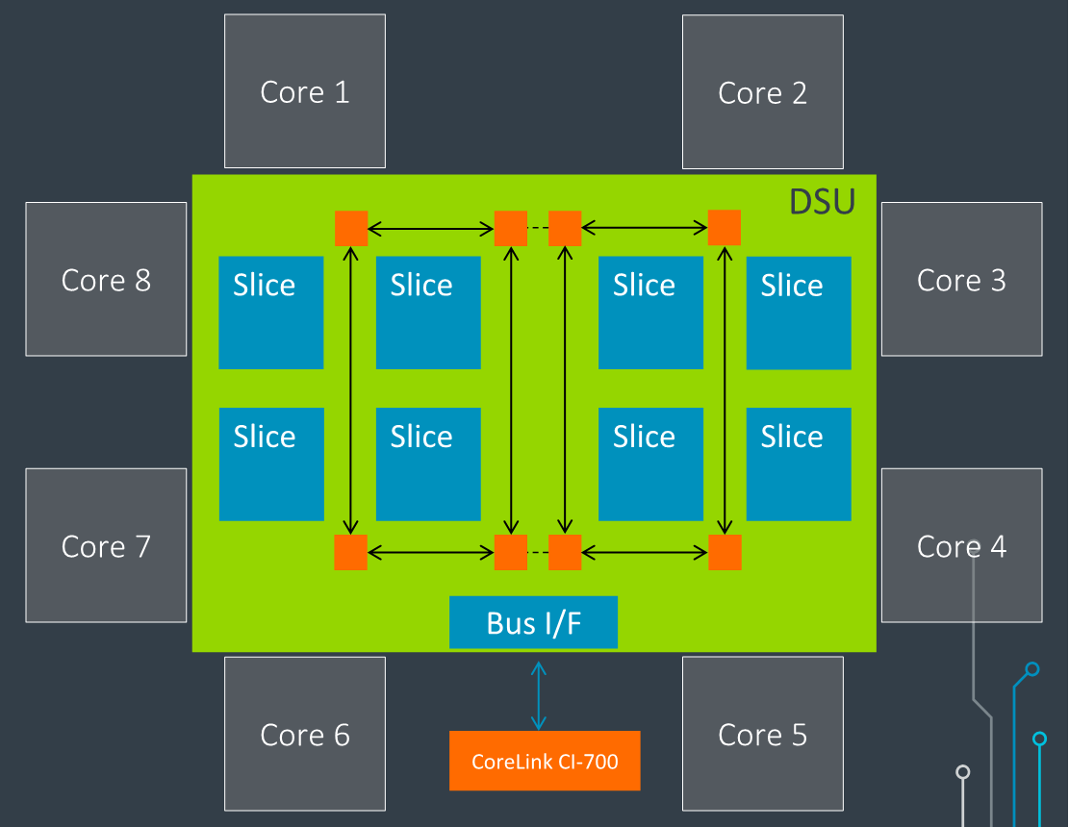
5.2 The Armv9-A based DynamIQ core cluster (8)
Interconnection of the slices [157]
Ring-based transport network
connects the cores to the
slices and the bus interfaces.
There are dual bi-directional
rings.
Traffic can take either
direction to shorten delay.

Slide 169
5.2 The Armv9-A based DynamIQ core cluster (9)
Principle of slicing L3 caches
L3 caches
(They are mostly unified and shared)
Not sliced
Sliced
Uniform
cache architecture
Non-uniform
cache architecture
The cache is made up as a single entity, accessible at a single point.
All accesses are equal long (uniform).
The cache is built up of multiple small slices,
properly interconnected, operating independently and in parallel.
In this way, the cache becomes physically distributed, but logically all slices are shared.
Cache accesses may be different long (non-uniform).
C
C
C
C
C
C
L3 slice 0
L3 slice 1
L3 $
L3 slice 2
L3 slice 0
C
C

Slide 170
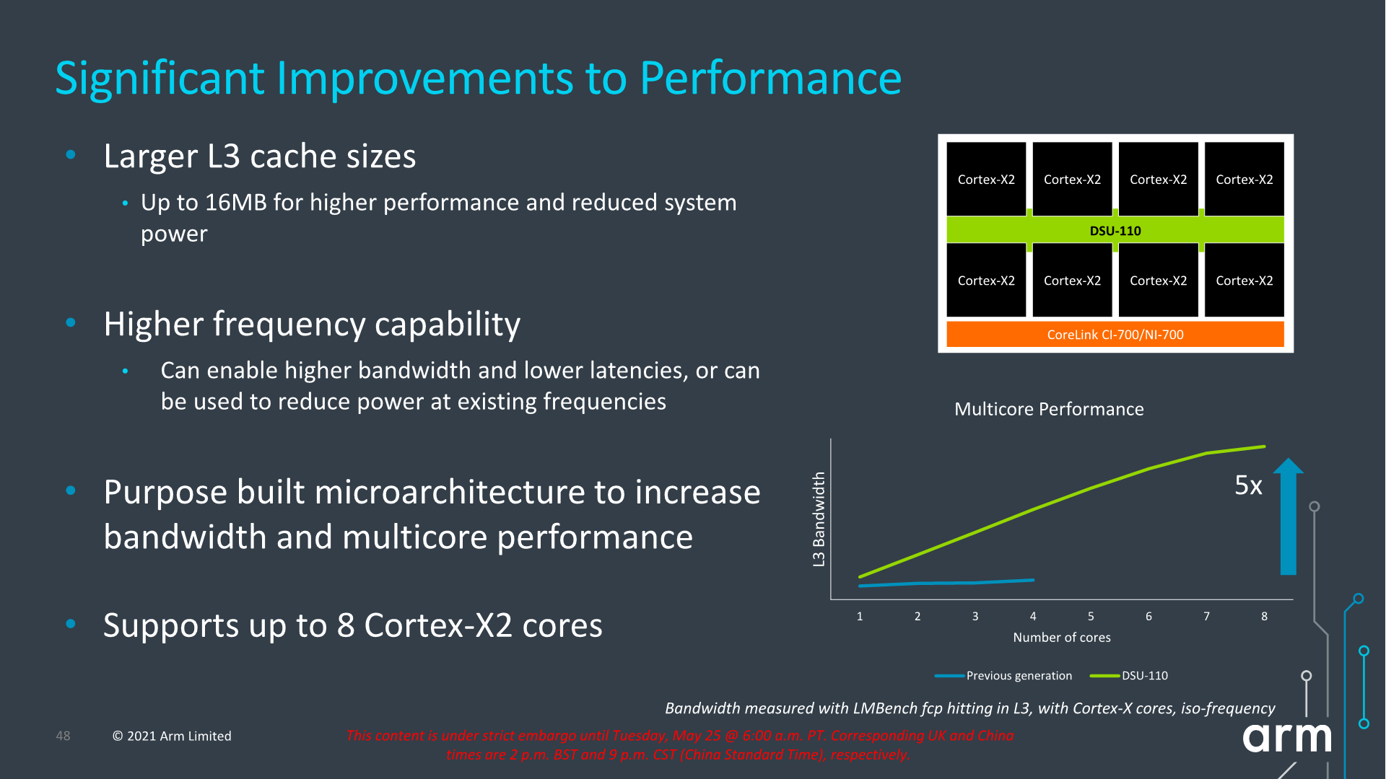
5.2 The Armv9-A based DynamIQ core cluster (10)
Major benefits of the sliced L3 caches -1
a) As slices of L3 caches can operate in parallel, sliced caches with n slices,
have in principle an n-times higher memory bandwidth than unsliced caches.
Figure: Raising the L3 cache bandwidth due to parallel operation of DSU slices [157]

Slide 171
5.2 The Armv9-A based DynamIQ core cluster (11)
Major benefits of the sliced L3 caches -2
b) Smaller cache slices have a lower access time than a large cache.

Slide 172
5.2 The Armv9-A based DynamIQ core cluster (12)
Consequence of slicing the L3 cache
While accessing sliced caches there are two access patterns:
the requested data is held in the accessed slice, i.e. it can be accessed
with a lower access time, and
b) the requested data is kept in a remote slice, than the access needs a
longer time.
It follows that cache access times are now non uniform, a sliced cache behaves
as a NUCA (Non-Uniform Cache Architecture).

Slide 173
5.2 The Armv9-A based DynamIQ core cluster (13)
Increasing the L3 cache size
In addition, the size of the L3 cache is raised from up to 4 MBs (in the previous
generation) to up to 16 MB to achieve higher performance and lower power
consumption.
Also the operation frequency has been raised to achieve higher bandwidth and
lower latencies.

Slide 174
5.2 The Armv9-A based DynamIQ core cluster (14)
Remarks to the emergence of sliced L3 caches
It is worth noting that L3 caches in Intel’s or AMD’s client cores and in ARM’s Cortex
cores followed the same evolution paths, namely all firms mentioned first introduced
homogeneous (not sliced) L3 caches displaced by sliced designs (as indicated below),
primarily to achieve higher performance (cache bandwidth) due to parallel operating
slices.
3-level cache architectures
Per-core, unified
L2 cache
Shared, unified
L3 cache
Not sliced
Sliced
Intel
Core 2 based
Nehalem 4C
(2008)
Core 2 based
Sandy Bridge 4C
(2011),
and subsequent proc.
AMD
K10 Barcelona
(2007)
K17 Zen core-based lines
(2017)
ARM
v8.2-A based cores
(2016)
v9-A based cores
(2021)

Slide 175
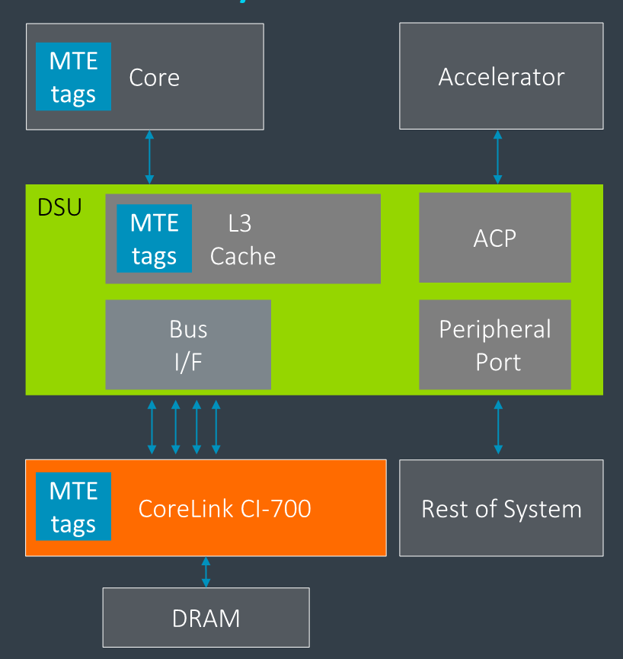
5.2 The Armv9-A based DynamIQ core cluster (20)
d) Wider (scalable) bus interface [157]
The Scalable bus interface is vastly enhanced by providing now 1, 2, or 4 256-bit wide
bus interfaces while an updated AMBA CHI bus protocol is used for more bandwidth
and MTE support.
By comparison, the previous
Armv8.2-A based DynamIQ core
cluster provided a 2x256-bit or
2x128-bit wide bus interface
(implementation dependent).

Slide 176
5.2 The Armv9-A based DynamIQ core cluster (21)
Scalability of the Armv9-A based DynamIQ core cluster [157]
As the above Figure indicates, the mix of the chosen core types depends on the
target device type.

Slide 177
5.3 Armv9-A based Cortex-A cores

Slide 178
5.3 Armv9-A based Cortex-A cores (1)
5.3 Introduction -1
Positioning and key features of Armv9-based Cortex-A cores
Cortex-A cores
Armv7-A based
Cortex-A cores
Armv8.0-A based
Cortex-A cores
Armv8.2-A based Cortex-A cores
Armv9-A based
Cortex-A cores
32-bit architectures
(announced in 2004)
Supporting big.LITTLE
core clusters
(since 2011,
in specific models)
64-bit architectures
(announced in 2012)
Supporting big.LITTLE
core clusters
64-bit architectures
(announced in 2017)
Supporting DynamIQ
core clusters
64-bit architectures
(announced in 2020)
Supporting Armv9-based
DynamIQ core clusters
First cores
Cortex-A8
Cortex-A57/A53
Cortex-A75/A55
Cortex-X2/A710/A510
Section 4.1
Section 5
Section 4.3
Section 5.3

Slide 179
5.3 Armv9-A based Cortex-A cores (2)
Introduction -2
Armv9-A based Cortex-A cores (Cortex-X2, Cortex-A710 and Cortex-A510)
were announced in 05/2020.
The ultimate performance Cortex-X2 is the “flagship core”, the Cortex-A710
“big core” provides balanced performance and efficiency whereas the Cortex-A510
is a high-efficiency “LITTLE core”.
The Cortex-X2, Cortex-A710 and Cortex-A510 are ARM’s first Armv9-A CPU
implementations for mobile CPUs whereas the Neoverse-N2 is the first one
for server processors.
The Cortex-X2 and A510 only run in the AArch64 execution mode whereas
the Cortex-A710 still supports the Aarch32 mode in order to satisfy Chinese
market needs.
Note that the Cortex-X2 and Cortex-A710 cores are traditional single core implementations
whereas the Cortex-A510 is designed as a dual core module.
We also point out that ARM announced to drop AArch32 support in all of its mobile
CPU cores by 2023.
Remark
The Cortex-X2 and the Cortex-A710 cores were designed in the Austin Design Center
whereas the Cortex-A510 by the Cambridge design team.

Slide 180
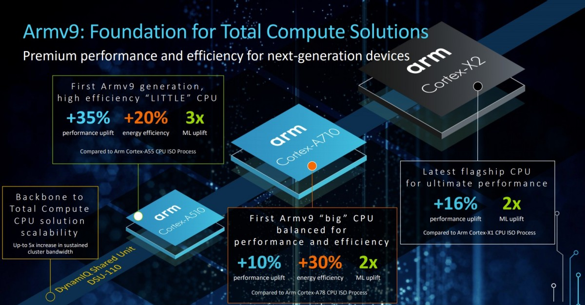
5.3 Armv9-A based Cortex-A cores (3)
Overview and performance expectations of Armv9-A based Cortex-A cores [165]
3.4.1 Main extensions of the Armv9.0 ISA

Slide 181
6. References

Slide 182
6. References (1)
[1]: Architecture and Implementation of the ARM Cortex-A8 Microprocessor, Design & Reuse,
http://www.design-reuse.com/articles/11580/architecture-and-implementation-of-the-
arm-cortex-a8-microprocessor.html
[2]: Shimpi A.L., Answered by the Experts: ARM's Cortex A53 Lead Architect, Peter Greenhalgh,
AnandTech, Dec. 17 2013, http://www.anandtech.com/show/7591/answered-by-the-
experts-arms-cortex-a53-lead-architect-peter-greenhalgh
[3]: Hill S., Design of a Reusable 1GHz, Superscalar ARM Processor, Hot Chips-18, Aug. 22 2006,
http://www.hotchips.org/wp-content/uploads/hc_archives/hc18/3_Tues/HC18.S6/HC18.S6T3.
pdf
[4]: Details of a New Cortex Processor Revealed, Cortex-A9, ARM Developers’ Conference,
Oct. 2007, http://rtcgroup.com/arm/2007/presentations/174%20-%20Details%20of%
20a%20New%20Cortex%20Processor%20Revealed%20Cortex-A9.pdf
[5]: ARM Teaching Material, http://www.arm.com/files/ppt/ARM_Teaching_Material.ppt
[6]: ARM Cortex Application Processors, http://www.arm.com/products/processors/index.php
[7]: ARM SecurCore Processors, http://www.arm.com/products/processors/securcore/index.php
[8]: Snyder C.D., ARM Family Expands at EPF, ARM11 Microarchitecture Stretches Pipe to Boost
Frequency, Microprocessor, June 3 2002
[9]: Hirata K., ARM11 MPCore, The streamlined and scalable ARM11 processor core, Jan. 2007,
http://www.aspdac.com/aspdac2007/pdf/archive/7D-2.pdf

Slide 183
6. References (2)
[10]: ARM Introduces The Cortex-M3 Processor To Deliver High Performance In Low-Cost
Applications, Oct. 19 2004, http://www.arm.com/about/newsroom/6750.php
[11]: NEON, ARM Technologies,
http://www.arm.com/products/processors/technologies/neon.php
[12]: Goodacre J., The Evolution of the ARM Architecture Towards Big Data and the Data-Centre,
8th Workshop on Virtualization in High-Performance Cloud Computing (VHPC’13),
Nov. 17-22 2013, http://www.virtical.eu/pub/sc13.pdf
[13]: Ferguson I., Redefining User Experiences, from IoT to Smart Mobile Devices, June 14 2013,
http://www.arm.com/zh/files/event/arm_multimedia_seminar_shenzhen_2013_ianferguson.
pdf
[14]: Goto H., ARM Cortex – A Family Architecture, 2010,
http://pc.watch.impress.co.jp/video/pcw/docs/423/409/p1.pdf
[15]: Stevens H., Introduction to AMBA 4 ACE and big.LITTLE Processing Technology, White Paper,
June 6 2011, http://www.arm.com/files/pdf/CacheCoherencyWhitepaper_6June2011.pdf
[16]: Shimpi A.L., The ARM Diaries, Part 2: Understanding the Cortex A12, AnandTech,
July 17 2013, http://www.anandtech.com/show/7126/the-arm-diaries-part-2-
understanding-the-cortex-a12
[17]: Shimpi A.L., ARM Cortex A17: An Evolved Cortex A12 for the Mainstream in 2015,
AnandTech, Febr. 11 2014, http://www.anandtech.com/show/7739/arm-cortex-a17
[18]: Ryan H., Intel, AMD & ARM Processors, University of Wisconsin DoIT Techstore
https://kb.wisc.edu/showroom/page.php?id=4927

Slide 184
6. References (3)
[19]: Rao A., ARM: a mandatory primer, Element14, 2014
[20]: Mali Performance Efficient Graphics, ARM
http://www.arm.com/products/multimedia/mali-performance-efficient-graphics/index.php
[21]: Cortex-A8 Processor, ARM Cortex-A Series,
http://www.arm.com/products/processors/cortex-a/cortex-a8.php
[22]: Architecture and Implementation of the ARM Cortex-A8 Microprocessor, White Paper,
Oct. 2005, https://www.pixhawk.ethz.ch/_media/software/optimization/neon_whitepaper.pdf
[23]: Shimpi A.L., Understanding the iPhone 3GS, AnandTech, July 7 2009,
http://www.anandtech.com/print/2798/
[24]: The ARM Cortex-A9 Processors, White Paper, Sept. 2009,
http://www.arm.com/files/pdf/armcortexa-9processors.pdf
[25]: Cortex-A9 MPCore, Technical Reference Manual, 2008-2012,
http://infocenter.arm.com/help/topic/com.arm.doc.ddi0407i/DDI0407I_cortex_a9_
mpcore_r4p1_trm.pdf
[26]: Goto H., ARM Cortex-A9r4 Core Block Diagram,
http://pc.watch.impress.co.jp/video/pcw/docs/614/543/08p.pdf
[27]: ARM Unveils Cortex-A9 Processors For Scalable Performance and Low-Power Designs,
Oct. 3 2007, http://www.arm.com/about/newsroom/18688.php
[28]: Goodacre J., The Effect and Technique of System Coherence in ARM Multicore Technology,
http://www.mpsoc-forum.org/previous/2008/slides/8-6%20Goodacre.pdf

Slide 185
6. References (4)
[29]: Goto H., ARM Cortex-A7/A9 vs Bobcat, Atom, 2010,
http://pc.watch.impress.co.jp/img/pcw/docs/487/030/html/9.jpg.html
[30]: Goto H., ARM Cortex-A12 Block Diagram, 2013,
http://pc.watch.impress.co.jp/video/pcw/docs/621/747/gp1.pdf
[31]: Rosinger S., The Top 5 Things to Know about Cortex-A12, ARM Connected Community,
Oct. 26 2013, http://community.arm.com/groups/processors/blog/2013/10/26/the-top-5-
things-to-know-about-cortex-a12
[32]: ARM Cortex-A17 MPCore Processor, Technical Reference Manual, 2014,
http://infocenter.arm.com/help/topic/com.arm.doc.ddi0535b/DDI0535B_cortex_a17_
r1p0_trm.pdf
[33]: Cortex-A17 Processor, ARM Cortex-A Series,
http://www.arm.com/products/processors/cortex-a/cortex-a17-processor.php
[34]: Rosinger S., ARM Cortex-A17/Cortex-A12 processor update, ARM Connected Community,
Oct. 1 2014, http://community.arm.com/groups/processors/blog/2014/09/30/arm-
cortex-a17-cortex-a12-processor-update
[35]: Cortex-A15 Processor, ARM Cortex-A Series,
http://www.arm.com/products/processors/cortex-a/cortex-a15.php
[36]: Lanier T., Exploring the Design of the Cortex-A15 Processor,
http://www.arm.com/files/pdf/AT-Exploring_the_Design_of_the_Cortex-A15.pdf

Slide 186
6. References (5)
[37]: Greenhalgh P., big.LITTLE Processing with ARM Cortex-A15 & Cortex-A7, White Paper,
Sept. 2011, http://www.arm.com/files/downloads/big_LITTLE_Final_Final.pdf
[38]: Stokes J., ARM fills out CPU lineup with Cortex A5, Ars Technica, Oct. 22 2009,
http://arstechnica.com/gadgets/2009/10/arm-fills-out-cpu-lineup-with-cortex-a5/
[39]: Hruska J., ARM Launches New Cortex-A5 As A Bulkward Against Future Atom processors,
Hot Hardware, Oct. 23 2009, http://hothardware.com/News/ARM-Launches-New-
CortexA5-As-A-Bulkward-Against-Future-Atom-processors
[40]: Cortex-A5 Processor, ARM Cortex-A Series,
http://www.arm.com/products/processors/cortex-a/cortex-a5.php
[41]: Bhattacharya A., Small, Quiet, and Cool, Power Efficient Processing with the Cortex-A5
Processor, http://www.arm.com/files/pdf/at2_-_power_efficient_processing_with_the_
cortex-a5_v1.pdf
[42]: Cortex-A5, The smallest, lowest power Armv7 application processor,
http://www.hitex.co.uk/fileadmin/uk-files/pdf/ARM%20Seminar%20Presentations%
202013/Hitex%20Cortex-A5%20Overview.pdf
[43]: Flautner K., Heterogeneity to the rescue, Nov. 2011,
https://www.bscmsrc.eu/sites/default/files/media/arm-heterogenous-mp-november-2011.
pdf
[44]: Shimpi A.L., ARM's Cortex A7: Bringing Cheaper Dual-Core & More Power Efficient High-End
Devices, AnandTech, Oct. 19 2011, http://www.anandtech.com/show/4991/

Slide 187
6. References (6)
[45]: Cortex-A7 Processor, ARM Cortex-A Series,
http://www.arm.com/products/processors/cortex-a/cortex-a7.php
[46]: Goto H., New design of mid-range CPU that ARM has announced "Cortex-A12", PC Watch,
June 4 2013, http://pc.watch.impress.co.jp/docs/column/kaigai/20130604_602106.html
[47]: Shimpi A.L., ARM's Cortex A57 and Cortex A53: The First 64-bit Armv8 CPU Cores,
AnandTech, Oct. 30 2012, http://www.anandtech.com/show/6420/arms-cortex-a57-
and-cortex-a53-the-first-64bit-armv8-cpu-cores
[48]: Smith K., Next-Generation Solutions: One Size Does Not Fit All, Nov. 2012,
http://www.armtechforum.com.cn/2012/3_Next-generation_Solutions_One_Size_does_
not_Fit_All.pdf
[49]: Smythe I., Building the future of 64-bit computing with Armv8-A, June 2014,
http://www.arm.com/files/event/2014_ARM_Multimedia_Seminar_ARM_Ian_Smythe.pdf
[50]: Ferguson I., ARM Servers, Why, Where, when, Nov. 27 2012,
http://openserversummit.com/English/Collaterals/Proceedings/2012/20121127_SA103_
Ferguson.pdf
[51]: Crijns K., ARM: 20 dollar and 64-bit Android smartphones to be expected, Hardware.info,
June 24 2014, http://us.hardware.info/reviews/5386/2/arm-20-dollar-and-64-bit-android-
smartphones-to-be-expected-android-64-bitn
[52]: Scaling Mobile Compute to the Data Centre, MPSoC’13,
http://www.mpsoc-forum.org/previous/2013/slides/2-Goodacre.pdf

Slide 188
6. References (7)
[53]: ARM Launches Cortex-A50 Series, the World's Most Energy-Efficient 64-bit Processors,
TechPowerUp, Oct. 30 2012, http://www.techpowerup.com/174709/arm-launches-cortex-
a50-series-the-worlds-most-energy-efficient-64-bit-processors.html
[54]: Mandyam L., Smartphone Powered Data Centers: Shifting Toward Energy Efficiency,
http://sites.ieee.org/scv-cs/files/2013/03/IEEE-event-April-slide-upload.pdf
[55]: Anthony S., ARM says $20 smartphones coming this year, shows off 64-bit Cortex-A53 and
A57 performance, Extreme Tech, May 6 2014, http://www.extremetech.com/computing/
181935-arm-says-20-smartphones-coming-this-year-shows-off-64-bit-cortex-a53-and-
a57-performance
[56]: Merritt R., ARM stretches out with A5 core, graphics, FPGAs, Oct. 21 2009,
http://www.embedded.com/print/4085371
[57]: Cormie D., The ARM11 Microarchitecture, April 2002
https://www.hashimi.ws/cs214/ref_doc/ARM11%20Microarchitecture%20White%20Paper.
pdf
[58]: Exynos 5 Octa, Block Diagram,
http://www.samsung.com/global/business/semiconductor/product/application/detail?
productId=7978&iaId=2341
[59]: Grabham D., From a small Acorn to 37 billion chips: ARM's ascent to tech superpower,
Techradar, July 19 2013, http://www.techradar.com/news/computing/from-a-small-acorn-
to-37-billion-chips-arm-s-ascent-to-tech-superpower-1167034
[60]: The ARM Architecture, http://www.eng.auburn.edu/~strouce/DaTseminar/UniPres07s.pdf
[61]: Wikipedia, ARM architecture, http://en.wikipedia.org/wiki/ARM_architecture

Slide 189
6. References (8)
[62]: Levy M., The History of The ARM Architecture: From Inception to IPO,
http://www.reds.ch/share/cours/ReCo/documents/TheHistoryOfTheArmArchitecture.pdf
[63]: Lemieux J., Introduction to ARM thumb, Embedded, Sept. 24 2003, http://www.embedded.
com/electronics-blogs/beginner-s-corner/4024632/Introduction-to-ARM-thumb
[64]: ARM Processor Architecture,
http://www.arm.com/products/processors/instruction-set-architectures/index.php
[65]: ARM Architecture Reference Manual, Armv5, DDI0100E, June 2000
[66]: ARM Architecture Reference Manual, Armv8, 2013, http://www.myir-tech.com/down/arm/
arch/Armv8-A_Architecture_Reference_Manual_%28Issue_A.a%29.pdf
[67]: Porthouse C., Use ARM DBX hardware extensions to accelerate Java in space-constrained
embedded apps, Embedded, Oct. 18 2007, http://www.embedded.com/design/prototyping-
and-development/4007206/3/PRODUCT-HOW-TO-Use-ARM-DBX-hardware-extensions-to-
accelerate-Java-in-space-constrained-embedded-apps
[68]: ARM Security Technology, Building a Secure System using TrustZone Technology, 2009,
http://infocenter.arm.com/help/topic/com.arm.doc.prd29-genc-009492c/PRD29-GENC-
009492C_trustzone_security_whitepaper.pdf
[69]: ARM Cortex-A53 MPCore Processor Technical Reference Manual, Cryptography Extension,
2013-2014,
http://infocenter.arm.com/help/index.jsp?topic=/com.arm.doc.ddi0500e/CJHDEBAF.html

Slide 190
6. References (9)
[70]: Shilov A., ARM’s high-end ‘Ares’ core for 10nm SoCs may be unveiled next year, KitGuru,
May 16 2015, http://www.kitguru.net/components/cpu/anton-shilov/arms-high-
performance-ares-core-may-be-unleashed-next-year/
[71]: Goto H., ARM Cortex-A57 Block Diagram,
http://images.anandtech.com/doci/8718/Hiroshige.Goto.png
[72]: Wasson S., Inside ARM's Cortex-A72 microarchitecture, TechReport, May 1 2015,
http://techreport.com/review/28189/inside-arm-cortex-a72-microarchitecture
[73]: Citizendium, Java platform, http://en.citizendium.org/wiki/Java_platform
[74]: Wasson S., Samsung's Galaxy Note 4 with the Exynos 5433 processor, TechReport,
01/31/2015, http://techreport.com/review/27539/samsung-galaxy-note-4-with-the-
exynos-5433-processor/2
[75]: Frumusanu A. & Smith R., ARM A53/A57/T760 investigated - Samsung Galaxy Note 4
Exynos Review, AnandTech, February 10, 2015,
http://www.anandtech.com/show/8718/the-samsung-galaxy-note-4-exynos-review
[76]: Riemenschneider F., Intel sei dank: Programmierbare Logik mit 1 GHz takten,
Elektroniknet, 29.10.2013 von Frank Riemenschneider,
http://www.elektroniknet.de/halbleiter/programmierbare-logik/artikel/102160/
[77]: Frumusamu A., ARM Announces New Cortex-A35 CPU - Ultra-High Efficiency For Wearables
& More, AnandTech, November 10, 2015,
http://anandtech.com/show/9769/arm-announces-cortex-a35

Slide 191
6. References (10)
[78]: Quested T., ARM scales up again in Cambridge, Businessweekly, 20 October, 2014,
http://www.businessweekly.co.uk/news/property-and-construction/17695-arm-scales-
again-cambridge#sthash.Pzg7jnpK.dpuf
[79]: ARM Architecture Reference Manual, Thumb-2 Supplement, 2004-2005,
http://read.pudn.com/downloads159/doc/709030/Thumb-2SupplementReferenceManual.pdf
[80]: Wanted: Java bytecode disassembler that shows addresses, opcodes, operands, in hex,
Reverse Engineering, 2013, http://reverseengineering.stackexchange.com/questions/
2036/wanted-java-bytecode-disassembler-that-shows-addresses-opcodes-operands-in-h
[81]: Barr M., KVM: A Small Java Virtual Machine for J2ME, Barr Group, May 4 2016,
http://www.barrgroup.com/Embedded-Systems/How-To/KVM-J2ME-Java-Virtual-Machine
[82]: What is Bytecode ?, March 21 2015,
http://interview-question-and-answers.blogspot.hu/2015/03/what-is-bytecode.html
[83]: The JVM – Java Virtual Machine, Android Developer, May 8 2015,
http://androiddeveloper.co.il/the-jvm-java-virtual-machine/
[84]: Java Virtual Machine, Free Download Java Virtual Machine, How to Download JVM,
Dev Manuals, Sept. 28 2010,
http://www.devmanuals.com/tutorials/java/corejava/javavirtualmachine.html
[85]: Srinivasan K., What is the difference between JRE,JVM and JDK?, Javabeat, Febr. 21 2013,
http://www.javabeat.net/what-is-the-difference-between-jrejvm-and-jdk/

Slide 192
6. References (11)
[86]: ARM Architecture Reference Manual, Armv7-A and Armv7-R edition, 2004-2012,
http://liris.cnrs.fr/~mmrissa/lib/exe/fetch.php?media=armv7-a-r-manual.pdf
[87]: Cortex-A7 MPCore, Technical Reference Manual, Rev. r0p3, 2011-2012,
http://infocenter.arm.com/help/topic/com.arm.doc.ddi0464d/DDI0464D_cortex_a7_
mpcore_r0p3_trm.pdf
[88]: Pardoe A., New Innovations in .NET Runtime, dotnetConf, 2014, Jun. 2014,
https://view.officeapps.live.com/op/view.aspx?src=http%3a%2f%2ffiles.channel9.
msdn.com%2fthumbnail%2f47cb5ae5-eb38-404d-80e8-7bae0a4efbaf.pptx
[89]: Cortex-A73 Processor, ARM,
https://www.arm.com/products/processors/cortex-a/cortex-a73-processor.php
[90]: Frumusanu A., ARM Announces New Cortex-A35 CPU - Ultra-High Efficiency For Wearables
& More, AnandTech, Nov. 10, 2015,
http://www.anandtech.com/show/9769/arm-announces-cortex-a35
[91]: Frumusanu A., ARM Reveals Cotex-A72 Architecture Details, AnandTech, Apr. 23, 2015,
http://www.anandtech.com/show/9184/arm-reveals-cortex-a72-architecture-details
[92]: Frumusanu A., The ARM Cortex A73 - Artemis Unveiled, AnandTech, May 29, 2016,
http://www.anandtech.com/show/10347/arm-cortex-a73-artemis-unveiled
[93]: Cortex-A73 Overview, ARM Developer, 2016,
https://developer.arm.com/products/processors/cortex-a/cortex-a73
[94]: Cortex-A35, ARM, 2015,
http://www.arm.com/products/processors/cortex-a/cortex-a35-processor.php

Slide 193
6. References (12)
[95]: Wasson S., Inside ARM's Cortex-A72 microarchitecture - The next-gen CPU core for mobile
devices and servers, Tech Report, May 1, 2015,
http://techreport.com/review/28189/inside-arm-cortex-a72-microarchitecture
[96]: Stephens N., Armv8-A Next-Generation Vector Architecture for HPC, Hot Chips 2016,
https://community.arm.com/groups/processors/blog/2016/08/22/technology-update-
the-scalable-vector-extension-sve-for-the-armv8-a-architecture
[97]: Brash D., The Armv8-A architecture and its ongoing development, ARM, 2014
https://community.arm.com/processors/b/blog/posts/the-armv8-a-architecture-and-its-
ongoing-development
[98]: Humrick M., Exploring DynamIQ and ARM’s New CPUs: Cortex-A75, Cortex-A55,
AnandTech, May 29, 2017,
https://www.anandtech.com/show/11441/dynamiq-and-arms-new-cpus-cortex-a75-a55
[99]: Frumusanu A., The ARM Cortex A73 - Artemis Unveiled, AnandTech, May 29, 2016,
http://www.anandtech.com/show/10347/arm-cortex-a73-artemis-unveiled
[100]: Turner C., ARM instruction sets and CPUs for wide ranging applications, ARM Tech Forum,
Taipei, July 4, 2017,
https://www.arm.com/files/event/20170704_ATF_TW_A3.pdf
[101]:Cortex-A75, ARM Developer,
https://developer.arm.com/products/processors/cortex-a/cortex-a75
[102]: Cortex-A73, ARM Developer,
https://developer.arm.com/products/processors/cortex-a/cortex-a73

Slide 194
6. References (13)
[103]: ARM Unveils Cortex-A75, A55 Processors And Mali-G72 GPU, ARM Developer,
https://www.xda-developers.com/arm-unveils-cortex-a75-a55-processors-and-mali-
g72-gpu/
[104]: DynamIQ power management support, Vers. 1.1, ARM ECM 0640541 Oct. 30 2017
[105]: Parris N., Boost SoC performance from edge to cloud ARM CoreLink System IP, ARM,
Nov. 2016,
http://www.armtechforum.com.cn/attached/article/2016ATS_C1_Neil_Parris
20161206151154.pdf
[106]: Greenhalgh P., ARM DynamIQ. Intelligent Solutions Using Cluster Based Multiprocessing,
Hot Chips 29, 2017 Aug. 12,
https://www.slideshare.net/ARMHoldings/arm-dynamiq-intelligent-solutions-using-
cluster-based-multiprocessing
[107]: Wathan G. : Arm DynamIQ: Technology for the next era of compute, ARM Community,
https://community.arm.com/processors/b/blog/posts/arm-dynamiq-technology-for-
the-next-era-of-compute
[108]: Walrath J., ARM Tech Day 2017: DynamIQ, Cortex-A55, A75, and Mali-G72,
PC Perspective, May 29, 2017,
https://www.pcper.com/reviews/General-Tech/ARM-Tech-Day-2017-DynamIQ-
Cortex-A55-A75-and-Mali-G72/Cortex-A75-and-Mali-G72
[109]: Rickards I. and Kucheria A., Energy Aware Scheduling (EAS) progress update, Linaro
Company, Sept. 18, 2015,
http://www.linaro.org/blog/core-dump/energy-aware-scheduling-eas-progress-update/

Slide 195
6. References (14)
[110]: Triggs R., A closer look at ARM’s new Cortex-A75 and Cortex-A55 CPUs, Android Authority,
May 31, 2017
https://www.androidauthority.com/arm-cortex-a75-cortex-a55-breakdown-770380/
[111]: Arm Cortex-A55: Efficient performance from edge to cloud, ARM Community,
https://community.arm.com/processors/b/blog/posts/arm-cortex-a55-efficient-
performance-from-edge-to-cloud
[112]: System Guidance for Infrastructure, ARM Developer,
https://developer.arm.com/products/system-design/system-guidance/system-guidance-
for-infrastructure
[113]: ARM® Architecture Reference Manual Armv8, for Armv8-A architecture profile,
ARM DDI 0487A.k_iss10775 (ID092916),2013-2016
https://silver.arm.com/download/ARM_and_AMBA_Architecture/AR150-DA-70000-r0p0-
01eac1/DDI0487A_k_armv8_arm_iss10775.pdf
[114]: Arm DynamIQ: Technology for the next era of compute, ARM Community,
https://community.arm.com/processors/b/blog/posts/arm-dynamiq-technology-for-the-
next-era-of-compute
[115]: ARM unveils multi-processor core with Linux SMP support, LinuxDevices, May 17, 2004,
http://linuxdevices.linuxgizmos.com/arm-unveils-multi-processor-core-with-linux-smp-
support/
[116]: ARM Architecture Reference manual Supplement - The Scalable Vector Extension (SVE),
for Armv8-A, ARM DDI 0584Ab (ID081717), 21 Aug. 2017,
https://developer.arm.com/docs/ddi0584/latest/arm-architecture-reference-manual-
supplement-the-scalable-vector-extension-sve-for-armv8-a

Slide 196
6. References (15)
[117]: ARM Q4 2016 Roadshow Slides, ARM Holdings, 2017
file:///C:/Users/sima/Downloads/ARM_SB_Q4_2016_Roadshow_Slides_FINAL.pdf
[118]: Triggs R., Everything you need to know about ARM’s DynamIQ, Android Authority,
May 29, 2017,
https://www.androidauthority.com/arm-dynamiq-need-to-know-770349/
[119]: Frumusanu A., Arm's Cortex-A76 CPU Unveiled: Taking Aim at the Top for 7nm,
AnandTech, May 31, 2018,
https://www.anandtech.com/show/12785/arm-cortex-a76-cpu-unveiled-7nm-powerhouse
[120]: Hruska J., ARM’s New Cortex-A76 SoC Targets Windows Laptop Market, ExtremeTech,
May 31, 2018,
https://www.extremetech.com/mobile/270362-arm-cortex-a76-targets-laptop-market
[121]: Humrick M., Exploring DynamIQ and ARM’s New CPUs: Cortex-A75, Cortex-A55,
AnandTech, May 29, 2017,
https://www.anandtech.com/show/11441/dynamiq-and-arms-new-cpus-cortex-a75-
a55/3
[122]: Cortex-A57 Software Optimization Guide, ARM, UAN 0015B, 2016,
http://infocenter.arm.com/help/topic/com.arm.doc.uan0015b/Cortex_A57_Software_
Optimization_Guide_external.pdf
[123]: ASIMD multiply-accumulate instruction, ARM Community, 2016,
https://community.arm.com/processors/f/discussions/7028/asimd-multiply-accumulate-
instruction

Slide 197
6. References (16)
[124]: Gianos C., Intel Xeon Processor E5-2600 v3 Product Family Architectural Overview ,
HPCC'14, Nov. 16 2014
[125]: Frumusanu A., ARM Unveils Client CPU Performance Roadmap Through 2020 – Taking
Intel Head On, AnandTech, Aug. 16, 2018,
https://www.anandtech.com/show/13226/arm-unveils-client-cpu-performance-roadmap
[126]: Frumusanu A., ARM's New Cortex-A77 CPU Micro-architecture: Evolving Performance,
AnandTech, May 27, 2019,
https://www.anandtech.com/show/14384/arm-announces-cortexa77-cpu-ip
[127]: Frumusanu A., Arm's New Cortex-A78 and Cortex-X1 Microarchitectures: An Efficiency and
Performance Divergence, AnandTech, May 26 2020,
https://www.anandtech.com/show/15813/arm-cortex-a78-cortex-x1-cpu-ip-diverging
[128]: Williamson P., Bringing the Digital World into Our New Reality, May 2020,
https://armkeil.blob.core.windows.net/developer/Files/pdf/news/arm-client-mobile-
launch-2020-deck.pdf
[129]: Hill B., Arm Unveils Cortex-A78, Cortex-X1 Architectures: Efficiency And Big Performance
Gains For Next-Gen Mobile Devices, Hot Hardware, May 26 2020,
https://hothardware.com/news/arm-cortex-a78-cortex-x1-mali-g78-snapdragon-875
[130]: Schor D., Arm Cortex-X1: The First From The Cortex-X Custom Program, Wikichip Fuse,
May 26 2020, https://fuse.wikichip.org/news/3543/arm-cortex-x1-the-first-from-the-
cortex-x-custom-program/

Slide 198
6. References (17)
[131]: Frumusanu A., ARM Details Built on ARM Cortex Technology License, AnandTech,
May 29 2016, https://www.anandtech.com/show/10366/arm-built-on-cortex-license
[132]: Caulfield I.M., Pathirane C.A.S., Instruction fusion, US 2017/0123808 A1, May 4 2017,
https://patents.google.com/patent/US20170123808
[133]: Hachman M., ARM challenges Intel in PCs with Deimos and Hercules chips, PC World,
Aug. 16 2018, https://www.pcworld.com/article/3297941/arm-challenges-intel-in-pcs-
with-deimos-and-hercules-chips.html
[134]: The Samsung Exynos 7420 Deep Dive – Inside A Modern 14nm SoC, June 29 2015,
http://monimega.com/blog/2015/06/29/the-samsung-exynos-7420-deep-dive-inside-a-
modern-14nm-soc/
[135]: Hsu D., ARM Cortex-A75 and Cortex-A55, ARM Tech Forum, Shenzen, Jun. 14, 2017,
https://docplayer.net/85228086-Arm-cortex-a75-and-cortex-a55.html
[136]: Introduction to SVE, 2021, 102476_0001_00_en_introduction-to-sve.pdf
[137]: Introduction to Trusted Execution Environment and ARM's TrustZone, #embeddedbits,
https://embeddedbits.org/introduction-to-trusted-execution-environment-tee-arm-trustzone/
[138]: Ngabonziza B., Martin D., Bailey A., Cho H. and Martin S., TrustZone Explained: Architectural
Features and Use Cases, IEEE 2nd International Conference on Collaboration and Internet
Computing, 2016, https://sefcom.asu.edu/publications/trustzone-explained-cic2016.pdf
[139]: Menarini F., Breaking TEE Security Part 1: TEEs, TrustZone and TEEGRIS, Riscure,
Febr. 23 2021, https://www.riscure.com/blog/tee-security-samsung-teegris-part1

Slide 199
6. References (18)
[140]: Carlini M., Kuriakose S.V., Trusted Firmware: Building Secure Firmware Collaboratively,
https://static.sched.com/hosted_files/osseu2020/71/TrustedFirmware_ELC_2020.pdf
[141]: Slava Makkaveev, The Road to Qualcomm TrustZone Apps Fuzzing, Checkpoint,
Nov. 14 2019, https://research.checkpoint.com/2019/the-road-to-qualcomm-trustzone-
apps-fuzzing/
[142]: Eyrolles N., TEE and trust: assessing the security of Arm’s TrustZone, Viaccess-orca,
Febr. 17 2021, https://www.viaccess-orca.com/blog/assessing-the-security-of-arms-trustzone
[143]: Security Analysis of TEEs on TrustZone, Viaccess-orca,
https://www.viaccess-orca.com/hubfs/TEE%20White%20Paper%20final%202021.pdf
[144]: Frumusanu A., Arm Announces Armv9 Architecture: SVE2, Security, and the Next Decade,
AnandTech, March 30 2021, https://www.anandtech.com/print/16584/arm-announces-
armv9-architecture
[145]: Shilov A., Arm Unveils Armv9 Instruction Set Architecture, Tom’s Hardware, March 31 2021,
https://www.tomshardware.com/news/arm-announces-armv9-isa
[146]: Bannister S., Memory Tagging Extension: Enhancing memory safety through architecture,
ARM Community, Aug. 5 2019, https://community.arm.com/developer/ip-products/
processors/b/processors-ip-blog/posts/enhancing-memory-safety
[147]: Armv8.5-A Memory Tagging Extension, White Paper
[148]: Serebryany K., Stepanov E., Shlyapnikov A., Tsyrklevich V., and Vyukov D., Memory Tagging
and how it improves C/C++ memory safety, Febr. 2018,
https://arxiv.org/ftp/arxiv/papers/1802/1802.09517.pdf

Slide 200
6. References (19)
[149]: Marvell PXA986, Notebook Check,
https://www.notebookcheck.net/Marvell-PXA986-Processor.97659.0.html
[150]: Cortex-A9, Phytec, https://www.phytec.in/products/processor-platforms/cortex-a9/
[151]: Teich P., Tearing apart Google’s TPU 3.0 AI coprocessor, TheNextPlatform, Mai 10, 2018,
https://www.nextplatform.com/2018/05/10/tearing-apart-googles-tpu-3-0-ai-coprocessor/
[152]: Arm Architecture Reference Manual Armv8, for Armv8-A architecture profile,
ARM Developer, 2020-2021
[153]: I will take you to the past and present of the mobile phone ARM processor in minutes, no
longer have to worry about my wife and wife let me choose a mobile phone...,
Programmer Sought, https://www.programmersought.com/article/77841675152/
[154]: Morgan T.P., ARM’S V9 Arhitecture Explains Why Nvidia Needs To Buy It, The Next Platform,
March 30 2021, https://www.nextplatform.com/2021/03/30/arms-v9-architecture-
explains-why-nvidia-needs-to-buy-it/
[155]: Gao Y., HPC Workload Performance Tuning on POWER8 with IBM XL Compilers and Libraries,
SPXXL/Scicomp Summer Workshop 2014, http://spscicomp.org/wordpress/wp-content/
uploads/2014/05/gao-IBM-XL-compilers-for-POWER8-Scicomp-2014.pdf
[156]: Morrison V., What Every Dev Must Know About Multithreaded Apps, MSDN Magazine, 2005,
https://msdn.microsoft.com/en-us/magazine/cc163744.aspx
[157]: Frumusanu A., Arm Announces Mobile Armv9 CPU Microarchitectures: Cortex-X2, Cortex-A710
& Cortex-A510, AnandTech, May 25 2021, https://www.anandtech.com/print/16693/arm-
announces-mobile-armv9-cpu-microarchitectures-cortexx2-cortexa710-cortexa510

Slide 201
6. References (20)
[158]: Frumusanu A., Arm Announces Neoverse V1, N2 Platforms & CPUs, CMN-700 Mesh: More
Performance, More Cores, More Flexibility, AnandTech, April 27 2021,
https://www.anandtech.com/print/16640/arm-announces-neoverse-v1-n2-platforms-
cpus-cmn700-mesh
[159]: Dave K., How Arm’s Total Compute solutions will power the next decade of compute,
ARM Community, May 25 2021, https://community.arm.com/developer/ip-products/
processors/b/processors-ip-blog/posts/total-compute-solutions
[160]: Frumusanu A., Arm Announces Neoverse V1 & N2 Infrastructure CPUs: +50% IPC, SVE
Server Cores, AnandTech, Sept. 22 2020, https://www.anandtech.com/show/16073/
arm-announces-neoverse-v1-n2
[161]: Shimpi A.L., AMD Discloses Bobcat & Bulldozer Architectures at Hot Chips 2010, AnandTech,
Aug. 24 2010, https://www.anandtech.com/show/3863/amd-discloses-bobcat-bulldozer-
architectures-at-hot-chips-2010
[162]: Sima D., the Processor Families Knowledge Base, Obuda University, 2021,
https://users.nik.uni-buda.hu//sima/index.html
[163]: Batten C., ECE 4750 Computer Architecture Intel Skylake,
https://www.csl.cornell.edu/courses/ece4750/2016f/handouts/ece4750-section-skylake.pdf
[164]: What is Intel AVX-512?, URTech, Nov. 2 2017,
https://www.urtech.ca/2017/11/solved-intel-avx-512/
[165]: ARM unveils Cortex-X2, A710, A510, new Mali GPUs as it prepares to go 64-bit only,
GSM Arena, 25 May, 2021,
https://www.gsmarena.com/arm_unveils_new_cpu_and_gpu_cores_including_an_a55_
replacement_as_it_prepares_to_go_64bit_only-news-49288.php

Slide 202
6. References (21)
[166]: https://www.statista.com/statistics/1131983/arm-based-chip-unit-shipments-as-reported-by-licensees-worldwide/
[167]: Shilov A.; Over 200 Billion Arm-Based Chips Shipped;tomshardware.com; October 20, 2021; https://www.tomshardware.com/news/over-200-billion-of-arm-chips-shipped
[168]: http://reds.heig-vd.ch/share/cours/reco/documents/thehistoryofthearmarchitecture.pdf
[169]: NVIDIA and SoftBank Group Announce Termination of NVIDIA’s Acquisition of Arm Limited; nvidianews; February 7. 2022.; https://nvidianews.nvidia.com/news/nvidia-and-softbank-group-announce-termination-of-nvidias-acquisition-of-arm-limited
[170]: Intel 64 and IA-32 Architectures Software Developer’s Manual Volume 1: Basic
Architecture, Order Number: 253665-067US, May 2018,
http://kib.kiev.ua/x86docs/SDMs/253665-067.pdf
[171]: Arm® Architecture Reference Manual for A-profile architecture ARM DDI 0487H.a (ID020222), 2022
[172]: Anderson M., ARM Neon Instruction Set and Why You Should Care, Presentation on Embedded Linux Conference, April 11-13, 2011, San Francisco,
https://elinux.org/images/4/40/Elc2011_anderson_arm.pdf
[173]: Frumusanu A.; Arm Announces Neoverse V1, N2 Platforms & CPUs, CMN-700 Mesh: More Performance, More Cores, More Flexibility; anadetech.com; April 27. 2021.; https://www.anandtech.com/Show/Index/16640?cPage=4&all=False&sort=0&page=5&slug=arm-announces-neoverse-v1-n2-platforms-cpus-cmn700-mesh

Slide 203
6. References (22)
[174]: Understanding the Armv8.x and Armv9.x extensions, Issue 2.1,ARM, 102378, 2021
https://documentation-service.arm.com/static/618bfdbbf45f0b1fbf3a7d58?token=
[175]: Triggs R.; Arm Cortex-X1 and Cortex-A78 CPUs: Big cores with big differences; androidauthority.com; May 26. 2020.; https://www.androidauthority.com/arm-cortex-x1-cortex-a78-1119666/
[176]: The Qualcomm Snapdragon 888 has been officially introduced: It will be the most powerful 5G chip in the world; chinaplanets.com; 08 December 2020.; https://chinaplanets.com/qualcomm-snapdragon-888-official/
[177]: Frumusanu A.; Arm Announces Mobile Armv9 CPU Microarchitectures: Cortex-X2, Cortex-A710&Cortex-A510.; anadtech.com; May 25. 2021.; https://www.anandtech.com/show/16693/arm-announces-mobile-armv9-cpu-microarchitectures-cortexx2-cortexa710-cortexa510
[178]: McGregor J.; Arm Upgrades Its Entire Portfolio of Pc and Mobile IP; eetasia.com; 31. May 2021.; https://www.eetasia.com/arm-upgrades-its-entire-portfolio-of-pc-and-mobile-ip/
[179]: Molka D., Performance Analysis of Complex Shared Memory Systems, ResearchGate,
March 2017, https://www.researchgate.net/publication/315703632_Performance_Analysis_
of_Complex_Shared_Memory_Systems
[180]: Intel 64 and IA-32 Architectures Software Developer’s Manual Volume 1: Basic
Architecture, Order Number: 253665-067US, May 2018,
http://kib.kiev.ua/x86docs/SDMs/253665-067.pdf
[181]: Lomont C., Introduction to Intel Advanced Vector Extensions, Intel, 23 May 2011,
https://software.intel.com/sites/default/files/m/d/4/1/d/8/Intro_to_Intel_AVX.pdf

