Slide 1
ARM’s CPU core designs
Lecture
Dezső Sima
Oct. 2022
(v7.1)
© Dezső Sima 2022

Slide 2
Forword (1)
Remarks to the terminology
The use of the terms processor and CPU needs clarification.
ARM designs functional units of processors, like CPU cores, GPUs, NPUs (Neural
Processing Units), MCs (Memory Controllers), on-die interconnects etc. and
markets the IP (Intellectual Property) of their designs to other firms.
By contrast, other firms, like Intel, AMD, Apple, Samsung, Qualcomm etc. are
designing full fledged processors, partly based on ARM’s IP (Intellectual Property)
while fabricate their processors by themselves (e.g. Intel, Samsung) or let them
manufacture by external foundries (e.g. TSMC, Samsung).
This is the reason, why we use a particular terminology while discussing
ARM’s related designs, as follows (see next Figure).
IP: Intellectual Property (szellemi termék) On-die interconnect: lapkán megvalósított kapcsolóhálózat

Slide 3
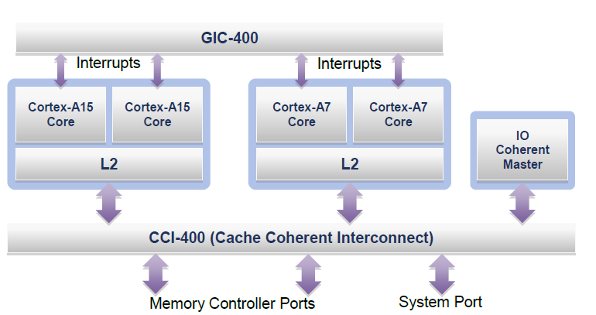
Forword (2)
Illustration of the terminology used
Processor
GIC: General
Interrupt Controller
CPU
Core cluster
CPU core
Figure: An example big.LITTLE processor [37]
CPU cores are the basic building blocks of processors, like ARM’s Cortex-A cores,
multiple CPU cores along with a shared cache may be set up to core clusters,
multiple core clusters may be included in a CPU and
a CPU augmented by further functional units, like GPUs, NPUs, a Cache Coherent
Interconnect makes up a processor, as demonstrated in the Figure above.

Slide 4
Forword (3)
Remark to the terminology -2
In their presentations and documentations ARM often designates cores as CPUs.
While relating to the Cortex-A family of CPUs neither ARM nor the Lecture Notes
are consequent in using the “A tag” (Application) in any case.
Nevertheless, the related Sections discuss only CPU cores based on the Armvx-A ISA,
regardless, whether the “A tag” is stated or not in a designation.

Slide 5
ARM’s CPU cores
1. Introduction to ARM
2. Evolution of the ARM ISA up to the Armv8 release
3. The Cortex family of CPU cores
4. The evolution path of CPU configurations
in Arm-based mobile processors
5. References
Notes:
5

Slide 6
1. Introduction to ARM

Slide 7
1. Introduction to ARM (1)
1. Introduction to ARM
ARM (ARM Holdings plc) was a British semiconductor design company with
its headquarter in Cambridge, that was acquired by Softbank (Japan) in 2016.
The company
designs low power processor components for the embedded, mobile and server
market, such as Cortex CPUs, Mali GPUs, Ethos NPUs, Memory Controllers
(DMC), on-chip interconnects etc. as well as
develops related software tools (e.g. development studios etc.),
and licences their IP (Intellectual Property) including their Arm ISA but
does not fabricate semiconductors.
Here we note that ARM announced in 2018 a new CPU family branding as well,
called Neoverse for processors and platforms, aiming at information
infrastructures (datacenters, routers, switches etc.), not discussed in this
Lecture.
plc: Public Limited Company (a.m. kft)
NPU: Neural Processing Unit
Intellectual Property: szellemi tulajdon

Slide 8
1. Introduction to ARM (2)
Example 1: ARM's IP offer related to the Cortex-A73 CPU [89]
Graphic IP | Other IP | Tools
ARM Mali™-G71 Mali-DP550 (Display processor) Mali-V550 (Video Processor) | ARM CoreLink™ CCI-550 (Cache Coherent Interconnect) CoreLink GIC-500 (Interrupt Controller) CoreLink MMU-500 (System Memory Management Unit) CoreLink TZC-400 (ARM TrustZone® Controller) CoreLink DMC-500/DMC-520 (Dynamic Memory Controller) ARM CoreSight™ SoC-400 (Debug and Trace) ARM POP™ (Physical IP) | ARM DS-5 Development Studio Fixed Virtual Platforms ARM Versatile™ Express ARM Compiler 6 ARM Fast Models

Slide 9
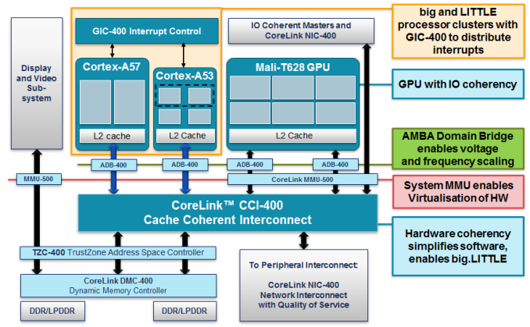
1. Introduction to ARM (3)
Example 2: Armv8.0-based SoC design with Cortex-A57/A53 CPUs and
CCI-400 interconnect (2012) [134]
ADB: AMBA Domain Bridge
(to implement DVFS)
Published by ARM and used in LG's Odin/Nuclun SoC.

Slide 10
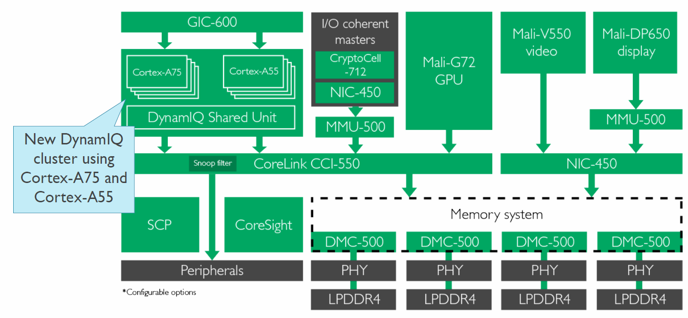
1. Introduction to ARM (4)
Example 3: Armv8.2-based SoC design with Cortex-A75/A55 CPUs and
CCI-550 interconnect (2017) [135]
CCI-550: Cache Coherent interconnect
MMU-500: Memory Management Unit (responsible for virtualization and caching)
NIC-450: Network Interconnect (interface converter)
GIC-600: General Interrupt Controller
SCP: System Control Processor

Slide 11
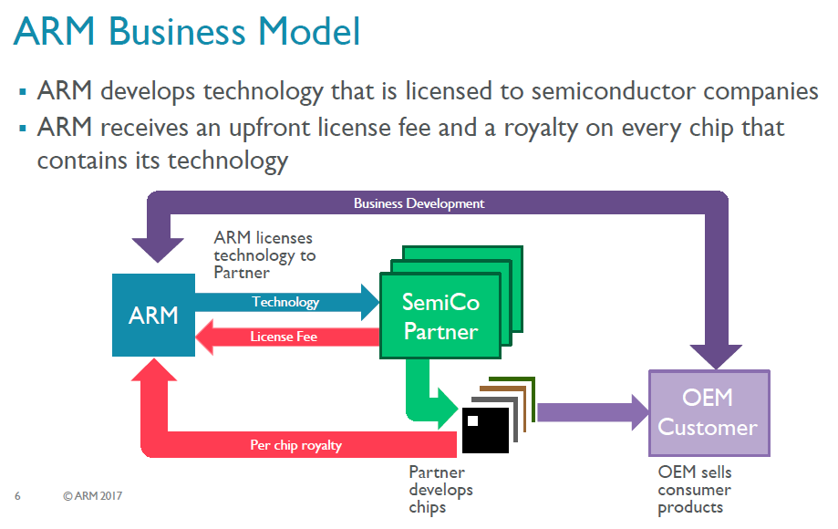
1. Introduction to ARM (5)
ARM's business model [117]
ARM possesses the Arm ISA as well as develops functional units and licenses them
to semiconductor companies.
ARM receives an upfront license fee and subsequently a royalty on every chip that contains
its technology.
Semiconductor partners fabricate and sell chips to OEMs (Original Equipment
Manufacturers) while OEMs provide feedback to Arm for new design needs.

Slide 12
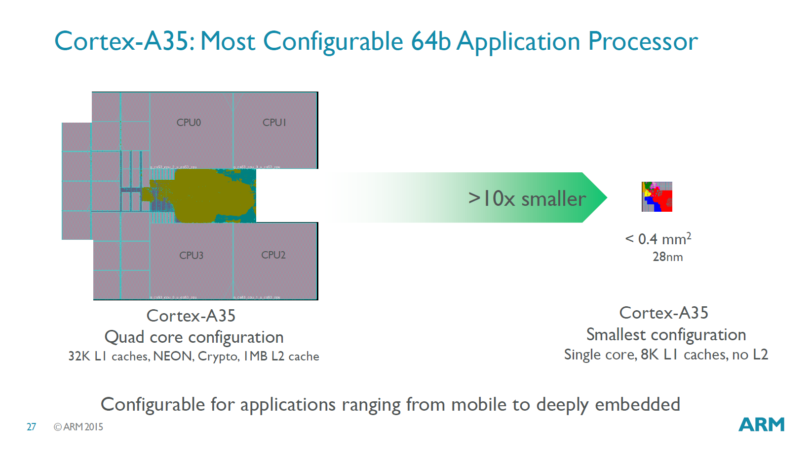
1. Introduction to ARM (6)
Configurability of ARM’s designs
ARM’s design are configurable, e.g. L1/L2/l3 cache sizes, core counts etc. may be
chosen by implementation.
The Figure below shows an example for configuration options of a Cortex-A35
CPU ranging from mobile to deeply embedded use.
Figure: Configuration options of a Cortex-A35 CPU [96]

Slide 13
1. Introduction to ARM (7)
Evolution of the approaches used for circuit design -1 [1]
Approaches to circuit design
Full custom design
Semi custom design
Full synthesizable design
Hand layout of the
entire circuit
The design will be subdivided into
functional units and further on into blocks
and the appropriate implementation technique
(hand layout, structured layout or automated layout)
is chosen for each.
Automated layout of the
entire circuit
Simple scaling, e.g.
from 28 nm to 16 nm
Power/performance
optimized
Implementation time
optimized
Trend

Slide 14
1. Introduction to ARM (8)
Evolution of the approaches used to circuit design -2 [1]
ARM's processor designs before the Cortex-A9 were partly hand layouts and
partly automated layouts.
ARM’s first fully synthesizable design was the Cortex-A9 processor (announced in 2007).
Recently, automated design tools are typically used for processor design.
Over time more and more advanced standard cell libraries were developed that
have a large variety of design options, e.g. cell types or drive strengths, which
lessens the need for custom design.

Slide 15
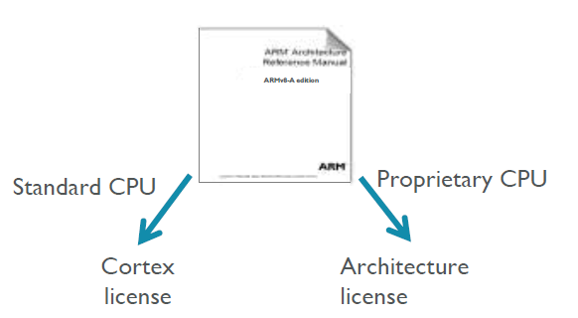
1. Introduction to ARM (9)
ARM’s licensing policy [131] -1
ARM provides either a Cortex license or an Architecture license.
In case of a Cortex license the licensee gets a complete standard microarchitecture
design (IP) with flexible configuration options, e.g. for the sizes of the L1 or L2
caches.
The Architecture license allows using the ARM ISA and the licensee has to design
their custom microarchitecture, which leads to a proprietary CPU.
E.g. Apple or Samsung bought an Architecture license, designed their CPUs
and named them as they liked.

Slide 16
1. Introduction to ARM (10)
ARM’s advanced “Built on ARM Cortex Technology” licensing model [131]
Introduced in 02/2016.
It is available only for lead partners.
The new license agreement allows licensees to request changes of the
microarchitecture and use this customized design in their products.
ARM provides its engineering and design services for implementing the requested
modifications for additional costs.
Under the license's terms, ARM still owns the IP, however the modified
microarchitecture is not shared or made available to other licensees.
Licensees have branding freedom.
An example is Qualcomm’s Kryo 280 CPU that is based on ARM’s Cortex-A73,
whereas earlier Qualcomm CPUs were custom designed based on an
Architecture license.

Slide 17
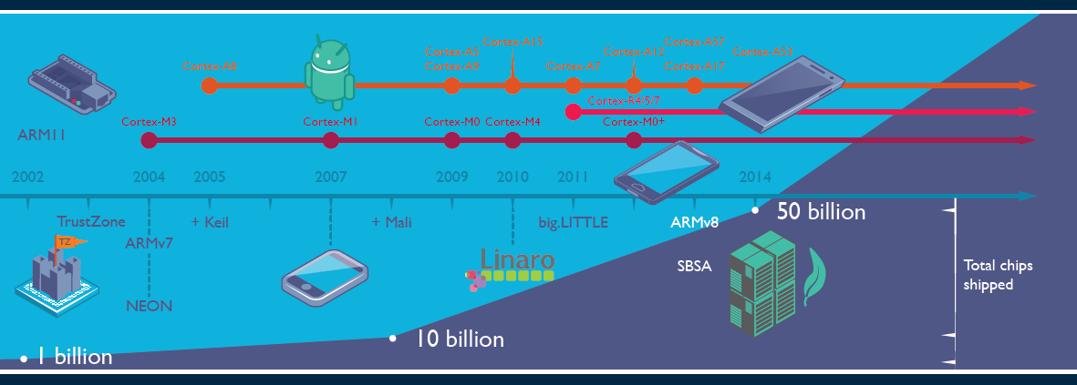
1. Introduction to ARM (11)
Evolution of ARM’s products and the total number of ARM based chips shipped [19]
Keil: Software development tool for embedded processors Cortex R: Real time M: Embedded
Linaro: Nonprofit company, established by ARM, Freescale, IBM, Samsung, ST-Ericsson and TI
to support open source software developers using Linux on SoCs.
SBSA: Server Base System Architecture, a standardized server platform for 64-bit ARM processors.

Slide 18
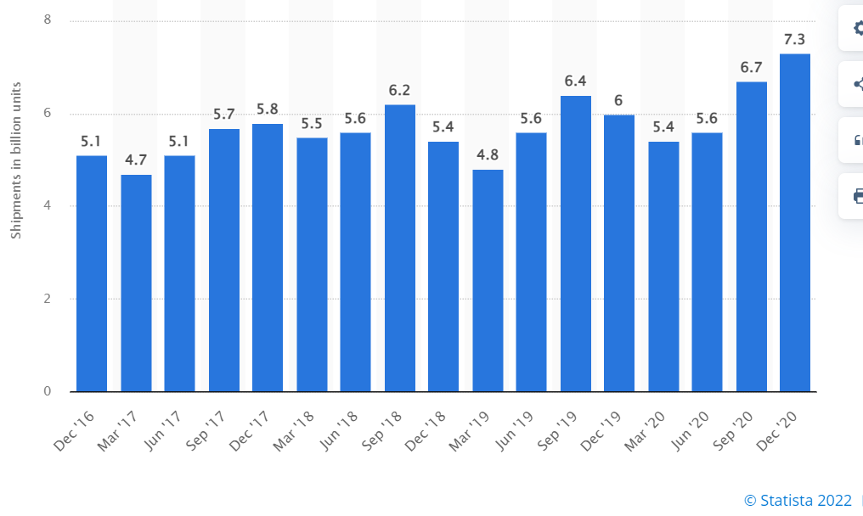
1. Introduction to ARM (12)
Number of ARM ISA-based chips shipped per quarter 2016-2020 [166]

Slide 19
1. Introduction to ARM (13)
Total number of ARM-based chips shipped until 10/2021
As ARM announced, until 10/2021 there were over 200 billion chips shipped with
their ISA [167].

Slide 20
1. Introduction to ARM (14)
Why AMD designs became dominant in the embedded and mobile market?
(including smartphones and tablets)
The ARM ISA is a RISC architecture in contrast to the x86 ISA which is a CISC
ISA.
RISC ISAs are Load/Store architectures which fetch their operands from
registers,
whereas CISC architectures allow operand fetches both from registers and the
memory.
This has two consequences;
CISC instructions are different long, they may be 1 to 15 byte long, partly why they may refer to memory operands, whereas RISC instructions are equal long (typically 4-byte), since they only refer to register operands (except LS instructions, which also my be encoded in 4-bytes).
b) CISC architectures consume inherently more power since memory fetches
and decoding need more power than register fetches and RISC decoding.
This is the reason why ARM designs dominate recently the embedded and the
mobile market (including smartphones and tablets) and why increasingly more
ARM ISA-based server processor designs appear (e.g. ARM’s Neoverse line).

Slide 21
1. Introduction to ARM (15)
Historical remarks -1 [60], [61]
ARM’s parent company is Acorn Computers (UK).
Acorn Computers started their Acorn RISC Machine project in October 1983
to develop a powerful processor for a line of business computers,
(two years after the introduction of the IBM PC).
The acronym ARM was coined originally at this time (1983) from the designation
Acorn RISC Machine.
In 1990 the company Advanced RISC Machines Ltd. (ARM Ltd.) was founded as a
joint venture of Acorn Computers, Apple Computers and VLSI Technology.
Accordingly, also the interpretation of ARM was changed to “Advanced RISC
Machines”.

Slide 22
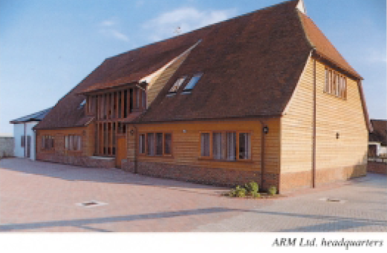
1. Introduction to ARM (16)
Historical remarks -2
Figure: The headquarters of ARM Ltd. about 1990 [62]

Slide 23
1. Introduction to ARM (17)
Optional reading: A brief account of the beginning of ARM [168]
“ARM’s First Chip¹ (from 1992)
Although the ARM processor were developed as a custom device for a highly specific purpose, the team designing it felt that the best way to produce a good custom solution was to produce a processor with good all-round performance. However, it’s interesting to note that the ARM’s architectural fate was sealed accidentally. While most of the RISC processor vendors were designing relatively huge chips (SPARC RISC, Intel i860, AMD 29000, etc.), ARM opted to develop a small-scale processor. One of the reasons the ARM processor was designed as a small-scale solution was that the resources to design it were not sufficient to allow the creation of a large and complex device. While this is now a technical plus for the ARM processor, it began as a necessity for a processor designed by a team of talented, but inexperienced designers (outside of university projects, most team members were programmers and board-level circuit designers) using new tools, some of which were far from state-of-the-art. Despite the unusal working quarters, the motivation and excitement of the small team was high and the company had an open, communicative style that helped maintain the “buzz”.
As with most start-up’s, ARM’s primary goal was to get the first product out; in this case, it was the ARM610, designed specifically for Apple. This product included full 32-bit addressing and endian-ness support, one of many changes requested by Apple in order to use the ARM processor in its planned products. An improved video controller, VIDC20, was also developed as well as a floating-point processor. Apple’s goal was to use the IP product within a hand-held personal organizer processor. The processor became known as ARM600, from which the 20 MHz ARM610 used in the Newton was later derived. At the same time, ARM Ltd.'s software team developed the ARM Cross Development Toolkit, a suite of software that allowed designers working on a range of platforms to use ARM development tools, assembler, compilers, and debugging and emulation programs.”
¹ Armv3 based

Slide 24
1. Introduction to ARM (18)
Historical remarks -3
Finally, in 1998 the company went to the stock exchange and its name was changed
to ARM Holdings plc, to its current designation.

Slide 25

1. Introduction to ARM (19)
Historical remarks -4
Figure: ARM's recent headquarter in Cambridge (UK) [78]

Slide 26
1. Introduction to ARM (20)
Acquisition of ARM by Softbank (Japan)
Announced in 07/2016
Completed in 09/2016
Price: 31 bUSD (ARM's revenues in 2015 ≈ 1.5 bUSD).

Slide 27
1. Introduction to ARM (21)
NVIDIA’s intention to acquire ARM from Softbank
Announced in 09/2020
Price: 40 bUSD
To be completed in 2022.
NVIDIA aims at “burying x86 PCs” as stated by their CEO (Huang) in 09/2020
[134]:
"The PC of the future will be made by new OEMs, sold through new distributors
and use a new instruction-set architecture.
ARM will be the most important CPU architecture of the future, and it already is
the fastest growing processor architecture.”

Slide 28
1. Introduction to ARM (22)
Cancellation of the acquisition of ARM by NVIDIA [169]
In 02/2022 NVIDIA and Softbank (ARM’s owner) announced the termination of
the previously planned transaction due to regulatory objections.
At this occasion Huang, CEO of NVIDIA stated that “I expect Arm to be the
most important CPU architecture of the next decade.”

Slide 29
2. Evolution of the ARM ISA up to the Armv8.0 release
2.1 Overview of the evolution of the Arm ISA
2.2 ISA extensions introduced to enhance compute capabilities
2.3 The SVE register set-based ISA extensions
2.4 Further extensions of the Armv8-A ISA for enhancing compute
capabilities

Slide 30
2.1 Overview of the evolution of the Arm ISA

Slide 31
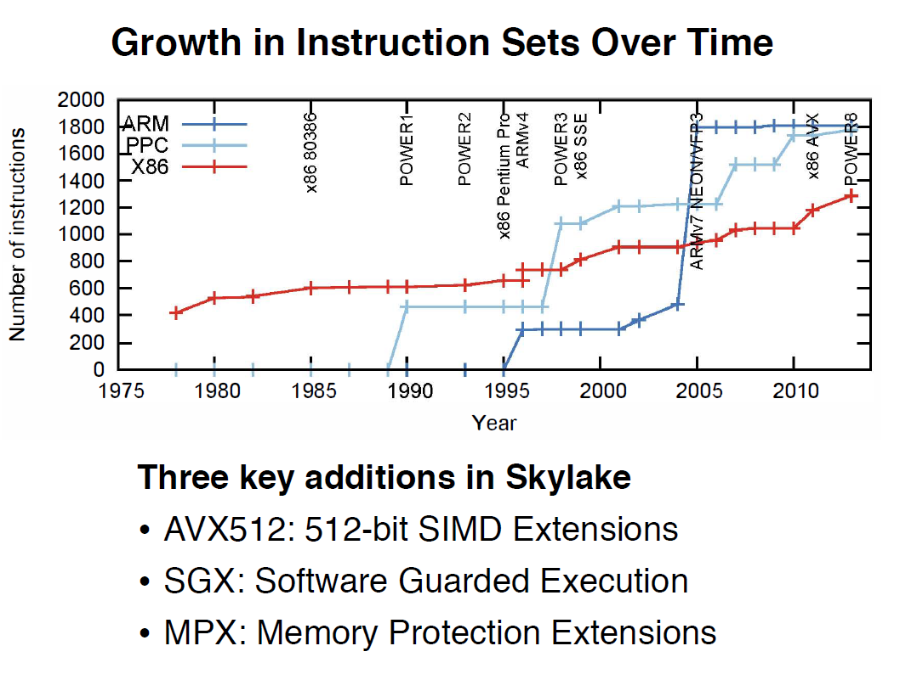
2.1 Overview of the evolution of the Arm ISA (1)
2.1 Overview of the evolution of the Arm ISA
Growth of instruction sets of processors over time [163]
Note in the above Figure that both RISC ISAs, (IBM’s PPC and the Arm ISA), as well as
the x86 CISC ISA evolve continuously, and the number of available instructions has been raised
tremendously in both RISC (Reduced Instruction Set Computer) and CISC (Complex
Instruction Set Computer) ISAs to far over 1000, thus recently the number of instructions
in RISC and CISC ISAs do not differ notably from each other any more.

Slide 32
2.1 Overview of the evolution of the Arm ISA (2)
Overview of ARM’s ISA versions
Also ARM’s ISA has been evolved enormously.
How huge work has been done is indicated by the fact that the recent (2022)
Architecture Reference Manual [171] covers more than 11000 pages.
A half page excerpt of the manual illustrates this on the next slide.

Slide 33
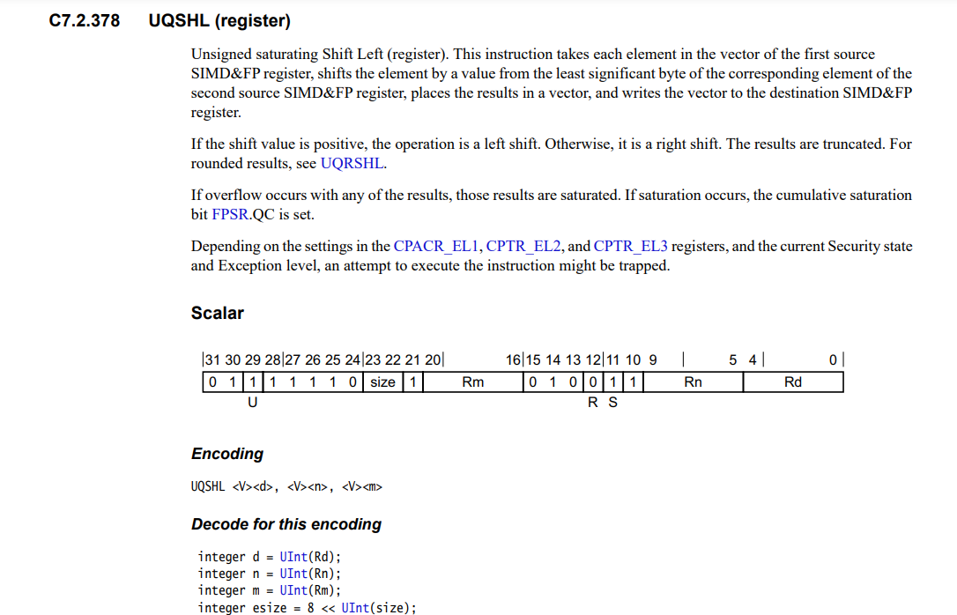
2.1 Overview of the evolution of the Arm ISA (3)
Example: 1/2 page excerpt of the Arm Architecture Reference Manual (2022) [171]
(1/2 from 11530)

Slide 34
2.1 Overview of the evolution of the Arm ISA (4)
ARM’s basic ISA
Until now there are nine ARM ISA versions, designated as Armv1 to Armv9,
described in related releases of the Architecture Reference Manual.
The earliest versions (Armv1 and Armv2) only provided an address range of
26 bits yet, the first ISA version with 32 bit address range became the Armv3,
first implemented (in the ARM60 processor) in 1992.
Arbitrarily, we consider the Armv3 ISA as ARM’s basic ISA and discuss its
evolution next.
Armv3
Armv4
Armv5
Armv6
Armv7-A
Armv8.0-A
Armv9-A
Example CPUs
ARM60
(1992)
ARM710T
(~1995)
ARM10200
(2000)
ARM1136
(2002)
Cortex-A5 - A15
(2005)
Cortex-A53/A57
(2012)
Neoverse N2/V1
Cortex-X2/A510/A710
cores (2021)

Slide 35
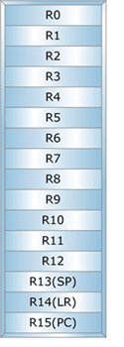
2.1 Overview of the evolution of the Arm ISA (5)
Key features of ARM’s basic ISA
It is a straightforward 32-bit RISC ISA, capable of processing only 32-bit scalar FX
and logical data, as it mainly aimed at embedded microcontrollers.
This ISA provides 16 32-bit registers, called the core registers.
13 out of them are used as general purpose registers (GPRs), the remaining three
are dedicated, as shown below.
GPR
Stack pointer
Link register
PC
Figure: Core registers in the Armv3-Armv7 ISA versions [63]

Slide 36
2.1 Overview of the evolution of the Arm ISA (6)
Main directions of extending ARM’s basic ISA (simplified)
Early focus of ARM ISA extensions (1)
As ARM’s early (26/32-bit) processors were mostly used in embedded applications,
the code size and the execution speed of bytecodes were of importance.
This motivated ARM to introduce enhancements first for reducing code size and
speeding up the execution of bytecodes, as pointed out in the next Figure.
Main directions of extending ARM’s basic ISA
ISA extensions
to reduce
code size
ISA extensions
to speed up
the execution of bytecodes
After focusing on mobiles
these extensions became obsolete
Later, more or less when ARM’s processors became 64-bit wide, these extensions
became obsolete.

Slide 37
2.1 Overview of the evolution of the Arm ISA (7)
Changing focus of using ARM processors in the early 2000’s (2)
Next, in the early 2000’s ARM processors found their way more and more
into mobiles where more general workloads were common, including graphics
processing.
This was the reason for introducing ISA extension for enhancing compute capabilities
by FP and SIMD processing and also for security improvements, as indicated below.
Main directions of extending ARM’s basic ISA
ISA extensions
to reduce
code size
ISA extensions
to speed up
the execution of bytecodes
ISA extensions
to enhance
compute capabilities
ISA extensions
to enhance
security
Discussed
subsequently
Not discussed

Slide 38
2.1 Overview of the evolution of the Arm ISA (8)
Overview of the main directions and actual extensions of ARM’s basic ISA
(For the explanation of the superscripts in the Figure see next slide)
The thumb instruction set aims at reducing code size.
AArch32
AArch64
AArch64
Crypto-graph. extension
To enhance
security
TrustZone
Confidential
Compute Arch.
MTE
A32
SVE⁴
(v8.2, opt.)
A64
Aarch32⁵
A64
SVE2
To enhance
compute
capabilities
SIMD
Adv. SIMD¹
(NEON)
VFPv1/2
VFPv3/v4²
To speed up
the execution
of bytecodes
Jazelle
(Jazelle DBX)
Jazelle
(ex. by SW)
Jazelle RCT³
(ThumbEE)
Thumb⁶
(Armv4T)
Thumb-2
(Armv6T2)
T32
(Thumb)
Armv4
Armv5
Armv6
Armv7-A
Armv8.0-A
Armv9-A
ARM710T
(~1995)
ARM10200
(2000)
ARM1136
(2002)
Cortex-A5 - A15
(2004)
Cortex-A53/A57
(2012)
Neoverse N2/V1
Cortex-X2/A510/A710
cores (2021)

Slide 39
2.1 Overview of the evolution of the Arm ISA (9)
Explanation of the superscripts in the previous Figure
¹Neon technology is ARM’s designation for Advanced SIMD extensions.
²The VFP subset became depricated in the Armv8 ISA.
³Jazelle-RTC (ThumbEE) became depricated in Armv7 Issue C in 10/2011.
⁴The SVE (Scalable Vector Extension) subset became introduced in the
Armv8.2 ISA as an optional feature, only in 2017.
⁵The AArch32 execution mode is only supported in certain implementations, e.g.
in the Cortex-A510 CPU.

Slide 40
2.1 Overview of the evolution of the Arm ISA (10)
The importance of the Armv7/v8 ISA releases
The Armv7 (2004) and especially the Armv8 (2012) ISA releases were major
contributors for enhancing the compute capabilities of ARM’s processors.
ARM announced the Armv7 ISA release in 2004 and along with it the Cortex Family
of CPU cores, these processors became the workhorse for mobile processors of the 2000’s.
Along with the Armv8 ISA revision in 2012 ARM opened the way for 64-bit processing
and provided largely enhanced register spaces for computing, as discussed later.
The new 64-bit Armv8 ISA introduced two execution modes (AArch32/Aarch64)
in order to provide backward compatibility with the 32-bit Armv7 ISA.
In the Aarch32 execution mode processors behave like Armv7 processors, so they
have the same execution capabilities as provided in the Armv7 ISA, whereas
in the Aarch64 execution mode the processor has a largely extended register space
for executing instructions, compared to the Armv7 ISA, as discussed later.
At the same time early aspects, like reducing code size and speeding up the
execution of bytecodes became pointless and their support was dropped,
as indicated in the next Figure.

Slide 41
2.1 Overview of the evolution of the Arm ISA (11)
The importance of the Armv9 release
The last phase of the ISA evolution revealed in 2021) is mainly connected to the
Armv9 release and provides enhanced support for AI.
AI support is manifested in further improving performance and security.
As performance is concerned, the Armv9 release made SVE mandatory
(optional from 2017 on) and introduced as mandatory feature SVE2
(see Section 2.3).
To improve security, Armv9 introduced the Confidential Compute Architecture
and also Memory Tagging (not discussed).

Slide 42
2.1 Overview of the evolution of the Arm ISA (12)
Summing up key issues of the overview of extending the Arm ISA (1)
Both RISC ISAs (IBM’s PPC and the Arm ISA), as well as the x86 CISC ISA evolve
continuously, and the number of available instructions has been raised tremendously
in both RISC (Reduced Instruction Set Computer) and CISC (Complex Instruction Set
Computer) ISAs to far over 1000, thus recently the number of instructions in RISC
and CISC ISAs do not differ notably from each other any more.
Overview of ARM’s ISA versions
Until now there are nine ARM ISA versions, designated as Armv1 to Armv9,
described in related releases of the Architecture Reference Manuals.
The earliest versions (Armv1 and Armv2) provided an address range of only
26 bits yet, the first ISA version with 32 bit address range became the Armv3,
first implemented in 1992.
Arbitrarily, we consider the Armv3 ISA as ARM’s basic ISA and discuss its
evolution.
Key features of ARM’s basic ISA
It is a straightforward 32-bit RISC ISA, capable of processing only 32-bit scalar FX
and logical data, as it mainly aimed at embedded microcontrollers.
The ISA provides 16 32-bit registers, called the core registers.
13 out of them are used as general purpose registers (GPRs), the remaining three
are dedicated.

Slide 43
2.1 Overview of the evolution of the Arm ISA (13)
Summing up key issues of the overview of extending the Arm ISA (2)
Changing focus of the ARM ISA extensions -1
As ARM’s early (26/32-bit) processors were mostly used in embedded applications,
the code size and the execution speed of bytecodes were of importance.
This motivated ARM to introduce early enhancements to reduce code size and
speed up the execution of bytecodes, not discussed in this Section.
Next, in the early 2000’s ARM processors found their way more and more
into mobiles where more general workloads were common, including graphics
processing.
This was the reason for enhancing compute capabilities by FP and SIMD processing,
and also by security improvements.
The Armv7 (2005) and especially the Armv8 (2011) ISA releases were major
contributions to this move.
ARM announced the Armv7 ISA release in 2004 and along with it the Cortex Family
of CPU cores, these processors became the workhorse for mobile processors of the 2000’s.

Slide 44
2.1 Overview of the evolution of the Arm ISA (14)
Summing up key issues of the overview of extending the Arm ISA (3)
Changing focus of the ARM ISA extensions -2
Along with the Armv8 ISA revision ARM opened the way for 64-bit processing
and provided largely enhanced register spaces.
The new 64-bit Armv8 ISA introduced two execution modes (AArch32/Aarch64)
in order to provide backward compatibility with the 32-bit Armv7 ISA.
In the Aarch32 execution mode the processor behaves like an Armv7 processor, so it
has the same execution capabilities as the Armv7 ISA, whereas in the Aarch64
execution mode the processor has a largely extended register set and a largely
enhanced register space for executing instructions, compared to the Armv7 ISA.
The last phase of the ISA evolution is mainly connected to the Armv9 release,
revealed in 2021.
In this phase of the evolution, performance and security remained the dominant
aspects and motivations to introduce further enhancements to compute capabilities,
like the SVE/SVE2 extension or extensions to security, such as the Confidential
Compute Architecture or the Memory Tagging Extension, to be discussed later.
At the same time early aspects, like reducing code size and speeding up the
execution of bytecodes became pointless and their support was dropped.

Slide 45
2.2 ISA extensions introduced to enhance compute capabilities

Slide 46
2.2 ISA extensions introduced to enhance compute capabilities (1)
2.2 ISA extensions introduced to enhance compute capabilities -1
Main directions of extending ARM’s basic ISA
ISA extensions
to reduce
code size
ISA extensions
to speed up
the execution of bytecodes
ISA extensions
to enhance
compute capabilities
ISA extensions
to enhance
security

Slide 47
2.2 ISA extensions introduced to enhance compute capabilities (2)
The starting point: ARM’s basic ISA (Armv3, 1992) [63], [66]
As already discussed and indicated in the Figure below, ARM’s basic ISA only provides
13 32-bit wide GPR registers and supports scalar computing with FX32 and Boolean data,
since it is mainly aimed at embedded microcontrollers.
32-bit wide
GPR register set
(Basic ISA)
R0
R1
R2
.
.
.
R12
R13(SP)
Stack pointer
Link register
PC
R14(LR)
R15(PC)
GPRs in the Armv3-Armv7 ISA
Basic ISA
Figure: ARM’s basic ISA
Scalar data (+Boolean)
FX32

Slide 48
2.2 ISA extensions introduced to enhance compute capabilities (3)
ISA extensions introduced to enhance compute capabilities -2
ARM’s ISA extensions for enhancing compute capabilities may best be described by
considering the register sets introduced for this reason and the declared ISA extensions
provided for manipulating data in the declared register spaces.

Slide 49
2.2 ISA extensions introduced to enhance compute capabilities (4)
Register sets introduced in the Arm ISA
In the long history of the Arm ISA, the firm introduced three different register sets,
as shown below.
Register sets introduced in the Arm ISA
(GPR register set
of the basic ISA)
Secondary register set
SVE register set
Introduced in
Armv3 (1992)
Armv5 (2000)
(yet in the FP coprocessor)
Armv8.2 (2016), optional
(in the AArch64 mode)
Armv9.0 (2021) mandatory
Extended in
Armv8 (2012)
Armv7 (2004)
(moved into the core)
Armv8 (2012)
(in the AArch64 mode)

Slide 50
2.2 ISA extensions introduced to enhance compute capabilities (5)
Extending the GPR and secondary register sets
As indicated in the previous Figure, in the course of the dynamic evolution of the
ARM ISA both the GPR and the secondary register space became extended,
as discussed next.

Slide 51
2.2 ISA extensions introduced to enhance compute capabilities (6)
a) Extending the GPR register set in the Armv8 ISA (2012) [63], [66]
The GPR register set was vastly enlarged in the Armv8 ISA release, as shown below.
32-bit wide
32-bit wide
64-bit wide
R0
X0
W0
R1
X1
W1
R2
X2
W2
W3
X3
.
.
.
.
.
.
.
.
.
R12
X12
W12
R13(SP)
Stack pointer
Link register
PC
X13
W13
R14(LR)
X14
W14
R15(PC)
.
.
.
.
.
.
X30
W30
X31
Dedicated use
W31
Dedicated use
32-bit access
64-bit access
GPRs in the Armv3-Armv7 ISA
and in the Armv8 ISA
in the AArch32 execution mode (2012)
GPRs in the Armv8 ISA
in the AArch64 execution mode (2012)

Slide 52
2.2 ISA extensions introduced to enhance compute capabilities (7)
b) Introducing a secondary register set into the Arm ISA and its extension
For efficient implementation of FP calculations needed e.g. in 3D applications, ARM
introduced a secondary register space of 32 32-bit wide registers in the Armv5 ISA
and implemented it in the FP coprocessor in 2000.
Subsequently, when the Arm ISA became widely used in mobiles, ARM extended this
register space to 32 64-bit registers and implemented it in the CPU core, to introduce
64/128-bit SIMD processing in 2004.
Finally, in the Armv8 Aarch64 execution mode ARM widened the secondary register set to
32 128-bit in 2012, to provide better support for 128-bit processing, as illustrated below.
(Implemented in
the coprocessor)
(Implemented in
the CPU core)
(Implemented in
the CPU core)
32
64
128
32
32
32
Armv5
Armv7 (or Armv8 AArch32 mode)
Armv8 AArch64 mode
(2000)
(2004)
(2012)
Figure: Introducing a secondary register set into the Arm ISA and its evolution

Slide 53
2.2 ISA extensions introduced to enhance compute capabilities (8)
ARM’s names of the introduced secondary register set
ARM’s names for the discussed additional register sets are confusing, as indicated below.
FP register set
Advanced SIMD and FP register set
(Extension register set)
SIMD and FP register set
32
64
128
32
32
32
Armv5
Armv7 (or Armv8 AArch32 mode)
Armv8 AArch64 mode
(2000)
(2004)
(2012)
Figure: Introduction and evolution of the secondary register set in the Arm ISA
This is the reason why we do not use ARM’s own register designations but refer to them
collectively as the secondary register set in this Section.

Slide 54
2.2 ISA extensions introduced to enhance compute capabilities (9)
c) Introducing the SVE register set into the Arm ISA [96]
The SVE (Scalable Vector Extension) was announced in 2016 (in the Hot Chips
conference) and introduced in the Armv8.2-based ISA in 2017 as an optional feature.
SVE is implemented only in the AArch64 mode of Armv8.2.
SVE aims at HPC scientific workloads rather than media or image processing.
It provides 32 registers (called Z0 – Z31), each up to 16 x 128 bit long
(implementation dependent) to hold data elements, as seen below.
SVE supports both FX- and FP SIMD processing.
SVE register set
128
---
32
(1...16)x 128 bit
Armv8.2 (AArch64 mode)
Figure: The SVE register set

Slide 55
2.2 ISA extensions introduced to enhance compute capabilities (10)
ISA extensions declared to the introduced register spaces
Next we are going to present ARM’s ISA extensions introduced up to the Armv8.0 ISA
for enhancing compute capabilities.
Key extensions brought in along with the Armv8.2 and Armv9 ISAs are described separately
in the Sections 4.2 and 5.2, (except the SVE/SVE2 extensions that are described
in the following Section).

Slide 56
2.2 ISA extensions introduced to enhance compute capabilities (11)
Overview of ARM’s ISA extensions declared to enhance compute capabilities -1
The sequence of ARM’s ISA extensions introduced represents a clear-cut logic as follows:
Based on the existing GPR register set, first FX SIMD instructions were added to
the scalar FX instructions provided by the basic ISA.
ARM’s ISA extensions introduced to enhance compute capabilities
FX SIMD
extensions
Based on the
GPR reg. set

Slide 57
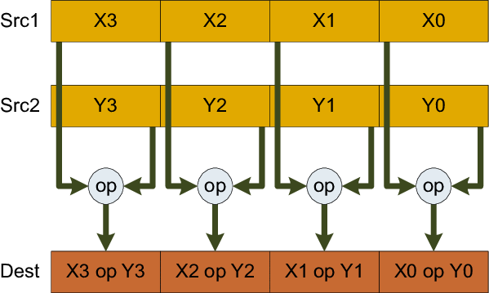
2.2 ISA extensions introduced to enhance compute capabilities (12)
Remarks to the introduction of SIMD instruction extensions
SIMD instructions execute the same operation on a number of data, as indicated
in the Figure below.
SIMD instructions may refer either to FX or FP data.
FX SIMD instructions support e.g. multimedia applications, by executing
(2/4/8 or more) FX-operations on pixels in-parallel, whereas
(FP SIMD instructions accelerate e.g. 3D graphics by executing multiple FP-operation
on graphics data).
Clearly, the introduction of SIMD instructions into a traditional ISA requires
an appropriate register space and ISA subset.
X:
Y:
Z = X op Y
Figure: Interpretation of the execution of SIMD instructions [179]

Slide 58
2.2 ISA extensions introduced to enhance compute capabilities (13)
Overview of ARM’s ISA extensions declared to enhance compute capabilities -2
Next the basic ISA was augmented by a secondary register set and based on it
scalar FP, vector FP (sequentially executed) and FX/FP SIMD instructions on
64/128-bit data vectors were introduced.
ARM’s ISA extensions introduced to enhance compute capabilities
Scalar FP
extensions
Vector FP
extension
FX/FP SIMD
extensions
(coproc. based)
(32-bit, coproc. based)
(Sequentially executed)
(64/128-bit, proc. based)
(Neon)
Based on the
secondary register set

Slide 59
2.2 ISA extensions introduced to enhance compute capabilities (14)
Remark to sequentially executed FP processing
ARM introduced in their ISA extension sequentially executed FP vector processing
by the FP coprocessor such that the coprocessor executed operations on up to 8
elements of two data vectors, held in coprocessor registers, one after another, in a loop.
This is in contrast to SIMD processing, when the operations are executed in parallel
on all elements of the vectors held in the register space.

Slide 60
2.2 ISA extensions introduced to enhance compute capabilities (15)
Overview of ARM’s ISA extensions declared to enhance compute capabilities -3
Finally, based on the SVE register set the very long FX/FP SIMD extensions were added,
that can operate on 128-2048 bit wide data vectors, as indicated below.
ARM’s ISA extensions introduced to enhance compute capabilities
Very long FX/FP SIMD
extensions
(128-2048-bit)
(SVE/SVE2)
Based on the
SVE register set

Slide 61
2.2 ISA extensions introduced to enhance compute capabilities (15b)
Summing up ARM’s ISA extensions declared to enhance compute capabilities -4
ARM’s ISA extensions introduced to enhance compute capabilities
FX SIMD
extensions
Scalar FP
extensions
Vector FP
extension
FX/FP SIMD
extensions
Very long FX/FP SIMD
extensions
(coproc. based)
(32-bit, coproc. based)
(Sequentially executed)
(64/128-bit)
(128-2048-bit)
(Neon)
(SVE/SVE2)
Based on the
GPR reg. set
Based on the
secondary register set
Based on the
SVE register set

Slide 62
2.2 ISA extensions introduced to enhance compute capabilities (16)
Remark: ARM’s names of their ISA extensions introduced to enhance compute capabilities
AMD refers to their ISA extensions aiming at enhancing compute capabilities by
confusing names, as shown below.
ARM’s ISA extensions introduced to enhance compute capabilities
FX SIMD
extensions
Scalar FP
extensions
Vector FP
extension
64/128-bit FX/FP SIMD extensions
128 - 2048-bit FX/FP SIMD
extensions
Designated at introduction
(SIMD)
(VFPv1/2)
(coproc. based)
(VFPv1/2)
(coproc. based)
(Sequentially
executed)
(Advanced SIMD)
(Neon) or (VFPv3/4)
(implementation
dependent)
(SVE/SVE2)
Introduced in
Armv6
(2002)
Armv5
(2000)
Armv5
(2000)
Armv7
(2005)
SVE: Armv8.2 (opt.) (2016)
SVE2: Armv9 (mandatory) (2021)
Based on the
GPR reg. set
Based on the
secondary register set
Based on the
SVE register set
(Section 2.3
Figure: AMD’s naming of their ISA extensions introduced to enhance compute capabiities
VFP: Vector FP
SVE: Scalable Vector Extension

Slide 63
2.2 ISA extensions introduced to enhance compute capabilities (17)
Recap: GPR and secondary register set based ISA extensions up to the Armv8.0
ARM ISA |  | Name of the extensions | Basic arch. |  | GPR-based FX-SIMD data type extension | Secondary register set based extensions
 |  |  | GPRs | Data type |  | Secondary reg. set | Scalar data types | SIMD (Vector) data types
Name
Armv1 | 1985 |  | n.a. | FX32
Armv2 | 1989 |  | n.a.
Armv3 | 1991 |  | 13x32
Armv4 | 1996
Armv5 | 2000 | VFP(v1)¹ |  |  |  | FP register set 32x32/16x64 | FP 32/64 | FP 32/64 Serially ex.
 |  | VFP2¹
Armv6 | 2002
 |  | SIMD |  |  | 32-bit wide FX8/16
Armv7 | 2005 | VFPv3² |  |  |  | Adv. SIMD and FP register set 32x64 or 16X128 | +FP 16⁵ | FP 16⁵/32/64
 |  | VFPv4^{2,3,4} |  |  |  |  | + FMA
 |  | Adv. SIMD (NEON)^{5,6} |  |  |  | 32x64 or16x128 | FP 32/64 | 64/128-bit wide FX 8/16/32/64 FP 16⁵/32/64 +FMA⁵
Armv8 | 2012 | SIMD/Neon (in AArch32) | 31x64 | FX32/64 | 32-bit wide FX8/16 | 32x64 or 16x128 | FP 16⁵/32/64 | As for Armv7 Adv. SIMD
 |  | SIMD/Neon (in AArch64) |  |  | 64-bit wide FX8/16/32 | SIMD and FP register set 32x128 | FX 8/…/64 FP 16⁵/32/64 | As for Armv7 Adv. SIMD

Slide 64
2.2 ISA extensions introduced to enhance compute capabilities (18)
Remarks
¹VFPv2 vs. VFP(v1): VFPv2 adds some enhancements and modifications to VFPv1
²VFPv3/v4 and advanced SIMD register space:
Certain processors implement only 16 64-bit wide registers with the option to use
this register space as 32 32-wide registers.
³VFP3/v4 is a subset of Neon
⁴VFP4 is implemented on certain ARMv7 processors.
It adds FMA (Fused Multiply Accumulate) instructons to the VFPv3 instructon set.
⁵FP16 supports only data conversion between FP16 and FP32/FP64.
⁶In the Advanced SIMD (NEON) extension FP16 is supported only if VFP3/VFP4
is implemented respectively, FMA if VFP4 is implemented.

Slide 65
2.2 ISA extensions introduced to enhance compute capabilities (19)
Arm ISA extensions used at present in numeric computations
From all extensions introduced for enhancing the compute capabilities of the Arm ISA,
recently only the 64/128-bit FX/FP SIMD extension (commonly called Neon) and
the 128-2028-bit long FX/FP SIMD extensions, called SVE/SVE2 are of importance,
since they absorb all previous extensions.
ARM’s ISA extensions introduced to enhance compute capabilities
FX SIMD
extensions
Scalar FP
extensions
Vector FP
extension
FX/FP SIMD
extensions
Very long FX/FP SIMD
extensions
(Coproc. based)
(Coproc. based)
(Sequentially executed)
(64/128-bit)
(128-2048-bit)
(Neon)
(2005)
(SVE/SVE2)
(2017/2021)
Based on the
GPR reg. set
Based on the
secondary register set
Based on the
SVE register set

Slide 66
2.2 ISA extensions introduced to enhance compute capabilities (20)
Remarks on the evolution of Intel’s x86 ISA SIMD extensions [142] -1
It is worth comparing the evolution of SIMD extensions provided by the x86 ISA with
those introduced by the Arm ISA.
Intel introduced their first multimedia inspired MMX extension in the Pentium M
processor in 1997 while using the 64-bit mantissa part of the FP registers.
Subsequently, Intel defined a dedicated register space in the SSE extension in the
Pentium III (Katmai) core in 1999, as seen in the next Figure.

Slide 67
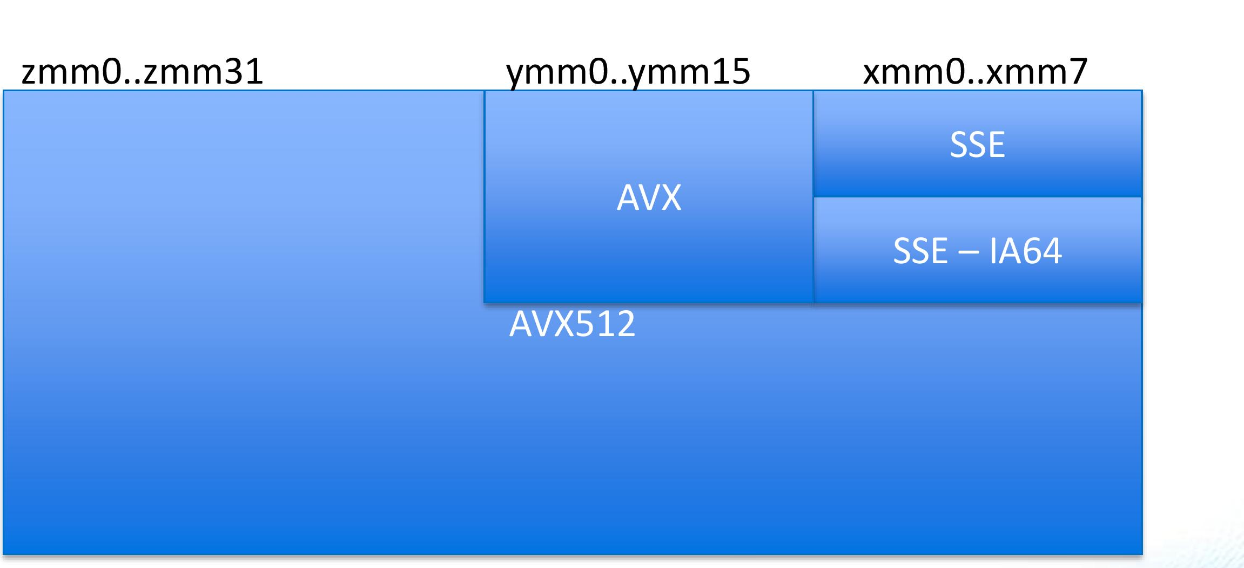
2.2 ISA extensions introduced to enhance compute capabilities (21)
Remarks on the evolution of Intel’s x86 ISA SIMD extensions [142] -2
The introduced dedicated register space was 8x128-bit in size.
It was extended in the following three steps:
first to 16x128-bit (in the SSE3 extension, in 2004),
then to 16x256-bit (in the AVX extension, in 2011) and
finally, to 32x512-bit (in the AVX512 extension, in 2017).
The extension was implemented in an aliased way, as discussed next.
zmm (511-0)
ymm (255-0)
xmm (128-0)
SSE (32-bit)
(xmm0-xmm7)
0
AVX/AVX2
ymm0-ymm15)
7
SSE3 (64-bit)
(xmm0-xmm15)
AVX-512
(zmm0-zmm31
15
AVX-512
(ymm0-ymm31
AVX-512
(xmm0-xmm31)
31
511
255
127
0
Figure: Dedicated register space of the x86 ISA for SIMD processing and its extension [180]

Slide 68
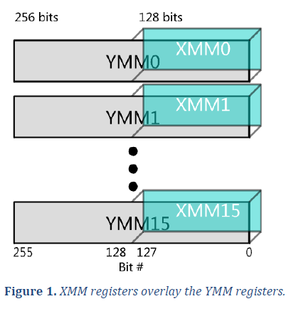
2.2 ISA extensions introduced to enhance compute capabilities (22)
Remark
In an aliased extension the lower parts of the extended registers (e.g. 256-bit registers)
are the initial (e.g. 128-bit) registers, as illustrated below.
Figure: Extending the existing 128-bit wide XMM [0, 15] SIMD register set
to the 256-bit YMM [0, 15] register set in an aliased way [181

Slide 69
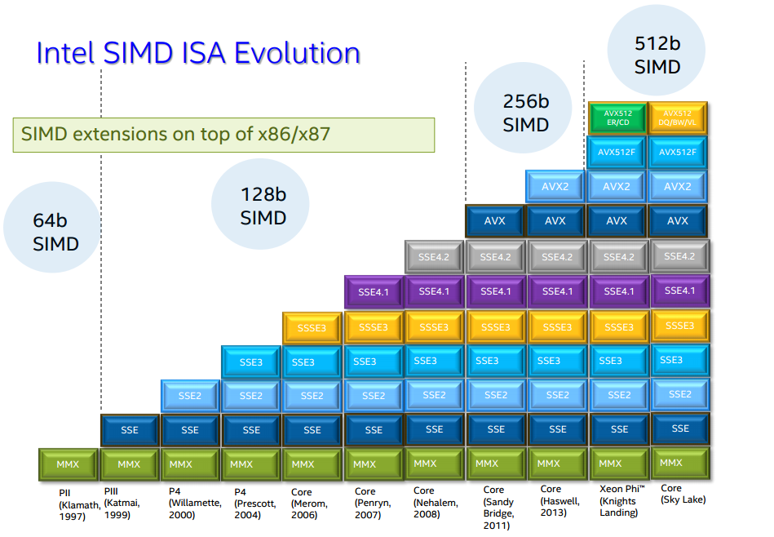
2.2 ISA extensions introduced to enhance compute capabilities (23)
Overview of Intel’s x86 ISA SIMD extensions [142]
Based on the register space extensions Intel
introduced the following SIMD extensions
of the x86 ISA:
Pentium_MMX
(1997)
PII
Klamath,
(1997)
Core
Cannon-Lake,
(2018)
Skylake-X/SP,
(2017)
(2016)

Slide 70
2.2 ISA extensions introduced to enhance compute capabilities (24)
Summing up Intel’s x86 ISA SIMD extensions [142]
SIMD extensions of Intel’s x86 ISA
MMX SIMD
extensions
SSE SIMD extensions
SSE2.SSE4.2 SIMD extensions
AVX SIMD extension
AVX2 SIMD extension
AVX-512
SIMD extension
64-bit
FX SIMD
128-bit
FP SIMD
128-bit
FX/FP SIMD
256-bit
FP SIMD
256-bit
FX/FP SIMD
512-bit
FX/FP SIMD
Introduced in
DTs/laptops
(Pentium-MMX)
(1997)
(Pentium III)
(1999)
(Pentium 4
Willamette)
(2000)
(Sandy Bridge)
(2011)
(Haswell
(2013)
(Cannon Lake)
(2018)

Slide 71
2.2 ISA extensions introduced to enhance compute capabilities (25)
Comparing Intel’s and AMD’s recent SIMD extensions
Beyond the general purpose 16x64-bit GPR and 8x80-bit FP architectural register
spaces, Intel’s x86-64 ISA declares three dedicated register spaces (of 16x128-,
16x256- and 32x512-bit) for SIMD operations, where the longer registers are aliased
with the smaller ones.
Intel introduced for each major ISA extension a different instructions set.
By contrast, AMD now makes use of two distinct register spaces for SIMD operations,
a 32x128-bit secondary register space for the Neon extension and a 32x128 to
2048-bit SVE register space for the SVE/SVE2 extensions.
The Neon and SVE ISA extensions make use of different ISA subsets, where the
SVE/SVE2 extensions are data length agnostic, i.e. the same instructions may be
used for different long data, e.g. for 128-, 256- or 512-bit data.
Here we note also that the Neon extension is expected to be replaced in the
future by the SVE2 extension, then all of ARM’s SIMD extensions may be used
in a unified way irrespective of their implementation width in the cores.

Slide 72
2.2 ISA extensions introduced to enhance compute capabilities (26)
Summing up key issues of ISA extensions introduced to enhance compute capabilities -1
The starting point: ARM’s basic ISA (Armv3, 1992) [63], [66]
As already discussed and indicated in the Figure below, ARM’s basic ISA only provides
13 32-bit wide GPR registers and supports scalar computing with FX32 and Boolean data,
since it is mainly aimed at embedded microcontrollers.
32-bit wide
GPR register set
(Basic ISA)
R0
R1
R2
.
.
.
R12
R13(SP)
Stack pointer
Link register
PC
R14(LR)
R15(PC)
GPRs in the Armv3-Armv7 ISA
Basic ISA
Figure: ARM’s basic ISA
Scalar data (+Boolean)
FX32

Slide 73
2.2 ISA extensions introduced to enhance compute capabilities (27)
Summing up key issues of ISA extensions introduced to enhance compute capabilities -2
ISA extensions introduced to enhance compute capabilities
ARM’s ISA extensions for enhancing compute capabilities may best be described by
considering the register sets introduced for this reason and the declared ISA extensions
provided for manipulating data in the declared register spaces.
Register sets introduced in the Arm ISA
In the long history of the Arm ISA, the firm introduced three different register sets,
as shown below.
Register sets introduced in the Arm ISA
(GPR register set
of the basic ISA)
Secondary register set
SVE register set
Extending the GPR and secondary register sets
As indicated in the previous Figure, in the course of the dynamic evolution of the
ARM ISA both the GPR and the secondary register space became extended,
as discussed next.

Slide 74
2.2 ISA extensions introduced to enhance compute capabilities (28)
Summing up key issues of ISA extensions introduced to enhance compute capabilities -3
a) Extending the GPR register set in the Armv8 ISA (2012) [63], [66]
The GPR register set was vastly enlarged in the Armv8 ISA release, as shown below.
32-bit wide
32-bit wide
64-bit wide
R0
X0
W0
R1
X1
W1
R2
X2
W2
W3
X3
.
.
.
.
.
.
.
.
.
R12
X12
W12
R13(SP)
Stack pointer
Link register
PC
X13
W13
R14(LR)
X14
W14
R15(PC)
.
.
.
.
.
.
X30
W30
X31
Dedicated use
W31
Dedicated use
32-bit access
64-bit access
GPRs in the Armv3-Armv7 ISA
and in the Armv8 ISA
in the AArch32 execution mode (2012)
GPRs in the Armv8 AArch64 execution mode (2012)

Slide 75
2.2 ISA extensions introduced to enhance compute capabilities (29)
Summing up key issues of ISA extensions introduced to enhance compute capabilities -4
b) Introducing a secondary register set into the Arm ISA and its extension
(Implemented in
the coprocessor)
(Implemented in
the CPU core)
(Implemented in
the CPU core)
32
64
128
32
32
32
Armv5
Armv7 (or Armv8 AArch32 mode)
Armv8 AArch64 mode
(2000)
(2004)
(2012)
Figure: Introducing a secondary register set into the Arm ISA and its evolution

Slide 76
2.2 ISA extensions introduced to enhance compute capabilities (30)
2.2 ISA extensions introduced to enhance compute capabilities (1)
Summing up key issues of ISA extensions introduced to enhance compute capabilities -5
Overview of ARM’s ISA extensions declared to enhance compute capabilities -1
The sequence of ARM’s ISA extensions introduced represents a clear-cut logic as follows:
Based on the existing GPR register set, first FX SIMD instructions were added to
the scalar FX instructions provided by the basic ISA.
Then the basic ISA was augmented by a secondary register set and based on it
scalar FP, vector FP (sequentially executed) and FX/FP SIMD instructions on
64/128-bit data vectors were introduced.
Finally, the very long SVE register set and FX/FP SIMD instructions on very long,
128-2048 bit wide data vectors were added, as indicated below.
ARM’s ISA extensions introduced to enhance compute capabilities
FX SIMD
extensions
Scalar FP
extensions
Vector FP
extension
FX/FP SIMD
extensions
Very long FX/FP SIMD
extensions
(coproc. based)
(32-bit, coproc. based)
(Sequentially executed)
(64/128-bit)
(128-2048-bit)
(Neon)
(SVE/SVE2)
Based on the
GPR reg. set
Based on the
secondary register set
Based on the
SVE register set

Slide 77
2.2 ISA extensions introduced to enhance compute capabilities (31)
Summing up key issues of ISA extensions introduced to enhance compute capabilities -6
Arm ISA extensions used at present in numeric computations
From all extensions introduced for enhancing the compute capabilities of the Arm ISA,
recently only the 64/128-bit FX/FP SIMD extension (commonly called Neon) and
the 128-2028-bit long FX/FP SIMD extensions, called SVE/SVE2 are of importance,
since they absorb all previous extensions.
ARM’s ISA extensions introduced to enhance compute capabilities
FX SIMD
extensions
Scalar FP
extensions
Vector FP
extension
FX/FP SIMD
extensions
Very long FX/FP SIMD
extensions
(Coproc. based)
(Coproc. based)
(Sequentially executed)
(64/128-bit)
(128-2048-bit)
(Neon)
(2005)
(SVE/SVE2)
(2017/2021)
Based on the
GPR reg. set
Based on the
secondary register set
Based on the
SVE register set

Slide 78
2.2 ISA extensions introduced to enhance compute capabilities (24)
Summing up Intel’s x86 ISA SIMD extensions [142]
SIMD extensions of Intel’s x86 ISA
MMX SIMD
extensions
SSE SIMD extensions
SSE2.SSE4.2 SIMD extensions
AVX SIMD extension
AVX2 SIMD extension
AVX-512
SIMD extension
64-bit
FX SIMD
128-bit
FP SIMD
128-bit
FX/FP SIMD
256-bit
FP SIMD
256-bit
FX/FP SIMD
512-bit
FX/FP SIMD
Introduced in
DTs/laptops
(Pentium-MMX)
(1997)
(Pentium III)
(1999)
(Pentium 4
Willamette)
(2000)
(Sandy Bridge)
(2011)
(Haswell
(2013)
(Cannon Lake)
(2018)

Slide 79
2.2 ISA extensions introduced to enhance compute capabilities (32)
Summing up key issues of ISA extensions introduced to enhance compute capabilities -7
Comparing Intel’s and AMD’s SIMD extensions
Beyond the general purpose 16x64-bit GPR register space, Intel’s x86-64 ISA
declares three dedicated register spaces (of 16x128-, 16x256- and 32x512-bit)
for SIMD operations, where the longer registers are aliased with the smaller ones.
Intel introduced for each major ISA extension a different instructions set.
By contrast, AMD recently, makes use of two distinct register spaces, a 32x128-bit
secondary register space for the Neon extension and a 32x128 to 2048-bit SVE
register space for the SVE/SVE2 extensions.
The Neon and SVE ISA extensions make use of different ISA subsets, where the
SVE/SVE2 extensions are data length agnostic, i.e. the same instructions may be
used for different long data, e.g. for 128-, 256- or 512-bit data.
Here we note also that the Neon extension is expected to be replaced in the
future by the SVE2 extension, then all of ARM’s SIMD extensions may be used
in a unified way irrespective of their implementation width in the cores.

Slide 80
2.3 The SVE register set-based ISA extensions

Slide 81
2.3 The SVE register set-based ISA extensions (1)
2.3 The SVE register set-based ISA extensions
Although the SVE extension was introduced in the Armv8.2-A ISA, (as an optional feature),
whereas the SVE2 in the Armv9-A ISA, (as a mandatory one), we discuss both
extensions within this Section in order to give a comprehensive overview of all
ISA extensions based on additional register spaces.
Both the SVE and SVE2 extensions are based on the SVE (Scalable Vector Extension)
register set, which is the third register set introduced into the Arm ISA, as indicated
below.
Register sets provided by the Arm ISA
The GPR register set
The secondary register set
The SVE register set
It supports
FX/ FX-SIMD operations
It supports
scalar FP/vector FP and
FX/FP SIMD operations
It supports
FX/FP SIMD operations
on long (up to 16x128-bit) data
Introduced in
Armv1/Armv6
Armv5/Armv7
Armv8.2
(1985/2002)
(2000/2005)
(2017)
Discussed in the previous Sections
Discussed in this Section

Slide 82
2.3 The SVE register set-based ISA extensions (2)
a) The SVE register set based SVE SIMD extension [96]
The SVE (Scalable Vector Extension) was announced in 2016 (in the Hot Chips
conference) and introduced in the Armv8.2-based ISA in 2017 as an optional feature.
SVE is implemented only in the AArch64 version of Armv8.2 and supports both
FX- and FP processing.
SVE aims at HPC scientific workloads rather than media or image processing.
It provides 32 registers (called Z0 – Z31), each including up to 16 x 128 bit lanes
(fields) to hold data elements, as seen below.
SVE register set
128
---
32
(1...16)x 128 bit
Armv8.2 (AArch64 mode)
Figure: The SVE register set

Slide 83
2.3 The SVE register set-based ISA extensions (3)
The SVE register set
The length of the SVE registers is implementation defined, though, their length
should be multiples of 128 bit, up to 16x128 (2048) bit.
The actual length of the SVE registers is held in a field (called LEN) in a control
register, not discussed here.
The 1. lanes (first 128 bits) of the SVE Z register set are shared with the 32 128-bit
wide SIMD registers (V0-31) of the Armv8.0 ISA, as indicated below.
LEN: 1 to 16
Designation of the SVE registers [96]

Slide 84
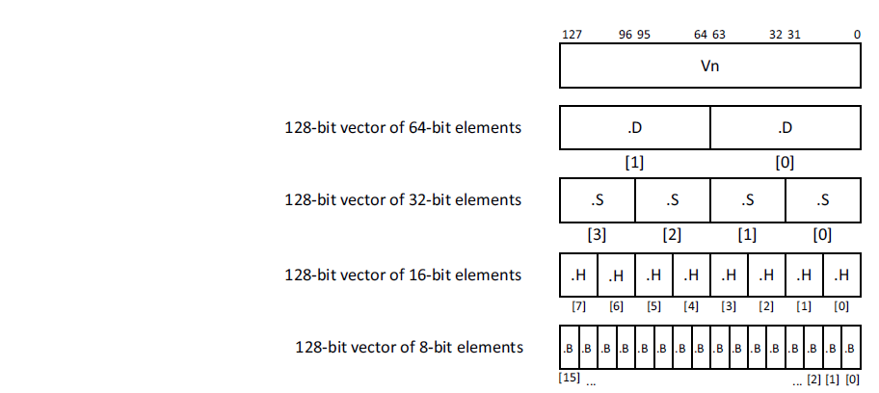
2.3 The SVE register set-based ISA extensions (4)
Possible data elements per 128-bit lane [116]
Possible data elements
in the 128-bit lanes
8-bit FX
16-bit FX/FP
32-bit FX/FP
64-bit FX/FP
128-bit FX

Slide 85
2.3 The SVE register set-based ISA extensions (5)
Summing up the layout of the SVE register extension (2017)
Armv8.2 (AArch64 mode)
(optional)
SVE register set
15.lane
2. lane
1. lane
---
32
128
Up to 16 x 128-bit (Up to 2048-bit)
SVE (2017)/SVE2 (2021) extensions
Up to 16x 128-bit wide lanes
FX/FP SIMD (vector) data
Each 128-bit lane holds: FX8/16/32/64
FP16¹/32/64
data elements
The data width must be multiples of 128 bits, up to 16x128-bit.
The 1. lanes (first 128 bits) of the SVE Z register set are shared with the 32 128-bit
wide SIMD registers (V0-31) of the Armv8.0 ISA.
¹: Only data conversions are supported

Slide 86
2.3 The SVE register set-based ISA extensions (6)
Key feature of the SVE extension: Vector length agnostic programming
As discussed both for the x86 and Arm ISAs, the evolution of instruction sets
is marked by supporting continuously wider SIMD execution, e.g. in the x86 ISA
first 64-bit, then 128-, 256- and lastly 512-bit long SIMD execution.
This way of evolution has however, a drawback in the x86 ISA, as each SIMD
extension brought with it a new subset of instructions, like MMX, SSE, SSE2,
SSE3, AVX, AVX512, so in order to utilize the benefits of wider and wider SIMD
execution resources software had be rewritten and recompiled.
The SVE extension makes programming “vector length agnostic” i.e. the
programmer doesn’t not need to use different instruction subsets while using
different long ISA extensions.

Slide 87
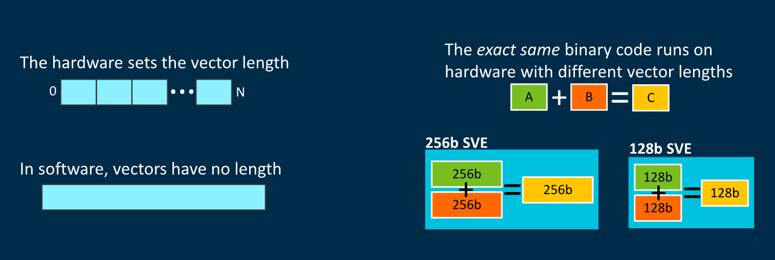
2.3 The SVE register set-based ISA extensions (7)
Interpretation of vector length agnostic programming [173]
(implemented by masking)
As the Figure above indicates, the same binary code runs on different wide hardware,
i.e. different wide SIMD execution units.

Slide 88
2.3 The SVE register set-based ISA extensions (8)
Benefits of vector length agnostic (VLA) programming
VLA simplifies programming and provides portability for binary code between
processors with different wide SIMD execution units, since instruction execution
will automatically be scaled to the width of the available execution resources.
A further benefit of vector length agnostic programming is that it allows
auto-vectorization by advanced compilers.

Slide 89
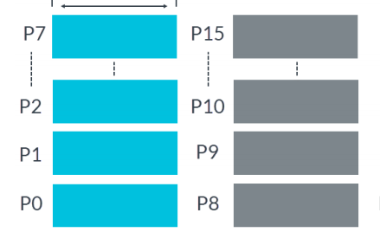
2.3 The SVE register set-based ISA extensions (9)
How ARM implements data vector length agnostic programming? [136]
The introduced SVE extension utilizes Predicate registers (P registers) as masks
to indicate which active elements of the Z-registers are involved in the operation.
There exist 16 Predicate registers, as seen below.
P0-P7 include predicates for loads, stores, and arithmetic operations,
P8-P15 are extra predicates for loop management.
Up to 16x16 bit
Figure: Predicate registers
Predicate registers hold one bit for each byte available in a Z register.
For example, an implementation providing 1024-bit Z registers has 128-bit wide
Predicate registers.

Slide 90
2.3 The SVE register set-based ISA extensions (10)
Specifying the word length (vector lengths) in the instructions -1
Predicate registers (1 bit for each byte) are used as masks for data operations.
A „1” value of the Predicate register will activate the associated byte, a „0” value
will neglect it.
The next example demonstrates this.

Slide 91
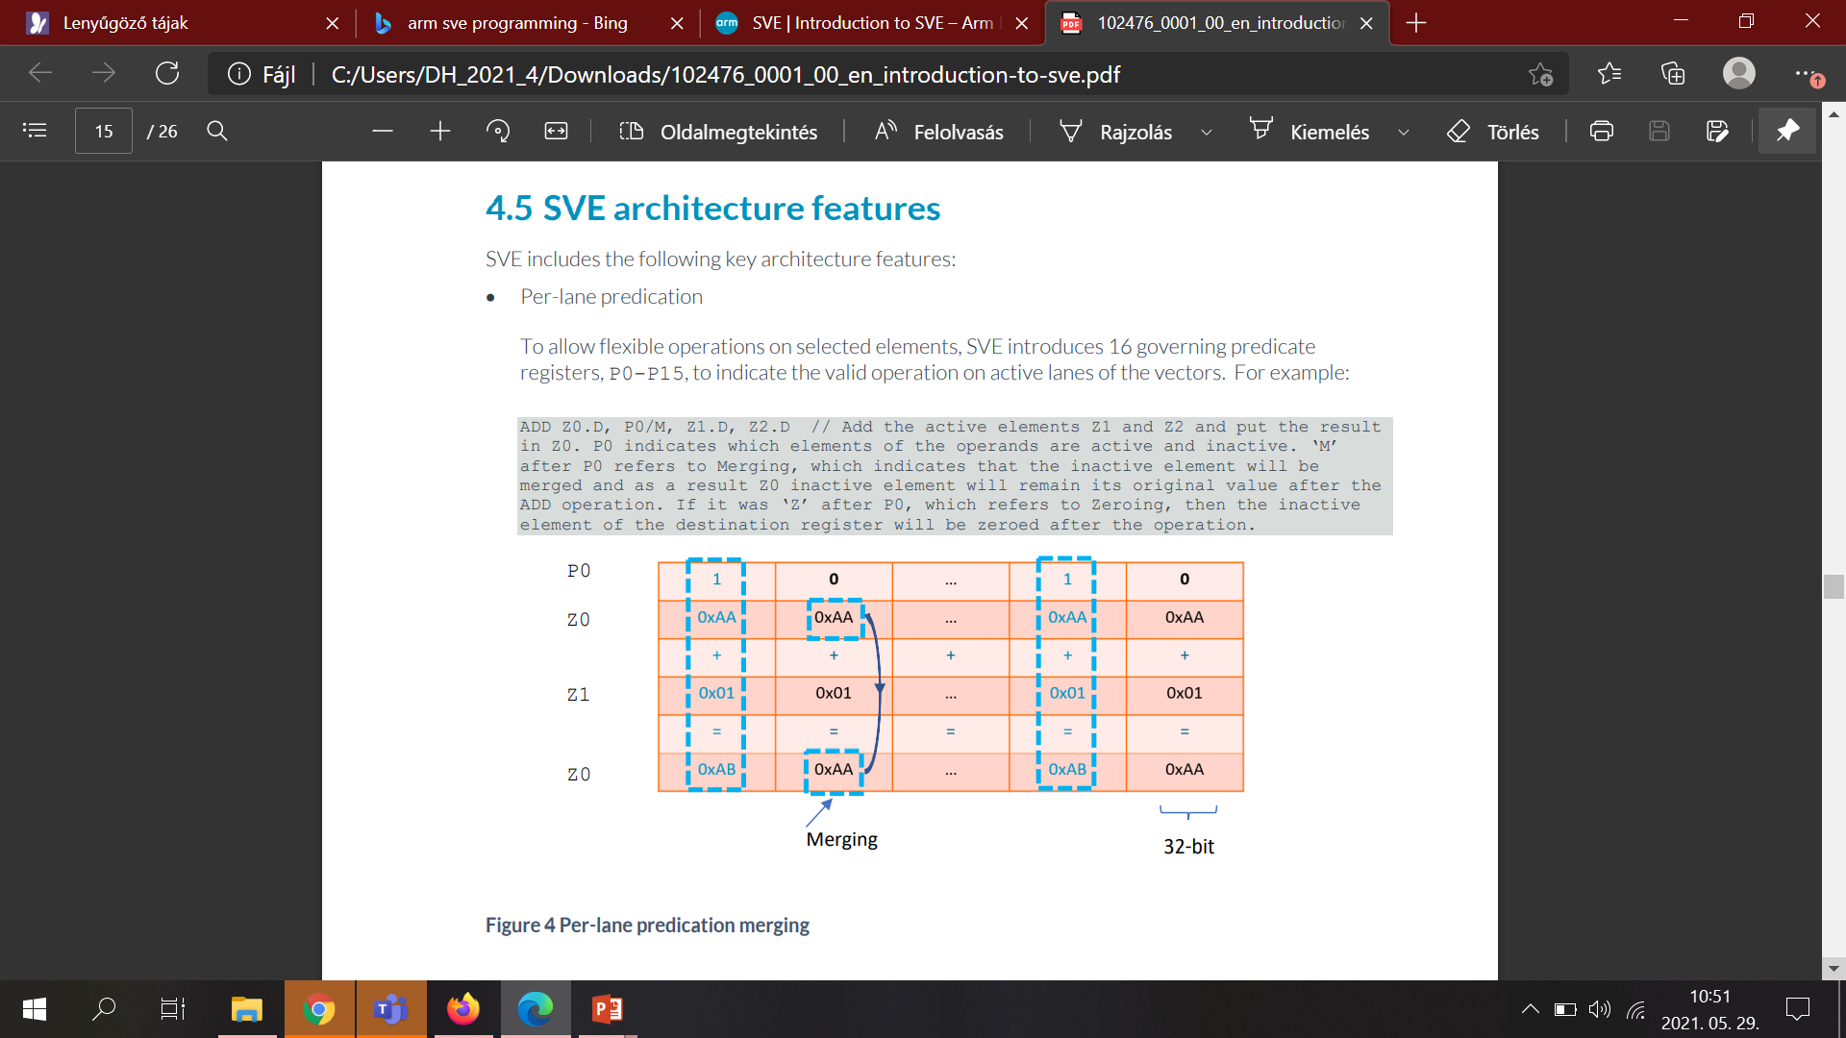
2.3 The SVE register set-based ISA extensions (11)
Example: Masking out active data elements from the SVE-registers by
using predicates while performing the zo < z1 + z0 operation [136]
1111
0000
1111
0000
The active data elements of the source registers Z0 and Z1 (indicated by the
„1” values per byte in the Predicate register P0) are added and the result is
written into the destination register Z0.
The masked out data elements of the SVE source register Z0 are copied into
the destination register Z0.

Slide 92
2.3 The SVE register set-based ISA extensions (12)
Specifying the length of the vectors (data words) in the instructions -2
While writing programs, beyond the operation code, source and destination
registers also a Predicate register has to be specified (that had been previously set)
to identify which data elements should be used in the referenced SVE registers.

Slide 93
2.3 The SVE register set-based ISA extensions (13)
Remark
Our previous discussion of interpreting the use of Predicate registers is strongly
simplified, for a more detailed explanation we refer to [116] or [136].

Slide 94
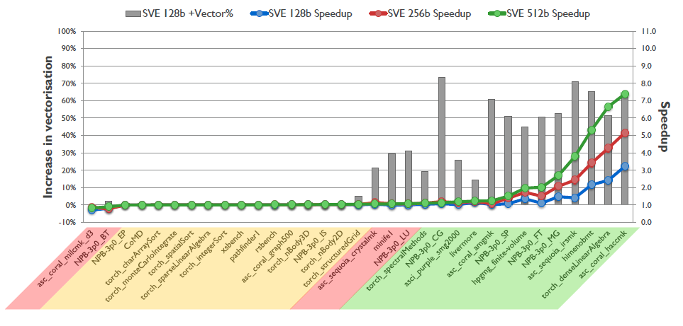
2.3 The SVE register set-based ISA extensions (14)
Speed-up potential of SVE [96]
As the above Figure indicates, SVE brings real speed-up only for appropriate workloads.

Slide 95
2.3 The SVE register set-based ISA extensions (15)
b) The 2. generation 128 – 2048-bit FX/FP SIMD extension, called the
SVE2 ISA extension
It was introduced in the Armv9-A ISA in 2021 as a mandatory feature.
As long as the SVE extension targeted mainly HPC (High Performance Computing)
workloads, the SVE2 extension has a much richer instruction subset and can be
considered as a future replacement of the recent SIMD extension (called Neon).

Slide 96
2.3 The SVE register set-based ISA extensions (16)
Contrasting the SVE and SVE2 SIMD extensions
ARM ISA |  | ISA extension | The SVE register set based SIMD extensions
 |  |  | Available register set | Scalar data types | Vector data types | Instruction subset
Name | Year
Armv8.2 (optional) | 2017 | SVE | SVE register set 32 registers each (1...16)x128-bit wide | --- | FX 8/16/32/64/128 FP 16/32/64 (1...16)x128-bit wide SIMD data (FMA available) | Small basic instruction subset aiming at HPC workloads
Armv9 (mandatory) | 2021 | SVE2
 |  |  |  |  |  | (Vastly enhanced instruction subset aiming at general-purpose workloads
SVE2 provides a large number of instruction set extensions that result in a faster,
more efficient execution on long SIMD data.
Execution resources provided for SVE/SVE2 instructions are 128-bit quantized,
that is they may be 128-bit, 256-bit etc. long up to 2048-bit.
HPC: High-Performance Computing (computing intensive)

Slide 97
2.3 The SVE register set-based ISA extensions (17)
Implementation of the SVE and SVE2 extensions
Until now SVE has been implemented only by Fujitsu in its A64FX processor.
It is an Armv8.2 ISA-based 48-core processor with 512-bit wide SIMD execution,
manufactured on 7 nm technology, used in the Fugaku supercomputer
(designed by Fujitsu, completed in 03/2021).
This is not surprising, since SVE targets HPC workloads whereas mobiles or
tablets do not run such workloads.
On the other hand, SVE2 is recently (2021) implemented in the Armv9 ISA-based
Neoverse and Cortex designs.

Slide 98
2.3 The SVE register set-based ISA extensions (18)
Major benefits of using the SVE and SVE2 extensions (recap) [144]
SVE and SVE2 have two major benefits:
a) They provide quantized very long vector sizes from 1x128-bit to 16x128-bit,
and
b) allow word length agnostic programming.
The resulting code can utilize the full width of recent and future execution units
without the need to rewrite or recompile the code.

Slide 99
2.3 The SVE register set-based ISA extensions (19)
The stunning dynamics of enhancing the Arm ISA
The thumb instruction set aims at reducing code size.
AArch32
AArch64
AArch64
Crypto-graph. extension
To enhance
security
TrustZone
Confidential
Compute Arch.
MTE
A32
SVE⁴
(v8.2, opt.)
A64
Aarch32⁵
A64
SVE2
To enhance
compute
capabilities
SIMD
Adv. SIMD¹
(NEON)
VFPv1/2
VFPv3/v4²
To speed up
the execution
of bytecodes
Jazelle
(Jazelle DBX)
Jazelle
(ex. by SW)
Jazelle RCT³
(ThumbEE)
Thumb⁶
(Armv4T)
Thumb-2
(Armv6T2)
T32
(Thumb)
Armv4
Armv5
Armv6
Armv7-A
Armv8.0-A
Armv9-A
ARM710T
(~1995)
ARM10200
(2000)
ARM1136
(2002)
Cortex-A5 - A15
(2005)
Cortex-A53/A57
(2012)
Neoverse N2/V1
Cortex-X2/A510/A710
cores (2021)
For the Remarks see the next slide.

Slide 100
2.3 The SVE register set-based ISA extensions (20)
Summing up key issues of SVE extensions enhancing computing capabilities -1
The SVE (Scalable Vector Extension) was announced in 2016 (in the Hot Chips
conference) and introduced in the Armv8.2-based ISA in 2017 as an optional feature.
SVE is implemented only in the AArch64 version of Armv8.2.
SVE aims at HPC scientific workloads rather than media or image processing.
It provides 32 registers (called Z0 – Z31), each including up to 16 x 128 bit lanes
to hold data elements for both FX- and FP SIMD processing, as seen below.
SVE register set
128
---
32
(1...16)x 128 bit
Armv8.2 (AArch64 mode)
Figure: The SVE register set
The data elements may be 8-bit FX, 16/32/64-bit FX/FP, 128-bit FX.
The 1. lanes (first 128 bits) of the SVE register set are shared with the 32 128-bit
wide SIMD registers of the Arm8.0 ISA.

Slide 101
2.3 The SVE register set-based ISA extensions (21)
Summing up key issues of SVE extensions enhancing computing capabilities -2
Key feature of the SVE extension: Vector length agnostic programming
The SVE extension makes programming “vector length agnostic” i.e. the programmer
doesn’t not need to use different instruction subsets while using different long
ISA extensions.
Benefits of vector length agnostic (VLA) programming
VLA simplifies programming and provides portability for binary code between
processors with different wide SIMD execution units since instruction execution
will automatically be scaled to the width of the available execution resources.
A further benefit of VLA programming is that it allows auto-vectorization by
advanced compilers.
How ARM implements data words agnostic programming? [136]
The introduced SVE extension utilizes Predicate registers (P registers) as masks
to indicate which active elements of the Z-registers are involved in the operation.
Predicate registers hold one bit for each byte available in a Z register.
For example, an implementation providing 1024-bit Z registers has 128-bit wide
Predicate registers.
There exist 16 Predicate registers.

Slide 102
2.3 The SVE register set-based ISA extensions (22)
Summing up key issues of SVE extensions enhancing computing capabilities -3
Specifying the length of the vectors (data words) in the instructions
Predicate registers are used as masks for particular data word formats
(e.g. 4x32-bit long data elements, or 8x16-bit data elements).
While writing programs, beyond the operation code, source and destination registers
also a Predicate register has to be specified (that had been previously set) to show
which data elements should be used in the referenced SVE registers.
A „1” value of the Predicate register will activate the associated byte, a „0” value
will neglect it.
Specifying theactual length of the SVE registers [136]
The actual length of the SVE registers is held in a field (called LEN) in a control
register.

Slide 103
2.3 The SVE register set-based ISA extensions (23)
Summing up key issues of SVE extensions enhancing computing capabilities -3
The SVE2 SIMD extension
It was introduced in the Armv9-A ISA in 2021 as a mandatory feature.
As long as the SVE extension targeted mainly HPC (High Performance Computing)
workloads, the SVE2 extension has a much richer instruction subset and can be
considered as a future replacement of the recent SIMD extension (called Neon).
Implementation of the SVE and SVE2 extensions
Until now SVE has been implemented only by Fujitsu in its A64FX processor.
It is an Armv8.2 ISA-based 48-core processor with 512-bit wide SIMD execution.
On the other hand, SVE2 is recently (2021) implemented in the Armv9 ISA-based
Neoverse N2 and V1 processor designs which target HPC and servers.

Slide 104
2.4 Further extensions of the Armv8-A ISA for enhancing compute capabilities

Slide 105
2.4 Further extensions of the Armv8-A ISA for enhancing compute capabilities (1)
2.4 Further extensions of the Armv8-A ISA for enhancing compute capabilities-1
Remarks to Armv8.0-A extensions [174]
Each Armv8.x-A extension includes a set of features, some mandatory and some
optional.
A processor implements an .x extension if it implements all the mandatory
features of that extension, and all mandatory features of all previous extensions.
The Arm architecture includes a set of feature registers that report the
features supported by the processor.
For each new feature added by a .x extension, even an optional features,
a field in these feature registers reports whether it is supported or not.
There is no field that reports whether a processor is Armv8.x-A.
Instead, software reads the feature fields for the mandatory 8.x-A features, and
if they all present, the processor is considered to be compliant with Armv8.x-A.
Actually, there is no known CPU that is considered to be Armv8.1 compliant,
the Cortex A55/A75/76/77/78/X1 are Armv8.2-A compliant and consequently,
they provide also Armv8.1 support.
Armv8.3 or higher ISA versions are implemented in Armv9-A compliant CPUs,
and there are no Cortex CPUs that are compliant with Armv8.3 or higher ISA
versions.

Slide 106
2.4 Further extensions of the Armv8-A ISA for enhancing compute capabilities (2)
Overview of the Armv8-A ISA extensions-1 [97]
Revision | Released | Main enhancements | Cortex-A/ Neoverse CPUs
Armv8-A | 10/2011 |  | A32/A35/ A53/A57/ A72/A73
Armv8.1-A | 12/2014 | Incremental benefits over v8.0-A relating to the instruction set, exception model and memory translation
Armv8.2-A | 04/2017 | Optional increase of the address space from 48 to 52 bits RAS extensions Statistical profiling to be able to analyze large working sets SVE (Scalable Vector Extension) (optional) Half-precision FP (FP16) (optional) BFfloat16 (optional) Dot product of two 32-bit vectors with 4x FX8 data (optional) | A55/A75/76/77/ 78/X1 (provide also Armv8.1 support) Neoverse N1, E1

Slide 107
2.4 Further extensions of the Armv8-A ISA for enhancing compute capabilities (3)
Overview of the Armv8-A ISA extensions -2 [97]
Revision | Released | Main enhancements | Cortex-A/ Neoverse CPUs
Armv8.3-A | 12/2017 | Pointer authentication Improvements to the exception model for nested virtualization | TBA
Armv8.4-A | 10/2018 | Activity Monitors Extension (AMU) (optional) Dot product of two 32-bit vectors with 4x FX8 data (mandatory) Cripto extensions Memory partitioning and monitoring capabilities New Secure EL2 state | Neoverse V1
Armv8.5-A | 07/2019 | Spectre and Meltdown Vulnerability Detection Memory Tagging Extension (optional) Random Number Generator Branch Target Identification | TBD
Armv8.6-A | 07/2020 | AMU Extension v1.1 (optional) Half-precision FP (FP16) (mandatory) BFloat16 (mandatory) | TBD
Armv8.7-A | 01/2021 | Alternate Floating Point Behaviour Support for 64-byte Load/Stores 52-bit Address Space for 4KB/16 KB Translation Granules (Smallest memory blocks) | TBD

Slide 108
2.4 Further extensions of the Armv8-A ISA for enhancing compute capabilities (4)
Discussed extensions of Armv8.x-A revisions aiming at enhancing compute capabilities
Half-precision FP and FP16 (BFfloat16)
(both optional in Armv8.2-A, mandatory in Arnv8.6-A)
b) Dot product of two 32-bit vectors with 4x FX8 data
(optional in Armv8.2-a, mandatory in Armv8.4-A)
A further optional enhancement of the Armv8.2 revision is the SVE extension,
that has already been discussed in Section 2.3.
Dot product: Skalár szorzat

Slide 109
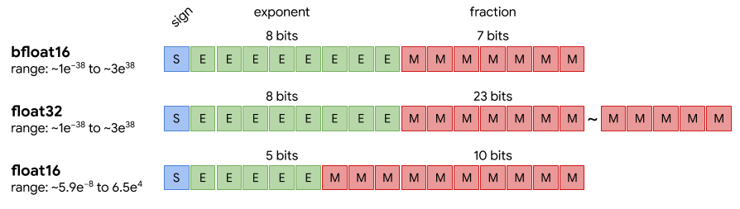
2.4 Further extensions of the Armv8-A ISA for enhancing compute capabilities (5)
a) Half-precision FP (FP16) and BFfloat16 data formats
In NN processing weights and activation data may be represented also by short,
even only 8 or 16-bit long data types, such as FP16 (dubbed also as float16),
Bfloat16 (named also as bfloat16) or Int8 (known also as int8) to keep twice or
four times more data in registers or memory and execute up to four times more
data per cycle than using FX32 data.
This was the reason why IEEE introduced the half-precision FP16 (float16) (in 2008)
and Google the Bfloat (bfloat) (brain FP) data format in 2018 (see the next Figure).
Figure: FP representation of data used in deep learning [151]
Both extensions became optional in Arnv8.2-A and mandatory in Armv8.6-A.
Due to its benefits the Bfloat16 (bfloat16) data type became in a short time
widespread, among others in Intel’s and AMD’s processors.

Slide 110
2.4 Further extensions of the Armv8-A ISA for enhancing compute capabilities (6)
b) Dot product of two 32-bit vectors with 4x FX8 data (optional) [152]
The int8MatMul instruction calculates the dot product of four 8-bit int8 data
elements included in the referenced first 32-bit SIMD data with the four
8-bit data elements of the referenced second SIMD data and accumulates
the result into the corresponding 32-bit destination register (see the Figure below).
int8_{i1}
int8_{i2}
int8_{i3}
int8_{i4}
int8_{j1}
int8_{j2}
int8_{j3}
int8_{j4}
32-bit SIMD data
int8MatMul = int8_{i1}*int8_{j1}+ int8_{i2}*int8_{j2}+ int8_{i3}*int8_{j3} + int8_{i4}*int8_{j4}
Figure: Interpretation of the int8MatMul instruction
The int8MatMul instruction is used to speed up matrix multiplications with 8-bit
integers, a common operation needed in NN calculations.
There are two versions of the instruction, one with signed 8-bit integers and
another with unsigned integers.
This feature is optional in Armv8.2-A implementations and mandatory in
Armv8.4 implementations.
Dot product: skalár szorzat

Slide 111
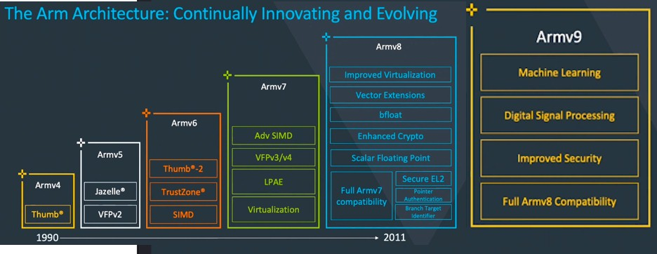
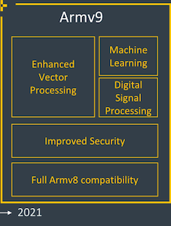
2.4 Further extensions of the Armv8-A ISA for enhancing compute capabilities (7)
The Armv9-A ISA [154], [144] -1
ARM announced the Armv9 ISA in 03/2021.
Its first implementation was the server oriented Neoverse N2 core (04/2021), followed by the mobile Cortex-X2, -A710 and –A510 cores, announced in 05/2021.
Adv. SIMD (NEON)
Figure: Evolution of the Arm ISA after the Armv3 release
As the above Figure shows, Armv9’s enhancements focus on vector processing
(by the mandatory support of SVE2), ML (Machine Learning), DSP and security.
SVE2 extension is dealt with in Section 2.3, here we do not discuss further enhancements.

Slide 112
3. The Cortex family of CPU cores

Slide 113
3. The Cortex family of CPU cores (1)
3. The Cortex family of CPU cores
In 10/2004 ARM announced the Cortex Family of CPU cores and its first model the
Cortex-M3 CPU core.
The Cortex brand is used by ARM’s for their mobile application oriented CPU cores,
based on the Armv7 ISA or later releases.
It is worth noting that ARM announced a second CPU brand in 2018 as well,
called Neoverse for CPU cores to be used in processors focused on information
infrastructures (datacenters, routers, switches etc.), discussed in another Chapter.

Slide 114
3. The Cortex family of CPU cores (2)
Profiles of ARM’s Cortex family of CPU cores [6], [7], [113] -1
In the technical specification of the Armv7 ISA ARM introduced three family profiles
to optimize its Cortex family CPU cores for specific market segments:
Profiles of ARM’s Cortex family of CPU cores
Cortex-A profile
(Application profile)
Cortex-R profile
(Real-time profile)
Cortex-M profile
(Microcontroller profile)

Slide 115
3. The Cortex family of CPU cores (3)
Profiles of ARM’s Cortex family of CPU cores [6], [7], [113] -2
The Cortex-A (application) profile
It aims at application processors running mobile OSs and user applications, like
processors in smartphones, tablets, netbooks, eBook readers etc.
At introduction it supported two instruction sets:
the 32-bit A32 and
the 16-bit T32 (which is a subset of the A32)
instruction sets.
Subsequently,
the Armv8.0-A ISA supports 64-bit processing and introduced two execution modes:
the AArch32 execution mode to maintain compatibility with the A32
instruction set and
the AArch64 execution modes, to allow using the new, 64-bit A64
instruction set.
At the same time, in the AArch64 mode ARM terminated the support
of the Thumb instruction set, finally
in the Armv9.0-A ISA
ARM withdrew the general availability of the AArch32 execution mode,
as indicated in the next Figure.

Slide 116
3. The Cortex family of CPU cores (4)
Cortex CPUs
AArch32
AArch64
AArch64
Crypto-graph. extension
To enhance
security
TrustZone
Confidential
Compute Arch.
MTE
A32
SVE⁴
(v8.2, opt.)
A64
Aarch32⁵
A64
SVE2
To enhance
compute
capabilities
SIMD
Adv. SIMD¹
(NEON)
VFPv1/2
VFPv3/v4²
To speed up
the execution
of bytecodes
Jazelle
(Jazelle DBX)
Jazelle
(ex. by SW)
Jazelle RCT³
(ThumbEE)
Thumb⁶
(Armv4T)
Thumb-2
(Armv6T2)
T32
(Thumb)
Armv4
Armv5
Armv6
Armv7-A
Armv8.0-A
Armv9-A
ARM710T
(~1995)
ARM10200
(2000)
ARM1136
(2002)
Cortex-A5 - A15
(2005)
Cortex-A53/A57
(2012)
Neoverse N2/V1
Cortex-X2/A510/A710
(2021)
For the Remarks see the next slide.

Slide 117
3. The Cortex family of CPU cores (5)
Remarks to the introduced extensions
¹The Advanced SIMD architecture extension is commonly referred to as the
NEON technology.
The VFP subset became depricated in the Armv8 ISA.
³Jazelle-RTC (ThumbEE) became depricated in Armv7 Issue C in 10/2011.
⁴The SVE (Scalable Vector Extension) subset became introduced in the
Armv8 ISA as an optional feature, only in 2017.
⁵The AArch32 execution mode is only supported in certain implementations, e.g.
in the Cortex-A510 CPU.
⁶ The Thumb extension aims at reducing code size.

Slide 118
3. The Cortex family of CPU cores (6)
Profiles of ARM’s Cortex family of CPU cores [6], [7], [113] -3
The Cortex-R (Real-time) profile [113]
It aims at embedded CPUs for real time applications, like mass storage or
printer controllers.
It supports the A32 and T32 instruction sets.
The Cortex-M (Microcontroller) profile [113]
CPUs of the M profile are optimized for deeply embedded CPUs aimed at
microcontroller and cost-sensitive applications, like automotive body electronics
or smart sensors.
It supports writing interrupt handlers in high-level languages.
It maintains a variant of the T32 instruction set.

Slide 119
3. The Cortex family of CPU cores (7)
Extending the ARM Cortex family with the SecurCore profile in 10/2007
In 10/2007 ARM introduced the SecurCore profile.
It is optimized for smart card and secure applications.

Slide 120
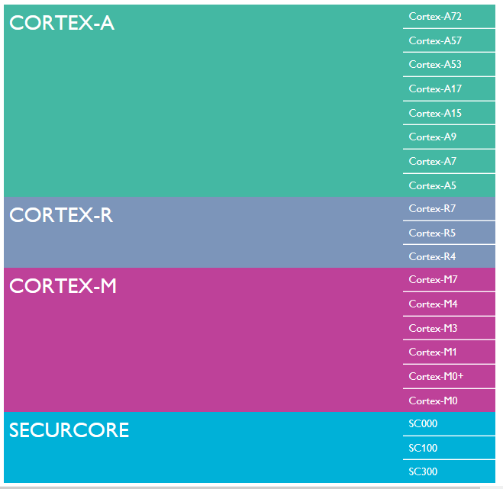
3. The Cortex family of CPU cores (8)
Overview of
Cortex profiles
and related CPU cores
(as of 2015) [6]

Slide 121
3. The Cortex family of CPU cores (9)
Remark
According to the general scope of this Lecture Notes, subsequently, we shall be
concerned only with the Cortex-A series of CPU cores.

Slide 122
4. The evolution path of CPU configurations in Arm-based
mobile processors
4.1 Overview of the evolution of Arm-based mobile processors
4.2 Single-core mobile processors
4.3 Symmetrical multicore-based mobile processors
4.4 big-LITTLE core clusters-based mobile processors
4.5 DynamIQ core clusters-based mobile processors
4.6 Armv9-A based DynamIQ core clusters-based
mobile processors
Notes:
122

Slide 123
4.1 Overview of the evolution of Arm-based mobile processors
Notes:
123

Slide 124
4.1 Overview of the evolution of Arm-based mobile processors (1)
4.1 Overview of the evolution of Arm-based mobile processors
There are five main steps of how CPU configurations of mobile processors have evolved,
as seen in the next Figure.
Main evolution steps of CPU configurations in mobile processors
Single core
CPUs
Multicore CPUs
Symmetrical
multicores
big.LITTLE
core clusters
DynamIQ
core clusters
Armv9
DynamIQ
core clusters
CC interconnect
CC interconnect
CC interconnect
CC interconnect
Typical width
32-bit
(≈2000-2010)
32-bit
(~2011-2013)
64-bit
(~2013-2016)
64-bit
(~2018-)
64-bit
(~2021-)
Based on
Up to Armv7
Armv7
Armv8
Armv8.2
Armv9
CC: Cache Coherent

Slide 125
4.1 Overview of the evolution of Arm-based mobile processors (2)
Evolution of multicore CPU configurations in various mobile processor lines -1
In the subsequent Figure we show which processor models implemented first the
main evolution steps and when.
Note that major vendors designing application processors followed the same
evolution paths in enhancing CPU configurations, more or less in the same time.

Slide 126
4.1 Overview of the evolution of Arm-based mobile processors (3)
Evolution of multicore CPU configurations in various mobile processor lines
Main evolution steps of CPU configurations in mobile processors
Symmetrical
multicores
big.LITTLE
core clusters
DynamIQ
core clusters
Armv9-A based
DynamIQ
core clusters
32-bit
64-bit
64-bit
64-bit
(Armv7)
(2010-2013)
(Armv8)
(2013-2016)
(Armv8.2)
(2018-2020)
(Armv9)
(2021-)
ARM
HP: Cortex-A15
MS: Cortex-A8/A9/A17
LP: Cortex-A5/A7
HP: Cortex-A57/A72/A73
LP: Cortex-A32/A35/A53
HP: Cortex-A75/
A76/A77/A78/X1
LP: A55
HP: Cortex-X2
MS: A-710
LP: A-510
Apple
A5 (2011)
(2C)
A10 (2016)
(2+2)C
A11 (2017)
(2+4)C
Samsung
Exynos
4412 4C (2012)
5410 (4+4)C (2013)
5420 (4+4)C (2013)
9810 (2018)
(4+4)C
2200 (2022)
(1+3+4)C
Qualcomm
Snapdragon
8260 2C (2013)
400 4C (2013)
615 (4+4) (2014)
810 (4+4) (2015)
845 (2018)
(4+4)C
8 Gen 1(2022)
(1+3+4)C
Huawei
Kirin
(K3V2 (2012))
920 (4+4)) 2014)
980 (2018)
(2+2+4)C
MediaTek
MT6582 4C (2013)
MT6592 8C (2013)
MT8135 (2+2)C (2013)
MT6595 (4+4)C (2014)
Helio P90 (2+6)C (2019)
Dimensity 9000 (1+3+4)C (2019)

Slide 127
4.1 Overview of the evolution of Arm-based mobile processors (4)
Remarks to the main evolution path of mobile CPU configurations -1
32-bit symmetrical multicores and 64-bit big.LITTLE designs are two major phases
of the evolution of mobile processors.
Nevertheless, major processor vendors chose two alternative paths to transit
between these major evolution phases, with each path consisting of two
consecutive steps, as follows:
in a first step switch from 32-bit to 64-bit, while retaining the symmetrical
multicore design style and then in a second step switch to the big.LITTLE
configuration or
in a first step switch to the 32-bit big.LITTLE configuration and then in a second step switch to 64 bit designs,
as shown in the subsequent Figure.

Slide 128
4.1 Overview of the evolution of Arm-based mobile processors (5)
Alternative design paths to switch from 32-bit symmetrical multicores to 64-bit
big. LITTLE designs
A7 (2013)
MT. 6732 (2014)
Q. Snapdragon 410 (2014)
Symmetrical
multicore
64-bit, Armv8.0
A10 (2016)
MT. 6755 (P10) (2015)
Q. Snapdragon 610 (2014)
Symmetrical
multicore
32-bit, Armv7
A.: Apple
MT.: MediaTek
Q.: Qualcomm
H.: Huawei
S.: Samsung
big.LITTLE
architecture
64-bit, Armv8.0
H. Kirin 920 (2014)
MT. 6595 (2014)
S. Exynos 5410 (2013)
big.LITTLE
architecture
32-bit, Armv7
H. Kirin 950 (2016)
MT. 6755 (P10) (2015)
S. Exynos 5433 (2014)
The reason for choosing two steps for transferring CPU designs from 32-bit
symmetrical multicores to 64-bit big.LITTLE designs is the intention to reduce
complexity of the transfer in a similar way why Intel choose a two step tik-tok
development model to transfer a given Core 2 processor design to a scaled down
design with a new microarchitecture.

Slide 129
4.1 Overview of the evolution of Arm-based mobile processors (6)
Remarks to the main evolution path of mobile CPU configurations -2
As a consequence of the two step transition from 32-bit multicore to 64-bit big.LITTLE
designs, main processor lines switched to 64-bit also along two paths:
either while retaining the symmetrical multicore design or
after switching to the big.LITTLE design
in the years between 2013 and 2015, as the next Figure indicates.

Slide 130
4.1 Overview of the evolution of Arm-based mobile processors (7)
Transition from 32-bit Armv7-based to Armv8.0-based 64-bit designs in major
mobile lines
*
9/2013
Apple
Ax
A7 with
2x Cyclone cores
*
Transition first to a 64-bit
symmetrical multicore design
and then to the big.little design
10/2014 ?
MediaTek
MT
MT6732 with
4x Cortex A53
*
Q4/2014
Qualcomm
Snapdragon
Snapdragon 410 with
4x Cortex-A53 cores
*
10/2014
Samsung
Exynos
Exynos 5433 with
4x Cortex A57 and 4x Cortex A53
Transition first to a 32-bit
big.little design and then
to a 64-bit design
*
Q1/2015
Huawei
Kirin
Kirin 930 with
4x Cortex A53 @ 2.0 GHz and
4x Cortex A53 @ 1.5 GHz
2013
2014
2016
Note that AMD switched to 64-bit designs in 2003 whereas Intel in 2004 in their x86
processor designs, i.e. about 10 years earlier.

Slide 131
4.1 Overview of the evolution of Arm-based mobile processors (8)
Main evolution steps of CPU configurations in Arm-based mobile processor lines -3
Subsequently, we detail individual steps of the outlined evolution of CPU configurations
of mobile processors.

Slide 132
4.2 Single-core mobile processors
Notes:
132

Slide 133
4.2 Single-core mobile processors (1)
4.1 Single-core mobile processors (1)
4.2 Single-core mobile processors
First mobiles, called also cellphones, emerged in the beginning of the 2000’s,
first smartphones in the second half of the 2000’, like RIM’s Blackberry 8100
(2006) or Apple’s iPhone (2007).
The mobile boom evoked the interest by many firms, thus mainly in the second half
of the 2000’s a large number of vendors began to design mobiles while using mostly
either ARM- or in-house designed Arm ISA-based cores, as the Table below indicates.
Vendor | Family | Processor | CPU core | ISA | Year
ARM | ARMx (CPUs) |  | ARM1 Cortex-A5 | Armv1- Armv7 | 1985- 2009
Qualcomm | MSM MSM Snapdragon | MSM2 MSM3000 QSD8250 | Intel 80186 ARM7TDMI Scorpion | x86 (16-bit) Armv4 Armv7 | 1995 1998 2007
MediaTek | MTx | MT6218B | ARM7EjS | Armv3 | 2003
Intel | Atom | Many | Bonnel | x86 (64-bit) | 2008
Huawei | Kirin | K3V1 | ARM926EJ-S | Armv5 | 2009
Apple | -- Ax | S5L8900 A4 | ARM1176jzf-s Cortex-A8 | Armv6 Armv7 | 2007 2010
Samsung | -- Exynos | S3C44B0 3110 | ARM7TDMI Cortex-A8 | Armv4 Armv7 | 2000 2010
AMD | Cat | Many | Bobcat | x86 (64-bit) | 2011
Table: Emergence of single core mobile CPUs

Slide 134
4.2 Single-core mobile processors (2)
Single core mobile processors -2
Single core mobile processors were the starting point of the impressive evolution
of application processors that powers mobiles.
Unfortunately, very few documentations are still available from those early
mobile processors.
From those yet available, subsequently we will show an example.
The chosen example is the Blackberry 8100 smartphone processor that came to the
market in 2006 and is considered to be the first smartphone, developed by the
Canadian firm RIM (Research in Motion).
It run under the BlackBerry OS.

Slide 135
4.2 Single-core mobile processors (3)
Example: RIM’s Blackberry Pearl 8100 smartphones (2006) including
single core processors [182]

Slide 136
4.2 Single-core mobile processors (4)
Remarks -1
Originally, the Blackberry Pearl 8100 used Intel’s PXA27X mobile processor
(with a clock frequency of 312 MHz).
The PXA27X processor implements Intel’s ARMv5 ISA-based Xscale architecture.

Slide 137
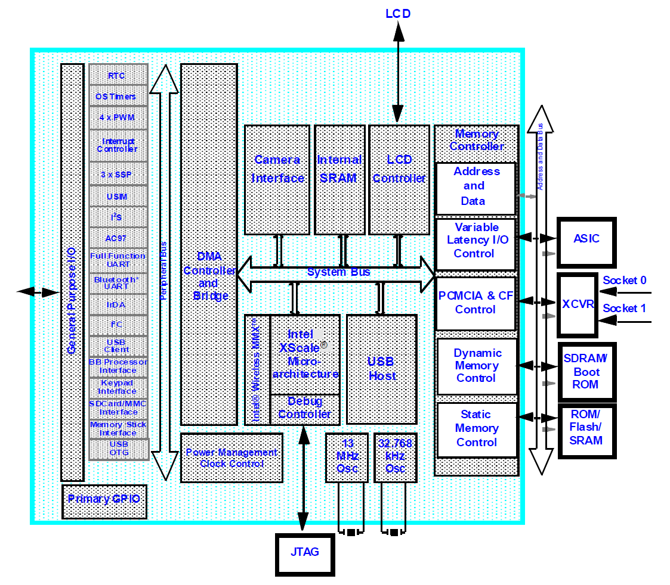
4.2 Single-core mobile processors (5)
Block diagram of Intel’s PXA27x, used originally in the Blackberry Pearl 8100 [183]

Slide 138
4.2 Single-core mobile processors (6)
Remarks -2
In 2006 Intel sold the ARMv5-based PXA microarchitecture family to Marvell.
Later Marvell designed and manufactured all application processors of the entire
Blackberry Pearl line (with certain enhanced features, like adding a GSM/CDMA
communication module) by themself.
Note that until 2006 Intel designed and manufactured Arm ISA-based mobile
processors.
Selling the Armv5-based PXA family and beginning to design Intel’s own x86-based
mobile family (that became the Atom line, introduced in 2008) was in fact a
decision with serious consequences for Intel.

Slide 139
4.2 Single-core mobile processors (7)
Remarks -3
We point out that first single core application processors did not include a GPU.
First mobile processors with an integrated GPU emerged around 2007/2008,
powering e.g. Apple’s iPhone (2007) or RIM’s Blackberry Storm 9500 (2008).
Note that mobile processors did integrate GPUs a few years earlier than desktops
processors, since desktop processors pioneering integrated GPUs emerged only
in 2011 (Intel’s Sandy Bridge and AMD’s Lliano).

Slide 140
4.3 Symmetrical multicore-based mobile processors
Notes:
140

Slide 141
4.3 Symmetrical multicore-based mobile processors (1)
4.3 Symmetrical multicore-based mobile processors -1
Emerging symmetrical multicores in mobile processors -1
As the first step of the evolution of CPU configurations, single core implementations were
replaced by Armv7-supported 32-bit symmetrical multicores, as indicated below.
Main evolution steps of CPU configurations in mobile processors
Single core
CPUs
Multicore CPUs
Symmetrical
multicores
big.LITTLE
core clusters
DynamIQ
core clusters
Armv9
DynamIQ
core clusters
CC interconnect
CC interconnect
CC interconnect
CC interconnect
Typical width
32-bit
(≈2000-2010)
32-bit
(~2011-2013)
64-bit
(~2013-2016)
64-bit
(~2018-)
64-bit
(~2021-)
Based on
Up to Armv7
Armv7
Armv8
Armv8.2
Armv9

Slide 142
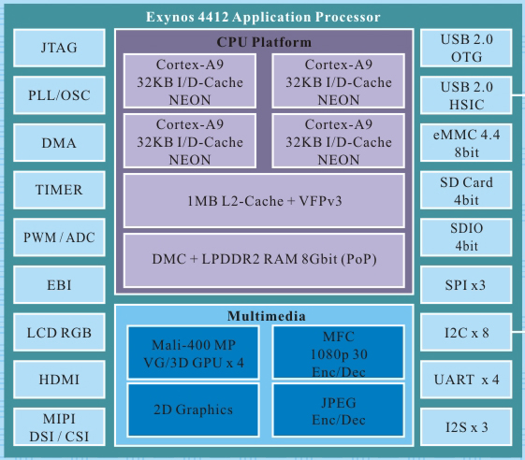
4.3 Symmetrical multicore-based mobile processors (2)
Symmetrical multicore-based mobile processors -2
Symmetrical multicores are processors with multiple CPU cores operating in parallel,
like Intel’s traditional multicore processors.
Example
Figure: Example of a symmetrical multicore processor [184]
(actually Samsung’s Exynos 4412 mobile processor, 2012)

Slide 143
4.3 Symmetrical multicore-based mobile processors (3)
Aim of introducing symmetrical multicores
The aim is raising performance by having more CPU cores for execution (rather than
increasing reliability by multiplication of the cores).

Slide 144
4.3 Symmetrical multicore-based mobile processors (4)
Emerging symmetrical multicores in mobile processors -2
Single core CPUs gave way to multicores around 2011-2013 (as seen below.)
Emergence of symmetrical multicores in mobiles
(Armv7)
(2004-2013)
ARM
(CPU cores)
HP: Cortex-A15 MPCore
MS: Cortex-A9/A17 MPCore
LP: Cortex-A5/A7 MPCore
Apple
A5 (2011)
(2C)
Samsung
Exynos
4412 4C (2012)
Qualcomm
Snapdragon
8260 2C (2013)
400 4C (2013)
Huawei
Kirin
(K3V2 (2012))
MediaTek
MT6582 4C (2013)
MT6592 8C (2013)

Slide 145
4.3 Symmetrical multicore-based mobile processors (5)
Emergence of symmetrical multicores in mobile processors -2
As the previous Figure indicates, the transfer from single core to symmetrical
multicore processors occurred in mobile processors (around 2011 – 2013)
about 6 years later than in desktop processors, since first dual-core desktop
processors were Intel’s Pentium D (2005), Core 2 (2006) and AMD’s K8-based
Toledo (2005).

Slide 146
4.3 Symmetrical multicore-based mobile processors (6)
Transition of 32-bit symmetrical multicores to 64-bit in mobile lines
Symmetrical multicores emerged in mobiles as Armv7-A ISA based 32-bit CPUs.
After introducing the 64-bit Armv8-A ISA in 2011, certain mobile vendors replaced
their 32-bit Armv7-A based CPUs by 64-bit Armv8-A based CPUs in their symmetrical
multicore processors, as the next Figure indicates.
*
9/2013
Apple
Ax
A7 with
2x Cyclone cores
*
10/2014 ?
MediaTek
MT
MT6732 with
4x Cortex A53
*
Q4/2014
Qualcomm
Snapdragon
Snapdragon 410 with
4x Cortex-A53 cores
2013
2014
2016
Figure: Transition from 32-bit Armv7-based to 64-bit Armv8-based cores in major mobile lines
while retaining symmetrical multicore design

Slide 147
4.3 Symmetrical multicore-based mobile processors (7)
Evolution of the core count in symmetrical multicores in mobile processors -1
First, typically dual core CPUs soon became enhanced to higher core counts, as seen below.
Core count in symmetrical multicores in mobile processors
2-cores
3-cores
4-cores
8-cores
Apple
A5 (2011)
(2x Cortex-A9)
A8X (2014)
(3x Typhoon)
Samsung
Exynos
Exynos 3250 (2011)
2x Cortex-A7
Exynos 4412 (2012)
4x Cortex-A9
Exynos 7580 (2015)
8x Cortex-A53
Qualcomm
Snapdragon
S200 (2013)
2x Cortex-A7
S400 (2013)
4x Cortex-A7
Huawei
Kirin
K3V2 (2012)
(4x Cortex-A9)
Kirin 620 (2015)
(8x Cortex-A53)
MediaTek
MT6572 (2013)
2x Cortex-A7
MT6582 (2013)
4x Cortex-A7
MT6592 (2013)
8x Cortex-A7
Note: After the model designations we indicate the release dates of the first models
of the related lines with the given number of cores.

Slide 148
4.3 Symmetrical multicore-based mobile processors (8)
Typical implementations of symmetrical multicores
Dual and quad core symmetrical multicores are built up in mobile processors as
dual- or four-way core clusters with a shared (inclusive) L2 cache (and private
L1 caches), as indicated below:
C0
C0
C0
C0
C0
C0
L1I/L1D
L1I/L1D
L1I/L1D
L1I/L1D
L1I/L1D
L1I/L1D
L2
L2
L2
L2
2-way core cluster with shared L2
4-way core cluster with shared L2
Octa core symmetrical multicores in Arm-based processors are implemented
typically as dual 4-way core clusters, they are also called multi-cluster SMPs.

Slide 149
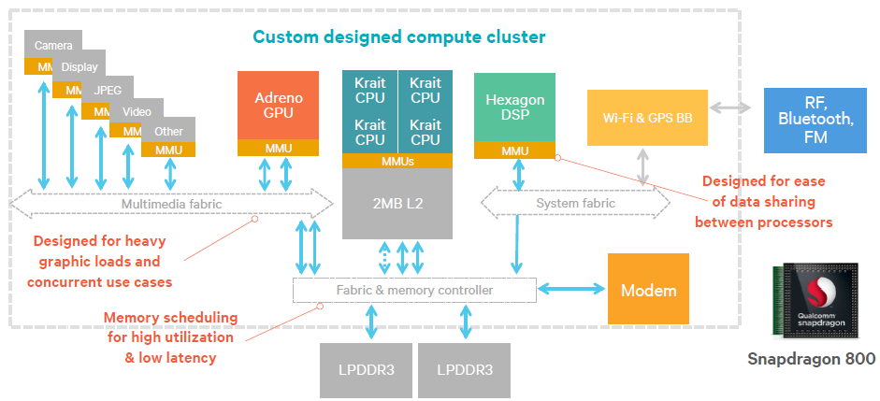
4.3 Symmetrical multicore-based mobile processors (9)
Example 1: Block diagram of a 32-bit quad core symmetrical multicore
(Qualcomm’s Snapdragon 800 SOC) (2013) [185]

Slide 150
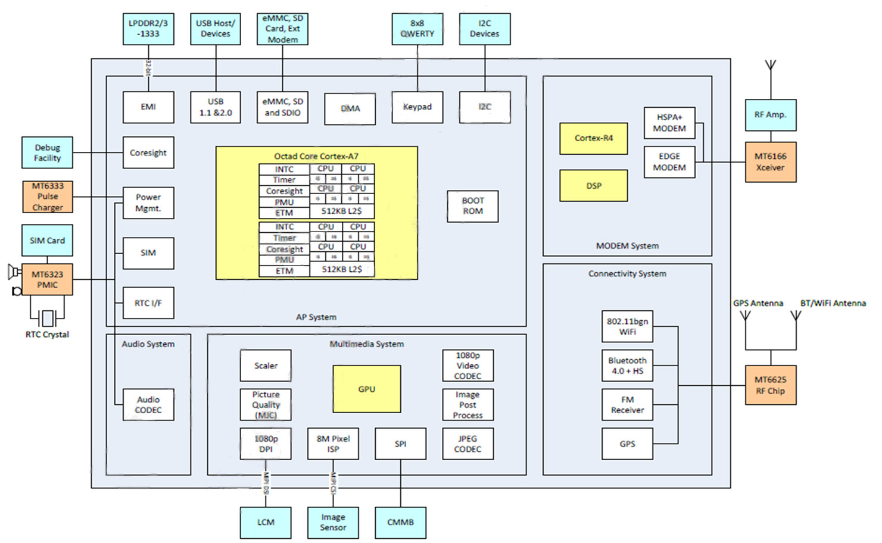
4.3 Symmetrical multicore-based mobile processors (10)
Example 2: Block diagram of a 32-bit octa core symmetrical multicore
(Block diagram of MediaTek1s MT6592 smartphone processor) [186]

Slide 151
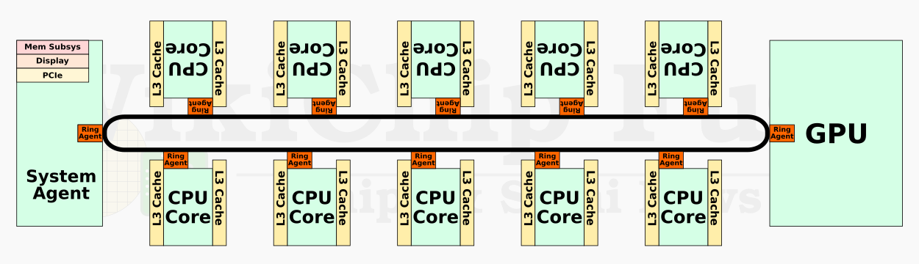
4.3 Symmetrical multicore-based mobile processors (11)
Remarks -1
Intel’s x86-based client or server processors are traditionally built up as symmetrical multicores.
There is however a difference in their layouts to mobile processors.
The difference is that Intel does not segment their multicores into core clusters,
as typical for Arm-based mobile processors, but implements homogeneous
symmetrical multicores, as shown below.
Cache-coherent ring bus
Figure: Intel’s 10th gen. Comet Lake processor built up as a homogeneous
symmetrical multicore [187]
Note here that recently Intel switched to big.LITTLE processing with heterogeneous
core clusters, as briefly mentioned in the next Section.

Slide 152
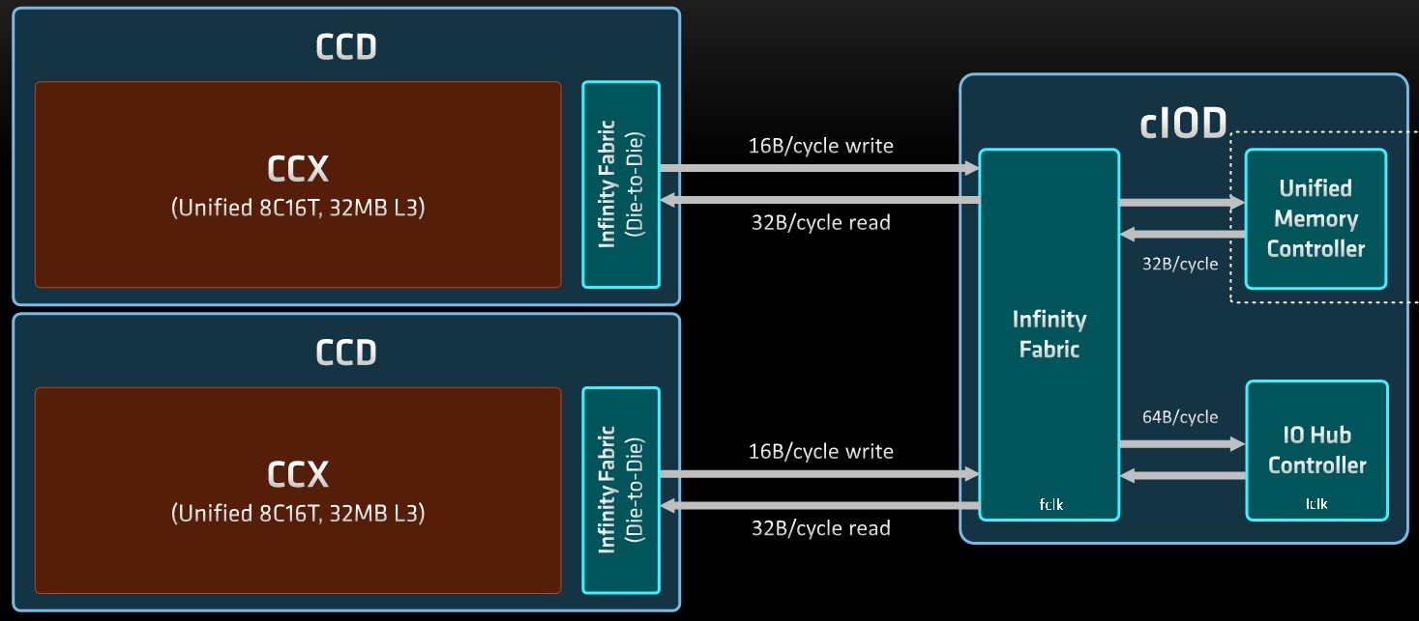
4.3 Symmetrical multicore-based mobile processors (12)
Remarks -2
By contrast, AMD implements their Zen-based x86 CPUs typically as symmetrical multicores
out of core clusters of 2, 4 or recently 8 cores.
Figure: Layout of AMD’s 16-core DT processor (Ryzen 5000) consisting of dual
8-core core clusters (CCXs) [188]

Slide 153
4.3 Symmetrical multicore-based mobile processors (13)
The need for cache coherency in multicore processors
With multiple cores fetching and storing data in cached environment, obviously
cache coherency needs to be maintained to access all the time the latest data.
Cache coherency is maintained by a cache coherency protocol, not discussed
in this Chapter.
In symmetrical multicores cache coherency is usually implemented by the shared
L2 cache and a cache coherent interconnect (often called fabric) that connects
the core cluster to the rest of the mobile processor.

Slide 154
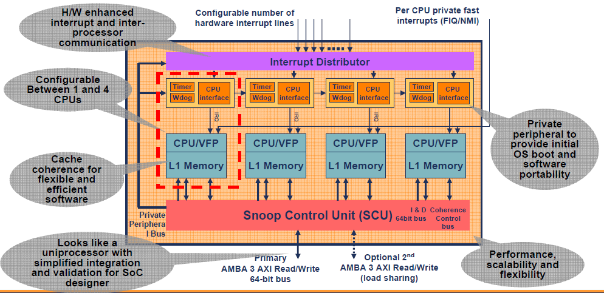
4.3 Symmetrical multicore-based mobile processors (14)
Historical remark: Emergence of core clusters in the ARM11 MPCore
The first 4-way core cluster was introduced by ARM in 2004, it was Armv6-based.
This core cluster however did not include an L2 cache yet, thus cache coherency was
provided by a dedicated Snoop Control Unit, as shown below.
Figure: ARM’s first 4-way core cluster (without an L2 cache) from 2004 [189]

Slide 155
4.4 big.LITTLE core clusters-based mobile processors
4.4.1 The rationale for big.LITTLE processing
4.4.2 Principle of big.LITTLE processing
4.4.3 Implementation of big.LITTLE processing
The Section 4.4.3 is omitted in the Lecture.
Notes:
155

Slide 156
4.4 big.LITTLE core clusters-based mobile processors (1)
4.4 big.LITTLE core clusters-based mobile processors
In the next major evolution step 32-bit symmetrical multicores gave way to
64-bit big.LITTLE architectures to raise performance and to reduce power consumption.
This transfer however, typically took place in two steps, as described subsequently.
Main evolution steps of CPU configurations in mobile processors
Single core
CPUs
Multicore CPUs
Symmetrical
multicores
big.LITTLE
core clusters
DynamIQ
core clusters
Armv9
DynamIQ
core clusters
CC interconnect
CC interconnect
CC interconnect
CC interconnect
Typical width
32-bit
(≈2000-2010)
32-bit
(~2011-2013)
64-bit
(~2013-2016)
64-bit
(~2018-)
64-bit
(~2021-)
Based on
Up to Armv7
Armv7
Armv8
Armv8.2
Armv9

Slide 157
4.4 big.LITTLE core clusters-based mobile processors (2)
Transfer paths from 32-bit symmetrical multicores to 64.bit big.LITTLE designs -1
The chosen paths for switching from 32-bit symmetrical multicore design to 64-bit
big.LITTLE designs were:
first switch to 64-bit and than to the big.LITTLE configuration or
first switch to the big.LITTLE configuration and then to 64 bit,
as indicated below.
A7 (2013)
MT. 6732 (2014)
Q. Snapdragon 410 (2014)
Symmetrical
multicore
64-bit, Armv8.0
A10 (2016)
MT. 6755 (P10) (2015)
Q. Snapdragon 610 (2014)
Symmetrical
multicore
32-bit, Armv7
A.: Apple
MT.: MediaTek
Q.: Qualcomm
H.: Huawei
S.: Samsung
big.LITTLE
architecture
64-bit, Armv8.0
H. Kirin 920 (2014)
MT. 6595 (2014)
S. Exynos 5410 (2013)
big.LITTLE
architecture
32-bit, Armv7
H. Kirin 950 (2016)
MT. 6755 (P10) (2015)
S. Exynos 5433 (2014)
Figure: Chosen pathways to switch to 64-bit big.LITTLE designs

Slide 158
4.4 big.LITTLE core clusters-based mobile processors (3)
Transfer paths from 32-bit symmetrical multicore to 64.bit big.LITTLE designs -2
As shown below, Apple and Qualcomm preferred to switch first to 64-bit and then to
the big.LITTLE configuration, whereas Huawei and Samsung chose the alternative path.
MediaTek, on the other hand, introduced both 64-bit symmetrical and 32-bit big.LITTLE
designs more or less in the same time, and switched subsequently to the 64-bit
big.LITTLE solution.
Apple (2013)
MediaTek (2014)
Qualcomm (2014)
Symmetrical
multicore
64-bit, Armv8.0
Apple (2016)
MediaTek (2015)
Qualcomm (2014)
Symmetrical
multicore
32-bit, Armv7
big.LITTLE
architecture
64-bit, Armv8.0
Huawei (2014)
MediaTek (2014)
Samsung (2013)
big.LITTLE
architecture
32-bit, Armv7
Huawei (2016)
MediaTek (2015)
Samsung (2014)
Figure: Chosen pathways to switch to 64-bit big.LITTLE designs

Slide 159
4.4 big.LITTLE core clusters-based mobile processors (5)
Transfer paths from 32-bit symmetrical multicore to 64.bit big.LITTLE designs -3
The reason for choosing two steps for transferring CPU designs from 32-bit
symmetrical multicores to 64-bit big.LITTLE designs is the intention to reduce
complexity of the transfer in a similar way why Intel choose a two step tik-tok
development model to transfer a given Core 2 processor design to a scaled down
design with a new microarchitecture, as already discussed before.

Slide 160
4.4 big.LITTLE core clusters-based mobile processors (6)
Introduction of big.LITTLE core clusters in mobile processors -1
Main evolution steps of CPU configurations in mobile processors
Symmetrical
multicores
big.LITTLE
core clusters
DynamIQ
core clusters
Armv9-A based
DynamIQ
core clusters
32-bit
64-bit
64-bit
64-bit
(Armv7)
(2010-2013)
(Armv8)
(2013-2016)
(Armv8.2)
(2018-2020)
(Armv9)
(2021-)
ARM
HP: Cortex-A15
MS: Cortex-A8/A9/A17
LP: Cortex-A5/A7
HP: Cortex-A57/A72/A73
LP: Cortex-A32/A35/A53
HP: Cortex-A75/
A76/A77/A78/X1
LP: A55
HP: Cortex-X2
MS: A-710
LP: A-510
Apple
A5 (2011)
(2C)
A10 (2016)
(2+2)C
A11 (2017)
(2+4)C
Samsung
Exynos
4412 4C (2012)
5410 (4+4)C (2013)
5420 (4+4)C (2013)
9810 (2018)
(4+4)C
2200 (2022)
(1+3+4)C
Qualcomm
Snapdragon
8260 2C (2013)
400 4C (2013)
615 (4+4) (2014)
810 (4+4) (2015)
845 (2018)
(4+4)C
8 Gen 1(2022)
(1+3+4)C
Huawei
Kirin
(K3V2 (2012))
920 (4+4)) 2014)
980 (2018)
(2+2+4)C
MediaTek
MT6582 4C (2013)
MT6592 8C (2013)
MT8135 (2+2)C (2013)
MT6595 (4+4)C (2014)
Helio P90 (2+6)C (2019)
Dimensity 9000 (1+3+4)C (2019)

Slide 161
4.4 big.LITTLE core clusters-based mobile processors (7)
big.LITTLE core clusters-based mobile processors (6)
The preceding Figure indicates that big.LITTLE CPU configurations were introduced
in Arm-based CPUs mainly between 2013-2014, while Apple was a latecomer, switching
to the big.LITTLE technology only in 2016.
Remarks to introducing the big.LITTLE technology in x86-based processors as well
In 2020 Intel entered the client market with two Lakefield processor models which
have big.LITTLE CPU design with one big and 4 LITTLE cores.
The Lakefield processors (with 7 W TDP) were implemented in the 3D packaging
technology and intended to be used in 2-in-1 or LW laptops.
Subsequently, in 2021, Intel introduced an improved big.LITTLE processor
family, called the 12th gen. Alder Lake family.
Alder Lake processors have up to 8 big and up to 8 LITTLE cores.
Its design goal is to cover all processor segments from mobiles to servers.
Low power U3 and U4 series of the Ader Lake line appeared in 2022 with 15 W
and 9 W TDP, respectively, targeting the 2-in-1 laptop and LW laptop segment.
Also AMD is expected to switch to big.LITTLE little architectures since the firm
filed a big.LITTLE patent in 2019 and according to rumours their Zen 5-based
processors, to be launched in 2024, will already be big.LITTLE designs.
LW: Lightweight

Slide 162
4.4.1 The rationale for big.LITTLE processing
Notes:
162

Slide 163
4.4.1 The rationale for big.LITTLE processing (1)
4.4.1 The rationale for big.LITTLE processing [190]
big.LITTLE technology mainly aims at power reduction.
It is based on the recognition that the workload on smartphone or tablet processors
dynamically changes, i.e. high intensity processor demands alternate with
low intensity processor demands, as shown in a subsequent Figure.
When
high intensity loads run on powerfull but power hungry cores whereas
low intensity loads on less powerful but less power hungry cores
the total power consumption can be reduced.

Slide 164
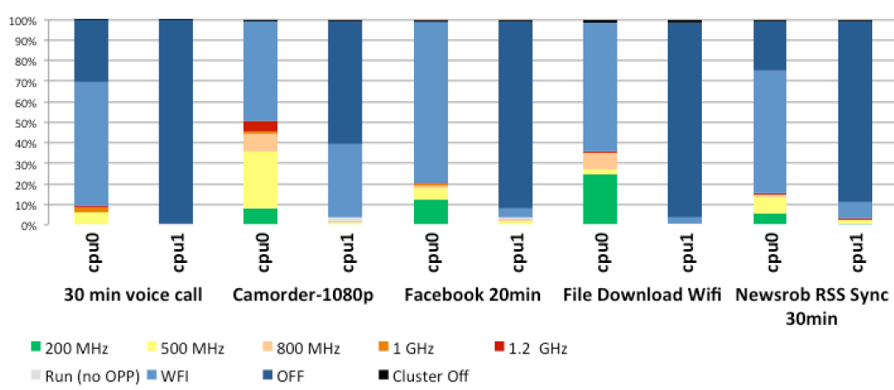
4.4.1 The rationale for big.LITTLE processing (2)
Example: Percentage of time spent in different processor states for less demanding
workloads in a dual core mobile device [191] -1
(Core)
WFI: Waiting for Interrupt
The graph above shows the percentage of time spent in DVFS (active) states,
in idle states and shutdown states in a dual core Cortex-A9 based mobile device.
In the diagram, the red color indicates the highest, green the lowest frequency
operating points whereas colors in between represent intermediate frequencies.
Light blue means that the core is idling for Waiting for Interrupt (WFI), dark blue
indicates that the core or the cluster is shut down, i.e. both cores are shut down.

Slide 165
4.4.1 The rationale for big.LITTLE processing (3)
Example: Percentage of time spent in DVFS states for low intensity
use cases in a mobile device [191] -2
As seen in the diagram, both cores spend most on their time in idle, shut down or
light intensity states, thus there is a large headroom for power saving when
less powerful but less power hungry cores are used for light intensity, idle or
shut down phases of the operation.

Slide 166
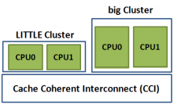
4.4.1 The rationale for big.LITTLE processing (4)
Remark: The big.LITTLE technology is an alternative task distribution policy
in heterogeneous multicore processors
Task distribution policies in heterogeneous multicore processors
Master/slave
processing
Task forwarding
to a dedicated accelerator
Task migration
to different kind of CPUs
Heterogeneous
master/slave processing
Heterogeneous
attached processing
Heterogeneous
big.LITLE processing
There is a master core (MCP)
and a number of slave cores.
The master core organizes
the operation of the slave cores
to execute a task
Beyond a CPU there are
dedicated accelerators,
like a GPU, available.
An instructon will be
forwarded to an accelerator
when it is capable of executing
this instruction more efficiently
than the CPU.
There are two or more clusters of cores, with
different power/performance characteristics,
e.g. two clusters; a LITTLE and a big one.
Cores of the LITTLE cluster execute
less demanding tasks and consume
less power, whereas cores of the big
cluster execute more demanding tasks
with higher power consumption.
MPC
Slave cores
CPU
GPU
E.g. the Cell processor from
IBM/Sony/Toshiba (2006).
Widely used in mobiles.
Widely used in mobiles.

Slide 167
4.4.2 Principle of big.LITTLE processing
Notes:
167

Slide 168

4.4.2 Principle of big.LITTLE processing (1)
4.4.2 Principle of implementing big.LITTLE processing -1 [192]

Slide 169
4.4.2 Principle of big.LITTLE processing (2)
Principle of implementing big.LITTLE processing -2
Let’s have two or more clusters of architecturally identical cores in a processor.
E.g. let’s take two clusters of four cores each;
a cluster of low performance/low power cores, termed as the LITTLE cores and
a cluster of higher performance higher power cores, termed as the big cores,
as seen in the Figure below.
Cluster of
big cores
Cluster of
LITTLE cores
CPU0
CPU1
CPU0
CPU1
Figure: A big.LITTLE configuration
consisting of two clusters
CPU2
CPU3
CPU2
CPU3
Cache coherent interconnect
To memory
Let’s interconnect these clusters by a cache coherent interconnect to have
a multicore processor, as indicated in the Figure above.

Slide 170
4.4.2 Principle of big.LITTLE processing (3)
Principle of implementing big.LITTLE processing -3 [193]
There are a number of alternatives how big.LITTLE technology can be
implemented, as discussed in Section 4.4.3.
Nevertheless, to give a conceivable description of its principle of operation we
assume a specific implementation, called exclusive cluster switching, when
any time either the big or the LITTLE cluster is operating, as detailed in Section
4.4.3 (not discussed in the Lecture).
Further on, let us suppose that all cores of a cluster operate at the same
operating point (i.e. at the same clock frequency and core voltage) while
there are a few operating points available for both the LITTLE and the big core
clusters, as indicated in the next Figure.

Slide 171
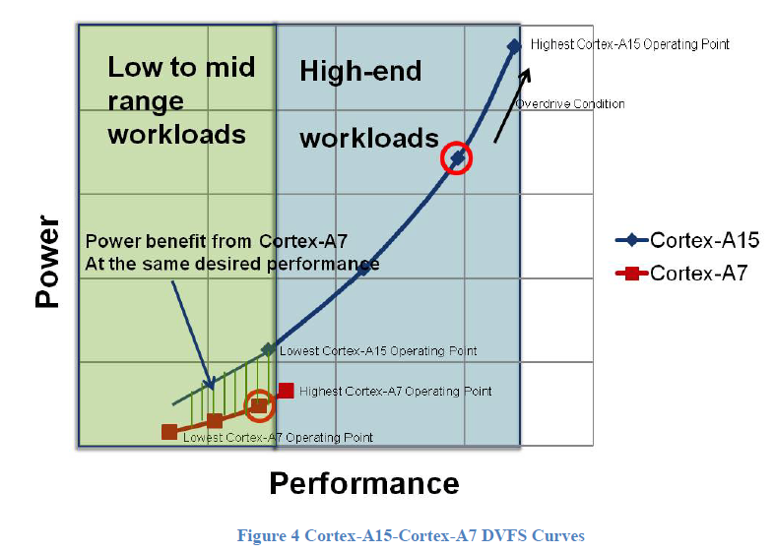
4.4.2 Principle of big.LITTLE processing (4)
Example: Operating points of a multiprocessor built up of two core clusters:
one of LITTLE cores (Cortex-A7) and one of big cores (Cortex-A15), as
described above [194]

Slide 172
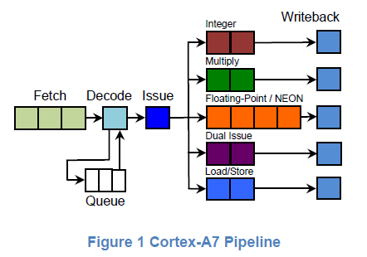
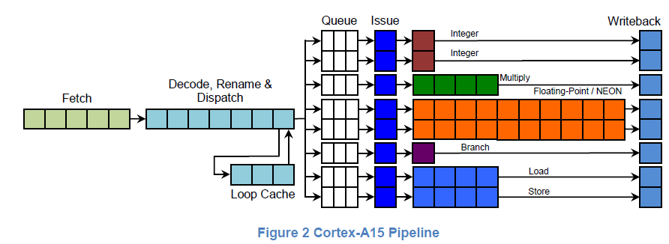
4.4.2 Principle of big.LITTLE processing (5)
Examples of big (Cortex-A15) and LITTLE cores (Cortex-A7) [194]

Slide 173
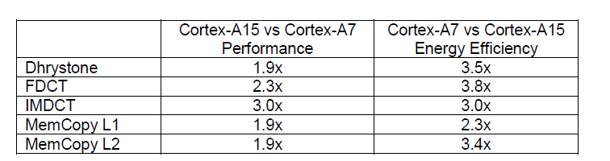
4.4.2 Principle of big.LITTLE processing (6)
Performance and energy efficiency comparison of the Cortex-A15 vs. the
Cortex-A7 cores while running different workloads [194]

Slide 174
4.4.2 Principle of big.LITTLE processing (7)
Principle of operation [193]
Let’s suppose that an appropriate OS routine (e.g. the cpufreq kernel routine of
Linux) tracks the workload and selects the operating points accordingly.
As long as the OS routine estimates that the actual workload can be tackled
by the cores of the „LITTLE” cluster it activates only the cores of this cluster.
If however the workload exceeds the performance capability of the LITTLE core
cluster, it activates the cluster of the high performance cores of the “big” cluster
and performs a cluster switch by migrating the actual workload from the cores
of the “LITTLE” cluster to the cores of the “big” cluster and switches off
the cores of the “LITTLE” cluster.
On the other hand, if the OS recognizes that the workload can be managed
by the cores of the “LITTLE” cluster alone, it initiates a cluster switch back
to the “LITTLE” cluster in a similar way as described above.
In this way, at any given time only cores of one cluster can be active and the
choice which cluster is activated depends on the intensity of the workload.
This kind of the big.LITTLE technology is called Exclusive cluster switching.

Slide 175
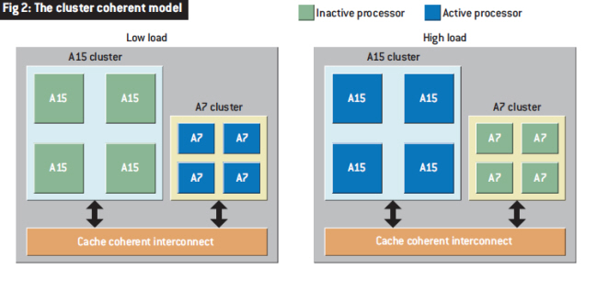
4.4.2 Principle of big.LITTLE processing (8)
Illustration of the described model of operation [195]
Note that at low load the LITTLE (A7) and at high load the big (A15) cluster is
operational.

Slide 176
4.4.3 Implementation of big.LITTLE processing
Optional reading, not part of the exam.
Notes:
176

Slide 177
4.4.3 Implementation of the big.LITTLE technology (1)
4.4.3 Implementation of big.LITTLE processing
Hardware requirements of big.LITTLE systems [190]
big and LITTLE cores of a big.LITTLE system need to satisfy a few requirements
for a seamless operation, such as
the big and LITTLE CPU cores must be architecturally identical,
i.e. they must have the same ISA in order to run the same instructions
and support the same ISA extensions concerning virtualization,
address space management etc. and
both core clusters must operate fully cache coherent to support seamless
task migration.
Recommended core pairings (around the introduction of big.LITTLE processing)
 | 1st Generation: ARMv7 (32-bit word length, 40-bit addresses) | 2nd Generation: ARMv8 (32/64-bit word length, up to 52-bit addresses)
High-performance CPU cores (big) | Cortex-A15, Cortex-A17 | Cortex-A57, Cortex-A72/73
High-efficiency CPU cores (LITTLE) | Cortex-A7 | Cortex-A53
In each of the above core combinations, the big and LITTLE clusters may have
up to four cores each.

Slide 178
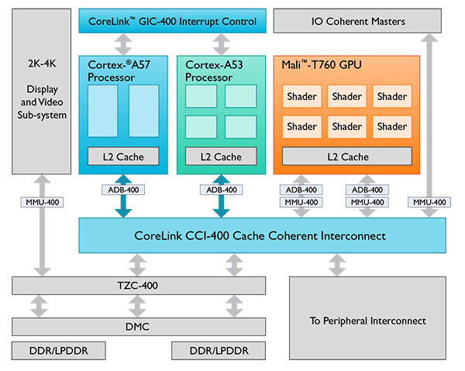
4.4.3 Implementation of the big.LITTLE technology (2)
Example 1: Block diagram of a 2. gen. two-cluster big.LITTLE SoC [190]
ADB-400: AMBA Domain Bridge
AMBA: Advanced Microcontroller Bus Architecture
TZC-400 TrustZone Address Space Controller
DMC: Dynamic Memory Controller

Slide 179
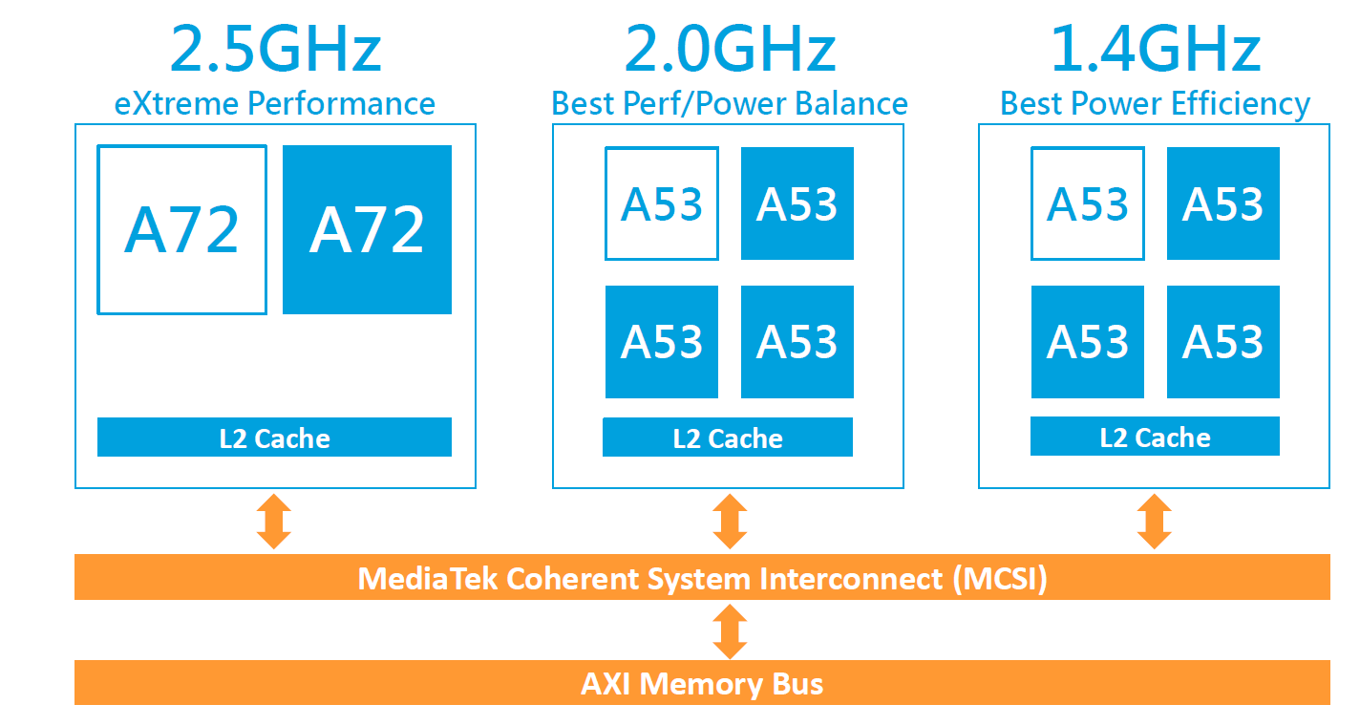
4.4.3 Implementation of the big.LITTLE technology (3)
Example 2: Block diagram of a 2. gen. three-cluster big.LITTLE SOC [196]
First three cluster (10-core) implementation (Q1/2016): MediaTek Helio X20 (6797).
It includes two A53 clusters with different maximum clock frequencies and
different performance-power characteristics, as well as a high performance Cortex-A72
cluster, as indicated in the next Figure.
Figure: Three cluster big.LITTLE implementation of MediaTek's Helio X20 [196]

Slide 180
4.4.3 Implementation of the big.LITTLE technology (4)
Power-performance characteristics of the three cluster configuration [197]
The scheduler activates workload dependent always the most appropriate cluster.

Slide 181
4.4.3 Implementation of the big.LITTLE technology (5)
Required software support of the big.LITTLE technology
The big.LITTLE technology needs appropriate software support, e.g. for load
tracking, task scheduling, including task migrations, power management, etc.
The software needed will be provided for the OEMs by the SoC supplier, usually
in form of kernel patches or an appropriate software package.
In this Chapter we will not go into details of required software support of the
big.LITTLE technology, but refer to the related literature.

Slide 182
4.4.3 Implementation of the big.LITTLE technology (6)
Main aspects of the implementation of the big.LITTLE technology
Subsequently, we discuss three main aspects of the design space of its implementation.
Implementation of the big-LITTLE technology
No. of core clusters
and no. of cores per cluster
Task scheduling
policy
Options for supplying
core frequencies and voltages
These design aspects will be discussed subsequently.

Slide 183
4.4.3 Implementation of the big.LITTLE technology (7)
a) Number of core clusters and number of cores per cluster -1
Implementation of the big-LITTLE technology
No. of core clusters
and no. of cores per cluster
Task scheduling
policy
Options for supplying
core frequencies and voltages
There are a number of alternative implementations of the big-LITTLE technology,
as far as the no. of core clusters and the number of cores per core clusters is
concerned, as indicated subsequently.

Slide 184
4.4.3 Implementation of the big.LITTLE technology (8)
Number of core clusters and number of cores per cluster -2
Number of core clusters
and number of cores per cluster
Dual core clusters used
Three core clusters used
Example
configurations
4 + 4
2 + 2
1 + 4
4 + 4 + 2
4 + 2 + 4
4 + 3 + 1
Cluster of
big cores
Cluster of
LITTLE cores
running at
a lower core
frequeency
Cluster of
LITTLE cores
running at a
higher core
fequency
Cluster of
big cores
Cluster of
LITTLE cores
CPU0
CPU1
CPU0
CPU1
CPU0
CPU1
CPU0
CPU1
CPU2
CPU3
CPU2
CPU3
CPU2
CPU3
CPU2
CPU3
CPU2
CPU3
Cache coherent interconnect
Cache coherent interconnect
Memory
Memory

Slide 185
4.4.3 Implementation of the big.LITTLE technology (9)
Example 1: Dual core clusters, 1+4 cores in Nvidia's
Tegra 3 with one A9 LP + four A9 (2011) and
Tegra 4 with one A15 LP + four A15 cores (2013).
Cluster of
high performance cores
CPU0
CPU1
“Cluster” of
a single
low power
core
It is called Nvidia's
Variable SMP
CPU2
CPU3
CPU0
Cache coherent interconnect
The LP tag designates a core running at a reduced clock rate.

Slide 186
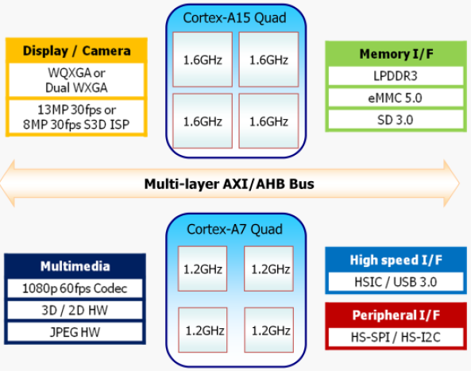
4.4.3 Implementation of the big.LITTLE technology (10)
Example 2: Dual core clusters, 4+4 cores: Samsung Exynos Octa 5410 [198]
It has been the world’s first octa core mobile processor.
Announced in 11/2012, launched in some Galaxy S4 models in 4/2013.
Figure: Block diagram of Samsung’s Exynos 5 Octa 5410 [198]

Slide 187
4.4.3 Implementation of the big.LITTLE technology (11)
Example 3: Three core clusters, 2+4+4 cores: Helio X20 (MediaTek MT6797)
This has been the world's first three cluster 10-core big.LITTLE implementation.
All cores in each cluster run at the same clock frequency, as shown below.
Announced in 9/2015, launched in 11/2015.
Figure: Three cluster big.LITTLE implementation in MediaTek's Helio X20 [186]

Slide 188
4.4.3 Implementation of the big.LITTLE technology (12)
b) Task scheduling policy -1
Implementation of the big-LITTLE technology
No. of core clusters
and no. of cores per cluster
Task scheduling
policy
Options for supplying
core frequencies and voltages
Remark
Although there are 3-cluster implementations (e.g. MediaTek’s Helio line) as well,
subsequently, we will discuss task scheduling policies while assuming 2-cluster
configurations for simplicity.
Nevertheless, in 3-cluster implementations, task scheduling follows the same
principles of operation as will be described for 2-cluster designs.

Slide 189
4.4.3 Implementation of the big.LITTLE technology (13)
b) Task scheduling policy -2
The kernel task scheduler may allocate threads to cores for execution either on
cluster- or core based, as detailed below.
Task scheduling policy
Cluster-based scheduling
Core-based scheduling
The scheduler selects a cluster as a whole and
allocates threads of the workload to cores
of the selected cluster.
The scheduler allocates threads of the workload
to individual cores
independently from their cluster affiliation.

Slide 190
4.4.3 Implementation of the big.LITTLE technology (14)
Cluster-based scheduling
When using cluster-based scheduling, the scheduler selects a cluster as a whole
depending on the workload intensity and allocates workload threads to the
cores of the selected cluster.
Cluster-based scheduling makes use of exclusive cluster allocation, meaning that
the scheduler allocates workload threads to cores of either the big or the LITTLE
cluster, but never to both, as illustrated below.
This kind of scheduling is designated as exclusive cluster allocation.
Low load
High load
Cluster of
big cores
Cluster of
big cores
Cluster of
LITTLE cores
CPU0
CPU1
Cluster of
LITTLE cores
CPU0
CPU1
CPU0
CPU1
CPU0
CPU1
CPU2
CPU3
CPU2
CPU3
CPU2
CPU3
CPU2
CPU3
Cache coherent interconnect
Cache coherent interconnect
Figure: Cluster-based scheduling with exclusive cluster allocation

Slide 191
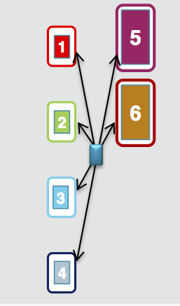
4.4.3 Implementation of the big.LITTLE technology (15)
Core–based scheduling
When using core-based scheduling the scheduler allocates workload threads
to individual cores, independently from their cluster affiliation.
Core-based scheduling makes use of inclusive core allocation, meaning that the
scheduler (named usually as the global scheduler) allocates workload threads
to all available big and LITTLE cores according to a chosen scheme.
This kind of scheduling is designated as inclusive core allocation.
Figure: Inclusive core allocation
(Implemented by a Global scheduler)

Slide 192
4.4.3 Implementation of the big.LITTLE technology (16)
Summing up the task scheduling policies of the big.LITTTLE technology
Task scheduling policies of the big-LITTLE technology
Cluster-based scheduling
Core-based scheduling
with exclusive
cluster allocation
with inclusive
core allocation
(from all clusters)
Exclusive cluster scheduling
Inclusive core scheduling
Designated also as
vSMP (Nvidia)
(Variable Symmetrical Multiprocessing)
Global Task scheduling (GTS)
Heterogeneous Multi-Processing (HMP)

Slide 193
4.4.3 Implementation of the big.LITTLE technology (17)
First appearance of task scheduling policies in big.LITTLE systems -1
Task scheduling policies of the big-LITTLE technology
Exclusive cluster scheduling
Inclusive core scheduling
vSMP (Nvidia)
(Variable Symmetrical Multiprocessing)
Global Task scheduling (GTS)
Heterogeneous Multi-Processing (HMP)
Described first in ARM’s
White Paper (2011) [192]
Described first in ARM’s
White Paper (2011) [192]
Used first in
Nvidia’s Tegra 3 (2011)
(1 A9 LP + 4 A9 cores)
Tegra 4 (2013)
(1 A15 LP core + 4 A15 cores)
Mediatek MT8135 (2013)
(2 A7 + 2 A 15 cores)
Samsung HMP on
Exynos 5 Octa 5420 (2013)
(4 A7 + 4 A15 cores)
Samsung Exynos 5
Octa 5410 (2013)
(4 A7 + 4 A15 cores)
Allwinner UltraOcta A80 (2014)
(4 A7 + 4 A15 cores)
Qualcomm Snapdragon S 808 (2014)
(4 A53 + 2 A57 cores)
Trend
ARM/Linaro EAS (2016)

Slide 194
4.4.3 Implementation of the big.LITTLE technology (18)
First appearance of task scheduling policies in big.LITTLE systems -2
As the previous Figure indicates, exclusive cluster allocation had been used first
for task scheduling in big.LITTLE designs (around 2011-2013) followed by the
inclusive core scheduling (around 2013-2014).

Slide 195
4.4.3 Implementation of the big.LITTLE technology (19)
The big.LITTLE technology as a major step in the evolution of CPU configurations
in mobile processors -1
Main evolution steps of CPU configurations in mobile processors
Symmetrical
multicores
big.LITTLE
core clusters
DynamIQ
core clusters
Armv9-A based
DynamIQ
core clusters
32-bit
64-bit
64-bit
64-bit
(Armv7)
(2010-2013)
(Armv8)
(2013-2016)
(Armv8.2)
(2018-2020)
(Armv9)
(2021-)
ARM
HP: Cortex-A15
MS: Cortex-A8/A9/A17
LP: Cortex-A5/A7
HP: Cortex-A57/A72/A73
LP: Cortex-A32/A35/A57
HP: Cortex-A75/
A76/A77/A78/X1
LP: A55
HP: Cortex-X2
MS: A-710
LP: A-510
Apple
A5 (2011)
(2C)
A10 (2016)
(2+2)C
A11 (2017)
(2+4)C
Samsung
Exynos
4412 4C (2012)
5410 (2013)
(4+4)C
5420 (2013)
(4+4)C
9810 (2018)
(4+4)C
2200 (2022)
(1+3+4)C
Qualcomm
Snapdragon
8260 2C (2013)
400 4C (2013)
615 (4+4) (2014)
810 (4+4) (2015)
845 (2018)
(4+4)C
8 Gen 1(2022)
(1+3+4)C
Huawei
Kirin
(K3V2 (2012))
920 (4+4)) 2014)
980 (2018)
(2+2+4)C
MediaTek
MT6582 4C (2013)
MT6592 8C (2013)
MT8135 (2+2)C (2013)
MT6595 (4+4)C (2014)
Helio P90 (2+6)C (2019)
Dimensity 9000 (1+3+4)C (2019)

Slide 196
4.4.3 Implementation of the big.LITTLE technology (20)
The big.LITTLE technology as a major step in the evolution of CPU configurations
in mobile processors -2
As the overview of the evolution of CPU configurations in the preceding Figure shows,
big.LITTLE CPU configurations were a major step of the evolution from symmetrical
multicores towards DynamIQ core clusters that has been introduced to reduce
power consumption.

Slide 197
4.4.3 Implementation of the big.LITTLE technology (21)
c) Options used for supplying core frequencies and voltages in big.LITTLE designs -1
Implementation of the big-LITTLE technology
No. of core clusters
and cores per cluster
Task scheduling
policy
Options for supplying
core frequencies and voltages

Slide 198
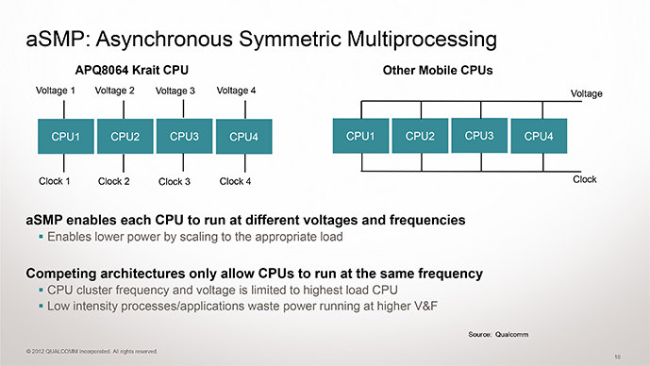
4.4.3 Implementation of the big.LITTLE technology (22)
Options used for supplying core frequencies and voltages in big.LITTLE designs -2
In fact there are two alternatives used for supplying core frequencies and voltages
in big.LITTLE designs, as follows:
Options used for supplying core frequencies and voltages in big.LITTLE designs
Per cluster shared core frequency
per cluster shared core voltage
Per core clock frequency
per core core voltage
Examples in mobiles
Used for clusters
of big.LITTLE configurations, e.g.
ARM’s big.LITTLE technology (2011)
Nvidia’s vSMP technology (2011)
Used often along with clock gating
and power gating
Also used in DynamIQ clusters (2017)
Provided in ARM’s Cortex design
but it isn’t employed generally
Qualcomm Snapdragon family
with the Scorpion, the Krait
and Kryo cores (since 2011)

Slide 199
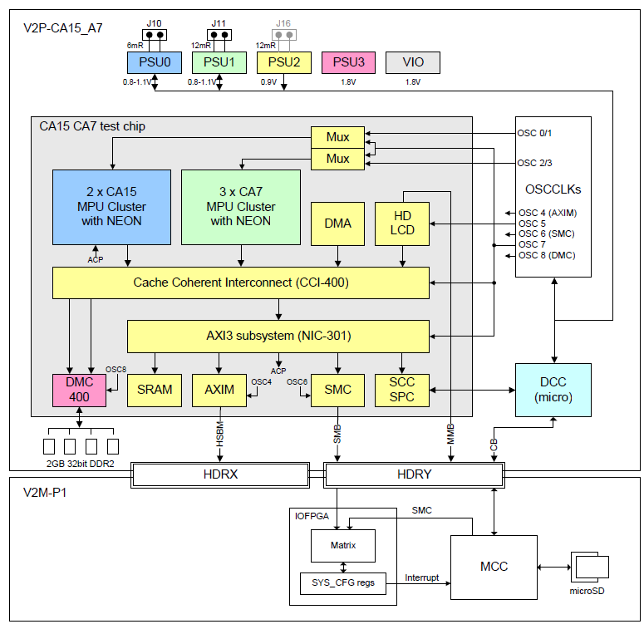
4.4.3 Implementation of the big.LITTLE technology (23)
Example 1: Per cluster clock and power domains in ARM’s big.LITTLE
test chip [199]
PSU: Power Supply Unit
CA15: Cortex-A15
CA7 : Cortex-A7
DCC: Cortex-M3
VID: Voltage
Identification

Slide 200
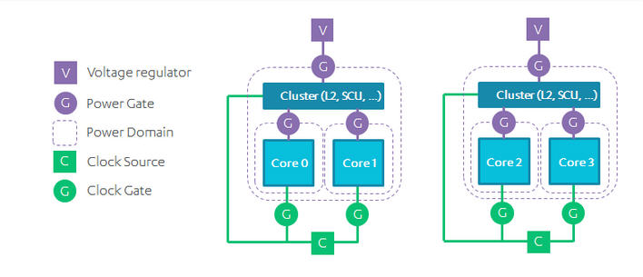
4.4.3 Implementation of the big.LITTLE technology (24)
Example 2: Per cluster clock and power domains enhanced with clock
and power gating used in a broad range of CPU designs [200]
Possible candidates of the above clock and power layout are:
SMPs
multi-cluster SMPs (e.g. 8-core SMPs)
traditional big-LITTLE configurations

Slide 201
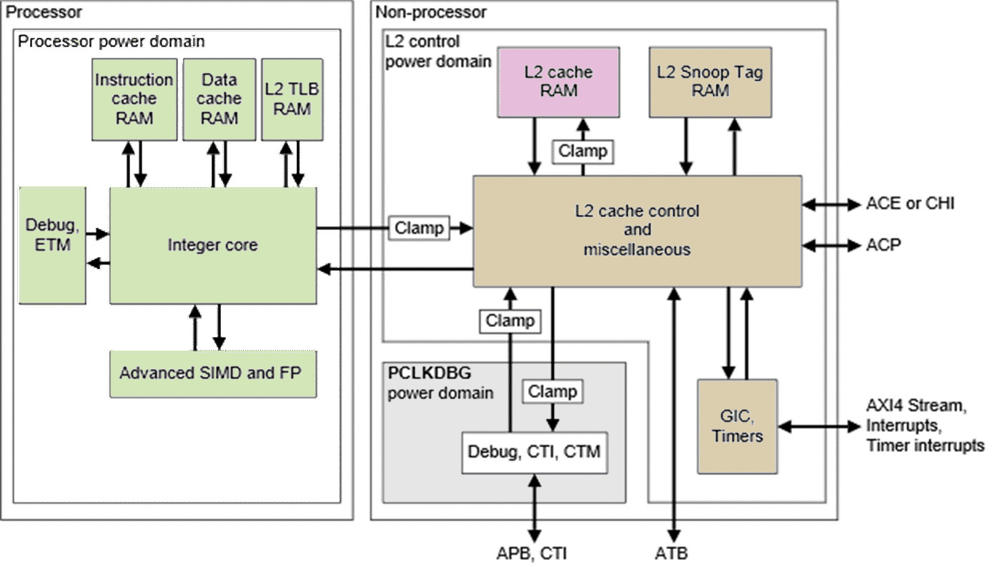
4.4.3 Implementation of the big.LITTLE technology (25)
Example 3: Per core power domains in the Cortex A-57 MPcore [201]
Notes: Different colors designate different power domains.
Each core has a separate power domain.

Slide 202
4.5 DynamIQ core clusters-based mobile processors

Slide 203
4.5 DynamIQ core cluster-based mobile processors (1)
4.5 DynamIQ core clusters-based mobile processors
Around 2018, the Armv8.2 revision was issued and big.LITTLE core clusters
gave way to dynamIQ core clusters to benefit of greater design flexibility and
improve power efficiency.
DynamiQ core cluster may include up to 8 cores from two core types (as seen below).
Main evolution steps of CPU configurations in mobile processors
Single core
CPUs
Multicore CPUs
Symmetrical
multicores
big.LITTLE
core clusters
DynamIQ
core clusters
Armv9
DynamIQ
core clusters
CC interconnect
CC interconnect
CC interconnect
CC interconnect
Typical width
32-bit
(≈2000-2010)
32-bit
(~2011-2013)
64-bit
(~2013-2016)
64-bit
(~2018-)
64-bit
(~2021-)
Based on
Up to Armv7
Armv7
Armv8
Armv8.2
Armv9

Slide 204
4.5 DynamIQ core cluster-based mobile processors (2)
Emergence of DynamIQ core clusters in mobile processors
Main evolution steps of CPU configurations in mobile processors
Symmetrical
multicores
big.LITTLE
core clusters
DynamIQ
core clusters
Armv9-A based
DynamIQ
core clusters
32-bit
64-bit
64-bit
64-bit
(Armv7)
(2010-2013)
(Armv8)
(2013-2016)
(Armv8.2)
(2018-2020)
(Armv9)
(2021-)
ARM
HP: Cortex-A15
MS: Cortex-A8/A9/A17
LP: Cortex-A5/A7
HP: Cortex-A57/A72/A73
LP: Cortex-A32/A35/A53
HP: Cortex-A75/
A76/A77/A78/X1
LP: A55
HP: Cortex-X2
MS: A-710
LP: A-510
Apple
A5 (2011)
(2C)
A10 (2016)
(2+2)C
A11 (2017)
(2+4)C
Samsung
Exynos
4412 4C (2012)
5410 (4+4)C (2013)
5420 (4+4)C (2013)
9810 (2018)
(4+4)C
2200 (2022)
(1+3+4)C
Qualcomm
Snapdragon
8260 2C (2013)
400 4C (2013)
615 (4+4) (2014)
810 (4+4) (2015)
845 (2018)
(4+4)C
8 Gen 1(2022)
(1+3+4)C
Huawei
Kirin
(K3V2 (2012))
920 (4+4)) 2014)
980 (2018)
(2+2+4)C
MediaTek
MT6582 4C (2013)
MT6592 8C (2013)
MT8135 (2+2)C (2013)
MT6595 (4+4)C (2014)
Helio P90 (2+6)C (2019)
Dimensity 9000 (1+3+4)C (2019)

Slide 205
4.5 DynamIQ core cluster-based mobile processors (3)
The DynamIQ core cluster -1
ARM started working on the DynamIQ core cluster technology in 2013 [202].
DynamIQ was announced in 03/2017.
It is an enhancement of the big.LITTLE technology, as indicated in the next slides.

Slide 206
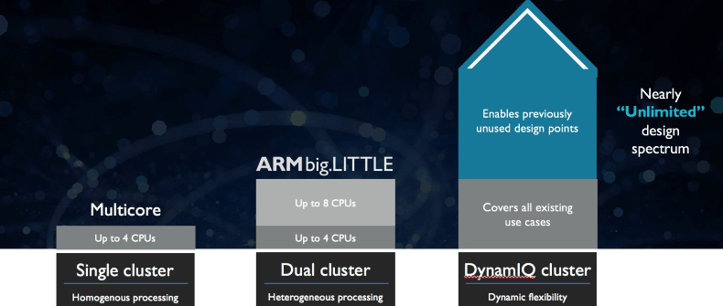
4.5 DynamIQ core cluster-based mobile processors (4)
The DynamIQ core cluster -2
It represents the third step in the evolution of the core cluster technology.
SMP
(
)
ARM11 MPCore (2004)
Cortex-A7/A15 (~2011)
Cortex-A55/A75 (~2017)
Figure: Evolution steps of the core cluster technology [203]

Slide 207
4.5 DynamIQ core cluster-based mobile processors (5)
Transition from the SMP to the big.LITTLE technology
4-way SMP core cluster
big and LITTLE core clusters
Cluster of
big cores
Cluster of
LITTLE cores
CPU0
CPU1
C0
C0
C0
C0
CPU0
CPU1
L1I/L1D
L1I/L1D
L1I/L1D
L1I/L1D
CPU2
CPU3
L2
CPU2
CPU3
L2
L2 cache
L2 cache
Cache coherent interconnect
Key features
(2011)
Based on Armv7-A/Armv8-A (2011)
Single cluster, up to 4 cores
Shared L2
Homogeneous processing
Based on Armv7/v8-A (2011)
Dual clusters, up to 4 cores each
Shared L2 caches
Heterogeneous processing

Slide 208
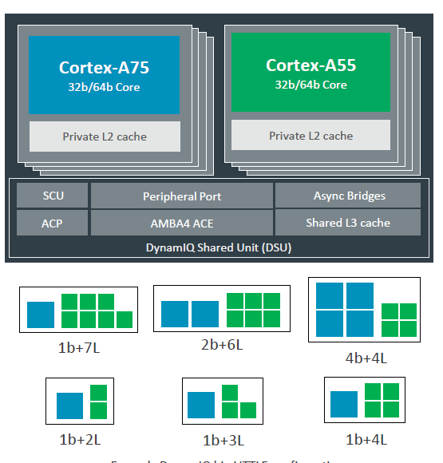
4.5 DynamIQ core cluster-based mobile processors (6)
Transition from the big.LITTLE technology to the DynamIQ core cluster
big and LITTLE core clusters
A single DynamIQ core cluster [205]
Cluster of
big cores
Cluster of
LITTLE cores
CPU0
CPU1
CPU0
CPU1
CPU2
CPU3
CPU2
CPU3
L2 cache
L2 cache
To cache coherent interconnect through the AMBA4 ACE bus
To
Cache coherent interconnect
(2011)
Key features
Based on Armv7/v8-A (2011)
Dual clusters, up to 4 cores each
Heterogeneous processing
Shared L2 caches, no L3
Based on Armv8.2-A (2017)
Single cluster, up to 8 cores (up to 4b), two core types
Private L2 caches, shared L3

Slide 209
4.5 DynamIQ core cluster-based mobile processors (7)
Assumed cores in DynamIQ core clusters
They assume two types of Armv8.2-A compatible cores, such as
the High performance Cortex-A75/A76/A77/A78/X1 and
the Low performance/High efficiency Cortex-A55
cores.

Slide 210
4.5 DynamIQ core cluster-based mobile processors (8)
Main enhancements introduced by DynamIQ core clusters
Up to 8 CPU cores of up to two core types (Armv8.2-A ISA based )
Private (per-core) L2 caches in the CPU cores
c) DynamIQ Shared Unit (DSU) with a shared L3 cache and snoop filter
d) Capability for partitioning the cores, the L3 cache and the ACP ports
e) Finer-grain frequency and voltage control
ACP: Accelerator Coherency Port, port for not cache coherent sensors and accelerators

Slide 211
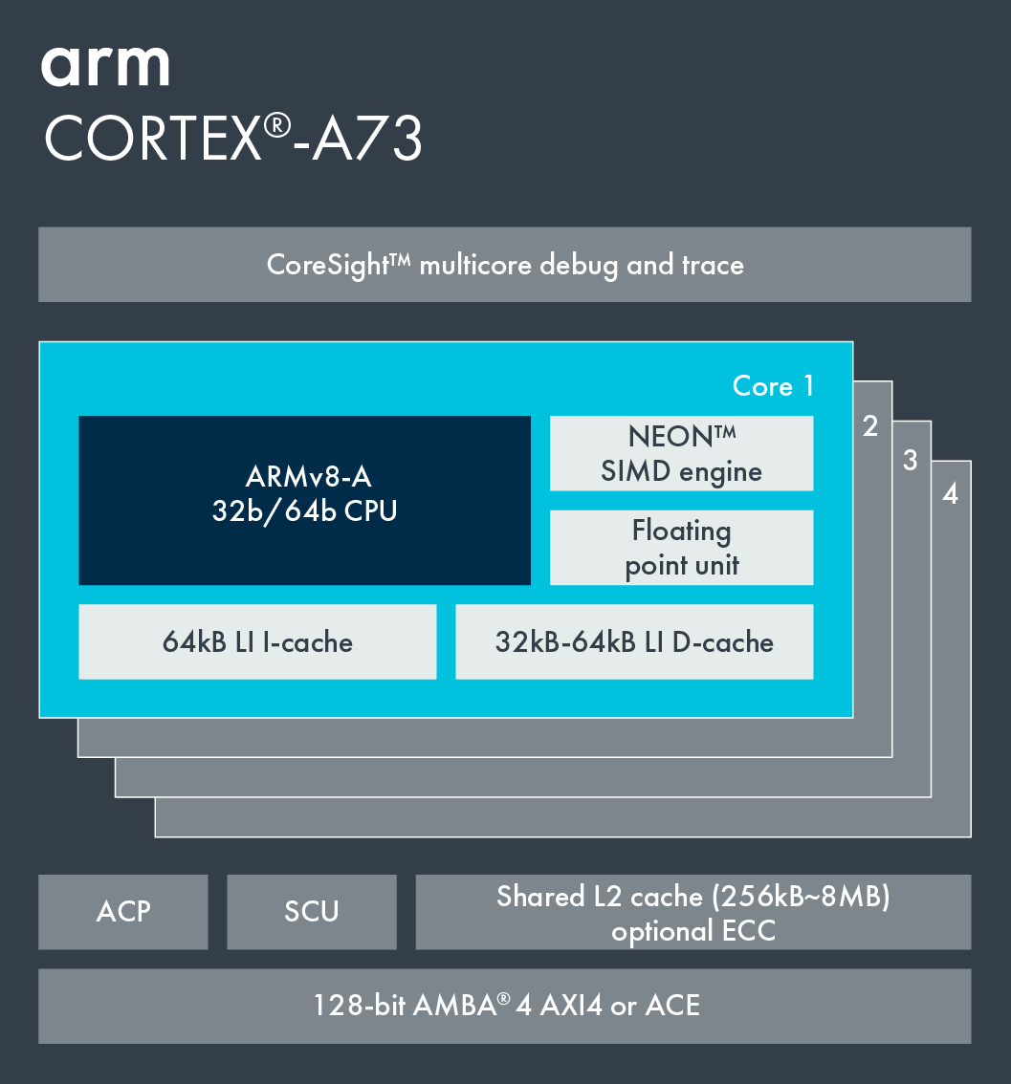
4.5 DynamIQ core cluster-based mobile processors (9)
a) Up to 8 CPU cores of up to two core types (Armv8.2-A ISA based)
big or LITTLE core cluster (2015) [206]
DynamIQ core cluster (2017) [205]
Cortex-A73 core
Armv8.0 CPU
Armv7/v8.0-A support,
e.g. Cortex-A53/A57/A72/A73,
single core type, up to 4 cores/cluster
Armv8.2-A support,
Cortex-A55/75 and subsequent Cortex-A7x cores
2 core types, up to 8 cores but only up to 4b/cluster

Slide 212
4.5 DynamIQ core cluster-based mobile processors (10)
b) Private (per-core) L2 caches in the CPU cores
big or LITTLE core cluster (2015) [206]
DynamIQ core cluster (2017) [205]
Cortex-A73 core
Armv8.0 CPU
Armv8.0-A support, e.g. Cortex-A53/
A57/A72/A73, up to 4 cores/cluster
Shared L2 cache
Armv8.2-A support, (Cortex-A55/75)
2 CPU types, up to 8 cores but only 4b/cluster
Private L2 caches, shared L3 cache

Slide 213

4.5 DynamIQ core cluster-based mobile processors (11)
c) DynamIQ Shared Unit (DSU) with a shared L3 cache and snoop filter [207]
(Partitions)
(Snoop filter)
(Per-core DVFS control,
Partial L3 power down)
(L3 cache)
(Up to two 128-bit AMBA 5 ACE,
or 256-bit AMBA 5 CHI)

Slide 214

4.5 DynamIQ core cluster-based mobile processors (12)
Reduced cache latencies [207]

Slide 215
4.5 DynamIQ core cluster-based mobile processors (13)
d) Capability for partitioning the cores, the L3 cache and the ACP ports [208]
It is feasible to set up up to four partitions by assigning
the cores,
sections of the L3 cache and
ACP ports
to maximum 4 partitions.
Partitioning may be unbalanced, e.g. to 1 CPU could be assigned 4 GB whereas
to the others the remaining 4 GB (assuming an 8 GB configuration).
The partitions are dynamic and can be created/adjusted during runtime by
the OS or hypervisor.
Partitioning can be useful for embedded systems that run a fixed workload or
applications that require a more deterministic runtime.
ACP: Accelerator Coherency Port, port for not cache coherent sensors and accelerators

Slide 216

4.5 DynamIQ core cluster-based mobile processors (14)
Example for partitioning the cores and the L3 cache [208]
ACP: Accelerator Coherency Port, port for not cache coherent sensors and accelerators

Slide 217

4.5 DynamIQ core cluster-based mobile processors (15)
e) Finer-grain frequency and voltage control [208]
In case of DynamIQ core clusters
groups of cores (i.e. partitions)
can run at different
frequencies and voltages.

Slide 218
4.5 DynamIQ core cluster-based mobile processors (16)
Main benefits of DynamIQ core clusters
greater flexibility with up to two core types and up to 8 cores
redesigned memory subsystem with lower access times
improved power efficiency through intelligent power management (EAS)
(Energy Aware Scheduling), not detailed here.

Slide 219
4.5 DynamIQ core cluster-based mobile processors (17)
Example of an Armv8.2-A based premium mobile system (2018) [209]
CCI-550: Cache Coherent Interconnect
MMU-500: Memory Management Unit (responsible for virtualization and caching)
NIC-450: Network Interconnect (interface converter)
GIC-600: General Interrupt Controller
SCP: System Control Processor

Slide 220
4.5 Armv9-A based DynamIQ core clusters-based
mobile processors

Slide 221
4.5 Armv9-A based DynamIQ core clusters-based mobile processors (1)
4.5 Armv9-A based DynamIQ core clusters-based mobile processors
Finally, in 2021 Armv9 was introduced and revised, Armv9-A based DynamIQ core
clusters were designed to enhance vector processing, ML and security (as detailed
in this Section).
Armv9-A based DynamiQ core cluster may include up to 8 cores from three core types,
as indicated below and provide further enhancements as well.
Main evolution steps of CPU configurations in mobile processors
Single core
CPUs
Multicore CPUs
Symmetrical
multicores
big.LITTLE
core clusters
DynamIQ
core clusters
Armv9-A based
DynamIQ
core clusters
CC interconnect
CC interconnect
CC interconnect
CC interconnect
Typical width
32-bit
(≈2000-2010)
32-bit
(~2011-2013)
64-bit
(~2013-2016)
64-bit
(~2018-)
64-bit
(~2021-)
Based on
Up to Armv7
Armv7
Armv8
Armv8.2
Armv9

Slide 222
4.5 Armv9-A based DynamIQ core clusters-based mobile processors (2)
Emergence of Armv9-A based DynamIQ core clusters in mobile processors
Main evolution steps of CPU configurations in mobile processors
Symmetrical
multicores
big.LITTLE
core clusters
DynamIQ
core clusters
Armv9-A based
DynamIQ
core clusters
32-bit
64-bit
64-bit
64-bit
(Armv7)
(2010-2013)
(Armv8)
(2013-2016)
(Armv8.2)
(2018-2020)
(Armv9)
(2021-)
ARM
HP: Cortex-A15
MS: Cortex-A8/A9/A17
LP: Cortex-A5/A7
HP: Cortex-A57/A72/A73
LP: Cortex-A32/A35/A53
HP: Cortex-A75/
A76/A77/A78/X1
LP: A55
HP: Cortex-X2
MS: A-710
LP: A-510
Apple
A5 (2011)
(2C)
A10 (2016)
(2+2)C
A11 (2017)
(2+4)C
Samsung
Exynos
4412 4C (2012)
5410 (4+4)C (2013)
5420 (4+4)C (2013)
9810 (2018)
(4+4)C
2200 (2022)
(1+3+4)C
Qualcomm
Snapdragon
8260 2C (2013)
400 4C (2013)
615 (4+4) (2014)
810 (4+4) (2015)
845 (2018)
(4+4)C
8 Gen 1(2022)
(1+3+4)C
Huawei
Kirin
(K3V2 (2012))
920 (4+4)) 2014)
980 (2018)
(2+2+4)C
MediaTek
MT6582 4C (2013)
MT6592 8C (2013)
MT8135 (2+2)C (2013)
MT6595 (4+4)C (2014)
Helio P90 (2+6)C (2019)
Dimensity 9000 (1+3+4)C (2019)

Slide 223
4.5 Armv9-A based DynamIQ core clusters-based mobile processors (3)
Armv9-A based DynamIQ core clusters
Predecessors: big.LITTLE and Armv8.2-A ISA-based DynamIQ core clusters
big and LITTLE core clusters
Arm 8.2-A ISA-based DynamIQ core cluster [205]
Cluster of
big cores
Cluster of
LITTLE cores
CPU0
CPU1
CPU0
CPU1
CPU2
CPU3
CPU2
CPU3
Shared L2
Shared L2
To the cache coherent interconnect through the AMBA4 ACE bus
To
Cache coherent interconnect
Two stand alone core clusters
with up to 4 cores (2011)

Slide 224
4.5 Armv9-A based DynamIQ core clusters-based mobile processors (4)
Recap: Block diagram of the Armv8.2-A based DynamIQ core cluster [207]
(Partitions)
(up to 4 MB)
(Per-core DVFS control,
Partial L3 power down)
(Up to two 128-bit AMBA 5 ACE,
or a single 256-bit AMBA 5 CHI bus)
Note: The Armv8.2-A-based DynamIQ core cluster is built up of up to 8 cores out of two core types and a shared DSU.
ACP: Accelerator Coherency Port, port for not cache coherent sensors and accelerators
Snoop filter: Used to speed up cache coherent memory accesses

Slide 225

4.5 Armv9-A based DynamIQ core clusters-based mobile processors (5)
Block diagram of the Armv9-A-based DynamIQ core cluster [210]
By contrast: The Armv9-A based DynamIQ core cluster is built up of up to
8 cores out of three core types and a sliced DSU, as described subsequently.
Armv9-A DynamIQ
core cluster

Slide 226
4.5 Armv9-A based DynamIQ core clusters-based mobile processors (6)
Overview of the main enhancements of the Armv9-A based DynamIQ
core cluster
Use of up to three core types rather than only two, as before.
Sliced L3 cache, snoop filter and the control logic
Memory Tagging Extension (MTE)
Wider (scalable) bus interface
Subsequently, we discuss the above mentioned enhancements.

Slide 227

4.5 Armv9-A based DynamIQ core clusters-based mobile processors (7)
a) Possible use of three core types rather than two as in DynamIQ core clusters [210]
As seen, the new Dynamic core cluster may have up to 8 cores out of 3 core types:
high-performance Cortex-X2 cores (even 8 Cortex-X cores),
the high-efficiency Cortex-A710 big and
the higher-efficiency Cortex-A510 LITTLE cores
while the chosen mix of the cores depends on the target device type.

Slide 228
4.5 Armv9-A based DynamIQ core clusters-based mobile processors (8)
b) Sliced implementation of the L3 cache, snoop filter and the control logic [210]
L3 cache, snoop filter
and control logic is
sliced.
Slices are interconnected
by dual bi-directional
ring buses
(see next slide)

Slide 229

4.5 Armv9-A based DynamIQ core clusters-based mobile processors (9)
Interconnection of the slices [210]
Ring-based transport network
connects the cores to the
slices and the bus interfaces.
There are dual bi-directional
rings.
Traffic can take either
direction to shorten delay.

Slide 230
4.5 Armv9-A based DynamIQ core clusters-based mobile processors (10)
Principle of slicing L3 caches
L3 caches
(They are mostly unified and shared)
Not sliced
Sliced
Uniform
cache architecture
Non-uniform
cache architecture
The cache is made up as a single entity, accessible at a single point.
All accesses are equal long (uniform).
The cache is built up of multiple small slices,
properly interconnected, operating independently and in parallel.
In this way, the cache becomes physically distributed, but logically all slices are shared.
Cache accesses may be different long (non-uniform).
C
C
C
C
C
C
L3 slice 0
L3 slice 1
L3 $
L3 slice 2
L3 slice 0
C
C

Slide 231

4.5 Armv9-A based DynamIQ core clusters-based mobile processors (11)
Major benefits of the sliced L3 caches -1
a) As slices of L3 caches can operate in parallel, sliced caches with n slices,
have in principle an n-times higher memory bandwidth than unsliced caches.
Figure: Raising the L3 cache bandwidth due to parallel operation of DSU slices [210]

Slide 232
4.5 Armv9-A based DynamIQ core clusters-based mobile processors (12)
Major benefits of the sliced L3 caches -2
b) Smaller cache slices have a lower access time than a large cache.

Slide 233
4.5 Armv9-A based DynamIQ core clusters-based mobile processors (13)
Consequence of slicing the L3 cache
While accessing sliced caches there are two access patterns:
the requested data is held in the accessed slice, i.e. it can be accessed
with a lower access time, and
b) the requested data is kept in a remote slice, than the access needs a
longer time.
It follows that cache access times are now non uniform, a sliced cache behaves
as a NUCA (Non-Uniform Cache Architecture).

Slide 234
4.5 Armv9-A based DynamIQ core clusters-based mobile processors (14)
Increasing the L3 cache size
In addition, the size of the L3 cache is raised from up to 4 MBs (in the previous
generation) to up to 16 MB to achieve higher performance and lower power
consumption.
Also the operation frequency has been raised to achieve higher bandwidth and
lower latencies.

Slide 235
4.5 Armv9-A based DynamIQ core clusters-based mobile processors (15)
Remarks to the emergence of sliced L3 caches
It is worth noting that L3 caches in Intel’s or AMD’s client cores and in ARM’s Cortex
cores followed the same evolution paths, namely all firms mentioned first introduced
homogeneous (not sliced) L3 caches displaced by sliced designs (as indicated below),
primarily to achieve higher performance (cache bandwidth) due to parallel operating
slices.
3-level cache architectures
Per-core, unified
L2 cache
Shared, unified
L3 cache
Not sliced
Sliced
Intel
Core 2 based
Nehalem 4C
(2008)
Core 2 based
Sandy Bridge 4C
(2011),
and subsequent proc.
AMD
K10 Barcelona
(2007)
K17 Zen core-based lines
(2017)
ARM
v8.2-A based cores
(2016)
v9-A based cores
(2021)

Slide 236
4.5 Armv9-A based DynamIQ core clusters-based mobile processors (16)
c) The Memory Tagging Extension (MTE)
Security issues concerning memory accesses
According to published figures of Microsoft and Google, over 70-75 % of
vulnerabilities come from memory safety issues (like buffer overflow-
based threats) [211]
Memory Tagging Extension aims at amending memory vulnerability.

Slide 237

4.5 Armv9-A based DynamIQ core clusters-based mobile processors (17)
Principle of memory tagging [202]
Memory tagging is implemented by locks and keys.
Locks are set in the memory and keys are attached to virtual memory addresses.
If the key matches the lock, the access is permitted, if not, an error occurs and
an exception is generated.
Figure: Using memory locks and
access keys to protect memory
against safety violations.

Slide 238
4.5 Armv9-A based DynamIQ core clusters-based mobile processors (18)
Principle of the implementation of memory tagging in ARM’s MTE -1 [212]
MTE provides locks to memory locations by adding a four bit tag to each 16 bytes
of the physical memory.
Keys, on the other hand are attached to pointers and thus virtual addresses,
as follows.
Concerning this point, MTE utilizes the fact that Armv8-A architectures do not
make use of the top byte of pointers (virtual addresses).
To implement keys MTE uses the Top Byte Ignore (TBI) feature of Armv8-A
architectures.
When TBI is enabled, the top byte of virtual addresses is ignored for address
translations, instead, four bits of the top bytes are used to store tags as keys,
as shown in the next Figure.

Slide 239

4.5 Armv9-A based DynamIQ core clusters-based mobile processors (19)
Principle of using the top byte of addresses for setting keys in ARM’s MTE [213]
Top byte of the adress

Slide 240

4.5 Armv9-A based DynamIQ core clusters-based mobile processors (20)
Placing memory tags into the cores, L3 and CI-700 (Coherent Interconnect) [214]

Slide 241
4.5 Armv9-A based DynamIQ core clusters-based mobile processors (21)
d) Wider (scalable) bus interface [210]
The Scalable bus interface to the Cache Coherent Interconnect (CI-700) is vastly
enhanced by providing now 1, 2, or 4 256-bit wide bus interfaces while an updated
AMBA CHI bus protocol is used for more bandwidth and MTE support.
By comparison, the previous
Armv8.2-A based DynamIQ core
cluster provided a 2x256-bit or
2x128-bit wide bus interface
(implementation dependent).

Slide 242
4.5 Armv9-A based DynamIQ core clusters-based mobile processors (22)
Scalability of the Armv9-A based DynamIQ core cluster [210]
As the above Figure indicates, the mix of the chosen core types depends on the
target device type.

Slide 243
4.5 Armv9-A based DynamIQ core clusters-based mobile processors (23)
Current performance of mobile processors
It is worth comparing both the performance of current mobile processors among
themselves and how their performance relates to client processors.
A recent publication [216] provides a convenient possibility for it by revealing the
performance (given in SPECint2017 scores measured for c/c++ workloads),
the average power consumption [W] and the energy consumed during benchmark
measurement [Joule] of current mobile processors, (see next Figure).
Remark [215]
The SPEC CPU 2017 benchmark package contains SPEC's next-generation, industry-
standardized, CPU intensive suites for comparing compute intensive performance,
stressing a system's processor, memory subsystem and compiler.

Slide 244

4.5 Armv9-A based DynamIQ core clusters-based mobile processors (24)
Performance (measured in SPECint2017 (c/c++) scores), average power (W) and
energy consumption (Joule) of current mobile processors [216] -1
S: Snapdragon (Qualcomm)
E: Exynos (Samsung)
D: Dimensity (MediaTek)
GS101 (Google)

Slide 245
4.5 Armv9-A based DynamIQ core clusters-based mobile processors (25)
Performance (measured in SPECint2017 (c/c++) scores), average power (W) and
energy consumption (Joule) of current mobile processors [216] -2
The cited results show the outstanding performance of the big cores of Apple’s
A14 and A15 cores.
The next highest performance provides the X2 core of Qualcomm’s Snapdragon
8 Gen1 processor.
High performance values provide Qualcomm’s further Snapdragon processors
based on the X1 core, whereas A77 or A78-based cores from Samsung or
MediaTek show comparable lower performance.
It is interesting to note that the big cores of Apple’s A14 and A15 processors have
already comparable performance figures with Intel’s and AMD’s client processors,
which have however a much higher power consumption (in the order of 100 W
TDP).

Slide 246
5. References

Slide 247
6. References (1)
[1]: Architecture and Implementation of the ARM Cortex-A8 Microprocessor, Design & Reuse,
http://www.design-reuse.com/articles/11580/architecture-and-implementation-of-the-
arm-cortex-a8-microprocessor.html
[2]: Shimpi A.L., Answered by the Experts: ARM's Cortex A53 Lead Architect, Peter Greenhalgh,
AnandTech, Dec. 17 2013, http://www.anandtech.com/show/7591/answered-by-the-
experts-arms-cortex-a53-lead-architect-peter-greenhalgh
[3]: Hill S., Design of a Reusable 1GHz, Superscalar ARM Processor, Hot Chips-18, Aug. 22 2006,
http://www.hotchips.org/wp-content/uploads/hc_archives/hc18/3_Tues/HC18.S6/HC18.S6T3.
pdf
[4]: Details of a New Cortex Processor Revealed, Cortex-A9, ARM Developers’ Conference,
Oct. 2007, http://rtcgroup.com/arm/2007/presentations/174%20-%20Details%20of%
20a%20New%20Cortex%20Processor%20Revealed%20Cortex-A9.pdf
[5]: ARM Teaching Material, http://www.arm.com/files/ppt/ARM_Teaching_Material.ppt
[6]: ARM Cortex Application Processors, http://www.arm.com/products/processors/index.php
[7]: ARM SecurCore Processors, http://www.arm.com/products/processors/securcore/index.php
[8]: Snyder C.D., ARM Family Expands at EPF, ARM11 Microarchitecture Stretches Pipe to Boost
Frequency, Microprocessor, June 3 2002
[9]: Hirata K., ARM11 MPCore, The streamlined and scalable ARM11 processor core, Jan. 2007,
http://www.aspdac.com/aspdac2007/pdf/archive/7D-2.pdf

Slide 248
6. References (2)
[10]: ARM Introduces The Cortex-M3 Processor To Deliver High Performance In Low-Cost
Applications, Oct. 19 2004, http://www.arm.com/about/newsroom/6750.php
[11]: NEON, ARM Technologies,
http://www.arm.com/products/processors/technologies/neon.php
[12]: Goodacre J., The Evolution of the ARM Architecture Towards Big Data and the Data-Centre,
8th Workshop on Virtualization in High-Performance Cloud Computing (VHPC’13),
Nov. 17-22 2013, http://www.virtical.eu/pub/sc13.pdf
[13]: Ferguson I., Redefining User Experiences, from IoT to Smart Mobile Devices, June 14 2013,
http://www.arm.com/zh/files/event/arm_multimedia_seminar_shenzhen_2013_ianferguson.
pdf
[14]: Goto H., ARM Cortex – A Family Architecture, 2010,
http://pc.watch.impress.co.jp/video/pcw/docs/423/409/p1.pdf
[15]: Stevens H., Introduction to AMBA 4 ACE and big.LITTLE Processing Technology, White Paper,
June 6 2011, http://www.arm.com/files/pdf/CacheCoherencyWhitepaper_6June2011.pdf
[16]: Shimpi A.L., The ARM Diaries, Part 2: Understanding the Cortex A12, AnandTech,
July 17 2013, http://www.anandtech.com/show/7126/the-arm-diaries-part-2-
understanding-the-cortex-a12
[17]: Shimpi A.L., ARM Cortex A17: An Evolved Cortex A12 for the Mainstream in 2015,
AnandTech, Febr. 11 2014, http://www.anandtech.com/show/7739/arm-cortex-a17
[18]: Ryan H., Intel, AMD & ARM Processors, University of Wisconsin DoIT Techstore
https://kb.wisc.edu/showroom/page.php?id=4927

Slide 249
6. References (3)
[19]: Rao A., ARM: a mandatory primer, Element14, 2014
[20]: Mali Performance Efficient Graphics, ARM
http://www.arm.com/products/multimedia/mali-performance-efficient-graphics/index.php
[21]: Cortex-A8 Processor, ARM Cortex-A Series,
http://www.arm.com/products/processors/cortex-a/cortex-a8.php
[22]: Architecture and Implementation of the ARM Cortex-A8 Microprocessor, White Paper,
Oct. 2005, https://www.pixhawk.ethz.ch/_media/software/optimization/neon_whitepaper.pdf
[23]: Shimpi A.L., Understanding the iPhone 3GS, AnandTech, July 7 2009,
http://www.anandtech.com/print/2798/
[24]: The ARM Cortex-A9 Processors, White Paper, Sept. 2009,
http://www.arm.com/files/pdf/armcortexa-9processors.pdf
[25]: Cortex-A9 MPCore, Technical Reference Manual, 2008-2012,
http://infocenter.arm.com/help/topic/com.arm.doc.ddi0407i/DDI0407I_cortex_a9_
mpcore_r4p1_trm.pdf
[26]: Goto H., ARM Cortex-A9r4 Core Block Diagram,
http://pc.watch.impress.co.jp/video/pcw/docs/614/543/08p.pdf
[27]: ARM Unveils Cortex-A9 Processors For Scalable Performance and Low-Power Designs,
Oct. 3 2007, http://www.arm.com/about/newsroom/18688.php
[28]: Goodacre J., The Effect and Technique of System Coherence in ARM Multicore Technology,
http://www.mpsoc-forum.org/previous/2008/slides/8-6%20Goodacre.pdf

Slide 250
6. References (4)
[29]: Goto H., ARM Cortex-A7/A9 vs Bobcat, Atom, 2010,
http://pc.watch.impress.co.jp/img/pcw/docs/487/030/html/9.jpg.html
[30]: Goto H., ARM Cortex-A12 Block Diagram, 2013,
http://pc.watch.impress.co.jp/video/pcw/docs/621/747/gp1.pdf
[31]: Rosinger S., The Top 5 Things to Know about Cortex-A12, ARM Connected Community,
Oct. 26 2013, http://community.arm.com/groups/processors/blog/2013/10/26/the-top-5-
things-to-know-about-cortex-a12
[32]: ARM Cortex-A17 MPCore Processor, Technical Reference Manual, 2014,
http://infocenter.arm.com/help/topic/com.arm.doc.ddi0535b/DDI0535B_cortex_a17_
r1p0_trm.pdf
[33]: Cortex-A17 Processor, ARM Cortex-A Series,
http://www.arm.com/products/processors/cortex-a/cortex-a17-processor.php
[34]: Rosinger S., ARM Cortex-A17/Cortex-A12 processor update, ARM Connected Community,
Oct. 1 2014, http://community.arm.com/groups/processors/blog/2014/09/30/arm-
cortex-a17-cortex-a12-processor-update
[35]: Cortex-A15 Processor, ARM Cortex-A Series,
http://www.arm.com/products/processors/cortex-a/cortex-a15.php
[36]: Lanier T., Exploring the Design of the Cortex-A15 Processor,
http://www.arm.com/files/pdf/AT-Exploring_the_Design_of_the_Cortex-A15.pdf

Slide 251
6. References (5)
[37]: Greenhalgh P., big.LITTLE Processing with ARM Cortex-A15 & Cortex-A7, White Paper,
Sept. 2011, http://www.arm.com/files/downloads/big_LITTLE_Final_Final.pdf
[38]: Stokes J., ARM fills out CPU lineup with Cortex A5, Ars Technica, Oct. 22 2009,
http://arstechnica.com/gadgets/2009/10/arm-fills-out-cpu-lineup-with-cortex-a5/
[39]: Hruska J., ARM Launches New Cortex-A5 As A Bulkward Against Future Atom processors,
Hot Hardware, Oct. 23 2009, http://hothardware.com/News/ARM-Launches-New-
CortexA5-As-A-Bulkward-Against-Future-Atom-processors
[40]: Cortex-A5 Processor, ARM Cortex-A Series,
http://www.arm.com/products/processors/cortex-a/cortex-a5.php
[41]: Bhattacharya A., Small, Quiet, and Cool, Power Efficient Processing with the Cortex-A5
Processor, http://www.arm.com/files/pdf/at2_-_power_efficient_processing_with_the_
cortex-a5_v1.pdf
[42]: Cortex-A5, The smallest, lowest power Armv7 application processor,
http://www.hitex.co.uk/fileadmin/uk-files/pdf/ARM%20Seminar%20Presentations%
202013/Hitex%20Cortex-A5%20Overview.pdf
[43]: Flautner K., Heterogeneity to the rescue, Nov. 2011,
https://www.bscmsrc.eu/sites/default/files/media/arm-heterogenous-mp-november-2011.
pdf
[44]: Shimpi A.L., ARM's Cortex A7: Bringing Cheaper Dual-Core & More Power Efficient High-End
Devices, AnandTech, Oct. 19 2011, http://www.anandtech.com/show/4991/

Slide 252
6. References (6)
[45]: Cortex-A7 Processor, ARM Cortex-A Series,
http://www.arm.com/products/processors/cortex-a/cortex-a7.php
[46]: Goto H., New design of mid-range CPU that ARM has announced "Cortex-A12", PC Watch,
June 4 2013, http://pc.watch.impress.co.jp/docs/column/kaigai/20130604_602106.html
[47]: Shimpi A.L., ARM's Cortex A57 and Cortex A53: The First 64-bit Armv8 CPU Cores,
AnandTech, Oct. 30 2012, http://www.anandtech.com/show/6420/arms-cortex-a57-
and-cortex-a53-the-first-64bit-armv8-cpu-cores
[48]: Smith K., Next-Generation Solutions: One Size Does Not Fit All, Nov. 2012,
http://www.armtechforum.com.cn/2012/3_Next-generation_Solutions_One_Size_does_
not_Fit_All.pdf
[49]: Smythe I., Building the future of 64-bit computing with Armv8-A, June 2014,
http://www.arm.com/files/event/2014_ARM_Multimedia_Seminar_ARM_Ian_Smythe.pdf
[50]: Ferguson I., ARM Servers, Why, Where, when, Nov. 27 2012,
http://openserversummit.com/English/Collaterals/Proceedings/2012/20121127_SA103_
Ferguson.pdf
[51]: Crijns K., ARM: 20 dollar and 64-bit Android smartphones to be expected, Hardware.info,
June 24 2014, http://us.hardware.info/reviews/5386/2/arm-20-dollar-and-64-bit-android-
smartphones-to-be-expected-android-64-bitn
[52]: Scaling Mobile Compute to the Data Centre, MPSoC’13,
http://www.mpsoc-forum.org/previous/2013/slides/2-Goodacre.pdf

Slide 253
6. References (7)
[53]: ARM Launches Cortex-A50 Series, the World's Most Energy-Efficient 64-bit Processors,
TechPowerUp, Oct. 30 2012, http://www.techpowerup.com/174709/arm-launches-cortex-
a50-series-the-worlds-most-energy-efficient-64-bit-processors.html
[54]: Mandyam L., Smartphone Powered Data Centers: Shifting Toward Energy Efficiency,
http://sites.ieee.org/scv-cs/files/2013/03/IEEE-event-April-slide-upload.pdf
[55]: Anthony S., ARM says $20 smartphones coming this year, shows off 64-bit Cortex-A53 and
A57 performance, Extreme Tech, May 6 2014, http://www.extremetech.com/computing/
181935-arm-says-20-smartphones-coming-this-year-shows-off-64-bit-cortex-a53-and-
a57-performance
[56]: Merritt R., ARM stretches out with A5 core, graphics, FPGAs, Oct. 21 2009,
http://www.embedded.com/print/4085371
[57]: Cormie D., The ARM11 Microarchitecture, April 2002
https://www.hashimi.ws/cs214/ref_doc/ARM11%20Microarchitecture%20White%20Paper.
pdf
[58]: Exynos 5 Octa, Block Diagram,
http://www.samsung.com/global/business/semiconductor/product/application/detail?
productId=7978&iaId=2341
[59]: Grabham D., From a small Acorn to 37 billion chips: ARM's ascent to tech superpower,
Techradar, July 19 2013, http://www.techradar.com/news/computing/from-a-small-acorn-
to-37-billion-chips-arm-s-ascent-to-tech-superpower-1167034
[60]: The ARM Architecture, http://www.eng.auburn.edu/~strouce/DaTseminar/UniPres07s.pdf
[61]: Wikipedia, ARM architecture, http://en.wikipedia.org/wiki/ARM_architecture

Slide 254
6. References (8)
[62]: Levy M., The History of The ARM Architecture: From Inception to IPO,
http://www.reds.ch/share/cours/ReCo/documents/TheHistoryOfTheArmArchitecture.pdf
[63]: Lemieux J., Introduction to ARM thumb, Embedded, Sept. 24 2003, http://www.embedded.
com/electronics-blogs/beginner-s-corner/4024632/Introduction-to-ARM-thumb
[64]: ARM Processor Architecture,
http://www.arm.com/products/processors/instruction-set-architectures/index.php
[65]: ARM Architecture Reference Manual, Armv5, DDI0100E, June 2000
[66]: ARM Architecture Reference Manual, Armv8, 2013, http://www.myir-tech.com/down/arm/
arch/Armv8-A_Architecture_Reference_Manual_%28Issue_A.a%29.pdf
[67]: Porthouse C., Use ARM DBX hardware extensions to accelerate Java in space-constrained
embedded apps, Embedded, Oct. 18 2007, http://www.embedded.com/design/prototyping-
and-development/4007206/3/PRODUCT-HOW-TO-Use-ARM-DBX-hardware-extensions-to-
accelerate-Java-in-space-constrained-embedded-apps
[68]: ARM Security Technology, Building a Secure System using TrustZone Technology, 2009,
http://infocenter.arm.com/help/topic/com.arm.doc.prd29-genc-009492c/PRD29-GENC-
009492C_trustzone_security_whitepaper.pdf
[69]: ARM Cortex-A53 MPCore Processor Technical Reference Manual, Cryptography Extension,
2013-2014,
http://infocenter.arm.com/help/index.jsp?topic=/com.arm.doc.ddi0500e/CJHDEBAF.html

Slide 255
6. References (9)
[70]: Shilov A., ARM’s high-end ‘Ares’ core for 10nm SoCs may be unveiled next year, KitGuru,
May 16 2015, http://www.kitguru.net/components/cpu/anton-shilov/arms-high-
performance-ares-core-may-be-unleashed-next-year/
[71]: Goto H., ARM Cortex-A57 Block Diagram,
http://images.anandtech.com/doci/8718/Hiroshige.Goto.png
[72]: Wasson S., Inside ARM's Cortex-A72 microarchitecture, TechReport, May 1 2015,
http://techreport.com/review/28189/inside-arm-cortex-a72-microarchitecture
[73]: Citizendium, Java platform, http://en.citizendium.org/wiki/Java_platform
[74]: Wasson S., Samsung's Galaxy Note 4 with the Exynos 5433 processor, TechReport,
01/31/2015, http://techreport.com/review/27539/samsung-galaxy-note-4-with-the-
exynos-5433-processor/2
[75]: Frumusanu A. & Smith R., ARM A53/A57/T760 investigated - Samsung Galaxy Note 4
Exynos Review, AnandTech, February 10, 2015,
http://www.anandtech.com/show/8718/the-samsung-galaxy-note-4-exynos-review
[76]: Riemenschneider F., Intel sei dank: Programmierbare Logik mit 1 GHz takten,
Elektroniknet, 29.10.2013 von Frank Riemenschneider,
http://www.elektroniknet.de/halbleiter/programmierbare-logik/artikel/102160/
[77]: Frumusamu A., ARM Announces New Cortex-A35 CPU - Ultra-High Efficiency For Wearables
& More, AnandTech, November 10, 2015,
http://anandtech.com/show/9769/arm-announces-cortex-a35

Slide 256
6. References (10)
[78]: Quested T., ARM scales up again in Cambridge, Businessweekly, 20 October, 2014,
http://www.businessweekly.co.uk/news/property-and-construction/17695-arm-scales-
again-cambridge#sthash.Pzg7jnpK.dpuf
[79]: ARM Architecture Reference Manual, Thumb-2 Supplement, 2004-2005,
http://read.pudn.com/downloads159/doc/709030/Thumb-2SupplementReferenceManual.pdf
[80]: Wanted: Java bytecode disassembler that shows addresses, opcodes, operands, in hex,
Reverse Engineering, 2013, http://reverseengineering.stackexchange.com/questions/
2036/wanted-java-bytecode-disassembler-that-shows-addresses-opcodes-operands-in-h
[81]: Barr M., KVM: A Small Java Virtual Machine for J2ME, Barr Group, May 4 2016,
http://www.barrgroup.com/Embedded-Systems/How-To/KVM-J2ME-Java-Virtual-Machine
[82]: What is Bytecode ?, March 21 2015,
http://interview-question-and-answers.blogspot.hu/2015/03/what-is-bytecode.html
[83]: The JVM – Java Virtual Machine, Android Developer, May 8 2015,
http://androiddeveloper.co.il/the-jvm-java-virtual-machine/
[84]: Java Virtual Machine, Free Download Java Virtual Machine, How to Download JVM,
Dev Manuals, Sept. 28 2010,
http://www.devmanuals.com/tutorials/java/corejava/javavirtualmachine.html
[85]: Srinivasan K., What is the difference between JRE,JVM and JDK?, Javabeat, Febr. 21 2013,
http://www.javabeat.net/what-is-the-difference-between-jrejvm-and-jdk/

Slide 257
6. References (11)
[86]: ARM Architecture Reference Manual, Armv7-A and Armv7-R edition, 2004-2012,
http://liris.cnrs.fr/~mmrissa/lib/exe/fetch.php?media=armv7-a-r-manual.pdf
[87]: Cortex-A7 MPCore, Technical Reference Manual, Rev. r0p3, 2011-2012,
http://infocenter.arm.com/help/topic/com.arm.doc.ddi0464d/DDI0464D_cortex_a7_
mpcore_r0p3_trm.pdf
[88]: Pardoe A., New Innovations in .NET Runtime, dotnetConf, 2014, Jun. 2014,
https://view.officeapps.live.com/op/view.aspx?src=http%3a%2f%2ffiles.channel9.
msdn.com%2fthumbnail%2f47cb5ae5-eb38-404d-80e8-7bae0a4efbaf.pptx
[89]: Cortex-A73 Processor, ARM,
https://www.arm.com/products/processors/cortex-a/cortex-a73-processor.php
[90]: Frumusanu A., ARM Announces New Cortex-A35 CPU - Ultra-High Efficiency For Wearables
& More, AnandTech, Nov. 10, 2015,
http://www.anandtech.com/show/9769/arm-announces-cortex-a35
[91]: Frumusanu A., ARM Reveals Cotex-A72 Architecture Details, AnandTech, Apr. 23, 2015,
http://www.anandtech.com/show/9184/arm-reveals-cortex-a72-architecture-details
[92]: Frumusanu A., The ARM Cortex A73 - Artemis Unveiled, AnandTech, May 29, 2016,
http://www.anandtech.com/show/10347/arm-cortex-a73-artemis-unveiled
[93]: Cortex-A73 Overview, ARM Developer, 2016,
https://developer.arm.com/products/processors/cortex-a/cortex-a73
[94]: Cortex-A35, ARM, 2015,
http://www.arm.com/products/processors/cortex-a/cortex-a35-processor.php

Slide 258
6. References (12)
[95]: Wasson S., Inside ARM's Cortex-A72 microarchitecture - The next-gen CPU core for mobile
devices and servers, Tech Report, May 1, 2015,
http://techreport.com/review/28189/inside-arm-cortex-a72-microarchitecture
[96]: Stephens N., Armv8-A Next-Generation Vector Architecture for HPC, Hot Chips 2016,
https://community.arm.com/groups/processors/blog/2016/08/22/technology-update-
the-scalable-vector-extension-sve-for-the-armv8-a-architecture
[97]: Brash D., The Armv8-A architecture and its ongoing development, ARM, 2014
https://community.arm.com/processors/b/blog/posts/the-armv8-a-architecture-and-its-
ongoing-development
[98]: Humrick M., Exploring DynamIQ and ARM’s New CPUs: Cortex-A75, Cortex-A55,
AnandTech, May 29, 2017,
https://www.anandtech.com/show/11441/dynamiq-and-arms-new-cpus-cortex-a75-a55
[99]: Frumusanu A., The ARM Cortex A73 - Artemis Unveiled, AnandTech, May 29, 2016,
http://www.anandtech.com/show/10347/arm-cortex-a73-artemis-unveiled
[100]: Turner C., ARM instruction sets and CPUs for wide ranging applications, ARM Tech Forum,
Taipei, July 4, 2017,
https://www.arm.com/files/event/20170704_ATF_TW_A3.pdf
[101]:Cortex-A75, ARM Developer,
https://developer.arm.com/products/processors/cortex-a/cortex-a75
[102]: Cortex-A73, ARM Developer,
https://developer.arm.com/products/processors/cortex-a/cortex-a73

Slide 259
6. References (13)
[103]: ARM Unveils Cortex-A75, A55 Processors And Mali-G72 GPU, ARM Developer,
https://www.xda-developers.com/arm-unveils-cortex-a75-a55-processors-and-mali-
g72-gpu/
[104]: DynamIQ power management support, Vers. 1.1, ARM ECM 0640541 Oct. 30 2017
[105]: Parris N., Boost SoC performance from edge to cloud ARM CoreLink System IP, ARM,
Nov. 2016,
http://www.armtechforum.com.cn/attached/article/2016ATS_C1_Neil_Parris
20161206151154.pdf
[106]: Greenhalgh P., ARM DynamIQ. Intelligent Solutions Using Cluster Based Multiprocessing,
Hot Chips 29, 2017 Aug. 12,
https://www.slideshare.net/ARMHoldings/arm-dynamiq-intelligent-solutions-using-
cluster-based-multiprocessing
[107]: Wathan G. : Arm DynamIQ: Technology for the next era of compute, ARM Community,
https://community.arm.com/processors/b/blog/posts/arm-dynamiq-technology-for-
the-next-era-of-compute
[108]: Walrath J., ARM Tech Day 2017: DynamIQ, Cortex-A55, A75, and Mali-G72,
PC Perspective, May 29, 2017,
https://www.pcper.com/reviews/General-Tech/ARM-Tech-Day-2017-DynamIQ-
Cortex-A55-A75-and-Mali-G72/Cortex-A75-and-Mali-G72
[109]: Rickards I. and Kucheria A., Energy Aware Scheduling (EAS) progress update, Linaro
Company, Sept. 18, 2015,
http://www.linaro.org/blog/core-dump/energy-aware-scheduling-eas-progress-update/

Slide 260
6. References (14)
[110]: Triggs R., A closer look at ARM’s new Cortex-A75 and Cortex-A55 CPUs, Android Authority,
May 31, 2017
https://www.androidauthority.com/arm-cortex-a75-cortex-a55-breakdown-770380/
[111]: Arm Cortex-A55: Efficient performance from edge to cloud, ARM Community,
https://community.arm.com/processors/b/blog/posts/arm-cortex-a55-efficient-
performance-from-edge-to-cloud
[112]: System Guidance for Infrastructure, ARM Developer,
https://developer.arm.com/products/system-design/system-guidance/system-guidance-
for-infrastructure
[113]: ARM® Architecture Reference Manual Armv8, for Armv8-A architecture profile,
ARM DDI 0487A.k_iss10775 (ID092916),2013-2016
https://silver.arm.com/download/ARM_and_AMBA_Architecture/AR150-DA-70000-r0p0-
01eac1/DDI0487A_k_armv8_arm_iss10775.pdf
[114]: Arm DynamIQ: Technology for the next era of compute, ARM Community,
https://community.arm.com/processors/b/blog/posts/arm-dynamiq-technology-for-the-
next-era-of-compute
[115]: ARM unveils multi-processor core with Linux SMP support, LinuxDevices, May 17, 2004,
http://linuxdevices.linuxgizmos.com/arm-unveils-multi-processor-core-with-linux-smp-
support/
[116]: ARM Architecture Reference manual Supplement - The Scalable Vector Extension (SVE),
for Armv8-A, ARM DDI 0584Ab (ID081717), 21 Aug. 2017,
https://developer.arm.com/docs/ddi0584/latest/arm-architecture-reference-manual-
supplement-the-scalable-vector-extension-sve-for-armv8-a

Slide 261
6. References (15)
[117]: ARM Q4 2016 Roadshow Slides, ARM Holdings, 2017
file:///C:/Users/sima/Downloads/ARM_SB_Q4_2016_Roadshow_Slides_FINAL.pdf
[118]: Triggs R., Everything you need to know about ARM’s DynamIQ, Android Authority,
May 29, 2017,
https://www.androidauthority.com/arm-dynamiq-need-to-know-770349/
[119]: Frumusanu A., Arm's Cortex-A76 CPU Unveiled: Taking Aim at the Top for 7nm,
AnandTech, May 31, 2018,
https://www.anandtech.com/show/12785/arm-cortex-a76-cpu-unveiled-7nm-powerhouse
[120]: Hruska J., ARM’s New Cortex-A76 SoC Targets Windows Laptop Market, ExtremeTech,
May 31, 2018,
https://www.extremetech.com/mobile/270362-arm-cortex-a76-targets-laptop-market
[121]: Humrick M., Exploring DynamIQ and ARM’s New CPUs: Cortex-A75, Cortex-A55,
AnandTech, May 29, 2017,
https://www.anandtech.com/show/11441/dynamiq-and-arms-new-cpus-cortex-a75-
a55/3
[122]: Cortex-A57 Software Optimization Guide, ARM, UAN 0015B, 2016,
http://infocenter.arm.com/help/topic/com.arm.doc.uan0015b/Cortex_A57_Software_
Optimization_Guide_external.pdf
[123]: ASIMD multiply-accumulate instruction, ARM Community, 2016,
https://community.arm.com/processors/f/discussions/7028/asimd-multiply-accumulate-
instruction

Slide 262
6. References (16)
[124]: Gianos C., Intel Xeon Processor E5-2600 v3 Product Family Architectural Overview ,
HPCC'14, Nov. 16 2014
[125]: Frumusanu A., ARM Unveils Client CPU Performance Roadmap Through 2020 – Taking
Intel Head On, AnandTech, Aug. 16, 2018,
https://www.anandtech.com/show/13226/arm-unveils-client-cpu-performance-roadmap
[126]: Frumusanu A., ARM's New Cortex-A77 CPU Micro-architecture: Evolving Performance,
AnandTech, May 27, 2019,
https://www.anandtech.com/show/14384/arm-announces-cortexa77-cpu-ip
[127]: Frumusanu A., Arm's New Cortex-A78 and Cortex-X1 Microarchitectures: An Efficiency and
Performance Divergence, AnandTech, May 26 2020,
https://www.anandtech.com/show/15813/arm-cortex-a78-cortex-x1-cpu-ip-diverging
[128]: Williamson P., Bringing the Digital World into Our New Reality, May 2020,
https://armkeil.blob.core.windows.net/developer/Files/pdf/news/arm-client-mobile-
launch-2020-deck.pdf
[129]: Hill B., Arm Unveils Cortex-A78, Cortex-X1 Architectures: Efficiency And Big Performance
Gains For Next-Gen Mobile Devices, Hot Hardware, May 26 2020,
https://hothardware.com/news/arm-cortex-a78-cortex-x1-mali-g78-snapdragon-875
[130]: Schor D., Arm Cortex-X1: The First From The Cortex-X Custom Program, Wikichip Fuse,
May 26 2020, https://fuse.wikichip.org/news/3543/arm-cortex-x1-the-first-from-the-
cortex-x-custom-program/

Slide 263
6. References (17)
[131]: Frumusanu A., ARM Details Built on ARM Cortex Technology License, AnandTech,
May 29 2016, https://www.anandtech.com/show/10366/arm-built-on-cortex-license
[132]: Caulfield I.M., Pathirane C.A.S., Instruction fusion, US 2017/0123808 A1, May 4 2017,
https://patents.google.com/patent/US20170123808
[133]: Hachman M., ARM challenges Intel in PCs with Deimos and Hercules chips, PC World,
Aug. 16 2018, https://www.pcworld.com/article/3297941/arm-challenges-intel-in-pcs-
with-deimos-and-hercules-chips.html
[134]: The Samsung Exynos 7420 Deep Dive – Inside A Modern 14nm SoC, June 29 2015,
http://monimega.com/blog/2015/06/29/the-samsung-exynos-7420-deep-dive-inside-a-
modern-14nm-soc/
[135]: Hsu D., ARM Cortex-A75 and Cortex-A55, ARM Tech Forum, Shenzen, Jun. 14, 2017,
https://docplayer.net/85228086-Arm-cortex-a75-and-cortex-a55.html
[136]: Introduction to SVE, 2021, 102476_0001_00_en_introduction-to-sve.pdf
[137]: Introduction to Trusted Execution Environment and ARM's TrustZone, #embeddedbits,
https://embeddedbits.org/introduction-to-trusted-execution-environment-tee-arm-trustzone/
[138]: Ngabonziza B., Martin D., Bailey A., Cho H. and Martin S., TrustZone Explained: Architectural
Features and Use Cases, IEEE 2nd International Conference on Collaboration and Internet
Computing, 2016, https://sefcom.asu.edu/publications/trustzone-explained-cic2016.pdf
[139]: Menarini F., Breaking TEE Security Part 1: TEEs, TrustZone and TEEGRIS, Riscure,
Febr. 23 2021, https://www.riscure.com/blog/tee-security-samsung-teegris-part1

Slide 264
6. References (18)
[140]: Carlini M., Kuriakose S.V., Trusted Firmware: Building Secure Firmware Collaboratively,
https://static.sched.com/hosted_files/osseu2020/71/TrustedFirmware_ELC_2020.pdf
[141]: Slava Makkaveev, The Road to Qualcomm TrustZone Apps Fuzzing, Checkpoint,
Nov. 14 2019, https://research.checkpoint.com/2019/the-road-to-qualcomm-trustzone-
apps-fuzzing/
[142]: Eyrolles N., TEE and trust: assessing the security of Arm’s TrustZone, Viaccess-orca,
Febr. 17 2021, https://www.viaccess-orca.com/blog/assessing-the-security-of-arms-trustzone
[143]: Security Analysis of TEEs on TrustZone, Viaccess-orca,
https://www.viaccess-orca.com/hubfs/TEE%20White%20Paper%20final%202021.pdf
[144]: Frumusanu A., Arm Announces Armv9 Architecture: SVE2, Security, and the Next Decade,
AnandTech, March 30 2021, https://www.anandtech.com/print/16584/arm-announces-
armv9-architecture
[145]: Shilov A., Arm Unveils Armv9 Instruction Set Architecture, Tom’s Hardware, March 31 2021,
https://www.tomshardware.com/news/arm-announces-armv9-isa
[146]: Bannister S., Memory Tagging Extension: Enhancing memory safety through architecture,
ARM Community, Aug. 5 2019, https://community.arm.com/developer/ip-products/
processors/b/processors-ip-blog/posts/enhancing-memory-safety
[147]: Armv8.5-A Memory Tagging Extension, White Paper
[148]: Serebryany K., Stepanov E., Shlyapnikov A., Tsyrklevich V., and Vyukov D., Memory Tagging
and how it improves C/C++ memory safety, Febr. 2018,
https://arxiv.org/ftp/arxiv/papers/1802/1802.09517.pdf

Slide 265
6. References (19)
[149]: Marvell PXA986, Notebook Check,
https://www.notebookcheck.net/Marvell-PXA986-Processor.97659.0.html
[150]: Cortex-A9, Phytec, https://www.phytec.in/products/processor-platforms/cortex-a9/
[151]: Teich P., Tearing apart Google’s TPU 3.0 AI coprocessor, TheNextPlatform, Mai 10, 2018,
https://www.nextplatform.com/2018/05/10/tearing-apart-googles-tpu-3-0-ai-coprocessor/
[152]: Arm Architecture Reference Manual Armv8, for Armv8-A architecture profile,
ARM Developer, 2020-2021
[153]: I will take you to the past and present of the mobile phone ARM processor in minutes, no
longer have to worry about my wife and wife let me choose a mobile phone...,
Programmer Sought, https://www.programmersought.com/article/77841675152/
[154]: Morgan T.P., ARM’S V9 Arhitecture Explains Why Nvidia Needs To Buy It, The Next Platform,
March 30 2021, https://www.nextplatform.com/2021/03/30/arms-v9-architecture-
explains-why-nvidia-needs-to-buy-it/
[155]: Gao Y., HPC Workload Performance Tuning on POWER8 with IBM XL Compilers and Libraries,
SPXXL/Scicomp Summer Workshop 2014, http://spscicomp.org/wordpress/wp-content/
uploads/2014/05/gao-IBM-XL-compilers-for-POWER8-Scicomp-2014.pdf
[156]: Morrison V., What Every Dev Must Know About Multithreaded Apps, MSDN Magazine, 2005,
https://msdn.microsoft.com/en-us/magazine/cc163744.aspx
[157]: Frumusanu A., Arm Announces Mobile Armv9 CPU Microarchitectures: Cortex-X2, Cortex-A710
& Cortex-A510, AnandTech, May 25 2021, https://www.anandtech.com/print/16693/arm-
announces-mobile-armv9-cpu-microarchitectures-cortexx2-cortexa710-cortexa510

Slide 266
6. References (20)
[158]: Frumusanu A., Arm Announces Neoverse V1, N2 Platforms & CPUs, CMN-700 Mesh: More
Performance, More Cores, More Flexibility, AnandTech, April 27 2021,
https://www.anandtech.com/print/16640/arm-announces-neoverse-v1-n2-platforms-
cpus-cmn700-mesh
[159]: Dave K., How Arm’s Total Compute solutions will power the next decade of compute,
ARM Community, May 25 2021, https://community.arm.com/developer/ip-products/
processors/b/processors-ip-blog/posts/total-compute-solutions
[160]: Frumusanu A., Arm Announces Neoverse V1 & N2 Infrastructure CPUs: +50% IPC, SVE
Server Cores, AnandTech, Sept. 22 2020, https://www.anandtech.com/show/16073/
arm-announces-neoverse-v1-n2
[161]: Shimpi A.L., AMD Discloses Bobcat & Bulldozer Architectures at Hot Chips 2010, AnandTech,
Aug. 24 2010, https://www.anandtech.com/show/3863/amd-discloses-bobcat-bulldozer-
architectures-at-hot-chips-2010
[162]: Sima D., the Processor Families Knowledge Base, Obuda University, 2021,
https://users.nik.uni-buda.hu//sima/index.html
[163]: Batten C., ECE 4750 Computer Architecture Intel Skylake,
https://www.csl.cornell.edu/courses/ece4750/2016f/handouts/ece4750-section-skylake.pdf
[164]: What is Intel AVX-512?, URTech, Nov. 2 2017,
https://www.urtech.ca/2017/11/solved-intel-avx-512/
[165]: ARM unveils Cortex-X2, A710, A510, new Mali GPUs as it prepares to go 64-bit only,
GSM Arena, 25 May, 2021,
https://www.gsmarena.com/arm_unveils_new_cpu_and_gpu_cores_including_an_a55_
replacement_as_it_prepares_to_go_64bit_only-news-49288.php

Slide 267
6. References (21)
[166]: https://www.statista.com/statistics/1131983/arm-based-chip-unit-shipments-as-reported-by-licensees-worldwide/
[167]: Shilov A.; Over 200 Billion Arm-Based Chips Shipped;tomshardware.com; October 20, 2021; https://www.tomshardware.com/news/over-200-billion-of-arm-chips-shipped
[168]: http://reds.heig-vd.ch/share/cours/reco/documents/thehistoryofthearmarchitecture.pdf
[169]: NVIDIA and SoftBank Group Announce Termination of NVIDIA’s Acquisition of Arm Limited; nvidianews; February 7. 2022.; https://nvidianews.nvidia.com/news/nvidia-and-softbank-group-announce-termination-of-nvidias-acquisition-of-arm-limited
[170]: Intel 64 and IA-32 Architectures Software Developer’s Manual Volume 1: Basic
Architecture, Order Number: 253665-067US, May 2018,
http://kib.kiev.ua/x86docs/SDMs/253665-067.pdf
[171]: Arm® Architecture Reference Manual for A-profile architecture ARM DDI 0487H.a (ID020222), 2022
[172]: Anderson M., ARM Neon Instruction Set and Why You Should Care, Presentation on Embedded Linux Conference, April 11-13, 2011, San Francisco,
https://elinux.org/images/4/40/Elc2011_anderson_arm.pdf
[173]: Frumusanu A.; Arm Announces Neoverse V1, N2 Platforms & CPUs, CMN-700 Mesh: More Performance, More Cores, More Flexibility; anadetech.com; April 27. 2021.; https://www.anandtech.com/Show/Index/16640?cPage=4&all=False&sort=0&page=5&slug=arm-announces-neoverse-v1-n2-platforms-cpus-cmn700-mesh

Slide 268
6. References (22)
[174]: Understanding the Armv8.x and Armv9.x extensions, Issue 2.1,ARM, 102378, 2021
https://documentation-service.arm.com/static/618bfdbbf45f0b1fbf3a7d58?token=
[175]: Triggs R.; Arm Cortex-X1 and Cortex-A78 CPUs: Big cores with big differences; androidauthority.com; May 26. 2020.; https://www.androidauthority.com/arm-cortex-x1-cortex-a78-1119666/
[176]: The Qualcomm Snapdragon 888 has been officially introduced: It will be the most powerful 5G chip in the world; chinaplanets.com; 08 December 2020.; https://chinaplanets.com/qualcomm-snapdragon-888-official/
[177]: Frumusanu A.; Arm Announces Mobile Armv9 CPU Microarchitectures: Cortex-X2, Cortex-A710&Cortex-A510.; anadtech.com; May 25. 2021.; https://www.anandtech.com/show/16693/arm-announces-mobile-armv9-cpu-microarchitectures-cortexx2-cortexa710-cortexa510
[178]: McGregor J.; Arm Upgrades Its Entire Portfolio of Pc and Mobile IP; eetasia.com; 31. May 2021.; https://www.eetasia.com/arm-upgrades-its-entire-portfolio-of-pc-and-mobile-ip/
[179]: Molka D., Performance Analysis of Complex Shared Memory Systems, ResearchGate,
March 2017, https://www.researchgate.net/publication/315703632_Performance_Analysis_
of_Complex_Shared_Memory_Systems
[180]: Intel 64 and IA-32 Architectures Software Developer’s Manual Volume 1: Basic
Architecture, Order Number: 253665-067US, May 2018,
http://kib.kiev.ua/x86docs/SDMs/253665-067.pdf
[181]: Lomont C., Introduction to Intel Advanced Vector Extensions, Intel, 23 May 2011,
https://software.intel.com/sites/default/files/m/d/4/1/d/8/Intro_to_Intel_AVX.pdf

Slide 269
6. References (23)
[182]: Carey D., Teardown: RIM fields BlackBerry with consumer appeal, EDN Network,
Jan. 22 2007, https://www.edn.com/Home/PrintView?contentItemId=4004648
[183]: Intel PXA27x Processor Family Electrical, Mechanical, and Thermal Specification, Data Sheet,
2005, http://www.penguin.cz/~utx/zaurus/datasheets/CPU/28000304.pdf
[184]: Klug B.; Samsung Galaxy Note 2 Review (T-Mobile) - The Phablet Returns; anandtech.com; 24. October 2012.; https://www.anandtech.com/show/6386/samsung-galaxy-note-2-review-t-mobile-/3
[185]: Katouzian A., The Qualcomm difference, 2013,
https://www.qualcomm.com/media/documents/files/the-qualcomm-difference.pdf
[186]: MT6592 Octa-Core Smartphone Application Processor, Technical Brief, July 6 2013,
http://www.datasheet4u.com/datasheet-pdf/Mediatek/MT6592/pdf.php?id=844976
[187]: Schor D., Intel Launches 10th Gen Comet Lake Desktop Processors, WikiChip Fuse 20 Apr., 2020, https://fuse.wikichip.org/news/3466/intel-launches-10th-gen-comet-lake-desktop-processors/
[188]: Cutress I. & Frumusanu A., AMD Zen 3 Ryzen Deep Dive Review: 5950X, 5900X, 5800X
and 5600X Tested, AnandTech, Nov. 5, 2020,
https://www.anandtech.com/print/16214/amd-zen-3-ryzen-deep-dive-review-5950x-
5900x-5800x-and-5700x-tested
[189]: Hirata K., ARM11 MPCore, The streamlined and scalable ARM11 processor core, Jan. 2007,
http://www.aspdac.com/aspdac2007/pdf/archive/7D-2.pdf
[190]: ARM, big.LITTLE Technology, 2014,
http://www.arm.com/products/processors/technologies/biglittleprocessing.php

Slide 270
6. References (24)
[191]: Jeff B., Advances in big.LITTLE Technology for Power and Energy Savings, White Paper,
Sept. 2012, http://www.arm.com/files/pdf/Advances_in_big.LITTLE_Technology_for_
Power_and_Energy_Savings.pdf
[192]: big.LITTLE MP, Linaro, https://wiki.linaro.org/projects/big.LITTLE.MP#Overview
[193]: Variable SMP – A Multi-Core CPU Architecture for Low Power and High Performance, Nvidia,
Whitepaper, 2011, http://www.nvidia.com/content/PDF/tegra_white_papers/tegra-
whitepaper-0911b.pdf
[194]: Greenhalgh P., Big.LITTLE Processing with ARM Cortex-A15 & Cortex-A7, White Paper,
Sept. 2011, http://www.arm.com/files/downloads/big.LITTLE_Final.pdf
[195]: Randhawa R., ARM's big.LITTLE systems provide more processing power for less energy,
New Electronics, July 10 2012, http://www.newelectronics.co.uk/electronics-technology/
arms-big-little-systems-provide-more-processing-power-for-less-energy/43563/
[196]: Cunningham A., MediaTek escalates the multicore madness with a 10-core smartphone SoC,
Ars Technica, May 12 2015, http://arstechnica.com/gadgets/2015/05/mediatek-escalates-
the-multicore-madness-with-a-10-core-smartphone-soc/
[197]: MediaTek CorePilot 3.0, White Paper,
http://cdn-cw.mediatek.com/White%20Papers/MediaTek%20CorePilot%203.0%20White%
20Paper%20PDFCP3WP%200915.pdf
[198]: Kim M., Kim H., Chung H., Lim K., Samsung Exynos 5410 Processor – Experience the
Ultimate Performance and Versatility, White Paper, 2013
[199]: CoreTile Express A15x2 A7x3 Power Management, Application Note 318, April 2013,
http://infocenter.arm.com/help/topic/com.arm.doc.dai0318e/DAI0318E_v2p_ca15_a7_
power_management.pdf

Slide 271
6. References (25)
[200]: Energy Aware Scheduling (EAS) progress update, Linaro, Sept. 18 2015,
https://www.linaro.org/blog/energy-aware-scheduling-eas-progress-update/
[201]: ARM Cortex-A57 MPCore Processor Technical Reference Manual, 2013,
http://infocenter.arm.com/help/index.jsp?topic=/com.arm.doc.ddi0488c/CACDDBBA.html
[202]: Frumusanu A., Arm Announces Armv9 Architecture: SVE2, Security, and the Next Decade,
AnandTech, March 30 2021, https://www.anandtech.com/print/16584/arm-announces-
armv9-architecture
[203]: Arm DynamIQ: Technology for the next era of compute, ARM Community,
https://community.arm.com/processors/b/blog/posts/arm-dynamiq-technology-for-the-
next-era-of-compute
[204]: ARM unveils multi-processor core with Linux SMP support, LinuxDevices, May 17, 2004,
http://linuxdevices.linuxgizmos.com/arm-unveils-multi-processor-core-with-linux-smp-
support/
[205]: Triggs R., Everything you need to know about ARM’s DynamIQ, Android Authority,
May 29, 2017, https://www.androidauthority.com/arm-dynamiq-need-to-know-770349/
[206]: Cortex-A73, ARM Developer,
https://developer.arm.com/products/processors/cortex-a/cortex-a73
[207]: Greenhalgh P., ARM DynamIQ. Intelligent Solutions Using Cluster Based Multiprocessing,
Hot Chips 29, 2017 Aug. 12,
https://www.slideshare.net/ARMHoldings/arm-dynamiq-intelligent-solutions-using-
cluster-based-multiprocessing
[208]: Humrick M., Exploring DynamIQ and ARM’s New CPUs: Cortex-A75, Cortex-A55,
AnandTech, May 29, 2017,
https://www.anandtech.com/show/11441/dynamiq-and-arms-new-cpus-cortex-a75-a55

Slide 272
6. References (26)
[209]: Walrath J., ARM Tech Day 2017: DynamIQ, Cortex-A55, A75, and Mali-G72,
PC Perspective, May 29, 2017,
https://www.pcper.com/reviews/General-Tech/ARM-Tech-Day-2017-DynamIQ-Cortex-A55-
A75-and-Mali-G72/Cortex-A75-and-Mali-G72
[210]: Frumusanu A., Arm Announces Mobile Armv9 CPU Microarchitectures: Cortex-X2, Cortex-A710
& Cortex-A510, AnandTech, May 25 2021, https://www.anandtech.com/print/16693/arm-
announces-mobile-armv9-cpu-microarchitectures-cortexx2-cortexa710-cortexa510
[211]: Bannister S., Memory Tagging Extension: Enhancing memory safety through architecture,
ARM Community, Aug. 5 2019, https://community.arm.com/developer/ip-products/
processors/b/processors-ip-blog/posts/enhancing-memory-safety
[212]: Armv8.5-A Memory Tagging Extension, White Paper;
[213]: Frumusanu A., Arm Announces Mobile Armv9 CPU Microarchitectures: Cortex-X2, Cortex- A710 & Cortex-A510, AnandTech, May 25 2021, https://www.anandtech.com/show/16693/arm-announces-mobile-armv9-cpu-microarchitectures-cortexx2-cortexa710-cortexa510
[214]: Frumusanu A., Arm Announces Mobile Armv9 CPU Microarchitectures: Cortex-X2, Cortex-A710
& Cortex-A510, AnandTech, May 25 2021, https://www.anandtech.com/print/16693/arm-
announces-mobile-armv9-cpu-microarchitectures-cortexx2-cortexa710-cortexa510
[215]: https://www.spec.org/cpu2017/
[216]: Cutress I., The Snapdragon 8 Gen 1 Performance Preview: Sizing Up Cortex-X2, AnandTech, Dec. 14, 2021, https://www.anandtech.com/show/17102/snapdragon-8-gen-1-performance-preview-sizing-up-cortex-x2/2

