Slide 1
Power management
Dezső Sima
November 2022
(Ver. 2.4)
© Sima Dezső, 2022

Slide 2
Power management
1. Significance of power management in processors
2. Power management at the circuit level
3. Power management at the platform level - Overview
4. Reducing power consumption of idle CPU cores
5. Reducing power consumption of active CPU cores
6. Utilizing the power headroom of processor packages
to raise performance
7. References

Slide 3
1. Significance of power management in processors
Notes:
3

Slide 4
1. Significance of power management in processors (1)
1. Significance of power management in processors -1
Processor evolution (and design) has two main goals:
raising processor performance and
reducing power consumption.
These goals are contradictory, higher performance calls for higher power consumption.
The decision of how much power budget is allocated to a processor, basically limits
its performance, as will be discussed later.

Slide 5
1. Significance of power management in processors (2)
1. Significance of power management in processors -2
Power consumption of processors - basics
Power consumption of processors
Dynamic power consumption
(Dynamic dissipation)
Static power consumption
(Static dissipation)
It is the power dissipated by the active transistors.
Caused while loading the dynamic capacitor (C_{dyn})
of the processor and discharging it per clock cycle.
It is the power dissipated by the idle transistors.
Caused by the leakage current (I_{leak})
flowing through the closed transistors.
Dynamic power consumption: D_{s}
D_{d} = const. * C_{dyn}∗V_{CC}² ∗ f_{c}
Static power consumption: D_{s}
D_{s} = V_{CC} ∗ I_{leak}
with V_{cc}: Core voltage
f_{c}: Clock frequency
Total power consumption = Dynamic power consumption + Static power consumption =
= D_{d} + D_{s} = const.* C_{dyn}∗ f_{c} * V_{CC}² + V_{CC} ∗ I_{leak}

Slide 6
1. Significance of power management in processors (3)
Remark: Simplified calculation of the Dynamic power consumption (D_{d}) -1
Active transistors can be modeled by the following circuit:
R_{s}
V_{CC}
C_{dyn}
R
I
V_{C}
ΔT
Clock
Figure: Model of active transistors in a processor
The capacitor will be charged and discharged in each clock pulse, as seen in the
next Figure.

Slide 7
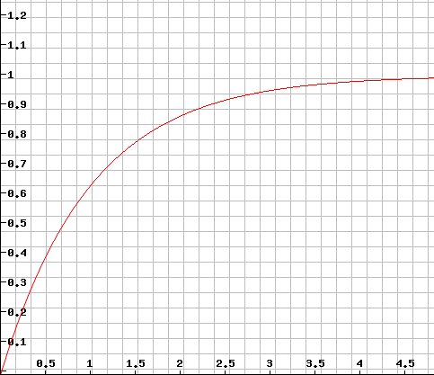





1. Significance of power management in processors (4)
Remark: Simplified calculation of the Dynamic power consumption (D_{d}) -2
Raising the voltage on the capacitor while charging it over a resistance
Vc
(V_{CC} = 1 V)
$${Vc=1− e}^{−t/τ}$$
$${VC=VCC ∗ (1− e}^{−t/τ})$$
$$with τ=Rs ∗ Cdyn$$
For V_{CC} = 1 V:
$${VC=1− e}^{−t/τ}$$
$$t/τ$$

Slide 8
1. Significance of power management in processors (5)
Remark: Simplified calculation of the Dynamic power consumption (D_{d}) -3
Let’s consider all active transistors on a die while taking the chosen model:
R_{s}
V_{CC}
C_{dyn}
R
I
V_{CC}
ΔT
Clock
Figure: Model of active transistors of a processor
While loading the capacitor C_{dyn} the charge Q will be accumulated and then discharged
over the resistor R during the halve clock period:
Q = C_{dyn} * V_{cc} = I * ΔT
ΔT = ½ * 1/f_{c}
Thus the dynamic dissipation is:
D_{d} = V_{cc} * I = V_{cc} * C_{dyn} * V_{cc}/ ΔT = C_{dyn} * V_{cc}² /(1/2 * 1/f_{c}) =
= 2 * C_{dyn} * V_{cc}² * f_{c}
D_{d}= const. * C_{dyn} * V_{cc}² * f_{c}
I.e.

Slide 9
1. Significance of power management in processors (6)
Characterizing the power consumption (dissipation) of processors by a TDP value
(Thermal Design Power)
TDP (Thermal Design Power) is the power consumption of a processor (package)
specified in datasheets, given usually in W.
It can be interpreted as the maximum power consumed by the processor
while running realistic, power intensive applications.
We note that realistic, power intensive applications should not be mixed up with
specific applications written to draw maximum power, called power viruses.
TDP serves as an indication to the power budget allocated to a processor,
at the same time it is a reference value for designing the cooling system
of the platform.
The cooling system (called also thermal solution) of a platform should guarantee
that the chip, more precisely the junction temperature (Tj) of the transistors
on the die does not exceed a given limit (Tjmax, e.g. 90º C) while the processor
dissipates TDP Watts.
TDP: Tervezési hőérték

Slide 10
1. Significance of power management in processors (7)
The notion of cTDP (configurable TDP)
It was introduced by Intel in 2012 (in their Ivy Bridge line and later on also
by AMD in their Kaveri line in 2014).
cTDP provides a flexibility for OEMs to build laptops or desktops compared to
designs based on a processor with a fixed TDP.
cTDP allows to choose a TDP value for a design from a TDP interval between a
lowest and highest value, instead of a fixed figure, e.g. any value between 12 W
and 28 W instead of 15 W.
Choosing a lower TDP will result in a more quiet device with less performance
and power consumption whereas a higher TDP vice versa.
Nevertheless, if an OEM chooses a higher TDP it has to provide an enhanced
cooling solution as well compared to that the nominal TDP value would require.

Slide 11
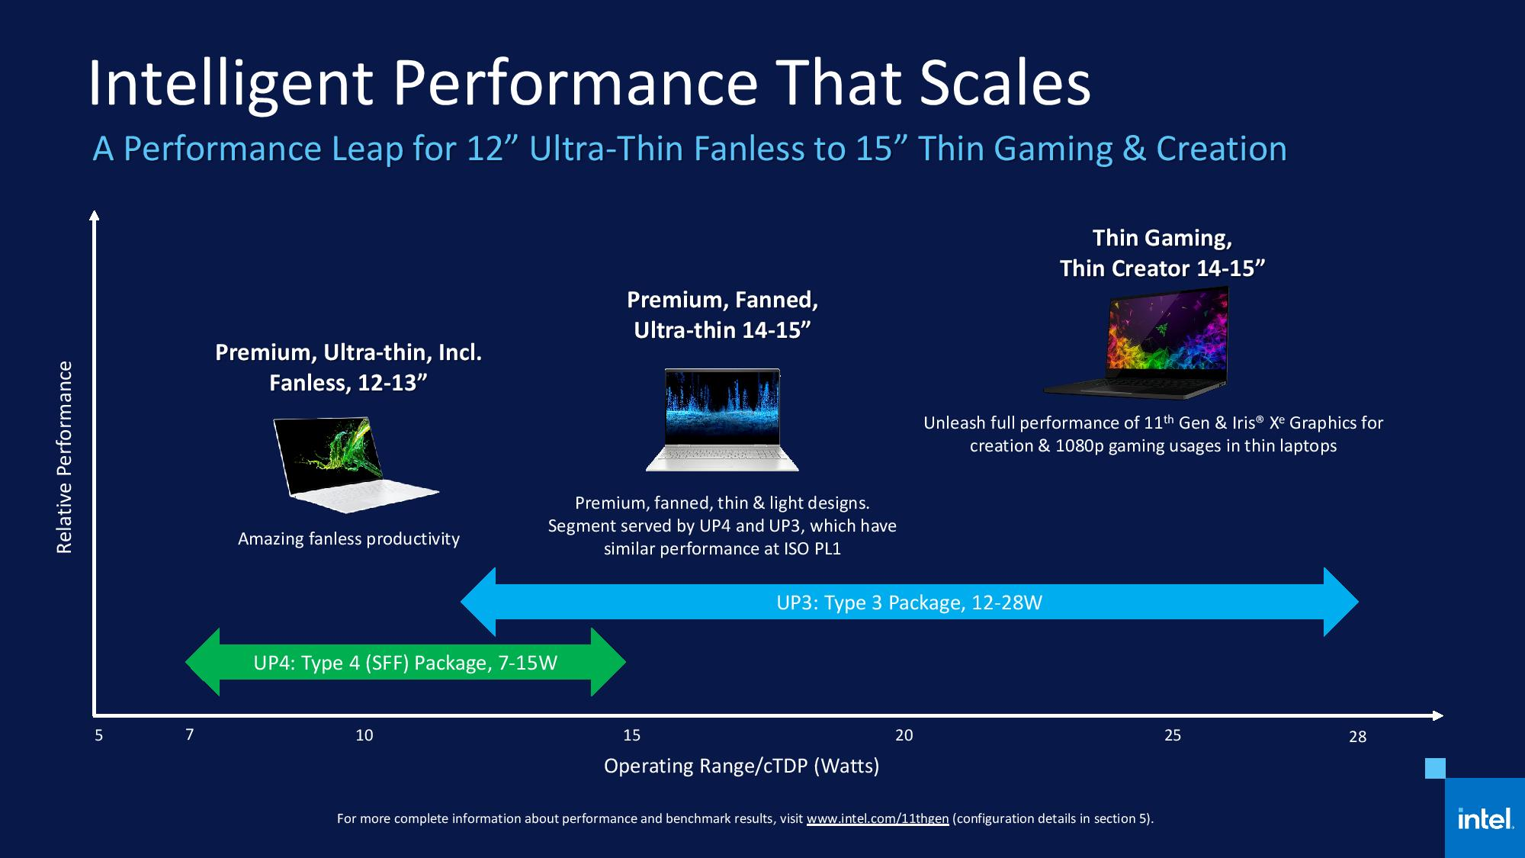
1. Significance of power management in processors (8)
Example for cTDP values of Intel’s UP3/UP4 class Tiger Lake models aiming at
laptops [1]
SFF: Small Form Factor
cTDP: configurable TDP

Slide 12
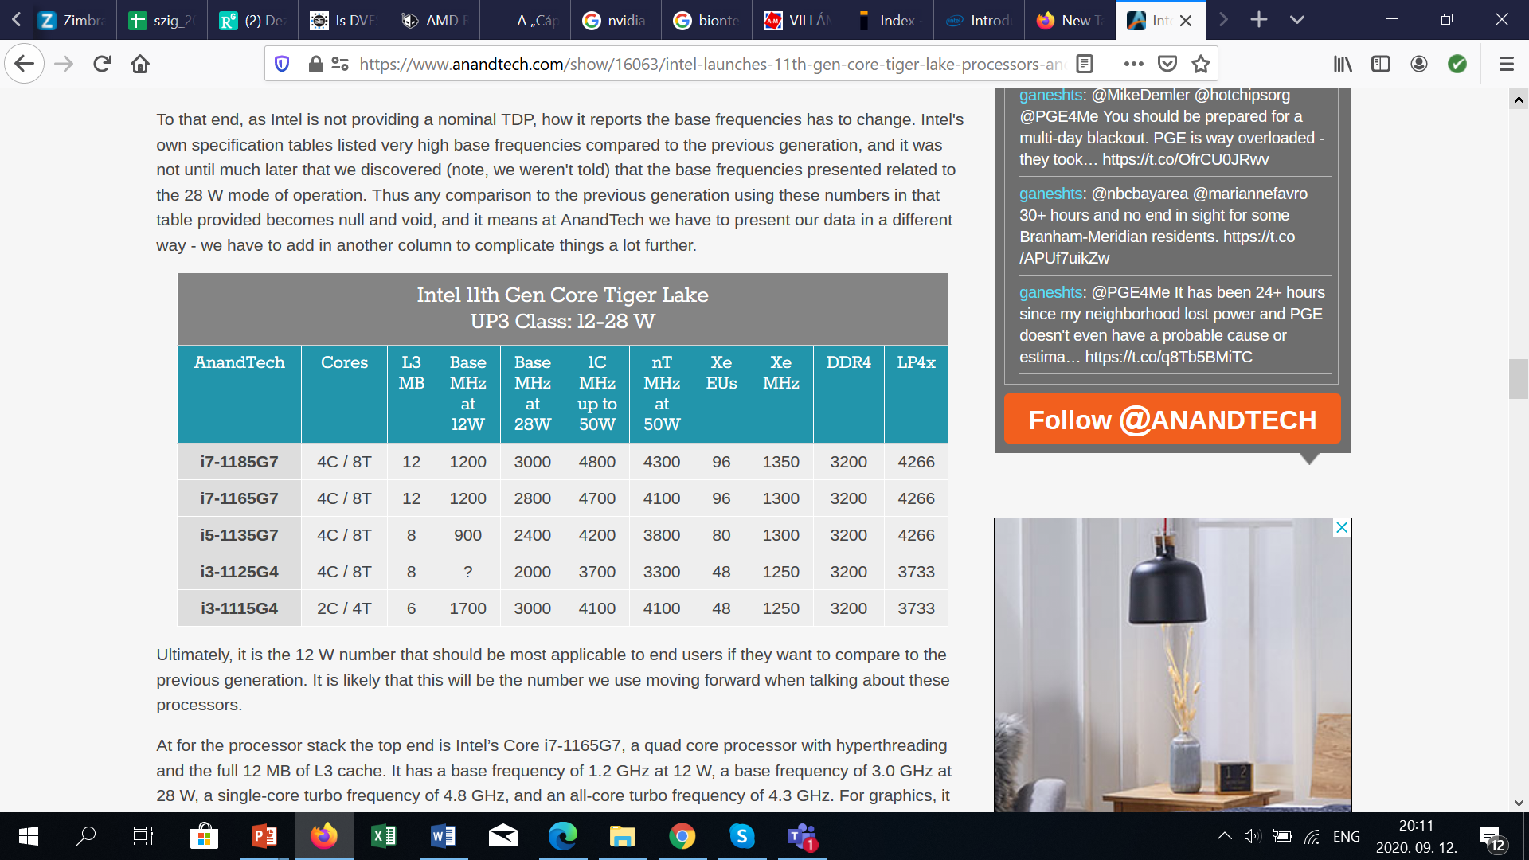
1. Significance of power management in processors (9)
Example for how heavily the base clock rate depends from the allocated
cDTP power budget in Intel’s UP3 class Tiger Lake models [1]

Slide 13
1. Significance of power management in processors (10)
Scenario TDP (SDP) [2]
Called also Scenario Design Point.
Introduced by Intel along with their 3. gen. Ivy Bridge line in 2012 and used from
time to time e.g. in the specification of their 7 W (SDP) Lakefield processors (2020).
The SDP only states the average power consumption of a processor using a certain
mix of benchmark programs to simulate "real-world" scenarios“.
The SPD value is remarkably lower than the related TDP value, e.g. for the 13 W
Core i7-3689Y Intel states an SDP of 7 W.
Declaring SPD values instead of or beyond the TDP is more or less a marketing ploy.

Slide 14
1. Significance of power management in processors (11)
Typical TDP values of different processor categories
Processor category |  | TDP | Intel’s usual tags
Servers |  | ≈85-250 W
HEDs |  | ≈100-150 W | X
 | High perf. | ≈70-95 W | K
 | Mainstream | ≈50-65 W | S
 | Low power | ≈35-45W | T
 | High perf. | ≈45 W | H/HQ
 | Mainstream | ≈25-35 W | U
 | Ultra-thin | ≈15 W | U
Tablets |  | ≈5 W | Y/m
Desktops
Notebooks

Slide 15
1. Significance of power management in processors (12)
How TDP (allocated power budget) limits the basic clock rate? -1
As an example, data on Intel’s Skylake DT and mobile processors show below how much
DTP limits the base clock frequency, though all cores of the processors concerned
have the same microarchitecture.
Models | TDP (W) | No. of cores | Graphics | No. of graphics EUs | eDRAM | Max. Base frequency (GHz)
6Yxx | 4.5 | 2 | HD 515 | 18 | -- | 1.2
I7-6xxxU | 15 | 2 | HD 540 | 48 | 64 MB | 2.2
I3/I5/i7-6xxxU | 15 | 2 | HD 520 | 24 | -- | 2.6
I3/I5/i7-6xxxU | 28 | 2 | HD 550 | 48 | 64 MB | 3.3
I3/i5/i7-6xxxT I3-6xxxH | 35 | 4 2 | HD 530 | 24 | -- | 2.8 2.7
I5/i7-6xxxHQ | 45 | 4 | HD 530 | 24 | -- | 2.9
I3-6xxx | 47 | 4 | HD 530 | 24 | -- | 2.9
I5/i7-6xxx | 65 | 4 | HD 530 | 24 | -- | 3.4
I5/i7-6xxxK | 91 | 4 | HD 530 | 24 | -- | 4.2
Table: Base clock frequency vs. TDP in Intel’s Skylake DT and mobile lines [3]

Slide 16
1. Significance of power management in processors (13)
How TDP (allocated power budget) limits the basic clock rate? -2
As data shows, 4.5 W allocated TDP restricts the basic core frequency to 1.2 GHz
whereas 91 W TDP allows a clock rate of up to 4.2 GHz.

Slide 17
1. Significance of power management in processors (14)
A lesson on the significance of dissipation - The Tale of Intel’s Pentium 4 family
Intel released its Pentium 4 family in 2000.
As Paul Otellini, Intel’s CEO at that time, declared in a keynote speech held at Intel
Developer Forum, Fall 2001: “And we're convinced that the microarchitecture that the
Pentium 4 embodies will be able to scale to 10 Gigahertz over its lifetime.” [4].
Nevertheless, Intel never reached 4 GHz and was forced to cancel the Pentium 4
line after a lifecycle of about 4 years in 2004, due to higher than expected
dissipation.
Too high dissipation was caused by Intel’s strive for high clock frequencies,
(by lengthening the cores processing pipeline), since higher clock frequencies
cause higher dynamic dissipation, as demonstrated in the next Figure.
CEO: Chief Executive Officer

Slide 18
1. Significance of power management in processors (15)
Rising of dissipation (D) per cm² die area [W/cm²] in Intel's Pentium family -1
≈ Limit of air cooling
Pentium
4
Pentium III

Slide 19
1. Significance of power management in processors (16)
Rising of dissipation (D) per cm² die area [W/cm²] in Intel's Pentium family -2
As the previous Figure shows, the dissipation of Pentium 4’s subsequent cores
dynamically rose, up to nearly 100 W/cm² for the 3. core (Prescott) that equals
about 100 W, as it has a die area of approximately 1 cm².
But this steep rise of dissipation could not be kept on further on while the
resulting power density became unmanageable since absorbing about 100 W
dissipation by means of air cooling was already a challenge in DTs of that time.
Intel was early in recognizing this intolerable trend, as a slide from a keynote
speech of Andy Groove from 12/2002 reveals (see next Figure).

Slide 20
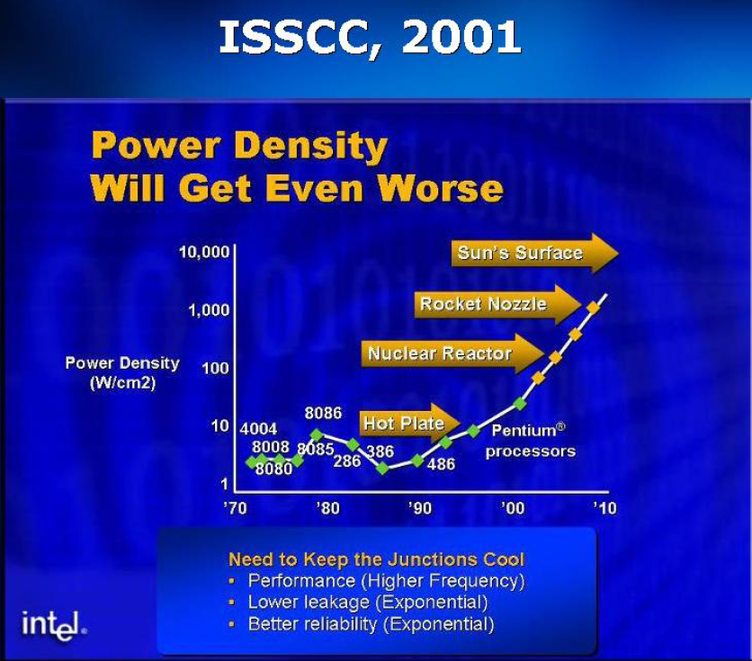
1. Significance of power management in processors (17)
Recognising the impact of rising power density (W/cm²) in Intel processors
at the IDM conference 2002 (A. Groove, Intel) [5]
A. Groove Keynote at IEDM Dec. 2002
IEDM: International Electron Device Meeting

Slide 21
1. Significance of power management in processors (18)
Intel’s lesson learnt from the Pentium 4 debackle -1
To address the relentless rise of dissipation while pursuing higher clock rates Intel
shifted in 2003 their focus of processor development from the pure performance goal
to power efficiency, as stated in a slide revealed at a shareholder’s meeting back in
4/2006 (see next slide).

Slide 22
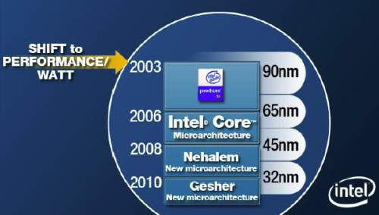
1. Significance of power management in processors (19)
Intel’s lesson learnt from the Pentium 4 debackle -2
Power efficiency is understood as performance per watt, given e.g. in GFLOPS/W.
Razin A., Core, Nehalem, Gesher. Intel: New Architecture Every Two Years,
Xbit Laboratories, April 28 2006,
http://www.xbitlabs.com/news/cpu/display/20060428162855.html
Figure: Intel’s plan for developing their manufacturing technology and processor lines
while indicating their shift to design processors by pursuing efficiency rather than
performance, revealed at a shareholder’s meeting back in 4/2006 [6]

Slide 23
1. Significance of power management in processors (20)
Remark
Note in the Figure that Intel designates the processor line succeeding Nehalem
“Gesher”.
In fact, this name was changed to Sandy Bridge, since Gesher (bridge in Hebrew)
was the name of a political party in Israel.

Slide 24
1. Significance of power management in processors (21)
Cancellation of the Pentium 4 family in 2004
A severe aftermath of the relentless rise of dissipation of the Pentium 4 cores was
the inevitable cancellation first of all announced processors with a clock rate over
3.6 GHz in 05/2004, and subsequently the withdrawal of entire Pentium 4 family
in 10/2004, as the next slides show.

Slide 25
1. Significance of power management in processors (22)
Introduction and withdrawal of Intel's P4 family due to overheating -1

Slide 26
1. Significance of power management in processors (23)
Introduction and withdrawal of Intel's P4 family due to overheating -2
Above Figure shows all models of the Pentium 4 family while different colors
identify subsequent cores (Willamet, Northwood, Prescott).
Below the processor designations we enlist main processor features, like technology,
transistor count, clock rates, cache size, FSB speed or socket types.
Left to the processor designations two vertical lines indicate hyperthreading.
As the transistor counts show (55 million), beginning with the 2. core (Northwood)
all models were prepared for hyperthreading, nevertheless Intel announced it
first for their DP server line, for reasons of marketing.
In addition, a white rectangle on the left of the model designation refers to 64-bit
support.
Transistor counts (125 million) of the 3. core (Prescott) reveal that Intel designed
its 3. core from the beginning on with 64-bit support, but again the firm introduced
it first for the DP server line, from marketing reasons.
The Figure indicates also that Intel cancelled all processors that were announced
with a clock frequency higher than 3.6 GHz.

Slide 27

1. Significance of power management in processors (24)
Intel's apology for withdrawal the Power 4 family in 10/2004 [7]
During an interview on stage at Gartner Group’s Fall Symposium/IT Expo in
Orlando Intel’s then Chief Executive Officer Craig Barrett got down on his knees.
In front of an audience of about 7000 information-technology professionals,
Barrett asked their forgiveness for the Santa Clara company latest product
slip up, and the cancellation of its Pentium 4 family in Oct. 2004.
Picture: 10/2004 Intel's CEO apologizes for the withdrawal of the Pentium 4 family [7]

Slide 28
1. Significance of power management in processors (25)
Intel’s lesson learnt from the Pentium 4 debackle -3
Learnt from Pentium 4’s fiasco, Intel based the design of their next, highly successful
processor family, the Core 2, on a low power design, which was the Pentium M
(mobile) processor.

Slide 29
1. Significance of power management in processors (26)
Summing up the evolution of processor design paradigms
As discussed before, Intel shifted their processor design paradigm from
pursuing high performance to pursuing high efficiency in the middle of the 2000’s.
By contrast, mobile processors are designed for low power consumption.
These facts are summarized in the Figure below.
Processor design paradigms
High performance
oriented design paradigm
High performance per Watt
oriented design paradigm
Low power consumption
oriented design paradigm
Expressed in
E.g. GFLOPS
E.g. GFLOPS/Watt
E.g. Watt
Examples
Client/server
processors
Until about Intel’s Pentium 4
(up to ≈ 2004)
From Intel’s Core 2 line on
(2006)
Mobile
processors
ARM ISA-based
processor lines
Intel’s Atom line
(2008-2016)
AMD’s Cat line
(2011-2016)

Slide 30
1. Significance of power management in processors (27)
Initiatives to reduce power consumption
Subsequently, we discuss two initiatives for reducing energy consumption, as follows:
a) The Energy Star initiative, and
b) AMD's initiative to achieve 25x energy efficiency increase between 2014-2020

Slide 31

1. Significance of power management in processors (28)
a) The Energy Star initiative to reduce energy consumption [8] -1
It was launched in 1992 by the US Environmental Protection Agency (EPA)
to generate awareness of energy saving in different processor categories, like
desktops, laptops etc.
The 5. version of this initiative was released in 2009.
It provides different formulae for calculating the annual Typical Energy Consumption
(TEC) in inactive ACPI states for different processor classes and gives
maximal TEC figures for permitting to use the Energy Star sticker.
ACPI: Advanced Configuration and Power Interface (open standard, originally developed by Intel, Microsoft and Toshiba in 1996).

Slide 32
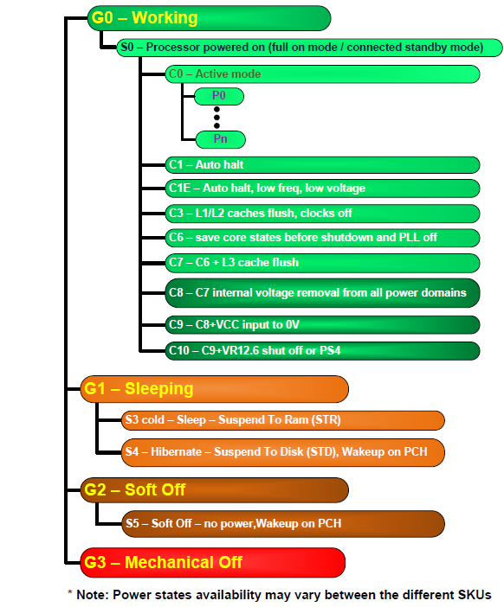
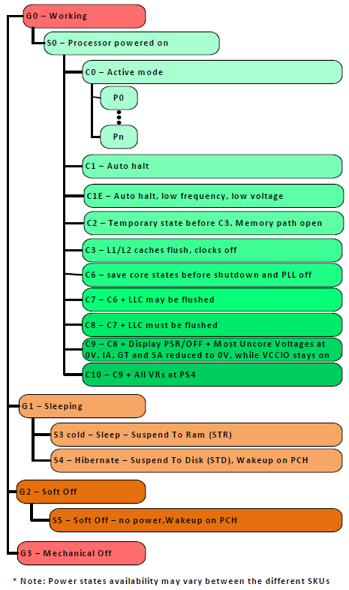
1. Significance of power management in processors (29)
Inactive ACPI standard states, referenced in the Energy Star initiative [9]
Gi: Global states
G0: Working state
Pi: Performance states
(active states, since ACPI 2.0))
Ci: Idle states
C1…C3 given in ACPI 1.0
(C4…Cn states since ACPI 2.0)
C1
C2
Cn
G1: OS-initiated, system context
saved, no rebooting needed.
G2/Soft off: OS-initiated shut down.
Power supply remains on,
system context is not saved,
the system must be restarted.
G3/Mechanical off: Entered by
activating a mechanical switch.
The system must be restarted.
S3-S5: System Sleep states
*

Slide 33
1. Significance of power management in processors (30)
Remark: The formula for calculating the TEC figure for laptops
in the 5. version of the Energy Star initiative [8]
For example the formula for calculating the TEC figure for laptops is:
TEC = (8760/1000) * (Poff * 60% + Psleep * 10% + Pidle * 30%) [kWhours]
where
there are 365x24 = 8760 hours/year
all Px values are power consumption values in Watts
Poff: It relates to the Off-state, i.e. to the ACPI S4 (Hibernate -
Suspend to disk or S5 (Soft off) states, where applicable.
Psleep: It relates to the Sleep state, i.e. to the ACPI S3 state (Sleep -
Suspend to RAM state).
Pidle: It relates to the Ci Idle states, i.e. to states when activity is limited to
basic applications that the system starts by default.
E.g.: Poff = 1W, PSleep = 1.7W, Pidle = 10W
The TEC limit depends on the laptop configuration.
E.g. The TEC limit for the lowest configuration laptop is 40.0 kWhours/year.
Laptops with lower TEC values as the related TEC limit may carry the Energy Star
sticker.

Slide 34
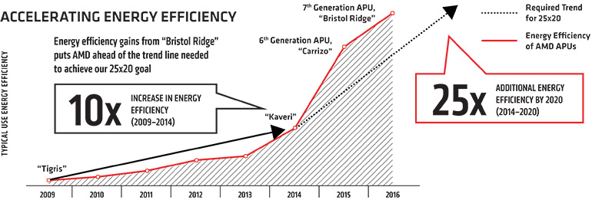
1. Significance of power management in processors (31)
b) AMD's initiative to achieve 25x energy efficiency increase in 2014-2020 -1
Announced: in 2014
Energy efficiency: Performance/Watt
Figure: Previous results and goals of AMD’s 25x energy efficiency increase initiative
[10], [11]
Tigris: AMD’s notebook platform

Slide 35
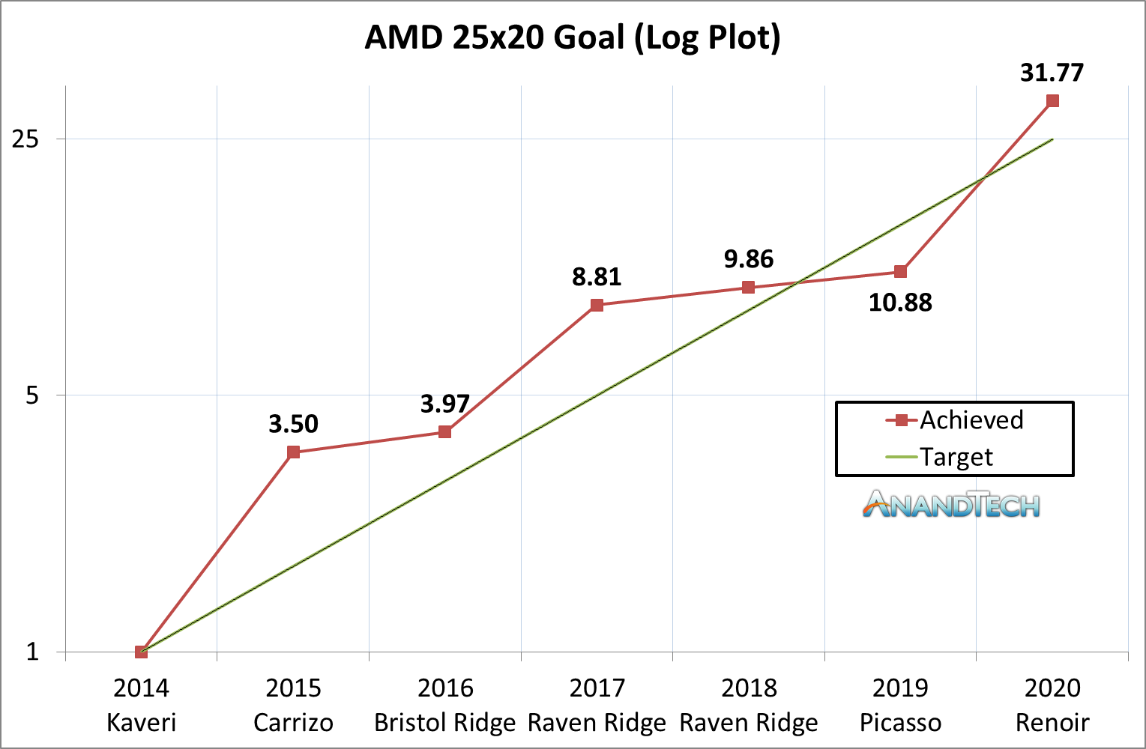
1. Significance of power management in processors (32)
AMD's initiative to achieve 25x energy efficiency increase in 2014-2020 -2
In 06/2020 AMD stated that the goals of their 25x energy efficiency increase
initiative were achieved, as the Zen 2-based Ryzen 7 4800H client processors
beat the company's baseline efficiency (of the Kaveri processor) by 31.7 times.
Figure: AMD’s achievement in increasing energy efficiency [12]

Slide 36
1. Significance of power management in processors (33)
AMD's initiative to achieve 25x energy efficiency increase in 2014-2020 -3
Note
Energy efficiency is extremely important also for supercomputers, there is list
maintained indicating the most energy efficient supercomputers, called the
"Green500“ list.

Slide 37
1. Significance of power management in processors (34)
Approaches and key techniques of power management in computers -2
While restricting our scope of power management only to processor-related approaches
(dismissing e.g. IC manufacturing, transistor or software possibilities) we can
distinguish three levels where power management can take place, as follows:
Approaches for power management (PM) of computers
(Strongly simplified)
PM at the circuit level
(Reducing power consumption
by appropriate circuit design)
PM at the processor level
PM at the platform level
(ACPI-based, achieved by
system design)
In the subsequent Figure we give an overview of the formost techniques used for
processor power management at the considered levels.

Slide 38
1. Significance of power management in processors (35)
Approaches and key techniques of power management in computers -2
Approaches for power management (PM) of computers
(Strongly simplified)
PM at the circuit level
(Reducing power consumption
by appropriate circuit design)
PM at the processor level
PM at the platform level
(ACPI-based, achieved by
system design)
PM of CPU cores
Clock gating
Power gating
FIVR
PM of idle CPU cores
PM of active CPU cores
Reducing
power consumption
of idle CPU cores
Reducing
power consumption
of active CPU cores
Utilizing the power headroom*
of a proc. package
to raise performance
C-state management
DVFS/CPPC/AVFS
Turbo Boost Technology
(ACPI-based)
CPPC: Collaborative Processor Performance Control
(DVFS, CPPC: ACPI-based)
(* see next slide)

Slide 39
1. Significance of power management in processors (36)
Remark
Power headroom: (Hőtartalék) It is the difference between the TDP and the actual
power consumption that can be utilized for raising clock frequency and thus
performance.

Slide 40
1. Significance of power management in processors (37)
Example: AMD’s techniques developed for reducing consumption
at the circuit and platform levels (2008-2014) [13] -1
(Also) AMD put a great emphasis on power reduction, as the next Figure demonstrates,
indicating AMD’s techniques developed for reducing power consumption
at the circuit and platform levels between 2008 and 2014.
Certain, more important techniques have been underlined.
The Figure shows also the power reduction results achieved in idle power
consumption for AMD’s DT and mobile processor lines.

Slide 41
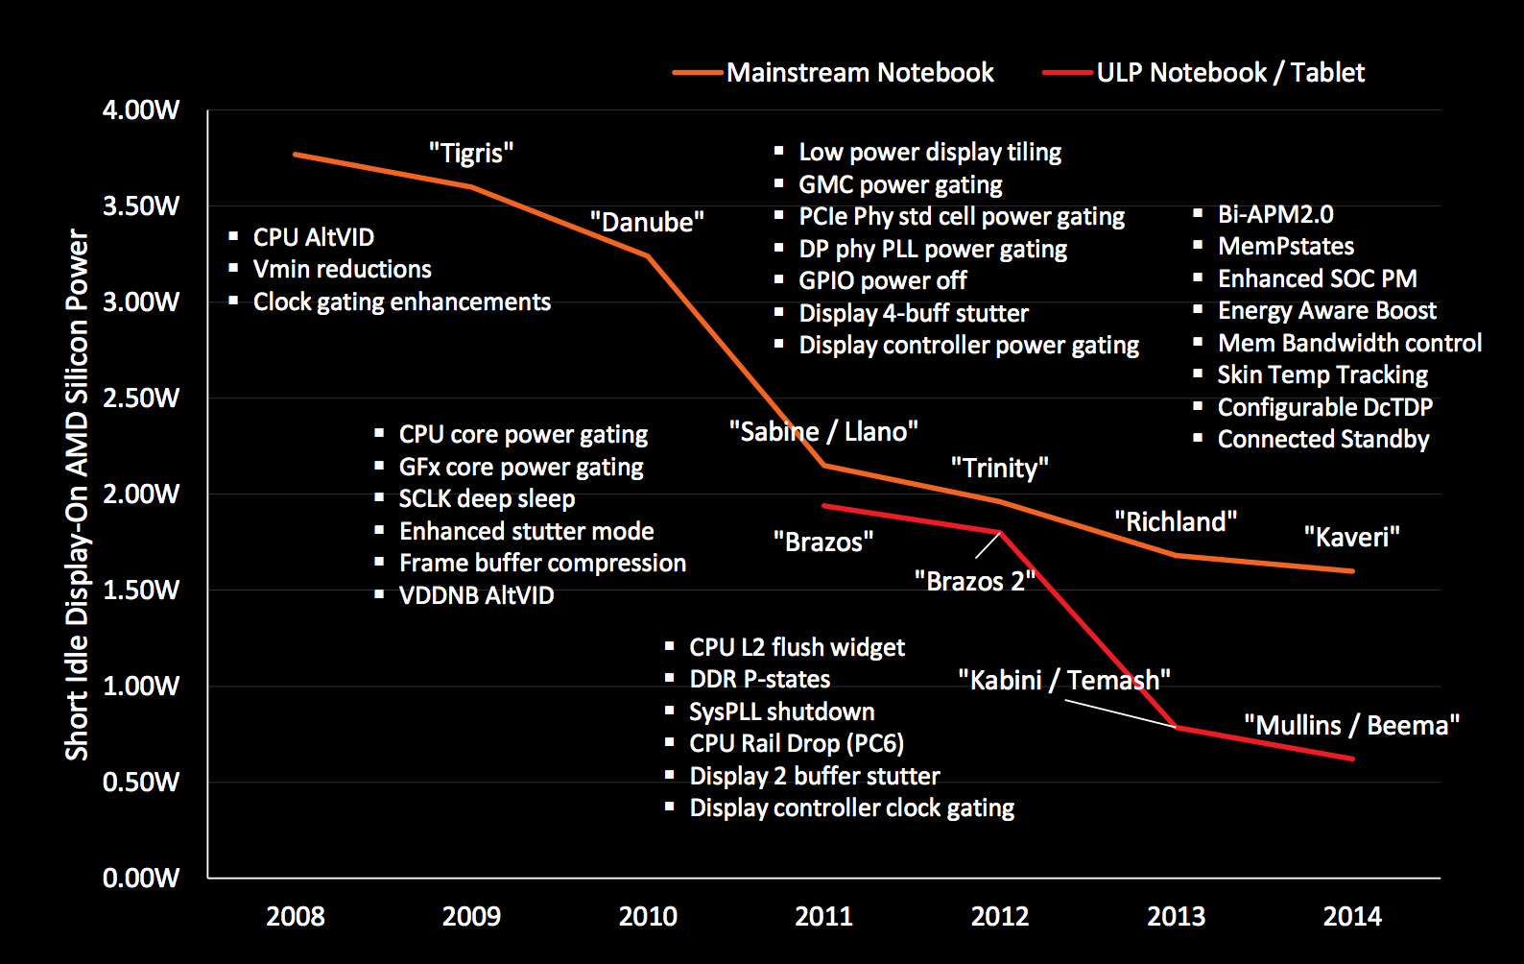
1. Significance of power management in processors (38)
Example: AMD’s techniques developed for reducing power consumption
at the circuit and platform levels (2008-2014) [99] -2

Slide 42
2. Power management at the circuit level
2.1 Clock gating
2.2 Power gating
2.3 Integrated Voltage Regulator (FIVR)

Slide 43
2.1 Clock gating

Slide 44
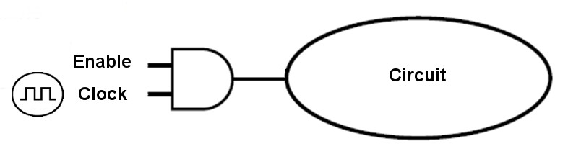
2.1 Clock gating (1)
2.1 Clock gating
It is a technique used to reduce dynamic power consumption by disabling clocking of currently not needed circuits.
Clocking is disabled by inserting AND gates (i.e. controlled on/off switches) that
are called clock gaters into the clock distribution network, as indicated below.
Circuit
Clock gater
Figure: Principle of clock gating

Slide 45
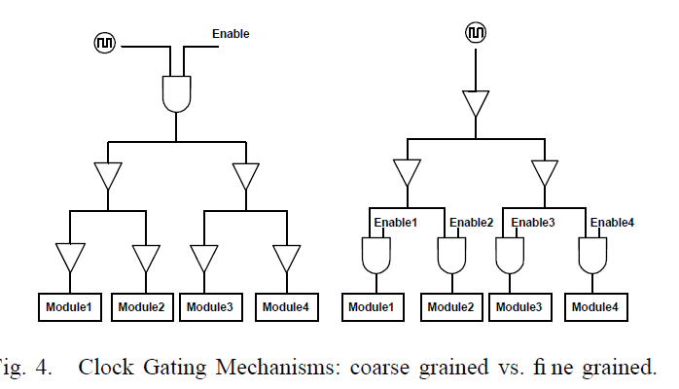
2.1 Clock gating (2)
Fine-grained or coarse grained clock gating -1
Clock gating can be applied either in a fine-grained or a coarse-grained fashion,
as the next Figure shows.
Fine-grained clock gating
Coarse-grained clock gating
Figure: Kinds of clock gating [14]
Fine-grained clock gating allows power saving at a low logic level, whereas
coarse-grained clock gating is used to disable clocking of currently idle units or
parts of them (e.g. an FP unit as long as only FX instructions are processed.

Slide 46
2.1 Clock gating (3)
Use of clock gating
Clock gating was introduced very early, in the second half of the 1990s.
As an example, DEC implemented it for clock gating the FP unit of their
Alpha 21264 DT processor (1996) or made extensive use of this technique in the
StrongARM SA110 embedded processor (1996).
At that time this technique was called conditional clocking.
Due to its benefits, soon clock gating became widely spread, e.g. in Intel's
Pentium 4 (2000) or Pentium M (Banias) (2003).
Recently, clock-gating is a pervasive technique used in processors.

Slide 47
2.2 Power gating

Slide 48
2.2 Power gating (1)
2.2 Power gating
Principle of power gating [15]
Power gating switches off idle units on the die (like a core) from the power supply
by means of power transistors (sleep transistors) to eliminate both dynamic and
static power consumption caused by leakage currents.
Figure: Principle of power gating [15]
(Power gating: Tápellátás kapuzása)

Slide 49
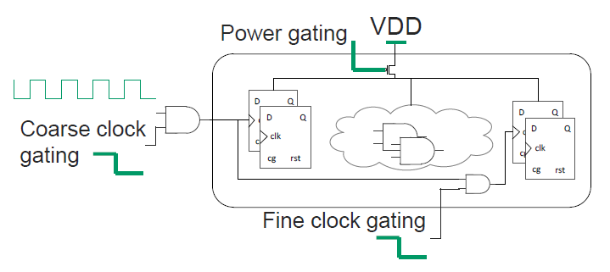
2.2 Power gating (2)
Advantage of power gating over clock gating
Note that clock gating eliminates only the dynamic part of power consumption, whereas
power gating removes both the dynamic and static part of power consumption
of a unit.
Both clock gating and power gating is typically used at the same time, as indicated
in the Figure below.
Figure: Contrasting clock gating and power gating [13]

Slide 50
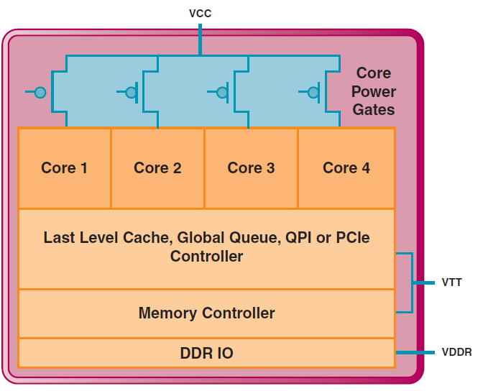
2.2 Power gating (3)
Example for using power gating for switching off idle cores in a multicore processor
In a multicore processor power gating allows to switch off individual, not used cores,
as indicated below.
VR
VR
VR
Figure: Power gating of a 4-core processor, implemented with a common voltage rail
the cores [16]
VR: Voltage Regulator

Slide 51
2.2 Power gating (4)
Power gating as a precondition for implementing Turbo Boost technology
Turbo Boost technology utilizes the actual power headroom of processors.
Consequently, the Turbo Boost technology can only be efficient if there is a
high enough power headroom at hand.
Since power gating eliminates both static and dynamic dissipation of idle cores,
it largely raises the power headroom of lightly loaded or idle processors.
Thus, power gating can be considered as a precondition for the implementation
of Turbo Boost technology, since clock gating alone does not provide enough
headroom for a noteworthy increase of the clock frequency.
Power headroom: (Hőtartalék) It is the difference between the TDP and the actual
power consumption.

Slide 52
2.2 Power gating (5)
Introduction of power gating in main computer families
Vendor | Family | Year of intro.
Intel | Nehalem | 2008
 | Westmere | 2010
 | Sandy Bridge | 2011
 | Ivy Bridge | 2012
 | Skylake | 2015
 | Atom families | 2010 - 2016
AMD | K12-based Llano K14-based Bobcat K15-based Bulldozer families | 2011 2011 2011 - 2015
IBM | POWER7+ | 2012
 | POWER8 (Iintegrated PG and DVFS) | 2014
As seen above, it was Intel who first introduced power gating in 2008, all other firms
followed suit.

Slide 53
2.2 Power gating (6)
Extent of the use of power gating (PG) -1
When Intel introduced power gating in its Nehalem line in 2008, this technique was
only limited to the cores.
Subsequently, due to its power saving benefits, power gating became widely used
by other vendors, such as AMD as well, not only for CPU cores but also for further
functional units (like the L3, GPU, MC etc.), as indicated in the next Figure.

Slide 54
2.2 Power gating (7)
Example: Power gating for further functional units as well rather than only
for the cores, in AMD's Llano line (2011) [17]
In Llano AMD power-gates virtually all units, such as
the Graphics Core (GFX)
the Graphics Memory Controller (GMC)
the Unified Video Decoder (UVD)
the x16 PCIe Expansion Graphics Controller.
AON: Always ON – refers to logic that is not power-gated
Figure: Use of power gating beyond CPU cores and L2 caches in Llano [17]
The GFX and GMC units have dynamic (hardware) power gating whereas other units
have static power-gating, i.e. power gating is controller by their drivers.
Note that in the above case the VddNB (Vdd Northbridge) rail is power-gated.

Slide 55
2.2 Power gating (8)
Summing up the extent of power gating (PG) -2
Extent of the use of power gating (PG)
PG covers
only the CPU cores
PG covers
beyond CPU cores also other units
(like the L3, GPU, MC etc.)
Intel's early PG solution in the
Nehalem (2008) processor line
Intel's PG solution in the
Westmere and Sandy Bridge lines
(cores, L3 cache) (2010/2011)
Intel's PG solution in the
Ivy Bridge line
(cores, PCIe, memory controller) (2012)
Intel's PG solution
since Lincroft-based Atom lines
(cores, graphics cores, video decoder/
encoder, display controller) (2010-2016)
AMD's PG solutions in
the Bulldozer (2011), Llano (2011)
and Bobcat (2011) lines
(cores, graphics core and controller,
PCIe controller, video decoder)
as well as in subsequent processors

Slide 56
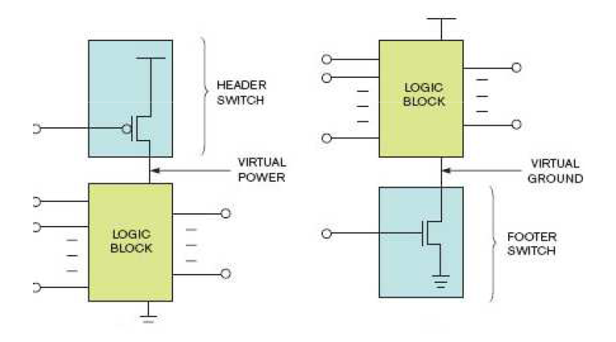
2.2 Power gating (9)
Implementing power gating: Alternatives for isolating the power supply
To implement power gating either Vcc (Vdd) or Vss (ground) should be isolated,
as indicated in the next Figure [18].
Isolate Vcc (Vdd)
Isolate Vss
Vcc (Vdd)
Vss

Slide 57
2.2 Power gating (10)
Use of alternatives for isolating the power supply
Intel and AMD employ different alternatives for isolating the power supply,
as indicated below.
Alternatives to isolate power supply
Switch off the Vcc (Vdd) voltage
Switch off Vss (ground)
Intel's solution
in the Nehalem and subsequent
processor families
AMD's solution for switching off cores
in the Bulldozer and Llano based
as well as subsequent processor lines
of these families
AMD's solution for switching off cores
in the Bobcat and subsequent processor lines
AMD's solution for switching off idle units rather than cores (e.g. graphics units
in the Bulldozer and Llano based
as well as subsequent processor lines of these families

Slide 58
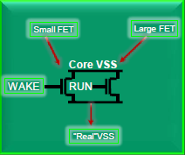
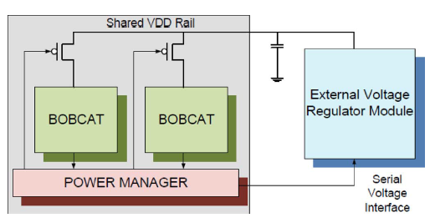
2.2 Power gating (11)
Examples for isolating the power supply
Isolating Vcc (Vdd) in Intel's Nehalem line (2008) [16]
Isolating Vss in AMD's Bulldozer line (2011) [19]
Isolating Vcc (Vdd) in AMD's Bobcat line (2011) [20]

Slide 59
2.2 Power gating (12)
Necessary operations prior to switching off cores by means of power gating
When cores are powered off their internal memories (registers, caches) will lost
their content.
This is the reason why before a core can be switched off
its (write back) caches need to be flushed
(i.e. modified cache lines need to be written back into the next level cache
if available else into the main memory) and
the execution state of the core needs to be preserved
(either in the main memory, in the next level cache (if existent) or in an
SRAM that has an independent power supply).
In addition, in order to reduce power consumption further on, typically also
core clocking will be halted and
the PLL is switched off.
PLL: Phase-Locked Loop (used as clock generator)

Slide 60
2.2 Power gating (13)
Alternative techniques used by Intel and AMD for saving the execution state
of cores
Alternatives techniques for saving the execution state of cores
Saving the execution state
of cores
into the main memory
Saving the execution state
of cores
into the last level cache
Saving the execution state
of cores
into an on-die SRAM
Intel
Penryn (2007)
Nehalem (2008)
Westmere (2010)
Sandy Bridge (2011)
Haswell (2013)
Broadwell (2014)
Skylake (2015)
Atom line (2010-2016)
Power gating (1)
AMD
Llano (2011)
Bulldozer (2011)
Piledriver (2012)
Steamroller (2013)
Excavator (2015)
Jaguar (2013)
(either into the L1 cache or
the main memory)
Puma (2014)
(into the L1 cache)
Bobcat (2011)
Jaguar (2013)
(either into the L1 cache or
the main memory)

Slide 61
2.3 Integrated Voltage Regulators (FIVRs)
2.3.1 Introduction to FIVRs
2.3.2 Implementation of FIVR
2.3.3 Assessment and use of FIVRs
Subsection 2.3.2 is not discussed in the Lecture
and is not part of the exam., except the slide “2.3.2 Implementation of FIVR (2)”

Slide 62
2.3 Integrated Voltage Regulators (FIVRs) (1)
2.3 Integrated Voltage Regulators (FIVRs)
FIVRs are instrumental in efficient implementation of mainboards and
power efficient processors.
Why, this Section will reveal it.
Note
In this Section we use the terms FIVR or integrated voltage regulator as synonyms.

Slide 63
2.3.1 Introduction to FIVRs

Slide 64
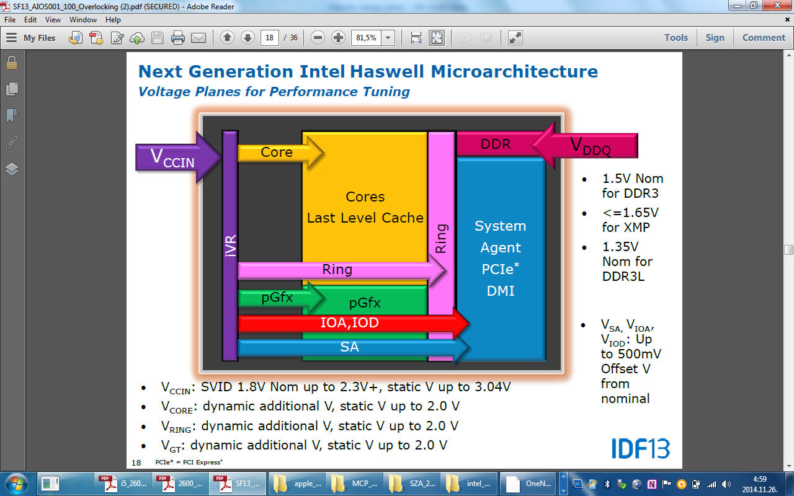
2.3.1 Introduction to FIVRs (1)
2.3.1 Introduction to FIVRs
Motivation for introducing integrated voltage regulation -1
Processors typically maintain multiple voltage planes to optimize power supply.
E.g. Intel’s DT and mobile Haswell processors have six voltage planes, as seen below.
Figure: Voltage planes
of Haswell DT and
mobile processors [21]
Voltage plane: feszültség szint
(Tápfeszültség)

Slide 65
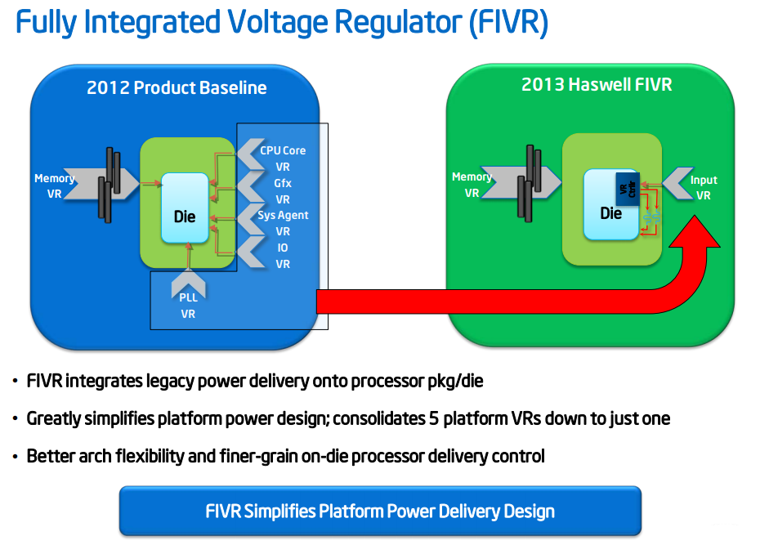
2.3.1 Introduction to FIVRs (2)
Motivation for introducing integrated voltage regulation -2
In order to supply the requested multiple voltage levels motherboards traditionally need multiple voltage regulators (VRs).
E.g. Ivy Bridge client processors need 6 different voltage regulators for the CPU cores,
graphics (Gfx), System Agent (SA), IO, PLL and Memory, as shown in the Figure below.
Ivy Bridge)
Figure: Voltage regulators (VRs) needed for Ivy Bridge client mainboards [7]

Slide 66
2.3.1 Introduction to FIVRs (3)
Principle of Intel’s FIVR (Fully Integrated Voltage Regulators)
To reduce the number of voltage regulators (VR) needed, Intel designed an integrated
voltage regulator, called FIVR (Fully Integrated Voltage Regulator) that integrates
legacy power delivery (except of the Memory VR) onto the mainboard, package and die.
FIVR was introduced in Intel’s Haswell processor, as shown below.
(Ivy Bridge)
Figure: Principle of integrating legacy power delivery (except of the Memory VR)
in Intel’s FIVR [7].
In the above example, FIVR consolidates five platform voltage regulators (VRs) into one.

Slide 67
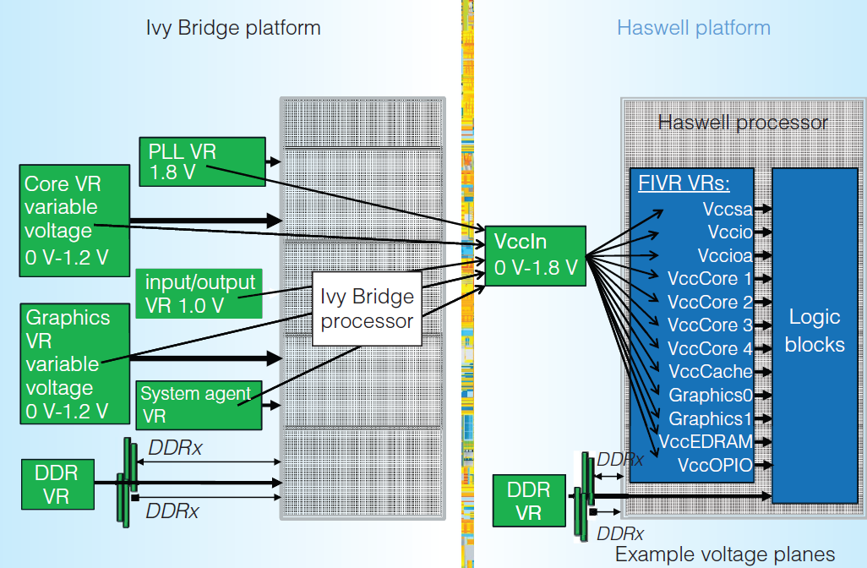
2.3.1 Introduction to FIVRs (4)
Example: Contrasting power delivery in the preceding Ivy Bridge and the
subsequent Haswell client platforms [22]
As seen FIVR greatly simplifies voltage delivery of a platform.

Slide 68
2.3.2 Implementation of FIVR

Slide 69
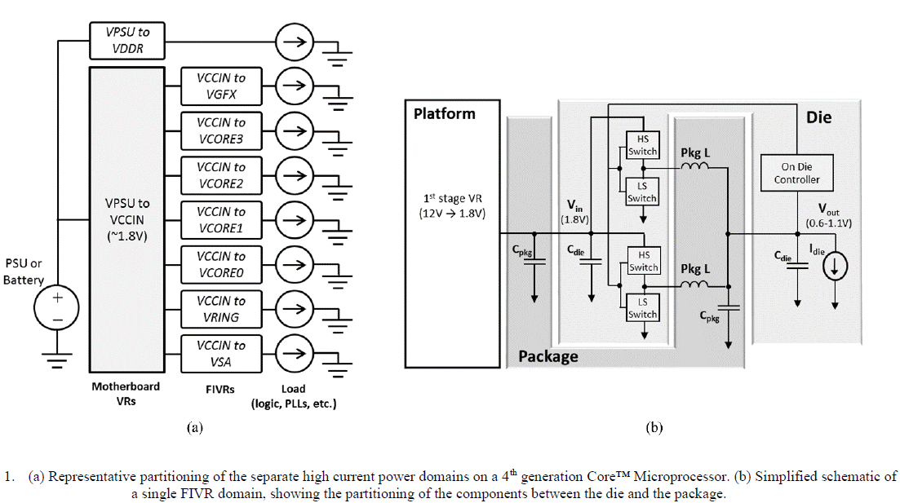
2.3.2 Implementation of FIVR (1)
2.3.2 Implementation of FIVR
Implementation of Intel’s 1. gen. FIVR, introduced in the Haswell line -1
Functional partitioning of the implementation
FIVR is built up of two stages.
The first stage of the voltage regulator
delivers 1.8 V by conversion from the
PSU or battery voltage (12V), which
is distributed across the microprocessor die.
The second conversion stage is comprised of
between 8 and 31 VRs (depending on
the actual product), which are 140MHz
synchronous multiphase buck converters
with up to 16 phases (to be discussed
later).
12 V
First stage
Second stage
Figure: Functional partitioning
of the FIVR [23]
PSU: Power Supply Unit

Slide 70
2.3.2 Implementation of FIVR (2)
Physical partitioning of the 1. gen. FIVR implementation [23]
The first stage is on the
motherboard.
The mid-frequency decoupling
capacitors and inductors
needed in the second stage,
are placed on the package.
The power FETs (switches),
control circuitry and high
frequency decoupling of the
second stage are on the die.
Each on die VR is independently
programmable to achieve
optimal operation given the
requirements of the domain
it is powering.
The Power Control Unit (PCU), specifies the input voltage, output voltage, number
of operating phases, and a variety of other settings to minimize the total power
consumption of the die.

Slide 71
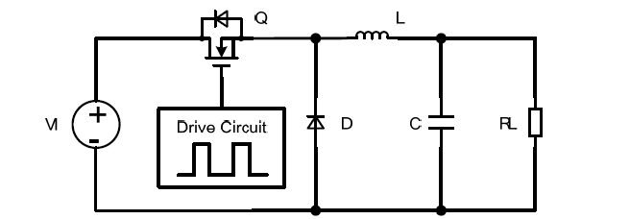
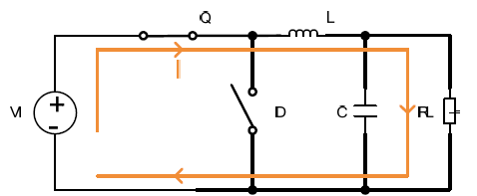
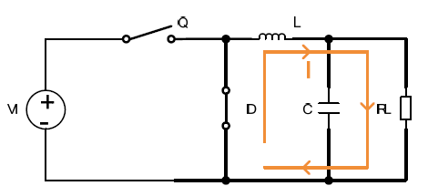

2.3.2 Implementation of FIVR (3)
Principle of operation of buck converters used in the 1. gen. FIVR [24]
Q: MOSFET
Drive circuit:
E.g. PWM modulated
(Pulse Width Modulated)
Figure: Block diagram of the buck converter (Kapcsolóüzemű DC/DC converter) [24]
On state
Off state
duty cycle
kitöltési tényező
Figure: Operation of the Buck converter [24]

Slide 72
2.3.2 Implementation of FIVR (4)
Operation of buck converters implemented in 1. gen. FIVRs [25]
The buck converter can be used to down-convert a DC voltage to a lower DC voltage
of the same polarity.
It uses a transistor as a switch that alternately connects and disconnects the input
voltage to an RC circuit by a frequency of 140 MHz.
While the switch is on, the voltage will rise on the capacitor, as indicated in the
Figure on the left of the previous slide.
When the switch is turned off, the input voltage is removed and the capacitor
discharges across the load.
Then the current “I” will continue to flow through the diode ”D”, but its magnitude
will drop.
This results in a ripple current (and voltage) across the RC network, as indicated
at the bottom of the previous Figure.
By switching between on-state and off-state continuously, the buck converter
decreases the voltage level from the input value to the output value.
It can be shown that the output voltage equals the input voltage multiplied by the
duty cycle (length of the on interval subdivided by the cycle time [98].

Slide 73
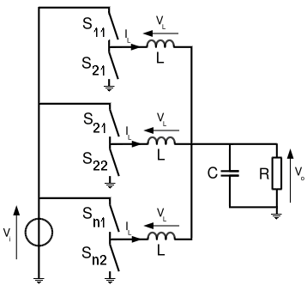
2.3.2 Implementation of FIVR (5)
Reducing voltage ripple of the 1. gen. buck converters by synchronous
n-phase buck converter design [26]
Fig.: Principle of a synchronous n-phase buck converter [26]
Obviously, the high of ripple can be reduced by replacing a single switch by multiple
synchronous switches, as seen above.

Slide 74
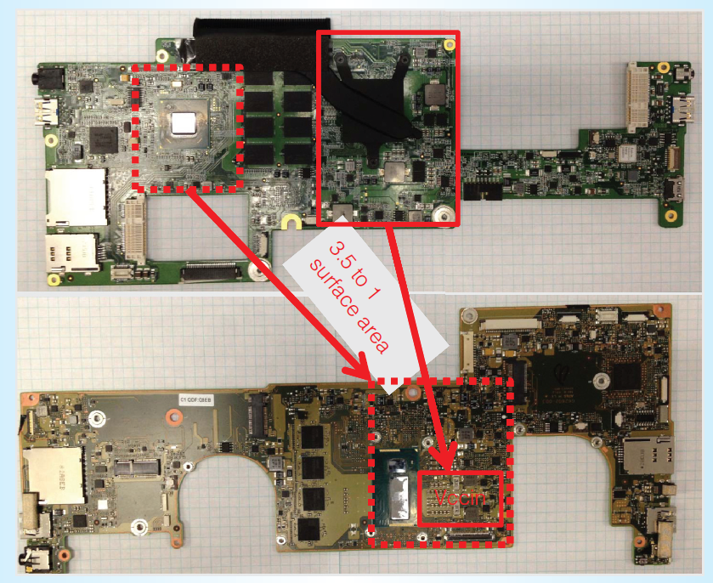
2.3.2 Implementation of FIVR (6)
Board space saving with Haswell’s FIVR vs. Ivy Bridge’s voltage regulators [22]

Slide 75
2.3.2 Implementation of FIVR (7)
Enhancing Intel’s original FIVR design in the subsequent Broadwell line
In their subsequent Broadwell line (9/2014) Intel enhanced the original FIVR design
in many aspects [27], not detailed here.
The resulting 2nd gen. design resulted in about 35 % less own power consumption
[27].

Slide 76
2.3.3 Assessment and use of FIVRs

Slide 77
2.3.3 Assessment and use of FIVRs (1)
2.3.3 Assessment and use of FIVRs
Benefits of FIVRs [7]
It greatly simplifies mainboard designs.
It replaces power gates.
It allows Per-Core-P-State control (PCPC).

Slide 78
2.3.3 Assessment and use of FIVRs (2)
a) Simplification of motherboard design
While reducing the number of VRs to be implemented on the mainboard, FIVRs greatly
reduce mainboard design.
(Ivy Bridge)
Figure: Using FIVRs in Haswell processors to reduce the number of VRs ftom 6 to 2 [7]

Slide 79
2.3.3 Assessment and use of FIVRs (3)
b) Replacing power gating by FIVR
Integrated voltage regulation allows to
supply zero-voltages as well to the
individual cores or units i.e. to switch off
individual units like power gating,
as the Figure on the right shows, so
their use makes power gating superfluous.
Remark
According to Intel’s documentation in client
processors all cores run at the same Vcc,
so in client processors FIVR operates just as
power gates and do not provide Per-Core
P-State control (PCPS).
Figure: Use of integrated voltage regulators in Intel's Haswell processor [33]

Slide 80
2.3.3 Assessment and use of FIVRs (4)
c) Enabling Per-Core P-State control (PCPS) in servers
Concerning the use of integrated voltage regulation is servers the following aspects
should be considered:
While using per-core-P-state control (to be discussed later), each active core runs
at its individually requested clock rate rather than at the clock rate requested
by the highest performing core, as in case without per-core P-state control.
Clearly, for high core count processors, say with 18 or more cores there is a big
difference in total power consumption between the case when all cores run
at their requested clock rate rather than at the clock rate of the highest performing
core.
Consequently, for high core count processors the use of per-core-count power control
and thus the implementation of integrated voltage regulation is crucial.
Moreover, the extra power consumption of integrated voltage regulation is less
detrimental in server processors, since server processors have right from the start
high TDP values of say 100 to 250 W and thus the additional power consumption
of integrated voltage regulation is relatively low.
Even FIVR can be considered to be a precondition for Per-Core P-State management
in high core count server processors.

Slide 81
2.3.3 Assessment and use of FIVRs (5)
Use of FIVRs for Per-Core P-State control (PCPS) in Intel’s server processors -1
FIVR obviously is an appropriate technique to deliver per-core core voltages
in server processors instead of implementing individual VRs on the motherboard.
So it is not surprising that along with implementing FIVR, Intel also introduced
PCPS control in their up to 18-core Haswell-EP server lines (in 2014) and continued
using this technique in their subsequent server lines along with PCPS as well,
as indicated in the Figure below.
Skylake-SP
Haswell-EP
Broadwell-EP
Cascade-Lake
Ice Lake
FIVR for
servers
*
*
*
*
*
*
2012
2014
2016
2018
2020
2022
Year
Figure: Use of integrated voltage regulation in Intel’s server processors

Slide 82
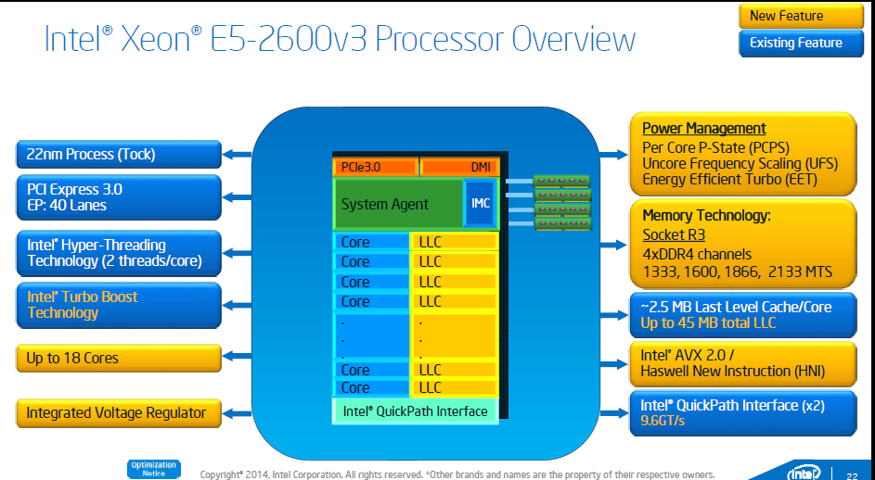
2.3.3 Assessment and use of FIVRs (6)
Intel’s disclosure for introducing “Per Core P-State” (PCPS) control in their
18-core E5-2600 v3 server processors (Haswell-EP) [31]

Slide 83
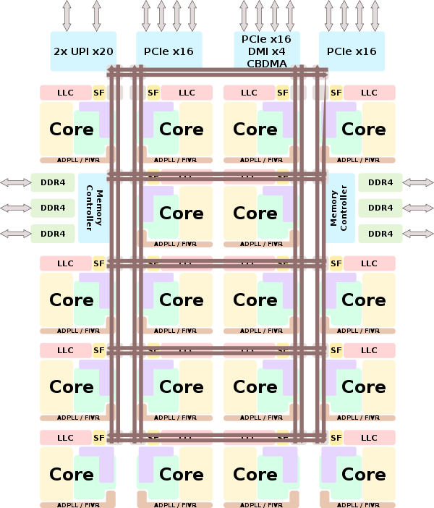
2.3.3 Assessment and use of FIVRs (7)
Example: Implementing per-core
FIVRs in an 18-core Skylake-SP
processor (2017) [29]
Here we note that the Skylake-SP
(Scalable Processor) line introduced
2D mesh interconnect and
makes use of per core P-state
control to reduce power
consumption, as seen in the
Figure below.
SF: Snoop Filter
ADPLL: All-Digital Phase-Locked Loop
(clock generator)

Slide 84
2.3.3 Assessment and use of FIVRs (8)
Use of FIVR for Per-Core P-State control (PCPS) in Intel’s server processors -2
Intel’s PCPS implementation is presumable based on hardware scheduling, revealed
in an Intel patent, filed in 03/2012 [30].

Slide 85
2.3.3 Assessment and use of FIVRs (9)
The lack of Per-Core-P-State control (PCPS) in Intel’s client processors
Despite its potential, until now (07/2022) Intel did not introduce Per-Core P-State
control in their client processors even while using FIVRs.
In fact, in Intel’s client processors all active cores share the same frequency and
voltage, and the highest frequency P-state requested among all active cores is
selected as the operating point for all active cores.
It follows that Intel’s client processors employ shared core voltages (with or
without FIVR) along with power gating (since its introduction in the Sandy Bridge
line in 2011), as illustrated in the next Figure.

Slide 86
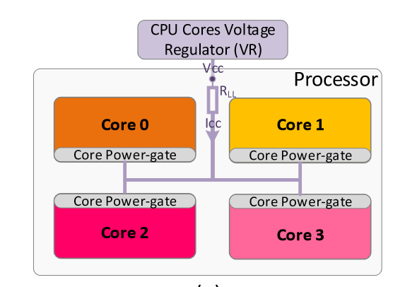
2.3.3 Assessment and use of FIVRs (10)
Example for using shared core voltage (without FIVR) along with power gating
in Intel’s client processors (without FIVRs) [32]

Slide 87
2.3.3 Assessment and use of FIVRs (11)
The lack of Per-Core-P-State control (PCPS) in Intel’s client processors
Despite its potential, until now (07/2022) Intel did not introduce Per-Core P-State
control in their client processors even while using FIVRs.
In fact, in Intel’s client processors all active cores share the same frequency and
voltage, and the highest frequency P-state requested among all active cores is
selected as the operating point for all active cores.
It follows that Intel’s client processors employ shared core voltages
either without FIVR, along with power gating (since its introduction in the
Sandy Bridge line in 2011), as illustrated in the next Figure,
or with FIVR, while FIVR provide power gating as well.

Slide 88
2.3.3 Assessment and use of FIVRs (12)
Drawbacks of FIVRs [7]
FIVRs clearly increase the power dissipation of the processor package
since FIVRs have their own power consumption.
Consequently, if a processor includes FIVRs and should have the same TDP
as before (i.e. without FIVR), it will have a lower power budget
for processing as before (TDP minus own power consumption), this
reduces the achievable clock frequency and thus performance.

Slide 89
2.3.3 Assessment and use of FIVRs (13)
Evolution and use of integrated voltage regulation
After introducing FIVR in their Haswell line and continuing its use it in their subsequent Broadwell lines as well, (actually both in its client and server lines), Intel continued using integrated voltage regulators differently in their client and server processors, as the next Figure indicates.
4th gen.
5th gen.
10th gen.
12th gen.
Haswell
Broadwell
Ice Lake
Alder Lake
FIVR for
clients
*
*
*
*
Skylake-SP
FIVR for
servers
Haswell-EP
Broadwell-EP
Cascade-Lake
Ice Lake
*
*
*
*
*
*
2012
2014
2016
2018
2020
2022
Year
Figure: Use of integrated voltage regulation in Intel’s clients and servers
In their server lines Intel continued using integrated voltage regulators, but in their
client lines Intel dropped it up to its 10th gen. Ice Lake line due its drawback,
and began to redesign it from the scratch on.

Slide 90
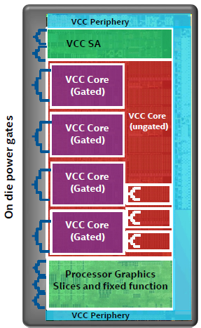
2.3.3 Assessment and use of FIVRs (14)
Reusing power gates in client processors after FIVR is omitted (from the
6th gen. Skylake line on (2015) up to the 9th gen. Coffee Lake line (2018)
Figure: Reuse of power gating in Intel's
Skylake client line [34]

Slide 91
2.3.3 Assessment and use of FIVRs (15)
Intel’s new design for client processors
To eliminate the additional heat, generated by integrated voltage regulators Intel
omitted their use in the subsequent Skylake client as the Figure below shows.
4th gen.
5th gen.
10th gen.
12th gen.
Haswell
Broadwell
Ice Lake
Alder Lake
FIVR for
clients
*
*
*
*
Skylake-SP
FIVR for
servers
Haswell-EP
Broadwell-EP
Cascade-Lake
Ice Lake
*
*
*
*
*
*
2012
2014
2016
2018
2020
2022
Year
Figure: Use of integrated voltage regulation in Intel’s clients and servers
Subsequently, Intel redesigned FIVR by replacing integrated voltage regulation from
the processor die onto the PCH die, (as shown in the next Figure) to avoid the
detrimental, additional power consumption of the FIVR being on the processor die, which
reduced the available power budget of the processor and thus lowered its clock rate
and performance.

Slide 92
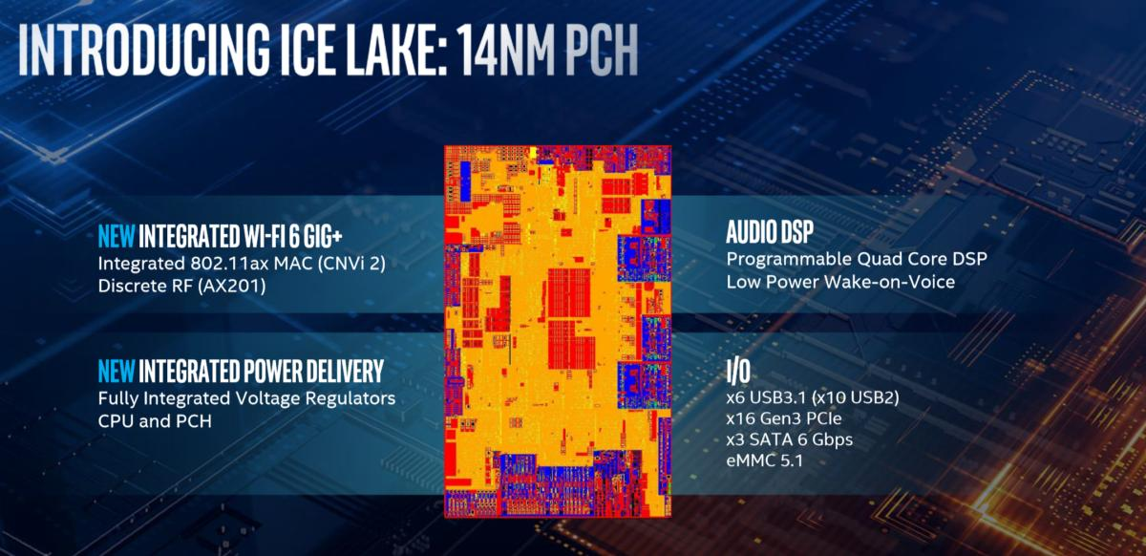
2.3.3 Assessment and use of FIVRs (16)
Replacing integrated voltage regulation from the processor die onto the PCH die [28]
The new FIVR design was introduced in Intel’s 10th gen. Ice Lake client line.
Notice that the 10th gen. 10 nm Ice Lake processor is connected to a 14 nm PCH.
Note also that in Intel’s client processors all active cores share the same frequency
and voltage (until now), thus only a single voltage plain is needed for all cores.

Slide 93
2.3.3 Assessment and use of FIVRs (17)
Per-core frequency and voltage scaling in AMD’s Zen lines [35]
As part of AMD’s Pure Power technology each core has
an individual VR (digital Voltage Regulator) and
a digital frequency synthesizer (DFS)
to independently vary core frequency and voltage for reducing power consumption.
The voltage regulators operate also as power gates.

Slide 94
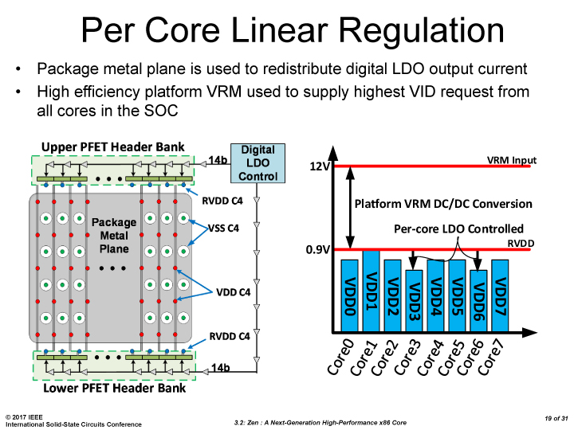
2.3.3 Assessment and use of FIVRs (18)
Implementing separate VRs for each core in AMD’s Zen lines [37]
Two stage voltage regulation (similar to Intel's two stage FIVR implementation):
1. stage: on the mainboard, it reduces voltage from 12 V to 0.9 V,
2. stage: separate on-die VRs for each core.
Example for per-core voltage regulation in a Ryzen desktop processor:
VRM: VR module input
RVDD: Unregulated supply
Figure: Per-core voltage regulation in a Ryzen desktop processor [37]
LDO: Low Dropout Voltage Regulator (DC/DC converter)

Slide 95
3. Power management at the platform level - Overview
Notes:
95

Slide 96
3. Power management at the platform level – Overview (1)
3. Power management at the platform level - Overview
Approaches for power management (PM) of computers
(Strongly simplified)
PM at the circuit level
(Reducing power consumption
by appropriate circuit design)
PM at the processor level
PM at the platform level
(ACPI-based, achieved by
system design)
PM of CPU cores
Clock gating
Power gating
FIVR
PM of idle CPU cores
PM of active CPU cores
Reducing
power consumption
of idle CPU cores
Reducing
power consumption
of active CPU cores
Utilizing the power headroom
of a proc. package
to raise performance
C-state management
DVFS/CPPC/AVFS
Turbo Boost Technology
(ACPI-based)
CPPC: Collaborative Processor Performance Control
(DVFS, CPPC: ACPI-based)

Slide 97
3. Power management at the platform level – Overview (2)
The need for a standard for power managing computers
Power management of processors, memory or I/O devices (like HD, SSD etc.)
needs typically a concerted effort of both system software (like OS, BIOS)
and hardware to accomplish PM actions on devices of various vendors.
Accordingly, PM standards emerged, first by Intel, targeting PM of processors
in the 1990s, then as a cooperative effort by Intel and Microsoft.
Finally, in 1996 a group of interested vendors, including Intel, Microsoft, Compaq,
and others, adopted the ACPI (Advanced Configuration and Power Interface)
standard, that covers both configuration issues (like hot plug) and PM of the
entire platform.
The next Figure summarizes this evolution.

Slide 98
3. Power management at the platform level – Overview (3)
Evolution of power management standards
Power management standards
(SL technology)
Advanced
Power Management
(APM)
Advanced Configuration
and Power Interface
(ACPI)
Introduced
10/1990
01/1992
12/1996
Vendor
Intel
Intel and Microsoft
Intel, Microsoft,
Compaq, Phoenix and Toshiba
A set of PM techniques
Open standard i.f.
between OS and BIOS
Open standard i.f.
between OS and HW
Typ. CPU scaling
SFS
(Static Frequency Scaling)
DFS
(Dynamic Frequency Scaling)
DVFS
(Dynamic Voltage and F. Scaling)
Done basically
for CPU:
for devices:
by SMM
by SMM
by OSPM/BIOS
by BIOS/OSPM/OS handlers
by OSPM
by OSPM
386SL (embedded)
486SL (embedded)
486 family (since 06/1993)
Pentium M and
subsequent processors
First proc. supp.
Pentium
First Intel’s
chipset supp.:
420EX
420ZX
430FX with PIIX
430HX/430VX with PIIX3
430TX with PIIX4 (ACPI 1.0)
OS support:
No OS support
needed
Windows 95 (08/1995)
Windows 98 (06/1998)
Windows 98 (ACPI 1.0) (06/1998)
Windows XP SP1 (ACPI 2.0) (02/2002)
SMM: System Management Mode (alternative SW runs instead the OR).

Slide 99
3. Power management at the platform level – Overview (4)
Emergence and evolution of the ACPI standard -1
The ACPI standard became widely accepted and underwent an intensive evolution,
as the following Figures show.
ACPI 1.0 (1996) did not yet have power management functionality.
It was ACPI 2.0 (2000) that introduced DFVS (Dynamic Voltage and Frequency Scaling),
(to be discussed later), supported by Windows XP SP1 for desktops and Windows
Server 2003, as the next Figure depicts.
SP: Service Pack

Slide 100
3. Power management at the platform level – Overview (5)
Emergence of the ACPI standard and its OS support
08/1995
05/1999
Consumer
products
W 95
W 98SE
ACPI 1.0
Introduction of OS support of DVFS (Dynamic Voltage and Frequency Scaling)
02/2000
10/2001
01/2007
End of 2009
Desktops/
Laptops
W 2000 Prof.
W XP
W Vista
W 7
ACPI 1.0
ACPI 1.0b
SP1 (09/2002): ACPI 2.0¹
ACPI 3.0
ACPI 3.0
02/2000
04/2003
02/2008
Servers
W 2000 Server
W Server 2003
W Server 2008
ACPI 1.0
ACPI 2.0¹
ACPI 3.0
07/1996
Corporate
products
W NT 4.0
12/1996
07/2000
09/2004
06/2009
12/2011
ACPI 1.0
ACPI 2.0
ACPI 3.0
ACPI 4.0
ACPI 5.0
1995
2000
2005
2010
¹: Windows XP and Windows Server 2003 do not support all of the ACPI 2.0 specification [38]
SP: Service Pack

Slide 101
3. Power management at the platform level – Overview (6)
Emergence and evolution of the ACPI standard -2
Subsequently, ACPI 3.0 (2004) introduced multicore and multithreading support,
assisted by Windows Vista for DTs and Windows Server 2008 for servers,
as the next Figure indicates.

Slide 102
3. Power management at the platform level – Overview (7)
Support of multicores and multithreading in ACPI 3.0 and its OS support
08/1995
05/1999
Consumer
products
W 95
W 98SE
ACPI 1.0
Support of multicores and multithreading
02/2000
10/2001
01/2007
End of 2009
Desktops/
Laptops
W 2000 Prof.
W XP
W Vista
W 7
ACPI 1.0
ACPI 1.0b
SP1 (09/2002): ACPI 2.0¹
ACPI 3.0
ACPI 3.0
02/2000
04/2003
02/2008
Servers
W 2000 Server
W Server 2003
W Server 2008
ACPI 1.0
ACPI 2.0¹
ACPI 3.0
07/1996
Corporate
products
W NT 4.0
12/1996
07/2000
09/2004
06/2009
12/2011
ACPI 1.0
ACPI 2.0
ACPI 3.0
ACPI 4.0
ACPI 5.0
1995
2000
2005
2010
¹: Windows XP and Windows Server 2003 do not support all of the ACPI 2.0 specification [38]

Slide 103
3. Power management at the platform level – Overview (8)
Emergence and evolution of the ACPI standard -2
The last major step in the evolution of ACPI arrived with its 5.0 release (2011)
providing Collaborative Processor Performance Control support, that will be
described later, (as shown in the next Figure).

Slide 104
3. Power management at the platform level – Overview (9)
Support of Collaborative Processor Performance Control in ACPI 5.0
08/1995
05/1999
Consumer
products
W 95
W 98SE
ACPI 1.0
02/2000
10/2001
01/2007
End of 2009
Desktops/
Laptops
W 2000 Prof.
W XP
W Vista
W 7
ACPI 1.0
ACPI 1.0b
SP1 (09/2002): ACPI 2.0¹
ACPI 3.0
ACPI 3.0
02/2000
04/2003
02/2008
Servers
W 2000 Server
W Server 2003
W Server 2008
ACPI 1.0
ACPI 2.0¹
ACPI 3.0
07/1996
Corporate
products
W NT 4.0
Collaborative Processor Performance Control
(Intel Speed Shift technology)
12/1996
07/2000
09/2004
06/2009
12/2011
ACPI 1.0
ACPI 2.0
ACPI 3.0
ACPI 4.0
ACPI 5.0
1995
2000
2005
2010
¹: Windows XP and Windows Server 2003 do not support all of the ACPI 2.0 specification [38]

Slide 105
3. Power management at the platform level – Overview (10)
Subsequent revisions of the ACPI standard
Revision 5.1 was released in 7/2014, in includes an update of CPPC
(Collaborative Processor Performance Control), called CPPC2.
The next update, Revision 6.0 appeared in 4/2015.
Subsequent revisions are:
ACPI 6.1 (1/2016)
ACPI 6.2 (5/2017)
ACPI 6.3 (1/2019)
These revisions include a large number of errata, clarifications and modifications
related to implementation issues, not worth to discuss.

Slide 106
3. Power management at the platform level – Overview (10)
PM of CPU cores
PM at the platform level covers a wide variety of platform elements, like the
processor, memory, HD- or SSD-devices etc.
From those, we will discuss only the processor level PM in a stand-alone Section.
Processor level PM covers virtually all elements of processors, like the cores,
GPU (if available), memory controller, PCI controller etc.
From all of these processor components, subsequently, we only focus on the
cores, and will discuss first the PM of idle cores followed by sections concerned
with the PM of active cores, as highlighted in the next Figure.

Slide 107
3. Power management at the platform level – Overview (11)
Power management of CPU-cores - Overview
Approaches for power management (PM) of computers
(Strongly simplified)
PM at the circuit level
(Reducing power consumption
by appropriate circuit design)
PM at the processor level
PM at the platform level
(ACPI-based, achieved by
system design)
PM of CPU cores
Clock gating
Power gating
FIVR
PM of idle CPU cores
PM of active CPU cores
Reducing
power consumption
of idle CPU cores
Reducing
power consumption
of active CPU cores
Utilizing the power headroom
of a proc. package
to raise performance
C-state management
DVFS/CPPC/AVFS
Turbo Boost Technology
(ACPI-based)
CPPC: Collaborative Processor Performance Control
(DVFS, CPPC: ACPI-based)

Slide 108
4. Reducing power consumption of idle CPU cores
4.1 Introduction to the ACPI C-states
4.2 Overview of ACPI-compliant C-state management
in Intel’s mobile lines
4.3 PCU-based C-state management
in Intel’s multithreaded multicore mobile lines
4.4 Evolution of C-state management in Intel's mobile lines
Section 4. will not be discussed.
Notes:
108

Slide 109
4. Reducing power consumption of idle CPU cores (1)
4. Reducing power consumption of idle CPU cores -1
Approaches for power management (PM) of computers
(Strongly simplified)
PM at the circuit level
(Reducing power consumption
by appropriate circuit design)
PM at the processor level
PM at the platform level
(ACPI-based, achieved by
system design)
PM of CPU cores
Clock gating
Power gating
FIVR
PM of idle CPU cores
PM of active CPU cores
Reducing
power consumption
of idle CPU cores
Reducing
power consumption
of active CPU cores
Utilizing the power headroom
of a proc. package
to raise performance
C-state management
DVFS/CPPC/AVFS
Turbo Boost Technology
(ACPI-based)
CPPC: Collaborative Processor Performance Control
(DVFS, CPPC: ACPI-based)

Slide 110
4. Reducing power consumption of idle CPU cores (2)
Reducing power consumption of idle CPU cores -2
By power managing idle CPU cores their power consumption can be reduced.
Its implementation is based on the ACPI defined C-states.
Bevor discussing how it is done, first we give an introduction to the ACPI
C-states.

Slide 111
4.1 Introduction to the ACPI C-states
Notes:
111

Slide 112
4.1 Introduction to the ACPI C-states (1)
4.1 Introduction to the ACPI C-states -1
C-states, more precisely the C1 – C3 states, have been introduced in the ACPI
standard 1.0 (in 1996) whereas additional C-states, the C4…Cn states are defined
in the ACPI 2.0 standard (in 2000), as seen in the next Figure.

Slide 113
4.1 Introduction to the ACPI C-states (2)
ACPI idle states C1 – Cn [9]
Pi: Performance states
(active states, since ACPI 2.0))
Ci: Idle states
C1 … C3 states since ACPI 1.0,
C4 … Cn states since ACPI 2.0
C1
C2
Gi: Global states
Cn
Si: System Sleep states
G1: OS-initiated, system context
saved, no rebooting needed.
G2/Soft off: OS-initiated shut down.
Power supply remains on,
system context is not saved,
the system must be restarted.
G3/Mechanical off: Entered by
activating a mechanical switch.
The system must be restarted.
*

Slide 114
4.1 Introduction to the ACPI C-states (3)
Introduction to C-states -2
We point out that the ACPI standard does not give a detailed specification
for the C4 ...Cn states, rather than standardizing the C4 … C4 states the ACPI
standard declares these states (called bewilderingly as additional processor
power states) as higher numbered Ci states that provide higher power savings
along with longer enter and exit latencies.
It follows that e.g. the C4 or C6 state may be specified differently from vendor
to vendor even from processor line to processor line.

Slide 115
4.1 Introduction to the ACPI C-states (4)
Introduction to C-states -3
In idle states the processor is powered on but does not execute instructions.
This allows to reduce power consumption by various techniques, such as
clock gating, power gating, reducing or switching off the supply voltage of
actually idle cores or caches etc..
Idle states are characterized by two key parameters: the power reduction
they provide and the time needed to enter and exit to and from an idle state.

Slide 116
4.1 Introduction to the ACPI C-states (5)
Power consumption vs. transfer latency of subsequent C-states
As stated before, higher numbered C states (deeper idle states) have lower power
consumption but increasingly longer transit latencies (enter plus exit times),
as indicated below for the C-states C1 - C6.
Power consumption
C0
D e e p e r i d l e s t a t e s
C1
C2
C3
C4
C5
C6
Enter + exit latency
Figure: Power consumption vs. transfer latency of C-states

Slide 117
4.1 Introduction to the ACPI C-states (6)
Example 1: Power consumption vs. enter + exit latencies of C states
in Intel's 130 nm Mobile Pentium 4 processor (2002) -1
Power consumption [W]
40
32W
(C0: TDP, else max values)
C0: Working
30
20
~ 20 FSB cycles
~100 FSB cycles
~30 μs for PLL stabilisation
na.
≈
7.5 W
7.5 W
7.5 W
10
C1: Auto Halt
C2: Stop Grant
C3: Sleep
5.0 W
5
5
5
C3: Deep Sleep
2.9 W
C4: Deeper Sleep
Stop execution
Proc. is clocked
but service snoops
latch interrupts
Stop execution
Stop proc. clock
but service snoops
latch interrupts
Stop servicing
snoops
Stop latching
interrupts
Enter + exit latency
(rough estimate)
Stop PLL
Reduce Vcc until
the retention voltage
of the L2 cache (V_{cc4})
Latching: Registering
Remark: fc = 2 GHz, FSB = 400 MHz (Northwood-based)
845MP/MZ

Slide 118
4.1 Introduction to the ACPI C-states (7)
Example 1: Power consumption vs. enter + exit latencies of C states
in Intel's 130 nm Mobile Pentium 4 processor (2002) -2
As the preceding Figure indicates, in C states the processor consumes significantly
less power (from 7.5 W down to 2.9 W) than in the C0 Working state (35 W).

Slide 119
4.1 Introduction to the ACPI C-states (8)
Example 2: Power consumption vs. enter + exit latencies of C-states
in Intel's 45 nm Penryn-based Mobile processor (T9xxx) (2008) -1
[39]
40
Power consumption
35W
C0: Working
30
~15 μs for PLL
stabilization
Not designated latencies
usually < 1 µs
~100-420 μs for
entering/exiting
C6
20
12.5W
11.8W
C1: Auto C2: Stop
Halt Grant
C3: Sleep
10
5.5W
5
C3: Deep Sleep
1.7W
1.3W
0.3W
C4: Deeper Sleep
C5: Enh.
Deeper Sleep
C6: Deep
Power Down
Enter + exit
latency
(rough estimate)
Stop execution
Stop proc. clock
but service snoops
latch interrupts
L1 caches are
flushed into the
L2 cache
No snnops
No latching of
interrupts
L2 partially flushed
Vcc lowered
(until both the
cores and the
L2 cache retain
their state)
Both cores
save their
architectural states
in on-die SRAMs
Vcc deep below the
core retention voltage
Stop proc. PLL
L2 entirely flushed
Vcc further lowered
(until the cores
retain their state)

Slide 120
4.1 Introduction to the ACPI C-states (9)
Example 2: Power consumption vs. enter + exit latencies of C-states
in Intel's 45 nm Penryn-based Mobile processor (T9xxx) (2008) -2
Note how far the processor consumption in the C0 working state (35 W) is reduced
in the C1 to C6 states, actually from 12.5 W in the C1 state to 0.3 W in the C6 state.
We also point out that the C6 state has a significantly lower power consumption (0.3 W)
than the C4 state (1.7 W) providing headroom for introducing a forerunner
of the Turbo Boost technology, called EDAT (discussed in Section 6.2).

Slide 121
4.2 Overview of ACPI-compliant C-state management
in Intel’s mobile lines
It will not be discussed.
Notes:
121

Slide 122
4.2 Overview of ACPI-compliant C-state management in Intel’s mobile lines (1)
4.2 Overview of ACPI-compliant C-state management in Intel’s mobile lines
Principle of ACPI-compliant C-state management in Intel’s mobile lines
OS recognizes idle periods of instruction execution and instructs the processor
to manage C-states through a software interface.
Interrupts let exit C-states and enter the C0 operating state.
This is summarized in the next Figure, along with the overview of their
implementation alternatives.

Slide 123
4.2 Overview of ACPI-compliant C-state management in Intel’s mobile lines (2)
Implementation alternatives of ACPI-compliant C-state management
in Intel’s mobile lines
ACPI-compliant C-state management
in Intel’s mobile lines
OS recognizes idle periods of instruction execution
and instructs the processor to manage C-states
through a software interface.
Interrupts let exit C-states
and enter the C0 operating state.
SB-based C-state management
in Intel’s single- and dual-core
mobile lines
PCU-based C-state management
in Intel’s multithreaded multicore
mobile lines
Control logic of the SB
is basically responsible
for managing C-states
On-die PCU
is basically responsible
for managing C-states
From the mobile Pentium II (1998) on
up to
Penryn-based mobiles (2008)
From the 2. gen. Nehalem
(Lynnfield)-based lines on
(2009)
SB: South Bridge
PCU: Power Control Unit

Slide 124
4.2 Overview of ACPI-compliant C-state management in Intel’s mobile lines (3)
Early, SB-based implementation of ACPI-based C-state management
employed in Intel’s single- and dual-core mobile processors -2
Intel’s early C-state management was based on the SB since early idle state
management was based on idle time counters, implemented in the SB,
indicating long inactivity of periphery units, like HD devices.
SB-based C-state management covered Intel’s single- and dual core mobile
processors, introduced between 1998 and 2008, as summarized in the Figure
above.

Slide 125
4.2 Overview of ACPI-compliant C-state management in Intel’s mobile lines (4)
Positioning Intel’s early, SB-based implementation of ACPI-based C-state
management
ACPI-compliant C-state management
in Intel’s mobile lines
OS recognizes idle periods of instruction execution
and instructs the processor to manage C-states
through a software interface.
Interrupts let exit C-states
and enter the C0 operating state.
SB-based C-state management
in Intel’s single- and dual-core
mobile lines
PCU-based C-state management
in Intel’s multithreaded multicore
mobile lines
Control logic of the SB
is basically responsible
for managing C-states
On-die PCU
is basically responsible
for managing C-states
From the mobile Pentium II (1998) on
up to
Penryn-based mobiles (2008)
From the 2. gen. Nehalem
(Lynnfield)-based lines on
(2009)
SB: South Bridge
PCU: Power Control Unit

Slide 126
4.2 Overview of ACPI-compliant C-state management in Intel’s mobile lines (5)
Advanced, PCU-based implementation of ACPI-based C-state management
employed in Intel’s multithreaded multicore lines
Next, along with their 2. generation Nahalem-based client lines (called Lynnfield)
Intel moved C-state management control to the processor, since the Nehalem
line introduced a powerful dedicated microcontroller with the performance of a
486 processor, called Power Control Unit (PCU).
PCU-based C-state management covers Intel’s multithreaded multicore lines
up to now, as seen in the next Figure.

Slide 127
4.2 Overview of ACPI-compliant C-state management in Intel’s mobile lines (6)
Positioning Intel’s PCU-based implementation of ACPI-based C-state
management
ACPI-compliant C-state management
in Intel’s mobile lines
OS recognizes idle periods of instruction execution
and instructs the processor to manage C-states
through a software interface.
Interrupts let exit C-states
and enter the C0 operating state.
SB-based C-state management
in Intel’s single- and dual-core
mobile lines
PCU-based C-state management
in Intel’s multithreaded multicore
mobile lines
Control logic of the SB
is basically responsible
for managing C-states
On-die PCU
is basically responsible
for managing C-states
From the mobile Pentium II (1998) on
up to
Penryn-based mobiles (2008)
From the 2. gen. Nehalem
(Lynnfield)-based lines on
(2009)
SB: South Bridge
PCU: Power Control Unit

Slide 128
4.2 Overview of ACPI-compliant C-state management in Intel’s mobile lines (7)
Implementation alternatives of ACPI-based C-state management -5
From both evolution phases of implementing C-state management in Intel’s
mobile line, subsequently we will discuss only the more advanced PCU
(Power Control Unit)-based implementation.

Slide 129
4.3 PCU-based C-state management
in Intel’s multithreaded multicore mobile lines
It will not be discussed.
Notes:
129

Slide 130
4.3 PCU-based C-state management in Intel's mobile lines (1)
4.3 PCU-based C-state management in Intel's multithreaded multicore
mobile lines -1
ACPI-compliant C-state management
in Intel’s mobile lines
OS recognizes idle periods of instruction execution
and instructs the processor to manage C-states
through a software interface.
Interrupts let exit C-states
and enter the C0 operating state.
SB-based C-state management
in Intel’s single and dual-core
mobile lines
PCU-based C-state management
in Intel’s multithreaded multicore
mobile lines
Control logic of the SB
is basically responsible
for managing C-states
On-die PCU
is basically responsible
for managing C-states
From the mobile Pentium II (1998) on
up to the
Penryn-based mobile lines (2008)
From the 2. gen. Nehalem
(Lynnfield)-based lines on
(2009)
Section 5.3
Section 5.4
SB: South Bridge
PCU: Power Control Unit

Slide 131
4.3 PCU-based C-state management in Intel's mobile lines (2)
PCU-based C-state management in Intel's multithreaded multicore
mobile lines -2
Intel introduced PCUs (Power Control Units) to accomplish power management
(i.e. P-state management, C-state management, the Turbo Boost technology etc.)
along with integrating memory controllers onto the processor die first in their
Nehalem line in 2008.
Subsequently, first mobiles with PCU-based C-state management arouse along with
the 2. generation Nehalem (Lynnfield) line of processors in 2009.
(Note here that the first generation Nehalem family was server oriented and
did not cover mobile models, whereas both generations introduced multithreading
into the Core 2 family).

Slide 132
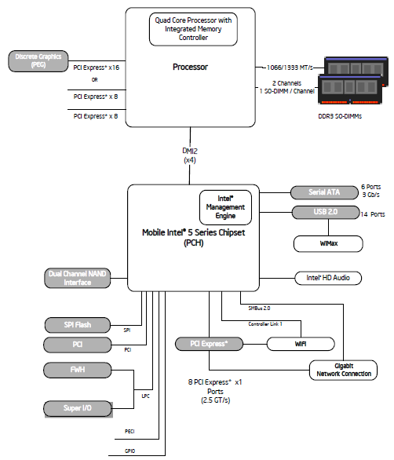
4.3 PCU-based C-state management in Intel's mobile lines (3)
Example 1: 2. gen Nehalem (Lynnfield)
based two-chip mobile platform
Intel's i7-900M (2009) [40]

Slide 133
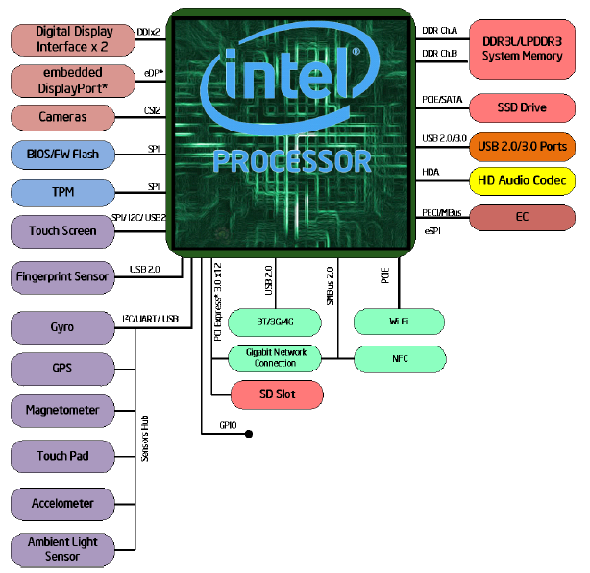
4.3 PCU-based C-state management in Intel's mobile lines (4)
Example 2: Skylake-based single-chip mobile platform Intel's i7-6xxxU SoC
(2015) [41]

Slide 134
4.3 PCU-based C-state management in Intel's mobile lines (5)
Main enhancements of the Nehalem-based multithreaded multi-core
processor lines aiming at power management
c) Utilizing power gating to switch off idle cores individually
The subsequent Haswell and Broadwell lines introduced integrated voltage
regulators, these replaced power gating, but after integrated power gating
was omitted due to additional dissipation in the Skylake line, Intel made use
of power gating anew to switch off idle cores.
b) Introducing on-die Power Control Units (PCUs)
(implemented actually as dedicated 32-bit microprocessors)
c) Introducing the Turbo Boost technology.
d) Implementing power management for the introduced L3 cache

Slide 135
4.3 PCU-based C-state management in Intel's mobile lines (6)
Main tasks of PCU-directed C-state management in Intel's multi-core
multi-threaded mobile lines -Overview
Main tasks of PCU-directed C-state management in Intel's multi-core multi-threaded mobile lines
(from the mobile 2. gen. Nehalem (Lynnfield)-based lines (2009)
a) Recognizing the length
of thread idleness
in time windows
by the OSPM
c) OSPM communicates
the target C-state
of the thread
to the processor
via a software interface
e) The PCU performs
the needed control
operations to accomplish
the transition to
the target core and
package C-state
b) Decision for the new
C-state of the thread
by the OSPM, based on the
length of thread idleness
and C-state history
d) The PCU coordinates
thread C-states
for multithreaded cores
and core C-states
in multicores if cores use
common resources
(e.g. Vcc or L3)

Slide 136
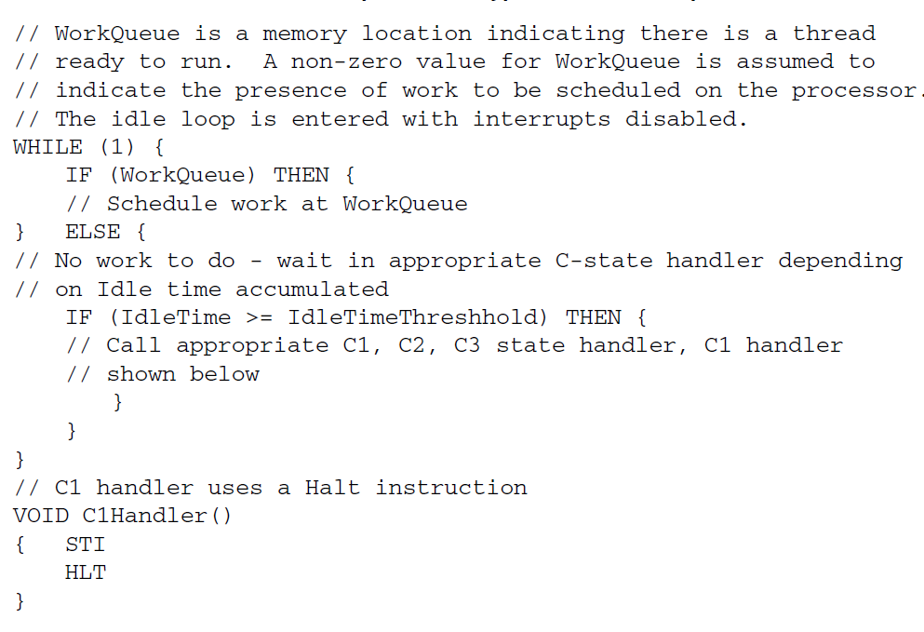
4.3 PCU-based C-state management in Intel's mobile lines (7)
a/b) Recognizing the length of thread idleness and determine the next
C-state
The OSPM recognizes the length of thread idleness for each thread in a loop,
as indicated below [42].
The above program segment shows only C1 – C3 states, higher states are
managed basically in the same way.

Slide 137
4.3 PCU-based C-state management in Intel's mobile lines (8)
c) OSPM communicates the target C-state of the thread to the processor
via a software interface -1
The OSPM has basically two software interfaces to communicate the target
C-state of the thread to the processor.
The primary interface is introduced along with the Core and Core 2 families and
is given by
the MWAIT(Cx) instructions [x denotes here the C-state level]
and the EAX and ECX MSRs (Machine Specific Registers),
as follows:

Slide 138
4.3 PCU-based C-state management in Intel's mobile lines (9)
The MWAIT Hints and MWAIT Extension MSR registers [43]
Bits | Description
3:0 | Sub C-state within a C-state, indicated by bits [7:4]
7:4 | Target C-state Value of 0 means C1; Value of 1 means C2 and so on Value of 01111B means C0 Note: Target C states for MWAIT extensions are processor-specific C-states, not ACPI C-states
31: 8 | Reserved
Table: MWAIT Hints MSR register (EAX)
Bits | Description
0 | Treat interrupts as break events even if masked (e.g., even if EFLAGS.IF=0). May be set only if CPUID.05H:ECX[bit 1] = 1.
31: 1 | Reserved
Table: MWAIT Extension MSR register (ECX)

Slide 139
4.3 PCU-based C-state management in Intel's mobile lines (10)
OSPM communicates the target C-state of the thread to the processor
via a software interface -2
The OSPM may also use a secondary, in fact ACPI interface by issuing the legacy
LVL-x I/O read instructions to the Processor Control Block registers of the SB,
called Level x registers, but these instructions will not be executed in the processor
but converted to MWAIT(Cx) instructions.

Slide 140
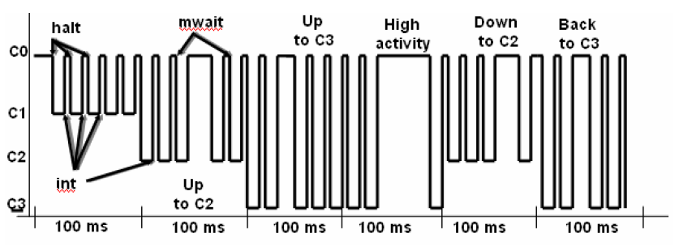
4.3 PCU-based C-state management in Intel's mobile lines (11)
Example for initiating C-state transitions by the OS Power Manager (OSPM)
The OSPM scheduler recognizes when no work is to do for the processor,
evaluates the rate of idle time in time windows (of e.g. 100 ms) and initiates
a transition to a target C-state according to the actual and prior utilization
in the time window, by sending MWAIT(Cx) instructions to the processor.
The following example will illustrate this.
Instructions to enter C states
MWAIT
(C2)
MWAIT
(C3)
MWAIR
(C3)
MWAIT
(C2)
MWAIT
(C3)
LVL_2
Example: Initiating C-state transitions by the OSPM [44]
int: interrupt

Slide 141
4.3 PCU-based C-state management in Intel's mobile lines (12)
d) The PCU coordinates thread C-states for multithreaded cores and
core C-states in multicores if cores use common resources (e.g. Vcc or L3)
The OSPM monitors individual threads and requests individual thread C-states.
On the other hand, threads that are running on the same core, share basic
per core resources, like L1 and L2 caches.
Therefore, for managing Core C-states the states of all threads running on
the same core need to be taken into consideration, in other words C-states
of the threads running on the same core need to be coordinated, as indicated
below.
Figure: Coordination of C-states of the threads running on the same core [45]

Slide 142
4.3 PCU-based C-state management in Intel's mobile lines (13)
Coordination of thread C-states resulting in core C-states
The coordination of thread C-states result in core C-state.
The general rule for coordinating thread C-states is as follows:
The lowest numbered thread state running on a core determines the core's
C-state.
E.g. if Thread 0 requests C1 state while Thread 1 the C3 state, this results
in a core C1 state.
It is the CPU that takes over the coordination of thread C-states resulting in
core C-states.

Slide 143
4.3 PCU-based C-state management in Intel's mobile lines (14)
Coordination of core C-states resulting in package C-states
There is a further need for coordinating the C-states of all cores within a processor
if there are common resources for all cores, like Vcc or the L3 cache.
Result of the coordination is the package C-state of the processor, as indicated below.
Figure: Coordination of core C-states resulting in a package C-state [45]
The general rule for the coordination of core C-states resulting in package C-states
is as follows:
A package C-state is determined by the lowest numbered core state.
E.g. if core 0 requests C1 state while core 1 requests C3 state, the resulting
package state will be the C1 package state, as indicated in the next Table.

Slide 144
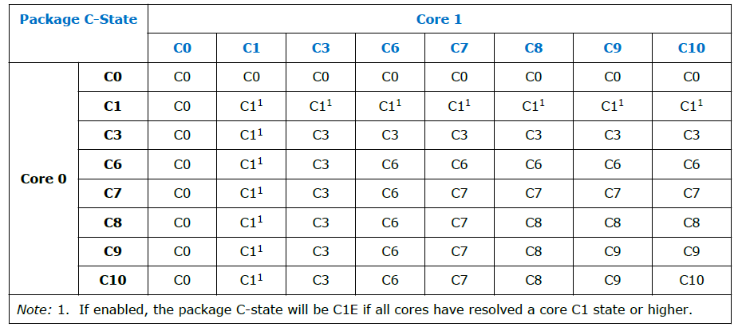
4.3 PCU-based C-state management in Intel's mobile lines (15)
Example: Coordination of core C-states resulting in package C-states
in Haswell-based dual-core mobile processors [9]
Note that the package C-state is determined by the C-state of the less idle core.

Slide 145
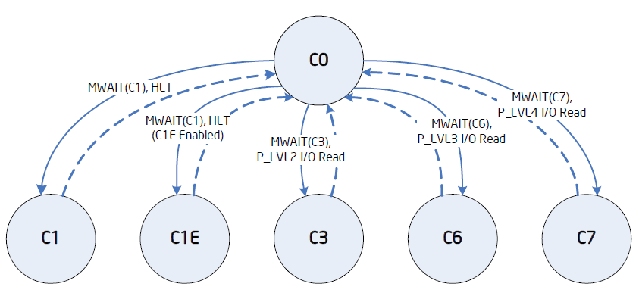
4.3 PCU-based C-state management in Intel's mobile lines (16)
e) The PCU performs the needed control operations to accomplish
the transition to the target core and package C-state
e1) Entering and exit requested Core C-states [45]

Slide 146
4.3 PCU-based C-state management in Intel's mobile lines (17)
Example: Package C-states
in Haswell-based mobiles
[9]

Slide 147
4.3 PCU-based C-state management in Intel's mobile lines (18)
e2) Core and package C-states and invoked power saving actions in PCU-
based C-state management in Intel’s multithreaded multicore mobile lines
Power
consumption
C0: Normal
C1: Auto Halt
C1E: Auto Halt +
lowest fc, Vcc
Core C3
Package C3
Core C6
Package C6
Core C7
Package C7
Core C8
Package C8
Core C10
Package C10
2. gen. Nehalem (Lynnfield) Mobile (2009), Westmere Mobile (2010),
Broadwell Mobile (2015)
Wake-up time
Sandy Bridge Mobile (2011), Ivy Bridge Mobile (2012)
Haswell Mobile (2014), Skylake Mobile (2015), Kaby Lake Mobile (2016)
Core level
power saving
approach
(per core
action)
Stop instr. exec.
Stop Core clock
Service snoops
Latch interrupts
Flush L1, L2
into the L3
Stop core PLL
Core saves
its arch. state
into an SRAM
Then Vcc 0
Stop core PLL
As Core C6, but
last core entering
Core C7, should
start flushing L3
by N-ways to mem.
As Core C6 state
As Core C6 state
Processor level
power saving
approach
(package
actions)
Snoop L3 cache
L3 cache is
snoopable
All uncore clocks
stopped
Most uncore
voltages 0
If L3 entirely
flushed, voltage
from the L3 cache
will be removed
Voltage removed
from all
power domains
VR is set to
low power state,
near shut off.

Slide 148
4.3 PCU-based C-state management in Intel's mobile lines (19)
Core C1-C7 states and Package
PC7-PC10 states as well as invoked
power saving actions in PCU-based
C-state management in multithreaded
multi-core mobile lines (simplified)
C1
Stop instruction execution
L1
L1
L1
L1
C0
Cn
L2
L2
C3
Flush
C3
Flush
L3
Stop core clocking
Stop core clocking
C6
C0
SRAM
C6
Cn
SRAM
Stop core PLL
Stop core PLL
Vcc
0
Vcc
0
L3
C7
Last core into C6:
Flush N-ways
Memory
PC7
If L3 entirely flushed: VL3 0
For all power domains: V 0
VR low power state
PC8
PC10

Slide 149
4.3 PCU-based C-state management in Intel's mobile lines (20)
Remark: Utilizing PCUs and the C6 idle state for implementing core parking -1
[46], [47]
Core parking is a new processor power reduction feature introduced in the
Windows 7 and Windows Server 2008 R2 OSs in 2009.
With core parking the PCU (Power Control Unit) of the processor and the OS
scheduler work together to dynamically adjust the number of cores that are
running threads (in a not detailed way).
The PCU chooses a minimum number of cores on which threads can be scheduled
by the OS.
The other cores are considered to be parked, the OS does not schedule any
threads on them and they can be dropped into a deep idle state, e.g. into the
C6 idle state.
If needed, parked cores can be re-activated.
The benefit of core parking is that parked cores being e.g. in the C6 idle state
have a very low power consumption.
In this way, core parking can increase power efficiency during lower usage
periods of the processor because parked cores can drop into a low-power state.

Slide 150
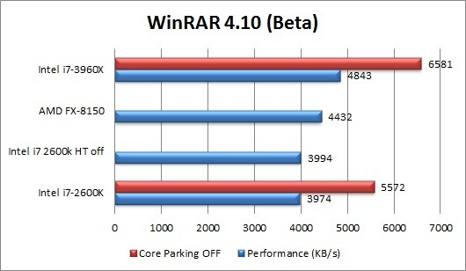
4.3 PCU-based C-state management in Intel's mobile lines (21)
Remark: Utilizing PCUs and the C6 idle state for implementing core parking -2
[46], [47]
On the other hand, the availability of less cores can reduce processor
performance in more demanding workloads, as indicated in the Figure below.
Figure: Example for performance reduction while running a demanding workload
with core parking enabled [48]

Slide 151
4.3 PCU-based C-state management in Intel's mobile lines (22)
Remark: Utilizing PCUs and the C6 idle state for implementing core parking -3
[46], [47]
Core parking can be tuned by specifying the minimum and maximum percentage
of unparked (i.e. for scheduling available) cores for every power plane
separately by appropriate PM settings.
By setting the minimum number of unparked cores to 100 % core parking can
simply be disabled.
Whether or not the tradeoff between power reduction and performance
implications result in a more or less efficient system is highly dependent on
the processor and the workload and need to be individually investigated.
With the introduction of the Speed Shift technology Intel announced that the
PCU will overtake the responsibility both for frequency scaling and core parking.

Slide 152
4.3 PCU-based C-state management in Intel's mobile lines (23)
Remark
There are some contradictions in the C-state descriptions of the datasheets
relating to different models.
Accordingly, there is a certain uncertainty in our descriptions as well.

Slide 153
4.4 Evolution of C-state management in Intel's
mobile lines
It will not be discussed.
Notes:
153

Slide 154
4.4 Evolution of C-state management in Intel's mobile lines (1)
4.4 Evolution of C-state management in Intel's mobile lines
Simplified overview, where some issues, like snooping or interrupt handling omitted.

Slide 155
4.4 Evolution of C-state management in Intel's mobile lines (2)
Evolution of C-state management in Intel's mobile lines
SB-based
in single core proc.
SB-based in dual-core processors
PCU-based in multithreaded
multi-core processors
Stop instruction execution
Stop core clocking
C1
Stop instr. exec.
Stop proc. clocking
C1
C1
Stop instruction execution
C0
C1
L1
L1
L1
C3
Stop all clocks
Stop PLL
L1
L1
C0
Cn
L1
L1
L1
C4
Vcc
Vcc4
C3
Flush
Flush
L2
L2
L2
C3
Flush
C3
Flush
PC3
2. core:
Flush
N-ways/Entirely
L3
Memory
Stop core clock
Stop core clock
Stop CPU PLL, stop FSB clock
C6
C0
SRAM
C6
Cn
SRAM
PC4
Vcc
Vcc4
Stop core PLL
Stop core PLL
Vcc
0
Vcc
0
PC4'
If L2 flushed:
Vcc
Vcc5
L3
C6
C0
SRAM
C1
SRAM
C7
Last core into C6:
Flush N-ways
PC6
After C0, C1
saved:
Vcc
Vcc6
Memory
Vcc4: Retention V of L3
Vcc5: Retention V of the cores
Vcc6: A low V (V: Voltage)
PC7
If L3 entirely flushed: VL3 0
For all power domains: V 0
VR low power state
Vcc4 : Retention V of L2
PC8
PC10

Slide 156
5. Reducing power consumption of active CPU cores
5.1 Overview
5.2 DVFS (Dynamic Voltage and Frequency Scaling)
5.3 CPPC (Collaborative Processor Performance Control)
5.4 AVFS (Adaptive Voltage or Frequency Scaling)
Section 5.4 will not be discussed in the Lecture.
Notes:
156

Slide 157
5.1 Overview
Notes:
157

Slide 158
5.1 Overview (1)
5.1 Overview -1
Approaches for power management (PM) of computers
(Strongly simplified)
PM at the circuit level
(Reducing power consumption
by appropriate circuit design)
PM at the processor level
PM at the platform level
(ACPI-based, achieved by
system design)
PM of CPU cores
Clock gating
Power gating
FIVR
PM of idle CPU cores
PM of active CPU cores
Reducing
power consumption
of idle CPU cores
Reducing
power consumption
of active CPU cores
Utilizing the power headroom
of a proc. package
to raise performance
C-state management
DVFS/CPPC/AVFS
Turbo Boost Technology
(ACPI-based)
CPPC: Collaborative Processor Performance Control
(DVFS, CPPC: ACPI-based)

Slide 159
5.1 Overview (2)
Overview -2
There are three basic techniques for reducing the power consumption of active
CPU cores:
DVFS: Dynamic Voltage and Frequency Scaling
CPPC: Cooperative Processor Performance Control
AVFS: Adaptive Voltage and Frequency Scaling
These techniques will be described in the next Sections.
CPPC: Kooperatív processzor teljesítmény vezérlés

Slide 160
5.2 DVFS (Dynamic Voltage and Frequency Scaling)
Notes:
160

Slide 161
5.2 DVFS (Dynamic Voltage and Frequency Scaling (1)
5.2 DVFS (Dynamic Voltage and Frequency Scaling)
Principle of DVFS (assuming a single threaded single core processor)
DVFS is based on two relationships:
a) Dynamic power consumption is given by:
Dd = const. * Vcc² * fc
with Vcc: core voltage
fc: clock frequency
b) The core voltage (Vcc) needed for maintaining the clock frequency (fc) is
nearly linearly proportional with the clock frequency (fc).
Vcc = const. * fc
If follows then that
Dd = const. * fc³.
Since Dd very strongly rises with fc, the idea of DVFS is to scale down fc
as far as possible, that is as far as scaling down of fc does not lengthen
noticeably the run time of the actual workload, and lower Vcc appropriately,
i.e. to the value needed for the reduced fc.
This principle will be applied in subsequent time windows of, say 30 or 100 ms,
to reduce dynamic power consumption.

Slide 162
5.2 DVFS (Dynamic Voltage and Frequency Scaling (2)
Principle of the implementation of DVFS -1
DVFS is implemented based on P-states (Performance states) defined by the
2. release of the ACPI standard, as indicated in the next Figure.

Slide 163
5.2 DVFS (Dynamic Voltage and Frequency Scaling (3)
ACPI P (Performance) states P0 – Pn [9]
Pi: Performance states
(active states, since ACPI 2.0))
Ci: Idle states
(C4…Cn states since ACPI 2.0)
C1
C2
Gi: Global states
Cn
Si: System Sleep states
G1: OS-initiated, system context
saved, no rebooting needed.
G2/Soft off: OS-initiated shut down.
Power supply remains on,
system context is not saved,
the system must be restarted.
G3/Mechanical off: Entered by
activating a mechanical switch.
The system must be restarted.
*

Slide 164
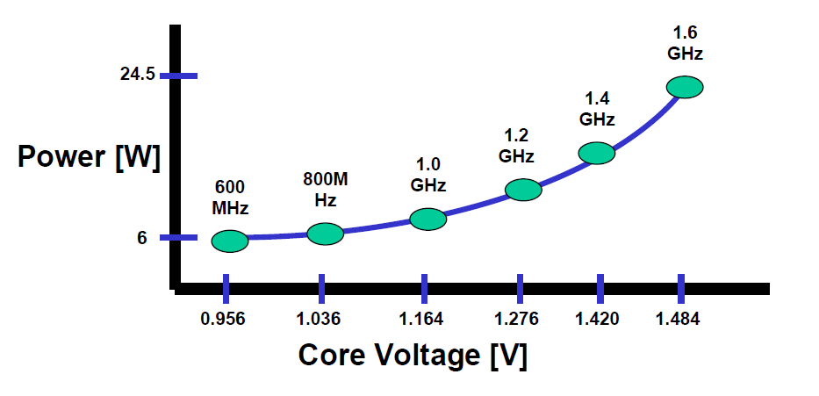
5.2 DVFS (Dynamic Voltage and Frequency Scaling (4)
Principle of the implementation of DVFS -2
P-states are possible operating points (Vcc and fc pairs) of a core while running
under DVFS.
An example below will illustrate this.
P1
P2
P6
Figure: Example of operating points (of Intel’s Pentium M processor (~2003))

Slide 165
5.2 DVFS (Dynamic Voltage and Frequency Scaling (5)
Principle of the implementation of DVFS -3
While implementing DVFS the OS continuously determines the lowest possible P state
in subsequent time windows that are needed to avoid a noticeable lengthening the
run time of the workload, to keep power consumption as low as possible.
Vcc
P0
Vcc0
●
Workload
P1
●
Highest
power
consumption
Vcc1
P2
Vcc2
●
.
.
Pn
Both fc and Vdd will be scaled
according to the workload intensity.
Vcc is chosen with a guard band
according to the actual fc values.
Vccn
●
Lowest
power
consumption
..
fc
fcn
fc2
fc1
fc0
Figure: Principle of DVFS
To do this the OS will assess the utilization rate of the core in each of the time windows
(as discussed later) and will scale down the basic clock frequency (and related core
voltage) according to the utilization rate determined, as the next example demonstrates it.

Slide 166
5.2 DVFS (Dynamic Voltage and Frequency Scaling (6)
Principle of the implementation of DVFS -4
Cont.
E.g. if a core recently runs at 2 GHz but is utilized only by 50 %, each second
clock cycle is wasted and the clock frequency can be reduced to 1 GHz without
worsening the user experience.
Then the OS selects the optimal working point from a given list of possible
P states (fc, Vcc values) by looking for the P-state with a core frequency
of at least 1 GHz.
Subsequently, the OS forwards the specification of the requested P-state to the
processor via a register interface that is defined by the ACPI standard, and finally,
the PCU (Power Control Unit) of the CPU will accomplish the required P-state
transition, as detailed subsequently.

Slide 167
5.2 DVFS (Dynamic Voltage and Frequency Scaling (7)
Remark
We note that certain early DVFS implementations (notable from AMD in about 2000)
were not ACPI-based but proprietary.
Nevertheless, we do not want to go into any details.

Slide 168
5.2 DVFS (Dynamic Voltage and Frequency Scaling (8)
Main tasks of implementing DVFS (assuming multiple cores and multithreading)
In a multithreaded core the OS allocates tasks to threads rather than to cores.
Then the OS has to determine thread utilization rather than core utilization.
Main tasks of OS directed DVFS implementation (assuming multiple cores and multithreading)
a) Determination of
the thread utilization
by the OS
c) Coordination of target P-states
if there are multiple threads
per core or multiple cores
(by the OS or proc.)
e) Accomplishing the
fc, Vcc transitions
by the PCU of the
processor
b) Based on the calculated
thread utilization
determination of
the target P-state
by the OS
d) Communicating
the target P-state
by the OS
to the processor

Slide 169
5.2 DVFS (Dynamic Voltage and Frequency Scaling (9)
a) Determination of thread utilization by the OS (simplified) [49] -1
Recent processors have two Model Specific Registers (MSRs) per thread
(called also logical processors), that are actually 64-bit counters.
These counters are updated only when the related processor is in the C0 state.
One of the counters (IA32_MPERF MSR (0xE7h)) will be incremented in proportion
to the base frequency,
the other one (IA32_APERF MSR (0xE8h)) will be incremented in proportion
to the actual clock frequency (performance).
Now the OS calculates the thread utilization (in %) in the actual time window
as the rate of the actual count and the base count taken in this window.
Remark: The 64-bit counters used to determine thread utilization were introduced
in the Pentium M Core Duo (Yonah) processor in 2006, based on an Intel patent [50].
Previous EIST implementations used Windows performance counters instead.

Slide 170
5.2 DVFS (Dynamic Voltage and Frequency Scaling (10)
b) Based on the calculated thread utilization, determination of the target
P-state by the OS
The OS has a list of available P states of the cores (specifying fc and needed Vcc).
From the available P-states the OS selects the lowest possible one to service the
actual load (i.e. utility rate).

Slide 171
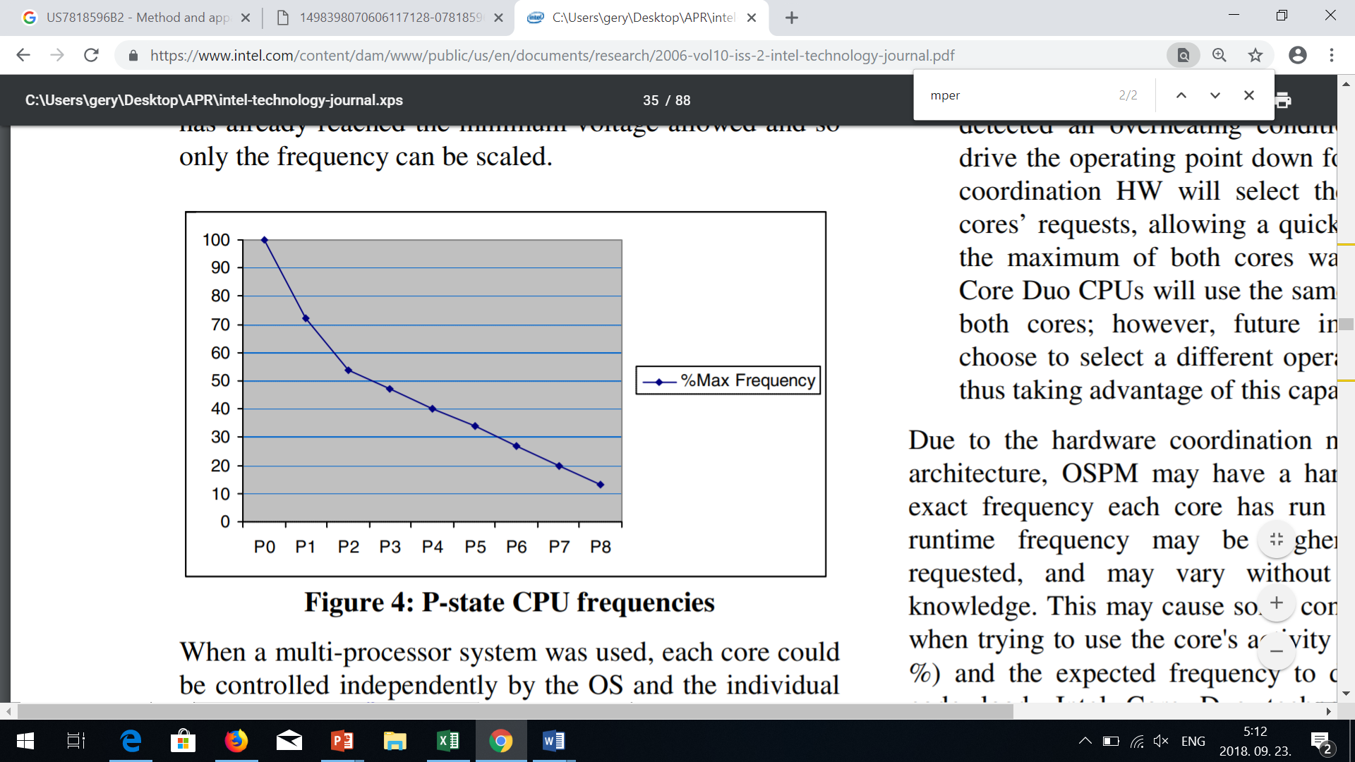
5.2 DVFS (Dynamic Voltage and Frequency Scaling (11)
Example allocation of a P-state to the actual thread utilization [51]
Core utilization %
Thread utilization %
Actual thread utilization %
As seen in Figure, in case of 65 % utilization, the P1 operating point will be chosen.

Slide 172
5.2 DVFS (Dynamic Voltage and Frequency Scaling (12)
c) Coordination of target P-states if there are multiple threads per core
If there are multiple threads running on the same core, the target P-state
(coordinated P-state) of the core will be the P-state of the most demanding
thread running on that core.
In addition, if the processor has multiple cores supplied by the same voltage,
there is a hardware dependency (as often in symmetrical multicores, or
in processors including core groups), and all related cores will run at the same
voltage (and clock frequency), in this case the target P-state becomes the
P-state of the most demanding core of all cores supplied by the same voltage.
Furthermore, if the cores running at the same voltage are multithreaded, the
most demanding thread of all threads will set the requested P-state.
Certain processors have per-core P-state control (like Intel’s recent server
processors or AMD’s Zen processors), in these cases obviously there is
no need to coordinate the P-states of the cores, but for multithreaded
processors (as typical in recent processors) it remains the need to coordinate
the target P-states of the threads running on the considered core.

Slide 173
5.2 DVFS (Dynamic Voltage and Frequency Scaling (13)
Example for the coordination of P-states in a dual-core multithreaded
processor if the cores are supplied by a common voltage [45]
Figure: Example for coordination of P-states in a dual-core multithreaded processor
if the cores are supplied by a common voltage [45]
In this case obviously, the P-state of the most demanding thread running on the dual-core
processor will determine the target P-state (coordinated P-states) of the processor.

Slide 174
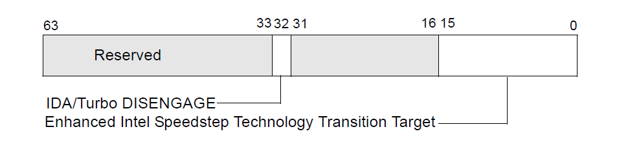
5.2 DVFS (Dynamic Voltage and Frequency Scaling (14)
d) Communicating the target P-state by the OS to the processor (simplified) [49]
If the new P-state differs from the actual one, the OS writes a proprietary code
to a given MSR (Model Specific Register), that identifies the target P-state.
Actually, there is an IA32_PERF_CTL register in the processor for each thread
(called also logical processor) and the OS writes a vendor specific code that
specifies the desired P-state into the bits 0-15 of the IA32_PERF_CTL register which
is allocated to the thread.
(Typically, bits [15:8] specify the target multiplier of the core clock (e.g. 34 for
34 x 133 MHz) and bits [7:0] the target core voltage, in a suitable coding).
IA_PERF_CTL
Multiplier
Vcc
8
7
Figure: Use of the IA32_PERF_CTL registers MSR to set a new P-state [49]
Note that core frequency results as the product of the multiplier value times the
bus clock frequency (133 MHz in the example above).

Slide 175
5.2 DVFS (Dynamic Voltage and Frequency Scaling (15)
e) Accomplishing the fc, Vcc transitions by the PCU of the processor
The PCU (Power Control Unit) of the processor takes notice of the state transition
request and performs it by setting the PLL associated to the core running the
considered thread and setting also the (VR) Voltage Regulator suitably.
PLL: Phase-Locked Loop (óragenerátor)

Slide 176
5.2 DVFS (Dynamic Voltage and Frequency Scaling (16)
Example: Accomplishing P-state transitions in Intel’s Nehalem proc.s [52] -1
The clock frequency will be generated by PLLs, based on the Bus clock (133 MHz)
multiplied by the clock multiplier that is read out from the IA_PERF_CTL register.
Note that each core’s gets the same clock frequency (red lines), consequently
all cores in client processors run at the same clock rate.
IA32_PERF_CTL MSR
I
PLL: Phase Locked Loop
(Fáziszárt hurok)
Figure: Accomplishing P-state transitions in Intel’s Nehalem-based processors [52]
PLL: Phased-Locked Loop

Slide 177
5.2 DVFS (Dynamic Voltage and Frequency Scaling (17)
Example: Accomplishing P-state transitions in Intel’s Nehalem proc.s [52] -2
The PCU reads out the target core voltage from the IA_PERF_CTL register and
sends the appropriate code of the core voltage to the Voltage Regulator (VR).
The VR sets then the requested core voltage (Vcc) via power gates.
In the example, all 4 cores share the same core voltage (yellow lines).
IA32_PERF_CTL MSR
I
Figure: Accomplishing P-state transitions in Intel’s Nehalem-based processors [52]

Slide 178
5.2 DVFS (Dynamic Voltage and Frequency Scaling (18)
Remark 1
There were two prior techniques:
SVFS (Static Voltage Scaling)
The processor has two voltage and frequency points, according to whether the
device is connected to the mains or the battery.
DFS (Dynamic Frequency Scaling)
The processor scales only the core frequency according to the workload
intensity to reduce power consumption.
Nevertheless, we do not discuss further on these techniques, only show their
use in the next Figure.

Slide 179
5.2 DVFS (Dynamic Voltage and Frequency Scaling (19)
Further techniques for reducing the power consumption of active CPU cores
Reducing the power consumption of active CPU cores
Static technique
Dynamic techniques
SVFS
DFS
DVFS
CPPC
AVFS
Examples
SpeedStep in
Mobile Pentium III (2000)
Mobile Pentium 4 (2002)
(Northwood based)
EIST in
Pentium M
(Banias) (2003)
and subsequent lines
Intel
Speed Shift in
Skylake (2015)
VIA
LongHaul 1.0 in
C3 Samuel (2000)
LongHaul 2.0 in
C3 Samuel 2 step. 1 (2001)
Adaptive PowerSaver
in Nano (2008)
PowerNow! and
Cool'n'Quiet
technologies
in mobiles/desktops
and servers (since 2000)
CPPC support in
the Zen 2-based
Ryzen 3000 line
(2019)
AVFS in
Excavator-based
Carizzo (2015)
Pure Power in
Ryzen (2017)
C
AMD
405LP (2002)
Dynamic Power
Performance Scaling in
PowerPC 750GX (2004)
PowerPC 970xx (2004)
Energy Scale
in POWER6
(2007) and
subsequent
processors
IBM
PowerPC 750FX
(2003)
Exynos 4 (2012)
(used in Galaxy III)
ASV in
Exynos 7420 (2015)
(used in Galaxy S6)
Samsung
ARM/National
IEM IP (2002)

Slide 180
5.2 DVFS (Dynamic Voltage and Frequency Scaling (20)
Remark 2
There are two direct improvements of DVFS:
CPPC (Collaborative Processor Performance Control)
In CPPC the PCU takes over the power management control from the OS
as done in case of the DVFS, to get a faster and more precise frequency and
voltage scaling (introduced in Skylake (2015)), to be discussed in Section 5.3).
AVFS (Adaptive Voltage and Frequency Scaling)
AVFS replaces the worst case design approach of DVFS by an adaptive approach,
to achieve a more efficient voltage and frequency scaling, it is discussed in
Section 5.4.
The next Figure indicates processor lines utilizing both techniques mentioned.
CPPC: Kooperatív processzor teljesítmény vezérlés

Slide 181
5.2 DVFS (Dynamic Voltage and Frequency Scaling (21)
Use of DVFS to reduce power consumption of active CPU cores
Reducing the power consumption of active CPU cores
Static technique
Dynamic techniques
SVFS
DFS
DVFS
CPPC
AVFS
Examples
SpeedStep in
Mobile Pentium III (2000)
Mobile Pentium 4 (2002)
(Northwood based)
EIST in
Pentium M
(Banias) (2003)
and subsequent lines
Intel
Speed Shift in
Skylake (2015)
VIA
LongHaul 1.0 in
C3 Samuel (2000)
LongHaul 2.0 in
C3 Samuel 2 step. 1 (2001)
Adaptive PowerSaver
in Nano (2008)
PowerNow! and
Cool'n'Quiet
technologies
in mobiles/desktops
and servers (since 2000)
CPPC support in
the Zen 2-based
Ryzen 3000 line
(2019)
AVFS in
Excavator-based
Carizzo (2015)
Pure Power in
Ryzen (2017)
AMD
405LP (2002)
Dynamic Power
Performance Scaling in
PowerPC 750GX (2004)
PowerPC 970xx (2004)
Energy Scale
in POWER6
(2007) and
subsequent
processors
IBM
PowerPC 750FX
(2003)
Exynos 4 (2012)
(used in Galaxy III)
ASV in
Exynos 7420 (2015)
(used in Galaxy S6)
Samsung
ARM/National
IEM IP (2002)

Slide 182
5.2 DVFS (Dynamic Voltage and Frequency Scaling (22)
Note that Intel and also AMD (in their recent Zen 2-based or newer lines) opted for
the CPPC technique to enhance DVFS.
By contrast, IBM’s server lines, AMD’s previous lines and ARM’s as well as
Samsung’s mobile processor lines have preferred AVFS rather than CPPC.

Slide 183
5.3 CPPC (Collaborative Processor Performance Control)
Notes:
183

Slide 184
5.3 CPPC (Collaborative Processor Performance Control) (1)
5.3 CPPC (Collaborative Processor Performance Control) -1
Reducing the power consumption of active CPU cores
Static technique
Dynamic techniques
SVFS
DFS
DVFS
CPPC
AVFS
Examples
SpeedStep in
Mobile Pentium III (2000)
Mobile Pentium 4 (2002)
(Northwood based)
EIST in
Pentium M
(Banias) (2003)
and subsequent lines
Speed Shift in
Skylake (2015)
Intel
VIA
LongHaul 1.0 in
C3 Samuel (2000)
LongHaul 2.0 in
C3 Samuel 2 step. 1 (2001)
Adaptive PowerSaver
in Nano (2008)
PowerNow! and
Cool'n'Quiet
technologies
in mobiles/desktops
and servers (since 2000)
CPPC support in
the Zen 2-based
Ryzen 3000 line
(2019)
AVFS in
Excavator-based
Carizzo (2015)
Pure Power in
Ryzen (2017)
AMD
405LP (2002)
Dynamic Power
Performance Scaling in
PowerPC 750GX (2004)
PowerPC 970xx (2004)
Energy Scale
in POWER6
(2007) and
subsequent
processors
IBM
PowerPC 750FX
(2003)
Exynos 4 (2012)
(used in Galaxy III)
ASV in
Exynos 7420 (2015)
(used in Galaxy S6)
Samsung
ARM/National
IEM IP (2002)

Slide 185
5.3 CPPC (Collaborative Processor Performance Control) (2)
CPPC (Collaborative Processor Performance Control) -2
This technology is based on a new processor performance control method
introduced in the ACPI 5.0 standard (2011), called the Collaborative Processor
Performance Control (CPPC).
If CPPC is implemented, it supersedes the previous ACPI 2.0 based DVFS
technology.
Intel introduced CPPC in their Skylake family (2015) and designated it as the
Speed Shift technology.
CPPC needs OS support, nevertheless OS support became available only after
launching the Skylake Family, in the Windows 10 2015 Fall Update.
The Collaborative Processor Performance Control technology is not bound to
Intel’s processors, also AMD introduced it in their Zen 2-based Ryzen 3000
DT line (2019).
It is worth noting that AMD’s CPPC implementation was already based on a new
revision of the CPPC standard (ACPI 5.1 (2014)) and was called CPPC2.
CPPC: Kooperatív processzor teljesítmény vezérlés

Slide 186
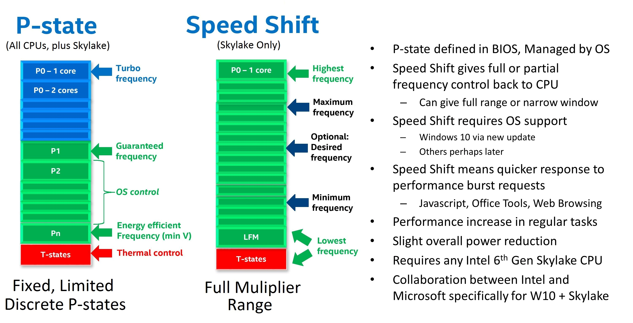
5.3 CPPC (Collaborative Processor Performance Control) (3)
Contrasting Intel's EIST and Speed Shift technologies -1
In Intel's EIST (DVFS) technology (2003)
ACPI 2.0-based DVFS
the OS assesses how far CPU cores or
threads (if multithreading) are utilized,
until 2006: by counting idle clock cycles
during thread scheduling - in time windows,
since 2006: by reading out two counters
(actually 2 MSRs: the IA32_MPERF and
IA32_APER Fregisters),
OS chooses the requested fc, Vcc (P-state),
OS coordinates P-states if needed, then
forwards the identifiers of the selected
P-state to an MSRs (the IA32_PERF_CTL)
and
finally, the PCU sets the requested P-state.
Drawbacks of DVFS are long control cycles
and the fact that it provides only a few
P-states for scaling, i.e. it implements a
coarse grained frequency control.
(PMU control)
Figure: BIOS declared P-states [53]
MSRs (Model-Specific Registers), introduced in the Intel's 80386 line, are registers
that are not necessarily available in subsequent lines of a processor family.

Slide 187
5.3 CPPC (Collaborative Processor Performance Control) (4)
Contrasting Intel's EIST and Speed Shift technologies -2
HCPS
By contrast, in the Speed Shift technology
ACPI 5.0-based CPPC
the OS and the processor collaborate
in controlling processor performance
such that the OS provides user
supplied control hints (e.g. whether
power or performance is preferred),
then transfers the power control
to the Power Control Unit (PCU)
of the processor and
the PCU autonomously controls
the performance states (fc and Vcc
settings) while performing
performance/energy efficiency
optimizations as well.
(OS sets
the limits)
Autonomous
control
by the PCU
A larger number of clock multiplier defined
frequency levels [53]

Slide 188
5.3 CPPC (Collaborative Processor Performance Control) (5)
Operation of the Speed Shift technology (more detailed)
First the OS provides user supplied control hints for the processor including min.
or max. performance limits, preference for energy efficiency or performance, etc.
Then the OS transfers performance control to the PCU and the PCU controls
autonomously P-states while performing P-state transitions much faster than
the OS would do.
The PCU assesses the performance request of the application in the same way
as the OS before, by reading the IA32_MPERF MSR and IA32_APERF MSR
registers etc.
Nevertheless, the PCU does not derive the requested fc and Vcc values alone
from the performance request of the application but carries out also
performance/energy efficiency optimizations as well [53].
If needed, the PCU coordinates the performance requests of threads belonging
to the same core or performance requests of a group of cores if they share the
same core voltage and clock frequency, as discussed before.
Finally, the PCU sets the requested Vcc and fc values in the same way as before.
The OS has the possibility to monitor the power management accomplished
by the PCU by reading a specific MSR register (the IA32_HWP_STATUS register),
and if necessary, a mechanism is invoked for the OS to overtake the performance
control from the PCU (not discussed here).

Slide 189
5.3 CPPC (Collaborative Processor Performance Control) (7)
Contrasting Intel’s EIST (DVFS) and SpeedStep (CPPC) PM technologies
Intel’s EIST (DVFS) + Turbo Boost
Intel’s SpeedStep (EIST)
PCU control
(OS sets
the limits)
PCU controls
(DVFS)
Figure: BIOS declared
P-states [53]
A larger number of clock multiplier
defined frequency levels [53]

Slide 190
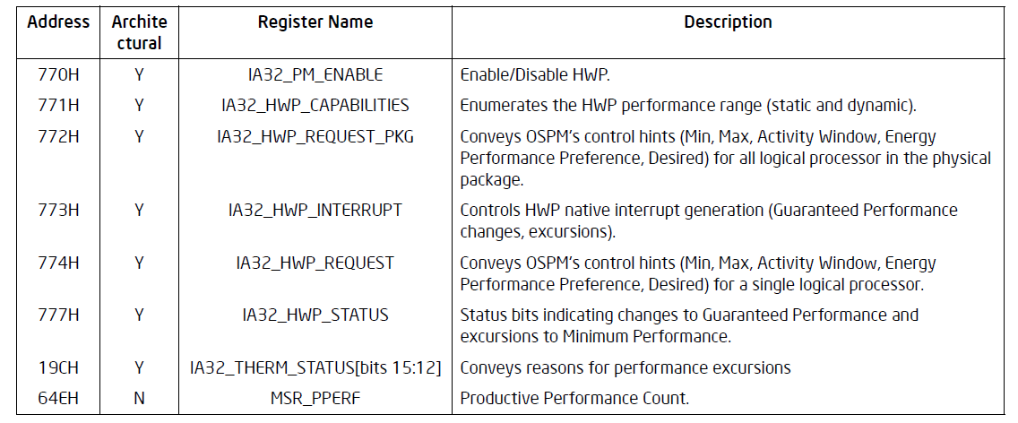
5.3 CPPC (Collaborative Processor Performance Control) (8)
MSRs used for Intel's Speed Shift technology -1
Intel defined a set of MSRs to support Speed Shift technology, as seen below.
Table: MSRs defined by Intel to support its Speed Shift technology [49]
In the Table HWP means Hardware Performance control, actually Speed Shift technology
(another name for CPPC used in Intel’s documentations).

Slide 191
5.3 CPPC (Collaborative Processor Performance Control) (6)
Benefits of the CPPC (alias Speed Shift) technology -1
a) A significantly finer frequency control
As long as the EIST technology provides only a few discrete fc values for scaling,
the Speed Shift technology may use every frequency multiplier value for setting fc
(as fc = multiplier * fbus), as indicated in the Figure below.
Intel’s EIST (DVFS) + Turbo Boost
Intel’s SpeedStep (EIST)
PCU control
(OS sets
the limits,
PCU controls
(DVFS)
Figure: BIOS declared
P-states [53]
A larger number of clock multiplier
defined frequency levels [53]

Slide 192
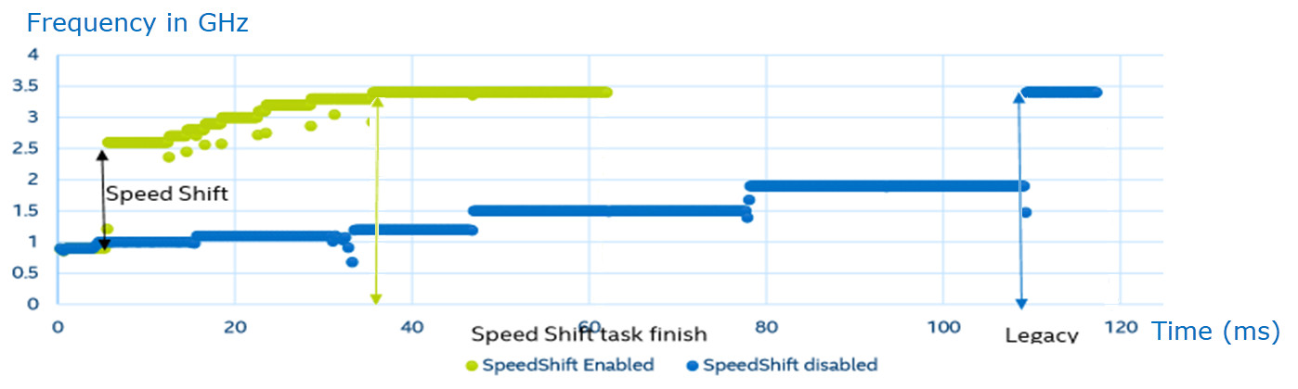
5.3 CPPC (Collaborative Processor Performance Control) (9)
Benefits of the CPPC (alias Speed Shift) technology -2
b) Significantly speeding up frequency scaling
Obviously, the PCU may perform frequency transition significantly faster than the OS.
Example for speeding up frequency transitions by Intel's Speed Shift technology
used in the 6. gen. Skylake line (2015) while running a representative task [53]
In the above example a frequency transition to the maximum core frequency
(3.5 GHz) needs without the SpeedShift technology 110 ms (blue line), and
with the SpeedShift technology (yellow-green line) only 35 ms.
This indicates that Speed Shift technology notable reduces the time needed
to perform frequency transitions.

Slide 193
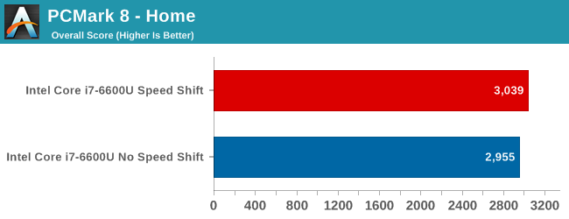
5.3 CPPC (Collaborative Processor Performance Control) (10)
Example 1: Performance increase achieved by the Speed Shift technology
while running the PCMark 8 - Home benchmark program [54]
The PCMark 8 Home edition is an industry standard benchmark for Windows 8
and Windows 7 apps, it covers real-world tasks and scenarios that reflect
PC usage in the home [54].
As seen, enabling the Speed Shift technology results in this case in a very small
gain of about 1.5 % [53].

Slide 194
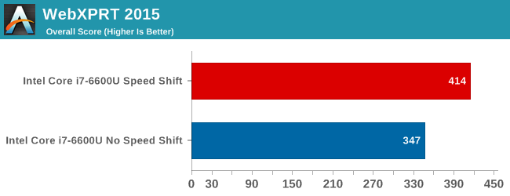
5.3 CPPC (Collaborative Processor Performance Control) (11)
Example 2: Performance increase achieved by the Speed Shift technology
while running the WebXPRT 2015 benchmark program [53]
WebXPRT covers six HTML5- and JavaScript-based workloads like Photo
Enhancement, Organize Albums, Stock Option Pricing, Sales Graphs.
For these applications Speed Shift technology results in a gain of about 20 %.

Slide 195
5.3 CPPC (Collaborative Processor Performance Control) (12)
Enhancing the Speed Shift technology in Intel's 7. generation Kaby Lake line
In their next generation Kaby Lake line (2017) Intel redesigned their Speed Shift
implementation and achieved a remarkable gain in speeding up clock frequency
transitions, as indicated in the next Figure.

Slide 196
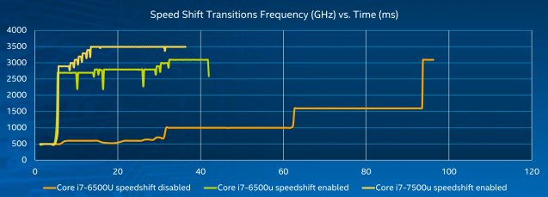
5.3 CPPC (Collaborative Processor Performance Control) (13)
Speeding up frequency transitions by using Intel's Speed Shift technology,
enhanced in the 7. gen. Kaby Lake line (2016), while running a representative
task [55]
As the Figure shows, with the enhanced implementation the max. clock frequency
will be achieved in about 10 ms rather than 35 ms as in the previous 6. gen.
Sky Lake line [55].

Slide 197
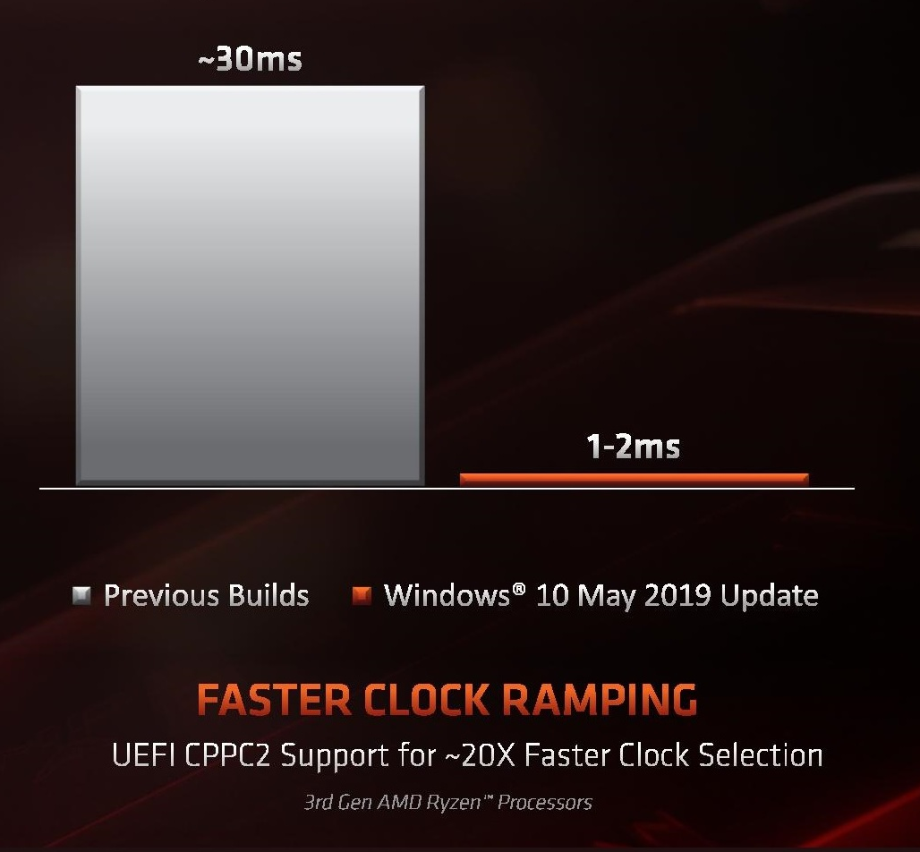
5.3 CPPC (Collaborative Processor Performance Control) (14)
AMD’s implementation of Collaborative Processor Performance Control
Along with their Zen 2-based Ryzen 3000 DT line (7/2019) also AMD implemented
the Collaborative Processor Performance Control Revision 2, called CPPC2.
No dedicated name for this technique became published so far.
Its use requires Windows 10 May 2019 update and a new BIOS release (7/2019)
supporting CPPC2.
AMD’s implementation is said
to provide a very fast clock
ramping of about 1–2 ms,
as the Figure on the right
indicates.
This time is much shorter than
Intel’s published figure for the
7. gen. Kaby Lake line (2016)
of about 15 ms.
Figure: Clock ramping in AMD’s
Zen 2-based Ryzen 3000 line
(2019) [56]
UEFI: Universal Extensible Firmware
Interface (replaces BIOS)

Slide 198
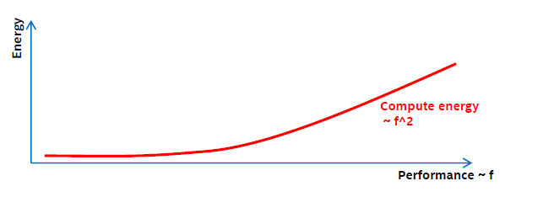
5.3 CPPC (Collaborative Processor Performance Control) (15)
Enhancing Intel’s Speed Shift technology by Duty cycle control [57] -1
(Optional reading)
While running applications
dynamic dissipation: ~ f³
runtime: ~ 1/f
total energy consumption originating from the dynamic dissipation: ~ f²
with f denoting the clock frequency.
As the performance is proportional with f, the energy consumption arising from the
dynamic dissipation is proportional to the square of the frequency (f), as seen below.
Figure: Dependence of energy consumption arising from the dynamic dissipation
(designated as Compute energy in the Figure) on the performance (~ f)

Slide 199

5.3 CPPC (Collaborative Processor Performance Control) (16)
Enhancing Intel’s Speed Shift technology by Duty cycle control [57] -2
On the other hand
the energy consumption originating from the static dissipation is proportional to
the runtime.
The runtime is inversely proportional to the frequency (f).
Consequently, the energy consumption arising from the static dissipation is
inversely proportional to the frequency (f) which is proportional to the
performance, as indicated in the Figure below.
Figure: Dependence of energy consumption originating from the static dissipation
and system power (designated as SoC and system energy in the Figure) on the performance (~ f) [57]

Slide 200

5.3 CPPC (Collaborative Processor Performance Control) (17)
Enhancing Intel’s Speed Shift technology by Duty cycle control [57] -3
As a consequence, the total energy consumption originating from both the
dynamic dissipation and
static dissipation as well as system power consumption
has a minimum, as indicated in the Figure below.
Figure: Dependence of energy consumption originating from both the dynamic dissipation (designated as the Compute energy in the Figure) and the static dissipation and system power (designated as SoC and system energy in the Figure) on the performance
Obviously, the min. energy consumption point (Pe) is the most efficient working point
of a core of the processor.

Slide 201

5.3 CPPC (Collaborative Processor Performance Control) (18)
Power management including duty cycle control [57] -1
Frequency will be lowered as far as possible until the Pe working point is reached.
Pe will be calculated every ms based on the workload and system characteristics.
There is no benefit when the system is clocked below the Pe point, as it would
increase the energy consumption.
Therefore, a so called EARtH algoritm overrides lower P requests and sets f
according to Pe.
The EARtH algorithm is activated only if it is possible to enter the package
sleep state.
Figure: Power management including duty cycle control [57]

Slide 202

5.3 CPPC (Collaborative Processor Performance Control) (19)
Power management including duty cycle control [57] -2
Operating the processor below the Pe point would increase the total energy
consumption due to the static power component.
In this region a more efficient technique to reduce power for low power demand
is turning the processor package on and off about 1000 times/sec, called
duty cycling, as shown in the Figure below.
Figure: Principle of duty cycling, used to reduce energy consumption below Pe
Then with the rate of the duty time (running at a performance corresponding
to Pe) the resulting performance can be scaled with the performance demand.
In the off-state the processor is in the C6 package idle state.
See the next Figure for the actions needed to set the processor into the package
C6 state.

Slide 203
5.3 CPPC (Collaborative Processor Performance Control) (20)
Power saving measures in C1 to C6 idle states
C1
Stop instruction execution
L1
L1
L1
L1
C0
Cn
L2
L2
C3
Flush
C3
Flush
L3
Stop core clocking
Stop core clocking
C6
C0
SRAM
C6
Cn
SRAM
(Intel’s solution)
Stop core PLL
Stop core PLL
Vcc
0
Vcc
0
To set Vcc to 0 (i.e. to switch off cores) needs typically power gating or integrated
voltage regulators.
The package C6 state is entered when all cores have already entered the C6
core state.

Slide 204
5.4 AVFS (Adaptive Voltage or Frequency Scaling)
Section 5.4 is not discussed in the Lecture.
Notes:
204

Slide 205
5.4 AVFS (Adaptive Voltage or Frequency Scaling) (1)
5.4 AVFS (Adaptive Voltage or Frequency Scaling) -1
Reducing the power consumption of active CPU cores
Static PM
of active CPU cores
Dynamic PM of active CPU cores
SVFS
DFS
DVFS
CPPC
AVFS
Examples
SpeedStep in
Mobile Pentium III (2000)
Mobile Pentium 4 (2002)
(Northwood based)
EIST in
Pentium M
(Banias) (2003)
and subsequent lines
Intel
Speed Shift in
Skylake (2015)
VIA
LongHaul 1.0 in
C3 Samuel (2000)
LongHaul 2.0 in
C3 Samuel 2 step. 1 (2001)
Adaptive PowerSaver
in Nano (2008)
PowerNow! and
Cool'n'Quiet
technologies
in mobiles/desktops
and servers (since 2000)
CPPC support in
the Zen 2-based
Ryzen 3000 line
(2019)
AVFS in
Excavator-based
Carizzo (2015)
Pure Power in
Ryzen (2017)
AMD
405LP (2002)
Dynamic Power
Performance Scaling in
PowerPC 750GX (2004)
PowerPC 970xx (2004)
Energy Scale
in POWER6
(2007) and
subsequent
processors
IBM
PowerPC 750FX
(2003)
Exynos 4 (2012)
(used in Galaxy III)
ASV in
Exynos 7420 (2015)
(used in Galaxy S6)
Samsung
ARM/National
IEM IP (2002)

Slide 206
5.4 AVFS (Adaptive Voltage or Frequency Scaling) (2)
5.4 AVFS (Adaptive Voltage or Frequency Scaling) -2
Note that first Intel and then also AMD have enhanced DVFS by CPPC whereas
IBM, Samsung and previously also AMD preferred AVFS.

Slide 207
5.4 AVFS (Adaptive Voltage or Frequency Scaling) (3)
DVFS (Dynamic Voltage and Frequency Scaling) (recap)
With DVFS the OS first typically assesses the actual workload and scales down fc
(and Vcc) as far as feasible without noticeable lengthening the runtime, while
choosing the appropriate Pi (fc and Vcc) working point from a look-up table.
In the look-up table Vcc is determined a priory at chip testing such that fc
should be maintained also under worst case conditions, i.e. Vc is determined
with a guard band.
Vcc
Look-up table
P0
P0: f0, Vcc0
P1: f1, Vcc1
P2: f2, Vcc2
.
.
Pn: fn, Vccn
Vcc0
●
Workload
P1
●
Highest
power
consumption
Vcc1
P2
Figure:
Principle of DVFS
●
Vcc2
.
.
Pn
Vccn
●
fc will be scaled according to the
workload intensity.
Vcc is chosen to maintain fc
with a guard band.
Lowest
power
consumption
..
fc
fcn
fc2
fc1
fc0

Slide 208

5.4 AVFS (Adaptive Voltage or Frequency Scaling) (4)
Example: Minimal (measured) and specified core voltage (Vcc) needed
for sustaining a given core frequency (fc) [55]
Guard band
(safety margin)

Slide 209
5.4 AVFS (Adaptive Voltage or Frequency Scaling) (5)
Considerations for choosing the (worst case) guard band in DVFS
In a worst case approach the guard band has to be chosen to compensate
for all possible variations, including
process variations (P) resulting from uncertainties of the fabrication process,
voltage variations (V) resulting from power supply inaccuracies, voltage
drops due to overloads etc.)
temperature variations (T),
aging.
E.g.: Process dependent min. core voltage levels needed to assure an expected
clock frequency may vary in different parts fabricated, as illustrated below.
Part
distribution
Vmin
1.2 V
1.0 V
0.9 V
Figure: Process dependent min. core voltage levels at a given core frequency [58]

Slide 210
5.4 AVFS (Adaptive Voltage or Frequency Scaling) (6)
Min. Vcc and guard band needed in DVFS (based on [58])
Min. Vcc
including a
conservative
guard band
(1.4 V)
1.2 v+GB)
Vcc
(Needed to assure a given fc)
Guard band (GB) to address
voltage variations,
temperature variations,
aging etc.
Min. Vcc
for slow parts
(1.2 V)
1.2 V
1.0 V
Min. Vcc
for fast parts
(0.8 V)
0.8 V

Slide 211


5.4 AVFS (Adaptive Voltage or Frequency Scaling) (7)
The aim of introducing AVFS instead of DVFS
In fact, the guard band can substantially be reduced if Vcc is selected not
according to its worst case conditions, while taking into account a number of
possible aspects, but is determined “on the spot” for a given platform.
This can be done e.g. by considering a “critical path” on the processor die and
taking into account that the rising edge of the clock lets start the signal flowing
through the critical path and thereafter the next rising edge of the clock
(in the pictured situation) will read in the signal available at the input of the
flip-flop, as indicated in the Figure below.
Clock
Figure: Considering a critical path on the processor die [58]
Now, if the signal delay through the critical path is less than the clock period,
the flip-flop will gate in a correct signal value.
In this case probably, the clock frequency may even be increased.

Slide 212
5.4 AVFS (Adaptive Voltage or Frequency Scaling) (7)
The aim of introducing AVFS instead of DVFS
In fact, the guard band can substantially be reduced if Vcc is selected not
according to its worst case conditions, while taking into account a number of
possible aspects, but is determined “on the spot” for a given platform.
This can be done e.g. by considering a “critical path” on the processor die and
comparing the delay of the rising edge of the clock through the critical path
with the arrival of the next rising edge of the clock (in the pictured situation),
while reading in the signal available at the end of the Critical Path at the time
when the next rising edge of the clock arrives by a flip-flop, as indicated in the
Figure below.
Clock
Figure: Use of a critical path on the processor die [58]
Now, if the signal delay through the critical path is less than the clock period,
the flip-flop will gate in a correct signal value.
In this case probably, the clock frequency may even be increased.

Slide 213


5.4 AVFS (Adaptive Voltage or Frequency Scaling) (8)
Principle of operation of a critical path monitor (based on [58])
Let’s compare the signal delay through a critical path of the processor with the
clock period.
Clock
Clock period
Clock period
Clock period
If the delay is less than
the clock period:
If the delay equals
the clock period:
If the delay is higher than
the clock period:
the clock edge arrives
in due time,
fc can be increased or
Vcc can be decreased
voltage is
correctly adjusted to
clock speed
the clock edge arrives
later than needed,
fc needs to be decreased or
Vcc needs to be increased
Utilized for AVFS

Slide 214
5.4 AVFS (Adaptive Voltage or Frequency Scaling) (9)
Using critical path monitors to reduce the guard band by replacing the
worst case a priory determination of Vcc by on spot measurement
Now, if the processor includes one or more critical path monitors that are capable
to indicate whether the operation is stable enough, then the AVFS control unit
can reduce Vcc and thus power consumption in a closed loop up to the point
(with a small guard band) that is just needed for the clock frequency fc
at present.
In this way with AVFS the actually needed min. Vcc will be determined on the spot
by a closed-loop measurement (with a small guard band) rather than as done
with DVFS during die testing in a worst case fashion with a large guard band.
Obviously, the above principle can also be used vice versa to determine the
max. possible fc at a given Vcc to raise performance.

Slide 215
5.4 AVFS (Adaptive Voltage or Frequency Scaling) (10)
Contrasting DVF and AVFS
AVFS vs. DVFS
DVFS
AVFS
(Dynamic Voltage and Frequency Scaling)
(Adaptive Voltage and Frequency Scaling)
Aim: reduce guard band and thus
either reduce dissipation or raise performance
DVFS is performed in an open loop.
AVFS is performed in a closed loop.
It means that the OS scales down
core frequency (fc)
according to the actual workload
and determines core voltage (Vcc)
statically, from a look-up table.
Vcc was determined previously
at chip testing while
a large guard band
is taken into account
to compensate for possible
PVT variations and aging.
It means that first the OS scales down
core frequency (fc) and core voltage (Vcc)
according to the actual workload
similarly to DVFS.
Then however, the processor
reduces the guard band as far as possible
by on-spot closed-loop measurement
while using critical path monitors.
that are capable to indicate instable
processor operation.
The reduced guard band can be utilized
either for decreasing Vcc or increasing fc.
PVT: Process, Voltage, Temperature

Slide 216


5.4 AVFS (Adaptive Voltage or Frequency Scaling) (11)
Alternatives of AVFS (Adaptive Voltage or Frequency Scaling)
There are two possible use cases how guard band reduction can be utilized in AVFS
Use cases of AVFS to exploit guard band reduction
AVS
(Adaptive Voltage Scaling)
AFS
(Adaptive Frequency Scaling)
It is also called Undervolting.
It is also called Overclocking).
AVFS is used to reduce Vcc
at a given fc (P-state)
to a min. allowed value.
AVFS is used to increase fc
at a given Vcc (P-state)
to the max. allowed value.

Slide 217
5.4 AVFS (Adaptive Voltage or Frequency Scaling) (12)
Overview of introduced AVFS implementations
(02/2015)
(03/2017)
AMD
Carizzo
Ryzen
lines
(Q1/2015)
HiSilicon (Huawei)
Kirin 930
(Q2/2015)
Samsung
Exynos
7420
(02/2008)
(2/2011)
(2/2012)
TI
OMAP3
OMAP4
OMAP5
(10/2007)
(2/2010)
(4/2014)
IBM
POWER6
POWER7
POWER8
/05/2008)
Via
Adaptive
PowerSaver
in Nano
(06/2004)
National
PowerWise
(macrocell)
2003
2004
2005
2006
2007
2008
2009
2010
2011
2012
2013
2014
2015
2016

Slide 218
5.4 AVFS (Adaptive Voltage or Frequency Scaling) (13)
Further details of the implementation of AVFS
(Optional reading)

Slide 219
5.4 AVFS (Adaptive Voltage or Frequency Scaling) (14)
Overview and key control technique of introduced AVFS technologies
Vendor | Designation | Used in | Introduced | Controlled by
National | PowerWise | (Macrocell) | 06/2004 | HPM (Hardware Perf. Monitors) (Critical path delay)
VIA | Adaptive PowerSaver | Nano | 11/2008 | Temperature headroom (Temperature sensors)
IBM | Adaptive Energy Management | POWER6 POWER7 POWER8 | 07/2007 02/2010 04/2014 | Critical Path Monitors
TI | SmartReflex | OMAP 3 OMAP4 OMAP5 | 02/2008 02/2011 02/2012 | Voltage Controlled Oscillator
Samsung | Adaptive Scaling Voltage | Exynos 7420 | Q2/2015 | Critical Path Monitors
AMD | Adaptive Frequency and Voltage scaling | Excavator-based Carizzo | 02/2015 | Replica paths (Critical Path monitors)
HiSilicon (Huawei) | AVS+ technology | Kirin 930 | Q1/2015 | HPM (Hardware Performance Monitors (no details revealed)
AMD | Pure Power | RyZen | Q1/2017 | Temperature, speed and voltage monitors

Slide 220
5.4 AVFS (Adaptive Voltage or Frequency Scaling) (15)
Principle of the implementation of AVFS -1 (based on [58])
Timing requirement for correct operation of digital circuits [58]
Vcc
fc
Critical path delay
Correct operation: if critical path delay ≤ application clock period
Basic relations
Application Clock Period decreases with higher fc (it needs higher Vcc).
Application Clock Period increases with lower fc (it needs lower Vcc).
Critical path delay decreases with higher Vcc.
Critical path delay increases with lower Vcc

Slide 221
5.4 AVFS (Adaptive Voltage or Frequency Scaling) (16)
Principle of implementation of AVFS
Processor dies have a large number of sensors, typically critical path monitors
(assumed subsequently) for checking circuit delays.
Critical path monitors provide output codes characterizing the actual delay on
them to a power controller.
The power controller, typically a microprocessor, periodically senses the output
signals of the critical path monitors and sets the supply voltage (in case of AVS)
or the clock frequency (in case of AFS) accordingly in a closed loop
to reduce supply voltage (in case of AVS) or
to increase clock frequency (in case of AFS)
as far as the actual circuit and environmental parameters (including
temperature, aging etc.) allow.

Slide 222

5.4 AVFS (Adaptive Voltage or Frequency Scaling) (17)
Example: Sensors implemented on a CCX die (4-core Core CompleX)
in AMD’s Zen processors to support AVS [59]
Critical path monitors overlook processor speed (clock frequency), they
allow to reduce core voltage in a controlled way as far as possible whereby
a given clock frequency remains maintained.
Critical path monitors: kritikus áramköri szakaszok sebességét ellenörző monitorok

Slide 223

5.4 AVFS (Adaptive Voltage or Frequency Scaling) (18)
Example: Closed-loop control in AMD’s Zen processors to implement AVS [60]
Precision Boost: AVS
Pure Power Control: Turbo Boost
Microcontroller

Slide 224

5.4 AVFS (Adaptive Voltage or Frequency Scaling) (19)
Example: Achieved gains in both use cases of AVFS in an IBM server [61]
AVS (Used for undervolting)
AFS (Used for overclocking)
cores
cores
Static guardband: Traditional worst case guardband.
Dynamic guardband: Use of AVFS to optimize voltage (AVS) or frequency (AFS)
(Workload: SPECPower_ssj 100 % load level (Energyscale DPS.-FP policy))
(Running on IBM Power 750 Express Server (32 cores, 64 GB, 22 C ambient temperature))

Slide 225
5.4 AVFS (Adaptive Voltage or Frequency Scaling) (20)
Remark: Coping with voltage droops -1 [62] (in the Lecture not discussed)
The supply voltage of microprocessors shows significant fluctuations caused by
fast changes in the current demand, including voltage droops in response to
workload variations, as indicated in the next Figure.

Slide 226

5.4 AVFS (Adaptive Voltage or Frequency Scaling) (21)
Variations of the supply voltage, including voltage droops [62]
http://www.goldfries.com/downloadables/AMD_Carrizo.pdf

Slide 227

5.4 AVFS (Adaptive Voltage or Frequency Scaling) (22)
Variations of the supply voltage, including voltage droops -2 [63]
These short voltage variations including voltage droops, may amount to
100 to 200 mV, as indicated below.
Figure: Voltage droop in the supply voltage [63]

Slide 228
5.4 AVFS (Adaptive Voltage or Frequency Scaling) (23)
Coping with voltage droops -2 [63]
To address voltage droops a large extra margin of 10 to 15 % needs to be added
to the ideal, voltage variations free min. voltage values needed to guarantee
a given fc.
This additional voltage margin gives rise to wasting power.
To avoid excess power consumption due to voltage droops a number of
techniques were introduced, including those used for Intel's Itanium Montecito
(2006), Nehalem (2008) and AMD's Steamroller-based Kaveri (2014)
processors, summarized in.
From these we show AMD's solution, called Adaptive Clocking System,
introduced in the Steamroller based Kaveri desktop and mobile processor,
in 2014.

Slide 229
5.4 AVFS (Adaptive Voltage or Frequency Scaling) (24)
AMD's Adaptive Clocking System -1 [63]
AMD's solution is based on a droop detector and a clock stretcher.
The droop detector is implemented as a delay line built up of 40 delay cells,
as shown below.

Slide 230

5.4 AVFS (Adaptive Voltage or Frequency Scaling) (25)
The droop detector in AMD's Adaptive Clocking System [63]
Figure: Droop detector [63]
DLL FSM: Delay Locked Loop Finite State Machine
PLL: Phased Locked Loop
PD: Phase Detector (generates a voltage signal which represents
the difference in phase between two signal inputs.)

Slide 231
5.4 AVFS (Adaptive Voltage or Frequency Scaling) (26)
AMD's Adaptive Clocking System -2 [63]
The delay line is designed so that at nominal voltage the rising edge travels to
the end.
As the supply voltage drops, the rising edge lags and the phase detector will be
triggered to indicate the delay.
A detected voltage drop will be forwarded to the clock stretcher that reduces
the clock speed, as shown below.

Slide 232
5.4 AVFS (Adaptive Voltage or Frequency Scaling) (27)
Adaptive Clocking System in AMD's Excavator-based Carizzo [62]
The response time of the Clock stretcher is less than 1 ns, as shown below.
Figure: Reducing the clock frequency due to a voltage drop in AMD's Excavator-based
Carizzo [62]

Slide 233

5.4 AVFS (Adaptive Voltage or Frequency Scaling) (28)
Power saving achieved in AMD's Adaptive Clocking System that addresses
also voltage droops, in the Steamroller-based Kaveri [62]

Slide 234
6. Utilizing the power headroom of processor packages
to raise performance
6.1 Introduction
6.2 Intel’s Turbo Boost technologies
6.3 AMD’s Turbo Boost technologies
Section 6.3 will not be discussed in the Lecture.
Notes:
234

Slide 235
6. Utilizing the power headroom of processor packages to raise performance
6. Utilizing the power headroom of processor packages to raise performance
Approaches for power management (PM) of computers
(Strongly simplified)
PM at the circuit level
(Reducing power consumption
by appropriate circuit design)
PM at the processor level
PM at the platform level
(ACPI-based, achieved by
system design)
PM of CPU cores
Clock gating
Power gating
FIVR
PM of idle CPU cores
PM of active CPU cores
Reducing
power consumption
of idle CPU cores
Reducing
power consumption
of active CPU cores
Utilizing the power headroom
of a proc. package
to raise performance
C-state management
DVFS/CPPC/AVFS
Turbo Boost Technology
(ACPI-based)
CPPC: Collaborative Processor Performance Control
(DVFS, CPPC: ACPI-based)
Power Headroom: disszipációs tartalék

Slide 236
6.1 Introduction
Notes:
236

Slide 237
6.1 Introduction (1)
6.1 Introduction
Intel introduced the Turbo Boost technology in their Nehalem line in 2008,
designated also as the 1. gen. Turbo Boost technology.
It is described in Section 6.2.1.
There are two enhancements of this technology:
the Turbo Boost 2.0, introduced in the Sandy Bridge line (2011), see Section
6.2.2 and
the Turbo Boost 3.0 (aka Turbo Boost Max 3.0) introduced in the Broadwell-E
HEDT line (2016), see Section 6.2.3.
Also AMD implemented the Turbo Boost technology, called the Turbo Core
technology, nevertheless with a delay of at least two years.
A brief cover of AMD’s Turbo Boost activities can be found in Section 6.3.

Slide 238
6.2 Intel’s Turbo Boost technologies
6.2.1 Intel’s 1. gen. Turbo Boost technology
6.2.2 Intel’s 2. gen. Turbo Boost technology
6.2.3 Intel’s 3. gen. Turbo Boost technology
6.2.4 Turbo Boost technology under Cooperative Processor
Performance Control (CPPC)
Notes:
238

Slide 239
6.2 Intel’s Turbo Boost technologies (1)
6.2 Intel’s Turbo Boost technologies
Turbo Boost technology is strongly connected to the notion of the TDP (Thermal
Design Power), this is the reason why we recap it subsequently.

Slide 240
6.2 Intel’s Turbo Boost technologies (2)
Interpretation of the notion of TDP (Thermal Design Power)
The TDP (Thermal Design Power) of a processor is a design parameter that
specifies the power budget allocated to the processor (package), given
typically in W.
It can be interpreted as the maximum power consumed by realistic, power
intensive applications.
Here we point out that TDP is not the maximum power consumption of a processor,
that can be generated by power viruses.
The TDP serves as a reference value for designing the cooling system of a platform.
The cooling system (called also thermal solution) of a platform has to be designed
such that that the chip, more precisely the junction temperature (Tj) of the
transistors on the die, does not exceed a given limit (Tjmax, e.g. 90º C) while
the processor dissipates as much power as the TDP value.
TDP: Tervezési hőérték Power budget: Disszipáció értéke [W]

Slide 241
6.2 Intel’s Turbo Boost technologies (3)
Typical TDP values of processor categories and related tags used by Intel
TDP |  | Intel’s usual tags
HEDTs/Servers (~85-200 W)
 | High perf. (~70-95/125 W) | K
 | Mainstream (~50-65 W) | S
 | Low power (~35-45W) | T
 | High perf. (≈ 45 W) | H/HQ
 | Mainstream/ Entry level (≈ 25-35 W) | U
 | Ultra-thin (≈ 15 W) | U
Tablets (≈5 W) |  | Y/m
Desktops
Notebooks

Slide 242
6.2 Intel’s Turbo Boost technologies (4)
Importance of the TDP value in processor design
TDP is the key limiter of the clock rate of processors, as the example below
for Intel’s 6th gen. Skylake client processors demonstrates.
Models | TDP (W) | No. of cores | Graphics | No. of graphics EUs | eDRAM | Max. Base frequency (GHz)
6Yxx | 4.5 | 2 | HD 515 | 18 | -- | 1.2
I7-6xxxU | 15 | 2 | HD 540 | 48 | 64 MB | 2.2
I3/I5/i7-6xxxU | 15 | 2 | HD 520 | 24 | -- | 2.6
I3/I5/i7-6xxxU | 28 | 2 | HD 550 | 48 | 64 MB | 3.3
I3/i5/i7-6xxxT I3-6xxxH | 35 | 4 2 | HD 530 | 24 | -- | 2.8 2.7
I5/i7-6xxxHQ | 45 | 4 | HD 530 | 24 | -- | 2.9
I3-6xxx | 47 | 4 | HD 530 | 24 | -- | 2.9
I5/i7-6xxx | 65 | 4 | HD 530 | 24 | -- | 3.4
I5/i7-6xxxK | 91 | 4 | HD 530 | 24 | -- | 4.2
Table: Dependence of the max. base clock frequency on the TDP value in Intel’s Skylake line [3]

Slide 243
6.2.1 Intel’s 1. gen. Turbo Boost technology
Notes:
243

Slide 244
6.2.1 Intel’s 1. gen. Turbo Boost technology (1)
6.2.1 Intel’s 1. gen. Turbo Boost technology -1
Principle of operation
The processor is designed for a given (allocated) TDP value.
If however, a processor dissipates actually less than its TDP value, a power headroom
arises.
The Turbo Boost technology converts power headroom to higher performance
by raising the clock frequency of the active cores.
Power headroom: Disszipációs tartalék

Slide 245
6.2.1 Intel’s 1. gen. Turbo Boost technology (2)
Illustration of the operation of Intel’s
1. gen. Turbo Boost technology,
introduced in the Nehalem family [64]
Zero power for
inactive cores
by power gating
Turbo mode utilizes the power headroom (unused power of the package up to the TDP)
to raise clock rate and thus performance.

Slide 246

6.2.1 Intel’s 1. gen. Turbo Boost technology (3)
The Turbo Boost mode as part of processor power management [65] -1
P-state: a voltage/frequency pair (ACPI terminology)
P0 indicates Turbo states
P1 is the P-state with the guaranteed frequency
Thermal Control: It throttles frequency if temperature
limits are exceeded
P0 1C: Max. frequency in Turbo Mode (while a single core is active)
LFM: Low Frequency Mode

Slide 247
6.2.1 Intel’s 1. gen. Turbo Boost technology (4)
The Turbo Boost mode as part of processor power management [65] -2
Above Figure shows how Turbo Boost technology frames into Intel’s DVFS-based
P-state power management.
Note that the Turbo Boost Technology is hardware controlled, i.e. PCU (Power
Control Unit) directed (to be discussed later).
Notice further on that there are different Turbo Boost states (and related frequencies)
depending on the number of active cores.
Turbo Boost states are designated as P0 states tagged by the number of active cores
and the character C, as follows:
P0 1C: Turbo Boost mode while a single core is active.
P0 2C: Turbo Boost mode while 2 cores are active.
.
.
.
P0 nC: Turbo Boost mode while n cores are active.
The less cores are active the higher is the Turbo Boost frequency, consequently
P0 1C is the highest power state with the highest turbo frequency and P0 nC
is the lowest turbo frequency.

Slide 248
6.2.1 Intel’s 1. gen. Turbo Boost technology (5)
Intel’s 1. gen. Turbo Boost technology -2
Along with the Turbo Boost technology Nehalem introduced a PCU (Power
Control Unit) to perform three main tasks:
to accomplish OS directed voltage and frequency transitions needed
for the DVFS technique,
to implement the Turbo Boost technology, and also
to continuously check current and power dissipation of the package
as well as the die temperature, and if needed to take appropriate measures.

Slide 249
6.2.1 Intel’s 1. gen. Turbo Boost technology (6)
Principle of operation of Intel’s 1. gen. Turbo Boost technology
The processor switches to the Turbo mode when the following four conditions
are met:
the OS requests the highest performance state (P0)) while processing the
actual workload,
there remains a power headroom, i.e. the actual power consumption is less
then the TDP value,
the actual current is below a given limit and
also the die temperature is below a given limit.
If all of the above conditions are met, the PCU (Power Control Unit) invokes the
turbo mode and converts available power headroom into higher performance
by raising clock rate and core voltage of active cores to the Turbo boost frequency.
In Intel’s 1. gen. the Turbo Boost technology the Turbo boost frequency depends
actually on the number of active cores, the less cores are active the higher is
the Turbo Boost frequency.

Slide 250
6.2.1 Intel’s 1. gen. Turbo Boost technology (7)
Setting turbo boost frequencies (P0 1C etc.) in processors
Turbo boost frequencies (in P0 1C etc.) are factory determined during testing and
are given as frequency multiplier values related to the bus frequency (100 or
133 MHz) and are written into one internal register (MSR 1ADh) of the processor.
Given fields of the MSR 1ADh register hold the multiplier values for different
number of active cores, as for example the Table below indicates it for the
Nehalem DT i7-975 processor (with a bus frequency of 133 MHz)..
MSR 1ADh (in the Nehalem line of client processors)
Bits 31-24 | Bits 23-16 | Bits 15-08 | Bits 07-00
Ratio for 4 active cores | Ratio for 3 active cores | Ratio for 2 active cores | Ratio for 1 active core
26 | 26 | 26 | 27
Multiplier:
Table: Multiplier values kept in the MSR 1ADH for a given 4-core processor [66]
Resulting
Turbo boost
frequencies
fc in P0 1C
fc in P0 1C
fc in P0 1C
fc in P0 1C
3.46 GHz | 3.46 GHz | 3.46 GHz | 3.6 GHz
The MSR 1ADh can be read by the PCU or OS.
MSR: Model-Specific Register

Slide 251
6.2.1 Intel’s 1. gen. Turbo Boost technology (8)
Implementation of Intel’s 1. gen. Turbo Boost technology [67] -1
If the discussed 4 conditions for activating the Turbo Boost technology are fulfilled
first the PCU finds out how many cores are active momentarily.
It considers a core active if it is in the C0 (active) or C1 (Halt) state and inactive
if it is in the C3 or the C6 (or higher) idle states.
Based on the number of active cores the PCU reads out from the MSR 1ADH register
the associated frequency multiplier value and the code for the core voltage.
Then the PCU raises first the core voltage by sending the voltage code to the
VR (Voltage Regulator) and increments the frequency multiplier stepwise.
One step means that the PLL (Phase Locked Loop) raises the clock frequency
by the bus frequency (100 or 133 MHz) called one bin.
One bin equals 133 MHz in the Nehalem line or 100 MHz in the Sandy Bridge line.
The PCU repeats this process until the actual multiplier value equals the
multiplier value read out from the MSR 1ADH, unless any operating limit
(see next) is met.
The resulting turbo boost frequency will be the product of the multiplier value
read out from the MSR 1ADH register and the bus frequency.

Slide 252
6.2.1 Intel’s 1. gen. Turbo Boost technology (9)
Checking operating conditions during processor operation [68], [69]
The PCU continuously checks whether power and temperature remain below
specified limits.
To check power and temperature limits the PCU samples the actual power
consumption and die temperature in 5 ms intervals [68].
Power consumption is determined by monitoring the processor current at its
input pins as well as the associated voltage (Vcc) and calculating the power
consumption as a moving average.
Die temperature is monitored by DTSs (Digital Thermal Sensors) with an error
of ± 5 % [69].
This ensures that the junction temperature of the transistors remains below a
given limit (e.g. 90 C⁰).
When any factory configured limits is surpassed (the power consumption of the
processor or the junction temperature of any core) the PCU automatically
steps down core frequency in increments of 100 or 133 MHz, depending on the
value of the bus frequency.

Slide 253
6.2.1 Intel’s 1. gen. Turbo Boost technology (10)
Example: The PCU of Intel’s Nehalem processor [52] -1
IA32_PERF_CTL MSR
I
PLL: Phase-Locked Loop (Fázis-zárt hurok)

Slide 254
6.2.1 Intel’s 1. gen. Turbo Boost technology (11)
Remark 1
In the 1. gen. Turbo Boost technique, all active cores are running at the same clock
frequency and share the same power plane.

Slide 255
6.2.1 Intel’s 1. gen. Turbo Boost technology (12)
Remark 2
Idle cores are shut down in the 1. gen. Turbo technology by power gates.

Slide 256
6.2.1 Intel’s 1. gen. Turbo Boost technology (13)
Historical remark (optional reading)
Intel’s Turbo Boost technology was introduced in the Nehalem family (2008), but
previously the Penryn family already implemented a similar, more straightforward
technology, called EDAT (Enhanced Dynamic Acceleration Technology) in 2007.
First Penryn processors included dual cores, and introduced the C6 idle state.
Before entering the C6 idle state, the core saved its context into an SRAM and the
control circuitry switched off its supply voltage (Note: no power gating yet).
EDAT logic considered a core being in the ACPI C0 or C1 states “active”, whereas
cores in the C3 to C6 ACPI states were considered “idle”.
EDAT became activated if
one of the two cores became idle
the OS requested the highest P state for the active core and
power consumption remained below the TDP (Thermal Design Power).
When EDAT became active, control circuitry increased the clock frequency by 1 bin.
1 bin equated to ½ of the FSB clock frequency (266 MHz for an FSB of 533 MHz or
333 MHz for an FSB of 666 MHz).
Here we note that Penryn was a symmetrical multicore while cores were connected
via the FSB.
EDAT was controlled by dedicated EDAT circuitry and was implemented only in
mobile models of the Penryn family.

Slide 257

6.2.1 Intel’s 1. gen. Turbo Boost technology (14)
Principle of the operation of EDAT
Figure: Principle of the operation of EDAT [70]
C3-DPD is in fact the C6 idle state.
EDAT bin: 266 MHz for an FSB of 533 MHz or 333 MHz for an FSB of 666 MHz.

Slide 258
6.2.2 Intel’s 2. gen. Turbo Boost technology
Notes:
258

Slide 259
6.2.2 Intel’s 2. gen. Turbo Boost technology (1)
6.2.2 Intel’s 2. gen. Turbo Boost technology (Turbo Boost 2.0) [71]
It was introduced in the Sandy Bridge line (2010).
It utilizes the real temperature response of processors to power changes, since
the “thermal mass of the cooler” lets change die temperature only slowly,
as indicated in the Figure below.
While the processor temperature raises from a relative cool state but remains “low”,
consumed power (and thus core frequency) may be increased over TDP to raise performance.
Cooler
Thermal capacitance

Slide 260
6.2.2 Intel’s 2. gen. Turbo Boost technology (2)
Principle of operation of the 2. gen. Turbo Boost Technology [72] -1
During periods in which the CPU is idle or consuming less power than the TDP,
the processor accumulates an energy credit.
Here we note that Intel’s Sandy Bridge line makes use of power gating as well, which is
helpful to raise energy credits, which will contribute to higher turbo boost
frequencies.
The PCU may then utilize this energy credit to burst power consumption above TDP
for a short period of time, called the Turbo window, (of tens of seconds), and thus
raise clock frequency and performance, until the accumulated energy credit is
fully consumed, as depicted in the next Figure.
For example, if the available energy credit amounts to 1000 Ws, and turbo boost
operation requires 150W vs. 100 W TDP, the accumulated energy will be
consumed in 20 sec, i.e. the Turbo window may be 20 sec wide.
In addition, the PCU tracks the die temperature of the processor over the Turbo
window while using an exponential weight-moving average (EWMA) algorithm,
and if needed, it can initiate appropriate measures to limit die temperature.
Energy: The integral of power over a time interval (1 Joule = 1 W x 1 sec)

Slide 261
6.2.2 Intel’s 2. gen. Turbo Boost technology (3)
Principle of operation of Intel’s 2. gen. Turbo Boost technology [71] -2
P0 Turbo
state
C0 Turbo state
2. gen.
Turbo Boost
Stepped
voltage/frequency
transitions
1. gen.
Turbo Boost
“TDP”
30-60sec
Multiple algorithms are used to manage in parallel
current, power and
die temperature. [71]
Rolling average
die temperature
over a time window
Voltage/frequency is reduced in a stepped down fashion to avoid too massive transitions,
that may cause malfunctioning of the electronic circuits.

Slide 262
6.2.2 Intel’s 2. gen. Turbo Boost technology (4)
Contrasting Intel’s 1. and 2. gen. Turbo Boost Technologies [72]
Sandy Bridge’s 2. gen. turbo implementation differs significantly from that of prior-
generation CPUs as now the power consumption during turbo operation will surpass
TDP and this results in considerable higher turbo frequencies than in case of 1. gen.
turbo boost technology when the power consumption during turbo operation
does not exceed the TDP value.
Another difference is that the length of turbo boost intervals depends now basically
from the accumulated power budget and not from the current operating conditions.

Slide 263

6.2.2 Intel’s 2. gen. Turbo Boost technology (5)
Defined power levels (PL) in Intel’s 2. gen. Turbo Boost technology [73] -1
Current
TDP
(Temperature)
PL1: The cooling limit, it is effectively the TDP value.
PL1 may be sustained without time constraints, if cooling is properly designed.
PL2: The Peak Power Limit, this is the power that the processor consumes for a short time
(e.g. 20 s) while it is running in the turbo power mode.
τ: The Turbo Window, the time until the power budget is consumed in turbo mode.

Slide 264
6.2.2 Intel’s 2. gen. Turbo Boost technology (6)
Defined power levels (PL) in Intel’s 2. gen. Turbo Boost technology [73] -4
Current
TDP
PL3: Power limit arising from the battery protection current limit.
TDC: The Thermal Design Current, i.e. a the sustainable current that the processor
is capable to supply in turbo mode (Turbo módhoz igényelt áram).
RATL: Rolling Average Temperature Limit: Rolling average PL1 over time window τ (??)

Slide 265
6.2.2 Intel’s 2. gen. Turbo Boost technology (7)
Example power levels and turbo window, instrumental in turbo boost
operation
Sustained Power Level | PL1 / TDP | 100 W
Peak Power Level | PL2 | 150 W
Turbo Window | Tau | 20 s
Total Power Budget | (150-100) * 20 | 1000 Joule
Turbo Window (and Total Power Budget) is typically defined for around 95% of maximal power consumption.
The Total Power Budget (energy credit) can be interpreted as follows:
It is the power budget accumulated while the processor is idle or is running light
workloads and is consumed while turbo operation needs more power
than TDP (the Sustained Power Level, which is 100 W in our example).

Slide 266
6.2.2 Intel’s 2. gen. Turbo Boost technology (8)
Notice that PL2 may be notable higher than the TDP value.
E.g. for Intel’s Core i9-9900X HED PL2 is 210 W for running all 8 cores at 4.7 GHz
vs. 95 W TDP needed for running all cores at the base frequency of 3.6 GHz) [73].
This however requires an appropriate cooling.

Slide 267

6.2.2 Intel’s 2. gen. Turbo Boost technology (9)
Rising the Peak Power Level (PL2) in subsequent generations of Intel’s processors
In the course of processor evolution Intel continuously raised the Peak Power Level (PL2)
over the TDP, in order to increase turbo clock rates, as the Figure below indicates.
Turbo Power Range
TDP
Figure: Rise of the Peak Power Level (PL2) in Intel’s subsequent processor lines [74]
As an example the) Peak Power Level (PL2) of processors with a TDP of 15 W rose over years
first to 19 then to 35 W, next to 44 W (Ice Lake) and even to 50 W (Tiger Lake [74].)
Thus for a Tiger Lake processor with a 15 W TDP, the VR has to supply 50 W power.

Slide 268
6.2.2 Intel’s 2. gen. Turbo Boost technology (10)
Important turbo clock frequencies and the needed Peak Power level
The highest turbo frequency is the single core turbo frequency (often designated
as P0-1C), it occurs when only a single core is active.
The second highest turbo frequency is the dual core turbo frequency (P0-2C), it occurs
when two cores are active etc.
A further distinguished turbo clock frequency is the all core turbo frequency (often
named P0-nT), that occurs when all cores are active in turbo mode.
While increasing the number of active cores, the maximum turbo frequency decreases.
(Here we note that in client processors all active cores run at the same clock rate).
For achieving the maximum turbo boost frequencies mentioned above, the power
delivery system (VR) is assumed to supply the power level of PL2 (Peak Power Level)
that is typically much higher than the TDP, as discussed before.

Slide 269

6.2.2 Intel’s 2. gen. Turbo Boost technology (11)
Example for maximum turbo clock frequencies for different number of active cores
in Intel’s 8th gen. Coffee Lake line (while no AVX code is running) [75]
Note that column 1 of the turbo frequencies field provides the single core turbo frequencies
(P0-1C) whereas the last entry of this field shows the all core turbo frequencies (P0-nT).
E.g. for the 6-core i7-8700K the single core turbo frequency is 4.7 GHz whereas the
all core turbo frequency is 4.3 GHz.
The related PL2 value is 1.25xPL1= 1.25x95 W = 118.75 W [75].

Slide 270

6.2.2 Intel’s 2. gen. Turbo Boost technology (12)
Intelligent power sharing between CPU cores and the processor graphics (PG)
[71] -1
Cores and graphics in Sandy Bridge processors are integrated on the same die
and have separate voltage/frequency controls.
The package power consumption is then the sum of both components, as shown
below without turbo mode operation.
CPU
(CPU Power = const – PG Power)
Figure: Power sharing between CPU and GPU [65]

Slide 271

6.2.2 Intel’s 2. gen. Turbo Boost technology (13)
Intelligent power sharing between CPU cores and the processor graphics (PG)
[71] -2
In the 2. gen. turbo mode the power consumption of the package can exceed TDP
(for a short time, say e.g. for 20 s), as indicated by the red line.
If there is an available energy credit (after idle or light loaded operation), the PCU
can allocate it either to the cores, to the graphics or to both on demand, to raise
CPU performance, graphics performance or both.
Figure: Exceeding the TDP value of the package for a short time (e.g. 20 s) in Intel’s
Sandy Bridge processor [76]

Slide 272

6.2.2 Intel’s 2. gen. Turbo Boost technology (14)
Key features of Intel’s Turbo Boost techniques in subsequent processor families [55] -1
(EDAT)
Penryn
(EDAT)
Nehalem
Westmere
NHM/M
WSM/M
Penryn/M
Nehalem/M (Clarksfield)
Nehalem/D (Lynnfield)
Westmere/M (Arrandale)
Westmere/D (Clarkdale)
NHM/D
WSM/D
M: Mobile D: Desktop

Slide 273
6.2.2 Intel’s 2. gen. Turbo Boost technology (15)
Key features of Intel’s Turbo Boost techniques in subsequent processor families [55] -2
Above Figure sums up key features of Intel’s Turbo Boost implementations from
the Penryn to the Sandy Bridge family.
The dual core Penryn introduced a forerunner of the Turbo Boost technique, called EDAT.
In this case, when one of the two cores became idle, the active core’s clock frequency
was increased by 1 bin (1/2 of the FSB speed, e.g. by ½ x 666 MHz).
Nehalem introduced the 1. gen. Turbo Boost technique.
If the 4-core Nehalem processor consumes less power than the TDP, and all
further conditions for the turbo mode are met, turbo operation will start and
available power budget (TDP – actual power consumption), will be converted
to higher speed for the active cores.
Clock speed will be increased in bins, where one bin equals the bus frequency
(100 or 133.33 MHz).
The actual speed increase (number of bins) depends on the number of active cores
and is specified in an MSR.
The dual core Westmere has introduced on-package graphics, by integrating the
CPU die and the graphics die into the same package).
In this case, when the package consumes less power than the TDP, the PCU
will increase either the clock frequency of the CPU cores or of the graphics cores
but never both at the same time.

Slide 274
6.2.2 Intel’s 2. gen. Turbo Boost technology (16)
Key features of Intel’s Turbo Boost techniques in subsequent processor families [55] -3
Finally, Sandy Bridge introduced both on-die integrated graphics and the 2. gen.
Turbo Boost technique (beyond power gating).
Sandy Bridge’s 2. gen. turbo implementation already allows to exceed the TDP
for a limited time (say e.g. for 20 sec) and to raise either the clock frequency
of CPU cores, or of graphics cores or both to raise performance.
The amount of turbo upside is a function of the accrued energy credits collected
over a thermally significant time period, rather than factory set and depending
from the number of active cores, as in the 1. gen. Turbo Boost technique.

Slide 275
6.2.3 Intel’s 3. gen. Turbo boost technology
Notes:
275

Slide 276
6.2.3 Intel’s 3. gen. Turbo Boost technology (1)
6.2.3 Intel’s 3. gen. Turbo Boost technology -1
It is called also as the Turbo Boost 3.0 or Turbo Boost Max 3.0 Technology (TBMT).
It is an enhancement to the Turbo Boost 2.0 technology, aiming at higher
single thread performance.
The Turbo Boost Max Technology 3.0 doesn't replace the Turbo Boost 2.0 Technology,
but enhances it for single thread workloads.
In previous Turbo Boost technologies the OS allocates cores to threads without
making any distinction among the cores.
By contrast, in the Turbo Boost 3.0 technology, Intel determines the max.
clock speeds of all cores during processor testing and arrranges the cores into
an ordered list according to their max. clock speed, as seen in the next Figure.

Slide 277

6.2.3 Intel’s 3. gen. Turbo Boost technology (2)
Example core speed list used in the Turbo Boost 3.0 technology [77]
As the above Figure indicates, Core 9 is the fastest core in the core list shown.

Slide 278
6.2.3 Intel’s 3. gen. Turbo Boost technology (3)
Intel’s 3. gen. Turbo Boost technology [77] -2
The core list is written into the processor during testing (presumable into an MSR)
and is made available to the OS.
In single threaded applications the OS looks for the fastest core (called also
the favored core) and allocates it to the thread to be executed.
This means that Turbo Boost 3.0 needs OS support (not detailed here).
The Table below shows how far Turbo Boost 3.0 Technology improves clock speeds
in Broadwell-E HEDT processors vs. the 2. gen. Turbo Boost Technology.
 | Cores/threads | Base clock (all cores) GHz | Turbo 2.0 core (single core) GHz | Turbo 3.0 clock (single core) GHz
I7-6950X | 10/20 | 3.0 | 3.5 | 4.0
I7-6900K | 8/16 | 3.2 | 3.7 | 4.0
I7-6850K | 6/12 | 3.6 | 3.8 | 4.0
I7-6800K | 6/12 | 3.4 | 3.6 | 3.8
Table: Clock speed improvements achieved by the TBMT technology vs. the 2. gen.
Turbo Boost Technology in Intel’s Broadwell-E line [77]

Slide 279
6.2.3 Intel’s 3. gen. Turbo Boost technology (4)
Intel’s 3. gen. Turbo Boost technology [77] -3
Note that 3. gen. Turbo Boost technology was introduced for HEDTs (into the 6th gen.
Broadwell-E processors) in 2016, rather than for client processors, since this time
HEDTs provided already up to 10 cores whereas client processors only up to 4,
and obviously, while selecting and using the fastest core within 10 cores much more
clock speed gain can be expected than for 4 cores.

Slide 280
6.2.3 Intel’s 3. gen. Turbo Boost technology (5)
Subsequent evolution of the Turbo Boost 3.0 Technology [78]
Following its Broadwell-based HEDT line, Intel implemented TBMT in their subsequent
HEDT lines as well, with the following improvements:
for Broadwell-based HEDTs TBMT applies to 1 core further on,
for Skylake-based HEDTs TBMT applies to 2 cores whereas
for Cascade Lake-based HEDTs TBMT applies to 4 cores such that the 4 cores
are split into two dual core groups, the first group runs at full TBMT speed
but the second group runs at a 100 MHz less clock speed.

Slide 281
6.2.4 Turbo Boost technology under Cooperative Processor Performance Control (CPPC)
Notes:
281

Slide 282

6.2.4 Turbo Boost technology under CPPC (1)
6.2.4 Turbo Boost technology under Cooperative Processor Performance Control (CPPC) -1
With CPPC (introduced in Intel’s 6. gen. Skylake client processors in 2015), the OS
provides user supplied control hints and then the PCU (Power Control Unit) takes over
autonomously the power management of the cores from the OS, as indicated below,
while performing performance/energy efficiency optimizations as well.
PCU
control
PCU
control
Figure: Contrasting DVFS and CPPC based power management [79]

Slide 283
6.2.4 Turbo Boost technology under CPPC (2)
6.2.4 Turbo Boost technology under Cooperative Processor Performance Control (CPPC) -2
CPPC performs voltage/frequency scaling and turbo operation in an integrated
fashion.
Then CPPC is considered to be in the turbo mode, if the active cores are running
at a higher clock rate than the guaranteed one (i.e. the basic clock rate).
Here we note that in Intel’s client processors all active cores are running at the same
clock frequency, and core voltage, whereas in Intel’s server processors using
CPPC (beginning with the scalable Skylake-S) as well as in AMD’s Zen based
processors, cores are controlled individually (i.e. they are per-core power managed).

Slide 284
6.3 AMD’s Turbo Core technologies
6.3.1 AMD’s 1. gen. Turbo Core technology
6.3.2 AMD’s 2. gen. Turbo Core technology
6.3.3 AMD’s STAPM technology
6.3.4 AMD’s Precision Boost technology
6.3.5 AMD’s Precision Boost 2 technology
(Section 6.3 not discussed in the Lecture)
Notes:
284

Slide 285
6.3 AMD’s Turbo Core technologies
6.3 AMD’s Turbo Boost technologies
Precision Boost 2
v
Precision Boost
v
STAPM
v
2. gen.Turbo Core
v
(1. gen) Turbo Core
v
2009
2010
2011
2012
2013
2014
2015
2016
2017
2018
2019
2020

Slide 286
6.3. I A MD’s 1. gen. Turbo Core technology
Notes:
286

Slide 287
6.3.1 A MD’s Turbo Core technologies (1)
6.3.1 A MD’s 1. gen. Turbo Core technology -1
It appeared in K10.5 Istambul-based up to 6 core Phenom II X6 DT series
in 4/2010.
This processor did not yet support power-gating.
Much less power headroom could be utilized for the Turbo core technology.
Beyond the base clock frequency there was only a single higher frequency value,
the turbo frequency.
Due to the small amount of power headroom available Turbo core became
seldom activated and if so, only for short times, as shown in the next Figure.

Slide 288

6.3.1 A MD’s Turbo Core technologies (2)
Example: Operation of AMD’s 1. gen. Turbo Core technology in their K10.5
Istambul-based Phenom II X6 DT processor with up to 6 cores [80]

Slide 289
6.3.1 A MD’s Turbo Core technologies (3)
AMD’s 1. generation Turbo Core technology -2
The Turbo Core technology has been implemented in selected K10.5 Istambul-based
Phenom II X6 series (04/2010).
(Supporting models are ending with the letter T).
The introduction of the Turbo Core technology became feasible in this series
since these processors were manufactured by Global Foundries already
by the 45 nm high-k fabrication process.
The 45 nm process technology results in less leakage thus a higher power
headroom will be available for idle cores.

Slide 290
6.3.1 A MD’s Turbo Core technologies (4)
Principle of operation
In the case when
three or more cores enter the idle state (Boost eligible state) and
the active cores are in the P0 state,
idle cores (cores in the Boost eligible state) will be placed into the low power,
low clock frequency state.
In this state cores are clocked only at 800 MHz and their supply voltage
becomes decreased to a lower value.
Then up to three active cores will be switched into the PO Boost state.
In this state both their supply voltage and clock speed will be increased.
The frequency boost is up to 500 MHz, that can be utilized in single or
light threaded applications.

Slide 291
6.3.1 A MD’s Turbo Core technologies (5)
Comparing AMD’s Turbo Core implementation in their Phenom II X6 DT
with Intel’s Turbo Boost implementation in their Nehalem line (2008)
AMD’s Turbo Core technology, as implemented in their Phenom II X6 DT line is
less efficient than Intel’s Turbo Boost, as implemented in their Nehalem lines
(2008) [81].
One of the key differences is that in their Nehalem lines Intel already made use
of the efficient C6 idle state for completely shutting down inactive cores
through using power gates, so there is a larger power headroom that can be
utilized by the active cores in the Turbo mode.
Missing the C6 state and power gates can be the reason why AMD do not allows
to switch more than 3 cores into the Turbo Core mode.
Nevertheless, in their subsequent lines (K12-based Llano, K14-based Bobcat and
K15-based Bulldozer), introduced in 2011, also AMD implemented the C6 state
along with power gates and improved significantly the efficiency of their
Turbo Core technology.

Slide 292
6.3.1 A MD’s Turbo Core technologies (6)
P-state transition sequences in AMD’s first Turbo Core technology [82]

Slide 293
6.3.1 A MD’s Turbo Core technologies (7)
Resulting performance gain when using Turbo Core technology [82]

Slide 294
6.3.1 A MD’s Turbo Core technologies (8)
AMD’s enhanced 1. gen. Turbo Core implementation in their Bulldozer family
Subsequently AMD implemented an enhanced version of their 1. gen.
Turbo Core technology in Bulldozer-based servers and desktops
(Interlagos, Zambezi) in 10/2011.
These processors do already support power-gating.
Accordingly, much more headroom remains for utilizing Turbo core.
This implementation provides beyond the base clock frequency two turbo levels,
The 8-core Turbo frequency becomes activated if all cores are active but
there remains a power headroom up to the TDP, and
the 4-core Turbo frequency can be activated if at least half of the cores are
in the CC6 state and the active cores request max. performance.
For single threaded applications the active core will run basically at the 8-core
Turbo frequency and if there remains enough headroom to the TDP even
at the the 4-core Turbo frequency, as demonstrated below.

Slide 295

6.3.1 A MD’s Turbo Core technologies (9)
Principle of operation of AMD’s 1. gen. Turbo Core technology,
as introduced in the Bulldozer family [19]

Slide 296
6.3.1 A MD’s Turbo Core technologies (10)
Nominal, 8-core Turbo, and 4-core Max Turbo frequencies in AMD’s
Zambezi DT line [80]
AMD FX-series processors
Name | Nominal Frequency | 8-core Turbo frequency | 4-core Max Turbo frequency | TDP | Cores | Level 2 cache | Level 3 cache | Northbridge Frequency | SRP
FX-8150* | 3.6GHz | 3.9GHz | 4.2GHz | 125W | 8 | 8MB | 8MB | 2.2GHz | $245
FX-8120* | 3.1GHz | 3.4GHz | 4GHz | 95W/ 125W | 8 | 8MB | 8MB | 2.2GHz | $205
FX-8100 | 2.8GHz | 3.1GHz | 3.7GHz | 95W | 8 | 8MB | 8MB | 2GHz | Unknown
FX-6100* | 3.3GHz | 3.6GHz | 3.9GHz | 95W | 6 | 6MB | 8MB | 2GHz | $165
FX-4170 | 4.2GHz | None | 4.3GHz | 125W | 4 | 4MB | 8MB | 2.2GHz | Unknown
FX-B4150 | 3.8GHz | 3.9GHz | 4GHz | 95W | 4 | 4MB | 8MB | 2.2GHz | Unknown
FX-4100* | 3.6GHz | 3.7GHz | 3.8GHz | 95W | 4 | 4MB | 8MB | 2GHz | $115

Slide 297
6.3.2 A MD’s 2. gen. Turbo Core technology
Notes:
297

Slide 298
6.3.2 A MD’s 2. gen. Turbo Core technology (1)
6.3.2 A MD’s 2. gen. Turbo Core technology
Based on a patent filed in 2008 by Naffziger (one of AMD’s key processor
architects) [83], AMD introduced a greatly improved 2. generation Turbo Core
technique in all of their main processor families in 2011/2012, that is in the
Llano APU line (Family 12h) APU line (06/2011)
1. gen. Cat (Bobcat)-based Ontario/Zacate APU lines (01/2011) and
2. gen. Bulldozer (Piledriver)-based Trinity APU line (09/2012).
The 2. gen. Turbo Core technology introduces
power gating,
the C6 core idle state and
a System Manager Unit (SMU) that is based on a 32-bit microprocessor
(actually the Lattice Miki LM32 microprocessor)
Note that these innovations were introduced by Intel’s Nehalem family already
in 2008 (the C6 idle state even in the previous Penryn family in 2007).

Slide 299
6.3.2 A MD’s 2. gen. Turbo Core technology (2)
Principle of operation of the 2. gen. Turbo Core technique -1
Based on the cited patent, [84] these processors have a digital power monitor
that scans the activity level of a large number of relevant events in each core
(e.g. 95 in each Llano core) and the GPU, such as FX and FP operations,
L1/L2 cache accesses etc. and based on these activity readings the Turbo Core
Manager (actually the SMU) calculates the power dissipation values for each
core plus the GPU by using a set of appropriate weights.
These data allow to determine also the dissipation of the entire chip, as indicated
in the next Figure.
The above briefly described technique is sad to be accurate to within 2% across
a broad range of application types [84].

Slide 300

6.3.2 A MD’s 2. gen. Turbo Core technology (3)
Example: Simplified layout of Llano’s digital power monitor [85]
CAC: AC capacitance (C_{ac}) termed also as switching capacitance
(it models the switching behavior of a unit)

Slide 301
6.3.2 A MD’s 2. gen. Turbo Core technology (4)
Principle of operation of the 2. gen. Turbo Core technique -2
Based on the calculated power consumption of the socket the Turbo Core Manager
determines the actual energy margin to the target TDP as the difference
between the actual power consumption of the cores and the chip and the
related TDP figure.
Positive margins indicate power headroom
Negative margins indicate power overage
A power headroom can be utilized for increasing the clock frequency (for Turbo
boost)
Power overages, on the other hand, initiate throttling (clock reduction) of the
cores or even the GPU.
Turbo boosting behaves differently in the first implementations (in the Llano,
and Ontario or Zacate lines) and the subsequent implementations (beginning
with the Trinity line).
In the first 2. gen. Turbo Core implementations, when the OS requests higher
CPU performance for particular cores and there is a power headroom
available, the Turbo Core Manager initiates a clock frequency increase for the
related core.
Note that only the clock frequencies of the cores may be increased, but the
clock frequency of the GPU can not be boosted, not even in case when the
CPU cores are not fully utilized or are inactive.

Slide 302
6.3.2 A MD’s 2. gen. Turbo Core technology (5)
Advanced implementation of the 2. gen. Turbo Core technology in the
2. gen Bulldozer (Piledriver)-based Trinity APU line [86]
The major enhancement of the 2. gen. Turbo Core technology of the Trinity line
vs. the Llano APU line is that the Trinity APU implements a bi-directional turbo
management, unlike the Llano APU that could boost only the core frequencies.
This allows now to increase also the clock frequency of the GPU when there is a
heavy GPU load and enough power headroom is available, as the following
Figure demonstrates it for the dual-module (4 cores) Trinity A10-4600M
mobile APU.

Slide 303

6.3.2 A MD’s 2. gen. Turbo Core technology (6)
Example: Bi-directional Turbo Core implementation in the 2. gen. Turbo Core
technology in the 2. gen Bulldozer (Piledriver)-based Trinity APU line [86]
We note that
the compute modules have a base clock frequency of 2300 MHz that can be
boosted up to 3200 MHz, in steps of 100 MHz, whereas
the GPU has a base clock frequency of 496 MHz that can be raised to 685 MHz.

Slide 304
6.3.3 A MD’s STAPM (Skin Temperature Aware Power Management)
technology
Notes:
304

Slide 305
6.3.3 A MD’s STAPM (Skin Temperature Aware Power Management) (1)
AMD’s STAPM (Skin Temperature Aware Power Management) technology -1
It is AMD’s 3. gen. Turbo Boost technology.
This technology is similar to Intel’s 2. gen. Turbo Boost technology, as it takes
into account the chassis temperature, i.e. the “thermal mass” of the chassis.
AMD designates this chassis temperature aware Turbo Boost technology as
Skin Temperature Aware Power Management (STAPM).
STAPM raises performance by boosting CPU and/or GPU frequencies as long as
the estimated platform’s skin temperature remains below a specified limit.
This allows an additional performance improvement when the device chassis is
“cold” after switch off or in light loaded time intervals of the processor.
Here we note that compared to Intel’s 2. gen. Turbo Boost technology AMD’s
STAPM technology appeared with a time delay of about 3 years.

Slide 306

6.3.3 A MD’s STAPM (Skin Temperature Aware Power Management) (2)
Principle of AMD’s STAPM (Skin Temperature Aware Power Management)
[87]

Slide 307
6.3.3 A MD’s STAPM (Skin Temperature Aware Power Management) (3)
AMD’s STAPM (Skin Temperature Aware Power Management) technology -2
AMD introduced STAPM both in their mainline (Bulldozer-based) and low power
Cat line for laptop models in the middle of the 2010’s, more precisely along with
the Puma+-based Beema and Mullins lines (4/2014) and
the Excavator v1-based Carizo line (06/2015).
AMD continued to implement the STAPM technology in their Zen-based laptop
processors.

Slide 308
6.3.3 A MD’s STAPM (Skin Temperature Aware Power Management) (4)
Performance increase resulting from using the STAPM technology
Since most use cases for mobile devices are short in duration, STAMP results
often in notable performance increase, as seen in the Figure below for a
subsequent STAPM implementation [88].
Figure: Performance improvements for STAPM in AMD’s Excavator v2
(Family 15h Models 70h-7Fh)-based Bristol Ridge processors (05/2016) [88]

Slide 309
6.3.3 A MD’s STAPM (Skin Temperature Aware Power Management) (5)
Remark [88]
Further on, as the STAPM technology allows the cores or the GPU to run faster,
the time to completion will be shorter.
Then the additional power needed for higher clock frequencies is easily compensated
by reduced power consumption resulting from setting processor or platform
components sooner into idle states.

Slide 310

6.3.3 A MD’s STAPM (Skin Temperature Aware Power Management) (6)
Assumed principle of the implementation pf STAPM [89]
(Static power)
TE: Thermal Entity
Here we do not want to go into details, but refer to the source of the publication.

Slide 311
6.3.4 A MD’s Precision Boost technology
Notes:
311

Slide 312
6.3.4 AMD’s Precision Boost technology (1)
6.3.4 AMD’s Precision Boost technology -1
It is AMD’s 4. gen. Turbo Boost technology
AMD enhanced their Turbo Core technology in the subsequent Zen-based
1. gen. DT Ryzen (03/2017) and ThreadRipper lines (08/2017), their enhanced
technology is designated as the Precision Boost technology.
It makes use of the same closed loop control mechanism as AMD's Pure Power
technology (that is AVS), as indicated in the Figure below:
Figure: The closed loop control mechanism for Pure Power (i.e. AVS) and Precision Boost (i.e. Turbo Boost) [60]

Slide 313
6.3.4 AMD’s Precision Boost technology (2)
AMD’s Precision Boost technology -2
Specific features of the Precision Boost technology:
a) Kind of specifying the Turbo Boost frequencies
b) Fine grained tuning of the clock frequency (in 25 MHz steps)

Slide 314
6.3.4 AMD’s Precision Boost technology (3)
a) Kind of specifying the Precision Boost frequency [90]
Precision Boost makes use of two Turbo Boost frequencies,
one higher value for
for up to two active cores (in DTs), respectively
for up to four active cores (in the ThreadRipper line), whereas
a lower value for more active cores, as specified above.
The next two Figures illustrate this.

Slide 315

6.3.4 AMD’s Precision Boost technology (4)
Boost behavior in the Precision Boost technology
Up to two active cores
Up to four active cores
4.0 GHz
4.0 GHz
More than two active cores
More than four active cores
3.7 GHz
Figure: Boost behavior of the
Ryzen DT lines [90]
Figure: Boost behavior of the
ThreadRipper line (based on [90])

Slide 316


6.3.4 AMD’s Precision Boost technology (5)
b) Fine grained tuning of the clock frequency (in 25 MHz steps) [91]
Precision
Boost
XFR

Slide 317

6.3.4 AMD’s Precision Boost technology (6)
Assumed principle of fine grained tuning
While using Precision Boost all active cores operate at the same clock frequency
and core voltage.
Fine grained tuning will be performed by the SMU microprocessor that raises the
core voltage and the clock frequency (in 25 MHz steps) whereas checks whether
the limiting factors, including the temperature, SoC power and VRM current
(and with it the socket power consumption) remain in the factory boost range.
Temp
SoC
power
VRM
current
SMU: System Management Unit
Figure: Conceptual view of extending the limiters of Precision Boost with PBO [92]

Slide 318

6.3.4 AMD’s Precision Boost technology (7)
Introducing the XFR technology (eXtended Frequency Range) technology
for raising the clock frequency over the Turbo boost frequency - XFR
The XFR (eXtended Frequency Range) technology presumes a high performance
(premium) cooler system to keep die temperature within the given limit [91].
XFR provides an automated overclocking over the max. Turbo Boost frequency if there
is a premium cooler system and the operating conditions of the processor (e.g.
temperature data) allow it.
With XFR enabled the
processor may boost clock
frequency by 50 to 200 MHz
above the advertised
max. Turbo Boost frequency.
Figure: Principle of operation of XFR [91]

Slide 319

6.3.4 AMD’s Precision Boost technology (8)
Additional boost of clock frequencies by the XFR technology [91]

Slide 320

6.3.4 AMD’s Precision Boost technology (9)
Example frequency scaling in AMD’s Ryzen 7 1800X DT line [91]

Slide 321
6.3.4 AMD’s Precision Boost technology (10)
Remark
AMD’s Precision Boost technology (2017) is similar to Intel’s Thermal Velocity Boost
(TVB) technology (2018).

Slide 322
6.3.5 AMD’s Precision Boost 2 technology
Notes:
322

Slide 323
6.3.5 AMD’s Precision Boost 2 technology (1)
AMD’s Precision Boost 2 technology
It is AMD’s 5. gen. Turbo Boost technology.
Precision Boost 2 has been introduced in a number of Zen-based series, as follows:
Ryzen mobile APU series (Zen (Raven Ridge)-based, 14 nm, 10/2017)
Ryzen DT APU series (Zen+ (Pinnacle Ridge)-based, 12 nm 4/2018)
2. gen. Ryzen DT series (Zen+ (Pinnacle Ridge)-based, 12 nm, 4/2018) and
2. gen. ThreadRipper series, (Zen+ (Pinnacle Ridge)-based, 12 nm, 8/2018).

Slide 324
6.3.5 AMD’s Precision Boost 2 technology (2)
Deficiency of the boost behavior of the implemented Precision Boost
technology [93]
The step-like reduction of the boost frequency while entering more active threads
can unfavorable impact performance, especially in games.
In this case several additional threads could often be spawned in addition to the
one or two main threads and while the additional threads frequently do not
contribute as much to the performance they can cause the boost frequency
significantly drop.
This could partly explain the moderate performance of AMD’s Zen-based
processors in certain gain titles and other benchmarks compared to Intel.
In order to mend this deficiency, in their Precision Boost 2. technology AMD
implemented a gradual decrease of the boost frequency along with raising
the number of the active threads, as illustrated next.

Slide 325
6.3.5 AMD’s Precision Boost 2 technology (3)
Boost behavior in the Precision Boost technology
Up to two active cores
Up to four active cores
4.0 GHz
4.0 GHz
More than two active cores
More than four active cores
3.7 GHz
Figure: Boost behavior of the
Ryzen DT lines [90]
Figure: Boost behavior of the
ThreadRipper line (based on [90])

Slide 326

6.3.5 AMD’s Precision Boost 2 technology (4)
Enhanced boost behavior in the Precision Boost 2 technology [93]
n-

Slide 327
6.3.5 AMD’s Precision Boost 2 technology (5)
Principle of operation of Precision Boost 2 [94]
Precision Boost 2 technology raises the clock frequency for any active core count
as much as given limits (defined by factory boost settings) allow it.
The limiting factors are
SoC power (“Total Platform Limit”): the maximum amount of power the
CPU can draw before boost levels off (measured in Watts)
VRM current (“TDC Limit”): the maximum amount of current the motherboard
is allowed to deliver to the CPU after warming up to a steady-state
temperature before boost levels off
EDC current Limit - Electrical Design Current, maximum peak current that
can be delivered by the motherboard' voltage regulator (VRM) for a short
time, as a spike
Temp (°C): measured in degrees Celsius, the maximum temperature the CPU
die can reach before boost levels off.

Slide 328
6.3.5 AMD’s Precision Boost 2 technology (6)
Conceptual view of implementing Precision Boost 2 [92]
Temp
SoC
power
VRM
current
The inner triangle illustrates the factory boost range settings, the blue circles
represent actual operating points of the key limiting factors.
Clock frequency and core voltage of all active cores will be increased in 25 MHz
steps as long as one of the limiting factors reach the factory setting.

Slide 329

6.3.5 AMD’s Precision Boost 2 technology (7)
Precision Boost 2 technology as implemented in the 2. gen Ryzen DT line [95]
Boost behavior with Precision Boost 2
in the 2. gen. Ryzen Desktop line

Slide 330

6.3.5 AMD’s Precision Boost 2 technology (8)
Example for integrated per-core frequency and voltage management
in Precision Boost 2 [90]

Slide 331

6.3.5 AMD’s Precision Boost 2 technology (9)
Power consumption of the cores while raising the number of active cores
in the Ryzen 7 2700X 2. gen. desktop [95]
There are up to two active CCX units with up to 4 active cores/unit.
Green figures: not loaded cores - Yellow to red figures: loaded cores
Red figures appearing for few active cores indicate that in this case presumably
die temperature will constrain turbo clock frequency and determine the related
power consumption, whereas for yellow figures, seeing at many active cores,
the total power consumption limits clock frequency.

Slide 332

6.3.5 AMD’s Precision Boost 2 technology (10)
The XFR2 (eXtended Frequency Range) technology [95]
In the previous generation certain processor models could raise clock frequency
over the turbo boost frequency by 50 to 200 MHz if a premium cooling system
was used.
XFR2 allows a higher clock frequency boost assuming a premium cooling system
and a CPU temperature below 60 C⁰.

Slide 333
6.3.5 AMD’s Precision Boost 2 technology (11)
Introducing the Precision Boost Overdrive (PBO) technology [92]
It is a new feature of 2. gen. Ryzen DT and 2. gen. ThreadRipper processors,
aiming at increasing multihreaded performance.
It requires however the use of specific chipsets, as follows
in case of the 2. gen. DT series the series 400 chipsets (X470/B450) or
in case of the 2. gen. ThreadRipper series the X399 chipset
and the Ryzen Master overdrive utility release 1.3 or higher.
Unlike traditional overlocking while PBO is activated both Precision Boost 2 and
XFR2 (eXtended Frequency Range) remains enabled.

Slide 334

6.3.5 AMD’s Precision Boost 2 technology (12)
Relative merit of PBO [96]

Slide 335

6.3.5 AMD’s Precision Boost 2 technology (13)
Principle of operation of PBO [94]
When PBO is activated by means of the Ryzen Master overlocking utility the factory settings that determine the operation limits of Precision Boost 2 will be overwritten and the processor will operate outside the factory settings.
Temp
Temp
SoC
power
VRM
current
SoC
power
VRM
current
Figure: Conceptual view of extending the limiters of Precision Boost with PBO [94]
Note that the temperature limit with PBO remains unchanged.

Slide 336
6.3.5 AMD’s Precision Boost 2 technology (14)
Example for extending the limiters of Precision Boost with PBO [94]
For the 2. gen. Ryzen 2700X DT with 105 W TDP the default limits of
Precision Boost 2 are as follows:
PPT (Total Platform Limit): 141.75 W
TDC (Thermal Design Current): 95 A
EDC (Electrical Design Current): 140 A and
Tjmax (Die temperature): 85⁰ C.
When Precision Boost Overdrive mode is enabled the operation limiters will
be raised as given below:
PPT (Total Platform Limit): 1000 W
TDC (Thermal Design Current): 114 A
EDC (Electrical Design Current): 168 A and
Tjmax (Die temperature): 85⁰ C.
Nevertheless, with enabling the PBO mode invalidates AMD’s warranty.

Slide 337

6.3.5 AMD’s Precision Boost 2 technology (15)
Contrasting implications of using overclocking and PBO [97]

Slide 338

6.3.5 AMD’s Precision Boost 2 technology (16)
Example performance improvement achieved by employing PBO
in a ThreadRipper 2990WX for a multithreaded benchmark [92]

Slide 339
7. References
Notes:
339

Slide 340
7. References (1)
[1]: Cutress I., Intel Launches 11th Gen Core Tiger Lake: Up to 4.8 GHz at 50 W, 2x GPU with
Xe, New Branding, AnandTech, Sept. 2 2020, https://www.anandtech.com/show/16063/
intel-launches-11th-gen-core-tiger-lake-processors-and-evo-branding
[2]: Lal Shimpi A., Intel Brings Core Down to 7W, Introduces a New Power Rating to Get There: Y-Series SKUs Demystified AnandTech, Jan. 14 2013, https://www.anandtech.com/show/6655/intel-brings-core-down-to-7w-introduces-a-new-power-rating-to-get-there-yseries-skus-demystified
[3]: Cutress I., The Intel Skylake Mobile and Desktop Launch, with Architecture Analysis,
AnandTech, Sept. 1 2015, http://www.anandtech.com/show/9582/intel-skylake-mobile-
desktop-launch-architecture-analysis
[4]: Stevens A., Introduction to AMBA 4 ACE and big.LITTLE Processing Technology, White Paper,
June 6 2011, http://www.arm.com/files/pdf/CacheCoherencyWhitepaper_6June2011.pdf
[5]: CAS2K11 / UCAR AMD Opteron Platform Overview and Product Strategy, 2011,
http://www.cisl.ucar.edu/dir/CAS2K11/Presentations/laurie/CAS2K11-AMD-September-
2011-web.pdf
[6]: CoreLink CCN-504 Cache Coherent Network,
http://www.arm.com/products/system-ip/interconnect/corelink-ccn-504-cache-coherent-
network.php
[7]: CoreLink CCI-400 Cache Coherent Interconnect, Technical Reference Manual, 2011,
http://infocenter.arm.com/help/topic/com.arm.doc.ddi0470c/DDI0470C_cci400_r0p2_trm.
pdf
[8]: Cheng M., Freescale QorlQ Product Family Roadmap, APF-NET-T0795, April 2013,
http://www.nxp.com/files/training/doc/dwf/DWF13_APF_NET_T0795.pdf

Slide 341
7. References (2)
[9]: Mobile 4th Generation Intel Core Processor Family, Mobile Intel Pentium Processor Family,
and Mobile Intel Celeron Processor Family, Datasheet, Vol. 1 of 2, Sept. 2013
[10]: 25x20 Energy Efficiency Initiative, AMD,
http://www.amd.com/en-us/innovations/software-technologies/25x20
[11]: AMD Accelerates Energy Efficiency of APUs, Details Plans to Deliver 25x Efficiency Gains by
2020, AMD, June 19, 2014, http://www.amd.com/en-us/press-releases/Pages/amd-
accelerates-energy-2014jun19.aspx
[12]: Cutress J., AMD Succeeds in its 25x20 Goal: Renoir Crosses the Line in 2020, AnandTech,
June 25, 2020,
https://www.anandtech.com/show/15881/amd-succeeds-in-its-25x20-goal-renoir-zen2-
vega-crosses-the-line-in-2020
[13]: Rodriguez M., Kosonocky S., and Merrikh A. A., Server Power Delivery Challenges and
Opportunities, Powersoc 2014, Oct. 6 2014, http://pwrsocevents.com/wp- content/uploads/2014presentations/ts/S1_2%20Systems%20and%20Applications%20Rodriguez.pdf
[14]: Luo Y., Yu J., Yang J., Bhuyan L., Low power network processor design using clock gating,
DAC '05 Proceedings of the 42nd annual Design Automation Conference, pp. 712-715,
Anaheim, California, USA, June 13-17 2005
[15]: Kosonocky S., Practical Power Gating and Dynamic Voltage/Frequency Scaling, Hotchips,
Aug. 17 2011, http://www.hotchips.org/wp-content/uploads/hc_archives/hc23/
HC23.17.1-tutorial1/HC23.17.111.Practical_PGandDV-Kosonocky-AMD.pdf
[17]: Gunther S., Deval A., Burton T., Kumar R., Energy-Efficient Computing: Power Management
System on the Nehalem Family of Processors, Intel Technology Journal, vol. 14, Issue 3,
2010

Slide 342
7. References (3)
[17]: Foley D., AMD’s „LLANO” Fusion APU, Hot Chips 23, Aug. 19 2011,
http://www.hotchips.org/archives/hc23/HC23-papers/HC23.19.9-Desktop-CPUs/
HC23.19.930-Llano-Fusion-Foley-AMD.pdf
[18]: Apte C., Power Gating Implementation in SoCs, NanoCAD,
http://nanocad.ee.ucla.edu/pub/Main/SnippetTutorial/PG.pdf
[19]: White S., High-Performance Power-Efficient X86-64 Server and Desktop Processors,
Using the core codenamed „Bulldozer”, Aug. 19 2011, http://hotchips.org/uploads/hc23/
HC23.19.9-Desktop-CPUs/HC23.19.940-Bulldozer-White-AMD.pdf
[20]: Foley D & al., A Low-Power Integrated x86-64 and Graphics Processor for Mobile Computing
Devices, IEEE JSSC Vol. 47 No. 1, Jan. 2012,
http://ieeexplore.ieee.org/stamp/stamp.jsp?arnumber=06054032
[21]: LGA vs PGA – CPU Socket Types Explained, Unboxing Treatment, July 13 2017,
https://www.unboxingtreatment.com/2017/07/lga-pga-socket.html
[22]: Blythe D., Technology Insight: Next Generation Intel Processor Graphics Architecture
Code Name Skylake, SPCS003, IDF15, San Francisco, Aug. 2015
[23]: Junkins & al., Intel Processor Graphics: Architecture & Programming
[24]: Intel Processor Graphics Gen11 Architecture, Version 1.0,
https://software.intel.com/sites/default/files/managed/db/88/The-Architecture-of-Intel-
Processor-Graphics-Gen11_R1new.pdf?source=techstories.org
[25]: Switching regulator fundamentals Texas Instrument Application Report SNVA559C–September 2012; https://www.ti.com/lit/an/snva559c/snva559c.pdf?ts=1658144631114&ref_url=https%253A%252F%252Fwww.google.ch%252F

Slide 343
7. References (4)
[26]: Odapörköl a piacnak a Kaby Lake-G platform, Prohardver, Jan. 8 2018,
https://prohardver.hu/teszt/intel_core_radeon_odaporkol_piac_amd_platform/hova_
valo_ez.html
[27]: Broadwell : A family of IA 14nm processors Ankireddy Nalamalpu, Nasser Kurd, Anant Deval, Chris Mozak, Jonathan Douglas, Ashish Khanna, Fabrice Paillet, Gerhard Schrom, Boyd Phelps 2015 Symposium on VLSI Circuits (VLSI Circuits)Year: 2015 | Conference Paper | Publisher: IEEE
[28]: Hacman M., Intel’s ‘Ice Lake’ 10th-gen Core CPUs boost graphics and Wi-Fi, tap AI to offset slower turbo speeds, PCWorld, May 27, 2019., https://www.pcworld.com/article/397478/intel-ice-lake-cpu-10nm-10th-gen-core.html
[29]: Skylake (server) - Microarchitectures – Intel, https://en.wikichip.org/wiki/intel/microarchitectures/skylake_(server)
[30]: US 2014/0229750 A1 Method and Apparatus for Per Core Performance States, https://patents.google.com/patent/US20140229750
[31]: Dowler M., Installing an LGA 775 Processor Safely, PCStats, Jan. 8 2009,
http://www.pcstats.com/articleview.cfm?articleid=2231&page=2
[32]: https://people.inf.ethz.ch/omutlu/pub/DarkGates_hpca22.pdf
[33]: Hammerlund P. & al., Haswell: The Fourth Generation Intel Core Processor, IEEE MICRO,
March/April 2014, pp. 6-20
[34]: Mandelblat J., Technology Insight: Intel’s Next Generation Microarchitecture, Code Name
Skylake, IDF15, San Francisco, Aug. 2015

Slide 344
7. References (5)
[35]: Bouvier D., Gibney J., Branover A., Arora S., Delivering A New Level Of Visual Performance
In An SoC, AMD “Raven Ridge” APU, HotChips 30, 2018,
http://www.hotchips.org/archives/2010s/hc30/
[36]: Kanter D., Inside Barcelona: AMD's Next Generation, Real World Technologies, May 9, 2007,
http://www.hypertransport.org/docs/news/rwtech_inside_barcelona_05-16-07.pdf
[37]: Goto H., Larrabee architecture can be integrated into CPU”, PC Watch, Oct. 6 2008,
http://pc.watch.impress.co.jp/docs/2008/1006/kaigai470.htm
[38]: Windows Native Processor Performance Control in Windows Platform Design Notes,
Microsoft, 2002
[39]: Intel Core 2 Duo Processor and Intel Core 2 Extreme Processor on 45-nm Process for
Platforms Based on Mobile Intel 965 Express Chipset Family, Datasheet, Jan. 2008,
318914-001, http://download.intel.com/design/mobile/datashts/31891401.pdf
[40]: 6th Generation Intel Processor Datasheet for U/Y-Platforms, Vol. 1 of 2, March 2016
[41]: Intel Core i7-900 Mobile Processor Extreme Edition Series, Intel Core i7-800 and i7-700
Mobile Processor Series, Datasheet, Vol. One, Sept. 2009
[42]: IA-32 Intel Architecture Software Developer’s Manual, Volume 3: System Programming
Guide, No. 253668, 2004, http://www.scs.stanford.edu/nyu/04fa/lab/ia32/IA32-3.pdf
[43]: Intel 64 and IA-32 Architectures Software Developer’s Manual Volume 2B: Instruction Set
Reference, M-U, Sept. 2016, https://www.intel.com/content/dam/www/public/us/en/
documents/manuals/64-ia-32-architectures-software-developer-vol-2b-manual.pdf
[44]: Intel 64 and IA-32 Architectures Optimization 12. Reference Manual, Order No. 248966-033,
June 2016, http://www.intel.com/content/dam/www/public/us/en/documents/manuals/
64-ia-32-architectures-optimization-manual.pdf

Slide 345
7. References (6)
[45]: Mobile 3rd Generation Intel Core Processor Family, Mobile Intel Pentium Processor Family,
and Mobile Intel Celeron Processor Family, Datasheet, Vol. 1 of 2, June 2013,
http://www.intel.com/content/dam/www/public/us/en/documents/datasheets/3rd-gen-
core-family-mobile-vol-1-datasheet.pdf
[46]: Server Hardware Power Considerations, Microsoft,
https://msdn.microsoft.com/en-us/library/windows/hardware/dn567635(v=vs.85).aspx
[47]: Lince K., Tweaking CPU Core Parking, Microsoft, Sept. 14 2010,
https://blogs.technet.microsoft.com/klince/2010/09/14/tweaking-cpu-core-parking/
[48]: ParkControl Free – Tweak CPU Core Parking and Frequency Scaling, Bitsum,
https://bitsum.com/parkcontrol/
[49]: Intel 64 and IA-32 Architectures Software Developer’s Manual Volume 3B: System
Programming Guide, Part 2, Order Number: 253669-066US March 2018,
http://kib.kiev.ua/x86docs/SDMs/253669-066.pdf
[50]: Fenger R.J., Aggarwal A., Rotem E., Method and apparatus of power management of
processor, US 7818596 B2, Dec. 2006, http://www.google.com/patents/US7818596
[51]: Naveh A. et al., Power and Thermal Management in the Intel Core Duo Processor, Intel
Technology Journal, Vol. 10, Issue 2, 2006, http://www.intel.com/content/dam/www/
public/us/en/documents/research/2006-vol10-iss-2-intel-technology-journal.pdf
[52]: Gelsinger P., “Invent the new reality,” IDF Fall 2008, San Francisco
http://download.intel.com/pressroom/kits/events/idffall_2008/PatGelsinger_day1.pdf
[53]: Howse B., Examining Intel's New Speed Shift Tech on Skylake: More Responsive Processors,
AnandTech, Nov. 6 2015, http://www.anandtech.com/show/9751/examining-intel-
skylake-speed-shift-more-responsive-processors

Slide 346
7. References (7)
[54]: PCMark 8 - The Complete Benchmark for Windows, FutureMark,
https://www.futuremark.com/benchmarks/pcmark8
[55]: Cutress I., Intel Launches 7th Generation Kaby Lake: 15W/28W with Iris, 35-91W Desktop
and Mobile Xeon, AnandTech, Jan. 3 2017, http://www.anandtech.com/show/10959/intel-
launches-7th-generation-kaby-lake-i7-7700k-i5-7600k-i3-7350k
[56]: Cutress I., AMD Zen 2 Microarchitecture Analysis: Ryzen 3000 and EPYC Rome, AnandTech,
June 10 2019, https://www.anandtech.com/print/14525/amd-zen-2-microarchitecture-
analysis-ryzen-3000-and-epyc-rome
[57]: Rotem E., Intel Architecture, Code Name Skylake, Deep Dive: A New Architecture to Manage
Power Performance and Energy Efficiency, IDF15, San Francisco, Aug. 2015
[58]: Vainberg A., Adaptive Voltage Scaling (AVS), Oct. 13 2010,
http://pwrsocevents.com/wp-content/uploads/2010-presentations/102%20-%20Alex%20
Vainberg%20-%20Adaptive%20Voltage%20Scaling%20(AVS)%20Technology.pdf
[59]: Amjad T., AMD Zen CPU Core Implementation Details Shared At ISSCC, SegmentNext,
Febr. 9 2017, https://segmentnext.com/2017/02/09/amd-zen-cpu/
[60]: Teich P., The Heart Of AMD’s Epyc Comeback Is Infinity Fabric, The Next Platform, July 12
2017, https://www.nextplatform.com/2017/07/12/heart-amds-epyc-comeback-infinity-fabric/
[61]: Floyd M., Adaptive Energy Management Features of the POWER7 Processor, Hot Chips 22,
2010, http://researcher.watson.ibm.com/researcher/files/us-lefurgy/hotchips22_power7.pdf
[62]: New Performance Mobile APU -“CARRIZO”, ISSCC 2015,
http://www.goldfries.com/downloadables/AMD_Carrizo.pdf
[63]: Wilcox K. et al., Steamroller Module and Adaptive Clocking System in 28 nm CMOS,
IEEE Journal of Solid-State Circuits, Vol. 50, No. 1, Jan. 2015

Slide 347
7. References (8)
[64]: Power Management in Intel Architecture Servers, White Paper, April 2009
http://download.intel.com/support/motherboards/server/sb/power_management_
of_intel_architecture_servers.pdf
[65]: Rotem E., Naveh A., Rajwan D., Ananthakrishnan A. & Weissmann E., Power management
architecture of the 2nd generation Intel® Core microarchitecture, formerly codenamed
Sandy Bridge, Hot Chips, Aug. 2011,
http://www.hotchips.org/wp-content/uploads/hc_archives/hc23/HC23.19.9-Desktop-
CPUs/HC23.19.921.SandyBridge_Power_10-Rotem-Intel.pdf
[66]: Intel Turbo Boost Technology Frequency Table for Intel® Core™ i7 Processors,
Article ID: 000006652, Intel, 10-Jun-2016
https://www.intel.com/content/www/us/en/support/processors/000006652.html
[67]: Intel Turbo Boost Technology in Intel Core Microarchitecture (Nehalem) Based
Processors, White Paper, Nov. 2008
http://download.intel.com/design/processor/applnots/320354.pdf
[68]: Glaskowsky P.: Explaining Intel’s Turbo Boost technology, cnet News, Sept. 28 2009,
http://news.cnet.com/8301-13512_3-10362882-23.html
[69]: Intel CoreTM i7-900 Mobile Processor Extreme Edition Series, Intel Core i7-800 and
i7-700 Mobile Processor Series, Datasheet – Volume One, Sept. 2009
http://download.intel.com/design/processor/datashts/320765.pdf
[70]: Allarey J. et all, Power management Enhancements in the 45 nm Intel Core
Microarchitecture, Intel Technology Journal, Vol. 12, Issue 3, 2008
[71]: Kahn O., Valentine B.: Intel Next Generation Microarchitecture Codename Sandy Bridge:
New Processor Innovations, IDF 2010

Slide 348
7. References (9)
[72]: Rotem F. & Naveh A., Power Management Architecture of the Intel Microarchitecture Code-Named Sandy Bridge, ResearchGate, March 2012, https://www.researchgate.net/publication/241637649_Power-Management_Architecture_of_the_Intel_Microarchitecture_Code-Named_Sandy_Bridge
[73]: Cutress I., The Intel 9th Gen Review: Core i9-9900K, Core i7-9700K and Core i5-9600K
Tested, AnandTech, Oct. 19, 2018, https://www.anandtech.com/print/13400/intel-9th-
gen-core-i9-9900k-i7-9700k-i5-9600k-review
[74]: Cutress I., Intel Launches 11th Gen Core Tiger Lake: Up to 4.8 GHz at 50 W, 2x GPU with
Xe, New Branding, AnandTech, Sept. 2 2020, https://www.anandtech.com/show/16063/
intel-launches-11th-gen-core-tiger-lake-processors-and-evo-branding
[75]: 8th and 9th Generation Intel®Core™Processor Families and Intel®Xeon®E Processor Families, Intel, July 2020, https://www.intel.com/content/dam/www/public/us/en/documents/datasheets/8th-gen-core-family-datasheet-vol-1.pdf
[76]:Lal Shimpi A., Intel's Sandy Bridge Architecture Exposed, AnadTech, September 14, https://www.anandtech.com/show/3922/intels-sandy-bridge-architecture-exposed/8
[77]: Cutress I., The Intel Broadwell-E Review: Core i7-6950X, i7-6900K, i7-6850K and i7-6800K
Tested, AnandTech, May 31 2016, http://www.anandtech.com/show/10337/the-intel-
broadwell-e-review-core-i7-6950x-6900k-6850k-and-6800k-tested-up-to-10-cores/2
[78]: Turbo Boost Max Technology 3.0 (TBMT) https://en.wikichip.org/wiki/intel/turbo_boost_max_technology
[79]: Cutress I., Reaching for Turbo: Aligning Perception with AMD’s Frequency Metrics, September 17, 2019, https://www.anandtech.com/show/14873/reaching-for-turbo-aligning-perception-with-amds-frequency-metrics-/2

Slide 349
7. References (10)
[80]: Shimpi A. L., The Bulldozer Review: AMD FX-8150 Tested, AnandTech, Oct. 12 2011,
http://www.anandtech.com/show/4955/the-bulldozer-review-amd-fx8150-tested/4
[81]: Thomas S. L., Desktop Platform Design Overview for Intel Microarchitecture (Nehalem)
Based Platform, Presentation ARCS001, IDF 2009
[82]: AMD Turbo CORE Technology, On Select AMD Phenom II Processors, March 2010,
http://www.amd-news.com/assets/files/amd-cn/cn_2010-20_amd-turbo-core-technology.pdf
[83]: Naffziger S., US Patent 8010824, Aug. 30 2011
[84]: Jotwani R. et al., An x86-64 Core in 32 nm SOI CMOS, IEEE Journal of Solid-State
Circuits, Vol. 46, Issue 1, Jan. 2011
[85]: Foley D., AMD’s „LLANO” Fusion APU, Hot Chips 23, Aug. 19 2011,
http://www.hotchips.org/archives/hc23/HC23-papers/HC23.19.9-Desktop-CPUs/
HC23.19.930-Llano-Fusion-Foley-AMD.pdf
[86]: Angelini C., AMD Trinity On The Desktop: A10, A8, And A6 Get Benchmarked!,
Tom’s Hardware, Sept. 26 2012, http://www.tomshardware.com/reviews/a10-5800k-
a8-5600k-a6-5400k,3224-3.html
[87]: Cutress I., AMD Announces the 7th Generation APU: Excavator mk2 in Bristol Ridge and
Stoney Ridge for Notebooks, AnandTech, May 31 2016, https://www.anandtech.com/
show/10362/amd-7th-generation-apu-bristol-ridge-stoney-ridge-for-notebooks
[88]: Bristol Ridge: A 28-nm x86 Performance-Enhanced Microprocessor Through System Power
Management, IEEE Journal of Solid-State Circuits, Vol. 52, No. 1, Jan. 2017, pp. 89-97
[89]: White Paper, Advanced Power Management Helps Bring Improved Performance to Highly
Integrated x86 Processors, AMD, 2014

Slide 350
7. References (11)
[90]: Cutress I., Ryzen Mobile is Launched: AMD APUs for Laptops, with Vega and Updated Zen,
AnandTech, Oct. 26, 2017, https://www.anandtech.com/show/11964/ryzen-mobile-is-
launched-amd-apus-for-laptops-with-vega-and-updated-zen
[91]: Cutress I., The AMD Zen and Ryzen 7 Review: A Deep Dive on 1800X, 1700X and 1700,
AnandTech, March 2 2017, https://www.anandtech.com/show/11170/the-amd-zen-and-
ryzen-7-review-a-deep-dive-on-1800x-1700x-and-1700/9
[92]: Hallock R., Understanding Precision Boost Overdrive in Three Easy Steps,
AMD Communities, 13. Aug. 2018,
https://community.amd.com/community/gaming/blog/2018/08/13/understanding-
precision-boost-overdrive-in-three-easy-steps
[93]: Leather A., Frequency boosting could be the hot CPU topic of 2018, bit-tech, April 5, 2018,
https://www.bit-tech.net/blogs/cpu-frequency-boosting-could-be-the-hot-topic-of-2018/1
[94]: Gupsterg, Crosshair VII Hero Essential Info Thread, Republic of Gamers, April 25 2018,
https://rog.asus.com/forum/showthread.php?101617-Crosshair-VII-Hero-Essential-Info-
Thread
[95]: Cutress I., The AMD 2nd Gen Ryzen Deep Dive: The 2700X, 2700, 2600X, and 2600 Tested,
AnandTech, April 19 2018, https://www.anandtech.com/print/12625/amd-second-
generation-ryzen-7-2700x-2700-ryzen-5-2600x-2600
[96]: Raettig N., AMD Ryzen 2000 - Spiele-Benchmarks, Taktraten und Preise aufgetaucht,
GameStar, 07-03-2018, https://www.gamestar.de/artikel/amd-ryzen-2000-benchmarks-
taktraten-und-preise,3326979.html
[97]: Cutress I., The AMD Threadripper 2990WX 32-Core and 2950X 16-Core Review, AnandTech,
August 13, 2018,
https://www.anandtech.com/show/13124/the-amd-threadripper-2990wx-and-2950x-review
[98]: Buck Converter, https://www.sciencedirect.com/topics/engineering/buck-converter

Slide 351
7. References (12)
[99]: Shimpi A. L., AMD Beema/Mullins Architecture & Performance Preview, AnandTech, Apr.,,29, 2014,
https://www.anandtech.com/show/7974/amd-beema-mullins-architecture-a10-micro-6700t-
performance-preview

Slide 352


