Slide 1
Intel’s 2S server processors
Lectures
Dezső Sima
Nov. 2021
(Ver. 2.1)
© Sima Dezső, 2021

Slide 2
Foreword (1)
Foreword -1
Intel's multiprocessor server families
Xeon servers
Itanium servers
x86 ISA
IA-64 (VLIW) ISA
(2001 - 2017)
32-bit servers
64-bit servers
1998 - 2004
2S: 2004 – recently
4S/8S: 2005 - recently
The material presented in this Chapter is restricted to Intel’s 64-bit x86 server platforms
and processors, accordingly, previous 32-bit and IA64 (Itanium) based platforms
and processors are not covered.
Intel's first 64-bit 2S server processor (called Nocona) was based on the 3. core (called
Prescott) of the Pentium 4 family, it was yet a single core processor, introduced in 2004,
as seen in the next Figure.
*

Slide 3
Foreword (2)
The Nocona processor as Intel’s first 64-bit Pentium 4-based Xeon DP processor

Slide 4
Foreword (3)
Foreword -2
After Nocona, subsequently, all 2S processors released from 2005 on became multicores.
One more remark relates to the abbreviations DP and 2S.
First, Intel designated their dual processor server platforms and processors by the DP
(Dual Processor) tag, and their quad processor servers by the MP tag (Multi Processor).
Nevertheless, subsequently it became more common to use the S tags (Socket count) instead,
and differentiating multiprocessor platforms and processors accordingly by the 2S, 4S or 8S tags.
In this Chapter we will use the DP and 2S tags as synonyms.
*

Slide 5
Intel’s 64-bit 2S server platforms
1. Introduction to Intel’s 64-bit 2S server platforms and processors
2. Intel’s scalable 2S server platforms and processors
3. References
Notes:
5

Slide 6
Introduction to Intel’s 64-bit
2S server platforms and processors
1.1 The worldwide server market
1.2 The platform concept
1.3 Classification of server platforms
1.4 Naming scheme of Intel’s server processors
1.5 Overview of Intel’s 64-bit 2S server platforms
and processors
1.6 The key challenge in designing memory subsystems
of server processors
Notes:
6

Slide 7
1.1 The worldwide server market
Notes:
7

Slide 8

1.1 The worldwide server market (1)
1.1 The worldwide server market
Example of a recent datacenter [73]

Slide 9
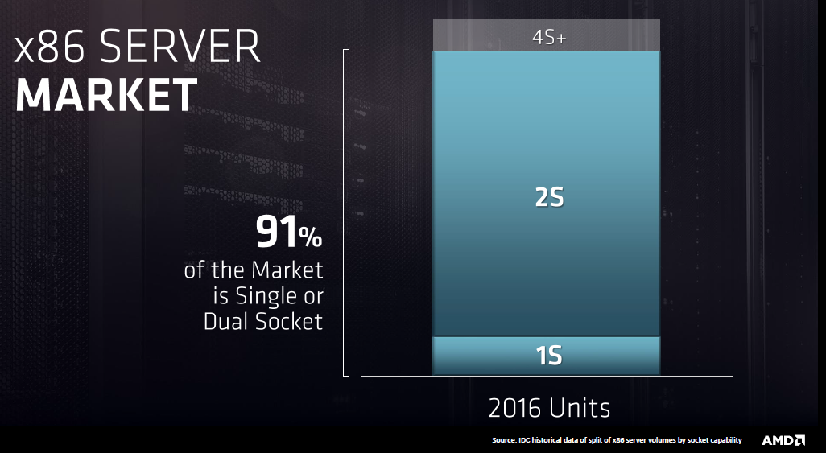
1.1 The worldwide server market (2)
The worldwide server market
Recent market share of 1S and 2S servers [74]
*

Slide 10
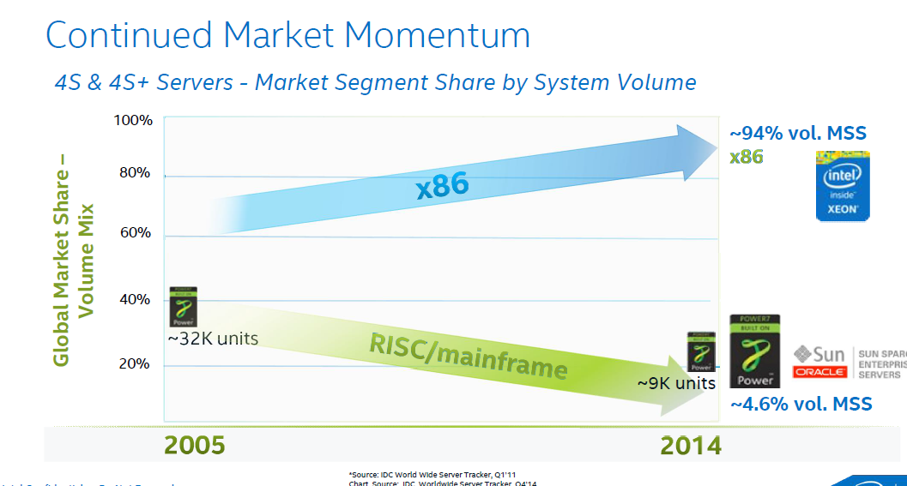
1.1 The worldwide server market (3)
The worldwide 4S (4-socket) server market 2005 -2014 [75]
MSS: Market Segment Share

Slide 11
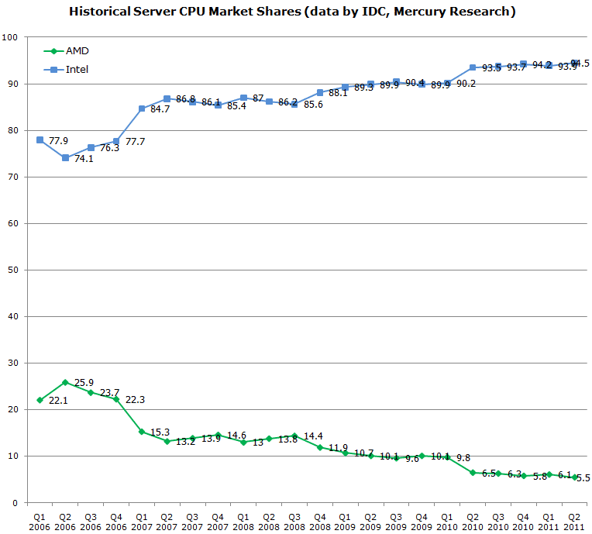
1.1 The worldwide server market (4)
Intel's vs. AMD's x86 server market share 2006 -2011 (Based on data by IDC) [76]
Penryn MP
Nehalem-EX DP/MP
Penryn DP
Core 2 Quad DP
Core 2 DP
K10 Barcelona MP
K10 Shanghai MP
K10 Istambul MP
K10 Magny Course MP

Slide 12
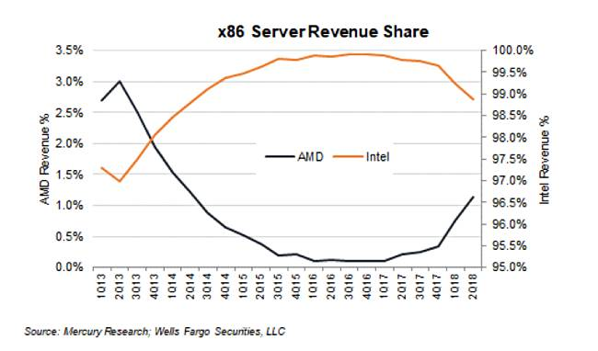
1.1 The worldwide server market (5)
Intel's vs AMD's x86 server market share 2013 – 2018 (Based on data from [72]
*

Slide 13
1.1 The worldwide server market (6)
Remark
In 06/2017 AMD launched their EPIC server processor line supporting 2-socket
configurations at its introduction.
EPIC server processors are based on the Zen microarchitecture.
Time will tell how far AMD will be able to gain market share from Intel.
*

Slide 14
1.1 The worldwide server market (7)
Worldwide top 5 server systems vendor revenues, market shares and growth, Q1 2016,
(Revenues are in Millions USD) [77]
Vendor | 1Q16 Revenue | 1Q16 Market Share | 1Q16/1Q15 Revenue Growth
1. HP | $3,306.8 | 26.7% | 3.5%
2. Dell | $2,267.8 | 18.3% | -1.8%
3. IBM | $1,139.5 | 9.2% | -32.9%
4. Lenovo * | $871.2 | 7.0% | -8.6%
5. Cisco * | $850.2 | 6.9% | -4.5%
ODM Direct | $863.8 | 7.0% | -11.0%
Others | $3,082.4 | 24.9% | 9.0%
Total | $12,382 | 100% | -3.6%
Source: IDC's Worldwide Quarterly Server Tracker, June 2016
HPE: HP Enterprise

Slide 15
1.1 The worldwide server market (8)
Emergence of ARM ISA based server processors -1
In 2019 ARM introduced a new server oriented processor line, called the Neoverse line, as the
next Figure indicates.

Slide 16
1.1 The worldwide server market (9)
ARM’s server oriented Neoverse processor line (2019)
7 nm
7 nm+
5 nm
Ares
Zeus
Perseus
Neoverse
N1
V1
N2
Atlas
Maya
Artemis
Prometheus
Enyo
Deimos
Hercules
ARM
CPUs
A57
A72
A73
A75
A76
A77
A78
Cortex
64-bit
Apollo
Ananke
Hellos
A53
A55
A65-AE
2011
2012
2013
2014
2015
2016
2017
2018
2019
2020
2021

Slide 17
1.1 The worldwide server market (10)
Emergence of ARM ISA based server processors -2
Built on ARM’s N1 Neoverse processor design, recently, two firms have unveiled powerful,
ARM ISA-based server processors, as follows:
Ampere introduced two Altra processors and
AWS (Amazon Web Services) introduced their Graviton processor line
(here we note that AWS does not sell their processors but uses them in-house to provide
on-demand cloud services),
as indicated in the next Figure.

Slide 18
1.1 The worldwide server market (11)
ARM-ISA-based server processor lines introduced by ARM, Ampere and AWS
80C/7 nm
128C/7 nm
8C/28 nm
32C/16nm
Skylark
QuickSilver
Mystique
Ampere
8C/40 nm
8C/28 nm
APM acquired by Macom, IP bought by Ampere
eMAG 8180
Altra
Altra Max
Storm
Shadowcat
Skylark
(Ares cores)
(Ares cores)
APM
X-Gene
X-Gene2
X-Gene3
16C/16 nm
64C/7 nm
(Applied Micro)
Amazon
AWS
Amazon buys
Anapura Lab
Gravition
Gravition2
(Ares cores)
7 nm
7 nm+
5 nm
Ares
Zeus
Perseus
Neoverse
N1
V1
N2
Atlas
Maya
Artemis
Prometheus
Enyo
Deimos
Hercules
ARM
CPUs
A57
A72
A73
A75
A76
A77
A78
Cortex
64-bit
Apollo
Ananke
Hellos
A53
A55
A65-AE
2011
2012
2013
2014
2015
2016
2017
2018
2019
2020
2021

Slide 19
1.1 The worldwide server market (12)
Comparing x86 and ARM ISA-based 2S server processors [63]
Top-of-Stack Competition
 | EPYC 7003 | Amazon Graviton2 | Ampere Altra | Intel Xeon
Platform | Milan | Graviton2 | QuickSilver | Ice Lake
Processor | 7763 | Graviton2 | Q80-33 | 8380
uArch | Zen 3 | N1 | N1 | Sunny Cove
Cores | 64 | 64 | 80 | 40
TDP | 280 W | ? | 250 W | 270 W
Base Freq | 2450 | 2500 | 3300 | 2300
Turbo Freq | 3500 | 2500 | 3300 | 3400
All-Core | ~3200 | 2500 | 3300 | 3000
L3 Cache | 256 MB | 32 MB | 32 MB | 60 MB
PCIe | 4.0 x128 | ? | 4.0 x128 | 4.0 x64
Chipset | On CPU | ? | On CPU | External
DDR4 | 8 x 3200 | 8 x 3200 | 8 x 3200 | 8 x 3200
DRAM Cap | 4 TB | ? | 4 TB | 4 TB
Optane | No | No | No | Yes
Price | $7890 | N/A | $4050 | $8099

Slide 20
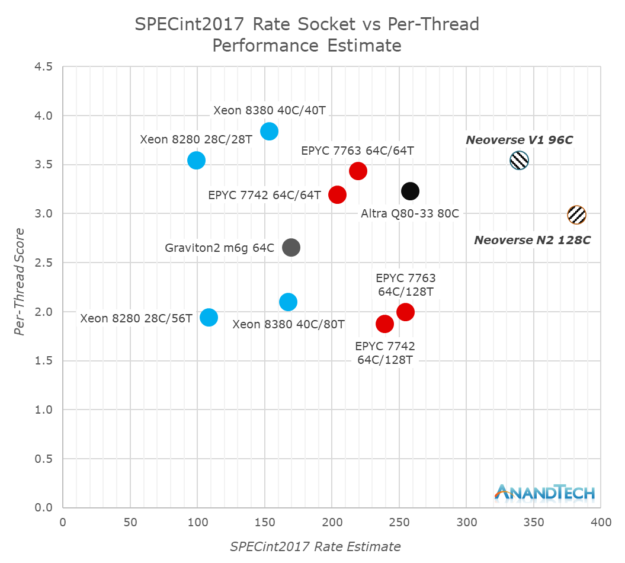
1.1 The worldwide server market (13)
SPECint2017 rate per socket and per-thread performance results (2021) [78]

Slide 21
1.1 The worldwide server market (14)
2021 performance results: SPECint2017 rate per socket vs. per-thread [78]
Note in the previous Figure that ARM ISA-based servers, introduced in the last few years,
already achieved performance levels comparable with Intel’s and AMD’s current server processors,
often with less power consumption, due to the inherent advantage of the ARM ISA vs. the
x86 ISA in respect of operand fetching (from registers vs. registers and memory).
*

Slide 22
1.2 The platform concept
Notes:
22

Slide 23
1.2 The platform concept (1)
1.2 The platform concept
The notion platform is widely used in different segments of the IT industry e.g. by
IC manufacturers, system providers or even by software suppliers with different interpretations.
Here we adopt the platform concept as used by system providers, like Intel or AMD.
The platform concept of system providers
The platform is given by the main components (“backbone”) of the system architecture, being typically
the processor or processors (in multiprocessors)
the related chipset as well as
the interfaces (buses) interconnecting them.
Remark
The designation platform is often understood as the entire system architecture.
*

Slide 24
1.2 The platform concept (2)
Example 1: A simple traditional 2S server platform
Core 2 (2C)
Core 2 (2C)
1333/1067 MT/s
FSB
E5000 MCH
(Enhanced)
ESI
631xESB/
632xESB IOH
FBDIMM
w/DDR2-533
2S: Dual Socket

Slide 25
1.2 The platform concept (3)
Example 2: The Brickland 2S platform based on Ivy Bridge-EX processors (2014)
Brickland
Xeon E7-2800 v2
(Ivy Bridge-EX)
/
Xeon E7-2800 v2
(Ivy Bridge-EX)
SMB
QPI 1.1
SMB
SMB
Ivy Bridge -EX (15C)
Ivy Bridge -EX (15C)
SMB
SMB
SMB
SMB
DMI2
QPI 1.1
DMI2
SMB
SMI2
7500 PCH
SMI2
Up to DDR3-1600
Up to DDR3-1600
SMI2: Scalable Memory Interface 2
(Parallel 64-bit VMSE data link between
the processor and the SMB)
SMB: Scalable Memory Buffer
(C112/C114: Jordan Creek 2)
(Performs conversion between the
parallel SMI2 and the parallel
DDR3/DDR4 DIMM interfaces)
C112: 2 DIMMs/channel
C114: 3 DIMMs/channel

Slide 26
1.2 The platform concept (4)
Compatibility of platform components (2)
Since platform components are interconnected via specified interfaces to build a platform,
platform components, such as processors or memories are compatible with a given platform
as long as they have the same interfaces (including interface parameters, such as expected
transfer rates etc.).
*

Slide 27
1.2 The platform concept (5)
Example for compatible processors of a platform
The Nehalem-EX and the Westmere-EX server processors are compatible within the Boxboro-EX
platform since both have the same interfaces.
Xeon 7500
(Nehalem-EX)
(Becton) 8C
/
Xeon E7-8800
(Westmere-EX) 10C
SMB
SMB
SMB
Nehalem-EX 8C
Westmere-EX 10C
QPI
Nehalem-EX 8C
Westmere-EX 10C
SMB
SMB
SMB
SMB
SMB
QPI
QPI
QPI
QPI
SMB
SMB
SMB
Nehalem-EX 8C
Westmere-EX 10C
Nehalem-EX 8C
Westmere-EX 10C
SMB
SMB
QPI
SMB
SMB
QPI
QPI
SMB
2x4 SMI
channels
2x4 SMI
channels
7500 IOH
PCIe
2.0
Nehalem-EX: up to DDR3-1067
Westmere-EX: up to DDR3-1333
ME
36
SMI: Scalable Memory Interface
(Serial link between the processor
and the SMB)
SMB: Scalable Memory Buffer
(Performs conversion between the
serial SMI and the parallel
DDR3 DIMM interfaces)
4 x QPI up to 6.4 GT/s
ESI
2 DIMMs/memory channel
ICH10
ME: Management Engine
Figure: The Boxboro-EX MP server platform supporting Nehalem-EX/Westmer-EX server processor

Slide 28
1.2 The platform concept (6)
Remark to the processor lines belonging to the same platforms
Typically, processors of the Tick phase and the subsequent Tock phase belong to the same
platform, e.g. the 65 nm Core 2 or the 45 nm Penryn-based 2S server processors build the core
of the mainstream 2S Bensley platform or the 45 Nehalem or the 32 nm Westmere-based
2S server processors are the basis of the high-performance 2S Boxboro-EX platform.

Slide 29
1.2 The platform concept (7)
Example for 2S server platforms with compatible processors
(Intel’s mainstream market segment specific 2S server platforms and processors)
Platform | Core | Techn. | Intro. | Efficient performance 2S server processors | Core count up to | Memory channels (up to)
Tylersburg-EP | Nehalem | 45 nm | 03/2009 | Xeon X/E55xx (Nehalem-EP) (Gainestown) | 4C | 3x DDR3-1333 per socket
 | Westmere | 32 nm | 3/2010 | Xeon X/E5600 (Westmere-EP) | 6C | 3x DDR3-1333 per socket
Romley-EP | Sandy Bridge | 32 nm | 3/2012 | Xeon E5-26xx (Sandy Bridge-EP) | 8C | 4x DDR3-1600 per socket
 | Ivy Bridge | 22 nm | 9/2013 | Xeon E5-26xx v2 (Ivy Bridge-EP) | 12C | 4x DDR3-1866 per socket
Grantley-EP | Haswell | 22 nm | 9/2014 | E5-2600xx v3 (Haswell-EP) | 18C | 4xDDR4-2133 per socket
 | Broadwell | 14 nm | 4/2016 | E5-26xx v4 (Broadwell-EP) | 22C | 4xDDR4-2400 per socket
Remark
Platforms may allow processor type dependent max. memory rates
Mainstream: Közepes teljesítményű/jó hatékonyságú

Slide 30
1.3 Classification of server platforms
1.3.1 Server platforms classified according to the number
of sockets supported
1.3.2 Server platforms classified according to
their memory attachment
1.3.3 Server platforms classified according to their
performance grade
1.3.4 Server platforms classified according to the number
of chips constituting the chipset
Notes:
30

Slide 31
1.3 Classification of server platforms (1)
1.3 Classification of server platforms
Subsequently, we provide a possible classification scheme of server processors while taking
into account the following four aspects:
the number of sockets supported
the way of memory attachment
the performance grade provided and
the number of chips constituting the chipset.
Obviously, there are a number of further aspects as well, like application domain, supported ISA
etc., nevertheless, we restrict the extent of our discussion to the four features mentioned.

Slide 32
1.3.1 Server platforms classified according to the number of sockets supported
Notes:
32

Slide 33
1.3.1 Server platforms classified according to the number of sockets supported (1)
1.3.1 Server platforms classified according to the number of sockets supported
Server platforms classified according to the number of sockets supported
(in general)
Uniprocessor server platforms
(UP-server platforms)
(Single socket server platforms)
Multiprocessor server platforms
(Multisocket server platforms)
2S (DP)
server platforms
4S (MP)
server platforms
8S (MP)
server platforms
More than 8 socket
server platforms
2-socket platforms
4-socket platforms
8-socket platforms
Platforms with
more than 8 sockets
*

Slide 34
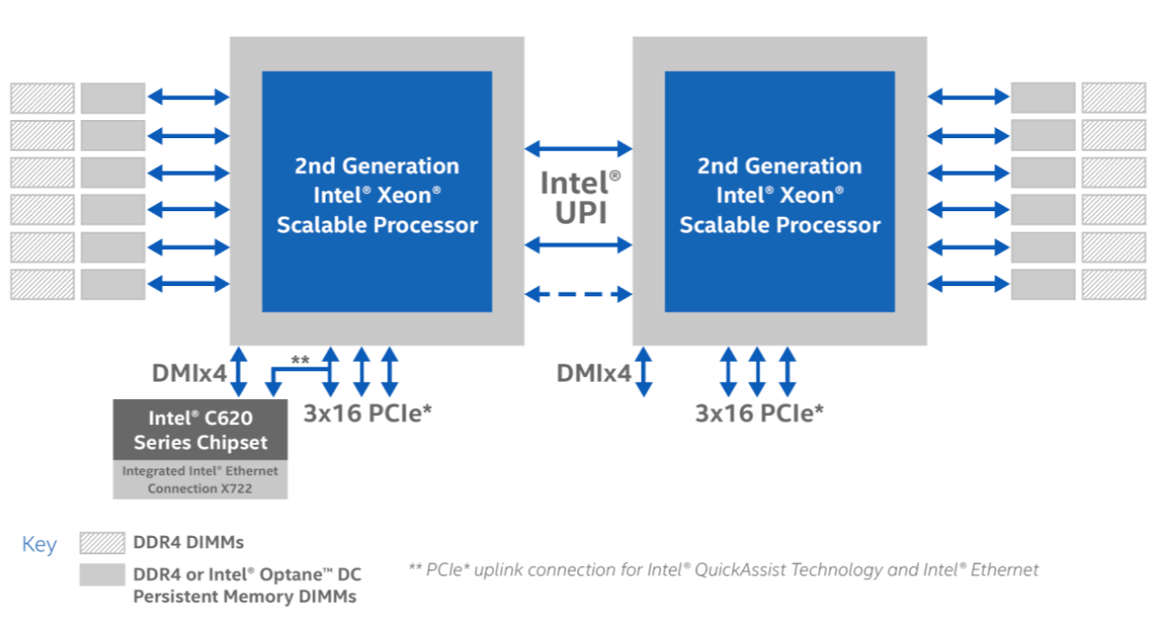
1.3.1 Server platforms classified according to the number of sockets supported (2)
Example 2S platform configuration with Cascade Lake-SP processors (2019) [79]

Slide 35
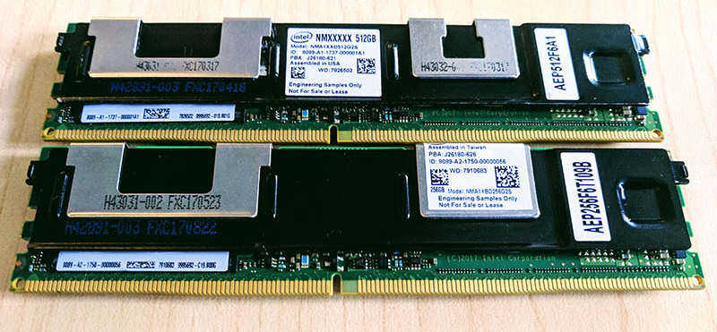
1.3.1 Server platforms classified according to the number of sockets supported (3)
Remark to Intel’s Optane DC Persistent Memory
The Optane memory is a persistent i.e. nonvolatile (nem-felejtő) memory, typically used in Intel’s
platforms, e.g. in server platforms as an extension of the main memory, since 2017.
It is based on a new memory technology, called 3D XPoint technology, developed by Intel and
Micron.
Figure: Optane DC Persistent Memory mounted onto a DDR4 DIMM
with DDR4 compatible contacts [80]
Note
The tag DC means Data Center.
*

Slide 36
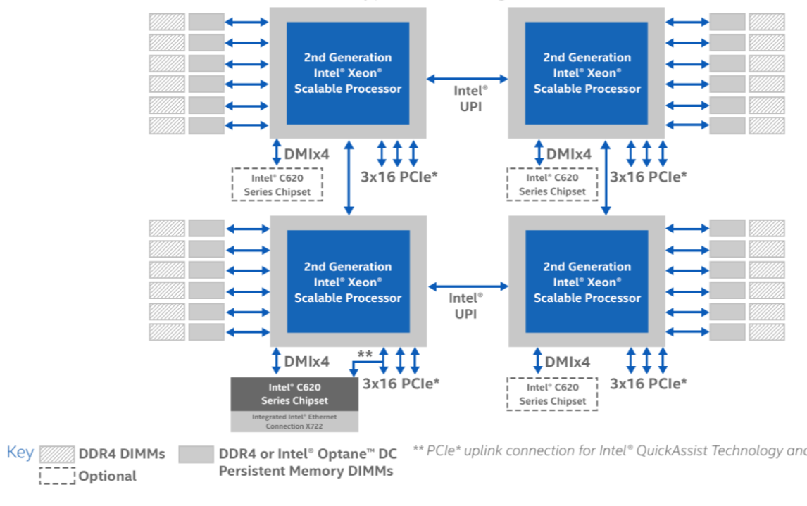
1.3.1 Server platforms classified according to the number of sockets supported (4)
Example 4S platform configuration with Cascade Lake-SP processors (2019) [79]

Slide 37
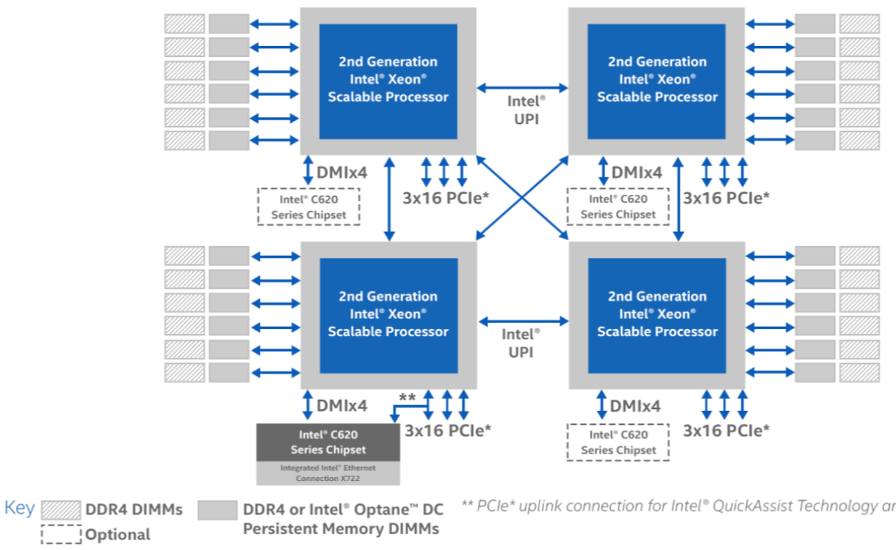
1.3.1 Server platforms classified according to the number of sockets supported (5)
Example 4S crossbar interconnected platform configuration with Cascade Lake-SP processors
(2019) [79]

Slide 38
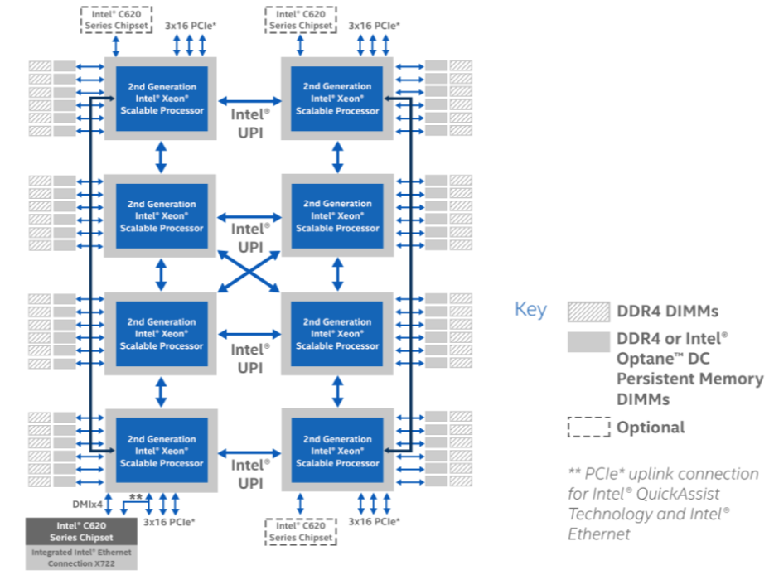
1.3.1 Server platforms classified according to the number of sockets supported (6)
Example 8S platform configuration with Cascade Lake-SP processors (2019) [79]

Slide 39
1.3.2 Server platforms classified according to
their memory attachment
Notes:
39

Slide 40
1.3.2 server platforms classified according to the way of how their memory is attached (1)
1.3.2 server platforms classified according to their memory attachment
Multiprocessor server platforms classified according to their memory attachment
UMA platforms
NUMA platforms
Multiprocessors (Multi socket system)
with Uniform Memory Access (UMA)
Multiprocessors (Multi socket system)
with Non-Uniform Memory Access
All processors access main memory
by the same latency.
Memory is attached via the MCH and the FSB.
The memory controller is implemented
on the MCH die.
Processors access memory by different latencies.
Each processor has its own access path
to the main memory.
Memory controllers are implemented
on the processor die.
Examples
Processor
Processor
Processor
QPI
Processor
MC
MC
QPI
QPI
FSB
E.g. DDR3-1333
IOH¹
E.g. DDR3-1333
MCH
MC
E.g. DDR2-533
ESI
ESI
ICH
ICH
¹ICH: I/O hub
*
ESI: Enterprise System Interface

Slide 41
1.3.2 server platforms classified according to the way of how their memory is attached (2)
Main features of UMA-type and NUMA-type server platforms
Min features of UMA and NUMA platforms
Main features of UMA platforms
Main features of NUMA platforms
All processors share the same memory space.
All processors share the same memory space.
All processors have the same memory access path
(e.g. via the MCH and the FSB).
Consequently, all processors access memory
basically with the same latency.
Processors access directly connected DIMMs,
(i.e. the local part of the main memory)
immediately, via their on-die memory controller,
whereas processors access DIMMs that are connected
to other processors than the requesting processor
(i.e. the remote parts of the main memory)
indirectly, via the processor owing the referenced
DIMM.
Processors access their local memory space
with a significantly shorter latency than their
remote memory space, consequently, processors
access memory with different latencies.
*

Slide 42
1.3.2 server platforms classified according to the way of how their memory is attached (3)
Example of measured read latencies of uncached data [81]
Read latencies depend on whether referenced data is kept in thei local or remote memory space.
a) Read latency of uncached data when referenced data is kept in the local memory space
Read latency:
65.1 ns (190 cycles)
IMC: Integrated Memory Controller

Slide 43
1.3.2 server platforms classified according to the way of how their memory is attached (4)
b) Read latency of uncached data when referenced data is kept in the remote memory
space [81]
Read latency:
106 ns (~310 cycles)
Read latency is increased now by the inter-processor access penalty of 41 ns in this case.

Slide 44
1.3.2 server platforms classified according to the way of how their memory is attached (5)
Transition from UMA platforms to NUMA platforms in the course of processor evolution
Transition from UMA platforms to NUMA platforms
Processors with UMA memory access (Memory is connected via the MCH)
Processors with NUMA memory access
(Memory is connected via the processor(s))
IBM POWER1 (RS/6000) (1990)
direct connection via external circuitry
since POWER5 (2C) (2005)
on-die integrated mem. controller
SPARC UltraSPARC II (1C) (~1997)
UltraSPARC III (1C) (2001)
and all subsequent Sun lines
AMD’s K7 lines (1C)
(1999-2003)
Opteron server lines (1C) (2003)
Opteron server lines (2C) 2005)
and all subsequent AMD lines
HP PA-8800 (2004)
PA-8900 (2005)
and all previous PA lines
Intel Core 2 Duo line (2C) (2006)
and all preceding Intel lines
Core 2 Quad line (2x2C) (2006/2007)
Penryn line (2x2C) (2008)
Nehalem lines (4C) (2008)
and all subsequent Intel lines
Intel Montecito (2C) (2006)
Tukwila (4C) (2010)

Slide 45
1.3.3 Server platforms classified according to their performance grade
Notes:
45

Slide 46
1.3.3 Server platforms classified according to their performance grade (1)
1.3.3 Server platforms classified according to their performance grade
Server platforms classified according to their performance grade
High-performance
server platforms
Mainstream
server platforms
Entry-level
server platforms
Here we note that first Pentium 4 and Core 2-based UMA platforms can be considered as
being “mainstream” platforms.
“Entry-level” platforms emerged in Intel’s designs as one of the last SMP platforms in 2007
whereas “High-performance” platforms turned up along with NUMA platforms in 2010,
as shown in the next Figure.
Mainstream: ≈ fővonal
*

Slide 47
1.3.3 Server platforms classified according to their performance grade (2)
Example: Emergence of “entry-level” and “high-performance” 2S server platform
alternatives in Intel’s designs
UMAs
NUMAs
Boxboro-EX platform
(Nehalem-EX-based)
Expandable (High-performance)
3/2010
Cranberry Lake platform
(Core 2 DP-based)
Entry-level
11/2007
Unnamed 64-bit platform
(Pentium 4 b. Nocona)
Mainstream
6/2004
2006
2006
2008
2010
2012
2014
2016
2018
2020
Year

Slide 48
1.3.4 Server platforms classified according to the number of chips
constituting the chipset
Notes:
48

Slide 49
1.3.4 Platforms classified according to the number of chips constituting the chipset (1)
1.3.4 Platforms classified according to the number of chips constituting the chipset
Implementation of platforms
classified according to the number of chips constituting the chipset
Platforms with
two-chip chipsets
Example 2S platforms
Truland platform (2005/2006)
Caneland platform (2007/2008)
Boxboro-EX platform (2010/2011)
*

Slide 50
1.3.4 Platforms classified according to the number of chips constituting the chipset (2)
Example of a platform with a 2-chip chipset: The Boxboro-EX 4S/8S server platform
supporting Nehalem-EX/Westmere-EX processors (2010-2011)
Xeon 7500
(Nehalem-EX)
(Becton) 8C
/
Xeon E7-4800
(Westmere-EX) 10C
SMB
SMB
SMB
Nehalem-EX 8C
Westmere-EX 10C
QPI
Nehalem-EX 8C
Westmere-EX 10C
SMB
SMB
SMB
SMB
SMB
QPI
QPI
QPI
QPI
SMB
SMB
SMB
Nehalem-EX 8C
Westmere-EX 10C
Nehalem-EX 8C
Westmere-EX 10C
SMB
SMB
QPI
SMB
SMB
QPI
QPI
SMB
2x4 SMI
channels
2x4 SMI
channels
7500 IOH
PCIe
2.0
Nehalem-EX: up to DDR3-1067
Westmere-EX: up to DDR3-1333
ME
36
SMI: Scalable Memory Interface
(Serial link between the processor
and the SMB)
SMB: Scalable Memory Buffer
(Performs conversion between the
serial SMI and the parallel
DDR3 DIMM interfaces)
4 x QPI up to 6.4 GT/s
ESI
2 DIMMs/memory channel
ICH10
ME: Management Engine
Nehalem-EX aimed Boxboro-EX MP server platform (for up to 10 C)

Slide 51
1.3.4 Platforms classified according to the number of chips constituting the chipset (3)
1.3.4 Platforms classified according to the number of chips constituting the chipset
Implementation of platforms
classified according to the number of chips constituting the chipset
Platforms with
two-chip chipsets
Platforms with
single-chip chipsets
Example 2S platforms
Truland platform (2005/2006)
Caneland platform (2007/2008)
Boxboro-EX platform (2010/2011)
Brickland platform (2014/2015)
Purley platform (2017)
*

Slide 52
1.3.4 Platforms classified according to the number of chips constituting the chipset (4)
Example of a platform with a single-chip chipset: The Brickland-EX 4S/8S server
platform supporting Ivy Bridge-EX/Haswell-EX/Broadwell-EX processors (2014-2016)
2x4 SMI2
channels
Xeon E7-8800 v2/v3/v4
(Ivy Bridge-EX / Haswell-EX /Broadwell-EX)
2x4 SMI2
channels
PCIe 3.0
PCIe 3.0
SMB
32
QPI
1.1
32
SMB
SMB
Ivy Bridge-EX 15C Haswell-EX 18C
Broadwell-EX 24C
Ivy Bridge-EX 15C Haswell-EX 18C
Broadwell-EX 24C
SMB
SMB
SMB
SMB
SMB
QPI 1.1
QPI 1.1
QPI 1.1
QPI 1.1
SMB
SMB
SMB
Ivy Bridge-EX 15C Haswell-EX 18C
Broadwell-EX 24C
Ivy Bridge-EX 15C Haswell-EX 18C
Broadwell-EX 24C
SMB
SMB
QPI
1.1
SMB
SMB
32
DMI2
4xPCIe2
32
SMB
PCIe 3.0
PCIe 3.0
C602J PCH
(Patsburg J)
Up to DDR3-1600
in both performance and lockstep modes and
up to DDR4-1866 in lockstep mode
ME
SMI2: Scalable Memory Interface 2
(Parallel 64-bit VMSE data link between
the processor and the SMB)
SMB: Scalable Memory Buffer
(C112/C114: Jordan Creek 2)
(Performs conversion between the
parallel SMI2 and the parallel
DDR3/DDR4 DIMM interfaces)
C112: 2 DIMMs/channel
C114: 3 DIMMs/channel
QPI 1.1: Up to 9.6 GT/s
ME: Management Engine

Slide 53
1.3.4 Platforms classified according to the number of chips constituting the chipset (5)
1.3.4 Platforms classified according to the number of chips constituting the chipset
Implementation of platforms
classified according to the number of chips constituting the chipset
Platforms with
two-chip chipsets
Platforms with
single-chip chipsets
Platforms without
a chipset
Example 2S platforms
Truland platform (2005/2006)
Caneland platform (2007/2008)
Boxboro-EX platform (2010/2011)
Brickland platform (2014/2015)
Purley platform (2017)
(AMD's 2S platform
With EPYC-7000 series processors)
*

Slide 54
1.3.4 Platforms classified according to the number of chips constituting the chipset (6)
Example of a platform without a chipset: AMD’s 2S server platform supporting
EPYC 7000 processors (2017)
AMD EPYC 7000
EPYC 32C
EPYC 32C
64
64
4x16 bit
differential links
PCIe 3.0
PCIe 3.0
8 channels
up to DDR4-2666
8 channels
up to DDR4-2666

Slide 55
1.4 Naming schemes of Intel’s servers
Notes:
55

Slide 56
1.4 Naming schemes of Intel’s servers (1)
1.4 Naming schemes of Intel’s server processors
a) Intel's naming scheme for servers until 2005
Until 2005 Intel named their servers by identifying clock frequency and server configuration,
like Xeon 2.8 GHz DP or Xeon 2.0 GHz MP, since Intel’s IC technology was superior to their
competitors and provided higher clock frequencies.
Remark
At that time AMD manufactured their processors in their own foundry, nevertheless by
a less advanced IC technology, so AMD's processors had from the start lower clock frequencies
vs. Intel’s processors.
To hide this deficiency, AMD introduced a new naming scheme for their processors beginning
with their Athlon XP desktop line in 2003.
The new naming scheme consisted of a four digit number and the +character., e.g.
Athlon 1600+.
AMD interpreted it as the relative performance level related to a given AMD DT model
(Athlon 1.4 GHz).
The relative performance was calculated as the average value of a wide range of benchmarks.
The actual clock frequencies however, were lower figures, e.g. the Athlon XP 1600+ had
a clock frequency of 1.4 GHz.
*

Slide 57
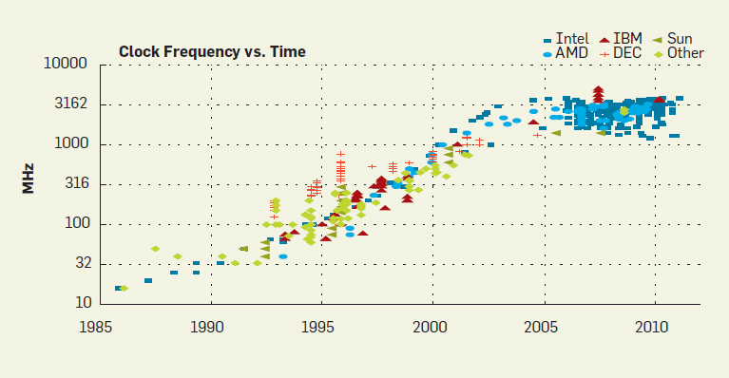
1.4 Naming schemes of Intel’s servers (2)
b) Intel’s naming scheme for servers used from 2005 to 2011
.
In the first years of the 2000's clock frequencies became stagnating, as indicated below [86].
Figure: Historical growth of clock rates [86]

Slide 58
1.4 Naming schemes of Intel’s servers (3)
Intel’s naming scheme for servers used between 2005 and 2011 -2
.
As an aftermath Intel disrupted using its previous naming scheme and introduced
an AMD like naming scheme in 2005, as follows:
Intel’s naming scheme introduced for their server processors in 2005
9000 series
7000 series
5000 series
3000 series
Itanium lines
of processors
MP server (4S)
lines
DP server (2S)
lines
UP server
lines
E.g. Intel’s subsequent DP (2S) server processor lines were designated as follows:
Platform | Core microarch. | Techn. | Intro. | Mainstream 2S server processors | Core count | Memory channels (supported by the MCH) (up to)
Bensley | Pentium 4 Prescott | 65 nm | 5/2006 | Xeon 5000 (Dempsey) | 2x1C | 4x DDR2-533 (FB-DIMM)
 | Core 2 | 65 nm | 6/2006 | Xeon 5100 (Woodcrest) | 2C | 4x DDR2-533 (FB-DIMM)
 | Core 2 | 65 nm | 11/2006 | Xeon 5300 (Clowertown) | 2x2C | 4x DDR2-533 (FB-DIMM)
 | Core 2 | 45 nm | 11/2007 | Xeon 5200 (Wolfdale) | 2C | 4x DDR2-533 (FB-DIMM)
 | Penryn | 45 nm | 11/2007 | Xeon 5400 (Harpertown) | 2x2C | 4x DDR2-533 (FB-DIMM)
The drawback of this naming scheme is that it does not reveal any significant features of the
related server families.
*

Slide 59
1.4 Naming schemes of Intel’s servers (4)
c) Intel's renewed naming scheme for servers unveiled along with the Westmere line -1
Intel introduced their new naming scheme for server processors and platforms in two steps;
c1) First Intel introduced the EX, EP and EN tags for their server processors and platforms
in 02/2009 to give a hint to the targeted market segment as follows:
EX: Expandable (high performance), instead of the previous 7000 tag,
EP: Efficient performance (EP) (mainstream) instead of the previous 5000 tag, and
EN: Entry Level,
as indicated in a slide presenting Intel’s Xeon enterprise roadmap for 2009/2010 (see the
next Figure).
*

Slide 60
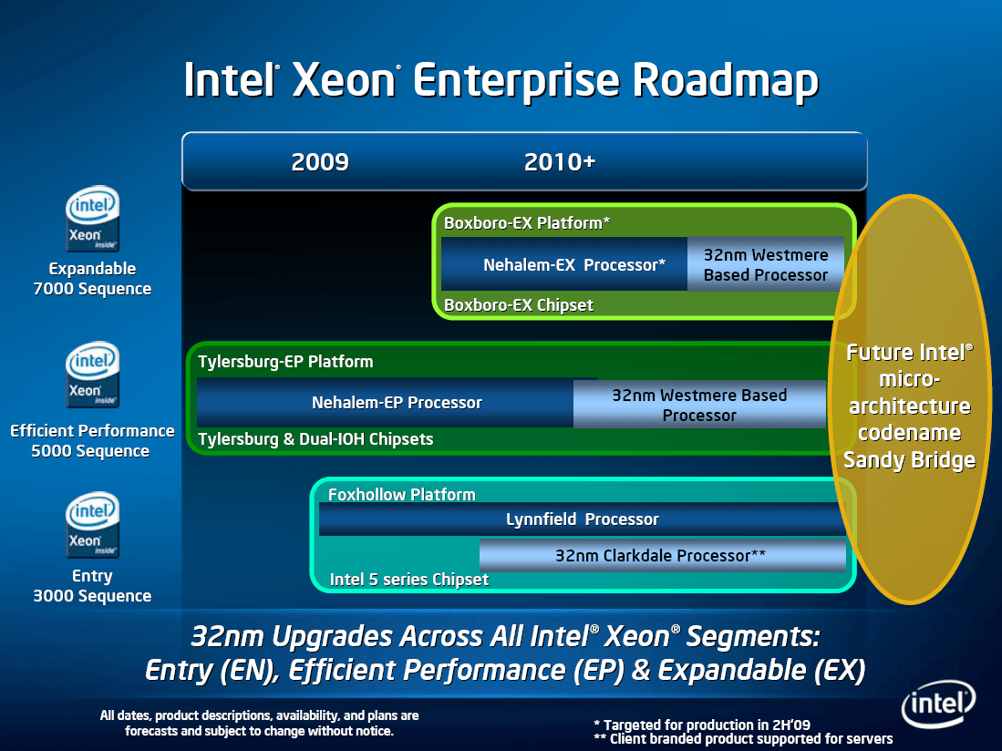
1.4 Naming schemes of Intel’s servers (5)
Introduction of the EX, EP and EN tags for server processors and platforms to indicate
their performance grade in 2009 [57]
(Uni-processor platform)

Slide 61
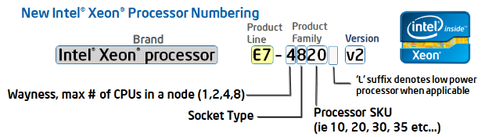
1.4 Naming schemes of Intel’s servers (6)
c2) Introducing a renewed naming scheme for servers along with the Westmere line -1
In 4/2011 Intel renewed its entire naming scheme to reflect more details in the designations.
This resulted in the following new naming scheme for servers:
Figure: Intel’s new Xeon naming scheme [127]
Interpretations
Product line: E3, E5 or E7 (E: Enterprise).
Wayness: Up to how many processors are natively supported in a system
Socket type: Signifies the targeted market segment of the processor,
8: Expandable (Extreme performance) (EX)
6: effective performance (EP)
4: entry level (EN)
Processor SKU: Last two digits of the model number (SKU: Storage Keeping Unit)
Version: The same version numbers indicate a common microarchitecture
Westmere/Sandy Bridge (without any version number)
v2: Ivy Bridge
v3: Haswell
v4: Broadwell etc.
*

Slide 62
1.4 Naming schemes of Intel’s servers (7)
Remarks
1) The designation of the server generations v2, v3 etc. does not coincide with the designation
of the microarchitecture and graphics generations, as shown below:
Microarchitecture | Architecture generation | Server generation | Graphics generation
Westmere |  | (without any v-tag | Gen. 5
Sandy Bridge | Gen. 2 | (without any v-tag | Gen. 6
Ivy Bridge | Gen. 3 | v2 | Gen. 7
Haswell | Gen. 4 | v3 | Gen 7.5
Broadwell | Gen. 5 | v4 | Gen. 8
2) At the same time the Itanium line has not been renamed, it remained the 9000-line, with
model numbers of 9300, 9500, up to 9700

Slide 63
1.4 Naming schemes of Intel’s servers (8)
Example 1: Intel's renewed naming scheme for high performance server processors
introduced along with their Westmere line -2
Accordingly, Intel’s high-end (EX) server line became designated as follows:
High-end server lines | Models | Scalability | Core count up to | Socket | Intro
Westmere-EX | E7-2800 E7-4800 E7-8800 | 2-socket 4-socket 8-socket | 10C | LGA 1567 | 2011
Ivy Bridge-EX | E7-28xx v2 E7-48xx v2 E7-88xx v2 | 2-socket 4-socket 8-socket | 15C | LGA 2011-1 | 2014
Haswell-EX | E7-48xx v3 E7-88xx v3 | 4-socket 8-socket | 14C 18C | LGA 2011-1 | 2015
Broadwell-EX | E7-48xx v4 E7-88xx v4 | 4-socket 8-socket | 16C 22C | LGA 2011-1 | 2016

Slide 64
1.4 Naming schemes of Intel’s servers (9)
Example 2: The full range of Intel’s server product lines in the Haswell family
The Haswell family
Haswell
(LGA1150)
Mobiles and desktops
Haswell-E
(LGA2011)
High end desktops
(HEDs)
Haswell-EN
(LGA1150)
Microservers/
UP servers
Haswell-EP
(LGA2011)
Efficient performance servers, workstations
Haswell-EX
(LG2011)
High-end servers
Up to 4 cores
i3/i5/i7 designations
Up to 8 cores
i7 designation
Up to 4 cores
E3 designation
Up to 18 cores
E5 designation
Up to 18 cores
E7 designation
Servers
Microservers
E3-1275L/1265L v3, 4C+G, HT, 6/2013 and 5/2014
E3-1240L/1230L/1220L v3, 2C/4C, HT, 6/2013 and 5/2014
UP Servers
E3-12x5/12x6 v3, 4C+G, HT, 6/2013 and 5/2014
E3-12x0/12x1 v3, 4C, HT, 6/2013 and 5/2014
Workstations
E5-16xx v3, 4/6/8C, 9/2014
2S-Servers
E5-2408LV v3, 4C, 1/2015 (embedded low power)
E5-26xx v3, 4/6/8/10/12/14/16/18C, 9/2014
4S-Servers
E5-46xx v3, 6/10/12/14/16/18C, 6/2015
E7-48xx v3, 8/10/12/14C, 5/2015
8S-Servers
E7-88xx v3, 4/10/16/18C, 5/2015

Slide 65
1.4 Naming schemes of Intel’s servers (10)
d) Intel’s latest naming scheme for servers introduced with the Skylake-SP line in 2017 -1
There is a drawback of Intel’s previous server implementation concept:
EX, EP and EN platforms are built up differently, as far as their
memory attachment,
number of available QPI links,
memory channels or
PCIe lanes
is considered, as the next example shows in case of the Ivy Bridge-based Romley-EN, Romley-EP
and Brickland server platforms.
*

Slide 66
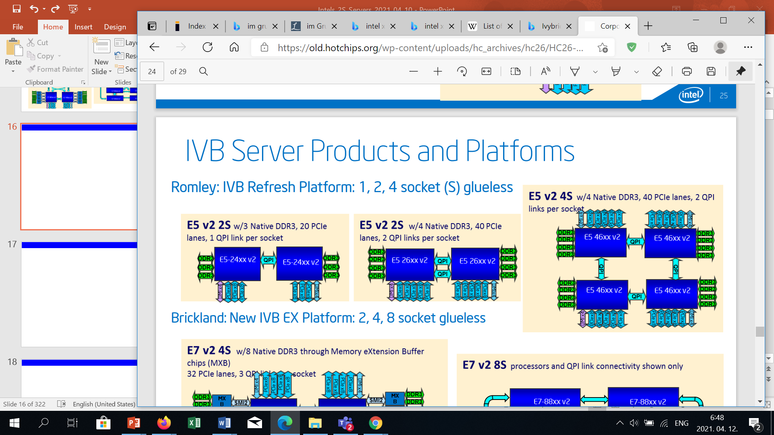
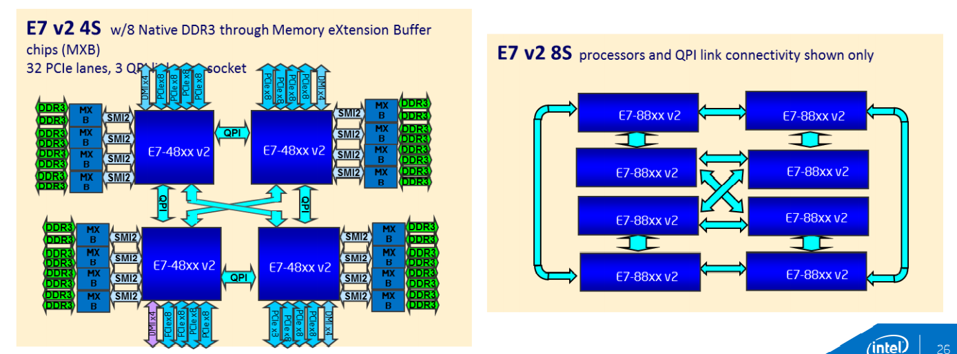
1.4 Naming schemes of Intel’s servers (11)
Example: E5-EN/EP, E7-EX platform options built up of Ivy Bridge-based server processors [83]
Romley platform
E5-EP: Efficient Performance level options
E5-EN: Entry level option
E
E5-46xxv2
E5-46xxv2
E5-24xxv2
E5-24xxv2
E5-26xxv2
E5-26xxv2
E5-46xxv2
E5-46xxv2
Brickland platform: E7-EX High-end platform options
E7-88xxv2
E7-88xxv2
E7-48xxv2
E7-48xxv2
E7-88xxv2
E7-88xxv2
E7-88xxv2
E7-88xxv2
E7-48xxv2
E7-48xxv2
E7-88xxv2
E7-88xxv2

Slide 67
1.4 Naming schemes of Intel’s servers (12)
Main differences in the implementation of Intel’s Ivy Bridge-based E5-EN, E5-EP and E7-EX
processors [83]
 | E5-EN lines of processors |  | E5-EP lines of processors | E7-EX lines of processors
No. of supported sockets | 2S | 2S/4S |  | 4S/8S
No. of QPI links (up to) | 1 QPI link |  | 2 QPI links | 4 QPI links
Type of memory attachment to the on-die MC(s) | Directly attached DDR3 memory channels to a single or dual MCs |  |  | Attachment via 4 low line count proprietary 64-bit parallel channels (SMI2 channels) with on-board memory buffers, while 2 DDR3/4 channels are connected to each memory buffer
No. of DDR3 memory channels | 3 DDR3 channels |  | 4 DDR3 channels | 8 DDR3 channels
No. of PCIe lanes | 3x8 lanes |  | 5x8 lanes | 4x8 lanes
PCH | 2S options: C600 (Patsburg) 4S options: C610 (Wellsburg) |  |  | C602 J (Patsburg J)
Here we note that Intel assigned the EN and EP performance grades to the E5 product line
whereas the EX performance grade to the E7 product line.

Slide 68
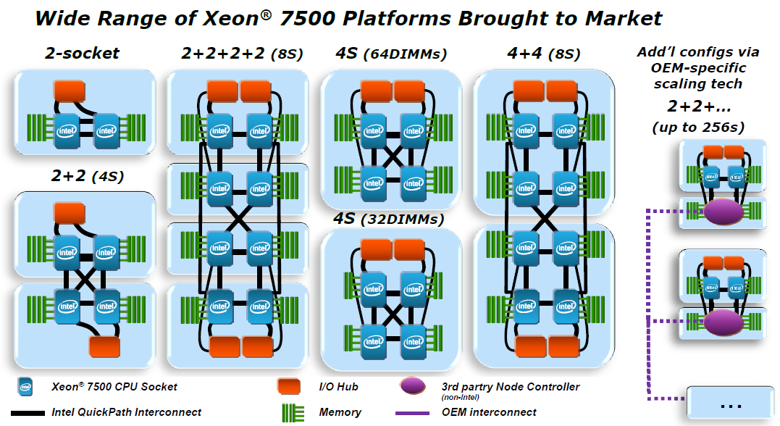
1.4 Naming schemes of Intel’s servers (13)
Benefit of the previous concept: Socket expandability within the same product line (E7-EX/E5-EP)
Expandability means in case of the high-performance (E7-EX) platforms that 2S/4S or 8S platforms may be
built from the same type of processor chips, IOHs and memory connection (as there are 4 QPI links).
Example: Expandability within the high-performance Nehalem-based E7 Boxboro-EX platform [58]
Similarly, in case of the E5- EP platform 2S or 4S configurations may be built while using 2 QPI links.

Slide 69
1.4 Naming schemes of Intel’s servers (14)
Intel’s latest implementation concept and naming scheme for servers introduced along with
the 5. gen. Skylake-SP line in 2017 -2
To avoid the drawbacks of their previous implementation concept in terms of design and
implementation cost and logistics, but keep the benefits in terms od scalability, Intel
switched to a new concept called scalable processors along with their 6. gen. Skylake-SP based
server processors in 2017.
The scalable processor concept consists of two elements:
1) unifying the processor implementations of the 2S, 4S, 8S configurations and
2) introducing four performance grades instead of two (E7/E5)
(while the E3 performance grade has been dropped)
as indicated in the next Figures.
*

Slide 70
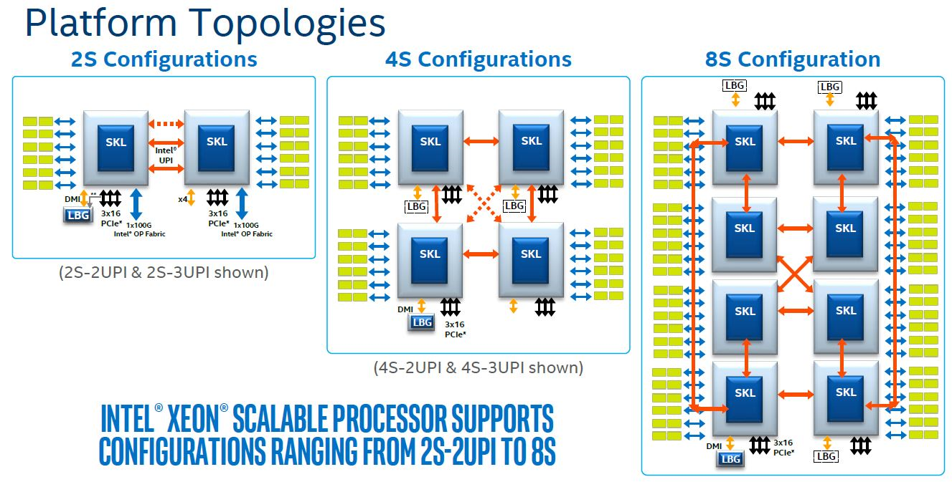
1.4 Naming schemes of Intel’s servers (16)
1) Unifying the 2S to 8S processor implementations for all scalable server processors [84]
LBG: Lewisburg (PCH)
OP: OmniPath
*

Slide 71
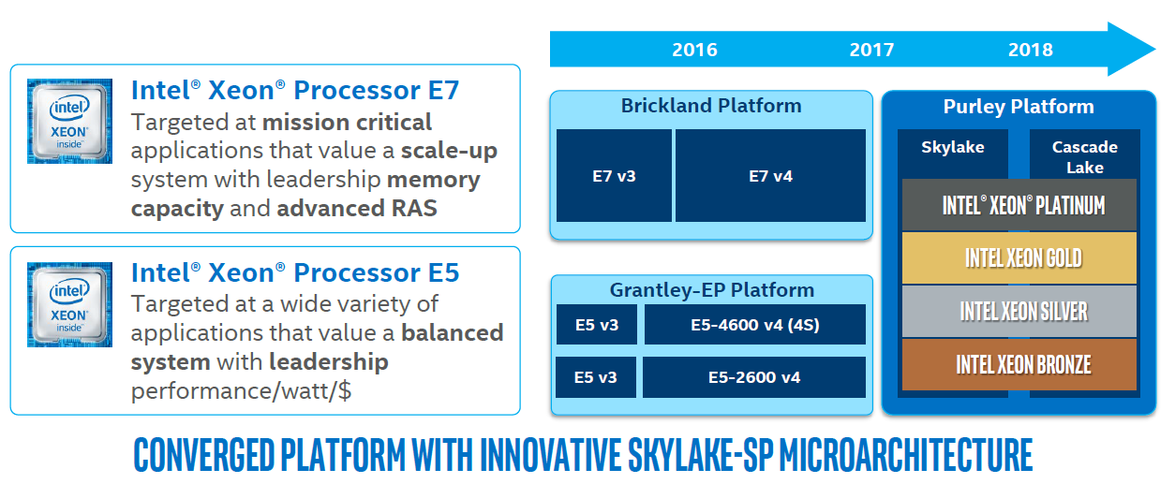
1.4 Naming schemes of Intel’s servers (15)
2) Introducing four performance grades instead of two (E7/E5) for scalable server
processors [84]
Haswell
Broadwell
(4S/8S)
(-SP)
(4S)
At introduction the introduced performance grades provided the following scalability:
Performance grade | Scalability
Platinum | 1 – 8
Gold | 1 – 4
Silver, Bronze | 1 -2
*

Slide 72
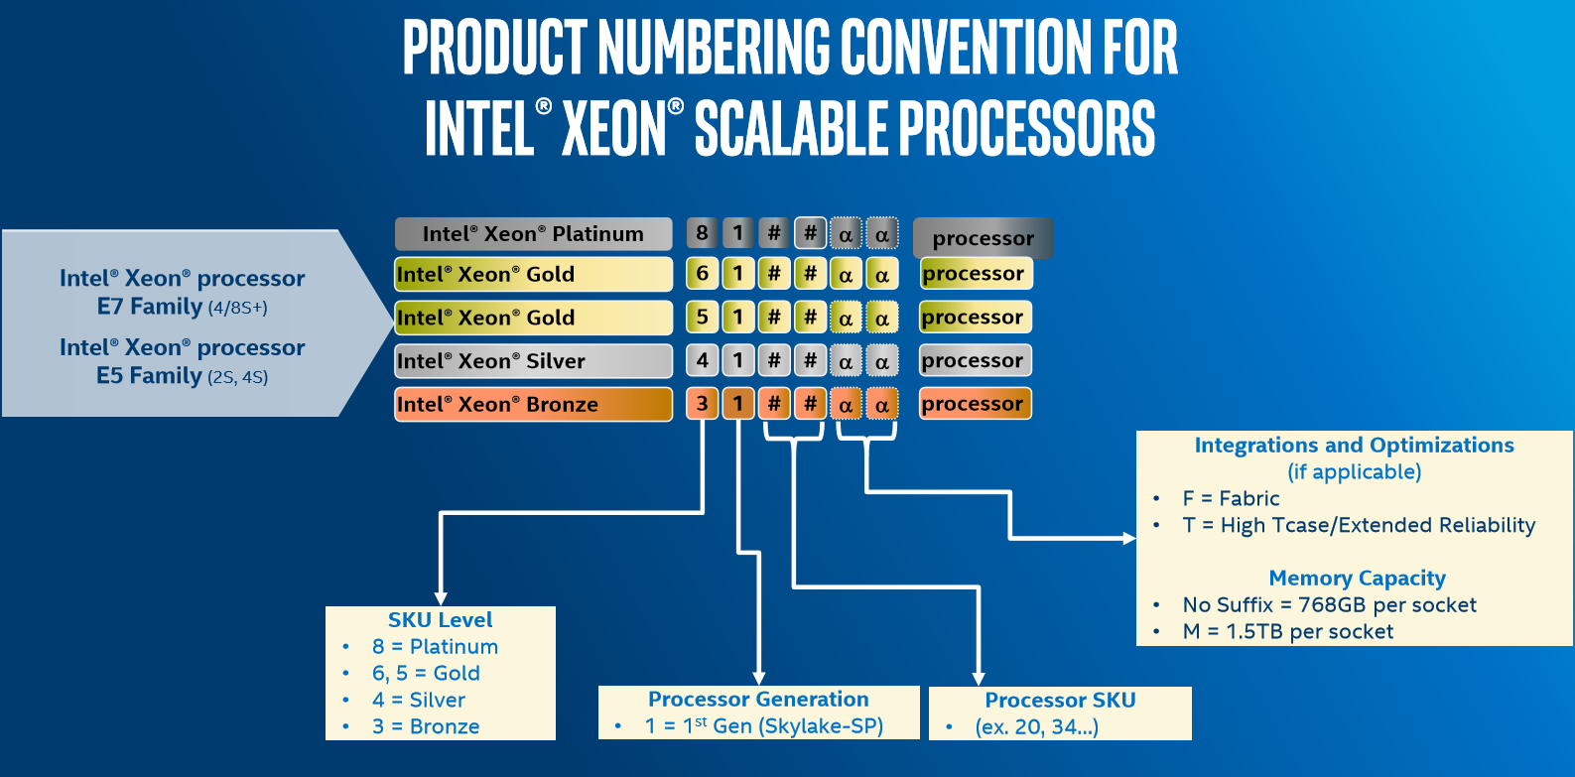
1.4 Naming schemes of Intel’s servers (17)
Corresponding new model naming starting with the 5. gen. Skylake-SP processor line [85]
(OmniPath)
*

Slide 73
1.5 Overview of Intel’s 64-bit 2S server platforms and processors
Notes:
73

Slide 74
1.5 Overview of Intel's 64-bit 2S server platforms and processors (1)
1.5 Overview of Intel’s 64-bit 2S server platforms and processors
Intel’s first 64-bit 2S processor, the Nocona was still a single core server processor but Intel’s all subsequent 2S server processors were already multicores.
For this reason we do not call attention to the multicore features subsequently.

Slide 75
1.5 Overview of Intel's 64-bit 2S server platforms and processors (2)
Intel’s server platforms classified according to their basic layout
Intel’s 2S server platforms classified according to their basic layout
Dedicated
server platforms
Market segment specific server platforms
Scalable
server platforms
There are dedicated platform designs
for 2S and 4S platform configurations.
Intel defined 3 market segments, called:
Expandable (High performance) (EX),
Efficient Performance (EP) (mainstream)
Entry-Level (EN)
market segments and used
different platform designs
for each market segment.
There is a single (unified)
platform design
for all market segments.
It is a kind of standardization
within each market segment.
It is a kind of standardization
for all market segments.
Used for UMA
platform topologies
with Pentium 4 to Penryn-based
server platforms
Used for NUMA
platform topologies
with Nehalem to Broadwell-based
server platforms
Used for subsequent NUMA
platform topologies
beginning with Skylake-based
server platforms
(2004 – 2007)
(2010 – 2016)
(2017 –)
but also as exceptions
for the Ice Lake 2S (2021) and
Cooper Lake 4S/8S (2020)
server platforms
*

Slide 76
1.5 Overview of Intel's 64-bit 2S server platforms and processors (3)
Overview of Intel’s 64-bit server platforms and processors -2
Our subsequent overview of Intel’s server platforms and processors takes into account four
previously discussed aspects:
a) the way of how their memory is attached (UMA or NUMA),
b) the basic layout of the platforms (dedicated, market segment oriented, scalable),
the performance grade (high performance, mainstream, entry-level) of the platform and
the number of processors supported by the platform (2S, 4S, 8S).
While bearing in mind these four aspects, Intel’s server platforms can be overviewed as follows:
*

Slide 77
1.3 Server platforms classified according to the number of sockets supported (4)
Overview of Intel’s 2S-8S 64-bit server platforms (1S platforms omitted) Stand 09/2021
UMA topology
NUMA topology
Dedicated
platforms
Market segment specific
platforms
Three performance grades are defined:
Expandable (EX) (High-performance)
Efficient Performance (EP) and
Entry-Level (EL)
Scalable
platforms
2S-8S
Sapphire
Rapids
Purley Platinum
*
*
*
2022?
4S/8S
4S/8S
Boxboro-EX
Brickland
Cedar Island
*
*
*
*
*
(dedicated)
4S
2S/4S
2S/4S
Truland MP
Caneland MP
Romley-EP
Grantley-EP
Purley Gold
*
*
*
*
*
*
*
*
*
2S
2S
2S
2S
Unnamed
Nocona-based
Bensley
Boxboro-EX
Romley-EN
Brickland
Purley Silver/Bronze
Whitley
*
*
*
*
*
*
*
*
*
*
*
(dedicated)
2004
2006
2008
2010
2012
2014
2016
2018
2020
Year

Slide 78
1.5 Overview of Intel's 64-bit 2S server platforms and processors (4b)
Overview of Intel’s 2S-8S 64-bit server platforms and processors (1S platforms omitted)
UMA topology
NUMA topology
Dedicated
platforms and processors
Market segment specific
platforms and processors
Three performance grades are defined:
Expandable (EX) (High-performance)
Efficient Performance (EP) and
Entry-Level (EL)
Scalable
platforms and processor
4S/8S
2S
Cedar Island
Whitley
*
*
Cooper Lake
(dedicated)
Ice Lake-SP
(dedicated)
2S/4S/8S
2S/4S/8S
4S/8S
2S-8S
Sapphire
Rapids
Boxboro-EX
Brickland
Brickland
Purley Platinum
*
*
*
*
*
*
*
*
b.: based
Nehalem
-EX
Westmere
-EX
Ivy Bridge
-EX
HW
-EX
BW
-EX
Skylake
-SP
Cascade
Lake
2022?
4S
2S/4S
2S-4S
Truland MP
Caneland MP
Romley-EP
Grantley-EP
Purley Gold
*
*
*
*
*
*
*
*
*
*
Pentium4 b.
Potomac
Pentium4 b.
7100
Core2 b..
7200
Core 2 b.
7300
Sandy Bridge
-EP
IB
-EP
Haswell
-EP
Broadwell
-EP
Skylake
-SP
Cascade
Lake
2S
2S
2S
Unnamed
Bensley
Tylersburg-EP
Romley-EN
Purley Silver/Bronze
*
*
*
*
*
*
*
*
*
*
Pentium 4 b.
Nocona
Pentium 4 b.
5000
Penryn b.
5400
Nehalem
-EP
Westmere
-EP
SB
-EN
Ivy Bridge
-EN
Skylake
-SP
Cascade
Lake
Pentium 4 b. Paxville-DP
2004
2006
2008
2010
2012
2014
2016
2018
2020
Year

Slide 79
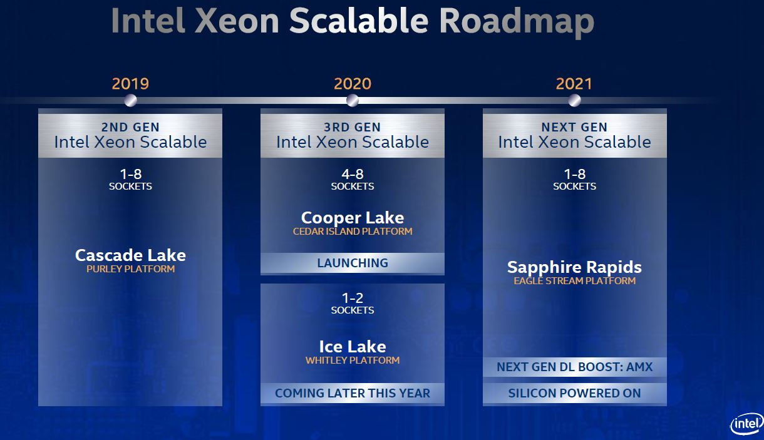
1.5 Overview of Intel's 64-bit 2S server platforms and processors (5)
Intel’s introduction of the dedicated 1S/2S Wheatley and the 4S/8S Cedar Island
platforms within the group of the 1S to 8S scalable platforms [71]

Slide 80
1.5 Overview of Intel's 64-bit 2S server platforms and processors (6)
Overview of Intel’s 64-bit 2S server platforms and processors
UMA topology
NUMA topology
Dedicated
2S platforms and processors
Market segment specific
2S platforms and processors
Three performance grades are defined:
Expandable (EX) (High-performance)
Efficient Performance (EP) and
Entry-Level (EL)
Scalable
2S platforms and processor
2S
2S
2S
Boxboro-EX
Brickland-EX
Purley Platinum
Whitley P.
*
*
*
*
*
*
b.: based
Nehalem
-EX
Westmere
-EX
Ivy Bridge
-EX
Skylake
-SP
Cascade
Lake
Ice Lake-SP
(dedicated)
2S
2S
2S
Romley-EP
Grantley-EP
Purley Gold
Whitley G.
*
*
*
*
*
*
*
Sandy Bridge
-EP
IB
-EP
Haswell
-EP
Broadwell
-EP
Skylake
-SP
Cascade
Lake
Ice Lake-SP
(dedicated)
2S
2S
2S
2S
Unnamed
Bensley
Tylersburg-EP
Romley-EN
Purley Silver/Bronze
Whitley S.
*
*
*
*
*
*
*
*
*
*
*
Pentium 4 b.
Nocona
Pentium 4 b.
5000
Penryn b.
5400
Nehalem
-EP
Westmere
-EP
SB
-EN
Ivy Bridge
-EN
Skylake
-SP
Cascade
Lake
Ice Lake-SP
(dedicated)
Pentium 4 b. Paxville-DP
2004
2006
2008
2010
2012
2014
2016
2018
2020
Year

Slide 81
1.5 Overview of Intel's 64-bit 2S server platforms and processors (7)
Overview of Intel’s dedicated 2S server platforms and processors
UMA topology
NUMA topology
Dedicated
2S platforms and processors
Market segment specific
2S platforms and processors
Three performance grades are defined:
Expandable (EX) (High-performance)
Efficient Performance (EP) and
Entry-Level (EL)
Scalable
2S platforms and processor
2S
2S
2S
Boxboro-EX
Brickland-EX
Purley Platinum
Whitley P.
*
*
*
*
*
*
Nehalem
-EX
Westmere
-EX
Ivy Bridge
-EX
Skylake
-SP
Cascade
Lake
Ice Lake-SP
(dedicated)
2S
2S
2S
Romley-EP
Grantley-EP
Purley Gold
Whitley G.
*
*
*
*
*
*
*
b.: based
Sandy Bridge
-EP
IB
-EP
Haswell
-EP
Broadwell
-EP
Skylake
-SP
Cascade
Lake
Ice Lake-SP
(dedicated)
2S
2S
2S
2S
Unnamed
Bensley
Tylersburg-EP
Romley-EN
Purley Silver/Bronze
Whitley S.
*
*
*
*
*
*
*
*
*
*
*
Pentium 4 b.
Nocona
Pentium 4 b.
5000
Penryn b.
5400
Nehalem
-EP
Westmere
-EP
SB
-EN
Ivy Bridge
-EN
Skylake
-SP
Cascade
Lake
Ice Lake-SP
(dedicated)
Pentium 4 b. Paxville-DP
2004
2006
2008
2010
2012
2014
2016
2018
2020
Year

Slide 82
1.5 Overview of Intel's 64-bit 2S server platforms and processors (8)
Intel’s dedicated 2S server platforms and processors classified according to their
performance grade (All of these platforms have UMA topology)
Intel’s dedicated 2S server platforms and processors
Mainstream
dedicated 2S server platforms
Entry-level
dedicated 2S server platform
Unnamed 2S platform with
90 nm Pentium 4 Prescott-based
DP server processors
Bensley 2S platform with
65 nm Pentium 4/Core 2/ 45 nm Penryn-based
DP server processors
(2005)
(2006/2006/2007)
Cranberry Lake 2S platform with
Core 2/Penryn-based
DP server processors
(2007)
Note
In lack of related documentation and also due to its modest importance here we omit Nocona-based platforms.

Slide 83
1.5 Overview of Intel's 64-bit 2S server platforms and processors (9)
Overview of Intel’s mainstream dedicated 2S server platforms and processors
Platform | Core microarch. | Techn. | Intro. | Mainstream 2S server processors | Core count | Memory channels (supported by the MCH) (up to)
 | Pentium 4 DP Prescott | 90 nm | 6/2004 | 90 nm Nocona | 1C | 2x DDR2-400
 | Pentium 4 Prescott | 90 nm | 10/2005 | Xeon DP 2.8 GHz (Paxville DP) | 2x1C | 2x DDR2-400
Bensley | Pentium 4 Prescott | 65 nm | 5/2006 | Xeon 5000 (Dempsey) | 2x1C | 4x DDR2-533 (FB-DIMM)
 | Core 2 | 65 nm | 6/2006 | Xeon 5100 (Woodcrest) | 2C | 4x DDR2-533 (FB-DIMM)
 | Core 2 | 65 nm | 11/2006 | Xeon 5300 (Clowertown) | 2x2C | 4x DDR2-533 (FB-DIMM)
 | Core 2 | 45 nm | 11/2007 | Xeon 5200 (Wolfdale) | 2C | 4x DDR2-533 (FB-DIMM)
 | Penryn | 45 nm | 11/2007 | Xeon 5400 (Harpertown) | 2x2C | 4x DDR2-533 (FB-DIMM)

Slide 84
1.5 Overview of Intel's 64-bit 2S server platforms and processors (10)
Overview of Intel’s entry-level dedicated 2S server processors and platforms
Platform | Core microarch. | Techn. | Intro. | Mainstream 2S server processors | Core count | Memory channels (supported by the MCH) (up to)
Cranberry Lake | Core 2 Penryn | 65 nm 45 nm | 11/2007 | Xeon 5100 (Woodcrest) Xeon 5200 (Wolfdale) Xeon 5300 (Clowertown) Xeon 5400 (Harpertown) | 2C 2C 2x2C 2x2C | 2x DDR2-667

Slide 85
1.5 Overview of Intel's 64-bit 2S server platforms and processors (11)
Overview of Intel’s market segment specific 2S server platforms and processors
UMA topology
NUMA topology
Dedicated
2S platforms and processors
Market segment specific
2S platforms and processors
Three performance grades are defined:
Expandable (EX) (High-performance)
Efficient Performance (EP) and
Entry-Level (EL)
Scalable
2S platforms and processor
2S
2S
2S
Boxboro-EX
Brickland-EX
Purley Platinum
Whitley P.
*
*
*
*
*
*
b.: based
Nehalem
-EX
Westmere
-EX
Ivy Bridge
-EX
Skylake
-SP
Cascade
Lake
Ice Lake-SP
(dedicated)
2S
2S
2S
Romley-EP
Grantley-EP
Purley Gold
Whitley G.
*
*
*
*
*
*
*
Sandy Bridge
-EP
IB
-EP
Haswell
-EP
Broadwell
-EP
Skylake
-SP
Cascade
Lake
Ice Lake-SP
(dedicated)
2S
2S
2S
2S
Unnamed
Bensley
Tylersburg-EP
Romley-EN
Purley Silver/Bronze
Whitley S.
*
*
*
*
*
*
*
*
*
*
*
Pentium 4 b.
Nocona
Pentium 4 b.
5000
Penryn b.
5400
Nehalem
-EP
Westmere
-EP
SB
-EN
Ivy Bridge
-EN
Skylake
-SP
Cascade
Lake
Ice Lake-SP
(dedicated)
Pentium 4 b. Paxville-DP
2004
2006
2008
2010
2012
2014
2016
2018
2020
Year

Slide 86
1.5 Overview of Intel's 64-bit 2S server platforms and processors (12)
Intel’s market segment specific 2S server platforms and processors
classified according to their performance grade
EX platforms (Expandable) High-performance
Intel’s market segment specific 2S platforms
Boxboro-EX 2S platform with
Nehalem-EX/Westmere-EX
server processors
Brickland 2S platform with
Ivy Bridge-EX
server processors
(2010/2011)
(2014)
EP platforms (Efficient Performance) Mainstream
Tylersburg-EP 2S platform with
Nehalem-EP/Westmere-EP
server processors
Romley-EP 2S platform with
Sandy Bridge-EP/Ivy Bridge-EP server processors
Grantley-EP 2S platform with
Haswell-EP/Broadwell-EP
server processors
(2009/2010)
(2012/2013)
(2014/2016)
E platforms (Entry) Entry-level
Romley-EN 2S platform with
Sandy Bridge-EN/Ivy Bridge-EN processors
(2012/2013)

Slide 87
1.5 Overview of Intel's 64-bit 2S server platforms and processors (13)
Overview of Intel’s expandable (EX)/high-performance
market segment specific 2S server platforms and processors
Platform | Core | Techn. | Intro. | High performance 2S server processors | Core count up to | Memory channels (up to)
Boxboro-EX | Nehalem | 45 nm | 3/2010 | Xeon X6500 (Beckton/ Nehalem-EX) | 8C | 8x DDR3-066 per socket (via SMI/SMB)
 | Westmere | 32 nm | 4/2011 | Xeon E7-28xx (Westmere-EX) | 10C | 8x DDR3-1333 per socket (via SMI/SMB)
Brickland-EX | Ivy Bridge | 22 nm | 2/2014 | E7-28xx v2 (Ivy Bridge-EX) | 15C | 8x DDR3-1600 per socket (via SMI2/SMB)

Slide 88
1.5 Overview of Intel's 64-bit 2S server platforms and processors (14)
Overview of Intel’s efficient performance (EP)/mainstream
market segment specific 2S server platforms and processors
Platform | Core | Techn. | Intro. | Efficient performance 2S server processors | Core count up to | Memory channels (up to)
Tylersburg-EP | Nehalem | 45 nm | 03/2009 | Xeon X/E55xx (Nehalem-EP) (Gainestown) | 4C | 3x DDR3-1333 per socket
 | Westmere | 32 nm | 3/2010 | Xeon X/E5600 (Westmere-EP) | 6C | 3x DDR3-1333 per socket
Romley-EP | Sandy Bridge | 32 nm | 3/2012 | Xeon E5-26xx (Sandy Bridge-EP) | 8C | 4x DDR3-1600 per socket
 | Ivy Bridge | 22 nm | 9/2013 | Xeon E5-26xx v2 (Ivy Bridge-EP) | 12C | 4x DDR3-1866 per socket
Grantley-EP | Haswell | 22 nm | 9/2014 | E5-2600xx v3 (Haswell-EP) | 18C | 4xDDR4-2133 per socket
 | Broadwell | 14 nm | 4/2016 | E5-26xx v4 (Broadwell-EP) | 22C | 4xDDR4-2400 per socket

Slide 89
1.5 Overview of Intel's 64-bit 2S server platforms and processors (15)
Overview of Intel’s entry/level market segment specific 2S server platforms and processors
Platform | Core | Techn. | Intro. | Entry-level 2S server processors | Core count up to | Memory channels (up to)
Romley-EN | Sandy Bridge | 32 nm | 5/2012 | Xeon E5-24xx Sandy Bridge-EN | 8C | 3x DDR3-1600 per socket (direct connected)
 | Ivy Bridge | 22 nm | 1/2014 | Xeon E5-24xx v2 (Ivy Bridge-EN) | 10C | 3x DDR3-1600 per socket (direct connected)

Slide 90
1.5 Overview of Intel's 64-bit 2S server platforms and processors (16)
Overview of Intel’s scalable 2S server platforms and processors
UMA topology
NUMA topology
Dedicated
2S platforms and processors
Market segment specific
2S platforms and processors
Three performance grades are defined:
Expandable (EX) (High-performance)
Efficient Performance (EP) and
Entry-Level (EL)
Scalable
2S platforms and processor
2S
2S
2S
Boxboro-EX
Brickland-EX
Purley Platinum
Whitley P.
*
*
*
*
*
*
b.: based
Nehalem
-EX
Westmere
-EX
Ivy Bridge
-EX
Skylake
-SP
Cascade
Lake
Ice Lake-SP
(dedicated)
2S
2S
2S
Romley-EP
Grantley-EP
Purley Gold
Whitley G.
*
*
*
*
*
*
*
Sandy Bridge
-EP
IB
-EP
Haswell
-EP
Broadwell
-EP
Skylake
-SP
Cascade
Lake
Ice Lake-SP
(dedicated)
2S
2S
2S
2S
Unnamed
Bensley
Tylersburg-EP
Romley-EN
Purley Silver/Bronze
Whitley S.
*
*
*
*
*
*
*
*
*
*
*
Pentium 4 b.
Nocona
Pentium 4 b.
5000
Penryn b.
5400
Nehalem
-EP
Westmere
-EP
SB
-EN
Ivy Bridge
-EN
Skylake
-SP
Cascade
Lake
Ice Lake-SP
(dedicated)
Pentium 4 b. Paxville-DP
2004
2006
2008
2010
2012
2014
2016
2018
2020
Year

Slide 91
1.5 Overview of Intel's 64-bit 2S server platforms and processors (17)
Intel’s scalable 2S server platforms and processors classified according to their
performance grade
High-performance
Purley 2S platform with
Skylake-SP/Cascade Lake
Platinum server processors
Whitley Platinum
2S platform with
Ice Lake Platinum
server processors
Intel’s 2S scalable platforms
(2017/2019)
(2021)
(Section 4.2.1)
(Section 4.2.2)
Efficient Performance/Mainstream
Purley 2S platform with
Skylake-SP/Cascade Lake
Gold server processors
Whitley Platinum
2S platform with
Ice Lake Gold
server processors
(2017/2019)
(2021)
(Section 4.2.1)
(Section 4.2.2)
Entry-level
Purley 2S platform with
Skylake-SP/Cascade Lake
Silver/Bronze server processors
Whitley Platinum
2S platform with
Ice Lake Silver
server processors
(2017/2019)
(2021)
(Section 4.2.1)
(Section 4.2.2)

Slide 92
1.5 Overview of Intel's 64-bit 2S server platforms and processors (18)
Overview of Intel’s high performance scalable 2S platform and processors
Platform | Core | Techn. | Intro. | High performance 2S server processors | Core count up to | Memory channels (up to)
Purley | Skylake-SP | 14 nm | 07/2017 | Xeon Platinum 8100 | 28C | 6x DDR4-2667 per socket
 | Cascade Lake | 14 nm | 04/2019 | Xeon Platinum 8200 Xeon Platinum 9200¹ | 28C 56C | 6x DDR4-2933 per socket² 2x6x DDR4-2400 per socket²
Whitley | Ice Lake | 10 nm | 04/2021 | Xeon Platinum 8300 | 40C | 8x DDR4-3200 per socket²
Source: Intel
¹ MCM (Mult-Chip Module)
² Optane memory supported

Slide 93
1.5 Overview of Intel's 64-bit 2S server platforms and processors (19)
Overview of Intel’s mainstream scalable 2S server platforms and processors
Platform | Core | Techn. | Intro. | Mainstream 2S server processors | Core count up to | Memory channels (up to)
Purley | Skylake-SP | 14 nm | 07/2017 | Xeon Gold 5100 Xeon Gold 4100 | 14C 12C | 6x DDR4-2666 per socket 6x DDR4-2400 per socket
 | Cascade Lake | 14 nm | 04/2019 | Xeon Gold 5200 Xeon Gold 6200 | 18C 28C | 6x DDR4-2667 per socket¹
Whitley | Ice Lake | 10 nm | 04/2021 | Xeon Gold 5300 Xeon Gold 6300 | 26C 32C | 8x DDR4-3200 per socket¹
¹ Optane memory supported
Source: Intel

Slide 94
1.5 Overview of Intel's 64-bit 2S server platforms and processors (20)
Overview of Intel’s entry-level scalable 2S server platforms and processors
Platform | Core | Techn. | Intro. | Entry-level 2S server processors | Core count up to | Memory channels (up to)
Purley | Skylake-SP | 14 nm | 07/2017 | Xeon Bronze 3100 Xeon Silver 4100 | 8C 12C | 6x DDR4-2133 per socket 6x DDR4-2400 per socket
 | Cascade Lake | 14 nm | 04/2019 | Xeon Bronze 3200 Xeon Silver 4200 | 6C 16C | 6x DDR4-2133 per socket¹ 6x DDR4-2400 per socket¹
Whitley | Ice Lake | 10 nm | 04/2021 | Xeon Silver 4300 | 20C | 8x DDR4-2667 per socket¹
¹ Optane memory supported
Source: Intel

Slide 95
1.6 The key challenge in designing memory subsystems
of server processors
Notes:
95

Slide 96
1.6 The key challenge in designing memory subsystems of server processors (1)
1.6 The key challenge in designing memory subsystems of server processors
The key challenge in designing memory subsystems of server processors becomes obvious
when we contrast the grows rates of core counts and memory speeds achieved in the course
of evolution.
*

Slide 97
1.6 The key challenge in designing memory subsystems of server processors (2)
a) Evolution of core counts in Intel’s Core 2-based high-end 2S server processors -1
Core
count
Cascade Lake-AP
(Two dies)
(14 nm)
56
Skylake-SP
Platinum/Gold
(14 nm)
*
40
Broadwell-EP
(14 nm)
*
Emergence of
L3 caches in Core 2-based
high-end 2S processor lines
Haswell-EP
(22 nm)
Ice Lake-SP
(10 nm)
28
*
*
24
Ivy-Bridge-EX
(22 nm)
*
Cascade Lake-SP
Platinum/Gold
(14 nm)
18
*
15
Westmere-EX
(32 nm)
*
~2x/4 years
12
Two-die
implementations
Nehalem-EX
(45 nm)
10
*
8
*
6
5300
(Core 2 b.)
(65 nm)
5400
(Penryn b.)
(45 nm)
4
*
*
DP 2.8 GHz
(Pentium 4 b.)
(90 nm)
~2x/2 years
2
*
*
5100
(Core 2-based)
(65 nm)
2006
2008
2010
2012
2014
2016
2018
2020
*
Year

Slide 98
1.6 The key challenge in designing memory subsystems of server processors (3)
Evolution of core counts in Intel’s Core 2-based high-end 2S server processors -2
As the related graph shows, core counts in Intel’s 2S server processors rose in two different rates, as follows:
*

Slide 99
1.6 The key challenge in designing memory subsystems of server processors (4)
a) Doubling core counts in Intel’s L3-less Core 2-based high-end 2S server processors -1
Core
count
Cascade Lake-AP
(Two dies)
(14 nm)
56
Skylake-SP
Platinum/Gold
(14 nm)
*
40
Broadwell-EP
(14 nm)
*
Emergence of
L3 caches in Core 2-based
high-end 2S processor lines
Haswell-EP
(22 nm)
Ice Lake-SP
(10 nm)
28
*
*
24
Ivy-Bridge-EX
(22 nm)
*
Cascade Lake-SP
Platinum/Gold
(14 nm)
18
*
15
Westmere-EX
(32 nm)
*
~2x/4 years
12
Two-die
implementations
Nehalem-EX
(45 nm)
10
*
8
*
6
5300
(Core 2 b.)
(65 nm)
5400
(Penryn b.)
(45 nm)
4
*
*
DP 2.8 GHz
(Pentium 4 b.)
(90 nm)
~2x/2 years
2
*
*
5100
(Core 2-based)
(65 nm)
2006
2008
2010
2012
2014
2016
2018
2020
*
Year

Slide 100
1.6 The key challenge in designing memory subsystems of server processors (5)
Evolution of core counts in Intel’s Core 2-based high-end 2S server processors -3
As indicated, in the first phase of the evolution core counts doubled roughly in every two
years.
This is obvious since according to Moore’s rule, the evolution of IC technology allowed
doubling transistor counts and thus core counts as well, roughly every two years.
This evolution phase lasted until L3 caches did not occupy large parts of the silicon area.
*

Slide 101
1.6 The key challenge in designing memory subsystems of server processors (6)
Evolution of core counts in Intel’s Core 2-based high-end 2S server processors -4
After L3 caches emerged, the evolution of core counts slowed down to a rate of doubling
approximately every four years, as the next Figure depicts.
*

Slide 102
1.6 The key challenge in designing memory subsystems of server processors (7)
Slowing down the evolution rate of core counts in Intel’s high-end 2S server processors
after L3 caches emerged
Core
count
Cascade Lake-AP
(Two dies)
(14 nm)
56
Skylake-SP
Platinum/Gold
(14 nm)
*
40
Broadwell-EP
(14 nm)
*
Emergence of
L3 caches in Core 2-based
high-end 2S processor lines
Haswell-EP
(22 nm)
Ice Lake-SP
(10 nm)
28
*
*
24
Ivy-Bridge-EX
(22 nm)
*
Cascade Lake-SP
Platinum/Gold
(14 nm)
18
*
15
Westmere-EX
(32 nm)
*
~2x/4 years
12
Two-die
implementations
Nehalem-EX
(45 nm)
10
*
8
*
6
5300
(Core 2 b.)
(65 nm)
5400
(Penryn b.)
(45 nm)
4
*
*
DP 2.8 GHz
(Pentium 4 b.)
(90 nm)
~2x/2 years
2
*
*
5100
(Core 2-based)
(65 nm)
2006
2008
2010
2012
2014
2016
2018
2020
*
Year

Slide 103
1.6 The key challenge in designing memory subsystems of server processors (8)
Evolution of core counts in Intel’s Core 2-based high-end 2S server processors -5
This reduced rate is similar to the rate of how transistor counts has been raised in Intel’s high-end
server processors, as the subsequent Table and the related Figure indicate.
Family | Technology | Core count | L3 cache | Transistors (million) | Die area (mm²)
7300 (Tigerton) | 65 nm | 2x2 | no L3 | 582 | 286
7400 (Dunnington) | 45 nm | 6 | 16 MB | 1900 | 503
Nehalem-EX | 45 nm | 8 | 8x3 MB | 2300 | 513
Westmere-EX | 32 nm | 10 | 10x3 MB | 2600 | 512
Ivy Bridge-EX | 22 nm | 15 | 14x2.5 MB | 4310 | 541
Haswell-EX | 22 nm | 18 | 18x2.5 MB | 5700 | 662
Broadwell-EX | 14 nm | 24 | 24x2.5 MB | 7200 | 456
(Source: Intel’s data)
Table: Specific data of Intel’s Core 2 based server processor dies
*

Slide 104
1.6 The key challenge in designing memory subsystems of server processors (9)
Evolution of transistor counts in Intel’s Core 2 based server processor dies
Transistor
count
(billion)
10
Broadwell-EX
(14 nm)
Emergence of
L3 caches
in the Core 2 line
Haswell-EX
(22 nm)
8
*
6
Ivy-Bridge-EX
(22 nm)
*
4
Westmere-EX
(32 nm)
*
Nehalem-EX
(45 nm)
7400
(45 nm)
*
~2x/4 years
2
*
*
2006
2008
2010
2012
2014
2016
Year
The slower rate of rising transitor counts than doubling according to Moore’s law can
presumable be attributed to power budget limitations of the die.
*

Slide 105
1.6 The key challenge in designing memory subsystems of server processors (10)
Evolution of core counts in Intel’s Core 2-based high-end 2S server processors -6
As the Table on the previous slide shows, when the L3 cache arrived (in the 7400 Dunnington
processor), the die area could yet notable be enlarged (from 286 mm² to 503 mm²) while
the transistor count rose (from the previous 582 million to 1.9 billion).
A significantly larger die area provided much better cooling conditions.
But subsequent processors were restricted to about the same silicon area of about 500 mm²,
due to decreasing yields for higher error rates and so no notable extra die area could
improve cooling.
As a consequence, subsequently dissipation became the limiting factor for raising transistor
counts and in line with it for raising core counts, which resulted in a reduced slope of
doubling core counts in approximately every four years.
*

Slide 106
1.6 The key challenge in designing memory subsystems of server processors (11)
Evolution of core counts in Intel’s Core 2-based high-end 2S server processors -7
Finally, IC fabrication difficulties, delayed Intel for about two years to continue raising core counts
by a rate of doubling in about four years.
*

Slide 107
1.6 The key challenge in designing memory subsystems of server processors (11b)
Slowing down the evolution rate of core counts in Intel’s high-end 2S server processors
after L3 caches emerged
Core
count
Cascade Lake-AP
(Two dies)
(14 nm)
56
Skylake-SP
Platinum/Gold
(14 nm)
*
40
Broadwell-EP
(14 nm)
*
Emergence of
L3 caches in Core 2-based
high-end 2S processor lines
Haswell-EP
(22 nm)
Ice Lake-SP
(10 nm)
28
*
*
24
Ivy-Bridge-EX
(22 nm)
*
Cascade Lake-SP
Platinum/Gold
(14 nm)
18
*
15
Westmere-EX
(32 nm)
*
~2x/4 years
12
Two-die
implementations
Nehalem-EX
(45 nm)
10
*
8
*
6
5300
(Core 2 b.)
(65 nm)
5400
(Penryn b.)
(45 nm)
4
*
*
DP 2.8 GHz
(Pentium 4 b.)
(90 nm)
~2x/2 years
2
*
*
5100
(Core 2-based)
(65 nm)
2006
2008
2010
2012
2014
2016
2018
2020
*
Year

Slide 108
1.6 The key challenge in designing memory subsystems of server processors (12)
b) Evolution of transfer rates of standard DDR memories in Intel’s Core 2 family
MT/s
4266
3733
3458
3200
*
*
2793
DDR4 ~ 2x /8 years
2666
*
2400
*
2133
*
1862
1600
*
*
DDR3 ~ 2x /8 years
1333
*
*
1066
*
*
≈
N1
N2
IB
HW
BW
SKL4
KBL
CFL
ICL
TGL
PN
SB
08
09
2010
11
12
13
14
2015
16
17
18
19
2020
Year
As the Figure indicates DDR3/4 memories double data rate in about 8 years.
*

Slide 109
1.6 The key challenge in designing memory subsystems of server processors (13)
b) What happens when over server generations the memory transfer rate raises slower
than the core count?
A comparison of the growth rates of core counts and memory transfer rates shows that
memory transfer rates rise at a slower rate than core counts (since memory transfer rates
double about every 8 years whereas core count approximately every four years).
Let’s now consider the per-core-memory bandwidth (BW_{M}/core) of a server processor.
BW_{M}/core = n_{M} ∗ w ∗ T_{M} /n_{C}
Obviously, in subsequent server generations the per-core-memory bandwidth should be
preserved in order to avoid performance degradation due to memory bottlenecks while
delivering requested data.
If however, in subsequent processor generations memory transfer rate (T_{M}) rises slower
than core count (n_{C}), the per core memory bandwidth (BW_{M}/core
BW_{M}/core = n_{M} ∗ w ∗ T_{M} /n_{C}
decreases since the ratio of T_{M} /n_{C} becomes smaller and thus a memory bandwidth gap arises.
*

Slide 110
1.6 The key challenge in designing memory subsystems of server processors (14)
c) How the per-core memory bandwidth can be preserved when over generations
the memory transfer rate rises slower than the core count?
When the ratio of T_{M} /n_{C} decreases, there is a possibility to preserve the per-core memory
bandwidth (BW_{M}/core) by suitable increasing the number of memory channels (n_{M}),
as the expression for BW_{M}/core reveals:
BW_{M}/core = n_{M} ∗ w ∗ T_{M} /n_{C}
In other words
in a processor family the per core memory bandwidth may be preserved over generations,
when the higher rate of rising core counts vs. memory rates in subsequent generations
is compensated by appropriately more memory channels, such that the expression
n_{M} ∗ T_{M} /n_{C} remains constant.
Here we assume unchanged memory channel widths (w).
*

Slide 111
1.6 The key challenge in designing memory subsystems of server processors (15)
d) How many memory channels (n_{M}) are needed per socket for preserving the per core
memory bandwidth of an n-core high-end 2S server?
Assuming that core counts and memory speeds will rise further on at the same rate as recently,
it can be shown that a high-end server with n_{C} cores needs approximately n_{M} = √2 ∗ √n
memory channels per socket if the per core memory bandwidth should be preserved
related to a selected reference implementation [124].
The calculated number of memory channels per socket (n_{M}) needed are shown in the Table below.
n_{C} | n_{M}
2 | 2.0
4 | 2.8
6 | 3.5
8 | 4.0
10 | 4.5
12 | 4.9
14 | 5.3
16 | 5.6
20 | 6.3
24 | 6.9
32 | 8.0
48 | 9.8
64 | 11.3
Table: The number of memory channels (n_{M}) needed
per socket for preserving the per core memory bandwidth
of a high-end server with n_{C} cores
*

Slide 112
1.6 The key challenge in designing memory subsystems of server processors (16)
e) The key challenge in designing memory subsystems of server processors
Since multicores emerged, providing enough memory channels and thus memory bandwidth
per socket is one of the key challenges in designing server processors and platforms, as core
counts continuously rise and it is an intricate task to increase the number of memory
channels due to electrical and power constraints.
*

Slide 113
1.6 The key challenge in designing memory subsystems of server processors (17)
Overview of Intel’s (64-bit) mainstream 2S server platforms and processors
Platform | Core microarch. | Techn. | Intro. | Mainstream 2S server processors | Core count | Memory channels (supported by the MCH) (up to)
 | Pentium 4 Prescott | 65 nm | 5/2006 | Xeon 5000 (Dempsey) | 2x1C | 4x DDR2-533 (FB-DIMM)
Bensley | Core 2 | 65 nm | 6/2006 | Xeon 5100 (Woodcrest) | 2C | 4x DDR2-533 (FB-DIMM)
 | Core 2 | 65 nm | 11/2006 | Xeon 5300 (Clowertown) | 2x2C | 4x DDR2-533 (FB-DIMM)
 | Core 2 | 45 nm | 11/2007 | Xeon 5200 (Wolfdale) | 2C | 4x DDR2-533 (FB-DIMM)
 | Penryn | 45 nm | Bensley | Xeon 5400 (Harpertown) | 2x2C | 4x DDR2-533 (FB-DIMM)
Tylersburg-EP | Nehalem | 45 nm | 03/2009 | Xeon X/E55xx (Nehalem-EP) (Gainestown) | 4C | 3x DDR3-1333 per socket
 | Westmere | 32 nm | 3/2010 | Xeon X/E5600 (Westmere-EP) | 6C | 3x DDR3-1333 per socket
Romley-EP | Sandy Bridge | 32 nm | 3/2012 | Xeon E5-26xx (Sandy Bridge-EP) | 8C | 4x DDR3-1600 per socket
 | Ivy Bridge | 22 nm | 9/2013 | Xeon E5-26xx v2 (Ivy Bridge-EP) | 12C | 4x DDR3-1866 per socket
Brickland | Haswell | 22 nm | 9/2014 | E5-2600xx v3 (Haswell-EP) | 18C | 4xDDR4-2133 per socket
 | Broadwell | 14 nm | 4/2016 | E5-26xx v4 (Broadwell-EP) | 22C | 4xDDR4-2400 per socket
Purley | Skylake-SP | 14 nm | 07/2017 | Xeon Gold 4100 Xeon Gold 5100 | 12C 14C | 6x DDR4-2400 per socket 6x DDR4-2666 per socket
 | Cascade Lake | 14 nm | 04/2019 | Xeon Gold 5200 Xeon Gold 6200 | 18C 28C | 6x DDR4-2667 per socket¹
Whitley | Ice Lake | 10 nm | 04/2021 | Xeon Gold 5300 Xeon Gold 6300 | 26C 32C | 8x DDR4-3200 per socket¹

Slide 114
2. Intel’s scalable 2S server platforms and processors
2.1 Overview of Intel’s scalable 2S server platforms
2.2 The scalable Purley platform with Skylake-SP/Cascade Lake
server processors
2.3 The scalable Whitley platform with 10 nm Ice Lake server processors
Notes:
114

Slide 115
2.1 Overview of Intel’s scalable
2S server platforms and processors
Notes:
115

Slide 116
2.1 Overview of Intel’s scalable 2S server platforms and processors (1)
2.1 Overview of Intel’s scalable 2S server platforms and processors
UMA topology
NUMA topology
Dedicated
2S platforms and processors
Market segment specific
2S platforms and processors
Three performance grades are defined:
Expandable (EX) (High-performance)
Efficient Performance (EP) and
Entry-Level (EL)
Scalable
2S platforms and processor
2S
2S
Boxboro-EX
Brickland-EX
Purley Platinum
Whitley P
*
*
*
*
*
*
b.: based
Nehalem
-EX
Westmere
-EX
Ivy Bridge
-EX
Skylake
-SP
Cascade
Lake
Ice Lake-SP
(dedicated)
2S
2S
Romley-EP
Grantley-EP
Purley Gold
Whitley G
*
*
*
*
*
*
*
Sandy Bridge
-EP
IB
-EP
Haswell
-EP
Broadwell
-EP
Skylake
-SP
Cascade
Lake
Ice Lake-SP
(dedicated)
2S
2S
2S
Unnamed
Bensley
Tylersburg-EP
Romley-EN
Purley Silver/Bronze
Whitley S/B
*
*
*
*
*
*
*
*
*
*
*
Pentium 4 b.
Nocona
Pentium 4 b.
5000
Penryn b.
5400
Nehalem
-EP
Westmere
-EP
SB
-EN
Ivy Bridge
-EN
Skylake
-SP
Cascade
Lake
Ice Lake-SP
(dedicated)
Pentium 4 b. Paxville-DP
2004
2006
2008
2010
2012
2014
2016
2018
2020
Year

Slide 117
2.1 Overview of Intel’s scalable 2S server platforms and processors (2)
Intel’s scalable 2S server platforms and processors classified according to their
performance grade
High-performance
Purley Platinium
2S platform with
Skylake-SP/Cascade Lake
server processors
Whitley Platinum
2S platform with
Ice Lake Platinum
server processors
Intel’s 2S scalable platforms
(2017/2019)
(2021)
(Section 2.2)
(Section 2.3)
Efficient Performance/Mainstream
Purley Gold
2S platform with
Skylake-SP/Cascade Lake
server processors
Whitley Platinum
2S platform with
Ice Lake Gold
server processors
(2017/2019)
(2021)
(Section 2.2)
(Section 2.3)
Entry-level
Purley Siver/Bronze
2S platform with
Skylake-SP/Cascad Lake
server processors
Whitley Platinum
2S platform with
Ice Lake Silver
server processors
(2017/2019)
(2021)
(Section 2.2)
(Section 2.3)

Slide 118
2.1 Overview of Intel’s scalable 2S server platforms and processors (3)
Overview of Intel’s high performance scalable 2S platform and processors
Platform | Core | Techn. | Intro. | High performance 2S server processors | Core count up to | Memory channels (up to)
Purley | Skylake-SP | 14 nm | 07/2017 | Xeon Platinum 8100 | 28C | 6x DDR4-2667 per socket
 | Cascade Lake | 14 nm | 04/2019 | Xeon Platinum 8200 Xeon Platinum 9200¹ | 28C 56C | 6x DDR4-2933 per socket² 2x6x DDR4-2400 per socket²
Whitley | Ice Lake | 10 nm | 04/2021 | Xeon Platinum 8300 | 40C | 8x DDR4-3200 per socket²
Source: Intel
¹ MCM (Mult-Chip Module)
² Optane memory supported

Slide 119
2.1 Overview of Intel’s scalable 2S server platforms and processors (4)
Overview of Intel’s mainstream scalable 2S server platforms and processors
Platform | Core | Techn. | Intro. | Mainstream 2S server processors | Core count up to | Memory channels (up to)
Purley | Skylake-SP | 14 nm | 07/2017 | Xeon Gold 5100 Xeon Gold 4100 | 14C 12C | 6x DDR4-2666 per socket 6x DDR4-2400 per socket
 | Cascade Lake | 14 nm | 04/2019 | Xeon Gold 5200 Xeon Gold 6200 | 18C 28C | 6x DDR4-2667 per socket¹
Whitley | Ice Lake | 10 nm | 04/2021 | Xeon Gold 5300 Xeon Gold 6300 | 26C 32C | 8x DDR4-3200 per socket¹
¹ Optane memory supported
Source: Intel

Slide 120
2.1 Overview of Intel’s scalable 2S server platforms and processors (5)
Overview of Intel’s entry-level scalable 2S server platforms and processors
Platform | Core | Techn. | Intro. | Entry-level 2S server processors | Core count up to | Memory channels (up to)
Purley | Skylake-SP | 14 nm | 07/2017 | Xeon Bronze 3100 Xeon Silver 4100 | 8C 12C | 6x DDR4-2133 per socket 6x DDR4-2400 per socket
 | Cascade Lake | 14 nm | 04/2019 | Xeon Bronze 3200 Xeon Silver 4200 | 6C 16C | 6x DDR4-2133 per socket¹ 6x DDR4-2400 per socket¹
Whitley | Ice Lake | 10 nm | 04/2021 | Xeon Silver 4300 | 20C | 8x DDR4-2667 per socket¹
¹ Optane memory supported
Source: Intel

Slide 121
2.1 Overview of Intel’s scalable 2S server platforms and processors (6)
Overview of Intel’s scalable server platforms and processors introduced up to 08/2021 -2
Obviously, all scalable server platforms are of NUMA type.
Note that the Purley platform with Skylake or Cascade Lake processors provides different
scalabilities as follows:
Platinium tagged processors provide a scalability of 1 – 8, whereas
Gold tagged processors restrict the scalability to 1 - 4 and
Silver or Bronze tagged processors even to 1 – 2.
By contrast the Whitley platform supports only 1 -2 socket configurations, as the next Figure
shows.
*

Slide 122
2.2 The scalable Purely platform with Skylake and
Cascade Lake server processors
2.2.1 Overview of the scalable Purley platform
2.2.2 The Skylake-SP (Xeon x1xx) processor line
2.2.3 The Cascade Lake-SP/AP (Xeon x2xx) processor lines
Notes:
122

Slide 123
2.2.1 Overview of the scalable Purley platform
Notes:
123

Slide 124
2.2.1 Overview of the scalable Purley platform (1)
2.2.1 Overview of the scalable Purley server platform and processors -2
High-performance
Purley 2S platform with
Skylake-SP/Cascade Lake
Platinum server processors
Whitley Platinum
2S platform with
Ice Lake Platinum
server processors
Intel’s 2S scalable platforms
(2017/2019)
(2021)
(Section 2.2)
(Section 2.3)
Efficient Performance/Mainstream
Purley 2S platform with
Skylake-SP/Cascade Lake
Gold server processors
Whitley Platinum
2S platform with
Ice Lake Gold
server processors
(2017/2019)
(2021)
(Section 2.2)
(Section 2.3)
Entry-level
Purley 2S platform with
Skylake-SP/Cascad Lake
Silver/Bronze server processors
Whitley Platinum
2S platform with
Ice Lake Silver
server processors
(2017/2019)
(2021)
(Section 2.2)
(Section 2.3)

Slide 125
2.2.1 Overview of the scalable Purley platform (2)
Overview of the scalable Purley platform 2
The Purley platform, termed also as the first generation scalable platform is introduced
in 7/2017, along with the 14 nm Skylake-SP (Scalable Family Processor) server processors.
Designed for existing and emerging server applications, such as data centers, cloud computing,
HPC and artificial intelligence.
*

Slide 126
2.2.1 Overview of the scalable Purley platform (3)
Key features of the scalable processor concept (2017) -1
1) Unifying the processor implementations of the 2S, 4S, 8S configurations while
*

Slide 127
2.2.1 Overview of the scalable Purley platform (4)
1) Unifying the 2S to 8S processor implementations for scalable server processors [84]
Note that memory is directly attached via 6 DDR4-2133/2400/2666 memory channels.
LBG: Lewisburg (PCH)
OP: OmniPath
*

Slide 128
2.2.1 Overview of the scalable Purley platform (5)
Key features of the scalable processor concept (2017) -2
2) Introducing four performance grades instead of two (E7/E5)
(while the E3 performance grade has been omitted)
as indicated in the following Figure.
*

Slide 129
2.2.1 Overview of the scalable Purley platform (6)
2) Introducing four performance grades instead of two (E7/E5) for scalable server
processors [84]
Haswell
Broadwell
(4S/8S)
(-SP)
(4S)
At introduction the introduced performance grades provided the following scalability:
Performance grade | Scalability
Platinum | 1 – 8
Gold | 1 – 4
Silver, Bronze | 1 -2
*

Slide 130
2.2.1 Overview of the scalable Purley platform (7)
Corresponding new model naming starting with the Skylake-SP processor line [85]
(OmniPath)
*

Slide 131
2.2.1 Overview of the scalable Purley platform (8)
Maximum core counts of the Skylake processors
Platinum: up to 28 cores
Gold: up to 14 cores
Silver: up to 12 cores and
Bronze: up to 8 cores.

Slide 132
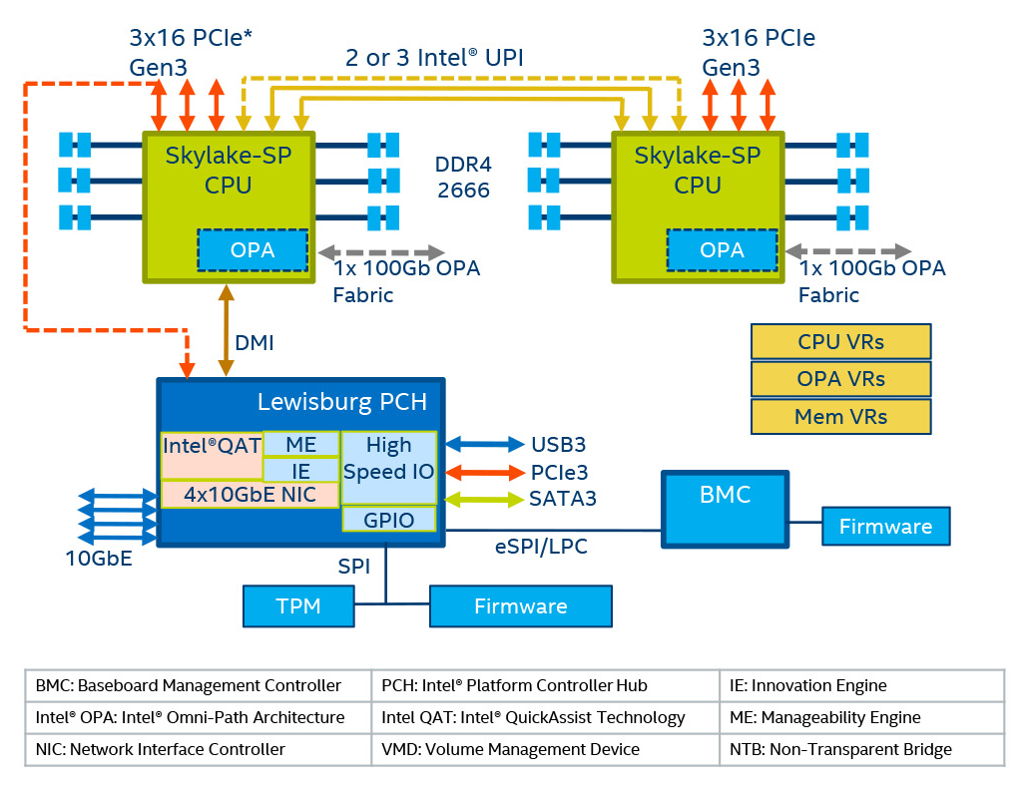
2.2.1 Overview of the scalable Purley platform (9)
Example: 2S server Skylake-SP configuration [88]
TPM: Trusted Platform Module

Slide 133
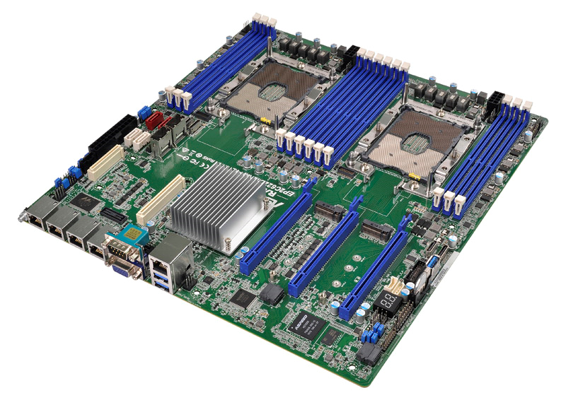
2.2.1 Overview of the scalable Purley platform (10)
Example: Mainboard of a 2S server based on Skylake-SP processors [89]

Slide 134
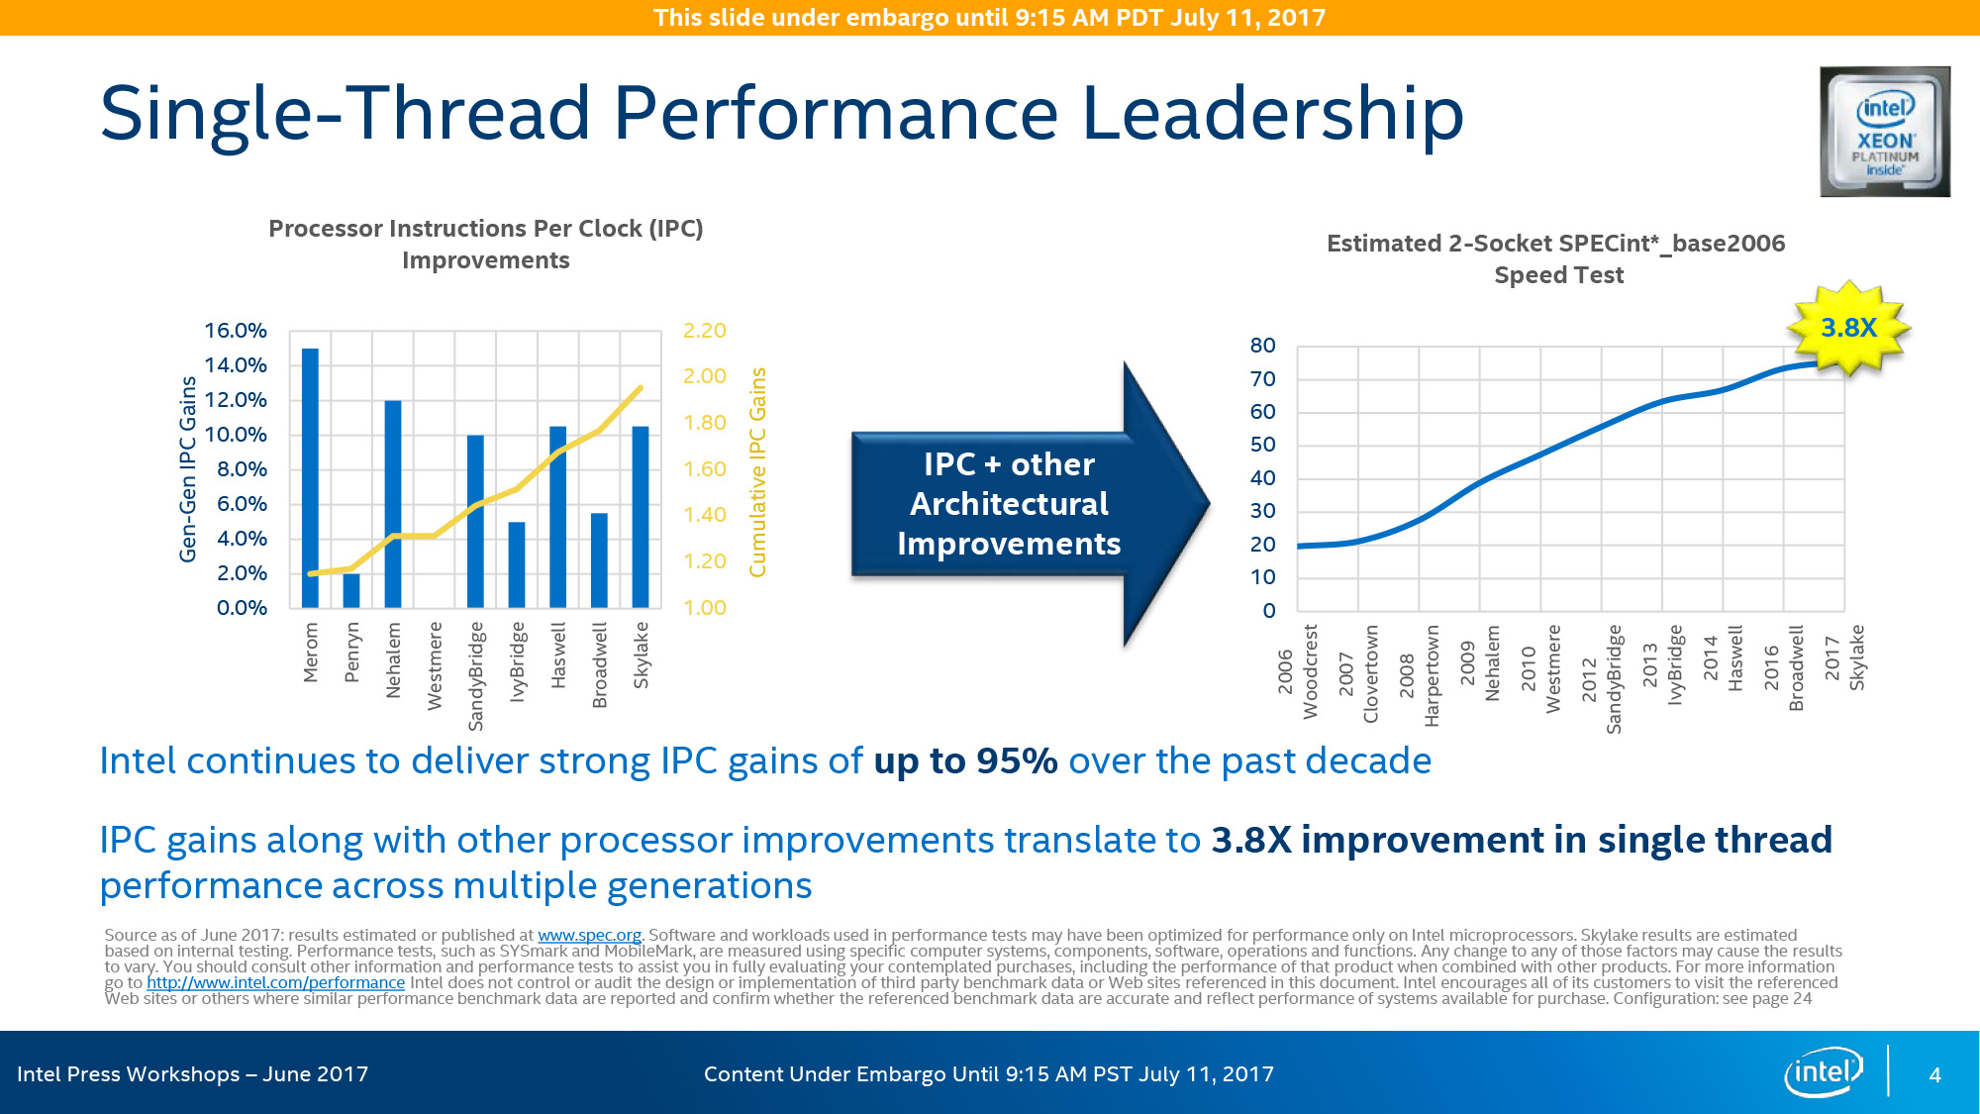
2.2.1 Overview of the scalable Purley platform (11)
IPC improvement in Intel's Core 2 family (Core 2 to Skylake) [90]
Core 2
(laptop)
Note that the new architectures of the Tock lines provide an IPC improvement of ≈ 10%.
*

Slide 135
2.2.1 Overview of the scalable Purley platform (12)
Single-thread performance improvement in Intel's 2S servers [90]
Core 2

Slide 136
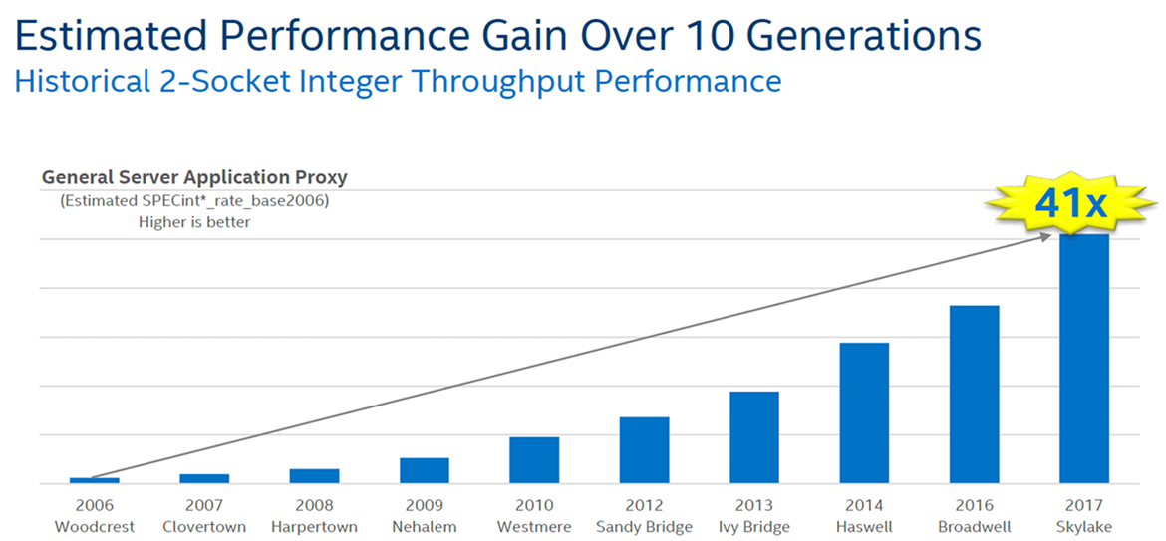
2.2.1 Overview of the scalable Purley platform (13)
Multi-thread integer performance (throughput) improvement in Intel's 2S server lines
[91]
Core 2
(server)

Slide 137
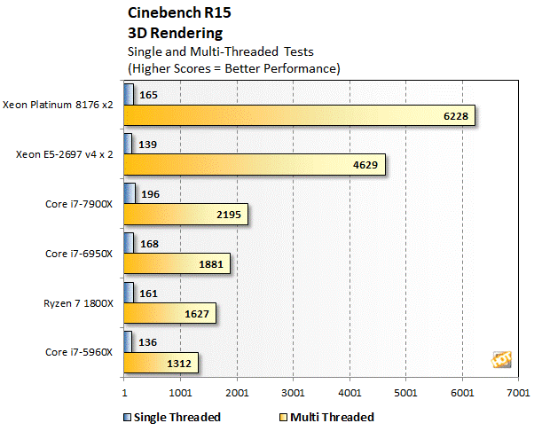
2.2.1 Overview of the scalable Purley platform (14)
Benchmark results published by Intel for running the Cinebench R35 benchmark [91]
28 cores
~8700 $
8 cores
~450 $

Slide 138
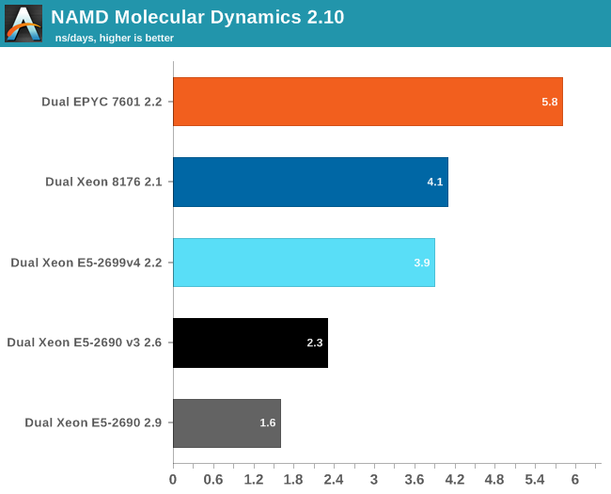
2.2.1 Overview of the scalable Purley platform (15)
Benchmark result published by AMD for running molecular dynamics [92]
32 cores
28 cores

Slide 139
2.2.2 The Skylake-SP (Xeon x1xx) processor line
Notes:
139

Slide 140
2.2.2 The Skylake-SP (Xeon x1xx processor line (1)
2.2.2 The Skylake-SP (Xeon x1xx) processor line
Model designations of the Skylake-SP processor line [93]
SKU: Stock Keeping Unit (Identification code in catalogues or stores)
*

Slide 141
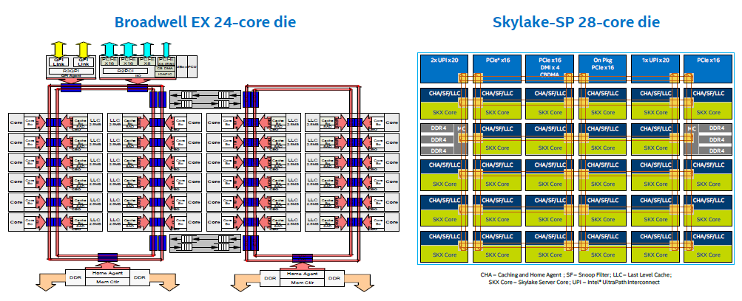
2.2.2 The Skylake-SP (Xeon x1xx processor line (2)
Up to 28 cores (up from 24 cores of the Broadwell line) [88]

Slide 142
2.2.2 The Skylake-SP (Xeon x1xx processor line (2)
Introducing 2D mesh interconnect instead of ring interconnect
Broadwell EX
up to 24 cores – Ring interconnect
Skylake-SP8
up to 28 cores – 2D mesh interconnect

Slide 143
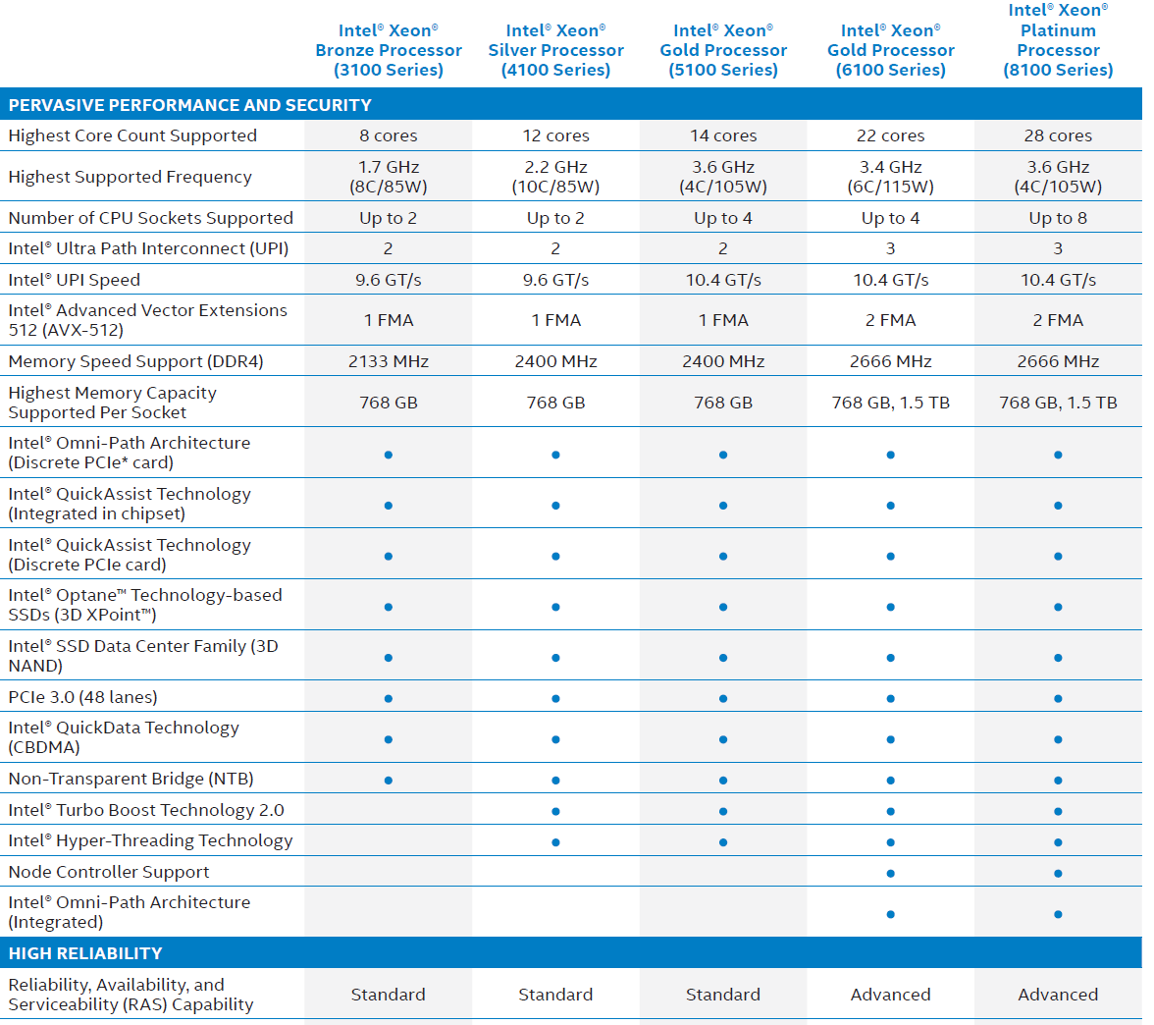
2.2.2 The Skylake-SP (Xeon x1xx processor line (3)
Main features of the Skylake-SP Platinum, Gold, Silver and Bronze series [94]

Slide 144
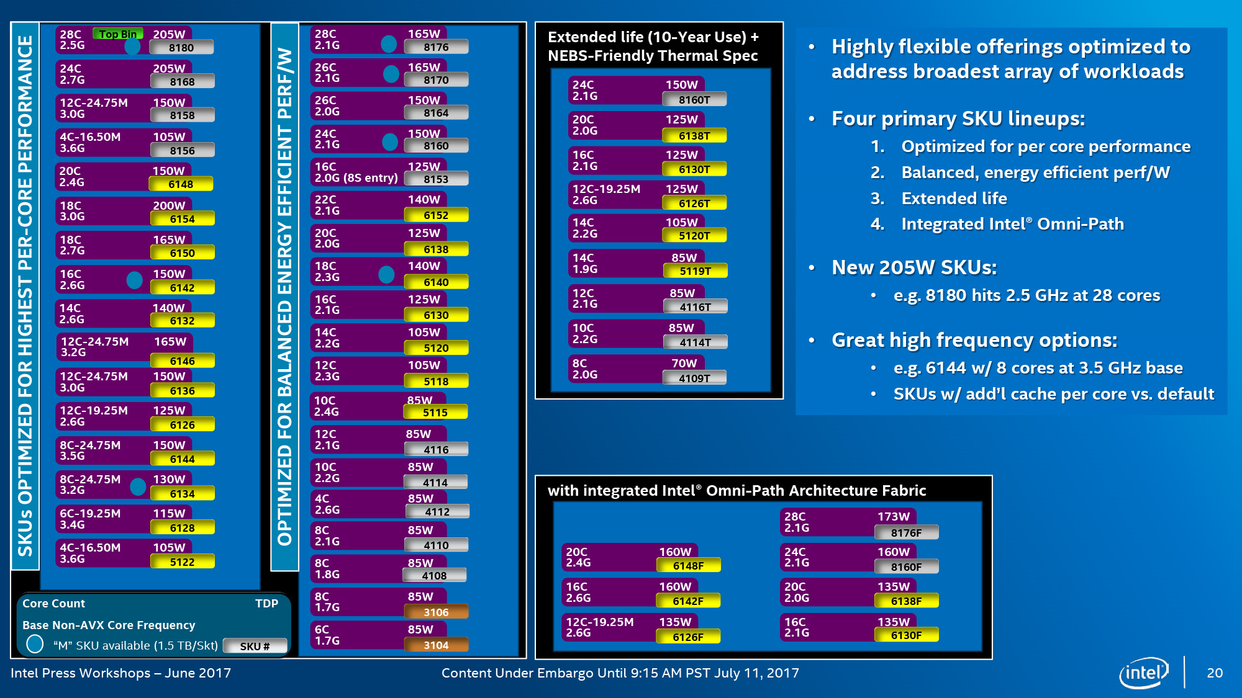
2.2.2 The Skylake-SP (Xeon x1xx processor line (4)
SKU line-ups
There are up to four lineups in all four series (Platinum, Gold, Silver, Bronze), as seen below [90].
(NEBS compliant)
NEBS compliant [150]:
NEBS (Network Equipment Building System) is a standard originating from Bell.
It consists of various engineering requirements deemed essential to the reliability, availability
and durability of equipment.

Slide 145
2.2.2 The Skylake-SP (Xeon x1xx processor line (5)
Skylake-SP series and line-ups [90]

Slide 146
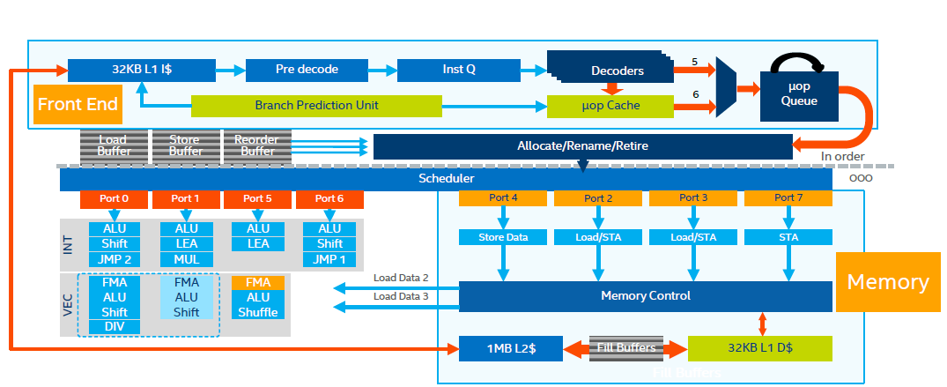
2.2.2 The Skylake-SP (Xeon x1xx processor line (6)
High-level overview of the microarchitecture of a Skylake-SP core [88]

Slide 147
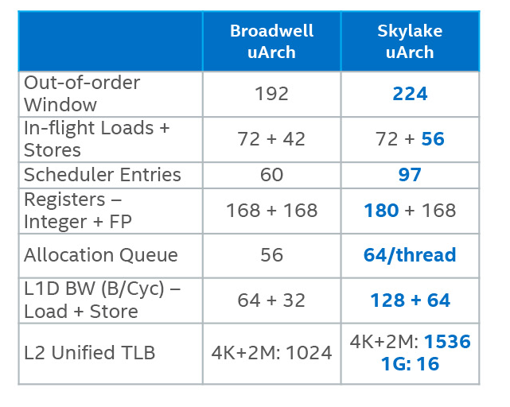
2.2.2 The Skylake-SP (Xeon x1xx processor line (7)
Quantitative improvements of the Skylake-SP microarchitecture vs. the previous one [88]
Out-of-order Window: ROB
TLB: Translation Lookaside Buffer

Slide 148
2.2.2 The Skylake-SP (Xeon x1xx processor line (8)
Positioning the Skylake microarchitectures among Intel’s 5th to 13th
generation microarchitectures (based on [66])
Node | Process (shrink) | New architecture | Optimizations
14 nm | 2014: Broadwell (5th gen.) | 2015: Skylake (6th gen.) | 2016: Kaby Lake mobile, DT (7th gen.) | 2017: Coffee Lake mobile, DT (8th gen.) | 2018: Coffee Lake Refresh DT (9th gen.) | 2019: Comet Lake mobile, DT (10th gen.) | 2021: Rocket Lake DT (11. gen. Cypress Cove) (backported)
10 nm | 2018: Cannon Lake mobile (8th gen. Palm Cove) | 2019: Ice Lake mobile (10th gen, Sunny Cove) +Lakefield mobile | 2020: Tiger Lake mobile (11th gen, Willow Cove) | 2021: Ice Lake-SP 2S server (Sunny Cove) | 2021: Alder Lake Mobile, DT (12th gen. Golden Cove)
7 nm | 2022: Meteor Lake (13th gen, Redwood Cove)
Remark
In the Figure we omitted Intel’s 8th gen. Amber Lake and Whiskey Lake mobile lines due to lack of space.
*

Slide 149
2.2.2 The Skylake-SP (Xeon x1xx processor line (9)
Remarks
The 2. gen. scalable Cascade Lake server processor is an optimization of the 1th gen. scalable
Skylake-SP server processor in a similar way as the 7. gen. Kaby Lake mobile/DT processor
is an optimization of the Skylake basic architecture.
*

Slide 150
2.2.3 The Cascade Lake-SP/AP (Xeon x2xx) processor lines
2.2.3.1 The Cascade Lake-SP line
2.2.3.2 The Cascade Lake-AP line
Notes:
150

Slide 151
2.2.3 The Cascade Lake-SP/AP (Xeon x2xx) processor lines (1)
Cascade Lake server product lines
Cascade Lake server product lines
Cascade Lake-SP line
Cascade Lake-AP line
Xeon-SP 82/62/52/42/32xx
(Platinum/Gold/Silver/Bronze)
Xeon-AP 92xx
(Platinum)
Up to 28 cores
Shipped in 04/2019
LGA3647
Up to 56 cores
Shipped in 04/2019
PGA5903 (to be soldered)
Section 2.2.3.1
Section 2.2.3.3
*

Slide 152
2.2.3.1 Introduction
Notes:
152

Slide 153
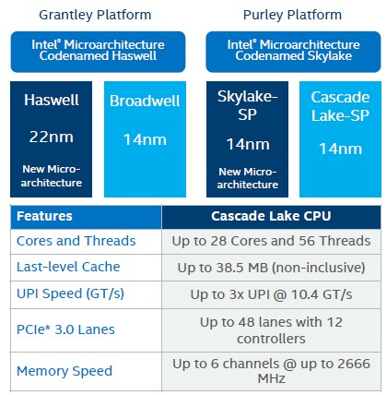
2.2.3.1 The Cascade Lake-SP line (1)
2.2.3.1 Introduction
The Cascade Lake lines are 2. gen. scalable server processor lines belonging to the Purley
platform, as seen below [111].
*

Slide 154
2.2.3.1 The Cascade Lake-SP line (2)
Intel’s Cascade Lake lines
Manufactured using the 14++ nm technology.
Announced in 11/2018, launched in 04/2019.
Same core counts, cache sizes and IO-speeds as in the first generation (Skylake-SP).
They are shipped in FCLGA-3647 packages, like Skylake-SP processors.
*

Slide 155
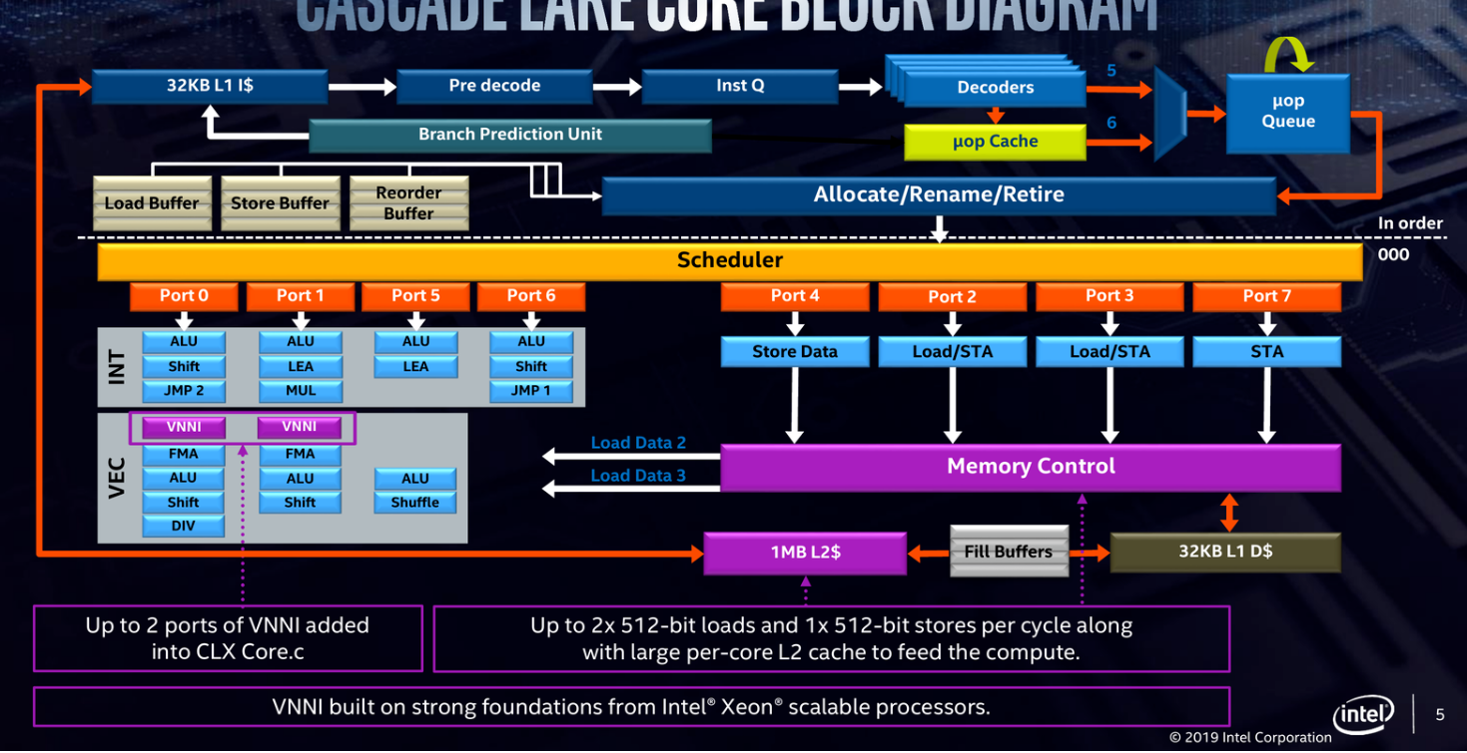
2.2.3.1 The Cascade Lake-SP line (3)
Improvements of the Cascade Lake core vs. the previous Skylake core [112]
Note that the Cascade Lake core is essentially the same as the Icelake core, nevertheless with
the enhancements indicated above (except the L2 cache as the Skylake has also 1 MB L2 cache)

Slide 156
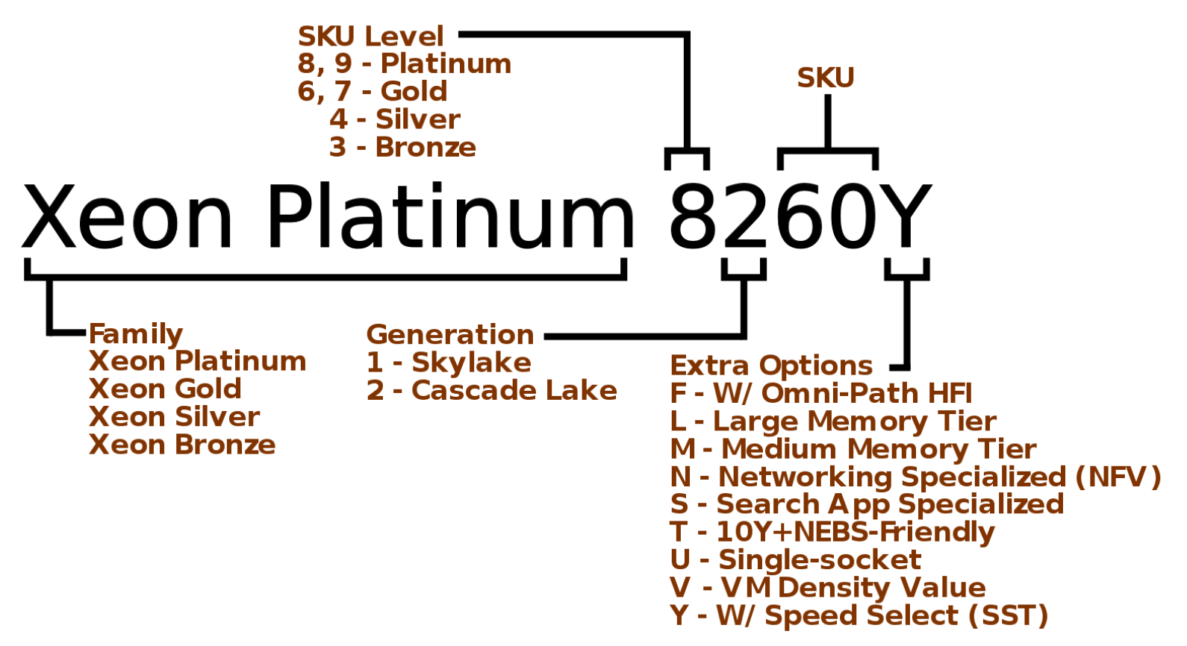
2.2.3.1 The Cascade Lake-SP line (4)
Model designation scheme of the Cascade Lake models [112]
Notes
Previous suffixes: only FMT
"L" suffix indicates a large memory (4.5 TiB) tier SKU
"M" suffix indicates a medium memory (2 TiB) tier SKU
"T" suffix indicates extended lifetime (10 year use) guarantees and NEBS-friendly packaging
specification
"Y" suffix indicates Speed Select Technology (SST)

Slide 157
2.2.3.1 The Cascade Lake-SP line (5)
Typical 2S platform configuration with Cascade Lake-SP processors [117]

Slide 158
2.2.3.1 The Cascade Lake-SP line (6)
Typical 4S crossbar platform configuration with Cascade Lake-SP processors [117]

Slide 159
2.2.3.1 The Cascade Lake-SP line (7)
Typical 4S platform configuration with Cascade Lake-SP processors [117]

Slide 160
2.2.3.1 The Cascade Lake-SP line (8)
Typical 8S platform configuration with Cascade Lake-SP processors [117]

Slide 161
2.2.3.1 The Cascade Lake-SP line (9)
Key improvements of the 14 nm Cascade Lake line
the VNNI (Vector Neural Network Instruction) ISA extension for supporting DL (Deep Learning)
the Optane persistent memory and
security mitigations,
not discussed in this Lecture.

Slide 162
2.2.3.2 The Cascade Lake-AP line
Notes:
162

Slide 163
2.2.3.2 The Cascade Lake-AP line (1)
2.2.3.2 The Cascade Lake-AP line
AP means Advanced Processor.
These processors have the model designations: Platinum 92xx.
The Cascade Lake-AP is manufactured on 14++ nm technology, and is an MCM design
including two dies, each with up to 28 cores.
Accordingly, the Cascade Lake-AP line has up to 56 cores and is targeting
demanding high-performance computing (HPC),
artificial intelligence (AI/DL) and
infrastructure-as-a-service (IaaS)
workloads.
Cascade Lake-AP processors are packaged in surface mounted BGA 5903 (Ball Grid Array)
packages, i.e. the sockets need to be soldered.
Note that Intel does not sell Cascade Lake-AP chips to OEMs. instead they are selling complete
boards with two BGA packages on it.
A roadmap from 08/2018 shows a shipping date of 2018 but subsequently, the final shipping
date slipped to 04/2019.
*

Slide 164
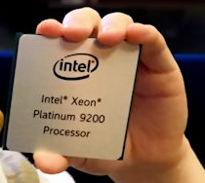
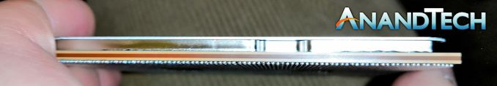
2.2.3.2 The Cascade Lake-AP line (2)
Physical implementation of the Cascade Lake-AP processor [114]
BGA 5903 package
Package size: 76.0 mm x 72.5 mm.
By contrast the Pentium Pro measures 67.6 x 62.5 mm or AMD’s EPYC: 75.4 x 58.5 mm.

Slide 165
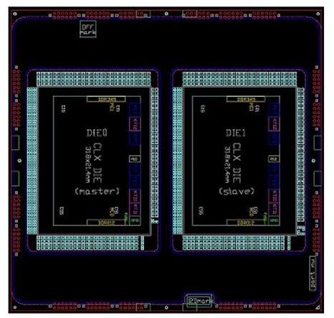
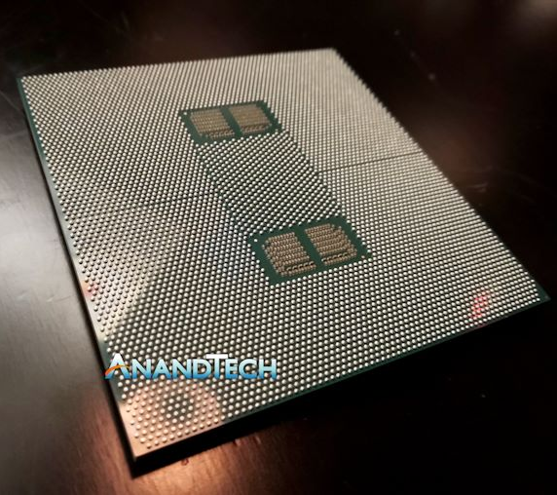
2.2.3.2 the Cascade Lake-AP line (3)
Top and bottom view of the Cascade Lake-AP package [114]
Top view: master and slave dies
Bottom view: BGA 5903 contacts

Slide 166
2.2.3.2 The Cascade Lake-AP line (4)
Contrasting key features of the Cascade Lake-SP/AP and Skylake-SP lines [115]
Intel Xeon Scalable
2nd Gen Cascade Lake |  | 1st Gen Skylake-SP
April 2019 | Released | July 2017
SP line: [8200] Up to 28 AP line: [9200] Up to 56 | Cores | [8100] Up to 28
1 MB L2 per core Up to 38.5 MB Shared L3 | Cache | 1 MB L2 per core Up to 38.5 MB Shared L3
Up to 48 Lanes | PCIe 3.0 | Up to 48 Lanes
Six Channels Up to DDR4-2933 1.5 TB Standard | DRAM Support | Six Channels Up to DDR4-2666 768 GB Standard
Up to 4.5 TB Per Processor | Optane Support | -
AVX-512 VNNI with INT8 | Vector Compute | AVX-512
Variant 2, 3, 3a, 4, and L1TF | Spectre/Meltdown Fixes | -
[8200] Up to 205 W [9200] Up to 400 W | TDP | Up to 205 W

Slide 167
2.2.3.2 The Cascade Lake-AP line (5)
Introduced Cascade Lake-AP models [115]
Intel Xeon Platinum 9200 Family (Cascade Lake AP)
AnandTech | Cores | Base Freq | Turbo Freq | L3 Cache | TDP | Price
Platinum 9282 | 56 C / 112 T | 2.6 GHz | 3.8 GHz | 77.0 MB | 400 W | 20530 $
Platinum 9242 | 48 C / 96 T | 2.3 GHz | 3.8 GHz | 71.5 MB | 350 W | 15493 $
Platinum 9222 | 32 C / 64 T | 2.3 GHz | 3.7 GHz | 71.5 MB | 250 W | 10280 $
Platinum 9221 | 32 C / 64 T | 2.1 GHz | 3.7 GHz | 71.5 MB | 250 W | 9342 $

Slide 168
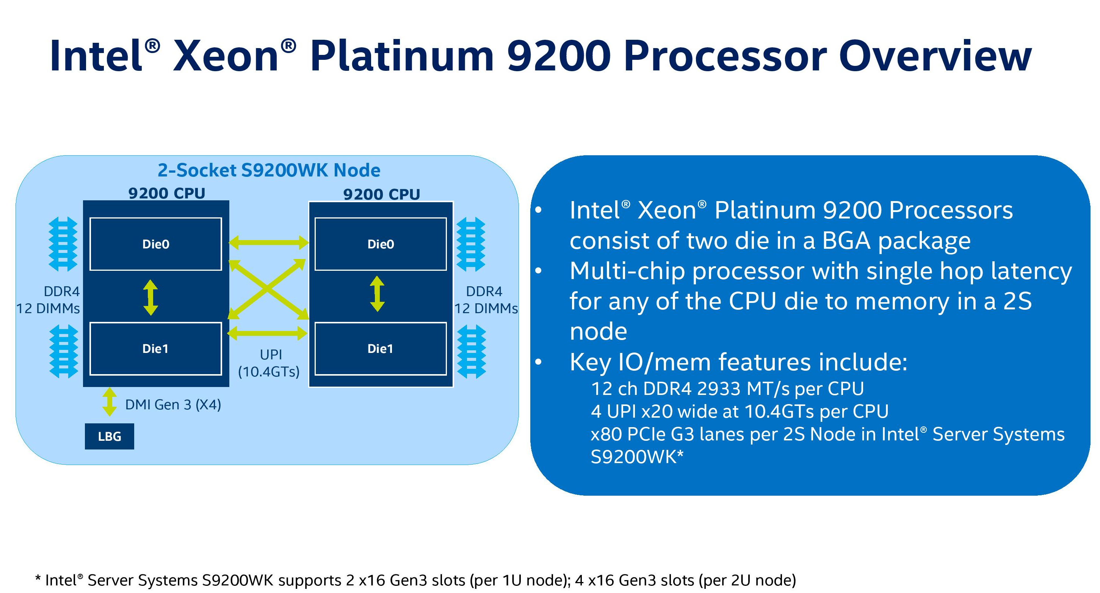
2.2.3.2 The Cascade Lake-AP line (6)
Use of a two socket Cascade Lake-AP node as a 4-processor server [115]
LBG: Lewisburg
*

Slide 169
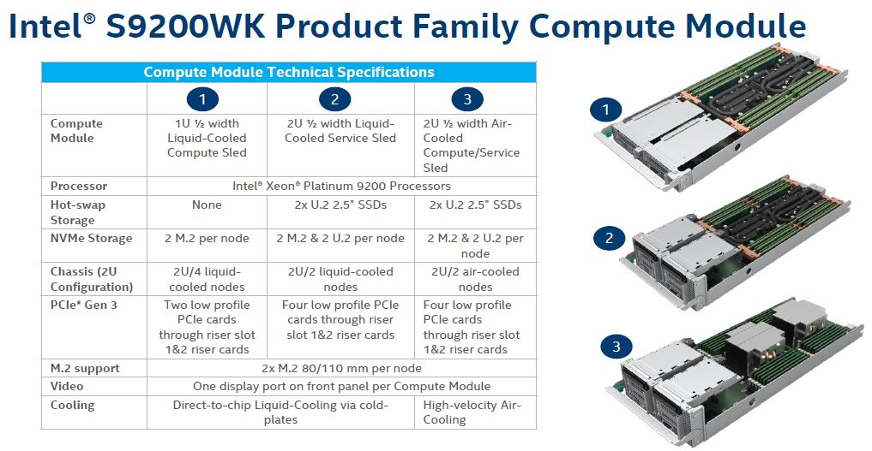
2.2.3.2 The Cascade Lake-AP line (7)
Intel’s S9200WK Compute Modules product family with dual Cascade Lake-AP
processors [114]

Slide 170
2.3 The scalable Whitley platform with 10 nm Ice Lake server processors
2.3.1 Overview of the scalable Whitley platform
2.3.2 The Ice Lake (Xeon x3xx) processor line
Notes:
170

Slide 171
2.3.1 Overview of the scalable Whitley platform (1)
2.3 The scalable Whitley server platform with the 10 nm Ice Lake processors -2
High-performance
Purley 2S platform with
Skylake-SP/Cascade Lake
Platinum server processors
Whitley Platinum
2S platform with
Ice Lake Platinum
server processors
Intel’s 2S scalable platforms
(2017/2019)
(2021)
(Section 2.2)
(Section 2.3)
Efficient Performance/Mainstream
Purley 2S platform with
Skylake-SP/Cascade Lake
Gold server processors
Whitley Platinum
2S platform with
Ice Lake Gold
server processors
(2017/2019)
(2021)
(Section 2.2)
(Section 2.3)
Entry-level
Purley 2S platform with
Skylake-SP/Cascad Lake
Silver/Bronze server processors
Whitley Platinum
2S platform with
Ice Lake Silver
server processors
(2017/2019)
(2021)
(Section 2.2)
(Section 2.3)

Slide 172
2.3.1 Overview of the scalable Whitley platform
Notes:
172

Slide 173
2.3.1 Overview of the scalable Whitley platform (2)
2.3.1 Overview of the scalable Whitley platform -2
First details presented in the Hot Chips conference in 08/2020.
Launched in 04/2021.
Based on the 10 nm Ice Lake-SP server processors.
Intel designates their Whitley 1S/2S platform with Ice Lake processors as their 3.-gen.
Xeon scalable platform, nevertheless, they call their 4S/8S Cedar Island server platform
with Cooper Lake processors also as the 3. gen. Xeon scalable platform, as seen in the
next Figure.
*

Slide 174
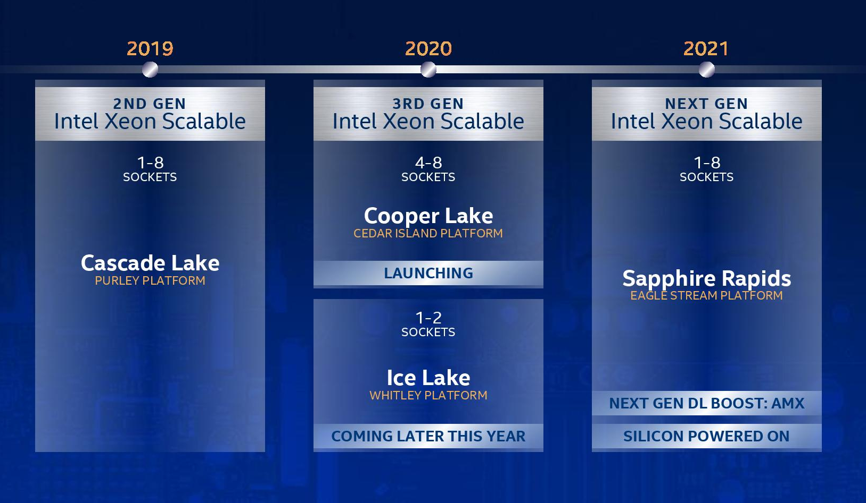
2.3.1 Overview of the scalable Whitley platform (3)
Roadmap of Intel’s Xeon Scalable server lines from 2020 [65]

Slide 175
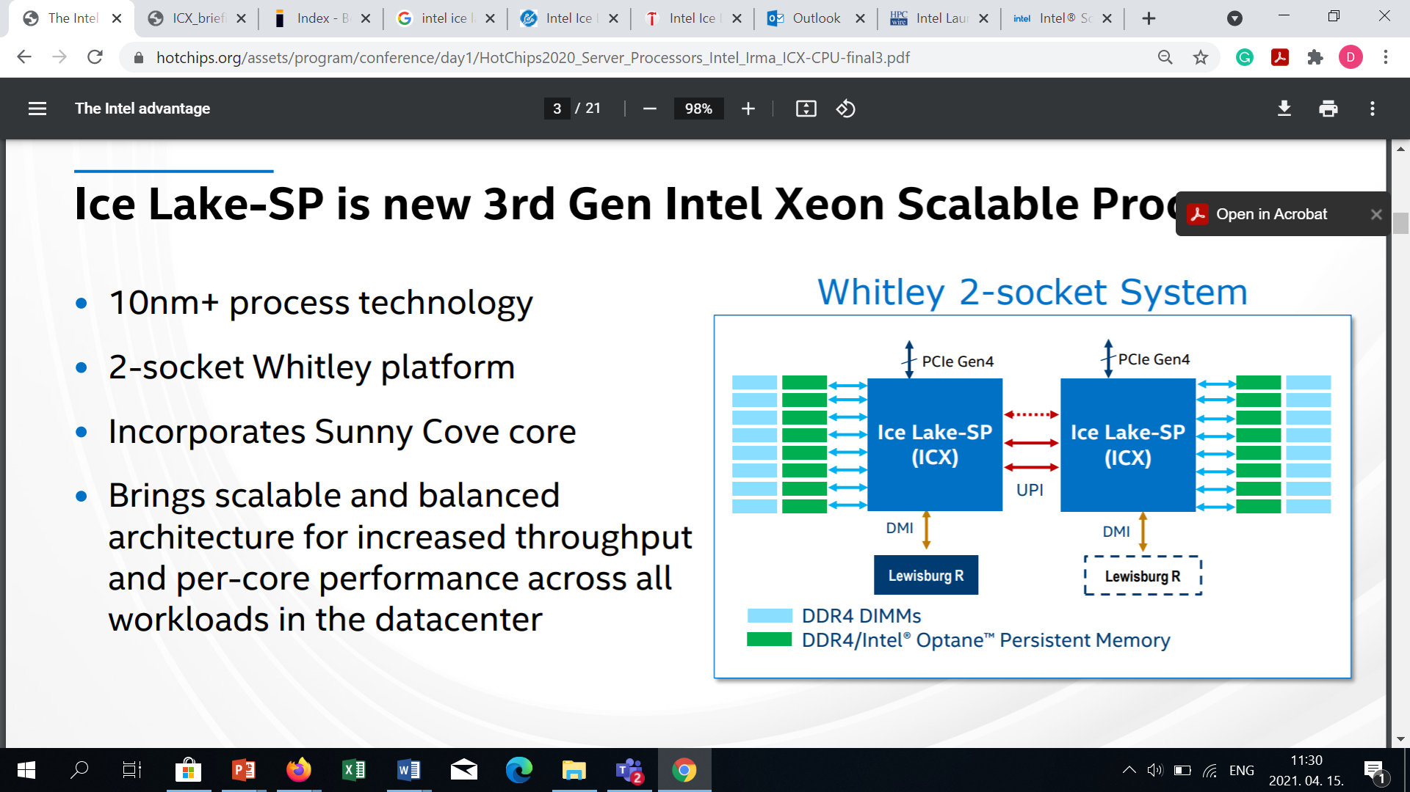
2.3.1 Overview of the scalable Whitley platform (4)
The 2S Whitley platform with Ice Lake-SP processors [62]
Note that Ice Lake-SP has 8 DDR4 memory channels whereas processors of the previous
Purley platform (Sky Lake-SP/ Cascade Lake-SP) only 6, to support up to 40 cores vs. 28.

Slide 176
2.3.2 The Ice Lake (Xeon x3xx) processor line
Notes:
176

Slide 177
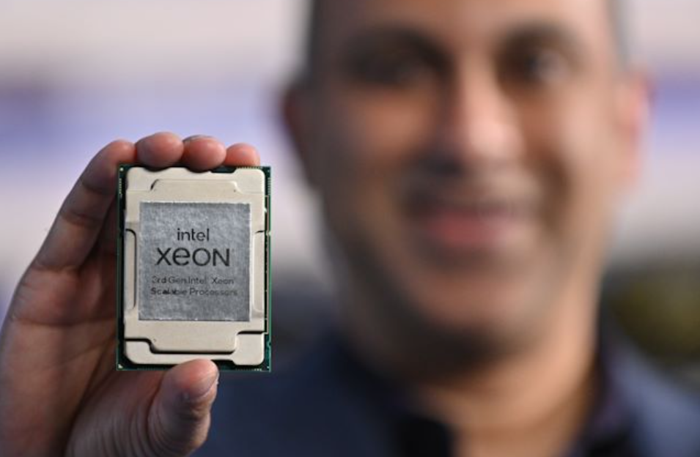
2.3.2 The Ice Lake (Xeon x3xx) processor line (1)
2.3.2 The Ice Lake (Xeon x3xx) processor line [63] -1

Slide 178
2.3.2 The Ice Lake (Xeon x3xx) processor line (2)
The Ice Lake (Xeon x3xx) processor line [63] -2
It is built upon the 10 nm process rather than on the previous 14 nm technology with
Sunny Cove cores, as indicated in the next Figure.
*

Slide 179
2.3.2 The Ice Lake (Xeon x3xx) processor line (3)
Positioning of the Ice Lake server processor and its Sunny Cove core among Intel’s
5th to 13th generation processors (based on [66])
Node | Process (shrink) | New architecture | Optimizations
14 nm | 2014: Broadwell (5th gen.) | 2015: Skylake (6th gen.) | 2016: Kaby Lake mobile, DT (7th gen.) | 2017: Coffee Lake mobile, DT (8th gen.) | 2018: Coffee Lake Refresh DT (9th gen.) | 2019: Comet Lake mobile, DT (10th gen.) | 2021: Rocket Lake DT (11. gen. Cypress Cove) (backported)
10 nm | 2018: Cannon Lake mobile (8th gen. Palm Cove) | 2019: Ice Lake mobile (10th gen, Sunny Cove) +Lakefield mobile | 2020: Tiger Lake mobile (11th gen, Willow Cove) | 2021: Ice Lake-SP 2S server (Sunny Cove) | 2021: Alder Lake Mobile, DT (12th gen. Golden Cove)
7 nm | 2022: Meteor Lake (13th gen, Redwood Cove)
Remark
In the Figure we omitted Intel’s 8th gen. Amber Lake and Whiskey Lake mobile lines due to lack of space.
*

Slide 180
2.3.2 The Ice Lake (Xeon x3xx) processor line (4)
The Sunny Cove core
The Sunny Cove core has already been used in the Ice Lake client processor and also in the
Lake Field big-little MCM processor, as seen in the above Figure.
The server variant has larger L2 (ML$) caches (1.25 MB vs. 0.5 MB)
*

Slide 181
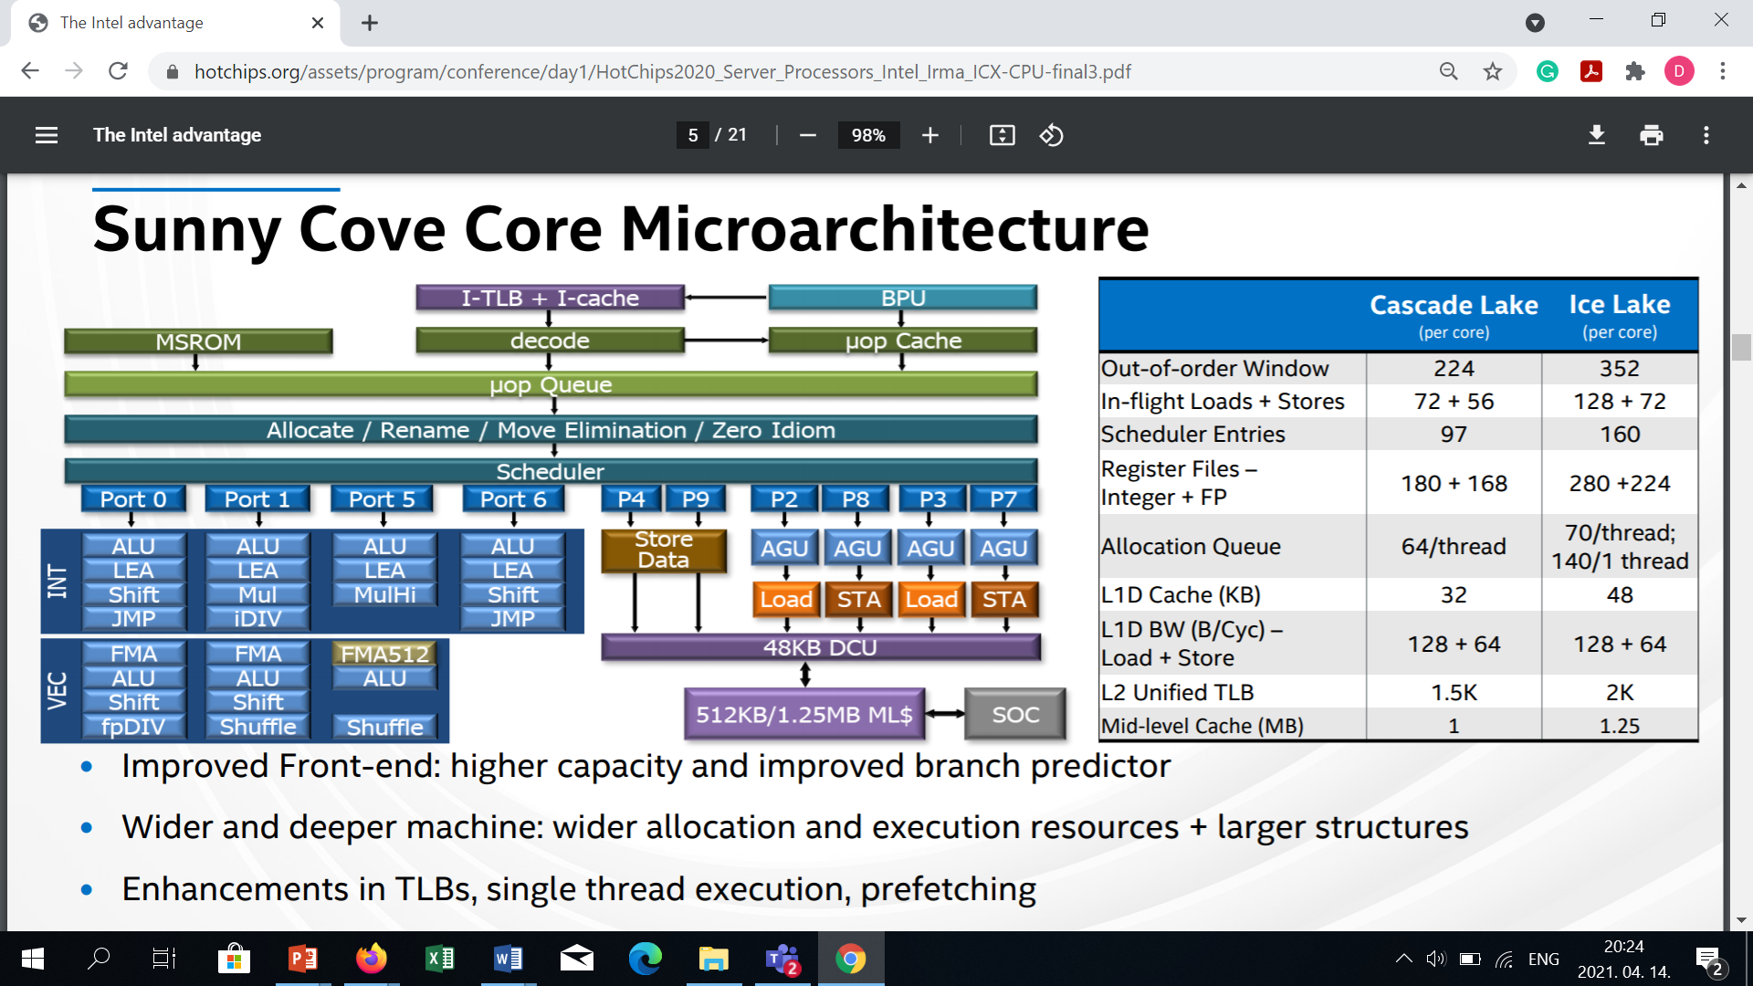
2.3.2 The Ice Lake (Xeon x3xx) processor line (5)
Microarchitecture of the Sunny Cove core (mobile/server)
Front-end
(Microcode Sequencer ROM)
Back-end
ML $ (Middle Level $) = L2 $: 512 KB in the Ice Lake mobile and 1.25 MB in the Ice Lake-SP server
processor (whereas Cascade Lake processors have 1 MB L2 caches).
DCU (Data Cache Unit) = L1D $
Clearing idiom: A kind of code optimization for clearing register contents

Slide 182
2.3.2 The Ice Lake (Xeon x3xx) processor line (6)
Enhancing core features vs. the previous Cascade Lake-SP processor [62]

Slide 183
2.3.2 The Ice Lake (Xeon x3xx) processor line (24)
Key features of Xeon Platinum 83xx series of the Ice Lake-SP line [63]
AnandTech |  | Cores w/HT | Base Freq | 1T Freq | nT Freq | L3 MB | TDP W | SGX GB | RCP 1ku | Optane DC
8380 |  | 40 | 2300 | 3400 | 3000 | 60 | 270 | 512 | $8099 | Yes
8368 | Q | 38 | 2600 | 3700 | 3300 | 57 | 270 | 512 | $6743 | Yes
8368 |  | 38 | 2400 | 3400 | 3200 | 57 | 270 | 512 | $6302 | Yes
8362 |  | 32 | 2800 | 3600 | 3500 | 48 | 265 | 64 | $5488 | Yes
8360 | Y | 36 | 2400 | 3500 | 3100 | 54 | 250 | 64 | $4702 | Yes
8358 | P | 32 | 2600 | 3400 | 3200 | 48 | 240 | 8 | $3950 | Yes
8358 |  | 32 | 2600 | 3400 | 3300 | 48 | 250 | 64 | $3950 | Yes
8352 | Y | 32 | 2200 | 3400 | 2800 | 48 | 205 | 64 | $3450 | Yes
8352 | V | 36 | 2100 | 3500 | 2500 | 54 | 195 | 8 | $3450 | Yes
8352 | S | 32 | 2200 | 3400 | 2800 | 48 | 205 | 512 | $4046 | Yes
8352 | M | 32 | 2300 | 3500 | 2800 | 48 | 185 | 64 | $3864 | Yes
8351 | N | 36 | 2400 | 3500 | 3100 | 54 | 225 | 64 | $3027 | Yes
Q = Liquid Cooled SKU
Y = Supports Intel SST-PP 2.0
Speed Selection Performance Profile
P = IaaS Cloud Specialised Processor
V = SaaS Cloud Specialised Processor
SGX: Software Guard Extensions (hardware-based memory encryption that isolates code and data in memory)
N = Networking/NFV Optimized
M = Media Processing Optimized
S = 512 GB SGX Enclave per CPU Guaranteed
RCP: Recommended Customer Price

Slide 184
2.3.2 The Ice Lake (Xeon x3xx) processor line (25)
Key features of Xeon Gold 63xx series of the Ice Lake-SP line [63]
 |  | Cores w/HT | Base Freq | 1T Freq | nT Freq | L3 MB | TDP W | SGX GB | RCP 1ku | Optane DC
6354 |  | 18 | 3000 | 3600 | 3600 | 39 | 205 | 64 | $2445 | Yes
6348 |  | 28 | 2600 | 3500 | 3400 | 42 | 235 | 64 | $3072 | Yes
6346 |  | 16 | 3100 | 3600 | 3600 | 36 | 205 | 64 | $2300 | Yes
6342 |  | 24 | 2800 | 3500 | 3300 | 36 | 230 | 64 | $2529 | Yes
6338 | T | 24 | 2100 | 3400 | 2700 | 36 | 165 | 64 | $2742 | Yes
6338 | N | 32 | 2200 | 3500 | 2700 | 48 | 185 | 64 | $2795 | Yes
6338 |  | 32 | 2000 | 3200 | 2600 | 48 | 205 | 64 | $2612 | Yes
6336 | Y | 24 | 2400 | 3600 | 3000 | 36 | 185 | 64 | $1977 | Yes
6334 |  | 8 | 3600 | 3700 | 3600 | 18 | 165 | 64 | $2214 | Yes
6330 | N | 28 | 2200 | 3400 | 2600 | 42 | 165 | 64 | $2029 | Yes
6330 |  | 28 | 2000 | 3100 | 2600 | 42 | 205 | 64 | $1894 | Yes
6326 |  | 16 | 2900 | 3500 | 3300 | 24 | 185 | 64 | $1300 | Yes
6314 | U | 32 | 2300 | 3400 | 2900 | 48 | 205 | 64 | $2600 | Yes
6312 | U | 24 | 2400 | 3600 | 3100 | 36 | 185 | 64 | $1450 | Yes
T = Long-Life and Extended Thermal Support
Y = Supports Intel SST-PP 2.0 (PP:Performance Profile)
N = Networking/NFV Optimized
U = Uniprocessor (1P Only)

Slide 185
2.3.2 The Ice Lake (Xeon x3xx) processor line (26)
Key features of the Xeon Gold 53xx and Silver 43xx series of the Ice Lake-SP line [63]
AnandTech |  | Cores w/HT | Base Freq | 1T Freq | nT Freq | L3 MB | TDP W | SGX GB | RCP 1ku | Optane DC
Xeon Gold 53xx series
5320 | T | 20 | 2300 | 3500 | 2900 | 30 | 150 | 64 | $1727 | Yes
5320 |  | 26 | 2200 | 3400 | 2800 | 39 | 185 | 64 | $1555 | Yes
5318 | Y | 24 | 2100 | 3400 | 2600 | 36 | 165 | 64 | $1273 | Yes
5318 | S | 24 | 2100 | 3400 | 2600 | 36 | 165 | 512 | $1667 | Yes
5318 | N | 24 | 2100 | 3400 | 2700 | 36 | 150 | 64 | $1375 | Yes
5317 |  | 12 | 3000 | 3600 | 3400 | 18 | 150 | 64 | $950 | Yes
5315 | Y | 8 | 3200 | 3600 | 3500 | 12 | 140 | 64 | $895 | Yes
Xeon Silver 43xx series
4316 |  | 20 | 2300 | 3400 | 2800 | 30 | 150 | 8 | $1002
4314 |  | 16 | 2400 | 3400 | 2900 | 24 | 135 | 8 | $694 | Yes
4310 | T | 10 | 2300 | 3400 | 2900 | 15 | 105 | 8 | $555
4310 |  | 12 | 2100 | 3300 | 2700 | 18 | 120 | 8 | $501
4309 | Y | 8 | 2800 | 3600 | 3400 | 12 | 105 | 8 | $501
Y = Supports Intel SST-PP 2.0
V = SaaS Cloud Specialised Processor
N = Networking/NFV Optimized
T = Long-Life and Extended Thermal Support
S = 512 GB SGX Enclave per CPU Guaranteed

Slide 186
2.3.2 The Ice Lake (Xeon x3xx) processor line (27)
Comparing x86 and ARM ISA-based 2S server processors [63]
Top-of-Stack Competition
 | EPYC 7003 | Amazon Graviton2 | Ampere Altra | Intel Xeon
Platform | Milan | Graviton2 | QuickSilver | Ice Lake
Processor | 7763 | Graviton2 | Q80-33 | 8380
uArch | Zen 3 | N1 | N1 | Sunny Cove
Cores | 64 | 64 | 80 | 40
TDP | 280 W | ? | 250 W | 270 W
Base Freq | 2450 | 2500 | 3300 | 2300
Turbo Freq | 3500 | 2500 | 3300 | 3400
All-Core | ~3200 | 2500 | 3300 | 3000
L3 Cache | 256 MB | 32 MB | 32 MB | 60 MB
PCIe | 4.0 x128 | ? | 4.0 x128 | 4.0 x64
Chipset | On CPU | ? | On CPU | External
DDR4 | 8 x 3200 | 8 x 3200 | 8 x 3200 | 8 x 3200
DRAM Cap | 4 TB | ? | 4 TB | 4 TB
Optane | No | No | No | Yes
Price | $7890 | N/A | $4050 | $8099

Slide 187
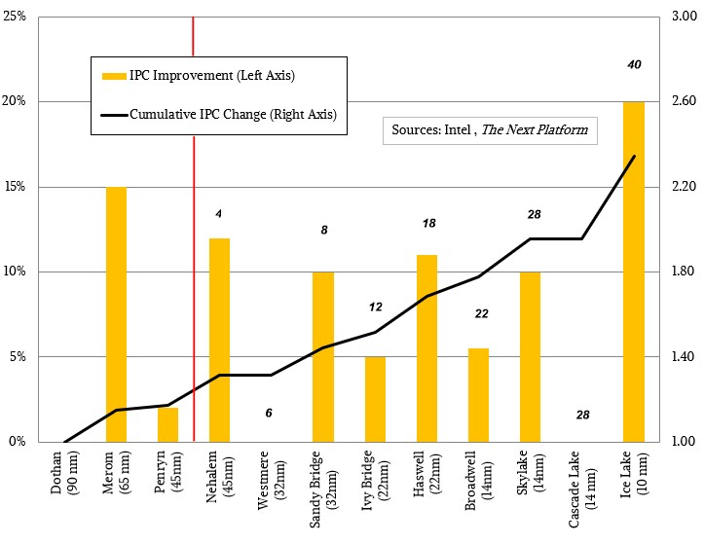
2.3.2 The Ice Lake (Xeon x3xx) processor line (28)
IPC improvements of Intel’s processors from the Pentium M (Dothan) to the Ice Lake [70]
The reference processor is Intel’s Pentium M (codename Dothan) processor (2003)
(Pentium M
(2004))
(Core 2
(2006))
*

Slide 188
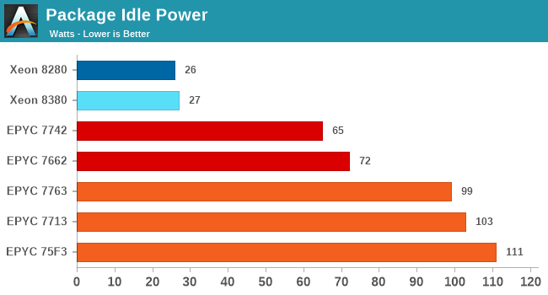
2.3.2 The Ice Lake (Xeon x3xx) processor line (29)
Package idle power [63]

Slide 189
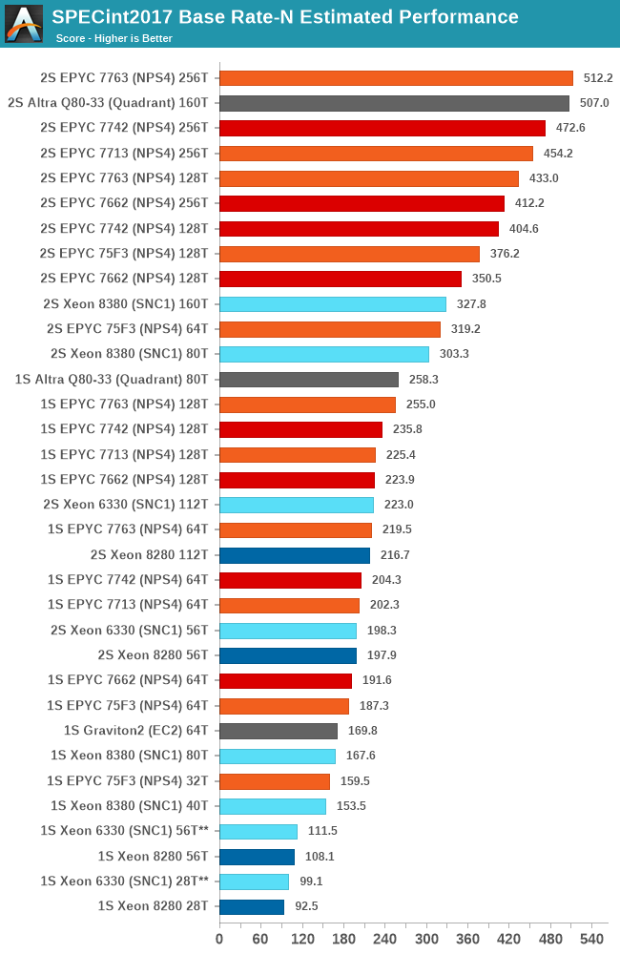
2.3.2 The Ice Lake (Xeon x3xx) processor line (30)
SPECint 2017 Base Rate N results of server processors [63]
NPS: NUMA domains per socket
(for tuning)
NPS!: CPU is partitioned
into 4 NUMA domains,
Memory is interleaved
over tű2 mem. channels
in each quadrant.
SNC1: One NUMA node
*

Slide 190
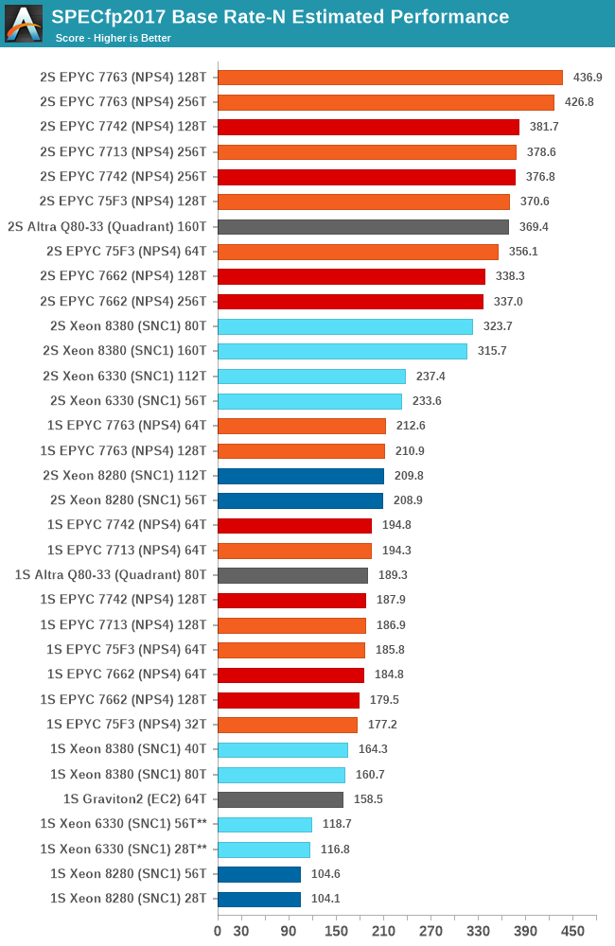
2.3.2 The Ice Lake (Xeon x3xx) processor line (31)
SPECfp 2017 Base Rate N results of server processors [63]
*

Slide 191
3. References
Notes:
191

Slide 192
3. References (1)
[1]: Radhakrisnan S., Sundaram C. and Cheng K., „The Blackford Northbridge Chipset for the
Intel 5000”, IEEE Micro, March/April 2007, pp. 22-33
[2]: Supermicro Motherboards, Super X7DB8+, Super X7DBE+, User’s Manual, Rev. 1.1a, 2006,
http://www.supermicro.com/manuals/motherboard/5000P/MNL-0830.pdf
[3]: Goto H., IDF 2007 Spring, PC Watch, April 26 2007,
http://pc.watch.impress.co.jp/docs/2007/0426/hot481.htm
[4]: Bryant D., “Intel Hitting on All Cylinders,” UBS Conf., Nov. 2007,
http://files.shareholder.com/downloads/INTC/0x0x191011/e2b3bcc5-0a37-4d06-
aa5a-0c46e8a1a76d/UBSConfNov2007Bryant.pdf
[5]: Goto H., IDF, Aug. 26 2005,
http://pc.watch.impress.co.jp/docs/2005/0826/kaigai207.htm
[6]: TechChannel, http://www.tecchannel.de/_misc/img/detail1000.cfm?pk=342850&
fk=432919&id=il-74145482909021379
[7]: Intel quadcore Xeon 5300 review, Nov. 13 2006, Hardware.Info,
http://www.hardware.info/en-US/articles/amdnY2ppZGWa/Intel_quadcore_Xeon_
5300_review
[8]: Wasson S., Intel's Woodcrest processor previewed, The Bensley server platform debuts,
May 23, 2006, The Tech Report,
http://techreport.com/articles.x/10021/1

Slide 193
3. References (2)
[9]: Kottapalli S., Baxter J., “Nehalem-EX CPU Architecture”, Hot Chips 21, 2009,
http://www.hotchips.org/archives/hc21/2_mon/HC21.24.100.ServerSystemsI-Epub/
HC21.24.122-Kottapalli-Intel-NHM-EX.pdf
[10]: Tempest i5000VF S5370, 2-way Intel Dempsey/Woodcrest CPU Bensley Server Platform,
http://www.tyan.com/tempest/training/s5370.pdf
[11]: Intel 5520 Chipset and Intel 5500 Chipset, Datasheet, March 2009,
http://www.intel.com/content/www/us/en/chipsets/5520-5500-chipset-ioh-datasheet.html
[12]: Neiger G., Santoni A., Leung F., Rodgers D., Uhlig R., Intel® Virtualization Technology:
Hardware support for efficient processor virtualization, Aug. 10 2006, Vol. 10, Issue 3,
http://www.intel.com/technology/itj/2006/v10i3/1-hardware/1-abstract.htm
[13]: Intel Software Networks: Forums,
http://software.intel.com/en-us/forums/showthread.php?t=56802
[14]: Wikipedia: x86 virtualization, 2011,
http://en.wikipedia.org/wiki/X86_virtualization#Intel_virtualization_.28VT-x.29
[15]: Sharma D. D., Intel 5520 Chipset: An I/O Hub Chipset for Server, Workstation, and High
End Desktop, Hotchips 2009, http://www.hotchips.org/archives/hc21/2_mon/
HC21.24.200.I-O-Epub/HC21.24.230.DasSharma-Intel-5520-Chipset.pdf
[16]: Morgan T. P., Intel's future Sandy Bridge Xeons exposed, May 30 2011, The Register,
http://www.theregister.co.uk/2011/05/30/intel_sandy_bridge_xeon_platforms/page2.html

Slide 194
3. References (3)
[17]: Nagaraj D., Kottapalli S., Westmere-EX: A 20 thread server CPU, Hot Chips 2010
http://www.hotchips.org/uploads/archive22/HC22.24.610-Nagara-Intel-6-Westmere-EX.pdf
[18]: Intel Xeon Processor E7-8800/4800/2800 Product Families, Datasheet Vol. 1 of 2,
April 2011, http://www.intel.com/Assets/PDF/datasheet/325119.pdf
[19]: Intel Xeon Processor 7500/6500 Series, Public Gold Presentation, March 30 2010,
http://cache-www.intel.com/cd/00/00/44/64/446456_446456.pdf
[20]: Jafarjead B., “Intel Core Duo Processor,” Intel, 2006,
http://masih0111.persiangig.com/document/peresentation/behrooz%20jafarnejad.ppt
[21]: Sommefeldt R., Intel Xeon 3.4GHz ['Nocona' core], Hexus, Aug. 18 2004,
http://www.hexus.net/content/item.php?item=822&page=1&search=reas
[22]: 3.6GHz 2MB 800MHz Intel Xeon Processor SL7ZC C8511, http://store.flagshiptech.com/
products/3.6GHz-2MB-800MHz-Intel-Xeon-Processor-SL7ZC-C8511.html
[23]: Gavrichenkov I., Workstation Processors Duel: AMD Opteron against Intel Xeon, Page 5,
Xbit Labs, Dec. 21 2005,
http://www.xbitlabs.com/articles/cpu/display/opteron-xeon-workstation_5.html
[24]: Glaskowsky P., Investigating Intel's Lynnfield mysteries, cnet News, Sept. 21 2009,
http://news.cnet.com/8301-13512_3-10357328-23.html
[25]: Kurd & al., Westmere: A Family of 32 nm IA Processors, Proc. ISSCC 2010, pp. 96-98

Slide 195
3. References (4)
[26]: Miller M. J., Intel Previews ISSCC: 6-Core Gulftown Processor, Forward Thinking,
Febr 3 2010, http://forwardthinking.pcmag.com/chips/282694-intel-previews-isscc-
6-core-gulftown-processor
[27]: Hill D., Chowdhury M., Westmere Xeon-56xx “Tick” CPU, Hot Chips 22, 2010,
http://www.hotchips.org/uploads/archive22/HC22.24.620-Hill-Intel-WSM-EP-print.pdf
[28]: Pawlowski S., Intelligent and Expandable High- End Intel Server Platform, Codenamed
Nehalem-EX, IDF 2009
[29]: Inkley B., Tetrick S.: Intel Multi-core Architecture and Implementations, IDF, Session
MATS002, March 7 2006
[30]: Smith S. L., Intel Roadmap Overview, IDF Fall, Aug. 20 2008,
http://download.intel.com/pressroom/kits/events/idffall_2008/SSmith_briefing_roadmap.pdf
[31]: Gelsinger P., IA: The Intelligent Architecture Investment, IDF Spring 2009,
http://download.intel.com/pressroom/kits/events/idfspr_2009/2009IDF_Gelsinger.pdf
[32]: Douglas J., Intel 8xx series and Paxville Xeon-MP Microprocessors,
http://www.hotchips.org/wp-content/uploads/hc_archives/hc17/3_Tue/HC17.S8/
HC17.S8T1.pdf
[33]: Gilbert J., Rowland M., The Intel Xeon Processor E5 Family; Architecture, Power Efficiency,
and Performance, HC24, Aug. 2012
[34]: Kanter D., Intel’s Quick Path Evolved, Real World Technologies, July 20 2011,
http://www.realworldtech.com/qpi-evolved/3/

Slide 196
3. References (5)
[35]: Intel Xeon Processor E5-1600/E5-2600/E5-4600 Product Families, Datasheet, Vol. One,
May 2012, http://www.intel.com/content/dam/www/public/us/en/documents/datasheets/
xeon-e5-1600-2600-vol-1-datasheet.pdf
[36]: Intel Xeon Processor E5-1600/E5-2600/E5-4600 v2 Product Families, Datasheet,
Vol. One of Two, March 2014, http://www.intel.com/content/dam/www/public/us/en/
documents/datasheets/xeon-e5-v2-datasheet-vol-1.pdf
[37]: Bach M., Tech Primer: Intel E5 Xeon CPUs (Sandy Bridge-EP), Puget Systems, March 6 2012,
http://www.pugetsystems.com/labs/articles/Tech-Primer-Intel-E5-Xeon-CPUs-Sandy-
Bridge-EP-130/
[38]: Ulvr P., Fait F., Built to Scale: Introducing the Intel Xeon Processor E5 Family, 2012,
http://www-05.ibm.com/cz/events/truck2012/bp/pdf/system_x_cast/Intel_Xeon_E5_
obchodni.pdf
[39]: Intel Data Direct I/O Technology (Intel DDIO): A Primer, Technical Brief, Febr. 2012,
http://www.intel.com/content/dam/www/public/us/en/documents/technology-briefs/
data-direct-i-o-technology-brief.pdf
[40]: Rotem E., Power management architecture of the 2nd generation Intel Core microarchitecture,
formerly codenamed Sandy Bridge, Hot Chips, Aug. 2011,
http://www.hotchips.org/wp-content/uploads/hc_archives/hc23/HC23.19.9-Desktop-CPUs/
HC23.19.921.SandyBridge_Power_10-Rotem-Intel.pdf
[41]: Morgan T.P., Intel carves up Xeon E5-2600 v2 chips for two-socket boxes, The Register,
Sept. 10 2013, http://www.theregister.co.uk/2013/09/10/intel_ivy_bridge_xeon_e5_
2600_v2_launch/

Slide 197
3. References (6)
[42]: De Gelas J., Intel's Xeon E5-2600 V2: 12-core Ivy Bridge EP for Servers, AnandTech,
Sept. 17 2013, http://www.anandtech.com/show/7285/intel-xeon-e5-2600-v2-12-core-
ivy-bridge-ep
[43]: De Gelas J., Westmere-EX: Intel Improves their Xeon Flagship, AnandTech, Apr. 6 2011,
http://www.anandtech.com/show/4259/westmereex-intels-flagship-improves
[44]: The Foundation for Better Business Intelligence, Intel Xeon Processor E7-8800/4800/2800
v2 Product Families, Product Brief, 2014, http://www.intel.eu/content/dam/www/public/
us/en/documents/product-briefs/xeon-e7-v2-family-brief.pdf
[45]: Rißka V., „Ivy Bridge-EX“ mit 15 Kernen als Intel Xeon E7 v2 nun offiziell, Computer Base,
Febr. 18 2014, http://www.computerbase.de/2014-02/ivy-bridge-ex-mit-15-kernen-als-
intel-xeon-e7-v2-nun-offiziell/
[46]: Intel C600 Series Chipset and Intel X79 Express Chipset, Datasheet, April 2013,
http://www.intel.com/content/dam/www/public/us/en/documents/datasheets/
c600-series-chipset-datasheet.pdf
[47]: Intel Xeon Processor E7 v2 2800/4800/8800 Product Family, Datasheet, Vol. Two,
March 2014, http://www.intel.com/content/dam/www/public/us/en/documents/datasheets/
xeon-e7-v2-datasheet-vol-2.pdf
[48]: Rusu S., Muljono H., Ayers D., Tam S. et al., Ivytown: A 22nm 15-core Enterprise Xeon
Processor Family, ISSCC 2014, Febr. 9-13. 2014
[49]: Intel Xeon Processor E5-2600 v2 Product Family, 2013,
http://media.wix.com/ugd/e53cc7_d9d115bb3548496481e893af130cf943.pdf

Slide 198
3. References (7)
[50]: Shvets G., Specifications of Xeon E7 v2 processors, CPU World, Febr. 2 2014,
http://www.cpu-world.com/news_2014/2014020201_Specifications_of_Xeon_E7_v2_
processors.html
[51]: Intel® Xeon® Processor E5-2600 Guide, Silicon Mechanics, 03/2012,
https://www.slideshare.net/waltermoss123/intel-xeon-processor-e5-2600-guide-silicon-
mechanics?from_action=save
[52]: De Gelas, J., Intel Xeon E5 Version 3: Up to 18 Haswell EP Cores, AnandTech, Sept. 8, 2014,
https://www.anandtech.com/print/8423/intel-xeon-e5-version-3-up-to-18-haswell-ep-
cores-
[53]: LRDIMM System-Level Validation Results on Intel® Xeon® E5-2600, Intel, 2013,
https://www.intel.la/content/dam/www/public/us/en/documents/platform-memory/ddr3-lrdimm-e5-family-
memory-list.pdf
[54]: De Gelas, J., LRDIMMs, RDIMMs, and Supermicro's Latest Twin, AnandTech, Aug. 3, 2012,
https://www.anandtech.com/show/6068/lrdimms-rdimms-supermicros-latest-twin/2
[55]: Valentine B., Intel Next Generation Microarchitecture Codename Haswell: New Processor
Innovations, 2012, http://ftp.software-sources.co.il/Processor_Architecture_Update-
Bob_Valentine.pdf
[56]: Supermicro X10DRC-T4+ X10DRC-LN4+ X10DRi-T4+ X10DRi-LN4+ User’s Manual Version 1.2a,
Supermicro, Jan. 31, 2020,
https://www.supermicro.com/manuals/motherboard/C600/MNL-1560.pdf
[57]: Gao Y., HPC Workload Performance Tuning on POWER8 with IBM XL Compilers and Libraries,
SPXXL/Scicomp Summer Workshop 2014, http://spscicomp.org/wordpress/wp-content/
uploads/2014/05/gao-IBM-XL-compilers-for-POWER8-Scicomp-2014.pdf

Slide 199
3. References (8)
[58]: Tucker G., Intel Xeon Processor Update, Intel, 2010,
https://docplayer.net/24981098-Intel-xeon-processor-update.html
[59]: Esmer I., Ivybridge Server Architecture: A Converged Server, Aug. 2014, Hot Chips 2014,
http://www.hotchips.org/wp-content/uploads/hc_archives/hc26/HC26-12-day2-epub/
HC26.12-8-Big-Iron-Servers-epub/HC26.13.832-IvyBridge-Esmer-Intel-IVB%20Server%
20Hotchips2014.pdf
[60]: Kumar A., Trivedi M., Intel Xeon Scalable Processor Architecture Deep Dive, June 12 2017,
https://www.primeline-solutions.de/files/intel-xeon-scalable-architecture-deep-dive_1.pdf
[61]: Intel Xeon Processor E5-1600/E5-2600/E5-4600 Product Families, Datasheet, Vol. One,
May 2012, https://www.intel.com/content/dam/www/public/us/en/documents/datasheets/
xeon-e5-1600-2600-vol-1-datasheet.pdf
[62]: Papazian I. E., New 3rd Gen Intel® Xeon® Scalable Processor (Codename: Ice Lake-SP),
Hot Chips, 2020,
https://www.hotchips.org/assets/program/conference/day1/HotChips2020_Server_
Processors_ Intel_Irma_ICX-CPU-final3.pdf
[63]: Frumusanu A., Intel 3rd Gen Xeon Scalable (Ice Lake SP) Review: Generationally Big,
Competitively Small, AnandTech, April 6, 2021,
https://www.anandtech.com/show/16594/intel-3rd-gen-xeon-scalable-review
[64]: Trader T., Intel Launches 10nm ‘Ice Lake’ Datacenter CPU with Up to 40 Cores, HPC Wire,
April 6, 2021,
https://www.hpcwire.com/2021/04/06/intel-launches-10nm-ice-lake-datacenter-cpu-
with-up-to-40-cores/

Slide 200
3. References (9)
[65]: Cutress I., Intel Launches Cooper Lake: 3rd Generation Xeon Scalable for 4P/8P Servers,
AnandTech, June 18, 2020
https://www.anandtech.com/print/15862/intel-launches-cooper-lake-3rd-generation-
xeon-scalable-for-4p8p-servers
[66]: Process–architecture–optimization model, Wikipedia, visited on 10/03/2021,
https://en.wikipedia.org/wiki/Process%E2%80%93architecture%E2%80%93optimization
_model
[67]: DiGiglio J. et al. Intel Speed Select Technology – Base Frequency - Enhancing Performance,
Application Note 338928-002US, Intel, 2019,
https://builders.intel.com/docs/networkbuilders/intel-speed-select-technology-base-
frequency-enhancing-performance.pdf
[68]: Intel(R) Speed Select Technology User Guide, The kernel development community, 2020
https://www.kernel.org/doc/html/latest/admin-guide/pm/intel-speed-select.html
[69]: Alcorn P., Intel Ice Lake Xeon Platinum 8380 Review: 10nm Debuts for the Data Center,
TomsHardware, April 7, 2021,
https://www.tomshardware.com/news/intel-ice-lake-xeon-platinum-8380-review-10nm-
debuts-for-the-data-center
[70]: Morgan t. P. Deep dive into Intel’s “Ice Lake” Xeon SP architecture, The next platform,
April 19, 2021,
https://www.nextplatform.com/2021/04/19/deep-dive-into-intels-ice-lake-xeon-sp-
architecture/

Slide 201
3. References (10)
[71]: Kennedy P., 3rd Generation Intel Xeon Scalable Cooper Lake Launched for 4P and 8P,
STH, June 18, 2020,
https://www.servethehome.com/3rd-generation-intel-xeon-scalable-cooper-lake/
[72]: Mellor C., Hmm, there's something fishy about this graph charting AMD's push into Intel's
server turf, The Register, Aug. 6, 2018,
https://www.theregister.com/2018/08/06/amd_epyc_intel_xeon_x86_server_revenue_share/
[73]: Intel Secretly Firefighting a Major CPU Bug Affecting Datacenters?, TechPowerUp,
Jan. 3, 2018,
https://www.techpowerup.com/240174/intel-secretly-firefighting-a-major-cpu-bug-
affecting-datacenters#g240174
[74]: A New Day for the Datacenter, Presentation at AMD Financial Analyst Day, May 16 2017,
http://ir.amd.com/phoenix.zhtml?c=74093&p=irol-analystday
[75]: De Gelas J., The Intel Xeon E7-8800 v3 Review: The POWER8 Killer?, AnandTech,
May 8 2015, http://www.anandtech.com/show/9193/the-xeon-e78800-v3-review
[76]: AMD, Intel server market trends, XbitLabs, Aug. 2011,
http://www.xbitlabs.com/picture/?src=/images/news/2011-08/amd_intc_server_mkt_
trends.png
[77]: Hibben M., Will IBM Sell Its Mainframe Business? Seeking Alpha, Jul. 20, 2016
http://seekingalpha.com/article/3989959-will-ibm-sell-mainframe-business?auth_
param=djq9a:1bovpmu:2be6695ecca2e22ac60039ce2a123ea7
[78]: Frumusanu A., Arm Announces Neoverse V1, N2 Platforms & CPUs, CMN-700 Mesh: More
Performance, More Cores, More Flexibility, anandTech, April 27, 2021,
https://www.anandtech.com/print/16640/arm-announces-neoverse-v1-n2-platforms-
cpus-cmn700-mesh

Slide 202
3. References (11)
[79]: Cascade Lake, 2nd Generation Intel® Xeon® Scalable Processors with Intel® C620
Series Chipsets (Purley Refresh), Intel, 2019,
https://www.intel.com/content/www/us/en/design/products-and-solutions/processors-
and-chipsets/cascade-lake/2nd-gen-intel-xeon-scalable-processors.html
[80]: Kennedy P., Intel Optane DC Persistent Memory Sampling Today Revenue Delivery 2018,
ServeTheHome, May 30, 2018,
https://www.servethehome.com/intel-optane-dc-persistent-memory-sampling-today-
revenue-delivery-2018/
[81]: Molka D., Hackenberg D., Schöne R., Müller M. S., Memory Performance and Cache
Coherency Effects on an Intel Nehalem multiprocessor System, Proc. 18th Int. Conf.
on Parallel Architectures and Compilation, Techniques, PACT 2009,
http://doi.ieeecomputersociety.org/10.1109/PACT.2009.22
[82]: Williams R., Intel Reveals Westmere 32nm Roadmap, Techgage, Febr. 10, 2009,
Intel Reveals Westmere 32nm Roadmap – Techgage
[83]: Esmer I., Ivybridge Server Architecture: A Converged Server, Aug. 2014, Hot Chips 2014,
http://www.hotchips.org/wp-content/uploads/hc_archives/hc26/HC26-12-day2-epub/
HC26.12-8-Big-Iron-Servers-epub/HC26.13.832-IvyBridge-Esmer-Intel-IVB%20Server%
20Hotchips2014.pdf
[84]: Kumar A., Trivedi M., Intel Xeon Scalable Processor Architecture Deep Dive, June 12 2017,
https://www.primeline-solutions.de/files/intel-xeon-scalable-architecture-deep-dive_1.pdf
[85]: De Gelas J., Cutress I., Sizing Up Servers: Intel's Skylake-SP Xeon versus AMD's EPYC
7000 - The Server CPU Battle of the Decade?, AnandTech, July 11 2017,
http://www.anandtech.com/show/11544/intel-skylake-ep-vs-amd-epyc-7000-cpu-battle-
of-the-decade/7

Slide 203
3. References (12)
[86]: Danowitz A. & al. CPU DB: Recording Microprocessor History, Communications of the
ACM, Vol. 55 No. 4, Pages 55-63
[87]: Niederste-Berg M., 28 core Skylake EP/EX plattform comes into view, Hardware LUXX,
26 May 2015, http://www.hardwareluxx.com/index.php/news/hardware/cpu/35474-
28-core-skylake-epex-plattform-comes-into-view.html
[88]: Kumar A., Trivedi M., Intel Xeon Scalable Processor Architecture Deep Dive, June 12 2017,
https://www.primeline-solutions.com/media/wysiwyg/news-presse/intel-xeon-scalable-
architecture-deep-dive_1.pdf
[89]: Kennedy P., Intel Xeon Scalable Processor Family Platform Level Overview, July 11 2017,
STH, https://www.servethehome.com/intel-xeon-scalable-processor-family-platform-
level-overview/
[90]: Shrout R., Intel Xeon Scalable Processor Launch - New Architecture, New Platform for
Data Center, PC Perspective, July 11 2017, https://www.pcper.com/reviews/Processors/
Intel-Xeon-Scalable-Processor-Launch-New-Architecture-New-Platform-Data-Center
[91]: Chiappetta M., Intel Xeon Scalable Debuts: Dual Xeon Platinum 8176 With 112 Threads
Tested, Hot Hardware, July 11 2017,
https://hothardware.com/reviews/intel-xeon-scalable-processor-family-review
[92]: Hruska J., AMD Epyc Faces Off With Intel Skylake-SP Xeon in Massive Server Battle,
ExtremeTech, July 12 2017, https://www.extremetech.com/computing/252262-amd-
epyc-faces-off-intel-skylake-sp-xeon-massive-server-battle
[93]: De Gelas J., Cutress I., Sizing Up Servers: Intel's Skylake-SP Xeon versus AMD's EPYC
7000 - The Server CPU Battle of the Decade?, AnandTech, July 11 2017,
http://www.anandtech.com/show/11544/intel-skylake-ep-vs-amd-epyc-7000-cpu-battle-
of-the-decade/7

Slide 204
3. References (13)
[94]: Intel Xeon Scalable Platform, Product Brief, Intel, July 2017,
https://newsroom.intel.com/newsroom/wp-content/uploads/sites/11/2017/07/intel-
xeon-scalable-processors-product-brief.pdf
[95]: Morgan T. P., Big Iron Xeons Get A Broadwell Compute And Memory Boost, The Next
Platform, June 6 2016, https://www.nextplatform.com/2016/06/06/big-iron-xeons-get-
broadwell-compute-memory-boost/
[96]: Mulnix D., Intel Xeon Processor Scalable Family Technical Overview, June 22 2017,
https://software.intel.com/en-us/articles/intel-xeon-processor-scalable-family-technical-
overview
[97]: Cutress I., The Intel Skylake-X Review: Core i9 7900X, i7 7820X and i7 7800X Tested,
AnandTech, June 19 2017, http://www.anandtech.com/print/11550/the-intel-skylakex-
review-core-i9-7900x-i7-7820x-and-i7-7800x-tested
[98]: Intel 64 and IA-32 Architectures Optimization Reference Manual, June 2016,
https://www.intel.com/content/dam/www/public/us/en/documents/manuals/64-ia-32-
architectures-optimization-manual.pdf
[99]: Intel Xeon Processor E5-1600/E5-2600/E5-4600 Product Families, Datasheet, Vol. One,
May 2012, https://www.intel.com/content/dam/www/public/us/en/documents/datasheets/
xeon-e5-1600-2600-vol-1-datasheet.pdf
[100]: Intel Xeon Scalable Platform, Newsroom, 2017,
https://newsroom.intel.com/newsroom/wp-content/uploads/sites/11/2017/07/intel-xeon-
scalable-processors-overview.pdf
[101]: Intel Xeon Phi Coprocessor Datasheet, Nov. 2012, http://www.intel.com/content/dam/
www/public/us/en/documents/product-briefs/xeon-phi-datasheet.pdf

Slide 205
3. References (14)
[102]: Deploying HPC Cluster with Mellanox InfiniBand Interconnect Solutions, Reference Design,
June 2014, http://www.mellanox.com/related-docs/solutions/deploying-hpc-cluster-with-
mellanox-infiniband-interconnect-solutions.pdf
[103]: Wardrope I., High Performance Computing - Driving Innovation and Capability, 2013,
http://www2.epcc.ed.ac.uk/downloads/lectures/IanWardrope.pdf
[104]: QLogic TrueScale InfiniBand, the Real Value, Solutions for High Performance Computing,
Technology Brief, 2009,
http://www.transtec.de/fileadmin/Medien/pdf/HPC/qlogic/qlogic_techbrief_truescale.pdf
[105]: Birrittella M. S., Intel Omni-Path Architecture Technology Overview, August 2015,
http://www.hoti.org/hoti23/slides/rimmer.pdf
[106]: Intel Scalable System Framework Intel HPC Developer Conference, Nov. 12-13 2016,
http://itoc.sjtu.edu.cn/wp-content/uploads/2016/05/Intel-Omni-Path-in-HPC.pdf
[107]: Safavi M., Thermal Design And NEBS Compliance, Electronics Cooling, Febr. 1 2006,
https://www.electronics-cooling.com/2006/02/thermal-design-and-nebs-compliance/
[108]: Morgan T. P., The X86 Battle Lines Drawn With Intel’s Skylake Launch, The Next Platform,
July 11 2017,
https://www.nextplatform.com/2017/07/11/x86-battle-lines-drawn-intels-skylake-launch/
[109]: Alcorn P., Intel Introduces New Mesh Architecture For Xeon And Skylake-X Processors,
Tom’s Hardware, June 15 2017, http://www.tomshardware.com/news/intel-mesh-
architecture-skylake-x-hedt,34806.html

Slide 206
3. References (15)
[110]: X11DPT-B User's Manual, SuperMicro, Revision 1.0, Aug. 2017,
https://www.supermicro.nl/manuals/motherboard/C620/MNL-2020.pdf
[111]: Morgan T. P., INTEL Pushes Xeon SP To The Next Level With Cascade Lake,
TheNextPlatform, April 2, 2019,
https://www.nextplatform.com/2019/04/02/intel-pushes-xeon-sps-to-the-next-level-
with-cascade-lake/
[112]: Cascade Lake - Microarchitectures – Intel, WikiChip,
https://en.wikichip.org/wiki/intel/microarchitectures/cascade_lake (visited 26/08/2019)
[113]: Tallis B., The Intel Optane Memory (SSD) Preview: 32GB of Kaby Lake Caching, AnandTech,
April 24, 2017,
https://www.anandtech.com/show/11210/the-intel-optane-memory-ssd-review-32gb-
of-kaby-lake-caching/5
[114]: Cutress I., Hands on with the 56-core Xeon Platinum 9200 CPU: Intel’s Biggest CPU
Package Ever, AnandTech, April 8, 2019,
https://www.anandtech.com/show/14182/hands-on-with-the-56core-xeon-platinum-
9200-cpu-intels-biggest-cpu-package-ever
[115]: Cutress I., The Intel Second Generation Xeon Scalable: Cascade Lake, Now with Up To
56-Cores and Optane!, AnandTech, April 2, 2019,
https://www.anandtech.com/show/14146/intel-xeon-scalable-cascade-lake-deep-
dive-now-with-optane
[116]: Smith R., New Intel Cascade Lake Xeon 'Performance' CPUs: Cutting Prices Too, Anand,
Feb. 24 , 2020,
https://www.anandtech.com/show/15542/intel-updates-2nd-gen-xeon-scalable-family-
with-new-skus

Slide 207
3. References (16)
[117]: Cascade Lake, 2nd Generation Intel® Xeon® Scalable Processors with Intel® C620
Series Chipsets (Purley Refresh), Intel, 2019,
https://www.intel.com/content/www/us/en/design/products-and-solutions/processors-
and-chipsets/cascade-lake/2nd-gen-intel-xeon-scalable-processors.html
[118]: Cutress I., Intel Launches Optane DIMMs Up To 512GB: Apache Pass Is Here!, AnandTech,
May 30, 2018,
https://www.anandtech.com/show/12828/intel-launches-optane-dimms-up-to-512gb-
apache-pass-is-here
[119]: Kennedy P., Intel Optane DC Persistent Memory Sampling Today Revenue Delivery 2018,
ServeTheHome, May 30, 2018,
https://www.servethehome.com/intel-optane-dc-persistent-memory-sampling-today-
revenue-delivery-2018/
[120]: Cutress I., The Intel Broadwell-E Review: Core i7-6950X, i7-6900K, i7-6850K and i7-6800K
Tested, AnandTech, May 31 2016, http://www.anandtech.com/show/10337/the-intel-
broadwell-e-review-core-i7-6950x-6900k-6850k-and-6800k-tested-up-to-10-cores/2
[121]: Malventano A., HOW 3D XPOINT PHASE-CHANGE MEMORY WORKS, PC Perspective,
June 2 2017, https://pcper.com/2017/06/how-3d-xpoint-phase-change-memory-works/
[122]: The Challenge of Keeping Up with Data, Intel, 2019,
https://www.intel.com/content/www/us/en/products/docs/memory-storage/optane-
persistent-memory/optane-dc-persistent-memory-brief.html
[123]: Process–architecture–optimization model, Wikipedia, visited on 10/03/2021,
https://en.wikipedia.org/wiki/Process%E2%80%93architecture%E2%80%93optimization
_model

Slide 208
3. References (17)
[124]: Sima D., The Square-Root Rule for Scaling Memory Channels in Servers, in Recent
Advances in Intelligent Engineering, ed., Kovács L., Haidegger T, Szakáll A., Springer,
2020, pp. 39-63

