Slide 1
AMD’s Zen family
Lecture
Dezső Sima
Sept. 2021
(Ver. 1.0)
© Sima Dezső, 2021

Slide 2
Preface
Preface
In this Chapter we focus on the design concept of AMD’s Zen core based processors
that resulted in higher performance processors than offered by Intel.
To reduce the length of this Chapter we do not discuss main features of their ISA,
their microarchitecture or power management.
These points are discussed then in Chapters dealing with mobile, client and
server processors in general.
Remark to the terminology
The term Zen-based is ambiguous.
It may refer either to Zen core based processors in general or to first generation
“Zen core”-based processors in particular.
To resolve this ambiguity, we designate in this Chapter Zen core-based
(Family 17h-based) processors simply as Zen-based and use the term
1. gen. Zen core-based if we refer to its first generation in particular.
In addition, AMD interprets the term mobile individually, by using this term
for laptops.
In this Chapter we follow AMD’s terminology, that is mobiles should be interpreted
as laptops.

Slide 3
AMD’s Zen processor family - Overview
1. Introduction
2. Cornerstones of AMD’s Zen processor family
3. Overview of AMD’s Zen lines
4. Case example: The Zen 3-based GPU-less Ryzen 5000
DT line (Vermeer-based)
5. References
Notes:
3

Slide 4
1. Introduction
Notes:
4

Slide 5
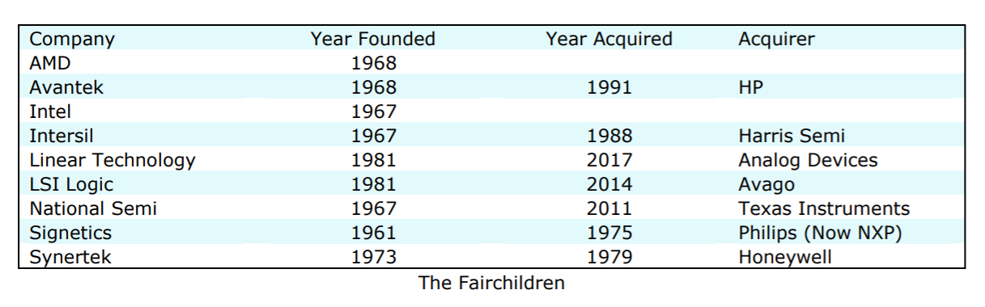
1. Introduction (1)
Emerging and concentration of semiconductor companies in the US [115]
The decade from 1965 to 1975 saw an explosion of new semiconductor companies,
as entrepreneurial technologists employed by Fairchild Semiconductor became
frustrated by the vendors management practices and set out on their own.

Slide 6
1. Introduction (2)
1. Introduction
Overview of AMD’s processor lines
AMD’s in-house designed x86 families
32-bit
x86 families
64-bit Hammer
family
Intermediate
families
The Bulldozer
family
The Cat
family
The Zen
family
K5/K6/K7
families
(32-bit
(Clients)
1996-2003)
K8/K10/K10.5
families
(08h/10h/10.5h)
(Servers,
clients)
(2003-2009)
Families
11h/12h
(Clients
oriented)
(2008-2011)
Family
15h
(High-performance
oriented)
(2011-2016)
Families
14h/16h
(Low-power
oriented)
(2011-2015)
Family
17h
(Modular design)
(2017- )
K7: Athlon (1999-2003)
Clients: Laptops/DTs
Remark
Before the in-house designed K5, AMD licensed and manufactured Intel designed processors.

Slide 7
1. Introduction (3)
AMD’s outstanding achievements in the beginning of the 2000’s -1
Extending the 32-bit x86 ISA to 64-bit x86-ISA [164] -1
In the 1990s CISC processors were 32-bit wide, nevertheless, in 1997 Intel
and hp (Hewlett Packard) jointly announced a new 64-bit VLIW ISA, called
the IA-64 (Intel Architecture 64) that became the Itanium line, to replace
32-bit designs.
*

Slide 8
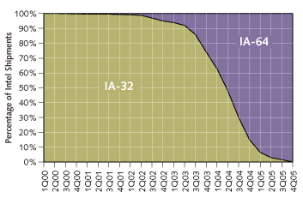
1. Introduction (3b)
Industry analyst’s prediction for how IA-64 will supplant IA-32 [211

Slide 9
1. Introduction (3c)
AMD’s outstanding achievements in the beginning of the 2000’s -2
Extending the 32-bit x86 ISA to 64-bit x86-ISA cont. [164] -2
By contrast, in 10/1999 AMD surprisingly announced their x86-64 ISA extension,
that was released in 8/2000.
The release encouraged the software community to begin incorporating
x86-64 technology into operating systems, applications, drivers and
development tools.
AMD’s goal was clearly formulated at revealing the x86-64 ISA specification
in 8/2000:
"Ultimately this technology is designed to help preserve the enterprise
community's enormous financial investment in 32-bit operating systems,
applications, development tools and support infrastructure while
providing a seamless path to deploy future 64-bit technology."
As AMD underlined, "Perhaps the most noteworthy feature of AMD's
approach to 64-bit computing is that it is an extension to the 32-bit
environment prevailing in the industry today rather than a radical
departure“, envisioned by Intel’s and HP’s joint IA64 VLIW architecture
concept, released in 1997 [210].
*

Slide 10
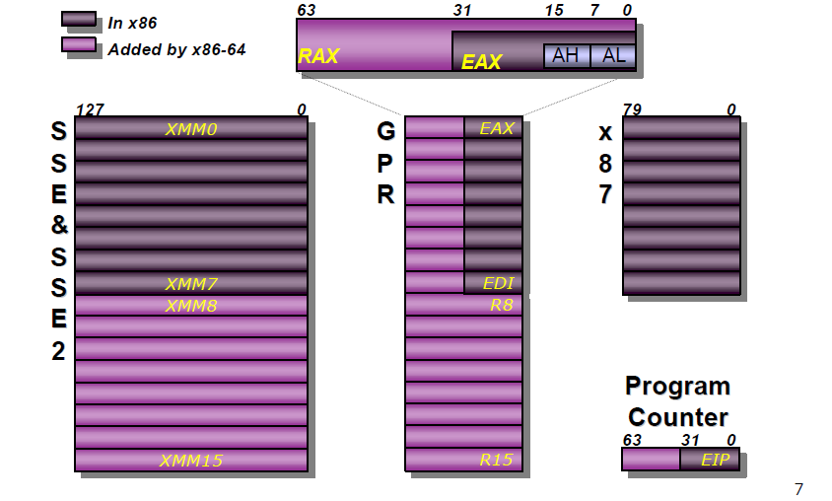
1. Introduction (4)
Extending the register set in the x86-64 ISA [167]
Notes:
10

Slide 11
1. Introduction (5)
AMD’s outstanding achievements in the beginning of the 2000’s -2
b) Developing the Direct Connect Architecture (DCA) multiprocessor concept
It originates from 10/1999 [165].
The Direct Connect Architecture (DCA) concept provides an efficient framework
for multiprocessors and is characterized by
an Integrated Memory Controller
to eliminate the memory bottleneck
first of all in servers.
up to 3 serial 2B–wide HyperTransport links
for chip-to-chip-communication
to eliminate the FSB bottleneck [167].
These links interconnect processors
in DP (2P) and MP (4P) multiprocessors
as well as processors with the chipset.
Figure: AMD’s Direct Connect Architecture
concept [168]
*

Slide 12
1. Introduction (6)
AMD’s outstanding achievements in the beginning of the 2000’s -3
Implementation of the x86-64 ISA extension and the DCA architecture
4/2002 AMD announced Microsoft support for their x86-64 family [166].
4/2003 AMD shipped the K8 processor in their Opteron server line (called Sledgehammer line), that is based on the x86-64 ISA and implements DCA.
Both the introduced server and subsequent desktop processors were superior
to Intel’s existing Pentium 4 based processors [169], and AMD began to
catch a higher share on the world market.
By contrast, Intel introduced the x86-64 ISA only in the 3. core of the Pentium 4
in 2004 and attached memory channels immediately to the processor die
in their Nehalem line in 2008.
Nevertheless, in 2006 Intel launched their Core 2 line and overtook superiority
in processor performance and therefore AMD’s share on the world market
started to shrink, as the next Figure indicates.
*

Slide 13
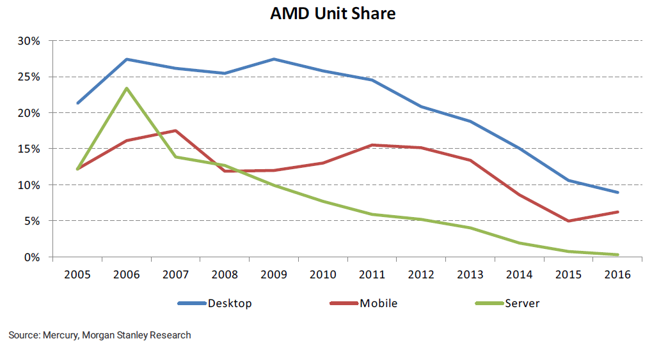
1. Introduction (7)
1. Introduction
AMD's decreasing unit shares on the world market 2006-2016 [51]

Slide 14
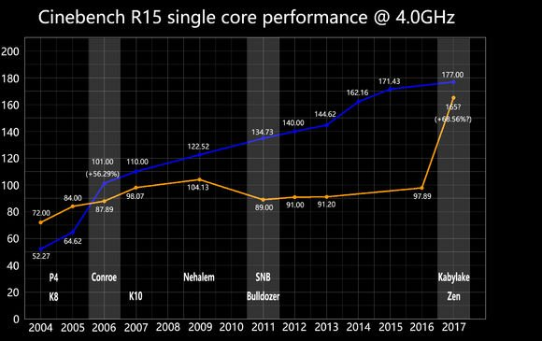
1. Introduction (8)
Efficiency of Intel and AMD CPUs - 2004 to 2017 [89]
(Core 2)
It makes clear why AMD loose their market share to Intel.

Slide 15
1. Introduction (9)
Content creation performance
Remarks on the CineBench benchmark [27]
It is a real-world cross-platform test suite that evaluates CPU and graphics
performance for 3D content creation.
It is based on MAXON's award-winning animation software Cinema 4D.

Slide 16
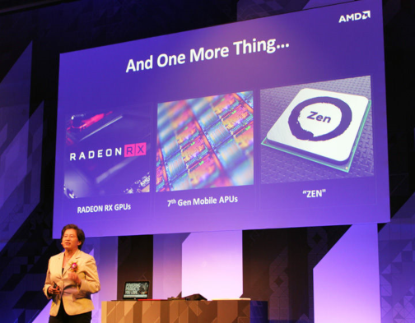
1. Introduction (10)
Announcing the Zen architecture at Computex 2016 as a turning point
in AMD’s market position [1]

Slide 17
1. Introduction (12)
AMD’s effort to design the Zen core [11]
M. Papermaster, CTO of AMD: Up to 300 engineers were working on the Zen core
spending over two million working hours.
Aim: optimizing the power/frequency curve.
CTO: Chief Technology Officer

Slide 18
1. Introduction (12)
AMD’s rising unit share on the world market after launching the Zen family
2017-2020 [116]
 | 2Q20 | 1Q20 | 4Q19 | 3Q19 | 2Q19 | 1Q19 | 4Q18 | 3Q18 | 2Q18 | 1Q18 | 4Q17 | 3Q17
DT | 19.2% | 18.6% | 18.3% | 18% | 17.1% | 17.1% | 15.8% | 13% | 12.3% | 12.2% | 12.0% | 10.9%
Mobile | 19.9% | 17.1% | 16.2% | 14.7% | 14.1% | 13.1% | 12.2% | 10.9% | 8.8%
Server | 5.8% | 5.1% | 4.5% | 4.3% | 3.4% | 2.9% | 3.2% | 1.6% | 1.4% | 0.8%

Slide 19
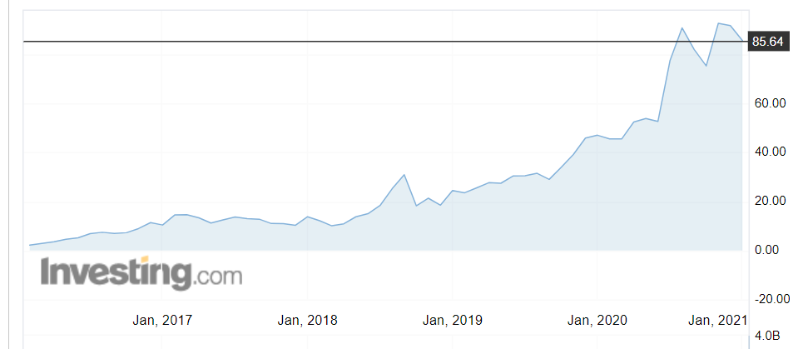
1. Introduction (13)
AMD’s stock price 2017 - 2021
Source: Investing.com

Slide 20
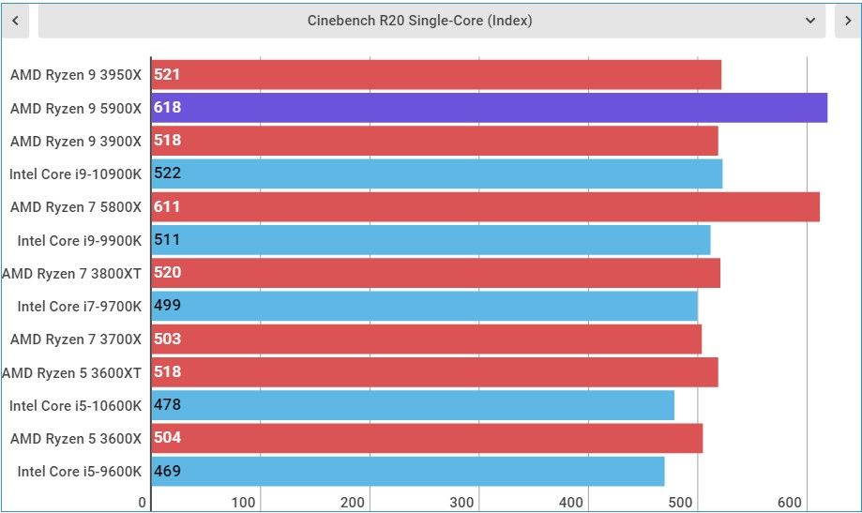
1. Introduction (14)
Single core (SC) Cinebench R20 benchmark results indicating AMD’s lead
in performance along with their Ryzen 9 5900 processor in 2021 [185]

Slide 21
1. Introduction (15)
Remark to the fight for supremacy in x86-based processors
Obviously, the fight for the crown of the highest performance DT processor
has not yet been finished yet and will go on.
One new episode of the state of affairs is Intel’s statement in 01/2021 claiming
that their i9-11900K 11th-Gen Rocket Lake processor has achieved 3 to 8 %
higher performance in gaming than AMD’s Ryzen95900X [201].
Surely, exciting times will follow in this duel.

Slide 22
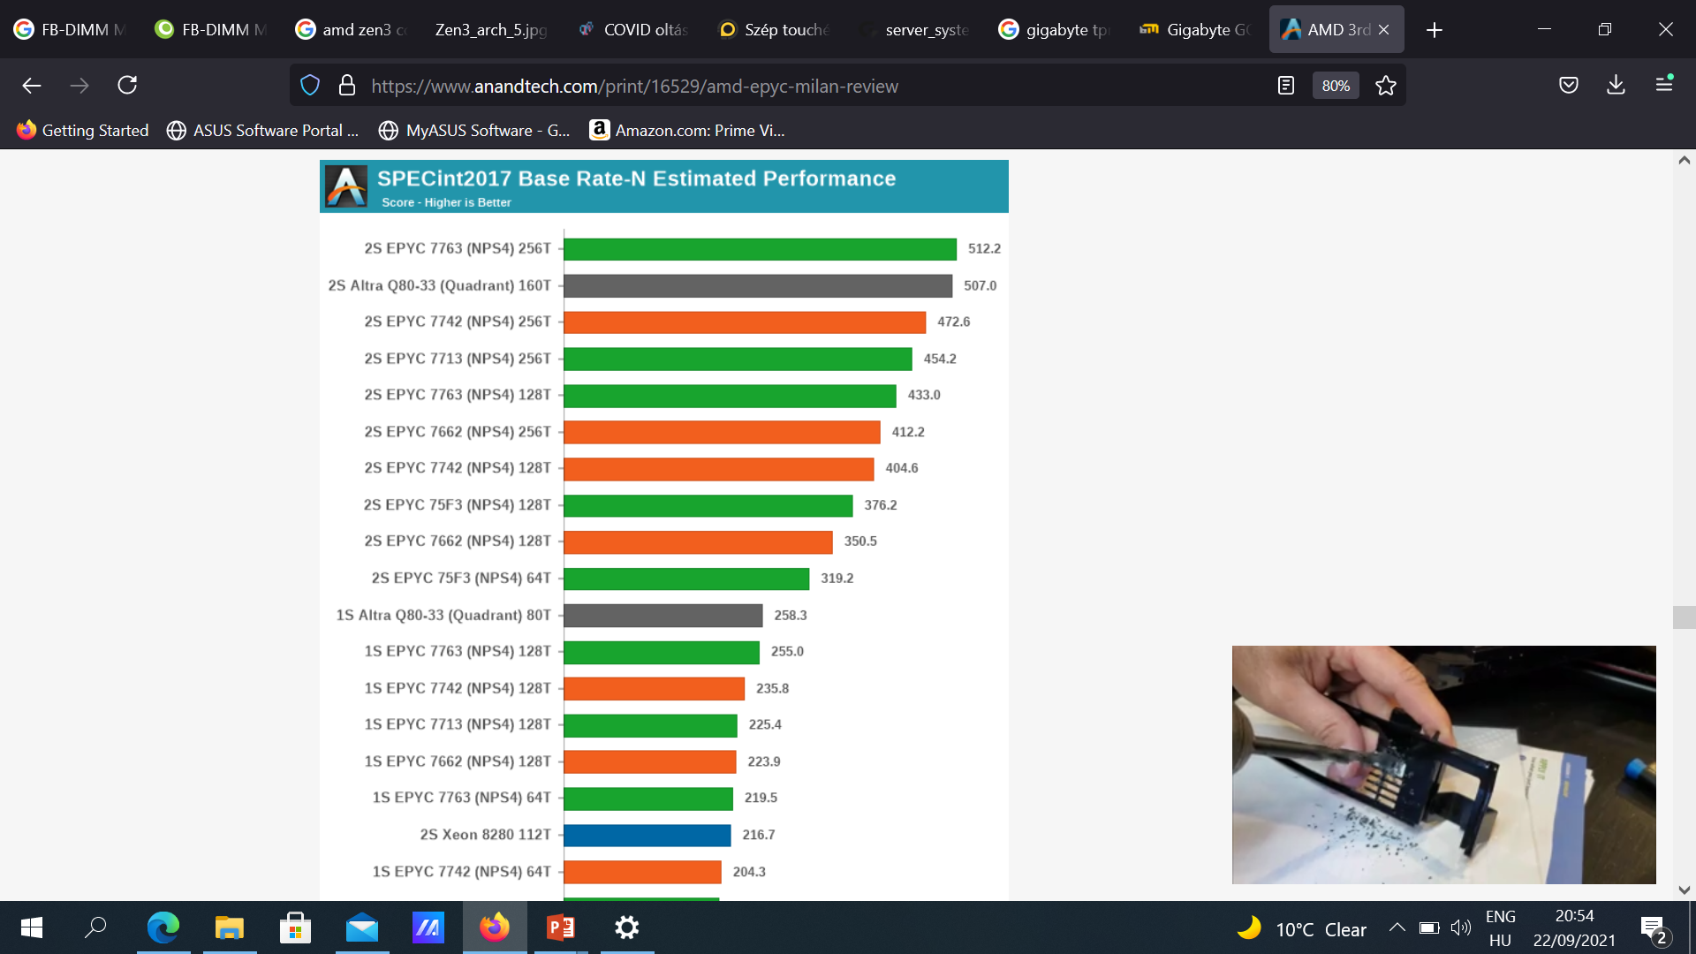
1. Introduction (16)
Performance of current 2S servers while running the SPECint2017 Rate N benchmark [208]
SPECint2017 Rate
integer benchmark
measure the throughput or work
per unit of time.
N means multithreading
is used.
Base means standard
setting for the
measurements (no tuning
allowed.)

Slide 23
1. Introduction (17)
Remarks to AMD’s recent performance figures achieved by 2S servers
As the previous Figure indicates AMD’s Zen 3-based 2S server processors have the
highest performance scores among recent 2S server processors while running the
SPECint2017 Rate N multithreaded benchmark, nevertheless, this is also the case
for a large number of other benchmarks.
Astonishingly enough, at the same time emerging ARM-based servers, like Ampere’s
80-core Altra Q80-33 2S servers achieve already competitive performance results,
which indicates an upcoming sharpening competition in this processor category.

Slide 24
2. Cornerstones of AMD’s Zen processor family
2.1 Overview
2.2 Multi-die approach rather than using monolithic dies
2.3 Modular approach to implementing processors
2.4 Hierarchical 3-level layout of CPUs and GPUs
2.5 A new cache coherent fabric to interconnect and
control multiple dies and sockets
2.6 MCM packaging to encase multiple dies
Notes:
24

Slide 25
2.1 Overview
Notes:
25

Slide 26
2.1 Overview (1)
2.1 Overview
How could AMD overtake the performance leadership with their Zen processors line?
AMD’s success can presumable be contributed to a set of design choices:
AMD’s key design choice has been to use the multi-die approach
to implement processors rather than hold on monolithic processor dies.
This choice implies however, four further decisions, as follows.
b) The multi-die approach allows using a modular, lego-like design concept
for implementing processors in such a way that processors targeting
mobiles, desktops, HEDTs or servers may be built up basically from
the same set of dies.
Concerning this point AMD’s choice has been to implement three types of dies:
CPU dies,
APU dies (dies with CPUs and GPUs, in future with accelerators) and
IO dies.
c) CPUs and APUs are designed on a three-level hierarchical concept.
d) Multiple dies within a package or even multiple processors of a server
need to be linked together by an efficient cache coherent interconnect
and control fabric.
This requirement was met by AMD by designing the Infinity Fabric (IF).
e) Multiple dies need to be packed together into processor packages, AMD
employed for it the MCM (Multi Chip Module) packaging technology.
These design decisions will be detailed subsequently.
*

Slide 27
2.2 Multi-die approach rather than using monolithic dies
Notes:
27

Slide 28
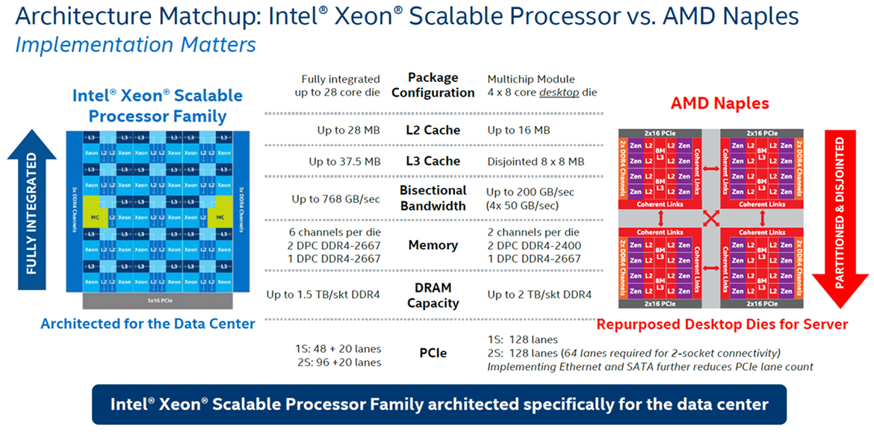
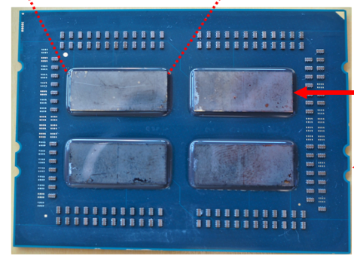
2.2 Multi-die approach rather than using monolithic dies (1)
2.2 Multi-die approach vs. monolithic dies
Design paradigms for implementing multicore processors
Monolithic implementation
Multi-die approach
All cores are implemented
on the same die
Cores are implemented on multiple dies,
these dies are properly interconnected and
mounted into the same package
Example
Intel's Skylake-SP (2017) [2]
AMD's EPYC (2017) processor [2], [3]
Up to 28 cores
Up to 4x8 cores
Single
package
*

Slide 29
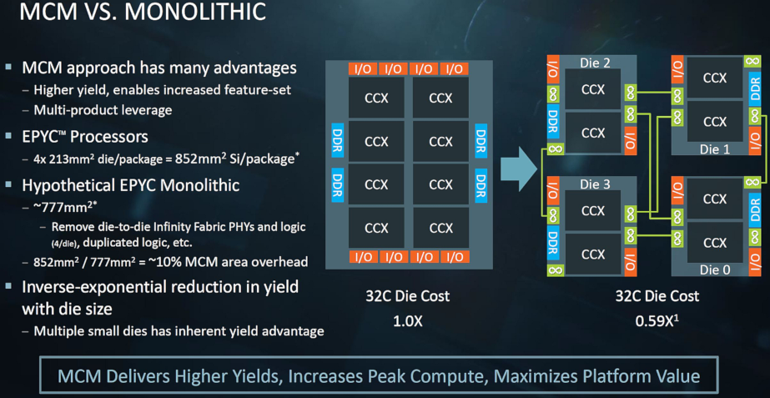
2.2 Multi-die approach rather than using monolithic dies (2)
AMD's cost argumentation for the multi die approach over the monolithic
implementation [7]
Presented by AMD at the Hot Chips Conference in Aug. 2017
*

Slide 30
2.2 Multi-die approach rather than using monolithic dies (3)
Pros and cons of the multi die approach [3]
Pros
Large dies may more economically be manufactured if they are segmented
into a number of smaller dies, since smaller dies have less failure rates and
thus higher yield.
The multi die approach allows using a modular, lego-like design concept for
implementing processors in such a way that processors for different market
segments, like mobiles, desktops, HEDTs or servers may be built up basically
from the same set of dies.
In large core count server processors, memory channels and I/O may become
linearly scaled with the core count assuming a proper design.
Cons
Multiple dies within a package or even multiple processors need to be linked
together by an efficient cache coherent interconnect and control fabric.
This causes additional transfer latencies that degrade performance and gives
rise to extra power consumption.
Multiple dies need to be packed together into processor package, this increases
fabrication cost.
*

Slide 31
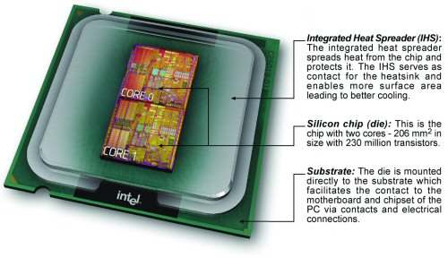
2.2 Multi-die approach rather than using monolithic dies (4)
Example of Intel’s early multi die design (Dual core DT Pentium D-820)
(5/2005)) [91], [92]

Slide 32
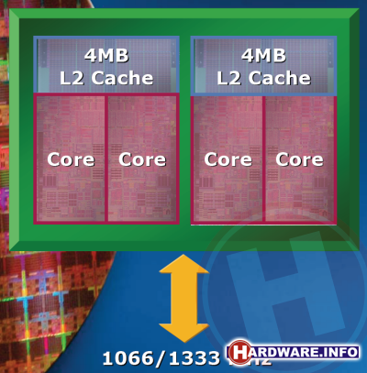
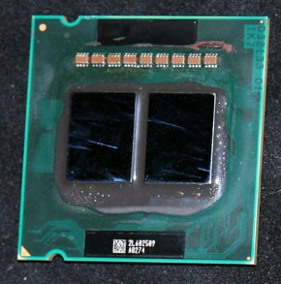
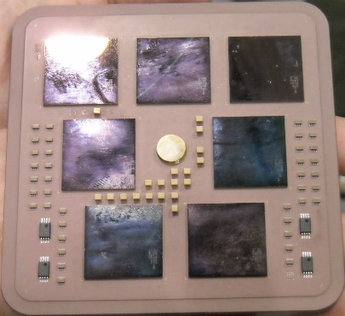
2.2 Multi-die approach rather than using monolithic dies (5)
Further examples for multi die designs of server processors
Intel
Paxville DP 2.8 (2x1C), 2xDP-enhanced Pentium 4 Prescott (10/2005)
Xeon 5000 (Dempsey), (2x1C), ~ the 65 nm shrink of the 90 nm Paxville DP 2.8 (5/2006)
Xeon 5300
(Clowertown) [4], [5]
Xeon 5300 (Clowertown) (2x2C) 2xCore 2-based 65 nm Xeon 5100 (Woodcrest), 11/2006
Xeon 5400 Harpertown 2x2C, 2x Core 2-based 45 nm 2C Harpertown (11/2007)
AMD
Opteron 6100 (Magny-Course) 2x6C, 2xBulldozer-based 45 nm Istambul die, (3/2010)
Opteron 6200 (Interlagos), 2x8C, 2xBulldozer-based 32 nm Orochi die, (11/2011)
Opteron 6300 (Abu Dhabi), 2x8C, 2xPiledriver-based 32 nm Abu Dhabi die, (11/2012)
Opteron 6400 (Warsaw), 2x8C, 2xPiledriver-based, 32-nm Abu-dhabi die, (2014)
IBM
POWER4, 2C on 4 chips, 180 nm, (12/2001)
z10, 10/2008) 5x4C,(up to 17C), 65 nm (10/2008)
z10 [6]
5 proc. dies
2 mem. control dies

Slide 33
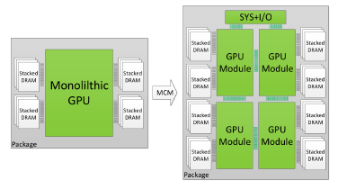
2.2 Multi-die approach rather than using monolithic dies (6)
NVIDIA's possible future use of multi die designs, revealed in a research
paper [32]

Slide 34
2.2 Multi-die approach rather than using monolithic dies (7)
Remarks to recent multi-die developments
1) In 06/2020 Intel introduced their mult-die (chiplet based) big.little 10nm/22 nm
mobile processor line, called Lakefield and plans to launch their similarly built up
DT oriented Alder Lake line in 2021.
2) Allegedly, also AMD is working on a flagship (RDNA 3) multi-chip GPU design that
features 160 CUs and a total of 10,240 stream processors [186].

Slide 35
2.3 Modular approach to implementing processors
Notes:
35

Slide 36
2.3 Modular approach to implement processors (1)
2.3 Modular design concept for implementing processors
As stated earlier, the multi die approach allowed AMD to use a modular, lego like design concept to implement processors targeting different market segments, such as mobiles, desktops, HEDTs or servers basically from the same set of dies.
This set includes three kind of dies:
CPU dies,
APU dies and
IO dies.
CPU dies do not include GPUs.
They are called Zeppelin dies in 1. gen. Zen processors and
CCDs (CPU Compute Dies) in subsequent generations.
APU dies (Accelerated Processing Units) include a CPU and an integrated GPU.
IO dies obviously perform IO functions.
They have two subtypes: IODs (IO Dies) used in HEDTs and servers, and
cIODs (client IO Dies) used in GPU-less DTs).
Here we note that DTs, HEDTs and server processors do not include GPUs and
beginning with Zen 2-based processors they are built up of multiple dies,
including an IO die,
whereas APU processors (laptops or DTs) are implemented as single die SoCs,
as shows in the next Figures.
*

Slide 37
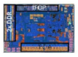
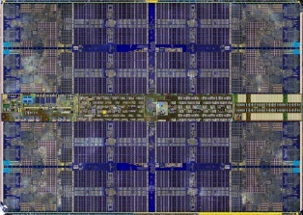
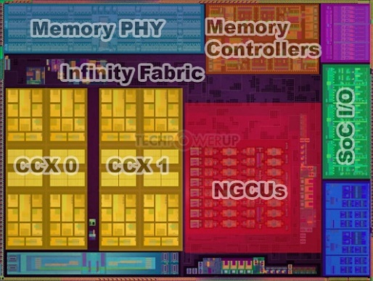
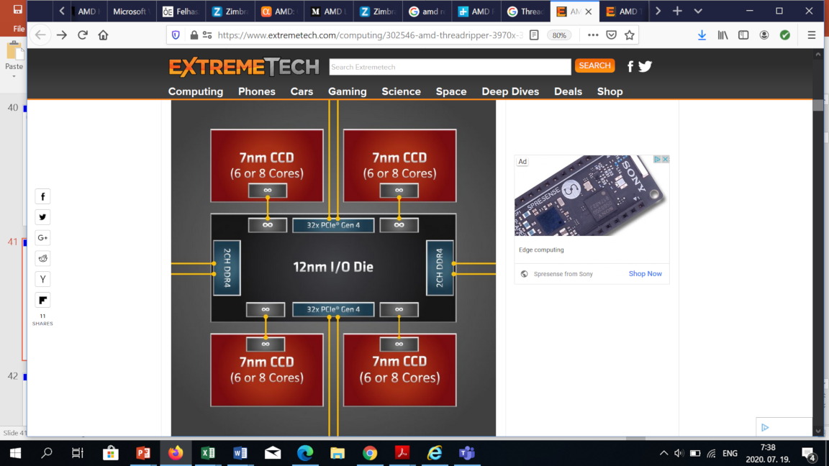
2.3 Modular approach to implement processors (2)
Example: Available die set of Zen 2-based processors
Die level building blocks of Zen 2-based processors
8-core CCD die
(two CCX core blocks
+ units for interconnects)
8-core APU die
(two CCX core blocks
+ Vega GPU + uncore)
IO dies
Client IO die (cIOD)
CCD: CPU Compute Die
12 nm, 2.09 btrs 125 mm² [128]
TR/server IO die (IOD)
12/14 nm IOD
(see Remark
on the next slide))
7 nm, 3.9 btrs 74 mm²
7 nm, 9.8 btrs,156 mm²
[125]
[190]
12/14 nm, 8.34 btrs 416 mm²
[127]
*

Slide 38
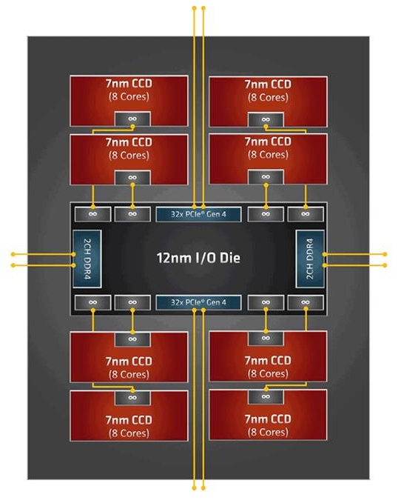
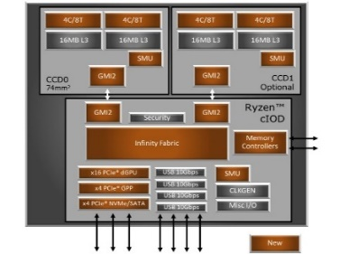
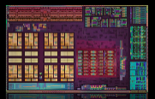
2.3 Modular approach to implement processors (3)
Example: The modular design concept in AMD’s Zen 2-based processor lines
AMD's Zen 2-based processor lines
(a): Mobile APUs
(Ryzen 4xxxU/H/HS)
DT APUs
(Ryzen 4xxxG/GE)
(b): GPU-less DTs
(Ryzen 3xxx/X)
(c): HEDTs
(Threadripper 39xxX)
(d): 1S/2S servers
(EPYC 7xx2/P)
1 APU die
(up to 8 cores)
1 or 2 CCD die(s)
+1 cIOD die
(up to 16 cores)
24/32C: 4x 6/8/-core CCD dies
+ 1 IOD die
64C: 8x 8-core CCD dies
+ 1 IOD die
24/32C: 4x 4/6/-core CCD dies
+ 1 IOD die
48/64C: 8x 4/6-core CCD dies
+ 1 IOD die
(Renoir) [126]
(Matisse) [107]
(Castle Peak) [127]
*
(Rome) [134]

Slide 39
2.4 Hierarchical 3-level layout of CPUs and GPUs
2.4.1 Overview
2.4.2 Evolution of Zen cores
2.4.3 Evolution of CCX core blocks
2.4.4 The GPU cores
2.4.5 The Vega GPU
2.4.6 Die level building blocks of Zen processors and their use
Notes:
39

Slide 40
2.4.1 Overview
Notes:
40

Slide 41
2.4.1 Overview (1)
2.4.1 Overview
As we have seen previously, AMD puts together their Zen-based processors out of
three die types, which are:
CPU dies,
GPU dies and
IO dies.
A specific feature of AMD’s design concept is that CPU and GPU dies are designed
on a hierarchical concept such that
the basic building blocks for both die types are cores,
cores are put together to build functional units, and
dies are built out of the functional units.
Consequently, while discussing the architecture of Zen processors we have to
consider the following spectrum of building blocks:
*

Slide 42
2.4.1 Overview (2)
The three level hierarchy of building blocks of Zen processors
Building blocks of Zen processors
CPU building blocks
Graphics building blocks
IO building blocks
CPU cores
CPU core blocks
CPU dies
GPU cores
GPUs (actually Vega GPU)
APU dies, they include
a GPU and one/two
CPU core blocks
IO die
It may have two alternatives:
one for clients and
one for HEDTs or
servers
*

Slide 43
2.4.1 Overview (3)
Key features of CPU building blocks in the Zen family
a) CPU cores are the basic elements of Zen CPUs.
AMD designed new CPU cores from the scratch and named them Zen cores.
Concerning the next level AMD made a fundamental decision: to use
CPU core blocks rather than implementing symmetrical multicores.
b) CPU core blocks constitute the second level of the CPU building blocks.
They consist of 4 to 8 cores grouped together to build a functional unit
along with private L1 and L2 caches for each core, as well as a shared, sliced
L3 cache serving all cores.
AMD designates a CPU core block as CCX (Core CompleX or CPU CompleX).
c) CPU dies represent the third level of CPU building blocks, they include basically
one or two CCXs.
First gen. CPU dies are termed Zeppelin dies, subsequent gen. CPU dies
became renamed to CCDs (Core Complex Dies).
Remark
Intel preferred symmetrical multicores for a long time in their Core 2 family.
Lastly, Intel introduced the core block concept along with the big.little layout,
multi-die implementation and MCM packaging in their Lakefield processor line
in 2020.
*

Slide 44
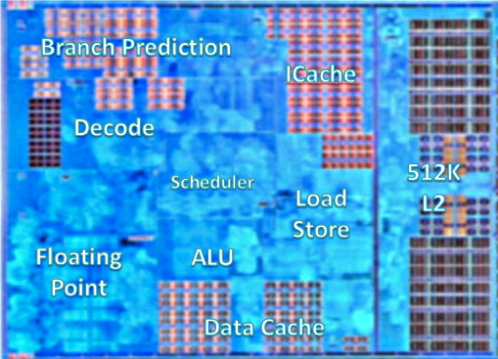
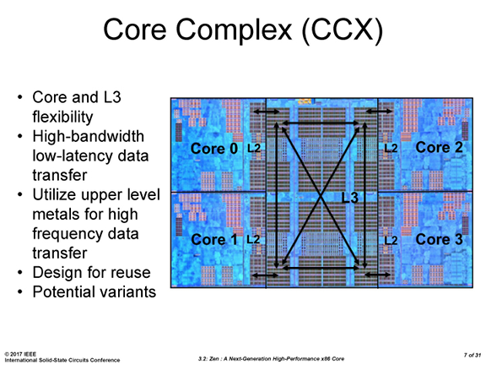
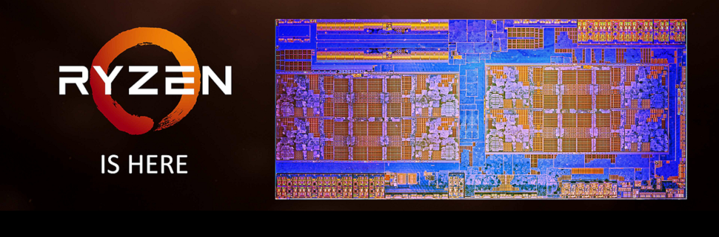
2.4.1 Overview (4)
Example: Hierarchy of CPU building blocks in 1. gen. (Zen-based) processors
a) CPU core :
Zen core [8]
b) CPU core block:
Zen-based CCX core block
called Core CompleX
(includes 4 cores and a
8 MB shared L3 cache) [9]
c) CPU die:
the Zeppelin die
(includes two Zen-based
CCX core blocks
and the uncore) [10]
CCX0
CCX1
Uncore: Memory and I/O controllers and functional units for interconnections.

Slide 45
2.4.1 Overview (5)
Key features of graphics building blocks of APU processors in the Zen family
a) GPU cores are the basic elements of GPUs.
A key design decision of AMD was to make use of Vega CUs (Compute Units)
for graphics processing in their ongoing Zen families, as detailed later in this
Section.
b) Vega GPUs represent the second level of graphics building blocks, they are
built up of a number of Vega CUs (typically 3 to 11) and additional units
needed for graphics processing.
c) APU dies are the third level of graphics building blocks, their key components are
a Vega GPU for graphics and also one or two CCX core blocks for computing.
AMD decided to implement APU processors as SoCs.
It follows that Zen-based APU dies have to have beyond a Vega GPU and a CCX
core block all further units that are needed for connecting memory, IO etc.
(often designated as the “uncore”).
SoC: System on Chip
*

Slide 46
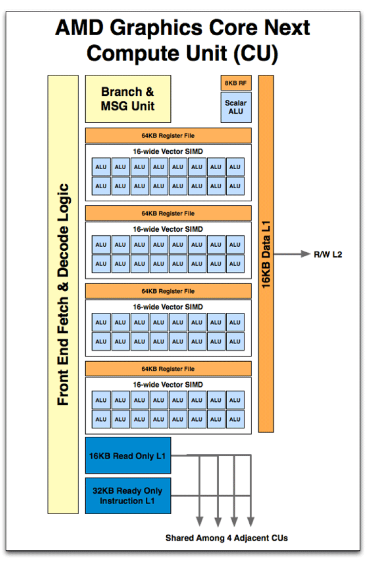
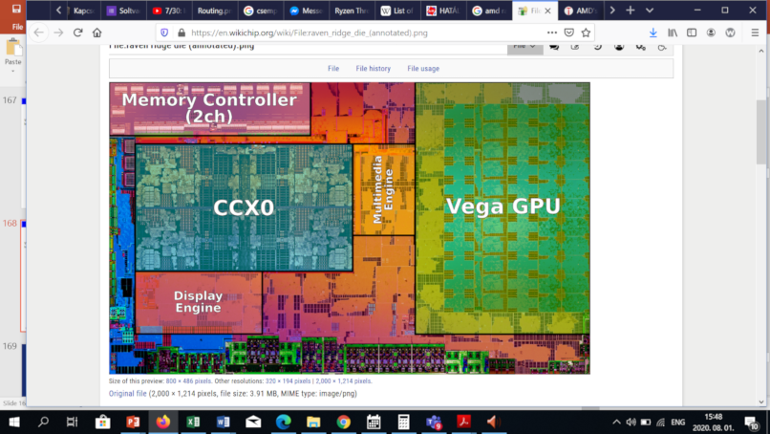
2.4.1 Overview (6)
Example: Hierarchy of graphics building blocks in Zen core-based APUs
Vega GPU core (CU)
(4x16 EUs
+L1 cache) [183]
a) GPU core:
b) GPU:
Vega GPU
(n CUs)
[123]
c) APU die:
Uncore: Memory and I/O controllers and further
functional units needed for a SoC
gen. APU die (Vega GPU, 4-core CCX +
uncore) (Raven Ridge die) [123]

Slide 47
2.4.2 Evolution of Zen cores
Notes:
47

Slide 48
2.4.2 Evolution of Zen cores (1)
2.4.2 Evolution of Zen cores [13], [170]
AMD began planning the Zen microarchitecture after re-hiring Jim Keller,
the famous processor architect, in 2012.
Announced at AMD's Financial Analyst Day in 5/2015.
First details of the Zen architecture were published at the Computex Conference
in 6/2016.
According to M. Papermaster, CTO of AMD up to 300 engineers were working
on the core design.
Key design objective was raising IPC rather than power reduction.
*

Slide 49
2.4.2 Evolution of Zen cores (2)
Main architectural improvements of the 1. gen. Zen core vs. the previous
Bulldozer design
a) Departure from the previous module concept and returning to the usual
core structure
b) Introducing multithreading
c) Introducing the SenseMI technology package that includes a number of
innovations,
as will be discussed subsequently.
*

Slide 50
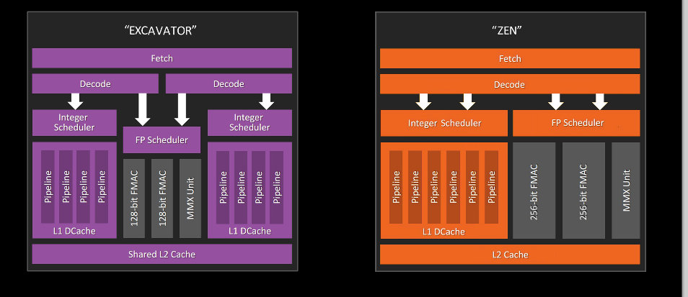
2.4.2 Evolution of Zen cores (3)
a) Departure from the previous module concept and returning to the usual
core structure [14]
With the Zen core AMD left the Bulldozer design style that was marked by cramming
two integer blocks and an FP block into a module and declaring the module as being
dual cores, and followed the regular path of building up cores, as indicated below.
*

Slide 51
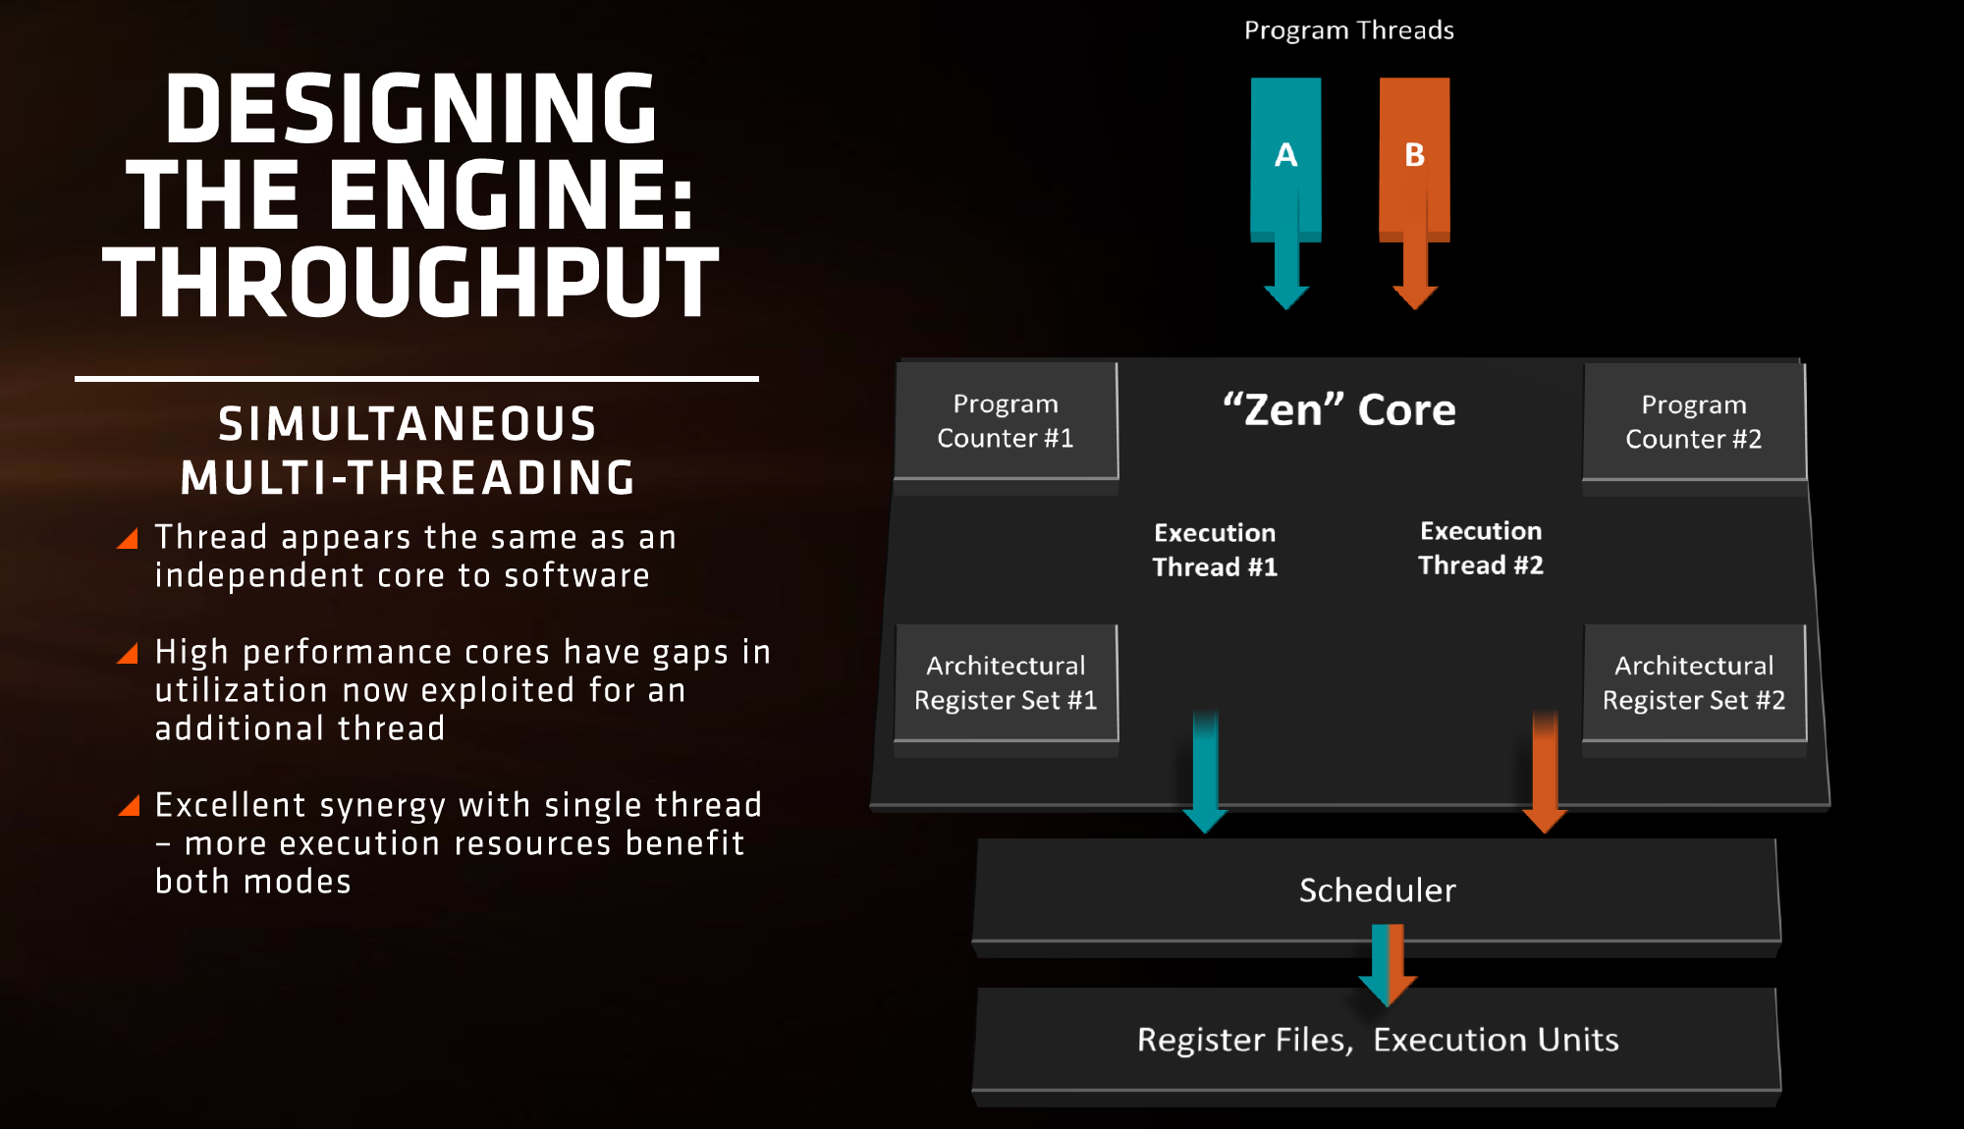
2.4.2 Evolution of Zen cores (4)
b) Introducing multithreading [10]
*

Slide 52
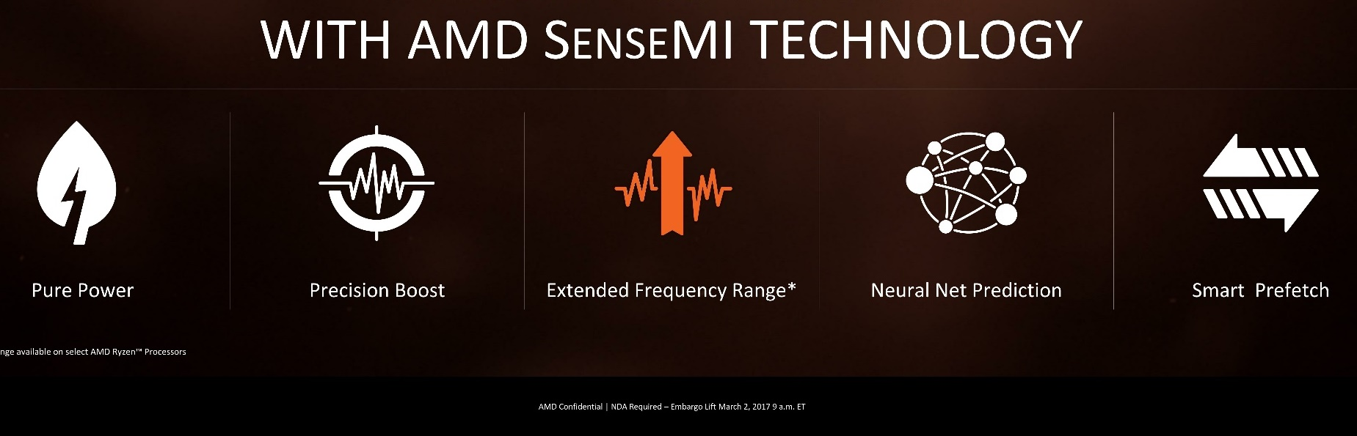
2.4.2 Evolution of Zen cores (5)
c) Introducing the SenseMI technology package that includes a number of
innovations, as indicated below [10]
Pure power (AVS)
(Adaptive Voltage
Scaling)
Precision Boost
(Enhanced Turbo Boost
like Intel’s SpeedShift)
Extended Frequency Range
(XFR) (Higher fc for
premium cooling,
like Intel’s TVB)
Neural Net
Prediction
Smart
Prefetch
To reduce
dissipation
To raise fc
To raise IPC
Here we do not go into the details of the SenseMI technology package.
AVS: Adaptive Voltage Scaling
TVB: Thermal Velocity Boost

Slide 53
2.4.2 Evolution of Zen cores (6)
Key benefits of Zen cores vs. the previous Excavator modules
Use of 14 nm process vs. 28 nm
52 % performance improvement for single threaded workloads
Up to 3.7x improvement in performance/Watt
SMT support (2-way)
*

Slide 54
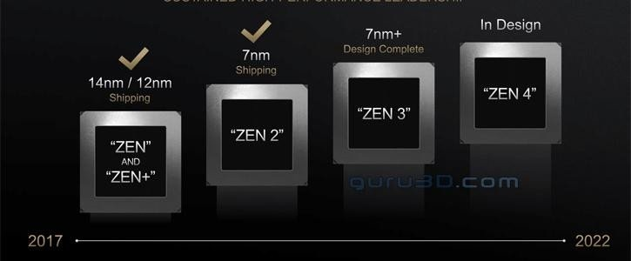
2.4.2 Evolution of Zen cores (7)
Evolution of the manufacturing technology of Zen cores (as of 01/2021) [117]

Slide 55
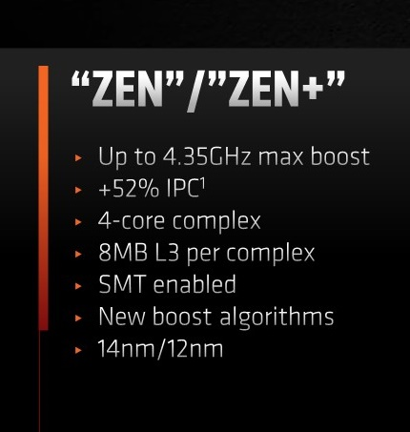
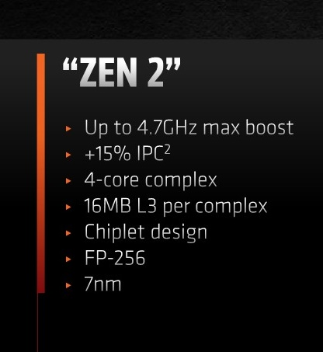
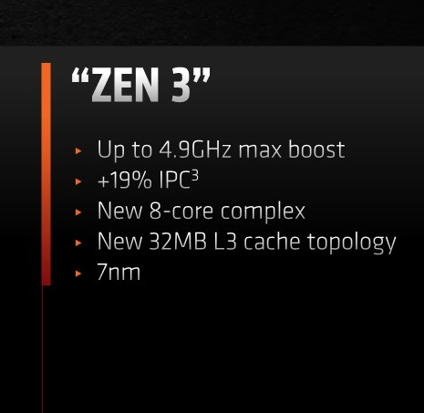
2.4.2 Evolution of Zen cores (8)
Evolution of key features of Zen cores [171]
*

Slide 56
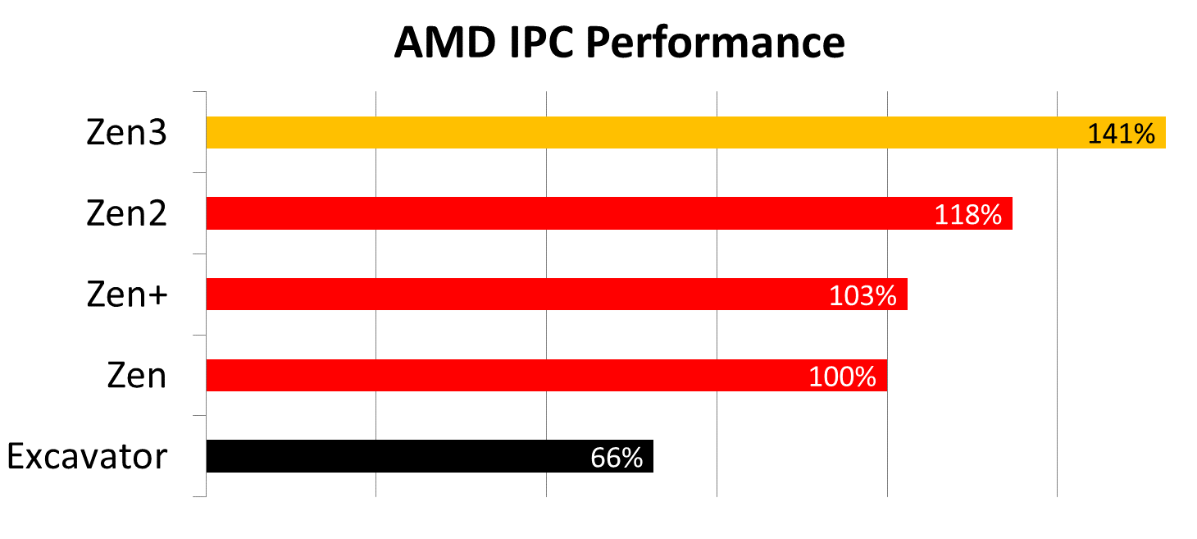
2.4.2 Evolution of Zen cores (9)
Per generation IPC improvements of AMD’s Zen cores [171]

Slide 57
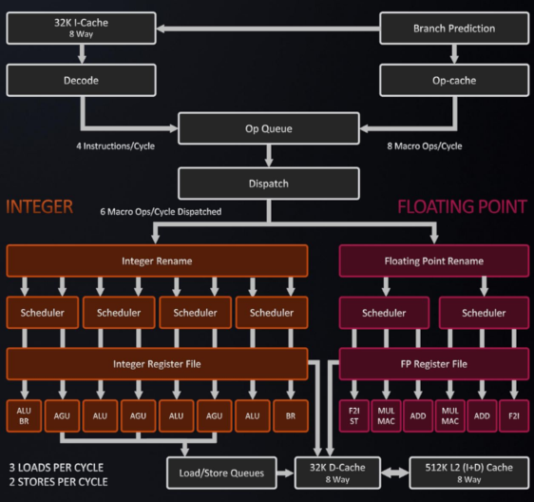
2.4.2 Evolution of Zen cores (10)
State of the art: The Zen 3 core’s microarchitecture [176]
2 threads/core (SMT)
State of the art branch predictor
Caches
I-cache 32k 8-way
Op-cache 4K instructions
D-cache 32k
L2-cache 512k
Decode
4 instr./cycle from decode
8 Macro op/cycle from
cached microcoded
instructions
Dispatch
6 ops/cycle dispatched
to FX or FP
Execution capabilities
4 FX units
dedicated branch unit
dedicated store data unit
3 address gen. units
3 mem. ops/cycle
max 2 can be stores
2 256-bit FP FMA/cycle

Slide 58
2.4.3 Evolution of CCX core blocks
Notes:
58

Slide 59
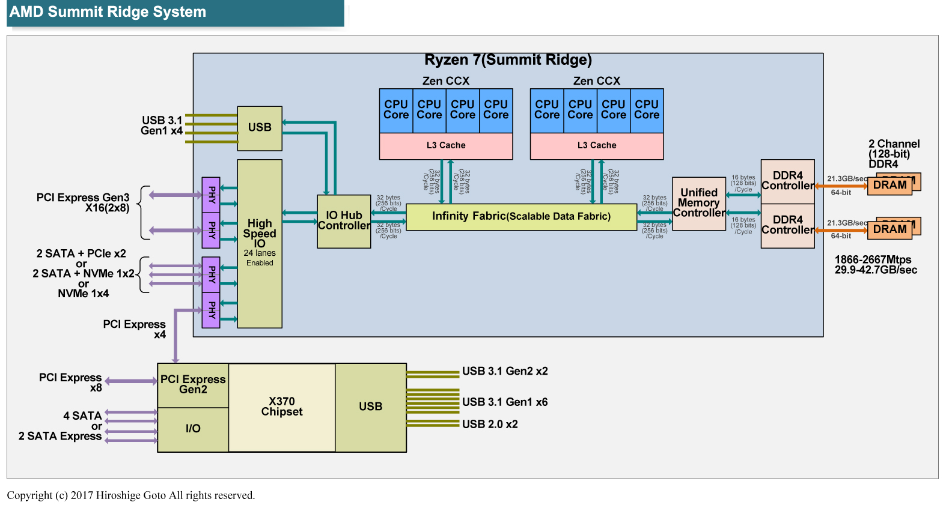
2.4.3 Evolution of CCX core blocks (1)
2.4.3 Evolution of CCX core blocks [9], [16]
CCX core blocks (Core CompleXes or CPU Complexes) are the basic functional units
of Zen processors in all generations.
The 1. gen. CCX (CPU-Complex) includes 4 cores, as seen already.
(8 MB)
(2017)
Individual cores of Zen-based CCXs (in all Zen generations) have private
64 KB L1 instruction caches
32 KB L1 data caches and
512 kB private L2 caches.
All 4 cores of 1. gen (Zen core-based) CCXs share an 8 MB sliced L3 cache,
as seen above.
*

Slide 60
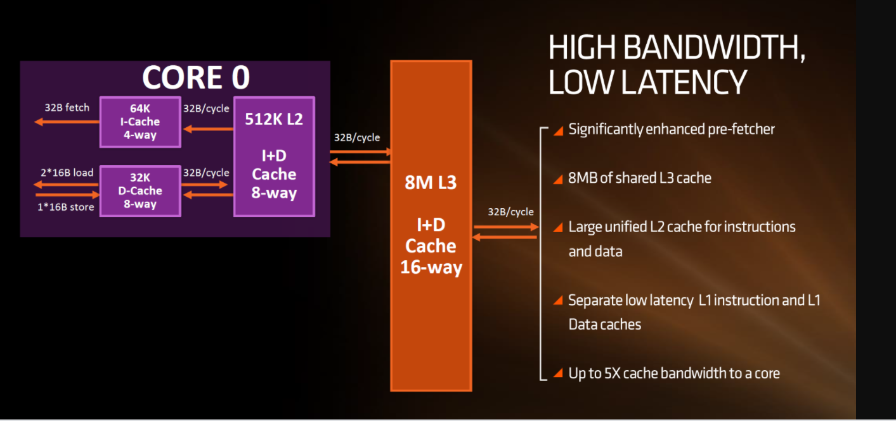
2.4.3 Evolution of CCX core blocks (2)
The cache hierarchy of 1. gen. Zen cores [199]
4x

Slide 61
2.4.3 Evolution of CCX core blocks (3)
The 1. gen. Zen core-based CCX core block in more detail [15]
The 8 MB sized L3 cache is split into four 2 MB slices (see the next Figure)
by low-order address interleaving (cím átlapolás, e.g. 00/01/10/11).
L3 cache slices are interconnected by a crossbar switch (as seen in the Figure),
thus each core can access each L3 cache segment with the same average latency.
L3 is mostly exclusive to the L2 cache, i.e. it is actually a victim cache to the L2.
2 MB L3
cache slice/core
Figure: The CCX core block [16]
The CCX core block is built up of 1.4 billion transistors on a die area of 44 mm^{2.}
*

Slide 62
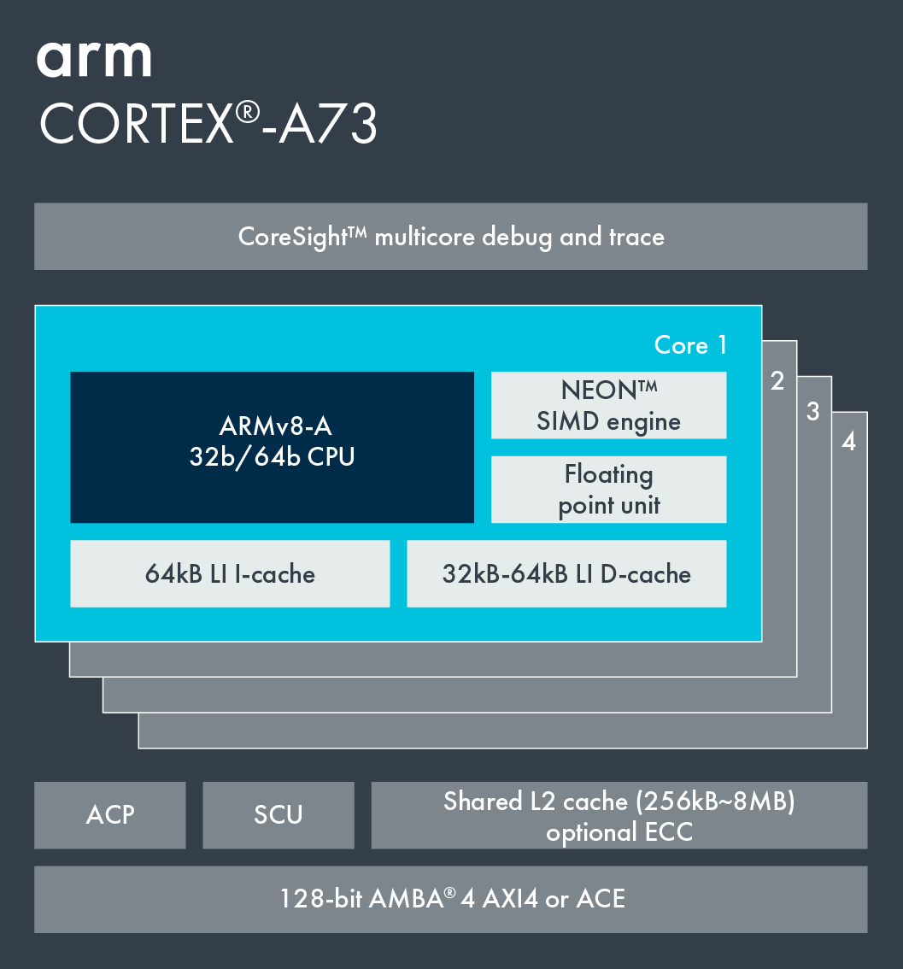
2.4.3 Evolution of CCX core blocks (4)
Comparing AMD's Zen core-based CCX core block and ARM's ARMv8 ISA
based core cluster (2011)
Cortex-A73 core
ARMv8.0 CPU
(8 MB)
(2017)
(2012) [55]
(In Cortex-A53/A57/A72/A73)
ACP: Accelerator Coherence Port
(to connect non-cached
coherent data sources)
SCU: Snoop Control Unit
(Provides coherence
within the the processor)
ECC: Error Correcting Code
AMBA: Advanced Microcontroller
Bus Architecture
(On-chip bus standard
for SoC) designs)
ACE: AXI Coherency Extensions
AMBA4 cache coherent interface
(Used in big.LITTLE systems
for smartphones, tablets, etc.)
AXI4: Advanced eXtensible Interface
(Not cache coherent interface)
*

Slide 63
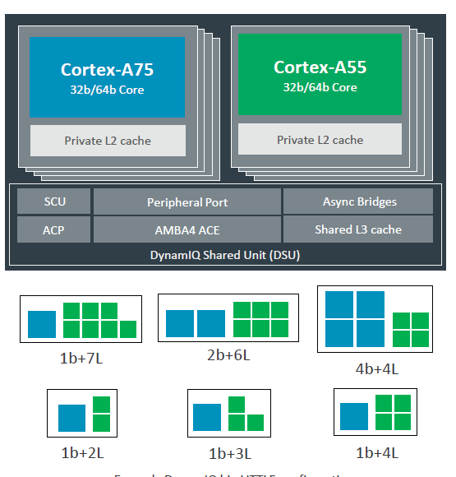
2.4.3 Evolution of CCX core blocks (5)
Comparing AMD’s Zen core-based CCX and ARM’s ARMv8.2-based DynamIQ
core clusters (2017)
(8 MB)
(2017)
(2017) [56]
ARMv8.2 support, (Cortex-A55/75 processors),
up to 8 cores
private L2 caches, shared L3 cache
*

Slide 64
2.4.3 Evolution of CCX core blocks (6)
Results of the comparisons
As the previous Figures indicate, AMD’s CCX core block is a more advanced building block
than ARM’s ARMv8 ISA-based core cluster but less advanced than ARM’s ARMv8.2
ISA-based DynamIQ core cluster.
*

Slide 65
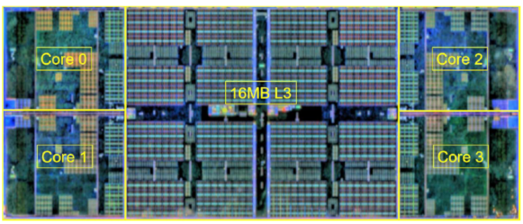
2.4.3 Evolution of CCX core blocks (7)
The Zen 2-based CCX core block [122]
The Zen 2-based CCX core block increased the size of L3 cache slices from 2 MB
to 4 MB, providing in this way 16 MB sliced L3 cache per CCX.
Figure: Zen 2-based CCX core block [122]
*

Slide 66
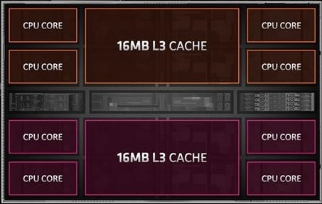
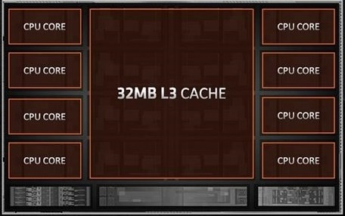
2.4.3 Evolution of CCX core blocks (8)
The Zen 3-based CCX core block -1
Zen 2-based CPU dies (called CCDs) incorporate two CCX core blocks, each with
4 cores and 16 MB L3 cache each.
Both CCX core blocks were interconnected on the CPU die (CCD).
By contrast, the new design includes 8-cores with a shared 32 MB cache, as seen in the Figure below.
Dual Zen 2 CCXs used in Zen 2-based CCDs
Zen 3 CCX used in Zen 3-based CCDs
Figure: Contrasting the Zen 2 and Zen 3-based CCX designs [171]
*

Slide 67
2.4.3 Evolution of CCX core blocks (9)
The Zen 3 CCX core block -2
The new design enables each core to access the whole 32 MB L3 cache, rather
than only 16 MB as in the previous design, which reduces the memory access
time in the 16-to-32 MB access window compared to the Zen 2-based CCX
implementation.
Further on, the new CCX layout reduces core-to-core latencies as well, as shown
in the next two Figures.
The Figures relate to Zen 2 and Zen 3-based 16-core (32-thread) GPU-less
DT processors.
*

Slide 68
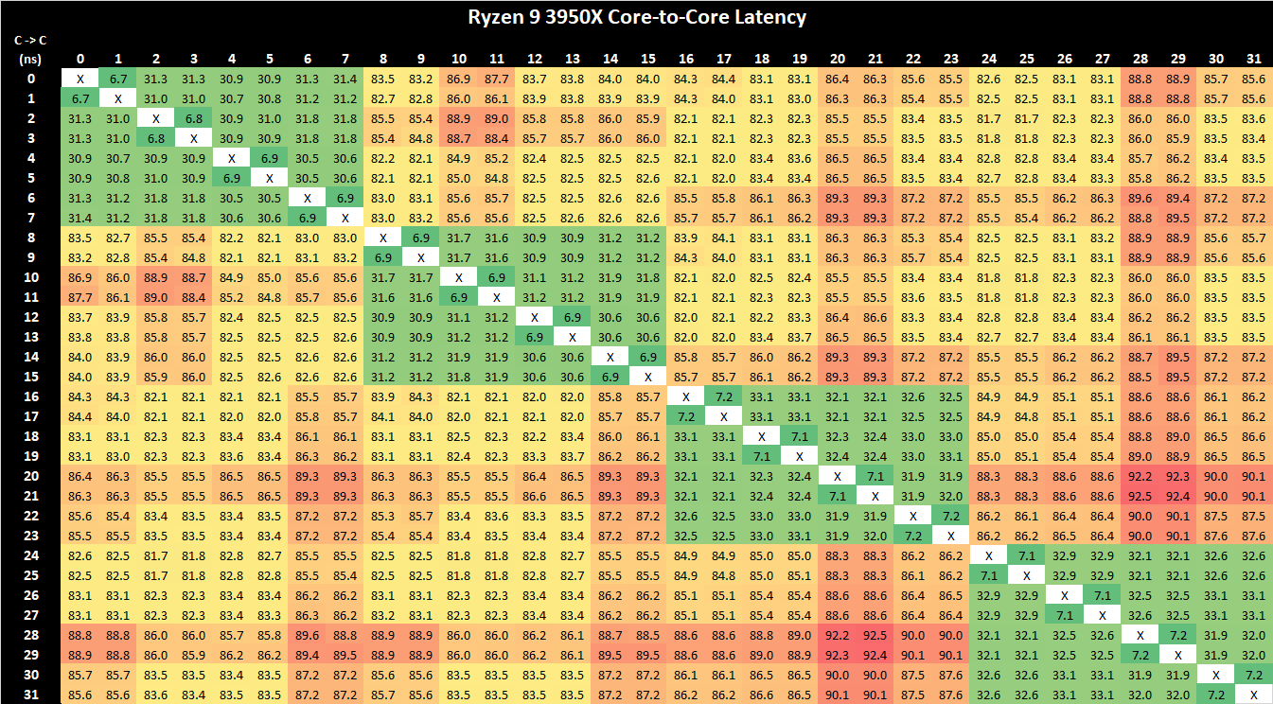
2.4.3 Evolution of CCX core blocks (10)
Core-to-core latencies in Zen 2-based CCDs [171]
In the Zen 2-based CCX only those core-to-core latencies are low that relate to the same 4-core
(8 thread) CCX.

Slide 69
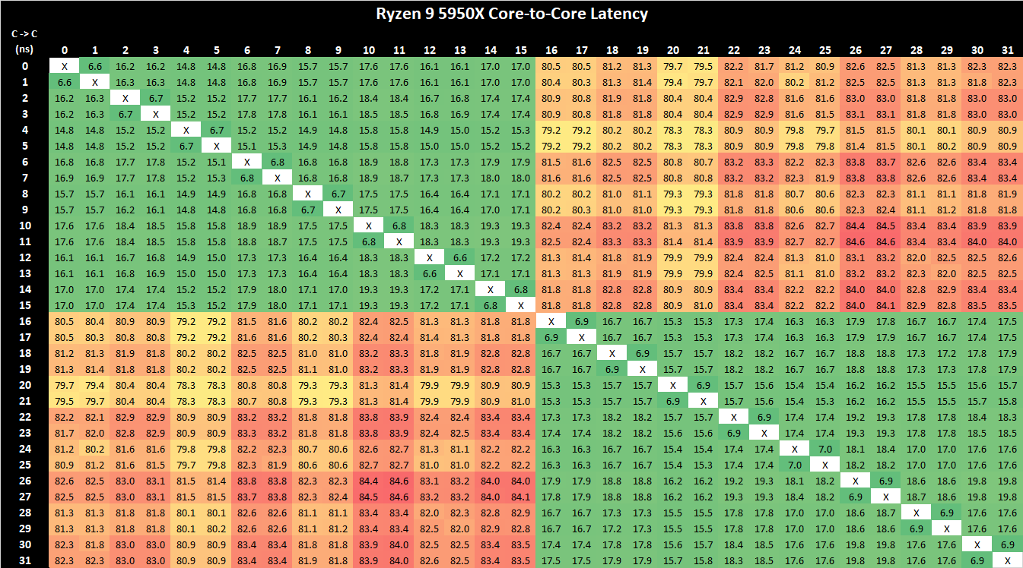
2.4.3 Evolution of CCX core blocks (11)
Core-to-core latencies in Zen 3-based CCDs [171]
By contrast, in the Zen 3-based CCX all latencies within the 8-core CCX core blocks remain low.

Slide 70
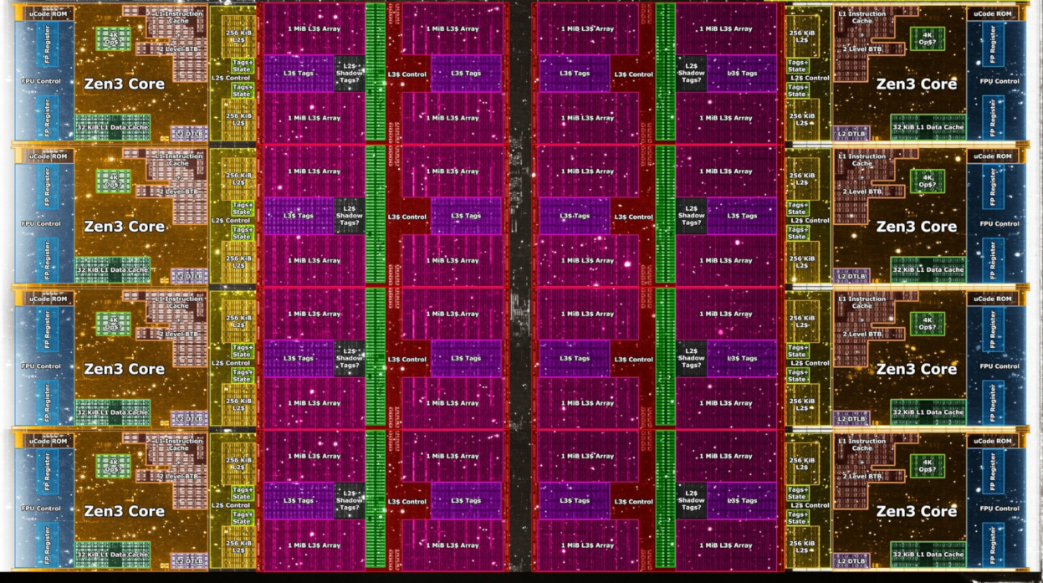
2.4.3 Evolution of CCX core blocks (12)
Die photo of a Zen 3-based CCX core block
(It is part of the CCD die of the GPU-less Ryzen 5000 (Vermere-based) processor) [200]
It includes 8 Zen 3 cores with 8x4 MB shared L3 cache.

Slide 71
2.4.4 The GPU cores
Notes:
71

Slide 72
2.4.4 The GPU cores (1)
2.4.4 The GPU cores
As GPU cores AMD utilized the Vega CU
(Compute Unit)) [183], to be discussed
later in this Section.
AMD’s GPUs in Zen-based processors
include a variable number of
CUs [183].
The Vega CU architecture is the 5. iteration of AMD’s GCN (Graphics Core Next) GPU architecture family, as shown in the next Table.
*

Slide 73
2.4.4 The GPU cores (2)
Evolution of AMD’s GCN (Graphics Core Next) and RDNA graphics architectures
GCN generation | Year of intro | Discrete GPU families | IGP in proc. families | Key additions
GCN 1th generation | 2012 | Southern Islands |  | Unified address space for CPU and GPU, New ISA, PCIe 3.0 64-thread wavefront
GCN 2nd generation | 2013 | Sea Islands | Temash, Kabini, Kaveri, Godavari, Mullins, Beema, Carrizo-L
GCN 3rd generation | 2014 | Volcanic Islands Pirate Islands | Carrizo, Bristol Ridge, Stoney Ridge | HBM for the Pirate Island family
GCN 4th generation | 2016 | Arctic Islands (Polaris) |  | HBM2, GDDR5
GCN 5th generation | 2017 | Vega | Raven Ridge (14 nm) Picasso (12 nm), Renoir (7 nm) Cezanne (7 nm) | 8-bit or 16-bit packed arithmetic for AI added
RDNA | 2019 | Navi (7 nm) |  | 32-thread wavefront (instead of 4x16-thread) PCIe 4.0, GDDR6
RDNA 2 | 2020 | Oberon (Big Navi) | (PlayStation 5) (7 nm) (Xbox series S) (7 nm) | Enhanced Compute Unit Infinity cache
RDNA (Radeon DNA): AMD considers it as the DNA that powers the games it runs. IGP: Integrated Graphics Processor

Slide 74
2.4.4 The GPU cores (3)
The Vega GPU core
(Vega CU (Compute Unit)) [183] -2
Each GCN-based CU includes four
SIMD units, each of them includes
16 ALUs, to be discussed subsequently.
SIMD units operate independently from
each other and execute the same
instruction for 16 threads at a time.
CUs can work on 4 instructions at once.
Each SIMD unit has a 64 KB register file
(1 K 32-bit registers per ALU).
The GCN CU has also a single scalar
FX32 ALU with a 8 KB register file,
which is shared by all four SIMD units.
*

Slide 75
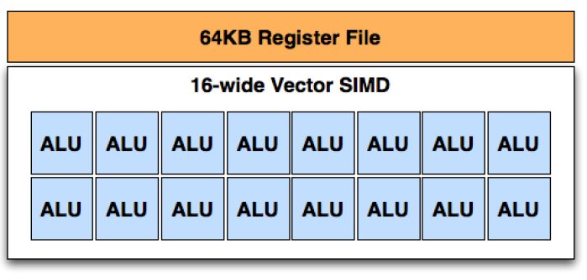
2.4.4 The GPU cores (4)
SIMD units of Vega computing cores [202]
SIMD unit
Each SIMD unit has 16 ALUs.
SIMD ALUs perform FP32 and FP64 operations (including fused or unfused
multiply-add) and need 4 clock cycles to execute an instruction and forward
its result.
Remark
In fused multiply-add operations no truncation is performed after multiplication,
truncation will be done only after addition.
*

Slide 76
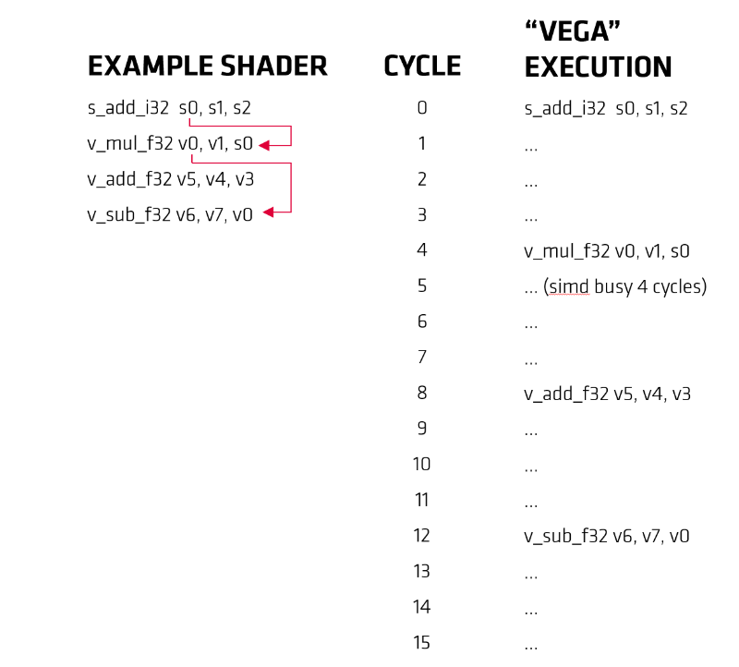
2.4.4 The GPU cores (5)
Vega instruction execution example [184]
Remarks
s_tagged instructions are scalar instructions,
v_tagged instructions are vector instructions.
Instruction execution in both cases comprises
four cycles, so execution of the program
snippet needs 16 cycles.

Slide 77
2.4.5 The Vega GPU
Notes:
77

Slide 78

2.4.5 The Vega GPU (1)
2.4.5 The Vega GPU [139]
S: Scalar
V: Vector
GDS: Global Data Share
LDS: Local Data Share
It is built up of a number of GCN-based CUs (e.g. of 8 CUs).

Slide 79

2.4.5 The Vega GPU (2)
The Zen core-based APU die – floorplan [203]
APU dies are conceived as single die stand alone SoCs, so they include beyond a
Vega GPU, one CCX core block and further functional units, like memory and IO
controllers, needed to serve a SoC.

Slide 80
2.4.6 Die level building blocks of Zen processors and their use
Notes:
80

Slide 81
2.4.6 Die level building blocks of Zen processors and their use (1)
2.4.6 Die level building blocks of Zen processors and their use
In this Section we provide an overview of the die sets available for implementing
Zen/Zen 2/Zen 3-based processors and show how actual processor lines are built up
out of the available die level building blocks.

Slide 82
2.4.6 Die level building blocks of Zen processors and their use (2)
Example 1: Available die set for implementing Zen-based processors
Die level building blocks of Zen-based (1. gen.) processors
8-core Zeppelin die
(two 4-core Zen-based
CCX core blocks
+ the uncore
4-core APU die
(single CCX core blocks
+ Vega GPU + uncore)
CCX0
CCX1
[10]
[123]
*

Slide 83


2.4.6 Die level building blocks of Zen processors and their use (3)
Example 1: Modular design of AMD's Zen-based (1. gen.) processors
AMD's Zen-based (1. gen.) processor lines
Mobile APUs
(Ryzen 2xxx/U/H)
DT APUs
(Ryzen 2xxxG/GE)
GPU-less DTs
(Ryzen 1xxx/X)
HEDTs
(Threadripper 19xxX)
1S/2S servers
(EPYC 7xx1/P)
Single APU die
(single CCX +
Vega GPU) [54]
Zeppelin die
(2x CCX)
2 Zeppelin dies
interconnected by the IF,
implemented as an MCM
4 Zeppelin dies
interconnected by the IF,
implemented as an MCM
(Raven Ridge) [98]
(Summit Ridge) [11]
(Naples) [11]
IF: Infinity Fabric
White Haven) [11]
*

Slide 84

2.4.6 Die level building blocks of Zen processors and their use (4)
Use of the Zeppelin die in AMD’s 1. gen. processor lines [77]
GPU-less DT
1S/2S server
HEDT
To allow this variability, the IO parts of the Zeppelin die are configurable.

Slide 85
2.4.6 Die level building blocks of Zen processors and their use (5)
Example 2: Available die set for implementing Zen 2-based processors
Die level building blocks of Zen 2-based processors
8-core GPU-less CCD die
(two CCX core blocks
+ uncore)
8-core APU die
(two CCX core blocks
+ Vega GPU + uncore)
IO dies
Client IO die (cIOD) [128]
CCD: CPU Compute Die
12 nm, 2.09 btrs 125 mm²
TR/server IO die (IOD)
12/14 nm IOD
(see Remark
on the next slide))
7 nm, 3.9 btrs 74 mm²
7 nm, 9.8 btrs,156 mm²
[125]
[190]
12/14 nm, 8.34 btrs 416 mm²
[127]
*

Slide 86
2.4.6 Die level building blocks of Zen processors and their use (6)
Example 2: The modular design of AMD’s Zen 2-based processors
AMD's Zen 2-based processor lines
(a): Mobile APUs
(Ryzen 4xxxU/H/HS)
DT APUs
(Ryzen 4xxxG/GE)
(b): GPU-less DTs
(Ryzen 3xxx/X)
(c): HEDTs
(Threadripper 39xxX)
(d): 1S/2S servers
(EPYC 7xx2/P)
1 APU die
(up to 8 cores)
1 or 2 CCD die(s)
+1 cIOD die
(up to 16 cores)
24/32C: 4x 6/8/-core CCD dies
+ 1 IOD die
64C: 8x 8-core CCD dies
+ 1 IOD die
24/32C: 4x 4/6/-core CCD dies
+ 1 IOD die
48/64C: 8x 4/6-core CCD dies
+ 1 IOD die
(Renoir) [126]
(Matisse) [107]
(Castle Peak) [127]
(Rome) [134]

Slide 87

2.4.6 Die level building blocks of Zen processors and their use (7)
Example 2: Zen 2-based processor packages [122]
Mobiles/DT APUs
GPU-less DTs
(1/2)
HEDTs
1S/2S servers
(4/8)
(2/4/
6/8

Slide 88


2.4.6 Die level building blocks of Zen processors and their use (8)
Example 3: Available die set for implementing Zen 3-based processors
Die level building blocks of Zen 3 processors
8-core GPU-less CCD die
(single CCX core block
+ uncore)
8-core Zen 3 APU die
(Zen 3 CCX + Vega GPU + uncore)
Client IO die (cIOD)
CCD: CPU Compute Die
12 nm, 2.09 btrs 125 mm² [128]
TR/server IO die (IOD)?
7 nm, 4.15 btrs 80.7 mm²
12/14 nm IOD
(see Remark)
[176]
[196]
7 nm, 10,7 btrs 180 mm²
14 nm, 8.34 btrs 416 mm² [127]
*

Slide 89




2.4.6 Die level building blocks of Zen processors and their use (9)
Example 3: The modular design of AMD’s Zen 3-based processors
AMD's Zen 3-based processor lines
Mobile APUs
(Ryzen 5xxxU/H/HS)
DT APUs
(Ryzen 5xxxG/GE)
GPU-less DTs
(Ryzen 5xxx/X)
(d): 1S/2S servers
(EPYC 7xx3/P)
1 APU die
(up to 8 cores)
1 or 2 CCD die(s)
+1 cIOD die
(up to 16 cores)
24/32C: 4x 4/6/-core CCD dies
+ 1 IOD die
48/64C: 8x 4/6-core CCD dies
+ 1 IOD die
[205]
[171]
[219]

Slide 90
2.5 A new cache coherent fabric
to interconnect and control multiple dies and sockets
Notes:
90

Slide 91
2.5 A new cache coherent fabric to interconnect and control multiple dies and sockets (1)
2.5 A new cache coherent fabric to interconnect and control multiple dies
and sockets
AMD designed the Infinity Fabric (IF) to serve as a cache coherent
interconnect and control network and introduced it along with the Zen core.
The task of the Infinity Fabric
it links together system units and
also provides system wide control functions, such as power management
or system security.
IF roots in the HyperTransport bus, it is similar to Intel's QPI or UPI
interconnection technology or ARM's CCN (Cache Coherent Network).
*

Slide 92

2.5 A new cache coherent fabric to interconnect and control multiple dies and sockets (2)
Key parts of AMD’s Infinity Fabric (IF)
Consequently, the Infinity Fabric consists of two key parts, a Scalable Control Fabric,
and a Scalable Data Fabric, as seen in the next Figure.
Power management
Security and Encryption
Test and initialization
Quality of Service
Coherent
advanced
HyperTransport
bus
Low latency
standardized
interfaces
Figure: Key parts of AMD's Infinity Fabric (IF)[19]
*

Slide 93
2.5 A new cache coherent fabric to interconnect and control multiple dies and sockets (3)
The Scalable Control Fabric -1
The Scalable Control Fabric is responsible for the system wide
Power management
Security and Encryption
Test and initialization
Quality of Service,
as indicated below.
Power management
Security and Encryption
Test and initialization
Quality of Service
Coherent
advanced
HyperTransport
bus
Low latency
standardized
interfaces
Figure: AMD's Infinity Fabric [19]
*

Slide 94
2.5 A new cache coherent fabric to interconnect and control multiple dies and sockets (4)
The Scalable Control Fabric -2
The Scalable Control Fabric incorporates central control elements, and
remote embedded elements dispersed in all blocks of the SoC.
The remote embedded elements are mainly sensors monitoring temperature,
speed and voltage, the data acquired is fed into the central control element
and allows to optimize power management in a closed control loop, as seen
in the next Figure and detailed in Section 7.
*

Slide 95

2.5 A new cache coherent fabric to interconnect and control multiple dies and sockets (5)
Principle of the operation of the Control Fabric part of the Infinity System [3]
Control algorithms for AVFS
Over 1000 sensors per CCX
The system may be customized
by choosing the proper balance between
performance and power consumption
For details see Section 7.

Slide 96
2.5 A new cache coherent fabric to interconnect and control multiple dies and sockets (6)
The Scalable Data Fabric (SDF) -1
The Scalable Data Fabric provides a high performance cache coherent data
interconnect for all system blocks.
It is a greatly enhanced version of the HyperTransport bus.
Power management
Security and Encryption
Test and initialization
Quality of Service
Coherent
advanced
HyperTransport
bus
Low latency
standardized
interfaces
Figure: AMD's Infinity Fabric [19]
*

Slide 97
2.5 A new cache coherent fabric to interconnect and control multiple dies and sockets (7)
The Scalable Data Fabric (SDF) -2
Its task is to interconnects
a) building blocks, like CCX core complexes, memory and IO-controllers within a die,
b) different dies within a socket via IFOP (IF On-Package) links and
c) two sockets of a 2S server via IFIS (IF Inter-Socket) links,
as the next examples illustrates.
*

Slide 98
2.5 A new cache coherent fabric to interconnect and control multiple dies and sockets (8)
a) Example 1 for using the IF to interconnect functional units within a die
(in a Zen core-based GPU-less DT processor (Ryzen 1000) [10]
256-bit/cycle
UMC
*

Slide 99

2.5 A new cache coherent fabric to interconnect and control multiple dies and sockets (9)
Example 2 for using the IF to interconnect functional units within a die
(in a Zen 3-based Ryzen 5000 (Cezanne) mobile APU SoC) [213]
APU: Accelerated Processing Unit (in AMD’s terminology a processor with a GPU)
SoC: System on a Chip

Slide 100

2.5 A new cache coherent fabric to interconnect and control multiple dies and sockets (10)
b) Example for interconnecting dies within a package
(in a 1. gen. EPYC server processor) [21]
The 4 dies are
8-core Zeppelin dies
Revealed in AMD's EPYC Launch event presentation, June 20 2017
*

Slide 101
2.5 A new cache coherent fabric to interconnect and control multiple dies and sockets (11)
Implementing the links that interconnect the dies within a package
(called IFOP links)
IFOP (IF On-Package)
links
The 4 dies are
8-core Zeppelin dies
Revealed in AMD's EPYC Launch event presentation, June 20 2017

Slide 102

2.5 A new cache coherent fabric to interconnect and control multiple dies and sockets (12)
Details of IFOP (IF On-Package) links -1
They provide a die-to-die communication path within a package.
Their length is about 10-20 mm.
IFOP links make use of single-ended signals with differential clocking
(detailed later).
Figure: Example implementation of 1. gen. IFOP links [206]
CAKE: Coherent AMD SocKet Extender (It takes SDF requests, encodes them into 128-bit
serialized packets per clock cycle and forwards them to the IFOP (or IFIP) interface.
Responses are also decoded by the CAKE and are forwarded back to the SDF) [207].

Slide 103
2.5 A new cache coherent fabric to interconnect and control multiple dies and sockets (13)
Signaling systems used in buses
Signals
Single ended
Voltage referenced
Differential
Typ.voltage
swings
S+
V_{REF}
S-
V_{CM}
t
t
t
3.3-5 V
600-800 mV
200-300 mV
Signaling
system
used in
TTL (5 V)
FPM/EDO
SSTL
SSTL2 (DDR)
SSTL1.8 (DDR2)
SSTL1.5 (DDR3)
RSL (RDRAM)
FSB
LVDS
PCIe
QPI, DMI, ESI
FB-DIMMs
LVTTL (3.3 V)
FPM/EDO
SDRAM
HI 1.5
DRSL
XDR (data)
Smaller voltage swings
LVDS: Low Voltage Differential Signaling LVTTL: Low Voltage TTL
(D)RSL: (Differential) Rambus Signaling Level SSTL: Stub Series Terminated Logic V_{CM}: Common Mode Voltage V_{REF}: Reference Voltage
*

Slide 104

2.5 A new cache coherent fabric to interconnect and control multiple dies and sockets (14)
Example: Implementation of 1.gen. IFOP links with
single-ended data lanes and differential clock lanes [87]
Differential lanes

Slide 105
2.5 A new cache coherent fabric to interconnect and control multiple dies and sockets (15)
Details of IFOP (IF On-Package) links _2
Power consumption in the 1. gen.: IF: 2 pJ/bit.
4 transfers/mem. clock.
32 lanes per link per direction.
Figure: Example implementation of 1. gen. IFOP links [206]
CAKE: Coherent AMD SocKet Extender (It takes SDF requests, encodes them into 128-bit
serialized packets per clock cycle and forwards them to the IFOP (or IFIP) interface.
Responses are also decoded by the CAKE and are forwarded back to the SDF) [207].

Slide 106

2.5 A new cache coherent fabric to interconnect and control multiple dies and sockets (16)
c) Example for interconnecting two sockets of a 2S server
(in a 1. gen. EPYC server processor) [21]
Socket 1
Socket 2
The 2x4 dies are
8-core Zeppelin dies
Revealed in AMD's EPYC Launch event presentation, June 20 2017
*

Slide 107
2.5 A new cache coherent fabric to interconnect and control multiple dies and sockets (17)
Implementing the links that interconnect two sockets of a 2S server
(called IFIS links)
Socket 1
Socket 2
IFIS (IF Inter-Socket)
links
The 2x4 dies are
8-core Zeppelin dies
Revealed in AMD's EPYC Launch event presentation, June 20 2017

Slide 108

2.5 A new cache coherent fabric to interconnect and control multiple dies and sockets (18)
Details of IFIS (IF Inter-socket) links
They provide communication paths between sockets.
Their lengths is > 20 mm.
IFIS links make use of differential signaling.
Power consumption in the 1. gen. IF: 11pJ/bit.
8 transfers/memory clock.
4x16 lanes per direction.
4x16 lanes/dir.
Figure: Example implementation of 1. gen. IFIS links [206]
CAKE: Coherent AMD SocKet Extender (It takes SDF requests, encodes them into 128-bit
serialized packets per clock cycle and forwards them to the IFOP (or IFIP) interface.
Responses are also decoded by the CAKE and are forwarded back to the SDF) [207].

Slide 109
2.5 A new cache coherent fabric to interconnect and control multiple dies and sockets (19)
Contrasting main features of 1. gen. IFOP and IFIS links
IFOP (IF On-Package) links
IFIS (IF Inter-Socket) links
They provide a communication path
within a package between dies.
Their length is about 10-20 mm.
IFOP links make use of single-ended signals
with differential clocking (detailed later).
Power consumption (1. gen. (IF): 2 pJ/bit.
4 transfers/mem. clock.
32 lanes per link per direction.
They provide a communication path
between sockets.
Their lengths is > 20 mm.
IFIS links make use of differential signaling.
Power consumption (1. gen. IF): 11pJ/bit.
8 transfers/memory clock.
4x16 lanes per direction.
In-band CRC, 8/9 efficient bandwidth
Examples
CAKE: Coherent AMD SocKet Extender
Figure: 1. gen. IFOP link [206]
Figure: 1. gen. IFIS link [206]
CAKE: Coherent AMD SocKet Extender (It takes SDF requests, encodes them into 128-bit
serialized packets per clock cycle and forwards them to the IFOP (or IFIP) interface.
Responses are also decoded by the CAKE and are forwarded back to the SDF) [207].

Slide 110

2.5 A new cache coherent fabric to interconnect and control multiple dies and sockets (20)
The 2. gen. Infinity Fabric (IF)
It has been introduced along with the Zen 2 core in 2019, with enhancements,
as seen below.
Figure: Major improvements of the 2. gen. IF [103]

Slide 111
2.6 MCM packaging to encase multiple dies
Notes:
111

Slide 112


2.6 MCM packaging to encase multiple dies (1)
2.6 MCM packaging to encase multiple dies -1
MCM (Multi-Chip Module) packaging is a kind of 2D packaging, as shown below.
Alternatives for in-package integration
2D packaging
(Horizontal die placement)
3D packaging
(Vertical die placement)
Both 2D and 3D packaging
(Horizontal and vertical
die placement
Dies are tiled side-by-side,
interconnected and packaged
Dies are stacked,
interconnected and packaged
Tiled and stacked dies are
interconnected and packaged
Intel’s recent
technologies
EMIB
Foveros
Foveros + EMIB
AMD’s recent
technologies
MCM
(Multi-chip Module)
Tiled: Egymás mellé helyezett
Sources of the Figures: [187], [188]
Stacked: Egymásra helyezett
*

Slide 113
2.6 MCM packaging to encase multiple dies (2)
MCM packaging to encase multiple dies-2
At the time being no details are available about the implementation of
AMD’s MCM technology.
Thus only some illustrations can be shown how this technology is used for
implementing Zen-based processors.

Slide 114

2.6 MCM packaging to encase multiple dies (3)
Use of MCM (Multi-Chip Module) packaging to encase multiple dies -3
The Figure below shows how MCM (Multi-Chip Module) technology is used to encase
multiple dies into a package in AMD 2. gen. 64-core EPYC server processor.
Figure: AMD 2. gen. 64-core EPYC server processor (Source: hothardware. com)
*

Slide 115
2.6 MCM packaging to encase multiple dies (4)
Examples of Zen 2-based processor packages [122]
(1/2)
(4/8)
(2/4/
6/8

Slide 116

2.6 MCM packaging to encase multiple dies (5)
AMD’s multi die packaging roadmap presented in 08/2021 [212]
Zen-based
processors
Zen 2-based
processors
??
*

Slide 117

2.6 MCM packaging to encase multiple dies (6)
AMD’s announced 3D V-cache technology to be introduced in early 2022 [213]
2x 64 MB L3 cache dies are stacked vertically atop of the core parts of the Zen 3-based
Ryzen die (called CCD), providing altogether 192 MB L3 cache for 8 cores.
*

Slide 118
3. Overview of AMD’s Zen lines
Notes:
118

Slide 119






3. Overview of AMD’s Zen lines (1)
3. Overview of AMD’s Zen lines -1
Brands of the Zen family, their logos, series and max. core counts [8]
Logo |  | Series | General Description | Cores up to
Clients (mobile-, DT processors)
 |  | Ryzen 3 | Entry level | 4
 |  | Ryzen 5 | Mid-range | 6
 |  | Ryzen 7 | High-end | 8
 |  | Ryzen 9 | High-end | 16
HEDTs (Enthusiasts/Workstations)
 | Ryzen Threadripper |  | Enthusiasts | 64
2S server processors
 |  | EPYC | High-perf. | 64
Brand: Márkanév

Slide 120
3. Overview of AMD’s Zen lines (2)
Overview of AMD’s Zen lines -2
As already discussed, there is a fundamental difference in implementing GPU-less
processors and processors which include a GPU, called APUs as follows.
GPU-less processors (GPU-less DTs, Threadrippers, EPYC servers) typically include
multiple dies (except 1. gen. Zen core-based GPU-less Ryzen processors)
whereas Zen-based APUs are implemented as single die SoCs.
This is the reason why we discuss the implementation of Zen processors
separately.
*

Slide 121
3. Overview of AMD’s Zen lines (3)
Overview of AMD’s Zen lines -3
Zen-based processor lines
Zen-based
GPU-less processor lines
Zen-based
APU processor lines
1S/2S server
lines
HEDT
lines
GPU-less DT
lines
DT APU
lines
Mobile APU
lines
Z
Z+
Z2
Z3
EPYC 7xx1
EPYC 7xx2
EPYC 7xx3
Threadripper 19xxX
Threadripper 29xxX
Threadripper 39xxX
R. 3/5/7 1xxx/X
R. 3/5/7 2xxx/X/E
R. 3/5/7/9 3xxx/X/XT
R. 5/7/9 5xxx/X
R. 3/5 2xxxG/GE
R. 3/5 3xxxG/GE
R. 3/5/7 4xxxG/GE
R. 3/5 5xxxG/GE
R. 3/5/7 2xxx/H/U
R. 3/5/7 3xxx/H/U
R. 3/5/7/9 4xxx/H/U
R. 3/5/7/9 5xxx/H/U
R.: Ryzen
Clients

Slide 122
3. Overview of AMD’s Zen lines (4)
Socketing, tagging and TDP values of AMD’s Zen-based client processor lines
Ryzen client processor lines
Desktop (DT) processor lines
PGA socket (AM4)
Mobile processor lines
(for laptops)
BGA socket (FP5/FP6)
GPU-less DT lines
DT APU lines
Mobile APU lines
Untagged lines
X lines
G lines
GE lines
H lines
U lines
65 W
95/105 W
65 W
35 W
35/45 W
15 W
PGA: Pin Grid Array (érintkező tűs tok) BGA: Ball Grid Array (forrasztó csúcsos tok)

Slide 123
3. Overview of AMD’s Zen lines (5)
Designations of AMD’s Zen-based client processor lines
Ryzen client processor lines
Desktop (DT) processor lines
PGA socket
AM4 (PGA-1331)
Mobile (laptop) processor lines
BGA socket
Zen/Zen+ based: FP5 (BGA-1140)
Zen 2/Zen 3-based: FP6 (BGA-1140)
GPU-less DT lines
DT APU lines
Mobile APU lines
Untagged lines
X lines
G lines
GE lines
H lines
U lines
65 W
95/105 W
65 W
35 W
35/45 W
15 W
Gen. | Based on | Models (Architecture) | Models (Architecture)
1. gen. | Zen | R.1000/X | R. 2000G/GE | R. 2000H/U
 |  | (Summit Ridge) | (Raven Ridge)
2. gen. | Zen+ | R. 2000/X/E | R. 3000G/GE | R. 3000H/U
 |  | (Pinnacle Ridge) | (Picasso)
3. gen. | Zen 2 | R. 3000/X/XT | R. 4000G/GE | R. 4000H/U
 |  | (Matisse) | (Renoir)
4. gen. | Zen 3 | R. 5000X | R. 6000G? | R. 5000H/HS/HX/U
 |  | (Vermeer) | (Rembrandt) | (Cezanne)

Slide 124
3. Overview of AMD’s Zen lines (6)
Main features of the AMD's 1S/2S EPYC server lines
 | 1. gen. EPYC | 2. gen. EPYC | 3. gen. EPYC
Architectures | Naples | Rome | Milan
Core/Technology | Zen 14 nm | Zen 2/7 mm | Zen 3/7 nm
Launched | 06/2017-11/2018 | 08/2019 +09/2019 | 03/2020
Launched Models | EPYC 7xx1 (2S server) EPYC 7xx1P (1S server) | EPYC 7xx2 (2S server) EPYC 7xx2P (1S server) | EPYC 7xx3 (2S) EPYC 7xF3 (2S) (proc. perf. optimized) EPYC 7xx3P (1S)
Layout | MCM (4x Zeppelin die) | MCM (8 dies with 2x CCX + one IO die) | MCM (8 dies with 2x CCX + one IO die)
Integrated GPU | No | No | No
Core count | 8/16/24/32 | 8 to 64 | 8 to 64
SMT | SMT | SMT | SMT
Mem. channels/rate | 8xDDR4-2666 | 8xDDR4-3200 | 8xDDR4-3200
PCIe lanes | 1S: 128x PCIe 3.0 2S: 64x PCIe 3.0 | 128x PCIe 4.0 | 128x PCIe 4.0
TDP | 120-180 W | 120-240 W | 155-280 W
Socket | SP3 (LGA 4094) | SP3 (LGA 4094) | SP3 (LGA 4094)
Chipset | No chipset, SOC | SoC | SoC

Slide 125
3. Overview of AMD’s Zen lines (7)
Main features of AMD’s Threadripper HEDT lines
 | 1. gen. Threadripper | 2. gen. Threadripper | 3.gen. Threadripper
Architecture | Whitehaven | Pinnacle Ridge | Castle Peak
Core / Technology | Zen / 14 nm | Zen+ / 12 nm | Zen 2 / 7 nm
Launched | 08/2017 | 08/2018 / 10/2018 | 11/2019 - 02/2020
Launched models | 1950X/1920X/ 1900X | 2990WX/2970WX 2950X/2920X | 3990X/3970X/3960X 39x5WX
Layout | MCM (2 Zeppelin dies) | MCM (up to 4 Zeppelin dies) | MCM (4/8 CCD with 6/8 cores and one I/O die)
Integrated GPU | No | No | No
Core count | 8/12/16 | 12/16/24/32 | 24/32/64
SMT | SMT | SMT | SMT
Mem. channels/rate | 4xDDR4-2666 | 4xDDR4-2933 | 4xDDR4-3200
PCIe 3.0 lanes | 64x PCIe 3.0 | 64x PCIe 3.0 | 64x PCIe 4.0
TDP | 180 W | 180/250 W | 280 W
Socket | TR4 (SP3r2) (LGA-4094) | TR4 (SP3r2) (LGA-4094) | sTRX4 (SP3r3) (LGA-4094)
Chipset | X399 | X399 | TRX40

Slide 126
3. Overview of AMD’s Zen lines (8)
Remarks to the SP3 server socket and the TR4 (SP3r2) HEDT sockets [119]
Both sockets are physically identical but electrically incompatible.
As long as socket SP3 is used for the 1. or 2. gen. EPYC server line that has a
SoC design and thus doesn't require a chipset, socket TR4 (SP3r2) supports
AMD’s 1. or 2. gen. Threadripper line and requires a compatible chipset to
provide improved functionality, e.g. series 300 or 400 chipsets.

Slide 127
3. Overview of AMD’s Zen lines (9)
Main features of AMD’s GPU-less Ryzen DT lines (see Section 5.1)
 | 1. gen. Ryzen DT | 2. gen. Ryzen DT | 3. gen. Ryzen DT | 4. gen. Ryzen DT
Architecture | Summit Ridge | Pinnacle Ridge | Matisse | Vermeer
CPU core/technology | Zen/ 14 nm | Zen+/ 12 nm | Zen 2/ 7 nm | Zen 3/ 7 nm
Launched | 03/2017 - 07/2017 | 04/2018 | 07/2019 – 04/2020 | 11/2020
Launched models | Ryzen 7 1x00/X Ryzen 5 1x00/X Ryzen 3 1x00/X | Ryzen 7 2700/X/E Ryzen 5 2600/X/E Ryzen 5 2500/X/E Ryzen 3 2300X | Ryzen 9 39x0/X/XT Ryzen 7 3x00X/XT Ryzen 5 3x00X/XT Ryzen 3x00/X | Ryzen 9 5950X Ryzen 9 5900X Ryzen 7 5700X Ryzen 5 5600X
Layout | Zeppelin die (2x CCX) | Zeppelin die (2x CCX) | Up to 3 dies: 1xCCD +cIOD or 2xCCD + cIOD | Up to 3 dies: 1xCCD +cIOD or 2xCCD + cIOD
Integrated GPU | No | No | No | No
Core count | 4/6/8 | 4/6/8 | 4/6/8/12/16 | 6/8/12/16
SMT | SMT (except Ryzen 3) | SMT | SMT | SMT
Mem. channels/rate | 2xDDR4-2666 | 2xDDR4-2933 | 2xDDR4-3200 | 2xDDR4-3200
PCIe lanes | 20x PCIe 3.0 | 20x PCIe 3.0 | 24x PCIe 4.0 | 24x PCIe 4.0
TDP | 65/95 W | 65/95/105 W | 65/95/105 W | 65/105 W
Socket | AM4 (PGA-1331) | AM4 (PGA-1331) | AM4 (PGA-1331) | AM4 (PGA-1331)
Chipset | 300/400-series | 300/400-series | 400/500-series | 400/500-series

Slide 128
3. Overview of AMD’s Zen lines (10)
Main features of AMD’s DT APU lines (see Section 5.2)
 | 1. gen. Ryzen DT APU | 2. gen. Ryzen DT APU | 3. gen. Ryzen DT APU | 4. gen. Ryzen DT APU
Architecture | Raven Ridge | Picasso | Renoir | Cezanne
CPU core/technology | Zen / 14 nm | Zen+ / 12 nm | Zen 2 / 7 nm | Zen 3 /7 nm
Launched | : 02/2018 - 04/2018 | 07/2019 / 09/2019 | 07/2020 | 01/2021
Launched models | R. 5 2400G/GE R. 3 2200G/GE | R. 5 3400G/GE R. 3 3200G/GE | R. 7 4700G/GE R. 5 4600G/GE R. 3 4300G/GE | R. 7 5700G etc. 2021 1H
Layout | CCX + G | CCX + G | CCD+G
Integrated GPU | Vega 11/8 | Vega 11/8 | Vega 8 - 3
Core count | 11/8 | 11/8 | 8/6/4
SMT | SMT only for Ryzen 5 | SMT only for Ryzen 5 | SMT
Mem. channels/ Rate (up to) | 2xDDR4-2933 | 2xDDR4-2933 | 2xDDR4-3200
PCIe lanes | 8+4+4 PCIe 3.0 | 8+4+4 PCIe 3.0 | 8+4+4 PCIe 3.0
TDP | 35/65 W | 35/ 65 W | 35/65 W
Socket | AM4 (PGA-1331) | AM4 (PGA-1331) | AM4 (PGA- 1331)
Chipset | 300/400-series | 300/400-series | 400/500-series

Slide 129
3. Overview of AMD’s Zen lines (11)
Main features of AMD’s Ryzen mobile APU lines (see Section 6)
 | 1. gen. Ryzen mobile APU line | 2. gen. Ryzen mobile APU line | 3. gen. Ryzen mobile APU line | 4. gen. Ryzen mobile APU line
Architecture | Raven Ridge | Picasso | Renoir | Cezanne
CPU core/techn.. | Zen / 14 nm | Zen+ / 12 nm | Zen 2 / 7 nm | Zen 3¹/Zen 2² / 7 nm
Launched | 10/2017-09/2018 | 01/2019-09/2019) | 03/2020-05/2020 | 01/2021
Launched models | R. 7 2x00H/U R. 5 2x00H/U R. 3 2x00U | R. 7 3xx00/H/U R. 5 3xx0/H/U R. 3 3x00U | R. 9 4900H/HS R. 7 4xx0/H/HS/U R. 5 4xx0/H/HS/U R. 3 4x00U | R. 9 5900H/HS/HX¹ R. 7 5xx0/H/HS/U^{1,2} R. 5 5xx0/H/HS/U^{1,2} R. 3 5300U²
Layout | Monolithic (CCX + G) | Monolithic (CCX + G) | Monolithic up to 2x CCX + G | Monolithic
Integrated GPU | Vega 3 - 11 | Vega 6 – 11 | Vega 5 - 8 | Vega na.
Core count | 2/4 | 4 | 4/6/8 | 4/6/8
SMT | Yes, except Ryzen 3 3x00U | Yes, except Ryzen 3 3300U | Yes, except Ryzen 3 4300U | Yes, all models
Mem. channels/rate | 2xDDR4-2400/ 3200 | 2xDDR4-2400 | 2xDDR4-3200/ 4x LPDDR4x-4266 | 2xDDR4-3200/ 4x LPDDR4x-4266
PCIe lanes | 8+8 PCIe 3.0 | 8+8 PCIe 3.0 | 8+12 PCIe 3.0 | na. PCIe 3.0
TDP | U:15W H:45 W | U:15W H:35W | U:15W HS: 35W H: 45W | U:15W HS:35W H: 35W HX: 45+W
Socket | FP5 (BGA-1140) | FP5 (BGA-1140) | FP6 (BGA-1140) | FP6 (BGA-1140)
Chipset | SoC | SoC | SoC | SoC

Slide 130
3. Overview of AMD’s Zen lines (12)
Brand names and related processor names in AMD’s Zen lines
 | Core | Zen | Zen+ | Zen 2 | Zen 3
 | Technology | 14 nm | 12 nm | 7 nm | 7 nm+
 | Launched in | 2017-2018 | 2018-2019 | 2019-2020 | 2020-2021
 | 2P servers (~120-240 W) | EPYC 7xx1 (Naples arch.) |  | EPYC 7xx2 (Rome arch.) | EPYC 7xx3? (Milan arch.)
 | 1P servers (~120-240 W) | EPYC 7xx1P (Naples arch.) |  | EPYC 7xx2P (Rome arch.) | EPYC 7xx3? (Milan arch.)
HEDTs | HEDT (~95-125 W) | Threadripper 19x0X (Whitehaven arch.) | Threadripper 29x0X/WX (Colfax arch.) | Threadripper 39x0X (Castle Peak arch.) | Threadripper 49x0X (Genesis Peak a.)
 | No GPU (~65-105 W) | Ryzen 7/5/3 1xxx/X (Summit Ridge a.) | Ryzen 7/5 2xxx/X (Pinnacle Ridge arch.) | Ryzen 9/7/5/3 3xxx/X (Matisse arch.) | Ryzen 9/7/5 5xxxX (Vermeer arch.)
 | APU (~35-65 W) | Ryzen 5/3 2x00G/GE (Raven Ridge arch.) | Ryzen 5/3 3xxx/G/GE (Picasso arch.) | Ryzen 7/5/3 4xx0G/GE (Renoir arch.) | Ryzen 6000 (Rembrandt arch.)
 | Mainstream (~35-55 W) | Ryzen 7/5/3 2x00H (Raven Ridge arch.) | Ryzen 7/5/3 3x00H (Picasso arch.) | Ryzen 9/7/5 4xx0H/HS (Renoir arch.) | Ryzen 9/7/5 5xx0H (Cezanne arch.)
 | Ultra portable (~10-25 W) | Ryzen 7/5/3 2xx0U (Raven Ridge arch.) | Ryzen 7/5/3 3xx0U (Picasso arch.) | Ryzen 7/5/3 4xx0U (Renoir arch.) | Ryzen 7/5/3 5xx0U (Cezanne arch.)
Servers
DTs
Notebooks

Slide 131

3. Overview of AMD’s Zen lines (13)
AMD’s Pro tagged models [120]
AMD’s Pro technologies feature set provides additional security, manageability, and business readiness.
Pro tagged models were introduced in parallel with the standard models in 2017.
To simplify our presentation Pro models are not indicated since their basic parameters are usually the same as those of the mainstream models.

Slide 132
4. Case example: The Zen 3-based GPU-less Ryzen 5000 DT line (Vermeer-based)
Notes:
132

Slide 133
4. Case example: the Zen 3-based GPU-less Ryzen 5000 DT line (Vermeer-based) (1)
4. Case example: the Zen 3-based GPU-less Ryzen 5000 DT line (Vermeer-based)
It is built on the Vermeer architecture.
Announced in 10/2020, launched in 11/2020.
These processors are aimed at gaming and are unlocked.
Implemented as an MCM package, consisting of up to three dies:
one or two eight-core 7 nm CPU chiplet(s) (CCDs), and
one 12 nm IO chiplet (cIOD) with dual memory controllers and PCIe 4.0 x24 lanes.
They have the AM4 socket.
The line makes use of 400/500-series chipsets and motherboards.
The Ryzen 9 5950X overtook the ST performance crone from Intel in the first
time for about 20 years.
ST: Single Thread
*

Slide 134
4. Case example: the Zen 3-based GPU-less Ryzen 5000 DT line (Vermeer-based) (2)
Main features of the Zen 3-based GPU-less Ryzen 5000 DT line -1
 | 1. gen. Ryzen DT | 2. gen. Ryzen DT | 3. gen. Ryzen DT | 4. gen. Ryzen DT
Architecture | Summit Ridge | Pinnacle Ridge | Matisse | Vermeer
CPU core/technology | Zen/ 14 nm | Zen+/ 12 nm | Zen 2/ 7 nm | Zen 3/ 7 nm
Launched | 03/2017 - 07/2017 | 04/2018 | 07/2019 – 04/2020 | 11/2020
Launched models | Ryzen 7 1x00/X Ryzen 5 1x00/X Ryzen 3 1x00/X | Ryzen 7 2700/X/E Ryzen 5 2600/X/E Ryzen 5 2500/X/E Ryzen 3 2300X | Ryzen 9 39x0/X/XT Ryzen 7 3x00X/XT Ryzen 5 3x00X/XT Ryzen 3x00/X | Ryzen 9 5950X Ryzen 9 5900X Ryzen 7 5700X Ryzen 5 5600X
Layout | Zeppelin die (2x CCX) | Zeppelin die (2x CCX) | Up to 3 dies: 1xCCD +cIOD or 2xCCD + cIOD | Up to 3 dies: 1xCCD +cIOD or 2xCCD + cIOD
Integrated GPU | No | No | No | No
Core count | 4/6/8 | 4/6/8 | 4/6/8/12/16 | 6/8/12/16
SMT | SMT (except Ryzen 3) | SMT | SMT | SMT
Mem. channels/rate | 2xDDR4-2666 | 2xDDR4-2933 | 2xDDR4-3200 | 2xDDR4-3200
PCIe lanes | 20x PCIe 3.0 | 20x PCIe 3.0 | 24x PCIe 4.0 | 24x PCIe 4.0
TDP | 65/95 W | 65/95/105 W | 65/95/105 W | 65/105 W
Socket | AM4 (PGA 1331) | AM4 (PGA 1331) | AM4 (PGA 1331) | AM4 (PGA 1331)
Chipset | 300/400-series | 300/400-series | 400/500-series | 400/500-series

Slide 135
4. Case example: the Zen 3-based GPU-less Ryzen 5000 DT line (Vermeer-based) (3)
Main features of the Zen 3-based Ryzen 5000 GPU-less DT line -2 [171]
AMD Ryzen 5000 Series Processors Zen 3 Microarchitecture
 | Cores Threads | Base freq. | Turbo freq | L3 Cache | TDP | MSRP
Ryzen 9 5950X | 16c/32t | 3400 | 4900 | 64 MB | 105 W | $799
Ryzen 9 5900X | 12c/24t | 3700 | 4800 | 64 MB | 105 W | $549
Ryzen 7 5800X | 8c/16t | 3800 | 4700 | 32 MB | 105 W | $449
Ryzen 5 5600X | 6c/12t | 3700 | 4600 | 32 MB | 65 W | $299
MSRP: Manufacturer's Suggested Retail Price

Slide 136

4. Case example: the Zen 3-based GPU-less Ryzen 5000 DT line (Vermeer-based) (4)
Ryzen 5000 series GPU-less DT topology with 1x CCD + cIOD [171]

Slide 137

4. Case example: the Zen 3-based GPU-less Ryzen 5000 DT line (Vermeer-based) (5)
Ryzen 5000 series GPU-less DT topology with 2x CCD + cIOD [171]

Slide 138

4. Case example: the Zen 3-based GPU-less Ryzen 5000 DT line (Vermeer-based) (6)
New CCD topology that reduces the effective memory latency [176]

Slide 139
4. Case example: the Zen 3-based GPU-less Ryzen 5000 DT line (Vermeer-based) (7)
Core-to-core latency of the Zen 2-based Ryzen 9 3950X processor [171]
(16 cores on 2 CCDs with 2 CCX/CCD and 4 cores/CCX)

Slide 140
4. Case example: the Zen 3-based GPU-less Ryzen 5000 DT line (Vermeer-based) (8)
Core-to-core latency of the Zen 3-based Ryzen 9 5950X processor [171]
(16 cores on 2 CCDs with 1 CCX/CCD and 8 cores/CCX)

Slide 141

4. Case example: the Zen 3-based GPU-less Ryzen 5000 DT line (Vermeer-based) (9)
The CCD die of the GPU-less Ryzen 5000 (Vermere-based) processor [200]

Slide 142

4. Case example: the Zen 3-based GPU-less Ryzen 5000 DT line (Vermeer-based) (10)
Turbo Clock frequency vs. core loading while using Precision Boost 2 [176]
(Data compression)
Remark: Precision Boost is similar to Intel’s SpeedStep (Skylake 2015) and was introduced
along with the Zen core in 2017 (Power Control Unit managed dissipation handling).

Slide 143

4. Case example: the Zen 3-based GPU-less Ryzen 5000 DT line (Vermeer-based) (11)
Max. turbo frequencies of (Zen 3-based) Ryzen 9 5950X and (Zen 2-based)
Ryzen 9 3950X [171]

Slide 144

4. Case example: the Zen 3-based GPU-less Ryzen 5000 DT line (Vermeer-based) (12)
Frequency ramp-up of Ryzen 9 5950X [171]

Slide 145

4. Case example: the Zen 3-based GPU-less Ryzen 5000 DT line (Vermeer-based) (13)
Per-core power consumption of the Ryzen 9 5950X [171]
Red color means: die temperature limits per core power consumtion.

Slide 146

4. Case example: the Zen 3-based GPU-less Ryzen 5000 DT line (Vermeer-based) (14)
Load dependent core and package power consumption of Ryzen 9 5950X [171]

Slide 147

4. Case example: the Zen 3-based GPU-less Ryzen 5000 DT line (Vermeer-based) (15)
Peak power consumption of the Ryzen 5950X and competing processors
while running the tests [171] -1

Slide 148
4. Case example: the Zen 3-based GPU-less Ryzen 5000 DT line (Vermeer-based) (16)
Peak power consumption of the Ryzen 5950X and competing processors
while running the tests [171] -1
As the above Figure shows, some Intel processors consume up to twice as much
power than their TDP value (e.g. about up to 250 W vs. 125 W TDP),
whereas AMD’s processors draw only about 40 % more power than their TDP
score.

Slide 149

4. Case example: the Zen 3-based GPU-less Ryzen 5000 DT line (Vermeer-based) (17)
Generational performance per clock improvement (Ryzen 9 5950X vs. Ryzen 9
3950X) while running various SPEC CPU benchmark programs [171]
19 %
Remark
Performance per clock improvement indicates efficiency improvement (~IPC boost)

Slide 150
4. Case example: the Zen 3-based GPU-less Ryzen 5000 DT line (Vermeer-based) (18)
Performance comparisons
There are a large number of performance tests published for various application
domains, like
Power (e.g. Peak Power),
Office,
Science (e.g. AI Benchmark 0.1.2. using TensorFlow),
Simulation,
Rendering (e.g. CineBench R20),
Encoding,
Rendering, MM content creation (e.g. CineBench 10, 15),
Web,
Synthetic (e.g. GeekBench 4,
SPEC (e.g. SPEC2006int/fp) etc.
From all of the results revealed for the Ryzen 5950X we show only three examples,
as follows:
Single thread (ST) SPEC2006int/fp that represents computing performance and
microarchitecture efficiency,
b) Multithread (MT) SPEC2006int/fp that represents computing performance,
c) MM content creation performance by CineBench R20 and
d) Gaming performance

Slide 151

4. Case example: the Zen 3-based GPU-less Ryzen 5000 DT line (Vermeer-based) (19)
a) Single thread (ST) SPEC2006int/fp results - comparison [171] -1

Slide 152

4. Case example: the Zen 3-based GPU-less Ryzen 5000 DT line (Vermeer-based) (20)
b) CineBench R20 ST score of Ryzen 9 5950X and competing processors [171]

Slide 153

4. Case example: the Zen 3-based GPU-less Ryzen 5000 DT line (Vermeer-based) (21)
c) CineBench R20 MT score of Ryzen 9 5950X and competing processors [171]

Slide 154

4. Case example: the Zen 3-based GPU-less Ryzen 5000 DT line (Vermeer-based) (22)
d) Gaming performance of Ryzen 9 9550X and competing processors [171]
Remark: Far cry 5 is a game developed by Ubisoft (Canada), released in 2018.

Slide 155
4. Case example: the Zen 3-based GPU-less Ryzen 5000 DT line (Vermeer-based) (23)
ST (Single Thread) SPEC2006int/fp results [171] -2
Previous results show that AMD’s Ryzen 9 5950X overtook the ST performance
crone from Intel in the first time for about 20 years (in that time AMD’s Athlon
processors provided higher performance than Intel’s competing Pentium III,
Pentium 4 processors) [172].
Remark to AMD’s Athlon (K7) processor
The success of the Athlon processor family can be contributed to Dirk Meyer who
was the co-architect of DEC’s Alpha 2064 to 20264 RISC processors, that were
the highest performance processors of that time, but he left DEC to AMD along with
many of his team colleges in 1996.
Remark to stepping down Intel’s CEO in 02/2020
After Intel had lost its leading role in IC manufacturing and processor performance
its recent CEO, Bob Swan resigned in 02/2020, only after two years of leadership.
*

Slide 156

4. Case example: the Zen 3-based GPU-less Ryzen 5000 DT line (Vermeer-based) (24)
AMD’s claims of leadership with their Ryzen 5000 GPU-less DT line [174]

Slide 157

4. Case example: the Zen 3-based GPU-less Ryzen 5000 DT line (Vermeer-based) (25)
Example: Zen 3-based Ryzen 5000 DT platform with the X570 chipset [173]

Slide 158
4. Case example: the Zen 3-based GPU-less Ryzen 5000 DT line (Vermeer-based) (26)
Remarks to the performance of Zen 3-based EPYC servers (called Milan)
At present AMD’s Zen 3-based EPYC servers also own the performance crown,
as indicated in the next two Figures.
*

Slide 159

4. Case example: the Zen 3-based GPU-less Ryzen 5000 DT line (Vermeer-based) (27)
Performance of current 2S servers while running the SPEC2017 Rate benchmark [208]
(ST version)
SPEC2017 Rate benchmark
measure the throughput or work per unit of time.
NPS1 implies that the CPU is a single NUMA domain, with all the cores in the socket and all the memory in this one NUMA domain. Memory is interleaved across the eight memory channels.
NPS4 partitions the CPU into four NUMA domains. Each quadrant is a NUMA domain here and memory is interleaved across the two memory channels in each quadrant [209].

Slide 160
4. Case example: the Zen 3-based GPU-less Ryzen 5000 DT line (Vermeer-based) (28)
Performance of current 2S servers while running the SPECint2017 Rate N benchmark [208]
(MT version)
SPECint2017 Rate
integer benchmark
measure the throughput or work
per unit of time.
N means multithreading
is used.
Base means standard
setting for the
measurements (no tuning
allowed.)

Slide 161
5. References
Notes:
161

Slide 162
5. References (1)
[1]: Morris J., Computex 2016: AMD inches closer to Zen, announces Polaris graphics and new
APUs, ZD Net, June 1 2016, http://www.zdnet.com/article/computex-2016-amd-inches-
closer-to-zen-announces-polaris-graphics-and-new-apus/
[2]: Chiappetta M., Intel Xeon Scalable Debuts: Dual Xeon Platinum 8176 With 112 Threads
Tested, Hot Hardware, July 11 2017,
https://hothardware.com/reviews/intel-xeon-scalable-processor-family-review
[3]: Teich P., The Heart Of AMD’s EPYC Comeback Is Infinity Fabric, The Next Platform, July 12,
2017,
https://www.nextplatform.com/2017/07/12/heart-amds-epyc-comeback-infinity-fabric/
[4]: Intel quadcore Xeon 5300 review, Nov. 13 2006, Hardware.Info,
http://www.hardware.info/en-US/articles/amdnY2ppZGWa/Intel_quadcore_Xeon_5300_
review
[5]: Wasson S., Intel's Woodcrest processor previewed, The Bensley server platform debuts,
May 23, 2006, The Tech Report, http://techreport.com/articles.x/10021/1
[6]: Wikipedia, IBM z10, https://en.wikipedia.org/wiki/IBM_z10
[7]: Kennedy P., AMD EPYC Infinity Fabric Update and MCM Cost Savings, STH, Aug. 22 2017,
https://www.servethehome.com/amd-epyc-infinity-fabric-update-mcm-cost-savings/
[8]: - List of AMD Ryzen microprocessorsZen - Microarchitectures – AMD, Wikipedia,
https://en.wikipedia.org/wiki/List_of_AMD_Ryzen_microprocessors
[9]: Amjad T., AMD Zen CPU Core Implementation Details Shared At ISSCC, SegmentNext,
Febr. 9 2017, https://segmentnext.com/2017/02/09/amd-zen-cpu/

Slide 163
5. References (2)
[10]: Cutress I., The AMD Zen and Ryzen 7 Review: A Deep Dive on 1800X, 1700X and 1700
AnandTech, March 2 2017, http://www.anandtech.com/show/11170/the-amd-zen-and-
ryzen-7-review-a-deep-dive-on-1800x-1700x-and-1700
[11]: Alcorn P., Intel Plays Defense: Inside Its EPYC Slide Deck, Tom’s Hardware, July 17 2017,
http://www.tomshardware.com/reviews/intel-amd-die-fabric-slides,5125-2.html
[12]: Wan S., AMD Releases EPYC Enterprise Processors, eTeknix, 2017,
https://www.eteknix.com/amd-releases-epyc-enterprise-processors/
[13]: Cutress I., AMD Gives More Zen Details: Ryzen, 3.4 GHz+, NVMe, Neural Net Prediction,
& 25 MHz Boost Steps, AnandTech, Dec. 13 2016, http://www.anandtech.com/show/10907/
amd-gives-more-zen-details-ryzen-34-ghz-nvme-neural-net-prediction-25-mhz-boost-steps
[14]: Hruska J., New leak hints at AMD Zen’s architecture, organization, Extreme Tech, April 29
2015, https://www.extremetech.com/gaming/204523-new-leak-hints-at-amd-zens-
architecture-organization
[15]: Clark M., A New x86 Core Architecture for the Next Generation of Computing, Hot Chips 28,
Aug. 23 2016, http://www.hotchips.org/wp-content/uploads/hc_archives/hc28/HC28.23-
Tuesday-Epub/HC28.23.90-High-Perform-Epub/HC28.23.930-X86-core-MikeClark-AMD-
final_v2-28.pdf
[16]: Singh T., Zen: A Next-Generation High-Performance x86 Core, Proc. ISSCC 2017, Session 3,
Digital Processors
[17]: Goto H., AMD Infinity Fabric, PC Watch, April 6 2017,
http://pc.watch.impress.co.jp/docs/column/kaigai/1053318.html

Slide 164
5. References (3)
[18]: Morgan T. P., AMD Winds Up One-Two Compute Punch For Servers, The Next Platform,
June 19 2017,
https://www.nextplatform.com/2017/06/19/amd-winds-one-two-compute-punch-servers/
[19]: Koduri R., AMD’s 2017 Financial Analyst Day, May 16 2017
[20]: Ung G. M., Ryzen Threadripper review: AMD's monster 1950X stomps on other CPUs,
PC World, Aug. 10 2017, https://www.pcworld.com/article/3214635/components-
processors/ryzen-threadripper-review-we-test-amds-monster-cpu.html
[21]: Cutress I., AMD's Future in Servers: New 7000-Series CPUs Launched and EPYC Analysis,
AnandTech, June 20 2017, http://www.anandtech.com/show/11551/amds-future-in-
servers-new-7000-series-cpus-launched-and-epyc-analysis/2
[22]: Alcorn P., Intel Core i9-7900X Review: Meet Skylake-X, Tom’s Hardware, June 19 2017,
http://www.tomshardware.com/reviews/intel-core-i9-7900x-skylake-x,5092-2.html
[23]: Cutress I., The AMD Ryzen Threadripper 1950X and 1920X Review: CPUs on Steroids,
AnandTech, Aug. 10 2017, http://www.anandtech.com/show/11697/the-amd-ryzen-
threadripper-1950x-and-1920x-review
[24]: Alcorn P., AMD Ryzen Threadripper 1950X Review, Tom’s Hardware, Aug. 10 2017,
http://www.tomshardware.com/reviews/amd-ryzen-threadripper-1950x-cpu,5167-2.html
[25]: Gasior G., Your guide to the Ryzen AM4 platform and its X370, B350, and A320 chipsets,
March 2 2017, https://rog.asus.com/articles/technologies/your-guide-to-the-ryzen-am4-
platform-and-its-x370-b350-and-a320-chipsets/

Slide 165
5. References (4)
[26]: Ung G. M., Why Ryzen Threadripper has two extra chips, PC World, July 27 2017,
https://www.pcworld.com/article/3211409/computers/why-ryzen-threadripper-has-two-
mysterious-chips.html
[27]: Cinebench, Maxon, https://www.maxon.net/en/products/cinebench/
[28]: AMD: Threadripper Owns Intel, Seeking Alpha, Aug. 11 2017,
https://seekingalpha.com/article/4097976-amd-threadripper-owns-intel?auth_param=
djq9a:1corga9:7e836bbeb489dc69af8486d4cc569a2e
[29]: A New Day for the Datacenter, Presentation at AMD Financial Analyst Day, May 16 2017,
http://ir.amd.com/phoenix.zhtml?c=74093&p=irol-analystday
[30]: Teich P., The New Server Economies Of Scale For AMD, The Next Platform, July 13 2017,
https://www.nextplatform.com/2017/07/13/new-server-economies-scale-amd/
[31]: Kingsley-Hughes A., AMD EPYC: What you need to know, ZD Net, June 21 2017,
http://www.zdnet.com/article/amd-epyc-what-you-need-to-know/
[32]: MCM-GPU: Multi-Chip-Module GPUs for Continued Performance Scalability, Nvidia,
http://research.nvidia.com/publication/2017-06_MCM-GPU%3A-Multi-Chip-Module-GPUs
[33]: H11DSI-NT Users’s Manual, Supermicro, 2017
[34]: Hruska J., Report: AMD Stealing Significant Market Share, Revenue from Intel, Extremetech
Sept. 6, 2017,
https://www.extremetech.com/computing/255122-european-retailer-shows-amd-stealing
-significant-market-share-revenue-intel

Slide 166
5. References (5)
[35]: Skylake (client) - Microarchitectures - Intel,
https://en.wikichip.org/wiki/intel/microarchitectures/skylake_(client)
[36]: Zen - Microarchitectures - AMD, WikiChip,
https://en.wikichip.org/wiki/amd/microarchitectures/zen
[37]: Kampman J., AMD's Ryzen 7 2700U and Ryzen 5 2500U APUs revealed, TechReport,
Oct. 26, 2017
http://techreport.com/review/32743/amd-ryzen-7-2700u-and-ryzen-5-2500u-apus-revealed
[38]: Cutress I., Ryzen Mobile is Launched: AMD APUs for Laptops, with Vega and Updated Zen,
AnandTech, Oct. 26, 2017,
https://www.anandtech.com/show/11964/ryzen-mobile-is-launched-amd-apus-for-laptops-
with-vega-and-updated-zen
[39]: Day M., Understanding Low Drop Out (LDO) Regulators, Texas Instruments, 2006
http://www.ti.com/lit/ml/slup239/slup239.pdf
[40]: Bright P., CPU competition at last: AMD Ryzen brings 8 cores from just $329, ArsTechnica,
2/22/2017, https://arstechnica.com/information-technology/2017/02/amd-ryzen-arrives-
march-2-8-cores-16-threads-from-just-329
[41]: Processor Programing Reference (PPR) for AMD Family 17h Model 01h, Revision B1 Processors,
54945 Rev. 1.14, April 15, 2017 ,
[42]: Kennedy P., Second AMD Naples Server Pictures and Platform Block Diagram 112 PCIe Lanes
Exposed!, ServeTheHome, April 6, 2017,
https://www.servethehome.com/wp-content/uploads/2017/04/AMD-Naples-Server-Block-
Diagram.jpg

Slide 167
5. References (6)
[43]: Infinity Fabric (IF) - AMD, https://en.wikichip.org/wiki/amd/infinity_fabric
[44]: Frumusanu A., ARM Reveals Cotex-A72 Architecture Details, AnandTech, Apr. 23, 2015,
http://www.anandtech.com/show/9184/arm-reveals-cortex-a72-architecture-details
[45]: Lee H-J., Shin Y., Bae S., Kim M., Kim K., 20nm High-K Metal Gate Heterogeneous 64-bit
Quad-core CPUs and Hexa-core GPU for High performance and Energy-efficient Mobile
Application Processor, ISOCC, 2015
[46]: Multi-core and System Coherence Design Challenges, ARM,
http://www.ece.cmu.edu/~ece742/lib/exe/fetch.php?media=arm_multicore_and_system_
coherence_-_cmu.pdf
[47]: Cheng M., NXP QorIQ Product Family Roadmap, Freescale, APF-NET-T0795, April 2013,
http://www.freescale.com/files/training/doc/dwf/DWF13_APF_NET_T0795.pdf
[48]: Kennedy P., AMD Ryzen 5 1600X and 1500X (6-core and 4-core) Announced, STH,
March 2, 2017,
https://www.servethehome.com/amd-ryzen-5-1600x-and-1500x-6-core-and-4-core-
announced/
[49]: ARM Cortex-A57 — So Big is Relative but How Relative is Your Big?, ARM,
https://community.arm.com/soc/b/blog/posts/arm-cortex-a57-so-big-is-relative-but-
how-relative-is-your-big
[50]: Moammer K., AMD Ryzen Architectural Deep-Dive – Ending The Intel Monopoly, WCCFtech,
Feb 15, 2017,
https://wccftech.com/amd-ryzen-architecture-detailed

Slide 168
5. References (7)
[51]: Cho A., Examining AMD Bear Logic, Seeking Alpha, Nov. 6. 2017,
https://seekingalpha.com/article/4121329-examining-amd-bear-logic
[52]: Bright P., Intel to build discrete GPUs, hires AMD’s top graphics guy to do it, ArsTechnica,
11/9 2017,
https://arstechnica.com/gadgets/2017/11/intel-poaches-amds-top-gpu-architect-to-build-
its-own-discrete-graphics-chips
[53]: Alcorn P., Hot Chips 2017: Intel Deep Dives Into EMIB, Hot Chips 2017, August 25, 2017,
http://www.tomshardware.com/news/intel-emib-interconnect-fpga-chiplet,35316.html
[54]: Mardi S., AMD Announces New Ryzen Mobile Processors, TeckKnow, Oct. 26, 2017
https://www.teckknow.com/amd-announces-new-ryzen-mobile-processors/
[55]: Cortex-A73, ARM Developer,
https://developer.arm.com/products/processors/cortex-a/cortex-a73
[56]: ARM Unveils Cortex-A75, A55 Processors And Mali-G72 GPU, ARM Developer,
https://www.xda-developers.com/arm-unveils-cortex-a75-a55-processors-and-mali-
g72-gpu/
[57]: Embedded Multi-die Interconnect Bridge, Intel, 2017,
https://www.intel.com/content/www/us/en/foundry/emib.html
[58]: Mujtaba H., Intel Kaby Lake-G Processors To Pack Fast Discrete GPU and HBM2 Memory –
Will Utilize Multi-Die Package Design, WCCFTech, Apr. 3, 2017
https://wccftech.com/intel-kaby-lake-g-hbm2-gpu-multi-die/

Slide 169
5. References (8)
[59]: Clark M., The "Zen" Architecture, ARM Ryzen Tech Day presentation, 2. March, 2017
[60]: AMD Tech Day, March 2, 2017, AMD Marketing
https://www.reddit.com/r/Amd/comments/5x4hxu/we_are_amd_creators_of_athlon_
radeon_and_other
[61]: Intelligent Energy Management: An SoC design based on ARM926EJ-S, Hot Chips 2003,
https://www.hotchips.org/wp-content/uploads/hc_archives/hc15/2_Mon/5.arm.pdf
[62]: Deo M., Enabling Next-Generation Platforms Using Intel's 3D System, White Paper, Altera,
2017, https://www.altera.com/content/dam/altera-www/global/en_US/pdfs/literature/
wp/wp-01251-enabling-nextgen-with-3d-system-in-package.pdf
[63]: Cutress I., The AMD 2nd Gen Ryzen Deep Dive: The 2700X, 2700, 2600X, and 2600 Tested,
AnandTech, April 19 2018, https://www.anandtech.com/print/12625/amd-second-
generation-ryzen-7-2700x-2700-ryzen-5-2600x-2600
[64]: AMDs 2019er CPU-Generationen heißen "Matisse" (CPU) und "Picasso" (APU), 3D Center,
Sept. 26 2017, http://www.3dcenter.org/news/amds-2019er-cpu-generationen-heissen-
matisse-cpu-und-picasso-apu
[65]: Bassiri S., AMD Ryzen 7 2700X and Ryzen 5 2600X Review, Tweak Town, April 19 2018,
https://www.tweaktown.com/reviews/8602/amd-ryzen-7-2700x-5-2600x-review/index2.html
[66]: Kingsley-Hughes A., AMD's 2nd-generation Ryzen - The ultimate desktop processor, ZD Net,
April 19 2018, https://www.zdnet.com/article/amds-2nd-generation-ryzen-the-ultimate-
desktop-processor/

Slide 170
5. References (9)
[67]: Kennedy P., Intel Optane Memory – 3D XPoint for Client Workloads Launched, STH,
March 27 2017, https://www.servethehome.com/intel-optane-memory-3d-xpoint-client-
workloads-launched/
[68]: Cutress I., AMD Tech Day at CES: 2018 Roadmap Revealed, with Ryzen APUs, Zen+ on 12nm,
Vega on 7nm, AnandTech, Febr. 1 2018, https://www.anandtech.com/print/12233/amd-
tech-day-at-ces-2018-roadmap-revealed-with-ryzen-apus-zen-on-12nm-vega-on-7nm
[69]: Garrou P., IFTLE 329 3D Integration Leaders – Europe; Trolls; More on Intel EMIB, Solid State
Technology, April 6 2017, http://electroiq.com/insights-from-leading-edge/2017/04/iftle-
329-3d-integration-leaders-europe-trolls-more-on-intel-emib/
[70]: Alcorn P., Intel Presents Its AMD EPYC Server Test Results, Tom’s Hardware, Nov. 27 2017,
https://www.tomshardware.com/news/amd-intel-epyc-xeon-benchmarks,35993.html
[71]: R281-Z91, https://b2b.gigabyte.com/Rack-Server/R281-Z91-rev-100#ov
[72]: AMD Introduces New Ryzen Mobile Processors, TechPowerUp, Oct. 26 2017,
https://www.techpowerup.com/forums/threads/amd-introduces-new-ryzen-mobile-
processors.238193/
[73]: Cutress I., The AMD Threadripper 2990WX 32-Core and 2950X 16-Core Review, AnandTech,
August 13, 2018,
https://www.anandtech.com/show/13124/the-amd-threadripper-2990wx-and-2950x-review
[74]: Cutress I., The AMD 2nd Gen Ryzen Deep Dive: The 2700X, 2700, 2600X, and 2600 Tested,
AnandTech, Apr. 19, 2018,
https://www.anandtech.com/show/12625/amd-second-generation-ryzen-7-2700x-2700-
ryzen-5-2600x-2600

Slide 171
5. References (10)
[75]: AMD SenseMI Technology, AMD, 2018,
https://www.amd.com/en/technologies/sense-mi
[76]: Leather A., Frequency boosting could be the hot CPU topic of 2018, bit-tech, April 5, 2018,
https://www.bit-tech.net/blogs/cpu-frequency-boosting-could-be-the-hot-topic-of-2018/1
[77]: Beck N. C al., “Zeppelin”: an SOC for Multi-chip Architectures, Presentation at ISSCC 2018,
Febr. 12, 2018,
https://www.slideshare.net/AMD/isscc-2018-zeppelin-an-soc-for-multichip-architectures
[78]: Schor D., ISSCC 2018: AMD’s Zeppelin; Multi-chip routing and packaging, WikiChip Fuse,
March 24, 2018,
https://fuse.wikichip.org/news/1064/isscc-2018-amds-zeppelin-multi-chip-routing-and-
packaging/
[79]: AMD StoreMI Technology, AMD, 2018, https://www.amd.com/en/technologies/store-mi
[80]: Cutress I., Intel Expands 8th Gen Core: Core i9 on Mobile, Iris Plus, Desktop, Chipsets,
and vPro, AnandTech, April 3 2018, https://www.anandtech.com/show/12607/intel-
expands-8th-gen-core-core-i9-on-mobile-iris-plus-desktop-chipsets-and-vpro
[81]: Raettig N., AMDRyzen 2000/X/E - Spiele-Benchmarks, Taktraten und Preise aufgetaucht,
GameStar, 07-03-2018,
https://www.gamestar.de/artikel/amd-ryzen-2000-benchmarks-taktraten-und-preise,
3326979.html
[82]: Hallock R., Understanding Precision Boost Overdrive in Three Easy Steps,
AMD Communities, 13. Aug. 2018,
https://community.amd.com/community/gaming/blog/2018/08/13/understanding-
precision-boost-overdrive-in-three-easy-steps

Slide 172
5. References (11)
[83]: Gupsterg, Crosshair VII Hero Essential Info Thread, Republic of Gamers, 04-25_2018,
https://rog.asus.com/forum/showthread.php?101617-Crosshair-VII-Hero-Essential-Info-
Thread
[84]: AMD Redefines High-Performance Computing with New Processor and Graphics Products
Preview at CES 2018, AMD, 2018 CES 1/7/2018,
https://www.amd.com/en-us/press-releases/Pages/ces-2018-2018jan07.aspx
[85]: Bott E., Intel Optane: Memory acceleration kicks PCs into warp drive on April 24, ZD Net,
March 27 2017, http://www.zdnet.com/article/intel-optane-memory-acceleration-
modules-to-go-on-sale-april-24/
[86]: Johndms, AMD Extended Frequency Range (XFR) – Explained, Linustechtips, Oct.23, 2017,
https://linustechtips.com/main/topic/850358-amd-extended-frequency-range-xfr-explained/
[87]: Beck, N. & al., "Zeppelin": An SoC for Multichip Architectures, ISSCC 2018, Febr. 12, 2018,
Digest of Technical Papers, pp. 40-42
[88]: Beck, N. & al., "Zeppelin": An SoC for Multichip Architectures, ISSCC 2018, Febr. 12, 2018,
Presentation slides,
https://www.slideshare.net/AMD/isscc-2018-zeppelin-an-soc-for-multichip-architectures
[89]: O Donnell D., OC'd Threadripper 2990WX beat 5.0GHz and topped Cinebench scores...with
caveats, Notebookcheck, Aug. 10, 2018,
https://www.notebookcheck.net/OC-d-Threadripper-2990WX-beat-5-0GHz-and-topped-
Cinebench-scores-with-caveats.321206.0.html
[90]: Gwennap : L., Sandy Bridge Spans Generations, Microprocessor, 9/27/10,
http://www.cs.nyu.edu/courses/fall13/CSCI-GA.3033-008/Microprocessor-Report-
Sandy-Bridge-Spans-Generations-243901.pdf

Slide 173
5. References (12)
[91]: Intel Pentium D 820 Review Overclock Benchmark –Overclocking D820, Xtreview,
2006-05-26, http://xtreview.com/review88.htm
[92]: Douglas J., Intel 8xx series and Paxville Xeon-MP Microprocessors, Hot Chips 17, 2005,
https://www.hotchips.org/wp-content/uploads/hc_archives/hc17/3_Tue/HC17.S8/
HC17.S8T1.pdf
[93]: Mujtaba H., AMD Officially Talks Zen 2 CPU Architecture: Significant Performance Uplift With
2X Throughput, Doubled Core Density With Up To 64 Cores, PCIe Gen 4.0 Support, Aiming
Server EPYC Rome 7nm CPUs First, WCCFTech, No. 6, 2018,
https://wccftech.com/amd-zen-2-7nm-cpu-architecture-epyc-rome-and-ryzen-official
[94]: Prickett T., AMD’s Long Road From Naples To Milan Centers On Rome, TheNextPlatform,
Nov. 6, 2018,
https://www.nextplatform.com/2018/11/06/amds-long-road-from-naples-to-milan-centers-
on-rome/
[95]: Prickett T., Intel To Challenge AMD With 48 Core “Cascade Lake” Xeon App, TheNextPlatform,
Nov. 5, 2018,
https://www.nextplatform.com/2018/11/05/intel-to-challenge-amd-with-48-core-cascade-
lake-xeon-ap/
[96]: Schiesser T., Our take on Intel's newly announced Skylake-X Refresh and Xeon W-3175X
28-core, TechSpot, Oct. 10, 2018,
https://www.techspot.com/news/76855-our-take-intel-newly-announced-skylake-x-refresh.
html
[97]: System Guidance for Infrastructure, ARM Developer,
https://developer.arm.com/products/system-design/system-guidance/system-guidance-
for-infrastructure

Slide 174
5. References (13)
[98]: Bouvier D., Delivering A New Level of Visual Performance in an SOC AMD “Raven Ridge” APU,
Hot Chips 30, 2018,
http://www.hotchips.org/archives/2010s/hc30/
[99]: 12LP 12nm FinFET Technology, Product Brief, PB12LP-1.1, GlobalFoundries,
https://www.globalfoundries.com/sites/default/files/product-briefs/pb-12lp-11-web.pdf
[100]: Alcorn P., AMD Launches 3000-series Picasso APUs, new H-Series and A-Series Processors,
TomsHardware, Jan. 6, 2019,
https://www.tomshardware.com/news/amd-3000-series-picasso-apu-ryzen,38290.html
[101]: Chromebook, 2019, https://en.wikipedia.org/wiki/Chromebook
[102]: Cutress I., AMD Ryzen 3rd Gen 'Matisse' Coming Mid 2019: Eight Core Zen 2 with PCIe 4.0
on Desktop, AnandTech, Jan. 9, 2019,
https://www.anandtech.com/show/13829/amd-ryzen-3rd-generation-zen-2-pcie-4-eight-
core
[103]: Cutress I., AMD Zen 2 Microarchitecture Analysis: Ryzen 3000 and EPYC Rome, AnandTech,
June 10, 2019,
https://www.anandtech.com/show/14525/amd-zen-2-microarchitecture-analysis-ryzen-
3000-and-epyc-rome
[104]: Sandhu T., AMD Ryzen 9 3950X unveiled - 16 cores and 32 threads for gamers,
June 11, Hexus,
https://manikantareddyd.github.io/blog/dynamic-branch-predictors/
[105]: AMD Ryzen 3000 "Zen 2" BIOS Analysis Reveals New Options for Overclocking & Tweaking,
Techpowerup, March 22, 2019,
https://www.techpowerup.com/253954/amd-ryzen-3000-zen-2-bios-analysis-reveals-
new-options-for-overclocking-tweaking

Slide 175
5. References (14)
[106]: Cinebench, Maxon, https://www.maxon.net/en/products/cinebench-r20-overview/
[107]: Alcorn P., AMD Ryzen 9 3900X and Ryzen 7 3700X Review: Zen 2 and 7nm Unleashed,
TomsHardware, July 7, 2019,
https://www.tomshardware.com/reviews/ryzen-9-3900x-7-3700x-review,6214.html
[108]: Tayal P., AMD EPYC Rome Cheaper, More Powerful than Intel CPU, Market Realist, Aug. 23,
2019,
https://marketrealist.com/2019/08/amd-epyc-rome-cheaper-more-powerful-than-intel/
[109]: Alcorn P., AMD Unveils 7nm EPYC Rome Processors, up to 64 Cores and 128 Threads
for $6,950, TomsHardware, Aug. 7, 2019,
https://www.tomshardware.com/news/amd-epyc-rome-7000-series-data-center-
processor-zen-2-7nm,40108.html
[110]: Mujtaba H., AMD EPYC Rome Officially Launched: 7nm High-Performance Server CPUs
With More Cores, Higher Frequencies – Best-In-Class Performance, Efficiency, and Value,
WCFTech, Aug. 7, 2019,
https://wccftech.com/amd-epyc-rome-7nm-server-cpu-official-launch-64-core-128-thread
-128-pcie-gen4/
[111]: Larabel M., POWER9 & ARM Performance Against Intel Xeon Cascadelake + AMD EPYC
Rome, Phoronix, Aug. 19, 2019,
https://www.phoronix.com/scan.php?page=article&item=rome-power9-arm&num=4
[112]: De Gelas J., AMD Rome Second Generation EPYC Review: 2x 64-core Benchmarked,
AnandTech, Aug. 7, 2019,
https://www.anandtech.com/show/14694/amd-rome-epyc-2nd-gen/8

Slide 176
5. References (15)
[113]: Larabel M., AMD EPYC 7002 Series Unveiled With Primed Linux Support & Strong Server
Performance, Phoronix, Aug. 9, 2019,
https://www.phoronix.com/scan.php?page=article&item=amd-linux-epyc-7002&num=1
[114]: Mujtaba H., AMD 2nd Gen EPYC Rome Processors Feature A Gargantuan 39.54 Billion
Transistors, IO Die Pictured in Detail, WCCFtech, Oct. 22, 2019,
https://wccftech.com/amd-2nd-gen-epyc-rome-iod-ccd-chipshots-39-billion-transistors/
[115]: EPYC: A Study in Energy Efficient CPU Design, Insight 64, 2018,
https://www.amd.com/system/files/documents/The-Energy-Efficient-AMD-EPYC-Design.pdf
[116]: Alcorn P., AMD Reaches Highest Overall x86 Chip Market Share Since 2013, Tom’s Hardware,
August 2020, https://www.tomshardware.com/news/amd-vs-intel-highest-overall-x86-
chip-market-share?utm_source=notification
[117]: Mujtaba H., AMD Ryzen 4000 CPUs With Zen 3 & Ryzen APUs ‘Renoir’ With Zen 2 Now
Supported By AIDA64, WCCF Tech, Nov. 28 2019,
https://wccftech.com/amd-ryzen-4000-cpu-zen-3-and-zen-2-support-aida64-v620/
[118]: AMD Releases PPR for Family 17h Model 60h, Revision A1 Processor, July 2020,
https://www.coelacanth-dream.com/posts/2020/07/09/amd-ppr-fam17h-model60h/
[119]: Socket TR4, Wikipedia, https://en.wikipedia.org/wiki/Socket_TR4
[120]: Cutress I., AMD Launches 12 Desktop Renoir Ryzen 4000G Series APUs: But You Can’t Buy
Them, AnandTech, July 21 2020, https://www.anandtech.com/show/15921/amd-launches-
12-desktop-renoir-ryzen-4000g-series-apus-but-you-cant-buy-them

Slide 177
5. References (16)
[121]: Annotated hi-res core die shots of Zen 1 and 2, AnandTech, Febr. 23 2020,
https://forums.anandtech.com/threads/annotated-hi-res-core-die-shots-of-zen-1-and-
2.2577382/
[122]: Singh T. & al., Zen 2: The AMD 7nm Energy-Efficient High-Performance x86-64 Microprocessor,
Presentation at Proc. IEEE ISSCC 2020, https://www.smalltechnews.com/archives/92710
[123]: File:raven ridge die (annotated).png, Wikichip,
https://en.wikichip.org/wiki/File:raven_ridge_die_(annotated).png
[124]: First information about the mainboard chipset for AMD's Zen processors, 3D Center,
May 8 2015, https://www.3dcenter.org/news/erste-informationen-zum-mainboard-chipsatz-
fuer-amds-zen-prozessoren
[125]: File:AMD Zen 2 CCD.jpg, Wikichip, https://en.wikichip.org/wiki/File:AMD_Zen_2_CCD.jpg
[126]: Mujtaba H., AMD Ryzen 4000 ‘Renoir’ Desktop APUs Launching on 21st July, Will Include
Ryzen 7 PRO 4750G, Ryzen 5 PRO 4650G & Ryzen 3 PRO 4350G, WCCF Tech, July 7 2020,
https://wccftech.com/amd-ryzen-4000-renoir-desktop-apu-21st-july-official-launch-lineup-
full-specs-detailed/
[127]: Hruska J., AMD Threadripper 3970X, 3960X, and Intel Core i9-10980XE CPUs Tested: Intel
Cuts Prices, AMD Redefines What’s Possible, Extreme Tech, Nov. 25 2019,
https://www.extremetech.com/computing/302546-amd-threadripper-3970x-3960x-intel-
10980xe-cascade-lake-cpu-review
[128]: Nafziger S. and al., AMD Chiplet Architecture for High-Performance Server and Desktop
Products, Proc. 2020 IEEE International Solid-State Circuits Conference (ISSCC) 2020,
pp. 43-44

Slide 178
5. References (17)
[129]: Zen 2 - Microarchitectures - AMD, Wikichip,
https://en.wikichip.org/wiki/amd/microarchitectures/zen_2
[130]: Chiappetta M., AMD Launches Ryzen 4000 Series For Laptops: Zen 2 Mobile Unleashed With
Big Performance Gains, Hot Hardware, March 16 2020,
https://hothardware.com/reviews/amd-ryzen-4000-series-mobile-processors
[131]: Schilling A., IOD of Ryzen and EPYC processors with detailed labeling, Hardware Luxx,
April 27 2020, https://www.hardwareluxx.de/index.php/news/hardware/prozessoren/
52995-iod-von-ryzen-und-epyc-prozessoren-mit-ausfuehrlicher-beschriftung.html
[132]: Schilling A., AMD Rome with 256 MB L3 cache: Two quad-core CCX with 16 MB per chiplet
each, Hardware Luxx, Nov. 26 2018,
https://www.hardwareluxx.de/index.php/news/hardware/prozessoren/47913-amd-rome-
mit-256-mb-l3-cache-zwei-quad-core-ccx-mit-jeweils-16-mb-pro-chiplet.html
[133]: Zen 2, Wikipedia, https://en.wikipedia.org/wiki/Zen_2
[134]: Chiappetta M., AMD Threadripper 3990X Review: A 64-Core Multithreaded Beast Unleashed,
Hot Hardware, Febr. 7 2020,
https://hothardware.com/reviews/amd-ryzen-threadripper-3990x-cpu-review
[135]: Mujtaba H., AMD Ryzen 4000 ‘Renoir’ Notebook CPU Family Officially Launched – Led By The
8 Core Ryzen 9 4900HS, Superior Performance & Value Than Intel Based Notebook Offerings,
WCCF Tech, March 30 2020, https://wccftech.com/amd-ryzen-4000h-notebook-cpu-family-
official-launch-ryzen-9-4900h-ryzen-7-4800h/

Slide 179
5. References (18)
[136]: Wallossek I., Gaming notebooks in a tight spot: Ryzen 4000 APUs in bandwidth limit, Tiger
Lake will probably come with only 4 cores in 2020 for the time being, and Ampere need
more speed, Igor’s Lab, July 23 2020,
https://www.igorslab.de/en/manufacturers-when-gaming-notebooks-in-the-clamp-ryzen-
4000-apus-in-the-bandwidth-limit-tiger-lake-comes-first-with-only-4-cores-2/
[137]: Risska V., Zen 2 architecture: Ryzen 3000 are AMD's most powerful desktop processors,
Computer Base, Nov. 6 2019,
https://www.computerbase.de/2019-06/amd-zen-2-ryzen-3000-architektur/
[138]: AMD Epyc 7002 servers from Lenovo from the end of August, Planet 3D Now, Nov. 8 2019,
https://www.planet3dnow.de/cms/49748-amd-epyc-7002-server-von-lenovo-ab-ende-august/
[139]: Broekhuijsen N., AMD's 64-Core EPYC and Ryzen CPUs Stripped: A Detailed Inside Look,
Tom’s Hardware, Oct. 23 2019, https://www.tomshardware.com/news/amd-64-core-epyc-
cpu-die-design-architecture-ryzen-3000
[140]: Shilov A., AMD Preps New Ryzen 2000-Series CPUs: 45W Ryzen 7 2700E & Ryzen 5 2600E
AnandTech, May 31 2018, https://www.anandtech.com/show/12841/amd-preps-new-
ryzen-2000series-cpus-45w-ryzen-7-2700e-ryzen-5-2600e
[141]: Cutress I., AMD To Launch New Ryzen 3000 XT CPUs: Zen 2 with More MHz, AnandTech,
June 16 2020, https://www.anandtech.com/show/15854/amd-ryzen-3000-xt-cpus-zen-2-
more-mhz
[142]: Taillac W., ASRock Rack X470D4U Review AMD Ryzen Meet Server, STH, May 18 2020,
https://www.servethehome.com/asrock-rack-x470d4u-review-amd-ryzen-meet-server/

Slide 180
5. References (19)
[143]: Asztalos O., Nem bonyolította túl az X570-es chipset tervezését az AMD, HWSW, May 24 2019,
https://www.hwsw.hu/hirek/60385/amd-x570-chipset-lapkakeszlet-alaplap-am4-ryzen-
3000-matisse.html
[144]: Hagedoorn H., Ryzen 3000 Ready Chipsets Overview, Guru 3D, June 5 2019,
https://www.guru3d.com/news-story/ryzen-3000-ready-chipsets-overview.html
[145]: Cutress I., AMD Ryzen 3000 APUs: Up to Vega 11, More MHz, Under $150, Coming July 7th
AnandTech, June 10 2019, https://www.anandtech.com/show/14523/amd-ryzen-3000-
apus-up-to-vega-11-more-mhz-under-150
[146]: Cutress I., AMD Details Renoir: The Ryzen Mobile 4000 Series 7nm APU Uncovered,
AnandTech, March 16 2020, https://www.anandtech.com/show/15624/amd-details-renoir-
the-ryzen-mobile-4000-series-7nm-apu-uncovered
[147]: Cutress I., AMD’s Mobile Revival: Redefining the Notebook Business with the Ryzen 9 4900HS
(A Review), AnandTech, April 9 2020, https://www.anandtech.com/print/15708/amds-
mobile-revival-redefining-the-notebook-business-with-the-ryzen-9-4900hs-a-review
[148]: Shilov A., AMD Launches Ryzen 7 2800H & Ryzen 5 2600H APUs for High-Performance Laptops
AnandTech, Sept. 18 2018, https://www.anandtech.com/show/13373/amd-launches-
ryzen-7-2800h-ryzen-5-2600h-apus
[149]: Campbell M., AMD's Ryzen 4000 G-Series desktop CPUs claim efficiency and gaming leadership,
Overclock 3D, July 21 2020, https://www.overclock3d.net/news/cpu_mainboard/amd_s_
ryzen_4000_g-series_desktop_cpus_claim_efficiency_and_gaming_leadership/1

Slide 181
17
[150]: DH5AV_JV_0V Schematics Document, Dec. 25 2017, https://www.innics.com/wp-content/
uploads/2019/06/Acer-Acer-Aspire-3-A315-Compal-LA-G021P-r1.B.pdf
[151]: Ung G.M., Ryzen 4000 CPUs explained: How AMD optimized Zen 2 for laptops, PC World,
March 16 2020, https://www.pcworld.com/article/3530289/ryzen-4000-cpus-amd-zen-2-
laptops.html
[152]: Alcorn P., AMD Dishes on Ryzen Mobile 'Renoir' 4000 Series: New Ryzen 9 4900H, HS-Series
Chips, Tom’s Hardware, March 16 2020, https://www.tomshardware.com/news/amd-
ryzen-mobile-Renoir-4000-series-9-4900h-hs-series
[153]: Chiappetta M., AMD Beema and Mullins Low Power 2014 APUs Tested, Hot Hardware,
April 29 2014, https://hothardware.com/reviews/amd-beema-and-mullins-mainstream-
and-lowpower-2014-apus-tested?page=2
[154]: Jain A. et al., Power management to change power limits based on device skin temperature,
US Patent, US9958921B2, https://patents.google.com/patent/US9958921B2/en
[155]: Rotem E., Intel Architecture, Code Name Skylake, Deep Dive: A New Architecture to Manage
Power Performance and Energy Efficiency, IDF15, San Francisco, Aug. 2015
[156]: Risska V., Ryzen 4000U / H "Renoir": The technology behind AMD's first 7 nm APU explained,
Computer Base, March 16 2020,
https://www.computerbase.de/2020-03/amd-renoir-cpu-gpu-apu-technik/
[157]: Cutress I., Frumusanu A., Bonshor G., The AMD Ryzen Threadripper 3960X and 3970X
Review: 24 and 32 Cores on 7nm, AnandTech, Nov. 25 2019,
https://www.anandtech.com/print/15044/the-amd-ryzen-threadripper-3960x-and-3970x-
review-24-and-32-cores-on-7nm

Slide 182
5. References (21)
[158]: Cutress I., Bonshor G., The 64 Core Threadripper 3990X CPU Review: In The Midst Of Chaos,
AMD Seeks Opportunity, AnandTech, Febr. 7 2020,
https://www.anandtech.com/print/15483/amd-threadripper-3990x-review
[159]: Cutress I., AMD Announces Ryzen Threadripper Pro: Workstation Parts for OEMs Only,
AnandTech, July 14 2020, https://www.anandtech.com/show/15910/amd-announces-
ryzen-threadripper-pro-workstation-parts-for-oems-only
[160]: AMD Zen 3 Could Bid the CCX Farewell, Feature Updated SMT, TechPowerUp, Oct. 7 2019,
https://www.techpowerup.com/259869/amd-zen-3-could-bid-the-ccx-farewell-feature-
updated-smt
[161]: About the CCIX Consortium, https://www.ccixconsortium.com/about/
[162]: Esteve E., CCIX Protocol Push PCI Express 4.0 up to 25G, SemiWiki, June 8 2017,
https://semiwiki.com/eda/synopsys/6826-ccix-protocol-push-pci-express-4-0-up-to-25g/
[163]: Kennedy P., AMD EPYC 7002 Series Rome Delivers a Knockout, STH, Aug. 7 2019,
https://www.servethehome.com/amd-epyc-7002-series-rome-delivers-a-knockout/
[164]: AMD Releases x86-64™ Architectural Specification; Enables Market Driven Migration to
64-Bit Computing, Aug. 10 2000
hhttp://www.amd.com/us/press-releases/Pages/Press_Release_715.aspx
[165]: AMD Discloses New Technologies At Microporcessor Forum, Oct. 5 1999
http://www.amd.com/us/press-releases/Pages/Press_Release_751.aspx
[166]: AMD and Microsoft Collaborate to further 64-Bit Computing, April 24 2002
http://www.amd.com/us/press-releases/Pages/Press_Release_19906.aspx

Slide 183
5. References (21)
[167]: Weber F., AMD’s Next Generation Microprocessor Architecture, Oct. 2001,
http://www.datasheetcatalog.org/datasheet/AdvancedMicroDevices/mXsutyv.pdf
[168]: Builder’s Guide for AMD Opteron Processor-Based Servers and Workstations, Febr. 2004
http://support.amd.com/us/Processor_TechDocs/30925.pdf
[169]: AMD64 Technology Wins Best Of Show At 2004 Teched, June 1 2004,
http://www.amd.com/us/press-releases/Pages/Press_Release_85830.aspx
[170]: Moammer K., AMD Announces Zen, 40% IPC Improvement Over Excavator – Coming
In 2016, Will Be Arriving To Desktops First, WCCFTECH, Mai 7, 2015,
https://wccftech.com/amd-zen-architecture-release-schedule-revealed-rolled-server-
market/
[171]: Cutress I. & Frumusanu A., AMD Zen 3 Ryzen Deep Dive Review: 5950X, 5900X, 5800X
and 5600X Tested, AnandTech, Nov. 5, 2020,
https://www.anandtech.com/print/16214/amd-zen-3-ryzen-deep-dive-review-5950x-
5900x-5800x-and-5700x-tested
[172]: Shimpi A. L., AMD's Athlon XP: Great performance, poor marketing, AnandTech, Oct. 9,
2001,
https://www.anandtech.com/print/835/
[173]: - AMD Ryzen 9 5950X Review, Techpowerup, Nov 17. 2020,
https://www.techpowerup.com/review/amd-ryzen-9-5950x/
[174]: Cutress I., AMD Ryzen 5000 and Zen 3 on Nov 5th: +19% IPC, Claims Best Gaming CPU,
AnandTech, Oct. 8, 2020,
https://www.anandtech.com/print/16148/amd-ryzen-5000-and-zen-3-on-nov-5th-19-
ipc-claims-best-gaming-cpu

Slide 184
5. References (22)
[175]: Cutress I., AMD Launches Ryzen 5000 Mobile: Zen 3 and Cezanne for Notebooks,
AnandTech, Jan. 12, 2021,
https://www.anandtech.com/show/16405/amd-launches-ryzen-5000-mobile-zen-3-
and-cezanne-for-notebooks
[176]: Chiapetta M., AMD Ryzen 9 5950X And 5900X CPU Review: Zen 3 Dominates,
Hot Hardware, Nov. 5, 2020,
https://hothardware.com/reviews/amd-ryzen-5000-zen-3-processor-review
[177]: Socket AM4 B550 Chipset Motherboards, AMD, https://www.amd.com/en/chipsets/b550
[178]: B550 AORUS MASTER (rev. 1.0), Gygabyte,
https://www.gigabyte.com/Motherboard/B550-AORUS-MASTER-rev-10#kf
[179]: Kiselev V., AMD AM4 Motherboards Selection Guide for Video Editors, Personal View,
Jan. 2019,
http://www.personal-view.com/talks/discussion/21405/amd-am4-motherboards-
selection-guide-for-video-editors/p1
[180]: Chia K., RYZEN 3000: Block diagram (redrawn), Thread 8, Mai 16. 2019,
https://twitter.com/chiakokhua/status/1132733771181113350
[181]: Chiapetta M., AMD Launches Ryzen 4000 Series For Laptops: Zen 2 Mobile Unleashed
With Big Performance Gains, Hot Hardware, March 16, 220,
https://hothardware.com/reviews/amd-ryzen-4000-series-mobile-processors
[182]: Cutress I., AMD Details Renoir: The Ryzen Mobile 4000 Series 7nm APU Uncovered,
AnandTech, March 16, 2020,
https://www.anandtech.com/show/15624/amd-details-renoir-the-ryzen-mobile-4000-
series-7nm-apu-uncovered/4

Slide 185
5. References (23)
[183]: Smith R., AMD's Graphics Core Next Preview: AMD's New GPU, Architected For Compute,
AnandTech, Dec. 21 2011, http://www.anandtech.com/show/4455/amds-graphics-core-
next-preview-amd-architects-for-compute/2
[184]: Introducing RDNA architecture, AMD, Aug. 2019,
https://www.amd.com/system/files/documents/rdna-whitepaper.pdf
[185]: Thomas B., AMD Ryzen 5000 release date, price, benchmarks and specs, TechRadar,
27 Jan.,2021,
https://www.techradar.com/news/amd-ryzen-5000
[186]: Campbell A., AMD's reportedly working on a multi-die RDNA 3 GPU - Navi 31 is MASSIVE!,
Overlock3D, 25 Jan., 2021,
https://overclock3d.net/news/gpu_displays/amd_s_reportedly_working_on_a_multi-die
_rdna_3_gpu_-_navi_31_is_massive/1
[187]: Intel Calls for 3D IC, EE Times, March 5 2015,
https://www.eetimes.com/author.asp?section_id=36&doc_id=1325921&image_number=1
[188]: Marcoux P., 2.5D, Silicon Interposers, Silicon Bridges, Glass Panels, Organic HDI,
http://www.meptec.org/Resources/1%20-%20ALLVIA%20-%20Marcoux.pdf
[189]: Burd T. & al., Zeppelin”: An SoC for Multichip Architectures, IEEE J. of SSC, Vol. 54, No. 1,
Jan. 2019, pp. 133-143
[190]: Tarunr B., AMD "Renoir" Die Annotation Raises Hopes of Desktop Chips Featuring x16
PEG, Techpowerup, June 19, 2020,
https://www.techpowerup.com/268747/amd-renoir-die-annotation-raises-hopes-of-
desktop-chips-featuring-x16-peg

Slide 186
5. References (23)
[191]: Cutress I., AMD Ryzen Mobile 4000: Measuring Renoir’s Die Size, AnandTech, Jan. 14,
2020,
https://www.anandtech.com/show/15381/amd-ryzen-mobile-4000-measuring-renoirs-
die-size
[192]: Cutress I., AMD Ryzen 4000 Mobile APUs: 7nm, 8-core on both 15W and 45W, Coming Q1,
AnandTech, Jan. 6, 2020,
https://www.anandtech.com/print/15324/amd-ryzen-4000-mobile-apus-7nm-8core-on-
both-15w-and-45w-coming-q1
[193]: Mujtaba H., AMD Ryzen 5000 Zen 3 ‘Vermeer’ Undressed, First Ever High-Res Die Shots
Close Ups Pictured & Detailed, WCCFTech, Nov. 9, 2020,
https://wccftech.com/amd-ryzen-5000-zen-3-vermeer-undressed-high-res-die-shots-
close-ups-pictured-detailed/
[194]: Vogel T., AMD Ryzen 5000: Die Zen-3-Architektur im Detail, PCGH, 05.11.2020,
https://www.pcgameshardware.de/Vermeer-Codename-276905/Specials/Zen-3-
analysiert-1361112/
[195]: Mujtaba H., AMD Ryzen 5000 ‘Cezanne’ APU Spotted, Zen 3 & 7 nm Vega Chips To Retain
AM4 Support Till 2021, WCCFTech, Jun. 23, 2020,
https://wccftech.com/amd-ryzen-5000-cezanne-apu-family-spotted-zen-3-cpu-veg-
gpu-cores/
[196]: Pirzada U., AMD Announces Zen 3 Based ‘Cezanne’ Ryzen 5000 Mobility Series Processors,
WCCFTech, Jan. 25, 2021,
https://wccftech.com/amd-announces-zen-3-based-cezanne-ryzen-5000-mobility-
series-processors/

Slide 187
5. References (24)
[197]: Sandhu T., deeper look at AMD 5000 Series Mobile processors, Hexus, Jan. 26, 2021,
https://hexus.net/tech/news/laptop/147336-a-deeper-look-amd-5000-series-mobile-
processors/
[198]: Ryzen 3000 delidded, https://www.youtube.com/watch?v=IPA-oQo3jzE,
Visited on 17. Febr. 2021
[199]: Cutress I., AMD Zen Microarchitecture: Dual Schedulers, Micro-Op Cache and Memory
Hierarchy Revealed, AnandTech, Aug. 18, 2016,
https://www.anandtech.com/print/10578/amd-zen-microarchitecture-dual-schedulers-
micro-op-cache-memory-hierarchy-revealed
[200]: Mujtaba H., AMD Ryzen 5000 Zen 3 ‘Vermeer’ Undressed, First Ever High-Res Die Shots Close Ups
Pictured & Detailed, WCCFTech, Nov. 9, 2020,
https://wccftech.com/amd-ryzen-5000-zen-3-vermeer-undressed-high-res-die-shots-
close-ups-pictured-detailed/
[201]: Alcorn P., Intel Teases Rocket Lake Core i9-11900K, Intends to Retake Gaming Crown
With 19% IPC Increase, Toms Hardware, 11 Jan. 2021,
https://www.tomshardware.com/news/intel-rocket-lake-s-gaming-crown-19-percent-
ipc-increase
[202]: Smith R., AMD's Graphics Core Next Preview: AMD's New GPU, Architected For Compute,
AnandTech, Dec. 21, 2011,
https://www.anandtech.com/show/4455/amds-graphics-core-next-preview-amd-
architects-for-compute
[203]: The Raven Ridge die, Wikichip, visited on 21 Febr. 2021,
https://en.wikichip.org/wiki/File:raven_ridge_die

Slide 188
5. References (25)
[204]: Fritchen F., Photostream, visited on 24. Febr., 2021,
https://www.flickr.com/photos/130561288@N04/48350029156
[205]: Sandhu T., AMD unleashes Zen 3 and reckons it's faster for gaming than Core i9, Hexus,
Oct. 8, 2020,
https://hexus.net/tech/news/cpu/146011-amd-unleashes-zen-3-reckons-faster-gaming-
core-i9/
[205]: Alcorn P., AMD Ryzen 5000 Mobile 'Cezanne' SoC Deep Dive: Zen 3 Powers Into Notebooks,
TomsHardware, Jan. 26, 2021,
AMD Ryzen 5000 Mobile 'Cezanne' SoC Deep Dive: Zen 3 Powers Into Notebooks | Tom's
Hardware (tomshardware.com)
[206]: Infinity Fabric (IF) – AMD, Infinity Fabric (IF) - AMD – WikiChip, visited on 25. Sept., 2021
[207]: Beck N. & al.: "Zeppelin": An SoC for Multichip Architectures, Proc. ISSCC 2018, IEEE,
pp. 40-42
[208]: Cutress I., Frumusanu A., MD 3rd Gen EPYC Milan Review: A Peak vs Per Core Performance
Balance, AnandTech, March 15, 2021,
AMD 3rd Gen EPYC Milan Review: A Peak vs Per Core Performance Balance (anandtech.com)
[209]: AMD Rome – is it for real? Architecture and initial HPC performance, Article Number:
000137696, Dell,
AMD Rome – is it for real? Architecture and initial HPC performance | Dell Hungary
[210]: ZDNet staff: AMD releases its "Hammer“, ZDNet, Aug. 17, 2000,
https://www.zdnet.com/article/amd-releases-its-hammer/
[211]: Gwennap L., Intel's Itanium and IA-64: Technology and Market Forecast, MDR, 2000

Slide 189
5. References (26)
[212]: AMD Investor-Presentation August 2021, AMD,
https://d1io3yog0oux5.cloudfront.net/_c89d59197e1048e82462d576c15bf11a/amd/db/
708/6446/pdf/AMD_Investor+Presentation+August+2021.pdf
[213]: Solca, B., AMD presents more details on Zen 3 3D V-Cache and the future of 3D stacking,
Notebookcheck, Aug. 24, 2021
https://www.notebookcheck.net/AMD-presents-more-details-on-Zen-3-3D-V-Cache-and-
the-future-of-3D-stacking.556527.0.html

