Slide 1
Architecture of mobile processors Lecture
Dezső Sima
Vers. 1.1
October 2021
© Sima Dezső, 2021

Slide 2
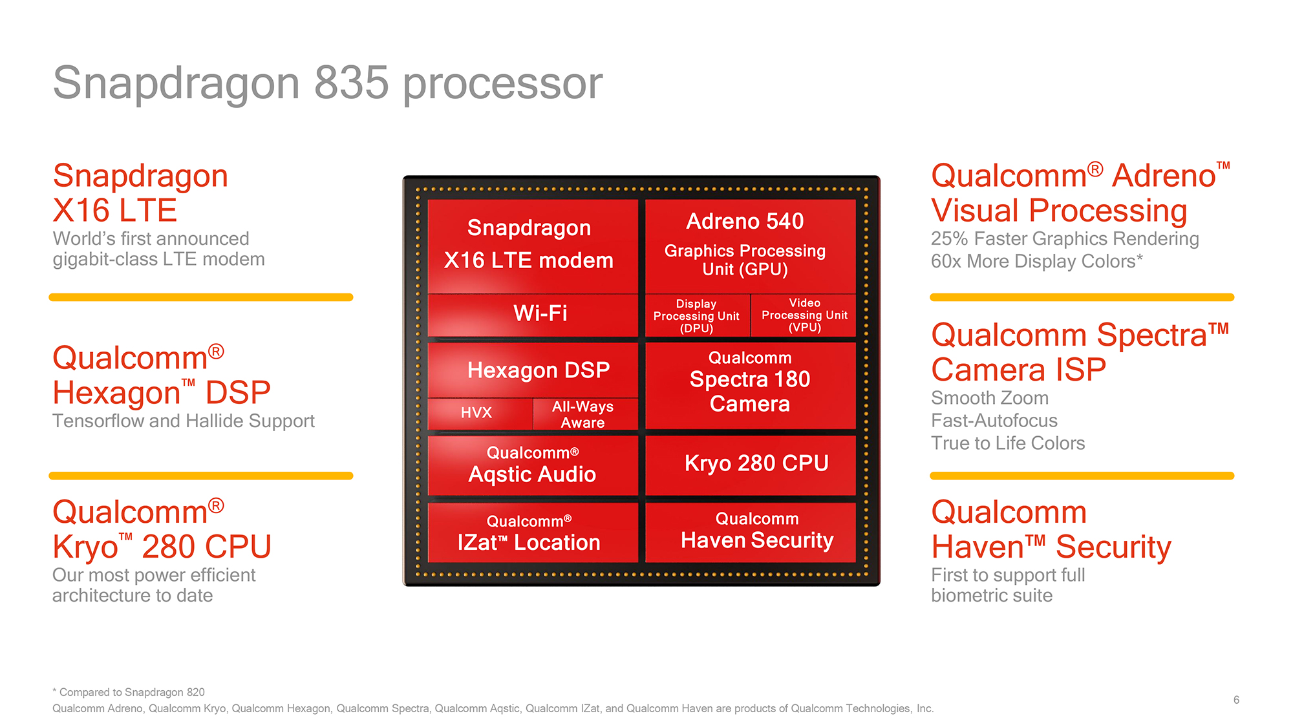
Mobile processors architectures (1)
Introductory remarks
Recent mobile processors include
a number of subsystems, like
the CPU subsystem,
the GPU,
the modem,
the camera subsystem etc.
as indicated in the Figure on the right
showing major subsystems of
Qualcomm’s Snapdragon 835 (2017).
From all of these subsystems
we will deal only with the CPU
in this Section.
Snapdragon 835 [14]
Izat: Qualcomm’s in-house location technology

Slide 3
Architecture of mobile processors
1. Overview of the evolution of mobile processors
2. Evolution of the architecture of CPUs in mobile
processors
3. Evolution of the width of mobile CPU cores
4. Case example: Evolution of Samsung’s Mongoose
core family
5. References

Slide 4
1. Overview of the evolution of mobile processors
Notes:
4

Slide 5
1. Overview of the evolution of mobile processors (1)
Preliminary notes
In this Chapter we understand mobile processors as processors used in
cellphones (feature phones or smartphones) and tablets.
Somewhat deliberately, we count then laptop- and desktop processors to client
processors.
The rationale of this distinction is that mobile processors are mostly ARM-based
whereas client processors mostly x86-based.
We note also that mobile processors are often designated also as application
processors.
We will use the terms mobile processors and application processors
interchangeably.

Slide 6
1. Overview of the evolution of mobile processors (2)
1. Overview of the evolution of mobile processors
Recently, there are only a few vendors who are designing mobile processors,
such as
Qualcomm
Apple
MediaTek
Samsung
HiSilicon LSI (Huawei).
All of these vendors, except Samsung, are fabless, they are designing
processors, but manufacturing will be done by TSMC (Taiwanese
Semiconductor Manufacturing Company) and Samsung.
The next Figure shows the market share of the cited vendors in terms of their
worldwide revenue.
*

Slide 7
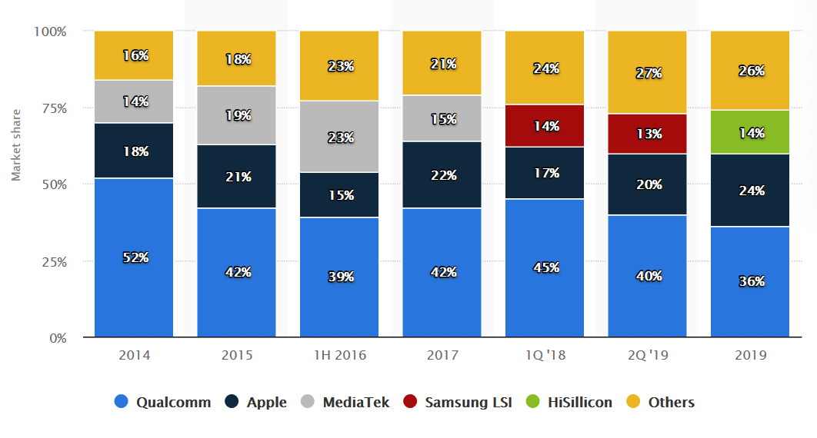
1. Overview of the evolution of mobile processors (3)
Worldwide market share of mobile processor suppliers according in terms of
their revenue 2014-2019 [60]
(Huawei)
HiSilicon is Huawei’s subsidiary fabless semiconductor manufacturing company.

Slide 8
1. Overview of the evolution of mobile processors (4)
The underlying ISA of mobile processors -1
First mobile processors were mostly based on the ARM ISA.
But then both Intel and AMD tried to get a foot in the door in the booming mobile
market with their x86 ISA based low power mobile processor lines.
Nevertheless, neither firm could achieve a notable market share and cancelled their lines.
In addition, Intel’s traditional x86 ISA-based Core 2 processors were also used
in 2-in-1 Windows tablets, these tablets achieved about 10 % share in tablets).
Mobile processors distinguished according to their underlying ISA
ARM ISA-based
mobile processors
x86 ISA-based
mobile processors
To be detailed next
Intel’s/AMD’s
Atom/Cat processors
Intel’s Core 2 processors
used in 2-to-one Windows tablets
Intel’s Atom family (2008-2016)
and AMD’s Cat family (2011-2016)
intended to be used in mobile
devices running under Windows.
In 2016 both Intel and AMD cancelled
their mobile oriented low power families.
Intel’s Core 2-based low-power
models are used in
2-to-1 Windows tablets,
like in Microsoft’s Surface line.
(a)
(b)
(c)
*

Slide 9
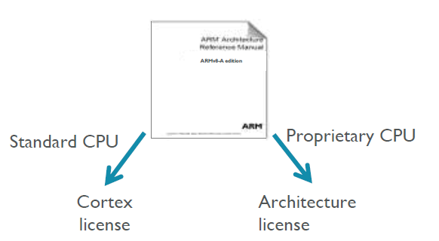
1. Overview of the evolution of mobile processors (5)
a) Use of ARM ISA-based processors in mobile devices -1 [62] -1
ARM provides either a Cortex license or an Architecture license.
In case of a Cortex license the licensee gets a complete standard microarchitecture
design (IP) with flexible configuration options, e.g. for the sizes of the L1 or L2
caches.
The Architecture license allows only using the ARM ISA and the licensee has to design
their custom microarchitecture, which leads to a proprietary CPU.
E.g. Apple or Samsung bought an Architecture license, custom designed their CPUs
and named them as they liked.
*

Slide 10
1. Overview of the evolution of mobile processors (6)
Use of ARM ISA-based processors in mobile devices -2
Use of ARM ISA-based processors in mobile devices
Use of ARM-licensed
Cortex cores
Use of in-house designed
custom cores
Apple
Ax famiily
ARM-licenced cores
(until the A5X in 2012)
In-house designed cores
since the A6, 2012
ARM licensed cores
until the in-house designed
Mongoose cores in 2016)
Samsung
Exynos family
In-house designed big Mongoose cores
but licensed LITTLE cores
between 2016-2020
ARM licensed big cores
beginning with the
Exynos 980 in 2020
ARM licensed cores
until 2008,
then both ARM-licensed
cores and in-house designed
Scorpion and Krait cores
until 2015.
Subsequently, only in-house
designed Kryo cores
(except the X1 big core
in the Snapdragon 888 (2020))
Qualcomm
Snapdragon family
HiSilicon (Huawei)
Kirin family
ARM-licensed cores.
MediaTek
Mtxxxx and
Helio families
ARM licensed cores

Slide 11
1. Overview of the evolution of mobile processors (7)
Use of ARM ISA-based processors in mobile devices -3
As the previous Figure shows, recently US-based Apple and Qualcomm use in-house
designed custom cores whereas other firms ARM licenced Cortex cores.

Slide 12
1. Overview of the evolution of mobile processors (8)
Evolution of ARM ISA-based mobile processors -1
In concert with the evolution of the ARM ISA also mobile processors evolved
by supporting continuously higher and higher ARM ISA versions.
A major step in this evolution path was a transition from Armv7-A based 32-bit
cores to Armv8-A based 64-bit cores, as indicated in the next Figure.
*

Slide 13
1. Overview of the evolution of mobile processors (9)
Timeline of the transition from 32-bit Armv7-based to 64-bit Armv8-based cores
in major mobile lines
*
9/2013
Apple
Ax
A7 with
2x Cyclone cores
*
10/2014 ?
MediaTek
MT
MT6732 with
4x Cortex A53
*
Q4/2014
Qualcomm
Snapdragon
Snapdragon 410 with
4x Cortex-A53 cores
*
10/2014
Samsung
Exynos
Exynos 5433 with
4x Cortex A57 and 4x Cortex A53
*
Q1/2015
Huawei
Kirin
Kirin 930 with
4x Cortex A53 @ 2.0 GHz and
4x Cortex A53 @ 1.5 GHz
2013
2014
2016
Figure: Transition from 32-bit Armv7-based to 64-bit Armv8-based cores in major mobile lines

Slide 14
1. Overview of the evolution of mobile processors (10)
Evolution of ARM ISA-based mobile processors -2
Nevertheless, there were two alternatives of how this transition happened:
a) to move to 64-bit while hold on the symmetrical multicore design or
b) to move to 64-bit while switching to the big.LITTLE design as well,
as the next Figure demonstrates.
*

Slide 15
1. Overview of the evolution of mobile processors (11)
Transition from 32-bit Armv7-based cores to 64-bit Armv8-based cores in major
mobile lines
*
9/2013
Apple
Ax
A7 with
2x Cyclone cores
*
Transition while retaining the symmetrical multicore design
10/2014 ?
MediaTek
MT
MT6732 with
4x Cortex A53
*
Q4/2014
Qualcomm
Snapdragon
Snapdragon 410 with
4x Cortex-A53 cores
*
10/2014
Samsung
Exynos
Exynos 5433 with
4x Cortex A57 and 4x Cortex A53
Transition while switching to
the big.LITTLE design
*
Q1/2015
Huawei
Kirin
Kirin 930 with
4x Cortex A53 @ 2.0 GHz and
4x Cortex A53 @ 1.5 GHz
2013
2014
2016
Figure: Transition from 32-bit Armv7-based to 64-bit Armv8-based cores in major mobile lines

Slide 16
1. Overview of the evolution of mobile processors (12)
Evolution of ARM ISA-based mobile processors -3
As the previous Figure indicates the transitions to the 64-bit Armv8-A ISA and
to the big.LITTE design style were more or less overlapping moves.
So it seems justified to look at the transitions to 64-bit Armv8-A ISA and the
big.LITTLE design style as one major evolution step of mobile processors that
took place around 2013-2016.
Soon after this transition ARM introduced their Armv8.2-A ISA revision that allowed
a further significant performance improvement, that invoked the next major step
of the evolution of mobile processors from 2017 on.
Accordingly, the evolution of ARM ISA-based multicore processors may be considered
as having taken place in three major steps (until now), as follows:
Evolution of ARM ISA-based multi-core mobile processors
ARMv7 ISA-based
32-bit architectures
with symmetrical multicores
ARMv8.0 ISA-based
ARMv8.2 or higher ISA-based
64-bit architectures
with big.LITTLE
core clusters
64-bit architectures
with DynamIQ
core clusters
*

Slide 17
1. Overview of the evolution of mobile processors (13)
Evolution of ARM ISA-based mobile processors -4
We note that big.LITTLE architectures and DynamIQ core clusters will be
described in Sections 2.4 and 2.5.

Slide 18
1. Overview of the evolution of mobile processors (14)
Evolution of supporting ARM ISA versions in major mobile processor lines
ARM ISA-based multi-core mobile processors
Armv7 ISA-based
32-bit architectures
with symmetrical multicores
(Except A15/A7-based proc.s.)
Armv8.0 ISA-based
Armv8.2 or higher ISA-based
64-bit architectures
with big.LITTLE
core clusters
64-bit architectures
with DynamIQ
core clusters
(2010-2013)
(2013-2016)
(2018-)
ARM
HP: Cortex-A15
MS: Cortex-A8/A9/A17
LP: Cortex-A5/A7
HP: Cortex-A57/A72/A73
LP: Cortex-A32/A35/A57
HP: Cortex-A75/
A76/A77/A78/X1
LP: A55
Qualcomm
Snapdragon 200-400
Snapdragon 600-602
Snapdragon 800-805
Snapdragon 410
Snapdragon 610-615
Snapdragon 808-821
Snapdragon 835-865
Snapdragon 7c-8cx
Samsung
Exynos 4
Exynos 5 up to 5430
Exynos 5 5433
Exynos 7/8
Exynos 9 8xxx
Exynos 9 9xxx
Exynos 900
Apple
A4-A6
A7-A10
A11, A12/A13 (v8.3)
MediaTek
MT 65xx
MT812x/813x/838x/839x
MT 67xx (~Helio P/X)
MT 816x/817x/873x
Helio G70-G90
Huawei
K3xx
Kirin 910-928
Kirin 650-658
Kirin 930-980
Kirin 990
HP: High Performance
MS: Mainstream
LP: Low Power

Slide 19
1. Overview of the evolution of mobile processors (15)
b) Intel’s/AMD’s x86 ISA-based Atom/Cat processors -1
In order to take a foot in the door in the booming mobile processor market both
Intel and AMD introduced low power x86 ISA-based mobile processor lines,
since their traditional lines were too power hungry for mobile use.
The introduced lines were:
Intel’s Atom line in 2008 and
AMD’s Cat line three years later, in 2011,
as seen in the next two Figures.
*

Slide 20
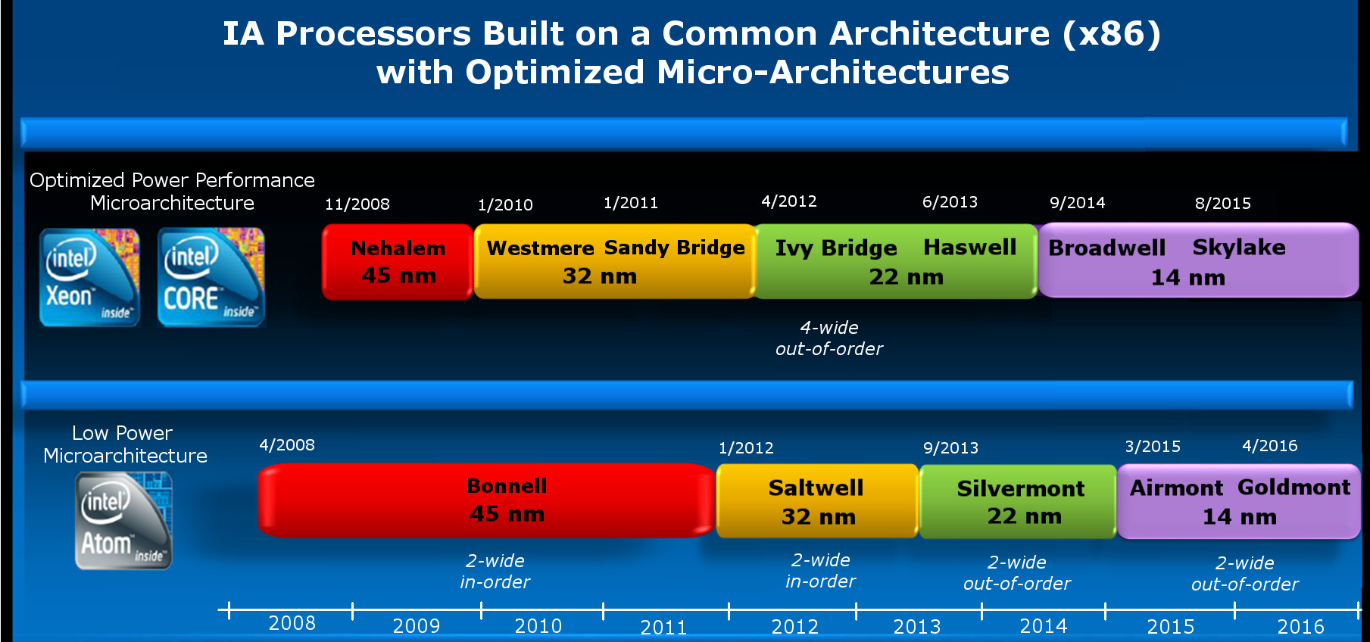
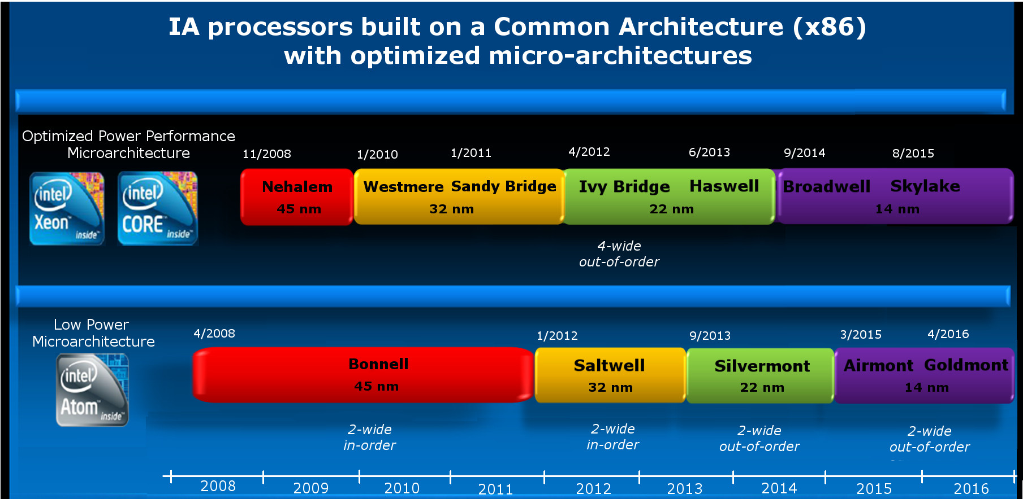
1. Overview of the evolution of mobile processors (16)
Intel’s x86-based Atom line introduced for mobiles [2]
5-wide
out-of-order
2-wide
in-order
2-wide
out-of-order
2-wide
out-of-order
3-wide
out-of-order
*

Slide 21
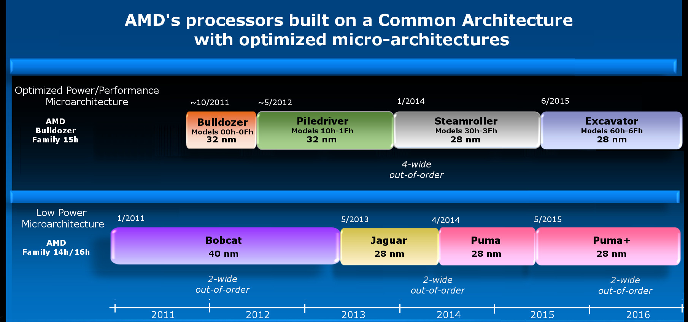
1. Overview of the evolution of mobile processors (17)
AMD’s x86-based Cat line introduced for mobiles
4-wide
out-of-order
4/2014
2-wide
out-of-order
2-wide
out-of-order
2-wide
out-of-order
2014
*

Slide 22
1. Overview of the evolution of mobile processors (18)
Intel’s/AMD’s x86-based Atom/Cat processors -2
Nevertheless, neither of both vendors could achieve a notable market share
in the mobile space, so finally both cancelled their mobile processor
developments in 2016.
*

Slide 23
1. Overview of the evolution of mobile processors (19)
Intel’s cancellation of their x86-based Atom line introduced for mobiles [2]
5-wide
out-of-order
2-wide
in-order
2-wide
out-of-order
2-wide
out-of-order
3-wide
out-of-order

Slide 24
1. Overview of the evolution of mobile processors (20)
AMD’s cancellation of their x86-based Cat line introduced for mobiles
4-wide
out-of-order
4/2014
2-wide
out-of-order
2-wide
out-of-order
2-wide
out-of-order
2014

Slide 25
1. Overview of the evolution of mobile processors (21)
c) Intel’s Core 2-based processors used in Windows 2-to-1 tablets
Intel’s Core 2-based low-power models find their way into a special segment
of tablets, called 2-to-1 Windows tablets, like in Microsoft’s Surface line from
2013 on.
2-to-1 tablets (called also 2-to-1 laptops, convertibles or detachables), represent
an intermediate device between tablets and laptops, as these devices can be
used either as stand alone tablets or as laptops when docked to a keyboard
(which is part of the device).
*

Slide 26
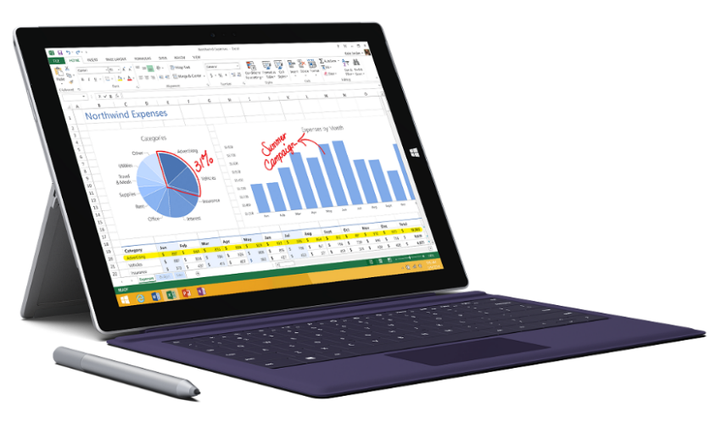
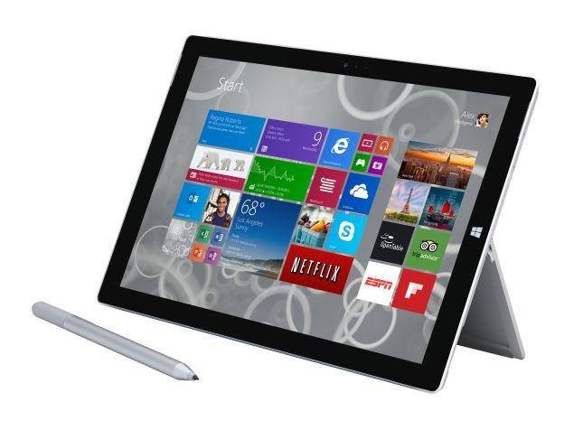
1. Overview of the evolution of mobile processors (22)
Example: Windows Surface Pro 3 (8/2014)
2 in 1 tablet 12”
Aim: Replacing laptops
Intel’s Surface Pro 3
used as a laptop [22]
Intel’s Surface Pro 3
used as a tablet [23]

Slide 27
1. Overview of the evolution of mobile processors (23)
Intel’s Core 2-based processors used in mobiles -2
First x86-based Windows tablets were introduced by Microsoft in 2013, called the
Surface Pro line, they were built on low power Core 2 models, as shown
in the Table below.
Model | Intro | Processor | Word length | Core count | OS
Surface Pro | 02/2013 | Ivy Bridge i5 | 64-bit | 2 | Windows 8 Pro
Surface Pro 2 | 10/2013 | Haswell i5 | 64-bit | 2 | Windows 8.1 Pro
Surface Pro 3 | 06/2014 | Haswell i3/i5/i7 | 64-bit | 2 | Windows 8.1 Pro
Surface Pro 4 | 10/2015 | Skylake-U i5 | 64-bit | 2 | Windows 10 Pro
Surface Pro 2017 | 06/2017 | Kaby Lake m3 | 64-bit | 2 | Windows 10 Pro
Surface Pro 6 | 10/2018 | Kaby Lake Refr. | 64-bit | 4 | Windows 10 Home
Surface Pro 7 | 10/2019 | Ice Lake i3/i5/i7 | 64-bit | 2/4 | Windows 10 Home
Table: Microsoft’s Intel Core 2-based Surface Pro Windows tablets

Slide 28
1. Overview of the evolution of mobile processors (24)
Intel’s Core 2-based processors used in mobiles -3
Subsequently, a number of OEMs followed suit with x86-based Windows tablets,
like Lenovo or Acer.
At present, x86-based 2-to-1 Windows tablets have a market share of about 10 %
among tablets, as the next Figure shows [61].
*

Slide 29
1. Overview of the evolution of mobile processors (25)
Intel’s Core 2-based processors used in mobiles -4
x86 processors–based tablets typically run under Windows, whereas tablets
built up of ARM ISA-based processors usually run under Android or iOS.
Here we note, that in 2017 also ARM processor based Windows tablets also
made their debut, (see later in this Section).
*

Slide 30
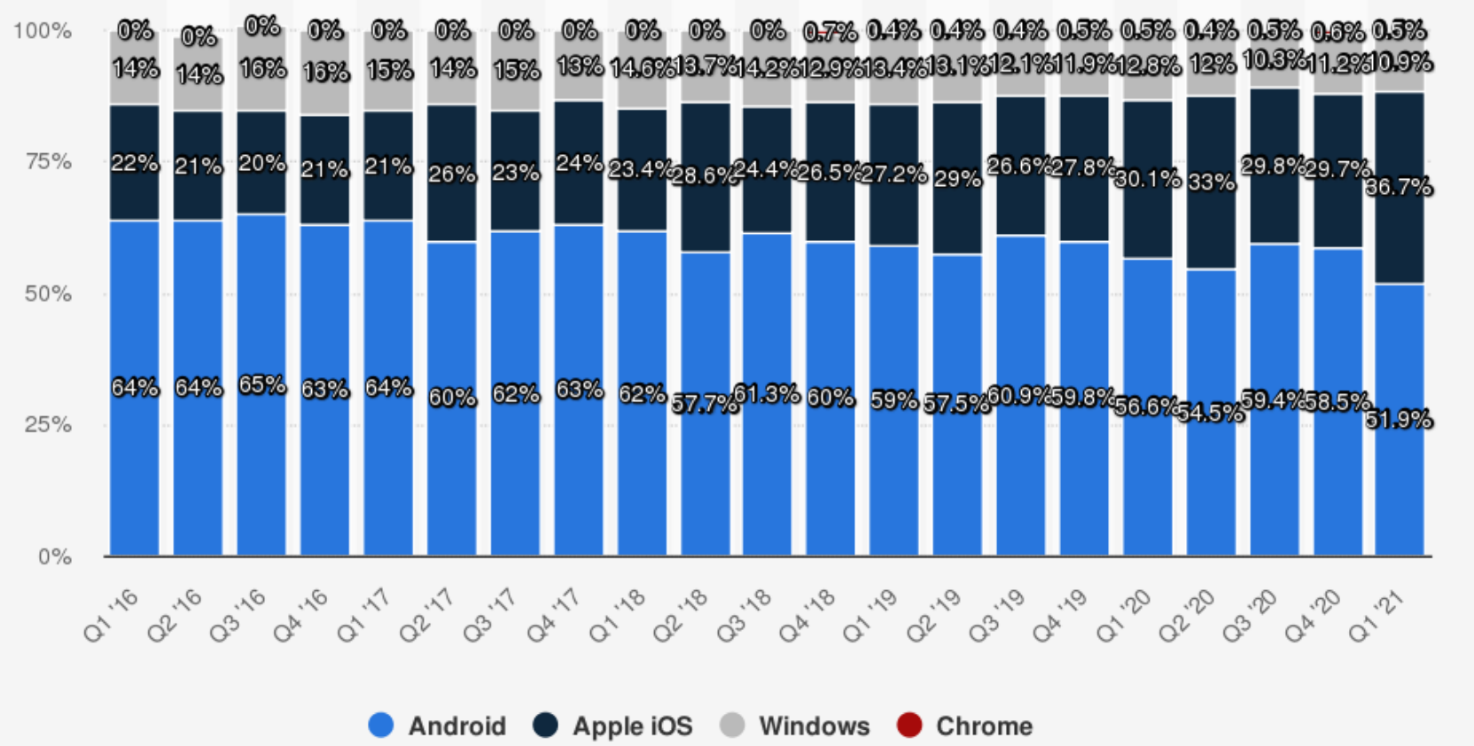
1. Overview of the evolution of mobile processors (26)
Tablet OS market share worldwide 2016-2021 [61]
In the Figure the grey coloured track represent 2-in-one tablets running under Windows.
*

Slide 31
1. Overview of the evolution of mobile processors (27)
Remarks to ARM ISA-based Windows 2-in-1 tablets
In 2017 Qualcomm debuted ARM ISA-based Snapdragon processors (see the
Figure below) targeting in the first line Always-On-Always-Connected 2-in-1
laptops running under Windows 10.
This is a remarkable move since previously Windows 2-in-1 laptops were
typical territory of x86 processors.
Qualcomm
Snapdragon
*
*
*
*
*
835
845
850
8cx
8c/7c
2017
2018
2019
2020
Figure: Qualcomm’s Snapdragon processors designed to run under Windows 10

Slide 32
1. Overview of the evolution of mobile processors (28)
Remark: Windows 10 support of the Snapdragon 800 and cx/c-tagged families
Model nr. | Windows support | Use
800 - 821 | no | In a large number of Android smartphones, e.g. in Samsung’s Galaxy S4-S7 families
835 | yes | In a large number of Android smartphones (e.g. in Samsung’s Galaxy S8 family) and in a few Windows 10-based 2-in-1 laptops
845 | yes | In Android smartphones (e.g. Samsung’s Galaxy S9) but no use in Windows 10-based devices
850 | yes | In a few Windows 10-based 2-in-1 laptops but not in Android devices
855 | no | In a large number of Android smartphones, e.g. in Samsung’s Galaxy S10 and Galaxy Note 10 families
855 Plus | no | In a large number of Android smartphones
865 | no | In a large number of Android smartphones, e.g. in Samsung’s Galaxy S20 family
8cx | yes | In a few Windows-based 2-in-1 laptops
8c | yes
7c | yes | In a few Windows-based 2-in-1 laptops

Slide 33
1. Overview of the evolution of mobile processors (29)
The underlying ISA of mobile processors – Summing up
Summing up, recent mobile processors are predominantly ARM ISA based,
nevertheless, some Windows 2-in-1 tablets make use of Intel’s Core 2 processors
(e.g. in Microsoft’s Surface tablets).
*

Slide 34
1. Overview of the evolution of mobile processors (30)
OSs support of mobile processors
Accordingly, recent mobile devices are running mainly under three OSs, as follows:
OS use in mobile devices
Android
iOS
Windows
Except Apple’s Axx-based
mobile devices
most other mobile devices,
built on ARM ISA-based
processors, including
Qualcomm’s Snapdragon,
Samsung’s Exynos,
MediaTek’s MT6xxx/8xxx or
Huawei Kirin processors,
run under Android
Apple Axx-based
mobile devices
on x86 ISA-based
mobile devices
on ARM-ISA based
2-to-1 Windows tablets
It is used in
2-in-1 laptops
built on
Qualcomm’s
8xx line
(introduced in 2017)
built on
Atom/Cat
processors
built on
Core 2–based
processors
It was used
in a few
mobile devices,
(but both lines
were cancelled
in 2016)
It is used in a few
Windows tablets,
or 2-in-1 laptops, like
Microsoft’s Surface,
Acer’s Switch or
Lenovo’s Yoga Book
lines
*
The next Figures give a more detailed account of OS support of smartphones and tablets.

Slide 35
1. Overview of the evolution of mobile processors (31)
Worldwide market share of smartphone OSs sold to end users 2009-2018 [56]
*
*

Slide 36
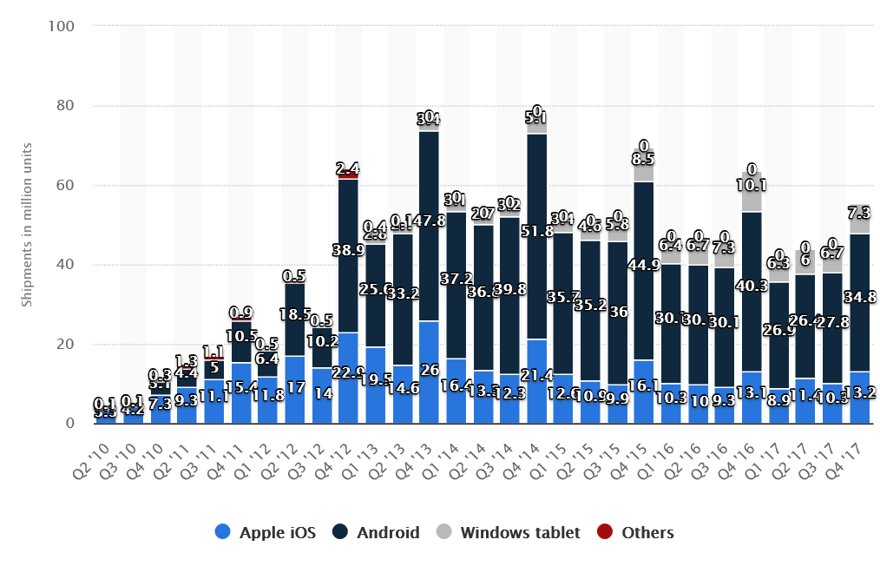
1. Overview of the evolution of mobile processors (32)
Worldwide shipments of tablet OSs Q2/2010 -Q4/2017 [57]

Slide 37
1. Overview of the evolution of mobile processors (33)
Remarks to further OSs used in a few mobile devices, like KaiOS, Nokia’s S40 and
the Symbian OS as well as Windows Phone OSs
KaiOS is a web-based operating system targeting cell phones and IoT devices
with a small memory footprint.
KaiOS is an offspring of the Firefox OS open-source project owned by Mozilla,
starting in 2011 but became an independent design of the US firm KaiOS
(established in 2016).
Nokia’s S40 was a software platform for mass market phones.
S40-based phones became popular in the first years of the 2010’s.
By contrasts, Nokia’s subsequent Series 60 devices were smartphones running
under the Symbian OS.
The Symbian OS was originally developed by Symbian Ltd. that was bought out
by Nokia in 2008 and made it open source.
The Symbian OS was primarily used by Nokia, but other firms, like Sony
or Samsung also licensed it.
After 2011, Nokia started Lumia phones, in partnership with Microsoft, that run
first, under Microsoft’s Windows Phone 7.5 then 8.0, 8.1 etc. but became
discontinued after 2014 due to lack of market success.

Slide 38
1. Overview of the evolution of mobile processors (34)
Remarks to the emergence of ARM ISA-based Apple processors in Apple’s Mac devices
After introducing the Core family in 2006 Apple made a transition in their
iMac/MacBook family of laptops and desktops from PowerPC processors to
Intel’s Core 2 processors.
Nevertheless, in 06/2020 Apple announced their plan to replace Intel’s x86
processors by ARM ISA-based in-house designed M1 processors in their Mac
family, running under macOS 11.0.
First Mac devices (13-inch MacBook Pro, MacBook Air, and Mac mini laptop and
desktop models) built on the M1 processor appeared in 11/2020.
*

Slide 39
1. Overview of the evolution of mobile processors (35)
Subsequently discussed key features of mobile processor architectures
In this chapter we are focusing only on two key issues of mobile processors,
as follows:
how CPU architectures evolved and
how the width of CPU cores evolved.
General processor issues like branch prediction, cache architecture, cache
coherency, memory attachment, heterogeneous computing with accelerators,
such as GPUs, NPUs (Neural Processing Units), interconnection networks
or platform issues, such as I/O interfaces are not discussed.
In addition, at the end of this Section we give a brief overview of the evolution
of Samsung’s proprietary Mongoose cores.
This is based on an account designers gave in 2020 after Samsung’ Austin
R&D Center (SARC), founded in 2010, was shut down in 2019 and related
processor design work cancelled.

Slide 40
2. Evolution of CPU architectures in mobile processors
2.1 Overview of the evolution
2.2 Single-core mobile processors
2.3 Symmetrical multicore-based mobile processors
2.4 big-LITTLE core clusters-based mobile processors
2.5 DynamIQ core clusters-based mobile processors
Notes:
40

Slide 41
2.1 Overview of the evolution
Notes:
41

Slide 42
2.1 Overview of the evolution (1)
2.1 Overview of the evolution -1
CPU architectures of mobile processors evolved in four consecutive steps, as follows.
First mobile processors were obviously, single-core implementations,
Then, around 2011-2013, single core implementations were replaced by
symmetrical multicores to raise performance.
Shortly thereafter symmetrical multicores gave way to big.LITTLE architectures
to reduce power consumption.
Finally, around 2018, big.LITTLE core clusters were substituted by dynamIQ core
clusters to benefit of greater design flexibility and improve power efficiency.
Main types of CPU architectures in mobile processors
Single core CPUs
Multicore CPUs
Symmetrical
multicores
big.LITTLE
core clusters
DynamIQ
core clusters
Typically 32-bit wide
(~2003-2010)
Typically 32-bit wide
(~2011-2013)
Typically 64-bit wide
(~2013-2016)
64-bit wide
(~2018-)
Figure: Evolution of the CPU architecture in mobile processors
*

Slide 43
2.1 Overview of the evolution (2)
2.1 Overview of the evolution -2
Note that the above overview of the evolution does not make any distinction between
32- and 64-bit designs since this feature does not impact significantly the basic
layout of the microarchitecture of mobile processors.
The next Figure gives an overview of how the CPU architecture of major mobile
processor lines evolved.
*

Slide 44
2.1 Overview of the evolution (3)
Evolution of CPU architectures in mobile processors
Major evolution steps of CPU architectures in mobile processors
Single core CPUs
Multicore CPUs
Symmetrical
multicores
big.LITTLE
core clusters
DynamIQ
core clusters
Exclusive cluster allocation
Inclusive
core allocation
(GTS)
Apple
ARM1176 (2007)
until A4 (2010)
A5 (2011)
(2C)
A10 (2016)
(2+2)C
A11 (2017)
(2+4)C
A12? (2018)
(2+4)C
Samsung
Exynos
3110 (2010)
3250 2C (2011)
4412 4C (2012)
5410 (2013)
(4+4)C
5420 (2013)
(4+4)C
9810 (2018)
(4+4)C
Qualcomm
Snapdragon
MSM 7225 (2007)
8260 2C (2013)
400 4C (2013)
808 (2+4)C (2014)
810 (4+4)C (2015)
845 (2018)
(4+4)C
855 (2018)
(1+3+4)C
Huawei
Kirin
(K3V1) (2009)
(K3V2 4C (2012))
920 (4+4)C (2014)
980 (2018)
(2+2+4)C
MediaTek
MT6218B
(2003)
MT6582 4C (2013)
MT6592 8C (2013)
MT8135 (2+2)C (2013)
MT6595 (4+4)C (2014)
Helio P90 (2+6)C (2019)

Slide 45
2.1 Overview of the evolution (4)
Remarks
There are two major options for the implementation of big.LITTLE architectures,
called exclusive cluster migration and inclusive core migration.
These terms will be described in the Section 2.4.3.
Next Sections overview subsequent steps of the evolution of CPU architectures
outlined above.

Slide 46
2.2 Single-core mobile processors
This Section is omitted in the Lecture.
Notes:
46

Slide 47
2.2 Single-core mobile processors (1)
2.2 Single core mobile processors -1
Main types of CPU architectures in mobile processors
Single core CPUs
Multcore CPUs
Symmetrical
multicores
big.LITTLE
core clusters
DynamIQ
core clusters
Cluster migration
Core migration
(GTS)
Apple
ARM1176 (2007)
until A4 (2010)
A5 (2011)
(2C)
A10 (2016)
(2+2)
A11 (2017)
(2+4)
Samsung
Exynos
3110 (2010)
3250 2C (2011)
4412 4C (2012)
5410 (2013)
(4+4)
5420 (2013)
(4+4)
9810 (2018)
(4+4)
Qualcomm
Snapdragon
MSM 7225 (2007)
8260 2C (2013)
400 4C (2013)
808 (2+4) (2014)
810 (4+4) (2015)
845 (2018)
(4+4)
Huawei
Kirin
(K3V1) (2009)
(K3V2 (2012))
920 (4+4)) 2014)
980 (2018)
(2+2+4)C
MediaTek
MT6218B
(2003)
MT6582 4C (2013)
MT6592 8C (2013)
MT8135 (2+2)C (2013)
MT6595 (4+4)C (2014)
Helio P90 (2+6)C (2019)

Slide 48
2.2 Single-core mobile processors (2)
Single core mobile processors -2
First mobiles, that is cell phones from the beginning of the 2000’s or
first smartphones from the second half of the 2000’, like RIM’s Blackberry 8100
(2006) or Apple’s iPhone (2007) or iPhone 4 (2010) included only single core
processors.
Unfortunately, very few documentations are still available from those early
mobile processors.
From those yet available, subsequently we will show an example.
The chosen example is the layout of the Blackberry 8100 mobile processor
that came to the market in 2006 and is considered to be the first smartphone,
developed by the Canadian firm RIM (Research in Motion).
It run under the BlackBerry OS.
Single core mobile processors were the starting point of the impressive evolution
of application processors that power mobiles.

Slide 49
2.2 Single-core mobile processors (3)
Example: RIM’s Blackberry Pearl 8100 smartphones (2006) include
single core processors [24]

Slide 50
2.2 Single-core mobile processors (4)
Remarks -1
Originally, the Blackberry Pearl 8100 used Intel’s PXA27X mobile processor
(with a clock frequency of 312 MHz).
The PXA27X processor implements Intel’s Xscale architecture that is based
on the ARMv5 ISA.

Slide 51
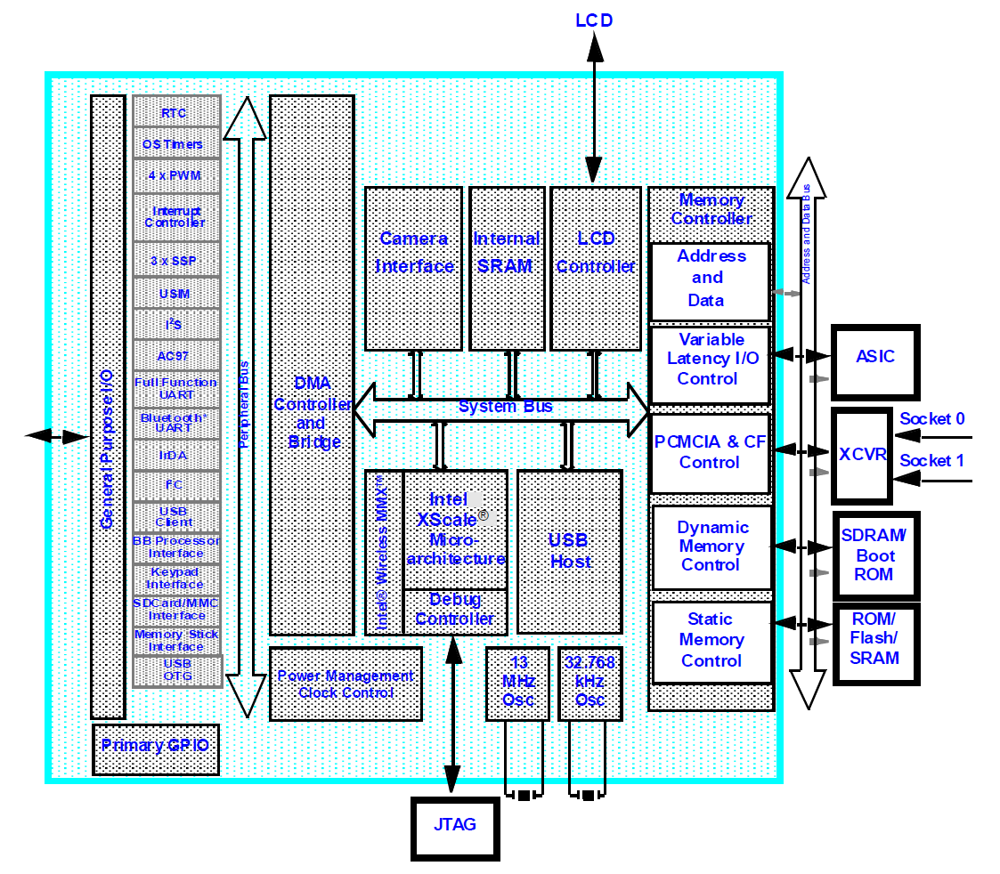
2.2 Single-core mobile processors (5)
Block diagram of Intel’s PXA27x used originally in the Blackberry Pearl 8100
[25]

Slide 52
2.2 Single-core mobile processors (6)
Remarks -2
In 2006 Intel sold the ARMv5 based PXA family to Marvell, thus subsequently
the PXA27X was replaced in the Blackberry 8100 by Marvell’s PXA90xB3C312.
Later Marvell designed and manufactured all application processors of the entire
Blackberry Pearl line (with certain enhanced features, like adding a GSM/CDMA
communication module).
Note that until 2006 Intel designed and manufactured mobile processors based
on the ARM ISA.
Supposedly, about the same time Intel started designing their x86-based mobile
Atom line that was introduced in 2008.

Slide 53
2.2 Single-core mobile processors (7)
Remarks -3
First single core application processors did not include a GPU.
First mobile processors with an integrated GPU emerged around 2007 to 2008,
like in Apple’s iPhone (2007) or RIM’s Blackberry Storm 9500 (2008).
Note that GPUs became integrated to the CPU die in mobiles a few years earlier
than in desktops, since desktop processors with integrated GPUs, such as
Intel’s Sandy Bridge or AMD’s Lliano, emerged both only in 2011.

Slide 54
2.3 Symmetrical multicore-based mobile processors
Notes:
54

Slide 55
2.3 Symmetrical multicore-based mobile processors (1)
2.3 Symmetrical multicore-based mobile processors -1
Main types of CPU architectures in mobile processors
Single core CPUs
Multicore CPUs
Symmetrical
multicores
big.LITTLE
core clusters
DynamIQ
core clusters
Cluster migration
Core migration
(GTS)
Apple
ARM1176 (2007)
until A4 (2010)
A5 (2011)
(2C)
A10 (2016)
(2+2)
A11 (2017)
(2+4)
Samsung
Exynos
3110 (2010)
3250 2C (2011)
4412 4C (2012)
5410 (2013)
(4+4)
5420 (2013)
(4+4)
9810 (2018)
(4+4)
Qualcomm
Snapdragon
MSM 7225 (2007)
8260 2C (2013)
400 4C (2013)
808 (2+4) (2014)
810 (4+4) (2015)
845 (2018)
(4+4)
Huawei
Kirin
(K3V1) (2009)
(K3V2 4C (2012)
920 (4+4)) 2014)
980 (2018)
(2+2+4)C
MediaTek
MT6218B
(2003)
MT6582 4C (2013)
MT6592 8C (2013)
MT8135 (2+2)C (2013)
MT6595 (4+4)C (2014)
Helio P90 (2+6)C (2019)

Slide 56
2.3 Symmetrical multicore-based mobile processors (2)
Emergence of symmetrical multicores in mobile processor lines -2
As the preceding Figure shows symmetrical multicores emerged in mobile processors
from 2011 on, i.e. about 6 years later than in desktop processors, such as Intel’s
dual-core Pentium D (2005) or AMD’s K8-based Toledo (2005).
*

Slide 57
2.3 Symmetrical multicore-based mobile processors (3)
Aim of introducing symmetrical multicores
The aim is raising performance by having more CPU cores for execution (rather than
increasing reliability by multiplication of the cores).
*

Slide 58
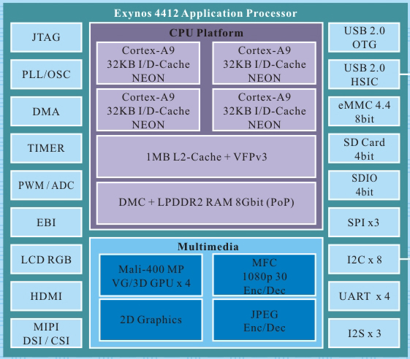
2.3 Symmetrical multicore-based mobile processors (4)
Symmetrical multicore-based mobile processors -2
Symmetrical multicores are processors with multiple CPU cores operating in parallel.
Example
Figure: Example of a symmetrical multicore processor
(actually Samsung’s Exynos 4412 mobile processor, 2012)
*

Slide 59
2.3 Symmetrical multicore-based mobile processors (5)
Evolution of symmetrical multicores in mobile processor lines -1
Symmetrical multicores
2-cores
3-cores
4-cores
8-cores
Apple
A5 (2011)
(2x Cortex-A9)
A8X (2014)
(3x Typhoon)
Samsung
Exynos
Exynos 3250 (2011)
2x Cortex-A7
Exynos 4412 (2012)
4x Cortex-A9
Exynos 7580 (2015)
8x Cortex-A53
Qualcomm
Snapdragon
S200 (2013)
2x Cortex-A7
S400 (2013)
4x Cortex-A7
Huawei
Kirin
K3V2 (2012)
(4x Cortex-A9)
Kirin 620 (2015)
(8x Cortex-A53)
MediaTek
MT6572 (2013)
2x Cortex-A7
MT6582 (2013)
4x Cortex-A7
MT6592 (2013)
8x Cortex-A7
Note: The dates after the model designations are the release dates of the
first models of the related lines providing the indicated number of cores.

Slide 60
2.3 Symmetrical multicore-based mobile processors (6)
Typical implementation of symmetrical multicores
Dual and quad core symmetrical multicores are built up as dual- or four-way
core clusters with a shared (inclusive) L2 cache (and private L1 caches),
as indicated below:
C0
C0
C0
C0
C0
C0
L1I/L1D
L1I/L1D
L1I/L1D
L1I/L1D
L1I/L1D
L1I/L1D
L2
L2
L2
L2
2-way core cluster with shared L2
4-way core cluster with shared L2
Octa core symmetrical multicores are implemented typically as dual 4-way
core clusters, they are also called multi-cluster SMPs.
During memory accesses, cache coherency within the core cluster is maintained
by the shared L2 cache by its cache coherency protocol.
A core cluster is connected to the rest of the mobile application processor
typically via a cache coherent interconnect.
*

Slide 61
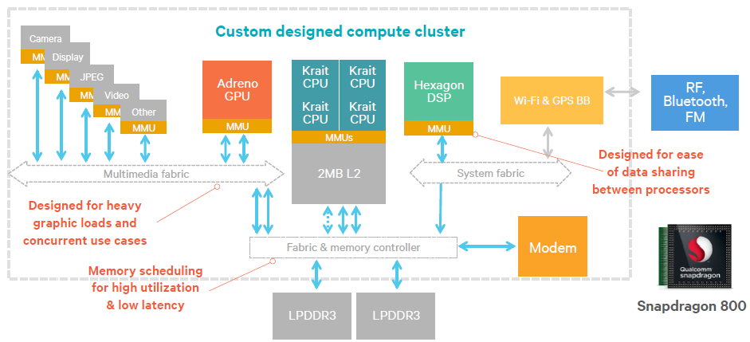
2.3 Symmetrical multicore-based mobile processors (7)
Example: Block diagram of a quad core symmetrical multicore
(Qualcomm’s Snapdragon 800 SOC) (2013) [27]

Slide 62
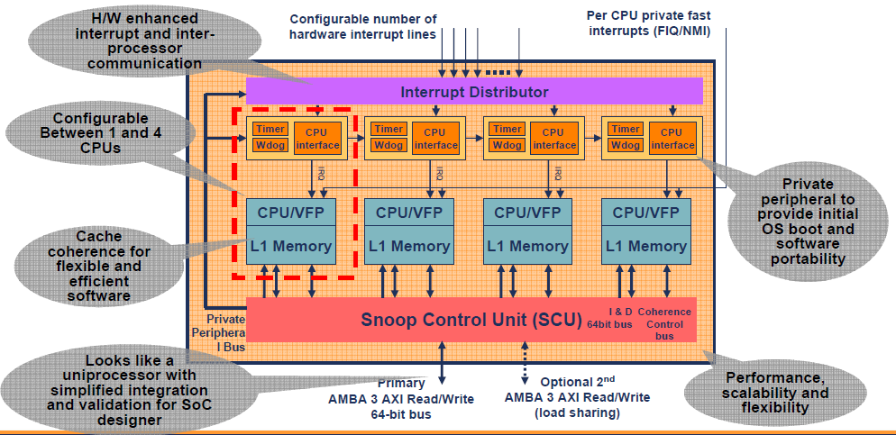
2.3 Symmetrical multicore-based mobile processors (8)
Historical remark: Emergence of core cluster in the ARM11 MPCore
The first 4-way core cluster was introduced by ARM in 2004, it was Armv6-based.
This core cluster however did not include an L2 cache, thus cache coherency was
provided by a dedicated Snoop Control Unit, as shown below.
Figure: ARM’s first 4-way core cluster (without an L2 cache) from 2004 [30]

Slide 63
2.4 big.LITTLE core clusters-based mobile processors
2.4.1 The rationale for big.LITTLE processing
2.4.2 Principle of big.LITTLE processing
2.4.3 Implementation of the big.LITTLE technology
2.4.4 Task scheduling of big.LITTLE mobile processors
Notes:
63

Slide 64
2.4 big-LITTLE core clusters-based mobile processors (1)
2.4 big-LITTLE core clusters-based mobile processors
Main types of CPU architectures in mobile processors
Single core CPUs
Multicore CPUs
Symmetrical
multicores
big.LITTLE
core clusters
DynamIQ
core clusters
Cluster migration
Core migration
(GTS)
Apple
ARM1176 (2007)
until A4 (2010)
A5 (2011)
(2C)
A10 (2016)
(2+2)
A11 (2017)
(2+4)
Samsung
Exynos
3110 (2010)
3250 2C (2011)
4412 4C (2012)
5410 (2013)
(4+4)
5420 (2013)
(4+4)
9810 (2018)
(4+4)
Qualcomm
Snapdragon
MSM 7225 (2007)
8260 2C (2013)
400 4C (2013)
808 (2+4) (2014)
810 (4+4) (2015)
845 (2018)
(4+4)
Huawei
Kirin
(K3V1) (2009)
(K3V2 (2012))
920 (4+4)) 2014)
980 (2018)
(2+2+4)C
MediaTek
MT6218B
(2003)
MT6582 4C (2013)
MT6592 8C (2013)
MT8135 (2+2)C (2013)
MT6595 (4+4)C (2014)
Helio P90 (2+6)C (2019)

Slide 65
2.4.1 The rationale for big.LITTLE processing
Notes:
65

Slide 66
2.4.1 The rationale for big.LITTLE processing (1)
2.4.1 The rationale for big.LITTLE processing [1]
big.LITTLE technology aims at power reduction.
The technology is based on the recognition that processors of smartphones or
tablets have dynamically changing loads, i.e. high intensity processor requests
alternate with low intensity processor requests.
The idea of the big.LITTLE technology is that power consumption of the chip
could be reduced when
high intensity loads would run on powerfull but power hungry cores whereas
low intensity loads on less powerful but less power hungry cores.
*

Slide 67
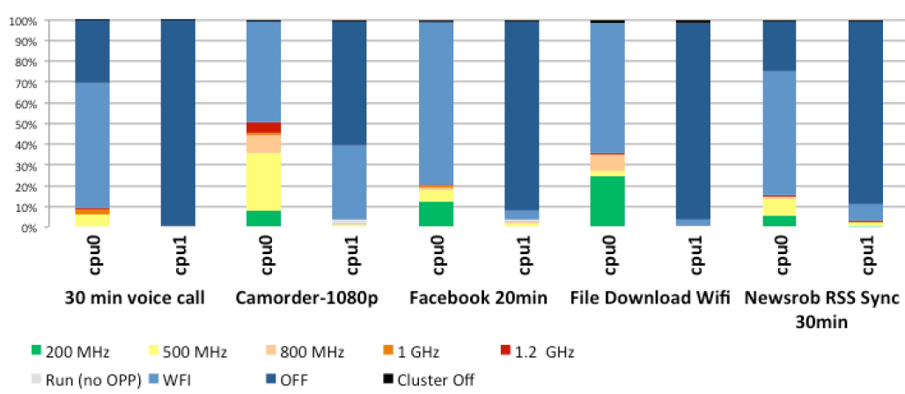
2.4.1 The rationale for big.LITTLE processing (2)
Example: Percentage of time spent in DVFS states for less demanding
workloads in a dual core mobile device [9] -1
(Core)
WFI: Waiting for Interrupt
The graph above shows the percentage of time spent in DVFS states, in idle states
and shutdown states in a dual core Cortex-A9 based mobile device.
In the diagram, the red color indicates the highest, green the lowest frequency operating points whereas colors in between represent intermediate frequencies.
Light blue means that the core is idling for Waiting for Interrupt (WFI), dark blue
indicates that the core is shut down, i.e. both cores are shut down.

Slide 68
2.4.1 The rationale for big.LITTLE processing (3)
Example: Percentage of time spent in DVFS states for low intensity
use cases in a mobile device [9] -2
As seen in the diagram, both cores spend most on their time in idle, shut down or
light intensity states, thus there is a large headroom for power saving when
less powerful but less power hungry cores are used for light intensity, idle or
shut down phases of the operation.

Slide 69
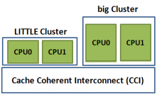
2.4.1 The rationale for big.LITTLE processing (4)
Remark: The big.LITTLE technology is an alternative of task distribution
policy in heterogeneous multicore processors
Task distribution policies in heterogeneous multicore processors
Master/slave
processing
Task forwarding
to a dedicated accelerator
Task migration
to different kind of CPUs
Heterogeneous
master/slave processing
Heterogeneous
attached processing
Heterogeneous
big.LITLE processing
There is a master core (MCP)
and a number of slave cores.
The master core organizes
the operation of the slave cores
to execute a task
Beyond a CPU there are
dedicated accelerators,
like a GPU, available.
An instructon will be
forwarded to an accelerator
when it is capable of executing
this instruction more efficiently
than the CPU.
There are two or more clusters of cores,
e.g. two clusters; a LITTLE and a big one.
Cores of the LITTLE cluster execute
less demanding tasks and consume
less power, whereas cores of the big
cluster execute more demanding tasks
with higher power consumption.
MPC
Slave cores
CPU
GPU
E.g. the Cell processor from
IBM/Sony/Toshiba (2006).
Widely used in mobiles.
*
Widely used in mobiles.

Slide 70
2.4.2 Principle of big.LITTLE processing
Notes:
70

Slide 71

2.4.2 Principle of big.LITTLE processing (1)
2.4.2 Principle of big.LITTLE processing -1 [6]

Slide 72
2.4.2 Principle of big.LITTLE processing (2)
Principle of big.LITTLE processing -2
Let’s have two or more clusters of architecturally identical cores in a processor.
E.g. let’s take two clusters of two cores each;
a cluster of low performance/low power cores, termed as the LITTLE cores and
a cluster of higher performance higher power cores, termed as the big cores,
as seen in the Figure below.
Cluster of
big cores
Cluster of
LITTLE cores
CPU0
CPU1
CPU0
CPU1
Figure: A big.LITTLE configuration
consisting of two clusters
CPU2
CPU3
CPU2
CPU3
Cache coherent interconnect
To memory
Let’s interconnect these clusters by a cache coherent interconnect to have
a multicore processor, as indicated in the Figure above.
*

Slide 73
2.4.2 Principle of big.LITTLE processing (3)
Principle of big.LITTLE processing-3 [4]
There are a number of alternatives how big.LITTLE technology can be
implemented, as discussed later.
Nevertheless, to give a conceivable description of its principle of operation we
assume a specific implementation, called exclusive cluster switching to be
detailed in Section 2.4.3.
Further on, let us suppose that all cores of a cluster operate at the same
operating point (i.e. at the same clock frequency and core voltage) while
there are a few operating points available for both the LITTLE and the big core
clusters, as indicated in the next Figure.
*

Slide 74
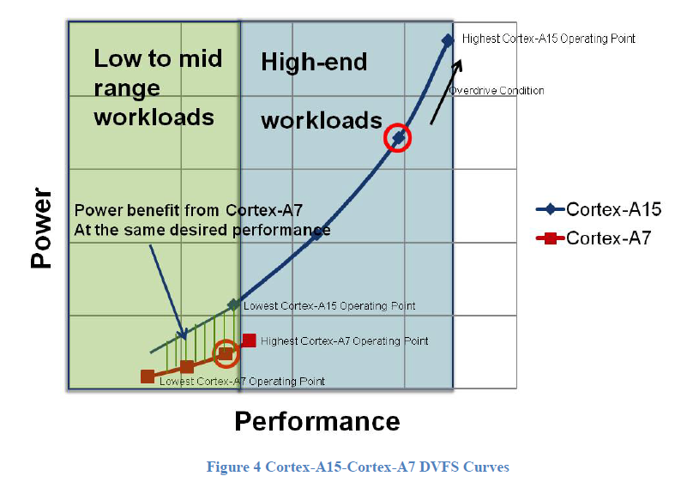
2.4.2 Principle of big.LITTLE processing (4)
Example: Operating points of a multiprocessor built up of two core clusters:
one of LITTLE cores (Cortex-A7) and one of big cores (Cortex-A15), as
described above [3]

Slide 75
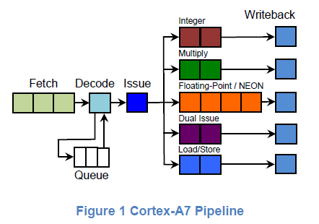
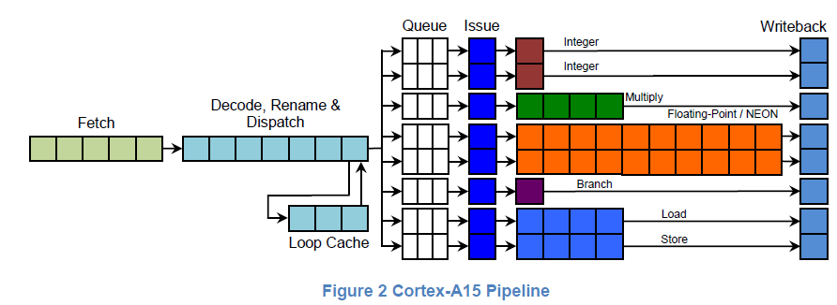
2.4.2 Principle of big.LITTLE processing (5)
Examples of big (Cortex-A15) and LITTLE cores (Cortex-A7) [3]

Slide 76
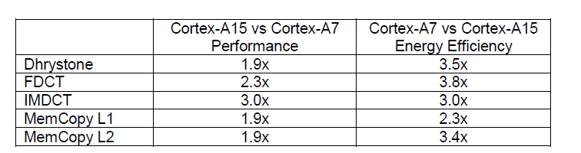
2.4.2 Principle of big.LITTLE processing (6)
Performance and energy efficiency comparison of the Cortex-A15 vs. the
Cortex-A7 cores [3]

Slide 77
2.4.2 Principle of big.LITTLE processing (7)
Principle of operation -2 [4]
Let’s suppose that an appropriate OS routine (e.g. the cpufreq kernel routine of
Linux) tracks the workload and selects the operating points accordingly.
As long as the OS routine estimates that the actual workload can be tackled
by the cores of the „LITTLE” cluster it activates only the cores of this cluster.
If however the workload exceeds the performance capability of the LITTLE core
cluster, it activates the cluster of the high performance cores of the “big” cluster
and performs a cluster switch by migrating the actual workload from the cores
of the “LITTLE” cluster to the cores of the “big” cluster and switches off
the cores of the “LITTLE” cluster.
On the other hand, if the OS recognizes that the workload can be managed
by the cores of the “LITTLE” cluster alone, it initiates a cluster switch back
to the “LITTLE” cluster in a similar way as described above.
In this way, at any given time only cores of one cluster can be active and the
choice which cluster is activated depends on the intensity of the workload.
This kind of the big.LITTLE technology is called Exclusive cluster switching.
*

Slide 78
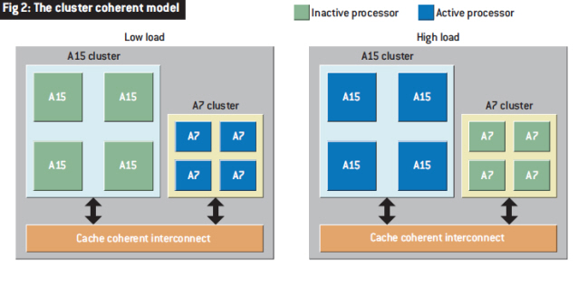
2.4.2 Principle of big.LITTLE processing (8)
Illustration of the described model of operation [7]
Note that at low load the LITTLE (A7) and at high load the big (A15) cluster is
operational.

Slide 79
2.4.3 Implementation of the big.LITTLE technology
Notes:
79

Slide 80
2.4.3 Implementation of the big.LITTLE technology (1)
2.4.3 Implementation of the big.LITTLE technology
Hardware requirements of big.LITTLE systems [1]
big and LITTLE cores of a big.LITTLE system need to satisfy a few requirements
for a seamless operation, such as
the big and LITTLE CPU cores must be architecturally identical,
i.e. they must have the same ISA in order to run the same instructions and
support the same ISA extensions concerning virtualization, address space
management etc. and
both core clusters must operate fully cache coherent to support seamless
task migration.
Recommended core pairings are
 | 1st Generation: ARMv7 (32-bit word length, 40-bit addresses) | 2nd Generation: ARMv8 (32/64-bit word length, up to 52-bit addresses)
High-performance CPU cores (big) | Cortex-A15, Cortex-A17 | Cortex-A57, Cortex-A72/73
High-efficiency CPU cores (LITTLE) | Cortex-A7 | Cortex-A53
In each of the above core combinations, the big and LITTLE clusters may have
up to four cores each.
*

Slide 81
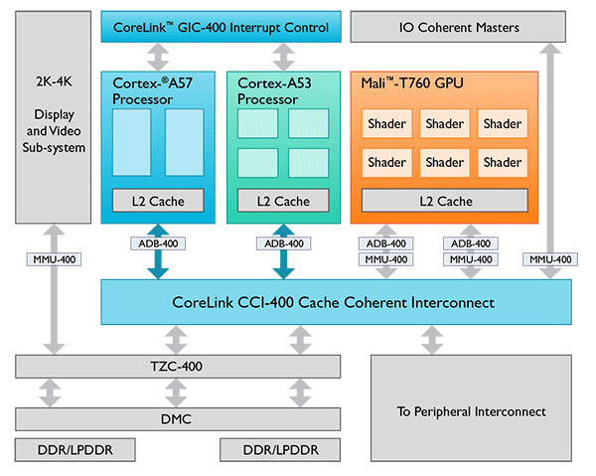
2.4.3 Implementation of the big.LITTLE technology (2)
Example 1: Block diagram of a 2. gen. two-cluster big.LITTLE SoC [1]
ADB-400: AMBA Domain Bridge
AMBA: Advanced Microcontroller Bus Architecture
TZC-400 TrustZone Address Space Controller
DMC: Dynamic Memory Controller

Slide 82
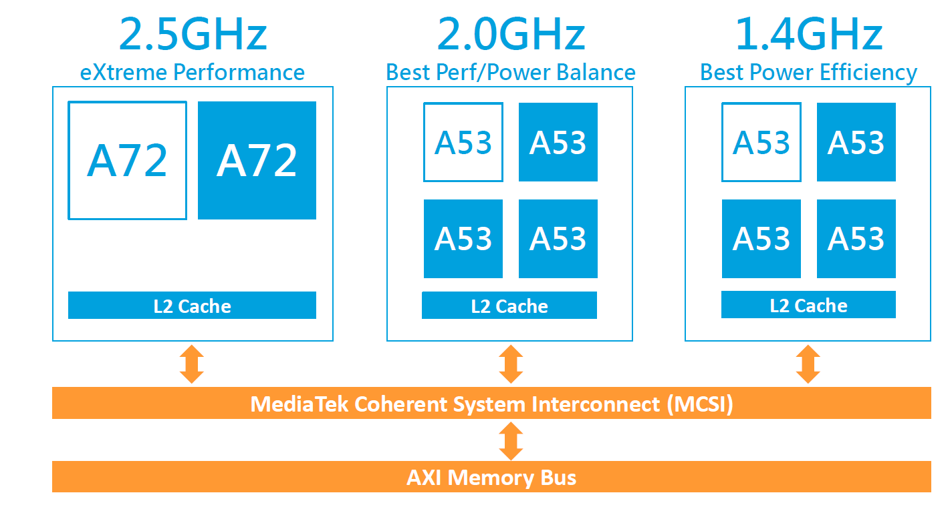
2.4.3 Implementation of the big.LITTLE technology (3)
Example 2: Block diagram of a 2. gen. three-cluster big.LITTLE SOC [46]
First three cluster (10-core) implementation (Q1/2016): MediaTek Helio X20 (6797).
It includes two A53 clusters with different maximum clock frequencies and
different performance-power characteristics, as indicated in the next Figure.
Figure: Three cluster big.LITTLE implementation of MediaTek's Helio X20 [46]

Slide 83
2.4.3 Implementation of the big.LITTLE technology (4)
Power-performance characteristics of the three cluster configuration [47]

Slide 84
2.4.3 Implementation of the big.LITTLE technology (5)
Required software support of the big.LITTLE technology
The big.LITTLE technology needs appropriate software support, e.g. for load
tracking, task scheduling, including task migrations, power management, etc.
The software needed will be provided for the OEMs by the SoC supplier, usually
in form of kernel patches or an appropriate software package.
In this chapter we will not go into details of the software required by the
big.LITTLE technology, but refer to the related literature.
*

Slide 85
2.4.3 Implementation of the big.LITTLE technology (6)
Main aspects of the implementation of the big.LITTLE technology
Concerning this point, subsequently, we discuss three main aspects of its design space.
Implementation of the big-LITTLE technology
No. of core clusters
and no. of cores per cluster
Basic policy of
task scheduling
Options for supplying
core frequencies and voltages
These design aspects will be discussed subsequently.
*

Slide 86
2.4.3 Implementation of the big.LITTLE technology (7)
a) Number of core clusters and number of cores per cluster -1
Implementation of the big-LITTLE technology
No. of core clusters
and no. of cores per cluster
Basic policy of
task scheduling
Options for supplying
core frequencies and voltages

Slide 87
2.4.3 Implementation of the big.LITTLE technology (8)
Number of core clusters and number of cores per cluster -2
Number of core clusters
and number of cores per cluster
Dual core clusters used
Three core clusters used
Example
configurations
4 + 4
2 + 2
1 + 4
4 + 4 + 2
4 + 2 + 4
4 + 3 + 1
Cluster of
big cores
Cluster of
LITTLE cores
running at
a lower core
frequeency
Cluster of
LITTLE cores
running at a
higher core
fequency
Cluster of
big cores
Cluster of
LITTLE cores
CPU0
CPU1
CPU0
CPU1
CPU0
CPU1
CPU0
CPU1
CPU2
CPU3
CPU2
CPU3
CPU2
CPU3
CPU2
CPU3
CPU2
CPU3
Cache coherent interconnect
Cache coherent interconnect
*
Memory
Memory

Slide 88
2.4.3 Implementation of the big.LITTLE technology (9)
Example 1: Dual core clusters, 1+4 cores in Nvidia's
Tegra 3 with one A9 LP + four A9 (2011) and
Tegra 4 with one A15 LP + four A15 cores (2013).
Cluster of
high performance cores
CPU0
CPU1
“Cluster” of
a single
low power
core
It is called Nvidia's
Variable SMP
CPU2
CPU3
CPU0
Cache coherent interconnect
The LP tag designates a core running at a reduced clock rate.

Slide 89
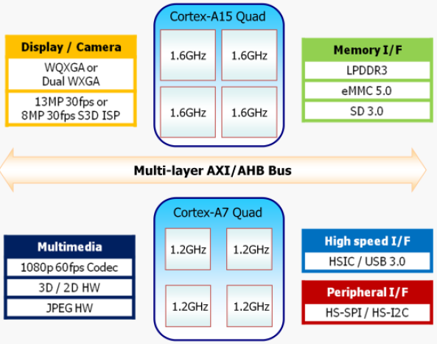
2.4.3 Implementation of the big.LITTLE technology (10)
Example 2: Dual core clusters, 4+4 cores: Samsung Exynos Octa 5410 [11]
It is the world’s first octa core mobile processor.
Announced in 11/2012, launched in some Galaxy S4 models in 4/2013.
Figure: Block diagram of Samsung’s Exynos 5 Octa 5410 [11]

Slide 90
2.4.3 Implementation of the big.LITTLE technology (11)
Example 3: Three core clusters, 2+4+4 cores: Helio X20 (MediaTek MT6797)
This is the world's first three cluster 10-core big.LITTLE implementation.
All cores in each cluster run at the same clock frequency, as shown below.
Announced in 9/2015, launched in 11/2015.
Figure: Three cluster big.LITTLE implementation in MediaTek's Helio X20 [46]

Slide 91
2.4.3 Implementation of the big.LITTLE technology (12)
b) Basic policy of task scheduling -1
Implementation of the big-LITTLE technology
No. of core clusters
and no. of cores per cluster
Basic policy of
task scheduling
Options for supplying
core frequencies and voltages
Remark
Although there are 3-cluster implementations (e.g. MediaTek’s Helio line) as well,
subsequently, when we discuss the basic policy of task scheduling we assume
2-cluster configurations for simplicity.
Nevertheless, task scheduling in 3-cluster implementations follow the same
principles of operation as will be described for 2-cluster designs.

Slide 92
2.4.3 Implementation of the big.LITTLE technology (13)
b) Basic policy of task allocation -2
The kernel task scheduler allocates threads to cores for execution either on a
cluster- or a core bases, as detailed below.
Basic policy of task allocation
Cluster-based allocation
Core-based allocation
The scheduler selects a cluster as a whole and
allocates threads of the workload to cores
of the selected cluster.
The scheduler allocates threads of the workload
to individual cores
independently from their cluster affiliation.
*

Slide 93
2.4.3 Implementation of the big.LITTLE technology (14)
Alternative cluster-based allocation policies
As indicated below, there are two options how cluster allocation can be performed;
the Exclusive and the Inclusive cluster allocation.
Cluster-based allocation
Exclusive
cluster allocation
Inclusive
Cluster allocation
While using exclusive cluster allocation the scheduler allocates threads of the
workload to cores of either the big or the LITTLE cluster but never to both.
By contrast, with inclusive cluster allocation, the scheduler allocates threads of
low intensity workloads only to cores of the LITTLE cluster but threads of
high intensity workloads to cores of both the big and the LITTLE clusters,
as indicated in the next Figure.
*

Slide 94
2.4.3 Implementation of the big.LITTLE technology (15)
Contrasting exclusive and inclusive cluster-based allocation (assuming two clusters)
Cluster-based allocation
Exclusive
cluster allocation
Inclusive
Cluster allocation
The scheduler allocates the workload either to the cores of the big or the LITTLE cluster but never to both.
The scheduler allocates low intensity workloads
only to cores of the LITTLE cluster but high intensity
workloads to cores of both clusters.
Low load
High load
Low load
High load
Cluster of
big cores
Cluster of
big cores
Cluster of
big cores
Cluster of
big cores
Cluster of
LITTLE cores
CPU0
CPU1
Cluster of
LITTLE cores
CPU0
CPU1
Cluster of
LITTLE cores
CPU0
CPU1
Cluster of
LITTLE cores
CPU0
CPU1
CPU0
CPU1
CPU0
CPU1
CPU0
CPU1
CPU0
CPU1
CPU2
CPU3
CPU2
CPU3
CPU2
CPU3
CPU2
CPU3
CPU2
CPU3
CPU2
CPU3
CPU2
CPU3
CPU2
CPU3
Cache coherent interconnect
Cache coherent interconnect
Cache coherent interconnect
Cache coherent interconnect
Exclusive cluster migration
Inclusive cluster migration

Slide 95
2.4.3 Implementation of the big.LITTLE technology (16)
Alternative core-based allocation policies
As indicated below, there are two options how core-based allocation can be
performed; the Exclusive- and the Inclusive core allocation.
Core-based allocation
Exclusive
core allocation
(in big.LITTLE core pairs)
Inclusive
core allocation
(from all clusters)
In case of exclusive core allocation, available big and LITTLE cores are ordered
into core pairs, consisting of a LITTLE and a big core, and the scheduler
allocates either the big or the LITTLE core of a core pair to a thread of the
workload but never both cores of the same core pair.
By contrast, in case of inclusive core allocation, all big and LITTLE cores are
considered as available for allocation at the same time.
The scheduler (designated usually as the global scheduler) allocates then threads
of the workload to all available big and LITTLE cores according to a chosen
scheme.
The next Figure illustrates both core allocation policies for eight cores.
*

Slide 96
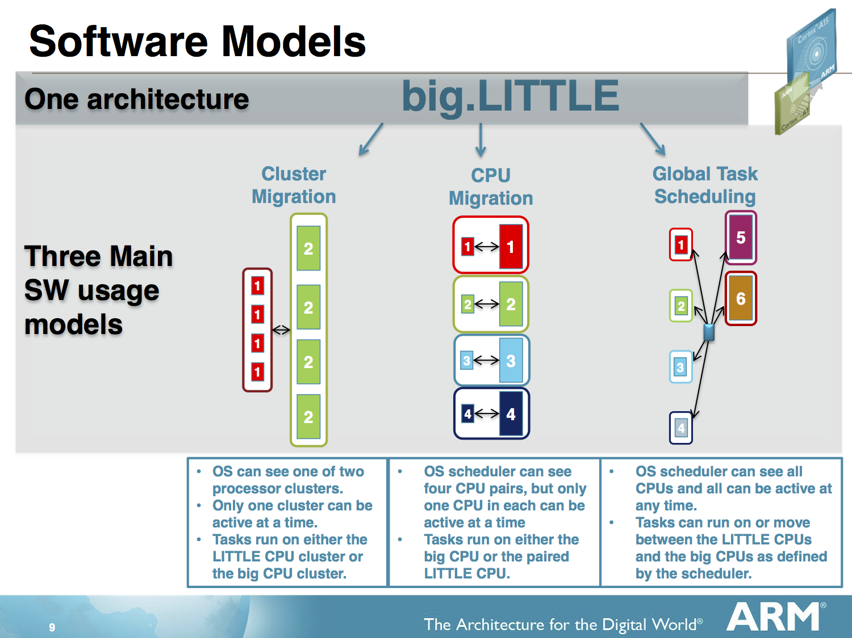
2.4.3 Implementation of the big.LITTLE technology (17)
Exclusive and inclusive core allocation [48]
Core-based allocation
Exclusive
core allocation
(in big.LITTLE core pairs)
Inclusive
core allocation
(from all clusters)
There are big and LITTLE cores
ordered in pairs.
In each core pair
either the big or the LITTLE core is allocated
if needed.
Both big and LITTLE cores may be used
at the same time.
A global scheduler allocates the workload
appropriately to all available
big and LITTLE cores.
Global scheduler

Slide 97
2.4.3 Implementation of the big.LITTLE technology (18)
Basic task allocation policies of the big.LITTLE technology and their
designations
While combining both aspects of the task allocation policy, i.e. the granularity of task
allocation and the exclusive or inclusive kind of task allocation we arrive at four basic
task allocation policies, as follows:
Basic policy of task allocation (in the big-LITTLE technology)
Cluster-based allocation
Core-based allocation
Exclusive
cluster allocation
Inclusive
cluster allocation
Exclusive
core allocation
(in big.LITTLE core pairs)
Inclusive
core allocation
(from all clusters)
Variable SMP (Nvidia)
Not used
In Kernel Switcher
(IKS)
Global Task scheduling (GTS)
Heterogeneous Multi-Processing (HMP)
*

Slide 98
2.4.3 Implementation of the big.LITTLE technology (19)
First appearance of basic task allocation policies in big.LITTLE systems
Basic policy of task allocation (in big-LITTLE systems)
Cluster-based allocation
Core-based allocation
Exclusive
cluster allocation
Inclusive
cluster allocation
Exclusive
core allocation
(in big.LITTLE core pairs)
Inclusive
core allocation
(from all clusters)
Variable SMP (Nvidia)
In Kernel Switcher
(IKS)
Global Task scheduling (GTS)
Heterogeneous Multi-Processing (HMP)
Described first in ARM’s
White Paper (2011) [3]
Described first in
ARM/Linaro EAS project
(2015) [49]
Described first in ARM’s
White Paper (2012) [9]
Described first in ARM’s
White Paper (2011) [3]
Used first in
Nvidia’s Tegra 3 (2011)
(1 A9 LP + 4 A9 cores)
Tegra 4 (2013)
(1 A15 LP core + 4 A15 cores)
No known
implementation
Implemented by Linaro
on ARM’s experimental
TC2 system (2013)
(3 A7 + 2 A15 cores)
Mediatek MT8135 (2013)
(2 A7 + 2 A 15 cores)
Samsung HMP on
Exynos 5 Octa 5420 (2013)
(4 A7 + 4 A15 cores)
Samsung Exynos 5
Octa 5410 (2013)
(4 A7 + 4 A15 cores)
Allwinner UltraOcta A80 (2014)
(4 A7 + 4 A15 cores)
Qualcomm Snapdragon S 808 (2014)
(4 A53 + 2 A57 cores)
ARM/Linaro EAS (2016)

Slide 99
2.4.3 Implementation of the big.LITTLE technology (20)
Use and evolution of the basic task allocation policies in mobiles
As the next Figure shows, first big.LITTLE systems made use of exclusive cluster
migration whereas subsequently, the inclusive core migration, called also Global
Task scheduling (GTS) or Heterogeneous Multi-Processing (HMP) became widely
spread.
*

Slide 100
2.4.3 Implementation of the big.LITTLE technology (21)
Utilized options of task allocation in the big.LITTLE technology -1
Basic policy of task allocation (in the big-LITTLE technology)
Cluster-based allocation
Core-based allocation
Exclusive
cluster allocation
Inclusive
cluster allocation
Exclusive
core allocation
(in big.LITTLE core pairs)
Inclusive
core allocation
(from all clusters)
Variable SMP (Nvidia)
In Kernel Switcher
(IKS)
Global Task scheduling (GTS)
Heterogeneous Multi-Processing (HMP)
Described first in ARM’s
White Paper (2011) [3]
Described first in
ARM/Linaro EAS project
(2015) [49]
Described first in ARM’s
White Paper (2012) [9]
Described first in ARM’s
White Paper (2011) [3]
Used first in
Nvidia’s Tegra 3 (2011)
(1 A9 LP + 4 A9 cores)
Tegra 4 (2013)
(1 A15 LP core + 4 A15 cores)
No known
implementation
Implemented by Linaro
on ARM’s experimental
TC2 system (2013)
(3 A7 + 2 A15 cores)
Mediatek MT8135 (2013)
(2 A7 + 2 A15 cores)
Samsung HMP on
Exynos 5 Octa 5420 (2013)
(4 A7 + 4 A15 cores)
Samsung Exynos 5
Octa 5410 (2013)
(4 A7 + 4 A15 cores)
Allwinner UltraOcta A80 (2014)
(4 A7 + 4 A15 cores)
Qualcomm Snapdragon S 808 (2014)
(4 A53 + 2 A57 cores)
ARM/Linaro EAS (2016)

Slide 101
2.4.3 Implementation of the big.LITTLE technology (22)
Use of the big.LITTLE technology in the evolution of CPU architectures of
mobile processors
Main types of architectures in mobile processors
Single CPU core
Multiple CPU cores
Symmetrical
multicores
big.LITTLE
core clusters
DynamIQ
core clusters
Exclusive
cluster allocation
Inclusive
core allocation
(GTS)
Apple
ARM1176 (2007)
until A4 (2010)
A5 (2011)
(2C)
A10 (2016)
(2+2)
A11 (2017)
(2+4)
Samsung
Exynos
3110 (2010)
3250 2C (2011)
4412 4C (2012)
5410 (2013)
(4+4)
5420 (2013)
(4+4)
9810 (2018)
(4+4)
Qualcomm
Snapdragon
MSM 7225 (2007)
8260 2C (2013)
400 4C (2013)
615 (4+4) (2014)
810 (4+4) (2015)
845 (2018)
(4+4)
Huawei
Kirin
(K3V1) (2009)
(K3V2 (2012))
920 (4+4)) 2014)
980 (2018)
(2+2+4)C
MediaTek
MT6218B
(2003)
MT6582 4C (2013)
MT6592 8C (2013)
MT8135 (2+2)C (2013)
MT6595 (4+4)C (2014)
Helio P90 (2+6)C (2019)

Slide 102
2.4.3 Implementation of the big.LITTLE technology (23)
c) Options for supplying core frequencies and voltages -1
Implementation of the big-LITTLE technology
No. of core clusters
and cores per cluster
Basic policy of
task scheduling
Options for supplying
core frequencies and voltages

Slide 103
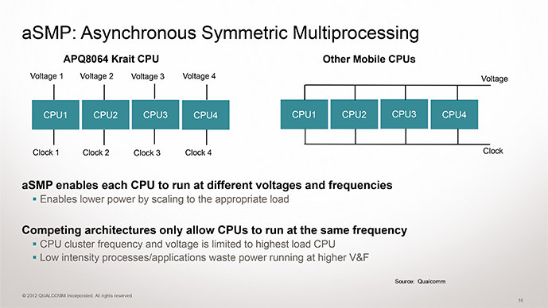
2.4.3 Implementation of the big.LITTLE technology (24)
Options for supplying core frequencies and voltages -2
Options for supplying core frequencies and voltages in a core cluster
Common core frequency
common core voltage
Per core core frequency
common core voltage
Per core clock frequency
per core core voltage
Examples in mobiles
Used for clusters
of big.LITTLE configurations, e.g.
ARM’s big.LITTLE technology (2011)
Nvidia’s vSMP technology (2011)
Used often along with clock gating
and power gating
Also used in DynamIQ clusters (2017)
Provided in ARM’s Cortex design
but it isn’t employed generally
No known implementation
Qualcomm Snapdragon family
with the Scorpion, the Krait
and Kryo cores (since 2011)

Slide 104
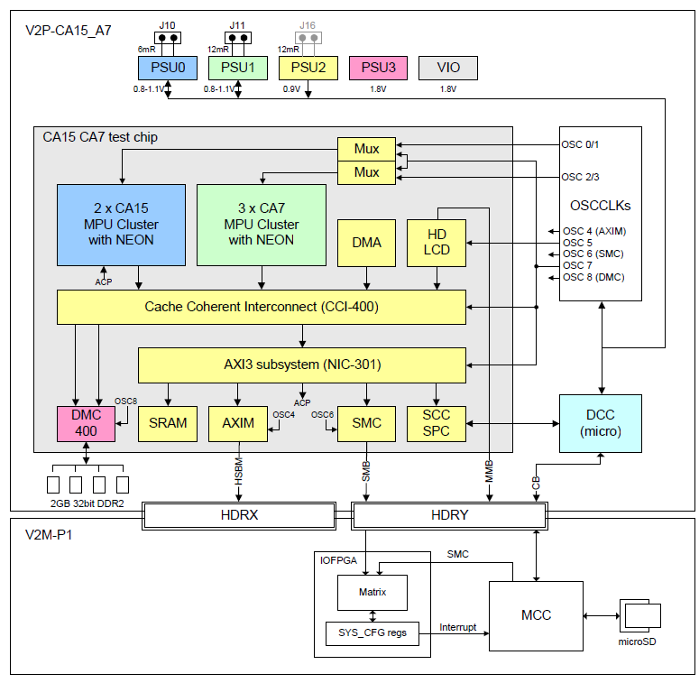
2.4.3 Implementation of the big.LITTLE technology (25)
Example 1: Per cluster clock and power domains in ARM’s big.LITTLE
test chip [10]
PSU: Power Supply Unit
CA15: Cortex-A15
CA7 : Cortex-A7
DCC: Cortex-M3

Slide 105
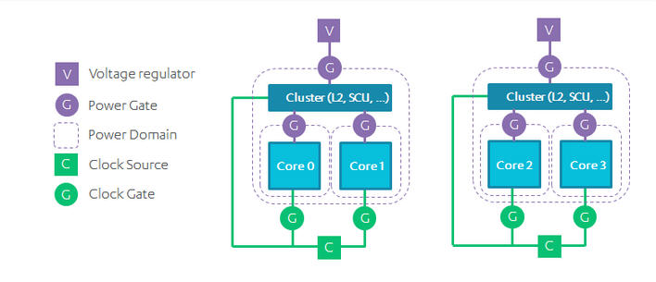
2.4.3 Implementation of the big.LITTLE technology (26)
Example 2: Per cluster clock and power domains enhanced with clock
and power gating that may be used in a broad range of CPU topologies [35]
Possible candidates of the above clock and power layout are:
SMPs
multi-cluster SMPs (e.g. 8-core SMPs)
traditional big-LITTLE configurations

Slide 106
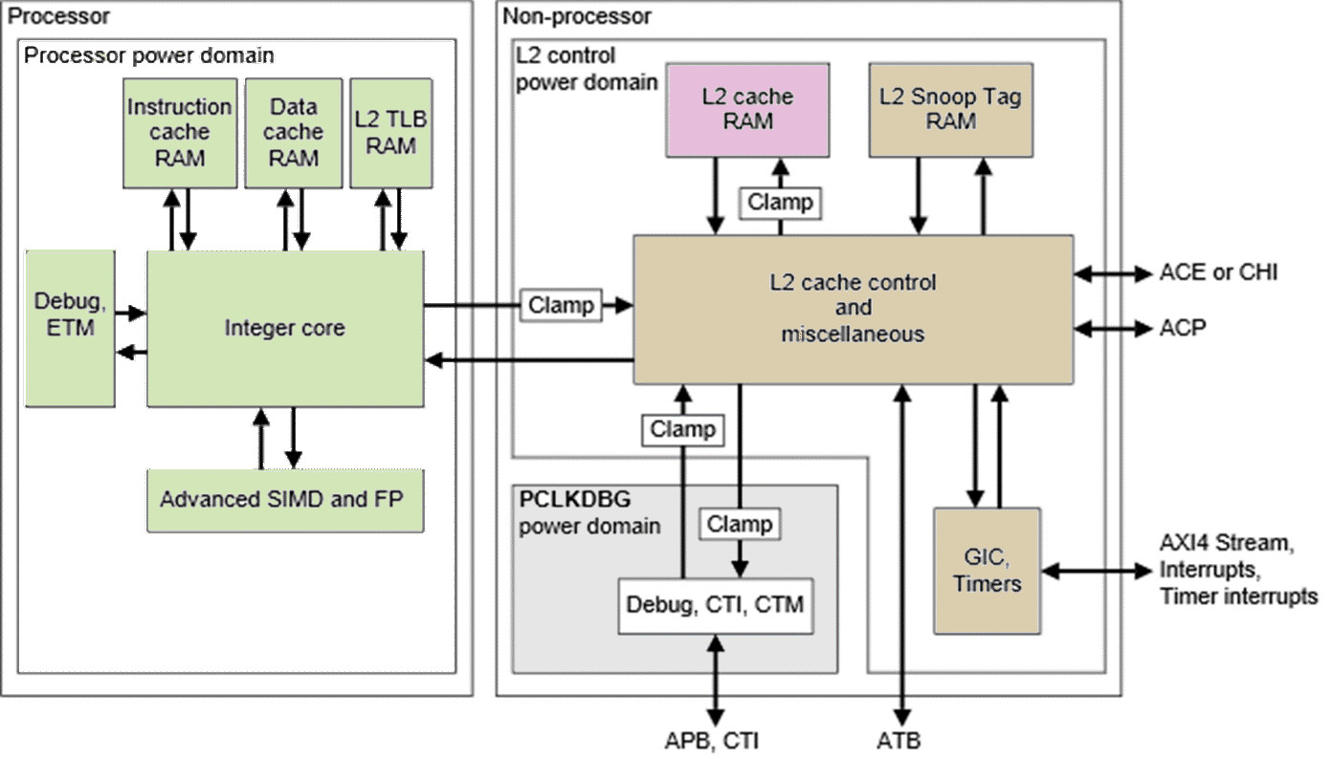
2.4.3 Implementation of the big.LITTLE technology (27)
Example 3: Per core power domains in the Cortex A-57 MPcore [50]
Notes: Different colors designate different power domains.
Each core has a separate power domain.

Slide 107
2.5 DynamIQ core clusters-based mobile processors

Slide 108
2.5 DynamIQ core clusters (1)
2.5 DynamIQ core clusters-based mobile processors -1
Main types of CPU architectures in mobile processors
Single core CPUs
Multicore CPUs
Symmetrical
multicores
big.LITTLE
core clusters
DynamIQ
core clusters
Exclusive
cluster allocation
Inclusive
core allocation
(GTS)
Apple
ARM1176 (2007)
until A4 (2010)
A5 (2011)
(2C)
A10 (2016)
(2+2)
A11 (2017)
(2+4)
Samsung
Exynos
3110 (2010)
3250 2C (2011)
4412 4C (2012)
5410 (2013)
(4+4)
5420 (2013)
(4+4)
9810 (2018)
(4+4)
Qualcomm
Snapdragon
MSM 7225 (2007)
8260 2C (2013)
400 4C (2013)
615 (4+4) (2014)
810 (4+4) (2015)
845 (2018)
(4+4)
Huawei
Kirin
(K3V1) (2009)
(K3V2 (2012))
920 (4+4)) 2014)
980 (2018)
(2+2+4)C
MediaTek
MT6218B
(2003)
MT6582 4C (2013)
MT6592 8C (2013)
MT8135 (2+2)C (2013)
MT6595 (4+4)C (2014)
Helio P90 (2+6)C (2019)

Slide 109
2.5 DynamIQ core clusters (2)
DynamIQ core clusters -2
ARM started working on the DynamIQ core cluster technology in 2013 [37].
It was announced in 03/2017.
It is an evolution of the big.LITTLE technology, as indicated in the next slide.
*

Slide 110
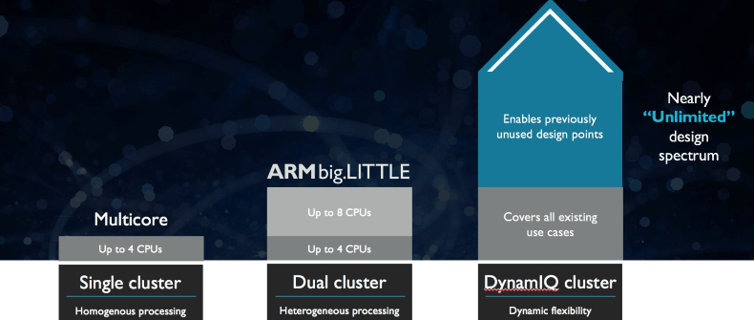
2.5 DynamIQ core clusters (3)
DynamIQ core clusters -3
It is the next step in the evolution of the core cluster technology.
SMP
(
)
ARM11 MPCore (2004)
Cortex-A7/A15 (~2011)
Cortex-A55/A75 (~2017)
Figure: Evolution steps of the core cluster technology [38]
*

Slide 111
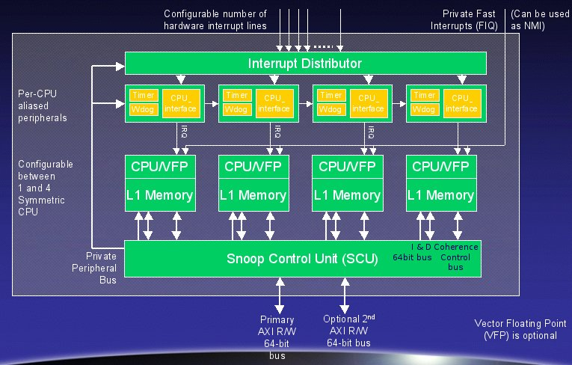
2.5 DynamIQ core clusters (4)
From the ARM11 MPCore to the big.LITTLE technology
SMP: ARM11 MPCore [39]
big.LITTLE
Cluster of
big cores
Cluster of
LITTLE cores
CPU0
CPU1
CPU0
CPU1
CPU2
CPU3
CPU2
CPU3
Cache coherent interconnect
(2004)
(2011)
SCU: Implements cache coherency

Slide 112
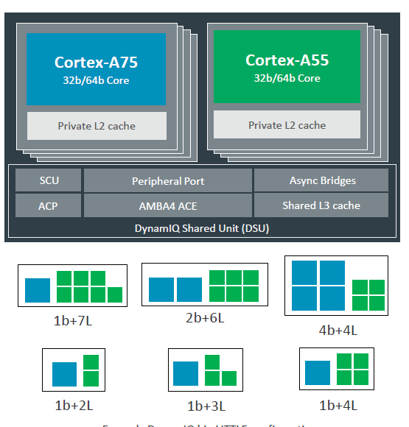
2.5 DynamIQ core clusters (5)
The DynamIQ technology as an evolution of the big.LITTLE technology
Two big.LITTLE core clusters
A single DynamIQ core cluster [40]
Cluster of
big cores
Cluster of
LITTLE cores
CPU0
CPU1
CPU0
CPU1
CPU2
CPU3
CPU2
CPU3
Cache coherent interconnect
To cache coherent interconnect through the AMBA4 ACE bus
To
Two stand alone clusters
with up to 4 cores (2011)
A single cluster of up to 8 cores of up two core types
(but up to 4 big cores) (2017)

Slide 113
2.5 DynamIQ core clusters (6)
DynamIQ core clusters -3
Benefits of the DynamIQ cluster technology:
greater flexibility
improved power efficiency through intelligent power management (EAS)
(Energy Aware Scheduling).
*

Slide 114
2.5 DynamIQ core clusters (7)
Remarks on EAS (Energy Aware Scheduling) [49]
Former Linux schedulers (like the CFS (Completely Fair Scheduler)) optimized for
the throughput and operate well in SMP configurations.
EAS is designed to optimize for lowest possible energy consumption while taking
into account different core configurations, e.g. big.LITTLE architectures.
ARM started to develop EAS in 2015 while working with the Linux community.
Scheduling issues will not be discussed in this Lecture.

Slide 115
2.5 DynamIQ core clusters (8)
DynamIQ core clusters -4
It assumes at least ARMv8.2 compatible cores, such as the Cortex-A55 and
Cortex-A75 cores.
*

Slide 116
2.5 DynamIQ core clusters (9)
Main enhancements of DynamIQ core clusters
Up to 8 CPU cores of up to 2 ARMv8.2 ISA based core types
Private (per-core) L2 caches in the CPU cores
c) DynamIQ Shared Unit (DSU) with a shared L3 cache and snoop filter
d) Capability for partitioning the cores and the L3 cache
e) Finer-grain frequency and voltage control
f) Cache stashing (not discussed)
*

Slide 117
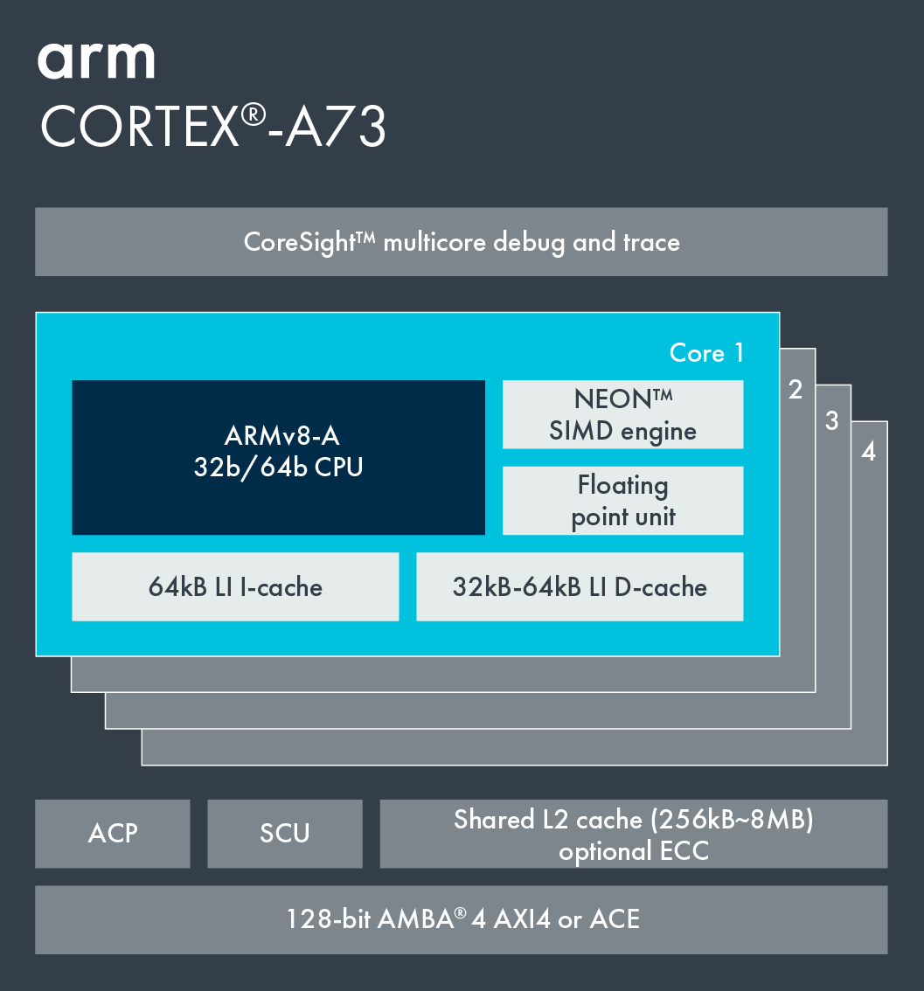
2.5 DynamIQ core clusters (10)
a) Up to 8 CPU cores of up to 2 ARMv8.2 ISA based core types
big.LITTLE core cluster (2015) [51]
DynamIQ core cluster (2017) [41]
Cortex-A73 core
ARMv8.0 CPU
ARMv8.0 support,
e.g. Cortex-A53/A57/A72/A73,
single CPU type, up to 4 cores/cluster
ARMv8.2 support,
Cortex-A55/75 or later cores
2 CPU types, up to 8 cores but only up to 4b/cluster
*

Slide 118
2.5 DynamIQ core clusters (11)
b) Private (per-core) L2 caches of the CPU cores
big.LITTLE core cluster (2015) [51]
DynamIQ core cluster (2017) [41]
Cortex-A73 core
ARMv8.0 CPU
ARMv8.0 support, e.g. Cortex-A53/
A57/A72/A73, up to 4 cores/cluster
Shared L2 cache
ARMv8.2 support, (Cortex-A55/75) or later cores
2 CPU types, up to 8 cores but only 4b/cluster
Private L2 caches, shared L3 cache
*

Slide 119
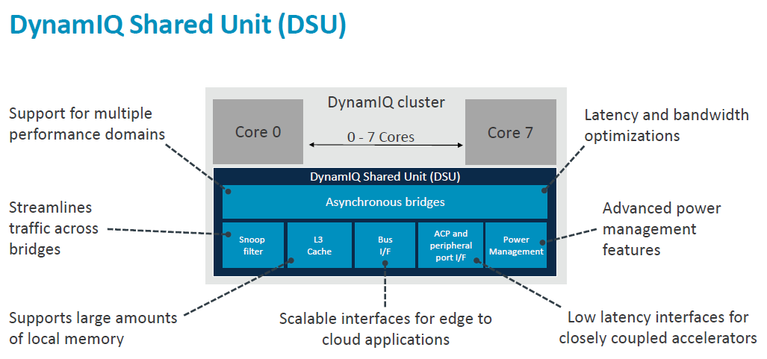
2.5 DynamIQ core clusters (12)
c) DynamIQ Shared Unit (DSU) with a shared L3 cache and snoop filter [41]
(Partitions)
(Per-CPU DVFS control,
Partial L3 power down)
(Up to two 128-bit AMBA 5 ACE,
256-bit AMBA 5 CHI)
Snoop filters (szimatolás szűrők) increase the efficiency of the implementation
of cache coherency (gyorsítótár tartalom egyezőség).
Snoop filters record the addresses of data that is stored in the caches,
observe data traffic and generate only necessary snoop traffic (e.g.
invalidating not more correct cache data).

Slide 120
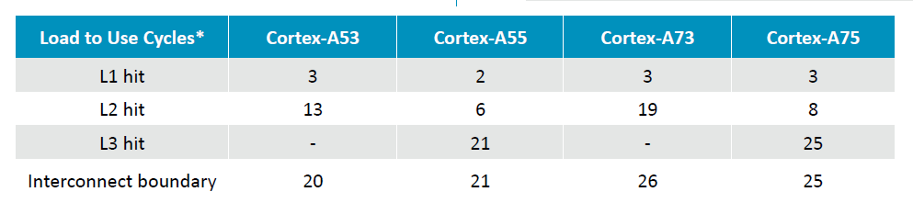
2.5 DynamIQ core clusters (13)
Additional benefit of the DSU: Reduced cache latencies [41]

Slide 121
2.5 DynamIQ core clusters (14)
d) Capability for partitioning the cores and the L3 cache [37]
It is feasible to set up up to four partitions by assigning the cores, the external
accelerators attached to the DSU via the ACP and sections of the L3 cache
into maximum 4 partitions.
Partitioning can be useful for embedded systems that run a fixed workload or
applications that require a more deterministic runtime.
Partitioning may be unbalanced, e.g. 1 CPU could be assigned 2 MB whereas
the other CPUs the remaining 2 MB memory (assuming an 8 MB configuration).
The partitions are dynamic and can be created/adjusted during runtime by
the OS or hypervisor.

Slide 122
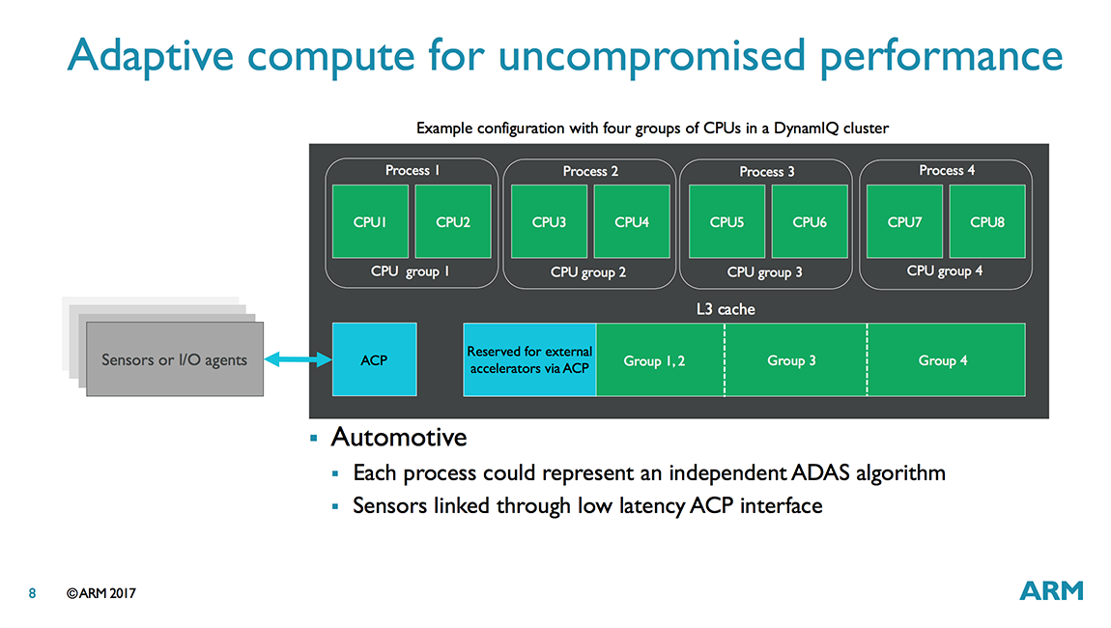
2.5 DynamIQ core clusters (15)
Example for partitioning the cores and the L3 [37]

Slide 123
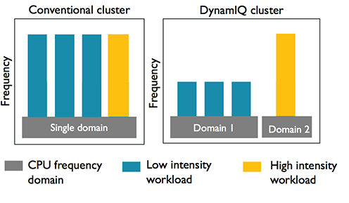
2.5 DynamIQ core clusters (16)
e) Finer-grain frequency and voltage control [37]
Groups of CPUs (i.e. partitions)
can run at different
frequencies and voltages.
*

Slide 124
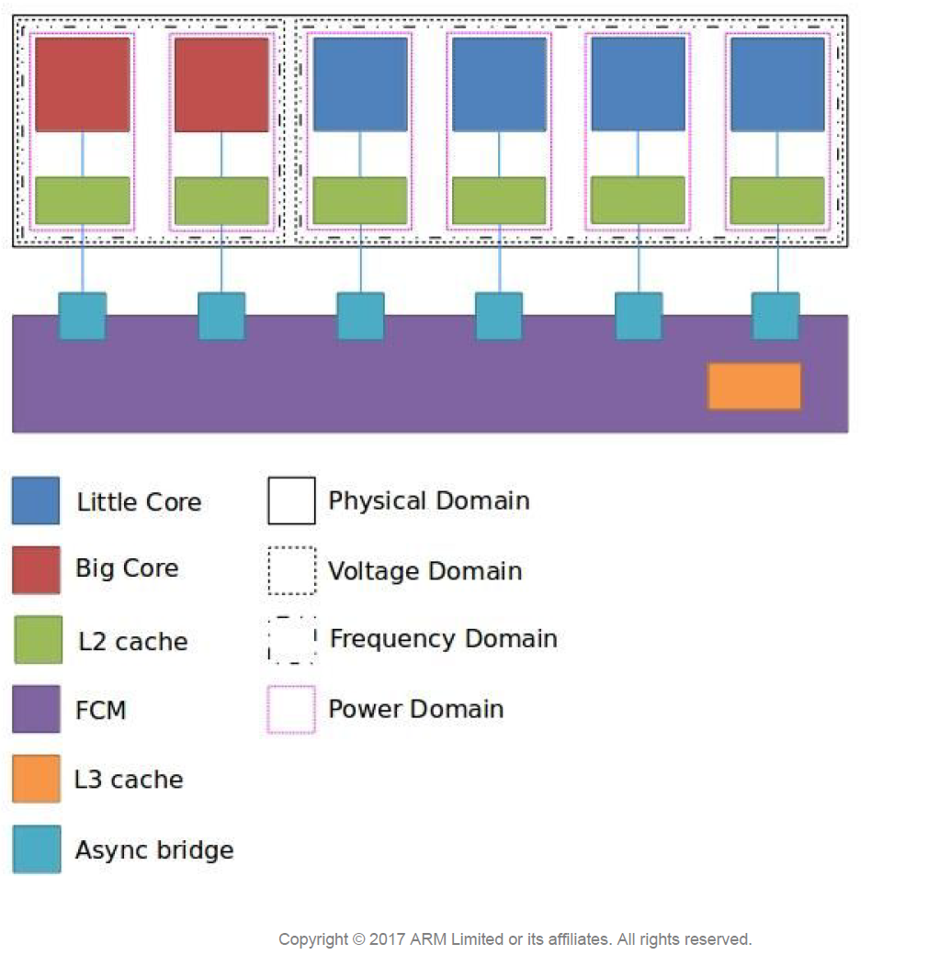
2.5 DynamIQ core clusters (17)
Example for 2 voltage and 2 frequency domains in a 2+4 DynamIQ cluster [36]
(switchable by power gates)

Slide 125
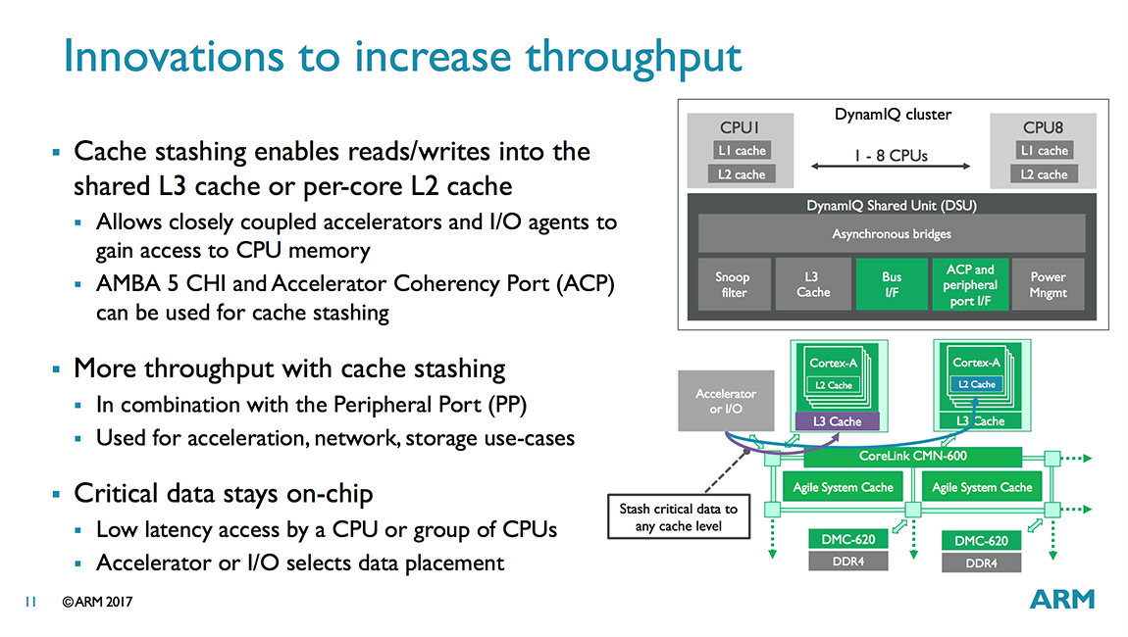
2.5 DynamIQ core clusters (21)
f) Cache stashing [37]
(not discussed)
It enables reads/writes into the
shared L3 cache or per-core
L2 cache.
It allows closely coupled accelerators
and I/O agents to access the CPU
memory via the AMBA 5 CHI (PP) or
ACP port.
Cache stashing increases throughput.

Slide 126
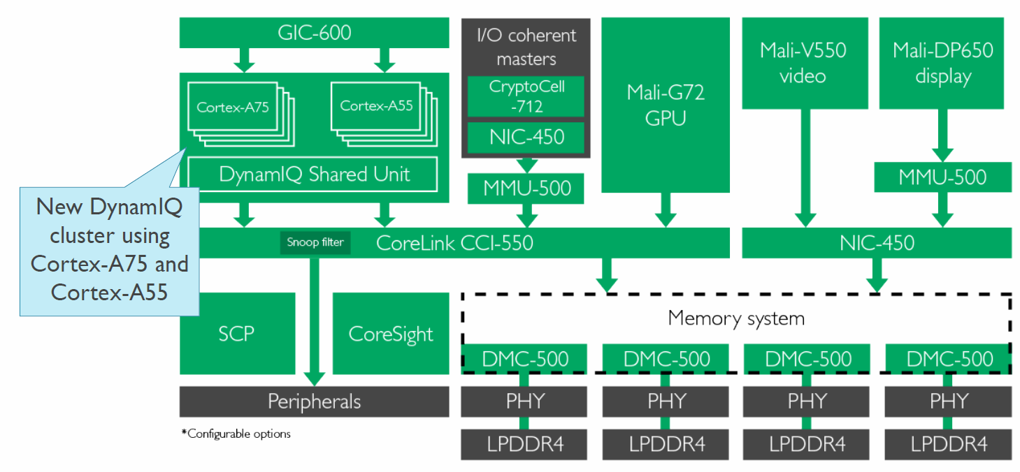
2.5 DynamIQ core clusters (22)
Use of a ring interconnect (CCI-550) to build premium mobile systems in 2018 [44]
CCI-550: Cache Coherent interconnect CoreSight: Debug and Trace
MMU-500: Memory Management Unit (responsible for virtualization and caching)
NIC-450: Network Interconnect (interface converter)
GIC-600: General Interrupt Controller
SCP: System Control Processor
*

Slide 127
3. Evolution of the width of mobile CPU cores

Slide 128
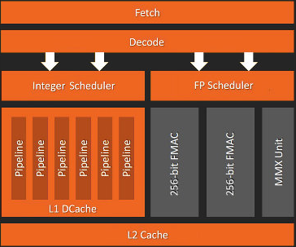
3. Evolution of the width of mobile CPU cores (1)
3. Evolution of the width of mobile CPU cores -1
Interpretation of the notion “width of CPU cores”
Recent CPU cores are typically built up of a sequential front-end and a parallel back-end.
(The front-end operates on bunches of instructions (e.g. 4 instructions) and operates
sequentially, i.e. it fetches, decodes, renames, dispatches instructions in a pipeline fashion.
(The back-end executes individual instructions in parallel)
Front-end
(~előfokozatok)
Width of the
microarchitecture
Back-end
(~utófokozat)
Figure: simplified block diagram of the microarchitecture of a recent CPU core
(actually that of ARM’s Zen core [20])
As the width of CPU cores we understand the thinnest stage of the front-end that is usually the width of the decoder stage, which is 4 in the Figure above.
*

Slide 129
3. Evolution of the width of mobile CPU cores (2)
Importance of the notion “width of the CPU core”
The width of the CPU core and the clock frequency are decisive for the single thread
(ST) performance and the power consumption of the CPU core.
On the other hand, the single thread performance and the core count determine
the multi thread (MT) performance while a given workload is running.
Obviously, the multi thread performance greatly depends on the kind of the workload.
*

Slide 130
3. Evolution of the width of mobile CPU cores (3)
Width of early mobile processor cores -1
As mobile processors emerged in the second halve of the 2000’s their cores were
typically 2- or 3 wide, as the next Tables show for ARM’s v7-based processors used
in mobile devices.
*

Slide 131
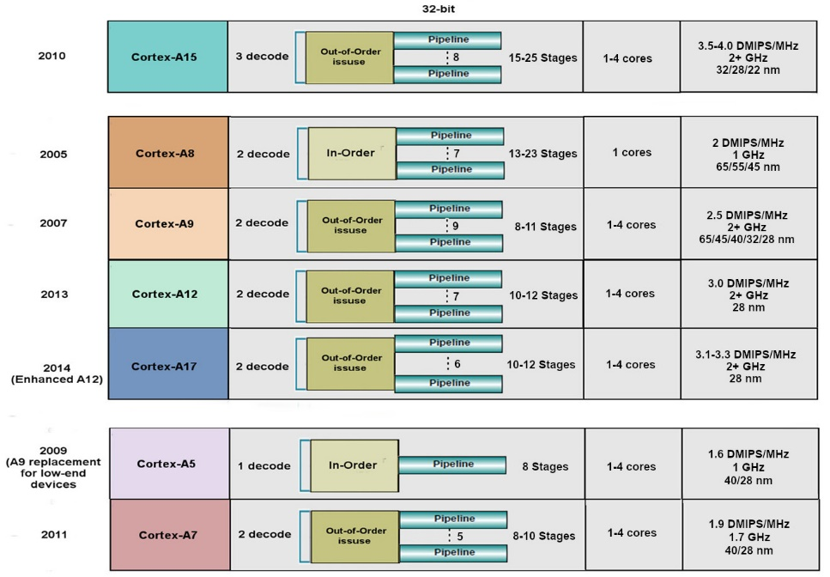
3. Evolution of the width of mobile CPU cores (4)
Example 1: Key features of Armv7 ISA based 32-bit cores (based on [21])
High performance
Mainstream
Low power

Slide 132
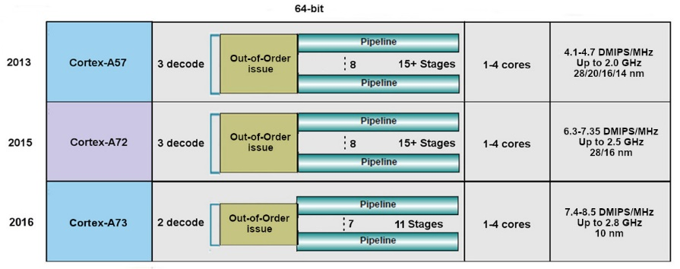
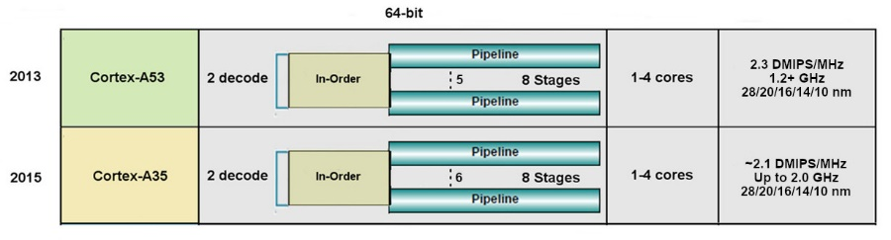
3. Evolution of the width of mobile CPU cores (5)
Example 2: Key features of Armv8.0 ISA based 64-bit cores replacing
Armv7 cores (based on [21])
High performance
Low power

Slide 133
3. Evolution of the width of mobile CPU cores (6)
Width of early mobile processor cores -2
Correspondingly, cores of Intel’s Atom processors (introduced in 2008) or AMD’s Cat
processors (launched in 2011) were also 2-wide (except of Intel’s later 3-wide
Airmont core), as discussed earlier.
*

Slide 134
3. Evolution of the width of mobile CPU cores (7)
Width of contemporary mobile CPU cores -1
In order to raise performance, ARM v8 and then v8.2 ISA based processors
became first 3 then 4 and subsequently 5-wide, as the next Table indicates.
*

Slide 135
3. Evolution of the width of mobile CPU cores (8)
Widening the CPU core in high-performance Cortex-A7x CPUs
Cortex model | ISA | Launched in | Target IC techn. | Decode rate | Dispatch rate | Issue rate | ROB size
A72 | ARM 8.0 | 02/2015 | 16 nm | 3 | 5 | 8 | n.a.
A73 | ARM 8.0 | 05/2016 | 10 nm | 2 | 4 | 7 | n.a.
A75 | ARM 8.2 | 05/2017 | 10 nm | 3 | 6 | 8 | 128
A76 | ARM 8.2 | 05/2018 | 12, 7, 5 nm | 4 | 8 | 9 | 128
A77 | ARM 8.2 | 05/2019 | 7, 5 nm | 4 | 6 | 12 | 160
A78 | ARM 8.2 | 05/2020 | 5 nm | 4 | 6 | 13 | n.a.
X1 | ARM 8.2 | 05/2020 | 5 nm | 5 | 8 | 15 | 224
Remarks
The A73 and A75 were designed in the Sophia Design Center all others in Austin.
The A72 and a73 support big.LITTLE core clusters the others DynamIQ core clusters.
The A72 introduced instruction fusion.
The A75 introduced FP16 and int8 datatypes to support AI
The A77 introduced a Macro-Op (MOP) cache
ROB: ReOrder Buffer (Out-of-order window) determines the max. number of in-flight
instructions
*

Slide 136
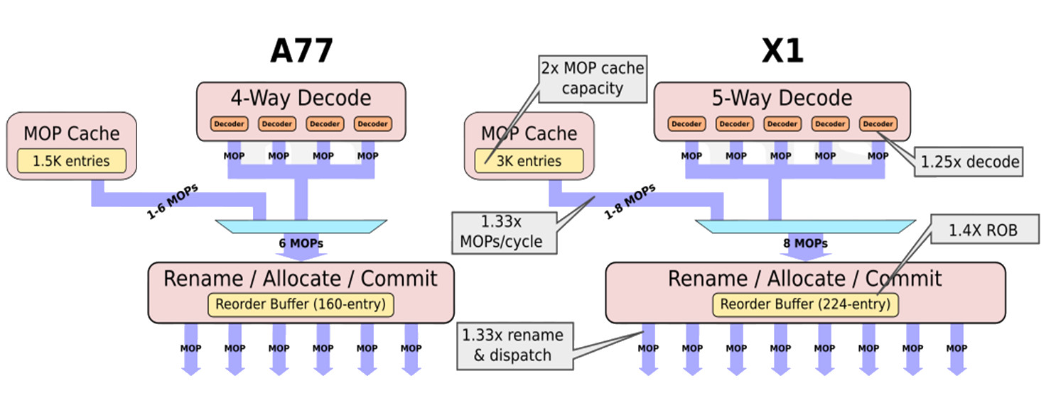
3. Evolution of the width of mobile CPU cores (9)
Example: Transition from 4-wide decoding to 5-wide decoding in ARM’s
mobile processors [130]
(2019)
(2020)
The 1.5K MOP cache, introduced into the A77, stores already decoded macro-
operations (MOPs).
It is used to re-use already decoded MOPs, e.g. to reduce the cost of missed
branch predictions.

Slide 137
3. Evolution of the width of mobile CPU cores (10)
Width of contemporary mobile CPU cores -2
Here we point out that Apple was very early to introduce 6-wide cores in their
A7 processor (in 2013) and later 7-wide (A11-A12X in 2017-2018) or even
8-wide (A13/A14/M1 in 2019-2020) cores, assuring Apple’s performance lead
in the mobile space.
As an example, the next Figure shows the assumed layout of of the big core of the
Apple A14 (Firestorm core) (2020)
*

Slide 138
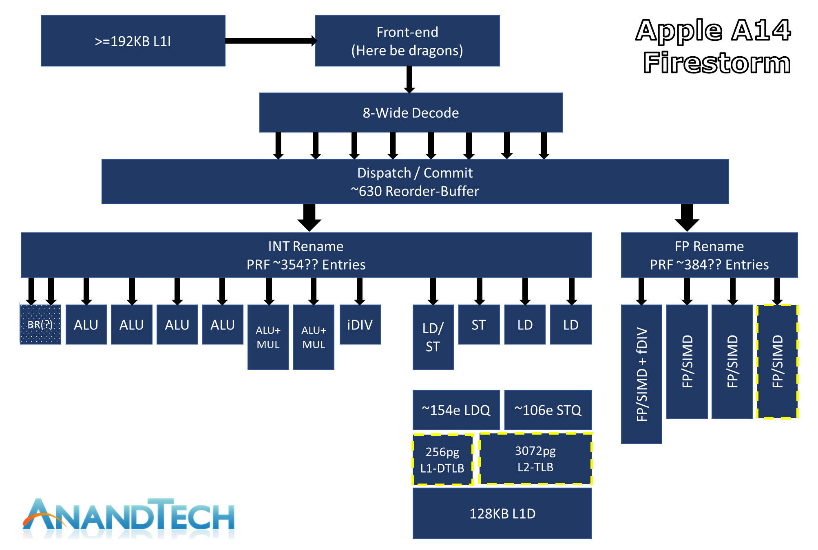
3. Evolution of the width of mobile CPU cores (11)
Example: Assumed layout of the big core of the Apple A14 (Firestorm) (2020) [63]

Slide 139
3. Evolution of the width of mobile CPU cores (12)
Evolution of the width of mobile CPU cores -2
Width of mobile cores
(or of big cores of big.LITTLE or dynamIQ core clusters)
2-wide
3-wide
4-wide
5-wide
ARM
v7 HP Cortex-A15
(2010)
v7 Cortex-A (2005-09)
(except 1-wide LP A5 (2009)
and 3-wide HP A15))
v8.0 HP Cortex-A73
(2016)
v8.0 HP Cortex-A (2013-15) (except 2-wide HP Cortex-A73)
v8.0/8.2 LP Cortex-A
(2013/2017)
v8.2 HP Cortex-A75
(2017)
v8.2 HP Cortex-A76
(2018) to
HP Cortex-A78
(2020)
v8.2 HP Cortex-X1
(2020))
Intel
Atom family (2008-15)
Airmont-based Atom core (2016)
AMD
Cat family (2011-2015)
Apple
v7 Cortex-A8 (2009)
v7 Swift (A6) (2012)
Qualcomm
v7 Scorpion
(S1-S3) (2007-10)
v7 Krait
(S4/S400/S60x/S80x)
(2012-14)
v8 Kryo/Kryo 280
(S820/821/835) (2015/2016/2017)
v8.2 Kryo 385
(S845) (2018)
Samsung
v7 Exynos 5
(2013-14)
v8 Exynos 7
(2016)
v8.0 M1 (2016)
(Exynos 8 Octa)
v8 M2 (2017)
(Exynos 9 Octa)
HP: High-Performance/big core
LP: Low-Power
*

Slide 140
3. Evolution of the width of mobile CPU cores (13)
Evolution of the width of mobile CPU cores -2
Width of mobile cores
(or of big cores of big.LITTLE or dynamIQ core clusters)
6-wide
7-wide
8-wide
ARM
Intel
AMD
Apple
v8.0 HP A7-A10X
(2013-2017)
v8.2 HP A11 (2017)
v8.3 HP A12/A12X
(2018)
v8.4 HP A13 (2019)
v8.6 HP A14/M1
(2028)
Qualcomm
Samsung
v8.2 M3 (2018) Exynos 9810)
v8.2 M4 (2019) Exynos 9820)
v8.2 M5 (2019) Exynos 990)
v8.2 M6
(2020)/cancelled
HP: High-Performance/big core
LP: Low-Power
*

Slide 141
3. Evolution of the width of mobile CPU cores (14)
Remark
Certain early mobile processors were only 1-wide, like
ARM’s 1176 used in Apple’s iPhone (2007) or
ARM’s Cortex-A5 (2009)
nevertheless, for better clarity these processors were not indicated in the previous
Figure.

Slide 142
3. Evolution of the width of mobile CPU cores (15)
Evolution of the width of CPU cores of Intel’s and AMD’s basic microarchitectures
Width of Intel’s and AMD’s basic microarchitectures
2-wide
3-wide
4-wide
5-wide
6-wide
Intel
Pentium
(1993)
Pentium II (Pentium Pro) 1996)
Pentium III (1999)
Pentium 4 (2000)
Core 2 (2006)
until
Broadwell (2014)
Skylake (2015)
and subsequent
symmetrical multicores
Alder Lake
(2021)
(big.LITTLE
configuration)
AMD
K5 (1996)
K6 (1997)
K7 Athlon (1998)
K8 (Hammer)-based
designs (2003)
K10 (Barcelona/Phenom) based lines (2007)
K10.5 (Shanghai etc.)
based lines (2008)
K15 Bulldozer-based
lines (2011)
Zen-based lines (2017)
Figure: Evolution of the width of CPU cores of Intel’s and AMD’s basic microarchitectures
It is for the first sight astonishing that mobile processors became even wider than
client processors, as the Figure below indicates.
This apparent contradiction is resolved by the fact that client processors are typically
x86-based CISC processors with variable instruction word length whereas mobile
processors are Arm ISA based RISC processors with fixed, 32-bit instruction word length,
whose decoding is a much simpler task as decoding variable length CISC instructions.
*

Slide 143
4. Case example: Evolution of Samsung’s Mongoose core family

Slide 144
4. Case example: Evolution of Samsung’s Mongoose core family (1)
4. Case example: Evolution of Samsung’s Mongoose core family [54], [55]
In 2010 Samsung established a design center to develop high-performance,
low-power CPU & GPU architectures called the Samsung Austin R&D Center
(SARC).
SARC designed the Mongoose custom CPU cores; i.e. the ARM v8-based M1 (2016),
M2 and the ARM v8.2-based M3 to M6 cores that are the key components
of Samsung‘s Exynos processor family used in Samsung‘s Galaxy lines of
smartphones and tablets.
Nevertheless, the Mongoose cores were not competitive with ARM‘s designs
in terms of power efficiency, performance and Si-area [55] so Samsung
shut down SARC in 12/2019.
After shutting down SARC, Samsung allowed the CPU design team to publish
a detailed, very informative account of the development of the Mx family
of cores, worth of briefly discussing it next.
Mongoose: mongúz
*

Slide 145
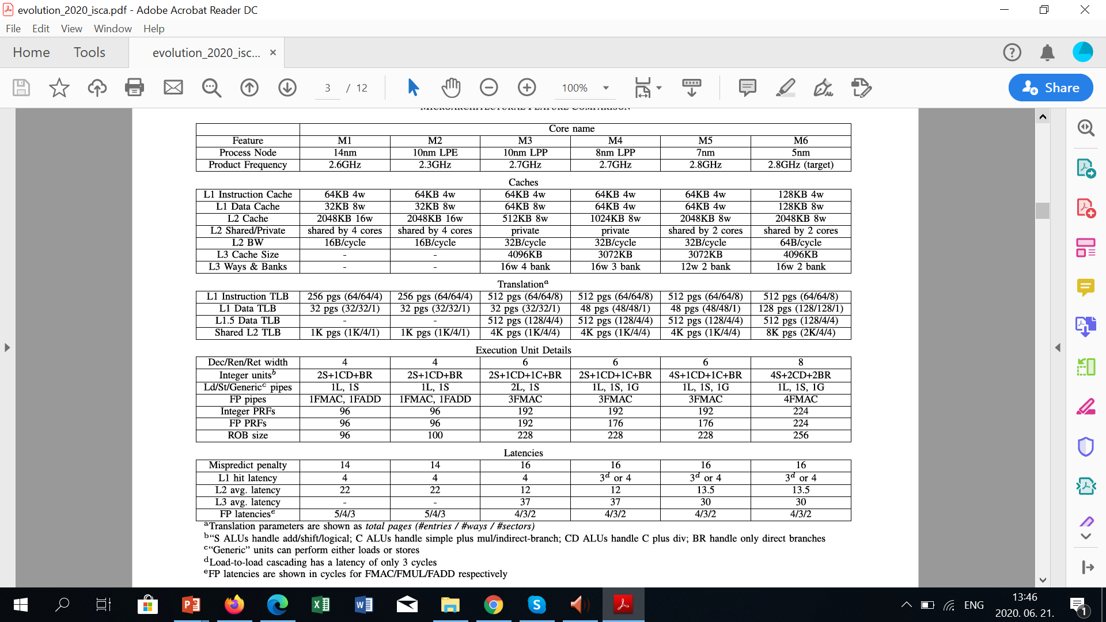
4. Case example: Evolution of Samsung’s Mongoose core family (2)
Main features of Samsung’s Mx family of CPU cores [54] -1

Slide 146
4. Case example: Evolution of Samsung’s Mongoose core family (3)
Main features of Samsung’s Mx family of CPU cores [54] -2
The first Mongoose core, the M1 was part of the Exynos 8890 processor
(Galaxy S7, 2016), whereas the last one, the M5 was used in the Exynos 990
(Galaxy S20, 2020).
We note that the M3 core of the Exynos 9810 (used in Galaxy S9, 2018) was
a major redesign for two reasons; first, it was already based on the ARM v8.2
ISA and second, it became a 6-wide core whereas the previous designs (M1/M2)
were only 4-wide.
SARC developed also the 8-wide M6 core, however this design was cancelled and
found not more use in Samsung’s Exynos line of processors.

Slide 147
4. Case example: Evolution of Samsung’s Mongoose core family (4)
Assessment of the 10-year long core development (M1 to M6) [54]
Throughout the Mx core generations, the focus was to improve performance across
a wide range of workloads.
Key areas of performance improvements
• Low-IPC workloads were greatly improved by more sophisticated prefetching,
as well as cache coherency protocol optimizations (replacements/victimizations/.
• Medium-IPC workloads benefited from MPKI (Mispredictions Per Kilo
Instructions) reduction and cache improvements.
• High-IPC workloads were augmented in the M3 core and beyond by widening
the core width from 4 to 6 and providing associated resources.
The average IPC of the M6 core could be improved to 2.71 related to the M1
across these workloads, which amounts to a compounded growth rate of
20.6% per year IPC improvement.
*

Slide 148
4. Case example: Evolution of Samsung’s Mongoose core family (5)
About the workload suit used for performance measurements [54]
The performance measurements were based on 4026 traces gathered from a
number of CPU-based benchmark packages, such as SPEC CPU2000 and
SPEC CPU2006; web suites including Speedometer, Octane, BBench, and
SunSpider; mobile suites such as AnTuTu and Geekbench; and popular mobile
games and applications.
The same set of workloads is employed across all of the generations.
Trace: nyomkövetés

Slide 149
4. Case example: Evolution of Samsung’s Mongoose core family (6)
Evolution of selected features of the microarchitecture of the Mx cores
Subsequently, we discuss the following issues concerning the development of the Mx
core family:
a) evolution of the clock frequency
b) introduction of a micro-operation cache
c) improving branch prediction accuracy
d) enhancing the extent of the execution resources provided
e) improving load latency.

Slide 150
4. Case example: Evolution of Samsung’s Mongoose core family (7)
a) Evolution of the clock frequency [54] -1

Slide 151
4. Case example: Evolution of Samsung’s Mongoose core family (8)
a) Evolution of the clock frequency [54] -2
As the Table indicates, the clock frequency of the cores could only slightly be
increased; as long as the M1 core was clocked at 2.6 GHz, the M5/M6 were
clocked only at 2.8 GHz.
*

Slide 152
4. Case example: Evolution of Samsung’s Mongoose core family (9)
b) Introduction of a micro-operation cache [54]
With increasing core width from 4 to 6, fetching and decoding instructions
became a more complex and more power consuming task.
To alleviate this the M5 core (2020) added a micro-operation cache that holds
up to 384 already fetched and decoded instructions and saves fetch and
decode time and power for repeated code sequences.
The micro-op cache provides up to 6 instructions/cycle to the subsequent
pipeline stages.
We note that the micro-operation cache added to the M5 is similar to the one
introduced by Intel in their Sandy Bridge processor much earlier, in 2011.
*

Slide 153
4. Case example: Evolution of Samsung’s Mongoose core family (10)
c) Improving branch prediction accuracy -1
Branch prediction accuracy can notably impact performance, this is the
reason why designers of the Mx cores put great emphasis on improving branch
prediction accuracy.
Rather than going into technical details of the implementation we provide the
results achieved in branch prediction accuracy over the generations of the Mx
cores in the next Figure.

Slide 154
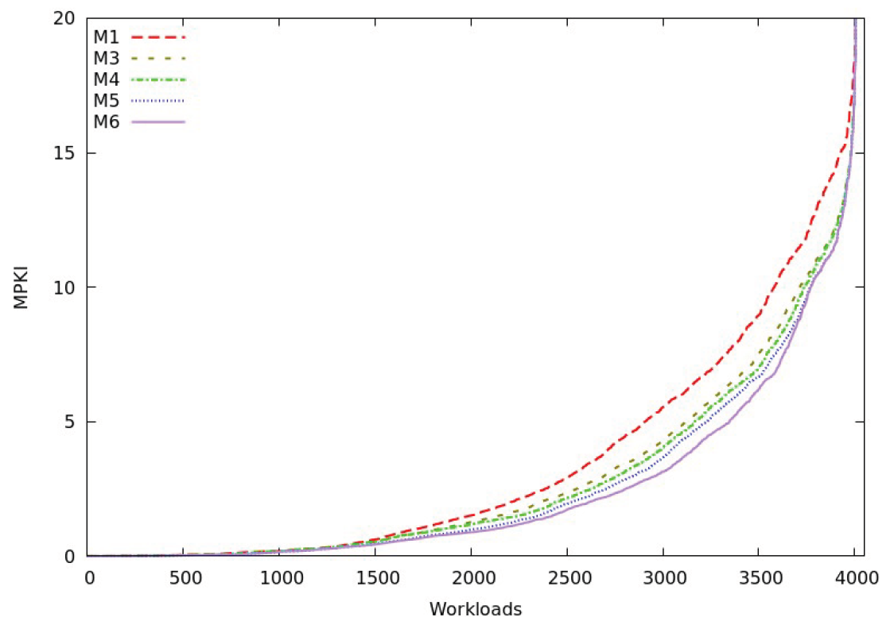
4. Case example: Evolution of Samsung’s Mongoose core family (11)
Improving branch prediction accuracy -2 [54]
MPKI: Missed Predictions per Kilo Instructions

Slide 155
4. Case example: Evolution of Samsung’s Mongoose core family (12)
d) Enhancing the extent of the execution resources provided [54] -1
Raising the number of execution units -1
Along with widening the core width from 4 to 6 in the M1 to M5 cores and then
to 8 Samsung approximately doubled the number of execution units, as seen
in the next Tables.
Table: Enhancing the execution resources over generations in Samsung’s M family [54]

Slide 156
4. Case example: Evolution of Samsung’s Mongoose core family (13)
Raising the number of execution units [54] -2
It is informative to compare the core width and the no. of execution units, see the
next Table:
Cores | Core width | No. of execution units
M1, M2 | 4 | 7
M3, M4 | 6 | 11
M5 | 6 | 13
M6 | 8 | 15
Table: Number of execution units provided in Mx cores
As seen, the number of execution units nearly scales with the width of the cores.
*

Slide 157
4. Case example: Evolution of Samsung’s Mongoose core family (14)
Increasing the size of the FX and FP register files [54] -1
Along with doubling the core width from 4 to 8 in the M1 to M6 cores Samsung
also more than doubled the size of the FX and FP register files, as seen below.
Table: Enhancing the execution resources over generations in Samsung’s M family [54]

Slide 158
4. Case example: Evolution of Samsung’s Mongoose core family (15)
Increasing the ROB size [54] -1
Along with doubling the core width from 4 to 8 in the M1 to M6 cores Samsung also
more than doubled the ROB size from 96 to 256, as the Figure below shows.
Table: Enhancing the execution resources over generations in Samsung’s M family [54]
Note that the ROB limits the number of in-fly instructions.
For comparison: Apple’s A14’s ROB size amounts to ~630.
All in all, the execution resources scale more or less with the width of the cores.

Slide 159
4. Case example: Evolution of Samsung’s Mongoose core family (16)
e) Improving load latency [54] -1
Load latency is another sensitive system parameter that can greatly affect
performance.
The Table summarizing the evolution of main features of the Mx cores reveals
how much effort has been taken to enhance the cache system, including
increasing the size of the L1 instruction cache from 64 KB to 128 KB
in the M6,
increasing the size of the L1 data cache from its initial value of 32 KB to
64 KB in the M3-M5 cores and finally to 128 KB in the M6,
introducing a 3-level cache system along with the M3,
replacing initially used shared 2MB L2 caches for 4-wide M1/M2 cores, first
by ½ MB/core private L2 caches along with the introduction of the 3-level
cache system in the M3 core, then switching to 2MB L2 caches shared
by 2 cores in the M5 and the M6.
In addition, also TLB (Translation Look-Aside Buffer) sizes were considerable
increased, as indicated in the Table cited.
As a result, load latencies could notable be reduced, as the next Figure shows.
Load latency: átlagos adat-olvasás késleltetése memória-adatok esetén (ciklus).

Slide 160
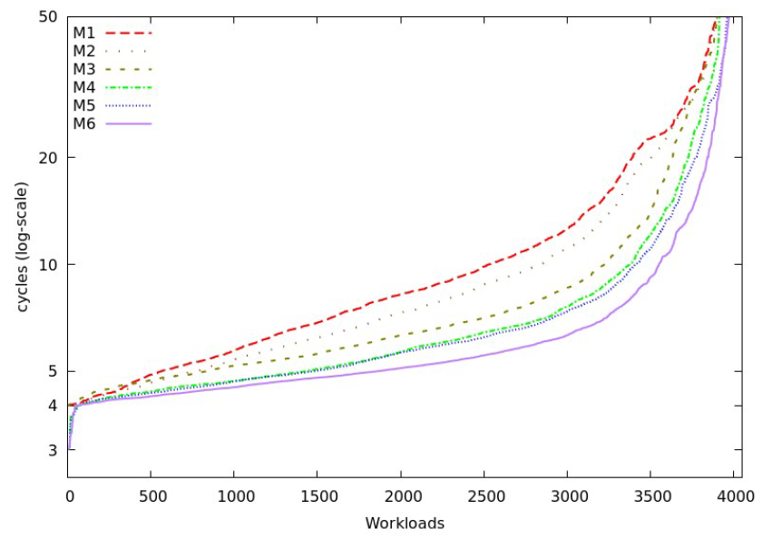
4. Case example: Evolution of Samsung’s Mongoose core family (17)
Improving load latency [54] -2

Slide 161
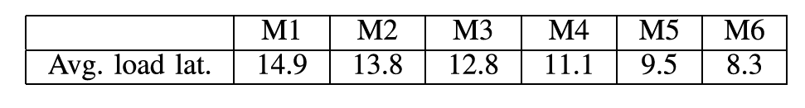
4. Case example: Evolution of Samsung’s Mongoose core family (18)
Improving the average load latency [54]
Load latency improvements resulted in notable reduction of their average values,
as the next Table depicts.

Slide 162
4. Case example: Evolution of Samsung’s Mongoose core family (19)
Total IPC improvement achieved along with the Mongoose family
The average IPC achieved within the Mx family from M1 to M6 amounts to 2.71,
as already stated, which equals to a compounded growth rate of 20.6% per year
IPC improvement.
Nevertheless, this dynamic rate of performance improvement was not sufficient
to become competitive to ARM‘s designs and Samsung was forced to cancell
their own processor initiative.

Slide 163
5. References

Slide 164
5. References (1)
[1]: ARM, big.LITTLE Technology, 2014,
http://www.arm.com/products/processors/technologies/biglittleprocessing.php
[2]: Flautner K., Heterogeneity to the rescue, 2011,
https://www.bscmsrc.eu/sites/default/files/media/arm-heterogenous-mp-november-2011.pdf
[3]: Greenhalgh P., Big.LITTLE Processing with ARM Cortex-A15 & Cortex-A7, White Paper,
Sept. 2011, http://www.arm.com/files/downloads/big.LITTLE_Final.pdf
[4]: Variable SMP – A Multi-Core CPU Architecture for Low Power and High Performance, Nvidia,
Whitepaper, 2011, http://www.nvidia.com/content/PDF/tegra_white_papers/tegra-
whitepaper-0911b.pdf
[5]: Klug B., Samsung Announces big.LITTLE MP Support in Exynos 5420, AnandTech,
Sept. 11 2013, http://www.anandtech.com/show/7313/samsung-announces-biglittle-
mp-support-in-exynos-5420
[6]: big.LITTLE MP, Linaro, https://wiki.linaro.org/projects/big.LITTLE.MP#Overview
[7]: Randhawa R., ARM's big.LITTLE systems provide more processing power for less energy,
New Electronics, July 10 2012, http://www.newelectronics.co.uk/electronics-technology/
arms-big-little-systems-provide-more-processing-power-for-less-energy/43563/
[8]: MediaTek Enables ARM big.LITTLE Heterogeneous Multi-Processing Technology in Mobile SoCs,
http://www.mediatek.com/_en/Event/201307_TrueOctaCore/MediaTekEnablesARM
bigLITTLEHMPTechnology.pdf
[9]: Jeff B., Advances in big.LITTLE Technology for Power and Energy Savings, White Paper,
Sept. 2012, http://www.arm.com/files/pdf/Advances_in_big.LITTLE_Technology_for_
Power_and_Energy_Savings.pdf

Slide 165
5. References (2)
[10]: CoreTile Express A15x2 A7x3 Power Management, Application Note 318, April 2013,
http://infocenter.arm.com/help/topic/com.arm.doc.dai0318e/DAI0318E_v2p_ca15_a7_
power_management.pdf
[11]: Kim M., Kim H., Chung H., Lim K., Samsung Exynos 5410 Processor – Experience the
Ultimate Performance and Versatility, White Paper, 2013
[12]: Shin Y., Shin K., Kenkare P., Kashyap R., 28nm high- metal-gate heterogeneous quad-core
CPUs for high-performance and energy-efficient mobile application processor,
2013 IEEE International Solid-State Circuits Conference Digest of Technical Papers,
IEEE, pp.154-155
[13]: Whitwam R., Samsung Exynos 5 Octa 5420 looks to correct past mistakes, shoddy graphics,
Extreme Tech, July 23 2013, http://www.extremetech.com/computing/162090-samsung-
looks-to-correct-past-mistake-with-updated-exynos-5-octa-5420-arm-chip
[14]: Triggs R., Snapdragon 835 unveiled – Everything you need to know, Android Authority,
Jan. 3 2017, https://www.androidauthority.com/qualcomm-details-snapdragon-835-735688
[15]: Grey G., big.LITTLE Software Update, Linaro, July 10 2013,
http://www.linaro.org/blog/hardware-update/big-little-software-update/
[16]: Poirier M., In Kernel Switcher: A solution to support ARM’s new big.LITTLE technology,
Linaro, Embedded Linux Conference, March 1 2013,
https://events.linuxfoundation.org/images/stories/slides/elc2013_poirier.pdf
[17]: Jeff B., big.LITTLE Technology Moves Towards Fully Heterogeneous Global Task Scheduling,
ARM TechCon, Nov. 2013, http://community.arm.com/servlet/JiveServlet/previewBody/
7763-102-1-12076/big.LITTLE%20technology%20moves%20towards%20fully%20
heterogeneous%20Global%20Task%20Scheduling_final%20%28pdf%29.pdf

Slide 166
5. References (3)
[18]: Boudra F., The Linaro IKS code now publicly available, Linaro, May 2 2013,
http://www.linaro.org/blog/releases-blog/the-linaro-iks-code-now-publicly-available/
[19]: Enabling the Next Mobile Computing Revolution with Highly Integrated ARMv8-A based SoCs,
ARM and Qualcomm, 2014,
http://www.arm.com/files/pdf/ARM_Qualcomm_White_paper_Final.pdf
[20]: Hruska J., New leak hints at AMD Zen’s architecture, organization, Extreme Tech, April 29
2015, https://www.extremetech.com/gaming/204523-new-leak-hints-at-amd-zens-
architecture-organization
[21]: Goto H., ARM Cortex – A Family Architecture, 2010,
http://pc.watch.impress.co.jp/video/pcw/docs/423/409/p1.pdf
[22]: Brown J., Under the Hood: Low-cost phone is rich in features, Jan. 7 2008,
https://www.embedded.com/print/4005673
[23]: Wang D., Base band application (MT6218B based platform), 2004,
http://d1.amobbs.com/bbs_upload782111/files_10/ourdev_394557.pdf
[24]: Carey D., Teardown: RIM fields BlackBerry with consumer appeal, EDN Network,
Jan. 22 2007, https://www.edn.com/Home/PrintView?contentItemId=4004648
[25]: Intel PXA27x Processor Family Electrical, Mechanical, and Thermal Specification, Data Sheet,
2005, http://www.penguin.cz/~utx/zaurus/datasheets/CPU/28000304.pdf
[26]: Mathew D.G. Snapdragon Processors, 2014,
https://www.slideshare.net/deepakmathew37/snapdragon-processors

Slide 167
5. References (4)
[27]: Katouzian A., The Qualcomm difference, 2013,
https://www.qualcomm.com/media/documents/files/the-qualcomm-difference.pdf
[28]: Huawei Releases Kirin 620 64-bit Octa Core Processor, Dec. 4 2014,
http://huaweinews.com/2014/12/kirin-620-processor/
[29]: HiKey (LeMaker version) Hardware User Manua,l Version 0.1, December 2015
[30]: Hirata K., ARM11 MPCore, The streamlined and scalable ARM11 processor core, Jan. 2007,
http://www.aspdac.com/aspdac2007/pdf/archive/7D-2.pdf
[31]: Glaskowsky P.: Investigating Intel's Lynnfield mysteries, cnet News, Sept. 21 2009,
http://news.cnet.com/8301-13512_3-10357328-23.html
[32]: Shimpi A.L., Intel's Sandy Bridge Architecture Exposed, Sept. 14 2010,
https://www.anandtech.com/Show/Index/3922?cPage=2&all=False&sort=0&page=
4&slug=intels-sandy-bridge-architecture-exposed
[33]: Kahn O., Valentine B.: Intel Next Generation Microarchitecture Codename Sandy Bridge:
New Processor Innovations, IDF 2010
[34]: Singh T., Zen: A Next-Generation High-Performance x86 Core, Proc. ISSCC 2017, Session 3,
Digital Processors
[35]: Energy Aware Scheduling (EAS) progress update, Linaro, Sept. 18 2015,
https://www.linaro.org/blog/energy-aware-scheduling-eas-progress-update/

Slide 168
5. References (5)
[36]: DynamIQ power management support, Vers. 1.1, ARM ECM 0640541 Oct. 30 2017
[37]: Humrick M., Exploring DynamIQ and ARM’s New CPUs: Cortex-A75, Cortex-A55,
AnandTech, May 29, 2017,
https://www.anandtech.com/show/11441/dynamiq-and-arms-new-cpus-cortex-a75-a55
[38]: Arm DynamIQ: Technology for the next era of compute, ARM Community,
https://community.arm.com/processors/b/blog/posts/arm-dynamiq-technology-for-the-
next-era-of-compute
[39]: ARM unveils multi-processor core with Linux SMP support, LinuxDevices, May 17, 2004,
http://linuxdevices.linuxgizmos.com/arm-unveils-multi-processor-core-with-linux-smp-
support/
[40]: Triggs R., Everything you need to know about ARM’s DynamIQ, Android Authority,
May 29, 2017, https://www.androidauthority.com/arm-dynamiq-need-to-know-770349/
[41]: Greenhalgh P., ARM DynamIQ. Intelligent Solutions Using Cluster Based Multiprocessing,
Hot Chips 29, 2017 Aug. 12,
https://www.slideshare.net/ARMHoldings/arm-dynamiq-intelligent-solutions-using-
cluster-based-multiprocessing
[42]: Parris N., Boost SoC performance from edge to cloud ARM CoreLink System IP, Nov. 2016,
http://www.armtechforum.com.cn/attached/article/2016ATS_C1_Neil_Parris20161206151154.pdf
[43]: System Guidance for Infrastructure, ARM Developer,
https://developer.arm.com/products/system-design/system-guidance/system-guidance-
for-infrastructure

Slide 169
5. References (6)
[44]: Walrath J., ARM Tech Day 2017: DynamIQ, Cortex-A55, A75, and Mali-G72,
PC Perspective, May 29, 2017,
https://www.pcper.com/reviews/General-Tech/ARM-Tech-Day-2017-DynamIQ-Cortex-A55-
A75-and-Mali-G72/Cortex-A75-and-Mali-G72
[45]: Anderson M., Scheduler Options in big.LITTLE Android Platforms, 2015,
http://events.linuxfoundation.org/sites/events/files/slides/GTS_Anderson.pdf
[46]: Cunningham A., MediaTek escalates the multicore madness with a 10-core smartphone SoC,
Ars Technica, May 12 2015, http://arstechnica.com/gadgets/2015/05/mediatek-escalates-
the-multicore-madness-with-a-10-core-smartphone-soc/
[47]: MediaTek CorePilot 3.0, White Paper,
http://cdn-cw.mediatek.com/White%20Papers/MediaTek%20CorePilot%203.0%20White%
20Paper%20PDFCP3WP%200915.pdf
[48]: big.LITTLE Technology: The Future of Mobile, White Paper, 2013,
https://www.arm.com/files/pdf/big_LITTLE_Technology_the_Futue_of_Mobile.pdf
[49]: Rickards I., Kucheria A., Energy Aware Scheduling (EAS) progress update, Linaro,
Sept. 18 2015, https://www.linaro.org/blog/core-dump/energy-aware-scheduling-eas-
progress-update/
[50]: ARM Cortex-A57 MPCore Processor Technical Reference Manual, 2013,
http://infocenter.arm.com/help/index.jsp?topic=/com.arm.doc.ddi0488c/CACDDBBA.html
[51]: Cortex-A73, ARM Developer,
https://developer.arm.com/products/processors/cortex-a/cortex-a73

Slide 170
5. References (7)
[52]: Chung H., Kang M. Cho H.-D., Heterogeneous Multi-Processing Solution of Exynos 5 Octa
with ARM® big.LITTLE™ Technology, White Paper, Samsung, 2012,
https://www.arm.com/files/pdf/Heterogeneous_Multi_Processing_Solution_of_
Exynos_5_Octa_with_ARM_bigLITTLE_Technology.pdf
[53]: GPU GFLOPS, https://gflops.surge.sh/
[54]: Grayson B. & al., Evolution of the Samsung Exynos CPU Microarchitecture,
Proc. 2020 ACM/IEEE 47th Annual International Symposium on Computer Architecture
(ISCA), pp. 40-51, ACM/IEEE, 2020,
https://www.iscaconf.org/isca2020/papers/466100a040.pdf
[55]: Patel I., Samsung Austin R&D Center reveals details of its unreleased Exynos M6 CPU
microarchitecture, XDA Developers, June 4, 2020,
https://www.xda-developers.com/samsung-austin-details-unreleased-exynos-m6-cpu-
microarchitecture/
[56]: Global mobile OS market share in sales to end users from 1st quarter 2009 to 2nd quarter
2018, statista, 2018,
https://www.statista.com/statistics/266136/global-market-share-held-by-smartphone-
operating-systems/
[57]: Global tablet shipments from 2010 to 2018, by operating system, Statista, 2018,
https://www.statista.com/statistics/273268/worldwide-tablet-sales-by-operating-system-
since-2nd-quarter-2010
[58]: Mobile operating systems' market share worldwide from January 2012 to December 2019,
Statista, 02/2020,
https://www.statista.com/statistics/272698/global-market-share-held-by-mobile-operating-
systems-since-2009/

Slide 171
5. References (8)
[59]: Tablet operating systems market share worldwide from 1Q'16 to 1Q'20, Statista, 05/2020,
https://www.statista.com/statistics/273840/global-market-share-of-tablet-operating-
systems-since-2010/
[60]: O'Dea S., Global market revenue share of leading smartphone applications processor vendors
from 2014 to 2019, Statista, 12/05/2020,
https://www.statista.com/statistics/233415/global-market-share-of-applications-processor-
suppliers/
[61]: Tablet operating systems market share worldwide from 1Q'16 to 1Q'21, Statista, Aug. 17, 2021,
https://www.statista.com/statistics/273840/global-market-share-of-tablet-operating-systems-
since-2010/
[62]: Frumusanu A., ARM Details Built on ARM Cortex Technology License, AnandTech,
May 29 2016, https://www.anandtech.com/show/10366/arm-built-on-cortex-license
[63]: Frumunasu A., Apple Announces The Apple Silicon M1: Ditching x86 - What to Expect,
Based on A14, AnandTech, Nov. 10, 2020,
Apple Announces The Apple Silicon M1: Ditching x86 - What to Expect, Based on A14 –
Print View (anandtech.com

