Slide 1
Evolution of Intel’s
transistor technology
45 nm – 14 nm
Dezső Sima
Vers. 1.0
October 2014

Slide 2
Contents
1. Overview of the evolution of Intel’s basic microarchitectures
2. The high-k + metal gate transistor
3. The 22 nm 3D Tri-Gate transistor
4. The 14 nm 3D Tri-Gate transistor

Slide 3
1. Overview of the evolution of Intel’s basic microarchitectures
Notes:
3

Slide 4
1. Overview of the evolution of Intel’s basic microarchitectures-1
1. Overview of the evolution of Intel’s basic microarchitectures (Based on [1])
1. gen.
2. gen.
3. gen.
4. gen.
5. gen.
Core 2
New
Microarch.
65 nm
Penryn
New
Process
45 nm
Nehalem
New
Microarch.
45 nm
Westmere
New
Process
32 nm
Sandy
Bridge
New
Microarch.
32 nm
Ivy
Bridge
New
Process
22 nm
Haswell
New
Microarchi.
22 nm
Broadwell
New
Process
14 nm
TOCK
TICK
TOCK
TICK
TOCK
TICK
TOCK
TICK
2006
2007
2008
2010
2011
2012
2013
2014
Figure 1.1: Intel’s Tick-Tock development model (Based on [1])

Slide 5
1. Overview of the evolution of Intel’s basic microarchitectures-2
Evolution of Intel’s process technologies [82]
2014
New transistor
structures
High K +
Metalgate
Tri Gate
1. gen.
Tri Gate
2. gen.
Related
proc. family
Penryn
Ivy Bridge
Broadwell

Slide 6
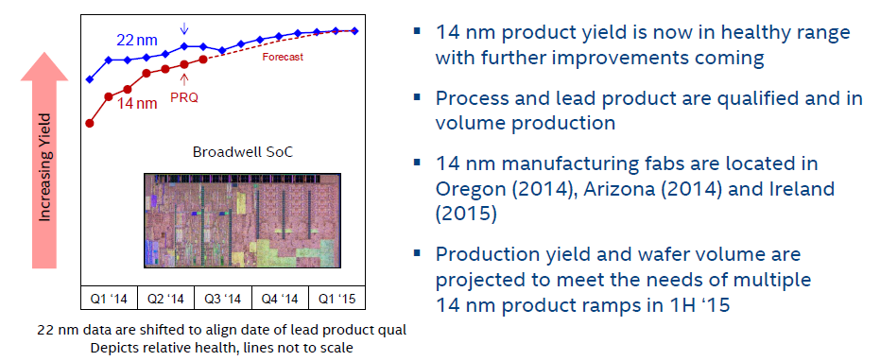
1. Overview of the evolution of Intel’s basic microarchitectures-3
14 nm Broadwell SOC yield trend [154]

Slide 7
2. The high-k + metal gate transistor
Notes:
7

Slide 8
2. The high-k + metal gate transistor-1
2. The high-k + metal gate transistor
1. gen.
2. gen.
3. gen.
4. gen.
5. gen.
Core 2
New
Microarch.
65 nm
Penryn
New
Process
45 nm
Nehalem
New
Microarch.
45 nm
Westmere
New
Process
32 nm
Sandy
Bridge
New
Microarch.
32 nm
Ivy
Bridge
New
Process
22 nm
Haswell
New
Microarchi.
22 nm
Broadwell
New
Process
14 nm
TOCK
TICK
TOCK
TICK
TOCK
TICK
TOCK
TICK
Figure: Intel’s Tick-Tock development model (Based on [1])
Introduced along with the Penryn family of processors in 2007.

Slide 9
2. The high-k + metal gate transistor-2
The need to introduce new transistor design [21]
Sub-threshold =
Source-Drain
Figure 3.1.1: Dynamic and static power dissipation trends in chips [21]

Slide 10
2. The high-k + metal gate transistor-3
Structure of the high-k + metal gate transistors [23]

Slide 11
2. The high-k + metal gate transistor-4
Benefits of the high-k + metal gate transistors [23], [24]

Slide 12
3. The 22 nm 3D Tri-Gate transistor
Notes:
12

Slide 13
3. The 22 nm 3D Tri-Gate transistor-1
3. The 22 nm 3D Tri-Gate transistor-1
1. gen.
2. gen.
3. gen.
4. gen.
5. gen.
Core 2
New
Microarch.
65 nm
Penryn
New
Process
45 nm
Nehalem
New
Microarch.
45 nm
Westmere
New
Process
32 nm
Sandy
Bridge
New
Microarch.
32 nm
Ivy
Bridge
New
Process
22 nm
Haswell
New
Microarchi.
22 nm
Broadwell
New
Process
14 nm
TOCK
TICK
TOCK
TICK
TOCK
TICK
TOCK
TICK
Figure: Intel’s Tick-Tock development model (Based on [1])
Introduced along with the Ivy Bridge family of processors in 2012.

Slide 14
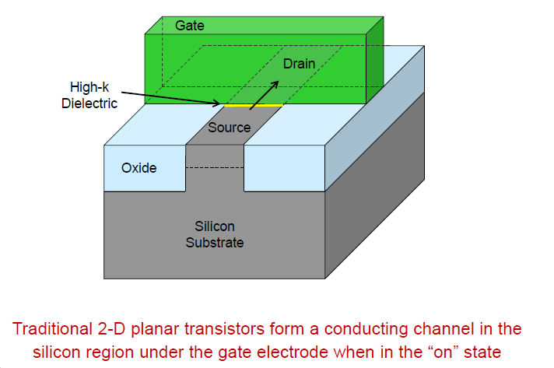
3. The 22 nm 3D Tri-Gate transistor-2
The traditional planar transistor [82]

Slide 15
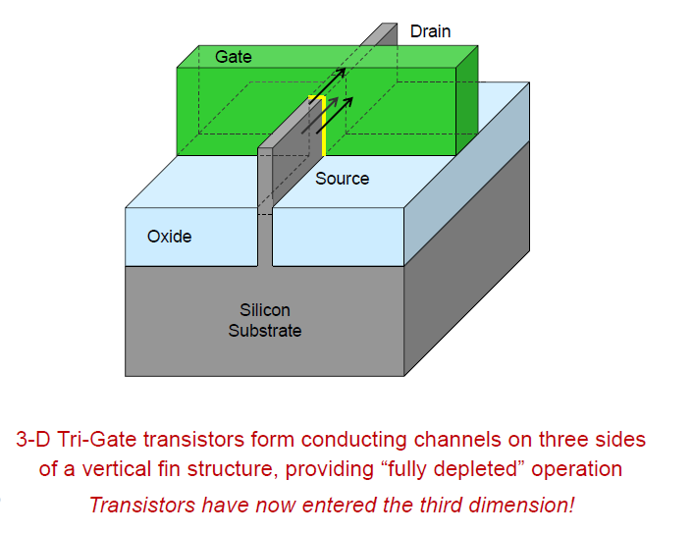
3. The 22 nm 3D Tri-Gate transistor-3
The 22 nm 3D Tri-Gate transistor-2 [82]
fin
The designation “tri-gate” originates from the fact that now the gate has three sides.

Slide 16
3. The 22 nm 3D Tri-Gate transistor-4
The 22 nm Tri-Gate transistor-3 [82]

Slide 17
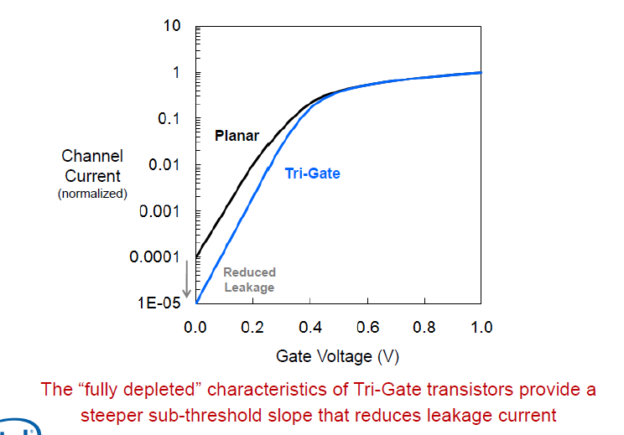
3. The 22 nm 3D Tri-Gate transistor-5
Switching characteristics of the traditional planar and tri-gate transistors [82]

Slide 18
3. The 22 nm 3D Tri-Gate transistor-6
Gate delay of the traditional planar and tri-gate transistors [82]
Gate delay: time difference between output signal and input signal of a gate (n x ps)

Slide 19
3. The 22 nm 3D Tri-Gate transistor-7
Intel’s 22 nm manufacturing fabs [82]

Slide 20
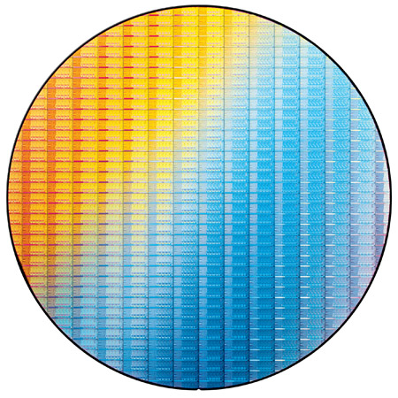
3. The 22 nm 3D Tri-Gate transistor-8
22 nm Ivy Bridge chips on a 300 mm wafer [82]

Slide 21
4. The 14 nm 3D Tri-Gate transistor
Notes:
21

Slide 22
4. The 14 nm 3D Tri-Gate transistor-1
4. The 14 nm 3D Tri-Gate transistor-1
1. gen.
2. gen.
3. gen.
4. gen.
5. gen.
Core 2
New
Microarch.
65 nm
Penryn
New
Process
45 nm
Nehalem
New
Microarch.
45 nm
Westmere
New
Process
32 nm
Sandy
Bridge
New
Microarch.
32 nm
Ivy
Bridge
New
Process
22 nm
Haswell
New
Microarchi.
22 nm
Broadwell
New
Process
14 nm
TOCK
TICK
TOCK
TICK
TOCK
TICK
TOCK
TICK
Figure: Intel’s Tick-Tock development model (Based on [1])
Introduced along with the Broadwell family of processors in 2014

Slide 23
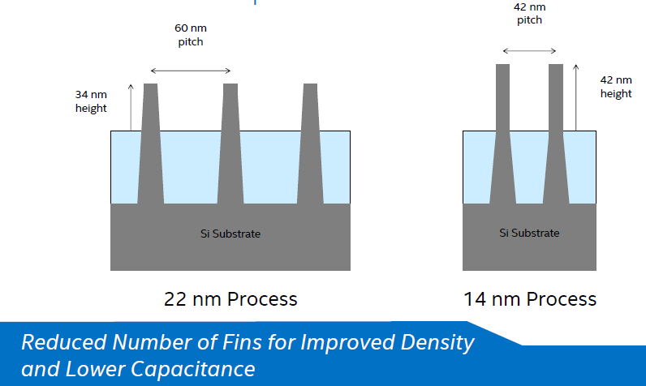
4. The 14 nm 3D Tri-Gate transistor-2
14 nm 2 generation Tri-gate transistors with fin improvement [154]

Slide 24
4. The 14 nm 3D Tri-Gate transistor-3
14 nm Broadwell SOC yield trend [154]

Slide 25
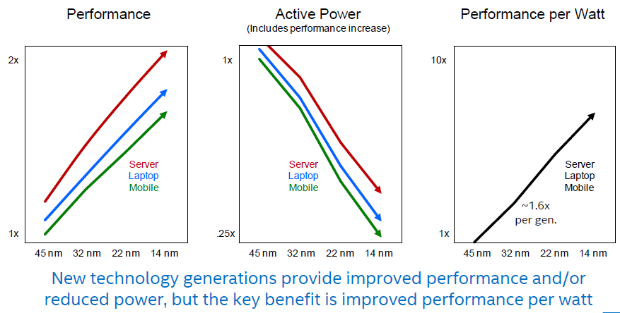
4. The 14 nm 3D Tri-Gate transistor-4
Benefits of reducing the feature size [154]

Slide 26
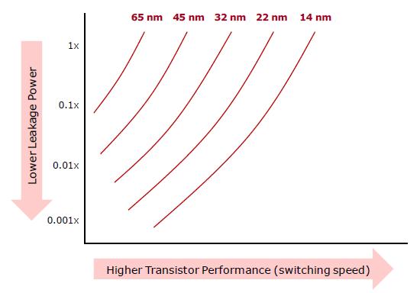
4. The 14 nm 3D Tri-Gate transistor-4
Leakage power vs clock speed for smaller feature sizes [154]
f_{c} > V_{c}
V_{c} > I_{l} > D_{s}

Slide 27
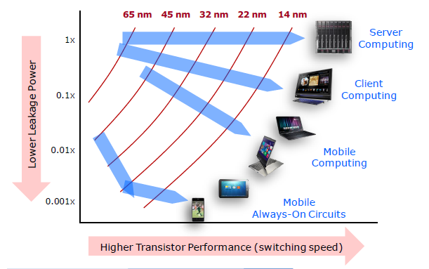
4. The 14 nm 3D Tri-Gate transistor-5
Clock speed vs. leakage power for smaller feature sizes and related product sectors [154]

