Slide 1
Mobile boom
Sima Dezső
Óbudai Egyetem
2014 május
(Ver. 1.2)
© Sima Dezső, 2014

Slide 2
Contents
1. The traditional computer market
2. The mobile boom
3. Requirements of mobile devices (tablets, smartphones) -
implications
4. Conclusions
5. References

Slide 3
1. The traditional computer market (1)
1. The traditional computer market
Main computer market segments around 2000
Servers
Desktops
Embedded
computer devices
E.g.
Intel’s Xeon lines
AMD’s Opteron lines
Intel’s Pentium 4 lines
AMD’s Athlon lines
ARM’s lines
Major trend in the first half of the 2000’s: spreading of laptops (first mobile devices)
Main computer market segments around 2005
Servers
Desktops
Laptops
Embedded
computer devices
E.g.
Intel’s Xeon lines
AMD’s Opteron lines
Intel’s Pentium 4 lines
AMD’s Athlon64 lines
Intel’s Celeron lines
AMD’s Duron lines
ARM’s lines

Slide 4
1. The traditional computer market (2)
Yearly worldwide sales and Compound Annual Growth Rates (CAGR)
of desktops and mobiles (laptops) as seen in 2006 [1]
CAGR 17%
CAGR 5%
Source: IDC March 2006

Slide 5
1. The traditional computer market (3)
Market positions of leading processor firms in traditional market segments

Slide 6
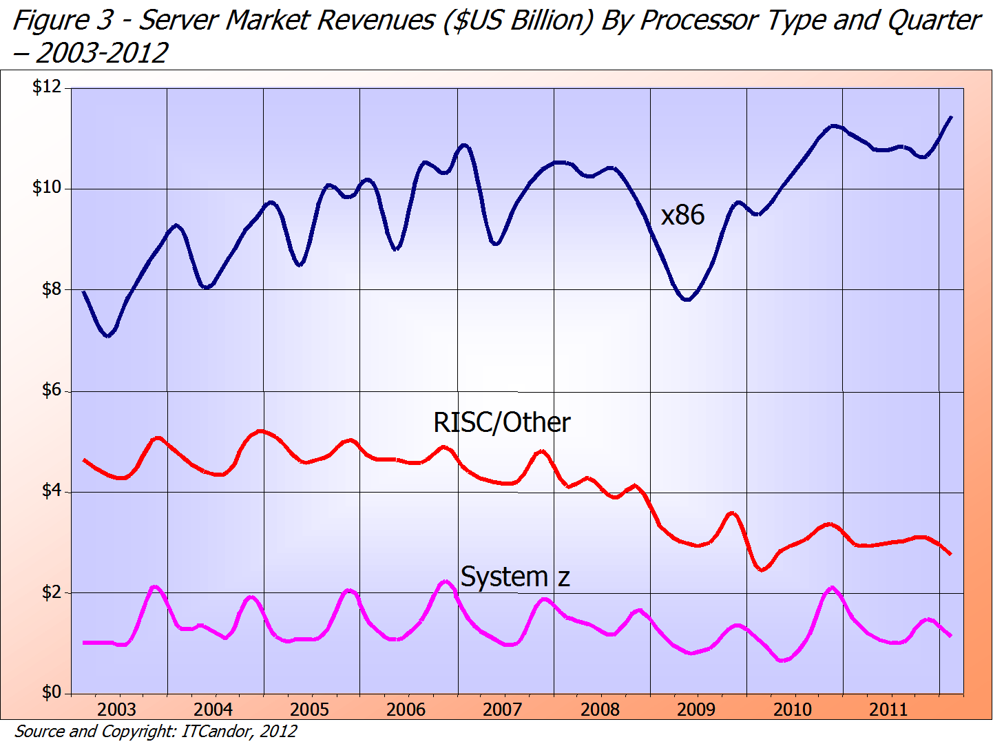
1. The traditional computer market (4)
Server market revenues by processor type and quarter ($US Billion) – 2003-2012 [14]
≈75 %
Intel/AMD
IBM POWER/Sun etc.
IBM
≈18 %
≈ 7 %

Slide 7
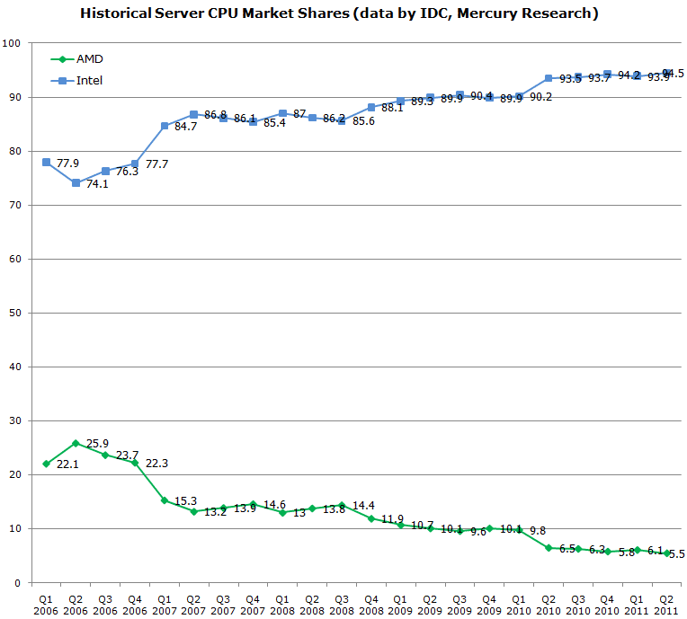
1. The traditional computer market (5)
x86 server market share of Intel and AMD [17]
Penryn MP
Nehalem-EX DP/MP
Penryn DP
Core 2 Quad DP
Core 2 DP
K10 Barcelona MP
K10 Shanghai MP
K10 Istambul MP
K10 Magny Course MP
Source: IDC,
Mercury Research

Slide 8
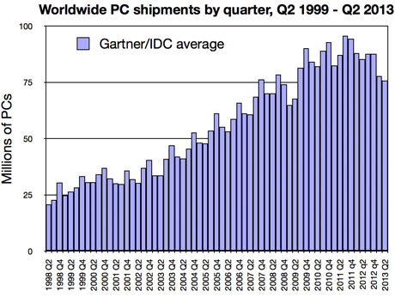
1. The traditional computer market (6)
Worldwide PC shipments by quarter, Q2 1999 – Q2 2013 [18]

Slide 9
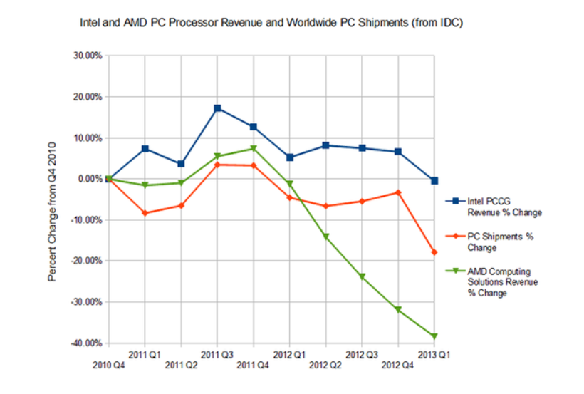
1. The traditional computer market (7)
Change of quarterly worldwide PC sales and related revenue changes of
Intel and AMD [30]

Slide 10
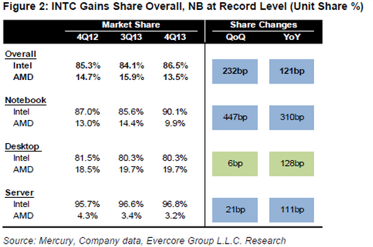
1. The traditional computer market (8)
Market share of Intel and AMD in desktops and traditional notebooks [32]

Slide 11
1. The traditional computer market (9)
Market share of Intel and AMD in desktops and traditional notebooks
Intel’s market share vs. AMD in desktops ≈ 80 %, in notebooks ≈ 85 - 90 %,
thus AMD’s share remains about 20 % in desktops and 10 -15 % in notebooks, [15], [16].

Slide 12
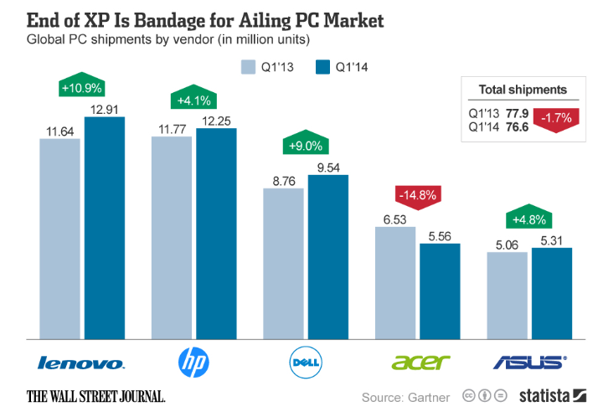
1. The traditional computer market (10)
Global PC shipments by vendor (in million units) [31]

Slide 13
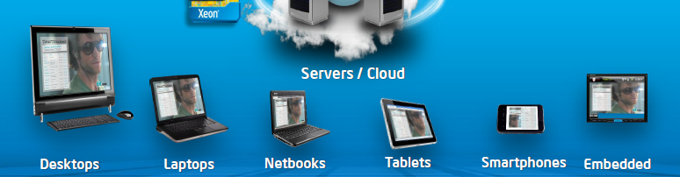
2. The mobile boom (1)
2. The mobile boom – beginning mainly in 2006
Diversification of mobile devices beginning mainly in 2006 [2]
Netbooks: Small sized laptops, i.e. laptops with a screen size of ~ 10” or less)

Slide 14
2. The mobile boom (2)
Spreading of smartphones
The birth of smartphones
Smartphones emerged in 2006 with the Blackberry Pearl 8100 design from the
Canadian firm RIM (Research in Motion) [5].
In 2007 Apple’s iPhone gave a strong momentum for rapid spreading of
smartphones.
Also in 2007 Google’s Android was unveiled and first Android-powered phones
sold in 10/2008 [6].

Slide 15
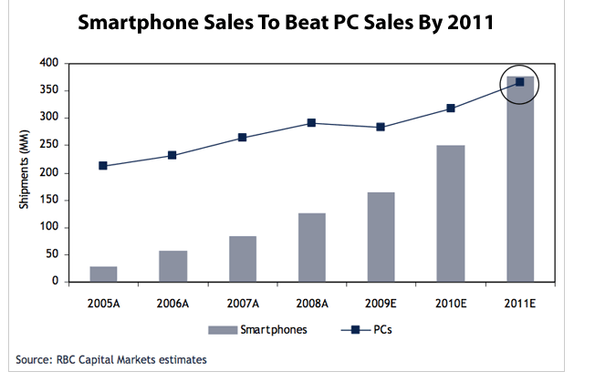
2. The mobile boom (3)
Rapid increase of smartphone sales in the second half of the 2000’s [4]
A: Actual values
E: Estimated

Slide 16
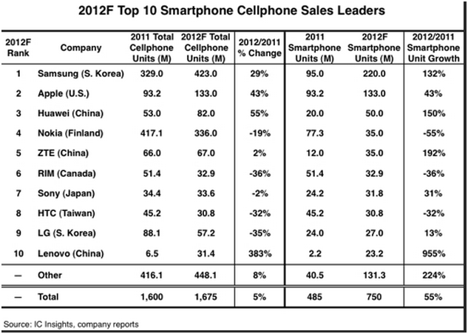
2. The mobile boom (4)
2011/2012 worldwide cellphone/smartphone sales by vendor [7]

Slide 17
2. The mobile boom (4a)
3Q/2013 worldwide smartphone sales by vendor (in thousand units) [33]
Company | 3Q13 Units | 3Q13 Market Share (%) | 3Q12 Units | 3Q12 Market Share (%)
Samsung | 80,356.8 | 32.1 | 55,054.2 | 32.1
Apple | 30,330.0 | 12.1 | 24,620.3 | 14.3
Lenovo | 12,882.0 | 5.1 | 6,981.0 | 4.1
LG Electronics | 12,055.4 | 4.8 | 6,986.1 | 4.1
Huawei | 11665.7 | 4.7 | 7,804.3 | 4.5
Others | 102941.8 | 41.1 | 70206.8 | 40.9
Total | 250,231.7 | 100.0 | 171,652.7 | 100.0

Slide 18
2. The mobile boom (5)
Operating systems of worldwide sold smartphones to end users in
2Q2013/2Q2012 [24]
Worldwide Smartphone Sales to End Users by Operating System in 2Q13 (Thousands of Units)
Source: Gartner (August 2013)
Operating System | 2Q13 Units | 2Q13 Market Share (%) | 2Q12 Units | 2Q12 Market Share (%)
Android | 177,898.2 | 79.0 | 98,664.0 | 64.2
iOS | 31,899.7 | 14.2 | 28,935.0 | 18.8
Microsoft | 7,407.6 | 3.3 | 4,039.1 | 2.6
BlackBerry | 6,180.0 | 2.7 | 7,991.2 | 5.2
Bada | 838.2 | 0.4 | 4,208.8 | 2.7
Symbian | 630.8 | 0.3 | 9,071.5 | 5.9
Others | 471.7 | 0.2 | 863.3 | 0.6
Total | 225,326.2 | 100.0 | 153,772.9 | 100.0

Slide 19
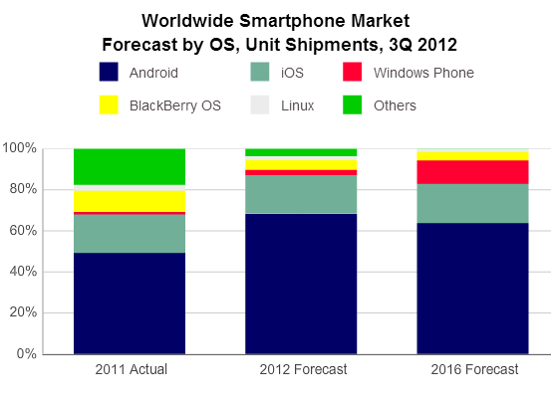
2. The mobile boom (6)
Operating systems of smartphones 2011/2012/2016 [7]

Slide 20
2. The mobile boom (7)
Remark
After the introduction of iPhone (2007) Steve Ballmer (CEO of Microsoft) said in an
interview [20]:
“There's no chance that the iPhone is going to get any significant market share.
No chance…
But if you actually take a look at the 1.3 billion phones that get sold, I'd prefer
to have our software in 60% or 70% or 80% of them, than I would to have 2%
or 3%, which is what Apple might get”.

Slide 21
2. The mobile boom (8)
Intel’s market share in the worldwide smartphone market
Intel entered the smartphone market in 1/2010 at the CES while announcing their
Moorestown platform running under given versions of Moblin (Intel’s Linux
alternative), MeeGo (Intel’s and Nokia’s Linux-based OS) or Android.
Although Intel quoted a few reference designs, actually no signs of shipping
Moorestown-based smartphones could be found on the internet.
Subsequently, Intel introduced a number of enhanced platforms, such as
the Medfield platform (01/2012)
the Lexington platform (01/2013) and
the Clover Trail+ platform (02/2013) and
the Merrifield platform (06/2013)
The Medfield platform did not brought Intel the expected success, in 1H2012 Intel
achieved a unit shipment share in smartphones of only 0.2% [29].
Nevertheless, Intel’s subsequent platforms and first of all their 22 nm Silvermont-
based Merrifield platforms to be available in Q1 2014, give Intel hopes to achieve
a much higher share on the smartphone market.

Slide 22
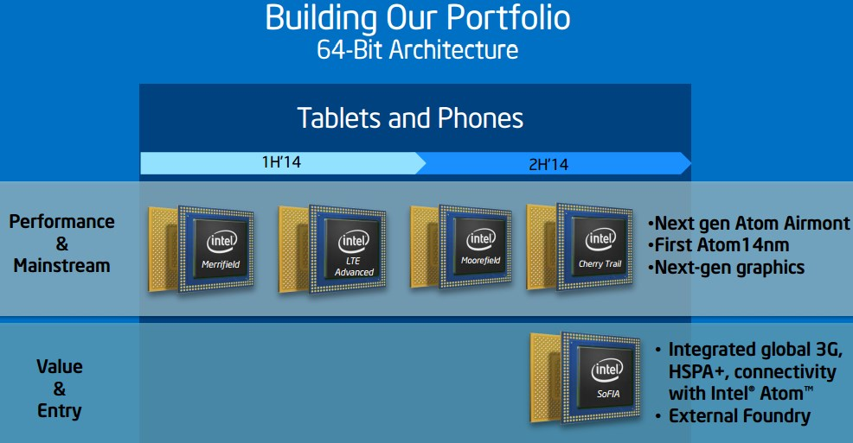
2. The mobile boom (8a)
Intel’s tablets an smartphones roadmap from 11/2013 []
http://www.extremetech.com/extreme/171682-medfield-two-years-in-what-killed-intels-mobile-phone-ambitions/2

Slide 23
2. The mobile boom (8b)
Intel’s acquisitions to accelerate LTE technology
(LTE (Long Term Evolution)
4G standard for wireless communication of high-speed data for mobile phones.
8/2010: Intel announces their plan to acquire Infineon Wireless Solution Business
8/2013 Intel acquires Fujitsu Wireless Business

Slide 24
2. The mobile boom (9)
Emergence of tablets
Visioning tablets
Tablets were envisioned by Steve Jobs already in 1983 saying
”Apple’s strategy is really simple. What we want to do is we want to put an
incredibly great computer in a book that you can carry around with you and learn
how to use in 20 minutes.
... And we really want to do it with a radio link in it so you don’t have to hook up
to anything and you’re in communication with all of these larger databases and
other computers” [19].

Slide 25
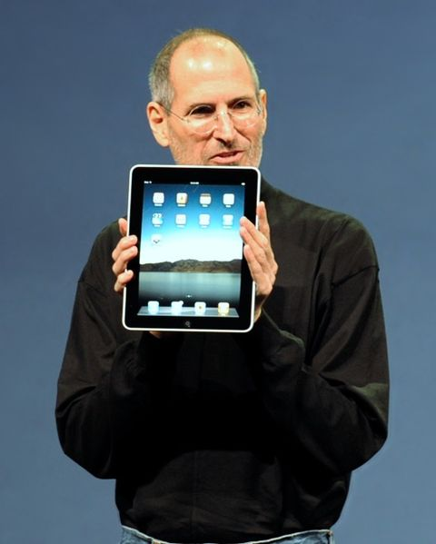
2. The mobile boom (10)
Designs leading to rapid spreading of tablets around 2010
From 2009 on: Android-based tablets arrived the market from many vendors.
2010: Apple’s iPad with 9.7 “ touch screen and Wi-Fi or additionally wireless
3G broadband internet connection (mobile internet connection), operating under
iOS [12].
Figure: Steve Jobs introducing the iPad in 2010 [12]

Slide 26
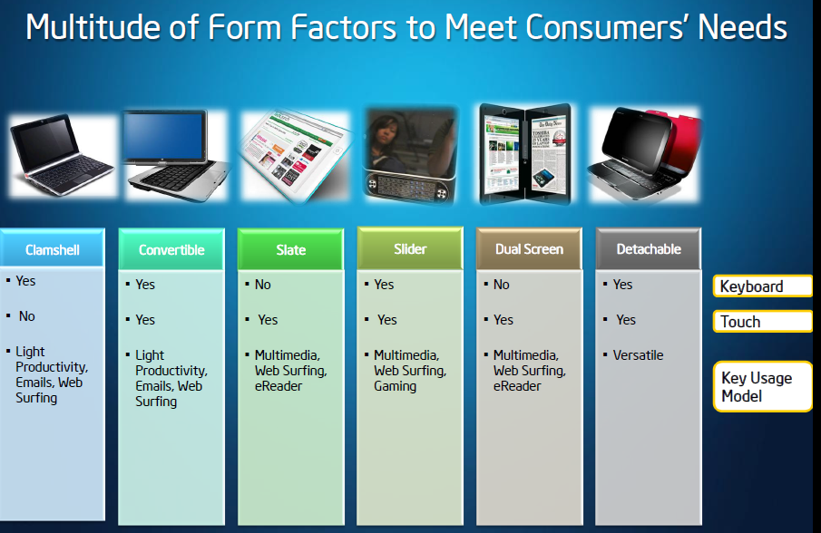
2. The mobile boom (11)
Implementation alternatives of tablets [8]

Slide 27
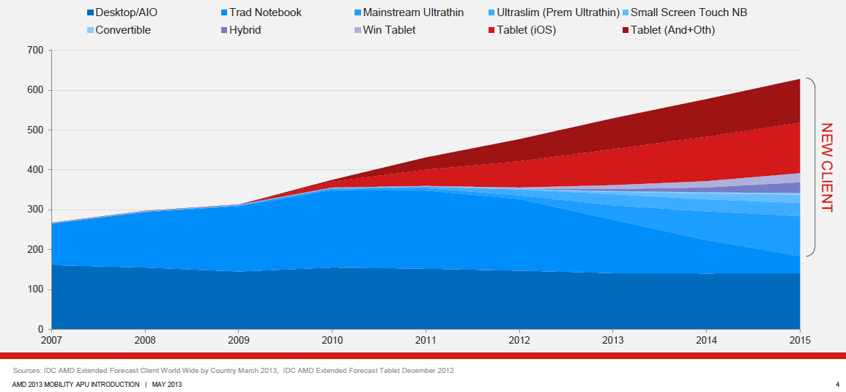
2. The mobile boom (12)
Rapid increase of tablet sales in the first half of the 2010’s
Besides smartphones, touchscreen tablets including a number of design alternatives that provide partly also keyboard/mouse input (like convertibles and hybrids) have recently the highest growth potential, as indicated in the Figure below (12/1012) [3].
Tablets
Notebooks
Desktops
Figure: Yearly worldwide sales figures of desktops, notebooks and tablets [3]

Slide 28
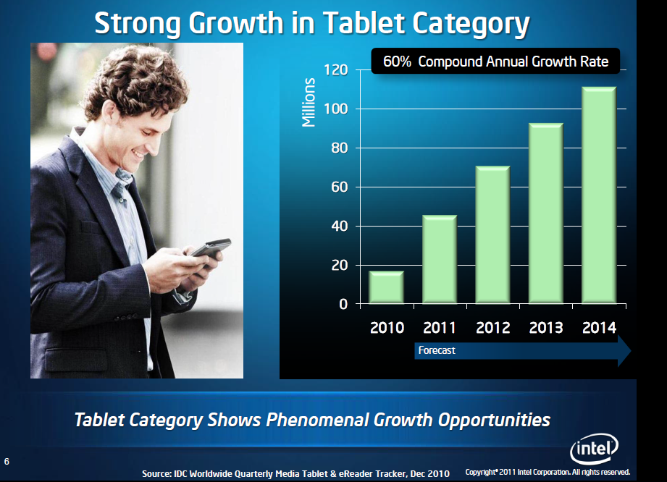
2. The mobile boom (13)
Expected growth in tablet sales from 2010 [27]

Slide 29
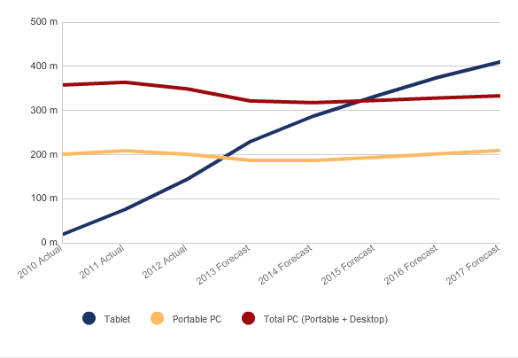
2. The mobile boom (14)
Worldwide tablet and PC (portable and desktop) sales [25]

Slide 30
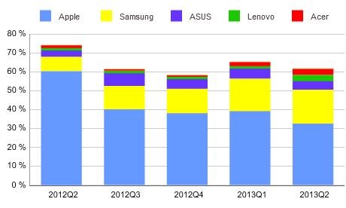
2. The mobile boom (15)
Market share of the top 5 worldwide tablet vendors Q2 2012 – Q2 2013 [25]

Slide 31
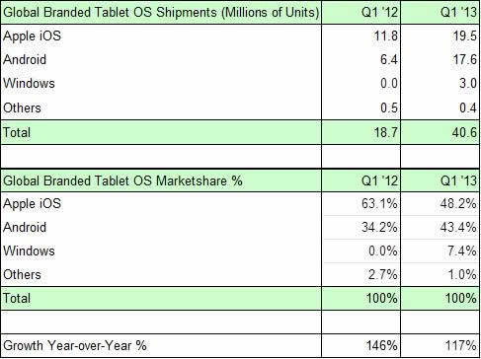
2. The mobile boom (16)
Operating systems used in tablets
(Worldwide figures in Q1/2012 and preliminary data for Q1/2013) [9]

Slide 32
2. The mobile boom (17)
Worldwide market share of tablets
As the previous Table shows, the worldwide market of tablets is dominated now by Apple’s
iPads and Android based tablets, manufactured mainly by Samsung.
It is to be mentioned that due to the high sales potential also Intel, AMD and Microsoft
entered the tablet market, as indicated below:
 | Platform | Processor | Intro. | OS
Intel | Oak Trail Clover Trail Bay Trail-T Cherry Trail | Atom/Lincroft Atom/Cloverview Atom/Valleyview-T Atom/Cherryview | 4/2011 9/2012 9/2013 Q4/2004 | Windows 7/Android/MeeGo Windows 8 Pro/Windows 8 Windows 8.1/Android Windows 8.1
AMD | Brazos Brazos-T Kabini/Temash Beema/Mullins | Bobcat/Desna Z-01 Bobcat/Hondo Z-60 Bobcat/Jaguar Bobcat/Puma+ | 6/2011 10/2012 5/2013 4/2014 | Windows 7 Windows 8 Windows 8 Windows 8.1
Microsoft | Surface RT Surface Pro Surface 2 Surface Pro 2 | Nvidia Tegra 3 with 4xARM Cortex-A9 Intel Ivy Bridge i5 Nvidia Tegra 4 with 4xARM Cortex-A15 Intel Haswell i5 | 10/2012 2/2013 10/2013 10/2013 | Windows RT Windows 8 Pro Windows RT 8.1 Windows 8.1 Pro
Table: Overview of Windows-based tablets introduced by Intel, AMD and Microsoft

Slide 33
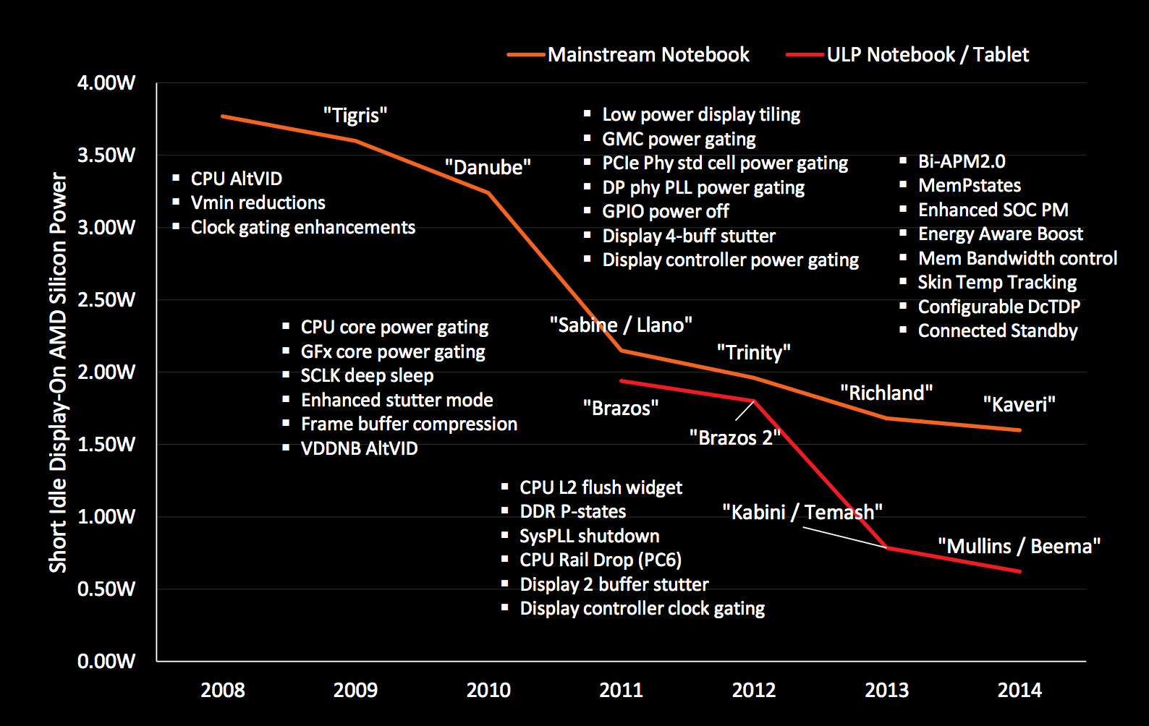
The fight for low power consumption: Example AMD’s efforts [34]

Slide 34
2. The mobile boom (18)
Market acceptance of Windows-based tablets
As shown in the Table before, the market share of Windows tablets in Q1/2013 remains
quite low (7.4 %) compared to iOS (48.2 %) and Android-based tablets (43.2 %), it can be
stated that until now the market acceptance of Intel’s, AMD’s and Microsoft’s tablets is modest.
Nevertheless, according to market research results, in Windows based tablets Intel achieved
in Q1 2013 a 90 % market share [28].
Despite the fact that both Intel’s Clover Trail and Bay Trail as well as AMD’s Temash-based
tablets have excellent features, market expectations for Windows-based tablets remain
modest also in a few years perspective, as the next market estimate for 2016 shows.
Tablet OS | 2012 Market Share (%) | 2016 Market Share (%) | CAGR 2012 – 2016 (%)
iOS | 53.8% | 49.7% | 20.9%
Android | 42.7% | 39.7% | 21.0%
Windows | 2.9% | 10.3% | 69.2%
Other | 0.6% | 0.3% | 7.7%
Grand Total | 100.0% | 100.0% | 23.3%
Source: IDC

Slide 35
3.Requirements of mobile devices - implications (1)
3. Requirements of mobile devices (tablets, smartphones) - implications
Only two aspects discussed:
a) Low power operation
b) Mobile, touch screen oriented operating systems

Slide 36
3.Requirements of mobile devices - implications (2)
a) Low power operation
Contrasting the design paradigms of traditional and mobile processors
Traditional processors
Tablets and smartphones
High performance/power
(e.g. GFLOPS/Watt)
Low power
(Watt)
(Number of operating hours)
Implications to the microarchitecture of low power CPUs (processor cores)

Slide 37
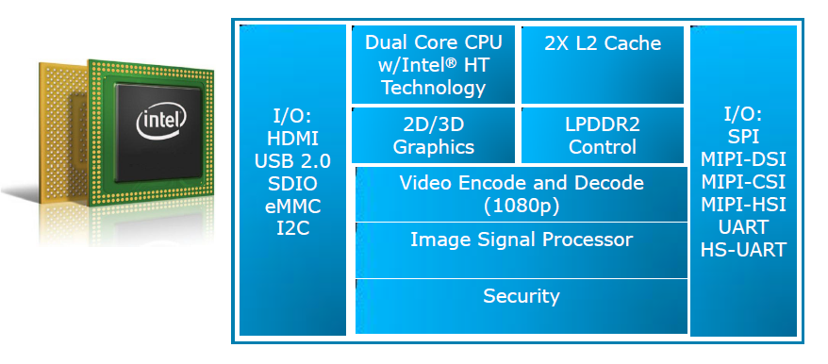
3.Requirements of mobile devices - implications (3)
Example: Block diagram of Intel’s Cloverview (Z2760) tablet processor (2012)
[13]

Slide 38
3.Requirements of mobile devices - implications (4)
Implications to the microarchitecture of low power CPUs-1
a) Low power CPUs need to have “narrow” microarchitectures (e.g. 2-wide)
Example: Microarchitectures of ARM CPUs underlying tablets and
smartphones [10]

Slide 39
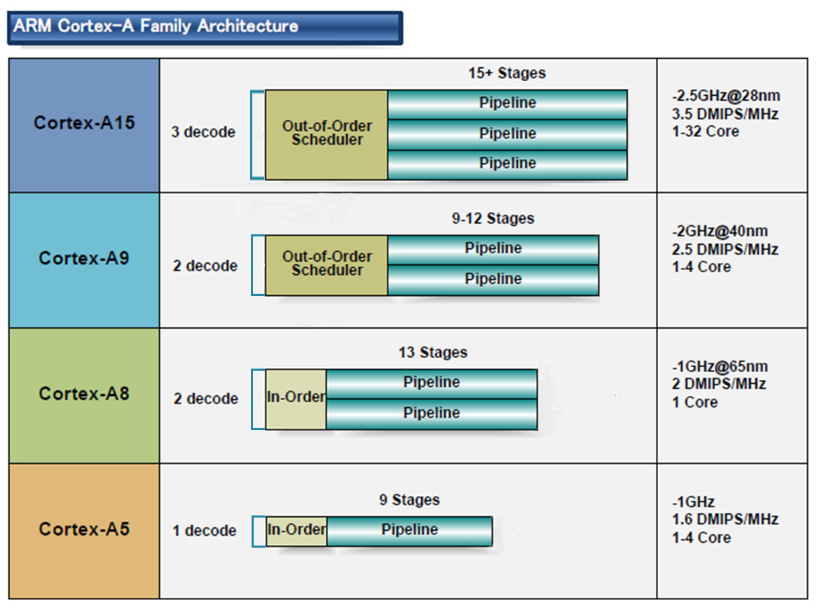
3.Requirements of mobile devices - implications (5)
Microarchitectures of ARM CPUs underlying tablets and smartphones [10]
32-bit
2010
2007
2005
2009
(A9 replacement
for low-end
devices)

Slide 40
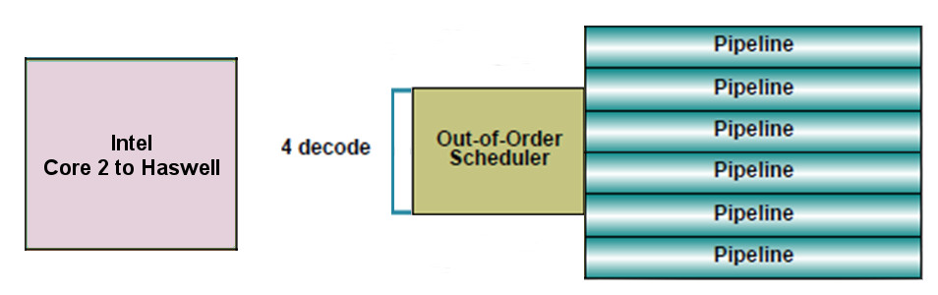
3.Requirements of mobile devices - implications (6)
By contrast typical microarchitectures of recent traditional processors
have wide microarchitectures, as the next example shows.
Example: Intel’s Core 2 – Haswell processors underlying laptops, PCs and
servers
64-bit

Slide 41
3.Requirements of mobile devices - implications (7)
Implications to the microarchitecture of low power CPUs-2
b) Low power CPUs need to have relative low base clock frequencies
Traditional CPUs
Mobile CPUs
High base clock frequency
(typically 2-3 GHz)
Relative low base clock frequency
(typically 1-1.5 GHz)
(D = const x fc x V², in addition higher fc requires higher V)

Slide 42
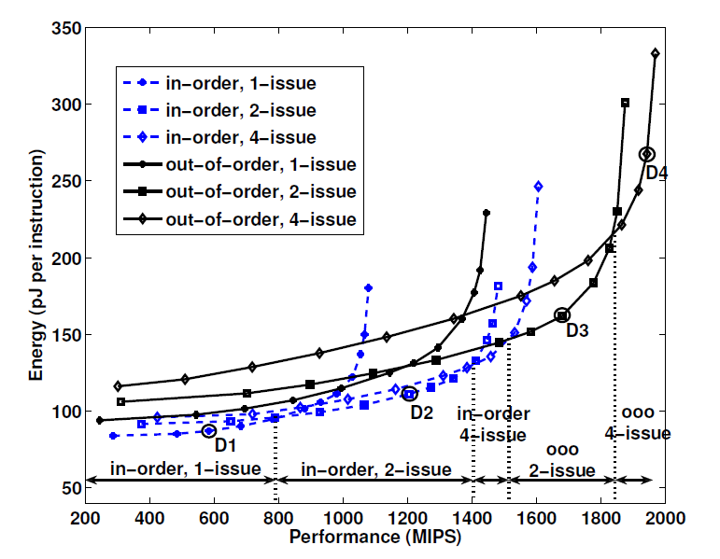
3.Requirements of mobile devices - implications (8)
Energy-performance tradeoffs of processor architectures
Figure: The energy (pJ per instruction) vs. performance tradeoffs in different CPU
layouts by jointly optimizing microarchitecture and circuit parameters [23].

Slide 43
3.Requirements of mobile devices - implications (9)
In the Figure the design point
D4 maps 4-wide out-of-order high performance traditional processors operating
at a high clock rate whereas
D2 reflects 2-wide in-order mobile processors operating at a considerable
lower clock rate.
Obviously,at the same performance, the design point D2 assures a more power
efficient operation than the design point D4,as shown in the next Figure..

Slide 44
3.Requirements of mobile devices - implications (9a)
Energy-performance tradeoffs of processor architectures
Figure: The energy (pJ per instruction) vs. performance tradeoffs in different CPU
layouts by jointly optimizing microarchitectural and circuit parameters [23].

Slide 45
3.Requirements of mobile devices - implications (10)
Consequences for Intel and AMD
Traditional CPUs of Intel and AMD are designed for high performance/power,
so they are power hungry,
but mobile devices require low power consumption, so
traditional microarchitectures of Intel and AMD are not suited for
low power constrained mobile devices.

Slide 46
3.Requirements of mobile devices - implications (11)
Foreseeable market situation
Market for traditional
devices
Market for mobile
devices
Intel/AMD/IBM
Apple/Samsung etc.
If Intel and AMD wanted to avoid shrinking market shares in the overall processor market
and benefit from the rapidly increasing mobile market
they need processors that are competitive with ARM designed ones.
Intel and AMD were forced
to introduce novel narrow (e.g. 2-wide) microarchitectures
for their CPUs and
clock them at a relative low rate.

Slide 47
3.Requirements of mobile devices - implications (12)
Intel’s response to the mobile challenge
Introduction of the Atom line of processors in 2008, as shown next.

Slide 48
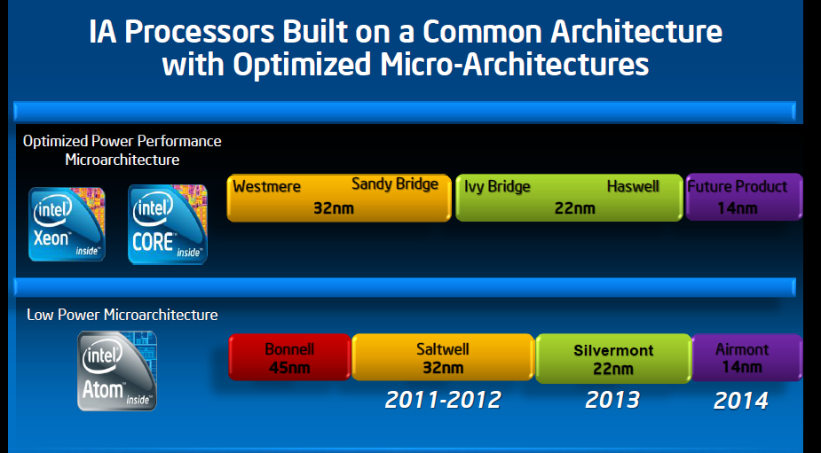
3.Requirements of mobile devices - implications (13)
Evolution of Intel’s basic architectures [2]
2008

Slide 49
3.Requirements of mobile devices - implications (14)
First implementation of the Atom-line of CPUs
It was an in-order 2-wide x86-32/64 superscalar clocked at 1.6 GHz.
Intel’s first Atom implementation was similar to the ARM Cortex-A8 design,
as indicated in the next Figure.

Slide 50
3.Requirements of mobile devices - implications (15)
Basic layout of the microarchitecture of ARM’s Cortex-A family [10]
32-bit
2010
2007
2005
2009
(A9 replacement
for low-end
devices)

Slide 51
3.Requirements of mobile devices - implications (16)
Intel’s recent implementation of the Atom-line of CPUs
It is the 22 nm Silvermont core, an out-of- order 2-wide x86-32/64 superscalar clocked at 1.6 GHz.
Intel’s recent Atom implementation is similar to the ARM Cortex-A9 design,
as indicated in the next Figure.

Slide 52
3.Requirements of mobile devices - implications (17)
Basic layout of the microarchitecture of ARM’s Cortex-A family [10]
32-bit
2010
2007
2005
2009
(A9 replacement
for low-end
devices)

Slide 53
3.Requirements of mobile devices - implications (18)
Intel’s Atom CPUs are intended to be used in a wide range of platforms
targeting
entry-level desktops
laptops
netbooks (small size laptops)
tablets and
smartphones
and newly also microservers.

Slide 54
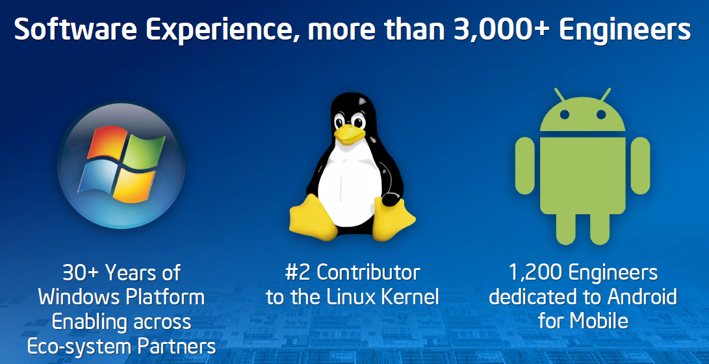
3.Requirements of mobile devices - implications (19)
Intel’s effort to optimize their devices from the software point of view
In their 2012 Investor meeting (5/2012) Intel revealed that more than 3000
engineers are working on OS support, among them about 1200 engineers
are dedicated to Android, as indicated below [11].

Slide 55
3.Requirements of mobile devices - implications (20)
AMD’s response to the mobile challenge-1
Introduction of the Bobcat line of processors in 1/2011.

Slide 56
3.Requirements of mobile devices - implications (21)
Evolution of AMD’s basic architectures
Optimized Power
Performance
Microarchitecture
~10/2011
~5/2012
11/2013?
AMD
Bulldozer
Family 15h
Bulldozer
Models 00h-0Fh
32nm
Piledriver
Models 10h-1Fh
32 nm
Steamroller
Models 30h-3Fh
28nm
Low Power
Microarchitecture
1/2011
5/2013
AMD
Family 14h/16h
Bobcat
40nm
Jaguar
28nm
Puma+
28nm
2011
2012
2013
2014

Slide 57
3.Requirements of mobile devices - implications (22)
Basic layout of the first implementation of AMD’s Bobcat CPU
The Bobcat CPU is an out-of-order 2-wide superscalar executing 64-bit x86 code,
its microarchitecture is similar to ARM’s Cortex A9 core, as indicated in the next
Figure.

Slide 58
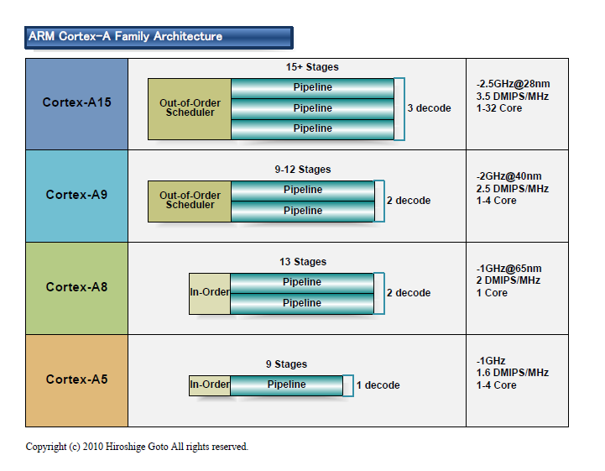
3.Requirements of mobile devices - implications (23)
Basic layout of the microarchitecture of ARM’s Cortex-A family [10]
32-bit
2010
2007
2005
2009
(A9 replacement
for low-end
devices)

Slide 59
3. Requirements of mobile devices - implications (24)
b) Mobile touch screen oriented operating systems
Traditional notebooks, PCs and servers
Tablets and smartphones
Windows versions and
Linux or Linux alternatives
Mainly Android and iOS
Microsoft’s response-1
2010: Windows Phone 7 (later Windows Phone 8)
2012: Windows 8: aim to cover PCs, notebooks and also tablets
2013: Windows 8.1
4/2014: Windows OSs for free for tablets and smartphones with display sizes
of less than 9 inch.
Market reflections: Windows Phone 7 and Windows 8 earned moderate success,
Android and iOS dominate further on the market.

Slide 60
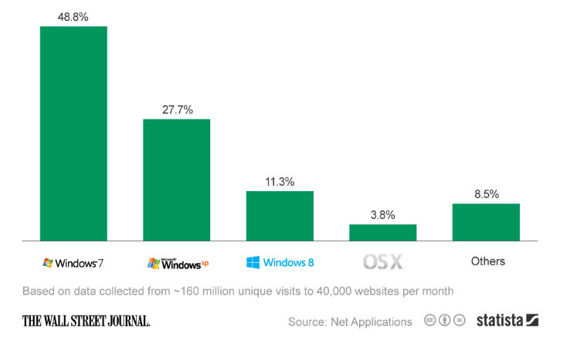
3.Requirements of mobile devices - implications (25)
Global market share of operating systems on PCs in 3/2013 [31]

Slide 61
3.Requirements of mobile devices - implications (26)
Microsoft’s response-2
Ballmer (CEO of Microsoft in 9/2012):
“I think that in a back-looking view, people would say we were a software company.
That's kind of how we were born.
I think when you look forward, our core capability will be software, (but)
you'll probably think of us more as a devices-and-services company.” [22]
Transitioning Microsoft into a devices-and-services company
2012: Windows Surface (Tegra 3/ARM A-9 CPU, Windows RT)
Windows Surface Pro (Intel Ivy Bridge i5 CPU, Windows 8)
2013: Xbox One game console (8 AMD Jaguar cores
(successor to Xbox 360)
2013: Microsoft purchases Nokia’s phone business
2013: Windows Surface 2 (Tegra 4/ARM A-15 CPU, Windows RT 8.1)
Windows Surface Pro 2 (Intel Haswell i5 CPU, Windows 8.1 Pro)

Slide 62
4. Conclusions (1)
4. Conclusions
Informatics came into a transitional phase
new paradigms
new devices
new players
Established companies have to respond early, quick and in an appropriate way
to the new challenges, else…
8/2011 Google acquires Motorola Mobility
9/2013 Microsoft purchases Nokia’s phone business
9/2013 BlackBerry lays off 4500 employees (~ 40% of their workforce)

Slide 63
4. Conclusions (2)
Even the largest IT firms have a hard time to cope with as indicated by
resignation of AMD’s, Intel’s and Microsoft’s CEOs (Chief Execution Officers):
1/2011 AMD: Dirk Meyer
11/2012 Intel: Paul Otellini
8/2013 Microsoft: Steve Ballmer

Slide 64
4. Conclusions (3)
But this transitional phase of informatics is also an opportunity and challenge
for individuals and institutions to catch up with the progress and make benefit of it.

Slide 65
Köszönöm a figyelmet!

Slide 66
5. References (1)
[1]: Bártfai D., Merre felé tartanak a hardverek?, Aug. 22-24 2007
[2]: Smith S.L., Intel Strategy & Technology Update, Barclays Capital Global Technology Conf.,
Dec. 2011, http://files.shareholder.com/downloads/INTC/1576180143x0x526852/c9868a3a-
494e-4506-bcc6-a631aca1fd75/Steve%20Smith%20Barclays%20Dec%202011.pdf
[3]: AMD 2013 Mobility APU Introduction, May 22 2013,
http://www.slideshare.net/AMD/amd-2013-mobility-apu-introduction-deck-final-for-lp
[4]: Frommer D., CHART OF THE DAY: Smartphone Sales To Beat PC Sales By 2011,
Business Insider, Aug. 21 2009, http://www.businessinsider.com/chart-of-the-day-
smartphone-sales-to-beat-pc-sales-by-2011-2009-8
[5]: Wikipedia, BlackBerry Pearl, http://en.wikipedia.org/wiki/BlackBerry_Pearl
[6]: Wikipedia, Android (operating system),
http://en.wikipedia.org/wiki/Android_%28operating_system%29
[7]: Ciufo C.A., Tizen OS for Smartphones – Intel’s Biggest Bet Yet, Jan. 4 2013,
http://eecatalog.com/caciufo/2013/01/04/samsung-hedges-apple-google-bets-with-intels-
html5-based-tizen/
[8]: Introduction of the Next Generation Intel Atom Processor, Oak Trail Z670, 4/2011,
http://newsroom.intel.com/docs/DOC-1976
[9]: Apple Maintains 48 Percent Share of Global Branded Tablet Shipments in Q1 2013,
Strategy Analytics, April 25 2013, Boston,
http://www.strategyanalytics.com/default.aspx?mod=pressreleaseviewer&a0=5351

Slide 67
5. References (2)
[10]: Goto H., ARM Cortex – A Family Architecture, 2010,
http://pc.watch.impress.co.jp/video/pcw/docs/423/409/p1.pdf
[11]: Eul H., Bell M., Mobile at Intel, Investor Meeting 2012,
http://www.cnx-software.com/pdf/Intel_2012/2012_Intel_Investor_Meeting_Eul_Bell.pdf
[12]: Wikipedia, iPad, http://en.wikipedia.org/wiki/IPad
[13]: Tablet Platforms with Next Generation Intel Atom Processor and Microsoft Windows 8,
IDF 2012
[14]: The $15.3 Billion Server Market – Surprisingly Buoyant In Q1 2012, IT Candor, July 3 2012,
http://www.itcandor.com/server-q112/
[15]: Shah A., Intel Loses Laptop Chip Market Share to AMD in Q3, PC World, Nov. 3 2011,
http://www.pcworld.com/article/243114/intel_loses_laptop_chip_market_share_to_amd_
in_q3.html
[16]: Perry D., AMD Steals Market Share From Intel, Tom’s Hardware, March 16 2012,
http://www.tomshardware.com/news/amd-intel-cpu-processor,15041.html
[17]: Shilov A., AMD Shows Off Opteron "Interlagos" Again: No Performance Benchmarks,
No Design Wins, No Launch Date Announced, Xbit Labs, Aug. 3 2011,
http://www.xbitlabs.com/news/cpu/display/20110803103016_AMD_Shows_Off_Opteron_
Interlagos_Again_No_Performance_Benchmarks_No_Design_Wins_No_Launch_Date_
Announced.html
[18]: Arthur C., PC business still waning as Microsoft's Windows 8 fails to lift it, 11 July 2013,
http://www.theguardian.com/technology/2013/jul/11/pc-business-microsoft-windows-8

Slide 68
5. References (3)
[19]: Golson J., Steve Jobs Envisioned the iPad in 1983, MacRumors, Oct. 2, 2012,
http://www.macrumors.com/2012/10/02/steve-jobs-envisioned-the-ipad-in-1983/
[20]: Yarow J., Steve Ballmer's Biggest Mistakes As CEO Of Microsoft, Business Insider, Aug. 27
2013,
http://www.businessinsider.com/steve-ballmers-most-epic-mistakes-as-ceo-of-microsoft-
2013-8?op=1
[21]: Thakkar S., Technology Insight: Intel platform for Tablets Code Name Bay Trail-T, IDF 2013
San Francisco, SPCS004,
https://intel.activeevents.com/sf13/connect/sessionDetail.ww?SESSION_ID=1153
[22]: Tu J., Ballmer trumpets Microsoft's 'epic year‘, The Seattle Times, 15. September 2012,
http://seattletimes.com/html/businesstechnology/2019168601_microsoftballmer16.html
[23]: Azizi O., Mahesri A., Lee B.C., Patel S., Horowitz M., Energy-Performance Tradeoffs in
Processor Architecture and Circuit Design: A Marginal Cost Analysis, ISCA’10,
June 19-23 2010, http://www.cse.ohio-state.edu/~cstewart/p26-azizi.pdf
[24]: Gartner Says Smartphone Sales Grew 46.5 Percent in Second Quarter of 2013 and Exceeded
Feature Phone Sales for First Time, Gartner, Aug. 14 2013,
http://www.gartner.com/newsroom/id/2573415
[25]: iCharts, Tablets, 2013, http://www.icharts.net/chartchannel/tablets
[26]: OEMs Are Killing The PC Industry, Seeking Alpha, Aug. 2 2013,
http://seekingalpha.com/article/1600652-oems-are-killing-the-pc-industry?source=
email_rt_article_readmore

Slide 69
5. References (4)
[27]: Introduction of the Next Generation Intel Atom Processor, Oak Trail Z670, 4/2011,
http://newsroom.intel.com/docs/DOC-1976
[28]: Android Support Can Expand AMD’s Footprint In The Tablet Market Trefis May 31 2013,
http:// www.trefis.com/stock/amd/articles/189584/android-support-can-expand-amds-
footprint-in-the-table-market/2013-05-31
[29]: Lomas N., Report: Intel Gained Just 0.2% Of Smartphone Chip Market In 1H As Qualcomm
Milked LTE Lead Tech Crunch, Oct. 5 2012, http://techcrunch.com/2012/10/05/report-
intel-gained-just-0-2-of-smartphone-chip-market-in-1h-as-qualcomm-milked-lte-lead/
[30]: Hibben M., Intel’s Soft Landing – at AMD’s Expense, The Motley Fool, April 23 2013,
http://beta.fool.com/markhibben/2013/04/23/intels-soft-landing-at-amds-expense/31867/
[31]: Blair M., Windows XP's Death Will Breathe Life Into Microsoft, Intel And AMD Shares,
Seeking Alpha, April 15 2014, http://seekingalpha.com/article/2143453-windows-xps-
death-will-breathe-life-into-microsoft-intel-and-amd-shares?isDirectRoadblock=false&uprof=
[32]: Jaynes J., Thursday Will Likely Center Around PCs For AMD, Seeking Alpha, April 15 2014,
http://seekingalpha.com/article/2141993-thursday-will-likely-center-around-pcs-for-
amd?isDirectRoadblock=false&uprof=
[33]: Gartner Says Smartphone Sales Accounted for 55 Percent of Overall Mobile Phone Sales in
Third Quarter of 2013, Press release, Nov. 14. 2013, Gartner,
http://www.gartner.com/newsroom/id/2623415
[34]: Shimoi A. L., AMD Beema/Mullins Architecture & Performance Preview, AnandTech, April 29,
2014, http://www.anandtech.com/show/7974/amd-beema-mullins-architecture-a10-micro-
6700t-performance-preview

