Slide 1
Intel’s Core family - TOCK lines
Core 2 to Skylake
Dezső Sima
Vers. 1.2
September 2015

Slide 2
Contents
1. Introduction
2. The Core 2 line
3. The Nehalem line
4. The Sandy Bridge line
5. The Haswell line
6. The Skylake line
7. The Kaby Lake line

Slide 3
1. Introduction
Notes:
3

Slide 4
1. Introduction (1)
1. Introduction
The evolution of Intel’s basic Core family
1. gen.
2. gen.
3. gen.
4. gen.
5. gen.
6. gen.
Core 2
New
Microarch.
65 nm
Penryn
New
Process
45 nm
Nehalem
New
Microarch.
45 nm
West-
mere
New
Process
32 nm
Sandy
Bridge
New
Microarch.
32 nm
Ivy
Bridge
New
Process
22 nm
Haswell
New
Microarchi.
22 nm
Broad-
well
New
Process
14 nm
Skylake
New
Microarchi.
14 nm
TOCK
TICK
TOCK
TICK
TOCK
TICK
TOCK
TICK
TOCK
Figure 1.1: Intel’s Tick-Tock development model (Based on [1])

Slide 5
1. Introduction (2)
Basic microarchitectures and their related shrinks
Considered from the Pentium 4 Prescott (the third core of Pentium 4) on.
Basic architectures | Basic architectures and their shrinks
Pentium 4 (Prescott) | 2005 90 nm Pentium 4 2006 65 nm Pentium 4
Core 2 | 2006 65 nm Core 2 2007 45 nm Penryn
Nehalem | 2008 45 nm Nehalem 2010 32 nm Westmere
Sandy Bridge | 2011 32 nm Sandy Bridge 2012 22 nm Ivy Bridge
Haswell | 2013 22 nm Haswell 2014 14 nm Broadwell
Skylake | 2015 14 nm Skylake ? 14 nm Kaby Lake ? 10 nm Cannonlake

Slide 6
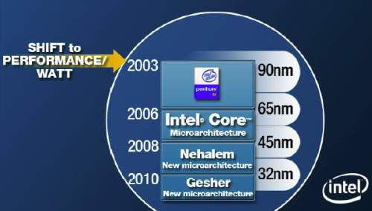
1. Introduction (3)
Changing the design paradigm to cope with raising dissipation
In 2003 Intel shifted the focus of their processor development from the pure performance goal
to the aspect of performance per watt, as stated in a slide from 4/2006, see below.
Figure 1.3: Intel’s plan to develop their manufacturing technology and processor lines
revealed at a shareholder’s meeting back in 4/2006 [74]

Slide 7
1. Introduction (4)
Changing the design paradigm for mobile processors
With the advent of mobile devices (about 2006) a new design paradigm arose for those devices.
Mobile devices require long operating hours i.e. low power consumption, this is contrast to the
design paradigm of traditional processors, as indicated below.
Traditional processors
Tablets and smartphones
High performance/power
(e.g. GFLOPS/Watt)
Low power
(Watt)
(Number of operating hours)

Slide 8
1. Introduction (5)
Key requirements for low power microarchitectures
Key requirements for low power microarchitectures
Narrow microarchitecture
Low processor clock frequency

Slide 9
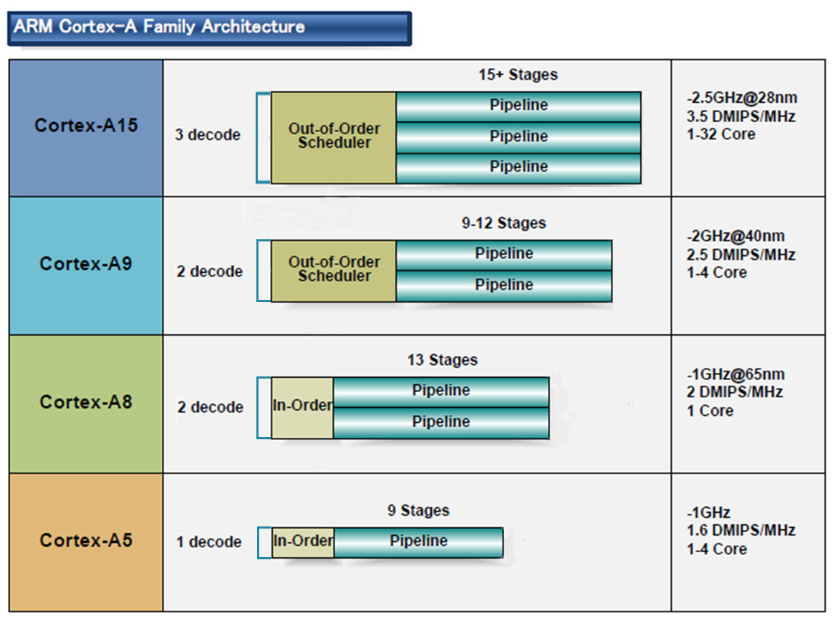
1. Introduction (6)
a) Low power CPUs need narrow microarchitectures
Example: Width of ARM’s 32-bit CPUs used in most tablets and smartphones [10]
32-bit
2010
2007
2005
2009
(A9 replacement
for low-end
devices)

Slide 10
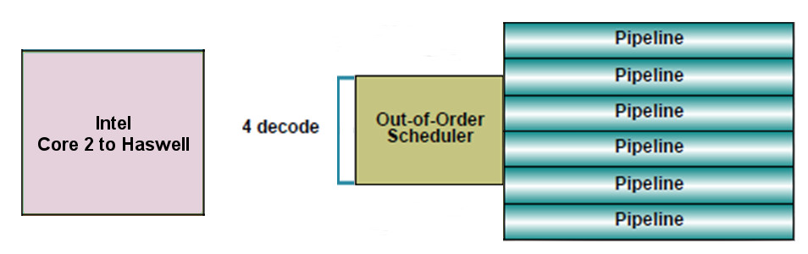
1. Introduction (7)
By contrast:
Intel’s and AMD’s recent processor lines
aims at high performance/power (in terms of GFLOPS/Watt)
accordingly
have 4-wide microarchitectures, as the next example shows:
64-bit
Example: Width of Intel’s Core 2 to Haswell processors underlying servers to laptops [10]

Slide 11
1. Introduction (8)
Consequences for Intel and AMD-1
Intel’s and AMD’s traditional microarchitectures are not suited for mobile devices.
If they want to become competitive with ARM designed ones, they need to design
new, narrow (e.g. 2-wide) low-power microarchitectures.

Slide 12
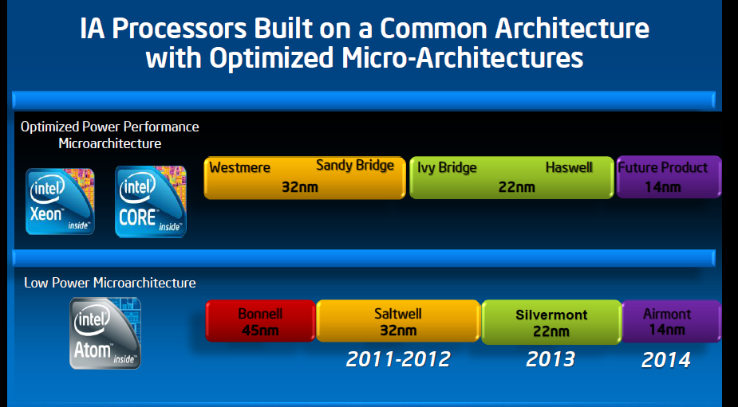
1. Introduction (9)
Emergence of Intel’s Atom line aiming for tablets and smartphones [2]
Broadwell
14 nm
4-wide
out-of-order
2008
2015
2-wide
in-order
2-wide
in order
2-wide
out-of-order
2-wide
out-of-order

Slide 13
1. Introduction (10)
b) Low power CPUs need low base clock frequencies
Traditional CPUs
Mobile CPUs
High base clock frequency
(typically 2-4 GHz)
Relative low base clock frequency
(typically 1-2 GHz)
( D = const x fc x V², in addition higher fc requires higher V)

Slide 14
1. Introduction (11)
Example: The max. base frequency of Skylake models resulting in different TDPs and
configurations (Based on data from [202])
TDP (W) | No. of cores | Graphics | No. of graphics EUs | eDRAM | Base frequency (GHz)
4.5 | 2 | HD 515 | 18 | -- | 1.2
15 | 2 | HD 540 | 48 | 64 MB | 2.2
15 | 2 | HD 520 | 24 | -- | 2.6
28 | 2 | HD 550 | 48 | 64 MB | 3.3
35 | 4 | HD 530 | 24 | -- | 2.8
45 | 4 | HD 530 | 24 | -- | 2.9
65 | 4 | HD 530 | 24 | -- | 3.4
91 | 4 | -- | -- | -- | 4.2
Note that low TDP can be achieved first of all by reducing the core frequency and limiting
the computer resources (cores, GPU EUs) provided.

Slide 15
1. Introduction (12)
Intel’s Tick-Tock model for the P4 and Core lines
Key new features of the ISP
and the microarchitecture
2 YEARS
TICK
TOCK
180nm
11/2000
New microarch.
Pentium 4 /Willamette
2 YEARS
TICK
TOCK
130nm
01/2002
New microarch.,
hyperthreading (HT)
Pentium 4 /Northwood
TICK
TOCK
90nm
02/2004
New microarch.,
64-bit
2 YEARS
Pentium 4 /Prescott
TICK Pentium 4 / Cedar Mill
01/2006
2 YEARS
TOCK Core 2
65nm
New microarch.: 4-wide core,
128-bit SIMD/FP, shared L2 , no HT
07/2006
TICK Penryn Family
11/2007
2 YEARS
45nm
New microarch.: integrated MC, QPI,
(inclusive) L3, HT
TOCK Nehalem
11/2008
TICK Westmere
01/2010
In package integr. GPU
2 YEARS
TOCK Sandy Bridge
32nm
New microarch.: 256-bit AVX,
ring bus, integr. GPU
01/2011
TICK Ivy Bridge
04/2012
2 YEARS
22nm
AVX2,
L4 cache (discrete eDRAM), FIVR
TOCK Haswell
06/2013
TICK Broadwell
09/2014
Shared Virtual Memory
2 YEARS
14nm
ISP,
Memory Side $ (eDRAM), No FIVR
TOCK Skylake
08/2015
Figure : Overview of Intel’s Tick-Tock model (Based on [3])

Slide 16
1. Introduction (12a)
Intel’s Tick-Tock model for the P4 and Core lines
Key new features
in power management
2 YEARS
TICK
TOCK
180nm
11/2000
Clock gating
Pentium 4 /Willamette
2 YEARS
TICK
TOCK
130nm
01/2002
Pentium 4 /Northwood
TICK
TOCK
90nm
02/2004
2 YEARS
Pentium 4 /Prescott
TICK Pentium 4 / Cedar Mill
01/2006
2 YEARS
65nm
Clock gating, PECI,
Platform Thermal Control by 3. party controller
TOCK Core 2
07/2006
TICK Penryn Family
11/2007
EDAT
2 YEARS
45nm
Integrated Power Gates, PCU,
Turbo Boost
TOCK Nehalem
11/2008
TICK Westmere
01/2010
2 YEARS
TOCK Sandy Bridge
32nm
01/2011
Turbo Boost 2.0
TICK Ivy Bridge
04/2012
2 YEARS
22nm
TOCK Haswell
06/2013
FIVR
TICK Broadwell
09/2014
2. gen. FIVR
2 YEARS
14nm
Speed Shift Technology,
Duty Cycle control, No FIVR
TOCK Skylake
08/2015
Figure : Overview of Intel’s Tick-Tock model (Based on [3])

Slide 17
1. Introduction (13)
Single thread IPC in Intel’s basic architectures (Based on [195])
2
24%
22%
Per Generation
1.9
20%
Cumulative
1.8
18%
1.7
16%
1.6
14%
12%
1.5
10%
1.4
8%
1.3
6%
1.2
4%
2%
1.1
0%
1
Pentium M
Dothan
Core 2
Penryn
NHM
(w/o SMT)
WSM
SNB
IVB
HSW
BRW
SKL
Note that Intel raised IPC in the Core family only less then 2-times in about 10 years.

Slide 18
1. Introduction (14)
Recent main product categories of Intel and underlying processor lines
Recent main product categories of Intel
Servers
Desktops/Laptops
(Client computing)
Tablets
Smartphones
Xeon lines
(X86/Itanium)
Core lines
(Basic architectures)
Atom lines
(+ LP Core models)
Atom lines

Slide 19
1. Introduction (15)
Intel’s Core-based mainstream DT platforms
Designation of the platform | Platform topology | Processor | Technology | Max. no. of cores (n_{C}) | Year of introduction | Processor socket | MCH/PCH | Highest mem./ speed grade | No. of mem. channels (n_{M})
Anchor Creek | Off-die MC | Pentium D | 90 nm | 2x1 | 5/2005 | LGA 775 | 945-955 | DD2-667 | 2
Bridge Creek |  | Core 2 | 65 nm | 2C | 6/2006 | LGA 775 | 945-975 | DDR2-800 | 2
Salt Creek |  | Core 2 Quad | 65 nm | 2x2C | 6/2007 | LGA 775 | 3 Series (Bearlake) | DDR3-1067 | 2
Boulder Creek |  | Penryn | 45 nm | 2x2C | 6/2008 | LGA 775 | 4 Series (Eaglelake) | DDR3-1067 | 2
Kings Creek | On-die MC | 2. G. Nehalem (Lynnfield) | 45 nm | 4C | 9/2009 | LGA 1156 | 5 Series (Ibex Peak) | DDR3-1333 | 2
 |  | Westmere (Clarkdale) | 32 nm | 2C+G | 1/2010 | LGA 1156 | 5 Series (Ibex Peak)
 |  | Sandy Bridge | 32 nm | 2C/4C+G | 1/2011 | LGA 1155 | 6 series (Cougar Point) | DDR3-1333 | 2
Sugar Bay
 |  | Ivy Bridge | 22 nm | 4C +G | 4/2012 | LGA 1155 | 7 series (Panther Point) | DDR3-1600 | 2
 |  | Haswell | 22 nm | 4C+G | 6/2013 | LGA 1155 | 8 Series (Lynx Point) | DDR3-1600 | 2
 |  | Haswell refresh | 22 nm |  | 5/2014 | LGA 1150 | 9 Series (Wild Cat Point) | DDR3-1666
 |  | Broadwell | 14 nm |  | 6/2015 | LGA 1150 | 9 Series (Wild Cat Point) | DDR3-1866
 |  | Skylake | 14 nm | 4C+G | 8/2015 | LGA 1151 | Series (Sunrise Point) | DDR4-2133 | 2

Slide 20
1. Introduction (16)
Key features of the evolution of Intel’s Core-based mainstream DT platforms
Their core count rose soon (already in 2007) to 4 and remain at this figure.
Two memory channels are used to connect memory.
Memory is connected up to the Penryn via the MCH thereafter immediately via the processor.
In a 10 year period memory speed rose about three times.

Slide 21
1. Introduction (17)
Intel’s Core based Extreme Edition (E-Series) DT platforms
Processor | Techn. | Date of intro. | Max. no. of cores | Platform topology | Highest mem./ speed | PCIe lanes | No. of mem. channels | MCH | Processor socket
1. G. Nehalem EE | 45 nm | 11/2008 | 4C | On-die MC | DDR3-1067 | 36 PCIe 2.0 on the X58 | 3 | X58 (Tylersburg) | LGA 1366
Westmere-EE | 32 nm | 3/2010 | 6C |  |  |  |  |  | LGA 1366
Sandy Bridge-E | 32 nm | 11/2011 | 6C |  | DDR3-1600 | 40 PCIe 2.0 on the die | 4 | X79 (Patsburg) | LGA 2011
Ivy Bridge-E | 22 nm | 9/2013 | 6C |  | DDR3-1866 | 40 PCIe 3.0 on the die | 4 |  | LGA 2011
Haswell-E | 14 nm | 8/2014 | 8C |  | DDR4-2133 |  | 4 | X99 (Wellsburg) | LGA 2011-3

Slide 22
1. Introduction (18)
Key features of Intel’s Core-based Extreme Edition lines (E-lines)
The Extreme Edition lines (E-lines) aim at high performance desktops for hardcore gamers
and graphics enthusiasts.
Key features of Intel’s Extreme Edition lines (E-lines):
They provide typically
more cores
more PCIe lanes (either on the PCH or on the die)
more memory channels (to appropriately service more processing resources)
than the standard desktop platform,
they are unlocked, nevertheless
they do not provide integrated graphics, as it is assumed that the installation is intended
to provide high quality graphics by attaching multiple discrete graphics cards.
They have a high power consumption of 130 to 150 W.

Slide 23
1. Introduction (19)
Server platforms classified according to the number of processors supported
Server platforms
Uniprocessor server platforms
(UP-server platforms)
Multiprocessor server platforms
1-processor server platforms
(1-socket server platforms)
Server platforms supporting more than one processor
(Multi-socket server platforms)
DP (2S)
server platforms
MP (4S)
server platforms
Platforms for more than four servers
2- processor server platforms
(2-socket server platforms)
4-processor server platforms
(4-socket server platforms)
(Server platforms for
more than four sockets)

Slide 24
1. Introduction (20)
Intel’s Core-based MP platforms
Platform | Platform topology | Date of intro. | Processor | Technology | Core count (up to) | No. and speed of memory channels/socket | Kind of connecting memory Socket
Truland MP | SMP w/dual FSBs | 3/2005 | 90 nm Pentium 4 MP (Potomac) | 90 nm | 1C | 1x DDR2-400/socket | 4 serial channels (IMI) via MCH LGA 604
 |  | 11/2005 | Xeon 7000 (Paxville MP) | 90 nm | 2x1C
 |  | 8/2006 | Xeon 7100 (Tulsa) | 65 nm | 2C
Caneland | SMP w/Quad FSBs | 9/2007 | Xeon 7200 Tigerton DC (Core 2) | 65 nm | 2C | 1x DDR2-667/socket (FB-DIMM) | 4 serial FB-DIMM channels via MCH LGA 604
 |  | 9/2007 | Xeon 7300 Tigerton QC (Core 2) | 65 nm | 2x2C
 |  | 9/2008 | Xeon 7400 (Dunnington) (Penryn) | 45 nm | 6C
Boxboro-EX | NUMA fully connect. | 3/2010 | Nehalem-EX (Xeon 7500/ (Beckton) | 45 nm | 8C | 8x DDR3-1067/socket | 4 serial channels (SMI) /processor LGA 1567
 |  | 4/2011 | Westmere-EX (E7-4800) | 32 nm | 10C
Brickland | NUMA fully connect. | 2/2014 | Ivy Bridge-EX (E7-4800 v2) | 22 nm | 15C | 8x DDR3-1600/socket | 4 parallel channels (SMI2)/processor LGA-2011-1
 |  | 5/2015 | Haswell-EX (E7-4800 v3) | 22 nm | (14C) 18C | 8x DDR4-1866/socket

Slide 25
1. Introduction (21)
Key features of the evolution of Intel’s Core-based MP platforms
Their core count raises more or less according to Moore’s rule (with a noticeable slow down
recently).
The number of memory channels rose rapidly from 1 per socket to 8 per socket to provide
enough memory bandwidth for the increasing number of cores.
Here we note that n cores need n-times higher memory bandwidth.
Memory speed rose about 4 times in a period of 10 years.
With the Nehalem basic architecture platform topology has changed from SMP to NUMA.

Slide 26
1. Introduction (22)
Remark: Classification of multiprocessor platforms according to their memory architecture
Multiprocessor platforms
classified according to their memory architecture
SMPs
(Symmetrical MultiProcessor)
NUMAs
Multiprocessors (Multi socket system)
with Uniform Memory Access (UMA)
Multiprocessors (Multi socket system)
with Non-Uniform Memory Access
All processors access main memory by the same
mechanism, (e.g. by individual FSBs and an MCH).
A particular part of the main memory can be accessed
by each processor immediately, other parts remotely.
Typical examples
Processor
Processor
Processor
QPI
Processor
QPI
QPI
FSB
E.g. DDR3-1333
IOH¹
E.g. DDR3-1333
MCH
E.g. DDR2-533
ESI
ESI
ICH
ICH
¹ICH: I/O hub
ESI: Enterprise System Interface

Slide 27
1. Introduction (23)
Historical increase of memory transfer rates in Intel’s DT and MP platforms
Transfer rate
(MT/s)
3000
DDR4/2133
DDR3/1866
DDR3
1600
2000
DDR3
1333
x
*
DDR3
1067
*
x
*
~ 2*/4 years
DDR2
800
*
DDR3
1600
DDR3
1866
1000
DDR2
667
*
x
DDR2
533
*
DDR3
1067
~ 2*/8 years
DDR
400
*
x
500
DDR
333
*
DDR2
667
DDR
266
x
*
*
MP
DDR
400
DT
*
200
100
50
≈
Year
2000
01
02
03
04
05
06
07
08
09
2010
11
12
13
14
15

Slide 28
1. Introduction (24)
Evolution of main features of Intel’s graphics families (based on [174])
Intel Core generation | Graphics generation | Models | Graphics Technology level | No. of graphics slices | No. of EUs | eDRAM | OpenGL version | DirectX version | OpenCL version
Westmere | 5th (Ironlake) | HD |  |  | 12 | -- | 2.1 | 10.1 | n.a.
Sandy Bridge | 6th | HD 2000 | GT1 | 1 (2x3 EU) | 6 |  | 3.1/3.3 | 10.1 | n.a.
 |  | HD 3000 | GT2 | 1 (4x3 EU) | 12
Ivy Bridge | 7th | HD 2500 | GT1 | 1 (6 EU) | 6 | -- | 4.0 | 11.0 | 1.2
 |  | HD 4000 | GT2 | 1 (2x8 EU) | 16
Haswell | 7.5th | HD 4200- HD 4700 | GT2 | 1 (2x10 EU) | 20 | -- | 4.3 | 11.1 | 1.2
 |  | HD 5000 Iris 5100 | GT3 | 2 | 40
 |  | Iris Pro 5200 |  |  |  | 128 MB
Broadwell | 8th | HD 5300- HD 5600 | GT2 | 1 (3x8 EU) | 23/24 | -- | 4.3 | 11.2 | 2.0
 |  | HD 6000 Iris 6100 | GT3 | 2 | 47/48
 |  | Iris Pro 6200 | GT3e | 2 | 48 | 128 MB
Skylake | 9th | HD 510 | GT1 | 1 (3x4 EU) | 12 | -- | 4.4 | 12 | 2.0
 |  | HD 515 | GT1.5 | 1 (3x6 EU) | 18
 |  | HD 520 | GT2 | 1 (3x8 EU) | 24
 |  | HD 535 | GT3 | 2 | 48
 |  | HD 540 | GT3e | 2 | 48 | 64 MB
 |  | HD 580 | GT4e | 3 | 72 | 64/128 MB

Slide 29
1. Introduction (25)
Key features of the evolution of Intel’s integrated graphics families
Intel’s graphics implementations are subdivided into
graphics generations (5th to 9th) and
graphics technology levels (GT1-GT4).
Graphics generations are bound to the basic architectures.
The graphics technology levels indicate the number of graphics slices (replicable sets of
graphics EUs)
The number of graphics EUs is increasing more or less according to Moore’s rule
(from 12 in 2010 to 72 in 2015)
With the Haswell basic architecture graphics became eDRAM support (first 64 MB
then 128 MB)
There is continuous support of newer versions of graphics APIs and of OpenCL.

Slide 30
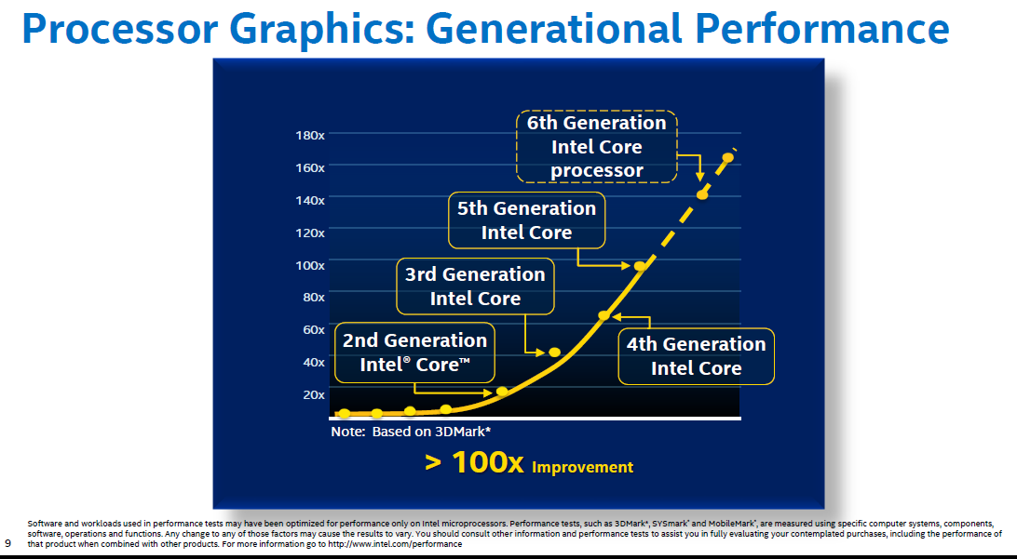
1. Introduction (26)
Graphics performance increase of subsequent Core generations [196]
Skylake
Broadwell
Haswell
Ivy Bridge
Sandy Bridge

Slide 31
2. The Core 2 line
2.1 Introduction
2.2 Major innovations of the Core 2 line
2.3 Performance leadership change between
Intel and AMD achieved by the Core 2
2.4 Die plot of the Core 2
2.5 Overview of Core 2 based processor lines
Notes:
31

Slide 32
2.1 Introduction
Notes:
32

Slide 33
2.1 Introduction (1)
2.1 Introduction-1
The Pentium 4 line was cancelled due to unmanageable high dissipation figures
of its third core (the 90 nm Prescott core)
(caused primarily by the design philosophy of the line
that preferred clock frequency over core efficiency for increasing performance).
For the development of the next processor line dissipation became the key design issue.
The next line became based primarily on the Pentium M – Intel’s first mobile line
since for its designs dissipation reduction was a key issue.
(The Pentium M line was a 32-bit line with 3 subsequent cores, designed at
Intel’s Haifa Research and Development Center) thus the Core 2 was developed also there.
The Haifa team had no experience with multithreading.
The Core microarchitecture does not support multithreading.

Slide 34
2.1 Introduction (2)
2.1 Introduction-2
The Core 2 is Intel’s 1. generation new microarchitecture, it is using 65 nm line width.
First delivered in 6/2006.
Figure 4.1.1: Intel’s Tick-Tock development model (Based on [1])
1. gen.
2. gen.
3. gen.
4. gen.
5. gen.
6. gen.
Core 2
New
Microarch.
65 nm
Penryn
New
Process
45 nm
Nehalem
New
Microarch.
45 nm
West-
mere
New
Process
32 nm
Sandy
Bridge
New
Microarch.
32 nm
Ivy
Bridge
New
Process
22 nm
Haswell
New
Microarchi.
22 nm
Broad-
well
New
Process
14 nm
Skylake
New
Microarchi.
14 nm
TOCK
TICK
TOCK
TICK
TOCK
TICK
TOCK
TICK
TOCK
Figure : Intel’s Tick-Tock development model (Based on [1])

Slide 35
2.1 Introduction (3)
The Core 2 line
Key new features of the ISP
and the microarchitecture
2 YEARS
TICK
TOCK
180nm
11/2000
New microarch.
Pentium 4 /Willamette
2 YEARS
TICK
TOCK
130nm
01/2002
New microarch.,
hyperthreading (HT)
Pentium 4 /Northwood
TICK
TOCK
90nm
02/2004
New microarch.,
64-bit
2 YEARS
Pentium 4 /Prescott
TICK Pentium 4 / Cedar Mill
01/2006
2 YEARS
TOCK Core 2
65nm
New microarch.: 4-wide core,
128-bit SIMD/FP, shared L2 , no HT
07/2006
TICK Penryn Family
11/2007
2 YEARS
45nm
New microarch.: integrated MC, QPI,
(inclusive) L3, HT
TOCK Nehalem
11/2008
TICK Westmere
01/2010
In package integr. GPU
2 YEARS
TOCK Sandy Bridge
32nm
New microarch.: 256-bit AVX,
ring bus, integr. GPU
01/2011
TICK Ivy Bridge
04/2012
2 YEARS
22nm
AVX2,
L4 cache (discrete eDRAM), FIVR
TOCK Haswell
06/2013
TICK Broadwell
09/2014
Shared Virtual Memory
2 YEARS
14nm
ISP,
Memory Side $ (eDRAM), No FIVR
TOCK Skylake
08/2015
Figure : Overview of Intel’s Tick-Tock model (Based on [3])

Slide 36
2.2 Major innovations of the Core 2 line
2.2.1 4-wide core
2.2.2 128-bit SIMD and FP units
2.2.3 Smart L2 cache
2.2.4 Innovations in power management
Notes:
36

Slide 37
2.2.1 4-wide core (1)
2.2 Major innovations of the Core 2 line
2.2.1 4-wide core
It means 4-wide front end and retire unit.
This is the key benefit of the Core 2 family.
By contrast
both Intel’s previous Pentium 4 family and AMD’s K8 have only 3-wide cores,
as the next Figures show.

Slide 38
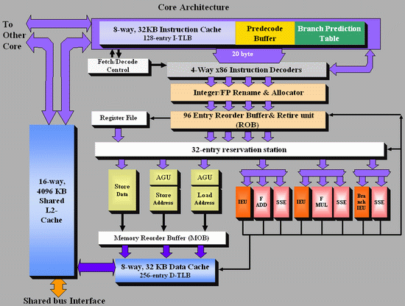
2.2.1 4-wide core (2)
Figure 2.2.1.1: Block diagram of Intel’s Core 2 microarchitecture [4]

Slide 39
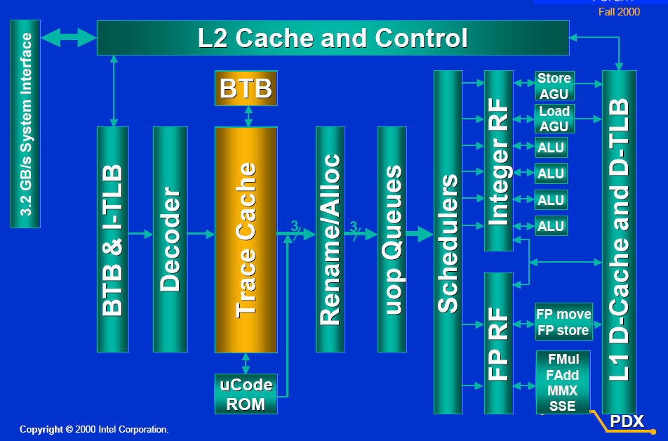
2.2.1 4-wide core (3)
Figure 2.2.1.2: Block diagram of Intel’s Pentium 4 microarchitecture [5]
Retire width: 3 instr./cycle

Slide 40
2.2.1 4-wide core (4)
Figure 2.2.1.3: Block diagram of AMD’s K8 microarchitecture[4]

Slide 41
2.2.2 128-bit wide SIMD and FP units (1)
2.2.2 128-bit wide SIMD and FP units
a) Overview of the x86 ISA extensions in Intel’s processor lines
They aim at providing enhanced media support.

Slide 42
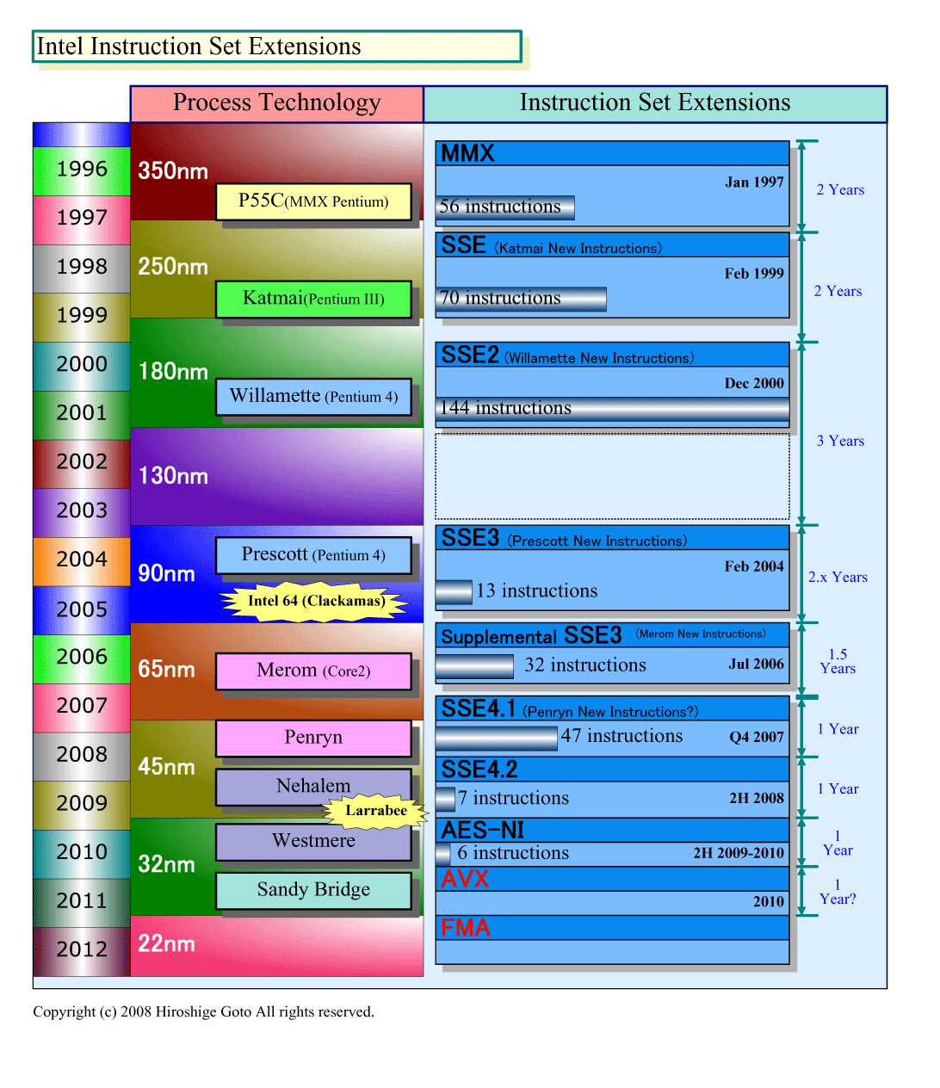
2.2.2 128-bit wide SIMD and FP units (2)
Overview of Intel’s x86 ISA extensions (based on [18])
Pentium III
MultiMedia eXtensions
Streaming SIMD Extensions
Pentium 4
Northwood (Pentium 4)
Core 2
Advanced Encryption Standard
Advanced Vector Extension
Ivy Bridge
Fused Multiply-Add instr.

Slide 43
2.2.2 128-bit wide SIMD and FP units (3)
Register spaces provided by Intel’s x86 ISA extensions (based on [18])
Pentium MMX
8 MM registers (64-bit),
aliased on the FP Stack registers
Pentium III
8 XMM registers (128-bit)
Pentium 4
16 XMM registers (128-bit)
Northwood (Pentium4)
Norhwood
Northwood (Pentium4)
Core 2
16 YMM registers (256-bit)
Ivy Bridge

Slide 44
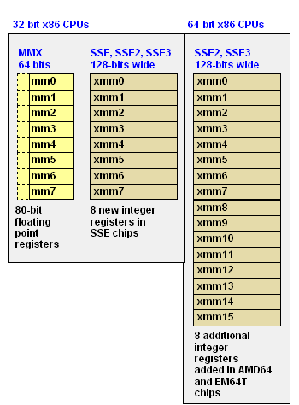
2.2.2 128-bit wide SIMD and FP units (4)
Illustration of the available SIMD register spaces of the MMX to SSE3/SSSE3 ISA
extensions in 32- and 64-bit ISAs [162]

Slide 45
2.2.2 128-bit wide SIMD and FP units (5)
Intel’s x86 ISA extensions - the operations introduced (based on [18])
Pentium III
64-bit FX SIMD with
32/16/8-bit operands (ops)
Support of MM
128-bit FX, FP SIMD with
32/16/8-bit FX, 32-bit FP ops.
Support of MM/3D
Pentium 4
128-bit FX, FP SIMD with
64/32/16/8-bit FX, 64/32-bit FP,
Support for MPEG-2, video, MP3
Northwood (Pentium4)
Norhwood
DSP-oriented FP enhancements,
enhanced thread manipulation
Core 2
Diverse arithmetic enhancements
Media acceleration
(video encoding, MM, gaming)
Accelerated string/text manip.,
appl. targeted acceleration
Accelerated encription operations
256-bit FX, FP SIMD with
64/32/16/8-bit FX, 64/32-bit FP
Ivy Bridge

Slide 46
2.2.2 128-bit wide SIMD and FP units (6)
Overview of the Supplemental Streaming SIMD Extension (SSSE3) of the Core 2 ISA
[161]
SSSE3 provide 32 instructions (represented by 14 mnemonics) to accelerate computations on
packed integers.
These include:
• Twelve instructions that perform horizontal addition or subtraction operations (operations
on adjacent numbers.
• Six instructions that evaluate absolute values.
• Two instructions that perform multiply and add operations and speed up the evaluation
of dot products.
• Two instructions that accelerate packed-integer multiply operations and produce integer
values with scaling.
• Two instructions that perform a byte-wise, in-place shuffle according to the second
shuffle control operand.
• Six instructions that negate packed integers in the destination operand if the signs of the
corresponding element in the source operand is less than zero.
• Two instructions that align data from the composite of two operands.

Slide 47
2.2.2 128-bit wide SIMD and FP units (7)
SIMD execution resources in Intel’s basic processors (based on [18])
Pentium III
2 x 32-bit FX MMX EUs
2 x 32-bit MMX,
2 x 32-bit SSE EUs
Pentium 4
1 full + 1 simple (moves/stores)
64-bit FP/SSE EUs
Northwood (Pentium 4)
Core 2
2 x 128-bit FP EUs +
3 x 128-bit SSE EUs
256-bit SSE EUs
Ivy Bridge

Slide 48
2.2.2 128-bit wide SIMD and FP units (8)
b) Contrasting the number of 128-bit wide execution units in Intel’s Pentium 4, Core 2
and AMD’s K8 -1
The Core 2 has 128-bit wide and more FP and SSE execution units than Pentium 4 or AMD’s K8,
as detailed below.
Core 2
two 128-bit FP units
three 128-bit SSE units
Pentium 4
single 64-bit FP/SSE unit
single 64-bit FP/SSE move unit
AMD K8
two 64-bit FP/SSE units
single 64-bit FP/SSE move unit
The next Figure demonstrates it.

Slide 49
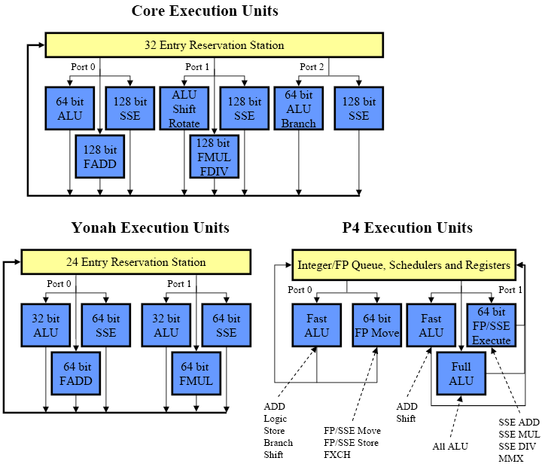
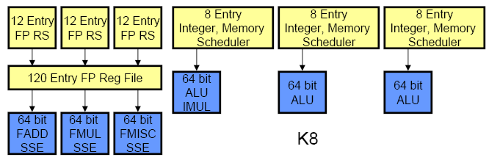
2.2.2 128-bit wide SIMD and FP units (9)
b) Contrasting the number of 128-bit wide execution units in Intel’s Pentium 4, Core 2
and AMD’s K8 -2 [159], [160]
K8 Execution Units
FP/SSE

Slide 50
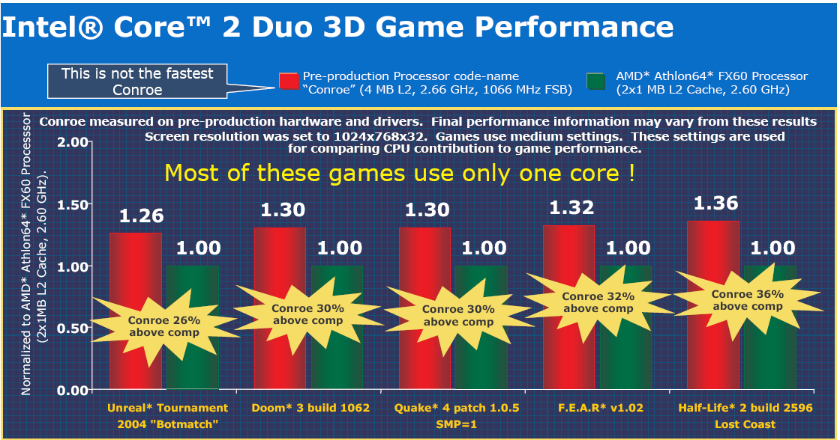
2.2.2 128-bit wide SIMD and FP units (10)
Core 2’s achieved performance boost for gaming apps vs. AMD’s Athlon 64 FX60 [13]

Slide 51
2.2.3 Shared L2 cache (1)
2.2.3 Shared L2 cache
In the Core 2 Intel makes use a shared L2 cache instead of private L2 caches and designates it
as smart L2 cache, as shown below.
Private
Shared
Core1
Core2
Core1
Core2
L2
Cache
L2
Cache
L2 Cache
Pentium 4-based DCs
Core 2-based DCs
Figure 2.2.3.1: Core’s shared L2 cache vs. Pentium 4’s private L2 caches

Slide 52
2.2.3 Shared L2 cache (2)
Benefits of shared caches vs. private caches
Dynamic cache allocation to the individual cores
Data sharing (no replicated data)
+ 2x bandwidth to L1 caches.

Slide 53
2.2.3 Shared L2 cache (3)
Drawbacks of shared caches
Shared caches combine memory access patterns
Reduce the efficiency of hardware prefetching vs private caches.
Choice between shared and private caches
Design decision depending on
whether benefits or drawbacks dominate as far as performance is concerned.
Trend
Core 2 prefers a shared L2 cache
Nehalem prefers private L2 caches
POWER5 prefers shared L2 cache
POWER6 prefers private L2 caches
This trend is due to the fact that efficient data prefetching became more important than
dynamic cache allocation or data sharing.

Slide 54
2.2.3 Shared L2 cache (4)
Intensive use of hardware prefetchers -1 [9]
Remarks
Intel’s first on-die L2 cache debuted only about two years earlier (8/1998),
in the second core of the Pentium II based Celeron line (called the Mendocino core,
built on 250 nm technology, with an L2 size of 128 KB)^{1,2}.
Intel’s first hardware prefetcher appeared subsequently in the Pentium 4 family,
associated with the L2 cache (one instruction and one data prefetcher (11/2000).
Principle of operation of the L2 hardware prefetcher
it monitors data access patterns and prefetches data automatically into the L2 cache,
it attempts to stay 256 bytes ahead of the current data access location,
the prefetcher remembers the history of cache misses to detect concurrent,
independent data streams that it tries to prefetch ahead of its use.
¹ The first Celeron model debuted in 4/1998, it was the low cost alternative to Pentium II,
and was designated as Cavington.
It was manufactured on 250 nm, run at 266 MHz, did not include an L2 cache and had 7.5 mtrs.
The second core of the Celeron line was launched in 8/1998 already with an L2 cache, run
at 266 and 300 MHz and incorporated 19,2 mtrs.
²Note: The debut of L2 was corrected in 29/10/2014.

Slide 55
2.2.3 Shared L2 cache (5)
Intensive use of hardware prefetchers -2 [11]
8 prefetchers in the two-core processor
2 data and 1 L1 instruction prefetchers per core,
able to handle multiple simultaneous patterns.
2 prefetchers in the L2 cache
tracking multiple access patterns per core.

Slide 56
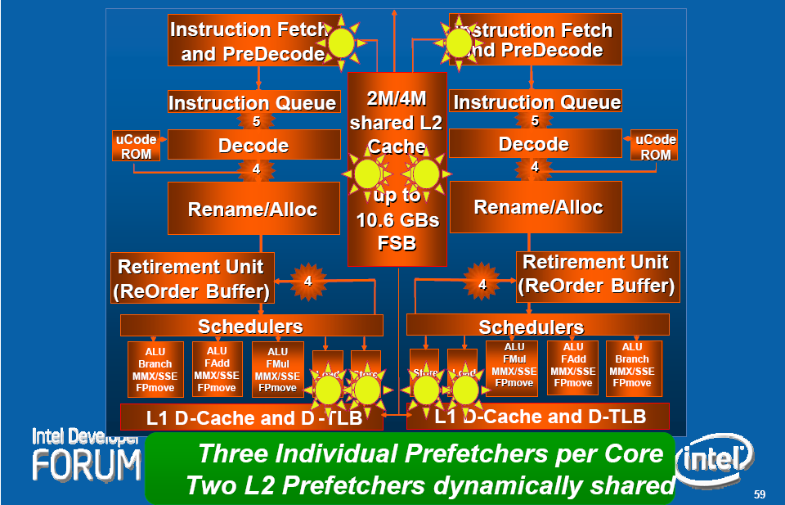
2.2.3 Shared L2 cache (6)
Hardware prefetchers in the Core 2 microarchitecture
Figure 2.2.3.2: Hardware prefetchers within the Core 2 microarchitecture [11]

Slide 57
2.2.4 Innovations in power management (1)
2.2.4 Innovations in power management
Shutting off not needed functional units of the processor
Platform Thermal Control

Slide 58
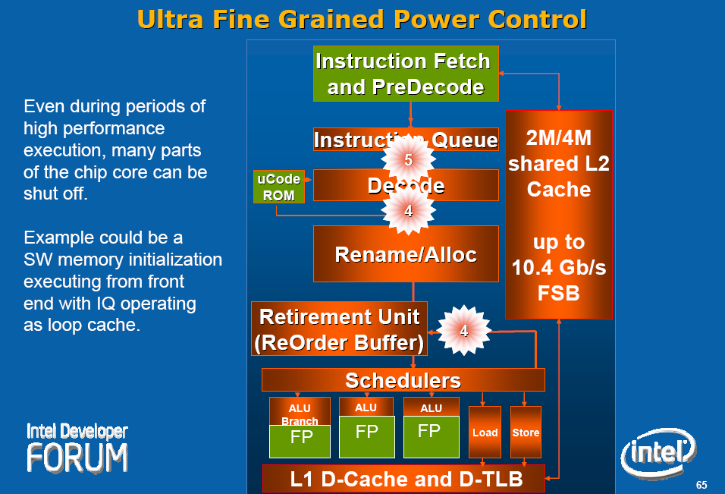
2.2.4 Innovations in power management (2)
Shutting off not needed functional units of the processor by clock gating [11]
Green units not needed
for the given operation,
they can be shut off.

Slide 59
2.2.4 Innovations in power management (3)
Platform Thermal Control [11], [20]
Digital
Thermal Sensors
(DTS) on the dies,
instead of
analog diodes,
providing
digital data,
scanned by
dedicated logic.
PECI
(Platform Environment Control Interface)
A single wire proprietary interface with
transfer rates of 2 kbit/s-2 Mbit/s)
DTSs report the difference between the
current temperature and the throttle point,
at which the processor reduces speed.

Slide 60
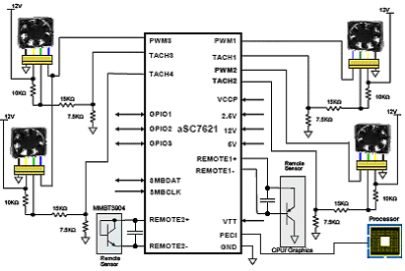
2.2.4 Innovations in power management (4)
Possible solution for the Platform Thermal Control Manager [88]
(ASIC (Application Specific IC/Microcontroller)
(Remote Sensor
CPU/Graphics)
(Remote Sensor)
Figure 2.2.4.1: The aSC7621 hardware monitor with fan control and PECI from Andigilog

Slide 61
2.3 Performance leadership change between Intel and AMD achieved by the Core 2
Notes:
61

Slide 62
2.3 Performance leadership change between Intel and AMD (1)
Performance leadership change between Intel and AMD achieved by the Core 2
In 2003 AMD introduced their K8-based processors implementing
the 64-bit x86 ISA and
the direct connect architecture concept, that includes
integrated memory controllers and
high speed point-to-point serial buses (the HyperTransport bus)
used to connect processors to processors and processors to south bridges.
AMD’s K8-based processors became the performance leader, first of all on the DP and MP
server market, where the 64-bit direct connect architecture has clear benefits
vs Intel’s 32-bit Pentium 4 based processors using shared FSBs to connect processors
to north bridges.

Slide 63
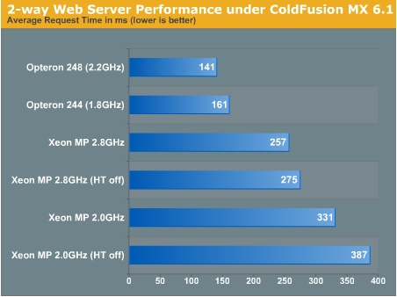
2.3 Performance leadership change between Intel and AMD (2)
Example 1: DP web-server performance comparison (2003)
Figure 2.3.1: DP web server performance comparison: AMD Opteron 248 vs. Intel Xeon 2.8 [6]

Slide 64
2.3 Performance leadership change between Intel and AMD (3)
Example 2: Summary assessment of extensive benchmark tests contrasting
dual Opterons vs dual Xeons (2003) [7]
“In the extensive benchmark tests under Linux Enterprise Server 8 (32 bit as well as 64 bit), the AMD Opteron made a good impression.
Especially in the server disciplines, the benchmarks (MySQL, Whetstone, ARC 2D, NPB, etc.) show quite clearly that the Dual Opteron puts the Dual Xeon in its place”.

Slide 65
2.3 Performance leadership change between Intel and AMD (4)
This situation has completely changed in 2006 when Intel introduced their Core 2
microarchitecture,
The Core 2 has
a 4-wide front-end and retire unit compared to the 3-wide K8,
two 128-bit FP units and three 128-bit SSE units compared to
two 64-bit FP/SSE units and a single 64-bit FP/SSE move unit available in the K8.
This and further enhancements of the Core microarchitecture, detailed subsequently,
resulted in record breaking performance figures.
Intel regained performance leadership vs AMD.

Slide 66
2.3 Performance leadership change between Intel and AMD (5)
Example: DP web-server performance comparison (2006)
Webserver Performance
 | MSI K2-102A2M Opteron 275 | MSI K2-102A2M Opteron 280 | Opteron 280 vs. Opteron 275 | Extrapolated Opteron 3 GHz | Xeon 5160 3 GHz
Jsp - Peak | 144 | 154 | 7% | 182 | 230
AMP - Peak | 984 | 1042 | 6% | 1178 | 1828
Jsp: Java Server Page performance
AMP: Apache/MySQL/PHP
Figure 2.2.1.8: DP web server performance comparison:
AMD Opteron 275/280 vs. Intel Xeon 5160 [8]
Remark
Both web-server benchmark results were published from the same source (AnandTech)

Slide 67
2.4 Die plot of the Core 2
Notes:
67

Slide 68
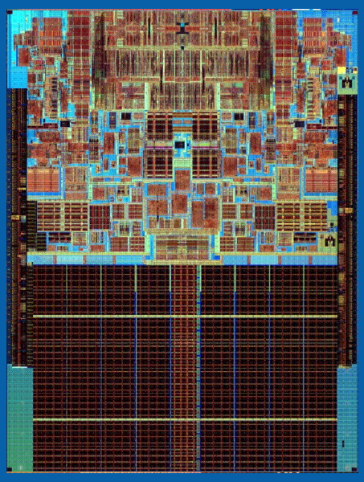
2.4 Die plot of the Core 2 (1)
2.4 Die plot of the Core 2 [163]
143 mm²
291 mtrs

Slide 69
2.5 Overview of Core 2 based processor lines
Notes:
69

Slide 70
2.5 Overview of Core 2 based processor lines (1)
2.5 Overview of Core 2 based processor lines
Mobiles
T5xxx/T7xxx, 2C ,Merom 8/2006
Desktops
E6xxx/E4xxx, 2C, Core 2 Duo, (Conroe) 7/2006
X6800 Core 2 Extreme, 2C, (Conroe) 7/2006
E6xxx/E4xxx, Core 2 Duo, 2C, (Allendale) 1/2007
Q6xxx Core 2 Quad, 2x2C (Kentsfield) (2xConroe) 1/2007
QX6xxx Core 2 Extreme Quad, 2x2C, (Kentsfield XE) 11/2006
Servers
UP-Servers
30xx, 2C, Conroe, 9/2006
30xx, 2C, Allendale 1/2007
32xx, 2x2C, Kentsfield (2xConroe) 1/2007
DP-Servers
51xx, 2C Woodcrest, 6/2006
53xx, 2x2, Clowertown, (2xWoodcrest) 11/2006
MP-Servers
72xx, 2C, Tigerton DC, (2xMP-enhanced SC Woodcrest) 9/2007
73xx, 2x2C, Tigerton QC, (2xMP-enhanced DC Woodcrest) 9/2007
Based on [43]

Slide 71
3. The Nehalem line
3.1 Introduction to the 1. generation Nehalem line
(Bloomfield)
3.2 Major innovations of the 1. gen. Nehalem line
3.3 Major innovations of the 2. gen. Nehalem line
(Lynnfield)
Notes:
71

Slide 72
3.1 Introduction to the 1. generation Nehalem line (Bloomfield)
Notes:
72

Slide 73
3.1 Introduction to the 1. generation Nehalem line (Bloomfield) (1)
3.1 Introduction to the 1. generation Nehalem line (Bloomfield)
Developed at Hillsboro, Oregon, at the site where the Pentium 4 emerged.
Experiences with HT
Nehalem became a multithreaded design.
The design effort took about five years and required thousands of engineers
(Ronak Singhal, lead architect of Nehalem) [37].
First implementation of the Nehalem microarchitecture appeared in the desktop segment
(Core i7-9xx (Bloomfield)) 4C in 11/2008
Figure 4.1.1: Intel’s Tick-Tock development model (Based on [1])
1. gen.
2. gen.
3. gen.
4. gen.
5. gen.
6. gen.
Core 2
New
Microarch.
65 nm
Penryn
New
Process
45 nm
Nehalem
New
Microarch.
45 nm
West-
mere
New
Process
32 nm
Sandy
Bridge
New
Microarch.
32 nm
Ivy
Bridge
New
Process
22 nm
Haswell
New
Microarchi.
22 nm
Broad-
well
New
Process
14 nm
Skylake
New
Microarchi.
14 nm
TOCK
TICK
TOCK
TICK
TOCK
TICK
TOCK
TICK
TOCK
Figure : Intel’s Tick-Tock development model (Based on [1])

Slide 74
3.1 Introduction to the 1. generation Nehalem line (Bloomfield) (2)
The Nehalem line
Key new features of the ISP
and the microarchitecture
2 YEARS
TICK
TOCK
180nm
11/2000
New microarch.
Pentium 4 /Willamette
2 YEARS
TICK
TOCK
130nm
01/2002
New microarch.,
hyperthreading (HT)
Pentium 4 /Northwood
TICK
TOCK
90nm
02/2004
New microarch.,
64-bit
2 YEARS
Pentium 4 /Prescott
TICK Pentium 4 / Cedar Mill
01/2006
2 YEARS
TOCK Core 2
65nm
New microarch.: 4-wide core,
128-bit SIMD/FP, shared L2 , no HT
07/2006
TICK Penryn Family
11/2007
2 YEARS
45nm
New microarch.: integrated MC, QPI,
(inclusive) L3, HT
TOCK Nehalem
11/2008
TICK Westmere
01/2010
In package integr. GPU
2 YEARS
TOCK Sandy Bridge
32nm
New microarch.: 256-bit AVX,
ring bus, integr. GPU
01/2011
TICK Ivy Bridge
04/2012
2 YEARS
22nm
AVX2,
L4 cache (discrete eDRAM), FIVR
TOCK Haswell
06/2013
TICK Broadwell
09/2014
Shared Virtual Memory
2 YEARS
14nm
ISP,
Memory Side $ (eDRAM), No FIVR
TOCK Skylake
08/2015
Figure : Overview of Intel’s Tick-Tock model (Based on [3])

Slide 75
3.1 Introduction to the 1. generation Nehalem line (Bloomfield) (3)
Nehalem lines
1. generation Nehalem processors
2. generation Nehalem processors
Mobiles
Mobiles
Core i7-9xxM Clarksfield 4C 9/2009
Core i7-8xxQM Clarksfield 4C 9/2009
Core i7-7xxQM Clarksfield 4C 9/2009
Desktops
Desktops
Core i7-9xx (Bloomfield) 4C 11/2008
Core i7-8xx (Lynnfield) 4C 9/2009
Core i5-7xx (Lynnfield) 4C 9/2009
Servers
Servers
UP-Servers
UP-Servers
35xx Bloomfield 4C 3/2009
34xx Lynnfield 4C 9/2009
C35xx Jasper forest¹ 4C 2/2010
DP-Servers
DP-Servers
55xx Gainestown (Nehalem-EP) 4C 3/2009
C55xx Jasper forest¹ 2C/4C 2/2010
¹Jasper forest: Embedded UP or DP server
Based on [44]

Slide 76
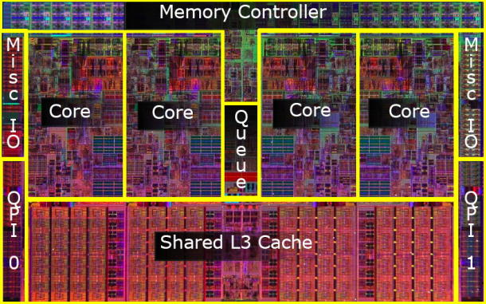
3.1 Introduction to the 1. generation Nehalem line (Bloomfield) (4)
Die shot of the 1. generation Nehalem desktop processor (Bloomfield) [45]
(8 MB)
Die shot of the Bloomfield chip [45]
Note
Both the desktop oriented Bloomfield chip and the DP server oriented Gainestown chip have
the same layout.
The Bloomfield die has two QPI bus controllers, in spite of the fact that they are not needed
for the desktop part.
In the Bloomfield die one of the controllers is simply not activated [45], whereas both are
active in the DP alternative (Gainestown).

Slide 77
3.2 Major innovations of the 1. generation Nehalem line
3.2.1 Integrated memory controller
3.2.2 QuickPath Interconnect bus (QPI)
3.2.3 New cache architecture
3.2.4 Simultaneous Multithreading
3.2.5 Enhanced power management
3.2.6 New socket
Notes:
77

Slide 78
3.2 Major innovations of the 1. generation Nehalem line (1)
3.2 Major innovations of the 1. generation Nehalem line [54]
The Major incentive for designing the microarchitecture of Nehalem: support of 4 cores.
4 cores need however twice as much bandwidth as dual core processors, such as the Core 2.
Two memory channels used for dual core processors are more or less the limit attachable to
the north bridge due to physical and electrical limitations.
Consequently, to provide enough bandwidth for 4 cores, a new memory design was necessary.
Major innovations of the 1. generation 4-core Nehalem line
Integrated memory controller
(Section 3.2.1)
QuickPath Interconnect bus (QPI)
(Section 3.2.2)
New cache architecture
(Section 3.2.3)
• Simultaneous Multithreading (SMT)
(Section 3.2.4)
SSE 4.2 ISA extension
(Not detailed)
Enhanced power management
(Section 3.2.5)
Advanced virtualization
(Not detailed)
New socket
(Section 3.2.6)
(8 MB)
Figure 3.2.1: Die photo of the Bloomfield/Gainestown chip

Slide 79
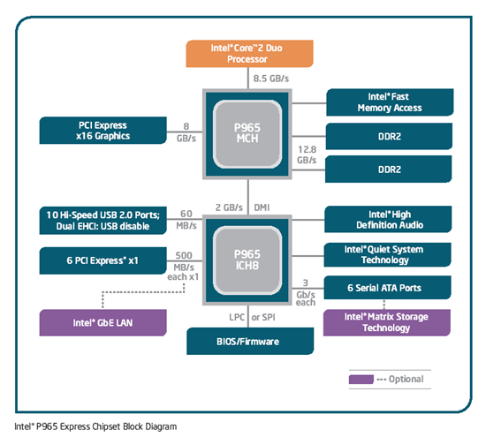
3.2.1 Integrated memory controller (1)
3.2.1 Integrated memory controller
Traditional system architectures, as shown below for the Core 2 Duo processor, can
implement not more than two high speed memory channels connected to the MCH.
These system architectures can provide enough bandwidth only for up to dual core processors.
Figure: Core 2 Duo based
platform [166]

Slide 80
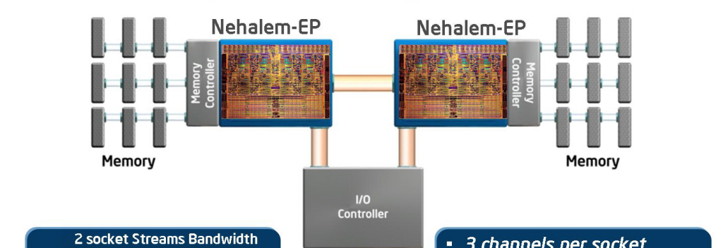
3.2.1 Integrated memory controller (2)
The need for integrated memory controller in a dual processor QC Nehalem platform
n cores
n times higher memory bandwidth need
Figure 3.2.1.1: Integrated memory controller of Nehalem [33]
Main features
3 channels per socket
Up to 3 DIMMs per channel (impl. dependent)
DDR3-800, 1066, 1333,…
Supports both RDIMMs and UDIMMs (impl. dependent)
Nehalem-EP (Efficient Performance):
Designation of the server line

Slide 81
3.2.1 Integrated memory controller (3)
Benefits and drawback of integrated memory controllers
Benefits
Low memory access latency
important for memory intensive apps.
Drawback of integrated memory controllers
Processor becomes memory technology dependent
For an enhanced memory solution (e.g. for increased memory speed)
a new processor modification is needed.

Slide 82
3.2.1 Integrated memory controller (4)
Non Uniform Memory Access (NUMA)
It is a consequence of using integrated memory controllers in case of multi-socket servers
Local memory access
Remote memory access
Figure 3.2.1.2: Non Uniform Memory Access (NUMA) in multi-socket servers [1]
Most multi-socket platforms use NUMA
Remote memory access latency ~ 1.7 x longer than local memory access latency
Demands a fast processor-to-processor interconnection to relay memory traffic (QPI)
Operating systems have to modify memory allocation strategies + related APIs

Slide 83
3.2.1 Integrated memory controller (5)
Memory latency comparison: Nehalem vs Penryn [1]
Harpertown: Quad-Core Penryn based server (Xeon 5400 series)

Slide 84
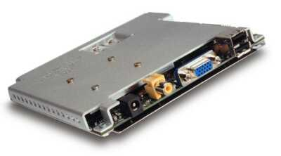
3.2.1 Integrated memory controller (6)
Remark
Intel’s Timna – a forerunner to integrated memory controllers [34]
Timna (announced in 1999, due to 2H 2000, cancelled in Sept. 2000)
Developed in Intel’s Haifa Design and Development Center.
Low cost microprocessor with integrated graphics and memory controller
(for Rambus DRAMs).
Due to design problems and lack of interest from many vendors,
Intel finally cancelled Timna in Sept. 2000.
Figure 3.2.1.4: The low cost (<600 $) Timna PC [40]

Slide 85
3.2.1 Integrated memory controller (7)
Point of attaching memory
Point of attaching memory
Attaching memory to the MCH
Attaching memory to the processor(s)
Examples
UltraSPARC II (1C) (~1997)
UltraSPARC III (2001)
and all subsequent Sun lines
AMD’s K7 lines (1C) (1999-2003)
Opteron server lines (2C) (2003)
and all subsequent AMD lines
POWER4 (2C) (2001)
POWER5 (2C) (2005)
and subsequent POWER families
PA-8800 (2004)
PA-8900 (2005)
and all previous PA lines
Core 2 Duo line (2C) (2006)
and all preceding Intel lines
Core 2 Quad line (2x2C) (2006/2007)
Penryn line (2x2C) (2008)
Nehalem lines (4) (2008)
and all subsequent Intel lines
Montecito (2C) (2006)
Tukwila (4C) (2010)

Slide 86
3.2.2 QuickPath Interconnect bus (QPI) (1)
3.2.2 QuickPath Interconnect bus (QPI) -1
Its debut is strongly motivated by the introduction of integrated memory controllers.
Formerly designated as the Common System Interface bus (CSI bus).
A serial, high speed differential point-to-point interconnect bus, similar to AMD’s
HyperTransport bus), used to connect processors to processors or processors to north bridges.

Slide 87
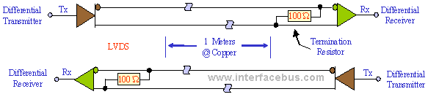
3.2.2 QuickPath Interconnect bus (QPI) (2)
Principle of differential interconnections [170]

Slide 88
3.2.2 QuickPath Interconnect bus (QPI) (2a)
3.2.2 QuickPath Interconnect bus (QPI)- 2
Consists of 2 unidirectional links, one in each directions, called the TX and RX
(T for Transmit, R for Receive).

Slide 89
3.2.2 QuickPath Interconnect bus (QPI) (3)
Signals of the QuickPath Interconnect bus (QPI bus) [22]
TX Unidirectional link
RX Unidirectional link
16 data
2 protocol
2 CRC
(DDR data transfer)

Slide 90
3.2.2 QuickPath Interconnect bus (QPI) (4)
QuickPath Interconnect bus (QPI) -3
Each unidirectional link comprises 20 data lanes and a clock lane, with
each lane consisting of a pair of differential signals.
(Lane: Vonalpár)

Slide 91
3.2.2 QuickPath Interconnect bus (QPI) (5)
Signaling systems used in buses
Signals
Single ended
Voltage referenced
Differential
Typ.voltage
swings
S+
V_{REF}
S-
V_{CM}
t
t
t
3.3-5 V
600-800 mV
200-300 mV
Signaling
system
used in
TTL (5 V)
FPM/EDO
SSTL
SSTL2 (DDR)
SSTL1.8 (DDR2)
SSTL1.5 (DDR3)
RSL (RDRAM)
FSB
LVDS
PCIe
QPI, DMI, ESI
FB-DIMMs
LVTTL (3.3 V)
FPM/EDO
SDRAM
HI 1.5
DRSL
XDR (data)
Smaller voltage swings
LVDS: Low Voltage Differential Signaling LVTTL: Low Voltage TTL
(D)RSL: (Differential) Rambus Signaling Level SSTL: Stub Series Terminated Logic V_{CM}: Common Mode Voltage V_{REF}: Reference Voltage

Slide 92
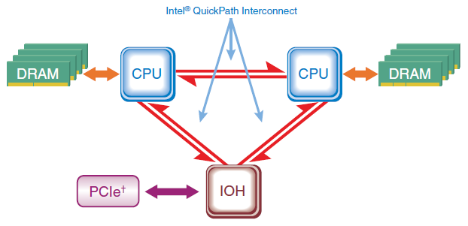
3.2.2 QuickPath Interconnect bus (QPI) (6)
QPI based DP server architecture [169] -1
Note
First generation Nehalem (Bloomfielf) supports only DP configurations.

Slide 93
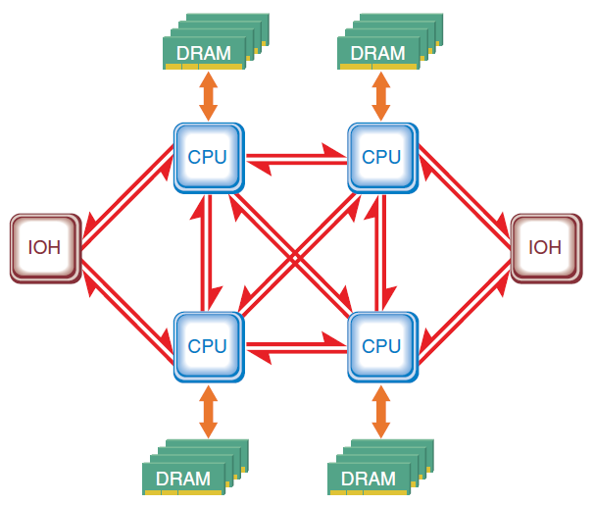
3.2.2 QuickPath Interconnect bus (QPI) (7)
QPI based MP server architecture [169] -2

Slide 94
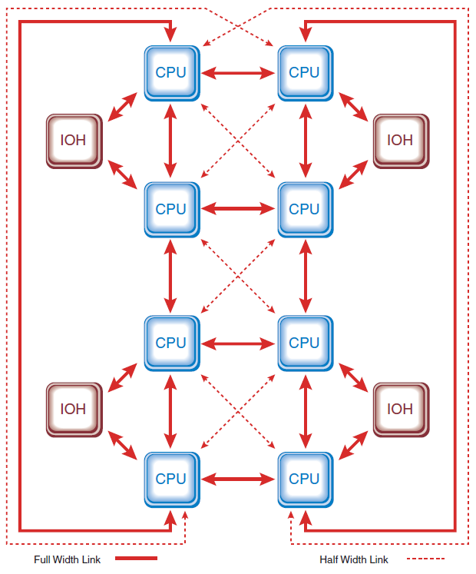
3.2.2 QuickPath Interconnect bus (QPI) (8)
QPI based 8-processor system architecture [169] -3

Slide 95
3.2.2 QuickPath Interconnect bus (QPI) (9)
Comparison of the transfer rates of the QPI, FSB and HT buses
QuickPath Interconnect Bus (QPI-bus)
up to 3.2 GHz DDR 2-Byte (Nehalem)
12.8 GB/s in each direction
up to 4.0 GHz GHz DDR 2-Byte (Sandy Bridge E/EP)
16.0 GB/s in each direction
up to 4.8 GHz GHz DDR 2-Byte (Haswell E/EP)
19.2 GB/s in each direction
Fastest FSB
400 MHz QDR 8 Byte
12.8 GB/s bidirectional
HyperTransport Bus (HT-bus)
Max. clock speed and width figures in AMD’s systems
HT 1.0: 0.8 GHz DDR 2-Byte
3.2 GB/s in each direction
HT 2.0: 1.0 GHz DDR 2-Byte
4.0 GB/s in each direction
HT 3.0: 2.6 GHz DDR 2-Byte
10.4 GB/s in each direction
HT 3.1: 3.2 GHz DDR 2-Byte
12.8 GB/s in each direction
DDR: Double Data Rate
QDR: Quad Data Rate

Slide 96
3.2.3 New cache architecture (1)
3.2.3 New cache architecture
2-level cache hierarchy
(Penryn)
3-level cache hierarchy
(Nehalem)
Core
Core
Core
Core
Core
32 kB/32 KB
L1 Caches
L1 Caches
L1 Caches
L1 Caches
L1 Caches
32 kB/32 KB
4 MB
Shared/
two cores
L2 Cache
L2 Caches
L2 Caches
L2 Cache
256 KB
Private
L3 Cache
Up to 8 MB
Inclusive
Figure 3.2.3.1: The 3-level cache architecture of Nehalem (based on [1])
Note the difference in the L2 cache sizes to the previous generation.

Slide 97
3.2.3 New cache architecture (2)
Distinguished features of Nehalem’s cache architecture
The L2 cache is private again rather than shared as in the Core and Penryn processors
Private L2
Shared L2
Pentium 4
Core
Penryn
Nehalem
Assumed reason for returning to the private scheme
Private caches allow a more effective hardware prefetching than shared ones, since
Hardware prefetchers look for memory access patterns.
Private L2 caches have more easily detectable memory access patterns
than shared L2 caches.

Slide 98
3.2.3 New cache architecture (3)
Remark
The POWER family had the same evolution path as above
Private L2
Shared L2
POWER4
POWER5
POWER6

Slide 99
3.2.3 New cache architecture (4)
The L3 cache is inclusive rather than exclusive
like in a number of competing designs, such as UltraSPARC IV+ (2005), POWER5 (2005),
POWER6 (2007), POWER7 (2010), AMD’s K10-based processors (2007).
Intel’s argumentation for inclusive caches [38]
Inclusive L3 caches prevent L2 snoop traffic for L3 cache misses since
with inclusive L3 caches an L3 cache miss means that the referenced data
doesn’t exist in any core’s L2 caches, thus no L2 snooping is needed.
By contrast, with exclusive L3 caches the referenced data may exist in any
of the L2 caches, thus L2 snooping is required,
as indicated in the next Figure.

Slide 100
3.2.3 New cache architecture (5)
Benefit of inclusive L3 caches (based on [209])
Inclusive L3
Exclusive L3
Core
Core
Core
Core
Core
Core
Core
Core
L1 Caches
L1 Caches
L1 Caches
L1 Caches
L1 Caches
L1 Caches
L1 Caches
L1 Caches
L2 Caches
L2 Caches
L2 Cache
L2 Cache
L2 Caches
L2 Caches
L2 Cache
L2 Cache
L3 Cache
L3 Cache
Miss
Miss
It is guaranteed that data is not on die
All other cores must be checked (snooped)!

Slide 101
3.2.3 New cache architecture (6)
Benefit of inclusive L3 caches (based on [209])
For higher core numbers L2 snooping becomes a more demanding task and overshadows the
benefits arising from the more efficient cache use of the explicit cache scheme.

Slide 102
3.2.3 New cache architecture (57
The notion of “Uncore” [1]

Slide 103
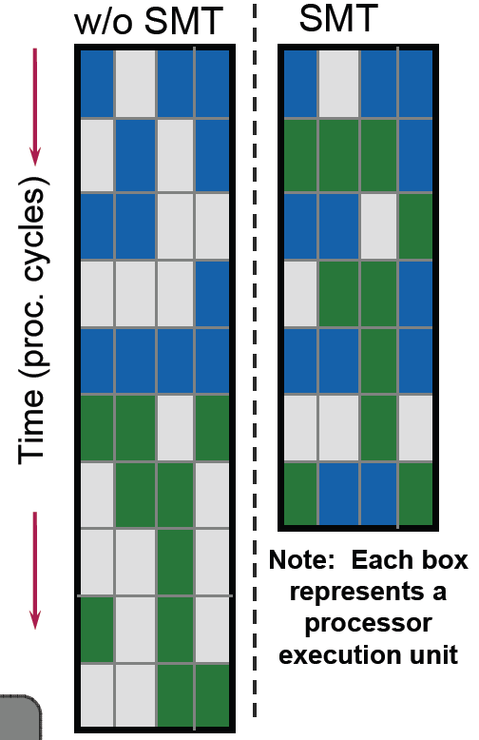
3.2.4 Simultaneous Multithreading (SMT) (1)
3.2.4 Simultaneous Multithreading (SMT)
Two-way multithreaded ( two threads at the same time)
Benefits
A 4-wide core is fed more efficiently (from 2 threads).
Hides latency of a single tread.
More performance with low additional die area cost,
May provide significant performance increase on
dedicated applications.
Figure 3.2.4.1: Simultaneous Multithreading (SMT) of Nehalem [1]

Slide 104
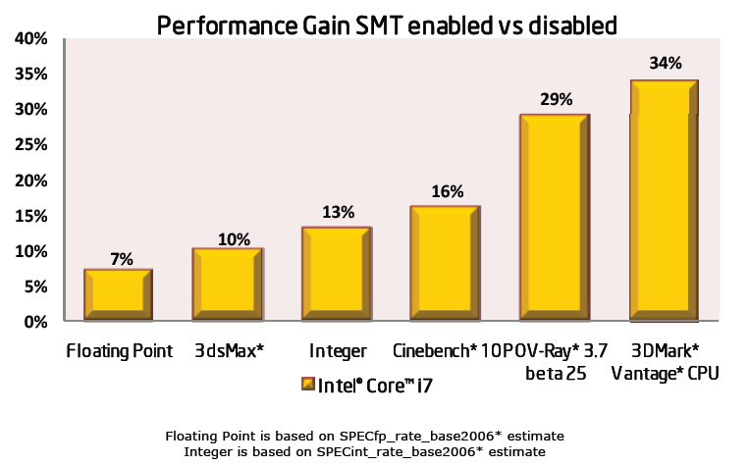
3.2.4 Simultaneous Multithreading (SMT) (2)
Performance gains achieved by Nehalem’s SMT [1]

Slide 105
3.2.5 Enhanced power management (1)
3.2.5 Enhanced power management
Discussed issues
Integrated power gates
Integrated Power Control Unit
Turbo Boost technology

Slide 106
3.2.5 Enhanced power management (2)
Use of integrated power gates [32]
Power switches

Slide 107
3.2.5 Enhanced power management (3)
Overview of the Power Control unit [32]
Allows to manage the power
of the whole chip as an entity.
Used also for the Turbo Boost Mode

Slide 108
3.2.5 Enhanced power management (4)
Nehalem’s Turbo Boost technology
Forerunner of Nehalem’s Turbo Boost technology in the Penryn
The Penryn core already introduced a less intricate technology for the same purpose,
termed as the (EDAT) Enhanced Dynamic Acceleration Technology that increases
clock frequency only for the mobile platform and in case if one of the two cores is inactive.
EDAT considers a core “active” if it is in ACPI C0 or C1 states, whereas cores in the C3
to C6 ACPI states are considered as “inactive”.

Slide 109
3.2.5 Enhanced power management (5)
ACPI states (underlying EDAT) [26]
ACPI: Advanced Configuration and Power Interface
An open standard for operating system worked out to enable power management.
Passive states
Intelligent
heuristics decides
when enter into.

Slide 110
3.2.5 Enhanced power management (6)
Principle of the operation of Nehalem’s Turbo Boost technology (1)
Nehalem has already a PCU (Power Control Unit) that is aware of the full power dissipation
of the whole package.
If the actual power dissipation is lower than a given limit, called TDP, the PCU increases the
clock frequency of the active cores to raise the performance.
TDP (Thermal Design Power) is the design value, given in W, for the cooling system of the
platform.
TDP is chosen such that it reflects the maximum power consumed by realistic power intensive
applications.
The cooling system (called also thermal solution) has to assure that the chip, more precisely
the junction temperature (Tj) does not exceed a given limit (Tjmax, e.g. 90 ºC⁾.

Slide 111
3.2.5 Enhanced power management (7)
Principle of the operation of
Nehalem's Turbo Boost technology (2) [52]
The Turbo mode uses the power headroom given by the unused TDP limit of the proc. package [52].

Slide 112
3.2.5 Enhanced power management (8)
Note that in Nehalem’s turbo mode all active cores in the processor will operate at the same fc
and voltage.

Slide 113
3.2.5 Enhanced power management (9)
Principle of the operation of Nehalem's Turbo Boost technology (3) [51]
The operating system is responsible for the power management by measuring the actual
workload and instructing the hardware to set fc and Vc accordingly.
If the OS requests the highest fc and the PCU recognizes that the actual power consumption
of the package is less than the TDP, i.e. there is a power headroom available due to
idle cores or
a light workload
it will increase the core frequency of the active cores e.g. in steps of 133 MHz, as long as
given limits, e.g. the power consumption of the processor package and the junction
temperatures of the cores remain below the given limits.
When the PCU detects that the given limits become exceeded it will step down clock frequency
in steps of e.g. 133 MHz.

Slide 114
3.2.5 Enhanced power management (10)
Assuring that power and temperature values do not exceed specified limits [53], [50]
To control fc the PCU samples the current power consumption and die temperatures in 5 ms
intervals [53].
Power consumption is determined by monitoring the processor current at its input pin as well
as the associated voltage (Vcc) and calculating the power consumption as a moving average.
The junction temperature of the cores are monitored by DTSs (Digital Thermal Sensors) with
an error of ± 5 % [50].
When the power consumption of the processor or the junction temperature of any core
exceeds the factory configured limits, the PCU automatically steps down core frequency
in increments of e.g. 133 MHz.

Slide 115
3.2.5 Enhanced power management (11)
The maximum Turbo Boost frequency [53]
Maximum turbo frequencies are factory configured and kept in an internal register (MSR 1ADH).
E.g. in case of the Core i7-920XM the basic core frequency is 2.0 GHz and the maximum
Turbo frequency is 3.2 GHz, which is 9 frequency bins (9 x 133 MHz) higher than the TDP limited
basic core frequency of 2.0 GHz.

Slide 116
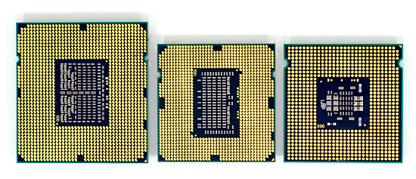
3.2.6 New sockets (1)
3.2.6 New sockets [167]
LGA-775
(Core 2)
LGA-1366
(Bloomfied)
LGA-1156
(Lynnfield)

Slide 117
3.3 Major innovations of the 2. generation Nehalem line (Lynnfield)
Notes:
117

Slide 118
3.3 Major innovations of the 2. generation Nehalem line (Lynnfield) (1)
Nehalem lines
1. generation Nehalem processors
2. generation Nehalem processors
Mobiles
Mobiles
Core i7-9xxM Clarksfield 4C 9/2009
Core i7-8xxQM Clarksfield 4C 9/2009
Core i7-7xxQM Clarksfield 4C 9/2009
Desktops
Desktops
Core i7-9xx (Bloomfield) 4C 11/2008
Core i7-8xx (Lynnfield) 4C 9/2009
Core i5-7xx (Lynnfield) 4C 9/2009
Servers
Servers
UP-Servers
UP-Servers
35xx Bloomfield 4C 3/2009
34xx Lynnfield 4C 9/2009
C35xx Jasper forest¹ 4C 2/2010
DP-Servers
DP-Servers
55xx Gainestown (Nehalem-EP) 4C 3/2009
C55xx Jasper forest¹ 2C/4C 2/2010
¹Jasper forest: Embedded UP or DP server
Based on [44]

Slide 119
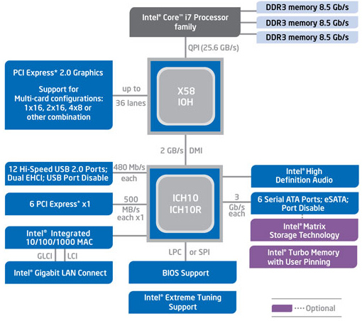
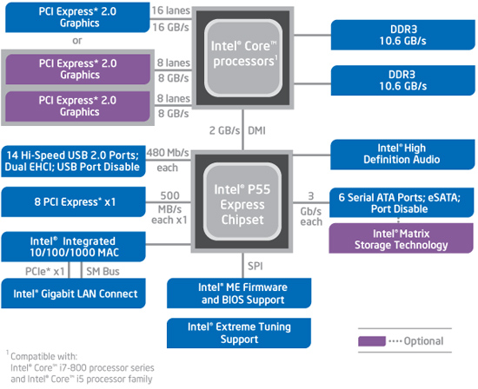
3.3 Major innovations of the 2. generation Nehalem line (Lynnfield) (2)
3.3 Major innovations of the 2. generation Nehalem line (Lynnfield) (1) [46]
a) The Lynnfield chip is a major redesign of the Bloomfield chip resulting in a cheaper and
more effective two-chip system solution instead of the previous three chip solution.
b) Further on, whereas the Bloomfield chip is connected to the X58 chipset via the QPI bus,
the Lynnfield chip is connected to the P55 PCH by a DMI interface, like in previous solutions.
The Bloomfield based platform (X58 + ICH10 / LGA-1366)
The Lynnfield based platform (P55 / LGA-1156)

Slide 120
3.3 Major innovations of the 2. generation Nehalem line (Lynnfield) (3)
Major innovations of the 2. generation Nehalem line (Lynnfield) (2) [46]
c) It provides only 16 PCIe 2.0 lanes to attach a graphics card immediately to the processor
rather than to the north bridge as done by 36 lanes in the previous solution.
The Bloomfield based platform (X58 + ICH10 / LGA-1366)
The Lynnfield based platform (P55 / LGA-1156)

Slide 121
3.3 Major innovations of the 2. generation Nehalem line (Lynnfield) (4)
Evolution of providing PCIe lanes for graphics

Slide 122
3.3 Major innovations of the 2. generation Nehalem line (Lynnfield) (5)
Main options of providing PCIe lanes on the processor for graphics cards in DT systems
PCIe lanes provided on the processor
1x x16 or 2x x8 lanes (DTs)
40 configurable lanes (HEDs)
(e.g. 2x x16 + 1x x8 or 4x x8)
(Desktops)
(Extreme Performance Desktops)
PCIe 1.0 lanes
PCIe
2.0
X16/
2x x8
P
Mem.
40
configurable
lanes
PCIe 2.0
P
Mem.
Type of available PCIe lanes
Periph. Contr.
P55/P67
PCIe 2.0 lanes
Periph. Contr.
X79
Intel 2. gen. Nehalem (Lynnfield) (4C), 2 MCh
with P55 (2009)
Intel Sandy Bridge (4C), 2 MCh with P67 (2011)
Intel Sandy Bridge-E (6C), 4 MCh with X79 (2011)
X16/
2x x8
40
configurable
lanes
P
Mem.
PCIe
3.0
P
Mem.
PCIe 3.0
PCIe 3.0 lanes
Periph. Contr.
Z77 to Z170
Periph. Contr.
X79
Intel Ivy Bridge (4C), 2 MCh with Z77 PCH (2012) to
Skylake (4C), 2 MCh with Z170 PCH (2015)
Intel Ivy Bridge-E (6C), 4 MCh with X79 (2013)
Intel Haswell-E (8C), 4 MCh with X79 (2014)
MCh: Memory Channel

Slide 123
3.3 Major innovations of the 2. generation Nehalem line (Lynnfield) (6)
Evolution of the topology and type of available PCIe lanes for graphics cards
Topology of PCIe lanes provided for graphics cards
PCIe lanes
on both the NB and the SB
PCIe lanes
on the NB
PCIe lanes
on the PCH
PCIe lanes
on the processor
PCIe 1.0
lanes
Type of available PCIe lanes
Trend
2. G. Nehalem (Lynnfield)
(2009)
Sandy Bridge (2011)
Sandy Bridge-E (2011)
PCIe 2.0
lanes
PCIe 3.0
lanes
Ivy Bridge (2012)
Ivy-Bridge-E (2013)
Haswell (2013)
Haswell-E (2014) tp
Skylake (2015)

Slide 124
3.3 Major innovations of the 2. generation Nehalem line (Lynnfield) (7)
Major innovations of the 2. generation Nehalem line (Lynnfield) (3) [46]
d) It supports only two DDR3 memory channels instead of three as in the previous solution.
e) Its socket needs less connections (LGA-1156) than the Bloomfield chip (LGA-1366).
All in all the Lynnfield chip is a cheaper and more effective successor of the Bloomfield chip,
aiming primarily for mobiles and desktops.
The Bloomfield based platform (X58 + ICH10 / LGA-1366)
The Lynnfield based platform (P55 / LGA-1156)

Slide 125
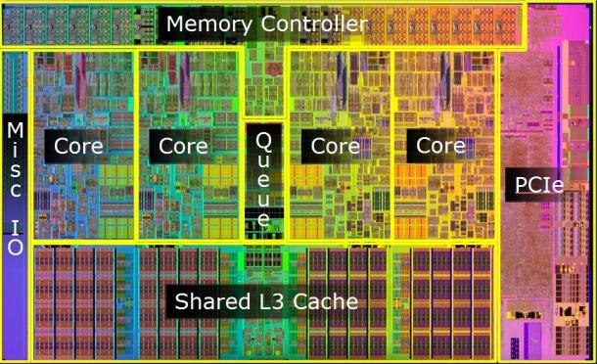
3.3 Major innovations of the 2. generation Nehalem line (Lynnfield) (8)
Die photos of the 1. and 2. gen.
Nehalem desktop chips
First generation: Bloomfield chip (11/2008)
(45 nm, 263 mm², 731 mtrs, LGA-1366)
[45], [46], [47]
Bloomfield
(desktop/DP server) []
Second generation: Lynnfield chip (9/2009) [45]
45 nm, 296 mm², 774 mtrs, LGA-1156) [45] [46] [48]

Slide 126
4. The Sandy Bridge line
4.1 Introduction
4.2 Major innovations of the Sandy Bridge line vs.
the 1. generation Nehalem line
4.3 Example for a Sandy Bridge based desktop
platform with the H67 chipset
Notes:
126

Slide 127
4.1 Introduction
Notes:
127

Slide 128
4.1 Introduction (1)
4.1 Introduction
Sandy Bridge is Intel’s next new microarchitecture using 32 nm line width.
First delivered in 1/2011.
It is termed also as Intel’s second generation Core processors.
Figure 4.1.1: Intel’s Tick-Tock development model (Based on [1])
1. gen.
2. gen.
3. gen.
4. gen.
5. gen.
6. gen.
Core 2
New
Microarch.
65 nm
Penryn
New
Process
45 nm
Nehalem
New
Microarch.
45 nm
West-
mere
New
Process
32 nm
Sandy
Bridge
New
Microarch.
32 nm
Ivy
Bridge
New
Process
22 nm
Haswell
New
Microarchi.
22 nm
Broad-
well
New
Process
14 nm
Skylake
New
Microarchi.
14 nm
TOCK
TICK
TOCK
TICK
TOCK
TICK
TOCK
TICK
TOCK
Figure : Intel’s Tick-Tock development model (Based on [1])

Slide 129
4.1 Introduction (2)
The Sandy Bridge line
Key new features of the ISP
and the microarchitecture
2 YEARS
TICK
TOCK
180nm
11/2000
New microarch.
Pentium 4 /Willamette
2 YEARS
TICK
TOCK
130nm
01/2002
New microarch.,
hyperthreading (HT)
Pentium 4 /Northwood
TICK
TOCK
90nm
02/2004
New microarch.,
64-bit
2 YEARS
Pentium 4 /Prescott
TICK Pentium 4 / Cedar Mill
01/2006
2 YEARS
TOCK Core 2
65nm
New microarch.: 4-wide core,
128-bit SIMD/FP, shared L2 , no HT
07/2006
TICK Penryn Family
11/2007
2 YEARS
45nm
New microarch.: integrated MC, QPI,
(inclusive) L3, HT
TOCK Nehalem
11/2008
TICK Westmere
01/2010
In package integr. GPU
2 YEARS
TOCK Sandy Bridge
32nm
New microarch.: 256-bit AVX,
ring bus, integr. GPU
01/2011
TICK Ivy Bridge
04/2012
2 YEARS
22nm
AVX2,
L4 cache (discrete eDRAM), FIVR
TOCK Haswell
06/2013
TICK Broadwell
09/2014
Shared Virtual Memory
2 YEARS
14nm
ISP,
Memory Side $ (eDRAM), No FIVR
TOCK Skylake
08/2015
Figure : Overview of Intel’s Tick-Tock model (Based on [3])

Slide 130
4.1 Introduction (3)
Overview of the Sandy Bridge family
The Sandy Bridge family
Sandy Bridge
Up to 4 cores
(This Section)
Sandy Bridge-E
Up to 6 cores
(Not discussed)
Sandy Bridge-EN/EP
Up to 8 cores
(Not discussed)
Mobiles
Core i3-23xxM, 2C, 2/2011
Core i5-24xxM//25xxM, 2C, 2/2011
Core i7-26xxQM/27xxQM/28xxQM, 4C, 1/2011
Core i7 Extreme-29xxXM , 4C, Q1 2011
Sandy Bridge-EN
(Entry)
(Socket: LGA 1356)
Sandy Bridge-EP
(Efficient Performance)
(Socket: LGA 2011)
Desktops
Core i3-21xx, 2C, 2/2011
Core i5-23xx 4C+G, 1/2011
Core i5/24xx/25xx, 4C+G, 1/2011
Core i7-26xx, 4C+G, 1/2011
Core i7-2700K, 4C+G10/2011
Core i7-3960X EE, 6C, 11/2011
Core i7-3930K, 6C, 11/2011
Core i7-3820, 4C, 11/2011
Servers
Microservers
E3 1220L/1230L/1260L, 2C/4C, 4/2011
UP-Servers
E3 12x0, 4C, 4/2011
E3 12x5, 4C+G, 4/2011
E5-14xx 4/6C, 5/2012
E5-16xx 4/6C, 3/2012
DP-Servers
E5-24xx 4/6/8C, 5/2012
E5-26xx 4/6/8C, 3/2012
MP-Servers
Based on [62] and [63]
E5-46xx 4/6/8C, 5/2012
Notes:
ridge-ex

Slide 131
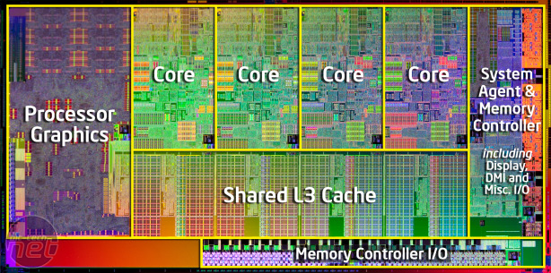
4.1 Introduction (4)
Main functional units of Sandy Bridge [96]
256 KB L2
(9 clk)
256 KB L2
(9 clk)
256 KB L2
(9 clk)
256 KB L2
(9 clk)
256 KB L2
(9 clk)
256 KB L2
(9 clk)
256 KB L2
(9 clk)
Hyperthreading
AES Instr.
VMX Unrestrict.
20 nm² / Core
32K L1D (3 clk)
AVX 256 bit
4 Operands
8 MB
@ 1.0 1.4 GHz
(to L3 connected)
(25 clk)
256 b/cycle Ring Architecture
PCIe 2.0
DDR3-1600
25.6 GB/s
32 nm process / ~225 nm² die size. 995 mtrs, 85W TDP

Slide 132
4.2 Major innovations of the Sandy Bridge line vs.
the 1. generation Nehalem line
4.2.1 Overview
4.2.2 Extension of the ISA by the 256-bit
AVX instruction set
4.2.3 New microarchitecture of the cores
4.2.4 On die ring interconnect bus
4.2.5 On die graphics unit
4.2.6 Turbo Boost 2.0 technology
Notes:
132

Slide 133
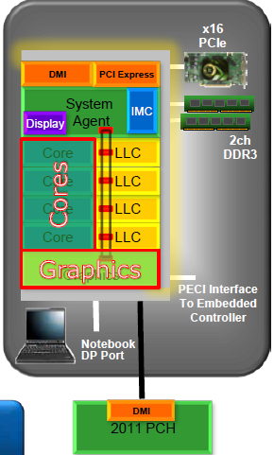
4.2.1 Overview (1)
4.2 Major innovations of the Sandy Bridge line vs. the 2. generation Nehalem line [61]
4.2.1 Overview
Extension of the ISA by the 256-bit
AVX instruction set (Section 4.2.2)
New microarchitecture for the cores
(Section 4.2.3)
On die ring interconnect bus
(Section 4.2.4)
On-die graphics unit
(Section 4.2.5)
Turbo Boost technology 2.0
(Section 4.2.6)

Slide 134
4.2.2 Extension of the ISA by the AVX instruction set (1)
4.2.2 Extension of the ISA by the 256-bit AVX instruction set
AVX: Advanced Vector Extensions
In the course of ISA extensions Intel expanded the previous 128-bit SSE SIMD instruction set (introduced with the Pentium III in 1999) by the 256-bit AVX SIMD instruction set, as follows:

Slide 135
4.2.2 Extension of the ISA by the AVX instruction set (2)
Width of Intel’s subsequent SIMD extensions (Based on [18])
Pentium III
64-bit
128-bit
Pentium III
Northwood (Pentium4)
Norhwood
Northwood (Pentium4)
Core 2
256-bit
Ivy Bridge

Slide 136
4.2.2 Extension of the ISA by the AVX instruction set (3)
The 256-bit AVX extension
It includes
Extension of the 128-bit wide XMM [0, 15] SIMD register set to the 256-bit YMM [0, 15]
register set.
b) Extension of the 128-bit SSE instruction set.

Slide 137
4.2.2 Extension of the ISA by the AVX instruction set (4)
Available SIMD register sets in Intel’s subsequent SIMD extensions (Based on [18])
Available register set
Pentium III
8 MM registers (64-bit),
aliased on the FP Stack registers
8 XMM registers (128-bit)
Pentium III
16 XMM registers (128-bit)
Northwood (Pentium4)
Norhwood
Northwood (Pentium4)
Core 2
16 YMM registers (256-bit)
Ivy Bridge

Slide 138
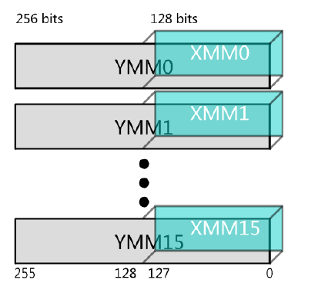
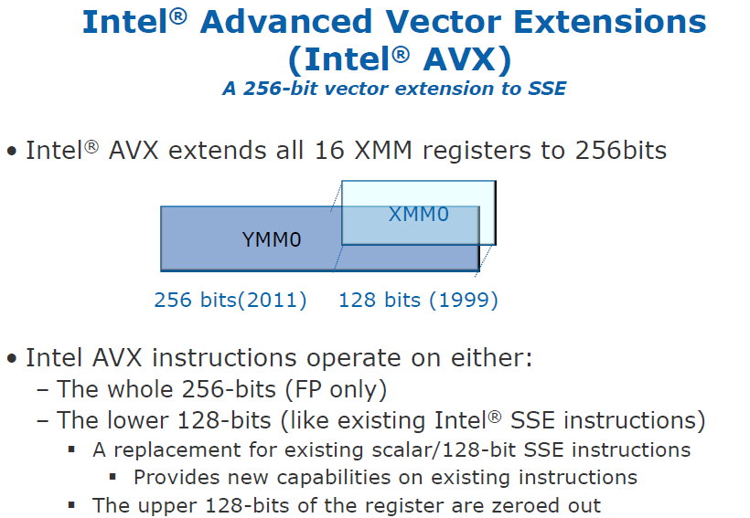
4.2.2 Extension of the ISA by the AVX instruction set (5)
Extension of the 128-bit wide XMM [0, 15] SIMD register set to the 256-bit
YMM [0, 15] register set [97], [168]

Slide 139
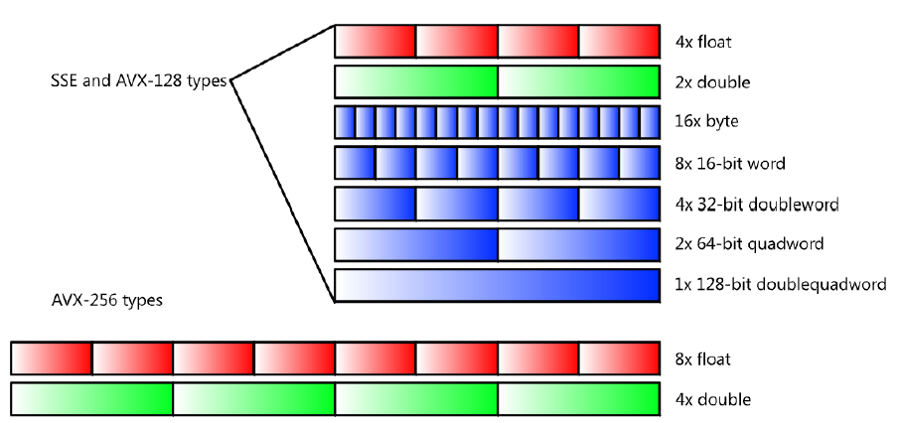
4.2.2 Extension of the ISA by the AVX instruction set (6)
b) Extension of the 128-bit SSE instruction set
Supported data types [168]
float
FX
float

Slide 140
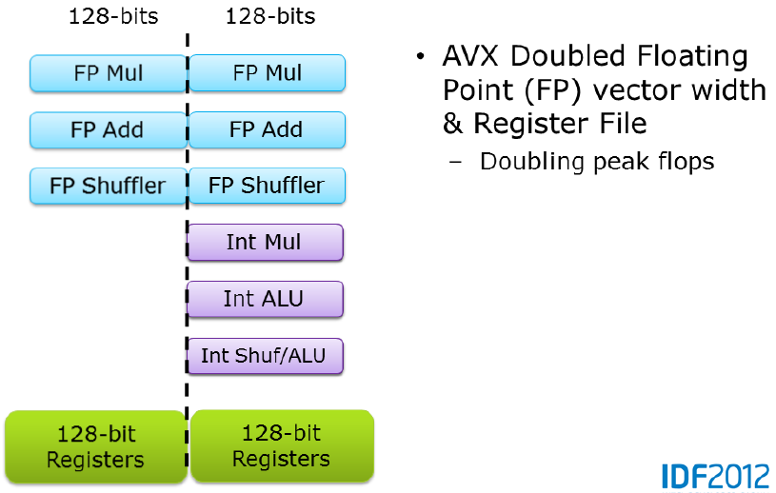
4.2.2 Extension of the ISA by the AVX instruction set (7)
Note
AVX doubled only FP vector width, as indicated in the Figure below [97].
AVX doubled FP vector width
and register file width
Doubling peak FLPOPS

Slide 141
4.2.2 Extension of the ISA by the AVX instruction set (8)
Implementation of AVX -1
To implement 256-bit FP operations Intel did not widen related data paths and FP execution units
to 256 bit, instead designers made use of two 128-bit data paths and two 128-bit
FP execution units in the same time, as indicated in the previous Figure [98].

Slide 142
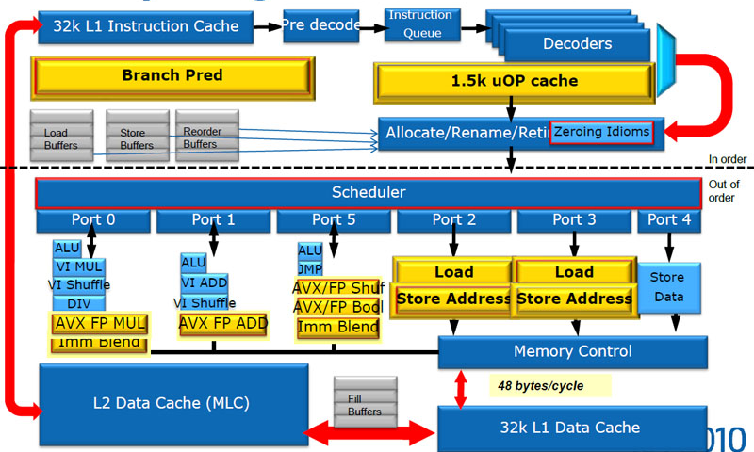
4.2.2 Extension of the ISA by the AVX instruction set (9)
Implementation of AVX -2
Intel redesigned large parts of the microarchitecture of the cores, as indicated by yellow boxes
in the Figure below.
Figure 4.2.2.1: Microarchitecture of the cores of Sandy Bridge [64]

Slide 143
4.2.3 New microarchitectures of the cores (1)
4.2.3 New microarchitecture of the cores
Intel redesigned large parts of the microarchitecture of the cores, as indicated by yellow boxes
in the Figure below.
Figure 4.2.3.1: Microarchitecture of the cores of Sandy Bridge [64]

Slide 144
4.2.3 New microarchitectures of the cores (2)
Here we do not want to go into details of the microarchitecture, but refer to two very detailed
descriptions [64], [98].

Slide 145
4.2.4 On-die ring interconnect bus (1)
4.2.4 On die ring interconnect bus [66]
System Agent
The ring has six bus stops for
interconnecting
four cores
four L3 slices
the GPU and
the System Agent
The four cores and the
L3 slices share the same
interfaces.

Slide 146
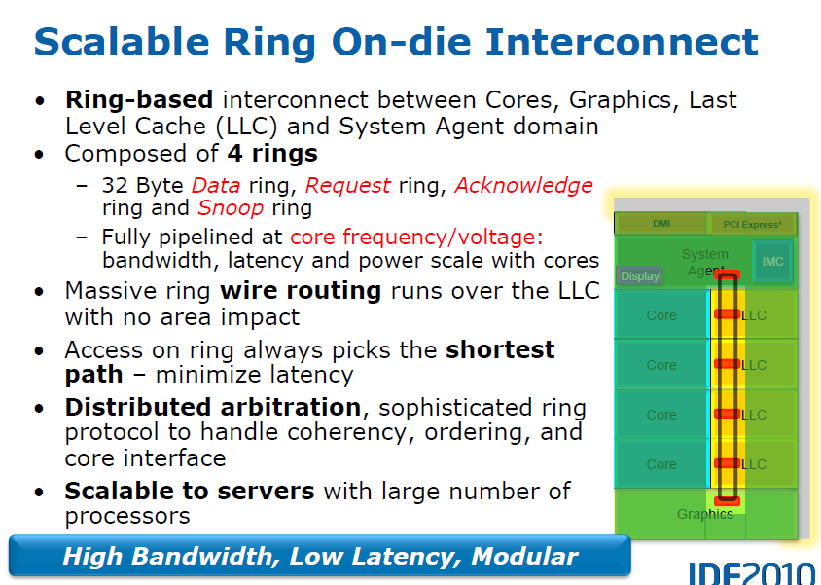
4.2.4 On-die ring interconnect bus (2)
Main feature of the on-die interconnect bus [64]
• It operates at core frequency (One stop/clock)

Slide 147
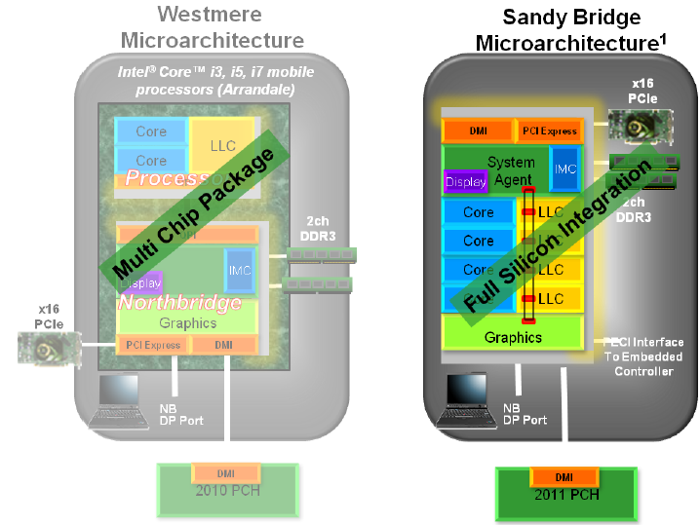
4.2.5 On die graphics unit (1)
4.2.5 On die graphics unit [99]
Evolution of graphics implementation from Westmere to Sandy Bridge [99]

Slide 148
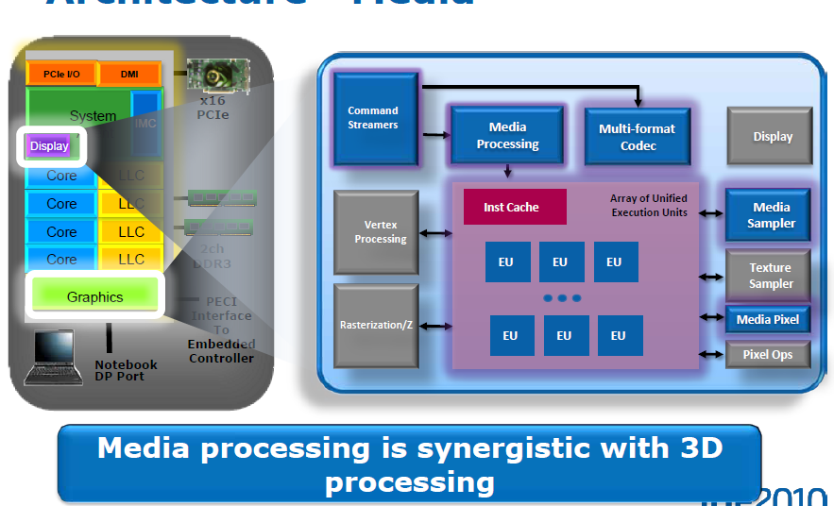
4.2.5 On die graphics unit (2)
Support of both media and graphics processing by the graphics unit [99]

Slide 149
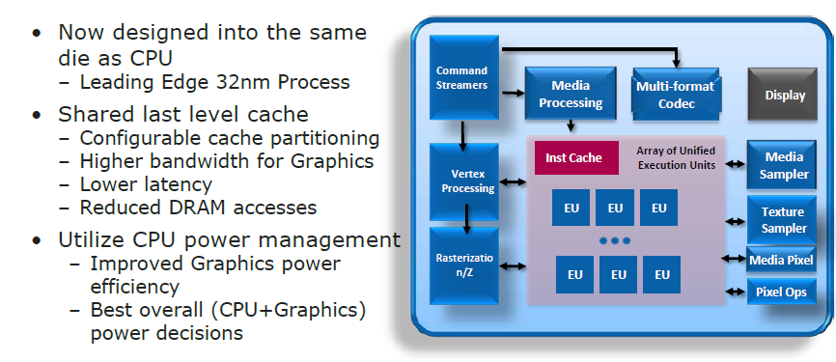
4.2.5 On die graphics unit (3)
8.2.5 On die graphics unit (1)
Main features of the on die graphics unit [99]
12 EUs

Slide 150
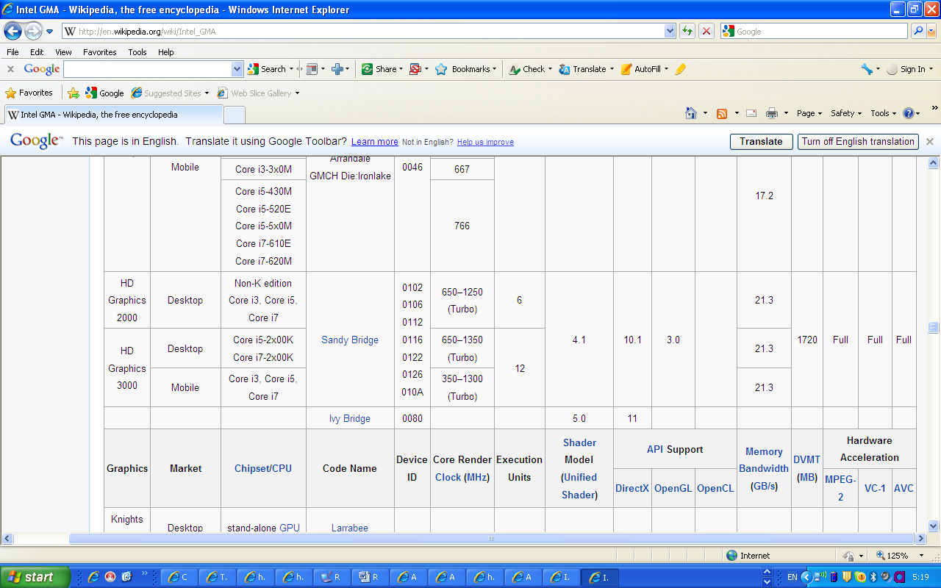
4.2.5 On die graphics unit (4)
8.2.5 On die graphics unit (1)
Specification data of the HD 2000 and HD 3000 graphics [100]
-

Slide 151
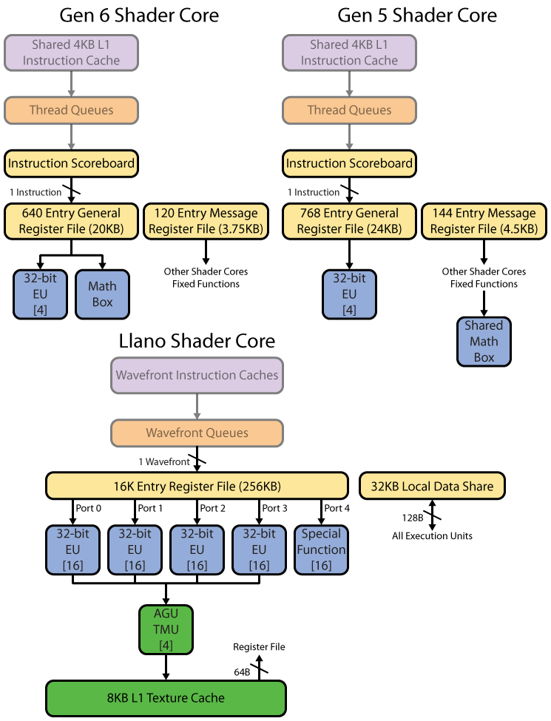
4.2.5 On die graphics unit (5)
Execution units (EU) of the graphics unit in Sandy Bridge [197]
Each EU is basically a 4-wide SP FP SIMD unit intended to operate on 4-component data
(RGBA), capable of executing 2-operation MAD instructions and also FX instructions.
EUs are 5-way multithreaded for GT2 graphics and 4-way multithreaded for GT1 graphics.
Each thread has a register set of 120 32 B registers.
There is also a fixed function Math Box for executing transcendental, e.g. trigonometric
instructions and also FP divide.
The EUs do not support DP FP operations.
RGBA: RGB Alpha (opacity)
Figure: Block diagram of an EU of the graphics unit of Sandy Bridge

Slide 152
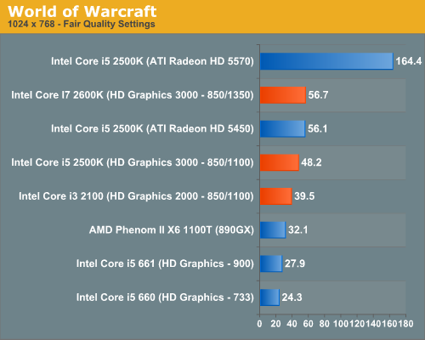
4.2.5 On die graphics unit (9)
Performance comparison of the Sandy Bridge’s graphics: gaming [101]
HD 5570
400 ALUs
i5/i7 2xxx/3xxx:
Sandy Bridge
i5 6xx
Arrandale
frames per sec

Slide 153
4.2.6 Turbo Boost technology 2.0 (1)
4.2.6 Turbo Boost 2.0 technology [64]
Designated also as the 2.0 generation Turbo Boost technology.
The concept utilizes the real temperature response of processors to power changes
in order to increase the extent of overclocking [64].
Cooler
Thermal capacitance

Slide 154
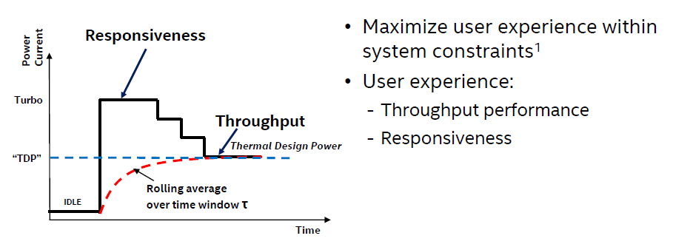
4.2.6 Turbo Boost technology 2.0 (2)
Main aspects of Intel’s Turbo Boost Technology 2.0 [198]

Slide 155
4.2.6 Boost technology 2.0 (3)
Based on the real temperature response the thermal energy budget accumulated during idle
periods can be utilized to push the core beyond the TDP for short periods of time (e.g. for 20 sec).
Multiple algorithms manage in parallel current, power and die temperature. [64]

Slide 156
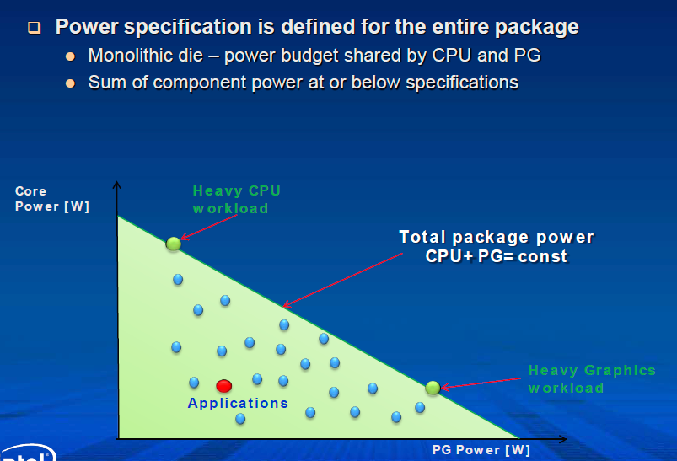
4.2.6 Enhanced Turbo Boost technology (4)
Intelligent power sharing between the cores and the integrated graphics [64]
Figure: Power sharing between CPU and GPU [207]

Slide 157
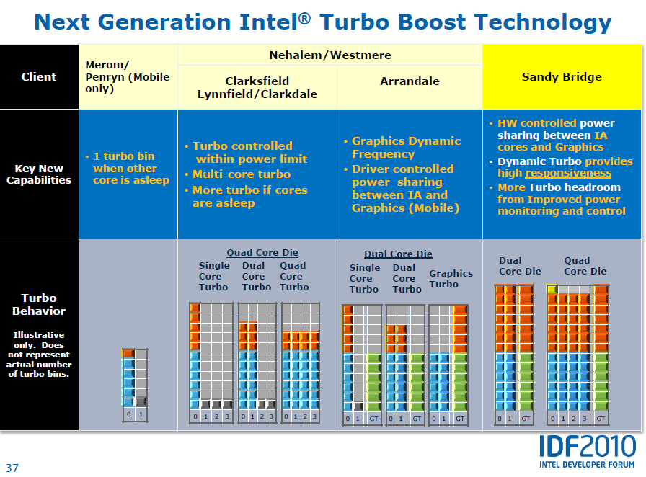
4.2.6 Enhanced Turbo Boost technology (5)
[61]
NHM/M
WSM/M
NHM/D
WSM/D

Slide 158
4.2.6 Enhanced Turbo Boost technology (6)
Remark
Individual cores may run at different frequencies but all cores share the same power plane.
Individual cores may be shut down if idle by power gates.

Slide 159
4.3 Example for a Sandy Bridge based desktop
platform with the H67 chipset
Notes:
159

Slide 160
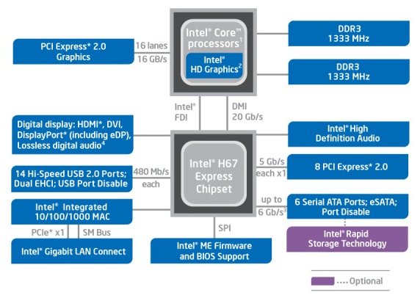
4.3 Example for a Sandy Bridge based desktop platform with the H67 chipset (1)
4.3 Example for a Sandy Bridge based desktop platform with the H67 chipset [102]

Slide 161
5. The Haswell line
5.1 Introduction
5.2 Major enhancements of the Haswell line vs.
the Sandy Bridge line
5.3 Major innovations of the Haswell line
5.4 Haswell based mobile and desktop processors
Notes:
161

Slide 162
5.1 Introduction
Notes:
162

Slide 163
5.1 Introduction (1)
5.1 Introduction
Haswell processors are termed also as the 4. gen. Intel Core processors, as indicated below.
Figure 4.1.1: Intel’s Tick-Tock development model (Based on [1])
1. gen.
2. gen.
3. gen.
4. gen.
5. gen.
6. gen.
Core 2
New
Microarch.
65 nm
Penryn
New
Process
45 nm
Nehalem
New
Microarch.
45 nm
West-
mere
New
Process
32 nm
Sandy
Bridge
New
Microarch.
32 nm
Ivy
Bridge
New
Process
22 nm
Haswell
New
Microarchi.
22 nm
Broad-
well
New
Process
14 nm
Skylake
New
Microarchi.
14 nm
TOCK
TICK
TOCK
TICK
TOCK
TICK
TOCK
TICK
TOCK
Figure : Intel’s Tick-Tock development model (Based on [1])
Launched: 6/2013 at Computex.

Slide 164
5.1 Introduction (2)
The Haswell line
Key new features of the ISP
and the microarchitecture
2 YEARS
TICK
TOCK
180nm
11/2000
New microarch.
Pentium 4 /Willamette
2 YEARS
TICK
TOCK
130nm
01/2002
New microarch.,
hyperthreading (HT)
Pentium 4 /Northwood
TICK
TOCK
90nm
02/2004
New microarch.,
64-bit
2 YEARS
Pentium 4 /Prescott
TICK Pentium 4 / Cedar Mill
01/2006
2 YEARS
TOCK Core 2
65nm
New microarch.: 4-wide core,
128-bit SIMD/FP, shared L2 , no HT
07/2006
TICK Penryn Family
11/2007
2 YEARS
45nm
New microarch.: integrated MC, QPI,
(inclusive) L3, HT
TOCK Nehalem
11/2008
TICK Westmere
01/2010
In package integr. GPU
2 YEARS
TOCK Sandy Bridge
32nm
New microarch.: 256-bit AVX,
ring bus, integr. GPU
01/2011
TICK Ivy Bridge
04/2012
2 YEARS
22nm
AVX2,
L4 cache (discrete eDRAM), FIVR
TOCK Haswell
06/2013
TICK Broadwell
09/2014
Shared Virtual Memory
2 YEARS
14nm
ISP,
Memory Side $ (eDRAM), No FIVR
TOCK Skylake
08/2015
Figure : Overview of Intel’s Tick-Tock model (Based on [3])

Slide 165
5.1 Introduction (3)
The Haswell line
Launched in 06/2013
22 nm IC technology
The Haswell refresh processors [176]
A second wave of Haswell processors, called the Haswell refresh processors launched in
5/2014.
They do not provide any significant changes vs. the first release processors.
Actually, the manufacturing process could be made more efficient and this resulted in slight
improvements in clock speeds.
DP/MP servers (Haswell-EP, Haswell-EX)
They were launched later, in 09/2014 and 05/2014, as indicated subsequently.

Slide 166
5.1 Introduction (4)
Overview of the Haswell family-1
The Haswell family
Haswell
(LGA1150)
Up to 4 cores
(This Section)
Haswell-E
(LGA2011)
Up to 8 cores
(Not discussed here)
Haswell-EP
(LGA2011)
Up to 18 cores
(Not discussed ere)
Haswell-EX
(LG2011)
Up to 18 cores
(Not discussed here)
Mobiles (SoCs)
Core i7-49xx/48xx/472x/471x/470x, 4C+G, HT, 6/2013 and 5/2014
Core i7-46xx/45xx, 2C+G, HT, 5/2013 and 6/2014
Core i5-43xx/42xx U/Y, 2C+G, HT, 6/2013 and 5/2014
Core i3-41xx/40xx, 2C+G, HT, 6/2013 and 5/2014
Desktops (2-chip designs)
Core i7-479x/478x/477x,476x, 4C+G, HT, 6/2013 and 5/2014
Core i5-46xx/45xx/44xx, 4C+G, HT, 6/2013 and 5/2014
Core i3-43xx/41xx, 2C+G, HT, 6/2013, 5/2014 and 3/2015
i7-5960X/5930K/5820K, 6/8 C, 8/2014
Servers
(See next slide)
Notes:
ridge-ex

Slide 167
5.1 Introduction (5)
Interpretation of the model suffixes [205]
Interpretation of the mobile suffixes
M – mobile processor (Socket G3
Q – quad-core
U – ultra-low power (BGA 1168 packaging)
X – "extreme"
Y – extreme low-power (BGA 1168 packaging)
E / H – BGA 1364 packaging
Interpretation of the desktop suffixes
K – unlocked (adjustable CPU multiplier up to 63x)
S – performance-optimized lifestyle (low power with 65 W TDP)
T – power-optimized lifestyle (ultra low power with 35–45 W TDP)
R – BGA packaging / High-performance GPU (currently Iris Pro 5200 (GT3e))
X – extreme performance (adjustable CPU ratio with no ratio limit)
BGA packaging (Ball Grid Array): for soldering
LGA packaging (Land Grid Array): removable

Slide 168
5.1 Introduction (6)
Overview of the Haswell family-2
The Haswell family
Haswell
(LGA1150)
Up to 4 cores
(This Section)
Haswell-E
(LGA2011)
Up to 8 cores
(Not discussed here)
Haswell-EP
(LGA2011)
Up to 18 cores
(Not discussed here)
Haswell-EX
(LG2011)
Up to 18 cores
(Not discussed here)
Servers
Microservers
E3-1275L/1265L v3, 4C+G, HT, 6/2013 and 5/2014
E3-1240L/1230L/1220L v3, 2C/4C, HT, 6/2013 and 5/2014
UP Servers
E3-12x5/12x6 v3, 4C+G, HT, 6/2013 and 5/2014
E3-12x0/12x1 v3, 4C, HT, 6/2013 and 5/2014
Workstations
E5-16xx v3, 4/6/8, 9/2014
DP-Servers
E5-26xx v3, 4/6/8/10/12/14/16/18C, 9/2014
MP-Servers
E5-46xx v3, 6/10/12/14/16/18C, 6/2015
E7-48xx v3, 8/10/12/14, 5/2015
E7-88xx v3, 4/10/16/18C, 5/2015

Slide 169
5.1 Introduction (7)
Note
Mobiles, desktops, microservers and UP servers include two or four cores,
high-end desktops (E-series) 6 to 8 cores whereas
workstations, DP and MP servers typically more, up to 18 cores,
as indicated in the above overviews.

Slide 170
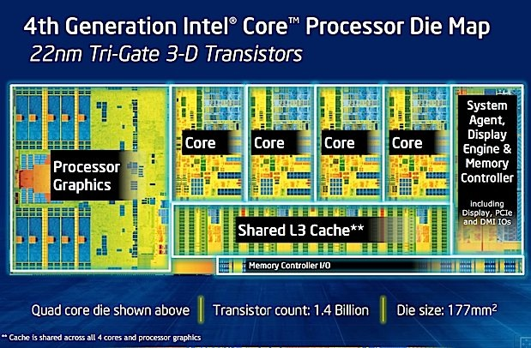
5.1 Introduction (7)
Die plot of a quad core Haswell processor [121]

Slide 171

5.1 Introduction (9)
Die plot of a dual core Haswell processor [177]

Slide 172

5.1 Introduction (10)
In package integrated CPU and PCH for mobile processors [204]
BGA: Ball Grid Array
PGA: Pin Grid array

Slide 173
5.1 Introduction (11)
Single thread IPC in Intel’s basic architectures [195]
20%
Per Generation
1.8
18%
Cumulative
1.7
16%
1.6
14%
12%
1.5
10%
1.4
8%
1.3
6%
1.2
4%
2%
1.1
0%
1
Core 2
Penryn
WSM
SNB
IVB
HSW
BRW
Pentium M
Dothan
NHM (w/o SMT)

Slide 174
5.2 Major enhancements of the Haswell line vs.
the Sandy Bridge line
5.2.1 Overview
5.2.2 ISA extension (of the cores) by the AVX2
instruction set
5.2.3 Enhanced microarchitecture for the cores
5.2.4 Enhanced graphics
Notes:
174

Slide 175

5.2.1 Overview (1)
5.2 Major enhanchements of the Haswell line vs. the Sandy Bridge line
5.2.1 Overview
ISA extension by the AVX2
instruction set (Section 5.2.2)
Enhanced microarchitecture for the cores
(Section 5.2.3)
Enhanced graphics (Section 5.2.4)

Slide 176

5.2.2 ISA extension by the AVX2 instruction set (1)
5.2.2 ISA extension by the AVX2 instruction set -1 [97]
FMA: Fused Multiply-Add

Slide 177

5.2.2 ISA extension by the AVX2 instruction set (2)
ISA extension by the AVX2 instruction set -2 [80]

Slide 178

5.2.2 ISA extension by the AVX2 instruction set (3)
Evolution of the AVX ISA extensions [97]

Slide 179

5.2.2 ISA extension by the AVX2 instruction set (4)
Expected future evolution of AVX [165]

Slide 180

5.2.3 Enhanced microarchitecture for the cores (1)
5.2.3 Enhanced microarchitecture for the cores [80]

Slide 181

5.2.3 Enhanced microarchitecture for the cores (2)
Buffer sizes of subsequent generations of the Core processors [80]

Slide 182

5.2.3 Enhanced microarchitecture for the cores (3)
Cache sizes, latencies and bandwidth values of subsequent Core generations [122]

Slide 183

5.2.3 Enhanced microarchitecture for the cores (4)
Issue rate and execution unit enhancements of Haswell [165]
FMA: Fused Multiply-Add (a x b+c)

Slide 184
5.2.4 Enhanced graphics (1)
5.2.4 Enhanced graphics
To compete with AMD’s advanced graphics solutions Intel put a great emphasis on enhancing
Haswell’s integrated graphics.
Main features of the new graphics units: are termed as Iris Pro and Iris graphics.
Sliced graphics architecture to allow scaling of EUs
Inclusion of eDRAM in high-end units.

Slide 185

5.2.4 Enhanced graphics (2)
a) Introduction of sliced graphics architecture
The new graphics architecture of Haswell is sliced, to allow scaling of EUs by using one or two slices/unit.
Each slice has two sub-slices, with up to 10 EUs/sub-slice, as indicated in the Figure below.
Figure: A sub-slice with 10 EUs
of the graphics unit of Haswell [199]

Slide 186

5.2.4 Enhanced graphics (3)
A slice of the graphics unit of Haswell including two sub-slices with 20 Eus [199]

Slide 187

5.2.4 Enhanced graphics (4)
The architecture of a GT3 graphics unit of Haswell including two slices with 40 EUs [199]

Slide 188

5.2.4 Enhanced graphics (5)
Block diagram of an EU of Haswell -1 [199]
Each EU has four functional units:
Two 4-way SIMD FPU units
1 Send unit (Load/Store) and
1 Branch unit.
An EU issues up to 4 instructions per cycle to the functional units.

Slide 189
5.2.4 Enhanced graphics (6)
Block diagram of an EU of Haswell -2 [199]
Each SIMD FPUs can execute 4 SP FP or 1/2/4/8/16/32 bit wide FX operations.
They can execute MAD instructions (Multiply-Add) per cycle.
Thus an EU can execute 2 FPU x SIMD4 x 2 (MAD) = 16 SP FP operations/cycle.
The EU is 7-way multithreaded.
Each thread has 128 32 B registers.
One of the FPUs also supports FX operations.
One of the FPUs also support transcendental math functions.

Slide 190
5.2.4 Enhanced graphics (7)
Interpretation of the notions Graphics Technology (GT) for the Haswell line and
subsequent lines
GT1 designates graphics with a single slice and reduces execution resources (less sub-slices
or less EUs per sub-slice)
GT2 designates graphics with a single slice (e.g. 20 EUs in the Haswell line)
GT3 designates graphics with dual slices (e.g. 40 EUs in the Haswell line)
GT4 designates graphics with triple slices.

Slide 191
5.2.4 Enhanced graphics (8)
Introducing the notions Iris/Iris Pro graphics
Intel designates their
high-end graphics as Iris graphics and
high-end graphics enhanced with embedded DRAM (eDRAM) as Iris Pro graphics.
The inclusion of eDRAM will be indicated also in the GT naming by supplementing the GT level
by the letter “e”, so GT3e designates GT3 level with eDRAM.
Haswell’s Iris graphics unit
(They incorporate two slices with altogether 40 EUs
Iris graphics unit
Iris Pro graphics unit
It is not enhanced by an
on package integrated eDRAM
It is enhanced by a 128 MB sized
on package integrated eDRAM

Slide 192
5.2.4 Enhanced graphics (9)
b)Inclusion of eDRAM in high-end graphics units
It will be discussed in Section 5.3.1

Slide 193
5.2.4 Enhanced graphics (10)
Evolution of main features of Intel’s graphics families
Intel Core generation | Graphics generation | Models | Graphics Technology level | No. of graphics slices | No. of EUs | eDRAM | OpenGL version | DirectX version | OpenCL version
Westmere | 5th (Ironlake) | HD |  |  | 12 | -- | 2.1 | 10.1 | n.a.
Sandy Bridge | 6th | HD 2000 | GT1 | 1 (2x3 EU) | 6 |  | 3.1/3.3 | 10.1 | n.a.
 |  | HD 3000 | GT2 | 1 (4x3 EU) | 12
Ivy Bridge | 7th | HD 2500 | GT1 | 1 (6 EU) | 6 | -- | 4.0 | 11.0 | 1.2
 |  | HD 4000 | GT2 | 1 (2x8 EU) | 16
Haswell | 7.5th | HD 4200- HD 4700 | GT2 | 1 (2x10 EU) | 20 | -- | 4.3 | 11.1 | 1.2
 |  | HD 5000 Iris 5100 | GT3 | 2 | 40
 |  | Iris Pro 5200 |  |  |  | 128 MB
Broadwell | 8th | HD 5300- HD 5600 | GT2 | 1(3x8 EU) | 23/24 | -- | 4.3 | 11.2 | 2.0
 |  | HD 6000 Iris 6100 | GT3 | 2 | 47/48
 |  | Iris Pro 6200 | GT3e | 2 | 48 | 128 MB
Skylake | 9th | HD 510 | GT1 | 1 (3x4 EU) | 12 | -- | 4.4 | 12 | 2.0
 |  | HD 515 | GT1.5 | 1 (3x6 EU) | 18
 |  | HD 520 | GT2 | 1 (3x8 EU) | 24
 |  | HD 535 | GT3 | 2 | 48
 |  | HD 540 | GT3e | 2 | 48 | 64 MB
 |  | HD 580 | GT4e | 3 | 72 | 64/128 MB

Slide 194

5.2.4 Enhanced graphics (11)
Graphics performance increase of subsequent Core generations [117]
Haswell
Ivy Bridge
Sandy Bridge

Slide 195
5.3 Major innovations of the Haswell line
5.3.1 On-package eDRAM cache
5.3.2 FIVR (Fully Integrated Voltage Regulator)
5.3.3 TSX (Transactional Synchronization Extensions)
Notes:
195

Slide 196
5.3 Major innovations of the Haswell line (1)
5.3 Major innovations of the Haswell line
On-package e-DRAM cache (Section 5.3.1)
FIVR (Fully Integrated Voltage Regulator) (Section 5.3.2)
TSX (Transactional Synchronization Extensions) (Section 5.3)

Slide 197

5.3.1 On-package eDRAM cache (1)
5.3.1 On-package eDRAM cache [117]

Slide 198
5.3.1 On-package eDRAM cache (2)
Principle of operation [117]
The on package eDRAM, designated also as Crystallwell, it operates as a true 4th level cache
of the memory hierarchy.
It acts as a victim buffer to the L3 cache, in the sense that anything evicted from the
L3 cache immediately goes into the L4 cache.
Both CPU and GPU requests are cached.
The cache partitioning between CPU and GPU is dynamic.
If the GPU is not in use the whole L4 cache may be devoted the CPU, in this case the CPU
has a 128 MB L4 cache.
Access latency after an L3 miss is 30 – 32 ns.
The L4 cache is capable of delivering 50 GB/s in each direction.
The Crystallwell die consumes between 0.5 and 1.0 W if idle and between 3.5 and 4.5 W
under full load.
The PCU (Power Control Unit) of the processor takes over the power management of the
eDRAM, beyond the power management of the CPU cores, GPU, L3 cache etc.

Slide 199

5.3.1 On-package eDRAM cache (3)
Implemented on-package eDRAM [124]
eDRAM chip

Slide 200

5.3.1 On-package eDRAM cache (4)
Memory latency vs. access range in a memory system with eDRAM cache (L4) [117]
Memory
L4
L3
L2
L1
Ivy Bridge
Ivy Haswel with Chrystallwelll
Ivy Haswell without CRW

Slide 201

5.3.2 FIVR (Fully Integrated Voltage Regulator) (1)
5.3.2 FIVR (Fully Integrated Voltage Regulator)
Voltage planes in desktop and mobile Haswell processors [173]

Slide 202

5.3.2 FIVR (Fully Integrated Voltage Regulator) (2)
Implementation of the voltage planes in Ivy Bridge and Haswell platforms [149]

Slide 203

5.3.2 FIVR (Fully Integrated Voltage Regulator) (3)
Functional partitioning of Haswell’s FIVR implementation [150]
FIVR is built up of two stages.
The first stage of the voltage regulator converts
from the PSU or battery voltage (12V)
to approximately 1.8V, which is distributed
across the microprocessor die.
The second conversion stage is comprised of
between 8 and 31 (depending on the
product) FIVRs, which are 140MHz
synchronous multiphase buck converters
with up to 16 phases.
12 V
First stage
Second stage
Functional partitioning

Slide 204
5.3.2 FIVR (Fully Integrated Voltage Regulator) (4)
Partitioning of the implementation [150]
The first stage is on the
motherboard.
The inductors and the midfrequency decoupling capacitors are placed on the package.
The power FETs, control circuitry and high frequency decoupling are on the die.
Each FIVR is independently programmable to achieve optimal operation given the requirements of the domain it is powering.
The settings are optimized by the Power Control Unit (PCU), which specifies the input voltage, output voltage, number of operating phases, and a variety of other settings to minimize the total power consumption of the die.

Slide 205




5.3.2 FIVR (Fully Integrated Voltage Regulator) (5)
Principle of operation of the Buck converter [151]
Q: MOSFET
Drive circuit:
E.g. PWM modulated
(Pulse Width Modulated)
Figure: Block diagram of the Buck converter [151]
On state
Off state
Figure: Operation of the Buck converter [151]

Slide 206

5.3.2 FIVR (Fully Integrated Voltage Regulator) (6)
Enhancing the buck converter to synchronous n-phase buck design to reduce ripple [152]
Fig. 9: Principle of a synchronous n-phase buck converter [152]

Slide 207

5.3.2 FIVR (Fully Integrated Voltage Regulator) (7)
Simplified block diagram of a single voltage plane in the FIVR domain of Haswell [150]
VID: Parallel Voltage Identification code

Slide 208

5.3.2 FIVR (Fully Integrated Voltage Regulator) (8)
Board space saving with Haswell’s FIVR vs. Ivy Bridge’s voltage regulator [149]

Slide 209
5.3.2 FIVR (Fully Integrated Voltage Regulator) (9)
Remark [171]
The availability of the FIVR solution allows a per-core P-state control of the
clock frequency and core voltage.
Despite this possibility only the server/workstation class processors make use
of this feature in the Haswell family, but desktop or mobile focused products no.

Slide 210

5.3.2 FIVR (Fully Integrated Voltage Regulator) (10)
Per Core P-State (PCPS) management in Intel’s i5-2600v3 (Haswell-EP) [172]

Slide 211

5.3.2 FIVR (Fully Integrated Voltage Regulator) (11)
Assessment of FIVR
Benefits of FIVR [178]

Slide 212
5.3.2 FIVR (Fully Integrated Voltage Regulator) (12)
Drawbacks of FIVR [178]
Hot running FIVR increases die temperature and thus it has a limiting effect on overclcking.
As a consequence, after using FIVR in Broadwell, Intel decided to remove it in their upcoming
Skylake and Kaby Lake processors.
Accordingly, related motherboards need to provide appropriate power delivery.
Nevertheless, sources state that in the subsequent 10 nm Cannonlake processors, due to
in 2017, Intel will make use again of the FIVR technology probably to achieve higher CPU
efficiency or due to the fact that thermal issues could be amended.

Slide 213

5.3.2 FIVR (Fully Integrated Voltage Regulator) (13)
Remark
In their subsequent Broadwell family (2014) Intel introduced the 2nd generation FIVR with 3DL
design [155]
3DL: 3D Layering

Slide 214
5.3.3 TSX (Transactional Synchronization Extensions)
Haswell also introduced a further new feature, called the Transactional Synchronization Extensions
(TSX) that was debuted on selected Haswell models (SKUs)..
TSX supports Transactional Memory in hardware (to be discussed later in the Chapter
high end MP servers).
Nevertheless, in August 2014 Intel announced a bug in the TSX implementation on all current
steppings of all Haswell models an disabled the TSX feature on affected CPUs via a microcode
update.
Subsequently, TSX became enabled first on a Broadwell model (Core M-5Y70) in 11/2014
then on the Haswell-EX in 5/2015.
SKU: Stock Keeping Unit

Slide 215
5.4 Haswell based mobile and desktop processors
Notes:
215

Slide 216
5.4 Haswell based mobile and desktop processors (1)
5.4 Haswell based mobile and desktop processors
The Haswell family
Haswell
(LGA 1150)
Up to 4 cores
(This Section)
Haswell-E
(LGA 2011)
Up to 8 cores
(Not discussed here)
Haswell-EP
(LGA 2011)
Up to 18 cores
(Not discussed ere)
Haswell-EX
(LGA 2011)
Up to 18 cores
(Not discussed here)
Mobiles (SoCs)
Core i7-49xx/48xx/472x/471x/470x, 4C+G, HT, 6/2013 and 5/2014
Core i7-46xx/45xx, 2C+G, HT, 5/2013 and 6/2014
Core i5-43xx/42xx U/Y, 2C+G, HT, 6/2013 and 5/2014
Core i3-41xx/40xx, 2C+G, HT, 6/2013 and 5/2014
Desktops (2 chips)
Core i7-479x/478x/477x,476x, 4C+G, HT, 6/2013 and 5/2014
Core i5-46xx/45xx/44xx, 4C+G, HT, 6/2013 and 5/2014
Core i3-43xx/41xx, 2C+G, HT, 6/2013, 5/2014 and 3/2015
i7-5960X/5930K/5820K, 6/8 C, 8/2014
Servers
(See next slide)
Notes:
ridge-ex

Slide 217
5.4 Haswell based mobile and desktop processors (2)
Main features of first introduced Haswell-based mobile Core i7 M-Series processors [125]
Intel 4th Gen Core i7 M-Series Mobile Processors
Model | Core i7-4930MX | Core i7-4900MQ | Core i7-4800MQ | Core i7-4702MQ | Core i7-4700MQ
Cores/Threads | 4/8 | 4/8 | 4/8 | 4/8 | 4/8
CPU Base Freq | 3.0 | 2.8 | 2.7 | 2.2 | 2.4
Max SC Turbo | 3.9 | 3.8 | 3.7 | 3.2 | 3.4
Max DC Turbo | 3.8 | 3.7 | 3.6 | 3.1 | 3.3
Max QC Turbo | 3.7 | 3.6 | 3.5 | 2.9 | 3.2
TDP | 57W | 47W | 47W | 37W | 47W
HD Graphics | 4600 | 4600 | 4600 | 4600 | 4600
GPU Clock | 400-1350 | 400-1300 | 400-1300 | 400-1150 | 400-1150
L3 Cache | 8MB | 8MB | 6MB | 6MB | 6MB
DDR3/DDR3L | 1600 | 1600 | 1600 | 1600 | 1600
vPro/TXT/VT-d | Yes | Yes | Yes | No | No
Intel SBA | No | No | No | Yes | Yes
Price | $1096 | $568 | $378

Slide 218
5.4 Haswell based mobile and desktop processors (3)
Main features of first issued Haswell-based Core i7 desktop processors [126]
Intel 4th Gen Core i7 Desktop Processors
Model | Core i7-4770K | Core i7-4770 | Core i7-4770S | Core i7-4770T | Core i7-4770R | Core i7-4765T
Cores/Threads | 4/8 | 4/8 | 4/8 | 4/8 | 4/8 | 4/8
CPU Base Freq | 3.5 | 3.4 | 3.1 | 2.5 | 3.2 | 2.0
Max Turbo | 3.9 (Unlocked) | 3.9 | 3.9 | 3.7 | 3.9 | 3.0
Test TDP | 84W | 84W | 65W | 45W | 65W | 35W
HD Graphics | 4600 | 4600 | 4600 | 4600 | Iris Pro 5200 | 4600
GPU Max Clock | 1250 | 1200 | 1200 | 1200 | 1300 | 1200
L3 Cache | 8MB | 8MB | 8MB | 8MB | 6MB | 8MB
DDR3 Support | 1333/1600 | 1333/1600 | 1333/1600 | 1333/1600 | 1333/1600 | 1333/1600
vPro/TXT/VT-d/SIPP | No | Yes | Yes | Yes | No | Yes
Package | LGA-1150 | LGA-1150 | LGA-1150 | LGA-1150 | BGA | LGA-1150
Price | $339 | $303 | $303 | $303 |  | $303

Slide 219

5.4 Haswell based mobile and desktop processors (4)
Example of a Haswell-based desktop platform [145]

Slide 220

5.4 Haswell based mobile and desktop processors (5)
Integer and FP performance of subsequent generations of desktop processors [127]
Haswell
Ivy Bridge
Sandy Bridge

Slide 221
5.4 Haswell based mobile and desktop processors (6)
Note
As the AVX2 extension of the Haswell processors introduces 256-bit FX operations, this line
has a considerable higher integer performance than previous Core generations.

Slide 222

5.4 Haswell based mobile and desktop processors (7)
Graphics performance of subsequent generations of desktop processors [127]
Haswell
Ivy Bridge
Sandy Bridge

Slide 223
6. The Skylake line
6.1 Introduction
6.2 Major enhancements of the Skylake line vs.
the Broadwell line
6.3 Major innovations of the Skylake line
6.4 Skylake based processor lines
Notes:
223

Slide 224
6.1 Introduction
Notes:
224

Slide 225
6.1 Introduction (1)
5.1 Introduction (1)
6.1 Introduction
The Skylake line is built on 14 nm technology.
Launched: 08/2015
Skylake processors are termed also as the 6. gen. Intel Core processors, as indicated below.
1. gen.
2. gen.
3. gen.
4. gen.
5. gen.
6. gen.
Core 2
New
Microarch.
65 nm
Penryn
New
Process
45 nm
Nehalem
New
Microarch.
45 nm
West-
mere
New
Process
32 nm
Sandy
Bridge
New
Microarch.
32 nm
Ivy
Bridge
New
Process
22 nm
Haswell
New
Microarchi.
22 nm
Broad-
well
New
Process
14 nm
Skylake
New
Microarchi.
14 nm
TOCK
TICK
TOCK
TICK
TOCK
TICK
TOCK
TICK
TOCK
Figure : Intel’s Tick-Tock development model (Based on [1])

Slide 226
6.1 Introduction (2)
The Skylake line
Key new features of the ISP
and the microarchitecture
2 YEARS
TICK
TOCK
180nm
11/2000
New microarch.
Pentium 4 /Willamette
2 YEARS
TICK
TOCK
130nm
01/2002
New microarch.,
hyperthreading
Pentium 4 /Northwood
TICK
TOCK
90nm
02/2004
New microarch.,
64-bit
2 YEARS
Pentium 4 /Prescott
TICK Pentium 4 / Cedar Mill
01/2006
2 YEARS
TOCK Core 2
65nm
New microarch., 4-wide core,
128-bit SIMD, no hyperthreading
07/2006
TICK Penryn Family
11/2007
2 YEARS
45nm
New microarch., integrated MC, QPI,
(inclusive) L3, HT
TOCK Nehalem
11/2008
TICK Westmere
01/2010
In package integr. GPU
2 YEARS
TOCK Sandy Bridge
32nm
256-bit AVX, new microarch.,
ring bus, integr. GPU
01/2011
TICK Ivy Bridge
04/2012
2 YEARS
22nm
AVX2,
L4 cache (discrete eDRAM), FIVR
TOCK Haswell
06/2013
TICK Broadwell
09/2014
Shared Virtual Memory
2 YEARS
14nm
ISP,
Memory Side $ (eDRAM), No FIVR
TOCK Skylake
08/2015
Figure : Overview of Intel’s Tick-Tock model (Based on [3])

Slide 227
6.1 Introduction (3)
Performance improvements provided by Skylake
According to sources quoting Intel’s statements [206] on average, Skylake has 10% better
performance, 30% better graphics performance.

Slide 228
6.1 Introduction (4)
Single thread IPC in Intel’s basic architectures (Based on [195])
2
24%
22%
Per Generation
1.9
20%
Cumulative
1.8
18%
1.7
16%
1.6
14%
12%
1.5
10%
1.4
8%
1.3
6%
1.2
4%
2%
1.1
0%
1
Pentium M
Dothan
Core 2
Penryn
NHM
(w/o SMT)
WSM
SNB
IVB
HSW
BRW
SKL
Note that Intel raised IPC in the Core family only less then 2-times in about 10 years.

Slide 229

6.1 Introduction (5)
Skylake Series -1 [206]
4.5 W
15/28 W
45 W
65/91 W

Slide 230

6.1 Introduction (6)
Skylake Series -2 [202]
BGA: Ball Grid Array (to be soldered)
LGA: Land Grid Array (to be socketed)

Slide 231

6.1 Introduction (7)
Main enhancements and innovations of Intel’s Skylake microarchitecture [200]
This diagram shows a kind of "superset" of Skylake. Different versions will not include all
of these parts, but these are all the different components that can be included.

Slide 232

The Skylake die [208]

Slide 233
6.2 Major enhancements of the Skylake line
6.2.1 More advanced microarchitecture of the cores
6.2.2 Enhanced graphics
Notes:
233

Slide 234
6.2 Major enhancements of the Skylake line
6.2 Major enhancements of the Skylake line
6.2.1 More advanced microarchitecture of the cores

Slide 235

6.2.1 More advanced microarchitecture of the cores (1)
Instruction window (ROB), buffer and register sizes of subsequent generations of the
Core 2 family [200]

Slide 236
6.2.2 Enhanced graphics (1)
6.2.2 Enhanced graphics
Performance increase of Intel’s graphics over generations [196]
Skylake
Broadwell
Haswell
Ivy Bridge
Sandy Bridge

Slide 237
6.2.2 Enhanced graphics (2)
Evolution of main features of Intel’s graphics families
Intel Core generation | Graphics generation | Models | Graphics Technology level | No. of graphics slices | No. of EUs | eDRAM | OpenGL version | DirectX version | OpenCL version
Westmere | 5th (Ironlake) | HD |  |  | 12 | -- | 2.1 | 10.1 | n.a.
Sandy Bridge | 6th | HD 2000 | GT1 | 1 (2x3 EU) | 6 |  | 3.1/3.3 | 10.1 | n.a.
 |  | HD 3000 | GT2 | 1 (4x3 EU) | 12
Ivy Bridge | 7th | HD 2500 | GT1 | 1 (6 EU) | 6 | -- | 4.0 | 11.0 | 1.2
 |  | HD 4000 | GT2 | 1 (2x8 EU) | 16
Haswell | 7.5th | HD 4200- HD 4700 | GT2 | 1 (2x10 EU) | 20 | -- | 4.3 | 11.1 | 1.2
 |  | HD 5000 Iris 5100 | GT3 | 2 | 40
 |  | Iris Pro 5200 |  |  |  | 128 MB
Broadwell | 8th | HD 5300- HD 5600 | GT2 | 1 (3x8 EU) | 23/24 | -- | 4.3 | 11.2 | 2.0
 |  | HD 6000 Iris 6100 | GT3 | 2 | 47/48
 |  | Iris Pro 6200 | GT3e | 2 | 48 | 128 MB
Skylake | 9th | HD 510 | GT1 | 1 (3x4 EU) | 12 | -- | 4.4 | 12 | 2.0
 |  | HD 515 | GT1.5 | 1 (3x6 EU) | 18
 |  | HD 520 | GT2 | 1 (3x8 EU) | 24
 |  | HD 530 | GT2 | 1 | 24
 |  | HD 540 | GT3e | 2 | 48 | 64 MB
 |  | HD 580 | GT4e | 3 | 72 | 64/128 MB

Slide 238

6.2.2 Enhanced graphics (3)
Expected main features of the Skylake line [190]

Slide 239

6.2.2 Enhanced graphics (4)
Skylake/Gen9 graphics architecture overview [196]
GT2

Slide 240

6.2.2 Enhanced graphics (5)
Gen9 graphics scalability -1 [196]

Slide 241

6.2.2 Enhanced graphics (6)
Gen9 graphics scalability -2 [196]

Slide 242

6.2.2 Enhanced graphics (7)
Gen9 graphics scalability -3 [196]
Scaling for GT 1.5 to reduce power

Slide 243

6.2.2 Enhanced graphics (8)
Gen9 graphics Codec support [196], [201]
With the new hardware accelerated codec solution watching a movie or video conferencing
can be done by highly efficient fixed-function circuits rather than by using more flexible, but
more power hungry CPU and GPU cores [201]

Slide 244

6.2.2 Enhanced graphics (9)
Gen9 graphics display support [201]
It supports 3 display pipes.
WiDi is Intel’s Wireless Display technology to transmit music, videos, movies, photos etc.
from a WiDi compatible computer to a compatible HDTV.
The initial version of WiDi supported only a low resolution of 720p, Skylake provides already
HD quality with a resolution of 1080.
Miracast is a WiDi standard of the Wi-Fi Alliance providing HD quality.

Slide 245

6.2.2 Enhanced graphics (10)
Note
Skylake does not make use of the FIVR technology, as indicated in the Figure below.
The reason for omitting FIVR in Skylake (and probably also is the subsequent Cannonlake) is
that it increases unduly the die temperature and limits overclocking.
Note that all cores share the same voltage
and even the same frequency.
Figure: Voltage domains of Skylake [200]

Slide 246
6.3 Major innovations of the Skylake line
6.3.1 Integrated ISP (Image Signal Processing)
6.3.2 Memory Side Cache
6.3.3 Innovations in power management
Notes:
246

Slide 247

6.3.1 Integrated ISP (Image Signal Processing) (1)
6.3 Major innovations of the Skylake line
6.3.1 Integrated ISP (Image Signal Processing) [200]
BOM: Bill of Material

Slide 248

6.3.2 Memory Side Cache (MSC) (1)
6.3.2 Memory Side Cache (MSC)
The eDRAM cache of Broadwell [200]
Note: The L4 eDRAM cache operates as a victim cache to the L3 (LLC).

Slide 249

6.3.2 Memory Side Cache (MSC) (2)
Memory Side Cache of the Skylake [200]
MS$: Memory Side Cache
CTL: Control

Slide 250
6.3.2 Memory Side Cache (MSC) (3)
Benefits of the Memory Side Cache (MSC) [200]
It is fully coherent.
Available for use by I/O devices and the Display engine as well.

Slide 251
6.3.3 Innovations in power management
6.3.3 Innovations in power management
6.3.3.1 SpeedShift Technology
6.3.3.2 Duty cycle control of the cores

Slide 252

6.3.3.1 Speed Shift Technology (1)
6.3.3.1 Speed Shift Technology [198]
The legacy power management technology, called the DVFS (Dynamic Voltage and
Frequency Scaling) -1
Intel’s DVFS implementation is termed as the SpeedStep technology, introduced with the
mobile Pentium III (~2000).
It is demand based, i.e. first the OS determines the actual core or processor utilization grade
based on the current workload, then it selects the appropriate working point, called P point,
of the core or of the processor.
The highest performance P point is termed as the P1 point, as seen in the Figure.
Each Pi point is set up of the operating {fci, Vci} values.
P1
P2
P6
Example: Intel’s SpeedStep technology used in their Pentium M processors (~2000) [210]

Slide 253
6.3.3.1 Speed Shift Technology (1a)
The legacy power management technology, called the DVFS (Dynamic Voltage and
Frequency Scaling) -2
Example: Intel’s SpeedStep technology used in their Pentium M processors (~2000) [210]
The OS selects the appropriate Pi point from the given set of available Pi while taking into
account both the workload demand and the user specified power management policy that
specifies the user’s power management priority (such as max. performance, longest
battery life or balanced).
The selected fci/Vci value will be communicated to the hardware (PLL, voltage regulator).

Slide 254

6.3.3.1 Speed Shift Technology (1)
The legacy power management technology, called the DVFS (Dynamic Voltage and
Frequency Scaling) -1
On the other hand, when the workload demands a higher
operating point than P1, the processor can take over the
control over the power management by activating the
turbo technology.
Lower than Pn states are used only to manage critical
conditions, like overheating the die.

Slide 255
6.3.3.1 Speed Shift Technology (2)
The drawback of the SpeedStep technology
The basic drawback is slow responsiveness, e.g. 30 ms responsiveness, needed until the OS
recognizes the change of operating conditions (e.g. workload) and responds by resetting the
operating point [201].
This is unfavorable for low residency workloads, like quickly changing video recording.

Slide 256
6.3.3.1 Speed Shift Technology (3)
Principle of the Speed Shift Technology
The OS passes the control over power management to the processor, more precisely to the
PCU (Power Control Unit) of the processor, along with hints about the user preference
concerning power management (like max. performance, max. battery life etc.).
The PCU performs the actual P-state control, called the Autonomous Control.
The Autonomous control can cover all P-states or a subset of the P-states, as indicated in the
next Figures.

Slide 257

6.3.3.1 Speed Shift Technology (4)
Passing power management control for all P-states to the CPU [198]

Slide 258

6.3.3.1 Speed Shift Technology (5)
Passing power management control for a subset of P-states to the CPU [198]

Slide 259
6.3.3.1 Speed Shift Technology (6)
Benefit of the Speed Shift Technology
It reduces the responsiveness of the power management from 30 ms to about 1 ms [201].

Slide 260

6.3.3.2 Duty cycle control (1)
6.3.3.2 Duty cycle control [198]
While running applications
dynamic dissipation: ~ f³
runtime: ~ 1/f
total energy consumption originating from the dynamic dissipation: ~ f²
with f denoting the clock frequency.
As the performance ~ f, the energy consumption originating from the dynamic dissipation
depends on the performance as shown below.
Figure: Dependence of energy consumption originating from the dynamic dissipation
(designated as Compute energy in the Figure) on the performance (~ f)

Slide 261

6.3.3.2 Duty cycle control (2)
On the other hand
the total energy consumption originating from static dissipation and system power depends
on the runtime, i.e.
the total energy consumption originating from static dissipation and system power: 1/f,
as indicated in the Figure below.
Figure: Dependence of energy consumption originating from the static dissipation
and system power (designated as SoC and system energy in the Figure) on the performance (~ f) [198]

Slide 262

6.3.3.2 Duty cycle control (3)
As a consequence, the total energy consumption originating from both the
dynamic dissipation and
static dissipation as well as system power consumption
has a minimum, as indicated in the Figure below.
Figure: Dependence of energy consumption originating from both the dynamic dissipation (designated as the Compute energy in the Figure) and the static dissipation and system power (designated as SoC and system energy in the Figure) on the performance
Obviously, the min. energy consumption point (Pe) is the most efficient working point of a core
of the processor.

Slide 263

6.3.3.2 Duty cycle control (4)
Power management with taking into account the most efficient Pe working point [198]
Frequency will be lowered as far as possible until the Pe working point is reached.
Pe will be calculated every ms based on the workload and system characteristics.
There is no benefit when the system is clocked below the Pe point, as it would increase
the energy consumption.
Therefore, a so called EARtH algoritm overrides lower P requests and sets f according to Pe.
The EARtH algorithm is activated only if it is possible to enter the package sleep state.
Figure: Power management with taking into account the most efficient Pe working point [198]

Slide 264

6.3.3.2 Duty cycle control (5)
Duty cycling [198]
While managing power going below Pe would reduce energy consumption inefficiently
due to the fixed power components.
In this region turning the package on and off, called duty cycling, reduces power
proportionally to run time, as shown in the Figure below.
Figure: Principle of duty cycling used to reduce energy consumption in the region below Pe
Duty cycling is more effective technique to reduce power for low computing demand in the
region below Pe than reducing frequency below the value associated with Pe..

Slide 265
6.4 The Skylake-based processor lines
Notes:
265

Slide 266

6.4 The Skylake-based processor lines (1)
6.4 The Skylake based processor lines
Key features of the Skylake lines -1 [202]
Dies: No. of cores and GT levels, e.g. 2+2 means: 2 cores +GT 2 graphics, etc.

Slide 267
6.4 The Skylake-based processor lines (2)
Key features of the Skylake line -2 [190]

Slide 268

6.4 The Skylake-based processor lines (3)
Expected launch dates of the Skylakes Series [192]

Slide 269
6.4 The Skylake-based processor lines (4)
1. Introduction (2)
The Skylake (6th Gen) mobile and desktop lines - Overview
Mobiles (SoC designs)
4.5 W Core M-line (Y-line) (BGA1515)
Core m7-6Y7x, 2C+HD 515, HT, 9/2015
Core m5-6Y5x, 2C+HD 515, HT, 9/2015
Core m3-6Y3x, 2C+HD 515, HT, 9/2015
15 W U-line (BGA1356)
Core i7-66x0U/65x0U, 2C+HD 515, HT, 9/2015
Core i5-63x0U/62x0U, 2C+HD 515, HT, 9/2015
Core i3-6100U, 2C+HD 515, HT, 9/2015
28 W U-line (SoC, BGA1356)
Core i7-65x7U, 2C+HD 550, HT, 9/2015
Core i5-62x7U, 2C+HD 550, HT, 9/2015
Core i3-61x7U, 2C+HD 550, HT, 9/2015

Slide 270
6.4 The Skylake-based processor lines (5)
Desktops (2-chip designs, 100 Series chipset)
35 W S-lines (LGA 1151)
Core i7-6700T 4C+HD 530, HT, 9/2015
Core i5-6600T/6500T/6400T, 4C+HD 530, HT, 9/2015
Core i3-6300T/6100T, 2C+HD 530, HT, 9/2015
45 W HQ/H-lines (BGA1440)
Core i7-6920HQ/6820HQ/6700HQ, 4C+HD 530, HT, 9/2015
Core i5-6440HQ/6300HQ, 4C+HD 530, HT, 9/2015
Core i3-6100H, 2C+HD 530, HT, 9/2015
65 W S-lines (LGA 1151)
Core i7-6700, 4C+HD 530, HT, 9/2015
Core i5-6600/6500/6400 4C+HD 530, HT, 9/2015
Core i3-6320/6300/6100, 2C+HD 530, HT, 9/2015
91 W S-lines, unlocked (LGA1151)
Core i7-6700K/6600K, 4C, HT, 8/2015
Microservers
45 W v5-lines (BGA)
Xeon E3-15x5M v5, 4C+HD 530, HT, 9/2015

Slide 271

6.4 The Skylake-based processor lines (6)
Example 1: Main features of the models of the 4.5 W Skylake m-line [202]

Slide 272

6.4 The Skylake-based processor lines (7)
Example 2: Main features of the models of the 91 W unlocked Skylake S-line [202]
Note that the 91 W unlocked Skylake S-line does not include integrated graphics, as most users
of this high-end processor will attach discrete graphics cards.

Slide 273
6.4 The Skylake-based processor lines (8)
The max. base frequency of Skylake models with different TDPs and configurations
(Based on data from [202])
TDP (W) | No. of cores | Graphics | No. of graphics EUs | eDRAM | Base frequency (GHz)
4.5 | 2 | HD 515 | 18 | -- | 1.2
15 | 2 | HD 540 | 48 | 64 MB | 2.2
15 | 2 | HD 520 | 24 | -- | 2.6
28 | 2 | HD 550 | 48 | 64 MB | 3.3
35 | 4 | HD 530 | 24 | -- | 2.8
45 | 4 | HD 530 | 24 | -- | 2.9
65 | 4 | HD 530 | 24 | -- | 3.4
91 | 4 | -- | -- | -- | 4.2
Note that low TDP can be achieved first of all by reducing the core frequency and limiting
the computer resources (cores, GPU EUs) provided.

Slide 274

6.4 The Skylake-based processor lines (9)
Intel Core i7-6700K desktop processor platform [203]

Slide 275
7. The Kaby Lake line
Notes:
275

Slide 276
7. The Kaby Lake line (1)
Preliminary information about the Kaby Lake line [179]
It is actually a Skylake refresh line manufacture on the 14 nm technology.
Announced on Intel’s Q2 2015 conference call.
Expected launch date: 2H 2016, it will be followed by the 10 nm Cannonlake in 2H 2017.
This means that the cadence of Intel’s technology transitions slowed down to about 2.5 years,
as Kranich, Intel’s CEO formulated:
The last two technology transitions have signaled that our cadence today is closer to
2.5 years than two."

Slide 277
7. The Kaby Lake line (2)
IMAGE
Expected main features of the Kaby Lake line [194]
Variant | KBL-Y (BGA) | KBL-U (BGA) | KBL-H (BGA) | KBL-S (LGA) | KBL-S (LGA)
Cores Configurations | 2 | 2/2 | 4/4 | 2/4/4 | 4/4
Graphic Configurations | GT2 | GT2/GT3 | GT2/GT4 | GT2/GT2/GT4 | GT0/GT2
eDRAM | N/A | N/A / 64 MB | N/A / 256 MB | N/A / N/A/ 64 MB | N/A
SOC Design | Yes | Yes | No - External PCH | No - External PCH | No - External PCH
TDP | 4.5W | 15W / 28W | 35W / 45W / TBD | 35W / 65W / 91W | 25W / 45W / 80W

Slide 278

7. The Kaby Lake line (3)
Expected system architecture of a U or Y-Series Kaby Lake processor [194]

Slide 279
8. References
Notes:
279

Slide 280
References (1)
[1]: Singhal R., “Next Generation Intel Microarchitecture (Nehalem) Family: Architecture Insight
and Power Management, IDF Taipeh, Oct. 2008, http://intel.wingateweb.com/taiwan08/
published/sessions/TPTS001/FA08%20IDFTaipei_TPTS001_100.pdf
[2]: Bryant D., “Intel Hitting on All Cylinders,” UBS Conf., Nov. 2007,
http://files.shareholder.com/downloads/INTC/0x0x191011/e2b3bcc5-0a37-4d06-
aa5a-0c46e8a1a76d/UBSConfNov2007Bryant.pdf
[3]: Fisher S., “Technical Overview of the 45 nm Next Generation Intel Core Microarchitecture
(Penryn),” IDF 2007, ITPS001, http://isdlibrary.intel-dispatch.com/isd/89/45nm.pdf
[4]: De Gelas J., “Intel Core versus AMD’s K8 architecture,” AnandTech, May 1 2006,
http://www.anandtech.com/cpuchipsets/intel/showdoc.aspx?i=2748&p=1
[5]: Carmean D., “Inside the Pentium 4 Processor Micro-architecture,” Aug. 2000,
http://people.virginia.edu/~zl4j/CS854/pda_s01_cd.pdf
[6]: Shimpi A. L. & Clark J., “AMD Opteron 248 vs. Intel Xeon 2.8: 2-way Web Servers
go Head to Head,” AnandTech, Dec. 17 2003,
http://www.anandtech.com/showdoc.aspx?i=1935&p=1
[7]: Völkel F., “Duel of the Titans: Opteron vs. Xeon : Hammer Time: AMD On The Attack,”
Tom’s hardware, Apr. 22 2003,
http://www.tomshardware.com/reviews/duel-titans,620.html
[8]: De Gelas J., “Intel Woodcrest, AMD's Opteron and Sun's UltraSparc T1:
Server CPU Shoot-out,” AnandTech, June 17 2006,
http://www.anandtech.com/IT/showdoc.aspx?i=2772&p=1

Slide 281
References (2)
[9]: Hinton G. & al., “The Microarchitecture of the Pentium 4 Processor,” Intel Technology
Journal, Q1 2001, pp. 1-13
[10]: Wechsler O., “Inside Intel Core Microarchitecture,” White Paper, Intel, 2006
[11]: Lee V., “Inside the Intel Core Microarchitecture,” IDF, May 2006, Shenzhen,
http://www.prcidf.com.cn/sz/systems_conf/track_sz/SMC/Intel%20Core%20uArch.pdf
[12]: Doweck J., “Inside Intel Core Microarchitecture,” Hot Chips 18, 2006,
http://www.hotchips.org/archives/hc18/
[13]: Gruen H., “Intel’s new Core Microarchitecture,” Develop Brighton, AMD Technical
Day, July 2006,
http://ati.amd.com/developer/brighton/03%20Intel%20MicroArchitecture.pdf
[14]: Doweck J., “Intel Smart Memory access: Minimizing Latency on Intel Core
Microarchitecture, ” Technology @ intel Magazine, Sept. 2006, pp. 1-7,
ftp://download.intel.com/corporate/pressroom/emea/deu/fotos/06-10-Strategie_Tag/
Intel/Intel_Core2_Prozessoren/Texte/ENG-Smart_Memory_Access_Technology@
Intel_Magazine_Article.pdf
[15]: Sima D., Fountain T., Kacsuk P., Advanced Computer Architectures, Addison Wesley,
Harlow etc., 1997
[16]: Jafarjead B., “Intel Core Duo Processor,” Intel, 2006,
http://masih0111.persiangig.com/document/peresentation/behrooz%20jafarnejad.ppt
[17]: Pawlowski S. & Wechsler O., “Intel Core Microarchitecture,” IDF Spring, 2006,
http://www.intel.com/pressroom/kits/core2duo/pdf/ICM_tech_overview.pdf

Slide 282
References (3)
[18]: Goto H., Larrrabee architecture can be integrated into CPU”, PC Watch, Oct. 6 2008,
http://pc.watch.impress.co.jp/docs/2008/1006/kaigai470.htm
[19]: SIMD Instruction Sets, http://softpixel.com/~cwright/programming/simd/index.php
[20]: Wikipedia: Platform Environment Control Interface,
http://en.wikipedia.org/wiki/Platform_Environment_Control_Interface
[21]: Kim N. S. et al., „Leakage Current: Moore’s Law Meets Static Power”, Computer,
Dec. 2003, pp. 68-75.
[22]: Ng P. K., “High End Desktop Platform Design Overview for the Next Generation
Intel Microarchitecture (Nehalem) Processor,” IDF Taipei, TDPS001, 2008,
http://intel.wingateweb.com/taiwan08/published/sessions/TDPS001/
FA08%20IDF-Taipei_TDPS001_100.pdf
[23]: Bohr M., Mistry K., Smith S., “Intel Demonstrates High-k + Metal Gate Transistor
Breakthrough in 45 nm Microprocessors,”, Intel, Jan. 2007,
http://download.intel.com/pressroom/kits/45nm/Press45nm107_FINAL.pdf
[24]: Scott D. S., “Toward Petascale and Beyond,” APAC Conference, Oct. 2007,
http://www.apac.edu.au/apac07/pages/program/presentations/
Tuesday%20Harbour%20A%20B/David_Scott.pdf
[25]: Smith S. L., “45 nm Product Press Briefing,” IDF Fall, 2007,
http://download.intel.com/pressroom/kits/events/idffall_2007/BriefingSmith45nm.pdf
[26]: Fisher S., “Technical Overview of the 45nm Next Generation Intel Core Microarchitecture
(Penryn),” IPTS001, Fall IDF 2007, http://isdlibrary.intel-dispatch.com/isd/89/45nm.pdf

Slide 283
References (4)
[27]: George V., 45nm Next Generation Intel Core Microarchitecture (Penryn),” Hot Chips 19,
2007, http://www.hotchips.org/archives/hc19/3_Tues/HC19.08/HC19.08.01.pdf
[28]: Wikipedia: Foxton Technology, http://en.wikipedia.org/wiki/Foxton_Technology
[29]: Coke J. & al., “Improvements in the Intel Core Penryn Processor Family Architecture
and Microarchitecture,” Intel Technology Journal, Vol. 12, No. 3, 2008, pp. 179-192
[30]: Fisher S., “Technical Overview of the 45nm Next Generation Intel Core Microarchitecture
(Penryn),” BMA S004, IDF 2007,
http://my.ocworkbench.com/bbs/attachment.php?attachmentid=318&d=1176911500
[31]: Gelsinger P. P., “Intel Architecture, Press Briefing, March 2008,
http://www.slideshare.net/angsikod/gelsinger-briefing-on-intel-architecture
[32]: Gelsinger P., “Invent the new reality,” IDF Fall 2008, San Francisco
http://download.intel.com/pressroom/kits/events/idffall_2008/PatGelsinger_day1.pdf
[33]: Brayton J.,”Nehalem: Talk of the Tock, Intel Next Generation Microprocessor,” IDF,
April 2008, Shanghai,
http://inteldeveloperforum.com.edgesuite.net/shanghai_2008/ti/TCH001/f.htm
[34]: Intel Timna Microprocessor Family, CPU World, http://www.cpu-world.com/CPUs/Timna/
[35]: Smith T., “Timna - Intel's first system-on-a-chip, Before 'Tolapai', before 'Banias'.
Register Hardware, Febr. 6 2007,
http://www.reghardware.co.uk/2007/02/06/forgotten_tech_intel_timna/

Slide 284
References (5)
[36]: Images, Xtreview,
http://xtreview.com/images/K10%20processor%2045nm%20architec%203.jpg
[37]: Singhal R. Intel’s i7, Podtech, http://www.podtech.net/home/5436/intels-core-i7
[38]: Strong B., “A Look Inside Intel: The Core (Nehalem) Microarchitecture,”
http://www.cs.utexas.edu/users/cart/arch/beeman.ppt
[39]: Valles A. C., Ansari Z., Mehrotra P.: “Tuning Your Software for the Next Generation
Intel Microarchitecture (Nehalem) Family,” IDF 2008, NGMS002,
http://www.benchmark.rs/tests/editorial/Nehalem_munich/presentations/
Software-Tuning_for_Nehalem.pdf
[40]: The low cost Tymna CPU, Tom’s hardware, Febr. 25 2000,
http://www.tomshardware.com/reviews/idf-2000,166-3.html
[41]: Intel® Virtualization Technology, Special issue, Vol. 10 No. 03 Aug. 2006,
http://www.intel.com/technology/itj/2006/v10i3/
[42]: Intel Core 2 Duo Processor E8000 and E7000 Series Datasheet, Intel, Jan. 2009
[43]: Wikipedia: List of Intel Core 2 microprocessors
http://en.wikipedia.org/wiki/List_of_Intel_Core_2_microprocessors
[44]: Wikipedia: Nehalem (microarchitecture)
http://en.wikipedia.org/wiki/Nehalem_(microarchitecture)
[45]: Glaskowsky P.: Investigating Intel's Lynnfield mysteries, cnet News, Sept. 21 2009,
http://news.cnet.com/8301-13512_3-10357328-23.html

Slide 285
References (6)
[46]: Shimpi A. L.: Intel's Core i7 870 & i5 750, Lynnfield: Harder, Better, Faster Stronger,
AnandTech, Sept. 8 2009, http://www.anandtech.com/show/2832
[47]: Intel Xeon Processor C5500/C3500 Series, Datasheet – Volume 1, Febr. 2010,
http://download.intel.com/embedded/processor/datasheet/323103.pdf
[48]: Intel CoreTM i7-800 and i5-700 Desktop Processor Series Datasheet – Volume 1,
July 2010, http://download.intel.com/design/processor/datashts/322164.pdf
[49]: Glaskowsky P.: Intel's Lynnfield mysteries solved, cnet News, Sept. 28 2009,
http://news.cnet.com/8301-13512_3-10362512-23.html
[50]: Intel CoreTM i7-900 Mobile Processor Extreme Edition Series, Intel Core i7-800 and
i7-700 Mobile Processor Series, Datasheet – Volume One, Sept. 2009
http://download.intel.com/design/processor/datashts/320765.pdf
[51]: Intel Turbo Boost Technology in Intel CoreTM Microarchitecture (Nehalem) Based
Processors, White Paper, Nov. 2008
http://download.intel.com/design/processor/applnots/320354.pdf
[52]: Power Management in Intel Architecture Servers, White Paper, April 2009
http://download.intel.com/support/motherboards/server/sb/power_management_
of_intel_architecture_servers.pdf
[53]: Glaskowsky P.: Explaining Intel’s Turbo Boost technology, cnet News, Sept. 28 2009,
http://news.cnet.com/8301-13512_3-10362882-23.html
[54]: Intel Xeon Processor 7500 Series, Datasheet – Volume 2, March 2010
http://www.intel.com/Assets/PDF/datasheet/323341.pdf

Slide 286
References (7)
[55]: Pawlowski S.: Intelligent and Expandable High- End Intel Server Platform, Codenamed
Nehalem-EX, IDF 2009
[56]: Kottapalli S., Baxter J.: Nehalem-EX CPU Architecture, Hot Chips 2009, Sept. 10 2009
http://www.hotchips.org/archives/hc21/2_mon/HC21.24.100.ServerSystemsI-Epub/
HC21.24.122-Kottapalli-Intel-NHM-EX.pdf
[57]: Kurd N. A. & all: A Family of 32 nm IA Processors, IEEE Journal of Solide-State Circuits,
Vol. 46, Issue 1., Jan. 2011, pp. 119-130
[58]: Hill D., Chowdhury M.: Westmere Xeon-56xx „Tick” CPU, Hot Chips 2010
http://www.hotchips.org/uploads/archive22/HC22.24.620-Hill-Intel-WSM-EP-print.pdf
[59]: Intel CoreTM i7-600, i5-500, i5-400 and i3-300 Mobile Processor Series, Datasheet -
Vol.1, Jan. 2010, http://download.intel.com/design/processor/datashts/322812.pdf
[60]: Nagaraj D., Kottapalli S.: Westmere-EX: A 20 thread server CPU, Hot Chips 2010
http://www.hotchips.org/uploads/archive22/HC22.24.610-Nagara-Intel-6-Westmere-EX.pdf
[61]: Kahn O., Piazza T., Valentine B.: Technology Insight: Intel Next Generation
Microarchitecture Codename Sandy Bridge, IDF 2010
extreme.pcgameshardware.de/.../281270d1288260884-bonusmaterial-pc- games-
hardware-12-2010-sf10_spcs001_100.pdf
[62]: Wikipedia: Sandy Bridge, http://en.wikipedia.org/wiki/Sandy_Bridge
[63]: http://ark.intel.com
[64]: Kahn O., Valentine B.: Intel Next Generation Microarchitecture Codename Sandy Bridge:
New Processor Innovations, IDF 2010

Slide 287
References (8)
[65]: Shimpi A. L.: Intel Pentium 4 1.4GHz & 1.5GHz, AnandTech, Nov. 20 2000
http://www.anandtech.com/show/661/5
[66]: Yuffe M., Knoll E., Mehalel M., Shor J., Kurts T.: A fully integrated multi-CPU, GPU and
memory controller 32nm processor, ISSCC, Febr. 20-24 2011, pp. 264-266
[67]: Intel Xeon Processor 7500/6500 Series, Public Gold Presentation, Data Center Group,
March 30. 2010, http://cache-www.intel.com/cd/00/00/44/64/446456_446456.pdf
[68]: Tang H., Cheng H.: Intel Xeon Processor E3 Family Based Servers: A Smart Investment
for Managing Your Small Business, IDF 2011
[69]: Thomadakis M. E. PhD: The Architecture of the Nehalem Processor and Nehalem-EP SMP
Platforms, Texas A&M University, March 17 2011
http://alphamike.tamu.edu/web_home/papers/perf_nehalem.pdf
[70]: Intel Xeon Processor E7-8800/4800/2800 Product Families, Datasheet Vol. 1 of 2,
April 2011, http://www.intel.com/Assets/PDF/datasheet/325119.pdf
[71]: Mitchell D., Intel Nehalem-EX review, PCPro,
http://www.pcpro.co.uk/reviews/processors/357709/intel-nehalem-ex
[72]: Rusu & al.: A 45 nm 8-Core Enterprise Xeon Processor, IEEE journal of Solid State Circuits,
Vol. 45, No. 1, Jan. 2010, pp. 7-14
[73]: Wechsler O., Multicore Archtecture Challenges and Opportunities, Intel’s Annual Symposium
on VLSI CAD and Validation, Keynote presentation, July 2007
http://www3.ee.technion.ac.il/sites/Workshop/upload/Events/ACRC%20-%20Intel/
Ofri-Wechsler%20Keynotes%20Speech.pdf

Slide 288
References (9)
[74]: Razin A., Core, Nehalem, Gesher. Intel: New Architecture Every Two Years,
Xbit Laboratories, April 28 2006,
http://www.xbitlabs.com/news/cpu/display/20060428162855.html
[75]: Har_Even B., Justin Rattner Keynote? Trusted Reviews, April 17 2007,
http://www.trustedreviews.com/news/IDF-Spring-2007-Day-One-Opening-Keynote
[76]: Weatherstone R., Intel Core i7-3960X Extreme Edition Processor (Sandy Bridge-E)
Review, Nov. 14 2011, Vortez, http://www.vortez.net/articles_pages/intel_core_i7_
3960x_extreme_edition_processor_sandy_bridge_e,2.html
[77]: Shimpi A. L., Intel Core i7 3960X (Sandy Bridge E) Review: Keeping the High End Alive,
Nov. 14 2011, AnandTech, http://www.anandtech.com/show/5091/intel-core-i7-3960x-
sandy-bridge-e-review-keeping-the-high-end-alive/4
[78]: Intel® X79 Express Chipset, http://www.intel.com/content/www/us/en/chipsets/
performance-chipsets/x79-express-chipset.html
[79]: Intel® Desktop Board DX79SI Extreme Series, 2011, http://www.intel.com/content/
dam/doc/product-brief/desktop-board-dx79si-extreme-brief.pdf
[80]: Chappell R., Toll B., Singhal R.: Intel Next Generation Microarchitecture Codename Haswell:
New Processor Innovations, IDF 2012
[81]: Olivera, A régóta várt Intel Ivy Bridge tesztje, Prohardware, April 13 2012,
http://prohardver.hu/teszt/intel_ivy_bridge_teszt/az_ivy_bridge.html

Slide 289
References (10)
[82]: Bohr M., Mistry K.: Intel’s Revolutionary 22 nm transistor technology, May 2011,
http://download.intel.com/newsroom/kits/22nm/pdfs/22nm-Details_Presentation.pdf
[83]: George V., Piazza T., Jiang H.: Technology Insight: Intel Next Generation Microarchitecture
Codename Ivy Bridge, IDF 2011
[84]: 3rd Generation Intel Core Processor Family Quad Core Launch Product Information,
April 23 2012, http://download.intel.com/newsroom/kits/core/3rdgen/pdfs/3rd_Generation
_Intel_Core_Product_Information.pdf
[85]: Ivy Bridge and Haswell die configurations (estimates included), Anandtech, March 21 2012,
http://forums.anandtech.com/showthread.php?t=2234017
[86]: Piazza T., Jiang H., Hammerlund P., Singhal R.: Technology Insight: Intel Next Generation
Microarchitecture Codename Haswell, IDF 2012 SPCS001
[87]: Haynes D.: 2012 Socket Guide, Aug. 4 2012,
http://www.ocmodshop.com/cpu-socket-guide-2012/lga2011/
[88]: O’Shea P., Thermal management solutions include support for Intel platform environmental
control interface, EE Times, Oct. 17 2006,
http://www.eetimes.com/document.asp?doc_id=1301982
[89]: Altavilla D., Intel Arrandale Core i5 and Core i3 Mobile Unveiled, Hot Hardware, Jan. 4 2010,
http://hothardware.com/Reviews/Intel-Arrandale-Core-i5-and-Core-i3-Mobile-Unveiled/
[90]: Shimpi A. L., The Intel Core i3 530 Review - Great for Overclockers & Gamers,
AnandTech, Jan. 22 2010, http://www.anandtech.com/show/2921

Slide 290
References (11)
[91]: Chiappetta M., Intel Clarkdale Core i5 Desktop Processor Debuts, Hot Hardware, Jan. 3 2010,
http://hothardware.com/Articles/Intel-Clarkdale-Core-i5-Desktop-Processor-Debuts/
[92]: Thomas S. L., Desktop Platform Design Overview for Intel Microarchitecture (Nehalem)
Based Platform, Presentation ARCS001, IDF 2009
[93]: Kirsch N., Intel Core i7-980X Six-Core Processor Extreme Edition Review, Legit Reviews,
March 11 2010, http://www.legitreviews.com/intel-core-i7-980x-six-core-processor-
extreme-edition-review_1245
[94]: Kanter D., Westmere Arrives, Real World Tech, March 17 2010,
http://www.realworldtech.com/westmere/2/
[95]: Hruska J., Intel Unveils 10-Core Xeons, Mission-Critical Servers, Hot Hardware, Apr. 5 2011,
http://hothardware.com/Reviews/Intel-Unveils-10Core-Xeons-MissionCritical-Servers/
[96]: Intel Sandy Bridge Review, Bit-tech, Jan. 3 2011,
http://www.bit-tech.net/hardware/cpus/2011/01/03/intel-sandy-bridge-review/1
[97]: Toll B., Locktyukhin M., Girkar M., Intel Advanced Vector Extensions 2 and Bit Manipulation
New Instructions, IDF 2012
[98]: Torres G., Inside the Intel Sandy Bridge Microarchitecture, Hardware Secrets, Dec. 30 2010,
http://www.hardwaresecrets.com/article/Inside-the-Intel-Sandy-Bridge-Microarchitecture/1161/2
[99]: Piazza T., Dr. Jiang H., Microarchitecture Codename Sandy Bridge: Processor
Graphics, Presentation ARCS002, IDF San Francisco, Sept. 2010

Slide 291
References (12)
[100]: Wikipedia: Intel GMA, 2011, http://en.wikipedia.org/wiki/Intel_GMA
[101]: Shimpi A. L., The Sandy Bridge Review: Intel Core i7-2600K, i5-2500K and Core i3-2100
Tested, AnandTech, Jan. 3 2011, http://www.anandtech.com/show/4083/the-sandy-
bridge-review-intel-core-i7-600k-i5-2500k-core-i3-2100-tested/11
[102]: Intel® Q67 Express Chipset, http://www.intel.com/content/www/us/en/chipsets/
mainstream-chipsets/q67-express-chipset.html
[103]: Rodolf K., Small and Medium Business Server Solutions from Intel, Sept. 20 2012
[104]: Intel Core i7 Processor Family for the LGA-2011 Socket, Datasheet, Vol.1, Nov. 2012,
http://www.intel.com/content/www/us/en/processors/core/core-i7-lga-2011-datasheet-
vol-1.html
[105]: Crijns K., nVidia GeForce GTX 680 Quad-SLI review, Hardware.info, March 23 2012,
http://nl.hardware.info/reviews/2641/nvidia-geforce-gtx-680-quad-sli-review-english-version
[106]: Wikipedia: List of Intel Xeon microprocessors,
http://en.wikipedia.org/wiki/List_of_Intel_Xeon_microprocessors#Sandy_Bridge-based_Xeons
[107]: Morgan T.P., Intel plugs both your sockets with 'Jaketown' Xeon E5-2600s, The Register,
March 6 2012, http://www.theregister.co.uk/2012/03/06/intel_xeon_2600_server_
chip_launch/
[108]: Intel Xeon E5-2690 001, CPU, Tom’s Hardware, http://www.tomshardware.com/gallery/
Intel-Xeon-E5-2690-001,0101-320460-0-2-3-1-jpg-.html

Slide 292
References (13)
[109]: System Architecture and Configuration, Oct. 2012,
http://www.qdpma.com/systemarchitecture/SystemArchitecture_2012Q4.html
[110]: Intel Xeon Processor E5-1600/E5-2600/E5-4600 Product Families, Datasheet, Vol.1,
May 2012, http://www.intel.la/content/www/xl/es/processors/xeon/xeon-e5-1600-2600-
vol-1-datasheet.html
[111]: Bolaria J., Romley Revamps Server Platforms, The Linley Group, April 2 2012,
http://www.linleygroup.com/mpr/article.php?id=10879
[112]: Angelini C., Intel Xeon E5-2600: Doing Damage With Two Eight-Core CPUs, Tom’s Hardware,
March 6 2012, http://www.tomshardware.com/reviews/xeon-e5-2687w-benchmark-
review,3149-10.html
[113]: Ulvr P., Fait F., Built to Scale: Introducing the Intel Xeon Processor E5 Family, 2012,
http://www-05.ibm.com/cz/events/truck2012/bp/pdf/system_x_cast/Intel_Xeon_E5_
obchodni.pdf
[114]: Panagiotidis N.G., Intel Xeon: the Enabling Technology to the Performing, Flexible & Energy
efficient Cloud Infrastructure, April 23 2013,
http://www.cisco.com/web/GR/connect2013/pdfs/007_intel_nikos_panagiotidis.pdf
[115]: Wikipedia: Ivy Bridge (microarchitecture),
http://en.wikipedia.org/wiki/Ivy_Bridge_%28microarchitecture%29
[116]: Vilches J., Intel Ivy Bridge: everything you need to know, TechSpot, March 8 2012,
http://www.techspot.com/guides/502-intel-ivy-bridge/page3.html

Slide 293
References (14)
[117]: Shimpi A.L., Intel Iris Pro 5200 Graphics Review: Core i7-4950HQ Tested, AnandTech,
June 1 2013, http://www.anandtech.com/show/6993/intel-iris-pro-5200-graphics-
review-core-i74950hq-tested
[118]: Product Brief Intel Xeon Processor E3-1200 v2 Product Family, 2012,
http://software.intel.com/sites/products/vcsource/files/xeon-e3-1200v2-brief__2_.pdf
[119]: Leberecht M., Expanding Intel Architecture Flexibility in the Data Center, March 20 2013,
http://www.worldhostingdays.com/downloads/2013/hStag2a1.pdf
[120]: Wikipedia: Haswell (microarchitecture),
http://en.wikipedia.org/wiki/Haswell_%28microarchitecture%29
[121]: Von Holzbauer F., Kugler A., Neue Intel-Architektur mit Grafik-Fokus, Chip Online,
June 1 2013, http://www.chip.de/artikel/Intel-Haswell-Neue-CPUs-fuer-Notebooks-und-
PCs_62209040.html
[122]: Valentine B., Intel Next Generation Microarchitecture Codename Haswell: New Processor
Innovations, 2012, http://ftp.software-sources.co.il/Processor_Architecture_Update-
Bob_Valentine.pdf
[123]: Brown M., Intel lifts the veil on Haswell graphics, PC World, May 2 2013,
http://www.pcworld.com/article/2037063/intel-lifts-the-veil-on-haswell-graphics.html
[124]: Scansen D., Intel Launches Next Generation of Microprocessors, Engineering, June 10 2013,
http://www.engineering.com/ElectronicsDesign/ElectronicsDesignArticles/ArticleID/
5838/Intel-Launches-Next-Generation-of-Microprocessors.aspx

Slide 294
References (15)
[125]: Walton J., Hit the Road, Jack: Intel’s Mobile Quad-Core Haswell SKUs, AnandTech,
June 1 2013, http://www.anandtech.com/show/7002/hit-the-road-jack-intels-mobile-
quadcore-haswell-skus
[126]: Walton J., Intel’s Haswell: Quad-Core Desktop Processor SKUs, AnandTech, June 1 2013,
http://www.anandtech.com/show/7001/intels-haswell-quadcore-desktop-processor-skus
[127]: Kirsch N., Intel Core i7-4770K Haswell Processor Performance Review Posted, Legit Reviews,
March 18 2013, http://www.legitreviews.com/intel-core-i7-4770k-haswell-processor-
performance-review-posted_15286
[128]: Kennedy P., Intel Xeon E3-1200 V3 Series Compute Value Comparison, STH, June 13 2013,
http://www.servethehome.com/intel-xeon-e3-1200-v3-series-compute-comparison/
[129]: Kennedy P., Leaked Intel Xeon E3-1200 V3 Series and Comparison to V1 and V2, STH,
April 3 2013, http://www.servethehome.com/leaked-intel-xeon-e3-1200-v3-series-
comparison-v1-v2/
[130]: Intel® Xeon® Processor E3-1200 v3 Product Family with Intel® HD Graphics P4600 and
Intel® C226 Chipset: Block Diagram, http://www.intel.com/content/www/us/en/
intelligent-systems/denlow/xeon-e3-1200-v3-c266-chipset-ibd.html
[131]: Chiappetta M., Intel Core i7-4960X Ivy Bridge-E CPU Review, Hot Hardware,
Sept. 3 2013, http://hothardware.com/Reviews/Intel-Core-i74690X-Extreme-Edition-
Ivy-Bridge-E-CPU-Review/?page=2
[132]: Intel Core i7 High End Desktop Processor Family for Socket LGA-2011, Aug. 2013,

Slide 295
References (16)
[133]: Pop S., Intel Releases Core i7 Extreme Central Processing Units, Softpedia, Sept. 9 2013,
http://news.softpedia.com/news/Intel-Releases-Core-i7-Extreme-Central-Processing-
Units-381369.shtml
[134]: Shimpi A.L., Intel Core i7 4960X (Ivy Bridge E) Review, AnandTech, Sept. 3 2013,
http://www.anandtech.com/show/7255/intel-core-i7-4960x-ivy-bridge-e-review
[135]: Hruska J., Core i7-4960X Ivy Bridge-E review: Intel’s Great Limp Forward, ExtremeTech,
Sept. 3 2013, http://www.extremetech.com/gaming/165498-core-i7-4960x-ivy-bridge-e-
review-intels-great-limp-forward
[136]: Novakovic N., Intel Xeon 2013 update – A bit later, but a bit better too, VR-Zone,
April 9 2013, http://vr-zone.com/articles/intel-xeon-2013-update--a-bit-later-but-a-bit-
better-too/19581.html?utm_source=feedburner&utm_medium=feed&utm_campaign=
Feed%3A+TheTomorrowTimes+%28The+Tomorrow+Times%29
[137]: De Gelas J., Intel's Xeon E5-2600 V2: 12-core Ivy Bridge EP for Servers, AnandTech,
Sept. 17 2013, http://www.anandtech.com/show/7285/intel-xeon-e5-2600-v2-12-core-
ivy-bridge-ep
[138]: Morgan T.P., Intel carves up Xeon E5-2600 v2 chips for two-socket boxes, The Register,
Sept. 10 2013, http://www.theregister.co.uk/2013/09/10/intel_ivy_bridge_xeon_e5_
2600_v2_launch/
[139]: Eshelman E., Intel Xeon E5-2600v2 “Ivy Bridge” Processor Review, Microway,
Sept. 10 2013, http://www.microway.com/hpc-tech-tips/intel-xeon-e5-2600v2-ivy-
bridge-processor-review/

Slide 296
References (17)
[140]: Shvets A., Intel Xeon E5-1600 v2 and E5-2600 v2 CPUs launched, CPU World,
Sept. 14 2013, http://www.cpu-world.com/news_2013/2013091401_Intel_Xeon_
E5-1600_v2_and_E5-2600_v2_CPUs_launched.html
[141]: Mujtaba H., Intel Ivy Bridge-EX Confirmed To Feature 15 Cores – Arrives in 2H 2013,
WCCF Tech, 2013, http://wccftech.com/intel-ivy-bridge-ex-feature-15-cores/
[142]: Shvets G., Some details of upcoming Intel Xeon E5 v2 and E7 v2 CPUs, CPU World,
April 2 2013, http://www.cpu-world.com/news_2013/2013040201_Some_details_of_
upcoming_Intel_Xeon_E5_v2_and_E7_v2_CPUs.html
[143]: Mouthaan M., Intel Haswell-E slides published; DDR4 and octa-cores, Hardware Info,
June 16 2013, http://us.hardware.info/news/35581/intel-haswell-e-slides-published-
ddr4-and-octa-cores
[144]: Introducing the 4th Generation Intel Core Processor (code-named Haswell), 2013,
http://software.intel.com/sites/default/files/introduction-to-intel-4th-generation-core-
processor.pdf
[145]: Unparalleled Performance and Responsiveness, Product Brief, Intel Z87 Chipset, 2013,
http://www.intel.com/content/dam/www/public/us/en/documents/product-briefs/
z87-chipset-brief.pdf
[146]: Haas, J. & Vogt P., Fully buffered DIMM Technology Moves Enterprise Platforms to the
Next Level,” Technology Intel Magazine, March 2005, pp. 1-7
[147]:
Intel Xeon processor E3-1200 v3 Product Family and the Emergence of Graphics in the
Cloud, June 3 2013,
http://www.yumpu.com/en/document/view/18758369/cover-slide-title-intel-newsroom

Slide 297
References (18)
[148]: Gasior G., Leaked slides expose Haswell's integrated voltage regulator, May 13, 2013,
http://techreport.com/news/24802/leaked-slides-expose-haswell-integrated-voltage-
regulator
[149]: Hammerlund P. & al., Haswell: The Fourth Generation Intel Core Processor, IEEE MICRO
March/April 2014, pp. 6-20
[150]: Burton E.A. & al., FIVR – Fully Integrated Voltage Regulators on 4th Generation Intel
Core™ SoCs, Proc. Twenty-Ninth Annual IEEE Applied Power Electronics Conference and
Exposition (APEC), 2014, pp. 432 - 439
[151]: Application Note: Atmel AT04204: Design a Buck Converter with XMEGA E, Atmel Corp.
2013, http://www.atmel.com/Images/Atmel-42183-Design-a-Buck-Converter-with-
XMEGA-E_AP-Note_AT04204.pdf
[152]: Buck converter, http://en.wikipedia.org/wiki/Buck_converter
[153]: Borkar R., A Multy Year Journey, Aug. 11 2014, Intel,
http://download.intel.com/newsroom/kits/14nm/pdfs/Intel_14nm_New_uArch.pdf
[154]: Bohr M., 14 nm Technology Announcement, Aug. 11 2014, Intel,
http://download.intel.com/newsroom/kits/14nm/pdfs/Intel_14nm_New_uArch.pdf
[155]: Jourdan S., Broadwell Microarchitecture Disclosure, Aug. 11 2014, Intel,
http://download.intel.com/newsroom/kits/14nm/pdfs/Intel_14nm_New_uArch.pdf
[156]: Chennupaty S., Jiang H., Sreenivas A., Technology insight: Intel’s Next Generation 14 nm
Microarchitecture for Client and Server, IDF 2014 SPCS002, San Francisco, 2014,
https://intel.activeevents.com/sf14/connect/sessionDetail.ww?SESSION_ID=1204

Slide 298
References (19)
[157]: Junkins S., The Compute Architecture of Intel Processor Graphics Gen8, IDF 2014,
https://software.intel.com/sites/default/files/managed/71/a2/Compute%20Architecture%
20of%20Intel%20Processor%20Graphics%20Gen8.pdf
[158]: Smith S.L., Intel Strategy & Technology Update, Barclays Capital Global Technology Conf.,
Dec. 2011, http://files.shareholder.com/downloads/INTC/1576180143x0x526852/c9868a
3a-494e-4506-bcc6-a631aca1fd75/Steve%20Smith%20Barclays%20Dec%202011.pdf
[159]: Kanter D., Intel’s merom Unveiled, Real World Technologies, March 9, 2006,
http://www.realworldtech.com/merom/6/
[160]: Kanter D., Inside Barcelona: AMD's Next Generation, Real World Technologies, May 9, 2007,
http://www.hypertransport.org/docs/news/rwtech_inside_barcelona_05-16-07.pdf
[161]: - Intel 64 and IA-32 Architectures Software Developer’s Manual Combined Volumes:
1, 2A, 2B, 2C, 3A, 3B and 3, Intel, Order Number: 325462-052US, September 2014,
http://www.intel.com/content/dam/www/public/us/en/documents/manuals/64-ia-32-
architectures-software-developer-manual-325462.pdf
[162]: - SSE, The Free Dictionary, http://encyclopedia2.thefreedictionary.com/Supplemental+SSE3
[163]: Doweck J., Inside Intel Core Microarchitecture, Hot Chips 18, 2006,
http://www.hotchips.org/wp-content/uploads/hc_archives/hc18/3_Tues/HC18.S9/
HC18.S9T4.pdf
[164]: Goto H., ARM Cortex – A Family Architecture, 2010,
http://pc.watch.impress.co.jp/video/pcw/docs/423/409/p1.pdf

Slide 299
References (20)
[165]: Borges L., Intel Technologies for High Performance Computing, Intel Software Solution
Conference 2014 Brazil, May 2014,
http://www.slideshare.net/IntelSoftwareBR/hpc-update-istep2014
[166]: Intel Core 2 Duo Processor, http://www.intel.com/pressroom/kits/core2duo/
[167]: Shimpi A. L., Intel’s Core i7 870 C i5 750 Lynnfield: Harder, Better, Faster, Stronger,
AnandTech, Sept. 8, 2009, http://www.anandtech.com/show/2832/2
[168]: Lomont C., Introduction to Intel® Advanced Vector Extensions, Intel, 23 May 2011,
https://software.intel.com/sites/default/files/m/d/4/1/d/8/Intro_to_Intel_AVX.pdf
[169]: Intel QuickPath Interconnect Electrical Architecture Overview, Intel, 2010,
http://jamesstovalldesign.files.wordpress.com/2012/08/pages-from-intel_qpied_final_
03-18-10.pdf
[170]: Davis L., PCI Express Bus,
http://www.interfacebus.com/PCI-Express-Bus-PCIe-Description.html
[171]: Wasson S., Intel's Xeon E5-2687W v3 processor reviewed, TechReport, Sept. 8 2014,
http://techreport.com/review/27018/intel-xeon-e5-2687w-v3-processor-reviewed
[172]: Klemm M., The Intel Platform for High Performance Computing, Intel, Oct. 07 2014
https://sharepoint.campus.rwth-aachen.de/units/rz/HPC/public/Shared%20Documents/
2014-10-07_aiXcelerate-01_Intel_Architecture-Haswell+Xeon_Phi.pdf
[173]: Moen M., Ragland D., Guerrero JJ., Overclocking Unlocked Intel Core Processors for
High Performance Gaming and Content Creation, IDF 2013, San Francisco, Sept. 1 2013,
AIOS001

Slide 300
References (21)
[174]: Wikipedia, Intel HD and Iris Graphics,
https://en.wikipedia.org/wiki/Intel_HD_and_Iris_Graphics
[175]: Intel Xeon Processor E3-1200 Product Family, Product Brief, 2011
[176]: Cutress I., The Intel Haswell Refresh Review: Core i7-4790, i5-4690 and i3-4360 Tested,
AnandTech, May 11 2014, http://www.anandtech.com/show/7963/the-intel-haswell-
refresh-review-core-i7-4790-i5-4690-and-i3-4360-tested/2
[177]: Altavilla D., Intel 5th Gen Core Series Mobile Processors A Huge Deal For Thin And Light
Notebooks, Forbes, Jan. 8 2015, http://www.forbes.com/sites/davealtavilla/2015/01/08/
intel-5th-gen-core-series-mobile-processors-a-huge-deal-for-thin-and-light-notebooks/
[178]: Campbell M., Intel to Bring back FIVR after Skylake and Kaby Lake CPUs, Overclock 3D,
July 13 2015, http://www.overclock3d.net/articles/cpu_mainboard/intel_to_bring_
back_fivr_after_skylake_and_kaby_lake_cpus/1
[179]: Howse B., Smith R., Tick Tock On The Rocks: Intel Delays 10nm, Adds 3rd Gen 14nm Core
Product "Kaby Lake„, AnandTech, July 16 2015,
http://www.anandtech.com/show/9447/intel-10nm-and-kaby-lake
[180]: Intel's (INTC) CEO Brian Krzanich on Q2 2015 Results - Earnings Call Transcript, Seeking
Alpha, July 15 2015, http://seekingalpha.com/article/3329035-intels-intc-ceo-brian-
krzanich-on-q2-2015-results-earnings-call-transcript?page=2
[181]: Cutress I., The Intel Broadwell Desktop Review: Core i7-5775C and Core i5-5675C Tested
(Part 1), AnandTech, June 2 2015,
http://www.anandtech.com/show/9320/intel-broadwell-review-i7-5775c-i5-5675c

Slide 301
References (22)
[182]: Johnson H., Voltage-Regulator Droop, Signal Consulting, Sept. 14 2006,
http://www.sigcon.com/Pubs/edn/VoltageRegulatorDroop.htm
[183]: Chennupaty S., Jiang H., Intel’s 14 nm Microarchitecture (Broadwell), IDF15
[184]: Hux A, 5th Generation Intel Core Processor Graphics: Gen8 Compute Architecture,
IDF15, GVCS001
[185]: Woligroski D., Intel's Broadwell Core M Processor: New Details, SKUs and Specifics,
Tom’s Hardware, Sept. 5 2014,
http://www.tomshardware.com/news/intel-broadwell-core-m,27596.html
[186]: Mujtaba H., Intel’s 14nm Core M Series “Broadwell-Y” Processors With 4.5W TDP Detailed –
Powers Fanless and 2 in 1 Mobility Devices, WCCF Tech, 2014,
http://wccftech.com/intel-14nm-core-m-broadwell-y-processors-detailed/
[187]: Cutress I., Intel Releases Broadwell-U: New SKUs, up to 48 EUs and Iris 6100, AnandTech,
Jan. 5 2015, http://www.anandtech.com/show/8814/intel-releases-broadwell-u-new-
skus-up-to-48-eus-and-iris-6100/4
[188]: Cutress I., Intel Launches Five 47W Laptop Broadwell SKUs, AnandTech, June 2 2015,
http://www.anandtech.com/show/9326/intel-launches-five-47w-laptop-broadwell-skus
[189]: Intel Z97 Chipset Platform Diagram, http://www.intel.com/content/www/us/en/chipsets/
performance-chipsets/z97-chipset-diagram.html
[190]: Detalles de los procesadores Intel “Skylake-S” (6° Gen), Taringa, March 2 2015,
http://www.taringa.net/posts/info/18522818/Detalles-de-los-procesadores-Intel-
Skylake-S-6-Gen.html

Slide 302
References (23)
[191]: Nguyen C., Intel's Skylake expected to bring stamina and speed to your laptop,
Techradar, 2015, http://www.techradar.com/news/computing-components/processors/
intel-s-skylake-processors-expected-to-bring-stamina-and-speed-to-your-laptop-1300173
[192]: Shilov A., Intel ‘Skylake’ launch schedule revealed: CPUs to arrive in August, Kit Guru,
May 21 2015, http://www.kitguru.net/components/cpu/anton-shilov/complete-intel-
skylake-launch-schedule-revealed-chips-to-be-showcased-in-august/
[193]: Novakovic N., Intel’s 2015 Roadmap Conundrum: Tick-Tock is Not a Swiss Clock, VR World,
May 31 2015, http://www.vrworld.com/2015/05/31/intels-2015-roadmap-conundrum-
tick-tock-is-not-a-swiss-clock/
[194]: Mujtaba H., Intel 14nm Kaby Lake “Skylake Refresh” Platform Detailed – Launching in
2H 2016, 256 MB eDRAM H-Series and 91W K-Series Unveiled, WCCF Tech, 2015,
http://wccftech.com/intel-14nm-kaby-lake-haswell-refresh-platform-detailed-launching-
2h-2016-256-mb-edram-hseries-91w-kseries-unveiled/#ixzz3hczeTsOH
[195]: Gianos C., Intel Xeon Processor E5-2600 v3 Product Family Architectural Overview ,
Nov. 16 2014
[196]: Blythe D., Technology Insight: Next Generation Intel Processor Graphics Architecture
Code Name Skylake, SPCS003, IDF15, San Francisco, Aug. 2015
[197]: Kanter D., Intel’s Ivy Bridge Graphics Architecture, Real World Technologies, April 22 2012,
http://www.realworldtech.com/ivy-bridge-gpu/2/
[198]: Rotem E., Intel Architecture, Code Name Skylake, Deep Dive: A New Architecture to Manage
Power Performance and Energy Efficiency, IDF15, San Francisco, Aug. 2015

Slide 303
References (24)
[199]: Junkins S., The Compute Architecture of Intel Processor Graphics Gen7.5, Aug. 1 2014,
https://software.intel.com/sites/default/files/managed/f3/13/Compute_Architecture_of_
Intel_Processor_Graphics_Gen7dot5_Aug2014.pdf
[200]: Mandelblat J., Technology Insight: Intel’s Next Generation Microarchitecture, Code Name
Skylake, IDF15, San Francisco, Aug. 2015
[201]: Bright P., The many tricks Intel Skylake uses to go faster and use less power, Ars Technica,
Aug. 19 2015, http://arstechnica.com/information-technology/2015/08/the-many-
tricks-intel-skylake-uses-to-go-faster-and-use-less-power/
[202]: Cutress I., The Intel Skylake Mobile and Desktop Launch, with Architecture Analysis,
AnandTech, Sept. 1 2015, http://www.anandtech.com/show/9582/intel-skylake-mobile-
desktop-launch-architecture-analysis
[203]: Chester E., Intel Skylake review: Core i7-6700K and Core i5-6600K review, Trusted Reviews,
Aug. 5 2015, http://www.trustedreviews.com/intel-skylake-review-core-i7-6700k-and-
core-i5-6600k-review#O6vSUh2MV2ptOwqm.99
[204]: Torres A., 4th Generation Intel Core Processor Family, Press Briefing, Spring 2013
[205]: Wikipedia, Haswell (microarchitecture),
https://en.wikipedia.org/wiki/Haswell_(microarchitecture)
[206]: Hollister S., Intel’s New Skylake Processors: What You Need To Know, Gizmodo,
Sept. 5 2015, http://gizmodo.com/intels-new-skylake-processors-what-you-need-to-
know-1728020921

Slide 304
erUp,
[207]: Rotem E., Naveh A., Rajwan D., Ananthakrishnan A. & Weissmann E., Power management
architecture of the 2nd generation Intel® Core microarchitecture, formerly codenamed
Sandy Bridge, Hot Chips, Aug. 2011,
http://www.hotchips.org/wp-content/uploads/hc_archives/hc23/HC23.19.9-Desktop-
CPUs/HC23.19.921.SandyBridge_Power_10-Rotem-Intel.pdf
[208] - Intel "Skylake" Die Layout Detailed, TechPowerUp, 18.08.2015,
http://www.techpowerup.com/215333/intel-skylake-die-layout-detailed.html
[209] Singhal R., Next Generation Intel Microarchitecture (Nehalem) Family: Architecture Insight
and Power Management, IDF Taipeh, Oct. 2008,
http://intel.wingateweb.com/taiwan08/published/sessions/TPTS001/FA08%20IDF
-Taipei_TPTS001_100.pdf
[210]: Enhanced Intel® SpeedStep Technology for the Intel® Pentium M Processor, White Paper,
March 2004, http://download.intel.com/design/network/papers/30117401.pdf

Slide 305

Intel’s Chief Executive Officer Craig Barrett at Gartner Group’s Fall Symposium/IT Expo in Orlando.
During an interview on stage with Garther analyst Martin Reynolds, Barrett got down on his knees.
In front of an audience of about 7000 information-technology professionals, Barrett asked their
forgiveness for the Santa Clara company latest product slip up, the cancellation of its 4 GHz
Pentium 4 chip.
Oct. 2004 Intel's then-CEO on his knees to apologize for not achieving the 4GHz mark
Server duel: Xeon Woodcrest vs. Opteron Socket F Door Redactie Tweakers, 7 september 2006
http://tweakers.net/reviews/646/2/server-duel-xeon-woodcrest-vs-opteron-socket-f-post-mortem-netburst.html

