Slide 1
4. Workload directed adaptive SMP multicores
Dezső Sima
December 2013
(v1.1, Last updated 10/12/2013)
© Dezső Sima 2013

Slide 2
4.1 Introduction to workload directed adaptive
SMP multicores

Slide 3
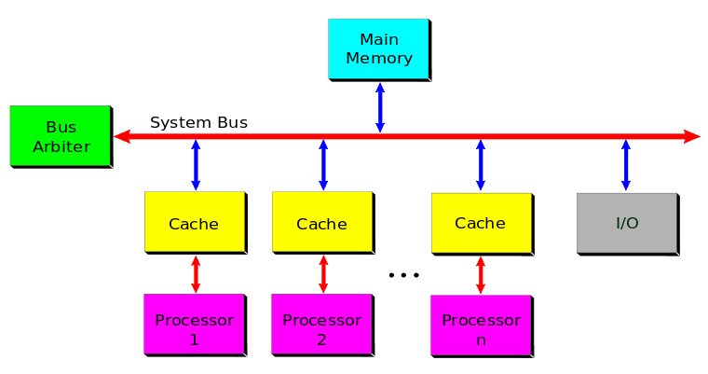
4.1 Introduction to workload directed adaptive SMP multicores (1)
4.1 Introduction to workload directed adaptive SMP multicores
Interpretation of the terms symmetric multiprocessing/multiprocessors (SMP)
In a symmetric multiprocessor all processors access main memory in the same way,
as indicated below.
Processor
1
Processor
2
Processor
n
Figure: Example of an SMP multiprocessor (Based on [1])

Slide 4
4.1 Introduction to workload directed adaptive SMP multicores (2)
Interpretation of the term symmetric multicore processor
In a symmetric multicore processor all cores access main memory in the same way,
as indicated below.
Core
1
Core
2
Core
n
Figure: Example of a symmetric multicore processor (Based on [1])

Slide 5
4.1 Introduction to workload directed adaptive SMP multicores (3)
Note
Unfortunately, in the literature usually, both symmetrical multiprocessors and
symmetrical multicores are designated in the same way, simply by the term SMP.
Despite the fact that this may lead to confusion in the terminology, in this section
subsequently we will designate symmetrical multicore processors as
SMP multicores or SMPs.

Slide 6
4.1 Introduction to workload directed adaptive SMP multicores (4)
Workload directed adaptive SMPs
Asynchronous adaptive SMPs
(aSMPs)
Synchronous adaptive SMPs
aSMP enables each core to run at different
voltage and frequency
This results in lower power by scaling down
voltage and frequency of each core
to the actual load
It restricts each core to run at the same
voltage and frequency
Voltage and frequency of the core cluster
is determined by the highest load
in the cluster
Cores running low intensity applications waste
power running at higher voltage and frequency
than needed.
Examples
Qualcomm Snapdragon S4 (2012)
ARM’s big.LITTLE technology (2011)
Nvidia’s vSMP technology (2011)
Based on [2]

Slide 7
4.1 Introduction to workload directed adaptive SMP multicores (5)
Synchronous adaptive SMPs
Synchronous adaptive SMP
in the 1 + n configuration
Synchronous adaptive SMP
in the n + n configuration
It is Nvidia’s solution, called
Variable SMP
E.g. ARM’s solution, called
big.LITTLE processing
Using two clusters of cores
a cluster of a single low power core and
a cluster of high performance cores.
Using two clusters of cores
a cluster of low power (LITTLE) cores and
a cluster of high performance (big) cores.
E.g.
Cluster of
high performance
cores
Cluster of
big cores
CPU0
CPU1
Cluster of
LITTLE cores
CPU0
CPU1
“Cluster” of
a single
low power
core
CPU0
CPU1
CPU2
CPU3
CPU2
CPU3
CPU0
CPU2
CPU3
Cache coherent interconnect
To memory
Cache coherent interconnect
To memory

Slide 8
4.1 Introduction to workload directed adaptive SMP multicores (6)
Example for performance and energy efficiency of
high performance (Cortex-A15) and low power (Cortex-A7) cores [3]

Slide 9
4.2 Principle of Nvidia’s variable SMP

Slide 10
4.2 Principle of Nvidia’s variable SMP (1)
4.2 Principle of Nvidia’s variable SMP
Nvidia’s variable SMP is in fact synchronous adaptive SMP in the 1 + n configuration.
It includes two clusters of cores, as shown below:
a “cluster” of a single low power core and
a cluster of high performance cores.
E.g.
Cluster of
high performance cores
CPU0
CPU1
“Cluster” of
a single
low power
core
CPU2
CPU3
CPU0
Cache coherent interconnect
Figure: Example layout of Nvidia’s variable SMP

Slide 11
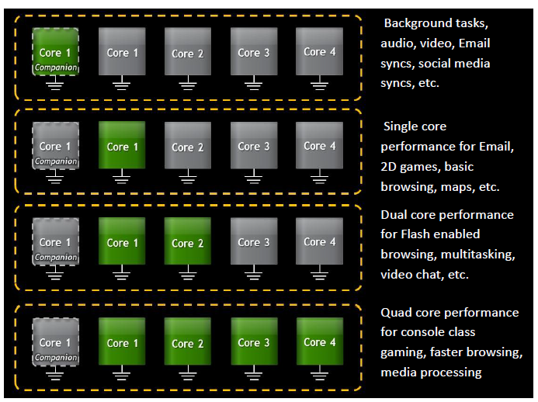
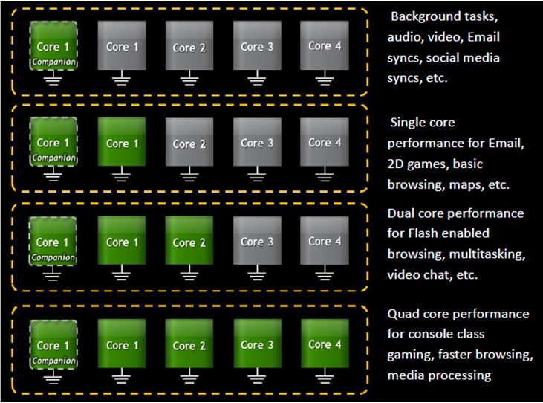
4.2 Principle of Nvidia’s variable SMP (2)
Usage models of synchronous adaptive SMPs in the 1 + n configuration
Usage models of synchronous adaptive SMPs in the 1 + n configuration
Exclusive use
of the clusters
Inclusive use
of the clusters
E.g.
Nvidia’s Variable SMP
in Tegra 3 (2011) and Tegra 4 (2013)
It is not implemented yet.

Slide 12
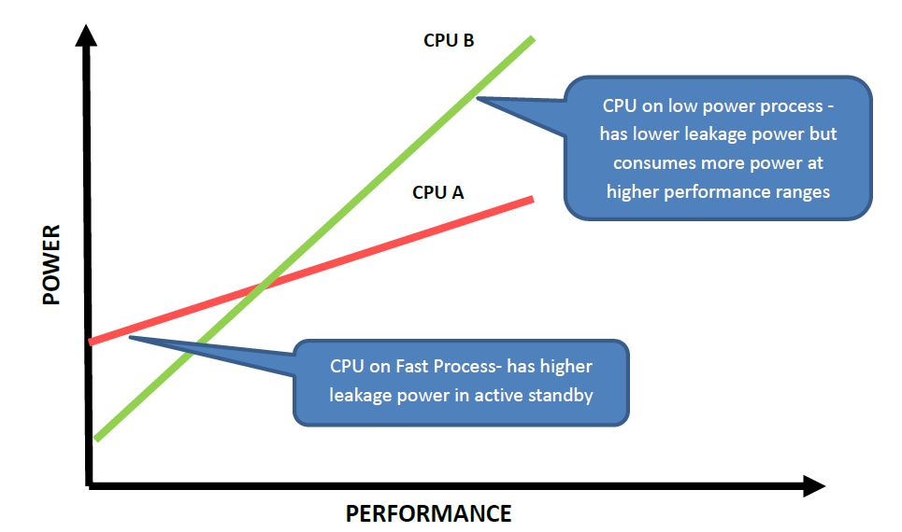
4.2 Principle of Nvidia’s variable SMP (3)
The low power core
Optimized for low power consumption by using transistors that require low power
to operate, as shown below [4].

Slide 13
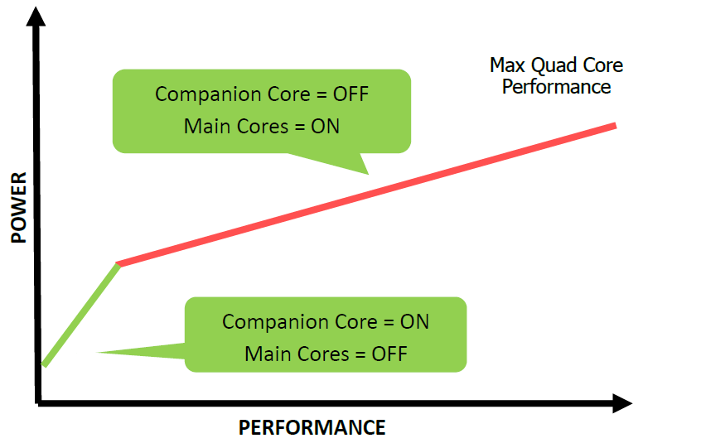
4.2 Principle of Nvidia’s variable SMP (4)
Power-Performance curve of Nvidia’s vSMP [4]

Slide 14
4.3 Principle of ARM’s big.LITTLE technology

Slide 15
4.3 Principle of ARM’s big.LITTLE technology (1)
4.3 Principle of ARM’s big.LITTLE technology
ARM’s big.LITTLE technology is in fact synchronous adaptive SMP in the n + n
configuration.
It includes two clusters of cores, as shown below:
a cluster of a low power cores, termed as the LITTLE cores and
a cluster of high performance cores, termed as the big cores.
Cluster of
big cores
Cluster of
LITTLE cores
CPU0
CPU1
CPU0
CPU1
CPU2
CPU3
CPU2
CPU3
Cache coherent interconnect
To memory
Figure: Example layout of ARM’s big.LITTLE technology

Slide 16
4.3 Principle of ARM’s big.LITTLE technology (2)
Usage models of synchronous adaptive SMPs in the n + n configuration
Usage models of synchronous adaptive SMPs in the n+n configuration
Exclusive/inclusive
use of the clusters
The cluster migration model

Slide 17
4.3 Principle of ARM’s big.LITTLE technology (3)
Exclusive/inclusive use of the clusters
Exclusive/inclusive use of the clusters
Exclusive use
of the clusters
Inclusive use
of the clusters
Clusters are used exclusively,
i.e. at a time one of the clusters is in use
as shown below for the cluster migration model
(to be discussed later)
Clusters are used inclusively,
i.e. at a time both clusters can be used
partly or entirely
Low load
High load
Low load
High load
Cluster of
big cores
Cluster of
big cores
Cluster of
big cores
Cluster of
big cores
Cluster of
LITTLE cores
CPU0
CPU1
Cluster of
LITTLE cores
CPU0
CPU1
Cluster of
LITTLE cores
CPU0
CPU1
Cluster of
LITTLE cores
CPU0
CPU1
CPU0
CPU1
CPU0
CPU1
CPU0
CPU1
CPU0
CPU1
CPU2
CPU3
CPU2
CPU3
CPU2
CPU3
CPU2
CPU3
CPU2
CPU3
CPU2
CPU3
CPU2
CPU3
CPU2
CPU3
Cache coherent interconnect
Cache coherent interconnect
Cache coherent interconnect
Cache coherent interconnect

Slide 18
4.3 Principle of ARM’s big.LITTLE technology (2)
Usage models of synchronous adaptive SMPs in the n + n configuration
Usage models of synchronous adaptive SMPs in the n+n configuration
Exclusive/inclusive
use of the clusters
The cluster migration model

Slide 19
4.3 Principle of ARM’s big.LITTLE technology (4)
The cluster migration model [5]
The cluster migration model
Exclusive use
of the clusters
Inclusive use
of the clusters
Cluster migration
Core migration
Core migration
big.LITTLE processing
with cluster migration
big.LITTLE processing
with core migration
big.LITTLE MP

Slide 20
4.3 Principle of ARM’s big.LITTLE technology (5)
Big.LITTLE processing with cluster migration [5]
There are two core clusters, the LITTLE core cluster and
the big core cluster.
Tasks run on either the LITTLE or the big core cluster, so
only one core cluster is active at any time (except a short
interval during a cluster switch).
Low workloads, such as background synch tasks, audio or
video playback run typically on the LITTLE core cluster.
If the workload becomes higher than the max performance
of the LITTLE core cluster the workload will be migrated
to the big core cluster and vice versa.

Slide 21
4.3 Principle of ARM’s big.LITTLE technology (6)
Cluster switches [6]
Cluster selection is driven by OS power management.
OS (e.g. the Linux cpufreq routine) samples the load for all cores in the cluster
and selects an operating point for the cluster.
It switches clusters at terminal points of the current clusters DVFS curve, as
illustrated in the next Figure.

Slide 22
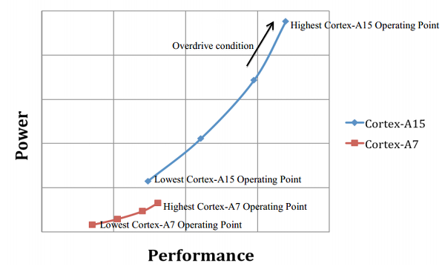
4.3 Principle of ARM’s big.LITTLE technology (7)
Power/performance curve during cluster switching [7]
DVFS operating points
(Low power core)
(High performance core)
A switch from the low power cluster to the high performance cluster is
an extension of the DVFS strategy.
A cluster switch lasts about 30 kcycles.

Slide 23
4.3 Principle of ARM’s big.LITTLE technology (8)
Big.LITTLE processing with core migration [5], [8]
There are two core clusters, the LITTLE core cluster and
the big core cluster.
Cores are grouped into pairs of one big core and one
LITTLE core.
The LITTLE and the big core of a group are used exclusively.
Each LITTLE core can switch to its big counterpart if it meets a higher load than its max. performance and vice versa.
Each core switch is independent from the others.

Slide 24
4.3 Principle of ARM’s big.LITTLE technology (9)
Core switches [6]
Core selection in any core pair is performed by OS power management.
The DVFS algorithm monitors the core load.
When a LITTLE core cannot service the actual load, a switch to its big counterpart
is initiated and the LITTLE core is turned off and vice versa.

Slide 25
4.3 Principle of ARM’s big.LITTLE technology (10)
big.LITTLE MP processing with core migration [8],[5]
The OS scheduler has all cores of both clusters at its
disposal and can activate all cores at any time.
Tasks can run or be moved between the LITTLE cores and
the big cores as decided by the scheduler.
big.LITTLE MP termed also as Heterogeneous Multiprocessing
(HMP).

Slide 26
4.3 Principle of ARM’s big.LITTLE technology (11)
Use of the big.LITTLE technology in recent mobile processors
big.LITTLE tecnology
Exclusive use
of the clusters
Inclusive use
of the clusters
Cluster migration
Core migration
Core migration
big.LITTLE processing
with cluster migration
big.LITTLE processing
with core migration
big.LITTLE MP
(Heterogeneous Multiprocessing)
Described first in ARM’s
White Paper (2011) [3]
Described first in ARM’s
White Paper (2012) [9]
Described first in ARM’s
White Paper (2011) [3]
Used in
Samsung Exynos 5
Octa 5410 (2013)
(4 + 4 cores)
Samsung HMP on Exynos 5
Octa 5420 (2013)
(4 + 4 cores)
Mediatek MT 8135 (2013)
(2 + 2 cores)
Renesas MP 6530 (2013)
(2 + 2 cores)

Slide 27
References (1)
[1]: Wikipedia, File:SMP - Symmetric Multiprocessor System.svg,
http://en.wikipedia.org/wiki/File:SMP_-_Symmetric_Multiprocessor_System.svg
[2]: Sag A., Qualcomm Snapdragon S4 Benchmarking Day, BSN, July 25 2012,
http://www.brightsideofnews.com/news/2012/7/25/qualcomm-snapdragon-s4-
benchmarking-day.aspx
[3]: Greenhalgh P., Big.LITTLE Processing with ARM Cortex-A15 & Cortex-A7, White Paper,
Sept. 2011, http://www.arm.com/files/downloads/big.LITTLE_Final.pdf
[4]: Variable SMP – A Multi-Core CPU Architecture for Low Power and High Performance, Nvidia,
Whitepaper, 2011, http://www.nvidia.com/content/PDF/tegra_white_papers/tegra-
whitepaper-0911b.pdf
[5]: Klug B., Samsung Announces big.LITTLE MP Support in Exynos 5420, AnandTech,
Sept. 11 2013, http://www.anandtech.com/show/7313/samsung-announces-biglittle-
mp-support-in-exynos-5420
[6]: Gupta A., Implications of Per CPU switching in a big.LITTLE system, ARM
[7]: Gálffy Cs., Érkezik a valóban nyolcmagos Samsung Exynos 5, HWSW, Sept. 10 2013,
http://www.hwsw.hu/hirek/50915/samsung-exynos-5-octa-arm-big-little-hmp-cortex.html
[8]: MediaTek Enables ARM big.LITTLE Heterogeneous Multi-Processing Technology in Mobile SoCs,
http://www.mediatek.com/_en/Event/201307_TrueOctaCore/MediaTekEnablesARM
bigLITTLEHMPTechnology.pdf
[9]: Jeff B., Advances in big.LITTLE Technology for Power and Energy Savings, White Paper,
Sept. 2012, http://www.arm.com/files/pdf/Advances_in_big.LITTLE_Technology_for_
Power_and_Energy_Savings.pdf

