Slide 1
Introduction to ARM’s processors
Dezső Sima
December 2013
(v1.1, Last updated 10/12/2013)
© Dezső Sima 2013

Slide 2
1.Introduction

Slide 3
1.1 Introduction to ARM

Slide 4
1.1 Introduction to ARM (1)
1.1 Introduction to ARM
ARM (ARM Holdings plc) is a British multinational semiconductor company with its
head office in Cambridge.
The company designs and licenses low power embedded and mobile ARM processors
as well as mobile GPUs (termed as Mali GPUs) along with the appropriate design
tools but does not fabricate semiconductors.
ARM designs dominate recently the embedded and the mobile market
(including smartphones and tablets).
As of 2013 37 billion ARM processors have been produced, up from 10 billion in 2008
[1].

Slide 5
1.1 Introduction to ARM (2)
Historical remarks [2], [3]
ARM spun out of Acorn Computers.
Acorn Computers started their Acorn RISC Machine project in October 1983
(two years after introducing the IBM PC) to develop their own powerful processor
for a line of business computers.
Thus the acronym ARM (Acorn RISC Machine) was coined in 1983.
The first prototype machine was named ARM1 and became operational in 1985,
whereas the first production system, the ARM2 in 1986.
In 1990 the company Advanced RISC Machines Ltd (ARM Ltd) was founded as a
joint venture of Acorn Computers, Apple Computers and VLSI Technology.
Accordingly, the interpretation of ARM was changed to “Advanced RISC Machines”.
Finally, in 1998 when the company went to the burse its name was changed to
ARM Holdings plc.

Slide 6
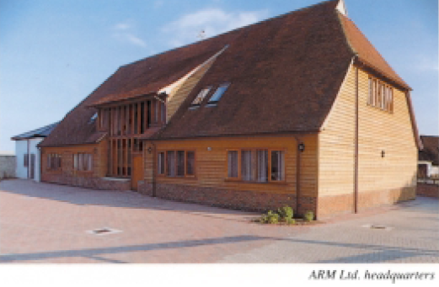
1.1 Introduction to ARM (3)
The headquarters of ARM Ltd [4]

Slide 7
1.2 Overview of ARM’s processor lines

Slide 8
1.2 Overview of ARM’s processor lines (1)
1.2 Overview of ARM’s processor lines
ARM designed until now eight ISA versions, designated as ARMv1 – ARMv8,
described in the related Architecture Reference Manuals.
Subsequently, we give an overview of ARM’s processor lines divided into three
groups, according their underlying ISAs, as follows.
ARM processors
Early
ARM processors
Advanced ARM processors
Recent
ARM Cortex processors
(ARMv1 – ARMv3)
(ARMv4 – ARMv6)
(ARMv7 – ARMv8)

Slide 9
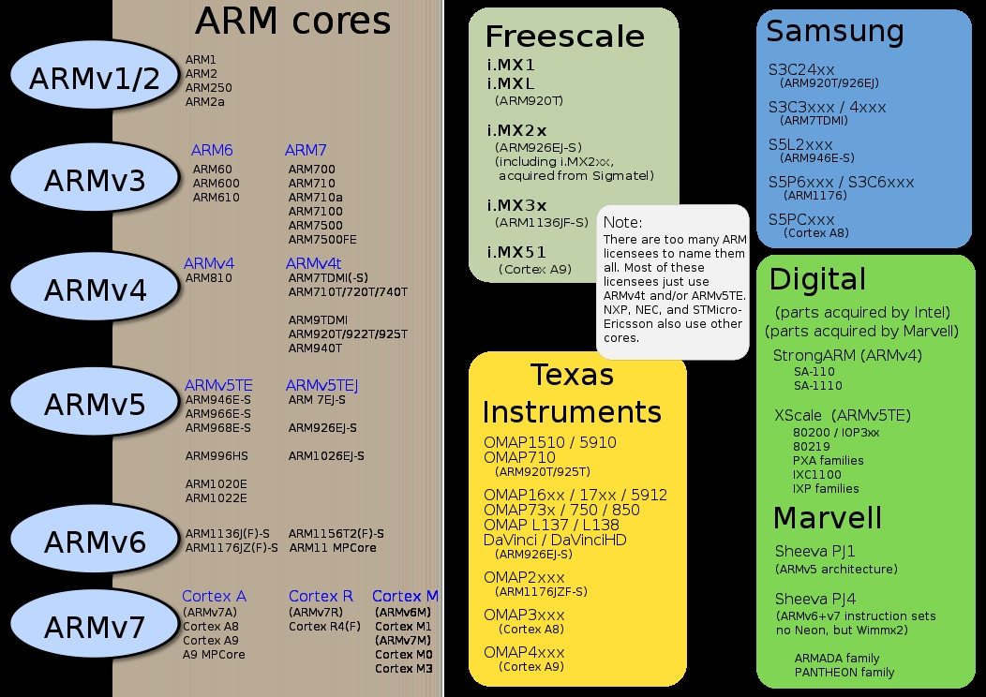
1.2 Overview of ARM’s processor lines (2)
Early ARM processors (ARMv1 – ARMv3)

Slide 10
1.2 Overview of ARM’s processor lines (3)
Remark
Processors based on the ARM ISA versions ARMv1 and ARMv2 had a 26-bit
address bus but 32-bit data paths.

Slide 11
1.2 Overview of ARM’s processor lines (4)
Advanced ARM processors (ARMv4 – ARMv6) [5]
ARMv7
version
ARM1156T2F-S™
ARM1136JF-S™
ARMv6
ARM1176JZF-S™
ARM102xE
XScaleTM
ARM1026EJ-S™
ARMv5
ARM9x6E
ARM926EJ-S™
SC200™
ARM7TDMI-S™
StrongARM®
ARM92xT
V4
SC100™
ARM720T™
1994
1996
1998
2000
2002
2004
2006
time
XScale is a trademark of Intel Corporation
Notes:
Versions mostly refer to the instruction set that the ARM core executes.
The ARM7, which is still the most often used core in a low-power design, executes the version 4T instruction set. Architectural extensions were added for version 5TE to include DSP instructions, such as 16-bit signed MLA instructions, saturation arithmetic, etc. The ARM926EJ-S and ARM1026EJ-S cores are examples of Version 5 architectures. Version 6 added instructions for doing byte manipulations and graphics algorithms more efficiently. The ARM11 family implemented the Version 6 architecture. Version 7 architectures (which include the Cortex family of cores, such as the Cortex A8, Cortex M3 and Cortex R4) extended the functionality by adding things such as Thumb2, low-power features, and more security.

Slide 12
1.2 Overview of ARM’s processor lines (5)
Advanced ARM processors (ARMv4 – ARMv6)-2 [5]

Slide 13
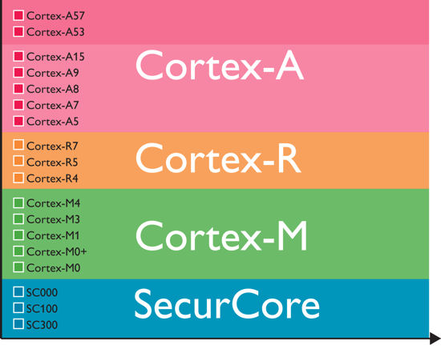
1.2 Overview of ARM’s processor lines (6)
Recent ARM processors (ARMv7 and ARMv8)
Recently, ARM do profile their architectures and processor families into four groups,
as indicated below for the Cortex and SC families of ARM processors.
Examples
Profiles
Figure: ARM’s recent processor profiles [6]

Slide 14
1.2 Overview of ARM’s processor lines (7)
Profiling ARMv7 and ARMv8 architectures and processors [6], [7]
The Cortex-A profile
It aims at high-end applications running open and complex OSs, like smartphones,
tablets, netbooks, eBook readers.
The Cortex-R profile
It marks processors for real time applications, like mass storage or printer controllers.
The Cortex-M profile
Processors of the M profile are optimized for cost sensitive and microcontroller
applications, like automotive body electronics, smart sensors.
The SecureCore profile
The ARM SecurCore™ processor family provides processors with security features
for applications like smartcards, pay TV, eGovernement.

Slide 15
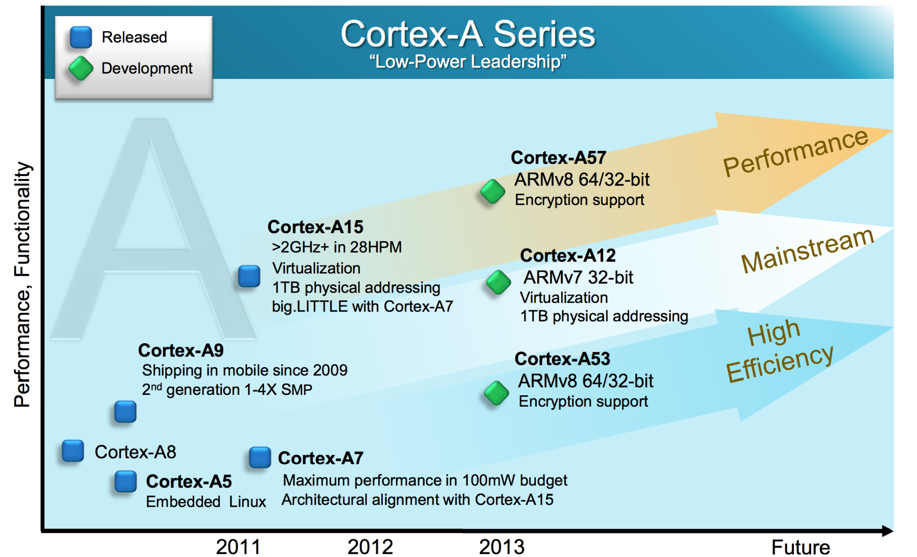
1.2 Overview of ARM’s processor lines (8)
Recent ARM Cortex-A processors [8]

Slide 16
2. Evolution of the ISA of the ARM processors

Slide 17
2.1 The original ARMv1 ISA

Slide 18
2.1 The originalARMv1 ISA (1)
2.1 The original ARMv1 ISA
It is a 32-bit RISC ISA supporting basically 32-bit processing of FX and logical data
in low power processors.
The ISA has 16 32-bit registers, called the core registers.
13 out of them are used as general purpose registers (GPRs), three are dedicated
registers, as shown below.
Stack pointer
Link register
PC
Figure: The core registers of the ARM ISA (in the ISA versions ARMv1-ARMv7) [9]

Slide 19
2.2 Main extensions introduced to the ARMv1 ISA version

Slide 20
2.2 Main extensions introduced to the original ARMv1 ISA version (1)
2.2 Main extensions introduced to the original ARMv1 ISA version-1
Subsequently, ARM enhanced the ISA of their processors resulting until now in
eight ISA versions, designated as ARMv2 to ARMv8, summarized in the next Figure.

Slide 21
2.2 Main extensions introduced to the original ARMv1 ISA version (2)
Main extensions introduced to the ARMv1 ISA version-2 (simplified)
AArch32
AArch64
Crypto-graphy ext.
Crypto-graphy ext.
TrustZone
NEON
SIMD
Adv. SIMD
Key feature ARMv7-A
compatibility
VFPv1/2
VFPv3/v4
Jazelle
Jazelle
(ex. by SW)
ThumbEE
(Jazelle-RCT)
Thumb
(ARMv4T)
Thumb-2
(ARMv6T2)
ARMv4
ARMv5
ARMv6
ARMv7-A/R
ARMv8-A
Examples
ARM920T
(~2000)
ARM926
(2001)
ARM1176
(2004)
Cortex-A5-15
(2006)
Cortex-A50
(2014)

Slide 22
2.2 Main extensions introduced to the original ARMv1 ISA version (3)
The AArch32/AArch64 execution modes of the ARMv8 ISA [11]
It introduces major changes to the ARM architecture while maintaining a high level
consistency with previous versions of the architecture.
ARMv8 has two distinct execution modes, as indicated below.
Execution modes of the ARMv8
Aarch32
execution mode
Aarch64
execution mode
It supports two 32-bit instruction sets,
the A32 and the T32 (Thumb) instructions sets.
In this mode the processor can run programs
developed for previous ISA versions.
It supports a single 64-bit instruction set,
called A64.
This is a fixed length powerful instruction set
that uses 32-bit instruction encodings.

Slide 23
2.2 Main extensions introduced to the original ARMv1 ISA version (4)
Main extensions introduced to the ARMv1 ISA version-3
We will discuss these enhancements subdivided into the following parts:
Main extensions introduced to the ARM ISA
ISA enhancements introduced
to enhance the compute capabilities
Further ISA enhancements
GPR-based
ISA enhancements
FP and Advanced SIMD registers based
ISA enhancements

Slide 24
2.2 Main extensions introduced to the original ARMv1 ISA version (5)
Extension of the GPRs in the ARMv8 ISA version [9], [11]
In the AArch64 mode of the ARMv8 ISA version ARM expanded the number of GPRs
from 13 32-bit registers to 31 64-bit wide registers, as shown in the next Figure.
32-bit wide
32-bit wide
64-bit wide
R0
R0
R0
R1
R1
R1
R2
R2
R2
.
.
.
.
.
.
.
.
.
X0
W0
R12
R12
R12
R13(SP)
Stack pointer
Link register
PC
R13(SP)
R13(SP)
R14(LR)
R14(LR)
R14(LR)
R15(PC)
.
.
.
.
.
.
X30
W30
X31
Dedicated use
W31
Dedicated use
32-bit mode
64-bit mode
GPRs in the original and the
AArch32 ARMv8 ISA execution mode
GPRs in the ARMv8 ISA
in the AArch64 execution mode

Slide 25
2.2 Main extensions introduced to the original ARMv1 ISA version (6)
Main extensions introduced to the ARMv1 ISA version-2
Main extensions introduced to the original ARM ISA
ISA enhancements introduced
to enhance the compute capabilities
Further ISA enhancements
GPR-based
ISA enhancements
FP and Advanced SIMD registers based
ISA enhancements

Slide 26
2.2 Main extensions introduced to the original ARMv1 ISA version (7)
Overview of the scalar FP and SIMD support of the ARMv5-v8 extensions
 | Year | FP/SIMD Extension |  | GPRs |  |  | FP/Advanced SIMD registers
 |  |  |  | Reg.s | S. data t. | V. data t. | Reg.s | S. data t. | V. data t.
ARMv1 | 1986 |  |  | 13x32
ARMv2 | 1989
ARMv3 | 1991
ARMv4 | 1996
ARMv5 | 2000 2001 | VFPv1 VFP2 |  |  |  |  | 32x32/16x64 | FP32/64
ARMv6 | 2004
ARMv7 | 2006 | VFPv3 VFPv4 |  |  |  |  | 32x32/32x64 or 32x32/16x64 | FP 16¹/32/64
 |  | Adv. SIMD² |  |  |  |  | 32x64/16x128 |  | 64/128-bit wide FX 8/16/32/64, FP16¹/32
ARMv8 | 2014 | A32 | FP | 31x64 |  |  | 32x32/32x64 | FP 32/64
 |  |  | Ad. SIMD |  |  |  | 32x64/16x128 |  | As for ARMv7
 |  | A64 | FP |  |  |  | 32x128 | FP 32/64
 |  |  | Ad. SIMD |  |  |  |  | FX 8/…/64 FP 32/64 | As for ARMv7 + FP 64
²: VFP3/4 Adv. SIMD = Neon
S: Scalar V: Vector t: Type
¹: FP16 Supports only converting

Slide 27
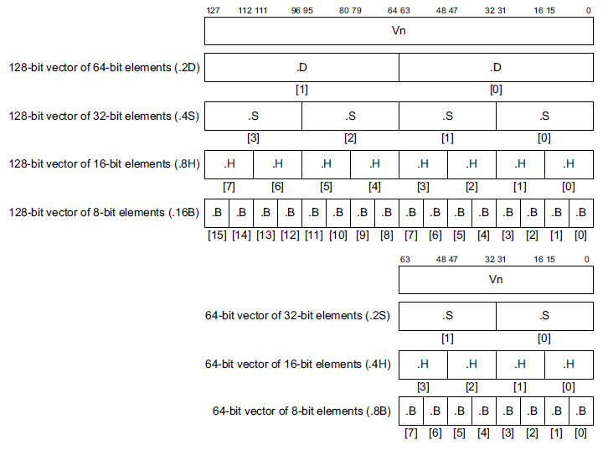
2.2 Main extensions introduced to the original ARMv1 ISA version (8)
Use of the FP and Advanced SIMD registers in the AArch64 execution mode
[11]
32 128-bit registers
32 64-bit registers

Slide 28
References (1)
[1]: Grabham D., From a small Acorn to 37 billion chips: ARM's ascent to tech superpower,
Techradar, July 19 2013, http://www.techradar.com/news/computing/from-a-small-acorn-
to-37-billion-chips-arm-s-ascent-to-tech-superpower-1167034
[2]: The ARM Architecture, http://www.eng.auburn.edu/~strouce/DaTseminar/UniPres07s.pdf
[3]: Wikipedia, ARM architecture, http://en.wikipedia.org/wiki/ARM_architecture
[4]: Levy M., The History of The ARM Architecture: From Inception to IPO,
http://www.reds.ch/share/cours/ReCo/documents/TheHistoryOfTheArmArchitecture.pdf
[5]: ARM Teaching Material, http://www.arm.com/files/ppt/ARM_Teaching_Material.ppt
[6]: ARM Cortex Application Processors, http://www.arm.com/products/processors/index.php
[7]: ARM SecurCore Processors, http://www.arm.com/products/processors/securcore/index.php
[8]: Shimpi A.L., The ARM Diaries, Part 2: Understanding the Cortex A12, AnandTech,
July 17 2013, http://www.anandtech.com/show/7126/the-arm-diaries-part-2-
understanding-the-cortex-a12
[9]: Lemieux J., Introduction to ARM thumb, Embedded, Sept. 24 2003, http://www.embedded.com/
electronics-blogs/beginner-s-corner/4024632/Introduction-to-ARM-thumb
[10]: Introducing NEON Development Article, ARM, 2009, http://infocenter.arm.com/help/topic/
com.arm.doc.dht0002a/DHT0002A_introducing_neon.pdf
[11]: ARM Architecture Reference Manual, ARMv8, 2013, http://www.myir-tech.com/down/arm/
arch/ARMv8-A_Architecture_Reference_Manual_%28Issue_A.a%29.pdf

