Slide 1
Evolution of Intel’s
x86 microarchitectures
Core 2 to Haswell
Dezső Sima
Vers. 1.0
October 2014

Slide 2
Contents
1. Introduction
2. The Core 2 line
3. The Nehalem line
4. The Sandy Bridge line
5. The Haswell line

Slide 3
1. Introduction (1)
1. Introduction
The evolution of Intel’s basic x86 microarchitectures
1. gen.
2. gen.
3. gen.
4. gen.
5. gen.
Core 2
New
Microarch.
65 nm
Penryn
New
Process
45 nm
Nehalem
New
Microarch.
45 nm
Westmere
New
Process
32 nm
Sandy
Bridge
New
Microarch.
32 nm
Ivy
Bridge
New
Process
22 nm
Haswell
New
Microarchi.
22 nm
Broadwell
New
Process
14 nm
TOCK
TICK
TOCK
TICK
TOCK
TICK
TOCK
TICK
Figure 1.1: Intel’s Tick-Tock development model (Based on [1])

Slide 4
1. Introduction (2)
Intel’s Tick-Tock model
Key microarchitectural features
2 YEARS
TICK
TOCK
180nm
11/2000
New microarch.
Pentium 4 /Willamette
2 YEARS
TICK
TOCK
130nm
01/2002
Adv. microarch., hyperthreading
Pentium 4 /Northwood
TICK
TOCK
90nm
02/2004
Adv. microarch., hyperthreading,
64-bit
2 YEARS
Pentium 4 /Prescott
TICK Pentium 4 / Cedar Mill
01/2006
2 YEARS
TOCK Core 2
65nm
New microarch., 4-wide core,
128-bit SIMD, no hyperthreading
07/2006
TICK Penryn Family
11/2007
2 YEARS
45nm
New microarch., hyperthreading,
(inclusive) L3, integrated MC, QPI
TOCK Nehalem
11/2008
TICK Westmere
01/2010
2 YEARS
TOCK Sandy Bridge
32nm
New microarch., 256-bit AVX,
integr. GPU, ring bus,
01/2011
TICK Ivy Bridge
04/2012
2 YEARS
22nm
Strongly tuned microarch., AVX2
L4 cache (discrete eDRAM), FIVR
TOCK Haswell
06/2013
TICK Broadwell
Q4/2014
Shared Virtual Memory
2 YEARS
14nm
TOCK Skylake
2015
Figure 1.2: Overview of Intel’s Tick-Tock model (Based on [3])

Slide 5
1. Introduction (3)
Basic microarchitectures and their related shrinks
Considered from the Pentium 4 Prescott (the third core of Pentium 4) on.
Basic architectures | Basic architectures and their shrinks
Pentium 4 (Prescott) | 2005 90 nm Pentium 4 2006 65 nm Pentium 4
Core 2 | 2006 65 nm Core 2 2007 45 nm Penryn
Nehalem | 2008 45 nm Nehalem 2010 32 nm Westmere
Sandy Bridge | 2011 32 nm Sandy Bridge 2012 22 nm Ivy Bridge
Haswell | 2013 22 nm Haswell 2014 14 nm Broadwell
Skylake | 2015 ? 14 nm Skylake

Slide 6
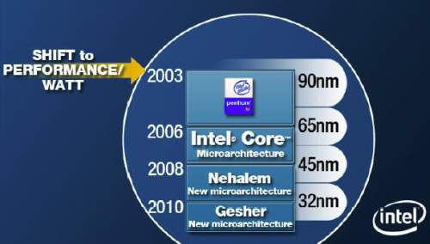
1. Introduction (4)
Remarks
In 2003 Intel shifted the focus of their processor development from the pure performance goal
to the aspect of performance per watt, as stated in a slide from 4/2006, see below.
Figure 1.3: Intel’s plan to develop their manufacturing technology and processor lines
revealed at a shareholder’s meeting back in 4/2006 [74]

Slide 7
1. Introduction (5)
2) Low power operation requires a design paradigm different from that of traditional processors,
as indicated below.
Traditional processors
Tablets and smartphones
High performance/power
(e.g. GFLOPS/Watt)
Low power
(Watt)
(Number of operating hours)
Implications to the microarchitecture of low power CPUs (processor cores)

Slide 8
1. Introduction (6)
Implications to the microarchitecture of low power CPUs-1
a) Low power CPUs need to have “narrow” microarchitectures (e.g. 2-wide)
Example: Microarchitectures of ARM CPUs underlying tablets and smartphones [164].

Slide 9
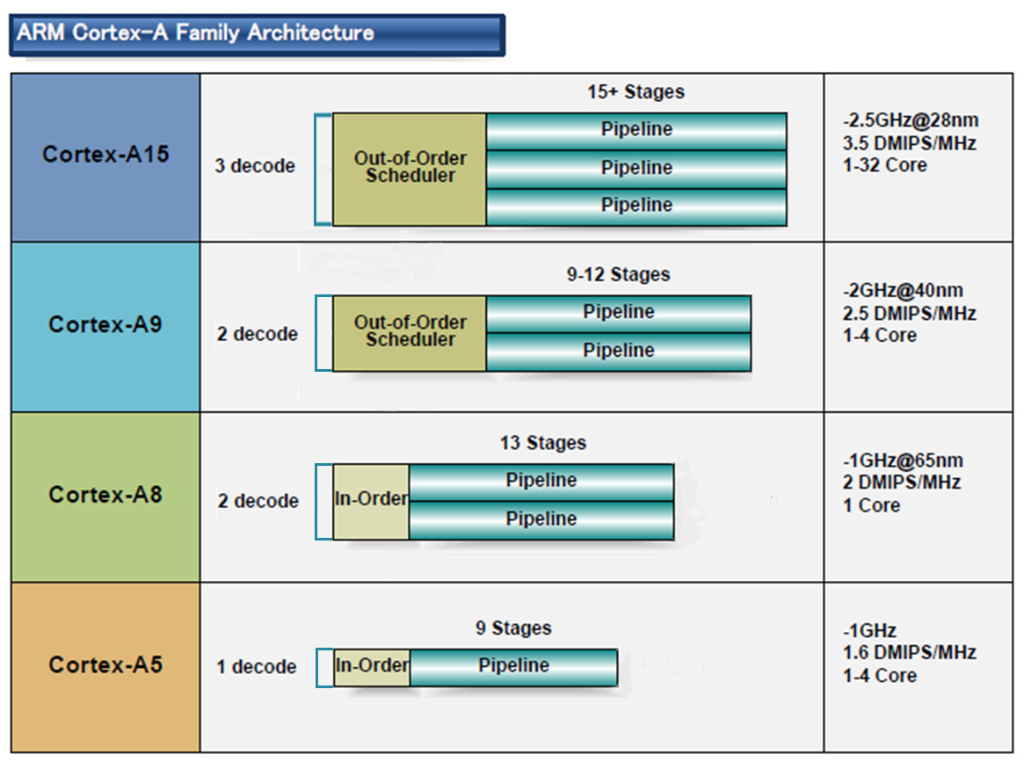
1. Introduction (7)
Microarchitectures of ARM CPUs underlying tablets and smartphones [164]
32-bit
2010
2007
2005
2009
(A9 replacement
for low-end
devices)

Slide 10
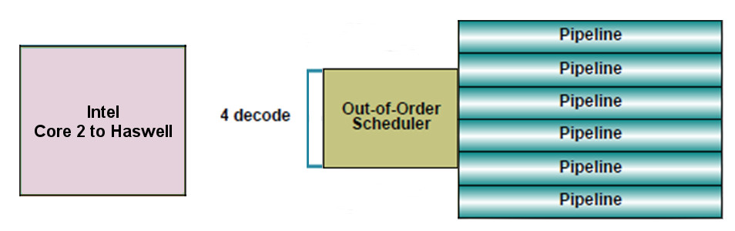
1. Introduction (8)
By contrast typical microarchitectures of recent traditional processors
have wide microarchitectures, as the next example shows.
Example: Intel’s Core 2 – Haswell processors underlying laptops, PCs and
servers
64-bit

Slide 11
1. Introduction (9)
Implications to the microarchitecture of low power CPUs-2
b) Low power CPUs need to have relative low base clock frequencies
Traditional CPUs
Mobile CPUs
High base clock frequency
(typically 2-3 GHz)
Relative low base clock frequency
(typically 1-1.5 GHz)
( D = const x fc x V², in addition higher fc requires higher V)

Slide 12
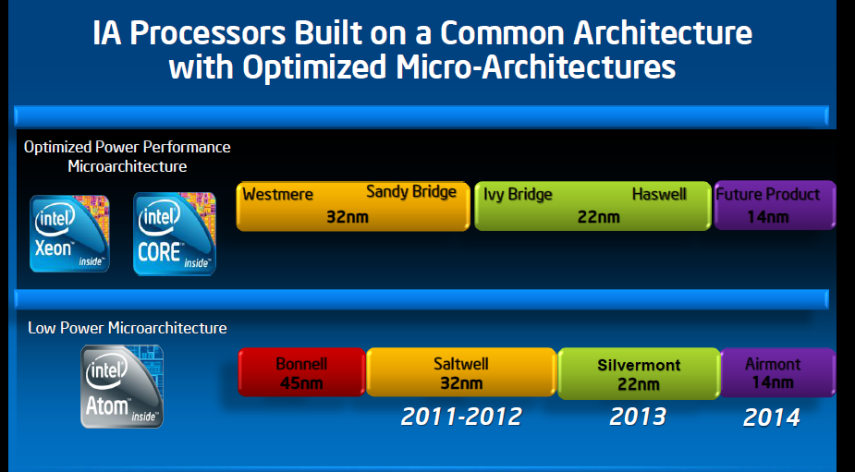
1. Introduction (10)
Splitting of Intel’s basic architectures in 2008 [158]
2008

Slide 13
2. The Core 2 line
2.1 Introduction
2.2 Major innovations of the Core 2 line
2.2.1 Wide execution
2.2.2 Smart L2 cache
2.2.3 Smart memory accesses
2.2.4 Enhanced digital media support
2.2.5 Intelligent power management
2.3 Die plot of the Core 2
2.4 Overview of Core 2 based processor lines
Notes:
13

Slide 14
2.1 Introduction (1)
2.1 Introduction
The Pentium 4 line was cancelled due to unmanageable high dissipation figures
of its third core (the 90 nm Prescott core)
(caused primarily by the design philosophy of the line
that preferred clock frequency over core efficiency for increasing performance).
For the development of the next processor line dissipation became the key design issue.
The next line became based primarily on the Pentium M – Intel’s first mobile line
since for its designs dissipation reduction was a key issue.
(The Pentium M line was a 32-bit line with 3 subsequent cores, designed at
Intel’s Haifa Research and Development Center) thus the Core 2 was developed also there.
The Haifa team had no experience with multithreading.
The Core microarchitecture does not support multithreading.

Slide 15
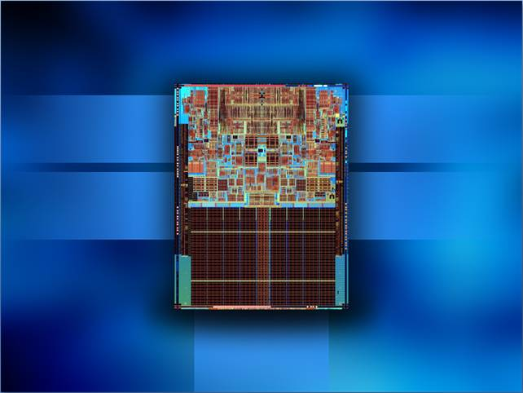

2.1 Introduction (2)
Key features of the Core 2 microarchitecture
Intel® Wide
Dynamic Execution
Intel® Intelligent
Power Capability
(Section 2.2.1)
(Section 2.2.5)
Intel® Advanced
Digital Media Boost
Intel® Smart
Memory Access
(Section 2.2.4)
(Section 2.2.3)
Intel® Advanced
Smart Cache
(Section 2.2.2)
Figure 2.1.1: Key features of the Core 2 microarchitecture [16]
Notes:
10/27/2014
15
WinHEC 2006

Slide 16
2.2.1 Wide execution (1)
2.2 Major innovations of the Core 2 line
2.2.1 Wide execution
a) 4-wide core
b) Wider and more FP and SIMD execution units

Slide 17
2.2.1 Wide execution (2)
a) 4-wide core
4-wide front end and retire unit.
This is the key benefit of the Core family.
By contrast
both Intel’s previous Pentium 4 family and AMD’s K8 have only 3-wide cores,
as the next Figures show.

Slide 18
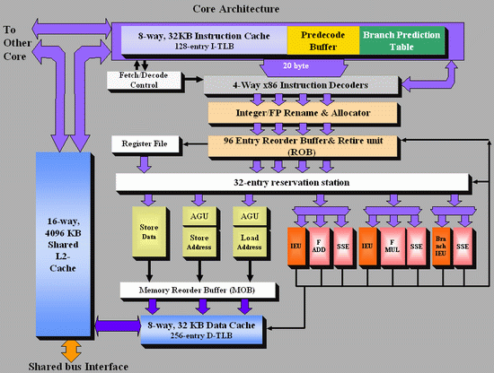
2.2.1 Wide execution (3)
Figure 2.2.1.1: Block diagram of Intel’s Core 2 microarchitecture [4]

Slide 19
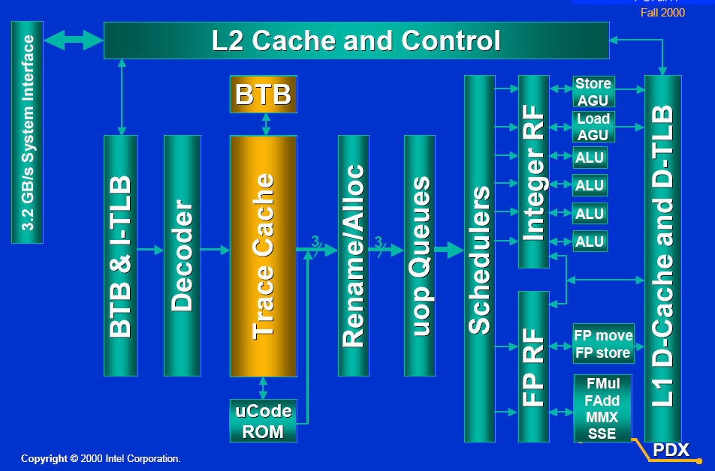
2.2.1 Wide execution (4)
Figure 2.2.1.2: Block diagram of Intel’s Pentium 4 microarchitecture [5]
Retire width: 3 instr./cycle

Slide 20
2.2.1 Wide execution (5)
Figure 2.2.1.3: Block diagram of AMD’s K8 microarchitecture[4]

Slide 21
2.2.1 Wide execution (6)
b) Wider and more FP and SIMD execution units
The Core 2 has more and wider FP and SSE execution units than Pentium 4 or AMD’s K8,
as detailed below.
Core 2
two 128-bit FP units
three 128-bit SSE units
Pentium 4
single 64-bit FP/SSE unit
single 64-bit FP/SSE move unit
AMD K8
two 64-bit FP/SSE units
single 64-bit FP/SSE move unit
The next Figure demonstrates it.

Slide 22
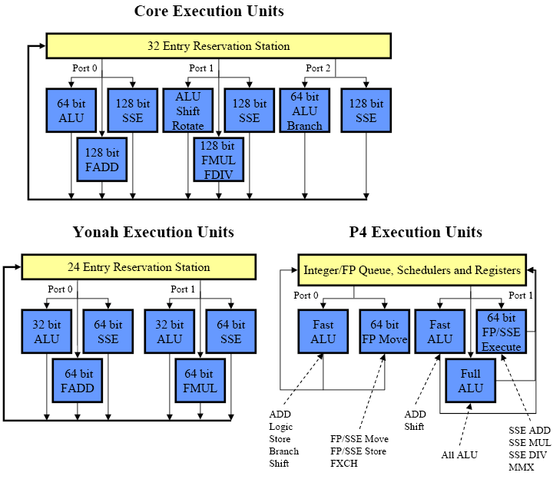
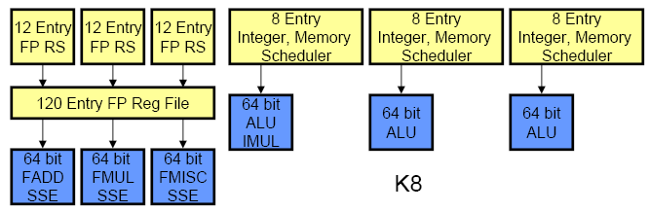
2.2.1 Wide execution (7)
Contrasting the execution resources of Core 2, P4 and K8 [159], [160]
K8 Execution Units
FP/SSE

Slide 23
2.2.1 Wide execution (8)
Performance leadership changes between Intel and AMD due to the Core 2
In 2003 AMD introduced their K8-based processors implementing
the 64-bit x86 ISA and
the direct connect architecture concept, that includes
integrated memory controllers and
high speed point-to-point serial buses (the HyperTransport bus)
used to connect processors to processors and processors to south bridges.
AMD’s K8-based processors became the performance leader, first of all on the DP and MP
server market, where the 64-bit direct connect architecture has clear benefits
vs Intel’s 32-bit Pentium 4 based processors using shared FSBs to connect processors
to north bridges.

Slide 24
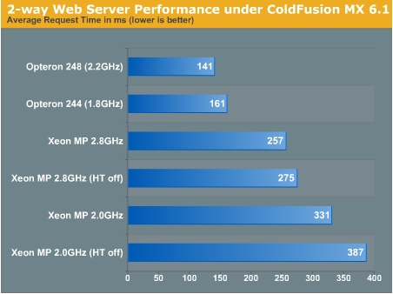
2.2.1 Wide execution (9)
Example 1: DP web-server performance comparison (2003)
Figure 2.2.1.7: DP web server performance comparison: AMD Opteron 248 vs. Intel Xeon 2.8 [6]

Slide 25
2.2.1 Wide execution (10)
Example 2: Summary assessment of extensive benchmark tests contrasting
dual Opterons vs dual Xeons (2003) [7]
“In the extensive benchmark tests under Linux Enterprise Server 8 (32 bit as well as 64 bit), the AMD Opteron made a good impression.
Especially in the server disciplines, the benchmarks (MySQL, Whetstone, ARC 2D, NPB, etc.) show quite clearly that the Dual Opteron puts the Dual Xeon in its place”.

Slide 26
2.2.1 Wide execution (11)
This situation has completely changed in 2006 when Intel introduced their Core 2
microarchitecture,
The Core 2 has
a 4-wide front-end and retire unit compared to the 3-wide K8,
two 128-bit FP units and three 128-bit SSE units compared to
two 64-bit FP/SSE units and a single 64-bit FP/SSE move unit available in the K8.
This and further enhancements of the Core microarchitecture, detailed subsequently,
resulted in record breaking performance figures.
Intel regained performance leadership vs AMD.

Slide 27
2.2.1 Wide execution (12)
Example: DP web-server performance comparison (2006)
Webserver Performance
 | MSI K2-102A2M Opteron 275 | MSI K2-102A2M Opteron 280 | Opteron 280 vs. Opteron 275 | Extrapolated Opteron 3 GHz | Xeon 5160 3 GHz
Jsp - Peak | 144 | 154 | 7% | 182 | 230
AMP - Peak | 984 | 1042 | 6% | 1178 | 1828
Jsp: Java Server Page performance
AMP: Apache/MySQL/PHP
Figure 2.2.1.8: DP web server performance comparison:
AMD Opteron 275/280 vs. Intel Xeon 5160 [8]
Remark
Both web-server benchmark results were published from the same source (AnandTech)

Slide 28
2.2.2 Smart L2 cache (1)
2.2.2 Smart L2 cache
In the Core 2 Intel makes use a shared L2 cache instead of private L2 caches and designates it
as smart L2 cache, as shown below.
Private
Shared
Core1
Core2
Core1
Core2
L2
Cache
L2
Cache
L2 Cache
Pentium 4-based DCs
Core 2-based DCs
Figure 2.2.2.1: Core’s shared L2 cache vs. Pentium 4’s private L2 caches

Slide 29
2.2.2 Smart L2 cache (2)
Benefits of shared caches vs. private caches
Dynamic cache allocation to the individual cores
Data sharing (no replicated data)
+ 2x bandwidth to L1 caches.

Slide 30
2.2.2 Smart L2 cache (3)
Drawbacks of shared caches
Shared caches combine memory access patterns
Reduce the efficiency of hardware prefetching vs private caches.
Choice between shared and private caches
Design decision depending on
whether benefits or drawbacks dominate as far as performance is concerned.
Trend
Core 2 prefers a shared L2 cache
Nehalem prefers private L2 caches
POWER5 prefers shared L2 cache
POWER6 prefers private L2 caches
This trend is due to the fact that efficient data prefetching became more important than
dynamic cache allocation or data sharing.

Slide 31
2.2.3 Smart memory accesses (1)
2.2.3 Smart memory accesses
Hardware prefetchers [9]
Remarks
Intel’s first on-die L2 cache debuted only about one year earlier (10/1999),
in the second core of the Pentium III line (called the Coppermine core,
built on 180 nm technology, with a size of 256 KB).
Intel’s first hardware prefetcher appeared subsequently in the Pentium 4 family,
associated with the L2 cache (2000).
Principle of operation of the L2 hardware prefetcher
it monitors data access patterns and prefetches data automatically into the L2 cache,
it attempts to stay 256 bytes ahead of the current data access location,
the prefetcher remembers the history of cache misses to detect concurrent,
independent data streams that it tries to prefetch ahead of its use.

Slide 32
2.2.3 Smart memory accesses (2)
Intensive use of hardware prefetchers [11]
8 prefetchers in the two-core processor
2 data and 1 L1 instruction prefetchers per core,
able to handle multiple simultaneous patterns.
2 prefetchers in the L2 cache
tracking multiple access patterns per core.

Slide 33
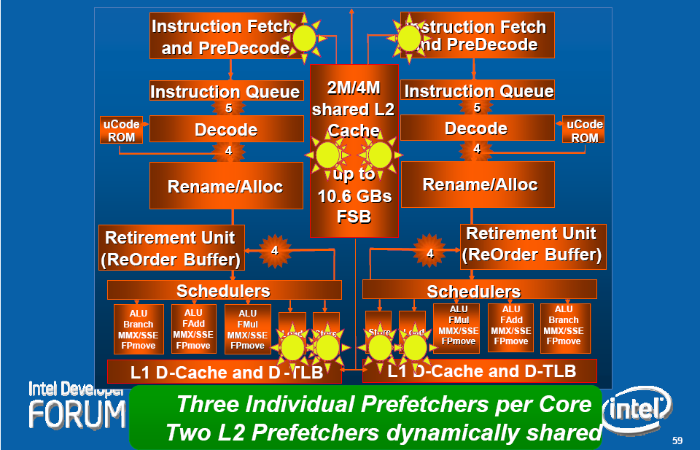
2.2.3 Smart memory accesses (3)
Hardware prefetchers in the Core 2 microarchitecture
Figure 2.2.3.1: Hardware prefetchers within the Core 2 microarchitecture [11]

Slide 34
2.2.4 Enhanced digital media support (1)
2.2.4 Enhanced digital media support
Wider and more FP/SSE Execution units (from 64-bit to 128-bit).
Supplemental SSE3 ISA extension (called SSSE3).

Slide 35
2.2.4 Enhanced digital media support (2)
Wider and more FP/SIMD execution units (from 64-bit to 128-bit) [159], [160]
K8 Execution Units
FP/SSE

Slide 36
2.2.4 Enhanced digital media support (3)
Supplemental SSE3 ISA extension (SSSE3)
Overview of the x86 ISA extensions in Intel’ processor lines

Slide 37
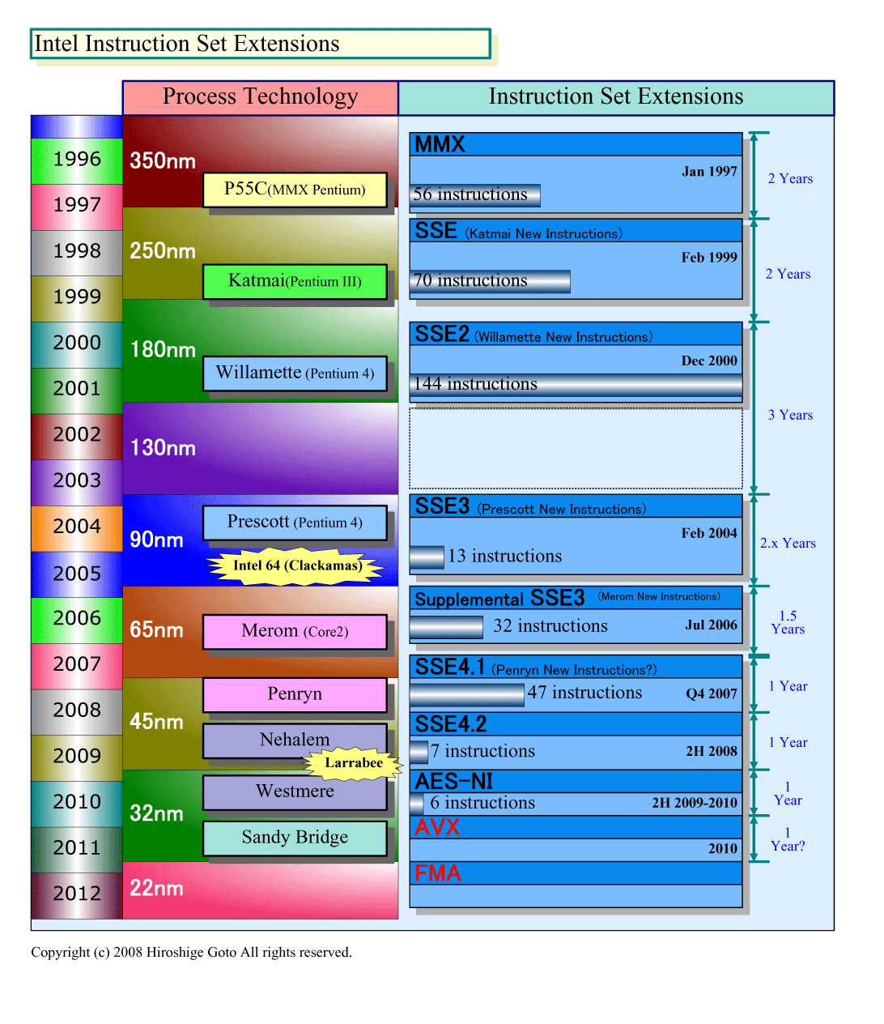
2.2.4 Enhanced digital media support (4)
Pentium III
8 MM registers (64-bit),
aliased on the FP Stack registers
8 XMM registers (128-bit)
Pentium 4
16 XMM registers (128-bit)
Northwood (Pentium4)
Norhwood
Northwood (Pentium4)
Core 2
16 YMM registers (256-bit)
Ivy Bridge
Figure 2.2.4.2: Intel’s x86 ISA extensions - the SIMD register space (based on [18]) BMA

Slide 38
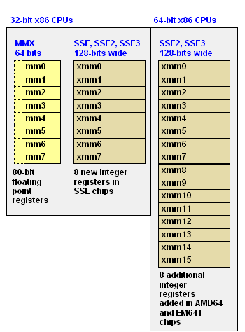
2.2.4 Enhanced digital media support (5)
Available SIMD register spaces of the MMX to SSE3/SSSE3 ISA extensions [162]

Slide 39
2.2.4 Enhanced digital media support (6)
Pentium III
2 x 32-bit FX MMX EUs
2 x 32-bit MMX,
2 x 32-bit SSE EUs
Pentium 4
1 full + 1 simple (moves/stores)
64-bit FP/SSE EUs
Northwood (Pentium 4)
Core 2
2 x 128-bit FP EUs +
3 x 128-bit SSE EUs
256-bit SSE EUs
Ivy Bridge
Figure 2.2.4.3: SIMD execution resources in Intel’s basic processors (based on [18])

Slide 40
2.2.4 Enhanced digital media support (7)
Pentium III
MultiMedia eXtensions
Streaming SIMD Extensions
Pentium 4
Northwood (Pentium 4)
Core 2
Advanced Encryption Standard
Advanced Vector Extension
Ivy Bridge
Fused Multiply-Add instr.
Figure 2.2.4.4: Overview of Intel’s x86 ISA extensions (based on [18])

Slide 41
2.2.4 Enhanced digital media support (8)
Pentium III
64-bit FX SIMD with
32/16/8-bit operands (ops)
Support of MM
128-bit FX, FP SIMD with
32/16/8-bit FX, 32-bit FP ops.
Support of MM/3D
Pentium 4
128-bit FX, FP SIMD with
64/32/16/8-bit FX, 64/32-bit FP,
Support for MPEG-2, video, MP3
Northwood (Pentium4)
Norhwood
DSP-oriented FP enhancements,
enhanced thread manipulation
Core 2
Diverse arithmetic enhancements
Media acceleration
(video encoding, MM, gaming)
Accelerated string/text manip.,
appl. targeted acceleration
Accelerated encription operations
256-bit FX, FP SIMD with
64/32/16/8-bit FX, 64/32-bit FP????,
Ivy Bridge
Figure 2.2.4.5: Intel’s x86 ISA extensions - the operations introduced (based on [17])

Slide 42
2.2.4 Enhanced digital media support (9)
Overview of the Supplemental Streaming SIMD Extension (SSSE3) of the Core 2 ISA
[161]
SSSE3 provide 32 instructions (represented by 14 mnemonics) to accelerate computations on
packed integers.
These include:
• Twelve instructions that perform horizontal addition or subtraction operations (operations
on adjacent numbers.
• Six instructions that evaluate absolute values.
• Two instructions that perform multiply and add operations and speed up the evaluation
of dot products.
• Two instructions that accelerate packed-integer multiply operations and produce integer
values with scaling.
• Two instructions that perform a byte-wise, in-place shuffle according to the second
shuffle control operand.
• Six instructions that negate packed integers in the destination operand if the signs of the
corresponding element in the source operand is less than zero.
• Two instructions that align data from the composite of two operands.

Slide 43
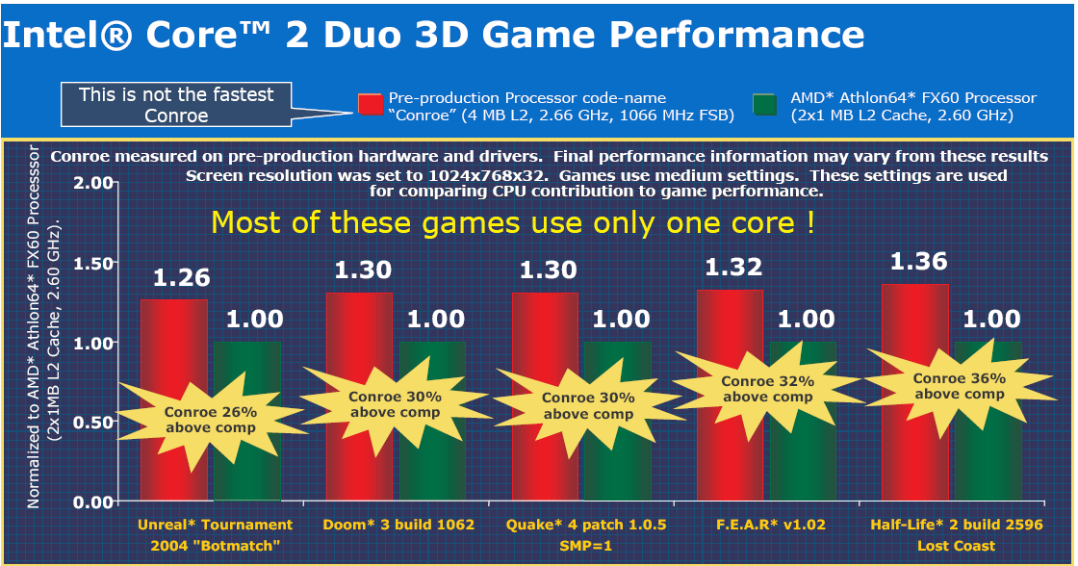
2.2.4 Enhanced digital media support (10)
Core 2’s Achieved performance boost for gaming apps
Figure 2.2.4.7: Achieved performance boost in Core2 for gaming vs AMD’s Athlon 64 FX60 [13]

Slide 44
2.2.5 Intelligent power management (1)
2.2.5 Intelligent Power management
Ultra fine grained power control
Platform Thermal Control

Slide 45
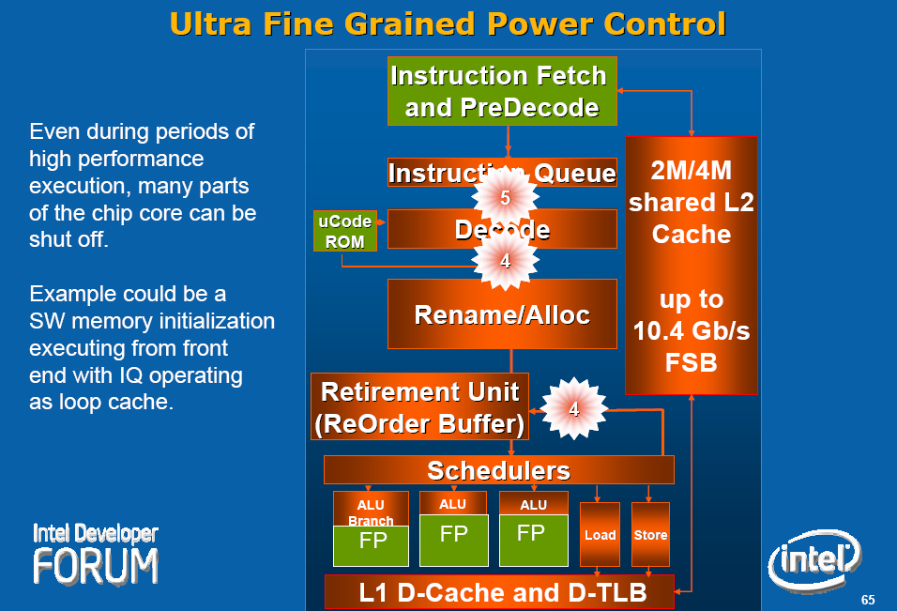
2.2.5 Intelligent power management (2)
Ultra fine grained (!) power control
Shutting down currently not needed units of the processor.
Green units not needed
for the given operation,
they can be shut off.
Figure 2.2.5.1: The operation of the Ultra fine grained power control – an example [11]

Slide 46
2.2.5 Intelligent power management (3)
Platform Thermal Control
Digital
Thermal Sensors
(DTS) on the dies,
instead of
analog diodes,
providing
digital data,
scanned by
dedicated logic.
PECI
(Platform Environment Control Interface)
A single wire proprietary interface with
transfer rates of 2 kbit/s-2 Mbit/s)
DTSs report the difference between the
current temperature and the throttle point,
at which the processor reduces speed.
Figure 2.2.5.2: Principle of the Platform Thermal Control [11] , [20]

Slide 47
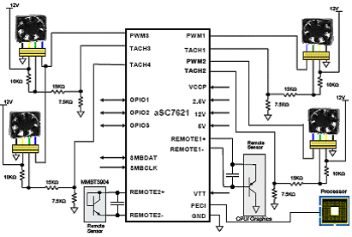
2.2.5 Intelligent power management (4)
Possible solution for the Platform Thermal Control Manager [88]
(ASIC (Application Specific IC/Microcontroller)
(Remote Sensor
CPU/Graphics)
(Remote Sensor)
Figure 2.2.5.3: The aSC7621 hardware monitor with fan control and PECI from Andigilog

Slide 48
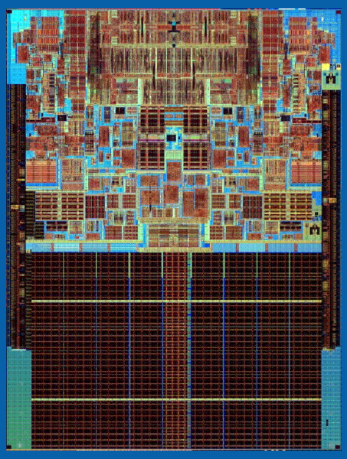
2.3 Die plot of the Core 2
2.3 Die plot of the Core 2 [163]
143 mm²
291 mtrs

Slide 49
2.4 Overview of Core 2 based processor lines (1)
2.4 Overview of Core 2 based processor lines
Mobiles
T5xxx/T7xxx, 2C ,Merom 8/2006
Desktops
E6xxx/E4xxx, 2C, Core 2 Duo, (Conroe) 7/2006
X6800 Core 2 Extreme, 2C, (Conroe) 7/2006
E6xxx/E4xxx, Core 2 Duo, 2C, (Allendale) 1/2007
Q6xxx Core 2 Quad, 2x2C (Kentsfield) (2xConroe) 1/2007
QX6xxx Core 2 Extreme Quad, 2x2C, (Kentsfield XE) 11/2006
Servers
UP-Servers
30xx, 2C, Conroe, 9/2006
30xx, 2C, Allendale 1/2007
32xx, 2x2C, Kentsfield (2xConroe) 1/2007
DP-Servers
51xx, 2C Woodcrest, 6/2006
53xx, 2x2, Clowertown, (2xWoodcrest) 11/2006
MP-Servers
72xx, 2C, Tigerton DC, (2xMP-enhanced SC Woodcrest) 9/2007
73xx, 2x2C, Tigerton QC, (2xMP-enhanced DC Woodcrest) 9/2007
Based on [43]

Slide 50
3. The Nehalem line
3.1 Introduction to the 1. generation Nehalem line
(Bloomfield)
3.2 Major innovations of the 1. gen. Nehalem line
3.2.1 Integrated memory controller
3.2.2 QuickPath Interconnect bus (QPI)
3.2.3 Simultaneous Multithreading
3.2.4 New cache architecture
3.2.5 Enhanced power management
3.2.6 New socket
3.3 Major innovations of the 2. gen. Nehalem line
(Lynnfield)
Notes:
50

Slide 51
3.1 Introduction to the 1. generation Nehalem line (Bloomfield) (1)
3.1 Introduction to the 1. generation Nehalem line (Bloomfield)
Developed at Hillsboro, Oregon, at the site where the Pentium 4 emerged.
Experiences with HT
Nehalem became a multithreaded design.
The design effort took about five years and required thousands of engineers
(Ronak Singhal, lead architect of Nehalem) [37].
First implementation of the Nehalem microarchitecture appeared in the desktop segment
(Core i7-9xx (Bloomfield)) 4C in 11/2008

Slide 52
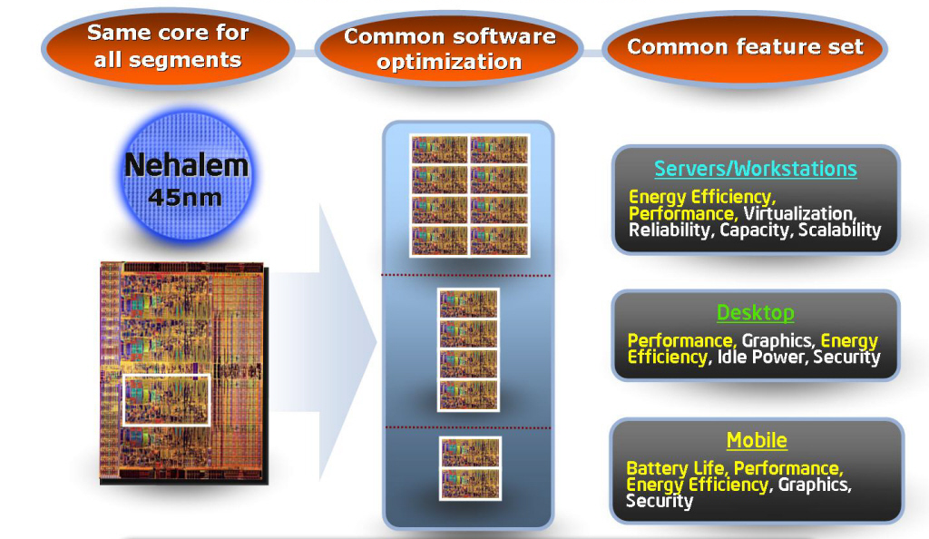
3.1 Introduction to the 1. generation Nehalem line (Bloomfield) (2)
Design objective: The same core for all major segments
Figure 3.1.1: Design objective of Nehalem [1]

Slide 53
3.1 Introduction to the 1. generation Nehalem line (Bloomfield) (3)
Nehalem lines
1. generation Nehalem processors
2. generation Nehalem processors
Mobiles
Mobiles
Core i7-9xxM Clarksfield 4C 9/2009
Core i7-8xxQM Clarksfield 4C 9/2009
Core i7-7xxQM Clarksfield 4C 9/2009
Desktops
Desktops
Core i7-9xx (Bloomfield) 4C 11/2008
Core i7-8xx (Lynnfield) 4C 9/2009
Core i5-7xx (Lynnfield) 4C 9/2009
Servers
Servers
UP-Servers
UP-Servers
35xx Bloomfield 4C 3/2009
34xx Lynnfield 4C 9/2009
C35xx Jasper forest¹ 4C 2/2010
DP-Servers
DP-Servers
55xx Gainestown (Nehalem-EP) 4C 3/2009
C55xx Jasper forest¹ 2C/4C 2/2010
¹Jasper forest: Embedded UP or DP server
Based on [44]

Slide 54
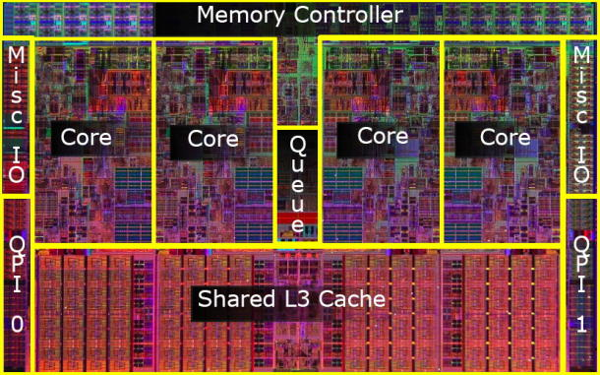
3.1 Introduction to the 1. generation Nehalem line (Bloomfield) (4)
Die shot of the 1. generation Nehalem desktop processor (Bloomfield) [45]
(8 MB)
Die shot of the Bloomfield chip [45]
Note
Both the desktop oriented Bloomfield chip and the DP server oriented Gainestown chip have
the same layout.
The Bloomfield die has two QPI bus controllers, in spite of the fact that they are not needed
for the desktop part.
In the Bloomfield die one of the controllers is simply not activated [45], whereas both are
active in the DP alternative (Gainestown).

Slide 55
3.2 Major innovations of the 1. generation Nehalem line (1)
3.2 Major innovations of the 1. generation Nehalem line [54]
The Major incentive for designing the microarchitecture of Nehalem: support of 4 cores.
4 cores need however twice as much bandwidth as dual core processors, such as the Core 2.
Two memory channels used for dual core processors are more or less the limit attachable to
the north bridge due to physical and electrical limitations.
Consequently, to provide enough bandwidth for 4 cores, a new memory design was necessary.
Major innovations of the 1. generation 4-core Nehalem line
Integrated memory controller
(Section 3.2.1)
QuickPath Interconnect bus (QPI)
(Section 3.2.2)
Simultaneous Multithreading (SMT)
(Section 3.2.3)
New cache architecture
(Section 3.2.4)
SSE 4.2 ISA extension
(Not detailed)
Enhanced power management
(Section 3.2.5)
Advanced virtualization
(Not detailed)
New socket
(Section 3.2.6)
(8 MB)
Figure 3.2.1: Die photo of the Bloomfield/Gainestown chip

Slide 56
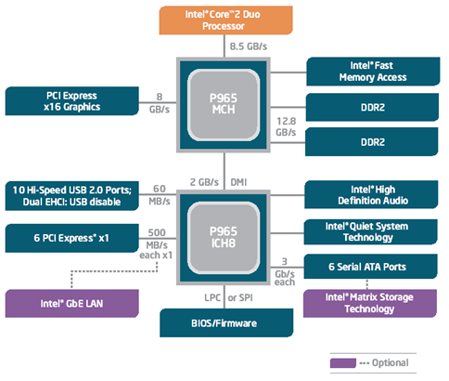
3.2.1 Integrated memory controller (1)
3.2.1 Integrated memory controller
Example: Dual channel DDR2 memory representing the feasible bandwidth limit for a
dual core Core 2 platform [166]

Slide 57
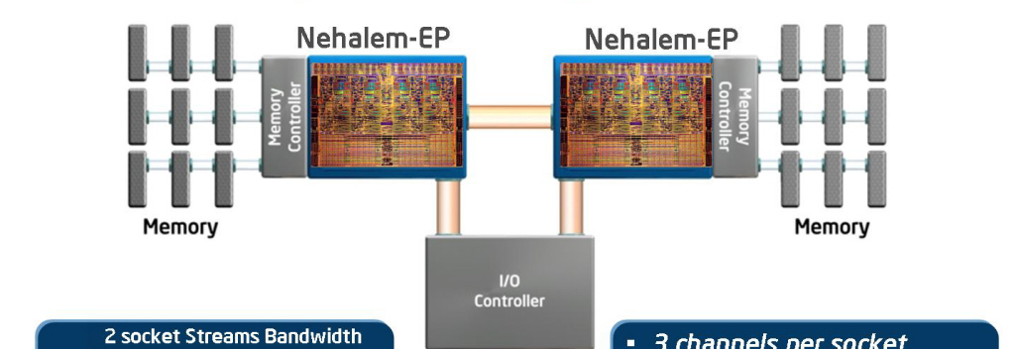
3.2.1 Integrated memory controller (2)
Integrated memory controller I a dual processor Nehalem platform
More cores
Higher memory bandwidth
Main features
3 channels per socket
Up to 3 DIMMs per channel (impl. dependent)
DDR3-800, 1066, 1333,…
Supports both RDIMM and UDIMM (impl. dependent)
Supports single, dual and quad-rank DIMMs
Nehalem-EP (Efficient Performance):
Designation of the server line
Figure 3.2.3.1: Integrated memory controller of Nehalem [33]

Slide 58
3.2.1 Integrated memory controller (3)
Benefits and drawback of integrated memory controllers
Benefits
Low memory access latency
important for memory intensive apps.
Drawback of integrated memory controllers
Processor becomes memory technology dependent
For an enhanced memory solution (e.g. for increased memory speed)
a new processor modification is needed.

Slide 59
3.2.1 Integrated memory controller (4)
Non Uniform Memory Access (NUMA)
It is a consequence of using integrated memory controllers in case of multi-socket servers
Local memory access
Remote memory access
Figure 3.2.3.2: Non Uniform Memory Access (NUMA) in multi-socket servers [1]
Most multi-socket platforms use NUMA
Remote memory access latency ~ 1.7 x longer than local memory access latency
Local memory bandwidth is up to 2 x greater than remote bandwidth
Demands a fast processor-to-processor interconnection to relay memory traffic (QPI)
Operating systems have to modify memory allocation strategies + related APIs

Slide 60
3.2.1 Integrated memory controller (5)
Memory latency comparison: Nehalem vs Penryn
Harpertown: Quad-Core Penryn based server (Xeon 5400 series)
Figure 3.2.3.3: Memory latency comparison: Nehalem vs. Penryn [1]

Slide 61
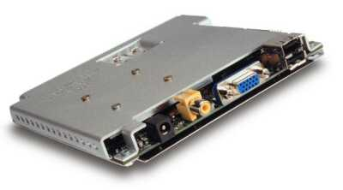
3.2.1 Integrated memory controller (6)
Remark
Intel’s Timna – a forerunner to integrated memory controllers [34]
Timna (announced in 1999, due to 2H 2000, cancelled in Sept. 2000)
Developed in Intel’s Haifa Design and Development Center.
Low cost microprocessor with integrated graphics and memory controller
(for Rambus DRAMs).
Due to design problems and lack of interest from many vendors,
Intel finally cancelled Timna in Sept. 2000.
Figure 3.2.3.4: The low cost (<600 $) Timna PC [40]

Slide 62
3.2.1 Integrated memory controller (7)
Point of attaching memory
Attaching memory to the MCH
Attaching memory to the processor(s)
Examples
UltraSPARC II (1C) (~1997)
UltraSPARC III (2001)
and all subsequent Sun lines
AMD’s K7 lines (1C) (1999-2003)
Opteron server lines (2C) (2003)
and all subsequent AMD lines
POWER4 (2C) (2001)
POWER5 (2C) (2005)
and subsequent POWER families
PA-8800 (2004)
PA-8900 (2005)
and all previous PA lines
Core 2 Duo line (2C) (2006)
and all preceding Intel lines
Core 2 Quad line (2x2C) (2006/2007)
Penryn line (2x2C) (2008)
Nehalem lines (4) (2008)
and all subsequent Intel lines
Montecito (2C) (2006)
Tukwila (4C) (2010)
Figure 3.2.3.5: Point of attaching memory

Slide 63
3.2.2 QuickPath Interconnect bus (QPI) (1)
3.2.2 QuickPath Interconnect bus (QPI)-1
Its debut is strongly motivated by the introduction of integrated memory controllers.
A serial, high speed differential point-to-point interconnect bus, similar to AMD’s
HyperTransport bus), used to connect processors to processors or processors to north bridges.
Formerly designated as the Common System Interface bus (CSI bus).
Consists of 2 unidirectional links, one in each directions, called the TX and RX
(T for Transmit, R for Receive).

Slide 64
3.2.2 QuickPath Interconnect bus (QPI) (2)
Signals of the QuickPath Interconnect bus (QPI bus)
TX Unidirectional link
RX Unidirectional link
16 data
2 protocol
2 CRC
(DDR data transfer)
Figure 3.2.4.1: Signals of the QuickPath Interconnect bus (QPI-bus) [22]

Slide 65
3.2.2 QuickPath Interconnect bus (QPI) (3)
QuickPath Interconnect bus (QPI)-2
Each unidirectional link comprises 20 data lanes and a clock lane, with
each lane consisting of a pair of differential signals.
(Lane: Vonalpár)

Slide 66
3.2.2 QuickPath Interconnect bus (QPI) (4)
Signaling systems used in buses
Signals
Single ended
Voltage referenced
Differential
Typ.voltage
swings
S+
V_{REF}
S-
V_{CM}
t
t
t
3.3-5 V
600-800 mV
200-300 mV
Signaling
system
used in
TTL (5 V)
FPM/EDO
SSTL
SSTL2 (DDR)
SSTL1.8 (DDR2)
SSTL1.5 (DDR3)
RSL (RDRAM)
FSB
LVDS
PCIe
QPI, DMI, ESI
FB-DIMMs
LVTTL (3.3 V)
FPM/EDO
SDRAM
HI 1.5
DRSL
XDR (data)
Smaller voltage swings
LVDS: Low Voltage Differential Signaling LVTTL: Low Voltage TTL
(D)RSL: (Differential) Rambus Signaling Level SSTL: Stub Series Terminated Logic V_{CM}: Common Mode Voltage V_{REF}: Reference Voltage
Figure 2.4: Signaling systems used in buses

Slide 67
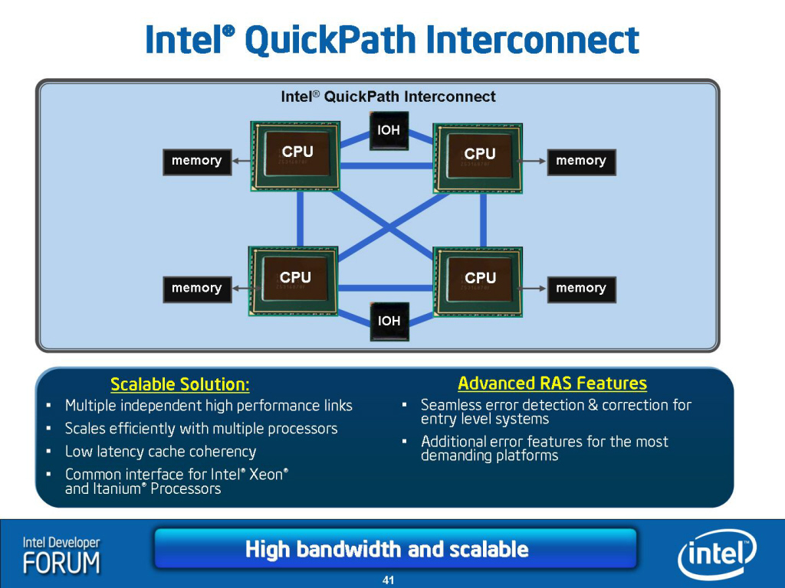
3.2.2 QuickPath Interconnect bus (QPI) (5)
QPI based DP and MP server system architectures
QPI
Figure 3.2.4.2: QPI based DP and MP server system architectures [31], [33]
Note
First generation Nehalem (Bloomfielf) supports only DP configurations.

Slide 68
3.2.2 QuickPath Interconnect bus (QPI) (6)
Comparison of the transfer rates of the QPI, FSB and HT buses
QuickPath Interconnect Bus (QPI-bus)
up to 3.2 GHz DDR 2-Byte (Nehalem)
12.8 GB/s in each direction
up to 4.0 GHz GHz DDR 2-Byte (Sandy Bridge E/EP)
16.0 GB/s in each direction
up to 4.8 GHz GHz DDR 2-Byte (Haswell E/EP)
19.2 GB/s in each direction
Fastest FSB
400 MHz QDR 8 Byte
12.8 GB/s bidirectional
HyperTransport Bus (HT-bus)
Max. clock speed and width figures in AMD’s systems
HT 1.0: 0.8 GHz DDR 2-Byte
3.2 GB/s in each direction
HT 2.0: 1.0 GHz DDR 2-Byte
4.0 GB/s in each direction
HT 3.0: 2.6 GHz DDR 2-Byte
10.4 GB/s in each direction
HT 3.1: 3.2 GHz DDR 2-Byte
12.8 GB/s in each direction
DDR: Double Data Rate
QDR: Quad Data Rate

Slide 69
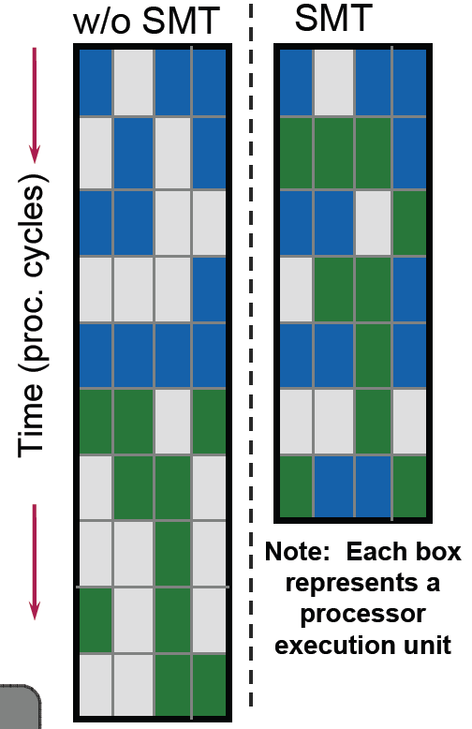
3.2.3 Simultaneous Multithreading (SMT) (1)
3.2.3 Simultaneous Multithreading (SMT)
Two-way multithreaded ( two threads at the same time)
Benefits
A 4-wide core is fed more efficiently (from 2 threads).
Hides latency of a single tread.
More performance with low additional die area cost,
May provide significant performance increase on
dedicated applications.
Figure 3.2.1.1: Simultaneous Multithreading (SMT) of Nehalem [1]

Slide 70
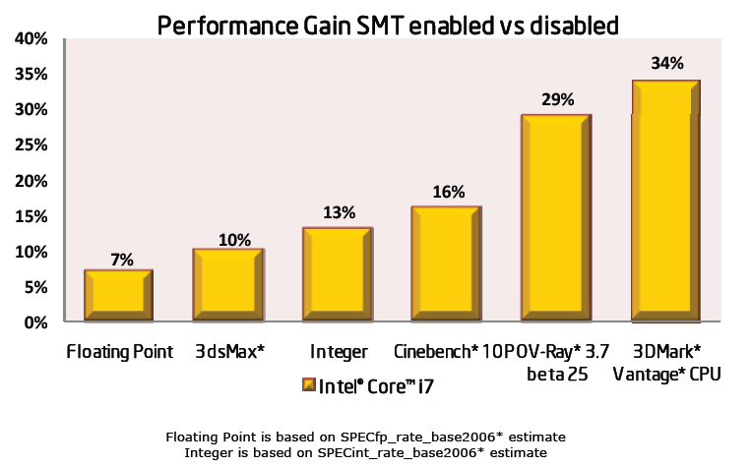
3.2.3 Simultaneous Multithreading (SMT) (2)
Performance gains of SMT
Figure 3.2.1.2: Performance gains achieved by Nehalem’ SMT [1]

Slide 71
3.2.4 New cache architecture (1)
3.2.4 New cache architecture
2-level cache hierarchy
(Penryn)
3-level cache hierarchy
(Nehalem)
Core
Core
Core
Core
Core
32 kB/32 KB
L1 Caches
L1 Caches
L1 Caches
L1 Caches
L1 Caches
32 kB/32 KB
4 MB
Shared/
two cores
L2 Cache
L2 Caches
L2 Caches
L2 Cache
256 KB
Private
L3 Cache
Up to 8 MB
Inclusive
Figure 3.2.2.1: The 3-level cache architecture of Nehalem (based on [1])
Note the difference in the L2 cache sizes.

Slide 72
3.2.4 New cache architecture (2)
Distinguished features of Nehalem’s cache architecture
The L2 cache is private again rather than shared as in the Core and Penryn processors
Private L2
Shared L2
Pentium 4
Core
Penryn
Nehalem
Assumed reason for returning to the private scheme
Private caches allow a more effective hardware prefetching than shared ones, since
Hardware prefetchers look for memory access patterns.
Private L2 caches have more easily detectable memory access patterns
than shared L2 caches.

Slide 73
3.2.4 New cache architecture (3)
Remark
The POWER family had the same evolution path as above
Private L2
Shared L2
POWER4
POWER5
POWER6

Slide 74
3.2.4 New cache architecture (4)
The L3 cache is inclusive rather than exclusive
as in a number of competing designs, such as UltraSPARC IV+ (2005), POWER5 (2005),
POWER6 (2007), POWER7 (2010), AMD’s K10-based processors (2007).
Intel’s argumentation for inclusive caches [38]
Inclusive L3 caches prevent L2 snoop traffic for L3 cache misses since
with inclusive L3 caches an L3 cache miss means that the referenced data
doesn’t exist in any core’s L2 caches, thus no L2 snooping is needed.
By contrast, with exclusive L3 caches the referenced data may exist in any
of the L2 caches, thus L2 snooping is required.
For higher core numbers L2 snooping becomes a more demanding task
and may overshadow the benefits arising from the more efficient cache use
of the explicit cache scheme.

Slide 75
3.2.4 New cache architecture (5)
The notion of “Uncore”
Figure 3.2.4.3: Interpretation of the notion “Uncore” [1]

Slide 76
3.2.5 Enhanced power management (1)
3.2.5 Enhanced power management
Discussed issues
Integrated power gates
Integrated Power Control Unit
Turbo boost technology

Slide 77
3.2.5 Enhanced power management (2)
Power switches
Figure 3.2.5.1: Use of integrated power gates [32]

Slide 78
3.2.5 Enhanced power management (3)
Allows to manage the power
of the whole chip as an entity.
Used also for the Turbo Boost Mode
Figure 3.2.5.2: Overview of the Power Control unit [32]

Slide 79
3.2.5 Enhanced power management (4)
Nehalem’s Turbo Mode
Aim
Utilization of the power headroom of inactive cores and that of active cores with light workload
for increasing clock frequency.
Remarks
1) The Penryn core already introduced a less intricate technology for the same purpose,
termed as the (EDAT) Enhanced Dynamic Acceleration Technology that increases
clock frequency only for the mobile platform and in case of inactive cores.
2) The Turbo Mode technology considers a core “active” if it is in ACPI C0 or C1 states,
whereas cores in the C3 to C6 ACPI states are considered as “inactive”.

Slide 80
3.2.5 Enhanced power management (5)
ACPI states [26]
Passive states
Intelligent
heuristics decides
when enter into.

Slide 81
3.2.5 Enhanced power management (6)
Understanding the notion of TDP and the related potential to boost performance (1) [50]
TDP (Thermal Design Power) is the maximum power consumed at realistic worst case
applications (TDP application) of a processor with a given clock frequency.
The cooling system (thermal solution) needs to be designed for the given TDP.
It has to ensure that the junction temperature (Tj) does not exceed its limit (Tjmax)
while the processor runs TDP applications.

Slide 82
3.2.5 Enhanced power management (7)
Understanding the notion of TDP and the related potential to boost performance (2) [50]
Typical workloads however, are not intensive enough to push power consumption to the TDP limit.
The remaining power headroom can be utilized to increase fc.
In principle, the clock frequency can be increased as long as the actual power consumption is
lower than the TDP and also the junction temperature remains below its max. value Tjmax.

Slide 83
3.2.5 Enhanced power management (8)
Principle of the Turbo Boost technology (1) [51]
If the OS requests an active core to increase fc over the max. core frequency that is set
according to the TDP value, but the actual power consumption is less than the TDP, i.e.
there is a power headroom available due to
idle cores or
a light workload
the turbo mode controller will increase the core frequency of the active cores e.g. in steps of
133 MHz, as long as given limits, e.g. the power consumption of the processor (socket) or
the junction temperatures of the cores remain below given limits.
When given limits become exceeded the turbo mode controller will step down clock frequency
in steps of 133 MHz.
Remarks
In Nehalem’s turbo mode all active cores in the processor will operate at the same fc and
voltage.

Slide 84
3.2.5 Enhanced power management (9)
Principle of the turbo boost technology (2) [52]
Figure 3.2.5.3: Turbo mode uses the available power headroom in processor package power limits [52]

Slide 85
3.2.5 Enhanced power management (10)
Maximum Turbo boost frequency [53]
Maximum turbo frequencies are factory configured and kept in an internal register (MSR 1ADH).
E.g. in case of the Core i7-920XM the basic core frequency is 2.0 GHz and the maximum
Turbo frequency is 3.2 GHz, which is 9 frequency bins higher than the TDP limited basic
core frequency of 2.0 GHz.

Slide 86
3.2.5 Enhanced power management (11)
Assuring that power and temperature values do not exceed specified limits [53], [50]
To control fc the turbo boost controller samples the current power consumption and
die temperatures in 5 ms intervals [53].
Power consumption is determined by monitoring the processor current at its input pin as well
as the associated voltage (Vcc) and calculating the power consumption as a moving average.
The junction temperature of the cores are monitored by DTSs (Digital Thermal Sensors) with
an error of ± 5 % [50].
When the power consumption of the processor or the junction temperature of any core
exceeds the factory configured limits, the turbo boost controller automatically steps down
core frequency in increments of e.g. 133 MHz.

Slide 87
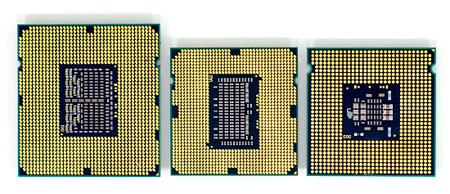
3.2.6 New sockets (1)
3.2.6 New sockets [167]
LGA-775
(Core 2)
LGA-1366
(Bloomfied)
LGA-1156
(Lynnfield)

Slide 88
3.3 Major innovations of the 2. generation Nehalem line (Lynnfield) (1)
Nehalem lines
1. generation Nehalem processors
2. generation Nehalem processors
Mobiles
Mobiles
Core i7-9xxM Clarksfield 4C 9/2009
Core i7-8xxQM Clarksfield 4C 9/2009
Core i7-7xxQM Clarksfield 4C 9/2009
Desktops
Desktops
Core i7-9xx (Bloomfield) 4C 11/2008
Core i7-8xx (Lynnfield) 4C 9/2009
Core i5-7xx (Lynnfield) 4C 9/2009
Servers
Servers
UP-Servers
UP-Servers
35xx Bloomfield 4C 3/2009
34xx Lynnfield 4C 9/2009
C35xx Jasper forest¹ 4C 2/2010
DP-Servers
DP-Servers
55xx Gainestown (Nehalem-EP) 4C 3/2009
C55xx Jasper forest¹ 2C/4C 2/2010
¹Jasper forest: Embedded UP or DP server
Based on [44]

Slide 89
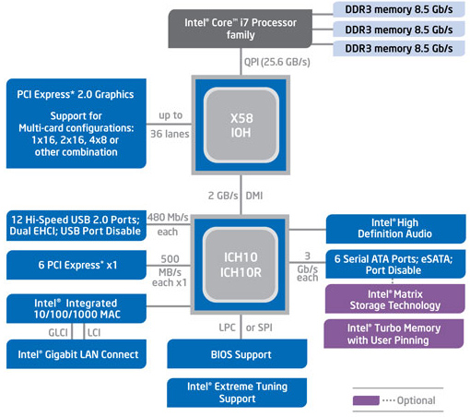
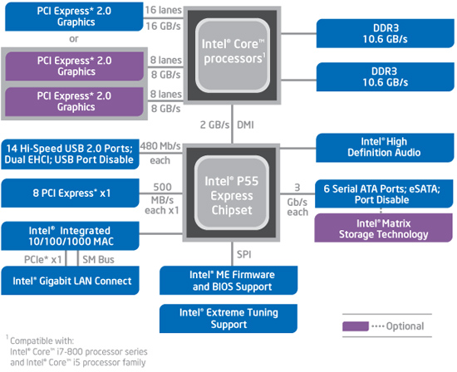
3.3 Major innovations of the 2. generation Nehalem line (Lynnfield) (2)
3.3 Major innovations of the 2. generation Nehalem line (Lynnfield) (1) [46]
a) The Lynnfield chip is a major redesign of the Bloomfield chip resulting in a cheaper and
more effective two-chip system solution instead of the previous three chip solution.
b) Further on, whereas the Bloomfield chip is connected to the X58 chipset via the QPI bus,
the Lynnfield chip is connected to the P55 PCH by a DMI interface, like in previous solutions.
The Bloomfield based platform (X58 + ICH10 / LGA-1366)
The Lynnfield based platform (P55 / LGA-1156)

Slide 90
3.3 Major innovations of the 2. generation Nehalem line (Lynnfield) (3)
Major innovations of the 2. generation Nehalem line (Lynnfield) (2) [46]
c) It provides only 16 PCIe 2.0 lanes to attach a graphics card immediately to the processor
rather than to the north bridge as done by 36 lanes in the previous solution.
The Bloomfield based platform (X58 + ICH10 / LGA-1366)
The Lynnfield based platform (P55 / LGA-1156)

Slide 91
3.3 Major innovations of the 2. generation Nehalem line (Lynnfield) (4)
Evolution of providing PCIe lanes for graphics

Slide 92
3.3 Major innovations of the 2. generation Nehalem line (Lynnfield) (5)
Main options of providing PCIe lanes on the processor for graphics cards in DT systems
PCIe lanes provided on the processor
1x x16 or 2x x8 lanes
40 configurable lanes
(e.g. 2x x16 + 1x x8 or 4x x8)
PCIe 1.0 lanes
PCIe
2.0
X16/
2x x8
P
Mem.
40
configurable
lanes
PCIe 2.0
P
Mem.
Type of available PCIe lanes
Periph. Contr.
P55/P67
PCIe 2.0 lanes
Periph. Contr.
X79
Intel 2. gen. Nehalem (Lynnfield) (4C), 2 MCh
with P55 (2009)
Intel Sandy Bridge (4C), 2 MCh with P67 (2011)
Intel Sandy Bridge-E (6C), 4 MCh with X79 (2011)
40
configurable
lanes
P
Mem.
PCIe
3.0
X16/
2x x8
P
Mem.
PCIe 3.0
PCIe 3.0 lanes
Periph. Contr.
Periph. Contr.
Z77
X79
Intel Ivy Bridge (4C), 2 MCh with Z77 PCH (2012)
Intel Ivy Bridge-E (6C), 4 MCh with X79 (2013)
Intel Haswell-E (8C), 4 MCh with X79 (2014)
MCh: Memory Channel

Slide 93
3.3 Major innovations of the 2. generation Nehalem line (Lynnfield) (6)
Evolution of the topology and type of available PCIe lanes for graphics cards
Topology of PCIe lanes provided for graphics cards
PCIe lanes
on both the NB and the SB
PCIe lanes
on the NB
PCIe lanes
on the PCH
PCIe lanes
on the processor
PCIe 1.0
lanes
Type of available PCIe lanes
Trend
2. G. Nehalem (Lynnfield)
(2009)
Sandy Bridge (2011)
Sandy Bridge-E (2011)
PCIe 2.0
lanes
PCIe 3.0
lanes
Ivy Bridge, (2012)
Ivy-Bridge-E (2013)
Haswell-E (2014)
Intel Sandy Bridge E (6C), 4 MCh with X79 (2011)

Slide 94
3.3 Major innovations of the 2. generation Nehalem line (Lynnfield) (7)
Major innovations of the 2. generation Nehalem line (Lynnfield) (3) [46]
d) It supports only two DDR3 memory channels instead of three as in the previous solution.
e) Its socket needs less connections (LGA-1156) than the Bloomfield chip (LGA-1366).
All in all the Lynnfield chip is a cheaper and more effective successor of the Bloomfield chip,
aiming primarily for mobiles and desktops.
The Bloomfield based platform (X58 + ICH10 / LGA-1366)
The Lynnfield based platform (P55 / LGA-1156)

Slide 95
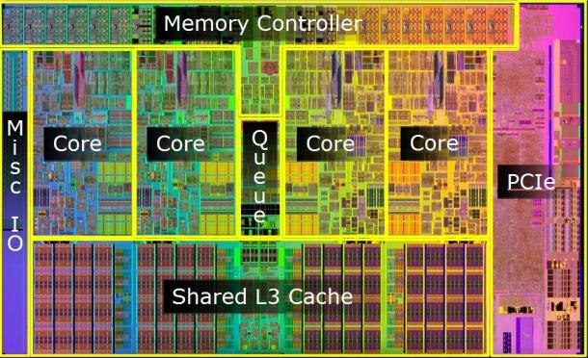
3.3 Major innovations of the 2. generation Nehalem line (Lynnfield) (8)
Die photos of the 1. and 2. gen.
Nehalem desktop chips
First generation: Bloomfield chip (11/2008)
(45 nm, 263 mm², 731 mtrs, LGA-1366)
[45], [46], [47]
Bloomfield
(desktop/DP server) []
Second generation: Lynnfield chip (9/2009) [45]
45 nm, 296 mm², 774 mtrs, LGA-1156) [45] [46] [48]

Slide 96
4. The Sandy Bridge line
4.1 Introduction
4.2 Major innovations of the Sandy Bridge line vs.
the 1. generation Nehalem line
4.2.1 Overview
4.2.2 Extension of the ISA (of the cores) by the
AVX instruction set
4.2.3 New microarchitecture of the cores
4.2.4 On die ring interconnect bus
4.2.5 On die graphics unit
4.2.6 Enhanced Turbo Boost technology
4.3 Example for a Sandy Bridge based desktop
platform with the H67 chipset
4.4 The E3-1200 UP microserver line
Notes:
96

Slide 97
4.1 Introduction (1)
4.1 Introduction
Sandy Bridge is Intel’s next new microarchitecture using 32 nm line width.
First delivered in 1/2011.
It is termed also as Intel’s second generation Core processors.
1. gen.
2. gen.
3. gen.
4. gen.
Merom
New
Microarchitecture
65nm
Penryn
New
Process
45nm
Nehalem
New
Microarchitecture
45nm
Westmere
New
Process
32nm
Sandy
Bridge
New
Microarchitecture
32nm
Ivy
Bridge
New
Process
22nm
Haswell
New
Microarchitecture
22nm
TOCK
TICK
TOCK
TICK
TOCK
TICK
TOCK
Figure 4.1.1: Intel’s Tick-Tock development model (Based on [1])

Slide 98
4.1 Introduction (2)
Overview of the Sandy Bridge family
The Sandy Bridge family
Sandy Bridge
Up to 4 cores
(This Section)
Sandy Bridge-E
Up to 6 cores
(Not discussed)
Sandy Bridge-EN/EP
Up to 8 cores
(Not discussed)
Mobiles
Core i3-23xxM, 2C, 2/2011
Core i5-24xxM//25xxM, 2C, 2/2011
Core i7-26xxQM/27xxQM/28xxQM, 4C, 1/2011
Core i7 Extreme-29xxXM , 4C, Q1 2011
Sandy Bridge-EN
(Entry)
(Socket: LGA 1356)
Sandy Bridge-EP
(Efficient Performance)
(Socket: LGA 2011)
Desktops
Core i3-21xx, 2C, 2/2011
Core i5-23xx 4C+G, 1/2011
Core i5/24xx/25xx, 4C+G, 1/2011
Core i7-26xx, 4C+G, 1/2011
Core i7-2700K, 4C+G10/2011
Core i7-3960X EE, 6C, 11/2011
Core i7-3930K, 6C, 11/2011
Core i7-3820, 4C, 11/2011
Servers
UP-Servers
E3 12x0, 4C,, 4/2011
E3 12x5, 4C+G,, 4/2011
E5-14xx 4/6C, 5/2012
E5-16xx 4/6C, 3/2012
DP-Servers
E5-24xx 4/6/8C, 5/2012
E5-26xx 4/6/8C, 3/2012
MP-Servers
E5-46xx 4/6/8C, 5/2012
Based on [62] and [63]
Notes:
ridge-ex

Slide 99
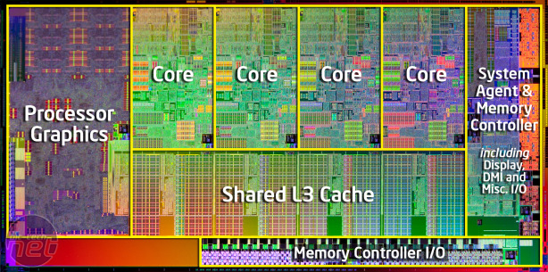
4.1 Introduction (3)
Main functional units of Sandy Bridge [96]
256 KB L2
(9 clk)
256 KB L2
(9 clk)
256 KB L2
(9 clk)
256 KB L2
(9 clk)
256 KB L2
(9 clk)
256 KB L2
(9 clk)
256 KB L2
(9 clk)
Hyperthreading
AES Instr.
VMX Unrestrict.
20 nm² / Core
32K L1D (3 clk)
AVX 256 bit
4 Operands
8 MB
@ 1.0 1.4 GHz
(to L3 connected)
(25 clk)
256 b/cycle Ring Architecture
PCIe 2.0
DDR3-1600
25.6 GB/s
32 nm process / ~225 nm² die size. 995 mtrs, 85W TDP

Slide 100
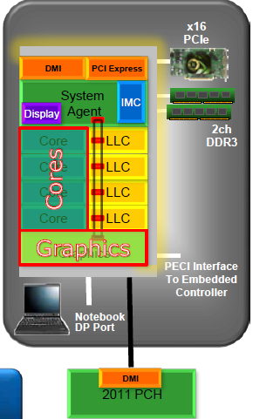
4.2.1 Overview (1)
4.2 Major innovations of the Sandy Bridge line vs. the 2. generation Nehalem line [61]
4.2.1 Overview
ISA extension (of the cores) by the AVX
instruction set (Section 4.2.2)
New microarchitecture for the cores
(Section 4.2.3)
On die ring interconnect bus
(Section 4.2.4)
On-die graphics unit
(Section 4.2.5)
Enhanced Turbo Boost technology
(Section 4.2.6)

Slide 101
4.2.2 Extension of the ISA (of the cores) by the AVX instruction set (1)
4.2.2 ISA extension (of the cores) by the AVX instruction set
AVX: Advanced Vector Extensions
In the course of ISA extensions Intel expanded the previous 128-bit SIMD instruction set (introduced with the Pentium III in 1999) by the 256-bit AVX instruction set, as follows:

Slide 102
4.2.2 Extension of the ISA (of the cores) by the AVX instruction set (2)
4.2.2 Extension of the ISA (of the cores) by the AVX instruction set (Based on [18])
Pentium III
8 MM registers (64-bit),
aliased on the FP Stack registers
8 XMM registers (128-bit)
Pentium III
16 XMM registers (128-bit)
Northwood (Pentium4)
Norhwood
Northwood (Pentium4)
Core 2
16 YMM registers (256-bit)
Ivy Bridge

Slide 103
4.2.2 Extension of the ISA (of the cores) by the AVX instruction set (3)
The AVX extension
It includes
Extension of the 128-bit wide XMM [0, 15] SIMD register set to the 256-bit YMM [0, 15]
register set.
b) Extension of the 128-bit SSE instruction set

Slide 104
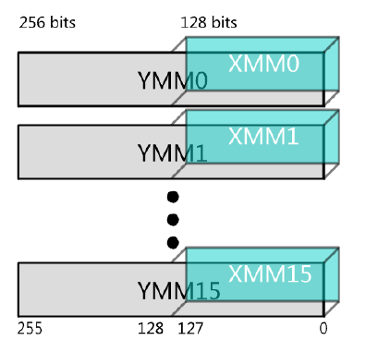
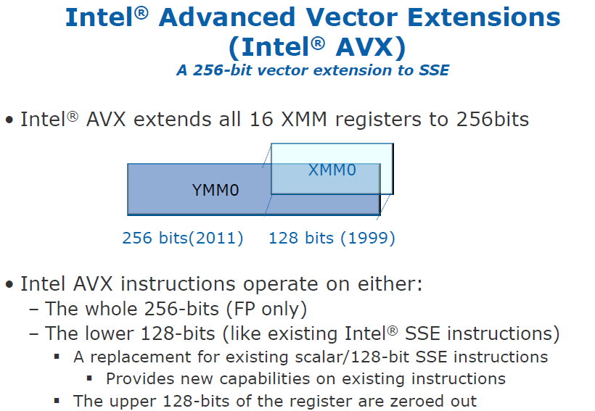
4.2.2 Extension of the ISA (of the cores) by the AVX instruction set (4)
Extension of the 128-bit wide XMM [0, 15] SIMD register set to the 256-bit
YMM [0, 15] register set [97], [168]

Slide 105
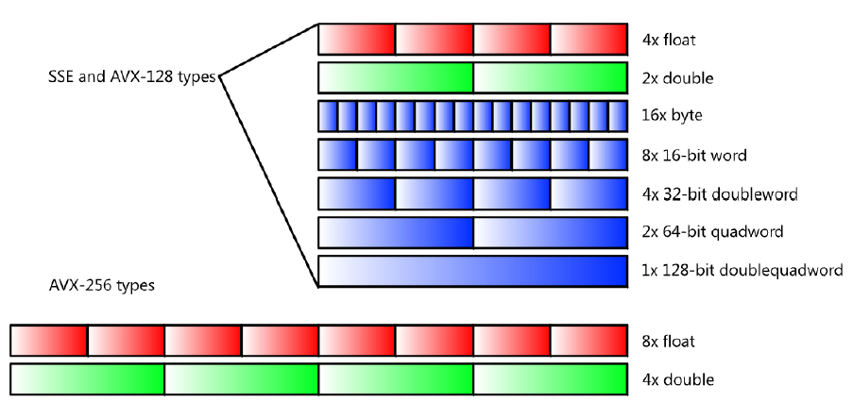
4.2.2 Extension of the ISA (of the cores) by the AVX instruction set (5)
b) Extension of the 128-bit SSE instruction set
Supported data types [168]

Slide 106
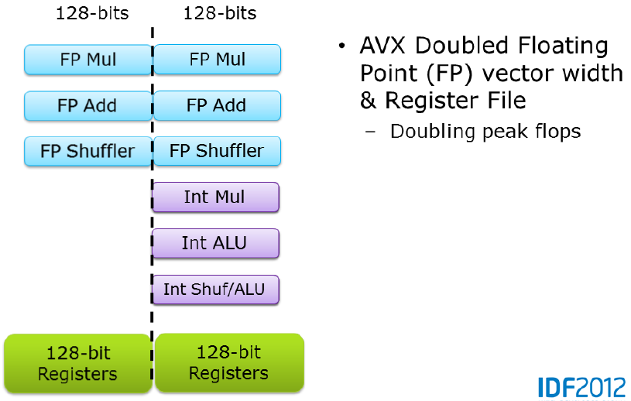
4.2.2 Extension of the ISA (of the cores) by the AVX instruction set (6)
Note
AVX doubled only FP vector width, as indicated in the Figure below [97].

Slide 107
4.2.2 Extension of the ISA (of the cores) by the AVX instruction set (7)
Implementation of AVX
To implement 256-bit FP operations Intel did not widen related data paths and FP execution units
to 256 bit, instead designers made use of two 128-bit data paths and two 128-bit
FP execution units in the same time, as indicated in the previous Figure [98].

Slide 108
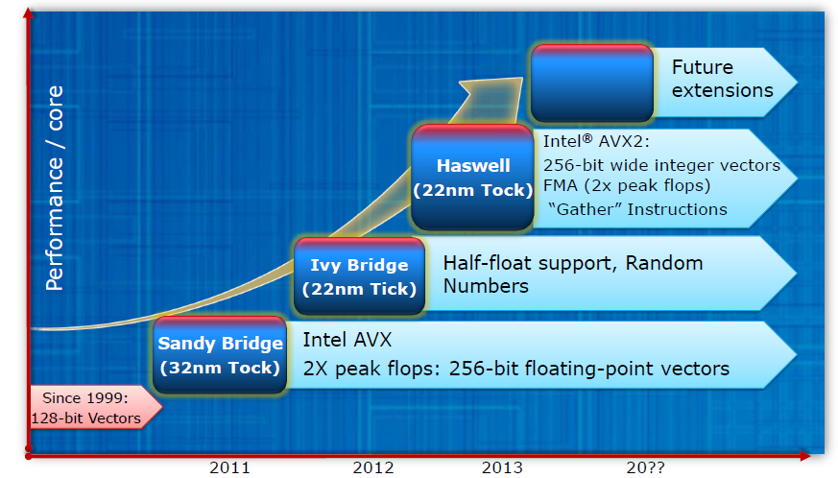
4.2.2 Extension of the ISA (of the cores) by the AVX instruction set (8)
Subsequent evolution of AVX [97]
(16-bit FP format)

Slide 109
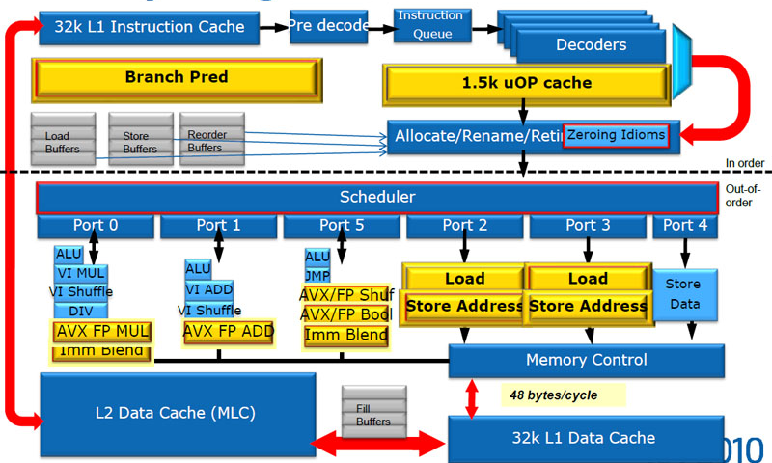
4.2.3 New microarchitectures of the cores (1)
4.2.3 New microarchitecture of the cores
Intel redesigned large parts of the microarchitecture of the cores, as indicated by yellow boxes
in the Figure below.
Figure 4.2.3.1: Microarchitecture of the cores of Sandy Bridge [64]

Slide 110
4.2.3 New microarchitectures of the cores (2)
Here we do not want to go into details of the microarchitecture, but refer to two very detailed
descriptions [64], [98].

Slide 111
4.2.4 On-die ring interconnect bus (1)
4.2.4 On die ring interconnect bus [66]
Six bus agents.
The four cores and the
L3 slices share interfaces.

Slide 112
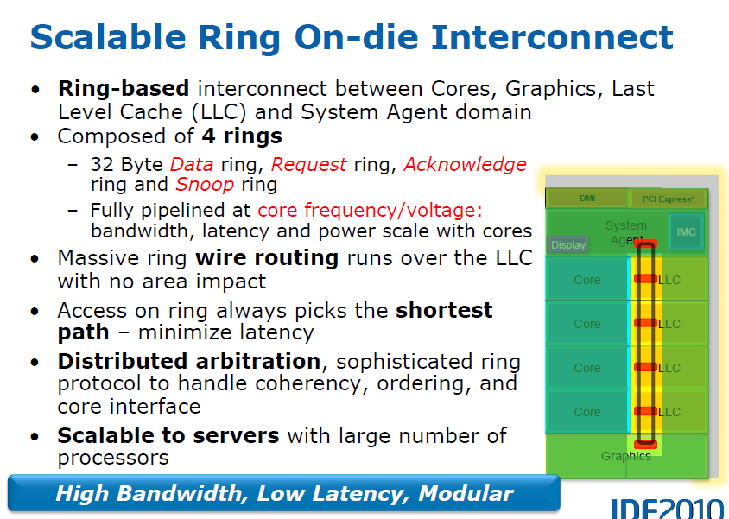
4.2.4 On-die ring interconnect bus (2)
Main features of the on-die interconnect bus [64]

Slide 113
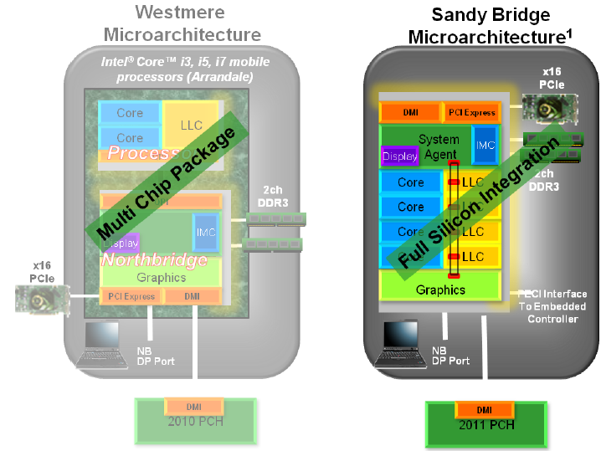
4.2.5 On die graphics unit (1)
4.2.5 On die graphics unit [99]
Evolution of graphics implementation from Westmere to Sandy Bridge [99]

Slide 114
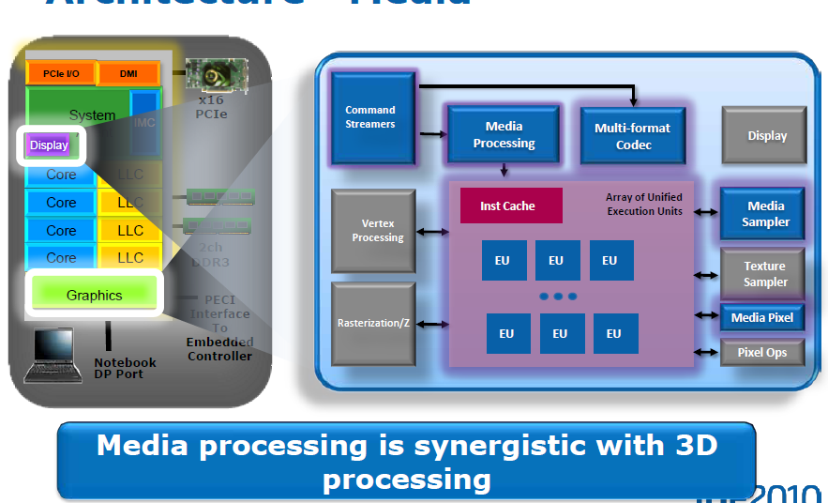
4.2.5 On die graphics unit (2)
Support of both media and graphics processing by the graphics unit [99]

Slide 115
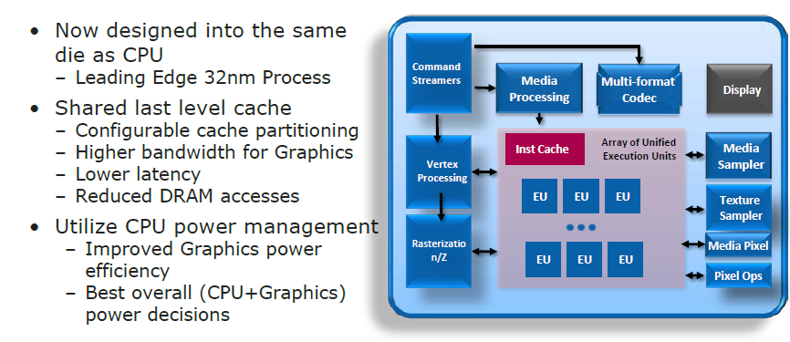
4.2.5 On die graphics unit (3)
8.2.5 On die graphics unit (1)
Main features of the on die graphics unit [99]
12 EUs

Slide 116
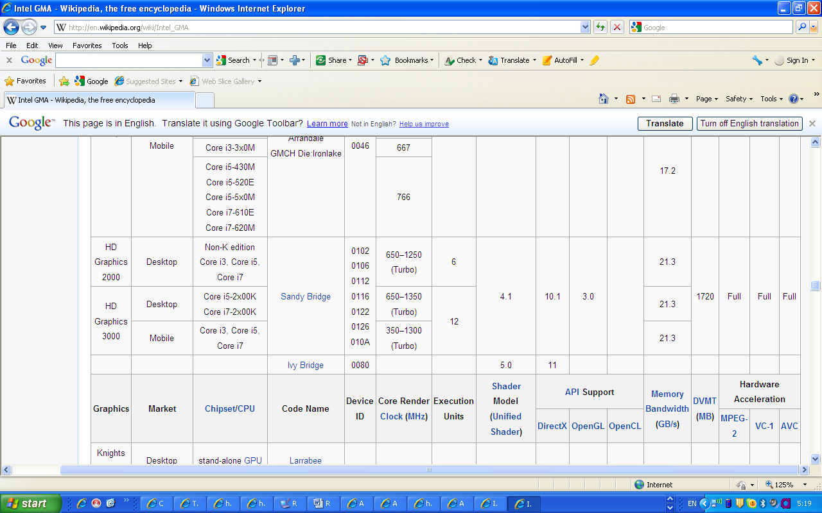
4.2.5 On die graphics unit (4)
8.2.5 On die graphics unit (1)
Specification data of the HD 2000 and HD 3000 graphics [100]
-

Slide 117
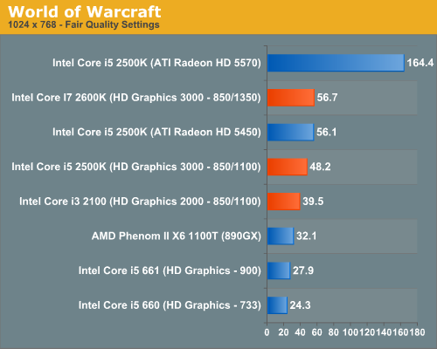
4.2.5 On die graphics unit (5)
Performance comparison of the Sandy Bridge’s graphics: gaming [101]
HD 5570
400 ALUs
i5/i7 2xxx/3xxx:
Sandy Bridge
i5 6xx
Arrandale
frames per sec

Slide 118
4.2.6 Enhanced Turbo Boost technology (1)
4.2.6 Enhanced Turbo Boost technology [64]
Designated also as the 2.0 generation Turbo Boost technology.
The concept utilizes the real temperature response of processors to power changes
in order to increase the extent of overclocking [64].
Cooler
Thermal capacitance

Slide 119
4.2.6 Enhanced Turbo Boost technology (2)
Based on the real temperature response the thermal energy budget accumulated during idle
periods can be utilized to push the core beyond the TDP for short periods of time (e.g. for 20 sec).
Multiple algorithms manage in parallel current, power and die temperature. [64]

Slide 120
4.2.6 Enhanced Turbo Boost technology (3)
Intelligent power sharing between the cores and the integrated graphics [64]

Slide 121
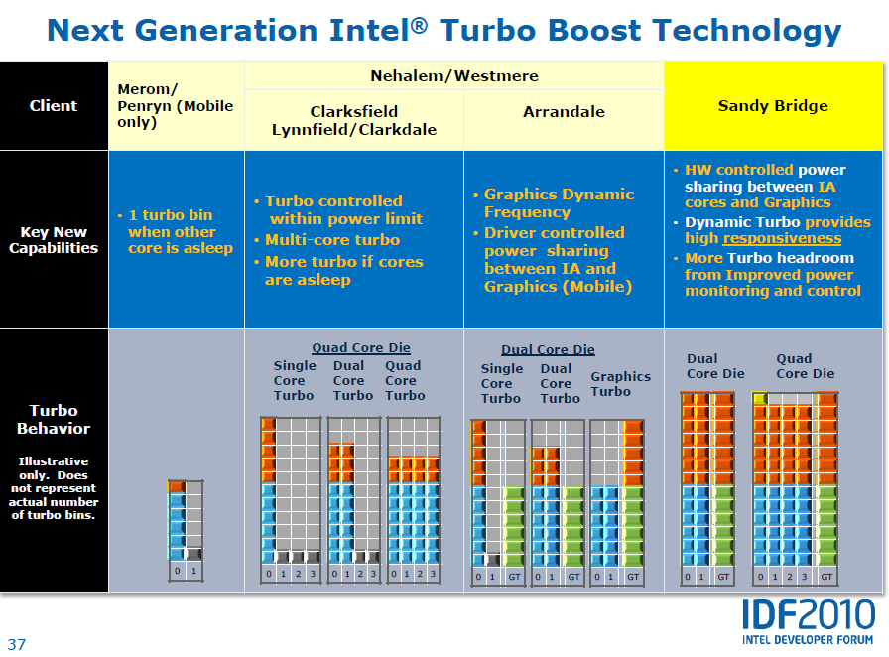
4.2.6 Enhanced Turbo Boost technology (4)
[61]
NHM/M
WSM/M
NHM/D
WSM/D

Slide 122
4.2.6 Enhanced Turbo Boost technology (5)
Remark
Individual cores may run at different frequencies but all cores share the same power plane.
Individual cores may be shut down if idle by power gates.

Slide 123
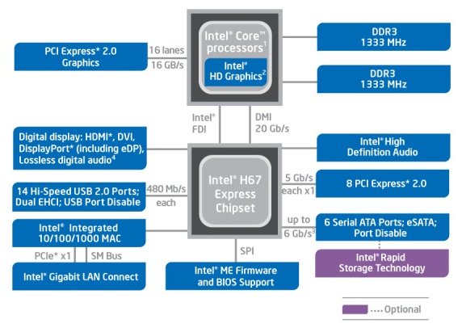
4.3 Example for a Sandy Bridge based desktop platform with the H67 chipset (1)
4.3 Example for a Sandy Bridge based desktop platform with the H67 chipset [102]

Slide 124
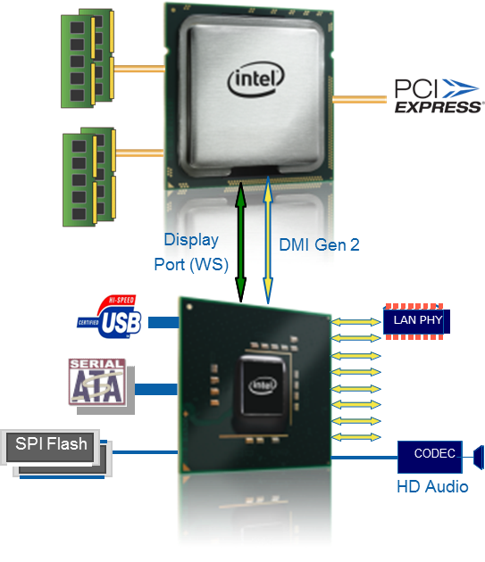
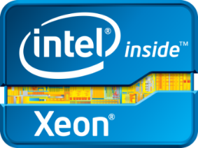
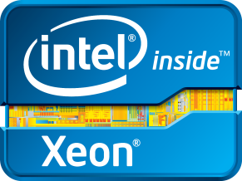
4.4 The E3-1200 UP server line (1)
4.4 The E3-1200 UP microserver line [103]
Intel® Xeon® Processor E3-1200 Product Family
Key Features¹
Next-Generation 32nm Intel® Microarchitecture
Intel® Turbo Boost 2.0 Technology for dynamic
frequency scaling
Intel® Hyper-Threading Technology
Up to 8MB shared L3 cache
Integrated memory controller for 2 channels of DDR3
Up to 32 UDIMMs of memory, up to 1333 MHz of speed
Flexible PCI Express* 2.0 Configurations
Intel® C200 Series Chipset Key Features
New single chip architecture
Up to 8 PCI Express 2.0 x1 Ports (5.0 GT/s)
Up to 2 (6Gb/s) ports plus 4 (3Gb/s) ports with
Intel® Rapid Storage Technology for RAID 0/1/5/10
Up to 12 USB 2.0 Ports
¹ Not all features are available on every processor SKU

Slide 125
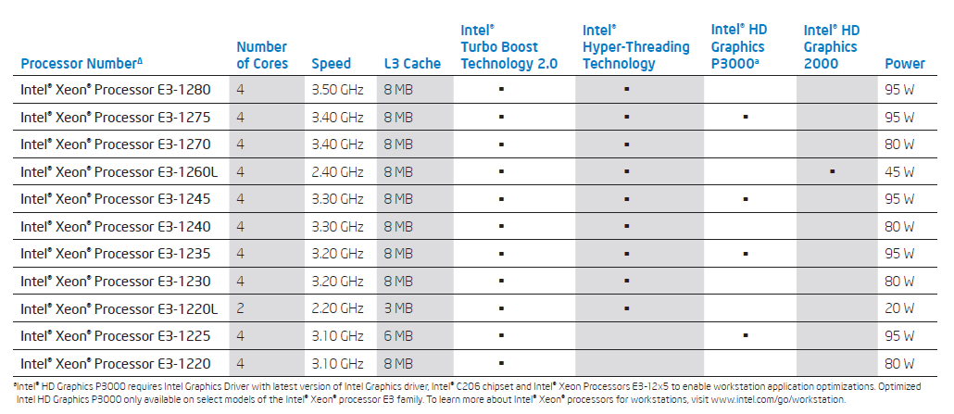
4.4 The E3-1200 UP server line (2)
Intel’s low power models of the Xeon E3-1200 processor line []
Product brief

Slide 126
5. The Haswell line
5.1 Introduction
5.2 Key enhancements of the Haswell cores
5.3 ISA enhancements of the Haswell cores
5.4 Main innovations of the Haswell processor
5.5 Main features of the Haswell line of mobile
and desktop processors
5.6 Haswell-based desktop platform
5.7 Integer and FP performance of subsequent
generations of Core processors
5.8 Graphics performance of subsequent
generations of Core processors
Notes:
126

Slide 127
5.9 Main features of Haswell-based Xeon E3-12xx
v3 line of server processors
5.10 Haswell-based Xeon E3-1200 v3 server
platform
Notes:
127

Slide 128
5.1 Introduction (1)
5.1 introduction
Haswell processors are termed also as the 4. gen. Intel Core processors, as indicated below.
1. gen.
2. gen.
3. gen.
4. gen.
Core 2
New
Microarchitecture
65nm
Penryn
New
Process
45nm
Nehalem
New
Microarchitecture
45nm
Westmere
New
Process
32nm
Sandy
Bridge
New
Microarchitecture
32nm
Ivy
Bridge
New
Process
22nm
Haswell
New
Microarchitecture
22nm
TOCK
TICK
TOCK
TICK
TOCK
TICK
TOCK
Figure 5.1.1: Intel’s Tick-Tock development model (Based on [1])
Launched: 6/2013 at Computex.

Slide 129
5.1 Introduction (2)
Overview of Haswell-based processor lines (Based on [120])
Mobiles
Core i3-40xx/41xxU/Y, 2C+G, HT, 6/2013
Core i5-42xx/43xxU/Y, 2C/4C+G, HT, 6/2013
Core i7-45xx-49xxU/Q, 2C/4C+G, HT, 5/2013
Core i7-4930MX, 4C+G, HT, 5/2013
Desktops
Core i3-41xx/43xx, 2C+G, HT, 6/2013
Core i5-44xx/45xx/46xx, 2C/4C+G, HT, 6/2013
Core i7-47xx, 4C+G, HT, 6/2013
Servers
Microservers
E3-12x0 v3, 4C, HT, 6/2013
E3-12x5 v3, 4C+G, HT, 6/2013

Slide 130
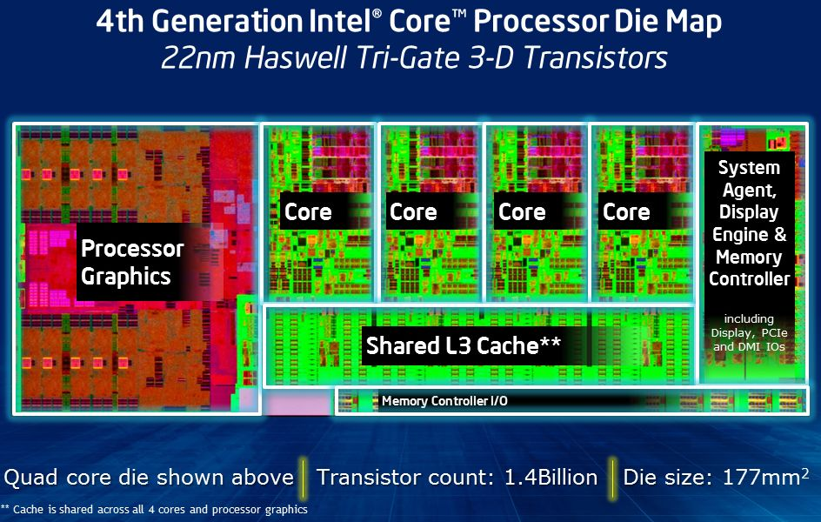
5.1 Introduction (3)
Die plot of a Haswell processor [121]

Slide 131

5.1 Introduction (4)
Sub-families of Haswell [144]

Slide 132

5.2 Key enhancements of the Haswell cores (1)
5.2 Key enhancements of the Haswell cores [80]

Slide 133

5.2 Key enhancements of the Haswell cores (2)
Buffer sizes of subsequent generations of Core processors [80]

Slide 134

5.2 Key enhancements of the Haswell cores (3)
Cache sizes, latencies and bandwidth values of subsequent Core generations [122]

Slide 135

5.2 Key enhancements of the Haswell cores (4)
Issue rate and execution unit enhancements of Haswell [165]
FMA: Fused Multiply-Add ( a x b+c)

Slide 136

5.3 ISA enhancements of the Haswell cores (1)
5.3 ISA enhancements of the Haswell cores [80]

Slide 137

5.3 ISA enhancements of the Haswell cores (2)
Evolution of the AVX ISA extension [97]

Slide 138

5.3 ISA enhancements of the Haswell cores (3)
Enhancements of AVX2 [97]

Slide 139

5.3 ISA enhancements of the Haswell cores (4)
FMA and peak FLOPs of Haswell [97]

Slide 140

5.3 ISA enhancements of the Haswell cores (5)
Upcoming SlideShare
Loading in...5
×
Expected future evolution of AVX [165]

Slide 141
5.4.1 Overview (1)
5.4 Main innovations of the Haswell processor
5.4.1 Overview
a) Enhanced graphics (Section 5.4.2)
b) On-package e-DRAM cache (Section 5.4.3)
c) FIVR (Fully Integrated Voltage Regulator) (Section 5.4.4)

Slide 142
5.4.2 Enhanced graphics (1)
5.4.2 Enhanced graphics
To compete with AMD’s advanced graphics solutions Intel put a great emphasis on enhancing
Haswell’s integrated graphics.
The new graphics units are termed as Iris Pro and Iris graphics.
Haswell’s graphics unit
(It incorporates 40 Execution Units)
Iris graphics unit
Iris Pro graphics unit
It is not enhanced by an
on package integrated eDRAM
It is enhanced by a 128 MB sized
on package integrated eDRAM

Slide 143

5.4.2 Enhanced graphics (2)
Main enhancements of the Iris Pro and Iris graphics units [123]

Slide 144

5.4.2 Enhanced graphics (3)
Graphics performance increase of subsequent Core generations [117]
Haswell
Ivy Bridge
Sandy Bridge

Slide 145

5.4.3 On-package eDRAM cache (1)
5.4.3 On-package eDRAM cache [117]

Slide 146
5.4.3 On-package eDRAM cache (2)
Principle of operation [117]
The on package eDRAM, designated also as Crystallwell, it operates as a true 4th level cache
of the memory hierarchy.
It acts as a victim buffer to the L3 cache, in the sense that anything evicted from the
L3 cache immediately goes into the L4 cache.
Both CPU and GPU requests are cached.
The cache partitioning between CPU and GPU is dynamic.
If the GPU is not in use the whole L4 cache may be devoted the CPU, in this case the CPU
has a 128 MB L4 cache.
Access latency after an L3 miss is 30 – 32 ns.
The L4 cache is capable of delivering 50 GB/s in each direction.
The Crystallwell die consumes between 0.5 and 1.0 W if idle and between 3.5 and 4.5 W
under full load.
The PCU (Power Control Unit) of the processor takes over the power management of the
eDRAM, beyond the power management of the CPU cores, GPU, L3 cache etc.

Slide 147

5.4.3 On-package eDRAM cache (3)
Implemented on-package eDRAM [124]
eDRAM chip

Slide 148

5.4.3 On-package eDRAM cache (4)
Memory latency vs. access range in a memory system with eDRAM cache (L4) [117]
Memory
L4
L3
L2
L1
Ivy Bridge
Ivy Haswel with Chrystallwelll
Ivy Haswell without CRW

Slide 149

5.4.4 Haswell’s Fully Integrated Voltage Regulator (FIVR) (1)
5.4.4 Fully Integrated Voltage Regulator (FIVR)
Implementation of the voltage planes in Ivy Bridge and Haswell platforms [149]

Slide 150

5.4.4 Haswell’s Fully Integrated Voltage Regulator (FIVR) (2)
Partitioning of Haswell’s FIVR implementation [150]
Functional partitioning
Partitioning of the implementation
LS Switch: Low Side Switch
HS Switch: High Side Switch

Slide 151
5.4.4 Haswell’s Fully Integrated Voltage Regulator (FIVR) (3)
Functional partitioning [150]
FIVR is built up of two stages.
The first stage of the voltage regulator,
which is on the motherboard, converts
from the PSU or battery voltage (12-20V)
to approximately 1.8V, which is distributed
across the microprocessor die.
The second conversion stage is comprised of
between 8 and 31 (depending on the
product) FIVRs, which are 140MHz
synchronous multiphase buck converters
with up to 16 phases.
First stage
Second stage

Slide 152
5.4.4 Haswell’s Fully Integrated Voltage Regulator (FIVR) (4)
Partitioning of the implementation [150]
The power FETs, control circuitry and high frequency decoupling are on the die, while the inductors and midfrequency input decoupling capacitors are placed on the package.
Each FIVR is independently programmable to achieve optimal operation given the requirements of the domain it is powering.
The settings are optimized by the Power Control Unit (PCU), which specifies the input voltage, output voltage, number of operating phases, and a variety of other settings to minimize the total power consumption of the die.

Slide 153




5.4.4 Haswell’s Fully Integrated Voltage Regulator (FIVR) (5)
Principle of operation of the Buck converter [151]
Q: MOSFET
Drive circuit:
E.g. PWM modulated
(Pulse Width Modulated)
Figure: Block diagram of the Buck converter []
On state
Off state
Figure: Operation of the Buck converter []

Slide 154

5.4.4 Haswell’s Fully Integrated Voltage Regulator (FIVR) (6)
Enhancing the buck converter to synchronous n-phase buck design to reduce ripple [152]
Fig. 9: Principle of a synchronous n-phase buck converter [152]

Slide 155

5.4.4 Haswell’s Fully Integrated Voltage Regulator (FIVR) (7)
Simplified block diagram of a single voltage plane in the FIVR domain of Haswell [150]

Slide 156

5.4.4 Haswell’s Fully Integrated Voltage Regulator (FIVR) (8)
Board space saving with Haswell’s FIVR vs. Ivy Bridge’s voltage regulator [149]

Slide 157

5.4.4 Haswell’s Fully Integrated Voltage Regulator (FIVR) (9)
Remark
In their subsequent Broadwell family (2014) Intel introduced the 2nd generation FIVR with 3DL
design [155]
3DL: 3D inductor

Slide 158
5.5.1 Example 1: Main features of Haswell-based mobile processors (1)
5.5 Main features of the Haswell based mobile and desktop processors
Mobiles
Core i3-40xx/41xxU/Y, 2C+G, HT, 6/2013
Core i5-42xx/43xxU/Y, 2C/4C+G, HT, 6/2013
Core i7-45xx-49xxU/Q, 2C/4C+G, HT, 5/2013
Core i7-4930MX, 4C+G, HT, 5/2013
Desktops
Core i3-41xx/43xx, 2C+G, HT, 6/2013
Core i5-44xx/45xx/46xx, 2C/4C+G, HT, 6/2013
Core i7-47xx, 4C+G, HT, 6/2013
Servers
Microservers
E3-12x0 v3, 4C, HT, 6/2013
E3-12x5 v3, 4C+G, HT, 6/2013

Slide 159
5.5.1 Example 1: Main features of Haswell-based mobile processors (2)
5.5.1 Example 1: Main features of Haswell-based mobile Core i7 M-Series processors
[125]
Intel 4th Gen Core i7 M-Series Mobile Processors
Model | Core i7-4930MX | Core i7-4900MQ | Core i7-4800MQ | Core i7-4702MQ | Core i7-4700MQ
Cores/Threads | 4/8 | 4/8 | 4/8 | 4/8 | 4/8
CPU Base Freq | 3.0 | 2.8 | 2.7 | 2.2 | 2.4
Max SC Turbo | 3.9 | 3.8 | 3.7 | 3.2 | 3.4
Max DC Turbo | 3.8 | 3.7 | 3.6 | 3.1 | 3.3
Max QC Turbo | 3.7 | 3.6 | 3.5 | 2.9 | 3.2
TDP | 57W | 47W | 47W | 37W | 47W
HD Graphics | 4600 | 4600 | 4600 | 4600 | 4600
GPU Clock | 400-1350 | 400-1300 | 400-1300 | 400-1150 | 400-1150
L3 Cache | 8MB | 8MB | 6MB | 6MB | 6MB
DDR3/DDR3L | 1600 | 1600 | 1600 | 1600 | 1600
vPro/TXT/VT-d | Yes | Yes | Yes | No | No
Intel SBA | No | No | No | Yes | Yes
Price | $1096 | $568 | $378

Slide 160
5.5.2 Example 2: Main features of Haswell-based Core i7 desktop processors (1)
5.5.2 Example 2: Main features of Haswell-based Core i7 desktop processors [126]
Intel 4th Gen Core i7 Desktop Processors
Model | Core i7-4770K | Core i7-4770 | Core i7-4770S | Core i7-4770T | Core i7-4770R | Core i7-4765T
Cores/Threads | 4/8 | 4/8 | 4/8 | 4/8 | 4/8 | 4/8
CPU Base Freq | 3.5 | 3.4 | 3.1 | 2.5 | 3.2 | 2.0
Max Turbo | 3.9 (Unlocked) | 3.9 | 3.9 | 3.7 | 3.9 | 3.0
Test TDP | 84W | 84W | 65W | 45W | 65W | 35W
HD Graphics | 4600 | 4600 | 4600 | 4600 | Iris Pro 5200 | 4600
GPU Max Clock | 1250 | 1200 | 1200 | 1200 | 1300 | 1200
L3 Cache | 8MB | 8MB | 8MB | 8MB | 6MB | 8MB
DDR3 Support | 1333/1600 | 1333/1600 | 1333/1600 | 1333/1600 | 1333/1600 | 1333/1600
vPro/TXT/VT-d/SIPP | No | Yes | Yes | Yes | No | Yes
Package | LGA-1150 | LGA-1150 | LGA-1150 | LGA-1150 | BGA | LGA-1150
Price | $339 | $303 | $303 | $303 |  | $303

Slide 161

5.6 Haswell-based desktop platform (1)
5.6 Haswell-based desktop platform [145]

Slide 162

5.7 Integer and FP performance of subsequent generations of Core processors (1)
5.7 Integer and FP performance of subsequent generations of Core processors [127]
Haswell
Ivy Bridge
Sandy Bridge

Slide 163
5.7 Integer and FP performance of subsequent generations of Core processors (2)
Note
The AVX2 extension of Haswell processors introduces 256-bit FX operations, due to this fact
Haswell processors have a considerable higher integer performance than the previous Core
generations.

Slide 164

5.8 Graphics performance of subsequent generations of Core processors (1)
5.8 Graphics performance of subsequent generations of Core processors [127]
Haswell
Ivy Bridge
Sandy Bridge

Slide 165
5.9 Main features of Haswell-based Xeon E3-12xx v3 line of server processors (1)
5.9 Main features of Haswell-based Xeon E3-12xx v3 line of server processors-1 [147]
Mobiles
Core i3-40xx/41xxU/Y, 2C+G, HT, 6/2013
Core i5-42xx/43xxU/Y, 2C/4C+G, HT, 6/2013
Core i7-45xx-49xxU/Q, 2C/4C+G, HT, 5/2013
Core i7-4930MX, 4C+G, HT, 5/2013
Desktops
Core i3-41xx/43xx, 2C+G, HT, 6/2013
Core i5-44xx/45xx/46xx, 2C/4C+G, HT, 6/2013
Core i7-47xx, 4C+G, HT, 6/2013
Servers
Microservers
E3-12x0 v3, 4C, HT, 6/2013
E3-12x5 v3, 4C+G, HT, 6/2013

Slide 166

5.9 Main features of Haswell-based Xeon E3-12xx v3 line of server processors (2)
Main features of Haswell-based Xeon E3-12xx v3 line of server processors-2 [147]

Slide 167

5.9 Main features of Haswell-based Xeon E3-12xx v3 line of server processors (3)
Main features of subsequent generations of E3-1200 Xeon processors [129]
V1: Sandy Bridge V2: Ivy Bridge V3: Haswell

Slide 168

5.10 Haswell-based Xeon E3-1200 v3 server platform (1)
5.10 Haswell-based Xeon E3-1200 v3 server platform [130]

Slide 169
6. References
Notes:
169

Slide 170
References (1)
[1]: Singhal R., “Next Generation Intel Microarchitecture (Nehalem) Family: Architecture Insight
and Power Management, IDF Taipeh, Oct. 2008, http://intel.wingateweb.com/taiwan08/
published/sessions/TPTS001/FA08%20IDFTaipei_TPTS001_100.pdf
[2]: Bryant D., “Intel Hitting on All Cylinders,” UBS Conf., Nov. 2007,
http://files.shareholder.com/downloads/INTC/0x0x191011/e2b3bcc5-0a37-4d06-
aa5a-0c46e8a1a76d/UBSConfNov2007Bryant.pdf
[3]: Fisher S., “Technical Overview of the 45 nm Next Generation Intel Core Microarchitecture
(Penryn),” IDF 2007, ITPS001, http://isdlibrary.intel-dispatch.com/isd/89/45nm.pdf
[4]: De Gelas J., “Intel Core versus AMD’s K8 architecture,” AnandTech, May 1 2006,
http://www.anandtech.com/cpuchipsets/intel/showdoc.aspx?i=2748&p=1
[5]: Carmean D., “Inside the Pentium 4 Processor Micro-architecture,” Aug. 2000,
http://people.virginia.edu/~zl4j/CS854/pda_s01_cd.pdf
[6]: Shimpi A. L. & Clark J., “AMD Opteron 248 vs. Intel Xeon 2.8: 2-way Web Servers
go Head to Head,” AnandTech, Dec. 17 2003,
http://www.anandtech.com/showdoc.aspx?i=1935&p=1
[7]: Völkel F., “Duel of the Titans: Opteron vs. Xeon : Hammer Time: AMD On The Attack,”
Tom’s hardware, Apr. 22 2003,
http://www.tomshardware.com/reviews/duel-titans,620.html
[8]: De Gelas J., “Intel Woodcrest, AMD's Opteron and Sun's UltraSparc T1:
Server CPU Shoot-out,” AnandTech, June 17 2006,
http://www.anandtech.com/IT/showdoc.aspx?i=2772&p=1

Slide 171
References (2)
[9]: Hinton G. & al., “The Microarchitecture of the Pentium 4 Processor,” Intel Technology
Journal, Q1 2001, pp. 1-13
[10]: Wechsler O., “Inside Intel Core Microarchitecture,” White Paper, Intel, 2006
[11]: Lee V., “Inside the Intel Core Microarchitecture,” IDF, May 2006, Shenzhen,
http://www.prcidf.com.cn/sz/systems_conf/track_sz/SMC/Intel%20Core%20uArch.pdf
[12]: Doweck J., “Inside Intel Core Microarchitecture,” Hot Chips 18, 2006,
http://www.hotchips.org/archives/hc18/
[13]: Gruen H., “Intel’s new Core Microarchitecture,” Develop Brighton, AMD Technical
Day, July 2006,
http://ati.amd.com/developer/brighton/03%20Intel%20MicroArchitecture.pdf
[14]: Doweck J., “Intel Smart Memory access: Minimizing Latency on Intel Core
Microarchitecture, ” Technology @ intel Magazine, Sept. 2006, pp. 1-7,
ftp://download.intel.com/corporate/pressroom/emea/deu/fotos/06-10-Strategie_Tag/
Intel/Intel_Core2_Prozessoren/Texte/ENG-Smart_Memory_Access_Technology@
Intel_Magazine_Article.pdf
[15]: Sima D., Fountain T., Kacsuk P., Advanced Computer Architectures, Addison Wesley,
Harlow etc., 1997
[16]: Jafarjead B., “Intel Core Duo Processor,” Intel, 2006,
http://masih0111.persiangig.com/document/peresentation/behrooz%20jafarnejad.ppt
[17]: Pawlowski S. & Wechsler O., “Intel Core Microarchitecture,” IDF Spring, 2006,
http://www.intel.com/pressroom/kits/core2duo/pdf/ICM_tech_overview.pdf

Slide 172
References (3)
[18]: Goto H., Larrrabee architecture can be integrated into CPU”, PC Watch, Oct. 6 2008,
http://pc.watch.impress.co.jp/docs/2008/1006/kaigai470.htm
[19]: SIMD Instruction Sets, http://softpixel.com/~cwright/programming/simd/index.php
[20]: Wikipedia: Platform Environment Control Interface,
http://en.wikipedia.org/wiki/Platform_Environment_Control_Interface
[21]: Kim N. S. et al., „Leakage Current: Moore’s Law Meets Static Power”, Computer,
Dec. 2003, pp. 68-75.
[22]: Ng P. K., “High End Desktop Platform Design Overview for the Next Generation
Intel Microarchitecture (Nehalem) Processor,” IDF Taipei, TDPS001, 2008,
http://intel.wingateweb.com/taiwan08/published/sessions/TDPS001/
FA08%20IDF-Taipei_TDPS001_100.pdf
[23]: Bohr M., Mistry K., Smith S., “Intel Demonstrates High-k + Metal Gate Transistor
Breakthrough in 45 nm Microprocessors,”, Intel, Jan. 2007,
http://download.intel.com/pressroom/kits/45nm/Press45nm107_FINAL.pdf
[24]: Scott D. S., “Toward Petascale and Beyond,” APAC Conference, Oct. 2007,
http://www.apac.edu.au/apac07/pages/program/presentations/
Tuesday%20Harbour%20A%20B/David_Scott.pdf
[25]: Smith S. L., “45 nm Product Press Briefing,” IDF Fall, 2007,
http://download.intel.com/pressroom/kits/events/idffall_2007/BriefingSmith45nm.pdf
[26]: Fisher S., “Technical Overview of the 45nm Next Generation Intel Core Microarchitecture
(Penryn),” IPTS001, Fall IDF 2007, http://isdlibrary.intel-dispatch.com/isd/89/45nm.pdf

Slide 173
References (4)
[27]: George V., 45nm Next Generation Intel Core Microarchitecture (Penryn),” Hot Chips 19,
2007, http://www.hotchips.org/archives/hc19/3_Tues/HC19.08/HC19.08.01.pdf
[28]: Wikipedia: Foxton Technology, http://en.wikipedia.org/wiki/Foxton_Technology
[29]: Coke J. & al., “Improvements in the Intel Core Penryn Processor Family Architecture
and Microarchitecture,” Intel Technology Journal, Vol. 12, No. 3, 2008, pp. 179-192
[30]: Fisher S., “Technical Overview of the 45nm Next Generation Intel Core Microarchitecture
(Penryn),” BMA S004, IDF 2007,
http://my.ocworkbench.com/bbs/attachment.php?attachmentid=318&d=1176911500
[31]: Gelsinger P. P., “Intel Architecture, Press Briefing, March 2008,
http://www.slideshare.net/angsikod/gelsinger-briefing-on-intel-architecture
[32]: Gelsinger P., “Invent the new reality,” IDF Fall 2008, San Francisco
http://download.intel.com/pressroom/kits/events/idffall_2008/PatGelsinger_day1.pdf
[33]: Brayton J.,”Nehalem: Talk of the Tock, Intel Next Generation Microprocessor,” IDF,
April 2008, Shanghai,
http://inteldeveloperforum.com.edgesuite.net/shanghai_2008/ti/TCH001/f.htm
[34]: Intel Timna Microprocessor Family, CPU World, http://www.cpu-world.com/CPUs/Timna/
[35]: Smith T., “Timna - Intel's first system-on-a-chip, Before 'Tolapai', before 'Banias'.
Register Hardware, Febr. 6 2007,
http://www.reghardware.co.uk/2007/02/06/forgotten_tech_intel_timna/

Slide 174
References (5)
[36]: Images, Xtreview,
http://xtreview.com/images/K10%20processor%2045nm%20architec%203.jpg
[37]: Singhal R. Intel’s i7, Podtech, http://www.podtech.net/home/5436/intels-core-i7
[38]: Strong B., “A Look Inside Intel: The Core (Nehalem) Microarchitecture,”
http://www.cs.utexas.edu/users/cart/arch/beeman.ppt
[39]: Valles A. C., Ansari Z., Mehrotra P.: “Tuning Your Software for the Next Generation
Intel Microarchitecture (Nehalem) Family,” IDF 2008, NGMS002,
http://www.benchmark.rs/tests/editorial/Nehalem_munich/presentations/
Software-Tuning_for_Nehalem.pdf
[40]: The low cost Tymna CPU, Tom’s hardware, Febr. 25 2000,
http://www.tomshardware.com/reviews/idf-2000,166-3.html
[41]: Intel® Virtualization Technology, Special issue, Vol. 10 No. 03 Aug. 2006,
http://www.intel.com/technology/itj/2006/v10i3/
[42]: Intel Core 2 Duo Processor E8000 and E7000 Series Datasheet, Intel, Jan. 2009
[43]: Wikipedia: List of Intel Core 2 microprocessors
http://en.wikipedia.org/wiki/List_of_Intel_Core_2_microprocessors
[44]: Wikipedia: Nehalem (microarchitecture)
http://en.wikipedia.org/wiki/Nehalem_(microarchitecture)
[45]: Glaskowsky P.: Investigating Intel's Lynnfield mysteries, cnet News, Sept. 21 2009,
http://news.cnet.com/8301-13512_3-10357328-23.html

Slide 175
References (6)
[46]: Shimpi A. L.: Intel's Core i7 870 & i5 750, Lynnfield: Harder, Better, Faster Stronger,
AnandTech, Sept. 8 2009, http://www.anandtech.com/show/2832
[47]: Intel Xeon Processor C5500/C3500 Series, Datasheet – Volume 1, Febr. 2010,
http://download.intel.com/embedded/processor/datasheet/323103.pdf
[48]: Intel CoreTM i7-800 and i5-700 Desktop Processor Series Datasheet – Volume 1,
July 2010, http://download.intel.com/design/processor/datashts/322164.pdf
[49]: Glaskowsky P.: Intel's Lynnfield mysteries solved, cnet News, Sept. 28 2009,
http://news.cnet.com/8301-13512_3-10362512-23.html
[50]: Intel CoreTM i7-900 Mobile Processor Extreme Edition Series, Intel Core i7-800 and
i7-700 Mobile Processor Series, Datasheet – Volume One, Sept. 2009
http://download.intel.com/design/processor/datashts/320765.pdf
[51]: Intel Turbo Boost Technology in Intel CoreTM Microarchitecture (Nehalem) Based
Processors, White Paper, Nov. 2008
http://download.intel.com/design/processor/applnots/320354.pdf
[52]: Power Management in Intel Architecture Servers, White Paper, April 2009
http://download.intel.com/support/motherboards/server/sb/power_management_
of_intel_architecture_servers.pdf
[53]: Glaskowsky P.: Explaining Intel’s Turbo Boost technology, cnet News, Sept. 28 2009,
http://news.cnet.com/8301-13512_3-10362882-23.html
[54]: Intel Xeon Processor 7500 Series, Datasheet – Volume 2, March 2010
http://www.intel.com/Assets/PDF/datasheet/323341.pdf

Slide 176
References (7)
[55]: Pawlowski S.: Intelligent and Expandable High- End Intel Server Platform, Codenamed
Nehalem-EX, IDF 2009
[56]: Kottapalli S., Baxter J.: Nehalem-EX CPU Architecture, Hot Chips 2009, Sept. 10 2009
http://www.hotchips.org/archives/hc21/2_mon/HC21.24.100.ServerSystemsI-Epub/
HC21.24.122-Kottapalli-Intel-NHM-EX.pdf
[57]: Kurd N. A. & all: A Family of 32 nm IA Processors, IEEE Journal of Solide-State Circuits,
Vol. 46, Issue 1., Jan. 2011, pp. 119-130
[58]: Hill D., Chowdhury M.: Westmere Xeon-56xx „Tick” CPU, Hot Chips 2010
http://www.hotchips.org/uploads/archive22/HC22.24.620-Hill-Intel-WSM-EP-print.pdf
[59]: Intel CoreTM i7-600, i5-500, i5-400 and i3-300 Mobile Processor Series, Datasheet -
Vol.1, Jan. 2010, http://download.intel.com/design/processor/datashts/322812.pdf
[60]: Nagaraj D., Kottapalli S.: Westmere-EX: A 20 thread server CPU, Hot Chips 2010
http://www.hotchips.org/uploads/archive22/HC22.24.610-Nagara-Intel-6-Westmere-EX.pdf
[61]: Kahn O., Piazza T., Valentine B.: Technology Insight: Intel Next Generation
Microarchitecture Codename Sandy Bridge, IDF 2010
extreme.pcgameshardware.de/.../281270d1288260884-bonusmaterial-pc- games-
hardware-12-2010-sf10_spcs001_100.pdf
[62]: Wikipedia: Sandy Bridge, http://en.wikipedia.org/wiki/Sandy_Bridge
[63]: http://ark.intel.com
[64]: Kahn O., Valentine B.: Intel Next Generation Microarchitecture Codename Sandy Bridge:
New Processor Innovations, IDF 2010

Slide 177
References (8)
[65]: Shimpi A. L.: Intel Pentium 4 1.4GHz & 1.5GHz, AnandTech, Nov. 20 2000
http://www.anandtech.com/show/661/5
[66]: Yuffe M., Knoll E., Mehalel M., Shor J., Kurts T.: A fully integrated multi-CPU, GPU and
memory controller 32nm processor, ISSCC, Febr. 20-24 2011, pp. 264-266
[67]: Intel Xeon Processor 7500/6500 Series, Public Gold Presentation, Data Center Group,
March 30. 2010, http://cache-www.intel.com/cd/00/00/44/64/446456_446456.pdf
[68]: Tang H., Cheng H.: Intel Xeon Processor E3 Family Based Servers: A Smart Investment
for Managing Your Small Business, IDF 2011
[69]: Thomadakis M. E. PhD: The Architecture of the Nehalem Processor and Nehalem-EP SMP
Platforms, Texas A&M University, March 17 2011
http://alphamike.tamu.edu/web_home/papers/perf_nehalem.pdf
[70]: Intel Xeon Processor E7-8800/4800/2800 Product Families, Datasheet Vol. 1 of 2,
April 2011, http://www.intel.com/Assets/PDF/datasheet/325119.pdf
[71]: Mitchell D., Intel Nehalem-EX review, PCPro,
http://www.pcpro.co.uk/reviews/processors/357709/intel-nehalem-ex
[72]: Rusu & al.: A 45 nm 8-Core Enterprise Xeon Processor, IEEE journal of Solid State Circuits,
Vol. 45, No. 1, Jan. 2010, pp. 7-14
[73]: Wechsler O., Multicore Archtecture Challenges and Opportunities, Intel’s Annual Symposium
on VLSI CAD and Validation, Keynote presentation, July 2007
http://www3.ee.technion.ac.il/sites/Workshop/upload/Events/ACRC%20-%20Intel/
Ofri-Wechsler%20Keynotes%20Speech.pdf

Slide 178
References (9)
[74]: Razin A., Core, Nehalem, Gesher. Intel: New Architecture Every Two Years,
Xbit Laboratories, April 28 2006,
http://www.xbitlabs.com/news/cpu/display/20060428162855.html
[75]: Har_Even B., Justin Rattner Keynote? Trusted Reviews, April 17 2007,
http://www.trustedreviews.com/news/IDF-Spring-2007-Day-One-Opening-Keynote
[76]: Weatherstone R., Intel Core i7-3960X Extreme Edition Processor (Sandy Bridge-E)
Review, Nov. 14 2011, Vortez, http://www.vortez.net/articles_pages/intel_core_i7_
3960x_extreme_edition_processor_sandy_bridge_e,2.html
[77]: Shimpi A. L., Intel Core i7 3960X (Sandy Bridge E) Review: Keeping the High End Alive,
Nov. 14 2011, AnandTech, http://www.anandtech.com/show/5091/intel-core-i7-3960x-
sandy-bridge-e-review-keeping-the-high-end-alive/4
[78]: Intel® X79 Express Chipset, http://www.intel.com/content/www/us/en/chipsets/
performance-chipsets/x79-express-chipset.html
[79]: Intel® Desktop Board DX79SI Extreme Series, 2011, http://www.intel.com/content/
dam/doc/product-brief/desktop-board-dx79si-extreme-brief.pdf
[80]: Chappell R., Toll B., Singhal R.: Intel Next Generation Microarchitecture Codename Haswell:
New Processor Innovations, IDF 2012
[81]: Olivera, A régóta várt Intel Ivy Bridge tesztje, Prohardware, April 13 2012,
http://prohardver.hu/teszt/intel_ivy_bridge_teszt/az_ivy_bridge.html

Slide 179
References (10)
[82]: Bohr M., Mistry K.: Intel’s Revolutionary 22 nm transistor technology, May 2011,
http://download.intel.com/newsroom/kits/22nm/pdfs/22nm-Details_Presentation.pdf
[83]: George V., Piazza T., Jiang H.: Technology Insight: Intel Next Generation Microarchitecture
Codename Ivy Bridge, IDF 2011
[84]: 3rd Generation Intel Core Processor Family Quad Core Launch Product Information,
April 23 2012, http://download.intel.com/newsroom/kits/core/3rdgen/pdfs/3rd_Generation
_Intel_Core_Product_Information.pdf
[85]: Ivy Bridge and Haswell die configurations (estimates included), Anandtech, March 21 2012,
http://forums.anandtech.com/showthread.php?t=2234017
[86]: Piazza T., Jiang H., Hammerlund P., Singhal R.: Technology Insight: Intel Next Generation
Microarchitecture Codename Haswell, IDF 2012 SPCS001
[87]: Haynes D.: 2012 Socket Guide, Aug. 4 2012,
http://www.ocmodshop.com/cpu-socket-guide-2012/lga2011/
[88]: O’Shea P., Thermal management solutions include support for Intel platform environmental
control interface, EE Times, Oct. 17 2006,
http://www.eetimes.com/document.asp?doc_id=1301982
[89]: Altavilla D., Intel Arrandale Core i5 and Core i3 Mobile Unveiled, Hot Hardware, Jan. 4 2010,
http://hothardware.com/Reviews/Intel-Arrandale-Core-i5-and-Core-i3-Mobile-Unveiled/
[90]: Shimpi A. L., The Intel Core i3 530 Review - Great for Overclockers & Gamers,
AnandTech, Jan. 22 2010, http://www.anandtech.com/show/2921

Slide 180
References (11)
[91]: Chiappetta M., Intel Clarkdale Core i5 Desktop Processor Debuts, Hot Hardware, Jan. 3 2010,
http://hothardware.com/Articles/Intel-Clarkdale-Core-i5-Desktop-Processor-Debuts/
[92]: Thomas S. L., Desktop Platform Design Overview for Intel Microarchitecture (Nehalem)
Based Platform, Presentation ARCS001, IDF 2009
[93]: Kirsch N., Intel Core i7-980X Six-Core Processor Extreme Edition Review, Legit Reviews,
March 11 2010, http://www.legitreviews.com/intel-core-i7-980x-six-core-processor-
extreme-edition-review_1245
[94]: Kanter D., Westmere Arrives, Real World Tech, March 17 2010,
http://www.realworldtech.com/westmere/2/
[95]: Hruska J., Intel Unveils 10-Core Xeons, Mission-Critical Servers, Hot Hardware, Apr. 5 2011,
http://hothardware.com/Reviews/Intel-Unveils-10Core-Xeons-MissionCritical-Servers/
[96]: Intel Sandy Bridge Review, Bit-tech, Jan. 3 2011,
http://www.bit-tech.net/hardware/cpus/2011/01/03/intel-sandy-bridge-review/1
[97]: Toll B., Locktyukhin M., Girkar M., Intel Advanced Vector Extensions 2 and Bit Manipulation
New Instructions, IDF 2012
[98]: Torres G., Inside the Intel Sandy Bridge Microarchitecture, Hardware Secrets, Dec. 30 2010,
http://www.hardwaresecrets.com/article/Inside-the-Intel-Sandy-Bridge-Microarchitecture/1161/2
[99]: Piazza T., Dr. Jiang H., Microarchitecture Codename Sandy Bridge: Processor
Graphics, Presentation ARCS002, IDF San Francisco, Sept. 2010

Slide 181
References (12)
[100]: Wikipedia: Intel GMA, 2011, http://en.wikipedia.org/wiki/Intel_GMA
[101]: Shimpi A. L., The Sandy Bridge Review: Intel Core i7-2600K, i5-2500K and Core i3-2100
Tested, AnandTech, Jan. 3 2011, http://www.anandtech.com/show/4083/the-sandy-
bridge-review-intel-core-i7-600k-i5-2500k-core-i3-2100-tested/11
[102]: Intel® Q67 Express Chipset, http://www.intel.com/content/www/us/en/chipsets/
mainstream-chipsets/q67-express-chipset.html
[103]: Rodolf K., Small and Medium Business Server Solutions from Intel, Sept. 20 2012
[104]: Intel Core i7 Processor Family for the LGA-2011 Socket, Datasheet, Vol.1, Nov. 2012,
http://www.intel.com/content/www/us/en/processors/core/core-i7-lga-2011-datasheet-
vol-1.html
[105]: Crijns K., nVidia GeForce GTX 680 Quad-SLI review, Hardware.info, March 23 2012,
http://nl.hardware.info/reviews/2641/nvidia-geforce-gtx-680-quad-sli-review-english-version
[106]: Wikipedia: List of Intel Xeon microprocessors,
http://en.wikipedia.org/wiki/List_of_Intel_Xeon_microprocessors#Sandy_Bridge-based_Xeons
[107]: Morgan T.P., Intel plugs both your sockets with 'Jaketown' Xeon E5-2600s, The Register,
March 6 2012, http://www.theregister.co.uk/2012/03/06/intel_xeon_2600_server_
chip_launch/
[108]: Intel Xeon E5-2690 001, CPU, Tom’s Hardware, http://www.tomshardware.com/gallery/
Intel-Xeon-E5-2690-001,0101-320460-0-2-3-1-jpg-.html

Slide 182
References (13)
[109]: System Architecture and Configuration, Oct. 2012,
http://www.qdpma.com/systemarchitecture/SystemArchitecture_2012Q4.html
[110]: Intel Xeon Processor E5-1600/E5-2600/E5-4600 Product Families, Datasheet, Vol.1,
May 2012, http://www.intel.la/content/www/xl/es/processors/xeon/xeon-e5-1600-2600-
vol-1-datasheet.html
[111]: Bolaria J., Romley Revamps Server Platforms, The Linley Group, April 2 2012,
http://www.linleygroup.com/mpr/article.php?id=10879
[112]: Angelini C., Intel Xeon E5-2600: Doing Damage With Two Eight-Core CPUs, Tom’s Hardware,
March 6 2012, http://www.tomshardware.com/reviews/xeon-e5-2687w-benchmark-
review,3149-10.html
[113]: Ulvr P., Fait F., Built to Scale: Introducing the Intel Xeon Processor E5 Family, 2012,
http://www-05.ibm.com/cz/events/truck2012/bp/pdf/system_x_cast/Intel_Xeon_E5_
obchodni.pdf
[114]: Panagiotidis N.G., Intel Xeon: the Enabling Technology to the Performing, Flexible & Energy
efficient Cloud Infrastructure, April 23 2013,
http://www.cisco.com/web/GR/connect2013/pdfs/007_intel_nikos_panagiotidis.pdf
[115]: Wikipedia: Ivy Bridge (microarchitecture),
http://en.wikipedia.org/wiki/Ivy_Bridge_%28microarchitecture%29
[116]: Vilches J., Intel Ivy Bridge: everything you need to know, TechSpot, March 8 2012,
http://www.techspot.com/guides/502-intel-ivy-bridge/page3.html

Slide 183
References (14)
[117]: Shimpi A.L., Intel Iris Pro 5200 Graphics Review: Core i7-4950HQ Tested, AnandTech,
June 1 2013, http://www.anandtech.com/show/6993/intel-iris-pro-5200-graphics-
review-core-i74950hq-tested
[118]: Product Brief Intel Xeon Processor E3-1200 v2 Product Family, 2012,
http://software.intel.com/sites/products/vcsource/files/xeon-e3-1200v2-brief__2_.pdf
[119]: Leberecht M., Expanding Intel Architecture Flexibility in the Data Center, March 20 2013,
http://www.worldhostingdays.com/downloads/2013/hStag2a1.pdf
[120]: Wikipedia: Haswell (microarchitecture),
http://en.wikipedia.org/wiki/Haswell_%28microarchitecture%29
[121]: Von Holzbauer F., Kugler A., Neue Intel-Architektur mit Grafik-Fokus, Chip Online,
June 1 2013, http://www.chip.de/artikel/Intel-Haswell-Neue-CPUs-fuer-Notebooks-und-
PCs_62209040.html
[122]: Valentine B., Intel Next Generation Microarchitecture Codename Haswell: New Processor
Innovations, 2012, http://ftp.software-sources.co.il/Processor_Architecture_Update-
Bob_Valentine.pdf
[123]: Brown M., Intel lifts the veil on Haswell graphics, PC World, May 2 2013,
http://www.pcworld.com/article/2037063/intel-lifts-the-veil-on-haswell-graphics.html
[124]: Scansen D., Intel Launches Next Generation of Microprocessors, Engineering, June 10 2013,
http://www.engineering.com/ElectronicsDesign/ElectronicsDesignArticles/ArticleID/
5838/Intel-Launches-Next-Generation-of-Microprocessors.aspx

Slide 184
References (15)
[125]: Walton J., Hit the Road, Jack: Intel’s Mobile Quad-Core Haswell SKUs, AnandTech,
June 1 2013, http://www.anandtech.com/show/7002/hit-the-road-jack-intels-mobile-
quadcore-haswell-skus
[126]: Walton J., Intel’s Haswell: Quad-Core Desktop Processor SKUs, AnandTech, June 1 2013,
http://www.anandtech.com/show/7001/intels-haswell-quadcore-desktop-processor-skus
[127]: Kirsch N., Intel Core i7-4770K Haswell Processor Performance Review Posted, Legit Reviews,
March 18 2013, http://www.legitreviews.com/intel-core-i7-4770k-haswell-processor-
performance-review-posted_15286
[128]: Kennedy P., Intel Xeon E3-1200 V3 Series Compute Value Comparison, STH, June 13 2013,
http://www.servethehome.com/intel-xeon-e3-1200-v3-series-compute-comparison/
[129]: Kennedy P., Leaked Intel Xeon E3-1200 V3 Series and Comparison to V1 and V2, STH,
April 3 2013, http://www.servethehome.com/leaked-intel-xeon-e3-1200-v3-series-
comparison-v1-v2/
[130]: Intel® Xeon® Processor E3-1200 v3 Product Family with Intel® HD Graphics P4600 and
Intel® C226 Chipset: Block Diagram, http://www.intel.com/content/www/us/en/
intelligent-systems/denlow/xeon-e3-1200-v3-c266-chipset-ibd.html
[131]: Chiappetta M., Intel Core i7-4960X Ivy Bridge-E CPU Review, Hot Hardware,
Sept. 3 2013, http://hothardware.com/Reviews/Intel-Core-i74690X-Extreme-Edition-
Ivy-Bridge-E-CPU-Review/?page=2
[132]: Intel Core i7 High End Desktop Processor Family for Socket LGA-2011, Aug. 2013,

Slide 185
References (16)
[133]: Pop S., Intel Releases Core i7 Extreme Central Processing Units, Softpedia, Sept. 9 2013,
http://news.softpedia.com/news/Intel-Releases-Core-i7-Extreme-Central-Processing-
Units-381369.shtml
[134]: Shimpi A.L., Intel Core i7 4960X (Ivy Bridge E) Review, AnandTech, Sept. 3 2013,
http://www.anandtech.com/show/7255/intel-core-i7-4960x-ivy-bridge-e-review
[135]: Hruska J., Core i7-4960X Ivy Bridge-E review: Intel’s Great Limp Forward, ExtremeTech,
Sept. 3 2013, http://www.extremetech.com/gaming/165498-core-i7-4960x-ivy-bridge-e-
review-intels-great-limp-forward
[136]: Novakovic N., Intel Xeon 2013 update – A bit later, but a bit better too, VR-Zone,
April 9 2013, http://vr-zone.com/articles/intel-xeon-2013-update--a-bit-later-but-a-bit-
better-too/19581.html?utm_source=feedburner&utm_medium=feed&utm_campaign=
Feed%3A+TheTomorrowTimes+%28The+Tomorrow+Times%29
[137]: De Gelas J., Intel's Xeon E5-2600 V2: 12-core Ivy Bridge EP for Servers, AnandTech,
Sept. 17 2013, http://www.anandtech.com/show/7285/intel-xeon-e5-2600-v2-12-core-
ivy-bridge-ep
[138]: Morgan T.P., Intel carves up Xeon E5-2600 v2 chips for two-socket boxes, The Register,
Sept. 10 2013, http://www.theregister.co.uk/2013/09/10/intel_ivy_bridge_xeon_e5_
2600_v2_launch/
[139]: Eshelman E., Intel Xeon E5-2600v2 “Ivy Bridge” Processor Review, Microway,
Sept. 10 2013, http://www.microway.com/hpc-tech-tips/intel-xeon-e5-2600v2-ivy-
bridge-processor-review/

Slide 186
References (17)
[140]: Shvets A., Intel Xeon E5-1600 v2 and E5-2600 v2 CPUs launched, CPU World,
Sept. 14 2013, http://www.cpu-world.com/news_2013/2013091401_Intel_Xeon_
E5-1600_v2_and_E5-2600_v2_CPUs_launched.html
[141]: Mujtaba H., Intel Ivy Bridge-EX Confirmed To Feature 15 Cores – Arrives in 2H 2013,
WCCF Tech, 2013, http://wccftech.com/intel-ivy-bridge-ex-feature-15-cores/
[142]: Shvets G., Some details of upcoming Intel Xeon E5 v2 and E7 v2 CPUs, CPU World,
April 2 2013, http://www.cpu-world.com/news_2013/2013040201_Some_details_of_
upcoming_Intel_Xeon_E5_v2_and_E7_v2_CPUs.html
[143]: Mouthaan M., Intel Haswell-E slides published; DDR4 and octa-cores, Hardware Info,
June 16 2013, http://us.hardware.info/news/35581/intel-haswell-e-slides-published-
ddr4-and-octa-cores
[144]: Introducing the 4th Generation Intel Core Processor (code-named Haswell), 2013,
http://software.intel.com/sites/default/files/introduction-to-intel-4th-generation-core-
processor.pdf
[145]: Unparalleled Performance and Responsiveness, Product Brief, Intel Z87 Chipset, 2013,
http://www.intel.com/content/dam/www/public/us/en/documents/product-briefs/
z87-chipset-brief.pdf
[146]: Haas, J. & Vogt P., Fully buffered DIMM Technology Moves Enterprise Platforms to the
Next Level,” Technology Intel Magazine, March 2005, pp. 1-7
[147]:
Intel Xeon processor E3-1200 v3 Product Family and the Emergence of Graphics in the
Cloud, June 3 2013,
http://www.yumpu.com/en/document/view/18758369/cover-slide-title-intel-newsroom

Slide 187
References (18)
[148]: Gasior G., Leaked slides expose Haswell's integrated voltage regulator, May 13, 2013,
http://techreport.com/news/24802/leaked-slides-expose-haswell-integrated-voltage-
regulator
[149]: Hammerlund P. & al., Haswell: The Fourth Generation Intel Core Processor, IEEE MICRO
March/April 2014, pp. 6-20
[150]: Burton E.A. & al., FIVR – Fully Integrated Voltage Regulators on 4th Generation Intel
Core™ SoCs, Proc. Twenty-Ninth Annual IEEE Applied Power Electronics Conference and
Exposition (APEC), 2014, pp. 432 - 439
[151]: Application Note: Atmel AT04204: Design a Buck Converter with XMEGA E, Atmel Corp.
2013, http://www.atmel.com/Images/Atmel-42183-Design-a-Buck-Converter-with-
XMEGA-E_AP-Note_AT04204.pdf
[152]: Buck converter, http://en.wikipedia.org/wiki/Buck_converter
[153]: Borkar R., A Multy Year Journey, Aug. 11 2014, Intel,
http://download.intel.com/newsroom/kits/14nm/pdfs/Intel_14nm_New_uArch.pdf
[154]: Bohr M., 14 nm Technology Announcement, Aug. 11 2014, Intel,
http://download.intel.com/newsroom/kits/14nm/pdfs/Intel_14nm_New_uArch.pdf
[155]: Jourdan S., Broadwell Microarchitecture Disclosure, Aug. 11 2014, Intel,
http://download.intel.com/newsroom/kits/14nm/pdfs/Intel_14nm_New_uArch.pdf
[156]: Chennupaty S., Jiang H., Sreenivas A., Technology insight: Intel’s Next Generation 14 nm
Microarchitecture for Client and Server, IDF 2014 SPCS002, San Francisco, 2014,
https://intel.activeevents.com/sf14/connect/sessionDetail.ww?SESSION_ID=1204
[157]: Junkins S., The Compute Architecture of Intel Processor Graphics Gen8, IDF 2014,
https://software.intel.com/sites/default/files/managed/71/a2/Compute%20Architecture%
20of%20Intel%20Processor%20Graphics%20Gen8.pdf

Slide 188
References (19)
Upcoming SlideShare
Loading in...5
×
[158]: Smith S.L., Intel Strategy & Technology Update, Barclays Capital Global Technology Conf.,
Dec. 2011, http://files.shareholder.com/downloads/INTC/1576180143x0x526852/c9868a
3a-494e-4506-bcc6-a631aca1fd75/Steve%20Smith%20Barclays%20Dec%202011.pdf
[159]: Kanter D., Intel’s merom Unveiled, Real World Technologies, March 9, 2006,
http://www.realworldtech.com/merom/6/
[160]: Kanter D., Inside Barcelona: AMD's Next Generation, Real World Technologies, May 9, 2007,
http://www.hypertransport.org/docs/news/rwtech_inside_barcelona_05-16-07.pdf
[161]: - Intel 64 and IA-32 Architectures Software Developer’s Manual Combined Volumes:
1, 2A, 2B, 2C, 3A, 3B and 3, Intel, Order Number: 325462-052US, September 2014,
http://www.intel.com/content/dam/www/public/us/en/documents/manuals/64-ia-32-
architectures-software-developer-manual-325462.pdf
[162]: - SSE, The Free Dictionary, http://encyclopedia2.thefreedictionary.com/Supplemental+SSE3
[163]: Doweck J., Inside Intel Core Microarchitecture, Hot Chips 18, 2006,
http://www.hotchips.org/wp-content/uploads/hc_archives/hc18/3_Tues/HC18.S9/
HC18.S9T4.pdf
[164]: Goto H., ARM Cortex – A Family Architecture, 2010,
http://pc.watch.impress.co.jp/video/pcw/docs/423/409/p1.pdf
[165]: Borges L., Intel Technologies for High Performance Computing, Intel Software Solution
Conference 2014 Brazil, May 2014,
http://www.slideshare.net/IntelSoftwareBR/hpc-update-istep2014
[166]: Intel Core 2 Duo Processor, http://www.intel.com/pressroom/kits/core2duo/

Slide 189
References (20)
[167]: Shimpi A. L., Intel’s Core i7 870 C i5 750 Lynnfield: Harder, Better, Faster, Stronger,
AnandTech, Sept. 8, 2009, http://www.anandtech.com/show/2832/2
[168]: Lomont C., Introduction to Intel® Advanced Vector Extensions, Intel, 23 May 2011,
https://software.intel.com/sites/default/files/m/d/4/1/d/8/Intro_to_Intel_AVX.pdf

