Slide 1
Apple’s mobile processors
Dezső Sima
Vers. 1.0
December 2014

Slide 2
Preface
Apple does not reveal any details about their mobile devices.
There are however two valuable sources of information relating to Apple’s SOC’s.
a) There are a few companies that teardown electronic devices, such as smartphones,
tablets, etc., i.e. they disassembly these products, identify components
and functionality, and publish their results either free of charge or for fees, like
Chipworks, Techinsights, Ifixit.
b) In a few cases even Apple reveals data for optimizing compiler operation, as in
case of the Cyclone core used in their A7/A8/A8X processors.
The information included in this chapter originates in most parts from these sources.

Slide 3
Contents
1. Overview of Apple’s mobile processors
2. The original Apple iPhone
3. Apple A4
4. Apple A6 with dual Swift cores
5. Apple A7 with dual Cyclone cores
6. Apple A8 with dual Cyclone cores
7. Apple A8X with triple Cyclone cores
8. References

Slide 4
1. Overview of Apple’s mobile processors
Notes:
4

Slide 5
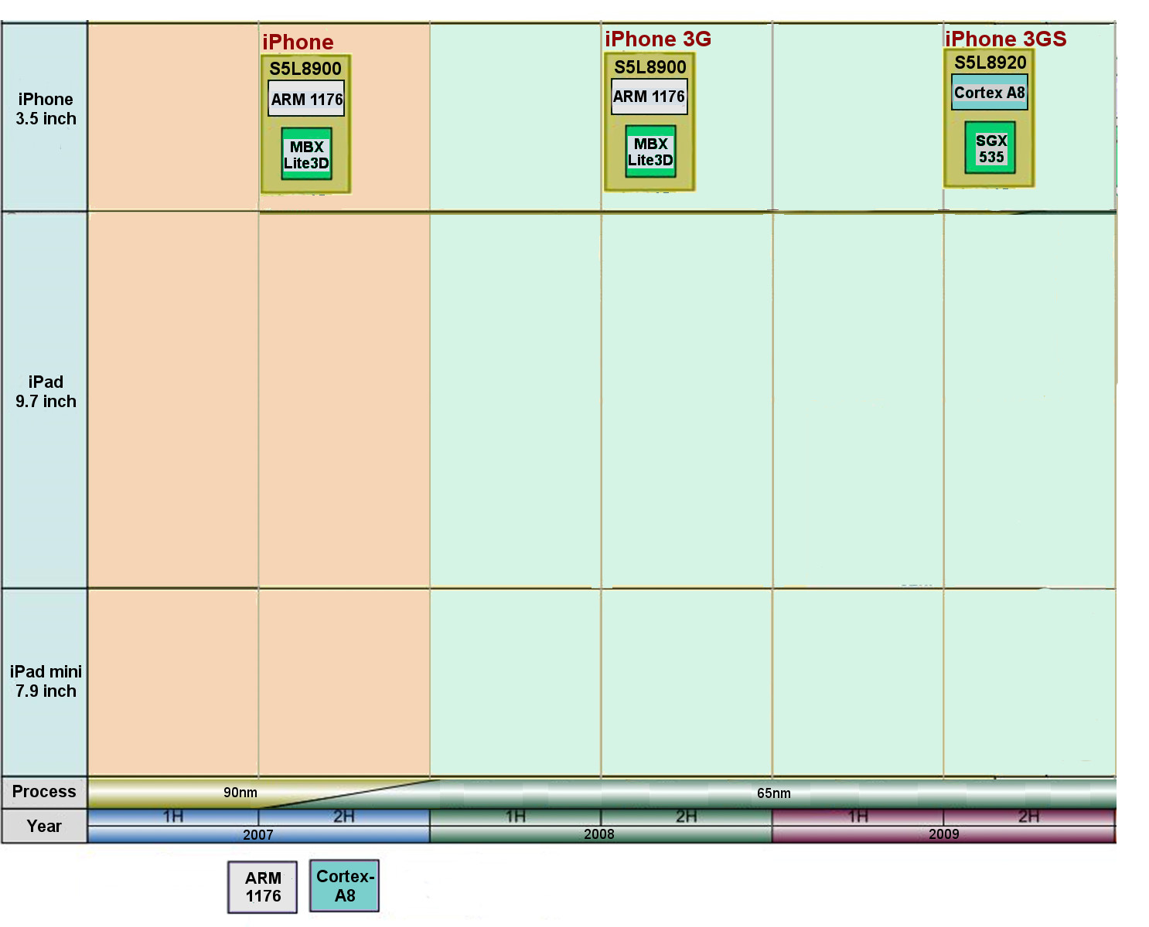
1. Overview of Apple’s mobile processors (1)
1. Overview of Apple’s mobile processors
Overview of Apple’s iPhone/iPad mobile devices-1 (based on [1])

Slide 6
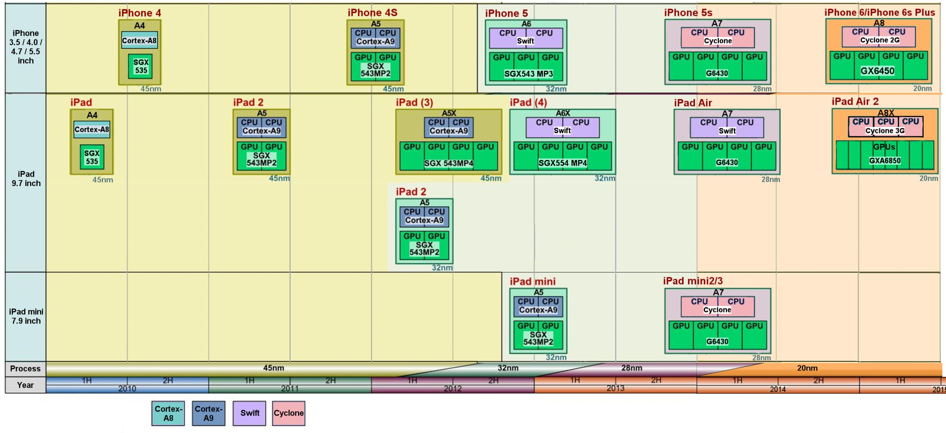
1. Overview of Apple’s mobile processors (2)
Overview of Apple’s iPhone/iPad mobile devices-2 (based on [1])

Slide 7
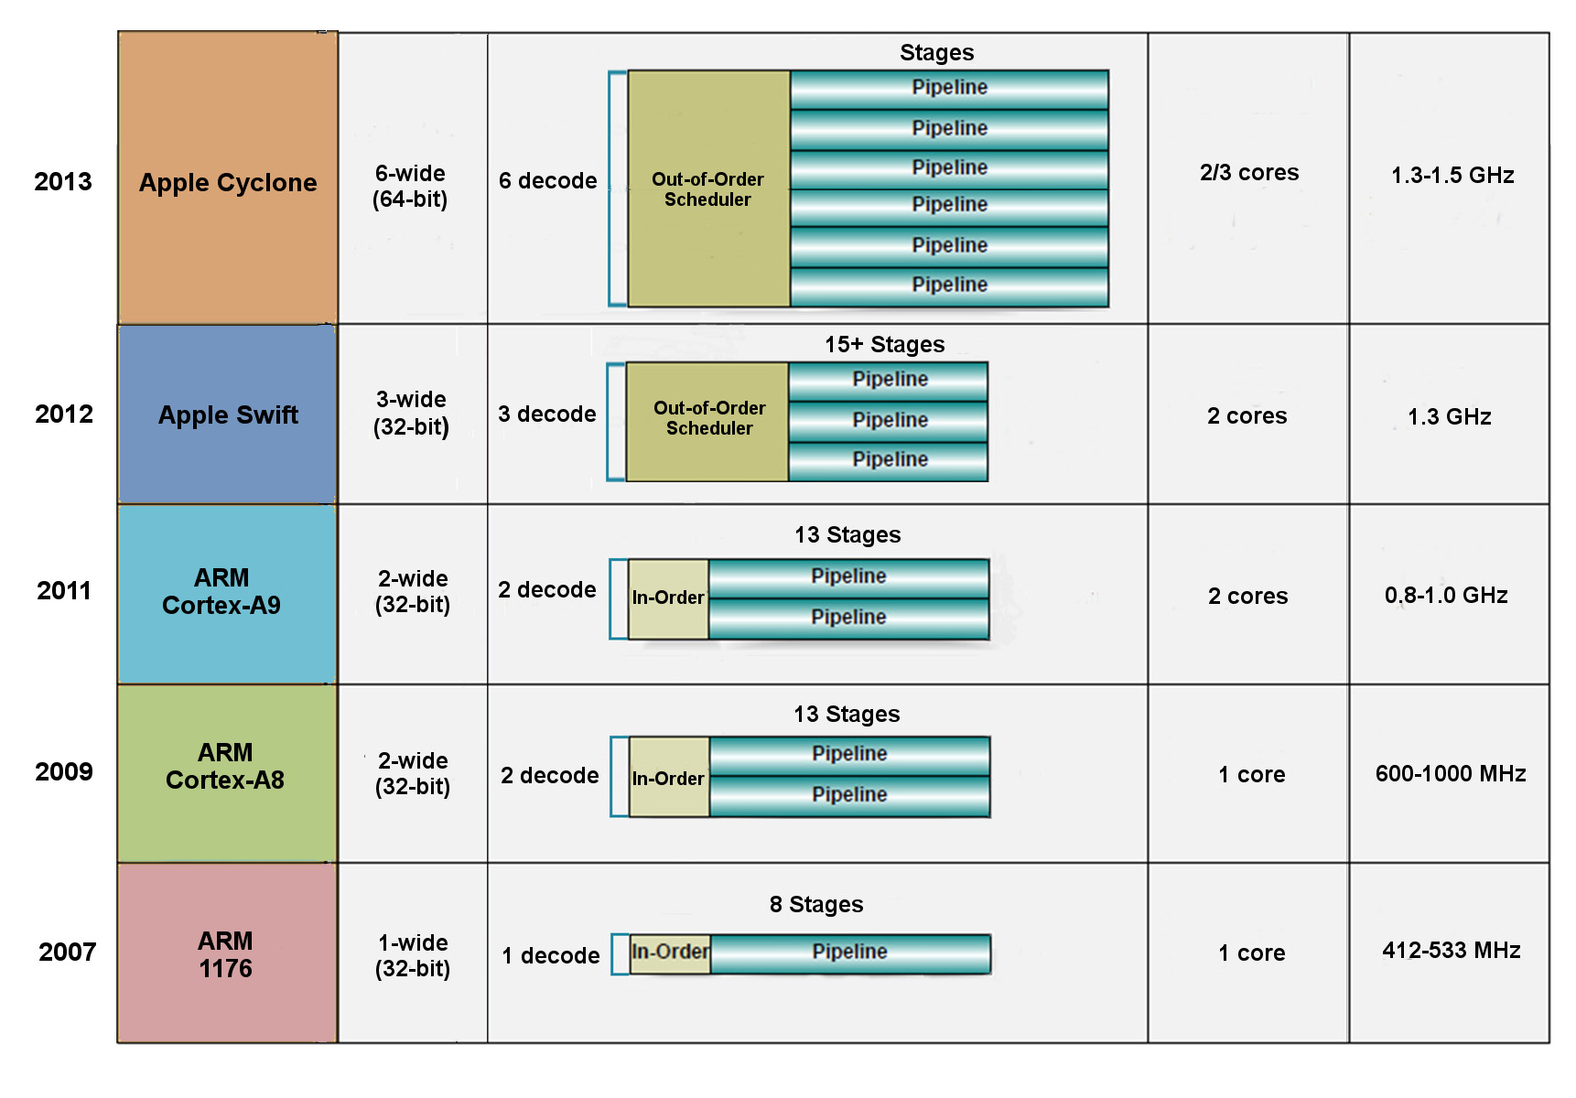
1. Overview of Apple’s mobile processors (3)
Key features of the processors used in Apple’s mobile devices (based on [2])

Slide 8
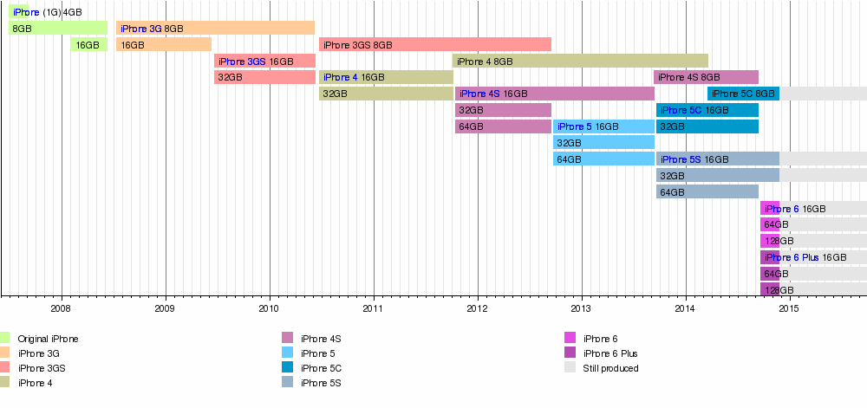
1. Overview of Apple’s mobile processors (4)
Overview of Apple’s iPhones and the size of the flash memory provided [3]

Slide 9
1. Overview of Apple’s mobile processors (5)
Main features of Apple’s iPhones-1 [4]

Slide 10
1. Overview of Apple’s mobile processors (6)
Main features of Apple’s iPhones-2 [4]

Slide 11
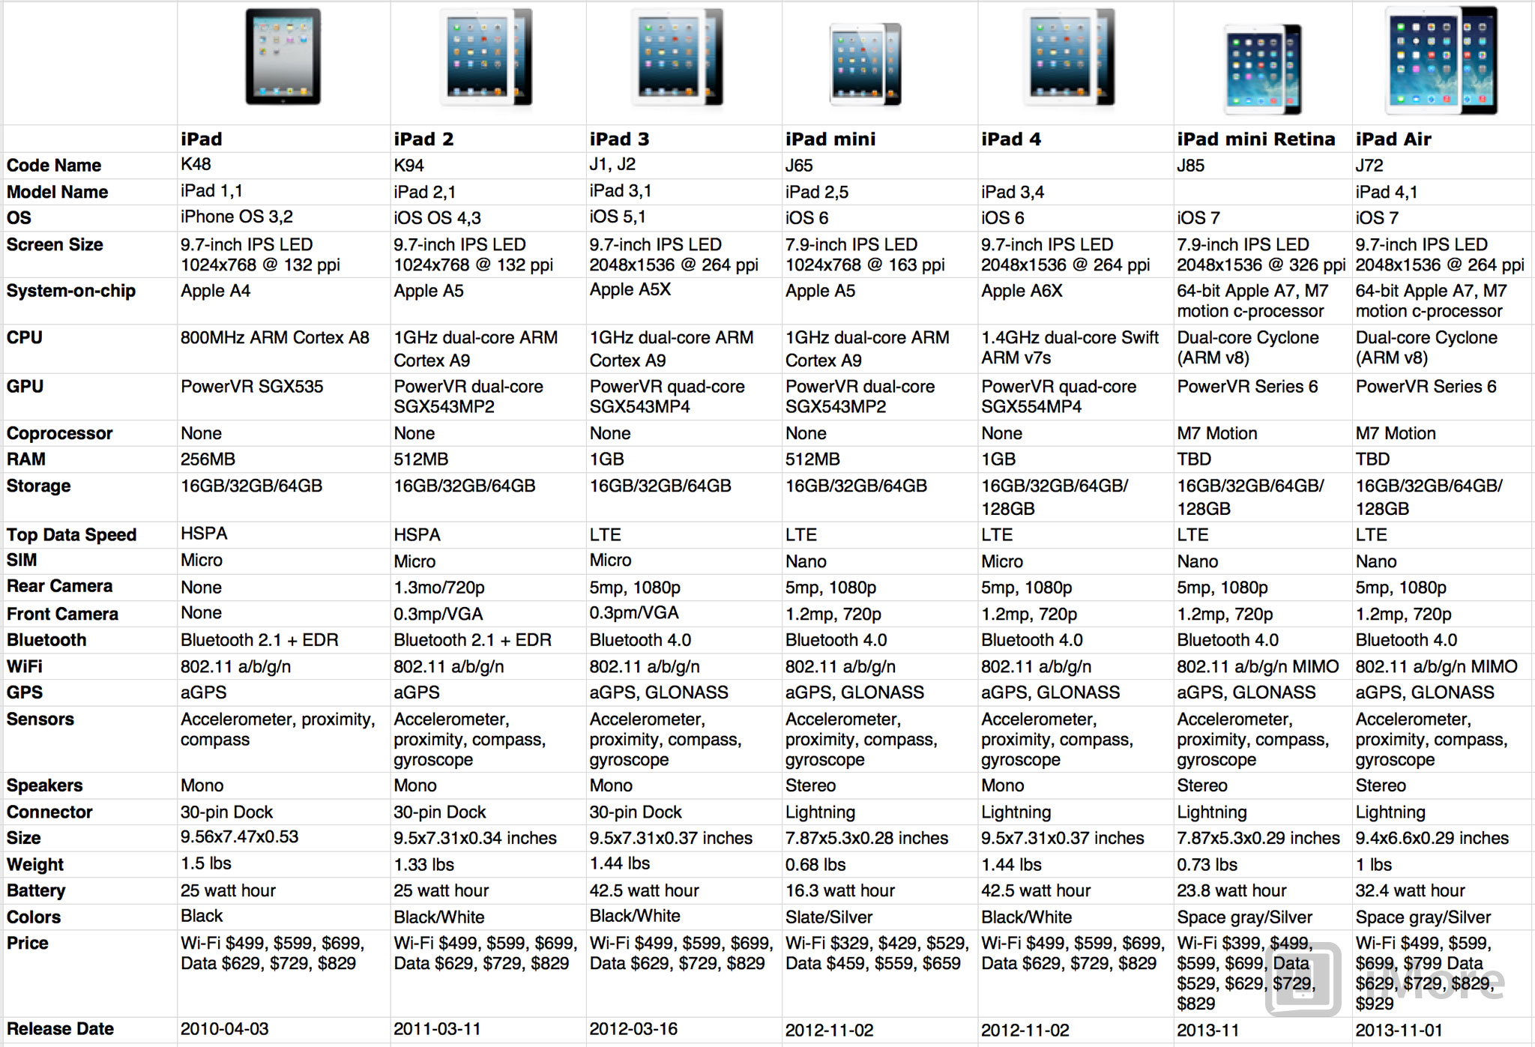
1. Overview of Apple’s mobile processors (7)
Main features of Apple’s iPads-1 [5]

Slide 12
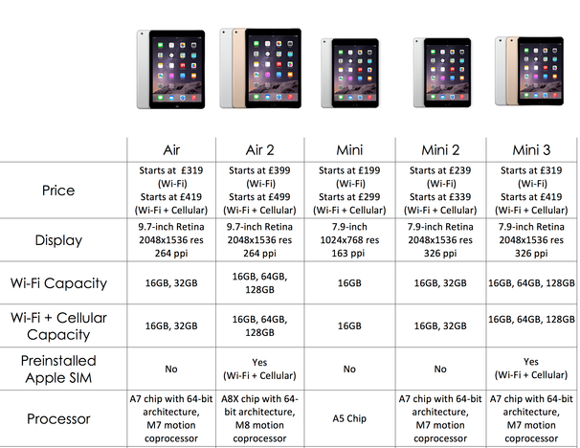
1. Overview of Apple’s mobile processors (8)
Main features of Apple’s iPads-2 [6]

Slide 13
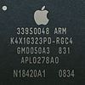
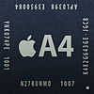
1. Overview of Apple’s mobile processors (9)
Main features of the processors used in Apple’s mobile devices-1
Type | Model no. | Image | Node | Die size | CPU | CPU ISA | CPU cache | GPU | Memory | Intro. | Utilizing devices
 | S5L8900X |  | 90 nm | 72 mm² | 1x ARM1176 412 MHz | ARMv6 | L1i: 16 KB L1d: 16 KB | PowerVR MBX Lite @ 103 MHz | 128 MB 16-bit SCh LPDDR-266 (532 MB/sec) |  | iPhone iPod Touch (1st gen.) iPhone 3G
 | APL0278 or S5L8720 |  | 65 nm | 36 mm² | 1x ARM1176 412–533 MHz | ARMv6 | L1i: 16 KB L1d: 16 KB | PowerVR MBX Lite @ 103–133 MHz | 32/128 MB 32-bit SCh LPDDR-133 | 9/2008 | iPod Touch (2nd gen.) iPod Nano (4th gen.)
 | APL0298 or S5L8920 |  | 65 nm | 71.8 mm² | 1x Cortex-A8 600 MHz | ARMv7 | L1i: 32 KB L1d: 32 KB L2: 256 KB | PowerVR SGX535 @ 150 MHz (1.2 GFLOPS) | 256 MB 32-bit SCh LPDDR-400 (1.6 GB/sec) | 6/2009 | iPhone 3GS
 | APL2298 or S5L8922 |  | 45 nm | 41.6 mm² | 1x Cortex-A8 600–800 MHz | ARMv7 | L1i: 32 KB L1d: 32 KB L2: 256 KB | PowerVR SGX535 @ 150–200 MHz (1.2–1.6 GFLOPS) | 256 MB 32-bit SCh LPDDR-400 (1.6 GB/sec) | 9/2009 | iPod Touch (3rd gen.)
A4 | APL0398 or S5L8930 |  | 45 nm | 53.3 mm² | 1x Cortex-A8 0.8–1.0 GHz | ARMv7 | L1i: 32 KB L1d: 32 KB L2: 512 KB | PowerVR SGX535 @ 200–250 MHz (1.6–2 GFLOPS) | 256 MB (iPad) 512 MB (iPhone 4) 32-bit DCh LPDDR-400 (3.2 GB/sec) | 3/2010 | iPad (1st gen.) iPhone 4 iPod Touch (4th gen.) Apple TV (2nd gen.)
6/2007
6/2008

Slide 14
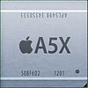
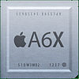
1. Overview of Apple’s mobile processors (10)
Main features of the processors used in Apple’s mobile devices-2
Type | Model no. | Image | Node | Die size | CPU | CPU ISA | CPU cache | GPU | Memory | Intro. | Utilizing devices
A5 | APL0498 or S5L8940 |  | 45 nm | 122.2 mm² | 2x Cortex-A9 0.8–1.0 GHz | ARMv7 | L1i: 32 KB L1d: 32 KB L2: 1 MB | PowerVR SGX543MP2 (2C) @ 200–250 MHz (12.8–16 GFLOPS) | 512 MB 32-bit DCh LPDDR2-800 (6.4 GB/sec) | 3/2011 | iPad 2 iPhone 4S
 | APL2498 or S5L8942 |  | 32 nm HKMG | 69.6 mm² | 2x Cortex-A9 0.8–1.0 GHz | ARMv7 | L1i: 32 KB L1d: 32 KB L2: 1 MB | PowerVR SGX543MP2 (2C) @ 200–250 MHz (12.8–16 GFLOPS) | 512 MB 32-bit DCh LPDDR2-800 (6.4 GB/sec) | 3/2012 | iPad 2 (iPad 2,4) iPod Touch (5th gen.) iPad Mini
 | APL7498 or S5L8947 |  | 32 nm HKMG | 37.8 mm² | 1x Cortex-A9 1.0 GHz | ARMv7 | L1i: 32 KB L1d: 32 KB L2: 1 MB | PowerVR SGX543MP2 (2C) @ 200–250 MHz (12.8–16 GFLOPS) | 512 MB 32-bit DCh LPDDR2-800 (6.4 GB/sec) | 3/2013 | AppleTV 3 (AppleTV3,2)
A5X | APL5498 or S5L8945 |  | 45 nm | 165 mm² | 2x Cortex-A9 1.0 GHz | ARMv7 | L1i: 32 KB L1d: 32 KB L2: 1 MB | PowerVR SGX543MP4 (4C) @ 250 MHz (32 GFLOPS) | 1 GB 32-bit 4Ch LPDDR2-800 (12.8 GB/sec) | 3/2012 | iPad (3rd gen.)
A6 | APL0598 or S5L8950 |  | 32 nm HKMG | 96.71 mm² | 2x Swift 1.3 GHz | ARMv7s | L1i: 32 KB L1d: 32 KB L2: 1 MB | PowerVR SGX543MP3 (3C) @ 266 MHz (25.5 GFLOPS) | 1 GB 32-bit DCh LPDDR2-1066 (8.528 GB/sec) | 9/2012 | iPhone 5 iPhone 5C
A6X | APL5598 or S5L8955 |  | 32 nm HKMG | 123 mm² | 2x Swift 1.4 GHz | ARMv7s | L1i: 32 KB L1d: 32 KB L2: 1 MB | PowerVR SGX554MP4 (4C) @ 266 MHz (68.1 GFLOPS) | 1 GB 32-bit 4Ch LPDDR2-1066 (17.1 GB/sec) | 10/2012 | iPad (4th gen.)

Slide 15
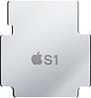
1. Overview of Apple’s mobile processors (11)
Main features of the processors used in Apple’s mobile devices-3
Type | Model no. | Image | Node | Die size | CPU | CPU ISA | CPU cache | GPU | Memory | Intro. | Utilizing devices
A7 | APL0698 or S5L8960 |  | 28 nm HKMG | 102 mm² | 2x Cyclone 1.3 GHz | ARMv8-A | L1i: 64 KB L1d: 64 KB L2: 1 MB L3: 4 MB | PowerVR G6430 (4C) @ 450 MHz (115.2 GFLOPS) | 1 GB 64-bit SCh LPDDR3-1600 (12.8 GB/sec) | 9/2013 | iPhone 5S iPad Mini 2 iPad Mini 3
 | APL5698 or S5L8965 |  | 28 nm HKMG | 102 mm² | 2x Cyclone 1.4 GHz | ARMv8-A | L1i: 64 KB L1d: 64 KB L2: 1 MB L3: 4 MB | PowerVR G6430 (4C) @ 450 MHz (115.2 GFLOPS) | 1 GB 64-bit SCh LPDDR3-1600 (12.8 GB/sec) | 10/2013 | iPad Air
A8 | APL1011 |  | 20 nm HKMG | 89 mm² | 2x Cyclone 2nd gen. 1.4 GHz | ARMv8-A | L1i: 64 KB L1d: 64 KB L2: 1 MB L3: 4 MB | PowerVR GX6450 (4C) @ 450 MHz (115.2 GFLOPS) | 1GB 64-bit SCh LPDDR3-1600 (12.8 GB/sec) | 9/2014 | iPhone 6 iPhone 6 Plus
A8X | APL1012 |  | 20 nm HKMG | 128 mm² | 3x Cyclone 2nd gen. 1.5 GHz | ARMv8-A | L1i: 64 KB L1d: 64 KB L2: 2 MB L3: 4 MB | PowerVR GXA6850 (8C) @ 450 MHz (230.4 GFLOPS) | 2 GB 64-bit DCh LPDDR3-1600 (25.6 GB/sec) | 10/2014 | iPad Air 2
S1 |  |  |  |  |  |  |  |  |  |  | Apple Watch

Slide 16
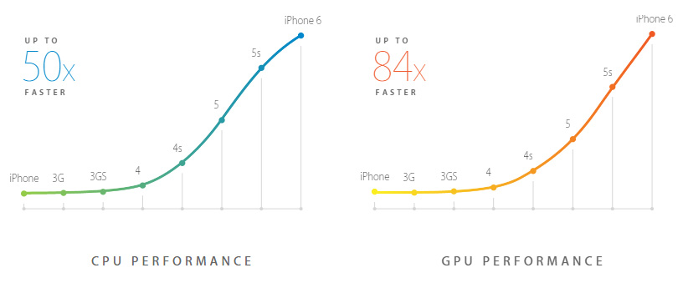
1. Overview of Apple’s mobile processors (12)
Performance increase of Apple’s iPhones [7]
iPhone 6 A8 SoC CPU and GPU performance graph (Apple’s own figures)

Slide 17
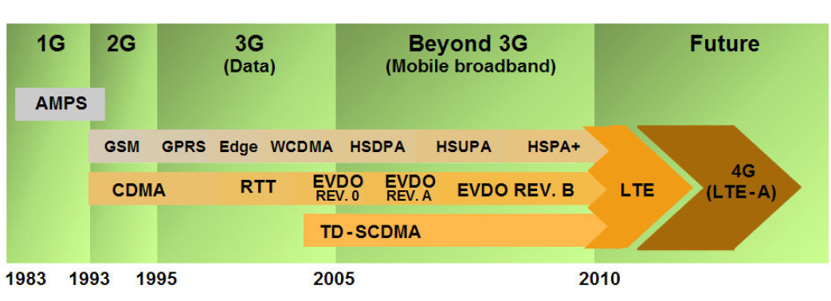
1. Overview of Apple’s mobile processors (13)
Evolution of cellular standards [8]

Slide 18
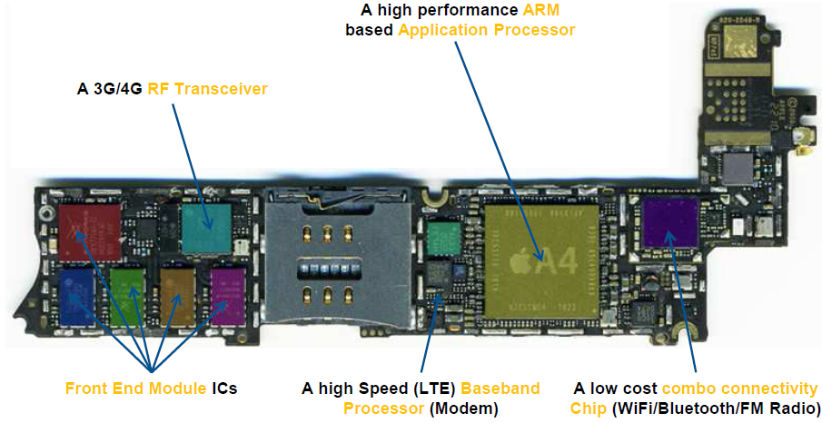
1. Overview of Apple’s mobile processors (14)
Main components of a smartphone or tablet [9]
Note
Processor memory (usually implemented as stacked memory on the processor) and
flash memory (usually implemented as an individual chip) not indicated in the Figure.

Slide 19
1. Overview of Apple’s mobile processors (15)
Apple’s patent issues [10]
Figure: Granted Apple patents
sorted by technology [10]

Slide 20
1. Overview of Apple’s mobile processors (16)
Overview of Apple’s iPhone/iPad mobile devices-1 (based on [1])

Slide 21
1. Overview of Apple’s mobile processors (17)
Overview of Apple’s iPhone/iPad mobile devices-2 (based on [1])

Slide 22
2. The original Apple iPhone
Notes:
22

Slide 23
2. The original Apple iPhone (1)
2. The original Apple iPhone-1
Type | Model no. | Image | Node | Die size | CPU | CPU ISA | CPU cache | GPU | Memory | Intro. | Utilizing devices
 | S5L8900X |  | 90 nm | 72 mm² | 1x ARM1176 412 MHz | ARMv6 | L1i: 16 KB L1d: 16 KB | PowerVR MBX Lite @ 103 MHz | 128 MB 16-bit SCh LPDDR-266 (532 MB/sec) |  | iPhone iPod Touch (1st gen.) iPhone 3G
 | APL0278 or S5L8720 |  | 65 nm | 36 mm² | 1x ARM1176 412–533 MHz | ARMv6 | L1i: 16 KB L1d: 16 KB | PowerVR MBX Lite @ 103–133 MHz | 32/128 MB 32-bit SCh LPDDR-133 | 9/2008 | iPod Touch (2nd gen.) iPod Nano (4th gen.)
 | APL0298 or S5L8920 |  | 65 nm | 71.8 mm² | 1x Cortex-A8 600 MHz | ARMv7 | L1i: 32 KB L1d: 32 KB L2: 256 KB | PowerVR SGX535 @ 150 MHz (1.2 GFLOPS) | 256 MB 32-bit SCh LPDDR-400 (1.6 GB/sec) | 6/2009 | iPhone 3GS
 | APL2298 or S5L8922 |  | 45 nm | 41.6 mm² | 1x Cortex-A8 600–800 MHz | ARMv7 | L1i: 32 KB L1d: 32 KB L2: 256 KB | PowerVR SGX535 @ 150–200 MHz (1.2–1.6 GFLOPS) | 256 MB 32-bit SCh LPDDR-400 (1.6 GB/sec) | 9/2009 | iPod Touch (3rd gen.)
A4 | APL0398 or S5L8930 |  | 45 nm | 53.3 mm² | 1x Cortex-A8 0.8–1.0 GHz | ARMv7 | L1i: 32 KB L1d: 32 KB L2: 512 KB | PowerVR SGX535 @ 200–250 MHz (1.6–2 GFLOPS) | 256 MB (iPad) 512 MB (iPhone 4) 32-bit DCh LPDDR-400 (3.2 GB/sec) | 3/2010 | iPad (1st gen.) iPhone 4 iPod Touch (4th gen.) Apple TV (2nd gen.)
6/2007
6/2007

Slide 24
2. The original Apple iPhone (2)
The original iPhone-2
Designated also as the iPhone 2G.
Introduced in 1/2007 by Steve Jobs at the McWorld Expo.
Figure: Steve Jobs introducing the iPhone at MacWorld Expo in 1/2007 [11]
The iPhone became available in 6/2007 in the US and later elsewhere.

Slide 25
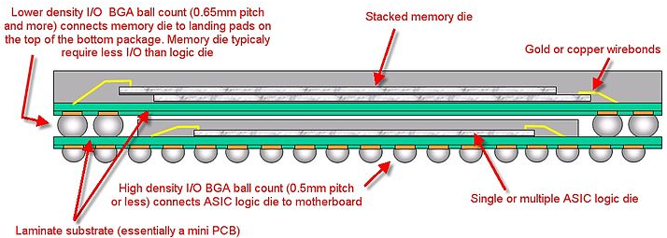
2. The original Apple iPhone (3)
Implementation of the iPhone (termed also as the iPhone 2)
The original iPhone was based on a PoP package (Package on Package), designated
as S5L8900B01, that included
the ARM1176ZF-S 32-bit processor with the ARMv6 ISA
Imagination Technologies’ Power VR MBX Lite 3D graphics accelerator
two 512 Mb DDR SDRAM (providing 128 MB stacked memory),
as illustrated below.
2x512 Mbit DDR SDRAM
ARM1176Z(F)-S + Power VR MBX Lite 3D
(not revealed weather on the same or on separate dies)
Figure: iPhone’s heart, the S5L8900B01 PoP, fabricated by Samsung (90 nm) [4]

Slide 26
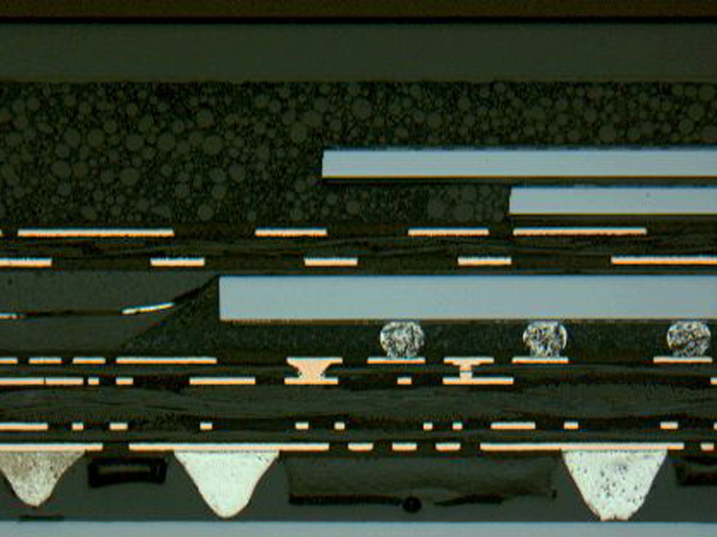
2. The original Apple iPhone (4)
Cross section of the iPhone [12]
DRAM dies
A4 die
Solder balls
Mini PCB

Slide 27
2. The original Apple iPhone (5)
Remarks
Multichip Packages (MCP) are standardized by JEDEC, the related standard originates
from 2006 (JC-63).
First PoPs emerged in cell phones around 2004 [13].
First generation PoP technology typically integrates the baseband or application
processor with one or two memory dies, as indicated in the next Figure.
Figure: Possible PoP structure for implementing a baseband or
application processor and two memory dies [13]
According to this, using PoP packaging for integrating the application processor and
the memory in Apple’s original iPhone was an early advanced packaging solution.

Slide 28
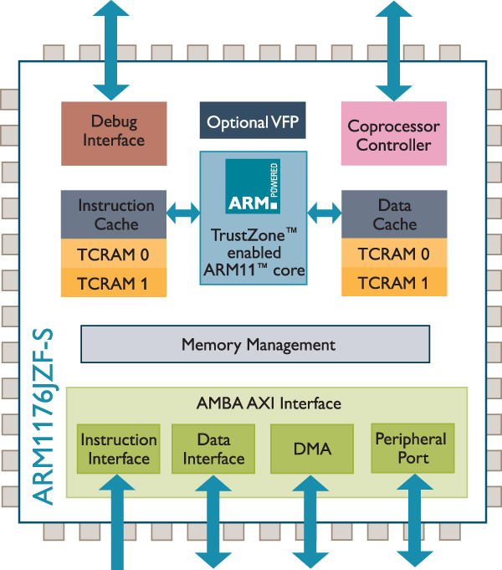
2. The original Apple iPhone (6)
The ARM1176JZF-S CPU [14]
The 32-bit CPU runs at a lower clock rate
(412 MHz) than possible (667 MHz)
to save power.
It supports the ARMv6 ISA.
It is a single issue processor.
It has 16 kB instruction and 16 kB data
caches, but no L2 cache.
It has a Vector FP Processing Unit (VFP).
Figure: The ARM1176JZF-S CPU [14]

Slide 29
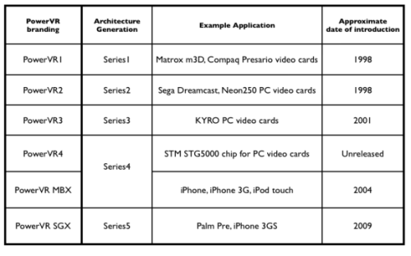
2. The original Apple iPhone (7)
The PowerVR MBX Lite 3D graphics accelerator
Figure: Generations of the PowerVR gaphics chips [15]

Slide 30
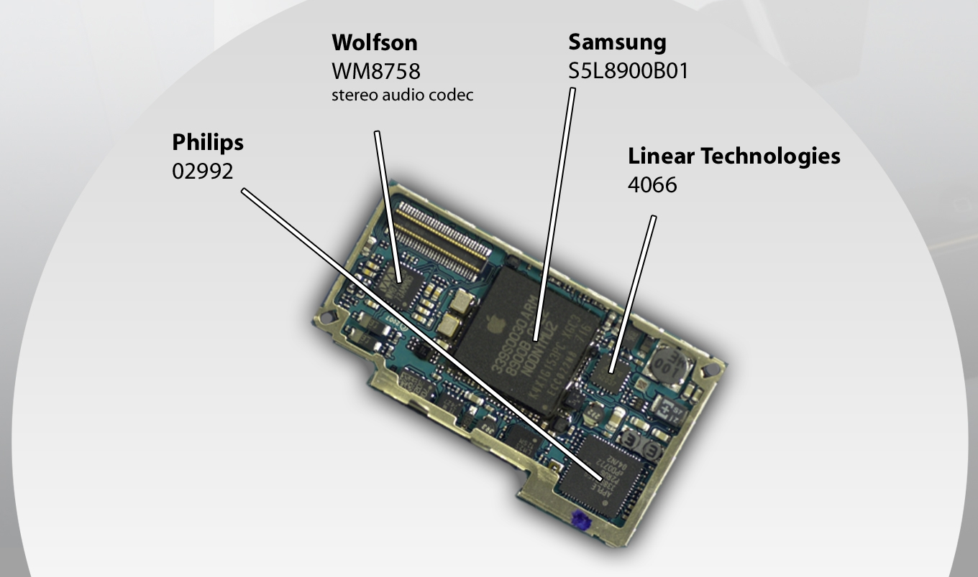
2. The original Apple iPhone (8)
The iPhone board (one side) [16]
ARM1176Z(F)-S +
128 MB of stacked, POP DDR SDRAM
Touchscreen controller
Battery charger

Slide 31
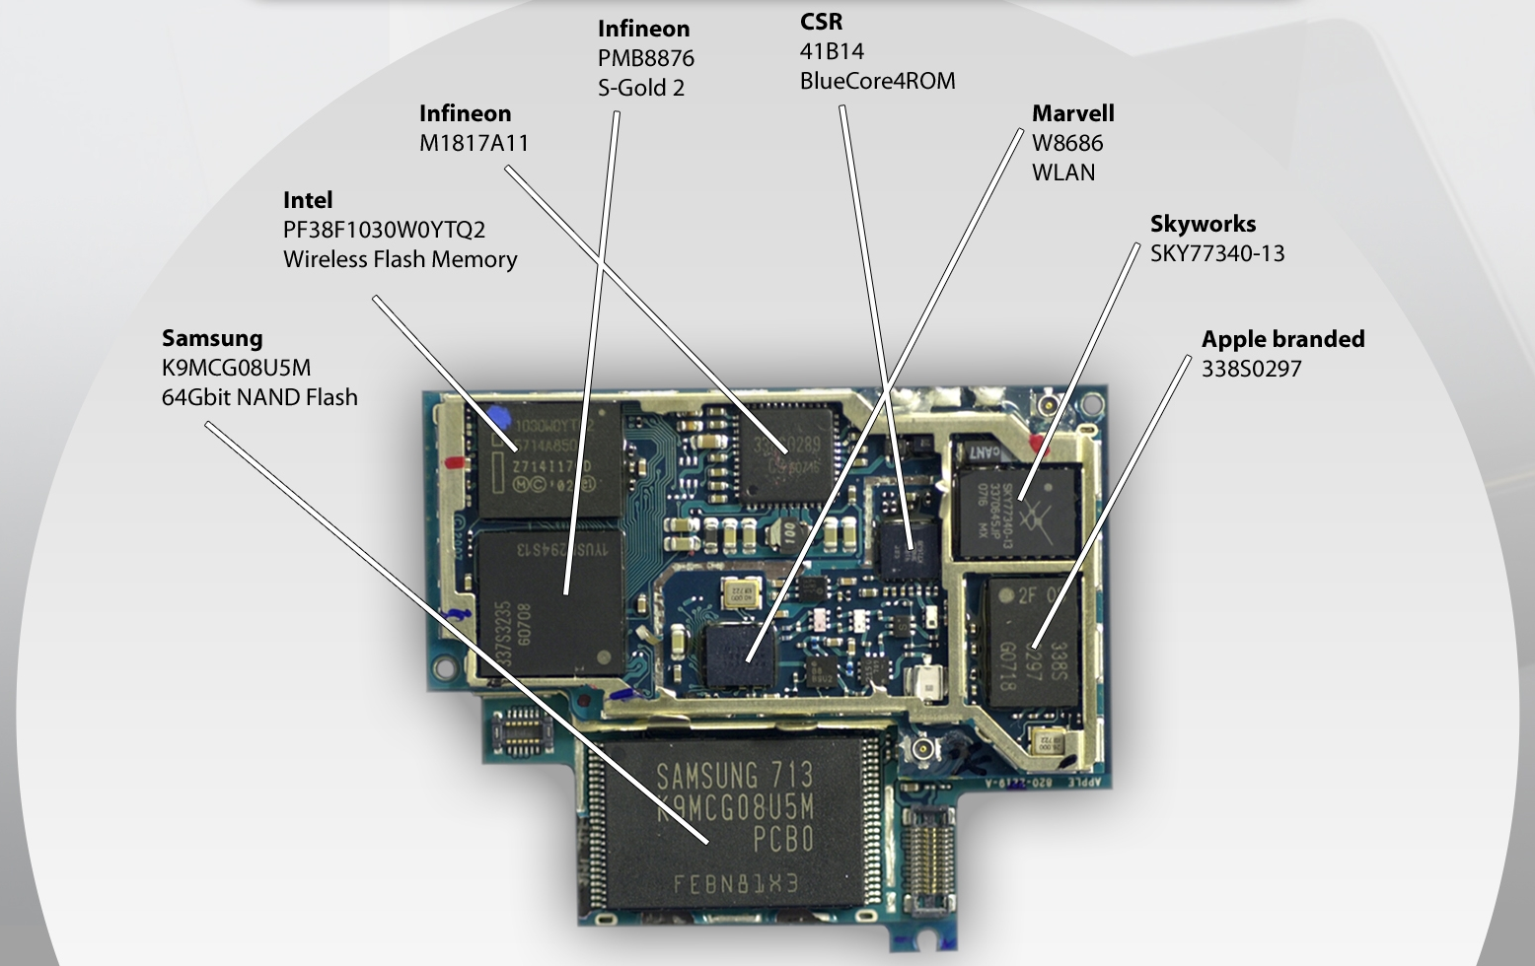
2. The original Apple iPhone (9)
The iPhone board (the other side) [16]
Baseband
modem
Bluetooth
RF transceiver
GSM/EDGE
quad-band amp
(8 GB)
EDGE MCP
MCP: Multi Chip Package)

Slide 32
3. Apple A4
Notes:
32

Slide 33
3. Apple A4 (1)
3. Apple A4-1
Type | Model no. | Image | Node | Die size | CPU | CPU ISA | CPU cache | GPU | Memory | Intro. | Utilizing devices
 | S5L8900X |  | 90 nm | 72 mm² | 1x ARM1176 412 MHz | ARMv6 | L1i: 16 KB L1d: 16 KB | PowerVR MBX Lite @ 103 MHz | 128 MB 16-bit SCh LPDDR-266 (532 MB/sec) |  | iPhone iPod Touch (1st gen.) iPhone 3G
 | APL0278 or S5L8720 |  | 65 nm | 36 mm² | 1x ARM1176 412–533 MHz | ARMv6 | L1i: 16 KB L1d: 16 KB | PowerVR MBX Lite @ 103–133 MHz | 32/128 MB 32-bit SCh LPDDR-133 | 9/2008 | iPod Touch (2nd gen.) iPod Nano (4th gen.)
 | APL0298 or S5L8920 |  | 65 nm | 71.8 mm² | 1x Cortex-A8 600 MHz | ARMv7 | L1i: 32 KB L1d: 32 KB L2: 256 KB | PowerVR SGX535 @ 150 MHz (1.2 GFLOPS) | 256 MB 32-bit SCh LPDDR-400 (1.6 GB/sec) | 6/2009 | iPhone 3GS
 | APL2298 or S5L8922 |  | 45 nm | 41.6 mm² | 1x Cortex-A8 600–800 MHz | ARMv7 | L1i: 32 KB L1d: 32 KB L2: 256 KB | PowerVR SGX535 @ 150–200 MHz (1.2–1.6 GFLOPS) | 256 MB 32-bit SCh LPDDR-400 (1.6 GB/sec) | 9/2009 | iPod Touch (3rd gen.)
A4 | APL0398 or S5L8930 |  | 45 nm | 53.3 mm² | 1x Cortex-A8 0.8–1.0 GHz | ARMv7 | L1i: 32 KB L1d: 32 KB L2: 512 KB | PowerVR SGX535 @ 200–250 MHz (1.6–2 GFLOPS) | 256 MB (iPad) 512 MB (iPhone 4) 32-bit DCh LPDDR-400 (3.2 GB/sec) | 3/2010 | iPad (1st gen.) iPhone 4 iPod Touch (4th gen.) Apple TV (2nd gen.)
6/2007
6/2007

Slide 34
3. Apple A4 (2)
Apple A4-2
Introduced in the
iPad (2010) and
iPhone 4 (2010).
The A4 is Apple’s first in-house design done in cooperation with Intrinsity
(a fabless semiconductor company, acquired by Apple in 2010).

Slide 35
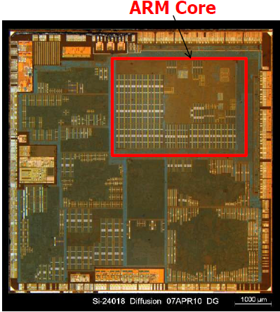
3. Apple A4 (3)
Main features of the A4 PoP [17]
The A4 PoP incorporates
the A4 SOC and
and 128 MB later 512MB
LPDDR 400 SDRAM stacked memory
(via 2x32-bit memory channels).
The A4 SOC includes among others
a single core ARM Cortex A8 CPU
supporting the ARMv7 ISA,
it is a dual-issue in order design,
clocked at 800 MHz and
including 512 kB L2,
dual core PowerVR SGX 535 GPU,
clocked at 200 MHz,
The internal designation of the A4 PoP
is S5L8930X.
The Pop was fabricated by Samsung
on a 45 nm process.
The die size is 53 mm².
Figure: Die plot of the A4 [17]

Slide 36
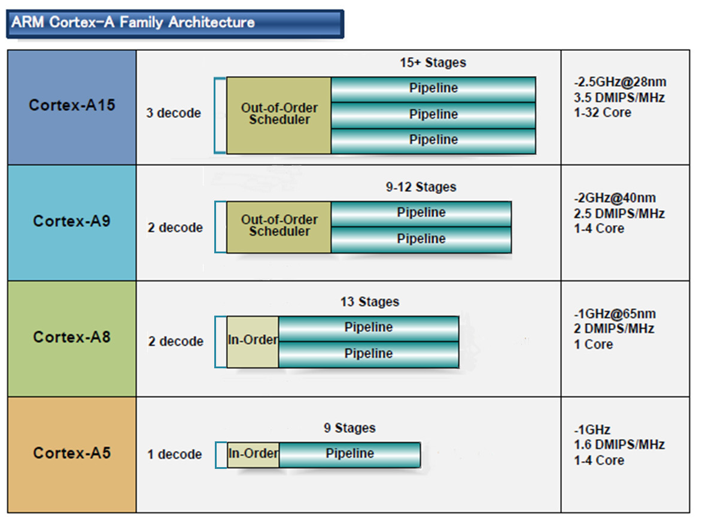
3. Apple A4 (4)
Microarchitecture of ARM’s 32-bit CPUs [2]
32-bit
2010
2007
2005
2009
(A9 replacement
for low-end
devices)

Slide 37
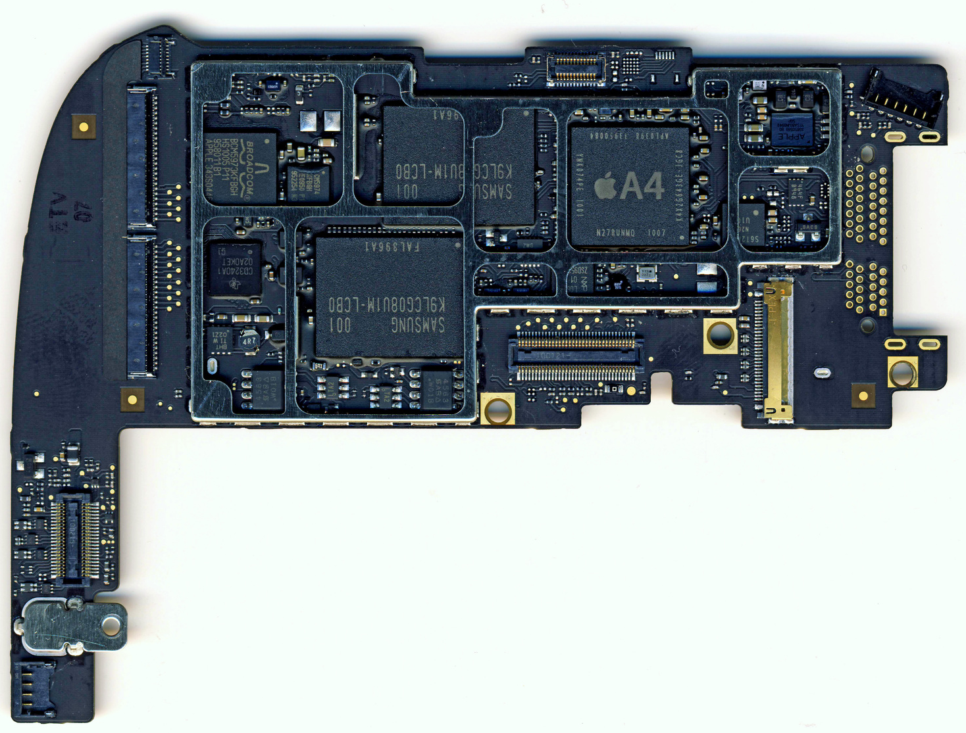
3. Apple A4 (5)
The iPad board-1 [12]

Slide 38
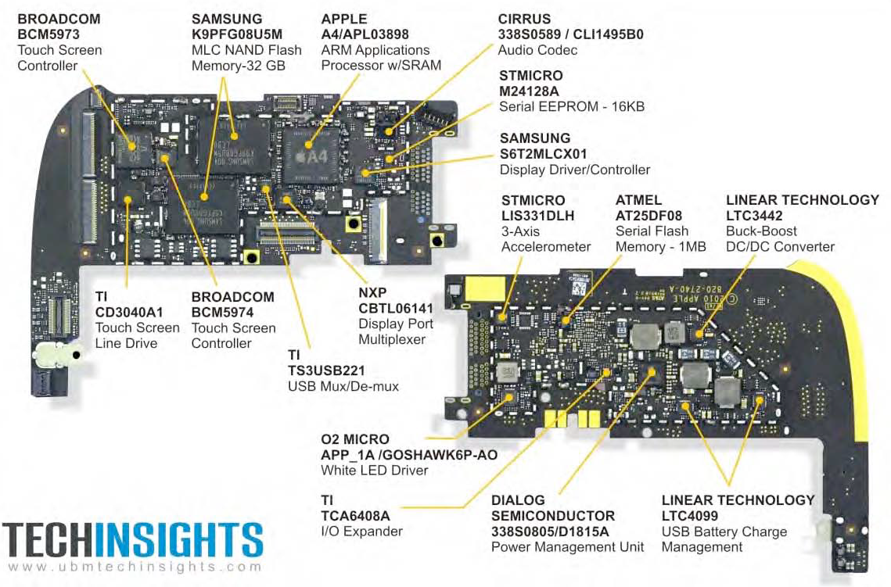
3. Apple A4 (6)
The iPad board-2 [18]

Slide 39
4. Apple A6 with dual Swift cores
Notes:
39

Slide 40
4. Apple A6 with dual Swift cores (1)
4. Apple A6 with dual Swift cores -1
Type | Model no. | Image | Node | Die size | CPU ISA | CPU | CPU cache | GPU | Memory | Intro. | Utilizing devices
A5 | APL0498 or S5L8940 |  | 45 nm | 122.2 mm² | ARMv7 | 0.8–1.0 GHz 2C Cortex-A9 | L1i: 32 KB L1d: 32 KB L2: 1 MB | PowerVR SGX543MP2 (2C) @ 200–250 MHz (12.8–16 GFLOPS) | 512 MB 32-bit DCh LPDDR2-800 (6.4 GB/sec) | 3/2011 | iPad 2 iPhone 4S
 | APL2498 or S5L8942 |  | 32 nm HKMG | 69.6 mm² | ARMv7 | 0.8–1.0 GHz 2C Cortex-A9 | L1i: 32 KB L1d: 32 KB L2: 1 MB | PowerVR SGX543MP2 (2C) @ 200–250 MHz (12.8–16 GFLOPS) | 512 MB 32-bit DCh LPDDR2-800 (6.4 GB/sec) | 3/2012 | iPad 2 (iPad2,4) iPod Touch (5th gen.) iPad Mini
 | APL7498 or S5L8947 |  | 32 nm HKMG | 37.8 mm² | ARMv7 | SC Cortex-A9 | L1i: 32 KB L1d: 32 KB L2: 1 MB | PowerVR SGX543MP2 (2C) @ 200–250 MHz (12.8–16 GFLOPS) | 512 MB 32-bit DCh LPDDR2-800 (6.4 GB/sec) | 3/2013 | AppleTV 3 (AppleTV3,2)
A5X | APL5498 or S5L8945 |  | 45 nm | 165 mm² | ARMv7 | 1.0 GHz 2C Cortex-A9 | L1i: 32 KB L1d: 32 KB L2: 1 MB | PowerVR SGX543MP4 (4C) @ 250 MHz (32 GFLOPS) | 1 GB 32-bit 4Ch LPDDR2-800 (12.8 GB/sec) | 3/2012 | iPad (3rd gen.)
A6 | APL0598 or S5L8950 |  | 32 nm HKMG | 96.71 mm² | ARMv7s | 1.3 GHz 2C Swift | L1i: 32 KB L1d: 32 KB L2: 1 MB | PowerVR SGX543MP3 (3C) @ 266 MHz (25.5 GFLOPS) | 1 GB 32-bit DCh LPDDR2-1066 (8.528 GB/sec) | 9/2012 | iPhone 5 iPhone 5C
A6X | APL5598 or S5L8955 |  | 32 nm HKMG | 123 mm² | ARMv7s | 1.4 GHz 2C Swift | L1i: 32 KB L1d: 32 KB L2: 1 MB | PowerVR SGX554MP4 (4C) @ 266 MHz (68.1 GFLOPS) | 1 GB 32-bit 4Ch LPDDR2-1066 (17.1 GB/sec) | 10/2012 | iPad (4th gen.)

Slide 41
4. Apple A6 with dual Swift cores (2)
Apple A6 with dual Swift codes -2
Introduction of the A6
It debuted in the iPhone5 (2012).
The A6 is Apple’s first own in-house design, it implements the ARMv7S ISA.
The S tag indicates an ISA extension implemented for the A6 (Swift) processor.

Slide 42
4. Apple A6 with dual Swift cores (3)
Remarks to the development of the A6 [19]
In 4/2008 Apple acquired PA Semi, a CPU design firm that had experience
in developing high performance PowerPC processors..
Previously, some of the team even took part also in the design of the low-power
StrongArm processor, at Digital Equipment Corporation.
About this time Apple also signed a licensing agreement with ARM to be able to
implement ARM compatible processors.
One group of the PA Semi employees set to work on the Apple A4, based on the
ARM Cortex A8 core whereas the other group began to define the microarchitecture
of the A6, designated as Swift.
In early 2010 the team completed the A6 microarchitecture design and started
with the physical design phase.
To enhance their physical design capabilities Apple acquired also Intrinsity.
With Intrinsity an experienced team of chip designers, specialized in high speed
physical design joined Apple.
Intrinsity just finalized tuning Samsung’s Hummingbird CPU for high speed and
low power, in cooperation with Samsung.
Apple’s A4 is based allegedly on the Hummingbird core.

Slide 43
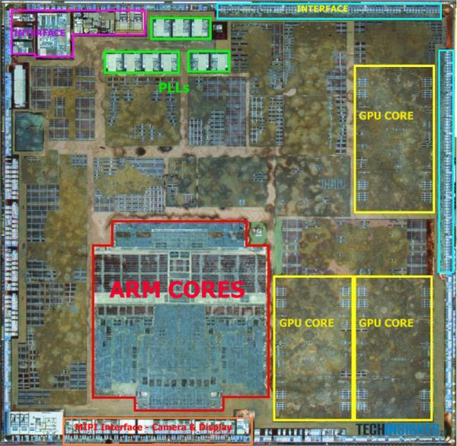
4. Apple A6 with dual Swift cores (4)
Main features of the A6 (Swift) PoP [17]
The A6 PoP incorporates
the A6 SOC and
1GB LPDDR2-1066 SDRAM
(via 2x32-bit memory channels).
the A6 SOC includes among others
dual Swift CPU cores
supporting the ARMv7s ISA
(enhanced ARMv7 for Swift),
it is a 3-wide out-of-order design,
clocked at 1.3 GHz and
including 1 1MB L2,
three core PowerVR SGX 545 GPU,
clocked at 333 MHz.
The internal designation of the A6 PoP
is S5L8930X.
The PoP was fabricated by Samsung
on a 32 nm process.
The die size is 97 mm².
Figure: The A6 SOC [17]

Slide 44
4. Apple A6 with dual Swift cores (5)
Main features of the A6 SOC compared with previous Apple processors [20]

Slide 45
4. Apple A6 with dual Swift cores (6)
Microarchitecture of the Swift core
The A6 is a 3-issue out-of-order superscalar with a dispatch rate of 4.
This is means that Apple’s A6 has a similar processing width as ARM’s Cortex A15,
as indicated in the next Figure.

Slide 46
4. Apple A6 with dual Swift cores (7)
Microarchitecture of ARM’s 32-bit CPUs [2]
32-bit
2010
2007
2005
2009
(A9 replacement
for low-end
devices)

Slide 47
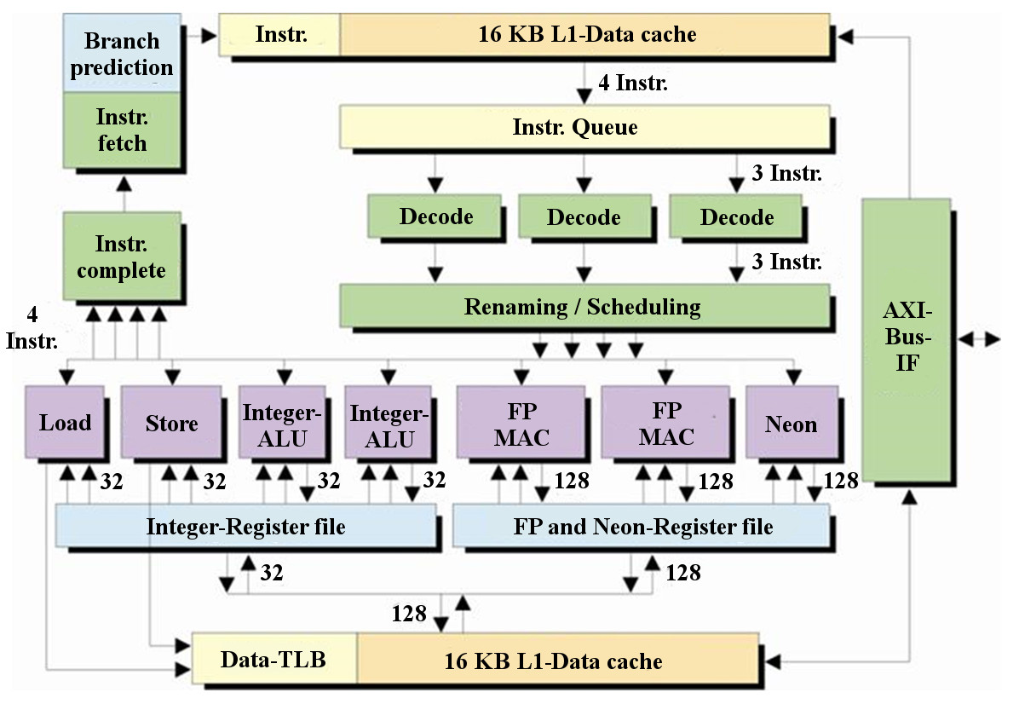
4. Apple A6 with dual Swift cores (8)
Assumed block diagram of the Swift core [21]

Slide 48
5. Apple A7 with dual Cyclone cores
Notes:
48

Slide 49
5. Apple A7 with dual Cyclone cores (1)
5. Apple A7 with dual Cyclone cores-1
Type | Model no. | Image | Node | Die size | CPU | CPU ISA | CPU cache | GPU | Memory | Intro. | Utilizing devices
A7 | APL0698 or S5L8960 |  | 28 nm HKMG | 102 mm² | 2x Cyclone 1.3 GHz | ARMv8-A | L1i: 64 KB L1d: 64 KB L2: 1 MB L3: 4 MB | PowerVR G6430 (4C) @ 450 MHz (115.2 GFLOPS) | 1 GB 64-bit SCh LPDDR3-1600 (12.8 GB/sec) | 9/2013 | iPhone 5S iPad Mini 2 iPad Mini 3
 | APL5698 or S5L8965 |  | 28 nm HKMG | 102 mm² | 2x Cyclone 1.4 GHz | ARMv8-A | L1i: 64 KB L1d: 64 KB L2: 1 MB L3: 4 MB | PowerVR G6430 (4C) @ 450 MHz (115.2 GFLOPS) | 1 GB 64-bit SCh LPDDR3-1600 (12.8 GB/sec) | 10/2013 | iPad Air
A8 | APL1011 |  | 20 nm HKMG | 89 mm² | 2x Cyclone 2nd gen. 1.4 GHz | ARMv8-A | L1i: 64 KB L1d: 64 KB L2: 1 MB L3: 4 MB | PowerVR GX6450 (4C) @ 450 MHz (115.2 GFLOPS) | 1GB 64-bit SCh LPDDR3-1600 (12.8 GB/sec) | 9/2014 | iPhone 6 iPhone 6 Plus
A8X | APL1012 |  | 20 nm HKMG | 128 mm² | 3x Cyclone 2nd gen. 1.5 GHz | ARMv8-A | L1i: 64 KB L1d: 64 KB L2: 2 MB L3: 4 MB | PowerVR GXA6850 (8C) @ 450 MHz (230.4 GFLOPS) | 2 GB 64-bit DCh LPDDR3-1600 (25.6 GB/sec) | 10/2014 | iPad Air 2
S1 |  |  |  |  |  |  |  |  |  |  | Apple Watch

Slide 50
5. Apple A7 with dual Cyclone cores (2)
A7 with dual Cyclone cores-2
Introduction
The A7 emerged in the mobile devices
iPhone 5S
iPad Mini 2
iPad Mini 3 and
iPad Air
in 2013.
It is Apple’s second own in-house design, it implements the ARMv8-A ISA,
that is the 64-bit ARMv8 ISA with custom Apple extensions.

Slide 51
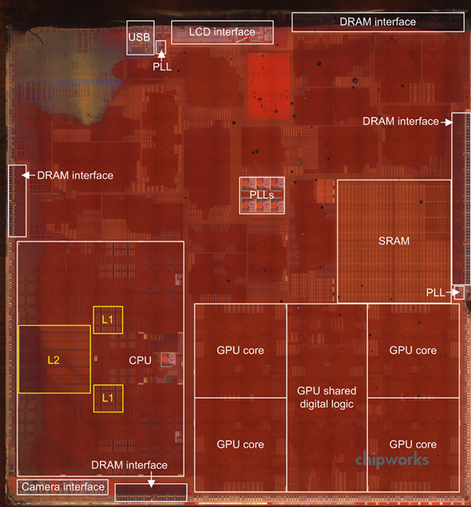
5. Apple A7 with dual Cyclone cores (3)
Main features of the A7 PoP [10]
The A7 PoP consists of the A7 SOC with stacked SDRAM.
The A7 SOC includes among others
dual Cyclone CPU cores that
support the ARMv8-A ISA
(ARMv8 enhanced for Apple).
Each core is an extraordinary wide,
6-issue out-of-order design,
that is clocked at 1.3 GHz and
includes 1MB L2,
a PowerVR 6430 GPU that has four
cores and is clocked at 450 MHz.
The stacked SDRAM is 1GB
LPDDR3-1600 SDRAM (attached via
2x32-bit memory channels).
The internal designation of the A7 PoP
is S5L8960X.
The PoP was fabricated by Samsung
on a 28 nm process.
The die size is 102 mm².
The transistor count is ~ 1 billion.
Figure: The A7 SOC [10]

Slide 52
5. Apple A7 with dual Cyclone cores (4)
Using a motion coprocessor (designated as M7) to reduce the load of the A7
[22], [23]
The iPhone 5s, iPad mini 2, 3 or the iPad Air A7 also include a motion coprocessor,
designated as M7.
It is actually an ARM Cortex-M3 microcontroller running at 180 MHz.
The chip collects information from sensors, such as the accelerometer, gyroscope
or magnetometer, processes these data and forwards workable data to the A7.
Health and fitness apps can then make use of these data e.g. for distinguishing
the type or speed of the motion currently taking place etc..
The low power M7 reduces the load on the A7 chip and greatly improves in this
way battery life.
Subsequent implementations of Apple’s mobile devices continue to make use
of motion coprocessors (designated as the M8 for the A8 and A8X SOCs).

Slide 53
5. Apple A7 with dual Cyclone cores (5)
Microarchitecture of the Cyclone core-1
In order to support LLVM compiler optimization Apple revealed the machine model
of the Cyclone core as follows.

Slide 54
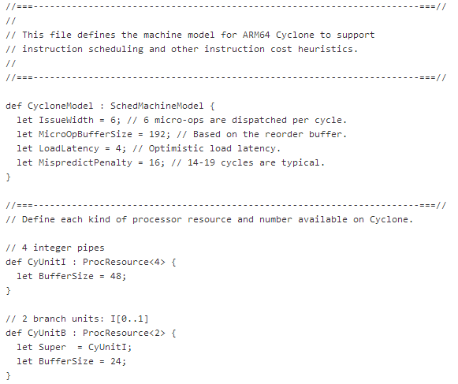
5. Apple A7 with dual Cyclone cores (6)
Part of the machine model of the Cyclone core as revealed by Apple [24]

Slide 55
5. Apple A7 with dual Cyclone cores (7)
Microarchitecture of the Cyclone core-2
Based on the above compiler specifications, Cyclone’s microarchitecture was
guessed in two publications, as shown next.

Slide 56
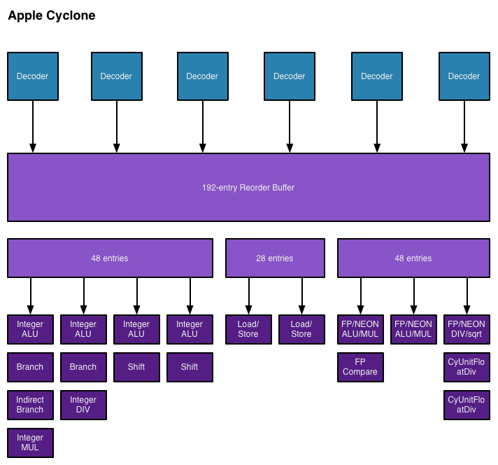
5. Apple A7 with dual Cyclone cores (8)
Assumed block diagram of the Cyclone core, based on [25]

Slide 57
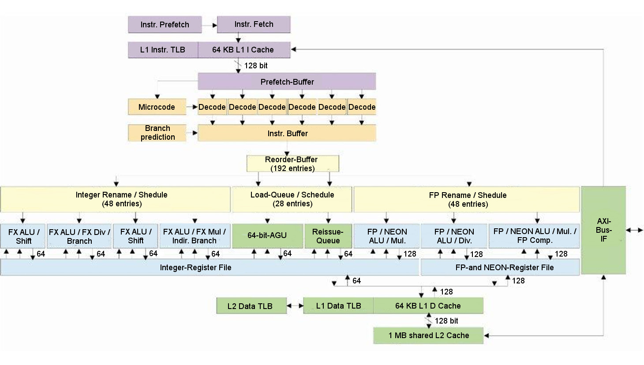
5. Apple A7 with dual Cyclone cores (9)
Assumed block diagram of the Cyclone core, based on [26]

Slide 58
5. Apple A7 with dual Cyclone cores (10)
Microarchitecture of the Cyclone core-3
As seen, the Cyclone core is an extremely wide - 6-wide - out-of-order superscalar with an issue rate of 9.
In contrast, even Intel’s and AMD’s recent performance/Watt oriented processors
such as Haswell, Broadwell, Bulldozer or Piledriver are only 4-wide designs,
as indicated in the next Figure.

Slide 59
5. Apple A7 with dual Cyclone cores (11)
Microarchitecture of the cores in Intel’s/AMD’s recent x86 processors
They aim at high performance/power (in terms of GFLOPS/Watt) and
have 4-wide microarchitectures, as the next example shows:
64-bit
Figure: Width of the coresin Intel’s Core 2 (2006) to Broadwell (2014) processors
that cover all segments, from servers to laptops.
We note that AMD introduced 4-wide microarchitectures only five years later, in their
Bulldozer line in 2011.

Slide 60
5. Apple A7 with dual Cyclone cores (12)
Remark [25]
Apple does not reveal any details of their processor microarchitectures.
Nevertheless, Apple has to specify microarchitecture parameters for compiler
designers to optimize compiler operation.
The assumed block diagram is built up out of those specifications (LLVM commits)
and related testing.

Slide 61
5. Apple A7 with dual Cyclone cores (13)
Contrasting key features of the A6 and A7 microarchitectures [25]

Slide 62
5. Apple A7 with dual Cyclone cores (14)
Performance comparison of Apple processors [27]
A8X
3C
A8
2C
A7
2C
A6X
2C
The benchmark scores for Geekbench 3 show that the 6-wide A7 has approximately
twice the performance of the 3-wide A6X.

Slide 63
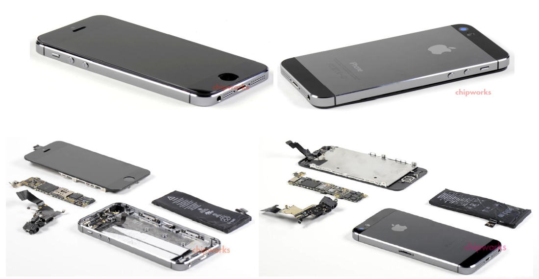
5. Apple A7 with dual Cyclone cores (15)
Example: Apple’s iPhone 5s xxx [10]
Apple iPhone 5s

Slide 64
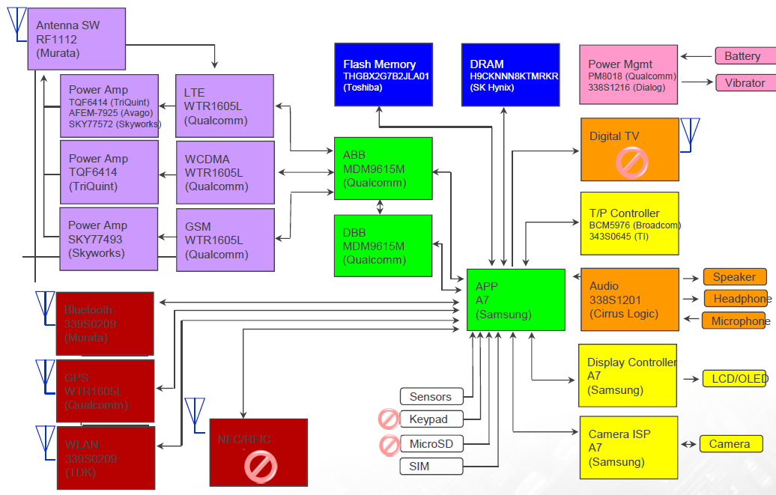
5. Apple A7 with dual Cyclone cores (16)
Assumed block diagram of the Apple iPhone 5s [10]

Slide 65
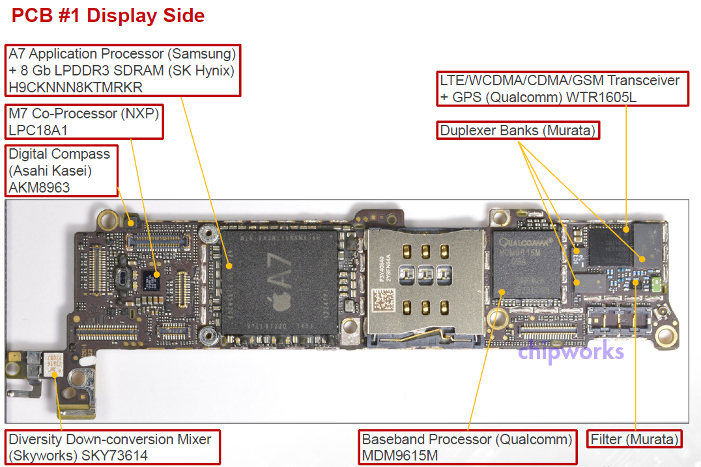
5. Apple A7 with dual Cyclone cores (17)
Display side of the PCB#1 in Apple’s iPhone 5s [10]

Slide 66
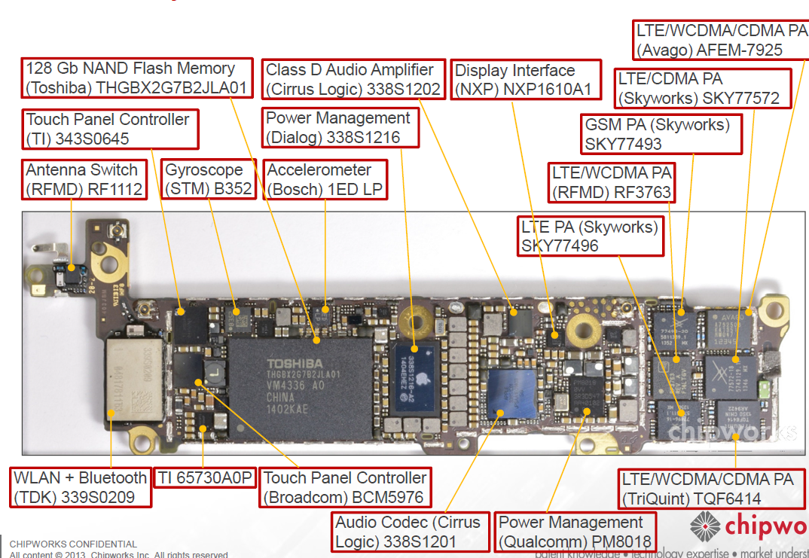
5. Apple A7 with dual Cyclone cores (18)
Battery side of the PCB#2 in Apple’s iPhone 5s [10]

Slide 67
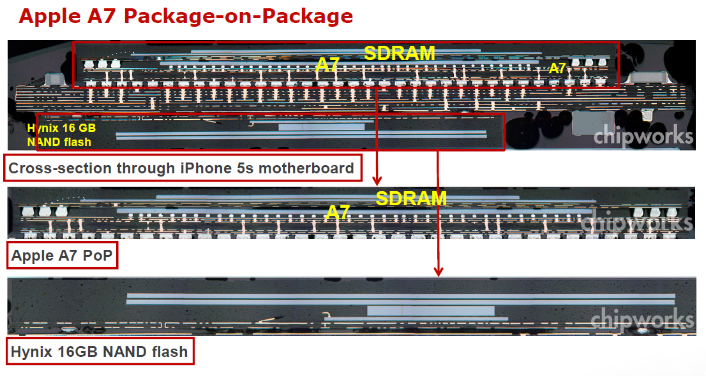
5. Apple A7 with dual Cyclone cores (19)
Apple’s A7 Package-on-Package in the iPhone 5s [10]

Slide 68
6. Apple A8 with dual Cyclone cores
Notes:
68

Slide 69
6. Apple A8 with dual Cyclone cores (1)
6. Apple A8 with dual Cyclone cores
Type | Model no. | Image | Node | Die size | CPU | CPU ISA | CPU cache | GPU | Memory | Intro. | Utilizing devices
A7 | APL0698 or S5L8960 |  | 28 nm HKMG | 102 mm² | 2x Cyclone 1.3 GHz | ARMv8-A | L1i: 64 KB L1d: 64 KB L2: 1 MB L3: 4 MB | PowerVR G6430 (4C) @ 450 MHz (115.2 GFLOPS) | 1 GB 64-bit SCh LPDDR3-1600 (12.8 GB/sec) | 9/2013 | iPhone 5S iPad Mini 2 iPad Mini 3
 | APL5698 or S5L8965 |  | 28 nm HKMG | 102 mm² | 2x Cyclone 1.4 GHz | ARMv8-A | L1i: 64 KB L1d: 64 KB L2: 1 MB L3: 4 MB | PowerVR G6430 (4C) @ 450 MHz (115.2 GFLOPS) | 1 GB 64-bit SCh LPDDR3-1600 (12.8 GB/sec) | 10/2013 | iPad Air
A8 | APL1011 |  | 20 nm HKMG | 89 mm² | 2x Cyclone 2nd gen. 1.4 GHz | ARMv8-A | L1i: 64 KB L1d: 64 KB L2: 1 MB L3: 4 MB | PowerVR GX6450 (4C) @ 450 MHz (115.2 GFLOPS) | 1GB 64-bit SCh LPDDR3-1600 (12.8 GB/sec) | 9/2014 | iPhone 6 iPhone 6 Plus
A8X | APL1012 |  | 20 nm HKMG | 128 mm² | 3x Cyclone 2nd gen. 1.5 GHz | ARMv8-A | L1i: 64 KB L1d: 64 KB L2: 2 MB L3: 4 MB | PowerVR GXA6850 (5C) @ 450 MHz (230.4 GFLOPS) | 2 GB 64-bit DCh LPDDR3-1600 (25.6 GB/sec) | 10/2014 | iPad Air 2
S1 |  |  |  |  |  |  |  |  |  |  | Apple Watch

Slide 70
6. Apple A8 with dual Cyclone cores (2)
Introduction of the Apple A8 with dual Cyclone cores [28]
The A8 emerged in the mobile devices
iPhone 6 and
iPhone 6 Plus
in 2014.
It is a 20 nm shrink of the A7 (fabricated by TSMC rather than Samsung, as
previously) with an improved GPU.
It contains 2 billion transistors, roughly twice compared to A7.
The die size has been reduced by about 13 % to 89 mm².
The A8 has approximately the same clock rate as the A7 (1.38 GHz).
The second generation Cyclone core is about 10 % faster than its predecessor
(the A7), as indicated in the subsequent Figure for the Geekbench 3 benchmark.

Slide 71
6. Apple A8 with dual Cyclone cores (3)
Performance comparison of Apple processors from the A6X to A8X [27]
A8X
3C
A8
2C
A7
2C
A6X
2C
The benchmark scores for Geekbench 3 show that the A8, i.e. the 20 nm shrink of
the 28 nm A7, has approximately 10% performance improvement over the A7.

Slide 72
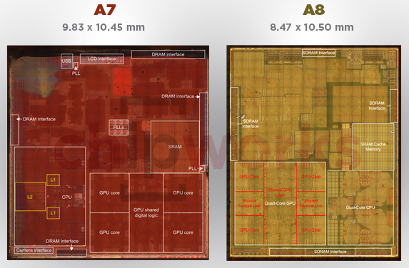
6. Apple A8 with dual Cyclone cores (4)
Comparing the die plots of A8 and A7 [29]

Slide 73
6. Apple A8 with dual Cyclone cores (5)
The assumed microarchitecture of the Cyclone core of the A8 [29]
It can be assumed that A8 includes the same Cyclone core as the A7.

Slide 74
6. Apple A8 with dual Cyclone cores (6)
Layout of the Cyclone core of the A8
Despite the fact that the A8 has presumable the same Cyclone core as the A7, its
core count is raised from about 1 billion to about 2 billion.
This astonishing doubling of the transistor count may result from the fact that
the A8 is a complete redesign of the A7 on a new process technology of TSMC
while focusing on raising the energy efficiency.
Actually, Apple declared that the A8 is up to 50 % more energy efficient than the A7.

Slide 75
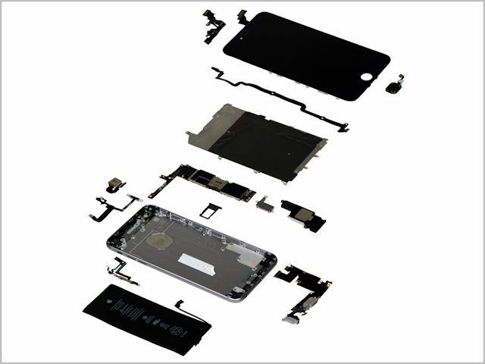
6. Apple A8 with dual Cyclone cores (7)
Exploded assembly drawing of the iPhone 6+ [30]
Logic board

Slide 76
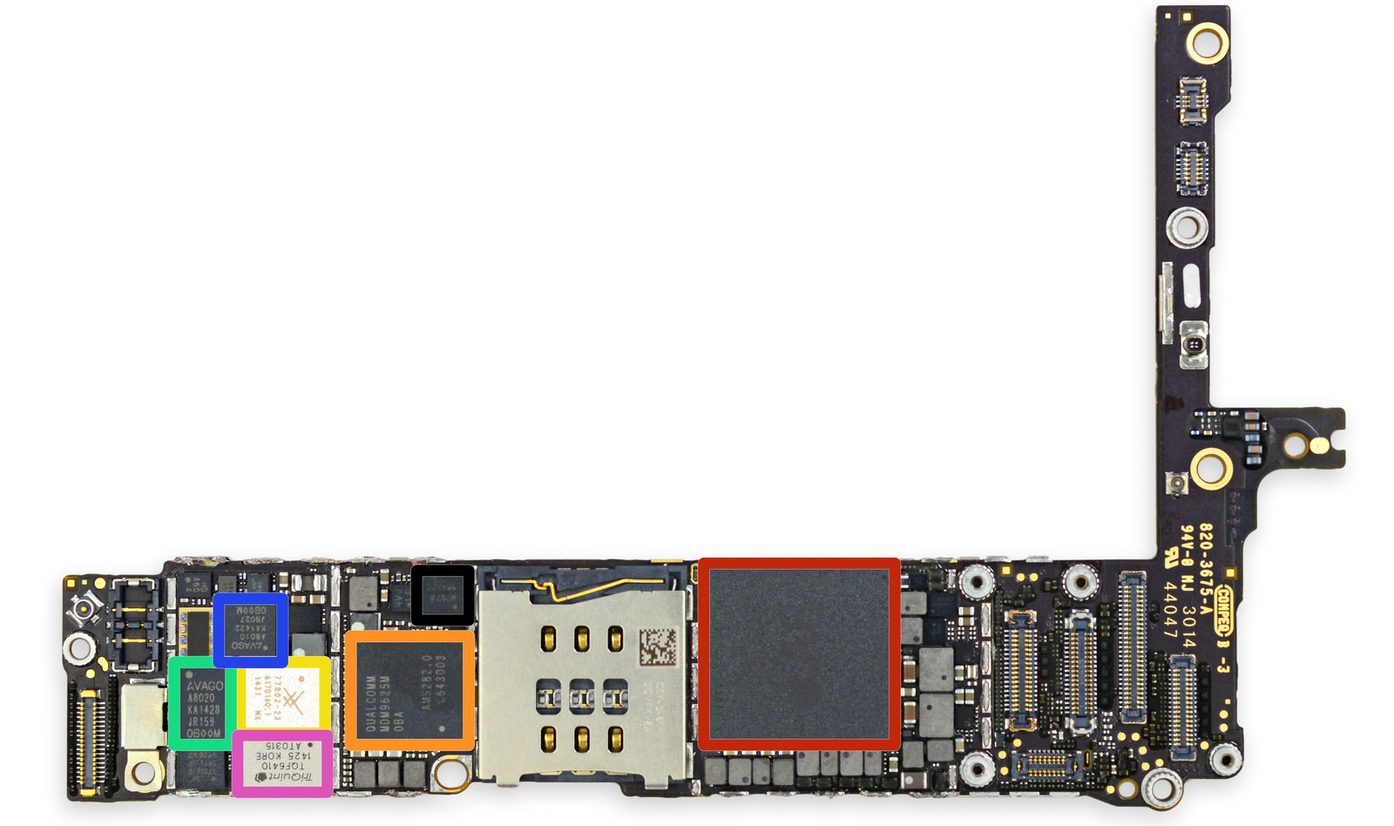
6. Apple A8 with dual Cyclone cores (8)
The front side of the logic board of the iPhone 6+ [31]-1
PAD: Integrated Power Amplifier-Duplexer

Slide 77
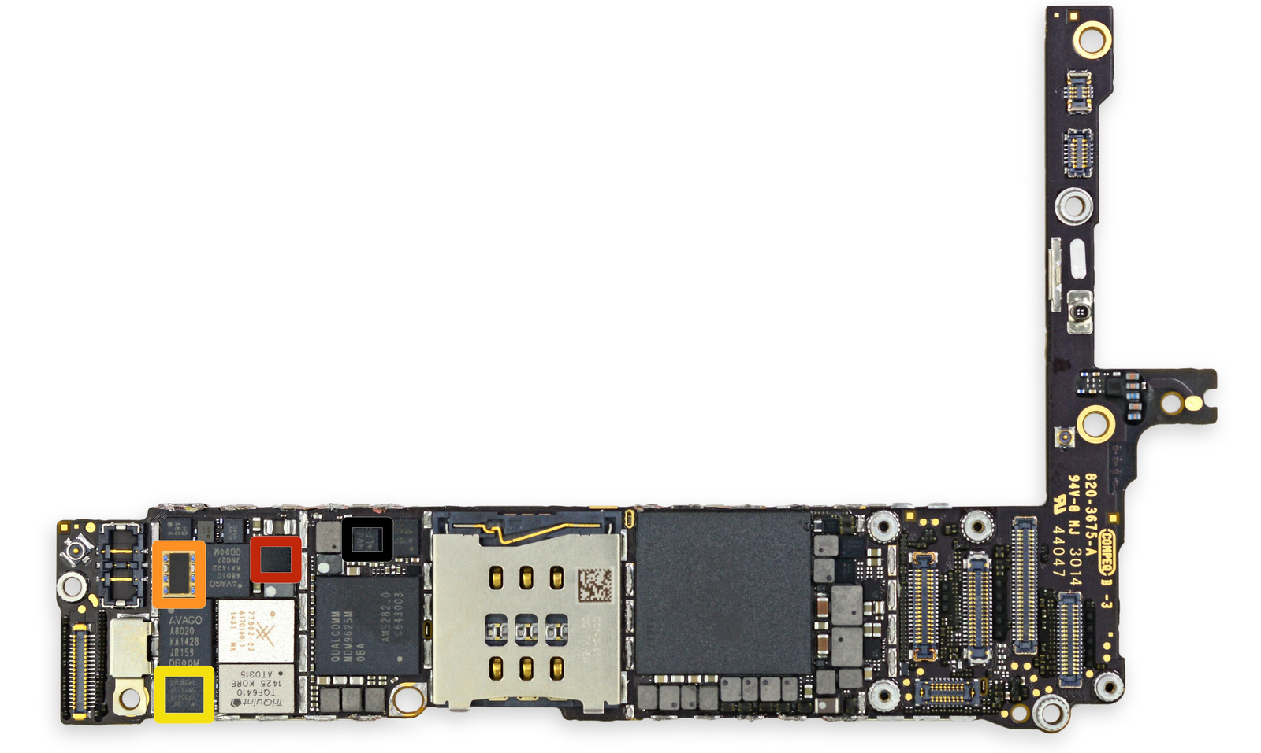
6. Apple A8 with dual Cyclone cores (9)
The front side of the logic board of the iPhone 6+ [31]-2

Slide 78
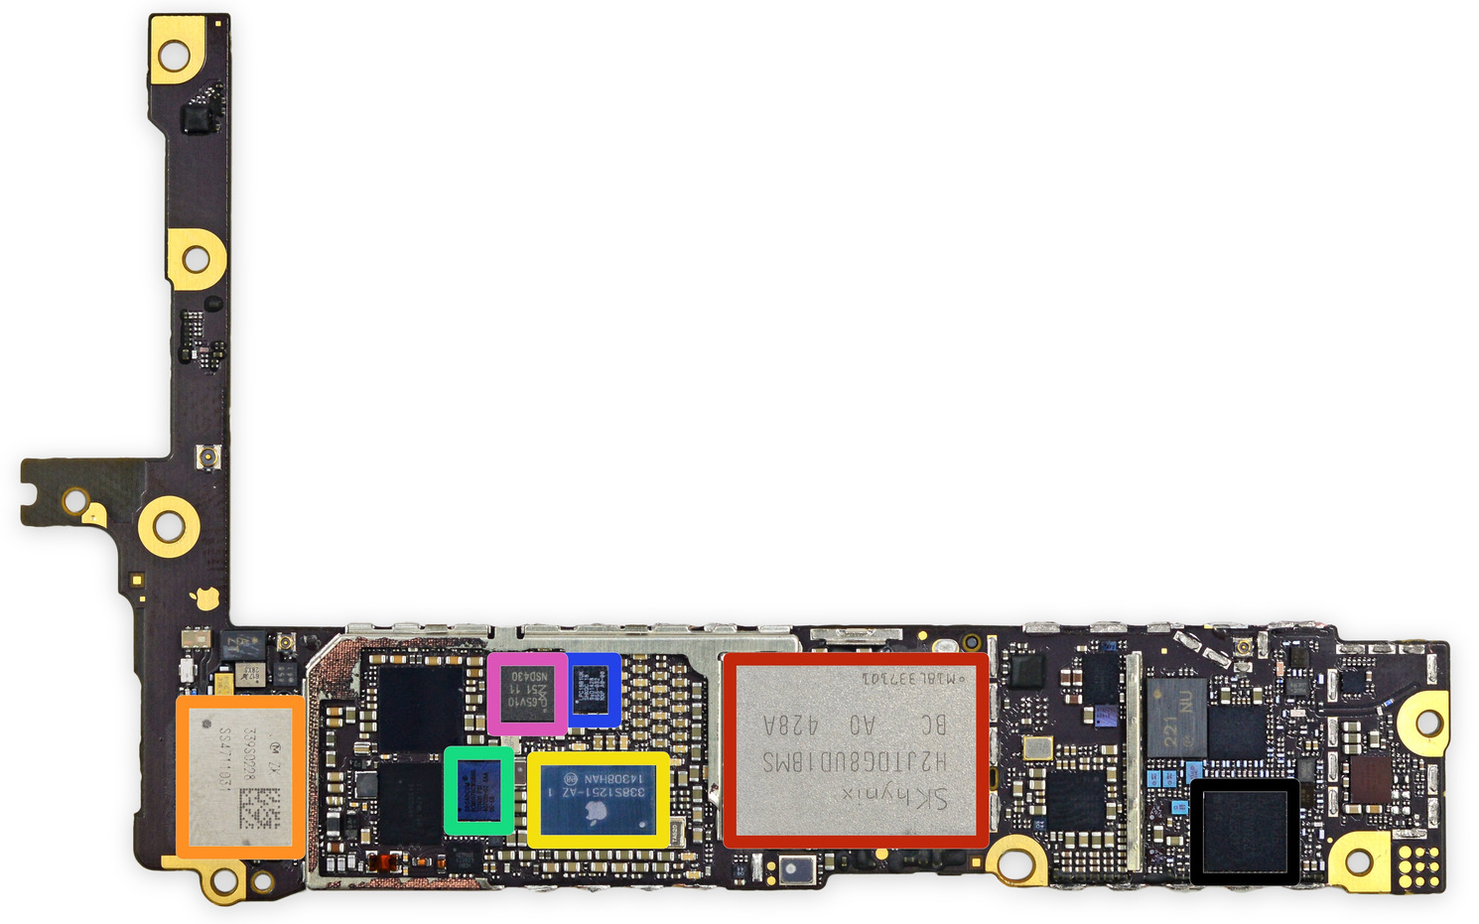
6. Apple A8 with dual Cyclone cores (10)
The back side of the logic board of the iPhone 6+ [31]-1

Slide 79
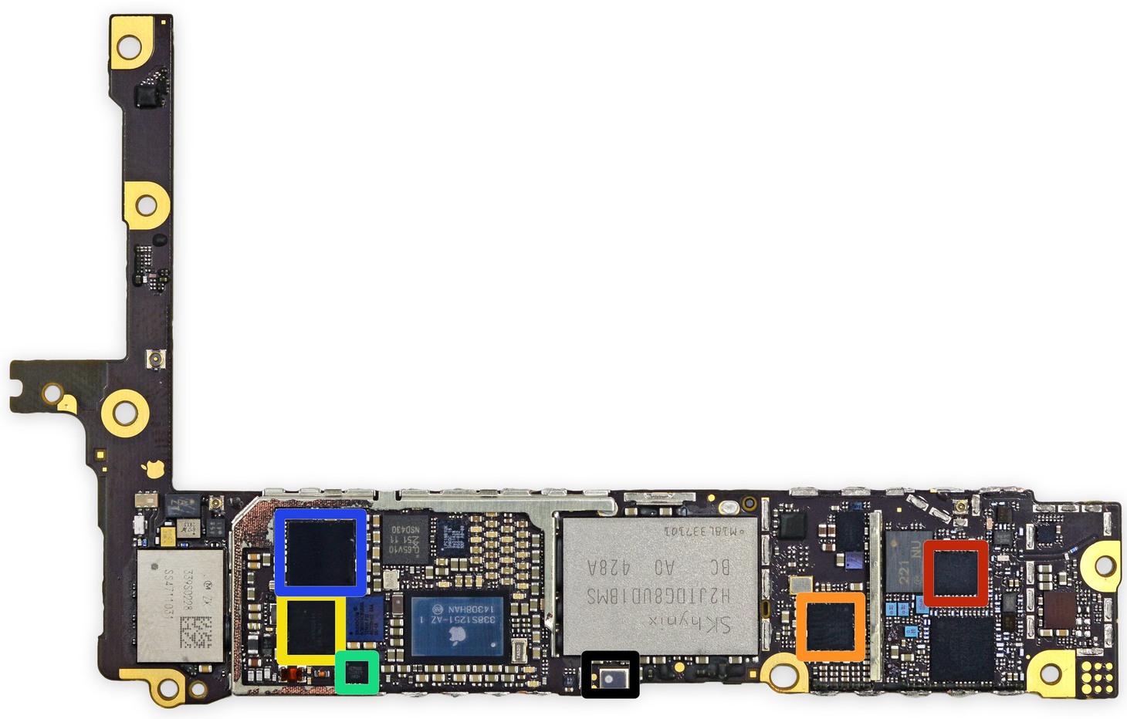
6. Apple A8 with dual Cyclone cores (11)
The back side of the logic board of the iPhone 6+ [31]-2

Slide 80
7. Apple A8X with triple Cyclone cores
Notes:
80

Slide 81
7. Apple A8X with triple Cyclone cores (1)
7. Apple A8X with triple Cyclone cores
Type | Model no. | Image | Node | Die size | CPU | CPU ISA | CPU cache | GPU | Memory | Intro. | Utilizing devices
A7 | APL0698 or S5L8960 |  | 28 nm HKMG | 102 mm² | 2x Cyclone 1.3 GHz | ARMv8-A | L1i: 64 KB L1d: 64 KB L2: 1 MB L3: 4 MB | PowerVR G6430 (4C) @ 450 MHz (115.2 GFLOPS) | 1 GB 64-bit SCh LPDDR3-1600 (12.8 GB/sec) | 9/2013 | iPhone 5S iPad Mini 2 iPad Mini 3
 | APL5698 or S5L8965 |  | 28 nm HKMG | 102 mm² | 2x Cyclone 1.4 GHz | ARMv8-A | L1i: 64 KB L1d: 64 KB L2: 1 MB L3: 4 MB | PowerVR G6430 (4C) @ 450 MHz (115.2 GFLOPS) | 1 GB 64-bit SCh LPDDR3-1600 (12.8 GB/sec) | 10/2013 | iPad Air
A8 | APL1011 |  | 20 nm HKMG | 89 mm² | 2x Cyclone 2nd gen. 1.4 GHz | ARMv8-A | L1i: 64 KB L1d: 64 KB L2: 1 MB L3: 4 MB | PowerVR GX6450 (4C) @ 450 MHz (115.2 GFLOPS) | 1GB 64-bit SCh LPDDR3-1600 (12.8 GB/sec) | 9/2014 | iPhone 6 iPhone 6 Plus
A8X | APL1012 |  | 20 nm HKMG | 128 mm² | 3x Cyclone 2nd gen. 1.5 GHz | ARMv8-A | L1i: 64 KB L1d: 64 KB L2: 2 MB L3: 4 MB | PowerVR GXA6850 (8C) @ 450 MHz (230.4 GFLOPS) | 2 GB 64-bit DCh LPDDR3-1600 (25.6 GB/sec) | 10/2014 | iPad Air 2
S1 |  |  |  |  |  |  |  |  |  |  | Apple Watch

Slide 82
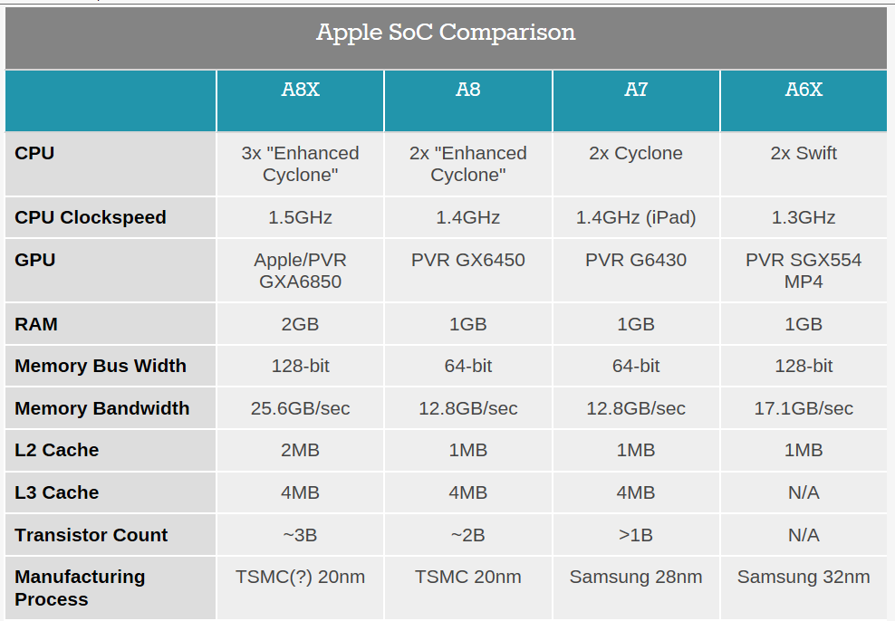
7. Apple A8X with triple Cyclone cores (2)
Main features of the Apple A8X compared to the Apple A8 [32]

Slide 83
7. Apple A8X with triple Cyclone cores (3)
Further enhancements of the A8X vs. the A8 SOC, not mentioned in the
above Table-1 [32]
The GXA6850 GPU of the A8X has 8 cores rather than only 4, as in case of the
GX6450 GPU of the A8 (see next Figure).

Slide 84
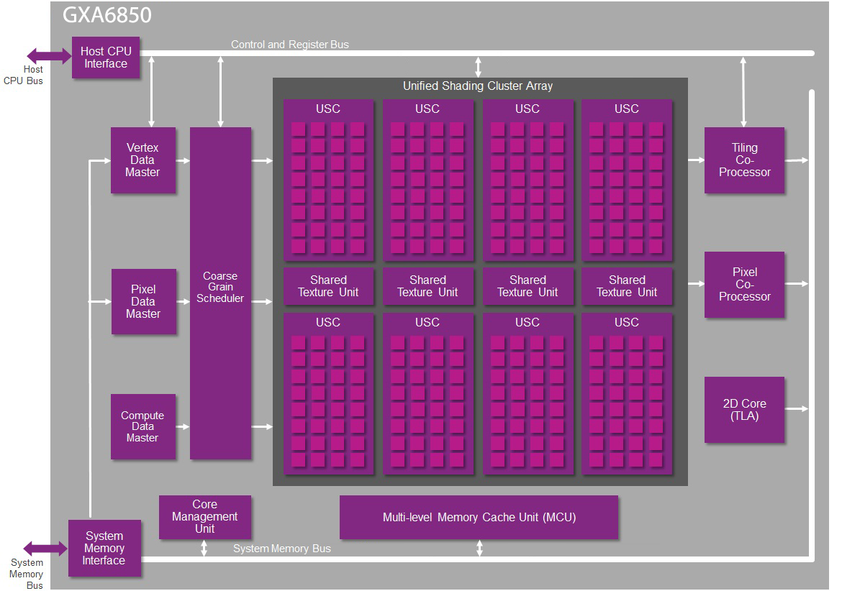
7. Apple A8X with triple Cyclone cores (4)
The GXA6850 GPU of the AX8-1 [32]

Slide 85
7. Apple A8X with triple Cyclone cores (5)
The GXA6850 GPU of the AX8-2 [33]
Each of the 8 graphics cores of the GXA6850 (called USC in the above Figure)
includes 32 FP32 ALUs.
Each ALU can perform 2 operations per cycle, consequently the GXA6850 can
execute 8x32x2 = 512 operations/cycle.
At an assumed clock rate of 450 MHz this results in 230 GFLOPS, a value that
exceeds by a small margin the FP performance of NVIDIA’s K1.

Slide 86
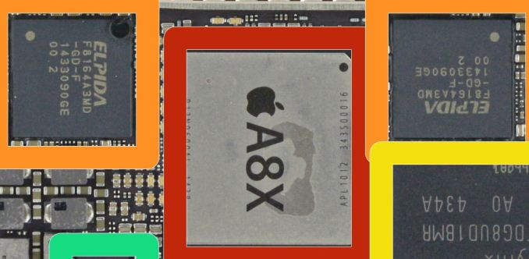
7. Apple A8X with triple Cyclone cores (6)
Further enhancements of the A8X vs. the A8 SOC not mentioned in the
above Table-2 [27]
b) The A8X makes use of 2 GB DRAM memory vs. only 1 GB available for the A8.
Nevertheless, instead of using stacked memory as in previous designs the DRAM
memory of the A8X is implemented in form of two external memory chips
mounted onto the PC board on both sides of the A8X chip, as seen below.
Figure: ELPIDA DRAM chips mounted onto the PC board on both sides of the A8X [27]

Slide 87
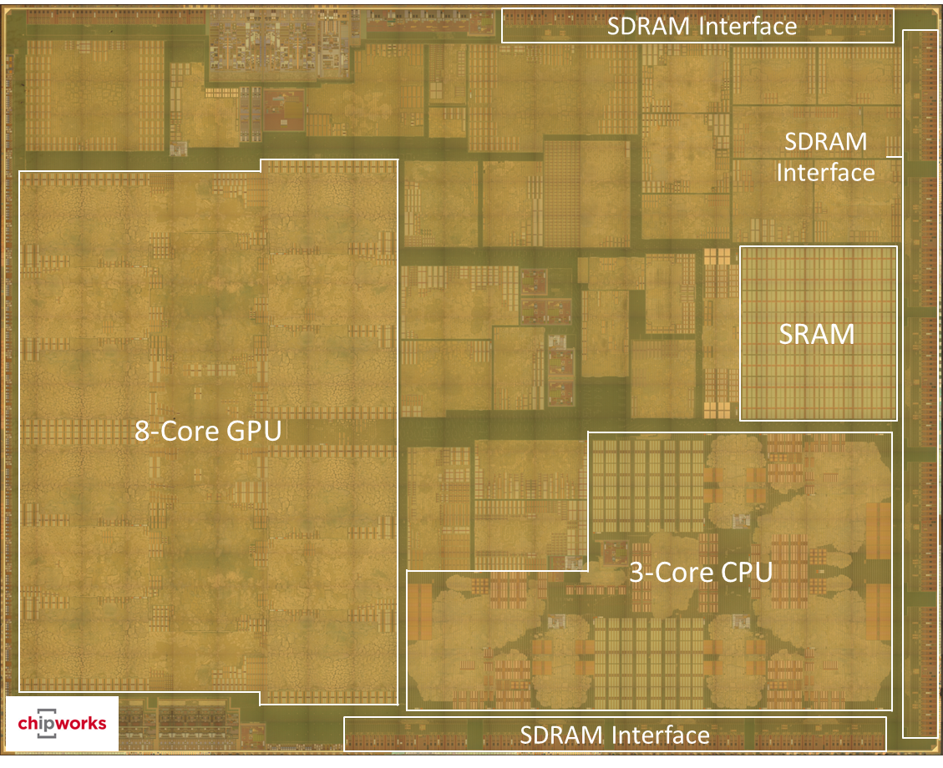
7. Apple A8X with triple Cyclone cores (7)
Die plot of the A8X [32]

Slide 88
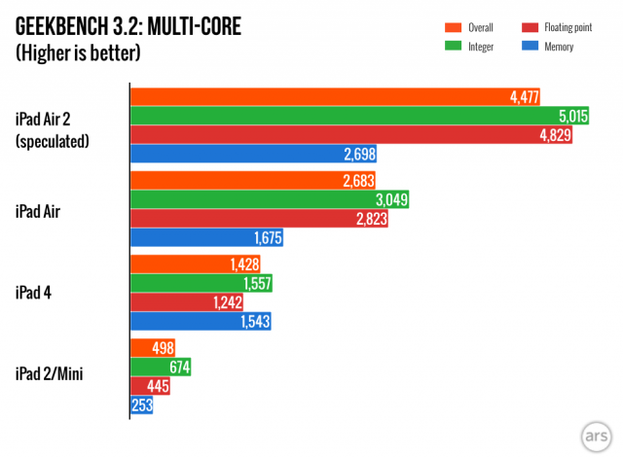
7. Apple A8X with triple Cyclone cores (8)
Performance of the iPad Air 2 vs. previous iPad models measured using
the Geekbench 3.2 benchmark [34]

Slide 89
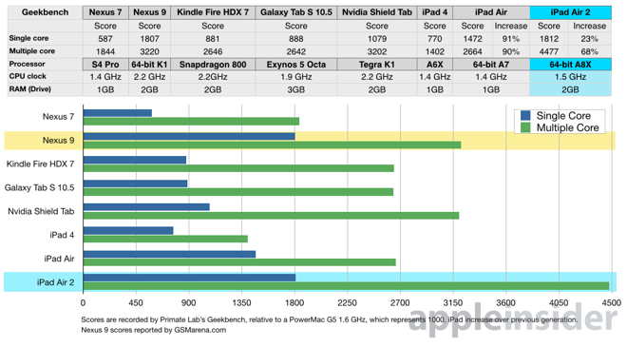
7. Apple A8X with triple Cyclone cores (9)
Performance of the iPad Air 2 vs. competing models measured using
the Geekbench 3.2 benchmark [35]

Slide 90
7. Apple A8X with triple Cyclone cores (10)
Implications of the extremely high performance figures of Apple’s A8X-based
iPad Air 2 [38]
Intel not only lost Apple as a perspective buyer of their chips for the iPad line,
but the iPad Air 2 also severely hit the perspective of their not so successful
Atom line.
NVIDIA’s Tegra 4 chips were not successful, so the firm announced that they
will abandon the phone market.
With Apple’s iPad Air 2 NVIDIA’s subsequent 64-bit K1 chip including 192 GPU
ALUs became a very powerful rival that incorporates 256 ALUs.
As a consequence, NVIDIA appears close to giving up their tablet interests.

Slide 91
7. Apple A8X with triple Cyclone cores (11)
Remark [36]
Texas Instruments OMAP family powers Kindle Fire and a variety of Samsung’s
Galaxy Tab models.
The failure of competing against Apple caused TI in 9/2012 to announce a
major shift in its business strategy, leaving the consumer application processor
business entirely and focusing towards embedded applications, such as
using processors in cars.

Slide 92
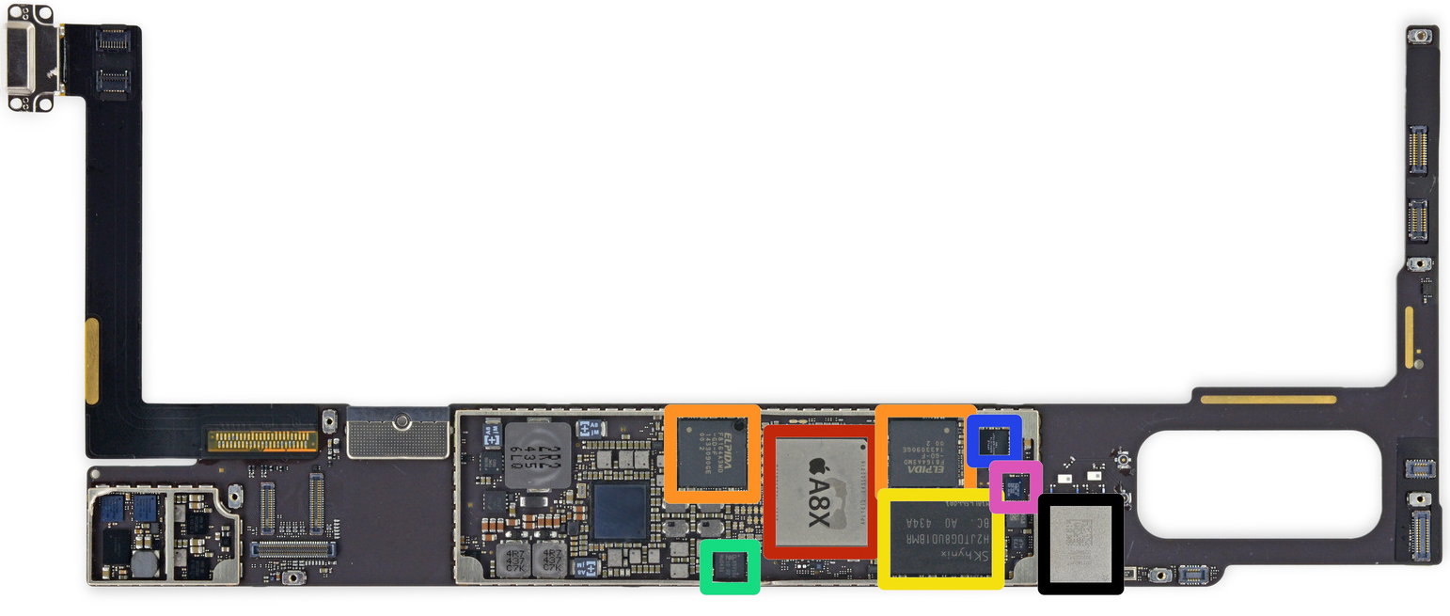
7. Apple A8X with triple Cyclone cores (12)
iPad Air 2 board with main components [37]

Slide 93
8. References
Notes:
93

Slide 94
8. References (1)
[1]: Goto H., The migration of semiconductor process that was hidden in the back of the iPad mini
and fourth generation iPad announcement, PC Watch, Oct. 24 2012,
http://pc.watch.impress.co.jp/docs/column/kaigai/20121024_568188.html
[2]: Goto H., ARM Cortex – A Family Architecture, 2010,
http://pc.watch.impress.co.jp/video/pcw/docs/423/409/p1.pdf
[3]: Wikipedia, iPhone (1st generation),
http://en.wikipedia.org/wiki/IPhone_%281st_generation%29
[4]: Microsystems Integration, Aug. 28-Sept. 2 2014,
http://www.colorado.edu/engineering/MCEN/MCEN5166/Lectures/MI_2_iPhone2_
1st2ndPKG_2014_Aug28.pdf
[5]: Ritchie R., Evolution of iPad: Specs over history, iMore, Oct. 22 2013,
http://www.imore.com/evolution-ipad
[6]: Betters E., Apple iPad showdown: Which tablet is best for you?, Pocket-lint, Oct. 16 2014,
http://www.pocket-lint.com/news/131406-apple-ipad-showdown-which-tablet-is-best-for-you
[7]: Anthony S., Apple’s A8 SoC analyzed: The iPhone 6 chip is a 2-billion-transistor 20nm monster,
ExtremeTech, Sept. 10 2014, http://www.extremetech.com/computing/189787-apples-a8-
soc-analyzed-the-iphone-6-chip-is-a-2-billion-transistor-20nm-monster
[8]: The Five Pitfalls of 4G Baseband SOC Design, Tensilica White Paper, Jan. 19 2010,
http://lteportal.com/Files/MarketSpace/Download/187_DownloadTheFivePitfallsWhite
Paper.pdf?PHPSESSID=3da81bf2f67dee99ff2117f3a8376439

Slide 95
8. References (2)
[9]: Gianesello F., Analog and RF Requirements for Advanced CMOS Nodes: The SOI Perspective,
Lund Circuit Design Workshop, Oct. 3 2012,
http://cdworkshop.eit.lth.se/fileadmin/cdworkshop/2012/STM-Gianesello.pdf
[10]: James D., Inside Today’s Systems & Chips: A Survey of the Past Year, Chipworks, 2013,
http://theconfab.com/wp-content/uploads/2014/dick_james_confab14.pdf
[11]: Apple iPhone megateszt - a bűnbeesés almája, Mobilarena, July 23 2007,
http://mobilarena.hu/teszt/apple_iphone_megateszt_a_bunbeeses_almaja/bevezeto.html
[12]: Apple A4 Teardown. iFixit,
https://www.ifixit.com/Teardown/Apple+A4+Teardown/2204
[13]: Dreiza M., Kim J.S., Smith L., Campos D., Saugier E. Jarvinen P., Joint Project for Mechanical
Qualification of Next Generation High Density Package-on-Package (PoP) with Through Mold
Via Technology, EMPC2009 – 17th European Microelectronics & Packaging Conference,
June 16 2009, Rimini, Italy
[14]: ARM1176 Processor, ARM Ltd.,
http://www.arm.com/products/processors/classic/arm11/arm1176.php
[15]: Apple iPhone 3GS - agyra gyúrt, Mobilarena, July 22 2009,
http://mobilarena.hu/teszt/apple_iphone_3gs_agyra_gyurt/hardveres_valtozasok.html
[16]: Mannion P., Under the Hood : Inside the Apple iPhone, EE Times, July 1 2007,
http://www.eetimes.com/document.asp?doc_id=1281295

Slide 96
8. References (3)
[17]: The History of Apple SoCs, MacRumors, Aug. 31 2014,
http://forums.macrumors.com/showthread.php?t=1770411
[18]: Morrissey S., iOS Forensic Analysis for iPhone, iPad and iPod touch, APress, 2010,
http://sensperiodit.files.wordpress.com/2011/04/ios-forensic-analysis-for-iphone-ipad-
and-ipod-touch.pdf
[19]: Gwennap L., How Apple Designed Own CPU For A6, The Linley Group, Sept. 15 2012,
http://www.linleygroup.com/newsletters/newsletter_detail.php?num=4881
[20]: Shimpi A.L, Klug B., Gowri V., The iPhone 5 Review, AnandTech, Oct. 16 2012,
http://www.anandtech.com/print/6330/the-iphone-5-review
[21]: Riemenschneider F., Der Krieg um die Smartphones: Die ARM‐Armada gegen Intel – eine
Analyse, Presentation in „Konferenz für ARM-Systementwicklung“, July 9 2013, München
[22]: Devine R., Strava Run updates to use the M7 motion coprocessor in the iPhone 5s, iMore,
Sept. 25 2013, http://www.imore.com/strava-run-updates-use-m7-motion-coprocessor-
iphone-5s
[23]: Slivka E., Inside Apple's A7 Chip, M7 Motion Coprocessor, and More from the iPhone 5s
MacRumors, Sept. 24 2013, http://www.macrumors.com/2013/09/24/inside-apples-a7-
chip-m7-motion-coprocessor-and-more-from-the-iphone-5s/
[24]: Anthony S., Apple’s A7 Cyclone CPU detailed: A desktop class chip that has more in common
with Haswell than Krait, ExtremeTech, March 31 2014,
http://www.extremetech.com/computing/179473-apples-a7-cyclone-cpu-detailed-a-
desktop-class-chip-that-has-more-in-common-with-haswell-than-krait

Slide 97
8. References (4)
[25]: Shimpi A.L., Apple's Cyclone Microarchitecture Detailed, AnandTech, March 31 2014,
http://www.anandtech.com/show/7910/apples-cyclone-microarchitecture-detailed
[26]: Riemenschneider F., Apples »Cyclone«-CPU-Architektur enthüllt, Elektroniknet,
March 31 2014, http://www.elektroniknet.de/halbleiter/prozessoren/artikel/107338/
[27]: Ho J., The Apple iPad Air 2 Review, AnandTech, Nov. 7 2014,
http://www.anandtech.com/print/8666/the-apple-ipad-air-2-review
[28]: Wikipedia, Apple A8, http://en.wikipedia.org/wiki/Apple_A8
[29]: Smith R., Chipworks Disassembles Apple's A8 SoC: GX6450, 4MB L3 Cache & More,
AnandTech, Sept. 23 2014, http://www.anandtech.com/show/8562/chipworks-a8
[30]: Hesseldahl A., Teardown Shows Apple’s iPhone 6 Cost at Least $200 to Build, Recode,
Sept. 23 2014, http://recode.net/2014/09/23/teardown-shows-apples-iphone-6-cost-at-
least-200-to-build/
[31]: iPhone 6 Plus Teardown, iFixit,
https://www.ifixit.com/Teardown/iPhone+6+Plus+Teardown/29206
[32]: Smith R., Apple A8X’s GPU - GXA6850, Even Better Than I Thought, AnandTech,
Nov. 11 2014, http://www.anandtech.com/show/8716/apple-a8xs-gpu-gxa6850-even-
better-than-i-thought
[33]: Hinum K., Apple A8X, Notebook Check, Oct. 17 2014,
http://www.notebookcheck.net/Apple-A8X-iPad-SoC.128403.0.html

Slide 98
8. References (5)
[34]: Anthony S., The iPad Air 2, with a tri-core CPU, is almost as fast as a modern PC,
ExtremeTech, Oct. 22 2014, http://www.extremetech.com/computing/192628-the-ipad-
air-2-with-a-tri-core-cpu-is-almost-as-fast-as-a-modern-pc
[35]: Dilger D.E., Apple's new A8X powered iPad Air 2 smokes new Android tablets, including
Nvidia's Tegra K1 Shield Tablet [u], Apple Insider, Oct. 21 2014,
http://appleinsider.com/articles/14/10/21/apples-new-a8x-powered-ipad-air-2-smokes-
new-android-tablets-including-nvidias-tegra-k1
[36]: Goddard L., Texas Instruments admits defeat, moves focus away from smartphone processors,
The Verge, Sept. 26 2012, http://www.theverge.com/2012/9/26/3411212/texas-
instruments-omap-smartphone-shift
[37]: iPad Air 2 Teardown, iFixit,
https://www.ifixit.com/Teardown/iPad+Air+2+Teardown/30592
[38]: Dilger D.E., Apple Inc. A8X iPad chip causing big problems for Intel, Qualcomm, Samsung
and Nvidia, Apple Insider, Nov. 14 2014,
http://appleinsider.com/articles/14/11/15/apple-inc-a8x-ipad-chip-causing-big-problems-
for-intel-qualcomm-samsung-and-nvidia

