Slide 1
Architectural integration of CPUs and GPUs
Sima Dezső
2014 Október
Version 1.0

Slide 2
Áttekintés
1. Introduction to architectural integration of the CPU and GPU
2. AMD’s approach to support heterogeneous computing
2.1 Introduction to HSA
2.2 Key hardware enhancements needed to implement HSA
2.3 AMD’s first implementation of HSA - Kaveri
3. Intel’s approach to support heterogeneous computing
3.1 Intel’s implementations of integrated graphics
3.2 Intel’s first implementation of Shared Virtual Memory
- The Core M processor

Slide 3
Áttekintés
4. NVIDIA’s approach to support heterogeneous computing
4.1 NVIDIA’s support of heterogeneous computing in CUDA
4.2 Overview of NVIDIA’s recent GPU implementations
4.3 NVIDIA’s planned introduction of Unified Memory
5. References

Slide 4
Introduction to architectural integration of
the CPU and GPU

Slide 5
1. Introduction to architectural integration of the CPU and GPU (1)
1. Introduction to architectural integration of the CPU and GPU
Heterogeneous processing with GPUs targets accelerating HPC by GPUs, i.e. by the large number
of FP units in a GPU.

Slide 6
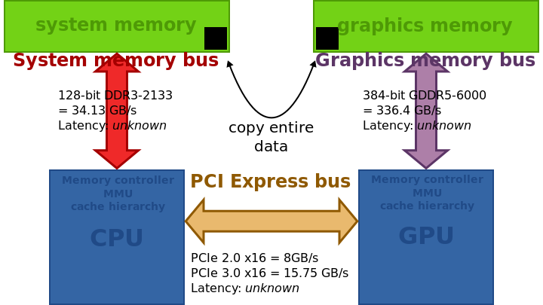
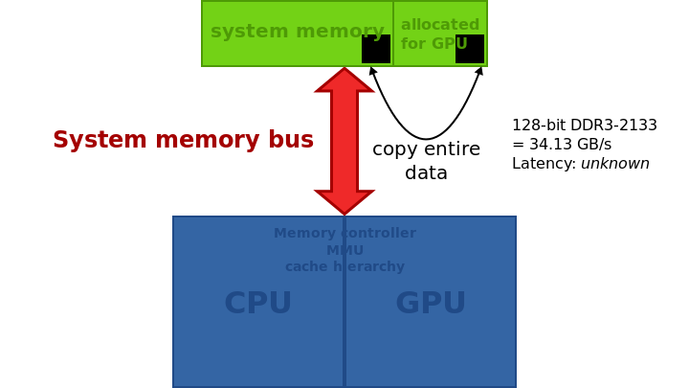
1. Introduction to architectural integration of the CPU and GPU (2)
Implementation alternatives of graphics memory [1]
Implementation of the graphics memory
Discrete graphics memory
Unified system memory
(Shared memory)
(Unified Virtual Memory)
(Unified Memory Architecture)
Implementation example
Typ. use
Graphics cards
On-die integrated graphics

Slide 7
1. Introduction to architectural integration of the CPU and GPU (3)
Key benefit/drawback of the Unified system memory [1]
Implementation of the graphics memory
Discrete graphics memory
Unified system memory
(Shared memory)
(Unified Virtual Memory)
(Unified Memory Architecture)
Implementation example
It eliminates the need for an extra graphics memory controller and bus but has the constraints
of a reduced memory bandwidth.

Slide 8
1. Introduction to architectural integration of the CPU and GPU (4)
Address spaces for Discrete and Unified System Memory (USM) [2]
No
USM
USM

Slide 9
1. Introduction to architectural integration of the CPU and GPU (5)
Main difficulties with heterogeneous computing
Their application programming needs HLL support (NVIDIA’s CUDA or OpenCL).
GPUs operate from their own address spaces, thus without appropriate hardware and software
support data to be processed by GPUs need to be loaded into their address space and
the results need to be sent back to the host.
Transferring data may be avoided with unified system memory and suitable software support
(CUDA 4.0 or OpenCL 1.2 or higher) assuming appropriate hardware.
Then data transfer will be substituted by address mapping (called zero copy).

Slide 10
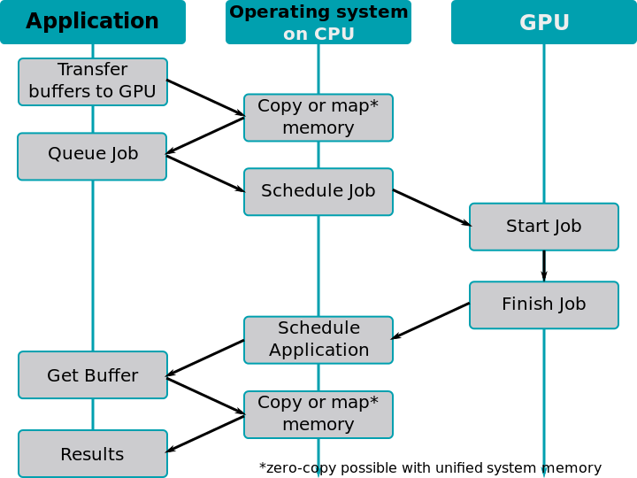
1. Introduction to architectural integration of the CPU and GPU (6)
Tasks to be performed for copying data/mapping address spaces for GPUs [1]

Slide 11
2. AMD’s approach to support
heterogeneous computing

Slide 12
2.1 Introduction to HSA

Slide 13
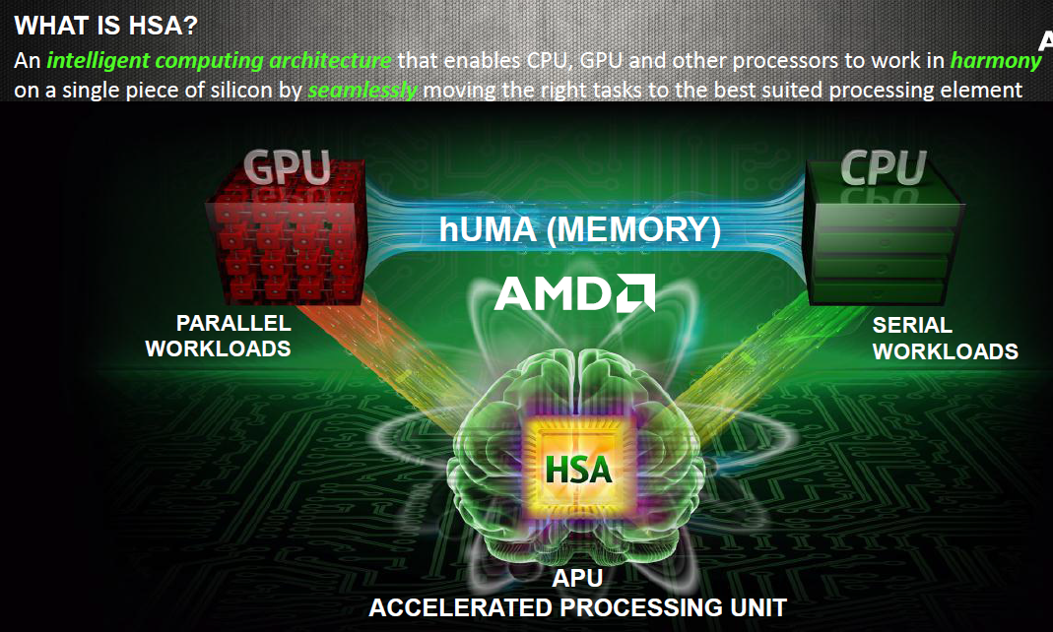
2.1 Introduction to HSA (1)
2.1 Introduction to HSA (Heterogeneous System Architecture)
The notion of HSA [3]

Slide 14
2.1 Introduction to HSA (2)
Aim of HSA-1 [4]

Slide 15
2.1 Introduction to HSA (3)
Aim of HSA-2 [5]

Slide 16
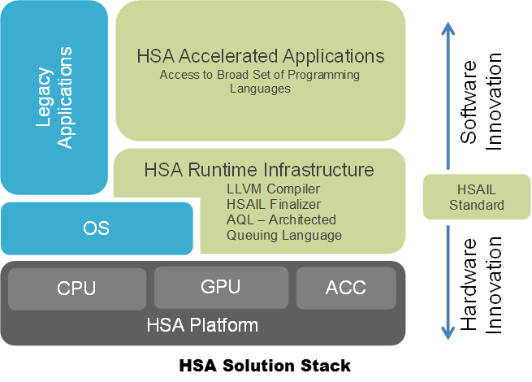
2.1 Introduction to HSA (4)
The entire HSA solution stack [6]
HSAIL: HAS Intermediate Language

Slide 17
2.1 Introduction to HSA (5)
Establishment of the HAS Foundation
In 6/2012 AMD, ARM, TI Qualcomm, Samsung and several other
leading semiconductor firms established the Heterogeneous
System Architecture (HAS) Foundation.
It is a non-profit consortium that aims at defining and promoting
open standards for heterogeneous computing.

Slide 18
2.2 Key hardware enhancements needed
to implement HSA

Slide 19
2.2 Key hardware enhancements needed to implement HSA (1)
2.2 Key hardware enhancements needed to implement HSA [5]
hUMA: heterogeneous UMA

Slide 20
2.2 Key hardware enhancements needed to implement HSA (2)
2.2.1 hUMA (Heterogeneous Uniform Memory Access)

Slide 21
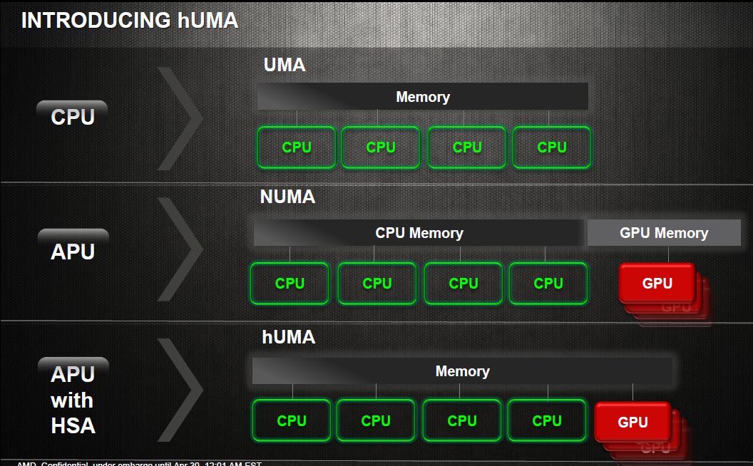
2.2 Key hardware enhancements needed to implement HSA (3)
The hUMA (heterogenous UMA) memory access scheme [3]
(Uniform Memory Access)
(Non-Uniform Memory Access)
(heterogeneous UMA)

Slide 22
2.2 Key hardware enhancements needed to implement HSA (4)
GPU co-processing without hUMA [3]

Slide 23
2.2 Key hardware enhancements needed to implement HSA (5)
GPU co-processing with hUMA [3]

Slide 24
2.2 Key hardware enhancements needed to implement HSA (6)
The evolution path to HSA in AMD’s subsequent Family 15h based APU lines [7]

Slide 25
2.2 Key hardware enhancements needed to implement HSA (7)
Key requirements of hUMA-1 [3]

Slide 26
2.2 Key hardware enhancements needed to implement HSA (8)
Key requirements of hUMA-2 [3]

Slide 27
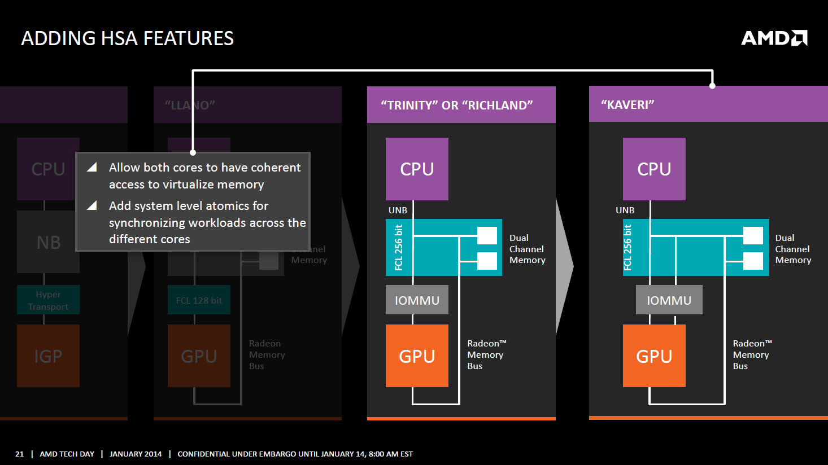
2.2 Key hardware enhancements needed to implement HSA (9)
Hardware support of memory management in Kaveri [8]
AMD Tech Day 2014 Jan

Slide 28
2.2 Key hardware enhancements needed to implement HSA (10)
2.2.2 hQ (heterogeneous Queuing)

Slide 29
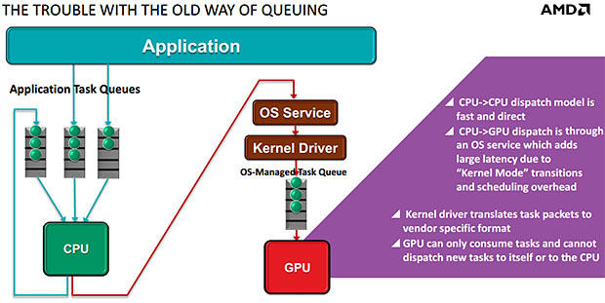
2.2 Key hardware enhancements needed to implement HSA (11)
Traditional management of application tasks queues [9]

Slide 30
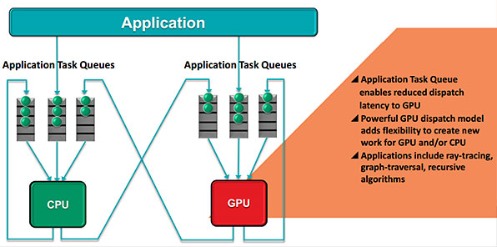
2.2 Key hardware enhancements needed to implement HSA (12)
Application task management with heterogeneous queuing (hQ) [9]

Slide 31
2.2 Key hardware enhancements needed to implement HSA (13)
Main features of hQ [9]
Heterogeneous queuing (hQ) is symmetrical.
It allows both the CPU and the GPU to generate tasks for themselves and for each other.
Work is specified in a standard packet format that will be supported by all HSA-compatible hardware, so
there's no need for the software to use vendor-specific code.
Applications can put packets directly into the task queues that will be accessed by the hardware.
Each application can have multiple task queues, and a virtualization layer allows HSA hardware to see all
the queues.

Slide 32
2.3 AMD’s first implementation of HSA - Kaveri

Slide 33
2.3 AMD’s first implementation of HSA – Kaveri (1)
2.3 AMD’s first implementation of HSA - Kaveri
AMD’s Kaveri
Launched in 6/2014
Is based on the 3. version of the Bulldozer family, called Steamroller.
Aims at desktop PCs and laptops.

Slide 34
2.3 AMD’s first implementation of HSA – Kaveri (2)
AMD’s Family 15h Steamroller-based Kaveri APU lines (based on [10])
Fam. 12h
40 nm
??
K14
F u s i o n
Fam. 12h
1.G.
Fam. 14h
Bobcat
2. G.
Brazos
(Desna)
2 Cores 1MB
DX11 GPU Core
DDR3
??

Slide 35
2.3 AMD’s first implementation of HSA – Kaveri (3)
Die shot of Kaveri [8]

Slide 36
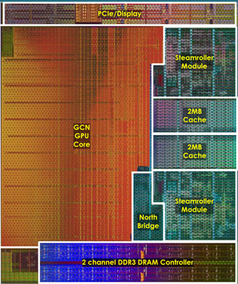
2.3 AMD’s first implementation of HSA – Kaveri (4)
Kaveri die layout [11]

Slide 37
3. Intel’s approach to support
heterogeneous computing

Slide 38
3.1 Intel’s implementations of integrated graphics

Slide 39
3.1 Intel’s implementations of integrated graphics (1)
3.1 Intel’s implementations of integrated graphics
Intel has a long history of integrated graphics, implemented first in the north bridge in the
8xx chipset (1999), as indicated below.
Implementation of integrated graphics
In the north bridge
In a multi-chip processor package
on a separate die
On the processor die
Both the CPU and the GPU are on separate dies
and are mounted into a single package
P
CPU
P
GPU
P
GPU
CPU
Mem.
IG
NB
Mem.
NB
Mem.
Periph. Contr.
South Bridge
South Bridge
Implementations about
1999 – 2009 such as
Intel’s 828xx chipset (1999)
and subsequent implementations
Intel’s Havendale (DT) and
Auburndale (M)
(scheduled for 1H/2009
but cancelled)
Arrandale (DT, 1/2010) and
Clarkdale (M, 1/2010)
Intel’s Sandy Bridge (1/2011) and
subsequent processors
AMD’s Swift (scheduled for 2009
but canceled)
AMD’s Bobcat-based APUs (M, 1/2011)
Llano APUs (DT, 6/2011)
and subsequent processors

Slide 40
3.1 Intel’s implementations of integrated graphics (2)
Unified Memory Architecture (UMA)
Some early graphics cards of other vendors and essentially all (in the north bridge) integrated
graphics designs of Intel already made use of the UMA design as early as in the second half
of the 1990s, as the next Figure shows for the integrated graphics of the Intel 810 chipset (1999).
CPU
Graphics/ Memory Controller
Gfx/Memory Arbiter
Optional Display Cache
Direct AGP
System memory
FB
Figure: The UMA design of an early (in the north bridge) integrated graphics [12]
Key benefit/drawback of the UMA design
The UMA design eliminates the need for an extra graphics memory controller and bus but has the
constraints of a reduced memory bandwidth.

Slide 41
3.1 Intel’s implementations of integrated graphics (3)
Intel’s UMA designs for heterogeneous processing
Subsequently, we discuss only those on-die integrated CPU-GPU solutions that support also HPC
by use of the integrated GPU.
These designs have OpenCL support, as follows.
OpenCL
support
OpenCL
2.0
OpenCL
1.2
OpenCL
1.2
OpenCL
1.2
No
OpenCL
Table: Intel’s processors with on-die integrated GPUs [13]

Slide 42
3.1 Intel’s implementations of integrated graphics (4)
Key benefit of OpenCL 1.2 supported Shared Physical Memory, illustrated on an example
[13]

Slide 43
3.1 Intel’s implementations of integrated graphics (5)
Shared Virtual Memory - based on the Broadwell architecture and supported by
OpenCL 2.0 [13]

Slide 44
3.1 Intel’s implementations of integrated graphics (6)
Key OpenCL 2.0 features [14]

Slide 45
3.2 Intel’s first implementation of Shared Virtual Memory
The Core M processor

Slide 46
3.2 Intel’s first implementation of Shared Virtual Memory – The Core M (1)
3.2 Intel’s first implementation of Shared Virtual Memory – The Core M processor
The Core M processor targets tablets and 2-in-1 devices
Based on the 14 nm Broadwell architecture
Includes Gen8 graphics
It is a SOC design
Announced: 8/2014
Launch planned: 4Q/2014.

Slide 47
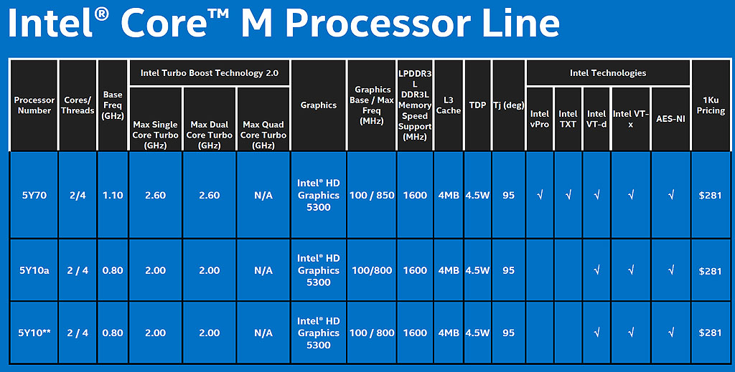
3.2 Intel’s first implementation of Shared Virtual Memory – The Core M (2)
Key features of the announced models of the Core M line [15]

Slide 48
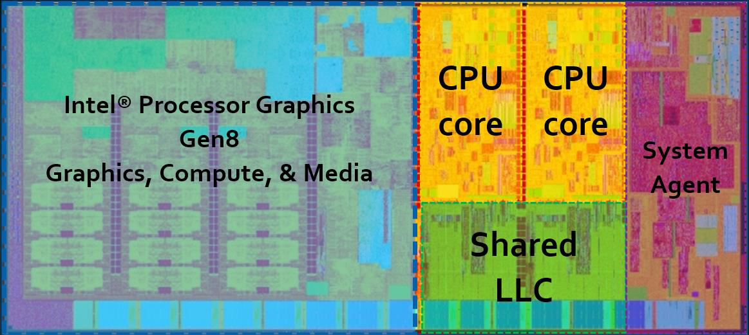
3.2 Intel’s first implementation of Shared Virtual Memory – The Core M (3)
Die layout of the Core M [13]

Slide 49
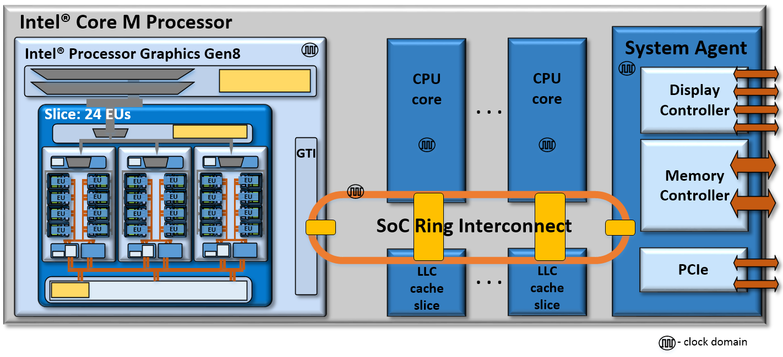
3.2 Intel’s first implementation of Shared Virtual Memory – The Core M (4)
Block diagram of the Core M [13]

Slide 50
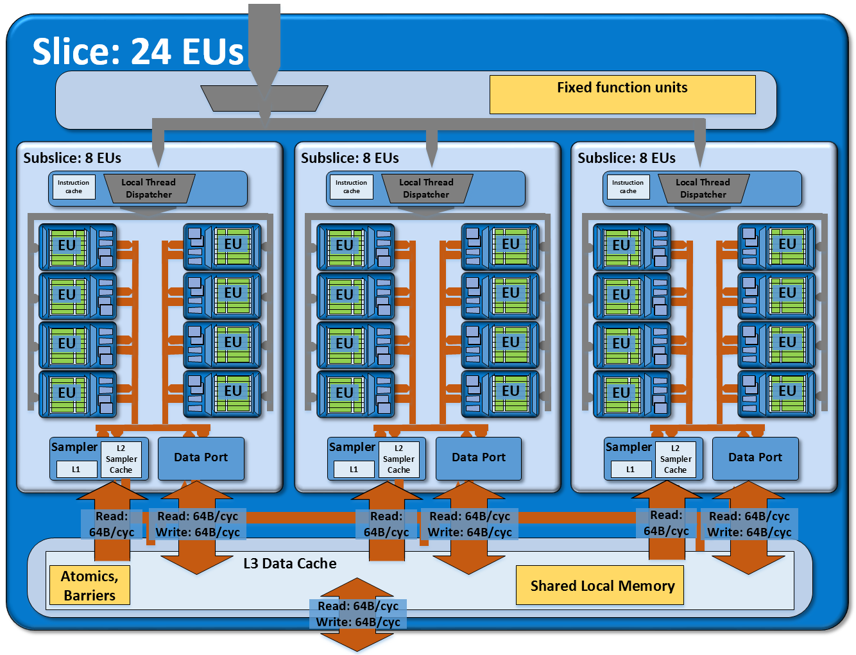
3.2 Intel’s first implementation of Shared Virtual Memory – The Core M (5)
Block diagram of the Gen8 graphics [13]

Slide 51
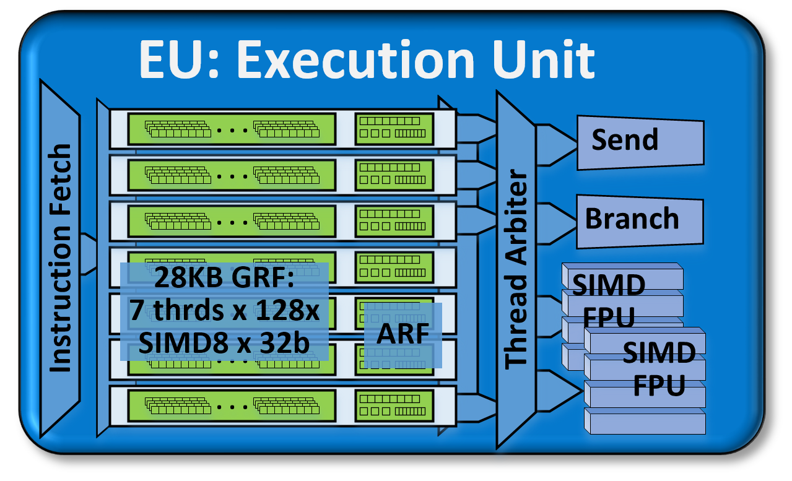
3.2 Intel’s first implementation of Shared Virtual Memory – The Core M (6)
Block diagram of an EU [13]
Each SIMD FPU: 16 x FP32 MAD
ARF: Architectural Register File

Slide 52
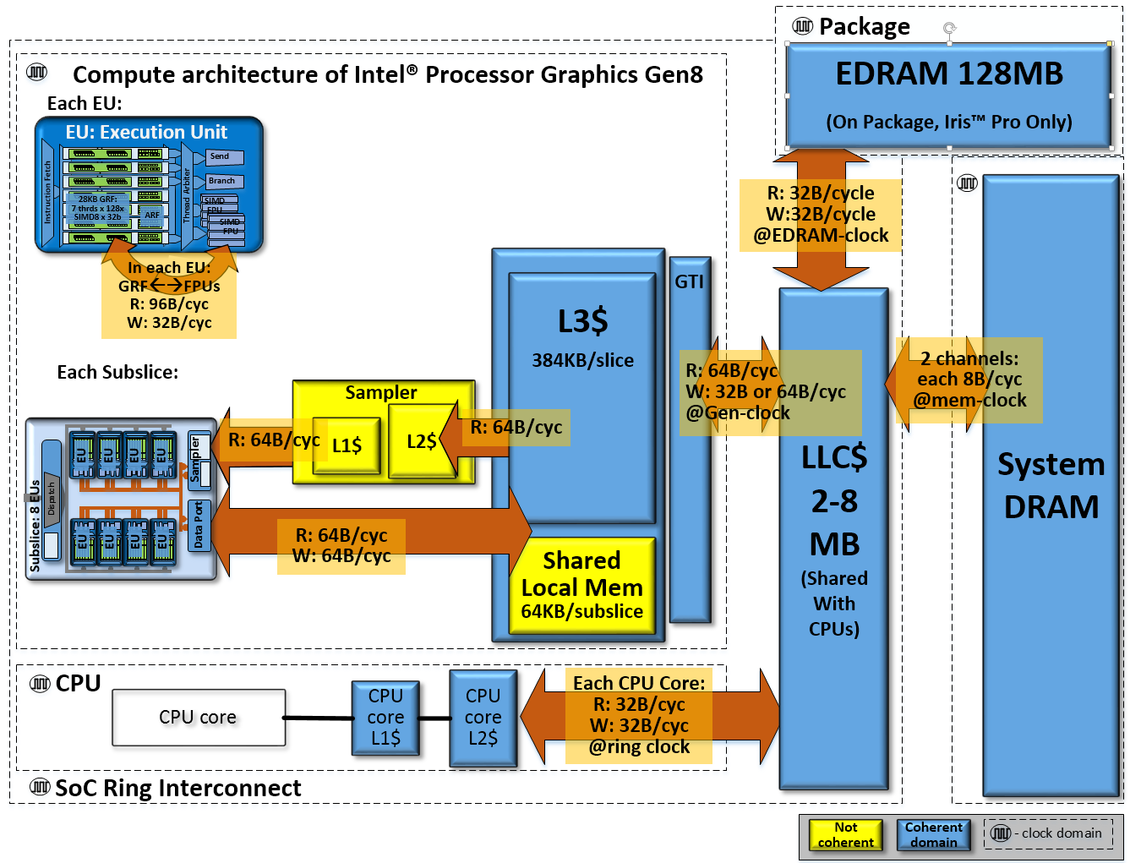
3.2 Intel’s first implementation of Shared Virtual Memory – The Core M (7)
Compute architecture of Core M [13]
Figure 8: A view of the SoC chip level memory hierarchy and
its theoretical peak bandwidths for the compute architecture of Intel® Processor Graphics Gen8.

Slide 53
4. NVIDIA’s approach to support
heterogeneous computing

Slide 54
4.1 NVIDIA’s support of heterogeneous computing in CUDA

Slide 55
4.1 NVIDIA’s support of heterogeneous computing in CUDA (1)
4.1 NVIDIA’s support of heterogeneous computing in CUDA
Unified Virtual Addressing (UVA) introduced in CUDA 4-1 [2]
No
No

Slide 56
4.1 NVIDIA’s support of heterogeneous computing in CUDA (2)
Unified Virtual Addressing (UVA) introduced in CUDA 4-2 [16]
UVA maintains a single virtual memory address space for all memory in the system,
and enables pointers to be accessed from GPU code no matter where in the system they
reside, whether its device memory (on the same or a different GPU), host memory, or
on-chip shared memory.
It provides a few simplifications for programing (like “Zero-Copy” that allows CUDA kernels to
directly read or write through the PCIe bus using the host address without previous
copying) but has the drawback of low performance since UVA assumes that all
communication goes through the PCIe bus.

Slide 57
4.1 NVIDIA’s support of heterogeneous computing in CUDA (3)
Introduction of unified memory in CUDA 6-1
In 11/2013 NVIDIA announced CUDA 6 that supports unified memory, as illustrated next.
Figure: Concept of Unified memory supported in CUDA 6 [17]

Slide 58
4.1 NVIDIA’s support of heterogeneous computing in CUDA (4)
Introduction of unified memory in CUDA 6-2 [18]
With unified memory CUDA programmers will be relived from the burden of explicitly copying
actual data from the system memory to the GPU memory and vice versa.
This makes coding simpler, as indicated in the next Figure.

Slide 59
4.1 NVIDIA’s support of heterogeneous computing in CUDA (5)
Simplifying programming in CUDA 6.0 [19]

Slide 60
4.1 NVIDIA’s support of heterogeneous computing in CUDA (6)
CUDA 6.0 differencies for Tegra K1 [19]

Slide 61
4.1 NVIDIA’s support of heterogeneous computing in CUDA (7)
Introduction of unified memory in CUDA 6-3
Note
When GPU memory is implemented separately from the CPU memory (as for discrete GPU cards)
CUDA 6.0 does not eliminate the need for data copying over the PCIe bus but relegates the task
of data copying and maintaining data integrity to the CUDA language implementation.

Slide 62
4.2 Overview of NVIDIA’s recent GPU implementations

Slide 63
4.2 Overview of NVIDIA’s recent GPU implementations (1)
4.2 Overview of NVIDIA’s recent GPU implementations
NVIDIA’s recent GPU implementations
Discrete GPUs
Integrated GPUs
Attached via the PCIe bus
(PCIe 3.0 x16)
On-die integrated in the Tegra SOC line
GeForce line of GPUs
Ultra Low Power (ULP) GeForce line of GPUs

Slide 64
4.2 Overview of NVIDIA’s recent GPU implementations (2)
The ULP (Ultra Low Power) graphics of the Tegra line
It is derived from the GeForce line of discrete GPUs, as indicated below.
ULP Graphics
Figure: Derivation of the ULP GPUs of the Tegra line from the GeForce GPUs of graphics cards [20]
Subsequently NVIDIA followed a split design paradigm by making use
of the GeForce GPU designs in their discrete GPUs and
of the ULP GeForce GPU designs in their integrated GPUs of the Tegra line.

Slide 65
4.2 Overview of NVIDIA’s recent GPU implementations (3)
NVIDIA’s split mobile and discrete GPU implementations [21]
With the split GPU design, NVIDIA made use of enhanced features first in their discrete
GeForce line and took over enhancements subsequently in their mobile ULP GeForce line.

Slide 66
4.2 Overview of NVIDIA’s recent GPU implementations (4)
Merging the discrete and integrated GPU designs beginning with the Tegra K1-1 [22]
With the Tegra K1 (Logan) design (launched in 1/2014) NVIDIA abandoned the split design
concept of GPUs and merged the discrete and integrated GPU lines, as indicated in the next
Figure, while supporting the whole feature set of the related discrete GPUs in the integrated
design (e.g. support of OpenGL 4.4, DirectX 11 or CUDA 6.0 provided by the Kepler design.

Slide 67
4.2 Overview of NVIDIA’s recent GPU implementations (5)
Merging the discrete and integrated GPU designs beginning with the Tegra K1-2 [21]
Moreover, NVIDIA announced that in future, (probably after the Maxwell GPU) they will follow the
mobile first paradigm meaning that future NVIDIA GPUs will be introduced as mobile designs
and will be adopted for higher product segments thereafter.

Slide 68
4.2 Overview of NVIDIA’s recent GPU implementations (6)
Introduction of unified physical memory in Tegra K1-1 [19]
Launched: 1/2014

Slide 69
4.2 Overview of NVIDIA’s recent GPU implementations (7)
Introduction of unified physical memory in Tegra K1-2 [21]
Image Signal Processing
ISP: Image Signal Processing
CSI: Camera Serial Interface

Slide 70
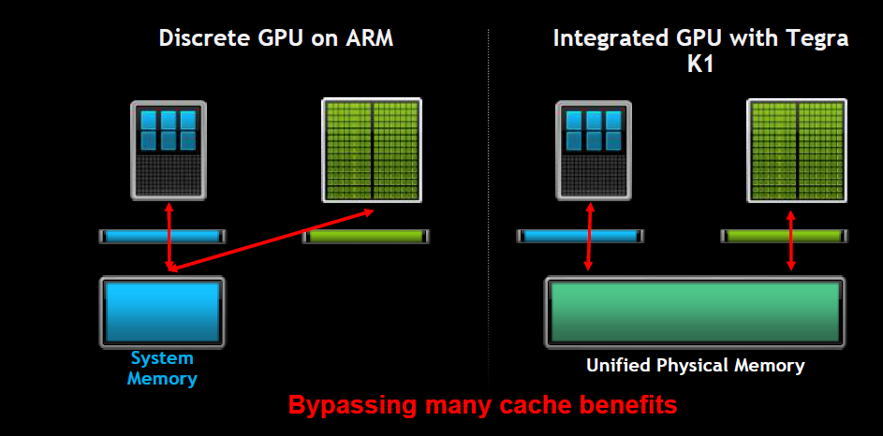
4.2 Overview of NVIDIA’s recent GPU implementations (8)
Zero copy with Unified Physical Memory [19]

Slide 71
4.2 Overview of NVIDIA’s recent GPU implementations (9)
Main features of Tegra K1 [19]

Slide 72
4.2 Overview of NVIDIA’s recent GPU implementations (10)
Two pin compatible versions of Tegra K1 [21]

Slide 73
4.3 NVIDIA’s planned introduction of Unified Memory

Slide 74
4.3 NVIDIA’s planned introduction of Unified Memory (1)
4.3 NVIDIA’s planned introduction of Unified Memory
NVIDIA planned to introduce Unified Memory in their subsequent Maxwell GPU design,
(designated yet as Unified Virtual Memory in the Figure), as seen next.

Slide 75
4.3 NVIDIA’s planned introduction of Unified Memory (2)
NVIDIA’s Tegra roadmap (Based on [18])

Slide 76
4.3 NVIDIA’s planned introduction of Unified Memory (3)
NVIDIA’s GPU roadmap from 11/2013 [17]
Nevertheless, NVIDIA modified their GPU roadmap in 3/2014 and delayed the introduction of
Unified Virtual Memory as shown in the next Figure.

Slide 77
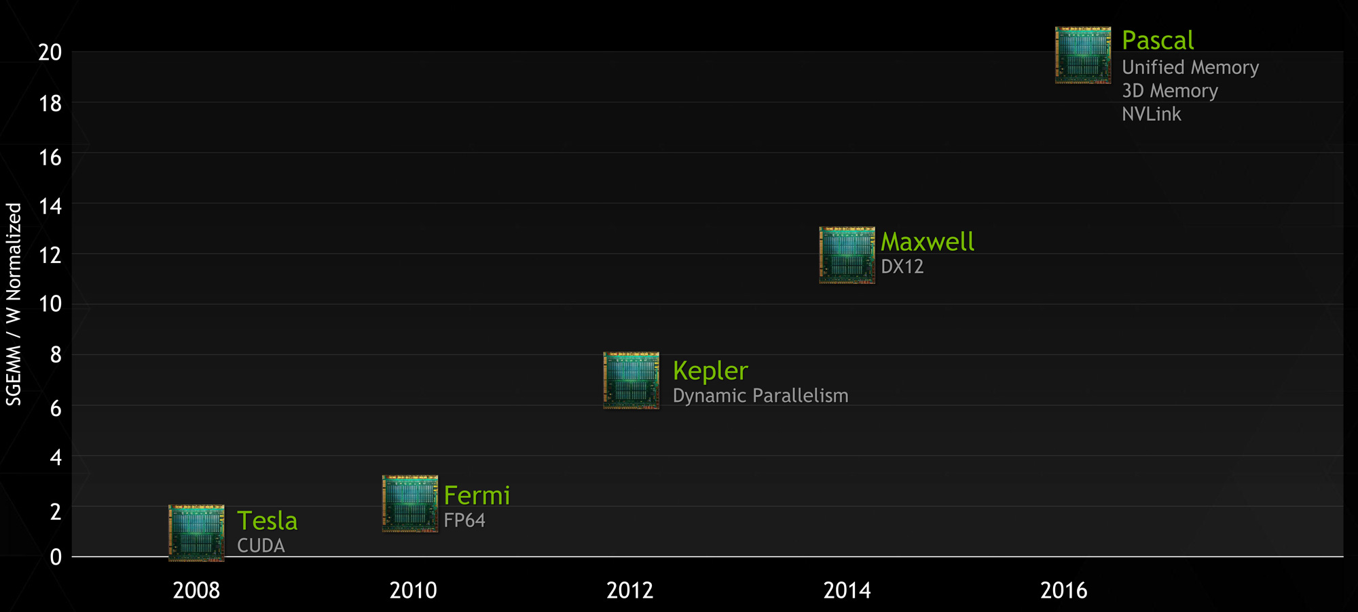
4.3 NVIDIA’s planned introduction of Unified Memory (4)
NVIDIA’s updated GPU roadmap from 3/2014 (showing Pascal instead of Volta) [23]
SGEMM: SinGle precision, General Matrix Multiply
Notes
In their GPU roadmap NVIDIA substituted Volta by Pascal.
Unified Virtual Memory (UVM) support became delayed, instead of Maxwell first Pascal will
support this feature.
Beyond UVM Pascal will provide stacked memory (planned already for Volta) and NVlink.

Slide 78
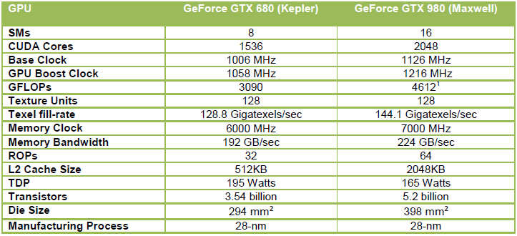
4.3 NVIDIA’s planned introduction of Unified Memory (5)
Main features of NVIDIA’s recent discrete GPU cards [24]

Slide 79
4.3 NVIDIA’s planned introduction of Unified Memory (6)
Planned enhancements for increasing the memory bandwidth for Unified Virtual Memory
a) Stacked memory
b) NVlink

Slide 80
4.3 NVIDIA’s planned introduction of Unified Memory (7)
a) Stacked Memory (Hybrid Memory Cube, 3D Memory) at a glance [25]

Slide 81
4.3 NVIDIA’s planned introduction of Unified Memory (8)
Speed benefit of stacked memory [25]

Slide 82
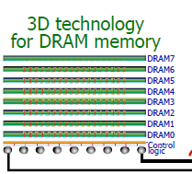
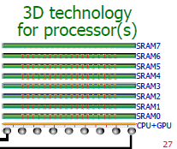
4.3 NVIDIA’s planned introduction of Unified Memory (9)
Use cases of stacked DRAM [25]
Nvidia Volta (2015) cancelled
NVIDIA Pascal (2016)
Intel Xeon Phi Knights Landing (2015)

Slide 83
4.3 NVIDIA’s planned introduction of Unified Memory (10)
Stacked memory in Volta
Nvidia disclosed earlier that they plan to introduced stacked GPU memory (3D memory) for their
Volta GPU, as the next Figure shows [26].

Slide 84
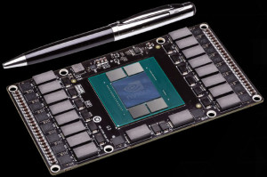
4.3 NVIDIA’s planned introduction of Unified Memory (11)
Stacked memory on a Pascal GPU [27]
. Stacked Memory will allow also smaller sized (1/3) GPU boards.

Slide 85
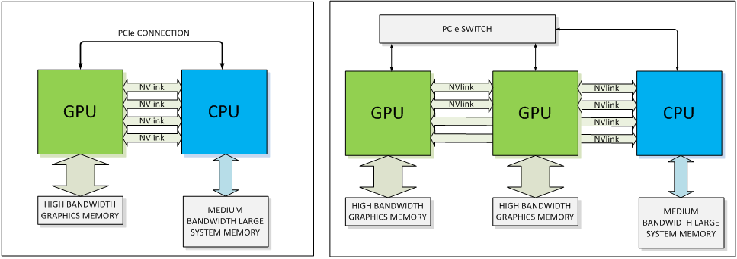
4.3 NVIDIA’s planned introduction of Unified Memory (12)
b) Nvlink [27]
Announced in 3/2014 by NVIDIA and IBM.
It is a high speed interconnect with differential lanes and embedded clock.
The basic building block for NVLink is an 8-lane, differential, bidirectional link providing a
bandwidth of 80 to 200 MB/s compared to ~8 GB/s allowed by an 8-lane PCIe 3.0 link.
iNvlink intends to introduce NVlink first in their Pascal GPU that is scheduled for 2016.
Figure: Use of Nvlink for connecting GPUs to a CPU [27]

Slide 86
5. References

Slide 87
5. References (1)
[1]: Wikipedia, Heterogeneous System Architecture,
http://en.wikipedia.org/wiki/Heterogeneous_System_Architecture
[2]: Schroeder T.C., Peer-to-Peer & Unified Virtual Addressing, 2011,
http://on-demand.gputechconf.com/gtc-express/2011/presentations/cuda_webinars_
GPUDirect_uva.pdf
[3]: Chu H., AMD heterogeneous Uniform Memory Access, April 30 2013,
http://events.csdn.net/AMD/GPUSat%20-%20hUMA_june-public.pdf
[4]: Heterogeneous System Architecture and the HSA Foundation, June 2012,
http://www.slideshare.net/hsafoundation/hsa-overview
[5]: AMD’s 2014 A-Series APU, Welcome to the revolution, Jan. 2014,
http://new.sliven.net/res/news/129364/Kaveri%20Press%20Deck-v1.01.pdf
[6]: What is Heterogeneous System Architecture (HSA)?, 2014,
http://developer.amd.com/resources/heterogeneous-computing/what-is-heterogeneous-
system-architecture-hsa/
[7]: Pollice M., Analysis: AMD Kaveri APU and Steamroller Core Architectural Enhancements
Unveiled, BSN, March 6 2013, http://www.brightsideofnews.com/news/2013/3/6/analysis-
amd-kaveri-apu-and-steamroller-core-architectural-enhancements-unveiled.aspx
[8]: Macri J., Kaveri Design and Architectural Overview, AMD Tech Day, Jan. 2014,
http://www.pcmhz.com/media/2014/01-ianuarie/14/amd/AMD-Tech-Day-Kaveri.pdf

Slide 88
5. References (2)
[9]: Gasior G., AMD's heterogeneous queuing aims to make CPU, GPU more equal partners,
Tech Report, October 22 2013, http://techreport.com/news/25545/amd-heterogeneous-
queuing-aims-to- make-cpu-gpu-more-equal-partners
[10]: Goto H., AMD CPU Transition, 2011,
http://pc.watch.impress.co.jp/video/pcw/docs/473/823/p7.pdf
[11]: Goto H., APU evolution and future memory architecture of AMD Kaveri, PC Watch,
Jan. 29 2014, http://translate.google.hu/translate?hl=hu&sl=ja&tl=en&u=http%3A%2F%
2Fpc.watch.impress.co.jp%2Fdocs%2Fcolumn%2Fkaigai%2F20140129_632794.html
[12]: Kerby B., Whitney, Intel's 810 Chipset - Part I, Tom’s Hardware, April 30 1999,
http://www.tomshardware.com/reviews/whitney,105-4.html
[13]: Junkins S., The Compute Architecture of Intel Processor Graphics Gen8, IDF 2014,
https://software.intel.com/sites/default/files/managed/71/a2/Compute%20Architecture%
20of%20Intel%20Processor%20Graphics%20Gen8.pdf
[14]: Smith R., Khronos @ SIGGRAPH 2013: OpenGL 4.4, OpenCL 2.0, & OpenCL 1.2 SPIR
Announced, AnandTech, July 22 2013, http://www.anandtech.com/show/7161/khronos-
siggraph-2013-opengl-44-opencl-20-opencl-12-spir-announced/3
[15]: Woligroski D., Intel's Broadwell Core M Processor: New Details, SKUs and Specifics,
Tom’s Hardware, Sept. 5 2014,
http://www.tomshardware.com/news/intel-broadwell-core-m,27596.html
[16]: Harris M., Unified Memory in CUDA 6, NVIDIA Developer Zone, Nov. 18 2013,
http://devblogs.nvidia.com/parallelforall/unified-memory-in-cuda-6/

Slide 89
5. References (3)
[17]: Smith R., NVIDIA Announces CUDA 6: Unified Memory for CUDA, AnandTech,
Nov. 14 2013, http://www.anandtech.com/show/7515/nvidia-announces-cuda-6-
unified-memory-for-cuda
[18]: Burke S., Analysis of NVidia's Unified Virtual Memory Roadmap Disappearance & an ARM
Future, Gamers Nexus, April 3 2014, http://www.gamersnexus.net/guides/1383-nvidia-
unified-virtual-memory-roadmap-tegra-future
[19]: Rao A., Compute with Tegra K1, GPU Technology Conference, 2014,
http://on-demand.gputechconf.com/gtc/2014/presentations/S4906-mobile-compute-
tegra-K1.pdf
[20]: Toksvig M., NVIDIA Tegra,
http://www.hotchips.org/wp-content/uploads/hc_archives/hc20/2_Mon/HC20.25.331.pdf
[21]: Klug B., Shimpi A.L., NVIDIA Tegra K1 Preview & Architecture Analysis, AnandTech,
Jan. 6 2014, http://www.anandtech.com/show/7622/nvidia-tegra-k1/3
[22]: Chester B., Xiaomi Announces the MiPad: The First Tegra K1 Device, AnandTech,
May 15 2014, http://www.anandtech.com/show/8022/xiaomi-announces-the-mipad-
the-first-tegra-k1-device
[23]: Smith R., NVIDIA Updates GPU Roadmap; Unveils Pascal Architecture For 2016, AnandTech,
March 26 2014, http://www.anandtech.com/show/7900/nvidia-updates-gpu-roadmap-
unveils-pascal-architecture-for-2016

Slide 90
5. References (4)
[24]: Hruska J., Nvidia Maxwell GTX 980 and GTX 970 reviewed: Crushing all challengers,
Extreme Tech, Sept. 19 2014, http://www.extremetech.com/computing/190463-nvidia-
maxwell-gtx-980-and-gtx-970-review
[25]: Ujaldón M., Many-core GPUs: Achievements and perspectives, 2013,
http://icpp2013.ens-lyon.fr/GPUs-ICPP.pdf
[26]: Demerjian C., Nvidia_Volta_mockup, SemiAccurate, May 19 2013,
http://semiaccurate.com/2013/05/20/nvidias-volta-gpu-raises-serious-red-flags-for-
the-company/nvidia_volta_mockup/
[27]: Foley D., NVLink, Pascal and Stacked Memory: Feeding the Appetite for Big Data,
NVIDIA Developer Zone, March 25 2014, http://devblogs.nvidia.com/parallelforall/
nvlink-pascal-stacked-memory-feeding-appetite-big-data/

