Slide 1
Architectural integration of CPUs and GPUs
Sima Dezső
2014 Október
Version 1.1

Slide 2
Áttekintés
1. Introduction to architectural integration of the CPU and GPU
2. AMD’s approach to support heterogeneous computing
2.1 Introduction to HSA
2.2 Key hardware enhancements needed to implement HSA
2.3 AMD’s first implementation of HSA - Kaveri
3. Intel’s approach to support heterogeneous computing
3.1 Intel’s implementations of integrated graphics
3.2 Intel’s first implementation of Shared Virtual Memory
- The Core M processor
4. NVIDIA’s planned introduction of Unified Memory
5. References

Slide 3
Introduction to architectural integration of
the CPU and GPU

Slide 4
1. Introduction to architectural integration of the CPU and GPU (1)
1. Introduction to architectural integration of the CPU and GPU
Aim of architectural integration of the CPU and GPU
Accelerated graphics processing
Heterogeneous processing
Accelerating graphics processing
by the higher bandwidth
of connecting the CPU and the GPU.
Cost reduction
Accelerating HPC by the GPU,
i.e. by the large number of FP units
available in a GPU.
Needs HLL support (CUDA, OPenCL)

Slide 5
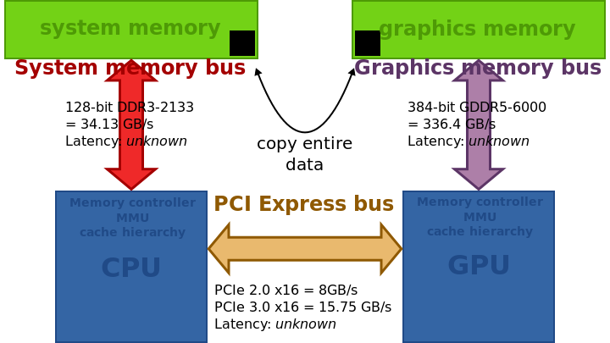
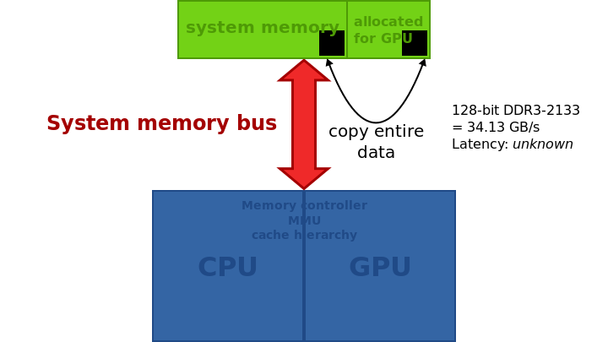
1. Introduction to architectural integration of the CPU and GPU (2)
Implementation alternatives of graphics memory [1]
Implementation of the graphics memory
Discrete graphics memory
Unified system memory
(Shared memory)
(Unified Virtual Memory)
(Unified Memory Architecture)
Implementation example
Typ. use
Graphics cards
On-die integrated graphics

Slide 6
1. Introduction to architectural integration of the CPU and GPU (3)
Key benefit/drawback of the Unified system memory [1]
Implementation of the graphics memory
Discrete graphics memory
Unified system memory
(Shared memory)
(Unified Virtual Memory)
(Unified Memory Architecture)
Implementation example
It eliminates the need for an extra graphics memory controller and bus but has the constraints
of a reduced memory bandwidth.

Slide 7
1. Introduction to architectural integration of the CPU and GPU (4)
Address spaces for Discrete and Unified System Memory (USM) [2]
No
USM
USM

Slide 8
1. Introduction to architectural integration of the CPU and GPU (5)
Main difficulty of heterogeneous computing
GPUs operate from their own address spaces, thus without appropriate hardware and software
support data to be processed by GPUs need to be loaded into their address space and
the results need to be sent back to the host.
Transferring data may be avoided with unified system memory and suitable software support
(CUDA 4.0 or OpenCL 1.2 or higher) assuming appropriate hardware.
Then data transfer will be substituted by address mapping (called zero copy).

Slide 9
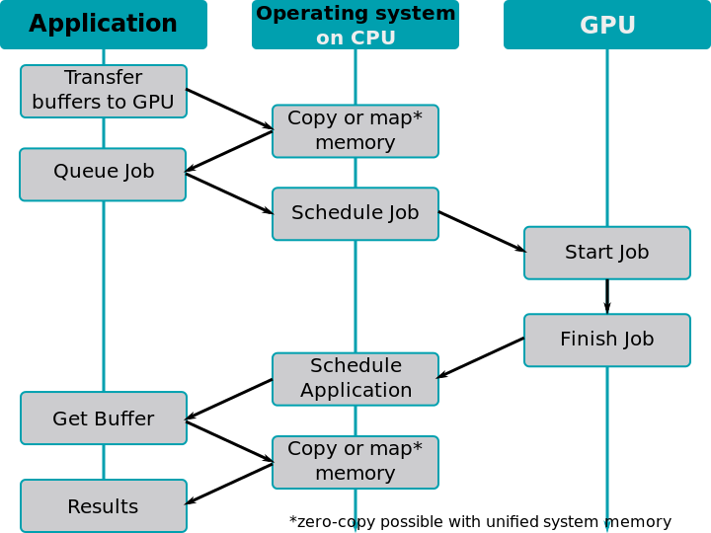
1. Introduction to architectural integration of the CPU and GPU (6)
Tasks to be performed for copying data/mapping address spaces for GPUs [1]

Slide 10
2. AMD’s approach to support
heterogeneous computing

Slide 11
2.1 Introduction to HSA

Slide 12
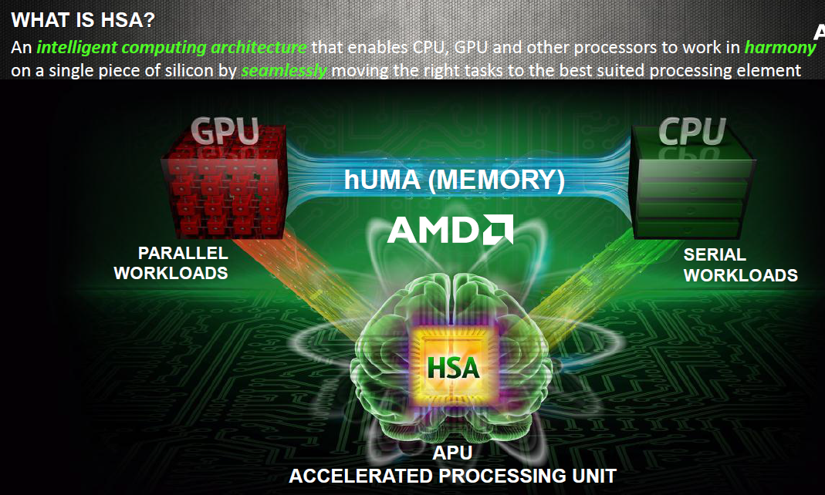
2.1 Introduction to HSA (1)
2.1 Introduction to HSA (Heterogeneous System Architecture)
The notion of HSA [3]

Slide 13
2.1 Introduction to HSA (2)
Aim of HSA-1 [4]

Slide 14
2.1 Introduction to HSA (3)
Aim of HSA-2 [5]

Slide 15
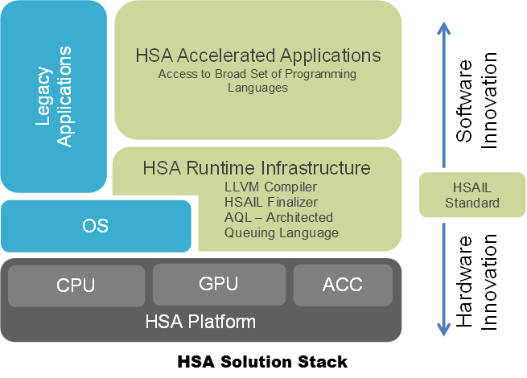
2.1 Introduction to HSA (4)
The entire HSA solution stack [6]
HSAIL: HSA Intermediate Language

Slide 16
2.1 Introduction to HSA (5)
Establishment of the HAS Foundation
In 6/2012 AMD, ARM, TI Qualcomm, Samsung and several other
leading semiconductor firms established the Heterogeneous
System Architecture (HSA) Foundation.
It is a non-profit consortium that aims at defining and promoting
open standards for heterogeneous computing.

Slide 17
2.2 Key hardware enhancements needed
to implement HSA

Slide 18
2.2 Key hardware enhancements needed to implement HSA (1)
2.2 Key hardware enhancements needed to implement HSA [5]
hUMA: heterogeneous UMA
UMA: Uniform Memory Access

Slide 19
2.2 Key hardware enhancements needed to implement HSA (2)
2.2.1 hUMA (Heterogeneous Uniform Memory Access)

Slide 20
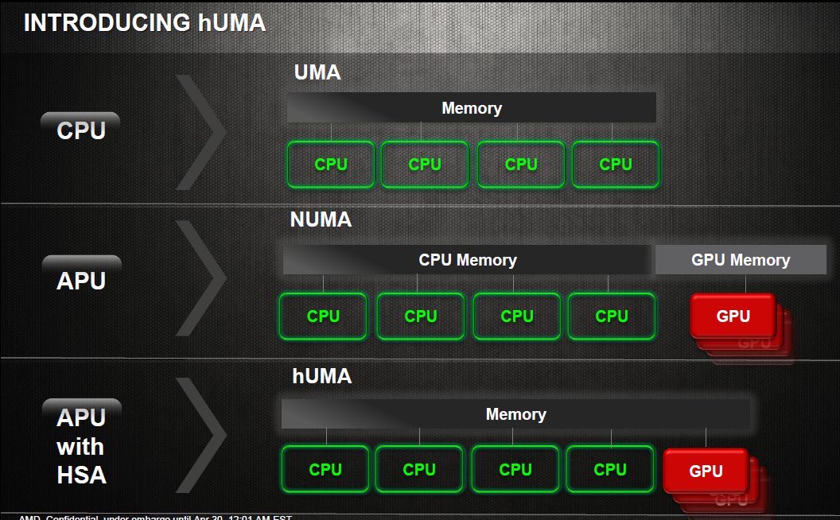
2.2 Key hardware enhancements needed to implement HSA (3)
The hUMA (heterogenous UMA) memory access scheme [3]
(Uniform Memory Access)
(Non-Uniform Memory Access)
(heterogeneous UMA)

Slide 21
2.2 Key hardware enhancements needed to implement HSA (4)
GPU co-processing of data structures without hUMA [3]

Slide 22
2.2 Key hardware enhancements needed to implement HSA (5)
GPU co-processing of data structures with hUMA [3]

Slide 23
2.2 Key hardware enhancements needed to implement HSA (6)
The evolution path to HSA in AMD’s subsequent Family 15h based APU lines [7]

Slide 24
2.2 Key hardware enhancements needed to implement HSA (7)
Key requirements of hUMA-1 [3]

Slide 25
2.2 Key hardware enhancements needed to implement HSA (8)
Key requirements of hUMA-2 [3]

Slide 26
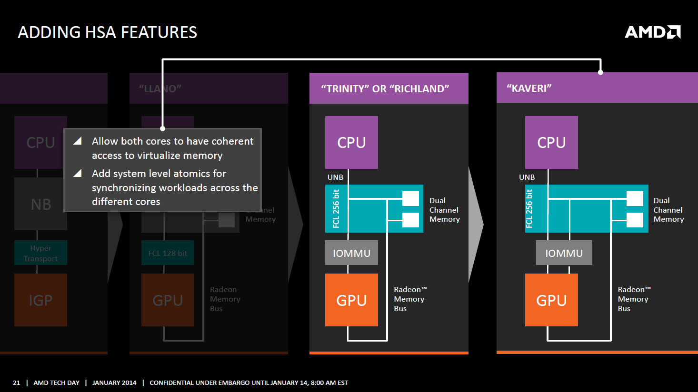
2.2 Key hardware enhancements needed to implement HSA (9)
Hardware support of memory management in Kaveri [8]
AMD Tech Day 2014 Jan

Slide 27
2.2 Key hardware enhancements needed to implement HSA (10)
2.2.2 hQ (heterogeneous Queuing)

Slide 28
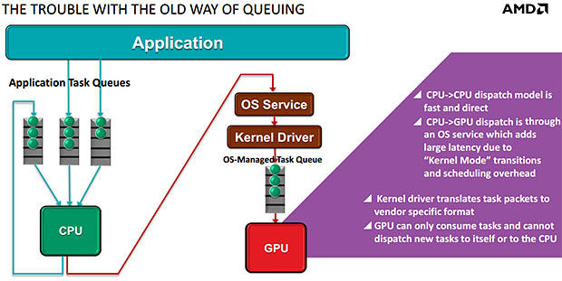
2.2 Key hardware enhancements needed to implement HSA (11)
Traditional management of application tasks queues [9]

Slide 29
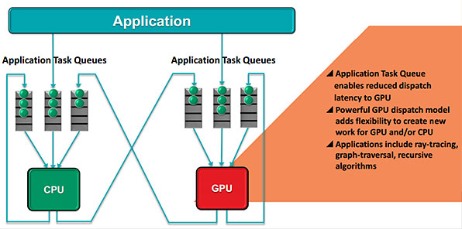
2.2 Key hardware enhancements needed to implement HSA (12)
Application task management with heterogeneous queuing (hQ) [9]

Slide 30
2.2 Key hardware enhancements needed to implement HSA (13)
Main features of hQ [9]
Heterogeneous queuing (hQ) is symmetrical.
It allows both the CPU and the GPU to generate tasks for themselves and for each other.
Work is specified in a standard packet format that will be supported by all HSA-compatible hardware, so
there's no need for the software to use vendor-specific code.
Applications can put packets directly into the task queues that will be accessed by the hardware.
Each application can have multiple task queues, and a virtualization layer allows HSA hardware to see all
the queues.

Slide 31
2.3 AMD’s first implementation of HSA - Kaveri

Slide 32
2.3 AMD’s first implementation of HSA – Kaveri (1)
2.3 AMD’s first implementation of HSA - Kaveri
AMD’s Kaveri
Launched in 6/2014
Is based on the 3. version of the Bulldozer family, called Steamroller.
Aims at desktop PCs and laptops.

Slide 33
2.3 AMD’s first implementation of HSA – Kaveri (2)
AMD’s Family 15h Steamroller-based Kaveri APU lines (based on [10])
Fam. 12h
40 nm
??
K14
F u s i o n
Fam. 12h
1.G.
Fam. 14h
Bobcat
2. G.
Brazos
(Desna)
2 Cores 1MB
DX11 GPU Core
DDR3
??

Slide 34
2.3 AMD’s first implementation of HSA – Kaveri (3)
Die shot of Kaveri [8]

Slide 35
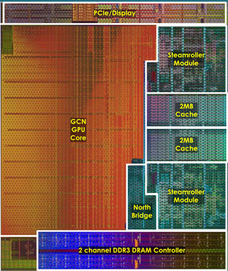
2.3 AMD’s first implementation of HSA – Kaveri (4)
Kaveri die layout [11]

Slide 36
3. Intel’s approach to support
heterogeneous computing

Slide 37
3.1 Intel’s implementations of integrated graphics

Slide 38
3.1 Intel’s implementations of integrated graphics (1)
3.1 Intel’s implementations of integrated graphics
Intel has a long history of integrated graphics, implemented first in the north bridge in the
8xx chipset (1999), as indicated below.
Implementation of integrated graphics
In the north bridge
In a multi-chip processor package
on a separate die
On the processor die
Both the CPU and the GPU are on separate dies
and are mounted into a single package
P
CPU
P
GPU
P
GPU
CPU
Mem.
IG
NB
Mem.
NB
Mem.
Periph. Contr.
South Bridge
South Bridge
Implementations about
1999 – 2009 such as
Intel’s 828xx chipset (1999)
and subsequent implementations
Intel’s Havendale (DT) and
Auburndale (M)
(scheduled for 1H/2009
but cancelled)
Arrandale (DT, 1/2010) and
Clarkdale (M, 1/2010)
Intel’s Sandy Bridge (1/2011) and
subsequent processors
AMD’s Swift (scheduled for 2009
but canceled)
AMD’s Bobcat-based APUs (M, 1/2011)
Llano APUs (DT, 6/2011)
and subsequent processors

Slide 39
3.1 Intel’s implementations of integrated graphics (2)
Unified Memory Architecture (UMA)
Some early graphics cards of other vendors and essentially all (in the north bridge) integrated
graphics designs of Intel already made use of the UMA design as early as in the second half
of the 1990s, as the next Figure shows for the integrated graphics of the Intel 810 chipset (1999).
CPU
Graphics/ Memory Controller
Gfx/Memory Arbiter
Optional Display Cache
Direct AGP
System memory
FB
Figure: The UMA design of an early (in the north bridge) integrated graphics [12]
Key benefit/drawback of the UMA design
The UMA design eliminates the need for an extra graphics memory controller and bus but has the
constraints of a reduced memory bandwidth.

Slide 40
3.1 Intel’s implementations of integrated graphics (3)
Intel’s on-die integrated graphics designs
Subsequently, we discuss only those on-die integrated CPU-GPU solutions that support also HPC
i.e. have OpenCL support, as follows.
OpenCL
support
OpenCL
2.0
OpenCL
1.2
OpenCL
1.2
OpenCL
1.2
No
OpenCL
Table: Intel’s processors with on-die integrated GPUs [13]

Slide 41
3.1 Intel’s implementations of integrated graphics (4)
Key benefit of OpenCL 1.2 supported Shared Physical Memory, illustrated on an example
[13]

Slide 42
3.1 Intel’s implementations of integrated graphics (5)
Shared Virtual Memory - based on the Broadwell architecture and supported by
OpenCL 2.0 [13]

Slide 43
3.1 Intel’s implementations of integrated graphics (6)
Key OpenCL 2.0 features [14]

Slide 44
3.2 Intel’s first implementation of Shared Virtual Memory
The Core M processor

Slide 45
3.2 Intel’s first implementation of Shared Virtual Memory – The Core M (1)
3.2 Intel’s first implementation of Shared Virtual Memory – The Core M processor
The Core M processor targets tablets and 2-in-1 devices
Based on the 14 nm Broadwell architecture
Includes Gen8 graphics
It is a SOC (System on Chip) design
Announced: 8/2014
Launch planned: 4Q/2014.

Slide 46
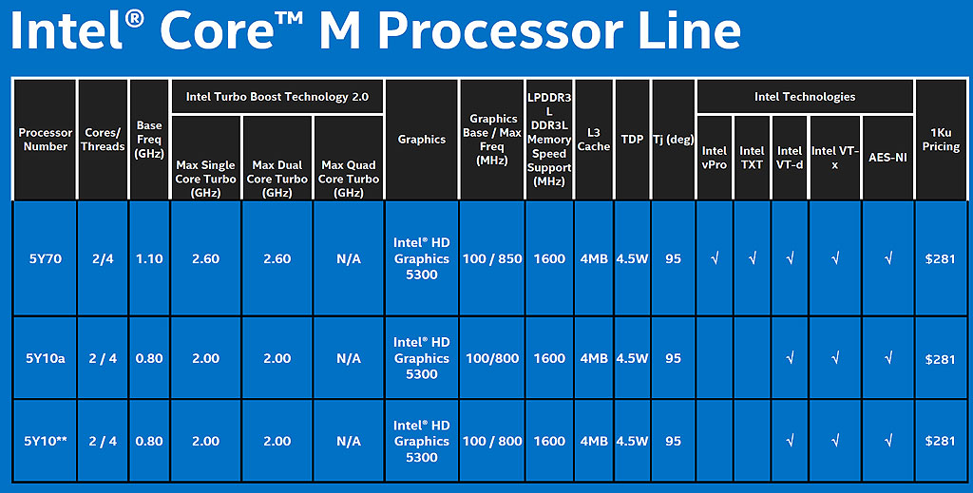
3.2 Intel’s first implementation of Shared Virtual Memory – The Core M (2)
Key features of the announced models of the Core M line [15]

Slide 47
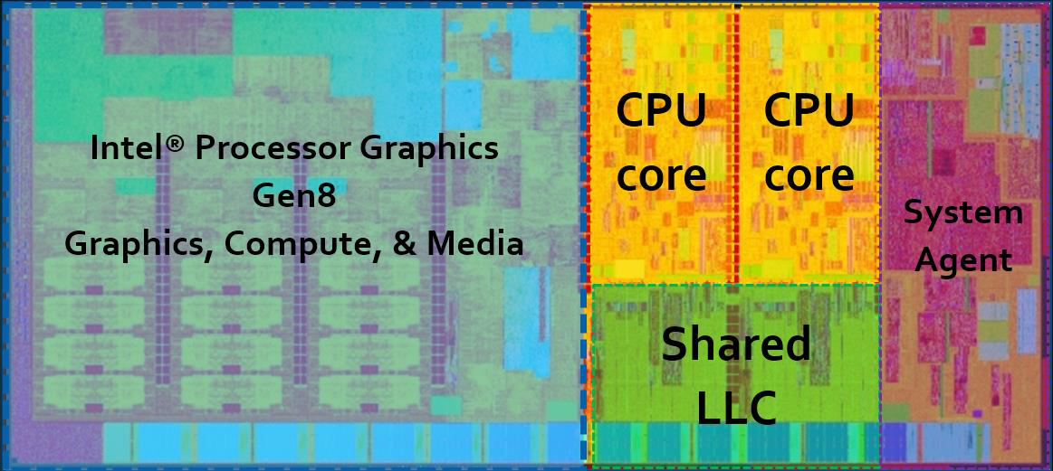
3.2 Intel’s first implementation of Shared Virtual Memory – The Core M (3)
Die layout of the Core M [13]

Slide 48
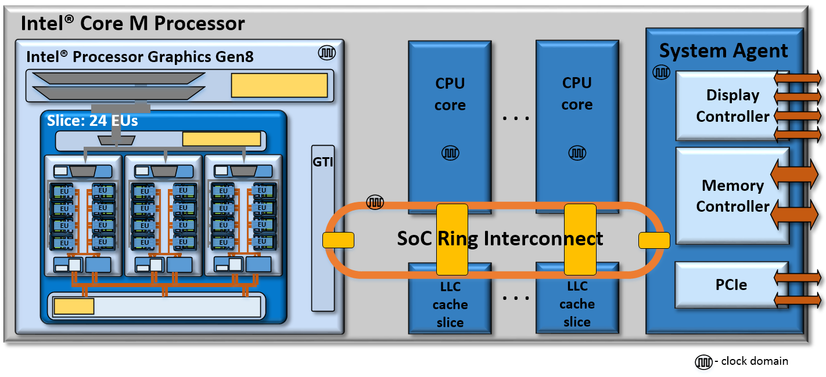
3.2 Intel’s first implementation of Shared Virtual Memory – The Core M (4)
Block diagram of the Core M [13]

Slide 49
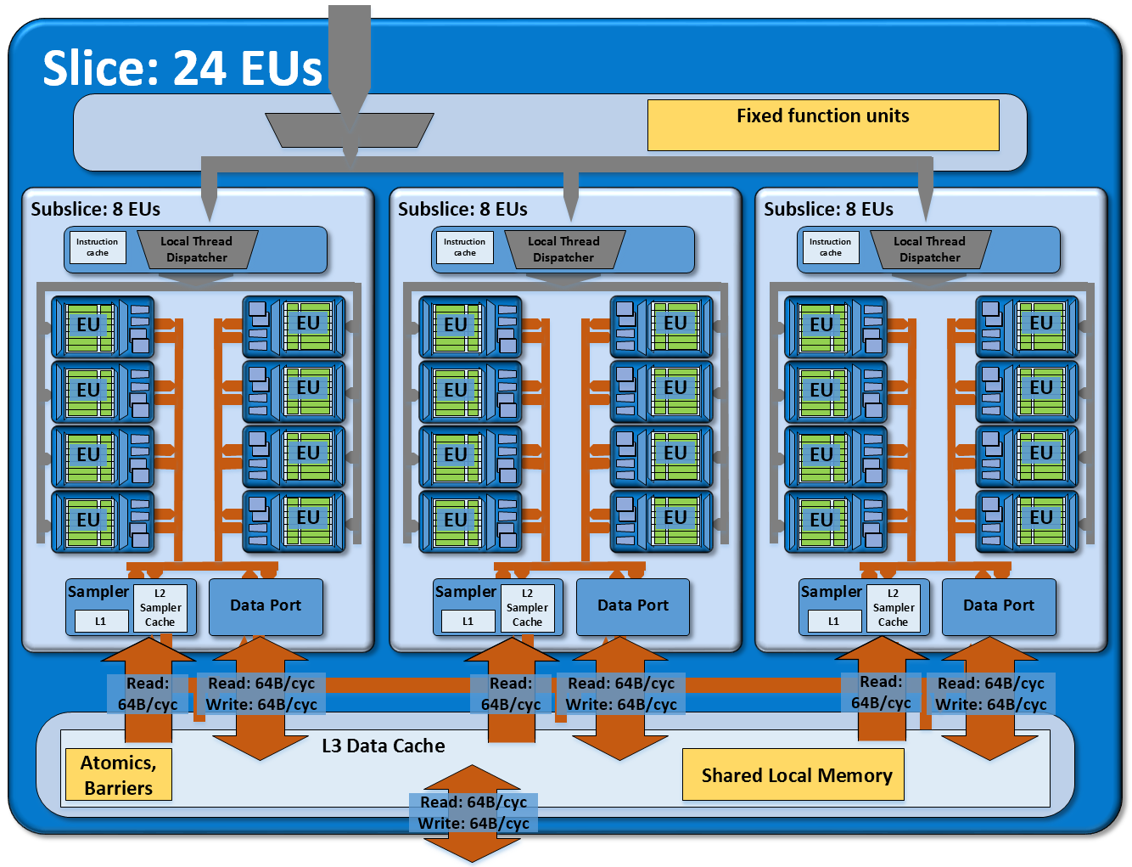
3.2 Intel’s first implementation of Shared Virtual Memory – The Core M (5)
Block diagram of the Gen8 graphics [13]

Slide 50
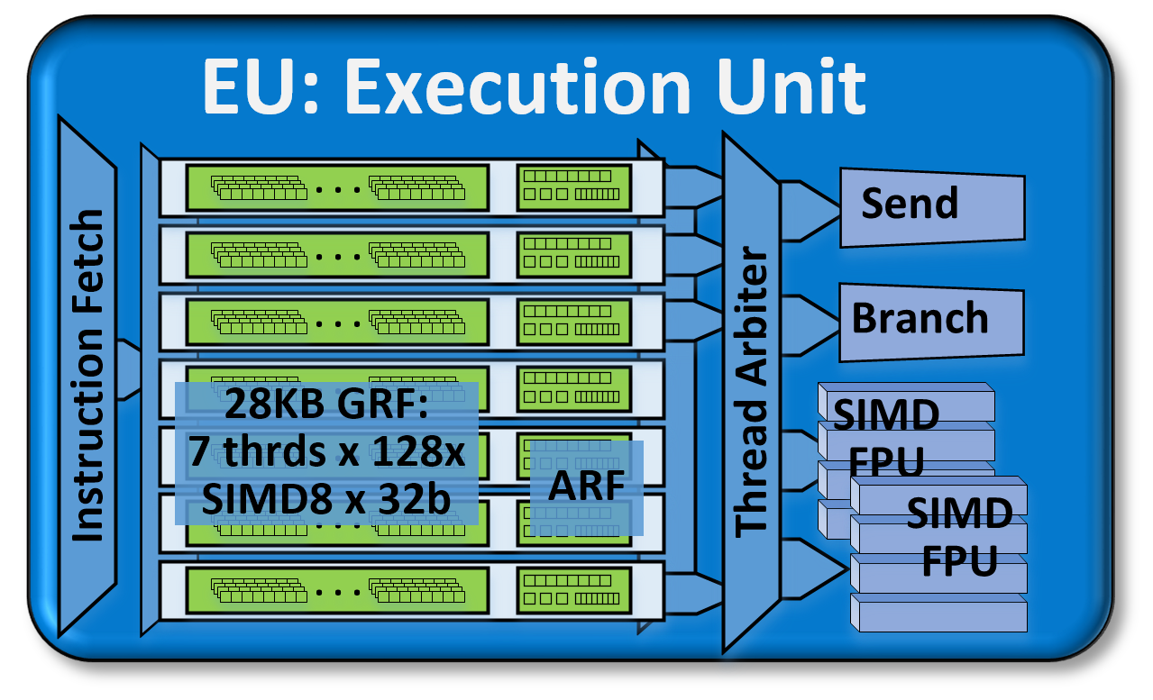
3.2 Intel’s first implementation of Shared Virtual Memory – The Core M (6)
Block diagram of an EU [13]
Each SIMD FPU: 16 x FP32 MAD
ARF: Architectural Register File

Slide 51
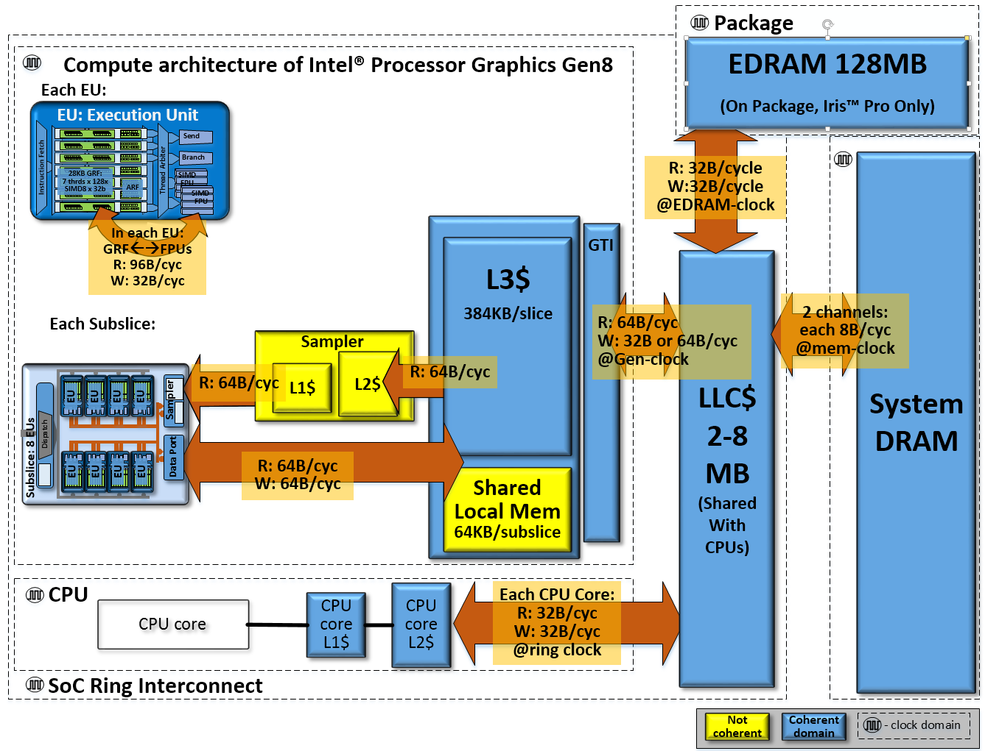
3.2 Intel’s first implementation of Shared Virtual Memory – The Core M (7)
Compute architecture of Core M [13]
Figure 8: A view of the SoC chip level memory hierarchy and
its theoretical peak bandwidths for the compute architecture of Intel® Processor Graphics Gen8.

Slide 52
4. NVIDIA’s planned introduction of Unified Memory

Slide 53
4. NVIDIA’s planned introduction of Unified Memory (1)
4. NVIDIA’s planned introduction of Unified Memory
NVIDIA planned to introduce Unified Memory in their subsequent Maxwell GPU design,
(designated yet as Unified Virtual Memory in the Figure), as seen next.

Slide 54
4. NVIDIA’s planned introduction of Unified Memory (2)
NVIDIA’s GPU roadmap from 11/2013 [17]
Nevertheless, NVIDIA modified their GPU roadmap in 3/2014 and delayed the introduction of
Unified Virtual Memory as shown in the next Figure.

Slide 55
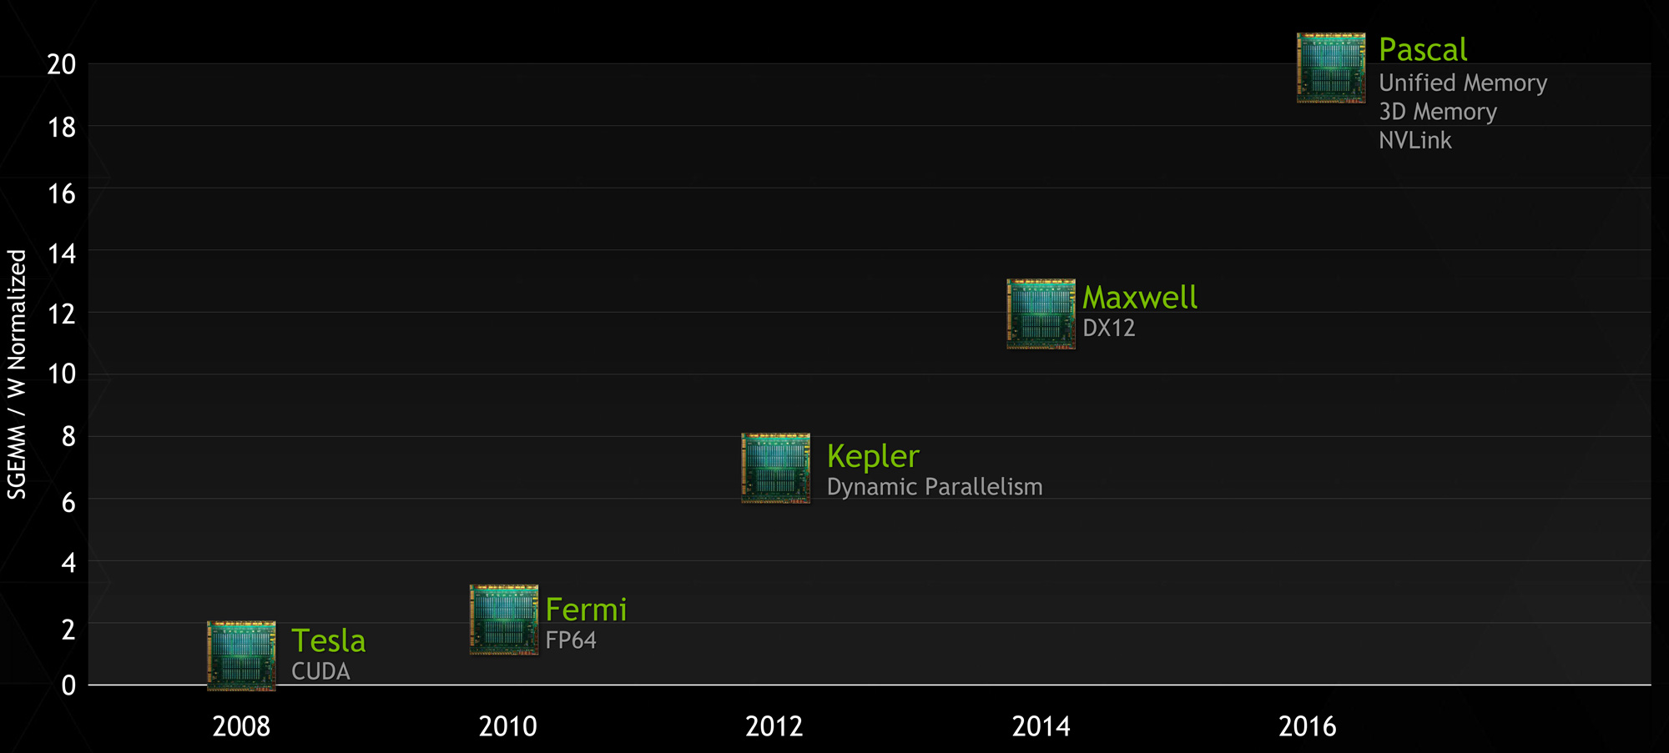
4. NVIDIA’s planned introduction of Unified Memory (3)
NVIDIA’s updated GPU roadmap from 3/2014 (showing Pascal instead of Volta) [23]
SGEMM: SinGle precision, General Matrix Multiply
Notes
In their GPU roadmap NVIDIA substituted Volta by Pascal.
Unified Virtual Memory (UVM) support became delayed, instead of Maxwell first Pascal will
support this feature.
Beyond UVM Pascal will provide stacked memory (planned already for Volta) and NVlink.

Slide 56
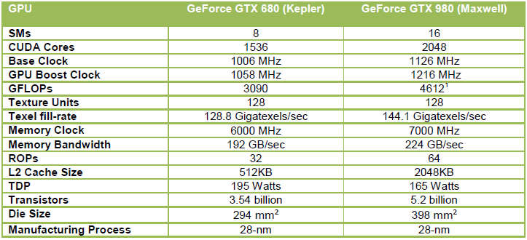
4. NVIDIA’s planned introduction of Unified Memory (4)
Main features of NVIDIA’s recent discrete GPU cards [24]

Slide 57
4. NVIDIA’s planned introduction of Unified Memory (5)
NVIDIA’s Tegra roadmap (Based on [18])

Slide 58
4. NVIDIA’s planned introduction of Unified Memory (6)
Planned enhancements for increasing the memory bandwidth for Unified Memory
a) Stacked memory
b) NVlink

Slide 59
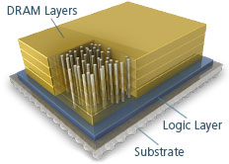
4. NVIDIA’s planned introduction of Unified Memory (7)
a) Stacked Memory (Hybrid Memory Cube, 3D Memory) at a glance [28]
HMC is a stacked memory.
It consists of
a vertical stack of DRAM dies that are connected using TSV (Through-Silicon-Via)
interconnects and
a high speed logic layer that handles all DRAM control within the HMC, as indicated
in the Figure below.
TSV interconnects
Figure: Main parts of a HMC memory [28]

Slide 60
4. NVIDIA’s planned introduction of Unified Memory (7a)
Key features of stacked memories [25]

Slide 61
4. NVIDIA’s planned introduction of Unified Memory (8)
Speed benefit of stacked memory [25]

Slide 62
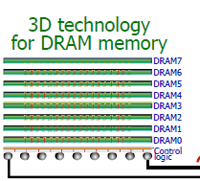
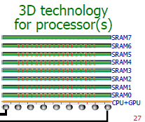
4. NVIDIA’s planned introduction of Unified Memory (9)
Use cases of stacked DRAM [25]
Nvidia Volta (2015) cancelled
NVIDIA Pascal (2016)
Intel Xeon Phi Knights Landing (2015)

Slide 63
4. NVIDIA’s planned introduction of Unified Memory (10)
Stacked memory in Volta
Nvidia disclosed earlier that they plan to introduced stacked GPU memory (3D memory) for their
Volta GPU, as the next Figure shows [26].

Slide 64
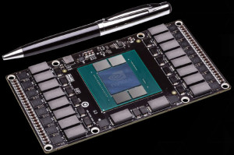
4. NVIDIA’s planned introduction of Unified Memory (11)
Stacked memory on a Pascal GPU [27]
. Stacked Memory will allow also smaller sized (1/3) GPU boards.

Slide 65
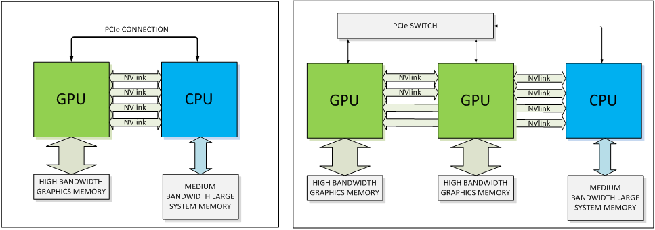
4. NVIDIA’s planned introduction of Unified Memory (12)
b) NVlink [27]
Announced in 3/2014 by NVIDIA and IBM.
It is a high speed interconnect with differential lanes and embedded clock.
The basic building block for NVLink is an 8-lane, differential, bidirectional link providing a
bandwidth of 80 to 200 MB/s compared to ~8 GB/s allowed by an 8-lane PCIe 3.0 link.
NVIDIA intends to introduce NVlink first in their Pascal GPU that is scheduled for 2016.
Figure: Use of Nvlink for connecting GPUs to a CPU [27]

Slide 66
5. References

Slide 67
5. References (1)
[1]: Wikipedia, Heterogeneous System Architecture,
http://en.wikipedia.org/wiki/Heterogeneous_System_Architecture
[2]: Schroeder T.C., Peer-to-Peer & Unified Virtual Addressing, 2011,
http://on-demand.gputechconf.com/gtc-express/2011/presentations/cuda_webinars_
GPUDirect_uva.pdf
[3]: Chu H., AMD heterogeneous Uniform Memory Access, April 30 2013,
http://events.csdn.net/AMD/GPUSat%20-%20hUMA_june-public.pdf
[4]: Heterogeneous System Architecture and the HSA Foundation, June 2012,
http://www.slideshare.net/hsafoundation/hsa-overview
[5]: AMD’s 2014 A-Series APU, Welcome to the revolution, Jan. 2014,
http://new.sliven.net/res/news/129364/Kaveri%20Press%20Deck-v1.01.pdf
[6]: What is Heterogeneous System Architecture (HSA)?, 2014,
http://developer.amd.com/resources/heterogeneous-computing/what-is-heterogeneous-
system-architecture-hsa/
[7]: Pollice M., Analysis: AMD Kaveri APU and Steamroller Core Architectural Enhancements
Unveiled, BSN, March 6 2013, http://www.brightsideofnews.com/news/2013/3/6/analysis-
amd-kaveri-apu-and-steamroller-core-architectural-enhancements-unveiled.aspx
[8]: Macri J., Kaveri Design and Architectural Overview, AMD Tech Day, Jan. 2014,
http://www.pcmhz.com/media/2014/01-ianuarie/14/amd/AMD-Tech-Day-Kaveri.pdf

Slide 68
5. References (2)
[9]: Gasior G., AMD's heterogeneous queuing aims to make CPU, GPU more equal partners,
Tech Report, October 22 2013, http://techreport.com/news/25545/amd-heterogeneous-
queuing-aims-to- make-cpu-gpu-more-equal-partners
[10]: Goto H., AMD CPU Transition, 2011,
http://pc.watch.impress.co.jp/video/pcw/docs/473/823/p7.pdf
[11]: Goto H., APU evolution and future memory architecture of AMD Kaveri, PC Watch,
Jan. 29 2014, http://translate.google.hu/translate?hl=hu&sl=ja&tl=en&u=http%3A%2F%
2Fpc.watch.impress.co.jp%2Fdocs%2Fcolumn%2Fkaigai%2F20140129_632794.html
[12]: Kerby B., Whitney, Intel's 810 Chipset - Part I, Tom’s Hardware, April 30 1999,
http://www.tomshardware.com/reviews/whitney,105-4.html
[13]: Junkins S., The Compute Architecture of Intel Processor Graphics Gen8, IDF 2014,
https://software.intel.com/sites/default/files/managed/71/a2/Compute%20Architecture%
20of%20Intel%20Processor%20Graphics%20Gen8.pdf
[14]: Smith R., Khronos @ SIGGRAPH 2013: OpenGL 4.4, OpenCL 2.0, & OpenCL 1.2 SPIR
Announced, AnandTech, July 22 2013, http://www.anandtech.com/show/7161/khronos-
siggraph-2013-opengl-44-opencl-20-opencl-12-spir-announced/3
[15]: Woligroski D., Intel's Broadwell Core M Processor: New Details, SKUs and Specifics,
Tom’s Hardware, Sept. 5 2014,
http://www.tomshardware.com/news/intel-broadwell-core-m,27596.html
[16]: Harris M., Unified Memory in CUDA 6, NVIDIA Developer Zone, Nov. 18 2013,
http://devblogs.nvidia.com/parallelforall/unified-memory-in-cuda-6/

Slide 69
5. References (3)
[17]: Smith R., NVIDIA Announces CUDA 6: Unified Memory for CUDA, AnandTech,
Nov. 14 2013, http://www.anandtech.com/show/7515/nvidia-announces-cuda-6-
unified-memory-for-cuda
[18]: Burke S., Analysis of NVidia's Unified Virtual Memory Roadmap Disappearance & an ARM
Future, Gamers Nexus, April 3 2014, http://www.gamersnexus.net/guides/1383-nvidia-
unified-virtual-memory-roadmap-tegra-future
[19]: Rao A., Compute with Tegra K1, GPU Technology Conference, 2014,
http://on-demand.gputechconf.com/gtc/2014/presentations/S4906-mobile-compute-
tegra-K1.pdf
[20]: Toksvig M., NVIDIA Tegra,
http://www.hotchips.org/wp-content/uploads/hc_archives/hc20/2_Mon/HC20.25.331.pdf
[21]: Klug B., Shimpi A.L., NVIDIA Tegra K1 Preview & Architecture Analysis, AnandTech,
Jan. 6 2014, http://www.anandtech.com/show/7622/nvidia-tegra-k1/3
[22]: Chester B., Xiaomi Announces the MiPad: The First Tegra K1 Device, AnandTech,
May 15 2014, http://www.anandtech.com/show/8022/xiaomi-announces-the-mipad-
the-first-tegra-k1-device
[23]: Smith R., NVIDIA Updates GPU Roadmap; Unveils Pascal Architecture For 2016, AnandTech,
March 26 2014, http://www.anandtech.com/show/7900/nvidia-updates-gpu-roadmap-
unveils-pascal-architecture-for-2016

Slide 70
5. References (4)
[24]: Hruska J., Nvidia Maxwell GTX 980 and GTX 970 reviewed: Crushing all challengers,
Extreme Tech, Sept. 19 2014, http://www.extremetech.com/computing/190463-nvidia-
maxwell-gtx-980-and-gtx-970-review
[25]: Ujaldón M., Many-core GPUs: Achievements and perspectives, 2013,
http://icpp2013.ens-lyon.fr/GPUs-ICPP.pdf
[26]: Demerjian C., Nvidia_Volta_mockup, SemiAccurate, May 19 2013,
http://semiaccurate.com/2013/05/20/nvidias-volta-gpu-raises-serious-red-flags-for-
the-company/nvidia_volta_mockup/
[27]: Foley D., NVLink, Pascal and Stacked Memory: Feeding the Appetite for Big Data,
NVIDIA Developer Zone, March 25 2014, http://devblogs.nvidia.com/parallelforall/
nvlink-pascal-stacked-memory-feeding-appetite-big-data/
[28] - A Revolution in Memory, Micron Technology Inc.,
http://www.micron.com/products/hybrid-memory-cube/all-about-hmc

