Slide 1
ARM’s processor lines
Dezső Sima
November 2015
(v1.1)
© Dezső Sima 2015

Slide 2
ARM’s processor lines
1. Evolution of ARM
2. Evolution of the ARM ISA
3. Approaches to circuit design
4. Overview of ARM’s processor families
5. Overview of ARM’s Cortex-A series
6. Overview of ARM’s Mali graphics series
7. ARM’s 64-bit Cortex-A series
8. References
Notes:
2

Slide 3
1. Evolution of ARM

Slide 4
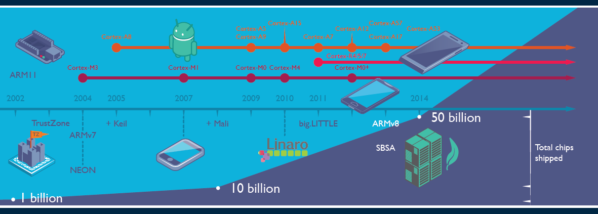
1. Evolution of ARM (2)
Total number of ARM based chips shipped [19]
Keil: Software development tool for embedded processors
Linaro: Nonprofit company, established by ARM, Freescale, IBM, Samsung, ST-Ericsson and TI
to support open source software developers using Linux on SoCs.
SBSA: Server Base System Architecture, a standardized server platform for 64-bit ARM processors.

Slide 5
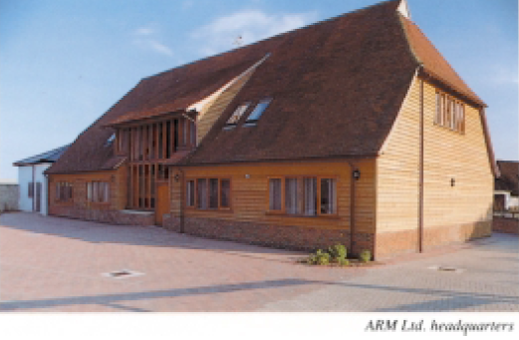
1. Evolution of ARM (5)
Historical remarks -2
Figure: The headquarters of ARM Ltd. about 1990 [62]

Slide 6
1. Evolution of ARM (7)
Historical remarks -4
Figure: ARM's recent headquarters in Cambridge (UK) [78]

Slide 7
2. Evolution of the ARM ISA
2.1 Overview
2.2 ISA extensions introduced to enhance compute capabilities
2.3 ISA extensions introduced to reduce the code size
2.4 ISA extensions introduced to enhance security
(Only Sections 2.1 and 2.2.3 care discussed)

Slide 8
2.1 Overview

Slide 9
2.1 Overview (2)
Key features of ARM’s basic ISA
It is a 32-bit RISC ISA capable to process basically 32-bit FX or logical data.
The ISA has 16 32-bit registers, called the core registers.
13 out of them are used as general purpose registers (GPRs), the remaining three
are dedicated registers, as shown below.
Stack pointer
Link register
PC
Figure: The core registers of the ARM ISA (in the ISA versions ARMv3-ARMv7) [63]

Slide 10
2.1 Overview (3)
Main extensions introduced to ARM’s basic ISA (simplified) -1
ARM’s ISA extensions
ISA extensions to
enhance compute capabilities
ISA extensions to reduce code size or
the execution speed
of Java bytecode
ISA extensions to enhance security

Slide 11
2.1 Overview (4)
Main extensions introduced to ARM’s basic ISA (simplified) -2 (Based on [64])
AArch32
AArch64
Crypto-graphy ext.
Crypto-graphy ext.
Security
TrustZone
SIMD
Adv. SIMD
(NEON¹)
Computing
Key feature ARMv7-A
compatibility
VFPv1/2
VFPv3/v4
Code size or
execution
speed of
Java
bytecode
Jazelle
Jazelle
(ex. by SW)
ThumbEE
(Jazelle-RCT)
Thumb
(ARMv4T)
Thumb-2
(ARMv6T2)
ARMv4
ARMv5
ARMv6
ARMv7-A/R
ARMv8-A
Examples
ARM710T
(~1995)
ARM926
(2001)
ARM1176
(2004)
Cortex-A5-15
(2006)
Cortex-A50
(2014)
¹The Advanced SIMD architecture extension is commonly referred to as the NEON technology.

Slide 12
2.2 ISA extensions introduced to enhance compute capabilities

Slide 13
2.2.1 Overview (1)
2.2 ISA extensions introduced to enhance compute capabilities -1
2.2.1 Overview
ARM’s ISA extensions
ISA extensions introduced
to enhance compute capabilities
ISA extensions introduced
to reduce code size or
the execution speed
of Java bytecode
ISA extensions introduced
to enhance security

Slide 14
2.2.1 Overview (2)
ISA extensions introduced to enhance the compute capabilities -2
(Based on [64])
AArch32
AArch64
Crypto-graphy ext.
Crypto-graphy ext.
TrustZone
SIMD
Adv. SIMD
(NEON¹)
Key feature ARMv7-A
compatibility
VFPv1/2
VFPv3/v4
Jazelle
Jazelle
(ex. by SW)
ThumbEE
(Jazelle-RCT)
Thumb
(ARMv4T)
Thumb-2
(ARMv6T2)
ARMv4
ARMv5
ARMv6
ARMv7-A/R
ARMv8-A
Examples
ARM710T
(~1995)
ARM926
(2001)
ARM1176
(2004)
Cortex-A5-15
(2006)
Cortex-A50
(2014)
¹The Advanced SIMD architecture extension is commonly referred to as the NEON technology.

Slide 15
2.2.1 Overview (3)
ISA extensions introduced to enhance the compute capabilities -3
As far as the extension for enhancing the compute capabilities are concerned we
have to take into account two distinct register sets;
the basic GPR register set and
the FP and advanced SIMD register set (since ARMv5).
In line with this, the compute oriented ISA extensions may be discussed
in two groups according to which instruction set is referred to by a specific
extension, as shown below.
ISA extensions introduced
to enhance compute capabilities
GPR-based
ISA extensions
FP and Advanced SIMD registers based
ISA extensions
SIMD extension
VFP (Vector Floating Point) extensions
The Advanced SIMD (NEON) SIMD) extension
Extensions of the ARMv8 ISA

Slide 16
2.2.1 Overview (4)
Overview of ISA extensions introduced to enhance compute capabilities
ARM ISA |  | Basic arch. |  | Name of the extensions |  | GPR-based extension | FP/SIMD register based extension
 |  | GPRs | Data type |  |  |  | FP/adv. SIMD reg. set | Scalar data types | Vector data types
Name | Year
ARMv1 | 1986 | n.a. | FX32
ARMv2 | 1989 | n.a.
ARMv3 | 1991 | 13x32
ARMv4 | 1996
ARMv5 | 2000 2001 |  |  | VFP(v1)¹ |  |  | 32x32/16x64 | FP32/64 | Serially executed
 |  |  |  | VFP2¹
ARMv6 | 2004 |  |  | SIMD |  | 32-bit w. FX8/16
ARMv7 | 2006 |  |  | VFPv3² |  |  | 32x64/32x32 or 16x64/32x32 | +FP 16⁴ | Serially executed
 |  |  |  | VFPv4² |  |  |  | + FMA
 |  |  |  | Adv. SIMD (NEON)³ |  |  | 32x64/16x128 | FX8/16/32/ 64 FP16³/32/64 | 64/128-bit wide FX 8/16/32/64, FP16³/32 +FMA³
ARMv8 | 2014 | 31x64 | FX32/64 | A32 | FP |  | 32x64/32x32 | FP32/64
 |  |  |  |  | Adv. SIMD |  | 32x64/16x128 |  | As for ARMv7
 |  |  |  | A64 | FP |  | 32x128 | FP 32/64
 |  |  |  |  | Adv. SIMD |  |  | FX 8/…/64 FP 32/64 | As for ARMv7 + FP 64
w: wide

Slide 17
2.2.2 GPR-based ISA extensions (1)
2.2.2 GPR-based ISA extensions
ISA extensions introduced
to enhance compute capabilities
GPR-based
ISA extensions
FP and Advanced SIMD registers based
ISA extensions
SIMD extension
VFP (Vector Floating Point) extensions
The Advanced SIMD (NEON) extension
Extensions of the ARMv8 ISA

Slide 18
2.2.3 FP and Advanced SIMD registers based ISA extensions (1)
2.2.3 FP and Advanced SIMD registers based ISA extensions
ISA extensions introduced
to enhance compute capabilities
GPR-based
ISA extensions
FP and Advanced SIMD registers based
ISA extensions
SIMD extension
a) VFP (Vector Floating Point) extensions
b) The Advanced SIMD (NEON) extension
c) Extensions provided by the ARMv8 ISA

Slide 19
2.2.3 FP and Advanced SIMD registers based ISA extensions (2)
a) VFP (Vector Floating Point) ISA extensions
We will discuss the VFP (Vector Floating Point) extensions subsequently in two parts,
in accordance with their introduction in the ARMv5 and ARMv6 ISA versions,
as shown below:
VFP (Vector Floating Point) extensions
VFPv1/VFPv2
VFPv3/VFPv4
Introduced in the ISA version
ARMv5
Introduced in the ISA version
ARMv6

Slide 20
2.2.3 FP and Advanced SIMD registers based ISA extensions (3)
a1) VFP (Vector Floating Point) extensions VFP(v1)/v2 [65] -1
It is a co-processor based extension to speed up scalar and vector FP32/64
operations, introduced along with the ARMv5 ISA version.
This extension is based on the new 32 32-bit wide VFP register file, organized as
four register banks, each including 8 registers, as seen below.
Figure: Register banks of the VFP extensions [65]

Slide 21
2.2.3 FP and Advanced SIMD registers based ISA extensions (5)
Example: Vector operation with 5 elements [65]
In the example the input operands are taken from the registers s10...s14 and
s18...s22, and the result is written into the registers s26...s30.
The execution is sequential (like a hardware implemented subroutine).

Slide 22
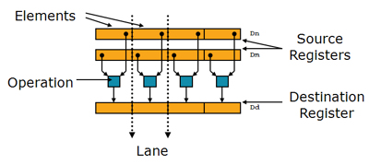
2.2.3 FP and Advanced SIMD registers based ISA extensions (7)
b) The Advanced SIMD (NEON) extension (introduced in the ARMv7 ISA) [11]
It is a 64/128-bit SIMD extension intended to accelerate multimedia and signal
processing algorithms such as video encode/decode, 2D/3D graphics, gaming,
speech or image processing.
NEON extends the 32x32-bit VFP register file to 32x64-bit, called the FP and
advanced SIMD register file, that may be used also as 16 128-bit wide registers,
and is shared with the VFP3/VFP4 extension.
NEON instructions operate on data held in the FP and advanced SIMD registers.
They perform the same operation on the data elements, as shown below.
Figure: SIMD data [11]
NEON instructions operate on 64 or 128-bit packed vectors of signed/unsigned
8-bit, 16-bit, 32-bit or 64-bit FX as well as on FP16 or FP32 data elements.
For FP16 data there are only conversion (FP16-FP32) operations supported.
FP16 data and FMA operations are supported only in the Advanced SIMDv2 option.

Slide 23
2.2.3 FP and Advanced SIMD registers based ISA extensions (8)
c) Extensions provided by the ARMv8 ISA [66]
The ARMv8 ISA version introduces major changes in the ARM architecture while
maintaining a high level of consistency with previous versions of the architecture.
ARMv8 has two distinct execution modes, as indicated below.
Execution modes of the ARMv8
Aarch32
execution mode
Aarch64
execution mode
It supports two 32-bit instruction sets,
the A32 and the T32 (Thumb) instructions sets.
In this mode the processor can run programs
developed for previous ISA versions.
It supports a single 64-bit instruction set,
called A64.
This is a fixed length powerful instruction set
that uses 32-bit instruction encodings.

Slide 24
2.2.3 FP and Advanced SIMD registers based ISA extensions (9)
Extension of the GPRs in the ARMv8 ISA [63], [66]
In the AArch64 mode the ARMv8 ISA version expands the number of GPRs
from 13 32-bit registers to 31 64-bit wide registers, as shown in the next Figure.
32-bit wide
32-bit wide
64-bit wide
R0
R0
R0
R1
R1
R1
R2
R2
R2
.
.
.
.
.
.
.
.
.
X0
W0
R12
R12
R12
R13(SP)
Stack pointer
Link register
PC
R13(SP)
R13(SP)
R14(LR)
R14(LR)
R14(LR)
R15(PC)
.
.
.
.
.
.
X30
W30
X31
Dedicated use
W31
Dedicated use
32-bit mode
64-bit mode
GPRs in the ARMv7 and the AArch32 execution mode of the ARMv8 ISA
GPRs in the AArch64 excution mode
of the ARMv8 ISA

Slide 25
2.2.3 FP and Advanced SIMD registers based ISA extensions (10)
Extension of the FP and advanced SIMD registers in the ARMv8 ISA [66]
In the AArch64 mode the ARMv8 ISA version expands the number of FP and
advanced SIMD registers from 16 (available in the ARMv7 ISA) to 32, as seen below.
128-bit wide
128-bit wide
V0
V0
V1
V1
V2
V2
.
.
.
.
.
.
V3
V12
V12
V13
V13
V14
V14
V15
.
.
.
V30
V31
FP and advanced SIMD registers
in ARMv7 and the AArch32 execution mode of the ARMv8 ISA
FP and advanced SIMD registers
in the AArch64 execution mode of the ARMv8 ISA

Slide 26
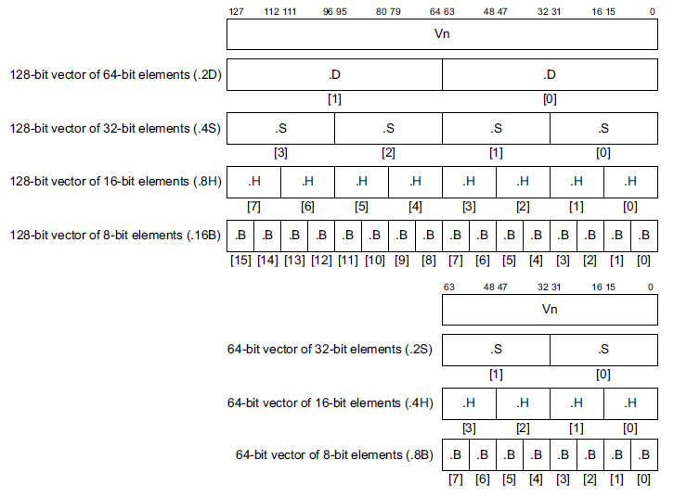
2.2.3 FP and Advanced SIMD registers based ISA extensions (11)
Use of the FP and Advanced SIMD registers in the AArch64 execution mode
[66]
32 128-bit registers
32 64-bit registers

Slide 27
2.3 ISA extensions introduced to reduce code size or
the execution speed of Java bytecode

Slide 28
2.3 ISA extensions introduced to reduce code size (1)
2.3 ISA extensions introduced to reduce code size or the execution speed
of Java bytecode -1
ARM’s ISA extensions
ISA extensions introduced
to enhance compute capabilities
ISA extensions introduced
to reduce code size or
the execution speed
of Java bytecode
ISA extensions introduced
to enhance security
a) The Thumb instruction set
b) Jazelle
c) Thumb EE (Jazelle)

Slide 29
2.3 ISA extensions introduced to reduce code size (2)
ISA extensions introduced to reduce code size -2 (Based on [64])
AArch32
AArch64
Crypto-graphy ext.
Crypto-graphy ext.
TrustZone
SIMD
Adv. SIMD
(NEON¹)
Key feature ARMv7-A
compatibility
VFPv1/2
VFPv3/v4
Jazelle
Jazelle
(ex. by SW)
ThumbEE
(Jazelle-RCT)
Thumb
(ARMv4T)
Thumb-2
(ARMv6T2)
ARMv4
ARMv5
ARMv6
ARMv7-A/R
ARMv8-A
Examples
ARM710T
(~1995)
ARM926
(2001)
ARM1176
(2004)
Cortex-A5-15
(2006)
Cortex-A50
(2014)
¹The Advanced SIMD architecture extension is commonly referred to as the NEON technology.

Slide 30
2.3 ISA extensions introduced to reduce code size (4)
Available GPR register sets in the ARM and the Thumb ISA [63]

Slide 31
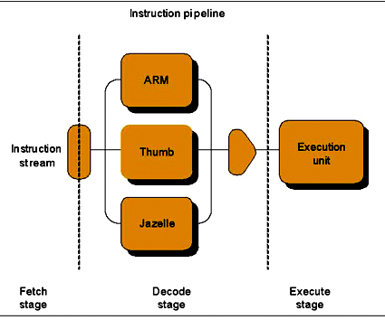
2.3 ISA extensions introduced to reduce code size (5)
b) Jazelle
It is ARM’s third ISA option, introduced in the ARMv5 ISA, as indicated below.
Figure: The Jazelle ISA extension as ARM’s third ISA alternative [67]
It aims at accelerating the execution of Java bytecode.

Slide 32
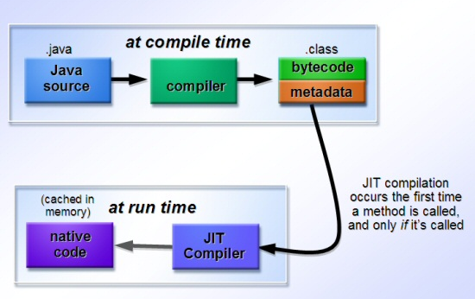
2.3 ISA extensions introduced to reduce code size (7)
Remark: Just-in-time (JIT) compilation in Java environment -1 [73]
Java bytecode is a platform neutral intermediate language.
Java bytecode programs are loaded and run by a Java Virtual Machine (JVM),
also known as a Java Runtime Environment (JRE).
Extensions
Platform neutral
portable bytecode
JVM
ThumbEE ISA
Figure: Just-in-time compilation in Java einvironment [73]

Slide 33
2.3 ISA extensions introduced to reduce code size (8)
Remark: Just-in-time (JIT) compilation in Java environment -2 [73]
The JIT compiler at runtime converts bytecode into native machine code.
JIT compilation occurs when each method is called at the first time, after which
the native code for that method remains cached in memory; this means that
subsequent executions of that method run as fast as native programs.
Extensions
Platform neutral
portable bytecode
JVM
ThumbEE ISA
Figure: Just-in-time compilation in Java einvironment [73]

Slide 34
2.4 ISA extensions introduced to enhance security

Slide 35
2.4 ISA extensions introduced to enhance security (1)
2.4 ISA extensions introduced to enhance security -1
ARM’s ISA extensions
ISA extensions introduced
to enhance compute capabilities
ISA extensions introduced
to reduce code size or
the execution speed
of Java bytecode
ISA extensions introduced
to enhance security
a) The TrustZone extension
b) The Cryptography extension

Slide 36
2.4 ISA extensions introduced to enhance security (2)
ISA extensions introduced to enhance security -2 (Based on [64])
AArch32
AArch64
Crypto-graphy ext.
Crypto-graphy ext.
TrustZone
SIMD
Adv. SIMD
(NEON¹)
Key feature ARMv7-A
compatibility
VFPv1/2
VFPv3/v4
Jazelle
Jazelle
(ex. by SW)
ThumbEE
(Jazelle-RCT)
Thumb
(ARMv4T)
Thumb-2
(ARMv6T2)
ARMv4
ARMv5
ARMv6
ARMv7-A/R
ARMv8-A
Examples
ARM710T
(~1995)
ARM926
(2001)
ARM1176
(2004)
Cortex-A5-15
(2006)
Cortex-A50
(2014)
¹The Advanced SIMD architecture extension is commonly referred to as the NEON technology.

Slide 37
3. Approaches to circuit design
(Not discussed)
Notes:
37

Slide 38
3. Approaches to circuit design (1)
3. Approaches to circuit design
Approaches to circuit design
Full custom design
Semi custom design
Full synthesizable design
Hand layout of the
entire circuit
The design will be subdivided into
functional units and further on into blocks
and the appropriate implementation technique
(hand layout, structured layout or automated layout)
is chosen for each.
Automated layout of the
entire circuit
Power/performance
optimized
Implementation time
optimized

Slide 39
3. Approaches to circuit design (5)
b) Structured layout of blocks [1]
The structured approach is typically used for regular structures, like datapaths.
In this approach the blocks will be manually mapped into the gate level and also
the logic gates of the blocks are manually placed to maintain a regular data-flow
within the blocks instead of generating a random gate structure by synthesis.
Nevertheless, the routing of the circuit elements is done automatically.
This approach offers more control over the design than an automated synthesis
approach and leads to a more predictable timing behavior.
On the other hand it yields better performance and less area than traditional
techniques.
Figure: Regular datapath structure [3]

Slide 40
3. Approaches to circuit design (6)
Benefits of the structured layout vs. fully synthesized layout [3]

Slide 41
3. Approaches to circuit design (9)
Example for a semi custom design: The Cortex-A8 [3]
Figure: Partitioning the Cortex-A8 into blocks implemented by different design
approaches [3]

Slide 42
3. Approaches to circuit design (11)
Evolution of the approaches used to circuit design [1]
Over time more and more advanced standard cell libraries were developed that
have a large variety of cell types and drive strengths which lessens the need
for custom design.
This is the reason why recently automated design tools are typically used for
processor design.
Approaches to circuit design
Full custom design
Semi custom design
Full synthesizable design
Hand layout of the
entire circuit
The design will be subdivided into
functional units and further on into blocks
and the appropriate implementation technique
(hand layout, structured layout or automated layout)
is chosen for each.
Automated layout of the
entire circuit
Power/performance
optimized
Implementation time
optimized
Trend

Slide 43
4. Overview of ARM’s processor series
4.1 Introduction
4.2 Processors implementing the ARMv1 – ARMv3 ISA
4.3 Processors implementing the ARMv4 – ARMv6 ISA
4.4 Processors implementing the ARMv7 – ARMv8 ISA

Slide 44
4.1 Overview of ARM’s processor series

Slide 45
4.1 Overview of ARM’s processor lines (1)
4.1 Introduction
Subsequently, we give an overview of ARM’s processor series subdivided into three
sections, according their underlying ISAs, as follows.
ARM’s processor series
Processors implementing
the ARMv1 – ARMv3 ISA
Processors implementing the ARMv4 – v6 ISA
Processors implementing
the ARMv7 – ARMv8 ISA
(Early ARM processors)
(Advanced ARM processors)
(ARM’s Cortex processors)
(~ 1985-1994)
(~ 1995-2004)
(Since 2004)
Section 4.2
Section 4.3
Section 4.2

Slide 46
4.2 Processors implementing the ARM v1 - ARM v3 ISA

Slide 47
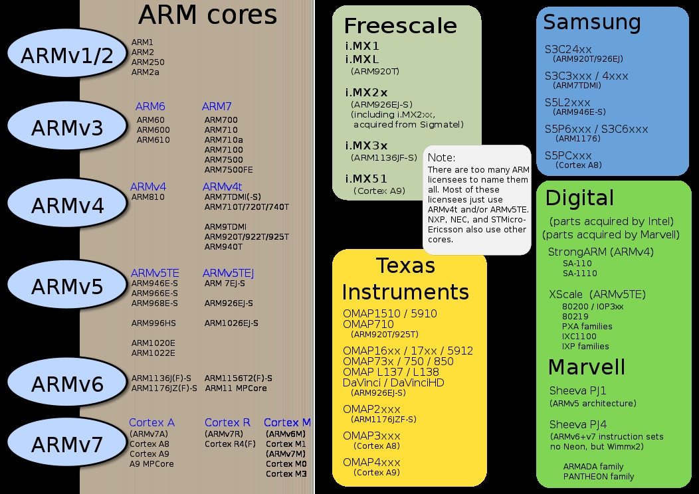
4.2 Processors implementing the ARM v1 - ARM v3 ISA (1)
4.2 Processors implementing the ARMv1 – ARMv3 ISA [5]

Slide 48
4.3 Processors implementing the ARM v4 - ARM v6 ISA

Slide 49
4.3 Processors implementing the ARM v4 - ARM v6 ISA (1)
4.3 Processors implementing the ARMv4 – ARMv6 ISA [5]

Slide 50
4.3 Processors implementing the ARM v4 - ARM v6 ISA (2)
Main extensions introduced in the ARMv4 – ARM v6 ISA versions (simplified)
AArch32
AArch64
Crypto-graphy ext.
Crypto-graphy ext.
TrustZone
SIMD
NEON
(Adv. SIMD)
Key feature ARMv7-A
compatibility
VFPv1/2
VFPv3/v4
Jazelle
Jazelle
(ex. by SW)
ThumbEE
(Jazelle-RCT)
Thumb
(ARMv4T)
Thumb-2
(ARMv6T2)
ARMv4
ARMv5
ARMv6
ARMv7-A/R
ARMv8-A
Examples
ARM710T
(~1995)
ARM926
(2001-)
ARM1176
(2004-)
Cortex-A series
(2005-)
Cortex-A50
(2014)
Figure: Enhancements of the ARMv6 ISA

Slide 51
4.3 Processors implementing the ARM v4 - ARM v6 ISA (3)
Overview of ARM’s processors implementing the ARMv4 – ARMv6 ISA [5]
ARM1156T2F-S
ARM1136JF-S™
ARM1136JF-S™
version
ARMv6
ARM1176JZF-S
ARM102xE
ARM1026EJ-S
XScale
ARMv5
ARM9x6E
ARM926EJ-S
ARM7TDMI-S
StrongARM
ARM92xT
SC200
ARMV4
SC100
ARM720T
1994
1996
1998
2000
2002
2006
time
2004
XScale is a trademark of Intel Corporation
Notes:
Versions mostly refer to the instruction set that the ARM core executes.
The ARM7, which is still the most often used core in a low-power design, executes the version 4T instruction set. Architectural extensions were added for version 5TE to include DSP instructions, such as 16-bit signed MLA instructions, saturation arithmetic, etc. The ARM926EJ-S and ARM1026EJ-S cores are examples of Version 5 architectures. Version 6 added instructions for doing byte manipulations and graphics algorithms more efficiently. The ARM11 family implemented the Version 6 architecture. Version 7 architectures (which include the Cortex family of cores, such as the Cortex A8, Cortex M3 and Cortex R4) extended the functionality by adding things such as Thumb2, low-power features, and more security.

Slide 52
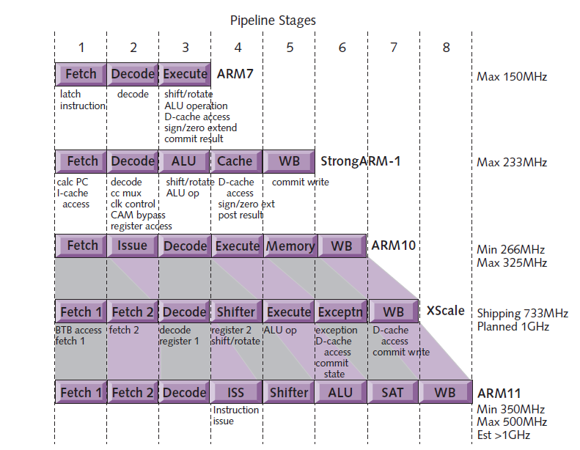
4.3 Processors implementing the ARM v4 - ARM v6 ISA (4)
Evolution of the pipeline length of ARM v4 – ARM v6 based processors [8]
ARMv4
ARMv4
ARMv5
ARMv5
ARMv6

Slide 53
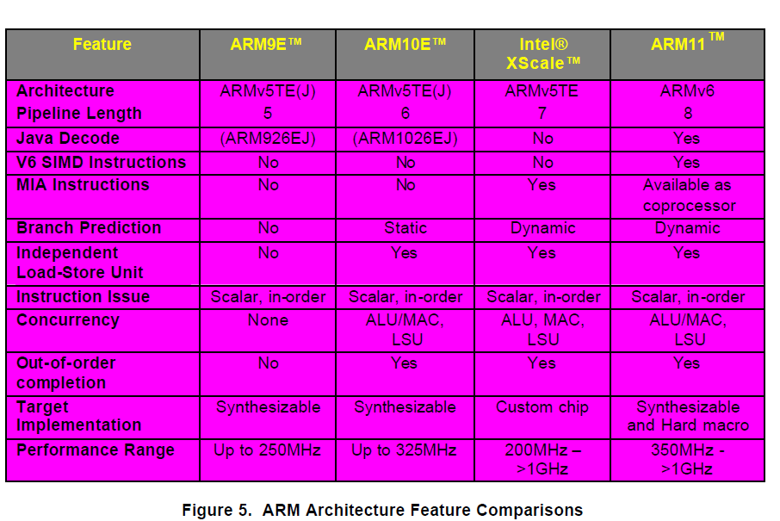
4.3 Processors implementing the ARM v4 - ARM v6 ISA (5)
Main features of the ARMv5 – ARMv6 processors (≈1999-2003) [57]

Slide 54
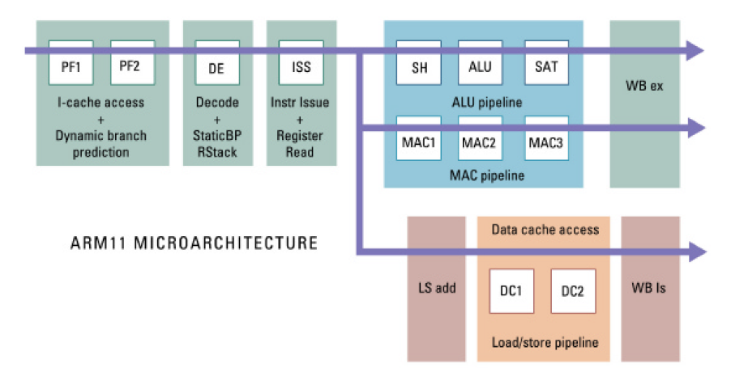
4.3 Processors implementing the ARM v4 - ARM v6 ISA (8)
Pipeline structure of the ARM11 [57]

Slide 55
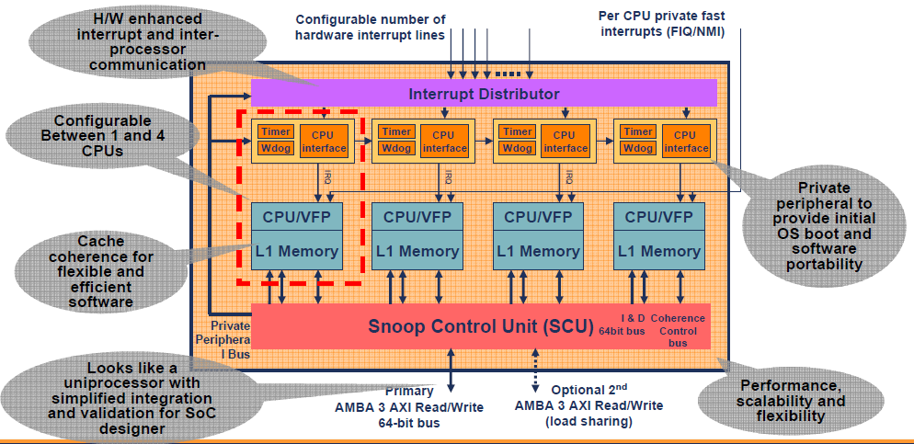
4.3 Processors implementing the ARM v4 - ARM v6 ISA 10)
Block diagram of the ARM11 MPCore [9]
Note that the ARM11 MPCore does not include an L2.

Slide 56
4.3 Processors implementing the ARM v4 - ARM v6 ISA 11)
Remark: Emergence of dual core processors
Year of launching | Dual core design
10/2001 | IBM launches dual core POWER4
11/2002 | IBM launches dual core POWER4+
05/2004 | ARM announces the availability of the synthesisable ARM11 MPCore quad core processor
05/2004 | IBM launches dual core POWER5
08/2004 | AMD demonstrates first x86 dual core (Opteron) processor
04/2005 | ARM demonstrates the ARM11 MPCore quad core test chip in cooperation with NEC
04/2005 | Intel launches dual core Pentium processors (Pentium D)
04/2005 | AMD launches dual core Opteron server processors
06/2006 | Intel launches the dual core Core 2 family
10/2007 | ARM launches their first multicore Cortex model (the quad core Cortex A9 MPcore)

Slide 57
4.4 Processors implementing the ARM v7 - ARM v8 ISA

Slide 58
4.4 Processors implementing the ARM v7 - ARM v8 ISA (4)
Recent ARM profiles
and processors [6]

Slide 59
4.4 Processors implementing the ARM v7 - ARM v8 ISA (1)
Introducing the 64-bit ARM v8 ISA and related processors
In 2012 ARM expanded their Cortex family by processors implementing the 64-bit
ARMv8 ISA, as indicate below.
Recent ARM processors
(The Cortex family)
ARM processors implementing the ARMv7 ISA
ARM processors implementing the
ARMv8 ISA
32-bit architectures
(Announced in 2004)
64-bit architectures
(Announced in 2012)

Slide 60
5. Overview of ARM’s Cortex-A series

Slide 61
5. Overview of ARM’s Cortex-A series (1)
5. Overview of ARM’s Cortex-A series
According to the general scope of this Lecture Notes, subsequently we will be
concerned only with the Cortex-A series.
Key features of ARM’s Cortex-A series
Multiprocessor capability
of the Cortex-A series
Performance classes
of the Cortex-A series
Word length
of the Cortex-A series

Slide 62
5. Overview of ARM’s Cortex-A series (2)
Multiprocessor capability of the Cortex-A series
Multiprocessor capability of the Cortex-A series
Single processor designs,
no multiprocessor
capability
Dual designs with two options
A-priory
multiprocessor designs
a single processor option and
a multiprocesor capable option
Cortex-A8 (2005)
Cortex-A9/Cortex-A9 MPCore (2007)
Cortex-A12/Cortex-A12 MPCore (2013)
Cortex-A15/Cortex-A15 MPCore (2010)
Cortex-A17/Cortex-A17 MPCore (2014)
Cortex-A7 MPCore (2011)
Cortex-A35 (2015)
Cortex-A53 (2012)
Cortex-A57 (2012)
Cortex-A72 (2015)
Here we note that in figures or tables we often omit the MPCore tag for the sake
of brevity.

Slide 63
5. Overview of ARM’s Cortex-A series (4)
Performance classes of the Cortex-A series -1 [12]
Performance classes of the Cortex-A models
High-performance models
Mainstream models
Low-power models
Cortex-A15
Cortex-A57
Cortex-A72
Cortex-A8
Cortex-A9
(Cortex-A12)
Cortex-A17
Cortex-A5
Cortex-A7
Cortex-A35
Cortex-A53

Slide 64
5. Overview of ARM’s Cortex-A series (5)
Performance classes of the Cortex-A series -2 (based on [12])
7
DMIPS/MHz
2/2015
Cortex-A72
ARMv8
16 nm
6
Announced
10/2012
Cortex-A57
ARMv8
20/16 nm
5
9/2010
Cortex-A15
ARMv7
32/28 nm
2/2014
Cortex-A17
ARMv7
28 nm
4
6/2013
Cortex-A12
ARMv7
20/16 nm
High Performance
3
Mainstream
10/2007
Cortex-A9
ARMv7
40 nm
10/2005
Cortex-A8
ARMv7
65 nm
10/2012
Cortex-A53
ARMv8
20/16 nm
11/2015
Cortex-A35
ARMv8
28 nm
2
10/2011
Cortex-A7
ARMv7
28 nm
10/2009
Cortex-A5
ARMv7
40 nm
1
Low power
2006
2007
2008
2009
2010
2011
2012
2013
2014
2015

Slide 65
5. Overview of ARM’s Cortex-A series (6)
Announcement dates and efficiency (DMIPS/MHz) of the Cortex-A models
Announced | Cortex-A model |  | DMIPS/MHz
10/2005 | Cortex-A8 |  | 2.0
10/2007 | Cortex-A9/A9 MPCore |  | 2.5
10/2009 | Cortex-A5/A5 MPCore |  | 1.6
9/2010 | Cortex-A15/A15 MPCore |  | 3.5-4.0
10/2011 | Cortex-A7 MP Core |  | 1.7
6/2013 | Cortex-A12/A12 MPCore |  | 3.0
2/2014 | Cortex-A17/A17 MPCore |  | 3.1-3.3
11/2015 | Cortex-A35 |  | ~ 2.1
10/2012 | Cortex-A53 |  | 2.3
10/2012 | Cortex-A57 |  | 4.1-4.7
2/2015 | Cortex-A72 |  | 6.3-7.35
Source: ARM
DMIPS: Dhrystone MIPS (A synthetic benchmark that indicates integer performance)

Slide 66
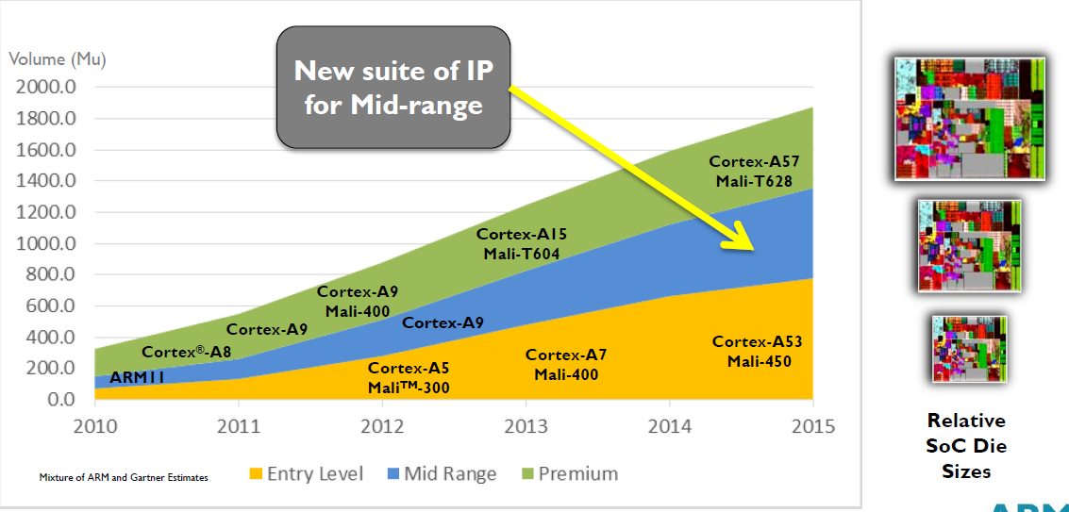
5. Overview of ARM’s Cortex-A series (7)
Yearly shipment of ARM Cortex-A chips in different performance classes
(data from 2013) [13]

Slide 67
5. Overview of ARM’s Cortex-A series (8)
Word length of the Cortex-A series
Word length of the Cortex-A series
ARM’s 32-bit Cortex-A models
ARM’s 64-bit Cortex-A models
Cortex-A5 to A17
Cortex-A53/A57/A72
Cortex-A35

Slide 68
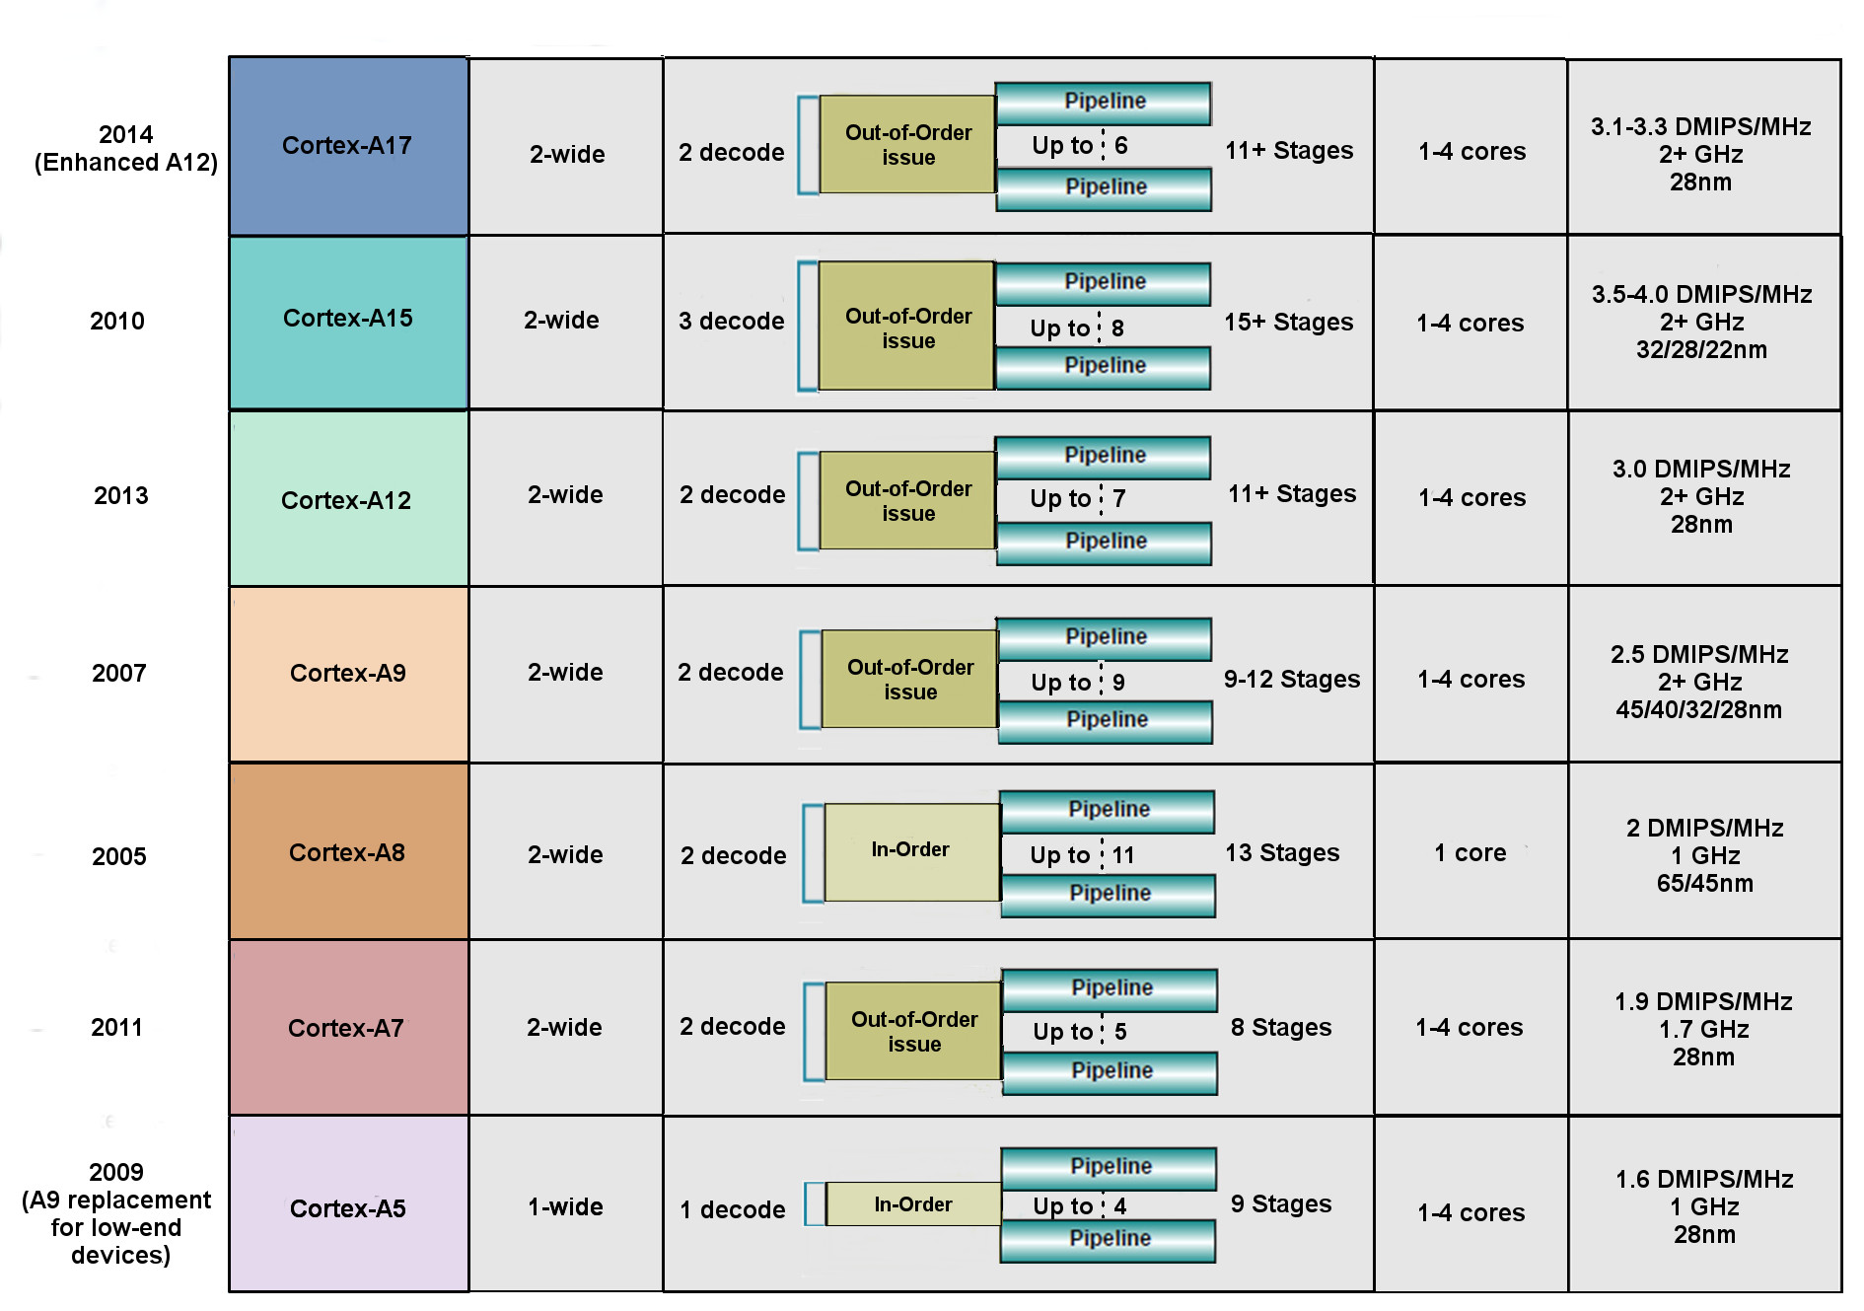
5. Overview of ARM’s Cortex-A series (9)
Key features of ARM’s 32-bit microarchitectures -1 (based on [14])

Slide 69
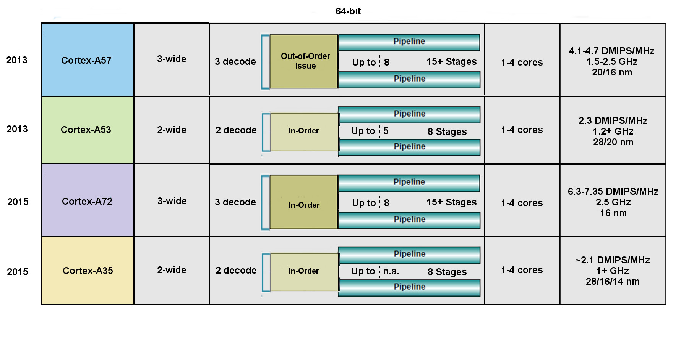
5. Overview of ARM’s Cortex-A series (10)
Key features of ARM’s 64-bit microarchitectures -2 (based on [14])
Remark: In the Cortex-A9 the NEON FP operates in order.

Slide 70
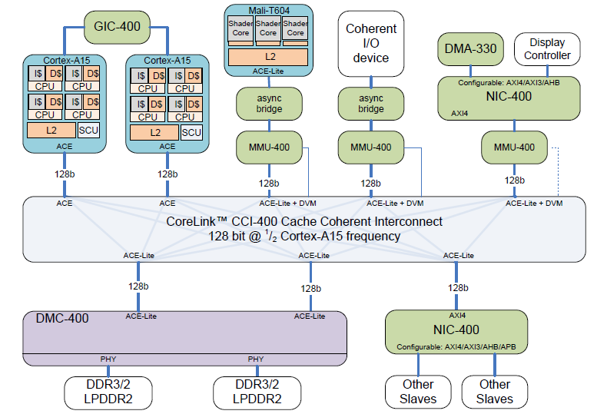
5. Overview of ARM’s Cortex-A series (11)
Example: Dual-core A15-based high performance cache coherent system [15]
Network
Interconnect
Network
Interconnect
Dynamic Memory Controller

Slide 71
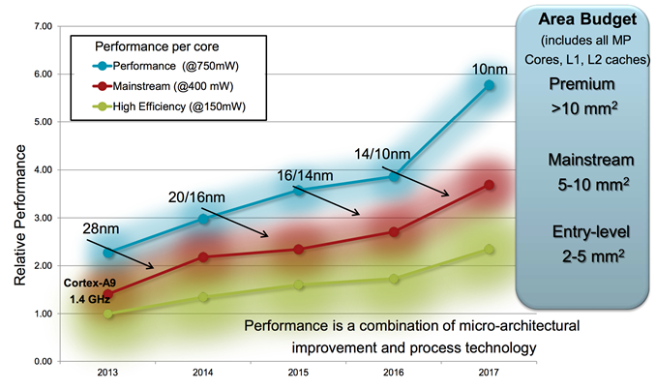
5. Overview of ARM’s Cortex-A series (12)
Relative per core performance of Cortex-A processors with different
power budget [16]

Slide 72
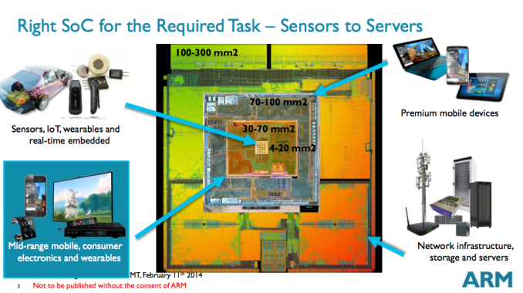
5. Overview of ARM’s Cortex-A series (13)
Die are requirement of different applications [17]

Slide 73
5. Overview of ARM’s Cortex-A series (14)
Use of 32-bit ARM Cortex-A models in mobiles [18]
 | (SOC) System- On-a-Chip | Notable Product(s) Containing | ARM Cortex-A model | No. of Cores
Apple | A4 | iPhone 4, iPod Touch (4th Gen), iPad (1st Gen), AppleTV (2nd Gen) | Cortex-A8 | 1
 | A5 | iPhone 4S, iPad 2, AppleTV (3rd Gen) | Cortex-A9 | 2
 | A5X | iPad (3rd Gen, Retina Display) | Cortex-A9 | 2
Samsung | Exynos 3 Single | Samsung Galaxy S, Samsung Galaxy Nexus S, | Cortex-A8 | 1
 | Exynos 4 Dual | Samsung Galaxy SII, Samsung Galaxy Note (International) | Cortex-A9 | 2
 | Exynos 4 Quad | Samsung Galaxy SIII | Cortex-A9 | 4
 | Exynos 5 Dual | Chrombook | Cortex-A15 | 2
Nvidia | Tegra | Microsoft Zune HD | (ARM11) | 1
 | Tegra 2 | ASUS Eee Pad Transformer, Samsung Galaxy Tab 10.1, Motorola Xoom, Dell Streak 7 & Pro, Sony Tablet S | Cortex-A9 | 2
 | Tegra 3 | ASUS Transformer Pad 300, ASUS Nexus 7, Acer Iconia Tab A510 & A700, HTC One X | Cortex-A9 | 4
Qualcomm | Snapdragon S1 | Large number of devices | (ARM11)/A5 | 1
Texas Instruments | OMAP 3 | Barnes and Noble Nook Color | Cortex-A8 | 1
 | OMAP 4 | Amazon Kindle Fire, Samsung Galaxy Tab 2, Blackberry Playbook, Samsung Galaxy Nexus, Barnes and Noble Nook Tablet | Cortex-A9 | 2
 | OMAP 5 | N/A | Cortex-A15 | 2

Slide 74
5. Overview of ARM’s Cortex-A series (15)
Total number of ARM chips shipped [19]
SBSA: Server Base System Architecture, it is a standardized platform for servers built on 64-bit
ARM processors

Slide 75
6. Overview of ARM’s Mali graphics series

Slide 76
6. Overview or ARM’s Mali graphics series (1)
6. Overview of ARM’s Mali graphics series (since 2010)
ARM also designs and licenses GPUs to be used as companion chips to their CPU
chips.
ARM’s GPU lines are designated as Mali graphicd series.
ARM Mali graphics series (since 2010)
Performance oriented
graphics series
Cost efficient
graphics series

Slide 77
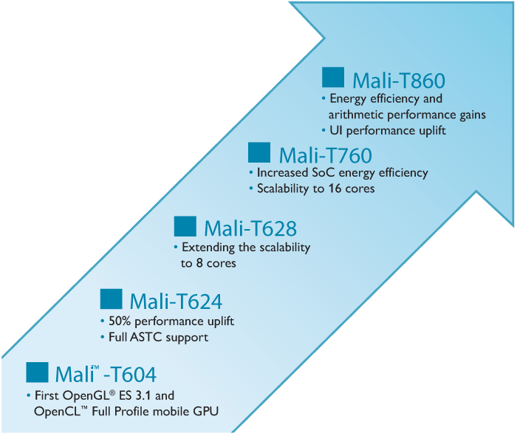
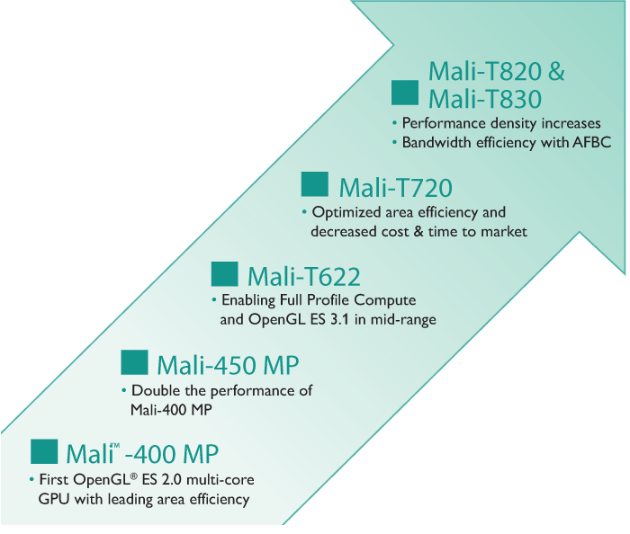
6. Overview of ARM’s Mali graphics lines (2)
Overview of ARM’s Mali graphics seeries
Only GPU parts announced since about 2010 will be discussed [20]
Performance oriented
graphics series
Mali-T6xx - Mali-T8xx
Cost efficient
graphics series
Mali-T4xx - Mali-T8xx

Slide 78
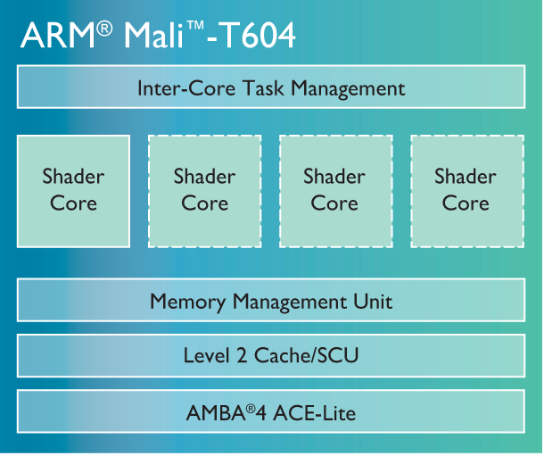
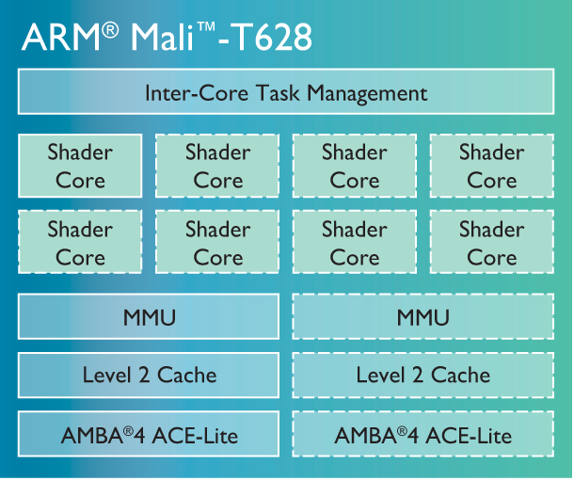
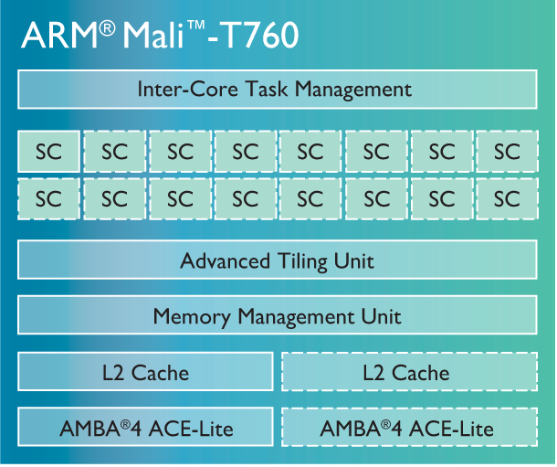
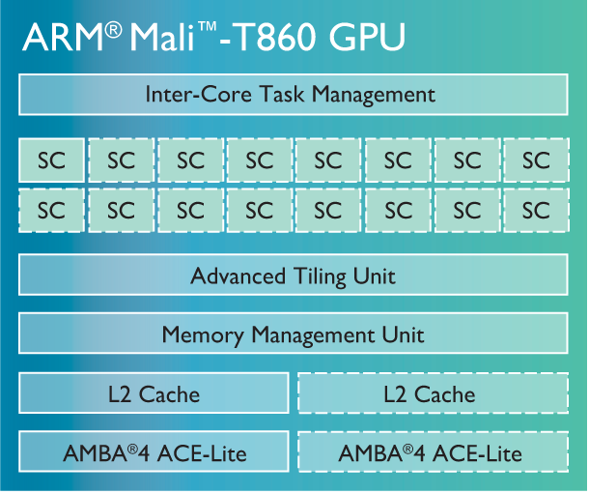
6. Overview of ARM’s Mali graphics lines (3)
ARM’s performance oriented Mali graphics series [20]

Slide 79
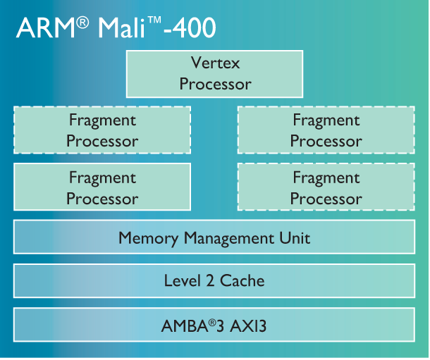
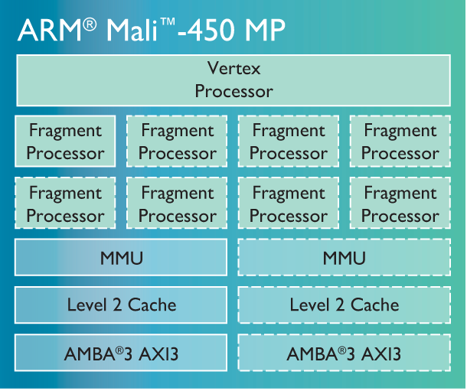
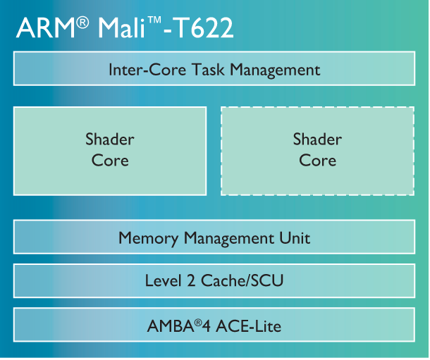
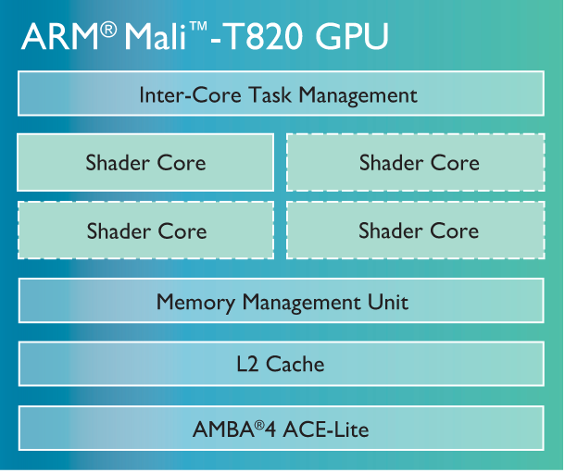
6. Overview of ARM’s Mali graphics lines (4)
ARM’s cost efficient Mali graphics series [20]

Slide 80
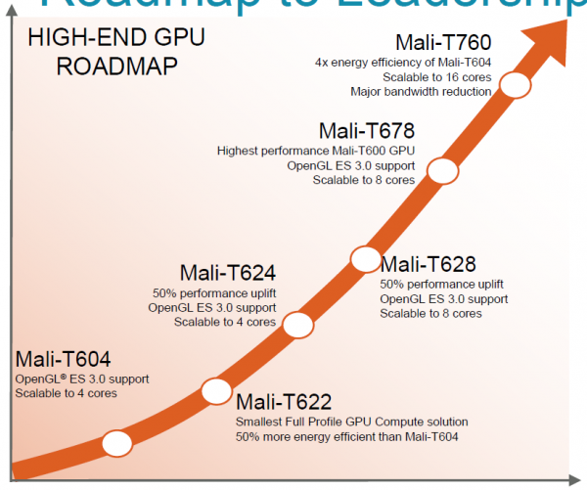
6. Overview of ARM’s Mali graphics lines (5)
ARM’s high-end GPU roadmap [51]
Companion GPU to A57 (announced 10/2013)

Slide 81
7. The 64-bit Cortex-A series
7.1 Overview of ARM’s 64-bit Cortex-A series
7.2 The 64-bit high performance Cortex-A57
7.3 The 64-bit low power Cortex-A53
7.4 The 64-bit low power Cortex-A35
7.5 The 64-bit high performance Cortex-A72
Notes:
81

Slide 82
7.1 Overview of ARM’s 64-bit Cortex-A series

Slide 83
7.1 Overview of ARM’s 64-bit Cortex-A series (1)
7.1 Overview of ARM’s 64-bit Cortex-A series -1 [64]
10/2011 ARM disclosed the 64-bit ARMv8 architecture
with enhancements as indicated in the Figure below
and discussed in Section 2.
AArch32
AArch64
Crypto-graphy ext.
Crypto-graphy ext.
TrustZone
SIMD
Adv. SIMD
(NEON)
Key feature ARMv7-A
compatibility
VFPv1/2
VFPv3/v4
Jazelle
Jazelle
(ex. by SW)
ThumbEE
(Jazelle-RCT)
Thumb
(ARMv4T)
Thumb-2
(ARMv6T2)
ARMv4
ARMv5
ARMv6
ARMv7-A/R
ARMv8-A
Examples
ARM710T
(~1995)
ARM926
(2001)
ARM1176
(2004)
Cortex-A5-15
(2006)
Cortex-A53/57
(2014)
Figure: Enhancements of the ARM architecture (based on [64])

Slide 84
7.1 Overview of ARM’s 64-bit Cortex-A series (2)
Overview of ARM’s 64-bit Cortex-A series -2
10/2012: ARM announced the 64-bit high performance Cortex-A-57 and the
low power Cortex-A-53 processors, as first implementations of the ARMv8
architecture, with immediate availability.
02/2015 ARM extended their 64-bit Cortex-A series by the high performance
Cortex-A72 model, and then in
11/2015 with the 64-bit low power Cortex-A35, as shown below.
ARM’s 64-bit Cortex A series
High performance
64-bit Cortex-A models
Mainstream
64-bit Cortex-A models
Low power
64-bit Cortex-A models
Cortex-A57 (2012)
Cortex-A72 (2015)
No announcement yet
Cortex-A53 (2012)
Cortex-A35 (2015)
Sections 7.2 and 7.5
Sections 7.3 and 7.4

Slide 85
5. Overview of ARM’s Cortex-A series (6)
Overview or ARM’s 64-bit Cortex-A series -3 (based on [12])
7
DMIPS/MHz
2/2015
Cortex-A72
ARMv8
16 nm
6
Announced
10/2012
Cortex-A57
ARMv8
20/16 nm
5
9/2010
Cortex-A15
ARMv7
32/28 nm
2/2014
Cortex-A17
ARMv7
28 nm
4
6/2013
Cortex-A12
ARMv7
20/16 nm
High Performance
3
Mainstream
10/2007
Cortex-A9
ARMv7
40 nm
10/2005
Cortex-A8
ARMv7
65 nm
11/2015
Cortex-A35
ARMv8
28 nm
2
10/2012
Cortex-A53
ARMv8
20/16 nm
10/2009
Cortex-A5
ARMv7
40 nm
10/2011
Cortex-A7
ARMv7
28 nm
1
Low power
2006
2007
2008
2009
2010
2011
2012
2013
2014
2015

Slide 86
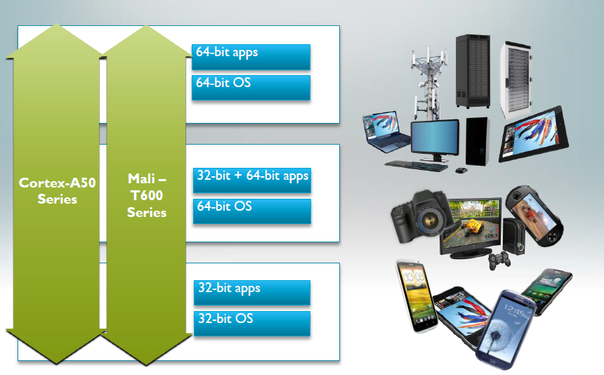
7.1 Overview of ARM’s 64-bit Cortex-A series (4)
The 64-bit Cortex-A series as the basis for scalable applications [48]

Slide 87
7.1 Overview of ARM’s 64-bit Cortex-A series (5)
Target markets of the 64-bit Cortex-A series [49]

Slide 88
7.1 Overview of ARM’s 64-bit Cortex-A series (6)
Main features of ARM’s 64-bit Cortex-A series [51]
CPU Core | Architecture | Efficiency | big.LITTLE | Announced | Available in devices | Target
Cortex-A72 | ARMv8 (64-bit) | 6.3-7.3 DMIPS/MHz | Yes (with A53/A35) | 2015 | n.a. | High-end
Cortex-A57 | ARMv8 (64-bit) | 4,8 DMIPS/MHz | Yes (with A53) | 2012 | 2015 | High-end
Cortex-A53 | ARMv8 (64-bit) | 2,3 DMIPS/MHz | Yes (with A57) | 2012 | 2H 2014 | Low power
Cortex-A35 | ARMv8 (64-bit) | 2,1 DMIPS/MHz | Yes (with A57/A72) | 2015 | 2H 2016 | Low power
Cortex-A17 | ARMv7 (32-bit) | 4,0 DMIPS/MHz | Yes (with A7) | 2014 | 2015 | Mainstream
Cortex-A15 | ARMv7 (32-bit) | 4,0 DMIPS/MHz | Yes (with A7) | 2010 | Now | High-end
Cortex-A12 | ARMv7 (32-bit) | 3,0 DMIPS/MHz | - | 2013 | 2H 2015 | Mainstream
Cortex-A9 | ARMv7 (32-bit) | 2,5 DMIPS/MHz | - | 2007 | Now (EOL) | High-end
Cortex-A8 | ARMv7 (32-bit) | 2,0 DMIPS/MHz | - | 2005 | Now (EOL) | High-end
Cortex-A7 | ARMv7 (32-bit) | 1,9 DMIPS/MHz | Yes (A15/A17) | 2011 | Now | Low power
Cortex-A5 | ARMv7 (32-bit) | 1,6 DMIPS/MHz | - | 2009 | Now | Low power

Slide 89
7.2 The 64-bit high performance Cortex-A57

Slide 90
5. Overview of ARM’s Cortex-A series (6)
7.2 The 64-bit high performance Cortex-A57 -1 (based on [12])
7
DMIPS/MHz
2/2015
Cortex-A72
ARMv8
16 nm
6
Announced
10/2012
Cortex-A57
ARMv8
20/16 nm
5
9/2010
Cortex-A15
ARMv7
32/28 nm
2/2014
Cortex-A17
ARMv7
28 nm
4
6/2013
Cortex-A12
ARMv7
20/16 nm
High Performance
3
Mainstream
10/2007
Cortex-A9
ARMv7
40 nm
10/2005
Cortex-A8
ARMv7
65 nm
10/2012
Cortex-A53
ARMv8
20/16 nm
11/2015
Cortex-A35
ARMv8
28 nm
2
10/2011
Cortex-A7
ARMv7
28 nm
10/2009
Cortex-A5
ARMv7
40 nm
1
Low power
2006
2007
2008
2009
2010
2011
2012
2013
2014
2015

Slide 91
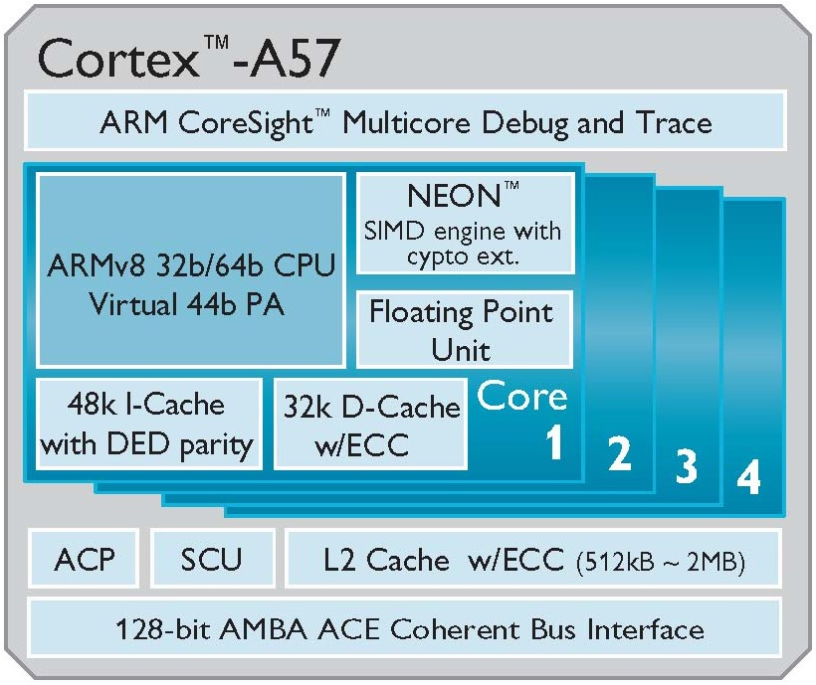
7.2 The 64-bit high performance Cortex-A57 (4)
High level block diagram of the Cortex-A57 [53]
PA: Physical Address
DED: Double Error Detection
ECC: Error Correcting Code
ACP: Accelerator Coherence Port
(to connect non-cached
coherent data sources)
SCU: Snoop Control Unit
AMBA: Advanced Microcontroller
Bus Architecture
(On-chip bus standard for
SoC) designs)
ACE: AXI Coherency Extensions
(Used in big.LITTLE systems
for smartphones, tablets,
etc.)
AXI: Advanced eXtensible Interface
(The most widespread AMBA
interface).

Slide 92
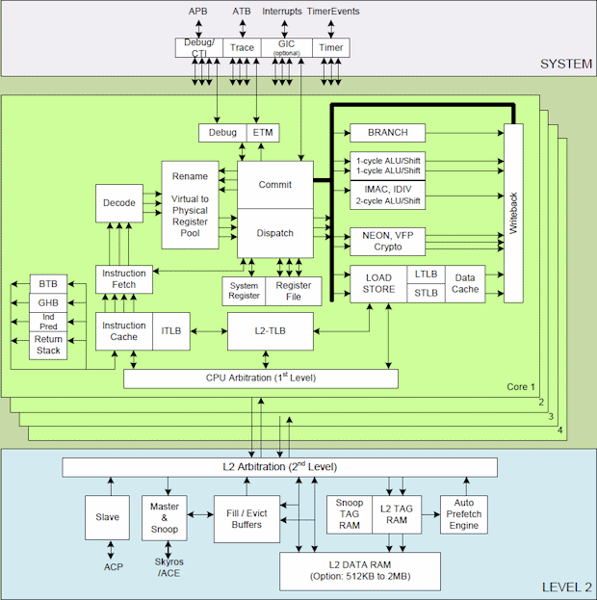
7.2 The 64-bit high performance Cortex-A57 (5)
Main functional blocks of the 64-bit high performance Cortex-A57 CPU [74]
APB
ATB
Interrupts

Slide 93
7.2 The 64-bit high performance Cortex-A57 (10)
Contrasting the Cortex-A53 and Cortex-A57 arithmetic pipelines
[Based on 54]
D: Decode
R: Rename
P: Dispatch
I: Issue
E: Execute
WB: Write Back
Note: Branch and Load/Store pipelines not shown
(1x Load/Store pipeline for the Cortex A-53 and
2x Load/Store and 1x Branch pipeline for the Cortex-A-57)

Slide 94
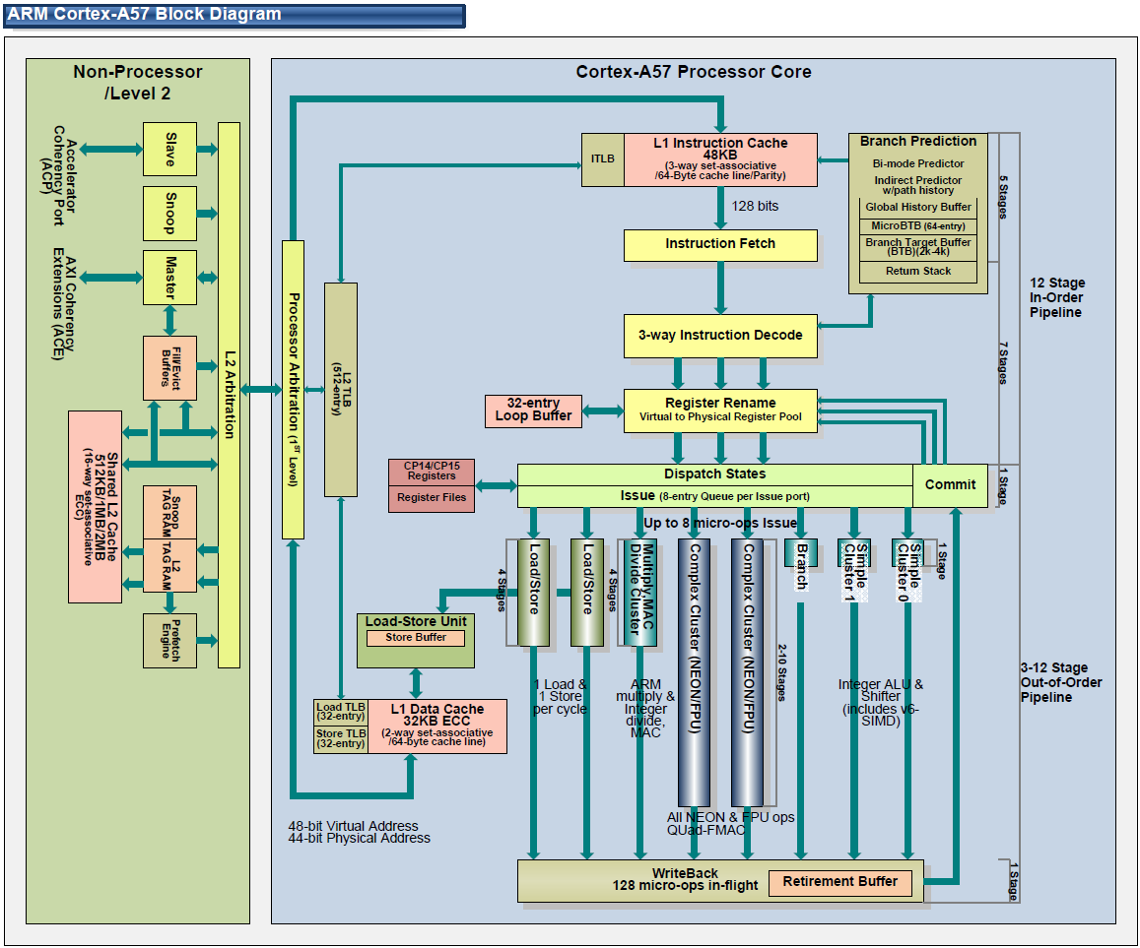
7.2 The 64-bit high performance Cortex-A57 (11)
Pipeline structure of the Cortex-A57 core (alternative view) [71]

Slide 95
7.2 The 64-bit high performance Cortex-A57 (12)
Cortex-A57/A53 performance - compared to the Cortex-A15 [55]

Slide 96
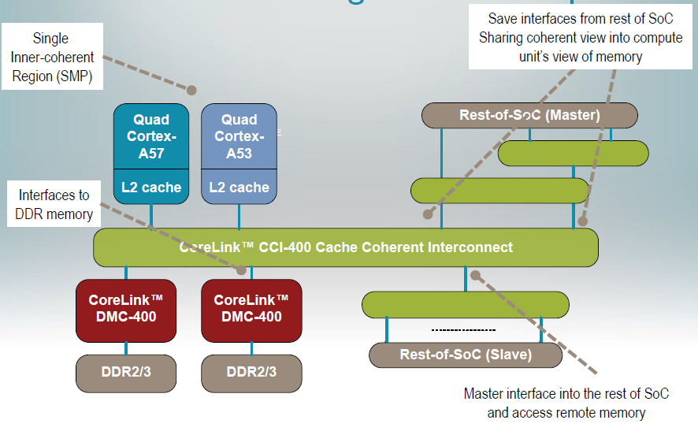
7.2 The 64-bit high performance Cortex-A57 (13)
Example: A Cortex-A57/Cortex-A53 big.LITTLE system [52]

Slide 97
7.3 The 64-bit low power Cortex-A53

Slide 98
5. Overview of ARM’s Cortex-A series (6)
7.3 The 64-bit low power Cortex-A53 -1 (based on [12])
7
DMIPS/MHz
2/2015
Cortex-A72
ARMv8
16 nm
6
Announced
10/2012
Cortex-A57
ARMv8
20/16 nm
5
9/2010
Cortex-A15
ARMv7
32/28 nm
2/2014
Cortex-A17
ARMv7
28 nm
4
6/2013
Cortex-A12
ARMv7
20/16 nm
High Performance
3
Mainstream
10/2007
Cortex-A9
ARMv7
40 nm
10/2005
Cortex-A8
ARMv7
65 nm
11/2015
Cortex-A35
ARMv8
28 nm
2
10/2012
Cortex-A53
ARMv8
20/16 nm
10/2011
Cortex-A7
ARMv7
28 nm
10/2009
Cortex-A5
ARMv7
40 nm
1
Low power
2006
2007
2008
2009
2010
2011
2012
2013
2014
2015

Slide 99
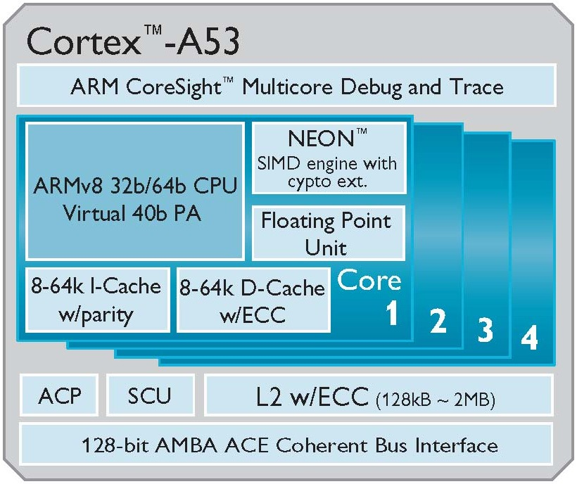
7.3 The 64-bit low power Cortex-A53 (3)
High level block diagram of the Cortex-A53 [53]
PA: Physical Address
DED: Double Error Detection
ECC: Error Correcting Code
ACP: Accelerator Coherence Port
(to connect non-cached
coherent data sources)
SCU: Snoop Control Unit
AMBA: Advanced Microcontroller
Bus Architecture
(On-chip bus standard for
SoC) designs)
ACE: AXI Coherency Extensions
(Used in big.LITTLE systems
for smartphones, tablets,
etc.)
AXI: Advanced eXtensible Interface
(The most widespread AMBA
interface).

Slide 100
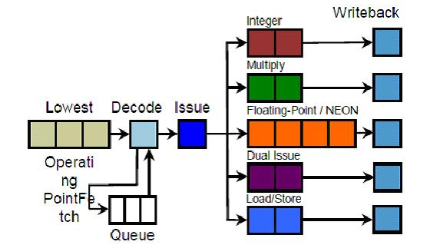
7.3 The 64-bit low power Cortex-A53 (5)
Key features of the microarchitecture of the Cortex-A53 core -2
The Cortex-A53 core has a dual-issue in-order front end with 5 pipelines constituting the back end, as indicated in the next Figure.
Dual
Fetch
Integer
Figure: Pipeline stages of the Cortex-A53 [76]
The pipeline for integer processing has 8 pipeline stages, NEON and FP
processing has two additional pipeline stages, as seen in the Figure above.

Slide 101
7.3 The 64-bit low power Cortex-A53 (6)
Contrasting the Cortex-A7 and Cortex-A53 microarchitectures [75]
ARM CPU Core Comparison
 | Cortex-A7 | Cortex-A53
ARM ISA | ARMv7 (32-bit) | ARMv8 (32/64-bit)
Issue Width | Partially 2 micro-ops | 2 micro-ops
Pipeline Length | 8 | 8
Integer Add | 2 | 2
Integer Mul | 1 | 1
Load/Store Units | 1 | 1
Branch Units | 1 | 1
FP/NEON ALUs | 1x64-bit | 1x64-bit
L1 Cache | 8KB-64KB I$ + 8KB-64KB D$ | 8KB-64KB I$ + 8KB-64KB D$
L2 Cache | 128KB - 1MB (Optional) | 128KB - 2MB (Optional)

Slide 102
7.3 The 64-bit low power Cortex-A53 (8)
Contrasting the Cortex-A53 and Cortex-A57 arithmetic pipelines
[Based on 54]
D: Decode
R: Rename
P: Dispatch
I: Issue
E: Execute
WB: Write Back
Note: Branch and Load/Store pipelines not shown
(1x Load/Store pipeline for the Cortex A-53 and
2x Load/Store and 1x Branch pipeline for the Cortex-A-57)

Slide 103
7.4 The 64-bit low power Cortex-A35

Slide 104
5. Overview of ARM’s Cortex-A series (6)
7.4 The 64-bit low power Cortex-A35- 1 (Based on [12])
7
DMIPS/MHz
2/2015
Cortex-A72
ARMv8
16 nm
6
Announced
10/2012
Cortex-A57
ARMv8
20/16 nm
5
9/2010
Cortex-A15
ARMv7
32/28 nm
2/2014
Cortex-A17
ARMv7
28 nm
4
6/2013
Cortex-A12
ARMv7
20/16 nm
High Performance
3
Mainstream
10/2007
Cortex-A9
ARMv7
40 nm
10/2005
Cortex-A8
ARMv7
65 nm
11/2015
Cortex-A35
ARMv8
28 nm
2
10/2012
Cortex-A53
ARMv8
20/16 nm
10/2011
Cortex-A7
ARMv7
28 nm
10/2009
Cortex-A5
ARMv7
40 nm
1
Low power
2006
2007
2008
2009
2010
2011
2012
2013
2014
2015

Slide 105
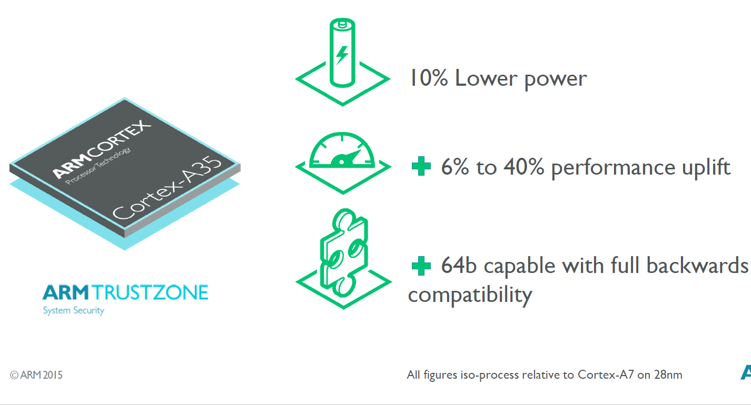
7.4 The 64-bit low power Cortex-A35 (3)
Efficiency of the 28 nm Cortex-A35 vs. the 28 nm Cortex-A7 [77]

Slide 106
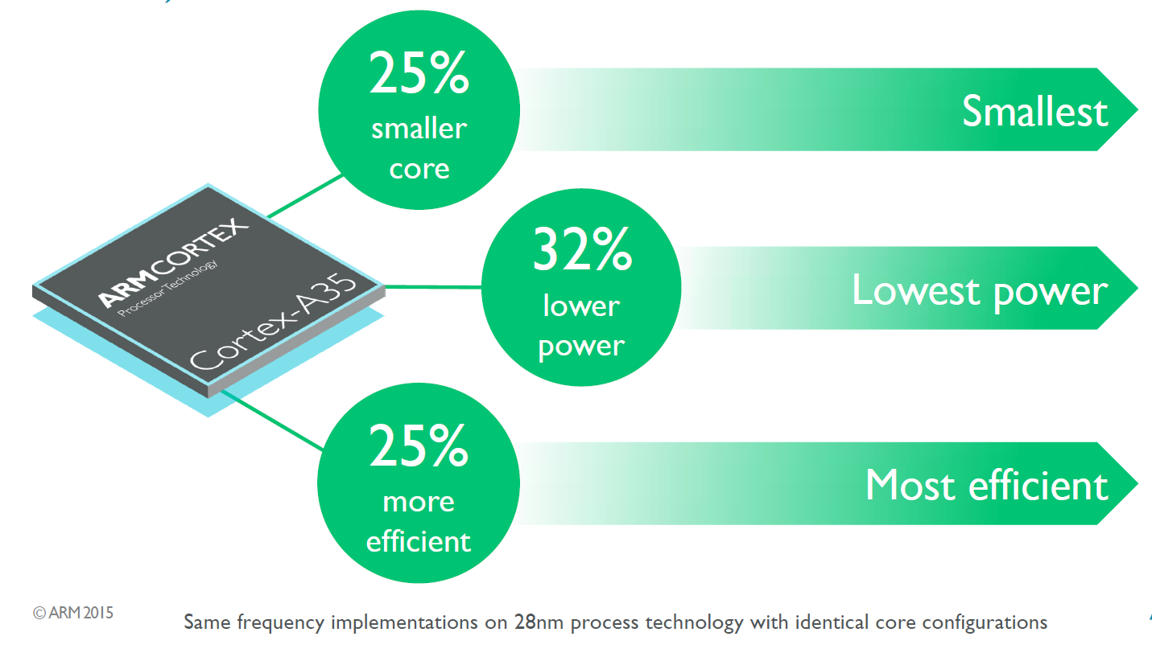
7.4 The 64-bit low power Cortex-A35 (4)
Efficiency of the 28 nm Cortex-A35 vs. the 28 nm Cortex-A53 [77]

Slide 107
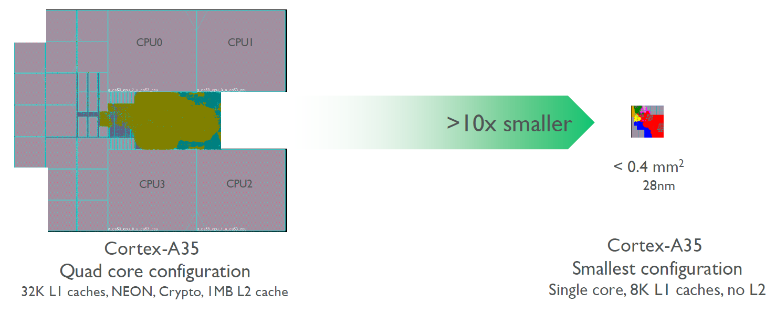
7.4 The 64-bit low power Cortex-A35 (5)
The 64-bit high performance Cortex-A35- 2
It is a widely configurable application processor ranging from mobiles to deeply
embedded, as indicated below.
Figure: Configuration options of the Cortex-A35 [77]
Target consumption is below 125 mW.
On 28 nm technology it achieves 1 GHz by 90 mW, for plannes smaller feature
size of 14/16 nm ARM expect less consumption.

Slide 108
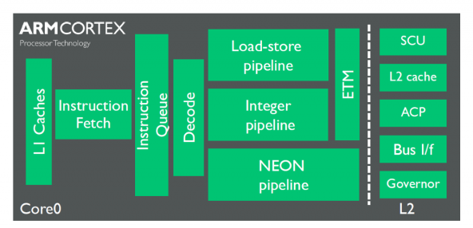
7.4 The 64-bit low power Cortex-A35 (6)
Microarchitecture of the Cortex-A35
It can have one to quad cores, as discussed before.
The Cortex-A35 cores have in-order, 8-stage FX pipelines with limited dual-issue
capability.
The pipeline layout is shown in the next Figure.
ETM: Embedded
Trace
Macrocell
(for debugging)
Figure: Pipeline layout of the Cortex-A35 [77]
Compared to the Cortex-A7 ARM improved many subsystems, like instruction
fetch, branch prediction, memory subsystem.

Slide 109
7.5 The 64-bit high performance Cortex-A72

Slide 110
5. Overview of ARM’s Cortex-A series (6)
7.5 The 64-bit high performance Cortex-A72 -1(Based on [12])
7
DMIPS/MHz
2/2015
Cortex-A72
ARMv8
16 nm
6
Announced
10/2012
Cortex-A57
ARMv8
20/16 nm
5
9/2010
Cortex-A15
ARMv7
32/28 nm
2/2014
Cortex-A17
ARMv7
28 nm
4
6/2013
Cortex-A12
ARMv7
20/16 nm
High Performance
3
Mainstream
10/2007
Cortex-A9
ARMv7
40 nm
10/2005
Cortex-A8
ARMv7
65 nm
11/2015
Cortex-A35
ARMv8
28 nm
2
10/2012
Cortex-A53
ARMv8
20/16 nm
10/2011
Cortex-A7
ARMv7
28 nm
10/2009
Cortex-A5
ARMv7
40 nm
1
Low power
2006
2007
2008
2009
2010
2011
2012
2013
2014
2015

Slide 111
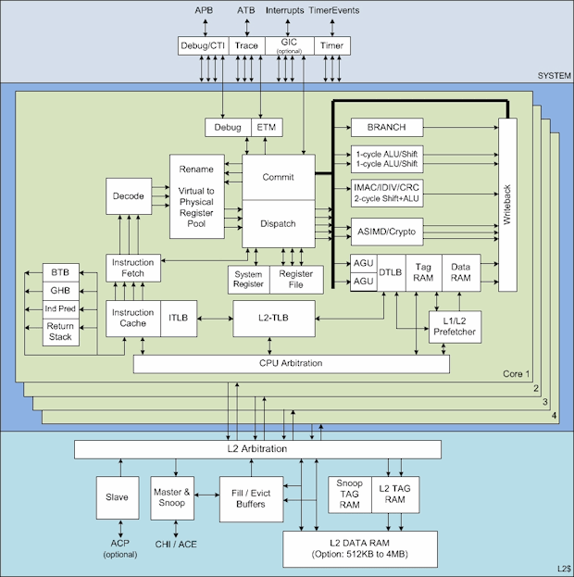
7.4 The 64-bit high performance Cortex-A72 (3)
Main functional blocks of the 64-bit high performance Cortex-A72 [72]
APB
ATB
Interrupts

Slide 112
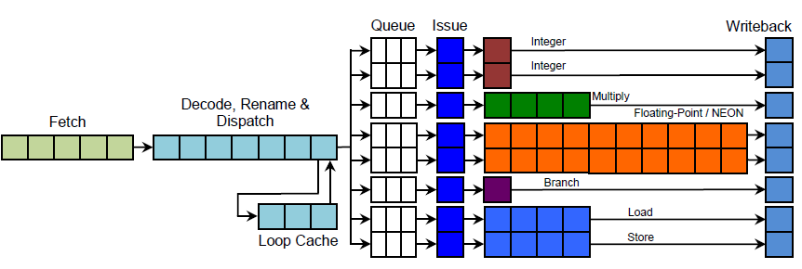
7.4 The 64-bit high performance Cortex-A72 (6)
Note
It is interesting to recognize that the pipeline structure of ARM’s high performance
processors (Cortex-A15/Cortex-A-57/Cortex-A72) remained basically the same,
as is demonstrated by the pipeline structure of the Cortex-A15 below.
Figure: Implementation of the Cortex-A15 pipelines [37]
As seen in the Figure there are also eight issue queues and basically the same
execution pipelines as in both the Cortex-A57 and Cortex-A72.
Nevertheless, the Cortex-A72 has a dispatch rate of 5 rather than 3 as both the
cortex-A15 and Cortex-a17 processors.

Slide 113
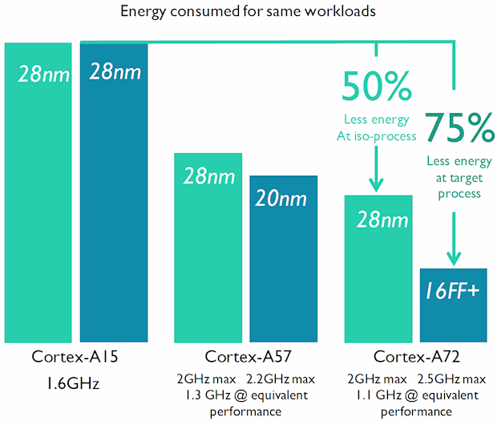
7.4 The 64-bit high performance Cortex-A72 (7)
Energy consumption of the Cortex-A72 compared to Cortex-A15/A57 [72]

Slide 114
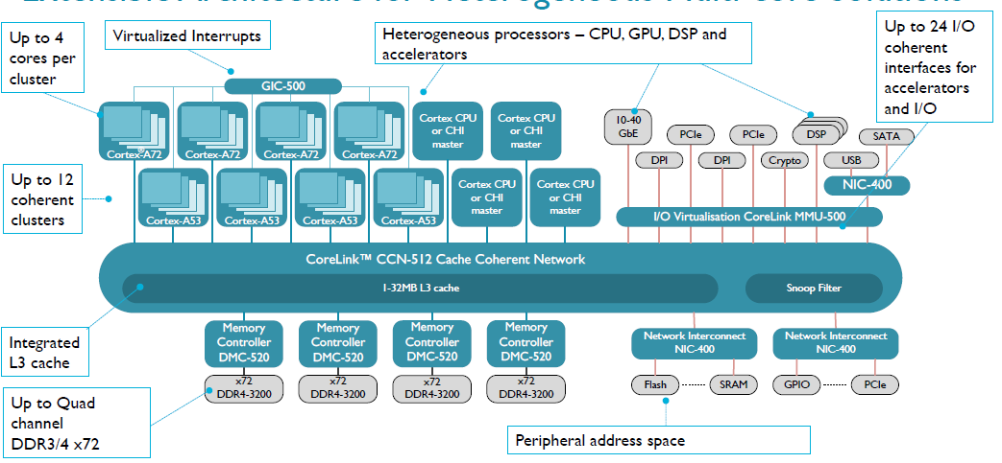
7.4 The 64-bit high performance Cortex-A72 (8)
CoreLink CCN512-based heterogeneous multi-core system [80]
CHI: Coherent Hub Interface

Slide 115
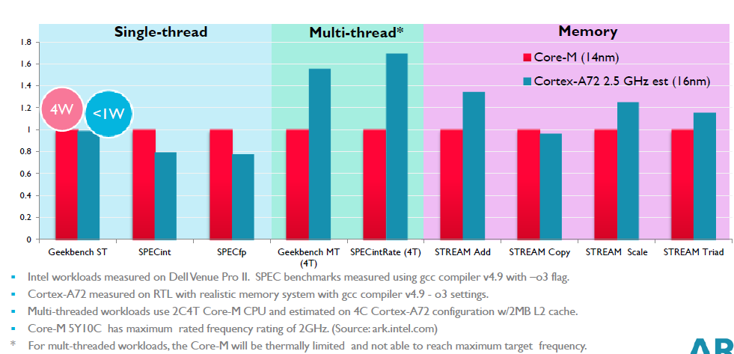
7.4 The 64-bit high performance Cortex-A72 (9)
Performance comparison: ARM’s Cortex-A72 vs. Intel’s Core-M [79]

Slide 116
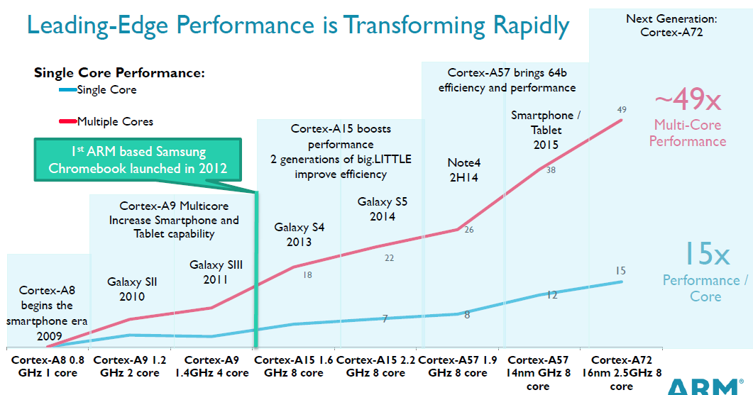
7.4 The 64-bit high performance Cortex-A72 (10)
Evolution of the performance of the ARM's Cortex-A line [79]
(≈ 4 x core count x 4 x DMIPS/MHz x 3 fc)

Slide 117
7.4 The 64-bit high performance Cortex-A72 (11)
Single thread IPC in Intel’s basic architectures (Based on [81])
2
24%
22%
Per Generation
1.9
20%
Cumulative
1.8
18%
1.7
16%
1.6
14%
12%
1.5
10%
1.4
8%
1.3
6%
1.2
4%
2%
1.1
0%
1
Pentium M Dothan
Core 2
Penryn
NHM (w/o SMT)
WSM
SNB
IVB
HSW
BRW
SKL
Note that Intel raised IPC in the Core family only less then 2-times in about 10 years.

