Slide 1
Intel’s High Performance
MP Servers and Platforms
Dezső Sima
September 2015
(Ver. 1.3)
© Sima Dezső, 2015

Slide 2
Intel’s high performance MP platforms
1. Introduction to Intel’ s high performance
multicore MP servers and platforms
2. Evolution of Intel’s high performance
multicore MP server platforms
3. Example 1: The Brickland platform
4. Example 2: The Purley platform
5. References
Notes:
2

Slide 3
Introduction to Intel’s high performance
MP servers and platforms
1.1 The worldwide 4S (4 Socket) server market
1.2 The platform concept
1.3 Server platforms classified according to the
number of processors supported
1.4 Multiprocessor server platforms classified
according to their memory architecture
1.5 Platforms classified according to the
number of chips constituting the chipset
1.6 Naming scheme of Intel’s servers
1.7 Overview of Intel’s high performance multicore
MP servers and platforms
Notes:
3

Slide 4
1.1 The worldwide 4S (4 Socket) server market
Notes:
4

Slide 5
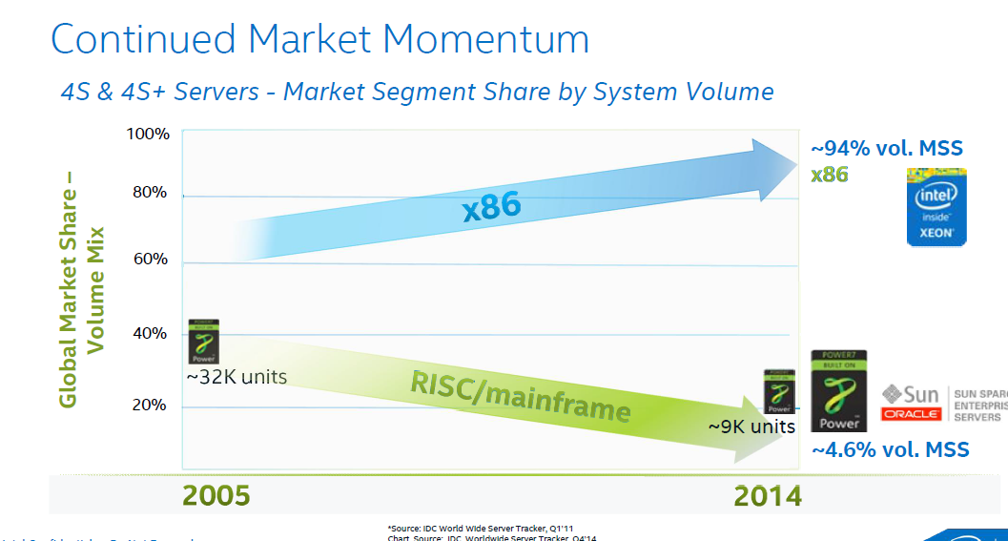
1.1 The worldwide 4S (4 Socket) server market (1)
1. Introduction to Intel’s high performance multicore MP servers and platforms
1.1 The worldwide 4S (4 Socket) server market [52]

Slide 6
1.2 The platform concept
Notes:
6

Slide 7
1.2 The platform concept (2)
Example 1: A simple traditional DC DP (2S) server platform (2007)
Core 2 (2C)
Core 2 (2C)
1066 MT/s
FSB
7200
ESI
631xESB/
632xESB IOH
FB-DIMM
w/DDR2-533

Slide 8
1.2 The platform concept (3)
Example 2: A recent 4S platform
(The Brickland 4S server platform including Haswell-EX processors (2015)
2x4 SMI2
channels
Xeon E7-4800 v3
(Haswell-EX)
2x4 SMI2
channels
PCIe 3.0
PCIe 3.0
SMB
32
QPI
1.1
32
SMB
SMB
Haswell-EX 14C
Haswell-EX 14C
SMB
SMB
SMB
SMB
SMB
QPI 1.1
QPI 1.1
QPI 1.1
QPI 1.1
SMB
SMB
SMB
Haswell--EX 14C
Haswell-EX 14C
SMB
SMB
QPI
1.1
SMB
SMB
32
DMI2
4xPCIe2
32
SMB
PCIe 3.0
PCIe 3.0
C602J PCH
(Patsburg J)
Up to DDR3-1600
in both performance and lockstep modes and
up to DDR4-1866 in lockstep mode
ME
SMI2: Scalable Memory Interface 2
(Parallel 64-bit VMSE data link between
the processor and the SMB)
SMB: Scalable Memory Buffer
(C112/C114: Jordan Creek 2)
(Performs conversion between the
parallel SMI2 and the parallel
DDR3/DDR4 DIMM interfaces)
C112: 2 DIMMs/channel
C114: 3 DIMMs/channel
QPI 1.1: Up to 9.6 GT/s
ME: Management Engine

Slide 9
1.2 The platform concept (5)
Example for compatibility of platform components
(The Boxboro-EX platform 2010/2011)
Xeon 7500
(Nehalem-EX)
(Becton) 8C
Xeon E7-4800
(Westmere-EX) 10C
/
SMB
SMB
SMB
Nehalem-EX 8C
Westmere-EX 10C
QPI
Nehalem-EX 8C
Westmere-EX 10C
SMB
SMB
SMB
SMB
SMB
QPI
QPI
QPI
QPI
SMB
SMB
SMB
Nehalem-EX 8C
Westmere-EX 10C
Nehalem-EX 8C
Westmere-EX 10C
SMB
SMB
QPI
SMB
SMB
QPI
QPI
SMB
2x4 SMI
channels
2x4 SMI
channels
7500 IOH
PCIe
2.0
Nehalem-EX: up to DDR3-1067
Westmere-EX: up to DDR3-1333
ME
36
SMI: Scalable Memory Interface
(Serial link between the processor
and the SMB)
SMB: Scalable Memory Buffer
(Performs conversion between the
serial SMI and the parallel
DDR3 DIMM interfaces)
4 x QPI up to 6.4 GT/s
ESI
2 DIMMs/memory channel
ICH10
ME: Management Engine
Figure: The Boxboro-EX MP server platform supporting Nehalem-EX/Westmer-EX server processor

Slide 10
1.3 Server platforms classified according to the number of
processors supported
Notes:
10

Slide 11
1.3 Server platforms classified according to the number of processors supported (1)
1.3 Server platforms classified according to the number of processors supported
Server platforms
Uniprocessor server platforms
(UP-server platforms)
Multiprocessor server platforms
1-processor server platforms
(1-socket server platforms)
Server platforms supporting more than one processor
(Multi-socket server platforms)
DP (2S)
server platforms
MP (4S)
server platforms
Platforms for more than four servers
2- processor server platforms
(2-socket server platforms)
4-processor server platforms
(4-socket server platforms)
(Server platforms for
more than four sockets)

Slide 12
1.4 Multiprocessor server platforms classified according to
their memory architecture
Notes:
12

Slide 13
1.4 Multiprocessor server platforms classified according to their memory arch. (1)
1.4 Multiprocessor server platforms classified according to their memory architecture (1)
Multiprocessor server platforms
classified according to their memory architecture
SMPs
(Symmetrical MultiProcessor)
NUMAs
Multiprocessors (Multi socket system)
with Uniform Memory Access (UMA)
Multiprocessors (Multi socket system)
with Non-Uniform Memory Access
All processors access main memory by the same
mechanism, (e.g. by individual FSBs and an MCH).
A particular part of the main memory can be accessed
by each processor locally, other parts remotely.
Typical examples
Processor
Processor
Processor
QPI
Processor
QPI
QPI
FSB
E.g. DDR3-1333
IOH¹
E.g. DDR3-1333
MCH
E.g. DDR2-533
ESI
ESI
ICH
ICH
¹ICH: I/O hub
ESI: Enterprise System Interface

Slide 14
1.4 Multiprocessor server platforms classified according to their memory arch. (2)
Main features of SMP-type and NUMA-type server platforms
Multiprocessor server platforms
classified according to their memory architecture
SMPs
(Symmetrical MultiProcessor)
NUMAs
All processors share the same memory space
and all processors access memory by
the same access mechanism,
(e.g. by the same FSB or by individual FSBs
and an MCH.
All processors share the same memory space, but
each processor is allocated a particular part of the
memory space, called the local memory space,
whereas the rest is considered as the remote
memory spaces.
Consequently, all processors access memory
basically with the same latency.
The local part of the main memory can be accessed
by each processor immediately, e.g. via their private
on-die memory controller,
whereas the remote parts of the main memory will be
accessed via the processor owing the requested
memory space.
Consequently, processors access their local memory
space in significantly shorter latency than
memory spaces remote to them.

Slide 15
1.4 Multiprocessor server platforms classified according to their memory arch. (3)
Example of measured read latencies of uncached data [73]
Read latencies depend on whether referenced data is kept in the own or remote main memory space.
a) Read latency when referenced data is kept in the own memory space
Read latency:
65.1 ns (190 cycles)

Slide 16
1.4 Multiprocessor server platforms classified according to their memory arch. (4)
b) Read latency when referenced data is kept in the remote memory space [73]
Read latency:
106 ns (~310 cycles)
Read latency is increased now by the inter-processor access penalty of 41 ns in this case.

Slide 17
1.5 Platforms classified according to the number of chips
constituting the chipset
Notes:
17

Slide 18
1.5 Platforms classified according to the number of chips constituting the chipset (1)
1.5 Classification of platforms according to the number of chips constituting
the chipset
Implementation of platforms
classified according to the number of chips constituting the chipset
Three-chip implementation
Two-chip implementation
The system architecture consists
basically of three chip types
(processors/MCH/ICH)
The system architecture consists
basically of two chip types
(processors/PCH)
Truland platform (2005/2006)
Caneland platform (2007/2008)
Boxboro-EX platform (2010/2011)
Brickland platform (2014/2015)
Purley platform (2017?)

Slide 19
1.5 Platforms classified according to the number of chips constituting the chipset (2)
Example of a 3-chip platform: The Boxboro-EX 4S server platform supporting
Nehalem-EX/Westmere-EX processors (2010/2011)
Xeon 7500
(Nehalem-EX)
(Becton) 8C
/
Xeon E7-4800
(Westmere-EX) 10C
SMB
SMB
SMB
Nehalem-EX 8C
Westmere-EX 10C
QPI
Nehalem-EX 8C
Westmere-EX 10C
SMB
SMB
SMB
SMB
SMB
QPI
QPI
QPI
QPI
SMB
SMB
SMB
Nehalem-EX 8C
Westmere-EX 10C
Nehalem-EX 8C
Westmere-EX 10C
SMB
SMB
QPI
SMB
SMB
QPI
QPI
SMB
2x4 SMI
channels
2x4 SMI
channels
7500 IOH
PCIe
2.0
Nehalem-EX: up to DDR3-1067
Westmere-EX: up to DDR3-1333
ME
36
SMI: Scalable Memory Interface
(Serial link between the processor
and the SMB)
SMB: Scalable Memory Buffer
(Performs conversion between the
serial SMI and the parallel
DDR3 DIMM interfaces)
4 x QPI up to 6.4 GT/s
ESI
2 DIMMs/memory channel
ICH10
ME: Management Engine
Nehalem-EX aimed Boxboro-EX MP server platform (for up to 10 C)

Slide 20
1.5 Platforms classified according to the number of chips constituting the chipset (3)
Example of a 2-chip platform: The Brickland-EX 4S server platform supporting
Ivy Bridge-EX/Haswell-EX processors
2x4 SMI2
channels
Xeon E7-4800 v3
(Haswell-EX)
2x4 SMI2
channels
PCIe 3.0
PCIe 3.0
SMB
32
QPI
1.1
32
SMB
SMB
Haswell-EX 18C
Haswell-EX 18C
SMB
SMB
SMB
SMB
SMB
QPI 1.1
QPI 1.1
QPI 1.1
QPI 1.1
SMB
SMB
SMB
Haswell--EX 18C
Haswell-EX 18C
SMB
SMB
QPI
1.1
SMB
SMB
32
DMI2
4xPCIe2
32
SMB
PCIe 3.0
PCIe 3.0
C602J PCH
(Patsburg J)
Up to DDR3-1600
in both performance and lockstep modes and
up to DDR4-1866 in lockstep mode
ME
SMI2: Scalable Memory Interface 2
(Parallel 64-bit VMSE data link between
the processor and the SMB)
SMB: Scalable Memory Buffer
(C112/C114: Jordan Creek 2)
(Performs conversion between the
parallel SMI2 and the parallel
DDR3/DDR4 DIMM interfaces)
C112: 2 DIMMs/channel
C114: 3 DIMMs/channel
QPI 1.1: Up to 9.6 GT/s
ME: Management Engine

Slide 21
1.6 Naming schemes of Intel’s servers
Notes:
21

Slide 22
1.6 Naming scheme of Intel’s servers (1)
1.6 Naming schemes of Intel’s servers
In 2005 Intel discontinued their previous naming scheme emphasizing clock frequency
like Xeon 2.8 GHz DP or Xeon 2.0 GHz MP, and introduced an AMD like naming scheme,
as follows:
Intel’s recent naming scheme of servers
9000 series
7000 series
5000 series
3000 series
Itanium lines
of processors
MP server
processor lines
DP server
processor lines
UP server
processor lines
Accordingly, Intel’s subsequent MP server processor lines were designated as follows:
Line | Processor | Based on
7000 | Paxville MP | Pentium 4 Prescott MP
7100 | Tulsa | Pentium 4 Prescott MP
7200 | Tigerton DC | Core 2
7300 | Tigerton QC | Core 2
7400 | Dunnington | Penryn
7500 | Beckton | Nehalem

Slide 23
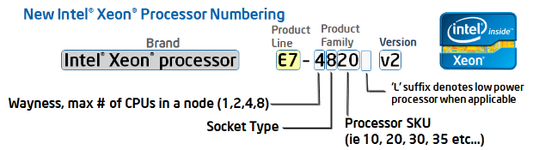
1.6 Naming scheme of Intel’s servers (2)
Renewed naming scheme of Intel’s servers
In 4/2011 Intel renewed their naming scheme for their whole processor offering.
This results in the following new naming scheme for servers:
Figure: Intel’s new Xeon naming scheme [127]
Product line: E7, E5 or E3.
Wayness: How many processors are natively supported in a system
Socket type: Signifies processor capability,
e.g. 8: high performance
6: effective performance etc..
Version: Xeon processors with a common version number share a common microarchitecture
Westmere (without version number)
v2: Ivy Bridge
v3: Haswell
v4: Broadwell

Slide 24
1.6 Naming scheme of Intel’s servers (3)
Remark
The designation of the server generations v2, v3 etc. does not coincides with the designation
of the microarchitectures, as follows:
Microarchitecture | Architecture generation | Server generation
Westmere |  | (without designation)
Sandy Bridge | Gen. 2
Ivy Bridge | Gen. 3 | v2
Haswell | Gen. 4 | v3
Broadwell | Gen. 5 | v4
Skylake | Gen. 6

Slide 25
1.6 Naming scheme of Intel’s servers (4)
Example: Server product lines of the Haswell family
The Haswell family
Haswell
(LGA1150)
Mobiles and desktops
Up to 4 cores
i3/i5/i7 designations
Haswell-E
(LGA2011)
High end desktops (HED)
Up to 8 cores
i7 designation
Haswell-EP
(LGA2011)
Effective performance servers
Up to 18 cores
Haswell-EX
(LG2011)
High-end erformance servers
Up to 18 cores
Servers
Microservers
E3-1275L/1265L v3, 4C+G, HT, 6/2013 and 5/2014
E3-1240L/1230L/1220L v3, 2C/4C, HT, 6/2013 and 5/2014
UP Servers
E3-12x5/12x6 v3, 4C+G, HT, 6/2013 and 5/2014
E3-12x0/12x1 v3, 4C, HT, 6/2013 and 5/2014
Workstations
E5-16xx v3, 4/6/8, 9/2014
DP-Servers
E5-26xx v3, 4/6/8/10/12/14/16/18C, 9/2014
MP-Servers
E5-46xx v3, 6/10/12/14/16/18C, 6/2015
E7-48xx v3, 8/10/12/14, 5/2015
E7-88xx v3, 4/10/16/18C, 5/2015

Slide 26
1.7 Overview of Intel’s high performance multicore MP servers
and platforms
Notes:
26

Slide 27
1.7 Overview of Intel’s high performance multicore MP servers and platforms (1)
1.7 Overview of Intel’s high performance multicore MP servers and platforms -1
Intel’s high performance multicore MP server platforms
Truland
(2005)
(90/65 nm)
Caneland
(2007)
(65/45 nm)
Boxboro-EX
(2010)
(45/32 nm)
Brickland-EX
(2014)
(22 nm)
Purley
(2017?)
(14 nm)
Pentium 4 Xeon MP
based
Core 2 Xeon MP
based
Nehalem-EX/
Westmere-EX
based
Ivy Bridge-EX/
Haswell-EX
Broadwell-EX
based
Skylake-EX
based

Slide 28
1.7 Overview of Intel’s high performance multicore MP servers and platforms (2)
Overview of Intel’s high performance multicore MP servers and platforms -2
 | Core | Techn. | Intro. | High performance MP server processor lines | Core count | Chipset | Proc. socket
Truland MP | Pentium 4 MP Prescott | 90 nm | 3/2005 | 90 nm Pentium 4 MP (Potomac) | 1C | E8500 + ICH5 | LGA 604
 | Pentium 4 Presc. | 90 nm | 11/2005 | 7000 (Paxville MP) | 2x1C | E8501 + ICH5
 | Pentium 4 Presc. | 65 nm | 8/2006 | 7100 (Tulsa) | 2x1C
Caneland MP | Core2 | 65 nm | 9/2007 | 7200 (Tigerton DC) 7300 (Tigerton QC) | 2C 2x2C | E7300 (Clarksboro)+ 631x/632x ESB | LGA 604
 | Penryn | 45 nm | 9/2008 | 7400 (Dunnington) | 6C
Boxboro-EX | Nehalem | 45 nm | 3/2010 | 7500 (Beckton/ Nehalem-EX) | 8C | 7500 (Boxboro) + ICH10 | LGA 1567
 | Westmere | 32 nm | 4/2011 | E7-4800 (Westmere-EX) | 10C
 | Sandy Bidge | 32 nm
Brickland | Ivy Bridge | 22 nm | 2/2014 | E7-4800 v2 (Ivy Bridge-EX) | 15C | C602J (Patsburg J) | LGA 2011-1
 | Haswell | 22 nm | 5/2015 | E7-4800 v3 (Haswell-EX) | 14C
 | Broadwell | 14 nm | ?? | E7-4800 v4 (Broadwell-EX) | 24C
Purley | Skylake | 14 nm | 2017?? | n.a. (Skylake-EX) | 28C | Lewisburg | Socket P

Slide 29
1.7 Overview of Intel’s high performance multicore MP servers and platforms (3)
Remark: Intel’s transfer to 64-bit ISA in their server lines [97]

Slide 30
2. Evolution of Intel’s high performance
multicore MP server platforms
Notes:
30

Slide 31
2. Evolution of Intel’s high performance multicore MP server platforms (1)
2. Evolution of Intel’s high performance multicore MP server platforms
Intel’s high performance multicore MP (4S) platforms -- Overview
 | Core | Techn. | Intro. | High performance MP server processor lines | Core count | Chipset | Proc. socket
Truland MP | Pentium 4 MP Prescott | 90 nm | 3/2005 | 90 nm Pentium 4 MP (Potomac) | 1C | E8500 + ICH5 | LGA 604
 | Pentium 4 Presc. | 90 nm | 11/2005 | 7000 (Paxville MP) | 2x1C | E8501 + ICH5
 | Pentium 4 Presc. | 65 nm | 8/2006 | 7100 (Tulsa) | 2x1C
Caneland | Core2 | 65 nm | 9/2007 | 7200 (Tigerton DC) 7300 (Tigerton QC) | 2C 2x2C | E7300 (Clarksboro)+ 631x/632x ESB | LGA 604
 | Penryn | 45 nm | 9/2008 | 7400 (Dunnington) | 6C
Boxboro-EX | Nehalem | 45 nm | 3/2010 | 7500 (Beckton/ Nehalem-EX) | 8C | 7500 + ICH10 | LGA 1567
 | Westmere | 32 nm | 4/2011 | E7-4800 (Westmere-EX) | 10C
 | Sandy Bidge | 32 nm
Brickland | Ivy Bridge | 22 nm | 11/2012 | E7-4800 v2 (Ivy Bridge-EX) | 15C | C602J (Patsburg J) | LGA 2011-1
 | Haswell | 22 nm | 5/2015 | E7-4800 v3 (Haswell-EX) | 14C
 | Broadwell | 14 nm | ?? | E7-4800 v4 (Broadwell-EX) | 24C
Purley | Skylake | 14 nm | 2017?? | n.a. (Skylake-EX) | 28C | Lewisburg | Socket P

Slide 32
2. Evolution of Intel’s high performance multicore MP server platforms (3)
Raising the memory transfer rate in Intel’s DT and MP platforms
Transfer rate
(MT/s)
3000
DDR4/2133
DDR3/1866
DDR3
1600
2000
DDR3
1333
x
*
DDR3
1067
*
x
*
~ 2*/4 years
DDR2
800
*
DDR3
1600
DDR3
1866
1000
DDR2
667
*
x
DDR2
533
*
DDR3
1067
~ 2*/8 years
DDR
400
*
x
500
DDR
333
*
DDR2
667
DDR
266
MP
x
*
*
DDR
400
*
200
DT
100
≈
Year
2000
01
02
03
04
05
06
07
08
09
2010
11
12
13
14
15

Slide 33
2. Evolution of Intel’s high performance multicore MP server platforms (5)
Example: Connecting memory in a Pentium 4-based single core Xeon MP platform
Intel’s first generation MP servers made use of an SMP (Symmetric Multiprocessor) topology
while using only a single FSB that connects all 4 single core processors to the MCH
(North Bridge), and provided only two memory channels, as shown below.
Xeon MP¹
SC
Xeon MP¹
SC
Xeon MP¹
SC
Xeon MP¹
SC
FSB
E.g. 400 MT/s
NB
E.g. HI 1.5
E.g. DDR-200/266
ICH
HI 1.5 266 MB/s
Figure: Pentium 4 MP aimed MP server platform for single core processors

Slide 34
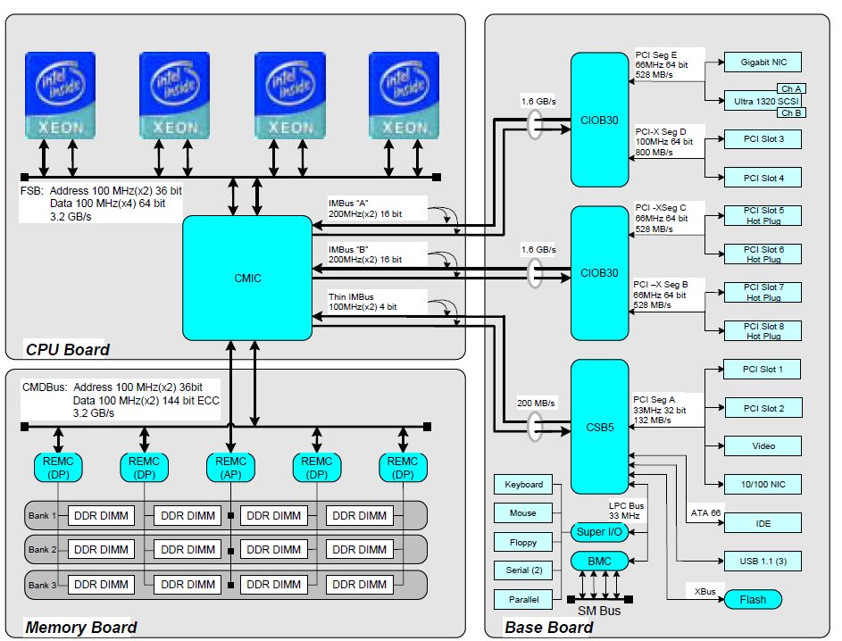
2. Evolution of Intel’s high performance multicore MP server platforms (6)
Example for Intel’s early Pentium 4 based server MP [101]

Slide 35
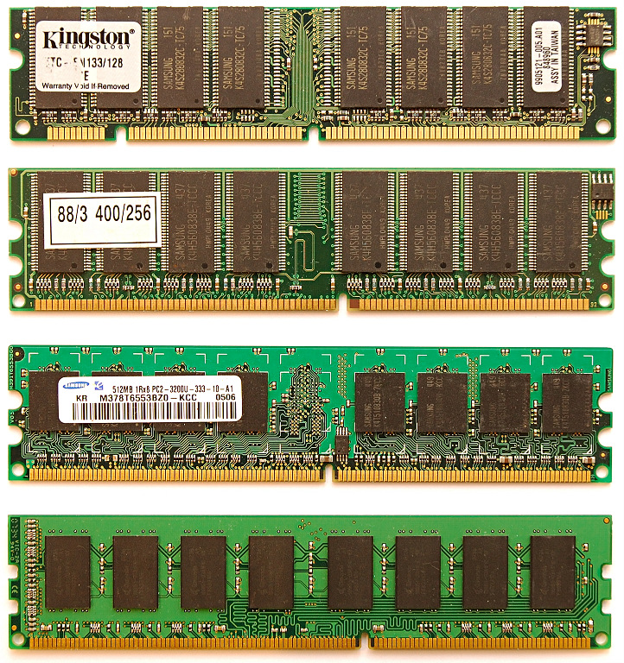
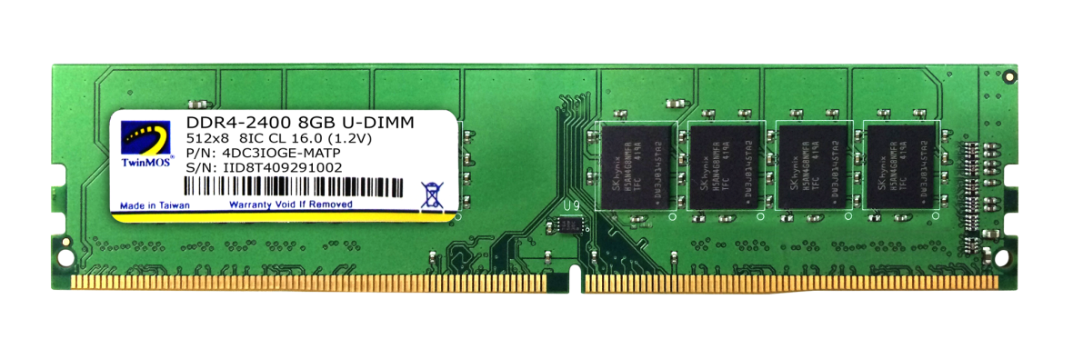
2. Evolution of Intel’s high performance multicore MP server platforms (8)
2.1 Overview of the Truland MP platform (1)
Pin counts of SDRAM to
DDR4 DIMMs
All these DIMMs
are 8-byte wide.
SDRAM
(SDR)
168-pin
DDR
184-pin
DDR2
240- pin
DDR3
240-pin
DDR4
284-pin
Notes:
35

Slide 36
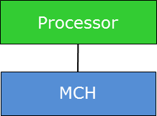
2. Evolution of Intel’s high performance multicore MP server platforms (10)
Possible solutions for raising the number of memory channels
DIMMs
Possible solutions for raising the number of memory channels
Connect memory immediately
to the processor(s)
Use low line count interfaces
between the MC and the DIMMs

Slide 37
2. Evolution of Intel’s high performance multicore MP server platforms (11)
Connect memory immediately to the processor
This is one option of the design aspect of choosing the connection point of the memory to the
platform
Connection point of the memory
Connect memory
via the MCH (Memory Control Hub)
Connect memory
via the processor(s)
Processor
Processor
Memory
MCH
Memory
The central connection of memory
causes severe bandwidth imitations
first of all for MP configurations.
The per processor connection of memory
provides inherent scaling
of the memory bandwidth with the processor count.

Slide 38
2. Evolution of Intel’s high performance multicore MP server platforms (12)
Use low line count interfaces between the MC and the DIMMs
This is one option of the design aspect of choosing the interface connecting the MC and the DIMMs
The interface connecting the MCs and the DIMMs
Use standard DRAM interfaces
between the MCs and the DIMMs
Use low line count interfaces
between the MCs and the DIMMs
DIMMs are connected to one or more memory controllers directly by standard DRAM interfaces.
The number of memory channels is limited due to spatial and electrical constraints typically to two.
DIMMs are connected to one or more memory controllers via low line count interfaces and interface converters, called memory extension buffers (MBs) in order to connect more than two memory channels
DIMMs
DIMMs
MC in
MCH/processor
MB
MC in
MCH/processor
MB
Standard DRAM
interface
Low line count
interface
Standard DRAM
interface

Slide 39
2. Evolution of Intel’s high performance multicore MP server platforms (13)
Evolution of connecting memory in Intel’s multicore MP platforms
Connection point of the memory
Connect memory
via the MCH
Connect memory
via the processor(s)
Traditional
solution
The interface
connecting the MCs and the DIMMs
Use standard DRAM interfaces between the
MCs and the DIMMs
Use low line count interfaces between the MCs and the DIMMs
Truland MP platform
(2005/2006)
Boxboro-EX platform
(2010/2011)
Caneland platform
(2007/2008)
Brickland platform
(2014/2015)

Slide 40
2. Evolution of Intel’s high performance multicore MP server platforms (15)
Expected number of memory channels (n_{M}/socket) for different core counts (n_{C})
arising from the scaling rule of memory channels

Slide 41
2. Evolution of Intel’s high performance multicore MP server platforms (16)
The FSB bottleneck in SMP configurations
In early SMP configurations (e.g. in first Pentium 4 based single core (SC) Xeon based systems)
there is a single FSB that interconnects the four processors with the NB (Northbridge),
as seen.
Xeon MP¹
SC
Xeon MP¹
SC
Xeon MP¹
SC
Xeon MP¹
SC
FSB
E.g. 400 MT/s
Up to 3.2 GB/s
NB
Up to 2 x 8 x 0.266 = 4.26 GB/s
E.g. HI 1.5
E.g. DDR-200/266
ICH
HI 1.5 266 MB/s
Figure: Pentium 4 MP aimed MP server platform (for single core processors)
As the bandwidth data on the Figure demonstrate, in the example there is already the FSB
that limits the overall memory bandwidth.

Slide 42
2. Evolution of Intel’s high performance multicore MP server platforms (18)
Resolving the FSB bottleneck by using dual FSBs in dual core MP server platforms
Xeon MP
(Potomac) 1C
/
Xeon 7000
(Paxville MP) 2x1C
/
Xeon 7100
(Tulsa) 2C
Xeon MP¹
SC
Xeon MP¹
SC
Xeon MP¹
SC
Xeon MP¹
SC
Pentium 4
Xeon MP 1C/2x1C
Pentium 4
Xeon MP 1C/2x1C
Pentium 4
Xeon MP 1C/2x1C
Pentium 4
Xeon MP 1C/2x1C
FSB
(800 MT/s)
FSB (400 MT/s)
Preceding NBs
XMB
8500¹/8501
XMB
XMB
XMB
E.g. DDR-200/266
E.g. HI 1.5
E.g. DDR-200/266
HI 1.5
DDR-266/333
DDR2-400
ICH5
DDR-266/333
DDR2-400
Preceding ICH
HI 1.5 266 MB/s
Previous Pentium 4 MP aimed
MP server platform (for single core processors)
(2004 and before)
90 nm Pentium 4 Prescott MP aimed
Truland MP server platform (for up to 2 C)
(2006)

Slide 43
2. Evolution of Intel’s high performance multicore MP server platforms (19)
Resolving the FSB bottleneck by using quad FSBs in up to 6 core MP server platforms
Xeon MP
(Potomac) 1C
/
Xeon 7000
(Paxville MP) 2x1C
/
Xeon 7100
(Tulsa) 2C
Xeon 7200
(Tigerton DC) 1x2C
/
Xeon 7300
(Tigerton QC) 2x2C
/
Xeon 7400
(Dunnington 6C)
Pentium 4
Xeon MP 1C/2x1C
Pentium 4
Xeon MP 1C/2x1C
Pentium 4
Xeon MP 1C/2x1C
Pentium 4
Xeon MP 1C/2x1C
Core2 (2C/4C)
Penryn (6C)
Core2 (2C/4C)
Penryn (6C)
Core2 (2C/4C)
Penryn (6C)
Core2 (2C/4C)
Penryn (6C)
FSB
(800 MT/s)
FSB
(1066 MT/s)
XMB
8500¹/8501
XMB
7300
up to
8 DIMMs
XMB
XMB
HI 1.5
ESI
DDR-266/333
DDR2-400
ICH5
DDR-266/333
DDR2-400
631xESB/
632xESB
FBDIMM
DDR2-533/667
90 nm Pentium 4 Prescott MP aimed
Truland MP server platform (for up to 2 C)
(2006)
Core 2 aimed
Caneland MP server platform (for up to 6 C)
(2007)
HI 1.5 (Hub Interface 1.5)
8 bit wide, 66 MHz clock, QDR,
266 MB/s peak transfer rate
ESI: Enterprise System Interface
4 PCIe lanes, 0.25 GB/s per lane (like the DMI interface,
providing 1 GB/s transfer rate in each direction)
¹ The E8500 MCH supports an FSB of 667 MT/s and consequently only the SC Xeon MP (Potomac)

Slide 44
2. Evolution of Intel’s high performance multicore MP server platforms (20)
Evolution of Intel’s high performance MP platforms – Memory architecture
Platform | Platform topology | Date of intro. | Processor | Techno- logy | Core count (up to) | No./kind of the links to mem. buffers | No. of mem. channels/ mem. buffer | No. /speed of mem. channels (up to)
Truland MP | SMP w/dual FSBs | 3/2005 | 90 nm Pentium 4 MP (Potomac) | 90 nm | 1C | 4 serial IMI channels from MCH to XMBs | 2 memory channels/ XMB | 2x DDR2-800/ socket
 |  | 11/2005 | Xeon 7000 (Paxville MP) | 90 nm | 2x1C
 |  | 8/2006 | Xeon 7100 (Tulsa) | 65 nm | 2C
Caneland | SMP w/Quad FSBs | 9/2007 | Xeon 7200 Tigerton DC (Core 2) | 65 nm | 2C | 4 serial FB-DIMM channels from MCH to AMBs | 1 memory channel/ AMB | 1x DDR2-667/ socket
 |  | 9/2007 | Xeon 7300 Tigerton QC (Core 2) | 65 nm | 2x2C
 |  | 9/2008 | Xeon 7400 (Dunnington) (Penryn) | 45 nm | 6C
Boxboro-EX | NUMA fully connect. by QPI buses | 3/2010 | Nehalem-EX (Xeon 7500/ (Beckton) | 45 nm | 8C | 4 serial SMI channels per proc. to 4 SMBs | 2 memory channels/ SMB | 8x DDR3-1067/ socket
 |  | 4/2011 | Westmere-EX (E7-4800) | 32 nm | 10C
Brickland | NUMA fully connect. by QPI buses | 2/2014 | Ivy Bridge-EX (E7-4800 v2) | 22 nm | 15C | 4 parallel SMI2 channels per proc. to 4 SMBs | 2 memory channels/ SMB | 8x DDR3-1600 (IWB) / DDR4-1866 (HSW)/ socket
 |  | 5/2015 | Haswell-EX (E7-4800 v3) | 22 nm | 18C
 |  | ?? | Broadwell-EX?? | 14 nm | 24C
Purley | NUMA fully connect. by UPI buses | 2017 | Skylake-EX | 14 nm | 28C | 6 channels per proc. | n.a. | DDR4-2666 mem. speed

Slide 45
2. Evolution of Intel’s high performance multicore MP server platforms (21)
Evolution of single core MP server platforms to dual core MP server platform
Xeon MP
(Potomac) 1C
/
Xeon 7000
(Paxville MP) 2x1C
/
Xeon 7100
(Tulsa) 2C
Xeon MP¹
SC
Xeon MP¹
SC
Xeon MP¹
SC
Xeon MP¹
SC
Pentium 4
Xeon MP 1C/2x1C
Pentium 4
Xeon MP 1C/2x1C
Pentium 4
Xeon MP 1C/2x1C
Pentium 4
Xeon MP 1C/2x1C
FSB
FSB
Preceding NBs
XMB
8500¹/8501
XMB
XMB
XMB
E.g. DDR-200/266
E.g. HI 1.5
E.g. DDR-200/266
IMI
HI 1.5
IMI
DDR-266/333
DDR2-400
ICH5
DDR-266/333
DDR2-400
Preceding ICH
HI 1.5 266 MB/s
Previous Pentium 4 MP aimed
MP server platform (for single core processors)
(2004 and before)
90 nm Pentium 4 Prescott MP aimed
Truland MP server platform (for up to 2 C)
(2006)
IMI (Independent Memory Interface): Low line count (70 signal lines) serial interface vs. DDR2 with 240 pins.
XMB: eXternal Memory Bridge

Slide 46
2. Evolution of Intel’s high performance multicore MP server platforms (22)
Evolution of dual core MP server platform to up to 6 core MP platform
Xeon MP
(Potomac) 1C
/
Xeon 7000
(Paxville MP) 2x1C
/
Xeon 7100
(Tulsa) 2C
Xeon 7200
(Tigerton DC) 1x2C
/
Xeon 7300
(Tigerton QC) 2x2C
/
Xeon 7400
(Dunnington 6C)
Pentium 4
Xeon MP 1C/2x1C
Pentium 4
Xeon MP 1C/2x1C
Pentium 4
Xeon MP 1C/2x1C
Pentium 4
Xeon MP 1C/2x1C
Core2 (2C/4C)
Penryn (6C)
Core2 (2C/4C)
Penryn (6C)
Core2 (2C/4C)
Penryn (6C)
Core2 (2C/4C)
Penryn (6C)
FSB
FSB
XMB
8500¹/8501
XMB
7300
up to
8 DIMMs
XMB
XMB
HI 1.5
ESI
DDR-266/333
DDR2-400
ICH5
DDR-266/333
DDR2-400
631xESB/
632xESB
FBDIMM
DDR2-533/667
90 nm Pentium 4 Prescott MP aimed
Truland MP server platform (for up to 2 C)
(2006)
Core 2 aimed
Caneland MP server platform (for up to 6 C)
(2007)
HI 1.5 (Hub Interface 1.5)
8 bit wide, 66 MHz clock, QDR,
266 MB/s peak transfer rate
ESI: Enterprise System Interface
4 PCIe lanes, 0.25 GB/s per lane (like the DMI interface,
providing 1 GB/s transfer rate in each direction)
¹ The E8500 MCH supports an FSB of 667 MT/s and consequently only the SC Xeon MP (Potomac)

Slide 47
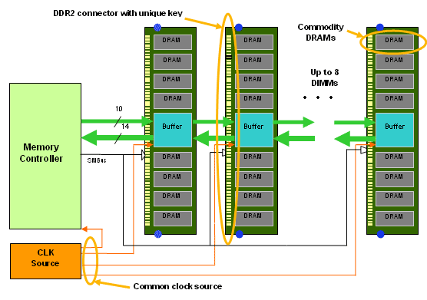
2. Evolution of Intel’s high performance multicore MP server platforms (24)
Layout of an FB-DIMM based memory subsystem -1 [102]
Figure: FB-DIMM memory architecture [102]

Slide 48
2. Evolution of Intel’s high performance multicore MP server platforms (26)
Layout of an FB-DIMM based memory subsystem -3 [102]
Figure: FB-DIMM memory architecture [102]

Slide 49
2. Evolution of Intel’s high performance multicore MP server platforms (29)
Main enhancements of the Nehalem-EX/Westmere-EX aimed up to 10 core Boxboro-EX
4S server platform (assuming 1 IOH)
Xeon 7500
(Nehalem-EX)
(Becton) 8C
/
Xeon E7-4800
(Westmere-EX) 10C
SMB
SMB
SMB
Nehalem-EX 8C
Westmere-EX 10C
QPI
Nehalem-EX 8C
Westmere-EX 10C
SMB
SMB
SMB
SMB
SMB
QPI
QPI
QPI
QPI
SMB
SMB
SMB
Nehalem-EX 8C
Westmere-EX 10C
Nehalem-EX 8C
Westmere-EX 10C
SMB
SMB
QPI
SMB
SMB
QPI
QPI
SMB
2x4 SMI
channels
2x4 SMI
channels
7500 IOH
PCIe
2.0
Nehalem-EX: up to DDR3-1067
Westmere-EX: up to DDR3-1333
ME
36
SMI: Scalable Memory Interface
(Serial link between the
processor and the SMB)
(Differential signaling, ~25 lanes)
SMB: Scalable Memory Buffer
(Conversion between the serial SMI and the parallel DDR3 DIMM interfaces)
4 x QPI up to 6.4 GT/s
ESI
2 DIMMs/memory channel
ICH10
ME: Management Engine
Nehalem-EX aimed Boxboro-EX MP server platform (for up to 10 C)
(2010/2011)

Slide 50
2. Evolution of Intel’s high performance multicore MP server platforms (31)
Returning to the stand alone memory buffer implementation in the Boxboro-EX
MP platform from using FB-DIMMs -2
Implementing memory extension buffers MBs)
Implementing stand alone MBs
mounted on the mainboard or
on a riser card
Implementing MBs
immediately on the DIMM
(called FB-DIMMs)
Truland MP platform
(2005/2006)
Caneland platform
(2007/2008)
Boxboro-EX platform
(2010/2011)
Brickland platform
(2014/2015)
Figure: Intel’s implementation of memory extension buffers

Slide 51
2. Evolution of Intel’s high performance multicore MP server platforms (32)
Main enhancement of the up to 15 core Ivy Bridge-EX aimed Brickland 4S server platform
Xeon E7-4800 v2
(Ivy Bridge-EX)
(Ivytown) 15C
2x4 SMI2
channels
2x4 SMI2
channels
PCIe 3.0
PCIe 3.0
SMB
32
32
SMB
SMB
Ivy Bridge-EX 15C
QPI
1.1
Ivy Bridge-EX 15C
SMB
SMB
SMB
SMB
SMB
QPI 1.1
QPI 1.1
QPI 1.1
QPI 1.1
SMB
SMB
SMB
Ivy Bridge-EX 15C
Ivy Bridge-EX 15C
SMB
SMB
QPI
1.1
SMB
SMB
32
DMI2
4xPCIe2
32
SMB
PCIe 3.0
PCIe 3.0
C602J PCH
(Patsburg J)
Up to DDR3-1600 in lockstep mode and
up to DDR3-1333 in independent channel mode
ME
SMI2: Scalable Memory Interface 2
(Parallel 64 bit VMSE data link between
the processor and the SMB)
SMB: Scalable Memory Buffer
(C102/C104: Jordan Creek)
(Performs conversion between the
parallel SMI2 and the parallel
DDR3-DIMM interfaces)
C102: 2 DIMMs/channel
C104: 3 DIMMs/channel
3 x QPI up to 8.0 GT/s
ME: Management Engine

Slide 52
2. Evolution of Intel’s high performance multicore MP server platforms (33)
Main enhancements of the up to 18 core Haswell-EX aimed Brickland 4S server platform
2x4 SMI2
channels
Xeon E7-4800 v3
(Haswell-EX)
2x4 SMI2
channels
PCIe 3.0
PCIe 3.0
SMB
32
QPI
1.1
32
SMB
SMB
Haswell-EX 18C
Haswell-EX 18C
SMB
SMB
SMB
SMB
SMB
QPI 1.1
QPI 1.1
QPI 1.1
QPI 1.1
SMB
SMB
SMB
Haswell--EX 18C
Haswell-EX 18C
SMB
SMB
QPI
1.1
SMB
SMB
32
DMI2
4xPCIe2
32
SMB
PCIe 3.0
PCIe 3.0
C602J PCH
(Patsburg J)
Up to DDR3-1600
in both performance and lockstep modes and
up to DDR4-1866 in lockstep mode
ME
SMI2: Scalable Memory Interface 2
(Parallel 64-bit VMSE data link between
the processor and the SMB)
(~110 bidirectional VMSE data lines)
SMB: Scalable Memory Buffer
(C112/C114: Jordan Creek 2)
(Performs conversion between the
parallel SMI2 and the parallel
DDR3/DDR4 DIMM interfaces)
C112: 2 DIMMs/channel
C114: 3 DIMMs/channel
3x QPI 1.1: Up to 9.6 GT/s
ME: Management Engine

Slide 53
2. Evolution of Intel’s high performance multicore MP server platforms (35)
Intel’s high performance MP platforms – Cache architectures
Platform | Platform topology | Date of intro. | Processor | Techno- logy | Core count (up to) | L2 cache | L3 cache
Truland MP | SMP w/dual FSBs | 3/2005 | 90 nm Pentium 4 MP (Potomac) | 90 nm | 1C | 1 MB | 8 MB
 |  | 11/2005 | Xeon 7000 (Paxville MP) | 90 nm | 2x1C | 2 MB L2/C | --
 |  | 8/2006 | Xeon 7100 (Tulsa) | 65 nm | 2C | 1 MB L2/C | 16 MB
Caneland | SMP w/Quad FSBs | 9/2007 | Xeon 7200 Tigerton DC (Core 2) | 65 nm | 2C | 4 MB/C | --
 |  | 9/2007 | Xeon 7300 Tigerton QC (Core 2) | 65 nm | 2x2C | 4 MB/C | ---
 |  | 9/2008 | Xeon 7400 (Dunnington) (Penryn) | 45 nm | 6C | 3 MB/C | 16 MB
Boxboro-EX | NUMA fully connect. by QPI buses | 3/2010 | Nehalem-EX (Xeon 7500/ (Beckton) | 45 nm | 8C | ¼ MB/C | 24 MB
 |  | 4/2011 | Westmere-EX (E7-4800) | 32 nm | 10C | ¼ MB/C | 30 MB
Brickland | NUMA fully connect. by QPI buses | 2/2014 | Ivy Bridge-EX (E7-4800 v2) | 22 nm | 15C | ¼ MB/C | 37.5 MB
 |  | 5/2015 | Haswell-EX (E7-4800 v3) | 22 nm | 18C | ¼ MB/C | 35 MB
 |  | ?? | Broadwell-EX | 14 nm | 24C | ¼ MB/C | 60 MB
Purley | NUMA fully connect. by UPI buses | 2017 | Skylake-EX | 14 nm | 28C | n.a. | n.a.

Slide 54
2. Evolution of Intel’s high performance multicore MP server platforms (36)
Intel’s high performance MP platforms – Connectivity
Platform | Platform topology | Date of intro. | Processor | Techno- logy | Core count (up to) | FSB/QPI | IF to chipset | PCIe
Truland MP | SMP w/dual FSBs | 3/2005 | 90 nm Pentium 4 MP (Potomac) | 90 nm | 1C | 2xFSB 667 MT/s | HI1.5 (266 MB/s bidirectional) | 28 x PCIe lanes on the MCH
 |  | 11/2005 | Xeon 7000 (Paxville MP) | 90 nm | 2x1C | 2xFSB 800 MT/s
 |  | 8/2006 | Xeon 7100 (Tulsa) | 65 nm | 2C
Caneland | SMP w/Quad FSBs | 9/2007 | Xeon 7200 Tigerton DC (Core 2) | 65 nm | 2C | 4xFSB 1066 MT/s | ESI x4 (4x PCIe lanes) (1GB/s per direction) | 28 x PCIe lanes on the MCH
 |  | 9/2007 | Xeon 7300 Tigerton QC (Core 2) | 65 nm | 2x2C
 |  | 9/2008 | Xeon 7400 (Dunnington) (Penryn) | 45 nm | 6C
Boxboro-EX | NUMA fully connect. by QPI buses | 3/2010 | Nehalem-EX (Xeon 7500/ (Beckton) | 45 nm | 8C | 4xQPI 6.4 GT/s (3 for NUMA) | QPI (6.4 GB/s) | 36 x PCIe 2.0 lanes on the IOH
 |  | 4/2011 | Westmere-EX (E7-4800) | 32 nm | 10C
Brickland | NUMA fully connect. by QPI buses | 2/2014 | Ivy Bridge-EX (E7-4800 v2) | 22 nm | 15C | 3xQPI 1.1 8 GT/s | DMI2 x4 (4xPCIe 2.0) (2 GB/s per direction) | 32 x PCIe 3.0 lanes on the proc.
 |  | 5/2015 | Haswell-EX (E7-4800 v3) | 22 nm | 18C | 3xQPI 1.1 9.6 GT/s
 |  | ?? | Broadwell-EX | 14 nm | 24C | 3xQPI 1.1
Purley | NUMA fully connect. by UPI buses | 2017 | Skylake-EX | 14 nm | 28C | 3xUPI 10.4 GT/s | DMI3 x4 (4xPCIe 3.0) (~ 4GB/s/dir. | 48 x PCIe lanes on the proc.

Slide 55
3. Example 1: The Brickland platform
3.1 Overview of the Brickland platform
3.2 Key innovations of the Brickland platform vs.
the previous Boxboro-EX platform
3.3 The Ivy Bridge-EX (E7-4800 v2) 4S processor line
3.4 The Haswell-EX (E7-4800 v3) 4S processor line
3.5 The Broadwell-EX (E7-4800 v4) 4S processor line
Notes:
55

Slide 56
3.1 Overview of the Brickland platform
Notes:
56

Slide 57
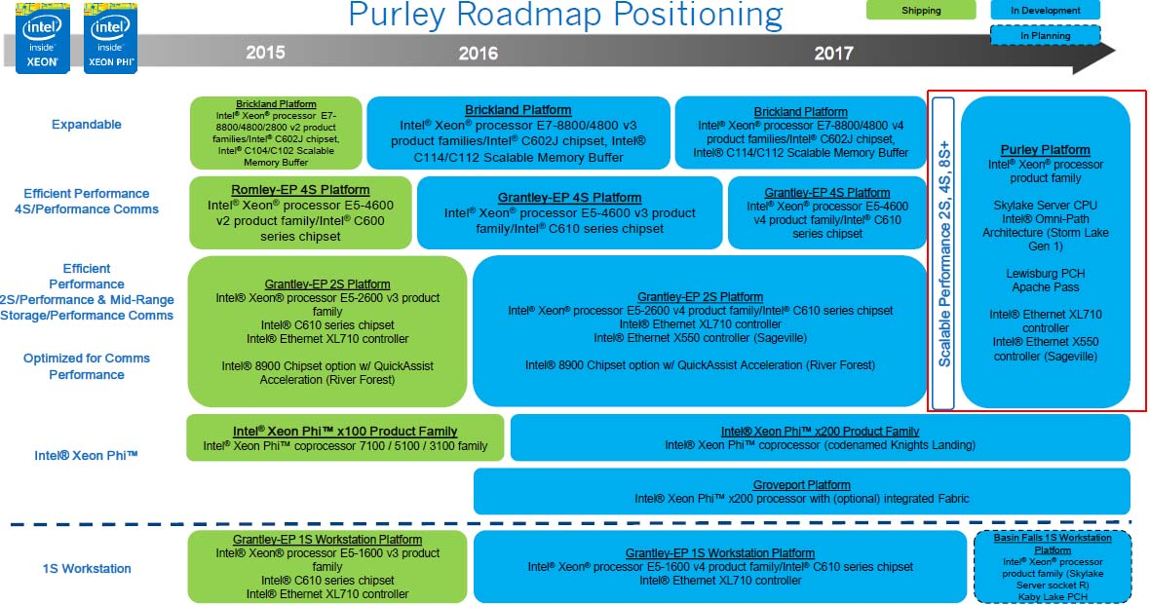
3.1 Overview of the Brickland platform (1)
3.1 Overview of the Brickland platform
Positioning the Brickland platform [112]

Slide 58
3.1 Overview of the Brickland platform (2)
The Brickland platform
2/2014
MP platforms
Brickland
2/2014
5/2015
MP cores
Xeon E7-4800 v2
Xeon
E7-4800 v3
(Ivy Bridge-EX)
(Ivytown) 15C
(Haswell-EX) 14C
22 nm/4310 mtrs/541 mm²
¼ MB L2/C
37.5 MB L3
3 QPI 1.1 links 8 GT/s
4 SMI2 links to 4 SMBs
2 mem. channels/SMB
up to 3 DIMMs/mem. channel
up to DDR3-1600 MT/s
6 TB (96x64 GB)
32 PCIe 3.0
LGA 2011-1
22 nm/5560 mtrs/661 mm²
¼ MB L2/C
35 MB L3
3 QPI 1.1 links 9.6 GT/s
4 SMI2 links to 4 SMBs
2 mem. channels/SMB
up to 3 DIMMs/mem. channel
up to DDR4-1866 MT/s
6 TB (96x64 GB)
32 PCIe 3.0
LGA 2011-1
3/2012
PCH
C602J
(Patsburg J)
Attached via x4 DMI2
Ivy Bridge-EX based
Haswell-EX based
Ivy Bridge-EX-based
22 nm
Haswell-EX based
22 nm

Slide 59
3.1 Overview of the Brickland platform (3)
Basic system architecture of the Brickland 4S server platform (2014/2015)
(assuming 2x3 DIMMs/SMB)
Xeon E7-4800 v2
(Ivy Bridge-EX)
(Ivytown) 15C
/
Xeon E7-4800 v3
(Haswell-EX)
14C
2x4 SMI2
channels
2x4 SMI2
channels
PCIe 3.0
PCIe 3.0
SMB
32
32
SMB
SMB
Ivy Bridge-EX
Haswell_EX
QPI
1.1
Ivy Bridge-EX
Haswell-EX
SMB
SMB
SMB
SMB
SMB
QPI 1.1
QPI 1.1
QPI 1.1
QPI 1.1
SMB
SMB
SMB
Ivy Bridge-EX
Haswell-EX
Ivy Bridge-EX Haswe-EX
SMB
SMB
QPI
1.1
SMB
SMB
32
DMI2
4xPCIe2
32
SMB
PCIe 3.0
PCIe 3.0
C602J PCH
(Patsburg J)
ME
SMI2: Scalable Memory Interface 2
(Parallel 64 bit VMSE data link between
the processor and the SMB)
SMB: Scalable Memory Buffer
(Performs conversion between the
parallel SMI2 and the parallel
DIMM interfaces)

Slide 60
3.1 Overview of the Brickland platform (4)
Contrasting differences in key features of the Ivy Bridge-EX and Haswell-EX based
Brickland platforms [114]
Feature | Ivy Bridge-EX based (E7-4800 v2) | Haswell-EX based (E7-4800 v3)
Cores | Up to 15 | Up to 14
LLC3 size | Up to 15x2.5 MB | Up to 14x2.5 MB
QPI | 3xQPI 1.1 Up to 8.0 GT/s in both dir. (16 GB/s per dir.) | 3xQPI 1.1 Up to 9.6 GT/s in both dir. (19.2 GB/s per dir.)
SMB | C102/C104 (Jordan Creek) C102: 2 DIMMs/SMB C103: 3 DIMMs/SMB | C112/C114 (Jordan Creek 2) C102: 2 DIMMs/SMB C103: 3 DIMMs/SMB
VMSE speed | Up to 2667 MT/s | Up to 3200 MT/s
DDR4 speed | n.a. | Perf. mode: up to 1600 MT/s Lockstep mode: up to 1866 MT/s
DDR3 speed | Perf. mode: up to 1333 MT/s Lockstep mode: up to 1600 MT/s | Perf. mode: up to 1600 MT/s Lockstep mode: up to 1600 MT/s

Slide 61
3.2 Key innovations of the Brickland platform vs.
the previous Boxboro-EX platform
Notes:
61

Slide 62
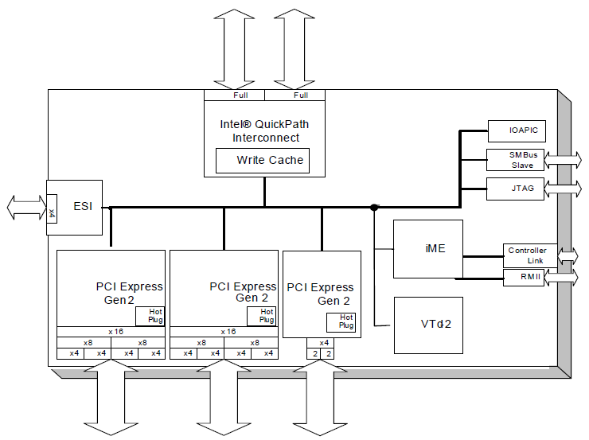
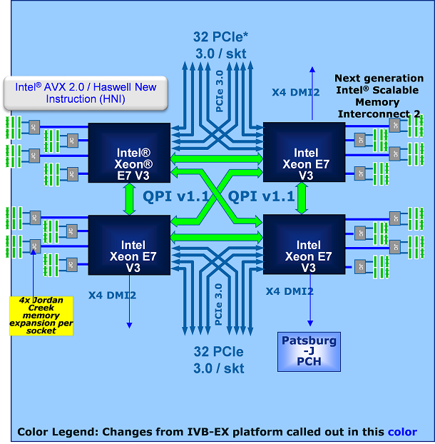
3.2 Key innovations of the Brickland platform (2)
3.2.1 Connecting PCIe links direct to the processors rather than to the MCH -1
3.2.1.1 Overview
Boxboro platform [106]
Brickland platform [114]
2 x QPI
36 lanes of PCIe 2.0

Slide 63
3.2 Key innovations of the Brickland platform (4)
3.2.1.2 Raising the PCIe lane count provided by the Brickland platform -1
As long as the Boxboro-EX platform provides 36 PCIe lanes, the Brickland platform affords
32 PCIe lanes per processor, i.e. 4 x 32 = 132 lanes in total for a 4S platform, as shown below.
Boxboro platform
Brickland platform
2 x QPI
36 lanes of PCIe 2.0
Figure: Connecting PCIe links direct to the processors rather than to the MCH

Slide 64
3.2 Key innovations of the Brickland platform (7)
a) Interconnecting the processors and the PCH by a DMI2 (4x PCIe 2.0) interface
Due to the reduced bandwidth demand of the chipset-processor interface, it suffices now
to interconnect the PCH with a single processor via a DMI2 interface consisting of 4 PCIe 2.0
lanes that provide a bandwidth of up to 4x0.5=2 GB/s, rather than using a QPI bus with
a bandwidth of 16.0 GB/s.
Figure: The Haswell-EX implementation of the Brickland platform [114]

Slide 65
3.2 Key innovations of the Brickland platform (8)
b) Providing only three QPI links per processor -1
As the Brickland platform does not need an extra QPI bus to interconnect the processor with
the PCH, it has only 3 QPI buses per processor rather than four compared to the previous
(Boxboro-EX) platform, as shown in the next Figure.
Figure: The Haswell-EX implementation of the Brickland platform [114]

Slide 66
3.2 Key innovations of the Brickland platform (10)
c) Implementing a single chip “chipset”
Inspired by the reduced functionality, the chipset is now implemented as a single chip solution
instead of using two chips, as in the previous Boxboro platform.
The single chip “chipset” is now designated as the PCH (Platform Controller Hub).
It is in particular the C602 J or Patsburg-J PCH, as shown below.
Figure: The Haswell-EX implementation of the Brickland platform [114]

Slide 67
3.2 Key innovations of the Brickland platform (12)
a) Redesigned, basically parallel MC-SMB interface, called SMI2 interface -1
Brickland platform
Boxboro-EX platform
DIMM
DIMM
DIMM
DIMM
DIMM
DIMM
DIMM
DIMM
DIMM
DIMM
DDR3
interface
DDR3/4
interface
(11 lanes)
SMI In
SMI2 data
Scalable Memory Buffer
(SMB)
Scalable Memory Buffer
(SMB)
SMI Out
SMI CMD
(14 lanes)
SMI: Serial, packet based, unidirectional links
with differential signaling
Up to 6.4 Gbps
SMI 2: 64-bit parallel, bidirectional data link
with single-ended voltage referenced signaling,
(VMSE (Voltage Mode single Ended) signaling)
Up to 3200 MT/s

Slide 68
3.2 Key innovations of the Brickland platform (14)
b) Enhanced DRAM interface
Brickland platform
Boxboro-EX platform
DIMM
DIMM
DIMM
DIMM
DIMM
DIMM
DIMM
DIMM
DIMM
DIMM
DDR3
interface
DDR3/4
interface
SMI In
SMI2 data
Scalable Memory Buffer
(SMB)
Scalable Memory Buffer
(SMB)
SMI Out
SMI CMD
Up to DDR3-1333
Up to 2 DIMMs per memory channel
Up to DDR4-1866
Up to 3 DIMMs per memory channel

Slide 69
3.2 Key innovations of the Brickland platform (15)
Operation modes of the SMBs in the Brickland platform [113]
Operation modes of the SMBs
Lockstep mode
Independent channel mode
(aka Performance mode)
In lockstep mode the same command is sent
on both DRAM buses.
The read or write commands are issued
simultaneously to the referenced DIMMs,
and the SMB interleaves the data on the
In the independent channel mode commands
sent to both DRAM channels are independent
from each other.

Slide 70
3.2 Key innovations of the Brickland platform (16)
DRAM speeds of the Brickland platform
Feature | Ivy Bridge-EX based (E7-4800 v2) | Haswell-EX based (E7-4800 v3)
SMB | C102C104 | C112/C114
DDR4 speed | n.a. | Independent mode: up to 1600 MT/s Lockstep mode: up to 1866 MT/s
DDR3 speed | Independent mode: up to 1333 MT/s Lockstep mode: up to 1600 MT/s | Independent mode: up to 1600 MT/s Lockstep mode: up to 1600 MT/s

Slide 71
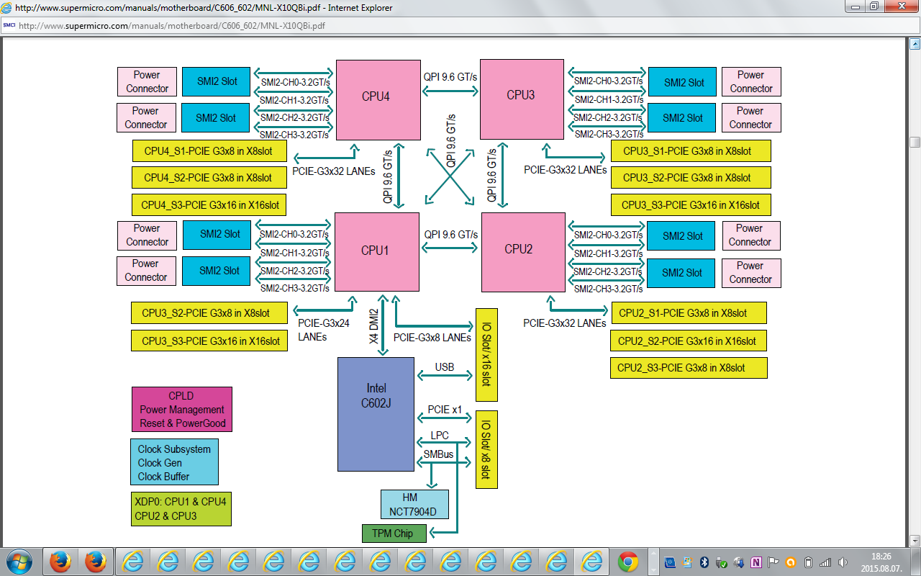
3.2 Key innovations of the Brickland platform (17)
Example for a Haswell-EX based Brickland platform [115]
Haswell-EX
E7-8800 v3 /E7-4800 v3 family
(18-Core), w/ QPI up to 9.6 GT/s

Slide 72
3.3 The Ivy Bridge-EX (E7-4800 v2) 4S processor line
Notes:
72

Slide 73
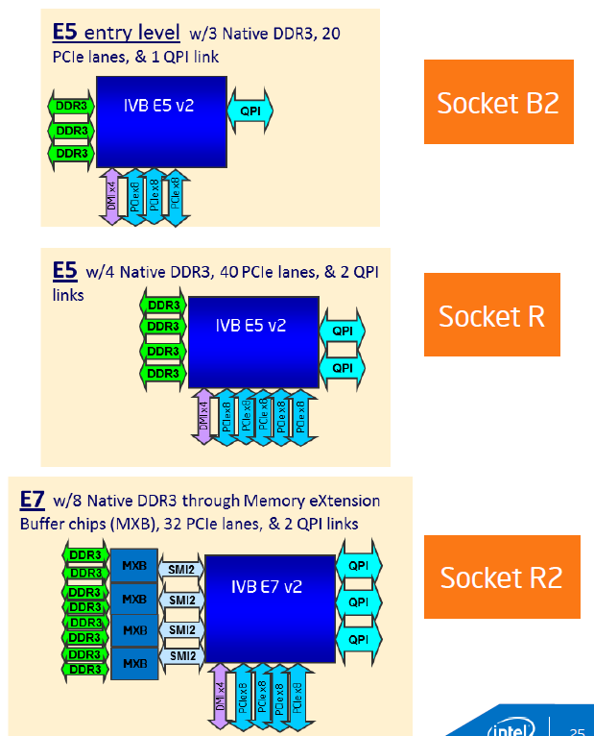
3.3 The Ivy Bridge-EX (E7-4800 v2) 4S processor line (2)
Ivytown processor alternatives for different server platforms 117]
E5 platform: Romley
Entry level
E5 v2 2400 1, 2 sockets
Performance level
E5 v2 2600 1, 2. 4 sockets
E7 platform: Brickland
High-performance level
E7 v2 4800/8800
2, 4, 8 sockets

Slide 74
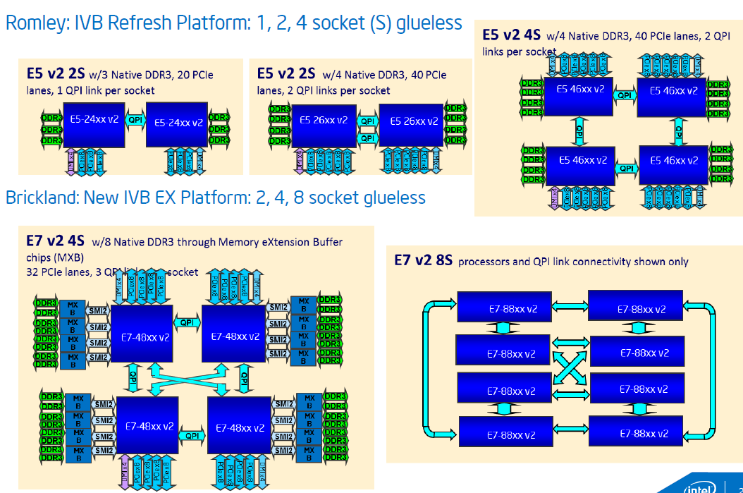
3.3 The Ivy Bridge-EX (E7-4800 v2) 4S processor line (3)
E5, E7 platform alternatives built up of Ivytown processors [117]
Romley Entry and Performance level platform alternatives
Brickland High performance platform alternatives

Slide 75
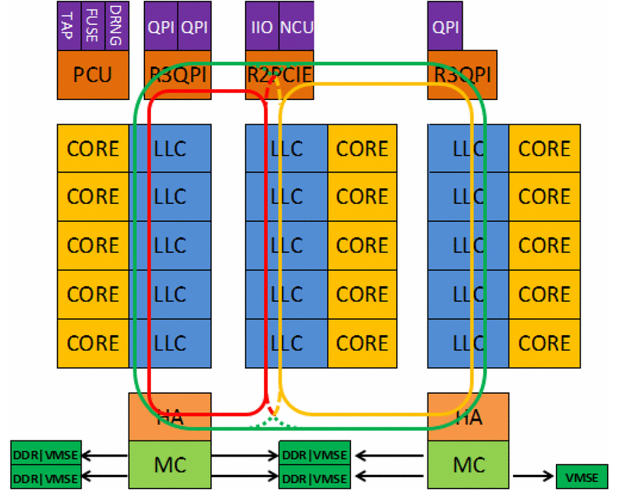
3.3 The Ivy Bridge-EX (E7-4800 v2) 4S processor line (4)
Block diagram of the Ivy Town processor
The processor consists of 3 slices, each with 5 cores and associated LLC segments, as seen below.
PCU: Power Control Unit
TAP: Test Access Port
FUSE: Fuse block, to configure the die
i.e. to have various core and
cache sizes as well as
different frequency and TDP
levels
DRNG: Digital Random Number
Generator
IIO: Integrated I/O block
HA: Home Agent providing
memory coherency
MC: Memory Controller
VMSE: Voltage-Mode Single-Ended
Interface (actually the
SMB)
Figure: Block diagram of the Ivy Town processor [116]

Slide 76
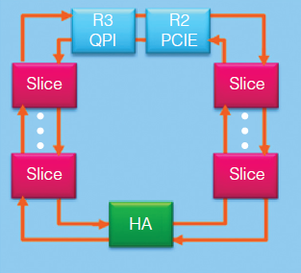
3.3 The Ivy Bridge-EX (E7-4800 v2) 4S processor line (5)
Layout of the ring interconnect bus used for dual slices (10 cores) [125]

Slide 77
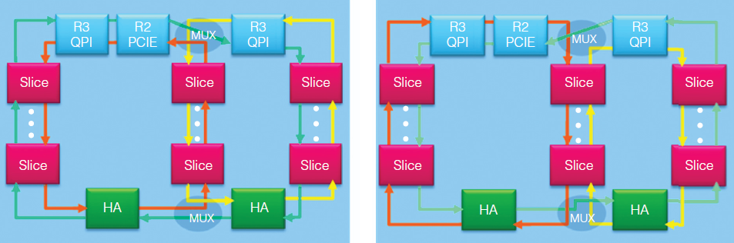
3.3 The Ivy Bridge-EX (E7-4800 v2) 4S processor line (6)
Layout of the ring interconnect bus used for three slices (15 cores) [125]
There are 3 virtual rings.
Multiplexers (MUXs) dynamically interconnect the rings, as shown below.
Clockwise outer ring
Counter-clockwise outer ring
Figure: Three-slice ring interconnect with three virtual rings interconnected by multiplexers [125]

Slide 78
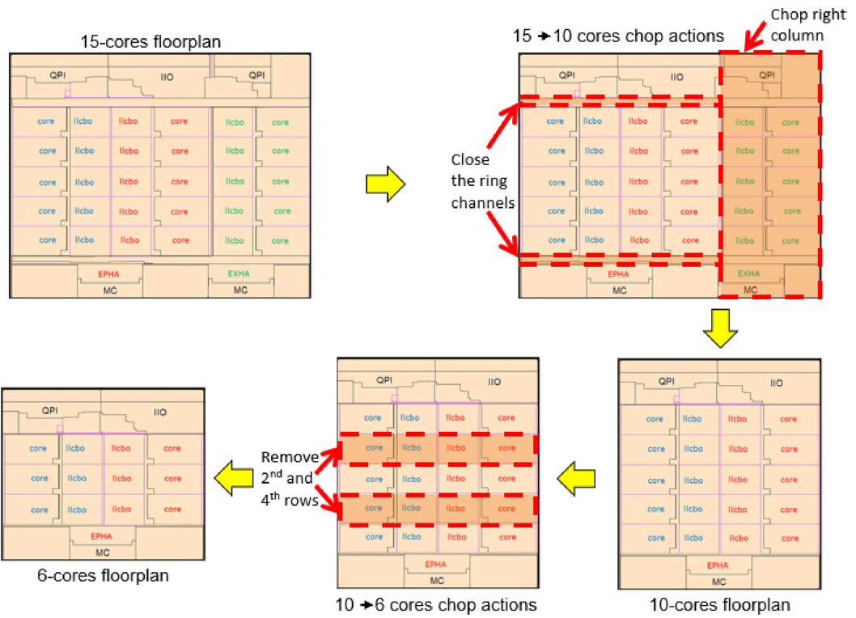
3.3 The Ivy Bridge-EX (E7-4800 v2) 4S processor line (7)
Implementing lower core variants through chopping [116]

Slide 79
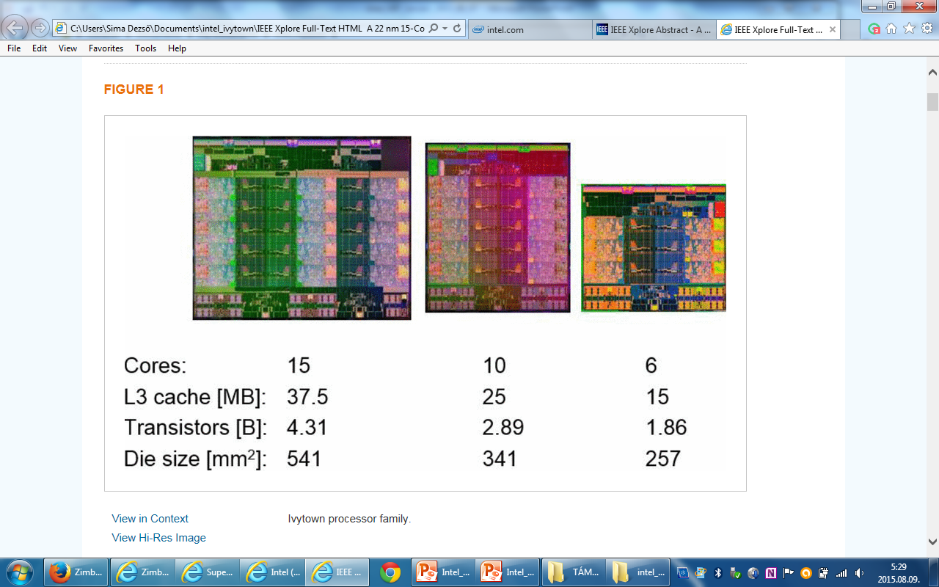
3.3 The Ivy Bridge-EX (E7-4800 v2) 4S processor line (8)
Lower core alternatives of the Ivytown processor achieved by chopping [116]
15 cores
10 cores
6 cores

Slide 80
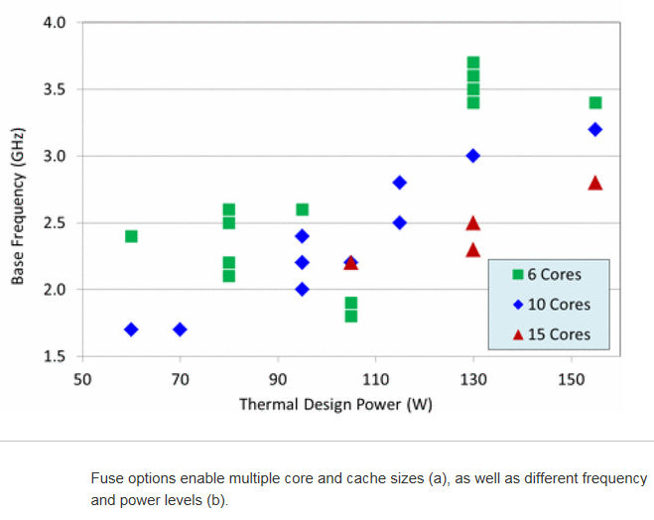
3.3 The Ivy Bridge-EX (E7-4800 v2) 4S processor line (9)
TDP vs. core frequency in different Ivytown processor alternatives [116]

Slide 81
3.4 The Haswell-EX (E7-4800 v3) 4S processor line
Notes:
81

Slide 82
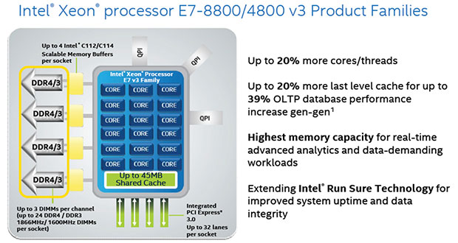
3.4 The Haswell-EX (E7-4800 v3) 4S processor line (2)
Basic layout of an 18 core 8S Haswell-EX v3 (E7-8800) processor [118]

Slide 83
3.4 The Haswell-EX (E7-4800 v3) 4S processor line (3)
Contrasting key features of the Ivy Bridge-EX and Haswell-EX processors -1 [114]
Feature | Ivy Bridge-EX (E7-4800 v2) | Haswell-EX (E7-4800 v3)
Cores | Up to 15 | Up to 14
LLC size (L3) | Up to 15x2.5 MB | Up to 14x2.5 MB
QPI | 3xQPI 1.1 Up to 8.0 GT/s in both dir. (16 GB/s per dir.) | 3xQPI 1.1 Up to 9.6 GT/s in both dir. (19.2 GB/s per dir.)
SMB | C102/C104 (Jordan Creek) C102: 2 DIMMs/SMB C103: 3 DIMMs/SMB | C112/C114 (Jordan Creek 2) C102: 2 DIMMs/SMB C103: 3 DIMMs/SMB
VMSE speed | Up to 2667 MT/s | Up to 3200 MT/s
DDR4 speed | n.a. | Perf. mode: up to 1600 MT/s Lockstep mode: up to 1866 MT/s
DDR3 speed | Perf. mode: up to 1333 MT/s Lockstep mode: up to 1600 MT/s | Perf. mode: up to 1600 MT/s Lockstep mode: up to 1600 MT/s
TSX | n.a. | Supported

Slide 84
3.4 The Haswell-EX (E7-4800 v3) 4S processor line (6)
Addressing race conditions
Basically there are two mechanisms to address race conditions in multithreaded programs,
as indicated below:
Basic mechanisms to address races in multithreaded programs
Locks
Transactional memory (TM)
Pessimistic approach,
it intends to prevent possible conflicts
by enforcing serialization of transactions
through locks.
Optimistic approach,
it allows parallel execution and thus
lets access conflicts to occur
but provides a checking and repair mechanism
for managing these conflicts, i.e.
it allows all threads to access shared data simultaneously
but after completing a transaction,
it will be checked whether a conflict arose,
if yes, the transaction will be rolled back and
then replayed if feasible else
executed while using locks.
The next Figure illustrates these synchronization mechanisms.

Slide 85
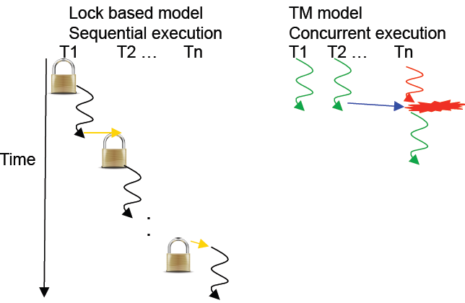
3.4 The Haswell-EX (E7-4800 v3) 4S processor line (7)
Illustration of lock based and transaction memory (TM) based thread synchronization
[126]
Conflict, to be
repaired

Slide 86
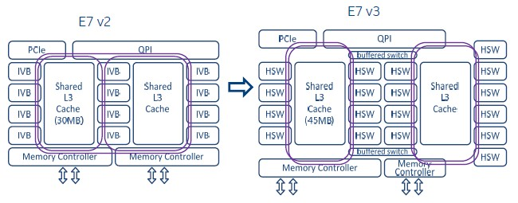
3.4 The Haswell-EX (E7-4800 v3) 4S processor line (9)
Contrasting the layout of the Haswell-EX cores vs. the Ivy Bridge-EX cores [111]
Haswell-EX has four core slides with 3x4 + 6 = 18 cores rather than 3x5 cores in case of
the Ivy Bridge-EX (only 3x 4 = 12 cores indicated in the Figure below).
Figure: Contrasting the basic layout of the Haswell-EX (E7 v3) and Ivy Bridge-EX (E7 v2)
processors [111]
Note that the E7-V3 has only two ring buses interconnected by a pair of buffered switches.

Slide 87
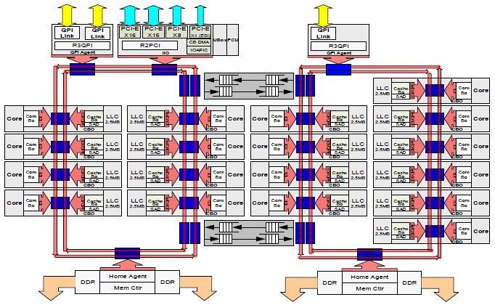
3.4 The Haswell-EX (E7-4800 v3) 4S processor line (10)
More detailed layout of the Haswell-EX die [111]

Slide 88
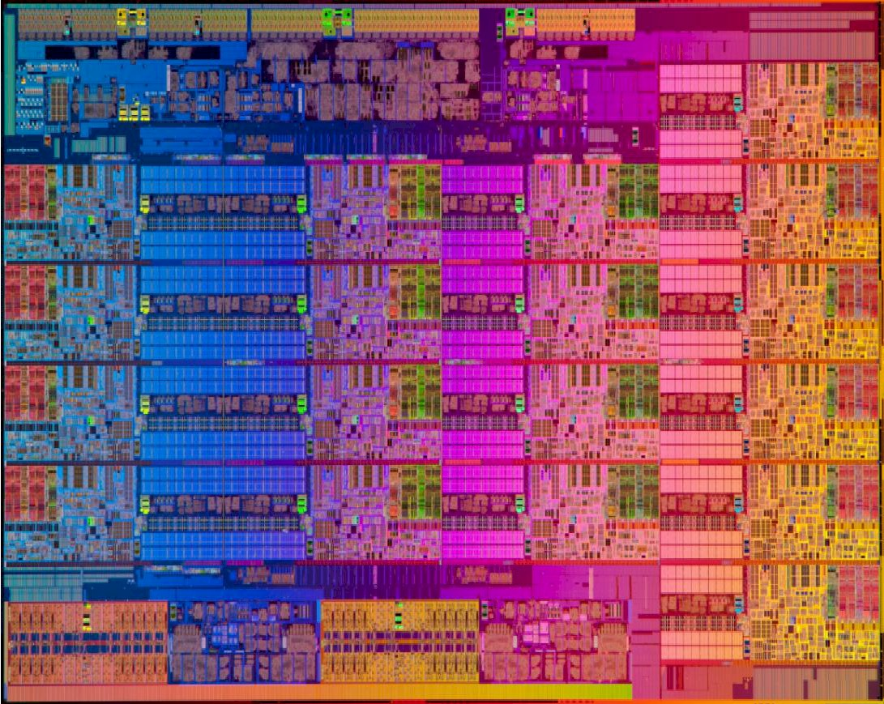
3.4 The Haswell-EX (E7-4800 v3) 4S processor line (11)
Die micrograph of an 18-core Haswell-EX processor [111]
22 nm, 5.7 billion transistors, 662 mm²

Slide 89
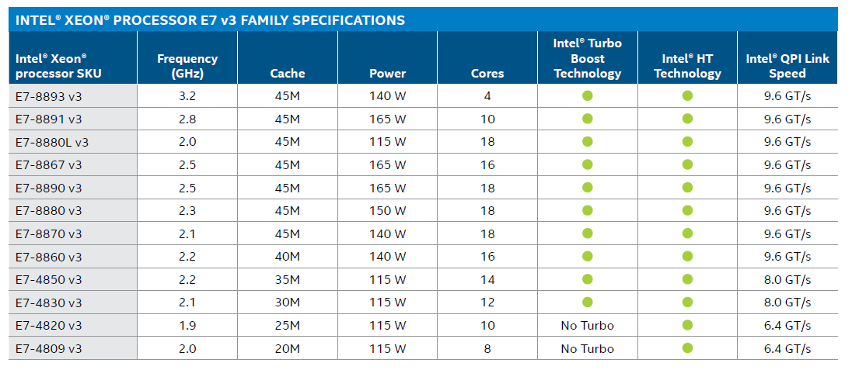
3.4 The Haswell-EX (E7-4800 v3) 4S processor line (12)
Main features of 4S and 8S Haswell-EX processors [120]

Slide 90
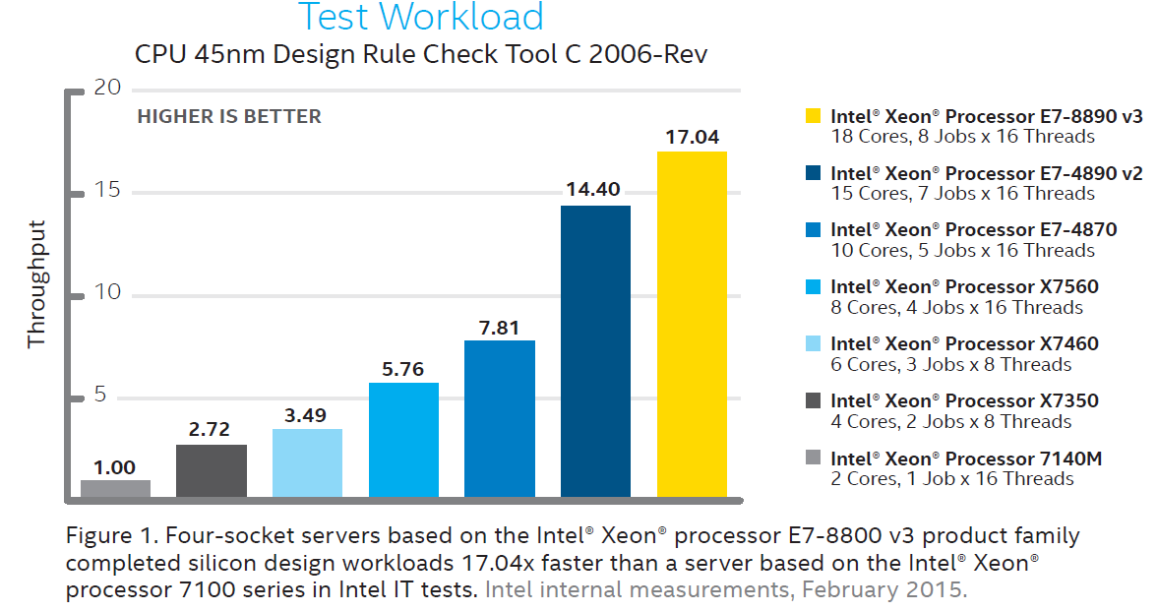
3.4 The Haswell-EX (E7-4800 v3) 4S processor line (13)
Performance comparison of MP processors -1 [121]
(The test workload is: CPU 45 nm Design Rule Check Tool C 2006 Rev.)
P4-based Tulsa (2006)
Core 2 Tigerton QC (2007)
Penryn Dunnington (2008)
Nehalem-EX (2010)
Westmere-EX (2011)
Ivy Bridge-EX (2014)
Haswell-EX (2015)

Slide 91
3.5 The Broadwell-EX (E7-4800 v4) 4S processor line
Notes:
91

Slide 92
3.5 The Broadwell-EX (E7-4800 v4) 4S processor line (1)
3.5 The Broadwell-EX (E7-4800 v4) 4S processor line
Positioning the Broadwell-EX line [112]

Slide 93
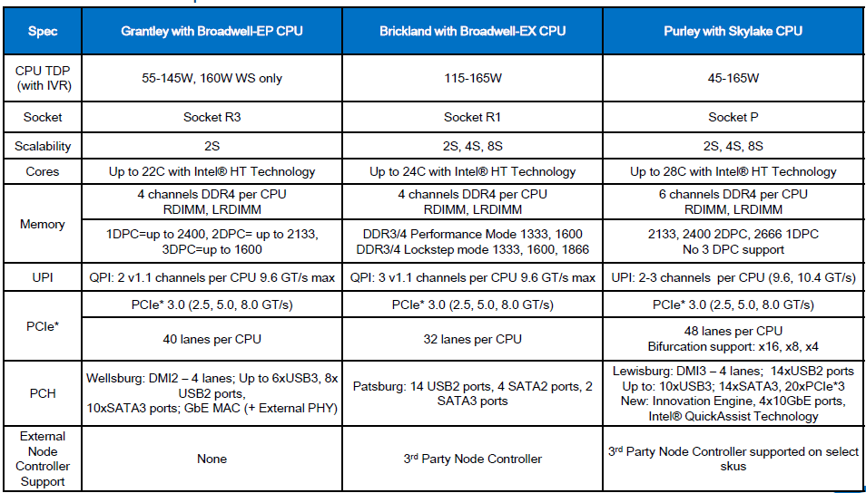
3.5 The Broadwell-EX (E7-4800 v4) 4S processor line (2)
Planned features of the Brickland platform with the Broadwell-EX processor line -1 [122]

Slide 94
4. Example 2: The Purley platform
Notes:
94

Slide 95
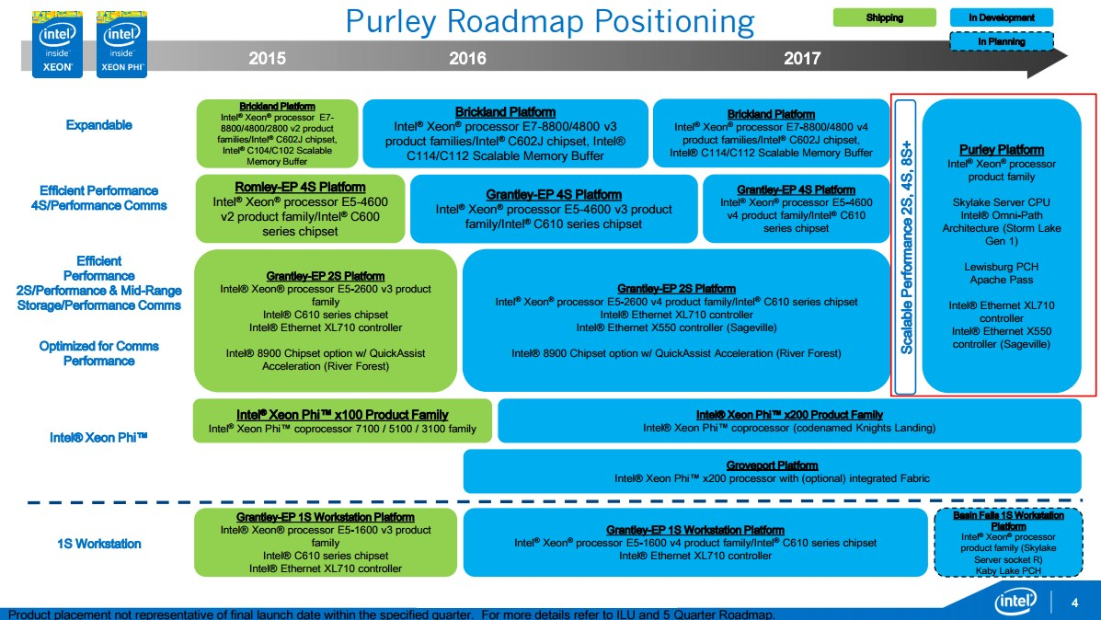
4. Example 2:. The Purley platform (2)
Positioning of the Purley platform [112]

Slide 96
4. Example 2:. The Purley platform (3)
Planned features of the Purley platform with the Skylake-EX processor line -1 [122]

Slide 97
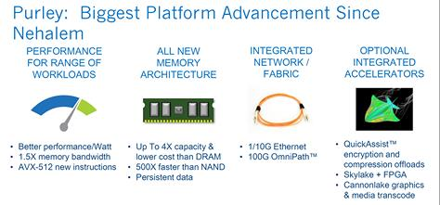
4. Example 2:. The Purley platform (4)
Key advancements of the Purley platform [123]

Slide 98
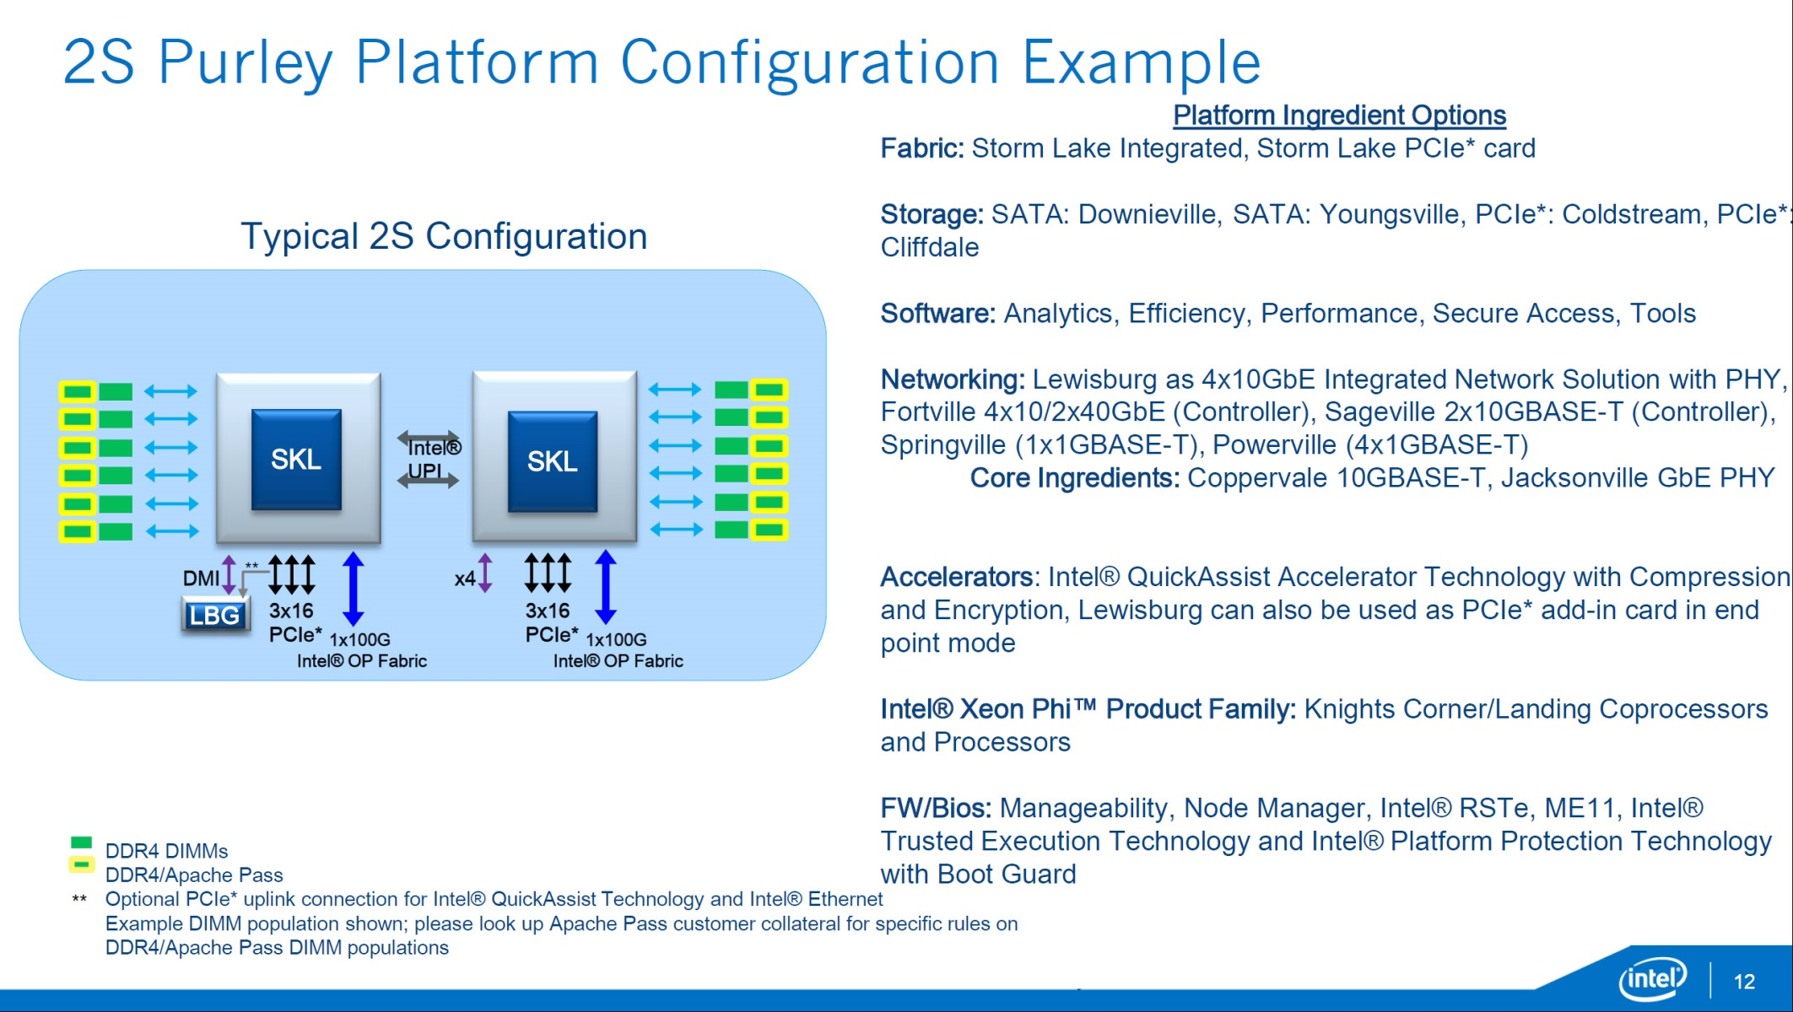
4. Example 2:. The Purley platform (5)
Example of a 2S Purley platform [123]
10GBASE-T: 10 Gbit/s Ethernet via copper twisted pair cable
(Lewisburg)

