Slide 1
Manycore
processors
Sima Dezső
2015. October
Version 6.2

Slide 2
Manycore processors (1)
Manycore processors
Multicore processors
Homogeneous
processors
Heterogeneous
processors
Traditional
MC processors
Manycore
processors
2 ≤ n ≈≤ 16 cores
with n ≈> 16 cores
Mobiles
Desktops
Servers
General purpose
computing
Experimental/prototype/
production systems

Slide 3
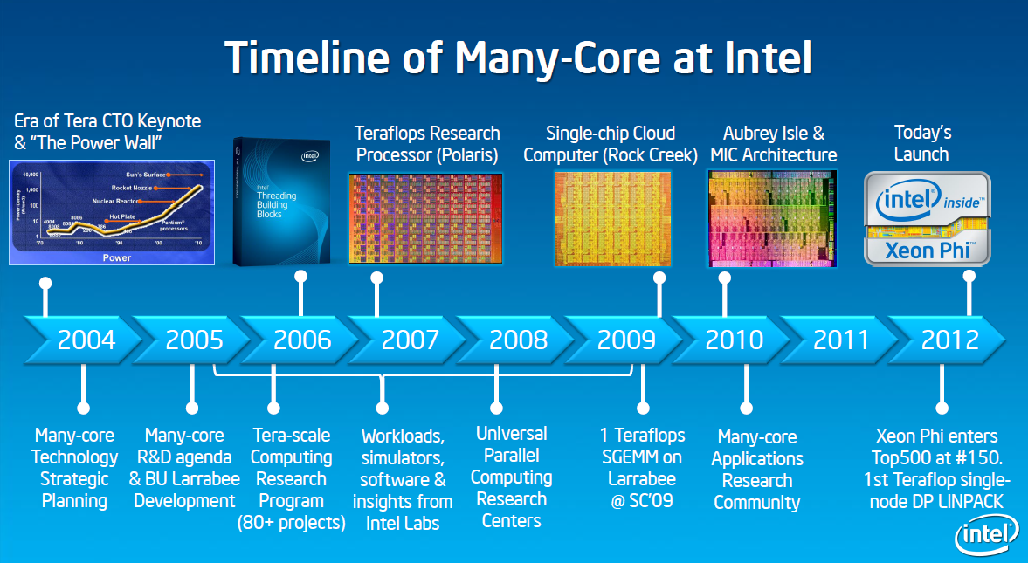
2. Manycore processors (2)
Overview of Intel’s manycore processors [1]
Knights Corner
Xeon Phi
80 core Tile
SCC
Knights Ferry

Slide 4
Manycore processors
1. Intel’s Larrabee
2. Intel’s 80-core Tile processor
3. Intel’s SCC (Single Chip Cloud Computer)
4. Intel’s MIC (Many Integrated Core)/Xeon Phi family
5. References

Slide 5
1. Intel’s Larrabee

Slide 6
1. Intel’s Larrabee (1)
1. Intel’s Larrabee -1 [1]
Knights Corner
Xeon Phi
80 core Tile
SCC
Knights Ferry

Slide 7
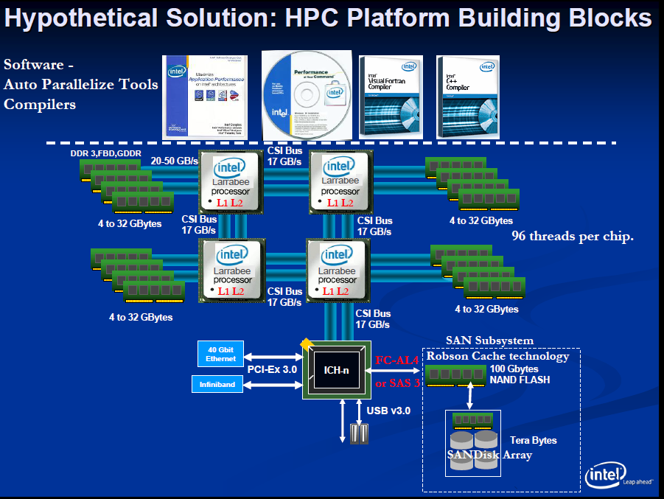
1. Intel’s Larrabee (3)
System architecture of Larrabee aiming at HPC (based on a presentation in 12/2006) [2]
CSI: Common System Interface
(QPI)

Slide 8
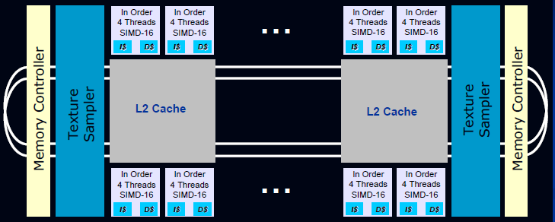
1. Intel’s Larrabee (4)
The microarchitecture of Larrabee [2]
It is based on a bi-directional ring interconnect.
It has a large number (24-32) of enhanced Pentium cores (4-way multithreaded,
SIMD-16 (512-bit) extension).
Larrabee includes a coherent L2 cache, built up of 256 kB/core cache segments.

Slide 9
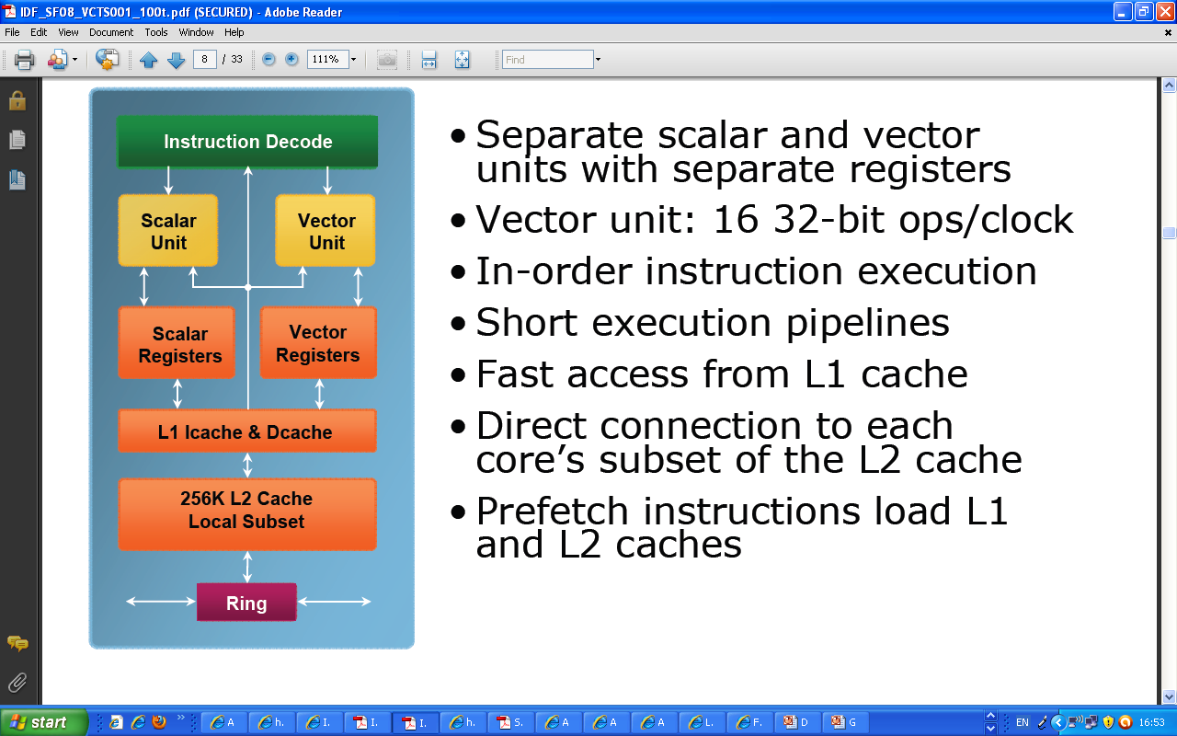
1. Intel’s Larrabee (5)
Block diagram of a Larrabee core [4]

Slide 10
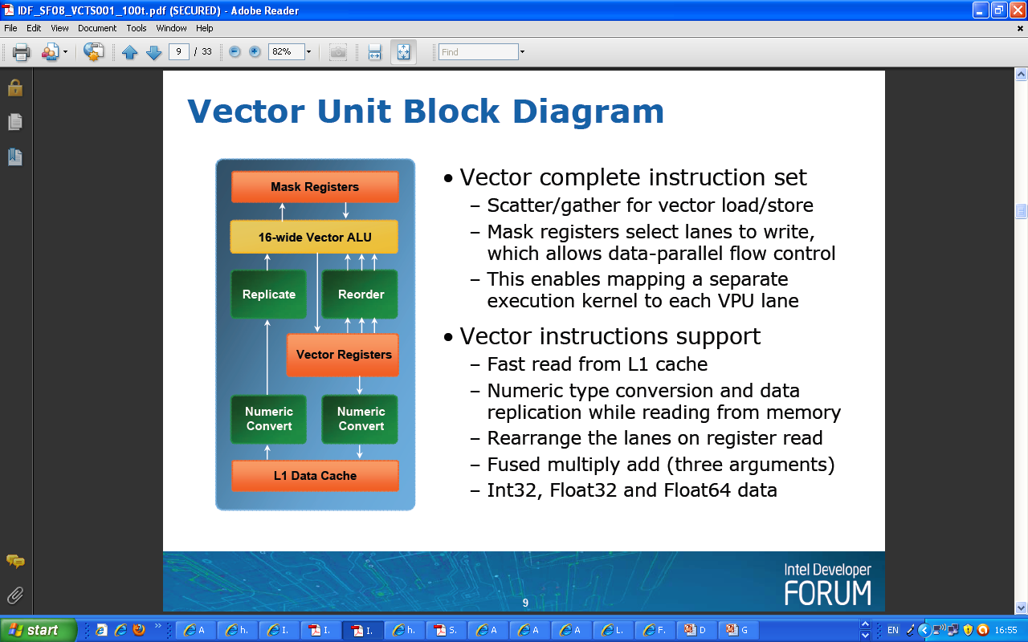
1. Intel’s Larrabee (6)
Block diagram of Larrabee’s vector unit [4]
16 x 32 bit

Slide 11
1. Intel’s Larrabee (7)
Design specifications of Larrabee and Sandy bridge (aka Gesher) [2]

Slide 12
2. Intel’s 80-core Tile processor

Slide 13
2. Intel’s 80-core Tile processor (1)
2. Intel’s 80-core Tile processor [1]
Positioning Intel’s 80-core Tile processor
Knights Corner
Xeon Phi
80 core Tile
SCC
Knights Ferry

Slide 14
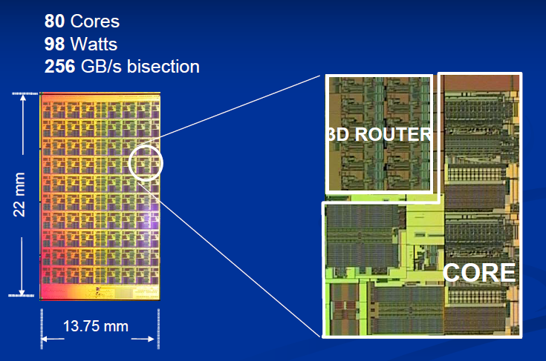
2. Intel’s 80-core Tile processor (3)
The 80-core Tile processor [2]
65 nm, 100 mtrs, 275 mm²

Slide 15
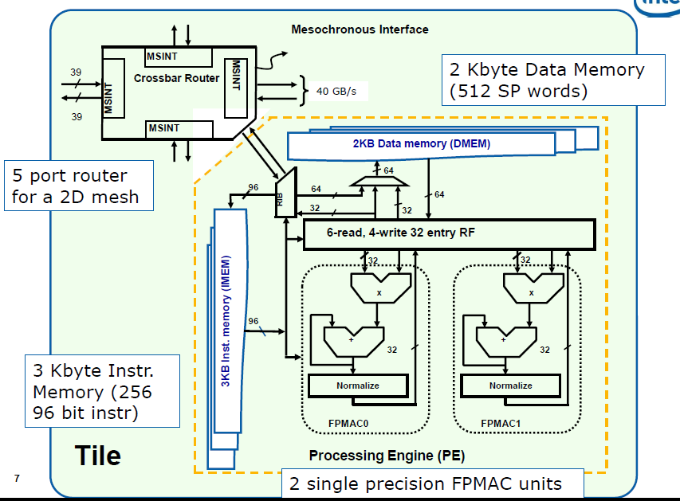
2. Intel’s 80-core Tile processor (5)
The 80 core “Tile” processor [14]
FP Multiply-Accumulate
(AxB+C)

Slide 16
2. Intel’s 80-core Tile processor (7)
The 80 core “Tile” processor [14]
FP Multiply-Accumulate
(AxB+C)

Slide 17
2. Intel’s 80-core Tile processor (9)
The 80 core “Tile” processor [14]
FP Multiply-Accumulate
(AxB+C)

Slide 18
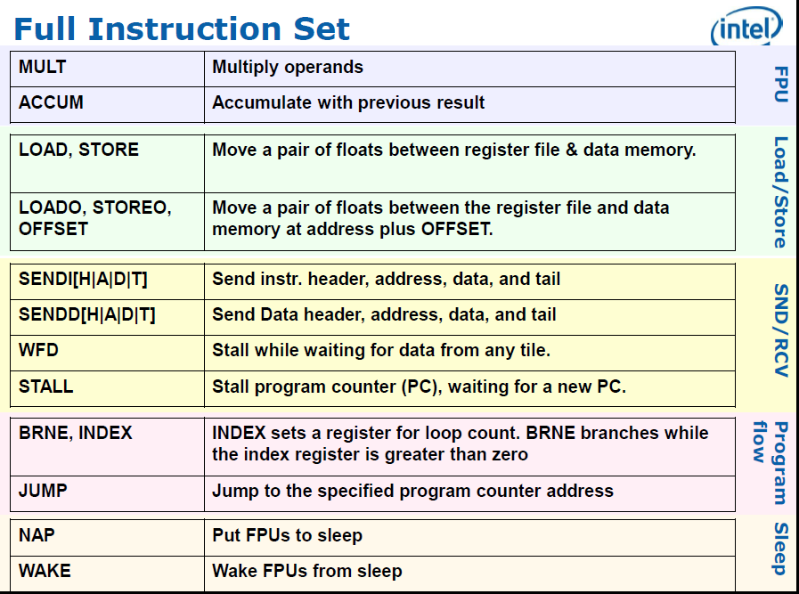
2. Intel’s 80-core Tile processor (11)
The full instruction set of the 80-core Tile processor [14]

Slide 19
2. Intel’s 80-core Tile processor (13)
The full instruction set of the 80-core Tile processor [14]

Slide 20
2. Intel’s 80-core Tile processor (15)
The 80 core “Tile” processor [14]
FP Multiply-Accumulate
(AxB+C)

Slide 21
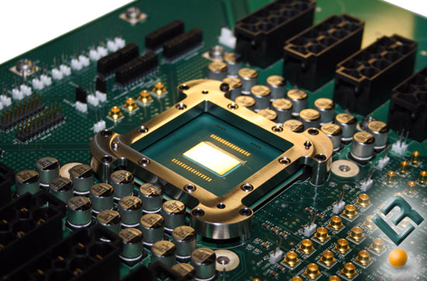
2. Intel’s 80-core Tile processor (16)
On board implementation of the 80-core Tile Processor [15]

Slide 22
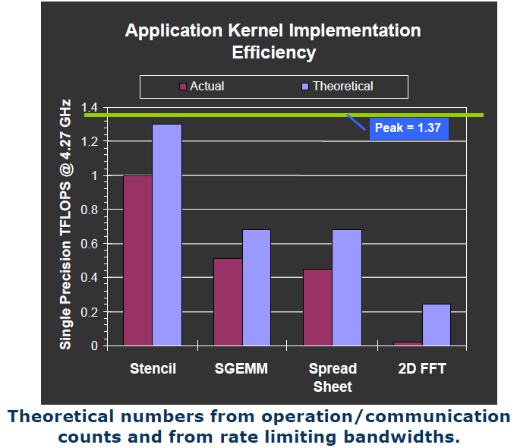
2. Intel’s 80-core Tile processor (17)
Achieved performance figures of the 80-core Tile processor [14]

Slide 23
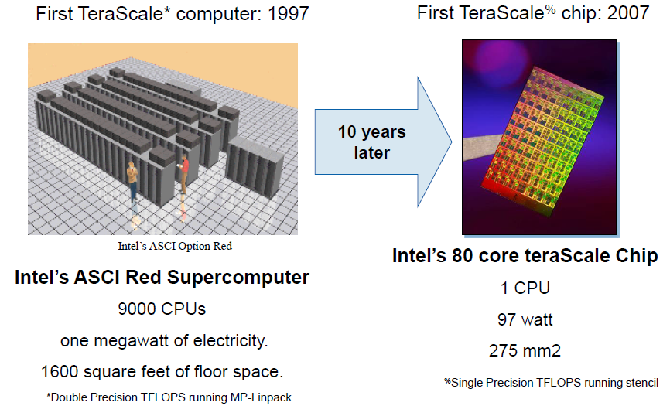
2. Intel’s 80-core Tile processor (18)
Contrasting the first TeraScale computer and the first TeraScale chip [14]
(Pentium II)

Slide 24
3. Intel’s SCC (Single-Chip Cloud Computer)

Slide 25
3. Intel’s SCC (Single-Chip Cloud Computer) (1)
3. Intel’s SCC (Single-Chip Cloud Computer)
Positioning Intel’s SCC [1]
Knights Corner
Xeon Phi
80 core Tile
SCC
Knights Ferry

Slide 26
3. Intel’s SCC (Single-Chip Cloud Computer) (4)
SCC overview [44]

Slide 27
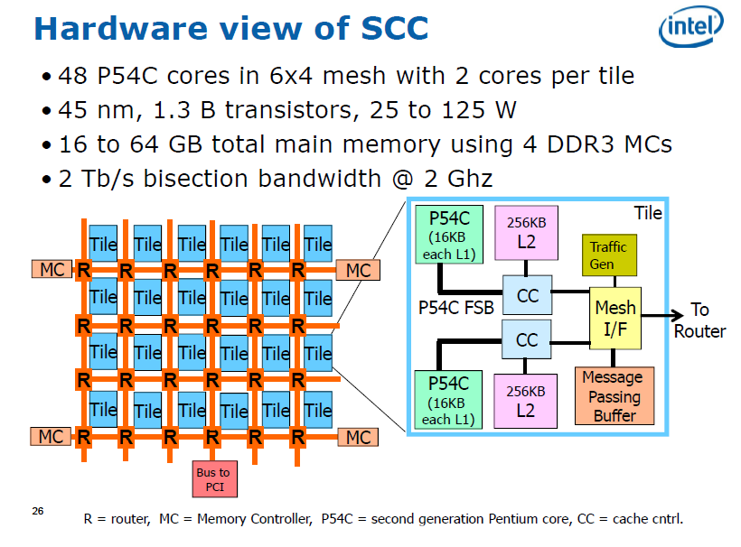
3. Intel’s SCC (Single-Chip Cloud Computer) (5)
Hardware overview [14]
(0.6 µm)

Slide 28
3. Intel’s SCC (Single-Chip Cloud Computer) (6)
System overview [14]
(Joint Test Action Group)
Standard Test Access Port

Slide 29
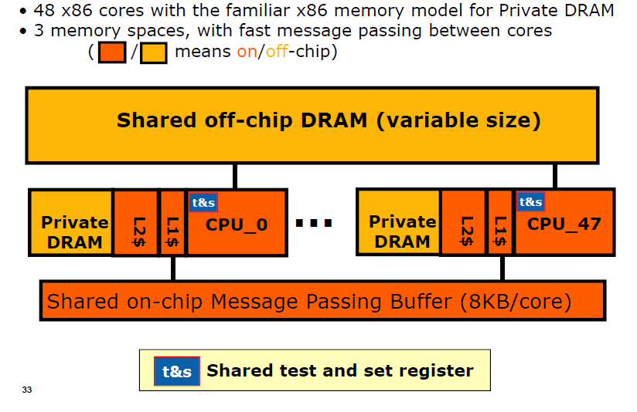
3. Intel’s SCC (Single-Chip Cloud Computer) (8)
Programmer’s view of SCC [14]

Slide 30
3. Intel’s SCC (Single-Chip Cloud Computer) (10)
Programmer’s view of SCC [14]

Slide 31
3. Intel’s SCC (Single-Chip Cloud Computer) (11)
Dual-core SCC tile [14]
GCU: Global Clocking Unit
MIU: Mesh Interface Unit

Slide 32
3. Intel’s SCC (Single-Chip Cloud Computer) (13)
Dissipation management of SCC -1 [16]

Slide 33
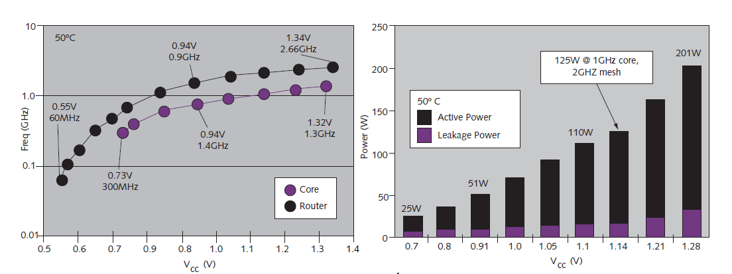
3. Intel’s SCC (Single-Chip Cloud Computer) (14)
Dissipation management of SCC -2 [16]
A software library supports both message-passing and DVFS based power management.

Slide 34
4. Intel’s MIC (Many Integrated Cores)/Xeon Phi
4.1 Overview
4.2 The Knights Ferry prototype system
4.3 The Knights Corner line
4.4 Use of Xeon Phi Knights Corner coprocessors
in supercomputers
4.5 The Knights Landing line

Slide 35
4.1 Overview
Notes:
35

Slide 36
4.1 Overview (1)
4.1 Overview
Positioning Intel’s MIC (Many Integrated Cores)/Xeon Phi family
Knights Corner
Xeon Phi
80 core Tile
SCC
Knights Ferry

Slide 37
4.1 Overview (2)
4.1 Overview of Intel’s MIC (Many Integrated Cores)/Xeon Phi family
05/10
06/12
Branding
MIC
(Many Integrated Cores)
Renamed to
Xeon Phi
05/10
45 nm/32 cores
SP: 0.75 TFLOPS
DP: --
Prototype
Knights Ferry
Knights Corner
05/10
22 nm/>50 cores
(announced)
11/12
22 nm/60 cores
SP: na
DP: 1.0 TFLOPS
06/13
22 nm/57/61 cores
SP: na
DP: > 1 TFLOPS
1. gen.
Knights
Corner
Xeon Phi 5110P
Xeon Phi
3120/7120
Knights Landing
06/13
Knights Landing
09/15
2. gen.
Xeon Phi
??
Xeon Phi
??
14 nm/? cores
SP: na
DP: ~ 3 TFLOPS
14 nm/72 cores
SP: na
DP: ~ 3 TFLOPS
06/12
Open source SW for
Knights Corner
Software
support
2010
2011
2012
2013
2014
2015

Slide 38
4.1 Overview (3)
Introduction of the MIC line and the Knights Ferry prototype system
They were based mainly on their ill-fated Larrabee project and partly on results of their SCC
(Single Cloud Computer) development.
Both introduced at the International Supercomputing Conference in 5/2010.
Figure: The introduction of Intel’s MIC (Many Integrated Core) architecture [5]

Slide 39
4.2 The Knights Ferry prototype system
Notes:
39

Slide 40
4.2 The Knights Ferry prototype system (1)
4.2 The Knights Ferry prototype system
05/10
06/12
Branding
MIC
(Many Integrated Cores)
Renamed to
Xeon Phi
05/10
45 nm/32 cores
SP: 0.75 TFLOPS
DP: --
Prototype
Knights Ferry
Knights Corner
05/10
22 nm/>50 cores
(announced)
11/12
22 nm/60 cores
SP: na
DP: 1.0 TFLOPS
06/13
22 nm/57/61 cores
SP: na
DP: > 1 TFLOPS
1. gen.
Knights
Corner
Xeon Phi 5110P
Xeon Phi
3120/7120
Knights Landing
06/13
Knights Landing
09/15
2. gen.
Xeon Phi
??
Xeon Phi
??
14 nm/? cores
SP: na
DP: ~ 3 TFLOPS
14 nm/72 cores
SP: na
DP: ~ 3 TFLOPS
06/12
Open source SW for
Knights Corner
Software
support
2010
2011
2012
2013
2014
2015

Slide 41
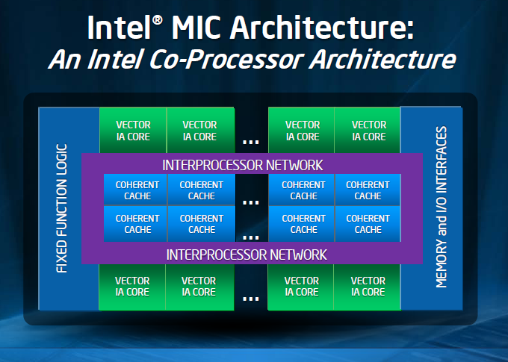
4.2 The Knights Ferry prototype system (3)
The microarchitecture of the Knights Ferry prototype system
It is a bidirectional ring based architecture with 32 Pentium-like cores and
a coherent L2 cache built up of 256 kB/core segments, as shown below.
Internal name of the
Knights Ferry processor:
Aubrey Isles
Figure: Microarchitecture of the Knights Ferry [5]

Slide 42
4.2 The Knights Ferry prototype system (4)
Comparing the microarchitectures of Intel’s Knights Ferry and the Larrabee
Microarchitecture of Intel’s Knight Ferry
(published in 2010) [5]
Microarchitecture of Intel’s Larrabee
(published in 2008) [3]

Slide 43
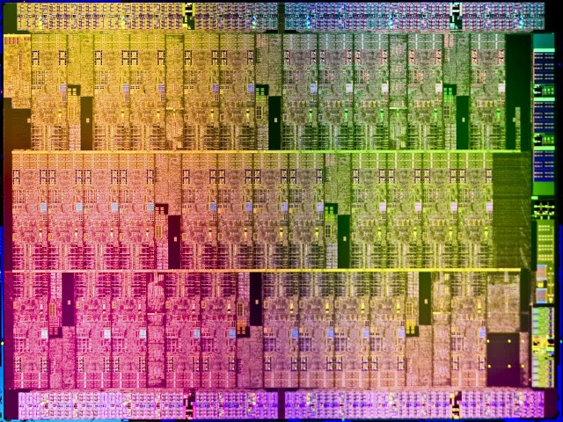
4.2 The Knights Ferry prototype system (5)
Die plot of Knights Ferry [18]

Slide 44
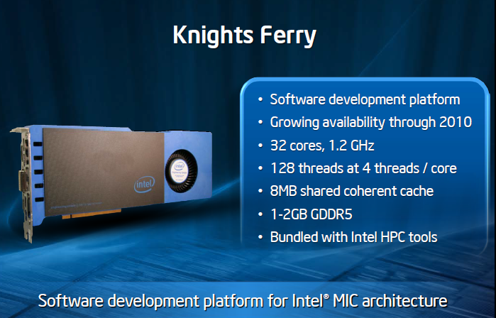
4.2 The Knights Ferry prototype system (6)
Main features of Knights Ferry
Figure: Knights Ferry at its debut at the International Supercomputing Conference in 2010 [5]

Slide 45
4.2 The Knights Ferry prototype system (7)
 | Intel’s Xeon Phi, formerly Many Integrated Cores (MIC) line
Core type | Knights Ferry | 5110P | 3120 | 7120
Based on | Aubrey Isle core
Introduction | 5/2010 | 11/2012 | 06/2013 | 06/2013
Processor
Technology/no. of transistors | 45 nm/2300 mtrs/684 mm² | 22 nm/ ~ 5 000 mtrs | 22 nm | 22 nm
Core count | 32 | 60 | 57 | 61
Threads/core | 4 | 4 | 4 | 4
Core frequency | Up to 1.2 GHz | 1.053 GHz | 1.1 GHz. | 1.238 GHz.
L2/core | 256 kByte/core | 512 kByte/core | 512 kB/core | 512 kB/core
Peak FP32 performance | > 0.75 TFLOPS | n.a. | n.a. | n.a.
Peak FP64 performance | -- | 1.01 TFLOPS | 1.003 TFLOPS | > 1.2 TFLOPŐS
Memory
Mem. clock | 5 GT/s? | 5 GT/s | 5 GT/s | 5.5 GT/s
No. of memory channels | 8 | Up to 16 | Up to 12 | Up to 16
Mem. bandwidth | 160 GB/s? | 320 GB/s | 240 GB/s | 352 GB/s
Mem. size | 1 or 2 GByte | 2 GByte | 6 GB | 16 GB
Mem. type | GDDR5 | GDDR5 | GDDR5 | GDDR5
System
ECC | no ECC | ECC | ECC | ECC
Interface | PCIe2.0x16 | PCIe2.0x16 | PCIe 2.0x16 | PCIe 2.0x16
Slot request | Single slot | Single slot | n.a. | n.a.
Cooling | Active | Active | Passive / Active cooling | Passive / Active cooling
Power (max) | 300 W | 245 W | 300 W | 300 W
Table 4.1: Main features of Intel’s Xeon Phi line [8], [13]

Slide 46
4.2 The Knights Ferry prototype system (8)
Significance of Knights Ferry
Knights Ferry became the software development platform for the MIC line, renamed later to
become the Xeon Phi line.
Figure: Knights Ferry at its debut at the International Supercomputing Conference in 2010 [5]

Slide 47
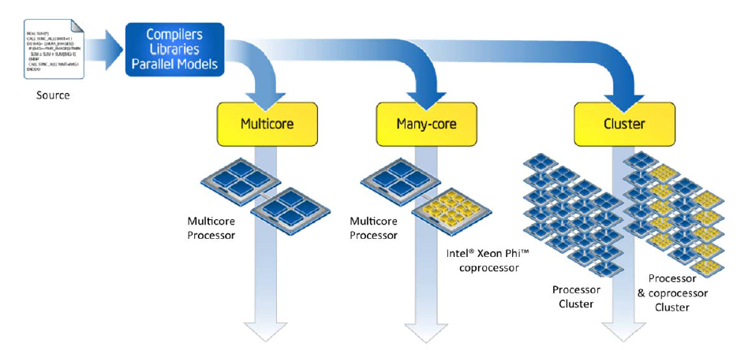
4.2 The Knights Ferry prototype system (10)
Principle of Intel’s common software development platform for multicores, many-cores
and clusters [10]

Slide 48
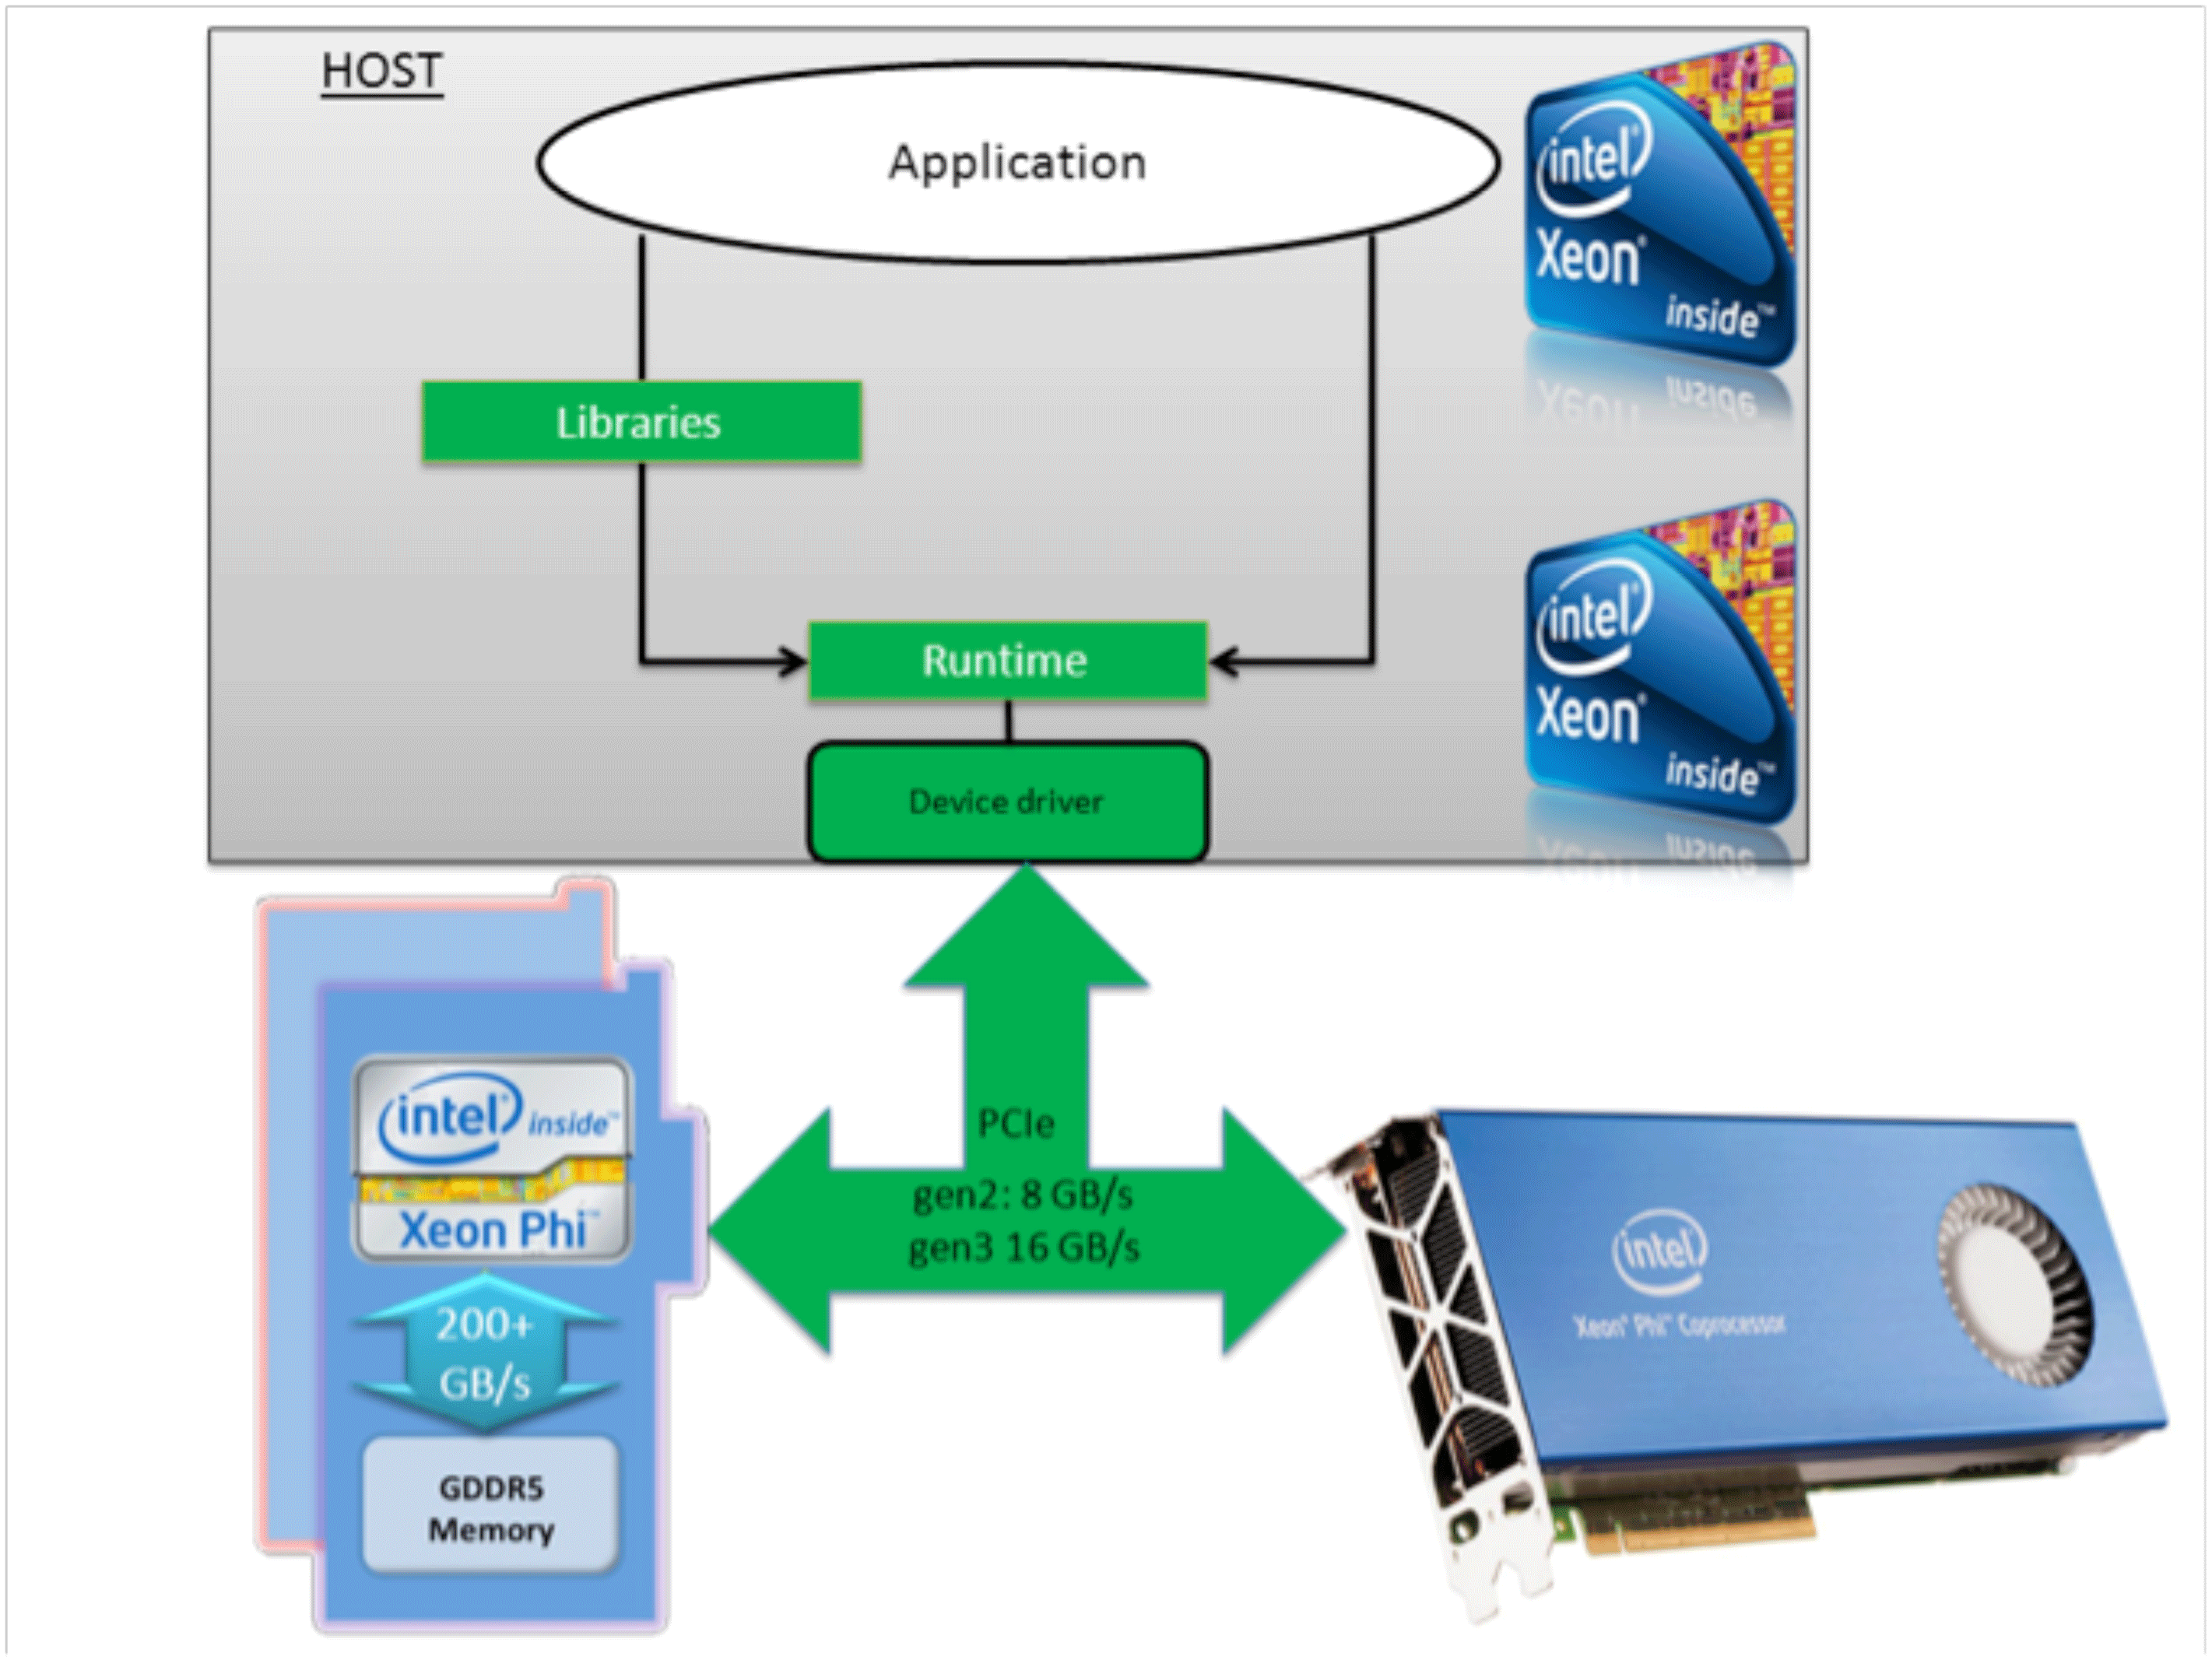
4.2 The Knights Ferry prototype system (11)
Principle of programming of the MIC/Xeon Phi [30]

Slide 49
4.2 The Knights Ferry prototype system (15)
Renaming the MIC branding to Xeon Phi and providing open source software support -2
05/10
06/12
Branding
MIC
(Many Integrated Cores)
Renamed to
Xeon Phi
05/10
45 nm/32 cores
SP: 0.75 TFLOPS
DP: --
Prototype
Knights Ferry
Knights Corner
05/10
22 nm/>50 cores
(announced)
11/12
22 nm/60 cores
SP: na
DP: 1.0 TFLOPS
06/13
22 nm/57/61 cores
SP: na
DP: > 1 TFLOPS
1. gen.
Knights
Corner
Xeon Phi 5110P
Xeon Phi
3120/7120
Knights Landing
06/13
Knights Landing
09/15
2. gen.
Xeon Phi
??
Xeon Phi
??
14 nm/? cores
SP: na
DP: ~ 3 TFLOPS
14 nm/72 cores
SP: na
DP: ~ 3 TFLOPS
06/12
Open source SW for
Knights Corner
Software
support
2010
2011
2012
2013
2014
2015

Slide 50
4.3 The Knights Corner line

Slide 51
4.3 The Knights Corner line (1)
4.3 The Knights Corner line [1]
Knights Corner
Xeon Phi
80 core Tile
SCC
Knights Ferry

Slide 52
4.3 The Knights Corner line (3)
Announcing the Knights Corner consumer product
05/10
06/12
Branding
MIC
(Many Integrated Cores)
Renamed to
Xeon Phi
05/10
45 nm/32 cores
SP: 0.75 TFLOPS
DP: --
Prototype
Knights Ferry
Knights Corner
05/10
22 nm/>50 cores
(announced)
11/12
22 nm/60 cores
SP: na
DP: 1.0 TFLOPS
06/13
22 nm/57/61 cores
SP: na
DP: > 1 TFLOPS
1. gen.
Knights
Corner
Xeon Phi 5110P
Xeon Phi
3120/7120
Knights Landing
06/13
Knights Landing
09/15
2. gen.
Xeon Phi
??
Xeon Phi
??
14 nm/? cores
SP: na
DP: ~ 3 TFLOPS
14 nm/72 cores
SP: na
DP: ~ 3 TFLOPS
06/12
Open source SW for
Knights Corner
Software
support
2010
2011
2012
2013
2014
2015

Slide 53
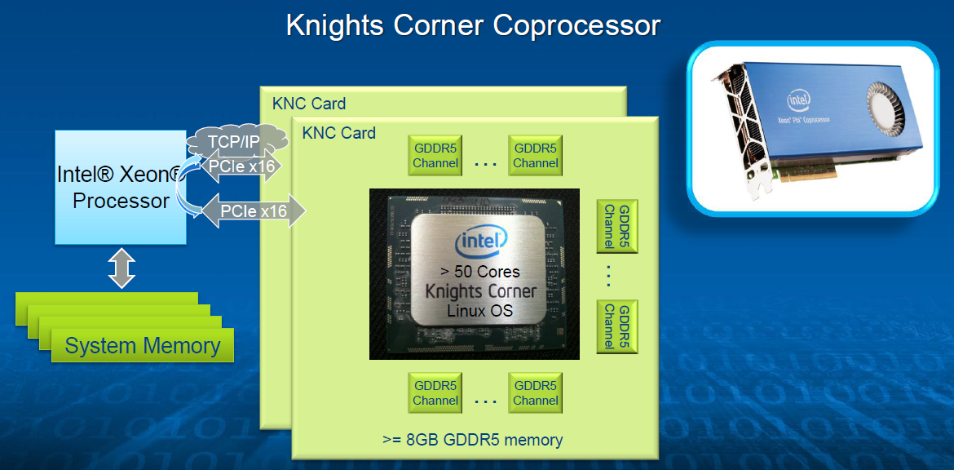
4.3 The Knights Corner line (5)
The system layout of the Knights Corner (KCN) DPA [6]

Slide 54
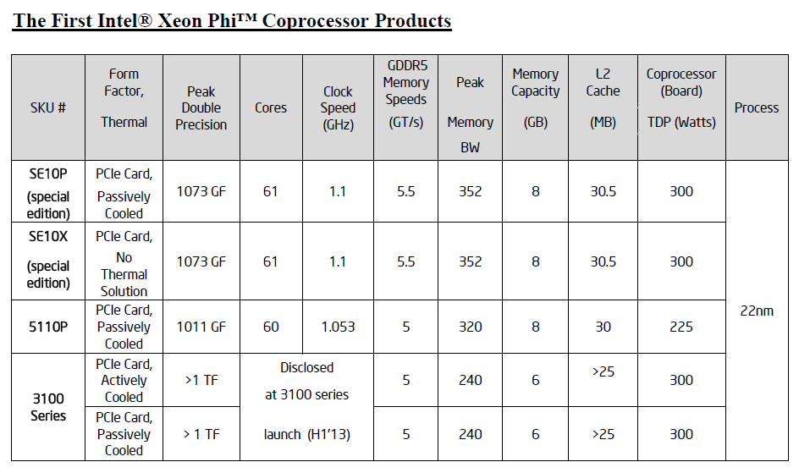
4.3 The Knights Corner line (7)
First introduced or disclosed models of the Xeon Phi line [7]
n
(nx1/2)
3200
Remark
The SE10P/X subfamilies are intended for customized products, like those used in supercomputers,
such as the TACC Stampede, built in Texas Advanced Computing Center (2012).

Slide 55
4.3 The Knights Corner line (8)
 | Intel’s Xeon Phi, formerly Many Integrated Cores (MIC) line
Core type | Knights Ferry | 5110P | 3120 | 7120
Based on | Aubrey Isle core
Introduction | 5/2010 | 11/2012 | 06/2013 | 06/2013
Processor
Technology/no. of transistors | 45 nm/2300 mtrs/684 mm² | 22 nm/ ~ 5 000 mtrs | 22 nm | 22 nm
Core count | 32 | 60 | 57 | 61
Threads/core | 4 | 4 | 4 | 4
Core frequency | Up to 1.2 GHz | 1.053 GHz | 1.1 GHz. | 1.238 GHz.
L2/core | 256 kByte/core | 512 kByte/core | 512 kB/core | 512 kB/core
Peak FP32 performance | > 0.75 TFLOPS | n.a. | n.a. | n.a.
Peak FP64 performance | -- | 1.01 TFLOPS | 1.003 TFLOPS | > 1.2 TFLOPŐS
Memory
Mem. clock | 5 GT/s? | 5 GT/s | 5 GT/s | 5.5 GT/s
No. of memory channels | 8 | Up to 16 | Up to 12 | Up to 16
Mem. bandwidth | 160 GB/s? | 320 GB/s | 240 GB/s | 352 GB/s
Mem. size | 1 or 2 GByte | 2 GByte | 6 GB | 16 GB
Mem. type | GDDR5 | GDDR5 | GDDR5 | GDDR5
System
ECC | no ECC | ECC | ECC | ECC
Interface | PCIex2.016 | PCIe2.0x16 | PCIe 2.0x16 | PCIe 2.0x16
Slot request | Single slot | Single slot | n.a. | n.a.
Cooling | Active | Active | Passive / Active cooling | Passive / Active cooling
Power (max) | 300 W | 245 W | 300 W | 300 W
Table 4.1: Main features of Intel’s Xeon Phi line [8], [13]

Slide 56
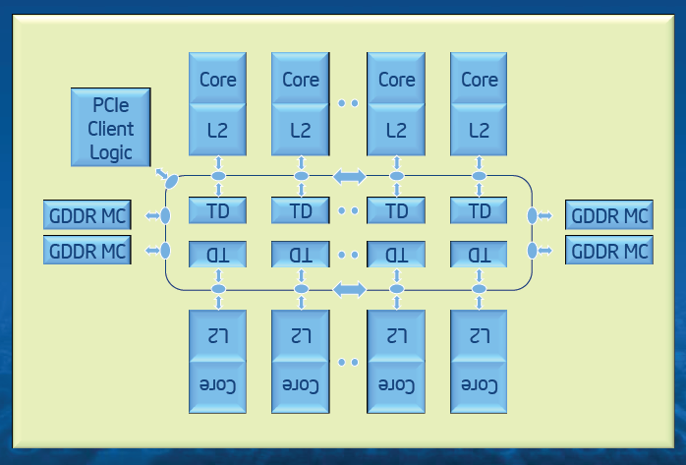
4.3 The Knights Corner line (9)
The microarchitecture of Knights Corner [6]
It is a bidirectional ring based architecture like its predecessors the Larrabee and Knights Ferry,
with an increased number (60/61) of significantly enhanced Pentium cores and a coherent
L2 cache built up of 256 kB/core segments, as shown below.
Figure: The microarchitecture of Knights Corner [6]

Slide 57
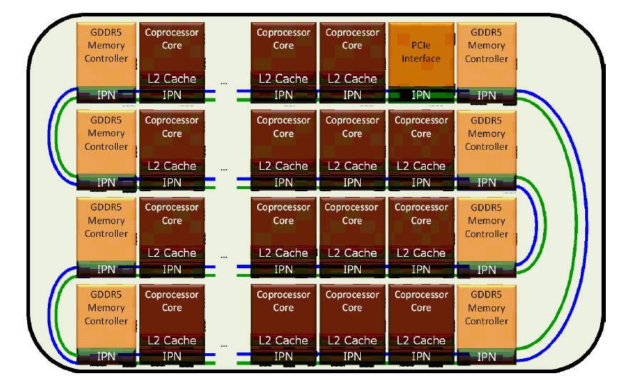
4.3 The Knights Corner line (10)
The layout of the ring interconnect on the die [8]

Slide 58
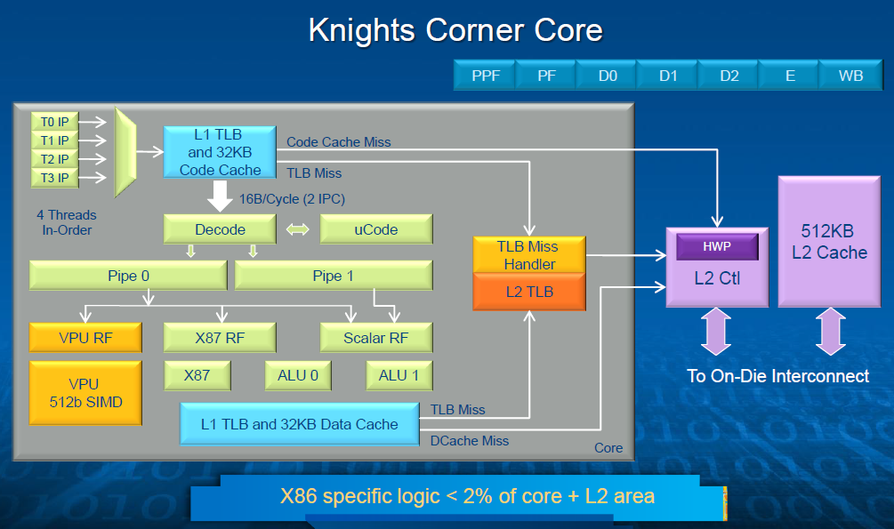
4.3 The Knights Corner line (11)
Block diagram of a core of the Knights Corner [6]
Heavily customized Pentium P54C

Slide 59
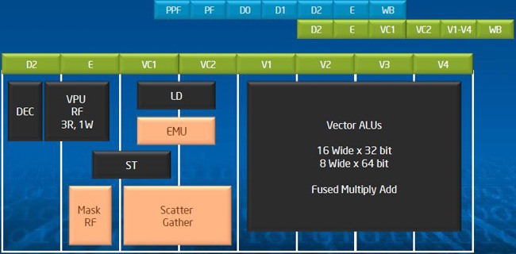
4.3 The Knights Corner line (12)
Block diagram and pipelined operation of the Vector unit [6]
EMU: Extended Math Unit
It can execute transcendental operations such as reciprocal, square root, and log,
thereby allowing these operations to be executed in a vector fashion [6]

Slide 60
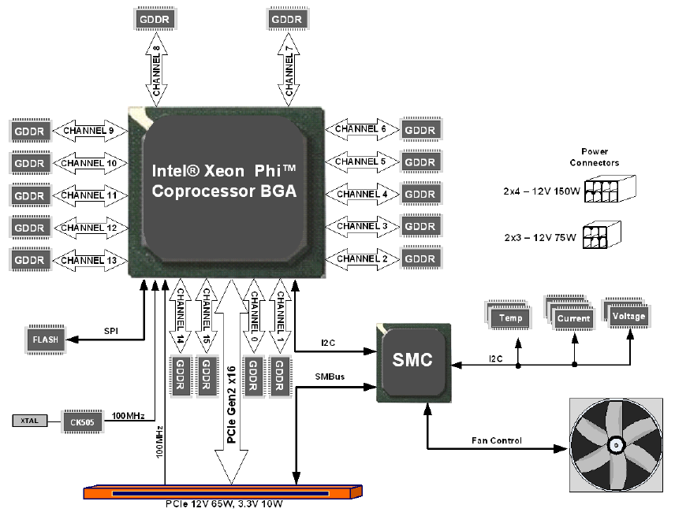
4.3 The Knights Corner line (13)
System architecture of the Xeon Phi co-processor [8]
SMC: System Management Controller

Slide 61
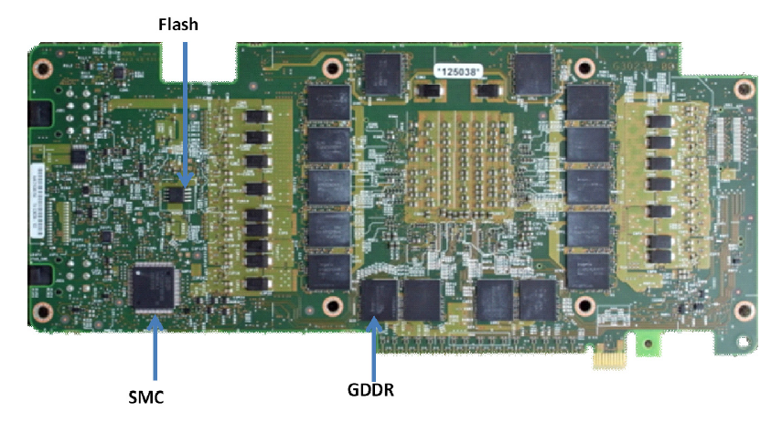
4.3 The Knights Corner line (15)
The Xeon Phi coprocessor board (backside) [8]

Slide 62
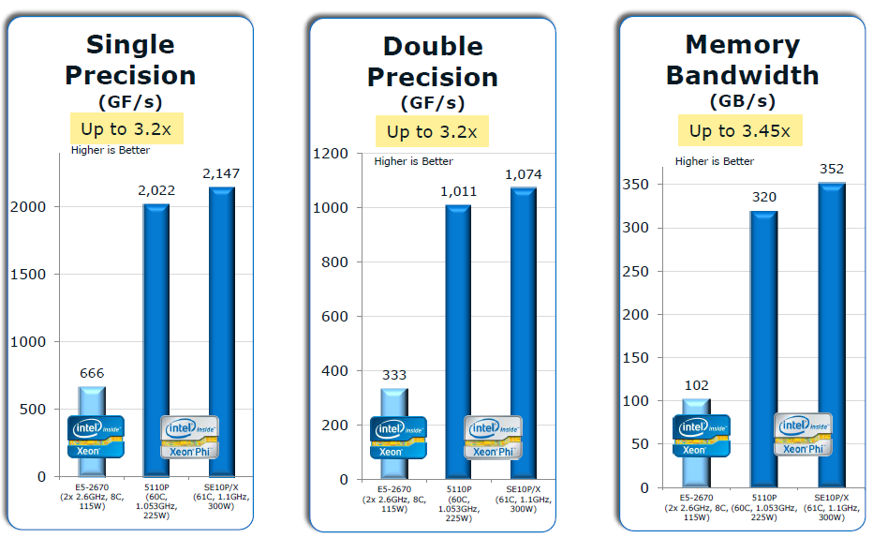
4.3 The Knights Corner line (16)
Peak performance of the Xeon Phi 5110P and SE10P/X vs. a 2-socket Intel Xeon server
[11]
The reference system is a 2-socket Xeon server with two Intel Xeon E5-2670 processors
(Sandy Bridge-EP: 8 cores, 20 MB L3 cache, 2.6 GHz clock frequency, 8.0 GT/s QPI speed,
DDR3 with 1600 MT/s).

Slide 63
4.3 The Knights Corner line (17)
Further models of the Knight Corner line introduced in 06/2013 [8], [13]
 | Intel’s Xeon Phi, formerly Many Integrated Cores (MIC) line
Core type | Knights Ferry | 5110P | 3120 | 7120
Based on | Aubrey Isle core
Introduction | 5/2010 | 11/2012 | 06/2013 | 06/2013
Processor
Technology/no. of transistors | 45 nm/2300 mtrs/684 mm² | 22 nm/ ~ 5 000 mtrs | 22 nm | 22 nm
Core count | 32 | 60 | 57 | 61
Threads/core | 4 | 4 | 4 | 4
Core frequency | Up to 1.2 GHz | 1.053 GHz | 1.1 GHz. | 1.238 GHz.
L2/core | 256 kByte/core | 512 kByte/core | 512 kB/core | 512 kB/core
Peak FP32 performance | > 0.75 TFLOPS | n.a. | n.a. | n.a.
Peak FP64 performance | -- | 1.01 TFLOPS | 1.003 TFLOPS | > 1.2 TFLOPS
Memory
Mem. clock | 5 GT/s? | 5 GT/s | 5 GT/s | 5.5 GT/s
No. of memory channels | 8 | Up to 16 | Up to 12 | Up to 16
Mem. bandwidth | 160 GB/s? | 320 GB/s | 240 GB/s | 352 GB/s
Mem. size | 1 or 2 GByte | 2 GByte | 6 GB | 16 GB
Mem. type | GDDR5 | GDDR5 | GDDR5 | GDDR5
System
ECC | no ECC | ECC | ECC | ECC
Interface | PCIex2.016 | PCIe2.0x16 | PCIe 2.0x16 | PCIe 2.0x16
Slot request | Single slot | Single slot | n.a. | n.a.
Cooling | Active | Active | Passive / Active cooling | Passive / Active cooling
Power (max) | 300 W | 245 W | 300 W | 300 W

Slide 64
4.4 Use of Xeon Phi Knights Corner coprocessors
in supercomputers

Slide 65
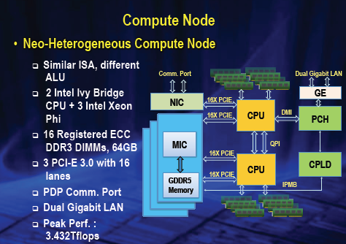
4.4 Use of Xeon Phi Knights Corner coprocessors in supercomputers (3)
Block diagram of a compute node of the Tianhe-2 [23]

Slide 66
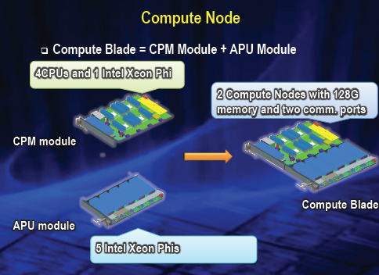
4.4 Use of Xeon Phi Knights Corner coprocessors in supercomputers (5)
Compute blade [23]
A Compute blade includes two nodes, but is built up of two halfboards, as indicated below.

Slide 67
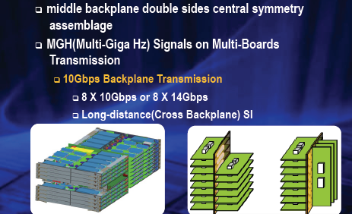
4.4 Use of Xeon Phi Knights Corner coprocessors in supercomputers (6)
Structure of a compute frame (rack) [23]
Note that the two halfboards of a blade are interconnected by a middle backplane.

Slide 68
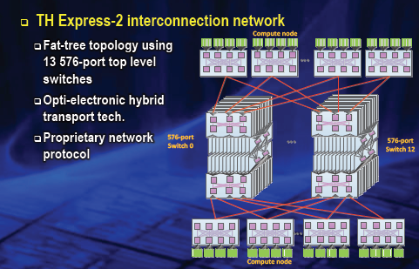
4.4 Use of Xeon Phi Knights Corner coprocessors in supercomputers (7)
The interconnection network [23]

Slide 69
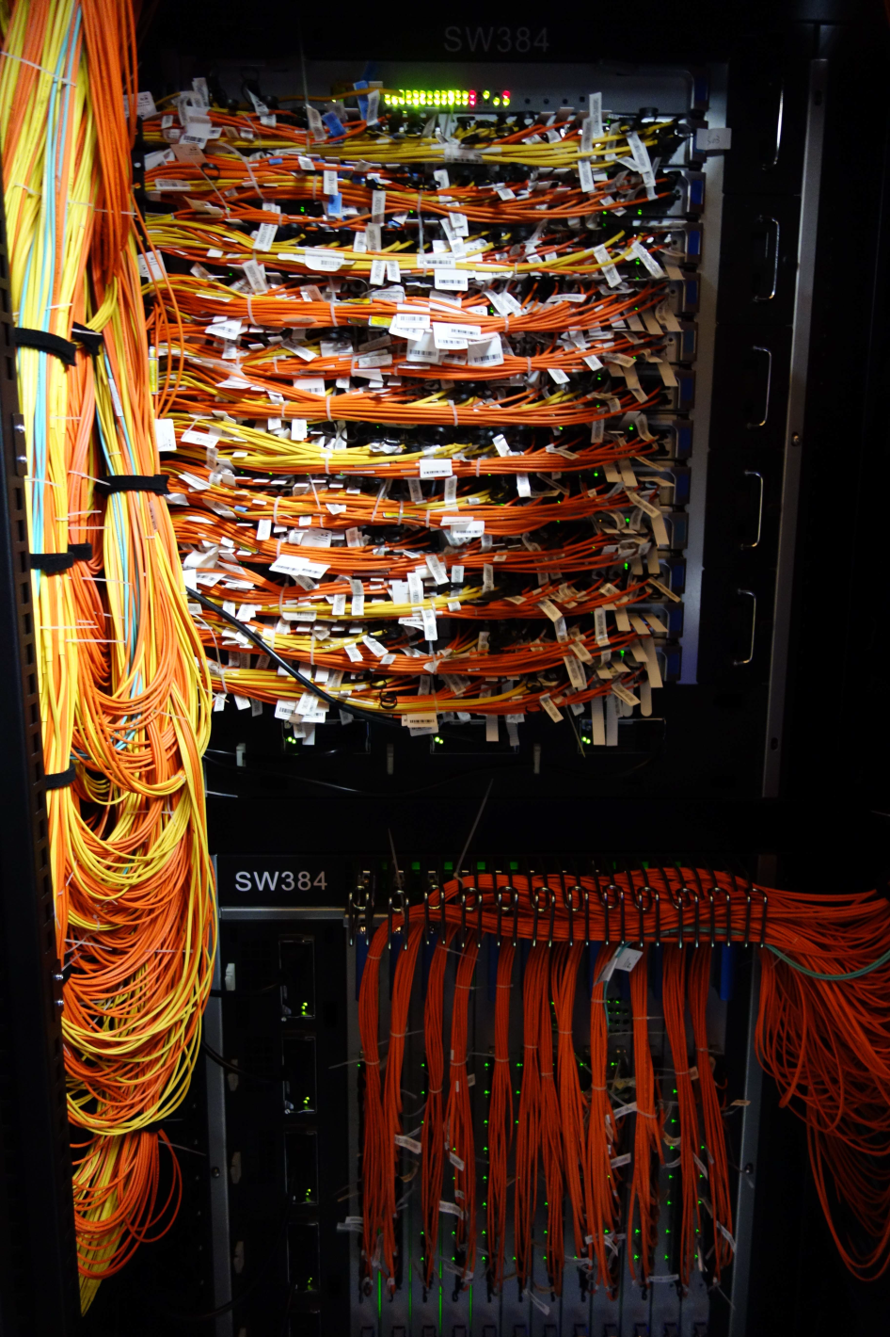
4.4 Use of Xeon Phi Knights Corner coprocessors in supercomputers (8)
Implementation of the interconnect [23]

Slide 70
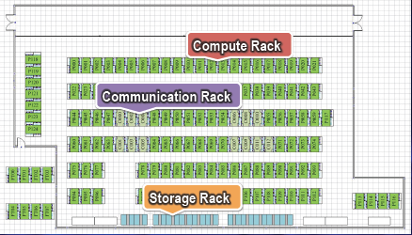
4.4 Use of Xeon Phi Knights Corner coprocessors in supercomputers (9)
Rack rows of the Tianhe-2 supercomputer [23]

Slide 71
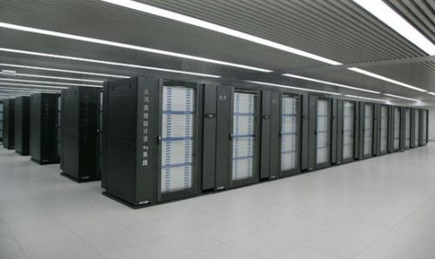
4.4 Use of Xeon Phi Knights Corner coprocessors in supercomputers (10)
View of the Tianhe-2 supercomputer [24]

Slide 72
4.5 The Knights Landing line

Slide 73
4.5 The Knights Landing line (2)
Announcing the Knights Landing 2. gen. Xeon Phi product in 06/2013
05/10
06/12
Branding
MIC
(Many Integrated Cores)
Renamed to
Xeon Phi
05/10
45 nm/32 cores
SP: 0.75 TFLOPS
DP: --
Prototype
Knights Ferry
Knights Corner
05/10
22 nm/>50 cores
(announced)
11/12
22 nm/60 cores
SP: na
DP: 1.0 TFLOPS
06/13
22 nm/57/61 cores
SP: na
DP: > 1 TFLOPS
1. gen.
Knights
Corner
Xeon Phi 5110P
Xeon Phi
3120/7120
Knights Landing
06/13
Knights Landing
09/15
2. gen.
Xeon Phi
??
Xeon Phi
??
14 nm/? cores
SP: na
DP: ~ 3 TFLOPS
14 nm/72 cores
SP: na
DP: ~ 3 TFLOPS
06/12
Open source SW for
Knights Corner
Software
support
2010
2011
2012
2013
2014
2015

Slide 74
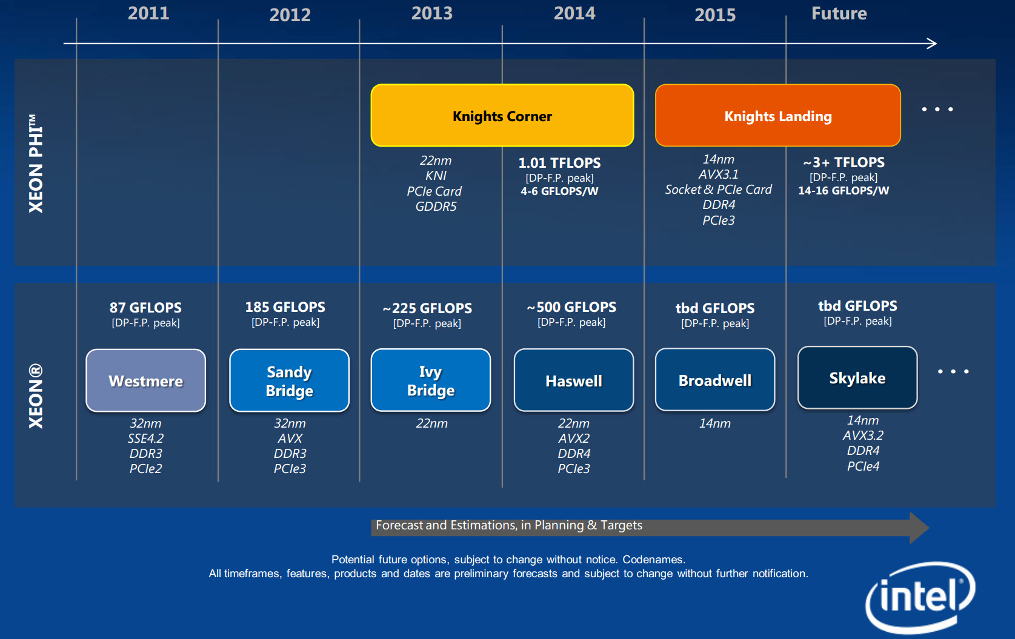
4.5 The Knights Landing line (3)
The Knights Landing line as revealed on a roadmap from 2013 [17]

Slide 75
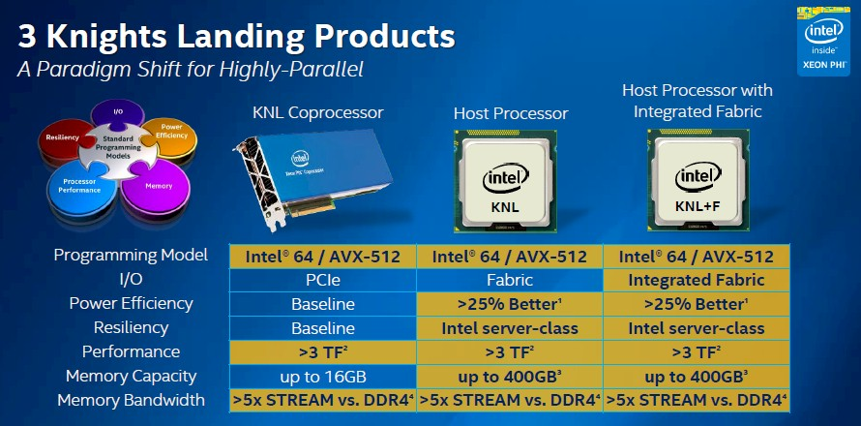
4.5 The Knights Landing line (4)
Knights Landing implementation alternatives
Three implementation alternatives
PCIe 3.0 coprocessor (accelerator) card
Stand alone processor without (in-package integrated) interconnect fabric and
Stand alone processor with (in-package integrated) interconnect fabric,
as indicated in the next Figure.
Figure: Implementation alternatives of Knights Landing [31]
Will debut in H2/2015

Slide 76
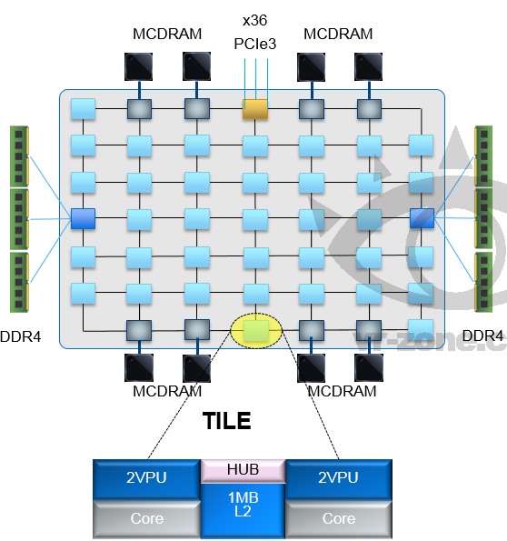
4.5 The Knights Landing line (6)
Layout and key features of the Knights Landing processor [18]
Up to 72 Silvermont (Atom) cores
4 threads/core
2 512 bit vector units
2D mesh architecture
6 channels DDR4-2400,
up to 384 GB,
8/16 GB high bandwidth on-package
MCDRAM memory, >500 GB/s
36 lanes PCIe 3.0
200 W TDP
MCDRAM: Multi-Channel DRAM

Slide 77
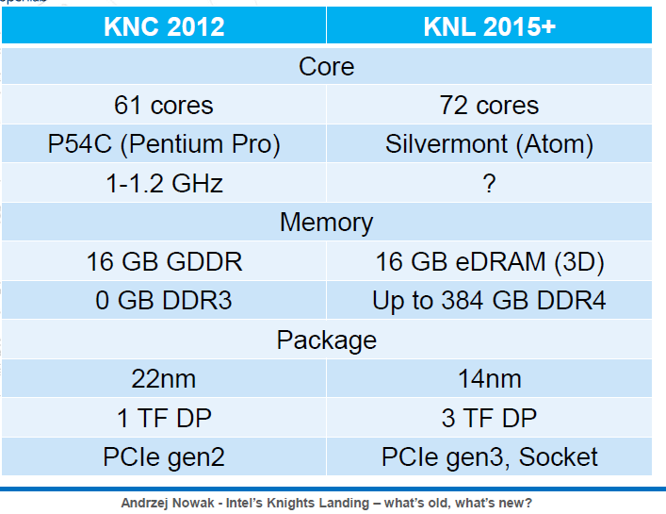
4.5 The Knights Landing line (8)
Contrasting key features of Knights Corner and Knights Landing [32]

Slide 78
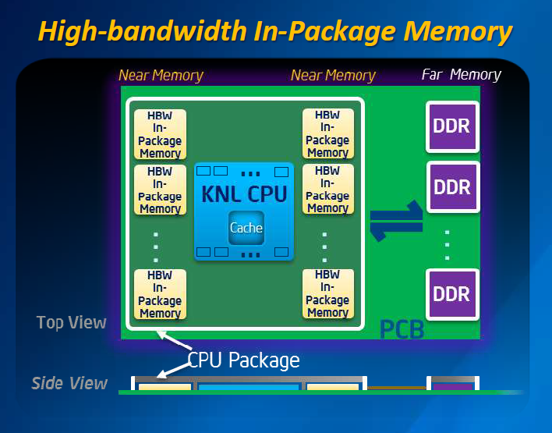
4.5 The Knights Landing line (9)
Use of High Bandwidth (HBW) In-Package memory in the Knights Landing [19]

Slide 79
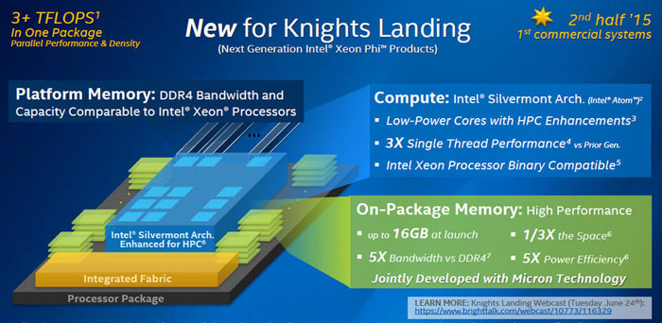
4.5 The Knights Landing line (10)
Implementation of Knights Landing [20]

Slide 80
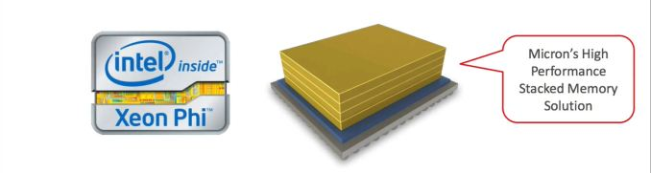
4.5 The Knights Landing line (11)
Introducing in-package integrated MCDRAMs-1 [20]
In cooperation with Micron Intel introduces in-package integrated Multi Channel DRAMs
in the Knights Landing processor, as indicated below.
Image Courtesy InsideHPC.com
The MCDRAM is a variant of HMC (Hybrid Memory Cube).

Slide 81
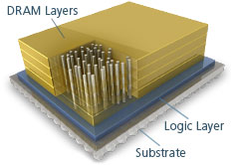
4.5 The Knights Landing line (12)
HMC (Hybrid Memory Cube) [21]-1
HMC is a stacked memory.
It consists of
a vertical stack of DRAM dies that are connected using TSV (Through-Silicon-Via)
interconnects and
a high speed logic layer that handles all DRAM control within the HMC, as indicated
in the Figure below.
TSV interconnects
Figure: Main parts of a HMC memory [21]

Slide 82
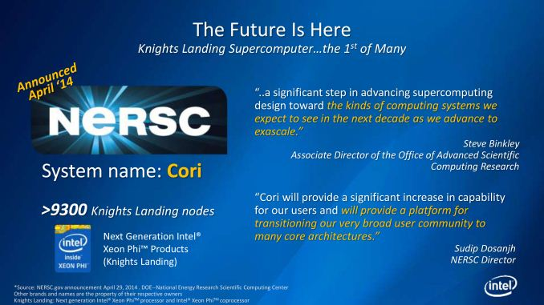
4.5 The Knights Landing line (15)
First Knights Landing based supercomputer plan [20]
Intel is involved in developing its first Knights Landing supercomputer for the National Energy
Research Scientific Computing Center (NERSC).
The new supercomputer will be designated as Cori and it will include >9300 Knights Landing
nodes, as indicated below.
Availability: ~ 09/2016.

Slide 83
4.5 The Knights Landing line (17)
Interconnection style of Intel’s many core processors
Interconnection style of Intel’s many core processors
Ring interconnect
2D grid
Larrabee (2006): 24-32 cores
Tile processor (2007): 80 cores
SCC (2010): 48 cores
Xeon Phi
Knights Ferry (2010): 32 cores
Knights Corner (2012): 57-61 cores
Xeon Phi
Knights Landing (2H/2015?): 72 cores
(As of 1/2015 no details available)

Slide 84

4.5 The Knights Landing line (18)
Layout of the main memory in Intel’s many core processors
Layout of the main memory
Traditional implementation
Distributed memory on the cores
Larrabee (2006): 24-32 cores
4 32-bit GDDR5 memory channels
attached to the ring
Tile processor (2007): 80 cores
Separate 2 kB/3 kB data and
instruction memories on each tile
SCC (2010): 48 cores
4 64-bit DDR3-800 memory channels
attached to the 2D grid
Xeon Phi
Knights Ferry (2010): 32 cores
8 32-bit GDDR5 5GT/s? memory channels
attached to the ring
Knights Corner (2012): 57-61 cores
Up to 16 32-bit GDDR5 5 /5.5 GT/s memory channels
attached to the ring
Knights Landing (2H/2015?): 72 cores
6 64-bit DDR4-2400 memory channels
attached to the 2D grid
+ Proprietary on-package MCDRAM (Multi-Channel DRAM)
with 500 GB/s bandwidth attached to the 2D grid

