Slide 1
The world market of processors
Dezső Sima
Vers. 1.0
September 2015

Slide 2
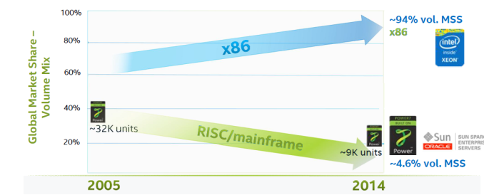
3. The processor war induced by the mobile boom (2)
Market share of x86 and RISC 4S/4S+ servers [16]
Source: IDC World Wide Server Tracker Q4’14
MSS: Market Segment Share

Slide 3
3. The processor war induced by the mobile boom (4)
Worldwide market share of application processors used in smartphones and
tablets in 2014 (based on revenue) [5]
Smartphone application processors worldwide market share 2014 (revenue) [5]
Qualcomm (USA) | 52 %
Apple (USA) | 18 %
MediaTek (Taiwan) | 14 %
Spreadtrum (China)
Samsung (S. Korea)
Tablet application processors worldwide market share 2014 (revenue) [5]
Apple (USA) | 27 %
Intel (USA) | 19 %
Qualcomm (USA) | 16 %
MediaTek (Taiwan)
Samsung (S. Korea)

Slide 4
3. The processor war induced by the mobile boom (5)
Mostly used CPU processors in smartphones and tablets (2014) [6]
Vendor | Processor line | Core | ISA
Qualcomm (USA) | Snapdragon 200-800 | Qualcomm designed Krait cores ARM Cortex A line | ARMv7 ARMv7/v8
Apple (USA) | Apple A6 Apple A7 | ARM Cortex A8 Apple designed Cyclone core | ARMv7 ARMv8
MediaTek (Taiwan) | MT6595 MT67xx | 4xARM Cortex A7/ 4xA17 (ARM big.LITTLE) 4xARM Cortex A53/4x A57 (ARM big.LITTLE) | ARMv7 ARMv8
Samsung (S. Korea) | Exynos | ARM Cortex A line | ARMv7
Spreadtrum (China) | SC77xx/88xx | ARM Cortex A5/A7 | ARMv7

Slide 5
3. The processor war induced by the mobile boom (6)
Morganfield
(2015?)
Intel’s Atom platforms targeting smartphones
(based on [11])
Moorefield
(2014)
Merrifield
(2014)
Performance (not to scale)
Clover Trail+
(2013)
Z5xxx
4xGoldmont
14 nm
+XMM 7360
Medfield
(2012)
Z35xx
4xSilvermont
22 nm
+XMM 7260/2/3
Morestown
(2010)
Z34x0
2xSilvermont
22 nm
+XMM 7160/7260
Z2580-2520
2xSaltwell
32 nm
+XMM 6268/6360/7160
Riverton
(2015)
Z2480/2460
1xSaltwell
32 nm
+XMM 6260
Binghampton
(2016)
Slayton
(2014)
Z6xx
1xBonnell
45 nm
+Wireless
module
Lexington
(2013)
Zxxxx
2xAirmont
14 nm
+?
Z3xxx
2xSilvermont
22 nm
+A-GOLD 620
Zxxx
2xAirmont
14 nm
+?
Z2420
1xSaltwell
32 nm
+XMM 6265

Slide 6
3. The processor war induced by the mobile boom (7)
Willow Trail
(2015?)
Intel’s platforms targeting tablets
(based on [11])
Cherry Trail
(2015)
Bay Trail
(2013)
Performance (not to scale)
Clover Trail
(2012)
Z5xxx
4xGoldmont
14 nm
+XMM 7360
W/A
Oak Trail
(2011)
Z4xxx
4xAirmont
14 nm
+XMM 7160/7260
W/A
Menlow
(2008)
Z37x0
4xSilvermont
22 nm
+XMM 6260/7160
W/A
Atom X3
(Sophia LTE)
(2015)
Z2760
2xSaltwell
32 nm
+XMM 6260
W
Atom X3
(Sophia 3G)
(2015)
Z670/650
1xBonnell
45 nm
+ no XMM
W/MeeGo/A
Z5xx
1xBonnell
45 nm
+ no XMM
W/Moblin
C3400
4xAirmont
28 nm
integrated LTE
modem
C3000
2xSilvermont
28 nm
integrated 3G
modem

Slide 7
3. The processor war induced by the mobile boom (8)
Intel’s effort to optimize their devices from the software point of view
In their 2012 Investor meeting (5/2012) Intel revealed that more than 3000
engineers are working on OS support, among them about 1200 engineers
are dedicated to Android, as indicated below [11].

