Slide 1
The mobile boom
Sima Dezső
2015 October
(Ver. 2.2)
© Sima Dezső, 2015

Slide 2
Contents
1. The traditional computer market
2. The smartphone boom
3. The tablet boom
4. Requirements of mobile devices
5. How leading IT vendors addressed the mobile boom?
6. Conclusions
7. References

Slide 3
1. The traditional computer market
Notes:
3

Slide 4
1. The traditional computer market (1)
1. The traditional computer market
Main computer market segments around 2000
Servers
Desktops
Embedded
computer devices
E.g.
Intel’s Xeon lines
AMD’s Opteron lines
Intel’s Pentium 4 lines
AMD’s Athlon lines
ARM’s lines
Major trend in the first half of the 2000’s: spreading of laptops (first mobile devices)

Slide 5
1. The traditional computer market (2)
Main computer market segments around 2005
Servers
Desktops
Laptops
Embedded
computer devices
E.g.
Intel’s Xeon lines
AMD’s Opteron lines
Intel’s Pentium 4 lines
AMD’s Athlon64 lines
Intel’s Celeron lines
AMD’s Duron lines
ARM’s lines

Slide 6
1. The traditional computer market (3)
Market share of leading processor firms in traditional computer segments

Slide 7
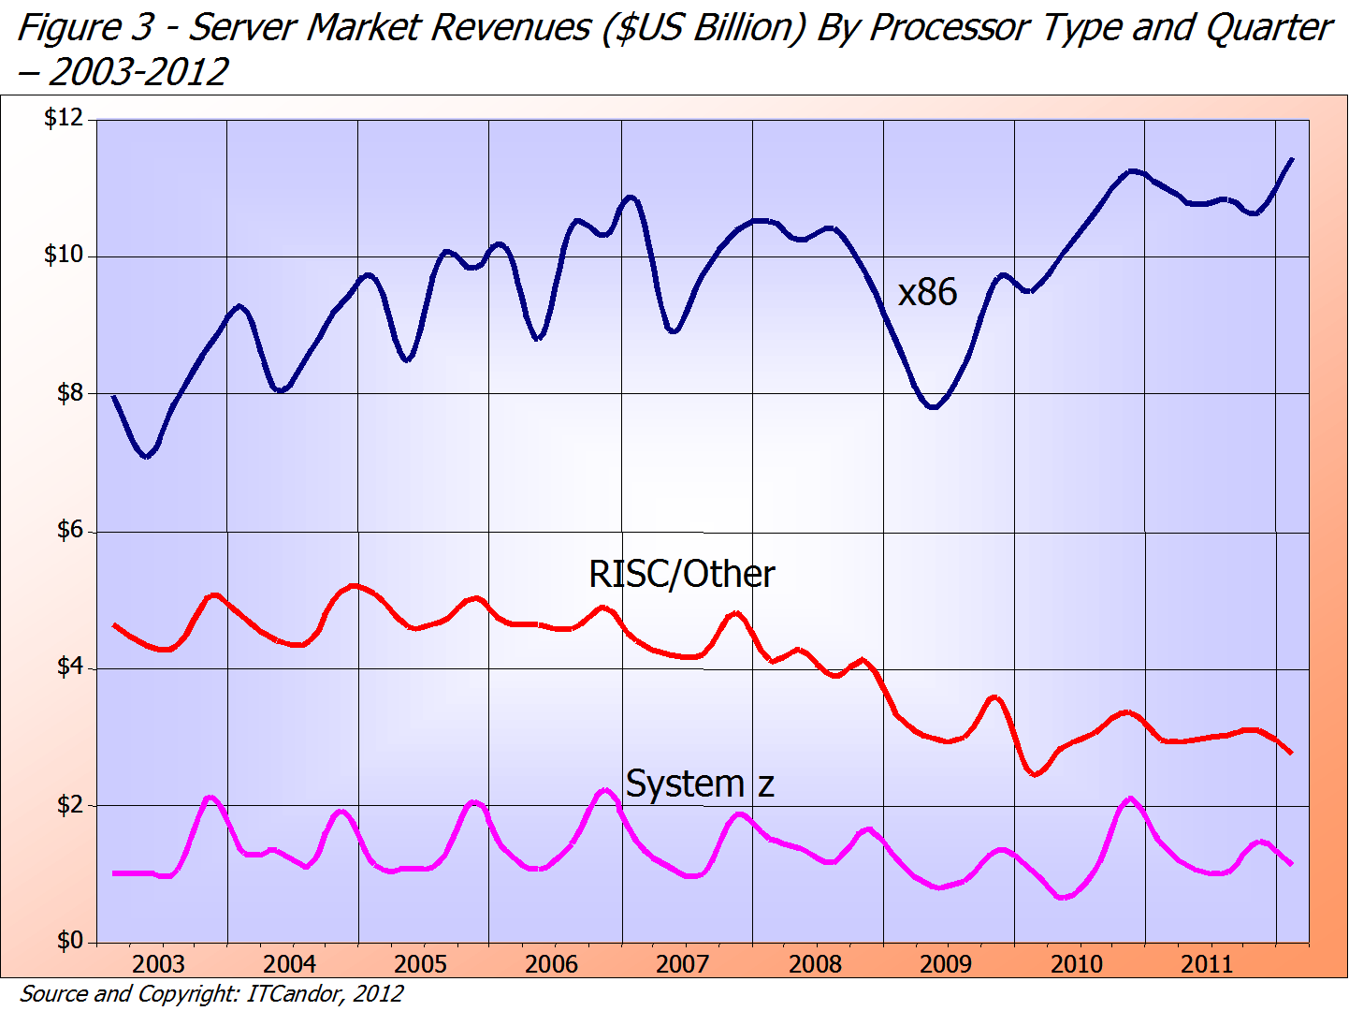
1. The traditional computer market (4)
Server market revenues by vendor ($US Billion) – 2003-2012 [14]
≈75 %
Intel/AMD
IBM POWER/Sun etc.
IBM
≈18 %
≈ 7 %

Slide 8
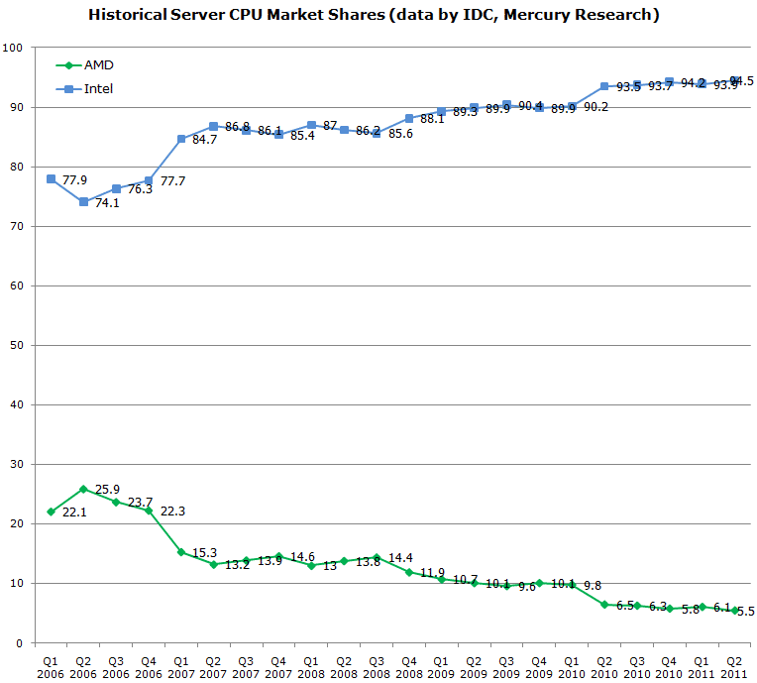
1. The traditional computer market (5)
x86 server market share of Intel and AMD [17]
Penryn MP
Nehalem-EX DP/MP
Penryn DP
Core 2 Quad DP
Core 2 DP
K10 Barcelona MP
K10 Shanghai MP
K10 Istambul MP
K10 Magny Course MP
Source: IDC,
Mercury Research

Slide 9
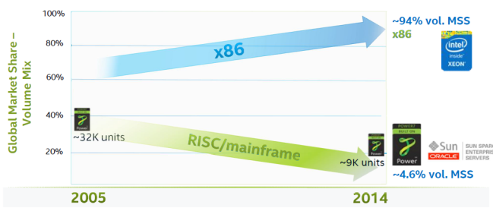
1. The traditional computer market (6)
Worldwide market share of x86 and RISC 4S/4S+ servers (by volume) [51]
Source: IDC World Wide Server Tracker Q4’14
MSS: Market Segment Share

Slide 10
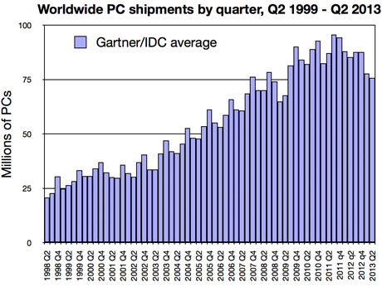
1. The traditional computer market (7)
Worldwide PC shipments by quarter, Q2 1999 – Q2 2013 [18]

Slide 11
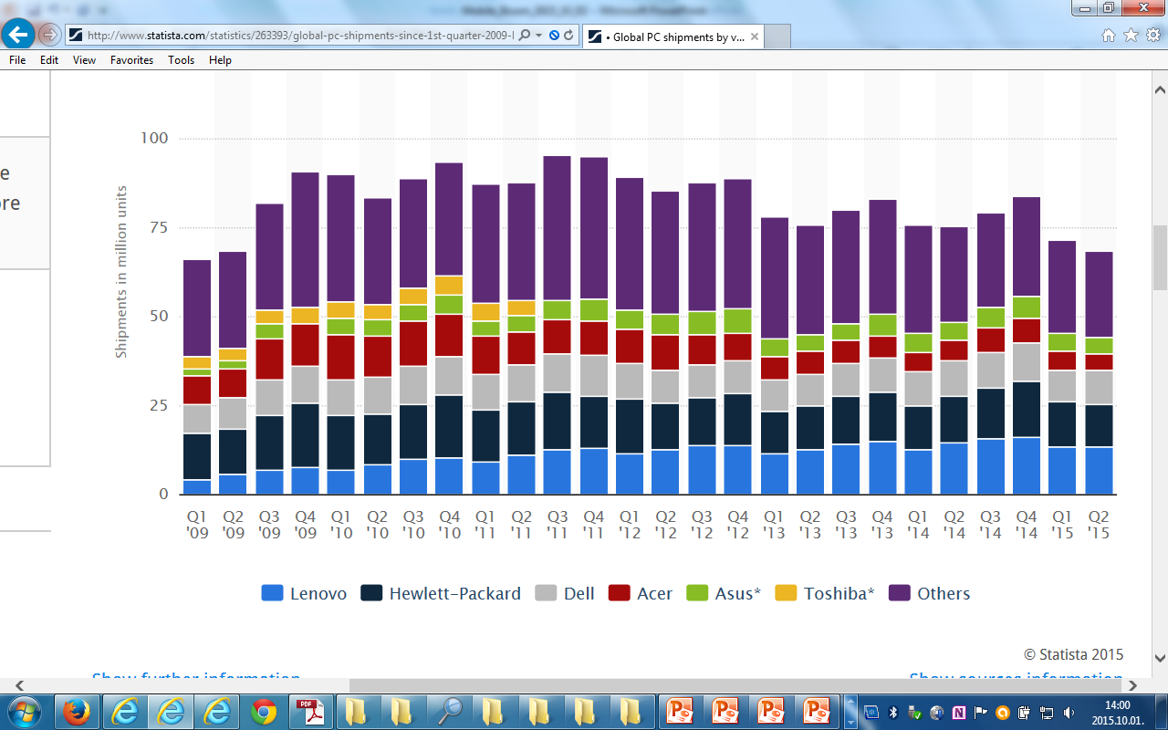
1. The traditional computer market (8)
Worldwide PC shipments by quarter Q1 2009 – Q2 2015 by vendor [52]

Slide 12
1. The traditional computer market (9)
Market share of Intel and AMD in desktops and traditional notebooks
Both in the desktop and notebook segments
Intel’s market share is ≈ 80 %, whereas
AMD’s share remains about 20 % [15], [16].

Slide 13
2. Emergence and spread of smartphones
Notes:
13

Slide 14
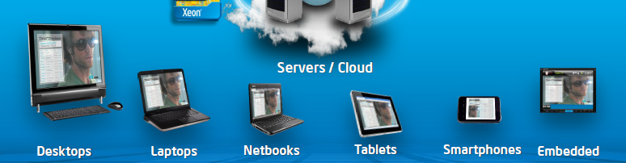
2. Emergence and spread of smartphones (1)
2. Emergence and spread of smartphones
Diversification of mobile devices mainly after 2005 [2]
The mobile boom

Slide 15
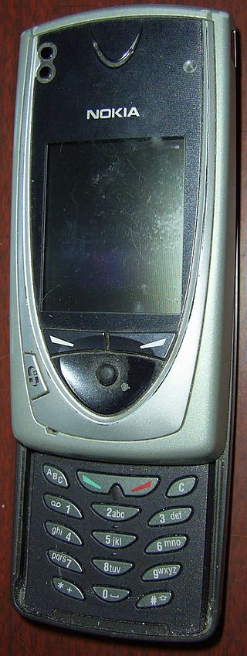
2. Emergence and spread of smartphones (2)
Emergence of smartphones-1
Forerunners of smartphones emerged already
at the beginning of the 2000’s, like Nokia’s 7650
(shipped in 2002).
The 7650 became the first widely available phone
with camera and color screen but supported
no video.
It was the first Nokia phone running under
the Symbian OS.
Figure: Nokia’s 7650 [39]

Slide 16
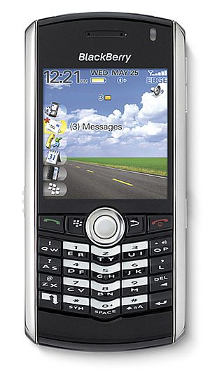
2. Emergence and spread of smartphones (3)
Emergence of smartphones-2
The emergence of smartphones is often
contributed to the BlackBerry Pearl 8100
line of the Canadian firm RIM
(Research in Motion)[5].
This phone – shipped in 2006 - supported
beyond a camera also video and became
very popular in the US.
It was run under the BlackBerry OS.
Figure: RIM’s BlackBarry Perl 8100
(2006) [38]

Slide 17
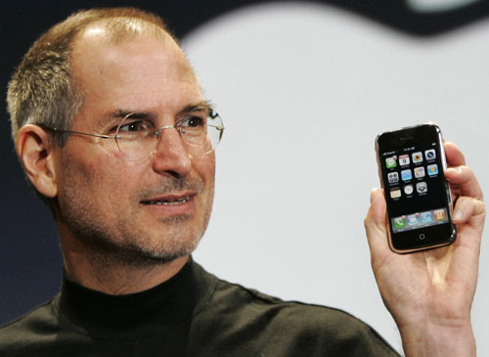
2. Emergence and spread of smartphones (4)
Early spread of smartphones-1
In 2007 Apple’s iPhone gave a strong momentum for rapid spreading of
smartphones.
It run under the iPhone OS (renamed later to iOS in 2010).
Figure: Steve Jobs introducing the iPhone at MacWorld Expo in 1/2007 [47]

Slide 18
2. Emergence and spread of smartphones (5)
Remark
After the introduction of iPhone (2007) Steve Ballmer (CEO of Microsoft) said in an
interview [20]:
“There's no chance that the iPhone is going to get any significant market share.
No chance…
But if you actually take a look at the 1.3 billion phones that get sold, I'd prefer
to have our software in 60% or 70% or 80% of them, than I would to have 2%
or 3%, which is what Apple might get”.

Slide 19
2. Emergence and spread of smartphones (6)
Early spread of smartphones-2
Google’s Android was unveiled also in 2007 with first Android-powered phones
sold in 10/2008 [6].

Slide 20
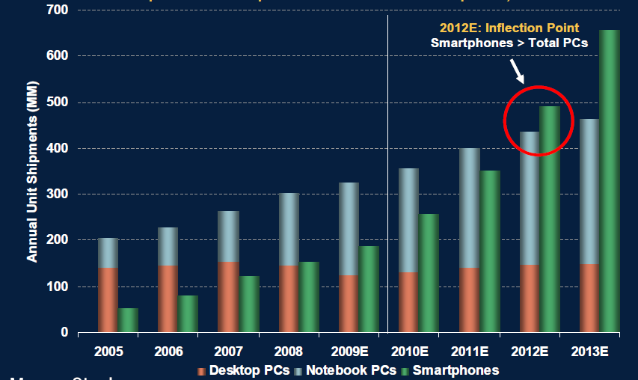
2. Emergence and spread of smartphones (7)
Worldwide unit shipments of PCs vs. smartphones 2005-2013 [37]
PCs: Desktop PCs + notebook PCs

Slide 21
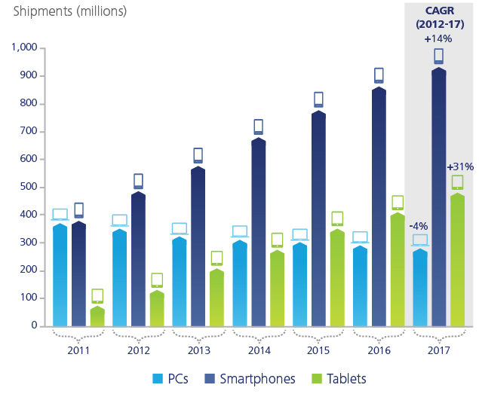
2. Emergence and spread of smartphones (8)
Worldwide unit shipment estimates of PCs vs. smartphones 2011-2017 [28]
Source: Gartner

Slide 22
2. Emergence and spread of smartphones (9)
Worldwide smartphone sales to end user by vendor in 2Q 2015 [53]
Company | 2Q15 Units | 2Q15 Market Share (%) | 2Q14 Units | 2Q14 Market Share (%)
Samsung | 72,072.5 | 21.9 | 76,129.2 | 26.2
Apple | 48,085.5 | 14.6 | 35,345.3 | 12.2
Huawei | 25,825.8 | 7.8 | 17,657.7 | 6.1
Lenovo* | 16,405.9 | 5.0 | 19,081.2 | 6.6
Xiaomi | 16,064.9 | 4.9 | 12,540.8 | 4.3
Others | 151,221.7 | 45.9 | 129,630.2 | 44.6
Total | 329,676.4 | 100.0 | 290,384.4 | 100.0
(Thousands of units)
Table 1
Worldwide Smartphone Sales to End Users by Vendor in 2Q15 (Thousands of Units)
Source: Gartner (August 2015)

Slide 23
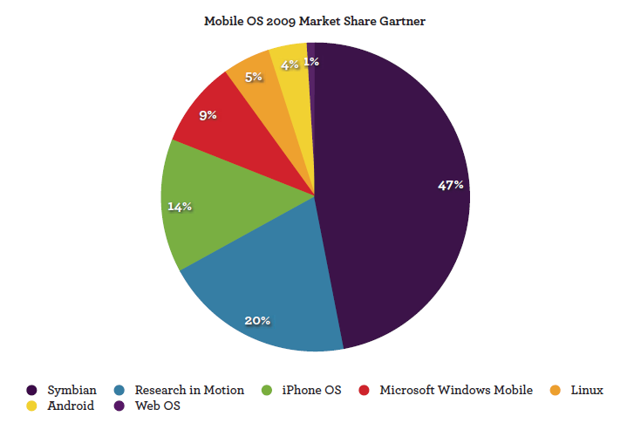
2. Emergence and spread of smartphones (10)
Worldwide market share of smartphone OSs in 2009 [41]
Google
MS
Nokia
Apple
RIM
(BlackBerry)

Slide 24
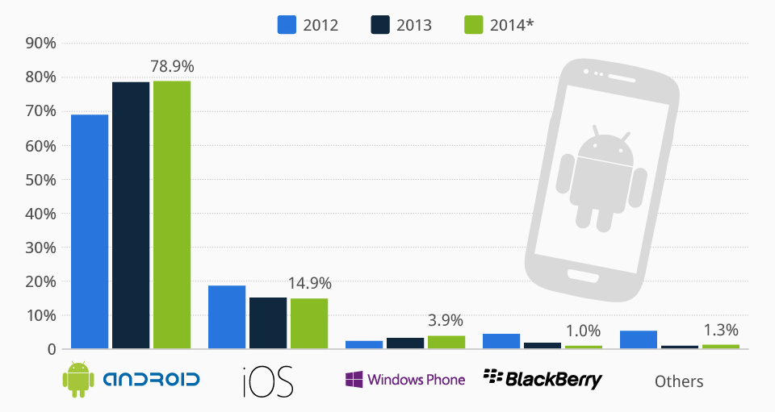
2. Emergence and spread of smartphones (11)
Worldwide market share of smartphone OSs in 2012-2014 [42]

Slide 25
2. Emergence and spread of smartphones (12)
Worldwide smartphone sales to end user by OS in 2Q 2015 [53]
Operating System | 2Q15 Units | 2Q15 Market Share (%) | 2Q14 Units | 2Q14 Market Share (%)
Android | 271,010 | 82.2 | 243,484 | 83.8
iOS | 48,086 | 14.6 | 35,345 | 12.2
Windows | 8,198 | 2.5 | 8,095 | 2.8
BlackBerry | 1,153 | 0.3 | 2,044 | 0.7
Others | 1,229.0 | 0.4 | 1,416.8 | 0.5
Total | 329,676.4 | 100.0 | 290,384.4 | 100.0
(Thousands of units)
Worldwide Smartphone Sales to End Users by Operating System in 2Q15 (Thousands of Units)
Source: Gartner (August 2015)

Slide 26
2. Emergence and spread of smartphones (13)
Worldwide market share of application processors in Q1 2014 used in
smartphones (based on revenue) [43]
Vendor | Market share | Processor line | Core | ISA
Qualcomm (USA) | 53 % | Snapdragon 200-800 | Qualcomm designed Krait cores ARM Cortex A line | ARMv7 ARMv7/v8
Apple (USA) | 16 % | Apple A6 Apple A7 | ARM Cortex A8 Apple designed Cyclone core | ARMv7 ARMv8
MediaTek (Taiwan) | 13 % | MT6595 MT67xx | 4xARM Cortex A7/ 4xA17 (ARM big.LITTLE) 4xARM Cortex A53/4x A57 (ARM big.LITTLE) | ARMv7 ARMv8
Samsung (S. Korea) |  | Exynos | ARM Cortex A line | ARMv7 ARM v8
Spreadtrum (China) |  | SC77xx/88xx | ARM Cortex A5/A7 | ARMv7

Slide 27
2. Emergence and spread of smartphones (14)
Main features of the Qualcomm Snapdragoon lines
Model | Released | Technology | CPU | Word length bit | Clock rate (up to) | Connectivity
820 | 2016 | 14 nm FinFET | Kryo 2.2 GHz (DC) + Kryo 1.7 GHz (DC) | 64 | 2.2 GHz | integrated LTE
810 | H2/2014 | 20 nm | ARM Cortex A57 (QC) + ARM Cortex A53 (QC) | 32/64 | 2.0 GHz | integrated LTE
808 | H1/2015 | 20 nm | ARM Cortex A57 (DC) + ARM Cortex A53 (QC) | 32/64 | 2.0 GHz | integrated LTE
805 | Q1/2014 | 28 nm | Krait 450 (QC) | 32 | 2.7 GHz | integrated LTE
801 | Q4/2013 | 28 nm | Krait 400 (QC) | 32 | 2.5 GHz | integrated LTE
800 | Q2/2013 | 28 nm | Krait 400 (QC) | 32 | 2.3 GHz | integrated LTE
615 | Q3/2014 | 28 nm | ARM Cortex A53 (QC) + ARM Cortex A53 (QC) | 32/64 | 1.7 GHz 1.0 GHz | integrated LTE
602 | Q1/2014 | 28 nm | Krait 300 (QC) | 32 | 1.5 GHz | integrated WiFi
600 | Q1/2013 | 28 nm | Krait 300 (QC) | 32 | 1.9 GHz | integrated WiFi
410 | 1H/2014 | 28 nm | ARM Cortex A53 (QC) + | 32/64 | 1.4 GHz | integrated LTE
400 | Q4/2013 | 28 nm | Krait 300 (QC) or ARM Cortex A7 (QC) | 32 | 1.7 GHz 1.4 GHz | integrated LTE
200 | 2013 | 28 nm | ARM Cortex A5 (QC) or ARM Cortex A7 (QC) | 32 | 1.4 GHz 1.2 GHz | integrated 3G

Slide 28
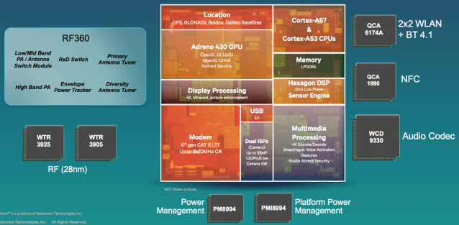
2. Emergence and spread of smartphones (15)
Qualcomm’s Snapdragon 810 platform [65]

Slide 29
2. Emergence and spread of smartphones (16)
Qualcomm’s RF-360 Radio Frequency unit [65]

Slide 30
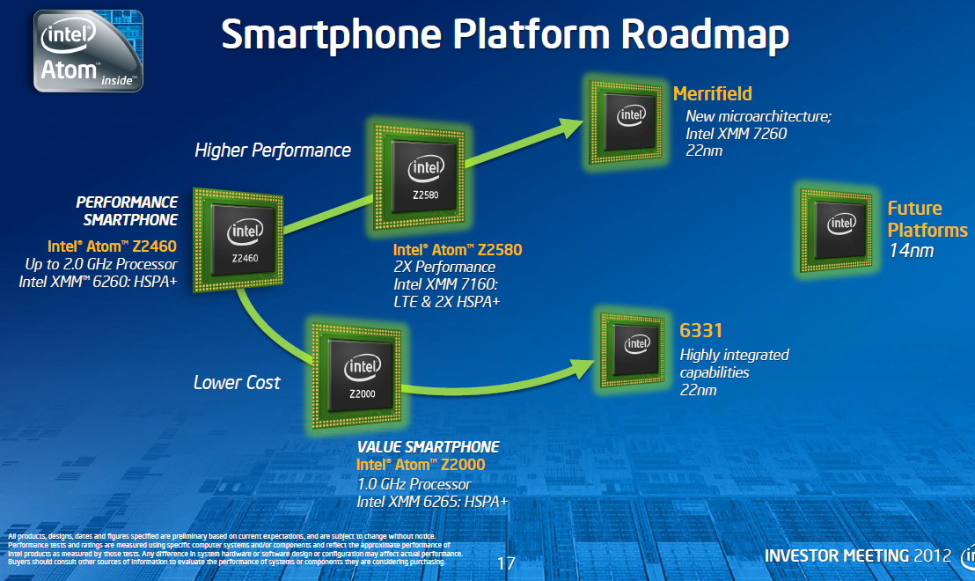
2. Emergence and spread of smartphones (17)
Morganfield
(2015?)
Intel’s Atom platforms targeting smartphones
(based on [33])
Moorefield
(2014)
Merrifield
(2014)
Performance (not to scale)
Clover Trail+
(2013)
Z5xxx
4xGoldmont
14 nm
+XMM 7360
Medfield
(2012)
Z35xx
4xSilvermont
22 nm
+XMM 7260/2/35
Morestown
(2010)
Z34x0
2xSilvermont
22 nm
+XMM 7160/7260
Z2580-2520
2xSaltwell
32 nm
+XMM 6268/6360/7160
Riverton
(2015)
Z2480/2460
1xSaltwell
32 nm
+XMM 6260
Binghampton
(2016)
Slayton
(2014)
Z6xx
1xBonnell
45 nm
+Wireless
module
Lexington
(2013)
Zxxxx
2xAirmont
14 nm
+?
Z3xxx
2xSilvermont
22 nm
+A-GOLD 620
Zxxx
2xAirmont
14 nm
+?
Z2420
1xSaltwell
32 nm
+XMM 6265

Slide 31
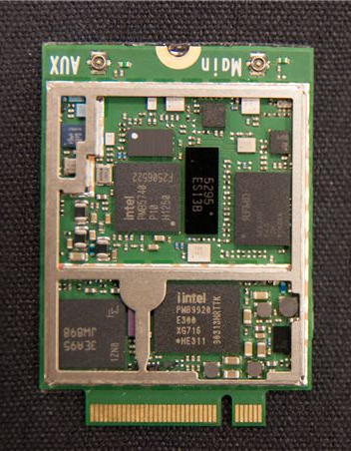
2. Emergence and spread of smartphones (18)
Intel’s XMM line
3G/4G modem + transceiver implemented on two chips
Transceiver
3G/4G modem
Figure: Implementation
example of the two chip
XMM7160 [46]

Slide 32
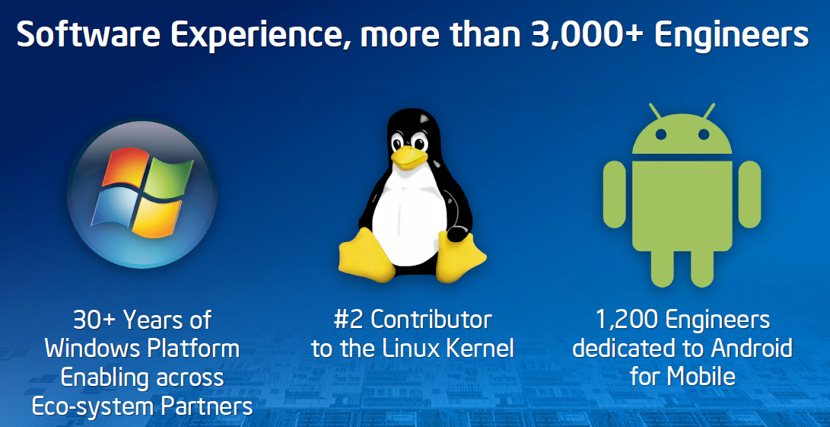
2. Emergence and spread of smartphones (19)
Intel’s effort to optimize their devices from the software point of view
In their 2012 Investor meeting (5/2012) Intel revealed that more than 3000
engineers are working on OS support, among them about 1200 engineers
are dedicated to Android, as indicated below [11].

Slide 33
2. Emergence and spread of smartphones (20)
Intel’s share in smartphone application processors [54]
Despite great efforts Intel could not yet become one of the 5 largest suppliers
of smartphone application processors.
According to industry sources in 2014 Intel achieved less than 1 % share in revenue
in smartphone application processors.

Slide 34
3. Emergence and spread of tablets
Notes:
34

Slide 35
3. Emergence and spread of tablets (1)
Emergence of tablets
Visioning tablets
Tablets were envisioned by Steve Jobs already in 1983 saying
”Apple’s strategy is really simple. What we want to do is we want to put an
incredibly great computer in a book that you can carry around with you and learn
how to use in 20 minutes.
... And we really want to do it with a radio link in it so you don’t have to hook up
to anything and you’re in communication with all of these larger databases and
other computers” [19].

Slide 36
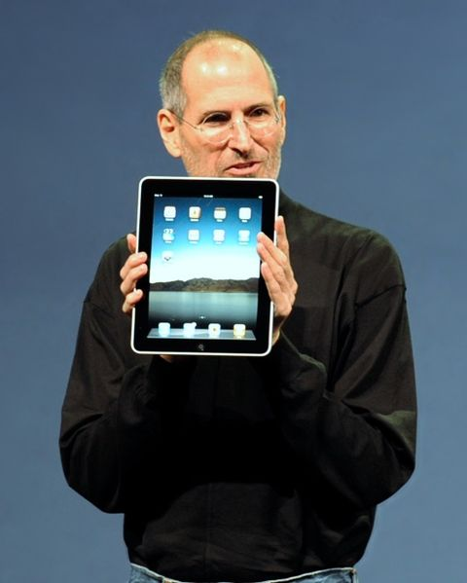
3. Emergence and spread of tablets (2)
Designs giving the final push for rapid spreading of tablets around 2010
From 2009 on: Android-based tablets arrived the market from many vendors.
2010: Apple’s iPad with 9.7 “ screen, touch screen and Wi-Fi or additionally wireless
3G broadband internet connection (mobile internet connection), operating under
iOS [12].
Figure: Steve Jobs introducing the iPad in 2010 [12]

Slide 37
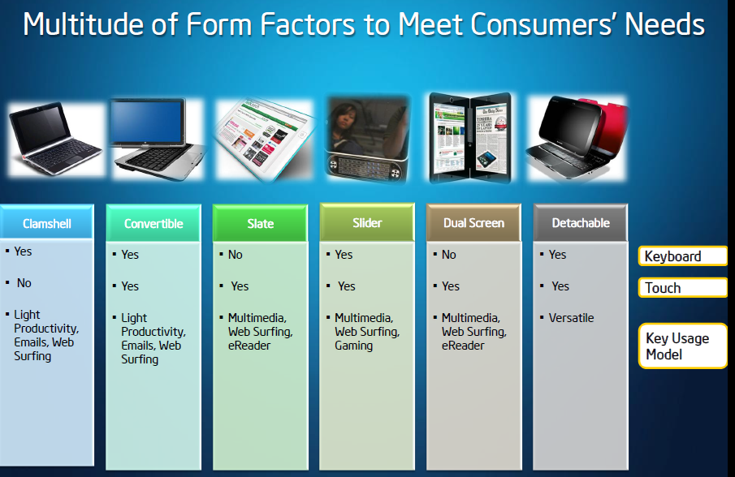
3. Emergence and spread of tablets (3)
Implementation alternatives of tablets-1 [8]

Slide 38
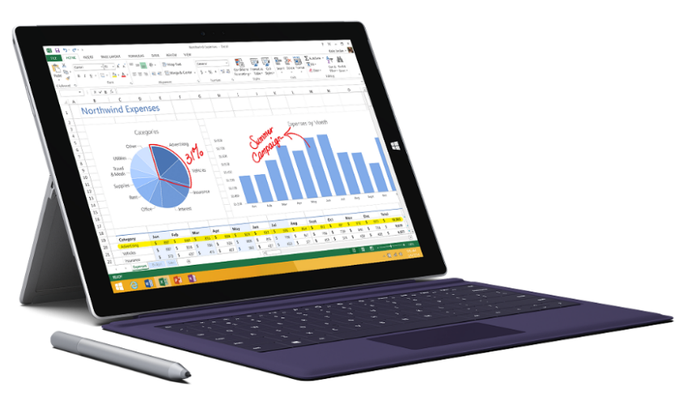
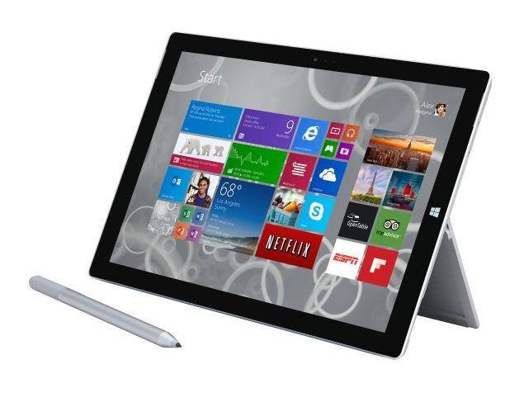
3. Emergence and spread of tablets (4)
Implementation alternatives of tablets-2 [8]
2 in 1 tablets (≈ attachable keyboard + touchscreen)
Example: Windows Surface Pro 3 (8/2014)
Aim: Replacing laptops
Intel’s Surface Pro 3
used as a laptop [22]
Intel’s Surface Pro 3
used as a tablet [23]

Slide 39
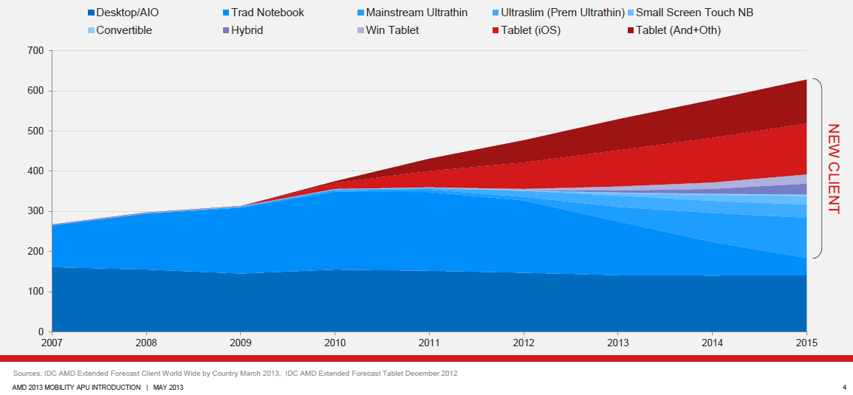
3. Emergence and spread of tablets (5)
Rapid increase of tablet sales in the first half of the 2010’s
Besides smartphones, tablets and all their alternative designs (that provide also keyboard/mouse input, such as convertibles or 2 in 1 designs) have recently the highest growth potential, as indicated in the Figure below (12/1012) [3].
Tablets
Notebooks
Desktops
Figure: Yearly worldwide sales figures of desktops, notebooks and tablets [3]

Slide 40
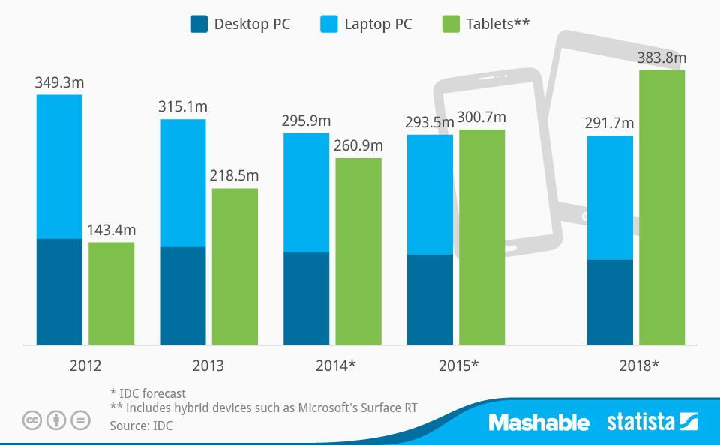
3. Emergence and spread of tablets (6)
Worldwide PC, laptop and tablet shipments 2012 – 2018 [55]
(Shipments in million units)

Slide 41
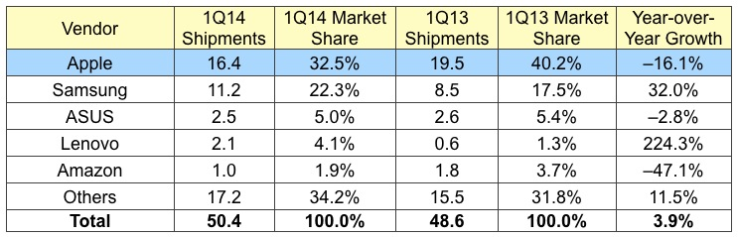
3. Emergence and spread of tablets (7)
1Q/2014 worldwide tablet shipments and market shares by vendors [31]
(Shipments in million units)

Slide 42
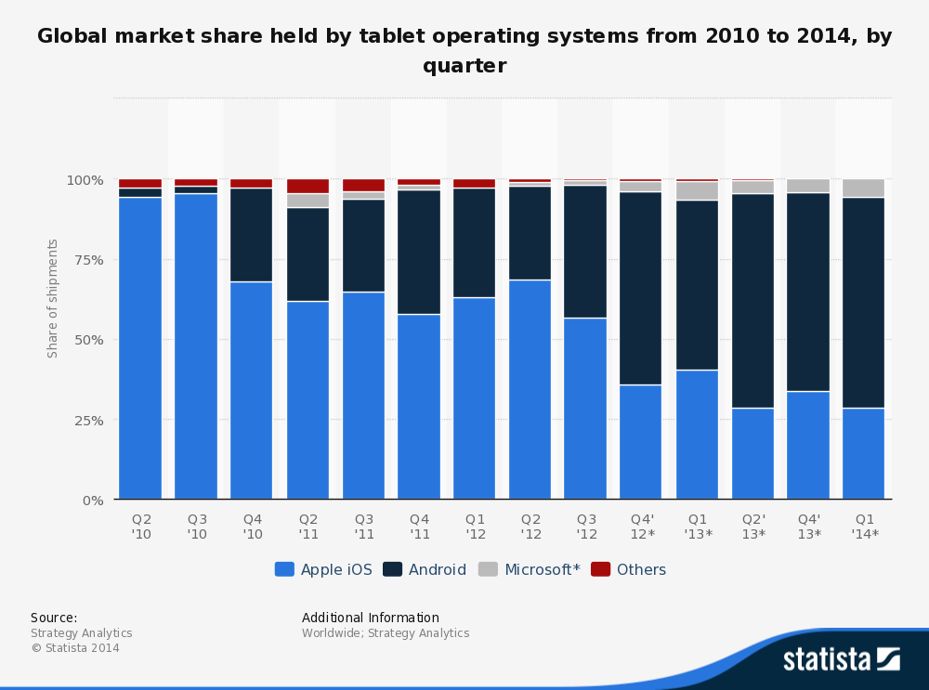
3. Emergence and spread of tablets (8)
Global market share of tablet OS shipments 2010 - 2014 by quarter [25]

Slide 43
3. Emergence and spread of tablets (9)
Willow Trail
(2015?)
Intel’s platforms targeting tablets
(based on [11])
Cherry Trail
(2015)
Bay Trail
(2013)
Performance (not to scale)
Clover Trail
(2012)
Z5xxx
4xGoldmont
14 nm
+XMM 7360
W/A
Oak Trail
(2011)
Z4xxx
4xAirmont
14 nm
+XMM 7160/7260
W/A
Menlow
(2008)
Z37x0
4xSilvermont
22 nm
+XMM 6260/7160
W/A
Atom X3
(Sophia LTE)
(2015)
Z2760
2xSaltwell
32 nm
+XMM 6260
W
Atom X3
(Sophia 3G)
(2015)
Z670/650
1xBonnell
45 nm
+ no XMM
W/MeeGo/A
Z5xx
1xBonnell
45 nm
+ no XMM
W/Moblin
C3400
4xAirmont
28 nm
integrated LTE
modem
C3000
2xSilvermont
28 nm
integrated 3G
modem

Slide 44
3. Emergence and spread of tablets (10)
Intel’s share in tablet application processors [35], [36], [56]
Intel’s subsidies for OEMs
Over the past four years Intel pays significant subsidies (~ 50 $/tablet) to
netbook and tablet manufacturers to switch from ARM based processors to
x86 Atom processors.
Results
In 2014 Intel achieved the 2. place in the worldwide market share in
tablet application processors (regarding revenues).
In two years Intel mobile division has lost 7 billion $.
According to industry sources for 2015 Intel will stop paying subsidies for OEMs.

Slide 45
3. Emergence and spread of tablets (11)
Worldwide market share of application processors used in tablets in 2014
(based on revenue) [57]
Tablet application processors worldwide market share 2014 (revenue) [57]
Apple (USA) | 27 %
Intel (USA) | 19 %
Qualcomm (USA) | 16 %
MediaTek (Taiwan)
Samsung (S. Korea)

Slide 46
4. Key requirement of mobile devices (tablets, smartphones)
Notes:
46

Slide 47
4. Key requirement of mobile devices (tablets, smartphones)
4. Key requirement of mobile devices (tablets, smartphones)
Key requirements of mobile devices (tablets, smartphones)
Low power operation
Connectivity
(3G/4G/Wi-Fi)
(Section 4.1)
(Section 4.2)

Slide 48
4.1 Low power operation
Notes:
48

Slide 49
4.1 Low power operation (1)
4.1 Low power operation
It will be expressed
either by specifying the power consumption, e.g. the TDP value of
the processor in Watt,
or in in length of the operating hours of the device under given conditions.

Slide 50
4.1 Low power operation (2)
Contrasting the design paradigms of traditional and mobile processors
Traditional processors
Tablets and smartphones
High performance/power
(e.g. GFLOPS/Watt)
Low power
(Watt)
(Number of operating hours)
In this point let’s focus on the microarchitecture of CPUs (processor cores)

Slide 51
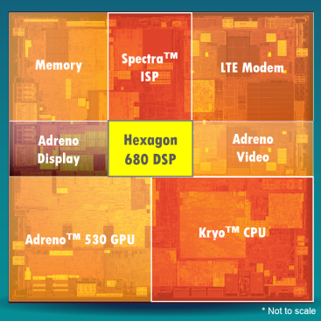
4.1 Low power operation (3)
Example: Block diagram of Qualcomm’s Snapdragon 820) (2015) [61]

Slide 52
4.1 Low power operation (4)
Key criteria for low power microarchitectures
Key criteria for low power microarchitectures
Narrow microarchitecture
Low processor clock frequency
(Section 4.1.2)
(Section 4.1.3)

Slide 53
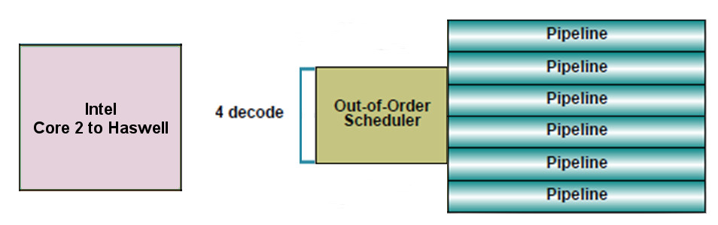
4.1 Low power operation (5)
4.1.2 “Narrow” microarchitectures
Microarchitecture of Intel’s and AMD’s recent traditional processors
they are aiming at high performance/power (in terms of GFLOPS/Watt)
consequently
have wide microarchitectures, as the next example shows:
64-bit
Skylake
Example: Width of Intel’s Core 2 (2006) to Skylake (2015) processors underlying
servers to laptops [10]
We note that AMD introduced 4-wide microarchitectures five years later, along with
the Bulldozer line in 2011.

Slide 54
4.1 Low power operation (6)
Microarchitectures of mobile processors
To reduce power consumption low power microarchitectures are narrower than
recent traditional processors, as the next Figure demonstrates.

Slide 55
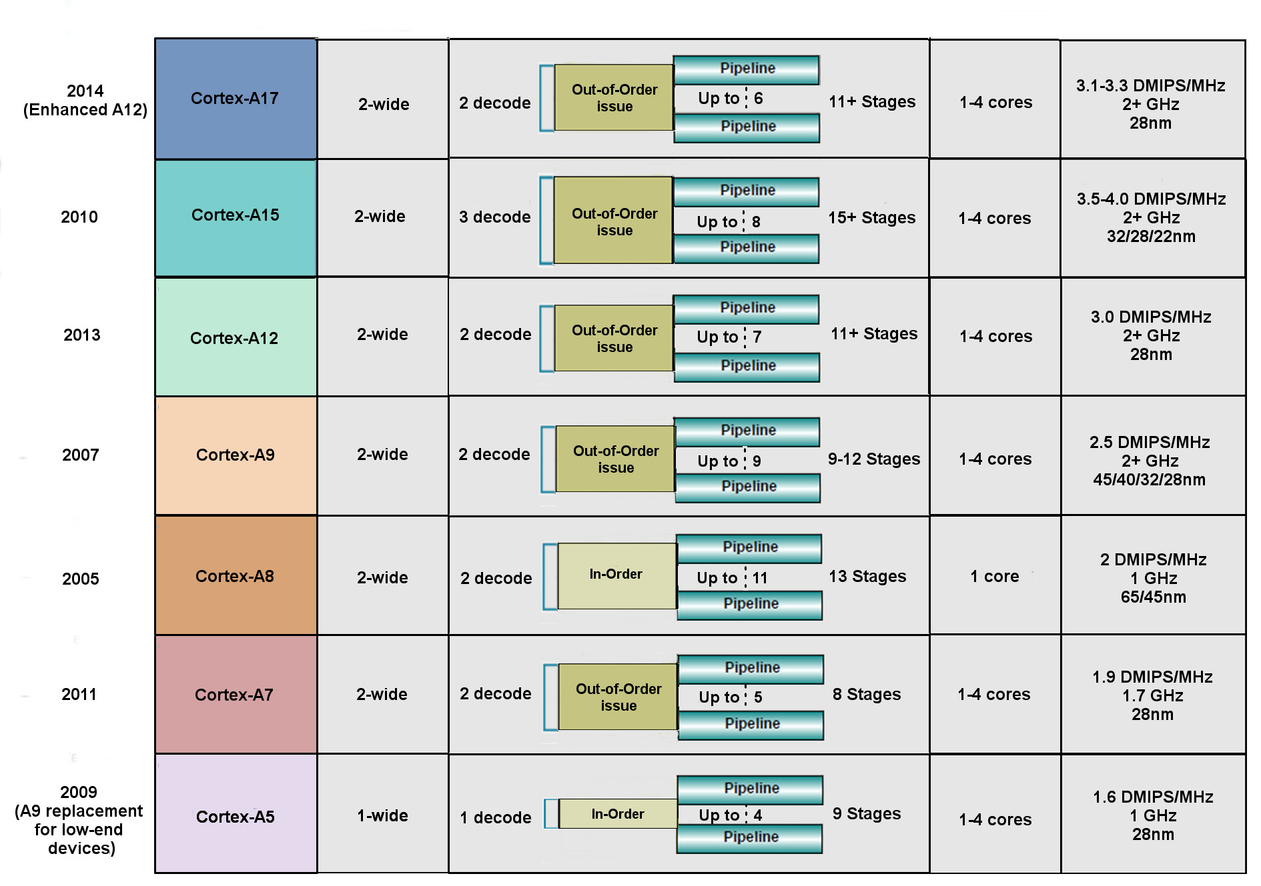
4.1 Low power operation (7)
Key features of ARM’s 32-bit microarchitectures -1 (based on [10])

Slide 56
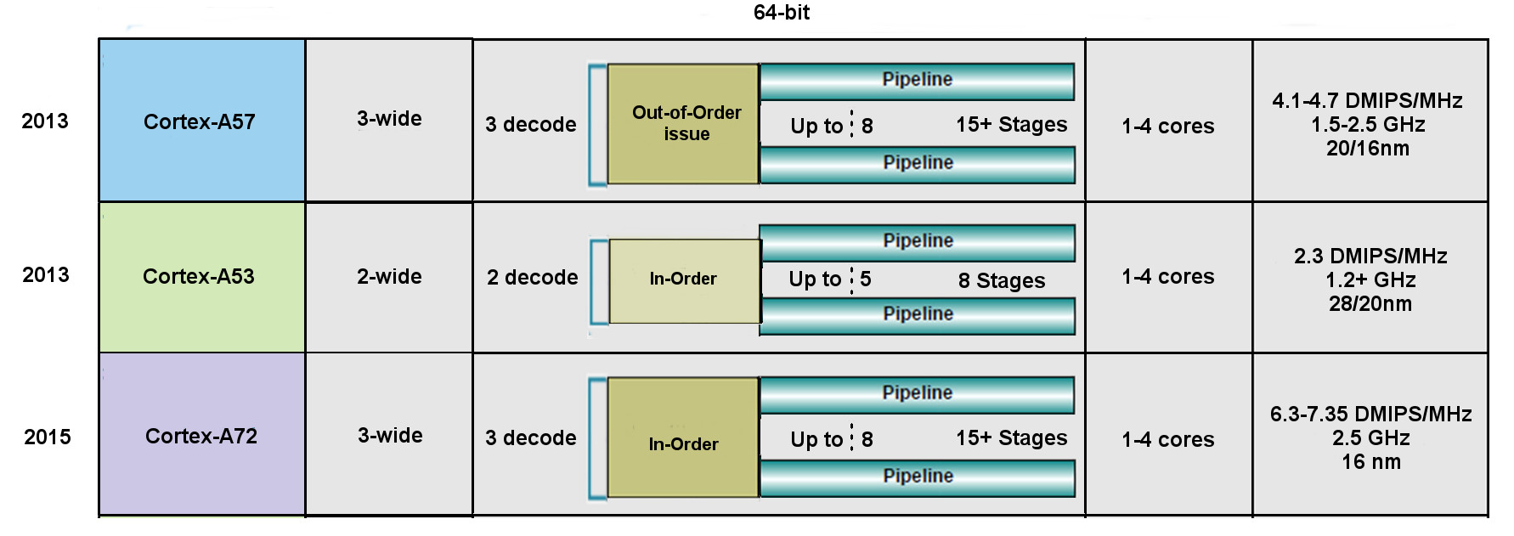
4.1 Low power operation (7a)
Key features of ARM’s 64-bit microarchitectures -2 (based on [10])
Remark: In the Cortex-A9 the NEON FP operates in order.

Slide 57
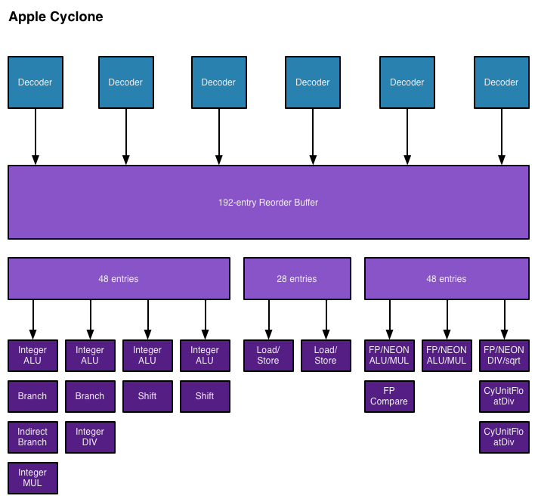
4.1 Low power operation (8)
Block diagram of Apple’s Cyclone core, introduced in the A7 SOC (2013) [48]

Slide 58
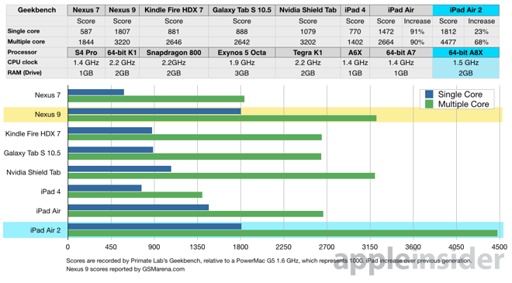
4.1 Low power operation (9)
Geekbench 3.2 results of recent tablets [49]
3 Cyclone
cores

Slide 59
4.1 Low power operation (10)
Implications of the extremely high performance figures of Apple’s A8X-based
iPad Air 2 (including 3 Cyclone cores) [50]
Intel not only lost Apple as a perspective buyer of their chips for the iPad line,
but the iPad Air 2 also severely hit the perspective of their not so successful
Atom line.
NVIDIA’s Tegra 4 chips were not successful, so the firm announced in 05/2014
that they will abandon the phone market.
Apple’s iPad Air 2 with its 256 GPU EUs became a very powerful rival to NVIDIA’s
subsequent 64-bit K1 chip that includes 192 GPU.
As a consequence, in 05/2015 NVIDIA announces that the vendor will leave
the mobile chip business.

Slide 60
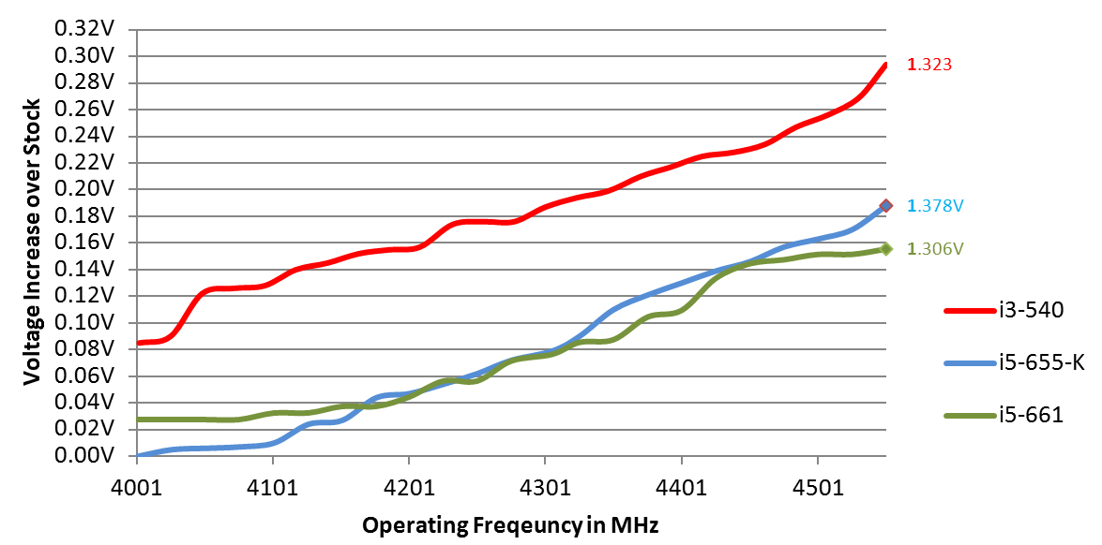
4.1 Low power operation (11)
4.1.3 Low clock frequency-1
Basics
D = const x fc x Vdd²
In addition: higher fc requires higher Vdd (Vdd ≈ const x fc).
Figure: Core voltage (Vdd) vs. clock frequency (fc) for Intel’s Westmere processors [26]

Slide 61
4.1 Low power operation (12)
Low clock frequency-2
It follows
Higher fc
higher Vdd
higher D (D ~ const. x fc³)
Traditional CPUs
Mobile CPUs
High base clock frequency
(typically 2-4 GHz)
Relative low base clock frequency
(typically 1-2 GHz)

Slide 62
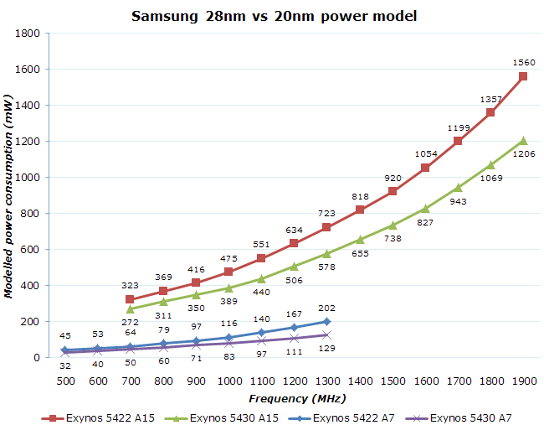
4.1 Low power operation (13)
Power consumption vs. fc in Samsung's 28 and 20 nm processors [66]
28 nm
20 nm
28 nm
20 nm

Slide 63
4.1 Low power operation (14)
Example: Max. base frequency of Skylake models with different TDPs and
configurations (Based on data from [58])
TDP (W) | No. of cores | Graphics | No. of graphics EUs | eDRAM | Base frequency up to (GHz)
4.5 | 2 | HD 515 | 18 | -- | 1.2
15 | 2 | HD 540 | 48 | 64 MB | 2.2
15 | 2 | HD 520 | 24 | -- | 2.6
28 | 2 | HD 550 | 48 | 64 MB | 3.3
35 | 4 | HD 530 | 24 | -- | 2.8
45 | 4 | HD 530 | 24 | -- | 2.9
65 | 4 | HD 530 | 24 | -- | 3.4
91 | 4 | -- | -- | -- | 4.2
Note that low TDP can be achieved first of all by reducing the core frequency and
limiting the computer resources (cores, GPU EUs) provided.

Slide 64
4.2 Connectivity
Notes:
64

Slide 65
4.2 Connectivity (1)
4.2 Connectivity
Connectivity may include (depending on the device type)
LAN connectivity
Wi-Fi connectivity
mobile broadband connectivity (recently 3G/4G).
Subsequently, we will focus only on the mobile broadband connectivity.

Slide 66
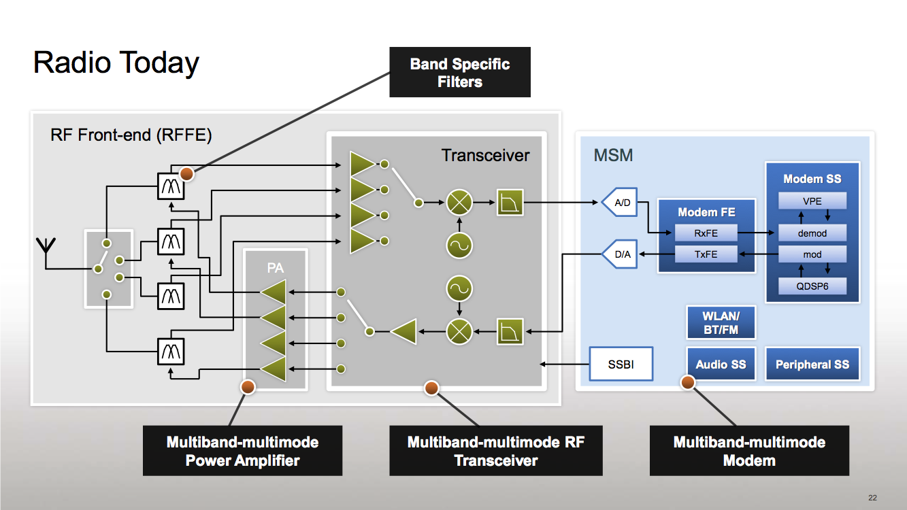
4.2 Connectivity (2)
Simplified view of a platform providing mobile broadband connectivity [59]
RF
Modem + Application Processor
(assuming an integrated implementation)
(DSP)
PA: Power Amplifier

Slide 67
4.2 Connectivity (3)
Integration of the application processor and the modem
Integrating the modem into the chip results in less costs and shorter time to
market.
Qualcomm pioneered this move designing integrated parts already about 1996.
Integration of the application processor and the modem
Use of discrete
application processor and modem
Use of integrated
application processor and modem
E.g.
Intel’s Atom line (2008)
except recent Atom X3 (Sophia (2015)
Apple’s own processor designs
(Swift (2012), Cyclone (2013)
Intel’s Atom X3 (Sophia) (2015)
Qualcomm’s MSM product offerings
since ~ 1996
including their Snapdragon families
NVIDIA’s Tegra 2-4, K1 (since 2011)
NVIDIA’s Tegra 4i (2014)
MediaTek’s 81xx line (2013)
MediaTek’s 6xxx/8xxx families (since ~ 2009)
except the 81xx line
Samsung’s Exynos 3/4/5/7 families
(since ~ 2010)

Slide 68
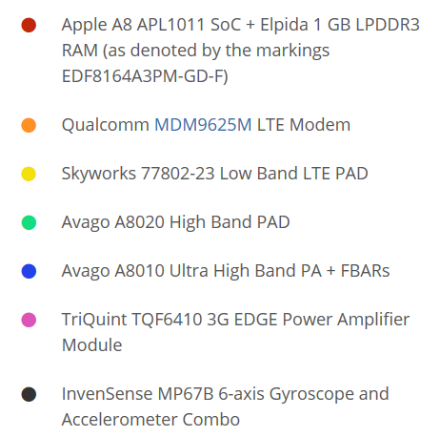
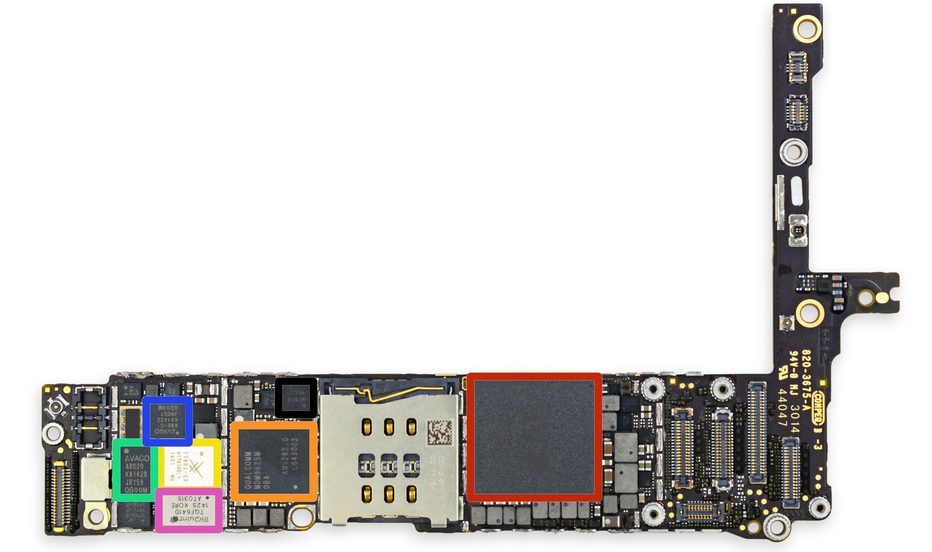
4.2 Connectivity (4)
Example of using discrete application processor and modem: The iPhone 6+
The front side of the
logic board [60]
PAD: Integrated Power Amplifier-Duplexer

Slide 69
4.2 Connectivity (5)
Example of using an integrated application processor and a modem
(Qualcomm’s Snapdragon 820) [61]

Slide 70
4.2 Connectivity (6)
Worldwide market share of smartphone and tablet application processors
in 2014 (based on revenue)
Smartphone application processors worldwide market share in Q1 2014 (revenue) [34]
Qualcomm (USA) | 53 %
Apple (USA) | 16 %
MediaTek (Taiwan) | 13 %
Samsung (S. Korea)
Spreadtrum (China)
Tablet application processors worldwide market share 2014 (revenue) [57]
Apple (USA) | 27 %
Intel (USA) | 19 %
Qualcomm (USA) | 16 %

Slide 71
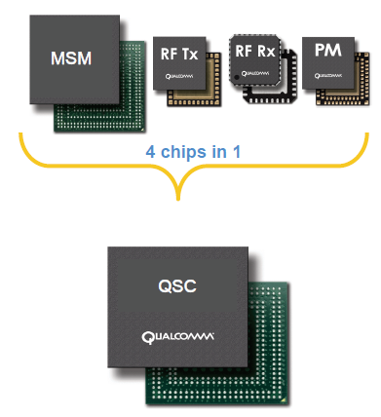
4.2 Connectivity (7)
Integrating the application processor, the modem, RF transmitter,
RF receiver and power manager IC onto a single chip
It became feasible for less demanding applications, e.g. for feature phones.
Example: Qualcomm’s QSCs (Qualcomm Single Chips)
Qualcomm provides single chip solutions
for feature phones, termed as
QSCs (Qualcomm Single Chips).
QSCs integrate the functions of
MSMs
RF Transmitters (RF Tx)
RF Receivers (RF Rx) and
Power manager ICs (PM)
as illustrated on the Figure left [62].
Figure: Qualcomm’s integrated QSC [62]

Slide 72
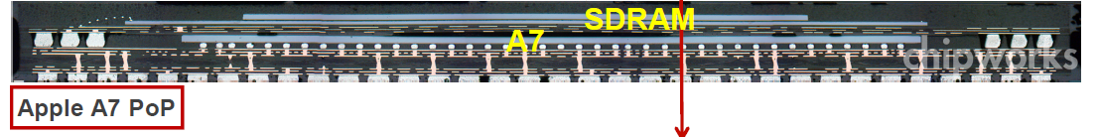
4.2 Connectivity (8)
Remark
Using PoP (Package on Package) memory
The processor die and the memory die or dies are mounted in the same package.
E.g. In Apple’s A7 Package-on-Package processor, as used in the iPhone 5s.
1GB LPDDR3-1600 SDRAM
Figure: Apple’s A7 PoP [63]

Slide 73
5. How leading IT vendors addressed the mobile boom?
5.1 Intel’s and AMD’s response to the mobile boom
5.2 Microsoft’s response to the mobile boom
Notes:
73

Slide 74
5.1 Intel’s and AMD’s response to the mobile boom
Notes:
74

Slide 75
5.1 Intel’s and AMD’s response to the mobile boom (1)
5.1 Intel’s and AMD’s response to the mobile boom-1
Intel’s and AMD’s traditional CPUs are designed for high performance/power,
consequently they are wide and power hungry,
but mobile devices require low power consumption, so
Intel’s and AMD’s traditional microarchitectures are not suited for mobile devices.

Slide 76
5.1 Intel’s and AMD’s response to the mobile boom (2)
(1)
Total shipments of smartphones vs. PCs and tablets 2011-2017 [28]
Smartphone and tablet shipments
will vastly exceed PC shipments
(desktops and notebooks)
in a few years
Source: Gartner (2013)

Slide 77
5.1 Intel’s and AMD’s response to the mobile boom (3)
Intel’s and AMD’s response to the mobile boom-2
To avoid shrinking market shares on the global processor market
and benefit from the rapidly increasing mobile market
Intel and AMD need processors that are competitive with ARM based designes.
Intel and AMD were forced
to introduce novel narrow (e.g. 2-wide), low-power microarchitectures
for their CPUs and
clock them at a relative low rate.

Slide 78
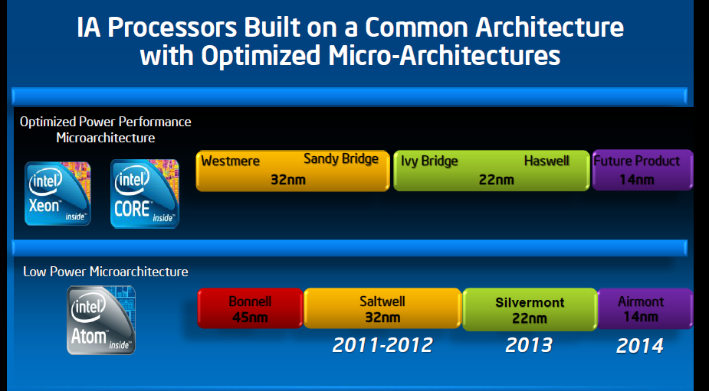
5.1 Intel’s and AMD’s response to the mobile boom (4)
Evolution of Intel’s basic architectures [Based on 2]
Broadwell
14 nm
4-wide
out-of-order
2008
2015
2-wide
in-order
2-wide
in order
2-wide
out-of-order
2-wide
out-of-order

Slide 79
5.1 Intel’s and AMD’s response to the mobile boom (5)
Evolution of AMD’s basic architectures
Optimized Power/Performance
Microarchitecture
~10/2011
~5/2012
1/2014
AMD
Bulldozer
Family 15h
Bulldozer
Models 00h-0Fh
32nm
Piledriver
Models 10h-1Fh
32 nm
Steamroller
Models 30h-3Fh
28nm
4-wide
out-of-order
Low Power
Microarchitecture
1/2011
5/2013
4/2014
AMD
Family 14h/16h
Bobcat
40nm
Jaguar
28nm
Puma
28nm
2-wide
out-of-order
2-wide
out-of-order
2-wide
out-of-order
2011
2012
2013
2014

Slide 80
5.1 Intel’s and AMD’s response to the mobile boom (6)
Use of AMD’s low power Jaguar architecture in game consoles
Most recent game consoles are based on AMD’s low power Jaguar architecture,
including
Nintendo Wii U (2012)
Sony Playstation 4 (2013)
Mixrosoft Xbox One (2013).
These consoles have a significant global market share, as indicated in the next
Figure.

Slide 81
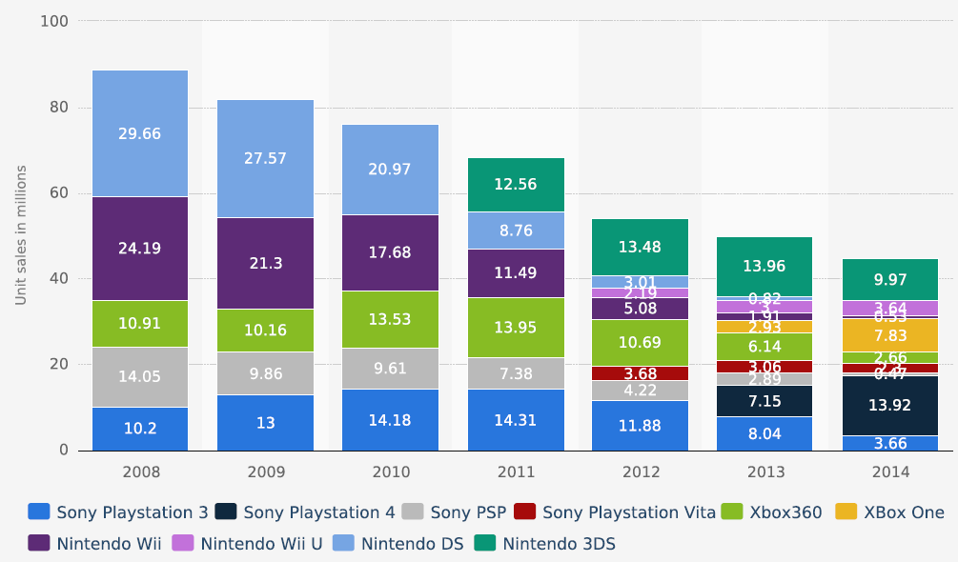
5.1 Intel’s and AMD’s response to the mobile boom (7)
Global unit sales of current generation video game consoles 2008-2014 [64]
(in million units)

Slide 82
5.1 Intel’s and AMD’s response to the mobile boom (8)
The effort needed to achieve considerable power reduction
In their designs both Intel and AMD lay great emphasis on the reduction of power
consumption.
To illustrate this we show a set of AMD’s power management techniques introduced
in a timeframe of about five years.

Slide 83
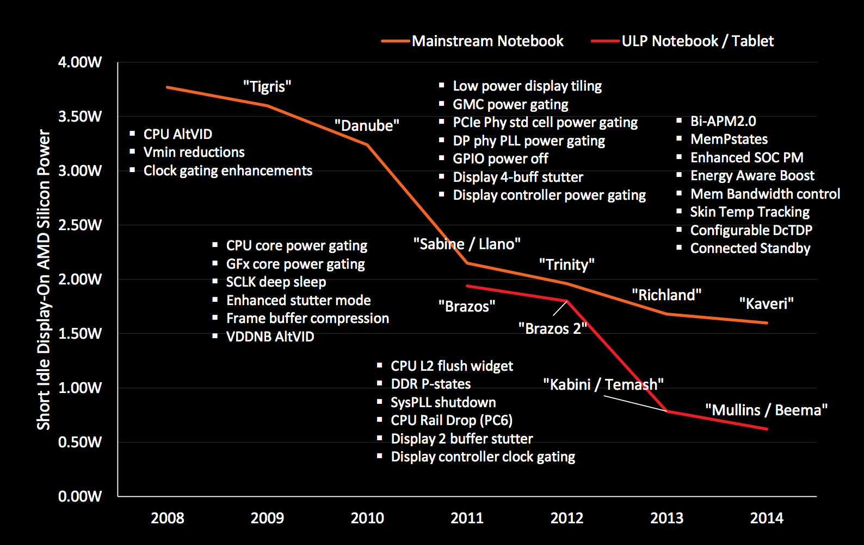
5.1 Intel’s and AMD’s response to the mobile boom (9)
AMD’s technologies developed to reduce power consumption (2008-2014) [27]

Slide 84
5.2 Microsoft’s response to the mobile boom
Notes:
84

Slide 85
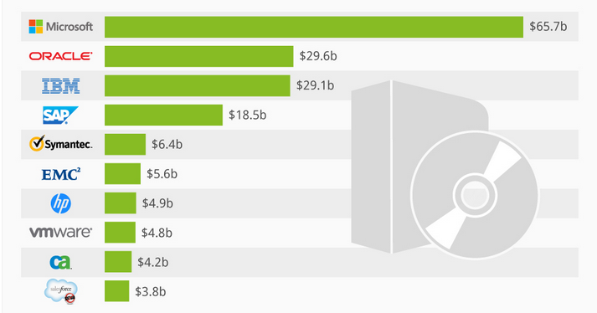
5.2 Microsoft’s response to the mobile boom (1)
5.2 Microsoft’s response to the mobile boom-1
Worldwide software revenues in 2013 [25]

Slide 86
5.2 Microsoft’s response to the mobile boom (2)
5.2 Microsoft’s response to the mobile boom-2
2010 Windows Phone 7 (later Windows Phone 8)
2012 Windows 8: aim to cover PCs, notebooks and also tablets
2013 Windows 8.1
2014 Windows 8.1 with Bing (Search Engine) for low cost devices
2014 Windows 9 skipped
2014 Windows 10 Technical Preview
2015 Windows 10 general availability
Windows Phone 7 was Microsoft’s first OS designed for phones.
Windows 8 was Microsoft’s try to cover the whole spectrum of computers from
server through desktops and notebooks till touchscreen tablets by a single OS.
Market reflections: Windows Phone 7 and Windows 8 earned moderate success,
Android and iOS dominate further on the market.
Windows 8.1 is an upgrade for Windows 8.
In 5/2014 Microsoft announced that Windows 8.1 with Bing.
It is the same as Windows 8, but is shipped with the Internet Explorer as
the default search engine.
It will be delivered for hardware manufacturers for free.
Windows 10 is released in 07/2015, it provides an updated Start menu.
To encourage its adoption Microsoft made it available free of charge during its
first year of availability to users with genuine copies of Windows 7/Windows 8.1.

Slide 87
5.2 Microsoft’s response to the mobile boom (3)
5.2 Microsoft’s response to the mobile boom-3
Ballmer (CEO of Microsoft in 9/2012):
“I think that in a back-looking view, people would say we were a software company.
That's kind of how we were born.
I think when you look forward, our core capability will be software, (but)
you'll probably think of us more as a devices-and-services company.” [22]
Transitioning Microsoft into a devices-and-services company
2012: Introduction of the Surface line of tablets running under Windows
2013: Xbox One game console (8 AMD Jaguar cores,
(successor to Xbox 360)
2013: Microsoft purchases Nokia’s phone business

Slide 88
5.2 Microsoft’s response to the mobile boom (4)
Overview of the Microsoft’s Surface family of tablets
Microsoft’s Surface family of tablets
Surface lines
Surface Pro lines
First Surface tablets are NVIDIA’s Tegra based
and run under Windows RT/Windows 8.1
Recent Surface tablets are Intel’s Atom based
and are running under Windows 8.1
Surface Pro tablets are Core 2 based
and run under Windows 8
or subsequent Windows versions
Less expensive models
High end models

Slide 89
5.2 Microsoft’s response to the mobile boom (5)
Microsoft’s Surface tablets-2
Main features of Microsoft’s Surface tablet lines
Model | Intro | Processor | Word length | Core nr. | OS
Surface | 10/2012 | Tegra 3 | 32-bit | 4 | Windows RT
Surface 2 | 10/2013 | Tegra 4 | 32-bit | 5 | Windows RT/Windows 8.1
Surface 3 | 05/2015 | Atom X7-Z8700 Airmont core | 64-bit | 4 | Windows 8.1
Table: Microsoft’s ARM/Intel Atom-based Surface RT /Surface 2 tablets

Slide 90
5.2 Microsoft’s response to the mobile boom (6)
Microsoft’s Surface tablets-3
Main features of Microsoft’s Surface Pro tablet lines
Model | Intro | Processor | Word length | Core nr. | OS
Surface Pro | 02/2013 | Ivy Bridge i5 | 64-bit | 2 | Windows 8 Pro
Surface Pro 2 | 10/2013 | Haswell i5 | 64-bit | 2 | Windows 8.1 Pro
Surface Pro 3 | 06/2014 | Haswell i3/i5/i7 | 64-bit | 2 | Windows 8.1 Pro
Surface Pro 4 | 11/2015 | Skylake m3/i5/i7 | 64-bit | 2 | Windows 10 Pro
Table: Microsoft’s Intel Core 2-based Surface Pro tablets

Slide 91
5.2 Microsoft’s response to the mobile boom (7)
Windows Surface Pro 3 (8/2014)
2 in 1 tablet 12”
Aim: Replacing laptops
Intel’s Surface Pro 3
used as a laptop [22]
Intel’s Surface Pro 3
used as a tablet [23]

Slide 92
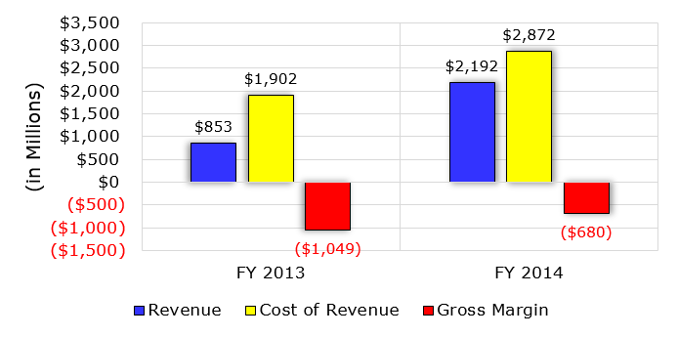
5.2 Microsoft’s response to the mobile boom (8)
Early financial performance of Microsoft’s Surface business [24]

Slide 93
6. Conclusions
Notes:
93

Slide 94
6. Conclusions (1)
6. Conclusions-1
Informatics came into a transitional phase
new paradigms
new devices
new players

Slide 95
6. Conclusions (2)
Conclusions-2
Established companies have to respond early, quick and in an appropriate way
to the new challenges, else…
8/2010 Intel acquires Infineon’s (former Siemens) Wireless Solutions business
8/2011 Google acquires Motorola Mobility
9/2013 Microsoft purchases Nokia’s phone business
9/2013 BlackBerry lays off 4500 employees (~ 40% of their workforce)
1/2014 Lenovo acquires Motorola Mobility from Google
5/2014 NVIDIA states that they will moving out from the smartphone market
6/2014 Broadcom decides to exit the baseband business

Slide 96
6. Conclusions (3)
Conclusions-3
Even the largest IT firms have a hard time to cope with as indicated by
resignation of AMD’s, Intel’s and Microsoft’s CEOs (Chief Execution Officers):
1/2011 AMD: Dirk Meyer
11/2012 Intel: Paul Otellini
8/2013 Microsoft: Steve Ballmer
But it is also an opportunity and challenge for individuals and institutions
to catch up with the progress and make benefit of it.

Slide 97
7. References
Notes:
97

Slide 98
7. References (1)
7. References
[1]: Bártfai D., Merre felé tartanak a hardverek?, Aug. 22-24 2007
[2]: Smith S.L., Intel Strategy & Technology Update, Barclays Capital Global Technology Conf.,
Dec. 2011, http://files.shareholder.com/downloads/INTC/1576180143x0x526852/c9868a3a-
494e-4506-bcc6-a631aca1fd75/Steve%20Smith%20Barclays%20Dec%202011.pdf
[3]: AMD 2013 Mobility APU Introduction, May 22 2013,
http://www.slideshare.net/AMD/amd-2013-mobility-apu-introduction-deck-final-for-lp
[4]: Frommer D., CHART OF THE DAY: Smartphone Sales To Beat PC Sales By 2011,
Business Insider, Aug. 21 2009, http://www.businessinsider.com/chart-of-the-day-
smartphone-sales-to-beat-pc-sales-by-2011-2009-8
[5]: Wikipedia, BlackBerry Pearl, http://en.wikipedia.org/wiki/BlackBerry_Pearl
[6]: Wikipedia, Android (operating system),
http://en.wikipedia.org/wiki/Android_%28operating_system%29
[7]: Ciufo C.A., Tizen OS for Smartphones – Intel’s Biggest Bet Yet, Jan. 4 2013,
http://eecatalog.com/caciufo/2013/01/04/samsung-hedges-apple-google-bets-with-intels-
html5-based-tizen/
[8]: Introduction of the Next Generation Intel Atom Processor, Oak Trail Z670, 4/2011,
http://newsroom.intel.com/docs/DOC-1976
[9]: Apple Maintains 48 Percent Share of Global Branded Tablet Shipments in Q1 2013,
Strategy Analytics, April 25 2013, Boston,
http://www.strategyanalytics.com/default.aspx?mod=pressreleaseviewer&a0=5351

Slide 99
7. References (2)
[10]: Goto H., ARM Cortex – A Family Architecture, 2010,
http://pc.watch.impress.co.jp/video/pcw/docs/423/409/p1.pdf
[11]: Eul H., Bell M., Mobile at Intel, Investor Meeting 2012,
http://www.cnx-software.com/pdf/Intel_2012/2012_Intel_Investor_Meeting_Eul_Bell.pdf
[12]: Wikipedia, iPad, http://en.wikipedia.org/wiki/IPad
[13]: Tablet Platforms with Next Generation Intel Atom Processor and Microsoft Windows 8,
IDF 2012
[14]: The $15.3 Billion Server Market – Surprisingly Buoyant In Q1 2012, IT Candor, July 3 2012,
http://www.itcandor.com/server-q112/
[15]: Shah A., Intel Loses Laptop Chip Market Share to AMD in Q3, PC World, Nov. 3 2011,
http://www.pcworld.com/article/243114/intel_loses_laptop_chip_market_share_to_amd_
in_q3.html
[16]: Perry D., AMD Steals Market Share From Intel, Tom’s Hardware, March 16 2012,
http://www.tomshardware.com/news/amd-intel-cpu-processor,15041.html
[17]: Shilov A., AMD Shows Off Opteron "Interlagos" Again: No Performance Benchmarks,
No Design Wins, No Launch Date Announced, Xbit Labs, Aug. 3 2011,
http://www.xbitlabs.com/news/cpu/display/20110803103016_AMD_Shows_Off_Opteron_
Interlagos_Again_No_Performance_Benchmarks_No_Design_Wins_No_Launch_Date_
Announced.html
[18]: Arthur C., PC business still waning as Microsoft's Windows 8 fails to lift it, 11 July 2013,
http://www.theguardian.com/technology/2013/jul/11/pc-business-microsoft-windows-8

Slide 100
7. References (3)
[19]: Golson J., Steve Jobs Envisioned the iPad in 1983, MacRumors, Oct. 2, 2012,
http://www.macrumors.com/2012/10/02/steve-jobs-envisioned-the-ipad-in-1983/
[20]: Yarow J., Steve Ballmer's Biggest Mistakes As CEO Of Microsoft, Business Insider, Aug. 27
2013,
http://www.businessinsider.com/steve-ballmers-most-epic-mistakes-as-ceo-of-microsoft-
2013-8?op=1
[21]: Arora, P., Microsoft Is Not Killing The Surface RT Lineup? Seeking Alpha, Aug. 25 2014,
http://www.macrumors.com/2012/10/02/steve-jobs-envisioned-the-ipad-in-1983/
[22]: Surface Pro 3 Fact sheet May 2014, Microsoft,
http://www.microsoft.com/global/eu/PublishingImages/Surfacepro3texhspecs.pdf
[23]: Microsoft Surface Pro, NDTV Gadget, May 2014,
http://gadgets.ndtv.com/microsoft-surface-pro-3-1611
[24]: Guenette S., Nearly $2 Billion In The Hole, Microsoft Continues To Dive Deeper Into Tablets,
Seeking Alpha, Aug. 8, 2014,
http://seekingalpha.com/article/2402725-nearly-2-billion-in-the-hole-microsoft-continues
-to-dive-deeper-into-tablets
[25]: Deskovich V., Microsoft: A Monopoly No More? Seeking Alpha, Jul. 11, 2014
http://seekingalpha.com/article/2309835-microsoft-a-monopoly-no-more
[26]: Gill R., Intel’s Core i5-655K & Core i7-875K: Overclocked and Analyzed, AnandTech,
May 28 2010, http://www.anandtech.com/show/3742/intels-core-i5655k-core-i7875k-
overclocked-and-analysed-/2
[27]: Shimpi A. L., AMD Beema/Mullins Architecture & Performance Preview, AnandTech,
April 29, 2014, http://www.anandtech.com/show/7974/amd-beema-mullins-architecture-
a10-micro-6700t-performance-preview

Slide 101
7. References (4)
[28]: Wilson S., & Wigginton C., Making open innovation work in mobile - Insights from the
semiconductor industry, Deloitte University Press, July 24v2013,
http://dupress.com/articles/making-open-innovation-work-in-mobile/
[30]: Arora P., Wait, Microsoft Is Not Killing The Surface RT Lineup? Seeking Alpha, Aug. 25, 2014,
http://seekingalpha.com/article/2447735-wait-microsoft-is-not-killing-the-surface-rt-lineup
[31]: Hodgins K., Apple Maintains Narrowing Lead in Tablet Market Share, MacRumors, May 1,
http://www.macrumors.com/2014/05/01/apple-tablet-market-share-1q14
[32]: Arora P., Wait, Microsoft Is Not Killing The Surface RT Lineup? Seeking Alpha, Aug. 25, 2014,
http://seekingalpha.com/article/2447735-wait-microsoft-is-not-killing-the-surface-rt-lineup
[33]: Eul H., & Bell M., Mobile at Intel, Investor Meeting 2012, Intel,
http://www.cnx-software.com/pdf/Intel_2012/2012_Intel_Investor_Meeting_Eul_Bell.pdf
[34]: Qualcomm dominates smartphone chip and baseband, tablet processor markets, Mobile
Europe, February 17 2014
http://www.mobileeurope.co.uk/Press-Wire/qualcomm-dominates-smartphone-chip-and
-baseband-tablet-processor-markets
[35]: Gartner Says Worldwide Tablet Sales Grew 68 Percent in 2013, With Android Capturing 62
Percent of the Market, Gartner, Newsroom, March 3, 2014,
http://www.gartner.com/newsroom/id/2674215
[36]: Trefis Team, Why Intel Can Gain Additional Share In The Mobile Market, Forbes, 5/09/2014
http://www.forbes.com/sites/greatspeculations/2014/05/09/why-intel-can-gain-additional-
share-in-the-mobile-market

Slide 102
7. References (5)
[37]: Meeker M., Devitt S., Vu L., Internet Trends, CM Summit, Morgan Stanley, New York,
June 7, 2010, http://demo.tizra.com/Morgan-Stanley-Internet-Trends-June-7-2010/3
[38]: Hardy E., BlackBerry Pearl 8100 Review, Brighthand, November 15 2006,
http://www.brighthand.com/phonereview/blackberry-pearl-8100-review/
[39]: Nokia 7650, Wikipedia, http://en.wikipedia.org/wiki/Nokia_7650
[40]: Bokil-Paranjape S., Worldwide smartphone sales hit 267 million in Q1 2014: Trend Force,
Phonearena, April 18 2014, http://www.fonearena.com/blog/101450/worldwide-
smartphone-sales-hit-267-million-in-q1-2014-trend-force.html
[41]: Grifiths H., How the ubiquity of today’s smartphones make an ideal platform for delivering
campus-based services, Ombiel, 2010,
http://www.rms-inc.com/files/datasheets/Ombiel_Whitepaper.pdf
[42]: Richter F., Android To Retain Big Lead In Maturing Smartphone Market, Statista, March 4
2014, http://www.statista.com/chart/1961/smartphone-market-share-2014
[43]: Smartphone Apps Processor Revenue Reached $4.7 Billion in Q1 2014 says Strategy
Analytics, Strategy Analytics, July 14 2014,
http://www.strategyanalytics.com/default.aspx?mod=pressreleaseviewer&a0=5543
[44]: Klug B. & Shimpi A. L., Qualcomm's New Snapdragon S4: MSM8960 & Krait Architecture
Explored, AnandTech, Oct. 7 2011, http://www.anandtech.com/show/4940/qualcomm-
new-snapdragon-s4-msm8960-krait-architecture
[45]: Lomas N., Report: Intel Gained Just 0.2% Of Smartphone Chip Market In 1H As Qualcomm
Milked LTE Lead, Tech Crunch, Oct. 5 2012, http://techcrunch.com/2012/10/05/report-
intel-gained-just-0-2-of-smartphone-chip-market-in-1h-as-qualcomm-milked-lte-lead

Slide 103
7. References (6)
[46]: Klug B., Intel XMM7160 LTE Modem Demonstrated on Live Network, AnandTech, Sept. 11
2013, http://www.anandtech.com/show/7321/intel-xmm7160-lte-modem-demonstrated-
on-live-network
[47]: Bocha, Apple iPhone megateszt, Mobilarena, 2007-07-23,
http://mobilarena.hu/teszt/apple_iphone_megateszt_a_bunbeeses_almaja/bevezeto.html
[48]: Shimpi A.L., Apple's Cyclone Microarchitecture Detailed, AnandTech, March 31 2014,
http://www.anandtech.com/show/7910/apples-cyclone-microarchitecture-detailed
[49]: Dilger D.E., Apple's new A8X powered iPad Air 2 smokes new Android tablets, including
Nvidia's Tegra K1 Shield Tablet [u], Apple Insider, Oct. 21 2014,
http://appleinsider.com/articles/14/10/21/apples-new-a8x-powered-ipad-air-2-smokes-
new-android-tablets-including-nvidias-tegra-k1
[50]: Dilger D.E., Apple Inc. A8X iPad chip causing big problems for Intel, Qualcomm, Samsung
and Nvidia, Apple Insider, Nov. 14 2014,
http://appleinsider.com/articles/14/11/15/apple-inc-a8x-ipad-chip-causing-big-problems-
for-intel-qualcomm-samsung-and-nvidia
[51]: De Gelas J., The Intel Xeon E7-8800 v3 Review: The POWER8 Killer?, AnandTech,
May 8, 2015, http://www.anandtech.com/show/9193/the-xeon-e78800-v3-review
[52]: Global PC shipments from 1st quarter 2009 to 2nd quarter 2015, by vendor (in million units),
Statista, http://www.statista.com/statistics/263393/global-pc-shipments-since-1st-
quarter-2009-by-vendor/

Slide 104
7. References (7)
[53]: Gartner Says Worldwide Smartphone Sales Recorded Slowest Growth Rate Since 2013,
Gartner, Newsroom, Aug. 20 2015, http://www.gartner.com/newsroom/id/3115517
[54]: Leswing K., Asus Zenfone 2 Preview: Intel's Best Chance In Years To Break Into
Smartphones, International Business Time, May 19 2015,
http://www.ibtimes.com/asus-zenfone-2-preview-intels-best-chance-years-break-
smartphones-1929726
[55]: Richter F., Tablets to Outsell PCs Worldwide by 2015, Statista, Febr. 28 2014,
http://www.statista.com/chart/1138/tablet-and-pc-shipment-forecast/
[56]: Dilger D. E., After losing Apple's iPad business, Intel has bled $7 billion while heavily
subsidizing cheap x86 Atom Android tablets, Appleinsider, November 16, 2014,
http://appleinsider.com/articles/14/11/16/after-losing-apples-ipad-business-intel-has-
bled-7-billion-while-heavily-subsidizing-cheap-x86-atom-android-tablets
[57]: Smartphone and tablet processor market share in 2014, May 7 2015
http://mobilesemi.blogspot.hu/2015/05/smartphone-and-tablet-processor-market.html
[58]: Cutress I., The Intel Skylake Mobile and Desktop Launch, with Architecture Analysis,
AnandTech, Sept. 1 2015, http://www.anandtech.com/show/9582/intel-skylake-mobile-
desktop-launch-architecture-analysis
[59]: Klug B., The State of Qualcomm's Modems - WTR1605 and MDM9x25, AnandTech,
Jan. 4 2013, http://www.anandtech.com/print/6541/the-state-of-qualcomms-modems-
wtr1605-and-mdm9x25
[60]: iPhone 6 Plus Teardown, iFixit,
https://www.ifixit.com/Teardown/iPhone+6+Plus+Teardown/29206

Slide 105
7. References (8)
[61]: Ho J., Qualcomm Details Hexagon 680 DSP in Snapdragon 820: Accelerated Imaging,
AnandTech, August 24, 2015, http://www.anandtech.com/print/9552/qualcomm-details-
hexagon-680-dsp-in-snapdragon-820-accelerated-imaging
[62]: QSC6055/QSC6065/QSC6075/QSC6085 Hardware Training, Introductions and Device
Overview, 80-VC881-21 Rev. A, April 2007,
http://www.droid-developers.org/images/3/3c/Qsc6085-overview.pdf
[63]: James D., Inside Today’s Systems & Chips: A Survey of the Past Year, Chipworks, 2013,
http://theconfab.com/wp-content/uploads/2014/dick_james_confab14.pdf
[64]: Global unit sales of current generation video game consoles from 2008 to 2014 (in million
units), Statista, http://www.statista.com/statistics/276768/global-unit-sales-of-video-
game-consoles/
[65]: Shimpi a. L., Qualcomm's Snapdragon 808/810: 20nm High-End 64-bit SoCs with LTE
Category 6/7 Support in 2015, AnandTech, April 7, 2014,
http://www.anandtech.com/show/7925/qualcomms-snapdragon-808810-20nm-highend-
64bit-socs-with-lte-category-67-support-in-2015
[66]: Frumusanu A. & Smith R., ARM A53/A57/T760 investigated - Samsung Galaxy Note 4
Exynos Review, AnandTech, February 10, 2015,
http://www.anandtech.com/print/8718/the-samsung-galaxy-note-4-exynos-review

