Slide 1
The world market of processors
Dezső Sima
Vers. 1.0
September 2015

Slide 2
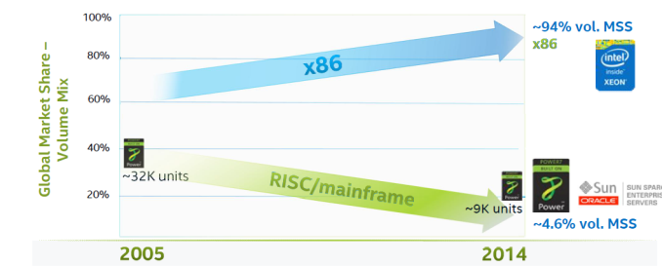
3. The processor war induced by the mobile boom (2)
Market share of x86 and RISC 4S/4S+ servers [16]
Source: IDC World Wide Server Tracker Q4’14
MSS: Market Segment Share

Slide 3
3. The processor war induced by the mobile boom (3)
Market share of Intel and AMD in desktops and traditional notebooks
Both in the desktop and notebook segments
Intel’s market share is ≈ 80 %, whereas
AMD’s share remains about 20 % [17], [18].

Slide 4
3. The processor war induced by the mobile boom (4)
Worldwide market share of application processors used in smartphones and
tablets in 2014 (based on revenue) [5]
Smartphone application processors worldwide market share 2014 (revenue) [5]
Qualcomm (USA) | 52 %
Apple (USA) | 18 %
MediaTek (Taiwan) | 14 %
Spreadtrum (China)
Samsung (S. Korea)
Tablet application processors worldwide market share 2014 (revenue) [5]
Apple (USA) | 27 %
Intel (USA) | 19 %
Qualcomm (USA) | 16 %
MediaTek (Taiwan)
Samsung (S. Korea)

Slide 5
3. The processor war induced by the mobile boom (5)
Mostly used CPU processors in smartphones and tablets (2014) [6]
Vendor | Processor line | Core | ISA
Qualcomm (USA) | Snapdragon 200-800 | Qualcomm designed Krait cores ARM Cortex A line | ARMv7 ARMv7/v8
Apple (USA) | Apple A6 Apple A7 | ARM Cortex A8 Apple designed Cyclone core | ARMv7 ARMv8
MediaTek (Taiwan) | MT6595 MT67xx | 4xARM Cortex A7/ 4xA17 (ARM big.LITTLE) 4xARM Cortex A53/4x A57 (ARM big.LITTLE) | ARMv7 ARMv8
Samsung (S. Korea) | Exynos | ARM Cortex A line | ARMv7
Spreadtrum (China) | SC77xx/88xx | ARM Cortex A5/A7 | ARMv7

Slide 6
3. The processor war induced by the mobile boom (6)
Morganfield
(2015?)
Intel’s Atom platforms targeting smartphones
(based on [11])
Moorefield
(2014)
Merrifield
(2014)
Performance (not to scale)
Clover Trail+
(2013)
Z5xxx
4xGoldmont
14 nm
+XMM 7360
Medfield
(2012)
Z35xx
4xSilvermont
22 nm
+XMM 7260/2/3
Morestown
(2010)
Z34x0
2xSilvermont
22 nm
+XMM 7160/7260
Z2580-2520
2xSaltwell
32 nm
+XMM 6268/6360/7160
Riverton
(2015)
Z2480/2460
1xSaltwell
32 nm
+XMM 6260
Binghampton
(2016)
Slayton
(2014)
Z6xx
1xBonnell
45 nm
+Wireless
module
Lexington
(2013)
Zxxxx
2xAirmont
14 nm
+?
Z3xxx
2xSilvermont
22 nm
+A-GOLD 620
Zxxx
2xAirmont
14 nm
+?
Z2420
1xSaltwell
32 nm
+XMM 6265

Slide 7
3. The processor war induced by the mobile boom (7)
Willow Trail
(2015?)
Intel’s platforms targeting tablets
(based on [11])
Cherry Trail
(2015)
Bay Trail
(2013)
Performance (not to scale)
Clover Trail
(2012)
Z5xxx
4xGoldmont
14 nm
+XMM 7360
W/A
Oak Trail
(2011)
Z4xxx
4xAirmont
14 nm
+XMM 7160/7260
W/A
Menlow
(2008)
Z37x0
4xSilvermont
22 nm
+XMM 6260/7160
W/A
Atom X3
(Sophia LTE)
(2015)
Z2760
2xSaltwell
32 nm
+XMM 6260
W
Atom X3
(Sophia 3G)
(2015)
Z670/650
1xBonnell
45 nm
+ no XMM
W/MeeGo/A
Z5xx
1xBonnell
45 nm
+ no XMM
W/Moblin
C3400
4xAirmont
28 nm
integrated LTE
modem
C3000
2xSilvermont
28 nm
integrated 3G
modem

Slide 8
3. The processor war induced by the mobile boom (8)
Intel’s effort to optimize their devices from the software point of view
In their 2012 Investor meeting (5/2012) Intel revealed that more than 3000
engineers are working on OS support, among them about 1200 engineers
are dedicated to Android, as indicated below [11].

Slide 9
3. The processor war induced by the mobile boom (9)
Intel’s share in smartphone application processors [19]
Despite great efforts Intel could not yet become one of the 5 largest suppliers
of smartphone application processors.
According to industry sources in 2014 Intel achieved less than 1 % share in revenue
in smartphone application processors.

Slide 10
3. The processor war induced by the mobile boom (10)
Intel’s share in tablet application processors [8], [9], [20]
Intel’s subsidies for OEMs
Over the past four years Intel pays significant subsidies (~ 50 $/tablet) to
netbook and tablet manufacturers to switch from ARM based processors to
x86 Atom processors.
Results
In 2014 Intel achieved the 2. place in the worldwide market share in
tablet application processors (regarding revenues).
In two years Intel mobile division has lost 7 billion $.
According to industry sources for 2015 Intel will stop paying subsidies for OEMs.

