Slide 1
ARM’s processor lines
Dezső Sima
November 2015
(v1.1)
© Dezső Sima 2015

Slide 2
ARM’s processor lines
1. Evolution of ARM
2. Evolution of the ARM ISA
3. Approaches to circuit design
4. Overview of ARM’s processor families
5. Overview of ARM’s Cortex-A series
6. Overview of ARM’s Mali graphics series
7. ARM’s 64-bit Cortex-A series
8. References
Notes:
2

Slide 3
1. Evolution of ARM

Slide 4
1. Evolution of ARM (1)
1. Evolution of ARM
ARM (ARM Holdings plc) is a British multinational semiconductor company with
its head office in Cambridge.
The company designs and licenses low power embedded and mobile ARM
processors as well as mobile GPUs (termed as Mali GPUs) along with the
appropriate design tools but does not fabricate semiconductors.
ARM designs dominate recently the embedded and the mobile market
(including smartphones and tablets).
As of 2014 more than 50 billion ARM based processors have been produced
in total, up from 10 billion in 2008 [59], [19], as indicated in the next Figure.
plc: public limited company (a.m. kft)

Slide 5
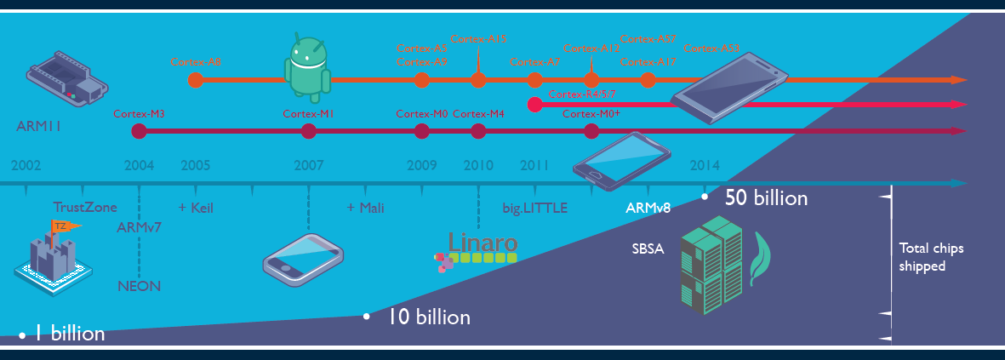
1. Evolution of ARM (2)
Total number of ARM based chips shipped [19]
Keil: Software development tool for embedded processors
Linaro: Nonprofit company, established by ARM, Freescale, IBM, Samsung, ST-Ericsson and TI
to support open source software developers using Linux on SoCs.
SBSA: Server Base System Architecture, a standardized server platform for 64-bit ARM processors.

Slide 6
1. Evolution of ARM (3)
ARM’s approach for taking part in the processor business
There are
semiconductor foundries without own processor designs, like TSMC,
Global Foundries
chipmakers with own foundries, like Intel, Samsung
chipmakers without own foundries, like Apple, IBM, AMD, MediaTek,
Qualcomm
a processor IP designing and licensing firm: ARM.
Chipmakers of mobile application processors (except Intel and AMD who use
x86 ISA) typically license the ARM ISA and develop their processors partly
in-house and partly based on ARM IP.
E.g. Apple developed their first application processors based on ARM IP
(the Cortex-A8/A9 cores), later theiy designed their processor cores in-house
(like the Swift or Cyclone cores).
ARM posesses the license of the ARM ISA and develops tools for designing
and manufacturing ARM ISA based processors and licenses these for a large
number of chipmakers for smartphone application processors.

Slide 7
1. Evolution of ARM (4)
Historical remarks [60], [61] -1
ARM’s parent company is Acorn Computers (UK).
Acorn Computers started their Acorn RISC Machine project in October 1983
(two years after the introduction of the IBM PC) to develop an own powerful
processor for a line of business computers.
The acronym ARM was coined originally at this time (1983) from the designation
Acorn RISC Machine.
In 1990 the company Advanced RISC Machines Ltd. (ARM Ltd.) was founded as a
joint venture of Acorn Computers, Apple Computers and VLSI Technology.
Accordingly, also the interpretation of ARM was changed to “Advanced RISC
Machines”.

Slide 8
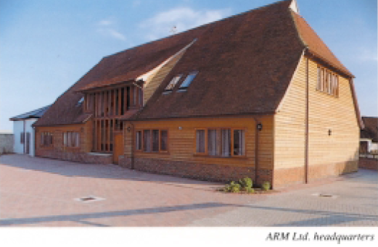
1. Evolution of ARM (5)
Historical remarks -2
Figure: The headquarters of ARM Ltd. about 1990 [62]

Slide 9
1. Evolution of ARM (6)
Historical remarks -3
Finally, in 1998 the company went to the stock exchange and its name was changed
to ARM Holdings plc, to its current designation.

Slide 10
1. Evolution of ARM (7)
Historical remarks -4
Figure: ARM's recent headquarters in Cambridge (UK) [78]

Slide 11
2. Evolution of the ARM ISA
2.1 Overview
2.2 ISA extensions introduced to enhance compute capabilities
2.3 ISA extensions introduced to reduce the code size
2.4 ISA extensions introduced to enhance security
(Only Sections 2.1 and 2.2.3 care discussed)

Slide 12
2.1 Overview

Slide 13
2.1 Overview (1)
2.1 Overview
There are 8 ARM ISA versions, designated as ARMv1 to ARMv8.
These are described in the related Architecture Reference Manuals.
The earliest versions (ARMv1 and ARMv2) provided an address range of only
26 bits, the first ISA version with 32 bit address range was the ARMv3.
Accordingly, we consider the ISA version ARMv3 as ARM’s basic ISA and discuss
its evolution subsequently.

Slide 14
2.1 Overview (2)
Key features of ARM’s basic ISA
It is a 32-bit RISC ISA capable to process basically 32-bit FX or logical data.
The ISA has 16 32-bit registers, called the core registers.
13 out of them are used as general purpose registers (GPRs), the remaining three
are dedicated registers, as shown below.
Stack pointer
Link register
PC
Figure: The core registers of the ARM ISA (in the ISA versions ARMv3-ARMv7) [63]

Slide 15
2.1 Overview (3)
Main extensions introduced to ARM’s basic ISA (simplified) -1
ARM’s ISA extensions
ISA extensions to
enhance compute capabilities
ISA extensions to reduce code size or
the execution speed
of Java bytecode
ISA extensions to enhance security

Slide 16
2.1 Overview (4)
Main extensions introduced to ARM’s basic ISA (simplified) -2 (Based on [64])
AArch32
AArch64
Crypto-graphy ext.
Crypto-graphy ext.
Security
TrustZone
SIMD
Adv. SIMD
(NEON¹)
Computing
Key feature ARMv7-A
compatibility
VFPv1/2
VFPv3/v4
Code size or
execution
speed of
Java
bytecode
Jazelle
Jazelle
(ex. by SW)
ThumbEE
(Jazelle-RCT)
Thumb
(ARMv4T)
Thumb-2
(ARMv6T2)
ARMv4
ARMv5
ARMv6
ARMv7-A/R
ARMv8-A
Examples
ARM710T
(~1995)
ARM926
(2001)
ARM1176
(2004)
Cortex-A5-15
(2006)
Cortex-A50
(2014)
¹The Advanced SIMD architecture extension is commonly referred to as the NEON technology.

Slide 17
2.2 ISA extensions introduced to enhance compute capabilities

Slide 18
2.2.1 Overview (1)
2.2 ISA extensions introduced to enhance compute capabilities -1
2.2.1 Overview
ARM’s ISA extensions
ISA extensions introduced
to enhance compute capabilities
ISA extensions introduced
to reduce code size or
the execution speed
of Java bytecode
ISA extensions introduced
to enhance security

Slide 19
2.2.1 Overview (2)
ISA extensions introduced to enhance the compute capabilities -2
(Based on [64])
AArch32
AArch64
Crypto-graphy ext.
Crypto-graphy ext.
TrustZone
SIMD
Adv. SIMD
(NEON¹)
Key feature ARMv7-A
compatibility
VFPv1/2
VFPv3/v4
Jazelle
Jazelle
(ex. by SW)
ThumbEE
(Jazelle-RCT)
Thumb
(ARMv4T)
Thumb-2
(ARMv6T2)
ARMv4
ARMv5
ARMv6
ARMv7-A/R
ARMv8-A
Examples
ARM710T
(~1995)
ARM926
(2001)
ARM1176
(2004)
Cortex-A5-15
(2006)
Cortex-A50
(2014)
¹The Advanced SIMD architecture extension is commonly referred to as the NEON technology.

Slide 20
2.2.1 Overview (3)
ISA extensions introduced to enhance the compute capabilities -3
As far as the extension for enhancing the compute capabilities are concerned we
have to take into account two distinct register sets;
the basic GPR register set and
the FP and advanced SIMD register set (since ARMv5).
In line with this, the compute oriented ISA extensions may be discussed
in two groups according to which instruction set is referred to by a specific
extension, as shown below.
ISA extensions introduced
to enhance compute capabilities
GPR-based
ISA extensions
FP and Advanced SIMD registers based
ISA extensions
SIMD extension
VFP (Vector Floating Point) extensions
The Advanced SIMD (NEON) SIMD) extension
Extensions of the ARMv8 ISA

Slide 21
2.2.1 Overview (4)
Overview of ISA extensions introduced to enhance compute capabilities
ARM ISA |  | Basic arch. |  | Name of the extensions |  | GPR-based extension | FP/SIMD register based extension
 |  | GPRs | Data type |  |  |  | FP/adv. SIMD reg. set | Scalar data types | Vector data types
Name | Year
ARMv1 | 1986 | n.a. | FX32
ARMv2 | 1989 | n.a.
ARMv3 | 1991 | 13x32
ARMv4 | 1996
ARMv5 | 2000 2001 |  |  | VFP(v1)¹ |  |  | 32x32/16x64 | FP32/64 | Serially executed
 |  |  |  | VFP2¹
ARMv6 | 2004 |  |  | SIMD |  | 32-bit w. FX8/16
ARMv7 | 2006 |  |  | VFPv3² |  |  | 32x64/32x32 or 16x64/32x32 | +FP 16⁴ | Serially executed
 |  |  |  | VFPv4² |  |  |  | + FMA
 |  |  |  | Adv. SIMD (NEON)³ |  |  | 32x64/16x128 | FX8/16/32/ 64 FP16³/32/64 | 64/128-bit wide FX 8/16/32/64, FP16³/32 +FMA³
ARMv8 | 2014 | 31x64 | FX32/64 | A32 | FP |  | 32x64/32x32 | FP32/64
 |  |  |  |  | Adv. SIMD |  | 32x64/16x128 |  | As for ARMv7
 |  |  |  | A64 | FP |  | 32x128 | FP 32/64
 |  |  |  |  | Adv. SIMD |  |  | FX 8/…/64 FP 32/64 | As for ARMv7 + FP 64
w: wide

Slide 22
2.2.1 Overview (5)
Remarks
¹VFPv2 vs. VFP(v1)
VFpv2 adds some instructon set enhancements and modifications to VFPv1
²VFPv3/v4 register space
Some processors implement 32 64-wide registers, with the option of using these
registers as 32 32-wide registers.
Other implementations provide only 16 64-bit wide registers with the option to use
the register space as 32x32-wide registers.
³Along with the Advanced SIMD (NEON) extension FP16 and FMA are supported
only in the Advanced SIMDv2 alternative.
FP16 supports only data conversion between FP16 and FP32
⁴FP16 supports only data conversion between FP16 and FP32

Slide 23
2.2.2 GPR-based ISA extensions (1)
2.2.2 GPR-based ISA extensions
ISA extensions introduced
to enhance compute capabilities
GPR-based
ISA extensions
FP and Advanced SIMD registers based
ISA extensions
SIMD extension
VFP (Vector Floating Point) extensions
The Advanced SIMD (NEON) extension
Extensions of the ARMv8 ISA

Slide 24
2.2.2 GPR-based ISA extensions (2)
The SIMD extension (introduced in the ARMv6)
It is based on the 13 32-bit wide GPR register set and provides instructons to be
performed on 4xFX8 or 2xFX16 data in parallel.
It is similar to Intel’ s MMX x86 ISA extension from 1997.
The SIMD extensions as introduced into the ISA version ARMv6 have only a
modest performance boosting potential and became obsolete by the
advanced SIMD (NEON) extension of the next ISA version.

Slide 25
2.2.3 FP and Advanced SIMD registers based ISA extensions (1)
2.2.3 FP and Advanced SIMD registers based ISA extensions
ISA extensions introduced
to enhance compute capabilities
GPR-based
ISA extensions
FP and Advanced SIMD registers based
ISA extensions
SIMD extension
a) VFP (Vector Floating Point) extensions
b) The Advanced SIMD (NEON) extension
c) Extensions provided by the ARMv8 ISA

Slide 26
2.2.3 FP and Advanced SIMD registers based ISA extensions (2)
a) VFP (Vector Floating Point) ISA extensions
We will discuss the VFP (Vector Floating Point) extensions subsequently in two parts,
in accordance with their introduction in the ARMv5 and ARMv6 ISA versions,
as shown below:
VFP (Vector Floating Point) extensions
VFPv1/VFPv2
VFPv3/VFPv4
Introduced in the ISA version
ARMv5
Introduced in the ISA version
ARMv6

Slide 27
2.2.3 FP and Advanced SIMD registers based ISA extensions (3)
a1) VFP (Vector Floating Point) extensions VFP(v1)/v2 [65] -1
It is a co-processor based extension to speed up scalar and vector FP32/64
operations, introduced along with the ARMv5 ISA version.
This extension is based on the new 32 32-bit wide VFP register file, organized as
four register banks, each including 8 registers, as seen below.
Figure: Register banks of the VFP extensions [65]

Slide 28
2.2.3 FP and Advanced SIMD registers based ISA extensions (4)
VFP (Vector Floating Point) extensions [65] -2
The first bank is used to hold scalar operands whereas to remaining three banks
vector operands.
A vector operand may refer to 2 to 8 registers from the same bank.
The vector length is given in a specific field of a control register.
The register numbers given in the instruction specify the first registers that
contain the first operands and specify the first destination register.
Each successive element of the vector is taken by incrementing appropriately the
register numbers.
The peculiarity of the VFP extension is that the elements of the vector are
processed sequentially rather than parallel as for usual SIMD execution.

Slide 29
2.2.3 FP and Advanced SIMD registers based ISA extensions (5)
Example: Vector operation with 5 elements [65]
In the example the input operands are taken from the registers s10...s14 and
s18...s22, and the result is written into the registers s26...s30.
The execution is sequential (like a hardware implemented subroutine).

Slide 30
2.2.3 FP and Advanced SIMD registers based ISA extensions (6)
a2) The VFPv3/v4 extension
It is an enhancement to the VFPv2 technology.
New features include
doubling the size of the register space to 32x64 bit registers, and
the introduction of instructions that perform conversions between
FX and FP data.

Slide 31
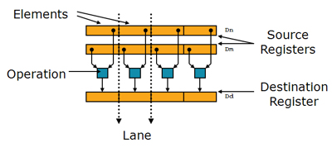
2.2.3 FP and Advanced SIMD registers based ISA extensions (7)
b) The Advanced SIMD (NEON) extension (introduced in the ARMv7 ISA) [11]
It is a 64/128-bit SIMD extension intended to accelerate multimedia and signal
processing algorithms such as video encode/decode, 2D/3D graphics, gaming,
speech or image processing.
NEON extends the 32x32-bit VFP register file to 32x64-bit, called the FP and
advanced SIMD register file, that may be used also as 16 128-bit wide registers,
and is shared with the VFP3/VFP4 extension.
NEON instructions operate on data held in the FP and advanced SIMD registers.
They perform the same operation on the data elements, as shown below.
Figure: SIMD data [11]
NEON instructions operate on 64 or 128-bit packed vectors of signed/unsigned
8-bit, 16-bit, 32-bit or 64-bit FX as well as on FP16 or FP32 data elements.
For FP16 data there are only conversion (FP16-FP32) operations supported.
FP16 data and FMA operations are supported only in the Advanced SIMDv2 option.

Slide 32
2.2.3 FP and Advanced SIMD registers based ISA extensions (8)
c) Extensions provided by the ARMv8 ISA [66]
The ARMv8 ISA version introduces major changes in the ARM architecture while
maintaining a high level of consistency with previous versions of the architecture.
ARMv8 has two distinct execution modes, as indicated below.
Execution modes of the ARMv8
Aarch32
execution mode
Aarch64
execution mode
It supports two 32-bit instruction sets,
the A32 and the T32 (Thumb) instructions sets.
In this mode the processor can run programs
developed for previous ISA versions.
It supports a single 64-bit instruction set,
called A64.
This is a fixed length powerful instruction set
that uses 32-bit instruction encodings.

Slide 33
2.2.3 FP and Advanced SIMD registers based ISA extensions (9)
Extension of the GPRs in the ARMv8 ISA [63], [66]
In the AArch64 mode the ARMv8 ISA version expands the number of GPRs
from 13 32-bit registers to 31 64-bit wide registers, as shown in the next Figure.
32-bit wide
32-bit wide
64-bit wide
R0
R0
R0
R1
R1
R1
R2
R2
R2
.
.
.
.
.
.
.
.
.
X0
W0
R12
R12
R12
R13(SP)
Stack pointer
Link register
PC
R13(SP)
R13(SP)
R14(LR)
R14(LR)
R14(LR)
R15(PC)
.
.
.
.
.
.
X30
W30
X31
Dedicated use
W31
Dedicated use
32-bit mode
64-bit mode
GPRs in the ARMv7 and the AArch32 execution mode of the ARMv8 ISA
GPRs in the AArch64 excution mode
of the ARMv8 ISA

Slide 34
2.2.3 FP and Advanced SIMD registers based ISA extensions (10)
Extension of the FP and advanced SIMD registers in the ARMv8 ISA [66]
In the AArch64 mode the ARMv8 ISA version expands the number of FP and
advanced SIMD registers from 16 (available in the ARMv7 ISA) to 32, as seen below.
128-bit wide
128-bit wide
V0
V0
V1
V1
V2
V2
.
.
.
.
.
.
V3
V12
V12
V13
V13
V14
V14
V15
.
.
.
V30
V31
FP and advanced SIMD registers
in ARMv7 and the AArch32 execution mode of the ARMv8 ISA
FP and advanced SIMD registers
in the AArch64 execution mode of the ARMv8 ISA

Slide 35
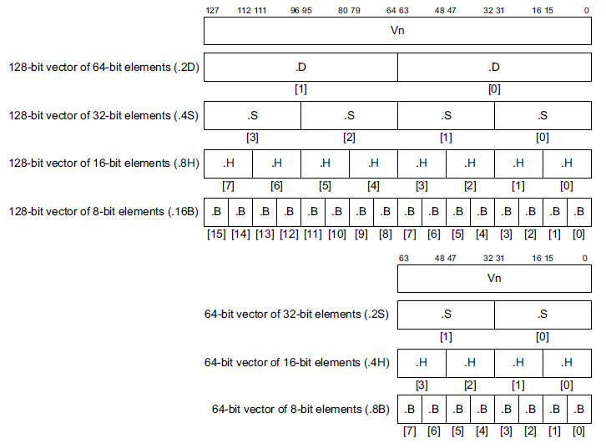
2.2.3 FP and Advanced SIMD registers based ISA extensions (11)
Use of the FP and Advanced SIMD registers in the AArch64 execution mode
[66]
32 128-bit registers
32 64-bit registers

Slide 36
2.3 ISA extensions introduced to reduce code size or
the execution speed of Java bytecode

Slide 37
2.3 ISA extensions introduced to reduce code size (1)
2.3 ISA extensions introduced to reduce code size or the execution speed
of Java bytecode -1
ARM’s ISA extensions
ISA extensions introduced
to enhance compute capabilities
ISA extensions introduced
to reduce code size or
the execution speed
of Java bytecode
ISA extensions introduced
to enhance security
a) The Thumb instruction set
b) Jazelle
c) Thumb EE (Jazelle)

Slide 38
2.3 ISA extensions introduced to reduce code size (2)
ISA extensions introduced to reduce code size -2 (Based on [64])
AArch32
AArch64
Crypto-graphy ext.
Crypto-graphy ext.
TrustZone
SIMD
Adv. SIMD
(NEON¹)
Key feature ARMv7-A
compatibility
VFPv1/2
VFPv3/v4
Jazelle
Jazelle
(ex. by SW)
ThumbEE
(Jazelle-RCT)
Thumb
(ARMv4T)
Thumb-2
(ARMv6T2)
ARMv4
ARMv5
ARMv6
ARMv7-A/R
ARMv8-A
Examples
ARM710T
(~1995)
ARM926
(2001)
ARM1176
(2004)
Cortex-A5-15
(2006)
Cortex-A50
(2014)
¹The Advanced SIMD architecture extension is commonly referred to as the NEON technology.

Slide 39
2.3 ISA extensions introduced to reduce code size (3)
a) The Thumb instruction set
This is an alternative instruction set that provides better code density.
It has been introduced in the ARMv4 ISA.
Processors with the T suffix provide beyond the default 32-bit ARM also the
16-bit Thumb instruction set.
Every Thumb instruction is encoded in 16-bits.
The Thumb instruction set is a subset of the ARM instruction set.
In the Thumb instructon set there are only 8 GPRs available for the programmer,
as shown in the next Figure.

Slide 40
2.3 ISA extensions introduced to reduce code size (4)
Available GPR register sets in the ARM and the Thumb ISA [63]

Slide 41
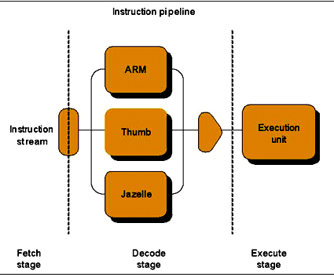
2.3 ISA extensions introduced to reduce code size (5)
b) Jazelle
It is ARM’s third ISA option, introduced in the ARMv5 ISA, as indicated below.
Figure: The Jazelle ISA extension as ARM’s third ISA alternative [67]
It aims at accelerating the execution of Java bytecode.

Slide 42
2.3 ISA extensions introduced to reduce code size (6)
c) ThumbEE (Jazelle RCT)
ThumbEE (JazelleRCT) is a Thumb like instruction set to efficiently execute
bytecode for a virtual machine, like the Java Virtual Machine (JVM).
It is benefitial e.g. for just-in-time compilation from a portable bytecode in
Java execution environment as the compiled binary will have smaller code size
than the code compiled for the ARM or the Thumb 2 instruction set.
Thumb EE was introduced in the ARMv6 ISA.
RCT: Runtime Compilation Target

Slide 43
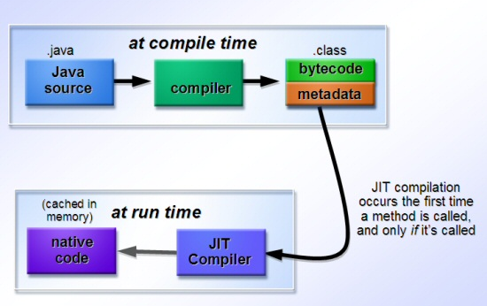
2.3 ISA extensions introduced to reduce code size (7)
Remark: Just-in-time (JIT) compilation in Java environment -1 [73]
Java bytecode is a platform neutral intermediate language.
Java bytecode programs are loaded and run by a Java Virtual Machine (JVM),
also known as a Java Runtime Environment (JRE).
Extensions
Platform neutral
portable bytecode
JVM
ThumbEE ISA
Figure: Just-in-time compilation in Java einvironment [73]

Slide 44
2.3 ISA extensions introduced to reduce code size (8)
Remark: Just-in-time (JIT) compilation in Java environment -2 [73]
The JIT compiler at runtime converts bytecode into native machine code.
JIT compilation occurs when each method is called at the first time, after which
the native code for that method remains cached in memory; this means that
subsequent executions of that method run as fast as native programs.
Extensions
Platform neutral
portable bytecode
JVM
ThumbEE ISA
Figure: Just-in-time compilation in Java einvironment [73]

Slide 45
2.4 ISA extensions introduced to enhance security

Slide 46
2.4 ISA extensions introduced to enhance security (1)
2.4 ISA extensions introduced to enhance security -1
ARM’s ISA extensions
ISA extensions introduced
to enhance compute capabilities
ISA extensions introduced
to reduce code size or
the execution speed
of Java bytecode
ISA extensions introduced
to enhance security
a) The TrustZone extension
b) The Cryptography extension

Slide 47
2.4 ISA extensions introduced to enhance security (2)
ISA extensions introduced to enhance security -2 (Based on [64])
AArch32
AArch64
Crypto-graphy ext.
Crypto-graphy ext.
TrustZone
SIMD
Adv. SIMD
(NEON¹)
Key feature ARMv7-A
compatibility
VFPv1/2
VFPv3/v4
Jazelle
Jazelle
(ex. by SW)
ThumbEE
(Jazelle-RCT)
Thumb
(ARMv4T)
Thumb-2
(ARMv6T2)
ARMv4
ARMv5
ARMv6
ARMv7-A/R
ARMv8-A
Examples
ARM710T
(~1995)
ARM926
(2001)
ARM1176
(2004)
Cortex-A5-15
(2006)
Cortex-A50
(2014)
¹The Advanced SIMD architecture extension is commonly referred to as the NEON technology.

Slide 48
2.4 ISA extensions introduced to enhance security (3)
a) The TrustZone extension [68]
It provides a system-wide protection against possible attacks.
It is achieved by partitioning system wide hardware and software resources so
that they exist in one of two worlds;
in the Secure world for the security subsystem and
the Normal world for everything else.
Hardware logic of the TrustZone ensures that no Secure world resources can be
accessed from the Normal world.
The trustZone extension was introduced as part of the ARMv6 ISA.
For details see e.g. [68].

Slide 49
2.4 ISA extensions introduced to enhance security (4)
b) The Cryptography extension [69]
It adds new instructions to accelerate the execution of cryptographic algorithms,
like
Encryption/decryption according to the Advanced Encryption Standard (AES),
Secure Hash Algorithm (SHA) functions SHA-1, SHA-224, and SHA-256.
It was introduced as part of the ARMv8 ISA.
It is similar to Intel’s AES-NI ISA extension introduced along with the Westmere
basic architecture (2009).

Slide 50
3. Approaches to circuit design
(Not discussed)
Notes:
50

Slide 51
3. Approaches to circuit design (1)
3. Approaches to circuit design
Approaches to circuit design
Full custom design
Semi custom design
Full synthesizable design
Hand layout of the
entire circuit
The design will be subdivided into
functional units and further on into blocks
and the appropriate implementation technique
(hand layout, structured layout or automated layout)
is chosen for each.
Automated layout of the
entire circuit
Power/performance
optimized
Implementation time
optimized

Slide 52
3. Approaches to circuit design (2)
Full custom design approach [1]
It is the traditional way to design circuits, like processors.
It means manual fine tuning the design for optimizing power consumption and or
performance.
Nevertheless, it implies long design times and costs thus most recent designs use
a semi custom or full automated approach.

Slide 53
3. Approaches to circuit design (3)
Semi custom design approach [1]
In this case the design will be subdivided into functional units and further on into
blocks and the appropriate implementation technique (hand layout, structured
layout or automated layout) is chosen for each.

Slide 54
3. Approaches to circuit design (4)
a) Hand layout of blocks [2]
Hand layout is deserved for data paths and queues which are regular structures
that allow a circuit designer to spot the regularity and benefit of which typically
results in a better design than would be achieved by automated layout.
By contrast, the layout of control logic is a very complex task where automated
tools cannot be beaten by custom layout.

Slide 55
3. Approaches to circuit design (5)
b) Structured layout of blocks [1]
The structured approach is typically used for regular structures, like datapaths.
In this approach the blocks will be manually mapped into the gate level and also
the logic gates of the blocks are manually placed to maintain a regular data-flow
within the blocks instead of generating a random gate structure by synthesis.
Nevertheless, the routing of the circuit elements is done automatically.
This approach offers more control over the design than an automated synthesis
approach and leads to a more predictable timing behavior.
On the other hand it yields better performance and less area than traditional
techniques.
Figure: Regular datapath structure [3]

Slide 56
3. Approaches to circuit design (6)
Benefits of the structured layout vs. fully synthesized layout [3]

Slide 57
3. Approaches to circuit design (7)
c) Automated layout of blocks [1]
The layout of control logic is a very complex task where automated tools cannot be
beaten by custom or semicustom layout if time and design cost is of consideration.

Slide 58
3. Approaches to circuit design (8)
Final words about the partition of a semi custom design [1]
The decision which parts should be designed by hand layout and which parts by
semi-custom or automated layout is a design trade-off between performance and
power requirements vs.design time (cost).

Slide 59
3. Approaches to circuit design (9)
Example for a semi custom design: The Cortex-A8 [3]
Figure: Partitioning the Cortex-A8 into blocks implemented by different design
approaches [3]

Slide 60
3. Approaches to circuit design (10)
Fully synthesizable design approach [1]
Recent tools allow already a fully synthesizable design, meaning that there is
no need to go to a hand-layout approach for some critical parts of the design.
Key benefits of a fully synthesizable design
Fully synthesizable designs allow a simple scaling of the design for various
various geometries, e.g. from 28 nm to 16nm.
In addition, such designs shorten the design process and allow licensees
to get to market earlier.
ARM’s first fully synthesizable design was the Cortex-A9 processor
(announced in 2007).
Previous designs, like that for the Cortex-A8, included partly hand layout and
partly automated layout.

Slide 61
3. Approaches to circuit design (11)
Evolution of the approaches used to circuit design [1]
Over time more and more advanced standard cell libraries were developed that
have a large variety of cell types and drive strengths which lessens the need
for custom design.
This is the reason why recently automated design tools are typically used for
processor design.
Approaches to circuit design
Full custom design
Semi custom design
Full synthesizable design
Hand layout of the
entire circuit
The design will be subdivided into
functional units and further on into blocks
and the appropriate implementation technique
(hand layout, structured layout or automated layout)
is chosen for each.
Automated layout of the
entire circuit
Power/performance
optimized
Implementation time
optimized
Trend

Slide 62
4. Overview of ARM’s processor series
4.1 Introduction
4.2 Processors implementing the ARMv1 – ARMv3 ISA
4.3 Processors implementing the ARMv4 – ARMv6 ISA
4.4 Processors implementing the ARMv7 – ARMv8 ISA

Slide 63
4.1 Overview of ARM’s processor series

Slide 64
4.1 Overview of ARM’s processor lines (1)
4.1 Introduction
Subsequently, we give an overview of ARM’s processor series subdivided into three
sections, according their underlying ISAs, as follows.
ARM’s processor series
Processors implementing
the ARMv1 – ARMv3 ISA
Processors implementing the ARMv4 – v6 ISA
Processors implementing
the ARMv7 – ARMv8 ISA
(Early ARM processors)
(Advanced ARM processors)
(ARM’s Cortex processors)
(~ 1985-1994)
(~ 1995-2004)
(Since 2004)
Section 4.2
Section 4.3
Section 4.2

Slide 65
4.2 Processors implementing the ARM v1 - ARM v3 ISA

Slide 66
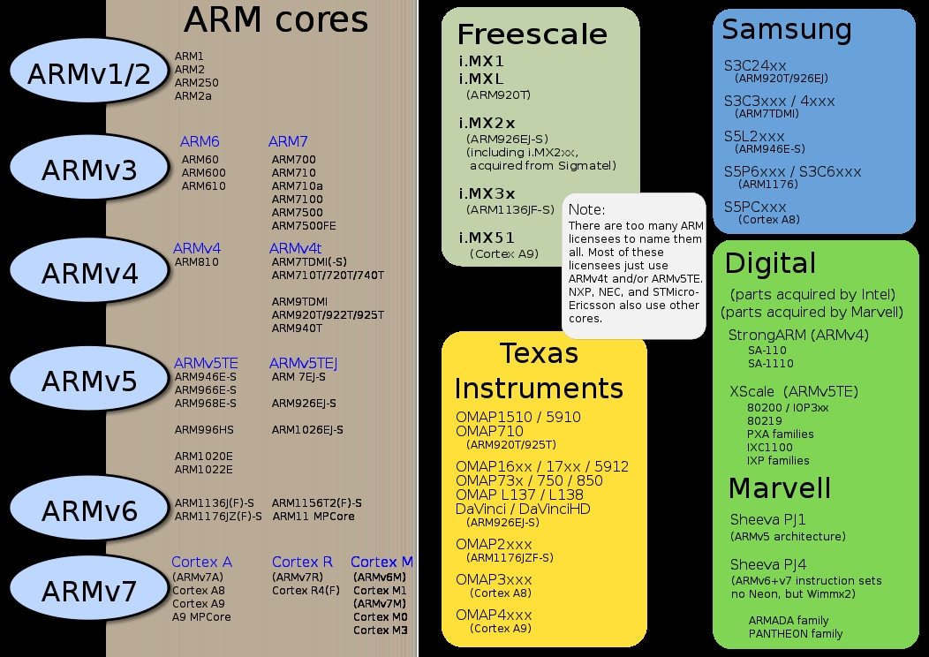
4.2 Processors implementing the ARM v1 - ARM v3 ISA (1)
4.2 Processors implementing the ARMv1 – ARMv3 ISA [5]

Slide 67
4.2 Processors implementing the ARM v1 - ARM v3 ISA (2)
Remarks
As already discussed in Section 2.1
processors based on the ARM ISA versions ARMv1 and ARMv2 (like ARM1,
ARM2 or ARM3) implement only a 26-bit address bus and a 32-bit data bus.
They are called 26-bit architectures.
By contrast, processors based on the ARMv3 or higher ISA version support
already a 32-bit address space and are known as 32-bit architectures
up to the ARMv7 ISA.
In the ARMv8 ISA the AArch64 mode supports already 64-bit addressing.

Slide 68
4.3 Processors implementing the ARM v4 - ARM v6 ISA

Slide 69
4.3 Processors implementing the ARM v4 - ARM v6 ISA (1)
4.3 Processors implementing the ARMv4 – ARMv6 ISA [5]

Slide 70
4.3 Processors implementing the ARM v4 - ARM v6 ISA (2)
Main extensions introduced in the ARMv4 – ARM v6 ISA versions (simplified)
AArch32
AArch64
Crypto-graphy ext.
Crypto-graphy ext.
TrustZone
SIMD
NEON
(Adv. SIMD)
Key feature ARMv7-A
compatibility
VFPv1/2
VFPv3/v4
Jazelle
Jazelle
(ex. by SW)
ThumbEE
(Jazelle-RCT)
Thumb
(ARMv4T)
Thumb-2
(ARMv6T2)
ARMv4
ARMv5
ARMv6
ARMv7-A/R
ARMv8-A
Examples
ARM710T
(~1995)
ARM926
(2001-)
ARM1176
(2004-)
Cortex-A series
(2005-)
Cortex-A50
(2014)
Figure: Enhancements of the ARMv6 ISA

Slide 71
4.3 Processors implementing the ARM v4 - ARM v6 ISA (3)
Overview of ARM’s processors implementing the ARMv4 – ARMv6 ISA [5]
ARM1156T2F-S
ARM1136JF-S™
ARM1136JF-S™
version
ARMv6
ARM1176JZF-S
ARM102xE
ARM1026EJ-S
XScale
ARMv5
ARM9x6E
ARM926EJ-S
ARM7TDMI-S
StrongARM
ARM92xT
SC200
ARMV4
SC100
ARM720T
1994
1996
1998
2000
2002
2006
time
2004
XScale is a trademark of Intel Corporation
Notes:
Versions mostly refer to the instruction set that the ARM core executes.
The ARM7, which is still the most often used core in a low-power design, executes the version 4T instruction set. Architectural extensions were added for version 5TE to include DSP instructions, such as 16-bit signed MLA instructions, saturation arithmetic, etc. The ARM926EJ-S and ARM1026EJ-S cores are examples of Version 5 architectures. Version 6 added instructions for doing byte manipulations and graphics algorithms more efficiently. The ARM11 family implemented the Version 6 architecture. Version 7 architectures (which include the Cortex family of cores, such as the Cortex A8, Cortex M3 and Cortex R4) extended the functionality by adding things such as Thumb2, low-power features, and more security.

Slide 72
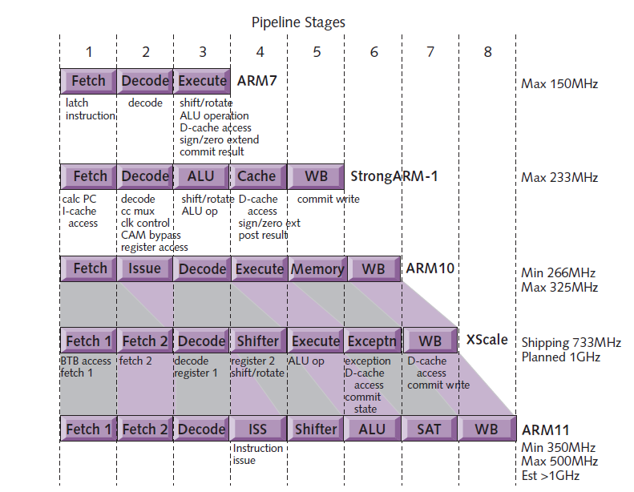
4.3 Processors implementing the ARM v4 - ARM v6 ISA (4)
Evolution of the pipeline length of ARM v4 – ARM v6 based processors [8]
ARMv4
ARMv4
ARMv5
ARMv5
ARMv6

Slide 73
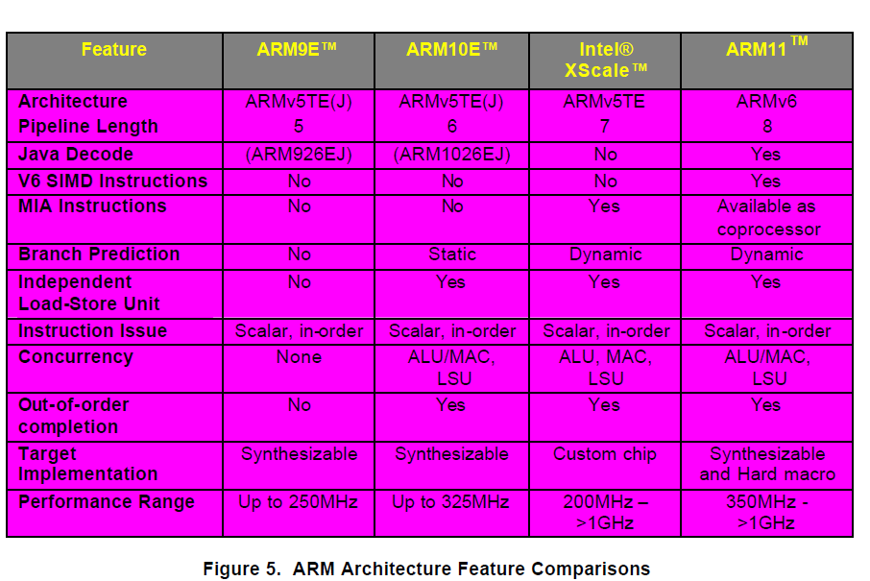
4.3 Processors implementing the ARM v4 - ARM v6 ISA (5)
Main features of the ARMv5 – ARMv6 processors (≈1999-2003) [57]

Slide 74
4.3 Processors implementing the ARM v4 - ARM v6 ISA (6)
Example: The ARM11/ARM11 MPCore processor
It implements the ARMv6 ISA and precedes the ARMv7 based Cortex line.
The evolution of the ARM11 line
10/2001: Disclosure of the ARMv6 ISA specification at the Microprocessor Forum
04/2002: ARM11 launched and details revealed at the Embedded Processor Forum
ARM11 is the first implementation of the ARMv6.

Slide 75
4.3 Processors implementing the ARM v4 - ARM v6 ISA (7)
Key microarchitecture features of the ARM11
It is a single issue in-order processor with three simultaneous operating pipelines
and a pipeline length of 8 stages, as indicated in the next Figure.

Slide 76
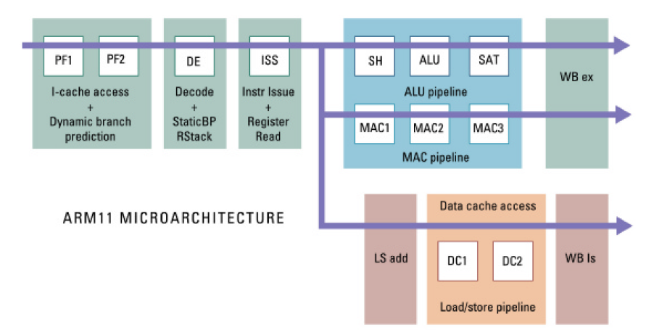
4.3 Processors implementing the ARM v4 - ARM v6 ISA (8)
Pipeline structure of the ARM11 [57]

Slide 77
4.3 Processors implementing the ARM v4 - ARM v6 ISA (9)
The ARM11 MPCore
07/2003: First public disclosure of the ARM11 MPCore.
05/2004: ARM11 MPCore (multi core ARM11 with 1-4 cores) available for licensing
with an evaluation system for early software development.
It is basically an up to four way cache coherent symmetric multicore processor
using a modified MESI protocol.
The ARM11 MPCore incorporates:
IEM (Intelligent Energy Manager)
It dynamically predicts the required performance and lowers
the voltage and frequency accordingly.
We note that issues of cache coherency are discussed in a separate Chapter.

Slide 78
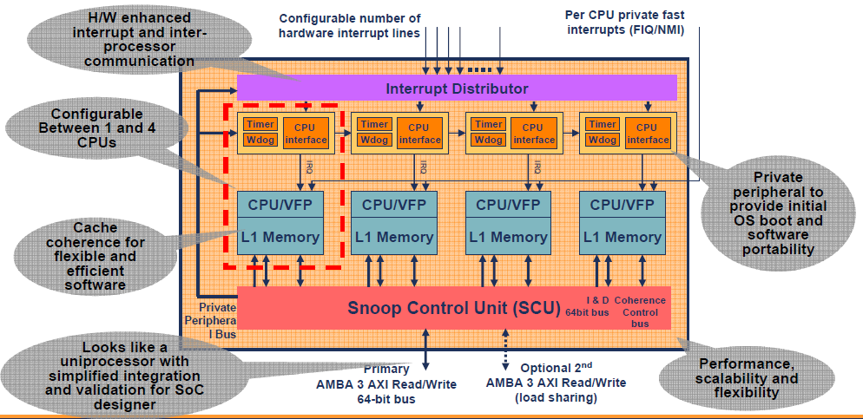
4.3 Processors implementing the ARM v4 - ARM v6 ISA 10)
Block diagram of the ARM11 MPCore [9]
Note that the ARM11 MPCore does not include an L2.

Slide 79
4.3 Processors implementing the ARM v4 - ARM v6 ISA 11)
Remark: Emergence of dual core processors
Year of launching | Dual core design
10/2001 | IBM launches dual core POWER4
11/2002 | IBM launches dual core POWER4+
05/2004 | ARM announces the availability of the synthesisable ARM11 MPCore quad core processor
05/2004 | IBM launches dual core POWER5
08/2004 | AMD demonstrates first x86 dual core (Opteron) processor
04/2005 | ARM demonstrates the ARM11 MPCore quad core test chip in cooperation with NEC
04/2005 | Intel launches dual core Pentium processors (Pentium D)
04/2005 | AMD launches dual core Opteron server processors
06/2006 | Intel launches the dual core Core 2 family
10/2007 | ARM launches their first multicore Cortex model (the quad core Cortex A9 MPcore)

Slide 80
4.4 Processors implementing the ARM v7 - ARM v8 ISA

Slide 81
4.4 Processors implementing the ARM v7 - ARM v8 ISA (1)
4.4 Processors implementing the ARM v7 - ARM v8 ISA
10/2004 ARM introduced the Cortex family based on the ARMv7 ISA.
It remained still a 32-bit architecture.

Slide 82
4.4 Processors implementing the ARM v7 - ARM v8 ISA (2)
Profiles of ARM’s Cortex family [6], [7]
In 3/2005 ARM revealed technical specifications for the ARMv7 ISA and introduced
three family profiles to optimize processors of their Cortex family for specific
market segments:
The Cortex-A profile
It aims at application processors for complex OS and user applications, like
processors in smartphones, tablets, netbooks, eBook readers etc.
The Cortex-R profile
It marks embedded processors for real time applications, like mass storage or printer
controllers.
The Cortex-M profile
Processors of the M profile are optimized for deeply embedded processors aimed at
microcontroller and cost sensitive applications, like automotive body electronics,
or smart sensors.

Slide 83
4.4 Processors implementing the ARM v7 - ARM v8 ISA (3)
Extending the ARM Cortex family with the SecurCore profile in 10/2007
In 10/2007 ARM introduced the SecurCore profile.
It is optimized for smart card and secure applications.

Slide 84
4.4 Processors implementing the ARM v7 - ARM v8 ISA (4)
Recent ARM profiles
and processors [6]

Slide 85
4.4 Processors implementing the ARM v7 - ARM v8 ISA (1)
Introducing the 64-bit ARM v8 ISA and related processors
In 2012 ARM expanded their Cortex family by processors implementing the 64-bit
ARMv8 ISA, as indicate below.
Recent ARM processors
(The Cortex family)
ARM processors implementing the ARMv7 ISA
ARM processors implementing the
ARMv8 ISA
32-bit architectures
(Announced in 2004)
64-bit architectures
(Announced in 2012)

Slide 86
5. Overview of ARM’s Cortex-A series

Slide 87
5. Overview of ARM’s Cortex-A series (1)
5. Overview of ARM’s Cortex-A series
According to the general scope of this Lecture Notes, subsequently we will be
concerned only with the Cortex-A series.
Key features of ARM’s Cortex-A series
Multiprocessor capability
of the Cortex-A series
Performance classes
of the Cortex-A series
Word length
of the Cortex-A series

Slide 88
5. Overview of ARM’s Cortex-A series (2)
Multiprocessor capability of the Cortex-A series
Multiprocessor capability of the Cortex-A series
Single processor designs,
no multiprocessor
capability
Dual designs with two options
A-priory
multiprocessor designs
a single processor option and
a multiprocesor capable option
Cortex-A8 (2005)
Cortex-A9/Cortex-A9 MPCore (2007)
Cortex-A12/Cortex-A12 MPCore (2013)
Cortex-A15/Cortex-A15 MPCore (2010)
Cortex-A17/Cortex-A17 MPCore (2014)
Cortex-A7 MPCore (2011)
Cortex-A35 (2015)
Cortex-A53 (2012)
Cortex-A57 (2012)
Cortex-A72 (2015)
Here we note that in figures or tables we often omit the MPCore tag for the sake
of brevity.

Slide 89
5. Overview of ARM’s Cortex-A series (3)
Remarks on the interpretation of the term MPCore by ARM
ARM introduced the term MPCore in connection with the announcement of the
ARM11 MPCore in 2004 and interpreted it as multicore implementation
(actually including up to 4 cores).
Along with the ARM Cortex-A9 MPCore ARM re-interpreted this term such
that it indicates now the multiprocessor capability of the processor.

Slide 90
5. Overview of ARM’s Cortex-A series (4)
Performance classes of the Cortex-A series -1 [12]
Performance classes of the Cortex-A models
High-performance models
Mainstream models
Low-power models
Cortex-A15
Cortex-A57
Cortex-A72
Cortex-A8
Cortex-A9
(Cortex-A12)
Cortex-A17
Cortex-A5
Cortex-A7
Cortex-A35
Cortex-A53

Slide 91
5. Overview of ARM’s Cortex-A series (5)
Performance classes of the Cortex-A series -2 (based on [12])
7
DMIPS/MHz
2/2015
Cortex-A72
ARMv8
16 nm
6
Announced
10/2012
Cortex-A57
ARMv8
20/16 nm
5
9/2010
Cortex-A15
ARMv7
32/28 nm
2/2014
Cortex-A17
ARMv7
28 nm
4
6/2013
Cortex-A12
ARMv7
20/16 nm
High Performance
3
Mainstream
10/2007
Cortex-A9
ARMv7
40 nm
10/2005
Cortex-A8
ARMv7
65 nm
10/2012
Cortex-A53
ARMv8
20/16 nm
11/2015
Cortex-A35
ARMv8
28 nm
2
10/2011
Cortex-A7
ARMv7
28 nm
10/2009
Cortex-A5
ARMv7
40 nm
1
Low power
2006
2007
2008
2009
2010
2011
2012
2013
2014
2015

Slide 92
5. Overview of ARM’s Cortex-A series (6)
Announcement dates and efficiency (DMIPS/MHz) of the Cortex-A models
Announced | Cortex-A model |  | DMIPS/MHz
10/2005 | Cortex-A8 |  | 2.0
10/2007 | Cortex-A9/A9 MPCore |  | 2.5
10/2009 | Cortex-A5/A5 MPCore |  | 1.6
9/2010 | Cortex-A15/A15 MPCore |  | 3.5-4.0
10/2011 | Cortex-A7 MP Core |  | 1.7
6/2013 | Cortex-A12/A12 MPCore |  | 3.0
2/2014 | Cortex-A17/A17 MPCore |  | 3.1-3.3
11/2015 | Cortex-A35 |  | ~ 2.1
10/2012 | Cortex-A53 |  | 2.3
10/2012 | Cortex-A57 |  | 4.1-4.7
2/2015 | Cortex-A72 |  | 6.3-7.35
Source: ARM
DMIPS: Dhrystone MIPS (A synthetic benchmark that indicates integer performance)

Slide 93
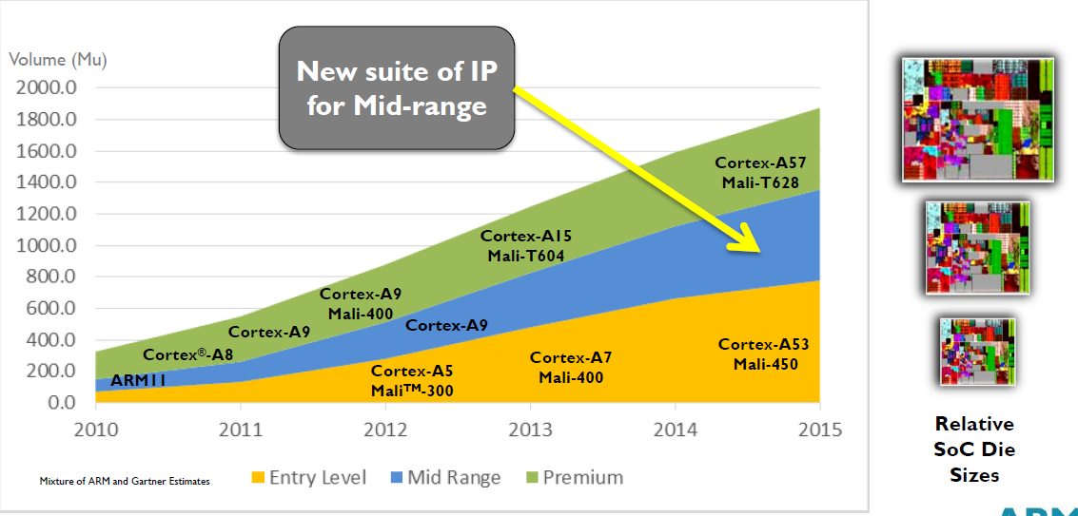
5. Overview of ARM’s Cortex-A series (7)
Yearly shipment of ARM Cortex-A chips in different performance classes
(data from 2013) [13]

Slide 94
5. Overview of ARM’s Cortex-A series (8)
Word length of the Cortex-A series
Word length of the Cortex-A series
ARM’s 32-bit Cortex-A models
ARM’s 64-bit Cortex-A models
Cortex-A5 to A17
Cortex-A53/A57/A72
Cortex-A35

Slide 95
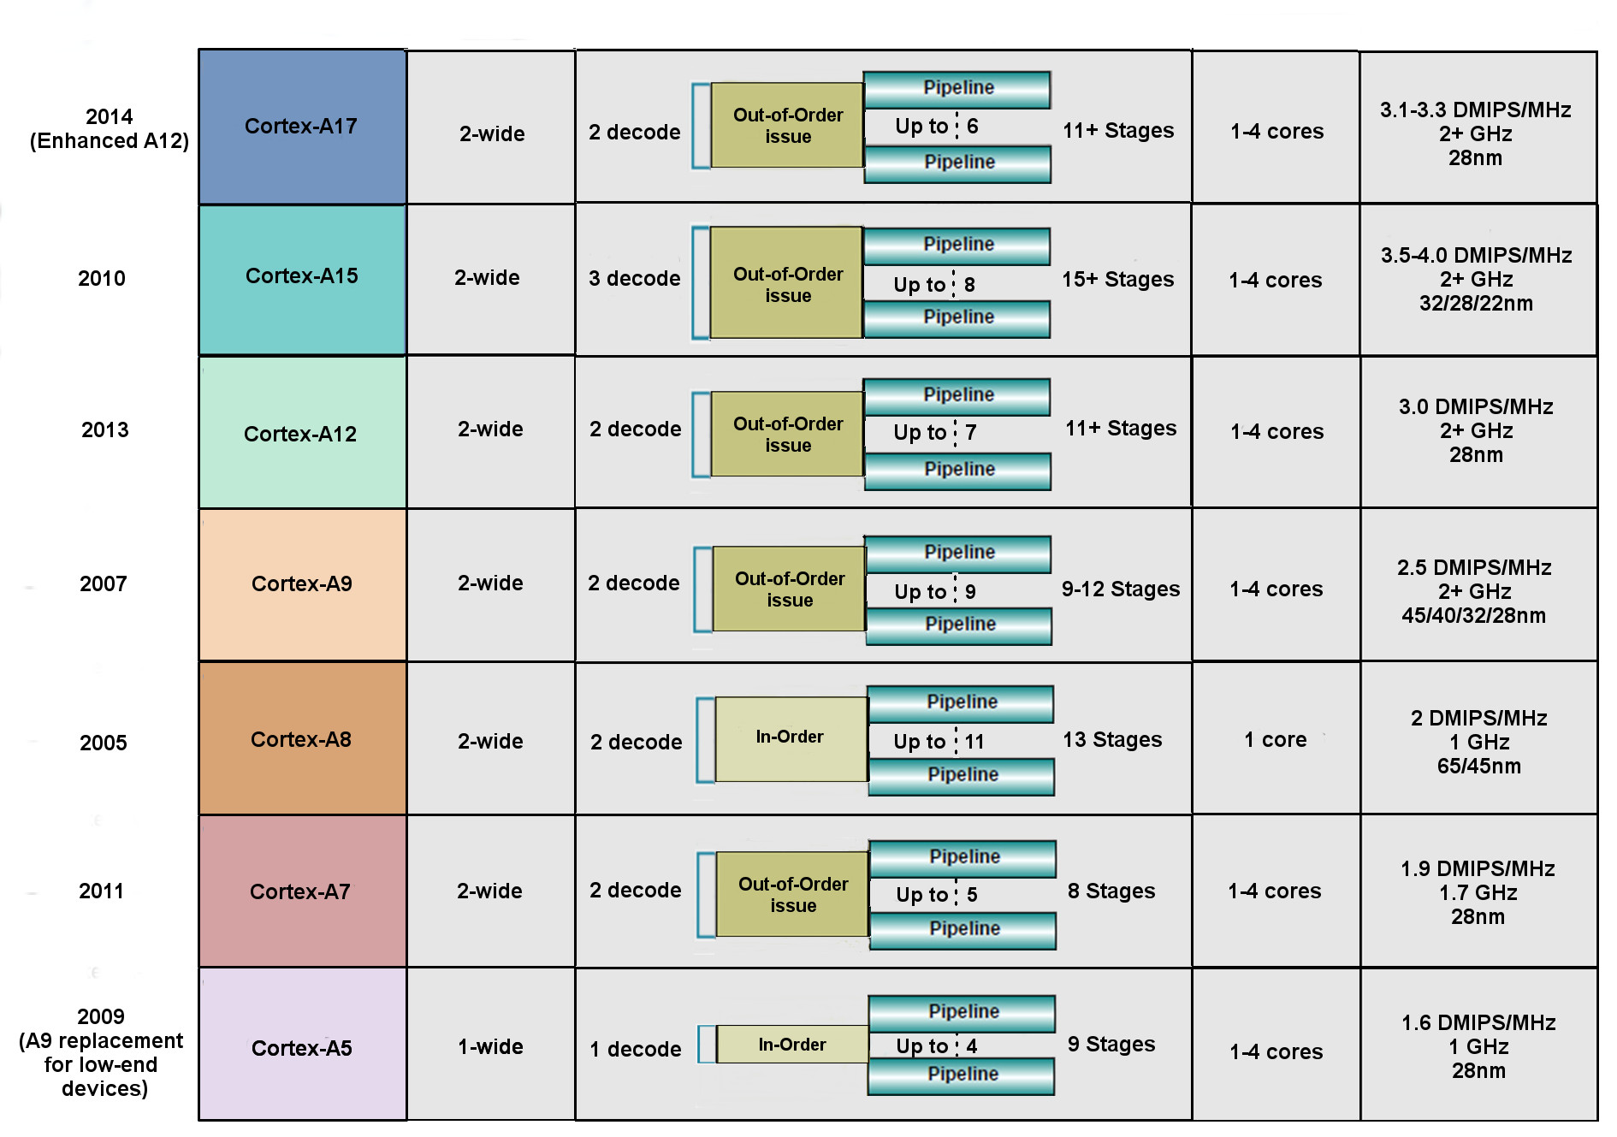
5. Overview of ARM’s Cortex-A series (9)
Key features of ARM’s 32-bit microarchitectures -1 (based on [14])

Slide 96
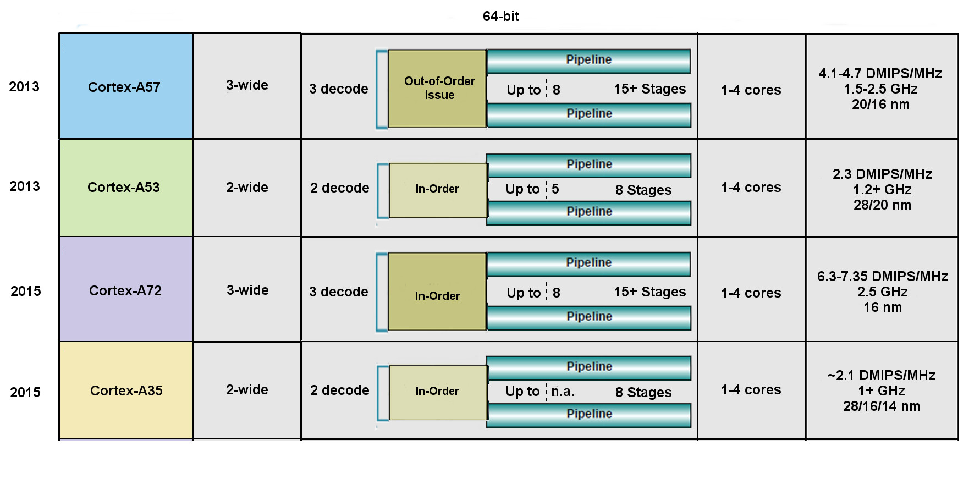
5. Overview of ARM’s Cortex-A series (10)
Key features of ARM’s 64-bit microarchitectures -2 (based on [14])
Remark: In the Cortex-A9 the NEON FP operates in order.

Slide 97
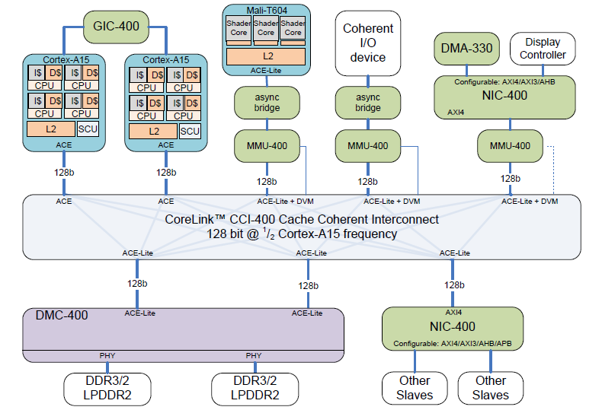
5. Overview of ARM’s Cortex-A series (11)
Example: Dual-core A15-based high performance cache coherent system [15]
Network
Interconnect
Network
Interconnect
Dynamic Memory Controller

Slide 98
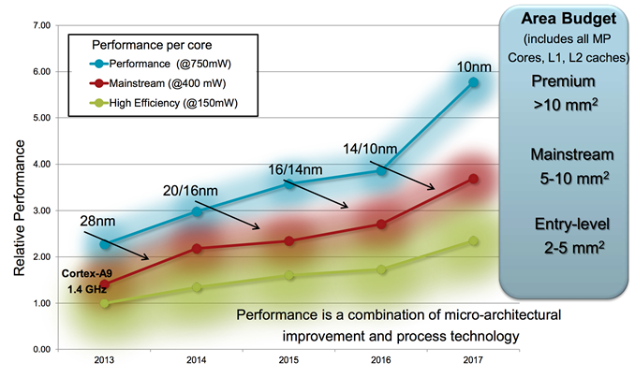
5. Overview of ARM’s Cortex-A series (12)
Relative per core performance of Cortex-A processors with different
power budget [16]

Slide 99
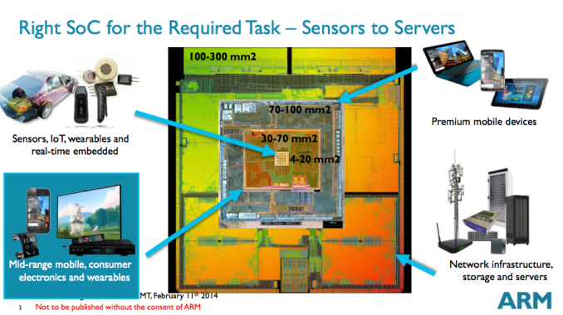
5. Overview of ARM’s Cortex-A series (13)
Die are requirement of different applications [17]

Slide 100
5. Overview of ARM’s Cortex-A series (14)
Use of 32-bit ARM Cortex-A models in mobiles [18]
 | (SOC) System- On-a-Chip | Notable Product(s) Containing | ARM Cortex-A model | No. of Cores
Apple | A4 | iPhone 4, iPod Touch (4th Gen), iPad (1st Gen), AppleTV (2nd Gen) | Cortex-A8 | 1
 | A5 | iPhone 4S, iPad 2, AppleTV (3rd Gen) | Cortex-A9 | 2
 | A5X | iPad (3rd Gen, Retina Display) | Cortex-A9 | 2
Samsung | Exynos 3 Single | Samsung Galaxy S, Samsung Galaxy Nexus S, | Cortex-A8 | 1
 | Exynos 4 Dual | Samsung Galaxy SII, Samsung Galaxy Note (International) | Cortex-A9 | 2
 | Exynos 4 Quad | Samsung Galaxy SIII | Cortex-A9 | 4
 | Exynos 5 Dual | Chrombook | Cortex-A15 | 2
Nvidia | Tegra | Microsoft Zune HD | (ARM11) | 1
 | Tegra 2 | ASUS Eee Pad Transformer, Samsung Galaxy Tab 10.1, Motorola Xoom, Dell Streak 7 & Pro, Sony Tablet S | Cortex-A9 | 2
 | Tegra 3 | ASUS Transformer Pad 300, ASUS Nexus 7, Acer Iconia Tab A510 & A700, HTC One X | Cortex-A9 | 4
Qualcomm | Snapdragon S1 | Large number of devices | (ARM11)/A5 | 1
Texas Instruments | OMAP 3 | Barnes and Noble Nook Color | Cortex-A8 | 1
 | OMAP 4 | Amazon Kindle Fire, Samsung Galaxy Tab 2, Blackberry Playbook, Samsung Galaxy Nexus, Barnes and Noble Nook Tablet | Cortex-A9 | 2
 | OMAP 5 | N/A | Cortex-A15 | 2

Slide 101
5. Overview of ARM’s Cortex-A series (15)
Total number of ARM chips shipped [19]
SBSA: Server Base System Architecture, it is a standardized platform for servers built on 64-bit
ARM processors

Slide 102
6. Overview of ARM’s Mali graphics series

Slide 103
6. Overview or ARM’s Mali graphics series (1)
6. Overview of ARM’s Mali graphics series (since 2010)
ARM also designs and licenses GPUs to be used as companion chips to their CPU
chips.
ARM’s GPU lines are designated as Mali graphicd series.
ARM Mali graphics series (since 2010)
Performance oriented
graphics series
Cost efficient
graphics series

Slide 104
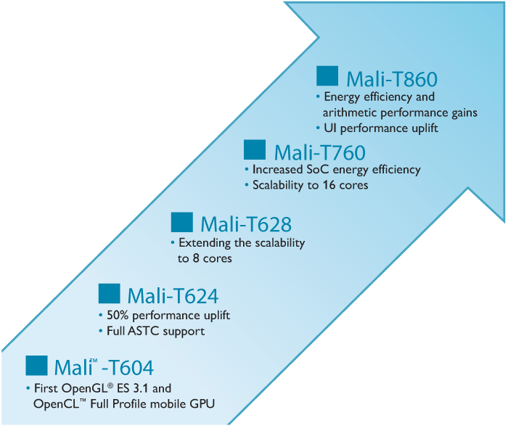
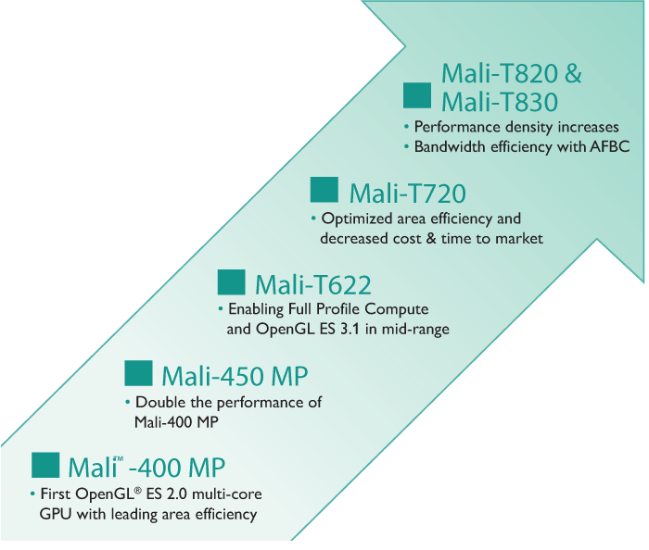
6. Overview of ARM’s Mali graphics lines (2)
Overview of ARM’s Mali graphics seeries
Only GPU parts announced since about 2010 will be discussed [20]
Performance oriented
graphics series
Mali-T6xx - Mali-T8xx
Cost efficient
graphics series
Mali-T4xx - Mali-T8xx

Slide 105
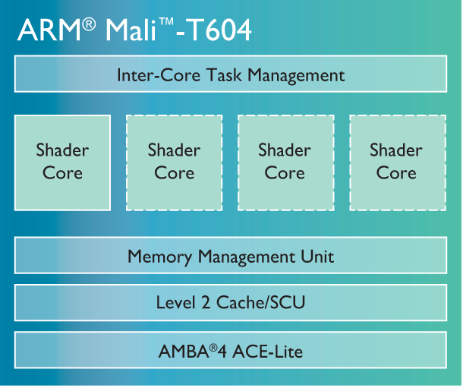
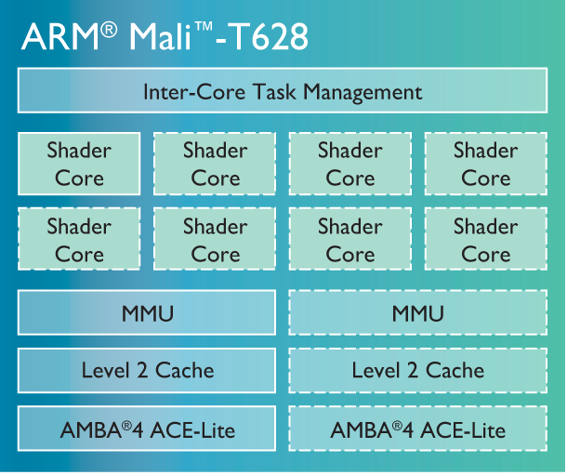
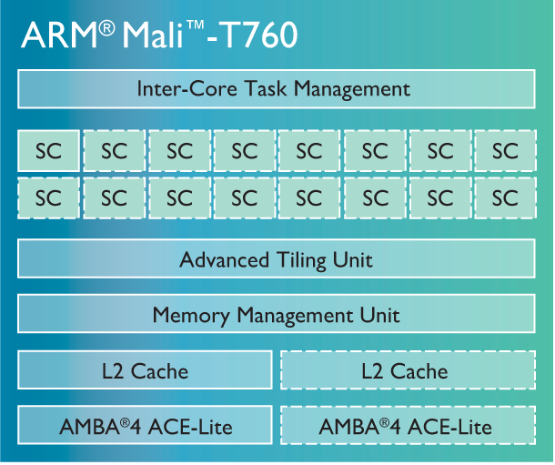
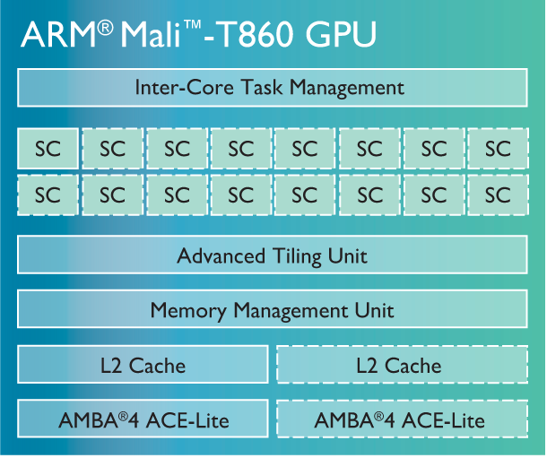
6. Overview of ARM’s Mali graphics lines (3)
ARM’s performance oriented Mali graphics series [20]

Slide 106
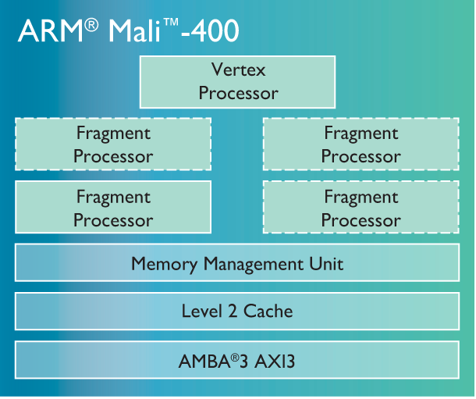
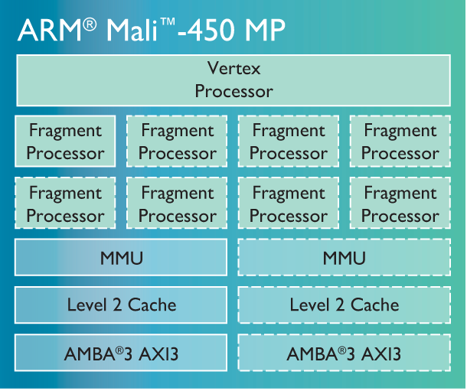
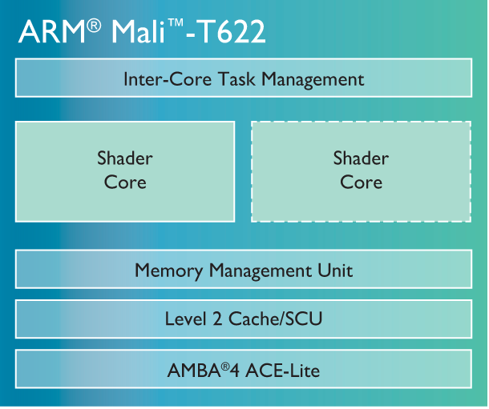
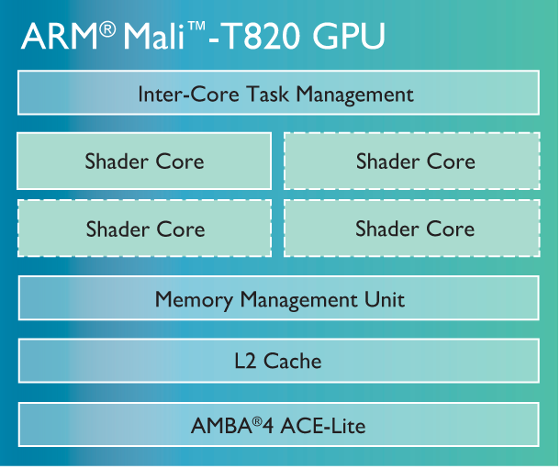
6. Overview of ARM’s Mali graphics lines (4)
ARM’s cost efficient Mali graphics series [20]

Slide 107
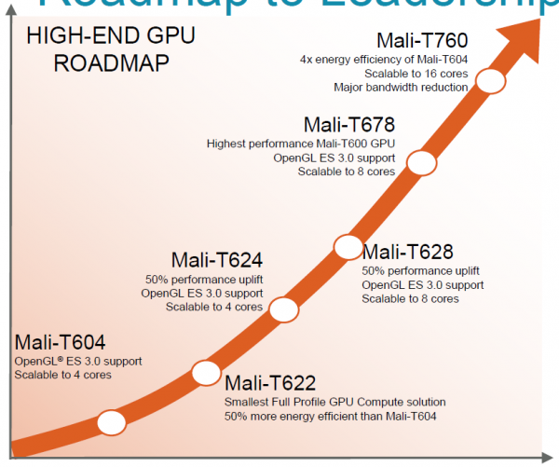
6. Overview of ARM’s Mali graphics lines (5)
ARM’s high-end GPU roadmap [51]
Companion GPU to A57 (announced 10/2013)

Slide 108
7. The 64-bit Cortex-A series
7.1 Overview of ARM’s 64-bit Cortex-A series
7.2 The 64-bit high performance Cortex-A57
7.3 The 64-bit low power Cortex-A53
7.4 The 64-bit low power Cortex-A35
7.5 The 64-bit high performance Cortex-A72
Notes:
108

Slide 109
7.1 Overview of ARM’s 64-bit Cortex-A series

Slide 110
7.1 Overview of ARM’s 64-bit Cortex-A series (1)
7.1 Overview of ARM’s 64-bit Cortex-A series -1 [64]
10/2011 ARM disclosed the 64-bit ARMv8 architecture
with enhancements as indicated in the Figure below
and discussed in Section 2.
AArch32
AArch64
Crypto-graphy ext.
Crypto-graphy ext.
TrustZone
SIMD
Adv. SIMD
(NEON)
Key feature ARMv7-A
compatibility
VFPv1/2
VFPv3/v4
Jazelle
Jazelle
(ex. by SW)
ThumbEE
(Jazelle-RCT)
Thumb
(ARMv4T)
Thumb-2
(ARMv6T2)
ARMv4
ARMv5
ARMv6
ARMv7-A/R
ARMv8-A
Examples
ARM710T
(~1995)
ARM926
(2001)
ARM1176
(2004)
Cortex-A5-15
(2006)
Cortex-A53/57
(2014)
Figure: Enhancements of the ARM architecture (based on [64])

Slide 111
7.1 Overview of ARM’s 64-bit Cortex-A series (2)
Overview of ARM’s 64-bit Cortex-A series -2
10/2012: ARM announced the 64-bit high performance Cortex-A-57 and the
low power Cortex-A-53 processors, as first implementations of the ARMv8
architecture, with immediate availability.
02/2015 ARM extended their 64-bit Cortex-A series by the high performance
Cortex-A72 model, and then in
11/2015 with the 64-bit low power Cortex-A35, as shown below.
ARM’s 64-bit Cortex A series
High performance
64-bit Cortex-A models
Mainstream
64-bit Cortex-A models
Low power
64-bit Cortex-A models
Cortex-A57 (2012)
Cortex-A72 (2015)
No announcement yet
Cortex-A53 (2012)
Cortex-A35 (2015)
Sections 7.2 and 7.5
Sections 7.3 and 7.4

Slide 112
5. Overview of ARM’s Cortex-A series (6)
Overview or ARM’s 64-bit Cortex-A series -3 (based on [12])
7
DMIPS/MHz
2/2015
Cortex-A72
ARMv8
16 nm
6
Announced
10/2012
Cortex-A57
ARMv8
20/16 nm
5
9/2010
Cortex-A15
ARMv7
32/28 nm
2/2014
Cortex-A17
ARMv7
28 nm
4
6/2013
Cortex-A12
ARMv7
20/16 nm
High Performance
3
Mainstream
10/2007
Cortex-A9
ARMv7
40 nm
10/2005
Cortex-A8
ARMv7
65 nm
11/2015
Cortex-A35
ARMv8
28 nm
2
10/2012
Cortex-A53
ARMv8
20/16 nm
10/2009
Cortex-A5
ARMv7
40 nm
10/2011
Cortex-A7
ARMv7
28 nm
1
Low power
2006
2007
2008
2009
2010
2011
2012
2013
2014
2015

Slide 113
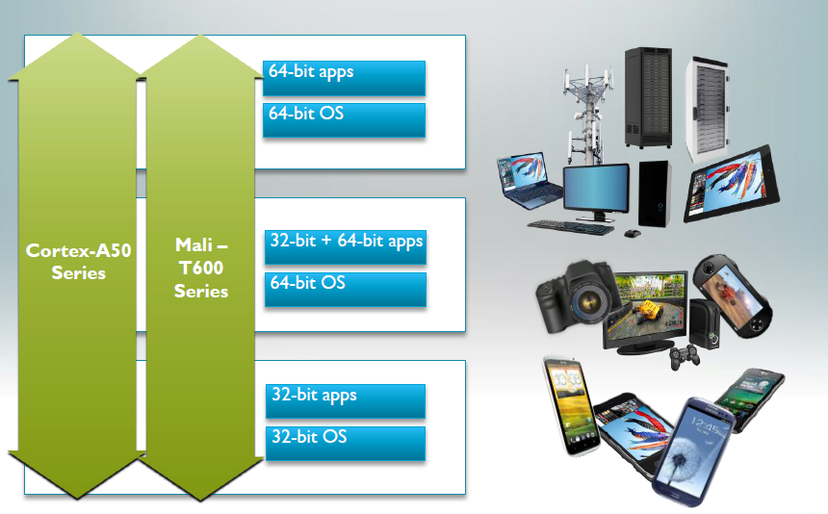
7.1 Overview of ARM’s 64-bit Cortex-A series (4)
The 64-bit Cortex-A series as the basis for scalable applications [48]

Slide 114
7.1 Overview of ARM’s 64-bit Cortex-A series (5)
Target markets of the 64-bit Cortex-A series [49]

Slide 115
7.1 Overview of ARM’s 64-bit Cortex-A series (6)
Main features of ARM’s 64-bit Cortex-A series [51]
CPU Core | Architecture | Efficiency | big.LITTLE | Announced | Available in devices | Target
Cortex-A72 | ARMv8 (64-bit) | 6.3-7.3 DMIPS/MHz | Yes (with A53/A35) | 2015 | n.a. | High-end
Cortex-A57 | ARMv8 (64-bit) | 4,8 DMIPS/MHz | Yes (with A53) | 2012 | 2015 | High-end
Cortex-A53 | ARMv8 (64-bit) | 2,3 DMIPS/MHz | Yes (with A57) | 2012 | 2H 2014 | Low power
Cortex-A35 | ARMv8 (64-bit) | 2,1 DMIPS/MHz | Yes (with A57/A72) | 2015 | 2H 2016 | Low power
Cortex-A17 | ARMv7 (32-bit) | 4,0 DMIPS/MHz | Yes (with A7) | 2014 | 2015 | Mainstream
Cortex-A15 | ARMv7 (32-bit) | 4,0 DMIPS/MHz | Yes (with A7) | 2010 | Now | High-end
Cortex-A12 | ARMv7 (32-bit) | 3,0 DMIPS/MHz | - | 2013 | 2H 2015 | Mainstream
Cortex-A9 | ARMv7 (32-bit) | 2,5 DMIPS/MHz | - | 2007 | Now (EOL) | High-end
Cortex-A8 | ARMv7 (32-bit) | 2,0 DMIPS/MHz | - | 2005 | Now (EOL) | High-end
Cortex-A7 | ARMv7 (32-bit) | 1,9 DMIPS/MHz | Yes (A15/A17) | 2011 | Now | Low power
Cortex-A5 | ARMv7 (32-bit) | 1,6 DMIPS/MHz | - | 2009 | Now | Low power

Slide 116
7.2 The 64-bit high performance Cortex-A57

Slide 117
5. Overview of ARM’s Cortex-A series (6)
7.2 The 64-bit high performance Cortex-A57 -1 (based on [12])
7
DMIPS/MHz
2/2015
Cortex-A72
ARMv8
16 nm
6
Announced
10/2012
Cortex-A57
ARMv8
20/16 nm
5
9/2010
Cortex-A15
ARMv7
32/28 nm
2/2014
Cortex-A17
ARMv7
28 nm
4
6/2013
Cortex-A12
ARMv7
20/16 nm
High Performance
3
Mainstream
10/2007
Cortex-A9
ARMv7
40 nm
10/2005
Cortex-A8
ARMv7
65 nm
10/2012
Cortex-A53
ARMv8
20/16 nm
11/2015
Cortex-A35
ARMv8
28 nm
2
10/2011
Cortex-A7
ARMv7
28 nm
10/2009
Cortex-A5
ARMv7
40 nm
1
Low power
2006
2007
2008
2009
2010
2011
2012
2013
2014
2015

Slide 118
7.2 The 64-bit high performance Cortex-A57 (2)
The 64-bit high performance Cortex-A57 -2 [12]
10/2012: Announced along with the low power Cortex-A53 processor, with
immediate availability for licensing.
2014: First mobile devices with Cortex-A57 models are emerged.
They are 64-bit successors to the high performance 32-bit Cortex A15.
The A57 and A53 models can be used either as stand alone processors or
as components of a big-LITTLE configuration, similar to the 32-bit
Cortex-A15/A7 combination.
Interoperability with the ARM Mali GPU family is provided.
Target process technology: 16 or 20 nm.

Slide 119
7.2 The 64-bit high performance Cortex-A57 (3)
Key features of the Cortex-A57
Fully compatible with the preceding ARMv7 32-bit ISA.
Integrated L2 cache of 512 kB to 2 MB.
Up to 4 Cortex-A57 CPUs that execute the ARMv8 64-bit ISA.
128-bit AMBA coherent interface for connecting multiple (up to 4)
Cortex-A57 processors.
System wide cache coherence supported by a Snoop Control Unit (SCU).
Remarks
AMBA: Advanced Microcontroller Bus Architecture
(On-chip bus standard for SoC) designs

Slide 120
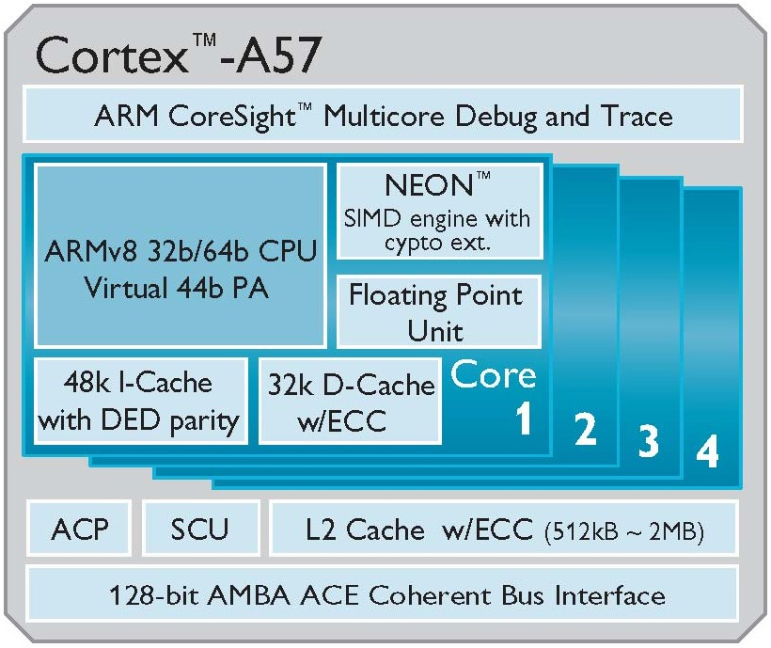
7.2 The 64-bit high performance Cortex-A57 (4)
High level block diagram of the Cortex-A57 [53]
PA: Physical Address
DED: Double Error Detection
ECC: Error Correcting Code
ACP: Accelerator Coherence Port
(to connect non-cached
coherent data sources)
SCU: Snoop Control Unit
AMBA: Advanced Microcontroller
Bus Architecture
(On-chip bus standard for
SoC) designs)
ACE: AXI Coherency Extensions
(Used in big.LITTLE systems
for smartphones, tablets,
etc.)
AXI: Advanced eXtensible Interface
(The most widespread AMBA
interface).

Slide 121
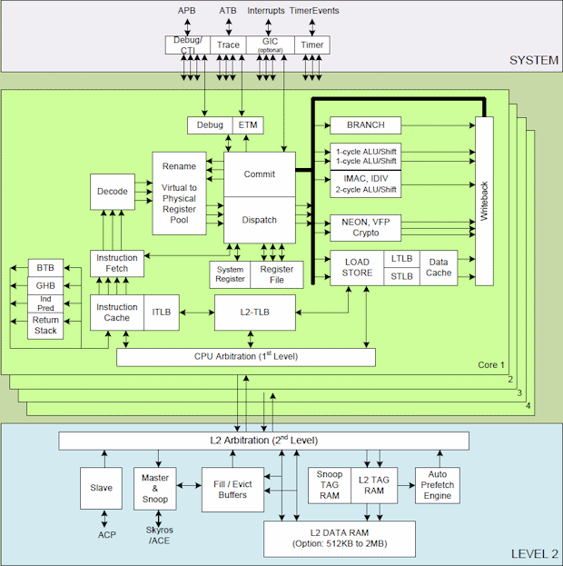
7.2 The 64-bit high performance Cortex-A57 (5)
Main functional blocks of the 64-bit high performance Cortex-A57 CPU [74]
APB
ATB
Interrupts

Slide 122
7.2 The 64-bit high performance Cortex-A57 (6)
Remarks: Non trivial abbreviations in the above Figure
ATB: AMBA Trace Bus
APB: Advanced Peripheral Bus
ACP: Accelerator Coherence Port
(to connect non-cached coherent data sources)
ACE: AXI Coherency Extensions
(Used in big.LITTLE systems for smartphones, tablets, etc.)
AXI: Advanced eXtensible Interface
(The most widespread AMBA interface).

Slide 123
7.2 The 64-bit high performance Cortex-A57 (7)
Key features of the microarchitecture of the Cortex-A57 core -1
Each core fetches four instructions per cycle from the Icache,
decodes and renames three microinstructions per cycle,
dispatches three microinstructions per cycle to the issue queues,
whereas the issue queues issue up to eight microinstructions per cycle
to the eight available execution units.
There are eight execution units available, as follows:
a branch unit
dual single cycle integer units
a multi-cycle integer MAC/DIV/CRC unit
dual Advanced SIMD (NEON)/FP. Crypto units and
dual load/store units.

Slide 124
7.2 The 64-bit high performance Cortex-A57 (8)
Key features of the microarchitecture of the Cortex-A57 core -2
Core efficiency: 4.8 DMIPS/MHz
Expected core frequency up to 2.5 GHz in a 16 nm process implementation.

Slide 125
7.2 The 64-bit high performance Cortex-A57 (9)
Pipeline of the Cortex-A57 core -1
The Cortex-A57 core has a 15 stages long integer pipeline with additional pipeline stages for NEON and FP processing, as indicated in the next two Figures.

Slide 126
7.2 The 64-bit high performance Cortex-A57 (10)
Contrasting the Cortex-A53 and Cortex-A57 arithmetic pipelines
[Based on 54]
D: Decode
R: Rename
P: Dispatch
I: Issue
E: Execute
WB: Write Back
Note: Branch and Load/Store pipelines not shown
(1x Load/Store pipeline for the Cortex A-53 and
2x Load/Store and 1x Branch pipeline for the Cortex-A-57)

Slide 127
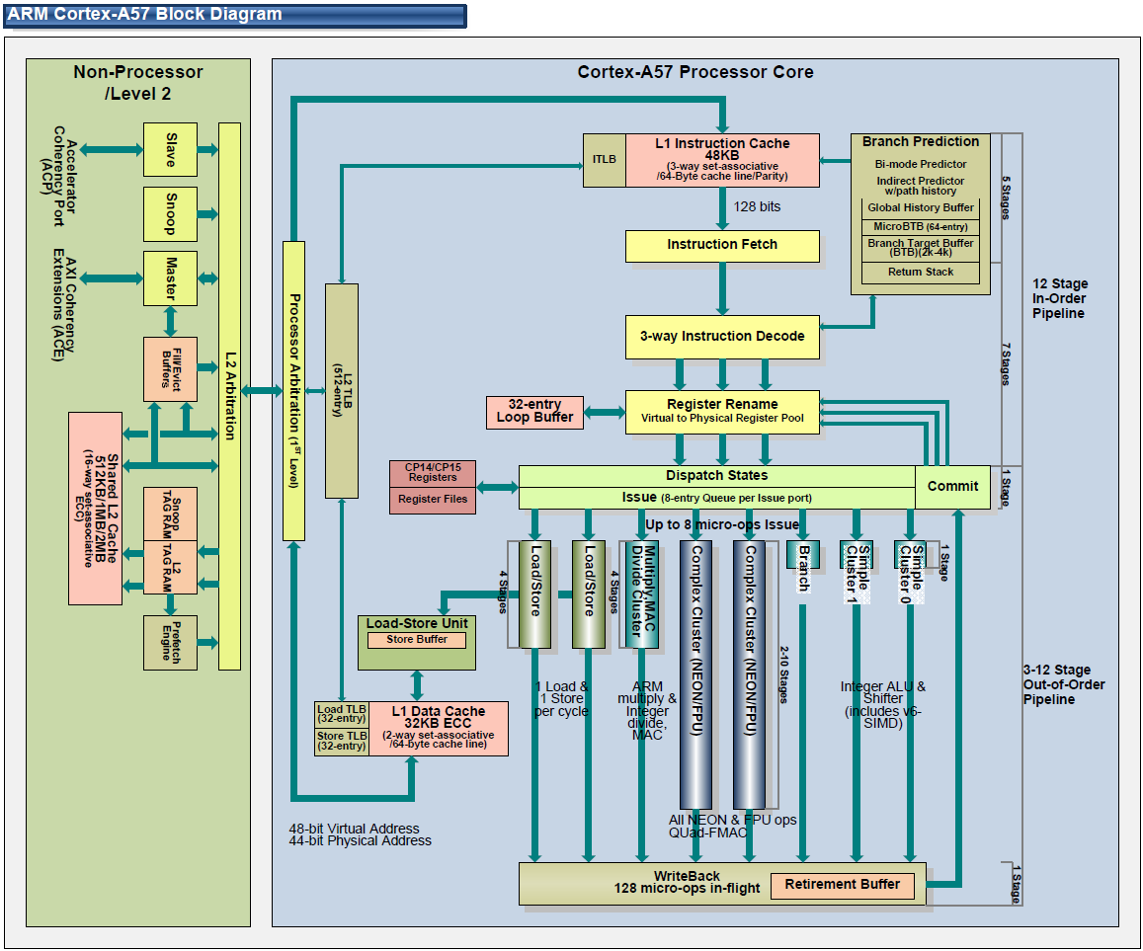
7.2 The 64-bit high performance Cortex-A57 (11)
Pipeline structure of the Cortex-A57 core (alternative view) [71]

Slide 128
7.2 The 64-bit high performance Cortex-A57 (12)
Cortex-A57/A53 performance - compared to the Cortex-A15 [55]

Slide 129
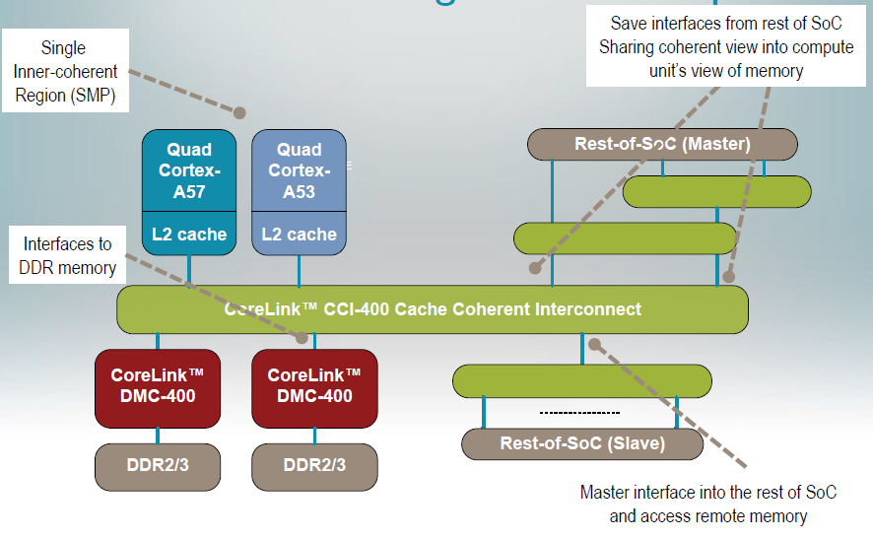
7.2 The 64-bit high performance Cortex-A57 (13)
Example: A Cortex-A57/Cortex-A53 big.LITTLE system [52]

Slide 130
7.3 The 64-bit low power Cortex-A53

Slide 131
5. Overview of ARM’s Cortex-A series (6)
7.3 The 64-bit low power Cortex-A53 -1 (based on [12])
7
DMIPS/MHz
2/2015
Cortex-A72
ARMv8
16 nm
6
Announced
10/2012
Cortex-A57
ARMv8
20/16 nm
5
9/2010
Cortex-A15
ARMv7
32/28 nm
2/2014
Cortex-A17
ARMv7
28 nm
4
6/2013
Cortex-A12
ARMv7
20/16 nm
High Performance
3
Mainstream
10/2007
Cortex-A9
ARMv7
40 nm
10/2005
Cortex-A8
ARMv7
65 nm
11/2015
Cortex-A35
ARMv8
28 nm
2
10/2012
Cortex-A53
ARMv8
20/16 nm
10/2011
Cortex-A7
ARMv7
28 nm
10/2009
Cortex-A5
ARMv7
40 nm
1
Low power
2006
2007
2008
2009
2010
2011
2012
2013
2014
2015

Slide 132
7.3 The 64-bit low power Cortex-A53 (2)
The 64-bit low power Cortex-A53 -2 [12]
10/2012: Announced along with the performance oriented Cortex-A57 processor,
with immediate availability for licensing.
2014: First mobile devices with the Cortex-A53.
It is the 64-bit successor to the Cortex-A7.
The A57 and A53 models can be used either as stand alone processors or
as components in a big-LITTLE configuration, similar to the 32-bit Cortex-A15
and A7 models.
Target process technology: 16 or 20 nm.

Slide 133
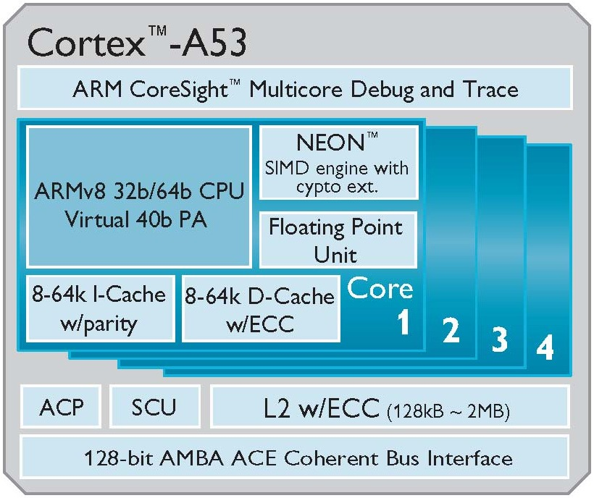
7.3 The 64-bit low power Cortex-A53 (3)
High level block diagram of the Cortex-A53 [53]
PA: Physical Address
DED: Double Error Detection
ECC: Error Correcting Code
ACP: Accelerator Coherence Port
(to connect non-cached
coherent data sources)
SCU: Snoop Control Unit
AMBA: Advanced Microcontroller
Bus Architecture
(On-chip bus standard for
SoC) designs)
ACE: AXI Coherency Extensions
(Used in big.LITTLE systems
for smartphones, tablets,
etc.)
AXI: Advanced eXtensible Interface
(The most widespread AMBA
interface).

Slide 134
7.3 The 64-bit low power Cortex-A53 (4)
Key features of the microarchitecture of the Cortex-A53 core -1
Fully compatible with the preceding ARMv7 32-bit ISA.
Integrated L2 cache of 128 kB to 2 MB.
Up to 4 Cortex-A53 CPU cores that execute the ARMv8 64-bit ISA.
128-bit AMBA coherent interface for connecting multiple (up to 4)
Cortex-A53 processors.
System wide cache coherence supported by a Snoop Control Unit (SCU).
Remarks
AMBA: Advanced Microcontroller Bus Architecture
(On-chip bus standard for SoC) designs

Slide 135
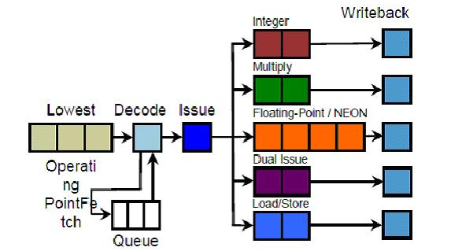
7.3 The 64-bit low power Cortex-A53 (5)
Key features of the microarchitecture of the Cortex-A53 core -2
The Cortex-A53 core has a dual-issue in-order front end with 5 pipelines constituting the back end, as indicated in the next Figure.
Dual
Fetch
Integer
Figure: Pipeline stages of the Cortex-A53 [76]
The pipeline for integer processing has 8 pipeline stages, NEON and FP
processing has two additional pipeline stages, as seen in the Figure above.

Slide 136
7.3 The 64-bit low power Cortex-A53 (6)
Contrasting the Cortex-A7 and Cortex-A53 microarchitectures [75]
ARM CPU Core Comparison
 | Cortex-A7 | Cortex-A53
ARM ISA | ARMv7 (32-bit) | ARMv8 (32/64-bit)
Issue Width | Partially 2 micro-ops | 2 micro-ops
Pipeline Length | 8 | 8
Integer Add | 2 | 2
Integer Mul | 1 | 1
Load/Store Units | 1 | 1
Branch Units | 1 | 1
FP/NEON ALUs | 1x64-bit | 1x64-bit
L1 Cache | 8KB-64KB I$ + 8KB-64KB D$ | 8KB-64KB I$ + 8KB-64KB D$
L2 Cache | 128KB - 1MB (Optional) | 128KB - 2MB (Optional)

Slide 137
7.3 The 64-bit low power Cortex-A53 (7)
Remarks [75]
We note that the Cortex-A7 has a partially dual-issue capability, meaning that the
second issue slot can only issue branch and integer operations.
In the Cortex-A53 the second issue slot can also issue load-store and FP/NEON
operations.
In additon, the branch prediction capabilities of the A53 were also significantly
improved by including conditional and indirect jump predictors.

Slide 138
7.3 The 64-bit low power Cortex-A53 (8)
Contrasting the Cortex-A53 and Cortex-A57 arithmetic pipelines
[Based on 54]
D: Decode
R: Rename
P: Dispatch
I: Issue
E: Execute
WB: Write Back
Note: Branch and Load/Store pipelines not shown
(1x Load/Store pipeline for the Cortex A-53 and
2x Load/Store and 1x Branch pipeline for the Cortex-A-57)

Slide 139
7.3 The 64-bit low power Cortex-A53 (9)
Key features of the microarchitecture of the Cortex-A53 core -3
Core efficiency: 2.3 DMIPS/MHz
Expected core frequency up to 1.5 GHz.

Slide 140
7.4 The 64-bit low power Cortex-A35

Slide 141
5. Overview of ARM’s Cortex-A series (6)
7.4 The 64-bit low power Cortex-A35- 1 (Based on [12])
7
DMIPS/MHz
2/2015
Cortex-A72
ARMv8
16 nm
6
Announced
10/2012
Cortex-A57
ARMv8
20/16 nm
5
9/2010
Cortex-A15
ARMv7
32/28 nm
2/2014
Cortex-A17
ARMv7
28 nm
4
6/2013
Cortex-A12
ARMv7
20/16 nm
High Performance
3
Mainstream
10/2007
Cortex-A9
ARMv7
40 nm
10/2005
Cortex-A8
ARMv7
65 nm
11/2015
Cortex-A35
ARMv8
28 nm
2
10/2012
Cortex-A53
ARMv8
20/16 nm
10/2011
Cortex-A7
ARMv7
28 nm
10/2009
Cortex-A5
ARMv7
40 nm
1
Low power
2006
2007
2008
2009
2010
2011
2012
2013
2014
2015

Slide 142
7.4 The 64-bit low power Cortex-A35 (2)
The 64-bit low power Cortex-A35- 2
Announced in 11/2015.
Devices expected by the end of 2016.
It is targeting a wide range of application processors from mobile to deeply
embedded.
It is ARM's most efficient application processor, as comparisons with the
Cortex-A7 and A53 demonstrate at the same feature size (28 nm), as seen
in the next Figure.

Slide 143
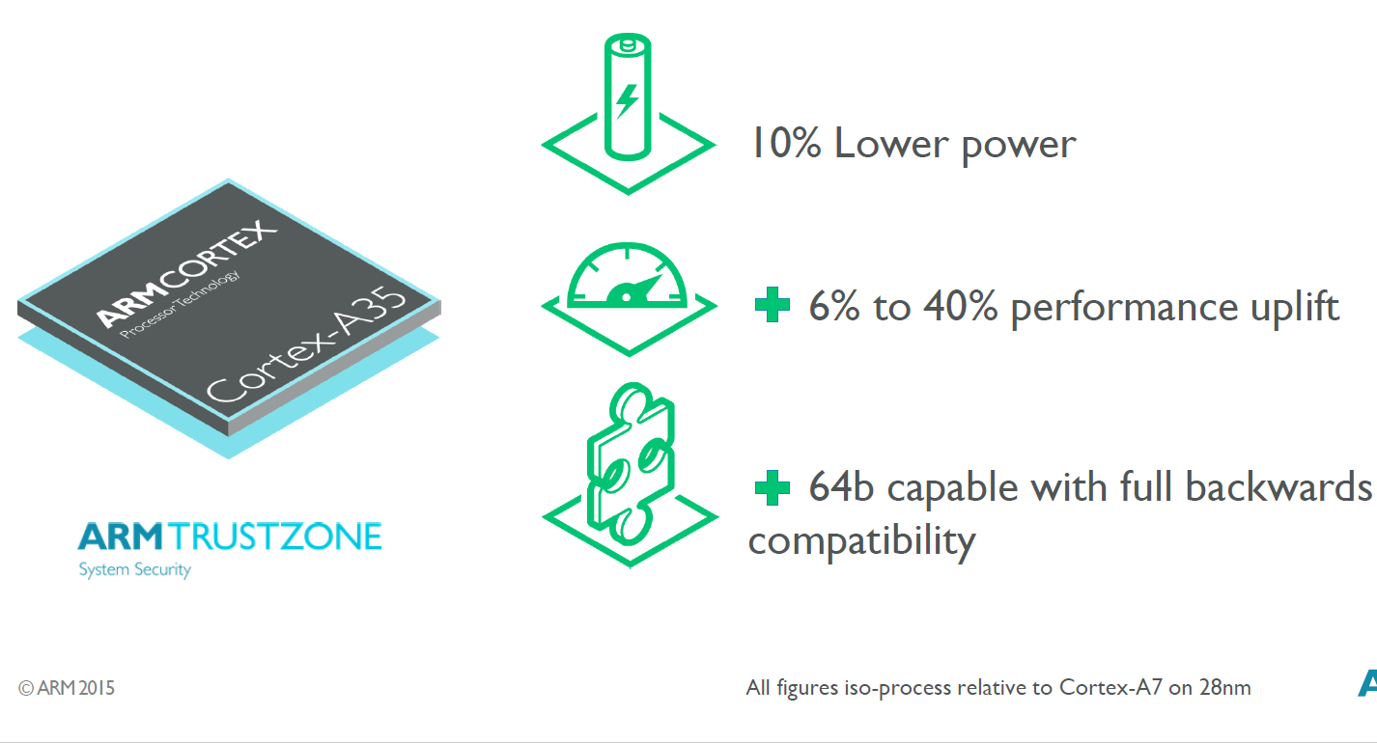
7.4 The 64-bit low power Cortex-A35 (3)
Efficiency of the 28 nm Cortex-A35 vs. the 28 nm Cortex-A7 [77]

Slide 144
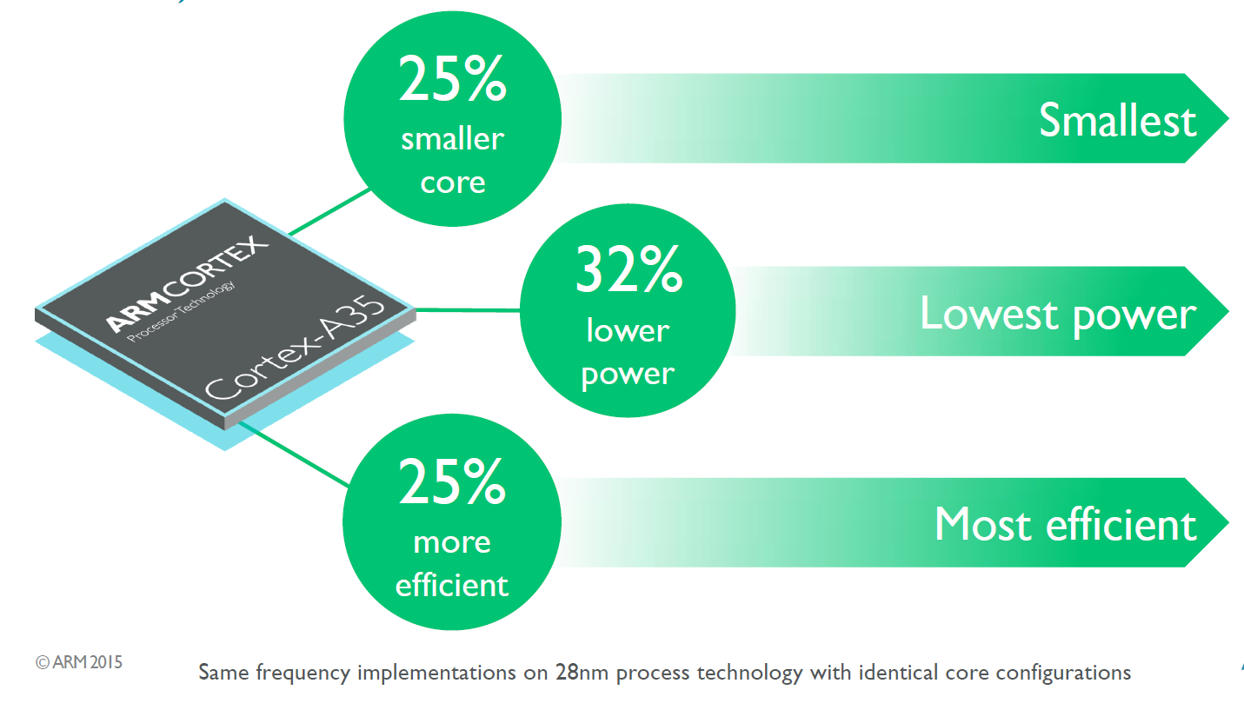
7.4 The 64-bit low power Cortex-A35 (4)
Efficiency of the 28 nm Cortex-A35 vs. the 28 nm Cortex-A53 [77]

Slide 145
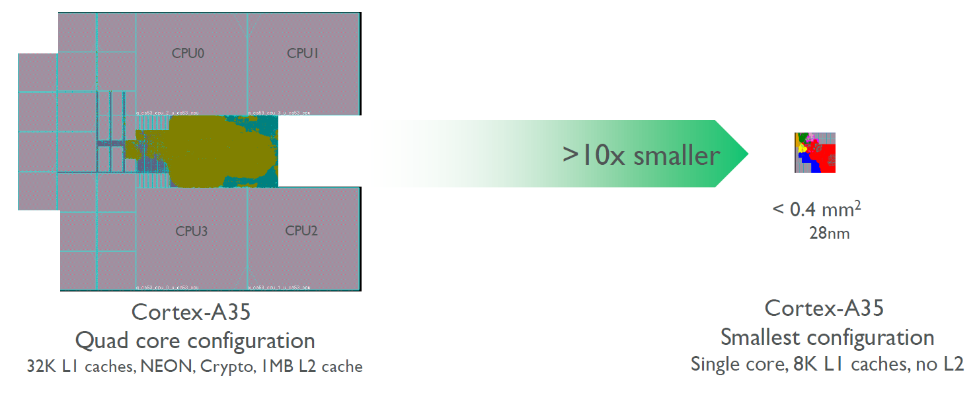
7.4 The 64-bit low power Cortex-A35 (5)
The 64-bit high performance Cortex-A35- 2
It is a widely configurable application processor ranging from mobiles to deeply
embedded, as indicated below.
Figure: Configuration options of the Cortex-A35 [77]
Target consumption is below 125 mW.
On 28 nm technology it achieves 1 GHz by 90 mW, for plannes smaller feature
size of 14/16 nm ARM expect less consumption.

Slide 146
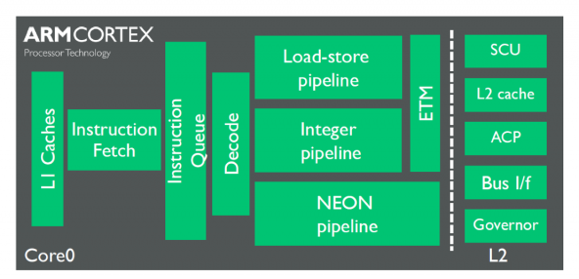
7.4 The 64-bit low power Cortex-A35 (6)
Microarchitecture of the Cortex-A35
It can have one to quad cores, as discussed before.
The Cortex-A35 cores have in-order, 8-stage FX pipelines with limited dual-issue
capability.
The pipeline layout is shown in the next Figure.
ETM: Embedded
Trace
Macrocell
(for debugging)
Figure: Pipeline layout of the Cortex-A35 [77]
Compared to the Cortex-A7 ARM improved many subsystems, like instruction
fetch, branch prediction, memory subsystem.

Slide 147
7.5 The 64-bit high performance Cortex-A72

Slide 148
5. Overview of ARM’s Cortex-A series (6)
7.5 The 64-bit high performance Cortex-A72 -1(Based on [12])
7
DMIPS/MHz
2/2015
Cortex-A72
ARMv8
16 nm
6
Announced
10/2012
Cortex-A57
ARMv8
20/16 nm
5
9/2010
Cortex-A15
ARMv7
32/28 nm
2/2014
Cortex-A17
ARMv7
28 nm
4
6/2013
Cortex-A12
ARMv7
20/16 nm
High Performance
3
Mainstream
10/2007
Cortex-A9
ARMv7
40 nm
10/2005
Cortex-A8
ARMv7
65 nm
11/2015
Cortex-A35
ARMv8
28 nm
2
10/2012
Cortex-A53
ARMv8
20/16 nm
10/2011
Cortex-A7
ARMv7
28 nm
10/2009
Cortex-A5
ARMv7
40 nm
1
Low power
2006
2007
2008
2009
2010
2011
2012
2013
2014
2015

Slide 149
7.4 The 64-bit high performance Cortex-A72 (2)
The 64-bit high performance Cortex-A72 -2
Announced in 2/2015

Slide 150
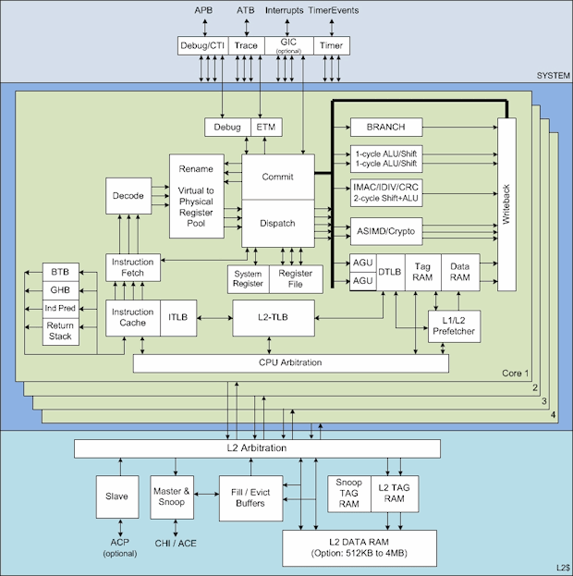
7.4 The 64-bit high performance Cortex-A72 (3)
Main functional blocks of the 64-bit high performance Cortex-A72 [72]
APB
ATB
Interrupts

Slide 151
7.4 The 64-bit high performance Cortex-A72 (4)
Remarks: Non trivial abbreviations on the above Figure
ATB: AMBA Trace Bus
APB: Advanced Peripheral Bus
ACP: Accelerator Coherence Port
(to connect non-cached coherent data sources)
ACE: AXI Coherency Extensions
(Used in big.LITTLE systems for smartphones, tablets, etc.)
AXI: Advanced eXtensible Interface
(The most widespread AMBA interface).

Slide 152
7.4 The 64-bit high performance Cortex-A72 (5)
Remarks to the operation of the Cortex-A72
Each core fetches four instructions per cycle from the Icache,
decodes and renames three microinstructions per cycle,
dispatches five microinstructions per cycle to the issue queues,
whereas the issue queues issue up to eight microinstructions per cycle
to the eight available execution units.
It has eight execution units, as followes:
a branch unit
dual single cycle integer units
a multi-cycle integer MAC/DIV/CRC unit
dual Advanced SIMD (NEON)/FP units and
dual load/store units.

Slide 153
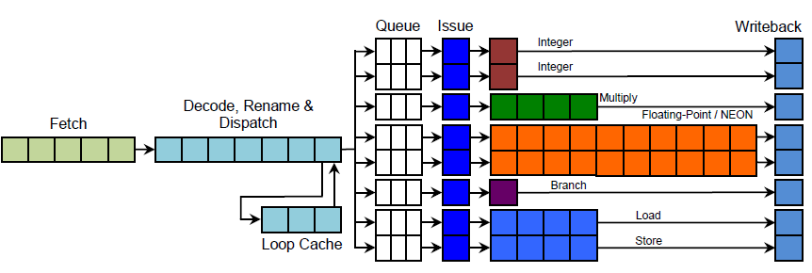
7.4 The 64-bit high performance Cortex-A72 (6)
Note
It is interesting to recognize that the pipeline structure of ARM’s high performance
processors (Cortex-A15/Cortex-A-57/Cortex-A72) remained basically the same,
as is demonstrated by the pipeline structure of the Cortex-A15 below.
Figure: Implementation of the Cortex-A15 pipelines [37]
As seen in the Figure there are also eight issue queues and basically the same
execution pipelines as in both the Cortex-A57 and Cortex-A72.
Nevertheless, the Cortex-A72 has a dispatch rate of 5 rather than 3 as both the
cortex-A15 and Cortex-a17 processors.

Slide 154
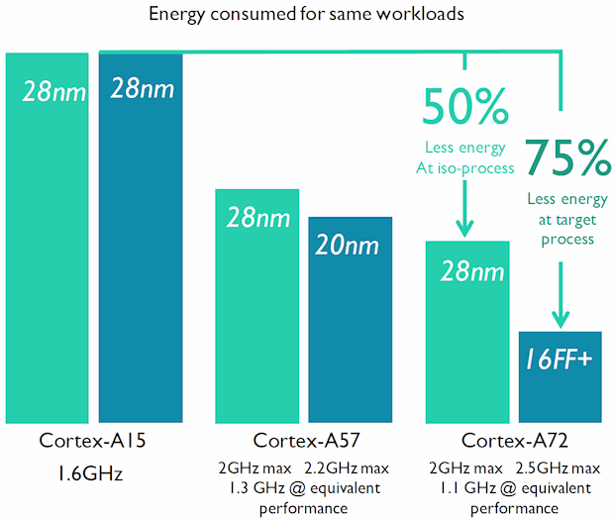
7.4 The 64-bit high performance Cortex-A72 (7)
Energy consumption of the Cortex-A72 compared to Cortex-A15/A57 [72]

Slide 155
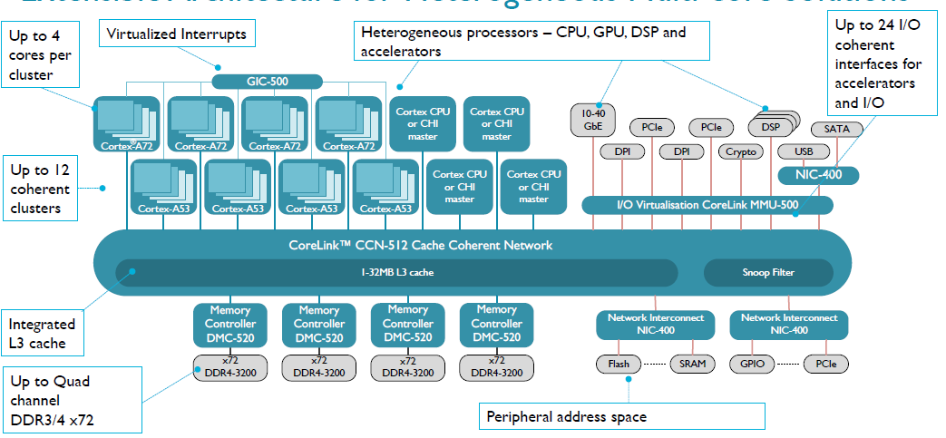
7.4 The 64-bit high performance Cortex-A72 (8)
CoreLink CCN512-based heterogeneous multi-core system [80]
CHI: Coherent Hub Interface

Slide 156
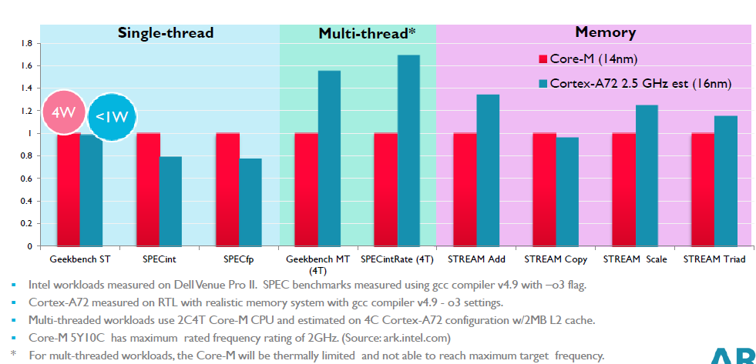
7.4 The 64-bit high performance Cortex-A72 (9)
Performance comparison: ARM’s Cortex-A72 vs. Intel’s Core-M [79]

Slide 157
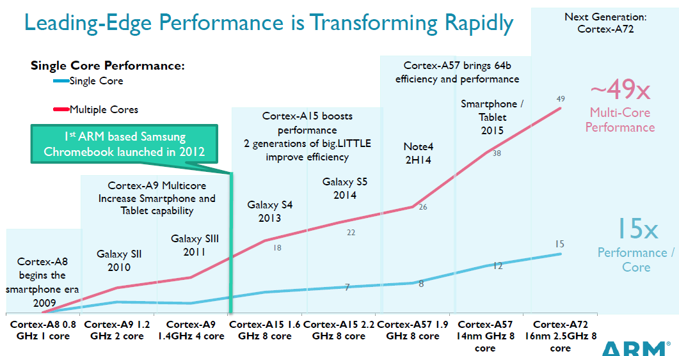
7.4 The 64-bit high performance Cortex-A72 (10)
Evolution of the performance of the ARM's Cortex-A line [79]
(≈ 4 x core count x 4 x DMIPS/MHz x 3 fc)

Slide 158
7.4 The 64-bit high performance Cortex-A72 (11)
Single thread IPC in Intel’s basic architectures (Based on [81])
2
24%
22%
Per Generation
1.9
20%
Cumulative
1.8
18%
1.7
16%
1.6
14%
12%
1.5
10%
1.4
8%
1.3
6%
1.2
4%
2%
1.1
0%
1
Pentium M Dothan
Core 2
Penryn
NHM (w/o SMT)
WSM
SNB
IVB
HSW
BRW
SKL
Note that Intel raised IPC in the Core family only less then 2-times in about 10 years.

Slide 159
8. References

Slide 160
8. References (1)
[1]: Architecture and Implementation of the ARM Cortex-A8 Microprocessor, Design & Reuse,
http://www.design-reuse.com/articles/11580/architecture-and-implementation-of-the-
arm-cortex-a8-microprocessor.html
[2]: Shimpi A.L., Answered by the Experts: ARM's Cortex A53 Lead Architect, Peter Greenhalgh,
AnandTech, Dec. 17 2013, http://www.anandtech.com/show/7591/answered-by-the-
experts-arms-cortex-a53-lead-architect-peter-greenhalgh
[3]: Hill S., Design of a Reusable 1GHz, Superscalar ARM Processor, Hot Chips-18, Aug. 22 2006,
http://www.hotchips.org/wp-content/uploads/hc_archives/hc18/3_Tues/HC18.S6/HC18.S6T3.
pdf
[4]: Details of a New Cortex Processor Revealed, Cortex-A9, ARM Developers’ Conference,
Oct. 2007, http://rtcgroup.com/arm/2007/presentations/174%20-%20Details%20of%
20a%20New%20Cortex%20Processor%20Revealed%20Cortex-A9.pdf
[5]: ARM Teaching Material, http://www.arm.com/files/ppt/ARM_Teaching_Material.ppt
[6]: ARM Cortex Application Processors, http://www.arm.com/products/processors/index.php
[7]: ARM SecurCore Processors, http://www.arm.com/products/processors/securcore/index.php
[8]: Snyder C.D., ARM Family Expands at EPF, ARM11 Microarchitecture Stretches Pipe to Boost
Frequency, Microprocessor, June 3 2002
[9]: Hirata K., ARM11 MPCore, The streamlined and scalable ARM11 processor core, Jan. 2007,
http://www.aspdac.com/aspdac2007/pdf/archive/7D-2.pdf

Slide 161
8. References (2)
[10]: ARM Introduces The Cortex-M3 Processor To Deliver High Performance In Low-Cost
Applications, Oct. 19 2004, http://www.arm.com/about/newsroom/6750.php
[11]: NEON, ARM Technologies,
http://www.arm.com/products/processors/technologies/neon.php
[12]: Goodacre J., The Evolution of the ARM Architecture Towards Big Data and the Data-Centre,
8th Workshop on Virtualization in High-Performance Cloud Computing (VHPC’13),
Nov. 17-22 2013, http://www.virtical.eu/pub/sc13.pdf
[13]: Ferguson I., Redefining User Experiences, from IoT to Smart Mobile Devices, June 14 2013,
http://www.arm.com/zh/files/event/arm_multimedia_seminar_shenzhen_2013_ianferguson.
pdf
[14]: Goto H., ARM Cortex – A Family Architecture, 2010,
http://pc.watch.impress.co.jp/video/pcw/docs/423/409/p1.pdf
[15]: Stevens H., Introduction to AMBA 4 ACE and big.LITTLE Processing Technology, White Paper,
June 6 2011, http://www.arm.com/files/pdf/CacheCoherencyWhitepaper_6June2011.pdf
[16]: Shimpi A.L., The ARM Diaries, Part 2: Understanding the Cortex A12, AnandTech,
July 17 2013, http://www.anandtech.com/show/7126/the-arm-diaries-part-2-
understanding-the-cortex-a12
[17]: Shimpi A.L., ARM Cortex A17: An Evolved Cortex A12 for the Mainstream in 2015,
AnandTech, Febr. 11 2014, http://www.anandtech.com/show/7739/arm-cortex-a17
[18]: Ryan H., Intel, AMD & ARM Processors, University of Wisconsin DoIT Techstore
https://kb.wisc.edu/showroom/page.php?id=4927

Slide 162
8. References (3)
[19]: Rao A., ARM: a mandatory primer, Element14, 2014
[20]: Mali Performance Efficient Graphics, ARM
http://www.arm.com/products/multimedia/mali-performance-efficient-graphics/index.php
[21]: Cortex-A8 Processor, ARM Cortex-A Series,
http://www.arm.com/products/processors/cortex-a/cortex-a8.php
[22]: Architecture and Implementation of the ARM Cortex-A8 Microprocessor, White Paper,
Oct. 2005, https://www.pixhawk.ethz.ch/_media/software/optimization/neon_whitepaper.pdf
[23]: Shimpi A.L., Understanding the iPhone 3GS, AnandTech, July 7 2009,
http://www.anandtech.com/print/2798/
[24]: The ARM Cortex-A9 Processors, White Paper, Sept. 2009,
http://www.arm.com/files/pdf/armcortexa-9processors.pdf
[25]: Cortex-A9 MPCore, Technical Reference Manual, 2008-2012,
http://infocenter.arm.com/help/topic/com.arm.doc.ddi0407i/DDI0407I_cortex_a9_
mpcore_r4p1_trm.pdf
[26]: Goto H., ARM Cortex-A9r4 Core Block Diagram,
http://pc.watch.impress.co.jp/video/pcw/docs/614/543/08p.pdf
[27]: ARM Unveils Cortex-A9 Processors For Scalable Performance and Low-Power Designs,
Oct. 3 2007, http://www.arm.com/about/newsroom/18688.php
[28]: Goodacre J., The Effect and Technique of System Coherence in ARM Multicore Technology,
http://www.mpsoc-forum.org/previous/2008/slides/8-6%20Goodacre.pdf

Slide 163
8. References (4)
[29]: Goto H., ARM Cortex-A7/A9 vs Bobcat, Atom, 2010,
http://pc.watch.impress.co.jp/img/pcw/docs/487/030/html/9.jpg.html
[30]: Goto H., ARM Cortex-A12 Block Diagram, 2013,
http://pc.watch.impress.co.jp/video/pcw/docs/621/747/gp1.pdf
[31]: Rosinger S., The Top 5 Things to Know about Cortex-A12, ARM Connected Community,
Oct. 26 2013, http://community.arm.com/groups/processors/blog/2013/10/26/the-top-5-
things-to-know-about-cortex-a12
[32]: ARM Cortex-A17 MPCore Processor, Technical Reference Manual, 2014,
http://infocenter.arm.com/help/topic/com.arm.doc.ddi0535b/DDI0535B_cortex_a17_
r1p0_trm.pdf
[33]: Cortex-A17 Processor, ARM Cortex-A Series,
http://www.arm.com/products/processors/cortex-a/cortex-a17-processor.php
[34]: Rosinger S., ARM Cortex-A17/Cortex-A12 processor update, ARM Connected Community,
Oct. 1 2014, http://community.arm.com/groups/processors/blog/2014/09/30/arm-
cortex-a17-cortex-a12-processor-update
[35]: Cortex-A15 Processor, ARM Cortex-A Series,
http://www.arm.com/products/processors/cortex-a/cortex-a15.php
[36]: Lanier T., Exploring the Design of the Cortex-A15 Processor,
http://www.arm.com/files/pdf/AT-Exploring_the_Design_of_the_Cortex-A15.pdf

Slide 164
6. References (5)
[37]: Greenhalgh P., big.LITTLE Processing with ARM Cortex-A15 & Cortex-A7, White Paper,
Sept. 2011, http://www.arm.com/files/downloads/big_LITTLE_Final_Final.pdf
[38]: Stokes J., ARM fills out CPU lineup with Cortex A5, Ars Technica, Oct. 22 2009,
http://arstechnica.com/gadgets/2009/10/arm-fills-out-cpu-lineup-with-cortex-a5/
[39]: Hruska J., ARM Launches New Cortex-A5 As A Bulkward Against Future Atom processors,
Hot Hardware, Oct. 23 2009, http://hothardware.com/News/ARM-Launches-New-
CortexA5-As-A-Bulkward-Against-Future-Atom-processors
[40]: Cortex-A5 Processor, ARM Cortex-A Series,
http://www.arm.com/products/processors/cortex-a/cortex-a5.php
[41]: Bhattacharya A., Small, Quiet, and Cool, Power Efficient Processing with the Cortex-A5
Processor, http://www.arm.com/files/pdf/at2_-_power_efficient_processing_with_the_
cortex-a5_v1.pdf
[42]: Cortex-A5, The smallest, lowest power ARMv7 application processor,
http://www.hitex.co.uk/fileadmin/uk-files/pdf/ARM%20Seminar%20Presentations%
202013/Hitex%20Cortex-A5%20Overview.pdf
[43]: Flautner K., Heterogeneity to the rescue, Nov. 2011,
https://www.bscmsrc.eu/sites/default/files/media/arm-heterogenous-mp-november-2011.
pdf
[44]: Shimpi A.L., ARM's Cortex A7: Bringing Cheaper Dual-Core & More Power Efficient High-End
Devices, AnandTech, Oct. 19 2011, http://www.anandtech.com/show/4991/

Slide 165
8. References (6)
[45]: Cortex-A7 Processor, ARM Cortex-A Series,
http://www.arm.com/products/processors/cortex-a/cortex-a7.php
[46]: Goto H., New design of mid-range CPU that ARM has announced "Cortex-A12", PC Watch,
June 4 2013, http://pc.watch.impress.co.jp/docs/column/kaigai/20130604_602106.html
[47]: Shimpi A.L., ARM's Cortex A57 and Cortex A53: The First 64-bit ARMv8 CPU Cores,
AnandTech, Oct. 30 2012, http://www.anandtech.com/show/6420/arms-cortex-a57-
and-cortex-a53-the-first-64bit-armv8-cpu-cores
[48]: Smith K., Next-Generation Solutions: One Size Does Not Fit All, Nov. 2012,
http://www.armtechforum.com.cn/2012/3_Next-generation_Solutions_One_Size_does_
not_Fit_All.pdf
[49]: Smythe I., Building the future of 64-bit computing with ARMv8-A, June 2014,
http://www.arm.com/files/event/2014_ARM_Multimedia_Seminar_ARM_Ian_Smythe.pdf
[50]: Ferguson I., ARM Servers, Why, Where, when, Nov. 27 2012,
http://openserversummit.com/English/Collaterals/Proceedings/2012/20121127_SA103_
Ferguson.pdf
[51]: Crijns K., ARM: 20 dollar and 64-bit Android smartphones to be expected, Hardware.info,
June 24 2014, http://us.hardware.info/reviews/5386/2/arm-20-dollar-and-64-bit-android-
smartphones-to-be-expected-android-64-bitn
[52]: Scaling Mobile Compute to the Data Centre, MPSoC’13,
http://www.mpsoc-forum.org/previous/2013/slides/2-Goodacre.pdf

Slide 166
8. References (7)
[53]: ARM Launches Cortex-A50 Series, the World's Most Energy-Efficient 64-bit Processors,
TechPowerUp, Oct. 30 2012, http://www.techpowerup.com/174709/arm-launches-cortex-
a50-series-the-worlds-most-energy-efficient-64-bit-processors.html
[54]: Mandyam L., Smartphone Powered Data Centers: Shifting Toward Energy Efficiency,
http://sites.ieee.org/scv-cs/files/2013/03/IEEE-event-April-slide-upload.pdf
[55]: Anthony S., ARM says $20 smartphones coming this year, shows off 64-bit Cortex-A53 and
A57 performance, Extreme Tech, May 6 2014, http://www.extremetech.com/computing/
181935-arm-says-20-smartphones-coming-this-year-shows-off-64-bit-cortex-a53-and-
a57-performance
[56]: Merritt R., ARM stretches out with A5 core, graphics, FPGAs, Oct. 21 2009,
http://www.embedded.com/print/4085371
[57]: Cormie D., The ARM11 Microarchitecture, April 2002
[58]: Exynos 5 Octa, Block Diagram,
http://www.samsung.com/global/business/semiconductor/product/application/detail?
productId=7978&iaId=2341
[59]: Grabham D., From a small Acorn to 37 billion chips: ARM's ascent to tech superpower,
Techradar, July 19 2013, http://www.techradar.com/news/computing/from-a-small-acorn-
to-37-billion-chips-arm-s-ascent-to-tech-superpower-1167034
[60]: The ARM Architecture, http://www.eng.auburn.edu/~strouce/DaTseminar/UniPres07s.pdf
[61]: Wikipedia, ARM architecture, http://en.wikipedia.org/wiki/ARM_architecture

Slide 167
8. References (8)
[62]: Levy M., The History of The ARM Architecture: From Inception to IPO,
http://www.reds.ch/share/cours/ReCo/documents/TheHistoryOfTheArmArchitecture.pdf
[63]: Lemieux J., Introduction to ARM thumb, Embedded, Sept. 24 2003, http://www.embedded.
com/electronics-blogs/beginner-s-corner/4024632/Introduction-to-ARM-thumb
[64]: ARM Processor Architecture,
http://www.arm.com/products/processors/instruction-set-architectures/index.php
[65]: ARM Architecture Reference Manual, ARMv5, DDI0100E, June 2000
[66]: ARM Architecture Reference Manual, ARMv8, 2013, http://www.myir-tech.com/down/arm/
arch/ARMv8-A_Architecture_Reference_Manual_%28Issue_A.a%29.pdf
[67]: Porthouse C., Use ARM DBX hardware extensions to accelerate Java in space-constrained
embedded apps, Embedded, Oct. 18 2007, http://www.embedded.com/design/prototyping-
and-development/4007206/3/PRODUCT-HOW-TO-Use-ARM-DBX-hardware-extensions-to-
accelerate-Java-in-space-constrained-embedded-apps
[68]: ARM Security Technology, Building a Secure System using TrustZone Technology, 2009,
http://infocenter.arm.com/help/topic/com.arm.doc.prd29-genc-009492c/PRD29-GENC-
009492C_trustzone_security_whitepaper.pdf
[69]: ARM Cortex-A53 MPCore Processor Technical Reference Manual, Cryptography Extension,
2013-2014, http://infocenter.arm.com/help/index.jsp?topic=/com.arm.doc.ddi0500e/
CJHDEBAF.html

Slide 168
8. References (9)
[70]: Shilov A., ARM’s high-end ‘Ares’ core for 10nm SoCs may be unveiled next year, KitGuru,
May 16 2015, http://www.kitguru.net/components/cpu/anton-shilov/arms-high-
performance-ares-core-may-be-unleashed-next-year/
[71]: Goto H., ARM Cortex-A57 Block Diagram,
http://images.anandtech.com/doci/8718/Hiroshige.Goto.png
[72]: Wasson S., Inside ARM's Cortex-A72 microarchitecture, TechReport, May 1 2015,
http://techreport.com/review/28189/inside-arm-cortex-a72-microarchitecture
[73]: Citizendium, Java platform, http://en.citizendium.org/wiki/Java_platform
[74]: Wasson s., Samsung's Galaxy Note 4 with the Exynos 5433 processor, TechReport,
01/31/2015, http://techreport.com/review/27539/samsung-galaxy-note-4-with-the-
exynos-5433-processor/2
[75]: Frumusanu A. & Smith R., ARM A53/A57/T760 investigated - Samsung Galaxy Note 4
Exynos Review, AnandTech, February 10, 2015,
http://www.anandtech.com/show/8718/the-samsung-galaxy-note-4-exynos-review
[76]: Riemenschneider F., Intel sei dank: Programmierbare Logik mit 1 GHz takten,
Elektroniknet, 29.10.2013 von Frank Riemenschneider,
http://www.elektroniknet.de/halbleiter/programmierbare-logik/artikel/102160/
[77]: Frumusamu A., ARM Announces New Cortex-A35 CPU - Ultra-High Efficiency For Wearables
& More, AnandTech, November 10, 2015,
http://anandtech.com/show/9769/arm-announces-cortex-a35

Slide 169
8. References (10)
[78]: Quested T., ARM scales up again in Cambridge, Businessweekly, 20 October, 2014,
http://www.businessweekly.co.uk/news/property-and-construction/17695-arm-scales-
again-cambridge#sthash.Pzg7jnpK.dpuf
[79]: Bryant L., Expanding Opportunities in Clamshell Devices, ARM Tech Forum, 16 June 2015,
Shenzhen,
http://www.arm.com/zh/files/event/ATF2015SZ_A3_Expanding_Opportunities_in_
Clamshell_Devices.pdf
[80]: Jeff B., ARM Processor Technology Update, ARM Cortex®-A72 Processor Taking Mobile
Performance and Efficiency To New Levels, ARM Tech Forum, September 2015,
https://www.arm.com/files/pdf/2_2015ATF_Korea_BrianJeff.pdf
[81]: Gianos C., Intel Xeon Processor E5-2600 v3 Product Family Architectural Overview,
Nov. 16 2014
https://www.yumpu.com/en/document/view/34127638/intelr-xeonr-processor-e5-2600-v3
-overview-for-sc14

