Slide 1
Intel’s High Performance
MP Servers and Platforms
Dezső Sima
September 2015
(Ver. 1.3)
© Sima Dezső, 2015

Slide 2
Intel’s high performance MP platforms
1. Introduction to Intel’ s high performance
multicore MP servers and platforms
2. Evolution of Intel’s high performance
multicore MP server platforms
3. Example 1: The Brickland platform
4. Example 2: The Purley platform
5. References
Notes:
2

Slide 3
Intel’s high performance MP platforms
Remark
The material presented in these slides is restricted to Intel’s multicore MP servers and platforms.
These emerged as dual core MP servers based on the 3. core (Prescott) of the Pentium 4
(called Paxville Xeon-MP or Xeon 7000) about 2005.
Accordingly, previous systems are not covered.

Slide 4
Introduction to Intel’s high performance
MP servers and platforms
1.1 The worldwide 4S (4 Socket) server market
1.2 The platform concept
1.3 Server platforms classified according to the
number of processors supported
1.4 Multiprocessor server platforms classified
according to their memory architecture
1.5 Platforms classified according to the
number of chips constituting the chipset
1.6 Naming scheme of Intel’s servers
1.7 Overview of Intel’s high performance multicore
MP servers and platforms
Notes:
4

Slide 5
1.1 The worldwide 4S (4 Socket) server market
Notes:
5

Slide 6
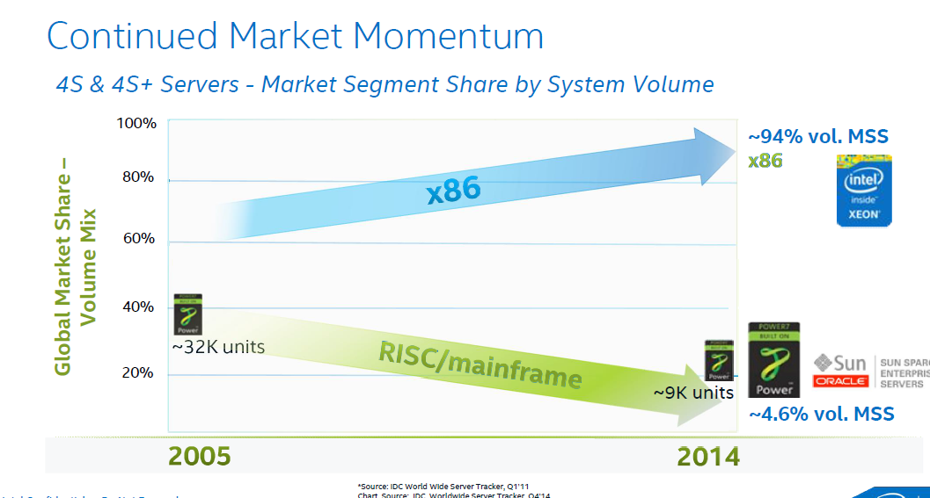
1.1 The worldwide 4S (4 Socket) server market (1)
1. Introduction to Intel’s high performance multicore MP servers and platforms
1.1 The worldwide 4S (4 Socket) server market [52]

Slide 7
1.2 The platform concept
Notes:
7

Slide 8
1.2 The platform concept (1)
1.2 The platform concept
The notion platform is widely used in different segments of the IT industry e.g. by
IC manufacturers, system providers or even by software suppliers with different interpretations.
Here we are focusing on the platform concept as used by system providers, like Intel or AMD.
The platform concept of system providers
The platform consists of the main components of the system architecture, being typically
the processor or processors (in multiprocessors)
the related chipset as well as
the interfaces (buses) interconnecting them.
Remark
The designation platform is often understood as the entire system architecture.

Slide 9
1.2 The platform concept (2)
Example 1: A simple traditional DC DP (2S) server platform (2007)
Core 2 (2C)
Core 2 (2C)
1066 MT/s
FSB
7200
ESI
631xESB/
632xESB IOH
FB-DIMM
w/DDR2-533

Slide 10
1.2 The platform concept (3)
Example 2: A recent 4S platform
(The Brickland 4S server platform including Haswell-EX processors (2015)
2x4 SMI2
channels
Xeon E7-4800 v3
(Haswell-EX)
2x4 SMI2
channels
PCIe 3.0
PCIe 3.0
SMB
32
QPI
1.1
32
SMB
SMB
Haswell-EX 14C
Haswell-EX 14C
SMB
SMB
SMB
SMB
SMB
QPI 1.1
QPI 1.1
QPI 1.1
QPI 1.1
SMB
SMB
SMB
Haswell--EX 14C
Haswell-EX 14C
SMB
SMB
QPI
1.1
SMB
SMB
32
DMI2
4xPCIe2
32
SMB
PCIe 3.0
PCIe 3.0
C602J PCH
(Patsburg J)
Up to DDR3-1600
in both performance and lockstep modes and
up to DDR4-1866 in lockstep mode
ME
SMI2: Scalable Memory Interface 2
(Parallel 64-bit VMSE data link between
the processor and the SMB)
SMB: Scalable Memory Buffer
(C112/C114: Jordan Creek 2)
(Performs conversion between the
parallel SMI2 and the parallel
DDR3/DDR4 DIMM interfaces)
C112: 2 DIMMs/channel
C114: 3 DIMMs/channel
QPI 1.1: Up to 9.6 GT/s
ME: Management Engine

Slide 11
1.2 The platform concept (4)
Compatibility of platform components (2)
Due to the fact that the platform components are connected via specified interfaces
multiple generations of platform components, such as processors or chipsets of a given line
are often compatible as long as they make use of the same interfaces and interface parameters
(such FSB speed) do not restrict this.

Slide 12
1.2 The platform concept (5)
Example for compatibility of platform components
(The Boxboro-EX platform 2010/2011)
Xeon 7500
(Nehalem-EX)
(Becton) 8C
Xeon E7-4800
(Westmere-EX) 10C
/
SMB
SMB
SMB
Nehalem-EX 8C
Westmere-EX 10C
QPI
Nehalem-EX 8C
Westmere-EX 10C
SMB
SMB
SMB
SMB
SMB
QPI
QPI
QPI
QPI
SMB
SMB
SMB
Nehalem-EX 8C
Westmere-EX 10C
Nehalem-EX 8C
Westmere-EX 10C
SMB
SMB
QPI
SMB
SMB
QPI
QPI
SMB
2x4 SMI
channels
2x4 SMI
channels
7500 IOH
PCIe
2.0
Nehalem-EX: up to DDR3-1067
Westmere-EX: up to DDR3-1333
ME
36
SMI: Scalable Memory Interface
(Serial link between the processor
and the SMB)
SMB: Scalable Memory Buffer
(Performs conversion between the
serial SMI and the parallel
DDR3 DIMM interfaces)
4 x QPI up to 6.4 GT/s
ESI
2 DIMMs/memory channel
ICH10
ME: Management Engine
Figure: The Boxboro-EX MP server platform supporting Nehalem-EX/Westmer-EX server processor

Slide 13
1.3 Server platforms classified according to the number of
processors supported
Notes:
13

Slide 14
1.3 Server platforms classified according to the number of processors supported (1)
1.3 Server platforms classified according to the number of processors supported
Server platforms
Uniprocessor server platforms
(UP-server platforms)
Multiprocessor server platforms
1-processor server platforms
(1-socket server platforms)
Server platforms supporting more than one processor
(Multi-socket server platforms)
DP (2S)
server platforms
MP (4S)
server platforms
Platforms for more than four servers
2- processor server platforms
(2-socket server platforms)
4-processor server platforms
(4-socket server platforms)
(Server platforms for
more than four sockets)

Slide 15
1.4 Multiprocessor server platforms classified according to
their memory architecture
Notes:
15

Slide 16
1.4 Multiprocessor server platforms classified according to their memory arch. (1)
1.4 Multiprocessor server platforms classified according to their memory architecture (1)
Multiprocessor server platforms
classified according to their memory architecture
SMPs
(Symmetrical MultiProcessor)
NUMAs
Multiprocessors (Multi socket system)
with Uniform Memory Access (UMA)
Multiprocessors (Multi socket system)
with Non-Uniform Memory Access
All processors access main memory by the same
mechanism, (e.g. by individual FSBs and an MCH).
A particular part of the main memory can be accessed
by each processor locally, other parts remotely.
Typical examples
Processor
Processor
Processor
QPI
Processor
QPI
QPI
FSB
E.g. DDR3-1333
IOH¹
E.g. DDR3-1333
MCH
E.g. DDR2-533
ESI
ESI
ICH
ICH
¹ICH: I/O hub
ESI: Enterprise System Interface

Slide 17
1.4 Multiprocessor server platforms classified according to their memory arch. (2)
Main features of SMP-type and NUMA-type server platforms
Multiprocessor server platforms
classified according to their memory architecture
SMPs
(Symmetrical MultiProcessor)
NUMAs
All processors share the same memory space
and all processors access memory by
the same access mechanism,
(e.g. by the same FSB or by individual FSBs
and an MCH.
All processors share the same memory space, but
each processor is allocated a particular part of the
memory space, called the local memory space,
whereas the rest is considered as the remote
memory spaces.
Consequently, all processors access memory
basically with the same latency.
The local part of the main memory can be accessed
by each processor immediately, e.g. via their private
on-die memory controller,
whereas the remote parts of the main memory will be
accessed via the processor owing the requested
memory space.
Consequently, processors access their local memory
space in significantly shorter latency than
memory spaces remote to them.

Slide 18
1.4 Multiprocessor server platforms classified according to their memory arch. (3)
Example of measured read latencies of uncached data [73]
Read latencies depend on whether referenced data is kept in the own or remote main memory space.
a) Read latency when referenced data is kept in the own memory space
Read latency:
65.1 ns (190 cycles)

Slide 19
1.4 Multiprocessor server platforms classified according to their memory arch. (4)
b) Read latency when referenced data is kept in the remote memory space [73]
Read latency:
106 ns (~310 cycles)
Read latency is increased now by the inter-processor access penalty of 41 ns in this case.

Slide 20
1.5 Platforms classified according to the number of chips
constituting the chipset
Notes:
20

Slide 21
1.5 Platforms classified according to the number of chips constituting the chipset (1)
1.5 Classification of platforms according to the number of chips constituting
the chipset
Implementation of platforms
classified according to the number of chips constituting the chipset
Three-chip implementation
Two-chip implementation
The system architecture consists
basically of three chip types
(processors/MCH/ICH)
The system architecture consists
basically of two chip types
(processors/PCH)
Truland platform (2005/2006)
Caneland platform (2007/2008)
Boxboro-EX platform (2010/2011)
Brickland platform (2014/2015)
Purley platform (2017?)

Slide 22
1.5 Platforms classified according to the number of chips constituting the chipset (2)
Example of a 3-chip platform: The Boxboro-EX 4S server platform supporting
Nehalem-EX/Westmere-EX processors (2010/2011)
Xeon 7500
(Nehalem-EX)
(Becton) 8C
/
Xeon E7-4800
(Westmere-EX) 10C
SMB
SMB
SMB
Nehalem-EX 8C
Westmere-EX 10C
QPI
Nehalem-EX 8C
Westmere-EX 10C
SMB
SMB
SMB
SMB
SMB
QPI
QPI
QPI
QPI
SMB
SMB
SMB
Nehalem-EX 8C
Westmere-EX 10C
Nehalem-EX 8C
Westmere-EX 10C
SMB
SMB
QPI
SMB
SMB
QPI
QPI
SMB
2x4 SMI
channels
2x4 SMI
channels
7500 IOH
PCIe
2.0
Nehalem-EX: up to DDR3-1067
Westmere-EX: up to DDR3-1333
ME
36
SMI: Scalable Memory Interface
(Serial link between the processor
and the SMB)
SMB: Scalable Memory Buffer
(Performs conversion between the
serial SMI and the parallel
DDR3 DIMM interfaces)
4 x QPI up to 6.4 GT/s
ESI
2 DIMMs/memory channel
ICH10
ME: Management Engine
Nehalem-EX aimed Boxboro-EX MP server platform (for up to 10 C)

Slide 23
1.5 Platforms classified according to the number of chips constituting the chipset (3)
Example of a 2-chip platform: The Brickland-EX 4S server platform supporting
Ivy Bridge-EX/Haswell-EX processors
2x4 SMI2
channels
Xeon E7-4800 v3
(Haswell-EX)
2x4 SMI2
channels
PCIe 3.0
PCIe 3.0
SMB
32
QPI
1.1
32
SMB
SMB
Haswell-EX 18C
Haswell-EX 18C
SMB
SMB
SMB
SMB
SMB
QPI 1.1
QPI 1.1
QPI 1.1
QPI 1.1
SMB
SMB
SMB
Haswell--EX 18C
Haswell-EX 18C
SMB
SMB
QPI
1.1
SMB
SMB
32
DMI2
4xPCIe2
32
SMB
PCIe 3.0
PCIe 3.0
C602J PCH
(Patsburg J)
Up to DDR3-1600
in both performance and lockstep modes and
up to DDR4-1866 in lockstep mode
ME
SMI2: Scalable Memory Interface 2
(Parallel 64-bit VMSE data link between
the processor and the SMB)
SMB: Scalable Memory Buffer
(C112/C114: Jordan Creek 2)
(Performs conversion between the
parallel SMI2 and the parallel
DDR3/DDR4 DIMM interfaces)
C112: 2 DIMMs/channel
C114: 3 DIMMs/channel
QPI 1.1: Up to 9.6 GT/s
ME: Management Engine

Slide 24
1.6 Naming schemes of Intel’s servers
Notes:
24

Slide 25
1.6 Naming scheme of Intel’s servers (1)
1.6 Naming schemes of Intel’s servers
In 2005 Intel discontinued their previous naming scheme emphasizing clock frequency
like Xeon 2.8 GHz DP or Xeon 2.0 GHz MP, and introduced an AMD like naming scheme,
as follows:
Intel’s recent naming scheme of servers
9000 series
7000 series
5000 series
3000 series
Itanium lines
of processors
MP server
processor lines
DP server
processor lines
UP server
processor lines
Accordingly, Intel’s subsequent MP server processor lines were designated as follows:
Line | Processor | Based on
7000 | Paxville MP | Pentium 4 Prescott MP
7100 | Tulsa | Pentium 4 Prescott MP
7200 | Tigerton DC | Core 2
7300 | Tigerton QC | Core 2
7400 | Dunnington | Penryn
7500 | Beckton | Nehalem

Slide 26
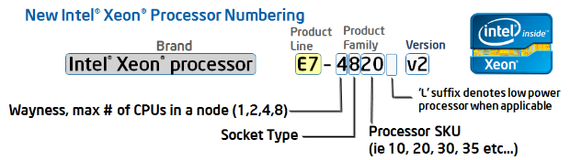
1.6 Naming scheme of Intel’s servers (2)
Renewed naming scheme of Intel’s servers
In 4/2011 Intel renewed their naming scheme for their whole processor offering.
This results in the following new naming scheme for servers:
Figure: Intel’s new Xeon naming scheme [127]
Product line: E7, E5 or E3.
Wayness: How many processors are natively supported in a system
Socket type: Signifies processor capability,
e.g. 8: high performance
6: effective performance etc..
Version: Xeon processors with a common version number share a common microarchitecture
Westmere (without version number)
v2: Ivy Bridge
v3: Haswell
v4: Broadwell

Slide 27
1.6 Naming scheme of Intel’s servers (3)
Remark
The designation of the server generations v2, v3 etc. does not coincides with the designation
of the microarchitectures, as follows:
Microarchitecture | Architecture generation | Server generation
Westmere |  | (without designation)
Sandy Bridge | Gen. 2
Ivy Bridge | Gen. 3 | v2
Haswell | Gen. 4 | v3
Broadwell | Gen. 5 | v4
Skylake | Gen. 6

Slide 28
1.6 Naming scheme of Intel’s servers (4)
Example: Server product lines of the Haswell family
The Haswell family
Haswell
(LGA1150)
Mobiles and desktops
Up to 4 cores
i3/i5/i7 designations
Haswell-E
(LGA2011)
High end desktops (HED)
Up to 8 cores
i7 designation
Haswell-EP
(LGA2011)
Effective performance servers
Up to 18 cores
Haswell-EX
(LG2011)
High-end erformance servers
Up to 18 cores
Servers
Microservers
E3-1275L/1265L v3, 4C+G, HT, 6/2013 and 5/2014
E3-1240L/1230L/1220L v3, 2C/4C, HT, 6/2013 and 5/2014
UP Servers
E3-12x5/12x6 v3, 4C+G, HT, 6/2013 and 5/2014
E3-12x0/12x1 v3, 4C, HT, 6/2013 and 5/2014
Workstations
E5-16xx v3, 4/6/8, 9/2014
DP-Servers
E5-26xx v3, 4/6/8/10/12/14/16/18C, 9/2014
MP-Servers
E5-46xx v3, 6/10/12/14/16/18C, 6/2015
E7-48xx v3, 8/10/12/14, 5/2015
E7-88xx v3, 4/10/16/18C, 5/2015

Slide 29
1.6 Naming scheme of Intel’s servers (5)
Renewed naming of Intel’s high-end MP (4S) servers
Accordingly, beginning with the Westmere-EX line Intel’s high-end 4S server lines are
designated as follows:
E7-4800 (Westmere-EX line)
E7-4800 v2 (Ivy Bridge-EX line)
E7-4800 v3 (Haswell-EX line)
E7-4800 v4 (Broadwell-EX line)

Slide 30
1.7 Overview of Intel’s high performance multicore MP servers
and platforms
Notes:
30

Slide 31
1.7 Overview of Intel’s high performance multicore MP servers and platforms (1)
1.7 Overview of Intel’s high performance multicore MP servers and platforms -1
Intel’s high performance multicore MP server platforms
Truland
(2005)
(90/65 nm)
Caneland
(2007)
(65/45 nm)
Boxboro-EX
(2010)
(45/32 nm)
Brickland-EX
(2014)
(22 nm)
Purley
(2017?)
(14 nm)
Pentium 4 Xeon MP
based
Core 2 Xeon MP
based
Nehalem-EX/
Westmere-EX
based
Ivy Bridge-EX/
Haswell-EX
Broadwell-EX
based
Skylake-EX
based

Slide 32
1.7 Overview of Intel’s high performance multicore MP servers and platforms (2)
Overview of Intel’s high performance multicore MP servers and platforms -2
 | Core | Techn. | Intro. | High performance MP server processor lines | Core count | Chipset | Proc. socket
Truland MP | Pentium 4 MP Prescott | 90 nm | 3/2005 | 90 nm Pentium 4 MP (Potomac) | 1C | E8500 + ICH5 | LGA 604
 | Pentium 4 Presc. | 90 nm | 11/2005 | 7000 (Paxville MP) | 2x1C | E8501 + ICH5
 | Pentium 4 Presc. | 65 nm | 8/2006 | 7100 (Tulsa) | 2x1C
Caneland MP | Core2 | 65 nm | 9/2007 | 7200 (Tigerton DC) 7300 (Tigerton QC) | 2C 2x2C | E7300 (Clarksboro)+ 631x/632x ESB | LGA 604
 | Penryn | 45 nm | 9/2008 | 7400 (Dunnington) | 6C
Boxboro-EX | Nehalem | 45 nm | 3/2010 | 7500 (Beckton/ Nehalem-EX) | 8C | 7500 (Boxboro) + ICH10 | LGA 1567
 | Westmere | 32 nm | 4/2011 | E7-4800 (Westmere-EX) | 10C
 | Sandy Bidge | 32 nm
Brickland | Ivy Bridge | 22 nm | 2/2014 | E7-4800 v2 (Ivy Bridge-EX) | 15C | C602J (Patsburg J) | LGA 2011-1
 | Haswell | 22 nm | 5/2015 | E7-4800 v3 (Haswell-EX) | 14C
 | Broadwell | 14 nm | ?? | E7-4800 v4 (Broadwell-EX) | 24C
Purley | Skylake | 14 nm | 2017?? | n.a. (Skylake-EX) | 28C | Lewisburg | Socket P

Slide 33
1.7 Overview of Intel’s high performance multicore MP servers and platforms (3)
Remark: Intel’s transfer to 64-bit ISA in their server lines [97]

Slide 34
2. Evolution of Intel’s high performance
multicore MP server platforms
Notes:
34

Slide 35
2. Evolution of Intel’s high performance multicore MP server platforms (1)
2. Evolution of Intel’s high performance multicore MP server platforms
Intel’s high performance multicore MP (4S) platforms -- Overview
 | Core | Techn. | Intro. | High performance MP server processor lines | Core count | Chipset | Proc. socket
Truland MP | Pentium 4 MP Prescott | 90 nm | 3/2005 | 90 nm Pentium 4 MP (Potomac) | 1C | E8500 + ICH5 | LGA 604
 | Pentium 4 Presc. | 90 nm | 11/2005 | 7000 (Paxville MP) | 2x1C | E8501 + ICH5
 | Pentium 4 Presc. | 65 nm | 8/2006 | 7100 (Tulsa) | 2x1C
Caneland | Core2 | 65 nm | 9/2007 | 7200 (Tigerton DC) 7300 (Tigerton QC) | 2C 2x2C | E7300 (Clarksboro)+ 631x/632x ESB | LGA 604
 | Penryn | 45 nm | 9/2008 | 7400 (Dunnington) | 6C
Boxboro-EX | Nehalem | 45 nm | 3/2010 | 7500 (Beckton/ Nehalem-EX) | 8C | 7500 + ICH10 | LGA 1567
 | Westmere | 32 nm | 4/2011 | E7-4800 (Westmere-EX) | 10C
 | Sandy Bidge | 32 nm
Brickland | Ivy Bridge | 22 nm | 11/2012 | E7-4800 v2 (Ivy Bridge-EX) | 15C | C602J (Patsburg J) | LGA 2011-1
 | Haswell | 22 nm | 5/2015 | E7-4800 v3 (Haswell-EX) | 14C
 | Broadwell | 14 nm | ?? | E7-4800 v4 (Broadwell-EX) | 24C
Purley | Skylake | 14 nm | 2017?? | n.a. (Skylake-EX) | 28C | Lewisburg | Socket P

Slide 36
2. Evolution of Intel’s high performance multicore MP server platforms (2)
The driving force of the evolution of memory subsystems in MP servers -1
Providing enough memory bandwidth is one of the key challenges in designing processor platforms since multicores emerged.
It has three main roots;
The total memory bandwidth of a multicore multiprocessor platform multiplies with
both the processor count and the core count [99].
Nevertheless, with time core count doubles about every two years, in accordance with Moore’s revised rule, whereas memory speed about every four to eight years, as indicated in the next Figure.

Slide 37
2. Evolution of Intel’s high performance multicore MP server platforms (3)
Raising the memory transfer rate in Intel’s DT and MP platforms
Transfer rate
(MT/s)
3000
DDR4/2133
DDR3/1866
DDR3
1600
2000
DDR3
1333
x
*
DDR3
1067
*
x
*
~ 2*/4 years
DDR2
800
*
DDR3
1600
DDR3
1866
1000
DDR2
667
*
x
DDR2
533
*
DDR3
1067
~ 2*/8 years
DDR
400
*
x
500
DDR
333
*
DDR2
667
DDR
266
MP
x
*
*
DDR
400
*
200
DT
100
≈
Year
2000
01
02
03
04
05
06
07
08
09
2010
11
12
13
14
15

Slide 38
2. Evolution of Intel’s high performance multicore MP server platforms (4)
The driving force for the evolution of memory subsystems in MP servers -2
Then while the core count doubles more or less in every two years, the available bandwidth,
i.e. the product of the number of memory channels, memory speed and data width, raises
slower than required and the bandwidth deficit need to be compensated by implementing
appropriately more memory channels, if core count proportional memory bandwidth should be provided.
Here we assume that the width of the memory channels remains unchanged.
c) The number of feasible memory channels is however severely limited typically to two
when high speed memory (e.g. DDR2/3/4) is attached in the traditional way, that is
by parallel DRAM channels via the MCH.

Slide 39
2. Evolution of Intel’s high performance multicore MP server platforms (5)
Example: Connecting memory in a Pentium 4-based single core Xeon MP platform
Intel’s first generation MP servers made use of an SMP (Symmetric Multiprocessor) topology
while using only a single FSB that connects all 4 single core processors to the MCH
(North Bridge), and provided only two memory channels, as shown below.
Xeon MP¹
SC
Xeon MP¹
SC
Xeon MP¹
SC
Xeon MP¹
SC
FSB
E.g. 400 MT/s
NB
E.g. HI 1.5
E.g. DDR-200/266
ICH
HI 1.5 266 MB/s
Figure: Pentium 4 MP aimed MP server platform for single core processors

Slide 40
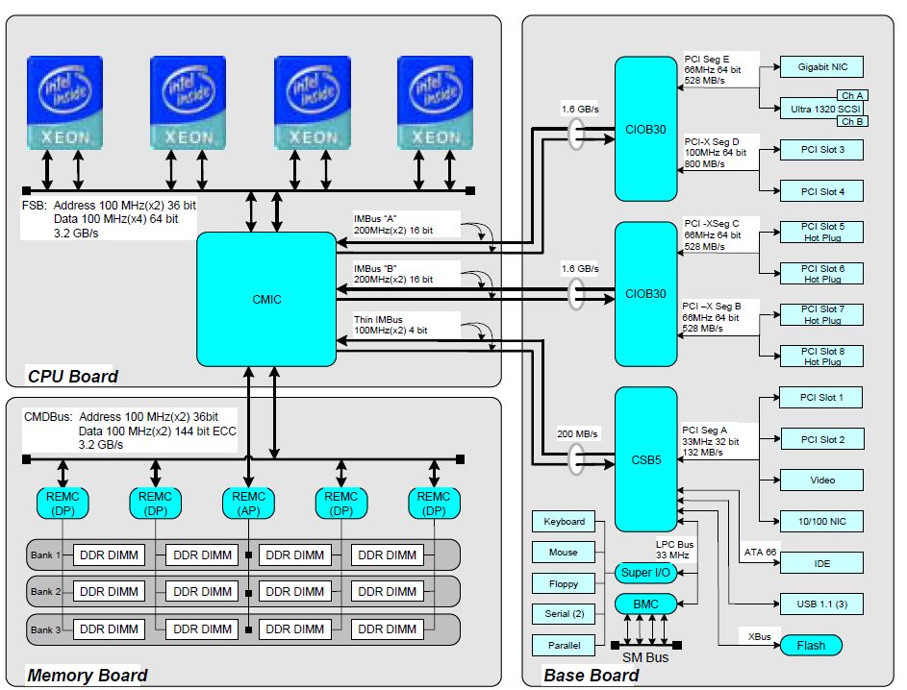
2. Evolution of Intel’s high performance multicore MP server platforms (6)
Example for Intel’s early Pentium 4 based server MP [101]

Slide 41
2. Evolution of Intel’s high performance multicore MP server platforms (7)
Why the number of memory channels is typically limited to two ? -1
If high speed (e.g. DDR2/3/4) DIMMs are connected via the MCH to a platform by standard
parallel memory buses, a large number of cupper traces are needed on the mainboard, e.g.
240 traces for DDR2/DDR3 DIMMs or 284 lines for DDR4 DIMMs, to connect the MCH to the
DIMM sockets, as shown in the next Figure.

Slide 42
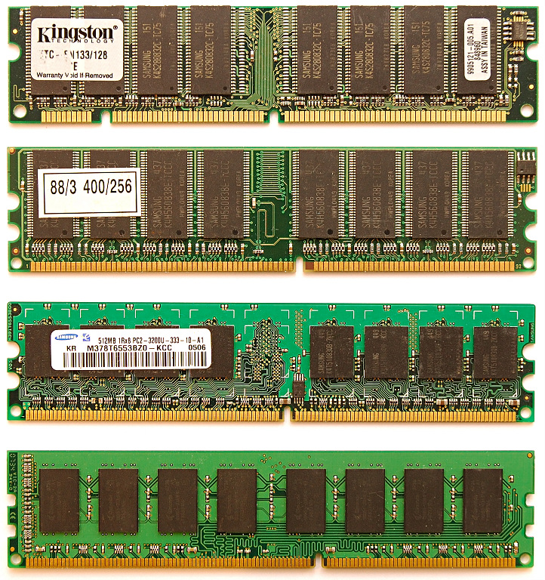
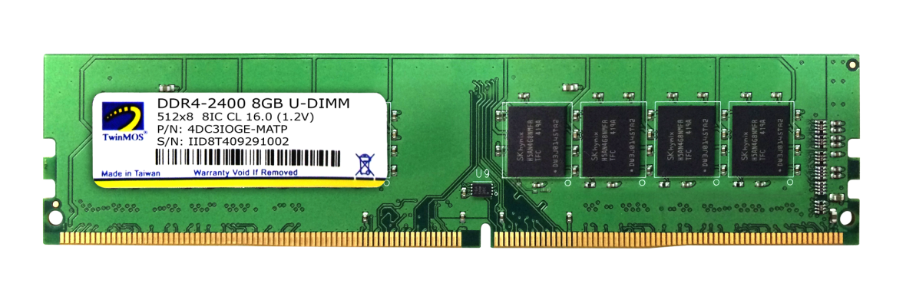
2. Evolution of Intel’s high performance multicore MP server platforms (8)
2.1 Overview of the Truland MP platform (1)
Pin counts of SDRAM to
DDR4 DIMMs
All these DIMMs
are 8-byte wide.
SDRAM
(SDR)
168-pin
DDR
184-pin
DDR2
240- pin
DDR3
240-pin
DDR4
284-pin
Notes:
42

Slide 43
2. Evolution of Intel’s high performance multicore MP server platforms (9)
Why the number of memory channels is typically limited to two? -2
For implementing more than two memory channels smaller and denser cupper traces
would be required on the mainboard due to space limitations.
This however, would cause higher ohmic resistance and coupling capacitance, which
would end up in longer rise and fall times, i.e. it would prevent the platform from
maintaining the desired high DRAM rate.
The fact that basically no more than two high speed memory channels can be connected
centrally, via the MCH limits the usability of connecting memory to the MCH by standard
memory channels to dual core servers, as shown in the example before.
This bottleneck can be remedied in two orthogonal ways,
• either by connecting memory immediately to the processors rather than to the MCH,
• or using low line count interfaces between the memory controller and the DIMMs,
as indicated in the next Figure.

Slide 44
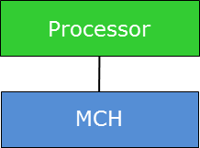
2. Evolution of Intel’s high performance multicore MP server platforms (10)
Possible solutions for raising the number of memory channels
DIMMs
Possible solutions for raising the number of memory channels
Connect memory immediately
to the processor(s)
Use low line count interfaces
between the MC and the DIMMs

Slide 45
2. Evolution of Intel’s high performance multicore MP server platforms (11)
Connect memory immediately to the processor
This is one option of the design aspect of choosing the connection point of the memory to the
platform
Connection point of the memory
Connect memory
via the MCH (Memory Control Hub)
Connect memory
via the processor(s)
Processor
Processor
Memory
MCH
Memory
The central connection of memory
causes severe bandwidth imitations
first of all for MP configurations.
The per processor connection of memory
provides inherent scaling
of the memory bandwidth with the processor count.

Slide 46
2. Evolution of Intel’s high performance multicore MP server platforms (12)
Use low line count interfaces between the MC and the DIMMs
This is one option of the design aspect of choosing the interface connecting the MC and the DIMMs
The interface connecting the MCs and the DIMMs
Use standard DRAM interfaces
between the MCs and the DIMMs
Use low line count interfaces
between the MCs and the DIMMs
DIMMs are connected to one or more memory controllers directly by standard DRAM interfaces.
The number of memory channels is limited due to spatial and electrical constraints typically to two.
DIMMs are connected to one or more memory controllers via low line count interfaces and interface converters, called memory extension buffers (MBs) in order to connect more than two memory channels
DIMMs
DIMMs
MC in
MCH/processor
MB
MC in
MCH/processor
MB
Standard DRAM
interface
Low line count
interface
Standard DRAM
interface

Slide 47
2. Evolution of Intel’s high performance multicore MP server platforms (13)
Evolution of connecting memory in Intel’s multicore MP platforms
Connection point of the memory
Connect memory
via the MCH
Connect memory
via the processor(s)
Traditional
solution
The interface
connecting the MCs and the DIMMs
Use standard DRAM interfaces between the
MCs and the DIMMs
Use low line count interfaces between the MCs and the DIMMs
Truland MP platform
(2005/2006)
Boxboro-EX platform
(2010/2011)
Caneland platform
(2007/2008)
Brickland platform
(2014/2015)

Slide 48
2. Evolution of Intel’s high performance multicore MP server platforms (14)
Assessing the number of memory channels required
As stated before, in MP servers the core count is raising more or less according to Moore’s
rule, i.e. it doubles about every two years, whereas memory speed raises slower,
it doubles only about every four to eight years.
If the arising bandwidth deficit should be compensated by raising the number of memory
channels, assuming otherwise unchanged platform conditions, like clock speed, width of
the memory channels etc.., a scaling rule can be formulated as follows:
It can be shown (related publication in preparation) that an up to date MP platform with
as many cores as feasible and using available high speed memory, will have linear memory
bandwidth scaling in respect to the core count (n_{C}) if the number of memory channels
per socket (n_{M}) amount to
n_{M} ~ √n_{C}.

Slide 49
2. Evolution of Intel’s high performance multicore MP server platforms (15)
Expected number of memory channels (n_{M}/socket) for different core counts (n_{C})
arising from the scaling rule of memory channels

Slide 50
2. Evolution of Intel’s high performance multicore MP server platforms (16)
The FSB bottleneck in SMP configurations
In early SMP configurations (e.g. in first Pentium 4 based single core (SC) Xeon based systems)
there is a single FSB that interconnects the four processors with the NB (Northbridge),
as seen.
Xeon MP¹
SC
Xeon MP¹
SC
Xeon MP¹
SC
Xeon MP¹
SC
FSB
E.g. 400 MT/s
Up to 3.2 GB/s
NB
Up to 2 x 8 x 0.266 = 4.26 GB/s
E.g. HI 1.5
E.g. DDR-200/266
ICH
HI 1.5 266 MB/s
Figure: Pentium 4 MP aimed MP server platform (for single core processors)
As the bandwidth data on the Figure demonstrate, in the example there is already the FSB
that limits the overall memory bandwidth.

Slide 51
2. Evolution of Intel’s high performance multicore MP server platforms (17)
Resolving the FSB bottleneck in SMP configurations -1
Obviously, in SMP configurations with higher core count and memory speeds, a single FSB
may severely limit memory bandwidth and thus performance.
This FSB caused bandwidth bottleneck may resolved by using more than one FSB, as indicated
in the subsequent Figures.

Slide 52
2. Evolution of Intel’s high performance multicore MP server platforms (18)
Resolving the FSB bottleneck by using dual FSBs in dual core MP server platforms
Xeon MP
(Potomac) 1C
/
Xeon 7000
(Paxville MP) 2x1C
/
Xeon 7100
(Tulsa) 2C
Xeon MP¹
SC
Xeon MP¹
SC
Xeon MP¹
SC
Xeon MP¹
SC
Pentium 4
Xeon MP 1C/2x1C
Pentium 4
Xeon MP 1C/2x1C
Pentium 4
Xeon MP 1C/2x1C
Pentium 4
Xeon MP 1C/2x1C
FSB
(800 MT/s)
FSB (400 MT/s)
Preceding NBs
XMB
8500¹/8501
XMB
XMB
XMB
E.g. DDR-200/266
E.g. HI 1.5
E.g. DDR-200/266
HI 1.5
DDR-266/333
DDR2-400
ICH5
DDR-266/333
DDR2-400
Preceding ICH
HI 1.5 266 MB/s
Previous Pentium 4 MP aimed
MP server platform (for single core processors)
(2004 and before)
90 nm Pentium 4 Prescott MP aimed
Truland MP server platform (for up to 2 C)
(2006)

Slide 53
2. Evolution of Intel’s high performance multicore MP server platforms (19)
Resolving the FSB bottleneck by using quad FSBs in up to 6 core MP server platforms
Xeon MP
(Potomac) 1C
/
Xeon 7000
(Paxville MP) 2x1C
/
Xeon 7100
(Tulsa) 2C
Xeon 7200
(Tigerton DC) 1x2C
/
Xeon 7300
(Tigerton QC) 2x2C
/
Xeon 7400
(Dunnington 6C)
Pentium 4
Xeon MP 1C/2x1C
Pentium 4
Xeon MP 1C/2x1C
Pentium 4
Xeon MP 1C/2x1C
Pentium 4
Xeon MP 1C/2x1C
Core2 (2C/4C)
Penryn (6C)
Core2 (2C/4C)
Penryn (6C)
Core2 (2C/4C)
Penryn (6C)
Core2 (2C/4C)
Penryn (6C)
FSB
(800 MT/s)
FSB
(1066 MT/s)
XMB
8500¹/8501
XMB
7300
up to
8 DIMMs
XMB
XMB
HI 1.5
ESI
DDR-266/333
DDR2-400
ICH5
DDR-266/333
DDR2-400
631xESB/
632xESB
FBDIMM
DDR2-533/667
90 nm Pentium 4 Prescott MP aimed
Truland MP server platform (for up to 2 C)
(2006)
Core 2 aimed
Caneland MP server platform (for up to 6 C)
(2007)
HI 1.5 (Hub Interface 1.5)
8 bit wide, 66 MHz clock, QDR,
266 MB/s peak transfer rate
ESI: Enterprise System Interface
4 PCIe lanes, 0.25 GB/s per lane (like the DMI interface,
providing 1 GB/s transfer rate in each direction)
¹ The E8500 MCH supports an FSB of 667 MT/s and consequently only the SC Xeon MP (Potomac)

Slide 54
2. Evolution of Intel’s high performance multicore MP server platforms (20)
Evolution of Intel’s high performance MP platforms – Memory architecture
Platform | Platform topology | Date of intro. | Processor | Techno- logy | Core count (up to) | No./kind of the links to mem. buffers | No. of mem. channels/ mem. buffer | No. /speed of mem. channels (up to)
Truland MP | SMP w/dual FSBs | 3/2005 | 90 nm Pentium 4 MP (Potomac) | 90 nm | 1C | 4 serial IMI channels from MCH to XMBs | 2 memory channels/ XMB | 2x DDR2-800/ socket
 |  | 11/2005 | Xeon 7000 (Paxville MP) | 90 nm | 2x1C
 |  | 8/2006 | Xeon 7100 (Tulsa) | 65 nm | 2C
Caneland | SMP w/Quad FSBs | 9/2007 | Xeon 7200 Tigerton DC (Core 2) | 65 nm | 2C | 4 serial FB-DIMM channels from MCH to AMBs | 1 memory channel/ AMB | 1x DDR2-667/ socket
 |  | 9/2007 | Xeon 7300 Tigerton QC (Core 2) | 65 nm | 2x2C
 |  | 9/2008 | Xeon 7400 (Dunnington) (Penryn) | 45 nm | 6C
Boxboro-EX | NUMA fully connect. by QPI buses | 3/2010 | Nehalem-EX (Xeon 7500/ (Beckton) | 45 nm | 8C | 4 serial SMI channels per proc. to 4 SMBs | 2 memory channels/ SMB | 8x DDR3-1067/ socket
 |  | 4/2011 | Westmere-EX (E7-4800) | 32 nm | 10C
Brickland | NUMA fully connect. by QPI buses | 2/2014 | Ivy Bridge-EX (E7-4800 v2) | 22 nm | 15C | 4 parallel SMI2 channels per proc. to 4 SMBs | 2 memory channels/ SMB | 8x DDR3-1600 (IWB) / DDR4-1866 (HSW)/ socket
 |  | 5/2015 | Haswell-EX (E7-4800 v3) | 22 nm | 18C
 |  | ?? | Broadwell-EX?? | 14 nm | 24C
Purley | NUMA fully connect. by UPI buses | 2017 | Skylake-EX | 14 nm | 28C | 6 channels per proc. | n.a. | DDR4-2666 mem. speed

Slide 55
2. Evolution of Intel’s high performance multicore MP server platforms (21)
Evolution of single core MP server platforms to dual core MP server platform
Xeon MP
(Potomac) 1C
/
Xeon 7000
(Paxville MP) 2x1C
/
Xeon 7100
(Tulsa) 2C
Xeon MP¹
SC
Xeon MP¹
SC
Xeon MP¹
SC
Xeon MP¹
SC
Pentium 4
Xeon MP 1C/2x1C
Pentium 4
Xeon MP 1C/2x1C
Pentium 4
Xeon MP 1C/2x1C
Pentium 4
Xeon MP 1C/2x1C
FSB
FSB
Preceding NBs
XMB
8500¹/8501
XMB
XMB
XMB
E.g. DDR-200/266
E.g. HI 1.5
E.g. DDR-200/266
IMI
HI 1.5
IMI
DDR-266/333
DDR2-400
ICH5
DDR-266/333
DDR2-400
Preceding ICH
HI 1.5 266 MB/s
Previous Pentium 4 MP aimed
MP server platform (for single core processors)
(2004 and before)
90 nm Pentium 4 Prescott MP aimed
Truland MP server platform (for up to 2 C)
(2006)
IMI (Independent Memory Interface): Low line count (70 signal lines) serial interface vs. DDR2 with 240 pins.
XMB: eXternal Memory Bridge

Slide 56
2. Evolution of Intel’s high performance multicore MP server platforms (22)
Evolution of dual core MP server platform to up to 6 core MP platform
Xeon MP
(Potomac) 1C
/
Xeon 7000
(Paxville MP) 2x1C
/
Xeon 7100
(Tulsa) 2C
Xeon 7200
(Tigerton DC) 1x2C
/
Xeon 7300
(Tigerton QC) 2x2C
/
Xeon 7400
(Dunnington 6C)
Pentium 4
Xeon MP 1C/2x1C
Pentium 4
Xeon MP 1C/2x1C
Pentium 4
Xeon MP 1C/2x1C
Pentium 4
Xeon MP 1C/2x1C
Core2 (2C/4C)
Penryn (6C)
Core2 (2C/4C)
Penryn (6C)
Core2 (2C/4C)
Penryn (6C)
Core2 (2C/4C)
Penryn (6C)
FSB
FSB
XMB
8500¹/8501
XMB
7300
up to
8 DIMMs
XMB
XMB
HI 1.5
ESI
DDR-266/333
DDR2-400
ICH5
DDR-266/333
DDR2-400
631xESB/
632xESB
FBDIMM
DDR2-533/667
90 nm Pentium 4 Prescott MP aimed
Truland MP server platform (for up to 2 C)
(2006)
Core 2 aimed
Caneland MP server platform (for up to 6 C)
(2007)
HI 1.5 (Hub Interface 1.5)
8 bit wide, 66 MHz clock, QDR,
266 MB/s peak transfer rate
ESI: Enterprise System Interface
4 PCIe lanes, 0.25 GB/s per lane (like the DMI interface,
providing 1 GB/s transfer rate in each direction)
¹ The E8500 MCH supports an FSB of 667 MT/s and consequently only the SC Xeon MP (Potomac)

Slide 57
2. Evolution of Intel’s high performance multicore MP server platforms (23)
A brief introduction to FB-DIMM memories
FB-DIMM memories were standardized and introduced in the 2006/2007 timeframe .
They supported DDR2 memories up to DDR2-667.
FB-DIMMs connect the MC and the DIMMs via low line count serial buses whereby the
memory buffers providing serial/parallel conversion to the DIMMs are placed onto the
DIMMs, as shown in the next Figure.

Slide 58
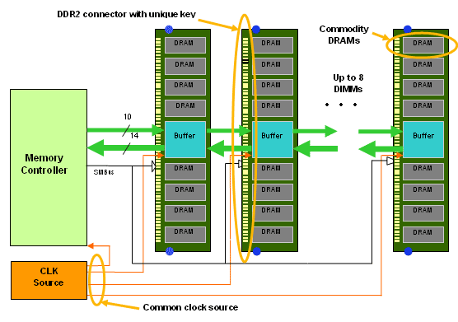
2. Evolution of Intel’s high performance multicore MP server platforms (24)
Layout of an FB-DIMM based memory subsystem -1 [102]
Figure: FB-DIMM memory architecture [102]

Slide 59
2. Evolution of Intel’s high performance multicore MP server platforms (25)
Layout of an FB-DIMM based memory subsystem -2 [102]
The standardized FB-DIMM technology supports a cascaded connection of up to 8 FB-DIMMs
to a memory controller by a packet based, bidirectional, point-to-point link.
The link make use of differential signaling and includes 14 read/10 write lanes, as indicated
in the next Figure.

Slide 60
2. Evolution of Intel’s high performance multicore MP server platforms (26)
Layout of an FB-DIMM based memory subsystem -3 [102]
Figure: FB-DIMM memory architecture [102]

Slide 61
2. Evolution of Intel’s high performance multicore MP server platforms (27)
Layout of an FB-DIMM based memory subsystem -4 [103]
The 14 inbound lanes carry data from the memory to the memory controller whereas the
10 outbound lanes transfer commands and data from the memory controller to the memory.
The transfer rate is 6 times the transfer rate of the memory, i.e. 6x667=4 MT/s over the
differential lines.
Data and commands, transferred in 12 cycles, from one frame, that is an inbound frame includes
12x14=168 bit whereas an outbound frame has 12x10=120 bits.
For more information we refer to the literature, e.g. [103].

Slide 62
2. Evolution of Intel’s high performance multicore MP server platforms (28)
Reasoning for using FB-DIMM memory in the Caneland platform
As FB-DIMMs need only a fraction of the lines compared to standard DDR2 DIMMs,
significantly more memory channels (e.g. 6 channels) may be connected to the MCH than
in case of high pin count DDR2 DIMMs.
Furthermore, due to the cascaded interconnection of the FB-DIMMs (with repeater
functionality), up to 8 DIMMs may be interconnected to a single DIMM channel instead of
two or three as typical for standard DDR2 memory channels.
This results in considerably more memory bandwidth and memory size by reduced mainboard
complexity.
Based on these benefits Intel decided to use FB-DIMM-667 memory in their server platforms,
first in their DP platforms already in 2006 followed by the Caneland MP platform in 2007,
as discussed before.

Slide 63
2. Evolution of Intel’s high performance multicore MP server platforms (29)
Main enhancements of the Nehalem-EX/Westmere-EX aimed up to 10 core Boxboro-EX
4S server platform (assuming 1 IOH)
Xeon 7500
(Nehalem-EX)
(Becton) 8C
/
Xeon E7-4800
(Westmere-EX) 10C
SMB
SMB
SMB
Nehalem-EX 8C
Westmere-EX 10C
QPI
Nehalem-EX 8C
Westmere-EX 10C
SMB
SMB
SMB
SMB
SMB
QPI
QPI
QPI
QPI
SMB
SMB
SMB
Nehalem-EX 8C
Westmere-EX 10C
Nehalem-EX 8C
Westmere-EX 10C
SMB
SMB
QPI
SMB
SMB
QPI
QPI
SMB
2x4 SMI
channels
2x4 SMI
channels
7500 IOH
PCIe
2.0
Nehalem-EX: up to DDR3-1067
Westmere-EX: up to DDR3-1333
ME
36
SMI: Scalable Memory Interface
(Serial link between the
processor and the SMB)
(Differential signaling, ~25 lanes)
SMB: Scalable Memory Buffer
(Conversion between the serial SMI and the parallel DDR3 DIMM interfaces)
4 x QPI up to 6.4 GT/s
ESI
2 DIMMs/memory channel
ICH10
ME: Management Engine
Nehalem-EX aimed Boxboro-EX MP server platform (for up to 10 C)
(2010/2011)

Slide 64
2. Evolution of Intel’s high performance multicore MP server platforms (30)
Returning to the stand alone memory buffer implementation in the Boxboro-EX
MP platform from using FB-DIMMs -1
FB-DIMM memories were introduced in the 2006/2007 timeframe and supported DDR2
memories up to DDR2-667.
Due to inherent drawbacks of FB-DIMM memories, such as higher dissipation caused by the
DA/AD conversions, longer access time due to the cascaded nature of accessing the DIMMs
and higher price, FB-DIMMs reached only a small market share.
This was the reason why memory vendors were reluctant to develop DDR3-based FB-DIMM
memory modules and why Intel was forced to move back to custom DDR3 DIMMs in their
Boxboro-EX platform.

Slide 65
2. Evolution of Intel’s high performance multicore MP server platforms (31)
Returning to the stand alone memory buffer implementation in the Boxboro-EX
MP platform from using FB-DIMMs -2
Implementing memory extension buffers MBs)
Implementing stand alone MBs
mounted on the mainboard or
on a riser card
Implementing MBs
immediately on the DIMM
(called FB-DIMMs)
Truland MP platform
(2005/2006)
Caneland platform
(2007/2008)
Boxboro-EX platform
(2010/2011)
Brickland platform
(2014/2015)
Figure: Intel’s implementation of memory extension buffers

Slide 66
2. Evolution of Intel’s high performance multicore MP server platforms (32)
Main enhancement of the up to 15 core Ivy Bridge-EX aimed Brickland 4S server platform
Xeon E7-4800 v2
(Ivy Bridge-EX)
(Ivytown) 15C
2x4 SMI2
channels
2x4 SMI2
channels
PCIe 3.0
PCIe 3.0
SMB
32
32
SMB
SMB
Ivy Bridge-EX 15C
QPI
1.1
Ivy Bridge-EX 15C
SMB
SMB
SMB
SMB
SMB
QPI 1.1
QPI 1.1
QPI 1.1
QPI 1.1
SMB
SMB
SMB
Ivy Bridge-EX 15C
Ivy Bridge-EX 15C
SMB
SMB
QPI
1.1
SMB
SMB
32
DMI2
4xPCIe2
32
SMB
PCIe 3.0
PCIe 3.0
C602J PCH
(Patsburg J)
Up to DDR3-1600 in lockstep mode and
up to DDR3-1333 in independent channel mode
ME
SMI2: Scalable Memory Interface 2
(Parallel 64 bit VMSE data link between
the processor and the SMB)
SMB: Scalable Memory Buffer
(C102/C104: Jordan Creek)
(Performs conversion between the
parallel SMI2 and the parallel
DDR3-DIMM interfaces)
C102: 2 DIMMs/channel
C104: 3 DIMMs/channel
3 x QPI up to 8.0 GT/s
ME: Management Engine

Slide 67
2. Evolution of Intel’s high performance multicore MP server platforms (33)
Main enhancements of the up to 18 core Haswell-EX aimed Brickland 4S server platform
2x4 SMI2
channels
Xeon E7-4800 v3
(Haswell-EX)
2x4 SMI2
channels
PCIe 3.0
PCIe 3.0
SMB
32
QPI
1.1
32
SMB
SMB
Haswell-EX 18C
Haswell-EX 18C
SMB
SMB
SMB
SMB
SMB
QPI 1.1
QPI 1.1
QPI 1.1
QPI 1.1
SMB
SMB
SMB
Haswell--EX 18C
Haswell-EX 18C
SMB
SMB
QPI
1.1
SMB
SMB
32
DMI2
4xPCIe2
32
SMB
PCIe 3.0
PCIe 3.0
C602J PCH
(Patsburg J)
Up to DDR3-1600
in both performance and lockstep modes and
up to DDR4-1866 in lockstep mode
ME
SMI2: Scalable Memory Interface 2
(Parallel 64-bit VMSE data link between
the processor and the SMB)
(~110 bidirectional VMSE data lines)
SMB: Scalable Memory Buffer
(C112/C114: Jordan Creek 2)
(Performs conversion between the
parallel SMI2 and the parallel
DDR3/DDR4 DIMM interfaces)
C112: 2 DIMMs/channel
C114: 3 DIMMs/channel
3x QPI 1.1: Up to 9.6 GT/s
ME: Management Engine

Slide 68
2. Evolution of Intel’s high performance multicore MP server platforms (34)
b) Redesigned SMI 2 interface between the processor and the memory buffers
resulting in reduced dissipation
The SMI link of the Boxboro-EX platform was a serial, packet based, differential link
including about 70 signal lines.
By contrast, as far as the data transfer is concerned, with the SMI2 link Intel changed to
64-bit parallel, bidirectional communication using single-ended voltage reference signals,
called VMSE (Voltage Mode Single Ended) signaling.
SMI 2 requires altogether about 110 signal lines, that is about 50 % more lines than SMI.
The reason for changing from serial transfer to parallel transfer in case of the data lines is
presumably the fact, that in this case AD/DA converting of data becomes superfluous and
this results in reduced dissipation.

Slide 69
2. Evolution of Intel’s high performance multicore MP server platforms (35)
Intel’s high performance MP platforms – Cache architectures
Platform | Platform topology | Date of intro. | Processor | Techno- logy | Core count (up to) | L2 cache | L3 cache
Truland MP | SMP w/dual FSBs | 3/2005 | 90 nm Pentium 4 MP (Potomac) | 90 nm | 1C | 1 MB | 8 MB
 |  | 11/2005 | Xeon 7000 (Paxville MP) | 90 nm | 2x1C | 2 MB L2/C | --
 |  | 8/2006 | Xeon 7100 (Tulsa) | 65 nm | 2C | 1 MB L2/C | 16 MB
Caneland | SMP w/Quad FSBs | 9/2007 | Xeon 7200 Tigerton DC (Core 2) | 65 nm | 2C | 4 MB/C | --
 |  | 9/2007 | Xeon 7300 Tigerton QC (Core 2) | 65 nm | 2x2C | 4 MB/C | ---
 |  | 9/2008 | Xeon 7400 (Dunnington) (Penryn) | 45 nm | 6C | 3 MB/C | 16 MB
Boxboro-EX | NUMA fully connect. by QPI buses | 3/2010 | Nehalem-EX (Xeon 7500/ (Beckton) | 45 nm | 8C | ¼ MB/C | 24 MB
 |  | 4/2011 | Westmere-EX (E7-4800) | 32 nm | 10C | ¼ MB/C | 30 MB
Brickland | NUMA fully connect. by QPI buses | 2/2014 | Ivy Bridge-EX (E7-4800 v2) | 22 nm | 15C | ¼ MB/C | 37.5 MB
 |  | 5/2015 | Haswell-EX (E7-4800 v3) | 22 nm | 18C | ¼ MB/C | 35 MB
 |  | ?? | Broadwell-EX | 14 nm | 24C | ¼ MB/C | 60 MB
Purley | NUMA fully connect. by UPI buses | 2017 | Skylake-EX | 14 nm | 28C | n.a. | n.a.

Slide 70
2. Evolution of Intel’s high performance multicore MP server platforms (36)
Intel’s high performance MP platforms – Connectivity
Platform | Platform topology | Date of intro. | Processor | Techno- logy | Core count (up to) | FSB/QPI | IF to chipset | PCIe
Truland MP | SMP w/dual FSBs | 3/2005 | 90 nm Pentium 4 MP (Potomac) | 90 nm | 1C | 2xFSB 667 MT/s | HI1.5 (266 MB/s bidirectional) | 28 x PCIe lanes on the MCH
 |  | 11/2005 | Xeon 7000 (Paxville MP) | 90 nm | 2x1C | 2xFSB 800 MT/s
 |  | 8/2006 | Xeon 7100 (Tulsa) | 65 nm | 2C
Caneland | SMP w/Quad FSBs | 9/2007 | Xeon 7200 Tigerton DC (Core 2) | 65 nm | 2C | 4xFSB 1066 MT/s | ESI x4 (4x PCIe lanes) (1GB/s per direction) | 28 x PCIe lanes on the MCH
 |  | 9/2007 | Xeon 7300 Tigerton QC (Core 2) | 65 nm | 2x2C
 |  | 9/2008 | Xeon 7400 (Dunnington) (Penryn) | 45 nm | 6C
Boxboro-EX | NUMA fully connect. by QPI buses | 3/2010 | Nehalem-EX (Xeon 7500/ (Beckton) | 45 nm | 8C | 4xQPI 6.4 GT/s (3 for NUMA) | QPI (6.4 GB/s) | 36 x PCIe 2.0 lanes on the IOH
 |  | 4/2011 | Westmere-EX (E7-4800) | 32 nm | 10C
Brickland | NUMA fully connect. by QPI buses | 2/2014 | Ivy Bridge-EX (E7-4800 v2) | 22 nm | 15C | 3xQPI 1.1 8 GT/s | DMI2 x4 (4xPCIe 2.0) (2 GB/s per direction) | 32 x PCIe 3.0 lanes on the proc.
 |  | 5/2015 | Haswell-EX (E7-4800 v3) | 22 nm | 18C | 3xQPI 1.1 9.6 GT/s
 |  | ?? | Broadwell-EX | 14 nm | 24C | 3xQPI 1.1
Purley | NUMA fully connect. by UPI buses | 2017 | Skylake-EX | 14 nm | 28C | 3xUPI 10.4 GT/s | DMI3 x4 (4xPCIe 3.0) (~ 4GB/s/dir. | 48 x PCIe lanes on the proc.

Slide 71
3. Example 1: The Brickland platform
3.1 Overview of the Brickland platform
3.2 Key innovations of the Brickland platform vs.
the previous Boxboro-EX platform
3.3 The Ivy Bridge-EX (E7-4800 v2) 4S processor line
3.4 The Haswell-EX (E7-4800 v3) 4S processor line
3.5 The Broadwell-EX (E7-4800 v4) 4S processor line
Notes:
71

Slide 72
3.1 Overview of the Brickland platform
Notes:
72

Slide 73
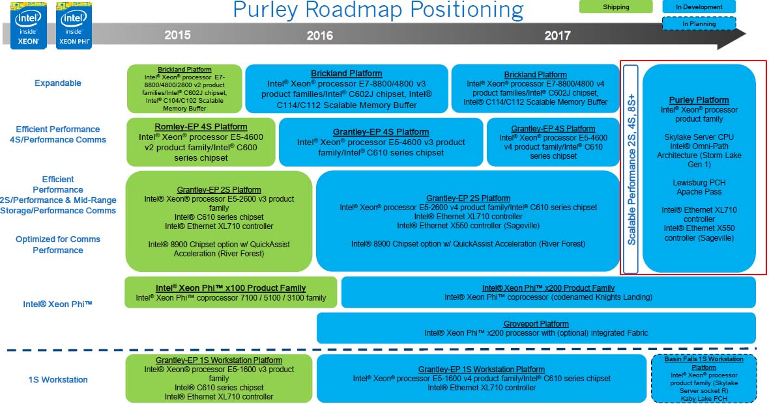
3.1 Overview of the Brickland platform (1)
3.1 Overview of the Brickland platform
Positioning the Brickland platform [112]

Slide 74
3.1 Overview of the Brickland platform (2)
The Brickland platform
2/2014
MP platforms
Brickland
2/2014
5/2015
MP cores
Xeon E7-4800 v2
Xeon
E7-4800 v3
(Ivy Bridge-EX)
(Ivytown) 15C
(Haswell-EX) 14C
22 nm/4310 mtrs/541 mm²
¼ MB L2/C
37.5 MB L3
3 QPI 1.1 links 8 GT/s
4 SMI2 links to 4 SMBs
2 mem. channels/SMB
up to 3 DIMMs/mem. channel
up to DDR3-1600 MT/s
6 TB (96x64 GB)
32 PCIe 3.0
LGA 2011-1
22 nm/5560 mtrs/661 mm²
¼ MB L2/C
35 MB L3
3 QPI 1.1 links 9.6 GT/s
4 SMI2 links to 4 SMBs
2 mem. channels/SMB
up to 3 DIMMs/mem. channel
up to DDR4-1866 MT/s
6 TB (96x64 GB)
32 PCIe 3.0
LGA 2011-1
3/2012
PCH
C602J
(Patsburg J)
Attached via x4 DMI2
Ivy Bridge-EX based
Haswell-EX based
Ivy Bridge-EX-based
22 nm
Haswell-EX based
22 nm

Slide 75
3.1 Overview of the Brickland platform (3)
Basic system architecture of the Brickland 4S server platform (2014/2015)
(assuming 2x3 DIMMs/SMB)
Xeon E7-4800 v2
(Ivy Bridge-EX)
(Ivytown) 15C
/
Xeon E7-4800 v3
(Haswell-EX)
14C
2x4 SMI2
channels
2x4 SMI2
channels
PCIe 3.0
PCIe 3.0
SMB
32
32
SMB
SMB
Ivy Bridge-EX
Haswell_EX
QPI
1.1
Ivy Bridge-EX
Haswell-EX
SMB
SMB
SMB
SMB
SMB
QPI 1.1
QPI 1.1
QPI 1.1
QPI 1.1
SMB
SMB
SMB
Ivy Bridge-EX
Haswell-EX
Ivy Bridge-EX Haswe-EX
SMB
SMB
QPI
1.1
SMB
SMB
32
DMI2
4xPCIe2
32
SMB
PCIe 3.0
PCIe 3.0
C602J PCH
(Patsburg J)
ME
SMI2: Scalable Memory Interface 2
(Parallel 64 bit VMSE data link between
the processor and the SMB)
SMB: Scalable Memory Buffer
(Performs conversion between the
parallel SMI2 and the parallel
DIMM interfaces)

Slide 76
3.1 Overview of the Brickland platform (4)
Contrasting differences in key features of the Ivy Bridge-EX and Haswell-EX based
Brickland platforms [114]
Feature | Ivy Bridge-EX based (E7-4800 v2) | Haswell-EX based (E7-4800 v3)
Cores | Up to 15 | Up to 14
LLC3 size | Up to 15x2.5 MB | Up to 14x2.5 MB
QPI | 3xQPI 1.1 Up to 8.0 GT/s in both dir. (16 GB/s per dir.) | 3xQPI 1.1 Up to 9.6 GT/s in both dir. (19.2 GB/s per dir.)
SMB | C102/C104 (Jordan Creek) C102: 2 DIMMs/SMB C103: 3 DIMMs/SMB | C112/C114 (Jordan Creek 2) C102: 2 DIMMs/SMB C103: 3 DIMMs/SMB
VMSE speed | Up to 2667 MT/s | Up to 3200 MT/s
DDR4 speed | n.a. | Perf. mode: up to 1600 MT/s Lockstep mode: up to 1866 MT/s
DDR3 speed | Perf. mode: up to 1333 MT/s Lockstep mode: up to 1600 MT/s | Perf. mode: up to 1600 MT/s Lockstep mode: up to 1600 MT/s

Slide 77
3.2 Key innovations of the Brickland platform vs.
the previous Boxboro-EX platform
Notes:
77

Slide 78
3.2 Key innovations of the Brickland platform (1)
3.2 Key innovations of the Brickland platform vs. the previous Boxboro-EX platform
3.2.1 Connecting PCIe links direct to the processors rather than to the MCH
3.2.2 New memory buffer design

Slide 79
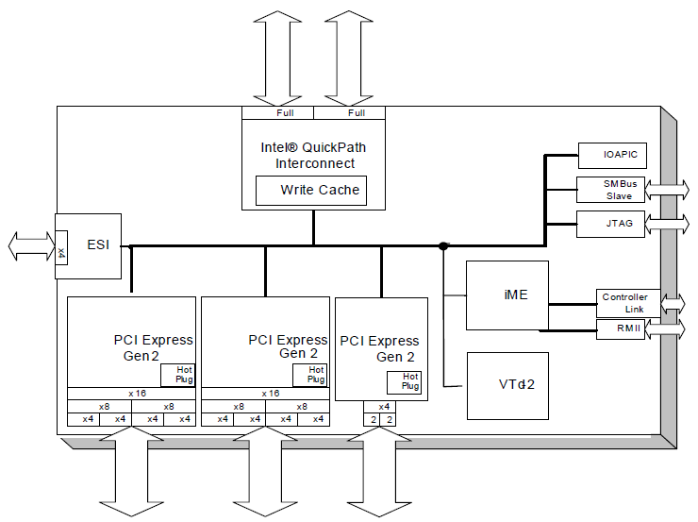
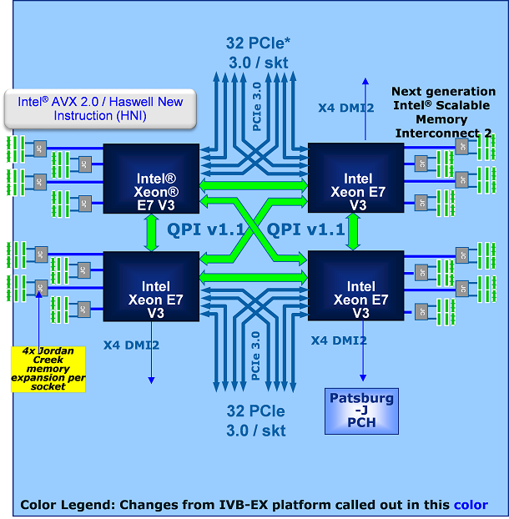
3.2 Key innovations of the Brickland platform (2)
3.2.1 Connecting PCIe links direct to the processors rather than to the MCH -1
3.2.1.1 Overview
Boxboro platform [106]
Brickland platform [114]
2 x QPI
36 lanes of PCIe 2.0

Slide 80
3.2 Key innovations of the Brickland platform (3)
Connecting PCIe links direct to the processors rather than to the MCH -2
It has two major implications, including
Raising the PCIe lane count provided by the Brickland platform (see Section 3.2.1.2)
Reducing the bandwidth needed between the processors and the chipset (see Section 3.2.1.3)

Slide 81
3.2 Key innovations of the Brickland platform (4)
3.2.1.2 Raising the PCIe lane count provided by the Brickland platform -1
As long as the Boxboro-EX platform provides 36 PCIe lanes, the Brickland platform affords
32 PCIe lanes per processor, i.e. 4 x 32 = 132 lanes in total for a 4S platform, as shown below.
Boxboro platform
Brickland platform
2 x QPI
36 lanes of PCIe 2.0
Figure: Connecting PCIe links direct to the processors rather than to the MCH

Slide 82
3.2 Key innovations of the Brickland platform (5)
3.2.1.2 Raising the PCIe lane count provided by the Brickland platform -2
If the PCI lanes are connected directly to the processors rather than to the MCH, the number of PCIe lanes supported by the platform will scale linearly with the number of processors.
In addition, the Brickland platform provides faster PCIe 3.0 lanes instead of PCI 2.0 lanes
of the previous Boxboro platform.

Slide 83
3.2 Key innovations of the Brickland platform (6)
3.2.1.3 Reducing the bandwidth demand between the processors and the chipset
By relocating the PCIe links from the MCH to the processors, the bandwidth needed
between the chipset and the processors becomes significantly reduced, as follows;
In the preceding Boxboro platform the MCH provides 36 PCIe 2.0 lanes with a total
bandwidth of 36x0.5 GB/s = 18 GB/s per direction.
This gives rise for using a QPI 1.1 bus width the bandwidth of 16.0 GB/s per direction
between the MCH and the processors.
By contrast, in the Brickland platform the PCIe lanes are connected immediately to the
processors and there is no need for providing the associated bandwidth.
This has three consequences;
Interconnecting the processors and the PCH by a DMI2 (4x PCIe 2.0) link
Providing only three QPI links per processor
Implementing a single chip “chipset”,
as discussed next.

Slide 84
3.2 Key innovations of the Brickland platform (7)
a) Interconnecting the processors and the PCH by a DMI2 (4x PCIe 2.0) interface
Due to the reduced bandwidth demand of the chipset-processor interface, it suffices now
to interconnect the PCH with a single processor via a DMI2 interface consisting of 4 PCIe 2.0
lanes that provide a bandwidth of up to 4x0.5=2 GB/s, rather than using a QPI bus with
a bandwidth of 16.0 GB/s.
Figure: The Haswell-EX implementation of the Brickland platform [114]

Slide 85
3.2 Key innovations of the Brickland platform (8)
b) Providing only three QPI links per processor -1
As the Brickland platform does not need an extra QPI bus to interconnect the processor with
the PCH, it has only 3 QPI buses per processor rather than four compared to the previous
(Boxboro-EX) platform, as shown in the next Figure.
Figure: The Haswell-EX implementation of the Brickland platform [114]

Slide 86
3.2 Key innovations of the Brickland platform (9)
Providing only three QPI links per processor -2
In addition, the Brickland platform supports already QPI 1.1 buses with the following speeds:
Ivy Bridge-EX based Brickland platforms: up to 8.0 Gbps
Nehalem-EX based Brickland platforms: up to 9.6 Gbps

Slide 87
3.2 Key innovations of the Brickland platform (10)
c) Implementing a single chip “chipset”
Inspired by the reduced functionality, the chipset is now implemented as a single chip solution
instead of using two chips, as in the previous Boxboro platform.
The single chip “chipset” is now designated as the PCH (Platform Controller Hub).
It is in particular the C602 J or Patsburg-J PCH, as shown below.
Figure: The Haswell-EX implementation of the Brickland platform [114]

Slide 88
3.2 Key innovations of the Brickland platform (11)
3.2.2 New memory buffer design
It has two main components, as follows:
a) Redesigned, basically parallel MC-SMB interface, called SMI2 interface
b) Enhanced DRAM interface

Slide 89
3.2 Key innovations of the Brickland platform (12)
a) Redesigned, basically parallel MC-SMB interface, called SMI2 interface -1
Brickland platform
Boxboro-EX platform
DIMM
DIMM
DIMM
DIMM
DIMM
DIMM
DIMM
DIMM
DIMM
DIMM
DDR3
interface
DDR3/4
interface
(11 lanes)
SMI In
SMI2 data
Scalable Memory Buffer
(SMB)
Scalable Memory Buffer
(SMB)
SMI Out
SMI CMD
(14 lanes)
SMI: Serial, packet based, unidirectional links
with differential signaling
Up to 6.4 Gbps
SMI 2: 64-bit parallel, bidirectional data link
with single-ended voltage referenced signaling,
(VMSE (Voltage Mode single Ended) signaling)
Up to 3200 MT/s

Slide 90
3.2 Key innovations of the Brickland platform (13)
a) Redesigned, basically parallel MC-SMB interface, called SMI2 interface -2
The SMI link of the Boxboro-EX platform was a serial, packet based,unidirectional link
with differential signaling, including about 70 signal lines.
By contrast, as far as the data transfer is concerned, with the SMI2 link Intel changed to
64-bit parallel, bidirectional communication using single-ended voltage reference signals,
called VMSE (Voltage Mode Single Ended) signaling.
SMI 2 requires altogether about 110 signal lines, that is about 50 % more lines than SMI.
The reason for changing from serial transfer to parallel transfer in case of the data lines is
presumably the fact, that in this case AD/DA converting of data becomes superfluous and
this results in reduced dissipation.
The SMI 2 operates
in the Ivy Town-EX based Brickland platform at a speed of up to 2667 MT/s and
in the Haswell-EX based Brickland platform at a speed of up to 3200 MT/s.

Slide 91
3.2 Key innovations of the Brickland platform (14)
b) Enhanced DRAM interface
Brickland platform
Boxboro-EX platform
DIMM
DIMM
DIMM
DIMM
DIMM
DIMM
DIMM
DIMM
DIMM
DIMM
DDR3
interface
DDR3/4
interface
SMI In
SMI2 data
Scalable Memory Buffer
(SMB)
Scalable Memory Buffer
(SMB)
SMI Out
SMI CMD
Up to DDR3-1333
Up to 2 DIMMs per memory channel
Up to DDR4-1866
Up to 3 DIMMs per memory channel

Slide 92
3.2 Key innovations of the Brickland platform (15)
Operation modes of the SMBs in the Brickland platform [113]
Operation modes of the SMBs
Lockstep mode
Independent channel mode
(aka Performance mode)
In lockstep mode the same command is sent
on both DRAM buses.
The read or write commands are issued
simultaneously to the referenced DIMMs,
and the SMB interleaves the data on the
In the independent channel mode commands
sent to both DRAM channels are independent
from each other.

Slide 93
3.2 Key innovations of the Brickland platform (16)
DRAM speeds of the Brickland platform
Feature | Ivy Bridge-EX based (E7-4800 v2) | Haswell-EX based (E7-4800 v3)
SMB | C102C104 | C112/C114
DDR4 speed | n.a. | Independent mode: up to 1600 MT/s Lockstep mode: up to 1866 MT/s
DDR3 speed | Independent mode: up to 1333 MT/s Lockstep mode: up to 1600 MT/s | Independent mode: up to 1600 MT/s Lockstep mode: up to 1600 MT/s

Slide 94
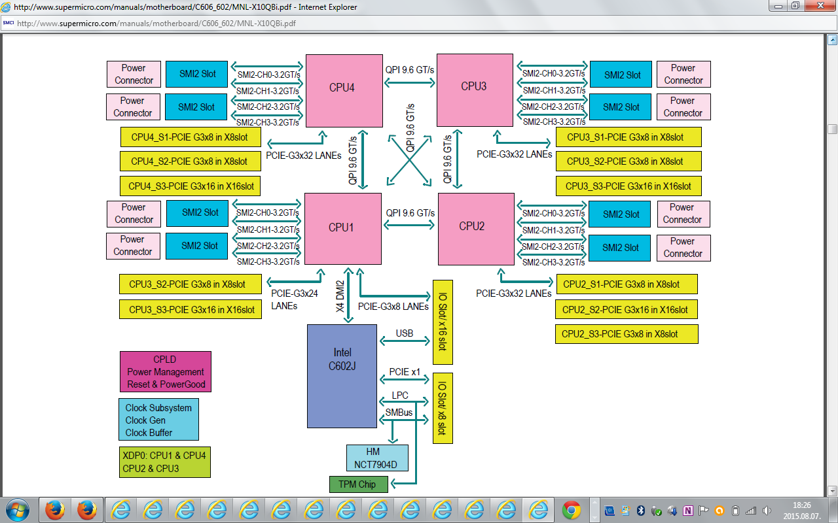
3.2 Key innovations of the Brickland platform (17)
Example for a Haswell-EX based Brickland platform [115]
Haswell-EX
E7-8800 v3 /E7-4800 v3 family
(18-Core), w/ QPI up to 9.6 GT/s

Slide 95
3.3 The Ivy Bridge-EX (E7-4800 v2) 4S processor line
Notes:
95

Slide 96
3.3 The Ivy Bridge-EX (E7-4800 v2) 4S processor line (1)
3.3 The Ivy Bridge-EX (4800 v2) 4S processor line [116]
Intel developed a single processor to cover all server market segments from 1S to 8S, called
the Ivytown processor.
It is manufactured on the 22 nm technology, includes up to 15 cores built up on 4.31 billion
transistors on a die of 541 mm².
Ivytown processor versions have a TDP of 40 to 150 W and operate at frequencies ranging
from 1.4 to 3.8 GHz.
The Ivytown processor was launched along with the Romley 2S server platform in 9/2013
followed by the Brickland 4S platform in 2/2014.

Slide 97
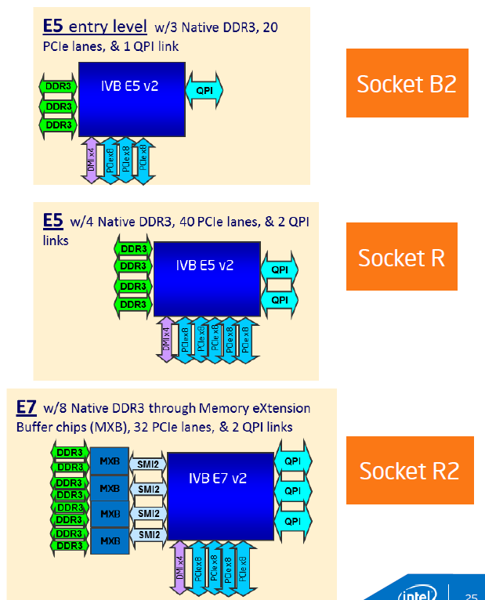
3.3 The Ivy Bridge-EX (E7-4800 v2) 4S processor line (2)
Ivytown processor alternatives for different server platforms 117]
E5 platform: Romley
Entry level
E5 v2 2400 1, 2 sockets
Performance level
E5 v2 2600 1, 2. 4 sockets
E7 platform: Brickland
High-performance level
E7 v2 4800/8800
2, 4, 8 sockets

Slide 98
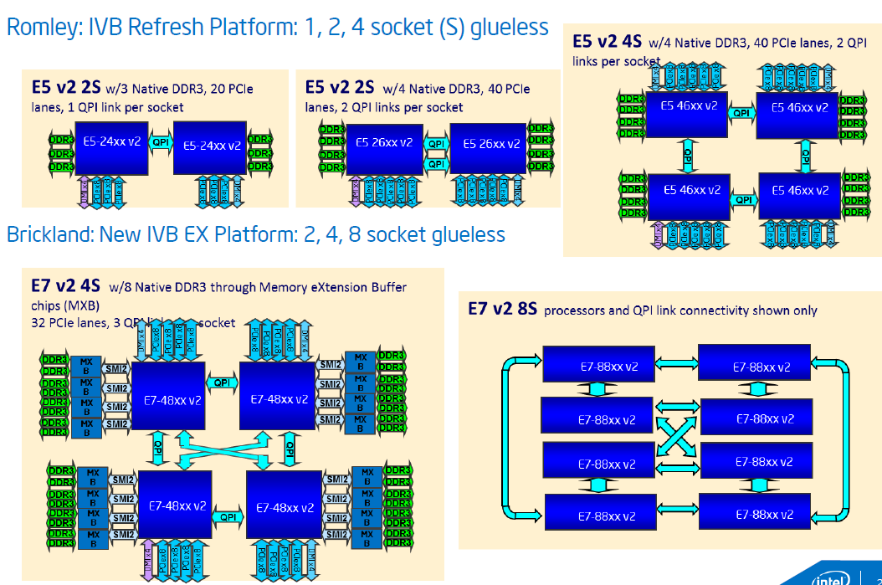
3.3 The Ivy Bridge-EX (E7-4800 v2) 4S processor line (3)
E5, E7 platform alternatives built up of Ivytown processors [117]
Romley Entry and Performance level platform alternatives
Brickland High performance platform alternatives

Slide 99
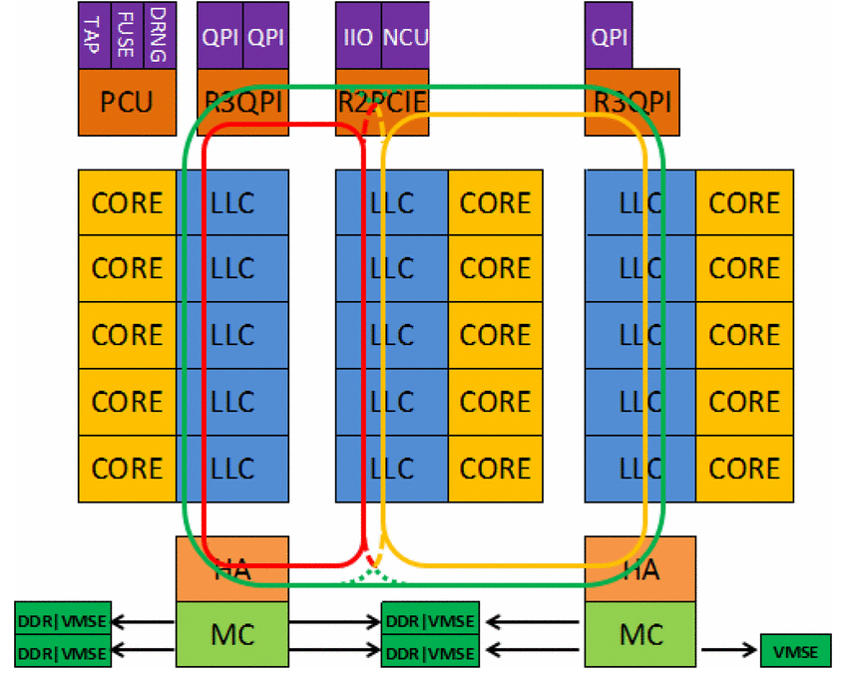
3.3 The Ivy Bridge-EX (E7-4800 v2) 4S processor line (4)
Block diagram of the Ivy Town processor
The processor consists of 3 slices, each with 5 cores and associated LLC segments, as seen below.
PCU: Power Control Unit
TAP: Test Access Port
FUSE: Fuse block, to configure the die
i.e. to have various core and
cache sizes as well as
different frequency and TDP
levels
DRNG: Digital Random Number
Generator
IIO: Integrated I/O block
HA: Home Agent providing
memory coherency
MC: Memory Controller
VMSE: Voltage-Mode Single-Ended
Interface (actually the
SMB)
Figure: Block diagram of the Ivy Town processor [116]

Slide 100
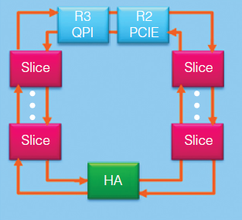
3.3 The Ivy Bridge-EX (E7-4800 v2) 4S processor line (5)
Layout of the ring interconnect bus used for dual slices (10 cores) [125]

Slide 101
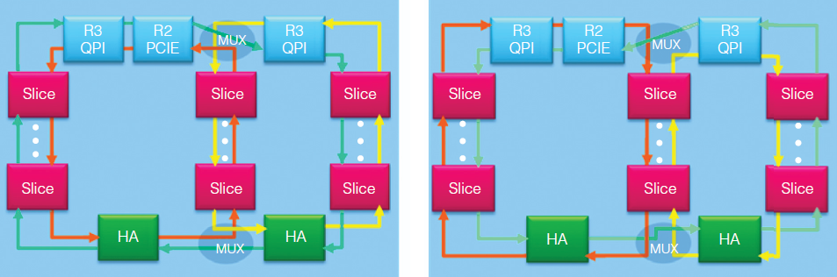
3.3 The Ivy Bridge-EX (E7-4800 v2) 4S processor line (6)
Layout of the ring interconnect bus used for three slices (15 cores) [125]
There are 3 virtual rings.
Multiplexers (MUXs) dynamically interconnect the rings, as shown below.
Clockwise outer ring
Counter-clockwise outer ring
Figure: Three-slice ring interconnect with three virtual rings interconnected by multiplexers [125]

Slide 102
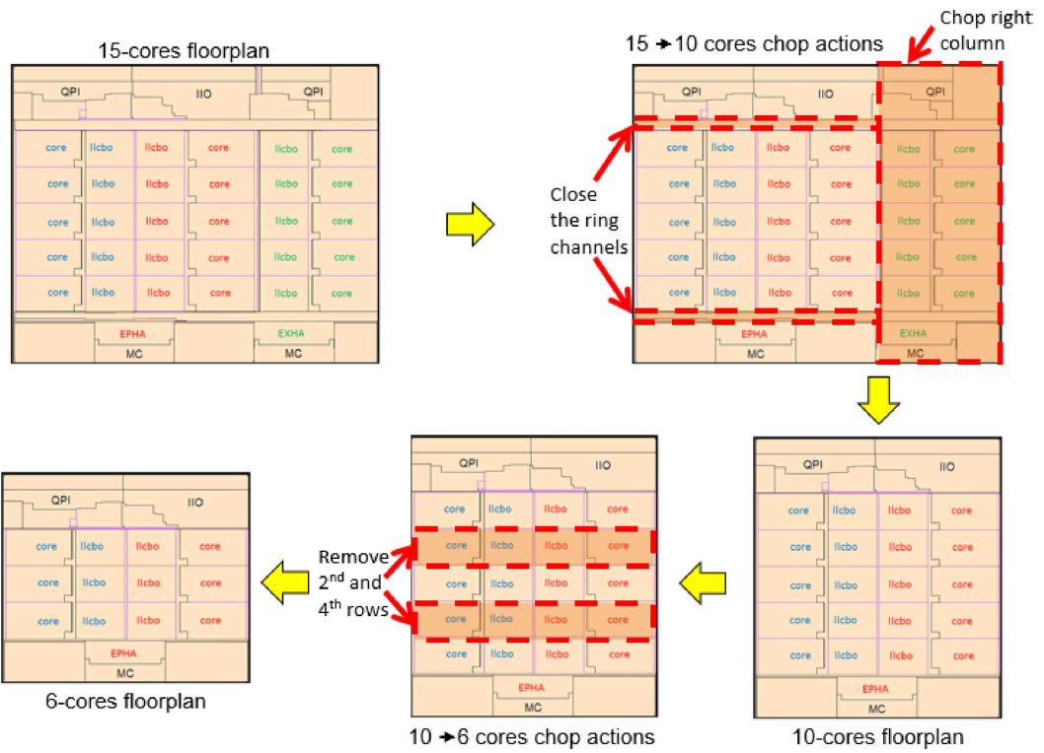
3.3 The Ivy Bridge-EX (E7-4800 v2) 4S processor line (7)
Implementing lower core variants through chopping [116]

Slide 103
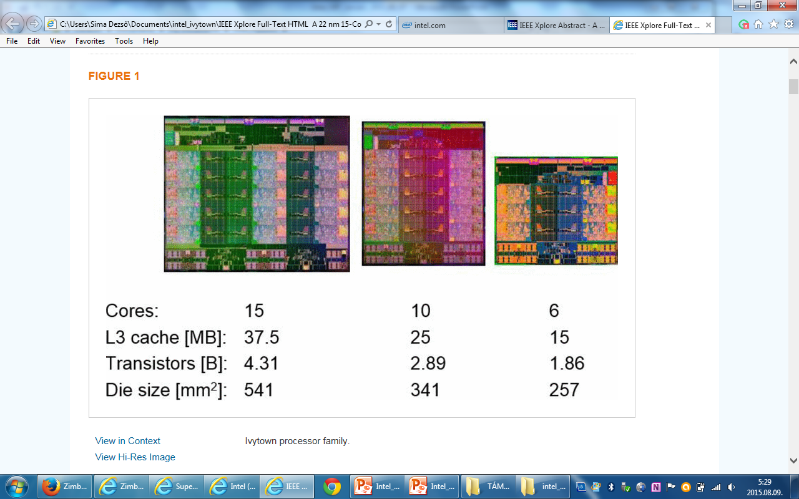
3.3 The Ivy Bridge-EX (E7-4800 v2) 4S processor line (8)
Lower core alternatives of the Ivytown processor achieved by chopping [116]
15 cores
10 cores
6 cores

Slide 104
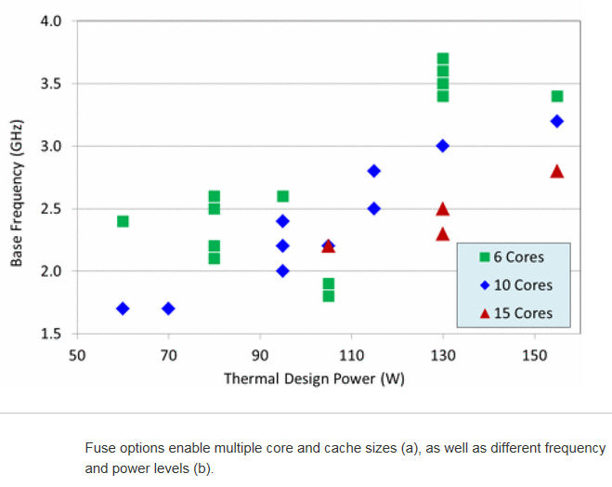
3.3 The Ivy Bridge-EX (E7-4800 v2) 4S processor line (9)
TDP vs. core frequency in different Ivytown processor alternatives [116]

Slide 105
3.4 The Haswell-EX (E7-4800 v3) 4S processor line
Notes:
105

Slide 106
3.4 The Haswell-EX (E7-4800 v3) 4S processor line (1)
3.4 The Haswell-EX (E7-4800 v3) 4S processor line
Launched in 5/2015
22 nm, 5.7 billion transistors, 662 mm, up to 18 cores
Number of cores
Up to 18 cores for 8S processors
Up to 14 cores for 4S ones (in 08/2015) instead 18 cores

Slide 107
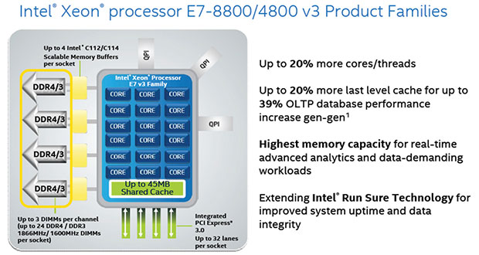
3.4 The Haswell-EX (E7-4800 v3) 4S processor line (2)
Basic layout of an 18 core 8S Haswell-EX v3 (E7-8800) processor [118]

Slide 108
3.4 The Haswell-EX (E7-4800 v3) 4S processor line (3)
Contrasting key features of the Ivy Bridge-EX and Haswell-EX processors -1 [114]
Feature | Ivy Bridge-EX (E7-4800 v2) | Haswell-EX (E7-4800 v3)
Cores | Up to 15 | Up to 14
LLC size (L3) | Up to 15x2.5 MB | Up to 14x2.5 MB
QPI | 3xQPI 1.1 Up to 8.0 GT/s in both dir. (16 GB/s per dir.) | 3xQPI 1.1 Up to 9.6 GT/s in both dir. (19.2 GB/s per dir.)
SMB | C102/C104 (Jordan Creek) C102: 2 DIMMs/SMB C103: 3 DIMMs/SMB | C112/C114 (Jordan Creek 2) C102: 2 DIMMs/SMB C103: 3 DIMMs/SMB
VMSE speed | Up to 2667 MT/s | Up to 3200 MT/s
DDR4 speed | n.a. | Perf. mode: up to 1600 MT/s Lockstep mode: up to 1866 MT/s
DDR3 speed | Perf. mode: up to 1333 MT/s Lockstep mode: up to 1600 MT/s | Perf. mode: up to 1600 MT/s Lockstep mode: up to 1600 MT/s
TSX | n.a. | Supported

Slide 109
3.4 The Haswell-EX (E7-4800 v3) 4S processor line (4)
Contrasting key features of the Ivy Bridge-EX and Haswell-EX processors -1 [114]
We note that the Haswell-EX processors support Intel’s Transactional Synchronization Extension
(TSX) that has been introduced with the Haswell core, but became disabled in the Haswell-EP
processors due to a bug.

Slide 110
3.4 The Haswell-EX (E7-4800 v3) 4S processor line (5)
Transactional Synchronization Extension (TSX)
Intel’s TSX is basically an ISA extension and its implementation to allow hardware supported
transactional memory.
Transactional memory is an efficient synchronization mechanism in concurrent programming
used to effectively manage race conditions occurring when multiple threads access shared
data.

Slide 111
3.4 The Haswell-EX (E7-4800 v3) 4S processor line (6)
Addressing race conditions
Basically there are two mechanisms to address race conditions in multithreaded programs,
as indicated below:
Basic mechanisms to address races in multithreaded programs
Locks
Transactional memory (TM)
Pessimistic approach,
it intends to prevent possible conflicts
by enforcing serialization of transactions
through locks.
Optimistic approach,
it allows parallel execution and thus
lets access conflicts to occur
but provides a checking and repair mechanism
for managing these conflicts, i.e.
it allows all threads to access shared data simultaneously
but after completing a transaction,
it will be checked whether a conflict arose,
if yes, the transaction will be rolled back and
then replayed if feasible else
executed while using locks.
The next Figure illustrates these synchronization mechanisms.

Slide 112
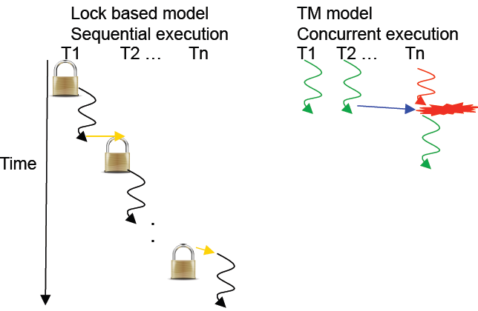
3.4 The Haswell-EX (E7-4800 v3) 4S processor line (7)
Illustration of lock based and transaction memory (TM) based thread synchronization
[126]
Conflict, to be
repaired

Slide 113
3.4 The Haswell-EX (E7-4800 v3) 4S processor line (8)
We note that in their POWER8 (2014) IBM also introduced hardware supported transactional
memory, called Hardware Transactional Memory (HTM).

Slide 114
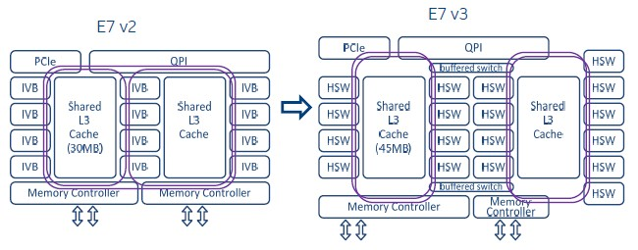
3.4 The Haswell-EX (E7-4800 v3) 4S processor line (9)
Contrasting the layout of the Haswell-EX cores vs. the Ivy Bridge-EX cores [111]
Haswell-EX has four core slides with 3x4 + 6 = 18 cores rather than 3x5 cores in case of
the Ivy Bridge-EX (only 3x 4 = 12 cores indicated in the Figure below).
Figure: Contrasting the basic layout of the Haswell-EX (E7 v3) and Ivy Bridge-EX (E7 v2)
processors [111]
Note that the E7-V3 has only two ring buses interconnected by a pair of buffered switches.

Slide 115
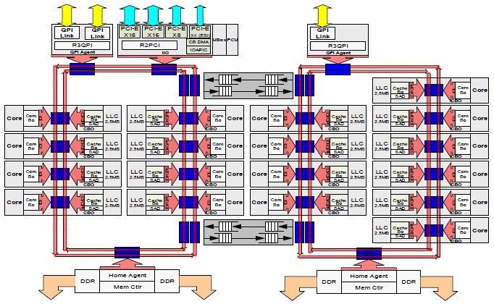
3.4 The Haswell-EX (E7-4800 v3) 4S processor line (10)
More detailed layout of the Haswell-EX die [111]

Slide 116
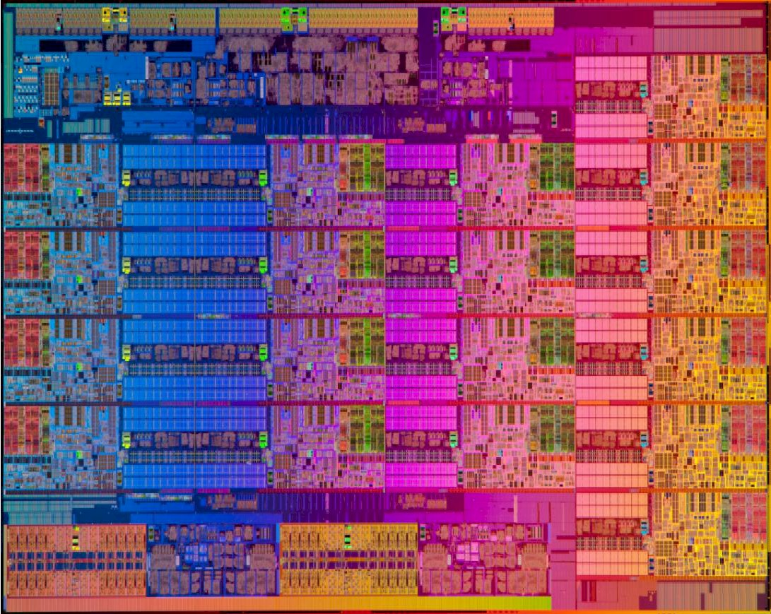
3.4 The Haswell-EX (E7-4800 v3) 4S processor line (11)
Die micrograph of an 18-core Haswell-EX processor [111]
22 nm, 5.7 billion transistors, 662 mm²

Slide 117
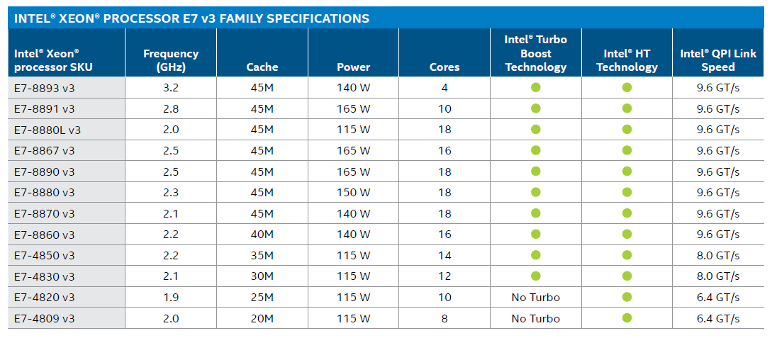
3.4 The Haswell-EX (E7-4800 v3) 4S processor line (12)
Main features of 4S and 8S Haswell-EX processors [120]

Slide 118
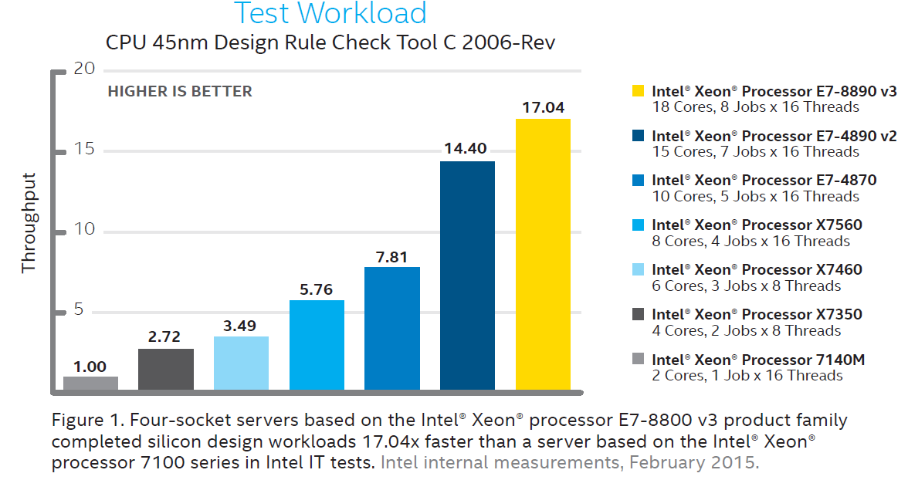
3.4 The Haswell-EX (E7-4800 v3) 4S processor line (13)
Performance comparison of MP processors -1 [121]
(The test workload is: CPU 45 nm Design Rule Check Tool C 2006 Rev.)
P4-based Tulsa (2006)
Core 2 Tigerton QC (2007)
Penryn Dunnington (2008)
Nehalem-EX (2010)
Westmere-EX (2011)
Ivy Bridge-EX (2014)
Haswell-EX (2015)

Slide 119
3.4 The Haswell-EX (E7-4800 v3) 4S processor line (14)
Performance comparison of MP processors -2 [121]
Note that with their MP line Intel achieved a more than 10-fold performance boost in 10 years.

Slide 120
3.5 The Broadwell-EX (E7-4800 v4) 4S processor line
Notes:
120

Slide 121
3.5 The Broadwell-EX (E7-4800 v4) 4S processor line (1)
3.5 The Broadwell-EX (E7-4800 v4) 4S processor line
Positioning the Broadwell-EX line [112]

Slide 122
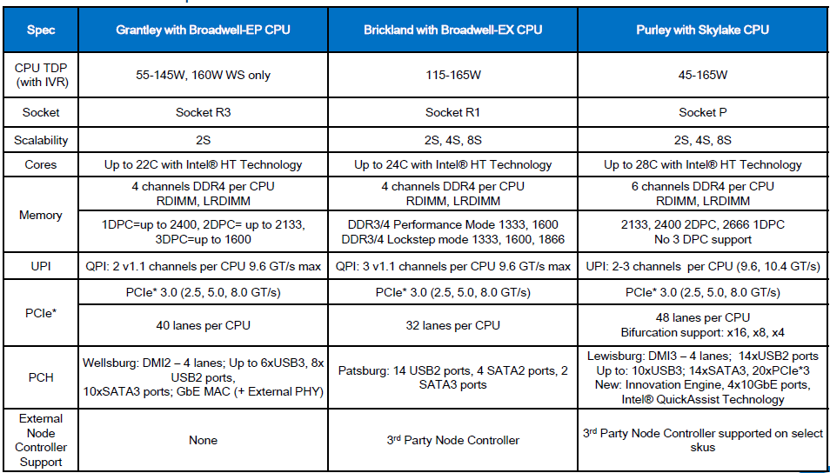
3.5 The Broadwell-EX (E7-4800 v4) 4S processor line (2)
Planned features of the Brickland platform with the Broadwell-EX processor line -1 [122]

Slide 123
3.5 The Broadwell-EX (E7-4800 v4) 4S processor line (3)
Planned features of the Broadwell-EX processor line -2 [122]
As seen in the above Table, the planned features – except of having 24 cores – are the same
as implemented in the Haswell-EX line.

Slide 124
4. Example 2: The Purley platform
Notes:
124

Slide 125
4. Example 2:. The Purley platform (1)
4. Example 2: The Purley platform
According to leaked Intel sources it is planned to be introduced in 2017.
It is based on the 14 nm Skylake family.

Slide 126
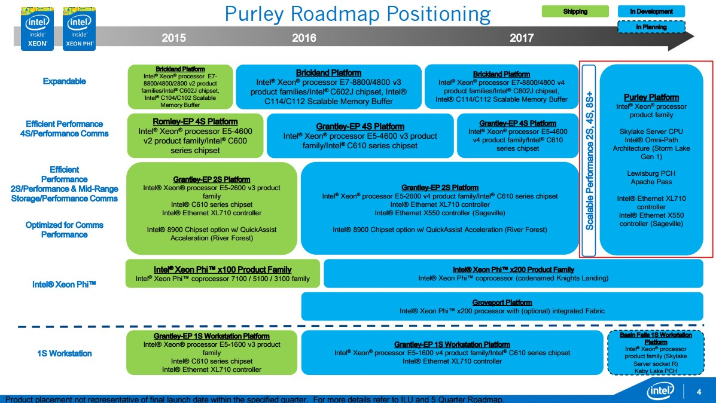
4. Example 2:. The Purley platform (2)
Positioning of the Purley platform [112]

Slide 127
4. Example 2:. The Purley platform (3)
Planned features of the Purley platform with the Skylake-EX processor line -1 [122]

Slide 128
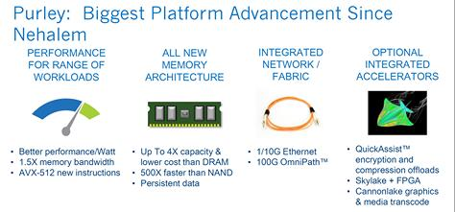
4. Example 2:. The Purley platform (4)
Key advancements of the Purley platform [123]

Slide 129
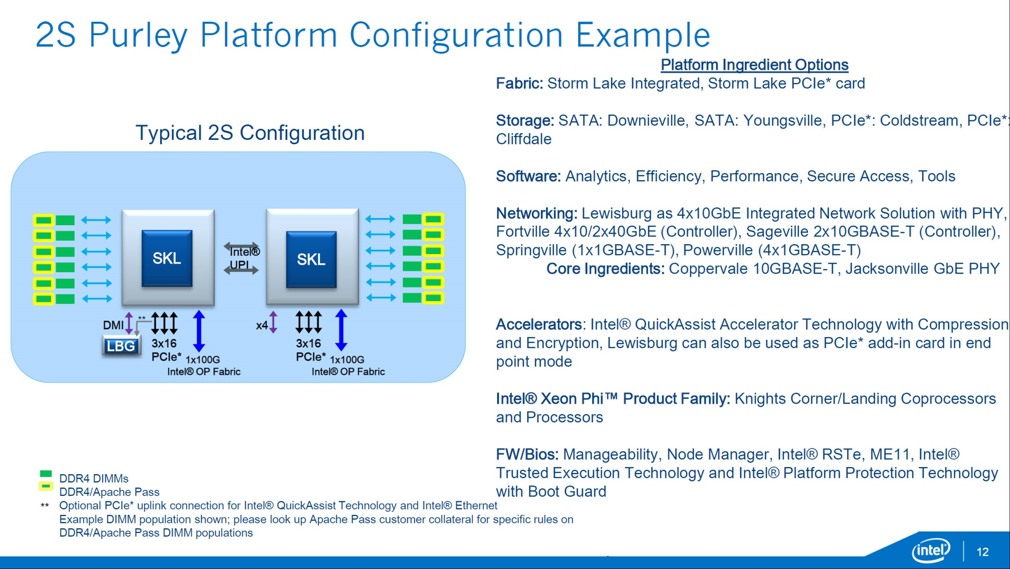
4. Example 2:. The Purley platform (5)
Example of a 2S Purley platform [123]
10GBASE-T: 10 Gbit/s Ethernet via copper twisted pair cable
(Lewisburg)

Slide 130
5. References
Notes:
130

Slide 131
5. References (1)
[1]: Radhakrisnan S., Sundaram C. and Cheng K., „The Blackford Northbridge Chipset for the
Intel 5000”, IEEE Micro, March/April 2007, pp. 22-33
[2]: Next-Generation AMD Opteron Processor with Direct Connect Architecture – 4P Server
Comparison, http://www.amd.com/us-en/assets/content_type/DownloadableAssets/4P_
Server_Comparison_PID_41461.pdf
[3]: Intel® 5000P/5000V/5000Z Chipset Memory Controller Hub (MCH) – Datasheet,
Sept. 2006. http://www.intel.com/design/chipsets/datashts/313071.htm
[4]: Intel® E8501 Chipset North Bridge (NB) Datasheet, Mai 2006,
http://www.intel.com/design/chipsets/e8501/datashts/309620.htm
[5]: Conway P & Hughes B., „The AMD Opteron Northbridge Architecture”, IEEE
MICRO, March/April 2007, pp. 10-21
[6]: Intel® 7300 Chipset Memory Controller Hub (MCH) – Datasheet, Sept. 2007,
http://www.intel.com/design/chipsets/datashts/313082.htm
[7]: Supermicro Motherboards, http://www.supermicro.com/products/motherboard/
[8]: Sander B., „AMD Microprocessor Technologies,” 2006,
http://www.ewh.ieee.org/r4/chicago/foxvalley/IEEE_AMD_Meeting.ppt
[9]: AMD Quad FX Platform with Dual Socket Direct Connect (DSDC) Architecture,
http://www.asisupport.com/ts_amd_quad_fx.htm
[10]: Asustek motherboards - http://www.asus.com.tw/products.aspx?l1=9&l2=39
http://support.asus.com/download/model_list.aspx?product=5&SLanguage=en-us

Slide 132
5. References (2)
[11]: Kanter, D. „A Preview of Intel's Bensley Platform (Part I),” Real Word Technologies,
Aug. 2005, http://www.realworldtech.com/page.cfm?ArticleID=RWT110805135916&p=2
[12]: Kanter, D. „A Preview of Intel's Bensley Platform (Part II),” Real Word Technologies,
Nov. 2005, http://www.realworldtech.com/page.cfm?ArticleID=RWT112905011743&p=7
[13]: Quad-Core Intel® Xeon® Processor 7300 Series Product Brief, Intel, Nov. 2007
http://download.intel.com/products/processor/xeon/7300_prodbrief.pdf
[14]: „AMD Shows Off More Quad-Core Server Processors Benchmark” X-bit labs, Nov. 2007
http://www.xbitlabs.com/news/cpu/display/20070702235635.html
[15]: AMD, Nov. 2006 http://www.asisupport.com/ts_amd_quad_fx.htm
[16]: Rusu S., “A Dual-Core Multi-Threaded Xeon Processor with 16 MB L3 Cache,” Intel, 2006,
http://ewh.ieee.org/r5/denver/sscs/Presentations/2006_04_Rusu.pdf
[17]: Goto H., Intel Processors, PCWatch, March 04 2005,
http://pc.watch.impress.co.jp/docs/2005/0304/kaigai162.htm
[18]: Gilbert J. D., Hunt S., Gunadi D., Srinivas G., “The Tulsa Processor,” Hot Chips 18, 2006,
http://www.hotchips.org/archives/hc18/3_Tues/HC18.S9/HC18.S9T1.pdf
[19]: Goto H., IDF 2007 Spring, PC Watch, April 26 2007,
http://pc.watch.impress.co.jp/docs/2007/0426/hot481.htm

Slide 133
5. References (3)
[20]: Hruska J., “Details slip on upcoming Intel Dunnington six-core processor,” Ars technica,
February 26, 2008, http://arstechnica.com/news.ars/post/20080226-details-slip-on-
upcoming-intel-dunnington-six-core-processor.html
[21]: Goto H., 32 nm Westmere arrives in 2009-2010, PC Watch, March 26 2008,
http://pc.watch.impress.co.jp/docs/2008/0326/kaigai428.htm
[22]: Singhal R., “Next Generation Intel Microarchitecture (Nehalem) Family:
Architecture Insight and Power Management, IDF Taipeh, Oct. 2008,
http://intel.wingateweb.com/taiwan08/published/sessions/TPTS001/FA08%20IDF
-Taipei_TPTS001_100.pdf
[23]: Smith S. L., “45 nm Product Press Briefing,”, IDF Fall 2007,
ftp://download.intel.com/pressroom/kits/events/idffall_2007/BriefingSmith45nm.pdf
[24]: Bryant D., “Intel Hitting on All Cylinders,” UBS Conf., Nov. 2007,
http://files.shareholder.com/downloads/INTC/0x0x191011/e2b3bcc5-0a37-4d06-
aa5a-0c46e8a1a76d/UBSConfNov2007Bryant.pdf
[25]: Barcelona's Innovative Architecture Is Driven by a New Shared Cache,
http://developer.amd.com/documentation/articles/pages/8142007173.aspx
[26]: Larger L3 cache in Shanghai, Nov. 13 2008, AMD,
http://forums.amd.com/devblog/blogpost.cfm?threadid=103010&catid=271
[27]: Shimpi A. L., “Barcelona Architecture: AMD on the Counterattack,” March 1 2007,
Anandtech, http://www.anandtech.com/cpuchipsets/showdoc.aspx?i=2939&p=1

Slide 134
5. References (4)
[28]: Rivas M., “Roadmap update,”, 2007 Financial Analyst Day, Dec. 2007, AMD,
http://download.amd.com/Corporate/MarioRivasDec2007AMDAnalystDay.pdf
[29]: Scansen D., “Under the Hood: AMD’s Shanghai marks move to 45 nm node,”
EE Times, Nov. 11 2008,
http://www.eetimes.com/news/latest/showArticle.jhtml?articleID=212002243
[30]: 2-way Intel Dempsey/Woodcrest CPU Bensley Server Platform, Tyan,
http://www.tyan.com/tempest/training/s5370.pdf
[31]: Gelsinger P. P., “Intel Architecture Press Briefing,”, 17. March 2008,
http://download.intel.com/pressroom/archive/reference/Gelsinger_briefing_0308.pdf
[32]: Mueller S., Soper M. E., Sosinsky B., Server Chipsets, Jun 12, 2006,
http://www.informit.com/articles/article.aspx?p=481869
[33]: Goto H., IDF, Aug. 26 2005,
http://pc.watch.impress.co.jp/docs/2005/0826/kaigai207.htm
[34]: TechChannel, http://www.tecchannel.de/_misc/img/detail1000.cfm?pk=342850&
fk=432919&id=il-74145482909021379
[35]: Intel quadcore Xeon 5300 review, Nov. 13 2006, Hardware.Info,
http://www.hardware.info/en-US/articles/amdnY2ppZGWa/Intel_quadcore_Xeon_
5300_review
[36]: Wasson S., Intel's Woodcrest processor previewed, The Bensley server platform debuts,
Mai 23, 2006, The Tech Report, http://techreport.com/articles.x/10021/1

Slide 135
5. References (5)
[37]: Enderle R., AMD Shanghai “We are back! TGDaily, November 13, 2008,
http://www.tgdaily.com/content/view/40176/128/
[38]: Clark J. & Whitehead R., “AMD Shanghai Launch, Anandtech, Nov. 13 2008,
http://www.anandtech.com/showdoc.aspx?i=3456
[39]: Chiappetta M., AMD Barcelona Architecture Launch: Native Quad-Core, Hothardware,
Sept. 10, 2007,
http://hothardware.com/Articles/AMD_Barcelona_Architecture_Launch_Native_
QuadCore/
[40]: Hachman M., “AMD Phenom, Barcelona Chips Hit By Lock-up Bug,”, ExtremeTech,
Dec. 5 2007, http://www.extremetech.com/article2/0,2845,2228878,00.asp
[41]: AMD Opteron™ Processor for Servers and Workstations,
http://amd.com.cn/CHCN/Processors/ProductInformation/0,,30_118_8826_8832,
00-1.html
[42]: AMD Opteron Processor with Direct Connect Architecture, 2P Server Power Savings
Comparison, AMD,
http://enterprise.amd.com/downloads/2P_Power_PID_41497.pdf
[43]: AMD Opteron Processor with Direct Connect Architecture, 4P Server Power Savings
Comparison, AMD,
http://enterprise.amd.com/downloads/4P_Power_PID_41498.pdf
[44]: AMD Opteron Product Data Sheet, AMD,
http://pdfs.icecat.biz/pdf/1868812-2278.pdf

Slide 136
5. References (6)
[45]: Images, Xtreview,
http://xtreview.com/images/K10%20processor%2045nm%20architec%203.jpg
[46]: Kanter D., “Inside Barcelona: AMD's Next Generation, Real World Tech., Mai 16 2007,
http://www.realworldtech.com/page.cfm?ArticleID=RWT051607033728
[47]: Kanter D,, “AMD's K8L and 4x4 Preview, Real World Tech. June 02 2006,
http://www.realworldtech.com/page.cfm?ArticleID=RWT060206035626&p=1
[48]: Kottapali S., Baxter J., “Nehalem-EX CPU Architecture”, Hot Chips 21, 2009,
http://www.hotchips.org/archives/hc21/2_mon/HC21.24.100.ServerSystemsI-Epub/
HC21.24.122-Kottapalli-Intel-NHM-EX.pdf
[49]: Kahn O., Piazza T., Valentine B., “Technology Insight: Intel next Generation
Microarchitecture Codename Sandy Bridge, IDF, San Francisco, Sept. 2010
[50]: Piazza T., Jiang H., “Intel Next Generation Microarchitecture Codename Sandy Bridge:
Processor Graphics, IDF, San Francisco, Sept. 2010
[51]: Braun-Protte T., “Intel die neuste Generation”, March 2010,
https://sp.ts.fujitsu.com/dmsp/docs/02_fujitsu_intel_server_cpu.pdf
[52]: De Gelas J., The Intel Xeon E7-8800 v3 Review: The POWER8 Killer?, AnandTech,
May 8 2015, http://www.anandtech.com/show/9193/the-xeon-e78800-v3-review
[53]: Tyan Confidential, Tempest i5000VF S5370, 2-way Intel Dempsey/Woodcrest CPU
Bensley Server Platform, http://www.tyan.com/tempest/training/s5370.pdf

Slide 137
5. References (7)
[54]: Intel 5520 Chipset and Intel 5500 Chipset, Datasheet, March 2009,
http://www.intel.com/content/www/us/en/chipsets/5520-5500-chipset-ioh-datasheet.html
[55]: Neiger G., Santoni A., Leung F., Rodgers D., Uhlig R., Intel® Virtualization Technology:
Hardware support for efficient processor virtualization, Aug. 10 2006, Vol. 10, Issue 3,
http://www.intel.com/technology/itj/2006/v10i3/1-hardware/1-abstract.htm
[56]: Intel Software Networks: Forums,
http://software.intel.com/en-us/forums/showthread.php?t=56802
[57]: Wikipedia: x86 virtualization, 2011,
http://en.wikipedia.org/wiki/X86_virtualization#Intel_virtualization_.28VT-x.29
[58]: Sharma D. D., Intel 5520 Chipset: An I/O Hub Chipset for Server, Workstation, and High
End Desktop, Hotchips 2009, http://www.hotchips.org/archives/hc21/2_mon/
HC21.24.200.I-O-Epub/HC21.24.230.DasSharma-Intel-5520-Chipset.pdf
[59]: Morgan T. P., Intel's future Sandy Bridge Xeons exposed, May 30 2011, The Register,
http://www.theregister.co.uk/2011/05/30/intel_sandy_bridge_xeon_platforms/page2.html
[60]: Gilbert J. D., Hunt S. H., Gunadi D., Srinivas G., The Tulsa Processor: A Dual Core Large
Shared-Cache Intel Xeon Processor 7000 Sequence for the MP Server Market Segment,
Aug 21 2006, http://www.hotchips.org/archives/hc18/3_Tues/HC18.S9/HC18.S9T1.pdf
[61]: Intel Server Board Set SE8500HW4, Technical Product Specification, Revision 1.0,
May 2005, ftp://download.intel.com/support/motherboards/server/sb/se8500hw4_board
_set_tpsr10.pdf

Slide 138
5. References (8)
[62]: Mitchell D., Intel Nehalem-EX review, PCPro,
http://www.pcpro.co.uk/reviews/processors/357709/intel-nehalem-ex
[63]: Nagaraj D., Kottapalli S.: Westmere-EX: A 20 thread server CPU, Hot Chips 2010
http://www.hotchips.org/uploads/archive22/HC22.24.610-Nagara-Intel-6-Westmere-EX.pdf
[64]: Intel Xeon Processor E7-8800/4800/2800 Product Families, Datasheet Vol. 1 of 2,
April 2011, http://www.intel.com/Assets/PDF/datasheet/325119.pdf
[65]: Supermicro P4QH6 / P4QH8 User’s Manual, 2002,
http://www.supermicro.com/manuals/motherboard/GC-HE/MNL-0665.pdf
[66]: Intel Xeon Processor 7500/6500 Series, Public Gold Presentation, March 30 2010,
http://cache-www.intel.com/cd/00/00/44/64/446456_446456.pdf
[67]: Supermicro X8QB6-F / X8QBE-F User’s Manual, 2010,
http://files.siliconmechanics.com/Documentation/Rackform/iServ/R413/Mainboard/MNL
-X8QB-E-6-F.pdf
[68]: Rusu & al.: A 45 nm 8-Core Enterprise Xeon Processor, IEEE journal of Solid State Circuits,
Vol. 45, No. 1, Jan. 2010, pp. 7-14
[69]: Jafarjead B., “Intel Core Duo Processor,” Intel, 2006,
http://masih0111.persiangig.com/document/peresentation/behrooz%20jafarnejad.ppt
[70]: Keutzer K., Malik S., Newton R., Rabaey J., Sangiovanni-Vincentelli A., System Level Design:
Orthogonalization of Concerns and Platform-Based Design, IEEE Transactions on
Computer-Aided Design of Circuits and Systems, Vol. 19, No. 12, Dec. 2000, pp.?????

Slide 139
5. References (9)
[71]: Perich D., Intel Volume platforms Technology Leadership, Presentation at HP World 2004,
http://98.190.245.141:8080/Proceed/HPW04CD/papers/4194.pdf
[72]: Krazit T., Intel Sheds Light on 2005 Desktop Strategy, IDG News Service, Dec. 07 2004,
http://pcworld.about.net/news/Dec072004id118866.htm
[73]: Molka D., Hackenberg D., Schöne R., Müller M. S., Memory Performance and Cache
Coherency Effects on an Intel Nehalem multiprocessor System, Proc. 18th Int. Conf.
on Parallel Architectures and Compilation, Techniques, PACT 2009,
http://doi.ieeecomputersociety.org/10.1109/PACT.2009.22
[74]: Radhakrishnan S., Chinthamani S., Cheng K., The Blackford Northbridge Chipset for
Intel 5000, IEEE MICRO, March-April 2007, pp. 22-33
[75]: Rolf T., Cache Organization and Memory Management of the Intel Nehalem Computer
Architecture, University of Utah, Dec. 2009, http://rolfed.com/nehalem/nehalemPaper.pdf
[76]: Levinthal D., Performance Analysis Guide for Intel Core i7 Processor and Intel Xeon 5500
processors, Version 1.0, 2008
http://software.intel.com/sites/products/collateral/hpc/vtune/performance_analysis_
guide.pdf
[77]: Ryszard Sommefeldt R., Intel Xeon 3.4GHz ['Nocona' core], 18th Aug, 2004,
http://www.hexus.net/content/item.php?item=822&page=1&search=reas
[78]: 3.6GHz 2MB 800MHz Intel Xeon Processor SL7ZC C8511, http://store.flagshiptech.com/
products/3.6GHz-2MB-800MHz-Intel-Xeon-Processor-SL7ZC-C8511.html
[79]: Gavrichenkov I., Workstation Processors Duel: AMD Opteron against Intel Xeon, Page 5
12/21/2005,
http://www.xbitlabs.com/articles/cpu/display/opteron-xeon-workstation_5.html

Slide 140
5. References (10)
[80]: Glaskowsky P.: Investigating Intel's Lynnfield mysteries, cnet News, Sept. 21. 2009,
http://news.cnet.com/8301-13512_3-10357328-23.html
[81]: Kurd & al., Westmere: A Family of 32 nm IA Processors, Proc. ISSCC 2010, pp. 96-98
[82]: Miller M. J.,Intel Previews ISSCC: 6-Core Gulftown Processor, Feb 03, 2010, http://
forwardthinking.pcmag.com/chips/282694-intel-previews-isscc-6-core-gulftown-processor
[83]: Hill D., Chowdhury M., Westmere Xeon-56xx “Tick” CPU, Hot Chips 22, 2010,
http://www.hotchips.org/uploads/archive22/HC22.24.620-Hill-Intel-WSM-EP-print.pdf
[84]: Pawlowski S.: Intelligent and Expandable High- End Intel Server Platform, Codenamed
Nehalem-EX, IDF 2009
[85]: Intel Sandy Bridge Review, Bit-tech, Jan. 3 2011,
http://www.bit-tech.net/hardware/cpus/2011/01/03/intel-sandy-bridge-review/1
[86]: Kahn O., Piazza T., Valentine B.: Technology Insight: Intel Next Generation
Microarchitecture Codename Sandy Bridge, IDF 2010
extreme.pcgameshardware.de/.../281270d1288260884-bonusmaterial-pc- games-
ardware-12-2010-sf10_spcs001_100.pdf
[87]: Inkley B., Tetrick S., Intel Multi-core Architecture and Implementations, IDF, Session
MATS002, March 7 2006
[88]: Smith S. L., Intel Roadmap Overview, IDF Fall, Aug. 20 2008
http://download.intel.com/pressroom/kits/events/idffall_2008/SSmith_briefing_roadmap.pdf
[89]: Intel Public Roadmap; Business Platforms for Desktop, Mobile & Data Center, H1’ 2011
http://www.2ncinesil.com/download/Public%20Roadmap%201H%202011.pptx

Slide 141
5. References (11)
[90]: Rusu S., „Circuit Technologies for Multi-Core Processor Design,” April 2006,
http://www.ewh.ieee.org/r6/scv/ssc/April06.pdf
[91]: Goto H., IDF, Aug. 26 2005,
http://pc.watch.impress.co.jp/docs/2005/0826/kaigai207.htm
[92]: TechChannel, http://www.tecchannel.de/_misc/img/detail1000.cfm?pk=342850&
fk=432919&id=il-74145482909021379
[93]: Sandy Bridge, http://en.wikipedia.org/wiki/Sandy_Bridge
[94]: Morgan T. P., Intel's future Sandy Bridge Xeons exposed, The Register, May 30. 2011,
http://www.theregister.co.uk/2011/05/30/intel_sandy_bridge_xeon_platforms
[95]: Gelsinger P., Keynote, IDF Spring 2005, March 2005,
http://www.intel.com/pressroom/kits/events/idfspr_2005/index.htm
[96]: Kuppuswamy, R. C al., Over one million TPCC with a 45nm 6-core Xeon® CPU,
IEEE International Solid-State Circuits Conference - Digest of Technical Papers,
ISSCC 2009, Feb. 2009, pp. 70 - 71,71a
[97]: Perich D., Intel Volume Platforms Technology Leadership, Solutions and Technology
Conference, HP World 2004,
http://www.openmpe.com/cslproceed/HPW04CD/papers/4194.pdf
[98]: De Gelas J., Westmere-EX: Intel Improves their Xeon Flagship, AnandTech, April 6 2011,
http://www.anandtech.com/show/4259/westmereex-intels-flagship-improves
[99]: Starke W.J., POWER7: IBM’s Next Generation, Balanced POWER Server Chip, Hot Chips 21,
http://www.hotchips.org/wp-content/uploads/hc_archives/hc21/3_tues/HC21.25.800.
ServerSystemsII-Epub/HC21.25.835.Starke-IBM-POWER7SystemBalancev13_display.pdf

Slide 142
5. References (12)
[100]: Intel E8500 Chipset eXternal Memory Bridge (XMB), Datasheet, March 2005,
http://www.intel.co.id/content/dam/doc/datasheet/e8500-chipset-external-memory-
bridge-datasheet.pdf
[101]: Intel Server System SSH4 Board Set, Technical Product Specification, Oct. 2003,
http://download.intel.com/support/motherboards/server/ssh4/ssh4_tps.pdf
[102]: Haas J. & Vogt P., Fully buffered DIMM Technology Moves Enterprise Platforms to the
Next Level, Technology Intel Magazine, March 2005, pp. 1-7
[103]: Ganesh B., Jaleel A., Wang D., Jacob B., Fully-Buffered DIMM Memory Architectures:
Understanding Mechanisms, Overheads and Scaling, 2007,
https://ece.umd.edu/~blj/papers/hpca2007.pdf
[104]: Smith S. L., Quad-Core Press Briefing, IDF 2006,
http://www.intel.com/pressroom/kits/quadcore/qc_pressbriefing.pdf
[105]: Smith S.L., Intel Enterprise Roadmap, IDF 2010
[106]: Intel 7500 Chipset, Datasheet, March 2010,
http://www.intel.com/content/dam/doc/datasheet/7500-chipset-datasheet.pdf
[107]: 7500/7510/7512 Scalable Memory Buffer, Datasheet, April 2011,
http://www.intel.com/content/www/us/en/chipsets/7500-7510-7512-scalable-memory-
buffer-datasheet.html
[108]: X8QB6-LF User Manual, Supermicro

Slide 143
5. References (13)
[109]: Baseboard management controller (BMC) definition, TechTarget, May 2007,
http://searchnetworking.techtarget.com/definition/baseboard-management-controller
[110]: Morgan T. P., Intel (finally) uncages Nehalem-EX beast, The Register, March 30 2010,
http://www.theregister.co.uk/2010/03/30/intel_nehalem_ex_launch/?page=2
[111]: Morgan T. P., Intel Puts More Compute Behind Xeon E7 Big Memory, The Platform,
May 5 2015, http://www.theplatform.net/2015/05/05/intel-puts-more-compute-behind-
xeon-e7-big-memory/
[112]: Niederste-Berg M., 28 core Skylake EP/EX plattform comes into view, Hardware LUXX,
26 May 2015, http://www.hardwareluxx.com/index.php/news/hardware/cpu/35474-
28-core-skylake-epex-plattform-comes-into-view.html
[113]: Intel C102/C104 Scalable Memory Buffer, Datasheet, Febr. 2014,
http://www.intel.com/content/dam/www/public/us/en/documents/datasheets/c102-c104-
scalable-memory-buffer-datasheet.pdf
[114]: Intel Xeon Processor E7-8800/4800 V3 Product Family, Technical Overview, May 21 2015,
https://software.intel.com/en-us/articles/intel-xeon-processor-e7-88004800-v3-product-
family-technical-overview
[115]: X10QBi Platform with X10QBi Baseboard, User’s manual, Supermicro, 2014,
ftp://ftp.supermicro.com/CDR-X10-Q_1.00_for_Intel_X10_Q_platform/MANUALS/X10QBi.pdf
[116]: Rusu S., Muljono H., Ayers D., Tam S., A 22nm 15-core enterprise Xeon processor family,
IEEE ISSC Journal, Vol. 50, Issue 1, Jan. 2015

Slide 144
5. References (14)
[117]: Esmer I., Ivybridge Server Architecture: A Converged Server, Aug. 2014, Hot Chips 2014,
http://www.hotchips.org/wp-content/uploads/hc_archives/hc26/HC26-12-day2-epub/
HC26.12-8-Big-Iron-Servers-epub/HC26.13.832-IvyBridge-Esmer-Intel-IVB%20Server%
20Hotchips2014.pdf
[118]: Chiappetta M., Intel Launches Xeon E7-8800 and E7-4800 v3 Processor Families,
Hot Hardware, May 5 2015,
http://hothardware.com/reviews/intel-launches-xeon-e7-v3-family-of-processors
[119]: Broadwell-EX/EP disappear from the latest Intel roadmap, AnandTech Forums,
http://forums.anandtech.com/showthread.php?t=2439161
[120]: Accelerate Big Data Insights with the Intel Xeon Processor E7-8800/4800 v3 Product
Families, Product Brief, 2015,
http://www.intel.com/newsroom/kits/xeon/e7v3/pdfs/Xeon_E7v3_ProductBrief.pdf
[121]: Accelerating Silicon Design with the Intel Xeon Processor E7-8800 v3 Product Family, 2015,
http://www.intel.com/content/dam/www/public/us/en/documents/product-briefs/xeon-
processor-e7-8800-v3-brief.pdf
[122]: Broadwell-EX/EP disappeared from Intel's enterprise roadmaps, Linus Tech Tips,
July 16 2015, http://linustechtips.com/main/topic/409185-broadwell-exep-disappeared-
from-intels-enterprise-roadmaps/
[123]: van Monsjou D., Massive Leak shows details on Skylake Xeon Chips, Overclock3D,
May 25 2015, http://www.overclock3d.net/articles/cpu_mainboard/massive_leak_shows_
details_on_skylake_xeon_chips/1

Slide 145
5. References (15)
[124]: Server duel: Xeon Woodcrest vs. Opteron Socket F, Tweakers, 7 September 2006,
http://tweakers.net/reviews/646/2/server-duel-xeon-woodcrest-vs-opteron-socket-f-
post-mortem-netburst.html
[125]: Papazian I. E. & al., Ivy Bridge Server: A Converged Design, IEEE MICRO, March-April
2015, pp. 16-25,
http://ieeexplore.ieee.org/xpl/articleDetails.jsp?reload=true&arnumber=7091791
[126]: Gao Y., HPC Workload Performance Tuning on POWER8 with IBM XL Compilers and Libraries,
SPXXL/Scicomp Summer Workshop 2014, http://spscicomp.org/wordpress/wp-content/
uploads/2014/05/gao-IBM-XL-compilers-for-POWER8-Scicomp-2014.pdf
[127]: New Xeon Processor Numbering, More Than Just a Number, Intel.com, April 5 2011,
https://communities.intel.com/community/itpeernetwork/datastack/blog/2011/04/05/
new-xeon-processor-numbering-more-than-just-a-number

