Slide 1
Introduction to multicores
Sima Dezső
September 2016
Version 2.1

Slide 2
Introduction to multicores
1. The necessity for emerging multicore processors
2. Classification of multicore processors
according to the organization of their CPU cores
3. Extending the microarchitecture
4. References

Slide 3
1. The necessity of emerging multicore processors

Slide 4
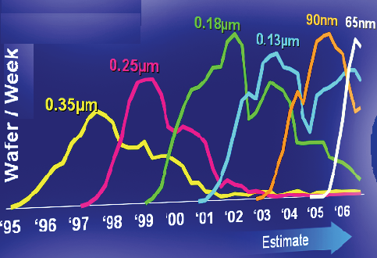
1. The necessity of emerging multicore processors (1)
1. The necessity of emerging multicore processors
The evolution of Intel’s IC manufacturing between 1995 and 2006 -1 [1]
Scaling: ~ 0.7/2 years

Slide 5
1. The necessity of emerging multicore processors (2)
The evolution of Intel’s IC manufacturing between 1995 and 2006-2
Scaling: ~ 0.7x/2 years
In every two years the same number of transistors can be implemented on ~ ½ Si die area
or
In every two years ~ 2x more transistors can be implemented on the same die area
Moore’s rule

Slide 6
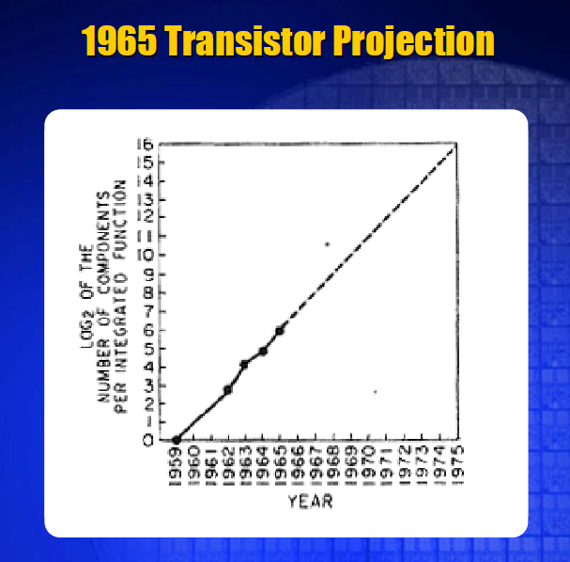
1. The necessity of emerging multicore processors (3)
Moore’s rule
Gordon Moore’s projection for raising transistor counts/die from 1965 [3]
His projection is
doubling transistor counts
about every year

Slide 7
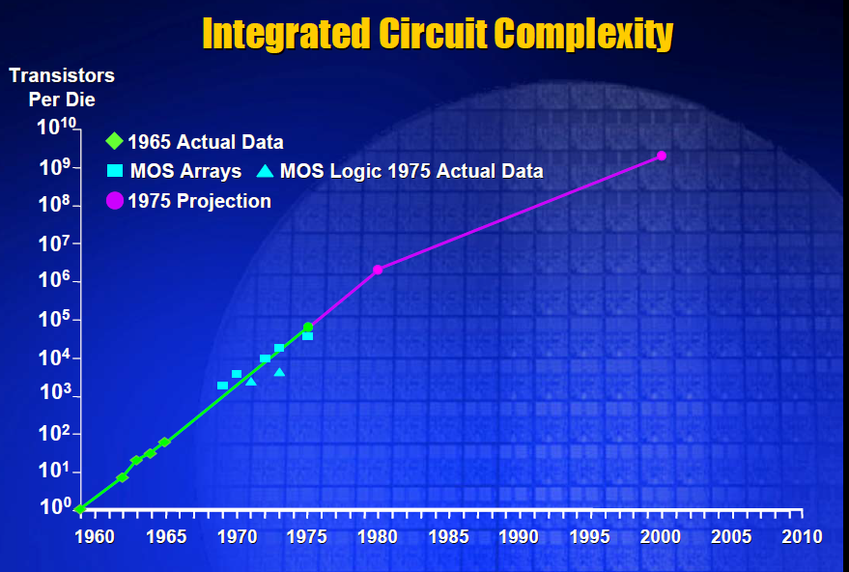
1. The necessity of emerging multicore processors (4)
Gordon Moore’s revised projection for raising transistor counts/die from 1975 [3]
≈ 2x/2 year
Moore’s revised projection from 1975
says doubling transistor counts/die
in about every two years,
beginning in 1980.
≈ 2x/year

Slide 8
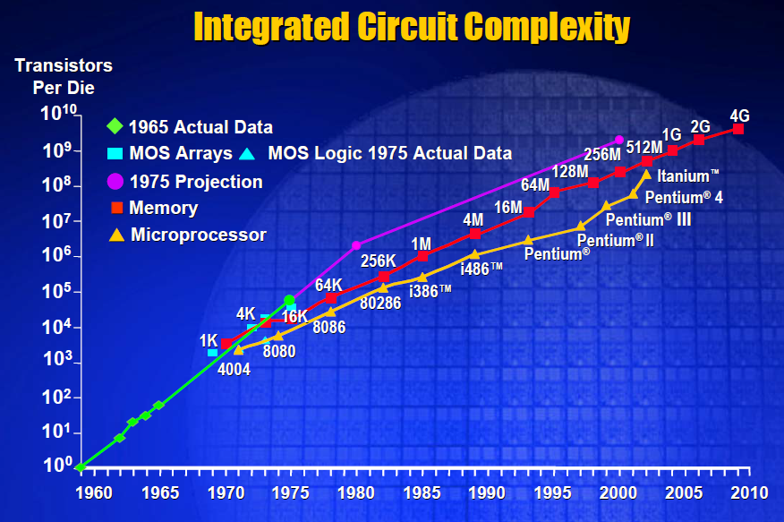
1. The necessity of emerging multicore processors (5)
Moore’s revised projection for the no. of transistors/die from 2003 [3]
≈ 2x/2 year
Actual data show in fact
doubling transistor counts/die
in every two years, beginning already from 1970.
≈ 2x/year

Slide 9
1. The necessity of emerging multicore processors (6)
Slowing down the cadence of Intel’s technology transitions [4]
Pentium 4
Willamette
nm
200
180 nm
Pentium 4
Northwood
180
11/00
01/02
160
Pentium 4
Prescott
140
130 nm
02/04
120
Pentium 4
Cedar Mill
100
90 nm
01/06
80
Penryn
65 nm
11/07
Westmere
60
45 nm
01/10
Ivy Bridge
40
32 nm
04/12
Broadwell
Cannonlake
22 nm
09/14
14 nm
2H/17
20
10 nm
0
2000
2002
2004
2006
2008
2010
2012
2014
2016
2018
On Intel’s Q2 2015 earnings conference call, on July 16 2015, Krzanich: in the second half of
2017, we expect to launch our first 10-nanometer product, code named Cannonlake.
The last two technology transitions have signaled that our cadence today is closer to 2.5 years
than two“ [8].

Slide 10
1. The necessity of emerging multicore processors (7)
Utilization of the surplus transistors (~2x/2 years)?
Utilization of the surplus transistors in the processor
For increasing the
processing width
For increasing IPC
(i.e. efficiency of the processor)
For larger caches
Branch prediction
Speculative loads ...
Increasing the size or
the associativity of
L2/L3...)
1
2
4
Pipeline
Superscalar
1. Gen.
2. Gen.
Summing up: About 2005 the microarchitecture of the processors became already highly
efficient by utilizing hundreds of millions of transistors per die.
Further hundred millions of transistors per die would result only in a marginal (a few %)
performance increase.

Slide 11
1. The necessity of emerging multicore processors (8)
1. The necessity of emerging multicore processors (1)
Consequences
After achieving highly efficient microarchitectures in the beginning of the 2000 by utilizing
n x 10⁸ transistors/die
The most efficient way of utilizing the surplus transistors is to design multicore processors
The emergence of multicore processors became a necessity

Slide 12
1. The necessity of emerging multicore processors (9)
Emergence of dual core processors
Year of launching | Dual core design
12/2001 | IBM launches dual core POWER4
11/2002 | IBM launches dual core POWER4+
05/2004 | ARM announces the availability of the synthetisable ARM11 MPCore quad core processor
05/2004 | IBM launches dual core POWER5
08/2004 | AMD demonstrates first x86 dual core (Opteron) processor
04/2005 | ARM demonstrates the ARM11 MPCore quad core test chip in cooperation with NEC
04/2005 | Intel launches dual core Pentium processors (Pentium D)
04/2005 | AMD launches dual core Opteron server processors
06/2006 | Intel launches the dual core Core 2 family

Slide 13
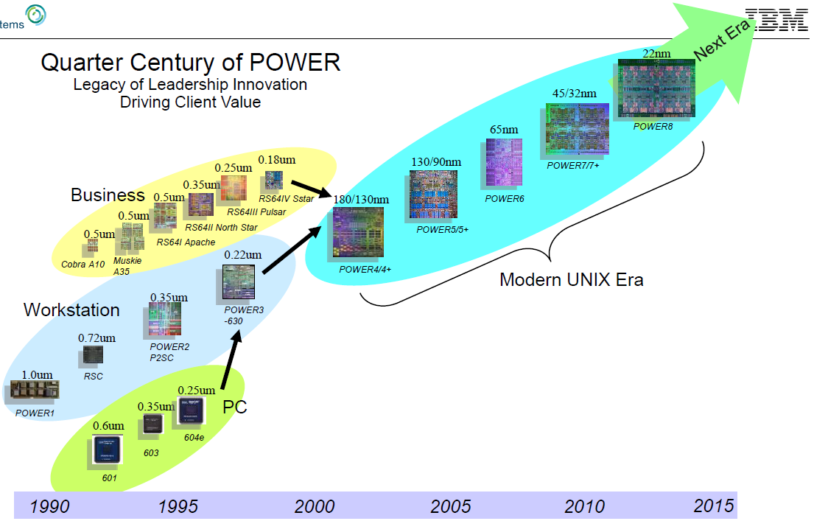
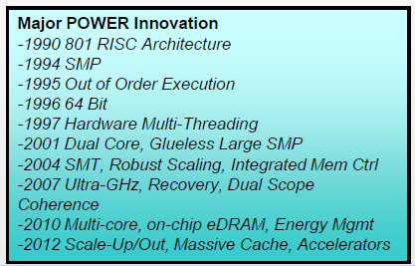
1. The necessity of emerging multicore processors (10)
The evolution of IBM’s major processor lines -1 [9], [30]
http://openpowerfoundation.org/wp-content/uploads/2016/04/5_Brad-McCredie.IBM_.pdf

Slide 14
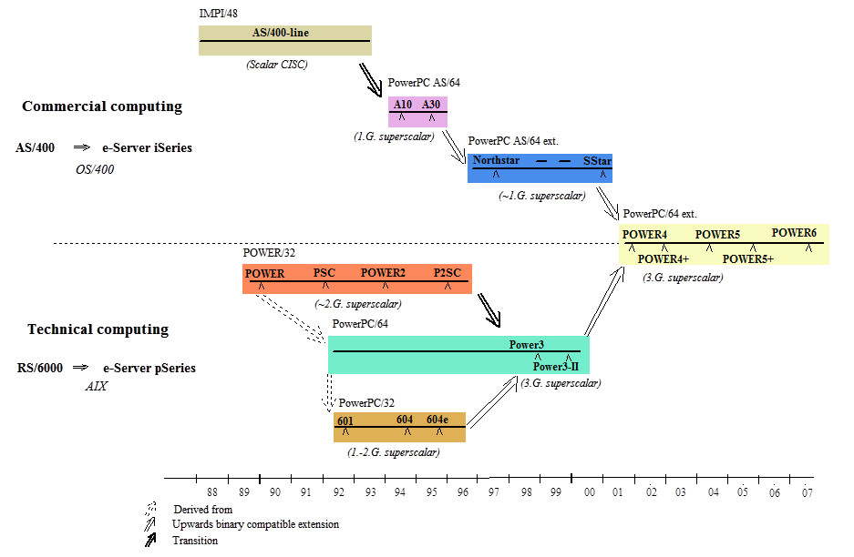
1. The necessity of emerging multicore processors (11)
The evolution of IBM’s major processor lines -2

Slide 15
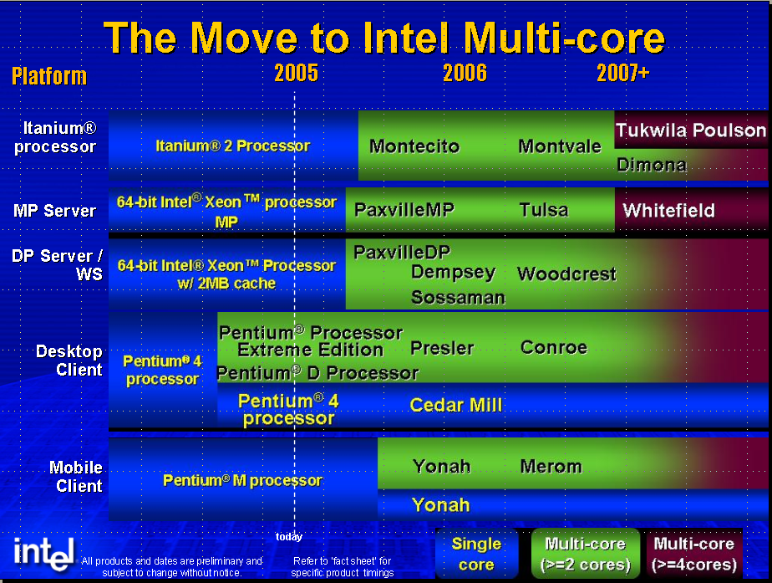
1. The necessity of emerging multicore processors (12)
Spreading of multicores in Intel’s processor categories [2]

Slide 16

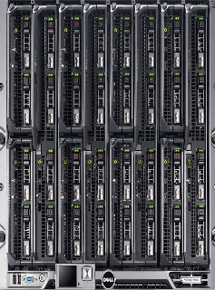
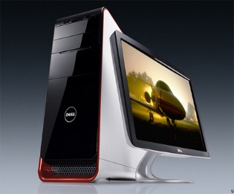
1. The necessity of emerging multicore processors (13)
Core counts in computing devices
Servers
High-End Desktops
High-End Desktops
Desktops
Laptops
Tablets
Smartphones
Traditional computers
Mobiles
Typical no.
of CPU cores
Up to 28
Up to 10
2 to 4
2 to 4
4 to 8
4 to 8

Slide 17
1. The necessity of emerging multicore processors (14)
The rate of rising core counts in Intel's servers
Core
count
32
Broadwell-EX
(14 nm)
24
Ivy-Bridge-EX
(22 nm)
*
16
*
15
Westmere-EX
(32 nm)
Nehalem-EX
(45 nm)
~2x/4 years
10
*
8
7400
(45 nm)
*
6
7300
(65 nm)
*
4
7000
(90 nm)
*
~2x/2 years
2
*
2006
2008
2010
2012
2014
2016
Year

Slide 18
1. The necessity of emerging multicore processors (15)
The rate of rising core counts in AMD's servers
Core
count
32
Piledriver 6300
2xWarsaw die
(32 nm)
24
Bulldozer 6200
2xOrochi die
(32 nm)
K10.5 6100
2xIstambul die
(45 nm)
?
16
*
15
Piledriver 6300
2xAbu Dhabi die
(32 nm)
12
*
10
K10.5/8400
Istambul
(45 nm)
8
K10/8300
Barcelona
(65 nm)
< 2x/4 years
6
*
4
K8/800
Egypt
(90 nm)
*
~2x/2 years
2
*
2006
2008
2010
2012
2014
2016
Year

Slide 19
2. Classification of multicore processors
according to the organization of their CPU cores

Slide 20
2. Classification of multicores according to the organization of the CPU cores (1)
2. Classification of multicore processors according to the organization of their CPU cores
Classification of multicore processors
according to the layout of their CPU cores
Multicores with
homogeneous CPU cores
Multicores with
heterogeneous CPU cores
Traditional
MC processors
Manycore
processors
big.LITTLE
processors
2 ≤ n ≈≤ 32 cores
with n ≈> 32 cores
Mobiles/
desktops
Servers
Cluster of
big cores
Cluster of
LITTLE cores
CPU0
CPU1
CPU0
CPU1
CPU2
CPU3
CPU2
CPU3
Mainstream computing
(since 2001-2006)
Mobiles (2006)
Experimental (2007-2010)
production systems,
Intel's Xeon Phi (2012)
Mobiles (since 2011)

Slide 21
2. Classification of multicores according to the organization of the CPU cores (2)
The reason for distinguishing between multicore and manycore processors
With core counts exceeding certain limits, e.g. recently 16 or 32 cores, some architectural
subsystems become incapable to suitable support the increased number of cores, e.g.
to provide high enough memory bandwidth or
to provide a fast enough core to core communication.
Therefore, such processors need a novel microarchitectures and will be typically called
manycore processors to distinguish them from traditional built multicore processors.

Slide 22
2. Classification of multicores according to the organization of the CPU cores (3)
Task distribution policies in multicore processors
Classification of multicore processors
according to the layout of their CPU cores
Multicores with
homogeneous CPU cores
Multicores with
heterogeneous CPU cores
Traditional
MC processors
Manycore
processors
big.LITTLE
processors
Mobiles/
desktops
Servers
Cluster of
big cores
Cluster of
LITTLE cores
CPU0
CPU1
CPU0
CPU1
CPU2
CPU3
CPU2
CPU3
More demanding tasks are
allocated to the big cores,
less demnding tasks to the
LITTLE cores to reduce
power consumption.
The task scheduler of the OS allocates the tasks
to the cores according to a selected scheduling policy.

Slide 23
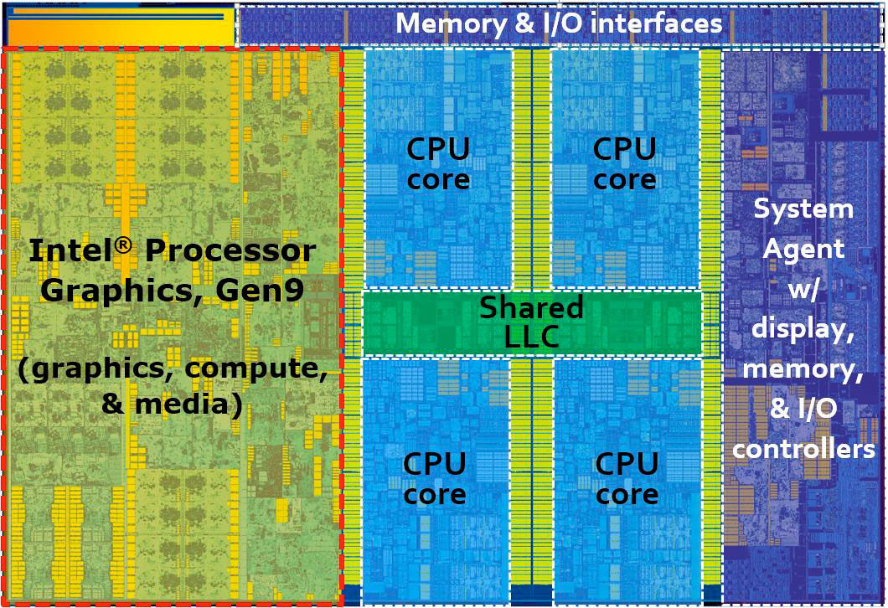
2. Classification of multicores according to the organization of the CPU cores (4)
Example 1. Desktop with homogeneous CPU cores: Intel's 4-core Skylake processor
(2015) [11]
14 nm, 1.7 billion transistors (?), 122 mm²

Slide 24
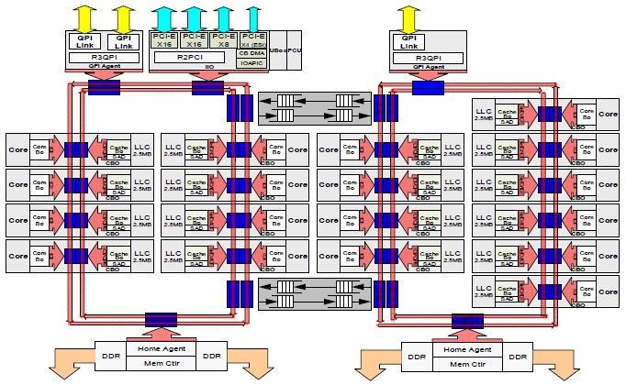
2. Classification of multicores according to the organization of the CPU cores (5)
Example 2. Server with homogeneous CPU cores: Intel's 18-core Haswell-EX processor
(2015) [10]

Slide 25
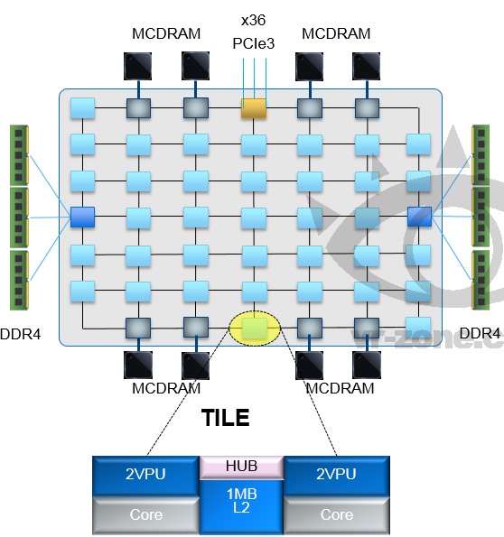
2. Classification of multicores according to the organization of the CPU cores (6)
Example 3. Manycore processor with homogeneous CPU cores: Intel’s Knights Landing
processor of the Xeon Phi line (2015) [5]
Up to 36 tiles with
72 Silvermont (Atom) cores
4 threads/core
2 512 bit vector units
2D mesh architecture
6 channels DDR4-2400,
up to 384 GB,
8x16 GB high bandwidth on-package
MCDRAM memory, >500 GB/s
36 lanes PCIe 3.0
200 W TDP
MCDRAM: Multi-Channel DRAM
(3D DRAM)

Slide 26
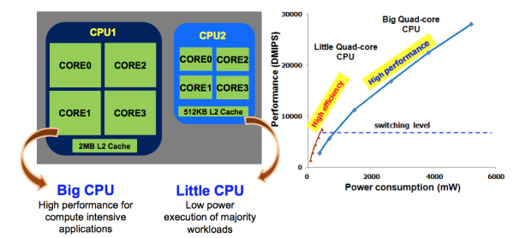
2. Classification of multicores according to the organization of the CPU cores (7)
Example 4. A mobile with heterogeneous CPU cores: Samsung Exynos 5 Octa 5410
in big.LITTLE configuration (2013 revealed) [12]
Principle of operation:
The big or the LITTLE core cluster is allocated for a task according to its performance demand,
the cluster of big cores is allocated to compute intensive tasks whereas the cluster of LITTLE
cores to less demanding tasks.

Slide 27
3. Extending the microarchitecture
3.1 Overview
3.2 Extending the microarchitecture by accelerators
3.3 Extending the microarchitecture by dedicated units
3.4 Principle of extending a microarchitecture
by accelerators or further dedicated units

Slide 28
3.1 Overview

Slide 29
3. Extending the microarchitecture - Overview
3. Extending the microarchitecture
3.1 Overview
Extending the microarchitecture
Extending the microarchitecture
by accelerators
Extending the microarchitecture
by dedicated units
Typical extensions: GPU, ISP (Image Signal Processor),
DSP (Digital Signal processor) etc.
Extensions needed typically in mobiles,
like a modem

Slide 30
3.2 Extending the microarchitecture by accelerators

Slide 31
3.2 Extending the microarchitecture by accelerators - Overview (1)
3.2 Extending the microarchitecture by accelerators
3.2.1 Overview
Aim
To speed up processing the microarchitecture of a processor may be extended by dedicated cores
executing special tasks, such as graphics processing, DSP, image processing etc. faster than
the host processor.
Designation
Multicore processors including also accelerators are called heterogeneous multicores since
they are built of cores with different ISAs.
Classidficaton of multicore processors
according to the kind of the cores included
Homogeneous
multicores
Heterogeneous
muticores
The processor includes only CPU cores,
but does not include
any accelerator.
All CPU cores are executing
the same ISA.
The processor includes
both CPU cores and accelerators,
like GPUs, modems, DSPs etc.
The CPU cores and the accelerators
are executing different ISAs.

Slide 32
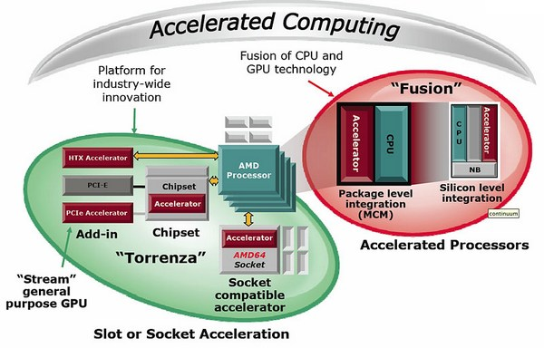
3.2 Extending the microarchitecture by accelerators - Overview (2)
AMD's early approach to accelerated processing (computing) (2006/2007) [13]

Slide 33
3.2 Extending the microarchitecture by accelerators - Overview (3)
General view of using accelerators
Heterogeneous processing
by means of using accelerators
It is based on one or more CPU cores and one or more accelerators (like a GPU)
for speeding-up computations
Main alternatives
Use of an
off-chip accelerator
Use of an
in package accelerator
Use of
on-chip accelerators
Use of
both off-chip and
on-chip accelerators
Examples
CPU
cores
Acc.
Acc.
CPU
cores
CPU
cores
CPU
cores
Acc.
Acc.
Acc.
...
Acc.
Acc.
Acc.
Examples
Processors with a GPU card
attached via the PCIe bus
Desktops, HEDs
Intel's Westmere
processors with an
in-package integrated
GPU
An increasing number of
recent and upcoming
processors with integrated
GPU and further accelerators
Processors with
hybrid graphics or
upcoming servers (e.g. IBM's POWER9)

Slide 34
3.2 Extending the microarchitecture by accelerators - Overview (4)
Main types of accelerators
Slave cores
GPUs
Further dedicated accelerators

Slide 35
3.2.2 Use of slave cores leading to Master/slave processing (1)
3.2.2 Use of slave cores leading to Master/slave processing
Principle
One master core utilizes a number of slave cores for speeding up the execution of dedicatated
tasks, such as executing algorithms on vector data (SIMD data).
Example: IBM/Sony/Toshiba: Cell BE (2006) designed for Sony's PS3 (Playstation 3).
The slave processors accelerate the execution of SIMD data.

Slide 36
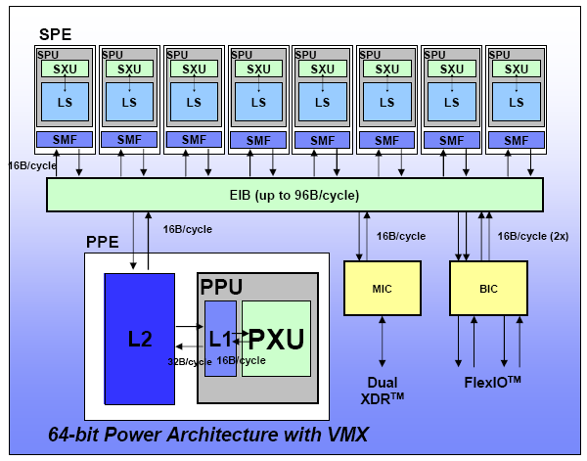
3.2.2 Use of slave cores leading to Master/slave processing (1)
Example for using slave cores in Master/slave processing: IBM/Sony/Toshiba: Cell BE
(2006) [14]
SPE: Synergistic Procesing Element
SPU: Synergistic Processor Unit
SXU: Synergistic Execution Unit
LS: Local Store of 256 KB
SMF: Synergistic Mem. Flow Unit
EIB: Element Interface Bus
PPE: Power Processing Element
PPU: Power Processing Unit
PXU: POWER Execution Unit
MIC: Memory Interface Contr.
BIC: Bus Interface Contr.
XDR: Rambus DRAM

Slide 37
3.2.2 Use of slave cores leading to Master/slave processing (1)
Remark
In the Cell processor
The ISA of the master processor (termed PPE) is compatible with IBM's PowerPC
ISA version 2.0.2 with vector/SIMD multimedia extensions,
the ISA of the slave processors (called SPE) operates primarily on SIMD vector operands,
both fixed-point and floating-point, with support for some scalar operands.

Slide 38
3.2.3 Use of GPUs to speed-up graphics or HPC processing (1)
3.2.3 Use of GPUs to speed-up graphics or HPC processing
Use of GPUs to speed-up
graphics or HPC processing
Main alternatives
Use of an
off-chip graphics card
Use of an
in package GPU
Use of an
on-chip GPU
Use of an
on-chip GPU and one
or more graphics cards
Examples
CPU
cores
CPU
cores
CPU
cores
CPU
cores
GPU
GPU
GPU
...
GPU
GPU
GPU
Acc.
Acc.
Examples
Processors with GPU cards
attached via the PCIe bus
Desktops, HEDs
Intel's Westmere
processors
(desktops, mobiles)
Mainstream mobiles
and desktopss
Hybrid graphics
on HEDs

Slide 39
3.2.3 Use of GPUs to speed-up graphics or HPC processing (2)
Note
GPUs include a large number of SP FP execution units, so they can advantagesly be used to
speed up FP intensive computations (called also HPC (High Performance Computing)).
Nevertheless, running HPC on GPUs needs software support, provided e.g. by OpenCL or
CUDA.
SP FP: Single Precision Floating Point

Slide 40
3.2.3 Use of GPUs to speed-up graphics or HPC processing (3)
Kind of graphics processing
Kind of graphics processing
Discrete graphics
Integrated graphics
Hybrid graphics
Use of graphics cards
attached via AGP, PCIe
Use of GPUs integrated
first into the north bridge,
then into the processor package
finally onto the processor die
Use of both graphics cards
and integrated graphics
Initially used
to provide graphics at all,
recently used to provide
higher performance graphics
than given by
integrated graphics.
Preferred for
low cost devices
Used only seldom
to boost graphics performance.

Slide 41
3.2.3 Use of GPUs to speed-up graphics or HPC processing (4)
Overview of the evolution of implementing graphics processing
Multiple
graphics cards
attached
via the chipset
and the PCIe bus
(2004-)
Multiple
graphics cards
attached
via the processor
and the PCIe bus
(2009-)
Multi-card
ready graphics
Hybrid graphics
Hybrid graphics
(2008-)
Graphics card
attached
via the NB and
the PCIe bus
(2004-)
Graphics card
attached
via the processor and
the PCIe bus
(2009-)
Native single card
graphics
Early discrete graphics
Graphics card
via the SysB
(ISA bus)
(1981-)
Graphics card
via the SysB
(PCI bus)
(1994-)
Graphics card
via the NB and
AGP 1x/2x bus
(1997-)
Graphics card
via the NB and
AGP 4x/8x bus
(1999-)
Integrated graphics
IGP: Integrated Graphics Processor
NB: North Bridge
MCP: Multi-Chip Package
SysB: System Bus
IGP in the
NB
(1999-)
IGP in an
MCP
(2009-)
IGP on the
processor die
(2011-)
≈
≈
1981
1990
2000
2004
2008
2010

Slide 42
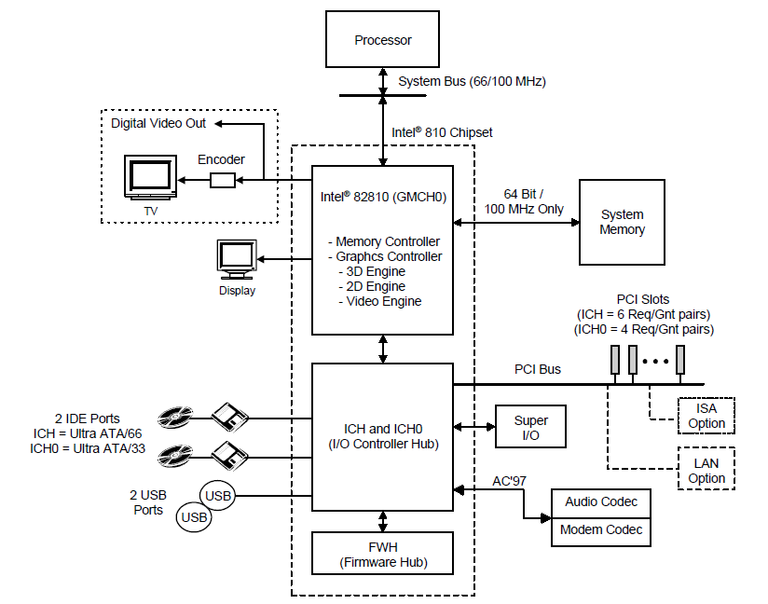
3.2.3 Use of GPUs to speed-up graphics or HPC processing (5)
Example 1: Integrating the graphics controller into the nort bridge
(actually Intel's first implementation in their 810 north bridge (GMCH)) (1999) [15]

Slide 43
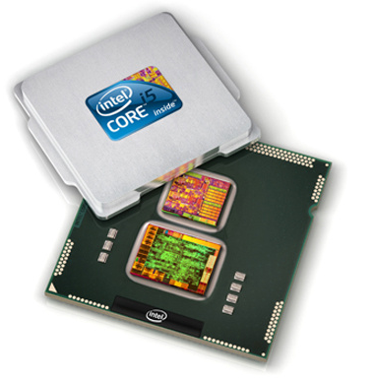
3.2.3 Use of GPUs to speed-up graphics or HPC processing (6)
Example 2: In-package integrated CPU/GPU i(n Intel's Westmere based Arrandale line)
(2010) [16]
32 nm CPU/45 nm discrete GPU

Slide 44
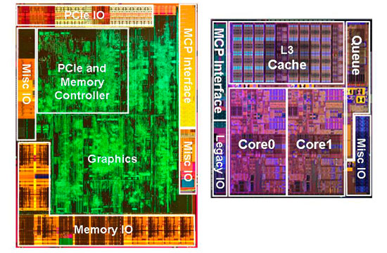
3.2.3 Use of GPUs to speed-up graphics or HPC processing (7)
Basic components of Intel's Westmere based mobile Arrandale line [17]
32 nm CPU
(Mobile implementation of the Westmere
basic architecture,
which is the 32 nm shrink of the
45 nm Nehalem basic architecture)
45 nm GPU
Intel’s GMA HD (Graphics Media Accelerator)
(12 Execution Units, Shader model 4, no OpenCL support)

Slide 45
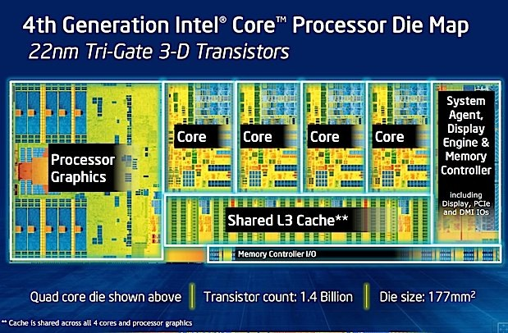
3.2.3 Use of GPUs to speed-up graphics or HPC processing (8)
Example 3: Introduction of on-chip integrated graphics in Intel's Sandy Bridge (2011)
[18]

Slide 46




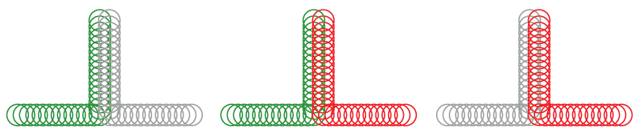


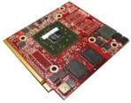
3.2.3 Use of GPUs to speed-up graphics or HPC processing (9)
Example 4: Principle of hybrid graphics: using both integrated and discrete graphics
(used first in 2008) [19]
Integrated
graphics
Discrete
graphics
Hybrid
graphics
AMD 7-Series Chipset
ATI Mobility Radeon™ HD 3600 Series or higher
ATI Mobility Radeon™ HD 3400 Series w/ATI Hybrid Graphics Technology
iGP
Enabled
Discrete
Disabled
iGP
Disabled
Discrete
Enabled
Both graphics cores
Enabled
Performance

Slide 47
3.2.4 Using further dedicated accelerators - Main use cases (1)
3.2.4 Using further dedicated accelerators - Main use cases
Using further dedicated accelerators
Main use cases
Use of
on-chip accelerators
Use of
both on-chip and
off-chip accelerators
Acc.
Acc.
CPU
cores
CPU
cores
Acc.
Acc.
...
Acc.
Acc.
An increasing number of
recent processors include additonal accelerators,
as demonstrated by examples
Upcoming high-end servers
(e.g. IBM's POWER9)

Slide 48
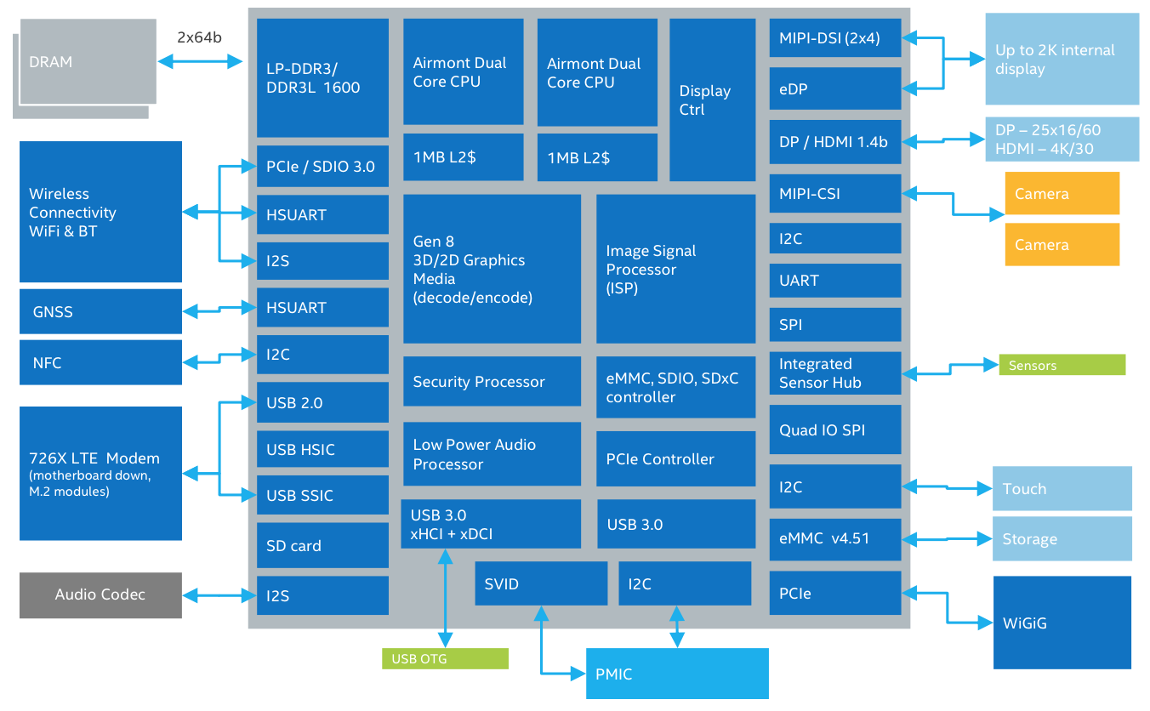
3.2.4 Using further dedicated accelerators - Main use cases (2)
Example 1: On-chip accelerators (Intel's Atom X5 mobile platform) (2015) [20]

Slide 49
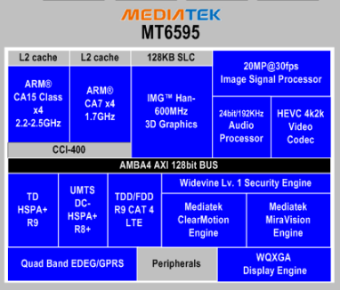
Block diagram of MT6595 Octa core big.LITTLE LTE platform [28]
Corepilot
Quad-core ARM
Cortex-A17 MPCore
plus
quad-core ARM
Cortex-A7 MPCore

Slide 50
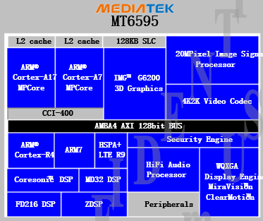
3.2.4 Using further dedicated accelerators - Main use cases (3)
Example 2: On-chip accelerators (MEDIATEK MT6595) (2014) [21]
Quad-core ARM® Cortex-A17 MPCore
plus Quad-core ARM® Cortex-
A7 MPCore

Slide 51
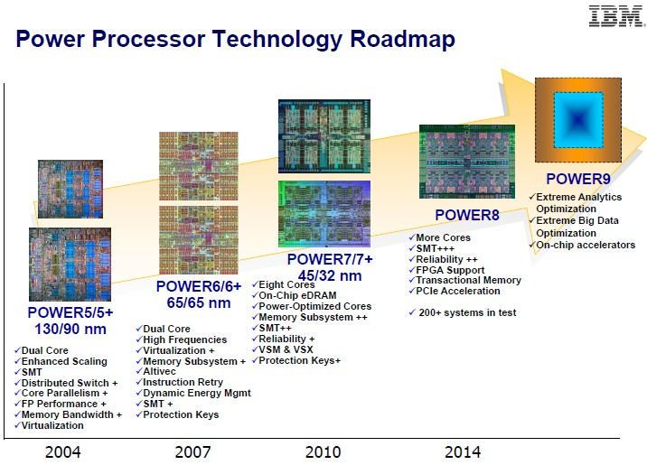
3.2.4 Using further dedicated accelerators - Main use cases (4)
Example 3: Evolution of IBM's POWER family by introducing accelerators [22]

Slide 52
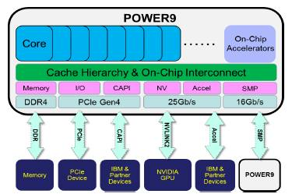
3.2.4 Using further dedicated accelerators - Main use cases (5)
Using both on-chip and off-chip accelerators in Intel's POWER9 (2016) [23]
CAPI: Coherent Accelerator Processor Interface (CAPI.
Provides a high-performance interface for the implementation of software-specific,
computation-heavy algorithms based on FPGAs.

Slide 53
3.3 Extending the microarchitecture by dedicated units

Slide 54
3.3 Extending the microarchitecture by dedicated units (1)
3.3 Extending the microarchitecture by dedicated units
Example: Extending the microarchitecture by modems to provide connectivity to broadband
communication networks

Slide 55
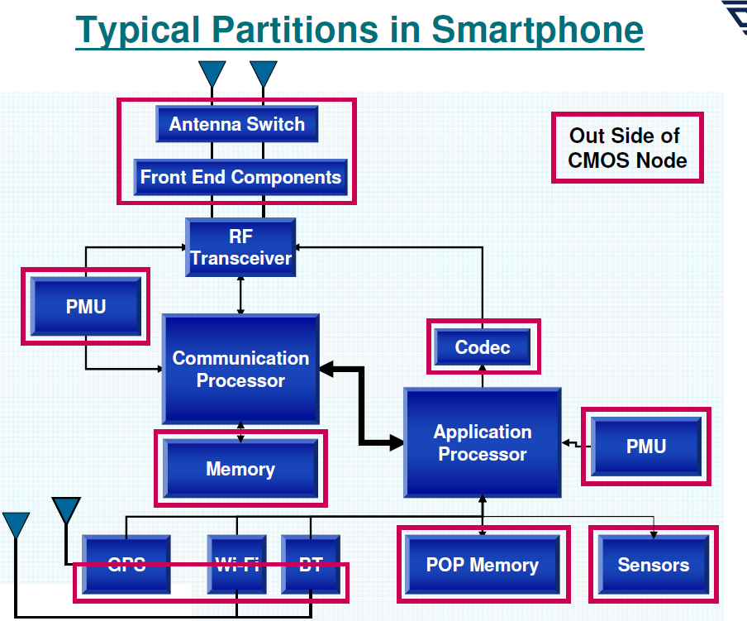
3.3 Extending the microarchitecture by dedicated units (2)
Main blocks of a smartphone [24]
PMU: Power
ManagementUnit
GPS/WiFi/BT

Slide 56
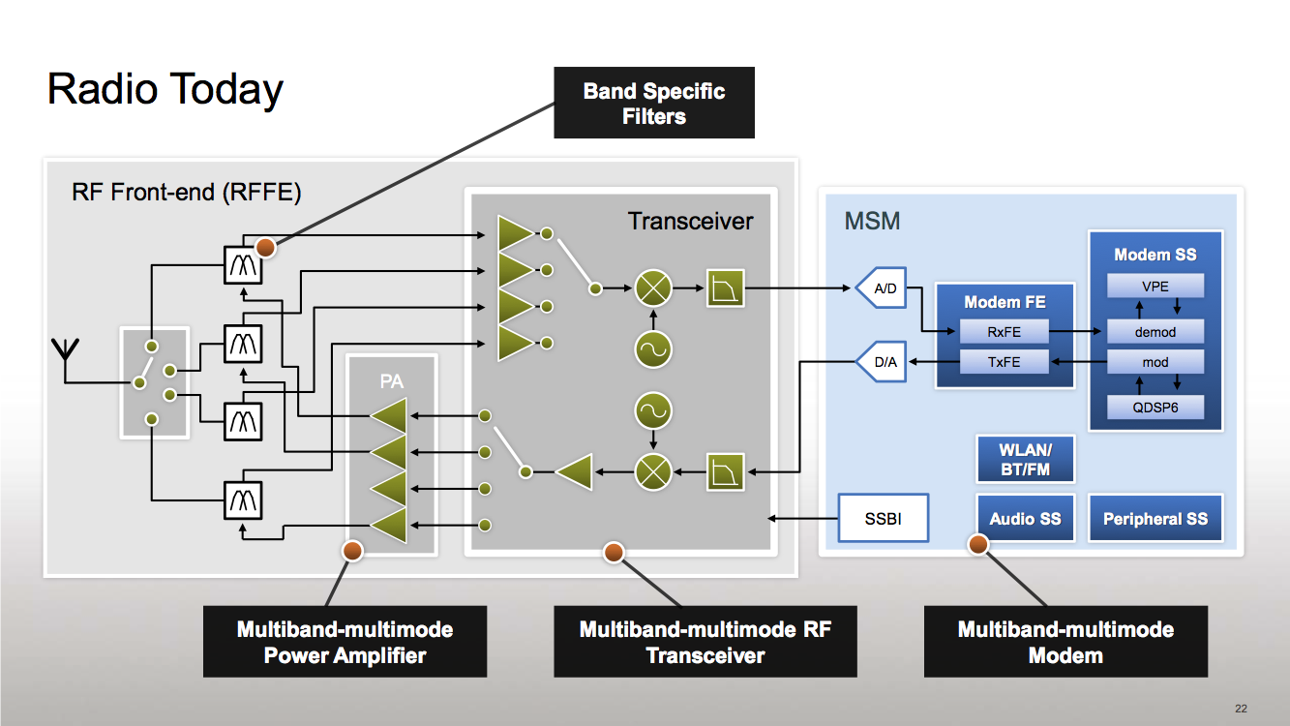
3.3 Extending the microarchitecture by dedicated units (3)
Main blocks of the RF Transceiver and the RF Front-end with Antenna switch [25]
RF
Modem + Application Processor
(assuming an integrated implementation)
Antenna
switch
(DSP)
PA: Power Amplifier

Slide 57
3.3 Extending the microarchitecture by dedicated units (4)
3G/4G connectivity [25]
RF
Modem + Application Processor
(assuming an integrated implementation)
(DSP)
PA: Power Amplifier

Slide 58
3.3 Extending the microarchitecture by dedicated units (5)
3G/4G connectivity [25]
RF
Modem + Application Processor
(assuming an integrated implementation)
(DSP)
PA: Power Amplifier

Slide 59
3.3 Extending the microarchitecture by dedicated units (6)
3G/4G connectivity [25]
RF
Modem + Application Processor
(assuming an integrated implementation)
(DSP)
PA: Power Amplifier

Slide 60
3.3 Extending the microarchitecture by dedicated units (7)
Attaching a modem to a processor assuming on-chip integrated graphics
Attaching a modem to a processor
assuming integrated graphics
The processor is assumed to have one or more CPU cores and a modem
Main alternatives
Use of an
off-chip modem
Use of an
in package modem
Use of an
integrated modem
Examples
CPU
cores
GPU
CPU
cores
GPU
CPU
cores
GPU
Acc.
Modem
Acc.
Modem
Modem
Examples
Mobiles with discreate modems
(see next slide)
Most recent mobiles
(see next slide)

Slide 61
3.3 Extending the microarchitecture by dedicated units (8)
Integration of the application processor and the modem
Integrating the modem into the chip results in less costs and shorter time to market.
Qualcomm pioneered this move by designing integrated parts already about 1996.
Integration of the application processor and the modem
Use of discrete
application processor and modem
Use of integrated
application processor and modem
Qualcomm’s MSM products (since ~ 1996)
including their Snapdragon families
MediaTek’s 6xxx/8xxx families (since ~ 2007)
except the 81xx line
NVIDIA’s Tegra 2-4, K1 (since 2011)
NVIDIA’s Tegra 4i (2014)
X
(2015)
Intel’s Atom line (2008)
except recent Atom X3 (Sophia (2015)
Intel’s Atom X3 (Sophia) (2015)
X
(2016)
Samsung’s Exynos 3/4/5/7 families
(since ~ 2010)
Samsung’s Exynos 8 (8890)
(2015)
Apple’s own processor designs
(stil recently - A10 (2016)

Slide 62
3.3 Extending the microarchitecture by dedicated units (9)
Example for a discrete modem (Intel's Atom X5 mobile platform) (2015) [20]
A block diagram of the Cherry Trail-based Atom x5 and x7 chips

Slide 63
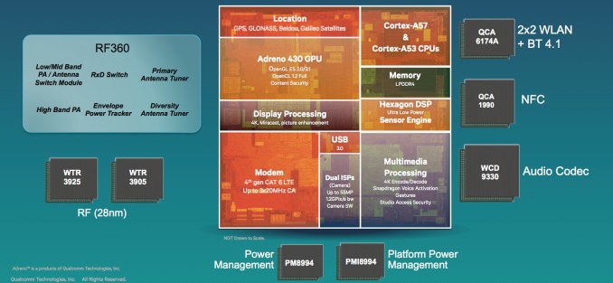
3.3 Extending the microarchitecture by dedicated units (10)
Example for an integrated modem: Qualcomm's Snapdragon 810 (2015) [26]
4xA57+4xA53
RF Frontend
(Near Field
Communication)
Transceivers

Slide 64
3.4 Principle of extending a microarchitecture by accelerators or further dedicated units

Slide 65
3.4 Principle of extending a microarchitecture (1)
3.4 Principle of extending a microarchitecture by accelerators or further dedicated units
Required infrastructure: a cache coherent interconnect
Nevertheless, this point will not be discussed only illustrated by examples).

Slide 66
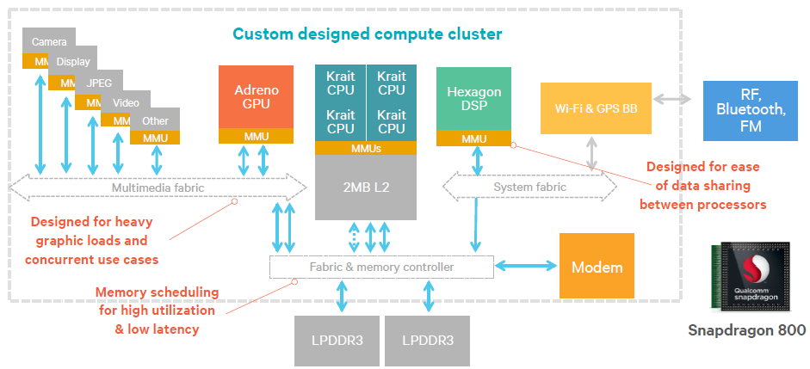
3.4 Principle of extending a microarchitecture (2)
Example 1: Cache coherent interconnect in Qualcomm's Snapdragon 800 SOC (2013) [27]

Slide 67
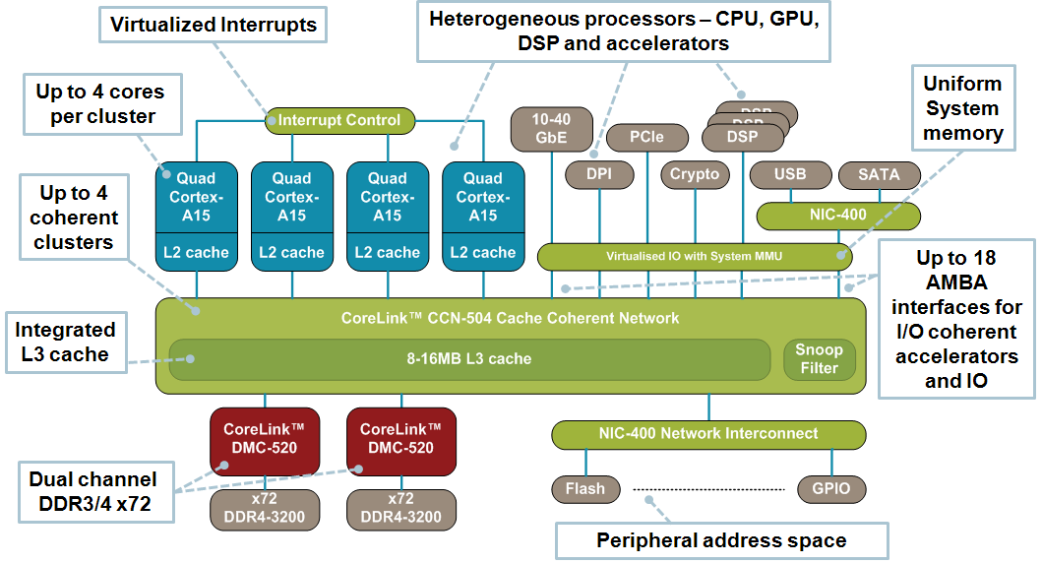
3.4 Principle of extending a microarchitecture (3)
Example 2: Cache coherent interconnect implemented by ARM's CCN-504 CCN (2012) [28]
DPI: Direct Programming Interface

Slide 68
3.4 Principle of extending a microarchitecture (4)
Remark
Patents have an immense role in the evolution of processor architectures.
As an example: Apple posseses about
13 000 patents.
Figure: Apple's patents classified to
various fields of technology [29]
SIRI: Intelligent personal assistant, became part of the iOS since the iOS5, introduced along with
the iPhone 4S in 2011.

Slide 69
4. References

Slide 70
4. References (1)
[1]: Timeline of Many-Core at Intel, intel.com,
http://download.intel.com/newsroom/kits/xeon/phi/pdfs/Many-Core-Timeline.pdf
[2]: Schmid P., The Pentium D: Intel's Dual Core Silver Bullet Previewed, Tom’s Hardware,
April 5 2005, http://www.tomshardware.com/reviews/pentium-d,1006-2.html
[3]: Moore G.E., No Exponential is Forever…, ISSCC, San Francisco, Febr. 2003,
http://ethw.org/images/0/06/GEM_ISSCC_20803_500pm_Final.pdf
[4]: Howse B., Smith R., Tick Tock On The Rocks: Intel Delays 10nm, Adds 3rd Gen 14nm Core
Product "Kaby Lake„, AnandTech, July 16 2015,
http://www.anandtech.com/show/9447/intel-10nm-and-kaby-lake
[5]: Anthony S., Intel unveils 72-core x86 Knights Landing CPU for exascale supercomputing,
Extremetech, November 26 2013,
http://www.extremetech.com/extreme/171678-intel-unveils-72-core-x86-knights-landing
-cpu-for-exascale-supercomputing
[6]: Radek, Chip Shot: Intel Reveals More Details of Its Next Generation Intel Xeon Phi Processor
at SC'13, Intel Newsroom, Nov 19, 2013,
http://newsroom.intel.com/community/intel_newsroom/blog/2013/11/19/chip-shot-at
-sc13-intel-reveals-more-details-of-its-next-generation-intelr-xeon-phi-tm-processor
[7]: Smith R., Intel’s "Knights Landing" Xeon Phi Coprocessor Detailed, AnandTech, June 26 2014,
http://www.anandtech.com/show/8217/intels-knights-landing-coprocessor-detailed
[8]: Intel's (INTC) CEO Brian Krzanich on Q2 2015 Results - Earnings Call Transcript, Seeking
Alpha, July 15 2015, http://seekingalpha.com/article/3329035-intels-intc-ceo-brian-
krzanich-on-q2-2015-results-earnings-call-transcript?page=2

Slide 71
4. References (2)
[9]: McCredie B., OpenPOWER and the Roadmap Ahead, OpenPOWER Summit 2016, April 5-8,
http://openpowerfoundation.org/wp-content/uploads/2016/04/5_Brad-McCredie.IBM_.pdf
[10]: Morgan T. P., Intel Puts More Compute Behind Xeon E7 Big Memory, The Platform,
May 5 2015, http://www.theplatform.net/2015/05/05/intel-puts-more-compute-behind-
xeon-e7-big-memory/
[11]: Intel "Skylake" Die Layout Detailed, TechPowerUp, Aug. 18 2015,
http://www.techpowerup.com/215333/intel-skylake-die-layout-detailed.html
[12]: Shin Y., Shin K., Kenkare P., Kashyap R., 28nm high- metal-gate heterogeneous quad-core
CPUs for high-performance and energy-efficient mobile application processor,
2013 IEEE International Solid-State Circuits Conference Digest of Technical Papers,
IEEE, pp.154-155
[13]: Nguyen T., AMD: Bringing "Torrenza" and "Fusion" Together, Daily Tech, March 17 2007,
http://www.dailytech.com/article.aspx?newsid=6512
[14]: Wright C., Henning P., Bergen B., Roadrunner Tutorial, An Introduction to Roadrunner,
and the Cell Processor, Febr. 7 2008,
http://www.lanl.gov/orgs/hpc/roadrunner/pdfs/Roadrunner-tutorial-session-1-web1.pdf
[15]: Intel 810 Chipset: Intel 82810/82810-DC100 Graphics and Memory Controller Hub (GMCH),
Datasheet, June 1999, http://download.intel.com/design/chipsets/datashts/29065602.pdf
[16]: Altavilla D., Intel Arrandale Core i5 and Core i3 Mobile Unveiled, Hot Hardware, Jan. 4 2010,
http://hothardware.com/Reviews/Intel-Arrandale-Core-i5-and-Core-i3-Mobile-Unveiled/

Slide 72
4. References (3)
[17]: Shimpi A. L., The Intel Core i3 530 Review - Great for Overclockers & Gamers,
AnandTech, Jan. 22 2010, http://www.anandtech.com/show/2921
[18]: Von Holzbauer F., Kugler A., Neue Intel-Architektur mit Grafik-Fokus, Chip Online,
June 1 2013, http://www.chip.de/artikel/Intel-Haswell-Neue-CPUs-fuer-Notebooks-und-
PCs_62209040.html
[19]: Shutter S., Solotko S., APCUG Breakfast Keynote 2008, Jan. 6 2008,
http://www.apcug.net/events/2008/files/APCUG_presentation_FINAL.ppt#1029,12,
ATI Hybrid Graphics Technology and ATI PowerXpress™ Technology
[20]: Anthony S., Intel unveils its next mobile maneuver: Atom x3, x5, and x7, Ars Technica,
March 2 2015, http://arstechnica.com/gadgets/2015/03/intel-unveils-its-next-mobile-
maneuver-atom-x3-x5-and-x7/
[21]: MT6595 Octa-Core Smartphone Application Processor, Technical Brief, Dec. 31 2013
[22]: Armasu L., IBM's Power9 CPU Could Be Game Changer In Servers And Supercomputers
With Help From Google, Nvidia, Tom’s Hardware, April 7 2016,
http://www.tomshardware.com/news/ibm-power9-servers-supercomputers-nvidia,31567.html
[23]: Morgan T. P., Power9 Will Bring Competition To Datacenter Compute, The Next Platform,
April 18 2016, http://www.nextplatform.com/2016/04/18/power9-will-bring-competition-
datacenter-compute/
[24]: Chang H., Multi-Die Integration Strategies and System Partitions in Mobile WWAN Devices,
Nov. 14 2012, http://meptec.org/Resources/1%20-%20Universal%20Scientific.pdf

Slide 73
4. References (4)
[25]: Klug B., The State of Qualcomm's Modems - WTR1605 and MDM9x25, AnandTech,
Jan. 4 2013, http://www.anandtech.com/print/6541/the-state-of-qualcomms-modems-
wtr1605-and-mdm9x25
[26]: Shimpi A.L., Qualcomm's Snapdragon 808/810: 20nm High-End 64-bit SoCs with LTE
Category 6/7 Support in 2015, AnandTech, April 7 2014,
http://www.anandtech.com/show/7925/qualcomms-snapdragon-808810-20nm-highend-
64bit-socs-with-lte-category-67-support-in-2015
[27]: Katouzian A., The Qualcomm difference, 2013,
https://www.qualcomm.com/media/documents/files/the-qualcomm-difference.pdf
[28]: CoreLink CCN Family, ARM,
http://www.arm.com/products/system-ip/interconnect/corelink-ccn-family.php
[29]: James D., Inside Today’s Systems & Chips: A Survey of the Past Year, 2013,
http://theconfab.com/wp-content/uploads/2014/dick_james_confab14.pdf
[30]: McCredie B., OpenPOWER and the Roadmap Ahead, OpenPOWER Summit 2016, April 5-8,
http://openpowerfoundation.org/wp-content/uploads/2016/04/5_Brad-McCredie.IBM_.pdf

