Slide 1
ARM’s processor lines
Dezső Sima
Dec. 2016
(v2.3)
© Dezső Sima 2016

Slide 2
ARM’s processor lines
1. Evolution of ARM
2. Evolution of the ARM ISA
3. Overview of ARM’s processor families
4. Overview of ARM’s Cortex-A series
5. Overview of ARM’s Mali graphics series
6. ARM’s 64-bit Cortex-A series
7. References
Notes:
2

Slide 3
1. Evolution of ARM

Slide 4
1. Evolution of ARM (1)
1. Evolution of ARM
ARM (ARM Holdings plc) is a British multinational semiconductor company with
its head office in Cambridge.
The company designs low power
ARM processors for the embedded, mobile and server market as well as
mobile GPUs (termed as Mali GPUs)
and licences their IP (Intellectual Property) including their ISA along with the
appropriate design tools but does not fabricate semiconductors.
plc: public limited company (a.m. kft)
intellectual property: a.m. szellemi tulajdon

Slide 5
1. Evolution of ARM (2)
Example: ARM's IP offer in addition to the Cortex-A73 processor [89]
Graphic IP | Other IP | Tools
ARM Mali™-G71 Mali-DP550 (Display processor) Mali-V550 (Video Processor) | ARM CoreLink™ CCI-550 (Cache Coherent Interconnect) CoreLink GIC-500 (Interrupt Controller) CoreLink MMU-500 (System Memory Management Unit) CoreLink TZC-400 (ARM TrustZone® Controller) CoreLink DMC-500/DMC-520 (Dynamic Memory Controller) ARM CoreSight™ SoC-400 (Debug and Trace) ARM POP™ (Physical IP) | ARM DS-5 Development Studio Fixed Virtual Platforms ARM Versatile™ Express ARM Compiler 6 ARM Fast Models

Slide 6
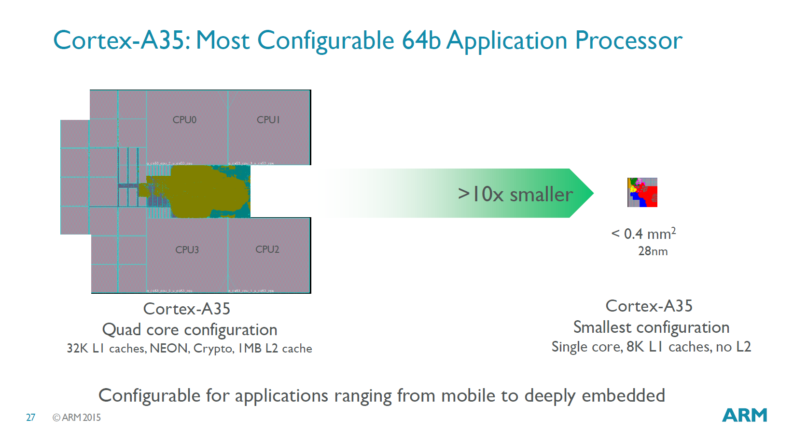
1. Evolution of ARM (3)
Example for the range of configurability of a processor [90]
Configuration options of the Cortex-A35 ranging from mobile to deeply embedded

Slide 7
1. Evolution of ARM (4)
Evolution of the approaches used to circuit design -1 [1]
Approaches to circuit design
Full custom design
Semi custom design
Full synthesizable design
Hand layout of the
entire circuit
The design will be subdivided into
functional units and further on into blocks
and the appropriate implementation technique
(hand layout, structured layout or automated layout)
is chosen for each.
Automated layout of the
entire circuit
Simple scaling, e.g.
from 28 nm to 16 nm
Power/performance
optimized
Implementation time
optimized
Trend

Slide 8
1. Evolution of ARM (5)
Evolution of the approaches used to circuit design -2 [1]
ARM’s first fully synthesizable design was the Cortex-A9 processor
(announced in 2007).
Previous designs, like that for the Cortex-A8, included partly hand layout and
partly automated layout.
Recently, automated design tools are typically used for processor design.
Over time more and more advanced standard cell libraries were developed that
have a large variety of design options, e.g. cell types or drive strengths, which
lessens the need for custom design.

Slide 9
1. Evolution of ARM (6)
Dominance of AMD desingns in the embedded and mobile market
(including smartphones and tablets)
ARM designs dominate recently the embedded and the mobile market
(including smartphones and tablets).
As of 2014 more than 50 billion ARM based processors have been produced
in total, up from 10 billion in 2008 [59], [19], as indicated in the next Figure.

Slide 10
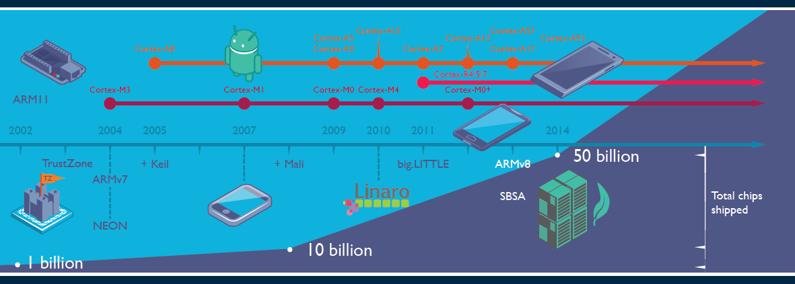
1. Evolution of ARM (7)
Total number of ARM based chips shipped [19]
Keil: Software development tool for embedded processors
Linaro: Nonprofit company, established by ARM, Freescale, IBM, Samsung, ST-Ericsson and TI
to support open source software developers using Linux on SoCs.
SBSA: Server Base System Architecture, a standardized server platform for 64-bit ARM processors.

Slide 11
1. Evolution of ARM (8)
Historical remarks [60], [61] -1
ARM’s parent company is Acorn Computers (UK).
Acorn Computers started their Acorn RISC Machine project in October 1983
(two years after the introduction of the IBM PC) to develop an own powerful
processor for a line of business computers.
The acronym ARM was coined originally at this time (1983) from the designation
Acorn RISC Machine.
In 1990 the company Advanced RISC Machines Ltd. (ARM Ltd.) was founded as a
joint venture of Acorn Computers, Apple Computers and VLSI Technology.
Accordingly, also the interpretation of ARM was changed to “Advanced RISC
Machines”.

Slide 12
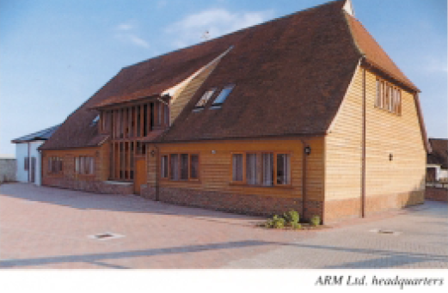
1. Evolution of ARM (9)
Historical remarks -2
Figure: The headquarters of ARM Ltd. about 1990 [62]

Slide 13
1. Evolution of ARM (10)
Historical remarks -3
Finally, in 1998 the company went to the stock exchange and its name was changed
to ARM Holdings plc, to its current designation.

Slide 14

1. Evolution of ARM (11)
Historical remarks -4
Figure: ARM's recent headquarter in Cambridge (UK) [78]

Slide 15
Acquisition of ARM by Softbank (Japan)
Announced in 07/2016
Completed in 09/2016
Price: 31 bUSD (ARM's revenues in 2015 ≈ 1.5 bUSD)

Slide 16
2. Evolution of the ARM ISA
2.1 Overview
2.2 ISA extensions introduced to enhance compute capabilities
2.3 ISA extensions introduced to reduce the code size
2.4 ISA extensions introduced to enhance security
(Only Sections 2.1 and 2.2 will be discussed)

Slide 17
2.1 Overview

Slide 18
2.1 Overview (1)
2.1 Overview
There are eight ARM ISA versions, designated as ARMv1 to ARMv8.
These are described in the related Architecture Reference Manuals.
The earliest versions (ARMv1 and ARMv2) provided an address range of only
26 bits, the first ISA version with 32 bit address range was the ARMv3.
Accordingly, we consider the ISA version ARMv3 as ARM’s basic ISA and discuss
its evolution subsequently.

Slide 19
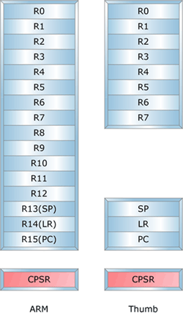
2.1 Overview (2)
Key features of ARM’s basic ISA
It is a 32-bit RISC ISA capable to process basically 32-bit FX or logical data.
The ISA has 16 32-bit registers, called the core registers.
13 out of them are used as general purpose registers (GPRs), the remaining three
are dedicated registers, as shown below.
Stack pointer
Link register
PC
Figure: The core registers of the ARM ISA (in the ISA versions ARMv3-ARMv7) [63]

Slide 20
2.1 Overview (3)
Main extensions introduced in ARM’s basic ISA (simplified) -1
ARM’s ISA extensions
ISA extensions
to enhance
compute capabilities
ISA extensions
to reduce
code size
ISA extensions
to speed up
the execution of bytecodes
ISA extensions
to enhance
security
Section 2.2
Section 2.3
Section 2.4
Section 2.5

Slide 21
2.1 Overview (4)
Main extensions introduced in ARM’s basic ISA (simplified) -2 (Based on [64])
AArch32
AArch64
Crypto-graphy ext.
To enhance
security
TrustZone
SVE⁴
To enhance
compute
capabilities
SIMD
Adv. SIMD¹
(NEON)
Adv. SIMD and FP
SIMD
and FP
VFPv1/2
VFPv3/v4²
To speed up
the execution
of bytecodes
Jazelle
(Jazelle DBX)
Jazelle
(ex. by SW)
Jazelle RCT³
(ThumbEE)
To reduce
code size
Thumb
(ARMv4T)
Thumb-2
(ARMv6T2)
ARMv4
ARMv5
ARMv6
ARMv7-A/R
ARMv8-A
Examples
ARM710T
(~1995)
ARM926
(2001)
ARM1176
(2004)
Cortex-A5-15
(2005)
Cortex-A53/A57
(2014)
Remarks: See on the next slide.

Slide 22
2.1 Overview (5)
Remarks
¹The Advanced SIMD architecture extension is commonly referred to as the
NEON technology.
The VFP subset became depricated in the ARMv8 ISA.
³Jazelle-RTC (ThumbEE) became depricated in ARMv7 Issue C in 10/2011.
⁴The VSE (Scalable Vector Extension) subset became introduced in the
ARMv8 ISA only in 2016.

Slide 23
2.2 ISA extensions introduced to enhance compute capabilities
2.2.1 Overview
2.2.2 The GPR register set based SIMD extension
2.2.3 Secondary register set based VFP and NEON extensions
2.2.4 The SVE register set based SVE extension
Only Section 2.2.1 will be discussed.

Slide 24
2.2.1 Overview

Slide 25
2.2.1 Overview (1)
2.2 ISA extensions introduced to enhance compute capabilities
2.2.1 Overview
ARM’s ISA extensions
ISA extensions
to enhance
compute capabilities
ISA extensions
to reduce
code size
ISA extensions
to speed up
the execution of bytecodes
ISA extensions
to enhance
security
Section 2.2
Section 2.3
Section 2.4
Section 2.5

Slide 26
2.2.1 Overview (2)
Overview of the ISA extensions introduced to enhance compute capabilities-1
AArch32
AArch64
Crypto-graphy ext.
To enhance
security
TrustZone
SVE⁴
To enhance
compute
capabilities
SIMD
Adv. SIMD¹
(NEON)
Adv. SIMD and FP
SIMD
and FP
VFPv1/2
VFPv3/v4²
To speed up
the execution
of bytecodes
Jazelle
(Jazelle DBX)
Jazelle
(ex. by SW)
Jazelle RCT³
(ThumbEE)
To reduce
code size
Thumb
(ARMv4T)
Thumb-2
(ARMv6T2)
ARMv4
ARMv5
ARMv6
ARMv7-A/R
ARMv8-A
Examples
ARM710T
(~1995)
ARM926
(2001)
ARM1176
(2004)
Cortex-A5-15
(2005)
Cortex-A53/A57
(2012)
Remarks: See on the slide 2.1 Overview (5).

Slide 27
2.2.1 Overview (3a)
Overview of the ISA extensions introduced to enhance compute capabilities-2
ARM ISA |  | Basic arch. |  | Name of the extensions |  | GPR-based FX-SIMD extension | FP or Adv. SIMD/FP registers based extensions
 |  | GPRs | Data type |  |  |  | Available reg. set | Scalar data types | Vector data types
Name | Year
ARMv1 | 1985 | n.a. | FX32
ARMv2 | 1989 | n.a.
ARMv3 | 1991 | 13x32
ARMv4 | 1996
ARMv5 | 2000 2001 |  |  | VFP(v1)¹ |  |  | FP register set 32x32/16x64 | FP 32/64 | FP 32/64 Serially ex.
 |  |  |  | VFP2¹
ARMv6 | 2004 |  |  | SIMD |  | 32-bit wide FX8/16
ARMv7 | 2006 |  |  | VFPv3² |  |  | Adv. SIMD and FP register set 32x64 or 16X128 | +FP 16⁴ | FP 16⁴/32/64 Serially executed
 |  |  |  | VFPv4^{2,3,4} |  |  |  | + FMA
 |  |  |  | Adv. SIMD (NEON)^{4,5} |  |  | 32x64 or16x128 |  | 64/128-bit wide FX 8/16/32/64, FP 16⁵/32/64 +FMA⁵
ARMv8 | 2012 | 31x64 | FX32/64 | A32 | Adv. SIMD and FP |  | 32x64 or 16x128 | FP 16⁴/32/64 | As for ARMv7
 |  |  |  | A64 | SIMD and FP |  | SIMD and FP register set 32x128 | FX 8/…/64 FP 16⁴/32/64 | As for ARMv7

Slide 28
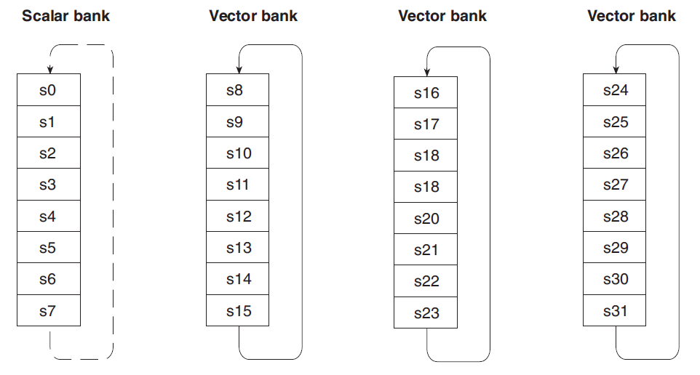
2.2.1 Overview (3b)
Example: Serially processed 5-element vector operation [65]
In the example the input operands are taken from the registers s10...s14 and
s18...s22, and the result is written into the registers s26...s30.
The execution is sequential (like a hardware implemented subroutine).

Slide 29
2.2.1 Overview (4)
Remarks
¹VFPv2 vs. VFP(v1): VFPv2 adds some enhancements and modifications to VFPv1
²VFPv3/v4 and advanced SIMD register space:
Certain processors implement only 16 64-bit wide registers with the option to use
this register space as 32 32-wide registers.
³VFP4 is implemented on certain ARMv7 processors.
It adds FMA (Fused Multiply Accumulate) instructons to the VFPv3 instructon set.
⁴FP16 supports only data conversion between FP16 and FP32/FP64.
⁵In the Advanced SIMD (NEON) extension FP16 is supported only if VFP3/VFP4
is implemented and FMA if VFP4 is implemented.

Slide 30
2.2.1 Overview (5a)
Overview of the ISA extensions introduced to enhance compute capabilities-3
ARM ISA |  | Name of the extensions |  | Scalable vector registers based extension
 |  |  |  | Scalable vector register set | Vector data types
Name | Year
ARMv8 | 2012 | A32 | Adv. SIMD and FP | 32x64/32x32
 |  |  |  | 32x64/16x128 | As for ARMv7
 |  | A64 | Adv. SIMD and FP | 32x128 | As for ARMv7 + FP 64
 | 2016 |  | SVE | (1...16)x128 | Not yet specified but supports both FX and FP data
SVE: Scalable Vector Extension

Slide 31
2.2.1 Overview (5b)
Avalable SVE registers [96]
LEN: 1 to 16

Slide 32
2.2.1 Overview (6)
ISA extensions introduced to enhance compute capabilities
ARM’s ISA extensions to enhance compute capabilities
The GPR register set based
SIMD extension
Secondary register set based
FP and SIMD extensions
The SVE register set based
SVE extension
It supports
FX-SIMD operations
It supports
FX/FP scalar and SIMD operations
It supports
FX/FP SIMD operations
on long vector data
Section 2.2.2
Section 2.2.3
Section 2.2.4

Slide 33
2.2.2 The GPR register set based SIMD extension

Slide 34
2.2.2 The GPR register set based SIMD extension (1)
2.2.2 The GPR register set based SIMD extension
ARM’s ISA extensions to enhance compute capabilities
The GPR register set based
SIMD extension
Secondary register set based
FP and SIMD extensions
The SVE register set based
SVE extension
It supports
FX-SIMD operations
It supports
FX/FP scalar and SIMD operations
It supports
FX/FP SIMD operations
on long vector data
Section 2.2.2
Section 2.2.3
Section 2.2.4

Slide 35
2.2.2 The GPR register set based SIMD extension (2)
Evolution of the GPR register set in the ARM ISA -1
...
ARMv3
Previously 26 bitwide)
ARMv7
ARMv8
(Aarch32)
ARMv8
(AArch64)
GPR register set
32
32
32
64
...
13
13
31
31

Slide 36
2.2.2 The GPR register set based SIMD extension (3)
The GPR register sets in the ARMv3-ARMv7 and the ARM v8 ISA [63], [66]
In the AArch64 mode the ARMv8 ISA version expands the number of GPRs
from 13 32-bit registers to 31 64-bit wide registers, as shown in the next Figure.
32-bit wide
32-bit wide
64-bit wide
R0
R0
R0
R1
R1
R1
R2
R2
R2
.
.
.
.
.
.
.
.
.
X0
W0
R12
R12
R12
R13(SP)
Stack pointer
Link register
PC
R13(SP)
R13(SP)
R14(LR)
R14(LR)
R14(LR)
R15(PC)
.
.
.
.
.
.
X30
W30
X31
Dedicated use
W31
Dedicated use
32-bit mode
64-bit mode
GPRs in the ARMv3-ARMv7 and the
ARMv8 AArch32 execution mode
GPRs in the ARMv8 AArch64 execution mode

Slide 37
2.2.2 The GPR register set based SIMD extension (4)
Introduction of the GPR register set based SIMD extension in the ARMv6 ISA
...
ARMv3
Previously 26 bitwide)
ARMv6
ARMv7
ARMv8
(Aarch32)
ARMv8
(AArch64)
GPR register set
32
32
32
64
...
13
13
31
31
Scalar data
Basic ISA
FX32
FX32/64
SIMD
extension
SIMD data
32-bit wide FX-SIMD FX8/16 operations

Slide 38
2.2.2 The GPR register set based SIMD extension (5)
The GPR register set based SIMD extension
It supports FX-SIMD operations on 32-bit wide SIMD data in the GPR registers.
Available instructions perform operations on 4xFX8 or 2xFX16 data in parallel.
It is similar to Intel’ s MMX x86 ISA extension from 1997.
The GPR register set based SIMD extension as introduced into the ARMv6 ISA
version provides only a modest performance boosting potential.
By contrast the subsequently, in the ARMv7 ISA version introduced, secondary
register set based advanced SIMD (NEON) extension has a much higher
performance boosting potential.

Slide 39
2. 2.2.3 Secondary register set based extensions

Slide 40
2.2.3.1 Secondary reg. set based FP and SIMD extensions - Overview (1)
2.2.3 Secondary register set based VFP and NEON extensions
2.2.3.1 Secondary register set based FP and SIMD extensions - Overview
ARM’s ISA extensions to enhance compute capabilities
The GPR register set based
SIMD extension
Secondary register set based
FP and SIMD extensions
The SVE register set based
SVE extension
It supports
FX-SIMD operations
It supports
FX/FP scalar and SIMD operations
It supports
FX/FP SIMD operations
on long vector data
Section 2.2.2
Section 2.2.3
Section 2.2.4

Slide 41
2.2.3.1 Secondary reg. set based FP and SIMD extensions - Overview (2)
Designation and size of the secondary register set in the ARMv5 - ARMv8 ISAs
ARMv5
ARMv7
(or ARMv8 AArch32 mode)
ARMv8
(AArch64 mode)
FP register set¹
Advanced SIMD
and FP register set¹
SIMD
and FP register set
32
64
128
32
32
32
or
or
16
16
64
128

Slide 42
2.2.3.1 Secondary reg. set based FP and SIMD extensions - Overview (3)
The secondary register set based FP and SIMD extensions - Overview
ARMv5
ARMv7
(or ARMv8 AArch32 mode)
ARMv8
(AArch64 mode)
FP register set¹
Advanced SIMD
and FP register set¹
SIMD
and FP register set
32
64
128
32
32
32
or
or
16
16
64
128
VFPv1/v2 extension
VFPv3/v4 extension²
SIMD and FP extension
Scalar data
Scalar data
FP32/64
FP16¹/32/64
Serially processed FP vector data
FP16¹/32/64
Up to 8xFP32 or 4xFP64
operationsc serially executed
Up to 8xFP32 or 4xFP64
operations serially executed
SIMD (vector) data
64/128-bit wide SIMD data
FX8/16/32/64
FP16³/32/64 operations
Advanced SIMD (NEON) extension
SIMD data
64/128-bit wide SIMD (vector) data
FX8/16/32/64
FP16³/32/64 operations

Slide 43
2.2.3.1 Secondary reg. set based FP and SIMD extensions - Overview (4)
Remarks
¹Certain models implement only half of the specified register numbers.
²The implementation of the VFP3 or VFP4 extensions presumes the implemetation of
the Advanced SIMD (NEON) extension.
²In the VFP3/VFP4 extensions only conversions between FP16 and FP32 or FP64 are
supported.

Slide 44
2.2.3.2 The VFPv1/v2 extensions (1)
2.2.3.2 The VFPv1/v2 extensions
ARMv5
ARMv7
(or ARMv8 AArch32 mode)
ARMv8
(AArch64 mode)
FP register set¹
Advanced SIMD
and FP register set¹
SIMD
and FP register set
32
64
128
32
32
32
or
or
16
16
64
128
VFPv1/v2 extension
VFPv3/v4 extension²
SIMD and FP extension
Scalar data
Scalar data
FP32/64
FP16¹/32/64
Serially processed FP vector data
FP16¹/32/64
Up to 8xFP32 or 4xFP64
operationsc serially executed
Up to 8xFP32 or 4xFP64
operations serially executed
SIMD (vector) data
64/128-bit wide SIMD data
FX8/16/32/64
FP16³/32/64 operations
Advanced SIMD (NEON) extension
SIMD data
64/128-bit wide SIMD (vector) data
FX8/16/32/64
FP16³/32/64 operations

Slide 45
2.2.3.2 The VFPv1/v2 extensions (2)
The FP register set (as introduced in the ARMv5) [65]
The new secondary register set is 32 x 32-bit or 16x64-bit wide and is
organized as four register banks, each including 8 registers, as seen below.
Figure: Register banks of the VFP1 and VFP2 extensions [65]

Slide 46
2.2.3.2 The VFPv1/v2 extensions (3)
Use of the FP register set [65]
The first bank is used to hold scalar operands whereas to remaining three banks
vector operands.
FP vector operands may refer to 2 to 8 registers from the same bank.
The vector length is given in a specific field of a control register.
The register numbers given in the instruction specify the first registers that
contain the first operands and specify the first destination register.
Each successive element of the vector is taken by incrementing appropriately the
register numbers.
The peculiarity of the VFP extension is that the elements of the vector are
processed sequentially rather than parallel as for usual SIMD execution.

Slide 47
2.2.3.2 The VFPv1/v2 extensions (4)
Example: Serially processed 5-element vector operation [65]
In the example the input operands are taken from the registers s10...s14 and
s18...s22, and the result is written into the registers s26...s30.
The execution is sequential (like a hardware implemented subroutine).

Slide 48
2.2.3.3 The VFPv3/v4 extensions (1)
2.2.3.3 The VFPv3/v4 extensions -1
ARMv5
ARMv7
(or ARMv8 AArch32 mode)
ARMv8
(AArch64 mode)
FP register set¹
Advanced SIMD
and FP register set¹
SIMD
and FP register set
32
64
128
32
32
32
or
or
16
16
64
128
VFPv1/v2 extension
VFPv3/v4 extension²
SIMD and FP extension
Scalar data
Scalar data
FP32/64
FP16¹/32/64
Serially processed FP vector data
FP16¹/32/64
Up to 8xFP32 or 4xFP64
operationsc serially executed
Up to 8xFP32 or 4xFP64
operations serially executed
SIMD (vector) data
64/128-bit wide SIMD data
FX8/16/32/64
FP16³/32/64 operations
Advanced SIMD (NEON) extension
SIMD data
64/128-bit wide SIMD (vector) data
FX8/16/32/64
FP16³/32/64 operations

Slide 49
2.2.3.3 The VFPv3/v4 extensions (2)
The VFPv3 and VFPv4 extensions -2
The underlying register set (called the Advanced SIMD and FP register set) is
an extension of the previous FP register set and is shared by the NEON
(Advanced SIMD and FP) extension.
ARMv5
ARMv7
(or ARMv8 AArch32 mode)
FP register set¹
Advanced SIMD
and FP register set¹
32
64
32
32
or
or
16
16
64
128
Figure: Extension of the secondary register set in the ARMv7 ISA

Slide 50
2.2.3.3 The VFPv3/v4 extensions (3)
The VFPv3 and VFPv4 extensions -3
The VFPv3/v4 extensions support basically the same operations as the previous
VFPv2 extension.
The main enhancements of VFPv3/v4 are:
VFPv3 support in addition FP16 (half-word FP) operations, nevertheless
the supported operations are restricted only to conversions between
FP16 and FP32 or FP64 data types.
VFPv4's main enhancement is support of FMA (Fused Multiply Add)
operations.

Slide 51
2.2.3.3 The VFPv3/v4 extensions (4)
Contrasting main features of the VFPv1/v2 and VFPv3/v4 extensions
VFP (Vector Floating Point) extensions
VFPv1/v2
VFPv3/v4
Introduced in the ISA version
ARMv5
Introduced in the ISA version
ARMv6
introduction of an FP register set
(32x32 or 16x64 bit)
supporting operations on
doubling the size of the FP register set to
32x64 or 16x128 bit registers, and
supporting oprations as in case of the previous
vFPv2 version plus
scalar FP data (FP32/FP64) and
serially processed FP vector data
(up to 8xFP32 or 4xFP64)
providing instructions that perform
conversions between FP16 and FP32
or FP64 data (since the VFP3) and
additonally FMA operations (in the
VFP4 extension).

Slide 52
2.2.3.4 Advanced SIMD (NEON) extension (1)
2.2.3.4 Advanced SIMD (NEON) extension -1
ARMv5
ARMv7
(or ARMv8 AArch32 mode)
ARMv8
(AArch64 mode)
FP register set¹
Advanced SIMD
and FP register set¹
SIMD
and FP register set
32
64
128
32
32
32
or
or
16
16
64
128
VFPv1/v2 extension
VFPv3/v4 extension²
SIMD and FP extension
Scalar data
Scalar data
FP32/64
FP16¹/32/64
Serially processed FP vector data
FP16¹/32/64
Up to 8xFP32 or 4xFP64
operationsc serially executed
Up to 8xFP32 or 4xFP64
operations serially executed
SIMD (vector) data
64/128-bit wide SIMD data
FX8/16/32/64
FP16³/32/64 operations
Advanced SIMD (NEON) extension
SIMD data
64/128-bit wide SIMD (vector) data
FX8/16/32/64
FP16³/32/64 operations

Slide 53
2.2.3.4 Advanced SIMD (NEON) extension (2)
2.2.3.4 The Advanced SIMD (NEON) extension of the ARMv7 -1
NEON shares its register set with the VFPv3/v4 extension.
The shared register set is called the Advanced SIMD and FP register set.
It is an extension of the previous FP register set, as shown in the Figure below.
ARMv5
ARMv7
(or ARMv8 AArch32 mode)
FP register set¹
Advanced SIMD
and FP register set¹
32
64
32
32
or
or
16
16
64
128
Figure: Extension of the secondary register set in the ARMv7 ISA

Slide 54
2.2.3.4 Advanced SIMD (NEON) extension (3)
2.2.3.4 The Advanced SIMD (NEON) extension of the ARMv7 [11] -2
NEON is intended to accelerate multimedia and signal processing algorithms
such as video encode/decode, 2D/3D graphics, gaming, speech or image
processing.

Slide 55
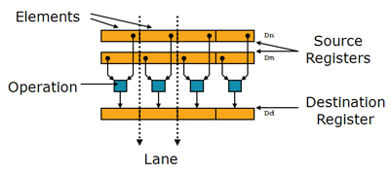
2.2.3.4 Advanced SIMD (NEON) extension (4)
The Advanced SIMD (NEON) extension of the ARMv7 ISA [11] -2
NEON instructions operate on 64 or 128-bit wide vector data (SIMD data) held
in the Advanced SIMD and FP register set.
They perform the same operation on all data elements, as indicated below.
Figure: SIMD data [11]
NEON instructions operate on 64 or 128-bit wide vectors with
FX8/FX16/FX32/FX64 or
FP16/FP32/FP64
data elements.
Remark
For FP16 data NEON supports only conversions between FP16 and FP32/FP64 data.
FP16 data operations are supported only in the Advanced SIMDv2 option.

Slide 56
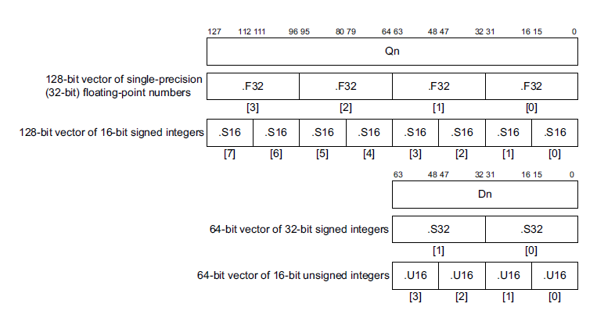
2.2.3.4 Advanced SIMD (NEON) extension (5)
Example vector data formats of the Advanced SIMD (NEON) extension [86]

Slide 57
2.2.3.5 The SIMD and FP extension of the ARMv8 ISA in AArch64 mode (1)
2.2.3.5 The SIMD and FP extension of the ARMv8 ISA in the AArch64 mode-1
ARMv5
ARMv7
(or ARMv8 AArch32 mode)
ARMv8
(AArch64 mode)
FP register set¹
Advanced SIMD
and FP register set¹
SIMD
and FP register set
32
64
128
32
32
32
or
or
16
16
64
128
VFPv1/v2 extension
VFPv3/v4 extension²
SIMD and FP extension
Scalar data
Scalar data
FP32/64
FP16¹/32/64
Serially processed FP vector data
FP16¹/32/64
Up to 8xFP32 or 4xFP64
operationsc serially executed
Up to 8xFP32 or 4xFP64
operations serially executed
SIMD (vector) data
64/128-bit wide SIMD data
FX8/16/32/64
FP16³/32/64 operations
Advanced SIMD (NEON) extension
SIMD data
64/128-bit wide SIMD (vector) data
FX8/16/32/64
FP16³/32/64 operations

Slide 58
2.2.3.5 The SIMD and FP extension of the ARMv8 ISA in AArch64 mode (2)
The SIMD and FP extension of the ARMv8 ISA in the AArch64 mode -2
The ARMv8 ISA version introduces major changes in the ARM architecture while
maintaining a high level of consistency with previous versions of the architecture.
ARMv8 has two distinct execution modes, as indicated below.
Execution modes of the ARMv8
Aarch32
execution mode
Aarch64
execution mode
It supports two 32-bit instruction sets,
the A32 and the T32 (Thumb) instructions sets.
In this mode the processor can run programs
developed for previous ISA versions.
It supports a single 64-bit instruction set,
called A64.
This is a fixed length powerful instruction set
that uses 32-bit instruction encodings.

Slide 59
2.2.3.5 The SIMD and FP extension of the ARMv8 ISA in AArch64 mode (3)
Extension of the secondary register set in the ARMv8 ISA [66]
The AArch64 mode the ARMv8 ISA expands the number of the secondary registers
from 32x64-bit or 16x64-bit (ARMv7 ISA) to 32x128-bit, as seen below.
64-bit wide
128-bit wide
128-bit wide
V0
V0
V0
V1
V1
V1
V2
V2
V2
.
.
.
.
.
.
.
.
.
or
V13
V13
V13
V14
V14
V14
V15
V15
V15
.
.
.
.
.
.
V30
V30
V31
V31
FP and advanced SIMD registers in the ARMv7 and ARMv8 AArch32 execution mode of the ARM ISA
SIMD and FP registers
in the ARMv8 AArch64 execution mode of the ARM ISA

Slide 60
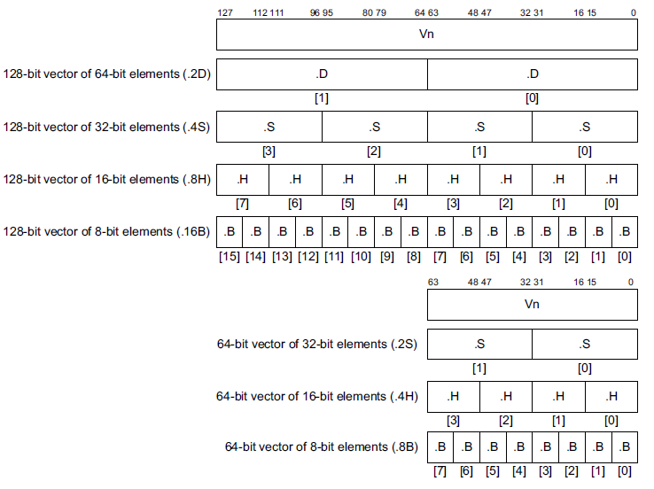
2.2.3.5 The SIMD and FP extension of the ARMv8 ISA in AArch64 mode (4)
Use cases of 64- and 128-bit wide SIMD data in the AArch64 mode [66]

Slide 61
2. 2.2.4 The SVE register set based SVE extension

Slide 62
. 2.2.4 The SVE register set based SVE extension (1)
2.2.4 The SVE register set based SVE extension
ARM’s ISA extensions to enhance compute capabilities
The GPR register set based
SIMD extension
The secondary register set based
FP and SIMD extensions
The SVE register set based
SVE extension
It supports
FX-SIMD operations
It supports
FX/FP scalar and SIMD operations
It supports
FX/FP SIMD operations
on long vector data
Section 2.2.2
Section 2.2.3
Section 2.2.4

Slide 63
. 2.2.4 The SVE register set based SVE extension (2)
The SVE (Scalable Vector Extension) introduced into the AArch64 mode
of the ARMv8 ISA [96]
It was announced in 8/2016 (in the Hot Chips conference).
General specification will be available in late 2016 / early 2017.
The vector length in SPE is a hardware choice from 1x128 bit to 16x128 bit,
first implementions (e.g. by Fujitsu) choose 4x128 bit = 512 bit vector length.
SVE is implemented only in the AArch64 version of ARMv8.
SVE aims at HPC scientific workloads rather than media or image processing.
It supports both FX and FP processing.

Slide 64
2.2.4 The SVE register set based SVE extension (3)
The SVE register set introduced in the AArch64 mode of the ARMv8 ISA
ARMv8
(AArch64 mode)
SVE register set
128
128
32
. . .
(1...16)x128

Slide 65
2.2.4 The SVE register set based SVE extension (4)
Avalable SVE registers [96]
LEN: 1 to 16

Slide 66
2.2.4 The SVE register set based SVE extension (5)
The SVE extension - Overview
ARMv8
(AArch64 mode)
SVE register set
128
128
32
. . .
(1...16)x128
SVE extension
FX and FP datatypes
(Not yet specified)
(1...16)x 128 bit wide SIMD data
(Supported operations not yet specified)

Slide 67
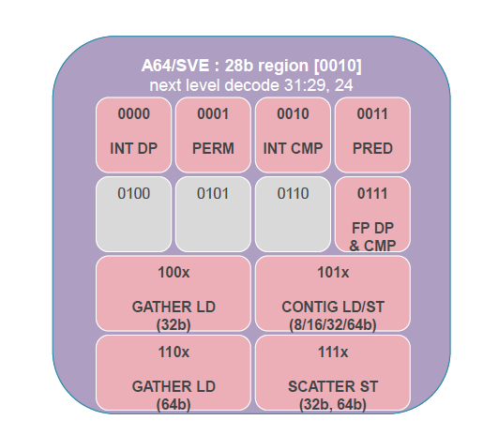
2.2.4 The SVE register set based SVE extension (6)
The SVE instruction set [96]

Slide 68
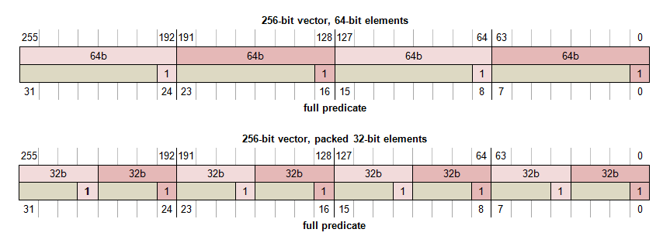
2.2.4 The SVE register set based SVE extension (7)
Example: Use of 256-bit vectors (either for FX or FP computations) [96]

Slide 69
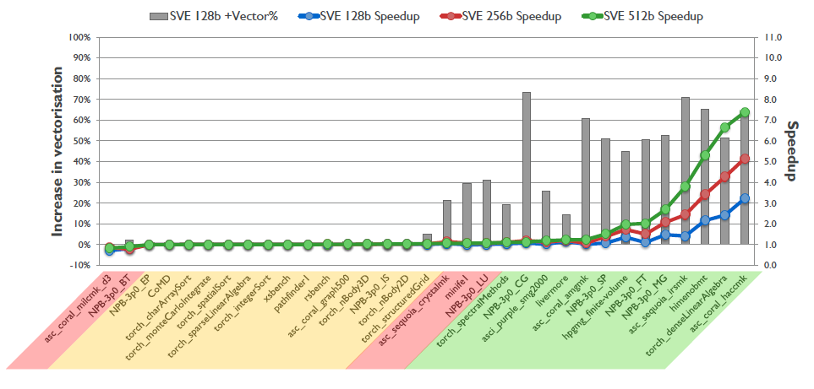
2.2.4 The SVE register set based SVE extension (8)
Speed-up potential of SVE [96]

Slide 70
2.3 ISA extensions introduced to reduce code size
(Not discussed)

Slide 71
2.3.1 ISA extensions introduced to reduce code size - Overview (1)
2.3 ISA extensions introduced to reduce code size
2.3.1 ISA extensions introduced to reduce code size - Overview (1)
ARM’s ISA extensions
ISA extensions
to enhance
compute capabilities
ISA extensions
to reduce
code size
ISA extensions
to speed up
the execution of bytecodes
ISA extensions
to enhance
security
Section 2.2
Section 2.3
Section 2.4
Section 2.5

Slide 72
2.3.1 ISA extensions introduced to reduce code size - Overview (2)
ISA extensions introduced to reduce code size - Overview (2) (Based on [64])
AArch32
AArch64
Crypto-graphy ext.
To enhance
security
TrustZone
SVE⁴
To enhance
compute
capabilities
SIMD
Adv. SIMD¹
(NEON)
Adv. SIMD and FP
SIMD
and FP
VFPv1/2
VFPv3/v4²
To speed up
the execution
of bytecodes
Jazelle
(Jazelle DBX)
Jazelle
(ex. by SW)
Jazelle RCT³
(ThumbEE)
To reduce
code size
Thumb
(ARMv4T)
Thumb-2
(ARMv6T2)
ARMv4
ARMv5
ARMv6
ARMv7-A/R
ARMv8-A
Examples
ARM710T
(~1995)
ARM926
(2001)
ARM1176
(2004)
Cortex-A5-15
(2005)
Cortex-A53/A57
(2012)
Remarks: See on the slide 2.1 Overview (5)

Slide 73
2.3.1 ISA extensions introduced to reduce code size - Overview (3)
ISA extensions introduced to reduce code size - Overview (3)
ISA extensions to reduce code size
The Thumb instruction set
(ARMv4/~1995))
The Thumb-2 instruction set
(ARMv6/~2005))
Only 16-bit Thumb instructions
Both 16 and 32-bit Thumb instructions
(Section 2.3.2)
(Section 2.3.3)

Slide 74
2.3.2 The Thumb instruction set (1)
2.3.2 The Thumb instruction set [67]
This is an alternative 16-bit instruction set that provides typically 35 to 40 %
better code density than traditional ARM code but reduces performance slightly,
e.g. by 10 %.
It has been introduced in the ARMv4 ISA.
Processors with the T suffix provide beyond the default 32-bit ARM also the
16-bit Thumb instruction set.
Thumb instructions are 16-bit long, most 32-bit ARM instructions can be recoded
to a single 16-bit Thumb instruction format.
The Thumb instruction set is a subset of the ARM instruction set.
There is a special instruction for entering the Thumb state (BX).
Compilers are usually able to generate code optinally either for the ARM or the
Thumb ISA.
In the Thumb instructon set there are only 8 GPRs available for the programmer,
as shown in the next Figure.

Slide 75
2.3.2 The Thumb instruction set (2)
Available GPR register sets in the ARM and the Thumb ISA [63]

Slide 76
2.3.3 The Thumb-2 instruction set (1)
2.3.3 The Thumb-2 instruction set [79]
It was introduced along with the ARM1156T2-S processor in 2005.
Thumb-2 is a superset of the 16-bit ARMv6 Thumb iSA.
It adds several new 16-bit instructions and also 32-bit instructions that can be
freely intermixed in a program.
The enhancements allow Thumb-2 to more efficiently cover the functionality of
the ARM instruction set.
In subsequent processors Thumb-2 replaced the Thumb instruction set.

Slide 77
2.4 ISA extensions to speed up
the execution of bytecodes
(Not discussed)

Slide 78
2.4.1 ISA extensions to speed up the execution of bytecodes - Overview (1)
2.4 ISA extensions introduced to speed up the execution of bytecodes
2.4.1 ISA extensions introduced to speed up the execution of bytecodes
- Overview (1)
ARM’s ISA extensions
ISA extensions
to enhance
compute capabilities
ISA extensions
to reduce
code size
ISA extensions
to speed up
the execution of bytecodes
ISA extensions
to enhance
security
Section 2.2
Section 2.3
Section 2.4
Section 2.5

Slide 79
2.4.1 ISA extensions to speed up the execution of bytecodes - Overview (2)
ISA extensions introduced to speed up the execution of bytecodes
Overview (2) (Based on [64])
AArch32
AArch64
Crypto-graphy ext.
To enhance
security
TrustZone
SVE⁴
To enhance
compute
capabilities
SIMD
Adv. SIMD¹
(NEON)
Adv. SIMD and FP
SIMD
and FP
VFPv1/2
VFPv3/v4²
To speed up
the execution
of bytecodes
Jazelle
(Jazelle DBX)
Jazelle
(ex. by SW)
Jazelle RCT³
(ThumbEE)
To reduce
code size
Thumb
(ARMv4T)
Thumb-2
(ARMv6T2)
ARMv4
ARMv5
ARMv6
ARMv7-A/R
ARMv8-A
Examples
ARM710T
(~1995)
ARM926
(2001)
ARM1176
(2004)
Cortex-A5-15
(2005)
Cortex-A53/A57
(2012)
Remarks: See on the slide 2.1 Overview (5).

Slide 80
2.4.1 ISA extensions to speed up the execution of bytecodes - Overview (3)
ISA extensions to speed up the execution of bytecodes - Overview (3)
Trivial implementation of Jazelle¹
Implemented for compatibility.
Does not accelerate the execution
of bytecodes,
the JVM uses software routines
to execute them.
Jazelle
(Jazelle DBX)
Section 2.4.4
+
Speeds up the execution
of Java bytecode
on resource-constrained
devices by partially
hardware support.
Jazelle RCT (ThumbEE)
Jazelle RCT (ThumbEE)
Depricated,
no more support
in ARMv8 processors
Speeds up bytecode execution
with JIT or AOT compilation.
Possible use for Java, .NET MSIL,
Python, Perl etc.
Section 2.4.2
Section 2.4.3
ARMv5TEJ
ARMv7-A
Issue A
ARMv7-A
Issue C
ARMv8
E.g.
ARM926
(2001)
Cortex-A8
(2005)
Cortex-A57/A53
(2012)
(2011)
¹A few ARMv7 processors, such as the Cortex-A5 and the Cortex-A9 support Jazelle DBX as an option.

Slide 81
2.4.2 Jazelle (Jazelle DBX) (1)
2.4.2 Jazelle (Jazelle DBX) -1
Trivial implementation of Jazelle¹
Does not accelerate the execution
of bytecodes,
the JVM uses software routines
to execute them.
Section 2.4.4
Jazelle
(Jazelle DBX)
+
Jazelle RCT (ThumbEE)
Jazelle RCT (ThumbEE)
Depricated,
no more support
in ARMv8 processors
Speeds up the execution
of Java bytecode
on resource-constrained
devices by partially
hardware support.
Speeds up bytecode execution
with JIT or AOT compilation.
Possible use for Java, .NET MSIL,
Python, Perl etc.
Section 2.4.2
Section 2.4.3
ARMv5TEJ
ARMv7-A
Issue A
ARMv7-A
Issue C
ARMv8
E.g.
ARM926
(2001)
Cortex-A8
(2005)
Cortex-A57/A53
(2012)
(2011)
¹A few ARMv7 processors, such as the Cortex-A5 and the Cortex-A9 support Jazelle DBX as an option.

Slide 82
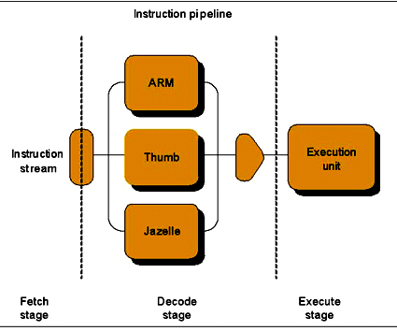
2.4.2 Jazelle (Jazelle DBX) (2)
2.4.2 Jazelle (Jazelle DBX) -2
It is ARM’s third ISA option, introduced in the ARMv5TEJ ISA (in 2001), as indicated
below.
Figure: The Jazelle ISA extension as ARM’s third ISA alternative [67]
It aims at accelerating the execution of Java bytecode.

Slide 83
2.4.2 Jazelle (Jazelle DBX) (3)
Java bytecode
It is one kind of bytecodes.
Bytecodes are compact 1-byte codes written for a stack based virtual machine
(virtual ISA).
All opcodes are one byte long followed by optional parameters.

Slide 84
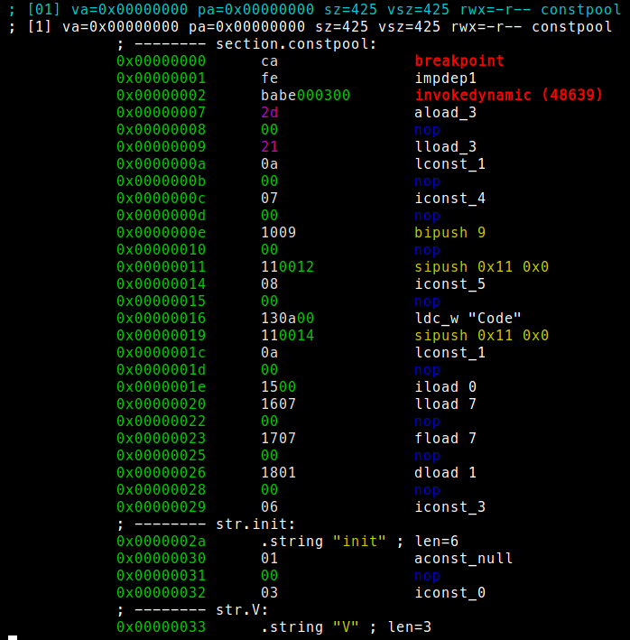
2.4.2 Jazelle (Jazelle DBX) (4)
Part of a Java
bytecode [80]

Slide 85
2.4.2 Jazelle (Jazelle DBX) (5)
The computational model assumed for bytecodes
The computational model of bytecodes presumes a stack based execution, i.e.
operands are first loaded into the stack and operations will be executed on the
operands being in the stack.

Slide 86
2.4.2 Jazelle (Jazelle DBX) (6)
Principle of generating and executing Java bytecode -1 [81]
Bytecodes are generated by compiling a source code assuming a virtual ISA
that is underlying the considered bytecode and is not bound to any real ISA,
like the ARM or x86 ISA.
So bytecodes can not be directly run on any processor, i.e. they are a kind of
pseudocode that can be executed by a virtual machine, as indicated in the
next Figure for the Java bytecode.

Slide 87
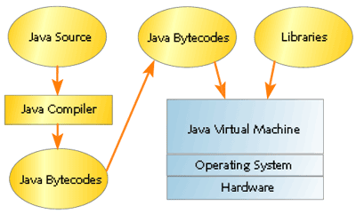
2.4.2 Jazelle (Jazelle DBX) (7)
Principle of generating and executing Java bytecode -2 [81]

Slide 88
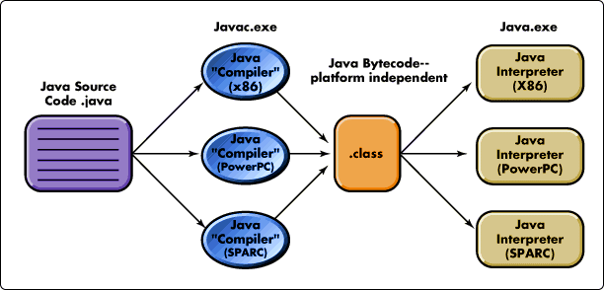
2.4.2 Jazelle (Jazelle DBX) (8)
Generating and executing Java bytecode on different platforms [82]
It is the task of the Java compiler to generate the Java bytecode from a given
source language.
The Java compiler runs under a given OS on a particular platform, as seen
in the Figure below.
Figure: Principle of generating Java bytecode [82]

Slide 89
2.4.2 Jazelle (Jazelle DBX) (9)
Principle of executing Java bytecode [83]
The most straightforward way to implement a Java Virtual Machine or virtual
machines at all is to use a software interpreter as a virtual machine.
A faster implementation can be achieved by compiling the bytecode by a JIT or
AOT compiler (as seen in the next Figure and discussed in Section 3.3.3)
on the processor itself and/or by using hardware support for the execution,
such as ARM's Jazelle DBX or a coprocessor.

Slide 90
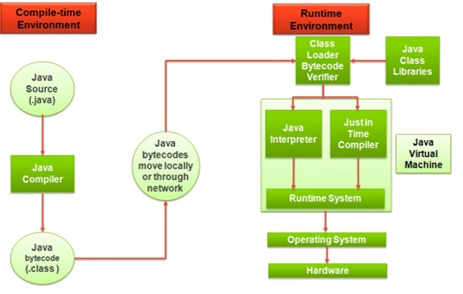
2.4.2 Jazelle (Jazelle DBX) (10)
Implementing a Java Virtual Machine by including a JIT compiler into it [83]

Slide 91
2.4.2 Jazelle (Jazelle DBX) (11)
Portability of the Java bytecode or bytecodes at all
Since bytecodes are not bound to a particular real ISA but will be executed
by a virtual machine that suits the target ISA and target OS, bytecodes are
portable.
It follows that for a given type of bytecode, e.g. Java bytecode, there are many
possible virtual machines, as the next Figure indicates.

Slide 92
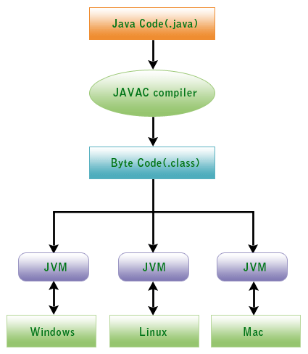
2.4.2 Jazelle (Jazelle DBX) (12)
Example: Executing Java bytecode on different platforms
The bytecode is processed by the JVM
component of the Java Runtime
Environment (JRE).
Each platform needs one or more JVMs
that suits the OS and the target ISA,
as indicated in the Figure.
It is then the task of the JVM to execute
the bytecode e.g. by interpreting each
bytecode instructions.
Figure: Different JVMs for different OSs and CPU ISA [84]

Slide 93
2.4.2 Jazelle (Jazelle DBX) (13)
Jazelle DBX support for executing Java bytecode on ARM processors
An inherent drawback of interpreting Java bytecode vs. compiled execution is
slower speed.
Jazelle DBX aims at mitigating this drawback by providing hardware support
for executing Java bytecode.
For this reason Jazelle DBX provides a third execution state, called the Jaselle
processor state, where the processor decodes Java bytecode to ARM
instructions as follows:
about 2/3 of Java bytecode will directly be mapped to ARM instructions, and
the remainder will be trapped as exceptions and emulated by multiple ARM
instructions via rougly 8 kB of microcode memory.
A special instruction (the BXJ instruction) is used to switch the processor from
the ARM state to the Jazelle state.
Jazelle DBX was introduced in the ARMv5 based ARM926 in 2001 and was used
in ARMv5 and ARMv6 processor implementations typically with very limited
memory.

Slide 94
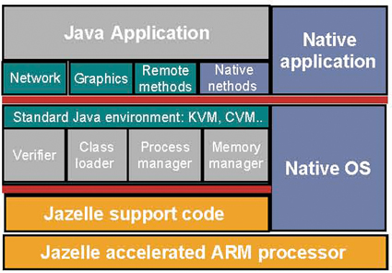
2.4.2 Jazelle (Jazelle DBX) (14)
Implementation of Jazelle DBX [67]

Slide 95
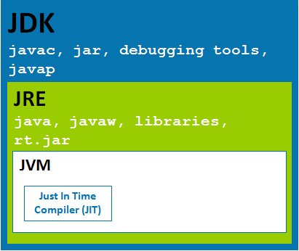
2.4.2 Jazelle (Jazelle DBX) (15)
Remark 1: The Java programming environment [85]
JDK (Java Developer Kit) contains
tools needed for developing Java
programs, such as the compiler
(javac.exe), etc.
The compiler converts Java code
into byte code.
JRE (Java Runtime Environment)
contains JVM that actually runs
the Java program, class libraries
and other supporting files.
JVM (Java Virtual Machine) runs
the program, and it uses the
class libraries, and other
supporting files provided in JRE.
To run Java programs, the fitting
JRE needs to be installed on the
system.
JVM itself is not platform independent.
When JVM has to interpret the byte codes to machine language, then it has to
interact with the OS and interpretes Java bytecode on the ARM ISA.
Figure: The Java programming environment [85]

Slide 96
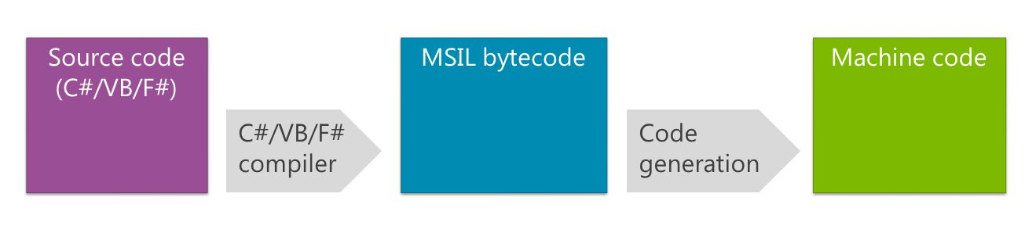
2.4.2 Jazelle (Jazelle DBX) (16)
Remark 2: Code generation in .NET
A further example for making use of the virtual machine principle is Microsoft's
MSIL bytecode (officially known as CIL (Common Intermediate language)), that is
utilized by the .NET framwork (see the Figure below).
Figure: Code generation in .NET [88]
.Net native deep dive

Slide 97
2.4.3 Jazelle RCT (Runtime Compilation Target) (1)
2.4.3 Jazelle RCT (Runtime Compilation Target) -1
It was introduced in 2005 (along with the first Cortex processor (Cortex-A8),
based on the ARMv7 Issue A,) but withdrawn in 2011 (with the ARMv7 Issue C,)
as seen below.
Trivial implementation of Jazelle¹
Does not accelerate the execution
of bytecodes,
the JVM uses software routines
to execute them.
Section 2.4.4
Jazelle
(Jazelle DBX)
+
Jazelle RCT (ThumbEE)
Jazelle RCT (ThumbEE)
Depricated,
no more support
in ARMv8 processors
Speeds up the execution
of Java bytecode
on resource-constrained
devices by partially
hardware support.
Speeds up bytecode execution
with JIT or AOT compilation.
Possible use for Java, .NET MSIL,
Python, Perl etc.
Section 2.4.2
Section 2.4.3
ARMv5TEJ
ARMv7-A
Issue A
ARMv7-A
Issue C
ARMv8
E.g.
ARM926
(2001)
Cortex-A8
(2005)
Cortex-A57/A53
(2012)
(2011)
¹A few ARMv7 processors, such as the Cortex-A5 and the Cortex-A9 support Jazelle DBX as an option.

Slide 98
2.4.3 Jazelle RCT (Runtime Compilation Target) (2)
Jazelle RCT (Runtime Compilation Target) [86] -2
Jazelle RCT is dubbed also as the ThumbEE extension, since it makes use
of the ThumEE execution environment that is based on an enhanced version
of the Thumb2 instruction set.
It aims at speeding up the execution of dynamically generated code.
This is code that is compiled e.g. from a portable bytecode e.g. Java, Perl, Python
bytecode or .Net MSIL, on the processor
either while downloading the bytecode (by an Ahead-Of-Time or AOT
compiler) or
during execution of the code (by an Just-In-Time compiler).

Slide 99
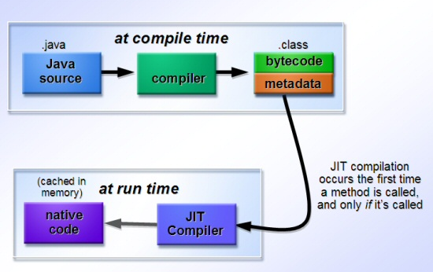
2.4.3 Jazelle RCT (Runtime Compilation Target) (3)
Example: Just-in-time (JIT) compilation in Java environment [73]
Java bytecode is loaded, compiled to native code each time a method is called, compiled code is cached in memory and will be executed by the Java Virtual Machine (JVM), as shwn below.
Extensions
Platform neutral
portable bytecode
JVM
ThumbEE ISA support
Figure: Just-in-time compilation in Java einvironment [73]

Slide 100
2.4.3 Jazelle RCT (Runtime Compilation Target) (4)
Benefits of using Jaselle RCT [67]
It provides a higher speed up in executing bytecode than Jaselle DBX but requires
more memory.
It follows that the introduction of Jazelle RCT (ThumbEE) made Jazelle DBX
more or less superfluous.
As a consequence, when ARMv7 based Cortex-A processors introduced
Jazelle RCT(ThumbEE), at the same time they typically stopped supporting
Jazelle DBX.
(In fact, the Cortex-A8/A7 or A15 processors as well as the subsequent ARMv8
based processors provided instead only a trivial (software emulated) Jazelle
implementation (see Section 2.4.4) whereas the Cortex-A5 and A9 processos
supported Jazelle DBX as an option).

Slide 101
2.4.3 Jazelle RCT (Runtime Compilation Target) (5)
Drawbacks of dynamic compilation [67]
AOT or JIT compilation causes a delay between an application's launch and its
actual run, this can prevent their use in real time application.
Further on, dynamically compiled code expands four to six times.
So, in addition to delaying the startup of an application, AOT and JIT compilation
requires extra memory for the code compiled.
As a consequence, ARM depricated the use of the Jazelle RCT (ThumbEE)
ISA extension in the ARMv7 Issue C (10/2011) and subsequent ARMv8 ISA.

Slide 102
2.4.4 Trivial implementation of Jazelle (1)
2.4.4 Trivial implementation of Jazelle -1
Trivial implementation of Jazelle¹
Does not accelerate the execution
of bytecodes,
the JVM uses software routines
to execute them.
Section 2.4.4
Jazelle
(Jazelle DBX)
+
Jazelle RCT (ThumbEE)
Jazelle RCT (ThumbEE)
Depricated,
no more support
in ARMv8 processors
Speeds up the execution
of Java bytecode
on resource-constrained
devices by partially
hardware support.
Speeds up bytecode execution
with JIT or AOT compilation.
Possible use for Java, .NET MSIL,
Python, Perl etc.
Section 2.4.2
Section 2.4.3
ARMv5TEJ
ARMv7-A
Issue A
ARMv7-A
Issue C
ARMv8
E.g.
ARM926
(2001)
Cortex-A8
(2005)
Cortex-A57/A53
(2012)
(2011)
¹A few ARMv7 processors, such as the Cortex-A5 and the Cortex-A9 support Jazelle DBX as an option.

Slide 103
2.4.4 Trivial implementation of Jazelle (2)
Trivial implementation of Jazelle -2 [87]
The introduction of Jazelle RCT in Cortex-A processors made Jazelle DBX obsolete,
but for reasons of compatibility, in subsequent processors ARM provided a
so called trivial implementation of Jazelle.
In the trivial Jazelle implementation, the processor does not accelerate
the execution of any bytecodes, JVM uses software routines to execute any
bytecode.

Slide 104
2.5 ISA extensions introduced to enhance security
(Not discussed)

Slide 105
2.5.1 ISA extensions introduced to enhance security - Overview (1)
2.5 ISA extensions introduced to enhance security
2.5.1 ISA extensions introduced to enhance security - Overview (1)
ARM’s ISA extensions
ISA extensions
to enhance
compute capabilities
ISA extensions
to reduce
code size
ISA extensions
to speed up
the execution of bytecodes
ISA extensions
to enhance
security
Section 2.2
Section 2.3
Section 2.4
Section 2.5

Slide 106
2.5.1 ISA extensions introduced to enhance security - Overview (2)
ISA extensions introduced to enhance security - Overview (2)
(Based on [64])
AArch32
AArch64
To enhance
security
Crypto-graphy ext.
TrustZone
SVE⁴
To enhance
compute
capabilities
SIMD
Adv. SIMD¹
(NEON)
Adv. SIMD and FP
SIMD
and FP
VFPv1/2
VFPv3/v4²
To speed up
the execution
of bytecodes
Jazelle
(Jazelle DBX)
Jazelle
(ex. by SW)
Jazelle RCT³
(ThumbEE)
To reduce
code size
Thumb
(ARMv4T)
Thumb-2
(ARMv6T2)
ARMv4
ARMv5
ARMv6
ARMv7-A/R
ARMv8-A
Examples
ARM710T
(~1995)
ARM926
(2001)
ARM1176
(2004)
Cortex-A5-15
(2005)
Cortex-A53/A57
(2012)
Remarks: See on the slide 2.1 Overview (5).

Slide 107
2.5.1 ISA extensions introduced to enhance security - Overview (3)
ISA extensions introduced to enhance security - Overview (3)
ISA extensios nroduced to enhance security
The TrustZone extension
The Cryptography extension
ARMv6 (2001)
ARMv8 (2012)
Section 2.5.2
Section 2.5.3

Slide 108
2.5.2 The TrustZone extension (1)
2.5.2 The TrustZone extension [68]
It provides a system-wide protection against possible attacks.
It is achieved by partitioning system wide hardware and software resources so
that they exist in one of two worlds;
in the Secure world for the security subsystem and
the Normal world for everything else.
Hardware logic of the TrustZone ensures that no Secure world resources can be
accessed from the Normal world.
The trustZone extension was introduced as part of the ARMv6 ISA.
For details see e.g. [68].

Slide 109
2.5.3 The Cryptography extension (1)
2.5.3 The Cryptography extension [69]
It adds new instructions to accelerate the execution of cryptographic algorithms,
like
Encryption/decryption according to the Advanced Encryption Standard (AES),
Secure Hash Algorithm (SHA) functions SHA-1, SHA-224, and SHA-256.
It was introduced as part of the ARMv8 ISA.
It is similar to Intel’s AES-NI ISA extension introduced along with the Westmere
basic architecture (2009).

Slide 110
3. Overview of ARM’s processor series
3.1 Introduction
3.2 Processors implementing the ARMv1 – ARMv2 ISA
3.3 Processors implementing the ARMv3 – ARMv6 ISA
3.4 Processors implementing the ARMv7 – ARMv8 ISA
Only Sections 3.1 and 3.4 will be discussed.

Slide 111
3.1 Overview of ARM’s processor series

Slide 112
3.1 Overview of ARM’s processor lines (1)
3.1 Overview of ARM's processor series
Subsequently, we give an overview of ARM’s processor series subdivided into three
sections, according their underlying ISAs, as follows.
ARM’s processor series
Processors implementing
the ARMv1 – ARMv2 ISA
Processors implementing the ARMv3 – v6 ISA
Processors implementing
the ARMv7 – ARMv8 ISA
(Earliest ARM processors)
(Early ARM processors)
(ARM’s Cortex processors)
(~ 1985-1990)
(~ 1991-2004)
(Since 2004/2012)
ARM1-ARM3
ARM6xx-ARM11xx
Cortex lines
26-bit address bus
32-bit data buses
32-bit address bus
32-bit data buses
ARMv7: 32-bit
ARMv8: 64-bit
with AArch64 and AArch32 modes

Slide 113
3.2 Processors implementing the ARM v1 - ARM v2 ISA

Slide 114
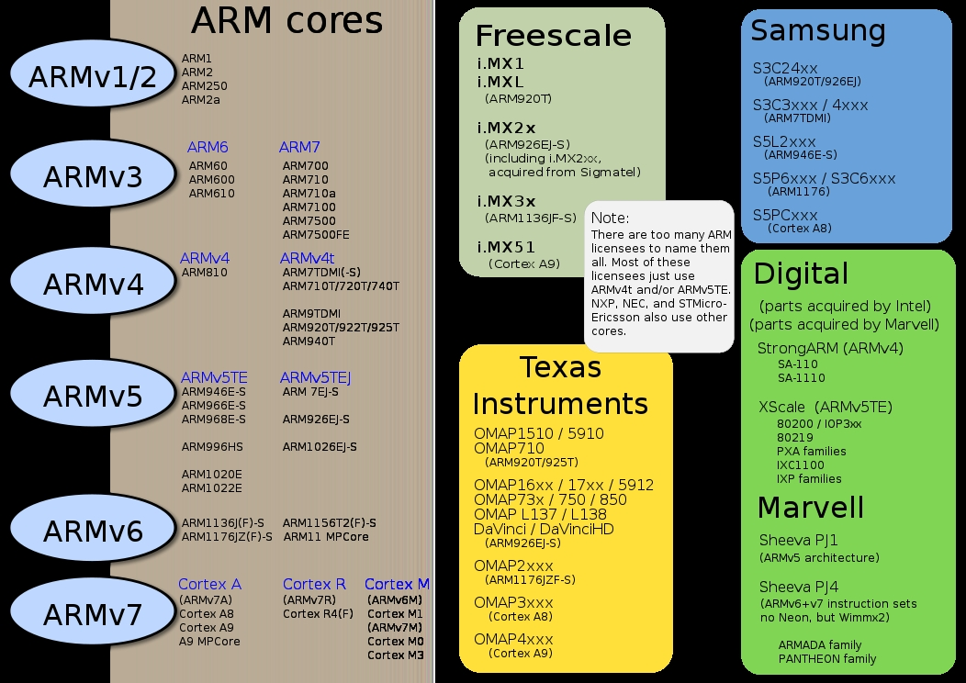
3.2 Processors implementing the ARM v1 - ARM v2 ISA (1)
3.2 Processors implementing the ARMv1 – ARMv2 ISA -1 [5]

Slide 115
3.2 Processors implementing the ARM v1 - ARM v2 ISA (2)
Remarks
As already discussed in Section 2.1
processors based on the ARM ISA versions ARMv1 and ARMv2 (like ARM1,
ARM2 or ARM3) implement only a 26-bit address bus and a 32-bit data bus.
They are called 26-bit architectures.
By contrast, processors based on the ARMv3 or higher ISA version support
already a 32-bit address space and are known as 32-bit architectures
up to the ARMv7 ISA.
In the ARMv8 ISA the AArch64 mode supports already 64-bit addressing.

Slide 116
3.3 Processors implementing the ARM v3 - ARM v6 ISA

Slide 117
3.3 Processors implementing the ARM v3 - ARM v6 ISA (1)
3.3 Processors implementing the ARMv3 – ARMv6 ISA [5]

Slide 118
3.3 Processors implementing the ARM v3 - ARM v6 ISA (2)
Main extensions introduced in the ARMv4 – ARM v6 ISA versions (simplified)
AArch32
AArch64
To enhance
security
Crypto-graphy ext.
TrustZone
SVE⁴
To enhance
compute
capabilities
SIMD
Adv. SIMD¹
(NEON)
VFPv1/2
VFPv3/v4²
To speed up
the execution
of bytecodes
Jazelle
(Jazelle DBX)
Jazelle
(ex. by SW)
Jazelle RCT³
(ThumbEE)
To reduce
code size
Thumb
(ARMv4T)
Thumb-2
(ARMv6T2)
ARMv4
ARMv5
ARMv6
ARMv7-A/R
ARMv8-A
Examples
ARM710T
(~1995)
ARM926
(2001)
ARM1176
(2004)
Cortex-A5-15
(2005)
Cortex-A53/A57
(2012)
Remarks: See on the slide 2.1 Overview (5).

Slide 119
3.3 Processors implementing the ARM v3 - ARM v6 ISA (3)
Overview of ARM’s processors implementing the ARMv4 – ARMv6 ISA [5]
ARM1156T2F-S
ARM1136JF-S™
ARM1136JF-S™
version
ARMv6
ARM1176JZF-S
ARM102xE
ARM1026EJ-S
XScale
ARMv5
ARM9x6E
ARM926EJ-S
ARM7TDMI-S
StrongARM
ARM92xT
SC200
ARMV4
SC100
ARM720T
1994
1996
1998
2000
2002
2006
time
2004
XScale is a trademark of Intel Corporation
Notes:
Versions mostly refer to the instruction set that the ARM core executes.
The ARM7, which is still the most often used core in a low-power design, executes the version 4T instruction set. Architectural extensions were added for version 5TE to include DSP instructions, such as 16-bit signed MLA instructions, saturation arithmetic, etc. The ARM926EJ-S and ARM1026EJ-S cores are examples of Version 5 architectures. Version 6 added instructions for doing byte manipulations and graphics algorithms more efficiently. The ARM11 family implemented the Version 6 architecture. Version 7 architectures (which include the Cortex family of cores, such as the Cortex A8, Cortex M3 and Cortex R4) extended the functionality by adding things such as Thumb2, low-power features, and more security.

Slide 120
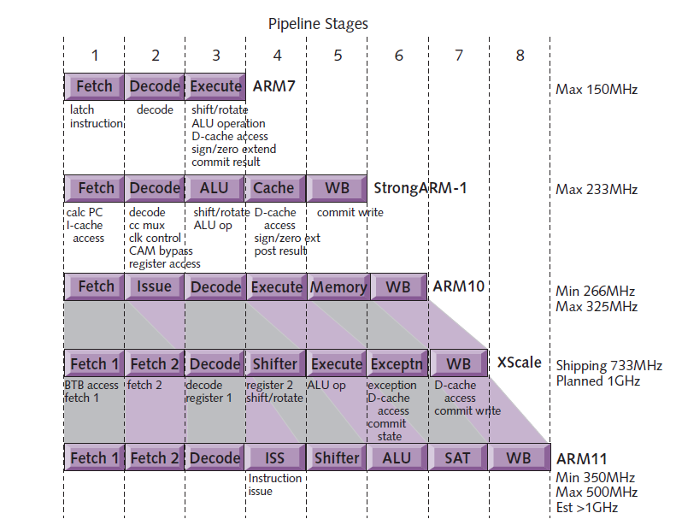
3.3 Processors implementing the ARM v3 - ARM v6 ISA (4)
Evolution of the pipeline length of ARM v4 – ARM v6 based processors [8]
ARMv4
ARMv4
ARMv5
ARMv5
ARMv6

Slide 121
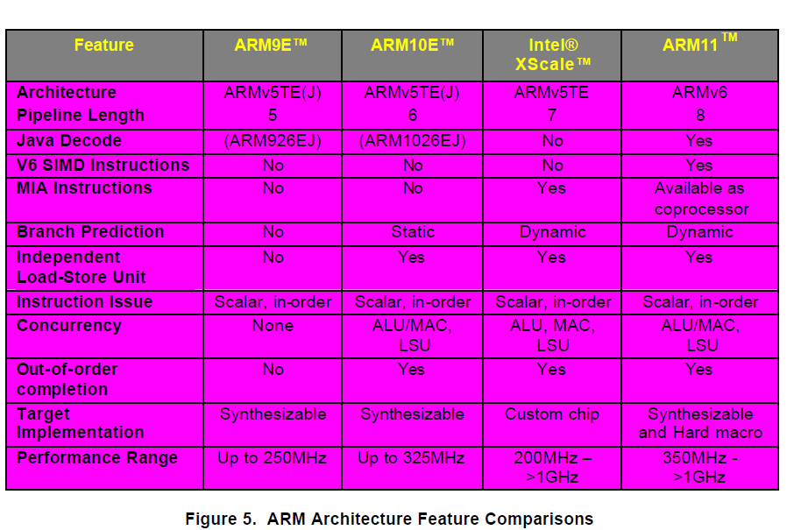
3.3 Processors implementing the ARM v3 - ARM v6 ISA (5)
Main features of the ARMv5 – ARMv6 processors (≈1999-2003) [57]

Slide 122
3.3 Processors implementing the ARM v3 - ARM v6 ISA (6)
Introduction of muticore processors by ARM: the ARM11 MPCore
07/2003: First public disclosure of the ARM11 MPCore.
05/2004: ARM11 MPCore (multi core ARM11 with 1-4 cores) available for licensing
with an evaluation system for early software development.
It is basically an up to four way (4-socket) cache coherent symmetric multicore
processor
The ARM11 MPCore incorporates:
IEM (Intelligent Energy Manager)
It dynamically predicts the required performance and lowers the voltage and
the frequency accordingly.

Slide 123
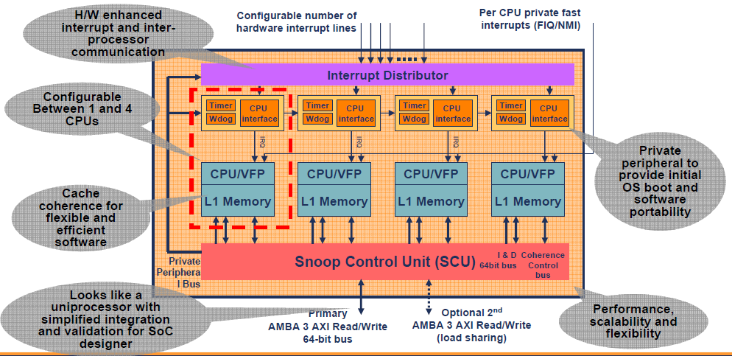
3.3 Processors implementing the ARM v3 - ARM v6 ISA (7)
Block diagram of the ARM11 MPCore [9]
Note that the ARM11 MPCore does not include an L2.

Slide 124
3.3 Processors implementing the ARM v3 - ARM v6 ISA (8)
Remark: Emergence of dual core processors
Year of launching | Dual core design
10/2001 | IBM launches dual core POWER4
11/2002 | IBM launches dual core POWER4+
03/2004 | Sun releases the UltraSPARC IV (Jaguar) dual core processor
05/2004 | ARM announces the availability of the synthetisable ARM11 MPCore quad core processor
05/2004 | IBM launches dual core POWER5
08/2004 | AMD demonstrates first x86 dual core (Opteron) processor
04/2005 | ARM demonstrates the ARM11 MPCore quad core test chip in cooperation with NEC
04/2005 | Intel launches dual core Pentium processors (Pentium D)
04/2005 | AMD launches dual core Opteron server processors
06/2006 | Intel launches their Core 2 line of multicore processors
10/2007 | ARM launches their first multicore Cortex model (the quad core Cortex A9 MPcore)

Slide 125
3.4 Processors implementing the ARM v7 - ARM v8 ISA

Slide 126
3.4 Processors implementing the ARM v7 - ARM v8 ISA (1)
3.4 Processors implementing the ARM v7 - ARM v8 ISA
10/2004 ARM announced the Cortex family and introduced its first member the
Cortex-M3, without announcing the ARMv7 ISA.

Slide 127
3.4 Processors implementing the ARM v7 - ARM v8 ISA (2)
Profiles of ARM’s Cortex family [6], [7]
In 3/2005 ARM revealed technical specifications for the ARMv7 ISA and introduced
three family profiles to optimize processors of their Cortex family for specific
market segments:
The Cortex-A profile
It aims at application processors for complex OS and user applications, like
processors in smartphones, tablets, netbooks, eBook readers etc.
The Cortex-R profile
It marks embedded processors for real time applications, like mass storage or printer
controllers.
The Cortex-M profile
Processors of the M profile are optimized for deeply embedded processors aimed at
microcontroller and cost sensitive applications, like automotive body electronics,
or smart sensors.

Slide 128
3.4 Processors implementing the ARM v7 - ARM v8 ISA (3)
Extending the ARM Cortex family with the SecurCore profile in 10/2007
In 10/2007 ARM introduced the SecurCore profile.
It is optimized for smart card and secure applications.

Slide 129
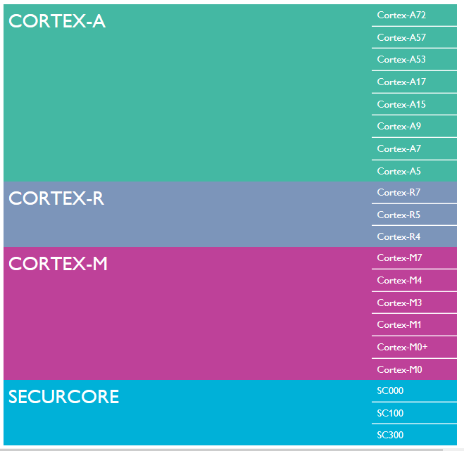
3.4 Processors implementing the ARM v7 - ARM v8 ISA (4)
Recent ARM profiles
and processors [6]

Slide 130
3.4 Processors implementing the ARM v7 - ARM v8 ISA (5)
Introducing the 64-bit ARM v8 ISA and related processors
In 2012 ARM expanded their Cortex family by processors implementing the 64-bit
ARMv8 ISA, as indicate below.
Recent ARM processors
(The Cortex family)
ARM processors implementing the ARMv7 ISA
ARM processors implementing the
ARMv8 ISA
32-bit architectures
(Announced in 2005)
64-bit architectures
(Announced in 2012)

Slide 131
4. Overview of ARM’s Cortex-A series

Slide 132
4. Overview of ARM’s Cortex-A series (1)
4. Overview of ARM’s Cortex-A series
According to the general scope of this Lecture Notes, subsequently we will be
concerned only with the Cortex-A series.
Key features of ARM’s Cortex-A series
Multiprocessor capability
of the Cortex-A series
Performance classes
of the Cortex-A series
Word length
of the Cortex-A series
Inclusion of an
L2 cache

Slide 133
4. Overview of ARM’s Cortex-A series (2)
a) Multiprocessor capability of the Cortex-A series
Multiprocessor capability of the Cortex-A series
Single processor designs,
no multiprocessor
capability
Dual designs with two options
A-priory
multiprocessor designs
a single processor option and
a multiprocessor capable option
Cortex-A8 (2005)
Cortex-A9/Cortex-A9 MPCore (2007)
(Cortex-A12/Cortex-A12 MPCore (2013))¹
Cortex-A15/Cortex-A15 MPCore (2010)
Cortex-A17/Cortex-A17 MPCore (2014)
Cortex-A7 MPCore (2011)
Cortex-A35 MPCore (2015)
Cortex-A53 MPCore (2012)
Cortex-A57 MPCore (2012)
Cortex-A72 MPCore (2015)
Cortex-A73 MPCore (2016)
Here we note that in figures or tables we often omit the MPCore tag for the sake
of brevity.
¹The model Cortex-A12 was introduced in 6/2013 but became withdrawn
in 10/2014 since its parameters were too close to that of the Cortex-A17, so
subsequently we will leave it out in most parts from our discussion.

Slide 134
4. Overview of ARM’s Cortex-A series (3)
Remarks on the interpretation of the term MPCore by ARM
ARM introduced the term MPCore in connection with the announcement of the
ARM11 MPCore in 2004 despite the fact that the ARM11 MPCore was actually
a multicore processor including up to 4 cores.
Along with the ARM Cortex-A9 MPCore (2007) ARM re-interpreted this term.
The ARM Cortex-A9 introduced 1-4 cores and it had two alternatives
ARM Cortex-A9 it does not support multiprocessor configurations and
ARM Cortex-A9 MPCore it supports multiprocessor configurations.
Since then MPCore indicates the multiprocessor capability of the processor.

Slide 135
4. Overview of ARM’s Cortex-A series (4)
b) Performance classes of the Cortex-A series -1 [12]
Performance classes of the Cortex-A models
High-performance models
Mainstream models
Low-power models
Cortex-A15
Cortex-A57
Cortex-A72
Cortex-A73
Cortex-A8
Cortex-A9
(Cortex-A12)¹
Cortex-A17
Cortex-A5
Cortex-A7
Cortex-A35
Cortex-A53
¹The model Cortex-A-12 was introduced in 6/2013 but became withdrawn
in 10/2014 since its parameters were too close to that of the Cortex-A17, so
subsequently we will leave it out in most parts from our discussion.

Slide 136
4. Overview of ARM’s Cortex-A series (5)
Performance classes of the Cortex-A series -2 (based on [12])
8
DMIPS/MHz
5/2016
Cortex-A73
ARMv8
10 nm
7
2/2015
Cortex-A72
ARMv8
16 nm
Announced
6
10/2012
Cortex-A57
ARMv8
20/16 nm
5
9/2010
Cortex-A15
ARMv7
32/28 nm
2/2014
Cortex-A17
ARMv7
28 nm
4
6/2013
Cortex-A12
ARMv7
28 nm
High Performance
3
Mainstream
10/2007
Cortex-A9
ARMv7
40 nm
11/2015
Cortex-A35
ARMv8
16/14 nm
2
10/2012
Cortex-A53
ARMv8
20/16 nm
10/2005
Cortex-A8
ARMv7
65 nm
10/2011
Cortex-A7
ARMv7
28 nm
10/2009
Cortex-A5
ARMv7
40 nm
1
Low power
2006
2007
2008
2009
2010
2011
2012
2013
2014
2015
2016

Slide 137
4. Overview of ARM’s Cortex-A series (5a)
Three design teams working in parallel []
8
DMIPS/MHz
Austin (Texas) designs
5/2016
Cortex-A73
ARMv8
10 nm
7
Sophia-Antipolis (France) designs
Announced
Cambridge (UK) designs
2/2015
Cortex-A72
ARMv8
16 nm
6
10/2012
Cortex-A57
ARMv8
20/16 nm
5
9/2010
Cortex-A15
ARMv7
32/28 nm
2/2014
Cortex-A17
ARMv7
28 nm
4
6/2013
Cortex-A12
ARMv7
28 nm
High Performance
3
Mainstream
10/2007
Cortex-A9
ARMv7
40 nm
11/2015
Cortex-A35
ARMv8
16/14 nm
2
10/2012
Cortex-A53
ARMv8
20/16 nm
10/2005
Cortex-A8
ARMv7
65 nm
10/2011
Cortex-A7
ARMv7
28 nm
10/2009
Cortex-A5
ARMv7
40 nm
1
Low power
2006
2007
2008
2009
2010
2011
2012
2013
2014
2015
2016
http://www.anandtech.com/show/10347/arm-cortex-a73-artemis-unveiled

Slide 138
4. Overview of ARM’s Cortex-A series (5b)
Remarks on the designs of the Cortex-A series (taken from []) -3
"...The A15, A57, A72 all belong to the Austin family of microarchitectures, and as one would have guessed from the name, this is because they originated from ARM's Austin CPU design centre.
The A5, A7 and A53 belong to the Cambridge family while the Cortex A12, A17 and today's new A73 belong to the Sophia family, owning its name to the small city of Sophia-Antipolis which houses one of Europe's largest technology parks as well as ARM's French CPU design centre. Refering to their design location is however not enough to disambiguate microprocessor families, as we'll see completely new designs come out from each R&D center. In fact, this has already happened as the A12/17/73 can be seen as a new generation over the preceding the A9 microarchitecture and as such can be referred to as a "second generation Sophia family". This is an important notion to consider as in the future we'll be seeing completely new microarchitectures come out of ARM's various design teams."
"The Cortex A73 being still in the same Sophia family effectively means the design is very much a 64-bit successor to the Cortex A17. The new core effectively inherits some of the main characteristics of its predecessor such as overall µarch philosophy as well as higher-level pipeline elements and machine width. And herein lies the biggest surprise of the Cortex A73 as a A72 successor: Instead of choosing to maintain A72’s 3-wide, or increase the microarchitecture’s decoder width, ARM opted to instead go back to a 2-wide decoder such as found on the current Sophia family. Yet the A73 positions itself a higher-performance and lower-power design compared to the larger A72."
http://www.anandtech.com/show/10347/arm-cortex-a73-artemis-unveiled

Slide 139
4. Overview of ARM’s Cortex-A series (6)
Announcement dates and efficiency (DMIPS/MHz) of the Cortex-A models
Announced | Cortex-A model |  | DMIPS/MHz
10/2005 | Cortex-A8 |  | 2.0
10/2007 | Cortex-A9/A9 MPCore |  | 2.5
10/2009 | Cortex-A5/A5 MPCore |  | 1.6
9/2010 | Cortex-A15/A15 MPCore |  | 3.5-4.0
10/2011 | Cortex-A7 MP Core |  | 1.7
6/2013 | (Cortex-A12/A12 MPCore) |  | 3.0
2/2014 | Cortex-A17/A17 MPCore |  | 3.1-3.3
11/2015 | Cortex-A35 MPCore |  | ~ 2.1
10/2012 | Cortex-A53 MPCore |  | 2.3
10/2012 | Cortex-A57 MPCore |  | 4.1-4.7
2/2015 | Cortex-A72 MPCore |  | 6.3-7.35
5/2016 | Cortex-A73 MPCore |  | 7.4-8.5
Source: ARM
DMIPS: Dhrystone MIPS (A synthetic benchmark that indicates integer performance)

Slide 140
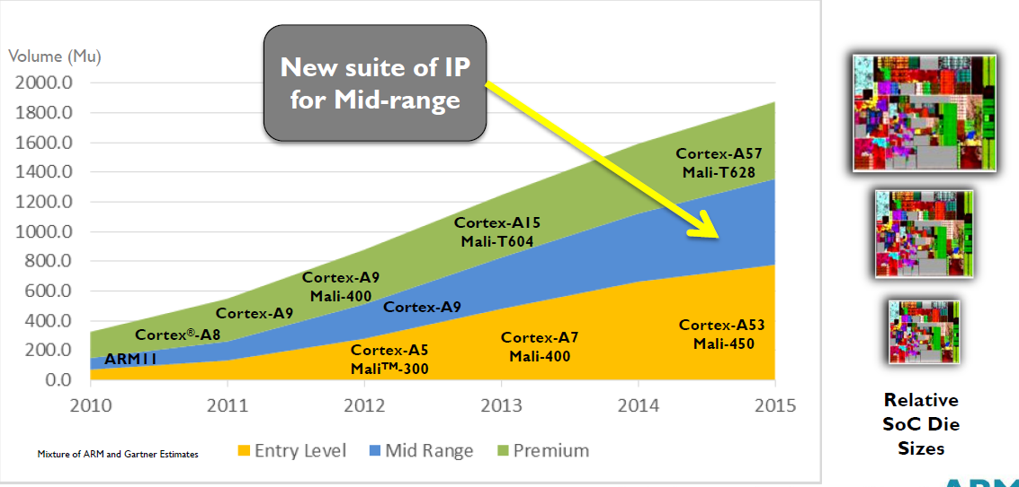
4. Overview of ARM’s Cortex-A series (7)
Yearly shipment of ARM Cortex-A chips in different performance classes
(data from 2013) [13]

Slide 141
4. Overview of ARM’s Cortex-A series (8)
c) Word length of the Cortex-A series
Word length of the Cortex-A series
ARM’s 32-bit Cortex-A models
ARM’s 64-bit Cortex-A models
Cortex-A5 to A17
Cortex-A53/A57/A72/A73
Cortex-A35

Slide 142
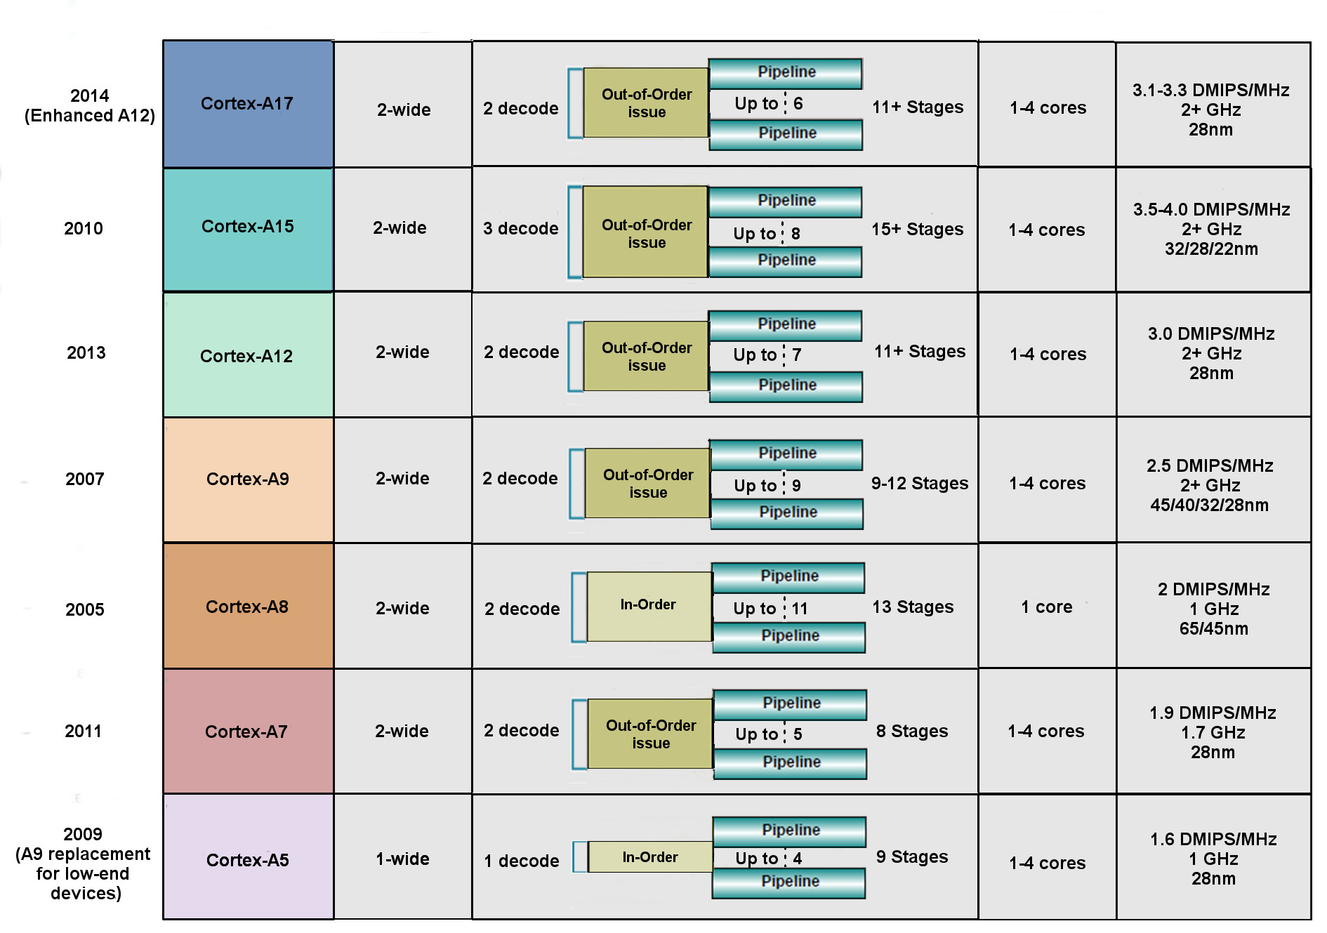
4. Overview of ARM’s Cortex-A series (9)
Key features of ARM’s 32-bit microarchitectures (based on [14])

Slide 143
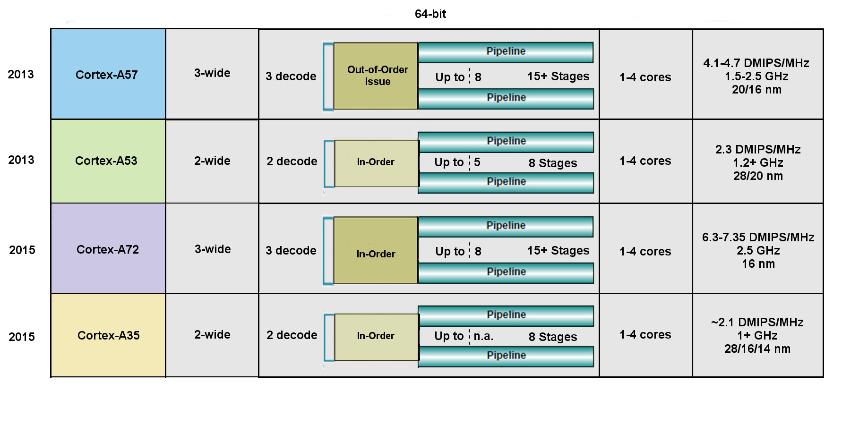
4. Overview of ARM’s Cortex-A series (10)
Key features of ARM’s 64-bit microarchitectures (based on [14])
Remark: In the Cortex-A9 the NEON FP operates in order.

Slide 144
4. Overview of ARM’s Cortex-A series (10)
Key features of ARM’s 64-bit microarchitectures (based on [14])
Remark: In the Cortex-A9 the NEON FP operates in order.

Slide 145
4. Overview of ARM’s Cortex-A series (11)
d) Inclusion of an L2 cache
Inclusion of an L2 cache
No L2 cache
Optional L2 cache
Mandatory L2 cache
Cortex-A5 (10/2009)
Cortex-A8 (10/2005)
Cortex-A9 (10/2007)
Cortex-A7 (10/2011)
Cortex-A15 (9/2010)
Cortex-A17 (2/2014)
All 64-bit models

Slide 146
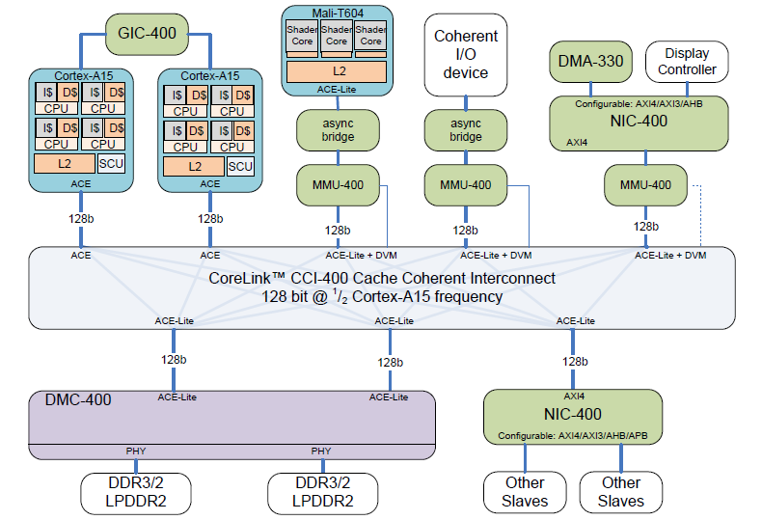
4. Overview of ARM’s Cortex-A series (12)
Example: Dual-core A15-based high performance cache coherent system [15]
Network
Interconnect
Network
Interconnect
Dynamic Memory Controller

Slide 147
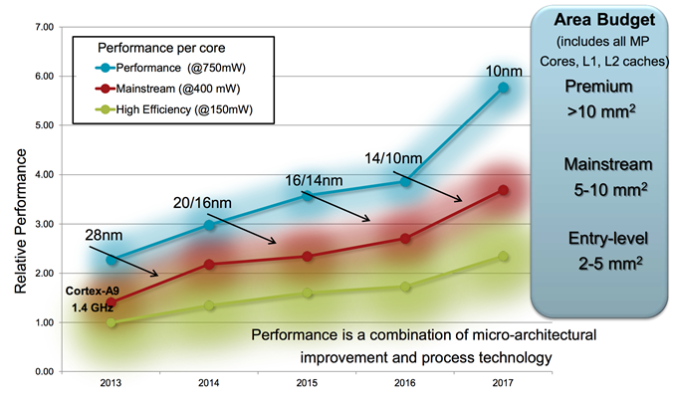
4. Overview of ARM’s Cortex-A series (13)
Relative per core performance of Cortex-A processors with different
power budget [16]

Slide 148
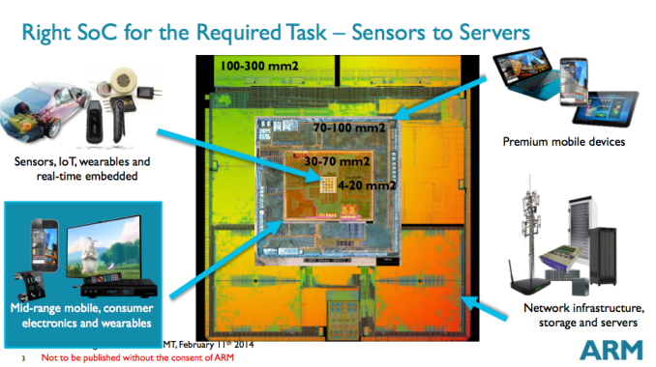
4. Overview of ARM’s Cortex-A series (14)
Die are requirement of different applications [17]

Slide 149
4. Overview of ARM’s Cortex-A series (15)
Use of 32-bit ARM Cortex-A models in mobiles [18]
 | (SOC) System- On-a-Chip | Notable Product(s) Containing | ARM Cortex-A model | No. of Cores
Apple | A4 | iPhone 4, iPod Touch (4th Gen), iPad (1st Gen), AppleTV (2nd Gen) | Cortex-A8 | 1
 | A5 | iPhone 4S, iPad 2, AppleTV (3rd Gen) | Cortex-A9 | 2
 | A5X | iPad (3rd Gen, Retina Display) | Cortex-A9 | 2
Samsung | Exynos 3 Single | Samsung Galaxy S, Samsung Galaxy Nexus S, | Cortex-A8 | 1
 | Exynos 4 Dual | Samsung Galaxy SII, Samsung Galaxy Note (International) | Cortex-A9 | 2
 | Exynos 4 Quad | Samsung Galaxy SIII | Cortex-A9 | 4
 | Exynos 5 Dual | Chrombook | Cortex-A15 | 2
Nvidia | Tegra | Microsoft Zune HD | (ARM11) | 1
 | Tegra 2 | ASUS Eee Pad Transformer, Samsung Galaxy Tab 10.1, Motorola Xoom, Dell Streak 7 & Pro, Sony Tablet S | Cortex-A9 | 2
 | Tegra 3 | ASUS Transformer Pad 300, ASUS Nexus 7, Acer Iconia Tab A510 & A700, HTC One X | Cortex-A9 | 4
Qualcomm | Snapdragon S1 | Large number of devices | (ARM11)/A5 | 1
Texas Instruments | OMAP 3 | Barnes and Noble Nook Color | Cortex-A8 | 1
 | OMAP 4 | Amazon Kindle Fire, Samsung Galaxy Tab 2, Blackberry Playbook, Samsung Galaxy Nexus, Barnes and Noble Nook Tablet | Cortex-A9 | 2
 | OMAP 5 | N/A | Cortex-A15 | 2

Slide 150
4. Overview of ARM’s Cortex-A series (16)
Total number of ARM chips shipped [19]
SBSA: Server Base System Architecture, it is a standardized platform for servers built on 64-bit
ARM processors

Slide 151
4. Overview of ARM’s Cortex-A series (17)
Remarks on the evolution of the Cortex-A series (taken from []) -1
There is a brief but essential description of ARM's Cortex series in []. Due to its
relevance in the following we will cite parts of it.
"The Cortex A9 was an incredibly important design for ARM as, in my view, it provided the corner-stone for SoC and device vendors to create some of the designs that powered some of the most successful devices that brought with them a turning-point in smartphone performance and experience. Apple’s A5, Samsung’s Exynos 4210/4412, and TI OMAP4430/4460 were all SoCs which made the A9 a very successful CPU micro-architecture.
Following the Cortex A9 we saw the introduction of the Cortex A15. The core was a substantial jump in terms of performance as it provided the single largest IPC improvement in ARM’s Cortex A-profile of application processors. While the A15 represented a large performance boost, it came at significant cost in terms of power efficiency and overall power usage. It took some time for the Cortex A15 to establish itself in the mobile space as the first designs such as the Exynos 5250 and 5410 failed to impress due to bad power efficiency due to various issues.
It’s at this point where ARM introduced big.LITTLE with the argument that one can have the best of both worlds, a high-power performant core together with a low-power high-efficiency core. It was not until late 2014 and 2015 did we finally see some acceptable implementations of A15 big.LITTLE solutions such as the Kirin 920 or Exynos 5422."

Slide 152
4. Overview of ARM’s Cortex-A series (18)
Remarks on the evolution of the Cortex-A series (taken from []) -2
"The Cortex A57 succeeded the Cortex A15 and was ARM’s first “big” core to employ ARMv8 64-bit ISA. Accompanied by the high-efficiency Cortex A53 cores this represented an important shift not unlike the x86-64 introduction in the desktop PC space well over a decade before. The cores came at a moment where the industry was still at shock of Apple’s introduction of the A7 SoC and Cyclone CPU micro-architecture, beating ARM in terms delivering the first 64-bit ARMv8 silicon. Suddenly everybody in the industry was playing catch-up in trying to bring their own 64-bit products as it was seen as an absolutely required feature-check to remain competitive.
This pressured shift to 64-bit was in my view a crippling blow to many 2015’s SoCs as it forced vendors into employing sub-optimal Cortex A57 and A53 designs. HiSilicon and MediaTek saw an actual regression in performance as flagship SoCs such as the Kirin 930 and Helio X10 had to make due with only A53 cores for performance as they decided against employing A57 cores due to power consumption concerns. The Kirin 930 or the X10 were in effect slower chipsets than their predecessors. Only Samsung was fairly successful in releasing reasonable designs such as the Exynos 5433 and Exynos 7420 – yet these had respectively regressed or barely improved in terms of power efficiency when compared to mature Cortex A15 implementations such as the Exynos 5430. Then of course we had sort of a lost generation of devices due to Qualcomm’s unsuccessful Snapdragon 810 and 808 SoCs, a topic we’ll eventually revisit in our deep dive of the Snapdragon 820 and Exynos 8890."
http://www.anandtech.com/show/10347/arm-cortex-a73-artemis-unveiled

Slide 153
4. Overview of ARM’s Cortex-A series (19)
Remarks on the evolution of the Cortex-A series (taken from []) -3
"Some readers will notice I left out the Cortex A12 and A17 – and I did that on purpose in trying to get to my point. The Cortex A12 was unveiled in July 2013 and presented as a successor to the Cortex A9. The core had a relatively short lifetime as it was quickly replaced within 6 months with the Cortex A17 in February 2014 which improved performance and also made the core big.LITTLE compatible with the Cortex A7. The Cortex A17 saw limited adoption in the mobile space. In fact, among the few SoCs such as Rockchip’s RK3288 and some little known chips such as HiSilicon’s Hi3536 multimedia SoC, it was only MediaTek’s MT6595 that saw moderate success in design wins such as Meizu’s MX4.
...
http://www.anandtech.com/show/10347/arm-cortex-a73-artemis-unveiled

Slide 154
5. Overview of ARM’s Mali graphics series
Will not be discussed.

Slide 155
5. Overview or ARM’s Mali graphics series (1)
5. Overview of ARM’s Mali graphics series (since 2010)
ARM also designs and licenses GPUs to be used as companion chips to their CPU
chips.
ARM’s GPU lines are designated as Mali graphics series.
ARM Mali graphics series (since 2010)
Performance oriented
graphics series
Cost efficient
graphics series

Slide 156
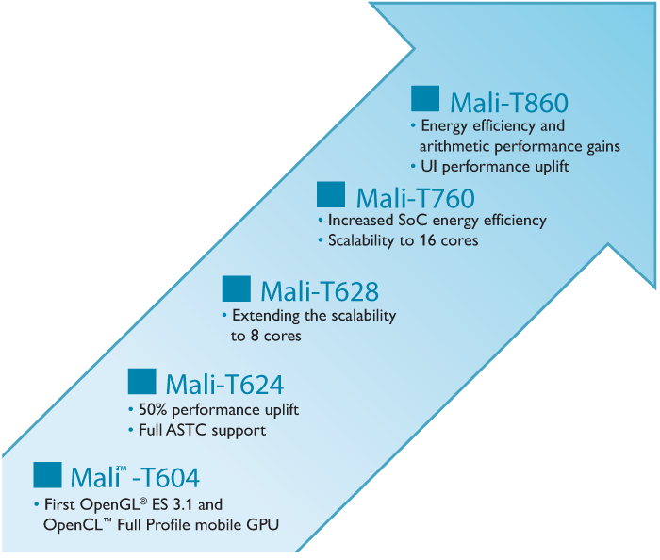
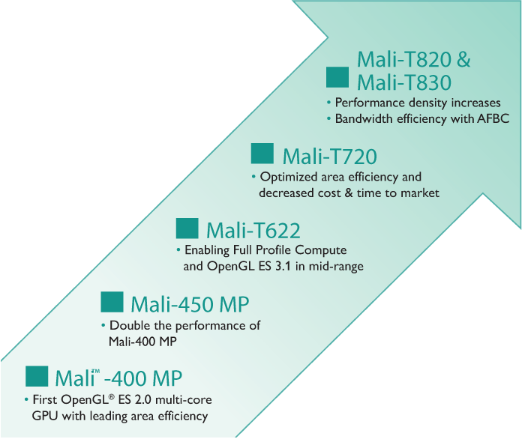
5. Overview of ARM’s Mali graphics lines (2)
Overview of ARM’s Mali graphics seeries
Only GPU parts announced since about 2010 will be discussed [20]
Performance oriented
graphics series
Mali-T6xx - Mali-T8xx
Cost efficient
graphics series
Mali-T4xx - Mali-T8xx

Slide 157
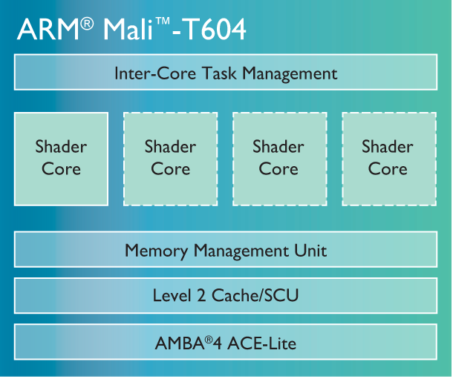

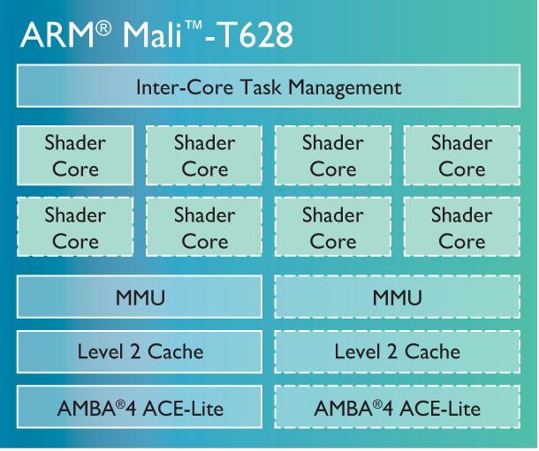
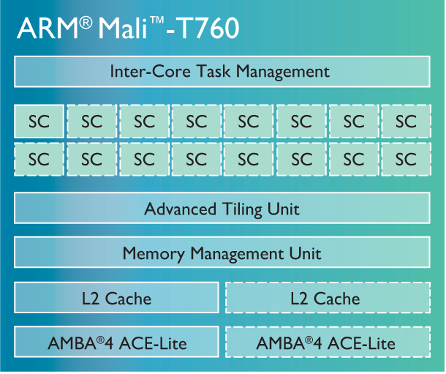
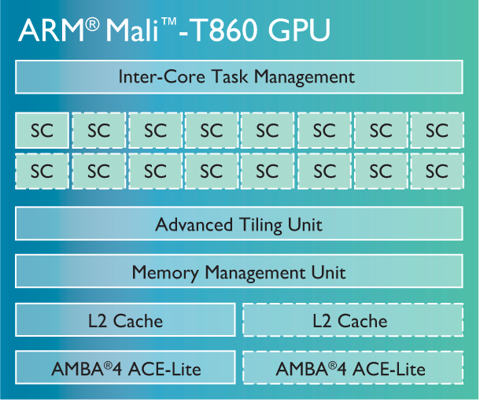
5. Overview of ARM’s Mali graphics lines (3)
ARM’s performance oriented Mali graphics series [20]

Slide 158
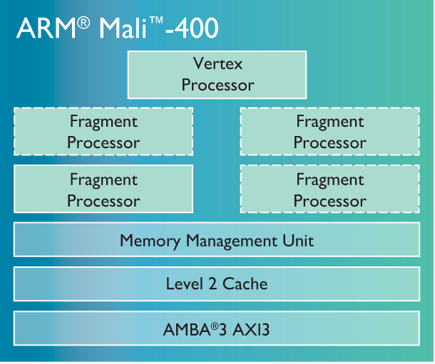
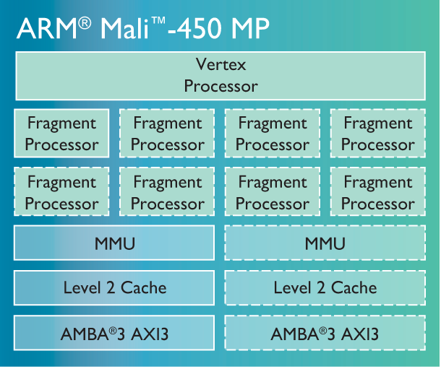
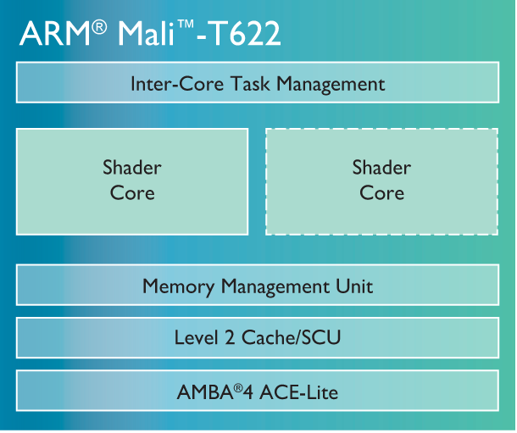

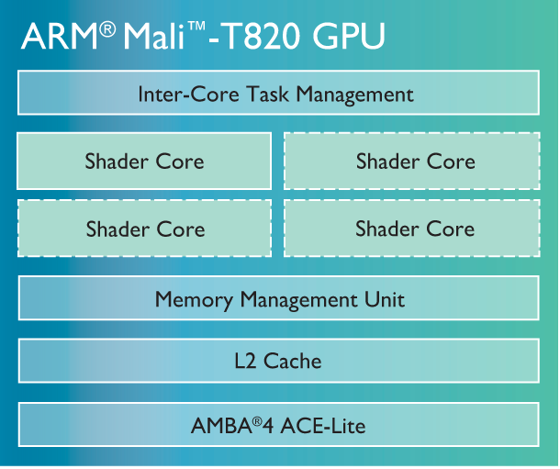

5. Overview of ARM’s Mali graphics lines (4)
ARM’s cost efficient Mali graphics series [20]

Slide 159
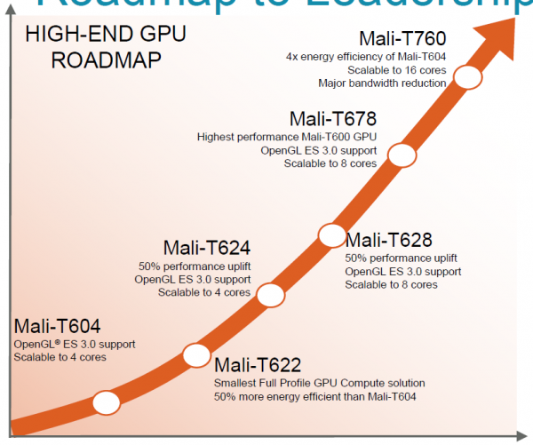
5. Overview of ARM’s Mali graphics lines (5)
ARM’s high-end GPU roadmap [51]
Companion GPU to A57 (announced 10/2013)

Slide 160
6. The 64-bit Cortex-A series
6.1 Overview of ARM’s 64-bit Cortex-A series
6.2 Example Cortex-A series processors
Notes:
160

Slide 161
6.1 Overview of ARM’s 64-bit Cortex-A series

Slide 162
6.1 Overview of ARM’s 64-bit Cortex-A series (1)
6.1 Overview of ARM’s 64-bit Cortex-A series -1 (Based on [64])
10/2011 ARM disclosed the 64-bit ARMv8 architecture
with enhancements as indicated in the Figure below
and discussed in Section 2.
AArch32
AArch64
To enhance
security
Crypto-graphy ext.
TrustZone
SVE⁴
To enhance
compute
capabilities
SIMD
Adv. SIMD¹
(NEON)
VFPv1/2
VFPv3/v4²
To speed up
the execution
of bytecodes
Jazelle
(Jazelle DBX)
Jazelle
(ex. by SW)
Jazelle RCT³
(ThumbEE)
To reduce
code size
Thumb
(ARMv4T)
Thumb-2
(ARMv6T2)
ARMv4
ARMv5
ARMv6
ARMv7-A/R
ARMv8-A
Examples
ARM710T
(~1995)
ARM926
(2001)
ARM1176
(2004)
Cortex-A5-15
(2005)
Cortex-A53/A57
(2012)
Remarks: See on the slide 2.1 Overview (5).

Slide 163
6.1 Overview of ARM’s 64-bit Cortex-A series (2)
Overview of ARM’s 64-bit Cortex-A series -2
10/2012: ARM announced the 64-bit high performance Cortex-A-57 and the
low power Cortex-A-53 processors, as first implementations of the ARMv8
architecture, with immediate availability.
02/2015 ARM extended their 64-bit Cortex-A series by the high performance
Cortex-A72 model, and in 11/2015 by the low power Cortex-A35, as shown
below.
05/2016 ARM extended the 64-bit Cortex-A series by the high performance
Cortex-A73 model.
ARM’s 64-bit Cortex A series
High performance
64-bit Cortex-A models
Mainstream
64-bit Cortex-A models
Low power
64-bit Cortex-A models
Cortex-A57 (2012)
Cortex-A72 (2015)
Cortex-A73 (2016)
No announcement yet
Cortex-A53 (2012)
Cortex-A35 (2015)
Section 6.2.2
Section 6.2.1

Slide 164
6.1 Overview of ARM’s 64-bit Cortex-A series (3)
Overview or ARM’s 64-bit Cortex-A series -3 (based on [12])
8
DMIPS/MHz
5/2016
Cortex-A73
ARMv8
10 nm
7
2/2015
Cortex-A72
ARMv8
16 nm
Announced
6
10/2012
Cortex-A57
ARMv8
20/16 nm
5
9/2010
Cortex-A15
ARMv7
32/28 nm
2/2014
Cortex-A17
ARMv7
28 nm
4
6/2013
Cortex-A12
ARMv7
28 nm
High Performance
3
Mainstream
10/2007
Cortex-A9
ARMv7
40 nm
11/2015
Cortex-A35
ARMv8
16/14 nm
2
10/2012
Cortex-A53
ARMv8
20/16 nm
10/2005
Cortex-A8
ARMv7
65 nm
10/2011
Cortex-A7
ARMv7
28 nm
10/2009
Cortex-A5
ARMv7
40 nm
1
Low power
2006
2007
2008
2009
2010
2011
2012
2013
2014
2015
2016

Slide 165
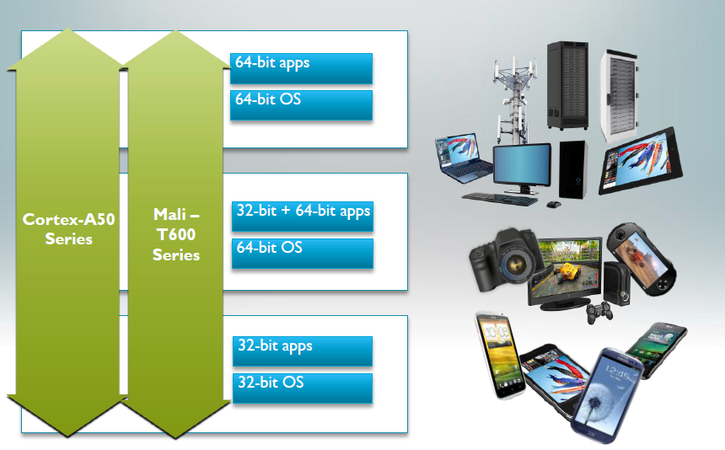
6.1 Overview of ARM’s 64-bit Cortex-A series (4)
The 64-bit Cortex-A series as the basis for scalable applications [48]

Slide 166
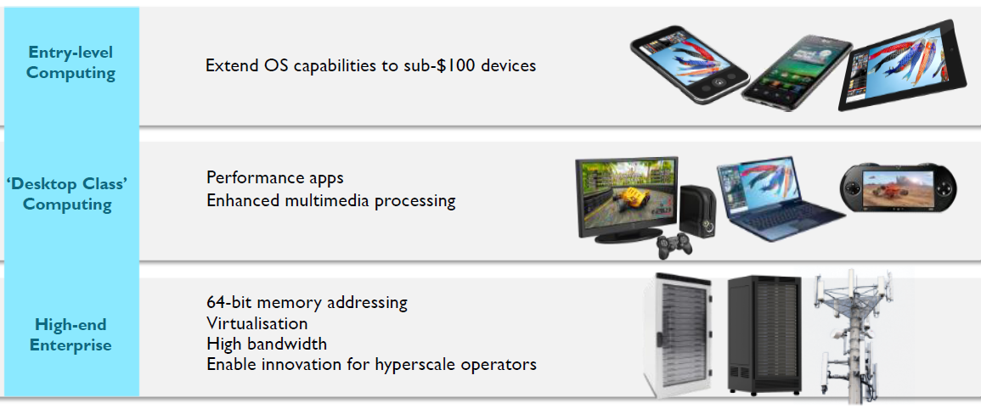
6.1 Overview of ARM’s 64-bit Cortex-A series (5)
Target markets of the 64-bit Cortex-A series [49]

Slide 167
6.1 Overview of ARM’s 64-bit Cortex-A series (6)
Main features of ARM’s 64-bit Cortex-A series [51]
CPU Core | Architecture | Efficiency | big.LITTLE | Announced | Available in devices | Target
Cortex-A73 | ARMv8 (64-bit) | 7.4-8.5 DMIPS/MHz | Yes (with A53/A35) | 2016 | 2017 | High-end
Cortex-A72 | ARMv8 (64-bit) | 6.3-7.3 DMIPS/MHz | Yes (with A53/A35) | 2015 | 2016 | High-end
Cortex-A57 | ARMv8 (64-bit) | 4,8 DMIPS/MHz | Yes (with A53) | 2012 | 2015 | High-end
Cortex-A53 | ARMv8 (64-bit) | 2,3 DMIPS/MHz | Yes (with A57) | 2012 | 2H 2014 | Low power
Cortex-A35 | ARMv8 (64-bit) | 2,1 DMIPS/MHz | Yes (with A57/A72) | 2015 | 2H 2016 | Low power
Cortex-A17 | ARMv7 (32-bit) | 4,0 DMIPS/MHz | Yes (with A7) | 2014 | 2015 | Mainstream
Cortex-A15 | ARMv7 (32-bit) | 4,0 DMIPS/MHz | Yes (with A7) | 2010 | Now | High-end
(Cortex-A12 | ARMv7 (32-bit) | 3,0 DMIPS/MHz | - | 2013 | 2H 2015 | Mainstream)
Cortex-A9 | ARMv7 (32-bit) | 2,5 DMIPS/MHz | - | 2007 | Now (EOL) | High-end
Cortex-A8 | ARMv7 (32-bit) | 2,0 DMIPS/MHz | - | 2005 | Now (EOL) | High-end
Cortex-A7 | ARMv7 (32-bit) | 1,9 DMIPS/MHz | Yes (A15/A17) | 2011 | Now | Low power
Cortex-A5 | ARMv7 (32-bit) | 1,6 DMIPS/MHz | - | 2009 | Now | Low power

Slide 168
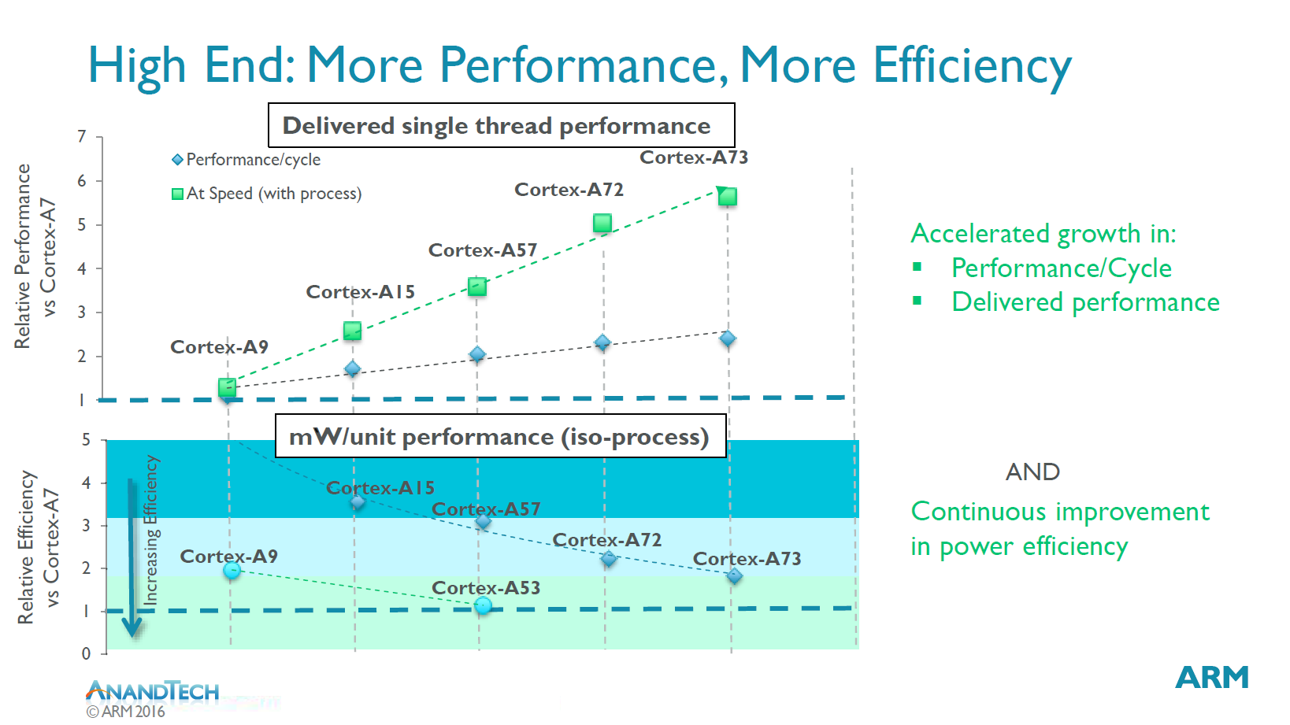
6.1 Overview of ARM’s 64-bit Cortex-A series (7)
Relative performance, efficiency and power efficiency of subsequent models
of the Cortex-A line []
2007

Slide 169
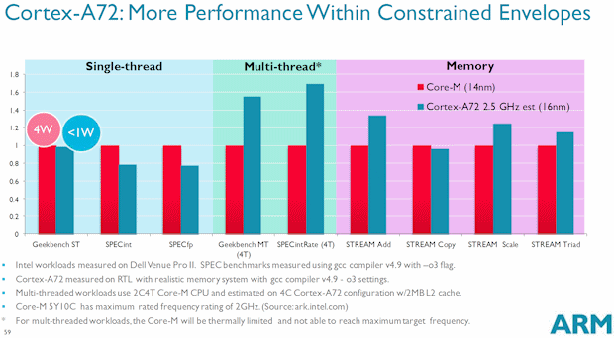
6.1 Overview of ARM’s 64-bit Cortex-A series (8)
Performance comparison: ARM’s Cortex-A72 vs. Intel’s Core-M [72]

Slide 170
6.1 Overview of ARM’s 64-bit Cortex-A series (9)
Wide configuration options - Example: The 64-bit low power Cortex-A35
It is a widely configurable application processor, as indicated below.
Figure: Configuration options of the Cortex-A35 [77]
It is configurable for applications ranging from mobiles to deeply embedded.
Target consumption is below 125 mW.
On 28 nm technology it achieves 1 GHz by 90 mW, for planned smaller feature
size of 14/16 nm ARM expect less consumption.

Slide 171
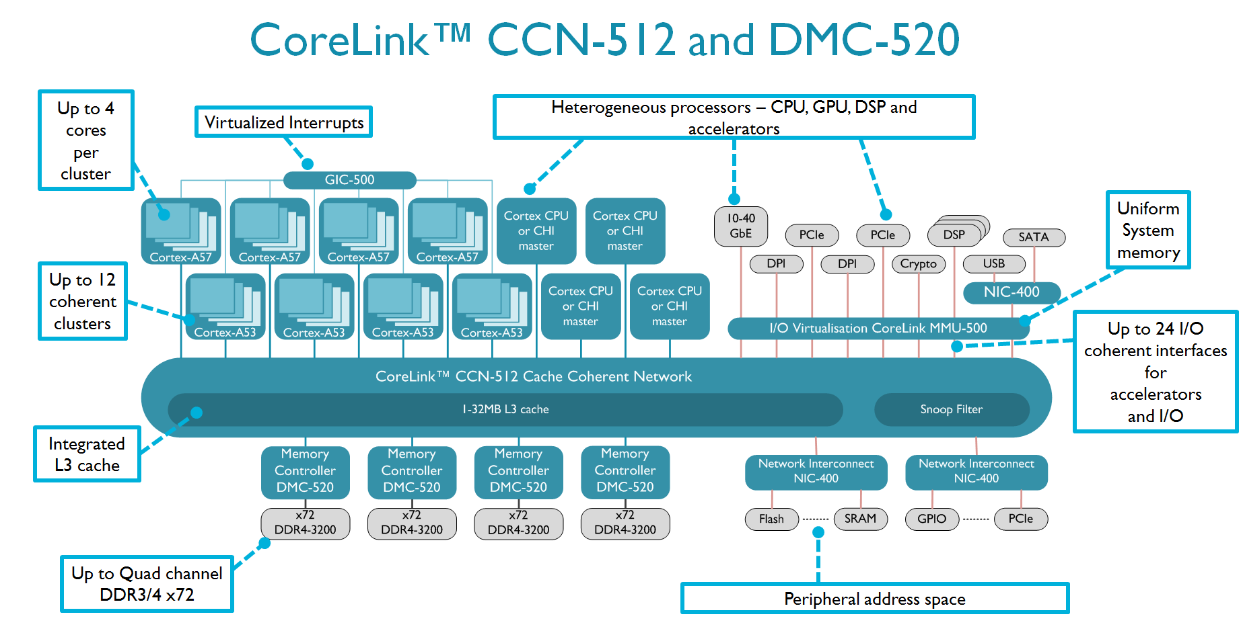
6.1 Overview of ARM’s 64-bit Cortex-A series (10)
Up to 48 core server SoC based on the CoreLink CCN512 interconnect [72]

Slide 172
6.2 Example 64-bit Cortex-A series processors
6.2.1 The high performance Cortex-A57
6.2.2 The high performance Cortex-A72
6.2.3 The high performance Cortex-A73
6.2.4 The low power Cortex-A53
6.2.5 The low power Cortex-A35
(Only the Sections 6.2.3 and 6.2.5 will be discussed)

Slide 173
6.2.1 The high performance Cortex-A57
(Not discussed)

Slide 174
6.2.1 The high performance Cortex-A57 (1)
6.2.1 The high performance Cortex-A57 -1 (based on [12])
8
DMIPS/MHz
5/2016
Cortex-A73
ARMv8
10 nm
7
2/2015
Cortex-A72
ARMv8
16 nm
Announced
6
10/2012
Cortex-A57
ARMv8
20/16 nm
5
9/2010
Cortex-A15
ARMv7
32/28 nm
2/2014
Cortex-A17
ARMv7
28 nm
4
6/2013
Cortex-A12
ARMv7
28 nm
High Performance
3
Mainstream
10/2007
Cortex-A9
ARMv7
40 nm
11/2015
Cortex-A35
ARMv8
16/14 nm
2
10/2012
Cortex-A53
ARMv8
20/16 nm
10/2005
Cortex-A8
ARMv7
65 nm
10/2011
Cortex-A7
ARMv7
28 nm
10/2009
Cortex-A5
ARMv7
40 nm
1
Low power
2006
2007
2008
2009
2010
2011
2012
2013
2014
2015
2016

Slide 175
6.2.1 The high performance Cortex-A57 (2)
The high performance Cortex-A57 -2
10/2012: Announced along with the low power Cortex-A53 processor, with
immediate availability for licensing.
2014: First mobile devices with Cortex-A57 models are emerged.
They are 64-bit successors to the high performance 32-bit Cortex A15.
The A57 and A53 models can be used either as stand alone processors or
as components of a big-LITTLE configuration, similar to the 32-bit
Cortex-A15/A7 combination.
Interoperability with the ARM Mali GPU family is provided.
Target process technology: 16 or 20 nm.

Slide 176
6.2.1 The high performance Cortex-A57 (3)
Key features of the microarchitecture of the Cortex-A57
Fully compatible with the preceding ARMv7 32-bit ISA.
Integrated L2 cache of 512 kB to 2 MB.
Up to 4 Cortex-A57 CPUs that execute the ARMv8 64-bit ISA.
128-bit AMBA ACE coherent interface for connecting multiple (up to 4)
Cortex-A57 processors.
Processor wide cache coherence supported by a Snoop Control Unit (SCU).
Remarks
AMBA: Advanced Microcontroller Bus Architecture
(On-chip bus standard for SoC) designs

Slide 177
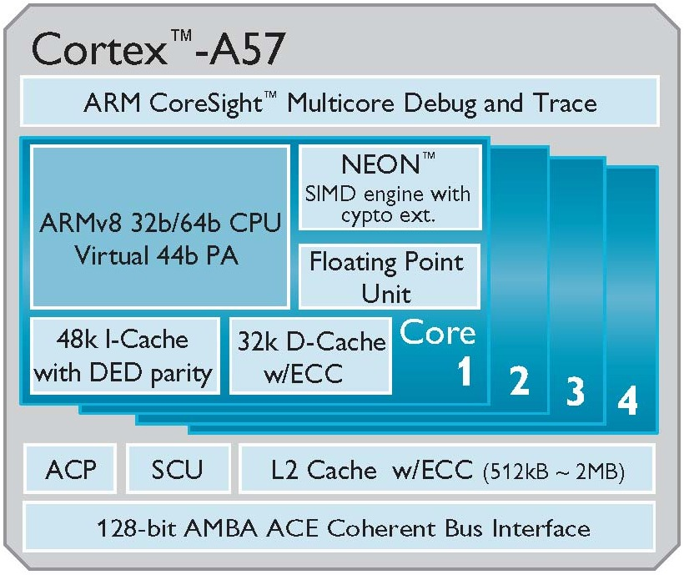
6.2.1 The high performance Cortex-A57 (4)
High level block diagram of the Cortex-A57 [53]
PA: Physical Address
DED: Double Error Detection
ECC: Error Correcting Code
ACP: Accelerator Coherence Port
(to connect non-cached
coherent data sources)
SCU: Snoop Control Unit
AMBA: Advanced Microcontroller
Bus Architecture
(On-chip bus standard for
SoC) designs)
ACE: AXI Coherency Extensions
(Used in big.LITTLE systems
for smartphones, tablets,
etc.)

Slide 178
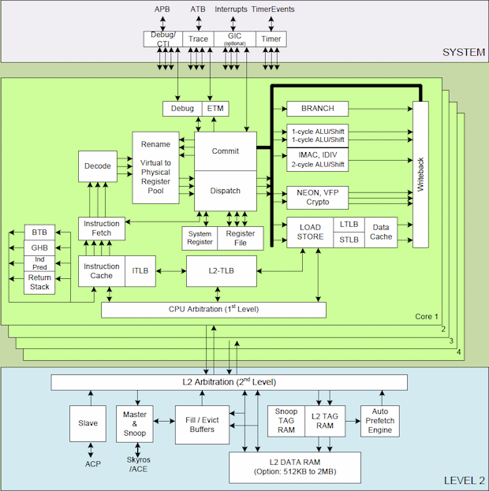
6.2.1 The high performance Cortex-A57 (5)
Main functional blocks of the high performance Cortex-A57 CPU [74]
APB
ATB
Interrupts

Slide 179
6.2.1 The high performance Cortex-A57 (6)
Remarks: Non trivial abbreviations in the above Figure
ATB: AMBA Trace Bus
APB: Advanced Peripheral Bus
ACP: Accelerator Coherence Port
(to connect non-cached coherent data sources)
ACE: AXI Coherency Extensions
(Used in big.LITTLE systems for smartphones, tablets, etc.)
AXI: Advanced eXtensible Interface
(The most widespread AMBA interface).

Slide 180
6.2.1 The high performance Cortex-A57 (7)
Key features of the microarchitecture of the Cortex-A57 core -1
Each core fetches four instructions per cycle from the Icache,
decodes and renames three microinstructions per cycle,
dispatches three microinstructions per cycle to the issue queues,
whereas the issue queues issue up to eight microinstructions per cycle
to the eight available execution units.
The available execution units are
a branch unit
dual single cycle integer units
a multi-cycle integer MAC/DIV/CRC unit
dual Advanced SIMD (NEON)/FP. Crypto units and
dual load/store units.

Slide 181
6.2.1 The high performance Cortex-A57 (8)
Key features of the microarchitecture of the Cortex-A57 core -2
Core efficiency: 4.8 DMIPS/MHz
Expected core frequency up to 2.5 GHz in a 16 nm process implementation.

Slide 182
6.2.1 The high performance Cortex-A57 (9)
Pipeline of the Cortex-A57 core -1
The Cortex-A57 core has a 3-wide in-order front end and an 8 issue-wide out-of-
order back end pipeline with 15 stages for integer processing and additional
pipeline stages for NEON and FP processing, as indicated in the next two
Figures.

Slide 183

6.2.1 The high performance Cortex-A57 (10)
Contrasting the Cortex-A53 and Cortex-A57 arithmetic pipelines
[Based on 54]
D: Decode
R: Rename
P: Dispatch
I: Issue
E: Execute
WB: Write Back
Note: Branch and Load/Store pipelines not shown
(1x Load/Store pipeline for the Cortex A-53 and
2x Load/Store and 1x Branch pipeline for the Cortex-A-57)

Slide 184

6.2.1 The high performance Cortex-A57 (11)
Pipeline structure of the Cortex-A57 core (alternative view) [71]

Slide 185

6.2.1 The high performance Cortex-A57 (12)
Cortex-A57/A53 performance - compared to the Cortex-A15 [55]

Slide 186


6.2.1 The high performance Cortex-A57 (13)
Example: A Cortex-A57/Cortex-A53 big.LITTLE system [52]

Slide 187
6.2.2 The high performance Cortex-A72
(Not discussed)

Slide 188
6.2.2 The high performance Cortex-A72 (1)
6.2.2 The high performance Cortex-A72 (1) (based on [12])
8
DMIPS/MHz
5/2016
Cortex-A73
ARMv8
10 nm
7
2/2015
Cortex-A72
ARMv8
16 nm
Announced
6
10/2012
Cortex-A57
ARMv8
20/16 nm
5
9/2010
Cortex-A15
ARMv7
32/28 nm
2/2014
Cortex-A17
ARMv7
28 nm
4
6/2013
Cortex-A12
ARMv7
28 nm
High Performance
3
Mainstream
10/2007
Cortex-A9
ARMv7
40 nm
11/2015
Cortex-A35
ARMv8
16/14 nm
2
10/2012
Cortex-A53
ARMv8
20/16 nm
10/2005
Cortex-A8
ARMv7
65 nm
10/2011
Cortex-A7
ARMv7
28 nm
10/2009
Cortex-A5
ARMv7
40 nm
1
Low power
2006
2007
2008
2009
2010
2011
2012
2013
2014
2015
2016

Slide 189
6.2.2 The high performance Cortex-A72 (2)
The high performance Cortex-A72 -2 [91]
02/2015: Announced along with the CoreLink CCI-500 cache Cache Coherent
Interconnect and the Mali T880 GPU with immediate availability for licensing.
Q1/2016: First premium level mobile devices with Cortex-A72.
The Cortex-A72 is based on the high performance 64-bit Cortex-A57.
Nevertheless, every logical block of the Cortex-A57 was optimized for
power efficiency.
It was designed in ARM's Austin, Texas design center.
The Cortex-A72 can be used either as stand alone processors or as part of
a big-LITTLE configuration along with the Cortex-A53 processors.
Interoperability with the ARM Mali GPU family.
Target process technology: 16 nm FinFET technology.

Slide 190

6.2.2 The high performance Cortex-A72 (3)
Sustained relative performance of high performance Cortex-a models
within a given power budget [91]
http://www.anandtech.com/show/9184/arm-reveals-cortex-a72-architecture-details

Slide 191

6.2.2 The high performance Cortex-A72 (4)
Energy consumption of high performance Cortex-A models for the same
workload [91]

Slide 192

6.2.2 The high performance Cortex-A72 (5)
High level block diagram of the Cortex-A72 [91]
ECC: Error Correcting Code
ACP: Accelerator Coherence Port
(to connect non-cached
coherent data sources)
SCU: Snoop Control Unit
(Provides coherence within the
the processor)
AMBA: Advanced Microcontroller
Bus Architecture
(On-chip bus standard for
SoC) designs)
ACE: AXI Coherency Extensions
AMBA4 cache coherent interface
(Used in big.LITTLE systems
for smartphones, tablets,
etc.)
CHI: Coherent Hub Interface
(AMBA5 Cache coherent
interface used in servers)

Slide 193
6.2.2 The high performance Cortex-A72 (6)
Key features of the microarchitecture of the Cortex-A72 [91]
It has a three-wide in-order front-end and a five-wide out-of-order back-end,
as seen in the next Figure.
Integrated L2 cache of 512 kB to 4 MB.
Up to 4 Cortex-A73 CPUs executing the ARMv8 64-bit ISA.
128-bit coherent AMBA4 ACE or AMBA5 CHI interface for connecting multiple
(up to 4) Cortex-A57 processors and further system components.
Processor wide cache coherence supported by a Snoop Control Unit (SCU).
Significant improvements in power efficiency through optimizing every block
of the Cortex-A57.
Remarks
AMBA: Advanced Microcontroller Bus Architecture
(On-chip bus standard for SoC) designs

Slide 194

6.2.2 The high performance Cortex-A72 (7)
Pipeline structure of the high-end Cortex-A72 [92]

Slide 195

6.2.2 The high performance Cortex-A72 (8)
More detailed block diagram of the high performance Cortex-A72 [95]

Slide 196
6.2.2 The high performance Cortex-A72 (9)
Remark
A detailed description of the microarchitecture of the Cortex-A72 can be found in [91].

Slide 197
6.2.3 The high performance Cortex-A73

Slide 198
6.2.3 The high performance Cortex-A73 (1)
6.2.2 The high performance Cortex-A73 (1) (based on [12])
8
DMIPS/MHz
5/2016
Cortex-A73
ARMv8
10 nm
7
2/2015
Cortex-A72
ARMv8
16 nm
Announced
6
10/2012
Cortex-A57
ARMv8
20/16 nm
5
9/2010
Cortex-A15
ARMv7
32/28 nm
2/2014
Cortex-A17
ARMv7
28 nm
4
6/2013
Cortex-A12
ARMv7
28 nm
High Performance
3
Mainstream
10/2007
Cortex-A9
ARMv7
40 nm
11/2015
Cortex-A35
ARMv8
16/14 nm
2
10/2012
Cortex-A53
ARMv8
20/16 nm
10/2005
Cortex-A8
ARMv7
65 nm
10/2011
Cortex-A7
ARMv7
28 nm
10/2009
Cortex-A5
ARMv7
40 nm
1
Low power
2006
2007
2008
2009
2010
2011
2012
2013
2014
2015
2016

Slide 199
6.2.3 The high performance Cortex-A73 (2)
The high performance Cortex-A73 -2 [92]
05/2016: Announced along with the G71 graphics processor with immediate
availability for licensing.
First premium level mobile devices with Cortex-A73 are expected in 2017.
The Cortex-A73 is successor to the high performance 64-bit Cortex-A72.
But whereas the Cortex-A72 was designed in Austin, Texas, the Cortex-A73
is a designed from scatch by a French team in Sophia-Antipolis design park.
The design started in 2013 inspired by the mainstream Cortex-A17.
The Cortex-A73 can be used either as stand alone processors or as part of
a big-LITTLE configuration along sith the Cortex-a53/A35 processors.
Interoperability with the ARM Mali GPU family is provided.
Target process technology: 10 nm FinFET technology.

Slide 200
6.2.3 The high performance Cortex-A73 (3)
Relative performance, efficiency and power efficiency of subsequent models
of the Cortex-A line [92]
2007

Slide 201

6.2.3 The high performance Cortex-A73 (4)
Cortex-A73 performance improvement over the Cortex-A72 [92]

Slide 202

6.2.3 The high performance Cortex-A73 (5)
Cortex-A73 power reduction over the Cortex-A72 [92]

Slide 203

6.2.3 The high performance Cortex-A73 (6)
Cortex-A73 performance improvement in a big-LITTE configuration [92]

Slide 204

6.2.3 The high performance Cortex-A73 (7)
High level block diagram of the Cortex-A73 [93]
ECC: Error Correcting Code
ACP: Accelerator Coherence Port
(to connect non-cached
coherent data sources)
SCU: Snoop Control Unit
(Provides coherence within the
the processor)
AMBA: Advanced Microcontroller
Bus Architecture
(On-chip bus standard for
SoC) designs)
AXI4: Advanced eXtensible Interface
(The most widespread AMBA4
non cache-coherent interface)
ACE: AXI Coherency Extensions
AMBA4 cache coherent interface
(Used in big.LITTLE systems
for smartphones, tablets,
etc.).

Slide 205
6.2.3 The high performance Cortex-A73 (8)
Key features of the microarchitecture of the Cortex-A73 [92]
It has a two-wide in-order front-end and a four-wide out-of-order back-end.
This is in contrast to the Cortex-A72 that has a three-wide in-order front-end
and a five-wide out-of-order back-end (see subsequent Figures).
Integrated L2 cache of 256 kB to 8 MB.
Up to 4 Cortex-A73 CPUs executing the ARMv8 64-bit ISA.
128-bit AMBA AXI4 non-coherent or ACE coherent interface for connecting
multiple (up to 4) Cortex-A57 processors and further system components.
Processor wide cache coherence supported by a Snoop Control Unit (SCU).
Remarks
AMBA: Advanced Microcontroller Bus Architecture
(On-chip bus standard for SoC) designs

Slide 206

6.2.3 The high performance Cortex-A73 (9)
Pipeline structure of the high-end Cortex-A73 [92]

Slide 207
6.2.3 The high performance Cortex-A73 (10)
By contrast: Pipeline structure of the high-end Cortex-A72 [92]

Slide 208
6.2.3 The high performance Cortex-A73 (11)
Key differences in the pipeline structure of the Cortex-A73 and -A72 [92]
The Cortex-A73 has a shorter pipeline than the -A72 (11+ stages vs. 14+ stages).
The Cortex-A73 has a smaller front-end than the -A72 (a dual-issue in-order
front-end vs. a three issue in-order front-end).
The Cortex-A73 has also a smaller back-end than the -A72 (four-wide out-of order
back-end with an issue rate of 7 vs. a five-wide out-of order back-end with an
issue-rate of 10).
Still the Cortex-A73 has a higher efficiency (7.4-8.5 DMIPS/MHz vs. 6.3-7.35
DMIPS/MHz).
This is achieved through a superior design.

Slide 209

6.2.3 The high performance Cortex-A73 (12)
Die size reduction in ARM's high-performance 64-bit processor line [92]

Slide 210

6.2.3 The high performance Cortex-A73 (13)
Range of scalability of the Cortex-A73 processor [92]

Slide 211
6.2.3 The high performance Cortex-A73 (14)
Remark
A detailed description of the microarchitecture of the cortex-A73 can be found in [92].

Slide 212
6.2.4 The low power Cortex-A53
(Not discussed)

Slide 213
6.2.4 The low power Cortex-A53 (1)
6.2.2 The low power Cortex-A53 -1 (based on [12])
8
DMIPS/MHz
5/2016
Cortex-A73
ARMv8
10 nm
7
2/2015
Cortex-A72
ARMv8
16 nm
Announced
6
10/2012
Cortex-A57
ARMv8
20/16 nm
5
9/2010
Cortex-A15
ARMv7
32/28 nm
2/2014
Cortex-A17
ARMv7
28 nm
4
6/2013
Cortex-A12
ARMv7
28 nm
High Performance
3
Mainstream
10/2007
Cortex-A9
ARMv7
40 nm
11/2015
Cortex-A35
ARMv8
16/14 nm
2
10/2012
Cortex-A53
ARMv8
20/16 nm
10/2005
Cortex-A8
ARMv7
65 nm
10/2011
Cortex-A7
ARMv7
28 nm
10/2009
Cortex-A5
ARMv7
40 nm
1
Low power
2006
2007
2008
2009
2010
2011
2012
2013
2014
2015
2016

Slide 214
6.2.4 The low power Cortex-A53 (2)
The low power Cortex-A53 -2 [75]
10/2012: Announced along with the performance oriented Cortex-A57 processor,
with immediate availability for licensing.
2014: First mobile devices with the Cortex-A53.
It is the 64-bit successor to the Cortex-A7.
The A57 and A53 models can be used either as stand alone processors or
as components in a big-LITTLE configuration, similar to the 32-bit Cortex-A15
and A7 models.
Target process technology: 16 or 20 nm.

Slide 215

6.2.4 The low power Cortex-A53 (3)
High level block diagram of the Cortex-A53 [53]
PA: Physical Address
ECC: Error Correcting Code
ACP: Accelerator Coherence Port
(to connect non-cached
coherent data sources)
SCU: Snoop Control Unit
AMBA: Advanced Microcontroller
Bus Architecture
(On-chip bus standard for
SoC) designs)
ACE: AXI Coherency Extensions
AMBA4 cache coherent interface
(Used in big.LITTLE systems
for smartphones, tablets,
etc.)

Slide 216
6.2.4 The low power Cortex-A53 (4)
Key features of the microarchitecture of the Cortex-A53 core -1
Fully compatible with the preceding ARMv7 32-bit ISA.
Integrated L2 cache of 128 kB to 2 MB.
Up to 4 Cortex-A53 CPU cores that execute the ARMv8 64-bit ISA.
128-bit AMBA coherent interface for connecting multiple (up to 4)
Cortex-A53 processors.
Processor wide cache coherence supported by a Snoop Control Unit (SCU).
Remarks
AMBA: Advanced Microcontroller Bus Architecture
(On-chip bus standard for SoC) designs

Slide 217

6.2.4 The low power Cortex-A53 (5)
Key features of the microarchitecture of the Cortex-A53 core -2
The Cortex-A53 core has a dual-issue in-order pipeline actually with 5 individual
pipelines constituting the back end, as indicated in the next Figure.
Dual
Fetch
Integer
Figure: Pipeline stages of the Cortex-A53 [76]
The pipeline for integer processing has 8 pipeline stages, NEON and FP
processing has two additional pipeline stages, as seen in the Figure above.

Slide 218
6.2.4 The low power Cortex-A53 (6)
Contrasting the Cortex-A7 and Cortex-A53 microarchitectures [75]
ARM CPU Core Comparison
 | Cortex-A7 | Cortex-A53
ARM ISA | ARMv7 (32-bit) | ARMv8 (32/64-bit)
Issue Width | Partially 2 micro-ops | 2 micro-ops
Pipeline Length | 8 | 8
Integer Add units | 2 | 2
Integer Mul unit | 1 | 1
Load/Store Units | 1 | 1
Branch Unit | 1 | 1
FP/NEON ALU | 1x64-bit | 1x64-bit
L1 Cache | 8KB-64KB I$ + 8KB-64KB D$ | 8KB-64KB I$ + 8KB-64KB D$
L2 Cache | 128KB - 1MB (Optional) | 128KB - 2MB (Optional)

Slide 219
6.2.4 The low power Cortex-A53 (7)
Remarks [75]
We note that the Cortex-A7 has a partially dual-issue capability, meaning that
the second issue slot can only issue branch and integer operations.
In the Cortex-A53 the second issue slot can also issue load-store and FP/NEON
operations.
In additon, the branch prediction capabilities of the A53 were also significantly
improved by including conditional and indirect jump predictors.

Slide 220
6.2.4 The low power Cortex-A53 (8)
Contrasting the Cortex-A53 and Cortex-A57 arithmetic pipelines
[Based on 54]
D: Decode
R: Rename
P: Dispatch
I: Issue
E: Execute
WB: Write Back
Note: Branch and Load/Store pipelines not shown
(1x Load/Store pipeline for the Cortex A-53 and
2x Load/Store and 1x Branch pipeline for the Cortex-A-57)

Slide 221
6.2.4 The low power Cortex-A53 (9)
Key features of the microarchitecture of the Cortex-A53 core -3
Core efficiency: 2.3 DMIPS/MHz
Expected core frequency up to 1.5 GHz.

Slide 222
6.2.5 The low power Cortex-A35

Slide 223
6.2.5 The low power Cortex-A35 (1)
6.2.3 The low power Cortex-A35 -1 (based on [12])
8
DMIPS/MHz
5/2016
Cortex-A73
ARMv8
10 nm
7
2/2015
Cortex-A72
ARMv8
16 nm
Announced
6
10/2012
Cortex-A57
ARMv8
20/16 nm
5
9/2010
Cortex-A15
ARMv7
32/28 nm
2/2014
Cortex-A17
ARMv7
28 nm
4
6/2013
Cortex-A12
ARMv7
28 nm
High Performance
3
Mainstream
10/2007
Cortex-A9
ARMv7
40 nm
11/2015
Cortex-A35
ARMv8
16/14 nm
2
10/2012
Cortex-A53
ARMv8
20/16 nm
10/2005
Cortex-A8
ARMv7
65 nm
10/2011
Cortex-A7
ARMv7
28 nm
10/2009
Cortex-A5
ARMv7
40 nm
1
Low power
2006
2007
2008
2009
2010
2011
2012
2013
2014
2015
2016

Slide 224
6.2.5 The low power Cortex-A35 (2)
The low power Cortex-A35 -2 [90]
11/2015: Announced with immediate availability for licensing.
End of 2016: First mobile devices with the Cortex-A35 expected.
It is the successor to the Cortex-A53.
It is the smallest, most efficient model of the Cortex series.
The A35 models can be used either as stand alone processors or as components
in a big-LITTLE configuration.
Target process technology: 16/14 nm.

Slide 225

6.2.5 The low power Cortex-A35 (3)
High level block diagram of the Cortex-A35 [94]
ECC: Error Correcting Code
ACP: Accelerator Coherence Port
(to connect non-cached
coherent data sources)
SCU: Snoop Control Unit
(Provides coherence within the
the processor)
AMBA: Advanced Microcontroller
Bus Architecture
(On-chip bus standard for
SoC) designs)
ACE: AXI Coherency Extensions
AMBA4 cache coherent interface
(Used in big.LITTLE systems
for smartphones, tablets,
etc.)
CHI: Coherent Hub Interface
(AMBA5 Cache coherent
interface used in servers)
AXI4: Advanced eXtensible Interface
(The most widespread AMBA4
non cache-coherent interface).
http://www.arm.com/products/processors/cortex-a/cortex-a35-processor.php

Slide 226
6.2.5 The low power Cortex-A35 (4)
Key features of the microarchitecture of the Cortex-A35 core -1 [90]
Fully compatible with the ARMv8 64-bit ISA.
In-order 8-stage pipeline with limited dual issue capability
Integrated L2 cache of 128 kB to 1 MB.
Up to 4 Cortex-A35 CPU cores.
Processor wide cache coherence supported by a Snoop Control Unit (SCU).
Optionally three 128-bit AMBA interfaces
AXI4: Advanced eXtensible Interface
(The most widespread AMBA4 non cache-coherent interface).
ACE: AXI Coherency Extensions
AMBA4 cache coherent interface used in big.LITTLE systems
for smartphones, tablets, etc.)
CHI: Coherent Hub Interface
(AMBA5 Cache coherent interface used in servers)
Remark
AMBA: Advanced Microcontroller Bus Architecture
(On-chip bus standard for SoC) designs

Slide 227

6.2.5 The low power Cortex-A35 (5)
The in-order 8-stage pipeline of the Cortex-A35 providing limited
dual issue capability Cortex-A35 [90]
ETM: Embedded Trace Macrocell, a low-level debugging technology in ARM microprocessors.
Governor: Hardware unit for setting the processor into the standby state.

Slide 228

6.2.5 The low power Cortex-A35 (6)
Relative performance of the Cortex-A35 vs. the Cortex-A7
assuming the same process technology (28 nm) [90]

Slide 229

6.2.5 The low power Cortex-A35 (7)
Relative power consumption of the Cortex-A35 vs. the Cortex-53 assuming
the same clock frequency and process technology (28 nm) [90]

Slide 230
6.2.5 The low power Cortex-A35 (8)
The range of configurability of the Cortex-a35 processor [90]
Configuration options of the Cortex-A35 are ranging from mobile to deeply embedded.

Slide 231
7. References

Slide 232
7. References (1)
[1]: Architecture and Implementation of the ARM Cortex-A8 Microprocessor, Design & Reuse,
http://www.design-reuse.com/articles/11580/architecture-and-implementation-of-the-
arm-cortex-a8-microprocessor.html
[2]: Shimpi A.L., Answered by the Experts: ARM's Cortex A53 Lead Architect, Peter Greenhalgh,
AnandTech, Dec. 17 2013, http://www.anandtech.com/show/7591/answered-by-the-
experts-arms-cortex-a53-lead-architect-peter-greenhalgh
[3]: Hill S., Design of a Reusable 1GHz, Superscalar ARM Processor, Hot Chips-18, Aug. 22 2006,
http://www.hotchips.org/wp-content/uploads/hc_archives/hc18/3_Tues/HC18.S6/HC18.S6T3.
pdf
[4]: Details of a New Cortex Processor Revealed, Cortex-A9, ARM Developers’ Conference,
Oct. 2007, http://rtcgroup.com/arm/2007/presentations/174%20-%20Details%20of%
20a%20New%20Cortex%20Processor%20Revealed%20Cortex-A9.pdf
[5]: ARM Teaching Material, http://www.arm.com/files/ppt/ARM_Teaching_Material.ppt
[6]: ARM Cortex Application Processors, http://www.arm.com/products/processors/index.php
[7]: ARM SecurCore Processors, http://www.arm.com/products/processors/securcore/index.php
[8]: Snyder C.D., ARM Family Expands at EPF, ARM11 Microarchitecture Stretches Pipe to Boost
Frequency, Microprocessor, June 3 2002
[9]: Hirata K., ARM11 MPCore, The streamlined and scalable ARM11 processor core, Jan. 2007,
http://www.aspdac.com/aspdac2007/pdf/archive/7D-2.pdf

Slide 233
7. References (2)
[10]: ARM Introduces The Cortex-M3 Processor To Deliver High Performance In Low-Cost
Applications, Oct. 19 2004, http://www.arm.com/about/newsroom/6750.php
[11]: NEON, ARM Technologies,
http://www.arm.com/products/processors/technologies/neon.php
[12]: Goodacre J., The Evolution of the ARM Architecture Towards Big Data and the Data-Centre,
8th Workshop on Virtualization in High-Performance Cloud Computing (VHPC’13),
Nov. 17-22 2013, http://www.virtical.eu/pub/sc13.pdf
[13]: Ferguson I., Redefining User Experiences, from IoT to Smart Mobile Devices, June 14 2013,
http://www.arm.com/zh/files/event/arm_multimedia_seminar_shenzhen_2013_ianferguson.
pdf
[14]: Goto H., ARM Cortex – A Family Architecture, 2010,
http://pc.watch.impress.co.jp/video/pcw/docs/423/409/p1.pdf
[15]: Stevens H., Introduction to AMBA 4 ACE and big.LITTLE Processing Technology, White Paper,
June 6 2011, http://www.arm.com/files/pdf/CacheCoherencyWhitepaper_6June2011.pdf
[16]: Shimpi A.L., The ARM Diaries, Part 2: Understanding the Cortex A12, AnandTech,
July 17 2013, http://www.anandtech.com/show/7126/the-arm-diaries-part-2-
understanding-the-cortex-a12
[17]: Shimpi A.L., ARM Cortex A17: An Evolved Cortex A12 for the Mainstream in 2015,
AnandTech, Febr. 11 2014, http://www.anandtech.com/show/7739/arm-cortex-a17
[18]: Ryan H., Intel, AMD & ARM Processors, University of Wisconsin DoIT Techstore
https://kb.wisc.edu/showroom/page.php?id=4927

Slide 234
7. References (3)
[19]: Rao A., ARM: a mandatory primer, Element14, 2014
[20]: Mali Performance Efficient Graphics, ARM
http://www.arm.com/products/multimedia/mali-performance-efficient-graphics/index.php
[21]: Cortex-A8 Processor, ARM Cortex-A Series,
http://www.arm.com/products/processors/cortex-a/cortex-a8.php
[22]: Architecture and Implementation of the ARM Cortex-A8 Microprocessor, White Paper,
Oct. 2005, https://www.pixhawk.ethz.ch/_media/software/optimization/neon_whitepaper.pdf
[23]: Shimpi A.L., Understanding the iPhone 3GS, AnandTech, July 7 2009,
http://www.anandtech.com/print/2798/
[24]: The ARM Cortex-A9 Processors, White Paper, Sept. 2009,
http://www.arm.com/files/pdf/armcortexa-9processors.pdf
[25]: Cortex-A9 MPCore, Technical Reference Manual, 2008-2012,
http://infocenter.arm.com/help/topic/com.arm.doc.ddi0407i/DDI0407I_cortex_a9_
mpcore_r4p1_trm.pdf
[26]: Goto H., ARM Cortex-A9r4 Core Block Diagram,
http://pc.watch.impress.co.jp/video/pcw/docs/614/543/08p.pdf
[27]: ARM Unveils Cortex-A9 Processors For Scalable Performance and Low-Power Designs,
Oct. 3 2007, http://www.arm.com/about/newsroom/18688.php
[28]: Goodacre J., The Effect and Technique of System Coherence in ARM Multicore Technology,
http://www.mpsoc-forum.org/previous/2008/slides/8-6%20Goodacre.pdf

Slide 235
7. References (4)
[29]: Goto H., ARM Cortex-A7/A9 vs Bobcat, Atom, 2010,
http://pc.watch.impress.co.jp/img/pcw/docs/487/030/html/9.jpg.html
[30]: Goto H., ARM Cortex-A12 Block Diagram, 2013,
http://pc.watch.impress.co.jp/video/pcw/docs/621/747/gp1.pdf
[31]: Rosinger S., The Top 5 Things to Know about Cortex-A12, ARM Connected Community,
Oct. 26 2013, http://community.arm.com/groups/processors/blog/2013/10/26/the-top-5-
things-to-know-about-cortex-a12
[32]: ARM Cortex-A17 MPCore Processor, Technical Reference Manual, 2014,
http://infocenter.arm.com/help/topic/com.arm.doc.ddi0535b/DDI0535B_cortex_a17_
r1p0_trm.pdf
[33]: Cortex-A17 Processor, ARM Cortex-A Series,
http://www.arm.com/products/processors/cortex-a/cortex-a17-processor.php
[34]: Rosinger S., ARM Cortex-A17/Cortex-A12 processor update, ARM Connected Community,
Oct. 1 2014, http://community.arm.com/groups/processors/blog/2014/09/30/arm-
cortex-a17-cortex-a12-processor-update
[35]: Cortex-A15 Processor, ARM Cortex-A Series,
http://www.arm.com/products/processors/cortex-a/cortex-a15.php
[36]: Lanier T., Exploring the Design of the Cortex-A15 Processor,
http://www.arm.com/files/pdf/AT-Exploring_the_Design_of_the_Cortex-A15.pdf

Slide 236
7. References (5)
[37]: Greenhalgh P., big.LITTLE Processing with ARM Cortex-A15 & Cortex-A7, White Paper,
Sept. 2011, http://www.arm.com/files/downloads/big_LITTLE_Final_Final.pdf
[38]: Stokes J., ARM fills out CPU lineup with Cortex A5, Ars Technica, Oct. 22 2009,
http://arstechnica.com/gadgets/2009/10/arm-fills-out-cpu-lineup-with-cortex-a5/
[39]: Hruska J., ARM Launches New Cortex-A5 As A Bulkward Against Future Atom processors,
Hot Hardware, Oct. 23 2009, http://hothardware.com/News/ARM-Launches-New-
CortexA5-As-A-Bulkward-Against-Future-Atom-processors
[40]: Cortex-A5 Processor, ARM Cortex-A Series,
http://www.arm.com/products/processors/cortex-a/cortex-a5.php
[41]: Bhattacharya A., Small, Quiet, and Cool, Power Efficient Processing with the Cortex-A5
Processor, http://www.arm.com/files/pdf/at2_-_power_efficient_processing_with_the_
cortex-a5_v1.pdf
[42]: Cortex-A5, The smallest, lowest power ARMv7 application processor,
http://www.hitex.co.uk/fileadmin/uk-files/pdf/ARM%20Seminar%20Presentations%
202013/Hitex%20Cortex-A5%20Overview.pdf
[43]: Flautner K., Heterogeneity to the rescue, Nov. 2011,
https://www.bscmsrc.eu/sites/default/files/media/arm-heterogenous-mp-november-2011.
pdf
[44]: Shimpi A.L., ARM's Cortex A7: Bringing Cheaper Dual-Core & More Power Efficient High-End
Devices, AnandTech, Oct. 19 2011, http://www.anandtech.com/show/4991/

Slide 237
7. References (6)
[45]: Cortex-A7 Processor, ARM Cortex-A Series,
http://www.arm.com/products/processors/cortex-a/cortex-a7.php
[46]: Goto H., New design of mid-range CPU that ARM has announced "Cortex-A12", PC Watch,
June 4 2013, http://pc.watch.impress.co.jp/docs/column/kaigai/20130604_602106.html
[47]: Shimpi A.L., ARM's Cortex A57 and Cortex A53: The First 64-bit ARMv8 CPU Cores,
AnandTech, Oct. 30 2012, http://www.anandtech.com/show/6420/arms-cortex-a57-
and-cortex-a53-the-first-64bit-armv8-cpu-cores
[48]: Smith K., Next-Generation Solutions: One Size Does Not Fit All, Nov. 2012,
http://www.armtechforum.com.cn/2012/3_Next-generation_Solutions_One_Size_does_
not_Fit_All.pdf
[49]: Smythe I., Building the future of 64-bit computing with ARMv8-A, June 2014,
http://www.arm.com/files/event/2014_ARM_Multimedia_Seminar_ARM_Ian_Smythe.pdf
[50]: Ferguson I., ARM Servers, Why, Where, when, Nov. 27 2012,
http://openserversummit.com/English/Collaterals/Proceedings/2012/20121127_SA103_
Ferguson.pdf
[51]: Crijns K., ARM: 20 dollar and 64-bit Android smartphones to be expected, Hardware.info,
June 24 2014, http://us.hardware.info/reviews/5386/2/arm-20-dollar-and-64-bit-android-
smartphones-to-be-expected-android-64-bitn
[52]: Scaling Mobile Compute to the Data Centre, MPSoC’13,
http://www.mpsoc-forum.org/previous/2013/slides/2-Goodacre.pdf

Slide 238
7. References (7)
[53]: ARM Launches Cortex-A50 Series, the World's Most Energy-Efficient 64-bit Processors,
TechPowerUp, Oct. 30 2012, http://www.techpowerup.com/174709/arm-launches-cortex-
a50-series-the-worlds-most-energy-efficient-64-bit-processors.html
[54]: Mandyam L., Smartphone Powered Data Centers: Shifting Toward Energy Efficiency,
http://sites.ieee.org/scv-cs/files/2013/03/IEEE-event-April-slide-upload.pdf
[55]: Anthony S., ARM says $20 smartphones coming this year, shows off 64-bit Cortex-A53 and
A57 performance, Extreme Tech, May 6 2014, http://www.extremetech.com/computing/
181935-arm-says-20-smartphones-coming-this-year-shows-off-64-bit-cortex-a53-and-
a57-performance
[56]: Merritt R., ARM stretches out with A5 core, graphics, FPGAs, Oct. 21 2009,
http://www.embedded.com/print/4085371
[57]: Cormie D., The ARM11 Microarchitecture, April 2002
[58]: Exynos 5 Octa, Block Diagram,
http://www.samsung.com/global/business/semiconductor/product/application/detail?
productId=7978&iaId=2341
[59]: Grabham D., From a small Acorn to 37 billion chips: ARM's ascent to tech superpower,
Techradar, July 19 2013, http://www.techradar.com/news/computing/from-a-small-acorn-
to-37-billion-chips-arm-s-ascent-to-tech-superpower-1167034
[60]: The ARM Architecture, http://www.eng.auburn.edu/~strouce/DaTseminar/UniPres07s.pdf
[61]: Wikipedia, ARM architecture, http://en.wikipedia.org/wiki/ARM_architecture

Slide 239
7. References (8)
[62]: Levy M., The History of The ARM Architecture: From Inception to IPO,
http://www.reds.ch/share/cours/ReCo/documents/TheHistoryOfTheArmArchitecture.pdf
[63]: Lemieux J., Introduction to ARM thumb, Embedded, Sept. 24 2003, http://www.embedded.
com/electronics-blogs/beginner-s-corner/4024632/Introduction-to-ARM-thumb
[64]: ARM Processor Architecture,
http://www.arm.com/products/processors/instruction-set-architectures/index.php
[65]: ARM Architecture Reference Manual, ARMv5, DDI0100E, June 2000
[66]: ARM Architecture Reference Manual, ARMv8, 2013, http://www.myir-tech.com/down/arm/
arch/ARMv8-A_Architecture_Reference_Manual_%28Issue_A.a%29.pdf
[67]: Porthouse C., Use ARM DBX hardware extensions to accelerate Java in space-constrained
embedded apps, Embedded, Oct. 18 2007, http://www.embedded.com/design/prototyping-
and-development/4007206/3/PRODUCT-HOW-TO-Use-ARM-DBX-hardware-extensions-to-
accelerate-Java-in-space-constrained-embedded-apps
[68]: ARM Security Technology, Building a Secure System using TrustZone Technology, 2009,
http://infocenter.arm.com/help/topic/com.arm.doc.prd29-genc-009492c/PRD29-GENC-
009492C_trustzone_security_whitepaper.pdf
[69]: ARM Cortex-A53 MPCore Processor Technical Reference Manual, Cryptography Extension,
2013-2014, http://infocenter.arm.com/help/index.jsp?topic=/com.arm.doc.ddi0500e/
CJHDEBAF.html

Slide 240
7. References (9)
[70]: Shilov A., ARM’s high-end ‘Ares’ core for 10nm SoCs may be unveiled next year, KitGuru,
May 16 2015, http://www.kitguru.net/components/cpu/anton-shilov/arms-high-
performance-ares-core-may-be-unleashed-next-year/
[71]: Goto H., ARM Cortex-A57 Block Diagram,
http://images.anandtech.com/doci/8718/Hiroshige.Goto.png
[72]: Wasson S., Inside ARM's Cortex-A72 microarchitecture, TechReport, May 1 2015,
http://techreport.com/review/28189/inside-arm-cortex-a72-microarchitecture
[73]: Citizendium, Java platform, http://en.citizendium.org/wiki/Java_platform
[74]: Wasson S., Samsung's Galaxy Note 4 with the Exynos 5433 processor, TechReport,
01/31/2015, http://techreport.com/review/27539/samsung-galaxy-note-4-with-the-
exynos-5433-processor/2
[75]: Frumusanu A. & Smith R., ARM A53/A57/T760 investigated - Samsung Galaxy Note 4
Exynos Review, AnandTech, February 10, 2015,
http://www.anandtech.com/show/8718/the-samsung-galaxy-note-4-exynos-review
[76]: Riemenschneider F., Intel sei dank: Programmierbare Logik mit 1 GHz takten,
Elektroniknet, 29.10.2013 von Frank Riemenschneider,
http://www.elektroniknet.de/halbleiter/programmierbare-logik/artikel/102160/
[77]: Frumusamu A., ARM Announces New Cortex-A35 CPU - Ultra-High Efficiency For Wearables
& More, AnandTech, November 10, 2015,
http://anandtech.com/show/9769/arm-announces-cortex-a35

Slide 241
7. References (10)
[78]: Quested T., ARM scales up again in Cambridge, Businessweekly, 20 October, 2014,
http://www.businessweekly.co.uk/news/property-and-construction/17695-arm-scales-
again-cambridge#sthash.Pzg7jnpK.dpuf
[79]: ARM Architecture Reference Manual, Thumb-2 Supplement, 2004-2005,
http://read.pudn.com/downloads159/doc/709030/Thumb-2SupplementReferenceManual.pdf
[80]: Wanted: Java bytecode disassembler that shows addresses, opcodes, operands, in hex,
Reverse Engineering, 2013, http://reverseengineering.stackexchange.com/questions/
2036/wanted-java-bytecode-disassembler-that-shows-addresses-opcodes-operands-in-h
[81]: Barr M., KVM: A Small Java Virtual Machine for J2ME, Barr Group, May 4 2016,
http://www.barrgroup.com/Embedded-Systems/How-To/KVM-J2ME-Java-Virtual-Machine
[82]: What is Bytecode ?, March 21 2015,
http://interview-question-and-answers.blogspot.hu/2015/03/what-is-bytecode.html
[83]: The JVM – Java Virtual Machine, Android Developer, May 8 2015,
http://androiddeveloper.co.il/the-jvm-java-virtual-machine/
[84]: Java Virtual Machine, Free Download Java Virtual Machine, How to Download JVM,
Dev Manuals, Sept. 28 2010,
http://www.devmanuals.com/tutorials/java/corejava/javavirtualmachine.html
[85]: Srinivasan K., What is the difference between JRE,JVM and JDK?, Javabeat, Febr. 21 2013,
http://www.javabeat.net/what-is-the-difference-between-jrejvm-and-jdk/

Slide 242
7. References (11)
[86]: ARM Architecture Reference Manual, ARMv7-A and ARMv7-R edition, 2004-2012,
http://liris.cnrs.fr/~mmrissa/lib/exe/fetch.php?media=armv7-a-r-manual.pdf
[87]: Cortex-A7 MPCore, Technical Reference Manual, Rev. r0p3, 2011-2012,
http://infocenter.arm.com/help/topic/com.arm.doc.ddi0464d/DDI0464D_cortex_a7_
mpcore_r0p3_trm.pdf
[88]: Pardoe A., New Innovations in .NET Runtime, dotnetConf, 2014, Jun. 2014,
https://view.officeapps.live.com/op/view.aspx?src=http%3a%2f%2ffiles.channel9.
msdn.com%2fthumbnail%2f47cb5ae5-eb38-404d-80e8-7bae0a4efbaf.pptx
[89]: Cortex-A73 Processor, ARM,
https://www.arm.com/products/processors/cortex-a/cortex-a73-processor.php
[90]: Frumusanu A., ARM Announces New Cortex-A35 CPU - Ultra-High Efficiency For Wearables
& More, AnandTech, Nov. 10, 2015,
http://www.anandtech.com/show/9769/arm-announces-cortex-a35
[91]: Frumusanu A., ARM Reveals Cotex-A72 Architecture Details, AnandTech, Apr. 23, 2015,
http://www.anandtech.com/show/9184/arm-reveals-cortex-a72-architecture-details
[92]: Frumusanu A., The ARM Cortex A73 - Artemis Unveiled, AnandTech, May 29, 2016,
http://www.anandtech.com/show/10347/arm-cortex-a73-artemis-unveiled
[93]: Cortex-A73 Overview, ARM Developer, 2016,
https://developer.arm.com/products/processors/cortex-a/cortex-a73
[94]: Cortex-A35, ARM, 2015,
http://www.arm.com/products/processors/cortex-a/cortex-a35-processor.php

Slide 243
7. References (12)
[95]: Wasson S., Inside ARM's Cortex-A72 microarchitecture - The next-gen CPU core for mobile
devices and servers, Tech Report, May 1, 2015,
http://techreport.com/review/28189/inside-arm-cortex-a72-microarchitecture
[96]: Stephens N., ARMv8-A Next-Generation Vector Architecture for HPC, Hot Chips 2016,
https://community.arm.com/groups/processors/blog/2016/08/22/technology-update-
the-scalable-vector-extension-sve-for-the-armv8-a-architecture

