Slide 1
Evolution of transistor technology
Dezső Sima
Vers. 2.2
Sept. 2016

Slide 2
Contents
1. Introduction
2. Moore's law
3. Brief introduction to MOSFET transistors
4. Evolution of transistor technology
5. Overview of the evolution of Intel's transistor technology
from 90 nm to 14 nm
6. Race of the IC vendors
7. References

Slide 3
1. Introduction
Notes:
3

Slide 4
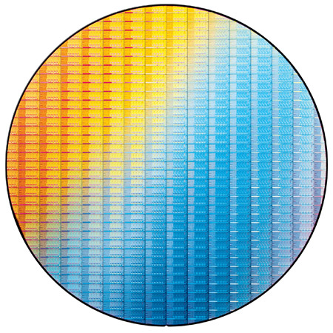
1. Introduction (1)
1. Introduction
Manufacturing of processor chips
Processor chips are produced on wafers, as seen in the example below.
Example: 22 nm Ivy Bridge chips on a 300 mm wafer [1]

Slide 5
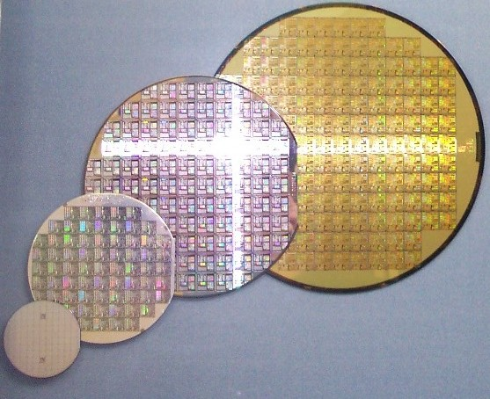
1. Introduction (2)
Early evolution of wafer sizes [2]
8"
6"
4"
2"

Slide 6
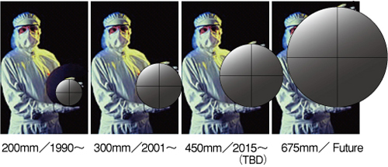
1. Introduction (3)
Subsequent evolution of wafer sizes [3]

Slide 7
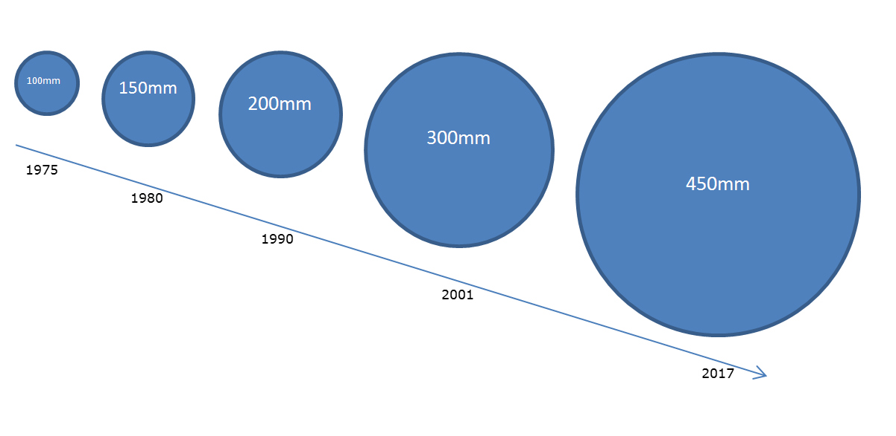
1. Introduction (4)
Introduction dates of larger wafer sizes [4]

Slide 8
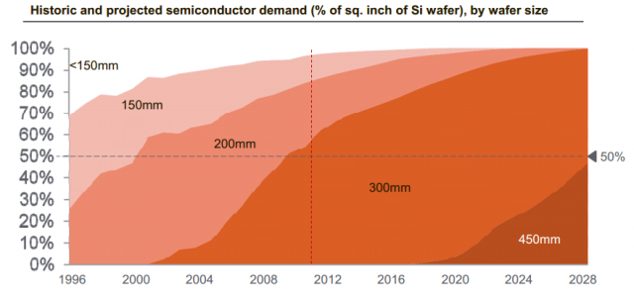
1. Introduction (5)
Historic distribution of wafer sizes actually produced [4]

Slide 9
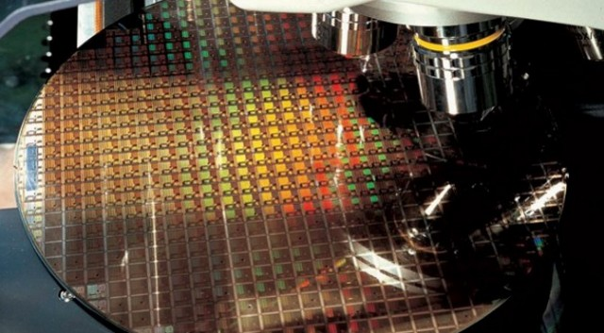
1. Introduction (6)
Visual checking of chips [5]

Slide 10
1. Introduction (7)
The IC production process
IC production needs 200 - 300 process steps, based on a number of masks, and includes
steps such as diffusion, etching, checkings etc..
The whole production process lasts about two to three months.
IC production facilities are called foundries or fabs.

Slide 11
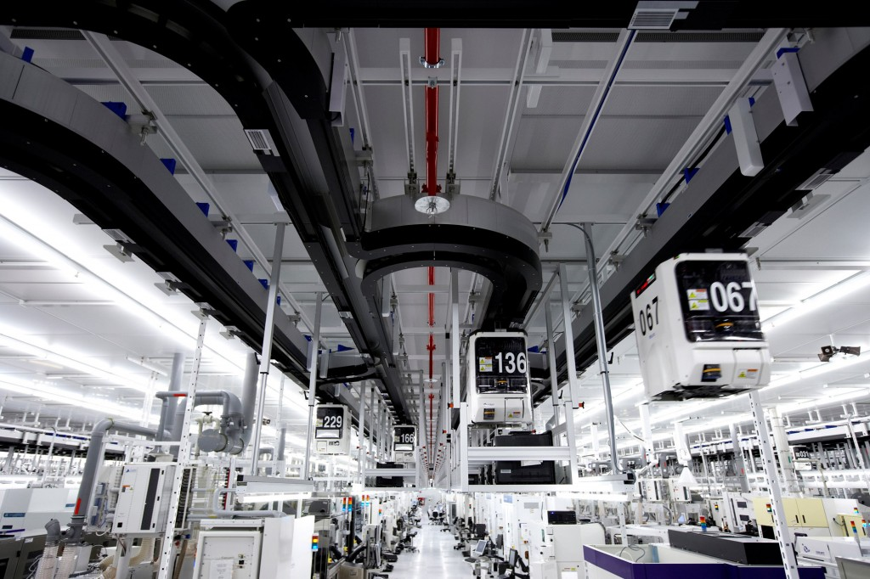
1. Introduction (8)
Internal view of a part of a foundry [6] -1

Slide 12
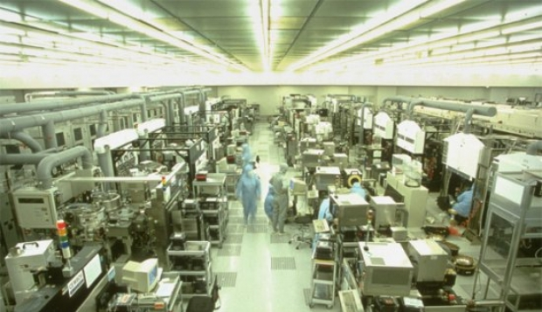
1. Introduction (9)
Internal view of a part of a foundry [7] -2

Slide 13
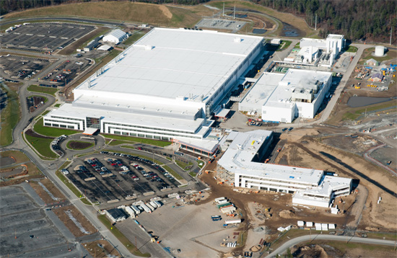
1. Introduction (10)
Bird's eye view of a foundry
Figure: Bird's eye view of Globalfoundries Fab 8 in New York (2012) producing 32 nm chips [8]

Slide 14
1. Introduction (11)
The cost for establishing a foundry
About 3 - 10 billion USD, increasing for smaller feature sizes.

Slide 15
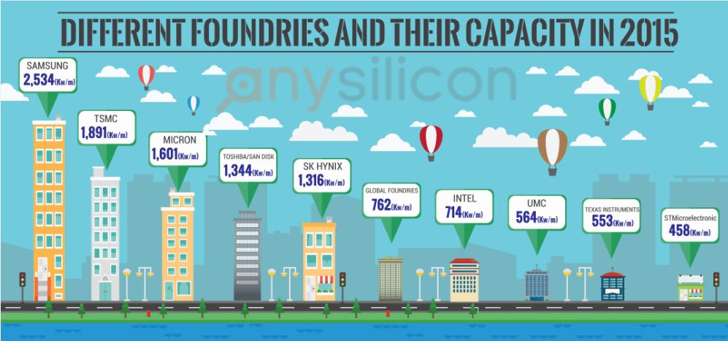
1. Introduction (12)
Production capacity of major vendors with foundries [9]
Kw/m: Kilowafer per month in 200 mm equivalents
Fabs which overtake orders for IC fabrication

Slide 16
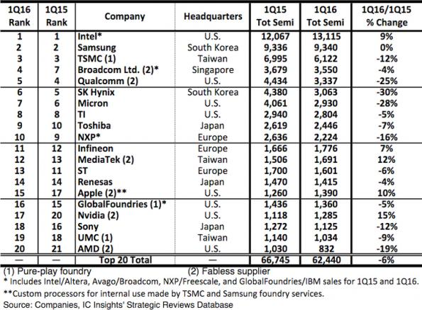
1. Introduction (13)
Sales revenues of the top 20 chip vendors (million USD) [10]
Pure-play foundry: A foundry without any semiconductor design capability.

Slide 17
1. Introduction (14)
Number of foundries owned by major firms
Major firms have a number of foundries for each current feature size (e.g. for 22 nm, 14/16 nm)
and also they continuoualy invest to build next generation fabs (e.g. recently 10 nm fabs).

Slide 18
1. Introduction (15)
Example: Intel’s 22 nm foundires [1]

Slide 19
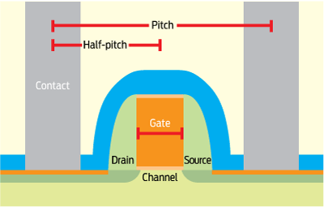
1. Introduction (16)
Characterizing process technology
Traditionally, IC process technologies are characterized by the minimum feature size.
Interpretation of the minimum feature size for MOS transistors:
It is the minimum length of the MOS transistor channel between the drain and the source.
Accordingly, the minimum feature size was interpreted traditionally as the gate length,
as indicated below:

Slide 20
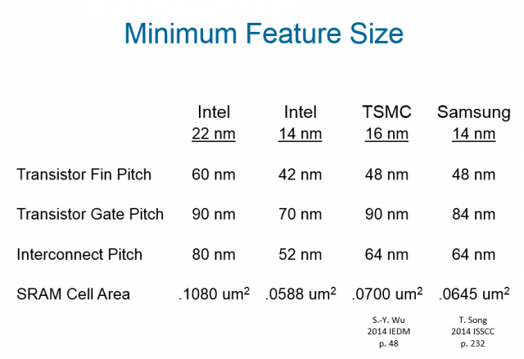
1. Introduction (17)
Recent interpretation of the minimum feature size
Recently, the minimum feature size is interpreted as the technology node.
It identifies the process technology of a given IC foundry (e.g. to be 22 nm or 14 nm node).
Then, process parameters cannot be simple derived from the feature size as before,
instead, select parameters relating to the same technology node can differ significantly, e.g.
by 20 %, from each other for the same process implemented by different vendors, as seen
in the Table below.
Table: MOS transistor parameters of different foundries belonging to 14 to 22 nm nodes [5]

Slide 21
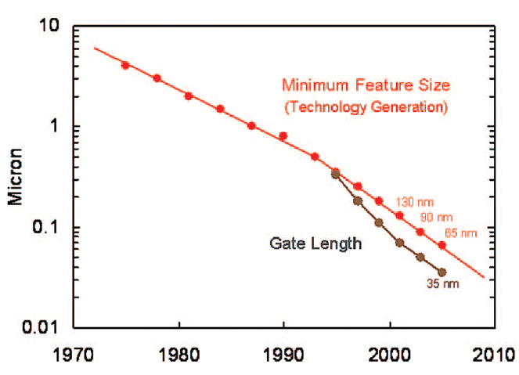
1. Introduction (18)
Shortening the minimum feature size in the course of the evolution of IC technology
For process technologies (rougly below 300 nm) the gate length became shorter than the
minimum feature size (node), as shown below for Intel's MOS processes.
Gate length
Minimum feature size
Figure: Gate length in Intel's subsequent MOS technologies [11]
As an example, in Intel's 65 nm technology the gate length amounts only to 35 nm.

Slide 22
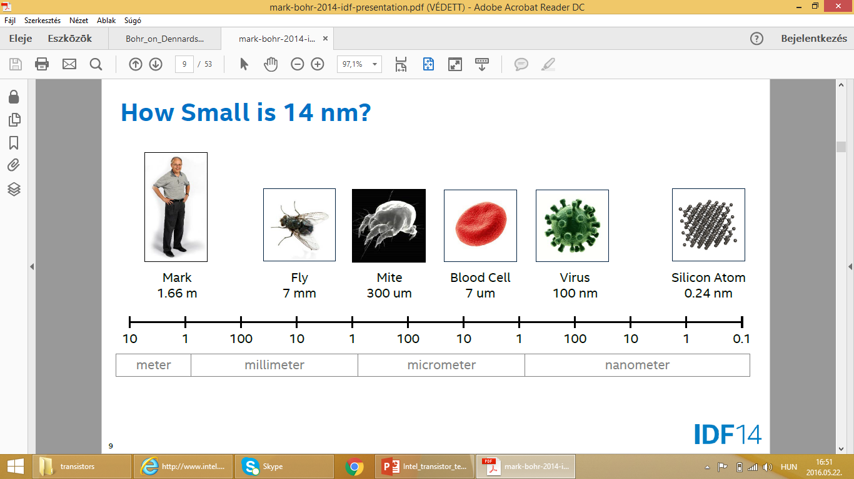
1. Introduction (19)
Illustrating a feature size of 10 nm [12]

Slide 23
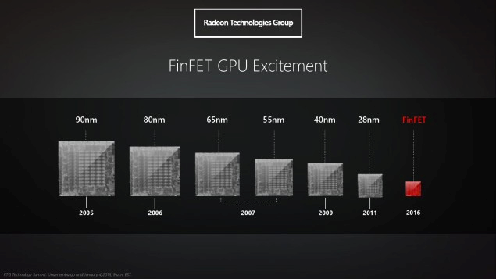
1. Introduction (20)
Historical evolution of AMD's GPU chip technology [13]
AMD at CES 2016 Polaris

Slide 24
2. Moore's law
Notes:
24

Slide 25
2. Moore’s law (1)
2. Moore's law
First planar transistors (~1959) and first integrated circuits (~1961) [14]

Slide 26

2. Moore’s law (2)
Original publication of Moore's law in 1965, stating that transistor counts double roughly
every year [15]

Slide 27
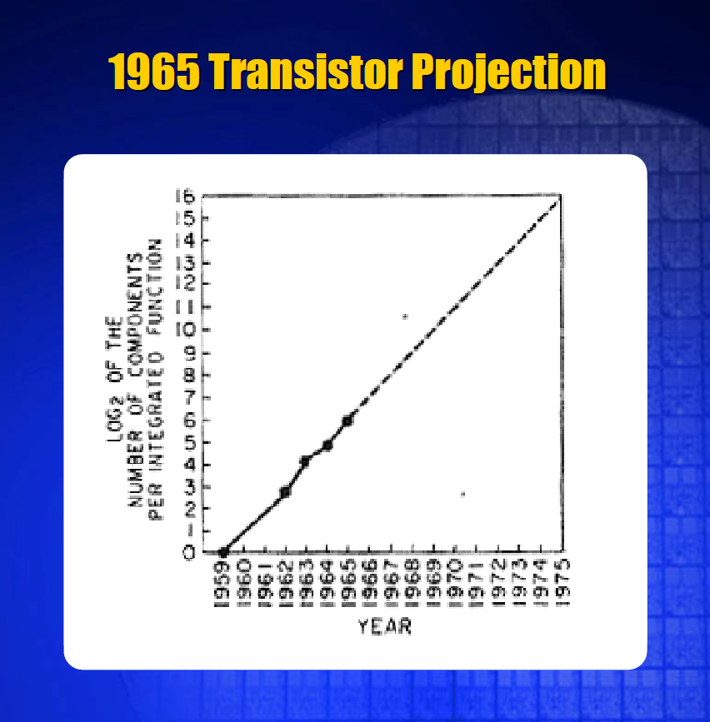
2. Moore’s law (3)
Moore’s original projection for increasing the number of components per IC [14]
Moore’s law

Slide 28
2. Moore’s law (4)
Implication of Moore's law to the emergence of 1K DRAMs and microprocessors -1
First commercially usable memory or microprocessor chips (1 Kb DRAMs, 4-bit microprocessors)
needed n×10³ transistors, as seen in the Figure below.

Slide 29
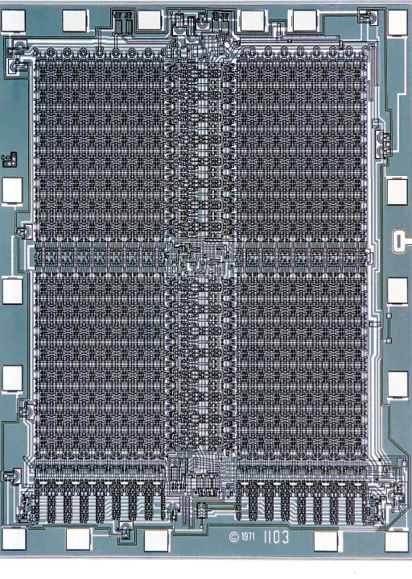
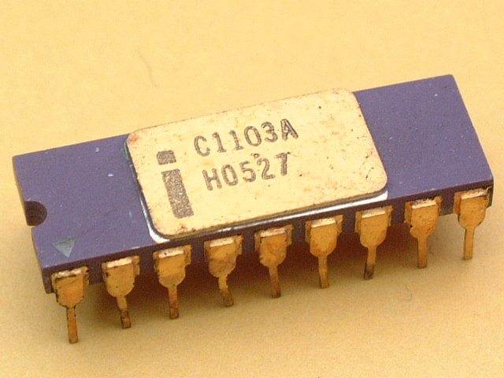
2. Moore’s law (5)
Intel's first 1 Kbit dynamic DRAM chip, the 1103 (Oct. 1970)
Main features:
1 Kx1-bit structure, pMOS technology, 3T (three-transistors per bit) design,
two power supplies (+16 V/+19 V), non-multiplexed addressing, 18-pin package.
Figure: Intel’s 1103 [17]
Figure: Die photo of Intel’s 1103 [18]

Slide 30
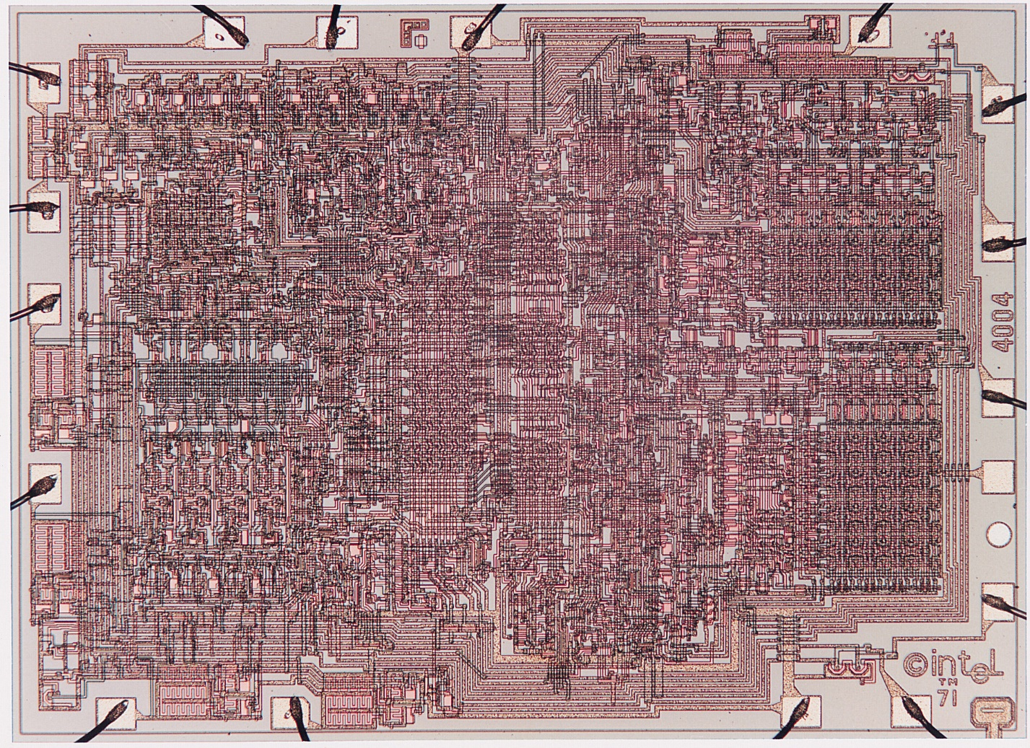
2. Moore’s law (6)
Intel's first microprocessor, the 4004 [16]
2300
transistors
Introduced:
11/1971

Slide 31
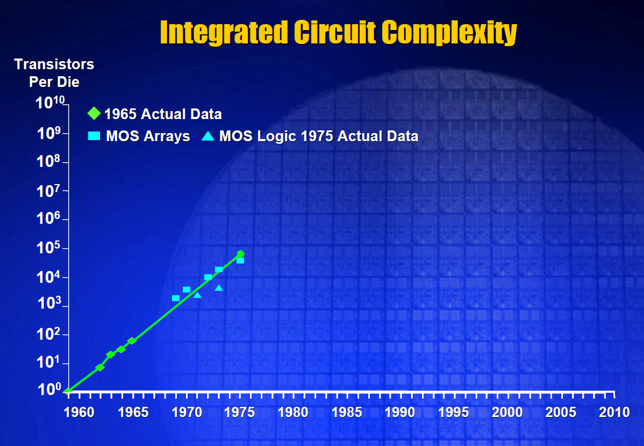
2. Moore’s law (7)
Implication of Moore's law to the emergence of 1K DRAMs and microprocessors -3
Due to Moore’s (oroginal) low, the integration of 2¹⁰ transistors on a chip needs ~ 10 years.
The implementation of first DRAMs and microprocessors needed a few thousand transistors.
1970/1971 became the birth years of DRAMs and microprocessors.
Figure: The rise of IC complexity (following Moore’s low) [14]

Slide 32
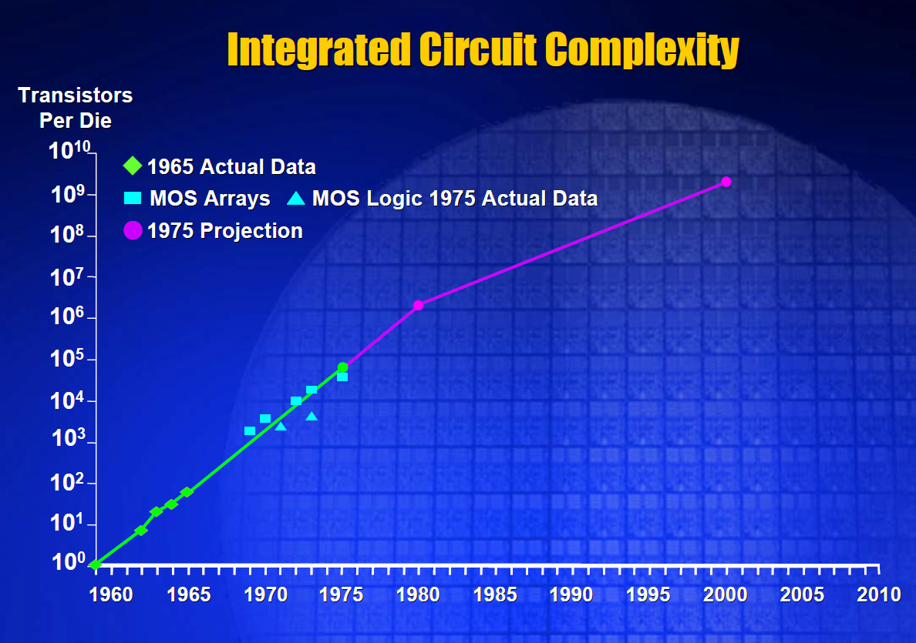
2. Moore’s law (8)
Moore’s revised law from 1975 [14]
~2x/2 years
~2x/1 year

Slide 33
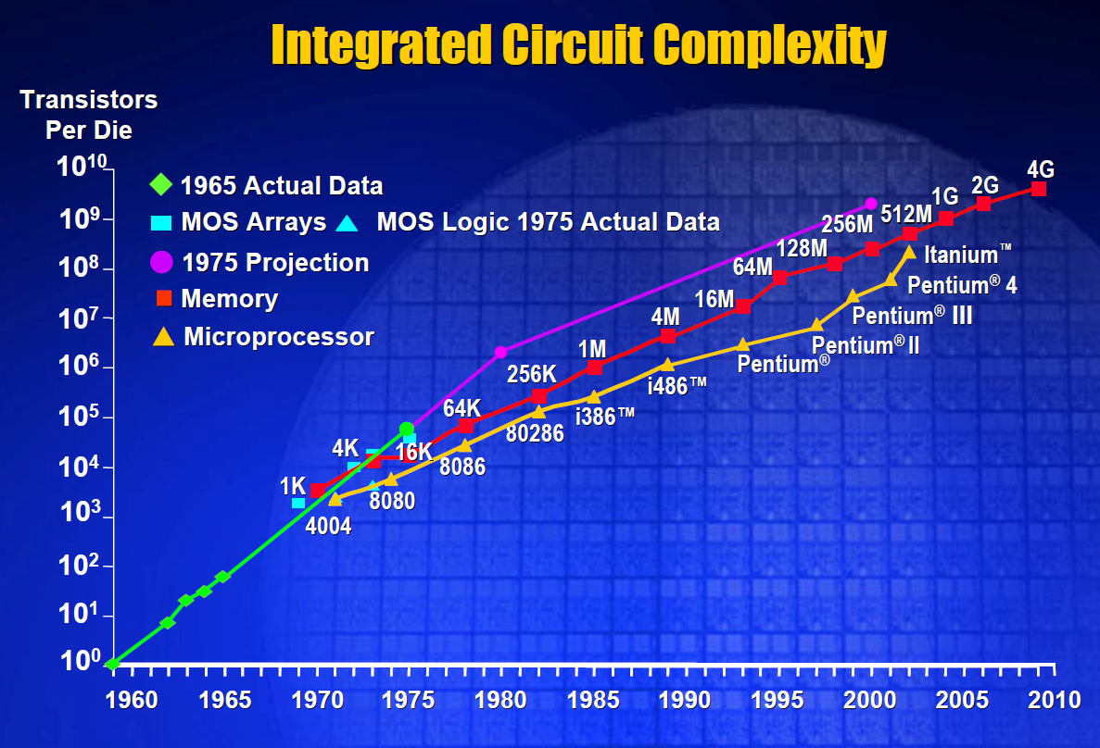
2. Moore’s law (9)
The actual rise of IC complexity in DRAMs and microprocessors [14]
~2x/2 years
~2x/1 year

Slide 34
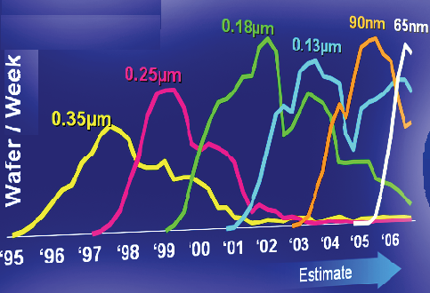
2. Moore’s law (10)
The underlying reason for Moore's law
In fact, Moore's law results from the cadence of the evolution of IC manufacturing technology.
The Figure below shows as an example the evolution of Intel's IC manufacturing technology
between 1995 and 2006.
Scaling: ~ 0.7/2 years
Figure: Evolution of Intel's IC manufacturing technology between 1995 and 2006 -1 [Intro to multicores 1]

Slide 35
2. Moore’s law (11)
Derivation of Moore's law from the scaling of IC manufacturing technology
Assumed scaling of IC manufacturing: ~ 0.7x/2 years
In every two years the same number of transistors can be implemented on ~ ½ Si die area
or
In every two years ~ 2x more transistors can be implemented on the same die area
Moore’s law

Slide 36
2. Moore’s law (12)
Lengthening the cadence of Intel’s technology transitions [36]
Pentium 4
Willamette
nm
200
180 nm
Pentium 4
Northwood
180
11/00
01/02
160
Pentium 4
Prescott
140
130 nm
02/04
120
Pentium 4
Cedar Mill
100
90 nm
01/06
80
Penryn
65 nm
11/07
Westmere
60
45 nm
01/10
Ivy Bridge
40
32 nm
04/12
Broadwell
Cannonlake
22 nm
09/14
14 nm
2H/17
20
10 nm
0
2000
2002
2004
2006
2008
2010
2012
2014
2016
2018
On Intel’s Q2 2015 earnings conference call, on July 16 2015, Krzanich: in the second half of 2017, we expect
to launch our first 10-nanometer product, code named Cannonlake.
The last two technology transitions have signaled that our cadence today is closer to 2.5 years than two“ [37].

Slide 37



2. Moore’s law (13)
Core counts in computing devices
Servers
High-End Desktops
High-End Desktops
Desktops
Laptops
Tablets
Smartphones
Traditional computers
Mobiles
Typical no.
of CPU cores
Up to 28
Up to 10
2 to 4
2 to 4
4 to 8
4 to 8

Slide 38
2. Moore’s law (14)
The rate of rising core counts in Intel's servers
Core
count
32
Broadwell-EX
(14 nm)
24
Ivy-Bridge-EX
(22 nm)
*
16
*
15
Westmere-EX
(32 nm)
Nehalem-EX
(45 nm)
~2x/4 years
10
*
8
7400
(45 nm)
*
6
7300
(65 nm)
*
4
7000
(90 nm)
*
~2x/2 years
2
*
2006
2008
2010
2012
2014
2016
Year

Slide 39
2. Moore’s law (15)
The rate of rising core counts in AMD's servers
Core
count
32
Piledriver 6300
2xWarsaw die
(32 nm)
24
Bulldozer 6200
2xOrochi die
(32 nm)
K10.5 6100
2xIstambul die
(45 nm)
?
16
*
15
Piledriver 6300
2xAbu Dhabi die
(32 nm)
12
*
10
K10.5/8400
Istambul
(45 nm)
8
K10/8300
Barcelona
(65 nm)
< 2x/4 years
6
*
4
K8/800
Egypt
(90 nm)
*
~2x/2 years
2
*
2006
2008
2010
2012
2014
2016
Year

Slide 40
2. Moore’s law (16)
The rate of rising memory transfer rates in Intel's DT and MP platforms
Transfer rate
(MT/s)
DDR4/2133
DDR3/1866
2400
2000
DDR3
1600
*
x
1600
DDR3
1333
x
*
*
DDR3
1866
DDR3
1066
*
DDR3
1600
1200
DDR2
800
1000
  ~ 2*/4 years
*
x
~ 2*/8 years
800
DDR2
666
DDR3
1066
DDR2
533
*
600
*
x
DDR
400
DDR2
666
DDR
333
*
400
x
DDR
266
*
MP
*
DDR
400
DT
*
200
t₀
2000
2002
2004
2006
2008
2010
2012
2014
2016
Year

Slide 41
2. Moore’s law (17)
Aftermath of the fact that memory speeds rise slower than core counts
In servers core counts rise as fast as technology allows but memory speeds increase
at a slower rate, as seen in the Figures before.
On the other hand to avoid memory bandwidth bottlenecks multicores need proportionally
more bandwidth than single core processors, i.e. an 8-core processor needs 8-times more
bandwidth than a single core processor.
It can be shown that in multicore servers while in subsequent generations both core counts
and memory speeds rise, albeit at different rates, the number of memory channels needed
for providing the same per core memory bandwidth as a baseline design is proportional
with the square root of the core count.
It means that doubling core counts in a baseline design requires approximately √2 times more
memory channels related to the baseline design.
As a consequence, designing the memory subsystem of multicore servers with ever raising
core counts is a sensitive and intricate issue, as discussed in a related Chapter.

Slide 42
3. Brief introduction to MOSFET transistors
It will not be discussed.
Notes:
42

Slide 43
3. Brief introduction to MOSFET transistors (1)
3. Brief introduction to MOSFET transistors
MOSFET: Metal-OXid-Semiconductor Field-Effect Transistor
MOSFET is often abreviated as MOS.
For simplicity, we consider only enhancement mode MOS transistors, as these devices are
the most common building elements of microprocessors.
Enhancement mode MOS transistors are off when the gate-source voltage is zero and will be
turned on for appropriate positive values of the gate-source input voltage.
MOSFET transitors
nMOS transistors
pMOS transistors

Slide 44
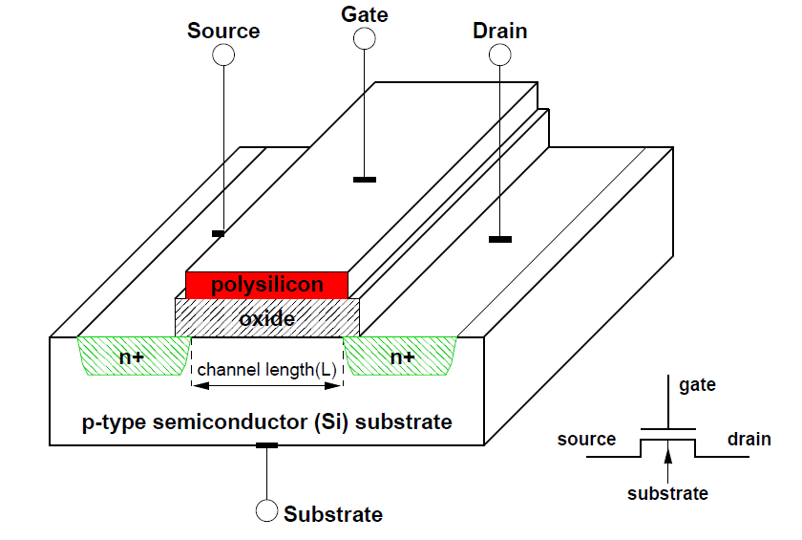
3. Brief introduction to MOSFET transistors (2)
Internal structure of the nMOS (nMOSFET) transistor [19]
The Source and the Drain are implemented as two highly (n+) doped diffusion regions.
Dpoing (e.g. by arsenid) aims at providing additional free electrons.
The area in-between forms a channel with controllable conductivity.
The Gate is built from a conductor, typically polysilicon, and is insulated from the Source-
Channel-drain structure by a layer of silicon dioxide (SiO2).
The voltage between the gate and the substrate induces an electric field which controls the
flow of electrons in the channel.
This gives rise to the name: Field-Effect Transistor (FET).

Slide 45
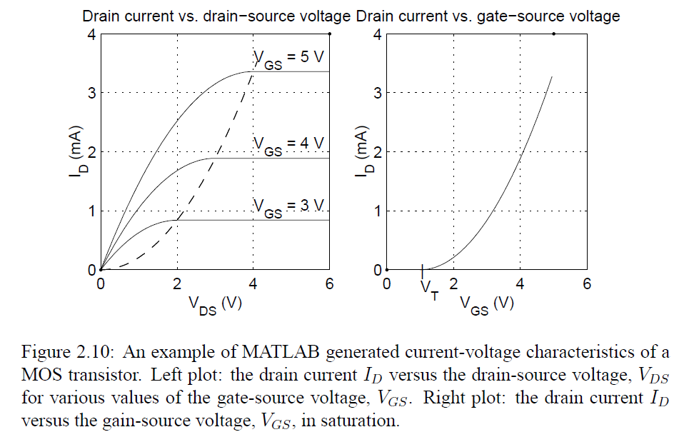
3. Brief introduction to MOSFET transistors (3)
Operation of the nMOS transistor [19] -1
The nMOS transistor has three operational regions.
Switched off region of the operation
If the Gate-Source voltage (VGS) is less than the Thrashold voltage (VT) (i.e. if VGS < VT)
the transistor is switched off, no Drain current is flowing, as the Figure on the left shows.
The transistor is also in the switched off state when VDS = 0, as indicated in the Figure
on the right.
Figure: ID vs. VGS and ID vs. VDS characteristics of the nMOS transistor [19]

Slide 46
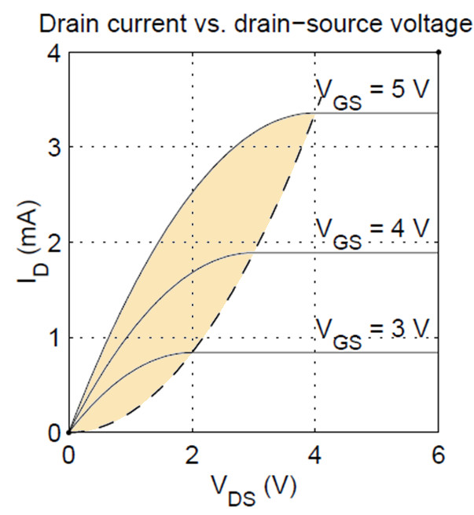
3. Brief introduction to MOSFET transistors (4)
Operation of the nMOS transistor [19] -2
b) Linear region of the operation
If VGS > VT and 0 < VDS < VSAT, the transistor operates in the linear state,
as the Figure on the right shows.
V_{SAT}
Figure: ID vs. VGS and ID vs. VDS characteristics of the nMOS transistor [19]

Slide 47
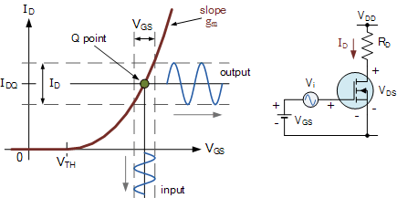
3. Brief introduction to MOSFET transistors (5)
Using the linear region of operation of an nMOSFET transisitor to built an amplifier [20]

Slide 48
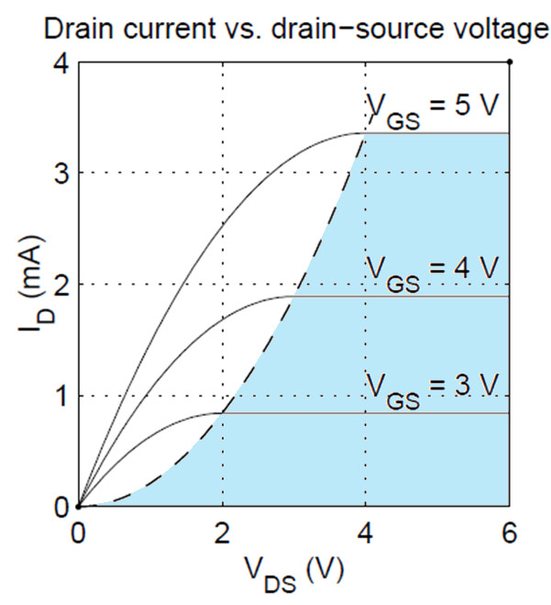
3. Brief introduction to MOSFET transistors (6)
Operation of the nMOS transistor [19] -3
c) Saturation region of the operation
If VGS > VT and VDS > VSAT (VDS) , the transistor operates in the saturation state,
as the Figure on the right shows.
, V_{GS} > V_{T}
, V_{GS} > V_{T}
V_{SAT}
Figure: ID vs. VGS and ID vs. VDS characteristics of the nMOS transistor [19]

Slide 49
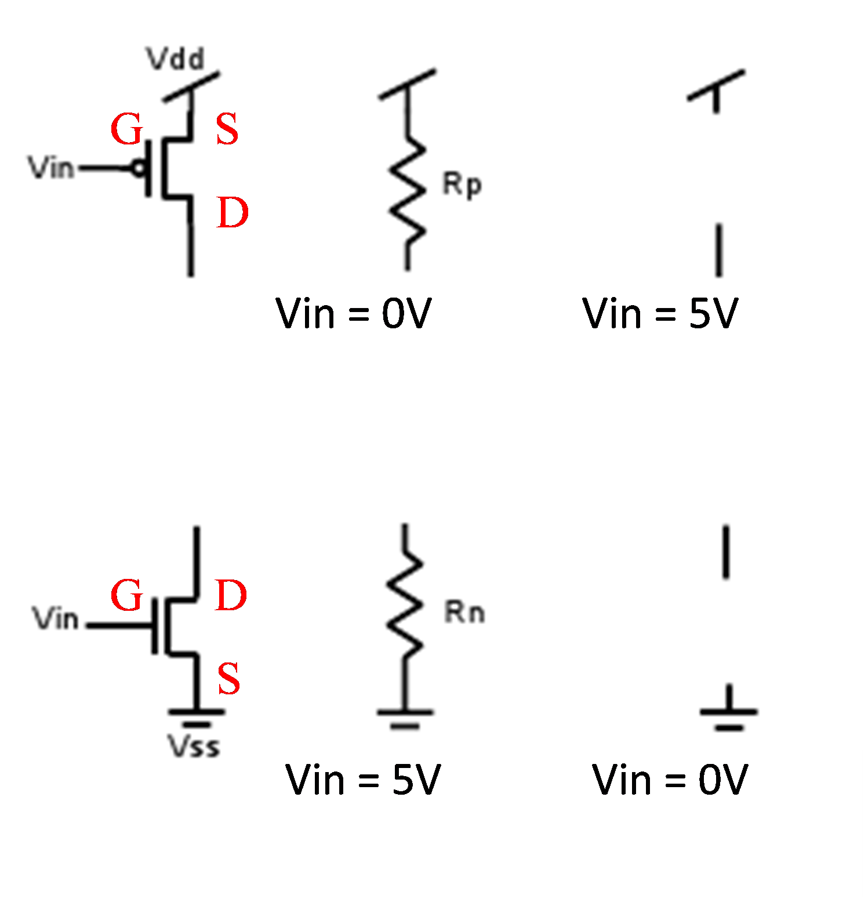
3. Brief introduction to MOSFET transistors (7)
Using an nMOS transistor as a switch
In the saturation region the nMOS transistor operates as a controlled switch, as indicated below.
V_{DS}
V_{DS} = V_{DD}
V_{DS} = V_{DD}
V_{GS}
V_{SS}
V_{GS} = V_{DD}
V_{GS} = 0
On
Off

Slide 50
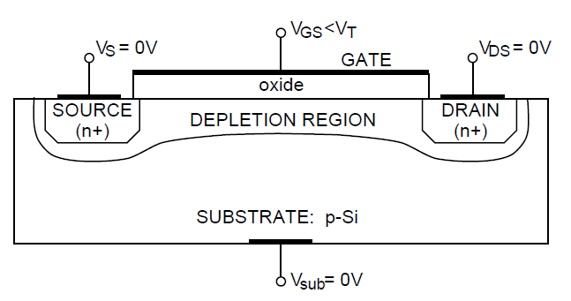
3. Brief introduction to MOSFET transistors (8)
Remark: Physical background of the operation of the enhancement mode nMOS transistor [19] -1
Switched off state
a1) Switched off stated due to VGS < VT (VDS is irrelevant and can be 0)
Figure: Formation of a depletion region in an enhancement-mode nMOS FET [19].
The electric field induced by the gate voltage points down from the gate through the
channel.
This fields repels the majority carriers (that is positive holes) of the p-type substrate,
from the channel hence forming a region depleted of carriers as shown in the Figure
above.
As a result, due to the lack of free carriers, no current will flow between the source and
the drain in this case, that is, ID = 0.
The threshold voltage VT depends on the actual fabrication technology and usually is
about 0.5V.

Slide 51
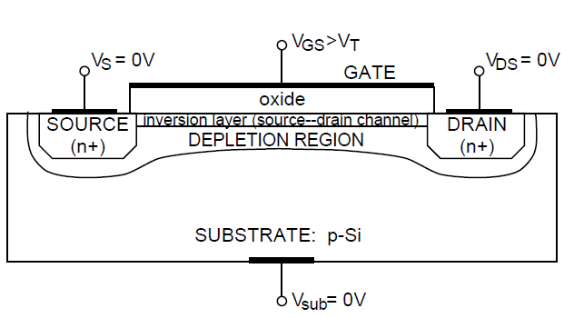
3. Brief introduction to MOSFET transistors (9)
Remark: Physical background of the operation of the enhancement mode nMOS transistor [19] -2
a2) Switched off stated due to VGS > VT and VDS = 0
Figure: Formation of the
conducting channel (inversion layer) in an enhancement mode nMOS [19].
When the gate voltage VGS increases above the threshold voltage VT, then the electric field
repels more holes from the channel area leaving an excess of electrons.
The field also pulls out electrons from the source and drain areas which have excess of
electrons since they are n+ regions.
As a result, in the channel area an inversion layer is formed in which there is an excess of
negative carriers, that is, electrons.
In other words a conducting channel has been formed between the source and drain.
But as the drain-source voltage is assumed to be 0, (VDS = 0) no drain corrent ID flows
in the channel (ID = 0).

Slide 52
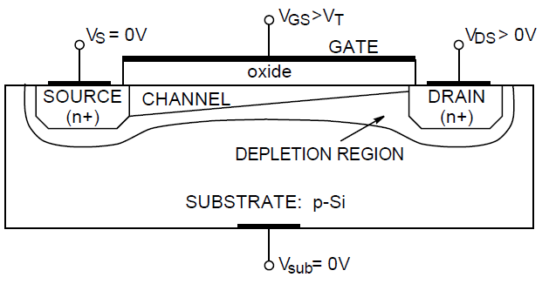
3. Brief introduction to MOSFET transistors (10)
Remark: Physical background of the operation of the enhancement mode nMOS transistor [19] -3
b) Linear state
If VGS > VT and 0 < VDS < VSAT
Figure: an nMOS
transisitor operating
in the linear region.
In this case, there are free electrons in the conducting channel, and when the drain-source
voltage increases above zero, VDS > 0, the negative carriers (electrons) will flow from the
source to the drain, resulting in a source-drain current, i.e. ID starts to flow.
When the VDS voltage is relatively small, the transistor operates in the so-called linear
region.
In this region of operation the drain current ID is a quadratic function of the source-drain
voltage, VDS.

Slide 53
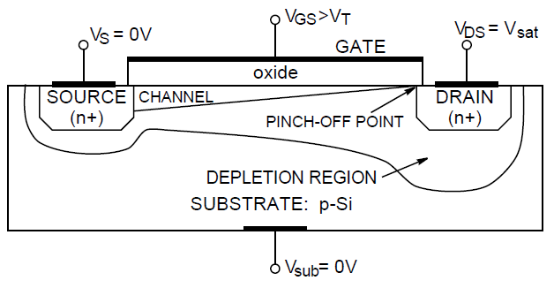
3. Brief introduction to MOSFET transistors (11)
Remark: Physical background of the operation of the enhancement mode nMOS transistor [19] -4
c) Saturation state
If VGS > VT and VDS > VSAT (VDS) , the transistor operates in the saturation region.
Figure: the nMOS
transistor operating
in the saturation region.
When the source-drain voltage, VDS, reaches a certain value, Vsat, the channel depth at the
drain end is reduced to zero.
This is called the pinch-off point (leszűkülési pont).
In other words, at the pinch-off point, VDS = Vsat.
From now on, a further increase of the source-drain voltage does not result in an increase
of the source-drain current and the transistor operates in the saturation mode.

Slide 54
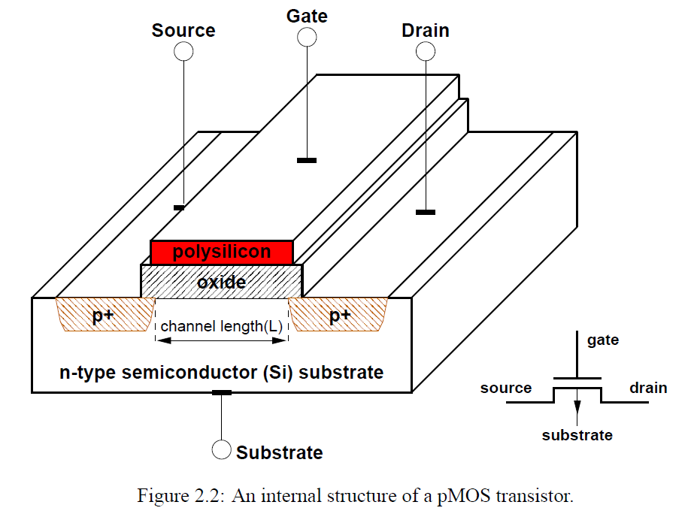
3. Brief introduction to MOSFET transistors (12)
Internal structure of the pMOS transistor [19]
As seen in the Figure, in p-type FET (pMOS) p- and n-types are exchanged.

Slide 55
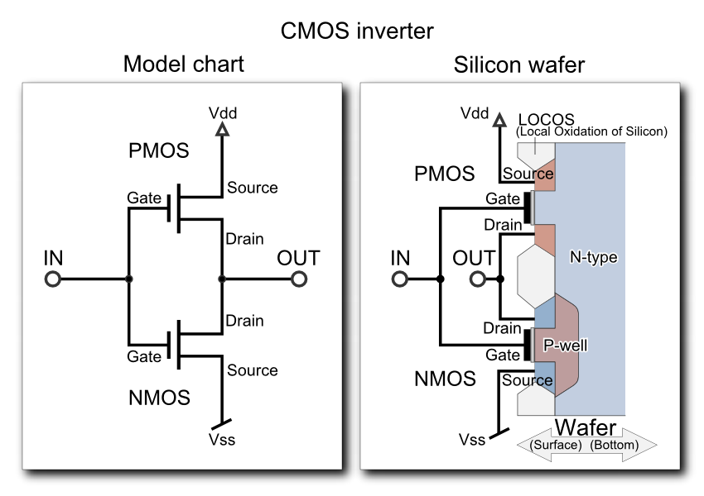
3. Brief introduction to MOSFET transistors (13)
CMOS (Complementary-Metal-Oxid semiconductor) inverter
A CMOS inverter consists of a pMOS and an nMOS transistor connected in series,
as indicated in the Figure below.
Figure: Schematics of a CMOS inverter [21]

Slide 56
3. Brief introduction to MOSFET transistors (14)
Simplified view of the operation of the inverter
In a simplified view the inverter operates as two switches connected in series, as seen below.
+V_{dd}
+V_{dd}
pMOS
If V_{in} is low
pMOS switch is on,
nMOS switch is off
V_{out} = +V_{dd}
Source
Gate
Source
Gate
pMOS
switch
Drain
Drain
V_{in}
V_{out}
V_{in}
V_{out}
Drain
Gate
Drain
Gate
nMOS
switch
Source
If V_{in} is high
pMOS switch is off,
nMOS switch is on
V_{out} = V_{ss} (GND)
nMOS
Source
V_{SS} (GND)
V_{SS} (GND)
Schematics of an inverter
Simplified view of its operation
Simplified principle of operation: From both switches one is on and the other one is off.
For low input voltages the pMOS transistor is on, the nMOs transistor is off and accordingly
the output is high.
By contrast, for high input voltages the pMOS transistor is off, the nMOs transistor is on
and accordingly the output is low.

Slide 57
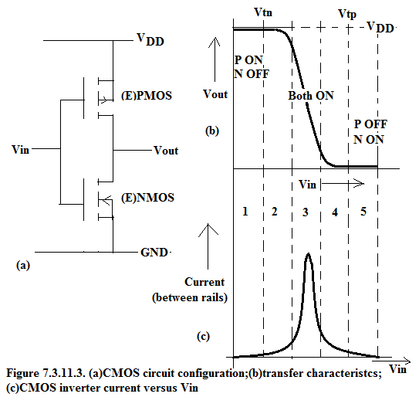
3. Brief introduction to MOSFET transistors (15)
A more accurate description of the operation of the CMOS inverter -1
The operation of a CMOS inverter can be described more accurately by its transfer and current
characteristics, see the Figure below.
Figure: a) Schematics of the inverter, b) Transfer characterisctics of the inverter (V_{out} vs. V_{in}),
c) Inverter current vs. input voltage (V_{in}) [22]

Slide 58
3. Brief introduction to MOSFET transistors (16)
A more accurate description of the operation of the CMOS inverter -2
Note
As figure c) indicates, the CMOS circuit draws current only when it is switched from
one logic state to another.
Consequently, CMOS circuits consumes significantly less power than TTL or nMOS circuits,
which draw current in the on state.
This is the main reason why microprocessors are typically built up of CMOS logic.
Another benefit of the CMOS circuits is their high noise immunity resulting from the
saturation mode operation.

Slide 59
3. Brief introduction to MOSFET transistors (17)
Implementation of a CMOS inverter on a Si die [21]

Slide 60
4. Evolution of transistor technology
4.1 Overview
4.2 The scaling law of MOSFET technology
4.3 Strained Si technology
4.4 The HKMG transistor
4.5 FinFET transisitors
Notes:
60

Slide 61
4.1 Overview of the evolution of transistor technology
Notes:
61

Slide 62
4.1 Overview of the evolution of transistor technology (1)
4.1 Overview of the evolution of transistor technology
Historical data on scaling down IC tecnology [23]
10 µm | 1971
6 µm | 1974
3 µm | 1977
1.5 µm | 1982
1 µm | 1985
800 nm | 1989
600 nm | 1994
350 nm | 1995
250 nm | 1997
180 nm | 1999
130 nm | 2001
90 nm | 2004
65 nm | 2006
45 nm | 2008
32 nm | 2010
22 nm | 2012
14 nm | 2014
10 nm | 2017
7 nm | 2019
Remark
Until recently typically Intel lead the way for scaling down feature sizes.

Slide 63
4.1 Overview of the evolution of transistor technology (2)
Overview of scaling down feature sizes in Intel’s basic microarchitectures (Based on [24])
1. gen.
2. gen.
3. gen.
4. gen.
5. gen.
6. gen.
Core 2
New
Microarch.
65 nm
Penryn
New
Process
45 nm
Nehalem
New
Microarch.
45 nm
West-
mere
New
Process
32 nm
Sandy
Bridge
New
Microarch.
32 nm
Ivy
Bridge
New
Process
22 nm
Haswell
New
Microarchi.
22 nm
Broad-
well
New
Process
14 nm
Skylake
New
Microarchi.
14 nm
TOCK
TICK
TOCK
TICK
TOCK
TICK
TOCK
TICK
TOCK
1/2008
1/2010
Clarkdale
4/2012
9/2014

Slide 64
4.1 Overview of the evolution of transistor technology (3)
Main contributions for the evolution of transistor technology
Main contributions for the evolution of transistor technology
The scaling law of
MOSFET technology
Strained
silicon technology
HKMG
transistors
FinFET
transistors
Used by Intel at
130 nm and before
90/65 nm
45/32 nm
22 nm and below
Section 4.2
Section 4.3
Section 4.4
Section 4.5
Methodology to produce
smaler feature sizes
Innovation
to improve speed
Required innovation
to reduce leaking current
and continue scaling down
Innovation
to improve speed and
power consumption

Slide 65
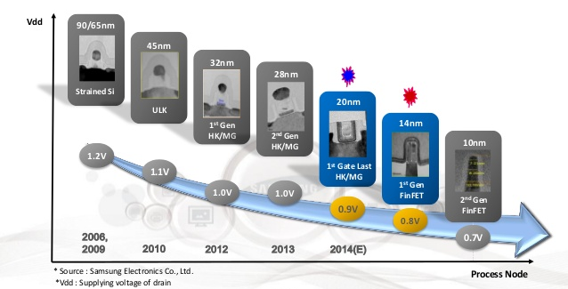
4.1 Overview of the evolution of transistor technology (4)
Decreasing the core voltage (and dissipation) in Samsung's subsequent IC processes [25]

Slide 66
4.2 The scaling law of MOSFET technology
Notes:
66

Slide 67
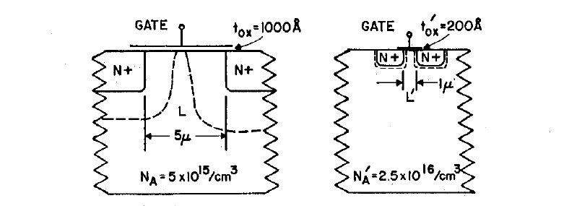
4.2 The scaling law of MOSFET technology (1)
4.2 The scaling law of MOSFET technology
The early evolution of transistor manufacturing technology was marked by scaling down
its structure.
The principle of scaling were laid down by a paper of Dennard in 1974 [26] based on research
work done by IBM.
Dennard's paper presumes a linear scaling of the transistor dimensions, as shown below.
Figure. Illustration of scaling down a transistor structure (commercially available at the
time of the publication) by a linear factor of k=5 [26]

Slide 68
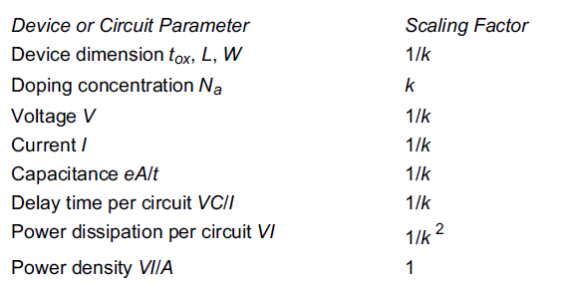
4.2 The scaling law of MOSFET technology (2)
Scaling down MOSFET transistor structures
The cited publication states how circuit parameters have to be be scaled down,
(see the Table below).
Table: Scaling of transistor and circuit parameters [26]
As the Table shows when scaling down transistor dimensions by a factor of k, relevant
transistor parameters, such as transistor dimensions, the supply voltage, currents need
also be scaled down by the same factor k.
Scaling down of transistor dimensions by a factor of k ideally reduces delay time by a factor
of k and the power dissipation of the circuit by a factor of k².
Here we note that albeit the power dissipation of a single transistor is scaled down by k²,
there are now k² times as many transistors on the same area as before, so a die of the
same dimensions as before consumes the same power as before. in other words
the power density remains constant.

Slide 69
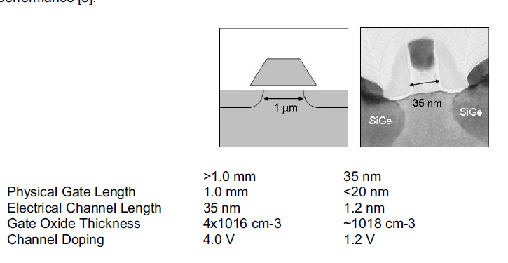

4.2 The scaling law of MOSFET technology (3)
Contrasting scalied down transistor structures from the middle of 1970's to about 2005
[11]
Transistor structure
in the middle of the 1970's
Intel's 65 nm transistor
structure (2005)
1 mm

Slide 70
4.2 The scaling law of MOSFET technology (4)
Limits of Dennard's scaling law
Dennard's paper neglects two points that became successively more critical, as follows [11].
At the time of the publication leakage currents could be ignored, as they were on the
order of 10⁻¹⁰, but subsequently till introducing the 65 nm technology they have
increased many orders of magnitude.
Another key point of Dennard's paper was the assumption that gate oxid thickness can be
scaled down further on for a long time.
Here we note that in 65 nm technology the SiO₂ dielectric is only 1.2 nm thick.
At this thickness the dielectric is only about 4 to 5 atomic layers thick and does not allow
a further scaling.
Due to these limitations - more or less at achieving the 65 nm technology, Dennard's
scaling law could not be followed further on for reducing transistor structures but
it became necessary to introduce a number of innovations, as discussed next.
Remark
The diameter of a Si atom is ~ 110x10⁻¹² m = 0.1x10⁻⁹ m = 0.1 nm

Slide 71
4.3 Strained Si technology
Notes:
71

Slide 72
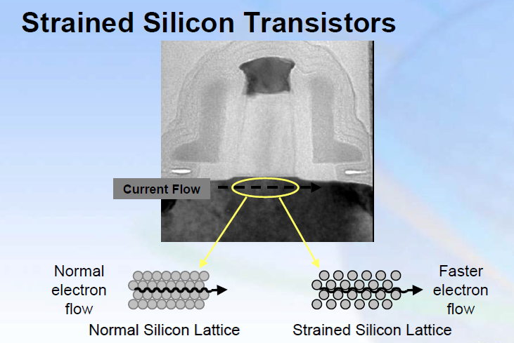
4.3 Strained Si technology (1)
4.3 Strained Si technology
Introduced by Intel along with the 90 nm technology to improve speed.
Principle
By using appropriate IC technologies the Si lattice becomes strained, i.e. the distance betwen
the Si atoms becomes wider, as indicated in the Figure below.
Figure: Principle of the strained Si technology [27]

Slide 73
4.3 Strained Si technology (2)
Benefits and drawbacks of the strained Si technology [27]
Benefits
It increases electron and hole mobility.
Greater mobility results in 10-20 % increase drive currents that raises performance.
Drawback
The strained Si process needs a few additional process steps that increase the total process cost
by less than 2 %.

Slide 74
4.4 The HKMG transistor
Notes:
74

Slide 75
4.4 The HKMG transistor (1)
4.4 The HKMG transistor
HKMG means High-k Metal Gate.
1. gen.
2. gen.
3. gen.
4. gen.
5. gen.
6. gen.
Core 2
New
Microarch.
65 nm
Penryn
New
Process
45 nm
Nehalem
New
Microarch.
45 nm
West-
mere
New
Process
32 nm
Sandy
Bridge
New
Microarch.
32 nm
Ivy
Bridge
New
Process
22 nm
Haswell
New
Microarchi.
22 nm
Broad-
well
New
Process
14 nm
Skylake
New
Microarchi.
14 nm
TOCK
TICK
TOCK
TICK
TOCK
TICK
TOCK
TICK
TOCK
Figure: Intel’s Tick-Tock development model (Based on [24])
HKMG transistors has been introduced by Intel along with the Penryn family of processors in 2007.

Slide 76
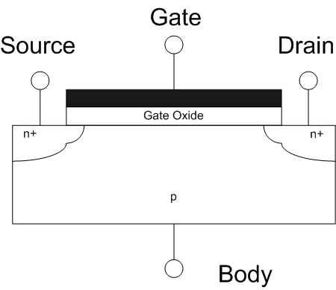
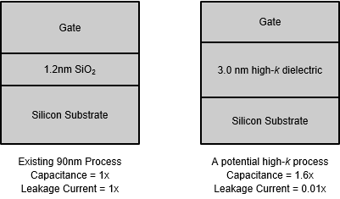
4.4 The HKMG transistor (2)
Limitation of MOSFET scaling in respect to the gate oxid (insulator) layer [28]
Layout of an nMOS transistor
Example implementation
of the gate oxid layer at 90 nm
When transistor structures have been scaled down to about 90 or 65 nm the width of the SiO₂
layer became as short as about 1 nm.
However, the distance between SiO₂ molecules is about 0.3 nm so for example a 1.2 nm SiO₂
layer is only about 4 SiO₂ molecules wide [29].
As a consequence, while transistor structures were scaled down to the low feature sizes of
90 or 65 nm the leakage current rose drastically, as the next figure shows.

Slide 77
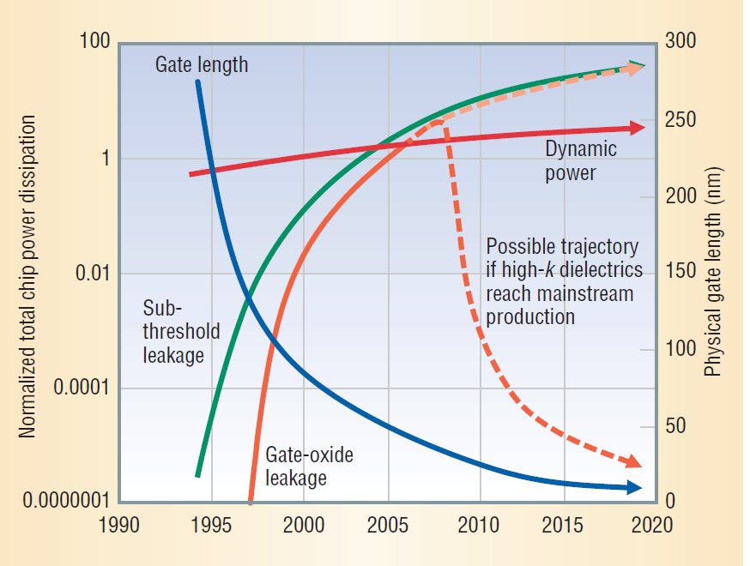
4.4 The HKMG transistor (3)
The need to introduce new transistor design [30]
Sub-threshold =
Source-Drain
Figure 3.1.1: Dynamic and static power dissipation trends in chips [30]

Slide 78

4.4 The HKMG transistor (4)
Principle of the HKMG transistor [28]
The gate oxide layer in a MOSFET can be modeled as a parallel plate capacitor.
The capacitance C of this parallel plate capacitor is given by
1.2 nm SiO₂
Where
A is the capacitor area
κ is the relative dielectric constant of the material (3.9 for SiO₂ and > 10 for a high k dielectric)
ε₀ is the permittivity of free space
t is the thickness of the capacitor oxide insulator

Slide 79
4.4 The HKMG transistor (5)
Principle of reducing the leakage current [28]
The thin SiO₂ insulator layer can be replaced by a wider high-k dielectric that provides the same
or higher capacitance, as shown below.
The wider high-k insulator layer results in considerable less leakage current, as the Figure
indicates.

Slide 80
4.4 The HKMG transistor (6)
Structure of the HKMG (High-k + Metal Gate) transistor [31]

Slide 81
4.4 The HKMG transistor (7)
Benefits of HKMG transistors [31]

Slide 82
4.5 FinFET transistors
4.5.1 Introduction to the FinFET transistors
4.5.2 Intel's 22 nm FinFET transistor
4.5.3 Intel's 14 nm FinFET transistor
Notes:
82

Slide 83
4.5.1 Introduction to the FinFET transistors
Notes:
83

Slide 84
4.5.1 Introduction to the FinFET transistors (1)
4.5.1 Introduction to the FinFET transisitors
The FinFET transistor is termed also as Tri-gate or 3D transistor.
The term FinFET (Fin Field Effect Transistor) was coined in 1999 by researchers at the
University of California, Berkley, nevertheless, first commercial implementations appiered
only more than 10 years later in 2012 by Intel under the designation Tri-gate transistor.
There is no consensus about how to designate MOS tranasistor structures using fins,
a few firms like IBM, AMD or the foundries TSMC or GlobalFoundries make use of the term
FinFET whereas Intel dubs such transistor structures as Tri-gate transistors.
Until now Intel developed two generations of FinFET transistors.
Intel's FinFET generations
Intel's 22 nm FinFET transistor
Intel's 14 nm FinFET transistor
First generation FinFET
Second generation FinFET
Appeared along with
Ivy Bridge line (4/2012)
Broadwell line (6/2015)

Slide 85
4.5.2 Intel's 22 nm FinFET transistor
Notes:
85

Slide 86
4.5.2 Intel’s 22 nm FinFET transistor (1)
4.5.2 Intel's 22 nm FinFET transistor -1
1. gen.
2. gen.
3. gen.
4. gen.
5. gen.
6. gen.
Core 2
New
Microarch.
65 nm
Penryn
New
Process
45 nm
Nehalem
New
Microarch.
45 nm
West-
mere
New
Process
32 nm
Sandy
Bridge
New
Microarch.
32 nm
Ivy
Bridge
New
Process
22 nm
Haswell
New
Microarchi.
22 nm
Broad-
well
New
Process
14 nm
Skylake
New
Microarchi.
14 nm
TOCK
TICK
TOCK
TICK
TOCK
TICK
TOCK
TICK
TOCK
Figure: Intel’s Tick-Tock development model (Based on [24])
Introduced along with the Ivy Bridge family of processors in 2012.

Slide 87
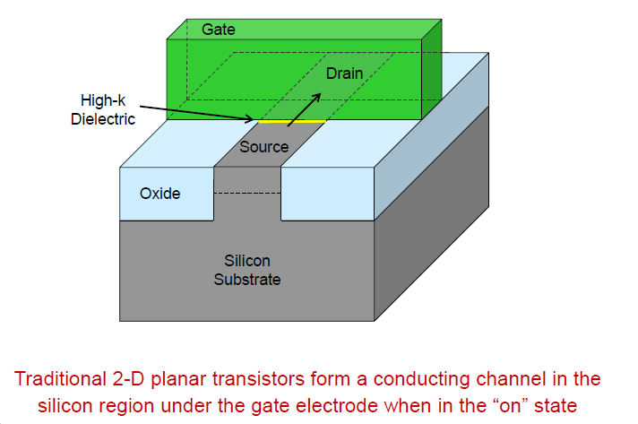
4.5.2 Intel’s 22 nm FinFET transistor (2)
The traditional planar transistor [1]

Slide 88
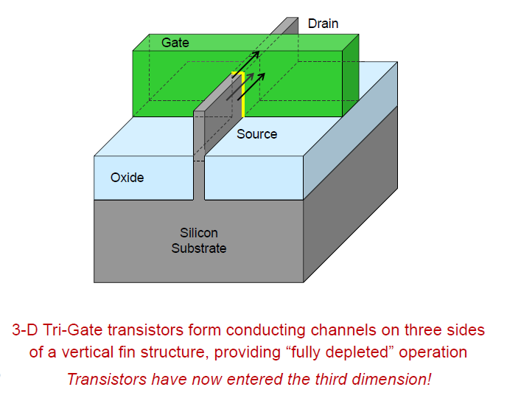
4.5.2 Intel’s 22 nm FinFET transistor (3)
The 22 nm FinFET transistor -2 [1]
fin
The designation “tri-gate” originates from the fact that now the gate has three sides.

Slide 89
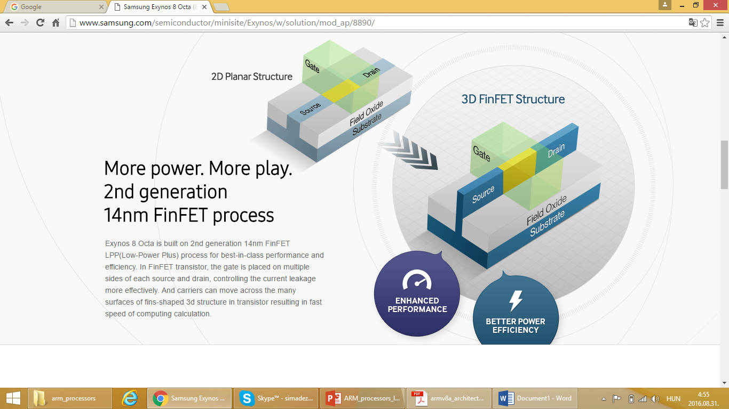
4.5.2 Intel’s 22 nm FinFET transistor (4)
Contrasting 2D planar and 3D FinFET transistor structures [38]

Slide 90
4.5.2 Intel’s 22 nm FinFET transistor (5)
The 22 nm FinFET transistor -3 [1]

Slide 91
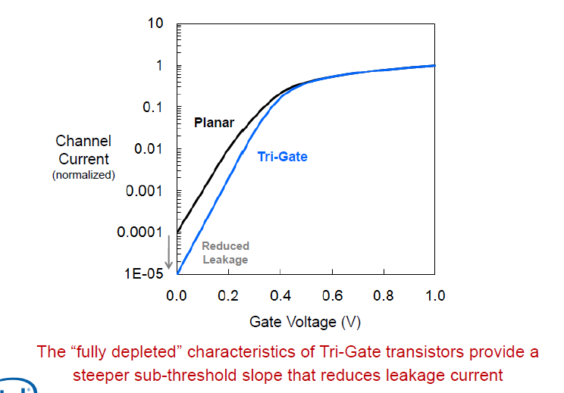
4.5.2 Intel’s 22 nm FinFET transistor (6)
Switching characteristics of the traditional planar and FinFET transistors [1]

Slide 92
4.5.2 Intel’s 22 nm FinFET transistor (7)
Gate delay of the traditional planar and FinFET transistors [1]
Gate delay: time difference between output signal and input signal of a gate (n x ps)

Slide 93
4.5.2 Intel’s 22 nm FinFET transistor (8)
Intel’s 22 nm FinFET manufacturing fabs [1]

Slide 94
4.5.3 Intel's 14 nm FinFET transistor
Notes:
94

Slide 95
4.5.3 Intel’s 14 nm FinFET transistor (1)
4.5.3 Intel's 14 nm FinFET transistor-1
1. gen.
2. gen.
3. gen.
4. gen.
5. gen.
6. gen.
Core 2
New
Microarch.
65 nm
Penryn
New
Process
45 nm
Nehalem
New
Microarch.
45 nm
West-
mere
New
Process
32 nm
Sandy
Bridge
New
Microarch.
32 nm
Ivy
Bridge
New
Process
22 nm
Haswell
New
Microarchi.
22 nm
Broad-
well
New
Process
14 nm
Skylake
New
Microarchi.
14 nm
TOCK
TICK
TOCK
TICK
TOCK
TICK
TOCK
TICK
TOCK
Figure: Intel’s Tick-Tock development model (Based on [24])
Introduced along with the Broadwell family of processors in 2014

Slide 96
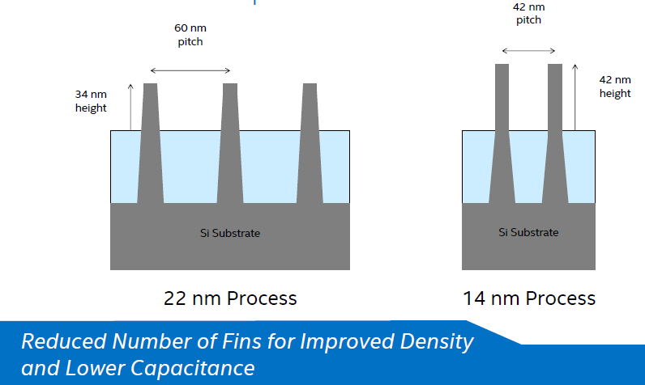
4.5.3 Intel’s 14 nm FinFET transistor (2)
14 nm 2 generation FinFET transistors with fin improvement [12]

Slide 97

4.5.3 Intel’s 14 nm FinFET transistor (3)
14 nm Broadwell SOC yield trend [12]

Slide 98

4.5.3 Intel’s 14 nm FinFET transistor (4)
Benefits of reducing the feature size [12]
New technology generations provide improved performance and/or reduced power,
but the key benefit is improved performance/Watt.

Slide 99

4.5.3 Intel’s 14 nm FinFET transistor (5)
Leakage power vs clock speed for smaller feature sizes [12]
f_{c} > V_{c} for const. nm
V_{c} > I_{l} > D_{s}

Slide 100

4.5.3 Intel’s 14 nm FinFET transistor (6)
Leakage power vs. clock speed for smaller feature sizes in different product sectors [12]

Slide 101
5. Overview of the evolution of Intel's transistor technology from 90 nm to 14 nm
Notes:
101

Slide 102

5. Evolution of Intel’s transistor technology from 90 nm to 14 nm (1)
5. Overview of the evolution of Intel's transistor technology from 90 nm to 14 nm [32]

Slide 103

5. Evolution of Intel’s transistor technology from 90 nm to 14 nm (2)
Evolution of Intel's transistor technology from 130 nm to 32 nm [33]

Slide 104

5. Overview of the evolution of Intel’s transistor technology from 90 nm to 14 nm (3)
Intel's lead in introducing new transistor technologies [15]

Slide 105
5. Evolution of Intel’s transistor technology from 90 nm to 14 nm (4)
Slowing down the cadence of the evolution of Intel’s process technologies
in light of Intel's technology roadmap published in 5/2011 [1]
2015
2017?
New transistor
structures
HKMG
FinFET
1. gen.
FinFET
2. gen.
Related
proc. family
Penryn
Ivy Bridge
Broadwell

Slide 106

5.Evolution of Intel’s transistor technology from 90 nm to 14 nm (5)
Intel’s relative yield trends of their 14 nm technology vs. their 22 nm technology [12]

Slide 107
6. Race of the IC vendors
Notes:
107

Slide 108
6. Race of the IC vendors (1)
6. Race of the IC vendors
Intel's lead in introducing new transistor technologies ut to the 14 nm technology [15]

Slide 109

6. Race of the IC vendors (2)
Intel’s lead in IC technology up to the 22/20 nm node, according to [12]
Logic area scaling
Intel
Others:
TSMC (Taiwan)
GlobalFoundries (Abu Dhabi)
( AMD Microelectronic 2009)
( IBM Microelectronic 2015)
Samsung Semiconductor
(South Korea)
Source: Intel 08/2014

Slide 110
6. Race of the IC vendors (3)
Evolution of IC technology by leading foundries (Partly based on [34])
 | Intel | TSMC | Global Foundries (Acquired AMD/IBM) | Samsung
45nm | HKMG: 11/2007 (Penryn) | - | 1/2009 (Phenom II) | End of 2007
40nm | - | 4/2009 (RV740) | -
32nm | 1/2010 (Westmere Clarkdale) | - | HKMG: 6/2011 (Llano) | HKMG: 6/2010
28nm | - | HKMG: 1/2012 (Tahiti) | 1/2014 (Kaveri) | 9/2013 (Apple A7)
22nm | FinFET 4/2012 (Ivy Bridge) | - | -
20nm | - | Roadmap: Begin of 2013 SoC-products: 1/2014 | Left out in favour of 14 nm technology
16nm | - | Roadmap: 11/2013 FinFET FF+: 7/2015 | -
14nm | Roadmap: 2013 Advanced FinFET CPU-products: 9/2014 (Broadwell) | - | Roadmap: End of 2014 Development cancelled Technology licenced from Samsung (4/2014) | FinFET LPE: 2/2015 FinFET PPE: 1/2016
10nm | Roadmap: 2015 Products expected: 2H/2017 (Cannonlake) | Roadmap: 2016 Products expected: Early 2017 | Roadmap: End of 2015 Products expected: 2017 | Late 2016
7nm | Roadmap: 2017 Products expected: 2018 or 2019 | 2018 | ? | ?
HKMG | With 45 nm (2007) | With 28 nm (2012) | With 32 nm (2011) | With 32 nm (2010)
3D-Transistors | With 22nm (2012) | With 16nm (2015) | With 14 nm (2015) | With 14 nm (2015)

Slide 111

6. Race of the IC vendors (4)
Cooperation of Samsung and GlobalFoundries in 14 nm FinFET production [35]

Slide 112
7. References
Notes:
112

Slide 113
7. References (1)
[1]: Bohr M., Mistry K.: Intel’s Revolutionary 22 nm transistor technology, May 2011,
http://download.intel.com/newsroom/kits/22nm/pdfs/22nm-Details_Presentation.pdf
[2]: Wikipedia, Wafer (electronics),
https://en.wikipedia.org/wiki/Wafer_(electronics)
[3]: The Evolution of AMHS, Daifuku, Jan. 2012,
http://www.daifuku.com/solution/technology/semiconductor/
[4]: Hruska J., Atom Everywhere: Intel breaks ground on first 450mm fab, Extreme Tech,
Aug. 7 2013, http://www.extremetech.com/extreme/163372-atom-everywhere-intel-
breaks-ground-on-first-450mm-fab
[5]: Hruska J., TSMC will begin 10nm production this year, claims 5nm by 2020, Extreme Tech,
Jan. 20 2016, http://www.extremetech.com/computing/221532-tsmc-will-begin-10nm-
production-this-year-claims-5nm-by-2020
[6]: Shilov A., GlobalFoundries to produce 14nm chips in the first half of 2015, KitGuru,
Dec. 18 2014, http://www.kitguru.net/components/graphic-cards/anton-shilov/
globalfoundries-to-produce-14nm-chips-in-the-first-half-of-2015/
[7]: Farrell N., TSMC promises 7nm chips in 2017, Fudzilla, April 22 2015,
http://www.fudzilla.com/news/processors/37587-tsmc-promises-7nm-chips-in-2017
[8]: Shilov A., Globalfoundries' Fab 8 Begins to Produce First Commercial Chips for Customers,
Xbit Labs, Jan. 11 2012, http://www.xbitlabs.com/news/other/display/20120111101201_
Globalfoundries_Fab_8_Begins_to_Produce_First_Commercial_Chips_for_Customers.html

Slide 114
7. References (2)
[9]: Top Semiconductor Foundries Capacity 2015-2016 (Infographic), Anysilicon, Jan. 21 2016,
http://anysilicon.com/top-semiconductor-foundries-capacity-2015-2016-infographic/
[10]: Clarke P., Sales declines dominate 1Q16 chip vendor ranking, EE Times, May 23 2016,
http://www.electronics-eetimes.com/news/sales-declines-dominate-1q16-chip-vendor-ranking-0
[11]: Bohr M., A 30 Year Retrospective on Dennard's MOSFET Scaling Paper, IEEE-SSCS, 2007,
http://www.eng.auburn.edu/~agrawvd/COURSE/READING/LOWP/Boh07.pdf
[12]: Bohr M., 14 nm Technology Announcement, Aug. 11 2014, Intel,
http://download.intel.com/newsroom/kits/14nm/pdfs/Intel_14nm_New_uArch.pdf
[13]: Mujtaba H., NVIDIA Pascal GPU Analysis – An In-Depth Look at NVIDIA’s Next-Gen Graphics
Cards Powering GeForce, Tesla and Quadro, WCCF Tech, Jan. 13 2016,
http://wccftech.com/nvidia-pascal-gpu-analysis/
[14]: Moore G. E., No Exponential is Forever... ISSCC 2003,
ftp://download.intel.com/research/silicon/Gordon_Moore_ISSCC_021003.pdf
[15]: Holt W., Advancing Moore's Law: Benefits Across the Portfolio, Investor Meeting, Nov. 21 2013,
http://www.semiwiki.com/forum/files/Intel%20Manufacturing%20Slides%202013.pdf
[16]: Myslewski R., Happy 40th birthday, Intel 4004! The first of the bricks that built the IT world,
The Register, Nov. 15 2011, http://www.theregister.co.uk/2011/11/15/the_first_forty_
years_of_intel_microprocessors/?page=2
[17]: 2116 Family, 16384 x 1 Bit Dynamic RAM, Data Catalog, Intel, 1977

Slide 115
7. References (3)
[18]: Intel Museum, Historical Documents,
http://download.intel.com/museum/research/arc_collect/history_docs/pix/1103.jpg
[19]: Paplinski A.P., CSE3142 Integrated Circuit Design, Monash University, 2006,
http://www.csse.monash.edu.au/courseware/cse3142/2006/Lnts/C02.pdf
[20]: MOSFET Amplifier, Electronics Tutorials,
http://www.electronics-tutorials.ws/amplifier/mosfet-amplifier.html
[21]: CMOS LOGIC Family, Emaze, https://www.emaze.com/@AIRQLQR/CMOS-LOGIC-FAMILY
[22]: NMOS Inverter vs CMOS Inverter -- transfer characteristics, Edaboard, July 19 2014,
http://www.edaboard.com/thread319744.html
[23]: Wikipedia, 32 nanometer, https://en.wikipedia.org/wiki/32_nanometer
[24]: Singhal R., “Next Generation Intel Microarchitecture (Nehalem) Family: Architecture Insight
and Power Management, IDF Taipeh, Oct. 2008, http://intel.wingateweb.com/taiwan08/
published/sessions/TPTS001/FA08%20IDFTaipei_TPTS001_100.pdf
[25]: Woo NS., Samsung System LSI Business, 2013,
http://www.slideshare.net/fullscreen/bassilis/samsung-analyst-day-2013-slsi-namsung-
woo-samsung-system-lsi-business/15
[26]: Dennard R.H., Gaensslen F.H., et al., Design of Ion-Implanted MOSFET’S with Very Small
Physical Dimensions, IEEE Journal of Solid State Circuits, Oct. 1974,
http://www.eng.auburn.edu/~agrawvd/COURSE/READING/LOWP/Design%20of%20ion-
implanted%20MOSFETs%20with%20very%20small%20physical%20dimensions.pdf

Slide 116
7. References (4)
[27]: Walden J., 90 nm and Beyond: Moore's Law and More, 2002,
http://www.eet.bme.hu/~mizsei/Nanoelektronika/vlsifuture03.pdf
[28]: Wikipedia, High-κ dielectric,
https://en.wikipedia.org/wiki/High-%CE%BA_dielectric
[29]: Misra D., Iwai H., Wong H., High-k Gate Dielectrics, The Electrochemical Society, 2005,
https://www.electrochem.org/dl/interface/sum/sum05/IF08-05_Pg30-34.pdf
[30]: Kim N. S. et al., „Leakage Current: Moore’s Law Meets Static Power”, Computer,
Dec. 2003, pp. 68-75.
[31]: Bohr M., Mistry K., Smith S., “Intel Demonstrates High-k + Metal Gate Transistor
Breakthrough in 45 nm Microprocessors,”, Intel, Jan. 2007,
http://download.intel.com/pressroom/kits/45nm/Press45nm107_FINAL.pdf
[32]: Tyson M., Intel confirms that its first 10nm chips will roll out in H2 2017, Hexus, Febr. 19 2016,
http://hexus.net/tech/news/cpu/90674-intel-confirms-first-10nm-chips-will-roll-h2-2017/
[33]: Jan C-H., RF CMOS Technology Scaling in High-k/Metal Gate Era for RF SoC (System-on-Chip)
Applications, IEDM’10 San Francisco, Dec. 2010, http://www.intel.com.br/content/dam/
doc/technology-brief/32nm-soc-with-rf-cmos-technology-presentation.pdf
[34]: Aktualisierte Fertigungsverfahren-Roadmap: GlobalFoundries & TSMC bei 14nm/16nm fast
zeitgleich, 3DCenter, Sept. 12 2014, http://www.3dcenter.org/news/aktualisierte-
fertigungsverfahren-roadmap-globalfoundries-tsmc-bei-14nm16nm-fast-zeitgleich

Slide 117
7. References (5)
[35]: Moammer K., Samsung and Globalfoundries Beat TSMC to FinFETs – What This Means For
AMD, Nvidia and Intel, WCCF Tech, Dec. 19 2014,
http://wccftech.com/samsung-globalfoundries-tsmc-finfet-production/
[36]: Howse B., Smith R., Tick Tock On The Rocks: Intel Delays 10nm, Adds 3rd Gen 14nm Core
Product "Kaby Lake„, AnandTech, July 16 2015,
http://www.anandtech.com/show/9447/intel-10nm-and-kaby-lake
[37]: Intel's (INTC) CEO Brian Krzanich on Q2 2015 Results - Earnings Call Transcript, Seeking
Alpha, July 15 2015, http://seekingalpha.com/article/3329035-intels-intc-ceo-brian-
krzanich-on-q2-2015-results-earnings-call-transcript?page=2
[38]: Exynos 8 Octa (8890), Samsung, 2016,
http://www.samsung.com/semiconductor/minisite/Exynos/w/solution/mod_ap/8890/

Slide 119

RF CMOS Technology Scaling in High-k/Metal Gate Era for RF SoC (System-on-Chip) Applications Chia-Hong
Jan IEDM ’10, San Francisco 2010
http://www.intel.com.br/content/dam/doc/technology-brief/32nm-soc-with-rf-cmos-technology-presentation.pdf

Slide 120
At the DreamHack gamer gathering in Austin, Texas Friday night
NVIDIA CEO Jen-Hsun Huang unveiled the Pascal GPU based
GeForce GTX 1080 and said
Several thousand people have been working on this project now for more than two years. This is the largest GPU endeavor, the largest chip processor endeavor, in the history of humanity. The R&D budget was several billion dollars,” Huang said.
[206]: NVIDIA CEO Jen-Hsun Huang Unveils GeForce GTX 1080, World’s Most Advanced GPU,
NVIDIA blog, May 06 2016, https://blogs.nvidia.com/blog/2016/05/06/geforce-gtx-1080/

Slide 121

http://hvg.hu/tudomany/20160429_windows_10_mobile_windows_phone_eladasok_microsoft_surface_phone_megjelenese

