Slide 1
Intel’s high-end
Multicore Server Platforms
Dezső Sima
November 2016
(Ver. 1.5)
© Sima Dezső, 2016

Slide 2
Intel’s high-end multicore server platforms
1. Introduction to Intel’ s high-end multicore
server processors and platforms
2. Evolution of Intel’s high-end multicore
server platforms
3. Example 1: The Brickland platform
4. Example 2: The Purley platform
5. References
Notes:
2

Slide 3
Intel’s high-end multicore 4S platforms -1
Remark -1
The material presented in these slides is restricted to Intel’s high-end multicore server processors
and platforms, accordingly previous server systems will not be covered.
Intel's multicore servers emerged based on the 3. core of the Pentium 4 family (on the 64-bit
version of the Prescott core) about 2005.
First they were implemented as two single core parts placed into the same package.

Slide 4
Intel’s high-end multicore 4S platforms -2
Introduction and withdrawal of intel's P4 family

Slide 5
Intel’s high-end multicore 4S platforms -3
Remark -2
First we give an overview of Intel's high-end multicore server processors and platforms then
we will focus on four socket (4S) called also four processor (MP) high-end multicore
server processors and platforms.

Slide 6
Introduction to Intel’s high-end
server processors and platforms
1.1 The worldwide 4S (4 Socket) server market
1.2 The platform concept
1.3 Server platforms classified according to the
number of processors supported
1.4 Server platforms classified according to their
performance
1.5 Server platforms classified according to their
memory architecture
1.6 Number and use of QPI buses in
NUMA type server processors
1.7 Server platforms classified according to the
number of chips constituting the platform
Notes:
6

Slide 7
Introduction to Intel’s high-end
server processors and platforms cont.
1.8 Naming scheme of Intel’s server processors
1.9 Overview of Intel’s high-end multicore
server processors and platforms
Notes:
7

Slide 8
1.1 The worldwide 4S (4 Socket) server market
Notes:
8

Slide 9
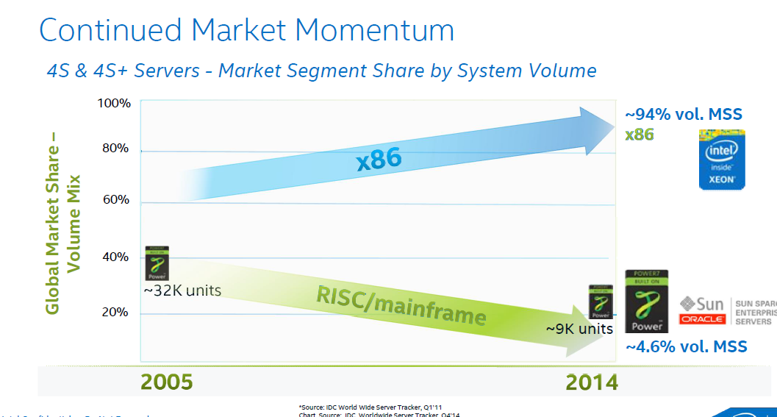
1.1 The worldwide 4S (4 Socket) server market (1)
1. Introduction to Intel’s high-end multicore 4S servers and platforms
1.1 The worldwide 4S (4 Socket) server market [52]
MSS: Segment Market Share (here unit share)
Revenue market share: Intel ~ 80 %, IBM ~ 12-15 %, Oracle: ~ 5 % [52]

Slide 10
1.1 The worldwide 4S (4 Socket) server market (2)
Top 5 worldwide server systems vendor revenues, market shares and growth, Q1 2016,
(Revenues are in Millions USD) [137]
Vendor | 1Q16 Revenue | 1Q16 Market Share | 1Q16/1Q15 Revenue Growth
1. HPE | $3,306.8 | 26.7% | 3.5%
2. Dell | $2,267.8 | 18.3% | -1.8%
3. IBM | $1,139.5 | 9.2% | -32.9%
4. Lenovo * | $871.2 | 7.0% | -8.6%
4. Cisco * | $850.2 | 6.9% | -4.5%
ODM Direct | $863.8 | 7.0% | -11.0%
Others | $3,082.4 | 24.9% | 9.0%
Total | $12,382 | 100% | -3.6%
IDC's Worldwide Quarterly Server Tracker, June 2016
HPE: HP Enterprise

Slide 11
1.2 The platform concept
Notes:
11

Slide 12
1.2 The platform concept (1)
1.2 The platform concept
The notion platform is widely used in different segments of the IT industry e.g. by
IC manufacturers, system providers or even by software suppliers with different interpretations.
Here we are focusing on the platform concept as used by system providers, like Intel or AMD.
The platform concept of system providers
The platform consists of the main components of the system architecture, being typically
the processor or processors (in multiprocessors)
the related chipset as well as
the interfaces (buses) interconnecting them.
Remark
The designation platform is often understood as the entire system architecture.

Slide 13
1.2 The platform concept (2)
Example 1: A simple traditional DC server platform
Core 2 (2C)
Core 2 (2C)
1333/1067 MT/s
FSB
E5000 MCH
(Enhanced)
ESI
631xESB/
632xESB IOH
FBDIMM
w/DDR2-533

Slide 14
1.2 The platform concept (3)
Example 2: A recent 4S platform
(The Brickland 4S server platform including Haswell-EX processors (2015)
2x4 SMI2
channels
Xeon E7-4800 v3
(Haswell-EX)
2x4 SMI2
channels
PCIe 3.0
PCIe 3.0
SMB
32
QPI
1.1
32
SMB
SMB
Haswell-EX 18C
Haswell-EX 18C
SMB
SMB
SMB
SMB
SMB
QPI 1.1
QPI 1.1
QPI 1.1
QPI 1.1
SMB
SMB
SMB
Haswell--EX 18C
Haswell-EX 18C
SMB
SMB
QPI
1.1
SMB
SMB
32
DMI2
4xPCIe2
32
SMB
PCIe 3.0
PCIe 3.0
C602J PCH
(Patsburg J)
Up to DDR3-1600
in both performance and lockstep modes and
up to DDR4-1866 in lockstep mode
ME
SMI2: Scalable Memory Interface 2
(Parallel 64-bit VMSE data link between
the processor and the SMB)
SMB: Scalable Memory Buffer
(C112/C114: Jordan Creek 2)
(Performs conversion between the
parallel SMI2 and the parallel
DDR3/DDR4 DIMM interfaces)
C112: 2 DIMMs/channel
C114: 3 DIMMs/channel
QPI 1.1: Up to 9.6 GT/s
ME: Management Engine

Slide 15
1.2 The platform concept (4)
Compatibility of platform components (2)
Due to the fact that the platform components are connected via specified interfaces
subsequent generations of platform components, such as processors or chipsets of a given line
are compatible as long as they make use of the same interfaces nevertheless, differing
interface parameters (such FSB speed) typically do not restrict this.

Slide 16
1.2 The platform concept (5)
Example for compatibility of platform components
Xeon 7500
(Nehalem-EX)
(Becton) 8C
/
Xeon E7-4800
(Westmere-EX) 10C
SMB
SMB
SMB
Nehalem-EX 8C
Westmere-EX 10C
QPI
Nehalem-EX 8C
Westmere-EX 10C
SMB
SMB
SMB
SMB
SMB
QPI
QPI
QPI
QPI
SMB
SMB
SMB
Nehalem-EX 8C
Westmere-EX 10C
Nehalem-EX 8C
Westmere-EX 10C
SMB
SMB
QPI
SMB
SMB
QPI
QPI
SMB
2x4 SMI
channels
2x4 SMI
channels
7500 IOH
PCIe
2.0
Nehalem-EX: up to DDR3-1067
Westmere-EX: up to DDR3-1333
ME
36
SMI: Scalable Memory Interface
(Serial link between the processor
and the SMB)
SMB: Scalable Memory Buffer
(Performs conversion between the
serial SMI and the parallel
DDR3 DIMM interfaces)
4 x QPI up to 6.4 GT/s
ESI
2 DIMMs/memory channel
ICH10
ME: Management Engine
Figure: The Boxboro-EX 4S server platform supporting Nehalem-EX/Westmer-EX server processor

Slide 17
1.3 Server platforms classified according to the number of
processors supported
Notes:
17

Slide 18
1.3 Server platforms classified according to the number of processors supported (1)
1.3 Server platforms classified according to the number of processors supported
Max. processor configuration supported
Uniprocessor server platforms
(UP-server platforms)
Multiprocessor server platforms
1-processor server platforms
(1-socket server platforms)
Server platforms supporting more than one processor
(Multi-socket server platforms)
2S (DP)
server platforms
4S (MP)
server platforms
8S
server platforms
> 8S
server platforms

Slide 19
1.4 Server platforms classified according to their performance
Notes:
19

Slide 20
1.4 Server platforms classified according to their performance (1)
1.4 Server platforms classified according to their performance
Classification of server processors according to their performance
Entry level
server processors
Effective performance
server processors
Extreme performance
server processors
E.g.
E5-1400/2400 (SB 2012)
E5-1400/2400 v2 (IB 2014)
E5-1400/2400 v3 (HW 2015)
E5-1600/2600/4600 (SB 2011)
E5-1600/2600/4600 v2 (IB 2013/2014)
E5-1600/2600/4600 v3 (HW 2014/2015)
E5-1600/2600/4600 v4 (BW 2016)
E7-2800/4800/8800 (WM 2011)
E7-2800/4800/8800 v2 (IB 2014)
E7-4800/8800 v3 (HW 2015)
E7-4800/8800 v4 (BW 2016)
SB: Sandy Bridge
IB: IVY Bridge
HW: Haswell
BW: Broadwell

Slide 21
1.5 Server platforms classified according to their
memory architecture
Notes:
21

Slide 22
1.5 Server platforms classified according to their memory architecture (1)
1.5 Server platforms classified according to their memory architecture (1)
Server platforms
classified according to their memory architecture
SMPs
(Symmetrical MultiProcessor)
NUMAs
Multiprocessors (Multi socket system)
with Uniform Memory Access (UMA)
Multiprocessors (Multi socket system)
with Non-Uniform Memory Access
All processors access main memory by the same
mechanism, (e.g. by individual FSBs and an MCH).
A particular part of the main memory can be accessed
by each processor immediately, other parts remotely.
Typical examples
Processor
Processor
Processor
QPI
Processor
QPI
QPI
FSB
E.g. DDR3-1333
IOH¹
E.g. DDR3-1333
MCH
E.g. DDR2-533
ESI
ESI
ICH
ICH
¹ICH: I/O hub
ESI: Enterprise System Interface

Slide 23
1.5 Server platforms classified according to their memory architecture (2)
Main features of SMP-type and NUMA-type server platforms
Multiprocessor server platforms
classified according to their memory architecture
SMPs
(Symmetrical MultiProcessor)
NUMAs
All processors share the same memory space
and all processors access memory by
the same access mechanism,
(e.g. by the same FSB or by individual FSBs
and an MCH.
All processors share the same memory space, but
each processor can access only a part of the memory
space immediately via its memory controller,
this part of the memory is called the local memory,
of a given processor, whereas the rest of the memory
is considered as the remote memory for the
considered processor.
Consequently, all processors access memory
basically with the same latency.
The remote memory can be accessed via the processor
owing the addressed part of the memory space.
Consequently, in NUMAs processors have two different
access latencies:
processors access their local memory space
in significantly shorter time than the memory space
remote to them.

Slide 24
1.5 Server platforms classified according to their memory architecture (3)
Example of measured read latencies of uncached data [73]
Read latencies depend on whether referenced data is kept in the own or remote main memory space.
a) Read latency of uncached data when referenced data is kept in the own memory space
Read latency:
65.1 ns (190 cycles)

Slide 25
1.5 Server platforms classified according to their memory architecture (4)
b) Read latency of uncached data when referenced data is kept in the remote memory space [73]
Read latency:
106 ns (~310 cycles)
Read latency is increased now by the inter-processor access penalty of 41 ns in this case.

Slide 26
1.6 Number and use of QPI buses in NUMA type
server processors
Notes:
26

Slide 27
1.6 Number and use of QPI buses in NUMA type server processors (1)
1.6 Number and use of the QPI buses in NUMA type server processors
Nehalem-EX / Westmere-EX
based (Boxboro) platforms
Ivy Bridge-EX / Haswell-EX / Broadwell-EX
based (Brickland) platforms
4 QPI buses
3 QPI buses
PCIe 3.0
PCIe 3.0
32
QPI
1.1
32
P
QPI
P
P
P
QPI
QPI
QPI
QPI
QPI
1.1
QPI
1.1
QPI
1.1
QPI
1.1
P
P
P
P
QPI
QPI
1.1
QPI
QPI
32
32
PCIe 3.0
DMI2
PCIe 3.0
IOH
PCIe
2.0
PCH
36
DMI2: 4xPCIe2
4 x SMB
per processor
ICH
4 x SMB
per processor
Note that in both platforms three QPI buses remain to interconnect processors.

Slide 28
1.6 Number and use of QPI buses in NUMA type server processors (2)
Scalability of Intel's NUMA platform
Three QPI busses may provide
full connectivity with full sized QPI buses up to 4S configurations or
full connectivity with two full sized and two half sized QPI buses for 8S configurations,
as indicated in the next Figure.

Slide 29
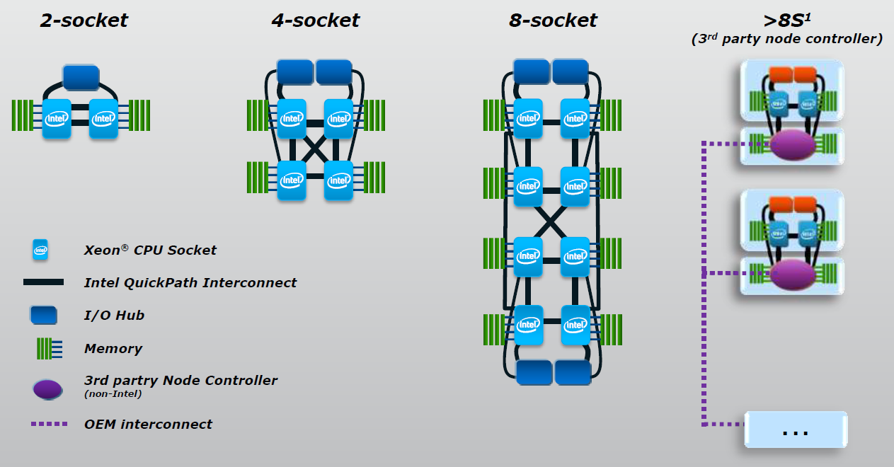
1.6 Number and use of QPI buses in NUMA type server processors (3)
Example: Scalability of Intel's Westmere-EX NUMA platforms [138]
(Note that one of the four QPI buses provided per processor aims at connecting the IOH)

Slide 30
1.7 Server platforms classified according to the number of chips
constituting the platform
Notes:
30

Slide 31
1.7 Platforms classified according to the number of chips constituting the plaform (1)
1.7 Server platforms classified according to the number of chips constituting
the platform
Server platforms
classified according to the number of chips constituting the chipset
Three-chip implementation
Two-chip implementation
The system architecture consists
basically of three chips
(processors/MCH/ICH)
The system architecture consists
basically of two chips
(processors/PCH)
Truland platform (2005/2006)
Caneland platform (2007/2008)
Boxboro-EX platform (2010/2011)
Brickland platform (2014/2015)
Purley platform (2017?)

Slide 32
1.7 Platforms classified according to the number of chips constituting the platform (2)
Example of a 3-chip implementation: The Boxboro-EX 4S server platform supporting
Nehalem-EX/Westmere-EX processors
Xeon 7500
(Nehalem-EX)
(Becton) 8C
/
Xeon E7-4800
(Westmere-EX) 10C
SMB
SMB
SMB
Nehalem-EX 8C
Westmere-EX 10C
QPI
Nehalem-EX 8C
Westmere-EX 10C
SMB
SMB
SMB
SMB
SMB
QPI
QPI
QPI
QPI
SMB
SMB
SMB
Nehalem-EX 8C
Westmere-EX 10C
Nehalem-EX 8C
Westmere-EX 10C
SMB
SMB
QPI
SMB
SMB
QPI
QPI
SMB
2x4 SMI
channels
2x4 SMI
channels
7500 IOH
PCIe
2.0
Nehalem-EX: up to DDR3-1067
Westmere-EX: up to DDR3-1333
ME
36
SMI: Scalable Memory Interface
(Serial link between the processor
and the SMB)
SMB: Scalable Memory Buffer
(Performs conversion between the
serial SMI and the parallel
DDR3 DIMM interfaces)
4 x QPI up to 6.4 GT/s
ESI
2 DIMMs/memory channel
ICH10
ME: Management Engine
Nehalem-EX aimed Boxboro-EX 4S server platform (for up to 10 C)

Slide 33
1.7 Platforms classified according to the number of chips constituting the platform (3)
Example of a 2-chip implementation: The Brickland-EX 4S server platform supporting
Ivy Bridge-EX/Haswell-EX/Broadwell-EX processors
2x4 SMI2
channels
Xeon E7-4800 v3
(Haswell-EX)
2x4 SMI2
channels
PCIe 3.0
PCIe 3.0
SMB
32
QPI
1.1
32
SMB
SMB
Haswell-EX 18C
Haswell-EX 18C
SMB
SMB
SMB
SMB
SMB
QPI 1.1
QPI 1.1
QPI 1.1
QPI 1.1
SMB
SMB
SMB
Haswell--EX 18C
Haswell-EX 18C
SMB
SMB
QPI
1.1
SMB
SMB
32
DMI2
4xPCIe2
32
SMB
PCIe 3.0
PCIe 3.0
C602J PCH
(Patsburg J)
Up to DDR3-1600
in both performance and lockstep modes and
up to DDR4-1866 in lockstep mode
ME
SMI2: Scalable Memory Interface 2
(Parallel 64-bit VMSE data link between
the processor and the SMB)
SMB: Scalable Memory Buffer
(C112/C114: Jordan Creek 2)
(Performs conversion between the
parallel SMI2 and the parallel
DDR3/DDR4 DIMM interfaces)
C112: 2 DIMMs/channel
C114: 3 DIMMs/channel
QPI 1.1: Up to 9.6 GT/s
ME: Management Engine

Slide 34
1.8 Naming schemes of Intel’s server processors
Notes:
34

Slide 35
1.8 Naming scheme of Intel’s server processors (1)
1.8 Naming schemes of Intel’s server processors
Until 2005 Intel named their server chips emphasizing clock frequency, like Xeon 2.8 GHz DP
or Xeon 2.0 GHz MP.
Subsequently, after Intel could not more sustain the rising of clock frequencies, they
introduced an AMD like naming scheme, as follows:
Intel’s second naming scheme of servers
9000 series
7000 series
5000 series
3000 series
Itanium lines
of processors
4S (MP) server
processor lines
2S (DP) server
processor lines
1S (UP) server
processor lines
Accordingly, Intel’s related 4S server processor lines were designated as follows:
Line | Processor | Based on
7000 | Paxville MP | Pentium 4 Prescott MP
7100 | Tulsa | Pentium 4 Prescott MP
7200 | Tigerton DC | Core 2
7300 | Tigerton QC | Core 2
7400 | Dunnington | Penryn
7500 | Beckton | Nehalem

Slide 36
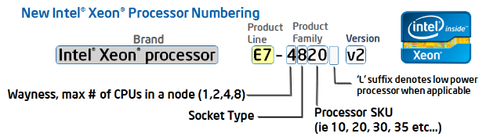
1.8 Naming scheme of Intel’s server processors (2)
Renewed naming scheme of Intel’s servers
In 4/2011 Intel renewed their naming scheme for their whole processor offering.
This results in the following new naming scheme for servers:
(Stock-Keeping Unit)
Figure: Intel’s new Xeon naming scheme [127]
Product line: E3, E5 or E7.
Wayness: How many processors are natively supported in a system
Socket type: Signifies processor capability,
e.g. 8: high performance
6: effective performance etc..
Version: Xeon processors with a common version number share a common microarchitecture
Westmere (without version number)
v2: Ivy Bridge
v3: Haswell
v4: Broadwell
v5: Skylake

Slide 37
1.8 Naming scheme of Intel’s server processors (3)
Remark
The designation of the server generations v2, v3 etc. does not coincides with the designation
of the microarchitectures, as follows:
Microarchitecture | Architecture generation | Server generation
Westmere |  | (without designation)
Sandy Bridge | Gen. 2
Ivy Bridge | Gen. 3 | v2
Haswell | Gen. 4 | v3
Broadwell | Gen. 5 | v4
Skylake | Gen. 6 | v5

Slide 38
1.8 Naming scheme of Intel’s server processors (4)
Example: Server product lines of the Haswell family
The Haswell family
Haswell
(LGA1150)
Mobiles and desktops
Up to 4 cores
i3/i5/i7 designations
Haswell-E
(LGA2011)
high-end desktops
(HED)
Up to 8 cores
i7 designation
Haswell-EN
(LGA2011)
Entry level
servers
Up to 18 cores
Haswell-EP
(LGA2011)
Effective performance servers
Up to 18 cores
Haswell-EX
(LG2011)
High-end performance servers
Up to 18 cores
Servers
Microservers
E3-1275L/1265L v3, 4C+G, HT, 6/2013 and 5/2014
E3-1240L/1230L/1220L v3, 2C/4C, HT, 6/2013 and 5/2014
UP Servers
E3-12x5/12x6 v3, 4C+G, HT, 6/2013 and 5/2014
E3-12x0/12x1 v3, 4C, HT, 6/2013 and 5/2014
Workstations
E5-16xx v3, 4/6/8, 9/2014
E5-14xx v3, 8C, 1/2015
2S-Servers
E5-26xx v3, 4/6/8/10/12/14/16/18C, 9/2014
E5-24xx v3, 4/6/8/10C, 1/2015
4S/8S-Servers
E5-46xx v3, 6/10/12/14/16/18C, 6/2015
E7-48xx v3, 8/10/12/14C, 5/2015
E7-88xx v3, 4/10/16/18C, 5/2015

Slide 39
1.8 Naming scheme of Intel’s server processors (5)
Renewed naming of Intel’s high-end 4S (MP) servers
Accordingly, beginning with the Westmere-EX line Intel’s high-end 4S server lines are
designated as follows:
E7-4800 (Westmere-EX line)
E7-4800 v2 (Ivy Bridge-EX line)
E7-4800 v3 (Haswell-EX line)
E7-4800 v4 (Broadwell-EX line)

Slide 40
1.9 Overview of Intel’s high-end multicore server processors
and platforms
Notes:
40

Slide 41
1.9 Overview of Intel’s high-end multicore server processors and platforms (1)
1.9 Overview of Intel’s high-end multicore server processors and platforms -1
Intel’s high-end multicore server platforms
Truland
(2005)
(90/65 nm)
Caneland
(2007)
(65/45 nm)
Boxboro-EX
(2010)
(45/32 nm)
Brickland-EX
(2014)
(22/14 nm)
Purley
(2017?)
(14 nm)
Pentium 4 Xeon MP
based
Core 2 Xeon MP
based
Nehalem-EX/
Westmere-EX
based
Ivy Bridge-EX/
Haswell-EX
Broadwell-EX
based
Skylake-EX
based

Slide 42
1.9 Overview of Intel’s high-end multicore server processors and platforms (2)
Overview of Intel’s high-end multicore server processor lines and platforms -2
 | Core | Techn. | Intro. | high-end server processor lines | Core count up to | Chipset | Proc. socket
Truland MP | Pentium 4 MP Prescott | 90 nm | 3/2005 | 90 nm Pentium 4 MP (Potomac) | 1C | E8500 + ICH5 | LGA 604
 | Pentium 4 Presc. | 90 nm | 11/2005 | 7000 (Paxville MP) | 2x1C | E8501 + ICH5
 | Pentium 4 Presc. | 65 nm | 8/2006 | 7100 (Tulsa) | 2x1C
Caneland MP | Core2 | 65 nm | 9/2007 | 7200 (Tigerton DC) 7300 (Tigerton QC) | 2C 2x2C | E7300 (Clarksboro)+ 631x/632x ESB | LGA 604
 | Penryn | 45 nm | 9/2008 | 7400 (Dunnington) | 6C
Boxboro-EX | Nehalem | 45 nm | 3/2010 | 7500 (Beckton/ Nehalem-EX) | 8C | 7500 (Boxboro) + ICH10 | LGA 1567
 | Westmere | 32 nm | 4/2011 | E7-8800/4800/2800 (Westmere-EX) | 10C
 | Sandy Bidge | 32 nm
Brickland | Ivy Bridge | 22 nm | 2/2014 | E7-8800/4800/2800 v2 (Ivy Bridge-EX) | 15C | C602J (Patsburg J) | LGA 2011-1
 | Haswell | 22 nm | 5/2015 | E7-8800/4800 v3 (Haswell-EX) | 18C
 | Broadwell | 14 nm | 6/2016 | E7-8800/4800 v4 (Broadwell-EX) | 24C
Purley | Skylake | 14 nm | 2017?? | n.a. (Skylake-EX) | 28C | Lewisburg | Socket P

Slide 43
1.9 Overview of Intel’s high-end multicore server processors and platforms (3)
Overview of Intel’s high-end multicore server processor lines and platforms -3
Here we note that the maximum core counts for the E7-8800 and E7-4800 processor lines,
supporting 8-processor and 4-processor platforms respectively, partly differ, as the next Table
shows.
Family | Processor line | Core no. up to | Processor line | Core no. up to
Westmere-EX | E7-8800 | 10 | E7-4800 | 10
Ivy Bridge-EX | E7-8800 v2 | 15 | E7-4800 v2 | 15
Haswell-EX | E7-8800 v3 | 18 | E7-4800 v3 | 14
Broadwell-EX | E7-8800 v4 | 24 | E7-4800 v4 | 16
Table: Max. core counts of E7-8800 and E7-4800 Xeon processor lines

Slide 44
1.9 Overview of Intel’s high-end multicore server processors and platforms (4)
Remark: Remember to Intel’s transfer to 64-bit ISA in their server lines [97]

Slide 45
2. Evolution of Intel’s high-end
multicore 4S server platforms
Notes:
45

Slide 46
2. Evolution of Intel’s high-end multicore 4S server platforms (1)
2. Evolution of Intel’s high-end multicore 4S server platforms
Intel’s high-end multicore 4S platforms -- Overview
 | Core | Techn. | Intro. | high-end 4S server processor lines | Core count up to | Chipset | Proc. socket
Truland MP | Pentium 4 MP Prescott | 90 nm | 3/2005 | 90 nm Pentium 4 MP (Potomac) | 1C | E8500 + ICH5 | LGA 604
 | Pentium 4 Presc. | 90 nm | 11/2005 | 7000 (Paxville MP) | 2x1C | E8501 + ICH5
 | Pentium 4 Presc. | 65 nm | 8/2006 | 7100 (Tulsa) | 2x1C
Caneland | Core2 | 65 nm | 9/2007 | 7200 (Tigerton DC) 7300 (Tigerton QC) | 2C 2x2C | E7300 (Clarksboro)+ 631x/632x ESB | LGA 604
 | Penryn | 45 nm | 9/2008 | 7400 (Dunnington) | 6C
Boxboro-EX | Nehalem | 45 nm | 3/2010 | 7500 (Beckton/ Nehalem-EX) | 8C | 7500 + ICH10 | LGA 1567
 | Westmere | 32 nm | 4/2011 | E7-4800 (Westmere-EX) | 10C
 | Sandy Bidge | 32 nm
Brickland | Ivy Bridge | 22 nm | 11/2012 | E7-4800 v2 (Ivy Bridge-EX) | 15C | C602J (Patsburg J) | LGA 2011-1
 | Haswell | 22 nm | 5/2015 | E7-4800 v3 (Haswell-EX) | 14C
 | Broadwell | 14 nm | 6/2016 | E7-4800 v4 (Broadwell-EX) | 16C
Purley | Skylake | 14 nm | 2017?? | n.a. (Skylake-EX) | na. | Lewisburg | Socket P

Slide 47
2. Evolution of Intel’s high-end multicore 4S server platforms (2)
Single thread IPC in Intel’s basic architectures (Based on [195])
2
24%
22%
Per Generation
1.9
20%
Cumulative
1.8
18%
1.7
16%
1.6
14%
12%
1.5
10%
1.4
8%
1.3
6%
1.2
4%
2%
1.1
0%
1
Pentium M
Dothan
Core 2
Penryn
NHM
(w/o SMT)
WSM
SNB
IVB
HSW
BRW
SKL
Note that Intel raised IPC in the Core family only less then 2-times in about 10 years.

Slide 48
2. Evolution of Intel’s high-end multicore 4S server platforms (3)
Intel’s high-end multicore platforms – Performance features (Source of data: Intel)
ILP (rel. to Xeon 7200)
ST perf. (rel. to Xeon 7200)
fmax (base)
GHz
1.6
1.6
Broadwell-EX
(14 nm), 24C
3.0
*
*
Haswell-EX
(22 nm), 18C
*
1.5
1.5
fmax (base)
2.5
*
*
*
*
*
1.4
1.4
Ivy-Bridge-EX
(22 nm), 15C
*
2.0
Westmere-EX
(32 nm), 10C
*
~2x/12 years
1.3
1.3
1.5
Nehalem-EX
(45 nm), 8C
*
Single thread (ST)
perf. rel. to Xeon 7200
1.2
1.2
Xeon 7400
(45 nm), 6C
1.0
ILP rel. to Xeon 7200
*
*
1.1
1.1
Xeon 7200
(65 nm), 2C
0.5
*
*
1.0
1.0
*
*
0.0
*
*
0.9
0.9
ST. Single Thread
*
0.8
0.8
*
2006
2008
2010
2012
2014
2016
Year

Slide 49
2. Evolution of Intel’s high-end multicore 4S server platforms (4)
The driving force of the evolution of memory subsystems in high-end servers -1
Providing enough memory bandwidth is one of the key challenges in designing processor platforms since multicores emerged.
It has three main roots;
The total memory bandwidth demand of a multicore multiprocessor platform
is directly proportional to both the processor count and the core count [99].
The memory bandwidth (BW) provided is
BW = n_{M} * T * w
with
n_{M}: No. of memory channels
T: Memory transfer rate (e.g. 1 G transfers/s)
w: Width of a memory channel (8 byte)
With time core count rises and the processor requires proportionally more bandwidth.
When memory transfer rate would rise in time in the same rate as the core count does
the processor would have the same per core memory bandwidth.
b) Nevertheless, with time core count raises faster than memory transfer rate,
as indicated next.

Slide 50
2. Evolution of Intel’s high-end multicore 4S server platforms (5a)
The rate of rising core counts in Intel's high-end servers -1
Core
count
32
Broadwell-EX
(14 nm)
24
Ivy-Bridge-EX
(22 nm)
*
16
*
15
Westmere-EX
(32 nm)
Nehalem-EX
(45 nm)
~2x/4 years
10
*
8
7400
(45 nm)
*
6
7300
(65 nm)
*
4
*
7000
(90 nm)
~2x/2 years
2
*
2006
2008
2010
2012
2014
2016
Year

Slide 51
olution of Intel’s high-end multicore 4S server platforms (5b)
The rate of rising core counts in Intel's high-end servers -2
In fact, core counts in Intel's high-end servers initially doubled about every two years,
in accordance with Moore’s revised rule but later after emerging L3 caches the rate of
raising core counts slowed down to doubling in about four years due to the reduced
silicon area remaining for the cores, as seen in the next Figure.
Figure: Die photo of the Nehalem processor [139]

Slide 52
2. Evolution of Intel’s high-end multicore 4S server platforms (6)
The rate of rising memory transfer rates in Intel’s DT and 4S platforms -1
Transfer rate
(MT/s)
3000
DDR4/2133
DDR3/1866
DDR3
1600
2000
DDR3
1333
x
*
DDR3
1067
*
x
*
~ 2*/4 years
DDR2
800
*
DDR3
1600
DDR3
1866
1000
DDR2
667
*
x
DDR2
533
*
DDR3
1067
~ 2*/8 years
DDR
400
*
x
500
DDR
333
*
DDR2
667
DDR
266
4S
x
*
*
DDR
400
*
200
DT
100
≈
Year
2000
01
02
03
04
05
06
07
08
09
2010
11
12
13
14
15

Slide 53
2. Evolution of Intel’s high-end multicore 4S server platforms (7)
The rate of rising memory transfer rates in Intel’s DT and 4S platforms -2
By contrast, memory speeds in Intel's multicore high-end servers and also DT platforms doubled
in case of DDR2 memories in about 4 years but later for DDR3 memories in about four years,
as the next Figure indicates.

Slide 54
2. Evolution of Intel’s high-end multicore 4S server platforms (8)
The driving force for the evolution of memory subsystems in high-end servers -2
Since memory speed raises slower than core count, the available bandwidth,
i.e. the product of the number of memory channels, memory speed and data width,
raises also slower than required.
As a consequence, the arising bandwidth deficit needs to be compensated by implementing
appropriately more memory channels, if the same per core memory bandwidth should be
provided while core counts raise:
BW = n_{M} * T * w
Here we assume that the width of the memory channels remains unchanged.
c) It is however not a straightforward task to increase the number of 64-bit memory channels
beyond two high speed 64-bit memory channels (e.g. DDR2/3/4 channels) if memory is
attached in the traditional way, that is via standard parallel DRAM channels to the MCH,
as discussed subsequently.

Slide 55
2. Evolution of Intel’s high-end multicore 4S server platforms (9)
Only limited number of 64-bit memory channels are attachable to the north bridge -1
Intel’s early 32-bit Pentium 4 Xeon MP based 4S servers were implemented as SMP
(Symmetric Multiprocessor) platforms with a single FSB that connects all 4 single core
processors to the north bridge (NB) and used typically four 32-bit memory channels,
as shown below.
Xeon MP¹
SC
Xeon MP¹
SC
Xeon MP¹
SC
Xeon MP¹
SC
FSB
E.g. 400 MT/s
NB
E.g. HI 1.5
E.g. DDR-200/266
2 x 64 bit
ICH
HI 1.5 266 MB/s
Figure: Pentium 4 MP aimed 4S server platform for single core processors

Slide 56
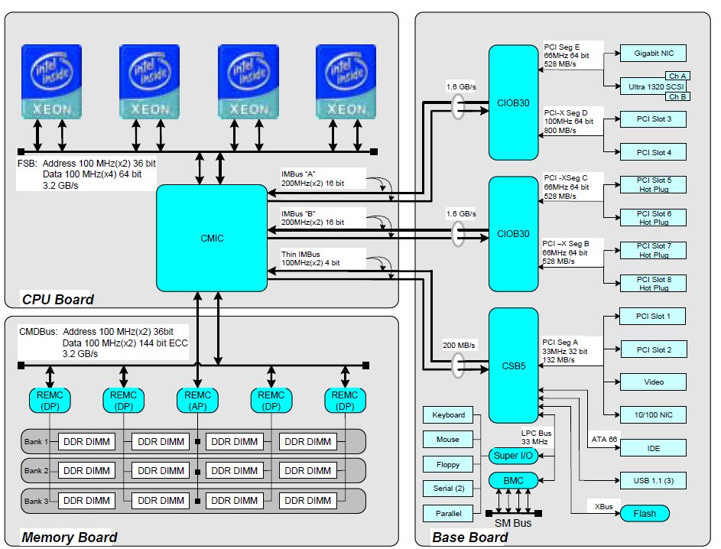
2. Evolution of Intel’s high-end multicore 4S server platforms (10)
Example for Intel’s early Pentium 4 based 4S server platform [101]
(Willamette based 32-bit Xeon (called Foster) (2002)
ServerWorks
Grand Champion HE chipset
~ 2 x 64 bit DDR2

Slide 57
2. Evolution of Intel’s high-end multicore 4S server platforms (11)
Only limited number of 64-bit memory channels are attachable to the north bridge -2
In fact, if high speed (e.g. DDR2/3/4) DIMMs are connected via the MCH to a platform by
standard parallel memory buses 240 copper traces are needed for DDR2/DDR3 DIMMs or
284 traces for DDR4 DIMMs on the mainboard to connect the MCH to the DIMM sockets,
as shown in the next Figure.

Slide 58
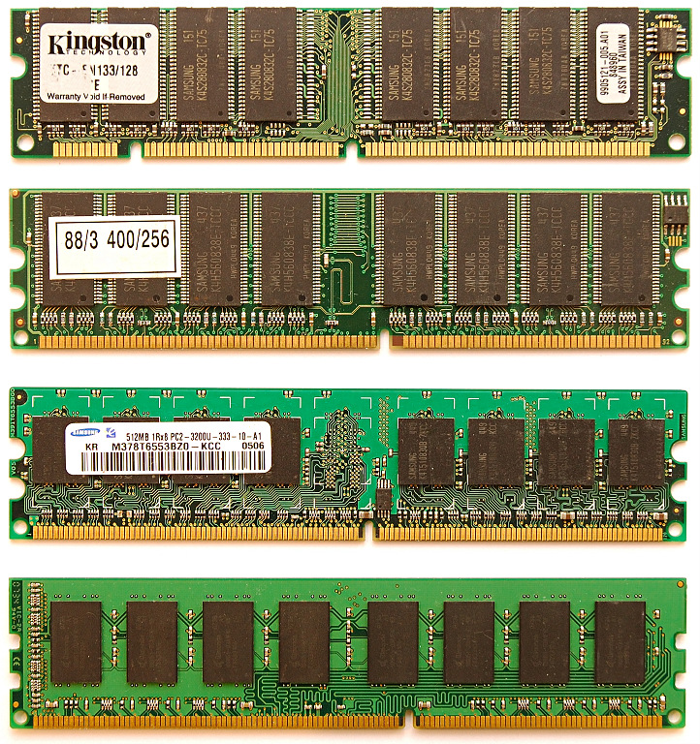
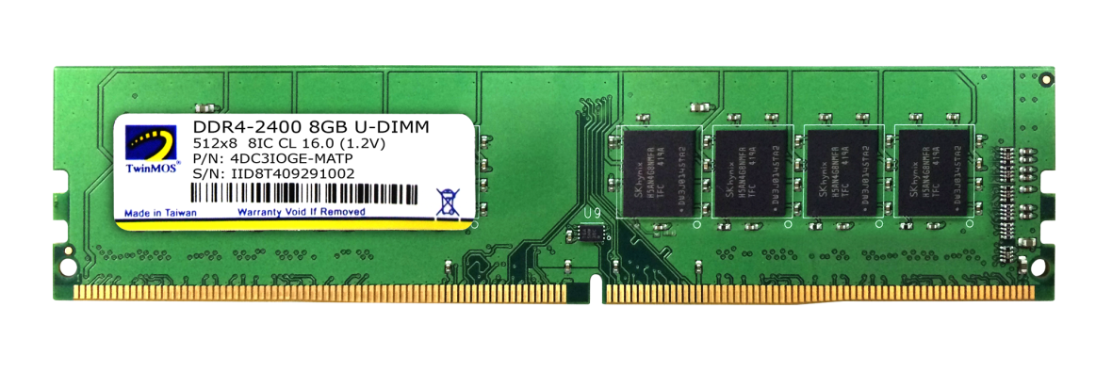
2. Evolution of Intel’s high-end multicore 4S server platforms (12)
2.1 Overview of the Truland MP platform (1)
Pin counts of SDRAM to
DDR4 DIMMs
All these DIMMs
are 8-byte wide.
SDRAM
(SDR)
168-pin
DDR
184-pin
DDR2
240- pin
DDR3
240-pin
DDR4
284-pin
Notes:
58

Slide 59
2. Evolution of Intel’s high-end multicore 4S server platforms (13)
Only limited number of 64-bit memory channels are attachable to the north bridge -3
The reason why typically not more than two 64-bit high speed memory channels (e.g. DDR2/DDR3 channels) may be connected to the north bridge is as follows:
For implementing more than two memory channels smaller and denser cupper traces
would be required on the mainboard due to space limitations.
This however, would cause higher ohmic resistance and coupling capacitance, which
would end up in longer rise and fall times, i.e. it would prevent the platform from
achieving the desired high DRAM rate, as indicated next.

Slide 60
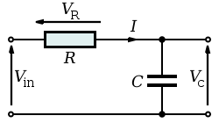



2. Evolution of Intel’s high-end multicore 4S server platforms (14)
Remark
Modeling the temporal behavior of raising the voltage on DIMM traces by a serial RC network
$${Vc=Vin x (1− e}^{−t/τ})$$
$$with τ=R x C$$
For Vin = 1V:
$${Vc=1− e}^{−t/τ}$$
Figure: The circuit model and the related expression for Vc [135]

Slide 61
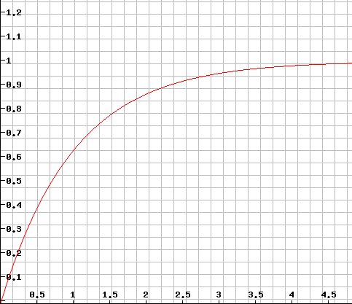



2. Evolution of Intel’s high-end multicore 4S server platforms (15)
Raising the voltage on a capacitor of a serial RC network that models DIMM traces
Vc
(Vin = 1 V)
$${Vc=1− e}^{−t/τ}$$
$$t/τ$$
$τ$ = R * C

Slide 62
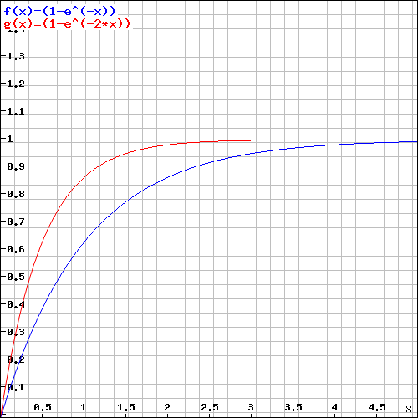
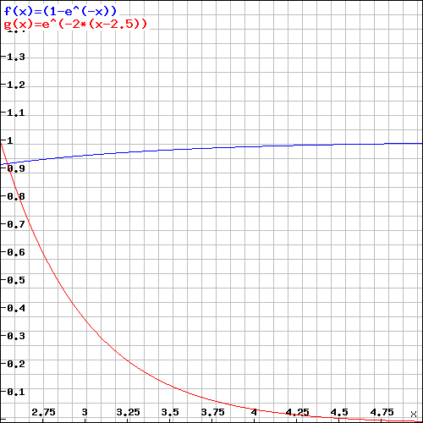




2. Evolution of Intel’s high-end multicore 4S server platforms (16)
Raising the voltage on a capacitor of a serial RC network that models DIMM traces
while τ is doubled
Vc
(Vin = 1 V)
$${Vc=1− e}^{−t/τ}$$
$${Vc=1− e}^{−t/2τ}$$
$$t/τ$$
$τ$ = R * C
As seen, for seriously larger T values the required max. transfer rate could not be provided.

Slide 63
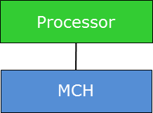
2. Evolution of Intel’s high-end multicore 4S server platforms (17)
Addressing the memory bandwidth bottleneck in servers
The fact that typically not more than two high speed memory channels may be connected centrally via the MCH, constrains the usability of connecting memory by standard memory channels to the MCH more or less to single core 4S servers.
This bottleneck can be remedied for 4S multicore multiprocessors in two orthogonal ways,
either by connecting memory immediately to the processor(s) rather than to the MCH,
or using low line count interfaces between the memory controller and the DIMMs,
as indicated in the next Figure.
DIMMs
Possible solutions for raising the number of memory channels
Connecting memory immediately
to the processor(s)
Using low line count interfaces
between the MC and the DIMMs

Slide 64
2. Evolution of Intel’s high-end multicore 4S server platforms (18)
a) Connecting memory via the processor(s)
It is one option of the design aspect of "Choice of the connection point of the memory",
as seen below.
Choice of the connection point of the memory
Connecting memory
via the MCH (Memory Control Hub)
Connecting memory
via the processor(s)
Processor
Processor
Memory
MCH
Memory
This is a central connection of the memory.
It causes severe bandwidth imitations
for multiprocessors, like 4S configurations.
This is a per processor connection of the memory.
It scales memory bandwidth inherently
with the processor count.
Figure: Options for the design aspect of Choosing the connection point of the memory

Slide 65
2. Evolution of Intel’s high-end multicore 4S server platforms (19)
Example for a platform with connecting memory via the processors
(Actually, Intel's Nehalem-based 5500 2S server, called Gainstown)
Processor
QPI
Processor
QPI
QPI
E.g. DDR3-1333
IOH¹
E.g. DDR3-1333
ESI
ICH
¹ICH: I/O hub
ESI: Enterprise System Interface

Slide 66
2. Evolution of Intel’s high-end multicore 4S server platforms (20)
b) Use low line count interfaces between the MCs and the DIMMs
It is one option of the design aspect of "Choice of the interface between the MCs and the DIMMs",
as seen below.
Choice of the interface between the MC and the DIMMs
Use standard DRAM interfaces
between the MCs and the DIMMs
Use low line count interfaces
between the MCs and the DIMMs
DIMMs are connected to one or more memory controllers directly by standard DRAM interfaces.
The number of memory channels is limited due to spatial and electrical constraints typically to two.
DIMMs are connected to one or more memory controllers via low line count interfaces and interface converters, called memory extension buffers (MBs) in order to connect more than two memory channels
DIMMs
DIMMs
MC in
MCH/processor
MB
MC in
MCH/processor
MB
Standard DRAM
interface
Low line count
interface
Standard DRAM
interface
Figure: Options of the design aspect of Choice of the interface between the MC and the DIMMs

Slide 67
2. Evolution of Intel’s high-end multicore 4S server platforms (21)
Evolution of connecting memory in Intel’s multicore high-end platforms within
the related design space
Choice of the connection point of the memory
Connecting memory
via the MCH
Connecting memory
via the processor(s)
Choice of the interface
between the MCs and the DIMMs
Traditional
solution
Use standard DRAM interfaces between the
MCs and the DIMMs
Use low line count interfaces between the MCs and the DIMMs
Truland MP platform
(2005/2006)
Boxboro-EX platform
(2010/2011)
Caneland platform
(2007/2008)
Brickland platform
(2014/2015)

Slide 68
2. Evolution of Intel’s high-end multicore 4S server platforms (22)
Assessing the number of memory channels required
As stated before, in high-end servers the core count raises faster than memory transfer rate.
If the arising bandwidth deficit should be compensated by raising the number of memory
channels, assuming otherwise unchanged platform conditions, like clock speed, width of
the memory channels etc., a scaling rule can be formulated as follows:
It can be shown (in a publication in preparation) that an up to date high-end server platform
with the highest available core count (n_{c}) and highest available memory transfer rate, will
have linear memory bandwidth scaling in respect to the core count (n_{C}) if the number of
memory channels per socket (n_{M}) amounts to
n_{M} ~ √2 x √n_{C}.

Slide 69
2. Evolution of Intel’s high-end multicore 4S server platforms (23)
Expected number of memory channels (n_{M}/socket) for different core counts (n_{C})
arising from the scaling rule of memory channels
n_{C}(t) | n_{M}(t)
2 | 2.0
4 | 2.8
6 | 3.5
8 | 4.0
10 | 4.5
12 | 4.9
14 | 5.3
16 | 5.6
20 | 6.3
24 | 6.9
32 | 8.0
48 | 9.8
64 | 11.3
72 | 12.0

Slide 70
2. Evolution of Intel’s high-end multicore 4S server platforms (24)
The FSB bottleneck in SMP configurations
In early SMP configurations (e.g. in first 32-bit Pentium 4 based single core (SC) Xeon based
systems) there is a single FSB that interconnects the four processors with the NB (Northbridge),
as seen below.
Xeon MP¹
SC
Xeon MP¹
SC
Xeon MP¹
SC
Xeon MP¹
SC
8 Byte
FSB
E.g. 400 MT/s
Up to 3.2 GB/s
NB
Up to 4 x 4 x 0.266 = 4.26 GB/s
E.g. HI 1.5
E.g. DDR-200/266
2 x 64 bit
ICH
HI 1.5 266 MB/s
Figure: 32-bit Pentium 4 MP aimed 4S server platform (for single core processors)
As the bandwidth data on the Figure demonstrate, in the example there is already the FSB
that limits the overall memory bandwidth.

Slide 71
2. Evolution of Intel’s high-end multicore 4S server platforms (25)
Resolving the FSB bottleneck in SMP configurations -1
Obviously, in SMP configurations with higher core count and memory speeds, a single FSB
may severely limit memory bandwidth and thus performance.
This FSB caused bandwidth bottleneck may resolved by using more than one FSB, as indicated
in the subsequent Figures.

Slide 72
2. Evolution of Intel’s high-end multicore 4S server platforms (26)
Resolving the FSB bottleneck by using dual FSBs in dual core 4S server platforms
Xeon MP
(Potomac) 1C
/
Xeon 7000
(Paxville MP) 2x1C
/
Xeon 7100
(Tulsa) 2C
Xeon MP¹
SC
Xeon MP¹
SC
Xeon MP¹
SC
Xeon MP¹
SC
Pentium 4
Xeon MP 1C/2x1C
Pentium 4
Xeon MP 1C/2x1C
Pentium 4
Xeon MP 1C/2x1C
Pentium 4
Xeon MP 1C/2x1C
FSB up to
(800 MT/s)
FSB (400 MT/s), 64-bit)
Preceding NBs
XMB
8500¹/8501
XMB
XMB
XMB
E.g. HI 1.5
E.g. DDR-200/266
2x IMI
HI 1.5
2x IMI
2 x 64 bit
DDR-266/333
DDR2-400
ICH5
DDR-266/333
DDR2-400
Preceding ICH
4 x 64 bit
4 x 64 bit
HI 1.5 266 MB/s
Previous 32-bit Pentium 4 MP aimed
4S server platform (for single core processors)
(2004 and before)
90 nm 64-bit Pentium 4 Prescott MP aimed
Truland MP server platform (for up to 2 C)
(2005)
¹The 8500 MCH support only 667 MT/sFSB speeds and is used in
single core configurations whereas the 8501 supports already
800 MT/s and is used for dual core configurations

Slide 73
2. Evolution of Intel’s high-end multicore 4S server platforms (27)
Resolving the FSB bottleneck by using quad FSBs in up to 6 core 4S server platforms
Xeon MP
(Potomac) 1C
/
Xeon 7000
(Paxville MP) 2x1C
/
Xeon 7100
(Tulsa) 2C
Xeon 7200
(Tigerton DC) 1x2C
/
Xeon 7300
(Tigerton QC) 2x2C
/
Xeon 7400
(Dunnington 6C)
Pentium 4
Xeon MP 1C/2x1C
Pentium 4
Xeon MP 1C/2x1C
Pentium 4
Xeon MP 1C/2x1C
Pentium 4
Xeon MP 1C/2x1C
Core2 (2C/4C)
Penryn (6C)
Core2 (2C/4C)
Penryn (6C)
Core2 (2C/4C)
Penryn (6C)
Core2 (2C/4C)
Penryn (6C)
FSB
(800 MT/s)
FSB
(1066 MT/s)
XMB
8500¹/8501
XMB
7300
up to
8 DIMMs
XMB
XMB
HI 1.5
ESI
DDR-266/333
DDR2-400
DDR-266/333
DDR2-400
FBDIMM
DDR2-533/667
ICH5
631xESB/
632xESB
4 x 64 bit
4 x 64 bit
4 memory channels
90 nm Pentium 4 Prescott MP aimed
Truland MP server platform (for up to 2 C)
(2006)
Core 2 aimed
Caneland MP server platform (for up to 6 C)
(2007)
HI 1.5 (Hub Interface 1.5)
8 bit wide, 66 MHz clock, QDR,
266 MB/s peak transfer rate
ESI: Enterprise System Interface
4 PCIe lanes, 0.25 GB/s per lane (like the DMI interface,
providing 1 GB/s transfer rate in each direction)
¹ The E8500 MCH supports an FSB of 667 MT/s and consequently only the SC Xeon MP (Potomac)

Slide 74
2. Evolution of Intel’s high-end multicore 4S server platforms (28)
Evolution of Intel’s high-end 4S multicore platforms – Memory architecture
Platform | Platform topology | Date of intro. | Processor | Techno- logy | Core count (up to) | No./kind of the links to mem. buffers | No. of mem. channels/ mem. buffer | No. /speed of mem. channels (up to)
Truland MP | SMP w/dual FSBs | 3/2005 | 90 nm Pentium 4 MP (Potomac) | 90 nm | 1C | 4 serial IMI channels from MCH to XMBs | 2 memory channels/ XMB | 2x DDR2-800/ socket
 |  | 11/2005 | Xeon 7000 (Paxville MP) | 90 nm | 2x1C
 |  | 8/2006 | Xeon 7100 (Tulsa) | 65 nm | 2C
Caneland | SMP w/Quad FSBs | 9/2007 | Xeon 7200 Tigerton DC (Core 2) | 65 nm | 2C | 4 serial FB-DIMM channels from MCH to AMBs | 1 memory channel/ AMB | 1x DDR2-667/ socket
 |  | 9/2007 | Xeon 7300 Tigerton QC (Core 2) | 65 nm | 2x2C
 |  | 9/2008 | Xeon 7400 (Dunnington) (Penryn) | 45 nm | 6C
Boxboro-EX | NUMA fully connect. by QPI buses | 3/2010 | Nehalem-EX (Xeon 7500/ (Beckton) | 45 nm | 8C | 4 serial SMI channels per proc. to 4 SMBs | 2 memory channels/ SMB | 8x DDR3-1067/ socket
 |  | 4/2011 | Westmere-EX (E7-4800) | 32 nm | 10C
Brickland | NUMA fully connect. by QPI buses | 2/2014 | Ivy Bridge-EX (E7-4800 v2) | 22 nm | 15C | 4 parallel SMI2 channels per proc. to 4 SMBs | 2 memory channels/ SMB | 8x DDR3-1600 (IWB) / DDR4-1866 (HSW)/ socket
 |  | 5/2015 | Haswell-EX (E7-4800 v3) | 22 nm | 14C
 |  | ?? | Broadwell-EX?? | 14 nm | 16C
Purley | NUMA fully connect. by UPI buses | 2017 | Skylake-EX | 14 nm | n.a.C | 6 channels per proc. | n.a. | DDR4-2666 mem. speed

Slide 75
2. Evolution of Intel’s high-end multicore 4S server platforms (29)
Evolution of 32-bit single core 4S server platforms to 64-bit dual core 4S server platform
Introducing low line count memory connection
Xeon MP
(Potomac) 1C
/
Xeon 7000
(Paxville MP) 2x1C
/
Xeon 7100
(Tulsa) 2C
Xeon MP¹
SC
Xeon MP¹
SC
Xeon MP¹
SC
Xeon MP¹
SC
Pentium 4
Xeon MP 1C/2x1C
Pentium 4
Xeon MP 1C/2x1C
Pentium 4
Xeon MP 1C/2x1C
Pentium 4
Xeon MP 1C/2x1C
FSB
FSB
Preceding NBs
XMB
8500¹/8501
XMB
XMB
XMB
E.g. HI 1.5
E.g. DDR-200/266
IMI
HI 1.5
IMI
2 x 64 bit
DDR-266/333
DDR2-400
ICH5
DDR-266/333
DDR2-400
Preceding ICH
HI 1.5 266 MB/s
4 x 64 bit
4 x 64 bit
Previous 32-bit Pentium 4 MP aimed
4S server platform (for single core processors)
(2004 and before)
64-bit Pentium 4 Prescott MP aimed
Truland MP server platform (for up to 2 C)
(2006)
IMI (Independent Memory Interface): Low line count (70 signal lines) serial interface vs. DDR2 with 240 pins.
XMB: eXternal Memory Bridge

Slide 76
2. Evolution of Intel’s high-end multicore 4S server platforms (30)
Evolution of dual core 4S server platform to up to 6 core 4S platform
Introducing low line count FB-DIMM memories
Xeon MP
(Potomac) 1C
/
Xeon 7000
(Paxville MP) 2x1C
/
Xeon 7100
(Tulsa) 2C
Xeon 7200
(Tigerton DC) 1x2C
/
Xeon 7300
(Tigerton QC) 2x2C
/
Xeon 7400
(Dunnington 6C)
Pentium 4
Xeon MP 1C/2x1C
Pentium 4
Xeon MP 1C/2x1C
Pentium 4
Xeon MP 1C/2x1C
Pentium 4
Xeon MP 1C/2x1C
Core2 (2C/4C)
Penryn (6C)
Core2 (2C/4C)
Penryn (6C)
Core2 (2C/4C)
Penryn (6C)
Core2 (2C/4C)
Penryn (6C)
FSB
FSB
XMB
8500¹/8501
XMB
7300
up to
8 DIMMs
XMB
XMB
HI 1.5
ESI
DDR-266/333
DDR2-400
ICH5
DDR-266/333
DDR2-400
631xESB/
632xESB
FB-DIMM
DDR2-533/667
90 nm Pentium 4 Prescott MP aimed
Truland MP server platform (for up to 2 C)
(2006)
Core 2 aimed
Caneland MP server platform (for up to 6 C)
(2007)
HI 1.5 (Hub Interface 1.5)
8 bit wide, 66 MHz clock, QDR,
266 MB/s peak transfer rate
ESI: Enterprise System Interface
4 PCIe lanes, 0.25 GB/s per lane (like the DMI interface,
providing 1 GB/s transfer rate in each direction)
¹ The E8500 MCH supports an FSB of 667 MT/s and consequently only the SC Xeon MP (Potomac)

Slide 77
2. Evolution of Intel’s high-end multicore 4S server platforms (31)
A brief introduction to FB-DIMM memories
FB-DIMM memories were standardized and introduced in the 2006/2007 timeframe.
They supported DDR2 memories up to DDR2-667.
FB-DIMMs connect the MC and the DIMMs via low line count serial buses whereby the
memory buffers providing serial/parallel conversion to the DIMMs are placed onto the
DIMMs, as shown in the next Figure.

Slide 78
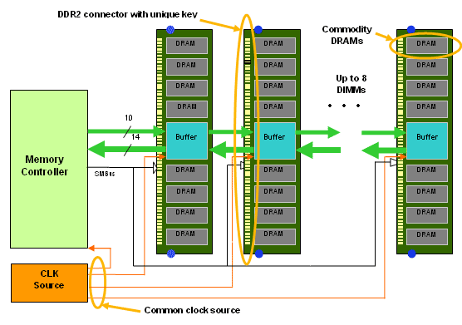
2. Evolution of Intel’s high-end multicore 4S server platforms (32)
Layout of an FB-DIMM based memory subsystem -1 [102]
Figure: FB-DIMM memory architecture [102]

Slide 79
2. Evolution of Intel’s high-end multicore 4S server platforms (33)
Layout of an FB-DIMM based memory subsystem -2 [102]
The standardized FB-DIMM technology supports a cascaded connection of up to 8 FB-DIMMs
to a memory controller by a packet based, bidirectional, point-to-point link.
The link make use of differential signaling and includes 14 read/10 write lanes, as indicated
in the next Figure.

Slide 80
2. Evolution of Intel’s high-end multicore 4S server platforms (34)
Layout of an FB-DIMM based memory subsystem -3 [102]
Figure: FB-DIMM memory architecture [102]

Slide 81
2. Evolution of Intel’s high-end multicore 4S server platforms (35)
Layout of an FB-DIMM based memory subsystem -4 [103]
The 14 inbound lanes carry data from the memory to the memory controller whereas the
10 outbound lanes transfer commands and data from the memory controller to the memory.
The transfer rate is 6 times the transfer rate of the memory, i.e. 6x667=4 MT/s over the
differential lines.
Data and commands, transferred in 12 cycles, from one frame, that is an inbound frame includes
12x14=168 bit whereas an outbound frame has 12x10=120 bits.
For more information we refer to the literature, e.g. [103].

Slide 82
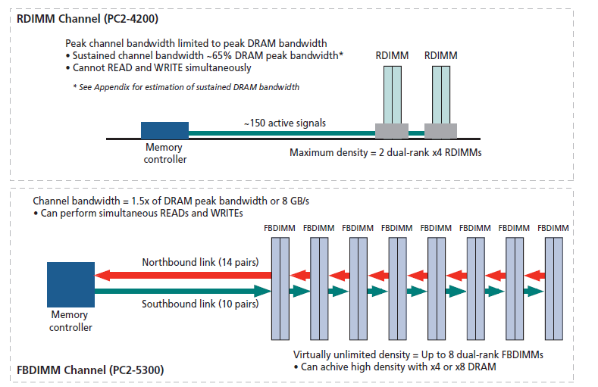
2. Evolution of Intel’s high-end multicore 4S server platforms (36)
Comparing the number of active signal lines in RDIMM and FB-DIMM channels [129]

Slide 83
2. Evolution of Intel’s high-end multicore 4S server platforms (37)
Reasoning for using FB-DIMM memory in the Caneland platform
As FB-DIMMs need only a fraction of the lines compared to standard DDR2 DIMMs,
significantly more memory channels (e.g. 6 channels) may be connected to the MCH than
in case of high pin count DDR2 DIMMs.
Furthermore, due to the cascaded interconnection of the FB-DIMMs (with repeater
functionality), up to 8 DIMMs may be interconnected to a single DIMM channel instead of
two or three as typical for standard DDR2 memory channels.
This results in considerably more memory bandwidth and memory size by reduced mainboard
complexity.
Based on these benefits Intel decided to use FB-DIMM-667 memory in their server platforms,
first in their DP platforms already in 2006 followed by the Caneland MP platform in 2007,
as discussed before.

Slide 84
2. Evolution of Intel’s high-end multicore 4S server platforms (38)
Main enhancements of the Nehalem-EX/Westmere-EX aimed up to 10 core Boxboro-EX
4S server platform (assuming 1 IOH)
Returning to the memory Buffer based low line count connection
Xeon 7500
(Nehalem-EX)
(Becton) 8C
/
Xeon E7-4800
(Westmere-EX) 10C
SMB
SMB
SMB
Nehalem-EX 8C
Westmere-EX 10C
QPI
Nehalem-EX 8C
Westmere-EX 10C
SMB
SMB
SMB
SMB
SMB
QPI
QPI
QPI
QPI
SMB
SMB
SMB
Nehalem-EX 8C
Westmere-EX 10C
Nehalem-EX 8C
Westmere-EX 10C
SMB
SMB
QPI
SMB
SMB
QPI
QPI
SMB
2x4 SMI
channels
2x4 SMI
channels
7500 IOH
PCIe
2.0
Nehalem-EX: up to DDR3-1067
Westmere-EX: up to DDR3-1333
ME
36
SMI: Scalable Memory Interface
(Serial link between the
processor and the SMB)
(Differential signaling, ~25 lanes)
SMB: Scalable Memory Buffer
(Conversion between the serial SMI and the parallel DDR3 DIMM interfaces)
4 x QPI up to 6.4 GT/s
ESI
2 DIMMs/memory channel
ICH10
ME: Management Engine
Nehalem-EX aimed Boxboro-EX 4S server platform (for up to 10 C) (2010/2011)

Slide 85
2. Evolution of Intel’s high-end multicore 4S server platforms (39)
Returning to the stand alone memory buffer implementation in the Boxboro-EX
4S platform from using FB-DIMMs -1
FB-DIMM memories were introduced in the 2006/2007 timeframe and supported DDR2
memories up to DDR2-667.
Due to inherent drawbacks of FB-DIMM memories, such as higher dissipation caused by the
DA/AD conversions, longer access time due to the cascaded nature of accessing the DIMMs
and higher price, FB-DIMMs reached only a small market share.
This was the reason why memory vendors were reluctant to develop DDR3-based FB-DIMM
memory modules and why Intel was forced to move back to custom DDR3 DIMMs in their
Boxboro-EX platform.

Slide 86
2. Evolution of Intel’s high-end multicore 4S server platforms (40)
Returning to the stand alone memory buffer implementation in the Boxboro-EX
4S platform from using FB-DIMMs -2
Implementing memory extension buffers MBs)
Implementing stand alone MBs
mounted on the mainboard or
on a riser card
Implementing MBs
immediately on the DIMM
(called FB-DIMMs)
Truland MP platform
(2005/2006)
Caneland platform
(2007/2008)
Boxboro-EX platform
(2010/2011)
Brickland platform
(2014/2015)
Figure: Intel’s implementation of memory extension buffers

Slide 87
2. Evolution of Intel’s high-end multicore 4S server platforms (41)
Main enhancement of the up to 15 core Ivy Bridge-EX aimed Brickland 4S server platform
Introducing low line count proprietary parallel memory connection to reduce dissipation
2x4 SMI2
channels
Xeon E7-4800 v2
(Ivy Bridge-EX)
(Ivytown) 15C
2x4 SMI2
channels
PCIe 3.0
PCIe 3.0
SMB
32
32
SMB
SMB
Ivy Bridge-EX 15C
QPI
1.1
Ivy Bridge-EX 15C
SMB
SMB
SMB
SMB
SMB
QPI 1.1
QPI 1.1
QPI 1.1
QPI 1.1
SMB
SMB
SMB
Ivy Bridge-EX 15C
Ivy Bridge-EX 15C
SMB
SMB
QPI
1.1
SMB
SMB
32
DMI2
4xPCIe2
32
SMB
PCIe 3.0
PCIe 3.0
C602J PCH
(Patsburg J)
Up to DDR3-1600 in lockstep mode and
up to DDR3-1333 in independent channel mode
ME
SMI2: Scalable Memory Interface 2
(Parallel 64 bit VMSE data link between
the processor and the SMB)
SMB: Scalable Memory Buffer
(C102/C104: Jordan Creek)
C102: 2 DIMMs/channel
C104: 3 DIMMs/channel
SMBs perform conversion between the
parallel SMI2 and the parallel
DDR3-DIMM interfaces
3 x QPI up to 8.0 GT/s
ME: Management Engine

Slide 88
2. Evolution of Intel’s high-end multicore 4S server platforms (42)
Introducing low line count proprietary SMI 2 interfaces between the processor and the
memory buffers to reduce dissipation
The SMI link of the Boxboro-EX platform was a serial, packet based, differential link
including about 70 signal lines.
By contrast, as far as the data transfer is concerned, with the SMI2 link Intel changed to
64-bit parallel, bidirectional communication using single-ended voltage reference signals,
called VMSE (Voltage Mode Single Ended) signaling.
SMI 2 requires altogether about 110 signal lines, that is about 50 % more lines than SMI.
The reason for changing from serial transfer to parallel transfer in case of the data lines is
presumably the fact, that in this case AD/DA converting of data becomes superfluous and
this results in reduced dissipation.

Slide 89
2. Evolution of Intel’s high-end multicore 4S server platforms (43)
Main enhancements of the up to 18 core Haswell-EX aimed Brickland 4S server platform
Redesigned low line count proprietary parallel memory connection to support DDR4 memory
2x4 SMI2
channels
Xeon E7-4800 v3
(Haswell-EX)
2x4 SMI2
channels
PCIe 3.0
PCIe 3.0
SMB
32
QPI
1.1
32
SMB
SMB
Haswell-EX 18C
Haswell-EX 18C
SMB
SMB
SMB
SMB
SMB
QPI 1.1
QPI 1.1
QPI 1.1
QPI 1.1
SMB
SMB
SMB
Haswell--EX 18C
Haswell-EX 18C
SMB
SMB
QPI
1.1
SMB
SMB
32
DMI2
4xPCIe2
32
SMB
PCIe 3.0
PCIe 3.0
C602J PCH
(Patsburg J)
Up to DDR3-1600
in both performance and lockstep modes and
up to DDR4-1866 in lockstep mode
ME
SMI2: Scalable Memory Interface 2
(Parallel 64-bit VMSE data link between
the processor and the SMB)
(~110 bidirectional VMSE data lines)
SMB: Scalable Memory Buffer
(C112/C114: Jordan Creek 2)
C112: 2 DIMMs/channel
C114: 3 DIMMs/channel
3x QPI 1.1: Up to 9.6 GT/s
SMBs performs conversion between the
parallel SMI2 and the parallel
DDR3/DDR4 DIMM interfaces
ME: Management Engine

Slide 90
2. Evolution of Intel’s high-end multicore 4S server platforms 44)
Main alternartives for connecting memory to a platform
Connecting memory to the processors
Connect memory
centrally via the MCH
(Memory Control Hub)
Connect memory
distributed via the processors
Connect memory
globally via an interconnect
Processor
Processor
Processor
QPI
Processor
Processor
Processor
GPU
FSB
QPI
QPI
IOH¹
Interconnect
MCH
E.g. DDR3-1333
E.g. DDR3-1333
ESI
ESI
MC
MC
IO
IO
ICH
E.g. DDR2-533
ICH
¹ICH: I/O hub
ESI: Enterprise
System Interface
The central connection of memory
causes severe bandwidth imitations
first of all for multiprocessors.
Per processor connected memory
provides inherent scaling
of the memory bandwidth
with the processor count.
An interconnect provides
the interconnection for all
system components

Slide 91
2. Evolution of Intel’s high-end multicore 4S server platforms (45)
Microarchitecture of the ARMv8-based dual socket Cavium ThunderX processor [128]

Slide 92
2. Evolution of Intel’s high-end multicore 4S server platforms (46)
Intel’s high-end 4S multicore platforms – Cache architectures
Platform | Platform topology | Date of intro. | Processor | Techno- logy | Core count (up to) | L2 cache | L3 cache (up to)
Truland MP | SMP w/dual FSBs | 3/2005 | 90 nm Pentium 4 MP (Potomac) | 90 nm | 1C | 1 MB | 8 MB
 |  | 11/2005 | Xeon 7000 (Paxville MP) | 90 nm | 2x1C | 2 MB L2/C | --
 |  | 8/2006 | Xeon 7100 (Tulsa) | 65 nm | 2C | 1 MB L2/C | 16 MB
Caneland | SMP w/Quad FSBs | 9/2007 | Xeon 7200 Tigerton DC (Core 2) | 65 nm | 2C | 4 MB/C | --
 |  | 9/2007 | Xeon 7300 Tigerton QC (Core 2) | 65 nm | 2x2C | 4 MB/C | ---
 |  | 9/2008 | Xeon 7400 (Dunnington) (Penryn) | 45 nm | 6C | 3 MB/C | 16 MB
Boxboro-EX | NUMA fully connect. by QPI buses | 3/2010 | Nehalem-EX (Xeon 7500/ (Beckton) | 45 nm | 8C | ¼ MB/C | 24 MB
 |  | 4/2011 | Westmere-EX (E7-4800) | 32 nm | 10C | ¼ MB/C | 30 MB
Brickland | NUMA fully connect. by QPI buses | 2/2014 | Ivy Bridge-EX (E7-4800 v2) | 22 nm | 15C | ¼ MB/C | 37.5 MB
 |  | 5/2015 | Haswell-EX (E7-4800 v3) | 22 nm | 14C | ¼ MB/C | 35 MB
 |  | 6/2016 | Broadwell-EX | 14 nm | 16C | ¼ MB/C | 40 MB
Purley | NUMA fully connect. by UPI buses | 2017 | Skylake-EX | 14 nm | n.a. | n.a. | n.a.

Slide 93
2. Evolution of Intel’s high-end multicore 4S server platforms (47)
Intel’s high-end 4S multicore platforms – Connectivity
Platform | Platform topology | Date of intro. | Processor | Techno- logy | Core count (up to) | FSB/QPI | IF to chipset | PCIe
Truland MP | SMP w/dual FSBs | 3/2005 | Pentium 4 MP (Potomac) | 90 nm | 1C | 2xFSB 667 MT/s | HI1.5 (266 MB/s bidirectional) | 28 x PCIe lanes on the MCH
 |  | 11/2005 | Xeon 7000 (Paxville MP) | 90 nm | 2x1C | 2xFSB 800 MT/s
 |  | 8/2006 | Xeon 7100 (Tulsa) | 65 nm | 2C
Caneland | SMP w/Quad FSBs | 9/2007 | Xeon 7200 Tigerton DC (Core 2) | 65 nm | 2C | 4xFSB 1066 MT/s | ESI x4 (4x PCIe lanes) (1GB/s per direction) | 28 x PCIe lanes on the MCH
 |  | 9/2007 | Xeon 7300 Tigerton QC (Core 2) | 65 nm | 2x2C
 |  | 9/2008 | Xeon 7400 (Dunnington) (Penryn) | 45 nm | 6C
Boxboro-EX | 4 S NUMA fully connected by 3 full sized QPI buses. 8 S NUMA partially connected by 3 full or half sized QPI buses. | 3/2010 | Nehalem-EX (Xeon 7500/ (Beckton) | 45 nm | 8C | 4xQPI 6.4 GT/s (3 for NUMA) | QPI (6.4 GB/s) | 36 x PCIe 2.0 lanes on the IOH
 |  | 4/2011 | Westmere-EX (E7-4800) | 32 nm | 10C
Brickland |  | 2/2014 | Ivy Bridge-EX (E7-4800 v2) | 22 nm | 15C | 3xQPI 1.1 8.0 GT/s | DMI2 x4 (4xPCIe 2.0) (2 GB/s per direction) | 32 x PCIe 3.0 lanes on the proc.
 |  | 5/2015 | Haswell-EX (E7-4800 v3) | 22 nm | 14C | 3xQPI 1.1 9.6 GT/s
 |  | 6/2016 | Broadwell-EX (E7-4800 v4) | 14 nm | 16C | 3xQPI 1.1 8.0 GT/s
Purley |  | 2017 | Skylake-EX | 14 nm | n.a. | 3xUPI 10.4 GT/s | DMI3 x4 (4xPCIe 3.0) (~ 4GB/s/dir. | 48 x PCIe lanes on the proc.

Slide 94
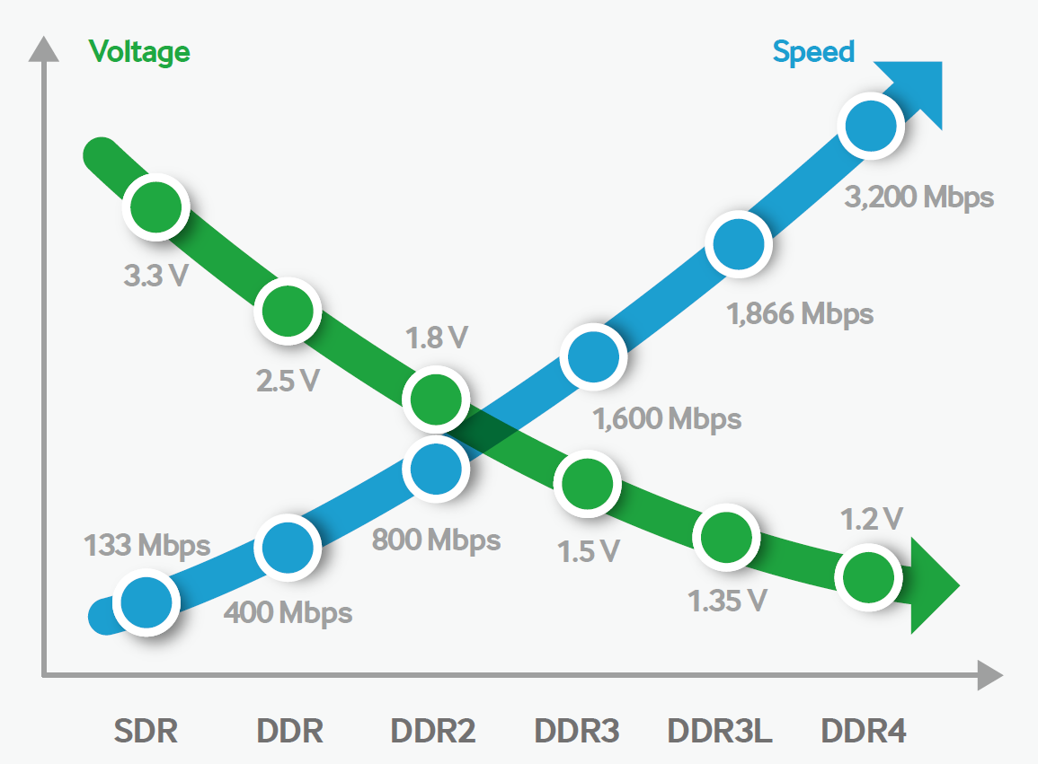
2. Evolution of Intel’s high-end multicore 4S server platforms (48)
Supply voltage and max. transfer rate (speed) of major DRAM technologies [136]

Slide 95
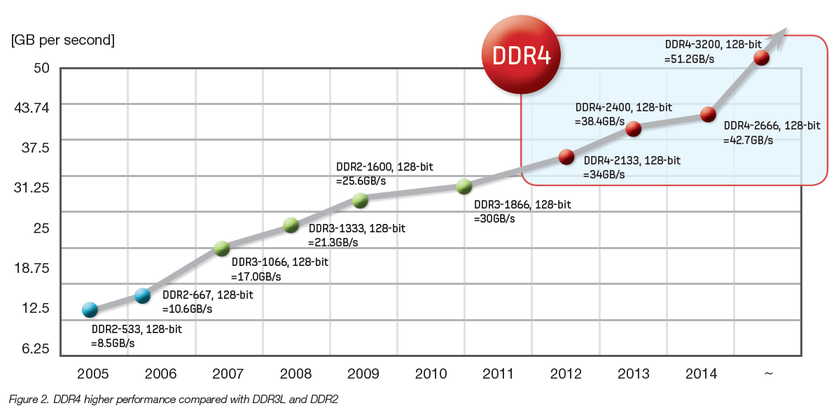
2. Evolution of Intel’s high-end multicore 4S server platforms (49)
Evolution of the transfer rate of Samsung's memory chips 2005 - 2016 [136]
~ 2x/6 y
~3x/4 y

Slide 96
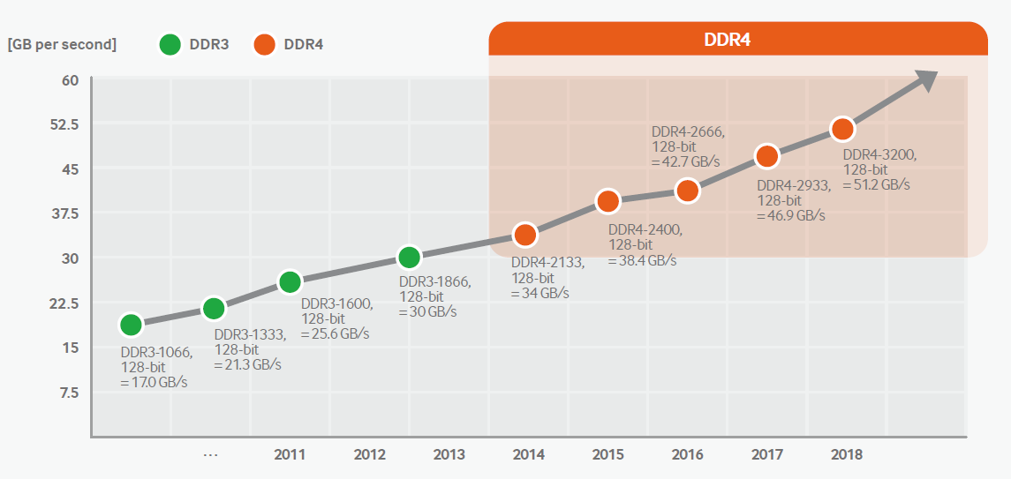
2. Evolution of Intel’s high-end multicore 4S server platforms (50)
Expected evolution of the transfer rate of Samsung's memory chips until 2018 [136]
~ 2 x /6 y
http://www.samsung.com/semiconductor/global/file/insight/2015/11/DDR4_Brochure_Nov-15-0.pdf

Slide 97
3. Example 1: The Brickland platform
3.1 Overview of the Brickland platform
3.2 Key innovations of the Brickland platform vs.
the previous Boxboro-EX platform
3.3 The Ivy Bridge-EX (E7-4800 v2) 4S processor line
3.4 The Haswell-EX (E7-4800 v3) 4S processor line
3.5 The Broadwell-EX (E7-4800 v4) 4S processor line
Notes:
97

Slide 98
3.1 Overview of the Brickland platform
Notes:
98

Slide 99
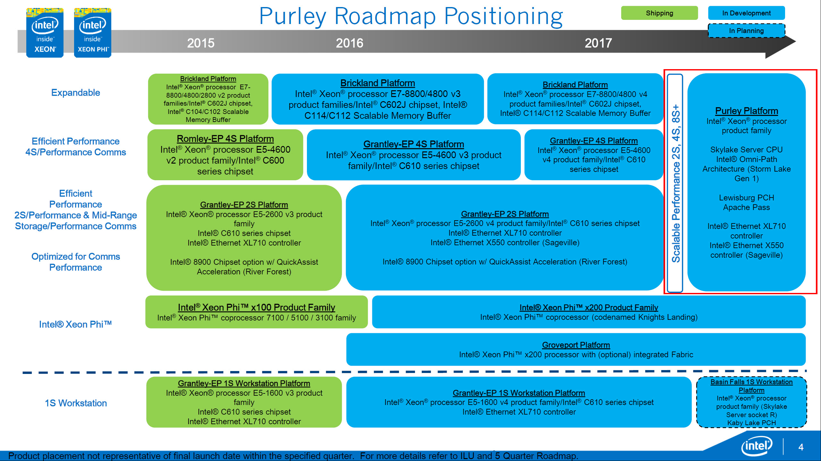
3.1 Overview of the Brickland platform (1)
3.1 Overview of the Brickland platform
Positioning the Brickland platform [112]

Slide 100
3.1 Overview of the Brickland platform (2)
The Brickland 4S (4S) platform
2/2014
4S platform
Brickland
2/2014
5/2015
6/2016
4S cores
Xeon E7-4800 v2
Xeon
E7-4800 v3
Xeon
E7-4800 v4
(Ivy Bridge-EX)
(Ivytown) 15C
(Haswell-EX) 14C
(Broadwell-EX) 16C
22 nm/4310 mtrs/541 mm²
¼ MB L2/C
37.5 MB L3
3 QPI 1.1 links 8 GT/s
4 SMI2 links to 4 SMBs
2 mem. channels/SMB
up to 3 DIMMs/mem. channel
up to DDR3-1600 MT/s
6 TB (96x64 GB)
32 PCIe 3.0
LGA 2011-1
22 nm/5560 mtrs/661 mm²
¼ MB L2/C
35 MB L3
3 QPI 1.1 links 9.6 GT/s
4 SMI2 links to 4 SMBs
2 mem. channels/SMB
up to 3 DIMMs/mem. channel
up to DDR4-1866 MT/s
6 TB (96x64 GB)
32 PCIe 3.0
LGA 2011-1
14 nm/7200 mtrs/456 mm²
¼ MB L2/C
40 MB L3
3 QPI 1.1 links 9.6 GT/s
4 SMI2 links to 4 SMBs
2 mem. channels/SMB
up to 3 DIMMs/mem. channel
up to DDR4-1866 MT/s
6 TB (96x64 GB)
32 PCIe 3.0
LGA 2011-1
3/2012
PCH
C602J
Ivy Bridge-EX based
(Patsburg J)
Haswell-EX based
Attached via x4 DMI2
Broadwell-EX based
Ivy Bridge-EX-based
22 nm
Haswell-EX based
22 nm
Broadwell-EX based
14 nm

Slide 101
3.1 Overview of the Brickland platform (3)
Basic system architecture of the Brickland 4S server platform
(assuming 2x3 DIMMs/SMB)
Xeon E7-4800 v2
(Ivy Bridge-EX)
(Ivytown) 15C
Xeon E7-4800 v3
(Haswell-EX)
14C
Xeon E7-4800 v4
(Broadwell-EX)
16C
/
/
2x4 SMI2
channels
PCIe 3.0
PCIe 3.0
2x4 SMI2
channels
SMB
32
32
SMB
SMB
Ivy Bridge-EX 15C
QPI
1.1
Ivy Bridge-EX 15C
SMB
SMB
SMB
SMB
SMB
QPI 1.1
QPI 1.1
QPI 1.1
QPI 1.1
SMB
SMB
SMB
Ivy Bridge-EX 15C
Ivy Bridge-EX 15C
SMB
SMB
QPI
1.1
SMB
SMB
32
DMI2
4xPCIe2
32
SMB
PCIe 3.0
PCIe 3.0
C602J PCH
(Patsburg J)
ME
SMI2: Scalable Memory Interface 2
(Parallel 64 bit VMSE data link between
the processor and the SMB)
SMB: Scalable Memory Buffer
(Performs conversion between the
parallel SMI2 and the parallel
DIMM interfaces)

Slide 102
3.1 Overview of the Brickland platform (4)
Contrasting differences in key features of the Ivy Bridge-EX and Haswell-EX based
Brickland platforms [114]
Feature | Ivy Bridge-EX based (E7-4800 v2) | Haswell-EX based (E7-4800 v3)
Cores | Up to 15 | Up to 14
LLC3 size | Up to 15x2.5 MB | Up to 14x2.5 MB
QPI | 3xQPI 1.1 Up to 8.0 GT/s in both dir. (16 GB/s per dir.) | 3xQPI 1.1 Up to 9.6 GT/s in both dir. (19.2 GB/s per dir.)
SMB | C102/C104 (Jordan Creek) C102: 2 DIMMs/SMB C103: 3 DIMMs/SMB | C112/C114 (Jordan Creek 2) C102: 2 DIMMs/SMB C103: 3 DIMMs/SMB
VMSE speed | Up to 2667 MT/s | Up to 3200 MT/s
DDR4 speed | n.a. | Perf. mode: up to 1600 MT/s Lockstep mode: up to 1866 MT/s
DDR3 speed | Perf. mode: up to 1333 MT/s Lockstep mode: up to 1600 MT/s | Perf. mode: up to 1600 MT/s Lockstep mode: up to 1600 MT/s

Slide 103
3.2 Key innovations of the Brickland platform vs.
the previous Boxboro-EX platform
Notes:
103

Slide 104
3.2 Key innovations of the Brickland platform (1)
3.2 Key innovations of the Brickland platform vs. the previous Boxboro-EX platform
3.2.1 Connecting PCIe links direct to the processors rather than to the MCH
3.2.2 New memory buffer design

Slide 105
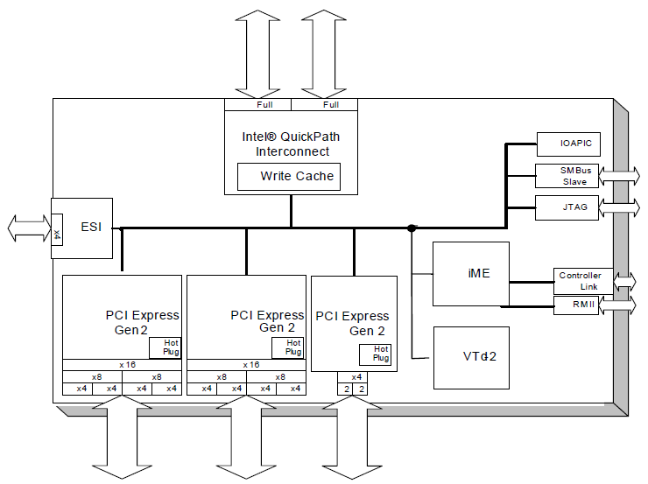
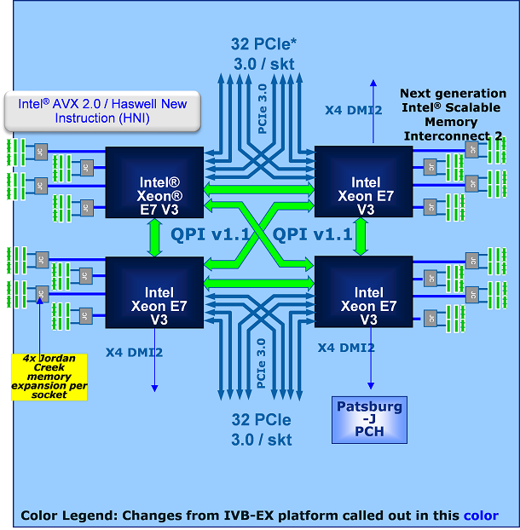
3.2 Key innovations of the Brickland platform (2)
3.2.1 Connecting PCIe links direct to the processors rather than to the MCH -1
3.2.1.1 Overview
Boxboro platform [106]
Brickland platform [114]
2 x QPI
7500 Chipset
36 lanes of PCIe 2.0

Slide 106
3.2 Key innovations of the Brickland platform (3)
Connecting PCIe links direct to the processors rather than to the MCH -2
It has two major implications, including
Raising the PCIe lane count provided by the Brickland platform (see Section 3.2.1.2)
Reducing the bandwidth needed between the processors and the chipset (see Section 3.2.1.3)

Slide 107
3.2 Key innovations of the Brickland platform (4)
3.2.1.2 Raising the PCIe lane count provided by the Brickland platform -1
The Boxboro-EX platform provides 36 PCIe lanes, by contrast the Brickland platform affords
32 PCIe lanes per processor, i.e. 4 x 32 = 132 lanes in total for a 4S platform, as shown below.
Boxboro platform
Brickland platform
2 x QPI
7500 Chipset
36 lanes of PCIe 2.0
Figure: Connecting PCIe links direct to the processors rather than to the MCH

Slide 108
3.2 Key innovations of the Brickland platform (5)
3.2.1.2 Raising the PCIe lane count provided by the Brickland platform -2
If the PCI lanes are connected directly to the processors rather than to the MCH, the number of PCIe lanes supported by the platform will scale linearly with the number of processors.
In addition, the Brickland platform provides faster PCIe 3.0 lanes instead of PCI 2.0 lanes
of the previous Boxboro platform.

Slide 109
3.2 Key innovations of the Brickland platform (6)
3.2.1.3 Reducing the bandwidth demand between the processors and the chipset
By relocating the PCIe links from the MCH to the processors, the bandwidth needed
between the chipset and the processors becomes significantly reduced, as follows;
In the preceding Boxboro platform the MCH provides 36 PCIe 2.0 lanes with a total
bandwidth of 36x0.5 GB/s = 18 GB/s per direction.
This gives rise for using a QPI 1.1 bus width the bandwidth of 16.0 GB/s per direction
between the MCH and the processors.
By contrast, in the Brickland platform the PCIe lanes are connected immediately to the
processors and there is no need for providing the associated bandwidth.
This has three consequences as follows:

Slide 110
3.2 Key innovations of the Brickland platform (7)
a) Interconnecting the processors and the PCH by a DMI2 (4x PCIe 2.0) interface
Due to the reduced bandwidth demand of the chipset-processor interface, it suffices now
to interconnect the PCH with a single processor via a DMI2 interface consisting of 4 PCIe 2.0
lanes that provide a bandwidth of up to 4x0.5=2 GB/s, rather than using a QPI bus with
a bandwidth of 16.0 GB/s.
Figure: The Haswell-EX implementation of the Brickland platform [114]

Slide 111
3.2 Key innovations of the Brickland platform (8)
b) Providing only three QPI links per processor -1
As the Brickland platform does not need an extra QPI bus to interconnect the processor with
the PCH, it has only 3 QPI buses per processor rather than four compared to the previous
(Boxboro-EX) platform, as shown in the next Figure.
Figure: The Haswell-EX implementation of the Brickland platform [114]

Slide 112
3.2 Key innovations of the Brickland platform (9)
Providing only three QPI links per processor -2
In addition, the Brickland platform supports already QPI 1.1 buses with the following speeds:
Ivy Bridge-EX based Brickland platforms: up to 8.0 Gbps
Nehalem-EX based Brickland platforms: up to 9.6 Gbps
Broadwell-EX based Brickland platforms: up to 9.6 Gbps (only for E7-8800 v4)

Slide 113
3.2 Key innovations of the Brickland platform (10)
c) Implementing a single chip “chipset”
Inspired by the reduced functionality, the chipset is now implemented as a single chip solution
instead of using two chips, as in the previous Boxboro platform.
The single chip “chipset” is now designated as the PCH (Platform Controller Hub).
It is in particular the C602 J or Patsburg-J PCH, as shown below.
Figure: The Haswell-EX implementation of the Brickland platform [114]

Slide 114
3.2 Key innovations of the Brickland platform (11)
3.2.2 New memory buffer design
It has two main components, as follows:
a) Redesigned, basically parallel MC-SMB interface, called SMI2 interface
b) Enhanced DRAM interface

Slide 115
3.2 Key innovations of the Brickland platform (12)
a) Redesigned, basically parallel MC-SMB interface, called SMI2 interface -1
Brickland platform
Boxboro-EX platform
DIMM
DIMM
DIMM
DIMM
DIMM
DIMM
DIMM
DIMM
DIMM
DIMM
DDR3
interface
DDR3/4
interface
SMI In
SMI2 data
Scalable Memory Buffer
(SMB)
Scalable Memory Buffer
(SMB)
SMI Out
SMI CMD
SMI: Serial, packet based link with
differential signaling
Up to 6.4 Gbps
SMI 2: 64-bit parallel, bidirectional data link with
single-ended voltage reference signaling,
(VMSE (Voltage Mode single Ended) signaling)
Up to 3200 MT/s

Slide 116
3.2 Key innovations of the Brickland platform (13)
a) Redesigned, basically parallel MC-SMB interface, called SMI2 interface -2
The SMI link of the Boxboro-EX platform was a serial, packet based, differential link
including about 70 signal lines.
By contrast, as far as the data transfer is concerned, with the SMI2 link Intel changed to
64-bit parallel, bidirectional communication using single-ended voltage reference signals,
called VMSE (Voltage Mode Single Ended) signaling.
SMI 2 requires altogether about 110 signal lines, that is about 50 % more lines than SMI.
The reason for changing from serial transfer to parallel transfer in case of the data lines is
presumably the fact, that in this case AD/DA converting of data becomes superfluous and
this results in reduced dissipation.
The SMI 2 operates
in the Ivy Town-EX based Brickland platform at a speed of up to 2667 MT/s and
in the Haswell-EX based Brickland platform at a speed of up to 3200 MT/s.

Slide 117
3.2 Key innovations of the Brickland platform (14)
b) Enhanced DRAM interface
Brickland platform
Boxboro-EX platform
DIMM
DIMM
DIMM
DIMM
DIMM
DIMM
DIMM
DIMM
DIMM
DIMM
DDR3
interface
DDR3/4
interface
SMI In
SMI2 data
Scalable Memory Buffer
(SMB)
Scalable Memory Buffer
(SMB)
SMI Out
SMI CMD
Up to DDR3-1333
Up to 2 DIMMs per memory channel
Up to DDR4-1866
Up to 3 DIMMs per memory channel

Slide 118
3.2 Key innovations of the Brickland platform (15)
Operation modes of the SMBs in the Brickland platform [113]
Operation modes of the SMBs
Lockstep mode
Independent channel mode
(aka Performance mode)
In lockstep mode the same command is sent
on both DRAM buses.
The read or write commands are issued
simultaneously to the referenced DIMMs,
and the SMB interleaves the data on the
In the independent channel mode commands
sent to both DRAM channels are independent
from each other.

Slide 119
3.2 Key innovations of the Brickland platform (16)
DRAM speeds of the Brickland platform
Feature | Ivy Bridge-EX based (E7-4800 v2) | Haswell-EX based (E7-4800 v3)
SMB | C102C104 | C112/C114
DDR4 speed | n.a. | Perf. mode: up to 1600 MT/s Lockstep mode: up to 1866 MT/s
DDR3 speed | Perf. mode: up to 1333 MT/s Lockstep mode: up to 1600 MT/s | Perf. mode: up to 1600 MT/s Lockstep mode: up to 1600 MT/s

Slide 120
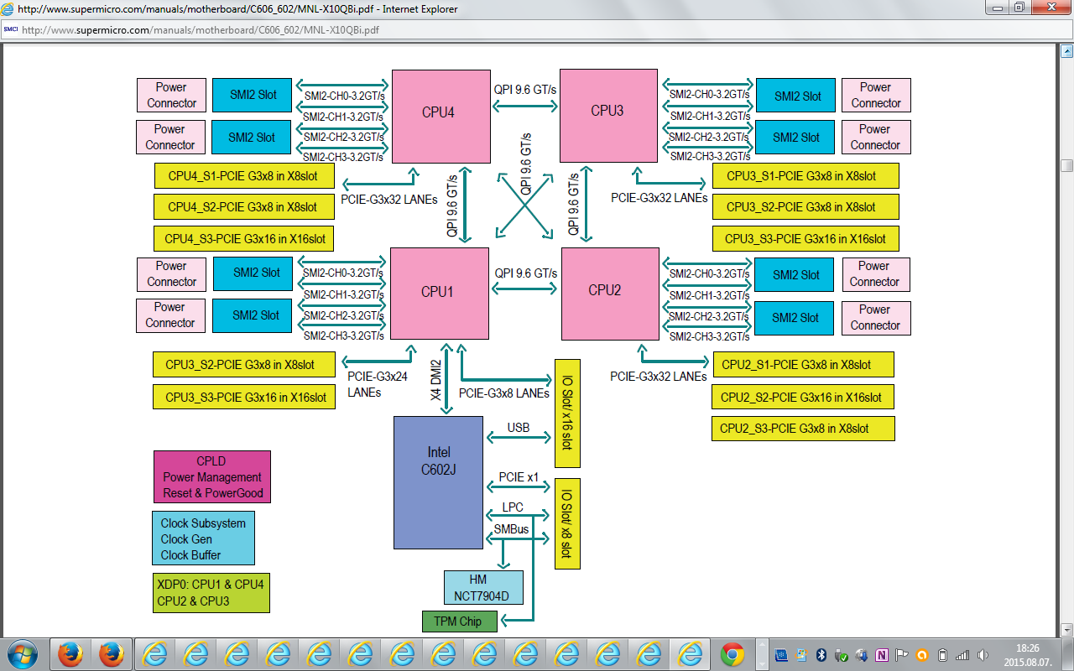
3.2 Key innovations of the Brickland platform (17)
Example for a Haswell-EX based Brickland platform [115]
Haswell-EX
E7-8800 v3 /E7-4800 v3 family
(18-Core), w/ QPI up to 9.6 GT/s

Slide 121
3.3 The Ivy Bridge-EX (E7-4800 v2) 4S processor line
Notes:
121

Slide 122
3.3 The Ivy Bridge-EX (E7-4800 v2) 4S processor line (1)
3.3 The Ivy Bridge-EX (4800 v2) 4S processor line [116]
Intel developed a single processor to cover all server market segments from 1S to 8S, called
the Ivytown processor.
It is manufactured on the 22 nm technology, includes up to 15 cores built up on 4.31 billion
transistors on a die of 541 mm².
Ivytown processor versions have a TDP of 40 to 150 W and operate at frequencies ranging
from 1.4 to 3.8 GHz.
The Ivytown processor was launched along with the Romley 2S server platform in 9/2013
followed by the Brickland 4S platform in 2/2014.

Slide 123
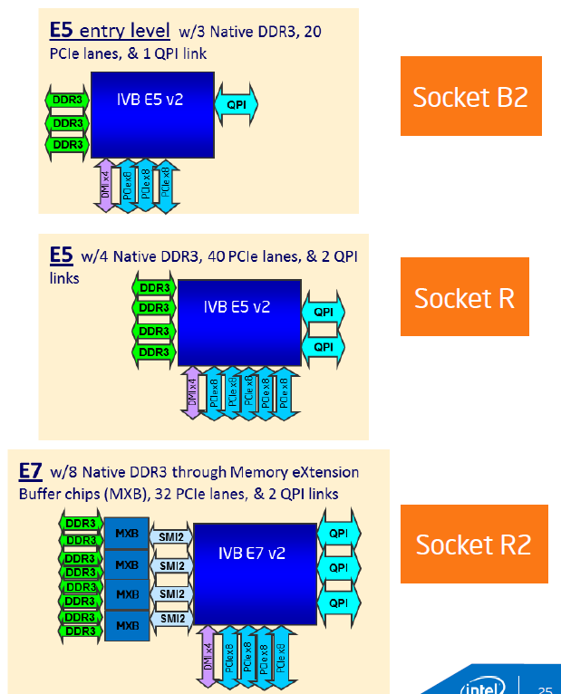
3.3 The Ivy Bridge-EX (E7-4800 v2) 4S processor line (2)
Server platforms and processor segments covered by the Ivytown processor [117]
E5 platform: Romley
Entry level
E5 2400 1, 2 sockets
Performance level
E5 2600 1, 2. 4 sockets
E7 platform: Brickland
High-performance level
E7 4800/8800 2, 4, 8 sockets

Slide 124
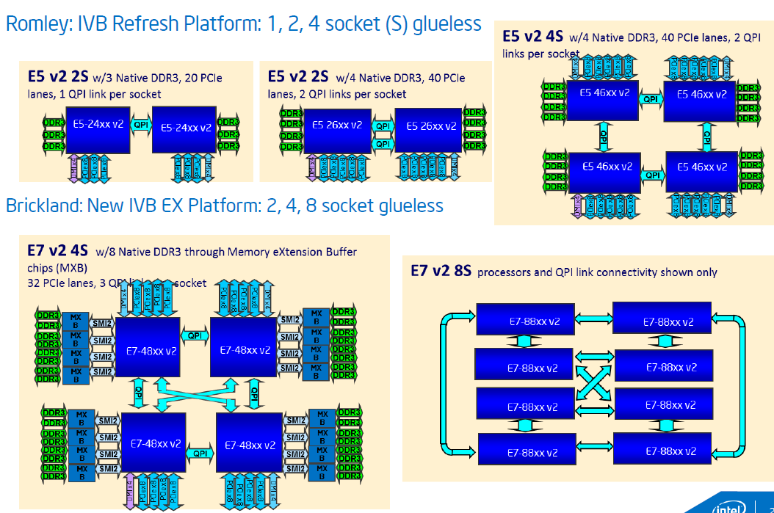
3.3 The Ivy Bridge-EX (E7-4800 v2) 4S processor line (3)
E5, E7 platform alternatives built up of Ivytown processors [117]
Romley Entry and Performance level platform alternatives
Brickland High performance platform alternatives

Slide 125
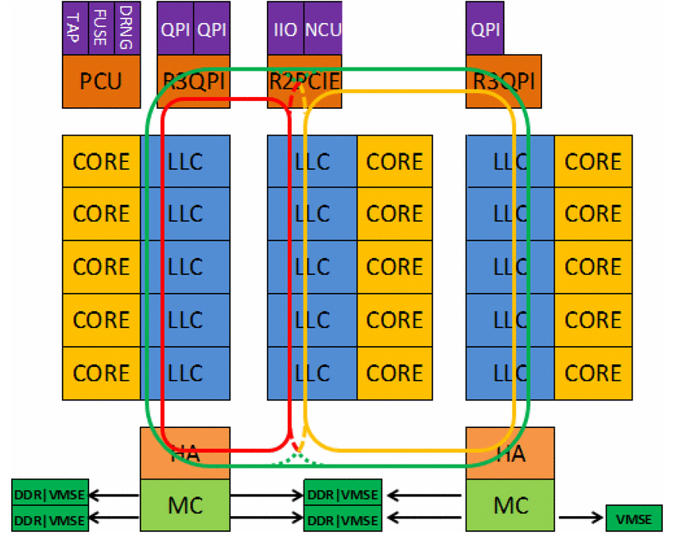
3.3 The Ivy Bridge-EX (E7-4800 v2) 4S processor line (4)
Block diagram of the 15-core Ivy Town processor
The processor consists of 3 slices, each with 5 cores and associated LLC segments, as seen below.
PCU: Power Control Unit
TAP: Test Access Port
FUSE: Fuse block, to configure the die
i.e. to have various core and
cache sizes as well as
different frequency and TDP
levels
DRNG: Digital Random Number
Generator
IIO: Integrated I/O block
HA: Home Agent providing
memory coherency
MC: Memory Controller
VMSE: Voltage-Mode Single-Ended
Interface (actually the
SMB)
Figure: Block diagram of the Ivy Town processor [116]

Slide 126
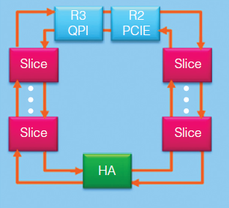
3.3 The Ivy Bridge-EX (E7-4800 v2) 4S processor line (5)
Layout of the ring interconnect bus used for dual slices (10 cores) [125]

Slide 127
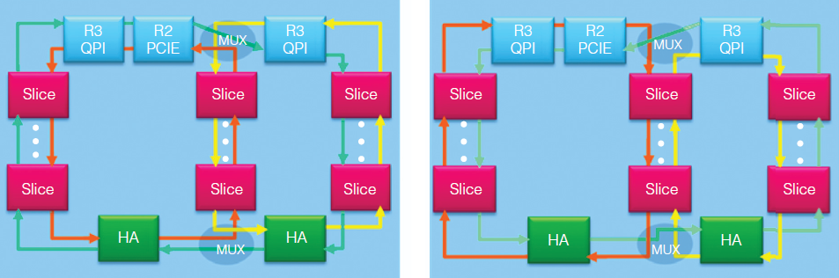
3.3 The Ivy Bridge-EX (E7-4800 v2) 4S processor line (6)
Layout of the ring interconnect bus used for three slices (15 cores) [125]
There are 3 virtual rings.
Multiplexers (MUXs) dynamically interconnect the rings, as shown below.
Clockwise outer ring
Counter-clockwise outer ring
Figure: Three-slice ring interconnect with three virtual rings interconnected by multiplexers [125]

Slide 128
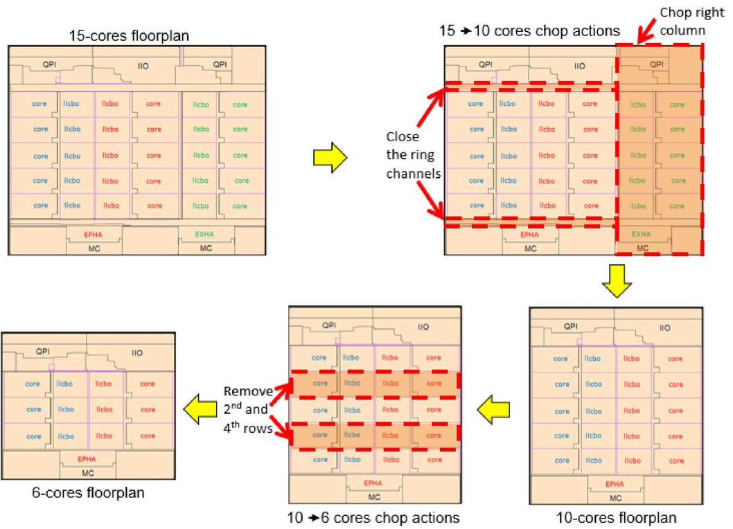
3.3 The Ivy Bridge-EX (E7-4800 v2) 4S processor line (7)
Implementing lower core variants through chopping [116]

Slide 129
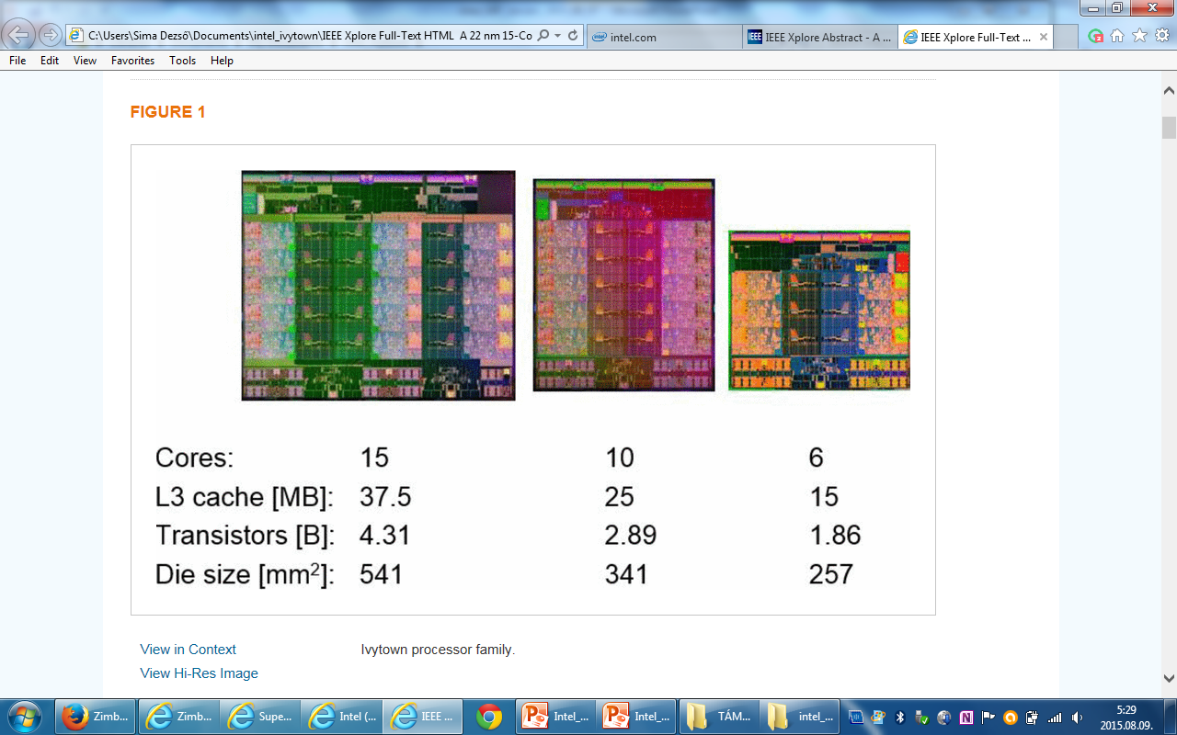
3.3 The Ivy Bridge-EX (E7-4800 v2) 4S processor line (8)
Lower core alternatives of the Ivytown processor achieved by chopping [116]
15 cores
10 cores
6 cores

Slide 130
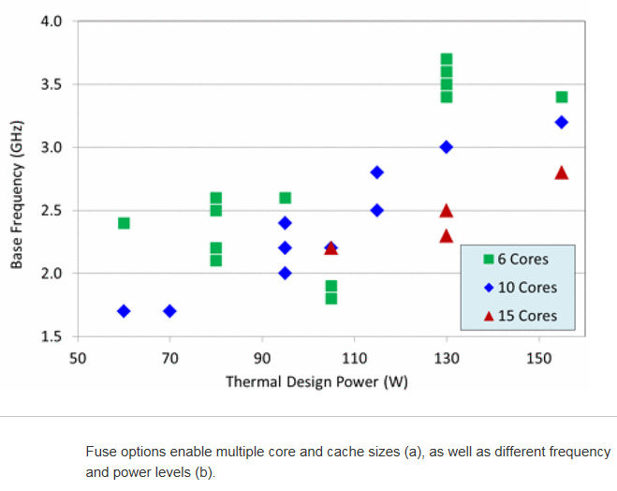
3.3 The Ivy Bridge-EX (E7-4800 v2) 4S processor line (9)
TDP vs. core frequency in different Ivytown processor alternatives [116]

Slide 131
3.4 The Haswell-EX (E7-4800 v3) 4S processor line
Notes:
131

Slide 132
3.4 The Haswell-EX (E7-4800 v3) 4S processor line (1)
3.4 The Haswell-EX (E7-4800 v3) 4S processor line
Launched in 5/2015
22 nm, 5.7 billion transistors, 662 mm (for 14 to 18 cores)
Number of cores
18 cores for 8S processors
14 cores for 4S ones (in 08/2015) instead 18 cores

Slide 133
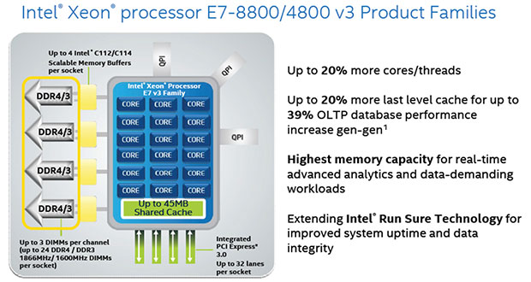
3.4 The Haswell-EX (E7-4800 v3) 4S processor line (2)
Basic layout of an 18 core 8S Haswell-EX v3 (E7-8800) processor [118]

Slide 134
3.4 The Haswell-EX (E7-4800 v3) 4S processor line (3)
Contrasting key features of the Ivy Bridge-EX and Haswell-EX processors -1 [114]
Feature | Ivy Bridge-EX (E7-4800 v2) | Haswell-EX (E7-4800 v3)
Cores | Up to 15 | Up to 14
LLC size (L3) | Up to 15x2.5 MB | Up to 14x2.5 MB
QPI | 3xQPI 1.1 Up to 8.0 GT/s in both dir. (16 GB/s per dir.) | 3xQPI 1.1 Up to 9.6 GT/s in both dir. (19.2 GB/s per dir.)
SMB | C102/C104 (Jordan Creek) C102: 2 DIMMs/SMB C103: 3 DIMMs/SMB | C112/C114 (Jordan Creek 2) C102: 2 DIMMs/SMB C103: 3 DIMMs/SMB
VMSE speed | Up to 2667 MT/s | Up to 3200 MT/s
DDR4 speed | n.a. | Perf. mode: up to 1600 MT/s Lockstep mode: up to 1866 MT/s
DDR3 speed | Perf. mode: up to 1333 MT/s Lockstep mode: up to 1600 MT/s | Perf. mode: up to 1600 MT/s Lockstep mode: up to 1600 MT/s
TSX | n.a. | Supported

Slide 135
3.4 The Haswell-EX (E7-4800 v3) 4S processor line (4)
Contrasting key features of the Ivy Bridge-EX and Haswell-EX processors -1 [114]
We note that the Haswell-EX processors support Intel’s Transactional Synchronization Extension
(TSX) that has been introduced with the Haswell core, but became disabled in the Haswell-EP
processors due to a bug.

Slide 136
3.4 The Haswell-EX (E7-4800 v3) 4S processor line (5)
Transactional Synchronization Extension (TSX)
Intel’s TSX is basically an ISA extension and its implementation to allow hardware supported
transactional memory.
Transactional memory is an efficient synchronization mechanism in concurrent programming
used to effectively manage race conditions occurring when multiple threads access shared
data.

Slide 137
3.4 The Haswell-EX (E7-4800 v3) 4S processor line (6)
Addressing race conditions
Basically there are two mechanisms to address race conditions in multithreaded programs,
as indicated below:
Basic mechanisms to address races in multithreaded programs
Locks
Transactional memory (TM)
Pessimistic approach,
it intends to prevent possible conflicts
by enforcing serialization of transactions
through locks.
Optimistic approach,
it allows access conflicts to occur
but provides a checking and repair mechanism
for managing these conflicts, i.e.
it allows all threads to access shared data simultaneously
but after completing a transaction,
it will be checked whether a conflict arose,
if yes, the transaction will be rolled back and
then replayed if feasible else
executed while using locks.
The next Figure illustrates these synchronization mechanisms.

Slide 138
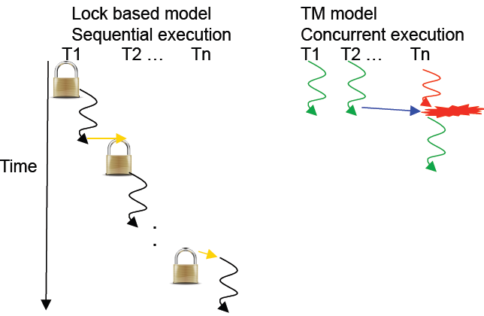
3.4 The Haswell-EX (E7-4800 v3) 4S processor line (7)
Illustration of lock based and transaction memory (TM) based thread synchronization
[126]
Conflict, to be
repaired

Slide 139
3.4 The Haswell-EX (E7-4800 v3) 4S processor line (8)
We note that in their POWER8 (2014) IBM also introduced hardware supported transactional
memory, called Hardware Transactional Memory (HTM).

Slide 140
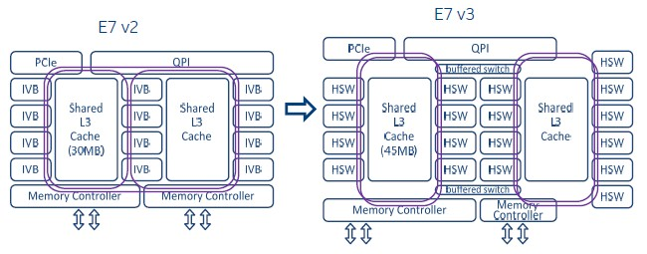
3.4 The Haswell-EX (E7-4800 v3) 4S processor line (9)
Contrasting the layout of the Haswell-EX cores vs. the Ivy Bridge-EX cores [111]
Haswell-EX has four core slides with 3x4 + 6 = 18 cores rather than 3x5 cores in case of
the Ivy Bridge-EX (only 3x 4 = 12 cores indicated in the Figure below).
Figure: Contrasting the basic layout of the Haswell-EX (E7 v3) and Ivy Bridge-EX (E7 v2)
processors [111]
Note that the E7-V3 has only two ring buses interconnected by a pair of buffered switches.

Slide 141
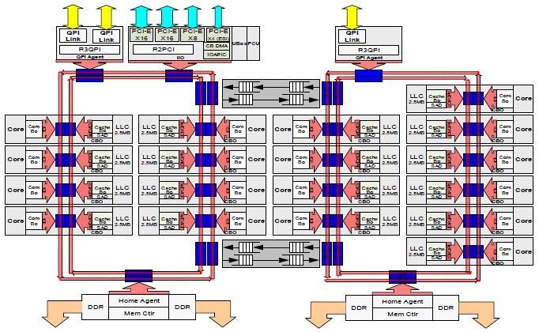
3.4 The Haswell-EX (E7-4800 v3) 4S processor line (10)
More detailed layout of the Haswell-EX die [111]

Slide 142
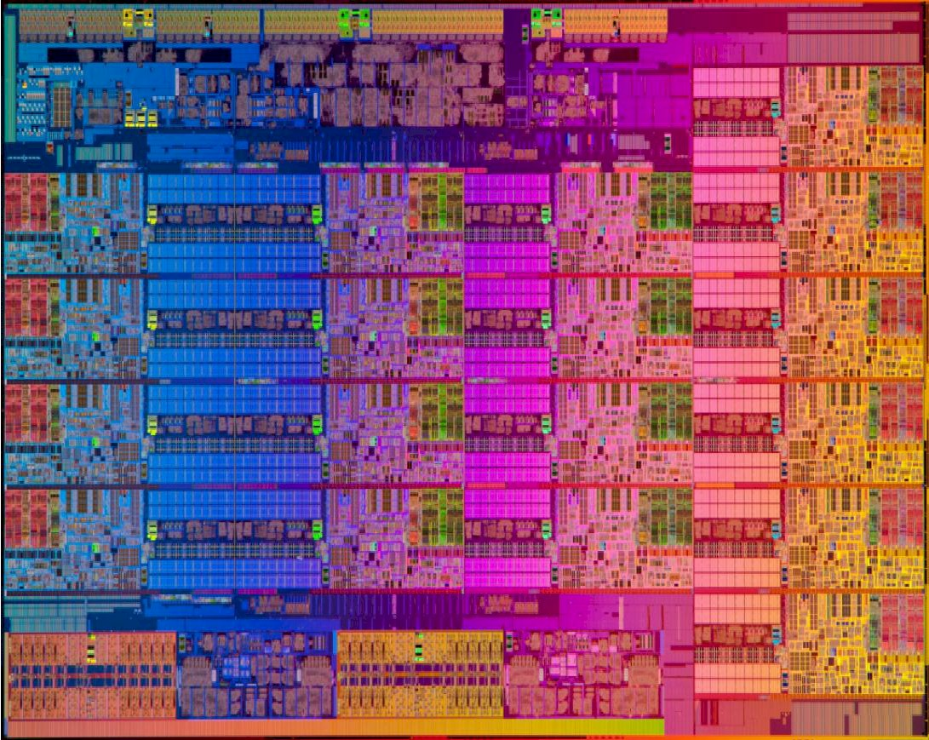
3.4 The Haswell-EX (E7-4800 v3) 4S processor line (11)
Die micrograph of an 18-core Haswell-EX processor [111]
22 nm, 5.7 billion transistors, 662 mm²

Slide 143
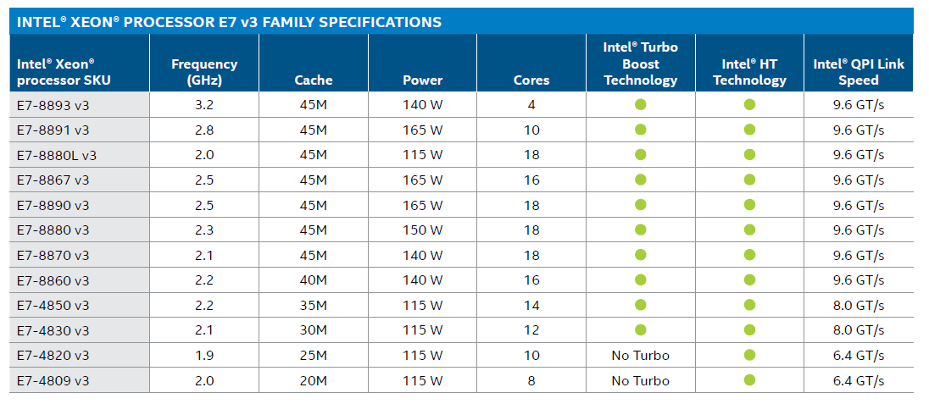
3.4 The Haswell-EX (E7-4800 v3) 4S processor line (12)
Main features of 4S and 8S Haswell-EX processors [120]

Slide 144
3.4 The Haswell-EX (E7-4800 v3) 4S processor line (13)
Power management improvements in the Haswell-EP and Haswell-EX server lines
The related product families are: the Xeon E5-4600/2600/1600 and the Xeon E7-8800/4800
The introduced key power management improvements include first of all:
Per core P-states (PCPS) and
Uncore frequency scaling
We underline that the installed OS has to support the above features.

Slide 145
3.4 The Haswell-EX (E7-4800 v3) 4S processor line (14)
Per core P-states (PCPS) in the HSW-EP and Haswell-EX lines [129], [130]
In the Haswell-EP and -EX server lines Intel introduced individual P-state control instructed
by the OS.
This means that each core can operate independently at individual clock rate and ssociated
core voltage.
Previously, in the Ivy Bridge and preceding generations all cores run at the same frequency
and voltage.

Slide 146
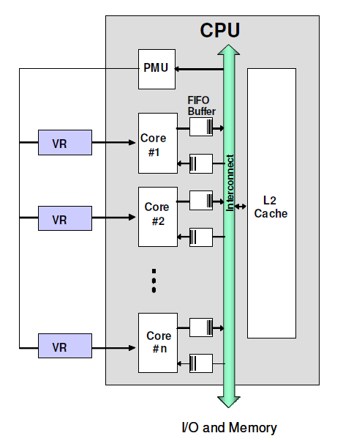
3.4 The Haswell-EX (E7-4800 v3) 4S processor line (15)
Remark 1 - Estimated gain of using individual P-states -1
Subsequently, we cite a study investigating the possible gain of using individual voltage and
clock domains [131].
The assumed microarchitecture of the study is seen below.
PMU: Power Management Unit
Based on sensed data it determines
individual clock and voltage values.
Note that due to the different clock rates
FIFO Buffers are needed between the cores
and the Interconnect for clock synchronization.
Clock synchronization adds latency to the
memory and cache transfers
Figure: Assumed microarchitecture in the cited
study (clock generation not indicated)

Slide 147
3.4 The Haswell-EX (E7-4800 v3) 4S processor line (16)
Remark 1 - Estimated gain of using individual P-states -2
General assessment of using single and multiple voltage domains stated in the study [131]:
"The advantage of a single voltage domain is the capability of sharing the current among the cores; when some cores consume less current or are turned off, current can be directed to the other active cores. This advantage comes at the cost of tying all the voltage domains together, forcing the same operation voltage to all cores.
On the other hand, multiple voltage domains topology provides the ability to deliver individual voltages and frequencies according to an optimization algorithm. In particular, when a single thread workload is executed, the entire CMP power budget can be assigned to a single core, which can consume 16 times higher power than each individual cores when executing a
balanced workload on all 16 cores. While in both cases the total CMP power is the same, separate power domains require at least one of the 16 VRs to deliver 16 times higher power than its nominal working point. Such a requirement is not feasible. The present study evaluates VR designed to deliver 130%–250% of the rated CMP current."

Slide 148
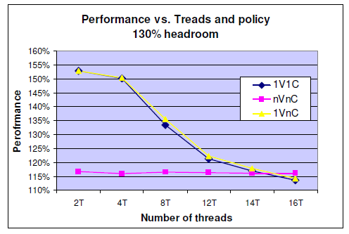
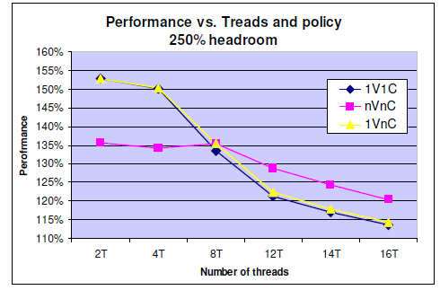
3.4 The Haswell-EX (E7-4800 v3) 4S processor line (17)
Estimated gain vs a baseline platform that does not make use of DVFS [131]
1V1C: Single Voltage domain, single Clock domain
nVnC: Multiple Voltage domains, multiple Clock domains
1VnC: Single Voltage domain, multiple Clock domains
The headroom is understood as the capability of the voltage regulators to deliver up to 130 % or 150 % of the rated current (the current consumed at the min. Vcc
design point (the lowest P point).
The study has shown that for low thread counts, typical in DT and mobile platforms, the use
of multiple voltage and clock domains degrades performance due to clock synchronization
needed that adds latency to memory and cache transfers.
By contrast, in processors that support a large number of threads, as typical in servers,
multiple voltage and frequency domains may be benefitial assuming that voltage regulators
have a high enough power delivery capability.

Slide 149
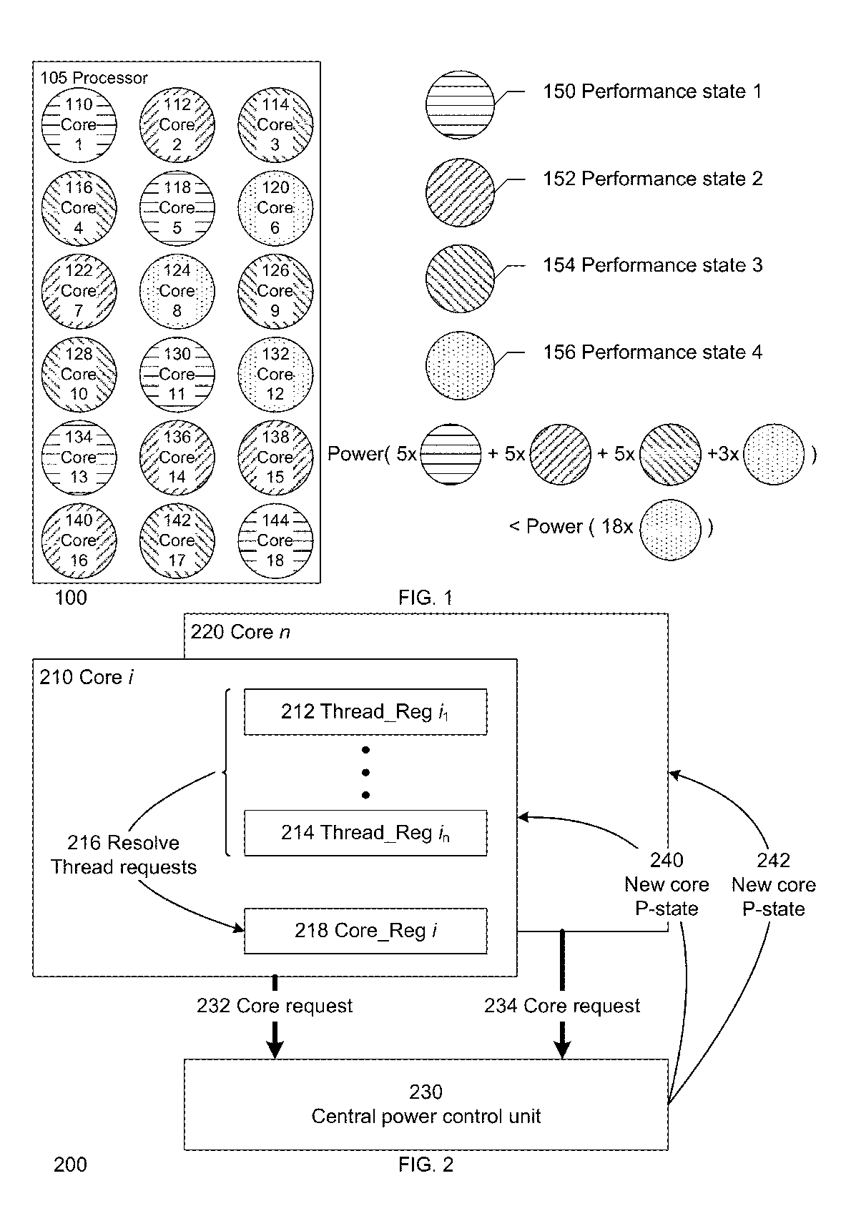
3.4 The Haswell-EX (E7-4800 v3) 4S processor line (18)
Remark 2 -Principle of operation of the Per-core P-state (PCPS) power management (simplified) -1
US patent application 20140229750 A1 (filed in 2012 and issued in 2014) reveals details
of the implementation [133].
The Figure below illustrates PCPS for an 18 core Haswell-EX processor when the cores
run a four different P-states.
Figure: Illustration of PCPS for an 18-core Haswell-EX processor if the cores run a four P-states []

Slide 150
3.4 The Haswell-EX (E7-4800 v3) 4S processor line (19)
Remark 2 -Principle of operation of the Per-core P-state (PCPS) power management (simplified) -2
According to the patent each core includes a set of 32-bit registers, one register for each
thread (Registers 212 to 214) plus an additional register (Register 218), as indicated
for two cores (Core i and Core n) below.
Figure: Per core implemented registers used for PCPS []

Slide 151
3.4 The Haswell-EX (E7-4800 v3) 4S processor line (20)
Remark 2 -Principle of operation of the Per-core P-state (PCPS) power management (simplified) -3
The per-thread available registers (Registers 212 to 214) provide a set of fields, detailed in
the patent.
The OS determines for each thread the requested P-state needed for executing the thread
at efficient performance (i.e. at the min. clock rate needed to execute the thread without
substantially lengthening its runtime. Note here that each thread is scheduled only for
in given time windows thus a higher clock rate would not substantially reduce its runtime).
Available core logic evaluates the per-thread requests, determines the highest performance
P-state needed for the core and writes this values into the additional register
(Register 218).
Finally, the requested P-state is communicated to the Central Power Control Unit (230) and
it sets the related individual voltage regulator and clock generator (PLL) belonging
to the core considered to obtain the requested P-state.

Slide 152
3.4 The Haswell-EX (E7-4800 v3) 4S processor line (21)
Uncore frequency scaling [132]
  With uncore frequency scaling the uncore voltage and frequency is independently controlled
  from the core's voltage and frequency settings.
  To achieve this the uncore needs to be implemented on a separate voltage and clock domain.
Benefit of uncore frequency scaling
For compute bound applications core frequency may be raised without needing
to increase uncore frequency and voltage or
for memory-bound applications uncore frequency may be raised without needing to
increase core frequency and voltage.
This allows to optimize performance by consuming less power.
Remark [132]
In Nehalem the cores were DVFS controlled whereas the uncore run at a fixed frequency
In the Sandy Bridge and Ivy Bridge cores and uncore were tight together
in Haswell each core and the uncore is treated separately.

Slide 153
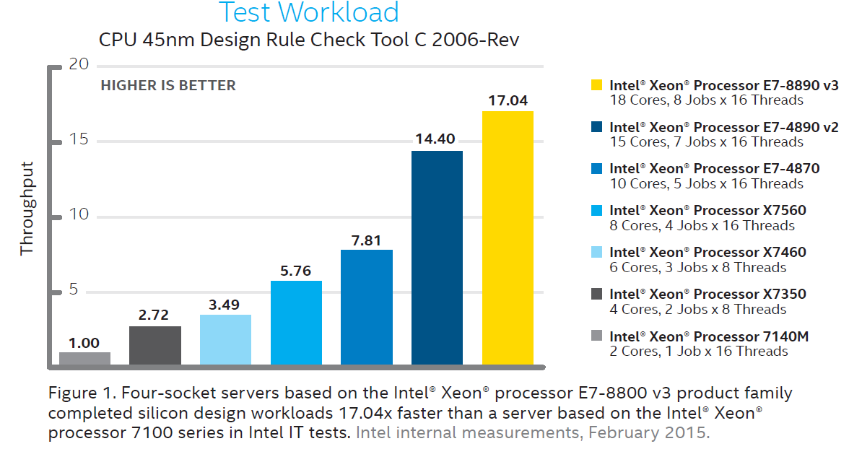
3.4 The Haswell-EX (E7-4800 v3) 4S processor line (23)
Performance comparison of 4S processors -1 [121]
(The test workload is: CPU 45 nm Design Rule Check Tool C 2006 Rev.)
P4-based Tulsa (2006)
Core 2 Tigerton QC (2007)
Penryn Dunnington (2008)
Nehalem-EX (2010)
Westmere-EX (2011)
Ivy Bridge-EX (2014)
Haswell-EX (2015)

Slide 154
3.4 The Haswell-EX (E7-4800 v3) 4S processor line (24)
Performance comparison of 4S processors -2 [121]
Note that with their 4S line Intel achieved a more than 10-fold performance boost in 10 years.

Slide 155
3.5 The Broadwell-EX (E7-4800 v4) 4S processor line
Notes:
155

Slide 156
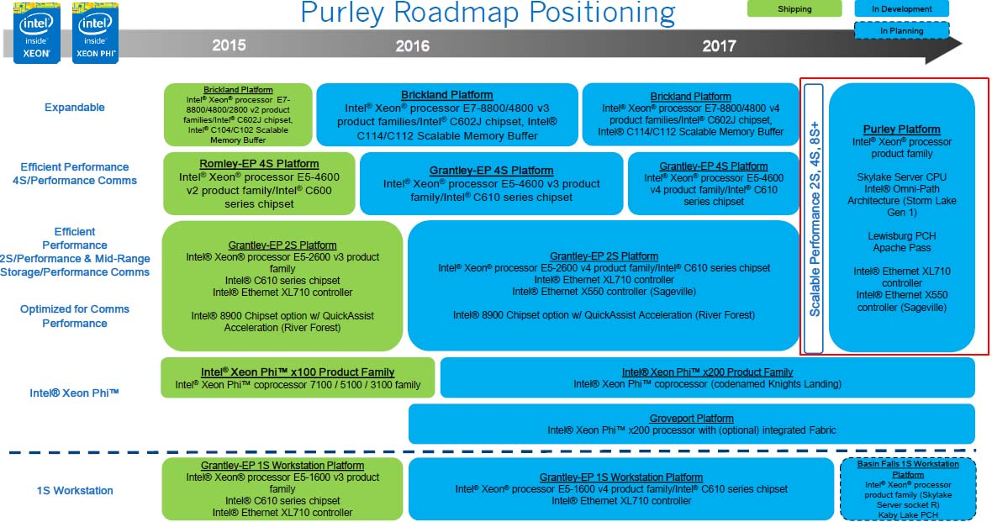
3.5 The Broadwell-EX (E7-4800 v4) 4S processor line (1)
3.5 The Broadwell-EX (E7-4800 v4) 4S processor line
Positioning the 14 nm Broadwell-EX line [112]

Slide 157
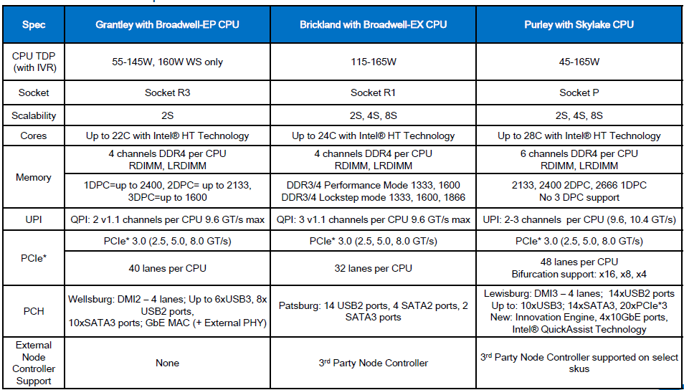
3.5 The Broadwell-EX (E7-4800 v4) 4S processor line (2)
Planned features of the Brickland platform with the Broadwell-EX processor line -1 [122]

Slide 158
3.5 The Broadwell-EX (E7-4800 v4) 4S processor line (3)
Main features of the Broadwell-EX processor line -2 [122]
As seen in the above Table, the planned features – except of having 24 cores – are the same
as implemented in the Haswell-EX line.

Slide 159
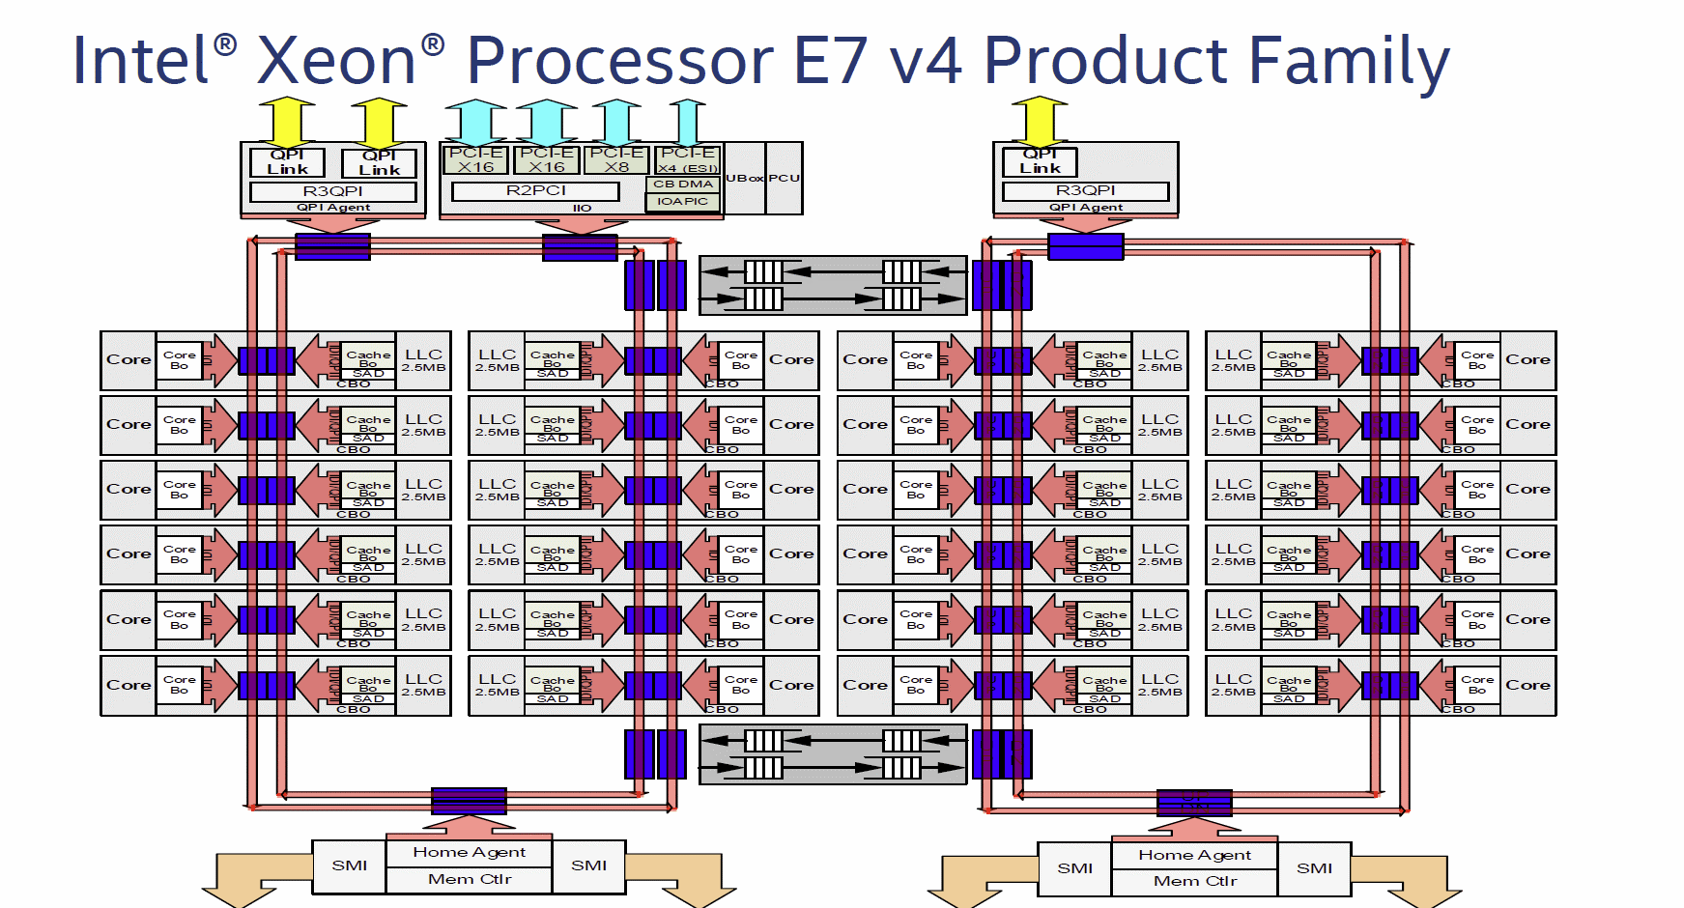
3.5 The Broadwell-EX (E7-4800 v4) 4S processor line (4)
Layout of the Broadwell-EX die [128]

Slide 160
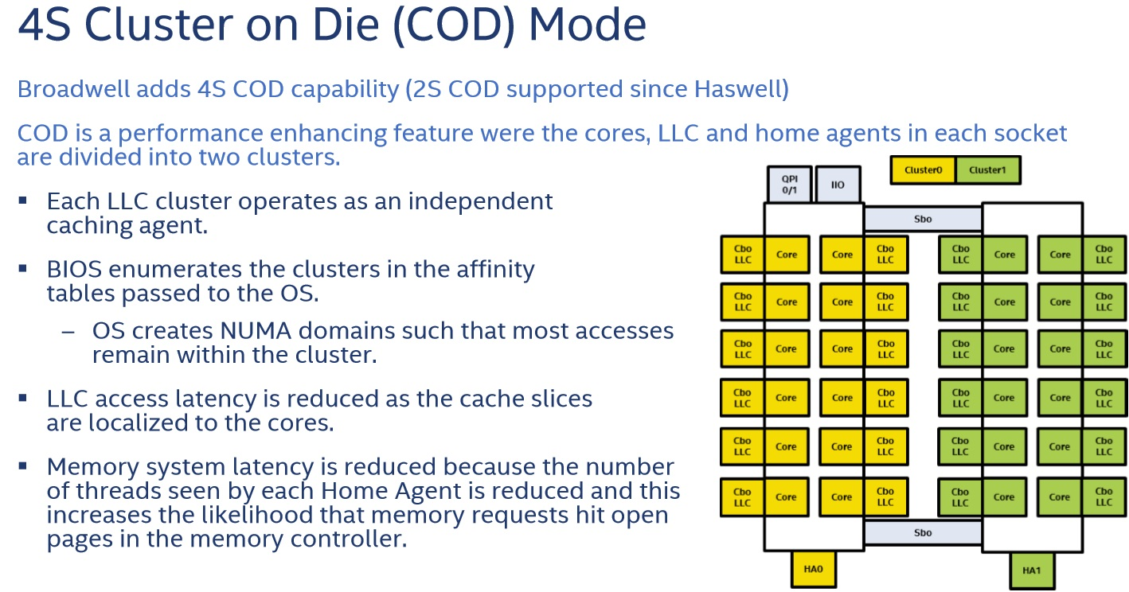
3.5 The Broadwell-EX (E7-4800 v4) 4S processor line (5)
4S Cluster on Die (COD) Mode [128]
COD is a performance enhancing feature, introduced with Haswell-EP, as 2S COD mode.
Broadwell-EX adds 4S COD capability by dividing 24 cores, 24 LLCs and the Home Agents
(HA) into two clusters, as seen below.
Figure: 4S Cluster on Die (COD) Mode [128]

Slide 161
3.5 The Broadwell-EX (E7-4800 v4) 4S processor line (6)
Principle of operation [128]
Each LLC cluster operates as an independent caching agent.
OS creates NUMA domains such that most memory accesses remain within the cluster.
Benefits
LLC access latency is reduced as the cache slices are more localized to the cores.
Memory system latency is reduced because the number of threads seen by each
Home Agent is reduced and this increases the likelihood that memory requests hit
open pages in the memory controller.

Slide 162
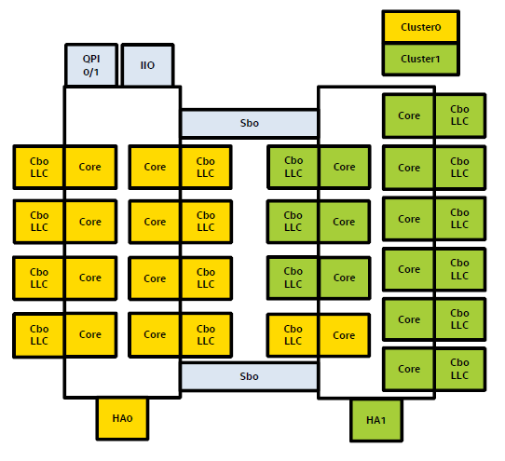
3.5 The Broadwell-EX (E7-4800 v4) 4S processor line (7)
Remark - Introduction of the COD mode already in Haswell-EP for 1S and 2S servers [134]
In case of an 18 core Haswell-EP (E5-2600 v3) processor the cores are partitioned into 2x 9 cores
as follows:
Figure: Partitioning 18 cores into 2x 9 cores for the COD mode in a Haswell-EP processor [134]

Slide 163
3.5 The Broadwell-EX (E7-4800 v4) 4S processor line (8)
Main features of the Broadwell-EX (Xeon E7-8800 v4 and 4800 v4) lines [128]
 | Cores / Threads | Clock / Turbo | L3 Cache | QPI | TDP | MSRP
Xeon E7-8890 v4 | 24 / 48 | 2.2 / 3.4 Ghz | 60 MB | 9.6 GT / s | 165 W | $7174.00
Xeon E7-8880 v4 | 22 / 44 | 2.2 / 3.3 Ghz | 55 MB | 9.6 GT / s | 150 W | $5895.00
Xeon E7-8870 v4 | 20 / 40 | 2.1 / 3.0 Ghz | 50 MB | 9.6 GT / s | 140 W | $4672.00
Xeon E7-8860 v4 | 18 / 36 | 2.2 / 3.2 Ghz | 45 MB | 9.6 GT / s | 140 W | $4061.00
Xeon E7-8855 v4 | 14 / 28 | 2.1 / 2.8 Ghz | 35 MB | 9.6 GT / s | 140 W | N/A
Xeon E7-8867 v4 | 18 / 36 | 2.4 / 3.3 Ghz | 45 MB | 9.6 GT / s | 165 W | $4672.00
Xeon E7-8891 v4 | 10 / 20 | 2.8 / 3.5 Ghz | 60 MB | 9.6 GT / s | 165 W | $6841.00
Xeon E7-8893 v4 | 4 / 8 | 3.2 / 3.5 Ghz | 60 MB | 9.6 GT / s | 140 W | $6841.00
Xeon E7-4850 v4 | 16 / 36 | 2.1 / 2.8 Ghz | 40 MB | 8.0 GT / s | 115 W | $3003.00
Xeon E7-4830 v4 | 14 / 28 | 2.0 / 2.8 Ghz | 35 MB | 8.0 GT / s | 115 W | $2170.00
Xeon E7-4820 v4 | 10 / 20 | 2.0 Ghz | 25 MB | 6.4 GT / s | 115 W | $1502.00
Xeon E7-4809 v4 | 8 / 16 | 2.1 Ghz | 20 MB | 6.4 GT / s | 115 W | $1223.00

Slide 164
4. Example 2: The Purley platform
Notes:
164

Slide 165
4. Example 2:. The Purley platform (1)
4. Example 2: The Purley platform
According to leaked Intel sources it is planned to be introduced in 2017.
It is based on the 14 nm Skylake family.

Slide 166
4. Example 2:. The Purley platform (2)
Positioning of the Purley platform [112]

Slide 167
4. Example 2:. The Purley platform (3)
Planned features of the Purley platform with the Skylake-EX processor line -1 [122]

Slide 168
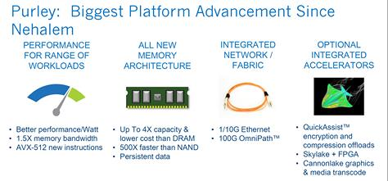
4. Example 2:. The Purley platform (4)
Key advancements of the Purley platform [123]

Slide 169
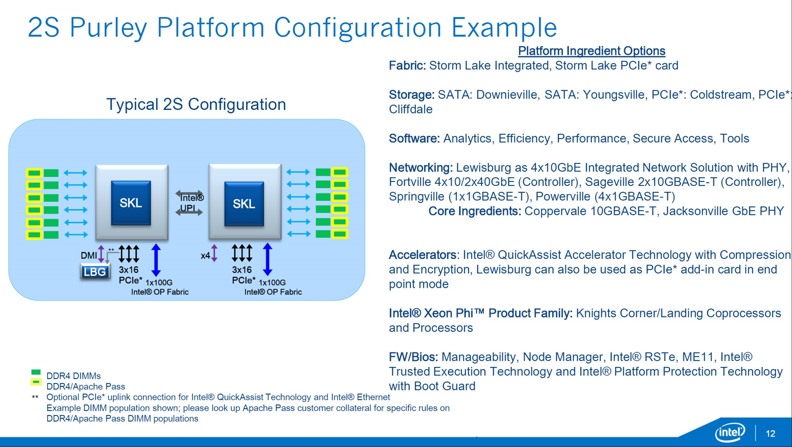
4. Example 2:. The Purley platform (5)
Example of a 2S Purley platform [123]
10GBASE-T: 10 Gbit/s Ethernet via copper twisted pair cable

Slide 170
5. References
Notes:
170

Slide 171
5. References (1)
[1]: Radhakrisnan S., Sundaram C. and Cheng K., „The Blackford Northbridge Chipset for the
Intel 5000”, IEEE Micro, March/April 2007, pp. 22-33
[2]: Next-Generation AMD Opteron Processor with Direct Connect Architecture – 4P Server
Comparison, http://www.amd.com/us-en/assets/content_type/DownloadableAssets/4P_
Server_Comparison_PID_41461.pdf
[3]: Intel® 5000P/5000V/5000Z Chipset Memory Controller Hub (MCH) – Datasheet,
Sept. 2006. http://www.intel.com/design/chipsets/datashts/313071.htm
[4]: Intel® E8501 Chipset North Bridge (NB) Datasheet, Mai 2006,
http://www.intel.com/design/chipsets/e8501/datashts/309620.htm
[5]: Conway P & Hughes B., „The AMD Opteron Northbridge Architecture”, IEEE
MICRO, March/April 2007, pp. 10-21
[6]: Intel® 7300 Chipset Memory Controller Hub (MCH) – Datasheet, Sept. 2007,
http://www.intel.com/design/chipsets/datashts/313082.htm
[7]: Supermicro Motherboards, http://www.supermicro.com/products/motherboard/
[8]: Sander B., „AMD Microprocessor Technologies,” 2006,
http://www.ewh.ieee.org/r4/chicago/foxvalley/IEEE_AMD_Meeting.ppt
[9]: AMD Quad FX Platform with Dual Socket Direct Connect (DSDC) Architecture,
http://www.asisupport.com/ts_amd_quad_fx.htm
[10]: Asustek motherboards - http://www.asus.com.tw/products.aspx?l1=9&l2=39
http://support.asus.com/download/model_list.aspx?product=5&SLanguage=en-us

Slide 172
5. References (2)
[11]: Kanter, D. „A Preview of Intel's Bensley Platform (Part I),” Real Word Technologies,
Aug. 2005, http://www.realworldtech.com/page.cfm?ArticleID=RWT110805135916&p=2
[12]: Kanter, D. „A Preview of Intel's Bensley Platform (Part II),” Real Word Technologies,
Nov. 2005, http://www.realworldtech.com/page.cfm?ArticleID=RWT112905011743&p=7
[13]: Quad-Core Intel® Xeon® Processor 7300 Series Product Brief, Intel, Nov. 2007
http://download.intel.com/products/processor/xeon/7300_prodbrief.pdf
[14]: „AMD Shows Off More Quad-Core Server Processors Benchmark” X-bit labs, Nov. 2007
http://www.xbitlabs.com/news/cpu/display/20070702235635.html
[15]: AMD, Nov. 2006 http://www.asisupport.com/ts_amd_quad_fx.htm
[16]: Rusu S., “A Dual-Core Multi-Threaded Xeon Processor with 16 MB L3 Cache,” Intel, 2006,
http://ewh.ieee.org/r5/denver/sscs/Presentations/2006_04_Rusu.pdf
[17]: Goto H., Intel Processors, PCWatch, March 04 2005,
http://pc.watch.impress.co.jp/docs/2005/0304/kaigai162.htm
[18]: Gilbert J. D., Hunt S., Gunadi D., Srinivas G., “The Tulsa Processor,” Hot Chips 18, 2006,
http://www.hotchips.org/archives/hc18/3_Tues/HC18.S9/HC18.S9T1.pdf
[19]: Goto H., IDF 2007 Spring, PC Watch, April 26 2007,
http://pc.watch.impress.co.jp/docs/2007/0426/hot481.htm

Slide 173
5. References (3)
[20]: Hruska J., “Details slip on upcoming Intel Dunnington six-core processor,” Ars technica,
February 26, 2008, http://arstechnica.com/news.ars/post/20080226-details-slip-on-
upcoming-intel-dunnington-six-core-processor.html
[21]: Goto H., 32 nm Westmere arrives in 2009-2010, PC Watch, March 26 2008,
http://pc.watch.impress.co.jp/docs/2008/0326/kaigai428.htm
[22]: Singhal R., “Next Generation Intel Microarchitecture (Nehalem) Family:
Architecture Insight and Power Management, IDF Taipeh, Oct. 2008,
http://intel.wingateweb.com/taiwan08/published/sessions/TPTS001/FA08%20IDF
-Taipei_TPTS001_100.pdf
[23]: Smith S. L., “45 nm Product Press Briefing,”, IDF Fall 2007,
ftp://download.intel.com/pressroom/kits/events/idffall_2007/BriefingSmith45nm.pdf
[24]: Bryant D., “Intel Hitting on All Cylinders,” UBS Conf., Nov. 2007,
http://files.shareholder.com/downloads/INTC/0x0x191011/e2b3bcc5-0a37-4d06-
aa5a-0c46e8a1a76d/UBSConfNov2007Bryant.pdf
[25]: Barcelona's Innovative Architecture Is Driven by a New Shared Cache,
http://developer.amd.com/documentation/articles/pages/8142007173.aspx
[26]: Larger L3 cache in Shanghai, Nov. 13 2008, AMD,
http://forums.amd.com/devblog/blogpost.cfm?threadid=103010&catid=271
[27]: Shimpi A. L., “Barcelona Architecture: AMD on the Counterattack,” March 1 2007,
Anandtech, http://www.anandtech.com/cpuchipsets/showdoc.aspx?i=2939&p=1

Slide 174
5. References (4)
[28]: Rivas M., “Roadmap update,”, 2007 Financial Analyst Day, Dec. 2007, AMD,
http://download.amd.com/Corporate/MarioRivasDec2007AMDAnalystDay.pdf
[29]: Scansen D., “Under the Hood: AMD’s Shanghai marks move to 45 nm node,”
EE Times, Nov. 11 2008,
http://www.eetimes.com/news/latest/showArticle.jhtml?articleID=212002243
[30]: 2-way Intel Dempsey/Woodcrest CPU Bensley Server Platform, Tyan,
http://www.tyan.com/tempest/training/s5370.pdf
[31]: Gelsinger P. P., “Intel Architecture Press Briefing,”, 17. March 2008,
http://download.intel.com/pressroom/archive/reference/Gelsinger_briefing_0308.pdf
[32]: Mueller S., Soper M. E., Sosinsky B., Server Chipsets, Jun 12, 2006,
http://www.informit.com/articles/article.aspx?p=481869
[33]: Goto H., IDF, Aug. 26 2005,
http://pc.watch.impress.co.jp/docs/2005/0826/kaigai207.htm
[34]: TechChannel, http://www.tecchannel.de/_misc/img/detail1000.cfm?pk=342850&
fk=432919&id=il-74145482909021379
[35]: Intel quadcore Xeon 5300 review, Nov. 13 2006, Hardware.Info,
http://www.hardware.info/en-US/articles/amdnY2ppZGWa/Intel_quadcore_Xeon_
5300_review
[36]: Wasson S., Intel's Woodcrest processor previewed, The Bensley server platform debuts,
Mai 23, 2006, The Tech Report, http://techreport.com/articles.x/10021/1

Slide 175
5. References (5)
[37]: Enderle R., AMD Shanghai “We are back! TGDaily, November 13, 2008,
http://www.tgdaily.com/content/view/40176/128/
[38]: Clark J. & Whitehead R., “AMD Shanghai Launch, Anandtech, Nov. 13 2008,
http://www.anandtech.com/showdoc.aspx?i=3456
[39]: Chiappetta M., AMD Barcelona Architecture Launch: Native Quad-Core, Hothardware,
Sept. 10, 2007,
http://hothardware.com/Articles/AMD_Barcelona_Architecture_Launch_Native_
QuadCore/
[40]: Hachman M., “AMD Phenom, Barcelona Chips Hit By Lock-up Bug,”, ExtremeTech,
Dec. 5 2007, http://www.extremetech.com/article2/0,2845,2228878,00.asp
[41]: AMD Opteron™ Processor for Servers and Workstations,
http://amd.com.cn/CHCN/Processors/ProductInformation/0,,30_118_8826_8832,
00-1.html
[42]: AMD Opteron Processor with Direct Connect Architecture, 2P Server Power Savings
Comparison, AMD,
http://enterprise.amd.com/downloads/2P_Power_PID_41497.pdf
[43]: AMD Opteron Processor with Direct Connect Architecture, 4P Server Power Savings
Comparison, AMD,
http://enterprise.amd.com/downloads/4P_Power_PID_41498.pdf
[44]: AMD Opteron Product Data Sheet, AMD,
http://pdfs.icecat.biz/pdf/1868812-2278.pdf

Slide 176
5. References (6)
[45]: Images, Xtreview,
http://xtreview.com/images/K10%20processor%2045nm%20architec%203.jpg
[46]: Kanter D., “Inside Barcelona: AMD's Next Generation, Real World Tech., Mai 16 2007,
http://www.realworldtech.com/page.cfm?ArticleID=RWT051607033728
[47]: Kanter D,, “AMD's K8L and 4x4 Preview, Real World Tech. June 02 2006,
http://www.realworldtech.com/page.cfm?ArticleID=RWT060206035626&p=1
[48]: Kottapali S., Baxter J., “Nehalem-EX CPU Architecture”, Hot Chips 21, 2009,
http://www.hotchips.org/archives/hc21/2_mon/HC21.24.100.ServerSystemsI-Epub/
HC21.24.122-Kottapalli-Intel-NHM-EX.pdf
[49]: Kahn O., Piazza T., Valentine B., “Technology Insight: Intel next Generation
Microarchitecture Codename Sandy Bridge, IDF, San Francisco, Sept. 2010
[50]: Piazza T., Jiang H., “Intel Next Generation Microarchitecture Codename Sandy Bridge:
Processor Graphics, IDF, San Francisco, Sept. 2010
[51]: Braun-Protte T., “Intel die neuste Generation”, March 2010,
https://sp.ts.fujitsu.com/dmsp/docs/02_fujitsu_intel_server_cpu.pdf
[52]: De Gelas J., The Intel Xeon E7-8800 v3 Review: The POWER8 Killer?, AnandTech,
May 8 2015, http://www.anandtech.com/show/9193/the-xeon-e78800-v3-review
[53]: Tyan Confidential, Tempest i5000VF S5370, 2-way Intel Dempsey/Woodcrest CPU
Bensley Server Platform, http://www.tyan.com/tempest/training/s5370.pdf

Slide 177
5. References (7)
[54]: Intel 5520 Chipset and Intel 5500 Chipset, Datasheet, March 2009,
http://www.intel.com/content/www/us/en/chipsets/5520-5500-chipset-ioh-datasheet.html
[55]: Neiger G., Santoni A., Leung F., Rodgers D., Uhlig R., Intel® Virtualization Technology:
Hardware support for efficient processor virtualization, Aug. 10 2006, Vol. 10, Issue 3,
http://www.intel.com/technology/itj/2006/v10i3/1-hardware/1-abstract.htm
[56]: Intel Software Networks: Forums,
http://software.intel.com/en-us/forums/showthread.php?t=56802
[57]: Wikipedia: x86 virtualization, 2011,
http://en.wikipedia.org/wiki/X86_virtualization#Intel_virtualization_.28VT-x.29
[58]: Sharma D. D., Intel 5520 Chipset: An I/O Hub Chipset for Server, Workstation, and High
End Desktop, Hotchips 2009, http://www.hotchips.org/archives/hc21/2_mon/
HC21.24.200.I-O-Epub/HC21.24.230.DasSharma-Intel-5520-Chipset.pdf
[59]: Morgan T. P., Intel's future Sandy Bridge Xeons exposed, May 30 2011, The Register,
http://www.theregister.co.uk/2011/05/30/intel_sandy_bridge_xeon_platforms/page2.html
[60]: Gilbert J. D., Hunt S. H., Gunadi D., Srinivas G., The Tulsa Processor: A Dual Core Large
Shared-Cache Intel Xeon Processor 7000 Sequence for the MP Server Market Segment,
Aug 21 2006, http://www.hotchips.org/archives/hc18/3_Tues/HC18.S9/HC18.S9T1.pdf
[61]: Intel Server Board Set SE8500HW4, Technical Product Specification, Revision 1.0,
May 2005, ftp://download.intel.com/support/motherboards/server/sb/se8500hw4_board
_set_tpsr10.pdf

Slide 178
5. References (8)
[62]: Mitchell D., Intel Nehalem-EX review, PCPro,
http://www.pcpro.co.uk/reviews/processors/357709/intel-nehalem-ex
[63]: Nagaraj D., Kottapalli S.: Westmere-EX: A 20 thread server CPU, Hot Chips 2010
http://www.hotchips.org/uploads/archive22/HC22.24.610-Nagara-Intel-6-Westmere-EX.pdf
[64]: Intel Xeon Processor E7-8800/4800/2800 Product Families, Datasheet Vol. 1 of 2,
April 2011, http://www.intel.com/Assets/PDF/datasheet/325119.pdf
[65]: Supermicro P4QH6 / P4QH8 User’s Manual, 2002,
http://www.supermicro.com/manuals/motherboard/GC-HE/MNL-0665.pdf
[66]: Intel Xeon Processor 7500/6500 Series, Public Gold Presentation, March 30 2010,
http://cache-www.intel.com/cd/00/00/44/64/446456_446456.pdf
[67]: Supermicro X8QB6-F / X8QBE-F User’s Manual, 2010,
http://files.siliconmechanics.com/Documentation/Rackform/iServ/R413/Mainboard/MNL
-X8QB-E-6-F.pdf
[68]: Rusu & al.: A 45 nm 8-Core Enterprise Xeon Processor, IEEE journal of Solid State Circuits,
Vol. 45, No. 1, Jan. 2010, pp. 7-14
[69]: Jafarjead B., “Intel Core Duo Processor,” Intel, 2006,
http://masih0111.persiangig.com/document/peresentation/behrooz%20jafarnejad.ppt
[70]: Keutzer K., Malik S., Newton R., Rabaey J., Sangiovanni-Vincentelli A., System Level Design:
Orthogonalization of Concerns and Platform-Based Design, IEEE Transactions on
Computer-Aided Design of Circuits and Systems, Vol. 19, No. 12, Dec. 2000, pp.?????

Slide 179
5. References (9)
[71]: Perich D., Intel Volume platforms Technology Leadership, Presentation at HP World 2004,
http://98.190.245.141:8080/Proceed/HPW04CD/papers/4194.pdf
[72]: Krazit T., Intel Sheds Light on 2005 Desktop Strategy, IDG News Service, Dec. 07 2004,
http://pcworld.about.net/news/Dec072004id118866.htm
[73]: Molka D., Hackenberg D., Schöne R., Müller M. S., Memory Performance and Cache
Coherency Effects on an Intel Nehalem multiprocessor System, Proc. 18th Int. Conf.
on Parallel Architectures and Compilation, Techniques, PACT 2009,
http://doi.ieeecomputersociety.org/10.1109/PACT.2009.22
[74]: Radhakrishnan S., Chinthamani S., Cheng K., The Blackford Northbridge Chipset for
Intel 5000, IEEE MICRO, March-April 2007, pp. 22-33
[75]: Rolf T., Cache Organization and Memory Management of the Intel Nehalem Computer
Architecture, University of Utah, Dec. 2009, http://rolfed.com/nehalem/nehalemPaper.pdf
[76]: Levinthal D., Performance Analysis Guide for Intel Core i7 Processor and Intel Xeon 5500
processors, Version 1.0, 2008
http://software.intel.com/sites/products/collateral/hpc/vtune/performance_analysis_
guide.pdf
[77]: Ryszard Sommefeldt R., Intel Xeon 3.4GHz ['Nocona' core], 18th Aug, 2004,
http://www.hexus.net/content/item.php?item=822&page=1&search=reas
[78]: 3.6GHz 2MB 800MHz Intel Xeon Processor SL7ZC C8511, http://store.flagshiptech.com/
products/3.6GHz-2MB-800MHz-Intel-Xeon-Processor-SL7ZC-C8511.html
[79]: Gavrichenkov I., Workstation Processors Duel: AMD Opteron against Intel Xeon, Page 5
12/21/2005,
http://www.xbitlabs.com/articles/cpu/display/opteron-xeon-workstation_5.html

Slide 180
5. References (10)
[80]: Glaskowsky P.: Investigating Intel's Lynnfield mysteries, cnet News, Sept. 21. 2009,
http://news.cnet.com/8301-13512_3-10357328-23.html
[81]: Kurd & al., Westmere: A Family of 32 nm IA Processors, Proc. ISSCC 2010, pp. 96-98
[82]: Miller M. J.,Intel Previews ISSCC: 6-Core Gulftown Processor, Feb 03, 2010, http://
forwardthinking.pcmag.com/chips/282694-intel-previews-isscc-6-core-gulftown-processor
[83]: Hill D., Chowdhury M., Westmere Xeon-56xx “Tick” CPU, Hot Chips 22, 2010,
http://www.hotchips.org/uploads/archive22/HC22.24.620-Hill-Intel-WSM-EP-print.pdf
[84]: Pawlowski S.: Intelligent and Expandable High- End Intel Server Platform, Codenamed
Nehalem-EX, IDF 2009
[85]: Intel Sandy Bridge Review, Bit-tech, Jan. 3 2011,
http://www.bit-tech.net/hardware/cpus/2011/01/03/intel-sandy-bridge-review/1
[86]: Kahn O., Piazza T., Valentine B.: Technology Insight: Intel Next Generation
Microarchitecture Codename Sandy Bridge, IDF 2010
extreme.pcgameshardware.de/.../281270d1288260884-bonusmaterial-pc- games-
ardware-12-2010-sf10_spcs001_100.pdf
[87]: Inkley B., Tetrick S., Intel Multi-core Architecture and Implementations, IDF, Session
MATS002, March 7 2006
[88]: Smith S. L., Intel Roadmap Overview, IDF Fall, Aug. 20 2008
http://download.intel.com/pressroom/kits/events/idffall_2008/SSmith_briefing_roadmap.pdf
[89]: Intel Public Roadmap; Business Platforms for Desktop, Mobile & Data Center, H1’ 2011
http://www.2ncinesil.com/download/Public%20Roadmap%201H%202011.pptx

Slide 181
5. References (11)
[90]: Rusu S., „Circuit Technologies for Multi-Core Processor Design,” April 2006,
http://www.ewh.ieee.org/r6/scv/ssc/April06.pdf
[91]: Goto H., IDF, Aug. 26 2005,
http://pc.watch.impress.co.jp/docs/2005/0826/kaigai207.htm
[92]: TechChannel, http://www.tecchannel.de/_misc/img/detail1000.cfm?pk=342850&
fk=432919&id=il-74145482909021379
[93]: Sandy Bridge, http://en.wikipedia.org/wiki/Sandy_Bridge
[94]: Morgan T. P., Intel's future Sandy Bridge Xeons exposed, The Register, May 30. 2011,
http://www.theregister.co.uk/2011/05/30/intel_sandy_bridge_xeon_platforms
[95]: Gelsinger P., Keynote, IDF Spring 2005, March 2005,
http://www.intel.com/pressroom/kits/events/idfspr_2005/index.htm
[96]: Kuppuswamy, R. C al., Over one million TPCC with a 45nm 6-core Xeon® CPU,
IEEE International Solid-State Circuits Conference - Digest of Technical Papers,
ISSCC 2009, Feb. 2009, pp. 70 - 71,71a
[97]: Perich D., Intel Volume Platforms Technology Leadership, Solutions and Technology
Conference, HP World 2004,
http://www.openmpe.com/cslproceed/HPW04CD/papers/4194.pdf
[98]: De Gelas J., Westmere-EX: Intel Improves their Xeon Flagship, AnandTech, April 6 2011,
http://www.anandtech.com/show/4259/westmereex-intels-flagship-improves
[99]: Starke W.J., POWER7: IBM’s Next Generation, Balanced POWER Server Chip, Hot Chips 21,
http://www.hotchips.org/wp-content/uploads/hc_archives/hc21/3_tues/HC21.25.800.
ServerSystemsII-Epub/HC21.25.835.Starke-IBM-POWER7SystemBalancev13_display.pdf

Slide 182
5. References (12)
[100]: Intel E8500 Chipset eXternal Memory Bridge (XMB), Datasheet, March 2005,
http://www.intel.co.id/content/dam/doc/datasheet/e8500-chipset-external-memory-
bridge-datasheet.pdf
[101]: Intel Server System SSH4 Board Set, Technical Product Specification, Oct. 2003,
http://download.intel.com/support/motherboards/server/ssh4/ssh4_tps.pdf
[102]: Haas J. & Vogt P., Fully buffered DIMM Technology Moves Enterprise Platforms to the
Next Level, Technology Intel Magazine, March 2005, pp. 1-7
[103]: Ganesh B., Jaleel A., Wang D., Jacob B., Fully-Buffered DIMM Memory Architectures:
Understanding Mechanisms, Overheads and Scaling, 2007,
https://ece.umd.edu/~blj/papers/hpca2007.pdf
[104]: Smith S. L., Quad-Core Press Briefing, IDF 2006,
http://www.intel.com/pressroom/kits/quadcore/qc_pressbriefing.pdf
[105]: Smith S.L., Intel Enterprise Roadmap, IDF 2010
[106]: Intel 7500 Chipset, Datasheet, March 2010,
http://www.intel.com/content/dam/doc/datasheet/7500-chipset-datasheet.pdf
[107]: 7500/7510/7512 Scalable Memory Buffer, Datasheet, April 2011,
http://www.intel.com/content/www/us/en/chipsets/7500-7510-7512-scalable-memory-
buffer-datasheet.html
[108]: X8QB6-LF User Manual, Supermicro

Slide 183
5. References (13)
[109]: Baseboard management controller (BMC) definition, TechTarget, May 2007,
http://searchnetworking.techtarget.com/definition/baseboard-management-controller
[110]: Morgan T. P., Intel (finally) uncages Nehalem-EX beast, The Register, March 30 2010,
http://www.theregister.co.uk/2010/03/30/intel_nehalem_ex_launch/?page=2
[111]: Morgan T. P., Intel Puts More Compute Behind Xeon E7 Big Memory, The Platform,
May 5 2015, http://www.theplatform.net/2015/05/05/intel-puts-more-compute-behind-
xeon-e7-big-memory/
[112]: Niederste-Berg M., 28 core Skylake EP/EX plattform comes into view, Hardware LUXX,
26 May 2015, http://www.hardwareluxx.com/index.php/news/hardware/cpu/35474-
28-core-skylake-epex-plattform-comes-into-view.html
[113]: Intel C102/C104 Scalable Memory Buffer, Datasheet, Febr. 2014,
http://www.intel.com/content/dam/www/public/us/en/documents/datasheets/c102-c104-
scalable-memory-buffer-datasheet.pdf
[114]: Intel Xeon Processor E7-8800/4800 V3 Product Family, Technical Overview, May 21 2015,
https://software.intel.com/en-us/articles/intel-xeon-processor-e7-88004800-v3-product-
family-technical-overview
[115]: X10QBi Platform with X10QBi Baseboard, User’s manual, Supermicro, 2014,
ftp://ftp.supermicro.com/CDR-X10-Q_1.00_for_Intel_X10_Q_platform/MANUALS/X10QBi.pdf
[116]: Rusu S., Muljono H., Ayers D., Tam S., A 22nm 15-core enterprise Xeon processor family,
IEEE ISSC Journal, Vol. 50, Issue 1, Jan. 2015

Slide 184
5. References (14)
[117]: Esmer I., Ivybridge Server Architecture: A Converged Server, Aug. 2014, Hot Chips 2014,
http://www.hotchips.org/wp-content/uploads/hc_archives/hc26/HC26-12-day2-epub/
HC26.12-8-Big-Iron-Servers-epub/HC26.13.832-IvyBridge-Esmer-Intel-IVB%20Server%
20Hotchips2014.pdf
[118]: Chiappetta M., Intel Launches Xeon E7-8800 and E7-4800 v3 Processor Families,
Hot Hardware, May 5 2015,
http://hothardware.com/reviews/intel-launches-xeon-e7-v3-family-of-processors
[119]: Broadwell-EX/EP disappear from the latest Intel roadmap, AnandTech Forums,
http://forums.anandtech.com/showthread.php?t=2439161
[120]: Accelerate Big Data Insights with the Intel Xeon Processor E7-8800/4800 v3 Product
Families, Product Brief, 2015,
http://www.intel.com/newsroom/kits/xeon/e7v3/pdfs/Xeon_E7v3_ProductBrief.pdf
[121]: Accelerating Silicon Design with the Intel Xeon Processor E7-8800 v3 Product Family, 2015,
http://www.intel.com/content/dam/www/public/us/en/documents/product-briefs/xeon-
processor-e7-8800-v3-brief.pdf
[122]: Broadwell-EX/EP disappeared from Intel's enterprise roadmaps, Linus Tech Tips,
July 16 2015, http://linustechtips.com/main/topic/409185-broadwell-exep-disappeared-
from-intels-enterprise-roadmaps/
[123]: van Monsjou D., Massive Leak shows details on Skylake Xeon Chips, Overclock3D,
May 25 2015, http://www.overclock3d.net/articles/cpu_mainboard/massive_leak_shows_
details_on_skylake_xeon_chips/1

Slide 185
5. References (15)
[124]: Server duel: Xeon Woodcrest vs. Opteron Socket F, Tweakers, 7 September 2006,
http://tweakers.net/reviews/646/2/server-duel-xeon-woodcrest-vs-opteron-socket-f-
post-mortem-netburst.html
[125]: Papazian I. E. & al., Ivy Bridge Server: A Converged Design, IEEE MICRO, March-April
2015, pp. 16-25,
http://ieeexplore.ieee.org/xpl/articleDetails.jsp?reload=true&arnumber=7091791
[126]: Gao Y., HPC Workload Performance Tuning on POWER8 with IBM XL Compilers and Libraries,
SPXXL/Scicomp Summer Workshop 2014, http://spscicomp.org/wordpress/wp-content/
uploads/2014/05/gao-IBM-XL-compilers-for-POWER8-Scicomp-2014.pdf
[127]: New Xeon Processor Numbering, More Than Just a Number, Intel.com, April 5 2011,
https://communities.intel.com/community/itpeernetwork/datastack/blog/2011/04/05/
new-xeon-processor-numbering-more-than-just-a-number
[128]: Pirzada U., Intel Launches Its 14nm Broadwell-EX Platform,WCCF Tech, 07 June 2016,
http://wccftech.com/intel-broadwell-ex-xeon-e7-8890-24-cores/
[129]: Karedla, R., Intel Xeon E5-2600 v3 (Haswell) Architecture & Features, Intel, 2014,
http://repnop.org/pd/slides/PD_Haswell_Architecture.pdf
[130]: Syamalakumari S., Intel® Xeon® Processor E7-8800/4800 V3 Product Family Technical
Overview, Intel, May 21 2015,
https://software.intel.com/en-us/articles/intel-xeon-processor-e7-88004800-v3-product
-family-technical-overview
[131]: Rotem E. et al., Multiple Clock and Voltage Domains for Chip Multi Processors,
Proc. 42nd Annual IEEE/ACM International Symposium on Microarchitecture (MICRO)
December 12–16, 2009, New York, NY, USA.

Slide 186
5. References (16)
[132]: Gianos C., Intel Xeon Processor E5-2600 v3 Product Family Architectural Overview,
Intel, Nov. 16, 2014,
https://www.yumpu.com/en/document/view/34127638/intelr-xeonr-processor-
e5-2600-v3-overview-for-sc14
[133]: US 2014/0229750 A1 Patent application Method and apparatus for per core performance
states, Filed March 13 2012, Published Aug. 14 2014
[134]: Klemm M., Programming and Tuning for Intel® Xeon® Processors, Intel, 2015,
https://www.dkrz.de/Nutzerportal-en/doku/training/introduction-to-mistral-july-2014/
Programming_and_Tuning_for_Intel_Xeon_Processors_2015-07-01_M.Klemm.pdf?
lang=en
[135]: https://en.wikipedia.org/wiki/RC_circuit
[136]: Samsung Memory DDR4 SDRAM, Broshure, Samsung, 2015,
http://www.samsung.com/semiconductor/global/file/insight/2015/11/DDR4_Brochure_
Nov-15-0.pdf
[137]: Hibben M., Will IBM Sell Its Mainframe Business? Seeking Alpha, Jul. 20, 2016
http://seekingalpha.com/article/3989959-will-ibm-sell-mainframe-business?auth_
param=djq9a:1bovpmu:2be6695ecca2e22ac60039ce2a123ea7
[138]: Intel Xeon Processor E7-8800/4800/2800 Product Families, Intel's presentation,
https://sp.ts.fujitsu.com/dmsp/Publications/public/ru_sap_hana_c_intel.pdf
[139]: Shimpi A. L. & Key G., The Dark Knight: Intel's Core i7, AnandTech, Nov. 3, 2008,
http://www.anandtech.com/show/2658

