Slide 1
The mobile boom
Sima Dezső
Nov. 2016
(Ver. 2.4)
© Sima Dezső, 2016

Slide 2
Contents
1. The traditional computer market
2. The smartphone boom
3. The tablet boom
4. Requirements of mobile devices
5. How leading IT vendors addressed the mobile boom?
6. Conclusions
7. References

Slide 3
1. The traditional computer market
Notes:
3

Slide 4
1. The traditional computer market (1)
1. The traditional computer market
Main computer market segments around 2000
Servers
Desktops
Embedded
computer devices
E.g.
Intel’s Xeon lines
AMD’s Opteron lines
Intel’s Pentium 4 lines
AMD’s Athlon lines
ARM’s lines
Major trend in the first half of the 2000’s: spreading of laptops (first mobile devices)

Slide 5
1. The traditional computer market (2)
Main computer market segments around 2005
Servers
Desktops
Laptops
Embedded
computer devices
E.g.
Intel’s Xeon lines
AMD’s Opteron lines
Intel’s Pentium 4 lines
AMD’s Athlon64 lines
Intel’s Celeron lines
AMD’s Duron lines
ARM’s lines

Slide 6
1. The traditional computer market (3)
Market share of leading processor firms in traditional computer segments

Slide 7
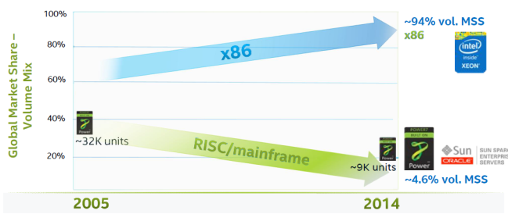
1. The traditional computer market (4)
Worldwide market share of x86 and RISC 4S/4S+ servers (by volume) [51]
Source: IDC World Wide Server Tracker Q4’14
MSS: Market Segment Share

Slide 8
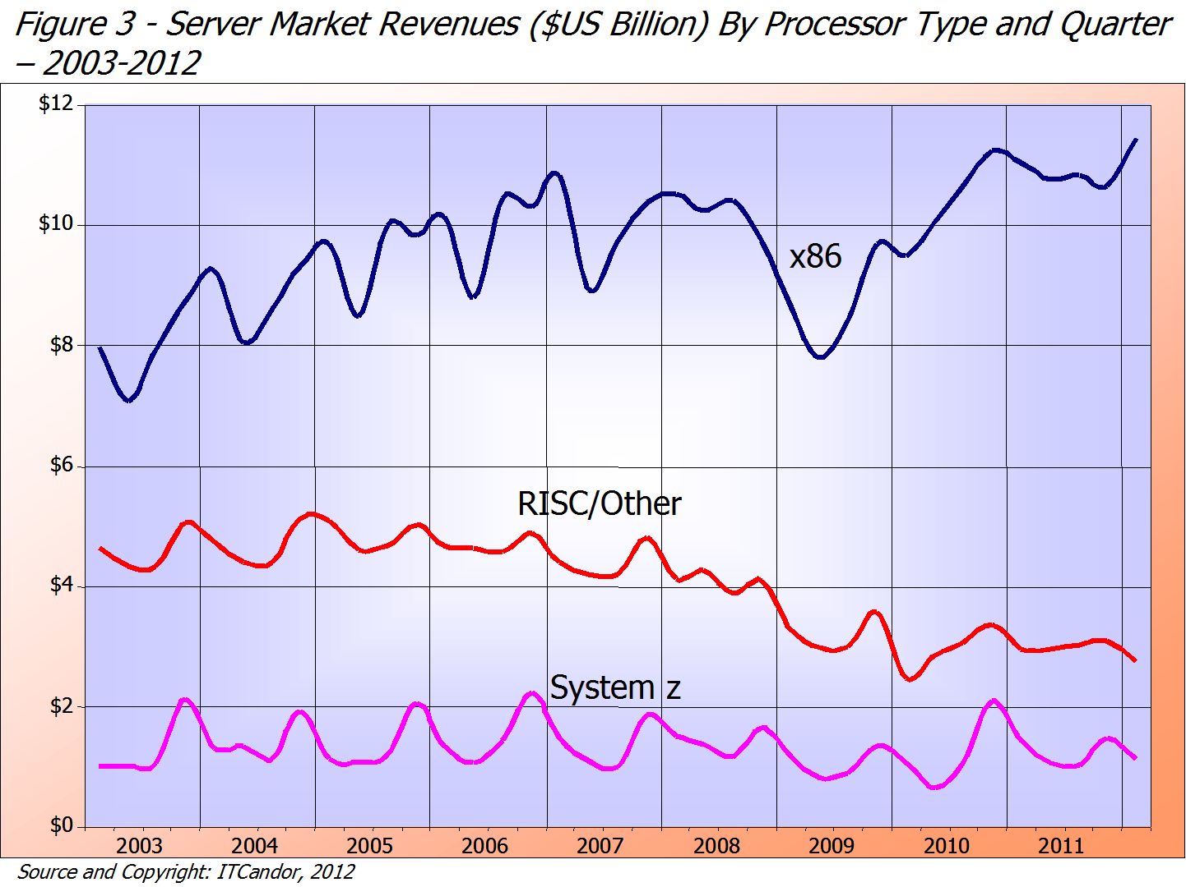
1. The traditional computer market (5)
Server market revenues by vendor ($US Billion) – 2003-2012 [14]
≈75 %
Intel/AMD
IBM POWER/Sun etc.
IBM
≈18 %
≈ 7 %

Slide 9
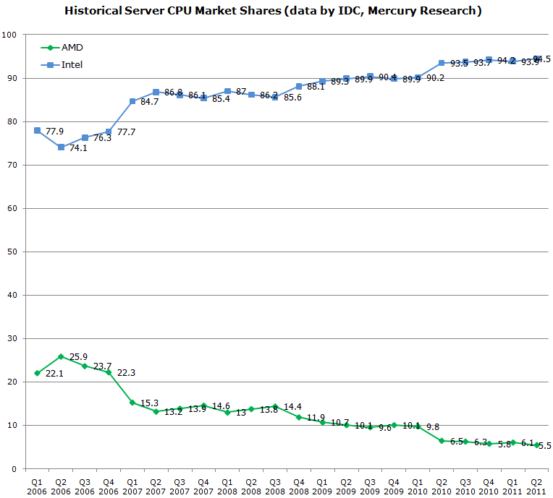
1. The traditional computer market (6)
x86 server market share of Intel and AMD [17]
Penryn MP
Nehalem-EX DP/MP
Penryn DP
Core 2 Quad DP
Core 2 DP
K10 Barcelona MP
K10 Shanghai MP
K10 Istambul MP
K10 Magny Course MP
Source: IDC,
Mercury Research

Slide 10
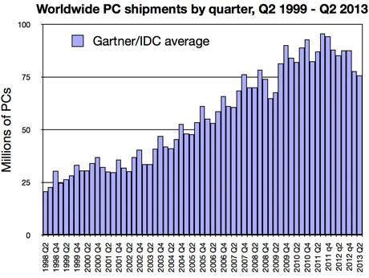
1. The traditional computer market (7)
Worldwide PC shipments by quarter, Q2 1999 – Q2 2013 [18]

Slide 11
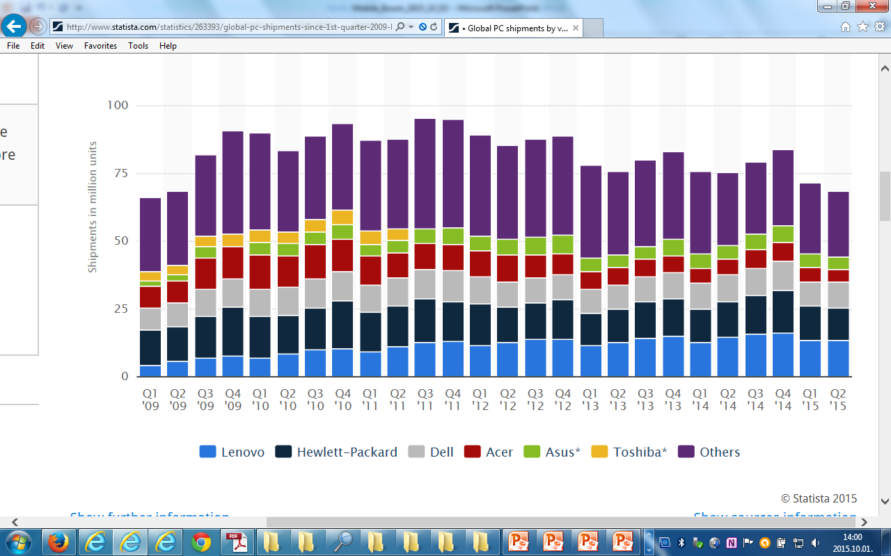
1. The traditional computer market (8)
Worldwide PC shipments by quarter Q1 2009 – Q2 2015 by vendor [52]

Slide 12
1. The traditional computer market (9)
Approximate market share Intel vs. AMD in the PC and laptop segment [65]
(No. of devices in use rather than purchased)
Updated 10th of June 2016

Slide 13
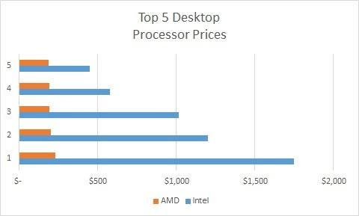
1. The traditional computer market (10)
Intel's dominance in high performance - high price (high margin)
desktop processors [66]

Slide 14
2. Emergence and spread of smartphones
Notes:
14

Slide 15
2. Emergence and spread of smartphones (1)
2. Emergence and spread of smartphones
Diversification of mobile devices mainly after 2005 [2]
The mobile boom

Slide 16
2. Emergence and spread of smartphones (2)
Emergence and rapid increase of smartphone sales 2005-2011 [4]
PC sales: Desktop + Notebook sales
A: Actual values
E: Estimated

Slide 17
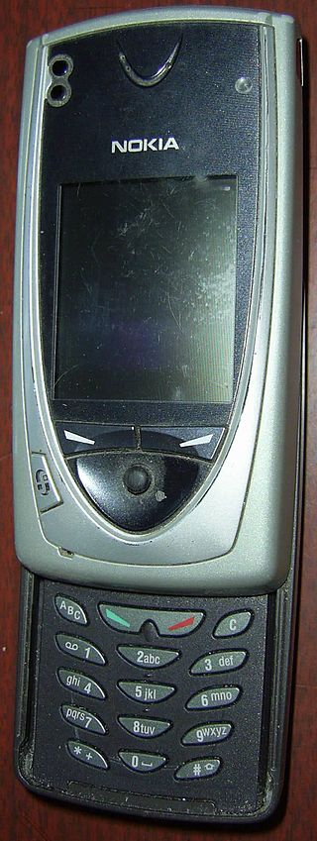
2. Emergence and spread of smartphones (3)
Emergence of smartphones-1
Forerunners of smartphones emerged already
at the beginning of the 2000’s, like Nokia’s 7650
(shipped in 2002).
The 7650 became the first widely available phone
with camera and color screen but supported
no video.
It was the first Nokia phone running under
the Symbian OS.
Figure: Nokia’s 7650 [39]

Slide 18
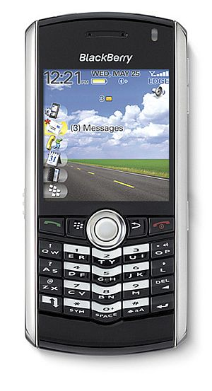
2. Emergence and spread of smartphones (4)
Emergence of smartphones-2
The emergence of smartphones is often
contributed to the BlackBerry Pearl 8100
line of the Canadian firm RIM
(Research in Motion)[5].
This phone – shipped in 2006 - supported
beyond a camera also video and became
very popular in the US.
It was run under the BlackBerry OS.
Figure: RIM’s BlackBarry Perl 8100
(2006) [38]

Slide 19
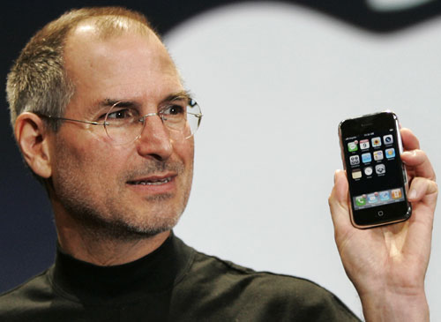
2. Emergence and spread of smartphones (5)
Early spread of smartphones-1
In 2007 Apple’s iPhone gave a strong momentum for rapid spreading of
smartphones.
It run under the iPhone OS (renamed later to iOS in 2010).
Figure: Steve Jobs introducing the iPhone at MacWorld Expo in 1/2007 [47]

Slide 20
2. Emergence and spread of smartphones (6)
Remark
After the introduction of iPhone (2007) Steve Ballmer (CEO of Microsoft) said in an
interview [20]:
“There's no chance that the iPhone is going to get any significant market share.
No chance…
But if you actually take a look at the 1.3 billion phones that get sold, I'd prefer
to have our software (Windows Phone) in 60% or 70% or 80% of them, than
I would to have 2% or 3%, which is what Apple might get”.

Slide 21
2. Emergence and spread of smartphones (7)
Early spread of smartphones-2
Google’s Android was unveiled also in 2007 with first Android-powered phones
sold in 10/2008 [6].

Slide 22
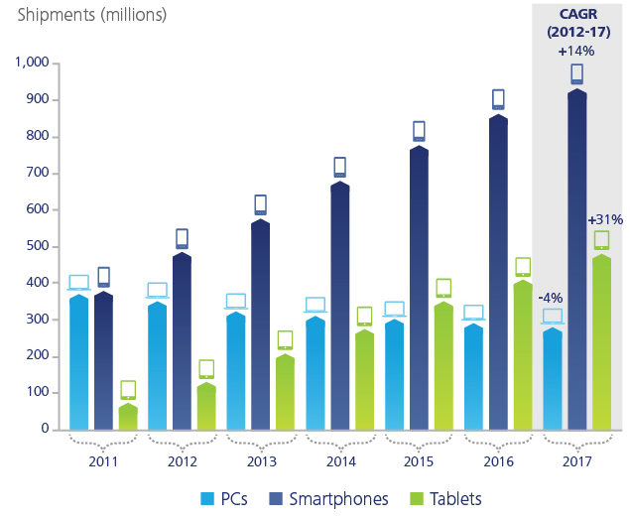
2. Emergence and spread of smartphones (9)
Worldwide unit shipment estimates of PCs vs. smartphones 2011-2017 [28]
Source: Gartner

Slide 23
2. Emergence and spread of smartphones (10)
Worldwide smartphone sales to end users by vendor in 2Q16
(Millions of units) [67]
Company | 2Q16 Q2 Units | 2Q16 Q2 Market share (%) | 2Q15 Q2 Units | 2Q15 Q2 Market share (%)
Samsung | 76,7 | 22.3 | 72,0 | 21.8
Apple | 44,4 | 12.9 | 48,1 | 14.6
Huawei (kínai) | 30,7 | 8.9 | 26,5 | 8.0
Oppo (kínai) | 18,5 | 5.4 | 8,1 | 2.4
Xiaomi (kínai) | 15,5 | 4.5 | 15,5 | 4.7
Others | 158,5 | 46.0 | 160,1 | 48.5
Total | 344,4 | 100.0 | 330,3 | 100.0
Source: Gartner (August 2016)

Slide 24
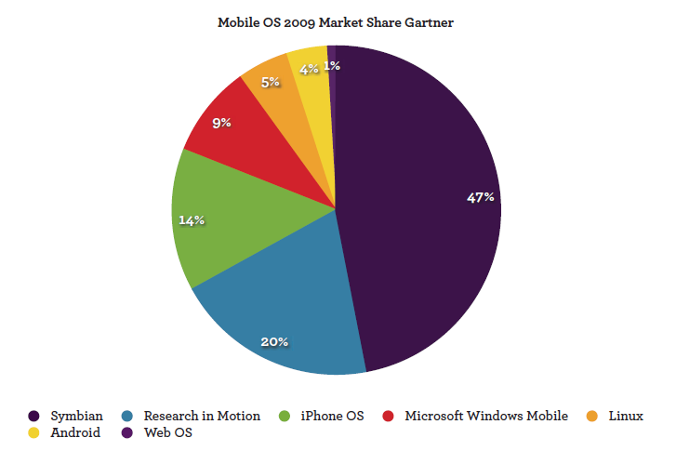
2. Emergence and spread of smartphones (11)
Worldwide market share of smartphone OSs in 2009 [41]
Google
MS
Nokia
Apple
RIM
(BlackBerry)

Slide 25
2. Emergence and spread of smartphones (12)
Worldwide market share of smartphone OSs in 2009-2015 [42]
http://venturebeat.com/2016/02/05/microsoft-nokia-and-the-burning-platform-a-final-look-at-the-failed-windows-phone-alliance/

Slide 26
2. Emergence and spread of smartphones (13)
Worldwide smartphone sales to end user by OS in 2Q 2016
(Millions of units) [67]
Operating System | 2Q16 Units | 2Q16 Market Share (%) | 2Q15 Units | 2Q15 Market Share (%)
Android | 296,9 | 86.2 | 271,6 | 82.2
iOS | 44,4 | 12.9 | 48,1 | 14.6
Windows | 2,0 | 0.6 | 8,2 | 2.5
Blackberry | 0,4 | 0.1 | 1,2 | 0.3
Others | 0,7 | 0.2 | 1,2 | 0.4
Total | 344,4 | 100.0 | 330,3 | 100.0
Source: Gartner (August 2016)

Slide 27
2. Emergence and spread of smartphones (13a)
Remark
After the introduction of iPhone (2007) Steve Ballmer (CEO of Microsoft) said in an
interview [20]:
“There's no chance that the iPhone is going to get any significant market share.
No chance…
But if you actually take a look at the 1.3 billion phones that get sold, I'd prefer
to have our software in 60% or 70% or 80% of them, than I would to have 2%
or 3%, which is what Apple might get”.

Slide 28
2. Emergence and spread of smartphones (14)
Worldwide market share of application processors in 2015 used in
smartphones (based on revenue) [43]
Vendor | Market share | Processor lines (examples) | Cores | ISA
Qualcomm (USA) | 42 % | Snapdragon 200-800 | Qualcomm designed Krait cores ARM Cortex A line | ARMv7 ARMv7/v8
Apple (USA) | 21 % | Apple A7-A9 Apple A10 | Apple designed Cyclone core 2xbig./4x LITTLE cores | ARMv8
MediaTek (Taiwan) | 19 % | Helio x10 Helio X20 | 8xARM Cortex A53 (ARM big.LITTLE) 2xARM Cortex A72/8x A53 (ARM big.LITTLE) | ARMv7 ARMv8
Samsung (S. Korea) |  | Exynos | ARM Cortex A line | ARMv7
Spreadtrum (China) |  | SC77xx/88xx | ARM Cortex A5/A7 | ARMv7
[Source: Strategy Analytics]

Slide 29
2. Emergence and spread of smartphones (15)
Main features of the Qualcomm Snapdragoon lines
Model | Released | Technology | CPU | Word length bit | Clock rate (up to) | Connectivity
821 | Q3/2016 | 14 nm | 4xKryo | 64 | 2.4 GHz | integrated LTE + RF
820 | Q4/2015 | 14 nm | 4xKryo | 64 | 2.2 GHz | integrated LTE + RF
810 | H2/2014 | 20 nm | 4x ARM Cortex A57 + 4x ARM Cortex A53 | 64 | 2.0 GHz | integrated LTE + RF
808 | H1/2015 | 20 nm | 2x ARM Cortex A57 + 4x ARM Cortex A53 | 64 | 2.0 GHz | integrated LTE + RF
805 | Q1/2014 | 28 nm | 4x Krait 450 | 32 | 2.7 GHz | integrated LTE + RF
801 | Q4/2013 | 28 nm | 4x Krait 400 | 32 | 2.5 GHz | integrated LTE + RF
800 | Q2/2013 | 28 nm | 4x Krait 400 | 32 | 2.3 GHz | integrated LTE + RF
602 | Q1/2014 | 28 nm | 4x Krait 300 | 32 | 1.5 GHz | integrated WiFi
600 | Q1/2013 | 28 nm | 4x Krait 300 | 32 | 1.9 GHz | integrated WiFi
410 | 1H/2014 | 28 nm | 4x ARM Cortex A53 | 64 | 1.4 GHz | integrated LTE + RF
400 | Q4/2013 | 28 nm | 4x Krait 300 or 4x ARM Cortex A7 | 32 | 1.7 GHz 1.4 GHz | integrated LTE + RF
200 | 2013 | 28 nm | 4x ARM Cortex A5 or 4x ARM Cortex A7 | 32 | 1.4 GHz 1.2 GHz | integrated 3G + RF
RF: Radio Frequency Front End implemented as a separate chip

Slide 30
2. Emergence and spread of smartphones (16)
Morganfield
(2015?)
Intel’s Atom platforms targeting smartphones
(based on [33])
Moorefield
(2014)
Merrifield
(2014)
Performance (not to scale)
Clover Trail+
(2013)
Z5xxx
4xGoldmont
14 nm
+XMM 7360
Medfield
(2012)
Z35xx
4xSilvermont
22 nm
+XMM 7260/2/35
Morestown
(2010)
Z34x0
2xSilvermont
22 nm
+XMM 7160/7260
Z2580-2520
2xSaltwell
32 nm
+XMM 6268/6360/7160
Riverton
(2015)
Z2480/2460
1xSaltwell
32 nm
+XMM 6260
Binghampton
(2016)
Slayton
(2014)
Z6xx
1xBonnell
45 nm
+Wireless
module
Lexington
(2013)
Zxxxx
2xAirmont
14 nm
+?
Z3xxx
2xSilvermont
22 nm
+A-GOLD 620
Zxxx
2xAirmont
14 nm
+?
Z2420
1xSaltwell
32 nm
+XMM 6265

Slide 31
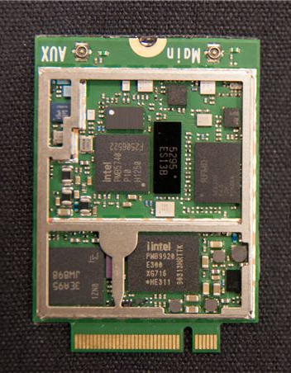
2. Emergence and spread of smartphones (17)
Intel’s XMM line
3G/4G modem + transceiver implemented basically on two chips
RF Transceiver
3G/4G modem
Figure: Implementation
example of the
XMM7160 [46]

Slide 32
2. Emergence and spread of smartphones (18)
Uniting Intel's smartphone and tablet platforms to mobile platforms
and classifying them into two performance classes in 2014 [] -1
Performance and Mid Mobile platform portfolio
Investor meeting Nov. 20 2014
http://files.shareholder.com/downloads/INTC/0x0x796060/CF287D82-FFFE-4A4E-93A9-53C56BFFD315/2014_Intel_IM_James.pdf

Slide 33
2. Emergence and spread of smartphones (19)
Uniting Intel's smartphone and tablet platforms to mobile platforms
and classifying them into two performance classes in 2014 [] -1
Value and Entry Mobile platform portfolio
Investor meeting Nov. 20 2014
http://files.shareholder.com/downloads/INTC/0x0x796060/CF287D82-FFFE-4A4E-93A9-53C56BFFD315/2014_Intel_IM_James.pdf

Slide 34
2. Emergence and spread of smartphones (20)
Intel’s effort to optimize their devices from the software point of view
In their 2012 Investor meeting (5/2012) Intel revealed that more than 3000
engineers are working on OS support, among them about 1200 engineers
are dedicated to Android, as indicated below [11].

Slide 35
2. Emergence and spread of smartphones (21)
Intel’s share in smartphone application processors [54]
Despite great efforts Intel could not yet become one of the 5 largest suppliers
of smartphone application processors.
According to industry sources in 2014 Intel achieved less than 1 % share in revenue
in smartphone application processors.

Slide 36
2. Emergence and spread of smartphones (22)
Intel's withdrawal from the mobile market
In 4/2016 Intel announced their withdrawal from the mobile market and
cancelled the Broxton and Sophia platforms.

Slide 37
3. Emergence and spread of tablets
Notes:
37

Slide 38
3. Emergence and spread of tablets (1)
Emergence of tablets
Visioning tablets
Tablets were envisioned by Steve Jobs already in 1983 saying
”Apple’s strategy is really simple. What we want to do is we want to put an
incredibly great computer in a book that you can carry around with you and learn
how to use in 20 minutes.
... And we really want to do it with a radio link in it so you don’t have to hook up
to anything and you’re in communication with all of these larger databases and
other computers” [19].

Slide 39
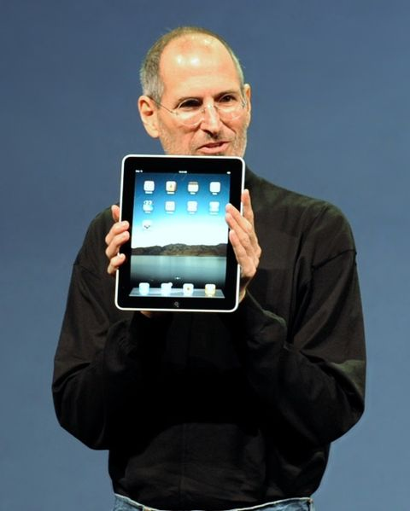
3. Emergence and spread of tablets (2)
Designs giving the final push for rapid spreading of tablets around 2010
From 2009 on: Android-based tablets arrived the market from many vendors.
2010: Apple’s iPad with 9.7 “ screen, touch screen and Wi-Fi or additionally wireless
3G broadband internet connection (mobile internet connection), operating under
iOS [12].
Figure: Steve Jobs introducing the iPad in 2010 [12]

Slide 40
3. Emergence and spread of tablets (3)
Implementation alternatives of tablets -1 [8]

Slide 41
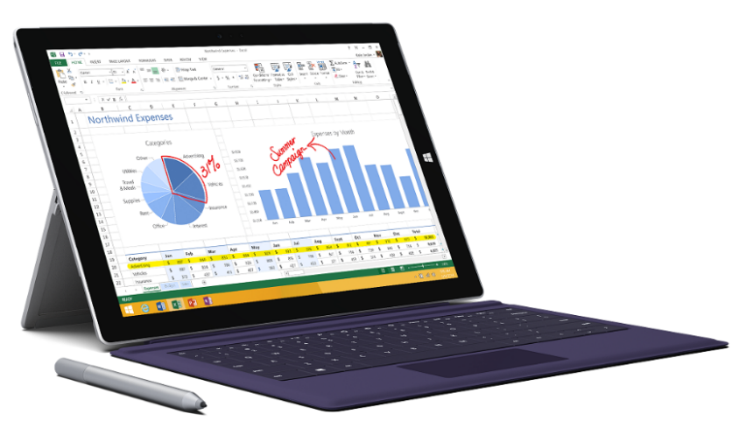
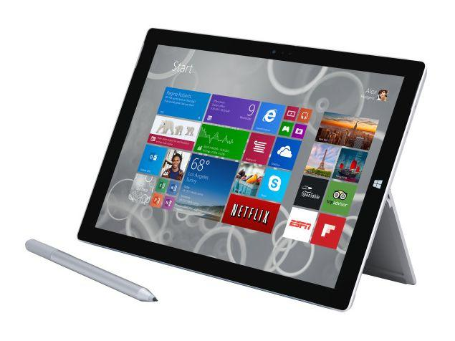
3. Emergence and spread of tablets (4)
Implementation alternatives of tablets-2 [8]
2 in 1 tablets (≈ attachable keyboard + touchscreen)
Example: Windows Surface Pro 3 (8/2014)
Aim: Replacing laptops
Intel’s Surface Pro 3
used as a laptop [22]
Intel’s Surface Pro 3
used as a tablet [23]

Slide 42
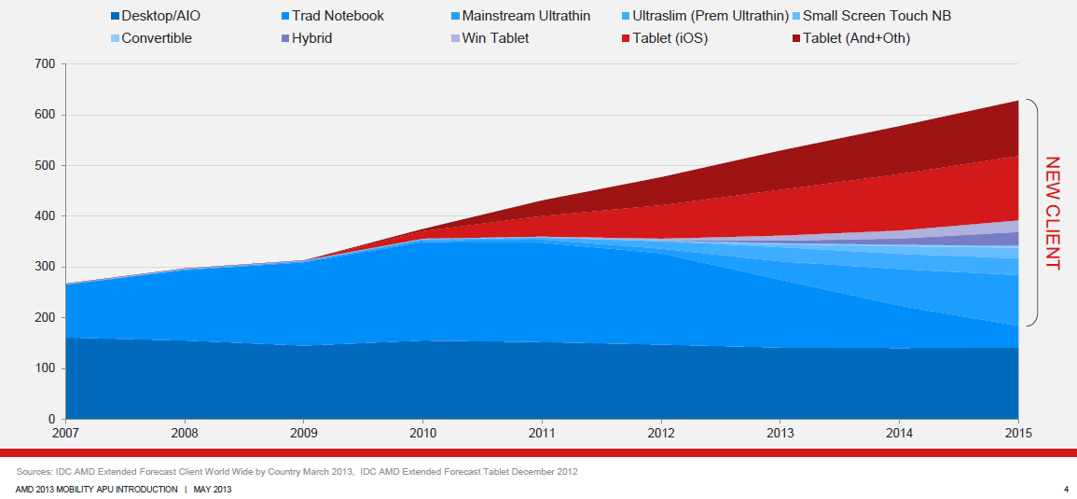
3. Emergence and spread of tablets (5)
Rapid increase of tablet sales in the first half of the 2010’s
Besides smartphones, tablets and all their alternative designs (that provide also keyboard/mouse input, such as convertibles or 2 in 1 designs) have recently the highest growth potential, as indicated in the Figure below (12/1012) [3].
Tablets
Notebooks
Desktops
Figure: Yearly worldwide sales figures of desktops, notebooks and tablets [3]

Slide 43
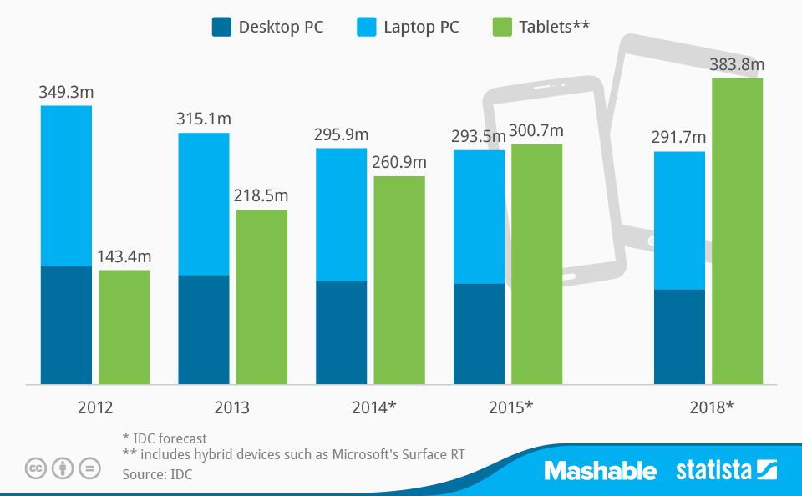
3. Emergence and spread of tablets (6)
Worldwide PC, laptop and tablet shipments 2012 – 2018 [55]
(Shipments in million units)

Slide 44
3. Emergence and spread of tablets (7)
2016 worldwide tablet shipments and market shares by vendors
(Shipments in million units)
Vendor | 2Q16 Unit Shipments | 2Q16 Market Share | 2Q15 Unit Shipments | 2Q15 Market Share | Year-Over-Year Growth
1. Apple | 10.0 | 25.8% | 11.0 | 24.9% | -9.2%
2. Samsung | 6.0 | 15.6% | 8.0 | 18.2% | -24.5%
3. Lenovo | 2.5 | 6.6% | 2.5 | 5.6% | 3.1%
4. Huawei | 2.2 | 5.6% | 1.3 | 2.9% | 71.0%
5. Amazon | 1.6 | 4.0% | 0.1 | 0.3% | 1208.9%
Others | 16.4 | 42.4% | 21.3 | 48.2% | -22.9%
Total | 38.7 | 100.0% | 44.1 | 100.0% | -12.3%
Source: IDC Press Release aug. 2016 https://www.idc.com/getdoc.jsp?containerId=prUS41632416

Slide 45
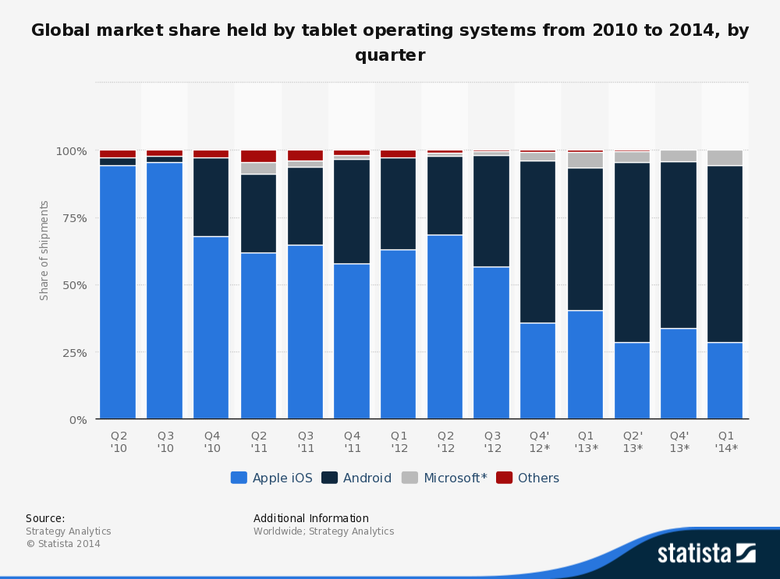
3. Emergence and spread of tablets (8a)
Global market share of tablet OS shipments 2010 - 2014 by quarter [25]

Slide 46
3. Emergence and spread of tablets (8b)
Global market share forecast of tablet OS shipments 2015 - 2019 []
https://www.idc.com/getdoc.jsp?containerId=prUS40660715

Slide 47
3. Emergence and spread of tablets (9)
Willow Trail
(2016?)
Intel’s platforms targeting tablets
(based on [11])
Cherry Trail
(2015)
Bay Trail
(2013)
Performance (not to scale)
Clover Trail
(2012)
Z5xxx
4xGoldmont
14 nm
+XMM 7360
W/A
Oak Trail
(2011)
Z4xxx
4xAirmont
14 nm
+XMM 7160/7260
W/A
Menlow
(2008)
Z37x0
4xSilvermont
22 nm
+XMM 6260/7160
W/A
Atom X3
(Sophia LTE)
(2015)
Z2760
2xSaltwell
32 nm
+XMM 6260
W
Atom X3
(Sophia 3G)
(2015)
Z670/650
1xBonnell
45 nm
+ no XMM
W/MeeGo/A
Z5xx
1xBonnell
45 nm
+ no XMM
W/Moblin
C3400
4xAirmont
28 nm
integrated LTE
modem
C3000
2xSilvermont
28 nm
integrated 3G
modem

Slide 48
3. Emergence and spread of tablets (10)
Uniting Intel's smartphone and tablet platforms to mobile platforms
and classifying them into two performance classes in 2014 [] -1
Performance and Mid Mobile platform portfolio
Investor meeting Nov. 20 2014
http://files.shareholder.com/downloads/INTC/0x0x796060/CF287D82-FFFE-4A4E-93A9-53C56BFFD315/2014_Intel_IM_James.pdf

Slide 49
3. Emergence and spread of tablets (11)
Uniting Intel's smartphone and tablet platforms to mobile platforms
and classifying them into two performance classes in 2014 [] -1
Value and Entry Mobile platform portfolio
Investor meeting Nov. 20 2014
http://files.shareholder.com/downloads/INTC/0x0x796060/CF287D82-FFFE-4A4E-93A9-53C56BFFD315/2014_Intel_IM_James.pdf

Slide 50
3. Emergence and spread of tablets (12)
Intel’s share in tablet application processors [35], [36], [56]
Intel’s subsidies for OEMs
Over the past four years Intel pays significant subsidies (~ 50 $/tablet) to
netbook and tablet manufacturers to switch from ARM based processors to
x86 Atom processors.
Results
In 2015 Intel achieved the 3. place in the worldwide market share in
tablet application processor revenue.
In two years Intel mobile division has lost 7 billion $.
According to industry sources in 2015 Intel has stopped paying subsidies
for OEMs.

Slide 51
3. Emergence and spread of tablets (13)
Worldwide market share of application processors used in tablets in 2015
(based on revenue)
Tablet application processors worldwide market share 2015 (revenue) [57]
Apple (USA) | 31 %
Qualcomm (USA) | 16 %
Intel (USA) | 14 %
MediaTek (Taiwan)
Samsung (S. Korea)
[Source: Strategy Analytics]

Slide 52
3. Emergence and spread of tablets (14)
Intel's withdrawal from the mobile market
In 4/2016 Intel announced their withdrawal from the mobile market and
cancelled the Broxton and Sophia platforms.

Slide 53
4. Key requirement of mobile devices (tablets, smartphones)
Notes:
53

Slide 54
4. Key requirement of mobile devices (tablets, smartphones)
4. Key requirement of mobile devices (tablets, smartphones)
Key requirements of mobile devices (tablets, smartphones)
Low power operation
Connectivity
(3G/4G/Wi-Fi)
(Section 4.1)
(Section 4.2)

Slide 55
4.1 Low power operation
Notes:
55

Slide 56
4.1 Low power operation (1)
4.1 Low power operation
It will be expressed
either by specifying the power consumption, e.g. the TDP value of
the processor in Watt,
or in in length of the operating hours of the device under given conditions.

Slide 57
4.1 Low power operation (2)
Contrasting the design paradigms of traditional and mobile processors
Traditional processors
Tablets and smartphones
High performance/power
(Power efficiency)
(e.g. GFLOPS/Watt)
Low power
(Watt)
(Number of operating hours)
In this point let’s focus on the microarchitecture of CPUs (processor cores)

Slide 58
4.1 Low power operation (3)
Example: Block diagram of Intel’s Cloverview (Z2760) tablet processor (2012)
[13]

Slide 59
4.1 Low power operation (4)
Key criteria for low power microarchitectures
Key criteria for low power microarchitectures
Narrow microarchitecture
Low processor clock frequency
(Section 4.1.2)
(Section 4.1.3)

Slide 60
4.1 Low power operation (5)
4.1.2 “Narrow” microarchitectures
Recent microarchitectures of Intel’s and AMD’s processors
they are aiming at high performance/power (in terms of GFLOPS/Watt)
consequently
have wide microarchitectures, as the next example shows:
64-bit
Skylake
Example: Width of Intel’s Core 2 (2006) to Skylake (2015) processors underlying
servers to laptops [10]
We note that AMD introduced 4-wide microarchitectures five years later, along with
the Bulldozer line in 2011.

Slide 61
4.1 Low power operation (6)
Microarchitectures of mobile processors
To reduce power consumption low power microarchitectures are narrower than
recent traditional processors, as the next Figure demonstrates.

Slide 62
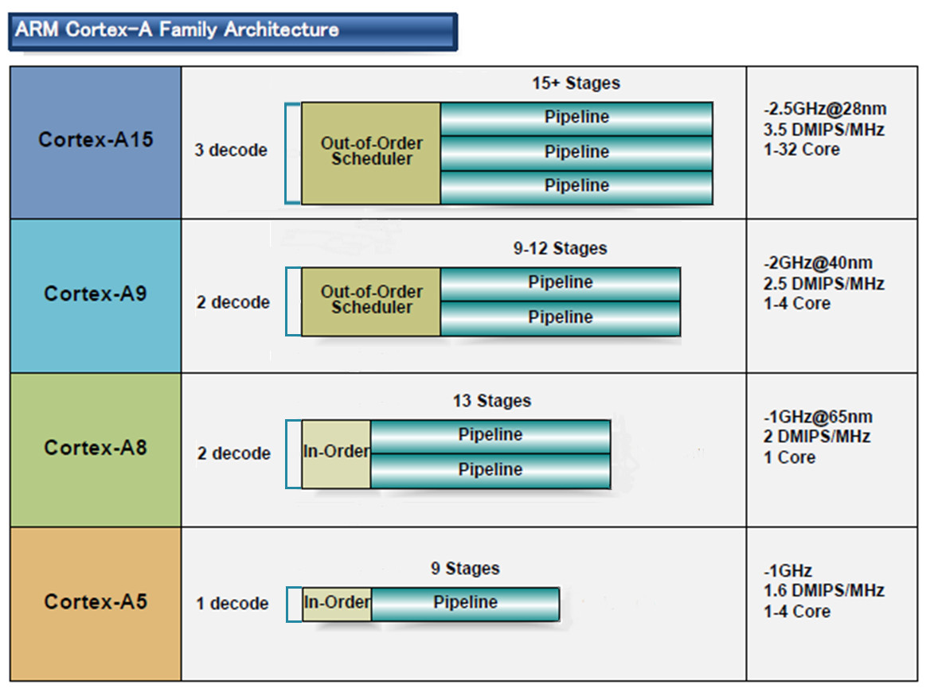
4.1 Low power operation (7)
Microarchitecture of ARM CPUs underlying most tablets and smartphones [10]
32-bit
2010
2007
2005
2009
(A9 replacement
for low-end
devices)

Slide 63
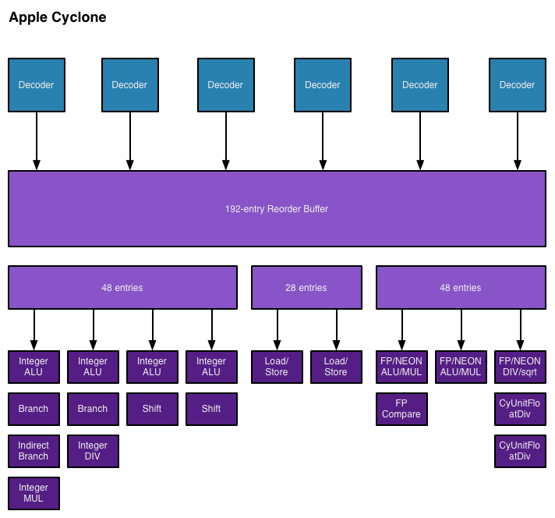
4.1 Low power operation (8)
Block diagram of Apple’s Cyclone core, introduced in the A7 SOC (2013) [48]

Slide 64
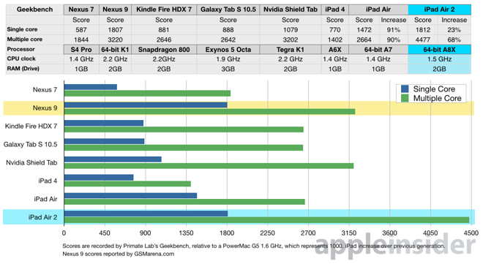
4.1 Low power operation (9)
Geekbench 3.2 results of recent tablets [49]
2013
2014
2 Cyclone
cores
3 Cyclone
cores

Slide 65
4.1 Low power operation (10)
Implications of the extremely high performance figures of Apple’s A8X-based
iPad Air 2 (including 3 Cyclone cores) [50]
Intel lost Apple as a perspective buyer of their chips for the iPad line,
and the iPad Air 2 also severely hit the perspective of their not so successful
Atom line.
NVIDIA’s Tegra 4 chips were not successful, so the firm announced in 05/2014
that they will abandon the phone market.
Apple’s iPad Air 2 with its 256 GPU EUs became a very powerful rival to NVIDIA’s
subsequent 64-bit K1 chip that includes 192 GPU.
As a consequence, NVIDIA appears close to giving up also their tablet interests.

Slide 66
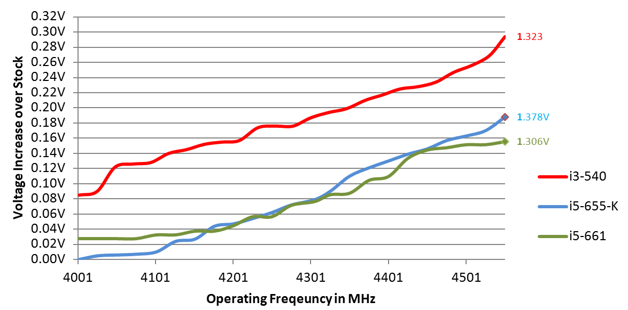
4.1 Low power operation (11)
4.1.3 Low clock frequency-1
Basics
D = const x fc x Vdd²
In addition: higher fc requires higher Vdd (Vdd ≈ const x fc).
Figure: Core voltage (Vdd) vs. clock frequency (fc) for Intel’s Westmere processors [26]

Slide 67
4.1 Low power operation (12)
Low clock frequency-2
It follows
Higher fc
higher Vdd
higher D
D ≈ fc³
Traditional CPUs
Mobile CPUs
High base clock frequency
(typically 2-4 GHz)
Relative low base clock frequency
(typically 1-2 GHz)

Slide 68
4.1 Low power operation (13)
Example: Base frequency of Skylake models with different TDPs and
configurations (Based on data from [58])
TDP (W) | No. of cores | Graphics | No. of graphics EUs | eDRAM | Base frequency up to (GHz)
4.5 | 2 | HD 515 | 18 | -- | 1.2
15 | 2 | HD 540 | 48 | 64 MB | 2.2
15 | 2 | HD 520 | 24 | -- | 2.6
28 | 2 | HD 550 | 48 | 64 MB | 3.3
35 | 4 | HD 530 | 24 | -- | 2.8
45 | 4 | HD 530 | 24 | -- | 2.9
65 | 4 | HD 530 | 24 | -- | 3.4
91 | 4 | -- | -- | -- | 4.2
Note that low TDP can be achieved first of all by reducing the core frequency and
limiting the computer resources (cores, GPU EUs) provided.

Slide 69
4.2 Connectivity
Notes:
69

Slide 70
4.2 Connectivity (1)
4.2 Connectivity
Connectivity may include (depending on the device type)
LAN connectivity
Wi-Fi connectivity (coined after Hi-Fi)
mobile broadband connectivity (recently 3G/4G).
Subsequently, we will focus only on the mobile broadband connectivity.

Slide 71
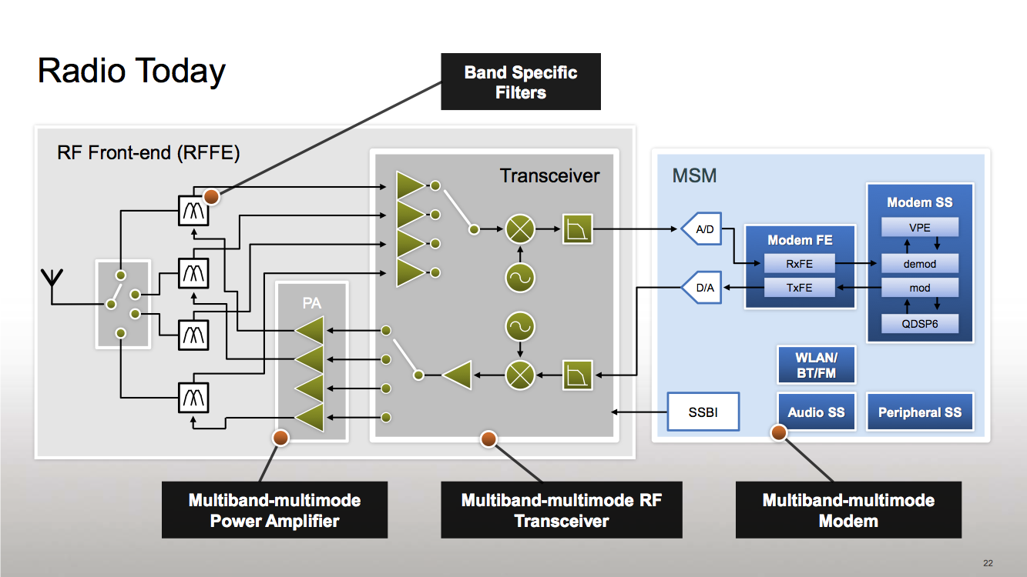
4.2 Connectivity (2)
Simplified view of a platform providing mobile broadband connectivity [59]
RF
Modem + Application Processor
(if integrated implementation)
Modem: Actually a baseband
processor that runs under a
proprietary real-time OS).
It has two functions:
LNA
Mixers
to performe modulation/
demodulation and
to manage the
communication
according to a protocol
(DSP)
PA: Power Amplifier LNA: Low Noise Amplifier Transceiver: Transmitter/Receiver
Multiband: multiple frequency bands, e.g. 900/1800 MHz
Multimode: 3G/ 4G (LTE)

Slide 72
4.2 Connectivity (3)
Integration of the application processor and the modem
Integrating the modem into the chip results in less costs and shorter time to
market.
Qualcomm pioneered this move designing integrated parts already about 1996.
Integration of the application processor and the modem
Use of discrete
application processor and modem
Use of integrated
application processor and modem
E.g.
Intel’s Atom line (2008)
except recent Atom X3 (Sophia (2015)
Apple’s own processor designs
(Swift (2012), Cyclone (2013)
Intel’s Atom X3 (Sophia) (2015)
Qualcomm’s MSM product offerings
since ~ 1996
including their Snapdragon families
NVIDIA’s Tegra 2-4, K1 (since 2011)
NVIDIA’s Tegra 4i (2014)
MediaTek’s 81xx line (2013)
MediaTek’s 6xxx/8xxx families (since ~ 2009)
except the 81xx line
Samsung’s Exynos 3/4/5/7 families
(since ~ 2010)
Samsung’s Exynos 8 Octa 8890
(2015)

Slide 73
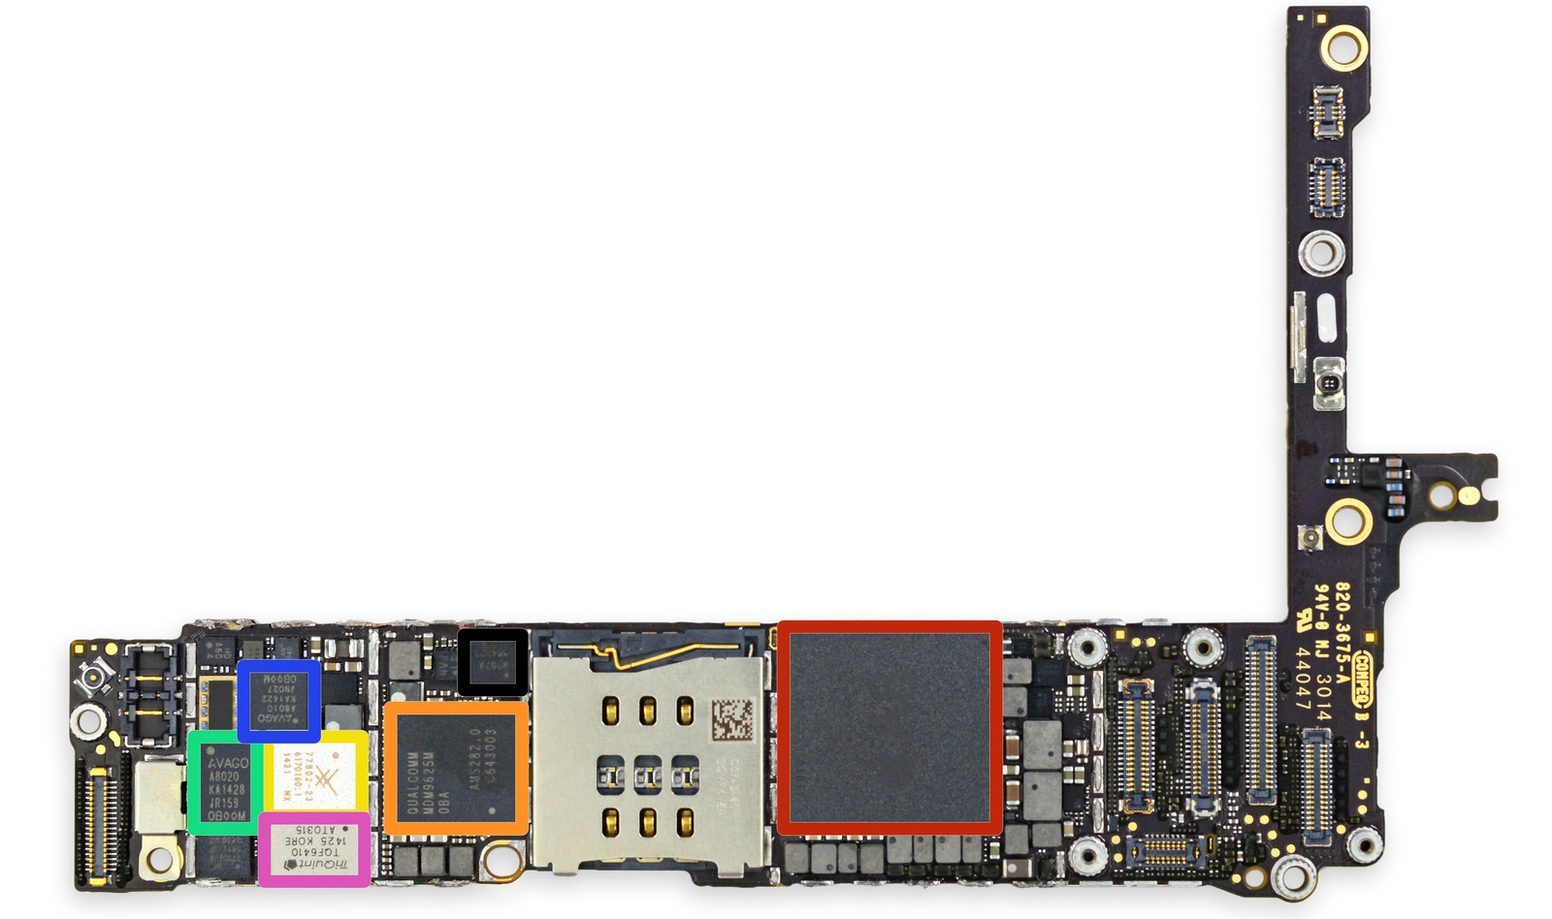
4.2 Connectivity (4)
Example of using discrete application processor and modem: The iPhone 6+
The front side of the
logic board [60]
PAD: Integrated Power Amplifier-Duplexer

Slide 74
4.2 Connectivity (5)
Example of using an integrated application processor and a modem
(Qualcomm’s Snapdragon 820) [61]

Slide 75
4.2 Connectivity (6)
Worldwide market share of smartphone and tablet application processors
in 2015 (based on revenue) [34]
Smartphone application processors worldwide market share 2015 (revenue)
Qualcomm (USA) | 42 %
Apple (USA) | 21 %
MediaTek (Taiwan) | 19 %
Samsung (S. Korea)
Spreadtrum (China)
Tablet application processors worldwide market share 2015 (revenue)
Apple (USA) | 31 %
Qualcomm (USA) | 16 %
Intel (USA) | 14 %
MediaTek (Taiwan)
Samsung (S. Korea)
[Source: Related press releases of Strategy Analytics]

Slide 76
4.2 Connectivity (7)
Integrating the application processor, the modem, RF transmitter,
RF receiver and power manager IC onto a single chip
It became also feasible for less demanding applications, e.g. for feature phones.
Example: Qualcomm’s QSCs (Qualcomm Single Chips)
Qualcomm provides single chip solutions
for feature phones, termed as
QSCs (Qualcomm Single Chips).
QSCs integrate the functions of
MSMs
RF Transmitters (RF Tx)
RF Receivers (RF Rx) and
Power manager ICs (PM)
as illustrated on the Figure left [62].
Figure: Qualcomm’s integrated QSC [62]

Slide 77
4.2 Connectivity (8)
Remark
Using PoP (Package on Package) memory
The processor die and the memory die or dies are mounted in the same package.
E.g. In Apple’s A7 Package-on-Package processor, as used in the iPhone 5s.
1GB LPDDR3-1600 SDRAM
Figure: Apple’s A7 PoP [63]

Slide 78
5. How leading IT vendors addressed the mobile boom?
5.1 Intel’s and AMD’s response to the mobile boom
5.2 Microsoft’s response to the mobile boom
Notes:
78

Slide 79
5.1 Intel’s and AMD’s response to the mobile boom
Notes:
79

Slide 80
5.1 Intel’s and AMD’s response to the mobile boom (1)
5.1 Intel’s and AMD’s response to the mobile boom-1
Intel’s and AMD’s traditional CPUs are designed for high performance/power,
consequently they are wide and power hungry,
but mobile devices require low power consumption, so
Intel’s and AMD’s traditional microarchitectures are not suited for mobile devices.

Slide 81
5.1 Intel’s and AMD’s response to the mobile boom (2) (1)
Total shipments of smartphones vs. PCs and tablets 2011-2017 [28]
Smartphone and tablet shipments
will vastly exceed PC shipments
(desktops and notebooks)
in a few years
Source: Gartner (2013)

Slide 82
5.1 Intel’s and AMD’s response to the mobile boom (3)
Intel’s and AMD’s response to the mobile boom-2
To avoid shrinking market shares on the global processor market
and benefit from the rapidly increasing mobile market
Intel and AMD need processors that are competitive with ARM based designes.
Intel and AMD were forced
to introduce novel narrow (e.g. 2-wide), low-power microarchitectures
for their CPUs and
clock them at a relative low rate.

Slide 83
5.1 Intel’s and AMD’s response to the mobile boom (4)
Evolution of Intel’s basic architectures [Based on 2]
4-wide
out-of-order
2008
2-wide
in-order
2-wide
in order
2-wide
out-of-order
2-wide
out-of-order

Slide 84
5.1 Intel’s and AMD’s response to the mobile boom (5)
Intel's delay in introducing the Goldmont core and the Broxton platform
(both targeting smartphones and tablets) -1
At their announcement in 2013 both the Goldmont Atom core and the Broxton
platform were scheduled for 2015, as indicated in the next Figure.
http://www.pcworld.com/article/2066162/intel-updates-atom-road-map-announces-chips-for-tablets-smartphones.html
Figure: Intel's roadmap for tablets and smartphones announced in 2013 []

Slide 85
5.1 Intel’s and AMD’s response to the mobile boom (6)
Intel's delay in introducing the Goldmont core and the Broxton platform
intended both for smartphones and tablets -2
The Goldmont core became introduced only in 4/2016 for the Apollo Lake
entry level desktop platform.
The Broxton platform became (after one year delay) cancelled in 4/2016,

Slide 86
5.1 Intel’s and AMD’s response to the mobile boom (7)
Intel's withdrawal from the smartphone and mobil market
In 4/2016 Intel announced their withdrawal from the mobil market.
Intel's statement says []:
"I can confirm that the changes included canceling the Broxton platform as
well as SoFIA 3GX, SoFIA LTE and SoFIA LTE2 commercial platforms
to enable us to move resources to products that deliver higher returns and
advance our strategy.
These changes are effective immediately."
At the same time Intel laid off about 12000 employees (~ 11 % of their
workforce).
http://www.anandtech.com/show/10288/intel-broxton-sofia-smartphone-socs-cancelled

Slide 87
5.1 Intel’s and AMD’s response to the mobile boom (8)
Evolution of AMD’s basic architectures
4-wide
out-of-order
4/2014
2-wide
out-of-order
2-wide
out-of-order
2-wide
out-of-order
2014

Slide 88
5.1 Intel’s and AMD’s response to the mobile boom (9)
Cancellation of AMD's Cat line in 2015
The last core of AMD's Cat line was the Puma+ core (launched in 6/2015 in the
Carrizo-L APU).
In AMD's 2016 Mobility roadmap there is no sign of an APU powered by the
Puma+ core or a derivative of a core belonging to the Cat line.
Instead AMD places emphasis on server chips based on the Zen processor or
ARM compatible processors, as indicated n the next Figure.

Slide 89
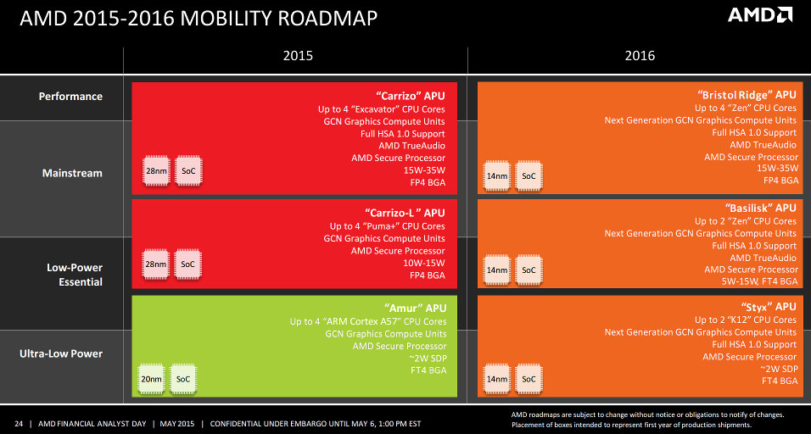
5.1 Intel’s and AMD’s response to the mobile boom (10)
AMD's leaked mobility roadmap for 2015-2016 without indicating the
Puma core for 2016 []
Excavator cores
http://hexus.net/tech/news/cpu/82813-leaked-slides-show-amd-desktop-mobility-roadmaps-2016/

Slide 90
5.1 Intel’s and AMD’s response to the mobile boom (11)
Use of AMD’s low power Jaguar architecture in game consoles
Most recent game consoles are based on AMD’s low power Jaguar architecture,
including
Nintendo Wii U (2012)
Sony Playstation 4 (2013)
Mixrosoft Xbox One (2013).
These consoles have a significant global market share, as indicated in the next
Figure.

Slide 91
5.1 Intel’s and AMD’s response to the mobile boom (12)
Global unit sales of current generation video game consoles 2008-2014 [64]
(in million units)

Slide 92
5.1 Intel’s and AMD’s response to the mobile boom (13)
The effort needed to achieve considerable power reduction
In their designs both Intel and AMD lay great emphasis on the reduction of power
consumption.
To illustrate this we show a set of AMD’s power management techniques introduced
in a timeframe of about five years.

Slide 93
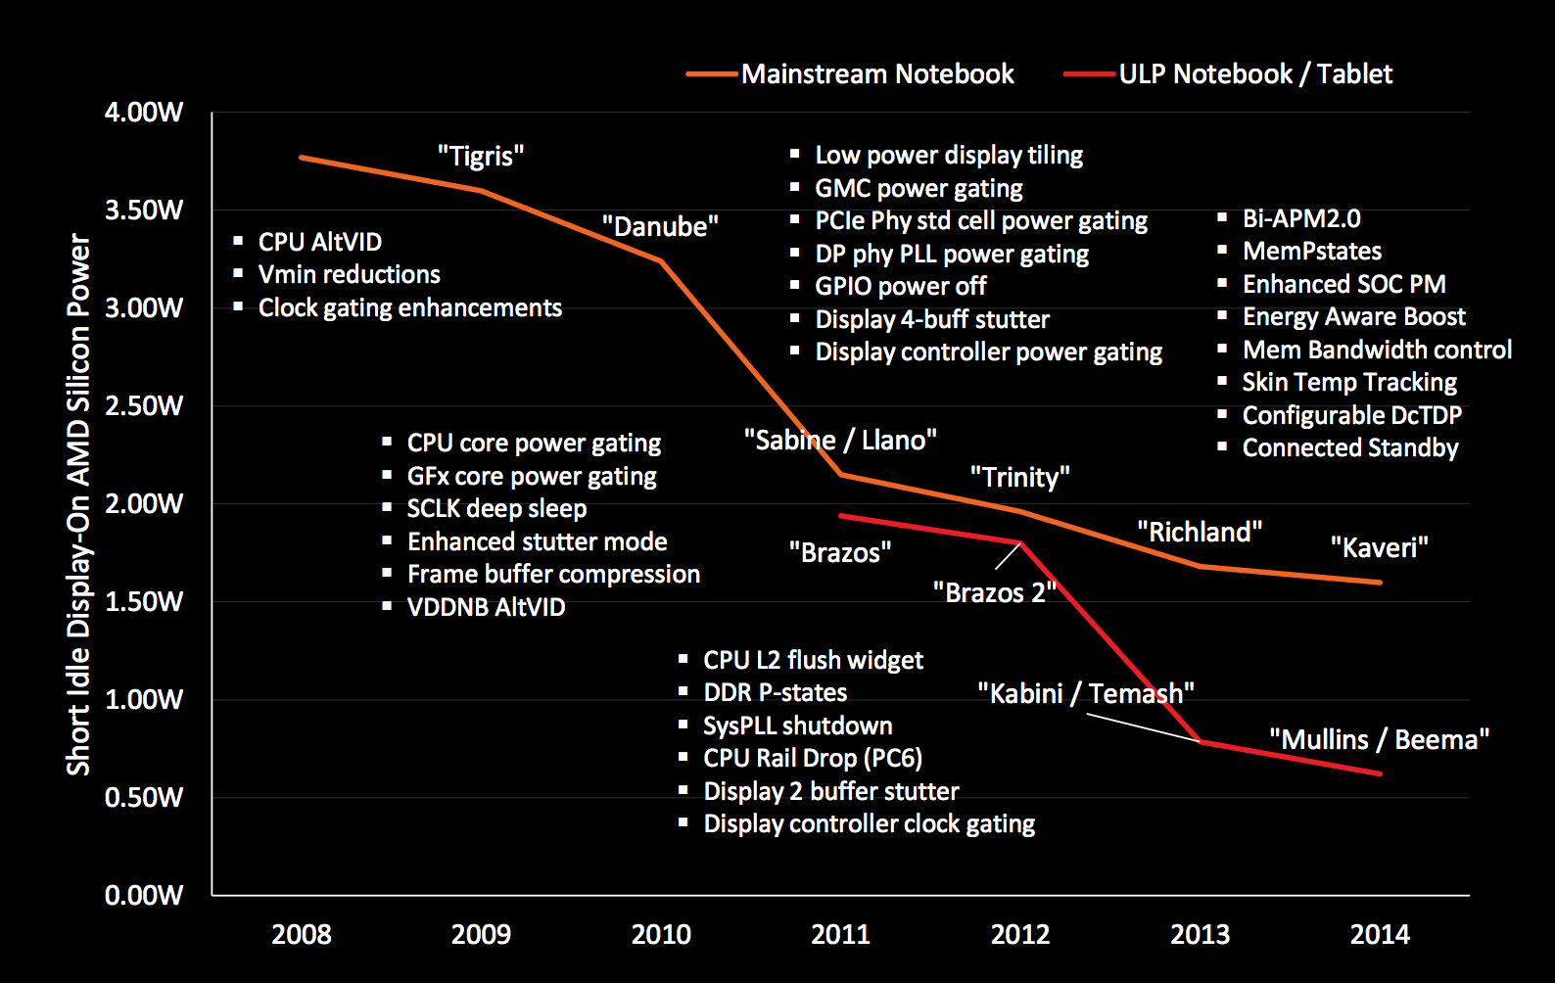
5.1 Intel’s and AMD’s response to the mobile boom (14)
AMD’s technologies developed to reduce power consumption (2008-2014) [27]

Slide 94
5.2 Microsoft’s response to address the mobile boom
Notes:
94

Slide 95
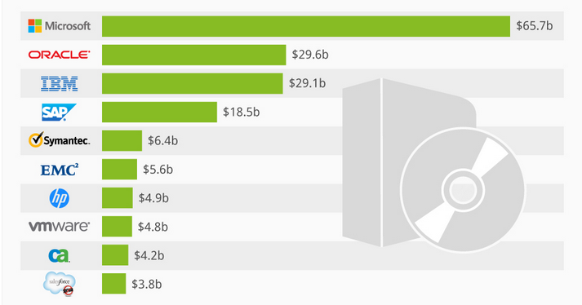
5.2 Microsoft’s response to the mobile boom (1)
5.2 Microsoft’s response to address the mobile boom -1
Worldwide software revenues in 2013 [25]

Slide 96
5.2 Microsoft’s response to the mobile boom (2)
Microsoft's response to address the mobile boom -2
Microsoft's response to address the mobile boom
Widening the scope
of Windows to cover also touchscreen tablets
Introduction of
Windows based OSs
for smartphones
Vision to become
a devices and services
company

Slide 97
5.2 Microsoft’s response to the mobile boom (3)
a) Widening the scope of Windows to cover also touchscreen tablets
OS releases aiming at covering touch screen tablets as well:
2012 Windows 8 it aims to cover PCs, notebooks and also tablets
2013 Windows 8.1
2014 Windows 8.1 with Bing for low cost devices
2014 Windows 9 skipped
2014 Windows 10 Technical Preview
2015 Windows 10 general availability
Windows 8 was Microsoft’s first try to cover the whole spectrum of computers from
servers through desktops and notebooks till touchscreen tablets by a single OS.
Market reflections: Windows 8 earned moderate success, Android and iOS
dominated further on the market for smartphones and tablets.
Windows 8.1 is an upgrade for Windows 8.
In 5/2014 Microsoft announced Windows 8.1 with Bing.
It is the same as Windows 8, but is shipped with the Internet Explorer as
the default search engine.
It will be delivered for hardware manufacturers for free.
Windows 10 is released in 07/2015, it provides an updated Start menu.
To encourage its adoption Microsoft made it available free of charge during its
first year of availability to users with genuine copies of Windows 7/Windows 8.1.

Slide 98
5.2 Microsoft’s response to the mobile boom (4)
b) Introduction of Windows based OSs for smartphones
In 10/2010 Microsoft introduced a Windows based OS designed especially for
smartphones, called the Windows Phone 7.
(Here we note that Microsoft provided also previously OSs for embedded or
mobile devices (like Windows Mobile 2003), but these OSs were based on the
Windows CE, an OS for embedded devices, optimized for minimal memory).
Releases of Microsoft's Windows Phone family
Windows Phone 7
It earned moderate success.
Windows Phone 8
Windows Phone 8.1
Windows 10 Mobile
Despite Microsoft's efforts, Windows based phone OSs could not achieve notable
market share, as indicated in the next Figure.

Slide 99
5.2 Microsoft’s response to the mobile boom (5)
Global market share of leading smartphone OSs in terms of sales figures
to end users from Q1 2009 to Q3 2015 []
http://venturebeat.com/2016/02/05/microsoft-nokia-and-the-burning-platform-a-final-look-at-the-failed-windows-phone-alliance/

Slide 100
5.2 Microsoft’s response to the mobile boom (6)
c) Microsoft's vision to become a devices and services company
Ballmer (CEO of Microsoft in 9/2012):
“I think that in a back-looking view, people would say we were a software company.
That's kind of how we were born.
I think when you look forward, our core capability will be software, (but)
you'll probably think of us more as a devices-and-services company.” [22]
Microsoft's vision to become a devices-and-services company
Microsoft's activities to become a devices and services company
Taking part in
the game console market
Introduction of the
Surface line of tablets
Entering the
phone business

Slide 101
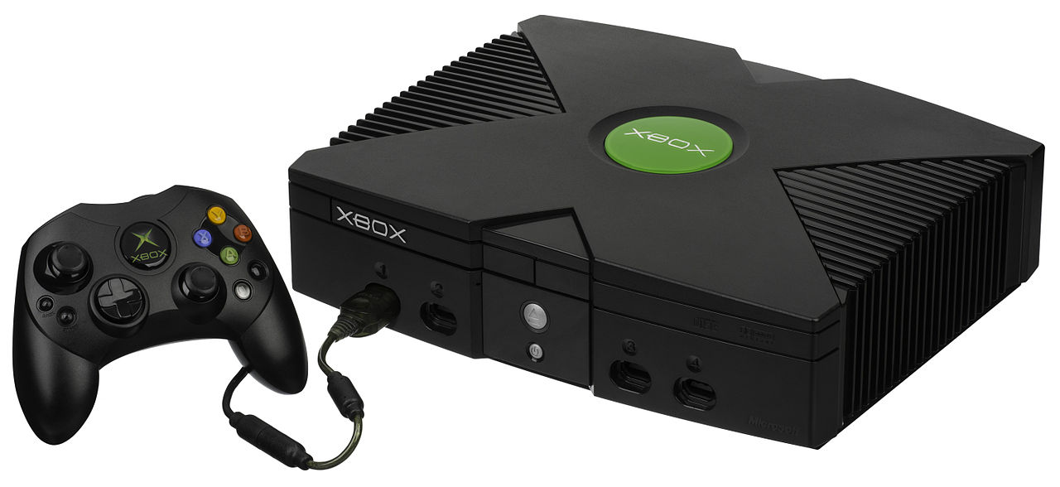
5.2 Microsoft’s response to the mobile boom (7)
ca) Microsoft's participation in the game console market []
Microsoft created a family of video game consoles, dubbed as Xbox.
Main models of the Xbox family
2001: The original Xbox
2005: Xbox 360
2013: Xbox One
Picture: The original Xbox console with the Controller []
https://en.wikipedia.org/wiki/Xbox

Slide 102
5.2 Microsoft’s response to the mobile boom (8)
cb) Introduction of the Surface family of tablets
Microsoft’s Surface family of tablets
Surface lines
Surface Pro lines
First Surface tablets are NVIDIA’s Tegra based
and run under Windows RT/Windows 8.1
Recent Surface tablets are Intel’s Atom based
and are running under Windows 8.1
Surface Pro tablets are Core 2 based
and run under Windows 8
or subsequent Windows versions
Less expensive models
High end models

Slide 103
5.2 Microsoft’s response to the mobile boom (9)
Overview of Microsoft’s Surface tablets
Main features of Microsoft’s Surface and Surface Pro tablet lines
Model | Intro | Processor | Word length | Core nr. | OS
Surface | 10/2012 | Tegra 3 | 32-bit | 4 | Windows RT
Surface 2 | 10/2013 | Tegra 4 | 32-bit | 5 | Windows RT/Windows 8.1
Surface 3 | 05/2015 | Atom X7-Z8700 Airmont core | 64-bit | 4 | Windows 8.1
Table: Microsoft’s ARM/Intel Atom-based Surface RT /Surface 2 tablets
The exclusivity of Windows RT drastically limits app availability, and is one of the main reasons why sales of Surface tablets remained lower than expected [21].
Model | Intro | Processor | Word length | Core nr. | OS
Surface Pro | 02/2013 | Ivy Bridge i5 | 64-bit | 2 | Windows 8 Pro
Surface Pro 2 | 10/2013 | Haswell i5 | 64-bit | 2 | Windows 8.1 Pro
Surface Pro 3 | 06/2014 | Haswell i3/i5/i7 | 64-bit | 2 | Windows 8.1 Pro
Table: Microsoft’s Intel Core 2-based Surface Pro tablets

Slide 104
5.2 Microsoft’s response to the mobile boom (10)
Example: Windows Surface Pro 3 (8/2014)
2 in 1 tablet 12”
Aim: Replacing laptops
Intel’s Surface Pro 3
used as a laptop [22]
Intel’s Surface Pro 3
used as a tablet [23]

Slide 105
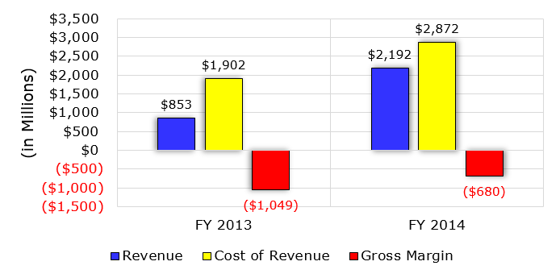
5.2 Microsoft’s response to the mobile boom (11)
Early financial performance of Microsoft’s Surface business [24]

Slide 106
5.2 Microsoft’s response to the mobile boom (12)
cc) Microsoft's move to enter the phone business
9/2013: Microsoft announces their plan to acquire the phone business of Nokia,
including the Lumia brand.
4/2014: Microsoft finalyses the acqisition by paying about 7 billion USD to Nokia,
and taking over about 25000 Nokia employees.
11/2014: Microsoft rebranded the Nokia Lumia line to Microsoft Lumia line.

Slide 107
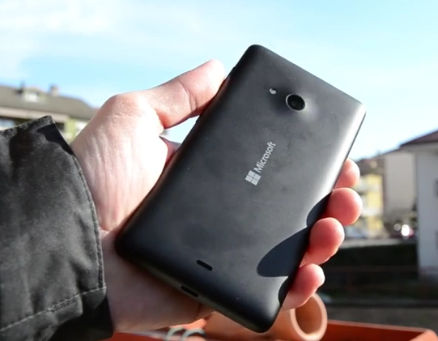
5.2 Microsoft’s response to the mobile boom (13)
The first Microsoft branded Lumia phone (the Lumia 535 from 11/2014) []
https://en.wikipedia.org/wiki/Microsoft_Lumia

Slide 108
5.2 Microsoft’s response to the mobile boom (14)
The outcome of Microsoft's Nokia deal -1
Microsoft's acquisition of Nokia's phone business did not seriously boost the sale
figures of Windows phone based Lumia devices, as indicated in the Figure below.
Microsoft ackquires
Nokia's phone buiness
Rebranding the Nokia Lumia line
to Microsoft Lumia line
378
1 % of worldwide
smartphone sales
Figure: Quarterly sale figures of Lumia devices (million units) []
(Nokia introduced the Lumia brand for a series of smartphones running Windows phone)
On the contrary, in about two years sale figures desreased below 1 % of the total
world sales of smartphones, as indicated in the Figure.
https://en.wikipedia.org/wiki/Microsoft_Lumia

Slide 109
5.2 Microsoft’s response to the mobile boom (15)
The outcome of Microsoft's Nokia deal -2
Consequences of deminishing sales figures of Windows based Lumia phones
In 7/2015 Microsoft restructured Microsoft Mobile and laid off 7200 employees.
In 5/2016 Microsoft made the decision to sell their feature phone business
to Foxconn (Taiwan), for 350 million USD.
As a consequence, 4500 Microsoft employes were moved to Foxconn.
At the same time Microsoft confirmed that it will continue to develop
Windows 10 Mobile, and support existing Lumia phones and ones built
by third-party phone makers [].
However, at this announcement Microsoft did not give any hint about the
continuation of developing Lumia phones.
http://www.theverge.com/2016/5/18/11699766/microsoft-lumia-phone-brand

Slide 110
5.2 Microsoft’s response to the mobile boom (16)
Remarks on the decline of Nokia's phone business
About the same time when Google's Android overtook the sales figures Nokia's
previously leading Symbian mobile OS, in 2/2011, Nokia set up a business
partnership with Microsoft and adopted Windows Phone as its primary platform
for future smartphones.
Nokia's next smartphones, dubbed as the Lumia line, run under Windows Phone 7.
The new line gained only moderate success.
Subsequently, in 9/2013 Microsoft and Nokia agreed that Microsoft will acquire
the phone business of Nokia, including related patents and the Lumia brand.
In 4/2014 the acquisiton becam finalized, Microsoft paid about 7 billion USD
to Nokia and took over about 25000 Nokia employees.

Slide 111
6. Conclusions
Notes:
111

Slide 112
6. Conclusions (1)
6. Conclusions -1
Informatics came into a transitional phase
new paradigms
new devices
new players

Slide 113
6. Conclusions (2)
Conclusions- 2
Established companies have to respond early, quick and in an appropriate way
to the new challenges, else…
8/2010 Intel acquires Infineon’s (former Siemens) Wireless Solutions business
8/2011 Google acquires Motorola Mobility
9/2013 Microsoft purchases Nokia’s phone business
9/2013 BlackBerry lays off 4500 employees (~ 40% of their workforce)
1/2014 Lenovo acquires Motorola Mobility from Google
5/2014 NVIDIA states that they will moving out from the smartphone market
6/2014 Broadcom decides to exit the baseband business

Slide 114
6. Conclusions (3)
Conclusions -3
Even the largest IT firms have a hard time to cope with as indicated by
resignation of AMD’s, Intel’s and Microsoft’s CEOs (Chief Execution Officers):
1/2011 AMD: Dirk Meyer
11/2012 Intel: Paul Otellini
8/2013 Microsoft: Steve Ballmer
But it is also an opportunity and challenge for individuals and institutions
to catch up with the progress and make benefit of it.

Slide 115
7. References
Notes:
115

Slide 116
7. References (1)
7. References
[1]: Bártfai D., Merre felé tartanak a hardverek?, Aug. 22-24 2007
[2]: Smith S.L., Intel Strategy & Technology Update, Barclays Capital Global Technology Conf.,
Dec. 2011, http://files.shareholder.com/downloads/INTC/1576180143x0x526852/c9868a3a-
494e-4506-bcc6-a631aca1fd75/Steve%20Smith%20Barclays%20Dec%202011.pdf
[3]: AMD 2013 Mobility APU Introduction, May 22 2013,
http://www.slideshare.net/AMD/amd-2013-mobility-apu-introduction-deck-final-for-lp
[4]: Frommer D., CHART OF THE DAY: Smartphone Sales To Beat PC Sales By 2011,
Business Insider, Aug. 21 2009, http://www.businessinsider.com/chart-of-the-day-
smartphone-sales-to-beat-pc-sales-by-2011-2009-8
[5]: Wikipedia, BlackBerry Pearl, http://en.wikipedia.org/wiki/BlackBerry_Pearl
[6]: Wikipedia, Android (operating system),
http://en.wikipedia.org/wiki/Android_%28operating_system%29
[7]: Ciufo C.A., Tizen OS for Smartphones – Intel’s Biggest Bet Yet, Jan. 4 2013,
http://eecatalog.com/caciufo/2013/01/04/samsung-hedges-apple-google-bets-with-intels-
html5-based-tizen/
[8]: Introduction of the Next Generation Intel Atom Processor, Oak Trail Z670, 4/2011,
http://newsroom.intel.com/docs/DOC-1976
[9]: Apple Maintains 48 Percent Share of Global Branded Tablet Shipments in Q1 2013,
Strategy Analytics, April 25 2013, Boston,
http://www.strategyanalytics.com/default.aspx?mod=pressreleaseviewer&a0=5351

Slide 117
7. References (2)
[10]: Goto H., ARM Cortex – A Family Architecture, 2010,
http://pc.watch.impress.co.jp/video/pcw/docs/423/409/p1.pdf
[11]: Eul H., Bell M., Mobile at Intel, Investor Meeting 2012,
http://www.cnx-software.com/pdf/Intel_2012/2012_Intel_Investor_Meeting_Eul_Bell.pdf
[12]: Wikipedia, iPad, http://en.wikipedia.org/wiki/IPad
[13]: Tablet Platforms with Next Generation Intel Atom Processor and Microsoft Windows 8,
IDF 2012
[14]: The $15.3 Billion Server Market – Surprisingly Buoyant In Q1 2012, IT Candor, July 3 2012,
http://www.itcandor.com/server-q112/
[15]: Shah A., Intel Loses Laptop Chip Market Share to AMD in Q3, PC World, Nov. 3 2011,
http://www.pcworld.com/article/243114/intel_loses_laptop_chip_market_share_to_amd_
in_q3.html
[16]: Perry D., AMD Steals Market Share From Intel, Tom’s Hardware, March 16 2012,
http://www.tomshardware.com/news/amd-intel-cpu-processor,15041.html
[17]: Shilov A., AMD Shows Off Opteron "Interlagos" Again: No Performance Benchmarks,
No Design Wins, No Launch Date Announced, Xbit Labs, Aug. 3 2011,
http://www.xbitlabs.com/news/cpu/display/20110803103016_AMD_Shows_Off_Opteron_
Interlagos_Again_No_Performance_Benchmarks_No_Design_Wins_No_Launch_Date_
Announced.html
[18]: Arthur C., PC business still waning as Microsoft's Windows 8 fails to lift it, 11 July 2013,
http://www.theguardian.com/technology/2013/jul/11/pc-business-microsoft-windows-8

Slide 118
7. References (3)
[19]: Golson J., Steve Jobs Envisioned the iPad in 1983, MacRumors, Oct. 2, 2012,
http://www.macrumors.com/2012/10/02/steve-jobs-envisioned-the-ipad-in-1983/
[20]: Yarow J., Steve Ballmer's Biggest Mistakes As CEO Of Microsoft, Business Insider, Aug. 27
2013,
http://www.businessinsider.com/steve-ballmers-most-epic-mistakes-as-ceo-of-microsoft-
2013-8?op=1
[21]: Arora, P., Microsoft Is Not Killing The Surface RT Lineup? Seeking Alpha, Aug. 25 2014,
http://www.macrumors.com/2012/10/02/steve-jobs-envisioned-the-ipad-in-1983/
[22]: Surface Pro 3 Fact sheet May 2014, Microsoft,
http://www.microsoft.com/global/eu/PublishingImages/Surfacepro3texhspecs.pdf
[23]: Microsoft Surface Pro, NDTV Gadget, May 2014,
http://gadgets.ndtv.com/microsoft-surface-pro-3-1611
[24]: Guenette S., Nearly $2 Billion In The Hole, Microsoft Continues To Dive Deeper Into Tablets,
Seeking Alpha, Aug. 8, 2014,
http://seekingalpha.com/article/2402725-nearly-2-billion-in-the-hole-microsoft-continues
-to-dive-deeper-into-tablets
[25]: Deskovich V., Microsoft: A Monopoly No More? Seeking Alpha, Jul. 11, 2014
http://seekingalpha.com/article/2309835-microsoft-a-monopoly-no-more
[26]: Gill R., Intel’s Core i5-655K & Core i7-875K: Overclocked and Analyzed, AnandTech,
May 28 2010, http://www.anandtech.com/show/3742/intels-core-i5655k-core-i7875k-
overclocked-and-analysed-/2
[27]: Shimpi A. L., AMD Beema/Mullins Architecture & Performance Preview, AnandTech,
April 29, 2014, http://www.anandtech.com/show/7974/amd-beema-mullins-architecture-
a10-micro-6700t-performance-preview

Slide 119
7. References (4)
[28]: Wilson S., & Wigginton C., Making open innovation work in mobile - Insights from the
semiconductor industry, Deloitte University Press, July 24v2013,
http://dupress.com/articles/making-open-innovation-work-in-mobile/
[30]: Arora P., Wait, Microsoft Is Not Killing The Surface RT Lineup? Seeking Alpha, Aug. 25, 2014,
http://seekingalpha.com/article/2447735-wait-microsoft-is-not-killing-the-surface-rt-lineup
[31]: Hodgins K., Apple Maintains Narrowing Lead in Tablet Market Share, MacRumors, May 1,
http://www.macrumors.com/2014/05/01/apple-tablet-market-share-1q14
[32]: Arora P., Wait, Microsoft Is Not Killing The Surface RT Lineup? Seeking Alpha, Aug. 25, 2014,
http://seekingalpha.com/article/2447735-wait-microsoft-is-not-killing-the-surface-rt-lineup
[33]: Eul H., & Bell M., Mobile at Intel, Investor Meeting 2012, Intel,
http://www.cnx-software.com/pdf/Intel_2012/2012_Intel_Investor_Meeting_Eul_Bell.pdf
[34]: Qualcomm dominates smartphone chip and baseband, tablet processor markets, Mobile
Europe, February 17 2014
http://www.mobileeurope.co.uk/Press-Wire/qualcomm-dominates-smartphone-chip-and
-baseband-tablet-processor-markets
[35]: Gartner Says Worldwide Tablet Sales Grew 68 Percent in 2013, With Android Capturing 62
Percent of the Market, Gartner, Newsroom, March 3, 2014,
http://www.gartner.com/newsroom/id/2674215
[36]: Trefis Team, Why Intel Can Gain Additional Share In The Mobile Market, Forbes, 5/09/2014
http://www.forbes.com/sites/greatspeculations/2014/05/09/why-intel-can-gain-additional-
share-in-the-mobile-market

Slide 120
7. References (5)
[37]: Meeker M., Devitt S., Vu L., Internet Trends, CM Summit, Morgan Stanley, New York,
June 7, 2010, http://demo.tizra.com/Morgan-Stanley-Internet-Trends-June-7-2010/3
[38]: Hardy E., BlackBerry Pearl 8100 Review, Brighthand, November 15 2006,
http://www.brighthand.com/phonereview/blackberry-pearl-8100-review/
[39]: Nokia 7650, Wikipedia, http://en.wikipedia.org/wiki/Nokia_7650
[40]: Bokil-Paranjape S., Worldwide smartphone sales hit 267 million in Q1 2014: Trend Force,
Phonearena, April 18 2014, http://www.fonearena.com/blog/101450/worldwide-
smartphone-sales-hit-267-million-in-q1-2014-trend-force.html
[41]: Grifiths H., How the ubiquity of today’s smartphones make an ideal platform for delivering
campus-based services, Ombiel, 2010,
http://www.rms-inc.com/files/datasheets/Ombiel_Whitepaper.pdf
[42]: Richter F., Android To Retain Big Lead In Maturing Smartphone Market, Statista, March 4
2014, http://www.statista.com/chart/1961/smartphone-market-share-2014
[43]: Smartphone Apps Processor Revenue Reached $4.7 Billion in Q1 2014 says Strategy
Analytics, Strategy Analytics, July 14 2014,
http://www.strategyanalytics.com/default.aspx?mod=pressreleaseviewer&a0=5543
[44]: Klug B. & Shimpi A. L., Qualcomm's New Snapdragon S4: MSM8960 & Krait Architecture
Explored, AnandTech, Oct. 7 2011, http://www.anandtech.com/show/4940/qualcomm-
new-snapdragon-s4-msm8960-krait-architecture
[45]: Lomas N., Report: Intel Gained Just 0.2% Of Smartphone Chip Market In 1H As Qualcomm
Milked LTE Lead, Tech Crunch, Oct. 5 2012, http://techcrunch.com/2012/10/05/report-
intel-gained-just-0-2-of-smartphone-chip-market-in-1h-as-qualcomm-milked-lte-lead

Slide 121
7. References (6)
[46]: Klug B., Intel XMM7160 LTE Modem Demonstrated on Live Network, AnandTech, Sept. 11
2013, http://www.anandtech.com/show/7321/intel-xmm7160-lte-modem-demonstrated-
on-live-network
[47]: Bocha, Apple iPhone megateszt, Mobilarena, 2007-07-23,
http://mobilarena.hu/teszt/apple_iphone_megateszt_a_bunbeeses_almaja/bevezeto.html
[48]: Shimpi A.L., Apple's Cyclone Microarchitecture Detailed, AnandTech, March 31 2014,
http://www.anandtech.com/show/7910/apples-cyclone-microarchitecture-detailed
[49]: Dilger D.E., Apple's new A8X powered iPad Air 2 smokes new Android tablets, including
Nvidia's Tegra K1 Shield Tablet [u], Apple Insider, Oct. 21 2014,
http://appleinsider.com/articles/14/10/21/apples-new-a8x-powered-ipad-air-2-smokes-
new-android-tablets-including-nvidias-tegra-k1
[50]: Dilger D.E., Apple Inc. A8X iPad chip causing big problems for Intel, Qualcomm, Samsung
and Nvidia, Apple Insider, Nov. 14 2014,
http://appleinsider.com/articles/14/11/15/apple-inc-a8x-ipad-chip-causing-big-problems-
for-intel-qualcomm-samsung-and-nvidia
[51]: De Gelas J., The Intel Xeon E7-8800 v3 Review: The POWER8 Killer?, AnandTech,
May 8, 2015, http://www.anandtech.com/show/9193/the-xeon-e78800-v3-review
[52]: Global PC shipments from 1st quarter 2009 to 2nd quarter 2015, by vendor (in million units),
Statista, http://www.statista.com/statistics/263393/global-pc-shipments-since-1st-
quarter-2009-by-vendor/

Slide 122
7. References (7)
[53]: Gartner Says Worldwide Smartphone Sales Recorded Slowest Growth Rate Since 2013,
Gartner, Newsroom, Aug. 20 2015, http://www.gartner.com/newsroom/id/3115517
[54]: Leswing K., Asus Zenfone 2 Preview: Intel's Best Chance In Years To Break Into
Smartphones, International Business Time, May 19 2015,
http://www.ibtimes.com/asus-zenfone-2-preview-intels-best-chance-years-break-
smartphones-1929726
[55]: Richter F., Tablets to Outsell PCs Worldwide by 2015, Statista, Febr. 28 2014,
http://www.statista.com/chart/1138/tablet-and-pc-shipment-forecast/
[56]: Dilger D. E., After losing Apple's iPad business, Intel has bled $7 billion while heavily
subsidizing cheap x86 Atom Android tablets, Appleinsider, November 16, 2014,
http://appleinsider.com/articles/14/11/16/after-losing-apples-ipad-business-intel-has-
bled-7-billion-while-heavily-subsidizing-cheap-x86-atom-android-tablets
[57]: Smartphone and tablet processor market share in 2014, May 7 2015
http://mobilesemi.blogspot.hu/2015/05/smartphone-and-tablet-processor-market.html
[58]: Cutress I., The Intel Skylake Mobile and Desktop Launch, with Architecture Analysis,
AnandTech, Sept. 1 2015, http://www.anandtech.com/show/9582/intel-skylake-mobile-
desktop-launch-architecture-analysis
[59]: Klug B., The State of Qualcomm's Modems - WTR1605 and MDM9x25, AnandTech,
Jan. 4 2013, http://www.anandtech.com/print/6541/the-state-of-qualcomms-modems-
wtr1605-and-mdm9x25
[60]: iPhone 6 Plus Teardown, iFixit,
https://www.ifixit.com/Teardown/iPhone+6+Plus+Teardown/29206

Slide 123
7. References (8)
[61]: Ho J., Qualcomm Details Hexagon 680 DSP in Snapdragon 820: Accelerated Imaging,
AnandTech, August 24, 2015, http://www.anandtech.com/print/9552/qualcomm-details-
hexagon-680-dsp-in-snapdragon-820-accelerated-imaging
[62]: QSC6055/QSC6065/QSC6075/QSC6085 Hardware Training, Introductions and Device
Overview, 80-VC881-21 Rev. A, April 2007,
http://www.droid-developers.org/images/3/3c/Qsc6085-overview.pdf
[63]: James D., Inside Today’s Systems & Chips: A Survey of the Past Year, Chipworks, 2013,
http://theconfab.com/wp-content/uploads/2014/dick_james_confab14.pdf
[64]: Global unit sales of current generation video game consoles from 2008 to 2014 (in million
units), Statista, http://www.statista.com/statistics/276768/global-unit-sales-of-video-
game-consoles/
[65]: CPU Benchmarks, Passmark Software, 10th june 2016,
http://www.cpubenchmark.net/market_share.html
[66]: Anchorite, AMD Is A Threat To Intel's X86 Market Share, Not Vice Versa, Seeking Alpha,
Jun. 10, 2016 ,
http://seekingalpha.com/article/3981352-amd-threat-intels-x86-market-share-vice-versa?
auth_param=djq9a:1blm8ut:579a4c85ebfd66607461f023a383c45c
[67]: Gartner Says Five of Top 10 Worldwide Mobile Phone Vendors Increased Sales in
Second Quarter of 2016, Gartner, Aug. 19, 2016,
http://www.gartner.com/newsroom/id/3415117
[68]: Jan C.-H., RF CMOS Technology Scaling in High-k/Metal Gate Era for RF SoC (System-on-Chip)
Applications, IEDM ’10, San Francisco 2010,
http://www.intel.com.br/content/dam/doc/technology-brief/32nm-soc-with-rf-cmos-technology-
presentation.pdf

Slide 124
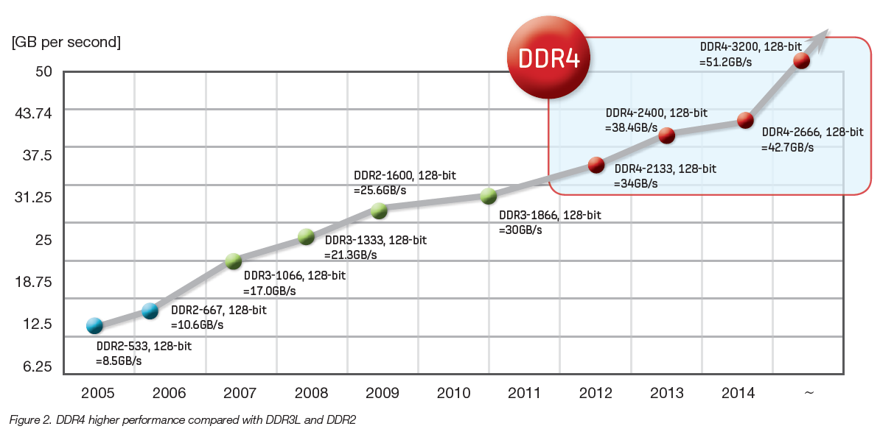
2x/6 y
3x/4 y

Slide 125
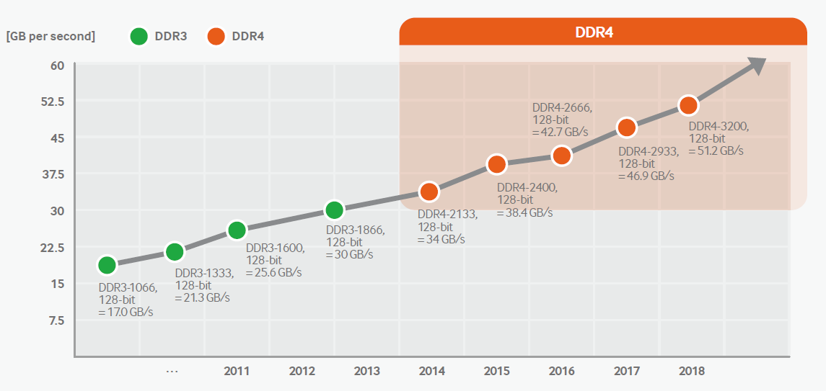
2 x /6 y
http://www.samsung.com/semiconductor/global/file/insight/2015/11/DDR4_Brochure_Nov-15-0.pdf

Slide 126
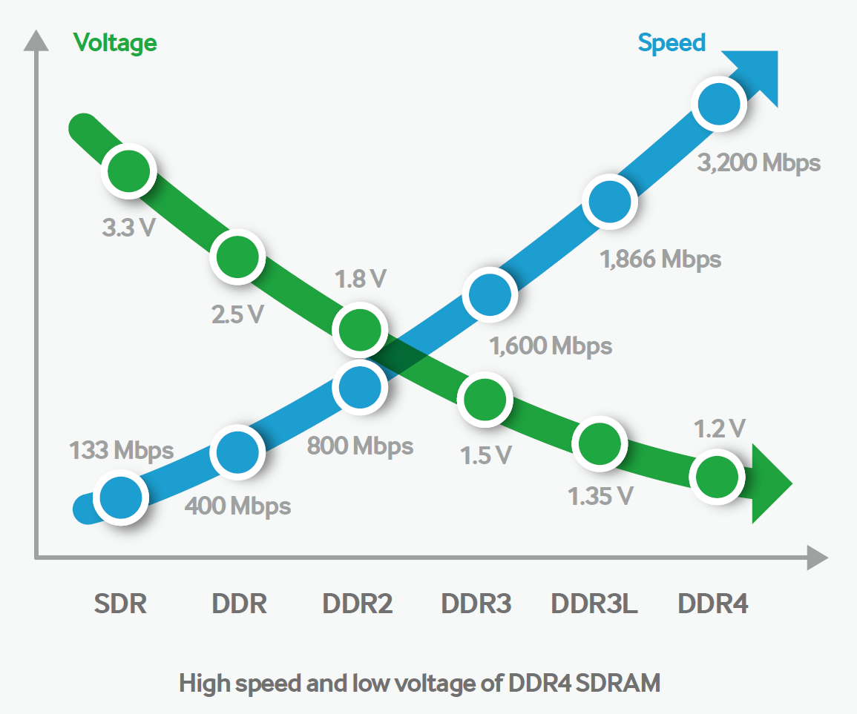
http://www.samsung.com/semiconductor/global/file/insight/2015/11/DDR4_Brochure_Nov-15-0.pdf

