Slide 1
The mobile boom
Sima Dezső
Nov. 2017
(Ver. 2.3)
© Sima Dezső, 2017

Slide 2
Contents
1. Emergence and spread of smartphones
2. Emergence and spread of tablets
3. Key requirements of mobile devices
4. How leading IT vendors addressed the mobile boom?
5. Conclusions
6. References

Slide 3
1. Emergence and spread of smartphones
Notes:
3

Slide 4
1. Emergence and spread of smartphones ()
1. Emergence and spread of smartphones
The traditional computer market around 1995
Main computer market segments around 1995
Servers
Desktops
Embedded
computer devices
E.g.
Intel’s Xeon lines
AMD’s Opteron lines
Intel’s Pentium 4 lines
AMD’s Athlon lines
ARM’s lines
From about 1995: spreading of laptops (aka notebooks) (portable computers)
*

Slide 5
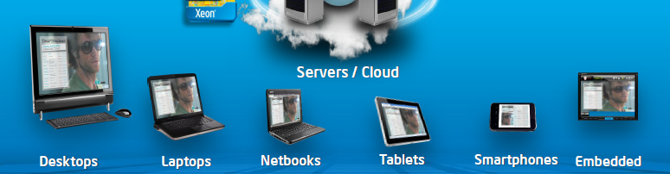
1. Emergence and spread of smartphones (1)
Emergence of mobile devices from about 2005 [2]
The mobile boom
Netbooks: Small size laptops (e.g. with a display size of 10" or smaller.)

Slide 6
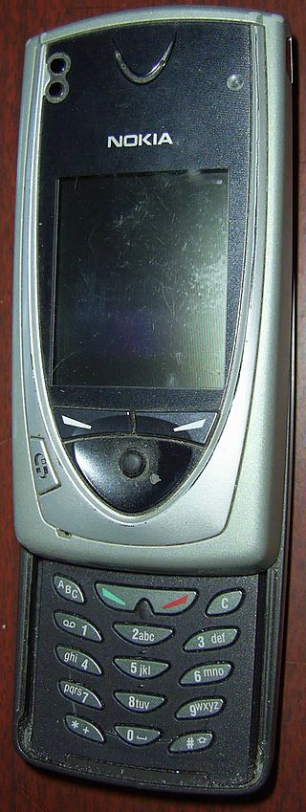
1. Emergence and spread of smartphones (2)
Emergence of smartphones-1
Forerunners of smartphones emerged already
at the beginning of the 2000’s, like Nokia’s 7650
(shipped in 2002).
The 7650 became the first widely available phone
with camera and color screen but supported
no video.
It was the first Nokia phone running under
the Symbian OS.
Figure: Nokia’s 7650 [39]

Slide 7
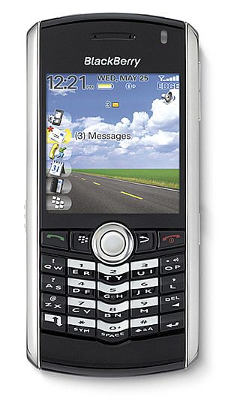
1. Emergence and spread of smartphones (3)
Emergence of smartphones-2
The emergence of smartphones is often
contributed to the BlackBerry Pearl 8100
line of the Canadian firm RIM
(Research in Motion)[5].
This phone – shipped in 2006 - supported
beyond a camera also video and became
very popular in the US.
It was run under the BlackBerry OS.
Figure: RIM’s BlackBarry Perl 8100
(2006) [38]
*

Slide 8
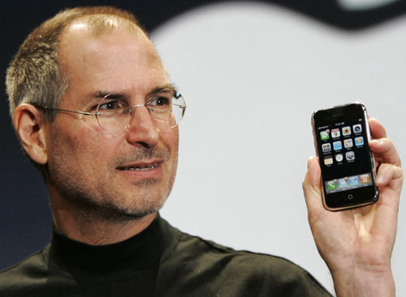
1. Emergence and spread of smartphones (4)
Early spread of smartphones-1
In 2007 Apple’s iPhone gave a strong momentum for rapid spreading of
smartphones.
It run under the iPhone OS (renamed later to iOS in 2010).
Figure: Steve Jobs introducing the iPhone at MacWorld Expo in 1/2007 [47]
*

Slide 9
1. Emergence and spread of smartphones (5)
Remark
After the introduction of iPhone (2007) Steve Ballmer (CEO of Microsoft) said in an
interview [20]:
“There's no chance that the iPhone is going to get any significant market share.
No chance…
But if you actually take a look at the 1.3 billion phones that get sold, I'd prefer
to have our software (Windows Phone) in 60% or 70% or 80% of them, than
I would to have 2% or 3%, which is what Apple might get”.

Slide 10
1. Emergence and spread of smartphones (6)
Early spread of smartphones-2
Google’s Android was unveiled also in 2007 with first Android-powered phones
sold in 10/2008 [6].
*

Slide 11
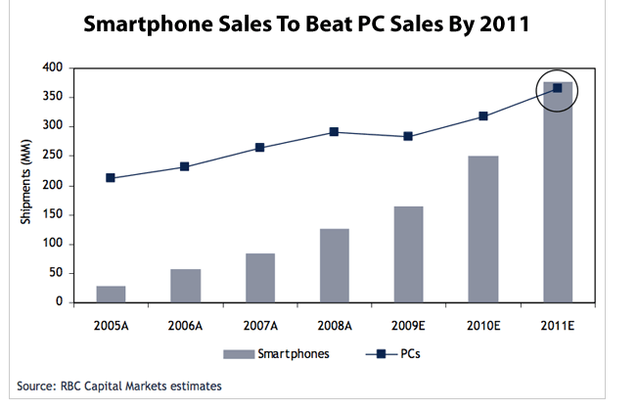
1. Emergence and spread of smartphones (7)
Emergence and rapid increase of smartphone sales 2005-2011 [4]
PC sales: Desktop + Notebook sales
A: Actual values
E: Estimated

Slide 12
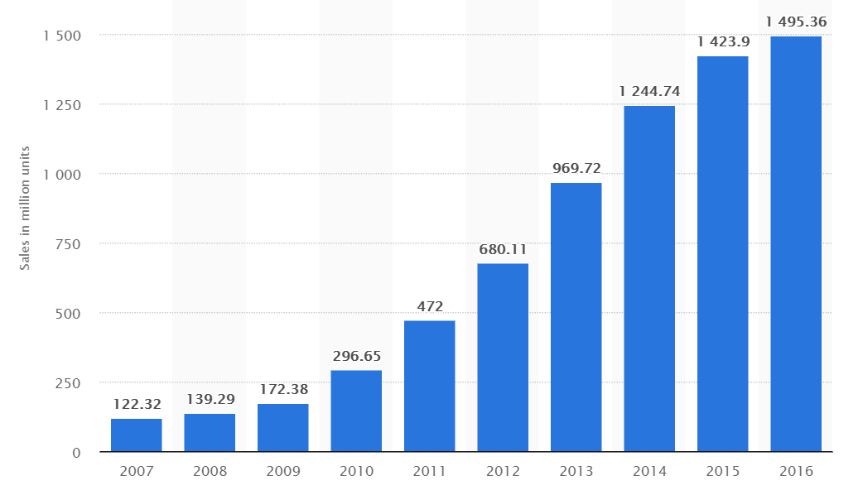
1. Emergence and spread of smartphones (8)
Worldwide unit shipments of smartphones 2007-2016 [28]

Slide 13
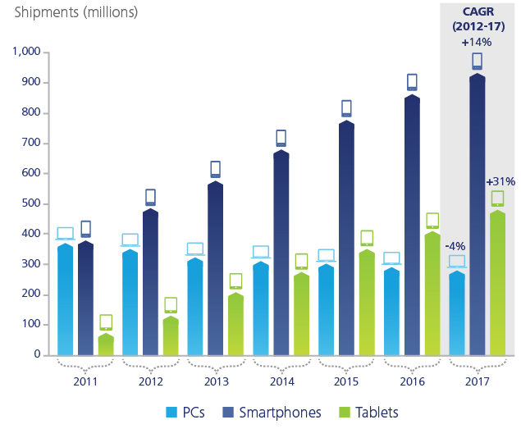
1. Emergence and spread of smartphones (9)
Worldwide unit shipment estimates of PCs vs. smartphones 2011-2017 [28]
CAGR: Compound Annual Growth Rate
Source: Gartner

Slide 14
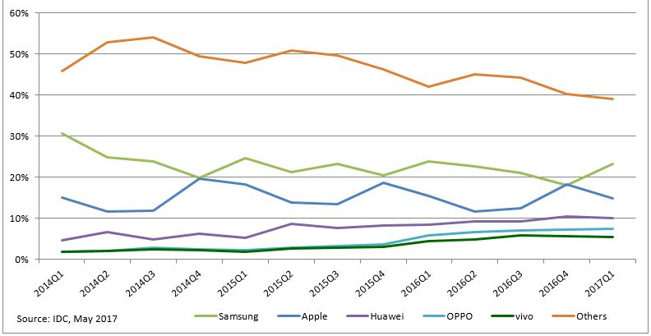
1. Emergence and spread of smartphones (10)
Worldwide smartphone market share in 2014-2017 (in unit shipments) [69]
Huawei: Chinese Oppo: Chinese Vivo: Chinese

Slide 15
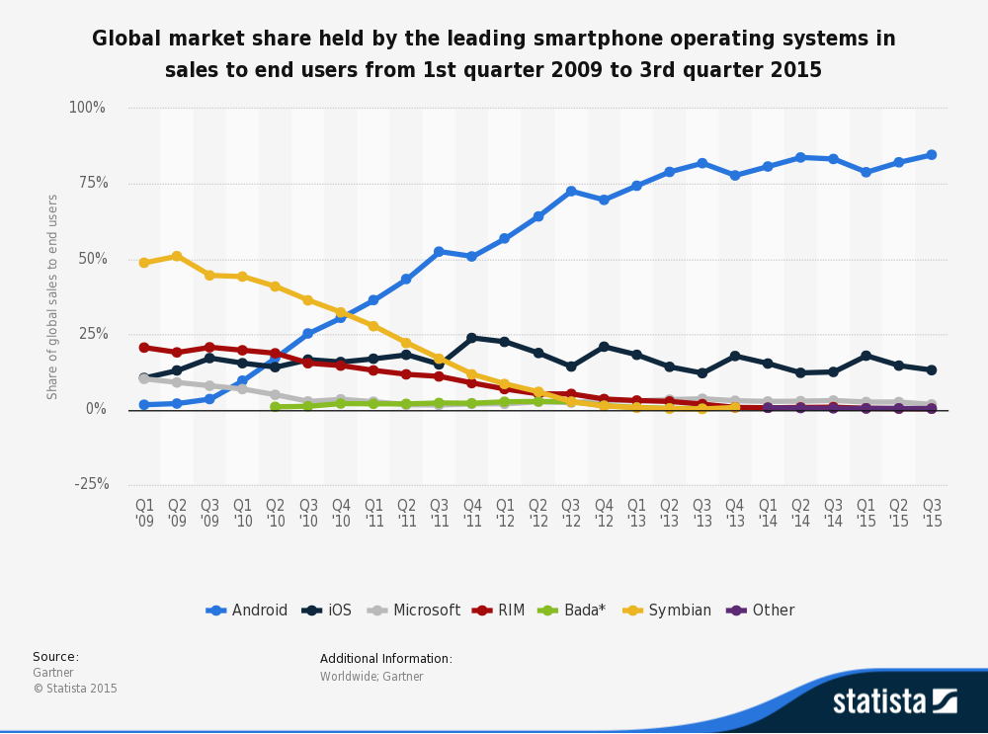
1. Emergence and spread of smartphones (11)
Worldwide market share of smartphone OSs in 2009-2015 [42]
*

Slide 16
1. Emergence and spread of smartphones (12)
Remember
After the introduction of iPhone (2007) Steve Ballmer (CEO of Microsoft) said in an
interview [20]:
“There's no chance that the iPhone is going to get any significant market share.
No chance…
But if you actually take a look at the 1.3 billion phones that get sold, I'd prefer
to have our software in 60% or 70% or 80% of them, than I would to have 2%
or 3%, which is what Apple might get”.

Slide 17
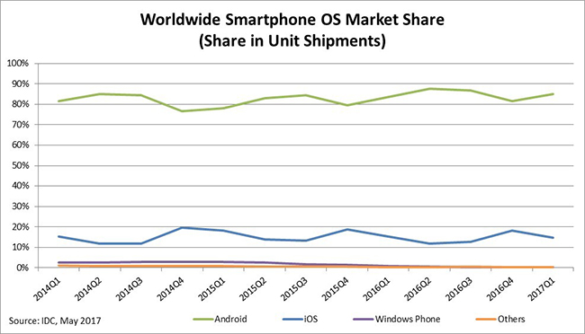
1. Emergence and spread of smartphones (13)
Worldwide smartphone OS market share in 2014-2017 (unit shipments) [70]

Slide 18
1. Emergence and spread of smartphones (14)
Worldwide market share of application processors in 1H 2017 used in
smartphones (based on revenue) [71]
Vendor | Market share | Processor lines (examples) | ISA
Qualcomm (USA) | 42 % | Snapdragon line 200-805 Snapdragoon 808-845 | ARMv7 ARMv8
Apple (USA) | 18 % | Apple A4-A6X Apple A7-A11 | ARMv7 ARMv8
MediaTek (Taiwan) | 18 % | Helio x10 Helio X20 | ARMv7 ARMv8
Samsung (S. Korea) |  | Exynos 5 line Exynos 7/8/9 | ARMv7 ARMv8
[Source: Strategy Analytics]
ARMv7: 32-bit
ARMv8: 64-bit
*

Slide 19
2. Emergence and spread of smartphones (15)
Main features of the Qualcomm Snapdragoon lines
Model | Released | Technology | CPU | Word length bit | Clock rate (up to) | Connectivity
835 | Q2/2017 | 10 nm | 4+4 Kryo 280 | 64 | 2.45 GHz | integrated LTE + RF
821 | Q3/2016 | 14 nm | 2+2 Kryo | 64 | 1.4 GHz | integrated LTE + RF
820 | Q4/2015 | 14 nm | 2+2 Kryo | 64 | 2.2 GHz | integrated LTE + RF
810 | H2/2014 | 20 nm | 4x ARM Cortex A57 + 4x ARM Cortex A53 | 64 | 2.0 GHz | integrated LTE + RF
808 | H1/2015 | 20 nm | 2x ARM Cortex A57 + 4x ARM Cortex A53 | 64 | 2.0 GHz | integrated LTE + RF
805 | Q1/2014 | 28 nm | 4x Krait 450 | 32 | 2.7 GHz | integrated LTE + RF
801 | Q4/2013 | 28 nm | 4x Krait 400 | 32 | 2.5 GHz | integrated LTE + RF
800 | Q2/2013 | 28 nm | 4x Krait 400 | 32 | 2.3 GHz | integrated LTE + RF
600 | Q1/2013 | 28 nm | 4x Krait 300 | 32 | 1.9 GHz | integrated WiFi
410 | 1H/2014 | 28 nm | 4x ARM Cortex A53 | 64 | 1.4 GHz | integrated LTE + RF
400 | Q4/2013 | 28 nm | 4x Krait 300 or 4x ARM Cortex A7 | 32 | 1.7 GHz 1.4 GHz | integrated LTE + RF
200 | 2013 | 28 nm | 4x ARM Cortex A5 or 4x ARM Cortex A7 | 32 | 1.4 GHz 1.2 GHz | integrated 3G + RF
RF: Radio Frequency Front End implemented as a separate chip

Slide 20
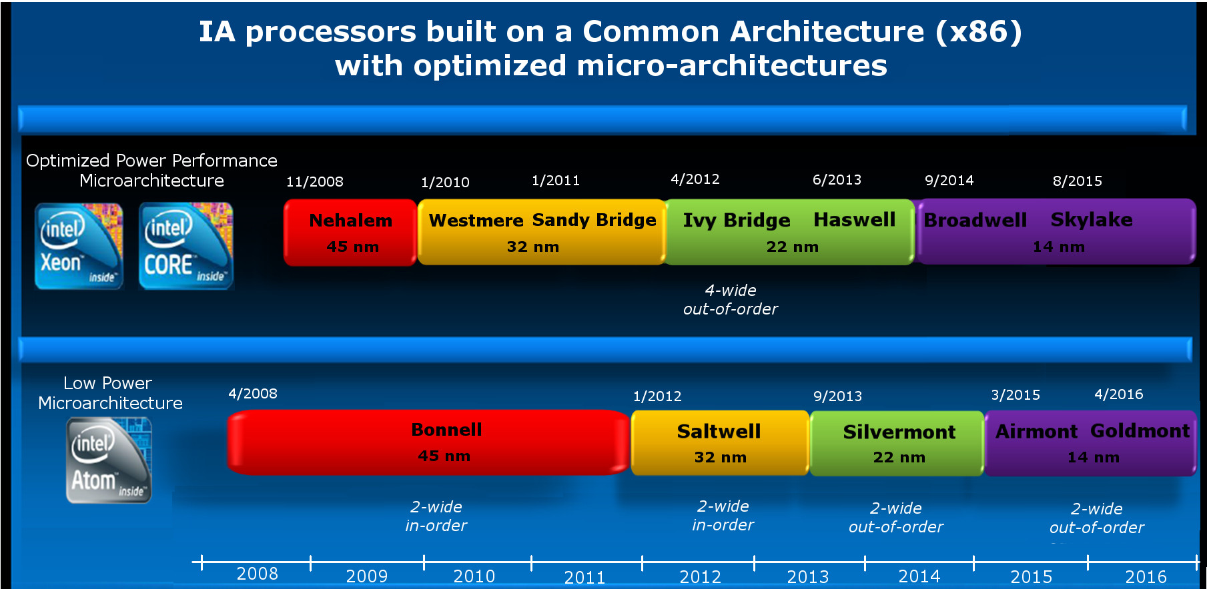
1. Emergence and spread of smartphones (16)
Intel's efforts to enter the mobile market [Based on 2]
Introduction of the Atom line targeting the mobile market
4-wide
out-of-order
2008
2-wide
in-order
2-wide
in order
2-wide
out-of-order
2-wide
out-of-order

Slide 21
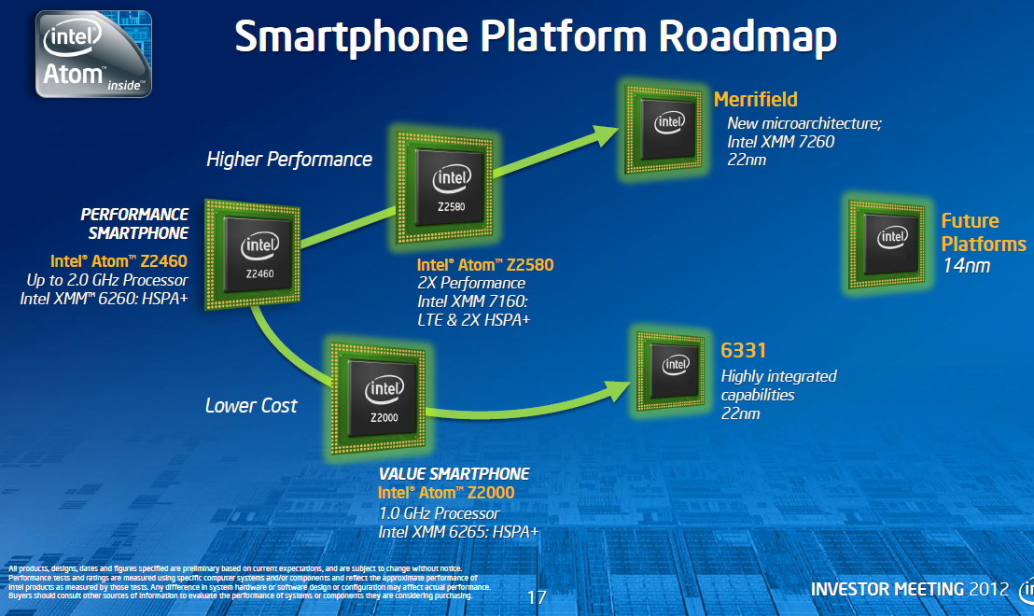
1. Emergence and spread of smartphones (17)
Intel’s Atom platforms targeting smartphones (based on [33])
Morganfield
(2016)
Moorefield
(2014)
Merrifield
(2014)
Performance (not to scale)
Clover Trail+
(2013)
Z5xxx
4xGoldmont
14 nm
+XMM 7360
Medfield
(2012)
Z35xx
4xSilvermont
22 nm
+XMM 7260/2/35
Morestown
(2010)
Z34x0
2xSilvermont
22 nm
+XMM 7160/7260
Cancelled
in 04/2016
Z2580-2520
2xSaltwell
32 nm
+XMM 6268/6360/7160
Binghampton
(2016)
Z2480/2460
1xSaltwell
32 nm
+XMM 6260
Riverton
(2015)
Slayton
(2014)
Z6xx
1xBonnell
45 nm
+Wireless
module
Lexington
(2013)
Zxxx
2xAirmont
14 nm
+?
Zxxxx
2xAirmont
14 nm
+?
Z3xxx
2xSilvermont
22 nm
+A-GOLD 620
Z2420
1xSaltwell
32 nm
+XMM 6265

Slide 22
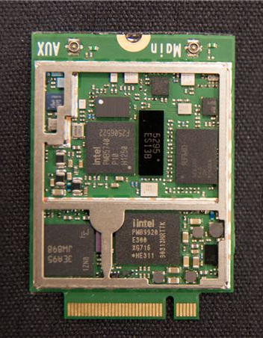
1. Emergence and spread of smartphones (18)
Intel’s XMM line including a 3G/4G modem an a transceiver (on two chips)
RF Transceiver
3G/4G modem
Figure: Implementation
example of the
XMM7160 [46]

Slide 23
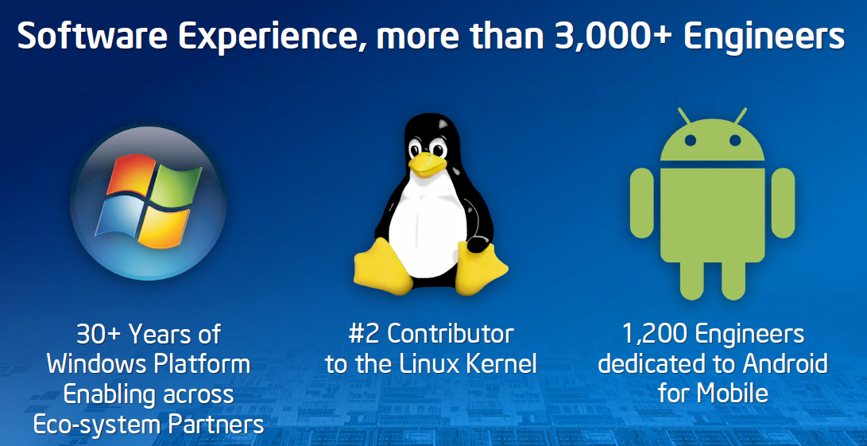
1. Emergence and spread of smartphones (19)
Intel’s effort to optimize their devices from the software point of view
In their 2012 Investor meeting (5/2012) Intel revealed that more than 3000
engineers are working on OS support, among them about 1200 engineers
are dedicated to Android, as indicated below [11].

Slide 24
1. Emergence and spread of smartphones (20)
Intel’s share in smartphone application processors in 2014 [54]
Despite great efforts Intel could not become one of the 5 largest suppliers
of smartphone application processors.
According to industry sources in 2014 Intel achieved less than 1 % share in revenue
in smartphone application processors.
*

Slide 25
1. Emergence and spread of smartphones (21)
Intel's withdrawal from the mobile market
In 4/2016 Intel announced their withdrawal from the mobile market.
*

Slide 26
2. Emergence and spread of tablets
Notes:
26

Slide 27
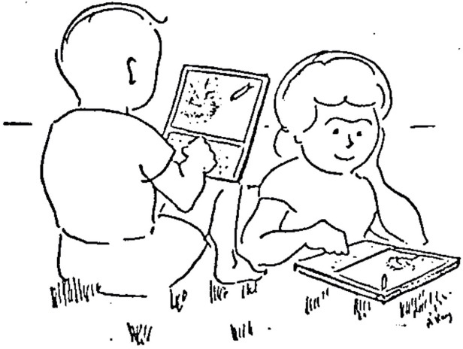
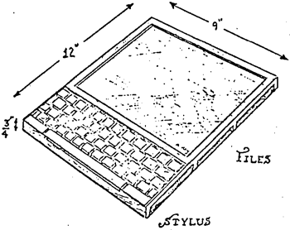
2. Emergence and spread of tablets (1)
2. Emergence and spread of tablets
An early vision of tablets targeting children - the Dynabook []
In 1972 at the ACM National Conference Alan Kay from the Xerox Palo Alto Research
Center (PARC) introduced a Personal Computer for Children, called the Dynabook.
Picture of a DynaBook
Picture of two kids sitting in the grass with Dynabooks
“This note speculates about the emergence of personal, portable information manipulators and their effects when used by both children and adults. Although it should be read as science fiction, current trends in miniaturization and price reduction almost guarantee that many of the notions discussed will actually happen in the near future."
*

Slide 28
2. Emergence and spread of tablets (2)
Steve Jobs vision of tablets
In a talk given at the Center for Design Innovation Steve Jobs envisioned tablets
already in 1983 saying
”Apple’s strategy is really simple. What we want to do is we want to put an
incredibly great computer in a book that you can carry around with you and learn
how to use in 20 minutes.
... And we really want to do it with a radio link in it so you don’t have to hook up
to anything and you’re in communication with all of these larger databases and
other computers” [19].
*

Slide 29
2. Emergence and spread of tablets (3)
The relation of the Dynabook and iPad [73]
In an interview in 2010 Kay said that "Jobs has known about the
Dynabook idea and the interim-Dynabook (called the PARC Alto)
for several decades".
Here we note that Steve Jobs and Apple engineers visited PARC in 1979.
While asking in the cited interview "whether he felt that Jobs
had stolen the idea for the iPad" Kay denied such a thought.
In fact, there is a difference in the usage models of Dynabook and IPad.
Dynabook represented an idea of active computing e.g. with children
programming it by means of its keyboard in Smalltalk.
By contrast, iPad is built for passive computing while using applications
downloaded e.g. from the App Store.

Slide 30
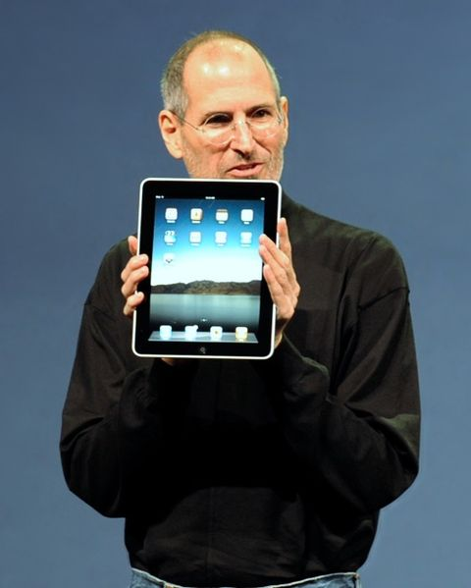
2. Emergence and spread of tablets (4)
Designs leading to the rapid spreading of tablets around 2010
From 2009 on Android-based tablets arrived the market from many vendors.
In 2010 Apple’s iPad was introduced with 9.7 “ screen, touch screen and Wi-Fi or
additionally wireless 3G broadband internet connection (mobile internet connection),
operating under iOS [12].
Figure: Steve Jobs introducing the iPad in 2010 [12]
*

Slide 31
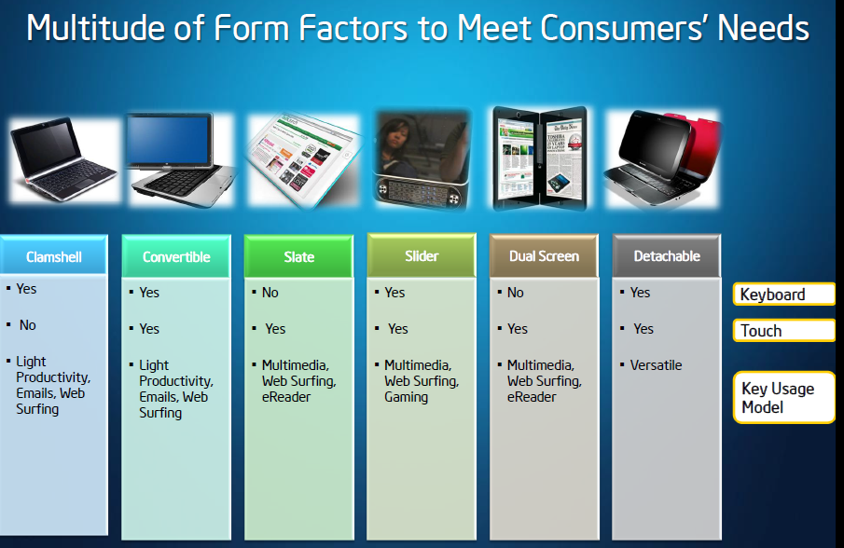
2. Emergence and spread of tablets (5)
Implementation alternatives of tablets -1 [8]

Slide 32
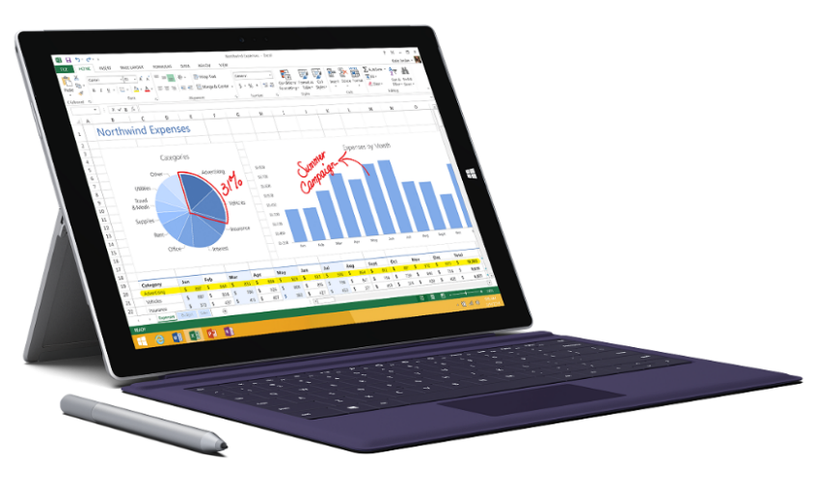
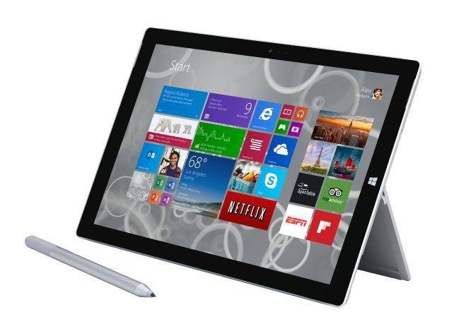
2. Emergence and spread of tablets (6)
Implementation alternatives of tablets -2 [8]
2 in 1 tablets (≈ attachable keyboard + touchscreen)
Example: Windows Surface Pro 3 (8/2014)
Aim: Replacing laptops
Intel’s Surface Pro 3
used as a laptop [22]
Intel’s Surface Pro 3
used as a tablet [23]

Slide 33
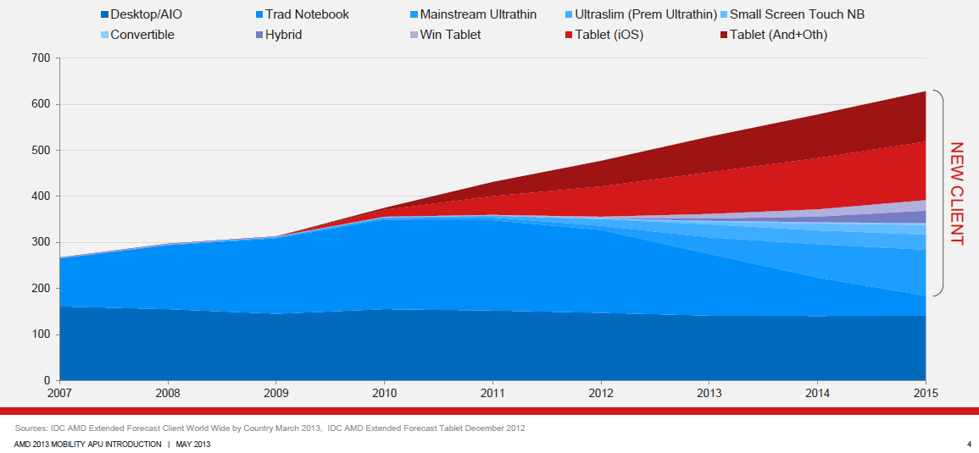
2. Emergence and spread of tablets (7)
Rapid increase of tablet sales in the first half of the 2010’s
Besides smartphones, tablets and all their alternative designs (that provide also keyboard/mouse input, such as convertibles or 2 in 1 designs) have recently the highest growth potential, as indicated in the Figure below (12/1012) [3].
Tablets
Notebooks
Desktops
Figure: Yearly worldwide sales figures of desktops, notebooks and tablets [3]

Slide 34
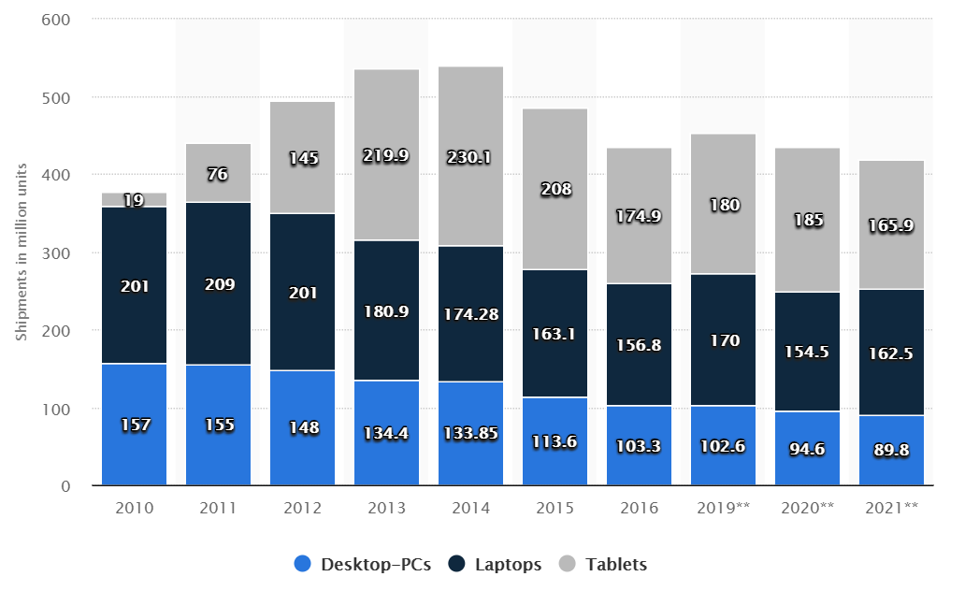
2. Emergence and spread of tablets (8)
Worldwide shipment of laptops, desktop PCs and tablets from 2010 to 2016
as well as sale forecasts until 2021 (in million units) [35]
Source: Gartner

Slide 35
2. Emergence and spread of tablets (9)
2016 worldwide tablet shipments (in million units) and market shares
by vendors [76]
Vendor | 2Q16 Unit Shipments | 2Q16 Market Share | 2Q15 Unit Shipments | 2Q15 Market Share | Year-Over-Year Growth
1. Apple | 10.0 | 25.8% | 11.0 | 24.9% | -9.2%
2. Samsung | 6.0 | 15.6% | 8.0 | 18.2% | -24.5%
3. Lenovo | 2.5 | 6.6% | 2.5 | 5.6% | 3.1%
4. Huawei | 2.2 | 5.6% | 1.3 | 2.9% | 71.0%
5. Amazon | 1.6 | 4.0% | 0.1 | 0.3% | 1208.9%
Others | 16.4 | 42.4% | 21.3 | 48.2% | -22.9%
Total | 38.7 | 100.0% | 44.1 | 100.0% | -12.3%

Slide 36
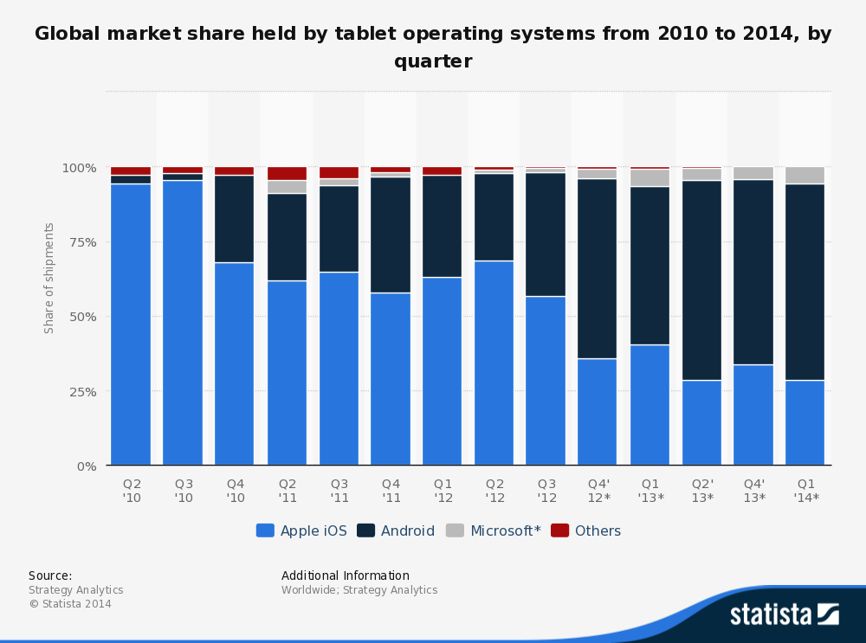
2. Emergence and spread of tablets (10)
Global market share of tablet OS shipments 2010 - 2014 by quarter [25]
*

Slide 37
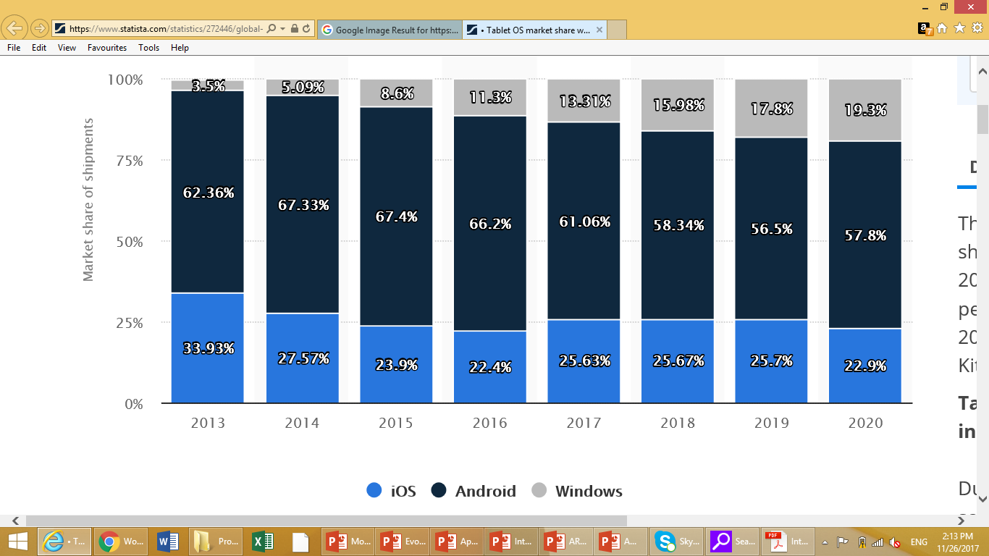
2. Emergence and spread of tablets (11)
Global market share of tablet OSs 2013-2017 and forecast until 2020 [88]

Slide 38
2. Emergence and spread of tablets (12)
Intel's platforms targeting tablets (based on [11])
Willow Trail
(2016)
Cherry Trail
(2015)
Bay Trail
(2013)
Performance (not to scale)
Clover Trail
(2012)
Z5xxx
4xGoldmont
14 nm
+XMM 7360
W/A
Oak Trail
(2011)
Z4xxx
4xAirmont
14 nm
+XMM 7160/7260
W/A
Menlow
(2008)
Z37x0
4xSilvermont
22 nm
+XMM 6260/7160
W/A
Cancelled
in 04/2016
Z2760
2xSaltwell
32 nm
+XMM 6260
W
Atom X3
(Sophia LTE)
(2015)
Atom X3
(Sophia 3G)
(2015)
Z670/650
1xBonnell
45 nm
+ no XMM
W/MeeGo/A
Z5xx
1xBonnell
45 nm
+ no XMM
W/Moblin
C3400
4xAirmont
28 nm
integrated LTE
modem
C3000
2xSilvermont
28 nm
integrated 3G
modem
W: Windows
A: Android

Slide 39
2. Emergence and spread of tablets (13)
Intel’s share in tablet application processors [35], [36], [56]
Intel ’s subsidies paid for OEMs
In the first years of 2010 Intel paid significant subsidies (~ 50 $/tablet) to
netbook and tablet manufacturers to achieve their switch from ARM based
processors to x86 Atom processors.
Achieved market share in 2015 due to paying subsidies
In 2015 Intel achieved the 3. place in the worldwide market share in
tablet application processor revenue, as the Table below shows.
Tablet application processors worldwide market share 2015 (revenue) [57]
Apple (USA) | 31 %
Qualcomm (USA) | 16 %
Intel (USA) | 14 %
MediaTek (Taiwan)
Samsung (S. Korea)
Table: Worldwide market share of application processors used in tablets in 2015
(based on revenue)
Subsidy: szubvenció
*

Slide 40
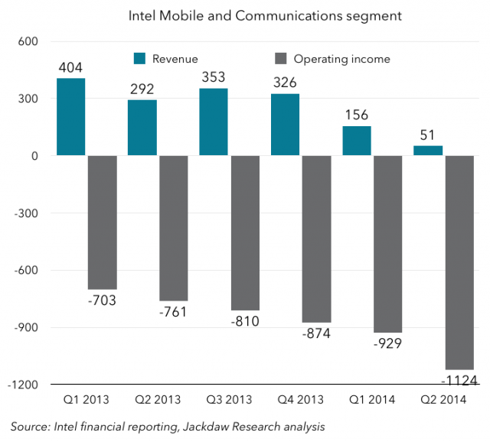
2. Emergence and spread of tablets (14)
Intel's losses on the mobile development in 2013 - 2014 [74]
Nevertheless, owing to subsidies Intel's mobile and communication division has lost
7 billion $ in the years 2013-2014 , as indicated in the next Figure [83].
Figure: Revenues/operating income of Intel's Mobile and Communications segment [83]

Slide 41
2. Emergence and spread of tablets (15)
Intel's withdrawal from the mobile market
Due to their high losses Intel first stopped paying subsidies and then in 4/2016
announced their withdrawal from the mobile market.
*

Slide 42
3. Key requirements of mobile devices (tablets, smartphones)
Notes:
42

Slide 43
3. Key requirement of mobile devices (tablets, smartphones)
3. Key requirements of mobile devices (tablets, smartphones)
Key requirements of mobile devices (tablets, smartphones)
Low power operation
Connectivity
(3G/4G/Wi-Fi)
(Section 3.1)
(Section 3.2)
*

Slide 44
3.1 Low power operation
Notes:
44

Slide 45
3.1 Low power operation (1)
3.1 Low power operation
It will be expressed
either by specifying the power consumption, e.g. the TDP value of
the processor in Watt,
or in in length of the operating hours of the device under given conditions.
Power consumption = Active power (C_{dyn}∗V_{CC}² ∗ f_{c}) + Leakage power (V_{CC} ∗ I_{leak})
*

Slide 46
3.1 Low power operation (1b)
Contrasting the design paradigms of traditional and mobile processors
Traditional processors
Tablets and smartphones
High performance/power
(Power efficiency)
(e.g. GFLOPS/Watt)
Low power consumption
(Watt)
(Number of operating hours)
*

Slide 47
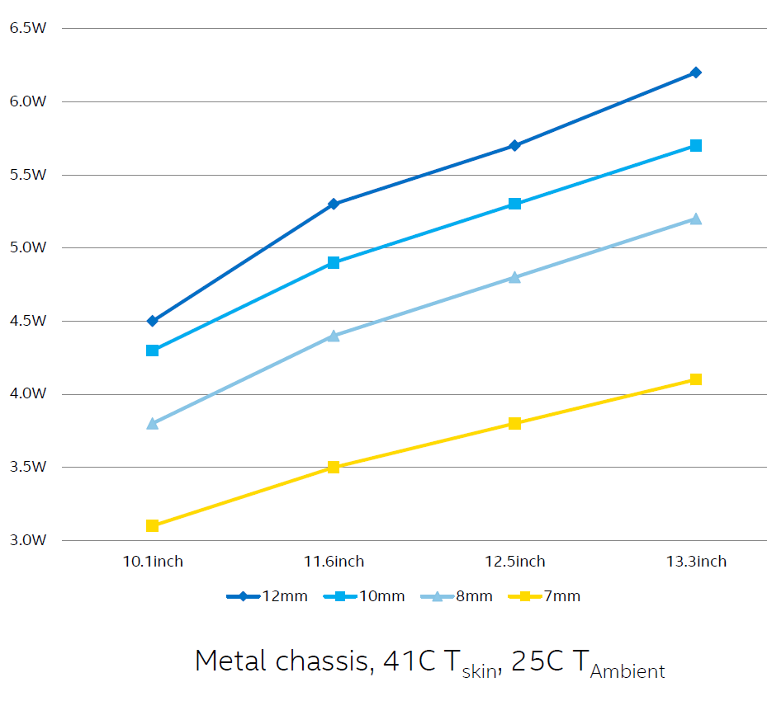
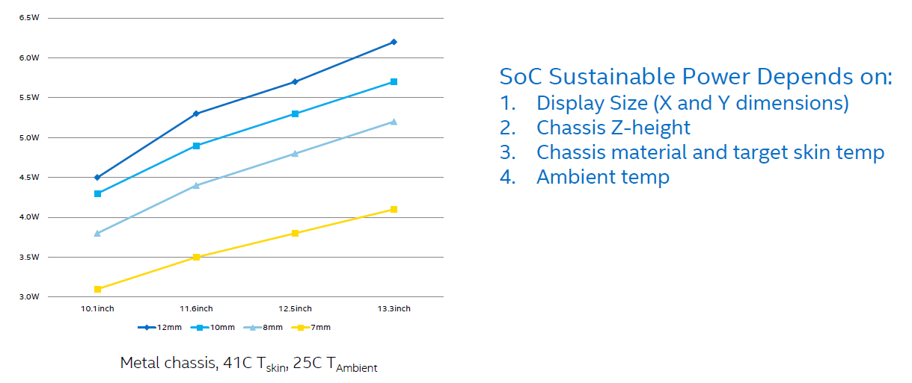
3.1 Low power operation (2)
Sustainable power for fanless tablets [78]
*

Slide 48
3.1 Low power operation (3)
Total platform power consumption
It results from the power consumption of the SOC, display, memory, network etc.
i.e. from any circuit that is mounted on the motherboard.

Slide 49
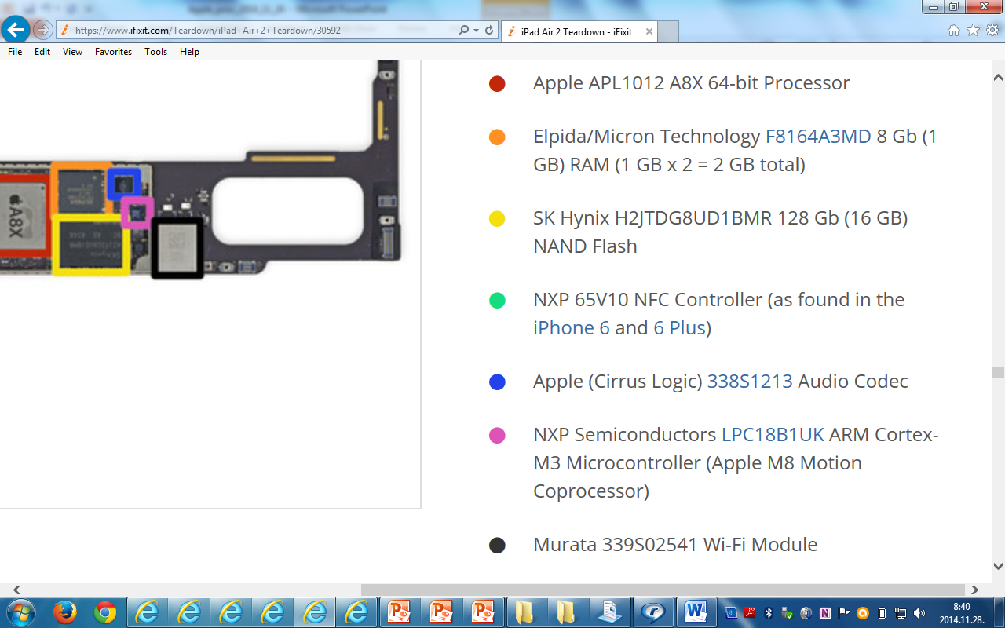
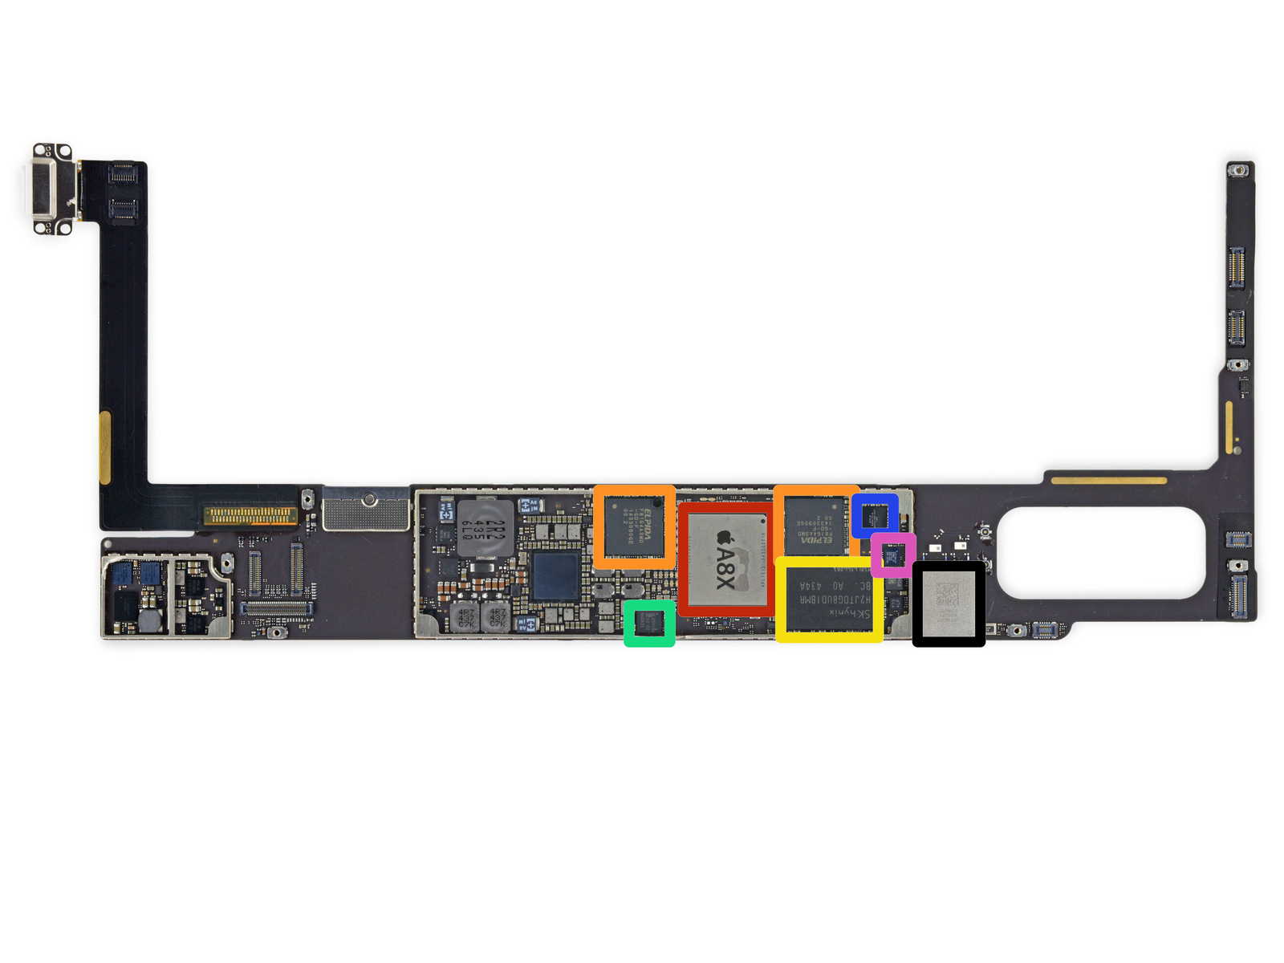
3.1 Low power operation (4)
Total power consumption of a tablet: Example one side of the iPad Air 2
motherboard [79]

Slide 50
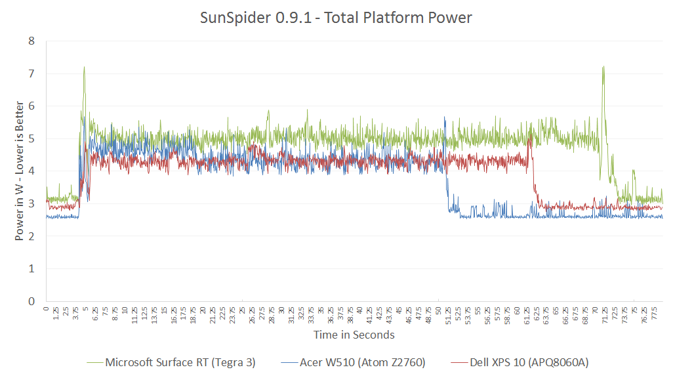
3.1 Low power operation (5)
Example: Total power consumption of tablets
while running the (SunSpider 0.9.1 benchmark) [80]
SunSpider, is a mid-length JavaScript benchmark.
NVidia T30
4+1x Cortex A9, 1.3 GHz)
Intel Atom Z2760
(2C, 1.8 GHz)
Qualcomm S4 (APQ8060A)
(2C 1.5 GHz)

Slide 51
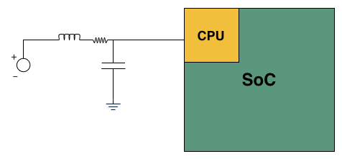
3.1 Low power operation (6)
Measuring the power consumption of a CPU [80]
e.g. 20 mΩ
Basic LC filter modified with an inline resistor

Slide 52
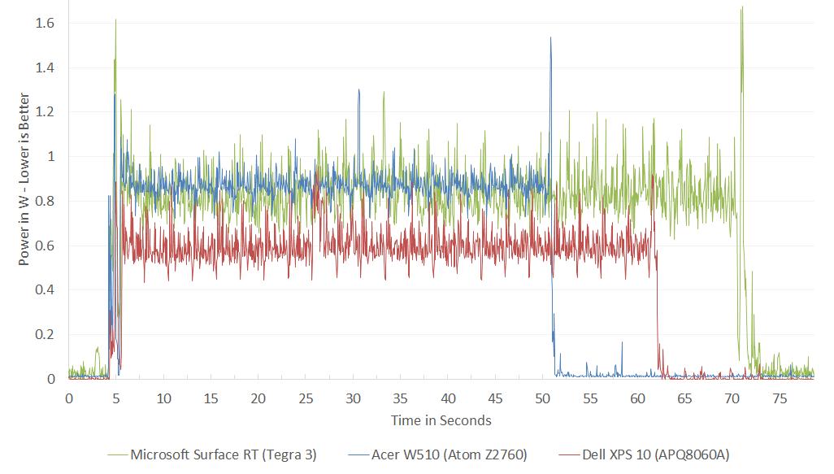
3.1 Low power operation (7)
Example: Power consumption of CPUs while running the (SunSpider 0.9.1
benchmark) [80]
SunSpider, is a mid-length JavaScript benchmark.
In the power consumption of Qualcomm's S4
the L2 cache is not taken into account.
NVidia T30
4+1x Cortex A9, 1.3 GHz)
Intel Atom Z2760
(2C, 1.8 GHz)
Qualcomm S4 (APQ8060A)
(2C 1.5 GHz)
*

Slide 53
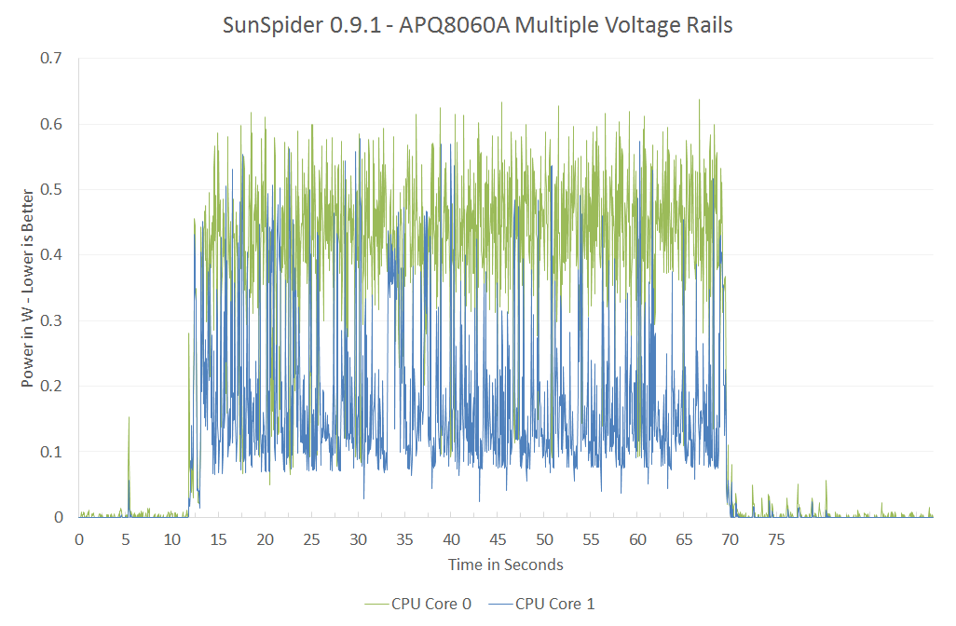
3.1 Low power operation (7b)
Remark to the power management of the referenced processors [80]
The cores in both the dual core Atom and 4+1 core NVIDIA's Tegra 3 share the
sare voltage and frequency during power management.
By contrast, the dual core Qualcomm's S4 make use of per core voltage and
frequency scaling, as indicated below.
In addition L2 has a separate voltage rail and can be power managed separately.
Figure: Power consumption of the S4 while running the Sunspider 0.9.1 benchmark [80]

Slide 54
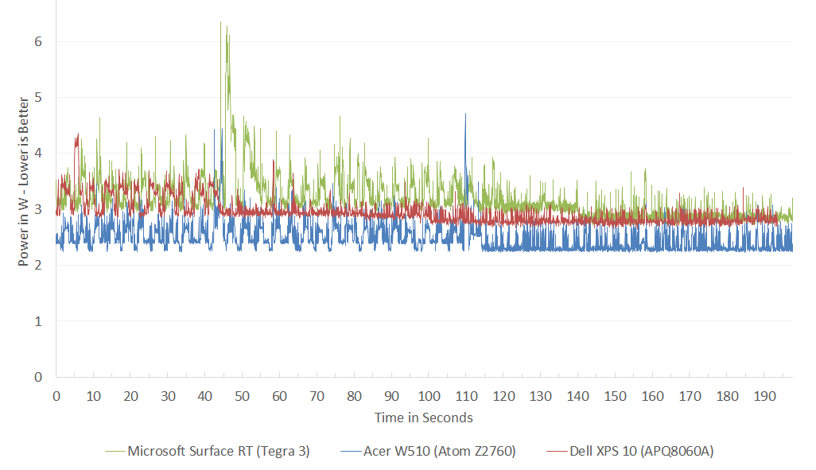
3.1 Low power operation (8)
Example: Total idle power consumption of tablets [80]
NVidia T30
4+1x Cortex A9, 1.3 GHz)
Intel Atom Z2760
(2C, 1.8 GHz)
Qualcomm S4 (APQ8060A)
(2C 1.5 GHz)

Slide 55
3.1 Low power operation (9)
Battery sizes of tablets - examples
Apple iPad: 32.4 Wh
Apple iPad Air: 32.4 Wh
Microsoft Surface RT: 31.5 Wh
Acer Iconia W510: 3.54 Ah (4.7 V)
Dell XPS 10: 28 Wh

Slide 56
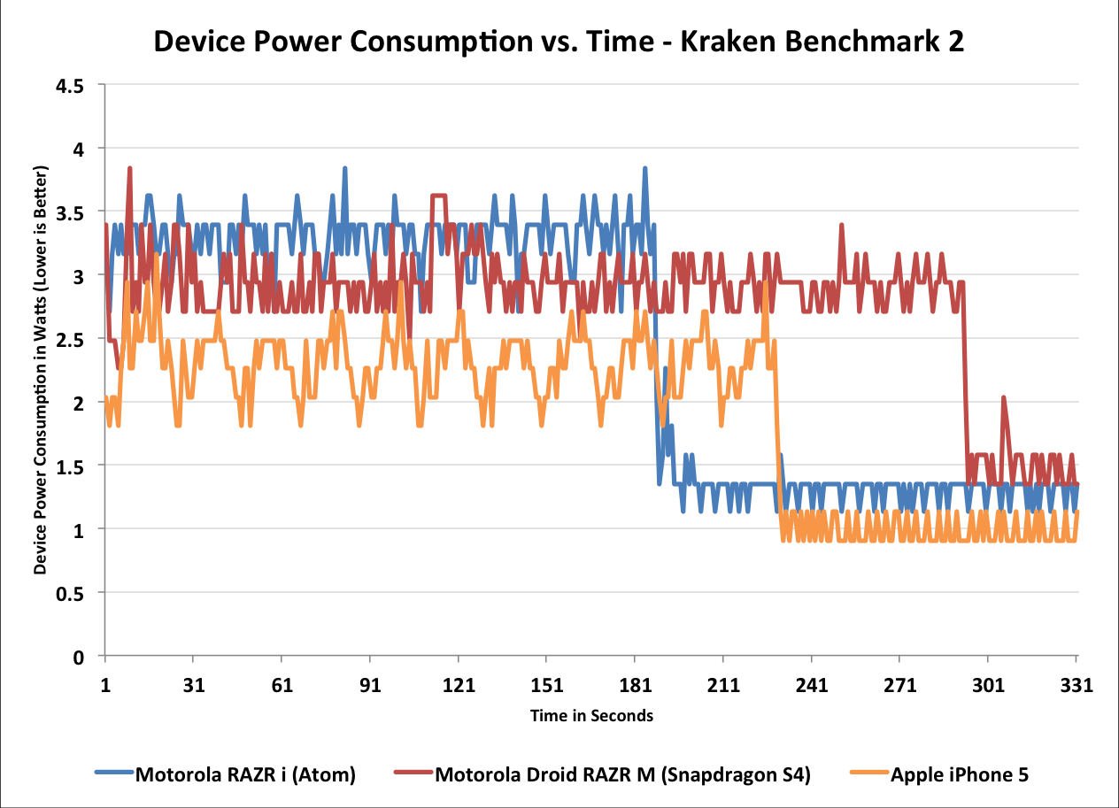
3.1 Low power operation (10)
Example: Power consumption of smartphones while running the (Kraken
Benchmark 2 [80]
1.6 GHz Atom Z2460 (x86-32)
1.5 GHz 2C MSM8960 (Krait 200, ARMv7)
*
1.3 GHz 2C A6 (Swift, ARMv7)

Slide 57
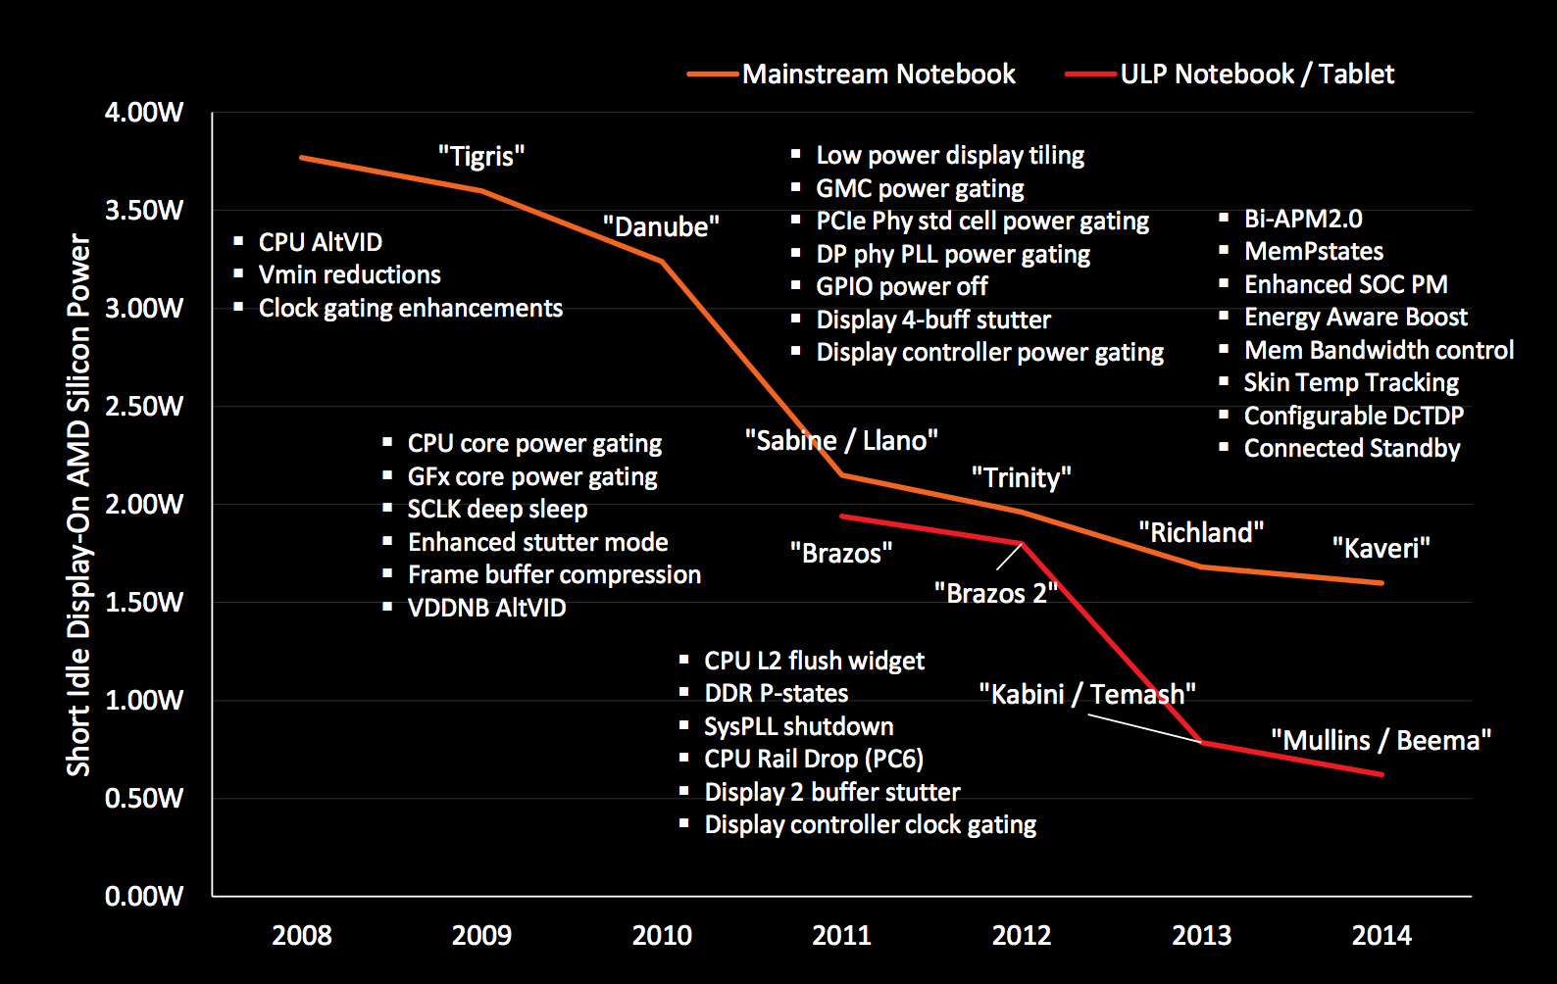
3.1 Low power operation (11)
Example: AMD’s technologies to reduce power consumption (2008-2014) [27]

Slide 58
3.1 Low power operation (12)
Achieving low power consumption
In this point let’s focus on the microarchitecture of CPUs (processor cores).
*

Slide 59
3.1 Low power operation (13)
Key enablers of low power microarchitectures
Key enablers of low power microarchitectures
Narrow microarchitecture
Low clock frequency
(Section 3.1.2)
(Section 3.1.3)
*

Slide 60
3.1 Low power operation (14)
3.1.2 “Narrow” microarchitectures -1
Obviously, a narrow microarchitecture consumes less power than a wider one.
What does a narrow microarchitecture mean?
*

Slide 61
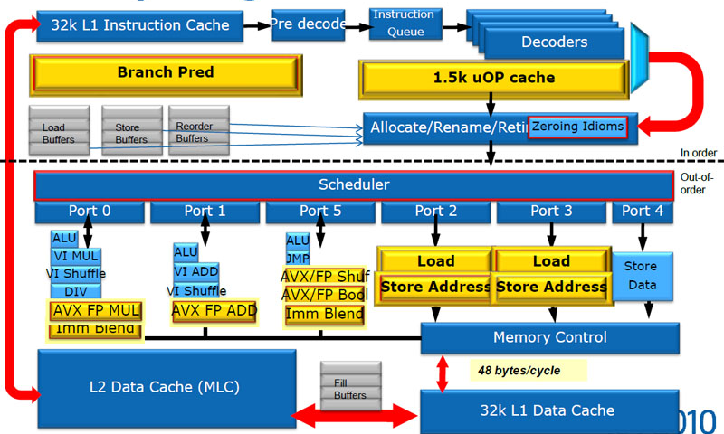
3.1 Low power operation (14b)
Example for the "width of a microarchitecture"
In-order
Front end
Out-of-order
parallel
Back end
Microarchitecture of the cores of Sandy Bridge [90]

Slide 62
3.1 Low power operation (14c)
3.1.2 “Narrow” microarchitectures -2
A suitable characteristics of the width of a microarchitecture is the width of its
front end, that can be characterized by the decode width.
We note that in a well designed microarchitecture all subsystems, like fetching,
decoding, renaming dispatching or issuing instructions are appropriately
fitted to each other.
To achieve low power consumption first application processors used in tablets
and smartphones were "thin" designs with a typical decode width of 2,
as shown in the next Figure.
*

Slide 63
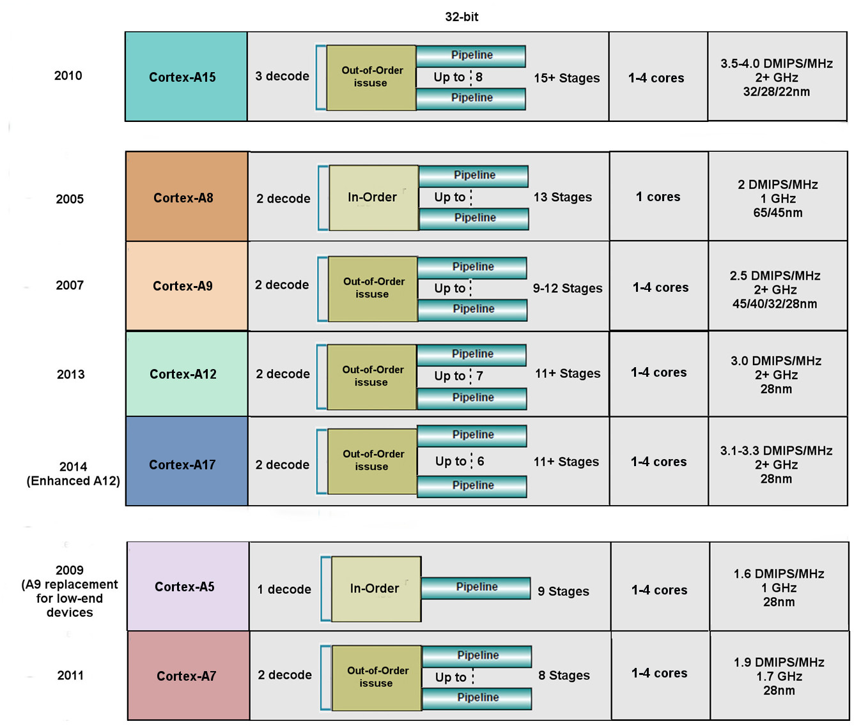
3.1 Low power operation (15)
Key features of ARMv7 ISA based early microarchitectures (based on [14])
High performance
Mainstream
Low power

Slide 64
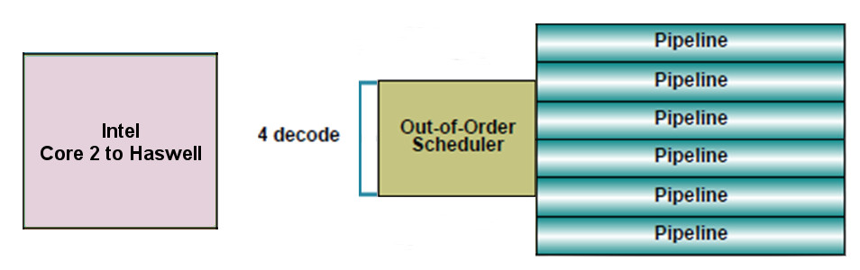
3.1 Low power operation (16)
“Narrow” microarchitectures -3
We note that at the same time Intel's mainline processors had a 4-wide
microarchitecture, as indicated below, to provide high performance/power
(in terms of GFLOPS/Watt).
64-bit
Intel
Core 2
to
Broadwell
Figure: Width of Intel’s Core 2 (2006) to Broadwell (2014) microarchitetures
underlying servers to laptops [10]

Slide 65
3.1 Low power operation (17)
Remarks
Evolution of the decode width in Intel's mainstream microarchitectures
up to the Pentium 4 (2000): 3-wide
beginning with the Core 2 (2006): 4-wide
beginning with the Skylake (2015): 5-wide
By contrast AMD's microarchitectures remained 3-wide until the K15 Bulldozer line
(2011).
This fact was a significant contributor to Intel's performance superiority.
*

Slide 66
3.1 Low power operation (18)
Evolution of the width of mobile microarchitectures -1
Advancements in IC technology and power management allowed to widen the
microarchitecture of mobiles without noticeable raising their power consumption,
as follows.
a) When ARM introduced the ARMv8-based (64-bit) processor line they increased
the microarchitecture width of their high-performance Cortex-A57 and the A72
processors from 2 to 3, to boost performance, as seen in the next Figure.
*

Slide 67
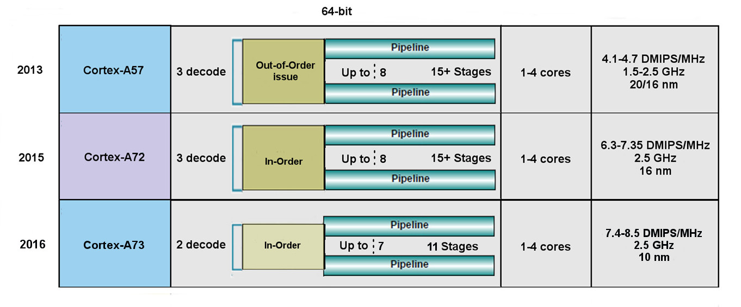
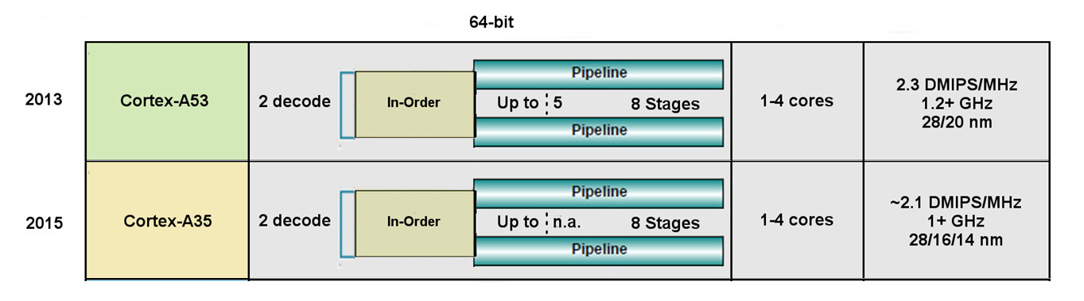
3.1 Low power operation (19)
Key features of ARMv8.0 ISA based microarchitectures (based on [14])
High performance
Low power

Slide 68
3.1 Low power operation (20)
Evolution of the width of mobile microarchitectures -2
ARM's also implemented their ARMv8.2-based high performance A75 processor
with a 3-wide microarchitecture.

Slide 69
3.1 Low power operation (21)
Evolution of the width of mobile microarchitectures -3
b) In 2014 a few papers (e.g. [48]) revealed that Apple's A6 (2013) has an
astonishingly wide (6-wide) dual-core microarchitecture (called Cyclon),
used in the iPad Air (see the next Figure).
*

Slide 70
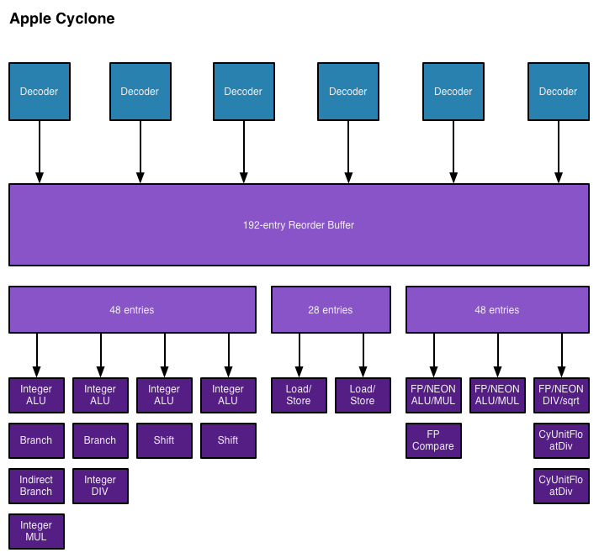
3.1 Low power operation (22)
Apple’s Cyclone core, introduced in the A7 SOC (2013) [48]

Slide 71
3.1 Low power operation (23)
Main features of Apple's A6 to A11 processors
HP: High Performance
EE: Energy Efficient
Name | Techn. | Cores | Launched | fc | Decode rate | Used in
A5X | 45 nm | 2x Cortex-A9 | 3/2011 | 1.0 GHz | 2 | iPad (3. gen.)
A6 | 32 nm | 2x Swift | 9/2012 | 1.3 GHz | 3 | iPhone 5/5C
A6X | 32 nm | 2x Swift | 10/2012 | 1.4 GHz | 3 | iPad (4th gen.)
A7 | 28 nm | 2x Cyclon | 09/2013 | 1.3 GHz | 6 | iPhone 5S iPad Mini 2/3
A7 | 28 nm | 2x Cyclon | 10/2013 | 1.4 GHz | 6 | iPad Air
A8 | 20 nm | 2x Typhoon | 09/2014 | 1.1 - 1.5 GHz | 6 | iPhone 6/6 Plus iPad Mini 4
A8X | 20 nm | 3x Typhoon | 10/2014 | 1.5 GHz | 6 | iPad Air 2
A9 | 14 nm | 2x Twister (Samsung) | 09/2015 | 1.85 GHz | 6 | iPhone 6S/6S Plus iPhone SE iPad (2017)
A9 | 16 nm | 2x Twister (TSMC) | 09/2015 | 1.85 GHz | 6
A9X | 16 nm | 2x Twister | 11/2015 | 2.16 - 2.26 GHz | 6 | iPad Pro 12.9" iPad Pro 9.7"
A10 | 16 nm | 2x Hurricane (HP) 2x Zephyr (EE) | 09/2016 | 2.34 GHz | n.a. | iPhone 7/7 Plus iMac Pro (2017)
A10X | 10 nm | 3x Hurricane (HP) 3x Zephyr (EE) | 06/2017 | 2.36 GHz | n.a. | iPad Pro 10.5" iPad Pro 12.9"
A11 | 10 nm | 2x Monsoon (HP) 4x Mistral (EE) | 09/2017 | 2.40 GHz | n.a. | iPhone 8/8 Plus iPhone X

Slide 72
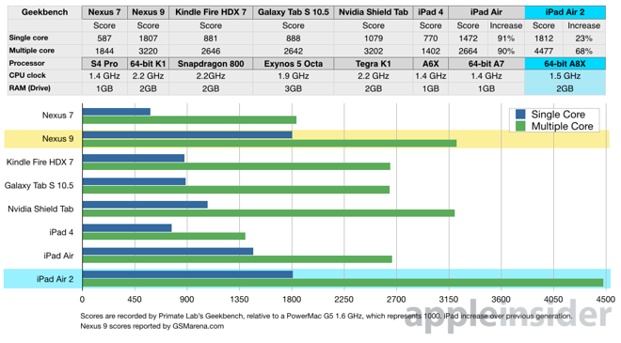
3.1 Low power operation (24)
The performance of Apple's Cyclone based tablets while running the
Geekbench 3.2 benchmark [49]
2013
2014
2 Cyclone
cores
K1
3 Typhoon
cores
A8X

Slide 73
3.1 Low power operation (25)
Evolution of the width of mobile microarchitectures -4
c) In 2016 Samsung introduced their Galaxy S7 tablet and Galaxy Note 7
smartphone that were based (partly) on the Exynos 8890 that included
four Exynos M1 (Mongoose) cores with a 4-wide microarchitecture
as well as four Cortex-A15 cores.

Slide 74
3.1 Low power operation (26)
Implications of the extremely high performance of Apple’s A8X-based
iPad Air 2 (including 3 Typhoon cores) [50]
Intel lost Apple as a perspective buyer of their chips for the iPad line,
and the iPad Air 2 also severely hit the perspective of their not so successful
Atom line.
NVIDIA’s Tegra 4 chips were not successful, so the firm announced in 05/2014
that they will abandon the phone market.
Apple’s iPad Air 2 with its A8X processor and its GPU with 256 EUs became a very
powerful rival to NVIDIA's subsequent 64-bit K1 chip including a GPU with
192 EUs.
As a consequence, NVIDIA also gave up their tablet interests.
*

Slide 75
3.1 Low power operation (27)
NVidia's leaving the smartphone and tablet market in June 2016 [81]
In 6/2016 (at Computex) NVIDIA's CEO declared the firm's leaving the smartphone
and tablet market by saying:
: “We are no longer interested in that market”. He adds, “Anybody can build
smartphones, and we’re happy to enjoy these devices, but we’ll let someone else
build them”.
Instead NVIDIA became interested in designing in-car computers and car
infotainment systems.
*

Slide 76
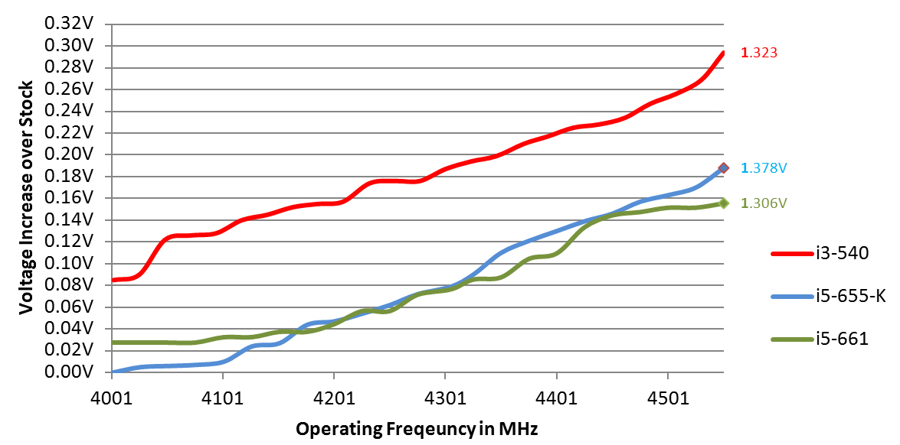
3.1 Low power operation (28)
3.1.3 Low clock frequency-1
Basics
Active power consumption = C_{dyn}∗V_{CC}² ∗ f_{c}
In addition: higher fc requires higher V_{CC} (V_{CC} ≈ const x f_{C}).
Figure: Core voltage (V_{CC}) vs. clock frequency (f_{C}) for Intel’s Westmere processors [26]

Slide 77
3.1 Low power operation (29)
Low clock frequency-2
It follows
Higher f_{C}
higher V_{CC}
higher D
D ≈ f_{C}³
Traditional CPUs
Mobile CPUs
Higher allowed power budget
Low power consumption
Relative high base clock frequency
(typically 2-4 GHz)
Relative low base clock frequency
(typically 1-2 GHz)
*

Slide 78
3.1 Low power operation (30)
Example: Base frequency of Skylake models with different TDPs and
configurations (Based on data from [58])
TDP (W) | No. of cores | Graphics | No. of graphics EUs | eDRAM | Base frequency up to (GHz)
4.5 | 2 | HD 515 | 18 | -- | 1.2
15 | 2 | HD 540 | 48 | 64 MB | 2.2
15 | 2 | HD 520 | 24 | -- | 2.6
28 | 2 | HD 550 | 48 | 64 MB | 3.3
35 | 4 | HD 530 | 24 | -- | 2.8
45 | 4 | HD 530 | 24 | -- | 2.9
65 | 4 | HD 530 | 24 | -- | 3.4
91 | 4 | -- | -- | -- | 4.2
Note that low TDP can be achieved first of all by reducing the core frequency and
limiting the computer resources (cores, GPU EUs) provided.
*

Slide 79
3.1 Low power operation (31)
Main features of Apple's A6 to A11 processors
HP: High Performance
EE: Energy Efficient
Name | Techn. | Cores | Launched | fc | Decode rate | Used in
A6 | 32 nm | 2x Swift | 0 9/2012 | 1.3 GHz | 3 | iPhone 5/5C
A6X | 32 nm | 2x Swift | 10/2012 | 1.4 GHz | 3 | iPad (4th gen.)
A7 | 28 nm | 2x Cyclon | 09/2013 | 1.3 GHz | 6 | iPhone 5S iPad Mini 2/3
A7 | 28 nm | 2x Cyclon | 10/2013 | 1.4 GHz | 6 | iPad Air
A8 | 20 nm | 2x Typhoon | 09/2014 | 1.1 - 1.5 GHz | 6 | iPhone 6/6 Plus iPad Mini 4
A8X | 20 nm | 3x Typhoon | 10/2014 | 1.5 GHz | 6 | iPad Air 2
A9 | 14 nm | 2x Twister (Samsung) | 09/2015 | 1.85 GHz | 6 | iPhone 6S/6S Plus iPhone SE iPad (2017)
A9 | 16 nm | 2x Twister (TSMC) | 09/2015 | 1.85 GHz | 6
A9X | 16 nm | 2x Twister | 11/2015 | 2.16 - 2.26 GHz | 6 | iPad Pro 12.9" iPad Pro 9.7"
A10 | 16 nm | 2x Hurricane (HP) 2x Zephyr (EE) | 09/2016 | 2.34 GHz | n.a. | iPhone 7/7 Plus iMac Pro (2017)
A10X | 10 nm | 3x Hurricane (HP) 3x Zephyr (EE) | 06/2017 | 2.36 GHz | n.a. | iPad Pro 10.5" iPad Pro 12.9"
A11 | 10 nm | 2x Monsoon (HP) 4x Mistral (EE) | 09/2017 | 2.40 GHz | n.a. | iPhone 8/8 Plus iPhone X

Slide 80
3.2 Connectivity
Notes:
80

Slide 81
3.2 Connectivity (1)
3.2 Connectivity
Connectivity may include (depending on the device type)
LAN connectivity
Wi-Fi connectivity (coined after Hi-Fi)
mobile broadband connectivity (recently 3G/4G).
Subsequently, we will focus only on the mobile broadband connectivity.

Slide 82
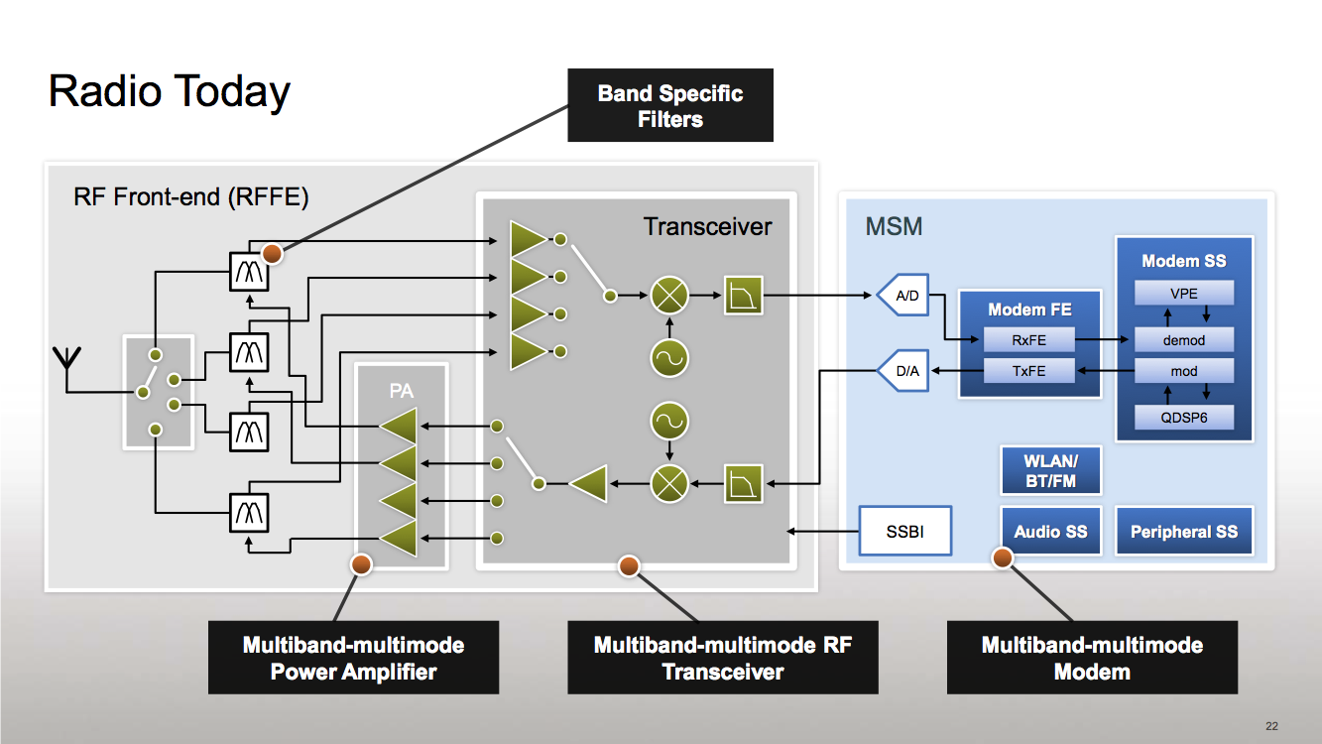
3.2 Connectivity (2)
Simplified view of a platform providing mobile broadband connectivity [59]
RF
Modem + Application Processor
(if integrated implementation)
Modem: Actually a baseband
processor that runs under a
proprietary real-time OS).
It has two functions:
LNA
Mixers
to performe modulation/
demodulation and
to manage the
communication
according to a protocol
(DSP)
PA: Power Amplifier LNA: Low Noise Amplifier Transceiver: Transmitter/Receiver
Multiband: multiple frequency bands, e.g. 900/1800 MHz
Multimode: 3G/ 4G (LTE)
*

Slide 83
3.2 Connectivity (3)
Integration of the application processor and the modem
Integrating the modem onto the application processor die results in less costs and
shorter time to market.
Qualcomm pioneered this move designing integrated parts already about 1996.
Integration of the application processor and the modem
Use of discrete
application processor and modem
Use of integrated
application processor and modem
Qualcomm’s MSM product offerings
since ~ 1996
including their Snapdragon families
MediaTek’s 81xx line (2013)
MediaTek’s 6xxx/8xxx families (since ~ 2009)
except the 81xx line
NVIDIA’s Tegra 2-4, K1 (since 2011)
NVIDIA’s Tegra 4i (2014)
Samsung’s Exynos 3/4/5/7 families
(since ~ 2010)
Samsung’s Exynos 8 Octa 8890
(2015)
E.g.
Intel’s Atom line (2008)
except recent Atom X3 (Sophia (2015)
Intel’s Atom X3 (Sophia) (2015)
Apple’s own processor designs
(Swift (2012), Cyclone (2013)
*

Slide 84
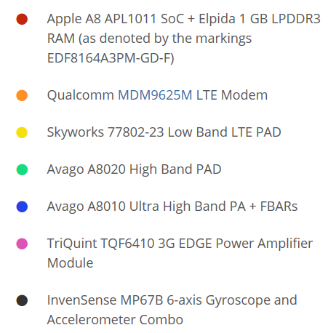
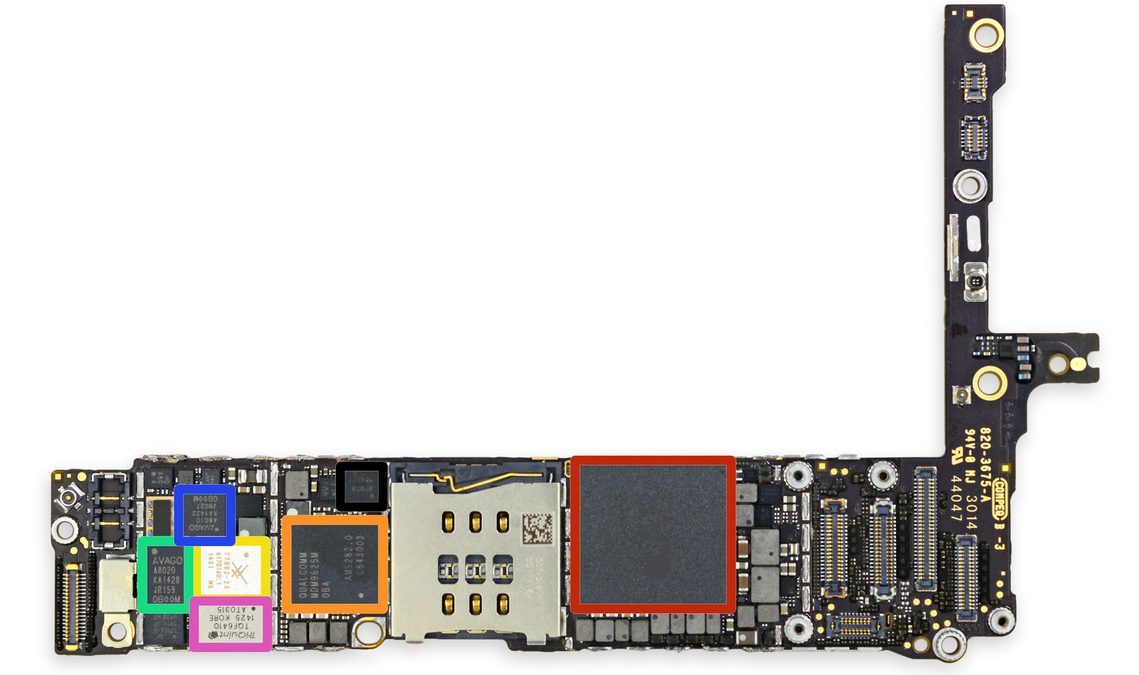
3.2 Connectivity (4)
Example of using discrete application processor and modem: The iPhone 6+
The front side of the
logic board [60]
PAD: Integrated Power Amplifier-Duplexer

Slide 85
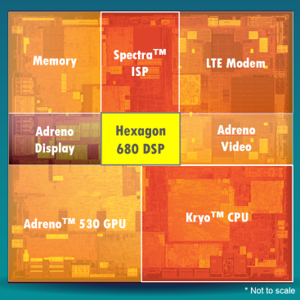
3.2 Connectivity (5)
Example of using an integrated application processor and a modem
(Qualcomm’s Snapdragon 820) [61]

Slide 86
3.2 Connectivity (6)
Worldwide market share of smartphone and tablet application processors
in 2015 (based on revenue) [34]
Smartphone application processors worldwide market share 2015 (revenue)
Qualcomm (USA) | 42 %
Apple (USA) | 21 %
MediaTek (Taiwan) | 19 %
Samsung (S. Korea)
Spreadtrum (China)
Tablet application processors worldwide market share 2015 (revenue)
Apple (USA) | 31 %
Qualcomm (USA) | 16 %
Intel (USA) | 14 %
MediaTek (Taiwan)
Samsung (S. Korea)
[Source: Related press releases of Strategy Analytics]
*

Slide 87
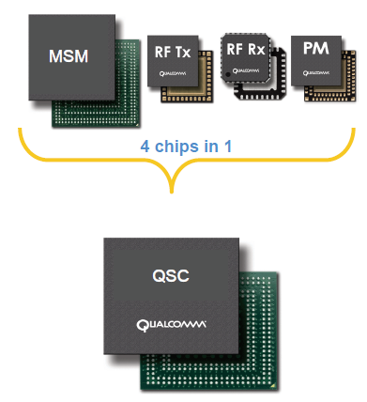
3.2 Connectivity (7)
Integrating the application processor, the modem, RF transmitter,
RF receiver and power manager IC onto a single chip
It became also feasible for less demanding applications, e.g. for feature phones.
Example: Qualcomm’s QSCs (Qualcomm Single Chips)
Qualcomm provides single chip solutions
for feature phones, termed as
QSCs (Qualcomm Single Chips).
QSCs integrate the functions of
MSMs
RF Transmitters (RF Tx)
RF Receivers (RF Rx) and
Power manager ICs (PM)
as illustrated on the Figure left [62].
Figure: Qualcomm’s integrated QSC [62]

Slide 88
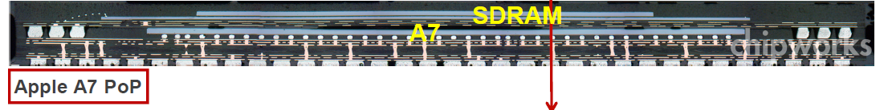
3.2 Connectivity (8)
Remark on using PoP (Package on Package) memories
In Apple's processors the processor die and the memory die or dies are mounted
in the same package already since the Apple A4 (2007).
E.g. In Apple’s A7 Package-on-Package processor, as used in the iPhone 5s.
1GB LPDDR3-1600 SDRAM
Figure: Apple’s A7 PoP [63]
*

Slide 89
4. How leading IT vendors addressed the mobile boom?
4.1 Intel’s and AMD’s response to the mobile boom
4.2 Microsoft’s response to the mobile boom
Notes:
89

Slide 90
4.1 Intel’s and AMD’s response to the mobile boom
Notes:
90

Slide 91
4.1 Intel’s and AMD’s response to the mobile boom (1)
4.1 Intel’s and AMD’s response to the mobile boom-1
Intel’s and AMD’s traditional CPUs are designed for high performance/power,
consequently they are wide and power hungry,
but mobile devices require low power consumption, so
Intel’s and AMD’s traditional microarchitectures are not suited for mobile devices.
*

Slide 92
4.1 Intel’s and AMD’s response to the mobile boom (2)
(1)
Total shipments of smartphones vs. PCs and tablets 2011-2017 [28]
Smartphone and tablet shipments
will vastly exceed PC shipments
(desktops and notebooks)
in a few years
Source: Gartner (2013)

Slide 93
4.1 Intel’s and AMD’s response to the mobile boom (3)
Intel’s and AMD’s response to the mobile boom-2
To avoid shrinking market shares on the global processor market
and benefit from the rapidly increasing mobile market
Intel and AMD need processors that are competitive with ARM based designs.
Intel and AMD were forced
to introduce novel narrow (i.e. 2-wide), low-power microarchitectures
for their CPUs and
clock them at a relative low rate.
*

Slide 94
4.1 Intel’s and AMD’s response to the mobile boom (4)
Evolution of Intel’s basic architectures [Based on 2]
4-wide
out-of-order
2008
2-wide
in-order
2-wide
in order
2-wide
out-of-order
2-wide
out-of-order

Slide 95
4.1 Intel’s and AMD’s response to the mobile boom (4)
Intel's market share achieved on the mobile market
In 2014 Intel achieved only less than 1 % share in revenue in smartphone
application processors [54].
By contrast, on the worldwide tablet market Intel achieved about 14 % market
share, albeit only due to paying subsidies for OEMs.
Nevertheless, owing to paying subsidies and due to low sales figures with mobile
products Intel lost about 7 billion $ in the years 2013-2014 [83] that lead to
Intel's withdrawal from the mobile market.
*

Slide 96
4.1 Intel’s and AMD’s response to the mobile boom (5)
Intel's withdrawal from the smartphone and mobil market
As Intel failed to gain traction in the mobile sector, in 4/2016 Intel announced
their withdrawal from the mobil market.
Intel's statement says [82]:
"I can confirm that the changes included canceling the Broxton platform as
well as SoFIA 3GX, SoFIA LTE and SoFIA LTE2 commercial platforms
to enable us to move resources to products that deliver higher returns and
advance our strategy.
These changes are effective immediately."
At the same time Intel laid off about 12000 employees (~ 11 % of their
workforce).
*

Slide 97

4.1 Intel’s and AMD’s response to the mobile boom (6)
Evolution of AMD’s basic architectures
4-wide
out-of-order
4/2014
2-wide
out-of-order
2-wide
out-of-order
2-wide
out-of-order
2014

Slide 98
4.1 Intel’s and AMD’s response to the mobile boom (7)
Cancellation of AMD's Cat line in 2015
Neither Intel nor AMD became successful on the mobile market, so beyond
Intel also AMD stopped their activities on this market.
The last core of AMD's Cat line was the Puma+ core (launched in 6/2015 in the
Carrizo-L APU).
In AMD's 2016 Mobility roadmap there is no sign of an APU powered by the
Puma+ core or a derivative of a core belonging to the Cat line, as seen in the
next Figure.
Instead AMD placed emphasis on Zen core based products.
*

Slide 99

4.1 Intel’s and AMD’s response to the mobile boom (8)
AMD's leaked mobility roadmap for 2015-2016 without indicating the
Puma core for 2016 [87]

Slide 100
4.1 Intel’s and AMD’s response to the mobile boom (9)
Use of AMD’s low power Jaguar architecture in game consoles
Most recent game consoles are based on AMD’s low power Jaguar architecture,
including
Nintendo Wii U (2012)
Sony Playstation 4 (2013)
Microsoft Xbox One (2013)
Ataribox (2017).
These consoles have a noticable global market share, as indicated in the next
Figure.
*

Slide 101

4.1 Intel’s and AMD’s response to the mobile boom (10)
Global unit sales of current generation video game consoles 2008-2014 [64]
(in million units)

Slide 102
4.2 Microsoft’s response to address the mobile boom
Notes:
102

Slide 103

4.2 Microsoft’s response to the mobile boom (1)
4.2 Microsoft’s response to address the mobile boom -1
Worldwide software revenues in 2013 [25]

Slide 104
4.2 Microsoft’s response to the mobile boom (2)
Microsoft's response to address the mobile boom -2
Microsoft's response to address the mobile boom
Widening the scope
of Windows to cover also touchscreen tablets
Introduction of
Windows based OSs
for smartphones
Vision to become
a devices and services
company
*

Slide 105
4.2 Microsoft’s response to the mobile boom (3)
a) Widening the scope of Windows to cover also touchscreen tablets
OS releases aiming at covering touch screen tablets as well:
2012 Windows 8 it aims to cover PCs, notebooks and also tablets
2013 Windows 8.1
2014 Windows 8.1 with Bing for low cost devices
2014 Windows 9 skipped
2014 Windows 10 Technical Preview
2015 Windows 10 general availability
Windows 8 was Microsoft’s first try to cover the whole spectrum of computers from
servers through desktops and notebooks till touchscreen tablets by a single OS.
Market reflections: Windows 8 earned moderate success, Android and iOS
dominated further on the market for smartphones and tablets.
Windows 8.1 is an upgrade for Windows 8.
In 5/2014 Microsoft announced Windows 8.1 with Bing.
It is the same as Windows 8, but is shipped with the Internet Explorer as
the default search engine.
It will be delivered for hardware manufacturers for free.
Windows 10 is released in 07/2015, it provides an updated Start menu.
To encourage its adoption Microsoft made it available free of charge during its
first year of availability to users with genuine copies of Windows 7/Windows 8.1.

Slide 106
4.2 Microsoft’s response to the mobile boom (4)
b) Introduction of Windows based OSs for smartphones
In 10/2010 Microsoft introduced a Windows based OS designed especially for
smartphones, called the Windows Phone 7.
(Here we note that Microsoft provided also previously OSs for embedded or
mobile devices (like Windows Mobile 2003), but these OSs were based on the
Windows CE, an OS for embedded devices, optimized for minimal memory).
Releases of Microsoft's Windows Phone family
Windows Phone 7
It earned moderate success.
Windows Phone 8
Windows Phone 8.1
Windows 10 Mobile
Windows 10 Mobile is designed to run both on ARM and x86-32
architectures.
Windows 10 Mobile was released for Lumia smartphones in 11/2015.
Despite Microsoft's efforts, Windows based phone OSs could not achieve notable
market share, as indicated in the next Figure.
Finally, in 10/2017 Intel cancelled Windows 10 Mobile.
*

Slide 107
4.2 Microsoft’s response to the mobile boom (5)
Global market share of leading smartphone OSs in terms of sales figures
to end users from Q1 2009 to Q3 2015 [42]

Slide 108
4.2 Microsoft’s response to the mobile boom (6)
c) Microsoft's vision to become a devices and services company
Ballmer (CEO of Microsoft in 9/2012):
“I think that in a back-looking view, people would say we were a software company.
That's kind of how we were born.
I think when you look forward, our core capability will be software, (but)
you'll probably think of us more as a devices-and-services company.” [22]
Microsoft's vision to become a devices-and-services company
Microsoft's activities to become a devices and services company
Taking part in
the game console market
Introduction of the
Surface line of tablets
Entering the
phone business
*

Slide 109

4.2 Microsoft’s response to the mobile boom (7)
ca) Microsoft's participation in the game console market []
Microsoft created a family of video game consoles, dubbed as Xbox.
Main models of the Xbox family
2001: The original Xbox
2005: Xbox 360
2013: Xbox One
Picture: The original Xbox console with the Controller
Source of the picture: https://en.wikipedia.org/wiki/Xbox
*

Slide 110
4.2 Microsoft’s response to the mobile boom (8)
cb) Introduction of the Surface family of tablets
Microsoft’s Surface family of tablets
Surface lines
Surface Pro lines
First Surface tablets are NVIDIA’s Tegra based
and run under Windows RT/Windows 8.1
Recent Surface tablets are Intel’s Atom based
and are running under Windows 8.1
Surface Pro tablets are Core 2 based
and run under Windows 8
or subsequent Windows versions
Less expensive models
High end models
*

Slide 111
4.2 Microsoft’s response to the mobile boom (9)
Overview of Microsoft’s Surface tablets -1
Main features of Microsoft’s Surface tablet line
Model | Intro | Processor | Word length | Core nr. | OS
Surface | 10/2012 | Tegra 3 | 32-bit | 4 | Windows RT
Surface 2 | 10/2013 | Tegra 4 | 32-bit | 5 | Windows RT
Surface 3 | 05/2015 | Atom X7-Z8700 Airmont core | 64-bit | 4 | Windows 8.1
Table: Microsoft’s ARM/Intel Atom-based Surface RT /Surface 2 tablets
Note that NVidia's Tegra processors and Windows RT are 32-bit ARMv7 based.
The exclusivity of Windows RT drastically limits app availability, and is one of the main reasons why sales of Surface tablets remained lower than expected [21].
In 2015 Microsoft dropped production of devices based on Windows RT.

Slide 112
4.2 Microsoft’s response to the mobile boom (10)
Overview of Microsoft’s Surface tablets -2
Main features of Microsoft’s Surface Pro tablet line
Model | Intro | Processor | Word length | Core nr. | OS
Surface Pro | 02/2013 | Ivy Bridge i5 | 64-bit | 2 | Windows 8 Pro
Surface Pro 2 | 10/2013 | Haswell i5 | 64-bit | 2 | Windows 8.1 Pro
Surface Pro 3 | 06/2014 | Haswell i3/i5/i7 | 64-bit | 2 | Windows 8.1 Pro
Surface Pro 4 | 10/2015 | Skylake-U i5 | 64-bit | 2 | Windows 10 Pro
Surface Pro 2017 | 06/2017 | Kaby Lake m3 | 64-bit | 2 | Windows 10 Pro
Table: Microsoft’s Intel Core 2-based Surface Pro tablets

Slide 113
4.2 Microsoft’s response to the mobile boom (11)
Example: Windows Surface Pro 3 (8/2014)
2 in 1 tablet 12”
Aim: Replacing laptops
Intel’s Surface Pro 3
used as a laptop [22]
Intel’s Surface Pro 3
used as a tablet [23]

Slide 114

4.2 Microsoft’s response to the mobile boom (12)
Further Surface products [84]

Slide 115

4.2 Microsoft’s response to the mobile boom (13)
Early financial performance of Microsoft’s Surface business [24]

Slide 116
4.2 Microsoft’s response to the mobile boom (14)
cc) Microsoft's move to enter the phone business
9/2013: Microsoft announces their plan to acquire the phone business of Nokia,
including the Lumia brand.
4/2014: Microsoft finalyses the acqisition by paying about 7 billion USD to Nokia,
and taking over about 25000 Nokia employees.
11/2014: Microsoft rebranded the Nokia Lumia line to Microsoft Lumia line.
*

Slide 117

4.2 Microsoft’s response to the mobile boom (15)
The first Microsoft branded Lumia phone (the Lumia 535 from 11/2014) [85]

Slide 118

4.2 Microsoft’s response to the mobile boom (16)
The outcome of Microsoft's Nokia deal -1
Microsoft's acquisition of Nokia's phone business did not seriously boost the sale
figures of Windows phone based Lumia devices, as indicated in the Figure below.
Microsoft ackquires
Nokia's phone buiness
Rebranding the Nokia Lumia line
to Microsoft Lumia line
378
1 % of worldwide
smartphone sales
Figure: Quarterly sale figures of Lumia devices (million units) [85]
(Nokia introduced the Lumia brand for a series of smartphones running Windows phone)
On the contrary, in about two years sale figures desreased below 1 % of the total
world sales of smartphones, as indicated in the Figure.

Slide 119
4.2 Microsoft’s response to the mobile boom (17)
The outcome of Microsoft's Nokia deal -2
Consequences of deminishing sales figures of Windows based Lumia phones
In 7/2015 Microsoft restructured Microsoft Mobile and laid off 7200 employees.
In 5/2016 Microsoft made the decision to sell their feature phone business
to Foxconn (Taiwan), for 350 million USD.
As a consequence, 4500 Microsoft employes were moved to Foxconn.
At the same time Microsoft confirmed that it will continue to develop
Windows 10 Mobile, and support existing Lumia phones and ones built
by third-party phone makers [86].
However, at this announcement Microsoft did not give any hint about the
continuation of developing Lumia phones.
*

Slide 120
4.2 Microsoft’s response to the mobile boom (18)
Remarks on the decline of Nokia's phone business
About the same time when Google's Android surpassed the sales figures Nokia's
previously leading Symbian mobile OS, in 2/2011, Nokia set up a business
partnership with Microsoft and adopted Windows Phone as its primary platform
for future smartphones.
Nokia's next smartphones, dubbed as the Lumia line, run under Windows Phone 7.
The new line gained only moderate success.
Subsequently, in 9/2013 Microsoft and Nokia agreed that Microsoft will acquire
the phone business of Nokia, including related patents and the Lumia brand.
In 4/2014 the acquisiton becam finalized, Microsoft paid about 7 billion USD
to Nokia and took over about 25000 Nokia employees.

Slide 121
5. Conclusions
Notes:
121

Slide 122
5. Conclusions (1)
5. Conclusions -1
Informatics came into a transitional phase
new paradigms
new devices
new players
*

Slide 123
5. Conclusions (2)
Conclusions- 2
Established companies have to respond early, quick and in an appropriate way
to the new challenges, else…
8/2010 Intel acquires Infineon’s (former Siemens) Wireless Solutions business
8/2011 Google acquires Motorola Mobility
9/2013 Microsoft purchases Nokia’s phone business
9/2013 BlackBerry lays off 4500 employees (~ 40% of their workforce)
6/2014 Broadcom decides to exit the baseband business
~ 2016 AMD leaves the mobile market
4/2016 Intel leaves the mobile market
5/2016 NVIDIA states that they will moving out from the smartphone market

Slide 124
5. Conclusions (3)
Conclusions -3
Even the largest IT firms have a hard time to cope with as indicated by
resignation of AMD’s, Intel’s and Microsoft’s CEOs (Chief Execution Officers):
1/2011 AMD: Dirk Meyer
11/2012 Intel: Paul Otellini
8/2013 Microsoft: Steve Ballmer
But it is also an opportunity and challenge for individuals and institutions
to catch up with the progress and make benefit of it.
*

Slide 125
6. References
Notes:
125

Slide 126
6. References (1)
6. References
[1]: Bártfai D., Merre felé tartanak a hardverek?, Aug. 22-24 2007
[2]: Smith S.L., Intel Strategy & Technology Update, Barclays Capital Global Technology Conf.,
Dec. 2011, http://files.shareholder.com/downloads/INTC/1576180143x0x526852/c9868a3a-
494e-4506-bcc6-a631aca1fd75/Steve%20Smith%20Barclays%20Dec%202011.pdf
[3]: AMD 2013 Mobility APU Introduction, May 22 2013,
http://www.slideshare.net/AMD/amd-2013-mobility-apu-introduction-deck-final-for-lp
[4]: Frommer D., CHART OF THE DAY: Smartphone Sales To Beat PC Sales By 2011,
Business Insider, Aug. 21 2009, http://www.businessinsider.com/chart-of-the-day-
smartphone-sales-to-beat-pc-sales-by-2011-2009-8
[5]: Wikipedia, BlackBerry Pearl, http://en.wikipedia.org/wiki/BlackBerry_Pearl
[6]: Wikipedia, Android (operating system),
http://en.wikipedia.org/wiki/Android_%28operating_system%29
[7]: Ciufo C.A., Tizen OS for Smartphones – Intel’s Biggest Bet Yet, Jan. 4 2013,
http://eecatalog.com/caciufo/2013/01/04/samsung-hedges-apple-google-bets-with-intels-
html5-based-tizen/
[8]: Introduction of the Next Generation Intel Atom Processor, Oak Trail Z670, 4/2011,
http://newsroom.intel.com/docs/DOC-1976
[9]: Apple Maintains 48 Percent Share of Global Branded Tablet Shipments in Q1 2013,
Strategy Analytics, April 25 2013, Boston,
http://www.strategyanalytics.com/default.aspx?mod=pressreleaseviewer&a0=5351

Slide 127
6. References (2)
[10]: Goto H., ARM Cortex – A Family Architecture, 2010,
http://pc.watch.impress.co.jp/video/pcw/docs/423/409/p1.pdf
[11]: Eul H., Bell M., Mobile at Intel, Investor Meeting 2012,
http://www.cnx-software.com/pdf/Intel_2012/2012_Intel_Investor_Meeting_Eul_Bell.pdf
[12]: Wikipedia, iPad, http://en.wikipedia.org/wiki/IPad
[13]: Tablet Platforms with Next Generation Intel Atom Processor and Microsoft Windows 8,
IDF 2012
[14]: The $15.3 Billion Server Market – Surprisingly Buoyant In Q1 2012, IT Candor, July 3 2012,
http://www.itcandor.com/server-q112/
[15]: Shah A., Intel Loses Laptop Chip Market Share to AMD in Q3, PC World, Nov. 3 2011,
http://www.pcworld.com/article/243114/intel_loses_laptop_chip_market_share_to_amd_
in_q3.html
[16]: Perry D., AMD Steals Market Share From Intel, Tom’s Hardware, March 16 2012,
http://www.tomshardware.com/news/amd-intel-cpu-processor,15041.html
[17]: Shilov A., AMD Shows Off Opteron "Interlagos" Again: No Performance Benchmarks,
No Design Wins, No Launch Date Announced, Xbit Labs, Aug. 3 2011,
http://www.xbitlabs.com/news/cpu/display/20110803103016_AMD_Shows_Off_Opteron_
Interlagos_Again_No_Performance_Benchmarks_No_Design_Wins_No_Launch_Date_
Announced.html
[18]: Arthur C., PC business still waning as Microsoft's Windows 8 fails to lift it, 11 July 2013,
http://www.theguardian.com/technology/2013/jul/11/pc-business-microsoft-windows-8

Slide 128
6. References (3)
[19]: Golson J., Steve Jobs Envisioned the iPad in 1983, MacRumors, Oct. 2, 2012,
http://www.macrumors.com/2012/10/02/steve-jobs-envisioned-the-ipad-in-1983/
[20]: Yarow J., Steve Ballmer's Biggest Mistakes As CEO Of Microsoft, Business Insider, Aug. 27
2013,
http://www.businessinsider.com/steve-ballmers-most-epic-mistakes-as-ceo-of-microsoft-
2013-8?op=1
[21]: Arora, P., Microsoft Is Not Killing The Surface RT Lineup? Seeking Alpha, Aug. 25 2014,
http://www.macrumors.com/2012/10/02/steve-jobs-envisioned-the-ipad-in-1983/
[22]: Surface Pro 3 Fact sheet May 2014, Microsoft,
http://www.microsoft.com/global/eu/PublishingImages/Surfacepro3texhspecs.pdf
[23]: Microsoft Surface Pro, NDTV Gadget, May 2014,
http://gadgets.ndtv.com/microsoft-surface-pro-3-1611
[24]: Guenette S., Nearly $2 Billion In The Hole, Microsoft Continues To Dive Deeper Into Tablets,
Seeking Alpha, Aug. 8, 2014,
http://seekingalpha.com/article/2402725-nearly-2-billion-in-the-hole-microsoft-continues
-to-dive-deeper-into-tablets
[25]: Deskovich V., Microsoft: A Monopoly No More? Seeking Alpha, Jul. 11, 2014
http://seekingalpha.com/article/2309835-microsoft-a-monopoly-no-more
[26]: Gill R., Intel’s Core i5-655K & Core i7-875K: Overclocked and Analyzed, AnandTech,
May 28 2010, http://www.anandtech.com/show/3742/intels-core-i5655k-core-i7875k-
overclocked-and-analysed-/2
[27]: Shimpi A. L., AMD Beema/Mullins Architecture & Performance Preview, AnandTech,
April 29, 2014, http://www.anandtech.com/show/7974/amd-beema-mullins-architecture-
a10-micro-6700t-performance-preview

Slide 129
6. References (4)
[28]: Wilson S., & Wigginton C., Making open innovation work in mobile - Insights from the
semiconductor industry, Deloitte University Press, July 24v2013,
http://dupress.com/articles/making-open-innovation-work-in-mobile/
[30]: Arora P., Wait, Microsoft Is Not Killing The Surface RT Lineup? Seeking Alpha, Aug. 25, 2014,
http://seekingalpha.com/article/2447735-wait-microsoft-is-not-killing-the-surface-rt-lineup
[31]: Hodgins K., Apple Maintains Narrowing Lead in Tablet Market Share, MacRumors, May 1,
http://www.macrumors.com/2014/05/01/apple-tablet-market-share-1q14
[32]: Arora P., Wait, Microsoft Is Not Killing The Surface RT Lineup? Seeking Alpha, Aug. 25, 2014,
http://seekingalpha.com/article/2447735-wait-microsoft-is-not-killing-the-surface-rt-lineup
[33]: Eul H., & Bell M., Mobile at Intel, Investor Meeting 2012, Intel,
http://www.cnx-software.com/pdf/Intel_2012/2012_Intel_Investor_Meeting_Eul_Bell.pdf
[34]: Qualcomm dominates smartphone chip and baseband, tablet processor markets, Mobile
Europe, February 17 2014
http://www.mobileeurope.co.uk/Press-Wire/qualcomm-dominates-smartphone-chip-and
-baseband-tablet-processor-markets
[35]: Gartner Says Worldwide Tablet Sales Grew 68 Percent in 2013, With Android Capturing 62
Percent of the Market, Gartner, Newsroom, March 3, 2014,
http://www.gartner.com/newsroom/id/2674215
[36]: Trefis Team, Why Intel Can Gain Additional Share In The Mobile Market, Forbes, 5/09/2014
http://www.forbes.com/sites/greatspeculations/2014/05/09/why-intel-can-gain-additional-
share-in-the-mobile-market

Slide 130
6. References (5)
[37]: Meeker M., Devitt S., Vu L., Internet Trends, CM Summit, Morgan Stanley, New York,
June 7, 2010, http://demo.tizra.com/Morgan-Stanley-Internet-Trends-June-7-2010/3
[38]: Hardy E., BlackBerry Pearl 8100 Review, Brighthand, November 15 2006,
http://www.brighthand.com/phonereview/blackberry-pearl-8100-review/
[39]: Nokia 7650, Wikipedia, http://en.wikipedia.org/wiki/Nokia_7650
[40]: Bokil-Paranjape S., Worldwide smartphone sales hit 267 million in Q1 2014: Trend Force,
Phonearena, April 18 2014, http://www.fonearena.com/blog/101450/worldwide-
smartphone-sales-hit-267-million-in-q1-2014-trend-force.html
[41]: Grifiths H., How the ubiquity of today’s smartphones make an ideal platform for delivering
campus-based services, Ombiel, 2010,
http://www.rms-inc.com/files/datasheets/Ombiel_Whitepaper.pdf
[42]: Richter F., Android To Retain Big Lead In Maturing Smartphone Market, Statista, March 4
2014, http://www.statista.com/chart/1961/smartphone-market-share-2014
[43]: Smartphone Apps Processor Revenue Reached $4.7 Billion in Q1 2014 says Strategy
Analytics, Strategy Analytics, July 14 2014,
http://www.strategyanalytics.com/default.aspx?mod=pressreleaseviewer&a0=5543
[44]: Klug B. & Shimpi A. L., Qualcomm's New Snapdragon S4: MSM8960 & Krait Architecture
Explored, AnandTech, Oct. 7 2011, http://www.anandtech.com/show/4940/qualcomm-
new-snapdragon-s4-msm8960-krait-architecture
[45]: Lomas N., Report: Intel Gained Just 0.2% Of Smartphone Chip Market In 1H As Qualcomm
Milked LTE Lead, Tech Crunch, Oct. 5 2012, http://techcrunch.com/2012/10/05/report-
intel-gained-just-0-2-of-smartphone-chip-market-in-1h-as-qualcomm-milked-lte-lead

Slide 131
6. References (6)
[46]: Klug B., Intel XMM7160 LTE Modem Demonstrated on Live Network, AnandTech, Sept. 11
2013, http://www.anandtech.com/show/7321/intel-xmm7160-lte-modem-demonstrated-
on-live-network
[47]: Bocha, Apple iPhone megateszt, Mobilarena, 2007-07-23,
http://mobilarena.hu/teszt/apple_iphone_megateszt_a_bunbeeses_almaja/bevezeto.html
[48]: Shimpi A.L., Apple's Cyclone Microarchitecture Detailed, AnandTech, March 31 2014,
http://www.anandtech.com/show/7910/apples-cyclone-microarchitecture-detailed
[49]: Dilger D.E., Apple's new A8X powered iPad Air 2 smokes new Android tablets, including
Nvidia's Tegra K1 Shield Tablet [u], Apple Insider, Oct. 21 2014,
http://appleinsider.com/articles/14/10/21/apples-new-a8x-powered-ipad-air-2-smokes-
new-android-tablets-including-nvidias-tegra-k1
[50]: Dilger D.E., Apple Inc. A8X iPad chip causing big problems for Intel, Qualcomm, Samsung
and Nvidia, Apple Insider, Nov. 14 2014,
http://appleinsider.com/articles/14/11/15/apple-inc-a8x-ipad-chip-causing-big-problems-
for-intel-qualcomm-samsung-and-nvidia
[51]: De Gelas J., The Intel Xeon E7-8800 v3 Review: The POWER8 Killer?, AnandTech,
May 8, 2015, http://www.anandtech.com/show/9193/the-xeon-e78800-v3-review
[52]: Global PC shipments from 1st quarter 2009 to 2nd quarter 2015, by vendor (in million units),
Statista, http://www.statista.com/statistics/263393/global-pc-shipments-since-1st-
quarter-2009-by-vendor/

Slide 132
6. References (7)
[53]: Gartner Says Worldwide Smartphone Sales Recorded Slowest Growth Rate Since 2013,
Gartner, Newsroom, Aug. 20 2015, http://www.gartner.com/newsroom/id/3115517
[54]: Leswing K., Asus Zenfone 2 Preview: Intel's Best Chance In Years To Break Into
Smartphones, International Business Time, May 19 2015,
http://www.ibtimes.com/asus-zenfone-2-preview-intels-best-chance-years-break-
smartphones-1929726
[55]: Richter F., Tablets to Outsell PCs Worldwide by 2015, Statista, Febr. 28 2014,
http://www.statista.com/chart/1138/tablet-and-pc-shipment-forecast/
[56]: Dilger D. E., After losing Apple's iPad business, Intel has bled $7 billion while heavily
subsidizing cheap x86 Atom Android tablets, Appleinsider, November 16, 2014,
http://appleinsider.com/articles/14/11/16/after-losing-apples-ipad-business-intel-has-
bled-7-billion-while-heavily-subsidizing-cheap-x86-atom-android-tablets
[57]: Smartphone and tablet processor market share in 2014, May 7 2015
http://mobilesemi.blogspot.hu/2015/05/smartphone-and-tablet-processor-market.html
[58]: Cutress I., The Intel Skylake Mobile and Desktop Launch, with Architecture Analysis,
AnandTech, Sept. 1 2015, http://www.anandtech.com/show/9582/intel-skylake-mobile-
desktop-launch-architecture-analysis
[59]: Klug B., The State of Qualcomm's Modems - WTR1605 and MDM9x25, AnandTech,
Jan. 4 2013, http://www.anandtech.com/print/6541/the-state-of-qualcomms-modems-
wtr1605-and-mdm9x25
[60]: iPhone 6 Plus Teardown, iFixit,
https://www.ifixit.com/Teardown/iPhone+6+Plus+Teardown/29206

Slide 133
6. References (8)
[61]: Ho J., Qualcomm Details Hexagon 680 DSP in Snapdragon 820: Accelerated Imaging,
AnandTech, August 24, 2015, http://www.anandtech.com/print/9552/qualcomm-details-
hexagon-680-dsp-in-snapdragon-820-accelerated-imaging
[62]: QSC6055/QSC6065/QSC6075/QSC6085 Hardware Training, Introductions and Device
Overview, 80-VC881-21 Rev. A, April 2007,
http://www.droid-developers.org/images/3/3c/Qsc6085-overview.pdf
[63]: James D., Inside Today’s Systems & Chips: A Survey of the Past Year, Chipworks, 2013,
http://theconfab.com/wp-content/uploads/2014/dick_james_confab14.pdf
[64]: Global unit sales of current generation video game consoles from 2008 to 2014 (in million
units), Statista, http://www.statista.com/statistics/276768/global-unit-sales-of-video-
game-consoles/
[65]: CPU Benchmarks, Passmark Software, 10th june 2016,
http://www.cpubenchmark.net/market_share.html
[66]: Anchorite, AMD Is A Threat To Intel's X86 Market Share, Not Vice Versa, Seeking Alpha,
Jun. 10, 2016 ,
http://seekingalpha.com/article/3981352-amd-threat-intels-x86-market-share-vice-versa?
auth_param=djq9a:1blm8ut:579a4c85ebfd66607461f023a383c45c
[67]: Gartner Says Five of Top 10 Worldwide Mobile Phone Vendors Increased Sales in
Second Quarter of 2016, Gartner, Aug. 19, 2016,
http://www.gartner.com/newsroom/id/3415117
[68]: Jan C.-H., RF CMOS Technology Scaling in High-k/Metal Gate Era for RF SoC (System-on-
Chip) Applications, IEDM ’10, San Francisco 2010,
http://www.intel.com.br/content/dam/doc/technology-brief/32nm-soc-with-rf-cmos-
technology-presentation.pdf

Slide 134
6. References (9)
[69]: Smartphone Vendor Market Share, 2017 Q1, IDC ,
https://www.idc.com/promo/smartphone-market-share/vendor
[70]: Smartphone OS Market Share, 2017 Q1, IDC,
https://www.idc.com/promo/smartphone-market-share/os
[71]: Apple Tied with MediaTek for the #2 Spot in the Global Smartphone Applications Processor
Market, Patently Apple, 2107,
http://www.patentlyapple.com/patently-apple/2017/10/apple-tied-with-mediatek-for-the-
2-spot-in-the-global-smartphone-applications-processor-market.html
[72]: Kay A. C., (Xerox Palo Alto Research Center) A Personal Computer for Children of All Ages,
Proceedings of the ACM National Conference, Boston Aug. 1972 Vol. 1 Article No. 1.
[73]: Gruener W., Did Steve Jobs Steal The iPad? Genius Inventor Alan Kay Reveals All, Tom's
Hardware, April 17, 2010,
http://www.tomshardware.com/news/alan-kay-steve-jobs-ipad-iphone,10209.html
[74]: Triggs R., Intel is losing billions on mobile development, Android Authority, April 16, 2014,
https://www.androidauthority.com/intel-losing-billions-on-mobile-369148/
[75]: Shipment forecast of laptops, desktop PCs and tablets worldwide from 2010 to 2021
(in million units), Statista,
https://www.statista.com/statistics/272595/global-shipments-forecast-for-tablets-laptops
-and-desktop-pcs/
[76]: Worldwide Tablet Shipments Decline More Than 12% in Second Quarter as the Market
Shifts Its Focus Toward Productivity, IDC, 01 Aug 2016,
https://www.idc.com/getdoc.jsp?containerId=prUS41632416

Slide 135
6. References (10)
[77]: Dilger D. E.: IDC offers a rosy forecast for Microsoft Surface, reminiscent of its 2012
Windows Phone outlook, Appleinsider, Dec. 02, 2015,
http://appleinsider.com/articles/15/12/02/idc-offers-a-rosy-forecast-for-microsoft-surface-
reminiscent-of-its-2012-windows-phone-outlook
[78]: Jourdan S., Broadwell Microarchitecture Disclosures, Intel, Aug. 11, 2014,
http://download.intel.com/newsroom/kits/14nm/pdfs/Intel_14nm_New_uArch.pdf
[79]: iPad Air 2 Teardown, iFixit,
https://www.ifixit.com/Teardown/iPad+Air+2+Teardown/30592
[80]: Shimpi A. L., The ARM vs x86 Wars have Begun: In-Depth Power Analysis of Atom,
Krait C Cortex A15, AnandTech, Jan. 4, 2013,
https://www.anandtech.com/show/6536/arm-vs-x86-the-real-showdown
[81]: Nguyen H., NVIDIA Definitely “Not Interested” In Building Smartphones SoCs, Ubrergizmo,
06/04/2016,
http://www.ubergizmo.com/2016/06/nvidia-not-interested-smartphones-soc/
[82]: Smith R. and Cutress I., Intel's Changing Future: Smartphone SoCs Broxton & Sophia
Officially Cancelled, AnandTech, April 29, 2016,
https://www.anandtech.com/show/10288/intel-broxton-sofia-smartphone-socs-cancelled
[83]: Hruska J., How Intel lost the mobile market, part 2: the rise and neglect of Atom,
Extreme Tech, May 4, 2016,
https://www.extremetech.com/computing/227816-how-intel-lost-the-mobile-market-part-
2-the-rise-and-neglect-of-atom
[84]: Surface Pro (2017),
https://en.wikipedia.org/wiki/Surface_Pro_(2017)

Slide 136
6. References (11)
[85]: Microsoft Lumia,
https://en.wikipedia.org/wiki/Microsoft_Lumia
[86]: Warren T., Microsoft just hinted it's the end of Lumia phones, The Verge, Mai 18, 2016,
https://www.theverge.com/2016/5/18/11699766/microsoft-lumia-phone-brand
[87]: Tyson M., Leaked slides show AMD desktop and mobility roadmaps for 2016, Hexus,
April 30, 2015,
http://hexus.net/tech/news/cpu/82813-leaked-slides-show-amd-desktop-mobility-
roadmaps-2016/
[88]: Tablet operating systems' market share worldwide from 2013 to 2020, Statista, 2017,
https://www.statista.com/statistics/272446/global-market-share-held-by-tablet-operating-
systems/
[89]: Number of smartphones sold to end users worldwide from 2007 to 2016 (in million units),
Statista, 2017
https://www.statista.com/statistics/263437/global-smartphone-sales-to-end-users-since-
2007/
[90]: Kahn O., Valentine B.: Intel Next Generation Microarchitecture Codename Sandy Bridge:
New Processor Innovations, IDF 2010

