Slide 1
Intel’s Core 2 family - TOCK lines
The Skylake line
Dezső Sima
Vers. 3.1
October 2018

Slide 2
Contents
1. Introduction
2. The Core 2 line
3. The Nehalem line
4. The Sandy Bridge line
5. The Haswell line
6. The Skylake line
7. The Kaby Lake line
8. The Kaby Lake Refresh line
9. The Coffee Lake line
10. The Cannon Lake line (outlook)

Slide 3
6. The Skylake line
6.1 Introduction
6.2 Major enhancements of the Skylake line vs.
the Broadwell line
6.3 Major innovations of the Skylake line
6.4 Skylake based processor lines
Only Sections 6.1 to 6.3 will be discussed.
Notes:
3

Slide 4
6.1 Introduction
Notes:
4

Slide 5
6.1 Introduction (1)
5.1 Introduction (1)
6.1 Introduction
The Skylake line is built on 14 nm technology.
Announced: 08/2015
Available: 10/2015
Skylake processors are termed also as the 6. gen. Intel Core processors, as indicated below.
1. gen.
2. gen.
3. gen.
4. gen.
5. gen.
6. gen.
Core 2
New
Microarch.
65 nm
Penryn
New
Process
45 nm
Nehalem
New
Microarch.
45 nm
West-
mere
New
Process
32 nm
Sandy Bridge
New
Microarch.
32 nm
Ivy Bridge
New
Process
22 nm
Haswell
New
Microarchi.
22 nm
Broad-
well
New
Process
14 nm
Skylake
New
Microarchi.
14 nm
TOCK
TICK
TOCK
TICK
TOCK
TICK
TOCK
TICK
TOCK
Figure : Intel’s Tick-Tock development model (Based on [1])
*

Slide 6
6.1 Introduction (2)
The Skylake line -1
Key new features of the ISP
and the microarchitecture
2 YEARS
TICK Pentium 4 ( Cedar Mill)
Pentium D (Presler)
01/2006
2 YEARS
65nm
New microarch.: 4-wide core,
128-bit SIMD FX/FP EUs,
shared L2 , no HT
TOCK Core 2
07/2006
TICK Penryn Family
11/2007
2 YEARS
45nm
New microarch.: 4 cores, integr. MC,
QPI, private L2, (inclusive) L3, HT
TOCK Nehalem
11/2008
TICK Westmere
01/2010
In package integrated GPU
2 YEARS
32nm
New microarch.: 256-bit (FP) AVX,
ring bus, integrated GPU
TOCK Sandy Bridge
01/2011
TICK Ivy Bridge
04/2012
2 YEARS
22nm
New microarch.: 256-bit (FX) AVX2,
L4 cache (discrete eDRAM), TSX
TOCK Haswell
06/2013
TICK Broadwell
09/2014
Shared Virtual Memory
4 YEARS
TOCK Skylake
10/2015
New microarch.: 5-wide core,
ISP, Memory Side L4 cache, no FIVR
14nm
TOCK Kaby Lake
08/2016
Optane memory, in KBL G series:
in package integr. CPU, GPU, HBM2
TOCK Coffee Lake
10/2017
(USB Gen. 2, integr. conn., Optane 2)
TICK Cannonlake
05/2018
AVX512
?? YEARS
10nm
TOCK Icelake
??/2019
Figure is based on [3])
*

Slide 7
6.1 Introduction (2b)
The Skylake line -2
Key new features
in power management
2 YEARS
TICK Pentium 4 ( Cedar Mill)
Pentium D (Presler)
01/2006
2 YEARS
65nm
Clock gating, PECI,
Platform Thermal Control by
3. party controller
TOCK Core 2
07/2006
2 YEARS
TICK Penryn Family
11/2007
EDAT
45nm
Integrated Power Gates, PCU,
Turbo Boost
TOCK Nehalem
11/2008
TICK Westmere
01/2010
2 YEARS
32nm
TOCK Sandy Bridge
01/2011
Turbo Boost 2.0
2 YEARS
TICK Ivy Bridge
04/2012
22nm
FIVR
TOCK Haswell
06/2013
TICK Broadwell
09/2014
2. gen. FIVR
Speed Shift Technology,
Duty Cycle control,
No FIVR (except Skylake X)
4 YEARS
TOCK Skylake
10/2015
14nm
TOCK Kaby Lake
08/2016
Speed Shift Technology v2
TOCK Coffee Lake
10/2017
In H-series: TVB
(Thermal Velocity Boost)
TICK Cannonlake
05/2018
10nm
TOCK Icelake
??/2019
Figure is based on [3])
*

Slide 8
6.1 Introduction (3)
Performance improvements provided by Skylake
According to sources quoting Intel’s statements [206] on average, Skylake has 10% better
performance, 30% better graphics performance.
*

Slide 9
6.1 Introduction (4)
Single thread IPC in Intel’s basic architectures (Based on [195])
2
24%
22%
Per Generation
1.9
20%
Cumulative
1.8
18%
1.7
16%
1.6
14%
12%
1.5
10%
1.4
8%
1.3
6%
1.2
4%
2%
1.1
0%
1
Pentium M Dothan
Core 2
Penryn
NHM (w/o SMT)
WSM
SNB
IVB
HSW
BRW
SKL
Note that Intel raised IPC in the Core family only less then 2-times in about 10 years.
*

Slide 10
6.1 Introduction (5)
Skylake-based processor lines
The Skylake family
Skylake Mobiles
(SOCs)
BGA1515/1356/1440)
Skylake Desktops
(2-chip designs)
LGA1151
100 series PCH
Skylake-E
(2-chip designs)
LGA2066
X299 PCH
Skylake Microservers
(SOCs/2-chip designs)
BGA1440
LGA1151/C230 PCH
Skylake-SP
(2S servers)
(2-chip designs)
LGA3647
C620 series PCH
Up to 4 cores + G
m3/m5/m7 designartions
i3/i5/i7 designations
Up to 4 cores + G
i3/i5/i7 designations
Up to 10 cores
i7 designation
4 cores w/without G
E3 designation
Up to 28 cores
Platinum/Gold/Silver/Bronze
designations
(See on a
subsequent slide)
(See on a
subsequent slide)
(See on a
subsequent slide)
(See on a
subsequent slide)
(Won't be
detailed here)
Notes:
ridge-ex

Slide 11
6.1 Introduction (6)
1. Introduction (2)
The Skylake (6th Gen) mobile and desktop lines - Overview
Mobiles (SoC designs)
4.5 W Core M-line (Y-line) (BGA1515)
Core m7-6Y7x, 2C+HD 515, HT, 10/2015
Core m5-6Y5x, 2C+HD 515, HT, 10/2015
Core m3-6Y3x, 2C+HD 515, HT, 10/2015
15 W U-line (SoC, BGA1356)
Core i7-66x0U/65x0U, 2C+HD 515, HT, 10/2015
Core i5-63x0U/62x0U, 2C+HD 515, HT, 10/2015
Core i3-6100U, 2C+HD 515, HT, 10/2015
28 W U-line (SoC, BGA1356)
Core i7-65x7U, 2C+HD 550, HT, 10/2015
Core i5-62x7U, 2C+HD 550, HT, 10/2015
Core i3-61x7U, 2C+HD 550, HT, 10/2015
45 W HQ/H-lines (BGA1440)
Core i7-6920HQ/6820HQ/6700HQ, 4C+HD 530, HT, 10/2015
Core i5-6440HQ/6300HQ, 4C+HD 530, HT, 10/2015
Core i3-6100H, 2C+HD 530, HT, 10/2015
SoC: System on Chip

Slide 12
6.1 Introduction (7)
Desktops (2-chip designs, 100 Series chipset)
35 W S-lines (LGA 1151)
Core i7-6700T 4C+HD 530, HT, 10/2015
Core i5-6600T/6500T/6400T, 4C+HD 530, HT, 10/2015
Core i3-6300T/6100T, 2C+HD 530, HT, 10/2015
65 W S-lines (LGA 1151)
Core i7-6700, 4C+HD 530, HT, 10/2015
Core i5-6600/6500/6400 4C+HD 530, HT, 10/2015
Core i3-6320/6300/6100, 2C+HD 530, HT, 10/2015
91 W S-lines, unlocked (LGA1151)
Core i7-6700K/6600K, 4C, HT, 8/2015
HEDs (2-chip designs, X299 PCH)
140 W X-line, unlocked (LGA2066)
Core i7-7800X/7820X/7900X, 10C, HT, 6/2017

Slide 13
6.1 Introduction (8)
Microservers
25 W v5-lines (LGA 1151)
Xeon E3-1240L v5, 4C, HT, 10/2015
Xeon E3-1235L v5, 4C+HD P530, HT, 10/2015
25 W v5-lines (BGA 1440)
Xeon E3-1505L v5, 4C+HD P530, HT, 10/2015
45 W v5-lines (LGA 1151)
Xeon E3-1260L v5, 4C, HT, 10/2015
45 W v5-lines (BGA 1440)
Xeon E3-1505M/1535M v5, 4C+HD P530, HT, 10/2015
Xeon E3-1545M/1575M v5, 4C+HD P580, HT, 1/2016
80 W v5-lines (LGA1151)
Xeon E3-12x0L v5, 4C, HT, 10/2015
Xeon E3-12x5L v5, 4C+HD P530, HT, 10/2015

Slide 14
6.1 Introduction (9)
Main enhancements and innovations of Intel’s Skylake microarchitecture [200]
ISP: Image Signal Processor
This diagram shows a kind of "superset" of Skylake. Different versions will not include all
of these parts, but these are all the different components that can be included.
*

Slide 15
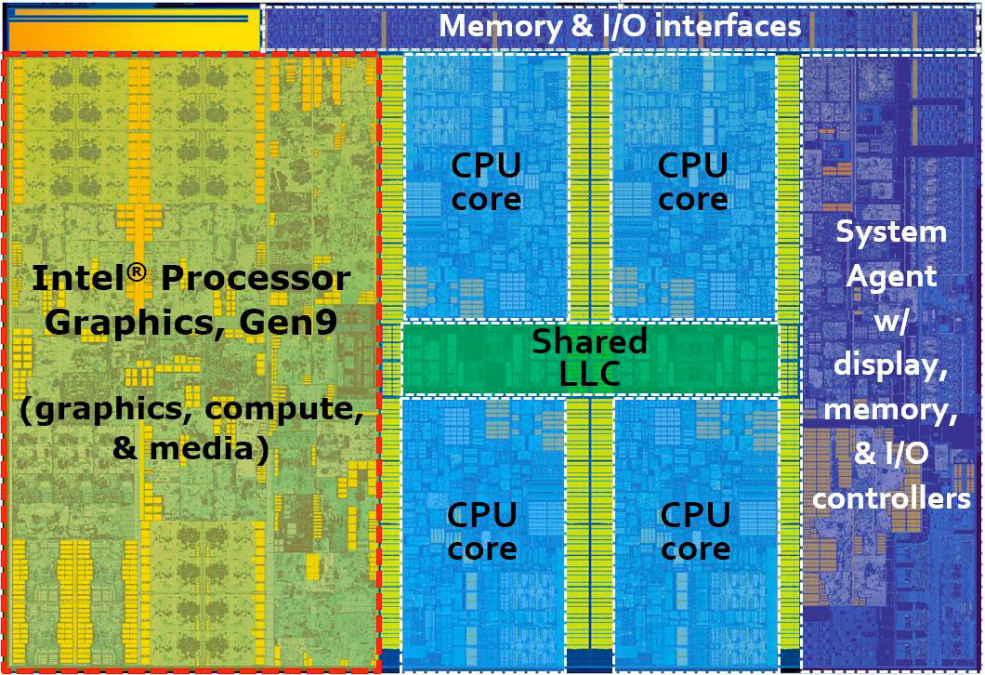
6.1 Introduction (10)
The Skylake die [208]

Slide 16
6.2 Major enhancements of the Skylake line
6.2.1 More advanced microarchitecture of the cores
6.2.2 Enhanced graphics
6.2.3 Support of PCIe 3.0
Enhancement: Továbbfejlesztés
Notes:
16

Slide 17
6.2 Major enhancements of the Skylake line (1)
6.2 Major enhancements of the Skylake line
6.2.1 More advanced microarchitecture of the cores [239]
Frontend
Backend
Note
The Skylake core is basically a master superset (see above) core with two derivatives:
the server core (supporting e.g. AVX-512) and
the client core.

Slide 18
6.2.1 More advanced microarchitecture of the cores (1)
Key improvements of the microarchitecture of the cores
5-wide decoding (vs. 4 previously)
larger buffer and register sizes (as detailed subsequently).
*

Slide 19
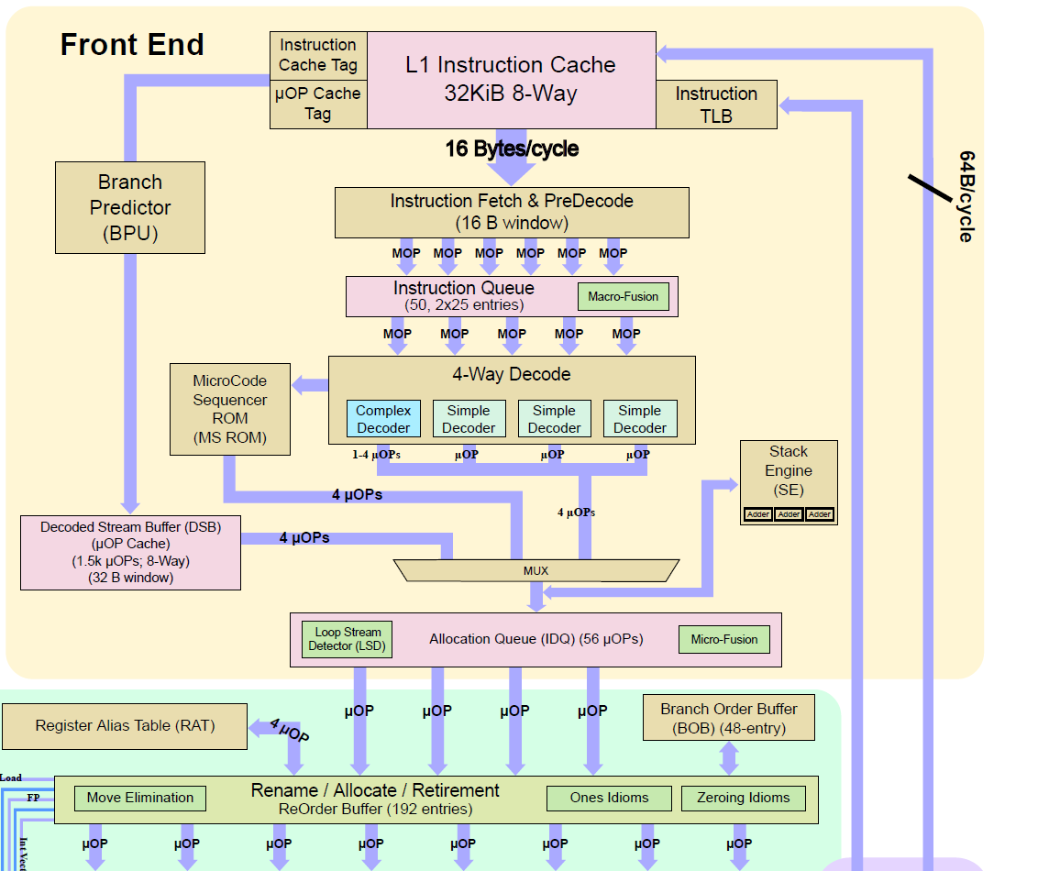
6.2.1 More advanced microarchitecture of the cores (2)
5-wide decoding -1
Broadwell’s frontend [241]
Skylake’s frontend [240]
*

Slide 20
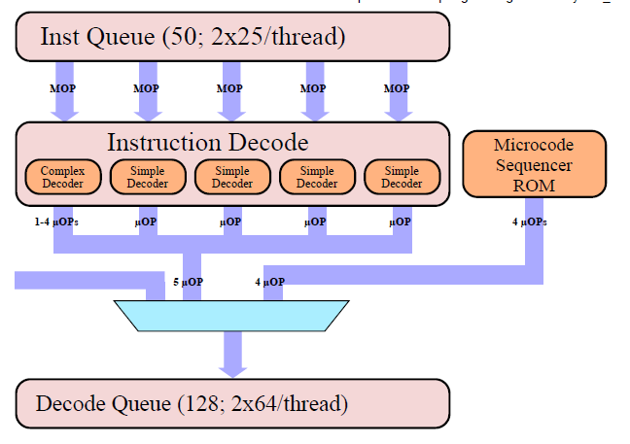
6.2.1 More advanced microarchitecture of the cores (3)
5-wide decoding -2
With 5-wide decoding the front-end becomes also 5-wide, as shown below.
μOP cache
6 μOP
Figure: Decoding in Skylake's core [240]
https://en.wikichip.org/wiki/intel/microarchitectures/skylake_(client)
*

Slide 21
6.2.1 More advanced microarchitecture of the cores (4)
5-wide decoding -3
Front-end width in Intel's microarchitectures
Up to the Pentium 4 (2000): 3-wide
Beginning with the Core 2 (2006): 4-wide
Beginning with the Skylake (2015): 5-wide
As illustration see the next Figures.
Remark
Also AMD's highly successful K7 Athlon microarchitecture (1999) had a front-end width of 3,
subsequently, AMD switched only quite late to a 4-wide microarchitecture along with their K15
Bulldozer line (in 2011).
*

Slide 22
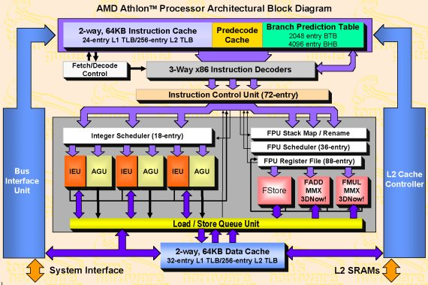
6.2.1 More advanced microarchitecture of the cores (5)
Figure: Block diagram of AMD’s Athlon microarchitecture (1999) [4]

Slide 23
6.2.1 More advanced microarchitecture of the cores (6)
Figure: Block diagram of Intel’s Pentium 4 microarchitecture 2000) [5]
Retire width: 3 instr./cycle

Slide 24
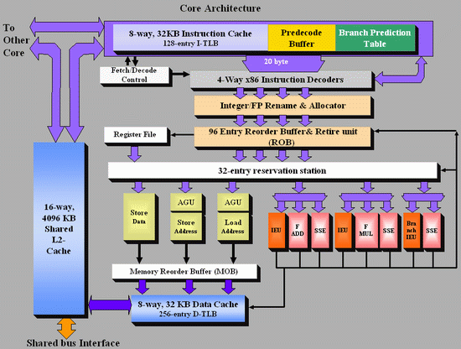
6.2.1 More advanced microarchitecture of the cores (7)
Figure: Block diagram of Intel’s Core 2 microarchitecture (2006) [3]

Slide 25
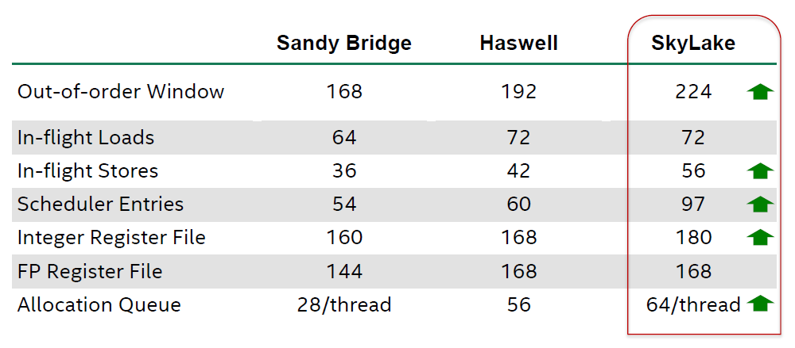
6.2.1 More advanced microarchitecture of the cores (8)
Larger buffer and register sizes
Instruction window (ROB), buffer and register sizes of subsequent generations of the
Core 2 family [200]
Out-of-order Window: Reorder Buffer (ROB)

Slide 26
6.2.2 Enhanced graphics (1)
6.2.2 Enhanced graphics
Performance increase of Intel’s graphics over generations [196]
Skylake
Broadwell
Haswell
Ivy Bridge
Sandy Bridge

Slide 27
6.2.2 Enhanced graphics (2)
Evolution of main features of Intel’s graphics families
Intel Core generation | Graphics generation | Models | Graphics Technology level | No. of graphics slices | No. of EUs | eDRAM | OpenGL version | DirectX version | OpenCL version
Westmere | 5th (Ironlake) | HD |  |  | 12 | -- | 2.1 | 10.1 | n.a.
Sandy Bridge | 6th | HD 2000 | GT1 | 1 (2x3 EU) | 6 |  | 3.1/3.3 | 10.1 | n.a.
 |  | HD 3000 | GT2 | 1 (4x3 EU) | 12
Ivy Bridge | 7th | HD 2500 | GT1 | 1 (6 EU) | 6 | -- | 4.0 | 11.0 | 1.2
 |  | HD 4000 | GT2 | 1 (2x8 EU) | 16
Haswell | 7.5th | HD 4200- HD 4700 | GT2 | 1 (2x10 EU) | 20 | -- | 4.3 | 11.1 | 1.2
 |  | HD 5000 Iris 5100 | GT3 | 2 | 40
 |  | Iris Pro 5200 |  |  |  | 128 MB
Broadwell | 8th | HD 5300- HD 5600 | GT2 | 1 (3x8 EU) | 23/24 | -- | 4.3 | 11.2 | 2.0
 |  | HD 6000 Iris 6100 | GT3 | 2 | 47/48
 |  | Iris Pro 6200 | GT3e | 2 | 48 | 128 MB
Skylake | 9th | HD 510 | GT1 | 1 (3x4 EU) | 12 | -- | 4.4 | 12 | 2.0
 |  | HD 515 | GT1.5 | 1 (3x6 EU) | 18
 |  | HD 520 | GT2 | 1 (3x8 EU) | 24
 |  | HD 530 | GT2 | 1 | 24
 |  | HD 540 | GT3e | 2 | 48 | 64 MB
 |  | HD 580 | GT4e | 3 | 72 | 64/128 MB

Slide 28
6.2.2 Enhanced graphics (3)
Main features of the Skylake line [190]
Tablets
Mobiles
High-perf.
mobiles
Desktops

Slide 29
6.2.2 Enhanced graphics (4)
Skylake/Gen9 graphics architecture overview [196]
GT2

Slide 30
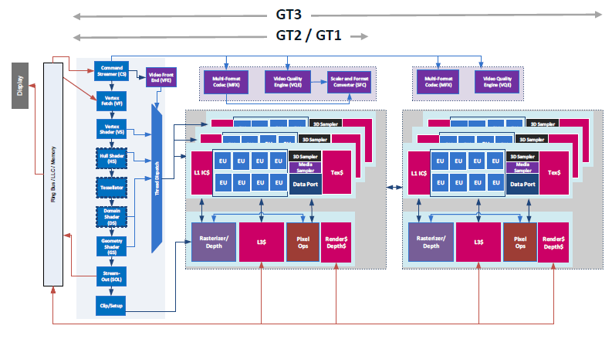
6.2.2 Enhanced graphics (5)
Gen9 graphics scalability -1 [196]

Slide 31
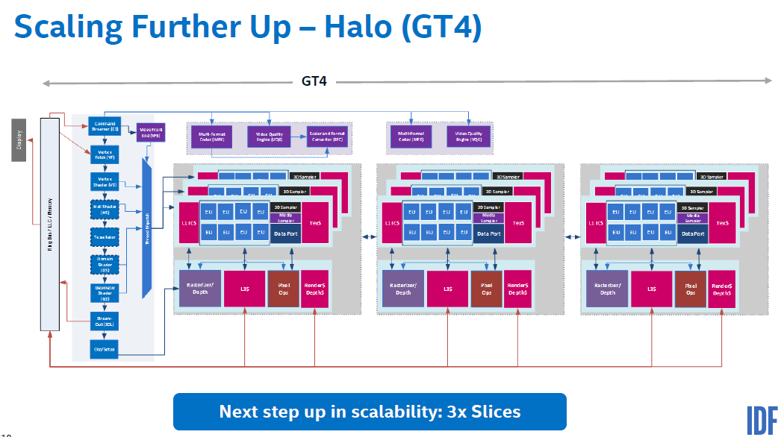
6.2.2 Enhanced graphics (6)
Gen9 graphics scalability -2 [196]

Slide 32
6.2.2 Enhanced graphics (7)
Gen9 graphics scalability -3 [196]
Scaling for GT 1.5 to reduce power

Slide 33
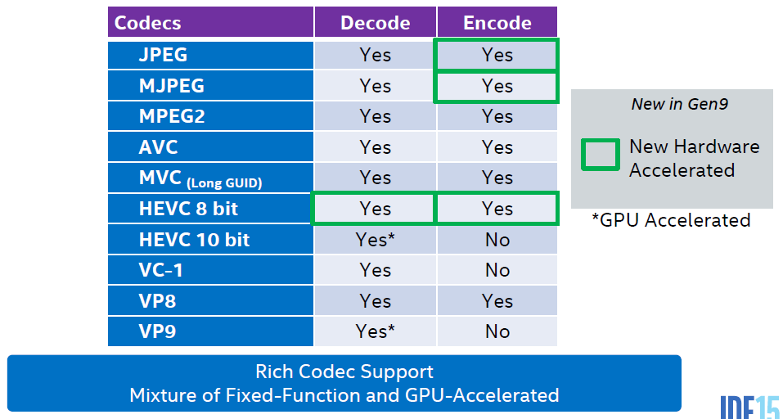
6.2.2 Enhanced graphics (8)
Gen9 graphics Codec support [196], [201]
With the new hardware accelerated codec solution watching a movie or video conferencing
can be done by highly efficient fixed-function circuits rather than by using more flexible, but
more power hungry CPU and GPU cores [201]

Slide 34
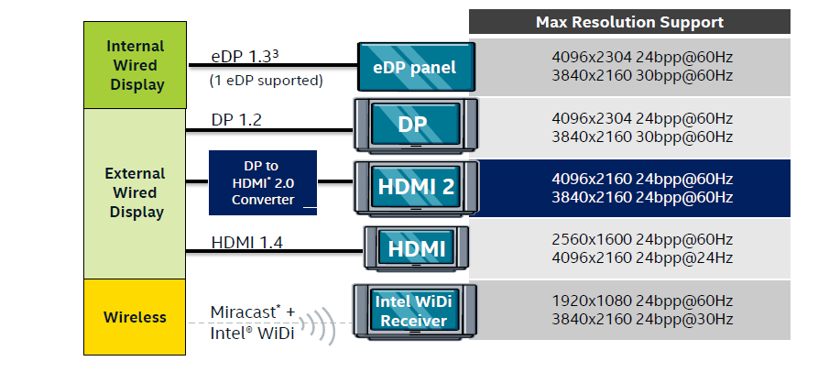
6.2.2 Enhanced graphics (9)
Gen9 graphics display support [201]
It supports 3 display pipes.
WiDi is Intel’s Wireless Display technology to transmit music, videos, movies, photos etc.
from a WiDi compatible computer to a compatible HDTV.
The initial version of WiDi supported only a low resolution of 720p, Skylake provides already
HD quality with a resolution of 1080.
Miracast is a WiDi standard of the Wi-Fi Alliance providing HD quality.

Slide 35
6.2.2 Enhanced graphics (10)
Note
Skylake does not make use of the FIVR technology, as indicated in the Figure below.
The reason for omitting FIVR in Skylake (and probably also is the subsequent Cannonlake) is
that it increases unduly the die temperature and limits overclocking.
Note that all cores share the same voltage
and even the same frequency.
Figure: Voltage domains of Skylake [200]
*

Slide 36
6.2.3 Support of PCIe 3.0 (1)
6.2.3 Support of PCIe 3.0
Example: Intel Core i7-6700K desktop processor platform [203]
*

Slide 37
6.2.3 Support of PCIe 3.0 (2)
Performance features of the PCIe standards [227]
PCI Express version | Line code | Transfer rate | Throughput per direction |  |  |  | Issued
 |  |  | ×1 | ×4 | ×8 | ×16
1.0 | 8b/10b | 2.5 GT/s | 250 MB/s | 1 GB/s | 2 GB/s | 4 GB/s | 2003
2.0 | 8b/10b | 5 GT/s | 500 MB/s | 2 GB/s | 4 GB/s | 8 GB/s | 2007
3.0 | 128b/130b | 8 GT/s | 984.6 MB/s | 3.94 GB/s | 7.9 GB/s | 15.8 GB/s | 2010
4.0 | 128b/130b | 16 GT/s | 1969 MB/s | 7.9 GB/s | 15.8 GB/s | 31.5 GB/s | 2017
5.0 | 128b/130b | 32 or 25 GT/s | 3938 or 3077 MB/s | 15.8 or 12.3 GB/s | 31.5 or 24.6 GB/s | 63.0 or 49.2 GB/s | 2019 (expected)
*

Slide 38
6.3 Major innovations of the Skylake line
6.3.1 Integrated ISP (Image Signal Processing)
6.3.2 Memory Side Cache
6.3.3 Innovations in power management
Notes:
38

Slide 39
6.3.1 Integrated ISP (Image Signal Processing) (1)
6.3 Major innovations of the Skylake line
6.3.1 Integrated ISP (Image Signal Processing) [200]
CSI: Camera Serial Interface
BOM: Bill of Material
*

Slide 40
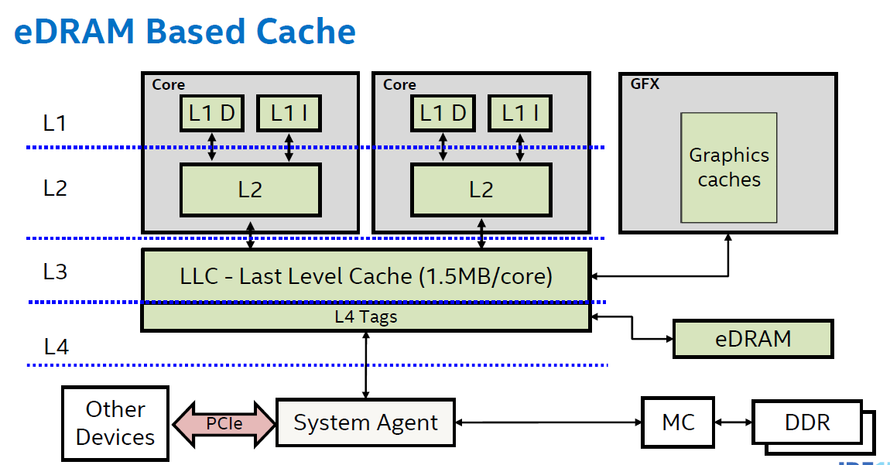
6.3.2 Memory Side Cache (MSC) (1)
6.3.2 Memory Side Cache (MSC)
The eDRAM cache of Broadwell [200]
Note: The L4 eDRAM cache operates as a victim cache to the L3 (LLC).
*

Slide 41
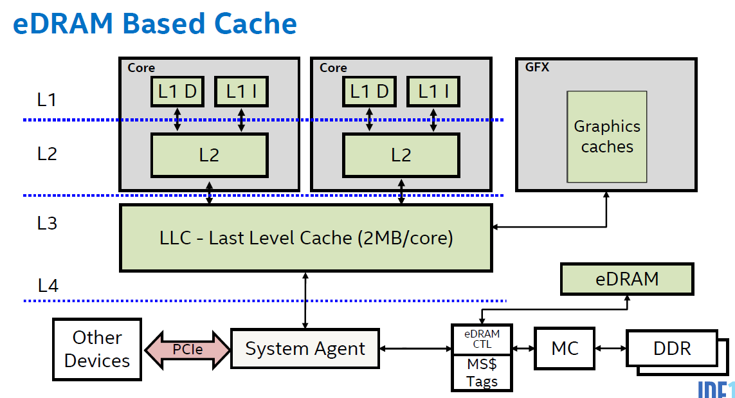
6.3.2 Memory Side Cache (MSC) (2)
Memory Side Cache of the Skylake [200]
MS$: Memory Side Cache
CTL: Control
*

Slide 42
6.3.2 Memory Side Cache (MSC) (3)
Benefits of the Memory Side Cache (MSC) [200]
It is fully coherent.
Available for use by I/O devices and the Display engine as well.
*

Slide 43
6.3.3 Innovations in power management (1)
6.3.3 Innovations in power management
6.3.3.1 Speed Shift Technology
6.3.3.2 Duty cycle control of the cores
*

Slide 44
6.3.3.1 Speed Shift Technology (1)
The legacy power management technology, called the DVFS
(Dynamic Voltage and Frequency Scaling) -1
On the other hand, when the workload demands a higher
operating point than P1, the processor can take over the
control over the power management by activating the
turbo technology.
Lower than Pn states are used only to manage critical
conditions, like overheating the die.
*

Slide 45
6.3.3.1 Speed Shift Technology (2)
The drawback of the SpeedStep technology
The basic drawback is slow responsiveness, e.g. 30 ms responsiveness, needed until the OS
recognizes the change of operating conditions (e.g. workload) and responds by resetting the
operating point [201].
This is unfavorable for low residency workloads, like quickly changing video recording.
*

Slide 46
6.3.3.1 Speed Shift Technology (3)
Principle of the Speed Shift Technology
The OS passes the control over power management to the processor, more precisely to the
PCU (Power Control Unit) of the processor, along with hints about the user preference
concerning power management (like max. performance, max. battery life etc.).
The PCU performs the actual P-state control, called Speed Shift Technology (Intel) or
or Autonomous Control (Intel) or Hardware Controlled Performance States (ACPI).
The Autonomous control can cover all P-states or a subset of the P-states, as indicated in the
next Figures.
*

Slide 47
6.3.3.1 Speed Shift Technology (4)
Passing power management control for all P-states to the CPU [198]
*

Slide 48
6.3.3.1 Speed Shift Technology (5)
Passing power management control for a subset of P-states to the CPU [198]
Turbo
(P1)
*

Slide 49
6.3.3.1 Speed Shift Technology (6)
Benefit of the Speed Shift Technology
It reduces the responsiveness of the power management from 30 ms to about 1 ms [201].
*

Slide 50
6.3.3.2 Duty cycle control (1)
6.3.3.2 Duty cycle control [198]
While running applications
dynamic dissipation: ~ f³
runtime: ~ 1/f
total energy consumption originating from the dynamic dissipation: ~ f²
with f denoting the clock frequency.
As the performance is proportional with f, the energy consumption arising from the dynamic
dissipation is proportional to the square of the frequency f, as indicated below.
Figure: Dependence of energy consumption arising from the dynamic dissipation
(designated as Compute energy in the Figure) on the performance (~ f)
*

Slide 51
6.3.3.2 Duty cycle control (2)
On the other hand
the energy consumption originating from the static dissipation is proportional to the runtime.
The runtime is inversely proportional to the frequency (f).
Consequently, the energy consumption arising from the static dissipation is inversely
proportional to the frequency (f) which is proportional to the performance, as indicated
in the Figure below.
Figure: Dependence of energy consumption originating from the static dissipation
and system power (designated as SoC and system energy in the Figure) on the performance (~ f) [198]
*

Slide 52
6.3.3.2 Duty cycle control (3)
As a consequence, the total energy consumption originating from both the
dynamic dissipation and
static dissipation as well as system power consumption
has a minimum, as indicated in the Figure below.
Figure: Dependence of energy consumption originating from both the dynamic dissipation (designated as the Compute energy in the Figure) and the static dissipation and system power (designated as SoC and system energy in the Figure) on the performance
Obviously, the min. energy consumption point (Pe) is the most efficient working point of a core
of the processor.
*

Slide 53
6.3.3.2 Duty cycle control (4)
Power management with taking into account the most efficient Pe working point [198]
Frequency will be lowered as far as possible until the Pe working point is reached.
Pe will be calculated every ms based on the workload and system characteristics.
There is no benefit when the system is clocked below the Pe point, as it would increase
the energy consumption.
Therefore, a so called EARtH algoritm overrides lower P requests and sets f according to Pe.
The EARtH algorithm is activated only if it is possible to enter the package sleep state.
Figure: Power management with taking into account the most efficient Pe working point [198]
*

Slide 54
6.3.3.2 Duty cycle control (5)
Duty cycling [198]
While managing power going below Pe would reduce energy consumption inefficiently
due to the fixed power components.
In this region turning the package on and off, called duty cycling, reduces power
proportionally to run time, as shown in the Figure below, about 1000 times in a sec.
Figure: Principle of duty cycling used to reduce energy consumption in the region below Pe
In the region below Pe duty cycling is a more effective technique to reduce power for low
power demand than reducing frequency below Pe.
*

Slide 55
6.3.3.2 Duty cycle control (6)
Power saving measures in C1 to C6 idle states
C1
Stop instruction execution
L1
L1
L1
L1
C0
Cn
L2
L2
C3
Flush
C3
Flush
L3
Stop core clocking
Stop core clocking
C6
C0
SRAM
C6
Cn
SRAM
Stop core PLL
Stop core PLL
Vcc
0
Vcc
0
L3

Slide 56
6.4 Skylake-based mobile and desktop lines
Notes:
56

Slide 57
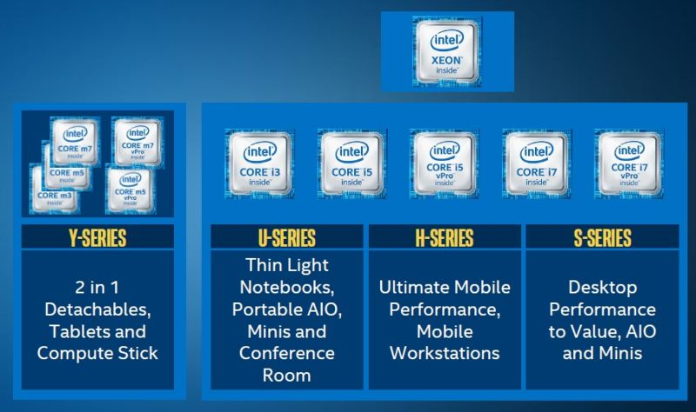
6.4 The Skylake-based mobile and desktop lines (1)
Overview of the Skylake-based mobile and desktop series -1 [206]
4.5 W
15/28 W
45 W
65/91 W

Slide 58
6.4 The Skylake-based mobile and desktop lines (2)
Overview of the Skylake-based mobile and desktop series -1 [202]
BGA: Ball Grid Array (to be soldered)
LGA: Land Grid Array (to be socketed)
Dies: No. of cores and GT levels, e.g. 2+2 means: 2 cores +GT 2 graphics, etc.

Slide 59
6.4 The Skylake-based mobile and desktop lines (3)
Key features of the Skylake-based mobile and desktop lines [190]

Slide 60
6.4 The Skylake-based mobile and desktop lines (4)
Example 1: Main features of the models of the 4.5 W Skylake m mobile line [202]

Slide 61
6.4 The Skylake-based mobile and desktop lines (5)
Remark
cTDP down – when a cooler or more quiet mode of operation is desired, this mode specifies a
lower TDP and lower guaranteed frequency versus the nominal mode.
cTDP up – when extra cooling is available, this mode specifies a higher TDP and higher
guaranteed frequency versus the nominal mode.

Slide 62
6.4 The Skylake-based mobile and desktop lines (6)
Example 2: The unlocked Skylake S desktop line
Main features of the unlocked Skylake S desktop line [202]
Note that the 91 W unlocked Skylake S-line does not include integrated graphics, as most users
of this high-end processor will attach discrete graphics cards.

Slide 63
6.4 The Skylake-based mobile and desktop lines (7)
Max. base frequency of Skylake models with different TDPs and configurations
(Based on data from [202])
TDP (W) | No. of cores | Graphics | No. of graphics EUs | eDRAM | Base frequency (GHz)
4.5 | 2 | HD 515 | 18 | -- | 1.2
15 | 2 | HD 540 | 48 | 64 MB | 2.2
15 | 2 | HD 520 | 24 | -- | 2.6
28 | 2 | HD 550 | 48 | 64 MB | 3.3
35 | 4 | HD 530 | 24 | -- | 2.8
45 | 4 | HD 530 | 24 | -- | 2.9
65 | 4 | HD 530 | 24 | -- | 3.4
91 | 4 | -- | -- | -- | 4.2
Note that low TDP can be achieved first of all by reducing the core frequency and limiting
the computer resources (cores, GPU EUs) provided.

Slide 64
6.4 The Skylake-based mobile and desktop lines (8)
Example Skylake-S platform: Intel Core i7-6700K desktop processor platform [203]

