Slide 1
AMD’s processor lines belonging to the
Zen Family (Family 17h)
Dezső Sima
October 2018
(Ver. 2.0)
© Sima Dezső, 2018

Slide 2
AMD’s processor lines belonging to the
Zen Family (Family 17h)
1. Introduction
2. The Zen cores
3. The 4-core CCX building block
4. The Zeppelin module
5. The Infinity Fabric
6. The Ryzen desktop line
7. The Ryzen Mobile line
8. The ThreadRipper HED line
9. The Epyc server line
10. References
Notes:
2

Slide 3
In the Lectures only Sections 1 - 4, 6.1 and 8.2 will be discussed
(except Sections 2.1.3 and 2.1.4).
Notes:
3

Slide 4
1. Introduction
Notes:
4

Slide 5
1. Introduction to AMD’s processor families (27)
1. Introduction
Overview of AMD’s processor lines
AMD’s in-house designed x86 families
32-bit
x86 families
The Hammer
family
Intermediate
families
The Bulldozer
family
The Cat
family
The Zen
family
K5/K6/K7
families
(32-bit
Mobile/DT)
1996-2003)
K8/K10/K10.5
families
(08h/10h/10.5h)
(64-bit
x86 family)
(2003-2009)
Families
11h/12h
(Mobile/DT
oriented)
(2008-2011)
Family
15h
(High-performance
oriented)
(2011-2016)
Families
14h/16h
(Low-power
oriented)
(2011-2015)
Family
17h
(Modular design)
(2017- )
K7: Athlon (1999-2003)
Remark
Before the in-house designed K5, AMD licensed and manufactured Intel designed processors.

Slide 6
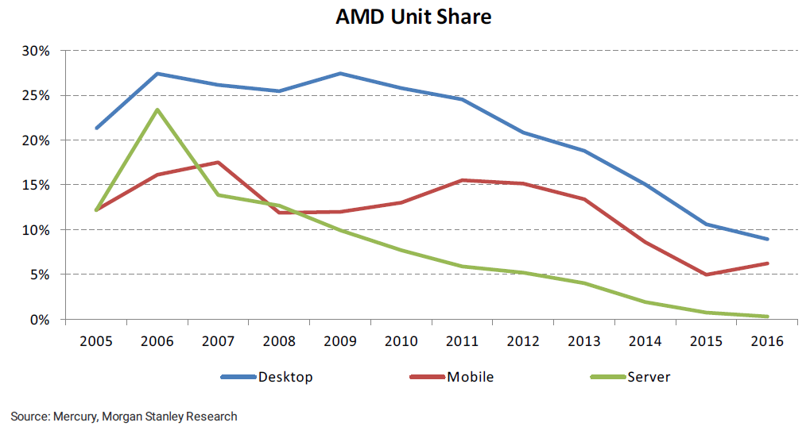
1. Introduction (1)
1. Introduction
AMD's unit shares on the world market [51]

Slide 7
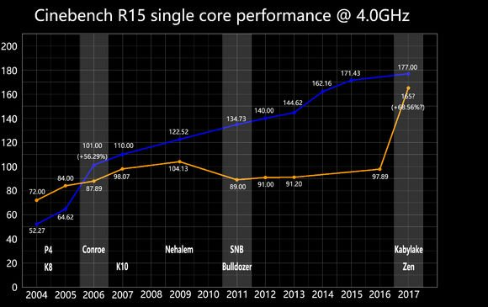
1. Introduction (1b)
Efficiency of Intel and AMD CPUs - 2004 to Ryzen [89]
(Core 2)

Slide 8
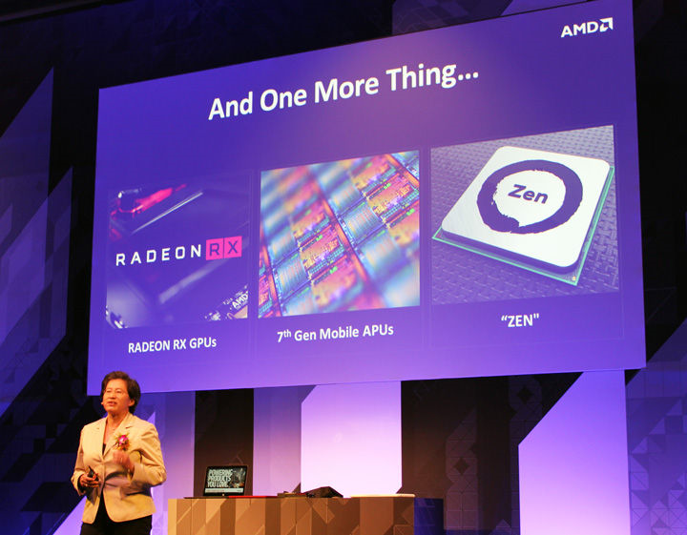
1. Introduction (2)
Announcing details of the Zen architecture at Computex 6/2016 [1]

Slide 9
1. Introduction (2b)
Brand names of AMD’s Zen-based (Family 17h-based) processor lines
 | Launched in | 2017-2018 | 2018 | 2019?
 |  | Family 17h (00h-0Fh) (Zen) | Family 17h (00h-0Fh) (Zen+) | Family 17h (xxh-xxh) (Zen2)
 |  | 14 nm | 12 nm | 7 nm
 | 4P servers
 | 2P servers | Epyc 7xx1
 | 1P servers | Epyc 7xx1P
 | (85-140 W)
 | HED (~95-125 W) | ThreadRipper (TR 1xxxX) | ThreadRipper (TR 2xxxX/WX)
 | Mainstream/ Entry level (30-95 W) | Summit Ridge (Ryzen 7/5/3 1xxx/1xxxX) Raven Ridge (APU) (Ryzen 7/5/3 2000G/GE) | Pinnacle Ridge (Ryzen 7/5 2xxx/2xxxX)
 | High perf. (~30-60 W)
 | Mainstream/Entry (~20-30 W)
 | Ultra portable (~10-15 W) | Raven Ridge (APU) (Ryzen 7/5/3 2x00U)
Tablet (~5 W)
Servers
Desktops
Notebooks

Slide 10
1. Introduction (3)
AMD Zen-based processor lines introduced in 2017 (except Pro series)
AMD's Zen-based processor lines introduced in 2017
 | Ryzen Mobile APU | Ryzen DT | ThreadRipper (HED) | Epyc
Market segment | Mobile | Desktop platform | HED | 1S/2S server
μarch./Technology | Zen 14 nm | Zen, 14 nm | Zen, 14 nm | Zen, 14 nm
Launched models | Ryzen 7 2700U Ryzen 5 2500U (10/2017) | Ryzen 7 (3/2017) Ryzen 5 (4/2017) Ryzen 3 (7/2017) | 1950X/1920X/1900X (8/2017) | Series 7000 (6/2017)
Layout | CCX + Vega 8/10 | Zeppelin die with 2x CCX | MCM (2x Zeppelin die) | MCM (4x Zeppelin die)
Integrated GPU | Yes | No | No | No
Core count | 4 | 4/6/8 | 8/12/16 | 8/16/24/32
SMT | SMT | SMT (except Ryzen 3) | SMT | SMT
Mem. channels/rate | 2xDDR4-2400 | 2xDDR4-2666 | 4xDDR4-2666 | 8xDDR4-2666
PCIe 3.0 lanes | ?? | 16xPCIe 3.0 | 60xPCIe 3.0 | 128 for 1S servers 64 for 2S servers
TDP | 15 W | 65/95 W | 180 W | 120/170/180 W
Socket | AM4 (1331) | AM4 (1331) | TR4 (SP3r2) (4094) | SP3 (4094)
Chipset | SoC | 300-series | X399 | No chipset, SOC

Slide 11
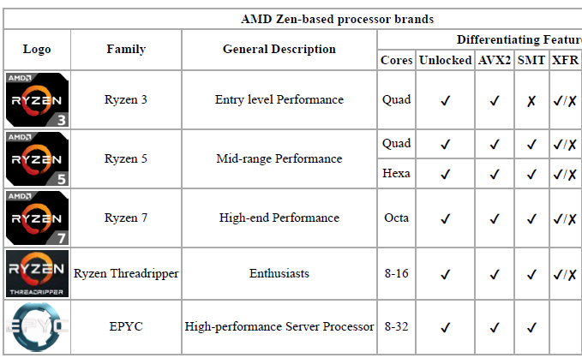

11. Introduction (4)
Processor logos of the Zen series [8]
Features
Ryzen Mobile
Mobile processors
with VEGA graphics
Quad

Slide 12
1. Introduction (5)
AMD Zen/Zen+ based processor lines introduced in 2018 (except Pro series)
AMD's Zen/Zen+ based processor lines introduced in 2018
 | Ryzen Mobil APU | Ryzen DT APU | 2.G Ryzen DT | 2.G ThreadRipper (HED)
μarch./tech. | Zen/14 nm | Zen/14 nm | Zen+/12 nm | Zen+/12 nm
Launched models | Ryzen 3 2320U Ryzen 3 2200U (1/2018) | Ryzen 5 2400G Ryzen 3 2200G (2/2018) Ryzen 5 2400GE Ryzen 3 2200GE (2/2018) | Ryzen 7 2700X Ryzen 7 2700 Ryzen 5 2600X Ryzen 5 2600 (4/2018) | 2990WX (8/2018) 2950X (8/2018) 2970WX (10/2018) 2920X (10/2018)
Layout | CCX + Vega 6/3 | CCX + Vega 11/8 | Zeppelin die (2x CCX) | MCM (up to 4 Zeppelin dies)
Integrated GPU | Yes | Yes | No | No
Core count | 2/4 | 4 | 6/ 8 | Up to 32
SMT (Multithreaded) | SMT only for Ryzen 3 2200U | SMT only for Ryzen 5 | SMT | SMT
Mem. channels/ data rate | 2xDDR4-2400 | 2xDDR4-2667 (G) 2xDDR4-2933(GE) | 2xDDR4-2933 | 4xDDR4-2933
PCIe lanes | ?? | ?? | 16x PCIe 3.0 | 60x PCIe 3.0
TDP | 15 W | 35/65 W | 65/95/105 W | 180/250 W
Socket | FP5 (na.) | AM4 (1331) | AM4 (1331) | TR4 (SP3r2) (4094)
Chipset | SoC | 300-series | 300/400-series | X399

Slide 13
1. Introduction (5b)
AMD’s effort to design the Zen core [10]
M. Papermaster, CTO of AMD: Up to 300 engineers were working on the Zen core
spending over two million working hours.
Aim: optimizing the power/frequency curve.
CTO: Chief Technology Officer

Slide 14
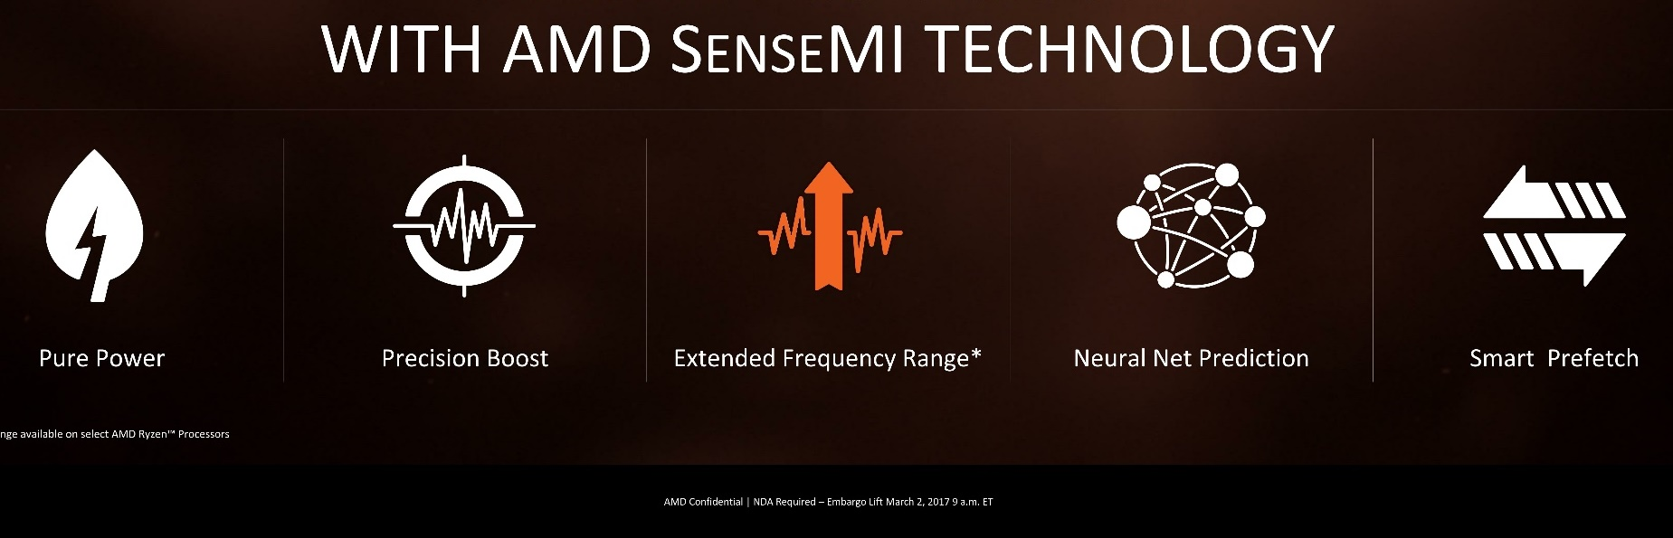
Innovations introduced within the Zen family [10]
Pure power
(AVS)
Precision Boost
(Enhanced Turbo Boost
like Intel’s SpeedShift)
Extended Frequency Range
(Higher fc for
premium cooling)
Neural Net
Prediction
Smart
Prefetch
To reduce
dissipation
To raise fc
To raise IPC
See
Section 2.1.3.1
See
Sections 2.1.3.2/2.1.3.3
See
Section 2.1.2

Slide 15
1. Introduction (6)
Use of advanced technologies in AMD’s mobile and desktop series [75] -1
 | Ryzen DT | 2nd gen. Ryzen DT | Ryzen DT APU with Radeon Vega graphics | Ryzen mobile APU with Radeon Vega graphics
Extended Frequency Range (XFR) | Yes (XFR) | Yes (XFR 2) | Yes (XFR 2) | Yes (Mobile XFR)⁴
Precision Boost (Turbo Boost) | Yes Precision Boost) | Yes (Precision Boost 2) | Yes (Precision Boost 2) | Yes (Precision Boost 2)
Neural Net Prediction (for branch prediction) | Yes | Yes | Yes | Yes
Pure Power (AVS) | Yes | Yes | Yes | Yes
Smart Prefetch (Advanced data prefetch) | )Yes | Yes | Yes | Yes

Slide 16
1. Introduction (7)
Use of advanced technologies in AMD’s HED and 2S server series [75] -2
 | ThreaRripper | 2nd gen Ryzen ThredRipper | Epyc
Extended Frequency Range (XFR) | Yes (XFR) | Yes (XFR 2) | No
Precision Boost (Turbo Boost) | Yes Precision Boost) | Yes (Precision Boost 2) | Yes (Precision Boost)
Neural Net Prediction (for branch prediction) | Yes | Yes | Yes
Pure Power (AVS) | Yes | Yes | Yes
Smart Prefetch (advanced data prefetch) | Yes | Yes | Yes

Slide 17
1. Introduction (8)
AMD’s Zen or Zen+ based processor series
Series | CPU core | μarch. | Techn. | Launched | Models
Ryzen DT | Summit Ridge | Zen | 14 nm | 3/2017 | Ryzen 1xxx Ryzen 1xxxX
Ryzen mobile APU | Raven Ridge | Zen | 14 nm | 10/2017 | Ryzen 2xxxU
Ryzen DT APU | Raven Ridge | Zen | 14 nm | 2/2018 | Ryzen 2xxxG Ryzen 2xxxGE
2. gen. Ryzen DT | Pinnacle Ridge | Zen+ | 12 nm | 4/2018 | Ryzen 2xxx Ryzen 2xxxX
ThreadRipper HED | Whitehaven | Zen | 14 nm | 8/2017 | TR 1xxx
2. gen. Threadripper HED | Pinnacle Ridge | Zen+ | 12 nm | 8/2018 | TR 2xxxX TR2xxxWX
EPYC 1S/2S server | Naples | Zen | 14 nm | 6/2017 | EPYC 7xxx

Slide 18
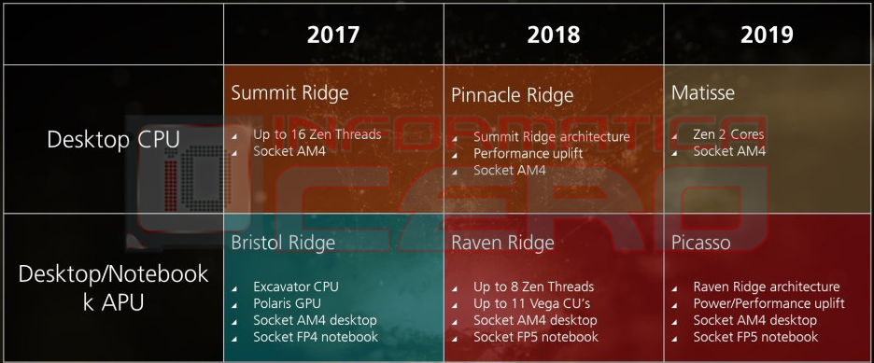
1. Introduction (9)
AMD’s 2017-2019 desktop/notebook roadmap [64]
Zen/14 nm
Zen+/12 nm
Zen 2/7 nm
(No GPU)
Zen/14 nm
Zen+/12 nm

Slide 19
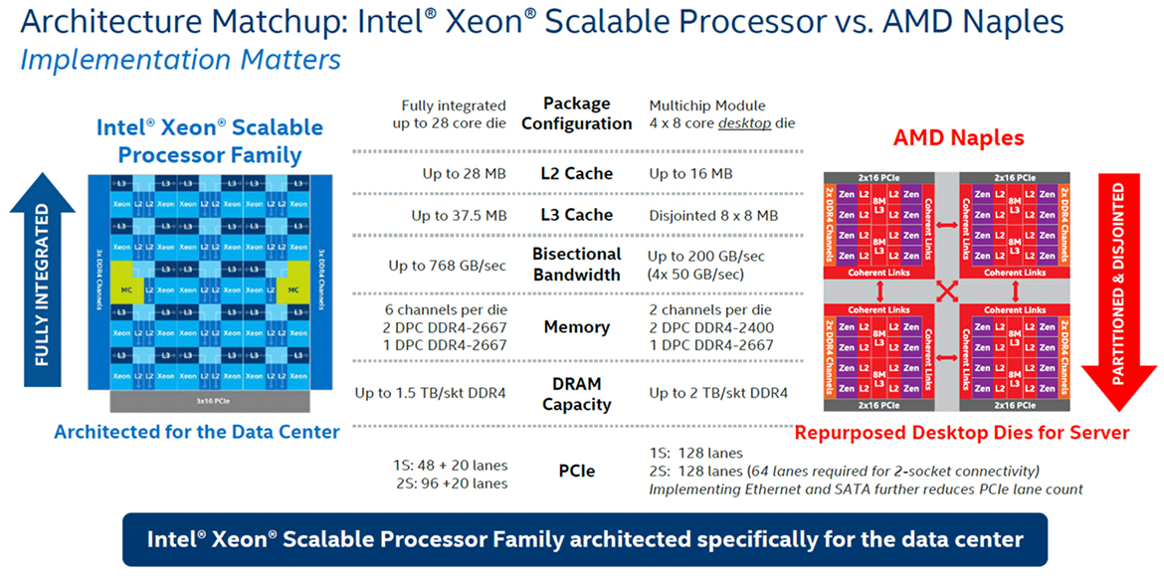
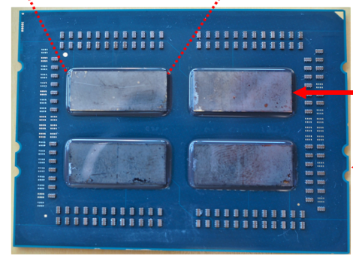
1. Introduction (10)
Design paradigms for segmenting multicore processors
Design paradigms for segmenting multicore processors
Monolithic implementation
Multi-Chip-Module (MCM)
All cores are implemented
on the same die
Cores are implemented on a number of dies,
they are properly interconnected and
mounted into the same package
Example
Intel's Skylake-SP (2017) [2]
AMD's Epyc (2017) [2], [3]
Up to 28 cores
Up to 4x8 cores
Single package
*

Slide 20
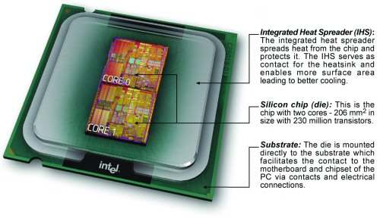
1. Introduction (10b)
Example of Intel’s early MCM design (Dual core DT Pentium D-820) (5/2005))
[91], [92]
Intel’s Pentium D-8xx (5/2005)

Slide 21
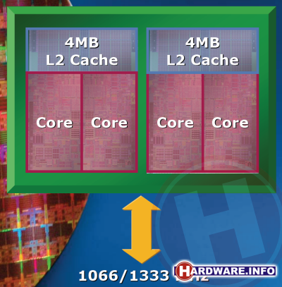
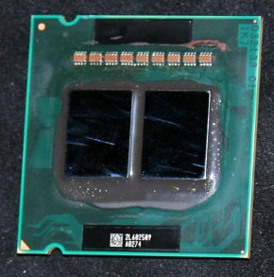
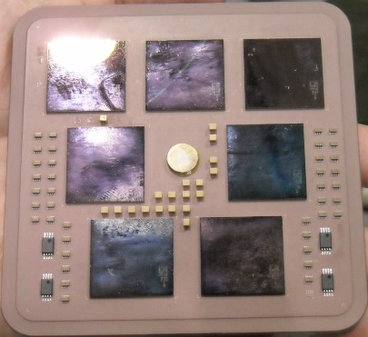
1. Introduction (11)
Further examples for MCM designs of server processors
Intel
Paxville DP 2.8 (2x1C), 2xDP-enhanced Pentium 4 Prescott (10/2005)
Xeon 5000 (Dempsey), (2x1C), ~ the 65 nm shrink of the 90 nm Paxville DP 2.8 (5/2006)
Xeon 5300
(Clowertown) [4], [5]
Xeon 5300 (Clowertown) (2x2C) 2xCore 2-based 65 nm Xeon 5100 (Woodcrest), 11/2006
Xeon 5400 Harpertown 2x2C, 2x Core 2-based 45 nm 2C Harpertown (11/2007)
AMD
Opteron 6100 (Magny-Course) 2x6C, 2xBulldozer-based 45 nm Istambul die, (3/2010)
Opteron 6200 (Interlagos), 2x8C, 2xBulldozer-based 32 nm Orochi die, (11/2011)
Opteron 6300 (Abu Dhabi), 2x8C, 2xPiledriver-based 32 nm Abu Dhabi die, (11/2012)
Opteron 6400 (Warsaw), 2x8C, 2xPiledriver-based, 32-nm Abu-dhabi die, (2014)
IBM
POWER4, 2C on 4 chips, 180 nm, (12/2001)
z10, 10/2008) 5x4C,(up to 17C), 65 nm (10/2008)
z10 [6]
5 proc. dies
2 mem. control dies

Slide 22
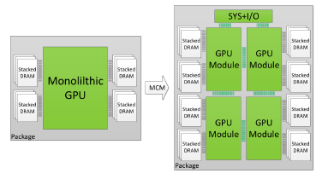
1. Introduction (12)
NVIDIA's possible future use of MCMs, revealed in a research paper [32]

Slide 23
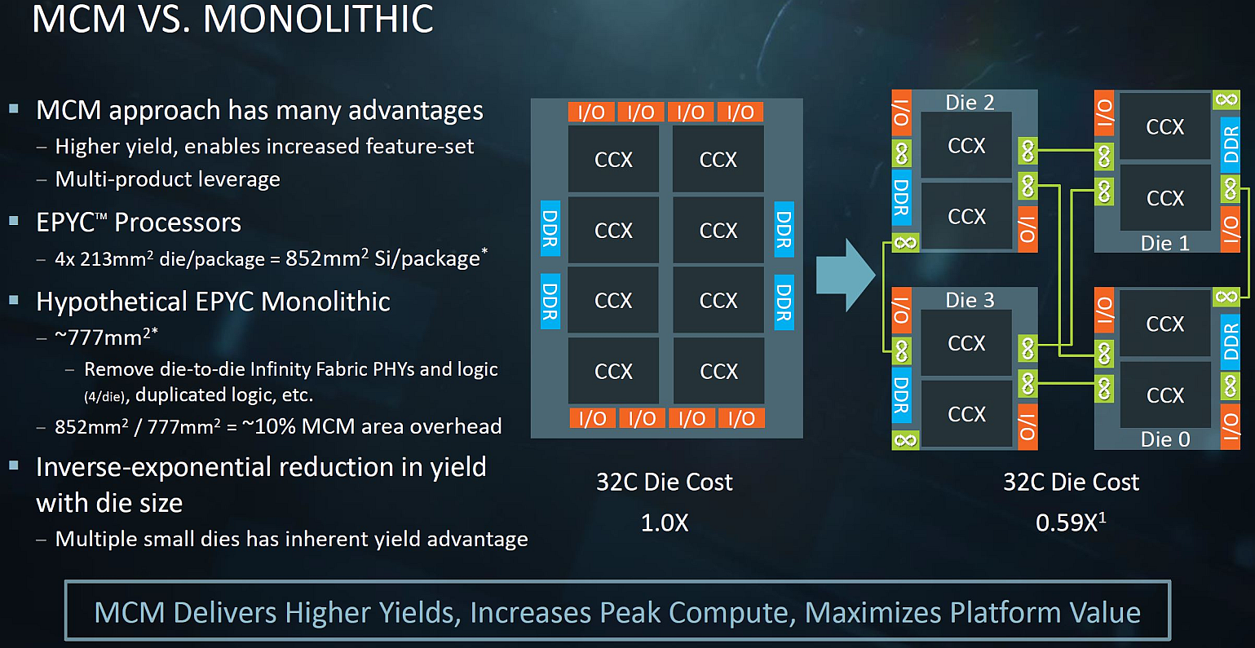
1. Introduction (13)
AMD's cost argumentation for the MCM layout over the monolithic one [7]
Presented by AMD at the Hot Chips Conference in Aug. 2017
*

Slide 24
1. Introduction (14)
Pros and cons of a modular processor design [3]
Pros
It is more economical to manufacture large core count, and therefore large dies
if segmented into a number of smaller dies
Memory channels and I/O become linearly scaled with the die count (by proper
design)
It becomes possible to design processors for different market segments
by including different numbers of the same die
Cons
High die-to-die transfer latencies that degrade performance
*

Slide 25
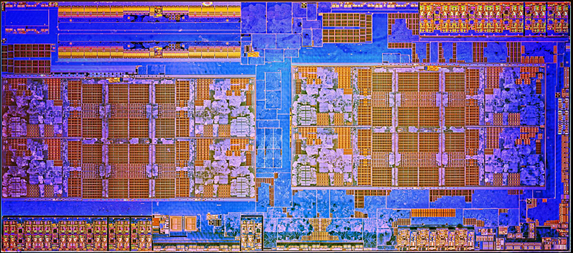
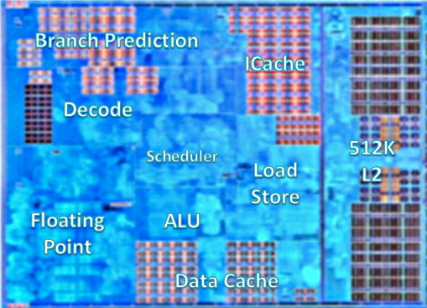
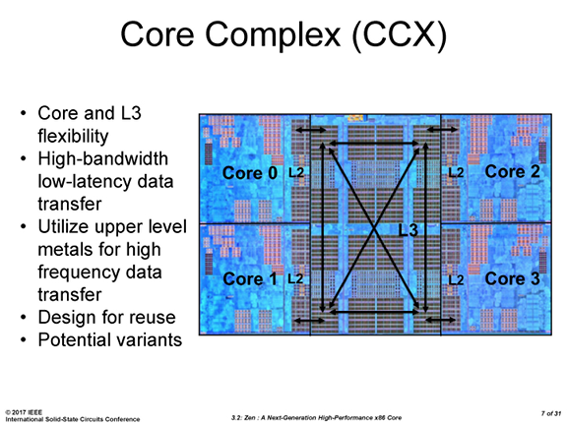
1. Introduction (15)
Basic building blocks of AMD's Zen-based processors
Basic building blocks of AMD's Zen-based processors
Zen core [8]
4-core CCX [9]
(Core CompleX)
8-core Zeppelin module [10]
2x CCX

Slide 26
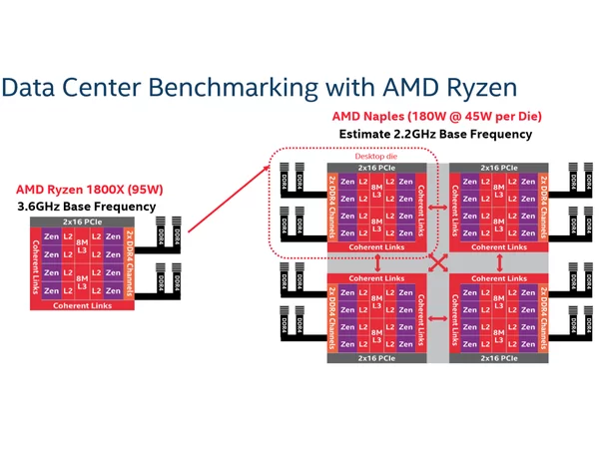
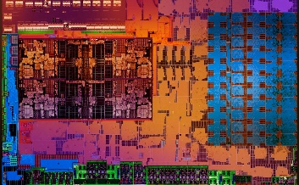
1. Introduction (16)
Overview of AMD's Zen-based processor lines
AMD's Zen-based processor lines
Ryzen Mobile
(Mobil)
Ryzen
(DT)
ThreadRipper
(HED)
Epyc
(1S/2S server)
Single CCX +
Vega GPU [54]
Zeppelin chip
(2x CCX)
1. gen: 2 Zeppelin chips
interconnected by the IF,
implemented as an MCM
2. gen: 4 Zeppelin chips
4 Zeppelin chips
interconnected by the IF,
implemented as an MCM
1. gen.
Drawings based on [11]
*

Slide 27
1. Introduction (17)
The cache coherent interconnect, called Infinity Fabric (IF)
It is used to interconnect
CCX modules on a die
dies to dies in an MCM (Multi-Chip-Module) or
two sockets in a 2S server,
as indicated in the next Figures, and discussed in more detail in Section 7.
*

Slide 28
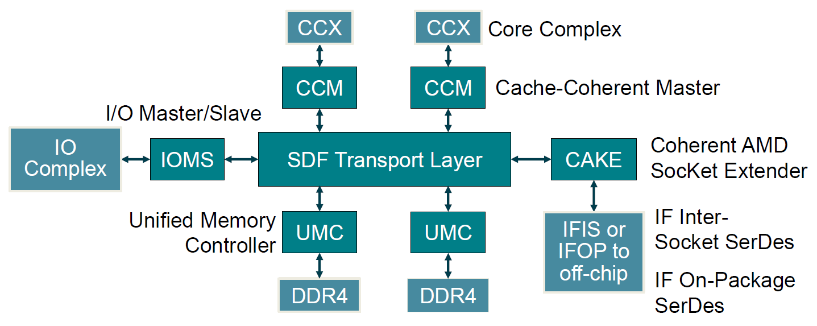
1. Introduction (18)
Interconnecting two CCX core complexes by means of the Infinity Fabric
(IF) in a Zeppelin die [88]
Infinity Fabric
IFOP: IF On-Package interconnect links
IFIS: IF Inter-Socket interconnect links
SDF implements a crossbar-type on-die interconnect.
SerDes: (Serializer/Deserializer) interface to another chip within the system

Slide 29
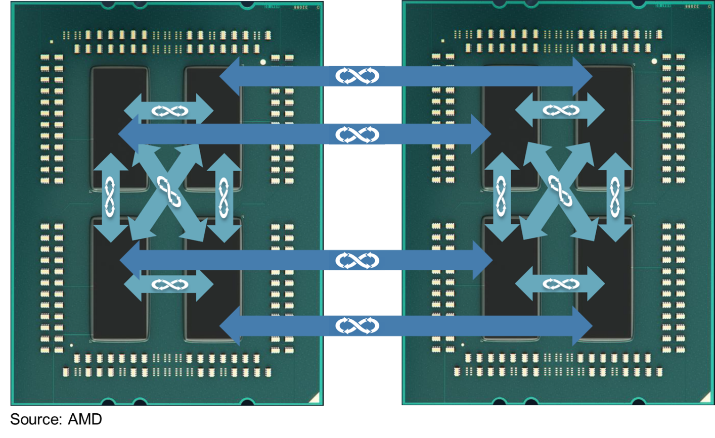
1. Introduction (19)
Interconnecting dies within a socket and two sockets of a server by means
of the infinity Fabric (IF) [3]

Slide 30
1. Introduction (20)
Key features of the cache coherent interconnect, called Infinity Fabric
It is an enhanced HyperTransport interconnect with
lower latency
higher bandwidth
lower power consumption and
the option to scale it up or down as needed.
*

Slide 31
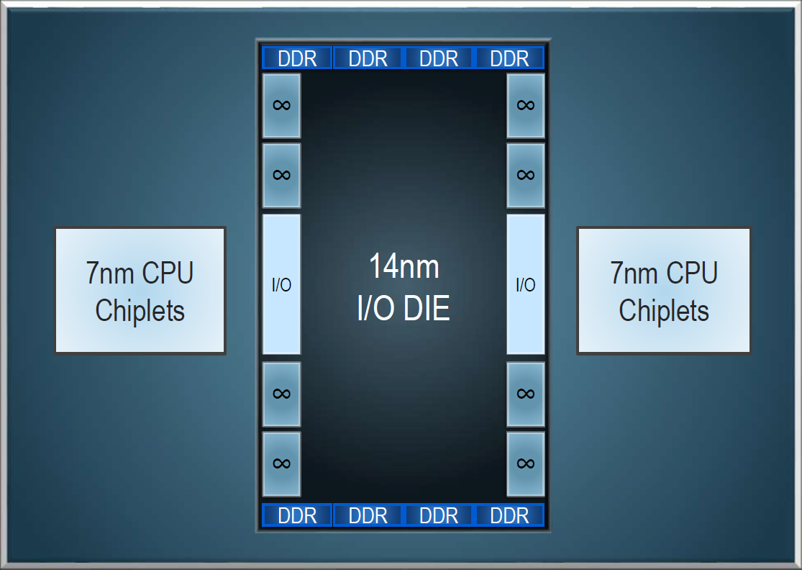
1. Introduction (21)
AMD’s new Zen 2-based Epyc server (Rome) for 64 cores (11/2018) -1
Eight channel memory controller with equal access latency.
Up to 4 TB DDR4 memory and 128 PCIe 4.0 lanes per socket (first PCIe 4.0!).

Slide 32
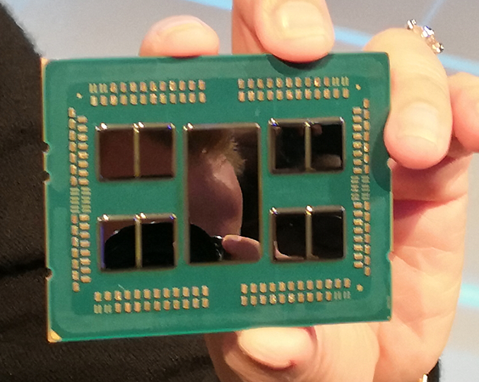
1. Introduction (22)
AMD’s new Zen 2-based Epyc server (Rome) for 64 cores (11/2018) -2
Eight CPU chiplets with 64 cores and a 14 nm I/O chip.
AMD has already started sampling EPYC 'Rome' processors to enterprise customers.

Slide 33
2. The Zen cores
2.1 The Zen core
2.2 The Zen+ core
Notes:
33

Slide 34
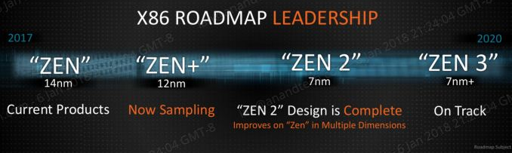
2. The Zen cores (1)
Roadmap of the Zen core as published in 2/2018 [68]
Current products
*

Slide 35
2.1 The Zen core
2.1.1 Introduction to the Zen core
2.1.2 Innovations and enhancements introduced to raise IPC
2.1.3 Power management in Zen cores
2.1.4 Further details relating the Zen core
Only Sections 2.1.1 and 2.1.2 will be discussed
Notes:
35

Slide 36
2.1.1 Introduction to the Zen core
Notes:
36

Slide 37
2.1 The Zen core (1)
2.1.1 Introduction to the Zen core [13]
First announced at AMD's Financial Analyst Day in 5/2016.
First details of the Zen architecture were published at the Computex Conference
in 6/2016.
According to M. Papermaster, CTO of AMD up to 300 engineers were working
on the core design.
Key design objective was raising IPC rather than power gain.
To achieve this AMD developed the SenseMI technology package, to be discussed
in Sections 2.1.2 and 2.1.3.
Key benefits of the Zen core vs. the previous Excavator architecture
14 nm process vs. 28 nm
52 % performance improvement for single threaded workloads
Up to 3.7x improvement in performance/Watt
SMT support (2-way)
*

Slide 38
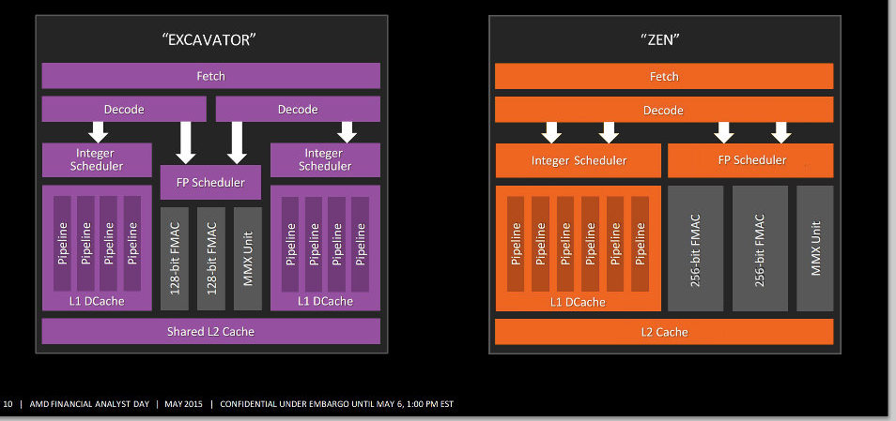
2.1 The Zen core (3)
Remark [14]
With Zen AMD departed from the Bulldozer design style cramming two integer parts
and an FP part into a module and declaring the module as being dual cores and
followed the regular way of building up cores.
*

Slide 39
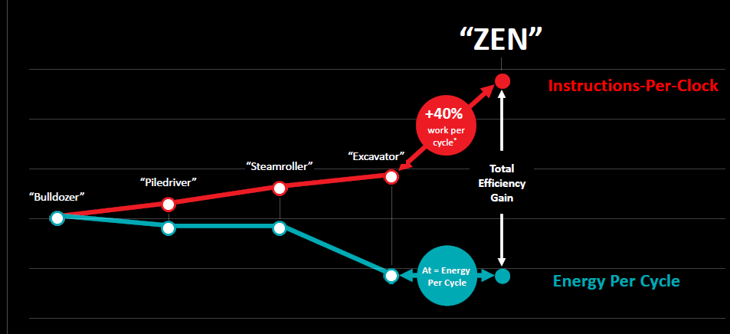
2.1 The Zen core (4)
IPC improvements of the Bulldozer Family and the Zen architecture [15]
3/2017
(14 nm)
Typical IPC increase: 15 % vs. previous family
6/2015
(28 nm)
1/2014
(28 nm)
11/2012
(32 nm)
11/2011
(32 nm)

Slide 40
2.1.2 Innovations and enhancements introduced to raise IPC
Notes:
40

Slide 41
2.1.2 Innovations and enhancements introduced to raise IPC (1)
2.1.2 Innovations and enhancements introduced to raise IPC
Innovations
a) Neural net improved branch predictor (Part of SenseMI)
b) Smart prefetch (Part of SenseMI)
c) Large Micro-Op cache (2K instructions)
Enhancements
d) Wider μop dispatch
Six-issue FX execution (up from 4)
Quad-issue FP execution (up from 3)
e) Further improvements of the microarchitecture
*

Slide 42
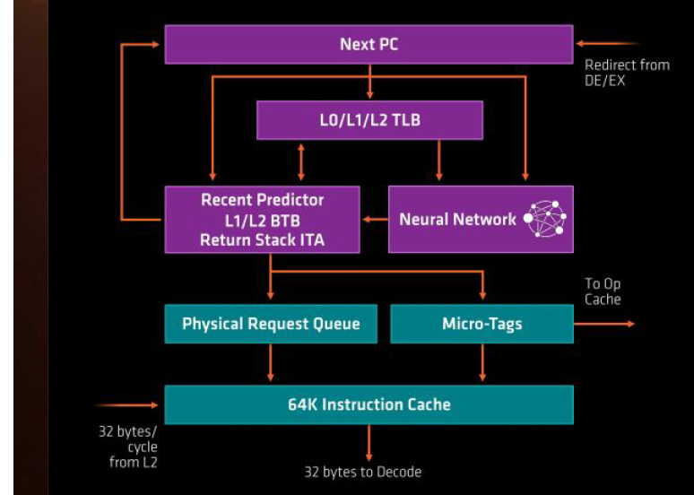
2.1.2 Innovations and enhancements introduced to raise IPC (2)
a) Neural-net improved branch predictor (Part of Sense MI) [10]

Slide 43
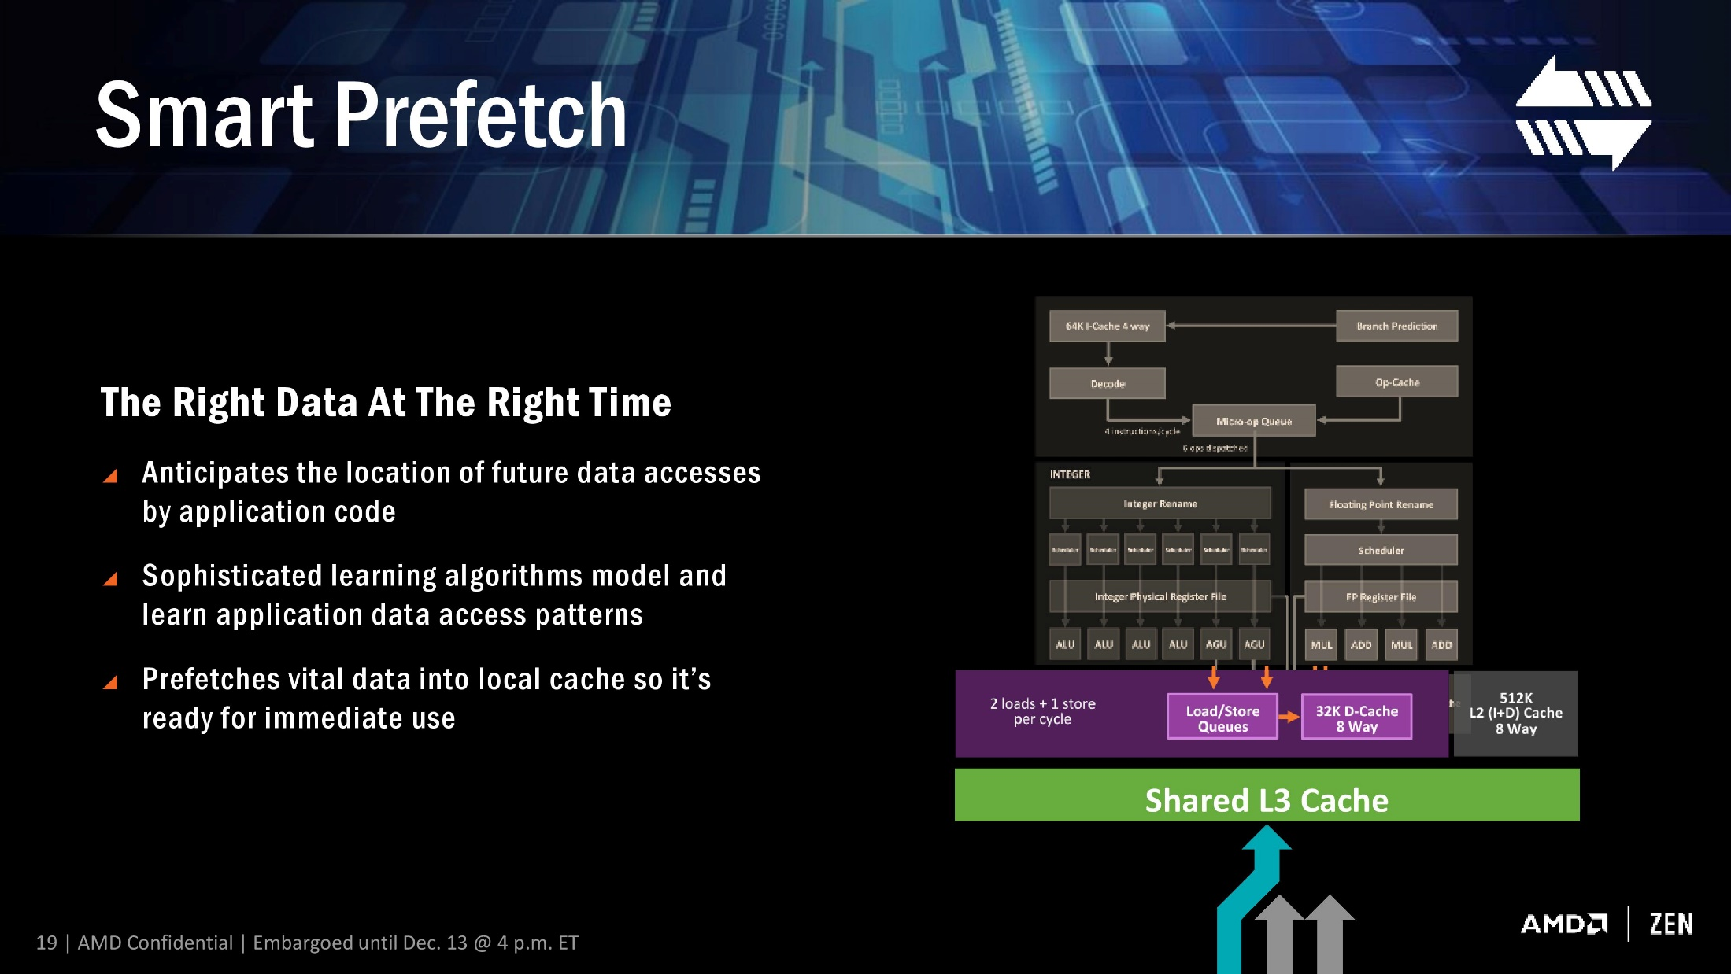
2.1.2 Innovations and enhancements introduced to raise IPC (3)
b) Smart prefetch (Part of Sense MI) [10]

Slide 44
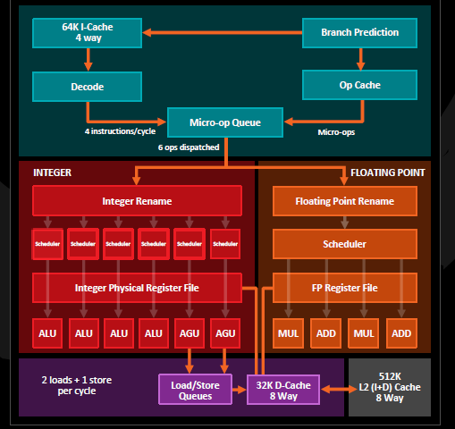
2.1.2 Innovations and enhancements introduced to raise IPC (4)
c) Large Micro-Op cache (2K instructions) [15]
8 macro-ops/cycle
4 ops dispatched

Slide 45
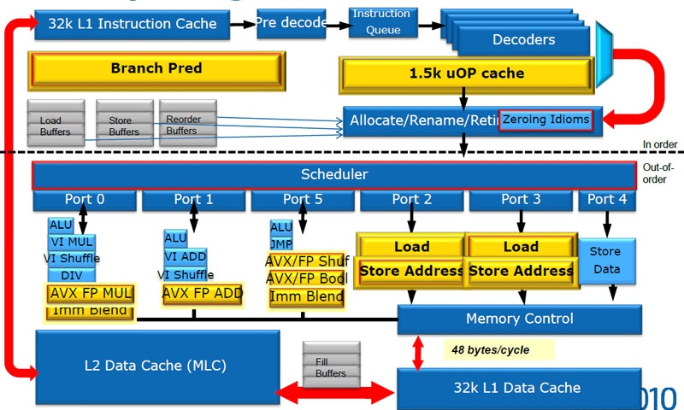
2.1.2 Innovations and enhancements introduced to raise IPC (5)
By contrast: The micro-op cache introduced in Intel’s Sandy Bridge [90]

Slide 46
2.1.2 Innovations and enhancements introduced to raise IPC (6)
d) Wider μop dispatch
Six-issue FX execution (up from 4) - Quad-issue FP execution (up from 3)
4 ops dispatched
6 ops dispatched
4 ops dispatched

Slide 47
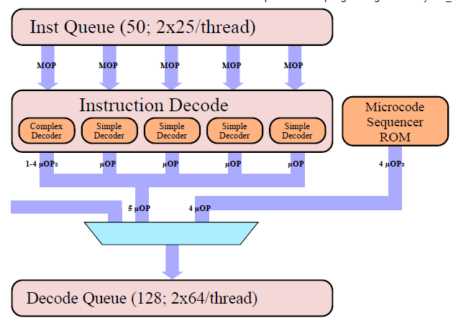
2.1.2 Innovations and enhancements introduced to raise IPC (7)
Comparison: Decoding in Intel's Skylake microarchitecture
5-wide decoding, as shown below.
μOP cache
6 μOP
Figure: Decoding in Intel's Skylake's core [35]

Slide 48
2.1.2 Innovations and enhancements introduced to raise IPC (8)
e) Further improvements of the microarchitecture of Zen
Feature | Zen | Excavator
ROB size (duplicated for each thread) | 192 | 128
ROB throughput | 8 instr./cyle | 4 instr./cycle
Integer scheduler size | 84 | 48
FP scheduler size | 96 | 60
Load Queue | 72 | 44
Store Queue | 44 | 32

Slide 49
2.1.3 Power management in Zen cores
It will be omitted
Notes:
49

Slide 50
2.1.3 Power management in Zen cores (1)
2.1.3 Power management in Zen cores
As part of the SenseMI technology suite AMD introduced the following three
new technologies aiming at the power management:
Pure Power technology (actually AVS)
Precision Boost technology (actually Turbo Boost similar to Intel’s SpeedShift)
XFR (eXtreme Frequency Range) technology (actually configurable TDP)
to be discussed next.
*

Slide 51
2.1.3 Power management in Zen cores (2)
2.1.3.1 Pure Power technology
It is basically an AVS (Adaptive Voltage Scaling) technology.
AVS is a kind of AVFS (Adaptive Voltage and Frequency Scaling) technology.
AVFS is an enhancement of the DVFS (Dynamic Voltage and Frequency Scaling).
*

Slide 52
2.1.3 Power management in Zen cores (3)
DVFS (Dynamic Voltage and Frequency Scaling)
Scaling means here controlling core voltage (Vcc) and frequency (fc) according
to the actual workload.
With DVFS the OS typically assesses the actual workload and scales down fc
as far as feasible without noticeable lengthening the runtime, then it selects
the Vcc value that is needed to maintain the chosen fc from a look up table.
Vcc is determined a priory at chip testing while a guard band is also provided.
Vcc
P0
Vcc0
●
Workload
P1
●
Highest
power
consumption
Vcc1
P2
Figure:
Principle of DVFS
●
Vcc2
.
.
Pn
fc will be scaled according to the
workload intensity.
Vcc is chosen to maintain fc
with a guard band.
Vccn
●
Lowest
power
consumption
..
fc
fcn
fc2
fc1
fc0
*

Slide 53
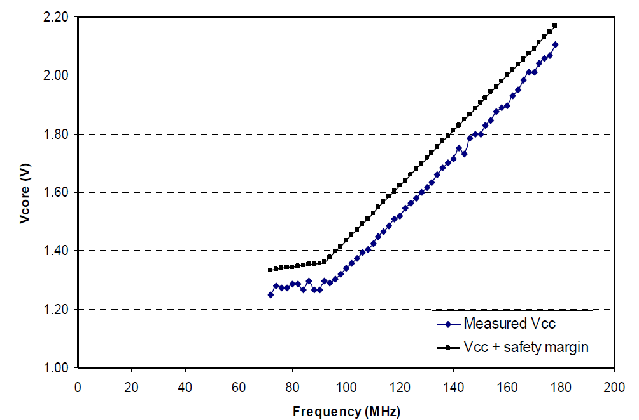
2.1.3 Power management in Zen cores (4)
Example: Minimal (measured) and specified core voltage (Vcc) needed
for sustaining a given core frequency (fc) [61]

Slide 54
2.1.3 Power management in Zen cores (5)
AVFS vs. DVFS
AVFS vs. DVFS
DVFS
AVFS
(Dynamic Voltage and Frequency Scaling)
(Adaptive Voltage and Frequency Scaling)
Aim: to reduce guard band and thus dissipation
DVFS is performed in an open loop.
AVFS is performed in a closed loop.
It means that the OS scales down
core frequency (fc)
according to the actual workload
and determines core voltage (Vcc)
statically (from a look-up table).
Vcc was determined previously
at chip testing while
a certain guard band
was taken into account
to compensate for PVT variations.
It means that first the OS scales down
core frequency (fc) and voltage (Vcc)
according to the actual workload
similarly to DVFS, but then the processor
strongly reduces the guard band
based on monitoring the actual parameters, like
speed, dissipation, die temperature etc..
PVT: Process, Voltage, Temperature

Slide 55
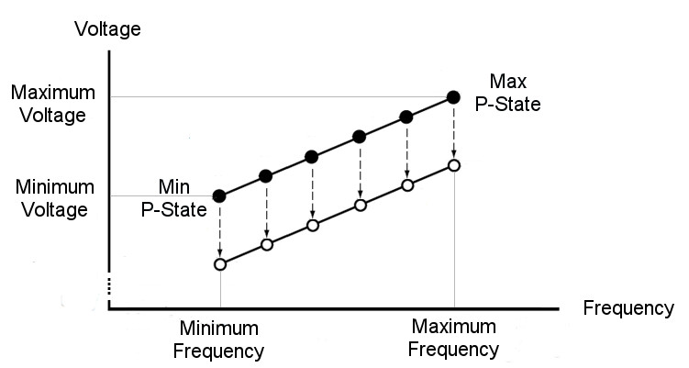
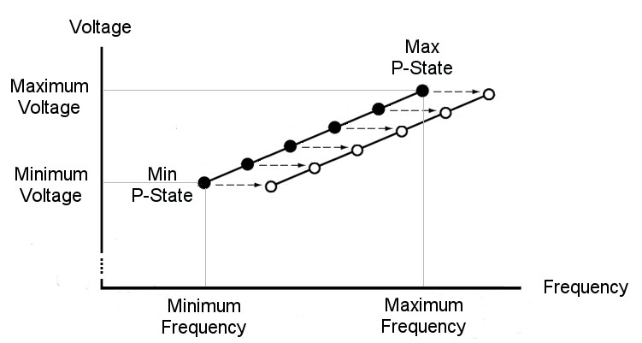
2.1.3 Power management in Zen cores (6)
Illustration of AVS and AFS
Use cases of AVFS to exploit guard band reduction
AVS
(Adaptive Voltage Scaling)
AFS
(Adaptive Frequency Scaling)
It is also called Undervolting
(Called Poor Power by AMD (Zen)
It is also called Overclocking
(Called Precision Boosting by AMD (Zen)
AVS is used to reduce Vcc
at a given fc (P-state)
to a min. allowed value,
to reduce power consumption.
AFS is used to increase fc
at a given Vcc (P-state)
to the max. allowed value
to raise performance.
Without AVS
Without AFS
AVS
AFS
With AFS
With AVS
*

Slide 56
2.1.3 Power management in Zen cores (7)
Overview of introduced AVFS implementations
(02/2015)
(03/2017)
AMD
Carizzo
Ryzen
lines
HiSilicon
(Huawei)
(Q1/2015)
Kirin 930
(Q2/2015)
Samsung
Exynos
7420
(02/2008)
(2/2011)
(2/2012)
TI
OMAP3
OMAP4
OMAP5
(10/2007)
(2/2010)
(4/2014)
IBM
POWER6
POWER7
POWER8
/05/2008)
Via
Adaptive
PowerSaver
in Nano
(06/2004)
National
PowerWise
(macrocell)
2003
2004
2005
2006
2007
2008
2009
2010
2011
2012
2013
2014
2015
2016

Slide 57
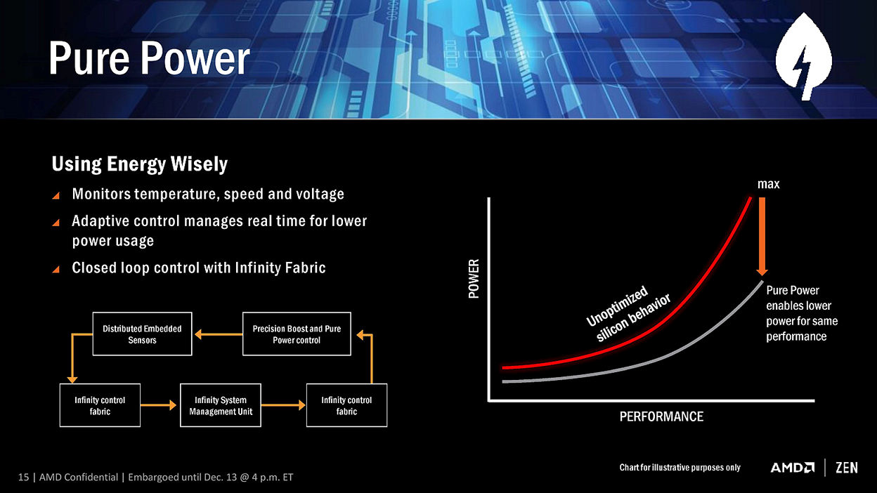
2.1.3 Power management in Zen cores (8)
Principle of AMD's Pure Power technology that implements AVS [10]

Slide 58
2.1.3 Power management in Zen cores (9)
Key points of the implementation of AMD's Pure Power (actually AVS)
a) Real time monitoring of temperature, speed and voltage by sensors,
b) Adaptive closed-loop control
c) Per-core scaling of core frequency and voltage
*

Slide 59
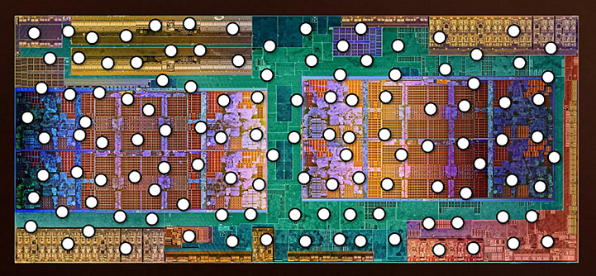
2.1.3 Power management in Zen cores (10)
a) Real time monitoring of temperature, speed and voltage by sensors
1000+ embedded sensors per CCX monitor temperature, speed and voltage per ms.
Figure: Distributed embedded sensors on a Ryzen die (including two CCXs) [10]

Slide 60
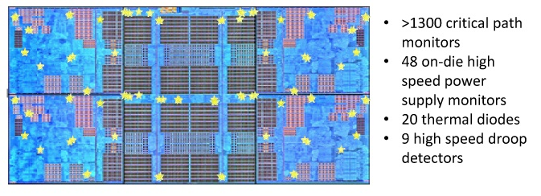
2.1.3 Power management in Zen cores (11)
Sensors implemented on a CCX die to support AVS [9]
Critical path monitors overlook processor speed (clock frequency), they
allow to reduce core voltage in a controlled way as far as possible whereby
a given clock frequency remains maintained.
Droops are rapid spikes in the voltage supply, they need to be addressed to avoid
erroneous operations (not detailed here).
Critical path monitors: kritikus áramköri szakaszok sebességét ellenörző monitorok

Slide 61
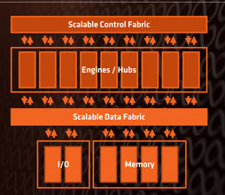
2.1.3 Power management in Zen cores (12)
b) Adaptive closed-loop control -1
The Infinity System's Scalable Control Fabric provides the required infrastructure
for AVS, as seen below.
Figure: The Infinity Fabric [38]

Slide 62
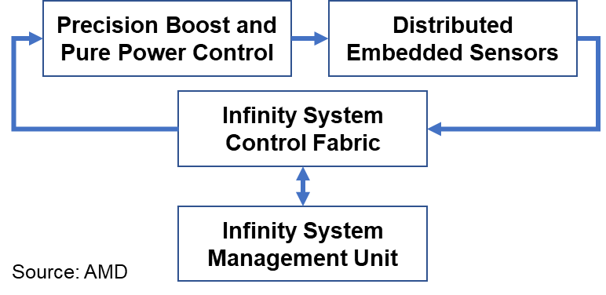
2.1.3 Power management in Zen cores (13)
b) Adaptive closed-loop control -2
There is closed loop control for implementing AVS, as indicated below.
Figure: The closed loop control mechanism for Pure Power (i.e. AVS) and Precision Boost (i.e. Turbo Boost) [3]

Slide 63
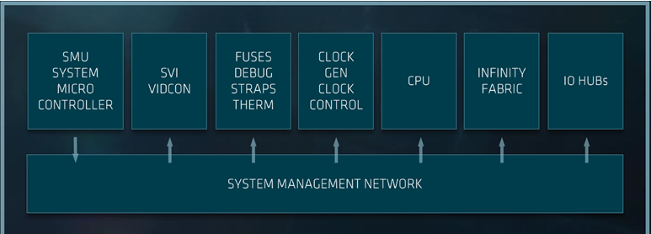
2.1.3 Power management in Zen cores (14)
b) Adaptive closed-loop control -3
An Infinity System Management Unit (based on the SMU microcontroller) is used
for system settings according to user requirements, as the Figure below shows.
The SMU (System Management Unit) microcontroller allows to chose the proper
balance of performance and power consumption.
Figure: Infinity System Management [3]
SVI: Serial VID Interface
VID: Voltage Identifier (transferred to the VR (Voltage Regulator)
*

Slide 64
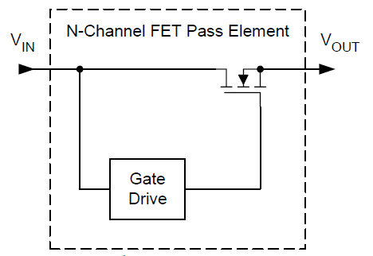
2.1.3 Power management in Zen cores (15)
c) Per core scaling of core frequency and voltage [16]
Each core has
a digital Low Drop-Out (LDO) Voltage Regulator (VR) and
a digital frequency synthesizer (DFS)
to independently vary core frequency and voltage for reducing
power consumption.
The voltage regulators operate also as power gates.
Remark
LDOs are one type of linear regulators, e.g. as seen below [39].
FET: Field Effect Transistor (térvezérlésű tranzisztor)
*

Slide 65
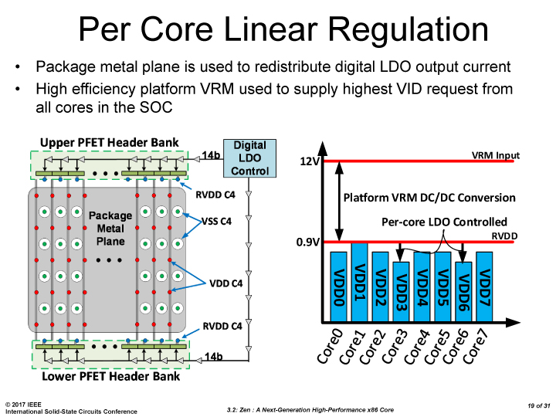
2.1.3 Power management in Zen cores (16)
Implementing separate VRs for each core [50]
Two stage voltage regulation (similar to Intel's two stage FIVR implementation):
1. stage: on the mainboard, it reduces voltage from 12 V to 0.9 V,
2. stage: separate on-die VRs for each core.
Example for per-core voltage regulation in a Ryzen desktop processor:
VRM: VR module input
RVDD: Unregulated supply
Figure: Per-core voltage regulation in a Ryzen desktop processor [50]
*

Slide 66
2.1.3 Power management in Zen cores (17)
2.1.3.2 Precision Boost -1
Basically, it is AMD's Turbo Boost implementation.
It makes use of the same closed loop control mechanism as AMD's Pure Power
(that is AVS):
Figure: The closed loop control mechanism for Pure Power (i.e. AVS) and Precision Boost (i.e. Turbo Boost) [3]

Slide 67
2.1.3 Power management in Zen cores (18)
2) Precision Boost -2
Specific features of the Precision Boost technology:
a) Specifying the Turbo Boost frequencies
b) Fine grained tuning of the clock frequency (in 25 MHz steps)
*

Slide 68
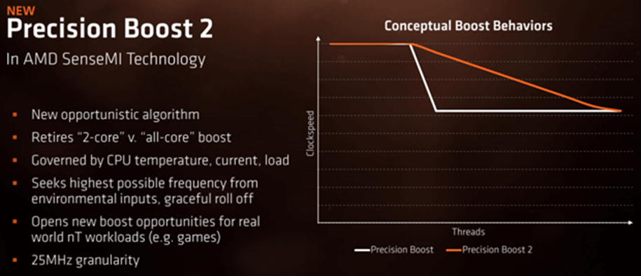
2.1.3 Power management in Zen cores (19)
a) Specifying the Turbo Boost frequency [38]
Precision Boost makes use of two Turbo Boost frequencies,
one higher value for the case if up to 2 cores are active (in DTs), and
a lower value for more active cores,
as indicated in the Figure below.
Up to two active cores
More than two active cores
Figure: Boost behavior in the Ryzen line [38]
*

Slide 69
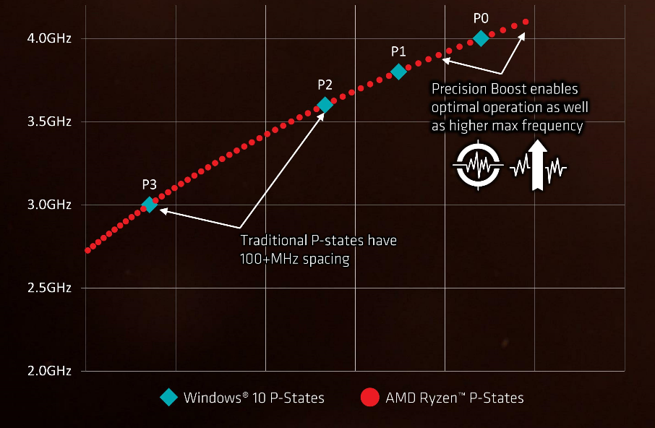
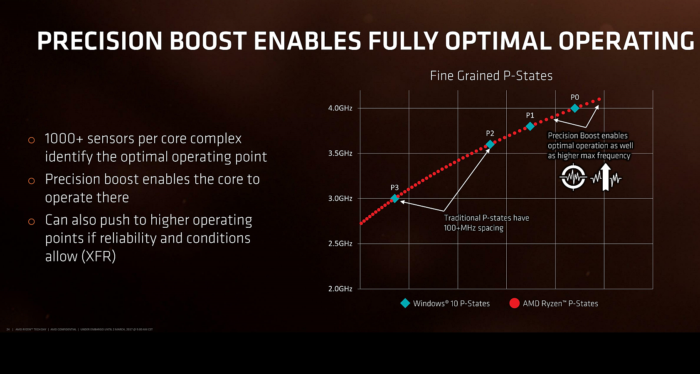
2.1.3 Power management in Zen cores (20)
b) Fine grained tuning of the clock frequency (in 25 MHz steps) [10]
Precision
Boost
XFR
*

Slide 70
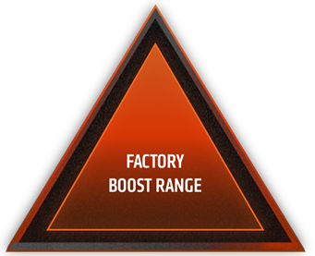
2.1.3 Power management in Zen cores (21)
Assumed principle of fine grained tuning
While using Precision Boost all active cores operate at the same clock frequency
and core voltage.
Fine grained tuning will be performed by the SMU microprocessor that raises the
core voltage and the clock frequency (in 25 MHz steps) whereas checks whether
the limiting factors, including the temperature, SoC power and VRM current
(and with it the socket power consumption) remain in the factory boost range.
Temp
SoC
power
VRM
current
Figure: Conceptual view of extending the limiters of Precision Boost with PBO [82]

Slide 71
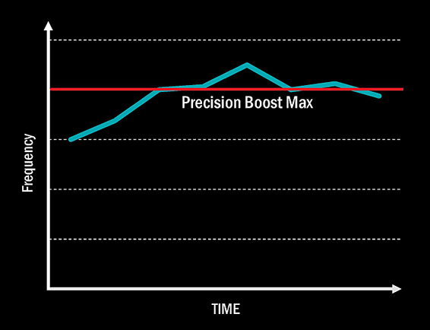
2.1.3 Power management in Zen cores (22)
2.1.3.3 Raising the clock frequency over the Turbo boost frequency - XFR
The XFR (eXtended Frequency Range) technology presumes a high performance
(premium) cooler system to keep die temperature within the given limit [10].
XFR provides an automated overclocking over the max. Turbo Boost frequency if there
is a premium cooler system and the operating conditions of the processor (e.g.
temperature data) allow it.
With XFR enabled the
processor may boost clock
frequency by 50 to 200 MHz
above the advertised
max. Turbo Boost frequency.
Figure: Principle of operation of XFR [10]
*

Slide 72
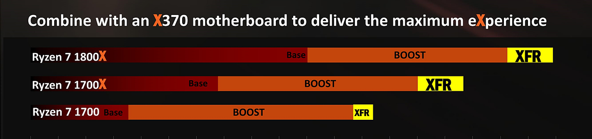
2.1.3 Power management in Zen cores (23)
Illustration of the operation of the XFR technology [10]

Slide 73
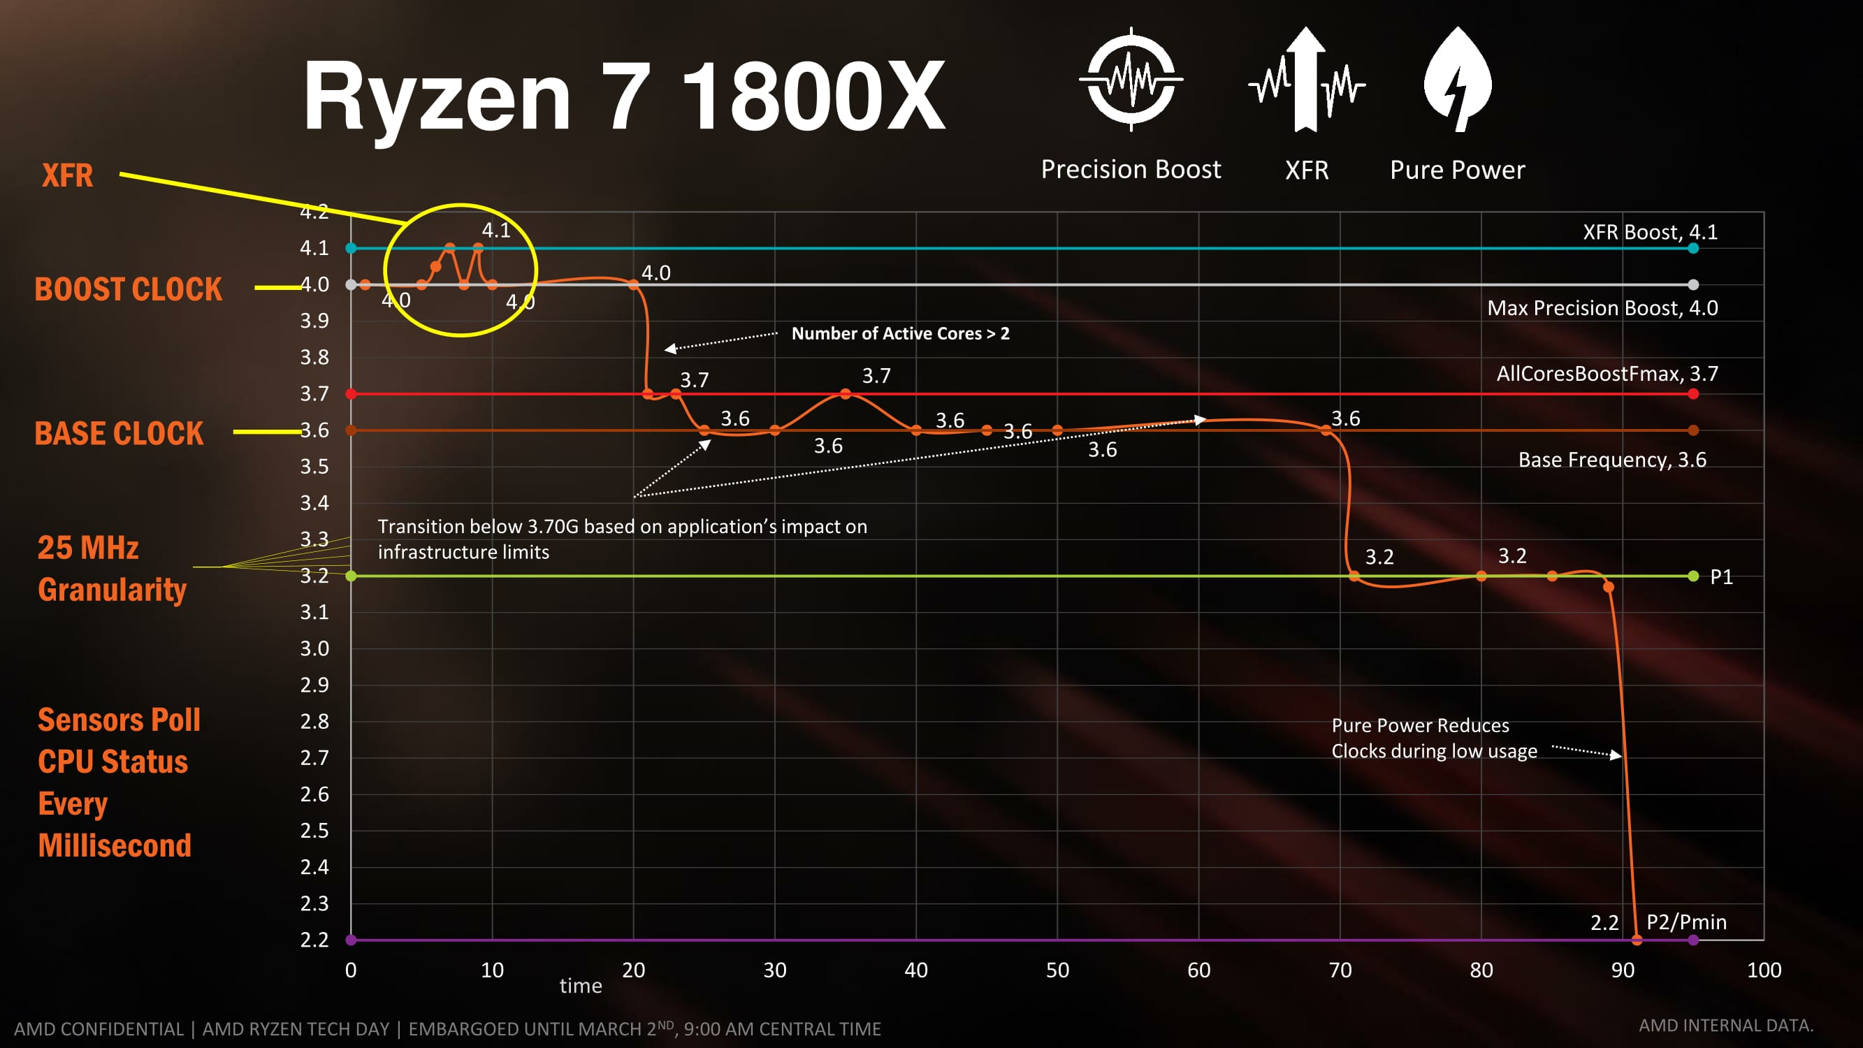
2.1.3 Power management in Zen cores (24)
Example frequency scaling in the Ryzen 7 1800X [10]

Slide 74
2.1.4 Further details relating the Zen core
It will be omitted
Notes:
74

Slide 75
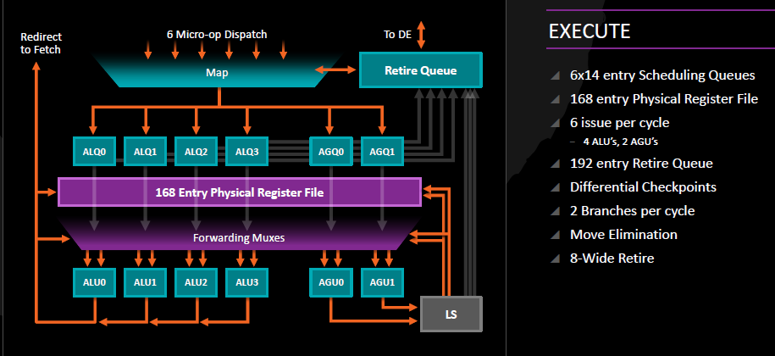
2.1.4 Further details relating the Zen core (1)
2.1.4 Further details relating the Zen core
Block diagram of the FX-execution of Zen [15]

Slide 76

2.1.4 Further details relating the Zen core (2)
Block diagram of the FP-execution of Zen [15]

Slide 77

2.1.4 Further details relating the Zen core (3)
The cache architecture of Zen [15]
L3 is a victim cache, it is filled from L2 victims

Slide 78

2.1.4 Further details relating the Zen core (4)
Implementation of SMT in Zen [10]

Slide 79
2.1.4 Further details relating the Zen core (5)
The Zen die [8]

Slide 80

2.1.4 Further details relating the Zen core (6)
Implementation of functional units on the Zen die [10]

Slide 81
2.2 The Zen+ core
Notes:
81

Slide 82

2.2 The Zen+ core (1)
2.2 The Zen+ core
Improvements yielding from the 12 nm technology [74]

Slide 83

2.2 The Zen+ core (2)
AMD’s use of the 12LP (Low Power) technology
(shown as an example while implementing a part of a datapath) [74]
While employing the 12LP technology AMD implemented the refreshed Ryzen DT
line on the same die size (213 mm²) and made use of the same number of
transistors (4.8 billion) as in their original design.
As a consequence, with reducing the feature size the dark silicon (unused silicon)
area has grown.
Since dark silicon acts as a thermal buffer between high-consumption parts of the
die it improves the thermal behavior of the die.
*

Slide 84
2.2 The Zen+ core (3)
Benefits of the 12LP technology according to AMD [74]
The new Ryzen 2000 series processors draw about 11 % less power than the
Ryzen 1000 series models at the same clock frequency.
It results about 15 % more performance at the same power.
*

Slide 85
2.2 The Zen+ core (4)
Benefits of the 12LP technology vs 14 nm technology in cache latencies
as given by AMD [74]
13% lower L1 latency (1.10ns vs. 0.95ns)
34% lower L2 latency (4.6ns vs. 3.0ns)
16% lower L3 latency (11.0ns vs. 9.2ns)
11% lower memory latency (74ns vs 66ns at DDR4-3200)
Increased DRAM rate (DDR4-2666 vs. DDR4-2933)

Slide 86

2.2 The Zen+ core (5)
Contrasting cache latencies in AMD’s 1000 and 2000 series Ryzen DT
processors [74]

Slide 87

2.2 The Zen+ core (6)
Contrasting cache latencies of AMD’s and competing Intel’s DT models [74]

Slide 88

2.2 The Zen+ core (7)
Contrasting IPC figures of subsequent DT models [74] -1
(12 nm)
(14 nm)
A12-9800:
Excavator-based
(28 nm)
As the Figure shows the R7 2700X provides on average only a few % (about 3 %)
higher IPC than the preceding R7 1800X.

Slide 89
2.2 The Zen+ core (8)
Contrasting IPC figures of subsequent DT models [74] -2
This about 3 % IPC boost is increased by
about 6 % average clock frequency gain and
by a few % gain due to Precision Boost 2 and XFR2
and results in an average performance gain of about 10 % over the previous DT
generation.

Slide 90

2.2 The Zen+ core (9)
Performance gain in subsequent Zen-based lines expected by AMD [74]
7 nm+
7 nm
12 nm
14 nm
CAGR: Compounded Annual Rate of Growth
(Compounded: year/previous year)

Slide 91
3. The 4-core CCX building block
Notes:
91

Slide 92
3. The 4-core CCX building block (1)
3. The 4-core CCX building block -1
Basic building blocks of AMD's Zen-based processors
Zen core [8]
4-core CCX [9]
(Core CompleX)
8-core Zeppelin module [10]
2x CCX

Slide 93
3. The 4-core CCX building block (2)
The 4-core CCX building block -2 [16]
The 4-bit CCX (CPU-Complex) is the basic building block of Zen-based
processor lines.
Each core has a private 512 kB L2 cache whereas all 4 cores share an 8 MB
L3 cache that is split into 4 slices (see Figure) by low-order address interleave.
It includes 1.4 billion transistors implemented on a die area of 44 mm^{2.}
Figure: The CCX building block [16]
*

Slide 94
3. The 4-core CCX building block (3)
The 4-core CCX building block -3 [15]
The L3 cache is mostly exclusive to the L2 cache, it is actually a victim cache
for the L2 cache.
Due to the internal crossbar interconnection (see previous Figure), each core
can access each L3 cache segment with the same average latency.
*

Slide 95


3. The 4-core CCX building block (4)
Block diagram and die photograph of the CCX Core CompleX [15], [59]

Slide 96


3. The 4-core CCX building block (5)
Comparing AMD's CCX (a) and ARM's MPCore (actually Cortex-A 73) (b)
Cortex-A73 core
ARMv8.0 CPU
(8 MB)
(2017)
b) 2016) [55]
ACP: Accelerator Coherence Port
(to connect non-cached
coherent data sources)
SCU: Snoop Control Unit
(Provides coherence
within the the processor)
ECC: Error Correcting Code
AMBA: Advanced Microcontroller
Bus Architecture
(On-chip bus standard
for SoC) designs)
ACE: AXI Coherency Extensions
AMBA4 cache coherent interface
(Used in big.LITTLE systems
for smartphones, tablets, etc.)
AXI4: Advanced eXtensible Interface
(Not cache coherent interface)
*

Slide 97

3. The 4-core CCX building block (5b)
Comparing ARM's MPCore (Cortex-A73) (a) and DynamIQ core clusters (b)
Cortex-A73 core
ARMv8.0 CPU
(a) (2016) [55]
(b) (2017) [56]
ARMv8.1 support, e.g. Cortex-A53/
A57/A72/A73, up to 4 cores
Shared L2 cache
ARMv8.2 support, (Cortex-A55/75), up to 8 cores
Shared L3 cache, partial L3 cache power down,
Private L2 caches
*

Slide 98
4. The Zeppelin module
Notes:
98

Slide 99
4. The Zeppelin module (1)
4. The Zeppelin module
Basic building blocks of AMD's Zen-based processors
Zen core [8]
4-core CCX [9]
(Core CompleX)
8-core Zeppelin module [10]
2x CCX

Slide 100
4. The Zeppelin module (2)
The Zeppelin module -1
It is based on two CCX blocks connected together by the Infinity Fabric, as seen below.
256-bit/cycle
Figure: Block diagram of the Zeppelin module based Ryzen processor [17]
*

Slide 101
4. The Zeppelin module (3)
The server first nature of the Zeppelin module [18]
AMD designed the Zeppelin module for the server market, but they utilize
it also as a modular building block for their consumer (Ryzen) and HED
(Threadripper) lines, as indicated in one of the preceding Figures.

Slide 102

4. The Zeppelin module (4)
Die photograph of the 14 nm Zeppelin die (Ryzen die) [78]

Slide 103

4. The Zeppelin module (5)
Floorplan of the 14 nm Zeppelin die (Ryzen die) [77] -1
4xSouth-
bridge
4x USB 3.1 Gen 1
IFIS: Infinity Fabric InterSocket/PCIe Gen 3 x16
IFOP: Infinity Fabric On-Package x4

Slide 104

4. The Zeppelin module (6)
Die photograph of the 12 nm Zeppelin die (Ryzen die) [63]

Slide 105
5. The Infinity Fabric
Will not be discussed
Notes:
105

Slide 106

5. The Infinity Fabric (1)
5. The Infinity Fabric (IF)
The IF is AMD's recent interconnection fabric used for linking system units
in a cache coherent way and provides also system wide control functions,
such as power management or system security.
It is the evolution of the HyperTransport bus, it is similar to Intel's QPI or UPI
interconnection technology or ARM's CCN (Cache Coherent Network).
The Infinity Fabric consists of two key parts, a Scalable Control Fabric, and a
Scalable Data Fabric, as seen in the next Figure.
Power management
Security and Encryption
Test and initialization
Quality of Service
Coherent
advanced
HyperTransport
bus
Low latency
standardized
interfaces
Figure: AMD's Infinity Fabric [19]
*

Slide 107

5. The Infinity Fabric (2)
AMD's Infinity Fabric in a Ryzen chip in more details [41]
SMUIO: System Management Unit I/O registers
DFT/DFD: Design for Test and Debug

Slide 108
5. The Infinity Fabric (3)
The Scalable Control Fabric -1
The Scalable Control Fabric is responsible for the system wide
Power management
Security and Encryption
Test and initialization
Quality of Service,
as indicated below.
Power management
Security and Encryption
Test and initialization
Quality of Service
Coherent
advanced
HyperTransport
bus
Low latency
standardized
interfaces
Figure: AMD's Infinity Fabric [19]
*

Slide 109
5. The Infinity Fabric (4)
The Scalable Control Fabric -2
The Scalable Control Fabric incorporates central control elements, and
remote embedded elements dispersed in all blocks of the SoC.
The remote elements are mainly sensors monitoring temperature, speed and
voltage, their data is fed into the central control element and allows to
optimize power management in a closed control loop, as seen in the
next Figure and detailed in Section 7.
*

Slide 110
5. The Infinity Fabric (5)
Principle of the operation of the Infinity System Control Fabric [3]
Control algorithms for AVFS
Over 1000 sensors per CCX
The system may be customized
by choosing the proper balance between
performance and power consumption
For details see Section 7.

Slide 111
5. The Infinity Fabric (6)
The Scalable Data Fabric (SDF) -1
The Scalable Data Fabric provides a high performance cache coherent data
pathway for interconnecting all system blocks.
It is an evolution of the HyperTransport bus.
Power management
Security and Encryption
Test and initialization
Quality of Service
Coherent
advanced
HyperTransport
bus
Low latency
standardized
interfaces
Figure: AMD's Infinity Fabric [19]
*

Slide 112

5. The Infinity Fabric (7)
The Scalable Data Fabric (SDF) -2
It interconnects
CCX building blocks within a die (not seen in the Figure)
different dies within a socket (designated as CPUs in the Figure),
both sockets of a 2S server or even further sockets.
as detailed subsequently.
CCX building blocks within a die,
different dies within a socket,
two sockets of a 2S server and
CCX building blocks within a die,
different dies within a socket,
two sockets of a 2S server and
Figure: Concept of the SDF [19]
*

Slide 113

5. The Infinity Fabric (8)
a) Interconnecting two CCX building blocks within a Ryzen chip [20]

Slide 114
5. The Infinity Fabric (9)
Interconnecting CCX building blocks and other units within a Ryzen chip [17]
SDF: 256 bits/cycle
1333 MT/s (Mem. clock)
Note: Bandwidth of 2 DDR4-2666 memory channels: 2x 8x 2666 MT/s = 42.667 GB/s
Bandwidth of the SDF: 256 bit x 1333 MT/s = 42.667 GB/s (bidirectional)

Slide 115
5. The Infinity Fabric (10)
Conceptual layout of the Infinity Fabric (IF) in a Zeppelin die [88]
IFOP: IF On-Package interconnect links
IFIS: IF Inter-Socket interconnect links
SDF implements a crossbar-type on-die interconnect.
SerDes: (Serializer/Deserializer) interface to another chip within the system

Slide 116

5. The Infinity Fabric (11)
SDF local memory access [88]

Slide 117

5. The Infinity Fabric (12)
SDF die-to-die memory access [88]

Slide 118
5. The Infinity Fabric (13)
Comparison: Intel’s and ARM’s on-die interconnects -1
Topology of on-die interconnects
Shared bus
based interconnects
Crossbar-based
interconnects
Higher
performance
for higher nc
Core
--
GPU
P
---
GPU
Bus
Crossbar
M
---
Per./IO
M
--
Per.
Examples
Intel
Nehalem (CC, on QPI, 2008)
ARM
AHB based SoCs
(non CC, ~2001) [8]
PL-300 interconnect
(non CC, on AXI3, 2004)
through the CCI 550 interconnect
(CC, on ACE, 2015)
CC: Cache Coherent

Slide 119
5. The Infinity Fabric (14)
Comparison: Intel’s and ARM’s on-die interconnects -2
Topology of on-die interconnects
Ring bus-based
interconnect topology
2D mesh-based
interconnect topology
Less cost
for higher nc
Shorter
access time
for higher nc
CC
--
A
--
IO
R
R
R
R
R
R
CC
CC
A
A
IO
IO
R
R
R
R
R
R
CC
CC
A
A
IO
IO
Ring
R
R
R
R
R
R
CC
CC
A
A
IO
IO
R
R
R
R
R
R
MC
MC
MC
P
P
P
MC
---
Per.
R
R
R
R
R
R
MC
MC
MC
P
P
P
CC: Core Cluster
A: Accelerator (e.g. GPU, NPU)
nc: Core count
Examples
Intel
Sandy Bridge (CC, on QPI, 2011)
Skylake-SP for servers
(CC, UPI, 2017)
Knights Landing for AI, (2016)
ARM
CCN-5xx interconnect for servers
(CC, on CHI, 2012)
CMN-6xx Interconnect for servers
(CC, on CHI, 2017)
*
*

Slide 120

5. The Infinity Fabric (15)
Example: ARM's CCI-400 crossbar interconnect fabric [46]
.
ACE: (AXI Coherency Extensions). ARM's coherent interface specification developed for
core clusters, introduced in 2011

Slide 121


5. The Infinity Fabric (16)
Example: ARM's CCN-504 ring interconnect fabric (dubbed Dickens) [47]
Remark: The Figure indicates only 15 ACE-Lite slave ports and 1 master port
whereas ARM's specifications show 18 ACE-Lite slave ports and 2 master ports.

Slide 122

5. The Infinity Fabric (17)
Example: Use of ARM's cache coherent CCN-504 interconnect in a server
system [49]

Slide 123

5. The Infinity Fabric (18)
b) Die-to-die interconnect in an Epyc server processor [21]
(Dies are Zeppelin modules)
Revealed in AMD's Epyc Launch event presentation, June 20 2017

Slide 124

5. The Infinity Fabric (19)
Die-to-die interconnect links, called IFOP (IF On-Package) interconnect links
e.g. in an Epyc server processor - detailed [7]
G0 - G3: 4 x 16 SERDES lanes
(in each direction)
Used for socket-to-socket
communication or PCIe 3.0 lanes
MA-MH: 8 x 64+8-bit DDR4
DRAM channels
∞: Die-to-die IF links (IFOP links)
32-bit per link per direction
interconnecting the chips
in a crossbar fashion
by single-ended signals
Differential clocking
(2 pJ/bit)
4 transfers/mem. clock
P0 - P3: 4 x 16 SERDES lanes
(in each direction)
Used to implement PCIe 3.0 lanes
Bi-dir. BW/link for DDR4-2666: 2x 4 x 4 B x 1333 MT/s = 42.67 GB/s

Slide 125

5. The Infinity Fabric (20)
Implementation of the IFOP (IF On-Package) interconnect links
2pJ/bit power consumption

Slide 126

5. The Infinity Fabric (21)
c) Socket-to-socket interconnect links, called IFIS (IF Inter-Socket)
interconnect links in a 2S Epyc server [21]
Revealed in AMD's Epyc Launch event presentation, June 20 2017

Slide 127

5. The Infinity Fabric (22)
Socket-to-socket interconnect links, called IFIS (IF Inter-Socket) interconnect links in a 2S Epyc server – detailed [43]
4x 16 lanes per direction, 8 transfers/memory clock
Differential signaling, (9 pJ/bit according to [43] or 11 pJ/bit according to [87])
In-band CRC, 8/9 bandwidth
BW for DDR4-2666: 8/9x 8x 2B x 1333 MT/s 2 (bi-dir.) = 37.92 GB/s
37.9 GB/s
bidir.
37.9 GB/s
bidir.
42.6 GB/s bidir.
42.6 GB/s bidir.
37.9 GB/s
bidir.
37.9 GB/s
bidir.
32 lines each, single ended signaling
(2 pJ/bit)
GMI: Global Memory Interconnect
SDF: Scalable Data Fabric

Slide 128

5. The Infinity Fabric (23)
Balancing bandwidths in a 2S Epyc server chip with DDR4-2667 [21]
Revealed in AMD's Epyc Launch event presentation June 20 2017

Slide 129

5. The Infinity Fabric (24)
I/O (PCIe 3.0) links provided by a 1S server [21]

Slide 130
5. The Infinity Fabric (25)
Latency and bandwith of IF links in EPYC processors [21]
EPYC (Naples) Thread Ping Connections
 | Latency | Bandwidth
Within A Core | 26 ns | -
Core-to-Core, Same CCX | 42 ns | -
Core-to-Core, Different CCX, Same Die | 142 ns | -
Die-to-Die, Same Package | ? | 42.6 GB/s
Die-to-Die, Different Socket, One Hop | ? | 37.9 GB/s
Die-to-Die, Different Socket, Two Hops | ? | 37.9 GB/s
Core to DRAM, Same Die | 90 nm | 42.6 GB/s
Core to DRAM, Different Die | 145 ns | 42.6 GB/s
Core to DRAM, Different Socket, One Hop | 200 ns | 37.9 GB/s
Core to DRAM, Different Socket, Two Hops | ? | 37.9 GB/s
Bandwidth: bidirectional

Slide 131
5. The Infinity Fabric (26)
Latencies and bandwidth in Intel's Skylake and Kaby Lake processors [22]
Processor | Line | Core count | Intra-Core Latency | Core-To-Core Latency | Core-To-Core Average Latency | Average Transfer Bandwidth
Core i9-7900X | Skylake-X | 10 | 14.5 - 16ns | 69.3 - 82.3ns | 75.56ns | 83.21 GB/s
Core i9-7900X @ 3200 MT/s | Skylake-X | 10 | 16 - 16.1ns | 76.8 - 91.3ns | 83.93ns | 87.31 GB/s
Core i7-6950X | Broadwell-E | 10 | 13.5 - 15.4ns | 54.5 - 70.3ns | 64.64ns | 65.67 GB/s
Core i7-7700K | Kaby Lake-S | 4 | 14.7 - 14.9ns | 36.8 - 45.1ns | 42.63ns | 35.84 GB/s
Core i7-6700K | Skylake-S | 4 | 16 - 16.4ns | 41.7 - 51.4ns | 46.71ns | 32.38 GB/s
Intra-core latency quantifies latency between threads that are resident on the same physical
core, while the core-to-core figures reflect thread-to-thread latency between two physical cores.
Core i9-7900K is most comparable to the 10-core Core i7-6950X, but the four-core models
are also included as a reference point.
6xxx models belong to the Skylake line, 7xxx models to the Kaby Lake line.

Slide 132

5. The Infinity Fabric (27)
DDR + IFOP (IF On-Package) routing [88]

Slide 133

5. The Infinity Fabric (28)
DDR + IFIS (IF Inter-Socket) package routing [88]

Slide 134
6. The Ryzen desktop line
6.1 The Ryzen desktop line
6.2 The 2. gen. desktop line
6.3 The Ryzen desktop APU line
Only Section 6.1 will be discussed
Notes:
134

Slide 135

6. The Ryzen desktop line
Roadmap of AMD’s desktop lines [64]
(Desktop no GPU 14 nm)
(Desktop no GPU 12 nm)
(Desktop no GPU 7 nm)
(Desktop APU 14 nm)
(Desktop APU 7 nm)

Slide 136
6.1 The Ryzen desktop line
Notes:
136

Slide 137
6.1 The Ryzen desktop line (1)
6.1 The Ryzen desktop line
Called also the 1. gen. Ryzen desktop line.
Designated also as the Summit Ridge line.
Launched in 3/2017 (Ryzen 7)
4/2017 (Ryzen 5)
7/2017 (Ryzen 3)
AMD introduced their Ryzen processor at their AMD Tech Day in March 2 2017
by saying proudly:
"We are AMD, creators of Athlon, Radeon and other famous microprocessors. We also power the Xbox One and PS4. Today we want to talk RYZEN, our new high-speed CPU five years in the making" [60].
Ryzen processors include a single Zeppelin die, called also the Ryzen die, which is
built up basically of two CCX complexes interconnected by the IF (Infinity Fabric),
as seen in the next slides.
Models of the Ryzen desktop line are unlocked.
They have AM4 socket (1331).
*

Slide 138

6.1 The Ryzen desktop line (2)
The increased maximum core count of the Ryzen desktops
Until introducing the Ryzen desktop line desktops provided up to 4 cores, as the
Figure below indicates.
Figure: Increasing the maximum core count along with the introduction of the
Ryzen desktop line [66]
The Ryzen desktop line provides up to 8 cores.
Subsequently, also Intel raised the max. core count to 6 in their 7. gen. Kaby Lake
Refresh desktop line in Q3 2017 to cope with AMD’s Ryzen line for MT workloads.

Slide 139
6.1 The Ryzen desktop line (3)
Positioning AMD's Zen-based Ryzen desktop lines
AMD's Zen-based processor lines
Ryzen Mobile
(Mobil)
Ryzen
(DT)
ThreadRipper
(HED)
Epyc
(1S/2S server)
Single CCX +
Vega GPU
Zeppelin chip
(2x CCX, no GPU)
2 Zeppelin chips
interconnected by the IF,
implemented as an MCM
4 Zeppelin chips
interconnected by the IF,
implemented as an MCM
Drawings based on [11]

Slide 140
6.1 The Ryzen desktop line (4)
Basic layout of AMD's Zen-based Zeppelin chip [20], [10]
4.8 billion transistors, 192mm² die

Slide 141
6.1 The Ryzen desktop line (5)
Block diagram of AMD's Zeppelin chip [17]
256-bit/cycle

Slide 142
6.1 The Ryzen desktop line (6)
Main features of AMD's Ryzen desktop line introduced in 2017
AMD's Zen-based processor lines introduced in 2017
DT | Ryzen Mobile | Ryzen DT | ThreadRipper (HED) | Epyc
Market segment | Mobile | Desktop platform | HED | 1S/2S server
μarch./Technology | Zen 14 nm | Zen, 14 nm | Zen, 14 nm | Zen, 14 nm
Launched models | Ryzen 7 2700U Ryzen 5 2500U (10/2017) | Ryzen 7 (3/2017) Ryzen 5 (4/2017) Ryzen 3 (7/2017) | 1950X/1920X/1900X (8/2017) | Series 7000 (6/2017)
Layout | CCX + Vega 8/10 | Zeppelin die with 2x CCX | MCM (2x Zeppelin die) | MCM (4x Zeppelin die)
Integrated GPU | Yes | No | No | No
Core count | 4 | 4/6/8 | 8/12/16 | 8/16/24/32
SMT | SMT | SMT (except Ryzen 3) | SMT | SMT
Mem. channels/rate | 2xDDR4-2400 | 2xDDR4-2666 | 4xDDR4-2666 | 8xDDR4-2666
PCIe 3.0 lanes | ?? | 16xPCIe 3.0 | 60xPCIe 3.0 | 128 for 1S servers 64 for 2S servers
TDP | 15 W | 65/95 W | 180 W | 120/170/180 W
Socket | AM4 (1331) | AM4 (1331) | TR4 (SP3r2) (4094) | SP3 (4094)
Chipset | SoC | 300-series | X399 | No chipset, SOC

Slide 143
6.1 The Ryzen desktop line (7)
Main features of the Ryzen and ThreadRipper lines [23]
AMD Ryzen SKUs
 | Cores/ Threads | Base/ Turbo | XFR | L3 | DRAM 1DPC | PCIe | TDP | SRP
TR 1950X | 16/32 | 3.4/4.0 | +200 | 32 MB | 4x2666 | 60 | 180W | $999
TR 1920X | 12/24 | 3.5/4.0 | +200 | 32 MB | 4x2666 | 60 | 180W | $799
TR 1920** | 12/24 | 3.2/3.8 | ? | 32 MB | 4-Ch? | 60 | 140W | ?
TR 1900X | 8/16 | 3.8/4.0 | +200 | 16 MB* | 4x2666* | 60 | 180W* | $549
Ryzen 7 1800X | 8/16 | 3.6/4.0 | +100 | 16 MB | 2x2666 | 16 | 95 W | $499
Ryzen 7 1700X | 8/16 | 3.4/3.8 | +100 | 16 MB | 2x2666 | 16 | 95 W | $399
Ryzen 7 1700 | 8/16 | 3.0/3.7 | +50 | 16 MB | 2x2666 | 16 | 65 W | $329
Ryzen 5 1600X | 6/12 | 3.6/4.0 | +100 | 16 MB | 2x2666 | 16 | 95 W | $249
Ryzen 5 1600 | 6/12 | 3.2/3.6 | +100 | 16 MB | 2x2666 | 16 | 65 W | $219
Ryzen 5 1500X | 4/8 | 3.5/3.7 | +200 | 16 MB | 2x2666 | 16 | 65 W | $189
Ryzen 5 1400 | 4/8 | 3.2/3.4 | +50 | 8 MB | 2x2666 | 16 | 65 W | $169
Ryzen 3 1300X | 4/4 | 3.5/3.7 | +200 | 8 MB | 2x2666 | 16 | 65 W | $129
Ryzen 3 1200 | 4/4 | 3.1/3.4 | +50 | 8 MB | 2x2666 | 16 | 65 W | $109
Product specifications subject to change.

Slide 144
6.1 The Ryzen desktop line (8)
Infinity Fabric thread latencies in AMD's Ryzen line [24]
Processor | Intra-Core Latency | Intra-CCX Core-to-Core Latency (same die) | Cross-CCX Core-to-Core Latency (different dies) | Cross-CCX Average Latency | Die-to-Die Latency | Die-To-Die Average Latency | Average Transfer Bandwidth
Ryzen 7 1800X | 14.8ns | 40.5 - 82.8ns | 120.9 - 126.2ns | 122.96ns | X | X | 48.1 GB/s
Ryzen 5 1600X | 14.7 - 14.8ns | 40.6 - 82.8ns | 121.5 - 128.2ns | 123.48ns | X | X | 43.88 GB/s

Slide 145
6.1 The Ryzen desktop line (9)
Interpretation of the Infinity Fabric latencies in the Table above [24]
Intra-core latency reflects the communication between two logical threads resident
on the same physical core, it is unaffected by memory speed.
Intra-CCX latencies quantify latency between threads that are on the same CCX
but not resident on the same core, it is also largely unaffected by memory speed.
Cross-CCX latency denotes latency between threads located on two separate CCX
building blocks.
Die-to-Die latency relates to latency between threads that are on different dies.
Ryzen line processors include only a single die so no Die-to-Die latencies can occur.

Slide 146

6.1 The Ryzen desktop line (10)
Ryzen based system architecture [25]

Slide 147

6.1 The Ryzen desktop line (11)
Single-threaded performance per Dollar on CPU benchmarks [10]
(Only Ryzen 7 models are shown)

Slide 148

6.1 The Ryzen desktop line (12)
Multi-threaded performance per Dollar on CPU benchmarks [10]
(Only Ryzen 7 models are shown)

Slide 149
6.2 The 2. gen. Ryzen desktop line
Notes:
149

Slide 150
6.2 The 2. gen. Ryzen desktop line (1)
6.2 The 2. gen. Ryzen desktop line
Code-named as the Pinnacle Ridge line.
Launched in 4/2018 as the Ryzen 7 2700X/2700 and
Ryzen 5 2600X/2600
models.
The line is manufactured on the 12 nm technology (by GlobalFoundries).
These processors are unlocked.
They have AM4 socket.
The line is accompanied by new motherboards (400-series) but they remained
compatible with the previous 300-series motherboards.
The processors come bundled with AMD’s Wraith Spire cooler.
*

Slide 151
6.2 The 2. gen. Ryzen desktop line (2)
Main features of the 2. gen. Ryzen desktop line
AMD's Zen/Zen+ based processor lines introduced in 2018
 | Ryzen Mobil APU | Ryzen DT APU | 2.G Ryzen DT | 2.G ThreadRipper (HED)
μarch./tech. | Zen/14 nm | Zen/14 nm | Zen+/12 nm | Zen+/12 nm
Launched models | Ryzen 3 2320U Ryzen 3 2200U (1/2018) | Ryzen 5 2400G Ryzen 3 2200G (2/2018) Ryzen 5 2400GE Ryzen 3 2200GE (2/2018) | Ryzen 7 2700X Ryzen 7 2700 Ryzen 5 2600X Ryzen 5 2600 (4/2018) | 2990WX (8/2018) 2950X (8/2018) 2970WX (10/2018) 2920X (10/2018)
Layout | CCX + Vega 6/3 | CCX + Vega 11/8 | Zeppelin die (2x CCX) | MCM (up to 4 Zeppelin dies)
Integrated GPU | Yes | Yes | No | No
Core count | 2/4 | 4 | 6/ 8 | Up to 32
SMT (Multithreaded) | SMT only for Ryzen 3 2200U | SMT only for Ryzen 5 | SMT | SMT
Mem. channels/ data rate | 2xDDR4-2400 | 2xDDR4-2667 (G) 2xDDR4-2933(GE) | 2xDDR4-2933 | 4xDDR4-2933
PCIe lanes | ?? | ?? | 16x PCIe 3.0 | 60x PCIe 3.0
TDP | 15 W | 35/65 W | 65/95/105 W | 180/250 W
Socket | FP5 (na.) | AM4 (1331) | AM4 (1331) | TR4 (SP3r2) (4094)
Chipset | SoC | 300-series | 300/400-series | X399

Slide 152

6.2 The 2. gen. Ryzen desktop line (3)
Advantages of the 12 nm technology [65]

Slide 153

6.2 The 2. gen. Ryzen desktop line (4)
The Ryzen+ die [63]
Die size: 213 mm², core count: 4.8 billion transistors.
This is the same data as for the previous Ryzen die.

Slide 154
6.2 The 2. gen. Ryzen desktop line (5)
Comparing the 14 nm and the 12 nm technologies [63]
The 12 nm part has more dark silicon, that is beneficial for the thermal behavior.

Slide 155
6.2 The 2. gen Ryzen desktop line (6)
Main features of the announced Ryzen+ desktop models [63]
AMD Ryzen 2000-Series CPUss
 | Ryzen 7 2700X | Ryzen 7 2700 | Ryzen 5 2600X | Ryzen 5 2600
CPU Cores/Threads | 8 / 16 | 8 / 16 | 6 / 12 | 6 / 12
Base CPU Frequency | 3.7 GHz | 3.2 GHz | 3.6 GHz | 3.4 GHz
Turbo CPU Frequency | 4.3 GHz | 4.1 GHz | 4.2 GHz | 3.9 GHz
TDP @ Base Frequency | 105 W | 65 W | 95 W | 65 W
L1 Cache | I: 64K. D: 32K | I: 64K. D: 32K | I: 64K. D: 32K | I: 64K. D: 32K
L2 Cache | 512 KB/core | 512 KB/core | 512 KB/core | 512 KB/core
L3 Cache | 16 MB | 16 MB | 16 MB | 16 MB
DRAM Support | DDR4-2933 Dual Channel | DDR4-2933 Dual Channel | DDR4-2933 Dual Channel | DDR4-2933 Dual Channel
PCIe Lanes (CPU) | 16 Free + 4 NVMe | 16 Free + 4 NVMe | 16 Free + 4 NVMe | 16 Free + 4 NVMe
Price | $329 | $299 | $229 | $199
Bundled Cooler | AMD Prism RGB | AMD Spire RGB | AMD Spire | AMD Stealth

Slide 156
6.2 The 2. gen. Ryzen desktop line (7)
Enhancements of the Ryzen+ desktop line vs. the previous Ryzen line
Precision Boost 2 technology
Precision Boost Overdrive (PBO)
c) XFR2 (Extended Frequency Range) technology
d) StoreMI technology

Slide 157
6.2 The 2. gen. Ryzen desktop line (8)
a) Precision Boost 2 technology
Precision Boost 2 has been introduced in a number of series as follows:
Ryzen mobile APU series (Zen (Raven Ridge)-based, 14 nm, 10/2017)
Ryzen DT APU series (Zen+ (Pinnacle Ridge)-based, 12 nm 4/2018)
2. gen. Ryzen DT series (Zen+ (Pinnacle Ridge)-based, 12 nm, 4/2018) and
2. gen. ThreadRipper series, (Zen+ (Pinnacle Ridge)-based, 12 nm, 8/2018).

Slide 158
6.2 The 2. gen. Ryzen desktop line (9)
Boost behavior in the Precision Boost technology
Up to two active cores
Up to four active cores
4.0 GHz
4.0 GHz
More than two active cores
More than four active cores
3.7 GHz
Figure: Boost behavior of the
Ryzen DT and mobile lines [38]
Figure: Boost behavior of the
ThreadRipper line (based on [38])

Slide 159
6.2 The 2. gen. Ryzen desktop line (10)
Deficiency of the boost behavior of the implemented Precision Boost
technology [76]
The step-like reduction of the boost frequency while entering more active threads
can unfavourable impact performance, especially in games.
In this case several additional threads could often be spawned in addition to the
one or two main threads and while the additional threads frequently do not
contribute as much to the performance they can cause the boost frequency
significantly drop.
This could partly explain the moderate performance of AMD’s Zen-based
processors in certain gain titles and other benchmarks compared to Intel.
In order to mend this deficiency AMD implemented a gradual decrease of the
boost frequency along with raising the number of the active threads in their
Precision Boost 2. technology, as discussed next.

Slide 160

6.2 The 2. gen. Ryzen desktop line (11)
Concept of the Precision Boost 2 technology -1 [76]
n-
https://www.bit-tech.net/blogs/cpu-frequency-boosting-could-be-the-hot-topic-of-2018/1/

Slide 161
6.2 The 2. gen. Ryzen desktop line (12)
Principle of operation of Precision Boost 2 [83]
Precision Boost 2 technology raises the clock frequency for any active core count
as much as given limits (defined by the factory boost settings) allow it.
The limiting factors are
SoC power (“PPT (Total Platform Limit”): the maximum amount of power the
CPU can draw before boost levels off (measured in watts)
VRM current (“TDC Limit”): the maximum amount of current the motherboard
is allowed to deliver to the CPU after warming up to a steady-state
temperature before boost levels off
EDC current Limit - Electrical Design Current, maximum peak current that
can be delivered by the motherboard' voltage regulator (VRM) for a short
time, as a spike
Temp (°C): measured in degrees Celsius, the maximum temperature the CPU
die can reach before boost levels off.

Slide 162
6.2 The 2. gen. Ryzen desktop line (13)
Conceptual view of implementing Precision Boost 2 [82]
Temp
SoC
power
VRM
current
The inner triangle illustrates the factory boost range settings, the blue circles
represent actual operating points of the key limiting factors.
Clock frequency and core voltage of all active cores will be increased in 25 MHz
steps as long as one of the limiting factors reach the factory setting.

Slide 163

6.2 The 2. gen. Ryzen desktop line (14)
Precision Boost 2 technology as implemented in the 2. gen Ryzen DT line [63]
Boost behavior with Precision Boost 2
in the 2. gen. Ryzen Desktop line

Slide 164

6.2 The 2. gen. Ryzen desktop line (15)
Power consumption of the cores while raising the number of active cores
in the Ryzen 7 2700X 2. gen. desktop [63]
There are up to two active CCX units with up to 4 active cores/unit.
Green figures: not loaded cores - Yellow to red figures: loaded cores
Red figures appearing for few active cores indicate that in this case presumably
die temperature will constrain turbo clock frequency and determine the related
power consumption, whereas for yellow figures, seeing at many active cores,
the total power consumption limits clock frequency.

Slide 165
6.2 The 2. gen. Ryzen desktop line (16)
b) Precision Boost Overdrive (PBO) [82]
It is a new feature of 2. gen. Ryzen DT and 2. gen. ThreadRipper processors,
aiming at increasing multihreaded performance.
It requires however the use of specific chipsets, as follows
in case of the 2. gen. DT series the series 400 chipsets (X470/B450) or
in case of the 2. gen. ThreadRipper series the X399 chipset
and the Ryzen Master overdrive utility release 1.3 or higher.
Unlike traditional overlocking while PBO is activated both Precision Boost 2 and
XFR2 (eXtended Frequency Range) remains enabled.

Slide 166

6.2 The 2. gen. Ryzen desktop line (17)
Relative merit of PBO [81]

Slide 167

6.2 The 2. gen. Ryzen desktop line (18)
Principle of operation of PBO [83]
When PBO is activated by means of the Ryzen Master overlocking utility the factory settings that determine the operation limits of Precision Boost 2 will be overwritten and the processor will operate outside the factory settings.
Temp
Temp
SoC
power
VRM
current
SoC
power
VRM
current
Figure: Conceptual view of extending the limiters of Precision Boost with PBO [82]
Note that the temperature limit with PBO remains unchanged.

Slide 168
6.2 The 2. gen. Ryzen desktop line (19)
Example for extending the limiters of Precision Boost with PBO [83]
For the 2. gen. Ryzen 2700X DT with 105 W TDP the default limits of
Precision Boost 2 are as follows:
PPT (Total Platform Limit): 141.75 W
TDC (Thermal Design Current): 95 A
EDC Electrical Design Current: 140 A and
Tjmax (Die temperature): 85 0C.
When Precision Boost Overdrive mode is enabled the operation limiters will
be raised as given below:
PPT (Total Platform Limit): 1000 W
TDC (Thermal Design Current): 114 A
EDC Electrical Design Current: 168 A and
Tjmax (Die temperature): 85 0C.
Nevertheless, with enabling the PBO mode invalidates AMD’s warranty.

Slide 169

6.2 The 2. gen. Ryzen desktop line (20)
Contrasting implications of using overclocking and PBO [73]

Slide 170

6.2 The 2. gen. Ryzen desktop line (21)
Example for performance improvement achieved by employing PBO
in a ThreadRipper 2990WX for a multithreaded benchmark [82]

Slide 171

6.2 The 2. gen. Ryzen desktop line (22)
c) The XFR2 (eXtended Frequency Range) technology [63]
In the previous generation certain processor models could raise clock frequency
over the turbo boost frequency by 50 to 200 MHz if a premium cooling system
was used.
XFR2 allows a higher clock frequency boost assuming a premium cooling system
and a CPU temperature below 60 C⁰.

Slide 172

6.2 The 2. gen. Ryzen desktop line (23)
d) The StoreMI technology [79] -1
The StoreMI technology combines fast SSD (up to 256 GB NVMe or SATA) and
large capacity HDD storage into a single drive (as indicated below) and
automatically moves the data accessed the most to the SSD.
Figure: The StoreMI technology providing a unified, fast, large capacity drive [79]

Slide 173
6.2 The 2. gen. Ryzen desktop line (24)
d) The StoreMI technology [79] -2
The unified storage has the responsiveness of SSD, and capacity of low priced
mechanical HDD.
In addition up to 2GB of DRAM can be included to have a last-level cache for
ultra-fast data access.
The StoreMI technology requires for 2. gen. Ryzen 2000-series DT processors
an AMD 400-series or for 2. gen. ThreadRipper processors an AMD X399
chipset.
The storage hierarchy is controlled by the AMD’s StoreMI software utility that
initially was sold for $20 but later became free of charge.

Slide 174

6.2 The 2. gen. Ryzen desktop line (25)
Benefit of AMD’s StoreMI technology in speeding up starting applications [66]

Slide 175
6.2 The 2. gen. Ryzen desktop line (26)
Intel’s competing solution: their Octane technology
Along with the 7th generation Core line, called the Kaby Lake line, Intel introduced
in 2017 their Octane memory technology and enhanced it in their subsequent
8th generation Coffee Lake line in 2018.
In order to contrast it with AMD’s StoreMI technology next we give a brief account
of Intel’s Octane memory enhancement solution.

Slide 176
6.2 The 2. gen. Ryzen desktop line (27)
Basic facts of Intel’s Octane memory
The Optane memory is nonvolatile memory typically used as a cache of a
HDD drive.
It is based on the 3D XPoint memory technology, announced by Intel and Micron
in 2016.
It has a typical size of 16 or 32 GB.
It is mounted on an M.2 card that is attached via 2 to 4 PCIe lanes.
Its use needs the Rapid Storage Technology driver (appropriate release no.).
*

Slide 177

6.2 The 2. gen. Ryzen desktop line (28)
Example: Optane memory installed on a mainboard [85]

Slide 178
6.2 The 2. gen. Ryzen desktop line (29)
Enhancements of the 2. gen. Optane memory
In the 1. gen. Optane memory, introduced along with the Kaby Lake line in 2017,
a single HD Boot drive was assumed and Octane memory served as a cache of it.
By contrast, its 2. gen., introduced along with the Coffee Lake line in 2018,
assumes a fast SSD Boot drive and a large HD data drive.
In this case the Optane memory serves as a cache for the data drive (see below).
 | 1. generation | 2. generation
Storage system assumed | HD Boot drive and Optane memory | Fast SSD Boot drive, a large HD data drive and Optane memory
Principle of operation | Optane memory serves as a cache of the Boot drive (HD) | Optane memory serves as cache of the large HD data drive
Processor support | 7. Generation (Kaby Lake) | 8. Generation (Coffee Lake)
PCH support | 200-series PCH or later | 300-series PCH
Intro | 2017 | 2018
Driver | RST 15.5 or later | RST 16.02 or later
OS | Windows 10 64-bit | Windows 10 64-bit
Table: Key features of the 1. and 2. generation Optane memory
*

Slide 179

6.2 The 2. gen. Ryzen desktop line (30)
Benefits of using Intel’s 2. generation Optane memory [80]
*

Slide 180

6.2 The 2. gen. Ryzen desktop line (31)
Increasing IPC in AMD’s subsequent desktop series [63]

Slide 181

6.2 The 2. gen. Ryzen desktop line (32)
Comparing single-threaded performance of competing desktop processors [63]
As the Figure indicates Intel’s 7. and 8. gen. desktops provide the highest single
thread performance for the benchmark used, nevertheless the performance gap
of AMD’s Ryzen+ processors became smaller.

Slide 182

6.2 The 2. gen. Ryzen desktop line (33)
Comparing multi-threaded performance of competing desktop processors [63]
The Figure indicates that AMD’s Ryzen+ based 8-core desktops have performance
and price advantages over Intel’s 4 or 6-core 7. and 8. gen. desktop processors.

Slide 183
6.3 The Ryzen desktop APU line
Notes:
183

Slide 184
6.3 The Ryzen desktop APU line (1)
6.3 The Ryzen desktop APU line
Code-name of the CPU the Raven Ridge line.
The line includes the models
Ryzen 5 2400G with Radeon RX Vega 11 and
Ryzen 3 2200G with Radeon RX Vega 8
graphics, launched in 02/2018 and the
Ryzen 5 2400GE with Radeon RX Vega 11 and
Ryzen 3 2200GE with Radeon RX Vega 8
graphics, launched in 04/2018.
The Ryzen desktop APU line is unlocked.
The line is manufactured on the 14 nm technology (by GlobalFoundries).
They have AM4 socket.
Unlike the 'G' models, however, the 'GE' processors are not bundled with a cooler.

Slide 185
6.3 The Ryzen desktop APU line (2)
Main features of AMD’s Ryzen desktop APU models [68]
Raven Ridge (Zen-based) vs. Bristol Ridge (Excavator-based)
 | Ryzen 5 2400G | Ryzen 5 2400GE | A12-9800 | Ryzen 3 2200G | Ryzen 3 2200GE | A10-9700
Core uArch | Zen | Zen | Excavator | Zen | Zen | Excavator
Launched | 02/2018 | 04/2018 | 09/2016 | 02/2018 | 04/2018 | 09/2016
Cores/Threads | 4 / 8 | 4 / 8 | 2 / 4 | 4 / 4 | 4 / 4 | 2 / 4
Base CPU Frequency | 3.6 GHz | 3.2 GHz | 3.8 GHz | 3.5 GHz | 3.2 GHz | 3.5 GHz
Turbo CPU Frequency | 3.9 GHz | 3.8 GHz | 4.2 GHz | 3.7 GHz | 3.6 GHz | 3.8 GHz
TDP | 65 W | 35 W | 65 W | 65 W | 35 W | 65 W
cTDP | 46-65 W | na | 45-65W | 46-65 W | na | 45-65W
L2 Cache | 512 KB/core | 512 KB/core | 1 MB/core | 512 KB/core | 512 KB/core | 1 MB/core
L3 Cache | 4 MB | 4 MB | - | 4 MB | 4 MB | -
Graphics | Vega 11 | Vega 11 | GCN 3 Gen | Vega 8 | Vega 8 | GCN 3 Gen
Compute Units | 11 CUs | 11 CUs | 8 CUs | 8 CUs | 8 CUs | 6 CUs
Streaming Processors | 704 SPs | 704 SPs | 512 SPs | 512 SPs | 512 SPs | 384 SPs
Base GPU Frequency | 1250 MHz | 1250 MHz | 1108 MHz | 1100 MHz | 1100 MHz | 1029 MHz
DRAM Support | DDR4-2667 | DDR4-2933 | DDR4-2400 | DDR4-2667 | DDR4-2933 | DDR4-2400
Price | $169 | na. | $99 | $99 | na. | $79

Slide 186
7. The Ryzen Mobile line
Will not be discussed
Notes:
186

Slide 187

7. The Ryzen Mobile line (1)
7. The Ryzen Mobile line -1
AMD's mobile processors since 2011 [38]

Slide 188
7. The Ryzen Mobile line (2)
The Ryzen Mobile line -2
Launched in 10/2017
Main components of the mobile models:
a 4-core CCX complex and
a Vega GPU
interconnected by AMD's Infinity Fabric,
as indicated in the next Figure.
*

Slide 189

7. The Ryzen Mobile line (3)
High-level block diagram of the Ryzen Mobile processors [38]
One coherent control and data fabric integrates and manages the full SoC.
The Infinity Fabric services 6 clients in the SoC.
Development work needed 4 years.
*

Slide 190
7. The Ryzen Mobile line (4)
Comparison: ARM's CCN-504 Cache-Coherent Interconnect based system architecture
up to
4
Cortex-A53/A57 etc.
Generic Interrupt Contr. (GIC_500)
Quad core
A57
Quad core
A35
GPU
Mali-T880
L2
L2
SCU
L2
SCU
MMU-500
ACE-Lite
128-bit
ACE or CHI
ACE or CHI
Cache Coherent Interconnect (CCN-504)
with L3 cache and Snoop Filter
CHI
CHI
DMC-520
DMC-520
DFI 3.0
DFI 3.0
DDR3/4/LPDDR3
DDR3/4/LPDDR3

Slide 191

7. The Ryzen Mobile line (5)
Die photograph of a Ryzen Mobile die [37]
4.95 billion transistors, 210 mm²

Slide 192

7. The Ryzen Mobile line (6)
Designation of AMD's Ryzen and Ryzen Mobile models [48]
AMD designates their mobile line as 2. generation models, model numbering
begins with 2 rather than 1) .
Mobile models provide improvements first of all in the power management,
as discussed in this Section.
Prosumer: Between professional and consumer
SKU: Stock Keeping Unit

Slide 193
7. The Ryzen Mobile line (7)
Main features of AMD's Ryzen Mobile line introduced in 2017-1
AMD's Zen-based processor lines introduced in 2017
 | Ryzen Mobile | Ryzen DT | ThreadRipper (HED) | Epyc
Market segment | Mobile | Desktop platform | HED | 1S/2S server
μarch./Technology | Zen 14 nm | Zen, 14 nm | Zen, 14 nm | Zen, 14 nm
Launched models | Ryzen 7 2700U Ryzen 5 2500U (10/2017) | Ryzen 7 (3/2017) Ryzen 5 (4/2017) Ryzen 3 (7/2017) | 1950X/1920X/1900X (8/2017) | Series 7000 (6/2017)
Layout | CCX + Vega 8/10 | Zeppelin die with 2x CCX | MCM (2x Zeppelin die) | MCM (4x Zeppelin die)
Integrated GPU | Yes | No | No | No
Core count | 4 | 4/6/8 | 8/12/16 | 8/16/24/32
SMT | SMT | SMT (except Ryzen 3) | SMT | SMT
Mem. channels/rate | 2xDDR4-2400 | 2xDDR4-2666 | 4xDDR4-2666 | 8xDDR4-2666
PCIe 3.0 lanes | ?? | 16xPCIe 3.0 | 60xPCIe 3.0 | 128 for 1S servers 64 for 2S servers
TDP | 15 W | 65/95 W | 180 W | 120/170/180 W
Socket | AM4 (1331) | AM4 (1331) | TR4 (SP3r2) (4094) | SP3 (4094)
Chipset | SoC | 300-series | X399 | No chipset, SOC

Slide 194
7. The Ryzen Mobile line (8)
Main features of AMD's first introduced Ryzen Mobile models -2 [38]
AMD Ryzen Mobile APUs
 | Ryzen 7 2700U with Vega 10 | Ryzen 5 2500U with Vega 8 | FX-9800P (Bristol Ridge)
CPU | Quad-Core with SMT 2.2 GHz Base 3.8 GHz Turbo Zen Cores, 14nm | Quad-Core with SMT 2.0 GHz Base 3.8 GHz Turbo Zen Cores, 14nm | Dual Module 2.7 GHz Base 3.6 GHz Turbo Excavator, 28nm
GPU | Vega 10 10 CUs (640 SPs) Up to 1300 MHz | Vega 8 8 CUs (512 SPs) Up to 1100 MHz | GCN 1.2 8 CUs (512 SPs) Up to 758 MHz
TDP | 15W | 15W | 15W
DRAM | Up to DDR4-2400 | Up to DDR4-2400 | Up to DDR4-1866
L2 Cache | 512 KB/core | 512 KB/core | 1 MB/module
L3 Cache | 1 MB/core | 1 MB/core | -
PCIe Lanes | ? | ? | 8 x PCIe 3.0
Die Size | 209.78 mm2 | 209.78 mm2 | 250.4 mm2
Transistors | 4.95 billion | 4.95 billion | 3.1 billion
Launch | October 2017 | October 2017 | May 2016

Slide 195
7. The Ryzen Mobile line (9)
Power management enhancements vs. the Ryzen line
a) Integrated voltage and frequency management
b) Precision Boost 2 technology (actually an Enhanced Turbo Boost technology)
c) Mobile XFR (eXtended Frequency Range) (actually Configurable TDP).
*

Slide 196
7. The Ryzen Mobile line (10)
a) Integrated voltage and frequency management
This means integrated, fine-grained voltage and frequency management for
the CPU cores and the GPU (i.e. power is allocated to the units that demand it).
Obviously, it needs per core and per GPU frequency and voltage regulation.

Slide 197


7. The Ryzen Mobile line (11)
Implementing per core and per GPU voltage regulation [38]
Two stage voltage regulation (VR):
1. stage: on the mainboard,
2. stage: separate on-die VRs
for each CPU core and
the graphics.
VRs are implemented as LDOs
(Digital Low-Dropout Regulators)
The LDOs serve also as
power gates.
Power reduction: ~ 35%.
On the mainboard
(12 V down to 0.9 V)

Slide 198

7. The Ryzen Mobile line (12)
Principle of implementing integrated voltage and frequency management [38]
Activity
DFSs
DFSs: Digital Frequency Syntesizers
TDC: Configurable TDP
*
PID Controller: A proportional–integral–derivative controller

Slide 199

7. The Ryzen Mobile line (13)
Example for integrated per-core frequency and voltage management [38]

Slide 200

7. The Ryzen Mobile line (14)
b) Enhanced Turbo Boost technology (termed Precision Boost 2 technology) [38]
Boost behavior in the Ryzen line
Boost behavior in the Ryzen Mobile line
There exist two Turbo Boost frequencies,
one if up to 2 cores are active the other
if more cores.
25 MHz granularity.
The Turbo Boost frequency gracefully rolls out
depending on the number of active threads,
CPU temperature and currents.
25 MHz granularity.
*

Slide 201

7. The Ryzen Mobile line (15)
c) Mobile XFR (eXtended Frequency Range) [38]
Assuming an enhanced cooling system, the sustained clock frequency can be
raised by the Mobile XFR (eXtended Frequency Range) technology within the
configurable TDP (TDC) limits.
This results in higher performance, as indicated in the Figure below.
Figure: Raising performance by the Mobile XFR technology [38]
*

Slide 202

7. The Ryzen Mobile line (16)
1T/nT performance comparison with Intel processors [72]
(Kaby Lake-Refresh)
(4 cores, 8/2017)
(Kaby Lake-U)
(2 cores, 1/2017)
(4 cores, 10/2017)
Cinebench: Cross platform CPU and graphics benchmark.

Slide 203

7. The Ryzen Mobile line (17)
Remark
On 06. Nov. 2017 Intel announced that it has been developing an 8. generation
H-series processor that makes use of AMD's Radeon Vega GPU along with a
high-bandwidth HBM2 stacked memory integrated in the same processor
package, as indicated in the Figure below.
The GPU and the HBM2 memory is interconnected by means of Intel's EMIB
(Embedded Multi-die Interconnect Bridge) technology (see the next Figure).
AMD Radeon Vega GPU
HBM2
Intel 8. gen.
H-series cores
Intel's EMIB
interconnection
Figure: Intel's planned 8. gen. H-series processor [52]

Slide 204

7. The Ryzen Mobile line (18)
Heterogeneous integration options [69]

Slide 205

7. The Ryzen Mobile line (19)
Implementation of EMIB [62]

Slide 206


7. The Ryzen Mobile line (20)
Intel's concept for interconnecting multiple dies through EMIB [57]

Slide 207
7. The Ryzen Mobile line (21)
Remark
In 01/2018 AMD extended its Ryzen mobile line with Ryzen 3 models, as follows:
Ryzen 3 2300U and
Ryzen 3 2200U
Main features of these models are shown in the next Table.

Slide 208
7. The Ryzen Mobile line (22)
Main features of AMD’s 2. wave mobile processors [84]
Model | Launched | CPU Cores | Threads | Max Clock (GHz) | Graphics Compute Units^{iii} | Max GPU clock (MHz) | L2/L3 cache (MB) | cTDP (Watts)
Ryzen™ 7 2700U with Radeon™ RX Vega 10 Graphics | 10/2017 | 4 | 8 | 3.8 | 10 | 1300 | 2/4 | 15W Nominal
Ryzen™ 5 2500U with Radeon™ Vega 8 Graphics | 10/2017 | 4 | 8 | 3.6 | 8 | 1100 | 2/4 | 15W Nominal
Ryzen™ 3 2300U with Radeon™ Vega 6 Graphics | 1/2018 | 4 | 4 | 3.4 | 6 | 1100 | 2/4 | 15W Nominal
Ryzen™ 3 2200U with Radeon™ Vega 3 Graphics | 1/2018 | 2 | 4 | 3.4 | 3 | 1000 | 1/4 | 15W Nominal

Slide 209
8. The ThreadRipper HED line
8.1 The 1. gen. ThreadRipper HED line
8.2 The 2. gen. Threadripper HED line
Only Section 8.2 will be discussed
Notes:
209

Slide 210
8. The ThreadRipper HED line (1)
8. The ThreadRipper HED lineT
AMD launched until now two generations of ThreadRipper processors:
the 1. generation in 2017 and
the 2. generation in 2018.
These two generations will be discussed subsequently.

Slide 211
8.1 The 1. gen. ThreadRipper HED line
Notes:
211

Slide 212
8.1 The 1. gen. ThreadRipper HED line (1)
8.1 The 1. gen. ThreadRipper HED line
Launched in 8/2017.
HED (or HEDT) meaning High-End Desktop.
2 Zeppelin chips interconnected by the IF, implemented as an MCM,
as indicated in the next slides.

Slide 213
8.1 The 1. gen. ThreadRipper HED line (2)
Positioning AMD's Zen-based Threadripper HED line
AMD's Zen-based processor lines
Ryzen mobile
(Mobil)
Ryzen
(DT)
ThreadRipper
(HED)
Epyc
(1S/2S server)
Single CCX +
Vega GPU
Zeppelin chip
(2x CCX, no GPU)
2 Zeppelin chips
interconnected by the IF,
implemented as an MCM
4 Zeppelin chips
interconnected by the IF,
implemented as an MCM
Drawings based on [11]

Slide 214

8.1 The 1. gen. ThreadRipper HED line (3)
Block diagram of 1. gen. ThreadRipper processors [36]

Slide 215
8.1 The 1. gen. ThreadRipper HED line (4)
Main features of the 1. gen. ThreadRipper line introduced in 2017
AMD's Zen-based processor line introduced in 2017s
 | Ryzen Mobile | Ryzen DT | ThreadRipper (HED) | Epyc
Market segment | Mobile | Desktop platform | HED | 1S/2S server
μarch./Technology | Zen 14 nm | Zen, 14 nm | Zen, 14 nm | Zen, 14 nm
Launched models | Ryzen 7 2700U Ryzen 5 2500U (10/2017) | Ryzen 7 (3/2017) Ryzen 5 (4/2017) Ryzen 3 (7/2017) | 1950X/1920X/1900X (8/2017) | Series 7000 (6/2017)
Layout | CCX + Vega 8/10 | Zeppelin die with 2x CCX | MCM (2x Zeppelin die) | MCM (4x Zeppelin die)
Integrated GPU | Yes | No | No | No
Core count | 4 | 4/6/8 | 8/12/16 | 8/16/24/32
SMT | SMT | SMT (except Ryzen 3) | SMT | SMT
Mem. channels/rate | 2xDDR4-2400 | 2xDDR4-2666 | 4xDDR4-2666 | 8xDDR4-2666
PCIe 3.0 lanes | ?? | 16xPCIe 3.0 | 60xPCIe 3.0 | 128 for 1S servers 64 for 2S servers
TDP | 15 W | 65/95 W | 180 W | 120/170/180 W
Socket | AM4 (1331) | AM4 (1331) | TR4 (SP3r2) (4094) | SP3 (4094)
Chipset | SoC | 300-series | 399-series | No chipset, SOC

Slide 216

8.1 The 1. gen. ThreadRipper HED line (5)
Memory access times and bandwidth while using the Infinity Fabric
in AMD's ThreadRripper processors [23]

Slide 217
8.1 The 1. gen. ThreadRipper HED line (6)
Infinity Fabric latencies in AMD's ThreadRipper and Ryzen lines [24]
Processor | Intra-Core Latency | Intra-CCX Core-to-Core Latency | Cross-CCX Core-to-Core Latency | Cross-CCX Average Latency | Die-to-Die Latency | Die-To-Die Average Latency | Average Transfer Bandwidth
TR 1950X Creator Mode DDR-2666 | 13.7 - 14.1 | 39.4 - 43.2ns | 157.6 - 171.3 | 168ns | 180.6 - 256.7ns | 238.47ns | 90.26 GB/s
TR 1950X Creator Mode DDR4-3200 | 13.8 - 14.9 | 39.2 - 45.4ns | 144.9 - 167.2ns | 160.1ns | 213.1 - 227.8ns | 216.9ns | 91.67 GB/s
TR 1950X Game Mode DDR4-2666 | 13.9 - 14.2ns | 39.5 - 42.3ns | 149.2 - 164.1ns | 159.66ns | X | X | 46.58 GB/s
TR 1950X Game Mode DDR4-3200 | 14.3 - 14.9ns | 41.2 - 46.2ns | 123 - 150.6ns | 145.44ns | X | X | 45.52 GB/s
Ryzen 7 1800X | 14.8ns | 40.5 - 82.8ns | 120.9 - 126.2ns | 122.96ns | X | X | 48.1 GB/s
Ryzen 5 1600X | 14.7 - 14.8ns | 40.6 - 82.8ns | 121.5 - 128.2ns | 123.48ns | X | X | 43.88 GB/s

Slide 218
8.1 The 1. gen. ThreadRipper HED line (7)
Interpretation of the Infinity Fabric latencies in the Table above [24]
The intra-core latency reflects the communication between two logical threads resident on the
same physical core, it is unaffected by memory speed.
Intra-CCX latencies quantify latency between threads that are on the same CCX but not
resident on the same core, it is also largely unaffected by memory speed.
Cross-CCX latency denotes latency between threads located on two separate CCX building
blocks.
Die-to-Die latency relates to latency between threads that are on different dies.
In Creator mode of the TR 1950X both dies are active but in the Game mode one die is
disabled so no Die-to-Die latency will occur.
Similarly, Ryzen line processors include only a single die, so no Die-to-Die latency can occur.

Slide 219

8.1 The 1. gen. ThreadRipper HED line (8)
Block diagram of a ThreadRipper platform [23]

Slide 220

8.1 The 1. gen. ThreadRipper HED line (9)
MCM implementation of the ThreadRipper processor line
AMD reuses the packaging of the EPYC line including the cooling solution,
it means
they put 4 chips into the package whereas two chips are actually dummies,
as seen below and
they use the TR4 socket with 4094 contacts.
it means
Figure: Cracked open Threadripper package [26]

Slide 221
8.1 The 1. gen. ThreadRipper HED line (10)
Main features of the Ryzen and ThreadRipper models [23]
AMD Ryzen SKUs
 | Cores/ Threads | Base/ Turbo | XFR | L3 | DRAM 1DPC | PCIe | TDP | SRP
TR 1950X | 16/32 | 3.4/4.0 | +200 | 32 MB | 4x2666 | 60 | 180W | $999
TR 1920X | 12/24 | 3.5/4.0 | +200 | 32 MB | 4x2666 | 60 | 180W | $799
TR 1920** | 12/24 | 3.2/3.8 | ? | 32 MB | 4-Ch? | 60 | 140W | ?
TR 1900X | 8/16 | 3.8/4.0 | +200 | 16 MB* | 4x2666* | 60 | 180W* | $549
Ryzen 7 1800X | 8/16 | 3.6/4.0 | +100 | 16 MB | 2x2666 | 16 | 95 W | $499
Ryzen 7 1700X | 8/16 | 3.4/3.8 | +100 | 16 MB | 2x2666 | 16 | 95 W | $399
Ryzen 7 1700 | 8/16 | 3.0/3.7 | +50 | 16 MB | 2x2666 | 16 | 65 W | $329
Ryzen 5 1600X | 6/12 | 3.6/4.0 | +100 | 16 MB | 2x2666 | 16 | 95 W | $249
Ryzen 5 1600 | 6/12 | 3.2/3.6 | +100 | 16 MB | 2x2666 | 16 | 65 W | $219
Ryzen 5 1500X | 4/8 | 3.5/3.7 | +200 | 16 MB | 2x2666 | 16 | 65 W | $189
Ryzen 5 1400 | 4/8 | 3.2/3.4 | +50 | 8 MB | 2x2666 | 16 | 65 W | $169
Ryzen 3 1300X | 4/4 | 3.5/3.7 | +200 | 8 MB | 2x2666 | 16 | 65 W | $129
Ryzen 3 1200 | 4/4 | 3.1/3.4 | +50 | 8 MB | 2x2666 | 16 | 65 W | $109

Slide 222
8.1 The 1. gen. ThreadRipper HED line (11)
Advanced technologies implemented in the ThreadRipper line
1) Pure Power technology (actually AVS)
2) Precision Boost technology (actually Turbo Boost)
3) XFR (eXtreme Frequency Range) technology (actually configurable TDP)
These technologies has already been discussed in Section 6.1, here we will briefly
touch upon some peculiarities of the implementation of the Precision Boost technology
in the ThreadRipper line.

Slide 223
8.1 The 1. gen. ThreadRipper HED line (12)
Boost behavior of the original Precision Boost technology -1
Up to two active cores
Up to four active cores
4.0 GHz
4.0 GHz
More than two active cores
More than four active cores
3.7 GHz
Figure: Boost behavior of the
Ryzen DT and mobile lines [38]
Figure: Boost behavior of the
ThreadRipper line (based on [38])

Slide 224
8.1 The 1. gen. ThreadRipper HED line (13)
Main parameters of the implementation of Precision Boost and XFR in the
ThreadRipper line [86]
Model | Base clock | Boost all | Boost up to 4 cores | XFR
TR1900X | 3.8 GHz | 3.7 GHz | 4.0 GHz | 4.2 GHz
TR1900X | 3.5 GHz
TR1900X | 3.4 GHz

Slide 225
8.1 The 1. gen. ThreadRipper HED line (14)
Content creation performance
Remarks on the CineBench benchmark [27]
It is a real-world cross-platform test suite that evaluates CPU and graphics
performance for 3D content creation.
It is based on MAXON's award-winning animation software Cinema 4D.

Slide 226

8.1 The 1. gen. ThreadRipper HED line (15)
CineBench R15.38 Single-Threaded performance [20]

Slide 227

8.1 The 1. gen. ThreadRipper HED line (16)
CineBench R15.38 Multi-Threaded performance [20]

Slide 228
8.1 The 1. gen. ThreadRipper HED line (17)
Content creation performance summary
As far as single thread performance matters Intel's high-end HED processors provide
a better performance (IPC), nevertheless for multithread applications AMD's
ThreadRipper 1950X is the clear winner.

Slide 229
8.1 The 1. gen. ThreadRipper HED line (18)
Gaming performance
Creator mode - Game mode of the ThreadRipper line
The Creator mode is the natural configuration of ThreadRipper processors with
all cores enabled.
In Gaming mode only one die is enabled, so only half of the cores are active.
This can be beneficial while running older games that are not prepared to use
more than 8 cores, in this case long Die-to-Die latencies could significantly
reduce performance.

Slide 230

8.1 The 1. gen. ThreadRipper HED line (19)
Gaming performance (Rainbow Six Siege 19x10 medium) average FPS [20]

Slide 231
8.1 The 1. gen. ThreadRipper HED line (20)
Gaming performance summary
In gaming Intel's HED processor provide 5 to 20 % better performance than AMD's
ThreadRipper processors, nevertheless "no one should buy a $1,000, 16-core CPU
just to play conventional gaming or run lightly threaded applications„ [28].

Slide 232
8.1 The 1. gen. ThreadRipper HED line (21)
Contrasting AMD's and Intel's competing HED processor models [23]
Intel’s vs. AMD’s competing processors
 |  | Cores/ Threads | Base/ Turbo | XFR | L3 | DRAM 1DPC | PCIe | TDP | Cost (8/10)
AMD | TR 1950X | 16/32 | 3.4/4.0 | +200 | 32 MB | 4x2666 | 60 | 180W | $999
Intel | i9-7900X | 10/20 | 3.3/4.3 | +200 | 13.75 | 4x2666 | 44 | 140W | $980
Intel | i7-6950X | 10/20 | 3.0/3.5 | +500 | 25 MB | 4x2400 | 40 | 140W | $1499
AMD | TR 1920X | 12/24 | 3.5/4.0 | +200 | 32 MB | 4x2666 | 60 | 180W | $799
Intel | i7-7820X | 8/16 | 3.6/4.3 | +200 | 11 MB | 4x2666 | 28 | 140W | $593
AMD | TR 1900X | 8/16 | 3.8/4.0 | +200 | 16 MB | 4x2666 | 60 | 180W | $549
AMD | R7 1800X | 8/16 | 3.6/4.0 | +100 | 16 MB | 2x2666 | 16 | 95 W | $419
AMD | R7 1700X | 8/16 | 3.4/3.8 | +100 | 16 MB | 2x2666 | 16 | 95 W | $350
AMD | R7 1700 | 8/16 | 3.0/3.7 | +50 | 16 MB | 2x2666 | 16 | 65 W | $291

Slide 233

8.1 The 1. gen. ThreadRipper HED line (22)
Sales figures Intel's Skylake/Kaby Lake HEDs vs. AMD's Ryzen HEDs
March - Aug. 2017 by Mindfactory Germany (on-line retailer company) [34]

Slide 234
8.2 The 2. gen. ThreadRipper HED line
Notes:
234

Slide 235
8.2 The 2. gen. ThreadRipper HED line (1)
8.2 The 2. gen. ThreadRipper HED line -1
Launched in 8/2018
It is based on the Zen+ μarchitecture, implemented on 12nm technology.

Slide 236
8.2 The 2. gen. ThreadRipper HED line (2)
The 2. gen. ThreadRipper HED line -2
AMD's Zen/Zen+ based processor lines introduced in 2018
 | Ryzen Mobil APU | Ryzen DT APU | 2.G Ryzen DT | 2.G ThreadRipper (HED)
μarch./tech. | Zen/14 nm | Zen/14 nm | Zen+/12 nm | Zen+/12 nm
Launched models | Ryzen 3 2320U Ryzen 3 2200U (1/2018) | Ryzen 5 2400G Ryzen 3 2200G (2/2018) Ryzen 5 2400GE Ryzen 3 2200GE (2/2018) | Ryzen 7 2700X Ryzen 7 2700 Ryzen 5 2600X Ryzen 5 2600 (4/2018) | 2990WX (8/2018) 2950X (8/2018) 2970WX (10/2018) 2920X (10/2018)
Layout | CCX + Vega 6/3 | CCX + Vega 11/8 | Zeppelin die (2x CCX) | MCM (up to 4 Zeppelin dies)
Integrated GPU | Yes | Yes | No | No
Core count | 2/4 | 4 | 6/ 8 | Up to 32
SMT (Multithreaded) | SMT only for Ryzen 3 2200U | SMT only for Ryzen 5 | SMT | SMT
Mem. channels/ data rate | 2xDDR4-2400 | 2xDDR4-2667 (G) 2xDDR4-2933(GE) | 2xDDR4-2933 | 4xDDR4-2933
PCIe lanes | ?? | ?? | 16x PCIe 3.0 | 60x PCIe 3.0
TDP | 15 W | 35/65 W | 65/95/105 W | 180/250 W
Socket | FP5 (na.) | AM4 (1331) | AM4 (1331) | TR4 (SP3r2) (4094)
Chipset | SoC | 300-series | 300/400-series | X399

Slide 237
8.2 The 2. gen. ThreadRipper HED line (3)
Positioning the 2. gen. ThreadRipper HED models [73]
1. Gen ThreadRipper (2017) |  |  |  | 2. gen. ThreadRipper (2018)
Model | Cores/ Threads | Price |  | Price | Cores/ Threads | Model
- |  |  |  | $1799 | 32/64 | TR 2990WX
- |  |  |  | $1299 | 24/48 | TR 2970WX
TR 1950X | 16/32 | $999 |  | $899 | 16/32 | TR 2950X
TR 1920X | 12/24 | $799 |  | $649 | 12/24 | TR 2920X
TR 1900X | 8/16 | $549
As seen in the Table, two of the new models are direct replacements of previous
1. gen. models (TR 2951X and the TR 2920X) whereas two new models
(TR 2990WX and TR2970WX) extend available core counts to 32 and 24 cores,
respectively.

Slide 238

8.2 The 2. gen. ThreadRipper HED line (4)
Architectural layout of the 2. gen. ThreadRipper models [73] -1
TR 2950: 8+8 cores
TR 2920: 6+6 cores
TR 2990WX: 8+8+8+8 cores
TR 2970WX: 6+6+6+6 cores

Slide 239
8.2 The 2. gen. ThreadRipper HED line (5)
Architectural layout of the 2. gen. ThreadRipper models [73] -2
What the above Figure indicates is that
the low core count models have two active dies with 8 and 6 cores respectively,
with both dies having direct access to memory and I/O, similar to the 1. gen.
models, whereas
the high core count models incorporate four active dies with 8 or 6 cores,
respectively.
In the latter case
two dies have direct access to memory and I/O whereas
the other two dies have no direct access to memory or I/O, only via the
direct-access dies, obviously with higher latency.
This kind of resource usage can be designated as being bi-modal.
The new high core count models target users with compute bound applications,
like simulations or physics calculations.
*

Slide 240
8.2 The 2. gen. ThreadRipper HED line (6)
Implications of the bi-modal layout of the high-core ThreadRpper models
for the scheduler
For obvious reasons the scheduler will assign tasks first to cores that are directly
attached to the memory and I/O before loading other cores.
Nevertheless, to prevent overheating, the scheduler will likely avoid loading all
cores of the direct connected dies before allocating tasks to not directly
connected dies, e.g. after loading 12 or 14 cores out of 16 it begins already
loading cores of not directly connected dies.
*

Slide 241

8.2 The 2. gen. ThreadRipper HED line (7)
Contrasting the layouts of the high core count ThreadRipper and the
EPIC models [73] -1
ThreadRipper 2990WX/2970WX
(TR4 (SP3r2) socket, 4094 pins))
EPIC
(SP3 socket, 4094 pins, not compatible)

Slide 242
8.2 The 2. gen. ThreadRipper HED line (8)
Contrasting the layouts of the high core count ThreadRipper and the
EPIC models [73] -2
The 1. gen. 1950X/2950X design (shown earlier) has two active silicon dies.
Cores on these dies can directly access two memory channels and 2x16 PCIe 3.0
lanes.
For the 1950X/2950X designs this results in four memory channels and 64
PCIe 3.0 lanes, although the processor can use only 60 lanes since 4 lanes
are reserved by the chipset.
In the 2. gen. 2990WX/2970WX design (seen on the left of the Figure), the two
inactive dies are now enabled, and there is a crossbar die-to-die interconnect
between all four cores.
Cores on the now enabled two dies do not have direct access to memory or I/O
thus for these cores each memory access requires an extra hop through the
die-to-die interconnect using AMD’s interconnect fabric which consumes extra
power (as will be discussed next).

Slide 243

8.2 The 2. gen. ThreadRipper HED line (9)
Recap: The Infinity Fabric (IF) [73]
It interconnects computing resources (like the cores, the GPU), memory and I/O.

Slide 244

8.2 The 2. gen. ThreadRipper HED line (10)
Breakdown of power consumption between the cores and the IF in the
16 cores (2 active dies) TR 2950X depending on loading [73]
As seen, the IF of the 16-core (2 active dies) TR 2950X consumes about 25 % of
the total power.
*

Slide 245

8.2 The 2. gen. ThreadRipper HED line (19)
Power consumption of the cores while raising the number of active cores
in the 2. gen. 16-core ThreadRipper 2950X processor (TDP: 180 W) [63]
There are up to two active dies with up to 8 active cores/unit.
Green figures: not loaded cores - Yellow to red figures: loaded cores
Red figures appearing for few active cores indicate that in this case presumably
die temperature will constrain turbo clock frequency and determine the related
power consumption, whereas for yellow figures, seeing at many active cores,
clearly the total power consumption limits clock frequency.
*

Slide 246

8.2 The 2. gen. ThreadRipper HED line (11)
Breakdown of power consumption between the cores and the IF in the
32-core, 4 active dies) TR 2990WX depending on loading [73]
As seen, the IF of the 32-core (4 active dies) TR 2990WX consumes already about
35 % of the total power due to the much more complex die-to-die interconnects.
*

Slide 247

8.2 The 2. gen. ThreadRipper HED line (12)
In contrast: Breakdown of power consumption between the cores and the IF
in the 32-core 4 active dies) EPIC 7610 depending on loading [73]
As seen, the IF of the 32-core (4 active dies) EPIC 7601 consumes already up to
50 % of the total power due to the much more complex die-to-die interconnect.
*

Slide 248
8.2 The 2. gen. ThreadRipper HED line (13)
Main features of the 2. gen. ThreadRipper processors [73]
2. gen. ThreadRipper processors
 | Launched | Cores/ Threads | Base/ Turbo | L3 | DRAM 1DPC | PCIe | TDP | SRP
TR 2990WX | 8/2018 | 32/64 | 3.0/4.2 | 64 MB | 4x2933 | 60 | 250 W | $1799
TR 2970WX | 10/2018 | 24/48 | 3.0/4.2 | 64 MB | 4x2933 | 60 | 250 W | $1299
TR 2950X | 8/2018 | 16/32 | 3.5/4.4 | 32 MB | 4x2933 | 60 | 180 W | $899
TR 2920X | 10/2018 | 12/24 | 3.5/4.3 | 32 MB | 4x2933 | 60 | 180 W | $649
Ryzen 7 2700X (DT in contrast) | 4/2018 | 8/16 | 3.7/4.3 | 16 MB | 2x2933 | 16 | 105 W | $329

Slide 249
8.2 The 2. gen. ThreadRipper HED line (14)
Note [73]
Preceding Figures let’s conclude that with increasing core count - beyond providing
enough memory bandwidth - the implementation of low power, scalable and high
performance interconnects will be a great challenge for processor designers.

Slide 250
8.2 The 2. gen. ThreadRipper HED line (15)
Enhancements of the 2. gen. ThreadRipper line vs. the 1. gen. line
Higher core counts (24 and 32 core models) vs. up to 16-core models
Precision Boost 2
Precision Boost Overdrive
StoreMe
The point of higher core counts has already been previously discussed, whereas
the enhancements b) to d) has already been detailed in Section 6.2.
Here subsequently we will only emphasize some peculiarities of the
implementation of the Precision Boost 2 technology in the 2. gen. ThreadRipper
line.
The enhancements of the 2. gen. Threadripper line will be omitted.

Slide 251
8.2 The 2. gen. ThreadRipper HED line (16)
Implementation of Precision Boost 2 in the 2. gen. ThreadRipper line
Precision Boost 2 has been introduced in a number of series as follows:
Ryzen mobile APU series (Zen (Raven Ridge)-based, 14 nm, 10/2017)
Ryzen DT APU series (Zen+ (Pinnacle Ridge)-based, 12 nm 4/2018)
2. gen. Ryzen DT series (Zen+ (Pinnacle Ridge)-based, 12 nm, 4/2018) and
2. gen. ThreadRipper series, (Zen+ (Pinnacle Ridge)-based, 12 nm, 8/2018).

Slide 252
8.2 The 2. gen. ThreadRipper HED line (17)
Boost behavior in the original Precision Boost technology -1
Up to two active cores
Up to four active cores
4.0 GHz
4.0 GHz
More than two active cores
More than four active cores
3.7 GHz
Figure: Boost behavior of the
Ryzen DT and mobile lines [38]
Figure: Boost behavior of the
ThreadRipper line (based on [38])
*

Slide 253

8.2 The 2. gen. ThreadRipper HED line (18)
Precision Boost 2 as implemented in the 2. gen. TR 2990WX [73]

Slide 254

8.2 The 2. gen. ThreadRipper HED line (20)
Benchmark results for the PCMark10 Extended Score [73]
73
Remark
PCMark covers about 14 different areas, including application startup, web,
spreadsheets, photo editing, rendering, video conferencing, and physics.

Slide 255

8.2 The 2. gen. ThreadRipper HED line (21)
Benchmark results for the single thread Geekbench 4 [73]
Remark
Geekbench 4 is a common tool for cross-platform testing between mobile, PC, and
Mac.
It is an advanced tool in synthetic testing across a range of algorithms assessing peak throughput.
Tests include encryption, compression, fast Fourier transform, memory operations,
n-body physics, matrix operations, histogram manipulation, and HTML parsing.

Slide 256

8.2 The 2. gen. ThreadRipper HED line (22)
Benchmark results for the multi thread Geekbench 4 [73]
As the benchmark results show Intel retains further on their single thread advantage,
whereas high-end 2. gen. ThreadRipper models provide the highest performance
in a large number of benchmarks.

Slide 257

8.2 The 2. gen. ThreadRipper HED line (23)
Benchmark results for the multi-thread Cinebench R15 [89]

Slide 258
9. The Epyc server line
Will not be discussed
Notes:
258

Slide 259
9. The Epyc server line (1)
9. The EPYC 1S/2S server line
Positioning AMD's Zen-based EPYC 1S/2S server line
AMD's Zen-based processor lines
Ryzen Mobile
(mobil)
Ryzen
(DT)
ThreadRipper
(HED)
Epyc
(1S/2S server)
Single CCX +
Vega GPU
Zeppelin chip
(2x CCX, no GPU)
2 Zeppelin chips
interconnected by the IF,
implemented as an MCM
4 Zeppelin chips
interconnected by the IF,
implemented as an MCM
Drawings based on [11]

Slide 260

9. The Epyc server line (2)
The EPYC server line
Launched in 6/2017.
It covers 1S and 2S servers.
The reason why AMD focuses on up to 2S servers is that these servers cover
recently over 90 % of the server market, as indicated below.
Figure : Recent market share of 1S and 2S servers [29]

Slide 261

9. The Epyc server line (3)
The EPIC package [21]
Package size: 58 x 75 mm, LGA 4094 socket (SP3).

Slide 262
9. The Epyc server line (4)
Main features of AMD's Epyc line introduced in 2017
AMD's Zen-based processor lines introduced in 2017
 | Ryzen Mobile | Ryzen DT | ThreadRipper (HED) | Epyc
Market segment | Mobile | Desktop platform | HED | 1S/2S server
μarch./Technology | Zen 14 nm | Zen, 14 nm | Zen, 14 nm | Zen, 14 nm
Launched models | Ryzen 7 2700U Ryzen 5 2500U (10/2017) | Ryzen 7 (3/2017) Ryzen 5 (4/2017) Ryzen 3 (7/2017) | 1950X/1920X/1900X (8/2017) | Series 7000 (6/2017)
Layout | CCX + Vega 8/10 | Zeppelin die with 2x CCX | MCM (2x Zeppelin die) | MCM (4x Zeppelin die)
Integrated GPU | Yes | No | No | No
Core count | 4 | 4/6/8 | 8/12/16 | 8/16/24/32
SMT | SMT | SMT (except Ryzen 3) | SMT | SMT
Mem. channels/rate | 2xDDR4-2400 | 2xDDR4-2666 | 4xDDR4-2666 | 8xDDR4-2666
PCIe 3.0 lanes | ?? | 16xPCIe 3.0 | 60xPCIe 3.0 | 128 for 1S servers 64 for 2S servers
TDP | 15 W | 65/95 W | 180 W | 120/170/180 W
Socket | AM4 (1331) | AM4 (1331) | TR4 (SP3r2) (4094) | SP3 (4094)
Chipset | SoC | 300-series | X399 | No chipset, SOC

Slide 263
9. The Epyc server line (5)
Die-to-die interconnections in a 1S EPYC server processor
A 1S EPYC server processor is built up of 4 Zeppelin dies interconnected by a crossbar
Infinity Fabric switch and implemented as an MCM (Multi-chip_Module), as shown
in the Figure below.
32-bit per link per direction
interconnecting the chips
in a crossbar fashion
by single-ended signals
with a bandwidth of 42.8 GB/s
per link in each direction.
Figure: Die interconnections in an 1S EPYC server [21]

Slide 264
9. The Epyc server line (6)
A more detailed presentation of a 1S Epyc server processor [7]
G0 - G3: 4 x 16 SERDES lanes
(in each direction)
Used for socket-to-socket
communication
MA-MH: 8 x 72-bit DDR4
DRAM channels
Up to 2 TB DDR4 memory
∞: Die-to-die IF links
16-bit per link per direction
interconnecting the chips
in a crossbar fashion
by single-ended signals
(2 pJ/bit TDP)
with a bandwidth of 42.6 GB/s
per link in each direction.
P0 - P3: 4 x 16 SERDES lanes
(in each direction)
Used to implement PCIe 3.0 lanes

Slide 265

9. The Epyc server line (7)
Dies and die interconnections within a 1S EPYC server [30]
A: 4 Zeppelin dies/socket B: A single Zeppelin die

Slide 266
9. The Epyc server line (8)
MCM-to-MCM interconnections in a 2S EPYC server processor
A 2S EPYC server processor is built up 2 EPYC processors that are interconnected
by the Infinity Fabric (IF), as shown in the Figure.
Up to 2x 32 cores,
2x 4 channel DDR4 memory,
up to 2x 2 TB memory,
2x 64 PCIe 3 lanes
4x die-to-die IF links
16 differential lanes per direction
(9 pJ/bit TDP)
interconnecting related dies
on the two sockets,
37.9 GB/s bandwidth bidirectional.
(Up to two hops are needed
for die-to-die transfers).
Figure: Built up of a 2S EPYC server [21]

Slide 267
9. The Epyc server line (9)
MCM-to MCM IF interconnections in a 2S Epyc server processor - detailed [43]
4x 16 lanes per direction
37.9 GB/s
bidir.
37.9 GB/s
bidir.
42.6 GB/s bidir.
42.6 GB/s bidir.
37.9 GB/s
bidir.
37.9 GB/s
bidir.
GMI: Global Memory Interconnect
SDF: Scalable Data Fabric

Slide 268

9. The Epyc server line (10)
Comparing memory latencies in Intel’s Xeon and AMD’s Epyc [70]

Slide 269
9. The Epyc server line (11)
Restrictions on the number of PCIe 3.0 lanes per socket -1
An Epic processor has 8 x 16 serialization-deserialization circuits (called SERDES)
that can be used either for implementing the interconnection lanes between
two sockets of a 2S server processor or PCIe 3.0 lanes, as indicated below.
G0 - G3: 4 x 16 SERDES circuits
(in each direction)
Used for PCIe 3.0 lanes in 1S
and for MCM-to-MCM
interconnection lanes
in a 2S configuration
P0 - P3: 4 x 16 SERDES lanes
(in each direction)
Used for PCIe 3.0 lanes
Figure: High-level block diagram of a Ryzen processor

Slide 270
9. The Epyc server line (12)
Restrictions on the number of PCIe 3.0 lanes per socket -2
In a 1S Epyc processor all SERDES circuits are available for PCIe 3.0 lanes,
thus 1S Epyc server processors can provide 6x16 = 128 PCIe 3.0 lanes.
By contrast, in 2S Epyc processors 4x16 lanes are needed to interconnect both
sockets, then only 4x 16 = 64 PCIe 3.0 lanes can be implemented per socket.
This design approach implies however, a serious restriction on the feasible
server configurations since a 4S configuration would require already 2x 64 lanes,
i.e. all 128 available SERDES circuits for interconnecting 4 sockets, consequently,
for a 4S configuration no PCIe 3 lanes could be provided.
In other words, the chosen IF solution allows only to implement 1S or 2S
configurations.
AMD is full aware of this restriction and did not announce any plans to develop
4S or 8S servers while employing IF.
This is understandable due to the low market share of 4S and 8S servers
vs. 1S and 2S servers.

Slide 271

9. The Epyc server line (13)
Width and bit rate of Infinity Fabric links in an Epyc processor [3]
Remarks
1) From the 4 available Cross-Sectional Links per die only 3 are needed
to interconnect the actual die with the further three dies of the processor.
2) The Die-to-Die interconnects are actually not differential lanes but single-ended
lines to reduce power consumption (resulting in 2 pJ/bit vs. 9 pJ/bit TDP.

Slide 272
9. The Epyc server line (14)
Additional features of EPYC-7000-series processors
a) Workload aware power management
b) Per core frequency and voltage scaling
c) Integrated secure processor

Slide 273

9. The Epyc server line (15)
a) Workload aware power management of the EPYC line [21]

Slide 274

9. The Epyc server line (16)
b) Per-core frequency and voltage scaling [21]
LDO: Low Drop Out Voltage Regulator

Slide 275

9. The Epyc server line (17)
c) Integrated secure processor [31]

Slide 276
9. The Epyc server line (18)
Main features of AMD's 1S EPYC-7000 series processors [21]
 | Cores Threads | Frequency (GHz) |  |  | L3 | DRAM | PCIe | TDP | Price
 |  | Base | All | Max
EPYC 7551P | 32 / 64 | 2.0 | 2.6 | 3.0 | 64 MB | 8 Ch DDR4 up to 2666 MT/s | 8 x16 PCIe | 180W | $2100
EPYC 7401P | 24 / 48 | 2.0 | 2.8 | 3.0 |  |  |  | 155W/170W | $1075
EPYC 7351P | 16 / 32 | 2.4 | 2.9 |  |  |  |  | 155W/170W | $750
Note that the P tag means 1S configuration.
The last numeric character in the model designation, i.e. 1 indicates generation 1.

Slide 277
9. The Epyc server line (19)
Main features of AMD's 2S EPYC-7000 series processors [21]
 | Cores Threads | Frequency (GHz) |  |  | L3 | DRAM | PCIe | TDP | Price
 |  | Base | All | Max
EPYC 7601 | 32 / 64 | 2.20 | 2.70 | 3.2 | 64 MB | 8 Ch DDR4 up to 2666 MT/s | 8 x16 PCIe | 180W | $4200
EPYC 7551 | 32 / 64 | 2.00 | 2.55 | 3.0 |  |  |  | 180W | >$3400
EPYC 7501 | 32 / 64 | 2.00 | 2.60 | 3.0 |  |  |  | 155W/170W | $3400
EPYC 7451 | 24 / 48 | 2.30 | 2.90 | 3.2 |  |  |  | 180W | >$2400
EPYC 7401 | 24 / 48 | 2.00 | 2.80 | 3.0 |  |  |  | 155W/170W | $1850
EPYC 7351 | 16 / 32 | 2.40 | 2.9 |  |  |  |  | 155W/170W | >$1100
EPYC 7301 | 16 / 32 | 2.20 | 2.7 |  |  |  |  | 155W/170W | >$800
EPYC 7281 | 16 / 32 | 2.10 | 2.7 |  | 32 MB |  |  | 155W/170W | $650
EPYC 7251 | 8 / 16 | 2.10 | 2.9 |  |  |  |  | 120W | $475

Slide 278

9. The Epyc server line (20)
Layout of a 2S EPYC server [29]
Note that it does not require a PCH.

Slide 279

9. The Epyc server line (21)
Example EPYC 2S motherboard (SuperMicro's H11DSi) -1 [33]
1. Dual AMD EPYC™ 7000-Series
Processors
2. 2TB Registered ECC DDR4
2666MHz SDRAM in 16 DIMMs
3. Expansion slots:
2 PCI-E 3.0 x16
3 PCI-E 3.0 x8
4. 10 SATA3, 1 M.2, 2 SATA DOM
5. Dual Gigabit Ethernet LAN Ports
6. ASPEED AST2500 BMC graphics
7. Up to 2 USB 3.0 ports
Up to 4 USB 2.0 ports
8. 8 4-pin PWM Fan & Speed control

Slide 280

9. The Epyc server line (22)
Example block diagram of a 2S Epyc server [71]

Slide 281

9. The Epyc server line (23)
Performance comparison AMD's EPIC vs. Intel's Broadwell server line
models while running the SPECint_rate_base2006 benchmark [21]

Slide 282
10. References
Notes:
282

Slide 283
10. References (1)
[1]: Morris J., Computex 2016: AMD inches closer to Zen, announces Polaris graphics and new
APUs, ZD Net, June 1 2016, http://www.zdnet.com/article/computex-2016-amd-inches-
closer-to-zen-announces-polaris-graphics-and-new-apus/
[2]: Chiappetta M., Intel Xeon Scalable Debuts: Dual Xeon Platinum 8176 With 112 Threads
Tested, Hot Hardware, July 11 2017,
https://hothardware.com/reviews/intel-xeon-scalable-processor-family-review
[3]: Teich P., The Heart Of AMD’s Epyc Comeback Is Infinity Fabric, The Next Platform, July 12 2017,
https://www.nextplatform.com/2017/07/12/heart-amds-epyc-comeback-infinity-fabric/
[4]: Intel quadcore Xeon 5300 review, Nov. 13 2006, Hardware.Info,
http://www.hardware.info/en-US/articles/amdnY2ppZGWa/Intel_quadcore_Xeon_5300_
review
[5]: Wasson S., Intel's Woodcrest processor previewed, The Bensley server platform debuts,
May 23, 2006, The Tech Report, http://techreport.com/articles.x/10021/1
[6]: Wikipedia, IBM z10, https://en.wikipedia.org/wiki/IBM_z10
[7]: Kennedy P., AMD EPYC Infinity Fabric Update and MCM Cost Savings, STH, Aug. 22 2017,
https://www.servethehome.com/amd-epyc-infinity-fabric-update-mcm-cost-savings/
[8]: WikiChip, Zen - Microarchitectures – AMD,
https://en.wikichip.org/wiki/amd/microarchitectures/zen
[9]: Amjad T., AMD Zen CPU Core Implementation Details Shared At ISSCC, SegmentNext,
Febr. 9 2017, https://segmentnext.com/2017/02/09/amd-zen-cpu/

Slide 284
10. References (2)
[10]: Cutress I., The AMD Zen and Ryzen 7 Review: A Deep Dive on 1800X, 1700X and 1700
AnandTech, March 2 2017, http://www.anandtech.com/show/11170/the-amd-zen-and-
ryzen-7-review-a-deep-dive-on-1800x-1700x-and-1700
[11]: Alcorn P., Intel Plays Defense: Inside Its EPYC Slide Deck, Tom’s Hardware, July 17 2017,
http://www.tomshardware.com/reviews/intel-amd-die-fabric-slides,5125-2.html
[12]: Wan S., AMD Releases EPYC Enterprise Processors, eTeknix, 2017,
https://www.eteknix.com/amd-releases-epyc-enterprise-processors/
[13]: Cutress I., AMD Gives More Zen Details: Ryzen, 3.4 GHz+, NVMe, Neural Net Prediction,
& 25 MHz Boost Steps, AnandTech, Dec. 13 2016, http://www.anandtech.com/show/10907/
amd-gives-more-zen-details-ryzen-34-ghz-nvme-neural-net-prediction-25-mhz-boost-steps
[14]: Hruska J., New leak hints at AMD Zen’s architecture, organization, Extreme Tech, April 29
2015, https://www.extremetech.com/gaming/204523-new-leak-hints-at-amd-zens-
architecture-organization
[15]: Clark M., A New x86 Core Architecture for the Next Generation of Computing, Hot Chips 28,
Aug. 23 2016, http://www.hotchips.org/wp-content/uploads/hc_archives/hc28/HC28.23-
Tuesday-Epub/HC28.23.90-High-Perform-Epub/HC28.23.930-X86-core-MikeClark-AMD-
final_v2-28.pdf
[16]: Singh T., Zen: A Next-Generation High-Performance x86 Core, Proc. ISSCC 2017, Session 3,
Digital Processors
[17]: Goto H., AMD Infinity Fabric, PC Watch, April 6 2017,
http://pc.watch.impress.co.jp/docs/column/kaigai/1053318.html

Slide 285
10. References (3)
[18]: Morgan T. P., AMD Winds Up One-Two Compute Punch For Servers, The Next Platform,
June 19 2017,
https://www.nextplatform.com/2017/06/19/amd-winds-one-two-compute-punch-servers/
[19]: Koduri R., AMD’s 2017 Financial Analyst Day, May 16 2017
[20]: Ung G. M., Ryzen Threadripper review: AMD's monster 1950X stomps on other CPUs,
PC World, Aug. 10 2017, https://www.pcworld.com/article/3214635/components-
processors/ryzen-threadripper-review-we-test-amds-monster-cpu.html
[21]: Cutress I., AMD's Future in Servers: New 7000-Series CPUs Launched and EPYC Analysis,
AnandTech, June 20 2017, http://www.anandtech.com/show/11551/amds-future-in-
servers-new-7000-series-cpus-launched-and-epyc-analysis/2
[22]: Alcorn P., Intel Core i9-7900X Review: Meet Skylake-X, Tom’s Hardware, June 19 2017,
http://www.tomshardware.com/reviews/intel-core-i9-7900x-skylake-x,5092-2.html
[23]: Cutress I., The AMD Ryzen Threadripper 1950X and 1920X Review: CPUs on Steroids,
AnandTech, Aug. 10 2017, http://www.anandtech.com/show/11697/the-amd-ryzen-
threadripper-1950x-and-1920x-review
[24]: Alcorn P., AMD Ryzen Threadripper 1950X Review, Tom’s Hardware, Aug. 10 2017,
http://www.tomshardware.com/reviews/amd-ryzen-threadripper-1950x-cpu,5167-2.html
[25]: Gasior G., Your guide to the Ryzen AM4 platform and its X370, B350, and A320 chipsets,
March 2 2017, https://rog.asus.com/articles/technologies/your-guide-to-the-ryzen-am4-
platform-and-its-x370-b350-and-a320-chipsets/

Slide 286
10. References (4)
[26]: Ung G. M., Why Ryzen Threadripper has two extra chips, PC World, July 27 2017,
https://www.pcworld.com/article/3211409/computers/why-ryzen-threadripper-has-two-
mysterious-chips.html
[27]: Cinebench, Maxon, https://www.maxon.net/en/products/cinebench/
[28]: AMD: Threadripper Owns Intel, Seeking Alpha, Aug. 11 2017,
https://seekingalpha.com/article/4097976-amd-threadripper-owns-intel?auth_param=
djq9a:1corga9:7e836bbeb489dc69af8486d4cc569a2e
[29]: A New Day for the Datacenter, Presentation at AMD Financial Analyst Day, May 16 2017,
http://ir.amd.com/phoenix.zhtml?c=74093&p=irol-analystday
[30]: Teich P., The New Server Economies Of Scale For AMD, The Next Platform, July 13 2017,
https://www.nextplatform.com/2017/07/13/new-server-economies-scale-amd/
[31]: Kingsley-Hughes A., AMD EPYC: What you need to know, ZD Net, June 21 2017,
http://www.zdnet.com/article/amd-epyc-what-you-need-to-know/
[32]: MCM-GPU: Multi-Chip-Module GPUs for Continued Performance Scalability, Nvidia,
http://research.nvidia.com/publication/2017-06_MCM-GPU%3A-Multi-Chip-Module-GPUs
[33]: H11DSI-NT Users’s Manual, Supermicro, 2017
[34]: Hruska J., Report: AMD Stealing Significant Market Share, Revenue from Intel, Extremetech
Sept. 6, 2017,
https://www.extremetech.com/computing/255122-european-retailer-shows-amd-stealing
-significant-market-share-revenue-intel

Slide 287
10. References (5)
[35]: Skylake (client) - Microarchitectures - Intel,
https://en.wikichip.org/wiki/intel/microarchitectures/skylake_(client)
[36]: Zen - Microarchitectures - AMD, WikiChip,
https://en.wikichip.org/wiki/amd/microarchitectures/zen
[37]: Kampman J., AMD's Ryzen 7 2700U and Ryzen 5 2500U APUs revealed, TechReport,
Oct. 26, 2017
http://techreport.com/review/32743/amd-ryzen-7-2700u-and-ryzen-5-2500u-apus-revealed
[38]: Cutress I., Ryzen Mobile is Launched: AMD APUs for Laptops, with Vega and Updated Zen,
AnandTech, Oct. 26, 2017,
https://www.anandtech.com/show/11964/ryzen-mobile-is-launched-amd-apus-for-laptops-
with-vega-and-updated-zen
[39]: Day M., Understanding Low Drop Out (LDO) Regulators, Texas Instruments, 2006
http://www.ti.com/lit/ml/slup239/slup239.pdf
[40]: Bright P., CPU competition at last: AMD Ryzen brings 8 cores from just $329, ArsTechnica,
2/22/2017, https://arstechnica.com/information-technology/2017/02/amd-ryzen-arrives-
march-2-8-cores-16-threads-from-just-329
[41]:Processor Programing Reference (PPR) for AMD Family 17h Model 01h, Revision B1 Processors,
54945 Rev. 1.14, April 15, 2017 ,
[42]: Kennedy P., Second AMD Naples Server Pictures and Platform Block Diagram 112 PCIe Lanes
Exposed!, ServeTheHome, April 6, 2017,
https://www.servethehome.com/wp-content/uploads/2017/04/AMD-Naples-Server-Block-
Diagram.jpg

Slide 288
10. References (6)
[43]: Infinity Fabric (IF) - AMD, https://en.wikichip.org/wiki/amd/infinity_fabric
[44]: Frumusanu A., ARM Reveals Cotex-A72 Architecture Details, AnandTech, Apr. 23, 2015,
http://www.anandtech.com/show/9184/arm-reveals-cortex-a72-architecture-details
[45]: Lee H-J., Shin Y., Bae S., Kim M., Kim K., 20nm High-K Metal Gate Heterogeneous 64-bit
Quad-core CPUs and Hexa-core GPU for High performance and Energy-efficient Mobile
Application Processor, ISOCC, 2015
[46]: Multi-core and System Coherence Design Challenges, ARM,
http://www.ece.cmu.edu/~ece742/lib/exe/fetch.php?media=arm_multicore_and_system_
coherence_-_cmu.pdf
[47]: Cheng M., NXP QorIQ Product Family Roadmap, Freescale, APF-NET-T0795, April 2013,
http://www.freescale.com/files/training/doc/dwf/DWF13_APF_NET_T0795.pdf
[48]: Kennedy P., AMD Ryzen 5 1600X and 1500X (6-core and 4-core) Announced, STH,
March 2, 2017,
https://www.servethehome.com/amd-ryzen-5-1600x-and-1500x-6-core-and-4-core-
announced/
[49]: ARM Cortex-A57 — So Big is Relative but How Relative is Your Big?, ARM,
https://community.arm.com/soc/b/blog/posts/arm-cortex-a57-so-big-is-relative-but-
how-relative-is-your-big
[50]: Moammer K., AMD Ryzen Architectural Deep-Dive – Ending The Intel Monopoly, WCCFtech,
Feb 15, 2017,
https://wccftech.com/amd-ryzen-architecture-detailed

Slide 289
10. References (7)
[51]: Cho A., Examining AMD Bear Logic, Seeking Alpha, Nov. 6. 2017,
https://seekingalpha.com/article/4121329-examining-amd-bear-logic
[52]: Bright P., Intel to build discrete GPUs, hires AMD’s top graphics guy to do it, ArsTechnica,
11/9 2017,
https://arstechnica.com/gadgets/2017/11/intel-poaches-amds-top-gpu-architect-to-build-
its-own-discrete-graphics-chips
[53]: Alcorn P., Hot Chips 2017: Intel Deep Dives Into EMIB, Hot Chips 2017, August 25, 2017,
http://www.tomshardware.com/news/intel-emib-interconnect-fpga-chiplet,35316.html
[54]: Mardi S., AMD Announces New Ryzen Mobile Processors, TeckKnow, Oct. 26, 2017
https://www.teckknow.com/amd-announces-new-ryzen-mobile-processors/
[55]: Cortex-A73, ARM Developer,
https://developer.arm.com/products/processors/cortex-a/cortex-a73
[56]: ARM Unveils Cortex-A75, A55 Processors And Mali-G72 GPU, ARM Developer,
https://www.xda-developers.com/arm-unveils-cortex-a75-a55-processors-and-mali-
g72-gpu/
[57]: Embedded Multi-die Interconnect Bridge, Intel, 2017,
https://www.intel.com/content/www/us/en/foundry/emib.html
[58]: Mujtaba H., Intel Kaby Lake-G Processors To Pack Fast Discrete GPU and HBM2 Memory –
Will Utilize Multi-Die Package Design, WCCFTech, Apr. 3, 2017
https://wccftech.com/intel-kaby-lake-g-hbm2-gpu-multi-die/

Slide 290
10. References (8)
[59]: Clark M., The "Zen" Architecture, ARM Ryzen Tech Day presentation, 2. March, 2017
[60]: AMD Tech Day, March 2, 2017, AMD Marketing
https://www.reddit.com/r/Amd/comments/5x4hxu/we_are_amd_creators_of_athlon_radeon_
and_other
[61]: Intelligent Energy Management: An SoC design based on ARM926EJ-S, Hot Chips 2003,
https://www.hotchips.org/wp-content/uploads/hc_archives/hc15/2_Mon/5.arm.pdf
[62]: Deo M., Enabling Next-Generation Platforms Using Intel's 3D System, White Paper, Altera,
2017, https://www.altera.com/content/dam/altera-www/global/en_US/pdfs/literature/
wp/wp-01251-enabling-nextgen-with-3d-system-in-package.pdf
[63]: Cutress I., The AMD 2nd Gen Ryzen Deep Dive: The 2700X, 2700, 2600X, and 2600 Tested,
AnandTech, April 19 2018, https://www.anandtech.com/print/12625/amd-second-
generation-ryzen-7-2700x-2700-ryzen-5-2600x-2600
[64]: AMDs 2019er CPU-Generationen heißen "Matisse" (CPU) und "Picasso" (APU), 3D Center,
Sept. 26 2017, http://www.3dcenter.org/news/amds-2019er-cpu-generationen-heissen-
matisse-cpu-und-picasso-apu
[65]: Bassiri S., AMD Ryzen 7 2700X and Ryzen 5 2600X Review, Tweak Town, April 19 2018,
https://www.tweaktown.com/reviews/8602/amd-ryzen-7-2700x-5-2600x-review/index2.html
[66]: Kingsley-Hughes A., AMD's 2nd-generation Ryzen - The ultimate desktop processor, ZD Net,
April 19 2018, https://www.zdnet.com/article/amds-2nd-generation-ryzen-the-ultimate-
desktop-processor/

Slide 291
10. References (9)
[67]: Kennedy P., Intel Optane Memory – 3D XPoint for Client Workloads Launched, STH,
March 27 2017, https://www.servethehome.com/intel-optane-memory-3d-xpoint-client-
workloads-launched/
[68]: Cutress I., AMD Tech Day at CES: 2018 Roadmap Revealed, with Ryzen APUs, Zen+ on 12nm,
Vega on 7nm, AnandTech, Febr. 1 2018, https://www.anandtech.com/print/12233/amd-
tech-day-at-ces-2018-roadmap-revealed-with-ryzen-apus-zen-on-12nm-vega-on-7nm
[69]: Garrou P., IFTLE 329 3D Integration Leaders – Europe; Trolls; More on Intel EMIB, Solid State
Technology, April 6 2017, http://electroiq.com/insights-from-leading-edge/2017/04/iftle-
329-3d-integration-leaders-europe-trolls-more-on-intel-emib/
[70]: Alcorn P., Intel Presents Its AMD EPYC Server Test Results, Tom’s Hardware, Nov. 27 2017,
https://www.tomshardware.com/news/amd-intel-epyc-xeon-benchmarks,35993.html
[71]: R281-Z91, https://b2b.gigabyte.com/Rack-Server/R281-Z91-rev-100#ov
[72]: AMD Introduces New Ryzen Mobile Processors, TechPowerUp, Oct. 26 2017,
https://www.techpowerup.com/forums/threads/amd-introduces-new-ryzen-mobile-
processors.238193/
[73]: Cutress I., The AMD Threadripper 2990WX 32-Core and 2950X 16-Core Review, AnandTech,
August 13, 2018,
https://www.anandtech.com/show/13124/the-amd-threadripper-2990wx-and-2950x-review
[74]: Cutress I., The AMD 2nd Gen Ryzen Deep Dive: The 2700X, 2700, 2600X, and 2600 Tested,
AnandTech, Apr. 19, 2018,
https://www.anandtech.com/show/12625/amd-second-generation-ryzen-7-2700x-2700-
ryzen-5-2600x-2600

Slide 292
10. References (10)
[75]: AMD SenseMI Technology, AMD, 2018,
https://www.amd.com/en/technologies/sense-mi
[76]: Leather A., Frequency boosting could be the hot CPU topic of 2018, bit-tech, April 5, 2018,
https://www.bit-tech.net/blogs/cpu-frequency-boosting-could-be-the-hot-topic-of-2018/1
[77]: Beck N. C al., “Zeppelin”: an SOC for Multi-chip Architectures, Presentation at ISSCC 2018,
Febr. 12, 2018,
https://www.slideshare.net/AMD/isscc-2018-zeppelin-an-soc-for-multichip-architectures
[78]: Schor D., ISSCC 2018: AMD’s Zeppelin; Multi-chip routing and packaging, WikiChip Fuse,
March 24, 2018,
https://fuse.wikichip.org/news/1064/isscc-2018-amds-zeppelin-multi-chip-routing-and-
packaging/
[79]: AMD StoreMI Technology, AMD, 2018, https://www.amd.com/en/technologies/store-mi
[80]: Cutress I., Intel Expands 8th Gen Core: Core i9 on Mobile, Iris Plus, Desktop, Chipsets,
and vPro, AnandTech, April 3 2018, https://www.anandtech.com/show/12607/intel-
expands-8th-gen-core-core-i9-on-mobile-iris-plus-desktop-chipsets-and-vpro
[81]: Raettig N., AMD Ryzen 2000 - Spiele-Benchmarks, Taktraten und Preise aufgetaucht,
GameStar, 07-03-2018,
https://www.gamestar.de/artikel/amd-ryzen-2000-benchmarks-taktraten-und-preise,
3326979.html
[82]: Hallock R., Understanding Precision Boost Overdrive in Three Easy Steps,
AMD Communities, 13. Aug. 2018,
https://community.amd.com/community/gaming/blog/2018/08/13/understanding-
precision-boost-overdrive-in-three-easy-steps

Slide 293
10. References (11)
[83]: Gupsterg, Crosshair VII Hero Essential Info Thread, Republic of Gamers, 04-25_2018,
https://rog.asus.com/forum/showthread.php?101617-Crosshair-VII-Hero-Essential-Info-
Thread
[84]: AMD Redefines High-Performance Computing with New Processor and Graphics Products
Preview at CES 2018, AMD, 2018 CES 1/7/2018,
https://www.amd.com/en-us/press-releases/Pages/ces-2018-2018jan07.aspx
[85]: Bott E., Intel Optane: Memory acceleration kicks PCs into warp drive on April 24, ZD Net,
March 27 2017, http://www.zdnet.com/article/intel-optane-memory-acceleration-
modules-to-go-on-sale-april-24/
[86]: Johndms, AMD Extended Frequency Range (XFR) – Explained, Linustechtips, Oct.23, 2017,
https://linustechtips.com/main/topic/850358-amd-extended-frequency-range-xfr-explained/
[87]: Beck, N. & al., "Zeppelin": An SoC for Multichip Architectures, ISSCC 2018, Febr. 12, 2018,
Digest of Technical Papers, pp. 40-42
[88]: Beck, N. & al., "Zeppelin": An SoC for Multichip Architectures, ISSCC 2018, Febr. 12, 2018,
Presentation slides,
https://www.slideshare.net/AMD/isscc-2018-zeppelin-an-soc-for-multichip-architectures
[89]: O Donnell D., OC'd Threadripper 2990WX beat 5.0GHz and topped Cinebench scores...with
caveats, Notebookcheck, Aug. 10, 2018,
https://www.notebookcheck.net/OC-d-Threadripper-2990WX-beat-5-0GHz-and-topped-
Cinebench-scores-with-caveats.321206.0.html
[90]: Gwennap : L., Sandy Bridge Spans Generations, Microprocessor, 9/27/10,
http://www.cs.nyu.edu/courses/fall13/CSCI-GA.3033-008/Microprocessor-Report-
Sandy-Bridge-Spans-Generations-243901.pdf

Slide 294
[91]: Intel Pentium D 820 Review Overclock Benchmark –Overclocking D820, Xtreview,
2006-05-26, http://xtreview.com/review88.htm
[92]: Douglas J., Intel 8xx series and Paxville Xeon-MP Microprocessors, Hot Chips 17, 2005,
https://www.hotchips.org/wp-content/uploads/hc_archives/hc17/3_Tue/HC17.S8/
HC17.S8T1.pdf

Slide 295

https://en.wikichip.org/wiki/File:amd_if-ifop-serdes.png

Slide 296

CAKE. The Coherent AMD socKet Extender (CAKE)
IFOP[edit]
The Infinity Fabric On-Package (IFOP) SerDes deal with die-to-die communication in the same package. AMD designed a fairly straightforward custom SerDes suitable for short in-package trace lengths which can achieve a power efficiency of roughly 2 pJ/b. This was done by using a 32-bit low-swing single-ended data transmission with differential clocking which consumes roughly half the power of an equivalent differential drive. They utilize a zero-power driver state from the TX/RX impedance termination to the ground while the driver pull-up is disabled. This allows transmitting zeros with less power than transmitting ones which is also leveraged when the link is idle. Additionally inversion encoding was used to save another 10% average power per bit.
Due to the performance sensitivity of the on-package links, the IFOP links are over-provisioned by about a factor of two relative to DDR4 channel bandwidth for mixed read/write traffic. They are bidirectional links and a CRC is transmitted along with every cycle of data. The IFOP SerDes do four transfers per CAKE clock.
Infinity Scalable Data Fabric (SDF) is the data communication plane of the Infinity Fabric.
https://en.wikichip.org/wiki/amd/infinity_fabric#CAKE

Slide 297

Infinity Fabric InterSocket (IFIS) SerDes are the second type which are used for package-to-package communications such as in two-way multiprocessing. The IFIS were designed so they could multiplexed with other protocols such as PCIe and SATA. They operate on TX/RX 16 differential data lanes at roughly 11 pJ/b. Those links are also aligned with the package pinout of standard PCIe lanes. Because they are 16-bit wide they run at 8 transfers per CAKE clock. Compared to the IFOP, the IFIS links have 8/9 of the bandwidth.
https://en.wikichip.org/wiki/amd/infinity_fabric#CAKE

Slide 298

https://images.anandtech.com/doci/13243/15347928592741412077127.jpg

