Slide 1
In-package integration of dies
Dezső Sima
Nov. 2018
(Ver. 1.0)
© Sima Dezső, 2018

Slide 2
In-package integration of dies
1. Introduction
2. Rationales for in-package integration of dies
3. Die placement alternatives for in-package integration
4. Power consumption of die-to-die interconnects
5. References
Notes:
2

Slide 3
1. Introduction

Slide 4
2.1 Introduction (1)
1. Introduction
This issue is only loosely related to the topic of computer architectures so
we give only a strongly simplified account of it.
A good overview of semiconductor packaging can be found e.g. in [4].

Slide 5
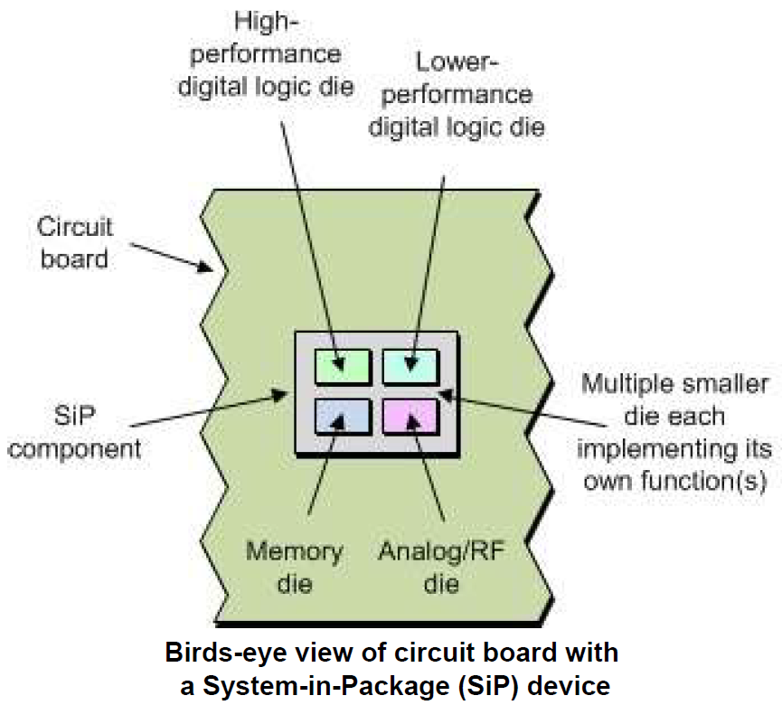
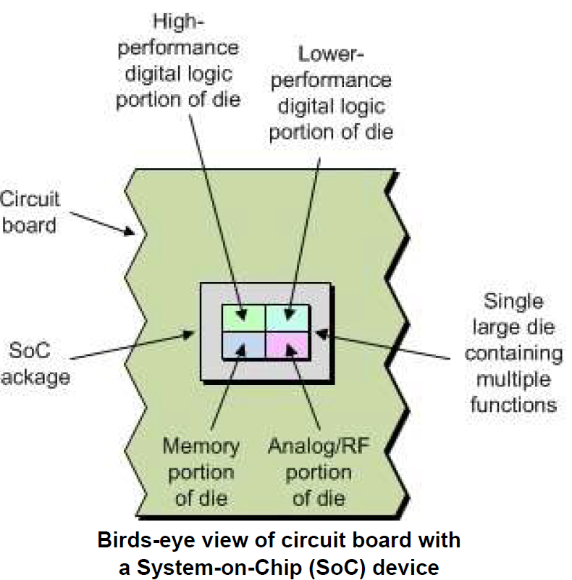
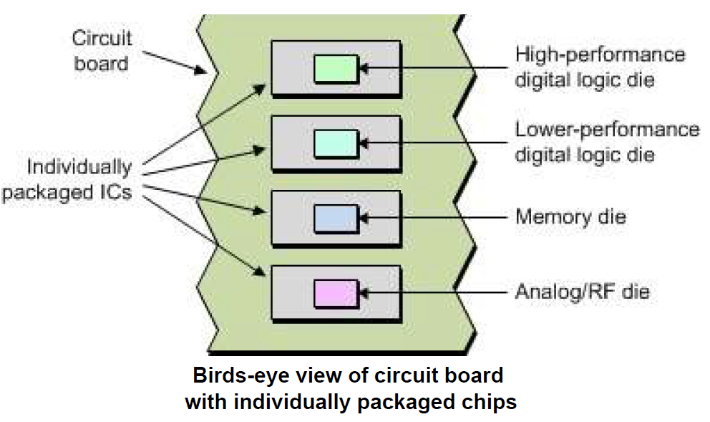
2.1 Introduction (2)
Basic approaches for system integration [14]
Basic approaches for system integration
Packaging dies individually
and mounting them on a PCB
In-package integration of dies
On-die integration of
functional units
Traditional placement on a PCB
It results in SiPs
(System-in-Package) devices
It results in SoCs
(System-on-Chip) devices
PCB: Printed Circuit Board

Slide 6
2.1 Introduction (2)
Basic approaches for system integration [14]
Basic approaches for system integration
Packaging dies individually
and mounting them on a PCB
In-package integration of dies
On-die integration of
functional units
Traditional placement on a PCB
It results in SiPs
(System-in-Package) devices
(Called also MCMs
Multi-Chip Modules)
It results in SoCs
(System-on-Chip) devices
PCB: Printed Circuit Board

Slide 7
2.1 Introduction (2)
Basic approaches for system integration [14]
Basic approaches for system integration
Packaging dies individually
and mounting them on a PCB
In-package integration of dies
On-die integration of
functional units
Traditional placement on a PCB
It results in SiPs
(System-in-Package) devices
It results in SoCs
(System-on-Chip) devices
PCB: Printed Circuit Board

Slide 8
2.1 Introduction (3)
Basic approaches for system integration [14]
Basic approaches for system integration
Packaging dies individually
and mounting them on a PCB
In-package integration of dies
On-die integration of
functional units
Traditional placement on a PCB
It results in SiPs
(System-in-Package) devices
(Called also MCMs
(Multi-Chip Modules)
It results in SoCs
(System-on-Chip) devices
PCB: Printed Circuit Board

Slide 9
2. Rationales for in-package integration of dies
2.1. Introduction
2.2 Rationales for homogeneous die integration
2.3 Rationales dor heterogeneous die integration

Slide 10
2.1 Introduction

Slide 11
2.1 Introduction (1)
2. Rationales for in-package integration of dies
2.1 Introduction
While discussing rationales for in-package die integration it makes sense
to differentiate between two types of die integration that is whether identical
or different dies will be integrated, as indicated below.
Types of integrating dies in a package
Homogeneous
die integration
Heterogeneous
die integration
Multiple copies of the same die
are properly interconnected and
mounted into the same package
Different dies, like CPU, GPU etc.
are properly interconnected and
mounted into the same package
*

Slide 12
2.2 Rationales for homogeneous die integration

Slide 13
2.2 Rationales for homogeneous die integration (1)
2.2 Rationales for homogeneous die integration
There may be two main reasons why a complex IC should be implemented
by multiple copies of the same dies, rather than by a single monolithic die:
a) To shorten time-to-market by interconnecting already existing circuits
rather than redesign the complex IC,
b) To reduce manufacturing costs by implementing multiple lower cost dies.
Next we give implementation examples for these.
*

Slide 14
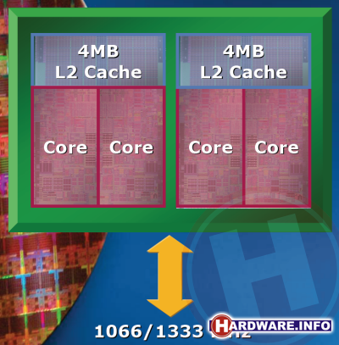
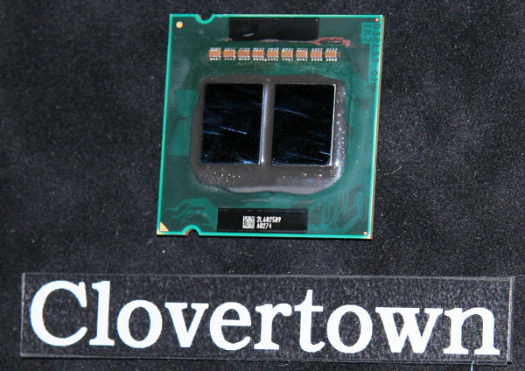
2.2 Rationales for homogeneous die integration (2)
a1) Example for shortening time-to-market:
Intel’s dual chip 4-core Xeon 5300 (Clovertown) DP processor (2006)
Intel introduced quad-core processors by employing existing dual-core designs
in their dual chip Xeon 5300 (Clovertown) DP processor (11/2006) by interconnecting
already existing dual core processor designs rather than redesigning the complex IC.
Xeon 5300 (Clovertown)
Core2-based/65 nm
2 x Xeon 5100
Figure: Intel’s quad core Xeon 5300 (Clovertown) DP processor (2006) [5], [6]

Slide 15
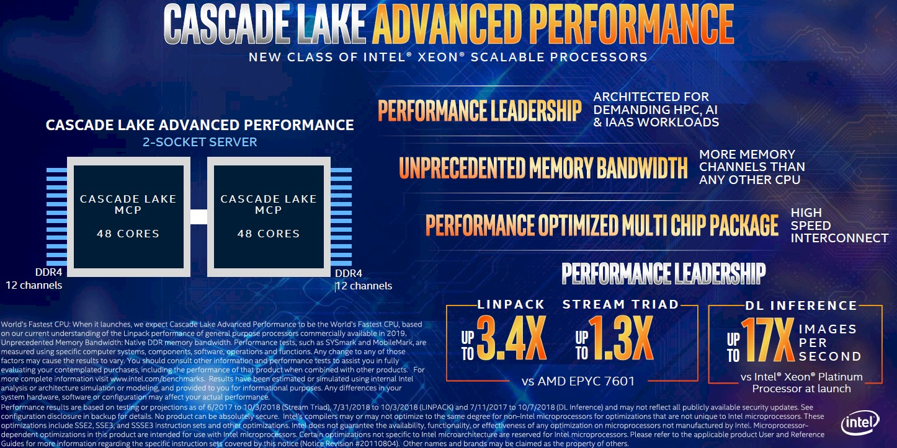
2.2 Rationales for homogeneous die integration (3)
a2) Example for shortening time-to-market:
Intel’s 48-core Xeon Cascade Lake-AP server processor (2018)
Presumable dual dies with 6 memory channels each, based on the Skylake-SP
processor.
*

Slide 16
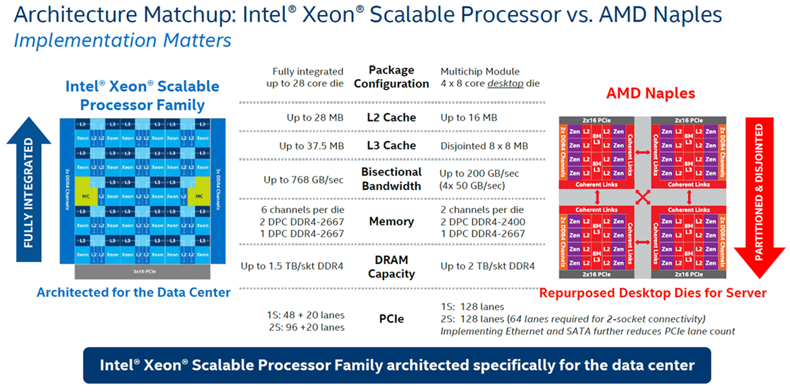
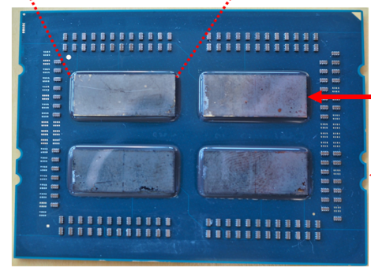
2.2 Rationales for homogeneous die integration (4)
b1) Example 1 for reducing manufacturing cost: AMD’s 32-core EPYC server
AMD preferred to implement their 32-core EPYC server processor by four,
less complex 8-core dies rather than implementing it as a 32-core monolithic die.
By contrast, Intel implemented their 28-core Skylake-SP server processor as a
monolithic die.
Intel's Skylake-SP (2017) [78]
AMD's Epyc (2017) [78]
Up to 28 cores
Up to 4x8 cores
Single package
*

Slide 17
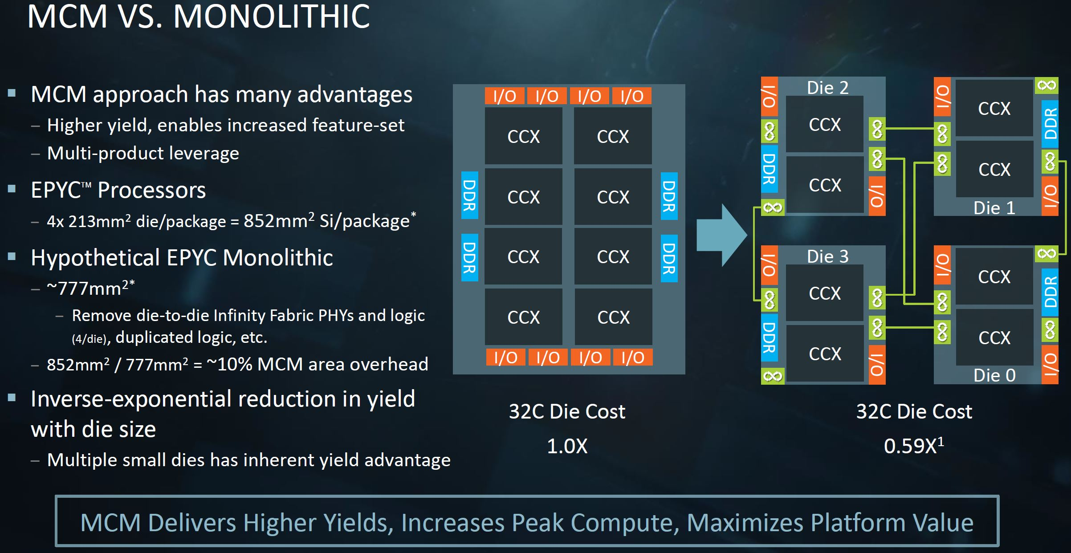
2.2 Rationales for homogeneous die integration (5)
AMD's argumentation for the cost benefit of the MCM layout over the
monolithic one [8]
Presented by AMD at the Hot Chips Conference in Aug. 2017
*

Slide 18
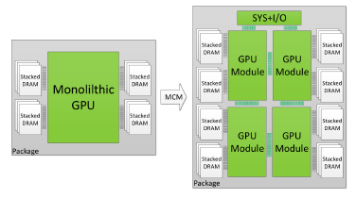
2.2 Rationales for homogeneous die integration (6)
b2) Example 2 for reducing manufacturing cost: Revealed in a research study
of NVIDIA
In a research paper NVIDIA discussed the potential benefits of implementing complex
GPUs by multiple lower cost dies [9].

Slide 19
2.2 Rationales for homogeneous die integration (7)
Further examples for homogeneous in-package die integration
Intel
Paxville DP 2.8 (2x1C), 2xDP-enhanced Pentium 4 Prescott (10/2005)
Xeon 5000 (Dempsey), (2x1C), ~ the 65 nm shrink of the 90 nm Paxville DP 2.8 (5/2006)
Xeon 5300 (Clowertown) (2x2C) 2xCore 2-based 65 nm Xeon 5100 (Woodcrest) (11/2006)
Xeon 5400 Harpertown 2x2C, 2x Core 2-based 45 nm Harpertown 2C (11/2007)
AMD
Opteron 6100 (Magny-Course) 2x4C, 2xBulldozer-based 45 nm Istambul die (3/2010)
Opteron 6200 (Interlagos), 2x8C, 2xBulldozer-based 32 nm Orochi die (11/2011)
Opteron 6300 (Abu Dhabi), 2x8C, 2xPiledriver-based 32 nm Abu Dhabi die (11/2012)
Opteron 6400 (Warsaw), 2x8C, 2xPiledriver-based, 32-nm Abu-dhabi die (2014)
Remarks
In 2009 AMD spun off its IC manufacturing facilities in Dresden, Germany and
established a joint IC fab in the US, called GlobalFoundries with a capital
investment firm from Abu Dhabi.
AMD had a minority share in GlobalFoundries until 2012 but then AMD sold their
share to GlobalFoundries entirely.
Presumably, AMD’s financial problems in developing its own IC manufacturing
facilities was the main reason why AMD chose MCM designs for their higher core
count server chips instead of relying on advanced IC technology needed for a
monolithic design.

Slide 20
2.3 Rationales for heterogeneous die integration

Slide 21
2.3 Rationales for heterogeneous die integration (1)
2.3 Rationales for heterogeneous die integration -1
Again there may be two main reasons why a complex IC should be implemented on a
number of different dies, rather than on a single monolithic die as follows:
a) To overcome transistor count limitations in case when a large transistor count
can not yet be implemented cost effectively on a single die,
b) To overcome technological limitations in case when different IC technologies
should be implemented on the same die such as “traditional IC technology”
and e-DRAM technology.
*

Slide 22
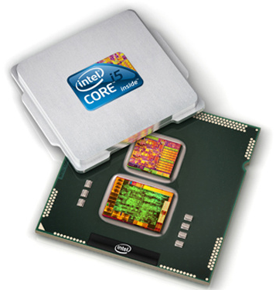
2.3 Rationales for heterogeneous die integration (2)
a1) Example 1 for overcoming transistor count limitations: Intel’s
Penryn-based mobile Arrandale line (2010) [10].
With 45 nm technology the number of transistors that could be cost effectively
produced did not yet allow an on-die CPU-GPU integration, so Intel choose an
in-package integration for their mobile Arrandale line (2010) [10].
Subsequently, while using the 32 nm technology also for the GPU, Intel could
integrate both the CPU and the GPU on the same die, in their Sandy Bridge (2011).
32 nm CPU/45 nm discrete GPU

Slide 23
2.3 Rationales for heterogeneous die integration (3)
a2) Example 2 for overcoming technological limitations relating to the
transistor count: IBM’s z10 processor module (2008)
The z10 includes 5 Processing Unit dies (PUs) (with each up to 4 cores) and
2 Storage Control dies (SCs), with more transistors than could be implemented
in 2008 on a single die while using 65 nm technology.
3490 signals
Figure: IBM’s z10 processor mounted as an MCM on a ceramic substrate [11]

Slide 24
2.3 Rationales for heterogeneous die integration (3)
Rationales for heterogeneous die integration -2
b) To overcome technological limitations in case when different IC technologies
should be implemented on the same die such as “traditional IC technology”
and e-DRAM technology.

Slide 25
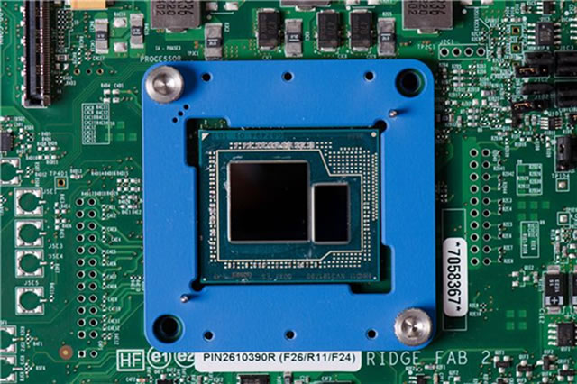
2.3 Rationales for heterogeneous die integration (4)
b1) Example 1 for overcoming technological limitations of IC manufacturing:
Intel’s Haswell processor with eDRAM L4 cache (2013)
The eDRAM technology differs from manufacturing processor logic, so Intel
produced the processor die and the eDRAM die separately and integrated these
dies subsequently into a single package [12].
eDRAM chip (128 MB)
*
Figure: Intel’s Haswell processor with in-package integrated eDRAM L4 cache [12]

Slide 26
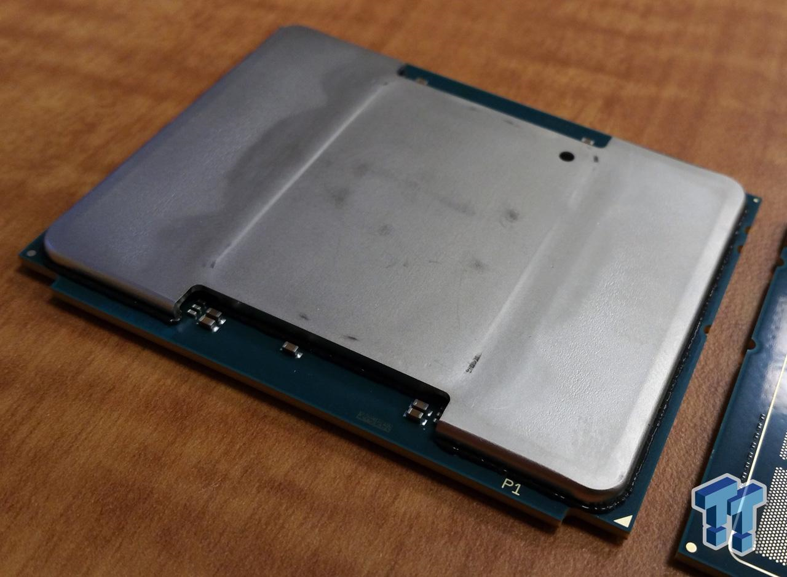
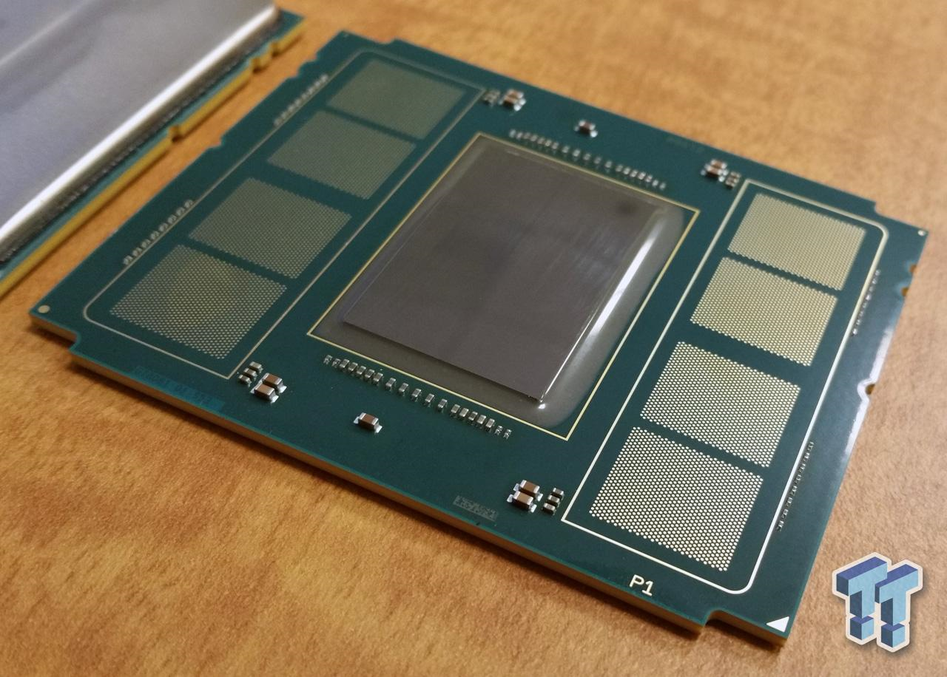
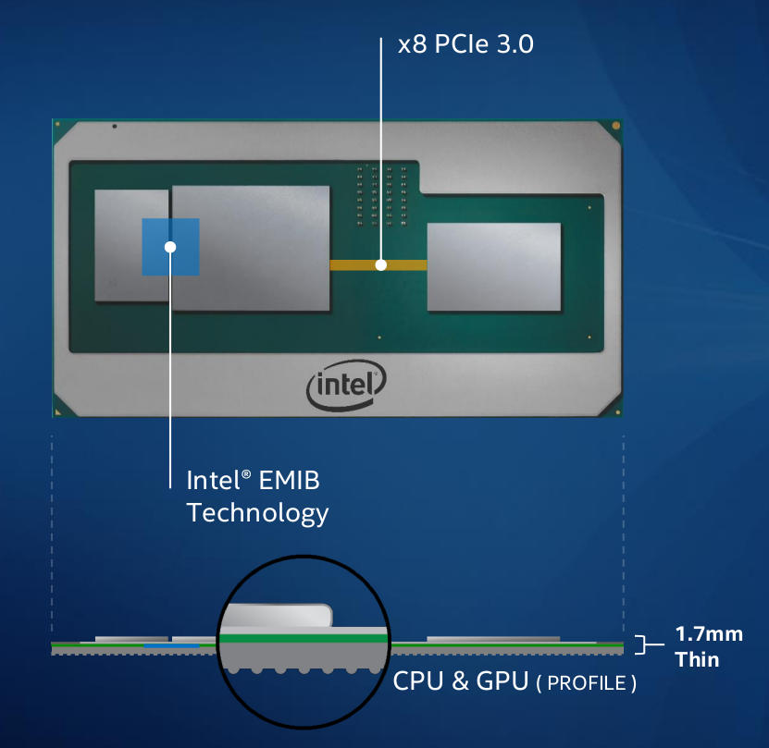
2.3 Rationales for heterogeneous die integration (5)
b2) Example 2 for overcoming technological limitations of IC manufacturing:
Intel’s Knights Landing (2016)
LGA 3647
76.0 mm × 56.5 mm
AMD’s
Vega
GPU
HBM2
Kaby Lake
CPU
The processor package encloses one CPU die, one Omni-Path die + 8 MCDRAM dies,
but the MCDRAM needs a different technology than a traditional processor. [13]

Slide 27
3. Die placement alternatives for in-package integration
3.1. Overview
3.2 Horizontal die placement in in-package integration
3.3 Vertical die placement in in-package integration
3.4 Both horizontal and vertical die placement
in in-package integration

Slide 28
3.1 Overview

Slide 29
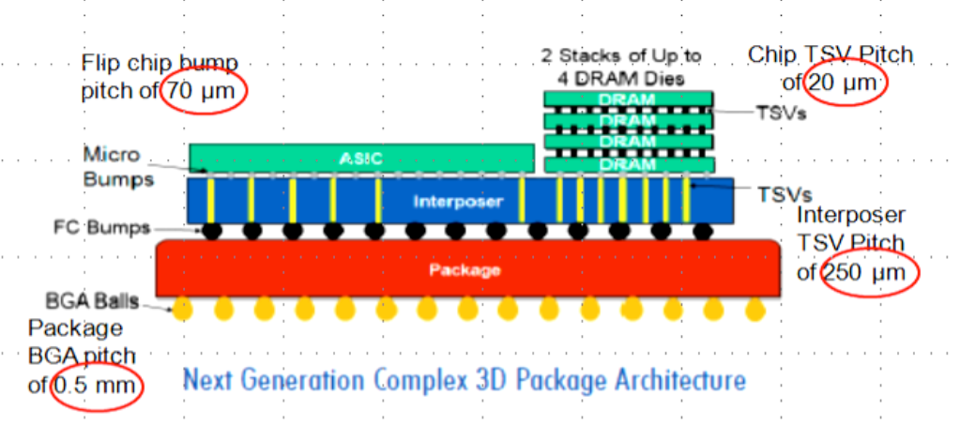
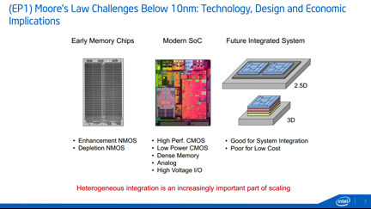
3.1 Overview (1)
3.1 Overview
Die placement alternatives for in-package integration
Die placement alternatives for in-package integration
Horizontal die placement
(called also 2D packaging)
Vertical die placement
(called also 3D packaging)
Both horizontal and vertical
die placement
The dies are tiled side-by-side,
interconnected and packaged
The dies are stacked,
interconnected and packaged
Tiled and stacked dies are
interconnected and packaged
Source of the Figures: [1], [19]
Stacked: Egymásra helyezett
*

Slide 30
3.2 Horizontal die placement in in-package integration

Slide 31
3.2 Horizontal die placement in in-package integration (1)
3.2 Horizontal die placement in in-package integration -1
Die placement alternatives for in-package integration
Horizontal die placement
(called also 2D packaging)
Vertical die placement
(called also 3D packaging)
Both horizontal and vertical
die placement
The dies are tiled side-by-side,
interconnected and packaged
The dies are stacked,
interconnected and packaged
Tiled and stacked dies are
interconnected and packaged
Source of the Figures: [1], [19]

Slide 32
3.2 Horizontal die placement in in-package integration (2)
Horizontal die placement in in-package integration -2
Horizontal die placement in in-package integration is also called as
2D packaging.
The dies are tiled side-by-side, interconnected and packaged, as indicated below.
Figure: Illustration of horizontal die placement in in-package integration [1]
*

Slide 33
3.2 Horizontal die placement in in-package integration (3)
Main alternatives for horizontal die placement in in-package integration
Main alternatives for horizontal die placement in in-package integration
Traditional packaging
2.5D packaging
EMIB technology
(Embedded Multi-Die
Interconnect Bridges)
Interconnections are made by
wires through wire bonding or
by conducting traces formed on a
ceramic, silicon, or organic substrate
made e.g. by thin film, thick film
or PCB technologies
Interconnections are provided
by multi-layered conducting traces
in a silicon or organic interposer,
serving as a redistribution layer
and by TSVs
(Through-Silicon-Vias)
Interconnections are provided
by multi-layered conducting traces
in a silicon interposer
serving as a redistribution layer
and by silicon bridges
*

Slide 34
3.2 Horizontal die placement in in-package integration (4)
a) Traditional packaging
Interconnections in traditional packaging may be implemented by a number of
technologies, like
by wires and using wire bonding or
by conducting traces formed e.g. by means of
thin film technology
thick film technology
PCB technology
Above technologies are definitely out-of-scope of our interest and won’t be discussed,
only illustrated here by examples.
Wire bonding: vezetékes kötés
*

Slide 35
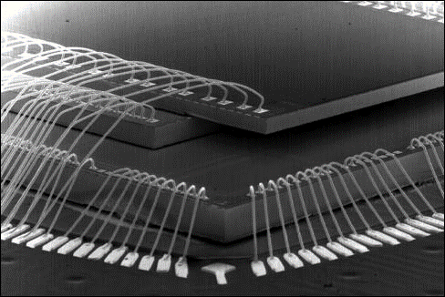
3.2 Horizontal die placement in in-package integration (5)
Example 1: Wire-bonding of three (in this case vertically placed) dies [15]

Slide 36
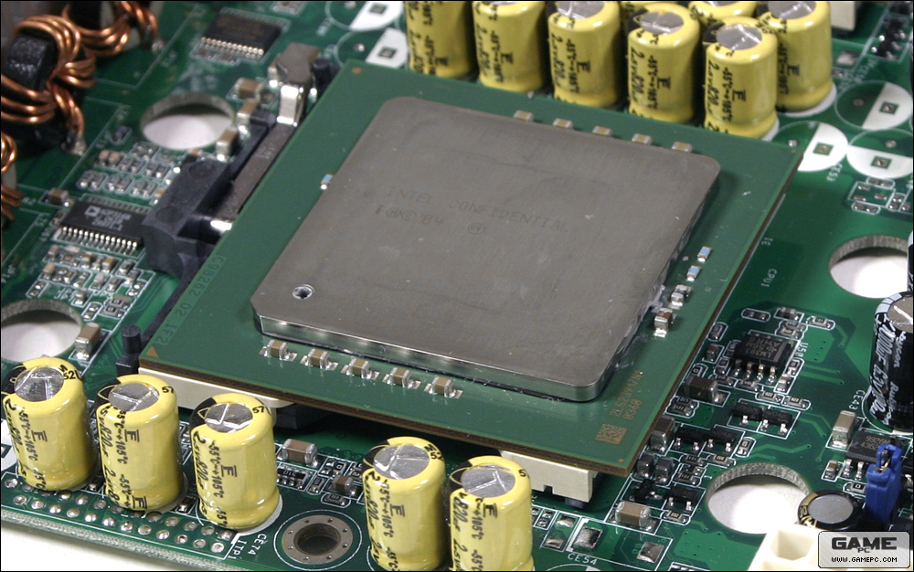
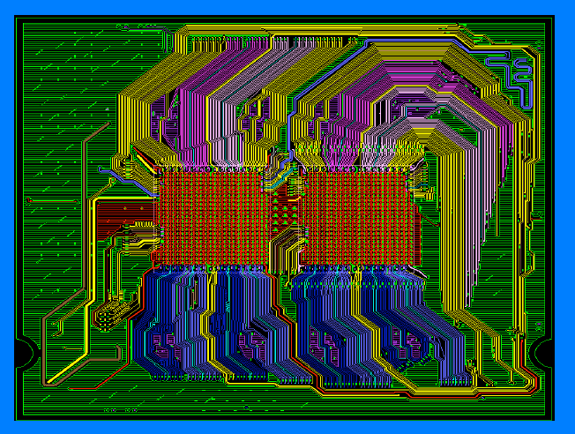
3.2 Horizontal die placement in in-package integration (6)
Example 2: Interconnecting two cores in Intel’s dual core Paxville DP
server processor (2005)
Figure: The Paxville DP processor [16]
(two Irwindale dies mounted on a carrier and
appropriately interconnected)
Figure: interconnections
on the carrier [17]

Slide 37
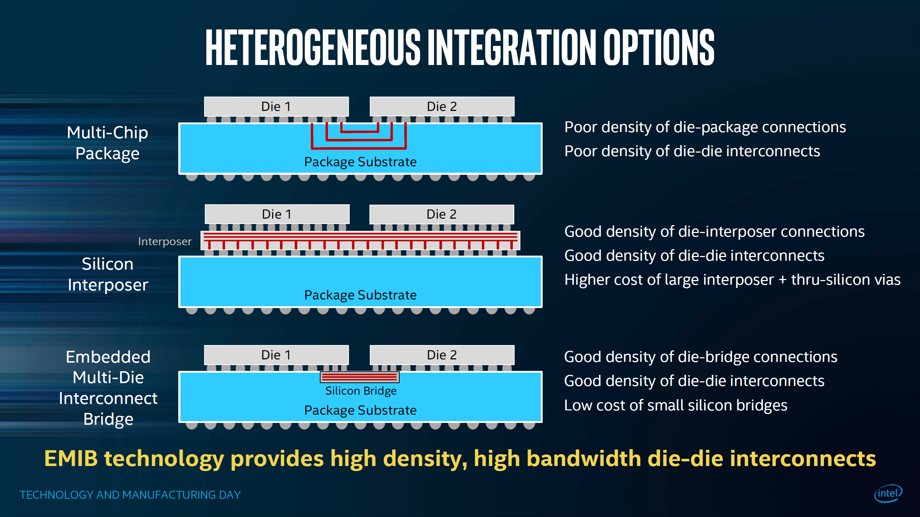
3.2 Horizontal die placement in in-package integration (7)
b) 2.5D packaging -1
In case of 2.5D packaging a thin interposer, made of silicon or an organic material
is placed between the dies and the package substrate that serves as a
redistribution layer (RDL), as seen below.
Figure: Using an interposer as a redistribution layer between the dies and the package substrate [18]
Redistribution layer: jelkapcsolati réteg
*

Slide 38
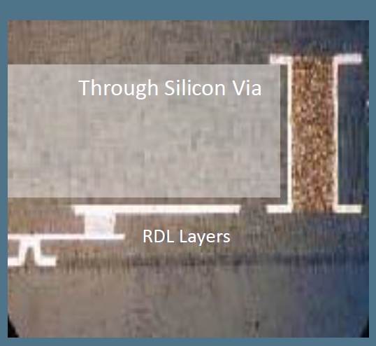
3.2 Horizontal die placement in in-package integration (8)
2.5D packaging -2
Further on in the 2.5D technology short, vertical conducting paths are used through
the interposer, called TSVs (Through-Silicon-Vias) to interconnect the dies and the
redistribution layer, as shown below.
Figure: TSVs (short vertical, conducting paths) interconnecting the dies and the redistribution layer (RDL) [19]
*

Slide 39
3.2 Horizontal die placement in in-package integration (9)
2.5D packaging -3
Unfortunately, 2D packaging technology is expensive due to the high costs of
the TSV technology and the silicon interposer.
Historical remark
Although TSVs were patented as early as 1962 (by W. Shockley), the term TSV
was coined only in the end of the 1990’s by Savastiouk, co-founder of the
company ALLVIA and the technology became used only in the second half of
the 2010s.
*

Slide 40
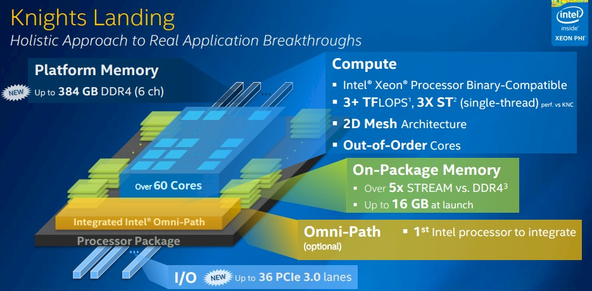
3.2 Horizontal die placement in in-package integration (10)
Example of using 2.5 packaging: Intel’s Knights Landing HPC processor
(2016)
LGA 3647
76.0 mm × 56.5 mm
The processor package encloses one CPU die, one Omni-Path die + 8 MCDRAM dies,
interconnected through TSVs [13]

Slide 41
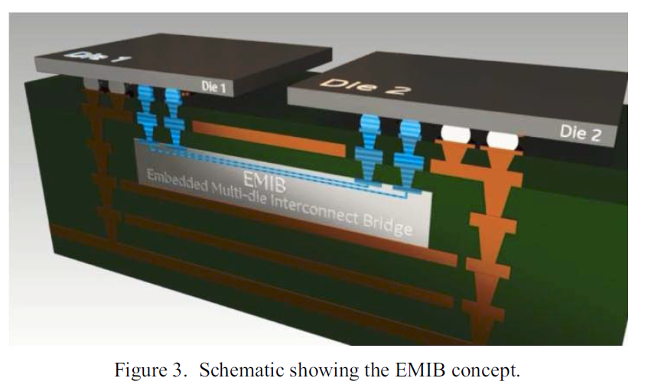
3.2 Horizontal die placement in in-package integration (11)
c) Interconnections by EMIB (Embedded Multi-Die Interconnect Bridge) [20]
EMIB makes use of short silicon bridges between the dies that are embedded into
the package substrate, as indicated below.
Figure: Schematic scheme of EMIB [20]
*

Slide 42
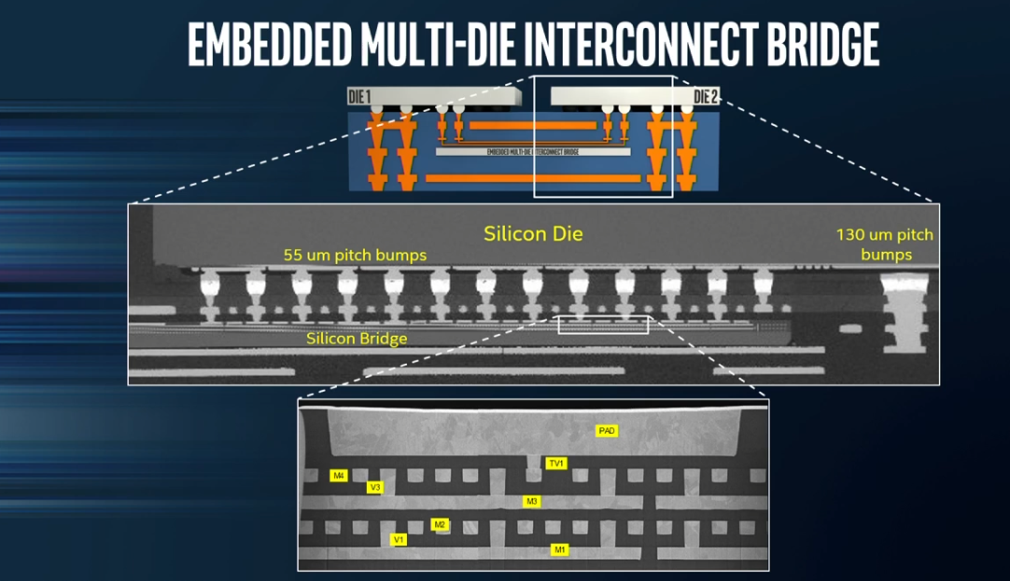
3.2 Horizontal die placement in in-package integration (12)
Silicon bridges
They provide a multi layer connection between adjacent dies, as seen below.
Figure: Silicon bridges in more detail [18]

Slide 43
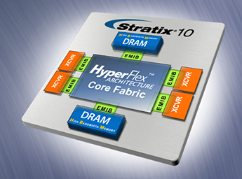
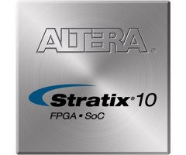
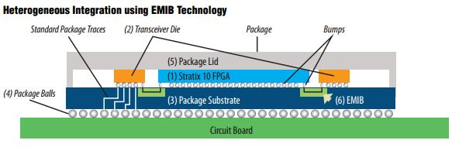
3.2 Horizontal die placement in in-package integration (13)
Example 1: Using EMIB to interconnect an FPGA die (Stratix-10) and four
HMB memories (2017) [21]
~50x50 mm

Slide 44
3.2 Horizontal die placement in in-package integration (14)
Example 2: Intel’s 8th gen. (Kaby Lake) G-series processor with EMIB
interconnect between AMD’s Vega GPU and the HBM2 memory die (2018)
[22]
HBM2
AMD’s Vega
GPU
Intel’s 8. gen.
Kaby Lake CPU
BGA2270
31 x 58 mm

Slide 45
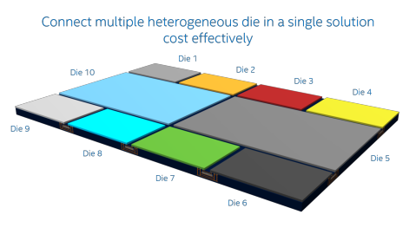
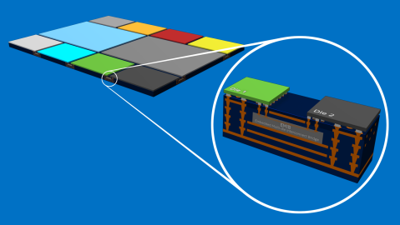
3.2 Horizontal die placement in in-package integration (15)
Intel's concept for interconnecting multiple dies through EMIB [23]

Slide 46
3.3 Vertical die placement in in-package integration

Slide 47
3.3 Vertical die placement in in-package integration (1)
3.3 Vertical die placement in in-package integration -1
Die placement alternatives for in-package integration
Horizontal die placement
(called also 2D packaging)
Vertical die placement
(called also 3D packaging)
Both horizontal and vertical
die placement
The dies are tiled side-by-side,
interconnected and packaged
The dies are stacked,
interconnected and packaged
Tiled and stacked dies are
interconnected and packaged
Source of the Figures: [1], [19]

Slide 48
3.3 Vertical die placement in in-package integration (2)
Vertical die placement in in-package integration -2
Vertical die placement in in-package integration is also called 3D packaging.
The dies are stacked, interconnected and packaged, as indicated below.
Figure: Illustration of vertical die placement in in-package integration [1]
*

Slide 49
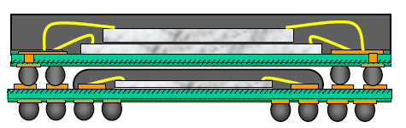
3.3 Vertical die placement in in-package integration (3)
Main alternatives for vertical die placement in in-package integration
Main alternatives for vertical die placements in in-package integration
3D-stacked packaging
by using TSVs (Through Silicon Vias)
PoP packaging
(Package-on-Package)
The dies are 3D stacked,
interconnected through TSVs and
enclosed into a single module
BGA (Ball-Grid-Array) packages are
interconnected and enclosed
into a single module
Source of the Figures: [1]. [19]
*

Slide 50
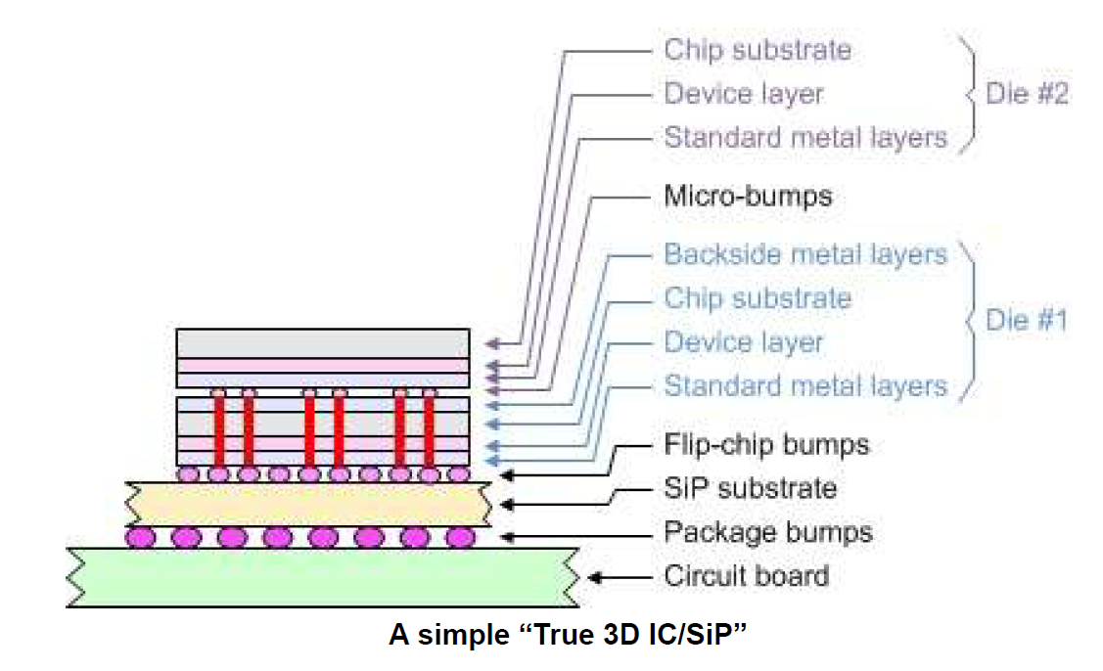
3.3 Vertical die placement in in-package integration (4)
a) 3D-stacked packaging by using TSVs (Through Silicon Vias) [14]
Implementing interconnects in 3D-stacked packaging
3D-stacked packageing does not use interposer layers but vias through active dies,
as indicated in the above and the subsequent Figures.
*

Slide 51
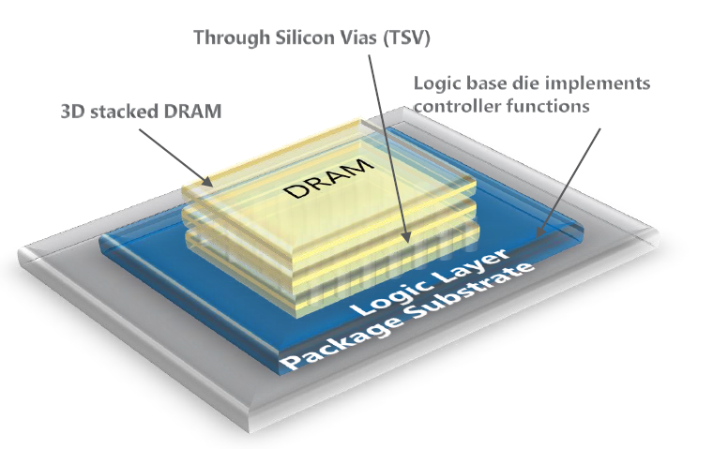
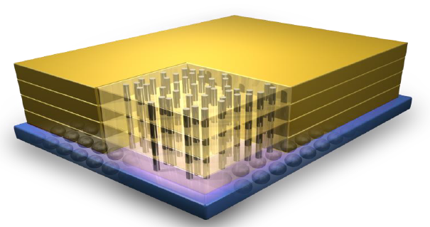
3.3 Vertical die placement in in-package integration (5)
Example: Micron’s 3D stacked memory called HMC (Hybrid Memory Cube)
[24]

Slide 52
3.3 Vertical die placement in in-package integration (6)
b) PoP packaging (Package-on-Package) -1
In this technology individual BGA (Ball-Grid-Array) packages are interconnected
and enclosed into a single module, in fact into a package.
Figure: Possible PoP structure for implementing two memory dies and
a baseband or application processor in a single module [80]
*

Slide 53
3.3 Vertical die placement in in-package integration (7)
PoP packaging (Package-on-Package) -2
Benefits of PoPs
discrete BGA packages can separately be tested,
only good parts will be used in final assembly.
PoP packaging is widely used in smartphones and tablets,
to efficiently implement logic and memory BGA packages in the same module,
like in in Apple’s devices, or
to raise memory size of a package by enclosing two or more memory packages
in a single module.
*

Slide 54
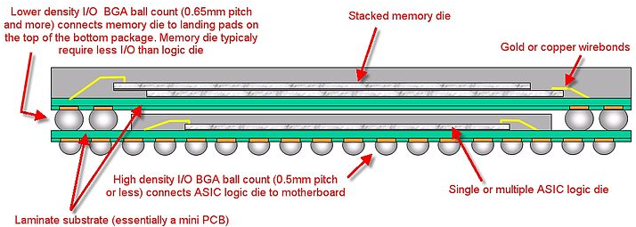
3.3 Vertical die placement in in-package integration (8)
Example: Apple’s iPhone’s incorporates a PoP (fabricated by Samsung)
that includes the application processor and 2 memory chips [79]
2x512 Mbit DDR SDRAM
ARM1176Z(F)-S + Power VR MBX Lite 3D
(not revealed weather on the same or on separate dies)
The PoP (S5L8900B01) incorporates 3 dies:
the processor die with the ARM1176ZF-S 32-bit processor (executing the
ARMv6 ISA) and Imagination Technologies’ PowerVR MBX Lite 3D
graphics accelerator, and
two 512 Mb LPDDR-266 SDRAM dies (providing 128 MB stacked memory),
as illustrated above.

Slide 55
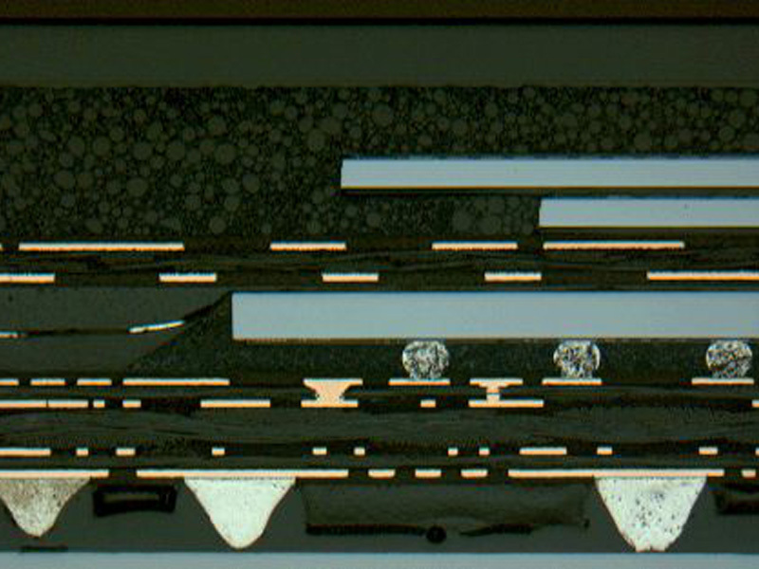
3.3 Vertical die placement in in-package integration (9)
Cross section of the iPhone [81]
DRAM dies
SOC die
Solder balls
Mini PCB

Slide 56
3.3 Vertical die placement in in-package integration (10)
Remarks
First PoPs emerged in cell phones around 2004 [13].
First generation PoP technology typically integrates the baseband or application
processor with one or two memory dies, as indicated in the preceding Figure.
Using PoP packaging for integrating the application processor and the memory
in Apple’s original iPhone was an early advanced packaging solution.
MCP became standardized by JEDEC about 2006 (JC-63).
*

Slide 57
3.4 Both horizontal and vertical die placement
in in-package integration

Slide 58
3.4 Both horizontal and vertical die placement in in-package integration (1)
3.4 Both horizontal and vertical die placement in in-package integration -1
Die placement alternatives for in-package integration
Horizontal die placement
(called also MCM packaging)
Vertical die placement
(called also 3D packaging)
Both horizontal and vertical
die placement
The dies are tiled side-by-side,
interconnected and packaged
The dies are stacked,
interconnected and packaged
Tiled and stacked dies are
interconnected and packaged
Source of the Figures: [1], [19]

Slide 59
3.4 Both horizontal and vertical die placement in in-package integration (2)
Both horizontal and vertical die placement in in-package integration -2
Trends in packaging technology point to an evolution to both horizontal and
vertical die placement, as indicated in the next slides.
*

Slide 60
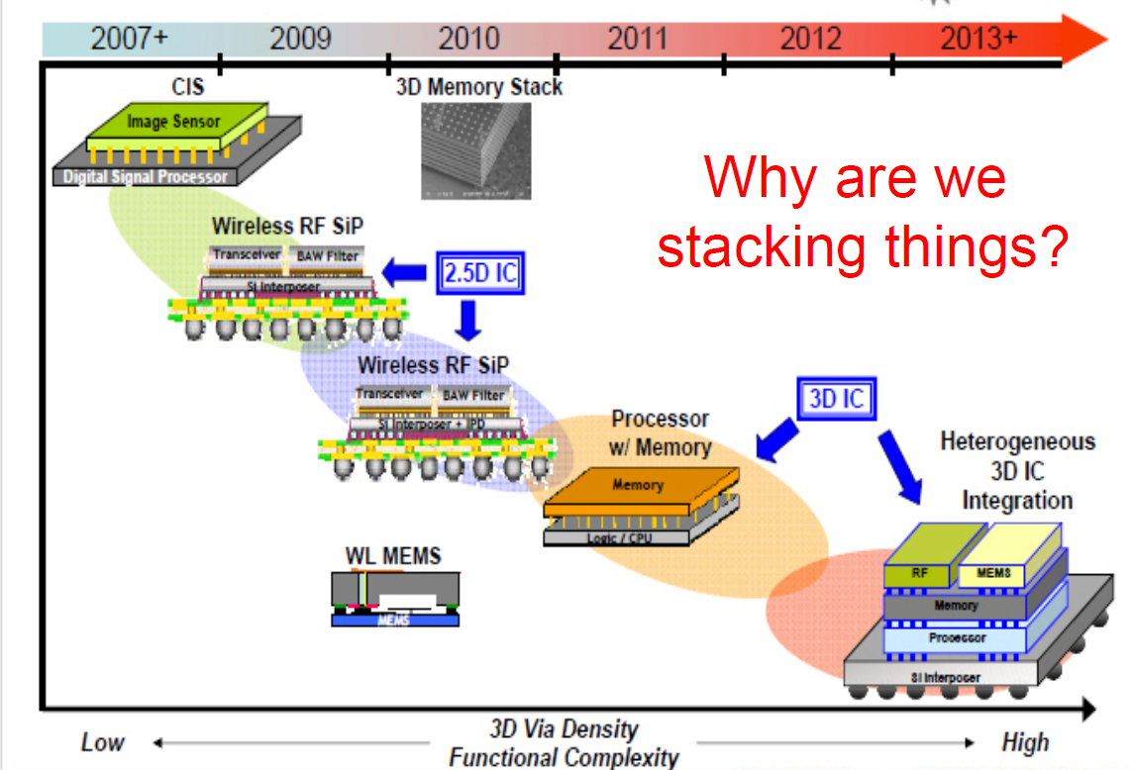
3.4 Both horizontal and vertical die placement in in-package integration (3)
The trend of in-package integration [19]

Slide 61
3.4 Both horizontal and vertical die placement in in-package integration (4)
Horizontal integration of vertically placed dies [19]

Slide 62
4. Power consumption of die-to-die interconnects

Slide 63
2.4 Power consumption of die-to-die interconnects (1)
4. Power consumption of die-to-die interconnects
Die-to-die interconnects may have a notable power consumption, as the subsequent
examples indicate.
*

Slide 64
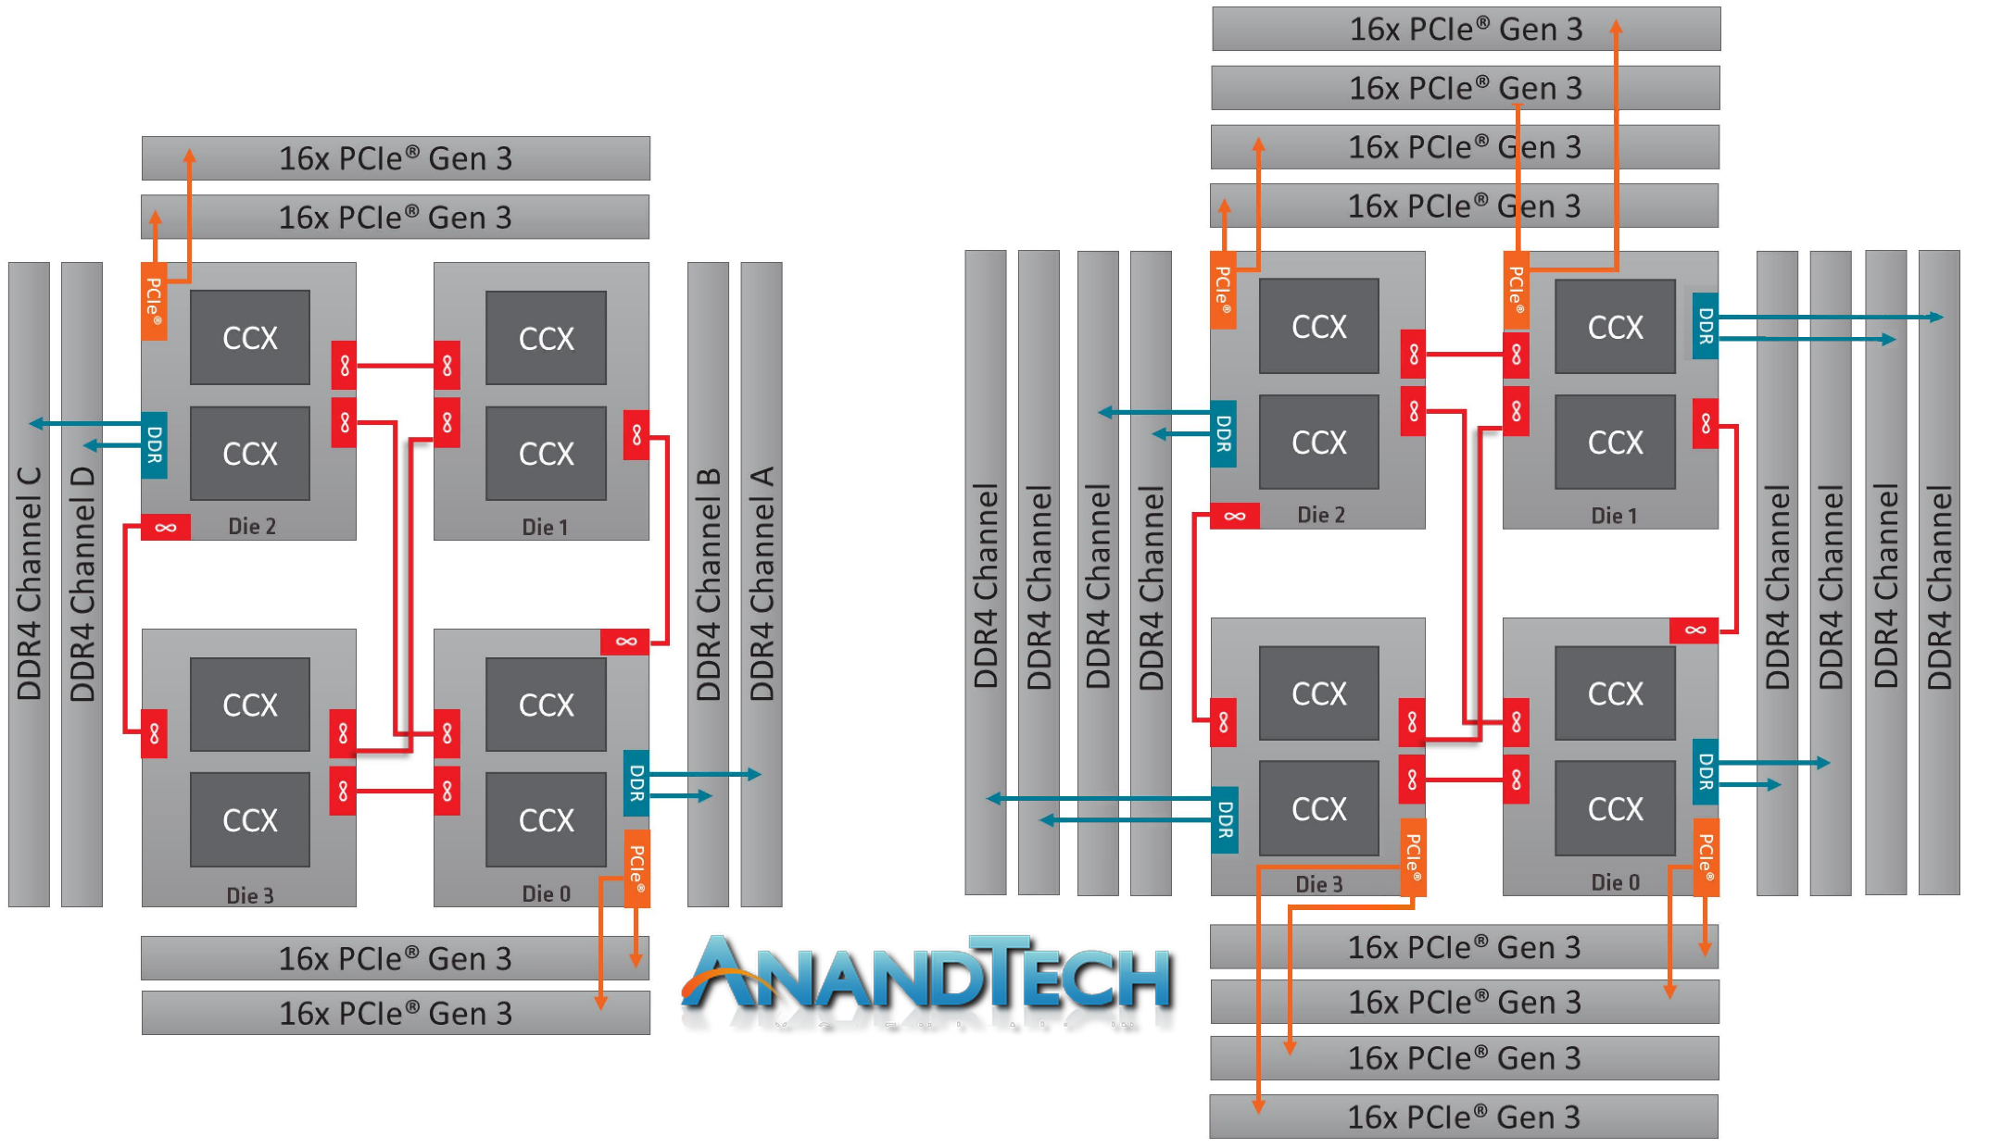
2.4 Power consumption of die-to-die interconnects (2)
a) Architectural layout of AMD’s 12- or 16-core ThreadRipper processors [73]
ThreadRipper 2990WX/2970WX
(TR4 (SP3r2) socket)

Slide 65
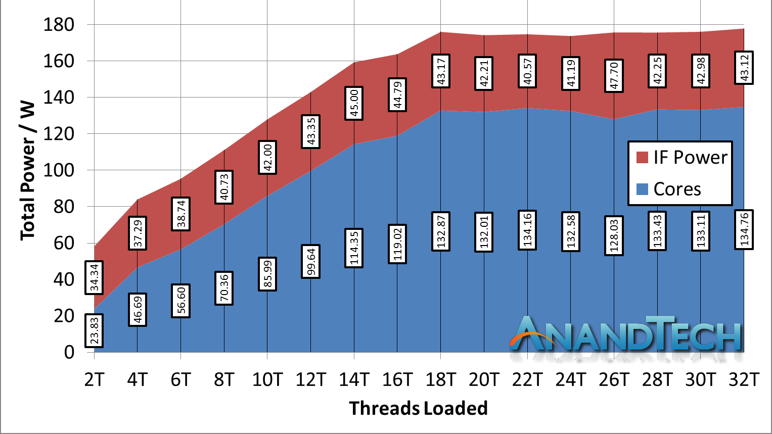
4. Power consumption of die-to-die interconnects (3)
Breakdown of power consumption between the cores and the IF in AMD’s
TR 2950X depending on loading [73]
As seen, the IF of the 16-core (2 active dies) TR 2950X consumes about 25 % of
the total power.
*

Slide 66
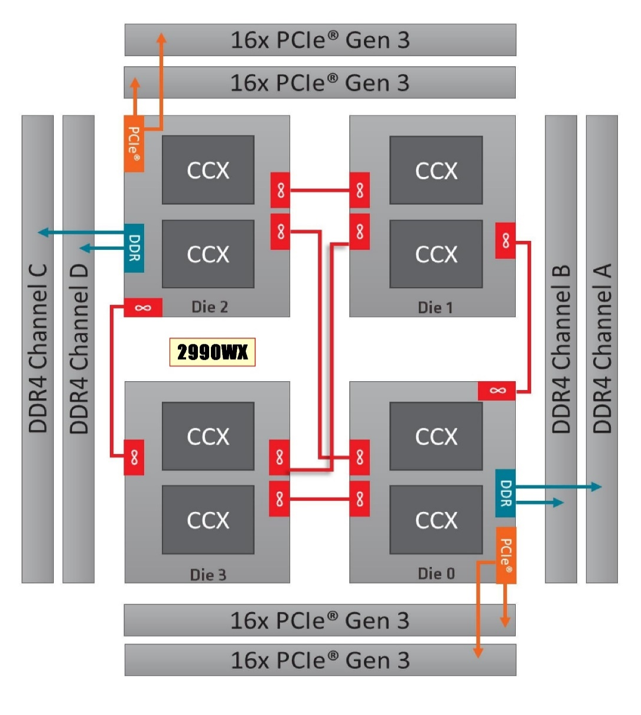
4. Power consumption of die-to-die interconnects (4)
b) Architectural layout of AMD’s 2. gen. 24/32-core ThreadRipper models [73]
TR 2990WX: 8+8+8+8 cores
TR 2970WX: 6+6+6+6 cores

Slide 67
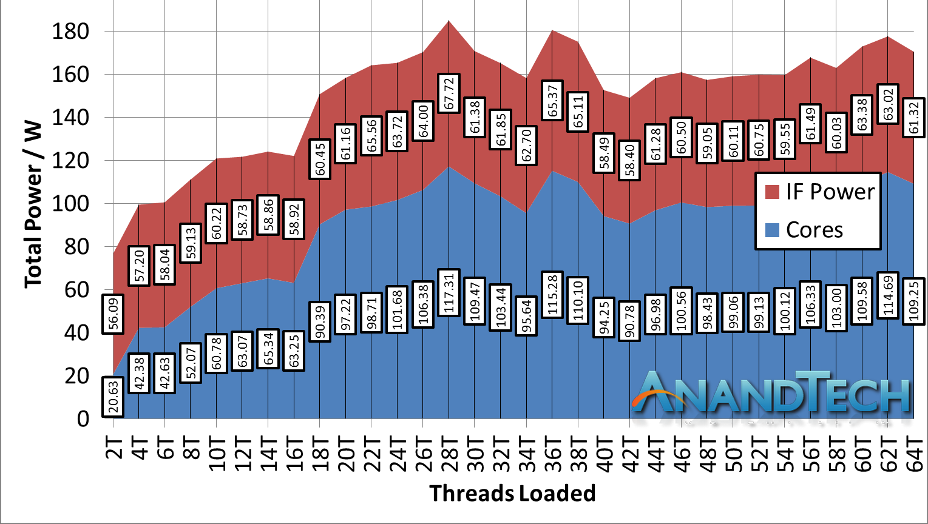
4. Power consumption of die-to-die interconnects (5)
Breakdown of power consumption between the cores and the IF in AMD’s
TR 2990WX depending on loading [73]
As seen, the IF of the 32-core (4 active dies) TR 2990WX consumes already about
35 % of the total power due to the much more complex die-to-die interconnects.
*

Slide 68
4. Power consumption of die-to-die interconnects (6)
c) Architectural layout of Amd’s 32-core EPIC server models [73]
EPIC
(SP3 socket)
*

Slide 69
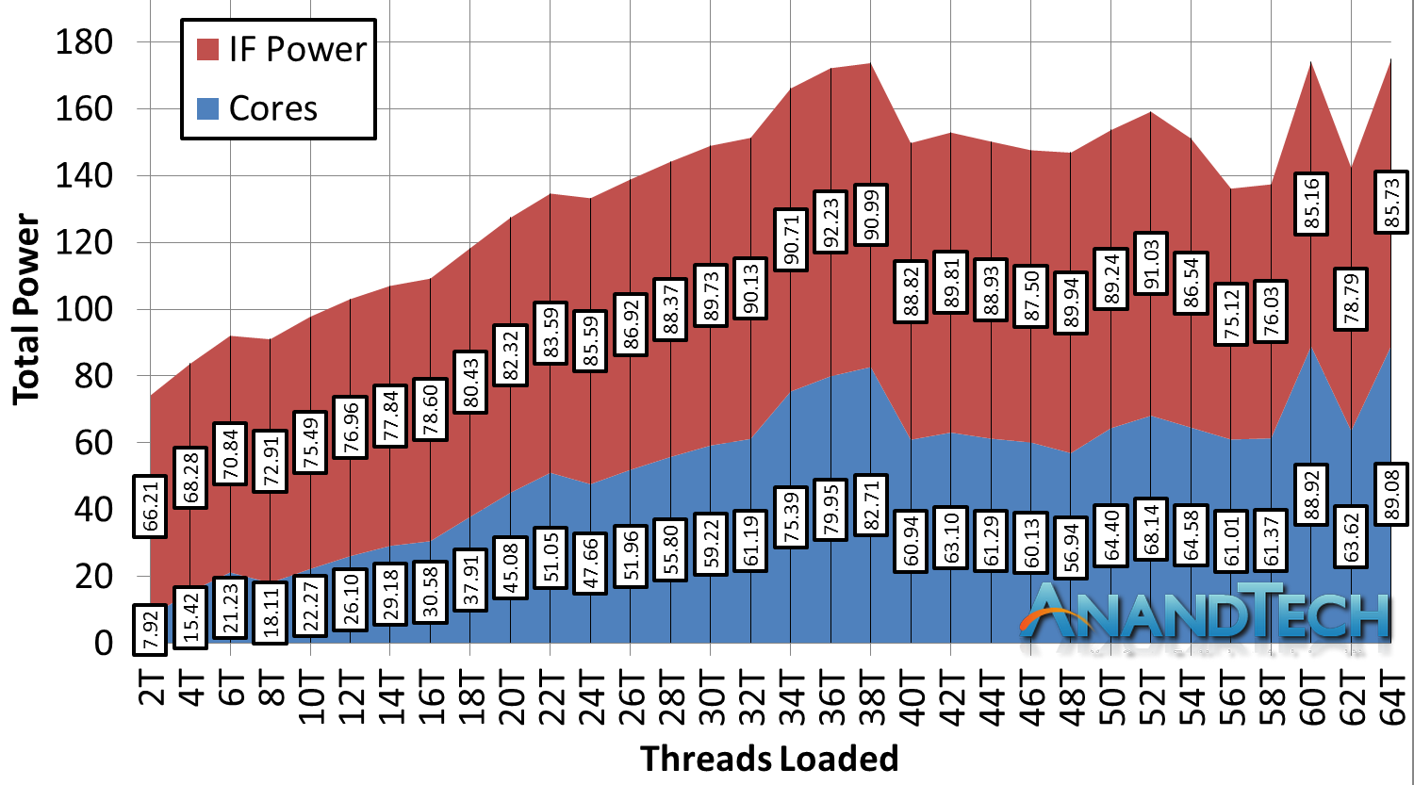
4. Power consumption of die-to-die interconnects (7)
Breakdown of power consumption between the cores and the IF in AMD’s
EPIC 7610 server processor depending on loading [73]
As seen, the IF of the 32-core (4 active dies) EPIC 7601 consumes already up to
50 % of the total power due to the much more complex die-to-die interconnect.
*

Slide 70
4. Power consumption of die-to-die interconnects (8)
Notes [73]
Note that the indicated power consumption includes both the die-to-die and the
on-die power consumption.
b) Preceding Figures let’s conclude that with increasing core count - beyond providing
enough memory bandwidth - the implementation of low power, scalable and high
performance interconnects will be a great challenge for processor designers.
*

Slide 71
5. References

Slide 72
5. References (1)
[1]: Intel Calls for 3D IC, EE Times, March 5 2015,
https://www.eetimes.com/author.asp?section_id=36&doc_id=1325921&image_number=1
[2]: Esmer I., Ivybridge Server Architecture: A Converged Server, Aug. 2014, Hot Chips 2014,
http://www.hotchips.org/wp-content/uploads/hc_archives/hc26/HC26-12-day2-epub/
HC26.12-8-Big-Iron-Servers-epub/HC26.13.832-IvyBridge-Esmer-Intel-IVB%20Server%
20Hotchips2014.pdf
[3]: Supermicro Motherboards, MNL-1594X6QT8, User Manual,
https://www.supermicro.com/manuals/motherboard/C606_602/MNL-1594.pdf
[4]: Lau J., MCM, SiP, SoC, and Heterogeneous Integration Defined and Explained, 3DInCities,
Aug. 7 2017, https://www.3dincites.com/2017/08/mcm-sip-soc-and-heterogeneous-
integration-defined-and-explained/
[5]: Intel quadcore Xeon 5300 review, Nov. 13 2006, Hardware.Info,
http://www.hardware.info/en-US/articles/amdnY2ppZGWa/Intel_quadcore_Xeon_5300_review
[6]: Wasson S., Intel's Woodcrest processor previewed, The Bensley server platform debuts,
May 23, 2006, The Tech Report, http://techreport.com/articles.x/10021/1
[7]: Teich P., The Heart Of AMD’s Epyc Comeback Is Infinity Fabric, The Next Platform, July 12 2017,
https://www.nextplatform.com/2017/07/12/heart-amds-epyc-comeback-infinity-fabric/
[8]: Kennedy P., AMD EPYC Infinity Fabric Update and MCM Cost Savings, STH, Aug. 22 2017,
https://www.servethehome.com/amd-epyc-infinity-fabric-update-mcm-cost-savings/
[9]: MCM-GPU: Multi-Chip-Module GPUs for Continued Performance Scalability, Nvidia,
http://research.nvidia.com/publication/2017-06_MCM-GPU%3A-Multi-Chip-Module-GPUs

Slide 73
5. References (2)
[10]: Altavilla D., Intel Arrandale Core i5 and Core i3 Mobile Unveiled, Hot Hardware, Jan. 4 2010,
http://hothardware.com/Reviews/Intel-Arrandale-Core-i5-and-Core-i3-Mobile-Unveiled
[11]: Stoerchle M., IBM System z10 Technologie, 2008,
https://www.guug.de/lokal/muenchen/2008-11-10/IBM_System_z_guug.pdf
[12]: Scansen D., Intel Launches Next Generation of Microprocessors, Engineering, June 10 2013,
http://www.engineering.com/ElectronicsDesign/ElectronicsDesignArticles/ArticleID/
5838/Intel-Launches-Next-Generation-of-Microprocessors.aspx
[13]: Mujtaba H., Intel Knights Landing Further Detailed – 16 GB High-Bandwidth On-Package
Memory, 384 GB DDR4 System Memory Support and 8 Billion Transistors, WCCF Tech,
March 26 2015, https://wccftech.com/intel-knights-landing-detailed-16-gb-highbandwidth-
ondie-memory-384-gb-ddr4-system-memory-support-8-billion-transistors/
[14]: Maxfield M., Design How-To, 2D vs. 2.5D vs. 3D ICs, EE Times, April 8 2012,
https://www.eetimes.com/document.asp?doc_id=1279540
[15]: Solberg V., 2.5D and 3D Semiconductor Package Technology: Evolution and Innovation,
http://www.circuitinsight.com/pdf/2.5d_3d_semiconductor_package_technology_ipc.pdf
[16]: Conolly C., „Intel Paxville Dual Core Xeon and the ASsus PVL-D Intel 7520,” Oct. 2005,
http://www.gamepc.com/labs/view_content.asp?id=paxville&page=1
[17]: Douglas J., „Intel 8xx series and Paxville Xeon-MP Microprocessors,”
http://www.hotchips.org/archives/hc17/3_Tue/HC17.S8/HC17.S8T1.pdf
[18]: Alcorn P., Hot Chips 2017: Intel Deep Dives Into EMIB, Tom’s Hardware, Aug. 25 2017,
https://www.tomshardware.com/news/intel-emib-interconnect-fpga-chiplet,35316.html

Slide 74
5. References (3)
[19]: Marcoux P., 2.5D, Silicon Interposers, Silicon Bridges, Glass Panels, Organic HDI,
http://www.meptec.org/Resources/1%20-%20ALLVIA%20-%20Marcoux.pdf
[20]: Mahajan R., Sankman R., et al., Embedded Multi-die Interconnect Bridge (EMIB) -- A High
Density, High Bandwidth Packaging Interconnect, IEEE 66th ECTC, 2016
[21]: Pirzada U., Intel and Altera Develop World’s First HBM2, 2.5D Stacked, SiPs With Integrated
Stratix 10 FPGA and SoC Solution, WCCF Tech, Nov. 17 2015,
https://wccftech.com/intel-altera-offering-hbm2-fpga-sip-stratix-10/
[22]: Demerjian C., Intel Kaby-G with “Not AMD” Radeon Vega M graphics fleshed out, Semi
Accurate, Jan. 7 2018, https://semiaccurate.com/2018/01/07/intel-kaby-g-not-amd-
radeon-vega-m-graphics-fleshed/
[23]: Embedded Multi-die Interconnect Bridge, Intel,
https://www.intel.com/content/www/us/en/foundry/emib.html
[24]: von Appen S., Hotti M., Hybrid Memory Cube, Micron Technology Inc., July 2017
[25]: Kumar A., Trivedi M., Intel Xeon Scalable Processor Architecture Deep Dive, June 12 2017,
https://www.primeline-solutions.de/files/intel-xeon-scalable-architecture-deep-dive_1.pdf
[26]: Heidekrüger A., CPU / GPU Technologies Now and Future, 2010,
http://www.hpcadvisorycouncil.com/events/2011/switzerland_workshop/pdf/Presentations/
Day%202/10_AMD_CPU.pdf
[27]: Anthony S., Intel unveils 72-core x86 Knights Landing CPU for exascale supercomputing,
Extremetech, Nov. 26 2013, http://www.extremetech.com/extreme/171678-intel-unveils-
72-core-x86-knights-landing-cpu-for-exascale-supercomputing

Slide 75
5. References (4)
[28]: Anthony S., ARM says $20 smartphones coming this year, shows off 64-bit Cortex-A53 and
A57 performance, Extreme Tech, May 6 2014,
http://www.extremetech.com/computing/181935-arm-says-20-smartphones-coming-
this-year-shows-off-64-bit-cortex-a53-and-a57-performance
[29]: Frumusanu A., The Samsung Exynos 7420 Deep Dive - Inside A Modern 14nm SoC,
AnandTech, June 29 2015, http://www.anandtech.com/show/9330/exynos-7420-deep-dive
[30]: Merritt R., ARM stretches out with A5 core, graphics, FPGAs, Oct. 21 2009,
http://www.embedded.com/print/4085371
[31]: Etienne S., Nvidia’s GTX 1050 3GB graphics card will cater to the budget PC gamer,
The Verge, May 23 2018, https://www.theverge.com/circuitbreaker/2018/5/23/17384410/
nvidia-gtx-1050-card-budget-diy-pc-gaming
[32]: Pikalov S., Intel 965 Express Chipsets with Official Support for Core 2 Duo/Extreme,
IXBT Labs, Sept. 14 2006, http://ixbtlabs.com/articles2/mainboard/i965-chipset.html
[33]: Intel X58 Express Chipset Product Brief, Intel, 2008,
https://www.intel.com/Assets/PDF/prodbrief/x58-product-brief.pdf
[34]: Intel Q57 Express Chipset Product Brief, Intel, 2009,
http://www.hard-net.de/info_wissen/chipsatz/intel/Q57.pdf
[35]: Intel Q67 Express Chipset, http://www.intel.com/content/www/us/en/chipsets/mainstream-
chipsets/q67-express-chipset.html

Slide 76
5. References (5)
[36]: Unparalleled Performance and Responsiveness, Product Brief, Intel Z87 Chipset, 2013,
http://www.intel.com/content/dam/www/public/us/en/documents/product-briefs/
z87-chipset-brief.pdf
[37]: Cutress I., Intel Z87 Motherboard Review with Haswell: Gigabyte, MSI, ASRock and ASUS,
AnandTech, June 27 2013, https://www.anandtech.com/show/6989/intel-z87-
motherboard-review-with-haswell-gigabyte-msi-asrock-and-asus-at-200
[38]: Kampman J., Intel product brief spills the beans on the Z390 chipset, Tech Report,
May 14 2018, https://techreport.com/news/33634/intel-product-brief-spills-the-beans-
on-the-z390-chipset
[39]: Intel Core M Processor Family Datasheet, Sept. 2014,
https://www.intel.in/content/dam/www/public/us/en/documents/datasheets/core-m-
processor-family-datasheet-vol-1.pdf
[40]: Yuffe M., Knoll E., Mehalel M., Shor J., Kurts T., A fully integrated multi-CPU, GPU and
memory controller 32nm processor, ISSCC, Febr. 20-24 2011, pp. 264-266
[41]: Morgan T. P., Intel Puts More Compute Behind Xeon E7 Big Memory, The Platform,
May 5 2015, http://www.theplatform.net/2015/05/05/intel-puts-more-compute-behind-
xeon-e7-big-memory/
[42]: Wasson S., Inside ARM's Cortex-A72 microarchitecture, TechReport, May 1 2015,
http://techreport.com/review/28189/inside-arm-cortex-a72-microarchitecture
[43]: 64 Bit Juno ARM® Development Platform, ARM, 2014,
https://www.arm.com/files/pdf/Juno_ARM_Development_Platform_datasheet.pdf

Slide 77
5. References (6)
[44]: CoreLink CCI-400 Cache Coherent Interconnect, Technical Reference Manual, 2011,
http://infocenter.arm.com/help/topic/com.arm.doc.ddi0470c/DDI0470C_cci400_r0p2_trm.pdf
[45]: Lacouvee D., Fact or Fiction: Android apps only use one CPU core, May 25 2015,
http://www.androidauthority.com/fact-or-fiction-android-apps-only-use-one-cpu-core-
610352/
[46]: Wikipedia, Advanced Microcontroller Bus Architecture,
https://en.wikipedia.org/wiki/Advanced_Microcontroller_Bus_Architecture
[47]: Stevens A., Introduction to AMBA 4 ACE and big.LITTLE Processing Technology, White Paper,
June 6 2011, https://www.arm.com/files/pdf/CacheCoherencyWhitepaper_6June2011.pdf
[48]: AMBA, Advanced Microcontroller Bus Architecture Specification, Document Number:
ARM IHI 0001D, April 1997
[49]: Andrews J. R., Co-Verification of Hardware and Software for ARM SoC Design,
Elsevier Inc. 2005
[50]: Intel PXA270 Processor Data Sheet, 2006, https://docs.toradex.com/100210-colibri-arm-
som-pxa270-electrical-mechanical-specification.pdf
[51]: Stuecheli J., POWER8, Hot Chips, 2013, http://www.hotchips.org/wp-content/uploads/
hc_archives/hc25/HC25.20-Processors1-epub/HC25.26.210-POWER-Studecheli-IBM.pdf
[52]: US7917730B2 patent, inventors Marino C.F. et al., Processor chip with multiple computing
elements and external i/o interfaces connected to perpendicular interconnection trunks
communicating coherency signals via intersection bus controller, Assignee IBM, 2011,
https://patents.google.com/patent/US7917730

Slide 78
5. References (7)
[53]: Multi-Layer AHB, AHB-Lite,
http://www.13thmonkey.org/documentation/ARM/multilayerAHB.pdf
[54]: Multi-layer AHB Overview, DVI 0045A, ARM Limited, 2001,
http://pdf.datasheetarchive.com/indexerfiles/Datasheets-SL1/DSASL001562.pdf
[55]: ARM CoreLink NIC-400 Network Interconnect, Technical Reference Manual, Rev. r0p3,
2012-2014, https://static.docs.arm.com/ddi0475/e/DDI0475E_corelink_nic400_network_
interconnect_r0p3_trm.pdf
[56]: ARM Cortex-A7, http://www.arm.com/products/processors/cortex-a/cortex-a7.php
[57]: Multi-core and System Coherence Design Challenges,
http://www.ece.cmu.edu/~ece742/f12/lib/exe/fetch.php?media=arm_multicore_and_
system_coherence_-_cmu.pdf
[58]: Intel Xeon Phi Coprocessor Datasheet, Nov. 2012, http://www.intel.com/content/dam/
www/public/us/en/documents/product-briefs/xeon-phi-datasheet.pdf
[59]: Cheng M., Freescale QorlQ Product Family Roadmap, APF-NET-T0795, April 2013,
https://www.nxp.com/files-static/training/doc/dwf/DWF13_APF_NET_T0795.pdf
[60]: CoreLink CCN-504 Cache Coherent Network,
http://www.arm.com/products/system-ip/interconnect/corelink-ccn-504-cache-coherent-
network.php
[61]: Parris N., Boost SoC performance from edge to cloud ARM CoreLink System IP, ARM,
Nov. 2016, http://www.armtechforum.com.cn/attached/article/2016ATS_C1_Neil_Parris
20161206151154.pdf

Slide 79
6. References (8)
[62]: Chiappetta M., Intel Xeon Scalable Debuts: Dual Xeon Platinum 8176 With 112 Threads
Tested, Hot Hardware, July 11 2017,
https://hothardware.com/reviews/intel-xeon-scalable-processor-family-review
[63]: De Gelas J., New ARM IP Launched: CMN-600 Interconnect for 128 Cores and DMC-620, an
8Ch DDR4 IMC, AnandTech, Sept. 27 2016, https://www.anandtech.com/show/10711/
arm-cmn-600-dmc-620-128-cores-8-channel-ddr4
[64]: System Guidance for Infrastructure, ARM Developer,
https://developer.arm.com/products/system-design/system-guidance/system-guidance-
for-infrastructure
[65]: De Gelas J., Cutress I., Sizing Up Servers: Intel's Skylake-SP Xeon versus AMD's EPYC
7000 - The Server CPU Battle of the Decade?, AnandTech, July 11 2017,
https://www.anandtech.com/show/11544/intel-skylake-ep-vs-amd-epyc-7000-cpu-battle-
of-the-decade/23
[66]: IBM Power 595 Technical Overview and Introduction, Red Paper, Aug. 2008,
http://www.redbooks.ibm.com/redpapers/pdfs/redp4440.pdf
[67]: IBM Power Systems E870 and E880 Technical Overview and Introduction, Red Paper,
Dec. 2014, http://www.redbooks.ibm.com/redpapers/pdfs/redp5137.pdf
[68]: Nikhil R. S., A programming/specification and verification problem based on the Intel QPI
protocol (“QuickPath Interconnect”), IFIP Working Group 2.8, 27th meeting, Shirahama,
Japan April 2010,
http://www.cs.ox.ac.uk/ralf.hinze/WG2.8/27/slides/rishiyur1.pdf

Slide 80
5. References (9)
[69]: Ng P. K., “High End Desktop Platform Design Overview for the Next Generation Intel
Microarchitecture (Nehalem) Processor,” IDF Taipei, TDPS001, 2008,
http://intel.wingateweb.com/taiwan08/published/sessions/TDPS001/FA08%20IDF-
Taipei_TDPS001_100.pdf
[70]: Safranek R., Intel QuickPath Interconnect Overview, Hot Chips 21, 2009,
https://www.hotchips.org/wp-content/uploads/hc_archives/hc21/1_sun/HC21.23.1.
SystemInterconnectTutorial-Epub/HC21.23.120.Safranek-Intel-QPI.pdf
[71]: Safranek R., Moravan M., QuickPath Interconnect: Rules of the Revolution, Dr. Dobbs Go
parallel, Nov. 4 2009,
http://www.drdobbs.com/go-parallel/article/print?articleId=221600290
[72]: An Introduction to the Intel QuickPath Interconnect, Document Number: 320412-001US,
Jan. 2009, http://www.intel.com/content/www/us/en/io/quickpath-technology/quick-
path-interconnect-introduction-paper.html
[73]: Fiber Transceiver Solution,
http://www.fiber-optic-transceiver-module.com/things-you-should-know-about-infiniband.html
[74]: Wasson S., Intel reveals details of its Omni-Path Architecture interconnect, TechReport,
Aug. 26 2015, http://techreport.com/news/28908/intel-reveals-details-of-its-omni-path-
architecture-interconnect
[75]: Kennedy P., Supermicro releases new high-density storage and Omni-Path products,
ServeTheHome, Nov. 16 2015, http://www.servethehome.com/supermicro-releases-new-
high-density-storage-and-omni-path-products/
[76]: Birrittella M. S., Intel Omni-Path Architecture Technology Overview, August 2015,
http://www.hoti.org/hoti23/slides/rimmer.pdf

Slide 81
5. References (10)
[77]: Intel Core i5-8600 3.1 GHz Review, TechPower, Apr. 25, 2018,
https://www.techpowerup.com/reviews/Intel/Core_i5_8600/3.html
[78]: Alcorn P., Intel Plays Defense: Inside Its EPYC Slide Deck, Tom’s Hardware, July 17, 2017,
https://www.tomshardware.com/reviews/intel-amd-die-fabric-slides,5125-3.html
[79]: Microsystems Integration, Aug. 28-Sept. 2 2014,
http://www.colorado.edu/engineering/MCEN/MCEN5166/Lectures/MI_2_iPhone2_
1st2ndPKG_2014_Aug28.pdf
[80]: Dreiza M., Kim J.S., Smith L., Campos D., Saugier E. Jarvinen P., Joint Project for Mechanical
Qualification of Next Generation High Density Package-on-Package (PoP) with Through
Mold Via Technology, EMPC2009 – 17th European Microelectronics & Packaging Conference,
June 16 2009, Rimini, Italy
[81]: Apple A4 Teardown. iFixit,
https://www.ifixit.com/Teardown/Apple+A4+Teardown/2204
[82]: Kennedy P., Resetting Scalable Expectations Intel Cascade Lake-SP at Hot Chips 30,
ServeTheHome, Aug. 23, 2018,
https://www.servethehome.com/resetting-scalable-expectations-intel-cascade-lake-sp-
at-hot-chips-30

