Slide 1
Intel’s Core 2 family - TOCK lines
Kaby Lake to Coffee Lake
Dezső Sima
Vers. 3.1
October 2018

Slide 2
Contents
1. Introduction
2. The Core 2 line
3. The Nehalem line
4. The Sandy Bridge line
5. The Haswell line
6. The Skylake line
7. The Kaby Lake line
8. The Kaby Lake Refresh line
9. The Coffee Lake line
10. The Cannon Lake line (outlook)

Slide 3
7. The Kaby Lake line
7.1 Introduction
7.2 Major enhancements of the Kaby Lake line
7.3 Major innovation of the Kaby Lake line:
The Optane memory
7.4 Kaby Lake-based processor lines
Notes:
3

Slide 4
7.1 Introduction
Notes:
4

Slide 5
7.1 Introduction (1)
7.1 Introduction
The 7th generation Kaby Lake line is actually a Skylake refresh line (Tock line) manufactured
on 14 nm technology.
Note that Intel designates it as a new generation in contrast to the Devil’s Cannon models
that were similar optimizations then of the Haswell (4. generation) line.
22 nm
14 nm
Ivy Bridge
3. gen.
Haswell
4. gen
Broadwell
5. gen.
Skylake
6. gen.
Kaby Lake
7. gen.
Figure: Enhancing the Tick-Tock model with an optimization phase [225]
It is important to note that with the 14 nm technology the cadence of Intel’s technology
transitions slowed down to about 2.5 years, as Kranich, Intel’s CEO stated at Intel’s
Q2 2015 Investor's conference call (07/2015). [228]:
The last two technology transitions have signaled that our cadence today is closer to
2.5 years than two."
Kaby Lake launched: in 08/2016 (U and Y platforms) and in 01/2017 (H and S platforms).
Desktop chips use the the same socket type (LGA1151) as the preceeding Skylake chips.
*

Slide 6
7.1 Introduction (1b)
1. Introduction (1)
The 7th generation of the Core 2 family: The Kaby Lake lines
gen.
2. gen.
3. gen.
4. gen.
5. gen.
Core 2
New
Microarch.
65 nm
Penryn
New
Process
45 nm
Nehalem
New
Microarch.
45 nm
West-
mere
New
Process
32 nm
Sandy Bridge
New
Microarch.
32 nm
Ivy Bridge
New
Process
22 nm
Haswell
New
Microarchi.
22 nm
Broad-
well
New
Process
14 nm
TOCK
TICK
TOCK
TICK
TOCK
TICK
TOCK
TICK
(2006)
(2007)
(2008)
(2010)
(2011)
(2012)
(2013)
(2014)
6. gen.
7. gen.
8. gen.¹
9. gen.
¹Astonishingly, the 8th generation encompasses
Skylake
New
Microarch.
14 nm
Kaby Lake
New
Microarch.
14 nm
Kaby Lake
Refresh
New
Microarch.
14 nm
Ice
Lake?
New
Process
10 nm
beyond Kaby Lake Refresh also the
Kaby Lake G with AMD Vega graphics
Coffee Lake and
10 nm Cannon Lake designs [218].
TOCK
TOCK
TOCK
TICK
(2015)
(2016)
(2017)
(2018)

Slide 7
7.1 Introduction (2)
The Kaby Lake line -1
Key new features of the ISP
and the microarchitecture
2 YEARS
TICK Pentium 4 ( Cedar Mill)
Pentium D (Presler)
01/2006
2 YEARS
65nm
New microarch.: 4-wide core,
128-bit SIMD FX/FP EUs,
shared L2 , no HT
TOCK Core 2
07/2006
TICK Penryn Family
11/2007
2 YEARS
45nm
New microarch.: 4 cores, integr. MC,
QPI, private L2, (inclusive) L3, HT
TOCK Nehalem
11/2008
TICK Westmere
01/2010
In package integrated GPU
2 YEARS
32nm
New microarch.: 256-bit (FP) AVX,
ring bus, integrated GPU
TOCK Sandy Bridge
01/2011
TICK Ivy Bridge
04/2012
2 YEARS
22nm
New microarch.: 256-bit (FX) AVX2,
L4 cache (discrete eDRAM), TSX
TOCK Haswell
06/2013
TICK Broadwell
09/2014
Shared Virtual Memory
TOCK Skylake
New microarch.: 5-wide core,
ISP, Memory Side L4 cache, no FIVR
4 YEARS
10/2015
14nm
Optane memory, in KBL G series:
in package integr. CPU, GPU, HBM2
TOCK Kaby Lake
08/2016
TOCK Coffee Lake
10/2017
6C, (USB G2, integr. connectivity,
Optane 2)
TICK Cannonlake
05/2018
AVX512
?? YEARS
10nm
TOCK Icelake
??/2019
Figure is based on [3])

Slide 8
7.1 Introduction (3)
7.4.1 The Kaby Lake line -2
Key new features
in power management
2 YEARS
TICK Pentium 4 ( Cedar Mill)
Pentium D (Presler)
01/2006
2 YEARS
65nm
Clock gating, PECI,
Platform Thermal Control by
3. party controller
TOCK Core 2
07/2006
2 YEARS
TICK Penryn Family
11/2007
EDAT
45nm
Integrated Power Gates, PCU,
Turbo Boost
TOCK Nehalem
11/2008
TICK Westmere
01/2010
2 YEARS
32nm
TOCK Sandy Bridge
01/2011
Turbo Boost 2.0
2 YEARS
TICK Ivy Bridge
04/2012
22nm
FIVR
TOCK Haswell
06/2013
TICK Broadwell
09/2014
2. gen. FIVR
Speed Shift Technology,
Duty Cycle control, No FIVR
(except Skylake X)
4 YEARS
TOCK Skylake
10/2015
14nm
TOCK Kaby Lake
08/2016
Speed Shift Technology v2
TOCK Coffee Lake
10/2017
In H-series: TVB
(Thermal Velocity Boost)
TICK Cannonlake
05/2018
10nm
TOCK Icelake
??/2019
Figure is based on [3])
*

Slide 9
7.2 Major enhancements of the Kaby Lake line
7.2.1 Use of an optimized 14 nm process,
termed the 14 nm+ process
7.2.2 Enhanced Speed Shift technology (termed v2)
Notes:
9

Slide 10
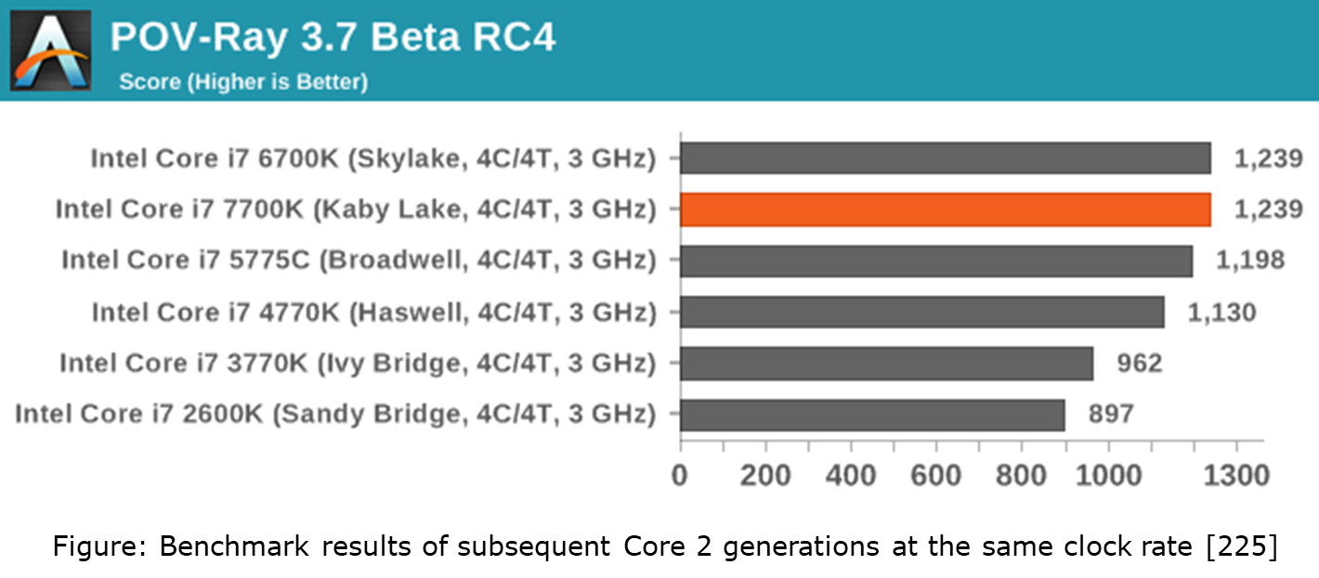
7.2.1 Use of an optimized 14 nm process, termed the 14 nm+ process (1)
7.2.1 Use of an optimized 14 nm process, termed the 14 nm+ process [225]
Kaby Lake processors have the same IPC scores as the previous Skylake models,
as benchmark figures at the same clock rate demonstrate (see the Figure below).
The new 14nm+ process has a higher power efficiency, i.e.
same frequency at lower power, or
higher frequency at same power

Slide 11
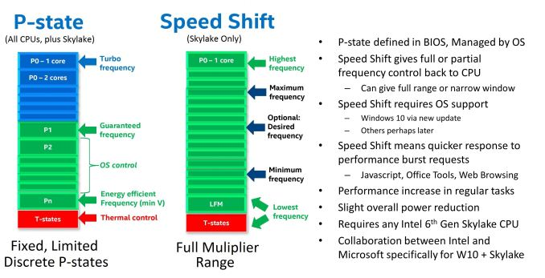
7.2.2 Enhanced Speed Shift technology (v2) (1)
7.2.2 Enhanced Speed Shift technology (v2)
The Speed Shift technology has been introduced in the Skylake line, as indicated below.
Figure: Main features of the Speed Shift technology vs. the Enhanced SpeedStep technology [225]

Slide 12
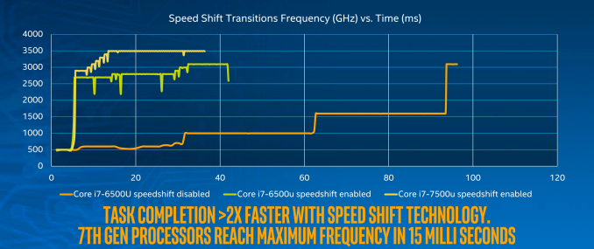
7.2.2 Enhanced Speed Shift technology (v2) (2)
Benefit of the Speed Shift technology v2 [225]
Speed Shift v2 results in faster frequency transitions, as the Figure below shows.
Figure: Achieving the max. clock frequency with and without the Speed Shift technology
while contrasting both versions of this technology
Faster frequency transitions result in reducing task completion, as also indicated
in the Figure.
*

Slide 13
7.3 Major innovation of the Kaby Lake line: The Optane memory
Notes:
13

Slide 14
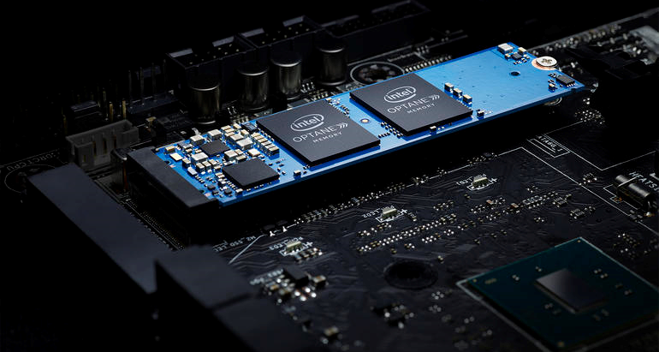
7.3 Major innovation of the Kaby Lake line (1)
7.3 Major innovation of the Kaby Lake line: The Optane memory -1
Optane memory is an innovation related to the PCH.
It is nonvolatile (nem-felejtő) memory typically used as a cache of a HDD drive.
The Optane memory has a typical size of 16 or 32 GB.
It is mounted on an M.2 card that is attached via 2 to 4 PCIe lanes (see the Figure below).
Its use needs the Rapid Storage Technology driver (Release 15.5 or later).
Figure: Optane memory installed on a mainboard [229]
*

Slide 15
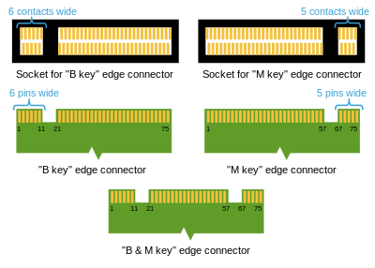
7.3 Major innovation of the Kaby Lake line (2)
The M.2 interface standard
It is an interface specification for internally mounted expansion cards and associated
connectors from PCI-SIG, its 1. version was issued in 2013.
It replaces the mSATA standard while providing different module widths and lengths,
as seen below.
The M.2 standard is particularly suited for small devices, like thin laptops or tablets.
Figure: M.2 sockets and edge connectors [238]

Slide 16
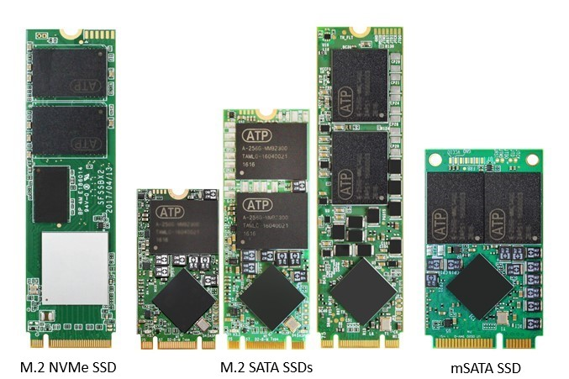
7.3 Major innovation of the Kaby Lake line (3)
M.2 card examples contrasted with mSATA (miniSATA) [290]
NVMe: Non-Volatile Memory express

Slide 17
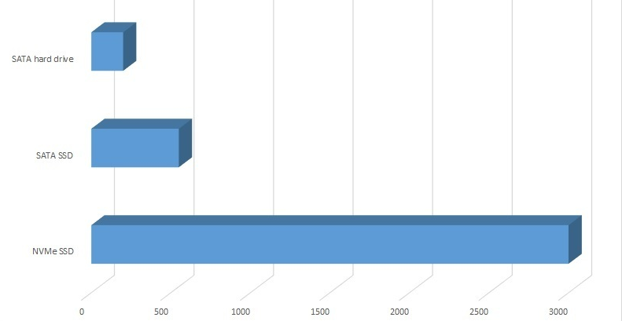
7.3 Major innovation of the Kaby Lake line (4)
Sustained throughput of SATA hard rive, SATA SSD and NvMe SSD [MB/s] [291]
HDD = 200MB/s, SATA SSD = 550MB/s, NVMe SSD = 3GB/s.

Slide 18
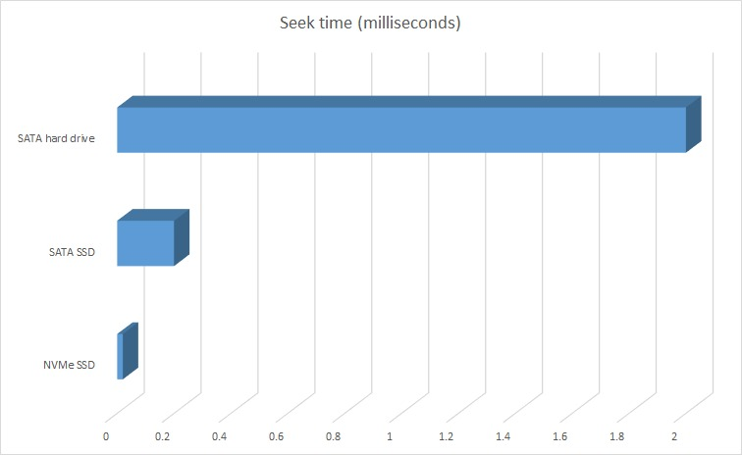
7.3 Major innovation of the Kaby Lake line (5)
Seek time of SATA hard rive, SATA SSD and NvMe SSD [ms] [291]
HD = 2-5 ms seek, SATA SSD = 0.2 ms seek, NVMe SSD = 0.02 ms seek.

Slide 19
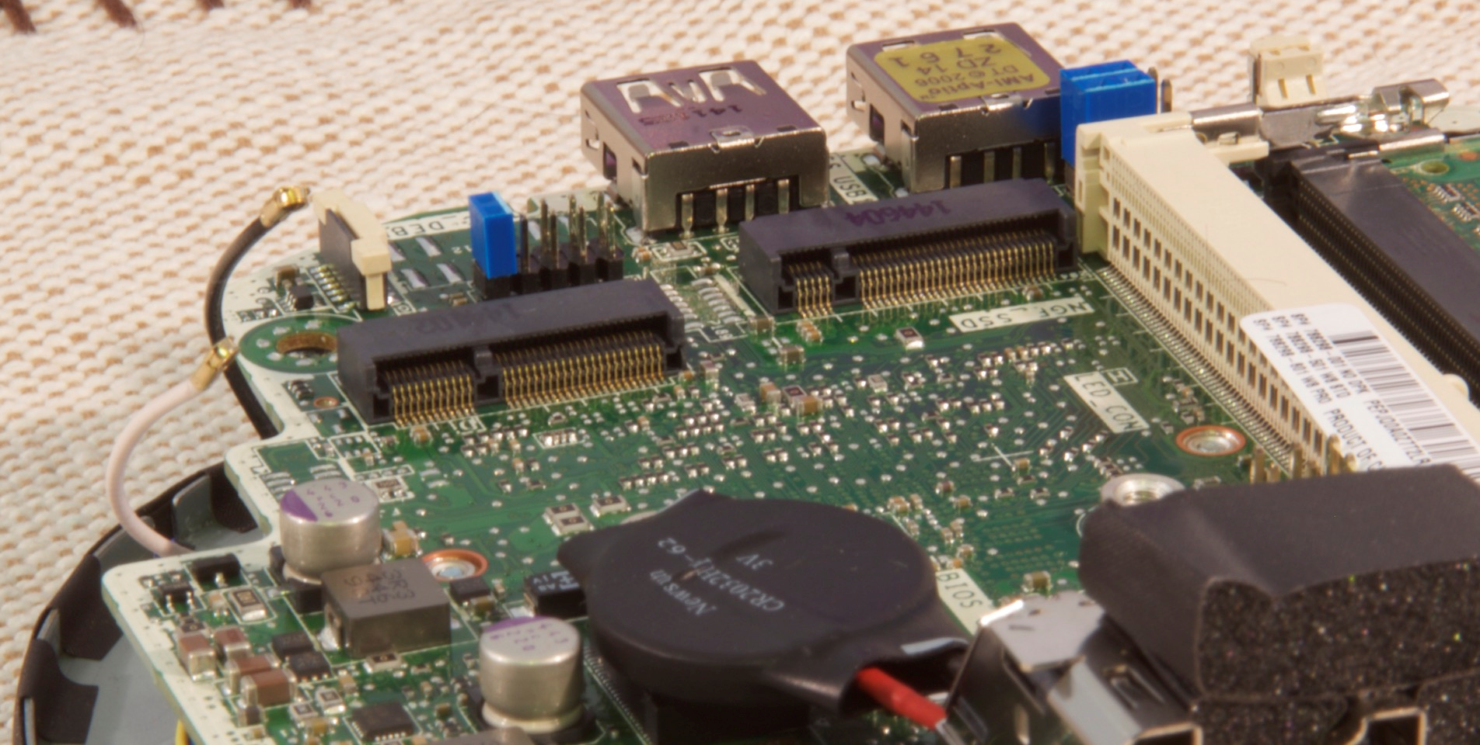
7.3 Major innovation of the Kaby Lake line (6)
Example for dual M.2 sockets mounted on a motherboard [230]
M.2 SATA
mSATA

Slide 20
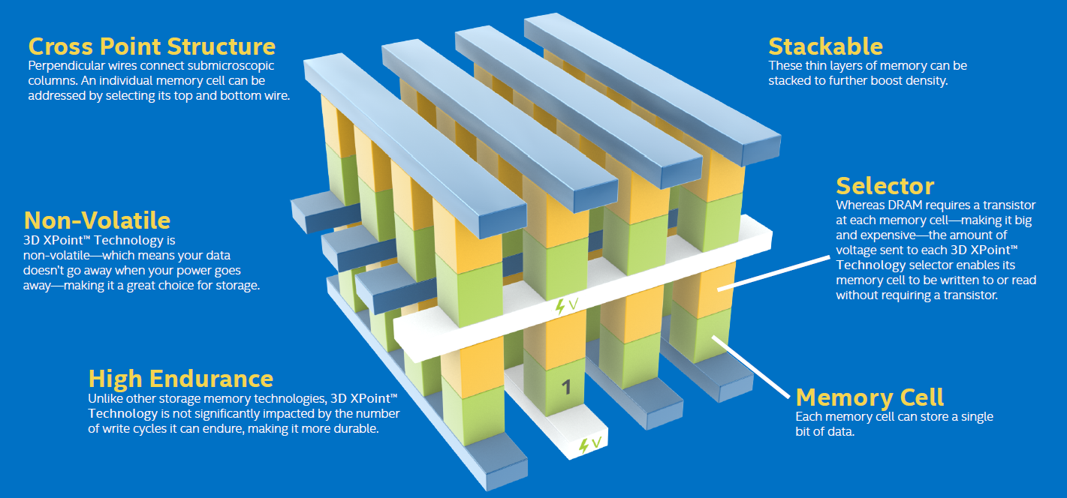
7.3 Major innovation of the Kaby Lake line (7)
Optane memory -2
It is based on the 3D XPoint memory technology, announced by Intel and Micron in 2016.
3D Xpoint (Cross-Point) memory is a high-density, stackable, bit-level addressable matrix of
non-volatile memory, as indicated below.
It provides more endurability than SSD devices.
First devices with Optane memory has been introduced in 1H 2017.
Figure: 3D XPoint memory [225]

Slide 21
7.3 Major innovation of the Kaby Lake line (8)
Main requirements for using Optane memory modules [229]
7th generation (Kaby Lake) processor with an Intel 200 series chipset,
an M.2 type socket on a PCIe 3.0 interface connected via 2 or 4 lanes,
64-bit Windows 10 OS,
Rapid Storage Technology (RST) driver 15.5 or later
appropriate system firmware (BIOS).
Note that the Optane memory, as introduced along with the 7th generation (Kaby Lake)
processors is designated as the 1. generation Optane memory and it supports only a single HD
drive.
Platforms with both a HD and SSD drive will be supported by the 2. generation Optane memory
introduced along with the 8th generation (Coffee Lake) processors.
HD (Hard Drive): Merevlemez

Slide 22
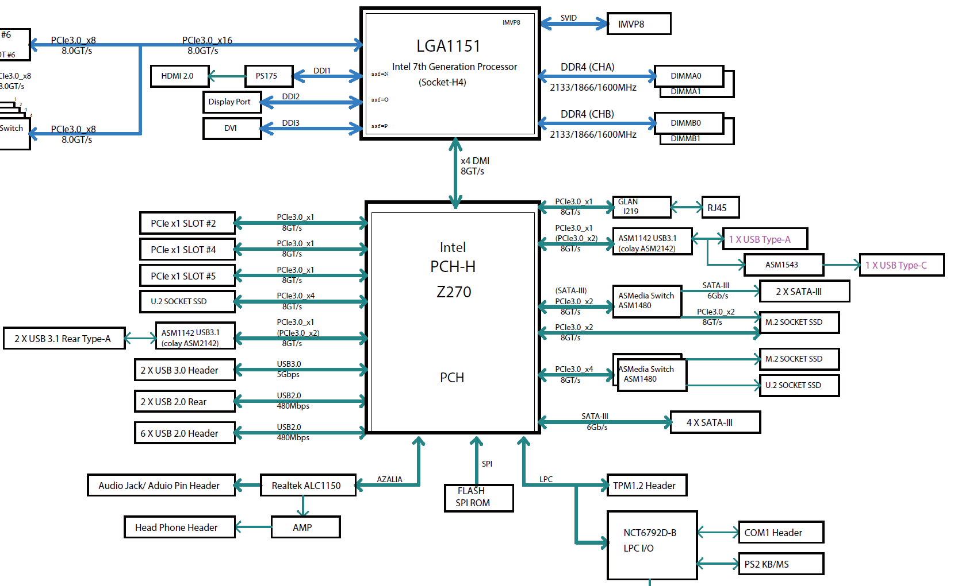
7.3 Major innovation of the Kaby Lake line (9)
Attaching two M.2 connectors to a Kaby Lake S-series DT processor
Block diagram of Supermicro’s MNL-1909 motherboard [253]

Slide 23
7.4 Kaby Lake-based processor lines
7.4.1 Overview of the Kaby Lake processor line
7.4.2 Example 1: The mobile Kaby Lake Y and U-series
7.4.3 Example 2: The 8th generation mobile Kaby Lake G-series
7.4.4 Example 3: The enthusiast mobile Kaby Lake X-series
Only Section 7.4.3 will be discussed.
Notes:
23

Slide 24
7.4.1 Overview of the Kaby Lake processor line
Notes:
24

Slide 25
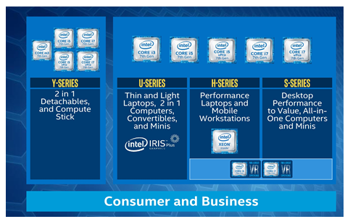
7.4.1 Overview of the Kaby Lake processor line (1)
7.4.1 Targeted market segments of the main Kaby Lake series [225]

Slide 26
7.4.1 Overview of the Kaby Lake processor line (2)
IMAGE
Key features of main Kaby Lake series [225]
 | Mobiles |  |  |  | Desktops
Variant | KBL-Y/Core m3 (BGA 1515) | KBL-U (BGA1356) | KBL-H (BGA1440) | KBL-G (BGA2270) | KBL-S (T/E/K/X) (LGA1151)
Cores/Threads | 2 | 2 | 2/4 | 4/8 | 2/4
Graphic Configurations | GT2 | GT2/GT3e | GT2 | AMD design | GT2
eDRAM | N/A | N/A / 64 MB | N/A | HBM2 | N/A
SOC Design | Yes | Yes | No, 200-series PCH | No HM175 PCH | No, 200-series PCH
TDP | 4.5W | 15W / 28W | 35W / 45W | 100W (Package) | 35W/51W/60W/ 65W/91W
Subclasses of the Mobile series
Y series: Mobile processors wih a very low TDP (4.5 W)
m3: Extreme low clock frequency models of the Y-series (1.0/1.1 GHz)
U-series: Mainline processors with a TDP of 15 or 28 W
H-series: High performance mobiles with a TDP of 35 or 45 W
of time, and at a level beyond that of the home PC user environment
G-series: High performance mobile with AMD Radeon RX Vega M GH graphics and HBM2 memory

Slide 27
7.4.1 Overview of the Kaby Lake processor line (3)
Subclasses of the desktop S-series
No suffix: Mainstream CPUs
T-series: Low power CPUs with lower TDP
E-series: Embedded series, Intel CPU will provide support for the product for a longer period
of time, and at a level beyond that of the home PC user environment
X-series: Extreme performance desktops
Microserver series
E3-series: Microservers
Further tags used to designate models of the Kaby Lake lines
K-tag: Multiplier-unlocked CPU that can be overclocked
Q-tag: Quad core model

Slide 28
7.4.1 Overview of the Kaby Lake processor line (4)
1. Introduction (2)
Overview of the Kaby Lake (7th Gen) processor series
Mobiles (M/Y/U and H-series) (SoC designs)
4.5 W Core M and Y-series (SoC designs, BGA1515)
Core i7-7Y75, 2C+HD 615, HT, 8/2016
Core i5-7Y5x, 2C+HD 615, HT, 8/2016 and 1/2017
Core m3-7Y3x, 2C+HD 615, HT, 8/2016 and 7/2017
15 W U-series (SoC designs, BGA1356)
Core i7-76x0U/75x0U, 2C+HD 620/640/650, HT, 8/2016 and 1/2017
Core i5-73x0U/72x0U, 2C+HD 620/640/650, HT, 8/2016 and 1/2017
Core i3-71xxU, 2C+HD 620/650, HT, 8/2016 and 7/2017
28 W U-series (SoC designs, BGA1356)
Core i7-7567U, 2C+HD 650, HT, 1/2017
Core i5-7287U/7267U, 2C+HD 650, HT, 1/2017
Core i3-7167U, 2C+HD 650, HT, 1/2017
35 W H-series (2-chip designs, 200-series PCH, BGA1440)
Core i3-7100H, 2C+HD 630, HT, 1/2017
45 W H-series (2-chip designs, 200-series PCH, BGA1440)
Core i7-7920HQ/7820HQ/7820HK/7700HQ, 4C+HD 630, HT, 1/2017
Core i5-7440HQ/,7300HQ 4C+HD 630, HT, 1/2017

Slide 29
7.4.1 Overview of the Kaby Lake processor line (5)
Enthusiast mobiles (G-series) (2-chip designs, HM175 chipset)
100 W (in package integrated AMD Vega graphics and HBM2, BGA2270)
Core i7-8809G/8709G/8706G/8705G/8305G, 4C+HD 630+AMD Vega M GH/GL + HBM2, HT
1/2018

Slide 30
7.4.1 Overview of the Kaby Lake processor line (6)
Desktops (S-series) (2-chip designs, 200-series chipset)
35 W T-tagged (LGA1151)
Core i7-7700T 4C+HD 630, HT, 1/2017
Core i5-7600T/7500T/7400T, 4C+HD 630, HT, 1/2015
Core i3-7300T/7100T/7101TE, 2C+HD 630, HT, 1/2017
51 W untagged (LGA 1151)
Core i3-7100/7300/7320, 2C+HD 630, HT, 1/2017
65 W untagged series (LGA1151)
Core i7-7700, 4C+HD 630, HT, 1/2017
Core i5-7600/7500/7400 4C+HD 630, HT, 1/2017
Core i3-7350K (60 W), 2C+HD 630, HT, 1/2017
91 W K-tagged, unlocked (LGA1151)
Core i7-7700K, 4C+HD630, HT, 1/2017
Core i5-7500K, 4C+HD630, HT, 1/2017
Enthusiast desktops (X-series) (2-chip designs, model 299 chipset)
112 W X-series, unlocked (LGA2066)
Core i7-7740X, 4C, (no integrated graphics), HT, 7/2017
Core i5-7640X, 4C (no integrated graphics), no HT, 7/2017

Slide 31
7.4.1 Overview of the Kaby Lake processor line (7)
Microservers (E3 v6-series)
25 W E3 v6-series (BGA 1440)
Xeon E3-1505L v6, 4C+HD P630, HT, 1/2017
45 W E3 v6-series (BGA 1440)
Xeon E3-1505M/1535M v6, 4C+HD P630, HT, 1/2017
72 W E3 v6-series (LGA 1151)
Xeon E3-12x0 v6, 4C, HT, 1/2017
73 W E3 v6-series (LGA 1151)
Xeon E3-12x5 v6, 4C+HD P630, HT, 1/2017

Slide 32
7.4.2 Example 1: The mobile Kaby Lake Y and U-series
Notes:
32

Slide 33
7.4.2 Example 1: The mobile Kaby Lake Y and U-series (1)
7.4.2 Example 1: The mobile Kaby Lake Y and U-series [225]
Main features of the mobile Kaby Lake Y and U-series
Intel Kaby Lake Y and U SKUs
 | Cores/ Threads | Base/ Turbo | IGP | L3 | eDRAM | TDP | Cost
Y-Series
i7-7Y75 | 2/4 | 1.3/3.6 | HD 615 | 4 MB | - | 4.5 W | $353
i5-7Y57 | 2/4 | 1.2/3.3 | HD 615 | 4 MB | - | 4.5 W | $253
i5-7Y54 | 2/4 | 1.2/3.2 | HD 615 | 4 MB | - | 4.5 W | $253
m3-7Y30 | 2/4 | 1.0/2.0 | HD 615 | 4 MB | - | 4.5 W | $253
U-Series
i7-7660U | 2/4 | 2.5/4.0 | Iris Plus 640 | 4 MB | 64 MB | 15 W | $373
i7-7600U | 2/4 | 2.8/3.9 | HD 620 | 4 MB | - | 15 W | $353
i7-7567U | 2/4 | 3.5/4.0 | Iris Plus 650 | 4 MB | 64 MB | 28 W | $373
i7-7560U | 2/4 | 2.4/3.8 | Iris Plus 640 | 4 MB | 64 MB | 15 W | $373
i7-7500U | 2/4 | 2.7/3.5 | HD 620 | 4 MB | - | 15 W | $353
i5-7360U | 2/4 | 2.3/3.6 | Iris Plus 640 | 4 MB | 64 MB | 15 W | $273
i5-7300U | 2/4 | 2.6/3.5 | HD 620 | 3 MB | - | 15 W | $253
i5-7200U | 2/4 | 2.5/3.1 | HD 620 | 3 MB | - | 15 W | $253
i5-7287U | 2/4 | 3.3/3.7 | Iris Plus 650 | 4 MB | 64 MB | 28 W | $273
i5-7267U | 2/4 | 3.1/3.5 | Iris Plus 650 | 4 MB | 64 MB | 28 W | $273
i5-7260U | 2/4 | 2.2/3.4 | Iris Plus 640 | 4 MB | 64 MB | 15 W | $273
i3-7167U | 2/4 | 2.8 | Iris Plus 650 | 3 MB | 64 MB | 28 W | $273
i3-7100U | 2/4 | 2.4 | HD 620 | 3 MB | - | 15 W | $253

Slide 34
7.4.2 Example 1: The mobile Kaby Lake Y and U-series (2)
Main features of Intel's 10th generation graphics included in the Kaby Lake line [174]
Market segment | Model number | Tier | Execution units | eDRAM (MB) | Base clock (MHz) | Boost clock (MHz) | GFLOPS | Used in
Consumer | HD Graphics 610 | GT1 | 12 | - | 300−350 | 900−1100 | ≈ 200 | Desktop Celeron, Desktop Pentium G45**, i3-7101
 | HD Graphics 615 | GT2 | 24 | − | 300 | 900–1050 | 345.6 – 403.2 | m3-7Y30, i5-7Y54, i7-7Y75
 | HD Graphics 620 |  |  |  |  | 1000–1050 | 384 – 403.2 | i3-7100U, i5-7200U, i5-7300U, i7-7500U, i7-7600U
 | HD Graphics 630 |  |  |  | 350 | 1000–1150 | 384 − 441.6 | Desktop Pentium G46**, i3, i5 and i7, and Laptop H-series i3, i5 and i7
 | Iris Plus Graphics 640 | GT3e | 48 | 64 | 300 | 950–1050 | 729.6 − 806.4 | i5-7260U, i5-7360U, i7-7560U, i7-7660U
 | Iris Plus Graphics 650 |  |  |  |  | 1050–1150 | 806.4 − 883.2 | i3-7167U, i5-7267U, i5-7287U, i7-7567U

Slide 35
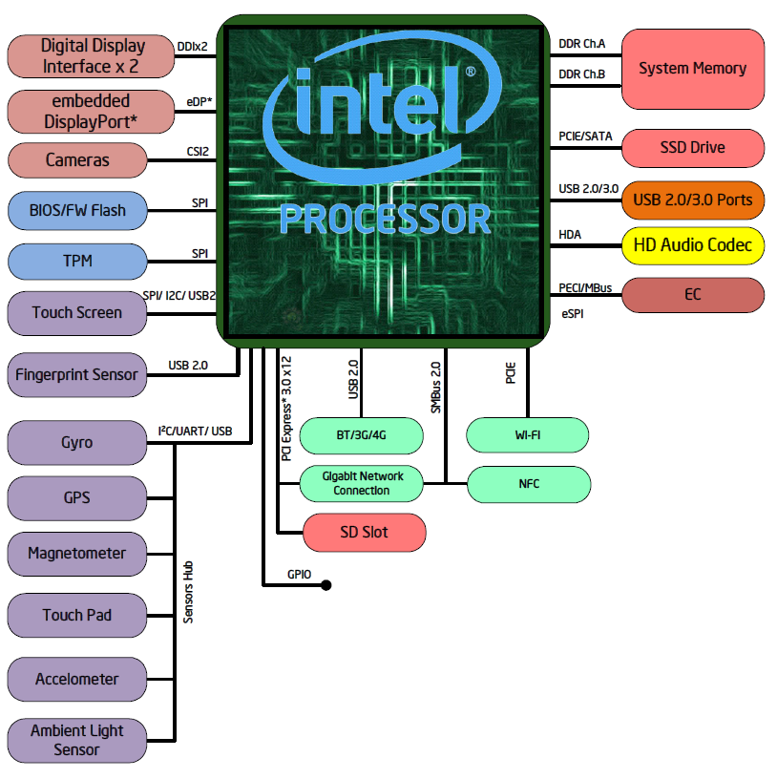
7.4.2 Example 1: The mobile Kaby Lake Y and U-series (3)
The Y/m and U-series platform [231]
7th gen.

Slide 36
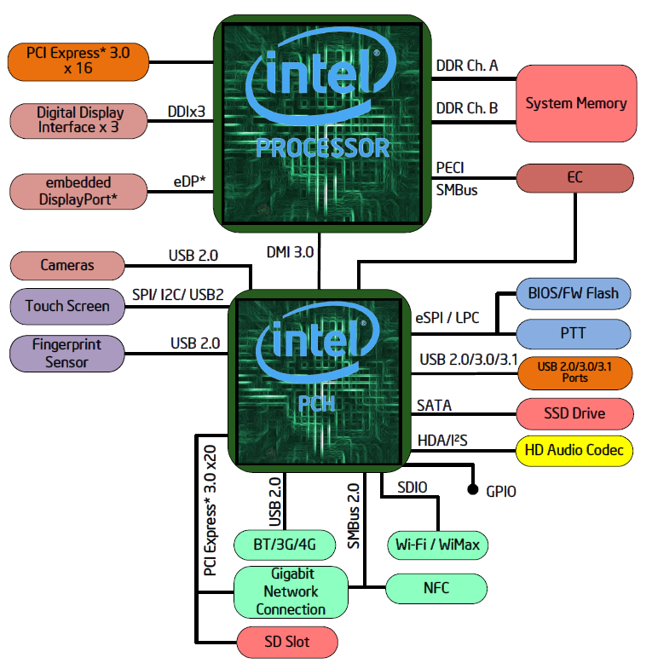
7.4.2 Example 1: The mobile Kaby Lake Y and U-series (4)
By contrast The mobile H-series and desktop S-series platforms [232], [233]
7th gen.
200-series

Slide 37
7.4.2 Example 1: The mobile Kaby Lake Y and U-series (5)
Main features of the Intel 200-series chipsets of the mobile H and desktop S series [225]
Intel 200-series Chipsets
 | Z270 | H270 |  | B250 |  | Q270 |  | Q250 |  | HM175 |  | QM175 |  | CM238
DMI | 3.0 | 3.0 |  | 3.0 |  | 3.0 |  | 3.0 |  | 3.0 |  | 3.0 |  | 3.0
PCIe 3.0 Lanes | 24 | 20 |  | 12 |  | 24 |  | 14 |  | 16 |  | 16 |  | 20
SATA 6 Gbps Ports | 6 | 6 |  | 6 |  | 6 |  | 6 |  | 4 |  | 4 |  | 8
USB 3.0 Ports | >= 10 | 8 |  | 6 |  | >= 10 |  | 8 |  | >= 8 |  | >= 8 |  | >= 10
Total USB 2/3 | 14 | 14 |  | 12 |  | 14 |  | 14 |  | 14 |  | 14 |  | 14
PCIe Config | x16 x8/x8 x8/x4/x4 | x16 |  | x16 |  | x16 x8/x8 x8/x4/x4 |  | x16 |  | x16 x8/x8 x8/x4/x4
Overclocking | Yes | No
vPro | No | No | No |  | Yes |  | No |  | No |  | Yes |  | Yes
Intel Manageability | No | No | No |  | Yes |  | Yes |  | No |  | Yes |  | Yes

Slide 38
7.4.3 Example 2: The 8th generation mobile Kaby Lake G-series
Notes:
38

Slide 39
7.4.3 Example 2: The 8th generation Kaby Lake G-series mobile processors (1)
7.4.3 Example 2: The 8th generation Kaby Lake G-series mobile processors -1 [253]
KLR
CL
KL G
KLR: Kaby Lake Refresh CL: Coffee Lake KL G: Kaby Lake G
*

Slide 40
Example 2: The 8th generation Kaby Lake G-series mobile processors (1b)
1. Introduction (1)
The 8th generation of the Core 2 family
gen.
2. gen.
3. gen.
4. gen.
5. gen.
Core 2
New
Microarch.
65 nm
Penryn
New
Process
45 nm
Nehalem
New
Microarch.
45 nm
West-
mere
New
Process
32 nm
Sandy Bridge
New
Microarch.
32 nm
Ivy Bridge
New
Process
22 nm
Haswell
New
Microarchi.
22 nm
Broad-
well
New
Process
14 nm
TOCK
TICK
TOCK
TICK
TOCK
TICK
TOCK
TICK
(2006)
(2007)
(2008)
(2010)
(2011)
(2012)
(2013)
(2014)
6. gen.
7. gen.
8. gen.¹
9. gen.
¹Astonishingly, the 8th generation encompasses
Skylake
New
Microarch.
14 nm
Kaby Lake
New
Microarch.
14 nm
Kaby Lake
Refresh
New
Microarch.
14 nm
Ice
Lake?
New
Process
10 nm
beyond Kaby Lake Refresh also the
Kaby Lake G with AMD Vega graphics
Coffee Lake and
10 nm Cannon Lake designs [218].
TOCK
TOCK
TOCK
TICK
(2015)
(2016)
(2017)
(2018)

Slide 41
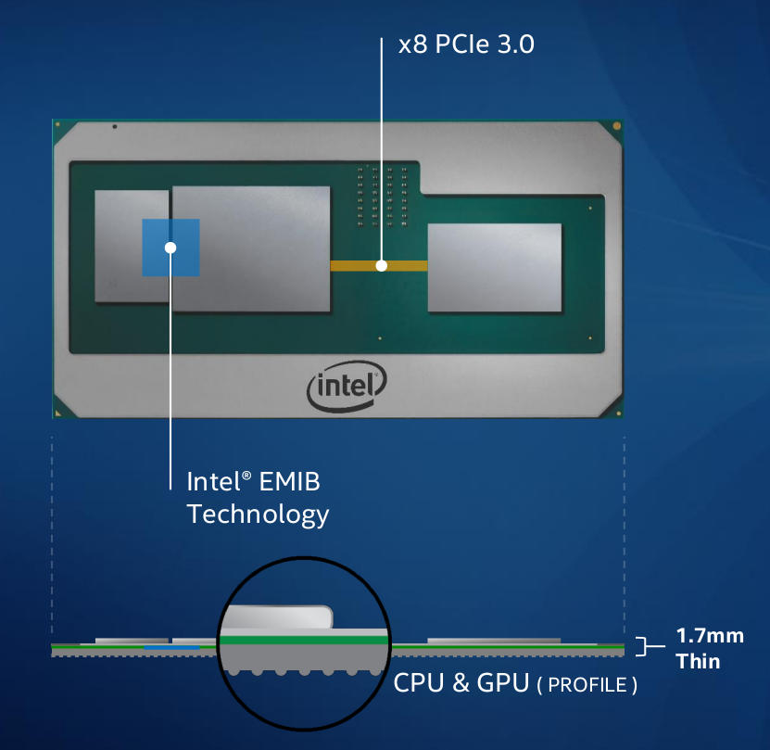
Example 2: The 8th generation Kaby Lake G-series mobile processors (2)
The Kaby Lake G-series mobile processors -2 [254]
Initial details were released in 11/2017.
Released in 01/2018
It is marked as 8. generation
processors.
Kaby Lake-G
i7-8809G
HBM2
AMD’s Vega
GPU
Intel’s 8. gen.
Kaby Lake CPU
The Kaby Lake-G line integrates
a Kaby Lake CPU
an AMD graphics unit
(Radeon RX Vega M GH or GL)
along with a 4 GB HBM2 VRAM,
into an MCM package.
The GPU is interconnected to the CPU
by an x8 PCI 3.0 lane whereas
the GPU is interconnected with the
HBM2 memory via Intel’s EMIB
(Embedded Multi-Die Interconnect Bridge)
technology, as the Figure shows.
BGA2270
31 x 58 mm
*

Slide 42
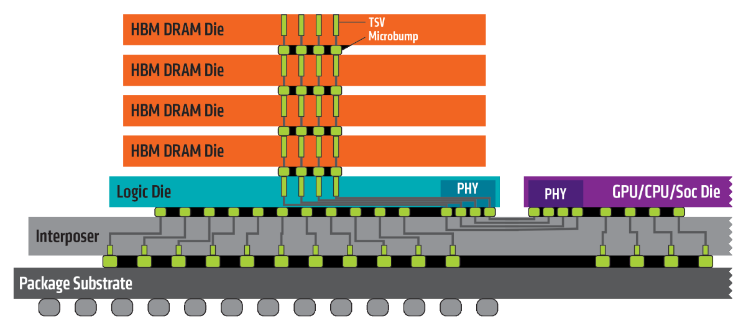
Example 2: The 8th generation Kaby Lake G-series mobile processors (2b)
Principle of the HBM2 (High Bandwidth Memory) [292]
Stacked DRAM dies

Slide 43
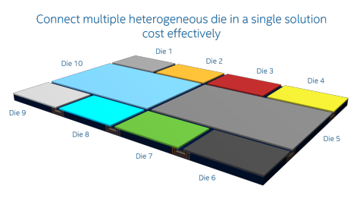
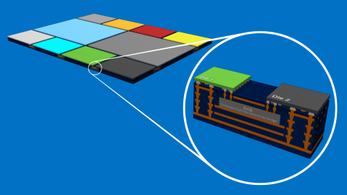
7.4.3 Example 2: The 8th generation Kaby Lake G-series mobile processors (2c)
Intel's concept for interconnecting multiple dies through EMIB [274]
EMIB: Embedded Multi-Die Interconnect Bridge
*

Slide 44
7.4.3 Example 2: The 8th generation Kaby Lake G-series mobile processors (3)
The Kaby Lake G-series mobile processors -3 [254]
We note that AMD’s Vega GPU has a considerable higher performance than Intel’s integrated
HD Graphics 630.
*

Slide 45
7.4.3 Example 2: The 8th generation Kaby Lake G-series mobile processors (4)
Additional benefit of the integrated CPU/GPU/HBM2 solution – less board space [255]
*

Slide 46
7.4.3 Example 2: The 8th generation Kaby Lake G-series mobile processors (5)
Main features of the Kaby Lake G-series mobile processors [255]
Model | Base/Turbo frequencyl | Cores/ Threads | L3 cache | TDP | AMD Radeon RX pGPU | HD Graphics IGP típusa
i7-8809G | 3,1/4,2 GHz | 4/8 | 8 MB | 100 W | Vega M GH | 630
i7-8709G | 3,1/4,1 GHz | 4/8 | 8 MB | 100 W | Vega M GH | 630
i7-8706G | 3,1/4,1 GHz | 4/8 | 8 MB | 65 W | Vega M GL | 630
i7-8705G | 3,1/4,1 GHz | 4/8 | 8 MB | 65 W | Vega M GL | 630
i5-8305G | 2,8/3,8 GHz | 4/8 | 6 MB | 65 W | Vega M GL | 630
The Vega M GH has about 10% higher performance than the Vega M GL.

Slide 47
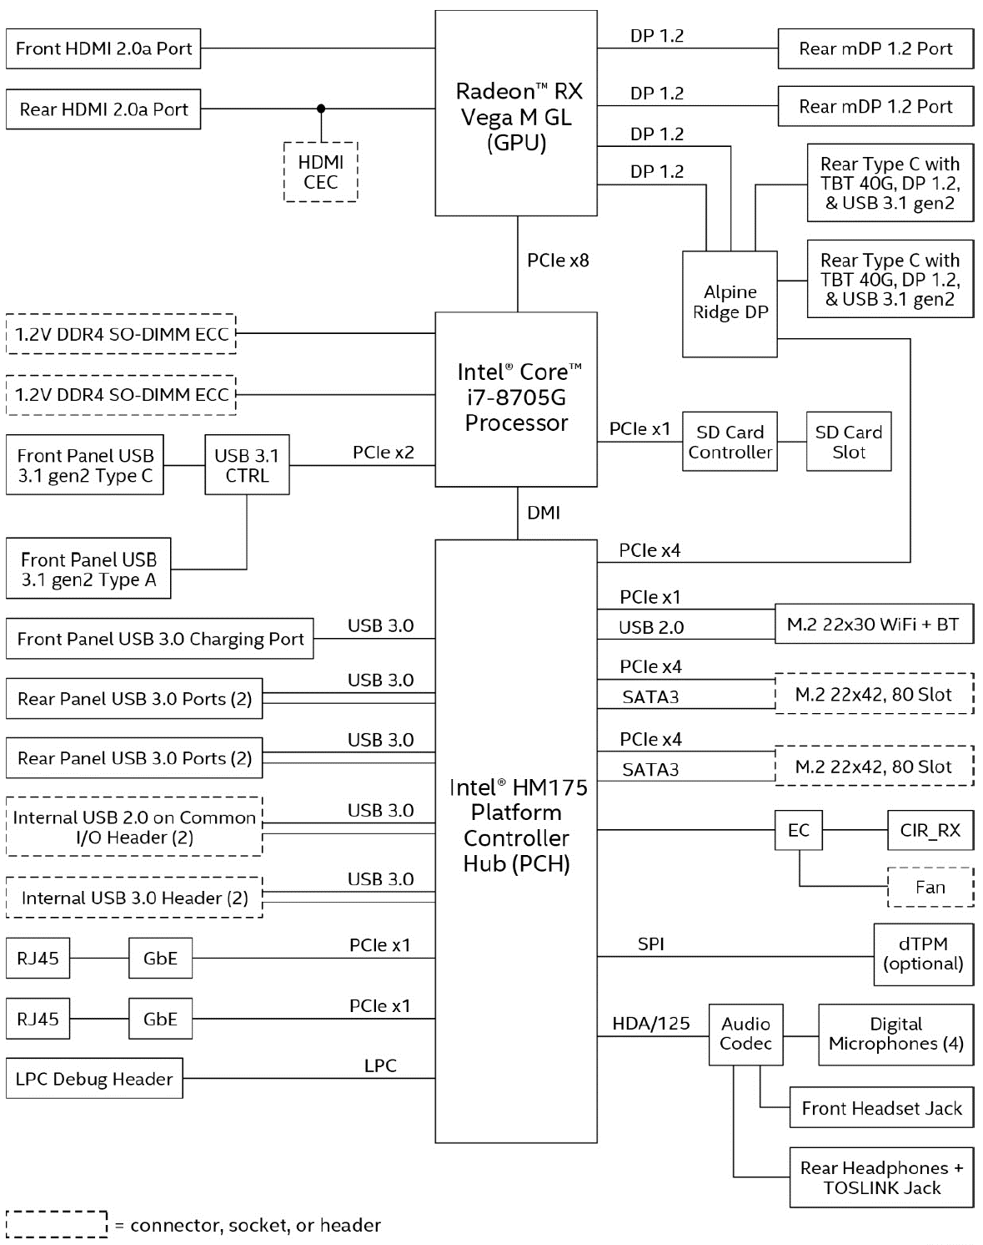
7.4.3 Example 2: The 8th generation Kaby Lake G-series mobile processors (6)
Block diagram of a Kaby Lake-G
based platform
(Intel’s NUC8i7HN kit) [256]

Slide 48
7.4.3 Example 2: The 8th generation Kaby Lake G-series mobile processors (7)
Cinebench R15 single thread
benchmark comparison [257]

Slide 49
7.4.3 Example 2: The 8th generation Kaby Lake G-series mobile processors (8)
Cinebench R15 multi-thread
benchmark comparison [257]

Slide 50
7.4.3 Example 2: The 8th generation mobile Kaby Lake G-series (9)
Remark
Cinebench is a real-world cross platform test suite that evaluates computer's performance
capabilities.
It is based on MAXON's animation software Cinema 4D, which is used extensively by studios
and production houses worldwide for 3D content creation.
It is often used to assess graphics capabilities of processors.
*

Slide 51
7.4.4 Example 3: The enthusiast mobile Kaby Lake X-series
Notes:
51

Slide 52
7.4.4 Example 3: The enthusiast mobile Kaby Lake X-series (1)
7.4.4 Example 3: The enthusiast mobile Kaby Lake X-series -1 [258]
Announced in 05/2017
Launched in 07/2017
The X-series includes the highest performance models of the Kaby lake line.
It has only two models (i7-7740-X and i5-7640X), as seen below.
Note
The designation of these models is mobile X-series in order to emphasize the vast difference
to the “ordinary” X-series used for HEDs, as the Table below shows.
Processor | Techn. | Date of intro. | Max. no. of cores | Platform topology | Highest mem./ speed | PCIe lanes | No. of mem. channels | PCH | Processor socket
Skylake-X | 14 nm | 6/2017 | 18C | On-die MC | DDR4-2666 | 44 PCI-3.0 on the die | 4 | X299 (Basin Falls) | LGA-2066
Kaby-Lake-X |  |  | 4C |  |  | 16
Table: Main features of the HED oriented Skylake-X and the enthusiast mobile oriented
Kaby Lake X-series

Slide 53
7.4.4 Example 3: The enthusiast mobile Kaby Lake X-series (2)
Main features of the enthusiast mobile Kaby Lake X-series -1 [258]
Intel Kaby Lake Processors
 | Core i7 |  | Core i5
 | Core i7-7740X | Core i7-7700K | Core i5-7640X | Core i5-7600K
Socket | LGA2066 | LGA1151 | LGA2066 | LGA1151
Cores/Threads | 4/8 | 4/8 | 4/4 | 4/4
Base Frequency | 4.3 GHz | 4.2 GHz | 4.0 GHz | 3.8 GHz
Turbo Frequency | 4.5 GHz | 4.5 GHz | 4.2 GHz | 4.2 GHz
TDP | 112 W | 91 W | 112 W | 91 W
L2 Cache | 256 KB/core
L3 Cache | 8 MB |  | 6 MB
DRAM Channels | 2
DRAM Support | DDR4-2666 | DDR4-2400 | DDR4-2666 | DDR4-2400
Graphics | None | HD 620 | None | HD 620
Price (MSRP) | $350 |  | $250
Price (7/21) | $349 | $309 | $248 | $239
Launched | July 2017 | Jan 2017 | July 2017 | Jan 2017

Slide 54
7.4.4 Example 3: The enthusiast mobile Kaby Lake X-series (3)
Main features of the Kaby Lake X-series models -2 [258]
Note the main differences between the enthusiast mobile Kaby Lake-X and desktop H-series
models in the Table above:
higher clock rates (e.g. 4.3 GHz base clock rate for the i7_7740X vs. 4.2 GHz for the
i7-7700K)
higher TDP (112 W vs. 91 W
higher memory rates (up to DDR4-2666 for the Kaby Lake-X series vs. up to DDR4-2400
for the Kaby Lake-H series)
no integrated graphics
higher prices

Slide 55
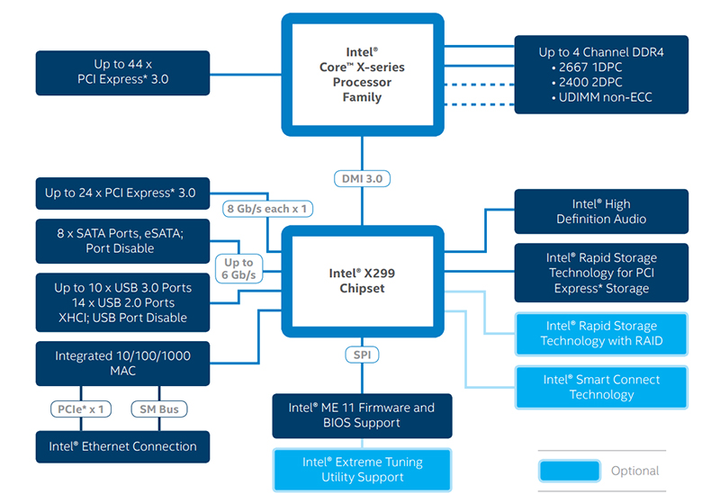
7.4.4 Example 3: The enthusiast mobile Kaby Lake X-series (4)
The Kaby Lake-X platform with the X299 chipset [259]
Kaby Lake-X processors have only
16 PCIe 3.0 lanes, in contrast
Skylake-X processors up to 44.
Kaby Lake-X processors have only
2 memory channels, in contrast
Skylake-X processors 4.

Slide 56
7.4.4 Example 3: The enthusiast mobile Kaby Lake X-series (5)
Optional liquid cooling solution for Kaby Lake-X models [258]

Slide 57
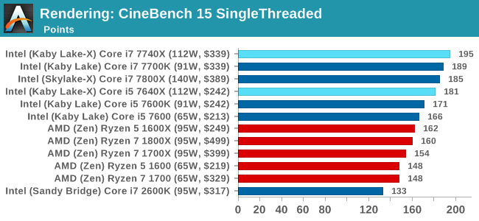
7.4.4 Example 3: The enthusiast mobile Kaby Lake X-series (6)
Cinebench R15 single threaded benchmark comparison [258]

Slide 58
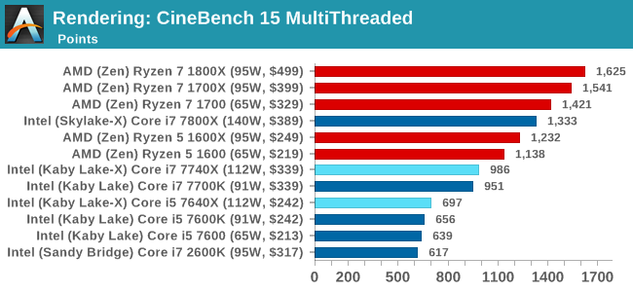
7.4.4 Example 3: The enthusiast mobile Kaby Lake X-series (7)
Cinebench R15 multi threaded benchmark comparison [258]

Slide 59
8. The Kaby Lake Refresh line
It will not be discussed.
Notes:
59

Slide 60
8. The Kaby Lake Refresh line (1)
8. The Kaby Lake Refresh line -1 [253]
KLR
CL
KL G
KLR: Kaby Lake Refresh CL: Coffee Lake KL G: Kaby Lake G
*

Slide 61
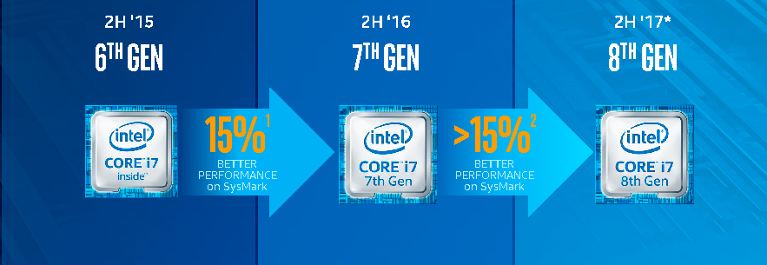
8. The Kaby Lake Refresh line (2)
The Kaby Lake Refresh line -2
It is the second refreshment of the Skylake line (as seen in the Figure below.
Skylake
Kaby Lake
Kaby Lake Refresh
Figure: The 8th generation Kaby Lake Refresh line [235]
Intel dubs it as belonging to the 8th generation Core architecture.
Here we note that the 8th generation does not only include the Kaby lake refresh line, which is
based on the enhanced 14 nm process (designated as 14 nm+), but also contains models of
the Kaby Lake G series with AMD Vega graphics (based on a 14 nm+) process,
the Coffee Lake line (based on the 14 nm++ process and
the Cannon Lake line (based on the 14 nm++ process),
as indicated in the next Figure.
*

Slide 62
8. The Kaby Lake Refresh line (3)
1. Introduction (1)
The Kaby Lake Refresh line -3
gen.
2. gen.
3. gen.
4. gen.
5. gen.
Core 2
New
Microarch.
65 nm
Penryn
New
Process
45 nm
Nehalem
New
Microarch.
45 nm
West-
mere
New
Process
32 nm
Sandy Bridge
New
Microarch.
32 nm
Ivy Bridge
New
Process
22 nm
Haswell
New
Microarchi.
22 nm
Broad-
well
New
Process
14 nm
TOCK
TICK
TOCK
TICK
TOCK
TICK
TOCK
TICK
(2006)
(2007)
(2008)
(2010)
(2011)
(2012)
(2013)
(2014)
6. gen.
7. gen.
8. gen.¹
9. gen.
¹Astonishingly, the 8th generation encompasses
Skylake
New
Microarch.
14 nm
Kaby Lake
New
Microarch.
14 nm
Kaby Lake
Refresh
New
Microarch.
14 nm
Ice
Lake?
New
Process
10 nm
beyond Kaby Lake Refresh also the
Kaby Lake G with AMD Vega graphics
Coffee Lake and
10 nm Cannon Lake designs [218].
TOCK
TOCK
TOCK
TICK
(2015)
(2016)
(2017)
(2018)

Slide 63
8. The Kaby Lake Refresh line (4)
The 8th generation of Intel’s Core 2 family [260]
Intel's Core Architecture Cadence (8/20)
Core Generation | Microarchitecture | Process Node | Release Year
2nd | Sandy Bridge | 32nm | 2011
3rd | Ivy Bridge | 22nm | 2012
4th | Haswell | 22nm | 2013
5th | Broadwell | 14nm | 2014
6th | Skylake | 14nm | 2015
7th | Kaby Lake | 14nm+ | 2016
8th | Kaby Lake Refresh Coffee Lake Kaby Lake G Cannon Lake | 14nm+ 14nm++ 14 nm+ 10nm | 2017 2017 2018 2018
9th | Ice Lake? ... | 10nm+ | 2018?
*

Slide 64
8. The Kaby Lake Refresh line (5)
The Kaby Lake Refresh line -3
It was introduced in 8/2017.
In incorporates U series 15 W mobile processors.

Slide 65
8. The Kaby Lake Refresh line (6)
Main features of Intel's Kaby Lake Refresh U line 15 W mobile processors [237]
7th Generation (Kaby Lake) |  |  |  |  | 8th Generation (Kaby Lake Refresh)
 | Cores | Freq + Turbo | L3 | Price |  | Cores | Freq + Turbo | L3 | Price
i7-7660U | 2/4 | 2.5/4.0 GHz | 4 MB | $415 | i7-8650U | 4/8 | 1.9/4.2 GHz | 8 MB | $409
i7-7560U |  | 2.4/3.8 GHz |  | $415 | i7-8550U |  | 1.8/4.0 GHz |  | $409
i5-7360U | 2/4 | 2.3/3.6 GHz | 3 MB | $304 | i5-8350U | 4/8 | 1.7/3.6 GHz | 6 MB | $297
i5-7260U |  | 2.2/3.4 GHz |  | $304 | i5-8250U |  | 1.6/3.4 GHz |  | $297
The Kaby Lake refresh models are 4+2 silicon designs, they include 4 cores and
GT2 level integrated graphics, whereas the previous generation Kaby Lake U series
models were 2+2 designs.

Slide 66
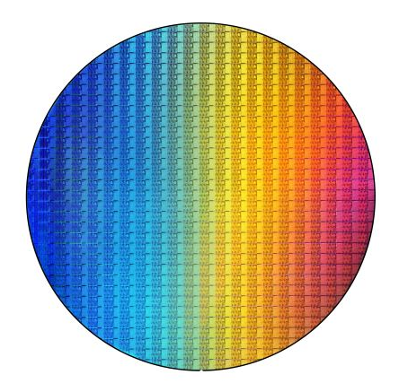
8. The Kaby Lake Refresh line (7)
Wafer with Kaby Lake Refresh U-series processors [237]
The wafer is assumed to have a 14” diameter and including about 480 dies [237].

Slide 67
8. The Kaby Lake Refresh line (8)
Enlarged part of the wafer with U-series processors (4 cores) [237]

Slide 68
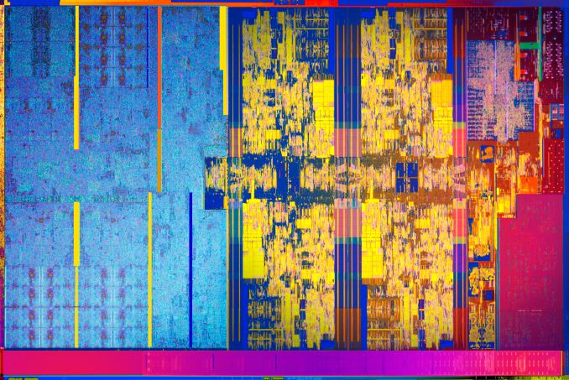
8. The Kaby Lake Refresh line (9)
Die photograph of a Kaby Lake Refresh U-series processor [237]
The die size is about 124 mm².

Slide 69
9. The Coffee Lake line
9.1 Introduction to the Coffee Lake line
9.2 Example 1: The first wave of Coffee Lake lines:
the up to 6-core DT S-series
9.3 Example 2: The second wave of DT Coffee Lake
S-series
9.4 Example 3 : Mobile Coffee Lake H-series
9.5 Example 4: Mobile Coffee Lake U-series
with Iris Plus graphics
Only Sections 9.1 to 9.3 will be discussed.
Notes:
69

Slide 70
9.1 Introduction to the Coffee Lake line
Notes:
70

Slide 71
9.1 Introduction (1)
1. Introduction (1)
9.1 Introduction to the Coffee Lake line -1
gen.
2. gen.
3. gen.
4. gen.
5. gen.
Core 2
New
Microarch.
65 nm
Penryn
New
Process
45 nm
Nehalem
New
Microarch.
45 nm
West-
mere
New
Process
32 nm
Sandy Bridge
New
Microarch.
32 nm
Ivy Bridge
New
Process
22 nm
Haswell
New
Microarchi.
22 nm
Broad-
well
New
Process
14 nm
TOCK
TICK
TOCK
TICK
TOCK
TICK
TOCK
TICK
(2006)
(2007)
(2008)
(2010)
(2011)
(2012)
(2013)
(2014)
6. gen.
7. gen.
8. gen.¹
9. gen.
¹Astonishingly, the 8th generation encompasses
Skylake
New
Microarch.
14 nm
Kaby Lake
New
Microarch.
14 nm
Kaby Lake
Refresh
New
Microarch.
14 nm
Ice
Lake?
New
Process
10 nm
beyond Kaby Lake Refresh also the
Kaby Lake G with AMD Vega graphics
Coffee Lake and
10 nm Cannon Lake designs [218].
TOCK
TOCK
TOCK
TICK
(2015)
(2016)
(2017)
(2018)

Slide 72
9.1 Introduction (1b)
9.1 Introduction to the Coffee Lake line -2
Key new features of the ISP
and the microarchitecture
2 YEARS
TICK Pentium 4 ( Cedar Mill)
Pentium D (Presler)
01/2006
2 YEARS
65nm
New microarch.: 4-wide core,
128-bit SIMD FX/FP EUs,
shared L2 , no HT
TOCK Core 2
07/2006
TICK Penryn Family
11/2007
2 YEARS
45nm
New microarch.: 4 cores, integr. MC,
QPI, private L2, (inclusive) L3, HT
TOCK Nehalem
11/2008
TICK Westmere
01/2010
In package integrated GPU
2 YEARS
32nm
New microarch.: 256-bit (FP) AVX,
ring bus, integrated GPU
TOCK Sandy Bridge
01/2011
TICK Ivy Bridge
04/2012
2 YEARS
22nm
New microarch.: 256-bit (FX) AVX2,
L4 cache (discrete eDRAM), TSX
TOCK Haswell
06/2013
TICK Broadwell
09/2014
Shared Virtual Memory
TOCK Skylake
New microarch.: 5-wide core,
ISP, Memory Side L4 cache, no FIVR
4 YEARS
10/2015
14nm
Optane memory, in KBL G series:
in package integr. CPU, GPU, HBM2
TOCK Kaby Lake
08/2016
TOCK Coffee Lake
10/2017
6C, (USB G2, integr. connectivity,
Optane 2)
TICK Cannonlake
05/2018
AVX512
?? YEARS
10nm
TOCK Icelake
??/2019
Figure is based on [3])
*

Slide 73
9.1 Introduction (1c)
9.1 Introduction to the Coffee Lake line -3
Key new features
in power management
2 YEARS
TICK Pentium 4 ( Cedar Mill)
Pentium D (Presler)
01/2006
2 YEARS
65nm
Clock gating, PECI,
Platform Thermal Control by
3. party controller
TOCK Core 2
07/2006
2 YEARS
TICK Penryn Family
11/2007
EDAT
45nm
Integrated Power Gates, PCU,
Turbo Boost
TOCK Nehalem
11/2008
TICK Westmere
01/2010
2 YEARS
32nm
TOCK Sandy Bridge
01/2011
Turbo Boost 2.0
2 YEARS
TICK Ivy Bridge
04/2012
22nm
FIVR
TOCK Haswell
06/2013
TICK Broadwell
09/2014
2. gen. FIVR
Speed Shift Technology,
Duty Cycle control, No FIVR
(except Skylake X)
4 YEARS
TOCK Skylake
10/2015
14nm
TOCK Kaby Lake
08/2016
Speed Shift Technology v2
TOCK Coffee Lake
10/2017
In H-series: TVB
(Thermal Velocity Boost)
TICK Cannonlake
05/2018
10nm
TOCK Icelake
??/2019
Figure is based on [3])
*

Slide 74
9.1 Introduction (1d)
Introduction to the Coffee Lake line -4 [253]
Models of the Coffee Lake line were launched in two waves until now (08/2018):
in 10/2017
in 04/2018
S-series desktop lines and
U-series mobile models
H-series performance mobile models
S-series desktop models,
M-series models as well as
300-series PCHs.
as the subsequent Figures indicate.

Slide 75
9.1 Introduction (2)
The Coffee Lake line -4 [253]
The 1. wave of Coffee Lake processors (10/2017)
KLR
CL
KL G
KLR: Kaby Lake Refresh CL: Coffee Lake KL G: Kaby Lake G

Slide 76
9.1 Introduction (3)
The Coffee Lake line -5 [253]
The 2. wave of Coffee Lake processors (4/2018)
CL
CL
CL
CL
(Improved)
CL
CL
for DTs and H-series mobiles

Slide 77
9.1 Introduction (4)
IMAGE
Key features of main Coffee Lake lines [261]
 | Mobiles |  |  | Desktops
Variant | U-series (BGA1528) | H-series (BGA1440) | H-series Xeon (BGA1440) | S-series) (LGA1151)
Cores/Threads | 2/4, 4/8 | 4/8, 6/12 | 4/8, 6/12 | 4/4, 6/6, 6/12
Graphic Configurations | GT3e | GT2 | GT2 | GT2
eDRAM | 128 MB | No | No | No
SOC Design | Yes | No, with PCH | No, with PCH | No, with PCH
TDP | 28W | 45W | 45W | 35W/62W/65W

Slide 78
9.1 Introduction (5)
Overview of the Coffee Lake (8th Gen) processor lines -1
Mobiles (300 series mobile chipset, Optane supported)
28 W U-series (SoC, BGA1528)
Core i7-8559U, 4C+Iris Plus Graphics 655HD, HT, 4/2018
Core i5-8269U/8259U, 4C+Iris Plus Graphics 655HD, HT, 4/2018
Core i3-8109U, 2C+Iris Plus Graphics 655HD, HT, 4/2018
45 W H-series (Two-chip designs, BGA1440)
Core i9-8950HK, 6C+UHD 630, HT, 4/2018
Core i7-8850H/8750H, 6C+UHD 630, HT, 4/2018
Core i5-8400H/,8300H 4C+UHD 630, HT, 4/2018
Mobile Xeon-E (Two-chip designs, Optane supported, ECC supported, CM246 PCH)
45 W M-series (BGA1440, 300-series chipset)
Xeon E2176M/E2186M 6C+UHD P630, HT, 4/2018

Slide 79
9.1 Introduction (6)
Overview of the Coffee Lake (8th Gen) processor leines -2
Desktops (S-series) (2-chip designs, LGA1151, 300-series desktop PCHs but
overclocking (in K-tagged (unlocked) models) requires the Z370 PCH, Optane supported)
35 W T-tagged (low-power)
Core i7-87700T 6C+UHD 630, HT, 4/2018
Core i5-8600T/8500T/8400T 6C+UHD 630, no HT, 4/2018
Core i3-8300T/8100T 4C+UHD 630, no HT, 4/2018
62 W untagged
Core i3-8300, 4C+UHD 630, no HT, 4/2018
65 W untagged
Core i7-8700, 6C+UHD 630, HT, 10/2017
Core i5-8400 6C+UHD 630, no HT, 10/2017
Core i5-8600/8500 6C+UHD 630, no HT, 4/2018
Core i3-8100 4C+UHD 630, no HT, 10/2017
91 W K-tagged (unlocked)
Core i3-8350K, 4C+UHD630, no HT, 10/2017
95 W K-tagged (unlocked)
Core i7-8700K, 6C+UHD630, HT, 10/2017
Core i5-8600K, 6C+UHD630, no HT, 10/2017

Slide 80
9.2 Example 1: The first wave of the Coffee Lake lines:
the up to 6-core DT S-series
Notes:
80

Slide 81
9.2 Example 1: The first wave of Coffee Lake lines: the up to 6-core DT S-series (1)
9.2 Example 1: The first wave of the Coffee Lake lines: the up to 6-core DT S-series [253]
Launched in 10/2017
KLR
CL
KL G
KLR: Kaby Lake Refresh CL: Coffee Lake KL G: Kaby Lake G

Slide 82
9.2 Example 1: The first wave of Coffee Lake lines: the up to 6-core DT S-series (2)
Main features of the up to 6-core DT S-series, launched in 10/2017 [260]

Slide 83
9.2 Example 1: The first wave of Coffee Lake lines: the up to 6-core DT S-series (3)
Comparing the Kaby Lake i7 K-tagged and the Coffee Lake i7 K-tagged models -1 [260]
Kaby Lake i7-K vs Coffee Lake i7-K
i7-7700K |  | i7-8700K
4C / 8T | Cores | 6C / 12T
4.2 GHz | Base Frequency | 3.7 GHz
4.5 GHz | Turbo Boost 2.0 | 4.7 GHz
8 MB | L3 Cache | 12 MB
DDR4-2400 | DRAM Support | DDR4-2666
GT2: 24 EUs | Integrated Graphics | GT2: 24 EUs
350 MHz | IGP Base Freq | 350 MHz
1.15 GHz | IGP Turbo | 1.20 GHz
16 | PCIe Lanes (CPU) | 16
< 24 | PCIe Lanes (Chipset) | < 24
95W | TDP | 95 W
$339 | Price (tray) | $359
$340 | Price (Newegg) | $380
$351 | Price (Amazon) | $N/A
(14 nm+)
(14 nm++)

Slide 84
9.2 Example 1: The first wave of Coffee Lake lines: the up to 6-core DT S-series (4)
Comparing the Kaby Lake i7 K-tagged and the Coffee Lake i7 K-tagged models -2 [260]
Note that the introduced Coffee Lake DT models are Intel’s first 6-core DT processors.
Presumably, this move is triggered by AMD’s introduction of 8-core Ryzen DT models.

Slide 85
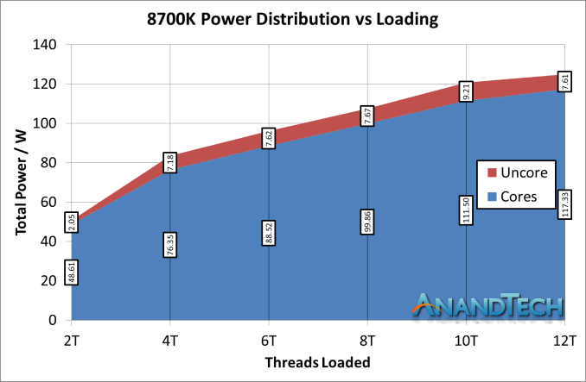
9.2 Example 1: The first wave of Coffee Lake lines: the up to 6-core DT S-series (4b)
Power distribution between “uncore” and cores in the i7-8700K with ring bus,
depending on loading [275]

Slide 86
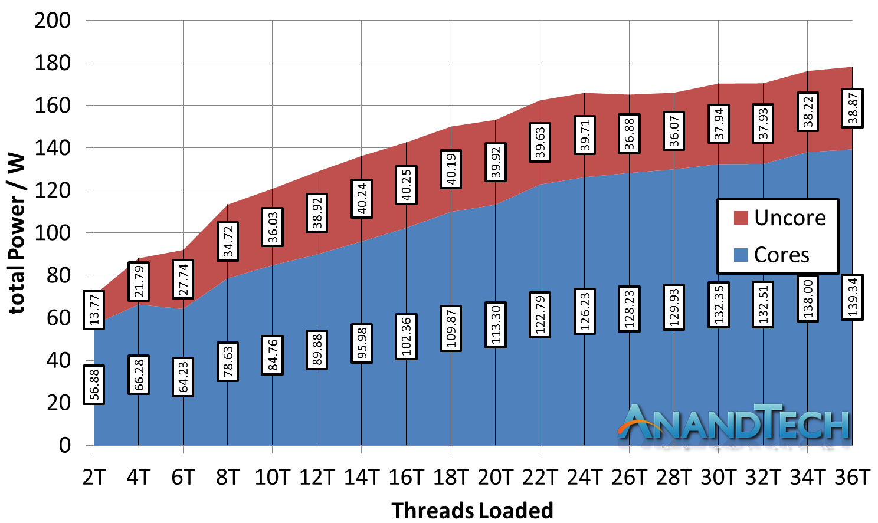
9.2 Example 1: The first wave of Coffee Lake lines: the up to 6-core DT S-series (4c)
By contrast: Power distribution between the “uncore” and cores in the i9-7980XE
(based on the Skylake-X core with 2D mesh), depending on loading [275]

Slide 87
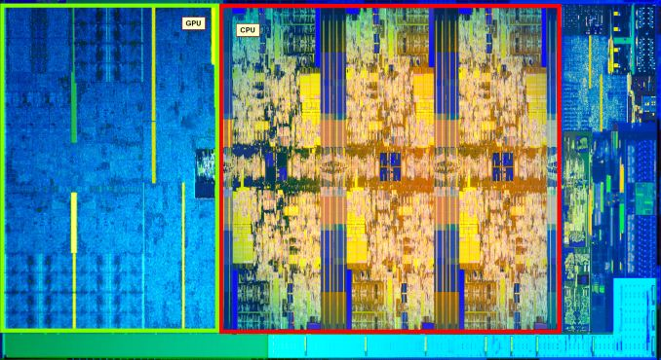
9.2 Example 1: The first wave of Coffee Lake lines: the up to 6-core DT S-series (5)
Die photograph of a 6-core Coffee Lake desktop processor [260]

Slide 88
9.2 Example 1: The first wave of Coffee Lake lines: the up to 6-core DT S-series (6)
Per-core (non-AVX) turbo frequencies of first wave Coffee Lake DT processors [260]
We note that turbo frequency data were not provided by Intel by measured by the reviewer [260],
i.e. these values may vary individually in the processors.

Slide 89
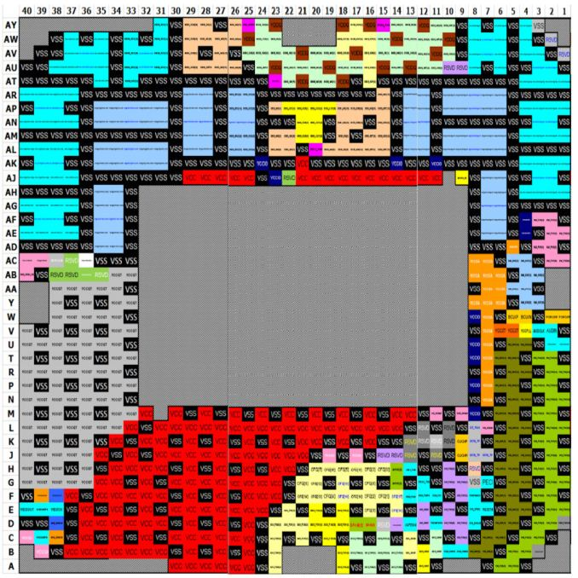
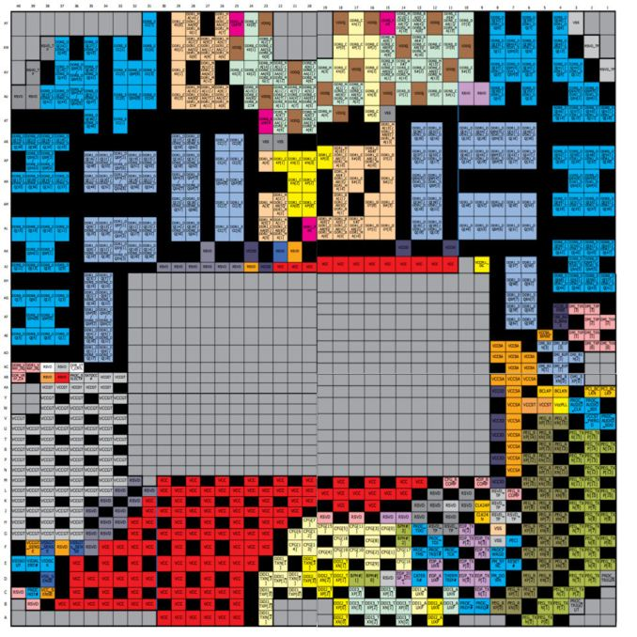
9.2 Example 1: The first wave of Coffee Lake lines: the up to 6-core DT S-series (7)
Socketing of Coffee Lake DT processors -1
Both the Kaby Lake and the Coffee Lake DT processors make use of the LGA1151 socket,
nevertheless, the pin-outs of both sockets differ from each other, i.e. they are not socket
compatible, as shown in the Figure below.
Coffee Lake
Kaby Lake
Figure: Pin-out differences of the LGA1151 sockets of the Coffee Lake and Kaby Lake DT processors [260]

Slide 90
9.2 Example 1: The first wave of Coffee Lake lines: the up to 6-core DT S-series (8)
Socketing of Coffee Lake DT processors [260] -2
The main difference in socketing is that from the until now reserved (RSVD) pins
18 are converted to red colored power (VSS) and
14 to grey colored ground (VSS) pins.

Slide 91
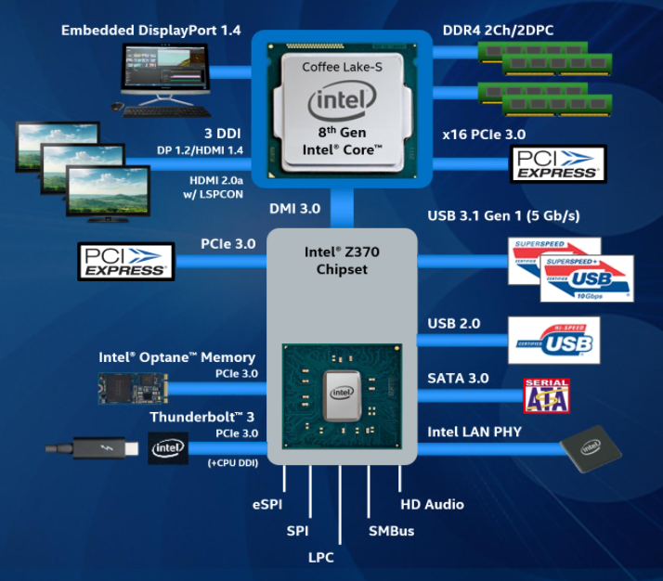
9.2 Example 1: The first wave of Coffee Lake lines: the up to 6-core DT S-series (9)
Coffee Lake DT platform [260]
It is supported by
the Z370 chipset.
The Z370 is
functionally
almost equivalent
with the Z270 chipset
of the Kaby Lake
DT series
but the Z270
can’t be used for
the Cannon Lake
DT platform.

Slide 92
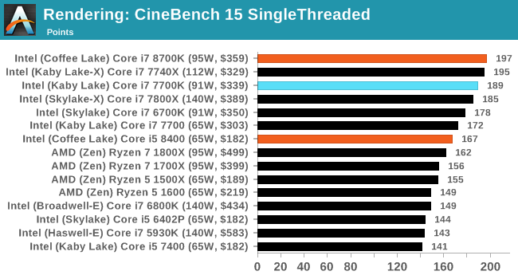
9.2 Example 1: The first wave of Coffee Lake lines: the up to 6-core DT S-series (10)
Cinebench R15 single threaded benchmark results - comparison [260]

Slide 93
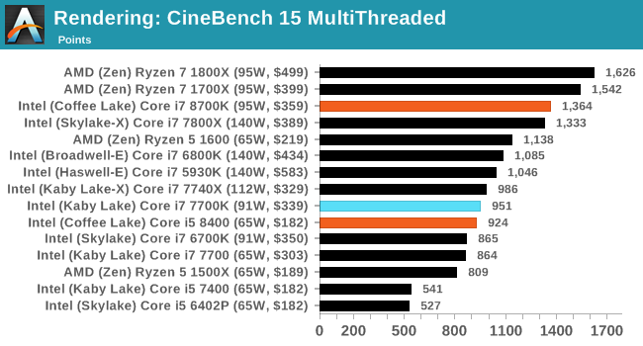
9.2 Example 1: The first wave of Coffee Lake lines: the up to 6-core DT S-series (11)
Cinebench R15 multi threaded benchmark results - comparison [260]
It is worth noting that the Coffee Lake i7-8700K has only about 3 % higher single threaded
performance than the Kaby Lake i7-7700K but provides about 45 % higher multi-threaded
performance due to its higher core count (6 vs. 4).

Slide 94
9.2 Example 1: The first wave of Coffee Lake lines: the up to 6-core DT S-series (12)
Remark [260]
It is interesting to note that the high-end Core i7-8700K essentially kills the related Kaby Lake-X
i7-7740K model since the former provides for less price more cores and performance.
This move can probably be explained again by Intel’s intention to encounter AMD’s Ryzen
introductions.

Slide 95
9.3 Example 2: The second wave of DT Coffee Lake S-series
Notes:
95

Slide 96
9.3 Example 2: The second wave of DT Coffe Lake S-series (1)
9.3 Example 2: The second wave of DT Coffe Lake S-series [253]
Launched in 04/2018
CL
CL
CL
CL
(Improved)
CL
CL
for DTs and H-series mobiles)
CL: Coffee Lake
*

Slide 97
9.3 Example 2: The second wave of DT Coffe Lake S-series (2)
Main features of the second wave DT Coffee Lake S-series processors [253]
 |  | Cores | TDP | Freq | L3 | vPro | DRAM DDR4 | iGPU | iGPU Turbo
Core i7-8700T* | $303 | 6 / 12 | 35 W | 2.4 / 4.0 | 12 MB | Yes | 2666 | 24 EUs | 1200
Core i5-8600* | $213 | 6 / 6 | 65 W | 3.1 / 4.3 | 9 MB | Yes | 2666 | 24 EUs | 1150
Core i5-8500* | $192 | 6 / 6 | 65 W | 3.0 / 4.1 | 9 MB | Yes | 2666 | 24 EUs | 1100
Core i5-8500T* | $192 | 6 / 6 | 35 W | 2.1 / 3.5 | 9 MB | Yes | 2666 | 24 EUs | 1100
Core i5-8400T* | $192 | 6 / 6 | 35 W | 1.7 / 3.3 | 9 MB | No | 2666 | 24 EUs | 1050
Core i3-8300* | $138 | 4 / 4 | 65 W | 3.7 | 8 MB | No | 2400 | 23 EUs | 1150
Core i3-8300T* | $138 | 4 / 4 | 35 W | 3.2 | 8 MB | No | 2400 | 23 EUs | 1100
Core i3-8100T* | $117 | 4 / 4 | 35 W | 3.1 | 6 MB | No | 2400 | 23 EUs | 1100
Note that higher numbered models support vPro technology (for enhanced business use)

Slide 98
9.3 Example 2: The second wave of DT Coffe Lake S-series (3)
New DT chipset launched providing enhancements to the previous Z370 [253]
Intel 8th Gen desktop chipsets (PCH)
 | Z370 | H370 | Q370 | B360 | H310
Launch | Oct '17 | Apr '18 | Apr '18 | Apr '18 | Apr '18
Market | Consumer - | Consumer Corporate | - Corporate | Consumer Corporate | Consumer -
ME Firmware | 11 | 12 | 12 | 12 | 12
HSIO Lanes | 30 | 30 | 30 | 24 | 14
Total USB | 14 | 14 | 14 | 12 | 10
Max USB 3.1 G2 | - | 4 | 6 | 4 | 0
Max USB 3.1 G1 | 10 | 10 | 8 | 6 | 4
SATA 6 Gbps | 6 | 6 | 6 | 6 | 4
PCH PCIe 3.0 Lanes | 24 | 20 | 24 | 12 | -
PCH PCIe 2.0 Lanes | - | - | - | - | 6
Max RST PCIe Storage | 3 | 2 | 3 | 1 | 0
Supports Optane | Y | Y | Y | Y | N
Integrated 802.11ac | N | Y | Y | Y | Y
Intel Smart Sound | Y | Y | Y | Y | N
Intel vPro | N | N | Y | N | N
TDP | 6 W | 6 W | 6 W | 6 W | 6 W
RST: Rapid Storage technology (Software RAID)
HSIO: High-Speed IO
ME: Management Engine

Slide 99
9.3 Example 2: The second wave of DT Coffe Lake S-series (4)
Enhancements introduced along with the new 8th gen. DT chipsets
a) USB Gen. 2 support
b) Integrated connectivity
c) Enhanced Optane support
*

Slide 100
9.3 Example 2: The second wave of DT Coffe Lake S-series (5)
a) USB Gen2 support [262]
Evolution of the USB standard
USB 1.0 (1996) Transfer rates of up to 1.5 MB/s
USB 2.0 (2000) Transfer rates of up to 60 MB/s
USB 3.0 (2008) (SuperSpeed transfer rate of up to 625 MB/s
The USB 3.0 specification recommends that the Standard-A USB receptacle
have a blue insert.
USB 3.1 (2013) has two alternatives:
USB 3.1 Gen. 1 and
USB 3.1 Gen 2 with the SuperSpeed+ transfer rate of up to 1.25 GB/s.
USB 3.2 (2017) Two new SuperSpeed+ transfer modes with transfer rates of 1.25 and 2.5 GB/s
over USB-C connectors.
*

Slide 101
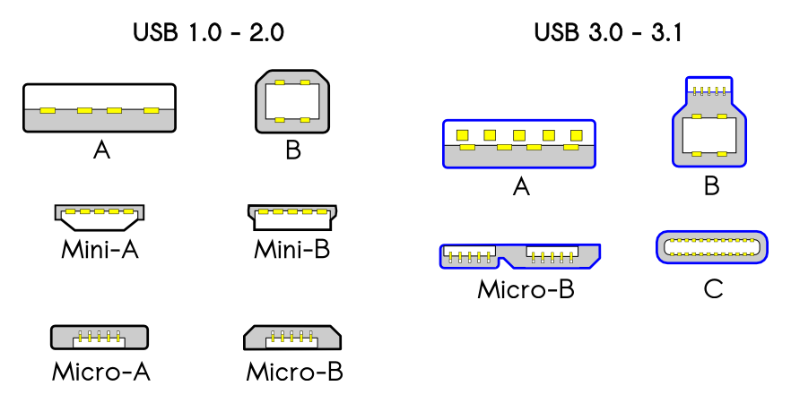
9.3 Example 2: The second wave of DT Coffe Lake S-series (6)
USB connectors [263]

Slide 102
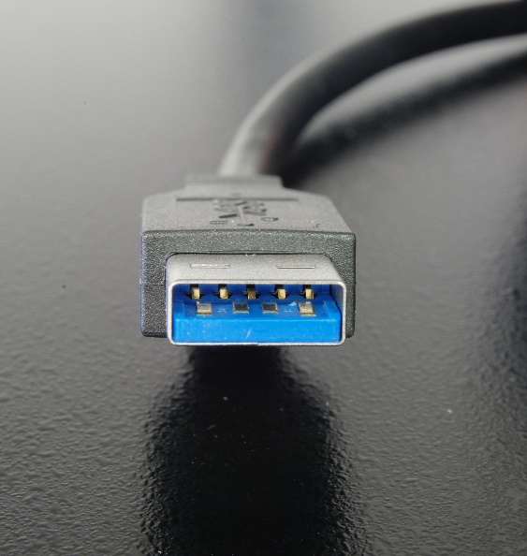
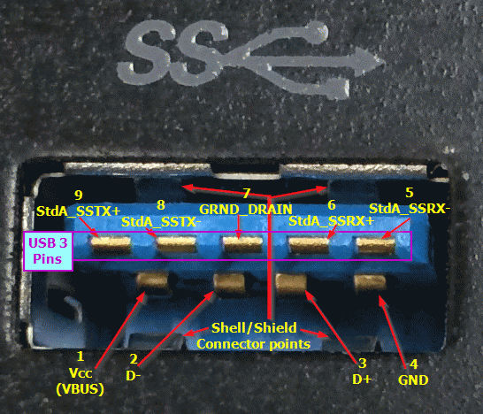
9.3 Example 2: The second wave of DT Coffe Lake S-series (7)
The USB 3.0 connector [262]
The SuperSpeed transfer rate of the USB 3.0 standard is based on the SuperSpeed bus that
incorporates two new serial point-to-point data lanes (for full duplex transfer) and a
Ground line, as shown in the Figure below.
Consequently, the USB standard needs new connectors (see the Figure before).
Figure: Front view of a Standard-A USB 3.0 connector, showing its front row of four pins for the USB 1.x/2.0 backward compatibility, and a second row of five pins for the new USB 3.0 connectivity (above).
The plastic insert is in the USB 3.0 standard blue color.
Figure: Pins of a standard USB 3.0 connector
*

Slide 103
9.3 Example 2: The second wave of DT Coffe Lake S-series (8)
b) Integrated connectivity support
Intel’s Integrated connectivity relates to partially integrating 802.11ac Wi-Fi, BT and RF blocks
onto the PCH, as detailed later in this section.
*

Slide 104
9.3 Example 2: The second wave of DT Coffe Lake S-series (9)
Introduction to the IEEE 802.11ac Wi-Fi standards
Key features of the IEEE 802.11 WiFi standards (Based on [264])
Standard | Approved in | Frequency band | Bandwidth | MIMO technology | Data rate (up to)
11.b | 1999 | 2.4 GHz | 22 MHz | no | 11 Mb/s
11.a | 1999 | 5 GHz | 20 MHz | no | 54 Mb/s
11.g | 2002 | 2.4 GHz | 20 GHz | no | 54 Mb/s
11.n | 2007 | 2.4 GHz/ 5 GHz | 20 MHz | MIMO up to 4 streams | 288.8 Mb/s
 |  |  | 40 MHz |  | 600 Mb/s
11.ac | 2013 | 5 GHz | 20 MHz | MIMO up to 8 streams | 346.8 Mb/s
 |  |  | 40 MHz |  | 800 Mb/s
 |  |  | 80 MHz |  | 1733.2 Mb/s
 |  |  | 160 MHz |  | 3466.8 Mb/s
MIMO: Multiple-Input Multiple-Output (többszörös átviteli csatorna)
*

Slide 105
9.3 Example 2: The second wave of DT Coffe Lake S-series (10)
Frequency bands used for WiFi [265]
*

Slide 106
9.3 Example 2: The second wave of DT Coffe Lake S-series (11)
Principle of the MIMO technology
MIMO (Multiple-Input Multiple-Output) was introduced in the IEEE 801.11n WiFi amendment
in order to significantly raise data rate.
It assumes multiple antennas both at the transmitter and the receiver and supports multiple
communication channels for transmitting multiple data streams simultaneously, e.g.
2 data streams, as the Figure below shows.
In the MIMO technology the transmitter splits the data stream to be transmitted into
sub-streams, these will be in transmitted in parallel over available channels and then
merged in the receiver, as indicated in the Figure.
Figure: Principle of the MIMO technology [266]
The 801.11n supports up to 4 whereas the 801.11ac up to 8 parallel data streams.
In actual implementations the number of available transmitter and receiver antennas
(channels) is usually given in the form of nTmR or nxm, e.g. 2T2R or 2x2.
*

Slide 107
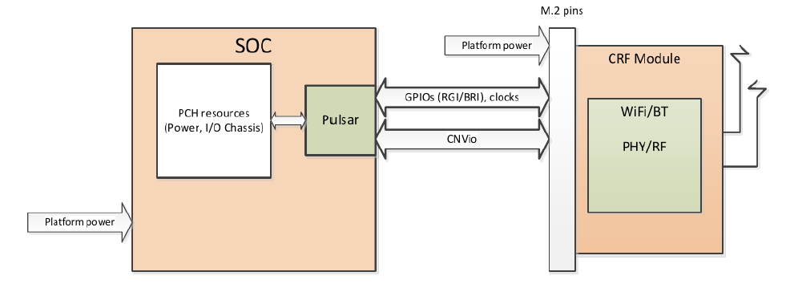
9.3 Example 2: The second wave of DT Coffe Lake S-series (12)
Intel’s Integrated connectivity (CNVi) -1
Traditionally, there is a Wi-Fi/BT/RF module that is placed differently to the processor,
e.g. on an M.2 card or as a chip mounted onto the mainboard.
With “Integrated connectivity” Intel partially integrates the Wi-Fi/BT/RF module onto the PCH.
In this kind of implementation” Intel places expensive functional blocks of the Wi-Fi/BT/RF
module, such as the logic, MAC (Multiplier-Accumulator) and memory onto the PCH, into a
block called Pulsar, whereas other parts of the module, like the PHY (Physical layer) and RF
remain on a companion RF module (CRF), dubbed Jefferson Peak, as seen below.
The CRF module is implemented on an M.2 card and is interconnected with the PCH via an
Intel proprietary bus, called the CNVio interface, as shown below.
PCH
(Jefferson Peak)
Pulsar
(Integr.
blocks)
(Companion
RF Module)
Figure: Intel’s 2T2R 802.11ac implementation called Integrated connectivity (CNVi) [267]
*

Slide 108
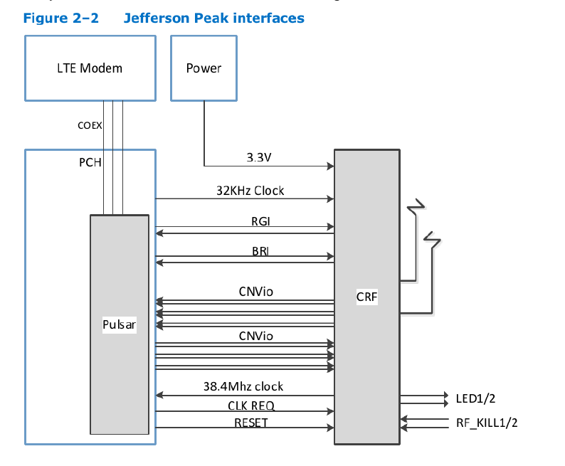
9.3 Example 2: The second wave of DT Coffe Lake S-series (13)
Interfacing the Companion RF module (CRF) to the PCH [267]
RGI: Radio Generic Interface, between CRF and Pulsar
BRI: Bluetooth Radio Interface, between CRF and Pulsar
CNVio: Proprietary Intel interface between CRF and Pulsar
The Intel proprietary CNVio bus
has two data lanes
and one clock for each direction.
Both data and clock signals are
differential, 100 Ώ signals.
Total number of the signals is
12 (6 pairs, 3 per direction).

Slide 109
9.3 Example 2: The second wave of DT Coffe Lake S-series (14)
Intel’s Integrated connectivity (CNVi) -2 [253]
Integrated connectivity is supported by the 300 series PCHs of the Coffee Lake line, both
by the DT and mobile PCH models. (except the earlier (10/2017) launched Z370 PCH).
As part of their Integrated connectivity technology Intel provides a number of CRF modules,
including
the AC-9560 (2T2R module, the only vPro enabled CRF),
The AC-9462 (a 1T1R module), and
The AC-9461 (a low-end 1T1R module).
All three CRFs are supported by Linux, Chrome OS, and Windows 10.

Slide 110
9.3 Example 2: The second wave of DT Coffe Lake S-series (15)
Intel’s Integrated connectivity implementation of 2T2R 802.11ac Wi-Fi [253]
This feature supports 160 MHz channel bandwidth and yields data rates up to 1733 Mb/s.
According to Intel this speed is 12x faster than 1T1R 802.11n support provided by low cost
WiFi solutions and twice as much as most 2T2R solutions available on the market.
We note that 2T2R support needs the AC9650 CRF, other models listed above do not
implement it (only the 1T1R mode with lower data rates).
Due to its additional costs (of about 15 $) only a few motherboards enable the Integrated
connectivity feature.

Slide 111
9.3 Example 2: The second wave of DT Coffe Lake S-series (16)
Remark 1
Actually Intel introduced Integrated connectivity already in 12/2017 in their low power
oriented Atom line (in the Gemini SOC platform with Goldmont Plus cores in the low cost
Pentium and Celeron models).
Remark 2
It can be presumed that Integrated connectivity aims at increasing Intel’s revenue, since
with it the Wi-Fi/BT/RF modules have to be bought from Intel as well.
*

Slide 112
9.3 Example 2: The second wave of DT Coffe Lake S-series (17)
c) Enhanced Optane support
The 1. gen. Optane memory was introduced along with the Kaby Lake processor line in 2017.
In the 1. generation a single HD Boot drive was assumed and the Octane memory served as
a cache of it.

Slide 113
9.3 Example 2: The second wave of DT Coffe Lake S-series (18)
Recap
The Optane memory is nonvolatile memory typically used as a cache of a HDD drive.
It is based on the 3D XPoint memory technology, announced by Intel and Micron in 2016.
It has a typical size of 16 or 32 GB.
It is mounted on an M.2 card that is attached via 2 to 4 PCIe lanes (see the Figure below).
Its use needs the Rapid Storage Technology driver (appropriate no.).
*

Slide 114
9.3 Example 2: The second wave of DT Coffe Lake S-series (19)
c) Enhanced Optane support
By contrast, the 2. gen., introduced along with the Coffee Lake line in 2018 assumes a
fast SSD Boot drive and a large HD data drive.
In this case the Optane memory serves as a cache of the data drive (see the Table below).
 | 1. generation | 2. generation
Storage system assumed | HD Boot drive and Optane memory | Fast SSD Boot drive, a large HD data drive and Optane memory
Principle of operation | Optane memory serves as a cache of the Boot drive (HD) | Optane memory serves as cache of the large HD data drive
Processor support | 7. Generation (Kaby Lake) | 8. Generation (Coffee Lake)
PCH support | 200-series PCH or later | 300-series PCH
Intro | 2017 | 2018
Driver | RST 15.5 or later | RST 16.02 or later
OS | Windows 10 64-bit | Windows 10 64-bit
Table: Key features of the 1. and 2. generation Optane memory
*

Slide 115
9.3 Example 2: The second wave of DT Coffe Lake S-series (20)
Benefits of using the 2. generation Optane memory [253]
*

Slide 116
9.3 Example 2: The second wave of DT Coffe Lake S-series (21)
Introducing the Core i9+, Core i7+, Core i5+ branding
The “+” tag in the processor designation refers to” supported by Optane technology”.
It was introduced along with the 8. generation (Coffee Lake line).
The new branding has a dark blue colored logo, as seen below.
CL
CL
CL
CL
CL
CL
for DTs and H-series mobiles)
Figure: Introducing dark blue colored logo for Optane supported “+” tagged processors [253]
*

Slide 117
9.4 Example 3: H-series mobile Coffee Lake processors
Notes:
117

Slide 118
9.4 Example 3 : Mobile Coffee Lake H-series (1)
9.4 Example 3 : Mobile Coffee Lake H-series [253]
CL
CL
CL
CL
(Improved)
CL
CL
for DTs and H-series mobiles)
CL: Coffee Lake

Slide 119
9.4 Example 3 : Mobile Coffee Lake H-series (2)
Main features of the flagship H-series mobile Coffee Lake processor (Core i9-8950HK)
vs. the flagship H-series Kaby Lake processor (Core i7-7820HK) [253]
 | Core i9-8950HK | Core i7-7820HK
Generation | Coffee Lake-H | Kaby Lake-H
Launch | April 2018 | January 2017
TDP | 45 W | 45 W
Cores | 6C / 12T | 4C/8T
Base Frequency | 2.9 GHz | 2.9 GHz
Turbo Frequency | 4.6 GHz | 3.9 GHz
Thermal Velocity Boost | +200 MHz | ---
iGPU | UHD 630 | HD 630
iGPU Base/Turbo | 350 / 1200 MHz | 350 / 1100 MHz
DRAM Support | DDR4-2666 | DDR4-2400
Optane Support | Yes | No
Tray Price | $583 | $378

Slide 120
9.4 Example 3 : Mobile Coffee Lake H-series (3)
Overview of the H-series mobile Coffee Lake processors
45 W H-series (Two-chip designs, BGA1440, 300-series mobile chipset)
Core i9-8950HK, 6C+UHD 630, HT, 4/2018
Core i7-8850H/8750H, 6C+UHD 630, HT, 4/2018
Core i5-8400H/,8300H 4C+UHD 630, HT, 4/2018

Slide 121
9.4 Example 3 : Mobile Coffee Lake H-series (4)
Innovative feature introduced in the Core i9-8950HK – Thermal Velocity Boost (TVB) [253]
TVB is a means to raise Turbo Boost frequencies given in specifications further on by 100 or
200 MHz.
Principle of TVB
If the temperature of the CPU is less than a certain limit (53⁰C)
single core turbo frequency will be raised by 200 MHz and
multi-core turbo frequency by 100 MHz.
Obviously, TVB will be more likely applicable in OEM designs with efficient cooling.
We note here that due to the complex manufacturing process, parameters of individual
processors have a variation, so certain processors may be more inclined to allow activating
TVB than others.
Actually, the Turbo Boost values indicated by Intel already are the increased values assuming
the use of TVB, this however is a questionable praxis since the usability of TVB can not be
guaranteed in all cases.
Presumable, in connection with this, Intel declines to specify per-core turbo frequencies by
saying
‘Intel specifies only base and single-core turbo frequencies for its processors and no longer
discloses turbo frequencies beyond this level of detail, as it is proprietary to Intel.’

Slide 122
9.4 Example 3 : Mobile Coffee Lake H-series (5)
Remark
Intel’s Thermal Velocity Boost (TVB) technology is similar to AMD’s XFR (eXtended Frequency
Range) technology introduced in the Ryzen desktop line in 03/2017.
XFR provides an automated overclocking over the max. Turbo Boost frequency if there is
a premium cooler system and the operating conditions of the processor (e.g. temperature
data) allow it.
In contrast to Intel, however AMD lists separately the max turbo and the XFR frequencies.

Slide 123
9.4 Example 3 : Mobile Coffee Lake H-series (6)
Main features of the further H-series mobile Coffee Lake models [253]
 |  | Cores | Base Freq | Turbo Freq | L3 | vPro | DRAM DDR4 | iGPU | iGPU Turbo
Core i7-8850H | $395 | 6 / 12 | 2.6 | 4.3 | 9 MB | Yes | 2666 | 24 EUs | 1150
Core i7-8750H | $395 | 6 / 12 | 2.2 | 4.2 | 9 MB | No | 2666 | 24 EUs | 1100
Core-i5-8400H | $250 | 4 / 8 | 2.5 | 4.2 | 8 MB | Yes | 2666 | 24 EUs | 1100
Core i5-8300H | $250 | 4 / 8 | 2.3 | 4.0 | 8 MB | No | 2666 | 23 EUs | 100

Slide 124
9.4 Example 3 : Mobile Coffee Lake H-series (7)
Main features of the mobile Coffee Lake PCHs [253]
Intel 8th Gen Mobile Chipsets (PCH)
 | HM370 | QM370 | QMS380
Launch | Apr '18 | Apr '18 | Apr '18
Market | Consumer - | - Corporate | - Corporate
ME Firmware | 12 | 12 | 12
HSIO Lanes | 25 | 30 | 30
Total USB | 14 | 14 | 6
Max USB 3.1 G2 | 4 | 6 | 0
Max USB 3.1 G1 | 8 | 10 | 6
SATA 6 Gbps | 4 | 4 | 4
PCH PCIe 3.0 Lanes | 16 | 20 | 8
Supports Optane | Y | Y | Y
Integrated 802.11ac | Y | Y | Y
Intel Smart Sound | Y | Y | Y
Intel vPro | N | Y | Y
TDP | 3 W | 3 W | 2.4 W
Price | $49 | $49 | N/A

Slide 125
9.5 Example 4: Mobile Coffee Lake U-series with
Iris Plus graphics
Notes:
125

Slide 126
9.5 Example 4: Mobile Coffee Lake U-series with Iris Plus graphics (1)
9.5 Example 4: Mobile Coffee Lake U-series with Iris Plus graphics [253]
Launched in 04/2018
CL
CL
CL
CL
(Improved)
CL
CL
for DTs and H-series mobiles)
CL: Coffee Lake

Slide 127
9.5 Example 4: Mobile Coffee Lake U-series with Iris Plus graphics (2)
Main features of mobile Coffee Lake U-series with Iris Plus graphics, 04/2018 -2 [253]

Slide 128
9.5 Example 4: Mobile Coffee Lake U-series with Iris Plus graphics (3)
Comparing graphics performance of the Coffee Lake U-series and Kaby Lake G-series
including AMD Radeon RX Vega M GH graphics [269]
The Coffee Lake U-series models make use of Intel’s Iris Plus Graphics 655.
Compared with this graphics AMD’s Radeon RX Vega M GH graphics of the Kaby Lake
G-series achieves much higher performance, as benchmark results show:
Average Benchmarks Intel Iris Plus Graphics 655 → 100%
Average Benchmarks AMD Radeon RX Vega M GH → 207%

Slide 129
10. The Cannon Lake line
(TICK line, nevertheless discussed from technological point of view)
Notes:
129

Slide 130
10. The Cannon Lake line (1)
10. The Cannon Lake line
Intel's technology roadmap published in 5/2011 [82]
As a technology roadmap from 5/2011 indicates, at that time the company planned to have
the 14 nm technology in 2013 and the 10 nm technology in 2015 based on a 2 year
cadence for a new technology node (see the Table below)
Intel’s technology roadmap from 05/2011 [82]
By contrast, Intel started production of their 14 nm Haswell line of processors in 2014 and
began small volume production of 10 nm unambitious 2-core Cannon Lake parts in 2018,
whereas volume production slipped to 2019.
The first 10 nm model, launched in 5/2018 is the Core i3-8121.
*

Slide 131
10. The Cannon Lake line (2)
Remark [270]
Concerning the delay of introducing the 10 nm technology Intel’s CEO Brian Krzanich said
during the company’s April 26 2018 earnings call with financial analysts:
“We are shipping [10-nm chips] in low volume and yields are improving, but the rate of
improvement is slower than we anticipated. As a result, volume production is moving from
the second half of 2018 into 2019. We didn't say first or second half, but we'll do it as quickly
as we can based on the yield.
We understand the yield issues and have defined improvements for them, but they will take
time to implement and qualify.”

Slide 132
10. The Cannon Lake line (3)
Main features of the Cannon Lake Core i3-8121U vs. the previous Kaby Lake i3-8130U -1
[271]
Intel Core i3-8121U |  | Intel Core i3-8130U
2.20 GHz | Frequency | 2.20 GHz
3.20 GHz | Turbo (1 Core) | 3.40 GHz
2.70 GHz | Turbo (All Cores) | 2.80 GHz
2 | Cores | 2
Yes | Hyperthreading | Yes
4 MB | Cache | 4 MB
No | GPU | Intel UHD Graphics 620
Cannon Lake | Architecture | Coffee Lake
DDR4-2400 SO-DIMM | Memory | DDR4-2400 SO-DIMM
2 | Memory channels | 2
No | ECC | Yes
3.0 | PCIe version | 3.0
16 | PCIe lanes | 12
10nm | Technology | 14nm
BGA 1356 | Socket | BGA 1356
15W | TDP | 15W
Yes | AVX-512 | No
Yes | AES-NI | Yes
VT-x, VT-x EPT, VT-d | Virtualization | VT-x, VT-x EPT, Vt-d
Q2/2018 | Release date | Q1/2018
Note that the 10 nm Cannon Lake part is dubbed as a gen. 8 part.

Slide 133
10. The Cannon Lake line (4)
Main features of the Cannon Lake Core i3-8121U vs. the previous Kaby Lake i3-8130U -2
[271]
As the comparison shows the Cannon Lake i3-8121U model has no GPU and does not show
convincing benefits over the previous Kaby Lake i3-8130U model.
The main noteworthy enhancement of the i3-8121U vs. the previous i3-8130U is that it
supports AVX 512 whereas the previous processor not.
As industry sources report, this model appeared already in a Lenovo IdeaPad 330 laptop
in 5/2018.

Slide 134
10. The Cannon Lake line (5)
Support of AVX-512 in Intel’s processor lines [272]
AVX-512 Support Propagation by Various Intel CPUs
 | Xeon, Core X | General | Xeon Phi
Skylake-SP | AVX512BW AVX512DQ AVX512VL | AVX512F AVX512CD | AVX512ER AVX512PF | Knights Landing
Cannon Lake | AVX512VBMI AVX512IFMA |  | AVX512_4FMAPS AVX512_4VNNIW | Knights Mill
Ice Lake | AVX512_VNNI AVX512_VBMI2 AVX512_BITALG AVX512+VAES AVX512+GFNI AVX512+VPCLMULQDQ | AVX512_VPOPCNTDQ
Source: Intel Architecture Instruction Set Extensions and Future Features Programming Reference (pages 12 and 13)

Slide 135
10. The Cannon Lake line (6)
300-Series PCHs, supported CPU models and application areas [273]
Intel's 300-Series and 240-Series PCHs
Chipset SKU | Silicon | Supported CPUs | Application
Z390 | Cannon Point-H CNP-H | Cannon Lake Coffee Lake-S | Enthusiast Desktops
H370 |  |  | Desktops
H310
Q370
Q360
B360
C246 |  |  | Workstations
CM246 |  | Cannon Lake Coffee Lake-H | Mobile Workstations
QM370 |  |  | High-End Laptops
HM370
 |  | Skylake-X | High-End Desktops
X399
9th Gen Core Platform I/O Controller | Cannon Point-LP CNP-LP | Cannon Point-U | Low-Power Laptop
PCH

Slide 136
References
Notes:
136

Slide 137
References (1)
[1]: Singhal R., “Next Generation Intel Microarchitecture (Nehalem) Family: Architecture Insight
and Power Management, IDF Taipeh, Oct. 2008, http://intel.wingateweb.com/taiwan08/
published/sessions/TPTS001/FA08%20IDFTaipei_TPTS001_100.pdf
[2]: Bryant D., “Intel Hitting on All Cylinders,” UBS Conf., Nov. 2007,
http://files.shareholder.com/downloads/INTC/0x0x191011/e2b3bcc5-0a37-4d06-
aa5a-0c46e8a1a76d/UBSConfNov2007Bryant.pdf
[3]: Fisher S., “Technical Overview of the 45 nm Next Generation Intel Core Microarchitecture
(Penryn),” IDF 2007, ITPS001, http://isdlibrary.intel-dispatch.com/isd/89/45nm.pdf
[4]:Pabst T., The New Athlon Processor: AMD Is Finally Overtaking Intel, Tom's Hardware,
August 9, 1999, http://www.tomshardware.com/reviews/athlon-processor,121-2.html
[5]: Carmean D., “Inside the Pentium 4 Processor Micro-architecture,” Aug. 2000,
http://people.virginia.edu/~zl4j/CS854/pda_s01_cd.pdf
[6]: Shimpi A. L. & Clark J., “AMD Opteron 248 vs. Intel Xeon 2.8: 2-way Web Servers
go Head to Head,” AnandTech, Dec. 17 2003,
http://www.anandtech.com/showdoc.aspx?i=1935&p=1
[7]: Völkel F., “Duel of the Titans: Opteron vs. Xeon : Hammer Time: AMD On The Attack,”
Tom’s Hardware, Apr. 22 2003,
http://www.tomshardware.com/reviews/duel-titans,620.html
[8]: De Gelas J., “Intel Woodcrest, AMD's Opteron and Sun's UltraSparc T1:
Server CPU Shoot-out,” AnandTech, June 17 2006,
http://www.anandtech.com/IT/showdoc.aspx?i=2772&p=1

Slide 138
References (2)
[9]: Hinton G. & al., “The Microarchitecture of the Pentium 4 Processor,” Intel Technology
Journal, Q1 2001, pp. 1-13
[10]: Wechsler O., “Inside Intel Core Microarchitecture,” White Paper, Intel, 2006
[11]: Lee V., “Inside the Intel Core Microarchitecture,” IDF, May 2006, Shenzhen,
http://www.prcidf.com.cn/sz/systems_conf/track_sz/SMC/Intel%20Core%20uArch.pdf
[12]: Doweck J., “Inside Intel Core Microarchitecture,” Hot Chips 18, 2006,
http://www.hotchips.org/archives/hc18/
[13]: Gruen H., “Intel’s new Core Microarchitecture,” Develop Brighton, AMD Technical
Day, July 2006,
http://ati.amd.com/developer/brighton/03%20Intel%20MicroArchitecture.pdf
[14]: Doweck J., “Intel Smart Memory access: Minimizing Latency on Intel Core
Microarchitecture, ” Technology @ intel Magazine, Sept. 2006, pp. 1-7,
ftp://download.intel.com/corporate/pressroom/emea/deu/fotos/06-10-Strategie_Tag/
Intel/Intel_Core2_Prozessoren/Texte/ENG-Smart_Memory_Access_Technology@
Intel_Magazine_Article.pdf
[15]: Sima D., Fountain T., Kacsuk P., Advanced Computer Architectures, Addison Wesley,
Harlow etc., 1997
[16]: Jafarjead B., “Intel Core Duo Processor,” Intel, 2006,
http://masih0111.persiangig.com/document/peresentation/behrooz%20jafarnejad.ppt
[17]: Pawlowski S. & Wechsler O., “Intel Core Microarchitecture,” IDF Spring, 2006,
http://www.intel.com/pressroom/kits/core2duo/pdf/ICM_tech_overview.pdf

Slide 139
References (3)
[18]: Goto H., Larrrabee architecture can be integrated into CPU”, PC Watch, Oct. 6 2008,
http://pc.watch.impress.co.jp/docs/2008/1006/kaigai470.htm
[19]: SIMD Instruction Sets, http://softpixel.com/~cwright/programming/simd/index.php
[20]: Wikipedia: Platform Environment Control Interface,
http://en.wikipedia.org/wiki/Platform_Environment_Control_Interface
[21]: Kim N. S. et al., „Leakage Current: Moore’s Law Meets Static Power”, Computer,
Dec. 2003, pp. 68-75.
[22]: Ng P. K., “High End Desktop Platform Design Overview for the Next Generation
Intel Microarchitecture (Nehalem) Processor,” IDF Taipei, TDPS001, 2008,
http://intel.wingateweb.com/taiwan08/published/sessions/TDPS001/
FA08%20IDF-Taipei_TDPS001_100.pdf
[23]: Bohr M., Mistry K., Smith S., “Intel Demonstrates High-k + Metal Gate Transistor
Breakthrough in 45 nm Microprocessors,”, Intel, Jan. 2007,
http://download.intel.com/pressroom/kits/45nm/Press45nm107_FINAL.pdf
[24]: Scott D. S., “Toward Petascale and Beyond,” APAC Conference, Oct. 2007,
http://www.apac.edu.au/apac07/pages/program/presentations/
Tuesday%20Harbour%20A%20B/David_Scott.pdf
[25]: Smith S. L., “45 nm Product Press Briefing,” IDF Fall, 2007,
http://download.intel.com/pressroom/kits/events/idffall_2007/BriefingSmith45nm.pdf
[26]: Fisher S., “Technical Overview of the 45nm Next Generation Intel Core Microarchitecture
(Penryn),” IPTS001, Fall IDF 2007, http://isdlibrary.intel-dispatch.com/isd/89/45nm.pdf

Slide 140
References (4)
[27]: George V., 45nm Next Generation Intel Core Microarchitecture (Penryn),” Hot Chips 19,
2007, http://www.hotchips.org/archives/hc19/3_Tues/HC19.08/HC19.08.01.pdf
[28]: Wikipedia: Foxton Technology, http://en.wikipedia.org/wiki/Foxton_Technology
[29]: Coke J. & al., “Improvements in the Intel Core Penryn Processor Family Architecture
and Microarchitecture,” Intel Technology Journal, Vol. 12, No. 3, 2008, pp. 179-192
[30]: Fisher S., “Technical Overview of the 45nm Next Generation Intel Core Microarchitecture
(Penryn),” BMA S004, IDF 2007,
http://my.ocworkbench.com/bbs/attachment.php?attachmentid=318&d=1176911500
[31]: Gelsinger P. P., “Intel Architecture, Press Briefing, March 2008,
http://www.slideshare.net/angsikod/gelsinger-briefing-on-intel-architecture
[32]: Gelsinger P., “Invent the new reality,” IDF Fall 2008, San Francisco
http://download.intel.com/pressroom/kits/events/idffall_2008/PatGelsinger_day1.pdf
[33]: Brayton J.,”Nehalem: Talk of the Tock, Intel Next Generation Microprocessor,” IDF,
April 2008, Shanghai,
http://inteldeveloperforum.com.edgesuite.net/shanghai_2008/ti/TCH001/f.htm
[34]: Intel Timna Microprocessor Family, CPU World, http://www.cpu-world.com/CPUs/Timna/
[35]: Smith T., “Timna - Intel's first system-on-a-chip, Before 'Tolapai', before 'Banias'.
Register Hardware, Febr. 6 2007,
http://www.reghardware.co.uk/2007/02/06/forgotten_tech_intel_timna/

Slide 141
References (5)
[36]: Images, Xtreview,
http://xtreview.com/images/K10%20processor%2045nm%20architec%203.jpg
[37]: Singhal R. Intel’s i7, Podtech, http://www.podtech.net/home/5436/intels-core-i7
[38]: Strong B., “A Look Inside Intel: The Core (Nehalem) Microarchitecture,”
http://www.cs.utexas.edu/users/cart/arch/beeman.ppt
[39]: Valles A. C., Ansari Z., Mehrotra P.: “Tuning Your Software for the Next Generation
Intel Microarchitecture (Nehalem) Family,” IDF 2008, NGMS002,
http://www.benchmark.rs/tests/editorial/Nehalem_munich/presentations/
Software-Tuning_for_Nehalem.pdf
[40]: The low cost Tymna CPU, Tom’s hardware, Febr. 25 2000,
http://www.tomshardware.com/reviews/idf-2000,166-3.html
[41]: Intel® Virtualization Technology, Special issue, Vol. 10 No. 03 Aug. 2006, http://www.intel.com/technology/itj/2006/v10i3/
[42]: Intel Core 2 Duo Processor E8000 and E7000 Series Datasheet, Intel, Jan. 2009
[43]: Wikipedia: List of Intel Core 2 microprocessors
http://en.wikipedia.org/wiki/List_of_Intel_Core_2_microprocessors
[44]: Wikipedia: Nehalem (microarchitecture)
http://en.wikipedia.org/wiki/Nehalem_(microarchitecture)
[45]: Glaskowsky P.: Investigating Intel's Lynnfield mysteries, cnet News, Sept. 21 2009,
http://news.cnet.com/8301-13512_3-10357328-23.html

Slide 142
References (6)
[46]: Shimpi A. L.: Intel's Core i7 870 & i5 750, Lynnfield: Harder, Better, Faster Stronger,
AnandTech, Sept. 8 2009, http://www.anandtech.com/show/2832
[47]: Intel Xeon Processor C5500/C3500 Series, Datasheet – Volume 1, Febr. 2010,
http://download.intel.com/embedded/processor/datasheet/323103.pdf
[48]: Intel CoreTM i7-800 and i5-700 Desktop Processor Series Datasheet – Volume 1,
July 2010, http://download.intel.com/design/processor/datashts/322164.pdf
[49]: Glaskowsky P.: Intel's Lynnfield mysteries solved, cnet News, Sept. 28 2009,
http://news.cnet.com/8301-13512_3-10362512-23.html
[50]: Intel CoreTM i7-900 Mobile Processor Extreme Edition Series, Intel Core i7-800 and
i7-700 Mobile Processor Series, Datasheet – Volume One, Sept. 2009
http://download.intel.com/design/processor/datashts/320765.pdf
[51]: Intel Turbo Boost Technology in Intel Core Microarchitecture (Nehalem) Based
Processors, White Paper, Nov. 2008 http://download.intel.com/design/processor/applnots/320354.pdf
[52]: Power Management in Intel Architecture Servers, White Paper, April 2009
http://download.intel.com/support/motherboards/server/sb/power_management_
of_intel_architecture_servers.pdf
[53]: Glaskowsky P.: Explaining Intel’s Turbo Boost technology, cnet News, Sept. 28 2009,
http://news.cnet.com/8301-13512_3-10362882-23.html
[54]: Intel Xeon Processor 7500 Series, Datasheet – Volume 2, March 2010
http://www.intel.com/Assets/PDF/datasheet/323341.pdf

Slide 143
References (7)
[55]: Pawlowski S.: Intelligent and Expandable High- End Intel Server Platform, Codenamed
Nehalem-EX, IDF 2009
[56]: Kottapalli S., Baxter J.: Nehalem-EX CPU Architecture, Hot Chips 2009, Sept. 10 2009
http://www.hotchips.org/archives/hc21/2_mon/HC21.24.100.ServerSystemsI-Epub/
HC21.24.122-Kottapalli-Intel-NHM-EX.pdf
[57]: Kurd N. A. & all: A Family of 32 nm IA Processors, IEEE Journal of Solide-State Circuits,
Vol. 46, Issue 1., Jan. 2011, pp. 119-130
[58]: Hill D., Chowdhury M.: Westmere Xeon-56xx „Tick” CPU, Hot Chips 2010
http://www.hotchips.org/uploads/archive22/HC22.24.620-Hill-Intel-WSM-EP-print.pdf
[59]: Intel Core i7-600, i5-500, i5-400 and i3-300 Mobile Processor Series, Datasheet -
Vol.1, Jan. 2010, http://download.intel.com/design/processor/datashts/322812.pdf
[60]: Nagaraj D., Kottapalli S.: Westmere-EX: A 20 thread server CPU, Hot Chips 2010
http://www.hotchips.org/uploads/archive22/HC22.24.610-Nagara-Intel-6-Westmere-EX.pdf
[61]: Kahn O., Piazza T., Valentine B.: Technology Insight: Intel Next Generation
Microarchitecture Codename Sandy Bridge, IDF 2010
extreme.pcgameshardware.de/.../281270d1288260884-bonusmaterial-pc- games-
hardware-12-2010-sf10_spcs001_100.pdf
[62]: Wikipedia: Sandy Bridge, http://en.wikipedia.org/wiki/Sandy_Bridge
[63]: http://ark.intel.com
[64]: Kahn O., Valentine B.: Intel Next Generation Microarchitecture Codename Sandy Bridge:
New Processor Innovations, IDF 2010

Slide 144
References (8)
[65]: Shimpi A. L.: Intel Pentium 4 1.4GHz & 1.5GHz, AnandTech, Nov. 20 2000
http://www.anandtech.com/show/661/5
[66]: Yuffe M., Knoll E., Mehalel M., Shor J., Kurts T.: A fully integrated multi-CPU, GPU and
memory controller 32nm processor, ISSCC, Febr. 20-24 2011, pp. 264-266
[67]: Intel Xeon Processor 7500/6500 Series, Public Gold Presentation, Data Center Group,
March 30. 2010, http://cache-www.intel.com/cd/00/00/44/64/446456_446456.pdf
[68]: Tang H., Cheng H.: Intel Xeon Processor E3 Family Based Servers: A Smart Investment
for Managing Your Small Business, IDF 2011
[69]: Thomadakis M. E. PhD: The Architecture of the Nehalem Processor and Nehalem-EP SMP
Platforms, Texas A&M University, March 17 2011
http://alphamike.tamu.edu/web_home/papers/perf_nehalem.pdf
[70]: Intel Xeon Processor E7-8800/4800/2800 Product Families, Datasheet Vol. 1 of 2,
April 2011, http://www.intel.com/Assets/PDF/datasheet/325119.pdf
[71]: Mitchell D., Intel Nehalem-EX review, PCPro,
http://www.pcpro.co.uk/reviews/processors/357709/intel-nehalem-ex
[72]: Rusu & al.: A 45 nm 8-Core Enterprise Xeon Processor, IEEE journal of Solid State Circuits,
Vol. 45, No. 1, Jan. 2010, pp. 7-14
[73]: Wechsler O., Multicore Archtecture Challenges and Opportunities, Intel’s Annual Symposium
on VLSI CAD and Validation, Keynote presentation, July 2007
http://www3.ee.technion.ac.il/sites/Workshop/upload/Events/ACRC%20-%20Intel/
Ofri-Wechsler%20Keynotes%20Speech.pdf

Slide 145
References (9)
[74]: Razin A., Core, Nehalem, Gesher. Intel: New Architecture Every Two Years,
Xbit Laboratories, April 28 2006,
http://www.xbitlabs.com/news/cpu/display/20060428162855.html
[75]: Har_Even B., Justin Rattner Keynote? Trusted Reviews, April 17 2007,
http://www.trustedreviews.com/news/IDF-Spring-2007-Day-One-Opening-Keynote
[76]: Weatherstone R., Intel Core i7-3960X Extreme Edition Processor (Sandy Bridge-E)
Review, Nov. 14 2011, Vortez, http://www.vortez.net/articles_pages/intel_core_i7_
3960x_extreme_edition_processor_sandy_bridge_e,2.html
[77]: Shimpi A. L., Intel Core i7 3960X (Sandy Bridge E) Review: Keeping the High End Alive,
Nov. 14 2011, AnandTech, http://www.anandtech.com/show/5091/intel-core-i7-3960x-
sandy-bridge-e-review-keeping-the-high-end-alive/4
[78]: Intel® X79 Express Chipset, http://www.intel.com/content/www/us/en/chipsets/
performance-chipsets/x79-express-chipset.html
[79]: Intel® Desktop Board DX79SI Extreme Series, 2011, http://www.intel.com/content/
dam/doc/product-brief/desktop-board-dx79si-extreme-brief.pdf
[80]: Chappell R., Toll B., Singhal R.: Intel Next Generation Microarchitecture Codename Haswell:
New Processor Innovations, IDF 2012
[81]: Olivera, A régóta várt Intel Ivy Bridge tesztje, Prohardware, April 13 2012,
http://prohardver.hu/teszt/intel_ivy_bridge_teszt/az_ivy_bridge.html

Slide 146
References (10)
[82]: Bohr M., Mistry K.: Intel’s Revolutionary 22 nm transistor technology, May 2011,
http://download.intel.com/newsroom/kits/22nm/pdfs/22nm-Details_Presentation.pdf
[83]: George V., Piazza T., Jiang H.: Technology Insight: Intel Next Generation Microarchitecture
Codename Ivy Bridge, IDF 2011
[84]: 3rd Generation Intel Core Processor Family Quad Core Launch Product Information,
April 23 2012, http://download.intel.com/newsroom/kits/core/3rdgen/pdfs/3rd_Generation
_Intel_Core_Product_Information.pdf
[85]: Ivy Bridge and Haswell die configurations (estimates included), Anandtech, March 21 2012,
http://forums.anandtech.com/showthread.php?t=2234017
[86]: Piazza T., Jiang H., Hammerlund P., Singhal R.: Technology Insight: Intel Next Generation
Microarchitecture Codename Haswell, IDF 2012 SPCS001
[87]: Haynes D.: 2012 Socket Guide, Aug. 4 2012,
http://www.ocmodshop.com/cpu-socket-guide-2012/lga2011/
[88]: O’Shea P., Thermal management solutions include support for Intel platform environmental
control interface, EE Times, Oct. 17 2006,
http://www.eetimes.com/document.asp?doc_id=1301982
[89]: Altavilla D., Intel Arrandale Core i5 and Core i3 Mobile Unveiled, Hot Hardware, Jan. 4 2010,
http://hothardware.com/Reviews/Intel-Arrandale-Core-i5-and-Core-i3-Mobile-Unveiled/
[90]: Shimpi A. L., The Intel Core i3 530 Review - Great for Overclockers & Gamers,
AnandTech, Jan. 22 2010, http://www.anandtech.com/show/2921

Slide 147
References (11)
[91]: Chiappetta M., Intel Clarkdale Core i5 Desktop Processor Debuts, Hot Hardware, Jan. 3 2010,
http://hothardware.com/Articles/Intel-Clarkdale-Core-i5-Desktop-Processor-Debuts/
[92]: Thomas S. L., Desktop Platform Design Overview for Intel Microarchitecture (Nehalem)
Based Platform, Presentation ARCS001, IDF 2009
[93]: Kirsch N., Intel Core i7-980X Six-Core Processor Extreme Edition Review, Legit Reviews,
March 11 2010, http://www.legitreviews.com/intel-core-i7-980x-six-core-processor-
extreme-edition-review_1245
[94]: Kanter D., Westmere Arrives, Real World Tech, March 17 2010,
http://www.realworldtech.com/westmere/2/
[95]: Hruska J., Intel Unveils 10-Core Xeons, Mission-Critical Servers, Hot Hardware, Apr. 5 2011,
http://hothardware.com/Reviews/Intel-Unveils-10Core-Xeons-MissionCritical-Servers/
[96]: Intel Sandy Bridge Review, Bit-tech, Jan. 3 2011,
http://www.bit-tech.net/hardware/cpus/2011/01/03/intel-sandy-bridge-review/1
[97]: Toll B., Locktyukhin M., Girkar M., Intel Advanced Vector Extensions 2 and Bit Manipulation
New Instructions, IDF 2012
[98]: Torres G., Inside the Intel Sandy Bridge Microarchitecture, Hardware Secrets, Dec. 30 2010,
http://www.hardwaresecrets.com/article/Inside-the-Intel-Sandy-Bridge-Microarchitecture/1161/2
[99]: Piazza T., Dr. Jiang H., Microarchitecture Codename Sandy Bridge: Processor
Graphics, Presentation ARCS002, IDF San Francisco, Sept. 2010

Slide 148
References (12)
[100]: Wikipedia: Intel GMA, 2011, http://en.wikipedia.org/wiki/Intel_GMA
[101]: Shimpi A. L., The Sandy Bridge Review: Intel Core i7-2600K, i5-2500K and Core i3-2100
Tested, AnandTech, Jan. 3 2011, http://www.anandtech.com/show/4083/the-sandy-
bridge-review-intel-core-i7-600k-i5-2500k-core-i3-2100-tested/11
[102]: Intel® Q67 Express Chipset, http://www.intel.com/content/www/us/en/chipsets/
mainstream-chipsets/q67-express-chipset.html
[103]: Rodolf K., Small and Medium Business Server Solutions from Intel, Sept. 20 2012
[104]: Intel Core i7 Processor Family for the LGA-2011 Socket, Datasheet, Vol.1, Nov. 2012,
http://www.intel.com/content/www/us/en/processors/core/core-i7-lga-2011-datasheet-
vol-1.html
[105]: Crijns K., nVidia GeForce GTX 680 Quad-SLI review, Hardware.info, March 23 2012,
http://nl.hardware.info/reviews/2641/nvidia-geforce-gtx-680-quad-sli-review-english-version
[106]: Wikipedia: List of Intel Xeon microprocessors,
http://en.wikipedia.org/wiki/List_of_Intel_Xeon_microprocessors#Sandy_Bridge-based_Xeons
[107]: Morgan T.P., Intel plugs both your sockets with 'Jaketown' Xeon E5-2600s, The Register,
March 6 2012, http://www.theregister.co.uk/2012/03/06/intel_xeon_2600_server_
chip_launch/
[108]: Intel Xeon E5-2690 001, CPU, Tom’s Hardware, http://www.tomshardware.com/gallery/
Intel-Xeon-E5-2690-001,0101-320460-0-2-3-1-jpg-.html

Slide 149
References (13)
[109]: System Architecture and Configuration, Oct. 2012,
http://www.qdpma.com/systemarchitecture/SystemArchitecture_2012Q4.html
[110]: Intel Xeon Processor E5-1600/E5-2600/E5-4600 Product Families, Datasheet, Vol.1,
May 2012, http://www.intel.la/content/www/xl/es/processors/xeon/xeon-e5-1600-2600-
vol-1-datasheet.html
[111]: Bolaria J., Romley Revamps Server Platforms, The Linley Group, April 2 2012,
http://www.linleygroup.com/mpr/article.php?id=10879
[112]: Angelini C., Intel Xeon E5-2600: Doing Damage With Two Eight-Core CPUs, Tom’s Hardware,
March 6 2012, http://www.tomshardware.com/reviews/xeon-e5-2687w-benchmark-
review,3149-10.html
[113]: Ulvr P., Fait F., Built to Scale: Introducing the Intel Xeon Processor E5 Family, 2012,
http://www-05.ibm.com/cz/events/truck2012/bp/pdf/system_x_cast/Intel_Xeon_E5_
obchodni.pdf
[114]: Panagiotidis N.G., Intel Xeon: the Enabling Technology to the Performing, Flexible & Energy
efficient Cloud Infrastructure, April 23 2013,
http://www.cisco.com/web/GR/connect2013/pdfs/007_intel_nikos_panagiotidis.pdf
[115]: Wikipedia: Ivy Bridge (microarchitecture),
http://en.wikipedia.org/wiki/Ivy_Bridge_%28microarchitecture%29
[116]: Vilches J., Intel Ivy Bridge: everything you need to know, TechSpot, March 8 2012,
http://www.techspot.com/guides/502-intel-ivy-bridge/page3.html

Slide 150
References (14)
[117]: Shimpi A.L., Intel Iris Pro 5200 Graphics Review: Core i7-4950HQ Tested, AnandTech,
June 1 2013, http://www.anandtech.com/show/6993/intel-iris-pro-5200-graphics-
review-core-i74950hq-tested
[118]: Product Brief Intel Xeon Processor E3-1200 v2 Product Family, 2012,
http://software.intel.com/sites/products/vcsource/files/xeon-e3-1200v2-brief__2_.pdf
[119]: Leberecht M., Expanding Intel Architecture Flexibility in the Data Center, March 20 2013,
http://www.worldhostingdays.com/downloads/2013/hStag2a1.pdf
[120]: Wikipedia: Haswell (microarchitecture),
http://en.wikipedia.org/wiki/Haswell_%28microarchitecture%29
[121]: Von Holzbauer F., Kugler A., Neue Intel-Architektur mit Grafik-Fokus, Chip Online,
June 1 2013, http://www.chip.de/artikel/Intel-Haswell-Neue-CPUs-fuer-Notebooks-und-
PCs_62209040.html
[122]: Valentine B., Intel Next Generation Microarchitecture Codename Haswell: New Processor
Innovations, 2012, http://ftp.software-sources.co.il/Processor_Architecture_Update-
Bob_Valentine.pdf
[123]: Brown M., Intel lifts the veil on Haswell graphics, PC World, May 2 2013,
http://www.pcworld.com/article/2037063/intel-lifts-the-veil-on-haswell-graphics.html
[124]: Scansen D., Intel Launches Next Generation of Microprocessors, Engineering, June 10 2013,
http://www.engineering.com/ElectronicsDesign/ElectronicsDesignArticles/ArticleID/
5838/Intel-Launches-Next-Generation-of-Microprocessors.aspx

Slide 151
References (15)
[125]: Walton J., Hit the Road, Jack: Intel’s Mobile Quad-Core Haswell SKUs, AnandTech,
June 1 2013, http://www.anandtech.com/show/7002/hit-the-road-jack-intels-mobile-
quadcore-haswell-skus
[126]: Walton J., Intel’s Haswell: Quad-Core Desktop Processor SKUs, AnandTech, June 1 2013,
http://www.anandtech.com/show/7001/intels-haswell-quadcore-desktop-processor-skus
[127]: Kirsch N., Intel Core i7-4770K Haswell Processor Performance Review Posted, Legit Reviews,
March 18 2013, http://www.legitreviews.com/intel-core-i7-4770k-haswell-processor-
performance-review-posted_15286
[128]: Kennedy P., Intel Xeon E3-1200 V3 Series Compute Value Comparison, STH, June 13 2013,
http://www.servethehome.com/intel-xeon-e3-1200-v3-series-compute-comparison/
[129]: Kennedy P., Leaked Intel Xeon E3-1200 V3 Series and Comparison to V1 and V2, STH,
April 3 2013, http://www.servethehome.com/leaked-intel-xeon-e3-1200-v3-series-
comparison-v1-v2/
[130]: Intel® Xeon® Processor E3-1200 v3 Product Family with Intel® HD Graphics P4600 and
Intel® C226 Chipset: Block Diagram, http://www.intel.com/content/www/us/en/
intelligent-systems/denlow/xeon-e3-1200-v3-c266-chipset-ibd.html
[131]: Chiappetta M., Intel Core i7-4960X Ivy Bridge-E CPU Review, Hot Hardware,
Sept. 3 2013, http://hothardware.com/Reviews/Intel-Core-i74690X-Extreme-Edition-
Ivy-Bridge-E-CPU-Review/?page=2
[132]: Intel Core i7 High End Desktop Processor Family for Socket LGA-2011, Aug. 2013,

Slide 152
References (16)
[133]: Pop S., Intel Releases Core i7 Extreme Central Processing Units, Softpedia, Sept. 9 2013,
http://news.softpedia.com/news/Intel-Releases-Core-i7-Extreme-Central-Processing-
Units-381369.shtml
[134]: Shimpi A.L., Intel Core i7 4960X (Ivy Bridge E) Review, AnandTech, Sept. 3 2013,
http://www.anandtech.com/show/7255/intel-core-i7-4960x-ivy-bridge-e-review
[135]: Hruska J., Core i7-4960X Ivy Bridge-E review: Intel’s Great Limp Forward, ExtremeTech,
Sept. 3 2013, http://www.extremetech.com/gaming/165498-core-i7-4960x-ivy-bridge-e-
review-intels-great-limp-forward
[136]: Novakovic N., Intel Xeon 2013 update – A bit later, but a bit better too, VR-Zone,
April 9 2013, http://vr-zone.com/articles/intel-xeon-2013-update--a-bit-later-but-a-bit-
better-too/19581.html?utm_source=feedburner&utm_medium=feed&utm_campaign=
Feed%3A+TheTomorrowTimes+%28The+Tomorrow+Times%29
[137]: De Gelas J., Intel's Xeon E5-2600 V2: 12-core Ivy Bridge EP for Servers, AnandTech,
Sept. 17 2013, http://www.anandtech.com/show/7285/intel-xeon-e5-2600-v2-12-core-
ivy-bridge-ep
[138]: Morgan T.P., Intel carves up Xeon E5-2600 v2 chips for two-socket boxes, The Register,
Sept. 10 2013, http://www.theregister.co.uk/2013/09/10/intel_ivy_bridge_xeon_e5_
2600_v2_launch/
[139]: Eshelman E., Intel Xeon E5-2600v2 “Ivy Bridge” Processor Review, Microway,
Sept. 10 2013, http://www.microway.com/hpc-tech-tips/intel-xeon-e5-2600v2-ivy-
bridge-processor-review/

Slide 153
References (17)
[140]: Shvets A., Intel Xeon E5-1600 v2 and E5-2600 v2 CPUs launched, CPU World,
Sept. 14 2013, http://www.cpu-world.com/news_2013/2013091401_Intel_Xeon_
E5-1600_v2_and_E5-2600_v2_CPUs_launched.html
[141]: Mujtaba H., Intel Ivy Bridge-EX Confirmed To Feature 15 Cores – Arrives in 2H 2013,
WCCF Tech, 2013, http://wccftech.com/intel-ivy-bridge-ex-feature-15-cores/
[142]: Shvets G., Some details of upcoming Intel Xeon E5 v2 and E7 v2 CPUs, CPU World,
April 2 2013, http://www.cpu-world.com/news_2013/2013040201_Some_details_of_
upcoming_Intel_Xeon_E5_v2_and_E7_v2_CPUs.html
[143]: Mouthaan M., Intel Haswell-E slides published; DDR4 and octa-cores, Hardware Info,
June 16 2013, http://us.hardware.info/news/35581/intel-haswell-e-slides-published-
ddr4-and-octa-cores
[144]: Introducing the 4th Generation Intel Core Processor (code-named Haswell), 2013,
http://software.intel.com/sites/default/files/introduction-to-intel-4th-generation-core-
processor.pdf
[145]: Unparalleled Performance and Responsiveness, Product Brief, Intel Z87 Chipset, 2013,
http://www.intel.com/content/dam/www/public/us/en/documents/product-briefs/
z87-chipset-brief.pdf
[146]: Haas, J. & Vogt P., Fully buffered DIMM Technology Moves Enterprise Platforms to the
Next Level,” Technology Intel Magazine, March 2005, pp. 1-7
[147]:
Intel Xeon processor E3-1200 v3 Product Family and the Emergence of Graphics in the
Cloud, June 3 2013,
http://www.yumpu.com/en/document/view/18758369/cover-slide-title-intel-newsroom

Slide 154
References (18)
[148]: Gasior G., Leaked slides expose Haswell's integrated voltage regulator, May 13, 2013,
http://techreport.com/news/24802/leaked-slides-expose-haswell-integrated-voltage-
regulator
[149]: Hammerlund P. & al., Haswell: The Fourth Generation Intel Core Processor, IEEE MICRO
March/April 2014, pp. 6-20
[150]: Burton E.A. & al., FIVR – Fully Integrated Voltage Regulators on 4th Generation Intel
Core™ SoCs, Proc. Twenty-Ninth Annual IEEE Applied Power Electronics Conference and
Exposition (APEC), 2014, pp. 432 - 439
[151]: Application Note: Atmel AT04204: Design a Buck Converter with XMEGA E, Atmel Corp.
2013, http://www.atmel.com/Images/Atmel-42183-Design-a-Buck-Converter-with-
XMEGA-E_AP-Note_AT04204.pdf
[152]: Buck converter, http://en.wikipedia.org/wiki/Buck_converter
[153]: Borkar R., A Multy Year Journey, Aug. 11 2014, Intel,
http://download.intel.com/newsroom/kits/14nm/pdfs/Intel_14nm_New_uArch.pdf
[154]: Bohr M., 14 nm Technology Announcement, Aug. 11 2014, Intel,
http://download.intel.com/newsroom/kits/14nm/pdfs/Intel_14nm_New_uArch.pdf
[155]: Jourdan S., Broadwell Microarchitecture Disclosure, Aug. 11 2014, Intel,
http://download.intel.com/newsroom/kits/14nm/pdfs/Intel_14nm_New_uArch.pdf
[156]: Chennupaty S., Jiang H., Sreenivas A., Technology insight: Intel’s Next Generation 14 nm
Microarchitecture for Client and Server, IDF 2014 SPCS002, San Francisco, 2014,
https://intel.activeevents.com/sf14/connect/sessionDetail.ww?SESSION_ID=1204

Slide 155
References (19)
[157]: Junkins S., The Compute Architecture of Intel Processor Graphics Gen8, IDF 2014,
https://software.intel.com/sites/default/files/managed/71/a2/Compute%20Architecture%
20of%20Intel%20Processor%20Graphics%20Gen8.pdf
[158]: Smith S.L., Intel Strategy & Technology Update, Barclays Capital Global Technology Conf.,
Dec. 2011, http://files.shareholder.com/downloads/INTC/1576180143x0x526852/c9868a
3a-494e-4506-bcc6-a631aca1fd75/Steve%20Smith%20Barclays%20Dec%202011.pdf
[159]: Kanter D., Intel’s merom Unveiled, Real World Technologies, March 9, 2006,
http://www.realworldtech.com/merom/6/
[160]: Kanter D., Inside Barcelona: AMD's Next Generation, Real World Technologies, May 9, 2007,
http://www.hypertransport.org/docs/news/rwtech_inside_barcelona_05-16-07.pdf
[161]: Intel 64 and IA-32 Architectures Software Developer’s Manual Combined Volumes:
1, 2A, 2B, 2C, 3A, 3B and 3, Intel, Order Number: 325462-052US, September 2014,
http://www.intel.com/content/dam/www/public/us/en/documents/manuals/64-ia-32-
architectures-software-developer-manual-325462.pdf
[162]: SSE, The Free Dictionary, http://encyclopedia2.thefreedictionary.com/Supplemental+SSE3
[163]: Doweck J., Inside Intel Core Microarchitecture, Hot Chips 18, 2006,
http://www.hotchips.org/wp-content/uploads/hc_archives/hc18/3_Tues/HC18.S9/
HC18.S9T4.pdf
[164]: Goto H., ARM Cortex – A Family Architecture, 2010,
http://pc.watch.impress.co.jp/video/pcw/docs/423/409/p1.pdf

Slide 156
References (20)
[165]: Borges L., Intel Technologies for High Performance Computing, Intel Software Solution
Conference 2014 Brazil, May 2014,
http://www.slideshare.net/IntelSoftwareBR/hpc-update-istep2014
[166]: Intel Core 2 Duo Processor, http://www.intel.com/pressroom/kits/core2duo/
[167]: Shimpi A. L., Intel’s Core i7 870 C i5 750 Lynnfield: Harder, Better, Faster, Stronger,
AnandTech, Sept. 8, 2009, http://www.anandtech.com/show/2832/2
[168]: Lomont C., Introduction to Intel® Advanced Vector Extensions, Intel, 23 May 2011,
https://software.intel.com/sites/default/files/m/d/4/1/d/8/Intro_to_Intel_AVX.pdf
[169]: Intel QuickPath Interconnect Electrical Architecture Overview, Intel, 2010,
http://jamesstovalldesign.files.wordpress.com/2012/08/pages-from-intel_qpied_final_
03-18-10.pdf
[170]: Davis L., PCI Express Bus,
http://www.interfacebus.com/PCI-Express-Bus-PCIe-Description.html
[171]: Wasson S., Intel's Xeon E5-2687W v3 processor reviewed, TechReport, Sept. 8 2014,
http://techreport.com/review/27018/intel-xeon-e5-2687w-v3-processor-reviewed
[172]: Klemm M., The Intel Platform for High Performance Computing, Intel, Oct. 07 2014
https://sharepoint.campus.rwth-aachen.de/units/rz/HPC/public/Shared%20Documents/
2014-10-07_aiXcelerate-01_Intel_Architecture-Haswell+Xeon_Phi.pdf
[173]: Moen M., Ragland D., Guerrero JJ., Overclocking Unlocked Intel Core Processors for
High Performance Gaming and Content Creation, IDF 2013, San Francisco, Sept. 1 2013,
AIOS001

Slide 157
References (21)
[174]: Wikipedia, Intel HD and Iris Graphics,
https://en.wikipedia.org/wiki/Intel_HD_and_Iris_Graphics
[175]: Intel Xeon Processor E3-1200 Product Family, Product Brief, 2011
[176]: Cutress I., The Intel Haswell Refresh Review: Core i7-4790, i5-4690 and i3-4360 Tested,
AnandTech, May 11 2014, http://www.anandtech.com/show/7963/the-intel-haswell-
refresh-review-core-i7-4790-i5-4690-and-i3-4360-tested/2
[177]: Altavilla D., Intel 5th Gen Core Series Mobile Processors A Huge Deal For Thin And Light
Notebooks, Forbes, Jan. 8 2015, http://www.forbes.com/sites/davealtavilla/2015/01/08/
intel-5th-gen-core-series-mobile-processors-a-huge-deal-for-thin-and-light-notebooks/
[178]: Campbell M., Intel to Bring back FIVR after Skylake and Kaby Lake CPUs, Overclock 3D,
July 13 2015, http://www.overclock3d.net/articles/cpu_mainboard/intel_to_bring_
back_fivr_after_skylake_and_kaby_lake_cpus/1
[179]: Howse B., Smith R., Tick Tock On The Rocks: Intel Delays 10nm, Adds 3rd Gen 14nm Core
Product "Kaby Lake„, AnandTech, July 16 2015,
http://www.anandtech.com/show/9447/intel-10nm-and-kaby-lake
[180]: Intel's (INTC) CEO Brian Krzanich on Q2 2015 Results - Earnings Call Transcript, Seeking
Alpha, July 15 2015, http://seekingalpha.com/article/3329035-intels-intc-ceo-brian-
krzanich-on-q2-2015-results-earnings-call-transcript?page=2
[181]: Cutress I., The Intel Broadwell Desktop Review: Core i7-5775C and Core i5-5675C Tested
(Part 1), AnandTech, June 2 2015,
http://www.anandtech.com/show/9320/intel-broadwell-review-i7-5775c-i5-5675c

Slide 158
References (22)
[182]: Johnson H., Voltage-Regulator Droop, Signal Consulting, Sept. 14 2006,
http://www.sigcon.com/Pubs/edn/VoltageRegulatorDroop.htm
[183]: Chennupaty S., Jiang H., Intel’s 14 nm Microarchitecture (Broadwell), IDF15
[184]: Hux A, 5th Generation Intel Core Processor Graphics: Gen8 Compute Architecture,
IDF15, GVCS001
[185]: Woligroski D., Intel's Broadwell Core M Processor: New Details, SKUs and Specifics,
Tom’s Hardware, Sept. 5 2014,
http://www.tomshardware.com/news/intel-broadwell-core-m,27596.html
[186]: Mujtaba H., Intel’s 14nm Core M Series “Broadwell-Y” Processors With 4.5W TDP Detailed –
Powers Fanless and 2 in 1 Mobility Devices, WCCF Tech, 2014,
http://wccftech.com/intel-14nm-core-m-broadwell-y-processors-detailed/
[187]: Cutress I., Intel Releases Broadwell-U: New SKUs, up to 48 EUs and Iris 6100, AnandTech,
Jan. 5 2015, http://www.anandtech.com/show/8814/intel-releases-broadwell-u-new-
skus-up-to-48-eus-and-iris-6100/4
[188]: Cutress I., Intel Launches Five 47W Laptop Broadwell SKUs, AnandTech, June 2 2015,
http://www.anandtech.com/show/9326/intel-launches-five-47w-laptop-broadwell-skus
[189]: Intel Z97 Chipset Platform Diagram, http://www.intel.com/content/www/us/en/chipsets/
performance-chipsets/z97-chipset-diagram.html
[190]: Detalles de los procesadores Intel “Skylake-S” (6° Gen), Taringa, March 2 2015,
http://www.taringa.net/posts/info/18522818/Detalles-de-los-procesadores-Intel-
Skylake-S-6-Gen.html

Slide 159
References (23)
[191]: Nguyen C., Intel's Skylake expected to bring stamina and speed to your laptop,
Techradar, 2015, http://www.techradar.com/news/computing-components/processors/
intel-s-skylake-processors-expected-to-bring-stamina-and-speed-to-your-laptop-1300173
[192]: Shilov A., Intel ‘Skylake’ launch schedule revealed: CPUs to arrive in August, Kit Guru,
May 21 2015, http://www.kitguru.net/components/cpu/anton-shilov/complete-intel-
skylake-launch-schedule-revealed-chips-to-be-showcased-in-august/
[193]: Novakovic N., Intel’s 2015 Roadmap Conundrum: Tick-Tock is Not a Swiss Clock, VR World,
May 31 2015, http://www.vrworld.com/2015/05/31/intels-2015-roadmap-conundrum-
tick-tock-is-not-a-swiss-clock/
[194]: Mujtaba H., Intel 14nm Kaby Lake “Skylake Refresh” Platform Detailed – Launching in
2H 2016, 256 MB eDRAM H-Series and 91W K-Series Unveiled, WCCF Tech, 2015,
http://wccftech.com/intel-14nm-kaby-lake-haswell-refresh-platform-detailed-launching-
2h-2016-256-mb-edram-hseries-91w-kseries-unveiled/#ixzz3hczeTsOH
[195]: Gianos C., Intel Xeon Processor E5-2600 v3 Product Family Architectural Overview ,
HPCC'14, Nov. 16 2014
[196]: Blythe D., Technology Insight: Next Generation Intel Processor Graphics Architecture
Code Name Skylake, SPCS003, IDF15, San Francisco, Aug. 2015
[197]: Kanter D., Intel’s Ivy Bridge Graphics Architecture, Real World Technologies, April 22 2012,
http://www.realworldtech.com/ivy-bridge-gpu/2/
[198]: Rotem E., Intel Architecture, Code Name Skylake, Deep Dive: A New Architecture to Manage
Power Performance and Energy Efficiency, IDF15, San Francisco, Aug. 2015

Slide 160
References (24)
[199]: Junkins S., The Compute Architecture of Intel Processor Graphics Gen7.5, Aug. 1 2014,
https://software.intel.com/sites/default/files/managed/f3/13/Compute_Architecture_of_
Intel_Processor_Graphics_Gen7dot5_Aug2014.pdf
[200]: Mandelblat J., Technology Insight: Intel’s Next Generation Microarchitecture, Code Name
Skylake, IDF15, San Francisco, Aug. 2015
[201]: Bright P., The many tricks Intel Skylake uses to go faster and use less power, Ars Technica,
Aug. 19 2015, http://arstechnica.com/information-technology/2015/08/the-many-
tricks-intel-skylake-uses-to-go-faster-and-use-less-power/
[202]: Cutress I., The Intel Skylake Mobile and Desktop Launch, with Architecture Analysis,
AnandTech, Sept. 1 2015, http://www.anandtech.com/show/9582/intel-skylake-mobile-
desktop-launch-architecture-analysis
[203]: Chester E., Intel Skylake review: Core i7-6700K and Core i5-6600K review, Trusted Reviews,
Aug. 5 2015, http://www.trustedreviews.com/intel-skylake-review-core-i7-6700k-and-
core-i5-6600k-review#O6vSUh2MV2ptOwqm.99
[204]: Torres A., 4th Generation Intel Core Processor Family, Press Briefing, Spring 2013
[205]: Wikipedia, Haswell (microarchitecture),
https://en.wikipedia.org/wiki/Haswell_(microarchitecture)
[206]: Hollister S., Intel’s New Skylake Processors: What You Need To Know, Gizmodo,
Sept. 5 2015, http://gizmodo.com/intels-new-skylake-processors-what-you-need-to-
know-1728020921

Slide 161
References (25)
[207]: Rotem E., Naveh A., Rajwan D., Ananthakrishnan A. & Weissmann E., Power management
architecture of the 2nd generation Intel® Core microarchitecture, formerly codenamed
Sandy Bridge, Hot Chips, Aug. 2011,
http://www.hotchips.org/wp-content/uploads/hc_archives/hc23/HC23.19.9-Desktop-
CPUs/HC23.19.921.SandyBridge_Power_10-Rotem-Intel.pdf
[208] - Intel "Skylake" Die Layout Detailed, TechPowerUp, 18.08.2015,
http://www.techpowerup.com/215333/intel-skylake-die-layout-detailed.html
[209] Singhal R., Next Generation Intel Microarchitecture (Nehalem) Family: Architecture Insight
and Power Management, IDF Taipeh, Oct. 2008,
http://intel.wingateweb.com/taiwan08/published/sessions/TPTS001/FA08%20IDF
-Taipei_TPTS001_100.pdf
[210]: Enhanced Intel® SpeedStep Technology for the Intel® Pentium M Processor, White Paper,
March 2004, http://download.intel.com/design/network/papers/30117401.pdf
[211]: Schilling A., Intel axes Fully Integrated Voltage Regulator for 'Skylake' and 'Kaby Lake',
HardwareLuxx, 08 July 2015,
http://www.hardwareluxx.com/index.php/news/hardware/cpu/36000-intel-axes-fully-
integrated-voltage-regulator-for-skylake-and-kaby-lake.html
[212]: Karedla R., Intel Xeon E5-2600 v3 (Haswell) Architecture & Features, Intel, 2014,
http://repnop.org/pd/slides/PD_Haswell_Architecture.pdf
[213]: Gwennap : L., Sandy Bridge Spans Generations, Microprocessor, 9/27/10,
http://www.cs.nyu.edu/courses/fall13/CSCI-GA.3033-008/Microprocessor-Report-
Sandy-Bridge-Spans-Generations-243901.pdf

Slide 162
References (25)
[214]: Stokes J., Inside the Machine, ars Technica Library, No Starch Press, san Francisco, 2007
[215]: Kuppuswamy, R. C al., Over one million TPCC with a 45nm 6-core Xeon® CPU,
IEEE International Solid-State Circuits Conference - Digest of Technical Papers,
ISSCC 2009, Feb. 2009, pp. 70 - 71a
[216]: Smith R., Intel's Changing Future: Smartphone SoCs Broxton & SoFIA Officially Cancelled,
AnandTech, April 29, 2016,
http://www.anandtech.com/show/10288/intel-broxton-sofia-smartphone-socs-cancelled
[217]: Qualcomm dominates smartphone chip and baseband, tablet processor markets, Mobile
Europe, February 17 2014
http://www.mobileeurope.co.uk/Press-Wire/qualcomm-dominates-smartphone-chip-and
-baseband-tablet-processor-markets
[218]: Passingham M., Intel 8th-gen CPUs Revealed: Double the cores, but where’s Coffee Lake?,
Trusted Reviews, Aug. 23 2017, http://www.trustedreviews.com/news/intel-8th-gen-
core-specs-technology-explained-2952599
[219]: Intel eases up in race to 10GHz, The Register, Sept. 25 2002,
https://www.theregister.co.uk/2002/09/25/intel_eases_up_in_race/
[220]: Server duel: Xeon Woodcrest vs. Opteron Socket F, Tweakers, Sept. 7 2006,
https://tweakers.net/reviews/646/2/server-duel-xeon-woodcrest-vs-opteron-socket-f-
post-mortem-netburst.html
[221]: X299 XPOWER GAMING AC, MSI,
https://www.msi.com/Motherboard/X299-XPOWER-GAMING-AC.html#productSpecification
-section

Slide 163
References (26)
[222]: Ung G. M., Intel Broadwell-E Core i7-6950X Review: The first 10-core enthusiast CPU is a
beast, PC World, May 30 2016, http://www.pcworld.com/article/3075433/computers/
intel-broadwell-e-core-i7-6950x-review-the-first-10-core-enthusiast-cpu-is-a-monster.html
[223]: Page M., Foxconn P9657AA-8KS2H P965 Express Core 2 Duo Motherboard Review,
PC Stats, Oct. 3 2006, http://www.pcstats.com/articleview.cfm?articleid=2012&page=3
[224]: Altavilla D., Intel Core M Broadwell Architecture Preview, Hot Hardware, Aug. 11 2014,
https://hothardware.com/reviews/intel-core-m-broadwell-architecture-preview?page=3
[225]: Cutress I., Intel Launches 7th Generation Kaby Lake: 15W/28W with Iris, 35-91W Desktop
and Mobile Xeon, AnandTech, Jan. 3 2017, http://www.anandtech.com/print/10959/intel-
launches-7th-generation-kaby-lake-i7-7700k-i5-7600k-i3-7350k
[226]: Cutress I., Devil’s Canyon Review: Intel Core i7-4790K and i5-4690K, AnandTech,
July 11 2014, http://www.anandtech.com/show/8227/devils-canyon-review-intel-core-
i7-4790k-and-i5-4690k
[227]: Wikipedia, PCI Express, https://en.wikipedia.org/wiki/PCI_Express
[228]: Intel (INTC) Brian M. Krzanich on Q2 2015 Results - Earnings Call Transcript, Seeking Alpha,
July 15 2015, https://seekingalpha.com/article/3329035-intel-intc-brian-m-krzanich-
on-q2-2015-results-earnings-call-transcript?page=2
[229]: Bott E., Intel Optane: Memory acceleration kicks PCs into warp drive on April 24, ZD Net,
March 27 2017, http://www.zdnet.com/article/intel-optane-memory-acceleration-
modules-to-go-on-sale-april-24/

Slide 164
References (27)
[230]: Cunningham A., Understanding M.2, the interface that will speed up your next SSD,
Ars Technica, Febr. 8 2015, https://arstechnica.com/gadgets/2015/02/understanding-
m-2-the-interface-that-will-speed-up-your-next-ssd/
[231]: 7th Generation Intel Processor Families for U/Y Platforms, Datasheet, Vol. 1 of 2, Aug. 2016
[232]: 7th Generation Intel Processor Families for S Platforms, Datasheet, Vol. 1 of 2, 2017,
http://www.mouser.com/ds/2/612/7th-gen-core-family-desktop-s-processor-lines-
data-1079425.pdf
[233]: 7th Generation Intel Processor Families for H Platforms, Datasheet, Vol. 1 of 2, 2017,
https://www.intel.com/content/www/us/en/processors/core/7th-gen-core-family-
mobile-h-processor-lines-datasheet-vol-1.html
[234]: Justin M., Sexton A., Intel's 200-Series Chipsets, Tom’s Hardware, Jan. 3 2017,
http://www.tomshardware.com/news/intel-200-series-chipsets,33305.html
[235]: Bright P., Intel says 8th-gen Coffee Lake chips will get 30% performance boost, Ars Technica,
May 30 2017, https://arstechnica.co.uk/gadgets/2017/05/intel-coffee-lake-performance/
[236]: Mujtaba H., Intel Coffee Lake Core i7-8700K Flagship 6 Core Specifications Leaked –
4.3 GHz Single Core Boost, 4.0 GHz Six Core Boost, 95W TDP, Supported on LGA 1151
Socket, Two More 6 Core SKUs Detailed, WCCF Tech, July 21 2017,
http://wccftech.com/intel-coffee-lake-core-i7-8700k-6-core-cpu-specifications-details-leak/
[237]: Cutress I., Intel Launches 8th Generation Core CPUs, Starting with Kaby Lake Refresh for
15W Mobile, AnandTech, Aug. 21 2017, http://www.anandtech.com/show/11738/intel-
launches-8th-generation-cpus-starting-with-kaby-lake-refresh-for-15w-mobile
[238]: Wikipedia, M.2, https://en.wikipedia.org/wiki/M.2

Slide 165
References (28)
[239]: Kennedy PIntel Xeon Scalable Processor Family Microarchitecture Overview,
STH, July 11, 2017
https://www.servethehome.com/intel-xeon-scalable-processor-family-microarchitecture-
overview/
[240]: Skylake (client) - Microarchitectures - Intel,
https://en.wikichip.org/wiki/intel/microarchitectures/skylake_(client)
[241]: Broadwell . Microarchitectures - Intel,
https://en.wikichip.org/wiki/intel/microarchitectures/broadwell
[242]: Ng P. K., High-End Desktop Platform Design Overview for the Next Generation Intel
Microarchitecture (Nehalem) Processor, IDF Taipei, 2008, TDPS001, Intel,
http://intel.wingateweb.com/taiwan08/published/sessions/TDPS001/FA08%20IDF-
Taipei_TDPS001_100.pdf
[243]: Intel Turbo Boost Technology Frequency Table for Intel® Core™ i7 Processors,
Article ID: 000006652, Intel, 10-Jun-2016
https://www.intel.com/content/www/us/en/support/processors/000006652.html
[244]: Intel® Turbo Boost Technology in Intel® Core™ Microarchitecture (Nehalem) Based
Processors Intel, Nov. 2008
http://files.shareholder.com/downloads/INTC/0x0x348508/C9259E98-BE06-42C8-A433-
E28F64CB8EF2/TurboBoostWhitePaper.pdf
[245]: Papermaster M., Back in High Performance...To Stay, AMD 2017 Financial Analyst Day,
May 16, 2017
http://ir.amd.com/phoenix.zhtml?c=74093&p=irol-analystday

Slide 166
References (28)
[246]: Allarey J. et all, Power management Enhancements in the 45 nm Intel Core
Microarchitecture, Intel Technology Journal, Vol. 12, Issue 3, 2008
[247]: Bohr M., Leading at the edge, Technology and manufacturing Day, Intel, 28/03/2017,
https://newsroom.intel.com/newsroom/wp-content/uploads/sites/11/2017/03/
Mark-Bohr-2017-Moores-Law.pdf
[248]: Cutress I., The Intel Skylake-X Review: Core i9 7900X, i7 7820X and i7 7800X Tested,
AnandTech, June 19 2017, http://www.anandtech.com/print/11550/the-intel-skylakex-
review-core-i9-7900x-i7-7820x-and-i7-7800x-tested
[249]: Intel® X58 Express Chipset Product Brief, Intel, 2008,
https://www.intel.com/Assets/PDF/prodbrief/x58-product-brief.pdf
[250]: Luk CK C al., Intel Processor Graphics: Architecture and Programming,
MICRO48-Tutorial on Intel® Processor Graphics: Architecture and Programming,
Aug. 27, 2015,
https://software.intel.com/en-us/blogs/2015/08/27/micro48-tutorial-on-intel-processor-
graphics-architecture-and-programming
[251]: Intel® 8 Series/C220 Series Chipset Family Platform Controller Hub (PCH) Datasheet,
Intel , 328904-003, 05/2014,
https://www.intel.com/content/dam/www/public/us/en/documents/datasheets/8-series-
chipset-pch-datasheet.pdf
[252]: Kozaczuk T., Microcontroller Architects Look to Embedded FPGAs for Flexibility, Chip
Design, Nov. 16 2016,
http://eecatalog.com/chipdesign/2016/11/16/microcontroller-architects-look-to-
embedded-fpgas-for-flexibility/

Slide 167
References (31)
[253]: Cutress I., Intel Expands 8th Gen Core: Core i9 on Mobile, Iris Plus, Desktop, Chipsets,
and vPro, AnandTech, April 3 2018, https://www.anandtech.com/show/12607/intel-
expands-8th-gen-core-core-i9-on-mobile-iris-plus-desktop-chipsets-and-vpro
[254]: Demerjian C., Intel Kaby-G with “Not AMD” Radeon Vega M graphics fleshed out,
SemiAccurate, Jan. 7 2018, https://semiaccurate.com/2018/01/07/intel-kaby-g-not-
amd-radeon-vega-m-graphics-fleshed/
[255]: Odapörköl a piacnak a Kaby Lake-G platform, Prohardver, Jan. 8 2018,
https://prohardver.hu/teszt/intel_core_radeon_odaporkol_piac_amd_platform/hova_
valo_ez.html
[256]: Intel NUC Kit NUC8i7HN, Technical Product Specification, July 2018,
https://www.intel.com/content/dam/support/us/en/documents/mini-pcs/nuc-kits/
NUC8i7HNK_TechProdSpec.pdf
[257]: Ngo A., Intel Hades Canyon NUC8i7HVK (i7-8809G, Radeon RX Vega M GH) Mini PC Review,
Notebook Check, March 29 2018, https://www.notebookcheck.net/Intel-Hades-Canyon-
NUC8i7HVK-i7-8809G-Radeon-RX-Vega-M-GH-Mini-PC-Review.290800.0.html
[258]: Cutress I., The Intel Kaby Lake-X i7 7740X and i5 7640X Review: The New Single-Threaded
Champion, OC to 5GHz, AnandTech, July 24 2017,
https://www.anandtech.com/show/11549/the-intel-kaby-lake-x-i7-7740x-and-i5-7640x-
review-the-new-single-thread-champion-oc-to-5ghz
[259]: Wanzi K., What you need to know about Intel's new X299 platform, Hardware Zone,
June 23 2017, https://www.hardwarezone.com.sg/feature-what-you-need-know-about-
intels-new-x299-platform

Slide 168
References (32)
[260]: Cutress I., The AnandTech Coffee Lake Review: Initial Numbers on the Core i7-8700K and
Core i5-8400, AnandTech, Oct. 5 2017, https://www.anandtech.com/show/11859/the-
anandtech-coffee-lake-review-8700k-and-8400-initial-numbers
[261]: 8th Gen Intel Core Processor Families, Datasheet Vol. 1, Rev. 001, April 2018, Intel,
https://www.intel.com/content/www/us/en/products/docs/processors/core/8th-gen-core-
family-datasheet-vol-1.html
[262]: Wikipedia, USB 3.0, https://en.wikipedia.org/wiki/USB_3.0
[263]: Wikipedia, USB (Physical), https://en.wikipedia.org/wiki/USB_(Physical)#Connectors
[264]: Wikipedia, IEEE 802.11, https://en.wikipedia.org/wiki/IEEE_802.11
[265]: Kwok E., Wireless Fundamental, 2014, https://www.netacad.com/sites/default/files/
images/careers/Webinars/BRS/brs_3_wireless_fundamental.pdf
[266]: Phanse K.S., Gopinath K.N., A Brief Tutorial on IEEE 802.11n, Slideshare, Sept. 29 2009,
https://www.slideshare.net/gopinathkn/80211n-tutorial?from_action=save
[267]: Intel Wireless-AC 9560 / 9560NGW (Jefferson Peak), April 2017, Rev. 1.0,
https://fccid.io/MSQ9560NG/User-Manual/9560NGW-User-Manual-3645366
[268]: Kennedy P., Intel Optane Memory – 3D XPoint for Client Workloads Launched, STH,
March 27 2017, https://www.servethehome.com/intel-optane-memory-3d-xpoint-client-
workloads-launched/
[269]: Intel Iris Plus Graphics 655 vs AMD Radeon RX Vega M GH vs Intel HD Graphics P630,
Notebook Check, https://www.notebookcheck.net/Iris-Plus-Graphics-655-vs-Vega-M-GH-
vs-HD-Graphics-P630_8828_8474_7657.247598.0.html

Slide 169
References (33)
[270]: Shilov A., Intel Delays Mass Production of 10 nm CPUs to 2019, AnandTech, April 27 2018,
https://www.anandtech.com/show/12693/intel-delays-mass-production-of-10-nm-cpus-
to-2019
[271]: Intel Core i3-8121U vs. Intel Core i3-8130U,
https://www.cpu-monkey.com/en/compare_cpu-intel_core_i3_8121u-877-vs-intel_
core_i3_8130u-879
[272]: Shilov A., Intel Documents Point to AVX-512 Support for Cannon Lake Consumer CPUs,
AnandTech, Oct. 19 2017, https://www.anandtech.com/show/11928/intels-document-
points-to-avx512-support-by-consumer-cannon-lake-cpus
[273]: Shilov A., Intel Outs Z390 & X399 PCHs for Cannon Lake & Coffee Lake CPUs, AnandTech,
April 26 2018, https://www.anandtech.com/show/12690/intel-lists-z390-x399-pchs-for-
cannon-lake-coffee-lake-cpus
[274]: Embedded Multi-die Interconnect Bridge, Intel, 2017,
https://www.intel.com/content/www/us/en/foundry/emib.htm
[275]: Cutress I., The AMD Threadripper 2990WX 32-Core and 2950X 16-Core Review,
AnandTech, Aug. 13, 2018,
https://www.anandtech.com/show/13124/the-amd-threadripper-2990wx-and-2950x-
review
[276]: Eul H., Bell M., Mobile at Intel, Investor Meeting 2012,
http://www.cnx-software.com/pdf/Intel_2012/2012_Intel_Investor_Meeting_Eul_Bell.pdf
[277]: Anand V., Showdown: Barcelona vs. Clovertown vs. Harpertown, HardwareZone,13/11/2007
https://www.hardwarezone.com.sg/feature-showdown-barcelona-vs-clovertown-vs-
harpertown/harpertown-clovertowns-new-45nm-successor-0

Slide 170
References (34)
[278]: Luo Y., Yu J., Yang J., Bhuyan L., Low power network processor design using clock gating,
DAC '05 Proceedings of the 42nd annual Design Automation Conference, pp. 712-715,
Anaheim, California, USA, June 13-17 2005
[279]: Hammerlund P. & al., Haswell: The Fourth Generation Intel Core Processor, IEEE MICRO,
March/April 2014, pp. 6-20
[280]: Mandelblat J., Technology Insight: Intel’s Next Generation Microarchitecture, Code Name
Skylake, IDF15, San Francisco, Aug. 2015
[281]: Windows Native Processor Performance Control in Windows Platform Design Notes,
Microsoft, 2002
[282]: Mobile 4th Generation Intel Core Processor Family, Mobile Intel Pentium Processor Family,
and Mobile Intel Celeron Processor Family, Datasheet, Vol. 1 of 2, Sept. 2013
[283]: Intel Core 2 Duo Processor and Intel Core 2 Extreme Processor on 45-nm Process for
Platforms Based on Mobile Intel 965 Express Chipset Family, Datasheet, Jan. 2008,
318914-001, http://download.intel.com/design/mobile/datashts/31891401.pdf
[284]: Intel 64 and IA-32 Architectures Optimization Reference Manual, Order No. 248966-033,
June 2016, http://www.intel.com/content/dam/www/public/us/en/documents/manuals/
64-ia-32-architectures-optimization-manual.pdf
[285]: IA-32 Intel Architecture Software Developer’s Manual, Volume 3: System Programming
Guide, No. 253668, 2004, http://www.scs.stanford.edu/nyu/04fa/lab/ia32/IA32-3.pdf
[286]: Intel I/O Controller Hub 8 (ICH8) Family, Datasheet, May 2007,
https://versalogic.com/support/Downloads/Iguana/intel-io-controller-hub-8-datasheet.pdf

Slide 171
References (35)
[287]: Intel® 64 and IA-32 Architectures Software Developer’s Manual Volume 3B: System
Programming Guide, Part 2, Order Number: 253669-066US March 2018,
http://kib.kiev.ua/x86docs/SDMs/253669-066.pdf
[288]: Fenger R.J., Aggarwal A., Rotem E., Method and apparatus of power management of
processor, US 7818596 B2, Dec. 2006, http://www.google.com/patents/US7818596
[289]: Naveh A. et al., Power and Thermal Management in the Intel Core Duo Processor, Intel
Technology Journal, Vol. 10, Issue 2, 2006, http://www.intel.com/content/dam/www/
public/us/en/documents/research/2006-vol10-iss-2-intel-technology-journal.pdf
[290]: What is M.2? Keys and Sockets Explained, ATP Electronics Taiwan Inc.
http://www.atpinc.com/Memory-insider/what-is-m.2-M-B-BM-key-socket-3
[291]: Jacobi J. L., NVMe SSDs: Everything you need to know about this insanely fast storage,
PCWorld, Aug 6, 2018,
https://www.pcworld.com/article/2899351/storage/everything-you-need-to-know-about-
nvme.html
[292]: Hruska J., Samsung Announces High-Speed HBM2 Breakthrough, Codenamed Aquabolt,
ExtremeTech, Jan. 11, 2018,
https://www.extremetech.com/computing/261866-samsung-announces-hbm2-high-
speed-breakthrough-codenamed-aquabolt

