Slide 1
Intel’s Core 2 family
Overview
Dezső Sima
Vers. 1.0
August 2019

Slide 2
1. Introduction
1. Overview of the evolution of Intel's Pentium 4 and
Core 2 families
2. Evolution of desktop and laptop processors
3. Evolution of HEDs (High-End Desktops)
4. Evolution of high-end 4S/8S servers
5. Evolution of tablet and smartphone processors
Notes:
2

Slide 3
Overview of the evolution of Intel's Pentium 4 and
Core 2 families
Notes:
3

Slide 4
1. Overview of the evolution of Intel's Pentium 4 and Core 2 families (1)
1. Overview of the evolution of Intel's Pentium 4 and Core 2 families (Based on [3])
The Core 2 family was preceded by the Pentium 4 family
The Pentium 4 family introduced important innovations, as listed below.
Key new features of the ISP
and the microarchitecture
2 YEARS
TICK
TOCK
180nm
11/2000
New microarch.
called Netburst
Pentium 4 /Willamette
2 YEARS
TICK
TOCK
130nm
01/2002
New microarch.,
Hyperthreading (HT)
Pentium 4 /Northwood
TICK
TOCK
90nm
02/2004
New microarch., 64-bit
Dual cores (DC) for the
Pentium D (Smithfield) (05/2005)
2 YEARS
Pentium 4 /Prescott
TICK Pentium 4 (Cedar Mill SC)
Pentium D (Presler DC)
01/2006
2 YEARS
TOCK Core 2
65nm
07/2006
Note
This is a single phase development model, in each generation both technology and
microarchitecture is changed.
*
*

Slide 5
1. Overview of the evolution of Intel's Pentium 4 and Core 2 families (2)
Design target of the Pentium 4 family
At Pentium 4's launch (Nov. 2000) Intel's vice president (Otellini) claimed the lifespan of the
Netburst microarchitecture to be 7 years and expected its clock frequency to break the
10 GHz mark in 2006 [219].
*

Slide 6
1. Overview of the evolution of Intel's Pentium 4 and Core 2 families (3)
Intel's Pentium 4 family
180 nm
130 nm
90 nm

Slide 7
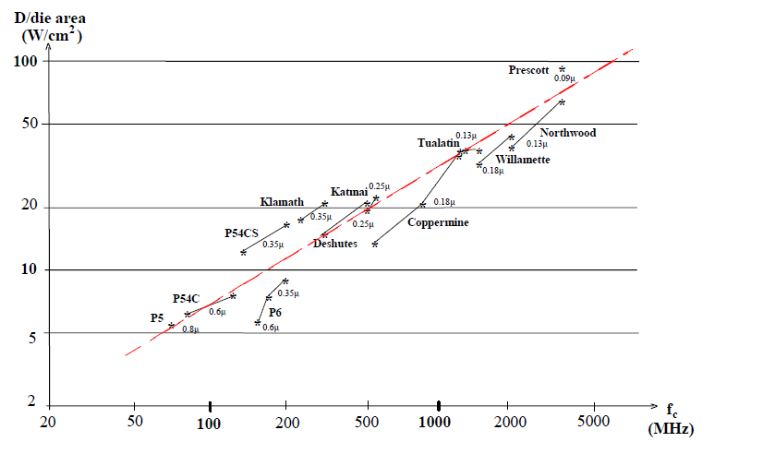
1. Overview of the evolution of Intel's Pentium 4 and Core 2 families (4)
Relative dissipation of Intel's x86 family of processors
Pentium 4
Pentium III
Pentium
*

Slide 8

1. Overview of the evolution of Intel's Pentium 4 and Core 2 families (5)
Intel's cancellation of 4 GHz Pentium 4 devices and subsequently the Pentium 4 line
In Oct. 2004 Intel's CEO (Chief Executing Officer) admitted that the Pentium 4 family
would not achieve 4 GHz [220].
Figure: In Oct. 2004 Crag Barrett, Intel's then-CEO on his knees to apologize for not achieving the
4GHz mark in front of an audience of 7000 informatics professional at the IT Expo in Orlando [220]
*

Slide 9
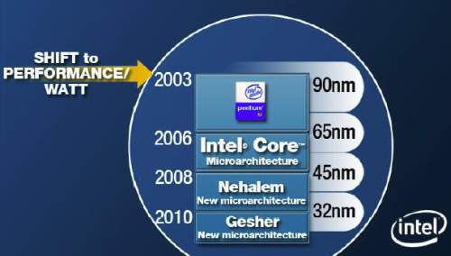
1. Overview of the evolution of Intel's Pentium 4 and Core 2 families (6)
Changing Intel's design paradigm to cope with raising dissipation about 2003
In 2003 Intel shifted the focus of their processor development from the pure performance goal
to the aspect of performance per watt, as stated in a slide from 4/2006, see below.
Figure 1.3: Intel’s plan to develop their manufacturing technology and processor lines
revealed at a shareholder’s meeting back in 4/2006 [74]
*

Slide 10
1. Overview of the evolution of Intel's Pentium 4 and Core 2 families (7)
Remark: A further change of the design paradigm for designing the mobile processors
With the advent of mobile devices (about 2006) a new design paradigm arose for those devices.
Mobile devices require long operating hours i.e. low power consumption, this is contrast to the
design paradigm of traditional processors, as indicated below.
Traditional processors
Tablets and smartphones
High performance/power
(e.g. GFLOPS/Watt)
Low power
(Watt)
(Number of operating hours)
*

Slide 11
1. Overview of the evolution of Intel's Pentium 4 and Core 2 families (8)
Introducing a two-phase development model (Tick-Tock model)for the Core 2 family
The two-phase model reduces the complexity of the development, as
the Tick phase focuses on the reduction of the feature size whereas
the Tock phase focuses on enhancing the microarchitecture.
*

Slide 12
1. Overview of the evolution of Intel's Pentium 4 and Core 2 families (9)
1. Introduction (1)
Development sites of subsequent generations of Intel's Core 2 family
gen.
2. gen.
3. gen.
4. gen.
5. gen.
Core 2
New
Microarch.
65 nm
Penryn
New
Process
45 nm
Nehalem
New
Microarch.
45 nm
West-
mere
New
Process
32 nm
Sandy
Bridge
New
Microarch.
32 nm
Ivy
Bridge
New
Process
22 nm
Haswell
New
Microarchi.
22 nm
Broad-
well
New
Process
14 nm
TOCK
TICK
TOCK
TICK
TOCK
TICK
TOCK
TICK
Haifa
Oregon
Oregon
Oregon
Haifa
Haifa
Oregon
Oregon
¹The 8th generation
encompasses the
following processor lines:
6. gen.
7. gen.
8. gen.¹
9. gen.
10. gen.
Skylake
New
Microarch.
14 nm
Kaby Lake
New
Microarch.
14 nm
Kaby Lake R/G
Coffee Lake
Amber Lake-Y
Whiskey Lake-U
Cannon Lake
14/10 nm
Coffee Lake R
New
Microarch.
14 nm
Ice Lake
Comet Lake
New
Microarch.
10 nm
Kaby Lake Refresh
Kaby Lake G with
AMD Vega graphics
Coffee Lake
Amber Lake Y
Whiskey Lake U
(all 14 nm) and
Cannon Lake
(10 nm)
TOCK
TOCK
TOCK
TOCK
TICK
Haifa
Haifa
Haifa
Haifa
Haifa
lines [218].
R: Refresh

Slide 13
1. Overview of the evolution of Intel's Pentium 4 and Core 2 families (10)
1. Introduction (1)
Arriving of subsequent generations in Intel's Core 2 family
gen.
2. gen.
3. gen.
4. gen.
5. gen.
Core 2
New
Microarch.
65 nm
Penryn
New
Process
45 nm
Nehalem
New
Microarch.
45 nm
West-
mere
New
Process
32 nm
Sandy
Bridge
New
Microarch.
32 nm
Ivy
Bridge
New
Process
22 nm
Haswell
New
Microarchi.
22 nm
Broad-
well
New
Process
14 nm
TOCK
TICK
TOCK
TICK
TOCK
TICK
TOCK
TICK
(2006)
(2007)
(2008)
(2010)
(2011)
(2012)
(2013)
(2014)
¹The 8th generation
encompasses the
following processor lines:
6. gen.
7. gen.
8. gen.¹
9. gen.
10. gen.
Skylake
New
Microarch.
14 nm
Kaby Lake
New
Microarch.
14 nm
Kaby Lake R/G
Coffee Lake
Amber Lake-Y
Whiskey Lake-U
Cannon Lake
14/10 nm
Coffee Lake R
New
Microarch.
14 nm
Ice Lake
Comet Lake
New
Microarch.
10 nm
Kaby Lake Refresh
Kaby Lake G with
AMD Vega graphics
Coffee Lake
Amber Lake Y
Whiskey Lake U
(all 14 nm) and
Cannon Lake
(10 nm)
TOCK
TOCK
TOCK
TOCK
TICK
(2015)
(2016)
(2017/18)
(2018)
(2019)
lines [218].
R: Refresh

Slide 14
1. Overview of the evolution of Intel's Pentium 4 and Core 2 families (11)
Designations of Intel’s processor series within the Core 2 processor family
EE
gen.
4/5/6xxx
2. gen.
2xxx
3. gen.
3xxx
4. gen.
4xxx
5. gen.
5xxx
M/DT
6/7/8/9xxx
i5/i7-xxx
i3/i5/i7-xxx
Core 2
New
Microarch.
65 nm
Penryn
New
Process
45 nm
Nehalem
New
Microarch.
45 nm
West-
mere
New
Process
32 nm
Sandy
Bridge
New
Microarch.
32 nm
Ivy
Bridge
New
Process
22 nm
Haswell
New
Microarchi.
22 nm
Broad-
well
New
Process
14 nm
TOCK
TICK
TOCK
TICK
TOCK
TICK
TOCK
TICK
HED
S
X/QX 6xxx
3/5/7xxx
QX 96/97xx
3/5/7xxx
i7-965/975
3/5xxx
980/990
E7-xxx
38/39xx
E3/E5/E7-xxxx
48/49xx
v2
58/59xx
v3
68/69xx
v4
¹The 8th generation
encompasses the
following processor lines:
6. gen.
7. gen.
8. gen.¹
9. gen.
10. gen.
Skylake
New
Microarch.
14 nm
Kaby Lake
New
Microarch.
14 nm
Kaby Lake R/G
Coffee Lake
Amber Lake-Y
Whiskey Lake-U
Cannon Lake
14/10 nm
Coffee Lake R
New
Microarch.
14 nm
Ice Lake
Comet Lake
New
Microarch.
10 nm
Kaby Lake Refresh
Kaby Lake G with
AMD Vega graphics
Coffee Lake
Amber Lake Y
Whiskey Lake U
(all 14 nm) and
Cannon Lake
(10 nm)
TOCK
TOCK
TOCK
TOCK
TICK
HED
S
i7-78xx/i9-79xx
v5/SP
v6
lines [218].
R: Refresh

Slide 15
1. Overview of the evolution of Intel's Pentium 4 and Core 2 families (12)
Basic microarchitectures and their related shrinks
Considered from the Pentium 4 Prescott core (the third core of Pentium 4) on.
Basic architectures | Basic architectures and their shrinks
Pentium 4 (Prescott) | 2005 90 nm Pentium 4 2006 65 nm Pentium 4
Core 2 | 2006 65 nm Core 2 2007 45 nm Penryn
Nehalem | 2008 45 nm Nehalem 2010 32 nm Westmere
Sandy Bridge | 2011 32 nm Sandy Bridge 2012 22 nm Ivy Bridge
Haswell | 2013 22 nm Haswell 2014 14 nm Broadwell
Skylake | 2015 14 nm Skylake 14 nm Kaby Lake 14 nm Coffee Lake 10 nm Cannon Lake
Icelake | 2019 10 nm Ice Lake

Slide 16
1. Overview of the evolution of Intel's Pentium 4 and Core 2 families (13)
Evolution of Intel’s IC technology
Pentium 4
Willamette
nm
200
180 nm
Pentium 4
Northwood
180
11/00
01/02
160
Pentium 4
Prescott
140
130 nm
02/04
120
Pentium 4
Cedar Mill
100
90 nm
01/06
80
Penryn
65 nm
11/07
Westmere
60
45 nm
01/10
Ivy Bridge
40
32 nm
04/12
Broadwell
Cannon lake
22 nm
09/14
14 nm
2H/17
20
10 nm
0
2000
2002
2004
2006
2008
2010
2012
2014
2016
2018
2018
On Intel’s Q2 2015 earnings conference call, on July 16 2015, Krzanich, Intel's CEO (Chief Executive Officer) told:
in the second half of 2017, we expect to launch our first 10-nanometer product, code named Cannonlake.
The last two technology transitions have signaled that our cadence today is closer to 2.5 years than two“ [180].
*

Slide 17
1. Overview of the evolution of Intel's Pentium 4 and Core 2 families (14)
Key ISA and microarchitecture innovations of the Core 2 family (based on [3]) -1
Key new features of the ISA
and the microarchitecture
2 YEARS
TICK Pentium 4 ( Cedar Mill)
Pentium D (Presler)
01/2006
2 YEARS
65nm
New microarch.: 4-wide core,
128-bit SIMD FX/FP EUs,
shared L2 , no HT
TOCK Core 2
1G
07/2006
2 YEARS
TICK Penryn Family
11/2007
45nm
New microarch.: 4 cores, integr. MC,
QPI, private L2, (inclusive) L3, HT
TOCK Nehalem
11/2008
TICK Westmere
01/2010
In package integrated GPU
2 YEARS
32nm
2G
New microarch.: 256-bit (FP) AVX,
ring bus, integrated GPU
TOCK Sandy Bridge
01/2011
3G
TICK Ivy Bridge
04/2012
2 YEARS
22nm
New microarch.: 256-bit (FX) AVX2,
L4 cache (discrete eDRAM), TSX
4G
TOCK Haswell
06/2013
5G
Shared Virtual Memory
TICK Broadwell
09/2014
6G
10/2015
New microarch.: 5-wide core,
ISP, Memory Side L4 cache, no FIVR
TOCK Skylake
TOCK Kaby Lake
14nm
08/2016
Optane memory, in KBL G series:
in package integr. CPU, GPU, HBM2
7G
TOCK Kaby Lake Refresh
6 YEARS
8G
14nm
08/2017
8G
6C, (PCHs of S-series DTs support:
USB G2, integr. conn., Optane 2)
TOCK Coffee Lake
10/2017
8G
TOCK Amber/Whiskey Lake
08/2018
9G
10/2018
TOCK Coffee Lake Refresh
8C
10G
08/2019
TOCK Comet Lake

Slide 18
1. Overview of the evolution of Intel's Pentium 4 and Core 2 families (15)
Key ISA and microarchitecture innovations of the Core 2 family (based on [3]) -1
Key new features of the ISA
and the microarchitecture
2 YEARS
8 G
05/2018
AVX 512
2 YEARS
TICK Cannon Lake
10nm
10 G
New microarchitecture
Thunderbolt 3, WiFi 6
TICK ICE Lake
07/2019

Slide 19
1. Overview of the evolution of Intel's Pentium 4 and Core 2 families (16)
Key power management innovations of the Core 2 family (based on [3]) -1
Key new features
of the power management
2 YEARS
TICK Pentium 4 ( Cedar Mill)
Pentium D (Presler)
01/2006
2 YEARS
65nm
Clock gating, PECI,
Platform Thermal Control by
3. party controller
TOCK Core 2
1G
07/2006
2 YEARS
TICK Penryn Family
11/2007
EDAT
45nm
Integrated Power Gates, PCU,
Turbo Boost
TOCK Nehalem
11/2008
TICK Westmere
01/2010
2 YEARS
32nm
2G
Turbo Boost 2.0
TOCK Sandy Bridge
01/2011
3G
2 YEARS
TICK Ivy Bridge
04/2012
22nm
4G
TOCK Haswell
06/2013
FIVR
5G
2. gen. FIVR
TICK Broadwell
09/2014
Speed Shift Technology,
Duty Cycle control, No FIVR
except Skylake X
6G
10/2015
TOCK Skylake
7G
14nm
TOCK Kaby Lake
08/2016
Speed Shift Technology v2
TOCK Kaby Lake Refresh
6 YEARS
8G
14nm
08/2017
TOCK Coffee Lake
In H-series: TVB
(Thermal Velocity Boost)
8G
10/2017
8G
TOCK Amber/Whiskey Lake
08/2018
9G
10/2018
TOCK Coffee Lake Refresh
STIM
10G
08/2019
TOCK Comet Lake

Slide 20
1. Overview of the evolution of Intel's Pentium 4 and Core 2 families (17)
Key power management innovations of the Core 2 family (based on [3]) -2
Key new features
of the power management
2 YEARS
8 G
05/2018
2 YEARS
TICK Cannon Lake
10nm
10 G
FIVR, Dynamic Tuning 2.0
(not discussed)
TICK ICE Lake
07/2019

Slide 21
1. Overview of the evolution of Intel's Pentium 4 and Core 2 families (18)
Raising of the single thread IPC in Intel’s basic architectures (Based on [195])
2
24%
22%
Per Generation
1.9
20%
Cumulative
1.8
18%
1.7
16%
1.6
14%
12%
1.5
10%
1.4
8%
1.3
6%
1.2
4%
2%
1.1
0%
1
Pentium M
Dothan
Core 2
Penryn
NHM
(w/o SMT)
WSM
SNB
IVB
HSW
BRW
SKL
Note that Intel raised IPC in the Core family only less then 2-times in about 10 years.
Tock models contribute by about 10 %, Tick models by about 5 % for raising IPC.
*

Slide 22
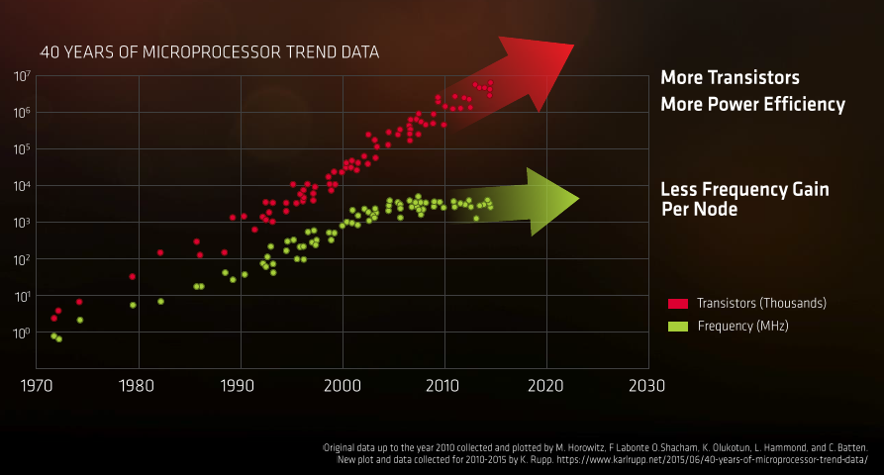
1. Overview of the evolution of Intel's Pentium 4 and Core 2 families (19)
General implications of the evolution of transistor technology [245]
Presentation at AMD's Financial Analyst Day May 16 2017
*

Slide 23

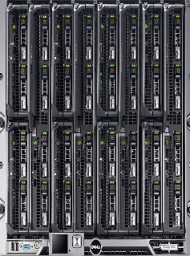
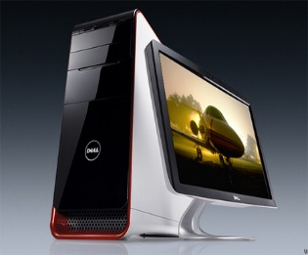
1. Overview of the evolution of Intel's Pentium 4 and Core 2 families (20)
Recent computer categories
Recent computer categories
Servers
HEDs
(High-End Desktops)
Desktops
Laptops
Tablets
Smartphones
(Client processors)
(Mobile processors)
Desktops
Smarphones
Desktops
Desktops
Laptops
Tablets
Servers
High-End Desktops
*

Slide 24
1. Overview of the evolution of Intel's Pentium 4 and Core 2 families (21)
Recent processor categories
Recent processor categories
Server
processors
HED processors
(High-End Desktop)
Desktop
processors
Laptop
(Notebook)
processors
Tablet
processors
Smartphone
processors
Desktops
Example
Intel processors:
(Client processors)
(Mobile processors)
Xeon E7/E5/E3
Platinum/Gold etc.
Core i9/i7
(Extreme Edition
or X models)
Core i9/i7/i5/i3
(Basic architectures)
Atom lines
Atom lines
C a n c e l l e d i n 2 0 1 6
Smarphones
Smarphones
Laptops
Tablets
Desktops
(Intel’s/AMD’sdesignation: Mobiles)
Tablets
Smartphones
Servers
High-End Desktops
Desktops
Typical config.
Up to 28C
2C - 18C
2C - 8C + G
(Up to 4C - 10C + G)
(by other vendors)
(Intel and AMD
designates them
also as mobile
processors)
*

Slide 25
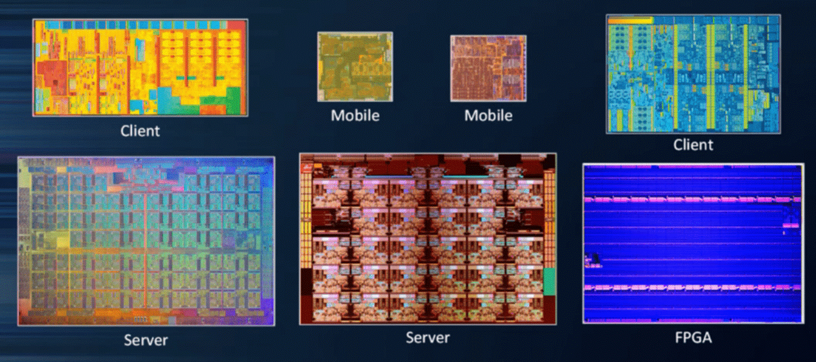
1. Overview of the evolution of Intel's Pentium 4 and Core 2 families (22)
14 nm dies of Intel's different processor categories (not on scale) [247]
Broadwell (2C, 82 mm²)
Skylake (4C, 122 mm²)
Knights Landing (72C, ~680 mm²)
Skylake-SP (28C, ~680 mm²)

Slide 26

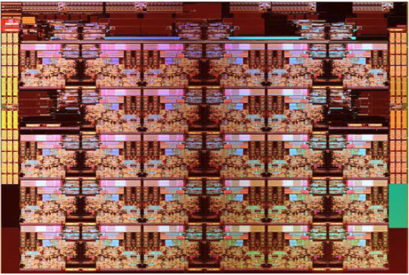
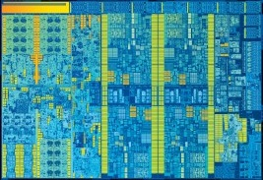
1. Overview of the evolution of Intel's Pentium 4 and Core 2 families (23)
14 nm dies of Intel's different processor categories (approximately on scale) [247]
Broadwell (2C, 82 mm²)
Skylake-SP (28C, ~680 mm²)
Skylake (4C, 122 mm²)

Slide 27
2. Evolution of desktop and laptop processors
Notes:
27

Slide 28
2. Evolution of desktop and laptop processors (1)
2. Evolution of desktop and laptop processors
Recent processor categories
Server
processors
HED processors
(High-End Desktop)
Desktop
processors
Laptop
(Notebook)
processors
Tablet
processors
Smartphone
processors
Desktops
Example
Intel processors:
(Client processors)
(Mobile processors)
Xeon E7/E5/E3
Platinum/Gold etc.
Core i9/i7
(Extreme Edition
or X models)
Core i7/i5/i3
(Basic architectures)
Atom lines
Atom lines
C a n c e l l e d i n 2 0 1 6
Smarphones
Smarphones
(Intel and AMD
designates them
also as mobile
processors)
Tablets
Desktops
Laptops
Tablets
Smartphones
(Intel’s/AMD’sdesignation: Mobiles)
Servers
High-End Desktops
Desktops

Slide 29
2. Evolution of desktop and laptop processors (2)
Intel’s Core-based mainstream DT and or laptop platforms -1
Designation of the platform | Platform topology | Processor | Technology | Max. no. of cores (n_{C}) | Year of intro. | Processor socket | MCH/PCH | Highest mem./ speed | No. of mem. channels
Anchor Creek | Off-die MC | Pentium D | 90 nm | 2x1 | 5/2005 | LGA 775 | 945-955 | DD2-667 | 2
Bridge Creek |  | Core 2 | 65 nm | 2C | 6/2006 | LGA 775 | 945-975 | DDR2-800 | 2
Salt Creek |  | Core 2 Quad | 65 nm | 2x2C | 6/2007 | LGA 775 | 3 Series (Bearlake) | DDR3-1067 | 2
Boulder Creek |  | Penryn | 45 nm | 2x2C | 6/2008 | LGA 775 | 4 Series (Eaglelake) | DDR3-1067 | 2
Kings Creek | On-die MC | 2. G. Nehalem (Lynnfield) | 45 nm | 4C | 9/2009 | LGA 1156 | 5 Series (Ibex Peak) | DDR3-1333 | 2
 |  | Westmere (Clarkdale) | 32 nm | 2C+G | 1/2010 | LGA 1156 | 5 Series (Ibex Peak)
 |  | Sandy Bridge | 32 nm | 2C/4C+G | 1/2011 | LGA 1155 | 6 series (Cougar Point) | DDR3-1333 | 2
Sugar Bay
Maho Bay |  | Ivy Bridge | 22 nm | 4C +G | 4/2012 | LGA 1155 | 7 series (Panther Point) | DDR3-1600 | 2
Shark Bay |  | Haswell | 22 nm | 4C+G | 6/2013 | LGA 1155 | 8 Series (Lynx Point) | DDR3-1600 | 2
 |  | Haswell refresh | 22 nm | 4C+G | 5/2014 | LGA 1150 | 9 Series (Wild Cat Point) | DDR3-1666
 |  | Broadwell | 14 nm | 4C+G | 6/2015 | LGA 1150 | 9 Series (Wild Cat Point) | DDR3-1866
 |  | Skylake | 14 nm | 4C+G | 10/2015 | LGA 1151 | Series (Sunrise Point) | DDR4-2133 | 2
 |  | Kaby Lake | 14 nm | 4C + G | 8/2016 | LGA 1151 | 200 Series | DDR4-2400 | 2
 |  | Coffee Lake | 14 nm | 6C +G | 10/2017 | LGA 1151 | 300 Series | DDR4-2666 | 2
 |  | Amber Lake | 14 nm | 2C+G | 8/2018 | BGA 1515 | 300 Series | LPDDR3-2133 | 2
 |  | Whiskey Lake | 14 nm | 4C+G | 8/2018 | BGA 1528 | 300 Series | DDR4-2400 | 2
 |  | Coffee Lake R. | 14 nm | 8C +G | 10/2018 | LGA 1151 | 300 Series | DDR4-2666 | 2
 |  | Comet Lake | 14 nm | 6C + G | 8/2019 | BGA 1528 | 400 Series | DDR4-2666 | 2

Slide 30
2. Evolution of desktop and laptop processors (2b)
Intel’s Core-based mainstream DT and or laptop platforms -2
Designation of the platform | Platform topology | Processor | Technology | Max. no. of cores (n_{C}) | Year of introduction | Processor socket | PCH | Highest mem./ speed | No. of mem. channels
 | On-die MC | Cannon Lake | 10 nm | 2C | 5/2018 | BGA | n.a. | DDR4-2400 | 2
 |  | Ice Lake | 10 nm | 4C | 7/2019 | BGA 1526/1377 | 300-series PCH | DDR4-3733 | 2

Slide 31
2. Evolution of desktop and laptop processors (3)
Max. number of cores -1
Designation of the platform | Platform topology | Processor | Technology | Max. no. of cores (n_{C}) | Year of intro. | Processor socket | MCH/PCH | Highest mem./ speed | No. of mem. channels
Anchor Creek | Off-die MC | Pentium D | 90 nm | 2x1 | 5/2005 | LGA 775 | 945-955 | DD2-667 | 2
Bridge Creek |  | Core 2 | 65 nm | 2C | 6/2006 | LGA 775 | 945-975 | DDR2-800 | 2
Salt Creek |  | Core 2 Quad | 65 nm | 2x2C | 6/2007 | LGA 775 | 3 Series (Bearlake) | DDR3-1067 | 2
Boulder Creek |  | Penryn | 45 nm | 2x2C | 6/2008 | LGA 775 | 4 Series (Eaglelake) | DDR3-1067 | 2
Kings Creek | On-die MC | 2. G. Nehalem (Lynnfield) | 45 nm | 4C | 9/2009 | LGA 1156 | 5 Series (Ibex Peak) | DDR3-1333 | 2
 |  | Westmere (Clarkdale) | 32 nm | 2C+G | 1/2010 | LGA 1156 | 5 Series (Ibex Peak)
 |  | Sandy Bridge | 32 nm | 2C/4C+G | 1/2011 | LGA 1155 | 6 series (Cougar Point) | DDR3-1333 | 2
Sugar Bay
Maho Bay |  | Ivy Bridge | 22 nm | 4C +G | 4/2012 | LGA 1155 | 7 series (Panther Point) | DDR3-1600 | 2
Shark Bay |  | Haswell | 22 nm | 4C+G | 6/2013 | LGA 1155 | 8 Series (Lynx Point) | DDR3-1600 | 2
 |  | Haswell refresh | 22 nm | 4C+G | 5/2014 | LGA 1150 | 9 Series (Wild Cat Point) | DDR3-1666
 |  | Broadwell | 14 nm | 4C+G | 6/2015 | LGA 1150 | 9 Series (Wild Cat Point) | DDR3-1866
 |  | Skylake | 14 nm | 4C+G | 10/2015 | LGA 1151 | Series (Sunrise Point) | DDR4-2133 | 2
 |  | Kaby Lake | 14 nm | 4C + G | 8/2016 | LGA 1151 | 200 Series | DDR4-2400 | 2
 |  | Coffee Lake | 14 nm | 6C +G | 10/2017 | LGA 1151 | 300 Series | DDR4-2666 | 2
 |  | Amber Lake | 14 nm | 2C+G | 8/2018 | BGA 1515 | 300 Series | LPDDR3-2133 | 2
 |  | Whiskey Lake | 14 nm | 4C+G | 8/2018 | BGA 1528 | 300 Series | DDR4-2400 | 2
 |  | Coffee Lake R. | 14 nm | 8C +G | 10/2018 | LGA 1151 | 300 Series | DDR4-2666 | 2
 |  | Comet Lake | 14 nm | 6C + G | 8/2019 | BGA 1528 | 400 Series | DDR4-2666 | 2

Slide 32
2. Evolution of desktop and laptop processors (3b)
Max. number of cores -2
Designation of the platform | Platform topology | Processor | Technology | Max. no. of cores (n_{C}) | Year of introduction | Processor socket | PCH | Highest mem./ speed | No. of mem. channels
 | On-die MC | Cannon Lake | 10 nm | 2C | 5/2018 | BGA | n.a. | DDR4-2400 | 2
 |  | Ice Lake | 10 nm | 4C | 7/2019 | BGA 1526/1377 | 300-series PCH | DDR4-3733 | 2

Slide 33
2. Evolution of desktop and laptop processors (4)
No. of memory channels -1
Designation of the platform | Platform topology | Processor | Technology | Max. no. of cores (n_{C}) | Year of intro. | Processor socket | MCH/PCH | Highest mem./ speed | No. of mem. channels
Anchor Creek | Off-die MC | Pentium D | 90 nm | 2x1 | 5/2005 | LGA 775 | 945-955 | DD2-667 | 2
Bridge Creek |  | Core 2 | 65 nm | 2C | 6/2006 | LGA 775 | 945-975 | DDR2-800 | 2
Salt Creek |  | Core 2 Quad | 65 nm | 2x2C | 6/2007 | LGA 775 | 3 Series (Bearlake) | DDR3-1067 | 2
Boulder Creek |  | Penryn | 45 nm | 2x2C | 6/2008 | LGA 775 | 4 Series (Eaglelake) | DDR3-1067 | 2
Kings Creek | On-die MC | 2. G. Nehalem (Lynnfield) | 45 nm | 4C | 9/2009 | LGA 1156 | 5 Series (Ibex Peak) | DDR3-1333 | 2
 |  | Westmere (Clarkdale) | 32 nm | 2C+G | 1/2010 | LGA 1156 | 5 Series (Ibex Peak)
 |  | Sandy Bridge | 32 nm | 2C/4C+G | 1/2011 | LGA 1155 | 6 series (Cougar Point) | DDR3-1333 | 2
Sugar Bay
Maho Bay |  | Ivy Bridge | 22 nm | 4C +G | 4/2012 | LGA 1155 | 7 series (Panther Point) | DDR3-1600 | 2
Shark Bay |  | Haswell | 22 nm | 4C+G | 6/2013 | LGA 1155 | 8 Series (Lynx Point) | DDR3-1600 | 2
 |  | Haswell refresh | 22 nm | 4C+G | 5/2014 | LGA 1150 | 9 Series (Wild Cat Point) | DDR3-1666
 |  | Broadwell | 14 nm | 4C+G | 6/2015 | LGA 1150 | 9 Series (Wild Cat Point) | DDR3-1866
 |  | Skylake | 14 nm | 4C+G | 10/2015 | LGA 1151 | Series (Sunrise Point) | DDR4-2133 | 2
 |  | Kaby Lake | 14 nm | 4C + G | 8/2016 | LGA 1151 | 200 Series | DDR4-2400 | 2
 |  | Coffee Lake | 14 nm | 6C +G | 10/2017 | LGA 1151 | 300 Series | DDR4-2666 | 2
 |  | Amber Lake | 14 nm | 2C+G | 8/2018 | BGA 1515 | 300 Series | LPDDR3-2133 | 2
 |  | Whiskey Lake | 14 nm | 4C+G | 8/2018 | BGA 1528 | 300 Series | DDR4-2400 | 2
 |  | Coffee Lake R. | 14 nm | 8C +G | 10/2018 | LGA 1151 | 300 Series | DDR4-2666 | 2
 |  | Comet Lake | 14 nm | 6C + G | 8/2019 | BGA 1528 | 400 Series | DDR4-2666 | 2

Slide 34
2. Evolution of desktop and laptop processors (4b)
No. of memory channels -2
Designation of the platform | Platform topology | Processor | Technology | Max. no. of cores (n_{C}) | Year of introduction | Processor socket | PCH | Highest mem./ speed | No. of mem. channels
 | On-die MC | Cannon Lake | 10 nm | 2C | 5/2018 | BGA | n.a. | DDR4-2400 | 2
 |  | Ice Lake | 10 nm | 4C | 7/2019 | BGA 1526/1377 | 300-series PCH | DDR4-3733 | 2

Slide 35
2. Evolution of desktop and laptop processors (5)
Platform topology -1
Designation of the platform | Off-die / on-die MC | Processor | Technology | Max. no. of cores (n_{C}) | Year of intro. | Processor socket | MCH/PCH | Highest mem./ speed | No. of mem. channels
Anchor Creek | Off-die MC (SMP) | Pentium D | 90 nm | 2x1 | 5/2005 | LGA 775 | 945-955 | DD2-667 | 2
Bridge Creek |  | Core 2 | 65 nm | 2C | 6/2006 | LGA 775 | 945-975 | DDR2-800 | 2
Salt Creek |  | Core 2 Quad | 65 nm | 2x2C | 6/2007 | LGA 775 | 3 Series (Bearlake) | DDR3-1067 | 2
Boulder Creek |  | Penryn | 45 nm | 2x2C | 6/2008 | LGA 775 | 4 Series (Eaglelake) | DDR3-1067 | 2
Kings Creek | On-die MC (NUMA) | 2. G. Nehalem (Lynnfield) | 45 nm | 4C | 9/2009 | LGA 1156 | 5 Series (Ibex Peak) | DDR3-1333 | 2
 |  | Westmere (Clarkdale) | 32 nm | 2C+G | 1/2010 | LGA 1156 | 5 Series (Ibex Peak)
 |  | Sandy Bridge | 32 nm | 2C/4C+G | 1/2011 | LGA 1155 | 6 series (Cougar Point) | DDR3-1333 | 2
Sugar Bay
Maho Bay |  | Ivy Bridge | 22 nm | 4C +G | 4/2012 | LGA 1155 | 7 series (Panther Point) | DDR3-1600 | 2
Shark Bay |  | Haswell | 22 nm | 4C+G | 6/2013 | LGA 1155 | 8 Series (Lynx Point) | DDR3-1600 | 2
 |  | Haswell refresh | 22 nm | 4C+G | 5/2014 | LGA 1150 | 9 Series (Wild Cat Point) | DDR3-1666
 |  | Broadwell | 14 nm | 4C+G | 6/2015 | LGA 1150 | 9 Series (Wild Cat Point) | DDR3-1866
 |  | Skylake | 14 nm | 4C+G | 10/2015 | LGA 1151 | Series (Sunrise Point) | DDR4-2133 | 2
 |  | Kaby Lake | 14 nm | 4C + G | 8/2016 | LGA 1151 | 200 Series | DDR4-2400 | 2
 |  | Coffee Lake | 14 nm | 6C +G | 10/2017 | LGA 1151 | 300 Series | DDR4-2666 | 2
 |  | Amber Lake | 14 nm | 2C+G | 8/2018 | BGA 1515 | 300 Series | LPDDR3-2133 | 2
 |  | Whiskey Lake | 14 nm | 4C+G | 8/2018 | BGA 1528 | 300 Series | DDR4-2400 | 2
 |  | Coffee Lake R. | 14 nm | 8C +G | 10/2018 | LGA 1151 | 300 Series | DDR4-2666 | 2
 |  | Comet Lake | 14 nm | 6C + G | 8/2019 | BGA 1528 | 400 Series | DDR4-2666 | 2

Slide 36
2. Evolution of desktop and laptop processors (5b)
Platform topology -2
Designation of the platform | Off-die / on-die MC | Processor | Technology | Max. no. of cores (n_{C}) | Year of introduction | Processor socket | PCH | Highest mem./ speed | No. of mem. channels
 | On-die MC (NUMA) | Cannon Lake | 10 nm | 2C | 5/2018 | BGA | n.a. | DDR4-2400 | 2
 |  | Ice Lake | 10 nm | 4C | 7/2019 | BGA 1526/1377 | 300-series PCH | DDR4-3733 | 2

Slide 37
2. Evolution of desktop and laptop processors (5c)
Attaching the memory controller off-die or on-die
Attaching the memory controller off-die or on-die
Placing the MC off-die
(into the MCH)
Placing the MC on-die
(onto the processor die)
Processor
Processor r
MC
Memory
FSB
FSB
MCH
MCH
MC
Memory
ICH
ICH

Slide 38
2. Evolution of desktop and laptop processors (6)
Consequence of placing the memory controller (MC) onto the proc. die in multiprocessors
Basic platform topologies of multiprocessors
classified according to their memory architecture
SMPs
(Symmetrical MultiProcessor)
NUMAs
Multiprocessors (Multi socket system)
with Uniform Memory Access (UMA)
Multiprocessors (Multi socket system)
with Non-Uniform Memory Access
All processors access main memory by the same
mechanism, (e.g. by individual FSBs and an MCH)
MC is off-die.
A particular part of the main memory can be accessed
by each processor immediately, other parts remotely.
MC is on-die
Typical examples
On-die MC
Processor
Processor
Processor
QPI
Processor
QPI
QPI
FSB
E.g. DDR3-1333
IOH¹
E.g. DDR3-1333
MCH
E.g. DDR2-533
ESI
ESI
ICH
ICH
Off-die MC
¹ICH: I/O hub
ESI: Enterprise System Interface
*

Slide 39
2. Evolution of desktop and laptop processors (7)
Speeding up the memory rate -1
Designation of the platform | Platform topology | Processor | Technology | Max. no. of cores (n_{C}) | Year of intro. | Processor socket | MCH/PCH | Highest mem./ speed | No. of mem. channels
Anchor Creek | Off-die MC | Pentium D | 90 nm | 2x1 | 5/2005 | LGA 775 | 945-955 | DD2-667 | 2
Bridge Creek |  | Core 2 | 65 nm | 2C | 6/2006 | LGA 775 | 945-975 | DDR2-800 | 2
Salt Creek |  | Core 2 Quad | 65 nm | 2x2C | 6/2007 | LGA 775 | 3 Series (Bearlake) | DDR3-1067 | 2
Boulder Creek |  | Penryn | 45 nm | 2x2C | 6/2008 | LGA 775 | 4 Series (Eaglelake) | DDR3-1067 | 2
Kings Creek | On-die MC | 2. G. Nehalem (Lynnfield) | 45 nm | 4C | 9/2009 | LGA 1156 | 5 Series (Ibex Peak) | DDR3-1333 | 2
 |  | Westmere (Clarkdale) | 32 nm | 2C+G | 1/2010 | LGA 1156 | 5 Series (Ibex Peak)
 |  | Sandy Bridge | 32 nm | 2C/4C+G | 1/2011 | LGA 1155 | 6 series (Cougar Point) | DDR3-1333 | 2
Sugar Bay
Maho Bay |  | Ivy Bridge | 22 nm | 4C +G | 4/2012 | LGA 1155 | 7 series (Panther Point) | DDR3-1600 | 2
Shark Bay |  | Haswell | 22 nm | 4C+G | 6/2013 | LGA 1155 | 8 Series (Lynx Point) | DDR3-1600 | 2
 |  | Haswell refresh | 22 nm | 4C+G | 5/2014 | LGA 1150 | 9 Series (Wild Cat Point) | DDR3-1666
 |  | Broadwell | 14 nm | 4C+G | 6/2015 | LGA 1150 | 9 Series (Wild Cat Point) | DDR3-1866
 |  | Skylake | 14 nm | 4C+G | 10/2015 | LGA 1151 | Series (Sunrise Point) | DDR4-2133 | 2
 |  | Kaby Lake | 14 nm | 4C + G | 8/2016 | LGA 1151 | 200 Series | DDR4-2400 | 2
 |  | Coffee Lake | 14 nm | 6C +G | 10/2017 | LGA 1151 | 300 Series | DDR4-2666 | 2
 |  | Amber Lake | 14 nm | 2C+G | 8/2018 | BGA 1515 | 300 Series | LPDDR3-2133 | 2
 |  | Whiskey Lake | 14 nm | 4C+G | 8/2018 | BGA 1528 | 300 Series | DDR4-2400 | 2
 |  | Coffee Lake R. | 14 nm | 8C +G | 10/2018 | LGA 1151 | 300 Series | DDR4-2666 | 2
 |  | Comet Lake | 14 nm | 6C + G | 8/2019 | BGA 1528 | 400 Series | DDR4-2666 | 2

Slide 40
2. Evolution of desktop and laptop processors (7b)
Speeding up the memory rate -2
Designation of the platform | Platform topology | Processor | Technology | Max. no. of cores (n_{C}) | Year of introduction | Processor socket | PCH | Highest mem./ speed | No. of mem. channels
 | On-die MC | Cannon Lake | 10 nm | 2C | 5/2018 | BGA | n.a. | DDR4-2400 | 2
 |  | Ice Lake | 10 nm | 4C | 7/2019 | BGA 1526/1377 | 300-series PCH | DDR4-3733 | 2

Slide 41
2. Evolution of desktop and laptop processors (8)
Key features of the evolution of Intel’s Core-based mainstream DT platforms
Their core count rose soon (already in 2007) to 4 and remain at this figure up to the
7. gen. Kaby Lake line, subsequent, 8. and 9. gen. lines (Coffee Lake/Coffee Lake Refresh)
raised the core count first to 6 then to 8.
Two memory channels are used to connect memory.
Memory is connected up to the Penryn via the MCH thereafter immediately via the processor.
In a 10 year period memory speed rose about three to four times.
*

Slide 42
2. Evolution of desktop and laptop processors (9)
Evolution of main features of Intel’s graphics families (based on [174]) -1
Intel Core generation | Graphics generation | Models | Graphics Technology level | No. of graphics slices | No. of EUs | eDRAM | OpenGL version | DirectX version | OpenCL version
Westmere | 5th (Ironlake) | HD |  |  | 12 | -- | 2.1 | 10.1 | n.a.
Sandy Bridge | 6th | HD 2000 | GT1 | 1 (2x3 EU) | 6 |  | 3.1/3.3 | 10.1 | n.a.
 |  | HD 3000 | GT2 | 1 (4x3 EU) | 12
Ivy Bridge | 7th | HD 2500 | GT1 | 1 (6 EU) | 6 | -- | 4.0 | 11.0 | 1.2
 |  | HD 4000 | GT2 | 1 (2x8 EU) | 16
Haswell | 7.5th | HD 4200- HD 4700 | GT2 | 1 (2x10 EU) | 20 | -- | 4.3 | 11.1 | 1.2
 |  | HD 5000 Iris 5100 | GT3 | 2 | 40
 |  | Iris Pro 5200 |  |  |  | 128 MB
Broadwell | 8th | HD 5300- HD 5600 | GT2 | 1 (3x8 EU) | 23/24 | -- | 4.3 | 11.2 | 2.0
 |  | HD 6000 Iris 6100 | GT3 | 2 | 47/48
 |  | Iris Pro 6200 | GT3e | 2 | 48 | 128 MB
Skylake | 9th | HD 510 | GT1 | 1 (3x4 EU) | 12 | -- | 4.4 | 12 | 2.0
 |  | HD 515 | GT1.5 | 1 (3x6 EU) | 18
 |  | HD 520 | GT2 | 1 (3x8 EU) | 24
 |  | HD 535 | GT3 | 2 | 48
 |  | HD 540 | GT3e | 2 | 48 | 64 MB
 |  | HD 580 | GT4e | 3 | 72 | 64/128 MB

Slide 43
2. Evolution of desktop and laptop processors (9b)
Evolution of main features of Intel’s graphics families (based on [174]) -2
Intel Core generationGT2 | Graphics generation | Models | Graphics Technology level | No. of graphics slices | No. of EUs | eDRAM | OpenGL version | DirectX version | OpenCL version
Kaby Lake | 9.5 | HD 610 | GT1 | 1(3x4 EU) | 12 | -- | 4.5 | 12_1 | 2.1
 |  | HD615 HD620 HD630 | GT2 | 1(3x8) | 24
 |  | HD640 HD650 | GT3 | 2 | 48
Coffee Lake |  | UHD 610 | GT1 | 1(3x4) | 12 | --
 |  | UHD630 | GT2 | 1(3x8) | 24
 |  | Iris Plus 655 | GT3e | 2 | 48 | 128
Amber Lake Y |  | HD615 | GT1 | 1(3x4) | 12 | --
Whiskey Lake U |  | UHD620 | GT2 | 1(3x8) | 24 | --
Comet Lake |  | UHD | GT2? | 1(3x8)? | 24? | --
Cannon Lake | --
Ice Lake | 11 | UHD | G1 | 4x8 | 32 | -- | 4.5 | 12_1 | 2.1
 |  | Iris Plus | G4 | 6x8 | 48 | na.
 |  | Iris Plus | G7 | 8x8 | 64 | na.

Slide 44
2. Evolution of desktop and laptop processors (10)
Evolution of main features of Intel’s graphics families (based on [174]) -2
Intel Core generation | Graphics generation | Models | Graphics Technology level | No. of graphics slices | No. of EUs | eDRAM | OpenGL version | DirectX version | OpenCL version
Westmere | 5th (Ironlake) | HD |  |  | 12 | -- | 2.1 | 10.1 | n.a.
Sandy Bridge | 6th | HD 2000 | GT1 | 1 (2x3 EU) | 6 |  | 3.1/3.3 | 10.1 | n.a.
 |  | HD 3000 | GT2 | 1 (4x3 EU) | 12
Ivy Bridge | 7th | HD 2500 | GT1 | 1 (6 EU) | 6 | -- | 4.0 | 11.0 | 1.2
 |  | HD 4000 | GT2 | 1 (2x8 EU) | 16
Haswell | 7.5th | HD 4200- HD 4700 | GT2 | 1 (2x10 EU) | 20 | -- | 4.3 | 11.1 | 1.2
 |  | HD 5000 Iris 5100 | GT3 | 2 | 40
 |  | Iris Pro 5200 |  |  |  | 128 MB
Broadwell | 8th | HD 5300- HD 5600 | GT2 | 1 (3x8 EU) | 23/24 | -- | 4.3 | 11.2 | 2.0
 |  | HD 6000 Iris 6100 | GT3 | 2 | 47/48
 |  | Iris Pro 6200 | GT3e | 2 | 48 | 128 MB
Skylake | 9th | HD 510 | GT1 | 1 (3x4 EU) | 12 | -- | 4.4 | 12 | 2.0
 |  | HD 515 | GT1.5 | 1 (3x6 EU) | 18
 |  | HD 520 | GT2 | 1 (3x8 EU) | 24
 |  | HD 535 | GT3 | 2 | 48
 |  | HD 540 | GT3e | 2 | 48 | 64 MB
 |  | HD 580 | GT4e | 3 | 72 | 64/128 MB

Slide 45
2. Evolution of desktop and laptop processors (10b)
Evolution of main features of Intel’s graphics families (based on [174]) -2
Intel Core generationGT2 | Graphics generation | Models | Graphics Technology level | No. of graphics slices | No. of EUs | eDRAM | OpenGL version | DirectX version | OpenCL version
Kaby Lake | 9.5 | HD 610 | GT1 | 1(3x4 EU) | 12 | -- | 4.5 | 12_1 | 2.1
 |  | HD615 HD620 HD630 | GT2 | 1(3x8) | 24
 |  | HD640 HD650 | GT3 | 2 | 48
Coffee Lake |  | UHD 610 | GT1 | 1(3x4) | 12 | --
 |  | UHD630 | GT2 | 1(3x8) | 24
 |  | Iris Plus 655 | GT3e | 2 | 48 | 128
Amber Lake Y |  | HD615 | GT1 | 1(3x4) | 12 | --
Whiskey Lake U |  | UHD620 | GT2 | 1(3x8) | 24 | --
Comet Lake |  | UHD | GT2? | 1(3x8)? | 24? | --
Cannon Lake | --
Ice Lake | 11 | UHD | G1 | 4x8 | 32 | -- | 4.5 | 12_1 | 2.1
 |  | Iris Plus | G4 | 6x8 | 48 | na.
 |  | Iris Plus | G7 | 8x8 | 64 | na.

Slide 46
2. Evolution of desktop and laptop processors (11)
Evolution of main features of Intel’s 5th to 9th graphics families (based on [174]) -3
Intel Core generation | Graphics generation | Models | Graphics Technology level | No. of graphics slices | No. of EUs | eDRAM | OpenGL version | DirectX version | OpenCL version
Westmere | 5th (Ironlake) | HD |  |  | 12 | -- | 2.1 | 10.1 | n.a.
Sandy Bridge | 6th | HD 2000 | GT1 | 1 (2x3 EU) | 6 |  | 3.1/3.3 | 10.1 | n.a.
 |  | HD 3000 | GT2 | 1 (4x3 EU) | 12
Ivy Bridge | 7th | HD 2500 | GT1 | 1 (6 EU) | 6 | -- | 4.0 | 11.0 | 1.2
 |  | HD 4000 | GT2 | 1 (2x8 EU) | 16
Haswell | 7.5th | HD 4200- HD 4700 | GT2 | 1 (2x10 EU) | 20 | -- | 4.3 | 11.1 | 1.2
 |  | HD 5000 Iris 5100 | GT3 | 2 | 40
 |  | Iris Pro 5200 |  |  |  | 128 MB
Broadwell | 8th | HD 5300- HD 5600 | GT2 | 1 (3x8 EU) | 23/24 | -- | 4.3 | 11.2 | 2.0
 |  | HD 6000 Iris 6100 | GT3 | 2 | 47/48
 |  | Iris Pro 6200 | GT3e | 2 | 48 | 128 MB
Skylake | 9th | HD 510 | GT1 | 1 (3x4 EU) | 12 | -- | 4.4 | 12 | 2.0
 |  | HD 515 | GT1.5 | 1 (3x6 EU) | 18
 |  | HD 520 | GT2 | 1 (3x8 EU) | 24
 |  | HD 535 | GT3 | 2 | 48
 |  | HD 540 | GT3e | 2 | 48 | 64 MB
 |  | HD 580 | GT4e | 3 | 72 | 64/128 MB

Slide 47
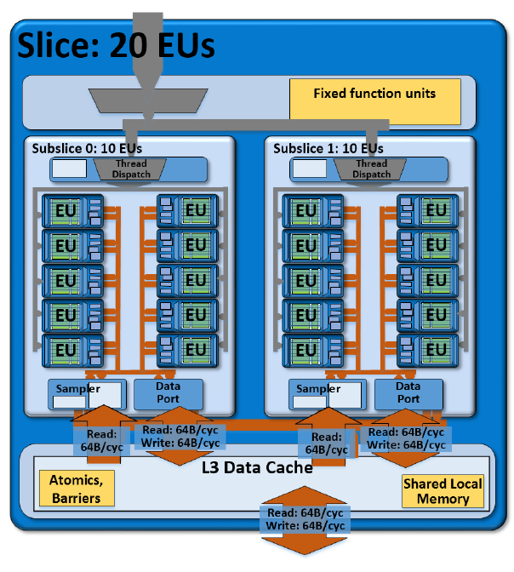
2. Evolution of desktop and laptop processors (12)
Example: A slice of the graphics unit of Haswell (6.5th gen. graphics)
1 slice (GT2): includs 20 EUs [199]

Slide 48
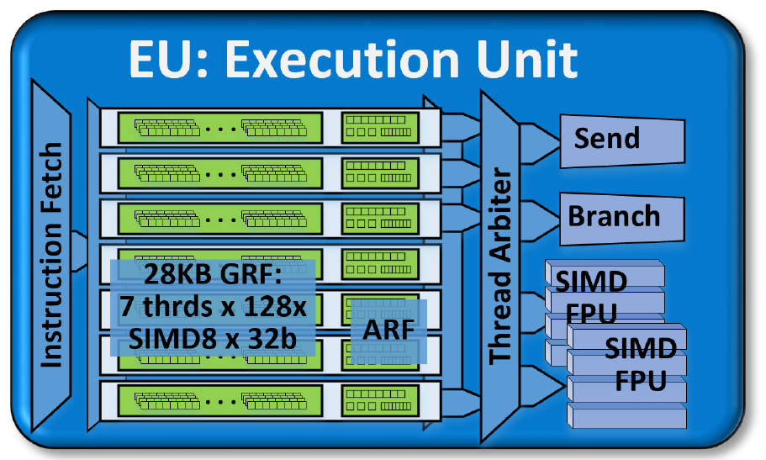
2. Evolution of desktop and laptop processors (13)
Block diagram of an EU of Haswell -1 [199]
SIMD: Single Instruction
Multiple Data
Each EU has four functional units:
Two SIMD FPU units
1 Send unit (Load/Store) and
1 Branch unit.
An EU issues up to 4 instructions per cycle to the functional units.
*

Slide 49
2. Evolution of desktop and laptop processors (14)
Block diagram of an EU of Haswell -2 [199]
Each SIMD FPUs can execute 4 SP FP MAD instructions (Multiply-Add)/cycle.
Thus an EU can execute 2 FPU x SIMD4 x 2 (MAD) = 16 SP FP operations/cycle.
The EU is 7-way multithreaded.
Each thread has 128 32 B registers.
One of the FPUs also supports FX operations (1/2/4/8/16/32 bit wide FX operations).
One of the FPUs also support transcendental math functions.
*

Slide 50
2. Evolution of desktop and laptop processors (15)
Evolution of main features of Intel’s 5th to 9th graphics families (based on [174])
Intel Core generation | Graphics generation | Models | Graphics Technology level | No. of graphics slices | No. of EUs | eDRAM | OpenGL version | DirectX version | OpenCL version
Westmere | 5th (Ironlake) | HD |  |  | 12 | -- | 2.1 | 10.1 | n.a.
Sandy Bridge | 6th | HD 2000 | GT1 | 1 (2x3 EU) | 6 |  | 3.1/3.3 | 10.1 | n.a.
 |  | HD 3000 | GT2 | 1 (4x3 EU) | 12
Ivy Bridge | 7th | HD 2500 | GT1 | 1 (6 EU) | 6 | -- | 4.0 | 11.0 | 1.2
 |  | HD 4000 | GT2 | 1 (2x8 EU) | 16
Haswell | 7.5th | HD 4200- HD 4700 | GT2 | 1 (2x10 EU) | 20 | -- | 4.3 | 11.1 | 1.2
 |  | HD 5000 Iris 5100 | GT3 | 2 | 40
 |  | Iris Pro 5200 |  |  |  | 128 MB
Broadwell | 8th | HD 5300- HD 5600 | GT2 | 1 (3x8 EU) | 23/24 | -- | 4.3 | 11.2 | 2.0
 |  | HD 6000 Iris 6100 | GT3 | 2 | 47/48
 |  | Iris Pro 6200 | GT3e | 2 | 48 | 128 MB
Skylake | 9th | HD 510 | GT1 | 1 (3x4 EU) | 12 | -- | 4.4 | 12 | 2.0
 |  | HD 515 | GT1.5 | 1 (3x6 EU) | 18
 |  | HD 520 | GT2 | 1 (3x8 EU) | 24
 |  | HD 535 | GT3 | 2 | 48
 |  | HD 540 | GT3e | 2 | 48 | 64 MB
 |  | HD 580 | GT4e | 3 | 72 | 64/128 MB
*

Slide 51
2. Evolution of desktop and laptop processors (16)
Evolution of main features of Intel’s 5th to 9th graphics families (based on [174]) -4
Intel Core generation | Graphics generation | Models | Graphics Technology level | No. of graphics slices | No. of EUs | eDRAM | OpenGL version | DirectX version | OpenCL version
Westmere | 5th (Ironlake) | HD |  |  | 12 | -- | 2.1 | 10.1 | n.a.
Sandy Bridge | 6th | HD 2000 | GT1 | 1 (2x3 EU) | 6 |  | 3.1/3.3 | 10.1 | n.a.
 |  | HD 3000 | GT2 | 1 (4x3 EU) | 12
Ivy Bridge | 7th | HD 2500 | GT1 | 1 (6 EU) | 6 | -- | 4.0 | 11.0 | 1.2
 |  | HD 4000 | GT2 | 1 (2x8 EU) | 16
Haswell | 7.5th | HD 4200- HD 4700 | GT2 | 1 (2x10 EU) | 20 | -- | 4.3 | 11.1 | 1.2
 |  | HD 5000 Iris 5100 | GT3 | 2 | 40
 |  | Iris Pro 5200 |  |  |  | 128 MB
Broadwell | 8th | HD 5300- HD 5600 | GT2 | 1 (3x8 EU) | 23/24 | -- | 4.3 | 11.2 | 2.0
 |  | HD 6000 Iris 6100 | GT3 | 2 | 47/48
 |  | Iris Pro 6200 | GT3e | 2 | 48 | 128 MB
Skylake | 9th | HD 510 | GT1 | 1 (3x4 EU) | 12 | -- | 4.4 | 12 | 2.0
 |  | HD 515 | GT1.5 | 1 (3x6 EU) | 18
 |  | HD 520 | GT2 | 1 (3x8 EU) | 24
 |  | HD 535 | GT3 | 2 | 48
 |  | HD 540 | GT3e | 2 | 48 | 64 MB
 |  | HD 580 | GT4e | 3 | 72 | 64/128 MB

Slide 52
2. Evolution of desktop and laptop processors (17)
Evolution of main features of Intel’s 5th to 9th graphics families (based on [174]) -5
Intel Core generation | Graphics generation | Models | Graphics Technology level | No. of graphics slices | No. of EUs | eDRAM | OpenGL version | DirectX version | OpenCL version
Westmere | 5th (Ironlake) | HD |  |  | 12 | -- | 2.1 | 10.1 | n.a.
Sandy Bridge | 6th | HD 2000 | GT1 | 1 (2x3 EU) | 6 |  | 3.1/3.3 | 10.1 | n.a.
 |  | HD 3000 | GT2 | 1 (4x3 EU) | 12
Ivy Bridge | 7th | HD 2500 | GT1 | 1 (6 EU) | 6 | -- | 4.0 | 11.0 | 1.2
 |  | HD 4000 | GT2 | 1 (2x8 EU) | 16
Haswell | 7.5th | HD 4200- HD 4700 | GT2 | 1 (2x10 EU) | 20 | -- | 4.3 | 11.1 | 1.2
 |  | HD 5000 Iris 5100 | GT3 | 2 | 40
 |  | Iris Pro 5200 |  |  |  | 128 MB
Broadwell | 8th | HD 5300- HD 5600 | GT2 | 1 (3x8 EU) | 23/24 | -- | 4.3 | 11.2 | 2.0
 |  | HD 6000 Iris 6100 | GT3 | 2 | 47/48
 |  | Iris Pro 6200 | GT3e | 2 | 48 | 128 MB
Skylake | 9th | HD 510 | GT1 | 1 (3x4 EU) | 12 | -- | 4.4 | 12 | 2.0
 |  | HD 515 | GT1.5 | 1 (3x6 EU) | 18
 |  | HD 520 | GT2 | 1 (3x8 EU) | 24
 |  | HD 535 | GT3 | 2 | 48
 |  | HD 540 | GT3e | 2 | 48 | 64 MB
 |  | HD 580 | GT4e | 3 | 72 | 64/128 MB

Slide 53
2. Evolution of desktop and laptop processors (18)
Key features of the evolution of Intel’s 5th to 9th integrated graphics families
Intel’s graphics implementations are subdivided into
graphics generations (5th to 11th) (Ice Lake introduced the graphics gen. 11 in 2019) and
graphics technology levels (GT1-GT4).
Graphics generations are bound to the basic architectures.
The graphics technology levels indicate the number of graphics slices (replicable sets of
graphics EUs) within each graphics generation.
The number of graphics EUs is increasing more or less according to Moore’s rule
(from 12 in 2010 to 72 in 2015).
With the Haswell basic architecture graphics became eDRAM support (first 64 MB
then 128 MB)
There is continuous support of newer versions of graphics APIs and of OpenCL.
*

Slide 54
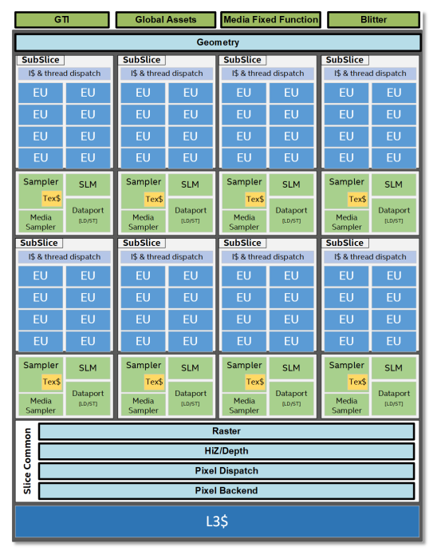
2. Evolution of desktop and laptop processors (19)
Redesigned architecture of
Intel’s 11th generation graphics
[326]
There are up to 8 subslices with
8 EUs each.

Slide 55
2. Evolution of desktop and laptop processors (20)
Comparing the Execution Units of Intel’s graphics generations 5 – 9.5 and 11
Execution Units (SIMD FPUs) implemented in
Intel’s graphics generations 5 -9.5 []a
Execution Units (ALUs) implemented in
Intel’s graphics generation 11 [236]
Each EU can execute 16 SP FP32 operations.
Each EU can execute 16 SP FP32 or
32 HP (Half Precision) FP16 operations
(for supporting AI).
AI: Artificial Intelligence
*

Slide 56
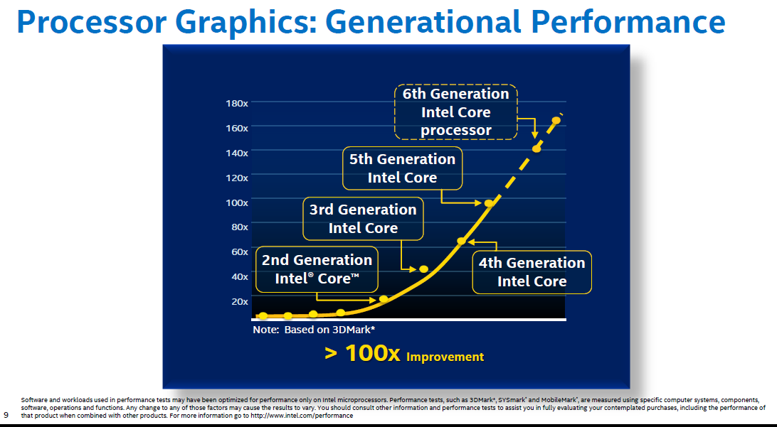
2. Evolution of desktop and laptop processors (21)
Graphics performance increase of subsequent Core generations [196]
Skylake
Broadwell
Haswell
Ivy Bridge
Sandy Bridge

Slide 57
3. Evolution of HEDs (High-End Desktops)
Notes:
57

Slide 58
3. Evolution of HEDs (High-End Desktops) (1)
3. Evolution of HEDs (High-End Desktops)
Recent processor categories
Server
processors
HED processors
(High-End Desktop)
Desktop
processors
Laptop
(Notebook)
processors
Tablet
processors
Smartphone
processors
Desktops
Example
Intel processors:
(Client processors)
(Mobile processors)
Xeon E7/E5/E3
Platinum/Gold etc.
Core i9/i7
(Extreme Edition
or X models)
Core i7/i5/i3
(Basic architectures)
Atom lines
Atom lines
C a n c e l l e d i n 2 0 1 6
Smarphones
Smarphones
(Intel and AMD
designates them
also as mobile
processors)
Tablets
Desktops
Laptops
Tablets
Smartphones
(Intel’s/AMD’sdesignation: Mobiles)
Servers
High-End Desktops
Desktops

Slide 59
3. Evolution of HEDs (High-End Desktops) (2)
HEDs (High-End Desktops)
They aim at high performance desktops for hardcore gamers and graphics enthusiasts.
*

Slide 60

3. Evolution of HEDs (High-End Desktops) (3)
Hardcore gamer scenario [221]

Slide 61
3. Evolution of HEDs (High-End Desktops) (4)
1. Introduction -2
Key features of Intel’s HED lines to support multiple (up to 4) discrete graphics cards:
They typically provide vs. mainstream desktops
more PCIe lanes (either on the PCH or on the die)
more cores and
more memory channels (to appropriately service more processing resources)
as indicated on the next Figure.
*

Slide 62
3. Evolution of HEDs (High-End Desktops) (5)
Number of PCIe lanes
Processor | Techn. | Date of intro. | No. of cores up to | Memory attachment | Mem. speed up to | PCIe lanes | No. of mem. channels | MCH | TDP | Processor socket
Core 2 Extreme X6800 | 65 nm | 7/2006 | 2C | Via MCH | DDR3-1066 | 32 PCIe 2.0 on the X38 | 2 | X38 | 65 W | LGA 775
Core 2 Extreme QX 6xxx | 65 nm | 11/2006 | 2x2C |  |  |  |  |  | 130 W | LGA 775
 |  |  |  |  |  |  |  |  | 130 W | LGA 775
Core 2 Extreme QX 9650 (Penryn) | 45 nm | 11/2007 | 2x2C
 |  |  |  |  | DDR3-1600 | 32 PCIe 2.0 on the X48 | 2 | X48 | 136 W | LGA 775
Core 2 Extreme QX 9770 (Penryn) | 45 nm | 3/2008 | 2x2C
1. G. Nehalem EE | 45 nm | 11/2008 | 4C | On-die MC | DDR3-1067 | 36 PCIe 2.0 on the X58 | 3 | X58 (Tylersburg) | 130 W | LGA 1366
Westmere EE | 32 nm | 3/2010 | 6C
 |  |  |  |  |  |  |  |  | 130 W | LGA 1366
Sandy Bridge E | 32 nm | 11/2011 | 6C
 |  |  |  |  | DDR3-1600 | 40 PCIe 2.0 on-die | 4 | X79 (Patsburg) | 130 W/ 150 W | LGA 2011
Ivy Bridge E | 22 nm | 9/2013 | 6C
 |  |  |  |  | DDR3-1866 | 40 PCIe 3.0 on-die | 4 |  | 130 W | LGA 2011
Haswell E | 14 nm | 8/2014 | 8C |  | DDR4-2133 |  | 4 | X99 (Wellsburg) | 140 W | LGA 2011-3
Broadwell E | 14 nm | 5/2016 | 10C
 |  |  |  |  | DDR4-2400 |  | 4 | X99 (Wellsburg) | 140 W | LGA_2011-3
Skylake X | 14 nm | 6/2017 | 18C
 |  |  |  |  | DDR4-2666 | 44 PCI-3.0 on-die | 4 | X299 (Basin Falls) | 140 W | LGA-2066
(Kaby Lake X) | 14 nm | 6/2017 | 4C |  | DDR4-2666 | 16 PCIe 3.0 on-die | 4 | X299 (Basin Falls) | 112 W | LGA-2066
The above HED models and lines are unlocked.
*

Slide 63
3. Evolution of HEDs (High-End Desktops) (6)
Number of on-die memory channels and PCIe lanes provided on Intel's DT and HED lines
PCIe lanes provided on the processor die
DT processors: 16 lanes
(1x16 or 2x8 or 1x8+2x4)
HED processors: 40 lanes (typical)
(configurable, e.g. 2x x16 + 1x x8 or 4x x8)
PCIe
2.0
x16/
2x x8
P
Mem.
40
configurable
lanes
P
Mem.
PCIe 2.0
PCIe 2.0 lanes
Periph. Contr.
P55/P67
Periph. Contr.
X79
Intel 2. gen. Nehalem (Lynnfield) (4C), 2 MCh
with P55 (2009)
Intel Sandy Bridge (4C), 2 MCh with P67 (2011)
Intel Sandy Bridge-E (6C), 4 MCh with X79 (2011)
PCIe generation
x16/
2x x8
40
configurable
lanes
P
Mem.
PCIe
3.0
P
Mem.
PCIe 3.0
Periph. Contr.
Z77/Z87/Z97/
Z170
Periph. Contr.
X79/Z99/
X299
PCIe 3.0 lanes
Intel Ivy Bridge (4C), 2 MCh with Z77 PCH (2012)
Intel Haswell (4C), 2 MCh with Z87 PCH (2013)
Intel Broadwell (4C), 2 MCh with Z97 PCH (2015)
Intel Skylake-S (4C), 2 MCh with Z170 PCH (2015)
Intel Ivy Bridge-E (6C), 4 MCh with X79 (2013)
Intel Haswell-E (8C) 4 MCh with X79 (2014)
Intel Broadwell-E (10C) 4 MCh with X99 (2016)
Intel Skylake-X (10C) 4 MCh with X299 (2017)
(44 PCIe lanes!)
*

Slide 64
3. Evolution of HEDs (High-End Desktops) (7)
Core counts of HED lines
Processor | Techn. | Date of intro. | No. of cores up to | Memory attachment | Mem. speed up to | PCIe lanes | No. of mem. channels | MCH | TDP | Processor socket
Core 2 Extreme X6800 | 65 nm | 7/2006 | 2C | Via MCH | DDR3-1066 | 32 PCIe 2.0 on the X38 | 2 | X38 | 65 W | LGA 775
Core 2 Extreme QX 6xxx | 65 nm | 11/2006 | 2x2C |  |  |  |  |  | 130 W | LGA 775
 |  |  |  |  |  |  |  |  | 130 W | LGA 775
Core 2 Extreme QX 9650 (Penryn) | 45 nm | 11/2007 | 2x2C
 |  |  |  |  | DDR3-1600 | 32 PCIe 2.0 on the X48 | 2 | X48 | 136 W | LGA 775
Core 2 Extreme QX 9770 (Penryn) | 45 nm | 3/2008 | 2x2C
1. G. Nehalem EE | 45 nm | 11/2008 | 4C | On-die MC | DDR3-1067 | 36 PCIe 2.0 on the X58 | 3 | X58 (Tylersburg) | 130 W | LGA 1366
Westmere EE | 32 nm | 3/2010 | 6C
 |  |  |  |  |  |  |  |  | 130 W | LGA 1366
Sandy Bridge E | 32 nm | 11/2011 | 6C
 |  |  |  |  | DDR3-1600 | 40 PCIe 2.0 on-die | 4 | X79 (Patsburg) | 130 W/ 150 W | LGA 2011
Ivy Bridge E | 22 nm | 9/2013 | 6C
 |  |  |  |  | DDR3-1866 | 40 PCIe 3.0 on-die | 4 |  | 130 W | LGA 2011
Haswell E | 14 nm | 8/2014 | 8C |  | DDR4-2133 |  | 4 | X99 (Wellsburg) | 140 W | LGA 2011-3
Broadwell E | 14 nm | 5/2016 | 10C
 |  |  |  |  | DDR4-2400 |  | 4 | X99 (Wellsburg) | 140 W | LGA_2011-3
Skylake X | 14 nm | 6/2017 | 18C
 |  |  |  |  | DDR4-2666 | 44 PCI-3.0 on-die | 4 | X299 (Basin Falls) | 140 W | LGA-2066
(Kaby Lake X) | 14 nm | 6/2017 | 4C |  | DDR4-2666 | 16 PCIe 3.0 on-die | 4 | X299 (Basin Falls) | 112 W | LGA-2066
The above HED models and lines are unlocked.

Slide 65
3. Evolution of HEDs (High-End Desktops) (8)
Remark
The Kaby Lake-X models in fact do not fit into the traditional HED line, they are actually the
highest performance models of the KabyLake line and are designated as mobile models.

Slide 66
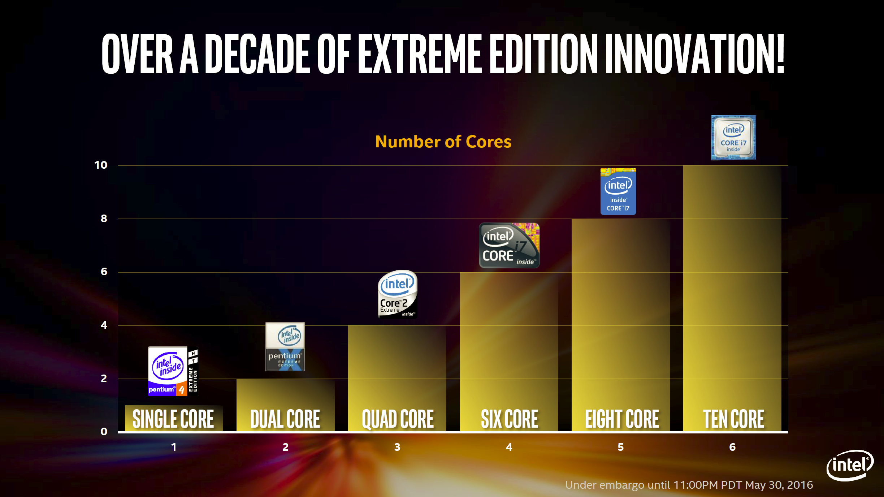
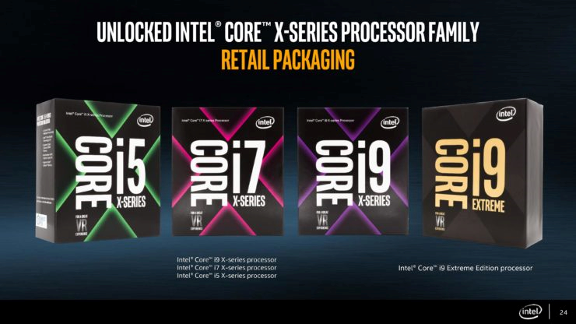

3. Evolution of HEDs (High-End Desktops) (9)
Evolution of the core counts in Intel's HED lines (Based on [222])
Skylake X
18
Number of cores
Broadwell E
Haswell E
Core 2
Extreme
QX6700
Westmere EE
Core 2
Extreme
X6800
Pentium 4 EE
3.2
18 CORE
2003
2006
2006
2010
2014
2016
2017

Slide 67
3. Evolution of HEDs (High-End Desktops) (10)
Number of memory channels
Processor | Techn. | Date of intro. | No. of cores up to | Memory attachment | Mem. speed up to | PCIe lanes | No. of mem. channels | MCH | TDP | Processor socket
Core 2 Extreme X6800 | 65 nm | 7/2006 | 2C | Via MCH | DDR3-1066 | 32 PCIe 2.0 on the X38 | 2 | X38 | 65 W | LGA 775
Core 2 Extreme QX 6xxx | 65 nm | 11/2006 | 2x2C |  |  |  |  |  | 130 W | LGA 775
 |  |  |  |  |  |  |  |  | 130 W | LGA 775
Core 2 Extreme QX 9650 (Penryn) | 45 nm | 11/2007 | 2x2C
 |  |  |  |  | DDR3-1600 | 32 PCIe 2.0 on the X48 | 2 | X48 | 136 W | LGA 775
Core 2 Extreme QX 9770 (Penryn) | 45 nm | 3/2008 | 2x2C
1. G. Nehalem EE | 45 nm | 11/2008 | 4C | On-die MC | DDR3-1067 | 36 PCIe 2.0 on the X58 | 3 | X58 (Tylersburg) | 130 W | LGA 1366
Westmere EE | 32 nm | 3/2010 | 6C
 |  |  |  |  |  |  |  |  | 130 W | LGA 1366
Sandy Bridge E | 32 nm | 11/2011 | 6C
 |  |  |  |  | DDR3-1600 | 40 PCIe 2.0 on-die | 4 | X79 (Patsburg) | 130 W/ 150 W | LGA 2011
Ivy Bridge E | 22 nm | 9/2013 | 6C
 |  |  |  |  | DDR3-1866 | 40 PCIe 3.0 on-die | 4 |  | 130 W | LGA 2011
Haswell E | 14 nm | 8/2014 | 8C |  | DDR4-2133 |  | 4 | X99 (Wellsburg) | 140 W | LGA 2011-3
Broadwell E | 14 nm | 5/2016 | 10C
 |  |  |  |  | DDR4-2400 |  | 4 | X99 (Wellsburg) | 140 W | LGA_2011-3
Skylake X | 14 nm | 6/2017 | 18C
 |  |  |  |  | DDR4-2666 | 44 PCI-3.0 on-die | 4 | X299 (Basin Falls) | 140 W | LGA-2066
(Kaby Lake X) | 14 nm | 6/2017 | 4C |  | DDR4-2666 | 16 PCIe 3.0 on-die | 4 | X299 (Basin Falls) | 112 W | LGA-2066
The above HED models and lines are unlocked.

Slide 68
3. Evolution of HEDs (High-End Desktops) (11)
Unlocked clock multiplier
Processor | Techn. | Date of intro. | No. of cores up to | Memory attachment | Mem. speed up to | PCIe lanes | No. of mem. channels | MCH | TDP | Processor socket
Core 2 Extreme X6800 | 65 nm | 7/2006 | 2C | Via MCH | DDR3-1066 | 32 PCIe 2.0 on the X38 | 2 | X38 | 65 W | LGA 775
Core 2 Extreme QX 6xxx | 65 nm | 11/2006 | 2x2C |  |  |  |  |  | 130 W | LGA 775
 |  |  |  |  |  |  |  |  | 130 W | LGA 775
Core 2 Extreme QX 9650 (Penryn) | 45 nm | 11/2007 | 2x2C
 |  |  |  |  | DDR3-1600 | 32 PCIe 2.0 on the X48 | 2 | X48 | 136 W | LGA 775
Core 2 Extreme QX 9770 (Penryn) | 45 nm | 3/2008 | 2x2C
1. G. Nehalem EE | 45 nm | 11/2008 | 4C | On-die MC | DDR3-1067 | 36 PCIe 2.0 on the X58 | 3 | X58 (Tylersburg) | 130 W | LGA 1366
Westmere EE | 32 nm | 3/2010 | 6C
 |  |  |  |  |  |  |  |  | 130 W | LGA 1366
Sandy Bridge E | 32 nm | 11/2011 | 6C
 |  |  |  |  | DDR3-1600 | 40 PCIe 2.0 on-die | 4 | X79 (Patsburg) | 130 W/ 150 W | LGA 2011
Ivy Bridge E | 22 nm | 9/2013 | 6C
 |  |  |  |  | DDR3-1866 | 40 PCIe 3.0 on-die | 4 |  | 130 W | LGA 2011
Haswell E | 14 nm | 8/2014 | 8C |  | DDR4-2133 |  | 4 | X99 (Wellsburg) | 140 W | LGA 2011-3
Broadwell E | 14 nm | 5/2016 | 10C
 |  |  |  |  | DDR4-2400 |  | 4 | X99 (Wellsburg) | 140 W | LGA_2011-3
Skylake X | 14 nm | 6/2017 | 18C
 |  |  |  |  | DDR4-2666 | 44 PCI-3.0 on-die | 4 | X299 (Basin Falls) | 140 W | LGA-2066
(Kaby Lake X) | 14 nm | 6/2017 | 4C |  | DDR4-2666 | 16 PCIe 3.0 on-die | 4 | X299 (Basin Falls) | 112 W | LGA-2066
The above HED models and lines are unlocked.

Slide 69
3. Evolution of HEDs (High-End Desktops) (12)
TDP (Thermal Design Power)
Processor | Techn. | Date of intro. | No. of cores up to | Memory attachment | Mem. speed up to | PCIe lanes | No. of mem. channels | MCH | TDP | Processor socket
Core 2 Extreme X6800 | 65 nm | 7/2006 | 2C | Via MCH | DDR3-1066 | 32 PCIe 2.0 on the X38 | 2 | X38 | 65 W | LGA 775
Core 2 Extreme QX 6xxx | 65 nm | 11/2006 | 2x2C |  |  |  |  |  | 130 W | LGA 775
 |  |  |  |  |  |  |  |  | 130 W | LGA 775
Core 2 Extreme QX 9650 (Penryn) | 45 nm | 11/2007 | 2x2C
 |  |  |  |  | DDR3-1600 | 32 PCIe 2.0 on the X48 | 2 | X48 | 136 W | LGA 775
Core 2 Extreme QX 9770 (Penryn) | 45 nm | 3/2008 | 2x2C
1. G. Nehalem EE | 45 nm | 11/2008 | 4C | On-die MC | DDR3-1067 | 36 PCIe 2.0 on the X58 | 3 | X58 (Tylersburg) | 130 W | LGA 1366
Westmere EE | 32 nm | 3/2010 | 6C
 |  |  |  |  |  |  |  |  | 130 W | LGA 1366
Sandy Bridge E | 32 nm | 11/2011 | 6C
 |  |  |  |  | DDR3-1600 | 40 PCIe 2.0 on-die | 4 | X79 (Patsburg) | 130 W/ 150 W | LGA 2011
Ivy Bridge E | 22 nm | 9/2013 | 6C
 |  |  |  |  | DDR3-1866 | 40 PCIe 3.0 on-die | 4 |  | 130 W | LGA 2011
Haswell E | 14 nm | 8/2014 | 8C |  | DDR4-2133 |  | 4 | X99 (Wellsburg) | 140 W | LGA 2011-3
Broadwell E | 14 nm | 5/2016 | 10C
 |  |  |  |  | DDR4-2400 |  | 4 | X99 (Wellsburg) | 140 W | LGA_2011-3
Skylake X | 14 nm | 6/2017 | 18C
 |  |  |  |  | DDR4-2666 | 44 PCI-3.0 on-die | 4 | X299 (Basin Falls) | 140 W | LGA-2066
(Kaby Lake X) | 14 nm | 6/2017 | 4C |  | DDR4-2666 | 16 PCIe 3.0 on-die | 4 | X299 (Basin Falls) | 112 W | LGA-2066
The above HED models and lines are unlocked.

Slide 70
3. Evolution of HEDs (High-End Desktops) (13)
Introduction -3
Key features of Intel’s HED lines (cont.):
They are equipped with a large number of PCIe lanes (typically 32 to 44) to connect
multiple discrete graphics cards vs. 16 typical in desktops,
they do not provide integrated graphics, as it is assumed that the installation is intended
to provide high quality graphics by attaching discrete graphics cards,
they have more cores than desktops than graphics offers more parallelism than typical
desktop workloads,
to support more cores typically they have more memory channels (up to 4),
they are unlocked and
have a higher TDP of 130 to 150 W vs. 65 to 95 W typical for DT processors.
*

Slide 71
4. Evolution of high-end 4S/8S servers
Notes:
71

Slide 72
4. Evolution of high-end 4S/8S servers (1)
4. Evolution of high-end 4S/8S servers
Recent processor categories
Server
processors
HED processors
(High-End Desktop)
Desktop
processors
Laptop
(Notebook)
processors
Tablet
processors
Smartphone
processors
Desktops
Example
Intel processors:
(Client processors)
(Mobile processors)
Xeon E7/E5/E3
Platinum/Gold etc.
Core i9/i7
(Extreme Edition
or X models)
Core i7/i5/i3
(Basic architectures)
Atom lines
Atom lines
C a n c e l l e d i n 2 0 1 6
Smarphones
Smarphones
(Intel and AMD
designates them
also as mobile
processors)
Tablets
Desktops
Laptops
Tablets
Smartphones
(Intel’s/AMD’sdesignation: Mobiles)
Servers
High-End Desktops
Desktops

Slide 73
4. Evolution of high-end 4S/8S servers (2)
Server platforms classified according to the number of processors supported
Server platforms
Uniprocessor server platforms
(UP-server platforms)
Multiprocessor server platforms
1-processor server platforms
(1-socket server platforms)
Server platforms supporting more than one processor
(Multi-socket server platforms)
2S (DP)
server platforms
4S/8S (MP)
server platforms
Platforms for more than 4 or 8 sockets
2- processor server platforms
(2-socket server platforms)
4/8-processor server platforms
(4/8-socket server platforms)
Server platforms for
more than the Intel
supported number of
sockets
(4 or 8 sockets)
They need third party
node controllers
*

Slide 74
4. Evolution of high-end 4S/8S servers (3)
Intel’s high-end 4S/8S server platforms built up of multicore processors -- Overview
 | Core | Techn. | Intro. | High-end 4S/8S server processor series | Core count | Chipset | Proc. socket
Truland MP | Pentium 4 MP Prescott | 90 nm | 3/2005 | 90 nm Pentium 4 MP (Potomac) | 1C | E8500 + ICH5 | LGA 604
 | Pentium 4 Prescott | 90 nm | 11/2005 | 7000 (Paxville MP) | 2x1C | E8501 + ICH5
 |  | 65 nm | 8/2006 | 7100 (Tulsa) | 2x1C
Caneland | Core2 | 65 nm | 9/2007 | 7200 (Tigerton DC) 7300 (Tigerton QC) | 2C 2x2C | E7300 (Clarksboro)+ 631x/632x ESB | LGA 604
 | Penryn | 45 nm | 9/2008 | 7400 (Dunnington) | 6C
Boxboro-EX | Nehalem | 45 nm | 3/2010 | 7500 (Beckton/ Nehalem-EX) | 8C | 7500 + ICH10 | LGA 1567
 | Westmere | 32 nm | 4/2011 | E7-8800 (Westmere-EX) | 10C
 | Sandy Bidge | 32 nm
Brickland | Ivy Bridge | 22 nm | 2/2014 | E7-8800 v2 (Ivy Bridge-EX) | 15C | C602J (Patsburg J) | LGA 2011-1
 | Haswell | 22 nm | 5/2015 | E7-8800 v3 (Haswell-EX) | 18C
 | Broadwell | 14 nm | 6/2016 | E7-8800 v4 (Broadwell-EX) | 24C
Purley | Skylake | 14 nm | 7/2017 | Platinum 8100 (Skylake-SP) | 28C | C620 (Lewisburg) | LGA 3647
 | Cascade Lake | 14 nm | 4/2019 | Platinum 8200 (Cascade Lake-SP) Platinum 9200 (Cascade Lake-AP) | 28 2x28
 |  |  |  |  |  |  | BGA 5903

Slide 75
4. Evolution of high-end 4S/8S servers (4)
a) The rate of rising core counts in Intel's high-end 4S/8S server processors -1
 | Core | Techn. | Intro. | High-end 4S/8S server processor series | Core count | Chipset | Proc. socket
Truland MP | Pentium 4 MP Prescott | 90 nm | 3/2005 | 90 nm Pentium 4 MP (Potomac) | 1C | E8500 + ICH5 | LGA 604
 | Pentium 4 Prescott | 90 nm | 11/2005 | 7000 (Paxville MP) | 2x1C | E8501 + ICH5
 |  | 65 nm | 8/2006 | 7100 (Tulsa) | 2x1C
Caneland | Core2 | 65 nm | 9/2007 | 7200 (Tigerton DC) 7300 (Tigerton QC) | 2C 2x2C | E7300 (Clarksboro)+ 631x/632x ESB | LGA 604
 | Penryn | 45 nm | 9/2008 | 7400 (Dunnington) | 6C
Boxboro-EX | Nehalem | 45 nm | 3/2010 | 7500 (Beckton/ Nehalem-EX) | 8C | 7500 + ICH10 | LGA 1567
 | Westmere | 32 nm | 4/2011 | E7-8800 (Westmere-EX) | 10C
 | Sandy Bidge | 32 nm
Brickland | Ivy Bridge | 22 nm | 2/2014 | E7-8800 v2 (Ivy Bridge-EX) | 15C | C602J (Patsburg J) | LGA 2011-1
 | Haswell | 22 nm | 5/2015 | E7-8800 v3 (Haswell-EX) | 18C
 | Broadwell | 14 nm | 6/2016 | E7-8800 v4 (Broadwell-EX) | 24C
Purley | Skylake | 14 nm | 7/2017 | Platinum 8100 (Skylake-SP) | 28C | C620 (Lewisburg) | LGA 3647
 | Cascade Lake | 14 nm | 4/2019 | Platinum 8200 (Cascade Lake-SP) Platinum 9200 (Cascade Lake-AP) | 28 2x28
 |  |  |  |  |  |  | BGA 5903

Slide 76
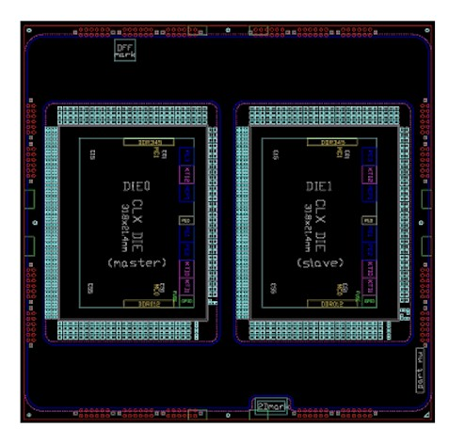
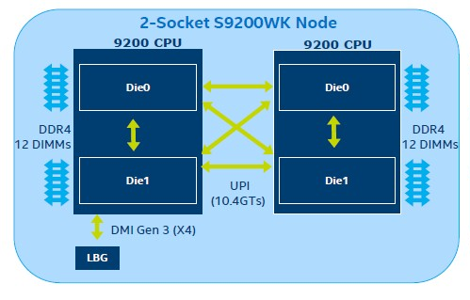
4. Evolution of high-end 4S/8S servers (4b)
Remark to Intel’s 56-core Cascade Lake 9200-AP processor line
With this processor line Intel intends to encounter AMD’s 64-core EPYC Rome line.
The 9200-AP is a dual-chip module with the Cascade Lake-SP dies interconnected properly,
presumable by an UPI bus, and placed into a BGA (Ball Grid Array) package, as indicated in the
left Figure, that will be surface mounted (soldered) onto the mainboard.
Figure: Dual-chip module of the 9200-AP [314]
Dual-socket server based on the 9200-AP [314]
A dual socket server built up of the Cascade Lake 9200-AP (see the Figure on the right) appears
and operates actually as 4-processor server.

Slide 77
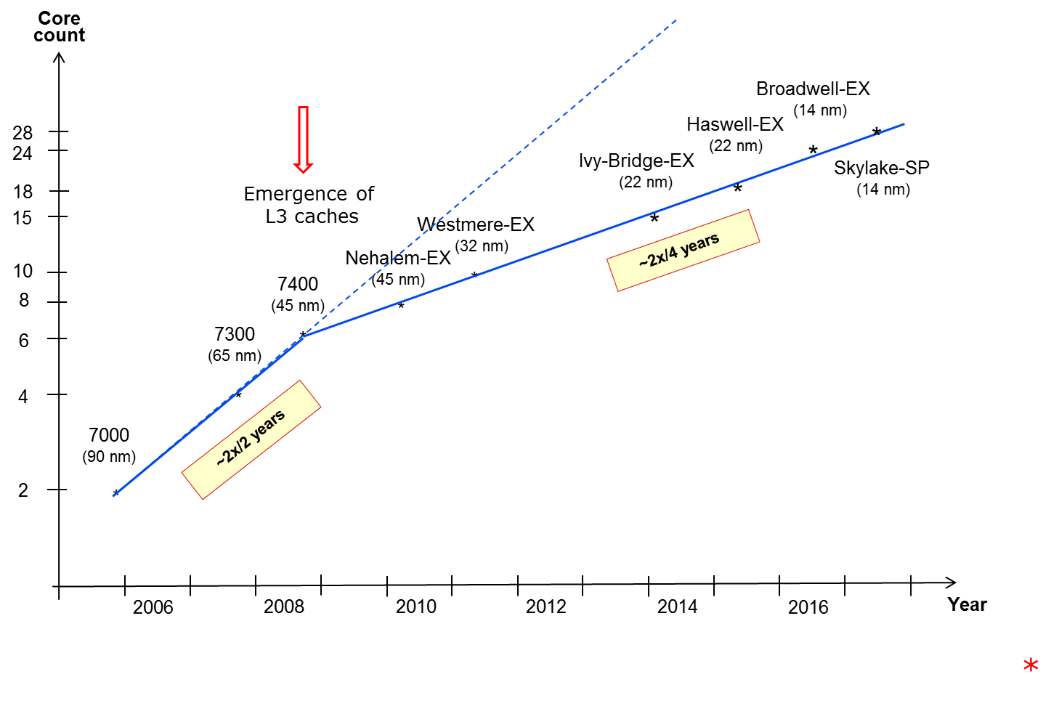
4. Evolution of high-end 4S/8S servers (5)
a) The rate of rising core counts in Intel's high-end 4S/8S server processors -2
(P4)
*

Slide 78
4. Evolution of high-end 4S/8S servers (6)
Remarks to the rate of rising core counts in Intel's high-end 4S/8S server processors -1
(Not discussed)
As the Figure above demonstrates, the core count of Intel’s early L3-less 4S server
processors has doubled roughly biannually.
This is obvious, since the evolution of IC technology allowed doubling transistor counts
roughly in every two years by introducing a smaller feature size (called technology node).
Consequently, in L3-less processors twice as many transistors per technology node permit
the doubling of core counts also roughly biannually.
When L3 caches first appeared in the Xeon 7400 within Intel’s Core 2 based server
processors, the transistor count rose to 1.9 billion from 582 million in the L3-less Xeon
7300, as indicated in Table below.
Model | Technology | Date of introduction | Core count | L3 cache | Transistors (million) | Die area (mm²)
7300 | 65 nm | 9/2007 | 2x2 | -- | 582 | 286
7400 | 45 nm | 8/2008 | 6 | 16 MB | 1900 | 503
Nehalem-EX | 45 nm | 3/2010 | 8 | 8x3 MB | 2300 | 513
Westmere-EX | 32 nm | 4/2011 | 10 | 10x3 MB | 2600 | 512
Ivy Bridge-EX | 22 nm | 2/2014 | 15 | 15x2.5 MB | 4310 | 541
Haswell-EX | 22 nm | 5/2015 | 18 | 18x2.5 MB | 5700 | 662
Broadwell-EX | 14 nm | 6/2016 | 24 | 24x2.5 MB | 7200 | 456
Table: Rising transistor counts in Intel's high-end 4S/8S server processsors

Slide 79
4. Evolution of high-end 4S/8S servers (7)
Die plot of the Xeon 7400 MP implementing 16 MB L3 cache [215]
2 cores
3 MB MLC
3 MB MLC
2 cores
Thermal
sensors
4 MB LLC
Address pad
Tags
Tags
8 MB L3
3 MB L2/2 cores
Data pad
3 MB MLC
4 MB LLC
2 cores
4 MB LLC
4 MB LLC

Slide 80
4. Evolution of high-end 4S/8S servers (8)
Remarks to the rate of rising core counts in Intel's high-end 4S/8S server processors -2
However, placing twice as many cores onto the die with the same L3 size per core
in every technology node, would need to double an already very high transistor count
in every technology node.
But, mainly due to power restrictions Intel could raise transistor counts on server dies
only at the modest rate of doubling roughly every four years, as above Table reveals,
leading to doubling core counts approximately every four years, as depicted in the above
Figure.
Recently, the nascent lengthening of the cadence of IC technology transitions also
contributes to reducing the rate at which the core count can be increased.
Model | Technology | Date of introduction | Core count | L3 cache | Transistors (million) | Die area (mm²)
7300 | 65 nm | 9/2007 | 2x2 | -- | 582 | 286
7400 | 45 nm | 8/2008 | 6 | 16 MB | 1900 | 503
Nehalem-EX | 45 nm | 3/2010 | 8 | 8x3 MB | 2300 | 513
Westmere-EX | 32 nm | 4/2011 | 10 | 10x3 MB | 2600 | 512
Ivy Bridge-EX | 22 nm | 2/2014 | 15 | 15x2.5 MB | 4310 | 541
Haswell-EX | 22 nm | 5/2015 | 18 | 18x2.5 MB | 5700 | 662
Broadwell-EX | 14 nm | 6/2016 | 24 | 24x2.5 MB | 7200 | 456
Table: Rising transistor counts in Intel's high-end 4S/8S server processors

Slide 81
4. Evolution of high-end 4S/8S servers (9)
Remarks to the rate of rising core counts in Intel's high-end 4S/8S server processors -3
Core
count
Broadwell-EX
(14 nm)
28
Haswell-EX
(22 nm)
*
24
Emergence of
L3 caches
in the Core 2 line
Ivy-Bridge-EX
(22 nm)
*
Skylake-SP
(14 nm)
18
*
15
Westmere-EX
(32 nm)
*
Nehalem-EX
(45 nm)
~2x/4 years
10
7400
(45 nm)
*
8
*
6
7300
(65 nm)
*
4
*
(P4)
~2x/2 years
7000
(90 nm)
2
*
*
(P4)
7100
(65 nm
16 MB L3)
2006
2008
2010
2012
2014
2016
Year
*

Slide 82
4. Evolution of high-end 4S/8S servers (10)
Remarks to the rate of rising core counts in Intel's high-end 4S/8S server processors -3
There are however, two anomalies to be mentioned.
First, the Xeon 7100 has less cores than expected by the trend for Intel’s early server
processors, simply due to the fact that it was implemented with a 16 MB L3 cache.
Second, the Xeon 7400 has already an L3 cache, nevertheless it fits to the trend line of
L3 cache-less processors.
The reason is a roughly doubled die area with reduced feature size vs. the preceding
Xeon 7300 (see Table above) which allows to implement a 16 MB L3 cache in addition to
the 6 cores without restricting the core count.
Subsequent server processors were then implemented nearly on the same die area
as the Xeon 7400, (as indicated in Table 1), so these processors fit already to the linear
trend with reduced slope.
Model | Technology | Date of introduction | Core count | L3 cache | Transistors (million) | Die area (mm²)
7300 | 65 nm | 9/2007 | 2x2 | -- | 582 | 286
7400 | 45 nm | 8/2008 | 6 | 16 MB | 1900 | 503
Nehalem-EX | 45 nm | 3/2010 | 8 | 8x3 MB | 2300 | 513
Westmere-EX | 32 nm | 4/2011 | 10 | 10x3 MB | 2600 | 512
Ivy Bridge-EX | 22 nm | 2/2014 | 15 | 15x2.5 MB | 4310 | 541
Haswell-EX | 22 nm | 5/2015 | 18 | 18x2.5 MB | 5700 | 662
Broadwell-EX | 14 nm | 6/2016 | 24 | 24x2.5 MB | 7200 | 456
Table: Rising transistor counts in Intel's high-end 4S/8S server processsors

Slide 83
2. Evolution of 4S/8S high-end servers (11)
b) The rate of rising memory transfer rates in Intel’s DT and high-end server processors -1
Transfer rate
(MT/s)
IB
DDR4/2400
DDR4/2133
3000
DDR3
1600
x
DDR3/1866
*
2000
DDR3
1333
x
*
x
DDR4
2666
DDR3
1067
x
*
DDR4
1866
~ 2*/4 years
DDR2
800
*
DDR3/4
1866
*
x
DDR3
1600
1000
DDR2
667
*
DDR2
533
*
DDR3
1067
~ 2*/8 years
DDR
400
*
x
500
DDR
333
*
DDR2
667
DDR
266
x
*
DDR
400
Emergence of
DDR4 memory
*
4S/8S
DT
*
Emergence of
DDR3 memory
200
100
50
≈
2000
01
02
03
04
05
06
07
08
09
2010
11
12
13
14
15
16
17
Year

Slide 84
4. Evolution of high-end 4S/8S servers (12)
The rate of rising mem. transfer rates in Intel’s high-end 4S/8S server processors -2
As the above Figure shows, in the course of the evolution of high-end 4S/8S servers
memory transfer rate has initially been doubled roughly every four years.
But after DDR3 memory emerged the growth rate of memory transfer rate slowed down
to doubling rougly every eight years due to the higher complexity of this technology.
Note that in the considered time interval memory transfer rate has always been risen
at a slower rate than core count, approximately at the half rate than the core count.
*

Slide 85
4. Evolution of high-end 4S/8S servers (13)
The requirement for scaling the memory bandwidth with the core count
As each core may operate independently from each other the memory bandwidth provided
needs to be linearly scaled with the core count, i.e. a processor with n-times more cores
as a reference platform requires n-times higher bandwidth as the reference platform.
*

Slide 86
4. Evolution of high-end 4S/8S servers (14)
Implication of the fact that memory transfer rates are rising slower than core counts
in servers
Over generations both the core count and the memory transfer rate are raising.
But the memory transfer rate of the reference platform rises slower than the core count,
thus the per core memory bandwidth will decrease since the memory bandwidth amounts to
the product of the transfer rate and the width of the memory interface (assuming that
no other changes become effective).
In other words, in the course of processor evolution a memory bandwidth gap arises that
needs to be removed by implementing appropriately more memory channels.
Thus removing the memory bandwidth gap more memory channels are needed,
this is the driving force of the evolution of server memory subsystems.
There is however, not a straightforward task to raise the number of memory channels,
one of the focal points of server evolution is how to resolve the memory bandwidth gap
by enhancing the memory subsystem.
In the chapter on high-end 4S/8S servers we will discuss possible avenues of coping
with this point.
*

Slide 87
5. Evolution of tablet and smartphone processors
Notes:
87

Slide 88
5. Evolution of tablet and smartphone processors (1)
5. Evolution of tablet and smartphone processors
Recent processor categories
Server
processors
HED processors
(High-End Desktop)
Desktop
processors
Laptop
(Notebook)
processors
Tablet
processors
Smartphone
processors
Desktops
Example
Intel processors:
(Client processors)
(Mobile processors)
Xeon E7/E5/E3
Platinum/Gold etc.
Core i9/i7
(Extreme Edition
or X models)
Core i7/i5/i3
(Basic architectures)
Atom lines
Atom lines
C a n c e l l e d i n 2 0 1 6
Smarphones
Smarphones
Laptops
Tablets
Desktops
(Intel’s/AMD’sdesignation: Mobiles)
Tablets
Smartphones
(Intel and AMD
designates them
also as mobile
processors)
Servers
High-End Desktops
Desktops

Slide 89
5. Evolution of tablet and smartphone processors (2)
Changing the design paradigm for implementing mobile processors
With the advent of mobile devices (about 2006) a new design paradigm arose for those devices.
Mobile devices require long operating hours i.e. low power consumption, this is contrast to the
design paradigm of traditional processors, as indicated below.
Traditional processors
Tablets and smartphones
High performance/power
(e.g. GFLOPS/Watt)
Low power
(Watt)
(Number of operating hours)
*

Slide 90
5. Evolution of tablet and smartphone processors (3)
Key requirements at the introduction of mobile, i.e. low power microarchitectures
Key requirements for low power microarchitectures
Narrow microarchitecture
Low processor clock frequency
*

Slide 91
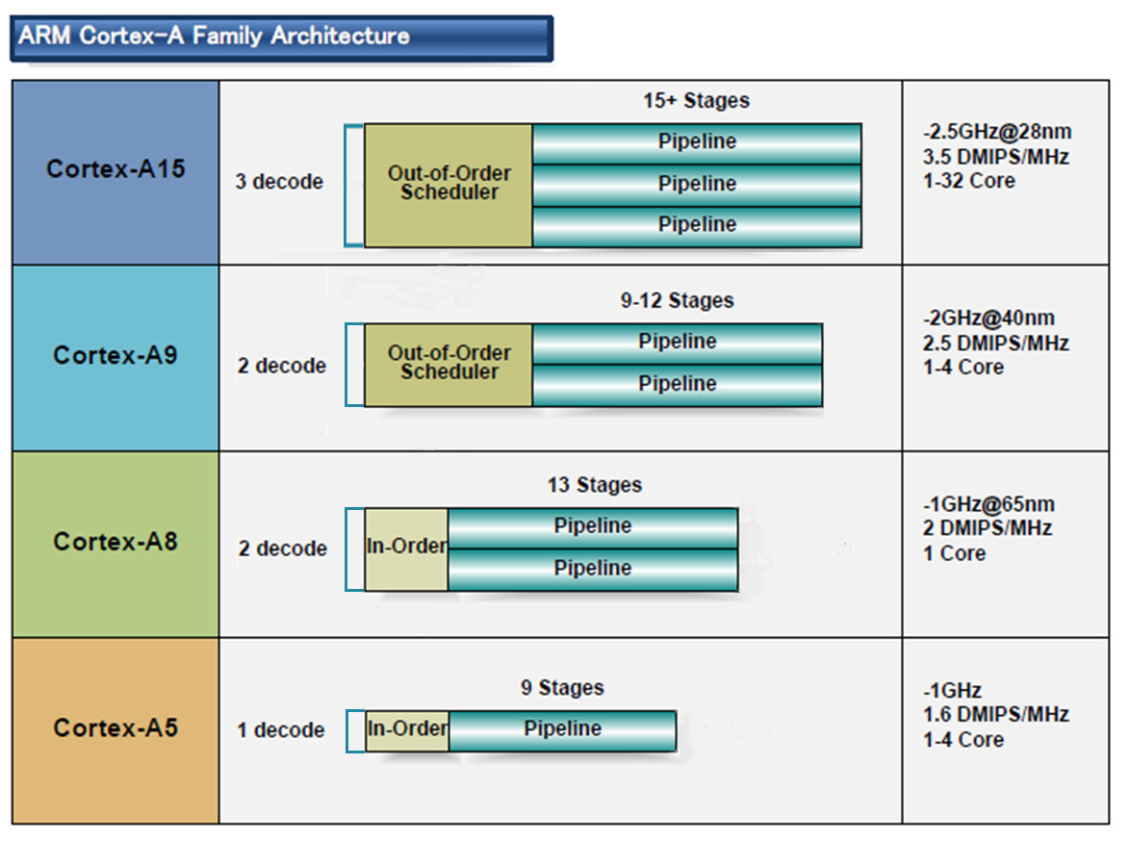
5. Evolution of tablet and smartphone processors (4)
a) Low power CPUs need narrow microarchitectures
Example: Width of ARM’s 32-bit CPUs used in most tablets and smartphones [10]
32-bit
2010
2007
2005
2009
(A9 replacement
for low-end
devices)
*

Slide 92
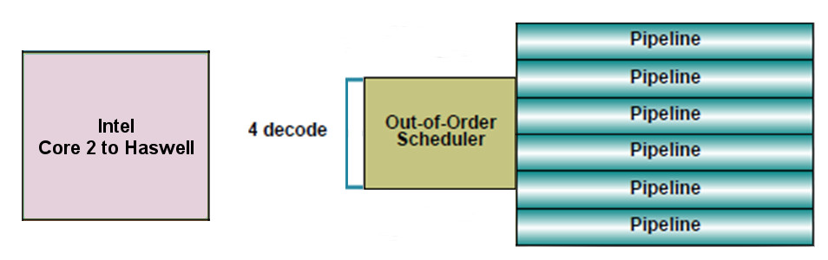
5. Evolution of tablet and smartphone processors (5)
By contrast:
Intel’s and AMD’s recent processor lines
aims at high performance/power (in terms of GFLOPS/Watt)
accordingly
have 4-wide microarchitectures, as the next example shows:
64-bit
Example: Width of Intel’s Core 2 to Haswell processors underlying servers to laptops [10]
*

Slide 93
5. Evolution of tablet and smartphone processors (6)
Consequences for Intel and AMD-1
Intel’s and AMD’s traditional microarchitectures are not suited for mobile devices.
Both Intel and AMD conceived, designed and introduced new, narrow (e.g. 2-wide) low-power microarchitectures.
*

Slide 94
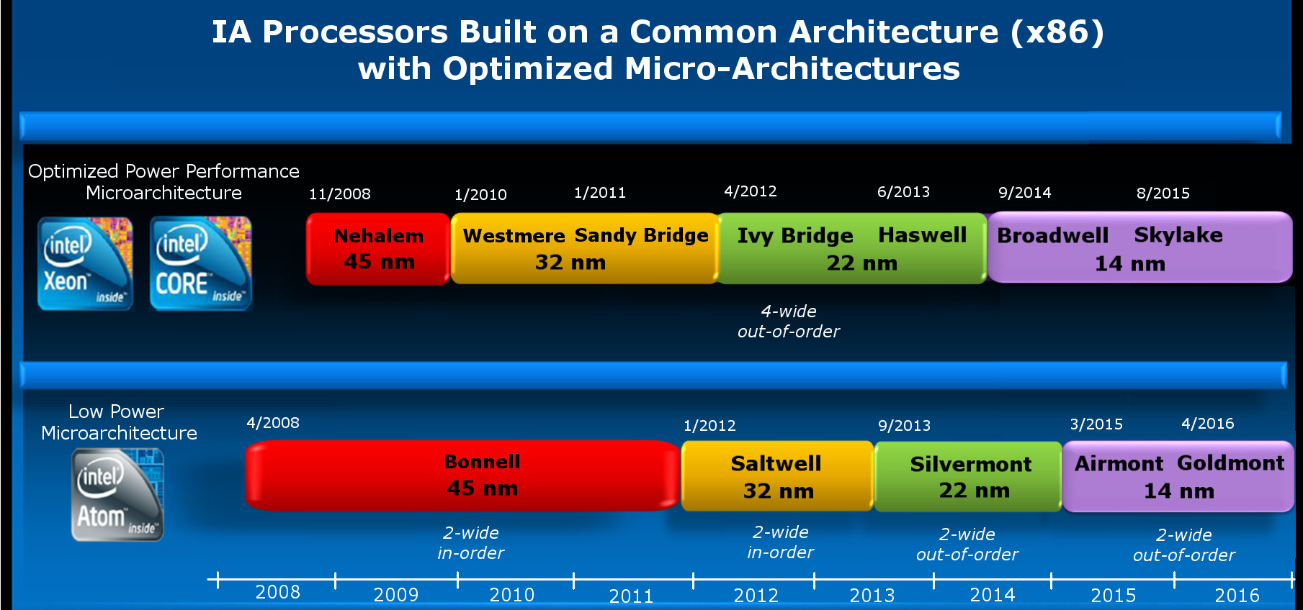
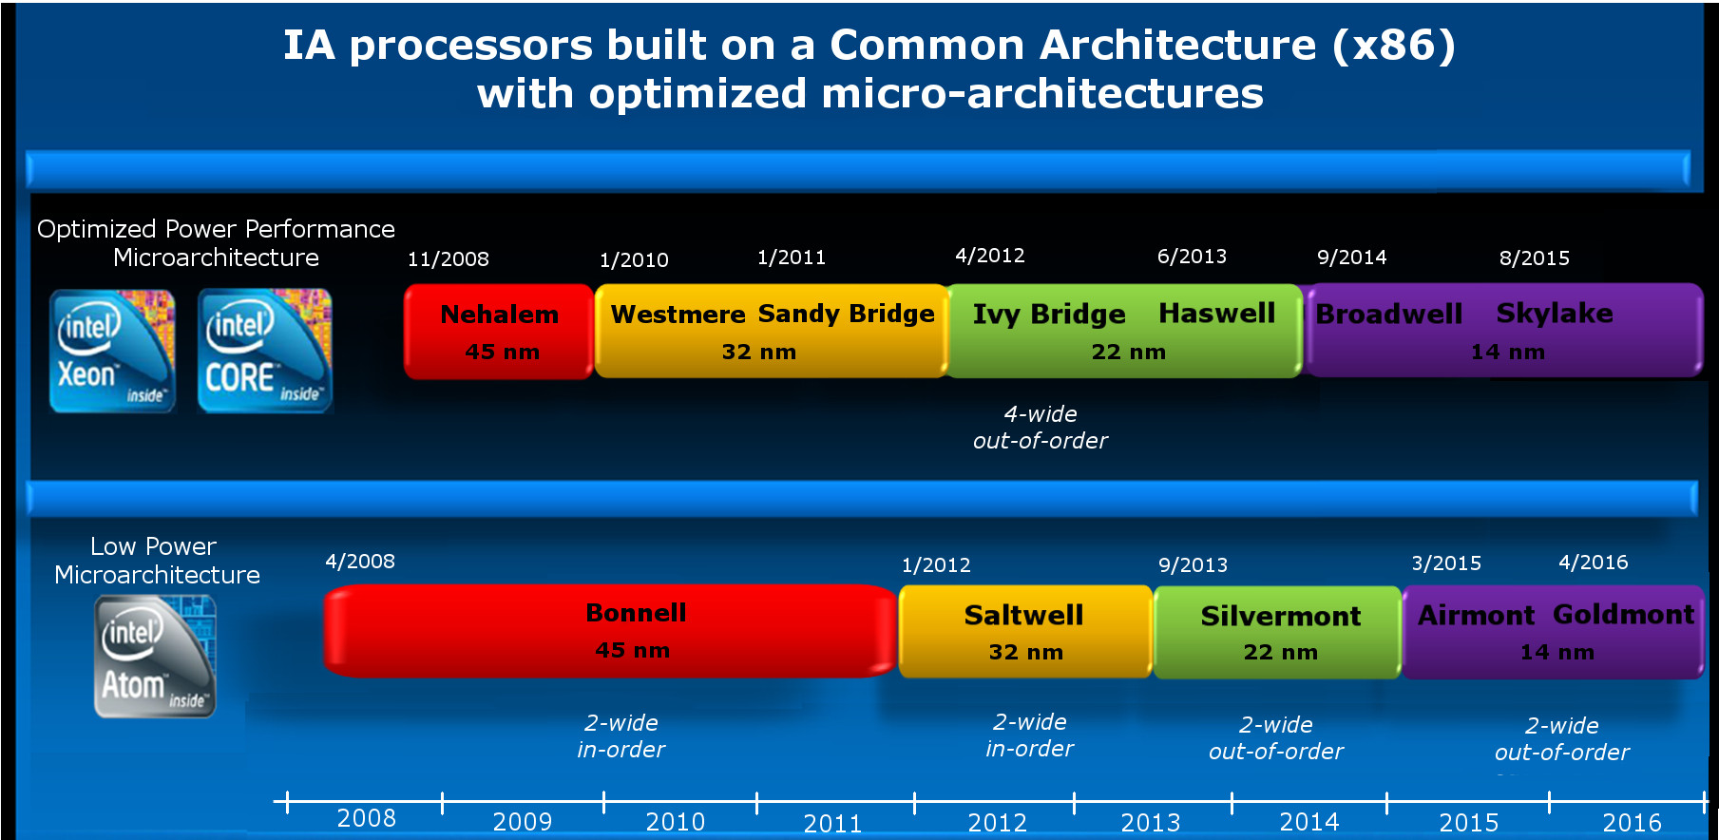
5. Evolution of tablet and smartphone processors (7)
Emergence of Intel’s Atom line aiming for tablets and smartphones (Based on [2])
4-wide
out-of-order
5
2008
2-wide
in-order
2-wide
out-of-order
2-wide
out-of-order
3-wide
out-of-order
2-wide
in-order
2-wide
in order
2-wide
out-of-order

Slide 95
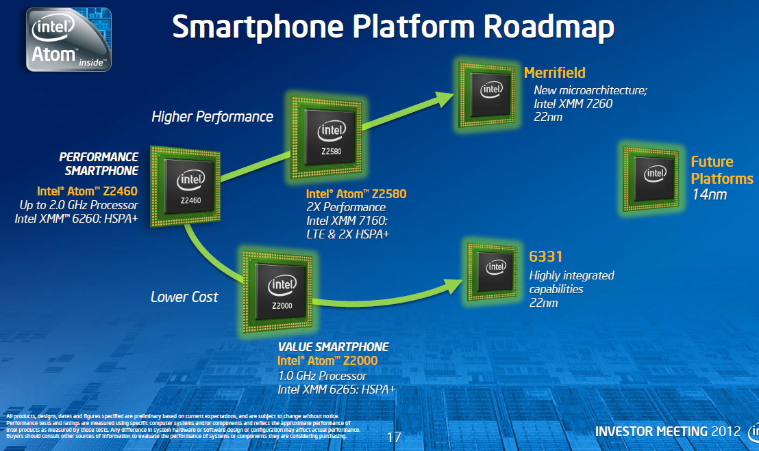
5. Evolution of tablet and smartphone processors (8)
Intel’s Atom-based smartphone platforms (based on [276])
Morganfield
(2016)
Moorefield
(2014)
Merrifield
(2014)
Performance (not to scale)
Clover Trail+
(2013)
Z5xxx
4x Goldmont
14 nm
+XMM 7360
Z35xx
4x Silvermont
22 nm
+XMM 7260/2/35
Medfield
(2012)
Z34x0
2x Silvermont
22 nm
+XMM 7160/7260
Cancelled
in 04/2016
Morestown
(2010)
Z2520-2580
2x Saltwell
32 nm
+XMM 6268/6360/7160
SoFIA
(x3 3G/LTE)
(2015)
Riverton
(2015)
Z2460/2480
1x Saltwell
32 nm
+XMM 6260
Slayton
(2014)
Lexington
(2013)
Z6xx
1x Bonnell
45 nm
+Wireless
module
C31xx/32xx/34xx
2x/4x Silvermont
28 nm
Integrated LTE
3G/4G modem
Z3xxx
2x Airmont
14 nm
Integrated
LTE modem
Z3xxx
2x Silvermont
22 nm
+A-GOLD 620
Z2420
1x Saltwell
32 nm
+XMM 6265
Cancelled
in 04/2016
Planned, not implemented
Eul H., & Bell M., Mobile at Intel, Investor Meeting 2012, Intel,
http://www.cnx-software.com/pdf/Intel_2012/2012_Intel_Investor_Meeting_Eul_Bell.pdf
Planned, not mplemented

Slide 96
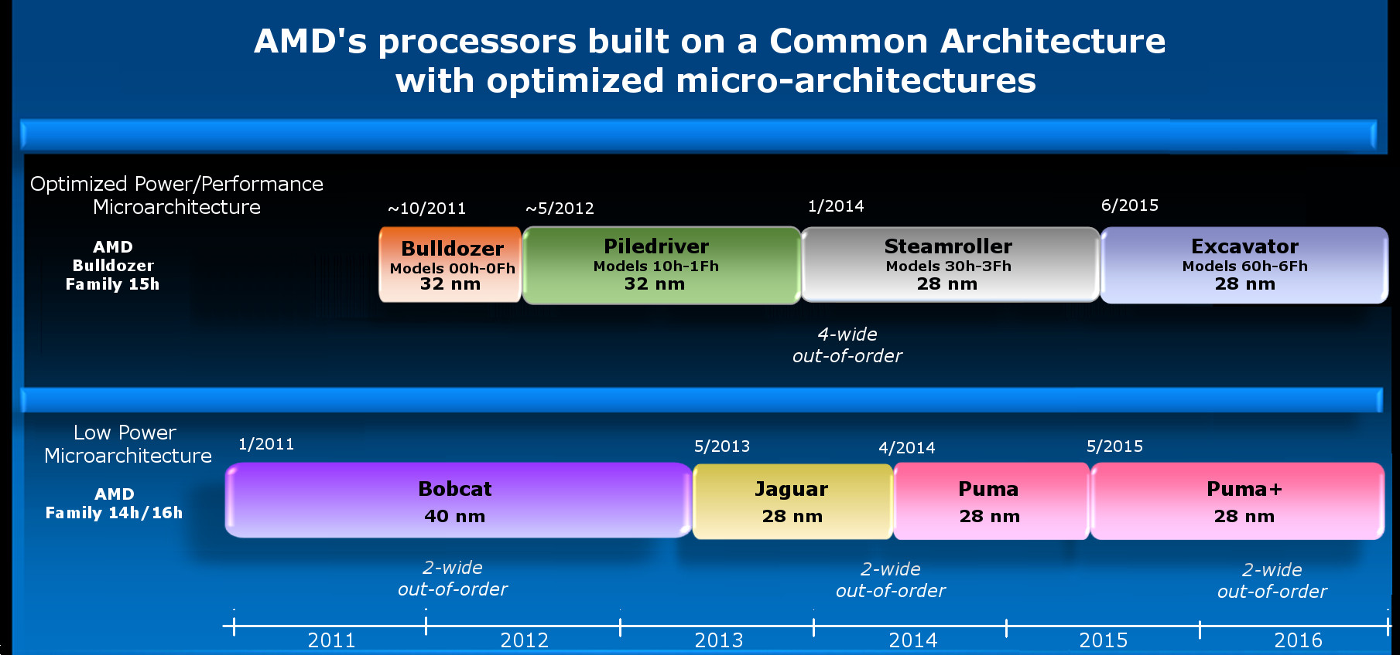
5. Evolution of tablet and smartphone processors (9)
Emergence of AMD's Cat line aiming for tablets and smartphones (Based on [2])
4-wide
out-of-order
4/2014
2-wide
out-of-order
2-wide
out-of-order
2-wide
out-of-order
2014

Slide 97
5. Evolution of tablet and smartphone processors (9b)
By contrast: Raising the width of mobile processors aiming at tablets and smartphones
Width of mobile cores
(or of big cores of big.LITTLE or dynamIQ core clusters)
2-wide
3-wide
4-wide
6-wide
ARM
v7 HP Cortex-A15
(2010)
v7 Cortex-A (2005-09)
(except 1-wide LP A5 (2009)
and 3-wide HP A15))
v8.0 HP Cortex-A73
(2016)
v8.0 HP Cortex-A (2013-15) (except 2-wide HP Cortex-A73)
v8.0/8.2 LP Cortex-A
(2013/2017)
v8.2 HP Cortex-A75
(2017)
v8.2 HP Cortex-A76
(2018)
v8.2 HP Cortex-A77
(2019)
Intel
Atom family (2008-15)
Airmont-based Atom core (2016)
AMD
Cat family (2011-2015)
Apple
v7 Cortex-A8 (2009)
v7 Swift (A6) (2012)
v8 Cyclone (A7) (2013)
and subsequent cores
Qualcomm
v7 Scorpion
(S1-S3) (2007-10)
v7 Krait
(S4/S400/S60x/S80x)
(2012-14)
v8 Kryo/Kryo 280
(S820/821/835) (2015/2016/2017)
v8.2 Kryo 385
(S845) (2018)
Samsung
v7 Exynos 5
(2013-14)
v8 Exynos 7
(2016)
v8 M1 (2016)
(Exynos 8 Octa)
v8 M2 (2017)
(Exynos 9 Octa)
v8.2 M3 (2018)
(Exynos 9810)
HP: High-Performance
LP: Low-Power

Slide 98
5. Evolution of tablet and smartphone processors (10)
b) Low power CPUs need to be operated at low base clock frequencies
Traditional CPUs
Mobile CPUs
High base clock frequency
(typically 2-4 GHz)
Relative low base clock frequency
(typically 1-2 GHz)
( Dd = const x fc x V², in addition higher fc requires about linearly higher higher V)
*

Slide 99
5. Evolution of tablet and smartphone processors (11)
Example: The max. base frequency of Skylake models resulting in different TDPs and
configurations (Based on data from [202])
TDP (W) | No. of cores | Graphics | No. of graphics EUs | eDRAM | Base frequency (GHz)
4.5 | 2 | HD 515 | 18 | -- | 1.2
15 | 2 | HD 540 | 48 | 64 MB | 2.2
15 | 2 | HD 520 | 24 | -- | 2.6
28 | 2 | HD 550 | 48 | 64 MB | 3.3
35 | 4 | HD 530 | 24 | -- | 2.8
45 | 4 | HD 530 | 24 | -- | 2.9
65 | 4 | HD 530 | 24 | -- | 3.4
91 | 4 | -- | -- | -- | 4.2
Note that low TDP can be achieved first of all by reducing the core frequency and limiting
the computer resources (cores, GPU EUs) provided.
*

Slide 100
5. Evolution of tablet and smartphone processors (12)
Worldwide market share of smartphone and tablet application processors in 2015
(based on revenue) [217]
Smartphone application processors worldwide market share 2015 (revenue)
Qualcomm (USA) | 42 %
Apple (USA) | 21 %
MediaTek (Taiwan) | 19 %
Samsung (S. Korea)
Spreadtrum (China)
Tablet application processors worldwide market share 2015 (revenue)
Apple (USA) | 31 %
Qualcomm (USA) | 16 %
Intel (USA) | 14 %
MediaTek (Taiwan)
Samsung (S. Korea)
[Source: Related press releases of Strategy Analytics]
*

Slide 101
5. Evolution of tablet and smartphone processors (13)
Intel's withdrawal from the smartphone and mobil market [216]
In 4/2016 Intel announced their withdrawal from the mobil market.
Intel's statement says:
"I can confirm that the changes included canceling the Broxton platform as well as SoFIA
3GX, SoFIA LTE and SoFIA LTE2 commercial platforms to enable us to move resources
to products that deliver higher returns and advance our strategy.
These changes are effective immediately."
At the same time Intel laid off about 12000 employees (~ 11 % of their workforce).
*

Slide 102
5. Evolution of tablet and smartphone processors (14)
AMD’s cancellation of their Cat line in 2015
The last core of AMD's Cat line was the Puma+ core (launched in 6/2015 in the
Carrizo-L APU).
In AMD's 2016 Mobility roadmap there is no sign of an APU powered by the Puma+ core
or a derivative of it belonging to the Cat line.
Instead AMD has been placed emphasis on the Zen architecture that has been launched
in 2017.
*

Slide 103
5. Evolution of tablet and smartphone processors (15)
NVidia's leaving the smartphone and tablet market in June 2016 [81]
In 6/2016 (at Computex) NVIDIA's CEO J. Huang declared the firm's leaving the
smartphone and tablet market by saying:
: “We are no longer interested in that market”. He adds, “Anybody can build smartphones,
and we’re happy to enjoy these devices, but we’ll let someone else build them”.
Instead NVIDIA became interested in designing in-car computers and car infotainment
systems (beyond graphics cards where they have the leading position).
*

Slide 104
