Slide 1
Client processors - 2
x86 ISA extensions
Dezső Sima
August 2019
(Ver. 1.1)
© Sima Dezső, 2019

Slide 2
2. x86 ISA extensions
2.1 Overview
2.2 x86 SIMD extensions
2.2.1 Introduction
2.2.2 The 64-bit MMX (Multi-Media eXtension)
2.2.3 The 128-bit SSE extension
2.2.4 Brief overview of the 256-bit AVX/AVX2 and
512-bit AVX-512 SIMD extensions
2.2.5 The 256-bit AVX/AVX2 SIMD extensions - detailed
2.2.6 The AVX-512 SIMD extension - detailed
2.3 x86 security extensions
2.4 x86 TSX (Transactional Synchronization Extensions)
Notes:
2

Slide 3
2.1 Overview
Notes:
3

Slide 4
2.1 Overview (1)
1. x86 ISA extensions
Growth of instruction sets over time [1]

Slide 5
2.1 Overview (2)
Example 1: ARM’s ISA extensions - Overview
ARM’s ISA extensions
ISA extensions
to reduce
code size
ISA extensions
to speed up
the execution of bytecodes
ISA extensions
to enhance
compute capabilities
ISA extensions
to enhance
security

Slide 6
2.1 Overview (3)
Evolution of ARM’s ISA extensions
AArch32
AArch64
Crypto-graphy ext.
To enhance
security
TrustZone
SVE⁴
To enhance
compute
capabilities
SIMD
Adv. SIMD¹
(NEON)
Adv. SIMD and FP
SIMD
and FP
VFPv1/2
VFPv3/v4²
To speed up
the execution
of bytecodes
Jazelle
(Jazelle DBX)
Jazelle
(ex. by SW)
Jazelle RCT³
(ThumbEE)
To reduce
code size
Thumb
(ARMv4T)
Thumb-2
(ARMv6T2)
ARMv4
ARMv5
ARMv6
ARMv7-A/R
ARMv8-A
Examples
ARM710T
(~1995)
ARM926
(2001)
ARM1176
(2004)
Cortex-A5 - A15
(2005)
Cortex-A53/A57
(2012)
Remarks: See on the slide 2.1 Overview (5).

Slide 7
2.1 Overview (4)
Example 2: Intel’s x86 ISA extensions - Overview
x86 ISA extensions
x86 SIMD
extensions
x86 security
extensions
x86 transactional synchronization extensions
Introduced in
Pentium-MMX
(1996)
Core 2
Trusted Execution Technology
(2006)
Haswell
TSX-Extensions
(2013)
(Section 2)
(Section 3)
(Section 4)
*

Slide 8
2.2.1 Introduction (10)
Evolution of Intel’s x86 SIMD ISA extensions [42]
Pentium_MMX
(1997)
PII
Klamath,
(1997)
Core
Cannon-Lake,
(2018)
Skylake-X/SP,
(2017)
(2016)

Slide 9
2.2.1 Introduction (11)
Principle of checking the availability of select ISA features
(by the CPUID instruction) [243]

Slide 10
2.2 x86 SIMD extensions
Notes:
10

Slide 11
2.2.1 Introduction
Notes:
11

Slide 12
2.2.1 Introduction (1)
2.2.1 Introduction -1
Why SIMD extensions?
Graphics, image processing, games etc., emerged in the first halve of the
1990s.
These new applications induced new requirements, like
speeding up graphics processing by using higher speed buses than the
PCI bus for connecting graphics card to the platform,
introducing low cost, low performance graphics processing by integrating
graphics processing units into north bridges or
speeding up calculations by vector processing.
Intel met these requirements by introducing
the AGP graphics interface standard and bus in 1996,
integrating graphics into the north-bridge, first, into the 810 GMCH chipset
in 1999 and
SIMD processing by means of the 64-bit MMX (Multi-Media eXtension)
of the x86 ISA in their Pentium-MMX in 1997.
Note that at that time CISC processors were 32-bit wide (as opposed to the
typically 64-bit wide RISC processors).
*

Slide 13
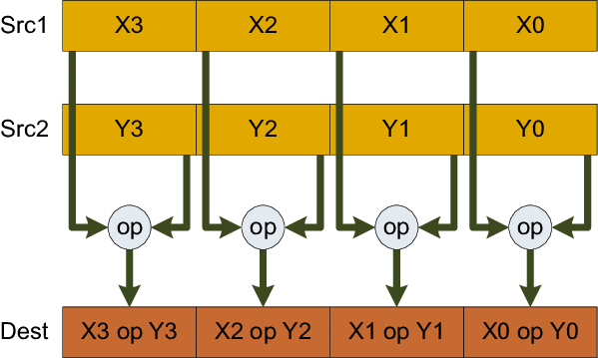
2.2.1 Introduction (1b)
Interpretation of the execution of SIMD instructions [40]
X:
Y:
Z = X op Y
SIMD instructions perform at the same time multiple operations on multiple fields
of registers.

Slide 14
2.2.1 Introduction (2)
Introduction -2
SIMD instructions may refer either for fixed point (FX) data or for
floating point (FP) data.
FX SIMD instructions support mainly multimedia applications, by executing
(2/4/8 or more) FX-operations on pixels in-parallel, whereas
FP SIMD instructions accelerate in the first line 3D graphics by executing
multiple FP-operations in parallel, as indicated in the Figure below.
*

Slide 15
7.1 Introduction to processor graphics (2b)
Example: Triangle representation of a dolphin [103]
Note that all vertices are given as SP FP data.

Slide 16
2.2.1 Introduction (3)
Remark: Emergence of FX and FP SIMD ISA extensions in processors [41] -1
A forerunner of FX SIMD processing was Intel’s i860 by implementing 8/16 or
32-bit FX processing in 64-bit FP registers in 1989 (not indicated in the next
Figure).
Next Motorola’s MC88110 and hp’s PA-7100LC followed with FX SIMD
implementations in 1992-1993, as shown in the next Figure (circled).

Slide 17
2.2.1 Introduction (4)
Emergence of FX SIMD ISA extensions in processors [41] -1
1990
1991
1992
1993
1994
1995
1996
1997
1998
1999
Multimedia support (FX SIMD)
Additional 3D support (FP SIMD)

Slide 18
2.2.1 Introduction (5)
Emergence of FX ISA extensions in processors [41] -3
1990
1991
1992
1993
1994
1995
1996
1997
1998
1999
Multimedia support (FX SIMD)
Additional 3D support (FP SIMD)

Slide 19
2.2.1 Introduction (6)
Emergence of FX SIMD ISA extensions in processors [41] -2
Driven by spreading multimedia applications, FX SIMD extensions soon
became a standard feature of most established processor families in the
first halve of the 1990’s (such as AltiVec from Motorola, MVI from Compaq,
MDMX from MIPS, MAX-2 from hp, VIS from Sun or MMX from Intel,
implemented in the related processors (see next Figure).

Slide 20
2.2.1 Introduction (7)
Emergence of FP SIMD ISA extensions in processors [41] -2
1990
1991
1992
1993
1994
1995
1996
1997
1998
1999
Multimedia support (FX SIMD)
Additional 3D support (FP SIMD)

Slide 21
2.2.1 Introduction (8)
Emergence of FP ISA extensions in processors [41] -1
Next, floating point SIMD extensions, like 3DNow! from AMD, CYRIX and IDT
and SSE from Intel, have emerged since 1998, and became implemented first
in the processors K6-2, K6-3 and Pentium III, followed by Motorola’s G4 and
AMD’s K7 in order to support 3D graphics applications (see next Figure).

Slide 22
2.2.1 Introduction (9)
Main instruction groups of Intel’s x86 SIMD extension
Intel’s x86 SIMD extensions
The MMX
SIMD extensions
The SSE, SSE2 to SSE 4.2
SIMD extensions
The AVX/AVX2 SIMD extensions
The AVX-512
SIMD extension
64-bit SIMD
128-bit SIMD
256-bit SIMD
512-bit SIMD
Intro in DTs/laptops
(Pentium-MMX)
(1997)
(Pentium III)
(1999)
(Sandy Bridge)
(2011)
(Cannon Lake)
(2018)
(Section 2.2)
(Section 2.3)
(Sections 2.4/2.5)
(Sections 2.4/2.6)
*

Slide 23
2.2.1 Introduction (10)
Evolution of Intel’s x86 ISA extensions [42]
Pentium_MMX
(1997)
PII
Klamath,
(1997)
Core
Cannon-Lake,
(2018)
Skylake-X/SP,
(2017)
(2016)

Slide 24
2.2.2 The 64-bit MMX (Multi-Media eXtension)
Notes:
24

Slide 25
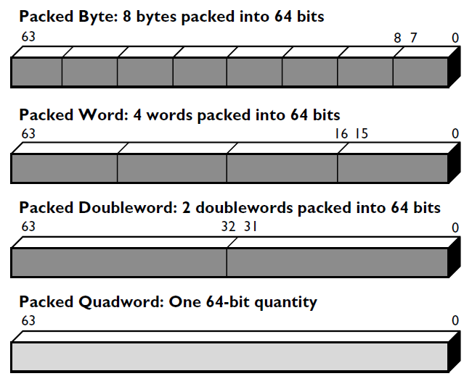
2.2.2 The 64-bit MMX (Multi-Media eXtension) (1)
2.2.2 The 64-bit MMX (Multi-Media eXtension) -1
Introduced in Intel’s Pentium-MMX processor in 01/1997.
It provides 64-bit vector processing for FX data (1x64, 2x32, 4x16, 8x8-bit),
as seen below.
Figure: Data types provided by MMX [43]
MMX does not have its own register set, instead the 64-bit mantissa part of
the existing FP register space is employed for SIMD processing (see next Figure).
This forbids mixing FP and SIMD computation in the same routine.
MMX offers 56 FX SIMD instructions.
*

Slide 26
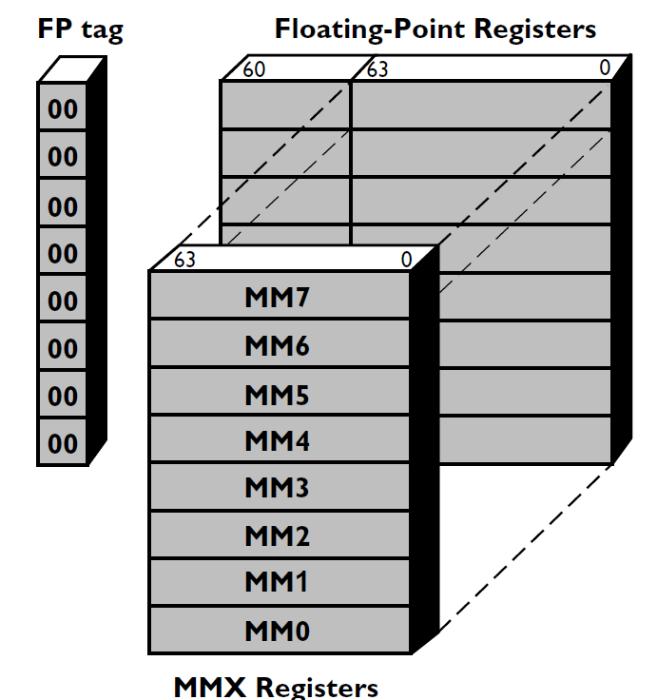
2.2.2 The 64-bit MMX (Multi-Media eXtension) (2)
Aliasing the MM0-MM7 register set with the FO0-FP7 registers [43]
8

Slide 27
2.2.2 The 64-bit MMX (Multi-Media eXtension) (3)
The 64-bit MMX (Multi-Media eXtension) -2
Next, Intel implemented MMX in their subsequent Pentium II cores
(Klamath (05/1997) and Deschutes (01/1998)).

Slide 28
2.2.2 The 64-bit MMX (Multi-Media eXtension) (4)
Remarks on AMD’s 3DNow! [44]
In 1998 AMD introduced the 3DNow! SIMD extension in their K6-2 processor.
3DNow! - as its name suggests - speeds up processing of FP SIMD data by
allowing to pack and process two SP FP data in 64-bit data words, as shown
below.
Figure: Two SP FP data in a 64-bit data word in AMD’s 3DNow! ISA extension [45]
3DNow! provides 21 instructions, mostly for SP FP processing.
There are however two instructions for processing FX data (averaging packed
8-bit unsigned integers and multiplying packed 16-bit integers).
AMD made a number of enhancements to 3DNow!, like 3DNow!+ or
Enhanced 3DNow!, but AMD’s SIMD extensions never gained much popularity,
so finally, AMD dropped supporting these extensions in their future processors
in 8/2010, and implemented Intel’s SIMD extensions.

Slide 29
2.2.3 The 128-bit SSE extension
Notes:
29

Slide 30
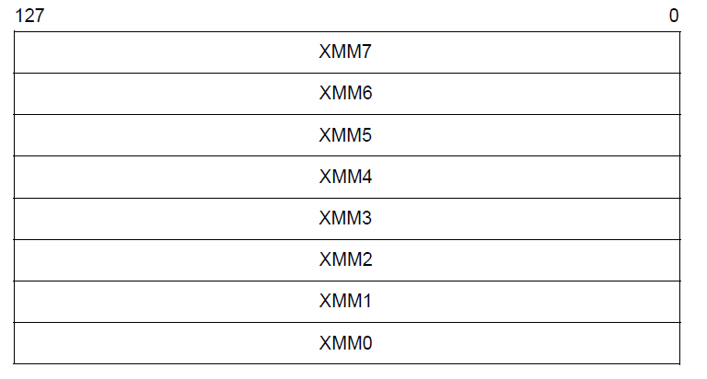
2.2.3 The 128-bit SSE extension (1)
2.2.3 The 128-bit SSE extension [46]
Introduced along with the Pentium III Katmai processor (02/1999).
It offers
eight dedicated 128-bit registers (XMM0-XMM7)
new 128-bit FP data type (4x SP FP)
70 new instructions.
Figure: SSE’s new
register space
(XMM0-XMM7)
The new 128-bit XMM registers can be used only for packed SP FP operands, but
FX SIMD data will be processed further on in the 64-bit MMX0-MMX7 registers.
Figure: SSE’s new data type (4x SP FP)
*

Slide 31
2.2.3 The 128-bit SSE extension (2)
Intel’s SSE2
Introduced along with the Pentium 4 Willamette core (12/2000).
It provides
6 new data types
140 new instructions
Figure: New 128-bit data types of SSE2 [47]
The XMM registers can now be used for all 64- and 128-bit FX/FP data types and
also for scalar DP FP data.
*

Slide 32
2.2.3 The 128-bit SSE extension (3)
Intel’s SSE3
Introduced along with the Pentium 4 Prescott core (02/2004)
13 new instructions are added.

Slide 33
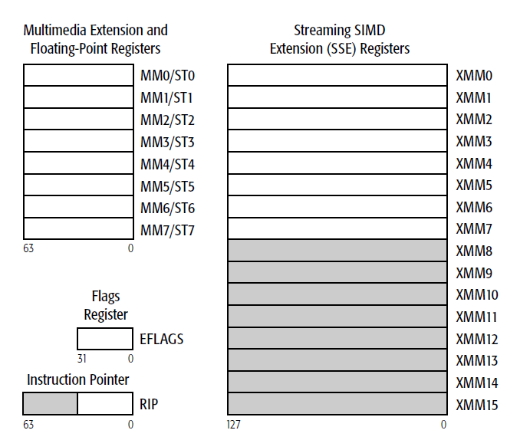
2.2.3 The 128-bit SSE extension (4)
Extending the number of the XMM registers to 16 -1
AMD’s move
In their x86-64 ISA extension – published in 1999 - AMD doubled the number of XMM registers (from 8 to 16) in the 64-bit operating mode, as shown below.
Figure: Doubling the number of XMM registers
in AMD’s x86-64 ISA extension (2000) [48]
The first AMD processor implementing the x86-64 ISA extension was the Opteron
server processor, released in 2003.

Slide 34
2.2.3 The 128-bit SSE extension (5)
Extending the number of the XMM registers to 16 -2
Intel’s move
Intel’s 64-bit x86 extension was called EM64T (Extended Memory Technology).
It is the same as AMD’s x86-64 extension named differently.
First processors implementing the 64-bit ISA extension were the Pentium 4-based
Xeon Nocona DP server and the Prescott-F DT processors in 2004.
*

Slide 35
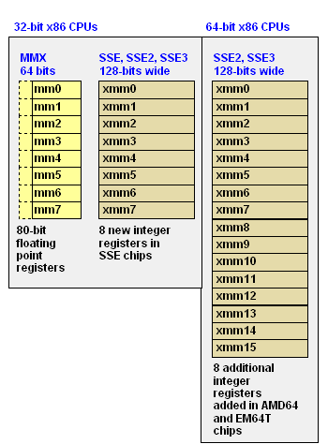
2.2.3 The 128-bit SSE extension (6)
Summing up the introduces SIMD register spaces in the MMX, SSE to SSE3
ISA extensions in 32- and 64-bit ISAs [49]

Slide 36
2.2.3 The 128-bit SSE extension (7)
f) Further SSE enhancements
Beginning with their Core family, Intel enhanced their SSE extensions under the
designations of SSSE3 (Core 2) to SSE 4.2 (Nehalem) from 2006 to 2008,
by a number of instructions, as indicated in the next Figure.

Slide 37
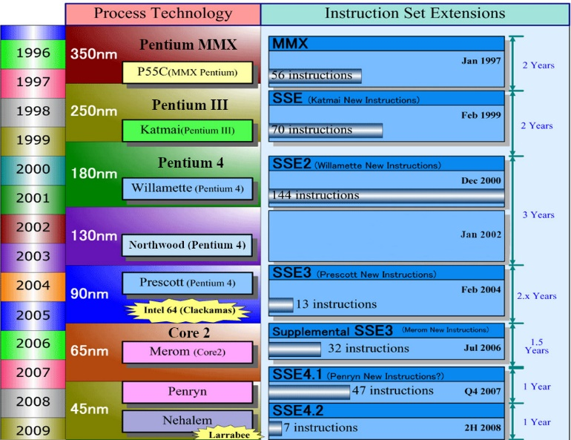
2.2.3 The 128-bit SSE extension (8)
Overview of Intel’s SSE3-SSE 4.2 SIMD extensions (Based on [50])

Slide 38
2.2.3 The 128-bit SSE extension (9)
Target application domains and introduced data types of the MMX/SSE ISA
extensions (based on [50])
64-bit FX SIMD with
64/32/16/8-bit operands (ops)
Support of MM
128-bit FP SIMD with 32-bit FP ops.
64/32/16/8-bit FX ops.
Support of MM/3D
128-bit FX, FP SIMD with
64/32/16/8-bit FX, 64/32-bit FP,
Support for MPEG-2, video, MP3
DSP-oriented FP enhancements,
enhanced thread manipulation
Diverse arithmetic enhancements
Media acceleration
(video encoding, MM, gaming)
Accelerated string/text manip.,
appl. targeted acceleration

Slide 39
2.2.3 The 128-bit SSE extension (10)
SIMD execution units (EUs) provided for the MMX - SSE ISA extensions
(based on [50])
2 x 32-bit FX MMX EUs
2 x 32-bit MMX,
2 x 32-bit SSE EUs
1 full + 1 simple (moves/stores)
64-bit FP/SSE EUs
2 x 128-bit FP EUs +
3 x 128-bit SSE EUs

Slide 40
2.2.4 Brief overview of the 256-bit AVX/AVX2 and
512-bit AVX-512 SIMD extensions
Notes:
40

Slide 41
2.2.4 Brief overview of the 256-bit AVX/AVX2 and 512-bit AVX-512 SIMD extensions (1)
2.2.4 Brief overview of the 256-bit AVX/AVX2 and 512-bit AVX-512 SIMD
extensions
This summary provides an overview of the evolution of
a) the register spaces,
b) the set of supported data types and
c) the instruction lists
while the AVX/AVX2 and AVX-512 ISA extensions were introduced.
*

Slide 42
2.2.4 Brief overview of the 256-bit AVX/AVX2 and 512-bit AVX-512 SIMD extensions (2)
a) Evolution of the register space
As part of the previous SSE extension, Intel introduced the 128-bit XMM [0, 15]
register space in the 64-bit execution mode and implemented the SSE extension
in the Pentium III Katmai core (1999) [51].
zmm (511-0)
ymm (255-0)
xmm (128-0)
SSE (32-bit)
(xmm0-xmm7)
0
AVX/AVX2
ymm0-ymm15)
7
SSE (64-bit)
(xmm0-xmm15)
AVX-512
(zmm0-zmm31
15
AVX-512
(ymm0-ymm31
AVX-512
(xmm0-xmm31)
31
511
255
127
0
*

Slide 43
2.2.4 Brief overview of the 256-bit AVX/AVX2 and 512-bit AVX-512 SIMD extensions (3)
The extended YMM [0, 15] AVX/AVX2 register space in 64-bit mode [51]
The YMM register space provides 16 256-bit wide registers named
(ymm0,ymm15).
zmm (511-0)
ymm (255-0)
xmm (128-0)
SSE (32-bit)
(xmm0-xmm7)
0
AVX/AVX2
ymm0-ymm15)
7
SSE (64-bit)
(xmm0-xmm15)
AVX-512
(zmm0-zmm31
15
AVX-512
(ymm0-ymm31
AVX-512
(xmm0-xmm31)
31
511
255
127
0
The lower 128 bits of the YMM registers are aliased to the respective 128-bit
XMM registers.
It was first implemented in Intel’s Sandy Bridge (2011) and then the Haswell
cores (2013), to support the 256-bit AVX and AVX2 extensions, respectively.
*

Slide 44
2.2.4 Brief overview of the 256-bit AVX/AVX2 and 512-bit AVX-512 SIMD extensions (4)
The extended ZMM [0, 31] AVX-512 register space in 64-bit mode [51]
In DTs the AVX-512 extension was introduced in Intel’s Cannon Lake core (2018).
zmm (511-0)
ymm (255-0)
xmm (128-0)
SSE (32-bit)
(xmm0-xmm7)
0
AVX/AVX2
ymm0-ymm15)
7
SSE (64-bit)
(xmm0-xmm15)
AVX-512
(zmm0-zmm31
15
AVX-512
(ymm0-ymm31
AVX-512
(xmm0-xmm31)
31
511
255
127
0
The AVX-512 ISA extension provides 32 512-bit wide SIMD registers [zmm0,zmm31].
The lower 256 bits of the ZMM registers are aliased to the respective 256-bit
YMM registers and the lower 128 bits to the respective 128-bit XMM registers.
*

Slide 45
2.2.4 Brief overview of the 256-bit AVX/AVX2 and 512-bit AVX-512 SIMD extensions (5)
b) Evolution of the set of supported data types
The previous SSE/SSE2 extensions introduced the 128-bit data types.
The SSE/SSE2 extensions were introduced in Intel’s Pentium III Katmai (1999) and
Pentium 4 Willamette (2000) cores, respectively.
Figure: Supported data types of SSE/SSE2 [47]
Note that SSE allows processing only SP FP data in 128-bit registers, whereas
SSE2 enables processing all indicated data types in 128-bit registers.
*

Slide 46
2.2.4 Brief overview of the 256-bit AVX/AVX2 and 512-bit AVX-512 SIMD extensions (6)
b) Evolution of the set of supported data types
New 256-bit wide FX/FP SIMD data types in the AVX/AVX2 extensions [47]
The AVX/AVX2 extensions were introduced in Intel’s Sandy Bridge (2011) and
Haswell (2013) cores, respectively.
Note that AVX allows processing only FP SIMD data in 256-bit registers, whereas
AVX2 let processing all indicated (FX and FP) SIMD data in 256-bit registers.
*

Slide 47
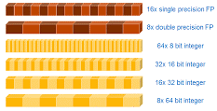
2.2.4 Brief overview of the 256-bit AVX/AVX2 and 512-bit AVX-512 SIMD extensions (7)
New 512-bit wide SIMD data types that make use of the extended
register space [69]
The AVX-512 extension was introduced in Intel’s Cannon Lake DT cores (2018).
16x single precision FP
8x double precision FP
64x 8 bit integer
Intel AVX-512
32x 16 bit integer
16x 32 bit integer
8x 64 bit integer
*

Slide 48
2.2.4 Brief overview of the 256-bit AVX/AVX2 and 512-bit AVX-512 SIMD extensions (8)
c) Evolution of the supported instruction list
Each SIMD extension requires the introduction of a large number of new
instructions,
e.g. alone AVX2 extends the ISA by 170 FX SIMD instructions and 93 FMA
(Fused Multiply-Add) operations.
Note that it was Intel’s AVX2 ISA extension that first provided dual operation
FMA instructions.
*

Slide 49
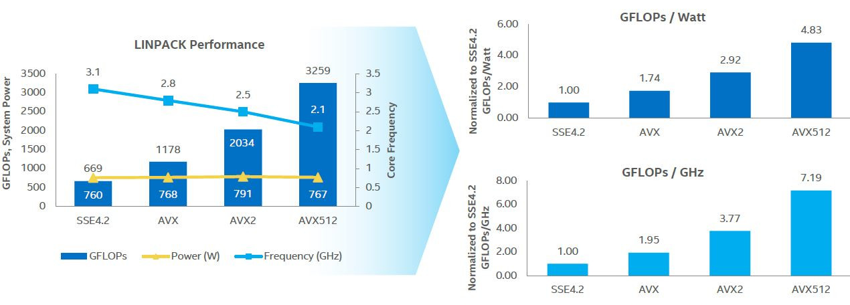
2.2.4 Brief overview of the 256-bit AVX/AVX2 and 512-bit AVX-512 SIMD extensions (9)
How performance and efficiency rose in the course of x86 SIMD evolution?
[52]

Slide 50
2.2.4 Brief overview of the 256-bit AVX/AVX2 and 512-bit AVX-512 SIMD extensions (10)
Performance increase in terms of SP FLOPS/DP FLOPS in the course of
x86 SIMD evolution [53]
SP/DP FLOPS data relate to dual FMA-capable 512-bit EUs.

Slide 51
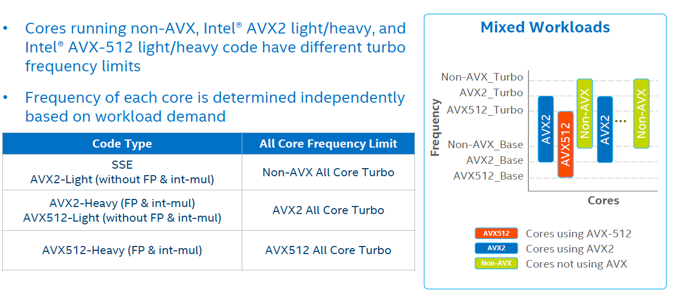
2.2.4 Brief overview of the 256-bit AVX/AVX2 and 512-bit AVX-512 SIMD extensions (11)
Reducing turbo frequencies while running AVX code [70]
Note that turbo frequency limits are controlled on a per core basis beginning from
the Broadwell processor.
*

Slide 52
2.2.4 Brief overview of the 256-bit AVX/AVX2 and 512-bit AVX-512 SIMD extensions (12)
Comparing the introduction of x86 ISA SIMD extensions Intel vs. AMD
Extension | Intel |  | AMD
MMX | Pentium MMX | 1/1997 | 3/1998 | K6
3DNow! | - |  | 2/1999 | K6-2
Enh. 3DNow! | - |  | 6/1999 | K7 Athlon Model 1
3DNow! Professional | - |  | 7/2001 | K7 Athlon MP Model 6
SSE | Pentium III Katmai | 2/1999 | 4/2003 | K8 Sledgehammer
SSE2 | Pentium 4 Willamete | 12/2000 | 4/2003 | K8 Sledgehammer
SSE3 | Pentium 4 Presocott | 2/2004 | 12/2004 | K8 Athens
SSSE3 | Core 2 | 7/2006 | 1/2011 | Family 14h Bobcat
SSE4.a | - |  | 8/2007 | K10 Barcelona
SSE4.1 | Penryn | 11/2007 | 11/2011 | Family 15h Bulldozer
SSE4.2 | Nehalem | 3/2009 | 11/2011 | Family 15h Bulldozer
AES-NI | Westmere | 3/2010 | 11/2011 | Family 15h Bulldozer
PCLMULQDQ instr. | Westmere | 3/2010 | 11/2011 | Family 15h Bulldozer
AVX | Sandy Bridge | 1/2011 | 11/2011 | Family 15h Bulldozer
AVX2 | Haswell | 6/2013 | 6/2015 | Family 15h Excavator
AVX-512 | Cannon Lake | 5/2018
MMX: Multi Media Extension
SSE: Streaming SIMD extension
SSSE3: Supplemental SSE3 (SSSE3)
AES: Advanced Encryption Standard
AVX: Advanced Vector Extension

Slide 53
2.2.5 The 256-bit AVX/AVX2 SIMD extensions - detailed
It will not be discussed.
Notes:
53

Slide 54
2.2.5 The 256-bit AVX/AVX2 SIMD extensions – detailed (1)
2.2.5 The 256-bit AVX and AVX2 SIMD extensions - detailed
Intel introduced 256-bit SIMD extensions in two steps:
a) first only FX SIMD operations in the AVX extension and then
b) added FP SIMD operations as well in the AVX2 extensions,
as detailed subsequently.

Slide 55
2.2.5 The 256-bit AVX/AVX2 SIMD extensions – detailed (2)
a) Introduction of the AVX ISA extension into the Sandy Bridge core (2011)
It provides 256-bit wide FP SIMD operations by
extending the existing 128-bit wide XMM [0, 15] register set to 256-bit wide
YMM [0, 15] register set,
introducing new 256-bit wide FP SIMD data types that make use of the
extended register space and
introducing the appropriate instructions to process 256-bit FP data in the
extended YMM [0, 15] register space,
as shown next.

Slide 56
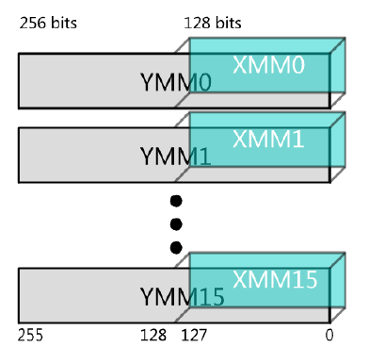
2.2.5 The 256-bit AVX/AVX2 SIMD extensions – detailed (3)
a1) Extending the existing 128-bit wide XMM [0, 15] SIMD register set
to the 256-bit YMM [0, 15] register set [54], [55]
Intel’s AVX instructions operate on either
the whole 256-bits (FP only) or
the lower 128-bits (like existing SSE instructions), then the upper 128-bits
of the registers are zeroed out.
*

Slide 57
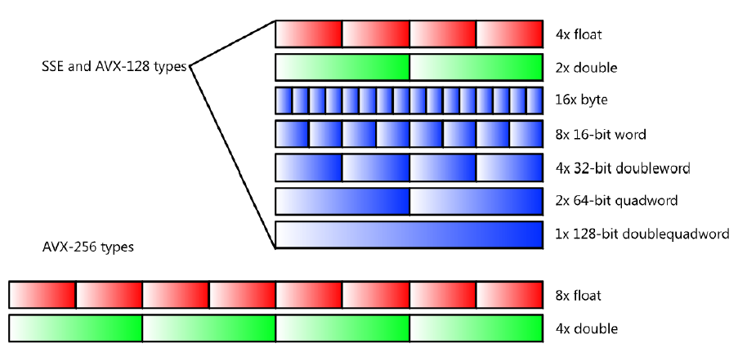
2.2.5 The 256-bit AVX/AVX2 SIMD extensions – detailed (4)
Introducing new 256-bit wide FP SIMD data types that make use of the
extended register space [55]
Supported data types
FP
float
FX
float
a2) Extending the 128-bit SSE instruction set

Slide 58
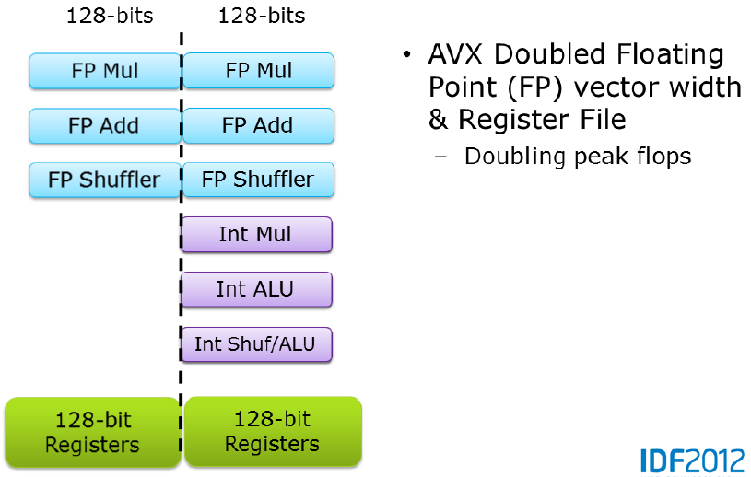
2.2.5 The 256-bit AVX/AVX2 SIMD extensions – detailed (5)
Introducing the appropriate instructions to process 256-bit FP data in the
extended YMM [0, 15] register space
AVX doubled register width and
the width of FP SIMD data
Doubling peak FLPOPS
Note
AVX doubled only the width of FP SIMD data, as indicated in the Figure above [54].
*

Slide 59
2.2.5 The 256-bit AVX/AVX2 SIMD extensions – detailed (6)
Implementation of AVX -1
To carry out 256-bit FP operations Intel implemented two 256-bit FP execution
units but did not widen related data paths to 256 bit, instead made use of two
existing 128-bit data paths of the units that are connected to the ports, as
indicated in the next Figures [22].
Sandy Bridge do not support FMA operations, nevertheless it is capable to execute
up to 8 DP FP or 16 SP FP operations.

Slide 60
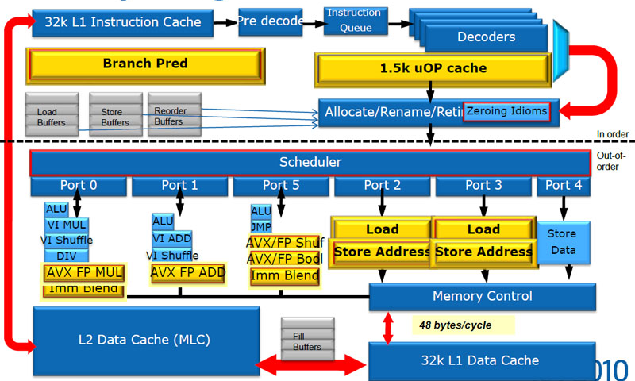
2.2.5 The 256-bit AVX/AVX2 SIMD extensions – detailed (7)
Implementation of AVX -2
Large parts of Sandy Bridge’s microarchitecture were redesigned (marked by yellow
boxes), among them two new 256-bit FP SIMD EUs (see the Figure below).
Figure: Microarchitecture of the Sandy Bridge core [22]

Slide 61
2.2.5 The 256-bit AVX/AVX2 SIMD extensions – detailed (8)
Implementation of AVX -3
Since 128-bit SSE and 256-bit AVX instructions can’t be mixed, Intel implements
256-bit AVX instructions by using the 128-bit datapath of the integer SIMD units.
This minimizes the impact of AVX on the die area while enabling to execute
two 256-bit AVX operations per clock (+ one 256-bit AVX load).
Figure: Use of the 128-bit datapath of integer SIMD units for executing
256-bit FP AVX instructions [56]

Slide 62
2.2.5 The 256-bit AVX/AVX2 SIMD extensions – detailed (9)
Introducing the appropriate instructions to process 256-bit FP data and
FMA operations in the extended YMM [0, 15] register space [47]
×Total instructions / different mnemonics

Slide 63
2.2.5 The 256-bit AVX/AVX2 SIMD extensions – detailed (10)
The symmetrical character of the SIMD extensions achieved by AVX2 [54]
AVX doubled FP register width
and vector width.
Doubling peak FLOPS
AVX2 doubles FX data width
and provides 2 256-bit FMA units.
Doubling peak FLOPS
FMA: Fused Multiply-Add
*

Slide 64
2.2.5 The 256-bit AVX/AVX2 SIMD extensions – detailed (11)
Peak FPLOPS by the SSE/AVX/AVX2 ISA extensions [57]

Slide 65
2.2.5 The 256-bit AVX/AVX2 SIMD extensions – detailed (12)
Example for calculating D = A x B + C with 8 32-bit wide data vectors by
using the AVX2 ISA extension [34]

Slide 66
2.2.5 The 256-bit AVX/AVX2 SIMD extensions – detailed (13)
Reducing the core and turbo core frequencies in Intel’s processors
while the core executes 256-bit wide SIMD operations
Both dual-operation capable 256-bit wide FMA units, introduced along with the
AVX” extension in the Haswell core, consume however, extremely high power,
as much that while they operate, the PCU (Power Control Unit) has to reduce
the clock frequency to remain within the TDP limit and avoid overheating.
(We note that prior Sandy Bridge cores already performed 256-bit SIMD operations
(called AVX operations) by means of two 256-bit EUs, however, these units could
execute only single operations at a time (e.g. a MUL operation) rather than dual
operation like MADs or FMAs.)

Slide 67
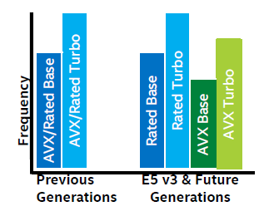
2.2.5 The 256-bit AVX/AVX2 SIMD extensions – detailed (14)
Reducing core frequencies in Intel’s Haswell processors while running
AVX instructions
Detected AVX instructions will be signaled to the PCU (Power Control Unit).
The PCU raises core voltage that results in higher dissipation.
At the same time the PCU reduces the clock frequency of the processor in order
to avoid exceeding the TDP limit and thus overheating.
The PCU delivers the higher voltage 1 ms longer than the last AVX instruction
completes and subsequently the core voltage will return to its nominal value.
Related to this, Intel added two AVX frequencies, as demonstrated subsequently for their Haswell-EP (E5-1600 v3 and E5-2600 v3) line of processors, as follows:
AVX base: it is the minimum frequency
for workloads using AVX instructions.
AVX Turbo: it is the maximum frequency
for workloads using all cores for executing
AVX instructions.
Figure: Core frequency limits in Haswell-EP and
previous lines [34]

Slide 68
2.2.5 The 256-bit AVX/AVX2 SIMD extensions – detailed (15)
On Haswell, one AVX instruction on one core forced all cores on the same socket to slow down their clock speed by around 2 to 4 speed bins (-200,-400 MHz) for at least 1 ms, as AVX has a higher power requirement that reduces how much a CPU can turbo. On Broadwell, only the cores that run AVX code will be reducing their clockspeed, allowing the other cores to run at higher speeds. [58]

Slide 69
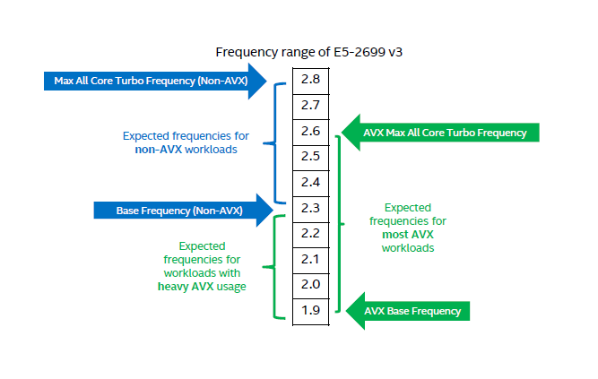
2.2.5 The 256-bit AVX/AVX2 SIMD extensions – detailed (16)
Example: Core frequency limits for Intel's E5-2699 v3 processor [34]
AVX Frequency Range Example – E5-2699 v3

Slide 70
2.2.6 The AVX-512 SIMD extension - detailed
It will not be discussed.
Notes:
70

Slide 71
2.2.6 The AVX-512 SIMD extension – detailed (1)
2.2.6 The AVX-512 SIMD extension - detailed
In DTs introduced into the Cannon Lake core (5/2018)
It provides 512-bit wide SIMD operations by
extending the existing 256-bit wide YMM [0, 15] register set to 512-bit
wide ZMM [0, 15] register set,
introducing new 512-bit wide SIMD data types that make use of the
extended register space and
introducing the appropriate instructions to process 512-bit SIMD data
in the extended ZMM [0, 31] register space,
as shown next.

Slide 72
2.2.6 The AVX-512 SIMD extension – detailed (2)
Extending the existing 256-bit wide YMM [0, 15] register set to 512-bit wide
ZMM [0, 31] register set [51] -1
zmm (511-0)
ymm (255-0)
xmm (128-0)
SSE (32-bit)
(xmm0-xmm7)
0
AVX/AVX2
ymm0-ymm15)
7
SSE (64-bit)
(xmm0-xmm15)
AVX-512
(zmm0-zmm31
15
AVX-512
(ymm0-ymm31
AVX-512
(xmm0-xmm31)
31
511
255
127
0
The AVX-512 ISA extension provides 512-bit wide SIMD registers (zmm0,zmm31).
The lower 256 bits of the ZMM registers are aliased to the respective 256-bit
YMM registers and the lower 128 bits are aliased to the respective 128-bit
XMM registers.

Slide 73
2.2.6 The AVX-512 SIMD extension – detailed (3)
Extending the existing 256-bit wide YMM [0, 15] register set to 512-bit wide
ZMM [0, 31] register set [51] -2
AVX-512 supports all prior SIMD (vector) instructions, namely Intel MMX, SSE,
SSE2, SSE3, SSSE3, SSE4.1, SSE4.2, AVX and AVX2.
In 64-bit mode the AVX-512 ISA extension provides 32 XMM, YMM and ZMM
SIMD registers [XMM 0, XMM 31], [YMM 0, YMM 31] and [ZMM 0, ZMM 31].
In 32-bit mode the number of available XMM/YMM/ZMM vector registers is still 8.

Slide 74
2.2.6 The AVX-512 SIMD extension – detailed (4)
Introducing new 512-bit wide SIMD data types that make use of the
extended register space [69]
16x single precision FP
8x double precision FP
64x 8 bit integer
Intel AVX-512
32x 16 bit integer
16x 32 bit integer
8x 64 bit integer

Slide 75
2.2.6 The AVX-512 SIMD extension – detailed (5)
Support of AVX-512 in Intel’s processor lines [59]
AVX-512 Support Propagation by Various Intel CPUs
 | Xeon, Core X | General | Xeon Phi
Skylake-SP | AVX512BW AVX512DQ AVX512VL | AVX512F AVX512CD | AVX512ER AVX512PF | Knights Landing
Cannon Lake | AVX512VBMI AVX512IFMA |  | AVX512_4FMAPS AVX512_4VNNIW | Knights Mill
Ice Lake | AVX512_VNNI AVX512_VBMI2 AVX512_BITALG AVX512+VAES AVX512+GFNI AVX512+VPCLMULQDQ | AVX512_VPOPCNTDQ
Source: Intel Architecture Instruction Set Extensions and Future Features Programming Reference (pages 12 and 13)

Slide 76
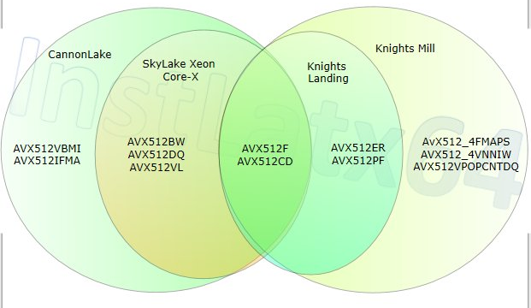
2.2.6 The AVX-512 SIMD extension – detailed (6)
AVX-512 instruction groups implemented in different processors
(According to Intel SDE 8.40 [60]

Slide 77
2.2.6 The AVX-512 SIMD extension – detailed (7)
Instruction groups of the AVX-512 extensions [53]
AVX512F | AVX-512 Foundation is base of the 512-bit SIMD instruction extensions which is a comprehensive list of features for most HPC and enterprise applications. It is the natural extensions to AVX/AVX2 which is extended using the EVEX prefix which builds on the existing VEX prefix. Any processor that implements any portion of the AVX-512 extensions MUST implement AVX512F.
AVX512CD | AVX-512 Conflict Detection for additional vectorization of loops with possible address conflict.
AVX512DQ | AVX-512 Doubleword and Quadword Instructions add new 32-bit and 64-bit AVX-512 instructions (conversion, transcendental support, etc..).
AVX512PF | AVX-512 Prefetch Instructions add new prefetch instructions for gather/scatter and PREFETCHWT1
AVX512ER | AVX-512 Exponential and Reciprocal Instructions (ERI) offer 28-bit precision RCP, RSQRT and EXP transcendentals for various scientific applications.
AVX512VL | AVX-512 Vector Length Instructions add vector length orthogonality, allowing most AVX-512 operations to also operate on XMM (128-bit SSE) registers and YMM (256-bit AVX) registers
AVX512BW | AVX-512 Byte and Word Instructions add support for for 8-bit and 16-bit integer operations.
AVX512IFMA | AVX-512 Integer Fused Multiply-Add Instructions with 52-bit precision.
AVX512VBMI | AVX-512 Vector Bit Manipulation, Version 1 add additional vector byte permutation instructions.
AVX512VBMI2 | AVX-512 Vector Bit Manipulation, Version 2 add additional vector byte permutation instructions.
AVX512VAES | AVX-512 Vector AES Instructions add vector AES operations
AVX512BITALG | AVX-512 Bit Algorithms add bit algorithms operations
AVX5124FMAPS | AVX-512 Fused Multiply Accumulation Packed Single precision Instructions add vector instructions for deep learning on floating-point single precision
AVX512VPCLMULQDQ | AVX-512 Vector Carry-less Multiply add vector carry-less multiply operations
AVX512GFNI | AVX-512 Galois Field New Instructions add Galois Field transformations instructions
AVX512VNNI | AVX-512 Vector Neural Network Instructions add vector instructions for deep learning
AVX5124VNNIW | AVX-512 Vector Neural Network Instructions Word Variable Precision Instructions for deep learning
AVX512VPOPCNTDQ | AVX-512 Vector Population Count in Doubleword or Quadword

Slide 78
2.2.6 The AVX-512 SIMD extension – detailed (8)
Performance and efficiency of the AVX-512 SIMD extension [52]

Slide 79
2.2.6 The AVX-512 SIMD extension – detailed (9)
Performance increase in SP FLOPS/DP FLOPS in the course of the x86 SIMD
evolution [53]
SP/DP FLOPS data relate to dual FMA-capable 512-bit EUs.

Slide 80
2.2.6 The AVX-512 SIMD extension – detailed (10)
Reducing turbo frequencies while running AVX code [70]
Note that turbo frequency limits are controlled on a per core basis beginning from
the Broadwell processor.
*

Slide 81
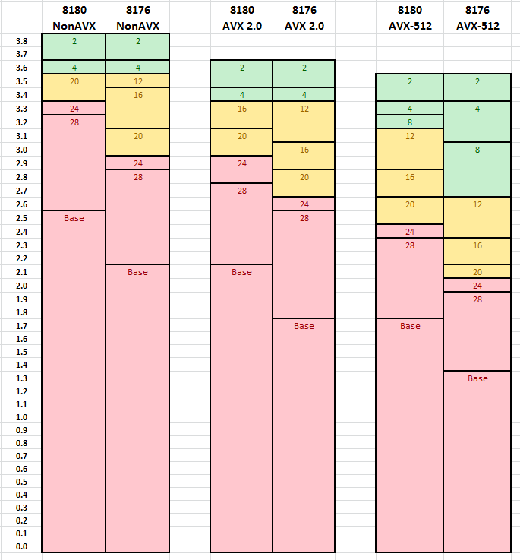
2.2.6 The AVX-512 SIMD extension – detailed (11)
Example: Non-AVX/AVX2/AVX-512 Turbo frequencies (GHz) for different
number of active cores [61]
Note that in Turbo mode
all active cores run at the
same frequency.
The base frequency is the
guaranteed clock frequency.

Slide 82
2.3 x86 security extensions
It will not be discussed
Notes:
82

Slide 83
2.3 x86 security extensions (1)
2.3 x86 security extensions
They provide a number of enhancements to improve security, including
SMX (Safer Mode Extensions)
AES-NI (Enhanced Encryption Standard-New Instructions) and
MPX (Memory Protection Extensions),
SGX (Software Guard Extensions)
introduced in the Core 2 to Skylake lines and briefly described next.
Subsequently, in response to the revealed security risks, like Spectre or Meltdown,
Intel introduced a large number of security extensions in their Ice lake line.
These instructions are listed at the end of this Section.

Slide 84
2.3 x86 security extensions (2)
SMX (Safer Mode Extensions) [62]
Introduced in the Core 2 family (2006) .
Safer Mode Extensions allow to establish a trusted execution environment
by invoking the GETSEC group of instructions.
It is part of Intel’s Trusted Execution Technology (TXT), designated before
10/2006 as the LeGrande technology.
TXT protects data within virtualized computing environments.
TXT became part of Intel’s business oriented vPro processor technology
(released in 2007) that is designed to provide protection against software
attacks, like viruses and other threats and also to enable remote PC
management.

Slide 85
2.3 x86 security extensions (3)
AES-NI (Enhanced Encryption Standard-New Instructions)
AES-NI includes 7 instructions and became supported first in Intel’s 32 nm
Westmere line of processors in 2010.
It supports the AES (Advanced Encryption Standard).
Remark
AES (Advanced Encryption Standard): is a specification for the encryption
of electronic data issued by NIST (U.S. National Institute of Standards and
Technology) in 2001.
It is currently one of the most popular algorithms used for data transmission
according to the SSL standard.
The AES algorithm uses 128, 192 or 256 bit long cryptographic keys to encrypt
and decrypt data in blocks of 128 bits.

Slide 86
2.3 x86 security extensions (4)
MPX (Memory Protection Extensions)
Introduced in the Skylake (2015)
It performs runtime buffer overflow checks to ensure that physical memory
accesses fall within the bounds of the memory allocated to the calling process.

Slide 87
2.3 x86 security extensions (5)
SGX (Software Guard Extensions) [63]
It is a set of security-related instructions introduced along with the Skylake
architecture (2015).
It allows user- or OS-level code to build private regions of memory, called
enclaves, whose contents are protected from reading or saving by any process
outside the enclave itself, even if the process runs at a higher privilege level.

Slide 88
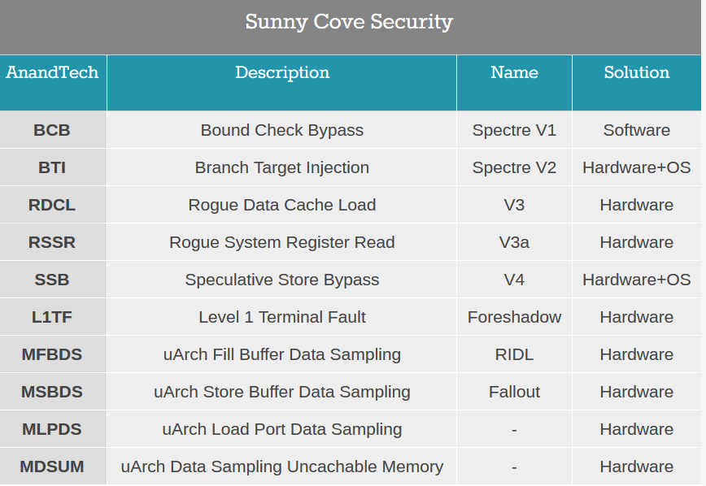
2.3 x86 security extensions (6)
Security extensions introduced in the Icy lake processor line [181]
For further details we refer to Intel’s related documents.

Slide 89
2.4 x86 TSX (Transactional Synchronization Extensions)
Notes:
89

Slide 90
2.4 x86 TSX (Transactional Synchronization Extensions) (1)
2.4 x86 TSX (Transactional Synchronization Extensions) [64]
It was debuted on selected Haswell models (SKUs) in 6/2013.
Haswell models below the 45xx SKU and K models (processors with unlocked
multiplier) do not support TSX.
TSX supports Transactional Memory in hardware (to be discussed briefly next).
Transactional memory extensions (actually four instructions) provide an efficient
synchronization mechanism in concurrent programming used to effectively
manage race conditions occurring when multiple threads access shared data.
Nevertheless, in August 2014 Intel announced a bug in the TSX implementation
on all current steppings of all Haswell models and disabled the TSX feature
on affected CPUs via a microcode update.
Subsequently, TSX became enabled first on a Broadwell model (Core M-5Y70)
in 11/2014 and then on the Haswell-EX in 5/2015.
SKU: Stock Keeping Unit (actually model designation)
*

Slide 91
2.4 x86 TSX (Transactional Synchronization Extensions) (2)
Addressing race conditions
Basically there are two mechanisms to address race conditions in multithreaded
programs, as indicated below:
Basic mechanisms to address races in multithreaded programs
Locks
Transactional memory (TM)
Pessimistic approach,
it intends to prevent possible conflicts
by enforcing serialization of transactions
through locks.
Optimistic approach,
it allows access conflicts to occur
but provides a checking and repair mechanism
for managing these conflicts, i.e.
it allows all threads to access shared data simultaneously
but after completing a transaction,
it will be checked whether a conflict arose,
if yes, the transaction will be rolled back and
then replayed if feasible else
executed while using locks.
The next Figure illustrates these synchronization mechanisms.

Slide 92
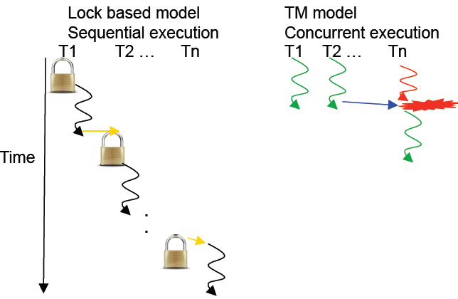
2.4 x86 TSX (Transactional Synchronization Extensions) (3)
Illustration of lock based and transaction memory (TM) based thread synchronization [71]
Conflict, to be
repaired

Slide 93
2.4 x86 TSX (Transactional Synchronization Extensions) (4)
Note
In their POWER8 (2014) IBM also introduced hardware supported transactional
memory, called simply Hardware Transactional Memory (HTM).

