Slide 1
Client processors - 5
On-die interconnects
Dezső Sima
October 2019
(Ver. 1.2)
© Sima Dezső, 2019

Slide 2
5. On-die interconnects
Notes:
2

Slide 3
5. On-die interconnects (1)
5. On-die interconnects of client processors -1
Interconnects are the skeletons of
the microarchitectures of processors,
multiprocessor servers or even
processor clusters.
Accordingly, we can differentiate between three levels of interconnects, as
indicated in the next Figure.
*

Slide 4
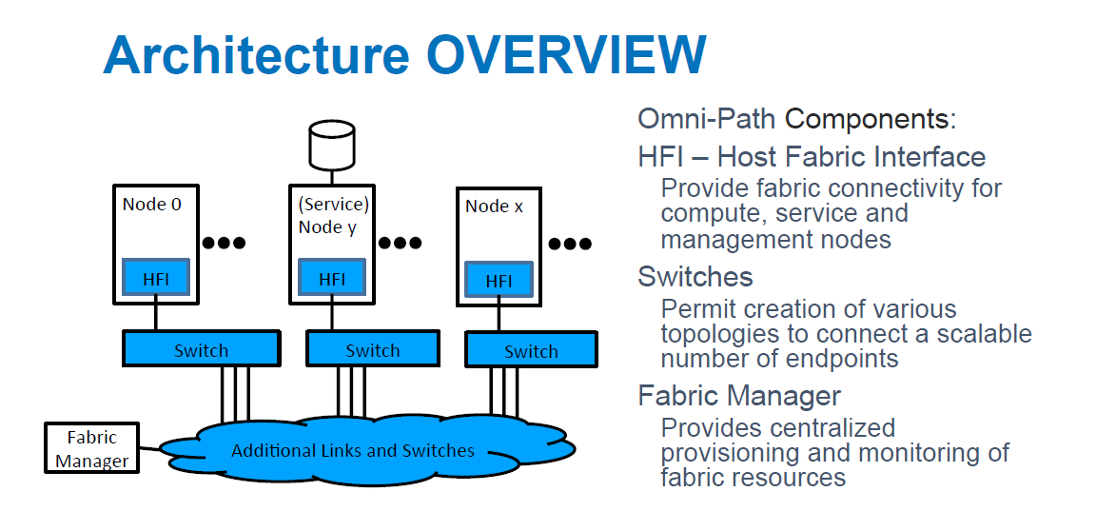
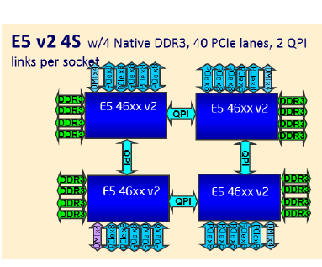
5. On-die interconnects (2)
On-die interconnects of client processors -2
Levels of interconnects
Intra-Processor
interconnects
Inter-processor
interconnects
Cluster
interconnects
Interconnect the functional
units of a processor
Interconnect processors
within a server
(e.g. DP/MP servers) [2]
Interconnect nodes
(e.g. 2P/4P servers) of a processor cluster [3]
GPU
MC
CPU
Disp
C.
IO C.
C: Controller
*

Slide 5
5. On-die interconnects (3)
On-die interconnects of client processors -3
Subsequently, we will focus only on the lowest level of interconnects, that is
processor interconnects while assuming monolithic processor implementations.
MCM (Multi-Chip Module) implementations of processors are dealt with in another
Chapter of the lecture notes.

Slide 6
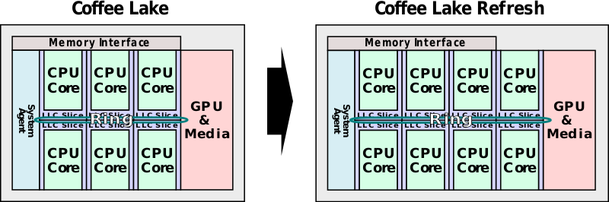
5. On-die interconnects (4)
CPU topologies used in multicore client processors
CPU topologies used in multicore client processors
Individual cores-based CPUs
Core clusters-based CPUs
Individual cores are the building blocks
of the CPU
CPU cores are arranged in core clusters
mostly of two or four cores.
The core clusters are then the building blocks
of the CPU.
Intel’s 8-core Coffee Lake Refresh
processor built up as an SMC (2018) [6]
SMC: Symmetrical MultiCore
*

Slide 7
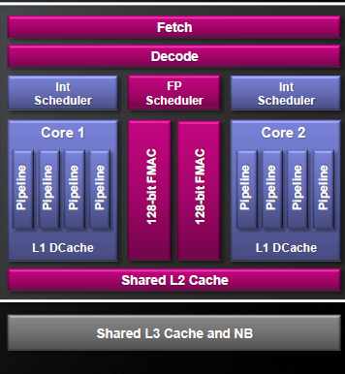
5. On-die interconnects (5)
Core clusters-based CPUs of client processors -1
Core clusters-based CPUs of client processors
Dual-core core clusters
Quad-core core clusters
Examples 1-2
AMD
Bulldozer’s Compute Module (2011-2016) [10]
Two separate FX cores, shared FP, L2
and front-end to save Si-area and power
L3 is shared at the chip level
(No L3 when GPU available)

Slide 8
5. On-die interconnects (6)
Remarks: AMD’s motivation for using compute modules in Bulldozer-based designs
AMD optimized the microarchitecture of their Bulldozer-based processors
for multithreaded workloads rather than for single threaded performance.
b) In light of the Fusion system architecture concept (that presumes the integration
of GPUs on the die) AMD’s belief is that heavy FP tasks should not be executed
on the CPU cores but on an integrated GPU.
As a consequence the FP part of the microarchitecture may be designed for a low
FP-load.
c) A further key aspect was reducing power consumption by less hardware resources.
AMD’s decision to use compute modules in their Bulldozer processors is in line with the above aspects.

Slide 9
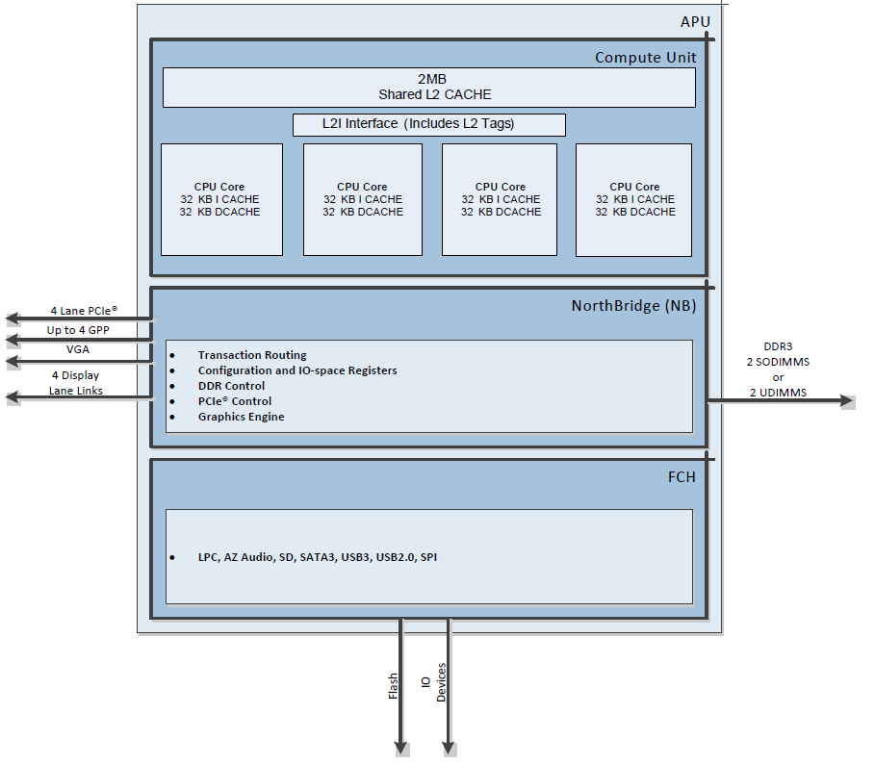
5. On-die interconnects (7)
Core clusters-based CPUs of client processors -1
Core clusters-based CPUs of client processors
Dual-core core clusters
Quad-core core clusters
Examples 1-2
AMD
Bulldozer’s Compute Module (2011-2016) [10]
Family 16h (Jaguar/Puma)-based lines (2013-2015) [9]
Two separate FX cores, shared FP, L2
and front-end to save Si-area and power
L3 is shared at the chip level
(No L3 when GPU available)
Shared L2, no L3

Slide 10
5. On-die interconnects (8)
Core clusters-based CPUs of client processors -2
Core clusters-based CPUs of client processors
Dual-core core clusters
Quad-core core clusters
Example 3
AMD
Zen core-based CCX (Core CompleX) (2017-)
CPU
core
L1
L2
CPU
core
L1
L2
CPU
core
L1
L2
CPU
core
L1
L2
Shared L3
Separate cores, L1, L2 private,
L3 is shared at the CCX level

Slide 11
5. On-die interconnects (9)
Evolution of 4-core core clusters (in mobile and client processors)
CPU
core
L1
CPU
core
L1
CPU
core
L1
CPU
core
L1
CPU
core
L1
CPU
core
L1
CPU
core
L1
CPU
core
L1
CPU
core
L1
L2
CPU
core
L1
L2
CPU
core
L1
L2
CPU
core
L1
L2
Shared L2
ARM (in mobiles)
Shared L3
Cortex-A5 (2009)
Cortex-A7-A9 (optional)
(2005-2011)
Cortex-A15/A17 (mandatory)
(2010/2014)
AMD (in clients and servers)
Family 16h (Jaguar/Puma)-based
lines (2013-2015)
Family 17h (Zen)-based CCX
(Core CompleX) (2017)
*

Slide 12
5. On-die interconnects (10)
On-die interconnects of client processors -4
On-die interconnects link CPU cores or CPU core clusters to the rest of processor
units, as outlined subsequently.

Slide 13
5. On-die interconnects (11)
On-die interconnects of client processors -4
Mostly used on-die interconnects of multicore client processors
Crossbar-based
interconnects
Ring bus-based
interconnect topology
Less cost
for higher nc
CPU
GPU
A
CPU
GPU
A
--
--
--
--
--
Crossbar
Ring bus
MC
IO C.
MC
IO C.
--
--
A: Accelerator (e.g. DSP, NPU)
MC: Memory Controller
nc: Core count
C: Controller
First client processor with ring bus:
Intel’s 4-core Sandy Bridge (2011)
*

Slide 14
5. On-die interconnects (12)
Evolution of on-die interconnects in high core-count processors (e.g. servers)
Evolution of on-die interconnects in high core count processors (e.g. servers)
Ring bus-based
interconnects
2D mesh-based
interconnect
(for servers)
Less cost
for higher nc
Shorter
access time
for higher nc
CPU
GPU
A
R
R
R
R
R
R
--
--
--
CC
CC
A
A
IO
IO
R
R
R
R
R
R
CC
CC
A
A
IO
IO
R
R
R
R
R
R
Ring bus
CC
CC
A
A
IO
IO
R
R
R
R
R
R
MC
MC
MC
P
P
P
R
R
R
R
R
R
MC
MC
MC
P
P
P
MC
--
IO C.
A: Accelerator (e.g. GPU, NPU)
nc: Core count
Examples
Intel
Nehalem-EX (8C, 2010)
and subsequent processors
Skylake-SP for servers
(CC, UPI, 2017)
Knights Landing for AI, (2016)
ARM
CCN-5xx interconnect for servers
(CC, on CHI, 2012)
CMN-6xx Interconnect for servers
(CC, on CHI, 2017)
*

Slide 15
5. On-die interconnects (13)
What type of on-die interconnects are used in multicore client processors?
Actually used on-die interconnects
of multicore client processors
Crossbar-based
interconnects
Ring bus-based
interconnects
Examples
Intel’s multicores up to and including) the
Westmere processor line (2005-2010)
AMD’s K8-based multicores,
like the Athlon 64X2 (2005)
AMD’s K10 (Barcelona)-based lines (2007)
AMD’s Family 12h (Llano)-based lines (2011)
AMD’s Family 14h/16h) (Cat)-based lines (2011-2015)
AMD’s Family 15h (Bulldozer)-based lines (2011-2016)
AMD’s Infinity Fabric (IF) (Part of Family 17h) (2017)
Intel’s multicores beginning with the
Sandy Bridge line (2011)

Slide 16
5. On-die interconnects (14)
Remark
On die interconnects have to provide a cache coherent interconnection between
the processor units, i.e. accessed data should always be the most recent data.
This is a rather sophisticated task, not discussed in this lecture note.

Slide 17
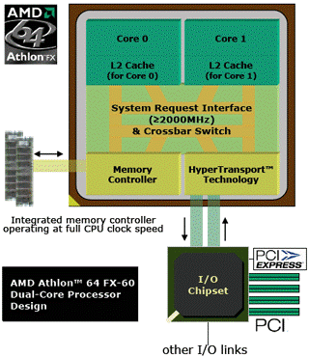
5. On-die interconnects (15)
Example 1: Crossbar interconnect
in AMD’s dual-core
Athlon 64 FX
processor (2006) [11]
Note: The Athlon 64 X2 is
AMD’s first dual core client
processor (it has no GPU).

Slide 18
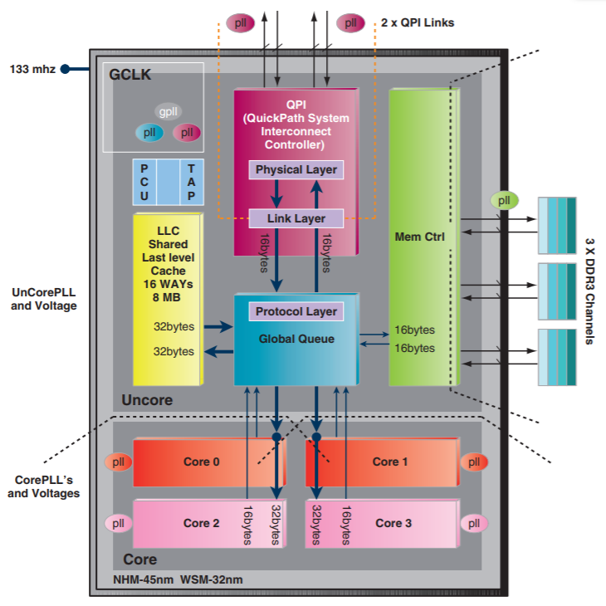
5. On-die interconnects (16)
Example 2: Crossbar interconnect
in Intel’s Nehalem-based
DP-server processor
(2008) [12]
Note: Nehalem-based desktop and
laptop processors employ
the same interconnect as
shown in the Figure
(but have no QPI links).
(Crossbar)

Slide 19
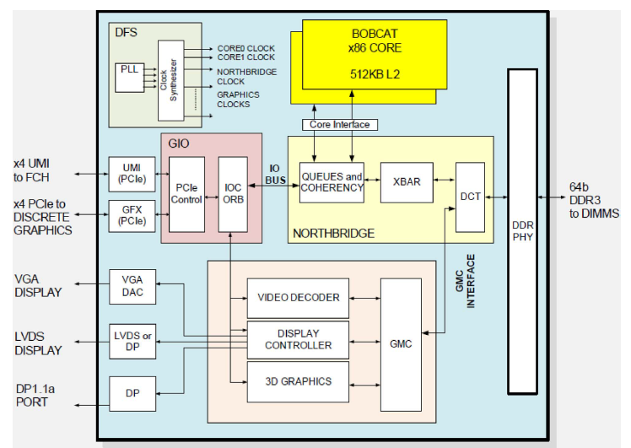
5. On-die interconnects (17)
Example 3: Crossbar interconnect in AMD’s Bobcat-based Zacate line (2011)
[13]
Zacate processor
Note: Zacate processors were the first Cat-based client processor with a GPU.

Slide 20
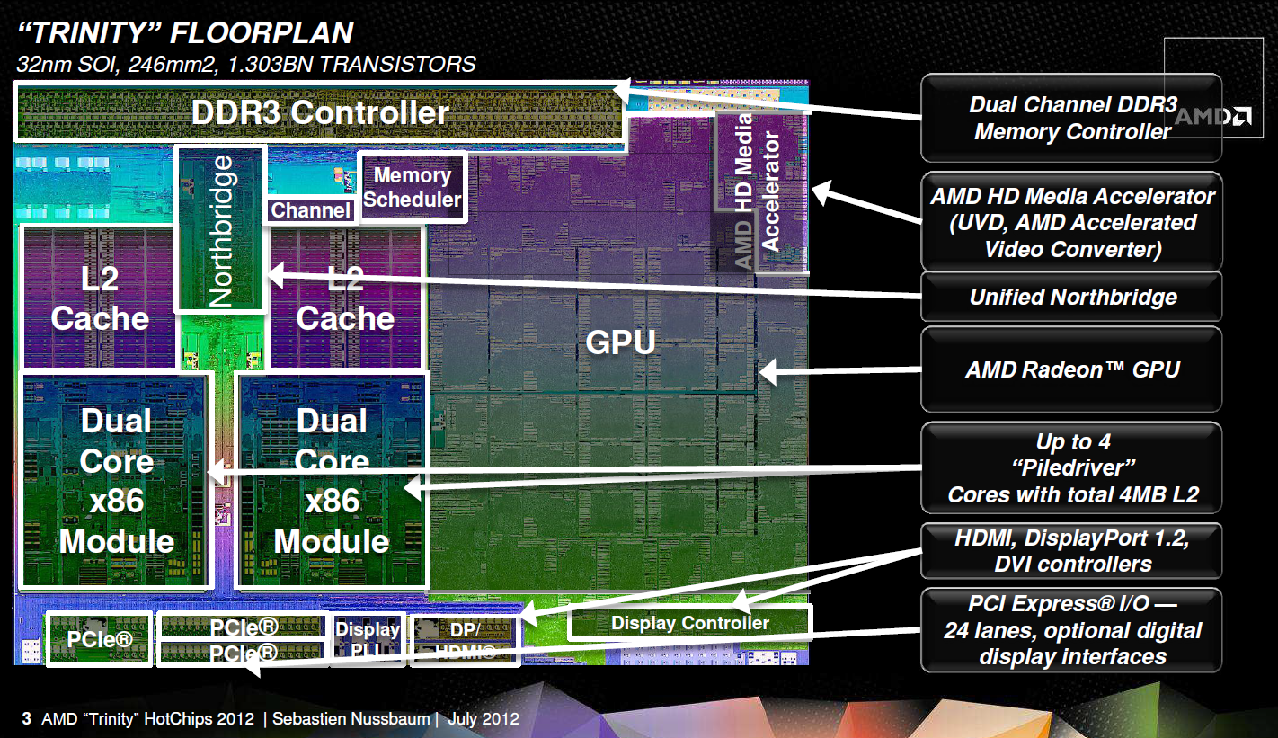
5. On-die interconnects (18)
Example 4: Crossbar interconnect in AMD’s Piledriver (2. gen. Bulldozer)-
based Trinity APU line (2012) [14] -1
Note: It was AMD’s first Bulldozer-based processor with 2-chip platform, integrated NB,
GPU and PCIe connection while using a PCIe x4 link to connect the chipset.

Slide 21
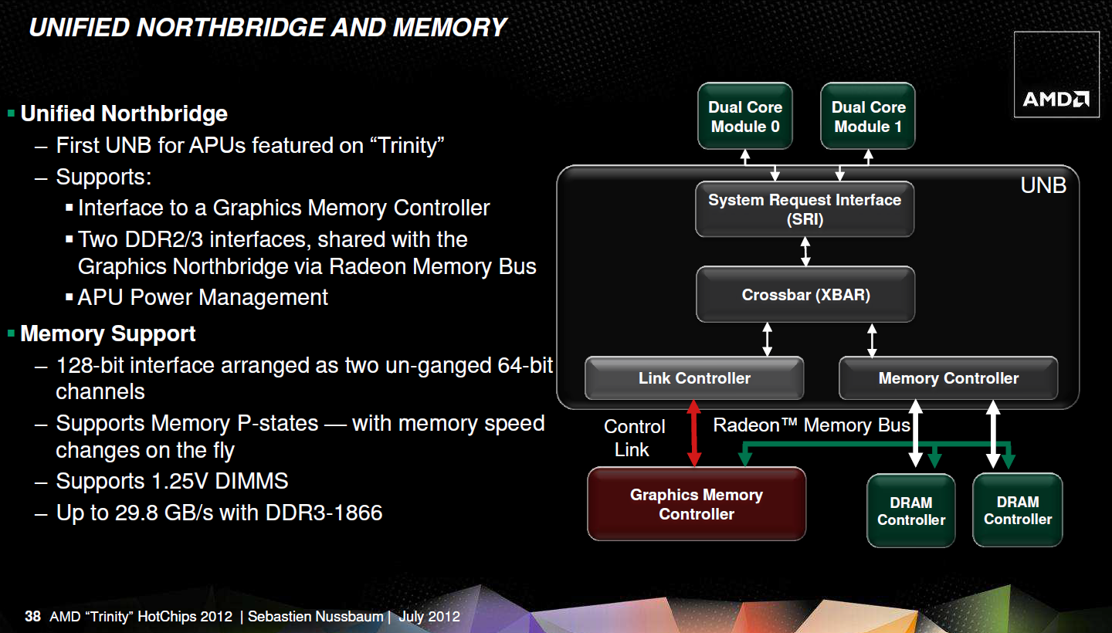
5. On-die interconnects (19)
Example 4: Crossbar interconnect in AMD’s Piledriver (2. gen Bulldozer)-
based Trinity APU line (2012) [14] -2

Slide 22
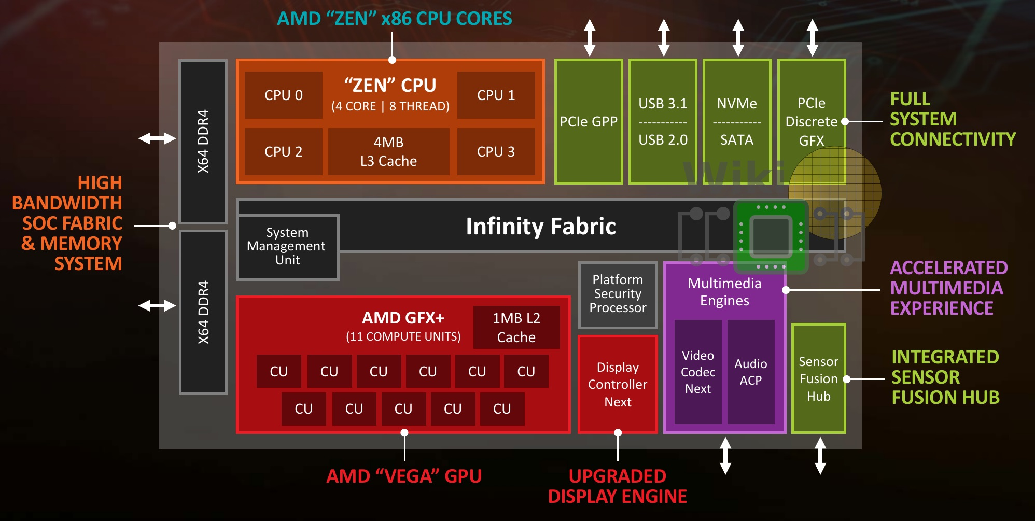
5. On-die interconnects (20)
Example 5: AMD Zen-based Ryzen APU lines (2017) [16] -1

Slide 23
5. On-die interconnects (21)
Example 5: AMD Zen-based Ryzen APU lines (2017) [16] -2
The IF interconnect fabric is based on a sparsely connected “crossbar” [16]

Slide 24
5. On-die interconnects (22)
Example 6: Ring-bus based (single level) on-die interconnect:
in Intel's 4 core Sandy Bridge line (2011) [15]
System Agent
The ring has six bus stops for
interconnecting
four cores
four L3 slices
the GPU and
the System Agent
The four cores and the
L3 slices share the same
interfaces.

Slide 25
5. On-die interconnects (23)
Example 7: Continued use of the ring bus in Intel’s subsequent Core 2-based
lines [6]
2. gen. 4-core Sandy Bridge,
…
8-gen. 6-core Coffee Lake and
9. gen. 8-core Coffee Lake Refresh
Sandy Bridge
Coffee Lake
Coffee Lake Refresh
(2011)
(2017)
(2018)

Slide 26
5. On-die interconnects (24)
Remark
Intel’s Atom family (2008 – 2015) make use of a not detailed interconnect fabric
that actually consists of two fabrics:
a memory fabric and
an IO fabric,
as indicated in the next Figure.
Since no relevant information could be found on these fabrics we can not go
into details.

Slide 27
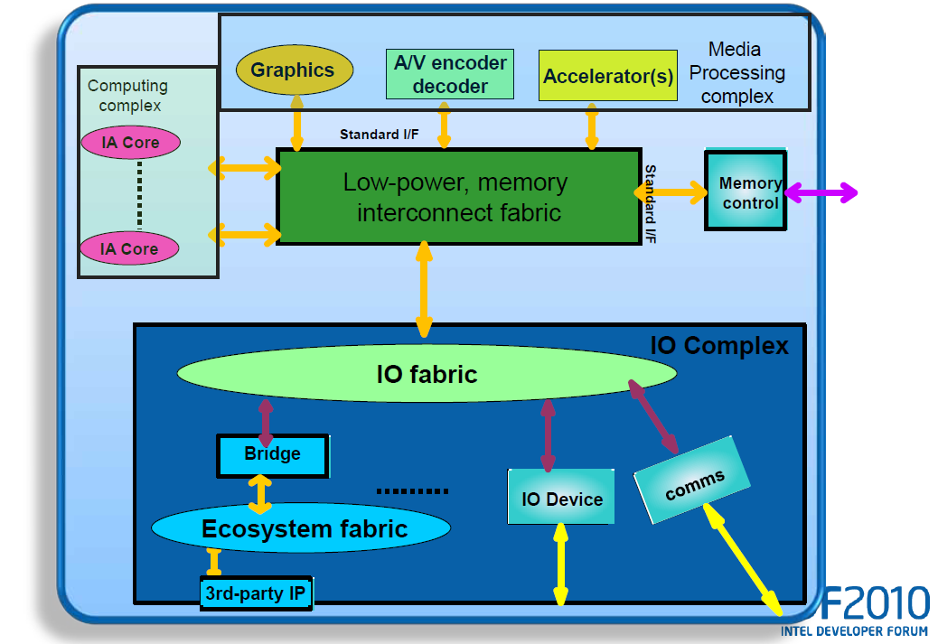
5. On-die interconnects (25)
Generic implementation of the interconnect in Atom processor-based
SoC architectures, revealed at IDF 2010 [17]

Slide 28
5. On-die interconnects (26)
Remark
For comparison, finally we give a short insight into the on-die interconnects
of recent mobile processors.

Slide 29
5. On-die interconnects (27)
Overview of ARM’s recent on-die interconnect solutions
ARM’s recent on-die interconnect solutions
ARM’s non-cache coherent interconnects
ARM’s cache coherent interconnect
Cache coherency is maintained by software.
Induces higher coherency traffic.
Is less effective in terms of
performance and power consumption.
Cache coherency is maintained by hardware.
Induces less coherency traffic.
Is more effective in terms of
performance and power consumption
ARM’s cache coherent interconnects for mobiles
They are crossbar based
Examples
PL-300 (2004)
NIC-301 (2006)
NIC-400 (2011)
CCI-400 (2010)
CCI-500 (2014)
CCI-550 (2015)
NIC: Network Interconnect
CMN: Coherent Mesh Network
CCI: Cache Coherent Interconnect
CCN: Cache Coherent Network

Slide 30
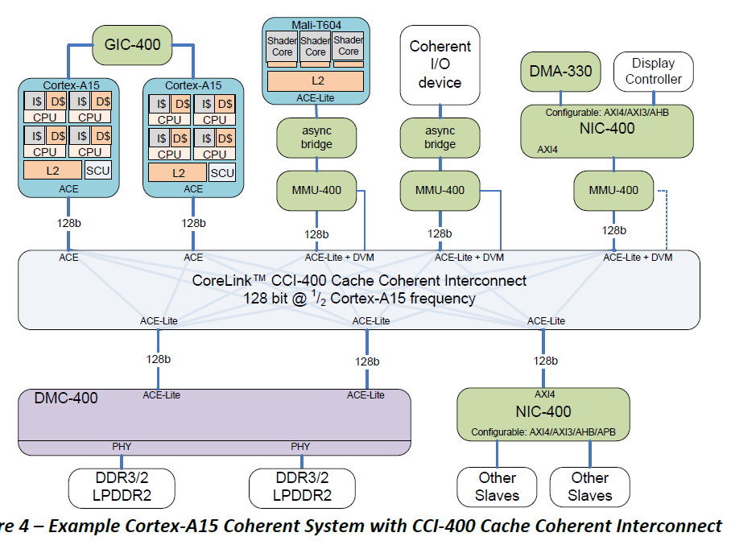
5. On-die interconnects (28)
Example 1: Dual Cortex-A15 SoC based on the CCI-400 interconnect [177]
(Generic Interrupt Controller)
(GPU)
(Network Interconnect)
(Memory
Management Unit)
(DVM: Distributed
Virtual Memory)
(Dynamic Memory Controller)
*

Slide 31
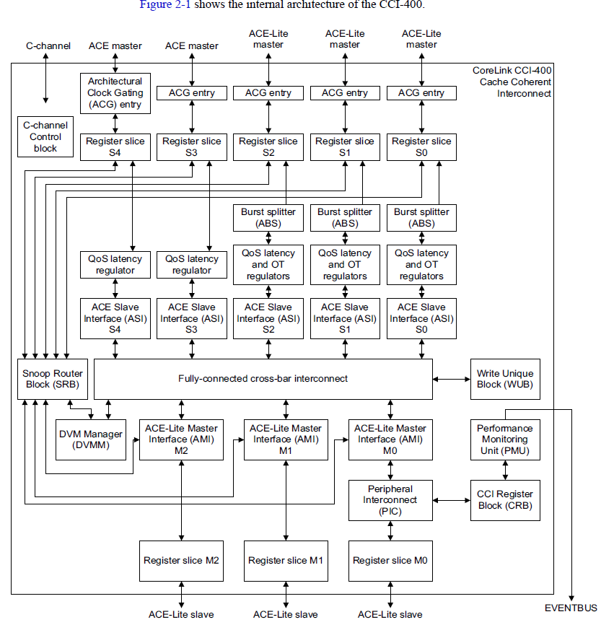
5. On-die interconnects (29)
Internal architecture
of the CCI-400
cache-coherent
Interconnect [178]

Slide 32
5. On-die interconnects (30)
2.3.7.1 Overview of ARM’s recent on-die interconnect solutions
ARM’s recent on-die interconnect solutions
ARM’s non-cache coherent interconnects
ARM’s cache coherent interconnect
Cache coherency is maintained by software.
Induces higher coherency traffic.
Is less effective in terms of
performance and power consumption.
Cache coherency is maintained by hardware.
Induces less coherency traffic.
Is more effective in terms of
performance and power consumption
ARM’s cache coherent interconnects for mobiles
ARM’s cache coherent interconnects for
enterprise computing
They are crossbar based
They are ring bus or 2D mesh based
Examples
PL-300 (2004)
NIC-301 (2006)
NIC-400 (2011)
CCI-400 (2010)
CCI-500 (2014)
CCI-550 (2015)
Ring:
CCN-502 (2014)
CCN-504 (2012)
CCN-508 (2013)
CCN-512 (2014)
2D Mesh:
CMN-600 (2017)
NIC: Network Interconnect
CMN: Coherent Mesh Network
CCI: Cache Coherent Interconnect
CCN: Cache Coherent Network

Slide 33
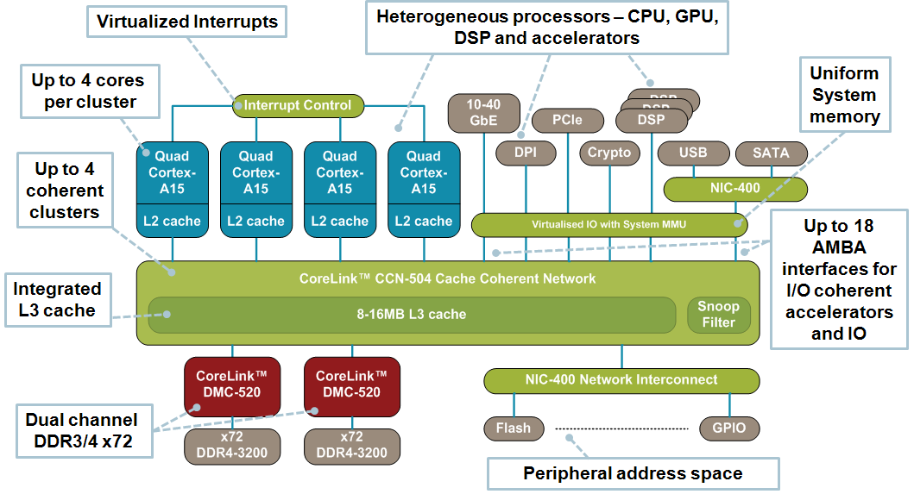
5. On-die interconnects (31)
Example 2: SOC based on the ring-bus based cache-coherent CCN-504
interconnect [179]
*

Slide 34
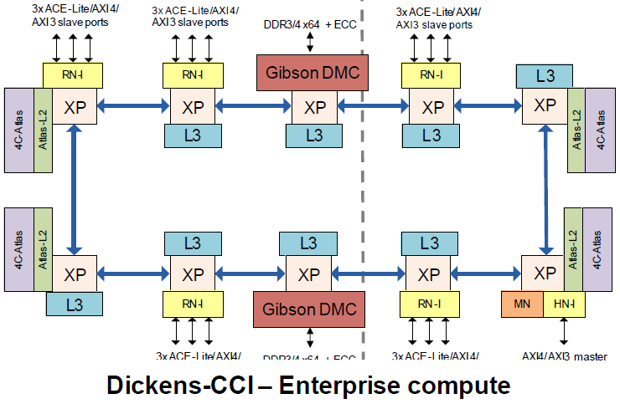
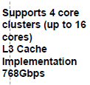
5. On-die interconnects (32)
The ring interconnect fabric of the CCN-504 (dubbed Dickens) (2012) [180]
Remark: The Figure indicates only 15 ACE-Lite slave ports and 1 master port
whereas ARM's specifications show 18 ACE-Lite slave ports and 2 master ports.

Slide 35
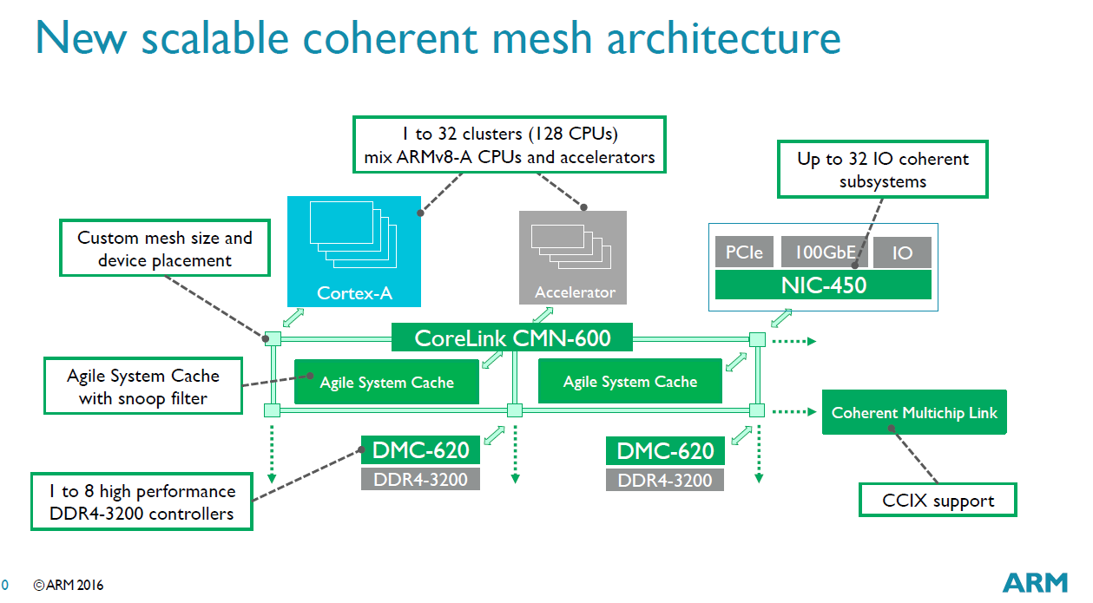
5. On-die interconnects (33)
The 2D mesh interconnect (CMN-600) for server systems (2017) [244]

Slide 36
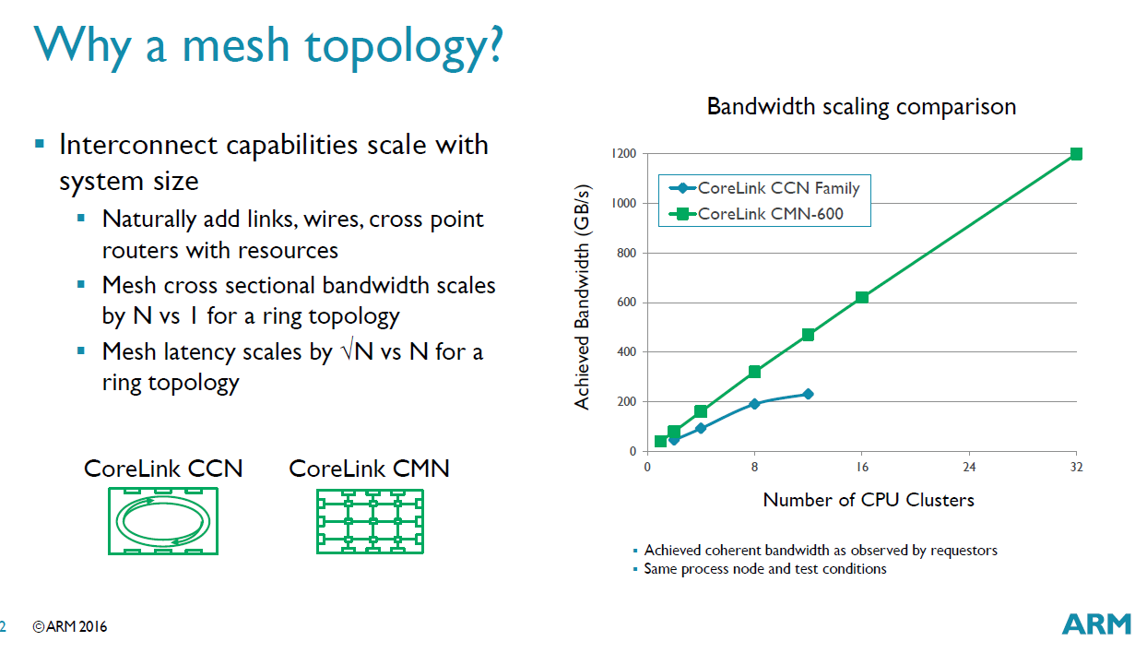
5. On-die interconnects (34)
The reason for changing the interconnect topology for servers [244]
Ring
interconnect
Mesh
interconnect
*

