Slide 1
Client processors – 6-2
Power management
Dezső Sima
October 2019
(Ver. 1.2)
© Sima Dezső, 2019

Slide 2
Contents
6.1 Significance of power management in processors
6.2 Reducing power consumption at the circuit level
6.3 Power management at the platform level - Overview
6.4 Reducing power consumption of idle CPU cores
6.5 Reducing power consumption of active CPU cores
6.6 Utilizing the power headroom of processor packages
to raise performance

Slide 3
6.3 Power management at the platform level - Overview
Notes:
3

Slide 4
6.3 Power management at the platform level – Overview (1)
6.3 Power management at the platform level - Overview
Approaches for power management of computers
(Strongly simplified)
Reducing power consumption
at the circuit level
(Achieved by circuit design)
PM at the platform level
(ACPI-based, achieved by system design)
Clock gating
Power gating
PM of the processor
PM of CPU cores
PM of idle CPU cores
PM of active CPU cores
Reducing
power consumption
of idle CPU cores
Reducing
power consumption
of active CPU cores
Utilizing the power headroom
of a proc. package
to raise performance
C-state management
DVFS/CPPC/AVFS
Turbo Boost Technology
(ACPI-based)
CPPC: Collaborative Processor Power Control
*

Slide 5
6.3 Power management at the platform level – Overview (2)
The need for a standard for power managing computers
Power management of processors or I/O devices (like memory, HD, SSD etc.)
needs typically a concerted effort of both system software (like OS, BIOS)
and hardware to accomplish PM actions on devices of various vendors.
PM standards emerged, first by Intel, targeting PM of processors in the 1990’s,
then as a cooperative effort by Intel and Microsoft.
Finally, in 1996 a group of interested vendors, including Intel, Microsoft, Compaq,
and others adopted the ACPI (Advanced Configuration and Power Interface)
standard, that supports the of configuration of platforms (like hot plug) and
PM of the entire platform.
The next Figure summarizes this evolution.
*

Slide 6
6.3 Power management at the platform level – Overview (3)
Evolution of power management standards
Power management standards
(SL technology)
Advanced
Power Management
(APM)
Advanced Configuration
and Power Interface
(ACPI)
Introduced
10/1990
01/1992
12/1996
Vendor
Intel
Intel and Microsoft
Intel, Microsoft,
Compaq, Phoenix and Toshiba
A set of proprietary
PM techniques
Open standard i.f.
between OS and BIOS
Open standard i.f.
between OS and HW
Typ. CPU scaling
SFS
DFS
DVFS
Done basically
for CPU:
for devices:
by SMM
by SMM
by OSPM/BIOS
by BIOS/OSPM/OS handlers
by OSPM
by OSPM
386SL (embedded)
486SL (embedded)
486 family (since 06/1993)
Pentium M and
subsequent processors
First proc. supp.
Pentium
First Intel’s
chipset supp.:
420EX
420ZX
430FX with PIIX
430HX/430VX with PIIX3
430TX with PIIX4 (ACPI 1.0)
OS support:
No OS support
needed
Windows 95 (08/1995)
Windows 98 (06/1998)
Windows 98 (ACPI 1.0) (06/1998)
Windows XP SP1 (ACPI 2.0) (02/2002)

Slide 7
6.3 Power management at the platform level – Overview (4)
Emergence and evolution of the ACPI standard
The ACPI standard became widely accepted and underwent an intensive evolution,
as the next Figures show.
*

Slide 8
6.3 Power management at the platform level – Overview (5)
Emergence of the ACPI standard and its OS support
08/1995
05/1999
Consumer
products
W 95
W 98SE
ACPI 1.0
Introduction of OS support of DVFS (Dynamic Voltage and Frequency Scaling)
02/2000
10/2001
01/2007
End of 2009
Desktops/
Laptops
W 2000 Prof.
W XP
W Vista
W 7
ACPI 1.0
ACPI 1.0b
SP1 (09/2002): ACPI 2.0¹
ACPI 3.0
ACPI 3.0
02/2000
04/2003
02/2008
Servers
W 2000 Server
W Server 2003
W Server 2008
ACPI 1.0
ACPI 2.0¹
ACPI 3.0
07/1996
Corporate
products
W NT 4.0
12/1996
07/2000
09/2004
06/2009
12/2011
ACPI 1.0
ACPI 2.0
ACPI 3.0
ACPI 4.0
ACPI 5.0
1995
2000
2005
2010
¹: Windows XP and Windows Server 2003 do not support all of the ACPI 2.0 specification [191]
*

Slide 9
6.3 Power management at the platform level – Overview (6)
Support of multicores and multithreading in ACPI 3.0 and its OS support
08/1995
05/1999
Consumer
products
W 95
W 98SE
ACPI 1.0
Support of multicores and multithreading
02/2000
10/2001
01/2007
End of 2009
Desktops/
Laptops
W 2000 Prof.
W XP
W Vista
W 7
ACPI 1.0
ACPI 1.0b
SP1 (09/2002): ACPI 2.0¹
ACPI 3.0
ACPI 3.0
02/2000
04/2003
02/2008
Servers
W 2000 Server
W Server 2003
W Server 2008
ACPI 1.0
ACPI 2.0¹
ACPI 3.0
07/1996
Corporate
products
W NT 4.0
12/1996
07/2000
09/2004
06/2009
12/2011
ACPI 1.0
ACPI 2.0
ACPI 3.0
ACPI 4.0
ACPI 5.0
1995
2000
2005
2010
¹: Windows XP and Windows Server 2003 do not support all of the ACPI 2.0 specification [191]
*

Slide 10
6.3 Power management at the platform level – Overview (7)
Support of Collaborative Processor Performance Control in ACPI 5.0
08/1995
05/1999
Consumer
products
W 95
W 98SE
ACPI 1.0
02/2000
10/2001
01/2007
End of 2009
Desktops/
Laptops
W 2000 Prof.
W XP
W Vista
W 7
ACPI 1.0
ACPI 1.0b
SP1 (09/2002): ACPI 2.0¹
ACPI 3.0
ACPI 3.0
02/2000
04/2003
02/2008
Servers
W 2000 Server
W Server 2003
W Server 2008
ACPI 1.0
ACPI 2.0¹
ACPI 3.0
07/1996
Corporate
products
W NT 4.0
Collaborative Processor Performance Control
(Intel Speed Shift technology)
12/1996
07/2000
09/2004
06/2009
12/2011
ACPI 1.0
ACPI 2.0
ACPI 3.0
ACPI 4.0
ACPI 5.0
1995
2000
2005
2010
¹: Windows XP and Windows Server 2003 do not support all of the ACPI 2.0 specification [191]

Slide 11
6.3 Power management at the platform level – Overview (8)
Subsequent revisions of the ACPI standard
Revision 5.1 was released in 7/2014, in includes an update of CPPC
(Collaborative Processor Performance Control), called CPPC2.
The next update, Revision 6.0 appeared in 4/2015.
Subsequent revisions are:
ACPI 6.1 (1/2016)
ACPI 6.2 (5/2017)
ACPI 6.3 (1/2019)

Slide 12
6.3 Power management at the platform level – Overview (9)
PM of CPU cores
PM at the platform level covers a wide variety of techniques targeting power
management of platform elements, like the processor, memory, HD- or
SSD-devices etc.
From those, we will discuss only the processor level PM.
Processor level PM extends virtually to all elements of the processors, like the
cores, GPU (if available), memory controller, PCI controller etc.
From all of these processor components, subsequently, we focus only on the
cores, and will discuss first the PM of idle cores followed by sections concerned
with the PM of active cores, as highlighted in the next Figure.
*

Slide 13
6.3 Power management at the platform level – Overview (10)
Power management of CPU-cores - Overview
Approaches for power management of computers
(Strongly simplified)
Reducing power consumption
at the circuit level
(Achieved by circuit design)
PM at the platform level
(ACPI-based, achieved by system design)
Clock gating
Power gating
PM of the processor
PM of CPU cores
PM of idle CPU cores
PM of active CPU cores
Reducing
power consumption
of idle CPU cores
Reducing
power consumption
of active CPU cores
Utilizing the power headroom
of a proc. package
to raise performance
C-state management
DVFS/CPPC/AVFS
Turbo Boost Technology
(ACPI-based)
CPPC: Collaborative Processor Power Control
*

Slide 14
6.4 Reducing power consumption of idle CPU cores
6.4.1 Introduction to the ACPI C-states
6.4.2 Overview of ACPI-compliant C-state management
in Intel’s mobile lines
6.4.3 PCU-based C-state management
in Intel’s multithreaded multicore mobile lines
6.4.4 Evolution of C-state management in Intel's mobile lines
Notes:
14

Slide 15
6.4 Reducing power consumption of idle CPU cores (1)
6.4 Reducing power consumption of idle CPU cores -1
Approaches for power management of computers
(Strongly simplified)
Reducing power consumption
at the circuit level
(Achieved by circuit design)
Platform level PM
(ACPI-based, achieved by system design)
Clock gating
Power gating
PM of the processor
PM of CPU cores
PM of idle CPU cores
PM of active CPU cores
Reducing
power consumption
of idle CPU cores
Reducing
power consumption
of active CPU cores
Utilizing the power headroom
of a proc. package
to raise performance
C-state management
DVFS/CPPC/AVFS
Turbo Boost Technology
(ACPI-based)
CPPC: Collaborative Processor Power Control
*

Slide 16
6.4 Reducing power consumption of idle CPU cores (2)
Reducing power consumption of idle CPU cores -2
By power managing idle CPU cores their power consumption can be reduced.
Its implementation is based on the ACPI defined C-states.
Bevor discussing how it is done, first we give an introduction to the ACPI
C-states.
*

Slide 17
6.4.1 Introduction to the ACPI C-states
Notes:
17

Slide 18
6.4.1 Introduction to the ACPI C-states (1)
6.4.1 Introduction to the ACPI C-states -1
C-states, more precisely the C1 – C3 states, have been introduced in the ACPI
standard 1.0 (in 1996) whereas additional C-states, the C4…Cn states ere defined
in the ACPI 2.0 standard (in 2000)), as seen in the next Figure.
*

Slide 19
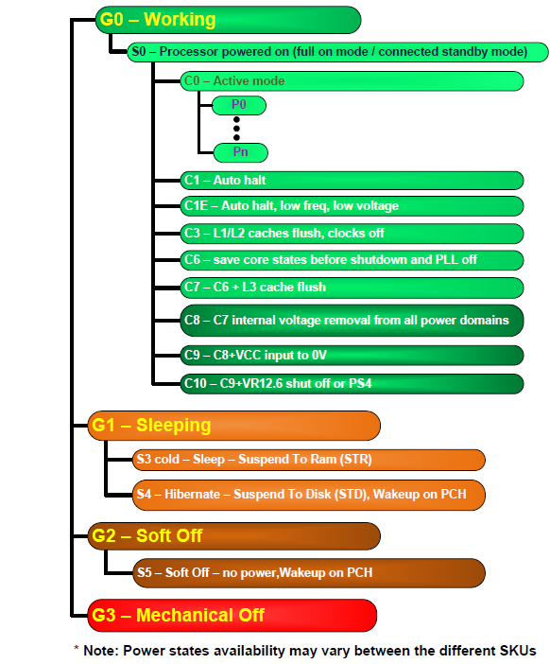
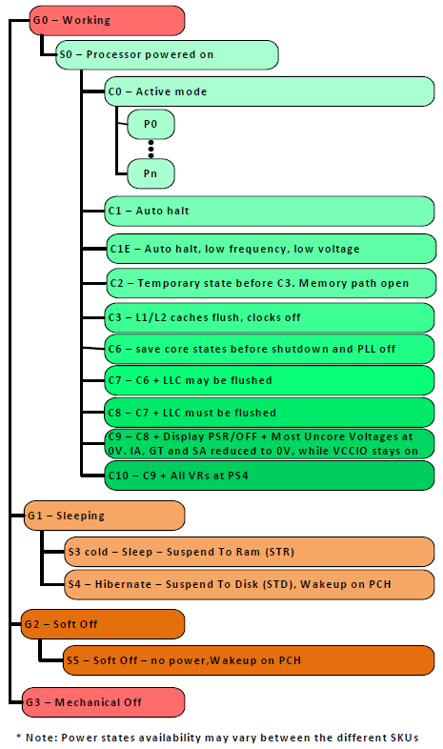
6.4.1 Introduction to the ACPI C-states (2)
ACPI idle states C1 – Cn [181]
Pi: Performance states
(active states, since ACPI 2.0))
Ci: Idle states
C1 … C3 states since ACPI 1.0,
C4 … Cn states since ACPI 2.0
C1
C2
Gi: Global states
Cn
Si: System Sleep states
G1: OS-initiated, system context
saved, no rebooting needed.
G2/Soft off: OS-initiated shut down.
Power supply remains on,
system context is not saved,
the system must be restarted.
G3/Mechanical off: Entered by
activating a mechanical switch.
The system must be restarted.
*

Slide 20
6.4.1 Introduction to the ACPI C-states (3)
Introduction to C-states -2
We point out that the ACPI standard does not give a detailed specification
for the C4 ...Cn states, rather than standardizing the C4 … C4 states the ACPI
standard declares these states (called bewilderingly as additional processor
power states) as higher numbered Ci states that provide higher power savings
along with longer enter and exit latencies.
It follows that e.g. the C4 or C6 state may be specified differently from vendor
to vendor even from processor line to processor line.
*

Slide 21
6.4.1 Introduction to the ACPI C-states (4)
Introduction to C-states -3
In idle states the processor is powered on but does not execute instructions.
This allows to reduce power consumption by various techniques, such as
clock gating, power gating, reducing or switching off the supply voltage of
actually idle cores or caches etc..
Idle states are characterized by two key parameters: the power reduction
they provide and the time needed to enter and exit to and from an idle state.
*

Slide 22
6.4.1 Introduction to the ACPI C-states (5)
Power consumption vs. transfer latency of subsequent C-states
As stated before, higher numbered C states (deeper idle states) have lower power
consumption but increasingly longer transit latencies (enter plus exit times),
as indicated below for the C-states C1 - C6.
Power consumption
C0
D e e p e r i d l e s t a t e s
C1
C2
C3
C4
C5
C6
Enter + exit latency
Figure: Power consumption vs. transfer latency of C-states
*

Slide 23
6.4.1 Introduction to the ACPI C-states (6)
Example 1: Power consumption vs. enter + exit latencies of C states
in Intel's 130 nm Mobile Pentium 4 processor (2002)
Power consumption [W]
40
32W
(C0: TDP, else max values)
C0: Working
30
20
~ 20 FSB cycles
~100 FSB cycles
~30 μs for PLL stabilisation
na.
≈
7.5 W
7.5 W
7.5 W
10
C1: Auto Halt
C2: Stop Grant
C3: Sleep
5.0 W
5
5
5
C3: Deep Sleep
2.9 W
C4: Deeper Sleep
Stop execution
Stop proc. clock
but service snoops
latch interrupts
Stop execution
Stop proc. clock
but service snoops
latch interrupts
Stop servicing
snoops
Stop latching
interrupts
Enter + exit latency
(rough estimate)
Stop PLL
Reduce Vcc until
the retention voltage
of the L2 cache (V_{cc4})
Remark: fc = 2 GHz, FSB = 400 MHz (Northwood-based)
845MP/MZ

Slide 24
6.4.1 Introduction to the ACPI C-states (7)
Example 2: Power consumption vs. enter + exit latencies of C-states
in Intel's 45 nm Penryn-based Mobile processor (T9xxx) (2008) -1
[192]
40
Power consumption
35W
C0: Working
30
~15 μs for PLL
stabilization
Not designated latencies
usually < 1 µs
~100-420 μs for
entering/exiting
C6
20
12.5W
11.8W
C1: Auto C2: Stop
Halt Grant
C3: Sleep
10
5.5W
5
C3: Deep Sleep
1.7W
1.3W
0.3W
C4: Deeper Sleep
C5: Enh.
Deeper Sleep
C6: Deep
Power Down
Enter + exit
latency
(rough estimate)
Stop execution
Stop proc. clock
but service snoops
latch interrupts
L1 caches are
flushed into the
L2 cache
No snnops
No latching of
interrupts
L2 partially flushed
Vcc lowered
(until both the
cores and the
L2 cache retain
their state)
Both cores
save their
architectural states
in on-die SRAMs
Vcc deep below the
core retention voltage
Stop proc. PLL
L2 entirely flushed
Vcc further lowered
(until the cores
retain their state)

Slide 25
6.4.1 Introduction to the ACPI C-states (8)
Example 2: Power consumption vs. enter + exit latencies of C-states
in Intel's 45 nm Penryn-based Mobile processor (T9xxx) (2008) -2
Note that the C6 state has a significantly lower power consumption (0.3 W) than
the C4 state (1.7 W) providing headroom for introducing a forerunner of the
Turbo Boost technology, called EDAT (discussed in Section 6.2).

Slide 26
6.4.2 Overview of ACPI-compliant C-state management
in Intel’s mobile lines
It will not be discussed.
Notes:
26

Slide 27
6.4.2 ACPI-compliant C-state management in Intel’s mobile lines (1)
6.4.2 Overview of ACPI-compliant C-state management in Intel’s mobile lines
Principle of ACPI-compliant C-state management in Intel’s mobile lines
OS recognizes idle periods of instruction execution and instructs the processor
to manage C-states through a software interface.
Interrupts let exit C-states and enter the C0 operating state.
This is summarized in the next Figure, along with the overview of their
implementation alternatives.

Slide 28
6.4.2 ACPI-compliant C-state management in Intel’s mobile lines (2)
Implementation alternatives of ACPI-compliant C-state management
in Intel’s mobile lines
ACPI-compliant C-state management
in Intel’s mobile lines
OS recognizes idle periods of instruction execution
and instructs the processor to manage C-states
through a software interface.
Interrupts let exit C-states
and enter the C0 operating state.
SB-based C-state management
in Intel’s single- and dual-core
mobile lines
PCU-based C-state management
in Intel’s multithreaded multicore
mobile lines
Control logic of the SB
is basically responsible
for managing C-states
On-die PCU
is basically responsible
for managing C-states
From the mobile Pentium II (1998) on
up to
Penryn-based mobiles (2008)
From the 2. gen. Nehalem
(Lynnfield)-based lines on
(2009)
SB: South Bridge
PCU: Power Control Unit

Slide 29
6.4.2 ACPI-compliant C-state management in Intel’s mobile lines (3)
Early, SB-based implementation of ACPI-based C-state management
employed in Intel’s single- and dual-core mobile processors -2
Intel’s early C-state management was based on the SB since early idle state
management was based on idle time counters, implemented in the SB,
indicating long inactivity of periphery units, like HD devices.
SB-based C-state management covered Intel’s single- and dual core mobile
processors, introduced between 1998 and 2008, as summarized in the Figure
above.

Slide 30
6.4.2 ACPI-compliant C-state management in Intel’s mobile lines (4)
Positioning Intel’s early, SB-based implementation of ACPI-based C-state
management
ACPI-compliant C-state management
in Intel’s mobile lines
OS recognizes idle periods of instruction execution
and instructs the processor to manage C-states
through a software interface.
Interrupts let exit C-states
and enter the C0 operating state.
SB-based C-state management
in Intel’s single- and dual-core
mobile lines
PCU-based C-state management
in Intel’s multithreaded multicore
mobile lines
Control logic of the SB
is basically responsible
for managing C-states
On-die PCU
is basically responsible
for managing C-states
From the mobile Pentium II (1998) on
up to
Penryn-based mobiles (2008)
From the 2. gen. Nehalem
(Lynnfield)-based lines on
(2009)
SB: South Bridge
PCU: Power Control Unit

Slide 31
6.4.2 ACPI-compliant C-state management in Intel’s mobile lines (5)
Advanced, PCU-based implementation of ACPI-based C-state management
employed in Intel’s multithreaded multicore lines
Next, along with their 2. generation Nahalem-based client lines (called Lynnfield)
Intel moved C-state management control to the processor, since the Nehalem
line introduced a powerful dedicated microcontroller with the performance of a
486 processor, called Power Control Unit (PCU).
PCU-based C-state management covers Intel’s multithreaded multicore lines
up to now, as seen in the next Figure.

Slide 32
6.4.2 ACPI-compliant C-state management in Intel’s mobile lines (6)
Positioning Intel’s PCU-based implementation of ACPI-based C-state
management
ACPI-compliant C-state management
in Intel’s mobile lines
OS recognizes idle periods of instruction execution
and instructs the processor to manage C-states
through a software interface.
Interrupts let exit C-states
and enter the C0 operating state.
SB-based C-state management
in Intel’s single- and dual-core
mobile lines
PCU-based C-state management
in Intel’s multithreaded multicore
mobile lines
Control logic of the SB
is basically responsible
for managing C-states
On-die PCU
is basically responsible
for managing C-states
From the mobile Pentium II (1998) on
up to
Penryn-based mobiles (2008)
From the 2. gen. Nehalem
(Lynnfield)-based lines on
(2009)
SB: South Bridge
PCU: Power Control Unit

Slide 33
6.4.2 ACPI-compliant C-state management in Intel’s mobile lines (7)
Implementation alternatives of ACPI-based C-state management -5
From both evolution phases of implementing C-state management in Intel’s
mobile line, subsequently we will discuss only the more advanced PCU
(Power Control Unit)-based implementation.

Slide 34
6.4.3 PCU-based C-state management
in Intel’s multithreaded multicore mobile lines
It will not be discussed.
Notes:
34

Slide 35
6.4.3 PCU-based C-state management in Intel's mobile lines (1)
6.4.3 PCU-based C-state management in Intel's multithreaded multicore
mobile lines -1
ACPI-compliant C-state management
in Intel’s mobile lines
OS recognizes idle periods of instruction execution
and instructs the processor to manage C-states
through a software interface.
Interrupts let exit C-states
and enter the C0 operating state.
SB-based C-state management
in Intel’s single and dual-core
mobile lines
PCU-based C-state management
in Intel’s multithreaded multicore
mobile lines
Control logic of the SB
is basically responsible
for managing C-states
On-die PCU
is basically responsible
for managing C-states
From the mobile Pentium II (1998) on
up to the
Penryn-based mobile lines (2008)
From the 2. gen. Nehalem
(Lynnfield)-based lines on
(2009)
Section 5.3
Section 5.4
SB: South Bridge
PCU: Power Control Unit
*

Slide 36
6.4.3 PCU-based C-state management in Intel's mobile lines (2)
PCU-based C-state management in Intel's multithreaded multicore
mobile lines -2
Intel introduced PCUs (Power Control Units) to accomplish power management
(i.e. P-state management, C-state management, the Turbo Boost technology etc.)
along with integrating memory controllers onto the processor die first in their
Nehalem line in 2008.
Subsequently, first mobiles with PCU-based C-state management arouse along with
the 2. generation Nehalem (Lynnfield) line of processors in 2009.
(Note here that the first generation Nehalem family was server oriented and
did not cover mobile models, whereas both generations introduced multithreading
into the Core 2 family).
*

Slide 37
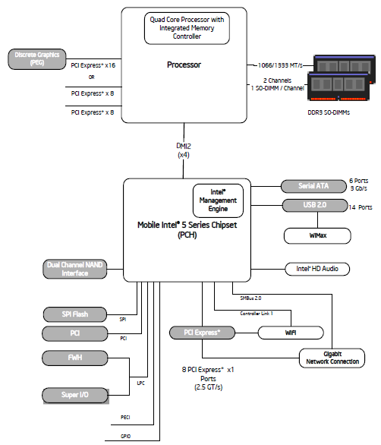
6.4.3 PCU-based C-state management in Intel's mobile lines (3)
Example 1: 2. gen Nehalem (Lynnfield)
based two-chip mobile platform
Intel's i7-900M (2009) [193]

Slide 38
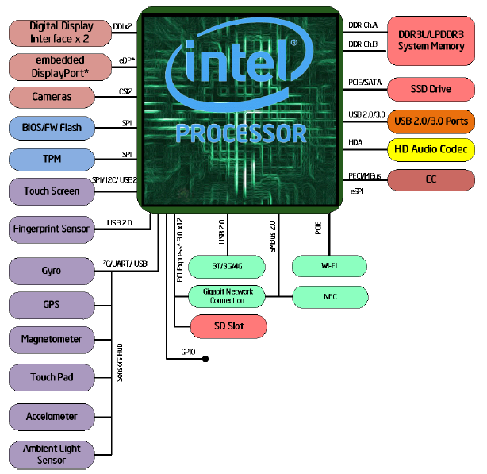
6.4.3 PCU-based C-state management in Intel's mobile lines (4)
Example 2: Skylake-based single-chip mobile platform Intel's i7-6xxxU SoC
(2015) [194]

Slide 39
6.4.3 PCU-based C-state management in Intel's mobile lines (5)
Main enhancements of the Nehalem-based multithreaded multi-core
processor lines aiming at power management
c) Utilizing power gating to switch off idle cores individually
The subsequent Haswell and Broadwell lines introduced integrated voltage
regulators, these replaced power gating, but after integrated power gating
was omitted due to additional dissipation in the Skylake line, Intel made use
of power gating anew to switch off idle cores.
b) Introducing on-die Power Control Units (PCUs)
(implemented actually as dedicated 32-bit microprocessors)
c) Introducing the Turbo Boost technology.
d) Implementing power management for the introduced L3 cache

Slide 40
6.4.3 PCU-based C-state management in Intel's mobile lines (6)
Main tasks of PCU-directed C-state management in Intel's multi-core
multi-threaded mobile lines -Overview
Main tasks of PCU-directed C-state management in Intel's multi-core multi-threaded mobile lines
(from the mobile 2. gen. Nehalem (Lynnfield)-based lines (2009)
a) Recognizing the length
of thread idleness
in time windows
by the OSPM
c) OSPM communicates
the target C-state
of the thread
to the processor
via a software interface
e) The PCU performs
the needed control
operations to accomplish
the transition to
the target core and
package C-state
b) Decision for the new
C-state of the thread
by the OSPM, based on the
length of thread idleness
and C-state history
d) The PCU coordinates
thread C-states
for multithreaded cores
and core C-states
in multicores if cores use
common resources
(e.g. Vcc or L3)

Slide 41
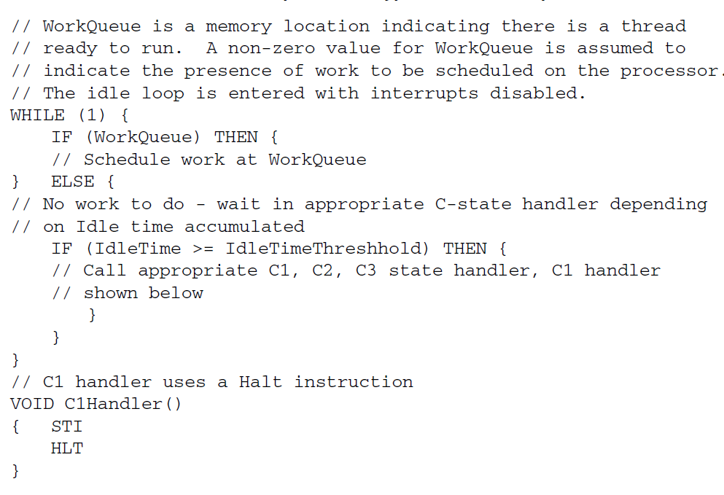
6.4.3 PCU-based C-state management in Intel's mobile lines (7)
a/b) Recognizing the length of thread idleness and determine the next
C-state
The OSPM recognizes the length of thread idleness for each thread in a loop,
as indicated below [195].
The above program segment shows only C1 – C3 states, higher states are
managed basically in the same way.

Slide 42
6.4.3 PCU-based C-state management in Intel's mobile lines (8)
c) OSPM communicates the target C-state of the thread to the processor
via a software interface -1
The OSPM has basically two software interfaces to communicate the target
C-state of the thread to the processor.
The primary interface is introduced along with the Core and Core 2 families and
is given by
the MWAIT(Cx) instructions [x denotes here the C-state level]
and the EAX and ECX MSRs (Machine Specific Registers),
as follows:

Slide 43
6.4.3 PCU-based C-state management in Intel's mobile lines (9)
The MWAIT Hints and MWAIT Extension MSR registers [196]
Bits | Description
3:0 | Sub C-state within a C-state, indicated by bits [7:4]
7:4 | Target C-state Value of 0 means C1; Value of 1 means C2 and so on Value of 01111B means C0 Note: Target C states for MWAIT extensions are processor-specific C-states, not ACPI C-states
31: 8 | Reserved
Table: MWAIT Hints MSR register (EAX)
Bits | Description
0 | Treat interrupts as break events even if masked (e.g., even if EFLAGS.IF=0). May be set only if CPUID.05H:ECX[bit 1] = 1.
31: 1 | Reserved
Table: MWAIT Extension MSR register (ECX)

Slide 44
6.4.3 PCU-based C-state management in Intel's mobile lines (10)
OSPM communicates the target C-state of the thread to the processor
via a software interface -2
The OSPM may also use a secondary, in fact ACPI interface by issuing the legacy
LVL-x I/O read instructions to the Processor Control Block registers of the SB,
called Level x registers, but these instructions will not be executed in the processor
but converted to MWAIT(Cx) instructions.

Slide 45
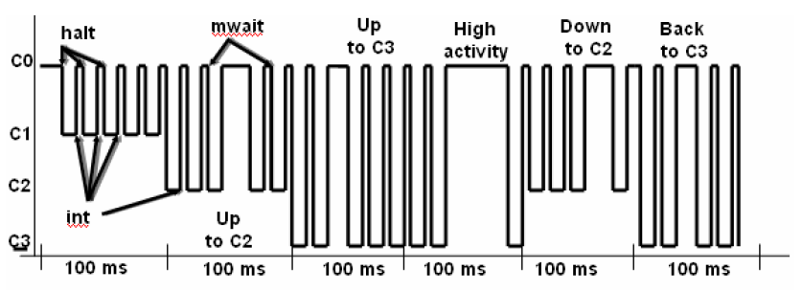
6.4.3 PCU-based C-state management in Intel's mobile lines (11)
Example for initiating C-state transitions by the OS Power Manager (OSPM)
The OSPM scheduler recognizes when no work is to do for the processor,
evaluates the rate of idle time in time windows (of e.g. 100 ms) and initiates
a transition to a target C-state according to the actual and prior utilization
in the time window, by sending MWAIT(Cx) instructions to the processor.
The following example will illustrate this.
Instructions to enter C states
MWAIT
(C3)
MWAIT
(C3)
MWAIR
(C3)
MWAIT
(C2)
MWAIT
(C2)
LVL_2
Example: Initiating C-state transitions by the OSPM [197]
int: interrupt

Slide 46
6.4.3 PCU-based C-state management in Intel's mobile lines (12)
d) The PCU coordinates thread C-states for multithreaded cores and
core C-states in multicores if cores use common resources (e.g. Vcc or L3)
The OSPM monitors individual threads and requests individual thread C-states.
On the other hand, threads that are running on the same core, share basic
per core resources, like L1 and L2 caches.
Therefore, for managing Core C-states the states of all threads running on
the same core need to be taken into consideration, in other words C-states
of the threads running on the same core need to be coordinated, as indicated
below.
Figure: Coordination of C-states of the threads running on the same core [198]

Slide 47
6.4.3 PCU-based C-state management in Intel's mobile lines (13)
Coordination of thread C-states resulting in core C-states
The coordination of thread C-states result in core C-state.
The general rule for coordinating thread C-states is as follows:
The lowest numbered thread state running on a core determines the core's
C-state.
E.g. if Thread 0 requests C1 state while Thread 1 the C3 state, this results
in a core C1 state.
It is the CPU that takes over the coordination of thread C-states resulting in
core C-states.

Slide 48
6.4.3 PCU-based C-state management in Intel's mobile lines (14)
Coordination of core C-states resulting in package C-states
There is a further need for coordinating the C-states of all cores within a processor
if there are common resources for all cores, like Vcc or the L3 cache.
Result of the coordination is the package C-state of the processor, as indicated below.
Figure: Coordination of core C-states resulting in a package C-state [198]
The general rule for the coordination of core C-states resulting in package C-states
is as follows:
A package C-state is determined by the lowest numbered core state.
E.g. if core 0 requests C1 state while core 1 requests C3 state, the resulting
package state will be the C1 package state, as indicated in the next Table.

Slide 49
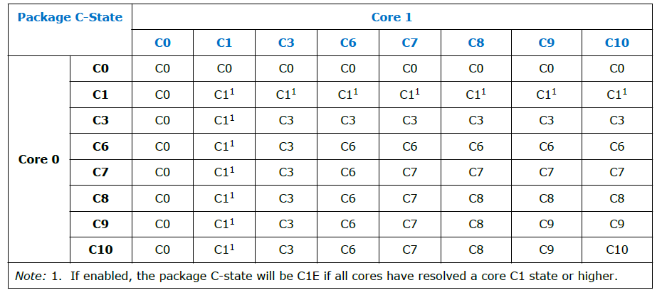
6.4.3 PCU-based C-state management in Intel's mobile lines (15)
Example: Coordination of core C-states resulting in package C-states
in Haswell-based dual-core mobile processors [181]
Note that the package C-state is determined by the C-state of the less idle core.

Slide 50
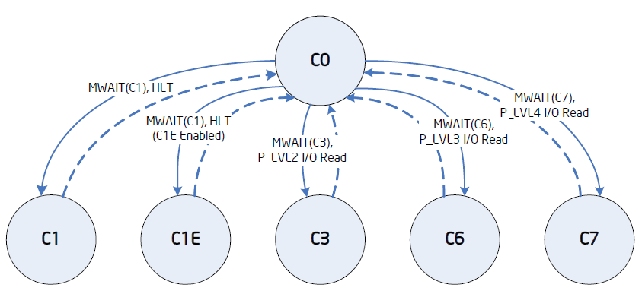
6.4.3 PCU-based C-state management in Intel's mobile lines (16)
e) The PCU performs the needed control operations to accomplish
the transition to the target core and package C-state
e1) Entering and exit requested Core C-states [198]

Slide 51
6.4.3 PCU-based C-state management in Intel's mobile lines (17)
Example: Package C-states
in Haswell-based mobiles
[181]

Slide 52
6.4.3 PCU-based C-state management in Intel's mobile lines (18)
e2) Core and package C-states and invoked power saving actions in PCU-
based C-state management in Intel’s multithreaded multicore mobile lines
Power
consumption
C0: Normal
C1: Auto Halt
C1E: Auto Halt +
lowest fc, Vcc
Core C3
Package C3
Core C6
Package C6
Core C7
Package C7
Core C8
Package C8
Core C10
Package C10
2. gen. Nehalem (Lynnfield) Mobile (2009), Westmere Mobile (2010),
Broadwell Mobile (2015)
Wake-up time
Sandy Bridge Mobile (2011), Ivy Bridge Mobile (2012)
Haswell Mobile (2014), Skylake Mobile (2015), Kaby Lake Mobile (2016)
Core level
power saving
approach
(per core
action)
Stop instr. exec.
Stop Core clock
Service snoops
Latch interrupts
Flush L1, L2
into the L3
Stop core PLL
Core saves
its arch. state
into an SRAM
Then Vcc 0
Stop core PLL
As Core C6, but
last core entering
Core C7, should
start flushing L3
by N-ways to mem.
As Core C6 state
As Core C6 state
Processor level
power saving
approach
(package
actions)
Snoop L3 cache
L3 cache is
snoopable
All uncore clocks
stopped
Most uncore
voltages 0
If L3 entirely
flushed, voltage
from the L3 cache
will be removed
Voltage removed
from all
power domains
VR is set to
low power state,
near shut off.

Slide 53
6.4.3 PCU-based C-state management in Intel's mobile lines (19)
Core C1-C7 states and Package
PC7-PC10 states as well as invoked
power saving actions in PCU-based
C-state management in multithreaded
multi-core mobile lines (simplified)
C1
Stop instruction execution
L1
L1
L1
L1
C0
Cn
L2
L2
C3
Flush
C3
Flush
L3
Stop core clocking
Stop core clocking
C6
C0
SRAM
C6
Cn
SRAM
Stop core PLL
Stop core PLL
Vcc
0
Vcc
0
L3
C7
Last core into C6:
Flush N-ways
Memory
PC7
If L3 entirely flushed: VL3 0
For all power domains: V 0
VR low power state
PC8
PC10

Slide 54
6.4.3 PCU-based C-state management in Intel's mobile lines (20)
Remark: Utilizing PCUs and the C6 idle state for implementing core parking -1
[199], [200]
Core parking is a new processor power reduction feature introduced in the
Windows 7 and Windows Server 2008 R2 OSs in 2009.
With core parking the PCU (Power Control Unit) of the processor and the OS
scheduler work together to dynamically adjust the number of cores that are
running threads (in a not detailed way).
The PCU chooses a minimum number of cores on which threads can be scheduled
by the OS.
The other cores are considered to be parked, the OS does not schedule any
threads on them and they can be dropped into a deep idle state, e.g. into the
C6 idle state.
If needed, parked cores can be re-activated.
The benefit of core parking is that parked cores being e.g. in the C6 idle state
have a very low power consumption.
In this way, core parking can increase power efficiency during lower usage
periods of the processor because parked cores can drop into a low-power state.

Slide 55
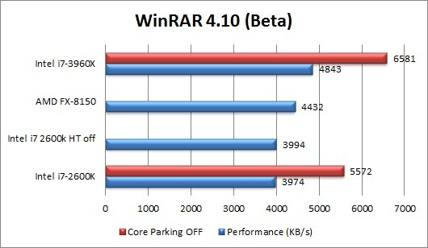
6.4.3 PCU-based C-state management in Intel's mobile lines (21)
Remark: Utilizing PCUs and the C6 idle state for implementing core parking -2
[199], [200]
On the other hand, the availability of less cores can reduce processor
performance in more demanding workloads, as indicated in the Figure below.
Figure: Example for performance reduction while running a demanding workload
with core parking enabled [201]

Slide 56
6.4.3 PCU-based C-state management in Intel's mobile lines (22)
Remark: Utilizing PCUs and the C6 idle state for implementing core parking -3
[199], [200]
Core parking can be tuned by specifying the minimum and maximum percentage
of unparked (i.e. for scheduling available) cores for every power plane
separately by appropriate PM settings.
By setting the minimum number of unparked cores to 100 % core parking can
simply be disabled.
Whether or not the tradeoff between power reduction and performance
implications result in a more or less efficient system is highly dependent on
the processor and the workload and need to be individually investigated.
With the introduction of the Speed Shift technology Intel announced that the
PCU will overtake the responsibility both for frequency scaling and core parking.

Slide 57
6.4.3 PCU-based C-state management in Intel's mobile lines (23)
Remark
There are some contradictions in the C-state descriptions of the datasheets
relating to different models.
Accordingly, there is a certain uncertainty in our descriptions as well.

Slide 58
6.4.4 Evolution of C-state management in Intel's
mobile lines
Notes:
58

Slide 59
6.4.4 Evolution of C-state management in Intel's mobile lines (1)
6.4.4 Evolution of C-state management in Intel's mobile lines
Simplified overview, where some issues, like snooping or interrupt handling omitted.

Slide 60
6.4.4 Evolution of C-state management in Intel's mobile lines (2)
Evolution of C-state management in Intel's mobile lines
SB-based
in single core proc.
SB-based in dual-core processors
PCU-based in multithreaded
multi-core processors
Stop instruction execution
Stop core clocking
C1
Stop instr. exec.
Stop proc. clocking
C1
C1
Stop instruction execution
C0
C1
L1
L1
L1
C3
Stop all clocks
Stop PLL
L1
L1
C0
Cn
L1
L1
L1
C4
Vcc
Vcc4
C3
Flush
Flush
L2
L2
L2
C3
Flush
C3
Flush
PC3
2. core:
Flush
N-ways/Entirely
L3
Memory
Stop core clock
Stop core clock
Stop CPU PLL, stop FSB clock
C6
C0
SRAM
C6
Cn
SRAM
PC4
Vcc
Vcc4
Stop core PLL
Stop core PLL
Vcc
0
Vcc
0
PC4'
If L2 flushed:
Vcc
Vcc5
L3
C6
C0
SRAM
C1
SRAM
C7
Last core into C6:
Flush N-ways
PC6
After C0, C1
saved:
Vcc
Vcc6
Memory
Vcc4: Retention V of L3
Vcc5: Retention V of the cores
Vcc6: A low V (V: Voltage)
PC7
If L3 entirely flushed: VL3 0
For all power domains: V 0
VR low power state
Vcc4 : Retention V of L2
PC8
PC10

Slide 61
6.5 Reducing power consumption of active CPU cores
6.5.1 Overview
6.5.2 DVFS (Dynamic Voltage and Frequency Scaling)
6.5.3 CPPC (Collaborative Processor Performance Control)
6.5.4 AVFS (Adaptive Voltage or Frequency Scaling)
Notes:
61

Slide 62
6.5.1 Overview
Notes:
62

Slide 63
6.5.1 Overview (1)
6.5.1 Overview -1
Approaches for power management of computers
(Strongly simplified)
Reducing power consumption
at the circuit level
(Achieved by circuit design)
Platform level PM
(ACPI-based, achieved by system design)
Clock gating
Power gating
PM of the processor
PM of CPU cores
PM of idle CPU cores
PM of active CPU cores
Reducing
power consumption
of idle CPU cores
Reducing
power consumption
of active CPU cores
Utilizing the power headroom
of a proc. package
to raise performance
C-state management
DVFS/CPPC/AVFS
Turbo Boost Technology
(ACPI-based)
CPPC: Collaborative Processor Power Control
*

Slide 64
6.5.1 Overview (2)
Overview -2
There are three basic techniques for reducing the power consumption of active
CPU cores:
DVFS: Dynamic Voltage and Frequency Scaling
CPPC: Collaborative Processor Power Control
AVFS: Adaptive Voltage and Frequency Scaling
These techniques will be described in the next Sections.

Slide 65
6.5.2 DVFS (Dynamic Voltage and Frequency Scaling)
Notes:
65

Slide 66
6.5.2 DVFS (Dynamic Voltage and Frequency Scaling (1)
6.5.2 DVFS (Dynamic Voltage and Frequency Scaling)
Principle of DVFS
There are two relationships DVFS is based on:
a) Dynamic power consumption is given by:
Dd = const. * Vcc² * fc
with Vcc: core voltage
fc: clock frequency
b) The core voltage (Vcc) that is needed for generating the clock frequency (fc) is
nearly linearly proportional with the clock frequency (fc).
Vcc = const. * fc
Since fc very sensitively impacts Dd (Dd = const. * fc³), the idea of DVFS is
to scale down fc as far as possible, that is as far as the run time of the actual
workload does not lengthen noticeably and lower Vcc to the reduced fc value
needed.
This principle will be applied in subsequent time windows of, say 100 ms to reduce
dynamic power consumption.
*

Slide 67
6.5.2 DVFS (Dynamic Voltage and Frequency Scaling (2)
Principle of the implementation of DVFS -1
DVFS is implemented based on P-states (Performance states) defined by the
2. release of the ACPI standard, as indicated in the next Figure.
*

Slide 68
6.5.2 DVFS (Dynamic Voltage and Frequency Scaling (3)
ACPI P (Performance) states P0 – Pn [181]
Pi: Performance states
(active states, since ACPI 2.0))
Ci: Idle states
(C4…Cn states since ACPI 2.0)
C1
C2
Gi: Global states
Cn
Si: System Sleep states
G1: OS-initiated, system context
saved, no rebooting needed.
G2/Soft off: OS-initiated shut down.
Power supply remains on,
system context is not saved,
the system must be restarted.
G3/Mechanical off: Entered by
activating a mechanical switch.
The system must be restarted.
*

Slide 69
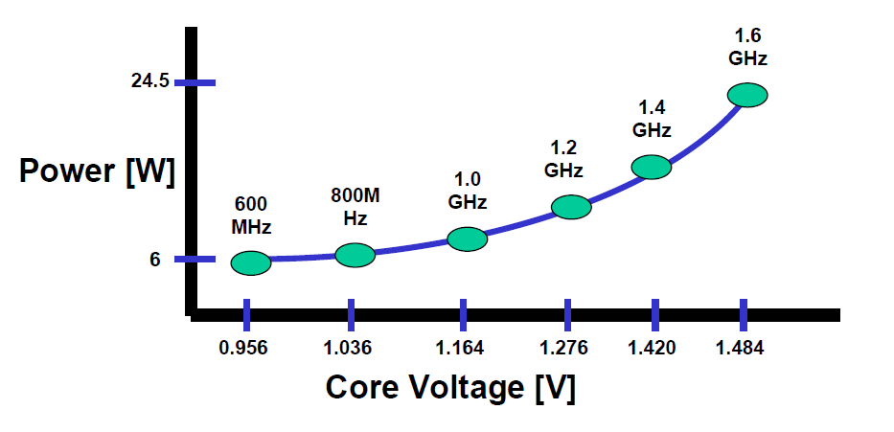
6.5.2 DVFS (Dynamic Voltage and Frequency Scaling (4)
Principle of the implementation of DVFS -2
P-states are possible operating points (Vcc and fc pairs) of a core while running
under DVFS.
An example below will illustrate this.
P1
P2
P6
Example: Operating points of Intel’s Pentium M processor (~2003)
*

Slide 70
6.5.2 DVFS (Dynamic Voltage and Frequency Scaling (5)
Principle of the implementation of DVFS -3
Now it is the task of the OS to determine how far fc and Vcc can be reduced
without causing a noticeable lengthening of the run time of the actual workload.
To do this the OS will assess the utilization rate of the core in subsequent
time windows (of. e.g. 100 ms) while running the actual workload and
will choose the P-states that is needed to perform this workload without
lengthening the run time.
E.g. if a core runs recently at 2 GHz but it is utilized only by 50 %, each second
clock cycle is wasted and the clock frequency can be reduced to 1 GHz without
worsening the user experience.
Then the OS selects the optimal working point from a given list of possible
working points (fc, Vcc values) by looking for the P-state with a core frequency
of at least 1 GHz.
*

Slide 71
6.5.2 DVFS (Dynamic Voltage and Frequency Scaling (6)
Principle of the implementation of DVFS -4
Subsequently, the OS will inform the processor about the P-state requested via
a software interface defined by the ACPI standard, and typically, the PCU
(Power Control Unit) of the CPU will accomplish the required P-state transition,
as will be detailed in more detail next.
*

Slide 72
6.5.2 DVFS (Dynamic Voltage and Frequency Scaling (7)
Principle of the implementation of DVFS -5
While operating, DVFS continuously scales down both the clock frequency (fc) and
the core voltage (Vcc) as far as feasible without noticeable lengthening the run time
of the workload, in order to reduce power consumption, as indicated below.
Vcc
P0
Vcc0
●
Workload
P1
●
Highest
power
consumption
Vcc1
P2
Vcc2
●
.
.
Pn
Vccn
●
Both fc and Vdd will be scaled
according to the workload intensity.
Vcc is chosen with a guard band
according to the actual fc values.
Lowest
power
consumption
..
fc
fcn
fc2
fc1
fc0
Figure: Principle of DVFS
Note that DVFS is a sort of demand based scaling of the clock frequency and
core voltage.
*

Slide 73
6.5.2 DVFS (Dynamic Voltage and Frequency Scaling (8)
Remark
We note that certain early DVFS implementations (notable from AMD in about 2000)
were not ACPI-based but proprietary.
Nevertheless, we do not want to go into any details.

Slide 74
6.5.2 DVFS (Dynamic Voltage and Frequency Scaling (9)
Main tasks of the implementation of DVFS (assuming multithreading)
Main tasks of OS directed DVFS implementation (assuming multithreading)
a) Determination of
the thread utilization
by the OS
c) Coordination of
target P-states
(by the OS or proc.)
e) Accomplishing the
fc, Vcc transitions
by the processor
b) Based on the calculated
thread utilization
determination of
the target P-state
by the OS
d) Communicating
the target P-state
by the OS
to the processor
*

Slide 75
6.5.2 DVFS (Dynamic Voltage and Frequency Scaling (10)
a) Determination of thread utilization by the OS (simplified) [202] -1
Recent processors have two Model Specific Registers (MSRs) per thread
(called also logical processors), that are actually 64-bit counters.
One of the counters (IA32_MPERF MSR (0xE7h)) will be incremented in proportion
to the base frequency,
the other one (IA32_APERF MSR (0xE8h)) will be incremented in proportion
to the actual performance.
These counters are updated only when the related processor is in the C0 state.
Now the OS calculates the thread utilization (in %) in the actual time window
as the rate of the actual count and the base count in this window.
Remark: The 64-bit counters used to determine thread utilization were introduced
in the Pentium M Core Duo (Yonah) processor in 2006, based on an Intel patent
[203].
*

Slide 76
6.5.2 DVFS (Dynamic Voltage and Frequency Scaling (11)
b) Based on the calculated thread utilization determination of the target
P-state by the OS
The OS has a list of available P states of the cores (specifying fc and needed Vcc).
From the available P-states the OS selects the lowest possible to service the
actual load (i.e. utility rate).
*

Slide 77
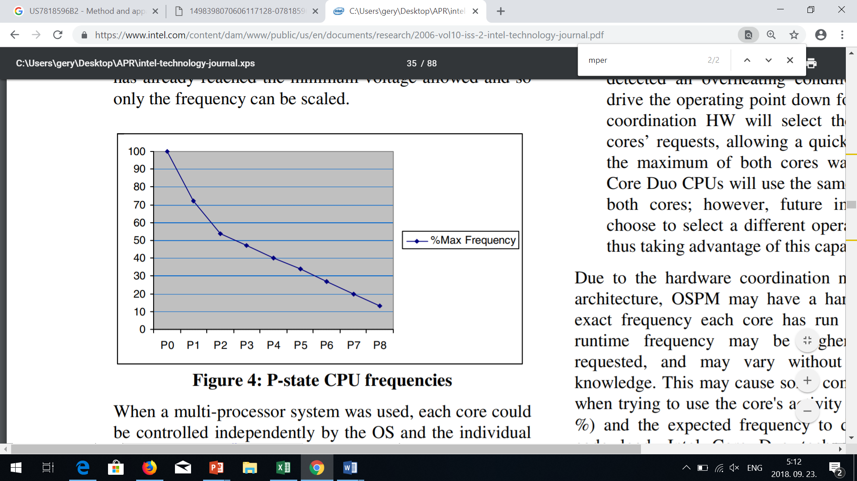
6.5.2 DVFS (Dynamic Voltage and Frequency Scaling (12)
Example allocation of a P-state to the actual thread utilization [204]
Core utilization %
Thread utilization %
Actual thread utilization %
*

Slide 78
6.5.2 DVFS (Dynamic Voltage and Frequency Scaling (13)
c) Coordination of target P-states
OS manages P-states of threads.
If there are multiple threads running on the same core, the target P-state
(coordinated P-state) needs to be the P-state of the most demanding thread
running on this core.
In addition, if multiple cores are supplied by a common voltage or common clock,
a coordination of the requested P-states for the cores is needed.
Then the target P-state of the cores becomes the P-state of the most demanding
core.
*

Slide 79
6.5.2 DVFS (Dynamic Voltage and Frequency Scaling (14)
Example for coordination of P-states in a dual-core multithreaded
processor if the cores are supplied by a common voltage [198]
Figure: Example for coordination of P-states in a dual-core multithreaded processor
if the cores are supplied by a common voltage [198]
Nevertheless we do not go into details concerning this point.

Slide 80
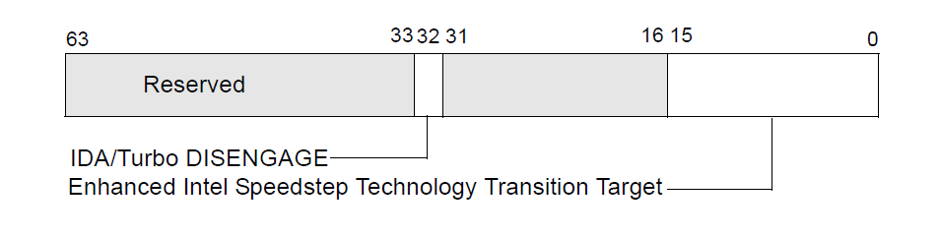
6.5.2 DVFS (Dynamic Voltage and Frequency Scaling (15)
d) Communicating the target P-state by the OS to the processor (simplified)
[202]
If the new P-state differs from the actual one, the OS writes a proprietary code
that identifies the target P-state, to a given MSR
(bits 0-15 of IA32_PERF_CTL (MSR 199h)) available for the core.
(Typically, bits [15:8] specify the target multiplier ratio e.g. 34 for
34 x 133 MHz) and bits [7:0] the target core voltage, in a suitable coding).
IA_PERF_CTL
Multiplier
Vcc
8
7
Figure: Use of the IA32_PERF_CTL (MSR 199h) MSR to set a new P-state [202]
*

Slide 81
6.5.2 DVFS (Dynamic Voltage and Frequency Scaling (16)
e) Accomplishing the fc, Vcc transitions by the processor
The PCU (Power Control Unit) takes notice of the state transition request and
performs it by setting the PLL associated to the core running the considered
thread and setting also the Voltage Regulator suitably.
*

Slide 82
6.5.2 DVFS (Dynamic Voltage and Frequency Scaling (17)
Example: Accomplishing P-state transitions in Intel’s Nehalem proc.s [205] -1
The clock frequency will be generated by PLLs, based on the Bus clock (133 MHz)
multiplied by the clock multiplier that is read out from the IA_PERF_CTL register.
Note that each core’s clock frequency (red lines) can individually be set.
IA32_PERF_CTL MSR
I
Figure: Accomplishing P-state transitions in Intel’s Nehalem-based processors [205]
*

Slide 83
6.5.2 DVFS (Dynamic Voltage and Frequency Scaling (18)
Example: Accomplishing P-state transitions in Intel’s Nehalem proc.s [205] -2
The PCU sends also the appropriate voltage value to the Voltage Regulator (VR)
that is read out from the IA_PERF_CTL register for setting the core voltage
needed.
As shown, all 4 cores are supplied by the same core voltage (yellow lines).
IA32_PERF_CTL MSR
I
Figure: Accomplishing P-state transitions in Intel’s Nehalem-based processors [205]
*

Slide 84
6.5.2 DVFS (Dynamic Voltage and Frequency Scaling (19)
Remark 1
There were two prior techniques:
SVFS (Static Voltage Scaling)
The processor has two voltage and frequency points, according to whether
it is connected to the mains or the voltage is supplied by the battery.
DFS (Dynamic Frequency Scaling)
The processor scales only the core frequency according to the workload
intensity to reduce power consumption.
Nevertheless, we do not discuss further on these techniques, only show their
use in the next Figure.

Slide 85
6.5.2 DVFS (Dynamic Voltage and Frequency Scaling (20)
Further techniques for reducing the power consumption of active CPU cores
Reducing the power consumption of active CPU cores
Static technique
Dynamic techniques
SVFS
DFS
DVFS
CPPC
AVFS
Examples
SpeedStep in
Mobile Pentium III (2000)
Mobile Pentium 4 (2002)
(Northwood based)
EIST in
Pentium M
(Banias) (2003)
and subsequent lines
Intel
Speed Shift in
Skylake (2015)
VIA
LongHaul 1.0 in
C3 Samuel (2000)
LongHaul 2.0 in
C3 Samuel 2 step. 1 (2001)
Adaptive PowerSaver
in Nano (2008)
PowerNow! and
Cool'n'Quiet
technologies
in mobiles/desktops
and servers (since 2000)
CPPC support in
the Zen 2-based
Ryzen 3000 line
(2019)
AVFS in
Excavator-based
Carizzo (2015)
Pure Power in
Ryzen (2017)
C
AMD
405LP (2002)
Dynamic Power
Performance Scaling in
PowerPC 750GX (2004)
PowerPC 970xx (2004)
Energy Scale
in POWER6
(2007) and
subsequent
processors
IBM
PowerPC 750FX
(2003)
Exynos 4 (2012)
(used in Galaxy III)
ASV in
Exynos 7420 (2015)
(used in Galaxy S6)
Samsung
ARM/National
IEM IP (2002)

Slide 86
6.5.2 DVFS (Dynamic Voltage and Frequency Scaling (21)
Remark 2
There are two improvements of DVFS:
Collaborative Processor Performance Control
It passes over the control of DVFS from the OS to the PCU, to get a faster and
finer frequency and voltage scaling (introduced in Skylake (2015)), to be
discussed in Section 5.3).
AVFS (Adaptive Voltage and Frequency Scaling)
It allows a more efficient voltage and frequency scaling by replacing the
worst case design approach by an adaptive approach, to be discussed in
Section 5.4.
An overview of their utilization is given in the next Figure.
*

Slide 87
6.5.2 DVFS (Dynamic Voltage and Frequency Scaling (22)
Use of DVFS to reduce power consumption of active CPU cores
Reducing the power consumption of active CPU cores
Static technique
Dynamic techniques
SVFS
DFS
DVFS
CPPC
AVFS
Examples
SpeedStep in
Mobile Pentium III (2000)
Mobile Pentium 4 (2002)
(Northwood based)
EIST in
Pentium M
(Banias) (2003)
and subsequent lines
Intel
Speed Shift in
Skylake (2015)
VIA
LongHaul 1.0 in
C3 Samuel (2000)
LongHaul 2.0 in
C3 Samuel 2 step. 1 (2001)
Adaptive PowerSaver
in Nano (2008)
PowerNow! and
Cool'n'Quiet
technologies
in mobiles/desktops
and servers (since 2000)
CPPC support in
the Zen 2-based
Ryzen 3000 line
(2019)
AVFS in
Excavator-based
Carizzo (2015)
Pure Power in
Ryzen (2017)
AMD
405LP (2002)
Dynamic Power
Performance Scaling in
PowerPC 750GX (2004)
PowerPC 970xx (2004)
Energy Scale
in POWER6
(2007) and
subsequent
processors
IBM
PowerPC 750FX
(2003)
Exynos 4 (2012)
(used in Galaxy III)
ASV in
Exynos 7420 (2015)
(used in Galaxy S6)
Samsung
ARM/National
IEM IP (2002)

Slide 88
6.5.3 CPPC (Collaborative Processor Performance Control)
Notes:
88

Slide 89
6.5.3 CPPC (Collaborative Processor Performance Control) (1)
6.5.3 CPPC (Collaborative Processor Performance Control) -1)
Reducing the power consumption of active CPU cores
Static technique
Dynamic techniques
SVFS
DFS
DVFS
CPPC
AVFS
Examples
SpeedStep in
Mobile Pentium III (2000)
Mobile Pentium 4 (2002)
(Northwood based)
EIST in
Pentium M
(Banias) (2003)
and subsequent lines
Speed Shift in
Skylake (2015)
Intel
VIA
LongHaul 1.0 in
C3 Samuel (2000)
LongHaul 2.0 in
C3 Samuel 2 step. 1 (2001)
Adaptive PowerSaver
in Nano (2008)
PowerNow! and
Cool'n'Quiet
technologies
in mobiles/desktops
and servers (since 2000)
CPPC support in
the Zen 2-based
Ryzen 3000 line
(2019)
AVFS in
Excavator-based
Carizzo (2015)
Pure Power in
Ryzen (2017)
AMD
405LP (2002)
Dynamic Power
Performance Scaling in
PowerPC 750GX (2004)
PowerPC 970xx (2004)
Energy Scale
in POWER6
(2007) and
subsequent
processors
IBM
PowerPC 750FX
(2003)
Exynos 4 (2012)
(used in Galaxy III)
ASV in
Exynos 7420 (2015)
(used in Galaxy S6)
Samsung
ARM/National
IEM IP (2002)

Slide 90
6.5.3 CPPC (Collaborative Processor Performance Control) (2)
CPPC (Collaborative Processor Performance Control) -2
This technology is based on a new processor performance control method
introduced in the ACPI 5.0 standard (2011), called the Collaborative Processor
Performance Control (CPPC).
If CPPC is implemented, it supersedes the previous ACPI 2.0 based DVFS
technology.
Intel introduced CPPC in their Skylake family (2015) and designated it as the
Speed Shift technology.
CPPC needs OS support, nevertheless OS support became available only after
launching the Skylake Family, in the Windows 10 2015 Fall Update.
The Collaborative Processor Performance Control technology is not bound to
Intel’s processors, also AMD introduced it in their Zen 2-based Ryzen 3000
DT line (2019).
In their Ryzen 3000 line AMD made use of a new revision of the CPPC standard,
called CPPC2, released in ACPI 5.1 (2014).
*

Slide 91
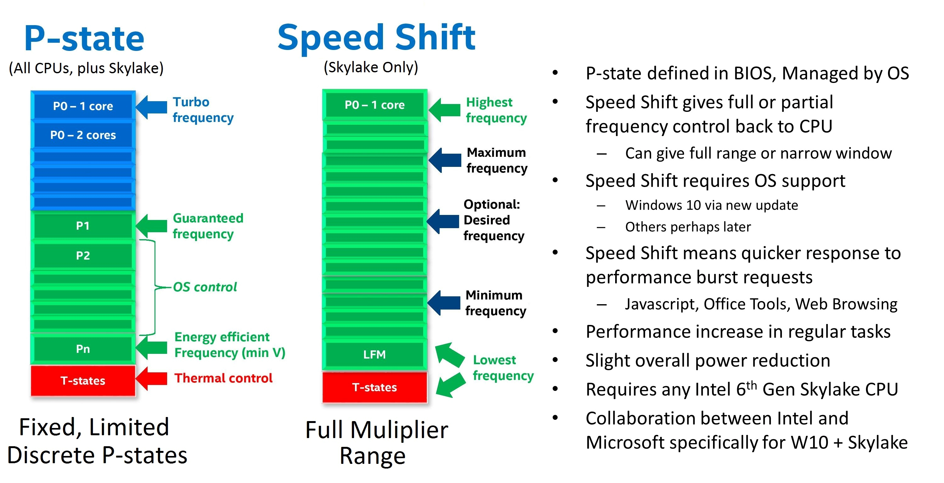
6.5.3 CPPC (Collaborative Processor Performance Control) (3)
Contrasting Intel's EIST and Speed Shift technologies -1
In Intel's EIST technology (2003)
ACPI-based DVFS
the OS assesses the required performance
in subsequent time windows, chooses and
communicates the appropriate P-state to
two MSRs of the processor,
(the IA32_PERF_CTL and
IA32_PERF_STATUS MSRs).
Since 2006 Intel also introduced two
counters to support the OS in assessing
thread activity in subsequent time windows
(the IA32_MPERF and IA32_APERF
registers).
The drawback of this mechanism is a long
control cycle and the fact that
DVFS provides only a few P-states
for frequency control, in other words
it implements a coarse grained
frequency control.
(PMU control)
Figure: BIOS declared P-states [206]
MSRs (Model-Specific Registers), introduced in the Intel's 80386 line, are registers
that are not necessarily available in subsequent lines of a processor family.
*

Slide 92
6.5.3 CPPC (Collaborative Processor Performance Control) (4)
Contrasting Intel's EIST and Speed Shift technologies -2
By contrast, in the Speed Shift technology
HCPS
the OS and the processor collaborate
in controlling processor performance
such that the OS supplies
performance guidance
to the processor, in form of hints
written into new MSRs, including
minimum and maximum
frequency limits, preference
towards energy efficiency or
performance etc. and
the processor’s Power Control Unit
(PCU) autonomously controls
performance states.
For assessing performance requests
the PCU makes use further on
of the counters introduced before.
Autonomous
control
(OS sets
the limit)
A larger number of clock multiplier defined
frequency levels [206]
*

Slide 93
6.5.3 CPPC (Collaborative Processor Performance Control) (5)
Contrasting Intel's EIST and Speed Shift technologies -3
Further significant differences between EIST and the Speed Shift technology are:
In the EIST technology the required performance is determined according to the thread or core activity alone, whereas in the Speed Shift technology further aspects, like energy consumption, may also be taken into account.
In this way, in the Speed Shift technology requested frequency and core voltage
values are results of an optimization while considering beyond thread and core
activity also energy efficiency [206].
In the EIST technology there are only a few discrete fc values available
(according to the P-states defined).
By contrast, the Speed Shift technology may use every frequency multiplier
value for setting fc (as fc = multiplier * fbus).
This allows a significantly finer frequency control than before with the EIST
technology.
*

Slide 94
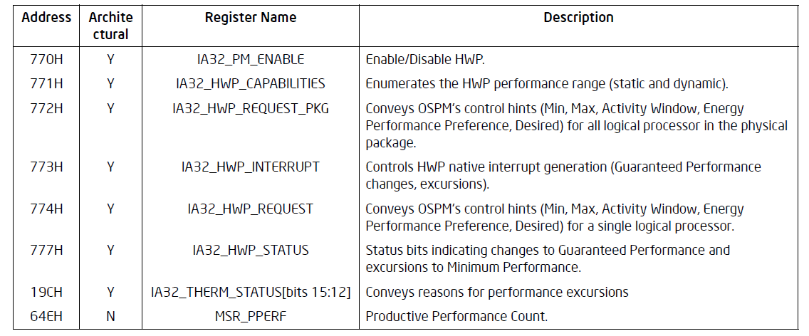
6.5.3 CPPC (Collaborative Processor Performance Control) (6)
Principle of operation of Intel's Speed Shift technology -1
Intel defined a set of MSRs to support Speed Shift technology, as seen below.
Table: MSRs defined by Intel to support the Speed Shift technology [202]
If enabled, the Speed Shift technology will be operated by reading or writing
specific MSR registers of the above register block, as discussed next.
HWP means Hardware Performance control, actually Speed Shift technology.

Slide 95
6.5.3 CPPC (Collaborative Processor Performance Control) (7)
Principle of operation of the Speed Shift technology -2
First the OS provides control hints for the processor including min. or max.
performance, energy or performance preference etc.
Then the OS transfers performance control to the PCU.
The PCU assesses the performance request of the application in the same way
as the OS before, by reading the IA32_MPERF MSR and IA32_APERF MSR
registers.
Nevertheless, the PCU does not derive the requested fc and Vcc values alone
from the performance request of the application but carries out also
performance/energy efficiency optimizations as well.
If needed, the PCU coordinates the performance requests of threads belonging
to the same processors or performance requests of cores if they are supplied
by the same core voltage as done before.
Finally, the PCU accomplishes setting the Vcc and fc values in the same way
as before.
The OS has the possibility to monitor the power management accomplished
by the PCU by reading a specific MSR register (the IA32_HWP_STATUS register).
If necessary, there is also a mechanism provided for the OS to overtake
the performance control from the PCU (not discussed here).

Slide 96
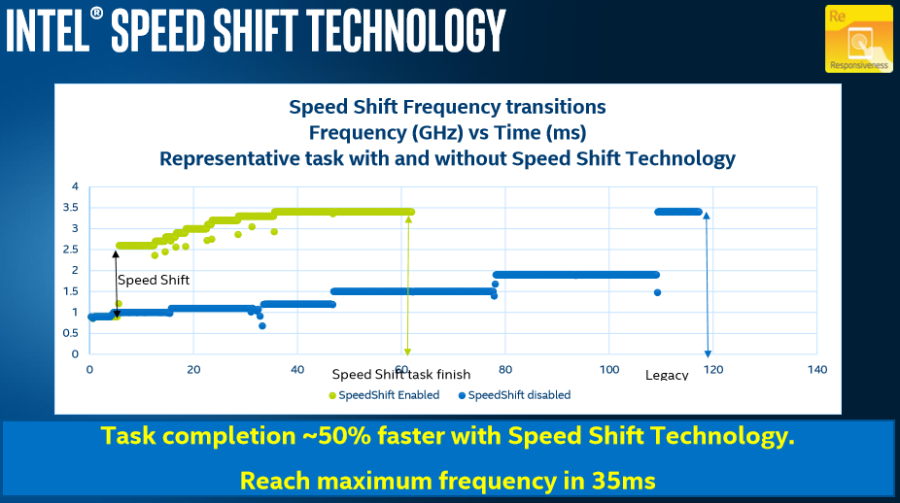
6.5.3 CPPC (Collaborative Processor Performance Control) (8)
Speeding up frequency transitions by using Intel's Speed Shift technology
in the 6. gen. Skylake line (2015) while running a representative task [206]
Frequency in GHz
Time (ms)
Note that Speed Shift technology reduces the time needed to achieve frequency
transitions, e.g. in the above Figure to achieve the maximum core frequency,
from about 115 ms to about 35 ms.
*

Slide 97
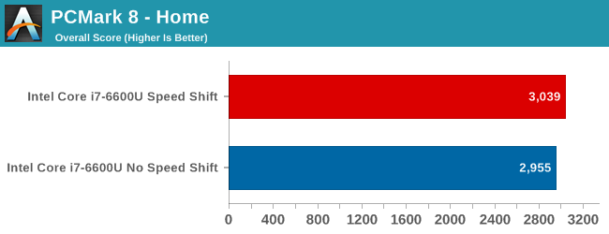
6.5.3 CPPC (Collaborative Processor Performance Control) (9)
Example 1: Performance increase achieved by the Speed Shift technology
while running the PCMark 8 - Home benchmark program [207]
The PCMark 8 Home edition is an industry standard benchmark for Windows 8
and Windows 7 apps, it covers real-world tasks and scenarios that reflect PC usage
in the home [207].
As seen, enabling the Speed Shift technology results in this case in a very small
gain of about 1.5 % [206].

Slide 98
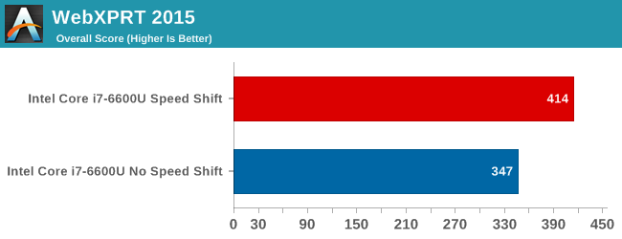
6.5.3 CPPC (Collaborative Processor Performance Control) (10)
Example 2: Performance increase achieved by the Speed Shift technology
while running the WebXPRT 2015 benchmark program [206]
WebXPRT covers six HTML5- and JavaScript-based workloads like Photo
Enhancement, Organize Albums, Stock Option Pricing, Sales Graphs.
For these applications Speed Shift technology results in a gain of about 20 %.

Slide 99
6.5.3 CPPC (Collaborative Processor Performance Control) (11)
Enhancing the Speed Shift technology in Intel's 7. generation Kaby Lake line
In their next generation Kaby Lake line (2017) Intel redesigned their Speed Shift
implementation and achieved a remarkable gain in speeding up clock frequency
transitions, as indicated in the next Figure.
*

Slide 100
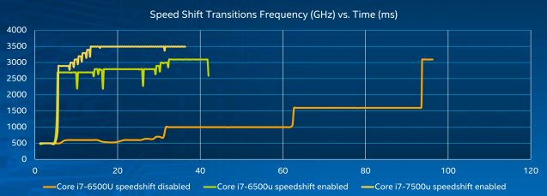
6.5.3 CPPC (Collaborative Processor Performance Control) (12)
Speeding up frequency transitions by using Intel's Speed Shift technology
in the 7. gen. Kaby Lake line (2016) while running a representative task
[208]
As the Figure shows with the enhanced implementation the max. clock frequency
will be achieved in about 15 ms rather than 35 ms as in the previous 6. gen.
Sky Lake line [208].

Slide 101
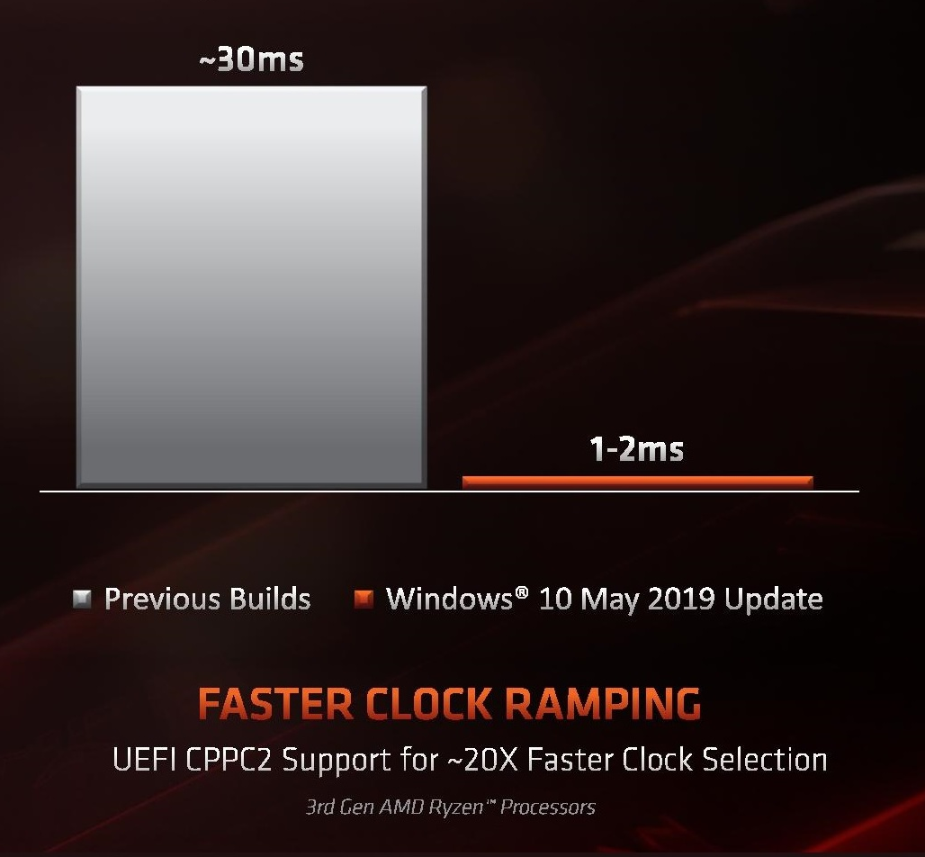
6.5.3 CPPC (Collaborative Processor Performance Control) (13)
AMD’s implementation of Collaborative Processor Performance Control
Along with their Zen 2-based Ryzen 3000 DT line (7/2019) also AMD implemented
the Collaborative Processor Performance Control Revision 2, called CPPC2.
No dedicated name for this technique became published so far.
Its use requires Windows 10 May update and a new BIOS release (7/2019)
supporting CPPC.
AMD’s implementation is sad
to provide a very fast clock
ramping of about 1–2 ms,
as the Figure on the right
indicates.
This time is much shorter than
Intel’s published figure for the
7. gen. Kaby Lake line (2016)
of about 15 ms.
Figure: Clock ramping in AMD’s
Zen 2-based Ryzen 3000 line
(2019) [209]
*

Slide 102
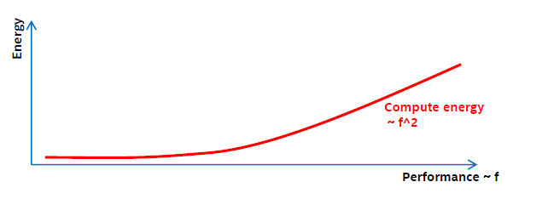
6.5.3 CPPC (Collaborative Processor Performance Control) (14)
Enhancing Intel’s Speed Shift technology by Duty cycle control [210] -1
While running applications
dynamic dissipation: ~ f³
runtime: ~ 1/f
total energy consumption originating from the dynamic dissipation: ~ f²
with f denoting the clock frequency.
As the performance is proportional with f, the energy consumption arising from the
dynamic dissipation is proportional to the square of the frequency (f), as seen below.
Figure: Dependence of energy consumption arising from the dynamic dissipation
(designated as Compute energy in the Figure) on the performance (~ f)
*

Slide 103
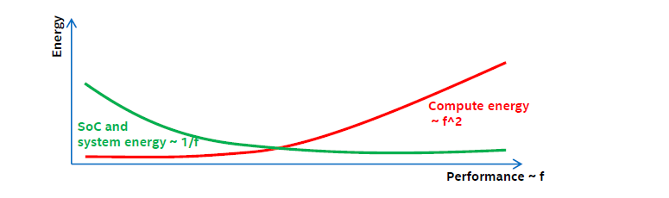
6.5.3 CPPC (Collaborative Processor Performance Control) (15)
Enhancing Intel’s Speed Shift technology by Duty cycle control [210] -2
On the other hand
the energy consumption originating from the static dissipation is proportional to
the runtime.
The runtime is inversely proportional to the frequency (f).
Consequently, the energy consumption arising from the static dissipation is
inversely proportional to the frequency (f) which is proportional to the
performance, as indicated in the Figure below.
Figure: Dependence of energy consumption originating from the static dissipation
and system power (designated as SoC and system energy in the Figure) on the performance (~ f) [210]
*

Slide 104
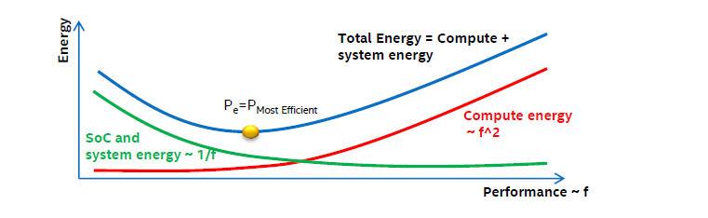
6.5.3 CPPC (Collaborative Processor Performance Control) (16)
Enhancing Intel’s Speed Shift technology by Duty cycle control [210] -3
As a consequence, the total energy consumption originating from both the
dynamic dissipation and
static dissipation as well as system power consumption
has a minimum, as indicated in the Figure below.
Figure: Dependence of energy consumption originating from both the dynamic dissipation (designated as the Compute energy in the Figure) and the static dissipation and system power (designated as SoC and system energy in the Figure) on the performance
Obviously, the min. energy consumption point (Pe) is the most efficient working point
of a core of the processor.
*

Slide 105
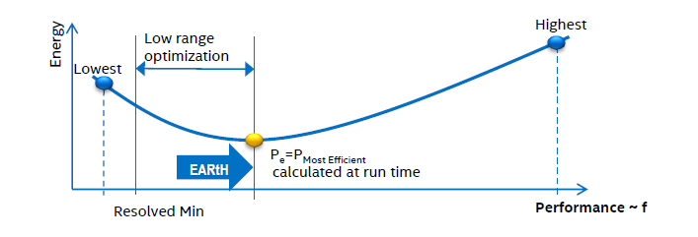
6.5.3 CPPC (Collaborative Processor Performance Control) (17)
Power management including duty cycle control [210] -1
Frequency will be lowered as far as possible until the Pe working point is reached.
Pe will be calculated every ms based on the workload and system characteristics.
There is no benefit when the system is clocked below the Pe point, as it would
increase the energy consumption.
Therefore, a so called EARtH algoritm overrides lower P requests and sets f
according to Pe.
The EARtH algorithm is activated only if it is possible to enter the package
sleep state.
Figure: Power management including duty cycle control [210]
*

Slide 106
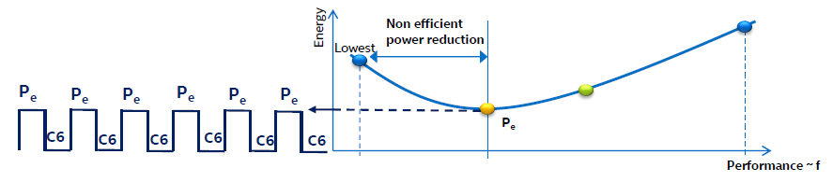
6.5.3 CPPC (Collaborative Processor Performance Control) (18)
Power management including duty cycle control [210] -2
Operating the processor below the Pe point would increase the total energy
consumption due to the static power component.
In this region a more efficient technique to reduce power for low power demand
is turning the processor package on and off about 1000 times/sec, called
duty cycling, as shown in the Figure below.
Figure: Principle of duty cycling, used to reduce energy consumption below Pe
Then with the rate of the duty time (running at a performance corresponding
to Pe) the resulting performance can be scaled with the performance demand.
In the off-state the processor is in the C6 package idle state.
See the next Figure for the actions needed to set the processor into the package
C6 state.
*

Slide 107
6.5.3 CPPC (Collaborative Processor Performance Control) (19)
Power saving measures in C1 to C6 idle states
C1
Stop instruction execution
L1
L1
L1
L1
C0
Cn
L2
L2
C3
Flush
C3
Flush
L3
Stop core clocking
Stop core clocking
C6
C0
SRAM
C6
Cn
SRAM
Stop core PLL
Stop core PLL
Vcc
0
Vcc
0
To set Vcc to 0 needs typically power gating or integrated voltage regulator
to switch off cores.
The package C6 state is entered when all cores have already entered the C6
core state.
*

Slide 108
6.5.4 AVFS (Adaptive Voltage or Frequency Scaling)
Notes:
108

Slide 109
6.5.4 AVFS (Adaptive Voltage or Frequency Scaling) (1)
6.5.4 AVFS (Adaptive Voltage or Frequency Scaling) -1
Reducing the power consumption of active CPU cores
Static PM
of active CPU cores
Dynamic PM of active CPU cores
SVFS
DFS
DVFS
CPPC
AVFS
Examples
SpeedStep in
Mobile Pentium III (2000)
Mobile Pentium 4 (2002)
(Northwood based)
EIST in
Pentium M
(Banias) (2003)
and subsequent lines
Intel
Speed Shift in
Skylake (2015)
VIA
LongHaul 1.0 in
C3 Samuel (2000)
LongHaul 2.0 in
C3 Samuel 2 step. 1 (2001)
Adaptive PowerSaver
in Nano (2008)
PowerNow! and
Cool'n'Quiet
technologies
in mobiles/desktops
and servers (since 2000)
CPPC support in
the Zen 2-based
Ryzen 3000 line
(2019)
AVFS in
Excavator-based
Carizzo (2015)
Pure Power in
Ryzen (2017)
AMD
405LP (2002)
Dynamic Power
Performance Scaling in
PowerPC 750GX (2004)
PowerPC 970xx (2004)
Energy Scale
in POWER6
(2007) and
subsequent
processors
IBM
PowerPC 750FX
(2003)
Exynos 4 (2012)
(used in Galaxy III)
ASV in
Exynos 7420 (2015)
(used in Galaxy S6)
Samsung
ARM/National
IEM IP (2002)

Slide 110
6.5.4 AVFS (Adaptive Voltage or Frequency Scaling) (2)
AVFS (Adaptive Voltage and Frequency Scaling)
It is an enhancement of the DVFS (Dynamic Voltage and Frequency Scaling).
*

Slide 111
6.5.4 AVFS (Adaptive Voltage or Frequency Scaling) (3)
DVFS (Dynamic Voltage and Frequency Scaling) (recap)
Scaling means here setting core voltage (Vcc) and frequency (fc) according
to the actual workload.
With DVFS the OS typically assesses the actual workload and scales down fc
as far as feasible without noticeable lengthening the runtime, then it selects
the Vcc value that is needed to maintain the chosen fc from a look-up table.
In the look-up table Vcc is determined a priory at chip testing while a guard
band is assured.
Vcc
Look-up table
P0
P0: f0, Vcc0
P1: f1, Vcc1
P2: f2, Vcc2
.
.
Pn: fn, Vccn
Vcc0
●
Workload
P1
●
Highest
power
consumption
Vcc1
P2
Figure:
Principle of DVFS
●
Vcc2
.
.
Pn
Vccn
●
fc will be scaled according to the
workload intensity.
Vcc is chosen to maintain fc
with a guard band.
Lowest
power
consumption
..
fc
fcn
fc2
fc1
fc0
*

Slide 112
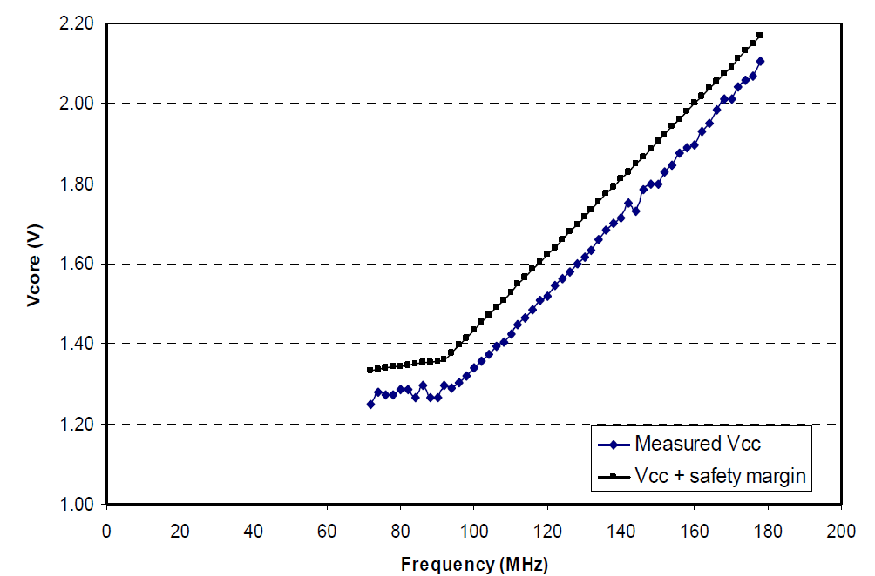
6.5.4 AVFS (Adaptive Voltage or Frequency Scaling) (4)
Example: Minimal (measured) and specified core voltage (Vcc) needed
for sustaining a given core frequency (fc) [208]

Slide 113
6.5.4 AVFS (Adaptive Voltage or Frequency Scaling) (5)
Motivation for introducing adaptive DVFS, called AVFS technologies
In the look-up table the Vcc values are set by chip testing while the chosen
values include a worst case guard band to compensate for possible variations,
including
process variations (P) resulting from uncertainties of the fabrication process,
voltage variations (V) resulting from power supply inaccuracies, voltage
drops due to overloads etc.)
temperature variations (T),
aging.
E.g.: Process dependent min. core voltage levels needed to assure an expected
clock frequency may vary in parts, as illustrated below.
Part
distribution
Vmin
Figure: Process dependent min. core voltage levels at a given core frequency [211]
*

Slide 114
6.5.4 AVFS (Adaptive Voltage or Frequency Scaling) (6)
Min. Vcc and guard band needed in DVFS (based on [211])
Min. Vcc
including a
conservative
guard band
(1.2 V +GB)
Vcc
(Needed to assure a given fc)
Guard band (GB) to address
voltage variations,
temperature variations,
aging etc.
Min. Vcc
for slow parts
(1.2 V)
1.2 V
1.0 V
Min. Vcc
for fast parts
(0.8 V)
0.8 V

Slide 115
6.5.4 AVFS (Adaptive Voltage or Frequency Scaling) (7)
AVFS vs. DVFS
AVFS vs. DVFS
DVFS
AVFS
(Dynamic Voltage and Frequency Scaling)
(Adaptive Voltage and Frequency Scaling)
Aim: to reduce guard band and thus dissipation
DVFS is performed in an open loop.
AVFS is performed in a closed loop.
It means that the OS scales down
core frequency (fc)
according to the actual workload
and determines core voltage (Vcc)
statically (from a look-up table).
Vcc was determined previously
at chip testing while
a certain guard band
was taken into account
to compensate for PVT variations.
It means that first the OS scales down
core frequency (fc) and voltage (Vcc)
according to the actual workload
similarly to DVFS, but then the processor
reduces the guard band
in a closed loop
as far as feasible
while monitoring processor operation
for avoiding already unsafe operating points.
PVT: Process, Voltage, Temperature
*

Slide 116
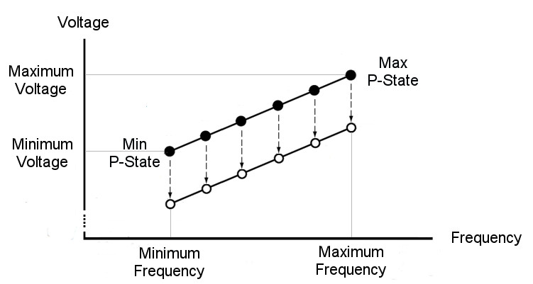
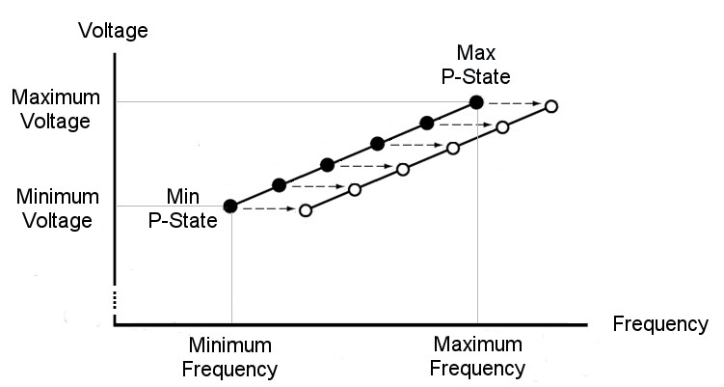
6.5.4 AVFS (Adaptive Voltage or Frequency Scaling) (8)
Alternatives of AVFS (Adaptive Voltage or Frequency Scaling)
There are two possible use cases how AVFS can be utilized to exploit
guard band reduction.
Use cases of AVFS to exploit guard band reduction
AVS
(Adaptive Voltage Scaling)
AFS
(Adaptive Frequency Scaling)
It is also called Undervolting.
It is also called Overclocking).
AVFS is used to reduce Vcc
at a given fc (P-state)
to a min. allowed value.
AVFS is used to increase fc
at a given Vcc (P-state)
to the max. allowed value.
*

Slide 117
6.5.4 AVFS (Adaptive Voltage or Frequency Scaling) (9)
Overview of introduced AVFS implementations
(02/2015)
(03/2017)
AMD
Carizzo
Ryzen
lines
HiSilicon
(Huawei)
(Q1/2015)
Kirin 930
(Q2/2015)
Samsung
Exynos
7420
(02/2008)
(2/2011)
(2/2012)
TI
OMAP3
OMAP4
OMAP5
(10/2007)
(2/2010)
(4/2014)
IBM
POWER6
POWER7
POWER8
/05/2008)
Via
Adaptive
PowerSaver
in Nano
(06/2004)
National
PowerWise
(macrocell)
2003
2004
2005
2006
2007
2008
2009
2010
2011
2012
2013
2014
2015
2016

Slide 118
6.5.4 AVFS (Adaptive Voltage or Frequency Scaling) (10)
Key features of introduced AVFS technologies
Vendor | Designation | Used in | Introduced | Controlled by
National | PowerWise | (Macrocell) | 06/2004 | HPM (Hardware Perf. Monitors) (Critical path delay)
VIA | Adaptive PowerSaver | Nano | 11/2008 | Temperature headroom (Temperature sensors)
IBM | Adaptive Energy Management | POWER6 POWER7 POWER8 | 07/2007 02/2010 04/2014 | Critical Path Monitors
TI | SmartReflex | OMAP 3 OMAP4 OMAP5 | 02/2008 02/2011 02/2012 | Voltage Controlled Oscillator
Samsung | Adaptive Scaling Voltage | Exynos 7420 | Q2/2015 | Critical Path Monitors
AMD | Adaptive Frequency and Voltage scaling | Excavator-based Carizzo | 02/2015 | Replica paths (Critical Path monitors)
HiSilicon (Huawei) | AVS+ technology | Kirin 930 | Q1/2015 | HPM (Hardware Performance Monitors (no details revealed)
AMD | Pure Power | RyZen | Q1/2017 | Temperature, speed and voltage monitors

Slide 119
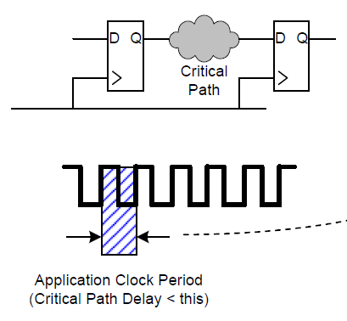
6.5.4 AVFS (Adaptive Voltage or Frequency Scaling) (11)
Principle of the implementation of AVFS -1 (based on [211])
Timing requirement for correct operation of digital circuits [211]
Vcc
fc
Critical path delay
Correct operation: if critical path delay ≤ Application clock period
Basic relations
Application Clock Period decreases with higher fc (it needs higher Vcc).
Application Clock Period increases with lower fc (it needs lower Vcc).
Critical path delay decreases with higher Vcc.
Critical path delay increases with lower Vcc
*

Slide 120
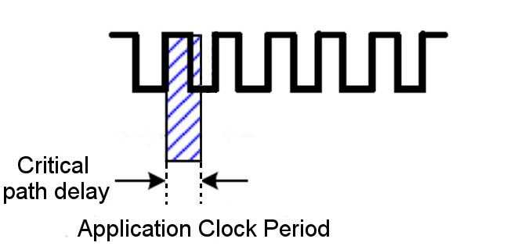
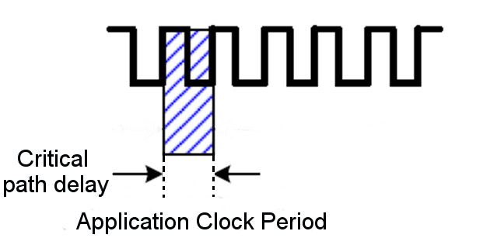
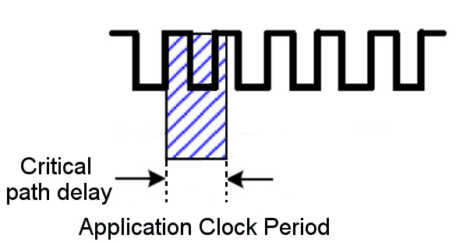
6.5.4 AVFS (Adaptive Voltage or Frequency Scaling) (12)
Principle of the implementation of AVFS -2 (based on [211])
Determine the speed of the device e.g. by measuring the delay of a clock edge
while travelling along a critical path.
Compare the measured delay critical path delay to the actual clock period.
If the delay is less than
the clock period
If the delay equals
the clock period
If the delay is higher than
the clock period
the clock edge arrives
in due time,
fc can be increased or
Vcc can be decreased
voltage is
correctly adjusted to
clock speed
the clock edge arrives
later than needed,
fc needs to be decreased or
Vcc needs to be increased
Utilized for AVFS
*

Slide 121
6.5.4 AVFS (Adaptive Voltage or Frequency Scaling) (13)
Principle of implementation of AVFS
Processor dies have a large number of sensors, typically critical path monitors
(assumed subsequently) for checking circuit delays.
Critical path monitors provide output codes characterizing the actual delay on
them to a power controller.
The power controller, typically a microprocessor, periodically senses the output
signals of the critical path monitors and sets the supply voltage (in case of AVS)
or the clock frequency (in case of AFS) accordingly in a closed loop
to reduce supply voltage (in case of AVS) or
to increase clock frequency (in case of AFS)
as far as the actual circuit and environmental parameters (including
temperature, aging etc. allow).
*

Slide 122
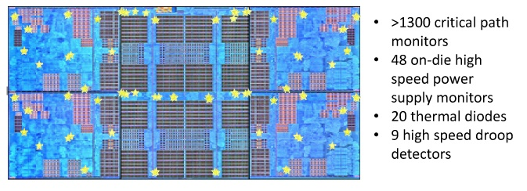
6.5.4 AVFS (Adaptive Voltage or Frequency Scaling) (14)
Example: Sensors implemented on a CCX die (4-core Core CompleX)
in AMD’s Zen processors to support AVS [212]
Critical path monitors overlook processor speed (clock frequency), they
allow to reduce core voltage in a controlled way as far as possible whereby
a given clock frequency remains maintained.
Critical path monitors: kritikus áramköri szakaszok sebességét ellenörző monitorok

Slide 123
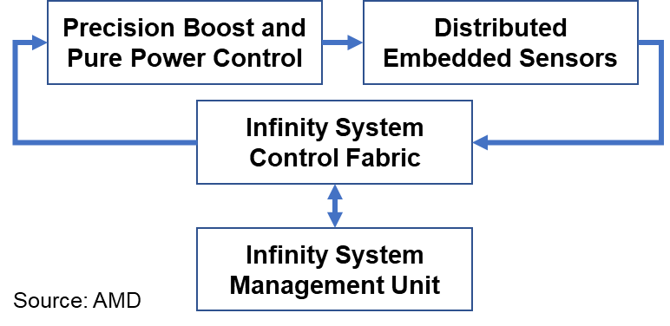
6.5.4 AVFS (Adaptive Voltage or Frequency Scaling) (15)
Example: Closed-loop control in AMD’s Zen processors to implement AVS [213]
Precision Boost: AVS
Pure Power Control: Turbo Boost
Microcontroller

Slide 124
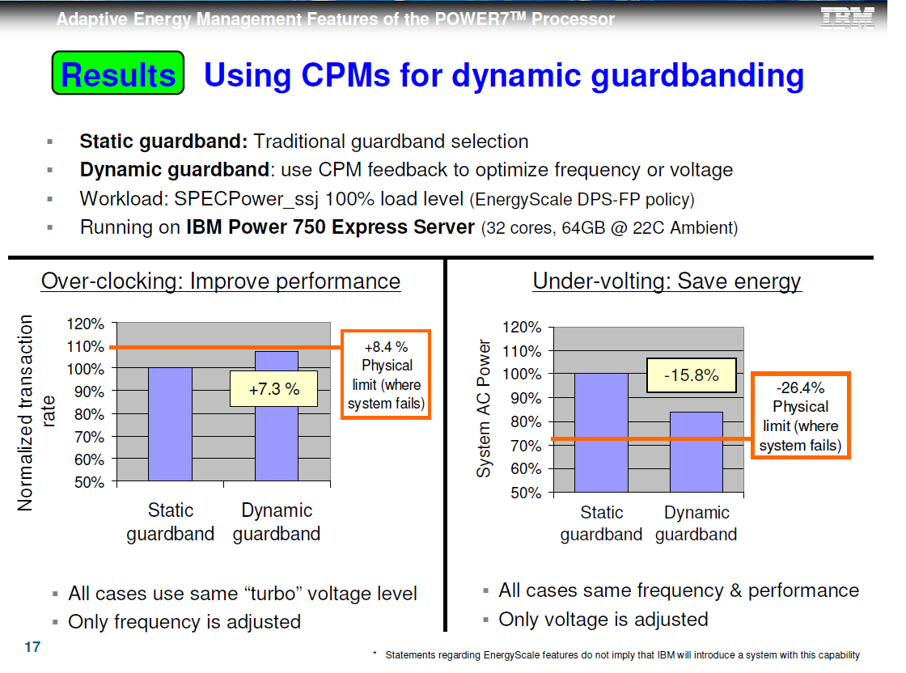
6.5.4 AVFS (Adaptive Voltage or Frequency Scaling) (16)
Example: Achieved gains in both use cases of AVFS in an IBM server [214]
AVS (Used for undervolting)
AFS (Used for overclocking)
cores
cores
Static guardband: Traditional worst case guardband.
Dynamic guardband: Use of AVFS to optimize voltage (AVS) or frequency (AFS)
(Workload: SPECPower_ssj 100 % load level (Energyscale DPS.-FP policy))
(Running on IBM Power 750 Express Server (32 cores, 64 GB, 22 C ambient temperature))

Slide 125
6.5.4 AVFS (Adaptive Voltage or Frequency Scaling) (17)
Remark: Coping with voltage droops -1 [215] (in the Lecture not discussed)
The supply voltage of microprocessors shows significant fluctuations caused by
fast changes in the current demand, including voltage droops in response to
workload variations, as indicated in the next Figure.

Slide 126
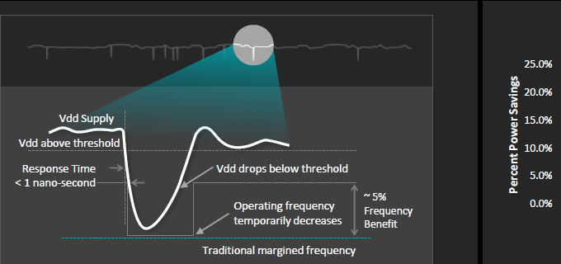
6.5.4 AVFS (Adaptive Voltage or Frequency Scaling) (18)
Variations of the supply voltage, including voltage droops [215]
http://www.goldfries.com/downloadables/AMD_Carrizo.pdf

Slide 127
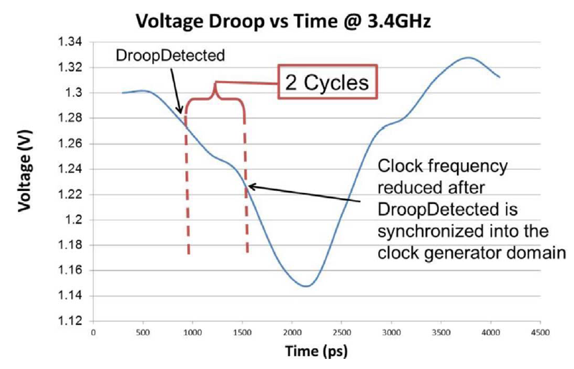
6.5.4 AVFS (Adaptive Voltage or Frequency Scaling) (19)
Variations of the supply voltage, including voltage droops -2 [216]
These short voltage variations including voltage droops, may amount to
100 to 200 mV, as indicated below.
Figure: Voltage droop in the supply voltage [216]

Slide 128
6.5.4 AVFS (Adaptive Voltage or Frequency Scaling) (20)
Coping with voltage droops -2 [216]
To address voltage droops a large extra margin of 10 to 15 % needs to be added
to the ideal, voltage variations free min. voltage values needed to guarantee
a given fc.
This additional voltage margin gives rise to wasting power.
To avoid excess power consumption due to voltage droops a number of
techniques were introduced, including those used for Intel's Itanium Montecito
(2006), Nehalem (2008) and AMD's Steamroller-based Kaveri (2014)
processors, summarized in.
From these we show AMD's solution, called Adaptive Clocking System,
introduced in the Steamroller based Kaveri desktop and mobile processor,
in 2014.

Slide 129
6.5.4 AVFS (Adaptive Voltage or Frequency Scaling) (21)
AMD's Adaptive Clocking System -1 [216]
AMD's solution is based on a droop detector and a clock stretcher.
The droop detector is implemented as a delay line built up of 40 delay cells.

Slide 130
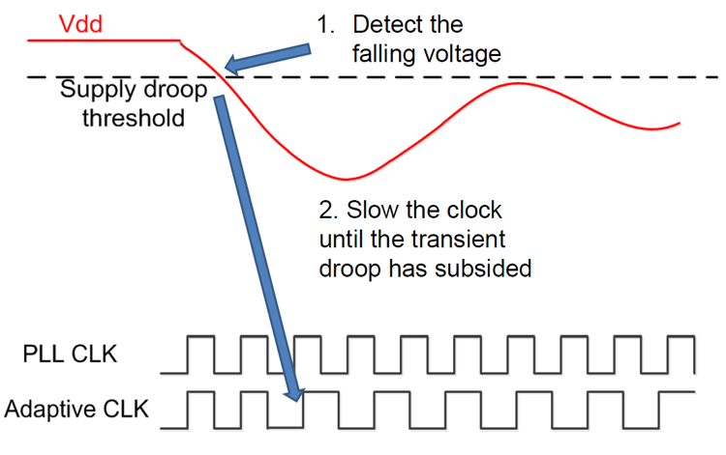
6.5.4 AVFS (Adaptive Voltage or Frequency Scaling) (22)
Principle of the operation of the droop detector []
The droop detector compares the phase of the reference clock signal (PLL which
uses a clean analog power supply with no noise), with clock phases that are
generated on the noisy digital power supply.
When a droop occurs, the reduction in voltage will slow down the noisy clock
and the phases on the noisy clock will fall behind the phases of the reference
clock.
Once the droop is detected, a clock stretching circuit increases the clock period
(i.e., decreasing frequency) to compensate.

Slide 131
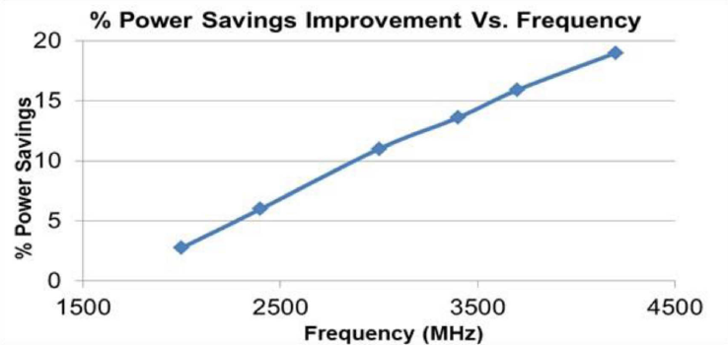
6.5.4 AVFS (Adaptive Voltage or Frequency Scaling) (23)
Power saving achieved in AMD's Adaptive Clocking System that addresses
also voltage droops, in the Steamroller-based Kaveri [215]

