Slide 1
Client processors - 8
Select platform issues
Dezső Sima
November 2019
(Ver. 1.2)
© Sima Dezső, 2019

Slide 2
8. Select platform issues
8.1 Evolution of memory subsystems
8.2 Evolution of attaching PCI lanes to platforms
8.3 Physical implementation of client processors

Slide 3
8.1 Evolution of memory subsystems
8.1.1 Overview
8.1.2 Options for attaching memory channels to a
client platform
8.1.3 Why attaching memory via the processors
became widespread?
8.1.4 Constrains relating the max. number of memory channels
while connecting DIMMs directly

Slide 4
8.1.1 Overview
Notes:
4

Slide 5
8.1.1 Overview (1)
8.1.1 Overview
The memory subsystem serves the entire platform, including the CPU cores.
Each CPU core operates on its own, accordingly each core needs the same
memory bandwidth for accessing instructions and data, in other words,
the memory bandwidth has to be linearly scaled with the core count.
For this reason, it is of importance to review how many cores DTs and laptops
have.
The next two Figures show it.
*

Slide 6
8.1.1 Overview (2)
Max. core counts of GPU-less desktop and laptop processors
Core
count
12
v
Ryzen
3.G.
10
8
v
v
v
v
Bulldozer
Zambezi
(4 CM)
Piledriver
Vishera
(4 CM)
X
Ryzen
1.G.
Ryzen
2.G.
6
(Core 2
Quad)
Nehalem
1. G.
Nehalem
2. G.
Subsequent DTs
include GPUs
X
4
v
v
v
v
Phenom
(Pentium
D)
Core 2
2
v
v
v
Athlon
64X2
Intel: (): Dual Chip Module
AMD: CM: Compute Module
X: Cancelled
2006
2008
2010
2012
2014
2016
2018
Year
*

Slide 7
8.1.1 Overview (3)
Max. core counts of desktop and laptop processors with integrated GPUs
Core
count
Coffee Lake R.
8
v
Coffee Lake
6
v
Sandy Bridge
Kaby Lake
4
v
v
v
v
v
v
v
v
v
v
v
v
v
v
v
X
v
v
Llano
Ryzen
APU
Bulldozer/Bobcat-based
(Westmere)
2
v
Intel (): On-package integrated
AMD: Bulldozer has 2 CMs (~ 4 cores)
2006
2008
2010
2012
2014
2016
2018
Year
*

Slide 8
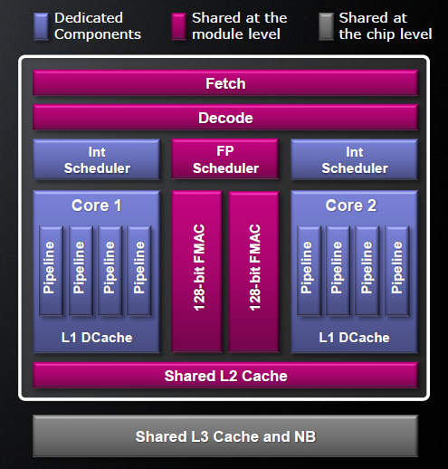
8.1.1 Overview (4)
Remark: AMD’s Compute Modules (CM) concept implemented in the Bulldozer line
AMD’s Compute Module (CM) represents – roughly speaking - two cores.
Nevertheless, these cores have both shared and per-core components, as indicated
in the Figure on the right.
Shared components are used by both
cores either at the module level or
at the chip level, as shown in the
referenced Figure.
The front-ends of both cores and the
L2 cache are shared at the module
level, the L3 cache and the North
Bridge (NB) are shared by all CMs
at the chip level.
The FX back-ends of the cores are
implemented on a per core basis,
they are the per-core components
of the CM.
Obviously, Compute Modules provide
less performance than two traditional
cores.
Figure: Concept of the Compute Module of the Bulldozer line [10]

Slide 9
8.1.1 Overview (5)
Why desktops and laptops provided not more than four cores for a long
time?
An early investigation of Wall from 1990 [7] revealed that general purpose workloads
(of that time), typically do not provide more exploitable parallelism than 4 to 6,
as the next Figure depicts.
*

Slide 10
8.1.1 Overview (6)
Wall’s results concerning the available parallelism in typical workloads [7]
Assumed ambitious hardware model
Available parallelism in an ambitious hardware model

Slide 11
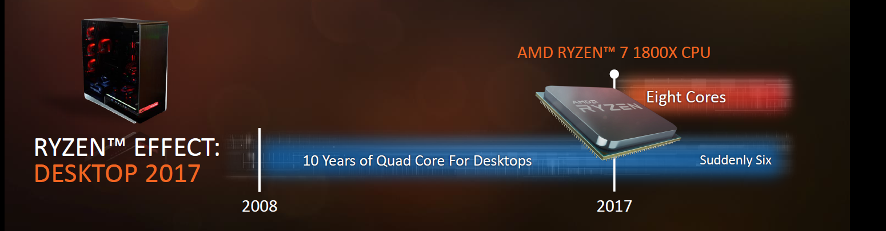
8.1.1 Overview (7)
Impact of introducing AMD’s 8-core (GPU-less) Ryzen desktops to the core
counts of Intel’s desktops
Historically, Intel’s desktop processors included up to 4 cores, as the Figure
below indicates.
Figure: Increasing the maximum core count of Intel’s 7. gen. desktop line to 6 cores
due to the introduction of AMD’s up to 8-core Ryzen desktop line [21]
In 2017 AMD introduced their GPU-less Ryzen desktop line with up to 8 cores.
Subsequently, also Intel raised the max. core count to 6 in their 7. gen. Kaby Lake
Refresh desktop line (in 10/2017) and then to 8 in the 9. gen .Coffee lake Refresh
line (in 10/2018), both with integrated GPUs to cope with AMD’s Ryzen line.
*

Slide 12
8.1.1 Overview (8)
Number of memory channels in Intel’s Core 2-based client processors
Designation of the platform | Platform topology | Processor | Technology | Max. no. of cores (n_{C}) | Year of introduction | Processor socket | MCH/PCH | Highest mem./ speed | No. of mem. channels
Anchor Creek | Off-die MC | Pentium D | 90 nm | 2x1 | 5/2005 | LGA 775 | 945-955 | DD2-667 | 2
Bridge Creek |  | Core 2 | 65 nm | 2C | 6/2006 | LGA 775 | 945-975 | DDR2-800 | 2
Salt Creek |  | Core 2 Quad | 65 nm | 2x2C | 6/2007 | LGA 775 | 3 Series (Bearlake) | DDR3-1067 | 2
Boulder Creek |  | Penryn | 45 nm | 2x2C | 6/2008 | LGA 775 | 4 Series (Eaglelake) | DDR3-1067 | 2
Kings Creek | On-die MC | 2. G. Nehalem (Lynnfield) | 45 nm | 4C | 9/2009 | LGA 1156 | 5 Series (Ibex Peak) | DDR3-1333 | 2
 |  | Westmere (Clarkdale) | 32 nm | 2C+G | 1/2010 | LGA 1156 | 5 Series (Ibex Peak)
 |  | Sandy Bridge | 32 nm | 2C/4C+G | 1/2011 | LGA 1155 | 6 series (Cougar Point) | DDR3-1333 | 2
Sugar Bay
Maho Bay |  | Ivy Bridge | 22 nm | 4C +G | 4/2012 | LGA 1155 | 7 series (Panther Point) | DDR3-1600 | 2
Shark Bay |  | Haswell | 22 nm | 4C+G | 6/2013 | LGA 1155 | 8 Series (Lynx Point) | DDR3-1600 | 2
 |  | Haswell refresh | 22 nm | 4C+G | 5/2014 | LGA 1150 | 9 Series (Wild Cat Point) | DDR3-1666
 |  | Broadwell | 14 nm | 4C+G | 6/2015 | LGA 1150 | 9 Series (Wild Cat Point) | DDR3-1866
 |  | Skylake | 14 nm | 4C+G | 10/2015 | LGA 1151 | Series (Sunrise Point) | DDR4-2133 | 2
 |  | Kaby Lake | 14 nm | 4C + G | 8/2016 | LGA 1151 | 200 Series | DDR4-2400 | 2
 |  | Coffee Lake | 14 nm | 6C +G | 10/2017 | LGA 1151 | 300 Series | DDR4-2666 | 2
 |  | Coffee Lake R. | 14 nm | 8C +G | 10/2018 | LGA 1151 | 300 Series | DDR4-2666 | 2

Slide 13
8.1.1 Overview (9)
Per core memory bandwidth in Intel’s 4, 6 and 8-core DT processor lines
Generation | Intro. | Core count up to | Memory transfer rate up to | No. of memory channels | Total memory bandwidth [GB/s] | Per core memory bandwidth [GB/s]
2 (Sandy Bridge) | 2011 | 4 | DDR2-800 | 2 | 12.8 | 3.2
8 (Coffee Lake) | 2017 | 6 | DDR4-2400 | 2 | 38.4 | 6.4
9 (Coffee Lake Refresh) | 2018 | 8 | DDR4-2666 | 2 | 42.656 | 5.3
Historically), the per core memory bandwidth in Intel’s DT lines has astonishingly
been increased, rather than decreased due to the slow rise of core counts and
massive boost of memory rates.
*

Slide 14
8.1.1 Overview (10)
Number of memory channels in AMD’s K8 and further lines
AMD’s client processors (with 2 to 12 cores) provide up to two memory channels,
including AMD’s Zen 2-based 7 nm 12 core Ryzen 9 3900X, introduced in 2019.
In the first sight, for 12 cores two channels may appear as less than required,
nevertheless a comparing per-core memory bandwidth figures of AMDs early
dual core and most recent 12-core DT platforms (see the Table below)reveals
a different picture.
Model | Intro. | Core count up to | Memory transfer rate up to | No. of memory channels | Total memory bandwidth [GB/s] | Per-core memory bandwidth [GB/s]
K8-based Athlon 64X2 | 2006 | 2 | DDR2-800 | 2 | 12.8 | 6.4
Zen 2-based Ryzen 9 3900X | 2019 | 12 | DDR4-3200 | 2 | 51.2 | 4.3
Table: Per-core memory bandwidth in AMD’s DT processors 2006 - 2019
According to the above comparison, the per core memory bandwidth has
remained almost the same despite the massive growth of the core counts due to
a noteworthy increase of memory speeds.

Slide 15
8.1.1 Overview (11)
Comparing the per-core bandwidth figures of Intel’s and AMD’s client
processors
A comparison reveals that both vendors provide in their multicore client processors
about the same per-core bandwidth of 3.2 GB/s to 6.4 GB/s).

Slide 16
8.1.1 Overview (12)
The rate of rising memory transfer rates in Intel’s DT and high-end servers
Transfer rate
(MT/s)
IB
DDR4/2400
DDR4/2133
3000
DDR3
1600
x
DDR3/1866
*
2000
DDR3
1333
x
*
x
DDR4
2666
DDR3
1067
x
*
DDR4
1866
~ 2*/4 years
DDR2
800
*
DDR3/4
1866
*
x
DDR3
1600
1000
DDR2
667
*
DDR2
533
*
DDR3
1067
~ 2*/8 years
DDR
400
*
x
500
DDR
333
*
DDR2
667
DDR
266
x
*
DDR
400
Emergence of
DDR4 memory
*
4S/8S
DT
*
Emergence of
DDR3 memory
200
100
50
≈
2000
01
02
03
04
05
06
07
08
09
2010
11
12
13
14
15
16
17
Year
*

Slide 17
8.1.2 Options for attaching memory channels to a client platform
Notes:
17

Slide 18
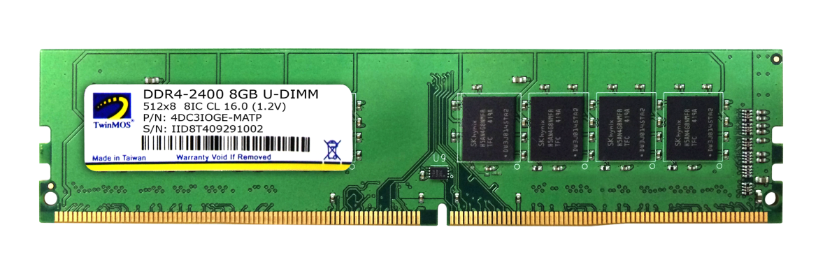
8.1.2 Options for attaching memory channels to a client platform (1)
8.1.2 Options for attaching memory to a client platform
In the platform one or more memory controllers are responsible for connecting
the memory.
Memory chips are placed on DIMMs (Dual-In-Line Memory Modules).
Figure: DDR4 DIMM
DIMMs are connected to the memory controller or controllers either directly or
indirectly, as indicated in the next Figure.
*

Slide 19
8.1.2 Options for attaching memory channels to a client platform (2)
Attaching DIMMs to platforms -1
Attaching DIMMs to a platform
Attaching DIMMs
directly, via the parallel DRAM interface
to a platform
Attaching DIMMs
indirectly, via memory buffers (MB)
to a platform
DRAM if.
Buffer if.
DRAM if.
DIMMs
DIMMs
Platform
Platform
MC
MC
MB
MB
Memory
channels
Memory
channels
Memory
Memory
Memory buffers (MB) perform an
interface conversion
to allow attaching more mem. channels to the platform.
The converted interface may be:
MC: Memory Controller
proprietary serial interface
proprietary parallel interface
standard FB-DIMM interface
Typical for client and recent server platforms
Typical for previous server platforms
*

Slide 20
8.1.2 Options for attaching memory channels to a client platform (3)
Attaching DIMMs to platforms -2
Subsequently, we constrain us to client platforms and assume direct connected
DIMMs to the discussed platform category.
*

Slide 21
8.1.2 Options for attaching memory channels to a client platform (4)
8.1.2 Options for attaching memory channels directly to a client platform -1
There are two main options how memory channels can directly be attached
to a client platform, as shown below.
Attaching memory channels directly to a client platform
Attaching memory channels
via the MCH
Attaching memory channels
via the processor
MC is integrated
into the MCH.
MC is integrated
onto the processor die.
The MC is usually linked
by an interconnect fabric to
other units (e.g. cores)
of the processor.
Processor
Processor r
MC
Memory
FSB
FSB
MCH
MCH
MC
Memory
ICH
ICH
*

Slide 22
8.1.2 Options for attaching memory channels to a client platform (5)
8.1.2 Options for attaching memory channels directly to a client platform -2
There are two main options how memory channels can directly been attached
to a client platform, as shown below.
Attaching memory channels directly to a client platform
Attaching memory channels
via the MCH
Attaching memory channels
via the processor
MC is integrated
into the MCH.
MC is integrated
onto the processor die.
The MC is usually linked
by an interconnect fabric to
other units (e.g. cores)
of the processor.
Used
by Intel
Up to the Penryn line
(Up to 2007)
From the Nehalem line on
(2008)
by AMD
Up to the K7 line
(1999-2003)
From the K8 (Hammer) line on
(2003)
Note that AMD began attaching memory channels via the processor very early
in 2003, 5 years before Intel.
MC: Memory Controller
*

Slide 23
8.1.2 Options for attaching memory channels to a client platform (6)
Options for attaching memory channels directly to a client platform -2
The discussed alternatives will be demonstrated subsequently by examples.

Slide 24
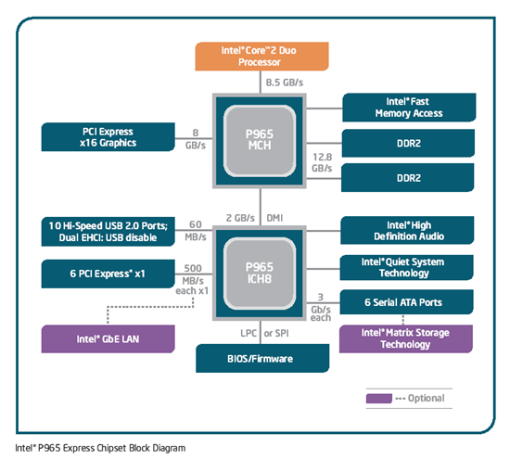
8.1.2 Options for attaching memory channels to a client platform (7)
Example 1: Attaching memory channels via the MCH
(actually in Intel’s Core 2 Duo based platform (2006)) [158]
FSB: 1066 MT/s
DDR2-800
*
Figure: Core 2 Duo based platform [158]

Slide 25
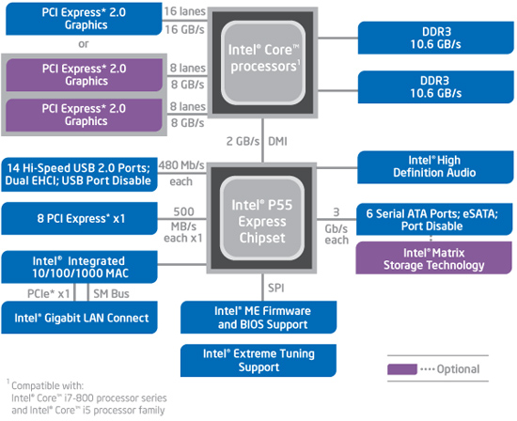
8.1.2 Options for attaching memory channels to a client platform (8)
Example 2: Attaching memory channels via the processor
(actually in Intel’s 2. gen. Nehalem based platform (2009)) [159]

Slide 26
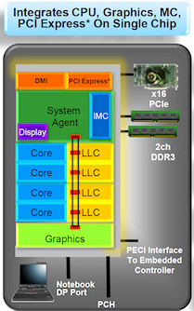
8.1.2 Options for attaching memory channels to a client platform (9)
Example 3: Attaching memory channels via the processor and a ring
interconnect (in Intel’s Sandy Bridge-based platforms (2011)) [160]
The MC is part of SA.
SA: System Agent
The ring interconnect is a cache coherent interconnect that services 6 ports.

Slide 27
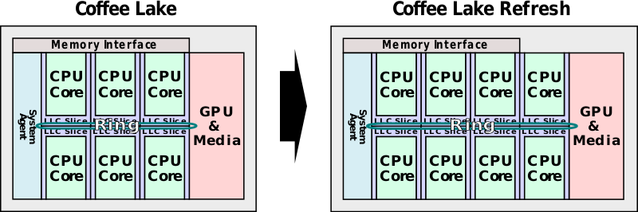
8.1.2 Options for attaching memory channels to a client platform (10)
Example 4: Attaching memory channels via the processor and a ring
interconnect in Intel’s 6 and 8-core client platforms [6]
Sandy Bridge
(2. gen.)
Coffee Lake
8. gen.)
Coffee Lake Refresh
(9. gen.)
4-cores
(2011)
(2017)
6-cores
(2018)
8-cores

Slide 28
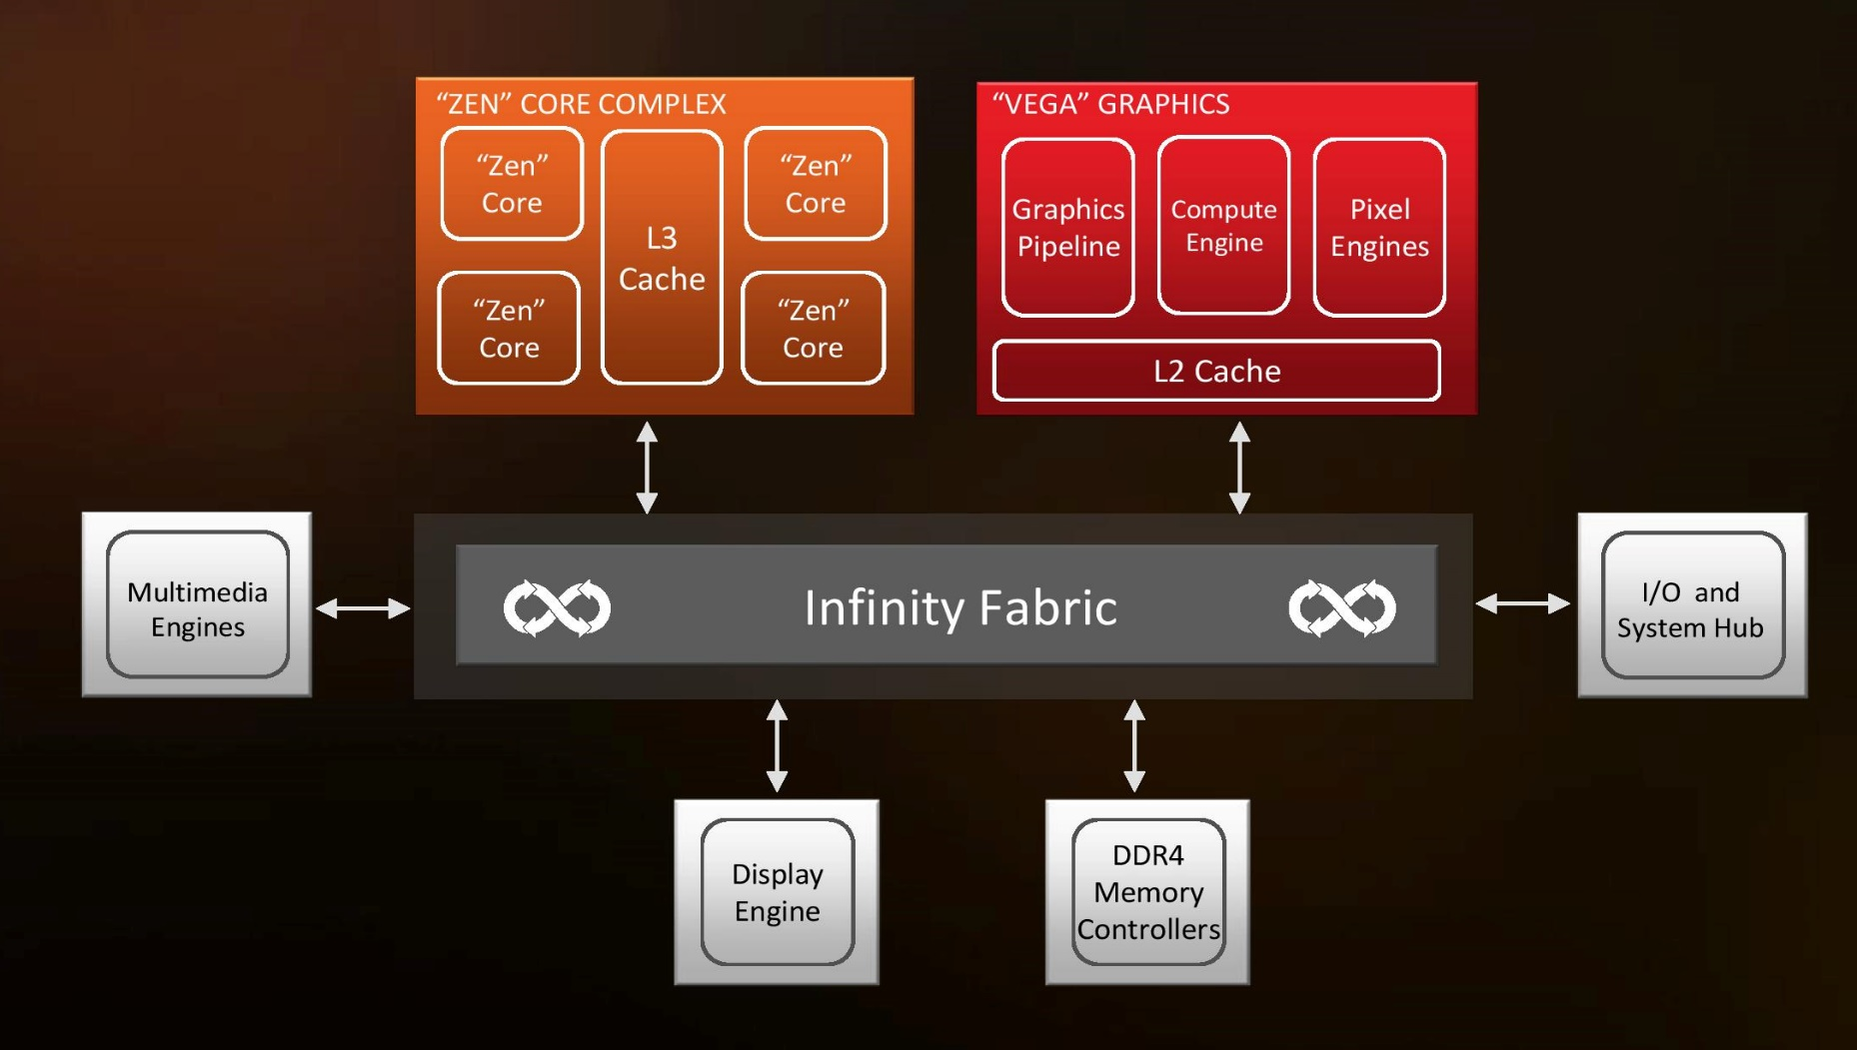
8.1.2 Options for attaching memory channels to a client platform (11)
Example 5: Attaching memory channels via the processor and an IF-based
interconnect (in AMD’s Zen-based mobile platform (2017)) [161]
(IF)
Dual
channels
The IF (Infinity Fabric) is a cache coherent interconnect that services 6 clients
in the above example, it is basically crossbar-based.

Slide 29
8.1.2 Options for attaching memory channels to a client platform (12)
Example 6: Attaching memory channels via a cache coherent, ring bus based
interconnect (CCN-504) in ARM’s Cortex-A53/57-based mobile platform
up to
4
Cortex-A53/A57 etc.
Generic Interrupt Contr. (GIC_500)
Quad core
A57
Quad core
A35
GPU
Mali-T880
L2
L2
SCU
L2
SCU
MMU-500
ACE-Lite
128-bit
ACE or CHI
ACE or CHI
Cache Coherent Interconnect (CCN-504)
with L3 cache and Snoop Filter
CHI
CHI
ACE and CHI are
ARM’s cache coherent buses
DMC-520
DMC-520
DFI 3.0
DFI 3.0
DDR3/4/LPDDR3
DDR3/4/LPDDR3

Slide 30
8.1.3 Why attaching memory via the processors became widespread?
Notes:
30

Slide 31
8.1.3 Why attaching memory via the processors became widespread? (1)
8.1.3 Why attaching memory via the processors became widespread? -1
In client processors, memory was attached via the MCH (Memory Control Hub) for
a long time, e.g. up to Intel’s Nehalem line (2008), while implementing up to two
memory channels, as seen for example below for Intel’s Core 2 Duo platforms.
FSB: 1066 MT/s
DDR2-800
Figure: Core 2 Duo based
platform [158]
*

Slide 32
8.1.3 Why attaching memory via the processors became widespread? (2)
Why attaching memory via the processors became widespread? -2
The above configuration is more or less balanced for DTs and laptops of that time,
that were built up of up to dual-core processors, as far as the computing
performance and the memory bandwidth is concerned that is needed for
supplying instructions and data, while running usual client workloads.
E.g. the considered platform has an FSB (Front Side Bus) bandwidth of
8.5 GB/s and is served by a memory bandwidth of 2x 6.4 GB/s = 12.8 GB/s.
Nevertheless, when servers, e.g. 4-socket servers, would have been attached
to the memory in a similar way, i.e. through memory channels connected
to the MCH, this system architecture would easily be proved memory bandwidth
limited, since now instead of one e.g. four processors would share the
available memory bandwidth, as seen in the next Figure.
*

Slide 33
8.1.3 Why attaching memory via the processors became widespread? (3)
Sharing the available memory bandwidth in a hypothetical 4S server
built up of the same processors and memory subsystem as seen before -1
Xeon MP¹
(2C)
Xeon MP¹
(2C)
Xeon MP¹
(2C)
Xeon MP¹
(2C)
FSB: e.g. 1066 MT/s
(4x 8.5 GB/s)
MCH
(2x 6.4 GB/s)
E.g. HI 1.5
E.g. DDR2-800
ICH
HI 1.5: 266 MB/s
Figure: A hypothetical 4S server platform built up of Core 2 processors
¹ Xeon MP processors based on Core 2 microarchitecture
*

Slide 34
8.1.3 Why attaching memory via the processors became widespread? (4)
Sharing the available memory bandwidth in a hypothetical 4S server
built up of the same processors and memory subsystem as seen before -2
Obviously, in the considered 4-socket server platform 4 processors share the
available memory bandwidth and so each processor would have on the average
only ¼ of the original bandwidth.
One possible way to avoid a memory bottleneck in servers is to attach memory
distributed via the processors rather than centrally via the MCH, as already
discussed and shown in the next Figure.
*

Slide 35
8.1.3 Why attaching memory via the processors became widespread? (5)
Example for attaching memory distributed via the processors in a 4S server
(actually, in Intel’s Skylake-SP based up to 28-core Purley server platform)
Platinum 8100
(Skylake-SP)
28C
PCIe 3.0
PCIe 3.0
40
40
Skylake-SP 28C
UPI
Skylake-SP 28C
UPI
UPI
UPI
UPI
Skylake-SP 28C
Skylake-SP 28C
UPI
40
DMI3
4xPCIe3
40
PCIe 3.0
PCIe 3.0
C621? PCH
(Lewisburg)
ME
Directly connected,
up to DDR4-2666 memory
3 x UPI up to 10.4 GT/s
Note scaling
*

Slide 36
8.1.3 Why attaching memory via the processors became widespread? (6)
Principle of accessing memory when memory is attached to the processors
When the memory is attached to the processors of a multiprocessor server
each processor has its own memory controller integrated on its die,
the entire memory address space is subdivided among all processors,
each memory controller serves directly its own address space but relaying
access requests to other parts of the address space through an available
bus system to the related processor and memory controller,
the remote memory controller will then perform the required access and
forward read data to the requesting processor.
*

Slide 37
8.1.3 Why attaching memory via the processors became widespread? (7)
Why attaching memory via the processors became widespread? -3
A further benefit of attaching memory channels directly to the processors is
obviously the lower access time for the cores, as indicated in the Figure below.
Attaching memory channels directly to a client platform
Attaching memory channels
via the MCH
Attaching memory channels
via the processor
Processor
Processor r
Memory
Processor r
Memory
MC
MC
FSB
FSB
FSB
MCH
Memory
MCH
PCH
MC
ICH
ICH
PCH: Platform Controller Hub
*

Slide 38
8.1.3 Why attaching memory via the processors became widespread? (8)
Why attaching memory via the processors became widespread? -4
Due to its benefits of connecting memory channels directly to the processors,
i.e. integrating the memory controller onto the processor die, this design option
became a major trend for attaching memory to a platform in the first half
of the 2000’s, as the next Figure shows.
*

Slide 39
8.1.3 Why attaching memory via the processors became widespread? (9)
The move to attach memory directly to a platform in major processor lines-1
Where to connect memory to the platform?
Attaching memory
via the MCH
Attaching memory
via the processor or
processors of a multiprocessor
Examples
UltraSPARC II (1C) (~1997)
UltraSPARC III (2001)
and all subsequent Sun lines
AMD’s K7 lines (1C) (1999-2003)
Opteron server lines (2C) (2003)
and all subsequent AMD lines
POWER4 (2C) (2001)
POWER5 (2C) (2005)
and subsequent POWER families
PA-8800 (2004)
PA-8900 (2005)
and all previous PA lines
Core 2 Duo line (2C) (2006)
and all preceding Intel lines
Core 2 Quad line (2x2C) (2006/2007)
Penryn line (2x2C) (2008)
Nehalem lines (4) (2008)
and all subsequent Intel lines
Montecito (2C) (2006)
Tukwila (4C) (2010)
*

Slide 40
8.1.3 Why attaching memory via the processors became widespread? (10)
The move to attach memory directly to a platform in major processor lines-2
Note that Intel was quite late in attaching memory directly to the processor,
since Intel followed this trend as late as 2008 with their Nehalem line and even
in 2010 with their Itanium line, as the above Figure indicates.
By comparison, AMD preceded Intel in this respect by 5 years.

Slide 41
8.1.4 Constrains relating the max. number of memory channels while connecting DIMMs directly to the MCH or the processor(s)
Notes:
41

Slide 42
8.1.4 Constrains concerning the number of memory channels (1)
8.1.4 Constrains relating the max. number of memory channels while
connecting DIMMs directly to the MCH or the processor(s) -1
If standard DIMM channels are directly connected to the MCH or the processor
(via the MC) each memory channel requires a large number of copper traces
on the motherboard that interconnect the DIMM socket either with the MCH
socket or the processor socket, since these interconnects are parallel, 8-byte
wide links.
The exact number of copper traces needed depends on the memory type used,
for actual numbers see the next Figure.
*

Slide 43
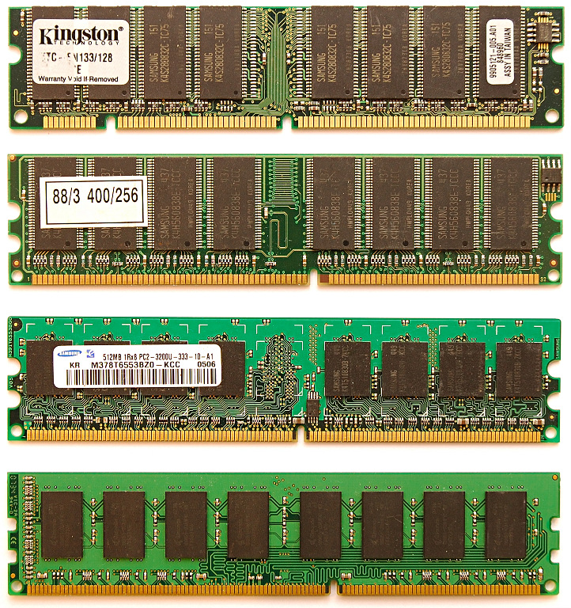
8.1.4 Constrains concerning the number of memory channels (2)
Pin counts of SDRAM to
DDR4 DIMMs
All these DIMMs
are 8-byte wide.
SDRAM
(SDR)
168-pin
DDR
184-pin
DDR2
240- pin
DDR3
240-pin
DDR4
284-pin
*
Notes:
43

Slide 44
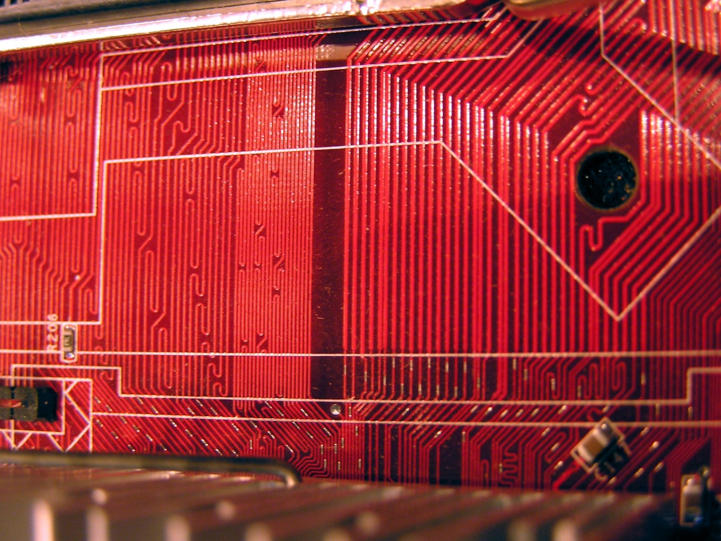
8.1.4 Constrains concerning the number of memory channels (3)
Constrains relating the max. number of memory channels while
connecting DIMMs directly to the MCH or the processor(s) -2
The interconnects between the MCH and the DIMM sockets are implemented
by dense copper trails on the motherboard, as seen below, typically equalized to
reduce skews (differences in signal propagation times occurring on different long
bit-lines).
Figure: Copper trails interconnecting the MCH or processor socket and the DIMM socket

Slide 45
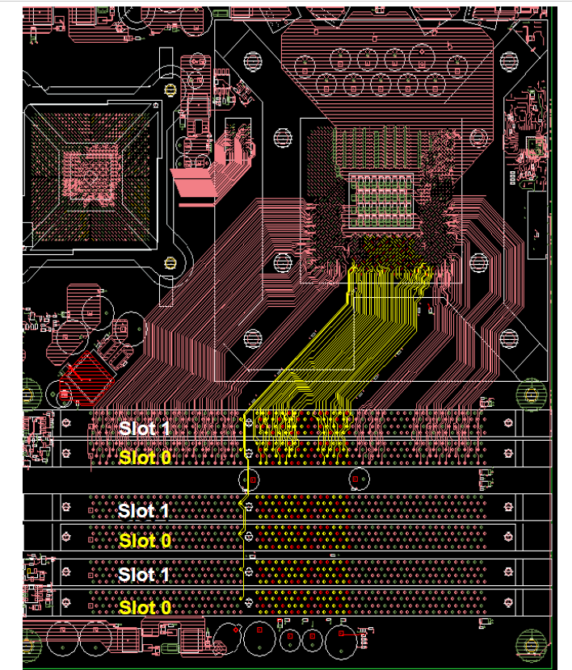
8.1.4 Constrains concerning the number of memory channels (4)
Example: Connecting
3 DDR3 memory channels
to the processor socket
[162]
Actually the Picture refers to Intel’s server oriented
1. gen. Nehalem processor

Slide 46
8.1.4 Constrains concerning the number of memory channels (5)
Constrains relating the max. number of memory channels while
connecting DIMMs directly to the MCH or the processor(s) -2
For direct connected memory channels electrical constrains can seriously limit
the maximum number of attachable memory channels for reasons, discussed
next.
The limitation arises basically out of the fact that the width and the distance
of the copper trails from each other determine the electrical parameters and
thus the temporal behavior of the interconnect, first of all its maximum
transfer rate, as discussed subsequently.
*

Slide 47
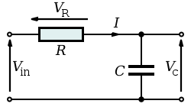



8.1.4 Constrains concerning the number of memory channels (6)
Modelling the temporal behavior of dense copper traces interconnecting
the MCH and the DIMMs
The temporal behavior of raising the voltage on DIMM traces can be modelled by a
serial RC network with R representing the ohmic impedance and C the
capacitance of a trace, as shown below.
$${Vc=Vin x (1− e}^{−t/τ})$$
$$with τ=R x C$$
For Vin = 1V:
$${Vc=1− e}^{−t/τ}$$
Figure: The circuit model and the related expression for Vc [163]
*

Slide 48
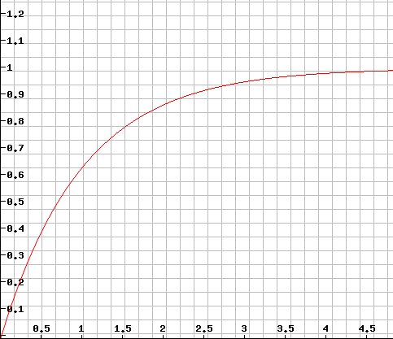



8.1.4 Constrains concerning the number of memory channels (7)
Raising the voltage on a capacitor of a serial RC network modeling DIMM
trails
Vc
(Vin = 1 V)
$${Vc=1− e}^{−t/τ}$$
$$t/τ$$
$τ$ = R * C

Slide 49






8.1.4 Constrains concerning the number of memory channels (8)
What happens if the number of direct attached memory channels would be doubled?
More memory channels would require more cupper traces to attach to the socket,
this could only be implemented with smaller and denser cupper traces, then
however R and C and thus τ of the cupper traces would be increased, as illustrated
in the Figure below.
MCH or processor socket
MCH or processor socket
$R,$
$$C$$
$$τ=R x C$$
$R$
$$C$$
$$τ=R x C$$
,

Slide 50
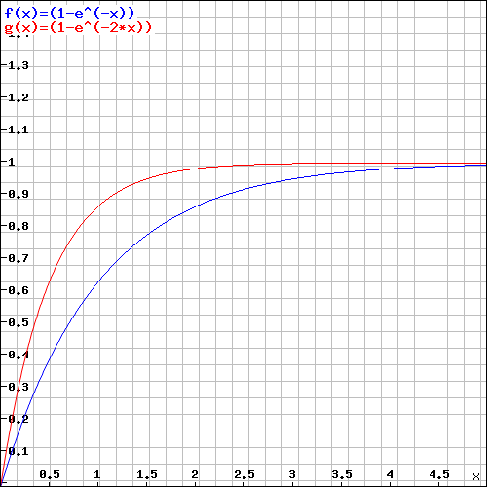
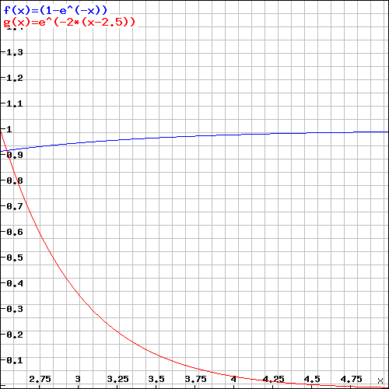




8.1.4 Constrains concerning the number of memory channels (9)
Raising the voltage on a capacitor of a serial RC circuit that models
DIMM trails when τ is doubled
Vc
(Vin = 1 V)
$${Vc=1− e}^{−t/τ}$$
$${Vc=1− e}^{−t/2τ}$$
$τ$ = R * C
$$t/τ$$
Long rise and fall times, however would reduce the feasible memory transfer rate.
*

Slide 51
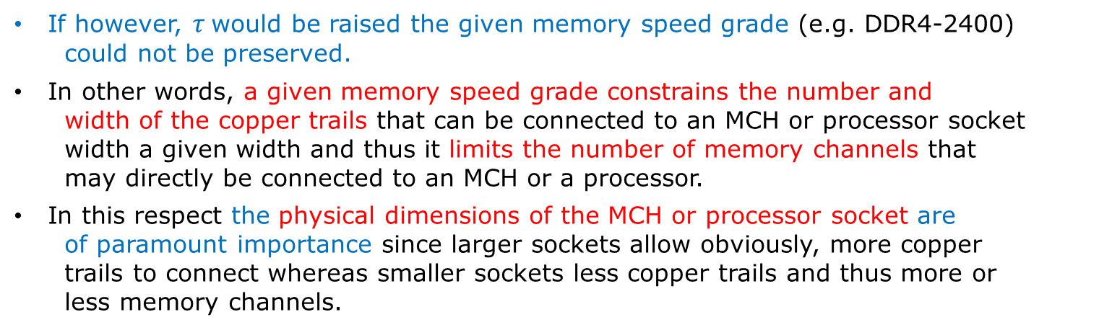
3.3 Constrains for raising the number of direct connected DRAM channels 10)
Constrains relating the max. number of memory channels while
connecting DIMMs directly to the MCH or the processor(s) -3
If however, $τ$would be raised the given memory speed grade (e.g. DDR4-2400)
could not be preserved.
In other words, a given memory speed grade constrains the number and
width of the copper trails that can be connected to an MCH or processor socket
width a given width and thus it limits the number of memory channels that
may directly be connected to an MCH or a processor.
In this respect the physical dimensions of the MCH or processor socket are
of paramount importance since larger sockets allow obviously, more copper
trails to connect whereas smaller sockets less copper trails and thus more or
less memory channels.
Usual MCH or client processor sockets of about 30 - 40 mm x 30 – 40 mm)
allow typically to connect up to two memory channels directly to an MCH or a
processor socket without degrading memory speed.
On the other hand, larger processor sockets enable connecting more memory channels, say up to 6 channels directly, as the next Figure indicates.
*

Slide 52
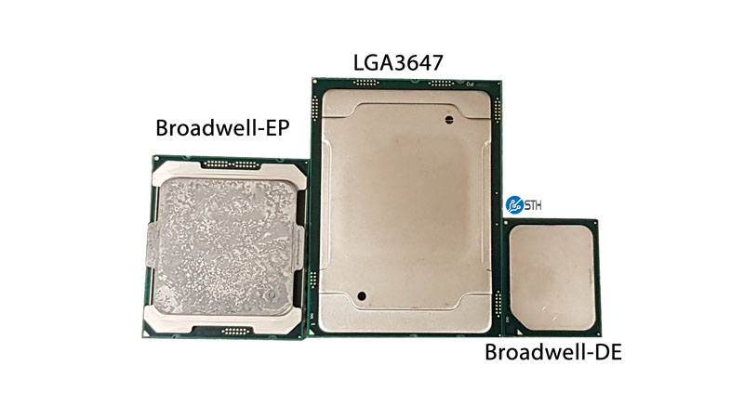
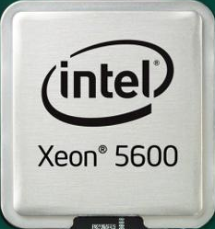
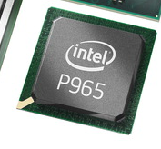
8.1.4 Constrains concerning the number of memory channels (11)
Socket sizes and number of direct connected memory channels for various
DT and server processors of Intel
Skylake-SP
(up to 28 cores)
Broadwell-EP
(up to 22 cores)
Westmere-EP
(up to 6 cores)
P965 GMCH
for Core 2
(2 cores)
34x34 mm
45x42.5 mm
58.5x51.0 mm
76x56 mm
BGA 1226
LGA 1366
LGA 2011-3
LGA 3647
2xDDR2 standard
mem. channels
on MCH
3xDDR3 standard
mem. channels
on processors
2x2 DDR4 standard
mem. channels
(2 on both side)
2x3 DDR4 standard
mem. channels
(3 on both side)
Source of the pictures [26]

Slide 53
8.2 Evolution of attaching PCIe lanes to platforms
Notes:
53

Slide 54
8.2 Evolution of attaching PCIe lanes to platforms (1)
8.2 Attaching PCIe lanes to platforms -1
Client platforms provide typically 16 PCIe lanes to allow connecting graphics cards
and further on x1, x2, x4-wide lanes to attach SSD, LAN controller etc., as the
following example indicates.
*

Slide 55
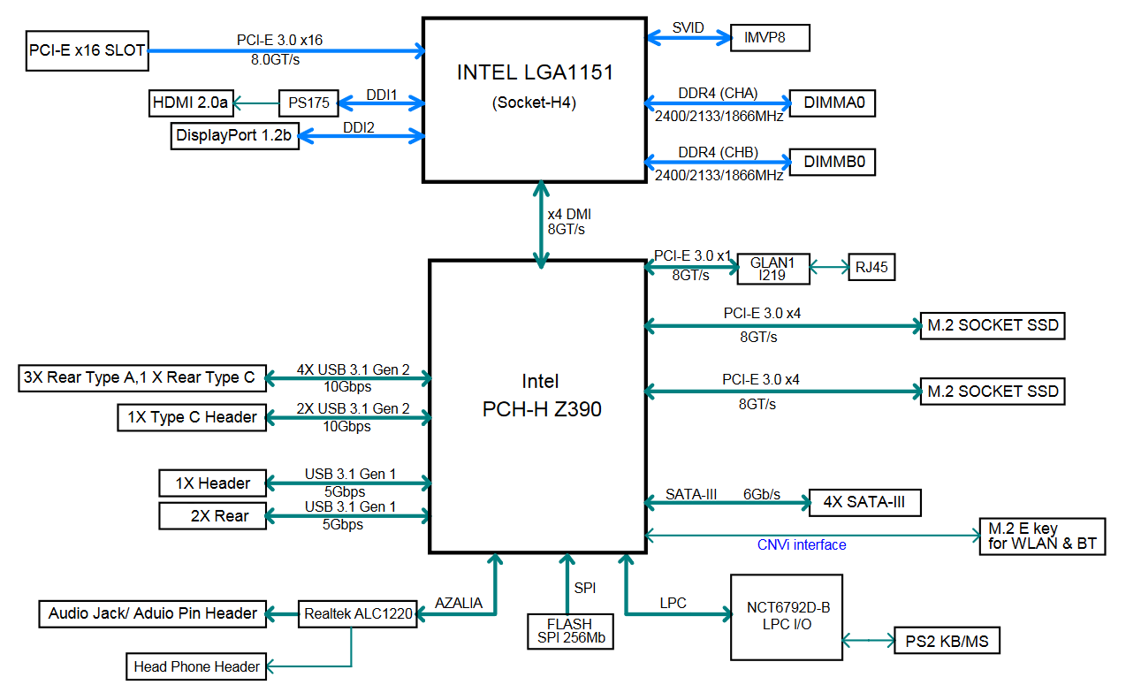
8.2 Evolution of attaching PCIe lanes to platforms (2)
Example: Block diagram of a motherboard with Intel’s 8th/9th gen. processor
[164]

Slide 56
8.2 Evolution of attaching PCIe lanes to platforms (3)
Attaching PCIe lanes to platforms -2
Providing typically 16 PCIe lanes by client platforms is in contrast to HEDs,
as they have mostly 36/40 or 44 PCIe lanes for attaching multiple graphics cards.
Concerning the PCIe lanes and the way how they are connected to a platform,
two evolution paths should be pointed out:
first, the point where PCIe lanes are attached to the platform has been
moved from the NB to the processor, and
b) second, PCIe lanes underwent a generational evolution, from generation 1
to generation 4, as indicated in the subsequent Table.
*

Slide 57
a) Evolution of attaching PCIe lanes to a client platform
Attaching PCIe lanes to a client platform
Attaching PCIe lanes
via the MCH
Attaching PCIe lanes
via the processor
or
Processor
Processor
Processor
PCIe
PCIe
FSB
FSB
FSB
MCH
PCIe
MCH
PCH
ICH
ICH
*

Slide 58
8.2 Evolution of attaching PCIe lanes to platforms (5)
Evolution of attaching PCIe lanes to Intel’s and AMD’s client platforms
The overall evolution of attaching PCIe lanes to a client platform can be summarized
in the next Figure.
Where to connect PCIe lanes
PCIe lanes
on the NB
PCIe lanes
on the processor
PCIe 1.0 lanes
2006: Intel
2005: AMD
PCIe 2.0 lanes
2007-2011: Intel
2008-2014: AMD
PCIe 2.0 lanes
Type of available PCIe lanes
PCIe 3.0 lanes
2012- : Intel
20014-2018: AMD
PCIe 4.0 lanes
2019: AMD
2009 (Intel)
2011 (AMD)
*

Slide 59
8.2 Evolution of attaching PCIe lanes to platforms (6)
Note
In introducing PCIe 1.0 to PCIe 3.0 lanes AMD lagged behind Intel one or two
years.
Nevertheless, in introducing PCIe 4.0 AMD came before Intel.
*

Slide 60
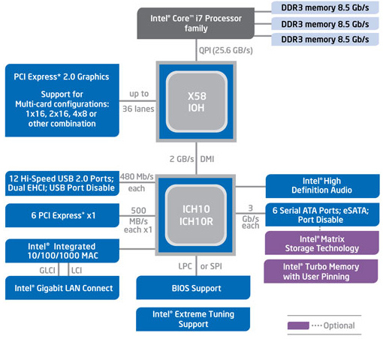
8.2 Evolution of attaching PCIe lanes to platforms (7)
Evolution of attaching PCIe 2.0 lanes to Intel’s platforms in Intel’s 1. and 2.
generation Nehalem lines (2008/2009) [159]
The 1. gen. Nehalem (Bloomfield)-based platform
(X58 + ICH10 / LGA-1366)
The 2. gen. Nehalem (Lynnfield)-based platform
(P55 / LGA-1156)
Remarks: The 2. gen. Nehalem line is client oriented whereas the 1. generation is
server oriented.
Thus it provides only 16 PCIe 2.0 lanes and two memory channels.
*

Slide 61
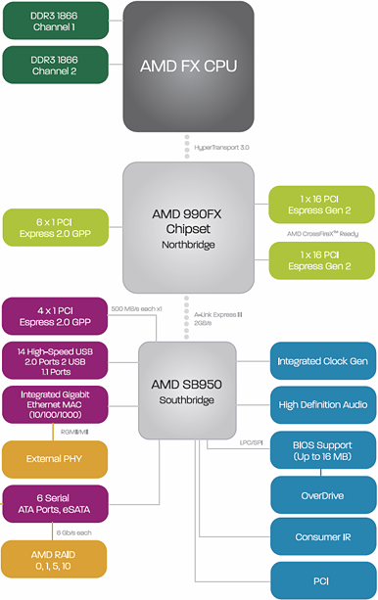
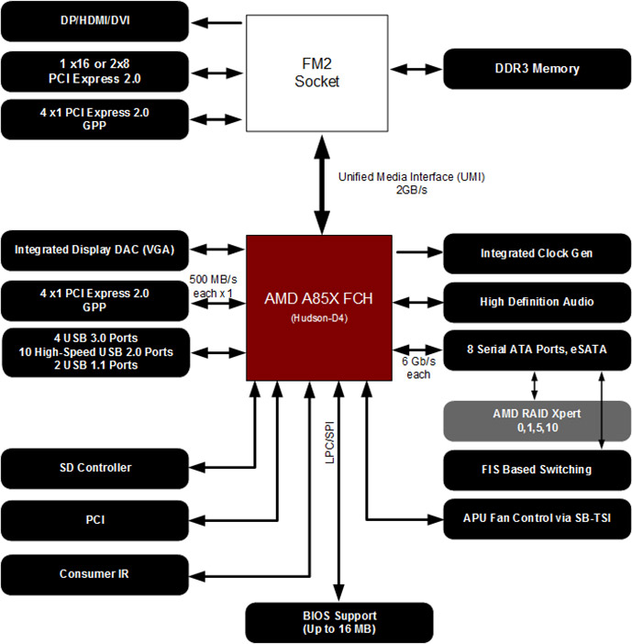
8.2 Evolution of attaching PCIe lanes to platforms (8)
Evolution of attaching PCIe 2.0 lanes in AMD’s 2. gen. Bulldozer (Piledriver)
-based client platforms (2012) [166], [167]
(HyperTransport 3.0)

Slide 62
8.2 Evolution of attaching PCIe lanes to platforms (10)
Consequences of attaching PCIe lanes immediately to the processor
rather than to the NB -1
There are two main consequences, as follows:
1) Three-chip platforms can now be replaced by two chip platforms
When connecting PCIe lanes directly to the processor, the NB has less tasks
to perform than before, thus the “reduced-function” NB and the SB can now
easily be integrated into one chip.
The integrated chip is called PCH (Platform Controller Hub) by Intel or FCH
(Fusion Control Hub) by AMD, as shown next.
*

Slide 63
8.2 Evolution of attaching PCIe lanes to platforms (11)
a) Three-chip platforms can now be replaced by two chip platforms
Example 1: Replacing 3-chip platforms by 2-chip platforms
in Intel’s 2. generation Nehalem line (Lynnfield) (2009) [159]
The 1. gen. Nehalem (Bloomfield)-based platform
(X58 + ICH10 / LGA-1366)
The 2. gen. Nehalem (Lynnfield)-based platform
(P55 / LGA-1156)

Slide 64
8.2 Evolution of attaching PCIe lanes to platforms (12)
Example 2: Replacing 3-chip platforms by 2-chip platforms in AMD’s
2. gen. Bulldozer (Piledriver)-based client processors (2012) [166], [167]
(HyperTransport 3.0)

Slide 65
8.2 Evolution of attaching PCIe lanes to platforms (13)
Consequences of attaching PCIe lanes immediately to the processor
rather than to the NB -2
2) The previous high BW processor-NB link can be replaced by a processor-PCH/FCH
link with significantly less bandwidth
When PCI 2.0 lanes are connected directly to the processor, the PCIe
communication bypasses the new control hub (PCH/FCH), consequently
less bandwidth is needed now between the processor and the new control hub.
As a consequence, the high bandwidth QPI/HT bus can be replaced by an
BW interface with less BW (called DMI/UMI,that is implemented basically
by 4 PCIe 2.0 lanes), as shown also subsequently.
*

Slide 66
8.2 Evolution of attaching PCIe lanes to platforms (14)
b) The previous high BW processor-NB link can be replaced by a processor-
PCH/FCH link with significantly less bandwidth
Example 1: Replacing the high BW processor-NB link by a smaller BW
processor-PCH link in Intel’s 2. gen. Nehalem line (Lynnfield) (2009) [159]
(in both directions)
The 1. gen. Nehalem (Bloomfield)-based platform
(X58 + ICH10 / LGA-1366)
The 2. gen. Nehalem (Lynnfield)-based platform
(P55 / LGA-1156)

Slide 67
8.2 Evolution of attaching PCIe lanes to platforms (15)
Example 2: Replacing the high BW HT bus by the low BW UMI bus in AMD’s
2. gen. Bulldozer (Piledriver)-based client processors (2012) [166], [167]
(HyperTransport 3.0)
10.4 GB/s (each direction)
Actually
PCIe 2.0 x4
Each direction)

Slide 68
8.2 Evolution of attaching PCIe lanes to platforms (4)
b) Evolution of subsequent PCIe generations [165]
PCI Express version | Intro- duced | Line code | Transfer rate in each direction | Throughput in each direction
 |  |  |  | ×1 | ×2 | ×4 | ×8 | ×16
1.0 | 2003 | 8b/10b | 2.5 GT/s | 250 MB/s | 0.50 GB/s | 1.0 GB/s | 2.0 GB/s | 4.0 GB/s
2.0 | 2007 | 8b/10b | 5.0 GT/s | 500 MB/s | 1.0 GB/s | 2.0 GB/s | 4.0 GB/s | 8.0 GB/s
3.0 | 2010 | 128b/130b | 8.0 GT/s | 984.6 MB/s | 1.97 GB/s | 3.94 GB/s | 7.88 GB/s | 15.8 GB/s
4.0 | 2017 | 128b/130b | 16.0 GT/s | 1969 MB/s | 3.94 GB/s | 7.88 GB/s | 15.75 GB/s | 31.5 GB/s
5.0 | 2019 | 128b/130b | 32.0 GT/s[ | 3938 MB/s | 7.88 GB/s | 15.75 GB/s | 31.51 GB/s | 63.0 GB/s

Slide 69
8.2 Evolution of attaching PCIe lanes to platforms (9)
Evolution of attaching PCIe lanes in Intel’s and AMD’s client processors
Intel’s processor lines
AMD’s processor lines
PCIe lanes
on the NB
PCIe lanes
on the processor
PCIe lanes
on the NB
PCIe lanes
on the processor
PCIe 1.0
lanes
Core 2 (2006)
Core 2 Quad (2006)
with 965/Series 3 NB
K8 with 6xx NB (2005)
Penryn (2007)
Penryn Quad (2008)
with Series 4 NB
Bobcat (2011)
Fam. 12h (Llano) (2012)
Piledriver (2012)
Jaguar (2013)
Puma (2014)
PCIe 2.0
lanes
2. G. Nehalem
(Lynnfield) (2009)
Sandy Bridge (2011)
K10 with 7xx NB (2008)
Fam. 11h (Griffin)
with 7xxM NB (2011)
G. Nehalem
(Bloomfield) (2008)
with X58 NB
Type of available PCIe lanes
Ivy Bridge (2012)
Haswell (2013)
Skylake (2015)
and further lines
Steamroller (2014)
Excavator 2015/2016)
Zen-based laines (2017)
Zen+-based (2018)
PCIe 3.0
lanes
PCIe 3.0
lanes
Zen 2-based lines (2019)

Slide 70
8.3 Physical implementation of client processors
8.3.1 Processor packages and sockets
8.3.2 Types of Intel’s client processors
(Ivy Bridge to Coffee Lake Refresh)
Notes:
70

Slide 71
8.3.1 Processor packages and sockets
Notes:
71

Slide 72
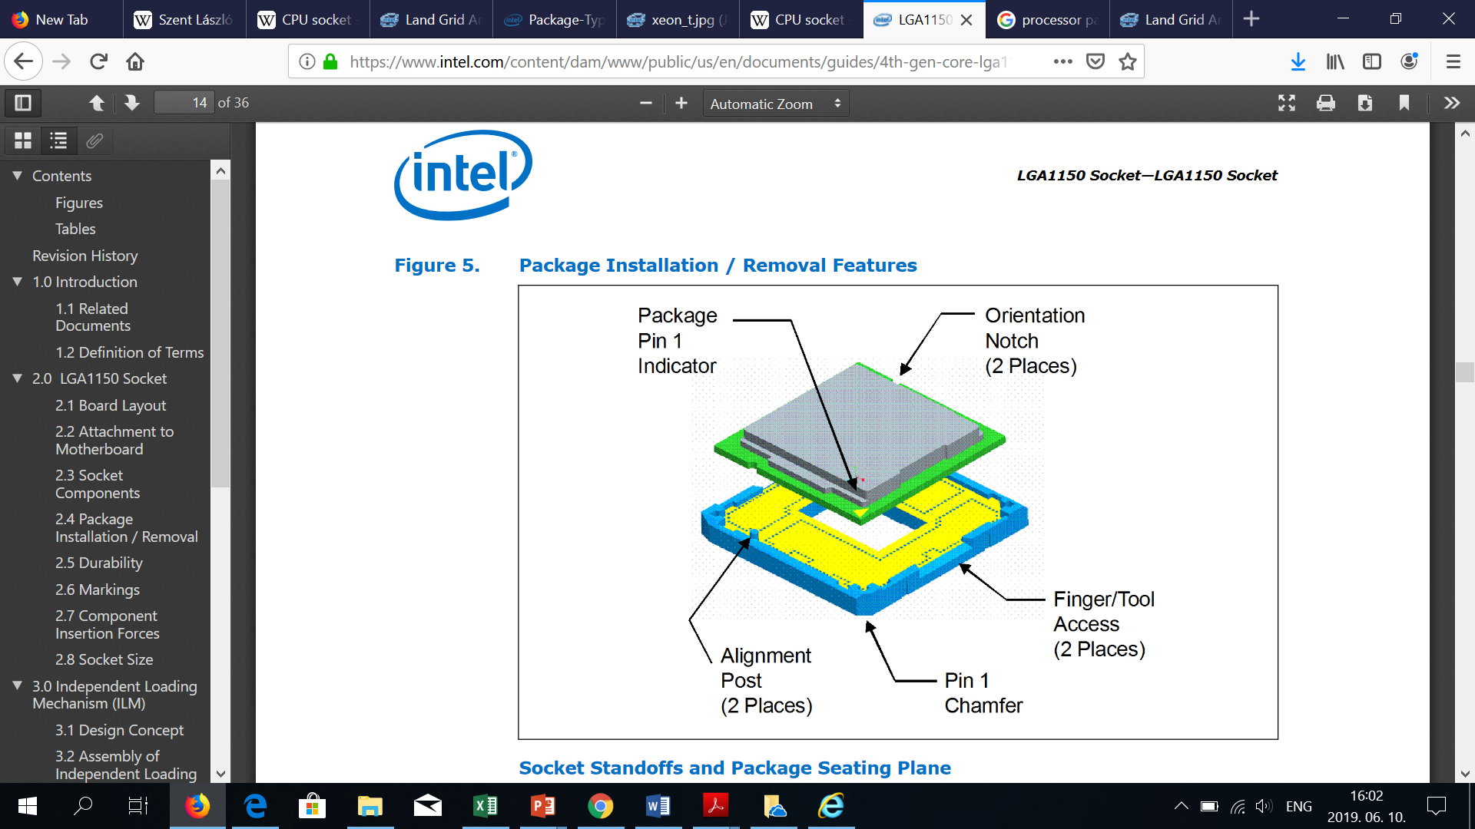
8.3.1 Processor packages and sockets (1)
Processor sockets and packages
Socket
Package
It houses the processor (package)
and provides the electrical contacts
for each of the pins or balls of the package.
It is mounted on the motherboard
Includes the die or dies.
Provides electrical contacts
for the socket (pins or balls).
The package is inserted into the socket.
Socket
Socket: Foglalat
Package: Tok
*

Slide 73
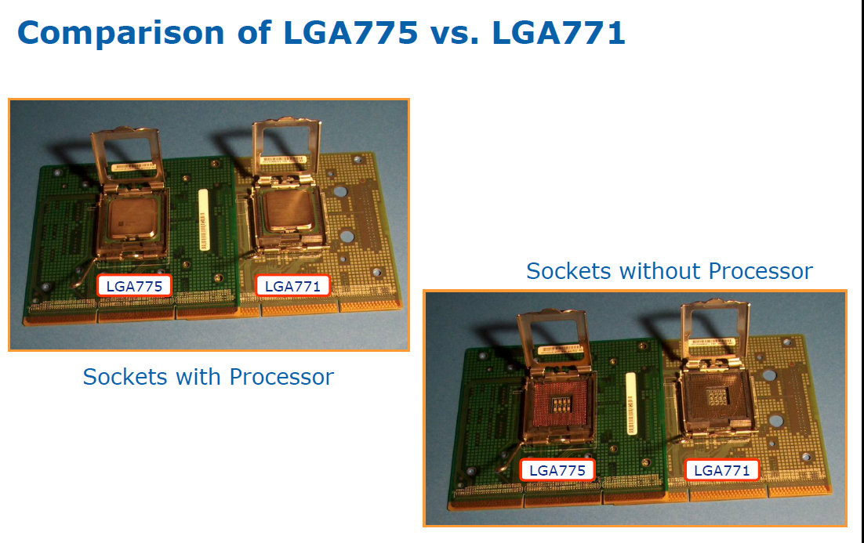
8.3.1 Processor packages and sockets (2)
Sockets without and with processor (i.e. package) [168]

Slide 74
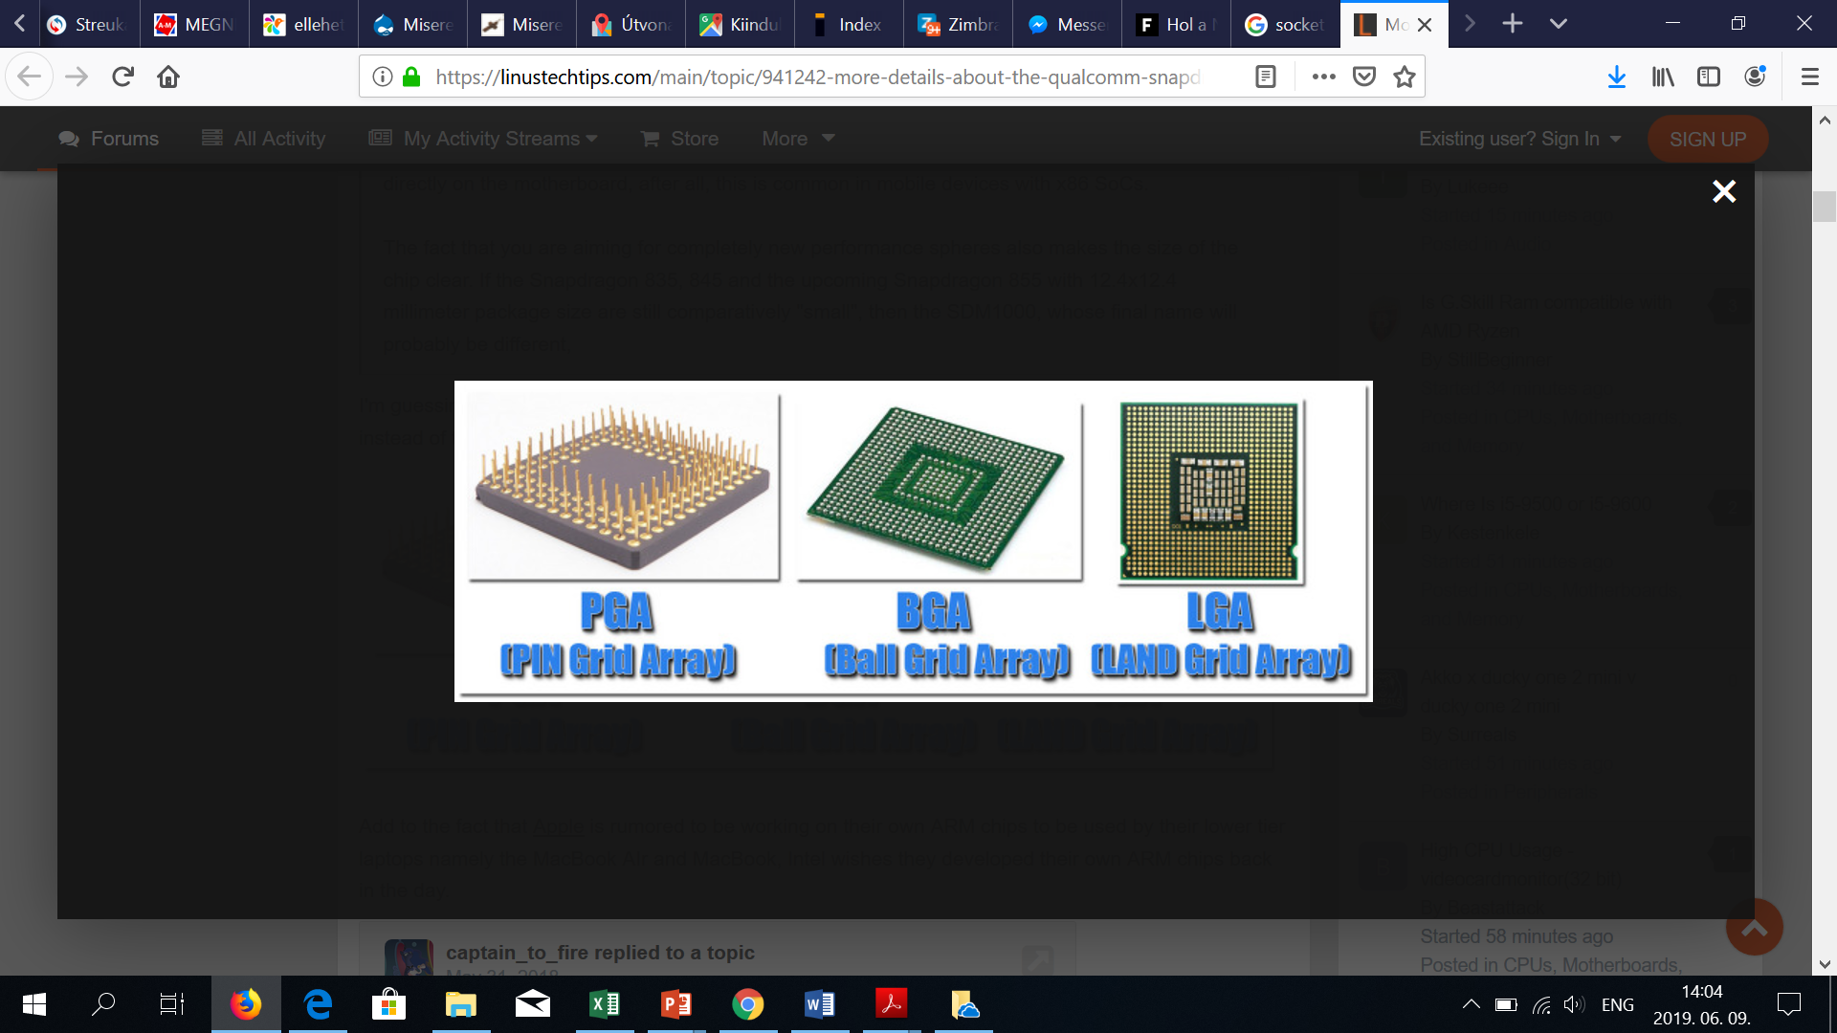
8.3.1 Processor packages and sockets (3)
Recent processor package types [169]
PGA
(Pin Grid Array)
LGA
(Land Grid Array)
BGA
(Ball Grid Array)
In the PGA package pins provide the contacts, arranged in a regular array.
LGA packages are essentially the direct opposite of PGAs, the contact pins are on the
socket, whereas contact pads on the package provide the connections.
BGA packages are soldered directly onto the motherboard, so practically they can not
be replaced without proper equipment.
*

Slide 75
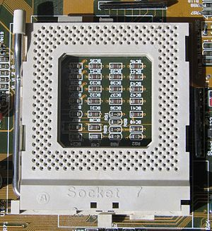
8.3.1 Processor packages and sockets (4)
Example of a PGA socket
actually a ceramic Socket 7 with 321 pins for Pentium processors [170]

Slide 76
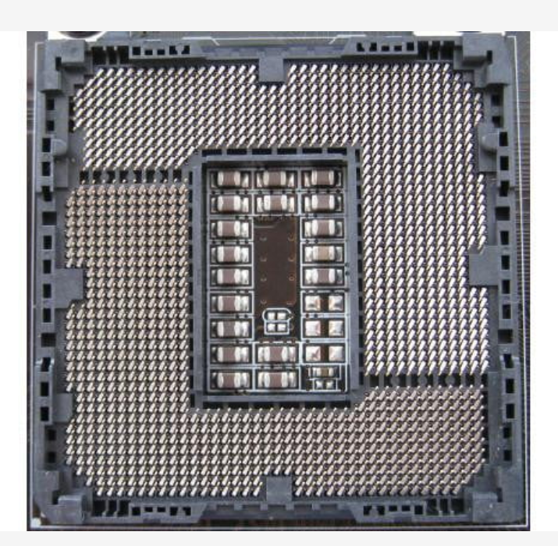
8.3.1 Processor packages and sockets (5)
Example of an LGA socket
(actually an LGA-1155 socket for Sandy Bridge/Ivy Bridge processors [171]

Slide 77
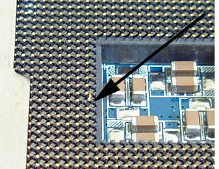
8.3.1 Processor packages and sockets (6)
Example: Picture of an LGA-775 socket with a dislodged pin (blown up) [172]

Slide 78
8.3.1 Processor packages and sockets (7)
Comparing benefits and drawbacks of PGA and LGA sockets [173]
Advantages of PGA sockets:
The motherboard can hardly be damaged by processor CPU misalignment.
(More durable motherboards).
It is much easier to repair bent pins on a PGA processor than on an
LGA motherboard.
(Slightly better repairability).
Advantages of LGA sockets:
The processors are less likely to be damaged by mishandling and drops,
because of no fragile pins.
(More durable processors).
LGA pins are smaller in physical size, allowing for more pins in the same
amount of space.
(More space efficient).
All in all, both LGA and PGA sockets have their respective pros and cons,
no definite answer can be given to the question which socket type is
more favorable.
Probably, however, LGA sockets can more conveniently be used, nevertheless,
a slightly bent pin can ruin the motherboard.
This can however, be avoided by handling the processor extra careful.

Slide 79
8.3.1 Processor packages and sockets (8)
Examples for processors with PGA or LGA sockets
PGA sockets
LGA sockets
Socket 7 for Intel Pentium (1993)
Socket A for AMD Athlon (2000)
Socket 423 for Intel Pentium 4 (2000)
Socket 603 for Intel Xeon (2001)
Socket 940 for AMD Opteron (2003)
Socket 939 for AMD Athlon 64 (2004)
LGA 775 for Intel Pentium 4 Prescott) (2004)
Socket T (LGA-775) for Intel Core 2 (2006)
Socket AM3 (940/941) for AMD
Phenom II (K10) (2007)
Sockets of Intel’s subsequent processors
Sockets of AMD’s subsequent processors
including the Ryzen family (2017)
AMD’s Threadripper and EPYC families (2017)

Slide 80
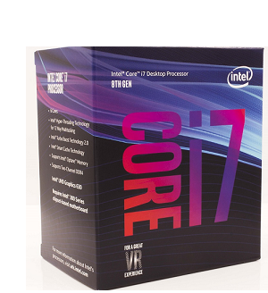
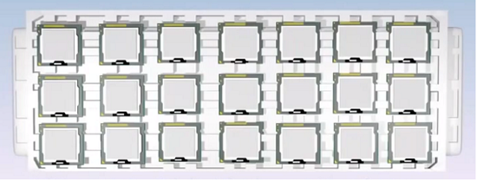
8.3.1 Processor packages and sockets (9)
Remark: Boxed and tray processors [174]
As the name implies, boxed processors ship in attractive retail packaging and
contain only one CPU.
End-users usually buy boxed processors through authorized retailers.
Tray processors ship in polystyrene trays and usually come in lots of 10.
Companies that manufacture or repair computers usually purchase trays of
processors from distributors or wholesalers.
Figure: Boxed processors
Figure: Tray processors
Wholesalers: A company that sells goods in large quantities to retailers.
*

Slide 81
8.3.2 Types of Intel’s client processors (Ivy Bridge to Caffee Lake Refr.)
Notes:
81

Slide 82
8.3.2 Types of Intel’s client processors (Ivy Bridge to Caffee Lake Refr.) (1)
8.3.2 Types of Intel’s client processors (Ivy Bridge to Caffee Lake Refr.)
Beginning with the Ivy Bridge line Intel introduced name suffixes in their
client processors, like i3/i5/i7-nxxxT, i3/i5/i7/nxxxS etc. with n: Gen. no.
Mostly used suffixes and their interpretations:
Mobile suffixes
M-nYxx/m3-nYxx: (actually a prefix): extreme low power (4.5/5 W, SoC)
Y: low-power (11.5/13 W, SoC)
U: ultra-low power (typically 15/28 W, SoC)
H: high-performance mobile (typically 35/45 W)
M: mobile processor (35/45 W)
MX: extreme performance mobile processor (57 W)
Q: quad-core
Desktop suffixes
T – power-optimized models (ultra low power with 35/45 W TDP)
S – performance-optimized models (low power with 65 W TDP)
R – BGA packaging / High-performance (GT3e) GPU with on-package eDRAM)
K – unlocked (adjustable CPU multiplier (60-95 W)
*

Slide 83
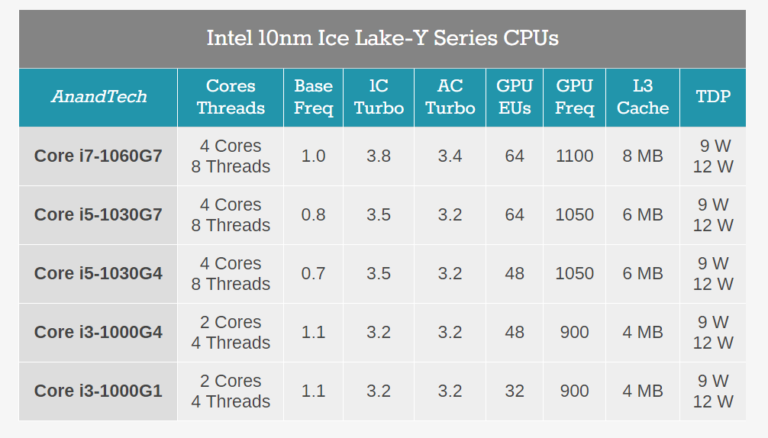
8.3.2 Types of Intel’s client processors (Ivy Bridge to Caffee Lake Refr.) (2)
Introducing graphics tags in the model designations of the Ice Lake line
Along with their Ice Lake line (2019) Intel introduced the Gx tags in the model names
to indicate the graphics performance of the related models, as indicated below.
Table: Main features of the models of the Ice Lake Y series [181]

Slide 84
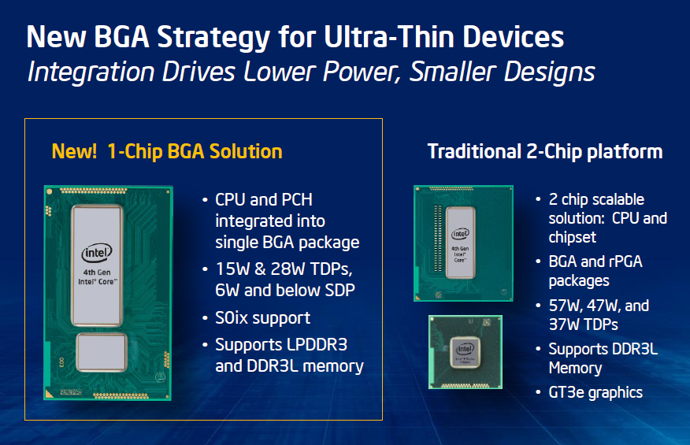
8.3.2 Types of Intel’s client processors (Ivy Bridge to Caffee Lake Refr.) (3)
Introducing On-package integrated CPU and PCH in Haswell’s mobiles [175]
Haswell
BGA: Ball Grid Array
SPD: Scenario Design Point
PGA: Pin Grid array
*

Slide 85
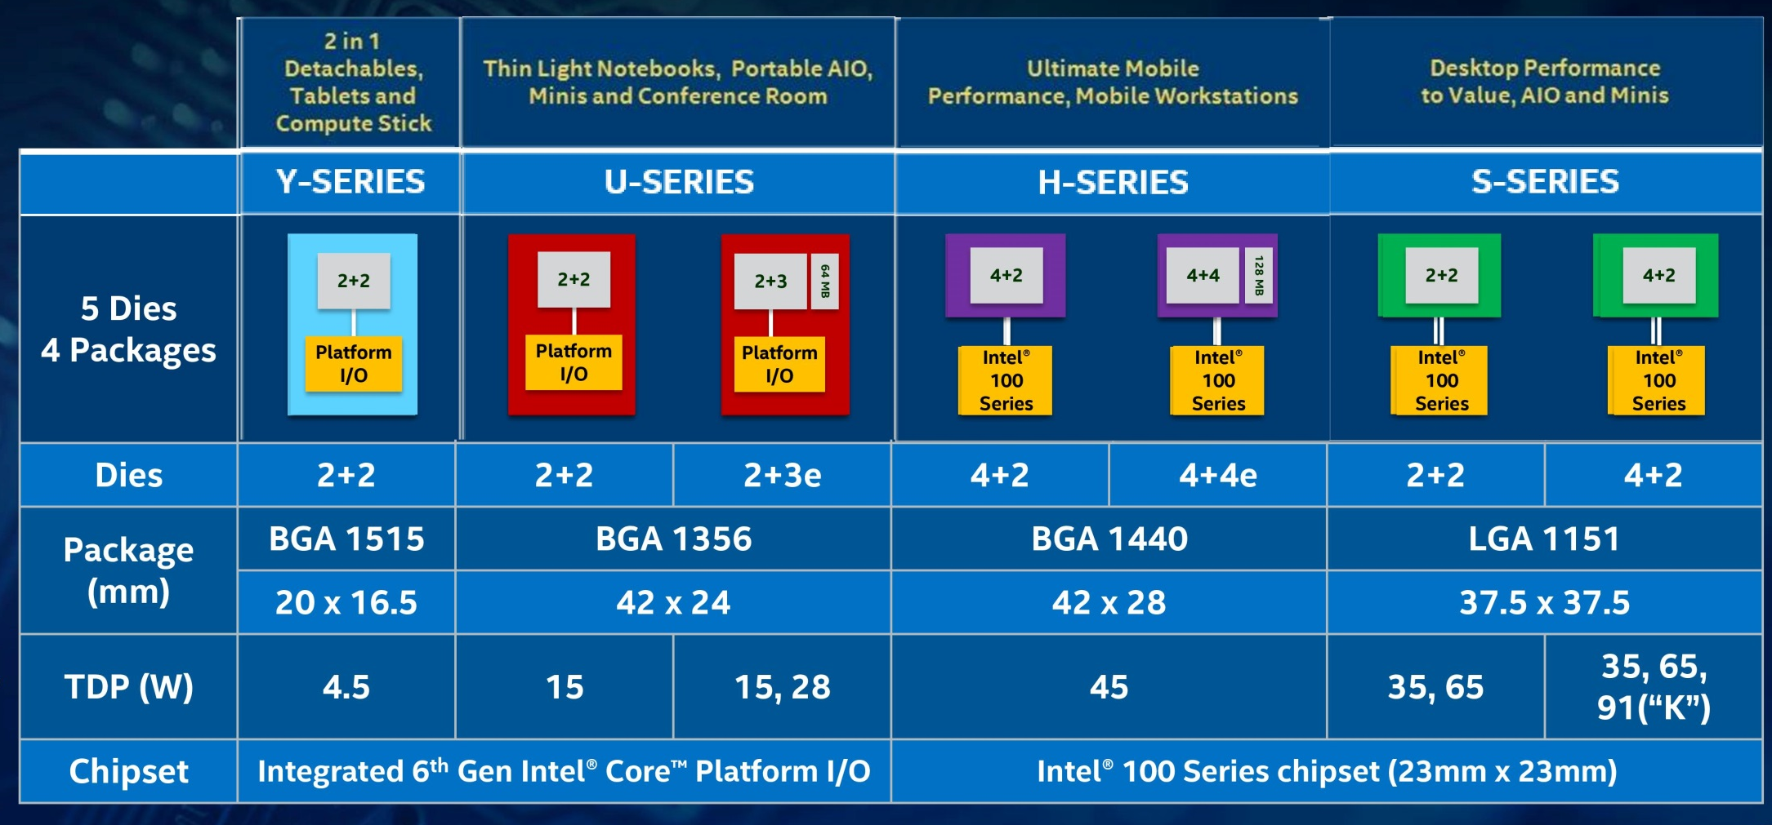
8.3.2 Types of Intel’s client processors (Ivy Bridge to Caffee Lake Refr.) (4)
Example 1: Die configurations in Skylake mobile and desktop models [19]
BGA: Ball Grid Array (to be soldered)
LGA: Land Grid Array (to be socketed)
Dies: No. of cores and GT levels, e.g. 2+2 means: 2 cores + GT 2 graphics, etc.

Slide 86
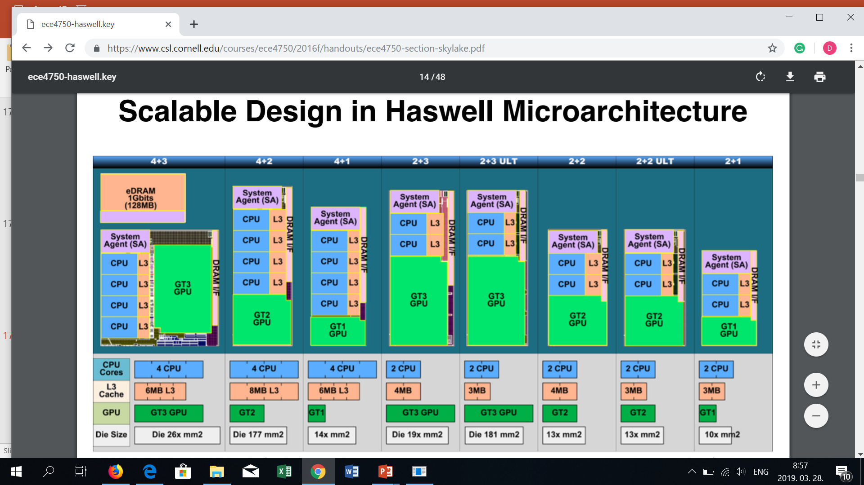
8.3.2 Types of Intel’s client processors (Ivy Bridge to Caffee Lake Refr.) (5)
Example 2: Die configurations in Haswell’s desktop and mobile models [89]

Slide 87
8.3.2 Types of Intel’s client processors (Ivy Bridge to Caffee Lake Refr.) (6)
TDP values and socket types of Intel’s mostly used mobile platform
generations of the Core 2 family (3rd to 9th gen.)
Gen. no. | Mobiles | Y | M-nY / m3/m5/m7-nY (n: Gen. no.) | U | H/HQ | M/QM/ MX | B | G
3 | Ivy Bridge | 13 BGA-1023 |  | 17/25 BGA-1023 |  | 35/45/55 PGA-988
4 | Haswell | 11.5 BGA-1168 |  | 15/28 BGA-1168 | 37/47 BGA-1364 | 37/47/57 PGA-946
5 | Broadwell |  | 4.5 BGA-1234 | 15/28 BGA-1168 | 47 BGA-1364
6 | Skylake |  | 4.5 BGA-1515 | 15/28 BGA-1356 | 35/45 BGA1440
7 | Kaby Lake |  | 4.5 BGA-1515 | 15/28 BGA-1356 | 35/45 BGA-1440 |  |  | 100 BGA-2270 (Vega)
8 | Coffee Lake |  | 5 BGA-1515 | 15/28 BGA-1528 Optane | 45 BGA-1440 | 45 BGA-1440 | 65 BGA-1440
9 | Coffee Lake Refr. |  | 5 BGA-1515 | 15/28 BGA-1528 Optane | 45 BGA-1440 | 45 BGA-1440 | 65 BGA-1440
Typical use
Ultra thin laptops
Laptops
Laptops/Desktops
SoC
2-chip

Slide 88
8.3.2 Types of Intel’s client processors (Ivy Bridge to Caffee Lake Refr.) (7)
TDP values and socket types of Intel’s mostly used desktop platform
generations of the Core 2 family (3rd to 9th gen.)
Gen. | Desktops | T | S | C | P | R (eDRAM) | -- | K
3 | Ivy Bridge | 35/45 LGA-1155 | 65 LGA-1155 |  |  |  | 55/77 LGA-1155 | 77 LGA-1155
4 | Haswell | 35/45 LGA-1150 | 65 LGA-1150 |  |  | 65 BGA-1364 | 54/84 LGA-1150 | 84/88 LGA-1150
5 | Broadwell |  |  | 65 LGA-1150 |  | 65 BGA-1364
6 | Skylake | 35 LGA-1151 |  |  | 54 LGA-1151 | 65 BGA-1440 | 51/65 LGA-1151 | 91 LGA-1151
7 | Kaby Lake | 35 LGA-1151 |  |  |  |  | 51/65 LGA-1151 | 60/91 LGA-1151
8 | Coffee Lake | 35 LGA-1151 |  |  |  |  | 62/65 LGA-1151 | 91/95 LGA-1151
9 | Coffee Lake Refr. | 35 LGA-1151 |  |  |  |  | 62/65 LGA-1151 | 91/95 LGA-1151
Typical use
Laptops
/desktops
Desktops
2-chip (all)
8/9. gen F: Lack of GPU but the same price

